Slide 1
The Disciple’s Model Prayer
by David Lee Burris

Slide 2
David Lee Burris:
Balancing Act - Saints & Citizens!
Genre Of Biblical Prayer In Sojourner Motif
Serious Endeavor: Bridge Between Worlds
Prayer Life Is Oriented In Watchfulness
Prayer Life Part Of Righteous Obedience
Prayer Is Learning Experience & Service
Piety Includes Others & Petty Only Self
Partisan Pride & Social Superiority Mocks
Prayer Princely Privilege – Duty & Honor
Prayer Requires Reconciliation Horizontal Before Supplication Vertical
Prayer Requires Honest & Humble Approach
In Prayer We Match God’s Demands Of Justice With Our Intercession Requests For Mercy
Public Prayer Is For The Spiritually Matured

Slide 3
Pagan Prayers: Repetition Of Verse & Chant Source: “The Message Of The Sermon On The Mount”
Commentary Quote On Matthew 6: 7 – To “Heap Up Empty Phrases” Or “Vain Repetition”
The Greek verb battalogeo is unique not only in biblical literature but elsewhere as well; no other use of the word is known beyond quotations of this verse. Some like (Erasmus) ‘suppose the word to be derived from Battus, a king of Cyrene, who is said to have stuttered; others from Battus, an author of tedious & wordy poems’. William Tyndale was the first translator to choose ‘babble’ as an equivalent English onomatopoeia, and NEB has taken it up: ‘Do not go babbling on like the heathen.’ (p. 143)

Slide 4
First Timothy 2: Lesson On Prayer
David Lee Burris:
Colossians 4: 2 – 4 ~ Paul Urges Steadfastness In Prayer – Combines Watchfulness & Prayer – Unites Thanksgiving & Prayer – Combines Evangelism & Prayer
“Pray” Translated From 5 Greek Verbs & 4 Nouns
The verbs and their definitions are: (1) “Euchomai,” “To ask, beseech, to pray to God for something.” (2) “Proseuchomai,” “A comprehensive term in the New Testament denoting prayer in general.” (3) “Erotao,” “to ask request, entreat, beseech.” (4) “Deomai,” “to desire, ask, to pray, make supplication.” (5) “Parakaleo,” “to beg, entreat, beseech.”
The nouns and their definitions are: (1) “Euche,” “a prayer, wish.” (2) “Proseuche,” “prayer (generally).” (3) “Deesis,” “a need, asking, entreaty, supplication.” (4) “Enteuxis,” “a petition to a superior.”
In other words, prayer involves asking, supplication, requesting, & thanking.
The context of our passage demonstrates that prayer involves inclusively each of these meanings. The phrase “giving of thanks” in (1 Tim. 2: 1) translates “eucharistia,” which in this context means, “a prayer of thanksgiving.” In (1 Tim. 1: 12), the Apostle Paul states “…I thank Christ Jesus our Lord…” “Thank” translates “charis,” the root word found in “eucharistia.” In this text, Paul uses a term which expresses his gratitude to deity (Christ) and this gratefulness was shown by Paul to Christ in prayer - - (1 Timothy 1: 12 thru Chapter 2).

Slide 5
Our Lord: The Master Teacher
Prayer Assumes Its Normal Relation With God’s Person, God’s Moving, & Son
Accepting The Person Of Christ Is The Condition Of Prayer – John 14: 13, 14
Prayer One Of The Great Truths Christ Came Into The World To Teach – It Was Lowly Lesson Of Heavenly Vocation Mankind Has Been Adverse To Learn
Jesus Christ – Ours Now & Theirs Then - Divine School Master Of Spiritual Disciplines – By Precept & By Example
Epitome Covering Circle Of His Life & His Character – Jesus At Prayer
Suppliant Of All Suppliants & Intercessor Of All Intercessors
In Lowliest Form He Approached God & With Strongest Pleas He Prayed
He Teaches Us The Importance Of Prayer By His Urgency For His Disciples To Pray
In Addition, He Shows Us How Far Prayer Enters Into The Purposes Of God
Prayer Is The Spiritual Law World-Wide That Touches Eternity
Mosaic Prayer Altar Regulations Are No Longer In Effect – Old Law Types & Shadows Are Done Away With By New Dispensational Testament & Covenant
Not Any Prayer Isolated To Sacred Space & Special Time But Now All Attached To Any Ordinary Occasions & Set Of Circumstances
Prayer Regulations Now Spiritually Violated By Anger & Irreverence & Other Heart Disease

Slide 6
Our Lord: The Master Teacher
David Lee Burris:
Our Faith - By Definition - A Steering Wheel - Not A Spare Tire!
Sacrificial Incense Heavenly Ascending Now That Of Brotherly Love
He Has Put The Expanding Forces Of His Cause As Receptive To Our Prayers
Jesus Makes Prayer Out As All-Inclusive: It Has No Limitation As To Extent Or Subject
Gods Answer To Prayer Rules Over Forces Of Nature & Injustices Of Men In An Arranged Coincidence > Luke 18: 1 - 8
Christ Illustrates How Prayer Relates Both To God’s Spiritual Work & His Worldly Rule
Matthew 18: 19 – Power Of Prayer Related To Purity Of Church & Unity Of Spirit
He Bases Both The Possibilities & Necessities Of Prayer On The Relation Of Father & Child; The Child Crying For Bread & The Parent Giving That Which The Child Has Asked
Sterile Religion & Barren Unfruitful Cannot Pray; We Are To Pray For Church Growth & For The Harvest – Matthew 9: 38
When Within The Crucible – With God As First Mover Not As Last Resort -Mitigating Prayer Can Ameliorate Severity – Matthew 24: 20
Christ Teaches Prayer As Not The Rote Of Mere Rite But Request For Answers, Pleas For Gain, & The Seeking Of Great Good
He Instructs Humankind That Personal Prayer Is To Be Most Holy & Private Exercise

Slide 7
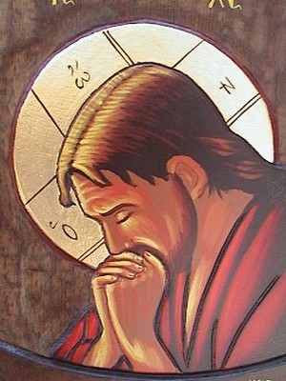
Our Lord: An Example Of Prayer Hebrews 5: 7 – Reviewed In Brief
“Who, in the days of his flesh, when he had offered up prayers and supplications, with strong crying and tears, unto him that was able to save him from death, and was heard in that he feared.”

Slide 8
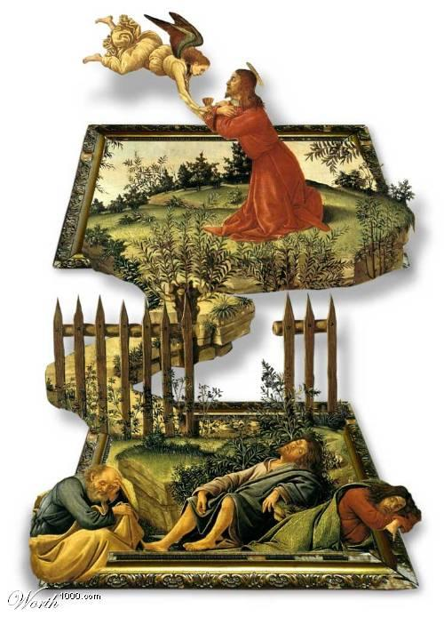

Slide 9
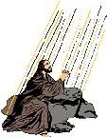
E. M. Bounds: Gethsemane Prayer
David Lee Burris: @ Jewish Theology – Righteous Forgiving Three Times Then They Reprobate
“We can pray against God’s will, as Moses did, to enter the promised land; as Paul did about the thorn in the flesh; as David did for his doomed child; as Hezekiah did to live. We must pray against God’s will three times when the stroke is the heaviest, the sorrow is the keenest, and the grief is the deepest. We may prostrate all night, as David did, through the hours of darkness. We may pray for hours, as Jesus did, and in the darkness of many nights, not measuring the hours by the clock, nor the nights by the calendar. It must all be, however, the prayer of submission … We are to be put into the crucible to be refined.”

Slide 10
Lord’s Prayer For His Apostles: Gospel Of John: Chapter 17
Prayer For Their Partners In The Divine Work
Prayer For Present Unity, Sanctification, & Their Keeping Unto Ultimate Glorification
Prays That They Keep From All Sin, From Sin In The Concrete & Sin In The Abstract
Prays That They Both Made Ready For Eternity & Equipped For Life On Earth
Prays That They Might Be Owned, Possessed, Filled, & All Guarded By God.
He Desired In Them A Holy Life & A Holy Work For God.
He Devoted Himself In Death In Order That They Might Be Devoted In Life To God.

Slide 11
THE LORD’S PRAYER AS MODEL PRAYER
INTRODUCTION.

Slide 12
Relation to Jewish Prayer
There are similarities between the Lord's Prayer and both Biblical and post-Biblical material in Jewish prayer. "Hallowed be thy name" is reflected in the Kaddish. "Lead us not into sin" is echoed in the "morning blessings" of Jewish prayer. A blessing said by some Jewish communities after the evening Shema includes a phrase quite similar to the opening of the Lord's Prayer: "Our God in heaven, hallow thy name, and establish thy kingdom forever, and rule over us for ever and ever."

Slide 13
From Introduction To Brad Young’s: “The Jewish Background To The Lord’s Prayer”
Even though many know the “The Lord’s Prayer” by heart, few know the meaning of the words they recite… In fact, the first barrier to a proper understanding of the prayer is the traditional title, “The Lord’s Prayer.” Jesus never prayed those familiar words himself; rather, he passed this prayer on to his followers. Hence, it’s really “The Disciples’ Prayer.”
This is only where the misunderstandings begin. The main problem is one of approach. Too often, the importance of the Jewish background of the prayer and of the language that Jesus used has been overlooked or minimized… One easily can miss the great depth of Jesus’ message.

Slide 14
From The Conclusion Of Brad Young’s: “The Jewish Background To The Lord’s Prayer”
This is the ‘Disciples’ Prayer,’ and it is a composite of the teaching and preaching themes of Jesus’ life and ministry, which can best be understood in light of their Jewish background. In many ways, these timeless words summarize Jesus’ message. Indeed, it is a prayer of repentance and dedication. Anyone praying these words is accepting the challenge of Jesus’ message.
Jesus called the people to repent and become part of his Kingdom… One is required to forgive and to live in right relationship with his neighbor. This relationship has a direct influence on one’s relationship to the Father in heaven.
Jesus challenged the people to return to God & to do his will.
Moreover, Jesus instructs his disciples to pray for their necessary provision. The physical needs of his followers are by no means excluded at the time of prayer…

Slide 15
The Shema Of Deuteronomy 6: 4 & 5 Prayer Parallels In Thought & Theology
Ken Stevenson In “Lord’s Prayer – Text In Tradition” - Page 25:
The Shema tells us to love the Lord with all our heart, soul, and strength; fundamental to Jewish piety…its threefold character, which Jesus would have known from an early age, lies behind much more of the New Testament than has so far been recognized.
That could suggest a correspondence with the Lord’s Prayer: the heart may be there in the hallowing of the name and daily bread; the soul in the coming of the kingdom and the gift of forgiveness; and strength in doing the will and protection from temptation and evil.
Even if such a view is thought schematic, the threefold focus of the Shema still parallels the threefold structure of both parts of the prayer.

Slide 16
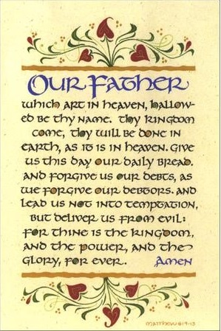

Slide 17
Reconstruction Of The Disciple’s Prayer In Hebrew
Translation Of Reconstruction
Our Father Who Art In Heaven,
May your name be sanctified.
May you continue establishing your Kingdom;
May your will be done
In heaven and in earth.
Give us this day our necessary portion.
Forgive us our sins as we also
Have forgiven those who have
Sinned against us.
Do not bring us into the grasp of temptation,
But deliver us from the evil one
Reconstructed Transliteration
Avinu shebashamayim
Yitkadesh shimcha
Tamlich malchutcha
Ye’ase r’tzoncha
Bashamayim uva’aretz
Et lechem chukenu ten lanu hayom
Um’chol lanu et chovotenu
Ka’asher machalnu gam
Anachnu l’chayavenu
V’al t’vienu lide nisayon
Ela tatzilenu min hara

Slide 18
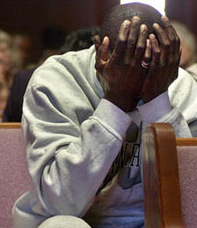
The Construct Of The Prayer
Carefully constructed so that’s its clear meaning and intent would not be lost through time or culture and in such a way that the disciples could connect the dots
It has a straightforward spiritual pattern and message that has remained untampered with and it is virtually impossible to twist or distort

Slide 19
The Construct Of The Prayer
The clauses number 7 and symbolize the human soul.
What it teaches is a pattern for the nourishment of the human soul and intimate communion with the eternal God
It connects us with God and God with us at the deepest level

Slide 20
Disciples’ Prayer In Scriptural Context Of Matthew’s Gospel
Pulpit, Homiletics, 3rd Part Of Sermon: The Danger Of Unreality:
Almsgiving & Prayer: Spiritual Estimate Of Actions Measured By Inward Motive. A Holy Life Has A Persuasive Eloquence. An Earthly Motive Destroys The Beauty Of Good Deeds. Deeds Done For Display Have No Depth – No Reality. Otherwise, Actions That To Other Mortal Men May Seem Magnificent Or Even Heroic Are In Reality Spiritually Worthless.
The False Motive: Unreality Is Hypocrisy; It Is Acting. The Hypocrite Assumes A Character Before Men That Is Not Really His. He Gives Charitably Because He Wishes Recognition. He Does Not In His Heart Pity The Afflicted; He Is Not Merciful; He Does Not Really Care To Do Good. He Forgets The Presence Of The All-Seeing God; He Thinks Only Of The Many Eyes That See His Outward Act, Not Of The One That Sees Its Inward Meaning And Estimates Its True Value. God Sees The Meaning Of All Deeds And Words – Every Secret Thought And Motive Of The Heart. The Prayer Of The Hypocrite Goes No Deeper Than The Lips. God Distinguishes In The Sound Of Many Voices In A Crowded Church Of Those Prayers Using The Sacred Name That Which Are Meant For His Ears Only.
The True Motive: In Giving - The Glory Of God! The Follower Of Christ In Denying Self Gives Out Of Love Of God & Love Of Man. He Gives In Simplicity & Singleness Of Heart. The Christian Lives As God Would Have Him – In Holy Love, In Deep Humility, In Quiet Obedience. In Prayer – First, In Individual Prayer He Is Private. This Is Not Only For Reasons Of True Modesty Or Real Humility But Also So As Not To Be Distracted. Second, Shut Also The Human Heart To The World & Pray To “Thy Father.” Third, In Our Praying Volume & Repetition Accomplish Nothing With God. The Translated Term “Vain Repetition” Can Be In The English Language Misleading & Can Be Thus Taken To The Extreme As Well. Actually, What Appears To Be Condemned Is The Multitude Of Words Without Thought. Therefore, Proscribed Prayers Have Less Value With God Than Those Done Extemporaneously. Moderate Repeat Cannot Be Forbidden Without Also Finding Fault With The Prayers Of King David & Jesus Christ – They Are Both Recorded As Petitioning On Concerns Three Times. This Would Coincide With The Jewish Practice Of Praying Three Times A Day. In Other Words, In Most Matters, It Would Be Good Advice To Bring It Before The Lord Over The Course Of A Calendar Day & Continue Further Only As Changes Occur. By Way Of Application - Unanswered Prayer Response: We Are To Be Yielded & Submissive. When God Is Silent It Means No! We Are To Accept It & To Trust Him; Moreover, We Reconcile Our Will To His!

Slide 21
Harmony Of The Two Gospel Narratives
Book Of Luke - Chapter 11: 2
Father,
Hallowed be thy name.
Thy kingdom come.
Give us each day our daily bread.
And forgive us our sins,
For we ourselves forgive
Everyone who is indebted to us;
And lead us not into temptation.
Matthew - Chapter 6 - Verse 9
Our Father who art in heaven,
Hallowed be thy name.
Thy kingdom come,
Thy will be done,
On earth as it is in heaven.
Give us this day our daily bread;
And forgive us our debts,
As we also have forgiven our debtors;
And lead us not into temptation,
But deliver us from evil.
[For thine is the kingdom,
and the power, and the glory,
forever, Amen.]

Slide 22
Early History Of Disciple’s Prayer
First: Called The “Our Father” Or The “Paternoster” Prayer
Later: From The Third Century Through To Today Most Have Signified It As The “Dominica Oratio” Or The “Lord’s Prayer”; But By The 16th Century Some Had Begun To Reference It Simply As The Savior’s “Prayer Of Charity” Or Of Lesser Import As His “Prayer Of Nature”
Theologians Generally Refer To As “The Canonical Prayer” Because It Only Is Directly Based In Scripture; The Longer Version Is At The Very Heart Of The Sermon On The Mount
According To Tertullian, The Earliest Tradition Was Founded On Baptismal Preaching Or Discipleship Training Which Became Known As Catechesis (Convert Instruction); Initially The Celebrant Alone Recited The Prayer But This Common Practice Slowly Changed Into The Norm Of Priests Reciting Singular Petitions & Worshippers Responding With Amen To Each
By The Fifth Century: Preaching On The Prayer Was Less Introduction Instruction & More Homily Of Devotion
By The Medieval Age The Prayer Had Become Associated With The Habit Of The Rosary Which The Protestant Movement Rightly Regarded As Scripturally Condemned Vain Repetition; Martin Luther Insisted That The “Our Father” Was Not For Self & Personal Devotion But Was Christ’s Continual Prayer For His Faithful Followers
Protestant Swiss Reformers Of The Middle Ages Considered It As A Model Prayer Of Community & Prayer Guidance Rather Than Liturgical Text
The German Reform Movement Led By Martin Luther Introduced Metrical Versions Of The Prayer; Although Of Protestant Origin, There Have Been Notable Variations On This Musical Theme By Roman Catholics
Augustine Of Hippo Divided The Prayer Into Separate Petitions & Then Included With Others Of His Sevenfold Structure: Beatitudes (Matt. 5: 3 – 9), Gifts Of The Spirit (Isaiah 11: 2), Seven Deadly Sins, & Seven Words From The Cross; John Calvin Said That There Were Six Petitions Because Temptation & Evil Belong Together
Augustine Distinguished Three Heavenly Petitions (Name, Kingdom, & Will) From Four Earthly Petitions (Bread, Forgiveness, Temptation, & Evil); By The 12th Century The Bread Petition Was Sub-divided Into Both Heavenly & Earthly
Martin Luther Modified The Augustinian Approach By Way Of: Three Spiritual Petitions (Name, Kingdom, Will), One Natural (Daily Bread), & Three For Deliverance (Sin, Temptation, Evil)
Others Contended The Prayer’s Literary Form Consists Of Six Items: Three Aspirations (Name, Kingdom, Will) & Three Petitions (Dread, Forgiveness, Protection)
Modern Writers Have Concentrated On The Eschatological Background Of The Prayer – The Inauguration Of The Kingdom Of God.

Slide 23
ISSUES OF INTERPRETATION
When we speak of “Our”, is it only for the initiated or baptized, or is it to be applied to the whole human race?
When we speak of God as “Father”, is this as adopted children, or as created, or as both?
When we speak of God’s name being “hallowed”, is this in our sacrifice of servant living, or part of the called out process of being a separated people, or is it necessary to the acceptable celebration and reverence of worship, or is this actually activity that can only be accomplished in an eschatological sense by God himself?
When we speak of the kingdom, is this the kingdom of the church as experienced currently, or is it the eternal kingdom of final perfection, or is it of dual fulfillment?
When we speak of doing the will, is this God’s permissive present or eternal ultimate will, or is it free will graciously guided by God?; Does “on earth as in heaven” refer to this “will” or to the “kingdom” prior or even the “hallowing” before?
Is the bread exclusively that materially consumed or the non-literal element of communion, or again, is it both? What is the meaning of epiousios ? Does it mean “for the coming (day),” or does it mean the bread we need “to survive”?
When we speak of forgiveness, how strong is the word “as”? Is the causative burden entirely on us? Is the theme of “debt” equal to that of forgiveness?
Temptation Prevention: Is God’s Leading – God’s Testing?: Or is the meaning in Aramaic of - “don’t let us be tempted” - more accurate - in terms of translation?
When we pray to be delivered from evil, is this a personal force as the Church Fathers claimed and early tradition held? Or is it more comprehensive, and therefore impersonal, as Augustine taught? Or is it even a part of the preceding petition against temptation as stated by later scholars?
Ending Doxology – “For thine is the kingdom, & the power, & the glory, forever. Amen.”: Is this from fourth century manuscript addition to the Greek text? What of 1 Peter 4:11?

Slide 24
THE LORD'S PRAYER
“Lord Teach
us to pray!”

Slide 25
LORD, TEACH US TO PRAY
1.
OUR FATHER WHICH ART IN HEAVEN
2.
HALLOWED BE THY NAME
3.
THY KINGDOM COME
4.
THY WILL BE DONE
5.
GIVE US THIS DAY OUR DAILY BREAD
6.
FORGIVE US OUR DEBTS
7.
LEAD US NOT INTO TEMPTATION

Slide 26
THE FRUITFUL PRAYER LIFE
PRAYER DOESN’T COME NATURALLY (EGO ISSUES)
PRAYER IS A LEARNED SKILL
A PATTERN IS USEFUL IN LEARNING HOW TO PRAY

Slide 27
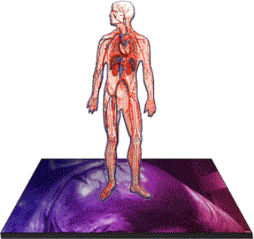
Spiritual Intensive Care

Slide 28
Prerequisite Presuppositions
We are inadequate to handle everything life throws at us
God is able to do exceeding abundantly above and beyond what we need,think or ask
God has invited us to come to Him at any time and about anything

Slide 29
Prerequisite Presuppositions
All of our lives would be better if we spent less time worrying and more time praying
Like the disciples we need help in how to pray

Slide 30
MENU

Slide 31
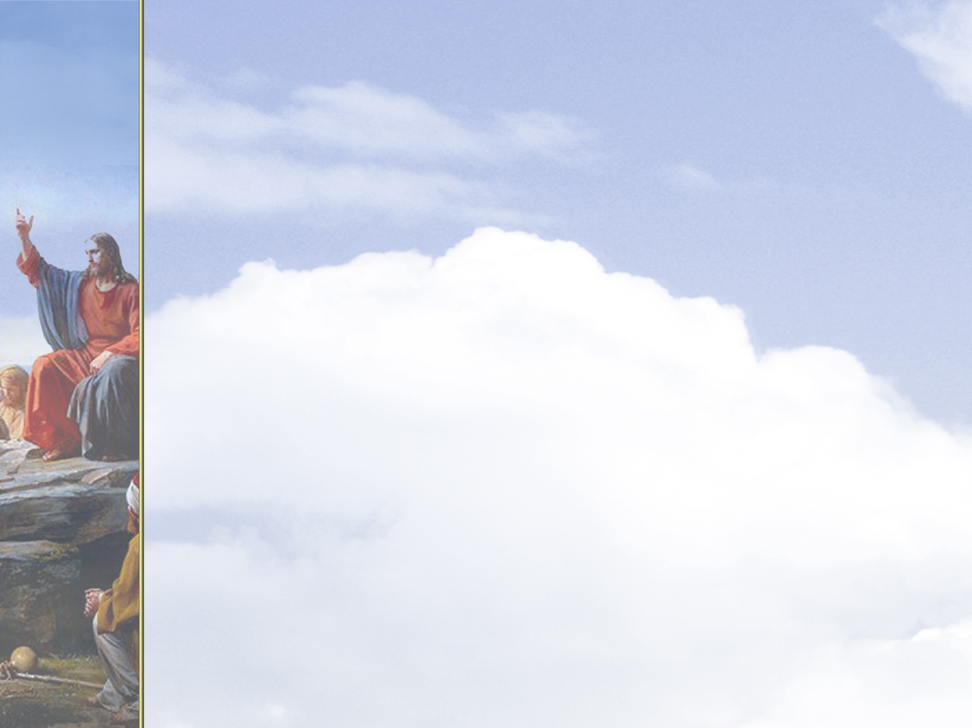
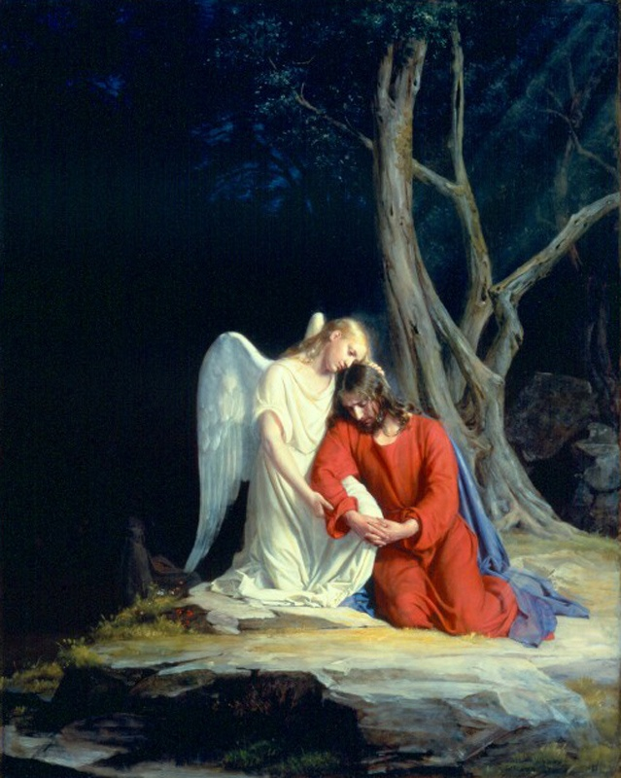
Jesus’ disciples had seen him pray many times.
Sometimes he prayed all night.
Sometimes his prayers were just one sentence.
Christ at Gethsemane
Cark Bloch

Slide 32
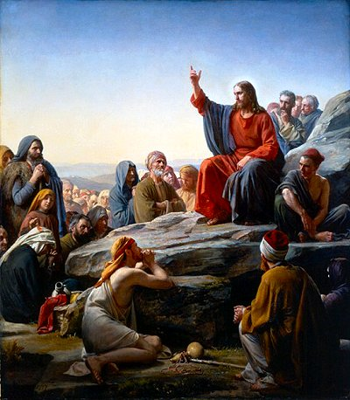
Jesus’ followers connected Jesus’ intense prayer life with the power he showed in every aspect of life.
One disciple asked Jesus to teach them how to pray.
Sermon on the Mount
Cark Bloch

Slide 33
Jesus gave them a deceptively simple, childlike prayer which has come to be known as “The Lord’s Prayer.”
The prayer is recorded in Luke 11:2-4 and Matthew 6:9-13.
Matthew’s version highlights seven key parts:

Slide 34
Seven Key Parts
1) Our Father which art in heaven,
2) hallowed be thy name,
3) thy kingdom come,
4) thy will be done in earth as it is in heaven.
5) Give us this day our daily bread.
6) Forgive us our debts, as we forgive our debtors.
7) And lead us not into temptation, but deliver us evil.

Slide 35
In this pattern, Jesus provided his followers with guidelines for prayer based on the attributes or characteristics of God.
The two main sections of the prayer divide with the words “your” and “our.”

Slide 36
The first part centers on making God our priority.
YOUR
Only by focusing on the patient and loving Father can we find the attitude that puts our own needs in perspective.

Slide 37
The second part focuses on our needs—body, soul, and spirit—and the needs of others.
OUR
In just three brief requests, Jesus targets all of human behavior and character and reminds us that we always need him.

Slide 38
It’s been said that if these three requests are prayed properly, nothing more need be said.
OUR
Only in moment-by-moment dependence on God will we experience the good things God wants to provide.

Slide 39
The Lord’s Prayer is a dangerous, life-changing prayer.
Jesus’ enemies eventually killed him for asserting his close tie to God through addressing God as “Father.”
Until Jesus gave his followers the right to be called children of God, this would have been blasphemy.

Slide 40
SHOULD BE KNOWN INSTEAD
AS THE “DISCIPLE’S PRAYER”

Slide 41
Corporate Prayer In Covenant Community
“If we believe in a real kingdom of God – an organic fellowship of interrelated lives – prayer should be as effective a force in this inter-related social world of ours as gravitation is in the world of matter. Personal spirits experience spiritual gravitation, soul reaches after soul, hearts draw towards one another. We are no longer in the net of blind fate, in the realm of impersonal force, we are in a love system where the aspiration of one heightens the entire group, and the need of one – even the least – draws upon the resources of all – even the Infinite. We are in actual Divine-human fellowship!” - American Quaker Rufus Jones
"OUR FATHER"

Slide 42
Corporate Prayer In Covenant Community
“Before all else, the teacher of peace and master of unity desires that we should not make our prayer individually and alone, as whoever prays by himself prays only for himself. We do not say: ‘My father, who are in the heavens,’ nor ‘Give me my bread this day.’ Nor does anybody request that his debt be pardoned for himself alone, nor ask that he alone be not led into temptation and delivered from the evil one. Our prayer is common & collective, and when we pray we pray not for one but for all people.” - Cyprian of Carthage, On the Lord’s Prayer
"OUR FATHER"

Slide 43
Model Prayer In Line Item Analysis
Our Father Which Art In Heaven.

Slide 44
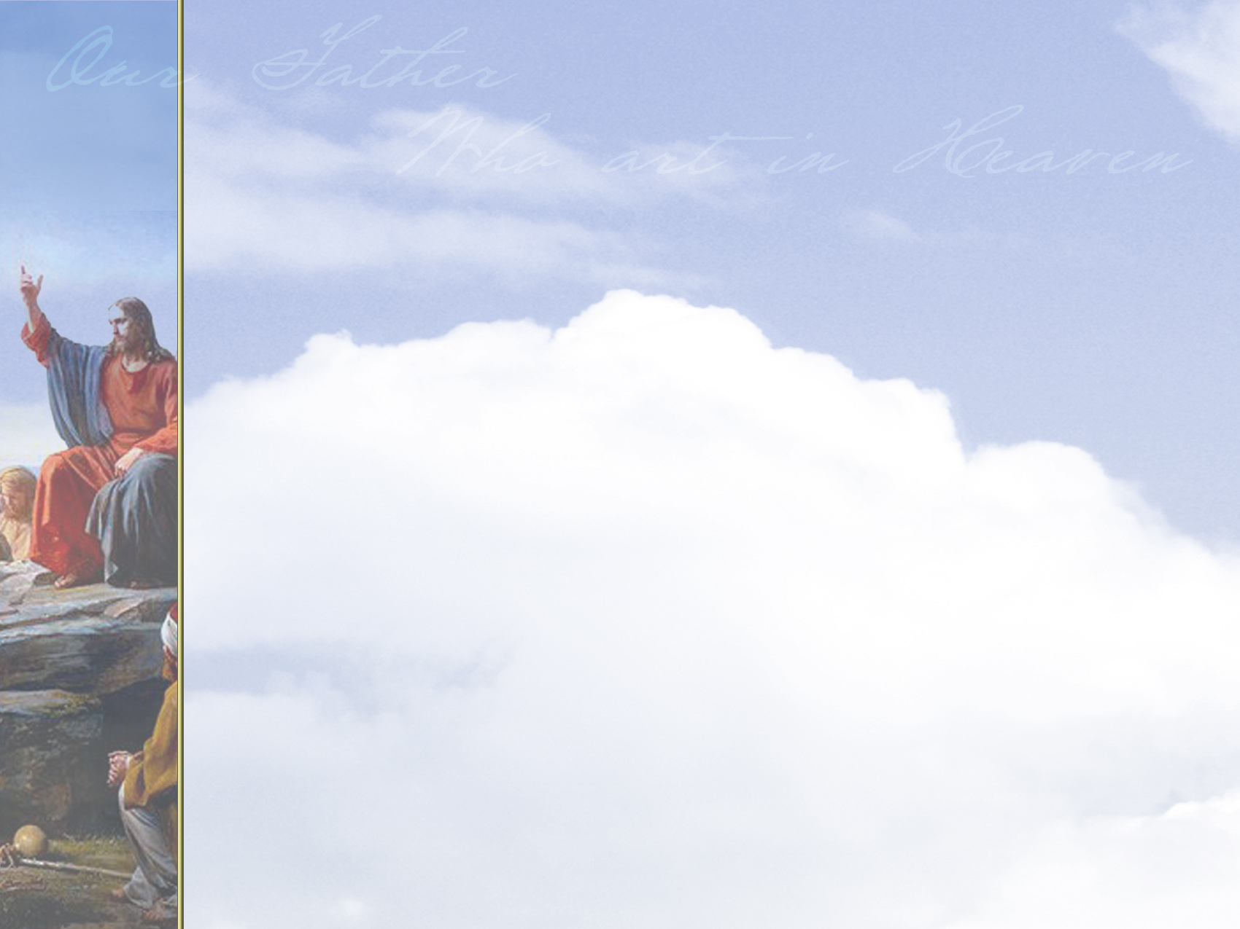
MENU

Slide 45
God’s Fatherly Love

Slide 46
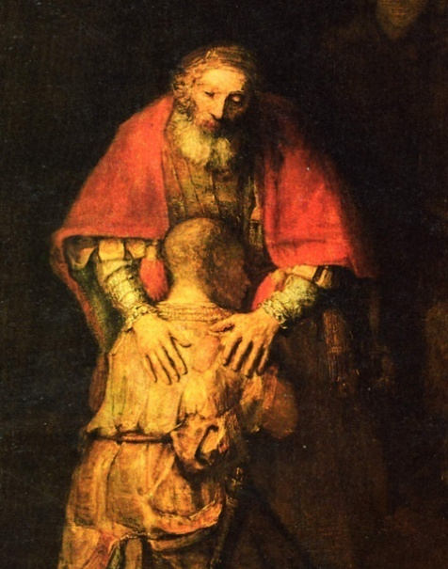
God is a loving and compassionate Father who gives life, provides for and protects those who trust him.
Like a caring human father, God wants a close relationship with his children.
The Return of the Prodigal Son (detail)
Rembrandt (1668)

Slide 47
Addressing God as “Our Father” plunges the person praying into a relationship.
A child approaching a loving father knows that father will give careful attention to the child’s requests and will be lovingly inclined towards the child’s best interests.

Slide 48
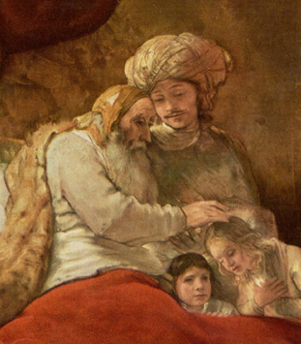
The child knows the father will answer.
This is how Jesus tells us to approach God—as trusting children of a patient, tender father.
Jacob Blessing the Sons of Joseph (detail) Rembrandt (1656)

Slide 49
John 1:12, 13
1 John 3:1
Hebrews 4:16
Click reference above to read passage.

Slide 50
During Jesus’ time, people understood God to be awesome, majestic, and far away in the unreachable heavens.
Though the Old Testament uses the metaphor of fatherhood when talking of God, no one would have dreamed of addressing God as Father in prayer.

Slide 51
Jesus’ use of the name “Abba” (like our “Daddy”) must have stunned his disciples.
In fact, Jesus’ use of the family name shocked the religious leaders of his day.

Slide 52
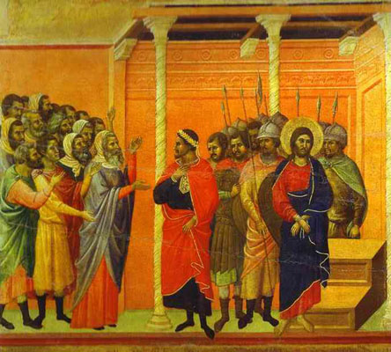
Eventually those religious leaders accused Jesus of blasphemy and crucified him for identifying himself as God’s Son!
Jesus Accused by the Pharisees Duccio di Buoninsegna (1308)

Slide 53
Jesus taught his followers that they should address God as “Father.”
He promised that their loving Father would care for all the needs of those who trust in him (Matthew 7:7-11).

Slide 54
Jesus willingly died a horrible death to purchase the right of believers in Christ to be called children of God.
It’s hard to comprehend that the God who has all the power in the universe will listen to our prayers because of the actions of his Son, Jesus!

Slide 55
Our Paternal Relationship
God is the Father of all men naturally but the “Abba Father” of those who are His special children bought by blood and adopted into a unique relationship
We enter not only recognizing His sovereign Majesty but also with the confidence of His fatherly goodness
He is both “our Father” and “our Father who art in heaven” (His transcendence and imminence)

Slide 56
Our Paternal Relationship
Due to our relationship with Him he is anxious and willing to grant us an audience
He has our best interest at heart and we are invited to draw near

Slide 57
The Artery Of Relationship
Unclogging Our Spiritual Arteries

Slide 58
Our Spiritual Arteries
The need for relationship
Our Father which art in Heaven,

Slide 59
Relationship
Before we can begin to pray we must settle the issue of whether God is our Father and we are His children
We have this unique relationship through the blood shed by Christ and the forgiveness given to us as a gift of grace.
We now have the joy of being in the family of God and we come into his presence as children running anxiously into their daddy’s presence

Slide 60
Isaiah 57:15… For this is what the high and lofty One says-- he who lives for ever, whose name is holy: I live in a high and holy place, but also with him who is contrite and lowly in spirit, to revive the spirit of the lowly and to revive the heart of the contrite.

Slide 61
Cultural Context: “Our Father Who Art In Heaven”
“Father” Is Generally Used As A Name For God With The Suffix “Our” In Rabbinic Literature. Even If Jewish Piety Wouldn’t Address As “Abba,” It Certainly Addresses God As Father (Hosea 11:1, Isaiah 63: 16, etc.)
Lucan Version Does Not Contain Expression “Who Art In Heaven”; These Beginning Words Were Well-Known In Early Jewish Prayers & Hebrew Scholars Speculate The Matthew Addition Was An Expansion To Explain The Concept To An Unfamiliar Gentile Audience.
While Luke Never Once Refers To God As The “Father Who Is In Heaven” Matthew Preserves Twelve Sayings Of Jesus Using This Expression. Other Opposing Hebrew Scholars Suggest Luke Left Out The Expanded Version Purposefully To Avoid Associations With The Gods Of Jupiter Or Zeus.
The Description Of God As “Father” Is Not Coincidental. In The Hebrew Family The Father Had A Place Of Honor, Dignity, & Authority; But He Also Was A Loving & Caring Figure.
The Idea That A Loving Father Has To Chastise His Son Is A Common Theme In Many Rabbinic Parables.
The Father Is Both A Provider & A Protector; Yet, Even If He Is Distant Because Of His Place Of Honor & Respect – He Displays Love & Affection To His Children.

Slide 62
The Artery Of Worship
Unclogging Our Spiritual Arteries

Slide 63
Some Givens
The essence of sin is found in self absorption
The sooner we learn its not about us the sooner we will enter the realm of spiritual fulfillment
We all worship. It’s “the what” that makes the difference
Worship is a critical spiritual discipline. Through worship He is enthroned as King not only of the universe but my life

Slide 64
Our Spiritual Arteries
The need for worship
Hallowed be thy name.

Slide 65
Model Prayer In Line Item Analysis
Our Father Which Art In Heaven.
Hallowed Be Thy Name.

Slide 66
MENU

Slide 67
God’s
Holiness

Slide 68
To hallow means to make holy.
To “hallow” God’s name means to honor it as holy and sacred.
When we pray, we enter the presence of God with reverence, worship, and thanksgiving.

Slide 69
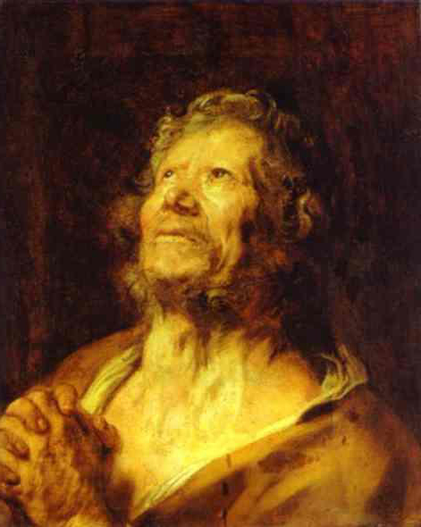
We thank God not only for what he’s done, but also for who he is.
God’s greatness and glory alone are worthy of praise and thankfulness.
An Apostle with Folded Hands Van Dyck (1618)

Slide 70
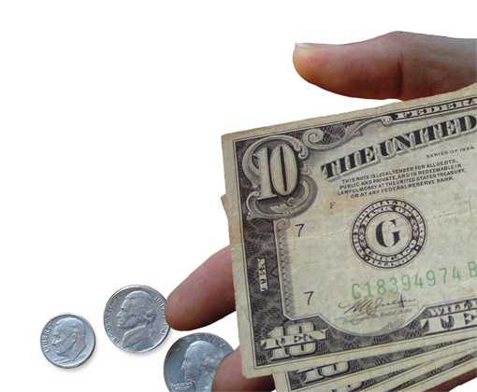
Thanksgiving recognizes that everything we have belongs to God, whether it be our talents, skills, possessions, jobs, or children.

Slide 71
Psalm 99:9
Exodus 20:7
1 Corinthians 10:31
Psalm 24:1
Click reference above to read passage.

Slide 72
Traditionally, God’s people, the Jews, never said or wrote the name of God.
To do so was considered not keeping the name of God holy.
God’s name represents his character, his plan, and his will.

Slide 73
We often think of cursing as a common misuse of God’s name, but what about attitudes of the heart?
Lack of respect or indifference by one who professes love for God may be just as much a sin (Revelation 3:15, 16).

Slide 74
Jesus encouraged his followers to use God’s name in honorable ways and for purposes that deepen and endear our bonds to him.
Part of showing reverence for the holy name of God is thanking him for who he is and for what he’s done.

Slide 75
Many psalms praise and worship God’s holy name (Psalm 100:4; 147:13).
Our greatest reverence, though, is shown by the stories our lives reveal.
Our Father’s name is most hallowed when we live in ways that attract others to him (1 Cor. 10:31, Matt. 5:16).

Slide 76
THY
THOU
THINE

Slide 77
@Reverence and Respect in Prayer by Gary Colley –
Solemn Speech. It is generally acknowledged in our time that thee, thou, thy, and thine, are reserved for the ‘solemn form’ of address to Deity. Not only is this acknowledged by grammarians, but also it is impressed upon us by songs that we sing and the scriptures we read. Even the Biblical names assigned to our God teach us that the highest language is to be used towards God. Some of these are Heavenly Father, Almighty God, Lord of Hosts, Eternal God, Most High, etc.

Slide 78
@Reverence and Respect in Prayer by Gary Colley –
Solemn Speech. The Revised Standard Version of the New Testament was published recently as 1946, yet in the introduction by Dean Weigle said: ‘After two years of debate & experiment it was decided to abandon these forms and follow modern usage, except in language addressed to God.’ They then addressed God with ‘thee & thou,’ to acknowledge His Deity. But in reference to Christ ‘you’ was used. By this they expressed what they believed: that Christ was not Deity.

Slide 79
@Reverence and Respect in Prayer by Gary Colley –
Solemn Speech. True, the ‘solemn form’ was taken from Post-Elizabethan English; so were many of the other terms that have now been incorporated into our language. These terms (THEE, THOU, THY, & THINE) are in our language for the express purpose of showing respect and reverence… and [we should] be pleased to have it so. We must conclude that this is the form of address in our language that expresses highest reverence and respect addressing our Heavenly Father.

Slide 80
What Is His Name
His name reveals to us who He is. It is descriptive
His name is His promise. If He is, He does!
His name is our joy. When we see Him as He is there is no problem to deep or situation too difficult. His words to us bring an abiding joy amidst life’s hurdles

Slide 81
His Name - Jehovah
JEHOVAH-JIREH
PROVIDER
JEHOVAH-NISSI
MY BANNER OF VICTORY
JEHOVAH-SHALOM
MY PEACE
JEHOVAH RAPHA
MY HEALER
JEHOVAH KAMA
THE GOD WHO IS JEALOUS

Slide 82
His Name Jehovah
JEHOVAH TSIDKENU
MY RIGHTEOUSNESS
JEHOVAH SHAMMAH
MY ONE WHO IS THERE
JEHOVAH ROHE
THE LORD MY SHEPHERD
JEHOVAH TSEBHAOTH
THE LORD OVER ALL

Slide 83
Hallowed Be Thy Name
What does the word “hallowed” mean
Hagiazo: the root word is holy
Means to be set aside, unlike any other, to be reverenced,absent from anything profane
The word is most often translated sanctified and means set apart as sacred.

Slide 84
Hallowed Be Thy Name
God has chosen to reveal what He is like through His name
There is only one who is due honor, glory. and praise. There is only one name to be revered, adored and glorified, There’s only one who deserves His name be given the utmost respect and the greatest fame

Slide 85
An Interesting Insight
Hallowed from the word hagiazo is in the imperative (it’s a command) and the passive (its something we cannot do but is done by another)
We are asking the Lord to have His name honored
It is our deepest desire that He would do whatever He can in our lives individually and corporately to have His name honored and glorified
When we acknowledge we are are incapable of giving Him the honor He is due we are giving Him the honor He is due

Slide 86
Why Hallow His Name
The chief end of man is to glorify God
Honoring His name is an acknowledgment of the holiness and uniqueness of who He is
It is the clear expression of our desire that because He is our source and strength, our rock and our fortress, that He might increase and we might decrease

Slide 87
How Can We Hallow His Name
Don’t blame God for your troubles. He is Holy and as God, good proceeds from Him. Because He is God all the time He is good all the time. What flows from Him is what He is
The chief end of our lives is to glorify God. It is our honor to worship and acknowledge who He is.
As Christians (little Christ’s) we have the high privilege and honor of reflecting who He is in who we are

Slide 88
Cultural Context: “Hallowed Be Thy Name”
This Phrase Is A Significant Petition. This Is More Than A Mere Formula Of Praise.
We “Hallow” God’s Name By “Sanctifying” It.
The Hebrew Phrase Parallels Here With That Found In Ezekiel 38: 23 Focusing On Divine Justice.
The Phrase Expresses Intense Desire & Is An Element Essential To The Rabbinic Blessing – “Grant It That All The World May Recognize And Sanctify The Name Of Our Father.”
Jesus’ Jewish Listeners Would Have Associated An Antithetic Meaning By Way Of Its Antonym – “Profane”; The Book Of Ezekiel Made Many Such Contrasts.
The Midrash Commentary On Leviticus 19: 2 Indicates Lifestyle Separation From The World Renders One Holy & This Type Life In Turn Sanctifies The Almighty.
The Midrash Commentary On Leviticus 22: 32 Indicates Sanctification Including “Delivering Over” & Suffering Possible Martyrdom For One’s Righteous Way Of Life.
Jesus Himself Extended Along These Lines In Matthew 5: 16 – “Let Your Light So Shine Before Men, That They May See Your Good Works And Give Glory To Your Father Who Is In Heaven.”

Slide 89
The Artery Of Priority
Unclogging Our Spiritual Arteries

Slide 90
Our Spiritual Arteries
The need for priority
Thy Kingdom come, and thy will be done.,

Slide 91
Model Prayer In Line Item Analysis
Our Father Which Art In Heaven.
Hallowed Be Thy Name.
Thy Kingdom Come.

Slide 92
MENU

Slide 93
God’s
Sovereignty

Slide 94
God has supreme power and authority over everything in heaven and earth.
When we acknowledge God’s sovereignty, we affirm and welcome his reign in our lives.
We promise to live in ways that honor him.

Slide 95
But God’s kingdom is both here and now—and yet to come.
During Jesus’ life on earth, his ministry was “to proclaim freedom for the prisoners, to recover sight for the blind, to release the oppressed, and to proclaim the year of the Lord’s favor” (Luke 4:18, 19).

Slide 96
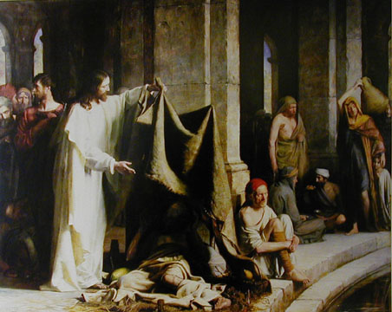
When Jesus was around, people were freed from sickness, suffering, and pain.
The Pool of Bethesda
Cark Bloch

Slide 97
Jesus said that the Kingdom of God was near (Mark 1:15).
When asked when the Kingdom of God would come, Jesus said, “The kingdom of God does not come with your careful observation, nor will people say, ‘Here it is,’ or ‘There it is,’ because the kingdom of God is within you.”

Slide 98
God’s kingdom will be evident in the lives of those who make him their Lord.
This petition asks the Lord to change our lives so that his goodness is always evident through us.

Slide 99
Some people have interpreted this prayer as an invitation to impact culture by passing laws calling people back to safer moral standards.
But Jesus made clear his Church’s mission: to lead people to himself.

Slide 100
Jesus commissioned all disciples to proclaim that Jesus is King and Lord over all (Matthew 28:18-20).
Our obedience to this commission helps spread God’s kingdom throughout the world.

Slide 101
Cultural Context: “Thy Kingdom Come”
It Is Essential To Keep In Mind That The Hebrew Language Emphasizes The Kind Of Action & Not The Time
In Later Hebrew, The Time Factor Became More Important, But The Emphasis Of The Petition Is Not Temporal
It Emphasizes Instead The Dynamic Force Of God’s Kingship Being Realized As His Will Is Done
Jesus’ Words Would Have Been In The Imperfect Tense, Which Indicates Incompleted Action – The Idea Is That A Process Is Taking Place.
Thus, This Statement Can Be Connected To The Growth Parables Of The Kingdom
It Is Linked Similarly To Matthew 12: 28 & Then In Turn To Exodus 8:19 & 31:18 – Conveying The Message Of Deliverance
The Mishnah Links The “Yoke Of The Kingdom” To The Ancient’s Affirmation Of Deuteronomy 6: 4
It Was Put Into Prayer Form & Was Known As The Shema Yisrael (“Hear, O Israel”) & Everyone Praying It Received As Similar The “Yoke Of The Kingdom”
Reciting This Prayer Of Acknowledgment Was Considered The First Step In The Spiritual Obedience To The Laws, Ordnances, & Commandments Of Ancient Israel

Slide 102
Cultural Context: “Thy Kingdom Come”
“Heaven” Was Often Substituted In Meaning For “God” Because Of The Special Sanctity Reserved For His Name. This Was Common In Jesus’ Day & Persons Accepting The Authority Of The Kingdom Of Heaven Were Said To Have Entered Into The Reign Of God.
The Mekilta, An Early Midrash, Comments On The Beginning Statement Of The Decalogue – “I Am The Lord Thy God” – Conditioning The Ancient’s Acceptance Of The Kingdom Of Heaven With The Omnipresent (God) “Doing Good For Us” – These Remarks Link The Liberation Of God’s People With The Theme Of The Kingdom
Therefore, God - In This Sense - Reigns By His Mighty Redemptive Acts Of Liberation!
Jesus’ Challenging Call To Repent Was An Essential Aspect Of His Proclamation Of The Kingdom
Furthermore, Jesus’ Public Ministry Demonstrated Many Acts Of Redemption That Were The Dynamic Realization Of God’s Kingdom.
In The Hebrew Translation Of The Blessing Of Matthew 5: 3 The Last Part Reads “They Make Up The Kingdom.” This Proper Translation Indicates As Well How The Kingdom Will Continue To Be Established.

Slide 103
“The Meaning Of The Millennium” by Robert Clouse DOUBLE APPLICATION: “THY KINGDOM COME”
“Amillennialists believe that the kingdom of God was founded by Christ at the time of his sojourn on earth, is operative in history now and is destined to be revealed in its fullness in the life to come. They understand the kingdom of God to be the reign of God dynamically active in human history through Jesus Christ. Its purpose is to redeem God’s people from sin and from demonic powers, and finally to establish the new heavens and the new earth. The kingdom of God means nothing less than God’s reign in Christ over his entire created universe. The kingdom of God is therefore both a present reality and a future hope.”

Slide 104
Amillennialism
What is Amillennialism?
Rather, the millennium symbolizes Christ’s reign in the lives of his people from the beginning of the church until his second coming.
Second Coming of Christ & Final Judgment
Millennium
Eternity
The Church Age
Tribulation

Slide 105
Amillennialism
What is Amillennialism?
Christ’s triumph over Satan through his death and resurrection in AD 30 restrained the power of Satan on the earth.
Second Coming of Christ & Final Judgment
Satan’s power is restrained
Millennium
Eternity
The Church Age
Tribulation
Notes:
See Revelation 20:1–3.

Slide 106
Amillennialism
What is Amillennialism?
Persecution of Christians (tribulation) will occur until Jesus comes again, as will the expansion of God’s kingdom (the millennium).
Second Coming of Christ & Final Judgment
Satan’s power is restrained
Millennium
Eternity
The Church Age
Tribulation

Slide 107
“A Case For Amillennialism” by Kim Riddlebarger DOUBLE APPLICATION: “THY KINGDOM COME”
“In other words, when the kingdom came in the person
of Jesus, the ‘age to come’ also had arrived, at least
in some provisional sense. The consummation of that
kingdom, when Jesus Christ returns to judge the world,
raise the dead, and make all things new, coincides with
the arrival of the ‘age to come’ in all its fullness. …the
presence of Jesus’ spiritual kingdom,‘the rule of Christ,’
is a reality which guarantees the consummation of the
kingdom of God yet to come. This is further reflected
in the Lord’s Prayer when Jesus exhorted believers to
pray for the consummation of that same kingdom which
dawned in his own person during his messianic mission
(Matthew 6: 9 – 13).” -- PAGES 109 & 110

Slide 108
Model Prayer In Line Item Analysis
Our Father Which Art In Heaven.
Hallowed Be Thy Name.
Thy Kingdom Come.
Thy Will Be Done.

Slide 109
Thy Kingdom Come Thy Will Be Done
It makes the declaration God is the awesome King Ps. 47:7 and He sits on the throne of His holiness. Ps 47:8
He is a great King Ps 95:3 not so because He is made so by His subjects but by the immensity of His being Jer. 23:24, 1Kings 8:27

Slide 110
Thy Kingdom Come Thy Will Be Done
He is a glorious King Ps 24:10. He is clothed with majesty Ps 93:1 and it is His righteous essence rather than His kingly robes that make Him glorious
His kingdom supercedes and encompasses all the other Kingdoms of this world Prov. 8:15

Slide 111
Therefore
The instructions He gives are my best hope for being fulfilled and happy as a citizen in the kingdom 1Kings 10:8
Since He is the great King above all kings and because He will be victorious it makes sense to be on the winning side and not oppose that which will ultimately triumph Ps 110:1

Slide 112
Where are your best days?
Past
Present
Future
Your
Heavenly Father
Experience
Resources
In What Or Who Are you Placing Your Trust?

Slide 113
Therefore
There is nothing or no one worthy of unconditional trust beyond the all wise King. Ps 9:10 Coming to Him as this petition exhorts is the beginning of wisdom

Slide 114
Our Spiritual Arteries
The need for priority
Thy Kingdom come, and they will be done, on earth, as it is in heaven.

Slide 115
How often do you feel rushed?
Do you feel the pressure to get more done in less time and with fewer resources?
Do you feel there are multiple things competing for your attention?
Does the word overwhelmed seem synonymous with your life?

Slide 116
Do you find some really important things remain undone?
Do you ever find yourself feeling you are working hard but not sure its worth the efforts?
Do you struggle with keeping first things first?

Slide 117
Peter Drucker
“We need to do first things first and second things not at all!”

Slide 118
Model Prayer In Line Item Analysis
Our Father Which Art In Heaven.
Hallowed Be Thy Name.
Thy Kingdom Come.
Thy Will Be Done,
In Earth As It Is In Heaven.

Slide 119
MENU

Slide 120
God’s
Authority

Slide 121
God’s perfect will is always being done in heaven.
But on earth, human free will often results in selfishness, greed, and evil.
In this part of the Lord’s Prayer, we ask that God’s good will would take place on earth.

Slide 122
We pray for God’s will to become our will.
God calls each one of his children to live rightly and do good to others, caring for those around us as much as ourselves.

Slide 123
We pray that all people submit to the will of God over their own desires and love God and neighbors as themselves.
Relationship with God depends on obedience to his will.
God’s will should be the context for everything we ask for, say, and do.

Slide 124
Psalm 143:10
Matthew 7:21
Matthew 26:39
Matthew 12:50
Click reference above to read passage.

Slide 125
The Bible says that we should “do nothing out of selfish ambition or vain conceit, but in humility consider others better than yourselves.”
Our attitude should be like Jesus’.
So often, when we come to God in prayer, we bring our own agendas.

Slide 126
We want our will to be done.
We want our wishes to be granted.
We want God to answer our prayers in a certain way.
Often God’s will differs from our own; in these situations, we need to trust God’s will over our own desires.

Slide 127
Christians have debated whether God’s will is done whether or not we pray.
Some question, “Why pray if God knows everything we need before we ask?”
Some question whether God takes action if we don’t initiate the request.

Slide 128
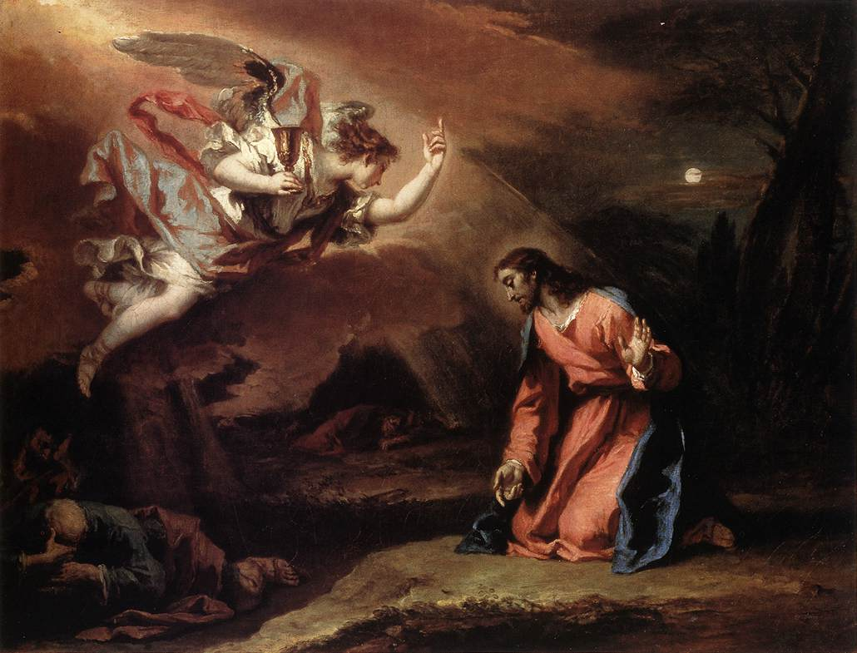
We trust in God’s sovereignty and his ability to exercise his good will.
We also trust his commands to exercise the muscles of our wills in prayer.
Prayer in the Garden
Sebastiano Ricci (c. 1730)

Slide 129
We pray, believing in God’s promises to respond in ways that are best for us (Luke 18:1).
Though we often pray for changes in circumstance, the real work of prayer changes us from the inside out (Romans 12:1, 2).

Slide 130
The more we talk with God, the more we find ourselves wanting to please him.
Prayer often changes our circumstances, but more importantly, it changes us and our priorities.

Slide 131
Cultural Context: “Thy Will Be Done On Earth As In Heaven”
The Words, “May You Continue Establishing Your Kingdom…” Are Paralleled By The Phrase, “Thy Will Be Done.”
The Second Line Of A Parallelism Reinforces & Strengthens The Preceding Statement.
Sometimes One Line Elucidates The Meaning Of The Other Which Is Our Case.
Thus, To Do The Will Of God Is To Be Part Of His Kingdom.
Jesus Does Not Instruct In This Case To Pray “If It Be Thy Will.”
It Is Within God’s Purpose That All Men Should Repent & Come Under His Reign.
The Greek Word Genathato Can Be Translated Back Into Either Of Two Hebrew Words Depending Upon The Context. The Most Literal Reconstruction Is Not Always The Most Reliable.
Hebrew Prayers That Have The Verb “To Be” Would Normally Be Followed By A Request Yet In Our Prayer Only The Words “In Heaven & In Earth” Finish.
The Common Jewish Prayer Formula, “May It Be Pleasing Before You,” Is Out Of Its Place Here Also. This Meaning Would Not Be Consistent With The Remainder Of That Petition.
Hebrew Stylistic Considerations Indicate That The Greek Should Be Translated By The Hebrew Root Asah, “To Do,” In The Phrase, “May Your Will Be Done…”
This Plea, That God’s Will Be Accomplished In Heaven & Earth Is Consistent With The Hope That All Repent & Obey.

Slide 132
Cultural Context: “Thy Will Be Done On Earth As In Heaven”
Significantly, This Entreaty Takes Is Stylistically Similar To Then Familiar Rabbinic Prayers For Safety In Travel. In Ancient Times, Taking A Trip Was Much More Dangerous Of A Proposition Than That Of Today.
Furthermore, There Is Another Similarity Regarding Traveler’s Prayers. These Prayers Were Structured Similarly & With Attached Phrases Nearly Identical To That From The Master Teacher. As An Example There Was A Popular Prayer With This Line: “Do Your Will In Heaven & Grant Satisfaction To Those That Fear You On Earth.
Moreover, There Was A Third Similarity – The Traveler’s Prayer Used The Word Asah As Well.
“In Heaven & On Earth” The More Rigorous Translation; “Hos” Or “As” Does Not Appear In The Codex Beza Cantabrigiensis, Which The Experts Think Preserves The Original Semitisms Better Than The Other Textual Witnesses. “Hos” Is Probably Scribal Noted Expanding On Verse 12.
The Hebrew Imagery Behind The Phrase Meant To Convey The Divine Majesty.
This Supplication Does Not Deal With Discerning God’s But In His Will Being Accomplished
This Is The Same Ancient Injunction Taught By Rabbis: “Do His Will As If It Were Your Will.”
Another Rabbinic Prayer Reads: “Sovereign Of The Universe, It Is Revealed And Known To You That Our Will Is To Do Your Will. What Prevents Us? The Leaven In The Dough And The Enslavement To The Kingdoms. May It Be Pleasing To You To Save Us From Their Hands. And May We Repent And Begin To Do Your Laws According To Your Will With A Perfect Heart.”
The Expression “Leaven In The Dough” Refers To Our Often Evil Inclinations & “Enslavement To The Kingdoms” Refers To Occupation Forces Restricting Religiously; These Rabbinic Parallels Deal With The Conflict Between Man’s Will & God’s Will. One’s Evil Desires Can Prevent That Person From Performing God’s Will With The Right Spirit.
Christ Himself Conforms His Will To That Of The Father’s – Luke 22: 42.

Slide 133
Highlights Of Spurgeon 04-30-1884: “Thy Will Be Done In Earth, As It Is In Heaven”
1) It Was So At The Start – The Garden Of Eden
It Will Be So At The Last – End Of The World
To Be Done In Spirit & In Truth!
To Be Done Constantly & Without Failure!
To Be Done Universally, & Without Selecting!
To Be Done Instantly, & Without Hesitation!
To Be Done Joyfully, & Without Weariness!
To Be Done Right Humbly, & In Lowliness!
Must Live Here Like One Come From Heaven.

Slide 134
Why This Petition is Critical
This request will identify the direction my life is taking
It will proclaim my number one priority
We cannot pray it honestly without bowing the knee and enthroning Him in our lives
This request will define who I am becoming
This question will tell me in advance how I will be remembered. It stores up for us the gold silver and precious stones for the final judgment

Slide 135
Christ’s Perspective Matthew 6:33
Seek first his kingdom and his righteousness, and all these things will be given to you as well.
There is a priority first place choice that takes care of all the urgent issues of life
Worry comes when our priorities get messed up

Slide 136
The Importance Of The Right Direction
Choosing your goals in life is not your most important decision, choosing your direction is far more critical
I need to set the direction of my life, much as did the Apostle Paul.
If I look only at certain goals, it can alter my decision making and sometimes entrap me.
I don’t want to finish my life at the top of the ladder only to find out its been leaning against the wrong wall

Slide 137
Getting The Question Right
A proposition. What can be accomplished is determined always by scarcest resource!
We normally start with money but soon learn there is always more than we thought and we shift to believing time is the most important and scarcest resource.

Slide 138
Getting The Question Right
After seeing time as most important we find there is more to do than our energy will allow so our energy becomes the scarcest resource so we move from spending our time to investing our time. We can no longer afford to spend our time on things that are meaningless

Slide 139
Getting The Question Right
Since we find our energy is limited we shift to asking what gives my life meaning and significance and we are forced to ask the question of priority.
At the end of our life what legacy will be left in time and what will be the eternal commentary on it.

Slide 140
The Concept Of Bless-ability
God does want to bless me and see my life be productive
The will of God is always good acceptable and perfect. (The word “easy” is not here in the promise)
Where my life is aligned and God’s priorities are mine I find blessing happiness and productivity

Slide 141
The Lord’s Prayer
Our Father, which art in heaven,
Hallowed be Thy name.
Thy kingdom come,
Thy will be done on earth as it is in heaven.
Give us this day our daily bread,

Slide 142
And forgive us our debts, as we forgive our debtors.
And lead us not into temptation,
But deliver us from evil;
For Thine is the kingdom, and the power, and the glory forever. Amen

Slide 143
THE LORD’S PRAYER AS MODEL PRAYER
LAST SLIDE OF PRESENTATION.

Slide 144
But as many as received him, to them gave he power to become the sons of God, even to them that believe on his name: Which were born, not of blood, nor of the will of the flesh, nor of the will of man, but of God. —John 1:12, 13
BACK

Slide 145
Behold, what manner of love the Father hath bestowed upon us, that we should be called the sons of God: therefore the world knoweth us not, because it knew him not. —1 John 3:1
Let us therefore come boldly unto the throne of grace, that we may obtain mercy, and find grace to help in time of need. —Hebrews 4:16
BACK

Slide 146
Ask, and it shall be given you; seek, and ye shall find; knock, and it shall be opened unto you: For every one that asketh receiveth; and he that seeketh findeth; and to him that knocketh it shall be opened. Or what man is there of you, whom if his son ask bread, will he give him a stone? Or if he ask a fish, will he give him a serpent? If ye then, being evil, know how to give good gifts unto your children, how much more shall your Father which is in heaven give good things to them that ask him. —Matthew 7:7-11
BACK

Slide 147
Exalt the LORD our God, and worship at his holy hill; for the LORD our God is holy. —Psalm 99:9
Thou shalt not take the name of the LORD thy God in vain; for the LORD will not hold him guiltless that taketh his name in vain. —Exodus 20:7
BACK

Slide 148
Whether therefore ye eat, or drink, or whatsoever ye do, do all to the glory of God.
—1 Corinthians 10:31
The earth is the LORD’s, and the fulness thereof; the world, and they that dwell therein. —Psalm 24:1
BACK

Slide 149
I know thy works, that thou art neither cold nor hot: I would thou wert cold or hot. So then because thou art lukewarm, and neither cold nor hot, I will spue thee out of my mouth. —Revelation 3:15, 16
BACK

Slide 150
Enter into his gates with thanksgiving, and into his courts with praise: be thankful unto him, and bless his name. —Psalm 100:4
For he hath strengthened the bars of thy gates; he hath blessed thy children within thee. —Psalm 147:13
BACK

Slide 151
Whether therefore ye eat, or drink, or whatsoever ye do, do all to the glory of God.
—1 Corinthians 10:31
Let your light so shine before men, that they may see your good works, and glorify your Father which is in heaven. —Matthew 5:16
BACK

Slide 152
And in the days of these kings shall the God of heaven set up a kingdom, which shall never be destroyed: and the kingdom shall not be left to other people, but it shall break in pieces and consume all these kingdoms, and it shall stand for ever.
—Daniel 2:44
BACK

Slide 153
And I heard a great voice out of heaven saying, Behold, the tabernacle of God is with men, and he will dwell with them, and they shall be his people, and God himself shall be with them, and be their God. And God shall wipe away all tears from their eyes; and there shall be no more death, neither sorrow, nor crying, neither shall there be any more pain: for the former things are passed away.
—Revelation 21:3, 4
BACK

Slide 154
And Jesus came and spake unto them, saying, All power is given unto me in heaven and in earth. Go ye therefore, and teach all nations, baptizing them in the name of the Father, and of the Son, and of the Holy Ghost: Teaching them to observe all things whatsoever I have commanded you: and, lo, I am with you always, even unto the end of the world. Amen. —Matthew 28:18-20
BACK

Slide 155
Teach me to do thy will; for thou art my God: thy spirit is good; lead me into the land of uprightness.
—Psalm 143:10
Not every one that saith unto me, Lord, Lord, shall enter into the kingdom of heaven; but he that doeth the will of my Father which is in heaven.
—Matthew 7:21
BACK

Slide 156
And he went a little farther, and fell on his face, and prayed, saying, O my Father, if it be possible, let this cup pass from me: nevertheless not as I will, but as thou wilt. —Matthew 26:39
For whosoever shall do the will of my Father which is in heaven, the same is my brother, and sister, and mother. —Matthew 12:50
And he spake a parable unto them to this end, that men ought always to pray, and not to faint. —Luke 18:1
BACK

Slide 157
I beseech you therefore, brethren, by the mercies of God, that ye present your bodies a living sacrifice, holy, acceptable unto God, which is your reasonable service. And be not conformed to this world: but be ye transformed by the renewing of your mind, that ye may prove what is that good, and acceptable, and perfect, will of God.
—Romans 12:1, 2
BACK

Slide 158
But seek ye first the kingdom of God, and his righteousness; and all these things shall be added unto you. Take therefore no thought for the morrow: for the morrow shall take thought for the things of itself. Sufficient unto the day is the evil thereof. —Matthew 6:33, 34
BACK

Slide 159
And Jesus said unto them, I am the bread of life: he that cometh to me shall never hunger; and he that believeth on me shall never thirst. —John 6:35
Every good gift and every perfect gift is from above, and cometh down from the Father of lights, with whom is no variableness, neither shadow of turning. —James 1:17
BACK

Slide 160
If we confess our sins, he is faithful and just to forgive us our sins, and to cleanse us from all unrighteousness. —1 John 1:9
For as the heaven is high above the earth, so great is his mercy toward them that fear him. As far as the east is from the west, so far hath he removed our transgressions from us.
—Psalm 103:11, 12
BACK

Slide 161
And they shall not teach every man his neighbour, and every man his brother, saying, Know the Lord: for all shall know me, from the least to the greatest. For I will be merciful to their unrighteousness, and their and their iniquities will I remember no more. —Hebrews 8:11, 12
BACK

Slide 162
Blessed are the merciful: for they shall obtain mercy. —Matthew 5:7
Ye have heard that it hath been said, Thou shalt love thy neighbour, and hate thine enemy. But I say unto you, Love your enemies, bless them that curse you, do good to them that hate you, and pray for them which despitefully use you, and persecute you; That ye may be the children of your Father which is in heaven: for he maketh his sun to rise on the evil and on the good, and sendeth rain on the just and on the unjust. —Matthew 5:43-45
BACK

Slide 163
And be ye kind one to another, tenderhearted, forgiving one another, even as God for Christ’s sake hath forgiven you. —Ephesians 4:32
He that saith he abideth in him ought himself also so to walk, even as he walked. —1 John 2:6
Then said Jesus, Father, forgive them; for they know not what they do. And they parted his raiment, and cast lots. —Luke 23:34
BACK

Slide 164
The discretion of a man deferreth his anger; and it is his glory to pass over a transgression. —Proverbs 19:11
To whom ye forgive any thing, I forgive also: for if I forgave any thing, to whom I forgave it, for your sakes forgave I it in the person of Christ; Lest Satan should get an advantage of us: for we are not ignorant of his devices. —2 Corinthians 2:10, 11
BACK

Slide 165
Therefore if thou bring thy gift to the altar, and there rememberest that thy brother hath ought against thee; Leave there thy gift before the altar, and go thy way; first be reconciled to thy brother, and then come and offer thy gift. —Matthew 5:23-24
BACK

Slide 166
For if ye forgive men their trespasses, your heavenly Father will also forgive you: But if ye forgive not men their trespasses, neither will your Father forgive your trespasses. —Matthew 6:14, 15
BACK

Slide 167
There hath no temptation taken you but such as is common to man: but God is faithful, who will not suffer you to be tempted above that ye are able; but will with the temptation also make a way to escape, that ye may be able to bear it. —1 Corinthians 10:13
Put on the whole armour of God, that ye may be able to stand against the wiles of the devil. —Ephesians 6:11
BACK

Slide 168
Wherein ye greatly rejoice, though now for a season, if need be, ye are in heaviness through manifold temptations: That the trial of your faith, being much more precious than of gold that perisheth, though it be tried with fire, might be found unto praise and honour and glory at the appearing of Jesus Christ: —1 Peter 1:6, 7
BACK

