Slide 1


The Disciple’s Model Prayer
by David Lee Burris

Slide 2

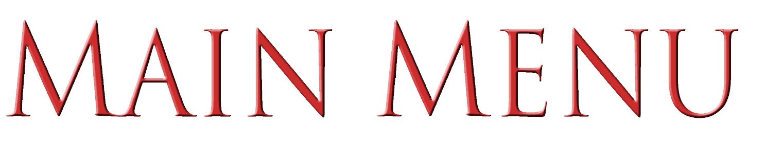
LORD, TEACH US TO PRAY
1.
OUR FATHER WHICH ART IN HEAVEN
2.
HALLOWED BE THY NAME
3.
THY KINGDOM COME
4.
THY WILL BE DONE
5.
GIVE US THIS DAY OUR DAILY BREAD
6.
FORGIVE US OUR DEBTS
7.
LEAD US NOT INTO TEMPTATION

Slide 3
The Lord’s Prayer
Our Father, which art in heaven,
Hallowed be Thy name.
Thy kingdom come,
Thy will be done on earth as it is in heaven.
Give us this day our daily bread,

Slide 4
And forgive us our debts, as we forgive our debtors.
And lead us not into temptation,
But deliver us from evil;
For Thine is the kingdom, and the power, and the glory forever. Amen

Slide 5
The Concept Of Bless-ability
God does want to bless me and see my life be productive
The will of God is always good acceptable and perfect. (The word “easy” is not here in the promise)
Where my life is aligned and God’s priorities are mine I find blessing happiness and productivity

Slide 6
MATTHEW 6:9-13
Our Father which art in heaven,
Hallowed be thy name.
Thy kingdom come.
Thy will be done in earth, as it is in heaven.
Give us this day our daily bread.

Slide 7
Our Spiritual Arteries
The need for provision
  Give us this day our daily bread

Slide 8
MATTHEW 6:9-13
Our Father which art in heaven,
Hallowed be thy name.
Thy kingdom come.
Thy will be done in earth, as it is in heaven.
Give us this day our daily bread.

Slide 9
Model Prayer In Line Item Analysis
Give Us This Day Our Daily Bread.

Slide 10
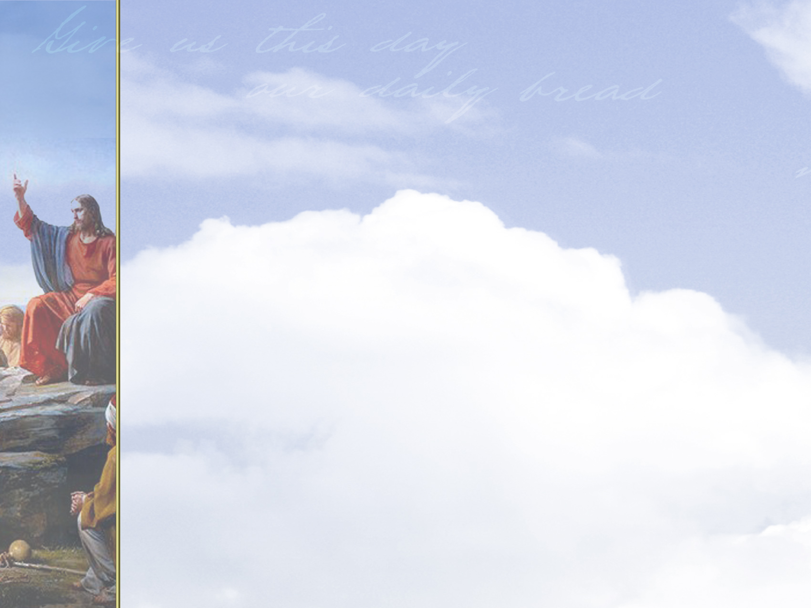


MENU

Slide 11
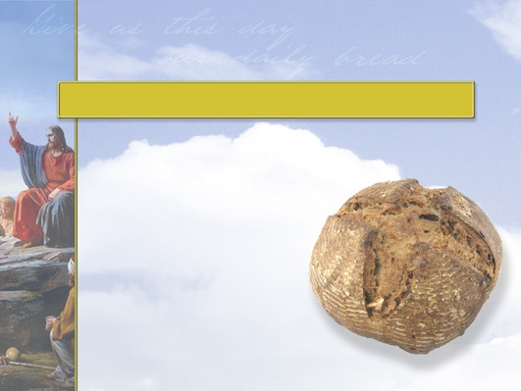

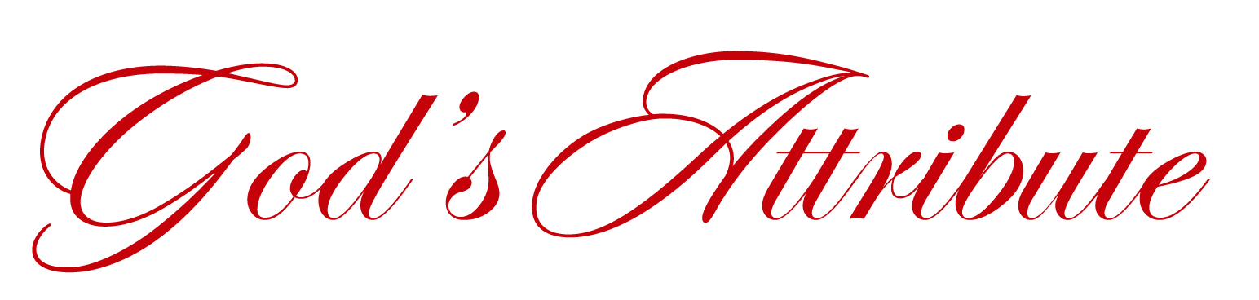
God’s
Providence

Slide 12
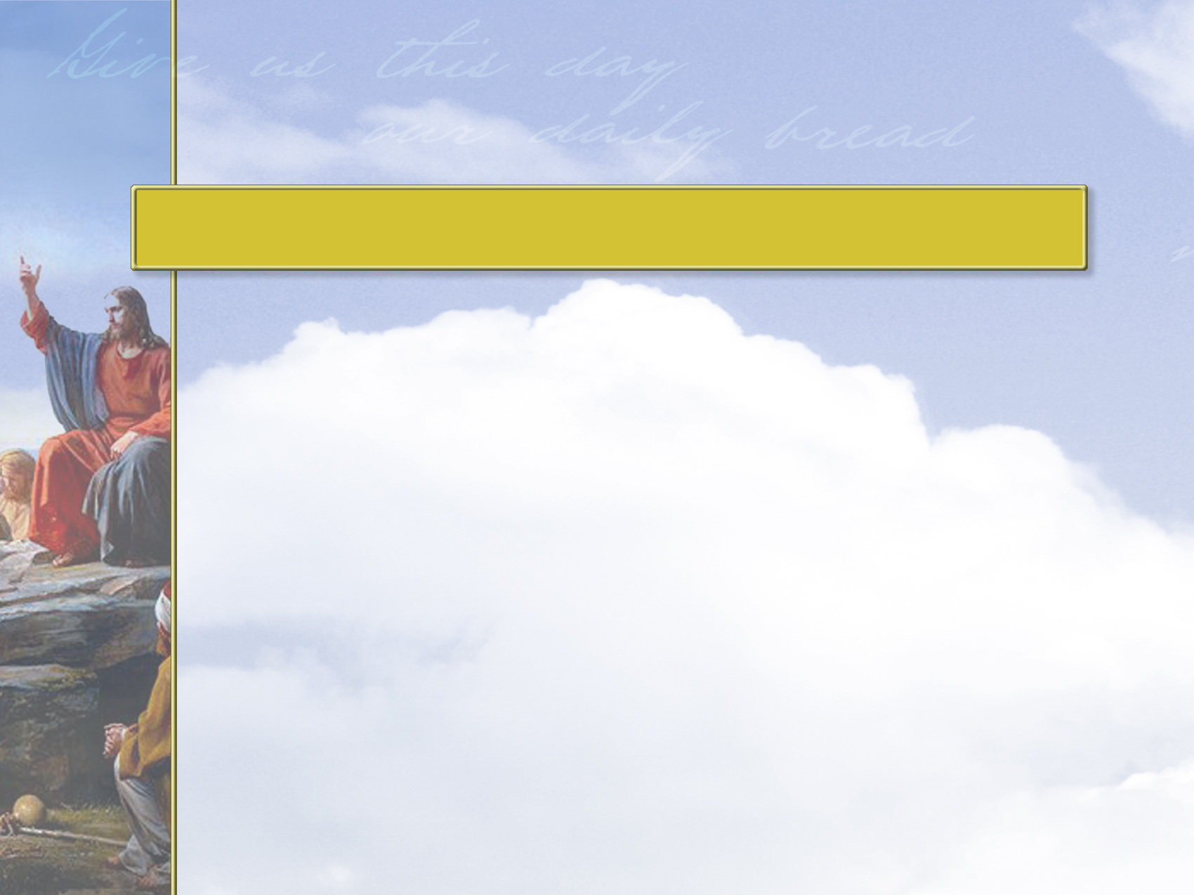
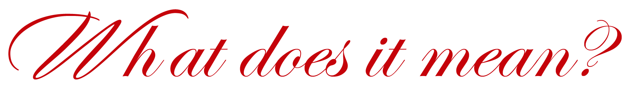

God is able to provide for all
our needs.
The Greek word for “bread”
represents not just food, but every physical thing we need.

Slide 13
When we pray for our daily bread, we ask God to provide for our needs of that day. This includes our:
  Material needs
  Physical needs
  Emotional needs
  Relational needs
  Spiritual needs

Slide 14
Daily bread can include daily needs of:
  Ministries
  People
  Communities
  Leaders
  Family and friends
  Personal needs

Slide 15
God commits himself to provide
for his children, yet God knows
more about what we need than we
ourselves know.
By praying for daily bread, we
are not taking it for granted, but
acknowledging that all our life
depends on his mercy.

Slide 16
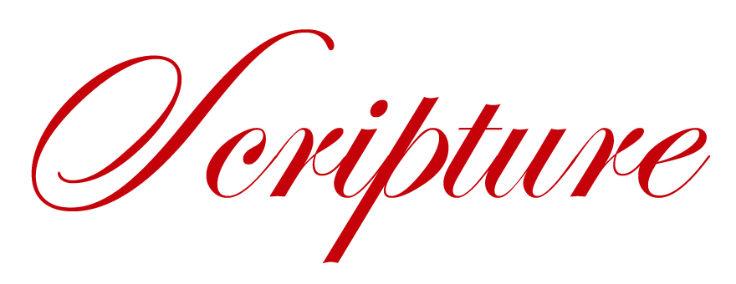
Matthew 6:33, 34
John 6:35
James 1:17
Click reference above to read passage.

Slide 17
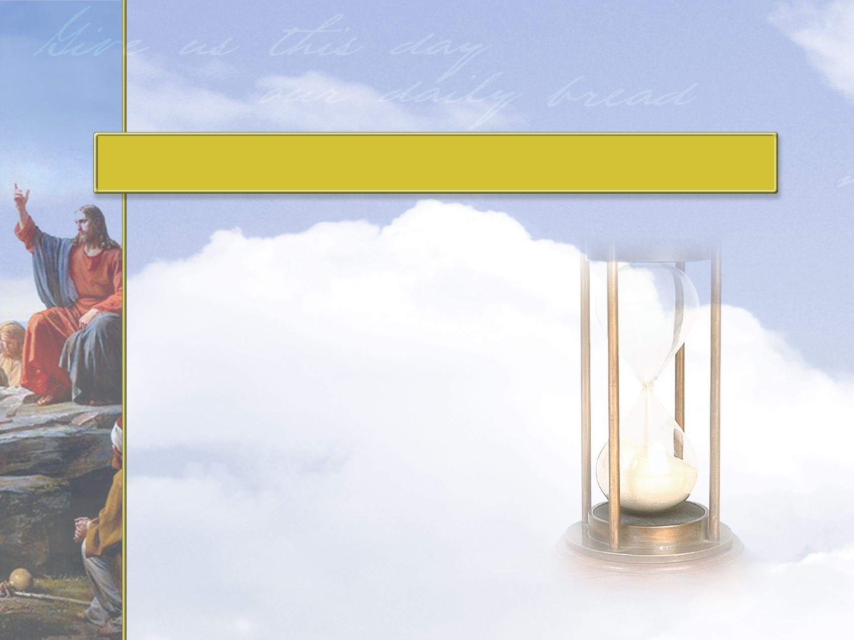
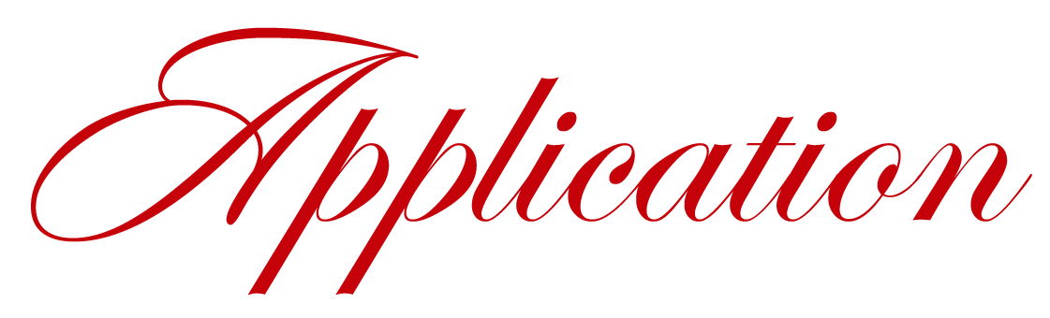
The phrase
“this day”
shows that we
rely on God
one day at
a time.

Slide 18
Compared to the rest of people on earth, we are wealthy Christians.
It’s far too easy for us to forget that not only our talents, resources, and opportunities come from God, but also the next meal.

Slide 19
Asking for what we need each day, even if it’s already in our refrigerators, encourages a relationship with the One who gives all.
God wants us to come to him not only with our big requests, but with our everyday requests as well.

Slide 20
He wants us to remember and ask for his help with the most basic needs:
  Disciplining our children
  Speaking to a spouse
  Conducting an office meeting
  Resolving a conflict with a friend

Slide 21
As a loving Father, God will always give us what’s best for us, not necessarily what we want.
What we receive will be what’s right for us and fits God’s greater goal of transforming us to be more like him.

Slide 22

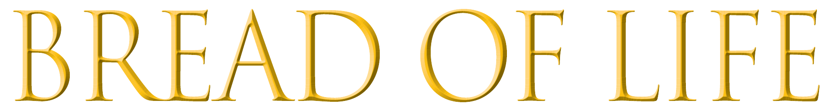


Living Bread (John 6:5)
Living Water (John 7:37, 38)

Slide 23
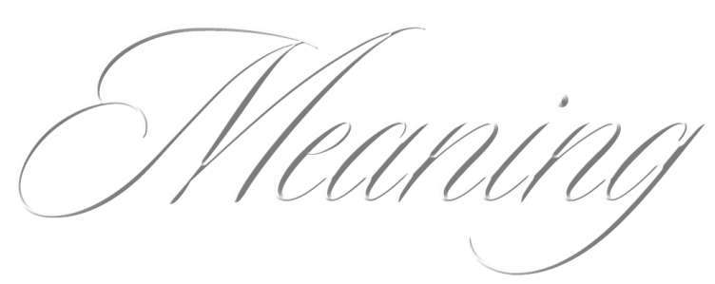
Jesus is our sustenance.

Slide 24

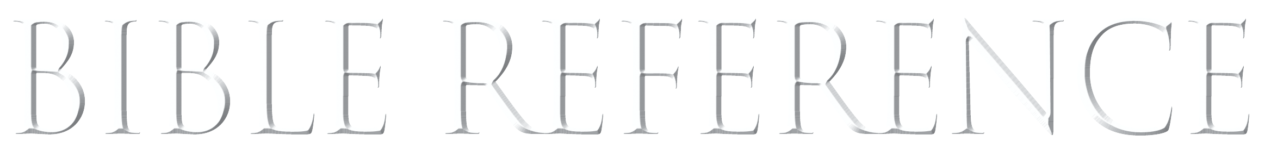
Then Jesus declared, “I am the bread of life. He who comes to me will never go hungry, and he who believes in me will never be thirsty.”
—John 6:35
BACK

Slide 25
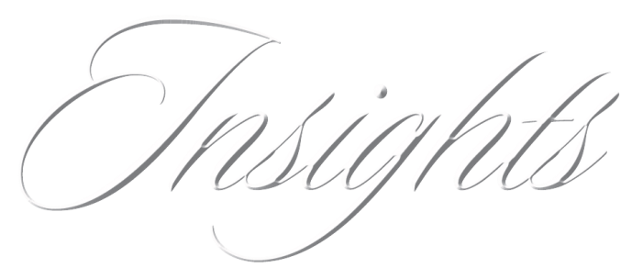
Jesus was born in Bethlehem, which means “the house of bread.”
He is our spiritual nourishment and the sustenance of the world.
All things are kept alive by Him.

Slide 26
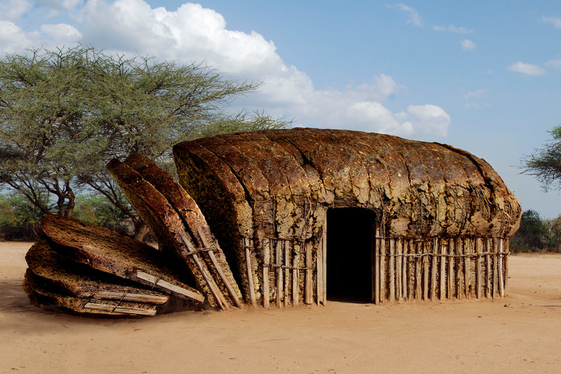

Slide 27
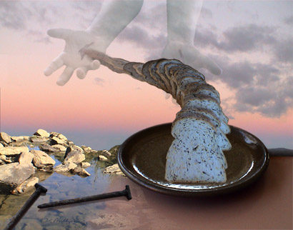

Slide 28

Cultural Context: “Give Us This Day Our Daily Bread”
David Lee Burris:
The Talmud Claims Creator Could Have Created A Plant That Grew Loaves Of Bread But Instead Made Wheat For Man To Mull & To Bake Because Of Garden Disobedience Of The First Couple.
More Than Any Other This Simple Petition Has Been The Focus Of Centuries Of Controversy.
The Greek Word Epiousion, Which Is Translated Here As “Daily,” Being Unusual In The Greek Is The Root Of The Problem.
In Fact, The Word Does Not Exist In Greek Outside Our N.T. Gospel Text Of Study.
Some Scholars Have Suggested That The Original Meaning Stresses “For The Next Day” From The Similar Greek Word Epeimi, “The Next…” This Usage Would Associate With The Wilderness Manna & Would Add Also Another Dimension Spiritualizing It In Application.
Debate About What Experts Expect – One Would Expect That The Hebrew Undertext For This Entreaty, Which Contains A Seemingly Unknown Greek Term, Would Have Been Derived From More Difficult Hebrew Idiom Than A Common Word Like “Tomorrow.”
Some Answer From O.T. Passage Perhaps Jesus Referencing i. e. Proverbs 30: 8 – “Remove Me Far From Falsehood And Lying; Give Me Neither Poverty Nor Riches; Feed Me With The Food That Is Needful For Me.”
The Hebrew Word For Food Used Here Is Lechem – By Way Of Extension It Has Signified All Of Human Necessity – The Phrase Refers To Any Man’s Allotted Or Assigned Portion – That Amount Required For Sustenance & Needed According To God’s Plan.
Theological Discussions In Jesus’ Day Did Not Require Recitation Of The Entire Verse. Jesus’ Listeners Were Acquainted With The Scriptures Enough To Catch His Allusion And Recognize The Verse.
In Turn, His Audience Would Have Made The Connection To The Sustenance While Their Ancestors Sojourned In The Wilderness.
Moreover, The Whole Verse In Proverbs Seems Into The Complex Flow Following The Entire Extent Of Expressions By Jesus On This Occasion.
Rabbinic Teaching Says – “He Who Created The Day Created Its Sustenance.”
This Prayer Professes That The Created Universe Is Not Clockwork Set In Motion & Seldom Observed By Disinterested Deity. The Disciples’ Prayer States Belief That God Holds All Things Together Moment To Moment & All Life Breath To Breath!
Actually, The Primary Focus Of This Petition Should Be On The Words “This Day.” Jesus Is Extreme In His Teaching Concerning Worry & Anxiety – Check Out The Beatitudes – Matthew 6: 25, 26.
The Promise That God Will Provide For The Disciple’s Physical Needs Must Be Seen In Light Of Jesus Challenge Of Matthew 6: 32, 33.

Slide 29
Model Prayer In Line Item Analysis
Give Us This Day Our Daily Bread.
And Forgive Us Our Debts,
As We Forgive Our Debtors.

Slide 30
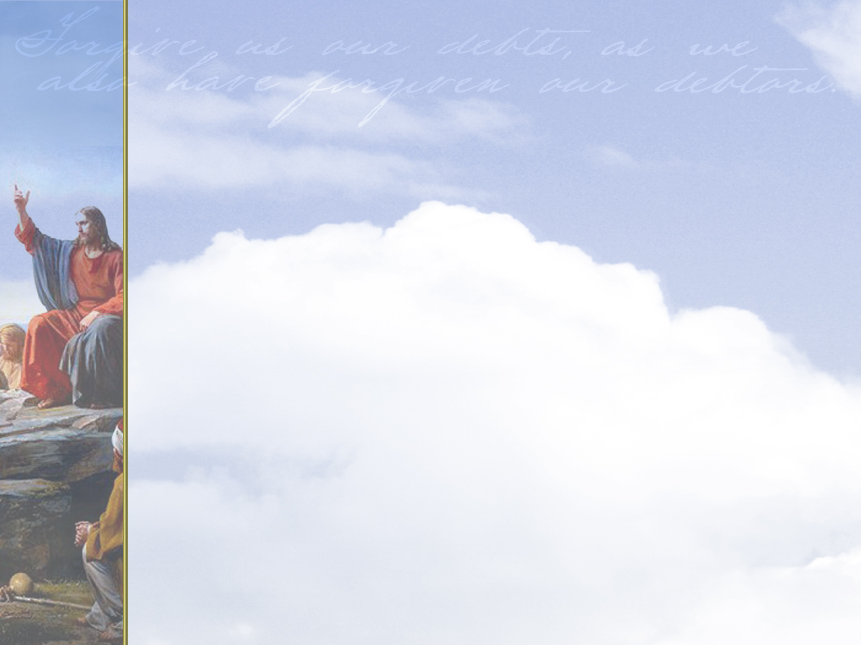

MENU

Slide 31
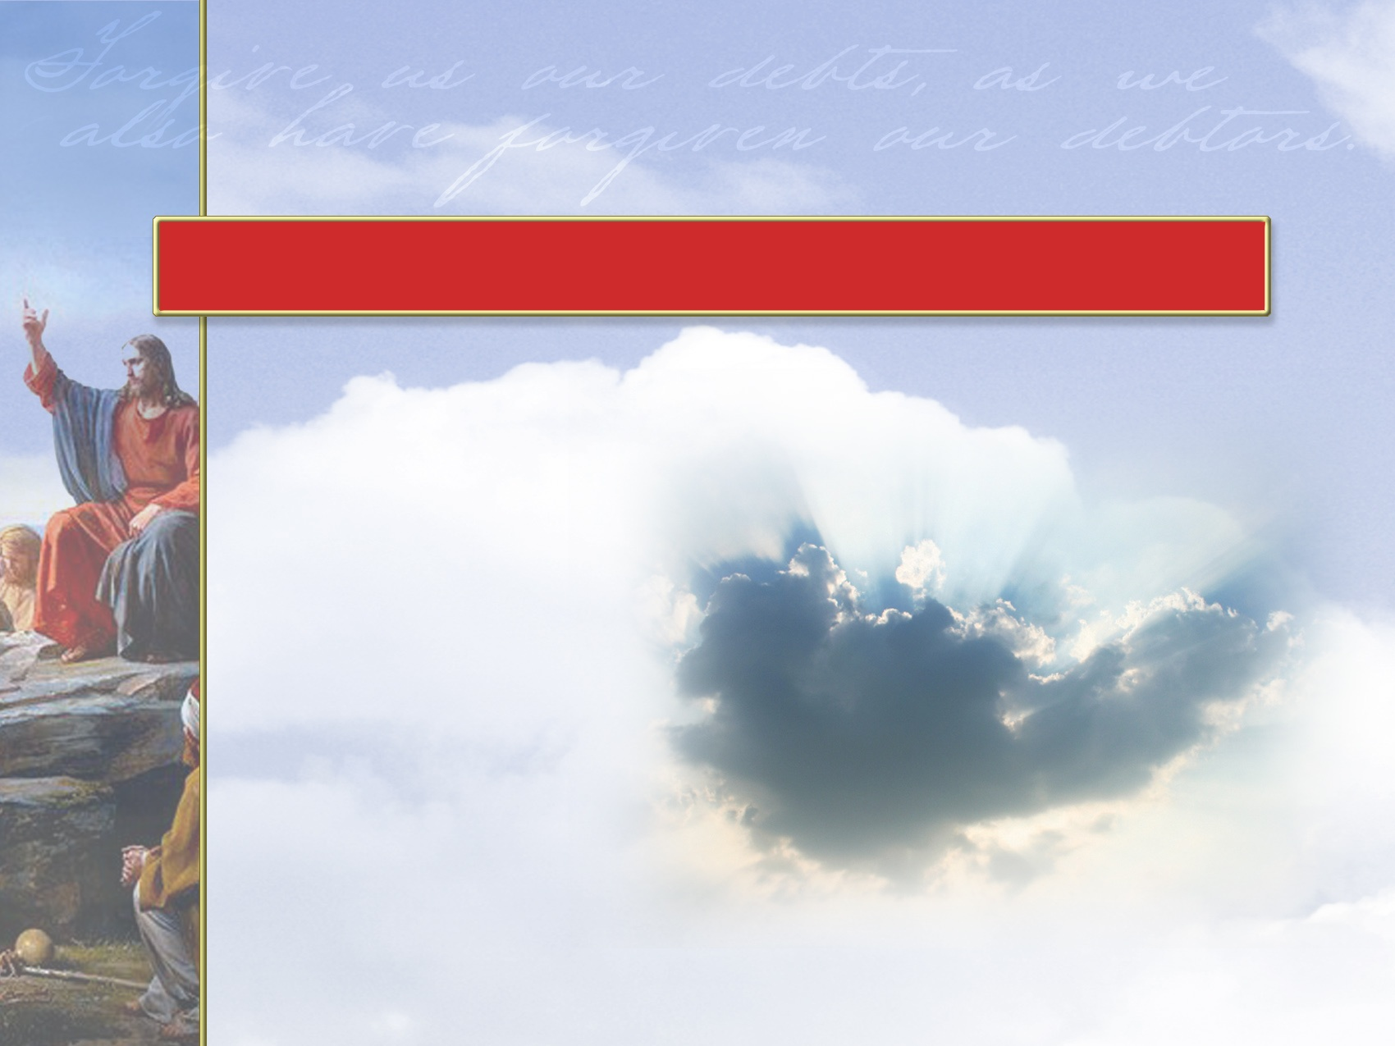

God’s
Mercy

Slide 32
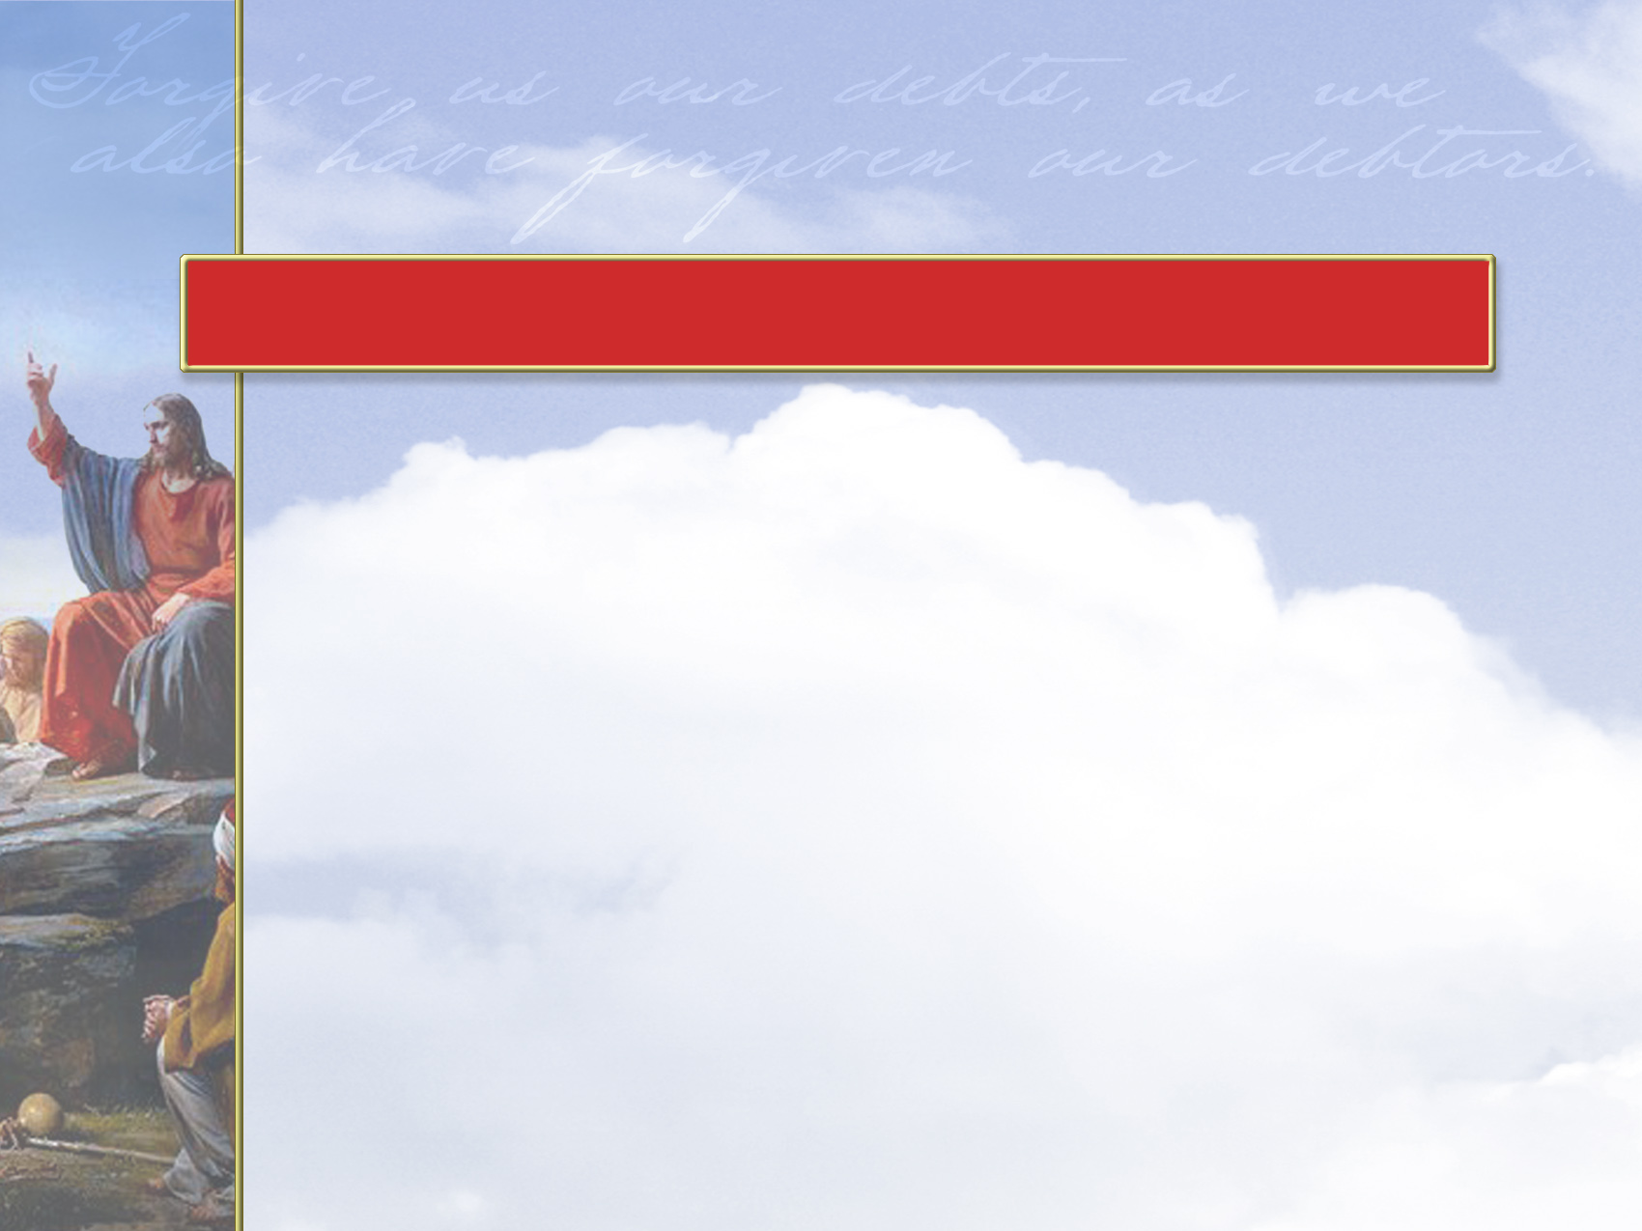

We ask God to forgive the wrong we have done as well as neglect of the good things we should have done.
But there is a catch: God will forgive us only as much as we forgive those who have injured us.

Slide 33
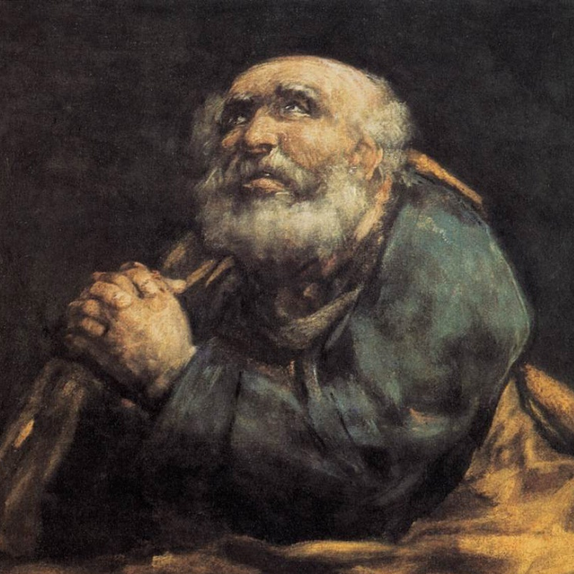
God is merciful
and he expects
us to be also.
If we refuse to
forgive others,
how can we expect
God’s forgiveness?
St. Peter Repentant
Goya (1823)

Slide 34
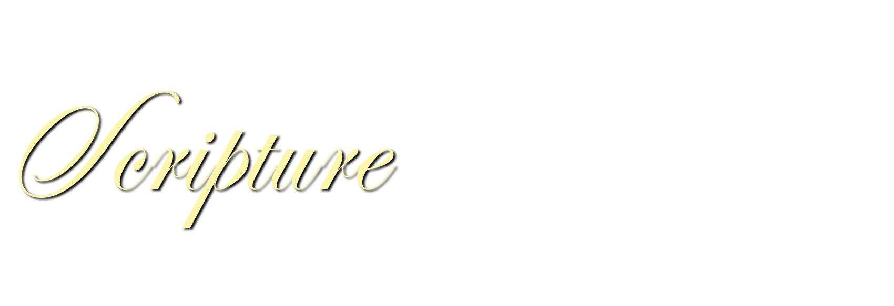
1 John 1:9
Psalm 103:12, 13
Hebrews 8:11, 12
Click reference above to read passage.

Slide 35

The New Testament uses five Greek words to talk about sin.
In all these cases, sin is what
separates us from God, our friends, and our families.
Without forgiveness, relationships suffer and redemption is not possible.

Slide 36
There are different meanings to each Greek word, such as:
  Slipping and falling (unintentional)
  “Missing the mark” as an arrow
  misses the target
  Stepping across the line (intentional)
  “Lawlessness” (open rebellion against God)

Slide 37
Another aspect of sin refers to a spiritual debt to God and a personal debt to others.
Often rendered “debts” or “trespasses” (Matthew 12-14), Jesus illustrates this aspect of sin in the Parable of
the Unforgiving Servant (Matthew 18:23-35).

Slide 38
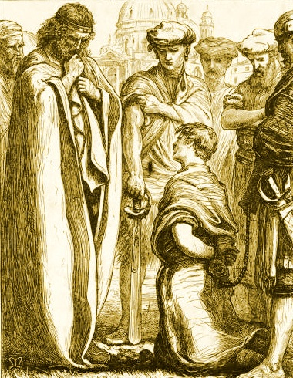
This Parable is about a man who owed the king over one million dollars.
After the man begged
for mercy, the king
forgave the debt.
Afterward, that same man
demanded a few dollars
from his neighbor.
The Unmerciful Servant
Millais (1864)

Slide 39
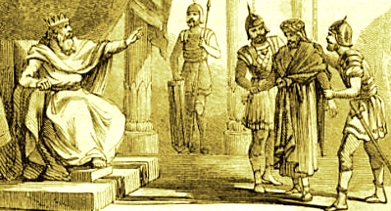
When his neighbor could not pay, the man had him thrown into prison.
Once the king
heard about it, he
had the man turned
over to the jailers
until he could
repay the debt.
The Parable of the Unmerciful Servant
Abbot (1878)

Slide 40
Jesus finished by saying, “This is how my heavenly Father will treat each of you unless you forgive your brother from your heart.”
Jesus makes it clear that God will not show mercy to the merciless!

Slide 41
Sometimes we are unaware of our sins.
Therefore, praying for forgiveness requires listening quietly in God’s presence so that he may reveal to us
our own acts of disobedience, our resentments, and our unresolved issues.

Slide 42
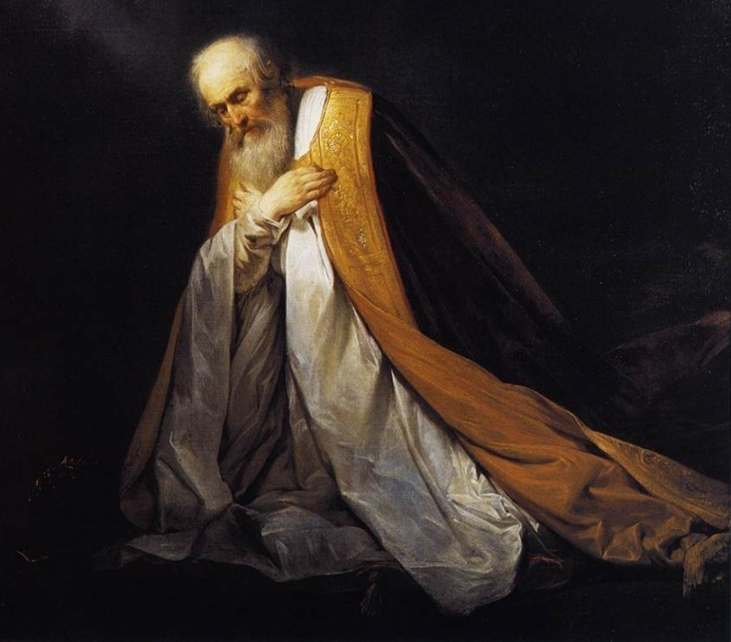
Though as Christians we inevitably continue to sin,
our lives ought to
be characterized
by a decreasing
frequency of sin
and an increased
sensitivity to it.
King David in Prayer
Pieter de Grebber (1635)

Slide 43


Forgiveness is a characteristic of a Christian life.
  By loving our enemies, we show that we are children of God (Matthew 5:7).
  When a Christian refuses to forgive, that person puts himself above God as judge (Matthew 5:43-45).

Slide 44
We follow Jesus, our role model, who forgave.
  Only through Jesus are we
  forgiven and made right with God
  (Ephesians 4:32; 1 John 2:6).
  Whatever we may suffer cannot come close to the offenses Jesus forgave during his time on earth. (Luke 23:34).
Notes:
fdfdfd

Slide 45
We are made in the image
of God, who forgives.
  We reflect the beauty and
  glory of our Creator when
  we forgive (Proverbs 19:11).

Slide 46
Forgiveness keeps Satan
from gaining a foothold.
  Forgiveness frees the conscience
  of guilt and brings peace of mind
  (2 Corinthians 2:10, 11).

Slide 47
Christ’s Body, the Church, cannot function without forgiveness.
  Grudges and resentments tarnish
  the Church’s witness and prevent
  the full benefits of God’s gifts
  (Matthew 5:23, 24).

Slide 48
Only by forgiving others can
we expect our own prayers for forgiveness to be answered.
  God will treat us in the same way we treat others (Matthew 6:14, 15).

Slide 49
“FORGIVE OUR DEBTS”
VERSUS
“FORGIVE OUR SINS”

Slide 50

Cultural Context: “Forgive Us Our Debts, As We Have Forgiven Our Debtors”
David Lee Burris:
Gossip Disguised As Prayer Requests?!
Major Thrust Of Of Jesus’ Teaching Is Humankinds’ Responsibility For Forgiveness.
The Force Of Forgiveness – That Between Man & Man – Linked To That Between Them & God – Powerfully Expressed In The Parable Of The Unjust Servant – Matthew 18: 23 – 35.
Approximately 170 B.C., Ben Sirach Placed Forgiveness In The Context Of Prayer: “Forgive Your Neighbor The Wrong He Has Done, And Then Your Sins Will Be Pardoned When You Pray…”
In The Mishnah, Relative To The Day Of Atonement, We Find This Advice: “…but does not atone for trespasses between a man and his neighbor unless he first appease his neighbor.”
Gamaliel Schooled: “Everyone Who Is Merciful To Others, Will Receive Mercy From Heaven.”
An Ancient Jewish Blessing - Recited After A Sick Person Has Recovered – Specific In Relation To Precarious Journey – Reads Thus: “Blessed Are You O Lord Our God, King Of The World, Who Does Good To Debtors, For He Has Done Good To Me.”
The Words Of Jesus Here Teach That We Must Forgive All Those Who Are Obligated To Us Or Have Sinned Against Us.
A Question Is Often Raised When Luke’s Version Is Compared To The Matthean Text; Instead Of “Forgive Us Our Debts,” He Has “Forgive Us Our Sins.” The Solution Is Found Noting That The Hebrew Word Chayav Was Adopted From Aramaic & Imported Into Hebrew Having Two Meanings – Both “Guilt” & “Debt”. In The Original Aramaic It Had Only One Meaning – “To Sin.”
Thus, When Luke Uses It For The Word “Sins,” He Seems To Be Explaining Or Clarifying The Term To The Gospel Reader.
The Word “Debts” Is More Generic, Flexible & Of Other Matters More Inclusive – Outreaching To Associated Activities & Related Behaviors.
Personal Debts Or Moral Obligations Connected To Interpersonal Relationships, As Well As Sins, Are Encompassed By Jesus’ Words.
Furthermore, Matthew Preserves The Idiom As “We Have Forgiven” In The Aorist Tense – Which Puts The Action In The Past.
Luke Closes The Loophole Preserving The Phrase In The Present Tense & Concept Of The Attitude Forward Continual Of Forgiveness.
This Prayer Command, Conviction, & Commitment Is Part Of The Plan Such That We Enjoy The Liberating Power Of Forgiveness!

Slide 51
Our Spiritual Arteries
The need for pardon
  And forgive us our sins as we forgive those who sin against us,

Slide 52
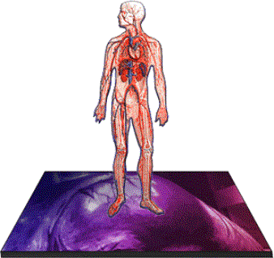
The Artery Of Pardon
“Forgive us our sins as we forgive those who sin against us”
Unclogging Our Spiritual Arteries

Slide 53


Slide 54

When We
Miss The Mark...

Slide 55

God’s eraser is right behind..

Slide 56
It Is Assumed
All us have and will sin both against God and others by omission and commission
All of us are going to have persons who sin against us
The guilt and shame of unforgiven sin stifles our spiritual life
We are called to be forgivers not simply the recipients of forgiveness

Slide 57
Forgiveness
Forgive us our sins as we forgive those who sin against us

Slide 58
12. And forgive us our sins, as we forgive those who sin against us.
14. For if ye forgive men their trespasses, your heavenly Father will also forgive you:
15. But if ye forgive not men their trespasses, neither will your Father forgive your trespasses.

Slide 60
Matthew 18:23-35
“For this reason, the Kingdom of Heaven can be compared to a king who decided to bring his accounts up to date with servants who had borrowed money from him.
In the process, one of his debtors was brought in who owed him millions of dollars.
He couldn’t pay, so the king ordered that he, his wife, his children, and everything he had be sold to pay the debt.

Slide 61
But the man fell down before the king and begged him, ‘Oh, sir, be patient with me, and I will pay it all.’
Then the king was filled with pity for him, and he released him and forgave his debt.
“But when the man left the king, he went to a fellow servant who owed him a few thousand dollars. He grabbed him by the throat and demanded instant payment.

Slide 62
His fellow servant fell down before him and begged for a little more time. ‘Be patient and I will pay it,’ he pleaded.
But his creditor wouldn’t wait. He had the man arrested and jailed until the debt could be paid in full.
“When some of the other servants saw this, they were very upset. They went to the king and told him what had happened.

Slide 63
Then the king called in the man he had forgiven and said, ‘You evil servant! I forgave you that tremendous debt because you pleaded with me.
Shouldn’t you have mercy on your fellow servant, just as I had mercy on you?’
Then the angry king sent the man to prison until he had paid every penny.
“That’s what my heavenly Father will do to you if you refuse to forgive your brothers and sisters in your heart.”

Slide 64
Luke 17:4 If he sins against you seven times in a day, and seven times comes back to you and says, ‘I repent,’ forgive him.”
Colossians 3:13 Bear with each other and forgive whatever grievances you may have against one another. Forgive as the Lord forgave you.
1John 1:9 If we confess our sins, he is faithful and just and will forgive us our sins and purify us from all unrighteousness.

Slide 65
Matthew 5:23-24
“So if you are standing before the altar in the Temple, offering a sacrifice to God, and you suddenly remember that someone has something against you, leave your sacrifice there beside the altar. Go and be reconciled to that person. Then come and offer your sacrifice to God.”

Slide 66
How It’s Translated
Trespasses: NKJV
Debts: ASV, KJV
Offences: MNT
Transgressions: NASB
Sin: NLT

Slide 67
Sin, Debt Trespass
paraptwma
paraptoma par-ap'-to-mah
trespass 9, offence 7, sin 3, fall 2,
fault 23
1) to fall beside or near something
2) a lapse or deviation from truth and uprightness
2a) a sin, misdeed

Slide 68
The concept expressed is that there is a standard and in relationship to the standard we have fallen.
In our relationship with God we have “fallen short” and without his mercy and forgiveness we will never stand again
In our relationship with one another we have failed to treat others as Christ would have done and failed in the second great command “To love our neighbor as ourselves”.

Slide 69
Forgive
afihmi aphiemi af-ee'-ay-mee
To send away
2) Let alone, let be, to disregard to leave
3) To let go, give up a debt, forgive, to remit
4) To keep no longer

Slide 70
The Artery of Forgiveness
The concept of forgiveness is so critical to our spiritual well-being that Jesus gives further explanation of it following the Amen
Jesus ties our willingness to forgive others to God’s willingness to forgive us.

Slide 71
To Forgive is Divine
Forgiveness has 2 parts:
  He/We let it go never to see it again
  The recipient of forgiveness has a clean slate with which to progress in the relationship
He has promised us that with confession comes forgiveness

Slide 72
I John 1:9
If we confess our sin He is faithful and just to forgive our sin and to cleanse us from all unrighteousness

Slide 73
Forgiveness
We have blown it in macro and micro ways
We have ready available access to forgiveness through the blood of Christ.
The power of God that forgives us is what gives us the grace to forgive others.

Slide 74
Forgiveness
Guilt and shame are a hindrance to a clean conscience.
Bitterness, anger, and unforgiveness are the cholesterol of our spiritual artery
To ask for forgiveness from God while not forgiving our brothers and sisters is an affront to the grace of God
We have been given grace so we can be channels of grace
We need to verbally confess the known and let God speak to us about the unknown

Slide 75
Forgiveness and Communion
There is an admonition of scripture to examine ourselves and so eat.
We are told that if we wish to come to God but are at loggerheads with fellow believers God will not hear us.
The cross says He is able: able to forgive you and give you the ability to forgive others. Anything less says the work of the cross was inadequate and incomplete.

Slide 76
The Artery Of Protection 1
Lead us not into temptation
Unclogging Our Spiritual Arteries

Slide 77
Our Spiritual Arteries
The need for protection
  And lead us not into temptation, but deliver us from evil,

Slide 78
Model Prayer In Line Item Analysis
Give Us This Day Our Daily Bread.
And Forgive Us Our Debts,
As We Forgive Our Debtors.
And Lead Us Not Unto Temptation,
But Deliver Us From The Evil One.

Slide 79

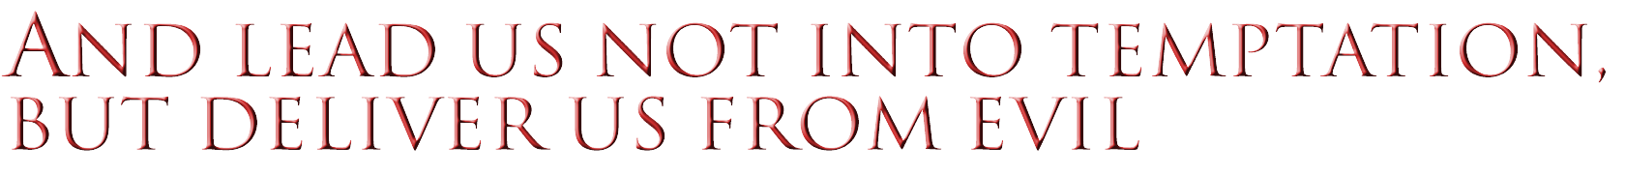
MENU

Slide 80
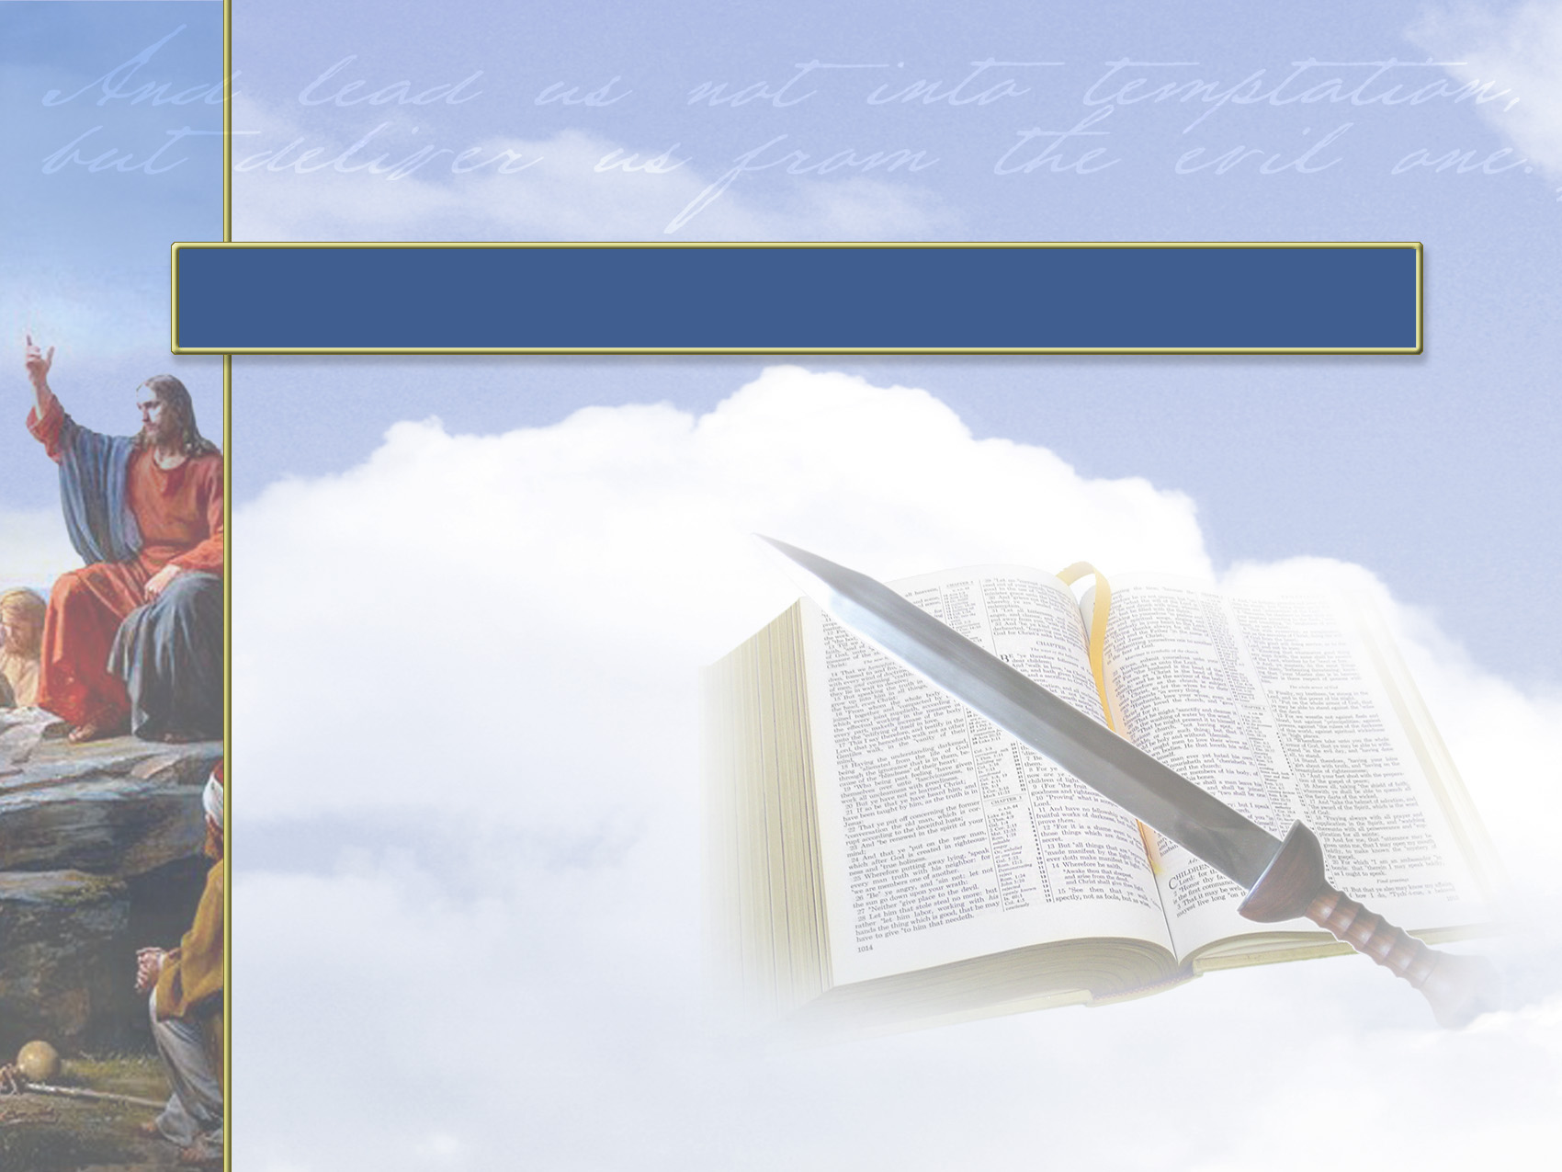
God’s
Protection

Slide 81
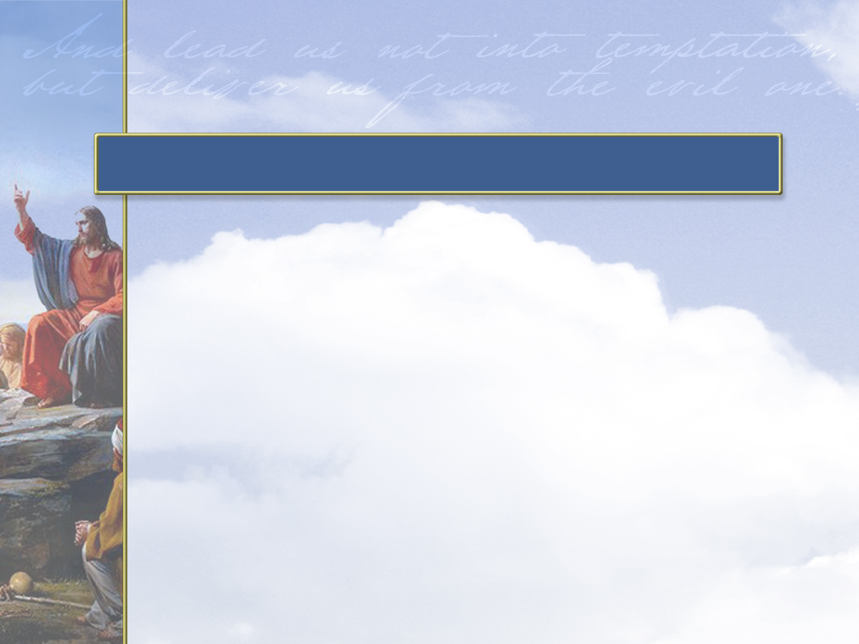
We are taught to pray that we
won’t be tempted to do wrong.
In a practical way, this is like
praying that God will keep our
minds off of tempting situations.

Slide 82
People used to excuse bad behavior by saying, “The devil made me do it.”
But in reality, the devil cannot make us do wrong; we do it ourselves.
God won’t make us obey him, but he does give us the power to walk away from wrong choices.

Slide 83
The Holy Spirit gives us strength to withstand temptation, avoid sin, and strive for holiness.
Satan is constantly seeking to attack the hearts and minds of those who love God.

Slide 84
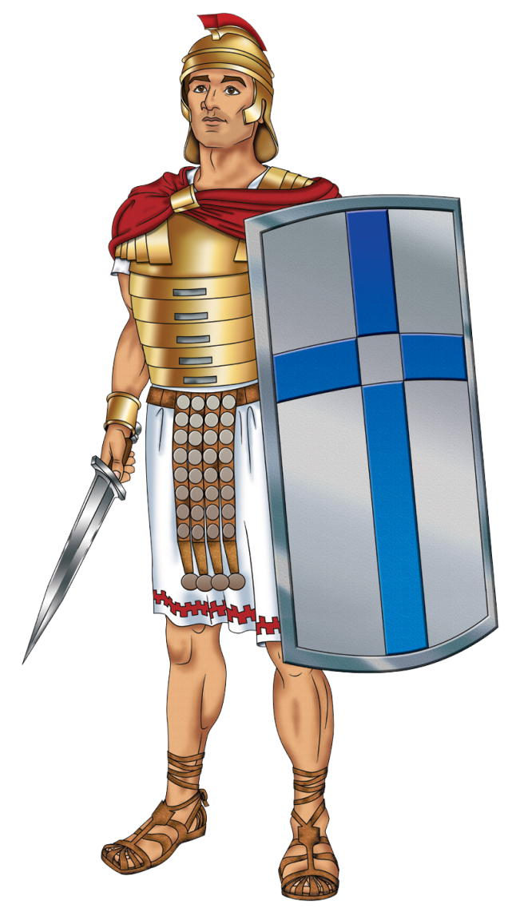
God provides us with the
defenses we need to
protect ourselves against
the weapons of Satan.
By praying for
protection, we prepare
each day for battle
against evil.

Slide 85
1 Corinthians 10:13
Ephesians 6:11
1 Peter 1:6, 7
Click reference above to read passage.

Slide 86
The Greek word for “temptation” emphasizes the idea of testing or proving, rather than simply an enticement to sin.
The Bible is clear that God is good and holy, and he would never lead us into sin.

Slide 87
James 1:13, 14 says that God does not tempt anyone, but each person is tempted by his own evil desire.
We pray this petition because it is better to avoid danger and all the trouble caused by sin than to have
to fight and face the possibility of losing to it!

Slide 88
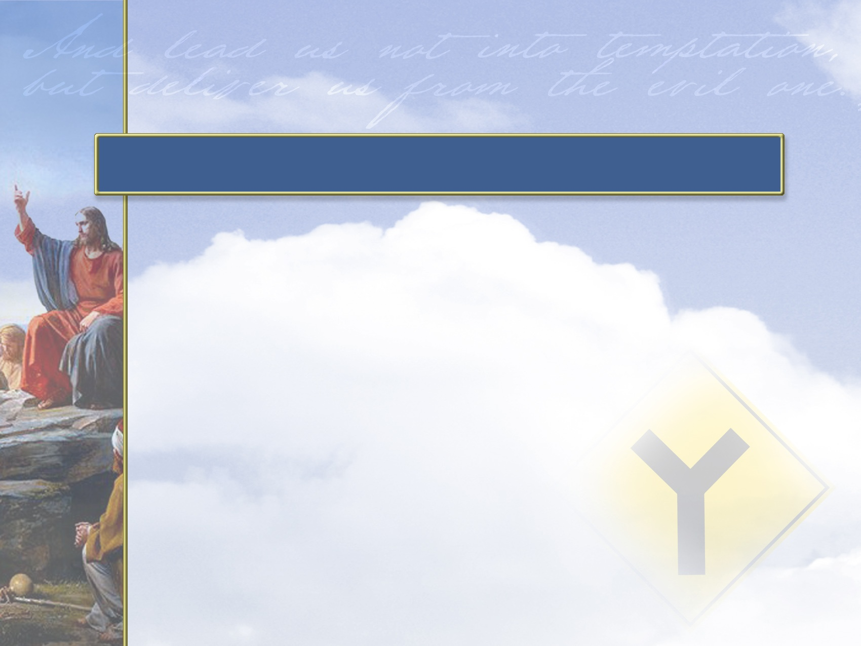
Realistically, having the potential to
do evil is part of being a human
being—it gives us the
opportunity to show
what we are becoming.
Genuine freedom
requires that there be a
choice between good and evil.

Slide 89
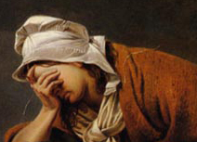
We also know that trials strengthen faith and character (1 Peter 1:6, 7).
Through our trials,
we are driven
closer to God
by prayer
and Scripture.
Lost in the Storm (detail)
Ansdell Richard

Slide 90
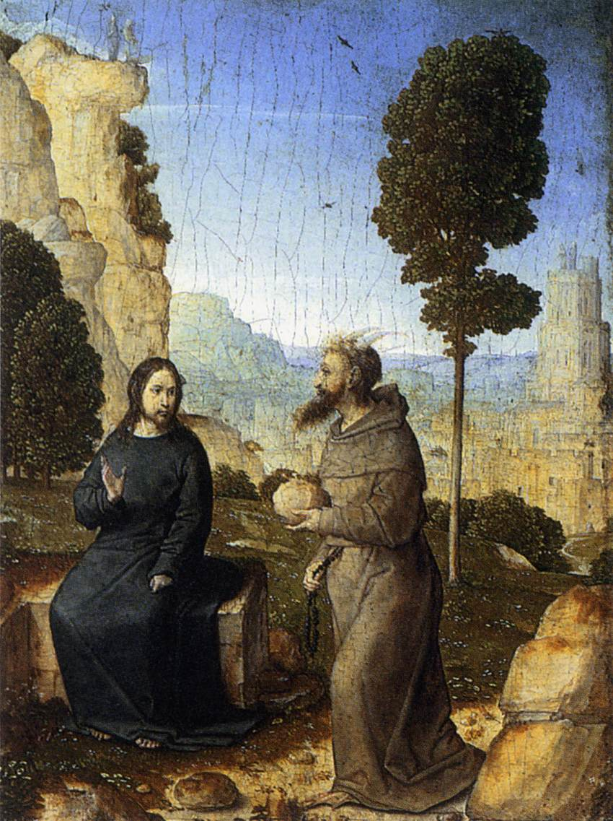
We are reminded not to place our
trust in ourselves.
Through trials, we
learn to trust God
more, and we gain the
ability to help others
in similar trials.
The Temptation of Christ
Flandes (c. 1500)

Slide 91
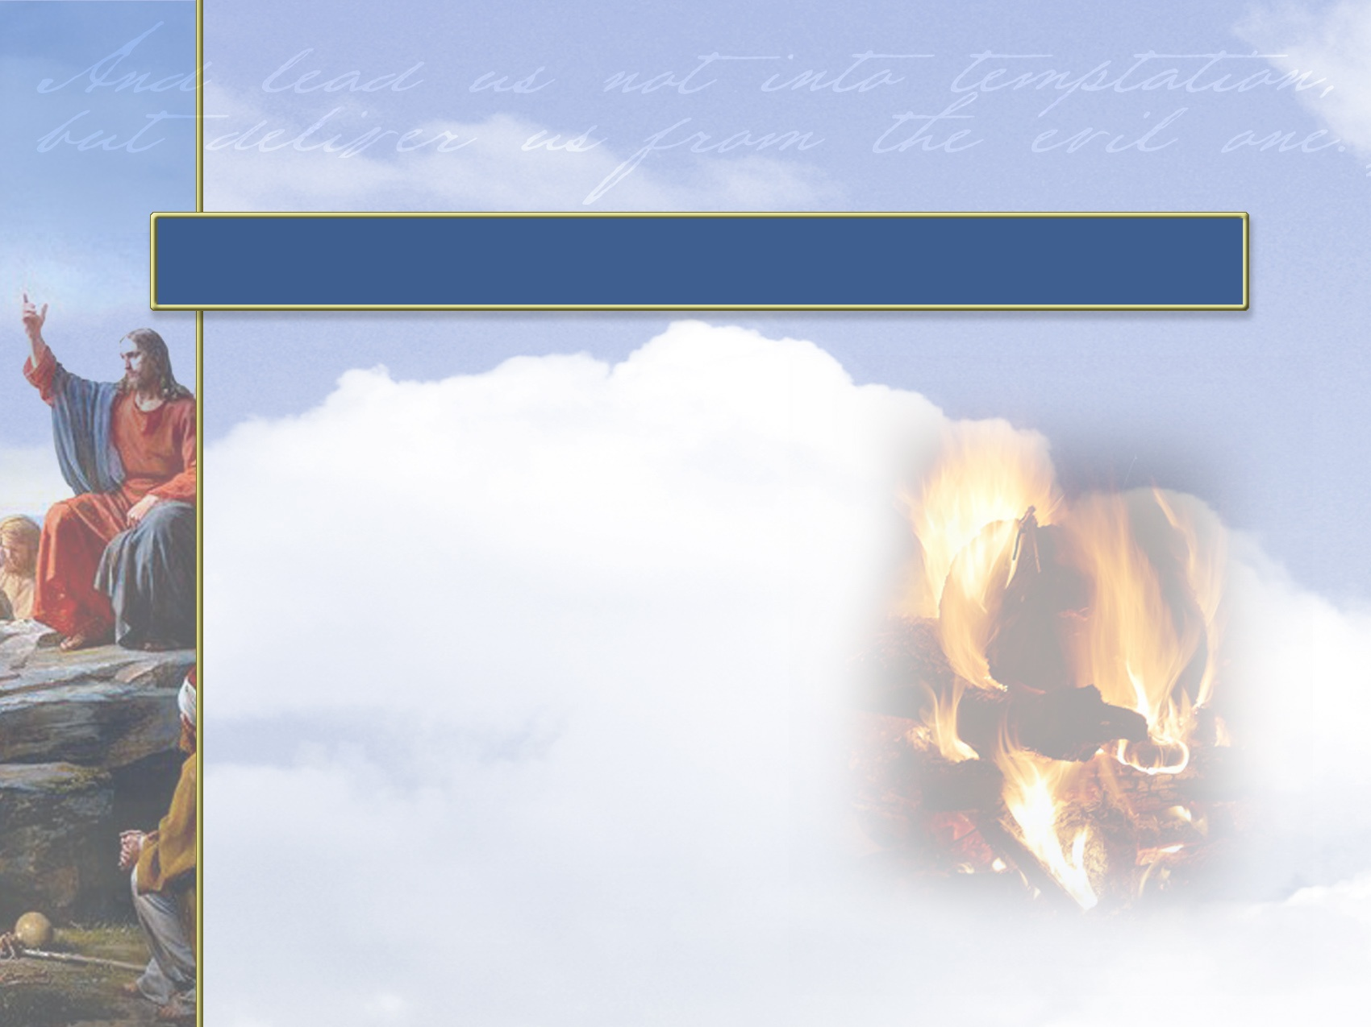
While human nature
resists the realities
of trials and
temptations, the
maturing Christian
accepts the refining
process they bring.

Slide 92
All that’s left is to throw ourselves on the Father.
The Father has promised not to leave us unprotected and exposed to attacks from the enemy (Satan), but to protect, deliver, and forgive.

Slide 93
Lead Us Not Into Temptation
Sin comes naturally
All of us are weak.
All of us are tempted.
All of us were fallen have fallen and will fall

Slide 94
Lead Us Not Into Temptation
All of us need protection
All of us have and will go down the wrong path naturally apart from Gods guidance and strength.
Our prayer should always be the expression of our desire to be led in the paths of righteousness.

Slide 95
The Process Of Temptation
A simple evil thought.
A strong imagination, or impression made on the imagination, by the thing to which we are tempted.
Delight in viewing it.
A desire empowered by promised pleasure. There is pleasure in sin
Consent of the will to perform it.

Slide 96
Lead us Not
From “phero” to keep from falling
Eis (into, unto, toward)
It is acknowledging the real weakness of the flesh to wander into that place of falling.
As His children we want more than anything else to please and glorify Him so we are asking that He would protect us from that assault which would cause us to fall and be defeated

Slide 97
Lead us not into temptation
What does it mean?
God never leads us into sin or tempts us to sin James 1:13. Always understand the hard by the clear
We are weak and we know it. The flesh has a great tendency to yield to the temptation of sin.
We all love to absolve ourselves of responsibility for the sins we commit
We need God to guide our feet into paths of righteousness

Slide 98
Lead us not into temptation
What does it mean?
We are asking God to keep His promise and not allow us to be overcome by anything the enemy throws against us. Satan is in the constant business of tempting us. He does want us to fall into temptation
There are 3 real enemies we face, all conspiring to lead us away from God. The world, the flesh, and the devil

Slide 99
Lead us not into temptation
What does it mean?
It is a petition asking God to protect us by controlling our path that we would not yield to temptation (the prayer of submission to do His will has already been expressed)
It is a statement of submission and acknowledgement of our complete dependence upon him. He has such control over our lives and the tempter that in all temptation we can be victorious because He is our Master

Slide 100
Temptation peirasmos pi-ras-mos
Translated as the fatal piercing of a spear
That assault which is beyond the grace and strength we have presently experienced
A trial that finds its root in the intent and work of Satan to destroy us

Slide 101
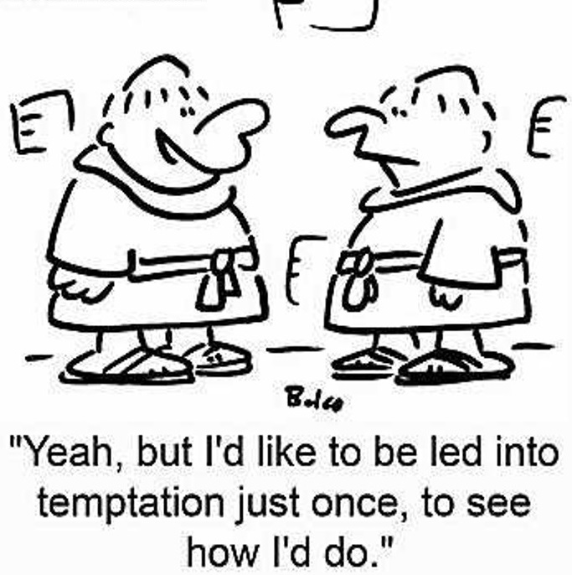

Slide 102
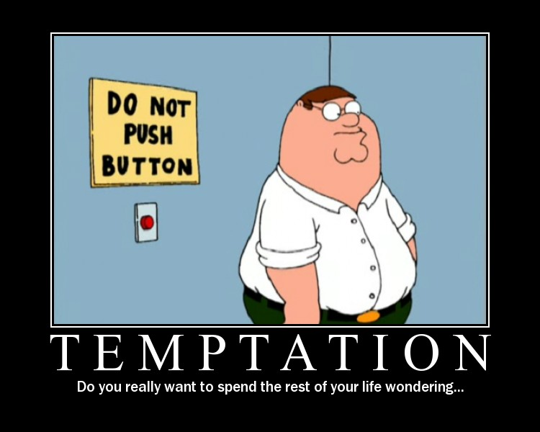

Slide 103
Understanding Temptation
Something that seeks to overcome the limits of my strength and resources
That which would compromise the integrity of my character
That which allows the weakness of the flesh to be victorious
That mindset which results in my rebelling against God
That assault that comes from the evil one

Slide 104
A Few Observations
There is a power hierarchy
    God
    Angels/demons
    Humanity
We cannot resist temptation. Try and you’ll see!

Slide 105
A Few Observations
God has promised in every situation
  We would not be tempted beyond what we can bear
  He will provide in every situation a way of escape
The only guaranteed means of escape is yielding to the One who is more powerful and can make us more than conquerors

Slide 106

We have all been told we should be content.
But there are some instances in which
being “good enough” is NOT good enough!
Name some other instances
where it’s not good to be satisfied.
The Bible tells us that Christians must
continue to grow into maturity.
Read these three passages of Scripture
to discover areas in which we must
resist the temptation to be satisfied:
Hebrews 5:11-14
Colossians 1:10
Colossians 1:11, 12

Slide 107
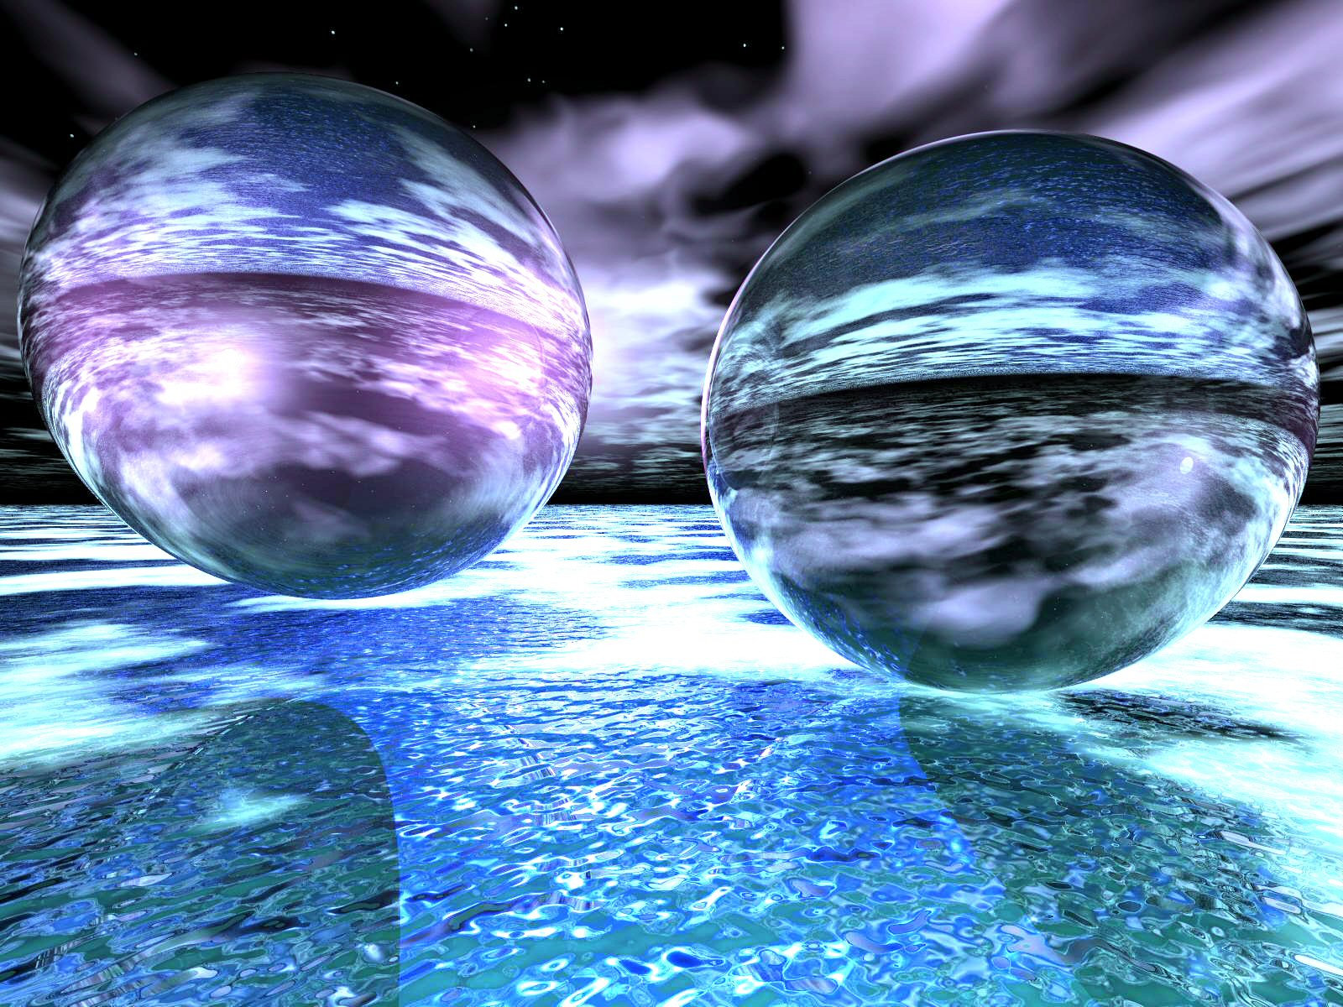
Cultural Context: “Lead Us Not Into Temptation,
1) Once Again, An Example Of Hebrew Parallelism With The Second Line Reinforcing The First.
2) With This Situation, The Second Phrase Elaborates More Fully As To Resulting Implications.
3) The Word “Temptation” In The Hebrew Frequently Has The Sense Of “Testing” Or “Trials.”
4) The Narrative Of Jesus’ Temptation Relates Three Tests Administered By Satan In An Attempt To Make Him Stumble.
5) In The Context Of The Disciples’ Prayer, The Word “Temptation” Points In Pre-Supposition To The Natural Inclination Of Human Beings Toward Sinful Behavior; To Avoid Sin, One Must Not Place Themselves In A Position To Be Put To The Test!
6) According To The Rabbis This Was King David’s Mistake – He Brought Himself To The Test & Failed Miserably.
7) The Tradition Teaches Warning. To Paraphrase: One Can Estimate Neither The Power Of Temptation Nor Their Ability To Resist – The Safest Course Is To Resist Through Running – To Find An Avenue Of Escape!
BUT DELIVER US FROM EVIL!

Slide 108
And forgive us our sins, as we forgive those sin against us
And lead us not into temptation, but deliver us from evil:
For Thine is the kingdom, and the power, and the glory, forever. Amen.

Slide 109
Cultural Context: “Lead Us Not Into Temptation,
BUT DELIVER US FROM EVIL!
The Next Line Of The Parallelism, “Deliver Us From Evil,” Goes Beyond The Sense Of One’s Test Or Trial – It Introduces The Idea Of Our Supplication To Be Saved From The Evil Force Connected With Our Temptation.
Prayers Of The Late Jewish Antiquity Display An Awareness Of The Awesome Power Of Evil – Which Can Overcome An Individual & Control Them.
One Of The Psalm Scrolls Among Those Of The Dead Sea Reads: “Do Not Let Satan Rule Over Me To Lead Me Astray.”
This Reading In Hebrew Is Almost Identical To That Of David’s Psalm 119: 133 – “Let No Iniquity Get Dominion Over Me.”
12) The Request Involves Much More Than Merely Asking To Overcome A Desire To Sin.
13) One Must Defeat This Powerful & Concrete Force That Seeks To Influence One’s Life.
In Other Words, All Christians Everywhere, Throughout History, Must Each Battle & Defeat Not Only Our Own Flesh But That Contrary Supernatural Personality – That Old Adversary Of Man & Woman From Way Back In The Garden – Satan!
In This Personal Conflict From The Dawn Of Human History We Have Help From God. As The Apostle Paul Writes In 1st Corinthians 10: 13 – “No Temptation Has Overtaken You That Is Not Common To Man. God Is Faithful, & He Will Not Let You Be Tempted Beyond Your Strength, But With That Temptation Will Also Provide The Way Of Escape, That You May Be Able To Endure It.”
However, We Are Often Brought To The Brink Of Our Breaking Point Such That We Discover For Ourselves Those Spiritual Strengths & Weaknesses On Which We Need To Work!

Slide 110
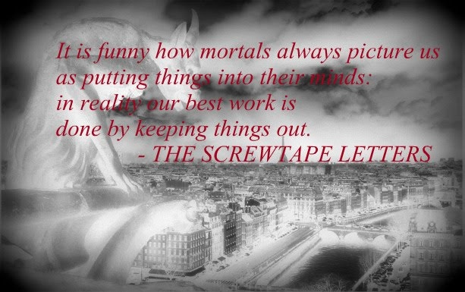

Slide 111
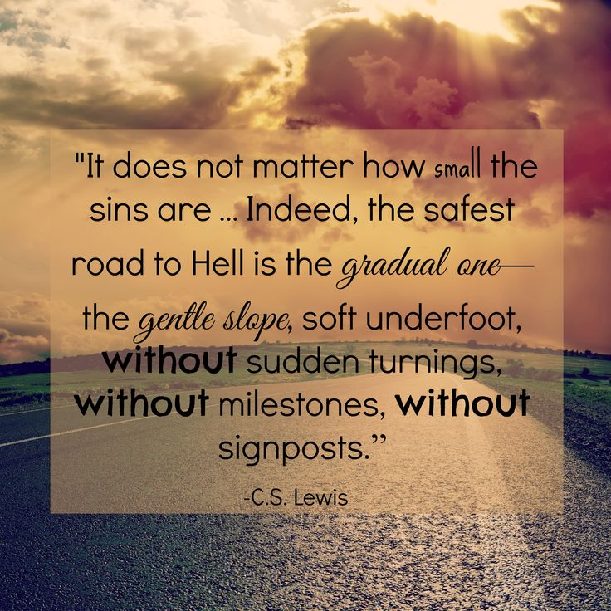

Slide 112
The deceit, the lie of the devil consists of this, that he wishes to make man believe that he can live without God's Word. Thus he dangles before man's fantasy a kingdom of faith, of power, and of peace, into which only he can enter who consents to the temptations; and conceals from men that he, as the devil, is the most unfortunate and unhappy of beings, since he is finally and eternally rejected by God.
Dietrich Bonhoeffer

Slide 113
The Artery Of Protection 2
Deliver us from evil (evil one)
Unclogging Our Spiritual Arteries

Slide 114
Our Spiritual Arteries
The need for protection
  And lead us not into temptation, but deliver us from evil,

Slide 115
The Armor of God
Ephesians 6:13-17
Use every piece of God’s armor to resist the enemy in the time of evil, so that after the battle you will still be standing firm.
Stand your ground, putting on the sturdy belt of truth and the body armor of God’s righteousness.
For shoes, put on the peace that comes from the Good News, so that you will be fully prepared.

Slide 116
In every battle you will need faith as your shield to stop the fiery arrows aimed at you by Satan.
Put on salvation as your helmet, and take the sword of the Spirit, which is the word of God.

Slide 117
Understanding The Text
Deliver us from evil (evil one)
  rhoumai rhoo'-om-ahee, middle voice (We can’t do it ourselves) deliver, deliverer
  poneros pon-ay-ros nominative case translated KJV as evil, wicked, bad but in this case the intent of Christ is to refer to Satan “the Evil One”. Satan is the personification of evil
Be our deliverer from the wicked/evil one

Slide 118
Deliver us from evil, (Evil One)
We are in a battle
It is a battle for which we are ill-equipped in the natural
Our battle is not against flesh & blood but against principalities & powers and against spiritual wickedness in high places. Satan is out to get us!

Slide 119
We need to know that the victory over the evil one is not won by us but has been won for us
Satan mounts an attack on all fronts
  The eye gate
  The ear gate
  The emotional gate
  The mind gate
  The will gate
  Any other gates he can get in. That’s what tempatation is about

Slide 120
We cannot defeat Satan by ourselves and do not have the strength for victory on our own
We are in a Spiritual Battle-Zone. Satan wants spiritually impotent Christians who are no threat to him.
The One who defeated Satan at Calvary can defeat Satan in our life if we will but ask

Slide 121
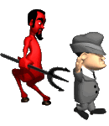
How Does Satan Work

Slide 122
God
1st Coming Of Christ
Nation
Disarm
Divert
Family
Distort
Fall
Discourage
Defeat
The Deadly D’s of the Devil
Destroy

Slide 123
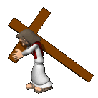
1st Coming
Of Christ
2nd Coming Of Christ
Church
Disarm
Divert
Distort
Discourage
Sending of
Holy Spirit
Defeat
The Deadly D’s of the Devil
Destroy

Slide 124
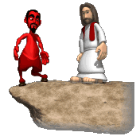
A Premise!
If God is for it, Satan is against it
If Satan is for it, God is against it

Slide 125
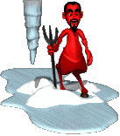
Satanic Strategies
Diverted Trust
Everything is relative (No absolute Truth)
Trust in human reason
Bending or compromising God’s Word to justify unethical behavior
Selfishness
Discredit your reputation
Negative attitudes
Fueling the Ego
Getting anger to rule your life

Slide 126
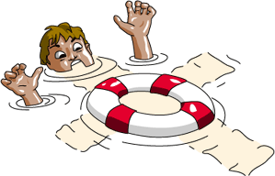

We need help

Slide 127
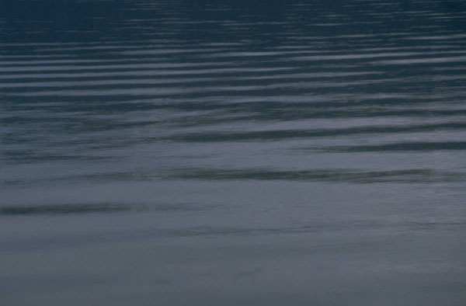
Why the Armor of God?
The problems we face are beyond our human strength or ability to conquer
The enemy is stronger than we are.
God’s desire is not our survival but victory
God knows what we need for victory and that’s what He’s given to us.
There is a modern world view which excludes biblical truth and will trap us in a morass of carnality. On our own we are destined to fail spiritually

Slide 128
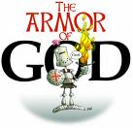
Protection
The weapons of our warfare can tear down strong holds.
2 Corinthians 10:4 For the weapons of our warfare are not carnal, but mighty through God to the pulling down of strong holds;

Slide 129
Protection
Without God’s help our lives are wide open to Satan’s tactics and antics
We need a hedge of protection around our minds, emotions, spirits and wills.

Slide 130
I Corinthians 10:12-13
If you think you are standing strong, be careful, for you, too, may fall into the same sin. But remember that the temptations that come into your life are no different from what others experience. And God is faithful. He will keep the temptation from becoming so strong that you can’t stand up against it. When you are tempted, he will show you a way out so that you will not give in to it.

Slide 131
What Is The Armor Of God?
It is God’s gift to us for our protection
Putting on the armor is putting on Christ.

Slide 132
Romans 13.12-14
The night is far spent; The day is at hand. Let is therefore take off the deeds of darkness, Let us put on the armor of light… … … … … …
Let us live honestly, as in the day, Not in reveling and drunkenness, Not in lust and licentiousness, Not in strife and jealousy;
But clothe yourselves with the Lord Jesus Christ, And make no provisions for your earthly nature and the gratification of its lusts.

Slide 133
What Is The Armor Of God
It is God’s gift to us for our protection
We need to put on daily the armor of God
Putting on the armor is putting on Christ.
God’s promise is victory in the midst of struggle not immunity from the struggle

Slide 134
1Peter 4
Do not think it strange, beloved, that a fiery ordeal has come to test you, as though some surprising thing had befallen you.
But be glad in the degree in which you share in the sufferings of Christ; so that when his glory shall be revealed, you too may be glad with triumphant gladness.

Slide 135
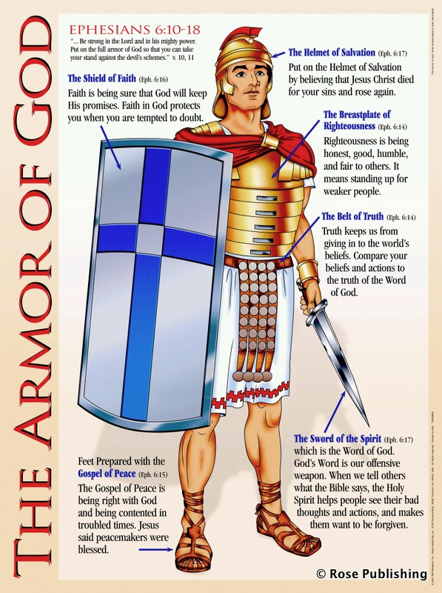
The Armor Of God

Slide 136
The Armor of God
The belt of truth to protect my emotions from being carnally governed. It assures me that He is truth and as I know Him and His will I will be protected from the enemies lies
We have all to some degree been influenced by the lies of world

Slide 137
The Armor of God
The breastplate of righteousness to assure me of my standing before God when accusations come. It allows me to see the truth about myself and that I have no standing before God apart from the the righteousness of Christ
Real assurance comes when I mentally accept the reality that - in addition to my own obedience – I’m beneficiary of the meritorious righteousness of Jesus Christ

Slide 138
The Armor of God
The Gospel of peace are my shoes so that where I walk peace will follow. I’m a minister of reconciliation. As I remain in Him I find myself with a calm in the midst of the storm, and as I follow him His peace reigns in my heart
You will keep him in perfect peace, the one whose mind focuses on you.
Isaiah 26:3

Slide 139
The Armor of God
The shield of faith so the enemies lies and deception will not penetrate my life. As I believe God and say “Amen” to His promises the lies and deception of the enemy are diverted away from me.
Faith is “a force” and stops the enemy in his tracks. Satan has no weapon that can nullify faith

Slide 140
The Armor of God
The helmet of salvation so that your mind is protected and renewed by the power of the gospel. My confidence is that He is my deliverer now, that He will never forsake me here and when the end comes I will be with Him forever
The battleground is the mind. Whatever we think about we become and do!
Victory comes through the renewal of the mind (Romans 12:1-2)

Slide 141
The Armor of God
The Sword of the Spirit which is God’s word is the weapon of choice for fighting the enemy. If God said it I can believe it. Hiding His word in your heart is a is the quickest way to respond to the attacks.
Knowing and using God’s word are not the same. It is “faithing” as we stand on his word when the attacks come

Slide 142
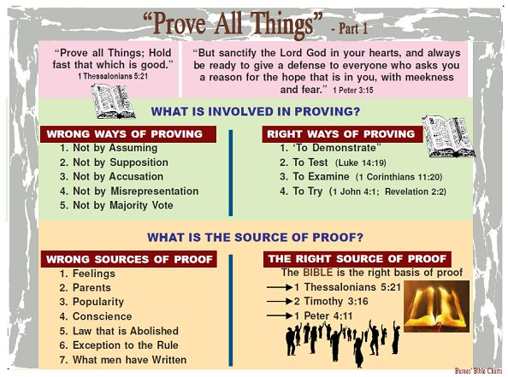

Slide 143
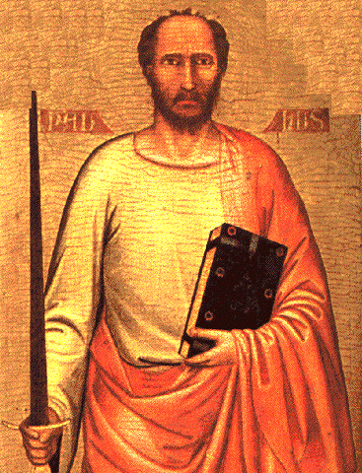
The Apostle Paul
THE SPIRITUAL SWORD

Slide 144
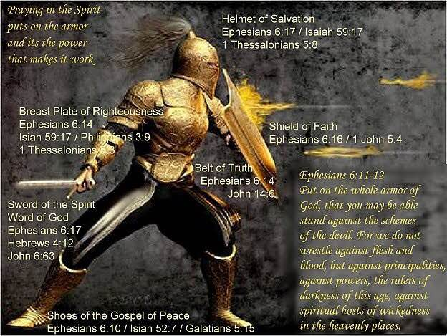

Slide 145

The Double-Edged Spiritual Sword
“For the word of God is living and powerful, and sharper than any two-edged sword, piercing even to the division of soul and spirit, and joints and marrow, and is a discerner of the thoughts and intents of the heart.”
- Hebrews 4: 12

Slide 146
The Double-Edged Spiritual Sword
INCLUDES the Word of God, the sword of the Spirit with double edge, one edge for convicting and converting some, and the other for condemning and destroying the unbelieving… sharper “more cutting” two-edged – sharpened at both edge and back. Its double power seems implied by its being “two-edged.” “It judges all that is in the heart, for there it passes through, at once punishing and searching…” [Chrysostom].
* Jamieson-Fausset-Brown On Hebrews 4:12

Slide 147
The Double-Edged Spiritual Sword
Philo similarly speaks of “God passing between the parts of Abraham’s sacrifices (Genesis 15: 17) where it is a burning lamp… which sword never ceases to divide all sensible things… {Paul’s audience was familiar with Philo}… even to dividing asunder of soul and spirit – i.e., reaching through to the separation of the animal soul, the lower part of man’s incorporeal nature, the seat of animal desires, which he has in common with the brutes… and of the joints and marrow-
* Jamieson-Fausset-Brown On Hebrews 4:12

Slide 148
The Double-Edged Spiritual Sword
As the knife of the Levitical priest reached to dividing parts, closely united as the joints of the limbs, and penetrated to the innermost parts, as the marrows; so the word of God divides the closely joined parts of man’s immaterial being, soul and spirit and penetrates to the innermost parts of the spirit. The Word’s dividing and far penetrating power has both a punitive and healing effect. discerner of the thoughts- “capable of judging the purposes.” intents- rather, “conceptions [Crellius]; “ideas” [Alford] refers to the intellect.
* Jamieson-Fausset-Brown On Hebrews 4:12

Slide 149
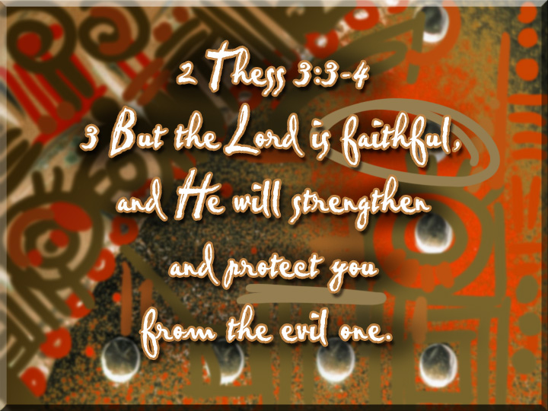

Slide 150
The Prayer Of Deliverance
“The evil from which we pray to be delivered is not that which is most oppressive in life, such as poverty, worries, hardship, burdens, sacrifices, pain, injustice, tyranny, and so on; it is the chain of circumstances that leads us into temptation, disturbing the balance, pushing life off-center, distorting the perspective. It will be seen at once that the so-called ‘good things’ of life are just as liable to cause such disturbance as the painful and hard realities. These things all possess the potential power to lead or force us into temptation & by that I mean all the things that can possibly come between us & God… Alfred Delp
"THE EVIL ONE"

Slide 151
MATTHEW 6:9-13
Our Father, who is in Heaven, Hallowed be Your name.
Your kingdom come, Your will be done, on earth as it is in Heaven.
Give us this day our daily bread;
and forgive us our debts as we also forgive our debtors.
And lead us not into temptation, but deliver us from the evil. For Yours is the kingdom, and the power, and the glory, forever. Amen.

Slide 152
And forgive us our sins, as we forgive those sin against us
And lead us not into temptation, but deliver us from evil:
For Thine is the kingdom, and the power, and the glory, forever. Amen.

Slide 153
For Thine is the Kingdom and the Power and the Glory Forever. Amen!
The Artery Of Praise
Unclogging Our Spiritual Arteries

Slide 154
Our Spiritual Arteries
The need for praise
  For Thine is the kingdom and the power and the glory forever, Amen

Slide 155

Seven Spiritual Arteries
Relationship
Worship
Priority
Provision
Forgiveness
Protection
Praise

Slide 156

The Context Of This Artery
We have petitioned God and are now at the end of this prayer
Do we finish with a sense of “I wonder if” or “I know that”
This praise is a statement of the anticipation and belief that we have that every request we have made is already answered (“I believe the answers on the way”)

Slide 157
Model Prayer In Line Item Analysis
For Thone Is The Kingdom, And The Power, And The Glory, Forever, AMEN!

Slide 158
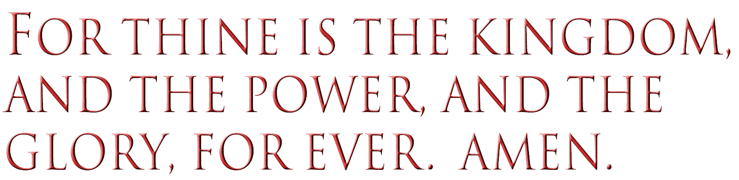
  According to several ancient manuscripts, these closing words of praise are present in the Gospel of Matthew.
  This phrase is absent from Luke’s Gospel in all manuscripts.
  Most modern translations omit the doxology because it is absent from several (other) ancient manuscripts.

Slide 159
Why This Part May Not Be In My Bible
There are 2 major manuscripts from which our English Bibles are translated
  Majority Text
  Textus Receptus: Oldest
The King James includes it and was translated from the Textus Receptus
NIV and others come from the majority text and it is not included

Slide 160
Why I Believe It Should Be Included
The prayer taught by Christ was virtually identically to the prayer of the Jewish people where the phrase was always included
The Rabinical tradition of the spiritual arteries had this artery included
There is a cohesiveness to the prayer when included that is missing when it is excluded. (It starts with God and ends with God)
The OT model from 1 Chronicles 29 seems to be consistent with this prayer

Slide 161
1 Chronicles 29:11-13
Yours, O LORD, is the greatness, the power, the glory, the victory, and the majesty. Everything in the heavens and on earth is yours, O LORD, and this is your kingdom. We adore you as the one who is over all things.
Riches and honor come from you alone, for you rule over everything. Power and might are in your hand, and it is at your discretion that people are made great and given strength.
O our God, we thank you and praise your glorious name!

Slide 162
Why I Believe It Should Be Included
As we pray we close our prayer with an acknowledgement that the petitions we make can only be answered because of who He is
It is a reminder to us that even as God answers our petitions it is done primarily for His glory
Beyond my needs being met I love Him so very much that I want to praise Him in advance that He is ready willing and able to meet my needs

Slide 163
This doxology, or ascription of praise, is connected with the prayer by the word "for," to signify that all these things--the reign, power, and glory of God--will be manifested by granting these petitions. It is not because we are to be benefited, but that God's name & perfections may be manifested. His glory is, then, the first and principal thing which we are to seek when we approach him.
Barnes Notes

Slide 164
3 Things Praise Does
His Presence: When we praise & worship God, we bring down His presence because he inhabits the praises of His people (Psalm 100:4). Literally our praise builds a throne upon which He sits
His Power: When we praise and worship God, He manifests his power (Acts 16: 30-31). His power saves, heals, and delivers.
His Glory: When we praise and worship God, the Glory of God comes & is seen (1st Kings 8: 10-11).

Slide 165

Praise enables you to see things from God’s perspective
Praise is not the response to coming into God’s presence (that’s worship) it is the vehicle of faith which brings us into His presence and allows us to experience His power

Slide 166
We Are Specifically Praising
God For 3 Things
For His Kingdom
For His Power
For His Glory

Slide 167
Thine is the Kingdom
basileia bas-il-i'-ah: royal power, kingship, dominion, rule
The right or authority to rule over a kingdom
The royal power of Jesus as the triumphant Messiah
A kingdom, the territory subject to the rule of a king

Slide 168
His Kingdom
Is eternal in scope
Is expanding
Is triumphant
Is now and then
Is manifest in our lives through righteousness peace and joy in the Holy Spirit ~ Romans 14:17
Is a message of hope for all

Slide 169
The Promise Of The Kingdom
Since He has control of all things, He can order all things to grant our petition
As we seek His ruler-ship in our lives, His will which is good acceptable and perfect will be worked out in our lives
The serendipity of being a citizen of this kingdom will allow more than I’ve asked or imagined to be my experience

Slide 170
Thine is the Power
dunamis doo'-nam-is:
Translates strength & ability
Inherent power, power residing through the virtue of its nature, or which a person or thing exerts and puts forth
Power for performing miracles
Moral power and excellence of soul
The power and influence which belong to riches and wealth
Power and resources arising from numbers
Power consisting in or resting upon armies, forces, hosts

Slide 171

His Power
Inherent in His nature (Omnipotent)
Is active in the affairs of this world
Is exercised justly
Is inexhaustible
Cannot be conquered
Is the power available to us to live life victoriously. Romans 8:11 (The power that raised Jesus from the dead is our power source)

Slide 172
Thine is the Glory
doxa dox'-ah a good opinion concerning one, resulting in praise, honor, and glory splendor, brightness magnificence, excellence, preeminence, dignity, grace
That which belongs to God alone
The kingly majesty which belongs to him as supreme ruler, majesty in the sense of the absolute perfection of his deity, the absolutely perfect inward or personal excellency of Christ; the majesty of Christ as Messiah
A most glorious condition, most exalted state
Of that condition with God the Father in heaven to which Christ was raised after he had achieved his work on earth

Slide 173

His Glory
His worth is the basis of our worship
It will expand until the glory of the Lord covers the earth as the waters cover the sea.
It is our chief aim that in all of life we would glorify Him

Slide 174



Slide 175

From “The Lord’s Prayer” - By Joel Nederhood:
Saying Of “Amen” In Conclusion
It Signifies Agreement -
Deuteronomy Chapter 27: This scripture passage pertains to a bad set of circumstances and contains the reading of difficult statements to God’s chosen people by their leaders concerning curses being brought by Him upon them for which they were to assent approval.
1st Chronicles Chapter 16: This scripture passage pertains to a situation that is positive and where the people of God are called upon to respond to something totally different. After a psalm of praise – all those there said “Amen” & “Praise the Lord.”
It Signifies Truthfulness –
Revelation Chapter One: Occurs Twice - Verses 5 thru 7
It is an expression of faith indicating belief that something or some statement is most assuredly accurate although it is in our minds counter-intuitive to any experienced frame of reference in terms of both defying our imagination and going beyond our comprehension.

Slide 176
MATTHEW 6:9-13
Our Father, who is in Heaven, Hallowed be Your name.
Your kingdom come, Your will be done, on earth as it is in Heaven.
Give us this day our daily bread;
and forgive us our debts as we also forgive our debtors.
And lead us not into temptation, but deliver us from the evil. For Yours is the kingdom, and the power, and the glory, forever. Amen.
http://www.godtube.com/watch/?v=9EFCJMNU

Slide 177
THE LORD’S PRAYER AS MODEL PRAYER
CONCLUSION.

Slide 178

LESSONS LEARNED:
Disciples’
Prayer
Checklist

Slide 179

Prayer Is Talking To God
Jesus addressed this prayer to the Father, and in so doing shows that such is the main purpose of prayer. It is not to fulfill a religious exercise or to impress fellow creatures with our beautiful wording!

Slide 180
Prayer Is To Be Done With Reverence
After the salutation, the prayer continues with “hallowed be thy name.” This illustrates that reverence and respect are to be coupled with love and affection!

Slide 181
Spiritual Requests Are The First Things
While most men would start by asking God for personal favors and blessings, Jesus shows us in this prayer that the spiritual must come first. We seek first the kingdom of God and its righteousness!

Slide 182
Effective Prayer Requires Commitment
Jesus applied several expressions that not only were a request but would then involve those of a sincere heart to a life of service. “Thy will be done” would my submitting to God’s will. It would be hypocrisy to pray for such and then live in rebellion to God’s will. Prayer must be in accord with our lives, or rather, our lives must be in accord with our prayers!

Slide 183
Disciple’s Prayer Includes The Material
It has been a source of controversy, but most students of the Bible share in the opinion that the bread of life of which we express our thanks is broad in its application. It is inclusive of our daily bread that physically sustains us. Although our attitude of approach must be toward contentment in circumstance and our focus of prayer primarily spiritual and even though this is a minor point here in the Lord’s formula of prayer - we must keep this in mind. In other words, we must not take for granted either our spiritual nor our physical dependence upon the Almighty each and every day!

Slide 184
Prayer Should Be Constant & Continual
After the prayer’s distilled version ends in Luke chapter 11, verse 4, the teaching of Jesus continues through the chapter. The illustration of a man who would eventually answer a neighbor’s repeated request implies two things. One, that God will also answer our prayers: sometimes by saying yes, sometimes by saying no, sometimes by saying wait awhile. Yet, He hears and answers His child’s prayers. Two, That We Need To Be Prayerful Always & To Be A Prayerful People!
To Pray Only In Distress Is Mocking

Slide 185




PRAISE
Psalm 100: 4
1 John 1: 9
Matthew 7: 7
2nd Chr. 30: 8
REPENT
ASKING
YIELDED

Slide 186

Are your Spiritual
Arteries Unclogged?

Slide 187


Slide 188

A Loss for
Words
Notes:
Languages are dying every day, and experts predict that about half of the world’s tongues will be gone by the end of the 21st century. Will one of these fatalities be the language of prayer?
Manx.
It’s the language of the Isle of Man, and on December 27, 1974, it was officially pronounced dead when its last native speaker died in the village of Cregneash at the age of 97.
Words like coghal, meaning a large chunk of dead flesh in an open wound, or the word jouyl, meaning devil, are now lost and out of use.
There are 6,800 spoken languages today, and experts believe that at least half will be dead by the end of the century. Nicholas Ostler is president of a foundation for endangered languages, and he is concerned about the large number of rare languages that are now in danger of becoming extinct. He points out that languages die for a number of reasons — war, genocide, disease, low birth rates, government policy. But globalization is probably posing the biggest threat of all. As the global village spreads and various economies become more intertwined, many people who speak minority languages will stop using them. For very practical reasons, they will switch to majority languages such as English, Chinese or Hindi—Urdu.
Australia is a good example. English came to this continent through British colonization, just as it came to North America, and it became the language of government and commerce. As a result, 138 of Australia’s 261 native languages are now nearly extinct.

Slide 189

When it comes to prayer, are we at a loss for words?
Notes:
Yet, understandably, neither Ostler nor other experts point to another language that may be in danger of extinction: the language of prayer.
Perhaps it’s not true. Who would admit that they don’t pray or believe in prayer? In fact, according to a George Barna survey, in 2001, 82 percent of adults said they pray at least once a week. And 89 percent believe there is a God who watches over us and who answers our prayers (see sidebar with more results of the survey).
Yet, praying once a week hardly seems like a strong endorsement of the power of prayer. If we really believed that God answers prayer, and that prayer unleashes the power of God, would we pray just once a week? Come on!
Perhaps it’s a case of people just mouthing the words, racing through the Prayer of Jabez or the Prayer of Jesus, thus relegating prayer to a minority language used by fewer and fewer people, leaving it with a cloudy and uncertain future. Have we allowed the dominant languages of government and commerce to take over our lives, edging out the lesser—known speech patterns that can connect us in a life—giving way to God? Have we pushed the language of prayer to the verge of extinction, making it a tongue that has just a handful of speakers, most of them elderly?
In short, when it comes to prayer, are we at a loss for words?
In Luke, the disciples of Jesus fear this very same future, so they ask him, “Lord, teach us to pray” (11:1). Jesus responds by instructing them to speak to God as they would speak to a member of their own family, calling God “Father” — an expression of intimacy and familiarity — and suggests that they make three requests. They should ask for bread, for forgiveness and for deliverance, and they should trust God to give them whatever they need.

Slide 190


Jesus assures us that God will answer our prayers!
Notes:
Jesus goes on to encourage us to pray with persistence, using the language of prayer to plead for what we need (vv. 5—8). And then he assures us that God will hear our prayer and answer us, for if we human parents know how to give good gifts to our children, then “how much more will the heavenly Father give the Holy Spirit to those who ask him!” (v. 13).
Jesus did not tell us what posture to assume when praying. Jurgen Moltmann, in his book The Source of Life: The Holy Spirit and the Theology of Life, observes that praying in the prone position denotes subservience, whereas the kneeling position — head bowed, eyes closed — speaks of an attitude of contrition and helplessness. Prayer while standing, with arms uplifted and outstretched, is a prayer of expectation in which the prayer—giver invites God to come into his life, indicating as well that the prayer—giver is ready to receive what God has to give.
Finally, it is worth noting that this language of prayer, may not be a “language” at all — in the sense that it is spoken by a linguistic system, be it English, Spanish, French or something else.
It may be a nonverbal language in which we speak to God by the manner in which we live. Ann and Barry Ulanov, in their book, Primary Speech: A Psychology of Prayer, note that “Prayer starts without words, and often ends without them.”

Slide 191

we will never be at a loss for words!
If we are in a close
Relationship with God,
Notes:
In any case, it is up to us to preserve this life—giving language, and keep it from extinction. Within the community of faith, we are challenged to create a healthy habitat for prayer, one in which we are not afraid to ask for the gifts we need for physical and spiritual health ... one in which we search diligently for the will of God among the many competing agendas of contemporary life ... one in which we knock again and again on the door to God’s kingdom, knock persistently through disciplined daily prayer, knock faithfully and forcefully with the full conviction that our Lord loves us and wants to meet our needs.
With such an approach, the language of prayer will remain alive and active and off the endangered list. It will keep us in close communication with God ... and never at a loss for words.
Source:
Ostler, Nicholas. “A loss for words.” Foreign Policy. November—December 2003, 30—31.

Slide 192

Prayer: Bridge Between Worlds

Slide 193
"In every joy that crowns my days,
In every pain I bear,
My heart shall find delight in praise,
Or seek relief in prayer.
"When gladness wings my favored hour,
Thy love my thoughts shall fill;
Resigned when storms of sorrow lower,
My soul shall meet thy will.
"My lifted eye, without a tear,
The gathering storm shall see;
My steadfast heart shall know no fear:
That heart shall rest on thee.”

Slide 194
Lord Jesus –
Settle dust, calm storms,
Quell the quaking.
Show the way, quiet hearts,
Still the shaking.
Pour Your Peace
Into troubled hearts;
Give Fresh Vision
For new starts!
- Sally Jadlow

Slide 195
THE LORD’S PRAYER AS MODEL PRAYER
LAST SLIDE OF PRESENTATION.

Slide 196

But as many as received him, to them
gave he power to become the sons of
God, even to them that believe on his
name: Which were born, not of blood, nor of the will of the flesh, nor of the
will of man, but of God.
—John 1:12, 13
BACK

Slide 197
Behold, what manner of love the Father
hath bestowed upon us, that we should
be called the sons of God: therefore the
world knoweth us not, because it knew
him not.
—1 John 3:1
Let us therefore come boldly unto the
throne of grace, that we may obtain
mercy, and find grace to help in time
of need. —Hebrews 4:16
BACK

Slide 198
Ask, and it shall be given you; seek, and ye
shall find; knock, and it shall be opened unto
you: For every one that asketh receiveth; and
he that seeketh findeth; and to him that
knocketh it shall be opened. Or what man is
there of you, whom if his son ask bread, will he
give him a stone? Or if he ask a fish, will he
give him a serpent? If ye then, being evil, know
how to give good gifts unto your children, how
much more shall your Father which is in
heaven give good things to them that
ask him. —Matthew 7:7-11
BACK

Slide 199
Exalt the LORD our God, and worship
at his holy hill; for the LORD our God
is holy.
—Psalm 99:9
Thou shalt not take the name of the
LORD thy God in vain; for the LORD
will not hold him guiltless that taketh
his name in vain.
—Exodus 20:7
BACK

Slide 200
Whether therefore ye eat, or drink,
or whatsoever ye do, do all to the
glory of God.
—1 Corinthians 10:31
The earth is the LORD’s, and the
fulness thereof; the world, and they
that dwell therein. —Psalm 24:1
BACK

Slide 201
I know thy works, that thou art
neither cold nor hot: I would thou
wert cold or hot. So then because thou
art lukewarm, and neither cold nor
hot, I will spue thee out of my mouth. —Revelation 3:15, 16
BACK

Slide 202
Enter into his gates with thanksgiving,
and into his courts with praise: be thankful unto him, and bless his name. —Psalm 100:4
For he hath strengthened the bars of
thy gates; he hath blessed thy children
within thee.
—Psalm 147:13
BACK

Slide 203
Whether therefore ye eat, or drink,
or whatsoever ye do, do all to the
glory of God.
—1 Corinthians 10:31
Let your light so shine before men,
that they may see your good works,
and glorify your Father which
is in heaven.
—Matthew 5:16
BACK

Slide 204
And in the days of these kings shall
the God of heaven set up a kingdom,
which shall never be destroyed: and
the kingdom shall not be left to other
people, but it shall break in pieces and
consume all these kingdoms, and it
shall stand for ever.
        —Daniel 2:44
BACK

Slide 205
And I heard a great voice out of heaven
saying, Behold, the tabernacle of God is
with men, and he will dwell with them,
and they shall be his people, and God
himself shall be with them, and be their God. And God shall wipe away all tears
from their eyes; and there shall be no
more death, neither sorrow, nor crying,
neither shall there be any more pain: for
the former things are passed away.
—Revelation 21:3, 4
BACK

Slide 206
And Jesus came and spake unto them,
saying, All power is given unto me in
heaven and in earth. Go ye therefore, and teach all nations, baptizing them in
the name of the Father, and of the Son,
and of the Holy Ghost: Teaching them
to observe all things whatsoever I have
commanded you: and, lo, I am with you
always, even unto the end of the world.
Amen. —Matthew 28:18-20
BACK

Slide 207
Teach me to do thy will; for thou art
my God: thy spirit is good; lead me
into the land of uprightness.
—Psalm 143:10
Not every one that saith unto me, Lord,
Lord, shall enter into the kingdom of
heaven; but he that doeth the will of
my Father which is in heaven.
        —Matthew 7:21
BACK

Slide 208
And he went a little farther, and fell on his
face, and prayed, saying, O my Father, if it be possible, let this cup pass from me: nevertheless
not as I will, but as thou wilt. —Matthew 26:39
For whosoever shall do the will of my Father
which is in heaven, the same is my brother, and
sister, and mother. —Matthew 12:50
And he spake a parable unto them to this end,
that men ought always to pray, and not
to faint. —Luke 18:1
BACK

Slide 209
I beseech you therefore, brethren, by
the mercies of God, that ye present your
bodies a living sacrifice, holy, acceptable unto God, which is your reasonable
service. And be not conformed to this
world: but be ye transformed by the
renewing of your mind, that ye may
prove what is that good, and acceptable,
and perfect, will of God.
—Romans 12:1, 2
BACK

Slide 210
But seek ye first the kingdom of God,
and his righteousness; and all these
things shall be added unto you. Take
therefore no thought for the morrow:
for the morrow shall take thought for
the things of itself. Sufficient unto the
day is the evil thereof.
—Matthew 6:33, 34
BACK

Slide 211
And Jesus said unto them, I am the
bread of life: he that cometh to me
shall never hunger; and he that
believeth on me shall never thirst.
—John 6:35
Every good gift and every perfect gift is
from above, and cometh down from the Father of lights, with whom is no
variableness, neither shadow of
turning. —James 1:17
BACK

Slide 212
If we confess our sins, he is faithful
and just to forgive us our sins, and to
cleanse us from all unrighteousness.
—1 John 1:9
For as the heaven is high above the
earth, so great is his mercy toward
them that fear him. As far as the east is
from the west, so far hath he removed
our transgressions from us.
        —Psalm 103:11, 12
BACK

Slide 213
And they shall not teach every man
his neighbour, and every man his
brother, saying, Know the Lord: for
all shall know me, from the least to
the greatest. For I will be merciful
to their unrighteousness, and their
and their iniquities will I
remember no more.
—Hebrews 8:11, 12
BACK

Slide 214
Blessed are the merciful: for they shall obtain
mercy. —Matthew 5:7
Ye have heard that it hath been said, Thou shalt
love thy neighbour, and hate thine enemy. But I
say unto you, Love your enemies, bless them that
curse you, do good to them that hate you, and
pray for them which despitefully use you, and
persecute you; That ye may be the children of
your Father which is in heaven: for he maketh
his sun to rise on the evil and on the good, and
sendeth rain on the just and on the unjust. —Matthew 5:43-45
BACK

Slide 215
And be ye kind one to another, tenderhearted,
forgiving one another, even as God for
Christ’s sake hath forgiven you.
—Ephesians 4:32
He that saith he abideth in him ought himself
also so to walk, even as he walked. —1 John 2:6
Then said Jesus, Father, forgive them; for
they know not what they do. And they parted
his raiment, and cast lots.
—Luke 23:34
BACK

Slide 216
The discretion of a man deferreth his
anger; and it is his glory to pass over a
transgression. —Proverbs 19:11
To whom ye forgive any thing, I forgive
also: for if I forgave any thing, to whom I
forgave it, for your sakes forgave I it in the
person of Christ; Lest Satan should get an
advantage of us: for we are not ignorant of
his devices.
—2 Corinthians 2:10, 11
BACK

Slide 217
Therefore if thou bring thy gift to the
altar, and there rememberest that
thy brother hath ought against thee;
Leave there thy gift before the altar,
and go thy way; first be reconciled
to thy brother, and then come and
offer thy gift. —Matthew 5:23-24
BACK

Slide 218
For if ye forgive men their trespasses,
your heavenly Father will also forgive
you: But if ye forgive not men their
trespasses, neither will your Father
forgive your trespasses.
—Matthew 6:14, 15
BACK

Slide 219
There hath no temptation taken you but
such as is common to man: but God is
faithful, who will not suffer you to be
tempted above that ye are able; but will with the temptation also make a way to escape,
that ye may be able to bear it.
—1 Corinthians 10:13
Put on the whole armour of God, that ye
may be able to stand against the wiles of
the devil. —Ephesians 6:11
BACK

Slide 220
Wherein ye greatly rejoice, though now for
a season, if need be, ye are in heaviness
through manifold temptations: That the
trial of your faith, being much more
precious than of gold that perisheth,
though it be tried with fire, might be found
unto praise and honour and glory at the
appearing of Jesus Christ:
—1 Peter 1:6, 7
BACK

