Slide 1
The Wilderness Temptation of Christ Within It’s Cultural Context
By David Lee Burris

Slide 3
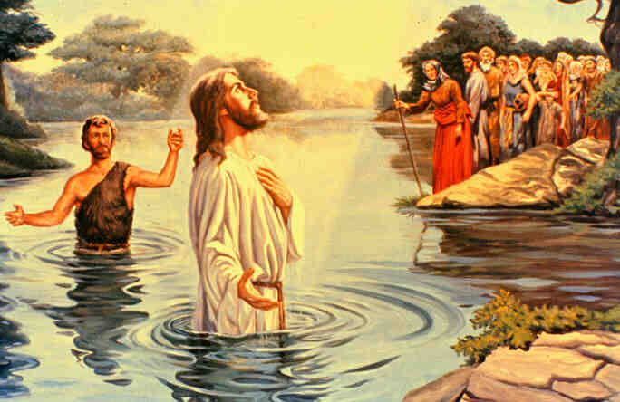

Slide 6
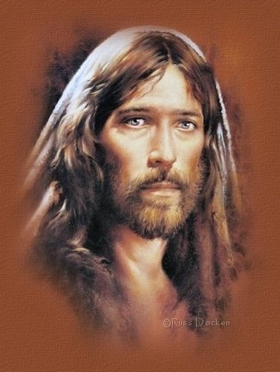
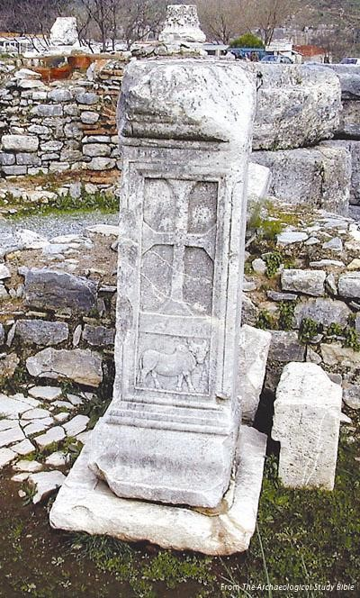
Two Gospels & Two Portraits
David Lee Burris: REDACTION CRITICISM
Gospels Written Ancient Biographic Manner With Small Emphasis on Formative Influence – Such Useless Information Because Main Character Greatest Formative Influence Forward.
Matthew’s Account - He wrote primarily to Jews, for he quotes many Old Testament prophecies Jesus fulfilled which declare Him King. The terms “king” and “kingdom” appear more in this rendition than the others.
Luke’s Account – Luke places emphasis on Jesus as Son of man. In his expansive style, the physician Luke, includes information that serves to model the personal life of Jesus in terms of frequency of events and levels of activity - i.e. Prayer Life. Moreover, while Luke is reliable to record the wonders, miracles, & other occurrences noteworthy of Jesus’ ministry, he details what was said more than what was done; Furthermore, he scopes the significant facts & focuses on the lessons taught; Finally, the writer Luke’s continual explanation of things known to every Jew indicates this freedman’s targeted audience were Gentiles like himself.
Luke’s Tomb

Slide 8
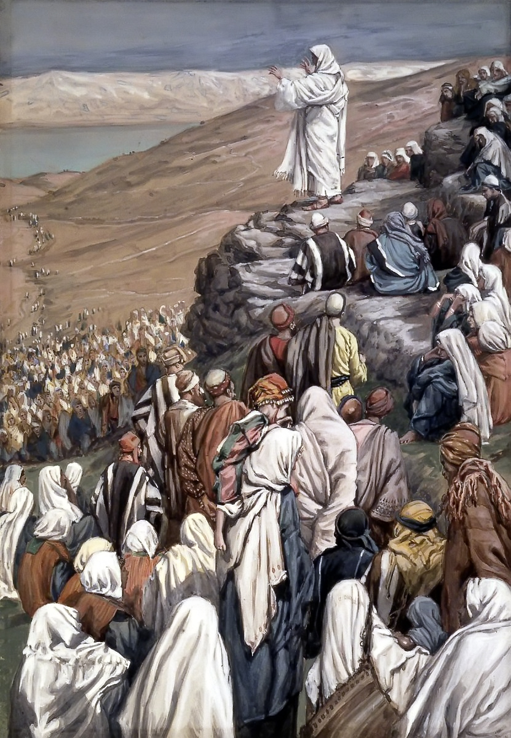

Slide 9
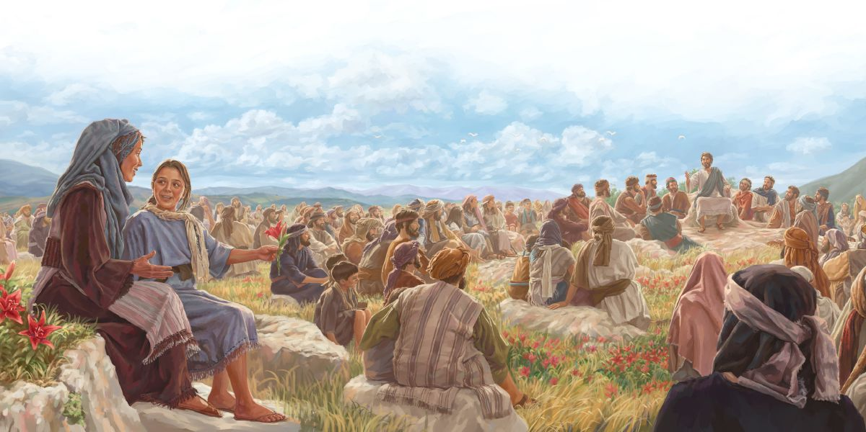

Slide 10
The Wilderness

Slide 11
Modern Art: The Temptation

Slide 12
Satan’s Strategy Of 3D
David Lee Burris:
Insight Into Satan’s ‘Modus Operandi’

Slide 13
Let’s Make A Deal!

Slide 14
David Lee Burris:
Mankind In The Garden – The Devil Point Blank
Jesus In The Wilderness – The Devil Point Blank
Saturating Surface Tactics: Human Drives & Hierarchy Of Needs

Slide 15
Expository Commentary
David Lee Burris:
Structural & Stylistic Analysis
Jamieson – Fausset – Brown
1. Mark’s Word (1:12) Links After Christ’s Baptism & Flows With Luke’s Word (4:1) That Jesus Was ‘Led Up Of The Spirit’
2. “To Be Tempted” – The Greek Word (peirazein) means simply to try or make proof of. The Spirit conducted Him into the wilderness simply to have His faith tried; but as the agent in this trial was to be the wicked one, whose whole object would be to seduce Him from His allegiance to God, it was a temptation in the bad sense of the term.
3. “He Afterward Hungered” – Links To Moses (Exodus 34: 28) & Elijah (1KIngs 19: 8) For The Same Period. The tempter’s whole object during the forty days was to generally dislodge from His breast the consciousness of His Sonship.
3. In Mark’s brief notice of the temptation there is one expressive particular not given either by Matthew or by Luke – that “He was with the wild beasts,” no doubt to add terror to the solitude.

Slide 16
Expository Commentary
Jamieson – Fausset – Brown
3. “And When The Tempter Came To Him” – Evidently we have a new scene.
3. “He Said, If Thou Be The Son Of God, Command This Stone That It Be Made Bread” - Why linger for weeks in this desert, wandering among the wild beasts & craggy rocks, unhonored, unattended, unpitied, ready to starve for want of the necessaries of life? Is this befitting ‘the Son of God’?
4. “And Jesus Answered Him, Saying, It Is Written (Deut. 8: 3), That Man Shall Not Live By Bread Alone, But By Every Word Of God”

Slide 19
Expository Commentary
Now, if Israel spent, not forty days, but forty years in a waste, howling wilderness, where there were no means of human subsistence, not starving, but divinely provided for, on purpose to prove to every age that human support depends not upon bread, but upon God’s unfailing word of promise & pledge of all needful providential care, am I, distrusting this word of God, and despairing of relief, to take the law into My own hand? As Israel’s condition in the wilderness didn’t justify their unbelieving murmurings or their frequent desperation, so neither would mine warrant the exercise of the power of the Son of God in snatching despairingly at unwarranted relief. As man, therefore, I will await divine supply, nothing doubting that at the fitting time it will arrive.

Slide 20
Expository Commentary
David Lee Burris: Isaiah 35: 1
The Lonely Or Isolated Experience Equipped Several Significant Old & New Testament Figures; It Is One Of Options In God’s Arsenal Today - An Efficacious Instrument To Prepare The Pliable!
For The Ages:
1st Temp – Inappropriate Claims On The Power & Promises Of God!
2nd Temp – Denial Of Or Theft Of Our Identity As Children Of God!
3rd Temp – Use Of Unsuitable Means To Achieve Our Goals!
Expository Expounds On Purposed Intent:
What was the high design of this? First, as we judge to give our Lord a taste of what lay before Him in the work He had undertaken; next, to make trial of the glorious equipment (3 for 3) for it which He had just received; reaching further, to give Him encouragement, by the victory now to be won, to go forward spoiling principalities and powers, until at length He should make a show of them openly, triumphing over them in His cross: that the tempter, too, might get a taste, at the very outset, of the new kind of material in man which he would find he had here to deal with; finally, that Jesus might acquire experimental ability in order ‘to succor them that are tempted’ (Hebrews 2: 18). The temptation evidently embraced two distinct stages: the one continuing throughout the forty days’ fast and the other, at the conclusion of that period.

Slide 21
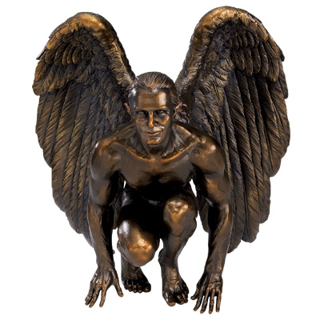
ii.
Probing Tactics Touching Sophisticated Sensitivities

Slide 23
Homiletic Commentary
Pulpit\Wilderness\Presumption & Ostentation
Second Temptation In Matthew’s Gospel:
Book Of Luke - Chapter 4 - Verses 9 Thru 12
> The Temptation Of Dueling Scripture - Jesus must consider what plan would be best for beginning his public work. This must have been with him a distinct subject of thought. And now Satan suggests that if he precipitated himself from the pinnacle of the city temple into the court, and did so with impunity as God’s Son, the people couldn’t but hail him as the promised Messiah. He should put his Sonship, the tempter suggests, to the test.

Slide 25
Homiletic Commentary
Preacher’s Commentary\Person Of The King\
:Testing & Ministry Of The King
Second Temptation In Matthew’s Gospel:
Book Of Luke - Chapter 4 - Verses 9 Thru 12
Psalm 91: 11 - Vs - Deuteronomy 6: 16 –
The second temptation was to make Jesus a wonder-worker and thereby attract people to follow Him. The tempter projected Him into a vision of standing atop the temple on Mount Zion. At the corner where the Royal Porch & Solomon’s Porch met was a drop of 450 feet into the valley of brook Kidron. A rabbinical tradition reads, “When the King Messiah does reveal Himself, then He comes and stands on the roof of the Holy Place.” This means to appear from above, miraculously introducing His national leadership.

Slide 27
Homiletic Commentary
Pulpit’s Bullets As Regards Purposed Intent:
Whether Temptations Of Appetite Or Ambition – Whether Necessary As Perfection Of His Human Nature Or For His Savior Role – The Three Temptations Recorded Mirror Those The Faithful Feel & Thus We Find Here For Our Edification.
It will be remembered that we are dealing with a narrative of real transactions. It is not a poem, not a parable.
Here is the tempter who is tempting us, adapting the form of his solicitations to our tempers, our endowments, our circumstances. Here are the characteristics of his approaches, his doubts, his ‘ifs’, his quotations from Scripture only when it suits his purpose to do so, his three great heads of temptation – that which seeks us thru bodily need or fleshly appetite, that which seeks us thru even our purer and higher instincts, that which would draw us into the net by stirring up the pride of life.

Slide 28
Homiletic Commentary
Preacher’s Points Regarding Purposed Intent
He Had His Sense Of Vocation Tested
Making Decision Between 2 Kingdoms
Tempter Attack From 3 Angles:
First was the temptation to turn the stone into bread, that is to use His powers selfishly. There is an inference that He could become a “bread Messiah,” a king who would use His power to meeting man’s material needs - securing service in His kingdom.
The second temptation was to make Jesus a wonder-worker and thereby attract people to follow Him.
The third temptation focused directly on Jesus’ ultimate mission. He had come to seek and save the lost, to reconcile men to God. The vision of the world that He came to save moved before Him.
The tempter was suggesting that Jesus should take another route to win the world than the way of the Cross. But Jesus knew that He couldn’t defeat evil by compromising with evil.

Slide 29
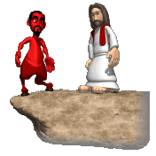
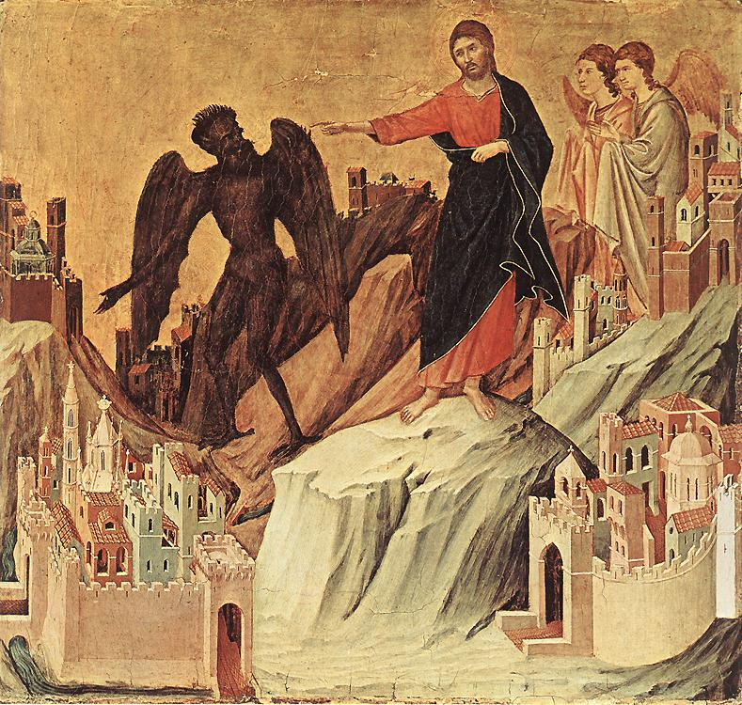
Luke 4: 6 – “I give it to whomever I wish.”

Slide 30
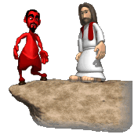

Slide 31
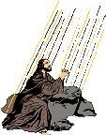
Nature Of This Temptation: Shortcut That Avoids Death

Slide 32
Flashback From Tempting Thought Satan Revisit In Matthew 16: 21
(22) “Far be it from You, Lord; this[crucifixion] shall not happen to You!”
(23) “Get behind Me, Satan! You are an offense to Me, for you are not mindful of the things of God, but the things of men.”

Slide 33
Flashback From Tempting Thought Satan Revisit In Matthew 16: 21
(23) “Get behind Me, Satan! You are an offense to Me, for you are not mindful of the things of God, but the things of men.”
“Peter is to get behind him, opiso mu, which means to follow, do not dictate, and so Peter’s proper position is to be with Jesus and follow where he is going, not to determine the conditions under which Jesus is going to be the Messiah!” - Tim Johnson

Slide 34
Luke 4: 6 – “I give it to whomever I wish.”
HOW?

Slide 35
The Prince Of This World
John 12: 31; 14: 30; 16: 11

Slide 36
“The God Of This World”
@ 2nd Corinthians 4: 4 - “…hath blinded the minds of them which believe not, lest the light of the glorious gospel of Christ… should shine unto them.”

Slide 37
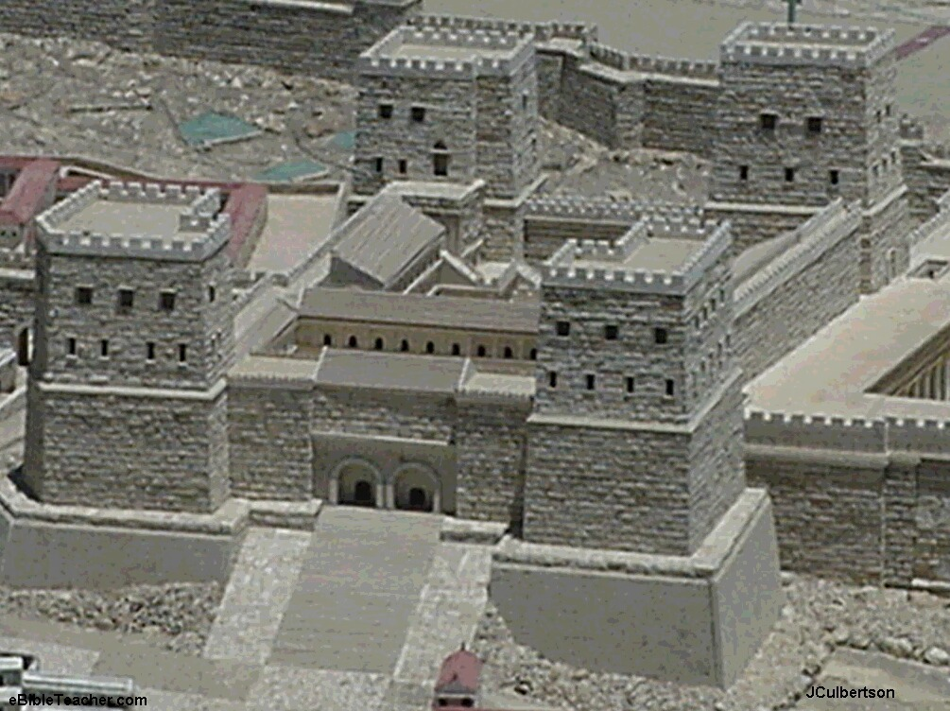
1^{st.} Obvious Outside & Alternative Agency

Slide 38
2^{nd.} God Would Allow Him Other Venue

Slide 39
To Take The Shortcut Would Short. Human Historical Consequences:
Relationship Regime Continuance:
Of Religion Ascribed Over Faith Consented
Of Shallow Shadow Over Spiritual Substance
Of Partiality Of Truth Over Purity Of Truth

Slide 40
iii.
Even...
Darkly Diabolical Tactics Targeting Messianic Mission

Slide 41
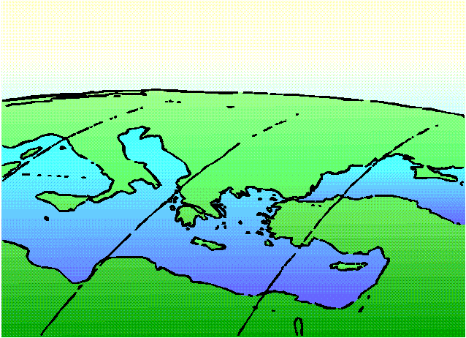
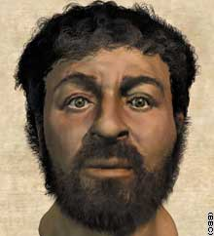
Non-Baltic Culture
My Support Materials From the Biblical Archaeology Society’s 2001 Topical Lectureship Series.
This Social Order That Valued Honor Scoring Overarched Throughout The Mediterranean Rim Of Antiquity.
It Expressed The Core Values Of The Bible World: Honor & Shame
The Writer Luke Felt No Need To Include Background Information For The Modern Western Mindset.
Proper Chapter Division Should Have Started With Luke 3: 23 and Extended Ending With Luke 4: 29.
saving face

Slide 44
Social Honor: Ascribed & Acquired
Military Historian & Greek Essayist Xenophon Said:
“In this man differs from other animals, I mean this craving
for honor…”
In Nicomachean Ethics, philosopher Aristotle said:
“The greatest of external goods – honor…
Being loved seems akin to being honored.
… [we] identify happiness with honor.”
In his City Of God, the theologian Augustine said:
“For the glory that the Romans burned to possess, be it noted… the love of praise. This one vice, that is, the love of praise, they overcame the love of money and many other vices.”

Slide 45
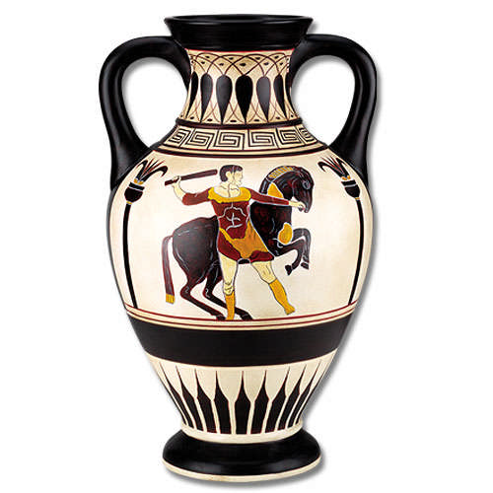
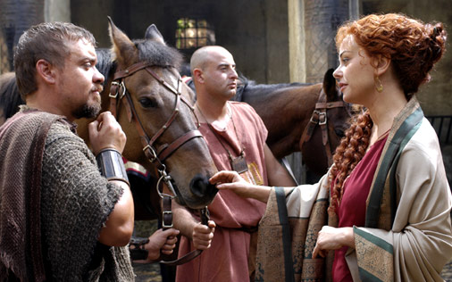
The Equestrian Order

Slide 46
Working Within The Ranking System
Corresponding With The Customs Of Antiquity & Ancient Commentaries By Aristotle – Plutarch – Philo – Josephus
Christ Said To Seek Station Of Humility
In Luke 14: Verses 8 & 9 -
“When you are invited by anyone to a wedding feast, do not sit down in the best place, lest one more honorable than you be invited by him;
“and he who invited you and him come and say to you ‘Give place to this man, and then you begin with shame to take the lowest place.”

Slide 47
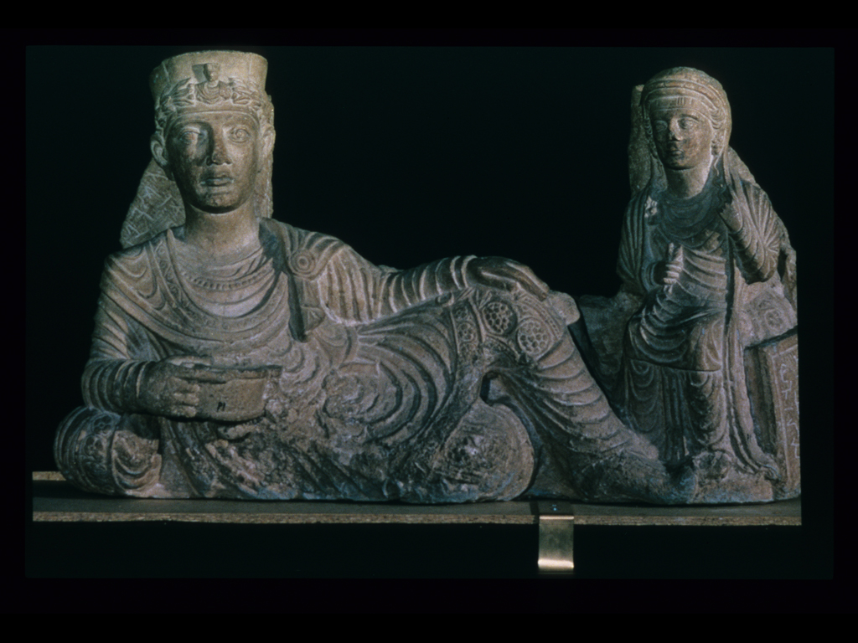

Slide 48
Teachings on Humility
Being Humble 14:7-11
At the same dinner, Jesus noticed how the Pharisees were sitting and gave them advice.
He advised them to sit at a lower place, and they might be moved to a higher place, instead of sitting down at a place of honor and risk being told to move to a lower place.
He said those who exalt themselves will be humbled; and those who humble themselves will be exalted.


Slide 49
Teachings on Humility
Being Hospitable 14:12-15
Jesus advised the one who invited him to the dinner to invite the poor, crippled, lame, and blind instead of his family and friends.
Jesus said that your family and friends can pay you back, but the poor, crippled, lame, and blind cannot.
After this, Jesus expanded on his point by telling a parable about a great dinner.


Slide 50
Teachings on Humility
The Parable of the Great Dinner 14:16-24
A man sent his slave out to let his guests know the dinner was ready.
The guests had excuses for why they couldn’t come.
When the slave’s master heard the excuses he became angry and he had the slave go into the streets and lanes of the town and invite all the poor, crippled, blind, and lame to his dinner.


Slide 51
Teachings on Humility
The Cost of Following Jesus 14:25-35
Jesus said that people who follow him need to make him a priority, even above their families.
People needed to know what they were risking by following him. Jesus compared this to a man estimating the cost of a tower before building it, and a king estimating the cost a war before sending his troops.
Jesus said salt is good, but if it loses its saltiness it is useless.


Slide 52
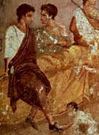

Slide 53
Men Gloried In Honor Not Trusted In Truth!
WHY?
ANSWER:

Slide 54
"Mouth Of Truth"

Slide 55
Ancient Manhole Cover

Slide 56
"La Bocca Della Verita"

Slide 57
Four Hundred Years Earlier

Slide 58
Pericles’ Funeral Oration
FOR WE ARE LOVERS OF THE BEAUTIFUL
IN OUR TASTES AND OUR STRENGTH LIES,
IN OUR OPINION, NOT IN DELIBERATION &
DISCUSSION, BUT IN KNOWLEDGE GAINED
BY DISCUSSION PREPARATORY TO ACTION.
WE HAVE A PECULIAR POWER OF THINKING
BEFORE WE ACT & OF ACTING, WHEREAS
OTHER MEN ARE COURAGEOUS OUT OF AN
IGNORANCE & HESITATE ON REFLECTION…

Slide 60
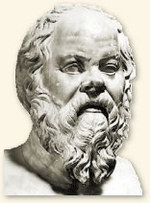
Story Of Socrates
David Lee Burris:
Evolved From Dynamism Thru Animism Thru Polytheism To Henotheism Or Deities Tribal Specific
Lived During Golden Age Of Pericles & He Died At 70 Years Old In 399 B.C.
Suicide Death After Being Personally Publicly Vilified – Aggressively Prosecuted – Ultimately Convicted By 501 Member Size Jury For Crime Of Official Atheism Or Not Believing In Those Gods The State Approved.
Most Influential Figure Of West Philosophy Divided Socratic & Pre-Socratic.

Slide 61
David Lee Burris:
Hubris Followed By Nemesis – Greek God Of Arrogance Precedes Greek Goddess Of Vengeance

Slide 62
Socrate’s Suicide
David Lee Burris:
State Censored From Public Proclaim Of Poor Shepherd Analogy Applied To Athens’ Elite.
“I am the gadfly which God has attached to the state.”
“I would rather die having spoken after my manner, then speak in your manner and live.”
“How little does the common herd know of the nature of right and truth.”
“The unexamined life is not worth living.”

Slide 63
Story Of Socrates
Socrates’ Defense “Apology”
1st – On trial for the charge of impiety, he tells a story as regards the Delphi Oracle proving him devout.
2nd – He continues by saying, “If you kill me, you will not harm me but yourselves, for the eternal law makes it impossible that the good man ever be harmed by a bad one.”
3rd – Evil cannot be done to a good man because of what a man is, because of his essence. Like the oracle, Socrates provides an answer in riddle.
4th – As he proceeds, he explains his answer. Man is a spiritual creature with an eternal soul.

Slide 64
David Lee Burris:
Hubris Followed By Nemesis – Greek God Of Arrogance Precedes Greek Goddess Of Vengeance
"I was really too honest a man
to be a politician and live."

Slide 65
Story Of Socrates
David Lee Burris:
“Socrates Meets Jesus” By – Peter Kreeft
Socrates’ Defense “Apology”
5th – He Applied Syllogistic Language Of Logic Elenchos As A Legal Brief: By obtaining agreement on each premise it would necessarily require acceptance of all his conclusions.
6th - The Health Of The Soul Is Through The Knowing Of One’s Self & Of Our Mutual Human Nature.
7th – The Health Of The Soul Is Through Lifting Truth, Loving True Wisdom, & Learning Ethical Virtue.
8th – Evil Is The Effect Of Ignorance & Cure To Moral Vice Is Knowledge.
Moral Of This Story
What Socrates Missed Was The Ego & The
Will. As We Now Know There Are Many
Morally Bankrupt Intellectuals. Jesus Christ
Addressed This Void About 400 Years Later.

Slide 66
David Lee Burris:
Hubris Followed By Nemesis – Greek God Of Arrogance Precedes Greek Goddess Of Vengeance
"I'm content with feeling a conviction
the eye of heaven is perpetually upon me;
that its divine providence & justice
will watch me in the next (life)"

Slide 67
Story Of Socrates
David Lee Burris:
Student Plato’s Four Great Truths: Our problem is that we are not good but full of vices – The cause of this is ignorance – The solution to the world’s problem is virtue. Good people make a good society – The way to virtue is knowledge of the Good.
Setting The Stage
Socratic Screening
Discussant Debate
1st – Is It True?
2nd – Is It Good?
3rd – Is It Useful?

Slide 68
Mara Bar-Serapion
Some time after the destruction of Jerusalem, Mara, a Syrian & probably Stoic philosopher, wrote a prison letter to his son, encouraging him to pursue wisdom. In his letter Jesus is compared to the philosophers Socrates and Pythagoras, writing, “What advantage did the Athenians gain from putting Socrates to death? Famine and plague came upon them as a judgment for their crime. What advantage did Samos gain from burning Pythagoras? In a moment their land was covered with sand. What advantage did the Jews gain from executing their King? It was just after that that their kingdom was abolished.”

Slide 69
Mediterranean bible rim Culture
My Support Materials From the Biblical Archaeology Society’s 2001 Topical Lectureship Series.
This Social Order That Valued Honor Scoring Overarched Throughout The Mediterranean Rim Of Antiquity.
It Expressed The Core Values Of The Bible World: Honor & Shame
The Writer Luke Felt No Need To Include Background Information For The Modern Western Mindset.
Proper Chapter Division Should Have Started With Luke 3: 23 and Extended Ending With Luke 4: 29.
saving face

Slide 70
Classical Culture Continuous About the Mediterranean Rim Virtue Priced Honor Over & Above Truth!

Slide 71
Mediterranean bible rim Culture
This Social Order That Valued Honor Scoring Overarched In The Mediterranean Rim Of Antiquity.
It Expressed The Core Values Of The Bible World: Honor & Shame
The Writer Luke Felt No Need To Include Background Information For The Modern Western Mindset.
Proper Chapter Division Should Have Started With Luke 3: 23 - & - Extended Ending With Luke 4: 29.
This Approach Provides The Proper Insight Into What Are Internal Indicators Of Intent & By That Illumination A Better Interpretation Of Verses 5 – 8

Slide 72
David Lee Burris:
Show KELLS Clip That Links Chap 3 & 4.
Mediterranean bible rim Culture
Professor Richard Rohrbaugh
Of Lewis & Clark Has Outlined:
These Verses In Total Amount To An Honor Test With Both Challenge and Response.
It Begins With The Honor Claim Found In Chapter Three – What Would Have Been Considered An Audacious Genealogy Traced All The Way Back To Father Adam and Then To The Almighty Himself.
During Bible Times and In That World - To Give Others Instruction Or To Have The Right Of Public Speech – Required Recognition Of Honor.
Honor Was Of Paternal Family Origin and Normatively Was Ascribed By The Ranking Of One’s Father and According To His Achievements.

Slide 73
Mediterranean bible rim Culture
Professor Richard Rohrbaugh
Of Lewis & Clark Has Outlined:
First & Second Stories Of Luke Chapter Four Are To Be Related Together As Both The Test & The Proof Of This Ultimate Genealogy & Claim Of Highest Honor.
Frequently, This Was A Game Of Wits; For With Every Heckler Challenge An Appropriate Answer Was Required. Perceptions and Expectation Norms Of Carefully Measured Response Had To Be Met To Maintain Both The Present & Obtain The Potential Audience.

Slide 74
Mediterranean bible rim Culture
Professor Richard Rohrbaugh
Of Lewis & Clark Has Outlined:
Satan Challenged The Lord’s Status Ranking Through Family By Way Of Charging Repeatedly ‘If you are the Son of God…’
Under This Classical World Honor System The Only Acceptable Way Of Demonstrating The Rank Of The Loyal Son Was By His Quoting The Beloved Father.
Lord Quotes Deuteronomy Linking To Manna & The Metaphor Of Forty
In That Sea Rim World To Resist One’s Adversary For 40 Days Made Any Duel By Then A Draw – W/O A Status Game Winner.

Slide 75
Mediterranean bible rim Culture
Professor Richard Rohrbaugh
Of Lewis & Clark Has Outlined:
What Immediately Followed Was The Offer Of Exchange.The Son Of Man Would Get The Due Honor Of Men By Paying Homage To Satan.
To ‘Worship’ In Literal Greek Meant ‘Fall Down In Front Of’ To Privately Greet By A Kiss On The Cheek Was Seen As Polite Deference To Another. But The Public Kissing Of Anothers’ Feet Was The Salutation & Expected Courtesy Of The Social Inferior - See Acts 10.

Slide 77
Mediterranean bible rim Culture
Professor Richard Rohrbaugh
Of Lewis & Clark Has Outlined:
As Christ Conveys His Experience In Public To The Narrative Of Luke His Middle Eastern Audience Has Likely Had Their Ears Perked By Recitation Of The Old Testament Scripture and By His Approach Of The Good Son.
After The Significant Period Of Forty Days, When Satan Ceases Cosmic Assault & Readily Departs, Many If Not Most Of This Targeted Audience Are Now Receptive To The Possibility That There Maybe More Here Than Meets The Eye With This Low Born & Very Humble Carpenter’s Son Of Nazareth.

Slide 78
Mediterranean bible rim Culture
Professor Richard Rohrbaugh
Of Lewis & Clark Has Outlined:
Moreover, As Honor Was Not Real Unless Recognized - The Original Middle-Eastern Reader Would Be Moved From Impressed To Astonished That - The Activities Of This Very Insignificant Individual Of Lowly Birth Were Treated As Would Be Those Of A Person Of High Note - As We Can See Reading Verses 14 & 15.
However, They Would Probably Suspend Their Verdict Until The Judgment Of The Claimant’s Old Home Town Was Made Known – This Was The Third Of Our Related Events & The Last In This Chained Sequence Of Salient Passages.

Slide 79
Christ Came Down From That Mountain!

Slide 80
Torturous Temptation For Truth
As Dietrich Bonhoeffer Wrote To The Western Mindset In The 20th Century Linking Concepts Of Suffering With Those Of Human Tempting…
Be Open To The 1st Century Oriental Versus Occidental Mindset Where Torture & Fasting Were Considered Induced Occasions Of Absolute Honesty & Heightened Lucidity.
Torture Was An External Initiative While Fasting Was An Internal Discipline Both Bringing The Individual To Their Edge Of Reality Where Resided Truth In Its Purity.
Jesus Experienced Both Forms Together By Way Of The Intrusion Of Satan - We Have An Emotional Trial Along With The Physical One.

Slide 81
Dietrich Bonhoeffer On Temptation
“The night of the last words of Jesus – ‘My God, my God, why hast thou forsaken me’ – has fallen, it must follow the hour of this wilderness temptation as the last fleshly-spiritual, complete temptation of the Savior. The suffering by Jesus of abandonment by God and man is God’s Word and judgment for him.” - page 121

Slide 82
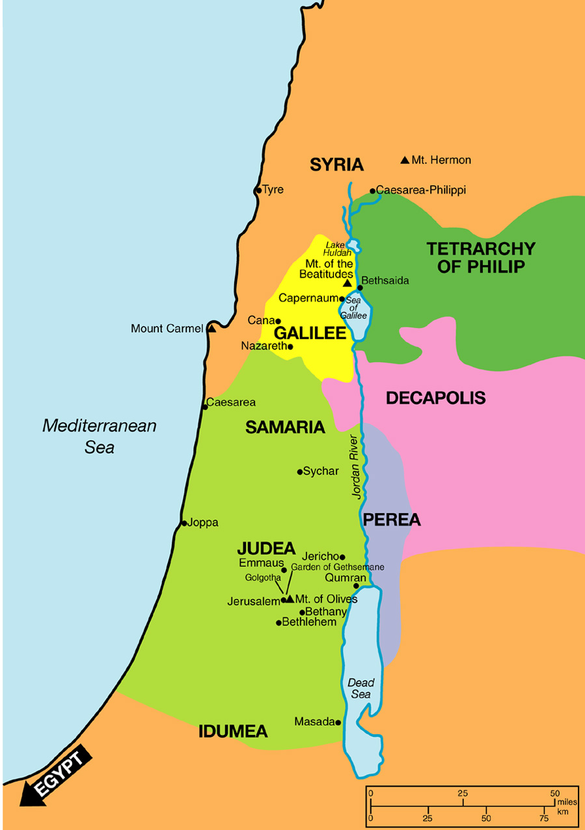
After being tempted by the devil, Jesus returns to Galilee

Slide 84
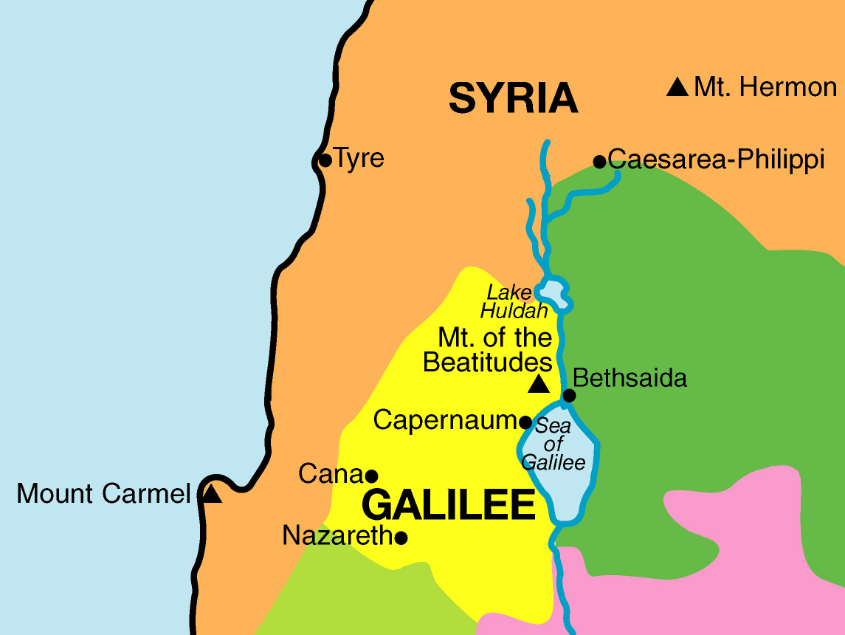
Jesus returns to his hometown of Nazareth

Slide 87
Synagogue
Metonymy
Religious
& Social
Activity

Slide 89
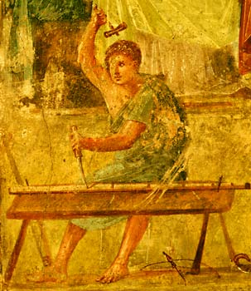
Mediterranean bible rim Culture
Professor Richard Rohrbaugh
Of Lewis & Clark Has Outlined:
When Jesus Assumes The Same Role In The Public Reading Of Torah – In This Case That Of Isaiah - As Is His Regular Practice In The Regional Synagogues – Per Verse 15 – He Gets Mixed Reception In His Hometown Of Little Nazareth – – Per Verse 22.
In Verse 21 He Makes This Same Ultimate Honor Claim That He Had Successfully Defended Privately On The Ubiquitous & Invisible Cosmic Level – To Finish Up His Defense and To Complete His Claim He Publicly Pronounces It At The Local Level Of His Home Town Where He Was Raised From Youth.

Slide 90
Mediterranean bible rim Culture
Professor Richard Rohrbaugh
Of Lewis & Clark Has Outlined:
The Small Town Village Residents and His Home Neighbors Would Not Recognize Or Respect An Exaggerated Ascribed Claim.
Jesus Performed An Honorific & Selective Assignment When He Was Challenged By Way Of An Family Insult. If This Were Not Complex By Way Of Challenge Response It Would Be Routine Or In Kind. But Such Insult Often Merited Increase. With Every Escalation This Game Of Wits Turns Into Spiraling Competition. Both Individuals Can Lose Honor By Resorting To Physical Violence. Truth Test: Who Loses Control Loses Honor!

Slide 91
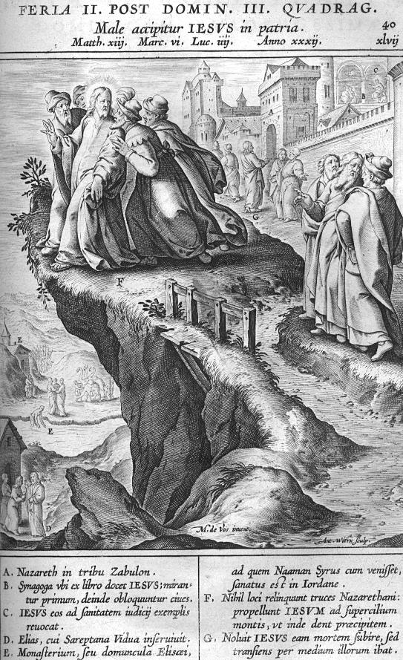

Slide 92
Mediterranean bible rim Culture
Professor Richard Rohrbaugh
Of Lewis & Clark Has Outlined:
Mutually Respected Third Parties Have To Be Identified To Stabilize The Situation. In This Instance, Due To The Nature Of The Claim, By Definition, No Qualified Third Party Neutral Would Be Located.
Although, Jesus Was Of Agony In Verse 24 - As To The Difficult Circumstances - As It Played Out In Verse 29 – From The Written Perspective Of The Greek Reader – At The Story’s End Jesus Christ Had Finally Handled Successfully His Worse Slight Of Honor – That From Them Whom Had Known Him Always!

Slide 93
1st century Culture
Scriptural Evidence As To The Reach, Control & Influence Of Such Social Systems Is Illustrated By The Very First Converts Of Messianic Message & of the Early “Godfearer” Audience – Those Blame Marginalized and Shame Game Losers – Publican & Prostitute Referenced Specific @Matthew 21:31

Slide 94
Jewish Savior Became Instead Their Great Stumbling Stone
The idea of a sacrificed Savior didn’t sit well with a performance oriented religion.
God often doesn’t measure up to the way we want things done: the Jews wanted a militant Messiah, God sent a Lamb, they wanted a crown, He sent a cross, they wanted political freedom, and He gave them personal freedom.
The idea of simply trusting was too good to be true and too hard to believe for them then and for many seekers of truth today.

Slide 95
scribe

Slide 96
“A half-truth is a whole lie.” Jewish Proverb

Slide 97
“Truth can
be denied,
but it can’t
be avoided.”
- Author Unknown

Slide 98
Jewish Savior Became Instead Their Great Stumbling Stone
He fulfilled everything the law required & qualified to be their long sought Savior.
Because He fulfilled everything the law required He showed that God was justified in judging lawbreakers.
His idea of how to get right with God seemed to undo the undoable.

Slide 99
No Room For Jesus
GETHSEMANE PLACE OF THE PRESS

Slide 100
Ephesians 5: 9
“for the fruit of the Spirit is in all goodness, righteousness, & truth.” (NKJ)

Slide 101
Ephesians 6: 14
“Stand therefore, having girded your waist with truth, having put on the breastplate of righteousness.”(NKJ)

Slide 102
John 8: 32
“And you shall know the truth, and the truth shall make you free.” (NKJ)

Slide 103
John 14: 6
Jesus said to him, ‘I am the way, the truth, and the life. No one comes to the Father except through Me.’ (NKJ)

Slide 104
Psalms 108: 4
“For Your mercy is great
above the heavens,
And Your truth
reaches to the
clouds.” (NKJ)

Slide 105
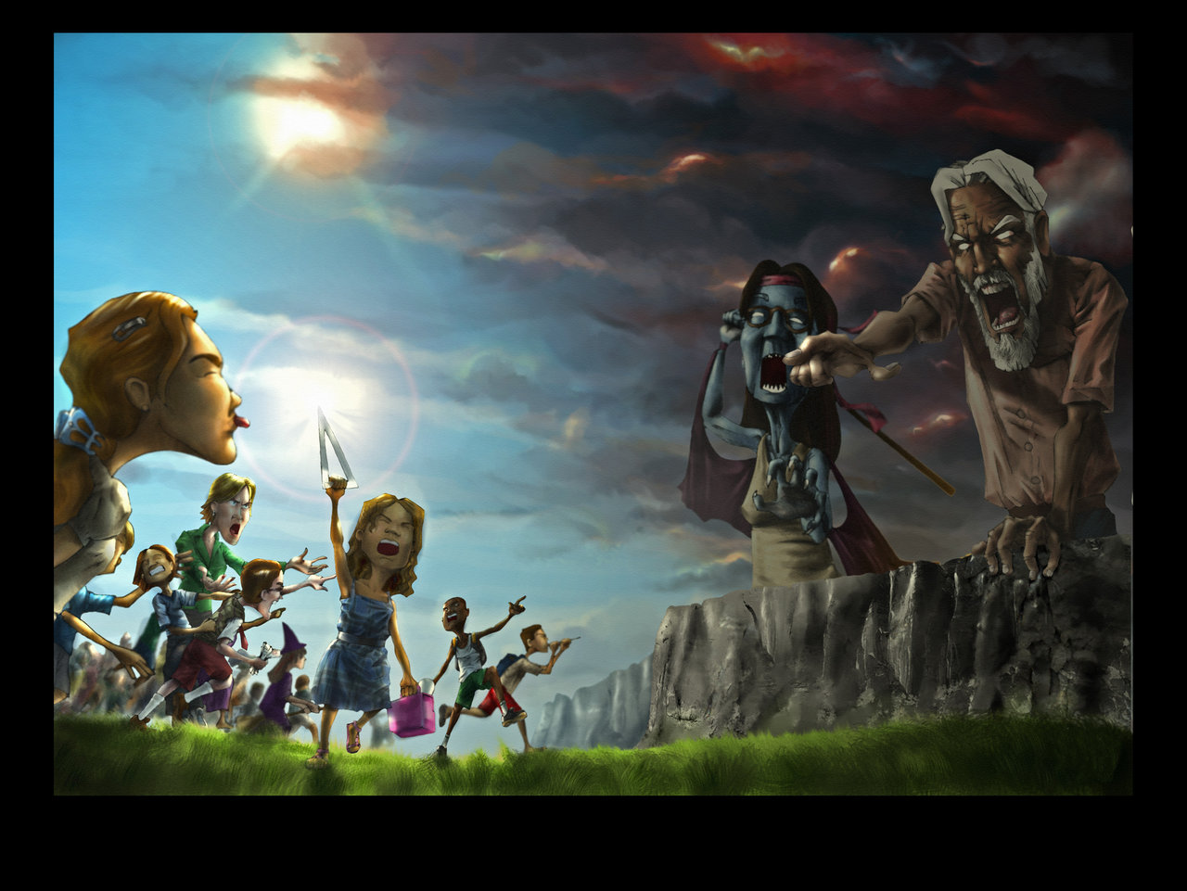
C. S. Lewis On Inherited Religion
“This very obvious fact that – - each generation is taught by an earlier generation – must be kept very firmly in mind. No generation can bequeath to the next generation what it has not got. … If we are skeptical we shall only teach skepticism to our pupils, if fools only folly, if vulgar only vulgarity, if saints sanctity, if heroes heroism. Education is only the most fully conscious of channels whereby each generation influences the next.”

Slide 106
Pontius Pilate
David Lee Burris:
Notice - Jewish Leaders Are To Pilate Being Both Obsequious & Appealing Pandectic
“What Is Truth?”

Slide 107
Jesus Christ
In John 4: 40, 41
“But you are not willing to come to Me that you might have life,
I do not receive honor from men.”

Slide 108
Savior’s Rejection
Explained In John 12: 43
“For they loved the
praise of men more than the praise of God.”

Slide 109
EDEN’S LOST SHAME ENDS NAKED ON THE CROSS

Slide 111
Pythagorus
In Sixth Century B.C. Wrote:
“Truth is so great a perfection, that if God would render Himself visible to men, He would chose light for His body & truth for His soul.”

Slide 112
George Orwell
“In a time of universal deceit, telling the truth becomes an act of rebellion.”

Slide 113
Joseph Sobran
“The attempt to silence a man is the greatest honor you can bestow on him. It means you recognize his superiority to yourself.”

Slide 114
Thomas Sowell
“There are only two ways of telling the complete truth – anonymously & posthumously.”

Slide 116
Truth Does Not Count Legally. The Concern Of Law Is Proof.
Of God's Love
THE TREE
Christ’s Death On Calvary’s Tree
Is Proof Of Gods Love For Man

Slide 117
Today’s Honor System
Our Era’s Equivalent To Honor Is Ethics
Our Era’s Equivalent To Truth Is Morals

Slide 118
Psalm 49: 20
“Man who is in honor, yet does not understand, is like the beasts that perish.”

Slide 119
Roger Anderson
“The world has a problem; it seeks to honor, uphold, exonerate and generally praise itself.”

Slide 120
Midori Koto
“Honor isn’t about making the right choices. It’s about dealing with the consequences.”

Slide 121
Andrew Carnegie
“All honor’s wounds are self-inflicted.”

Slide 122
African Proverb
“Where there is no shame, there is no honor.”

Slide 123
Philippians 3: 18,19
“They are the enemies of the cross of Christ: whose god is their belly, whose glory is in their shame.”

Slide 124
Scripture Proverbial
SINFUL SORROW SUPERSEDES SOCIAL SHAME

Slide 125
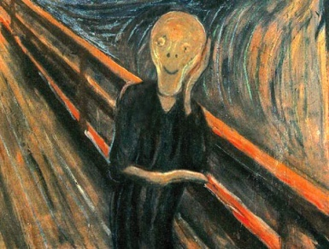
Different Perspective
NEW VISION

Slide 126
Lord Took On Himself Legal Guilt
Savior Took On Himself Social Shame

Slide 127
Cost Of The Lie “Paid In Full” …

Slide 128
That We Might Become…

Slide 129
Change Of Heart
Changes Of Life
Critical Change Of Relationships

Slide 130
In Antiquity Public Speakers Had To Be Authorized To Speak Under The Bible World’s Stratified System Of Honor Ranking.
Moreover, The Ancient Audience Of The Marketplace Or Public Square Could Only Be Maintained By Speaking With Authority.
Speakers Had To Withstand Questions Both Topical & Personal.
Our Lord Here Was An Example Of An Exceptional Speaker.
The Gospels Were Written Record Of His Oral Communications, The Audience Questions, & His Detailed Answers Of Deep Truth.
They Were Read As Treatises Of Deliberation & Conversation Including Instruction In Story Parables & Socratic Dialogue.
Our Lord Here Was An Example Of An Extraordinary Teacher.
Because Christ Additionally Asked Questions Of His Audience He Would Have Been Regarded Highly As A Master Teacher.
Because His Questions Continue To Resonate With Relevancy & To Work Within Our Hearts Current – He Is In His Own Category!
However, These Instances Are Included As Tools For Today, Ensamples For Edification & Instruction In Our Own Mission!

Slide 131
Pontius Pilate
David Lee Burris:
Notice - Jewish Leaders Are To Pilate Being Both Obsequious & Appealing Pandectic
“What Is Truth?”

Slide 132
MANKIND MADE IN HIS IMAGE
Genesis Chapter One, Verse 26
“And God Said, Let Us Make Man In Our Image, After Our Likeness…”

Slide 133
Imago Dei: In His Image
“According to Genesis 1: 26-27 [mankind was made] in God’s image. As the crown of God’s creation humanity uniquely displays the image of God by his rational capacities, moral volition, relational distinctives, spiritual qualities, & dominion over nature. Humans reflect the splendor of their Maker, yet in finite expression. As image-bearers humans possess inherent dignity & moral worth and should be treated with respect…”
Hugh Ross, Reasons To Believe, reasons.com

Slide 134
MANKIND ACTED AS AN ENEMY
Romans Chapter Five, Verses 7 thru 10
“For scarcely for a righteous man will one die: yet peradventure for a good man some would even dare to die.
…But God commendeth his love toward us, in that, while we were yet sinners, Christ died for us. (8)
…Much more then, being now justified by his blood, we shall be saved from wrath through him. (9)
For if, when we were enemies, we were reconciled to God by the death of his Son, much more, being reconciled, we shall be saved by his life.”

Slide 135
MANKIND TREATED AS FAMILY
Romans Chapter Five, Verses 7 thru 10
“For scarcely for a righteous man will one die: yet peradventure for a good man some would even dare to die.
…But God commendeth his love toward us, in that, while we were yet sinners, Christ died for us. (8)
…Much more then, being now justified by his blood, we shall be saved from wrath through him. (9)
For if, when we were enemies, we were reconciled to God by the death of his Son, much more, being reconciled, we shall be saved by his life.”

Slide 136
MANKIND TREATED AS FAMILY
Romans Chapter Eight, Verses 14 thru 17
“For you did not receive the spirit of bondage again to fear, but you received the Spirit of adoption by whom we cry out,
‘Abba (Daddy), Father’ ”

Slide 137
MANKIND TREATED AS FAMILY
Galatians Chapter Four, Verses 4 thru 7
“And because you are sons, God has sent forth the Spirit of His Son into your hearts, crying out,
‘Abba (Daddy), Father’ ”

Slide 138
Piercing Through To The Truth!

