Slide 1
CHURCH HISTORY AS FAMILY HISTORY
Family Tree: Restoration Movement 1832 Handshake: Movement Marriage Post-Civil War: Uncivil Movement Divorce
By David Lee Burris

Slide 2
Family History From Family Bibles: Physical Births & Spiritual Rebirths
EVER OPENED UP someone else’s old photo album?
Grandparents, aunts, second cousins, old Ford Model Ts, big hats. Or boat cars and poodle skirts. People smiling into long-vanished sunsets and sunrises. At first, it seems confusing. Maybe you can pick out an era, but these aren’t your grandparents and your second cousins, your stories, or your inside jokes.
But then you talk to the people who own the photo album. You listen to their stories and the photos come alive. You learn what it meant to be part of that family in all its struggles and heartaches and joys. What it meant to live at that moment in history.
What does this photo album teach the rest of us? Things we already knew, but things it is good to remember. The centrality of the Bible. The centrality of the body of Christ. How American culture and the Christian message influenced each other.
And how difficult it is to be “simply Christian.” Even when you go whole hog. Traditions and human constructions can turn out to be, in the end, inescapable. But also inescapable, in the end, is the grace of God. Thanks be to God, who redeems all constructions. – Editoral Notes Christian History Special Issue Stone-Campbell Movement

Slide 3
EPISODES & EVENTS: ALEXANDER CAMPBELL
1816 – Alexander Campbell @Baptist Redstone Congregation Delivers “Sermon on the Law”
NOTE: Thomas & Alexander Campbell Expelled for Teaching The Gospel Greater Than The Law.
1820 – Baptist Alexander Campbell Debates Presbyterian John Walker on the Topic of Infant Baptism.
1823 – Baptist Alexander Campbell Debates Presbyterian Will McCalla on the Topic of Infant Baptism.
1829 – Baptist Alexander Campbell Debates the Scotland Atheist Robert Owen on the Topic of “Religion the Cause Not the Answer to Social Problems.” (paraphrased)
NOTE: Alexander Campbell’s Argumentation was Nationwide Media Followed Representing Christian America
1830 – Unaffiliated Alexander Campbell Debates Presbyterian Obadiah Jennings on the Topic of “The Cult or Sect of Campbellism.”
1837 – (Christian Only) Alexander Campbell Debates Catholic Bishop John Purcell on the Topic of “Protestantism Versus Catholicism.”
1843 – (Christian Only) Alexander Campbell Debates Presbyterian Rice on the Topic of the “Operation of the Holy Spirit.”
1847 – Alexander Campbell Arrested During Scotland Tour Speaking on Slave Controversy.
1848 – Alexander Campbell Speaks Before U.S. Congress on the Subject of Carnal Warfare.
1849 – Alexander Campbell Accepts Presidency of American Christian Missionary Society.
1853 – Campbell Confronts Nashville’s Jesse Ferguson’s Last Chance Post-Mortem Gospel

Slide 4
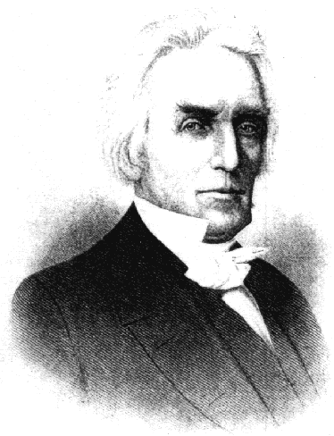
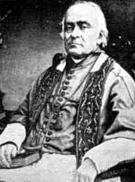
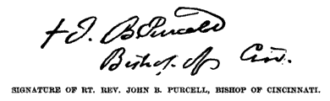
1837 The Campbell- Purcell Debate
On Catholicism vs. Protestantism
Held In January 13-21, 1837, Cincinnati, Ohio
John Baptist Purcell (1800-1883) was the 37 yr. old Bishop Of Cincinnati,
Campbell was 48
Regard for relics was rising with
5,ooo @ St. Anthony’s, Pittsburg
Notes:
Concerning the debate with Bishop Purcell, the Harbinger published, in 1837, the following from the Cincinnati Daily Gazette:
THE GRAND DEBATE.
As my opinion of the late discussion of the respective merits of Protestantism and Catholicism has been solicited by friends whose wishes I ought to respect, the following brief statement is submitted, with the hope that it will give no just cause of offense to any man or to any party.
Having attended throughout the discussion, with as much regularity as I conveniently could, I retired at the close, with increased confidence in the character of both Mr. Campbell and Bishop Purcell; being convinced that if the debate should be faithfully published, it would, in several ways, have a good influence upon society.
Mr. Campbell, I think, sustained the cause of Protestantism with candor, and with great ability; his documentary proofs were abundant and decisive, and his arguments were incontrovertible; and it is difficult to conceive how any impartial mind can hesitate to admit, that he deserves to be respected by Protestant Christians of all denominations, for this magnanimous effort to diffuse light upon a subject which we believe essential to the best interests of all mankind.
The Bishop also exhibited a degree of mildness and liberality of sentiment, that was not anticipated. His addresses, taken altogether, were calculated to make a good impression, both upon Protestants and upon Catholics: from the former they would remove prejudice, and incline to exercise more charity towards our Roman Catholic brethren; and on the latter, they tended to make the impression, that the spirit of persecution ought not to be indulged, and that the practice of it ought never to be adopted in these United States of America.
The Bishop has defended his cause with considerable ingenuity, and sometimes with striking displays of eloquence. We were pleased to notice his efforts to modify the Papal system, and to abandon the dark foundation of his predecessors; and we rejoice in the hope, that the Roman Catholic religion is not so infallible as to be incapable of improvement in the sunshine of American liberty.
Such of Mr. Campbell's positions as could be encountered with apparent plausibility, were promptly met by the Bishop; others, more [448] formidable, were passed by in silence. The ingenuity of this learned advocate of clerical power, in removing the impression made by the arguments of his antagonist, were sometimes very striking; insomuch, that some Protestants who were in attendance, were probably not without their fears that their cause would suffer loss by the controversy. Mr. Campbell, however, returned to the charge with a composed dignity, and with a freedom from all signs of intimidation, which evinced to all spectators that he had no misgivings of mind, and that he knew well the solidity of the ground on which he had taken his stand.
There was no point at which the Bishop appeared to falter more, than in his weak attempt to set aside Mr. Campbell's arguments, founded upon the prophecies of Daniel, the Apocalypse, and the Apostle Paul. Here, it is presumed, intelligent Catholics began to tremble for their champion. Mr. Campbell constantly saw his advantage, and improved it with a promptness and skill not often equalled, and perhaps never surpassed.
If the whole of this debate be faithfully published, I can not help thinking it will furnish a mental feast to the intelligent public, and that it will have a tendency no less to promote charity, than to disperse the mists of delusion, and to place the truth in a clear light before a rising and inquiring posterity.
In regard to Mr. Campbell's peculiar sentiments, I have not had the means of knowing precisely what they are. Whatever they be, they were not brought into this debate; for he took his stand, and kept it, on that firm ground which was occupied by the original Reformers, and on which Protestants of all denominations will readily agree with him. If he holds peculiar opinions which are injurious to this great cause, it is truly to be lamented; and we may hope that a good Providence will yet lead him out of such dangerous mistakes; for a mind like his ought always to be public property, as it was in the late famous discussion in the city of Cincinnati.
In conclusion, I will take the liberty to say, that I have no other feeling than that of affection and good will; both for Mr. Campbell and his learned and ingenious opponent, and while my faith in Protestantism is confirmed, my charity for the Catholic communion is considerably enlarged.
A. SHINN.
There is no abler defense of Protestantism in the English language than the Campbell-Purcell debate.
- Benjamin Lyon Smith, The Millennial Harbinger Abridged, (1902) pages 447-450

Slide 5
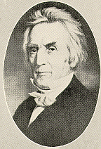
1843 Campbell-Rice Debate, Campbell's Last Public Debate Lasted Sixteen Days
1843 – 55 Years Old

Slide 6
Family History From Family Bibles: Physical Births & Spiritual Rebirths
DENOMINATIONS = DEGREES OF REFORM
SACRAMENTAL/LITURGICAL TRADITIONALIST
ANTI-TRADITIONAL REVIVALISTS MOVEMENT
RATIONALISM + NATURALISM
PRE-RESTORATION SCOTLAND
PRE-RESTORATION AMERICA
THE FIRST GREAT AWAKENING
THE SECOND GREAT AWAKENING
1832: RATIONALISM + REVIVALISM

Slide 7
OVERVIEW: ANCIENT ORDER RESTORE POINT
RACOON SMITH ENVOY CAMPBELL DISCIPLES TO STONE FOLLOWERS
RACOON SMITH EXTENDS THE RIGHT HAND OF FELLOWSHIP(1832)
RIGHT HAND METAPHOR – OATH, POWER, STRENGTH, ALLEGIANCE
RESTORATION COMMITMENT: TO USE BIBLE WORDS IN BIBLE WAYS
1832 HANDSHAKE REPRESENTS: RATIONALISM JOINS REVIVALISM
DISCIPLES DEVELOP RESTORED AUTHORITY LEVEL DECISION TREE
LEVELS: COMMAND – EXAMPLE – NECESSARY IMPLICATION/INFERENCE

Slide 8
Levels of Authority
Ideas discerned from the text have different levels of authority. That is to
say, some propositions derive less directly from the Bible than others.
Direct biblical authority describes ideas that exactly correspond to the teaching of the text. The sermon preaches what the Bible teaches.
Indirect biblical authority describes ideas that are only inferred from the text.
Casual biblical authority describes ideas that are only vaguely suggested by the text.
Corrupted biblical authority describes ideas that twist the meaning of the text into something it never intended.

Slide 9
David Lee Burris: Arrival At Formal Doctrine
Amphiboly Of Multiple Meaning Contextually Limiting; What Is Behavioral Approved Thread?
Tertiary Concept From 1647 Westminster Confession “necessary consequence scriptural deduced”
Disciples Decision Science:
Primary: Direct Command
Secondary: Approved Example
Tertiary: Necessary Implication

Slide 10
“Necessary Inference” by Hugo McCord: On the Subject of Inherited Sin
“Nowhere does the Bible say that children are born pure and sinless, but such is a necessary inference from Jesus’ words: ‘Permit the little children to come to me, and do not forbid them, for of such is the kingdom of heaven’ (Matthew 19: 14).”

Slide 11
“Necessary Inference” by Hugo McCord: On the Issue of Believer’s Baptism
“Nowhere does the Bible say that one must be old enough to believe before being baptized. But teaching must precede baptism: ‘Go ye therefore, and teach all nations, baptizing them’ (Matthew 28: 19). If teaching must precede baptism, it is a necessary inference that infants are not scriptural subjects for baptism.”

Slide 12
“Necessary Inference” by Hugo McCord: On Opinions of Goodness Salvation
“The Bible does not say that a good man unbaptized will be lost. However, since Cornelius was a good man (Acts 10: 2) but unsaved (Acts 11: 14) until his baptism in ‘water’ (Acts 10: 47,48), one has to infer that goodness alone will not save a person.”

Slide 13
“Necessary Inference” by Hugo McCord: On Conviction in Good Conscience
“The Bible does not say that a good conscience is insufficient to save a sincere person. However, since Paul with a ‘good conscience’ (Acts 23: 1) was the ‘chief of sinners’ (1Timothy 1: 15), one has to infer that something besides a good conscience is required for salvation.”

Slide 14
“Necessary Inference” by Hugo McCord: On the Topic of In & Out of Grace
“The Bible does not say that one ‘fallen from grace’ (Galatians 5: 4) had been in grace, but since one cannot fall out of something unless he had been in that something, it follows that the Galatian Christians who fell out of grace had been in grace.”

Slide 15
OVERVIEW: ANCIENT ORDER RESTORE POINT
1830 – Alexander Campbell Addresses the now Mormon Rigdon
Church of Christ Congregation Change Double Populate Mormonism
1860 - COMBINED RESTORATION 5TH LARGEST RELIGIOUS BODY U.S.
RESTORATION COUNTERS HISTORICAL META-NARRATIVE THREADLINE
CAMPBELLS RESPECTED OLD WORLD & NEW – REFORMERS & ELITE
ALEXANDER CAMPBELL POPULAR IN CHURCH CORRUPTION ATTACK
CORRUPT SOURCES: DIFFERENTIAL HIERARCHY & CHURCH W/STATE

Slide 16
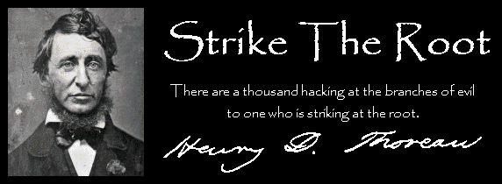
Churches Of Christ In The United States

Slide 17
Restoration Movement Principles “OUR POSITION” BY ISAAC ERRETT
David Lee Burris: POST-CIVIL WAR STANDOUT
Governor Of Ohio Wrote Of Errett: “In preaching he showed large practical sense in meeting thoughtful people on their own ground, appealing to canons of morals and of natural religion.”
“While agreeing on the divine inspiration of the Old and New Testaments, we differ on the question of their equal binding authority on Christians. With us, the Old Testament was of authority with Jews, the New Testament is now of authority with Christians.”

Slide 18
Restoration Movement Principles “OUR POSITION” BY ISAAC ERRETT
“While agreeing that the Bible furnishes an all-sufficient reve- lation of the Divine will and a perfect rule of faith & practice, we disagree practically in this; We act consistently with this principle, and repudiate all human authoritative creeds.”

Slide 19
Restoration Movement Principles “OUR POSITION” BY ISAAC ERRETT
“While heartily recognizing the perpetual agency of the Holy Spirit in the work of conversion – we repudiate all theories of spiritual operations and all theories of the Divine and human natures which logically rule out the word of God as the instrument of conversion, or which make the sinner passive and helpless, regarding regeneration as a miracle, and leading men to seek the evidence of acceptance with God in special revelations, rather than in the unchangeable promises of the gospel.”

Slide 20
Restoration Movement Principles “OUR POSITION” BY ISAAC ERRETT
“While agreeing with all the evangelical in the necessity of faith and repentance, we differ in this: We submit no other tests but faith & repentance, in admitting persons to baptism and church membership; we demand no narration of a religious experience other than expressed in a voluntary confession of faith in Jesus; we demand no probation to determine their fitness to come to church.”

Slide 21
Restoration Movement Principles “OUR POSITION” BY ISAAC ERRETT
“The Lord’s day – not the Jewish Sabbath – is a New Testament observance, which is not governed by statute, but by apostolic example and the devotion of loyal and loving hearts.”

Slide 22
Restoration Movement Principles Negative & Positive
It did not aim at merely correcting existing errors like the Reformation, but sought to lay aside errors to return to the Bible truths.
The Reformation leaders had no intention of adding another denomination to the many already existing. They sought rather to eliminate sectarianism by the return to the New Testament order of things.
They sought to reproduce the simple way of Christ by forsaking human devices, and the discarding of everything not found in apostolic Christianity.
The Restoration movement was not the idea of one person, but of many who were unhappy with sectarian dogmas.
A recognition of Christ as the sole and sovereign head of the church.
The acceptance of the New Testament as the only rule of faith and practice for Christians.
The making of a proper distinction between the Old and New Testaments.
The restoration of the apostolic church, with the simplicity of its order, as revealed in the New Testament.
The restoration of the autonomy of the local congregation.
The unity of all believers, produced by the above propositions.
The spirit and aim of the Restoration movement are expressed in the slogans adopted by its great leaders:
“Where the Scriptures speak, we speak; where the Scriptures are silent, we are silent.”
“No book but the Bible; no creed but Christ; no name but the divine name.”
“In faith, unity; in opinions, liberty; and in all things, charity.”

Slide 23
Family History From Family Bibles: Physical Births & Spiritual Rebirths
DENOMINATIONS = DEGREES OF REFORM
SACRAMENTAL/LITURGICAL TRADITIONALIST
ANTI-TRADITIONAL REVIVALISTS MOVEMENT
RATIONALISM + NATURALISM
PRE-RESTORATION SCOTLAND
PRE-RESTORATION AMERICA
THE FIRST GREAT AWAKENING
THE SECOND GREAT AWAKENING
1832: RATIONALISM + REVIVALISM
RE-BIRTH: NON-DENOMINATIONALISM

Slide 24
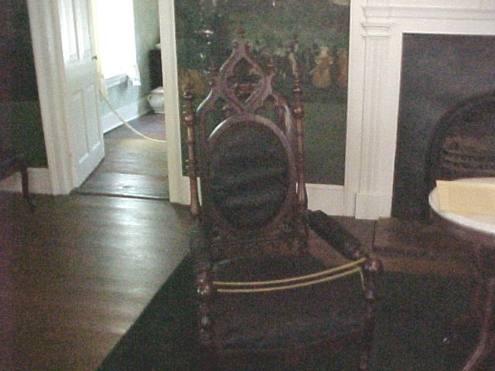
Well Known Dignitaries Stayed In Campbell’s Stranger’s Hall Annex
Included Were Henry Clay, John C. Calhoun, Jefferson Davis, Daniel Webster & James A. Garfield

Slide 25
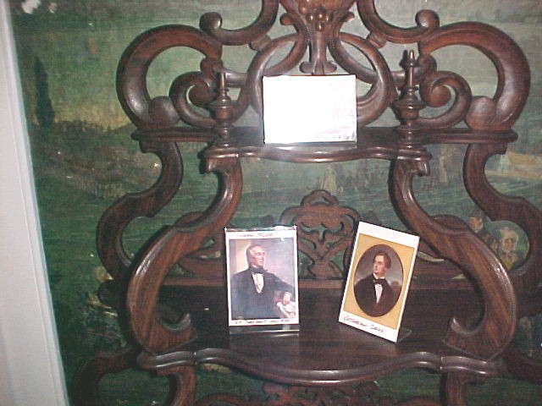
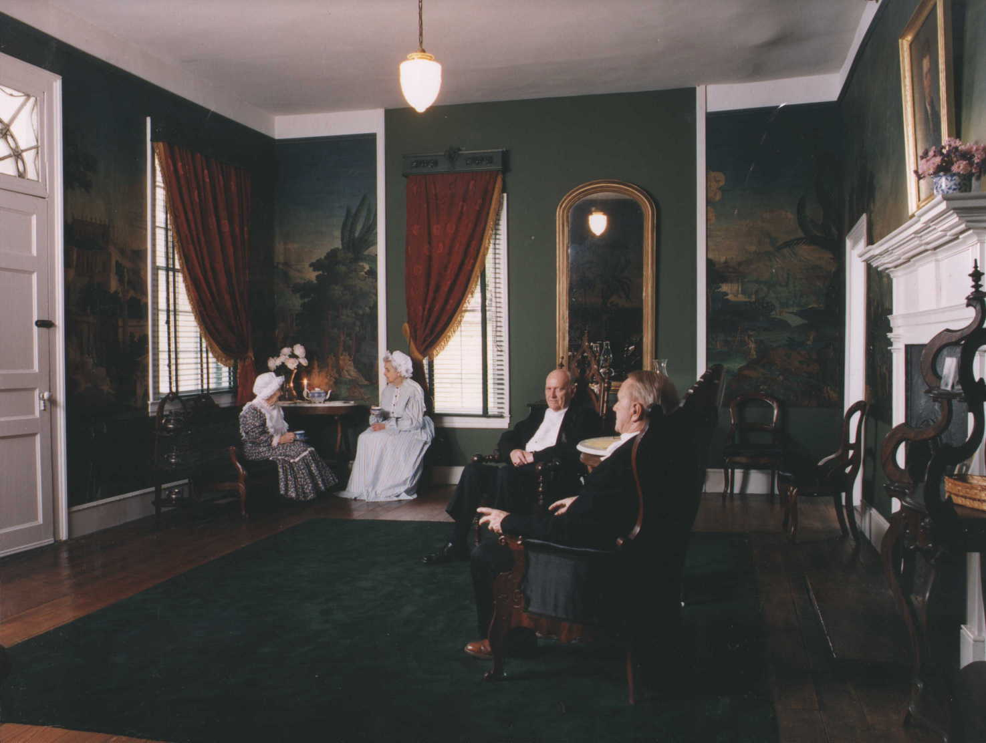
Stranger’s Hall
The Wall Paper In Stranger’s Hall Came From Italy. While Visiting In Nashville, Tennessee, Campbell Saw This Paper While Visiting Andrew Jackson At His Hermitage Home

Slide 26
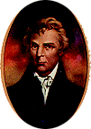
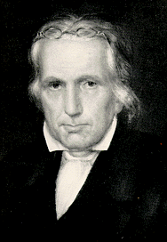
A Restoration Plea:
"In Doctrine, Unity."
"In Option, Liberty."
"In All Things, Love!"
* Restorer Plea Same As Reformer Meiderlin on “Essentials”

Slide 27
ANTINOMIANISM CHARGES IN CHURCH HISTORY
Emphasis On Liberty
Emphasis On Legalism
FIRST CENTURY NICOLAITANS
 |  | FIRST CENTURY JUDAIZERS
REFORMATION PERIOD MELANCHTHON
 |  | REFORMATION PERIOD ARICOLIANS
REFORMATION PERIOD LUTHERANS
 |  | REFORMATION PERIOD CALVINISTS
RESTORATION PERIOD CAMPBELLITES
BIBLICAL CHRISTIANITY

Slide 28
David Lee Burris:
Lawyer’s Maxim: “The big print giveth, the small print taketh away!”
Approach
Freedom
Responsibility
Legalism
No
Yes
License
Yes
No
Liberty
Yes
Yes

Slide 29
OVERVIEW: ANCIENT ORDER RESTORE POINT
1830 – Alexander Campbell Addresses the now Mormon Rigdon
Church of Christ Congregation Change Double Populate Mormonism
1860 - COMBINED RESTORATION 5TH LARGEST RELIGIOUS BODY U.S.
RESTORATION COUNTERS HISTORICAL META-NARRATIVE THREADLINE
CAMPBELLS RESPECTED OLD WORLD & NEW – REFORMERS & ELITE
ALEXANDER CAMPBELL POPULAR IN CHURCH CORRUPTION ATTACK
CORRUPT SOURCES: DIFFERENTIAL HIERARCHY & CHURCH W/STATE
COUNTERING CORRUPTION META-NARRATIVE WITH MILLENNIAL

Slide 30
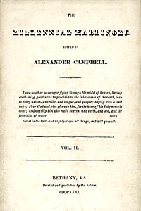
1830
January 4, Millennial Harbinger Begins
July 5, Last Issue Of The Christian Baptist

Slide 31
COUNTERING CHURCH CORRUPTION META-NARRATIVE WITH MILLENNIAL HARBINGER META-NARRATIVE

Slide 32
WAR WAS ON THE HORIZON

Slide 33
EPISODES & EVENTS: ALEXANDER CAMPBELL
1816 – Alexander Campbell @Baptist Redstone Congregation Delivers “Sermon on the Law”
NOTE: Thomas & Alexander Campbell Expelled for Teaching The Gospel Greater Than The Law.
1820 – Baptist Alexander Campbell Debates Presbyterian John Walker on the Topic of Infant Baptism.
1823 – Baptist Alexander Campbell Debates Presbyterian Will McCalla on the Topic of Infant Baptism.
1829 – Baptist Alexander Campbell Debates the Scotland Atheist Robert Owen on the Topic of “Religion the Cause Not the Answer to Social Problems.” (paraphrased)
NOTE: Alexander Campbell’s Argumentation was Nationwide Media Followed Representing Christian America
1830 – Unaffiliated Alexander Campbell Debates Presbyterian Obadiah Jennings on the Topic of “The Cult or Sect of Campbellism.”
1837 – (Christian Only) Alexander Campbell Debates Catholic Bishop John Purcell on the Topic of “Protestantism Versus Catholicism.”
1843 – (Christian Only) Alexander Campbell Debates Presbyterian Rice on the Topic of the “Operation of the Holy Spirit.”
1847 – Alexander Campbell Arrested During Scotland Tour Speaking on Slave Controversy.
1848 – Alexander Campbell Speaks Before U.S. Congress on the Subject of Carnal Warfare.
1849 – Alexander Campbell Accepts Presidency of American Christian Missionary Society.
1853 – Campbell Confronts Nashville’s Jesse Ferguson’s Last Chance Post-Mortem Gospel

Slide 34
Alexander Campbell Speech @Congress 1848:
“We have all a deep interest in the question; we can all do something to solve it; and it is everyone's duty to do all the good he can. We must create a public opinion on this subject. We should inspire a pacific spirit and urge on all proper occasions the chief objections to war. In the language of the eloquent Grimke, we must show that ‘the great objection to war is not so much the number of lives and the amount of property it destroys, as its moral influence on nations and individuals. It creates and perpetuates national jealousy, fear, hatred, and envy. It arrogates to itself the prerogative of the Creator alone - to involve the innocent multitude in the punishment of the guilty few. It corrupts the moral taste and hardens the heart; cherishes and strengthens the base and violent passions; destroys the distinguishing features of Christian charity - its universality and its love of enemies; turns into mockery and contempt the best virtue of Christians - humility; weakens the sense of moral obligation; banishes the spirit of improvement, usefulness, and benevolence; and inculcates the horrible maxim that murder and robbery are matters of state expediency.’"

Slide 35
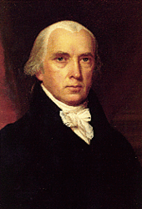
What One Founding Father Said Of Campbell
4th President of the U.S., James Madison said: “It was my pleasure to hear him very often as a preacher of the gospel, and I regard him as the ablest and most original expounder of the Scriptures I have ever heard.”
FEDERALIST PAPERS AUTHOR

Slide 36
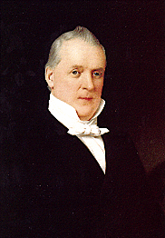
At Washington He Spoke In The Baptist Church Building. President Buchanan And Several Members Of His Cabinet Being Present.
The Corner-Stone Of New College Building Was Laid
President James Buchanan 1791-1868 Served 1857-1861

Slide 37
IN THE providential BOOK OF JOB

Slide 38
GOD’S LIGHTNING ARE CHARGED ARROWS!

Slide 39
THE THUNDER IS HIS VOICE!

Slide 40
Family History From Family Bibles: Annotation of Marriages & Divorces

Slide 41
The Church Across The Ages
of people, events
life and faith from
Glimpses
Slave Makes Good!
Christians drew members into their fellowship from every rank and race, an affront to proper, class-conscious Romans. A former slave who had worked the mines actually became the bishop of Rome – Callistus in 217.

Slide 42
Slave Preachers @Post-Constantine
What was the standard church practice in 400 A.D. regarding ordination of slaves?
It Was Forbidden!
Theoretically, it was permissible; practically, slaves weren’t expedient
If an owner didn’t want his slave ordained, the church ordained him anyway and provided compensation
The Owner Could Prevent!
x

Slide 43
“Slavery is an institution of the law of nations,
by which one man is made the property of another,
CONTRARY TO NATURAL RIGHT ."
~ The Justinian Code, 535 A.D.

Slide 44
Hope
Hope has two beautiful daughters:
Their names are anger and courage.
Anger that things are the way they are.
Courage to make them the way they ought to be.
* Augustine of Hippo

Slide 45
David Lee Burris:
Christian Emperor Theodosius invited Thessalonians to free games but sent his troops into the circus with orders to kill the 10,000 men, women, and children.
“The first recorded instance of Christians killing Pagans occurred shortly after {status change year 313}. In short order, the militant church extended its power by conquering lands & peoples throughout Europe, compelling them to become baptized Christians or die… As Charlemagne instructed his Christian troops in their conquest of the Saxons: ‘If there is anyone of the Saxon people lurking among them unbaptized, and if he scorns to come to baptism & stay a pagan - let him die’”.
"The first cause of slavery is sin -
that one man should be
put in bonds by another;
- Augustine On Slavery -
and this happens only by the judgment of God,
IN WHOSE EYES IT IS NO CRIME!"
- Gregory Boyd, Myth Of A Christian Nation

Slide 46
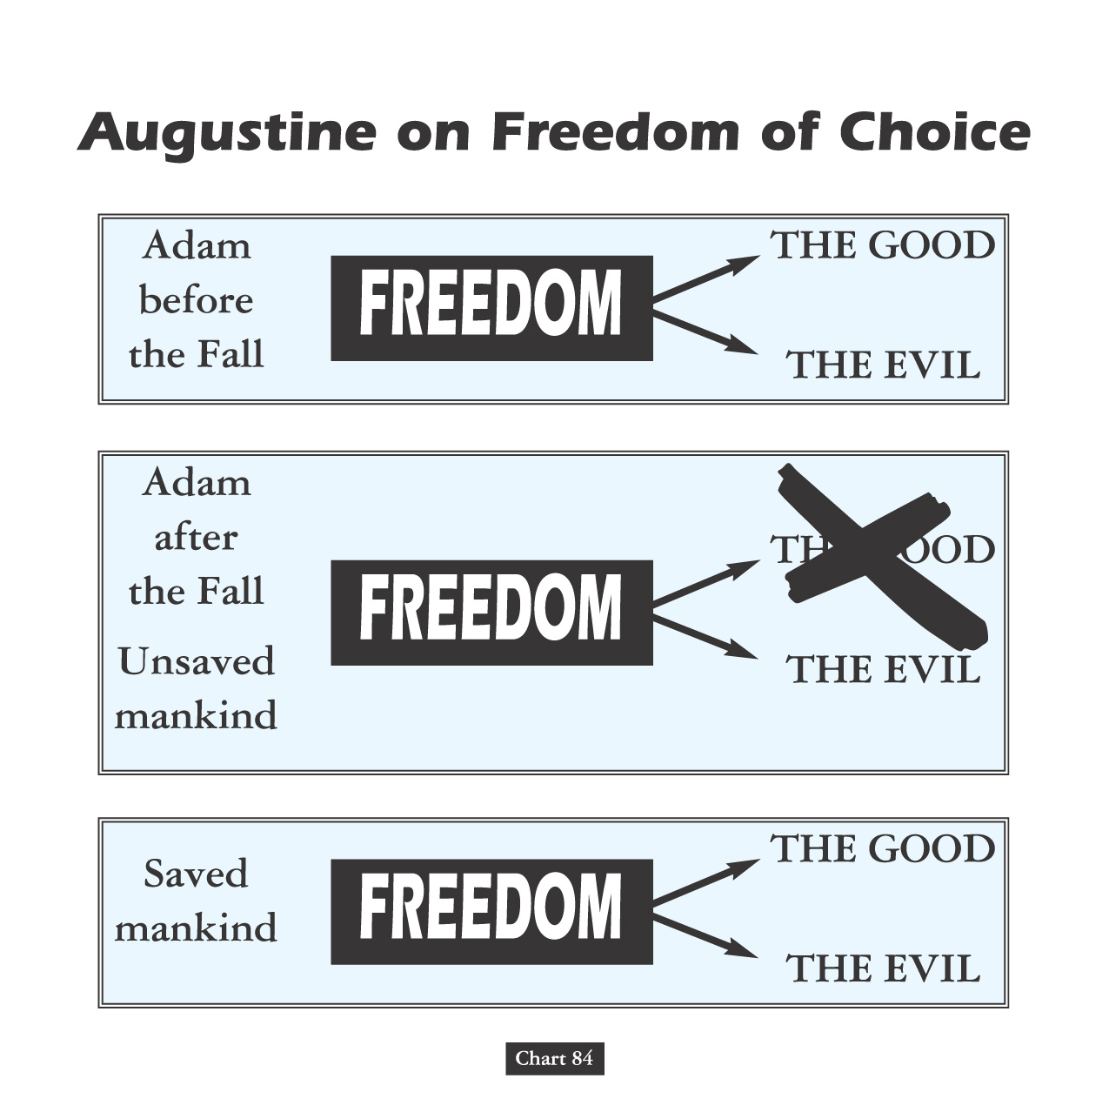
Both Popes Leo & Gregory Declare Slavery
Not A Peculiar - But - A Divine Institution!
"Slaves Are Men That From
The Vileness Of Their Condition
Must Not Enter The Clergy."

Slide 47
David Lee Burris:
Christian Emperor Theodosius invited Thessalonians to free games but sent his troops into the circus with orders to kill the 10,000 men, women, and children.
Calvin himself never opposed slavery. Most prominent Calvinist in Americas was Jonathan Edwards, he and George Whitefield are two most prominent preachers of great awakening. Edwards supported and even practiced slavery. Whitefield although Methodist, rejected abolitionist views of Wesley and adopted some of the Calvinist theology into his preachings. He actively supported slavery. Georgia outlawed slavery, and Whitefield travelled to promote pro slavery views in Georgia.
“The first recorded instance of Christians killing Pagans occurred shortly after {status change year 313}. In short order, the militant church extended its power by conquering lands & peoples throughout Europe, compelling them to become baptized Christians or die… As Charlemagne instructed his Christian troops in their conquest of the Saxons: ‘If there is anyone of the Saxon people lurking among them unbaptized, and if he scorns to come to baptism & stay a pagan - let him die’”.
- Gregory Boyd, Myth Of A Christian Nation

Slide 48
David Lee Burris:
He warned saying that they were subject to being mocked “by those who have read of more and worse things in the history of the world.”
Papacy Owned Slaves
Father Sandoval, a Catholic priest in the Americas wrote to Brother Luis Brandaon, a Church official in Africa, asking if the enslavement of Africans was legal according to Church doctrine. Brother Brandaon’s response, dated March 12, 1610, answered, ‘Your Reverence writes me that you would like to know whether the Negroes who are sent to your parts have been legally captured. To this I reply that I think your Reverence should have no scruples on this point, because this is a matter which has been questioned by the Board of Conscience in Lisbon, and all its members are learned and conscious men. We have been here ourselves for forty years and never did they consider the trade as illicit. Therefore we and the Fathers of Brazil buy these slaves for our service without any scruple.”

Slide 49
READ: Ex 21 – Deut 15: 12-18 – Deut 24: 7 – Lev 25: 39-55
Note the following: (1) God required humane treatment of servants. (2) Servants were freed after six years. (3) Servants were paid for the six years of work (twice the wages of a regular hireling). (4) Servants were treated as family. (5) Selling people into slavery was a capital crime (it brought the death penalty). (6) The Children of Israel were not to make slaves of their fellow Jews. (7) Fellow Jews were essentially made into hired servants. (8) It appears that these rules also applied to non-Jews.
Word Slave @Jeremiah 2:14 & Slaves @Revelation 18:13

Slide 50
The ancient world recognized degrees of slavery. Though much of their literature present freedom and slavery as exact opposites Greek and Roman culture support many degrees in between. The lowest slaves worked in unskilled manual labor. If someone was punished with slavery this is the kind of work they would likely be condemned to. Mines, mills, porters, bearers, etc. These slaves had no rights and few privileges. They were human beasts of burden. These slaves had the smallest chance of gaining their freedom. It's difficult to impress the master when all you do is haul things around and perform one mundane activity over and over again. But has already been pointed out by others there were also privileged slaves. These were the ones who often lived away from the master and rendered a payment (paramone) to the master. They were skilled workers like slave bankers, craftsmen, overseers, and the like. Though everything they earned legally belonged to the master it was customary that the master receive this paramone and not everything that the slave earned. The slave could then save up their earnings to eventually earn their freedom. Because they often lived away from the master or worked along side him, they had better chances of being granted freedom for their good work and were more in control of their own lives. Those that lived away from the master were in control of their own movements and lives with the exception of the payment to the master. These individuals functioned much like subcontractors. Even slaves who gained their freedom often lacked all of the freedoms that society could offer. Freedom did not mean citizenship so freedmen could not participate in politics and were excluded from other activities. When a slave bought their freedom it was fairly common that the agreement be sealed with a sort of contract. The slave would agree to render a fixed amount and often agree to perform services for their master at the former master's request. This obligation to provide for the former master could last until the master's death and, rarely, even afterward. If the obligations proved to be too burdensome a freedman could offer suit in Athens and if he won would be given unconditional freedom(not citizenship), but if he lost he would re re-enslaved. The stigma of having been a slave lasted for life and severely limited future opportunities.

Slide 51
The ancient world recognized degrees of slavery – continued.
Some points about Classical slavery: It was customary in Rome to free a slave after he had reached the age of 30 if he had rendered good service. This practice was far more common with domestic and skilled slaves in the city than with agrarian or unskilled slaves. It was recommended that a master in Athens immediately discuss with a slave what would be required of them to buy their freedom and how they would earn it. The master would try to arrange a marriage with the slave and have him start a family. If a slave knew what was required of him to gain his freedom and his freedom lay before him a a real possibility why risk rebellion or escape, especially if the slave had family also owned by the master. It was to encourage productivity and reduce rebellion or flight. It was recognized that slaves were human beings. It was just also recognized that these people were property. As such, slaves were to be treated with a certain level of decency (not hubris). Now many masters clearly had no compunctions about ruthlessly beating their slaves, but literary evidence from Rome and court records from Athens suggest that there was an expectation (and sometimes law) to treat slaves as people if only to avoid rebellion.

Slide 52
“There is a growing taste for opinionism in the Reformation ranks. This must be quashed out or there is an end to all moral and religious improvement. It has ever been the harbinger of schism, the forerunner of all discord and vain jangling.
It has been the plague of Christendom.
What is an opinion? Persuasion without proof, say some lexicographers. It is speculation built on probable evidence. It is neither knowledge or faith; but in the absence of these, it is an inference, a conclusion to which the mind assents according to its information or mode of reasoning…
To walk by opinions rather than faith is effectually to make the Book of God of no authority!”
- Alexander Campbell in 1837

Slide 53
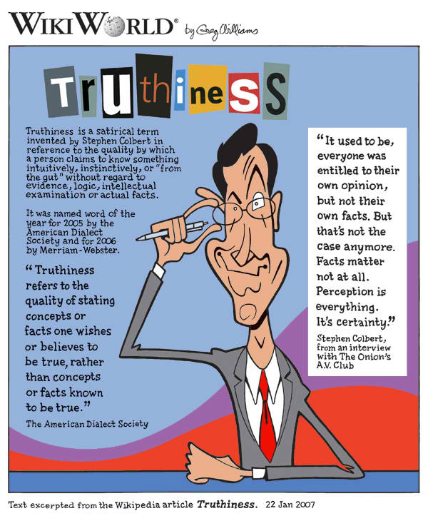
DISTORTIONS OF ABSOLUTE RIGHT
“Because of distortions and for no other reason, the average person thinks there is an occasional distinction between logical right and expedient right, between logical right and moral right, and also between expedient right and moral right. Despite widespread misconceptions, it seems
almost too prosaic to say that there is not. There is no distinction in the word itself; the distinction is only in the modifier used before the word, and the modifier designates an ingredient rather than a distinction. Right is certainly not absolute unless it has all the ingredients.” - HUMANETICS

Slide 54
The Principle Of Human Worth
The question of worthiness. By Luther’s lifetime worthiness itself had metamorphosed in meaning from a subjective introspective responsibility to an objective meaning measured by works.
Catholic hierarchs determine individual worthiness.
Reform churches each establish closed communions as evidencing their determinations of individual worth.
Restoration churches teach human worth as God given intrinsic and in the memorial supper - inner examined.

Slide 55
Does God Exist?\Oct90\Revolution Or Evolution?\Cecil Hook
David Lee Burris:
Notes On Roman Stylized Slavery: “Legally claiming personal bankruptcy opened the door for many to make their fortunes handling the affairs of the great houses of the prominent families of the cities. Slowly but surely these temporary slaves became essential to the maintenance of the household and then the dependency relationship would be reversed. Shortly thereafter these skilled individuals would buy out their contract and become manor caretakers – in other words – they went from self-enslavement to quoting their own salary in short order!” Myself
Was it sinful for christians to own slaves?
Would it have been proper to buy a slave?
What about one person enslaving another?
“Paul insists, ‘Do not become slaves of men?’ (1st Cor 7:23). If it is wrong for me to become a slave, it is wrong for me to enslave someone else. Through the working out of the Golden Rule, this great social change was to evolve…”

Slide 56
Does God Exist?\Oct90\Revolution Or Evolution?\Cecil Hook
David Lee Burris:
Notes On Roman Stylized Slavery: “Legally claiming personal bankruptcy opened the door for many to make their fortunes handling the affairs of the great houses of the prominent families of the cities. Slowly but surely these temporary slaves became essential to the maintenance of the household and then the dependency relationship would be reversed. Shortly thereafter these skilled individuals would buy out their contract and become manor caretakers – in other words – they went from self-enslavement to quoting their own salary in short order!” Myself
Was it sinful for christians to own slaves?
Would it have been proper to buy a slave?
What about one person enslaving another?
“Paul insists, ‘Do not become slaves of men?’ (1st Cor 7:23). If it is wrong for me to become a slave, it is wrong for me to enslave someone else. Through the working out of the Golden Rule, this great social change was to evolve…”
“God wants change in all individuals and societies. He does not, however, demand or expect that change to be an immediate leap from depravity to perfection. Conduct of a mature disciple is not demanded of a newborn in Christ; neither is infancy an acceptable standard for those who have had time and opportunity to grow toward the fullness of Christ!”

Slide 59
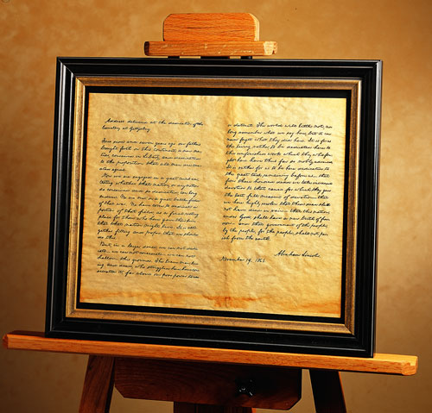
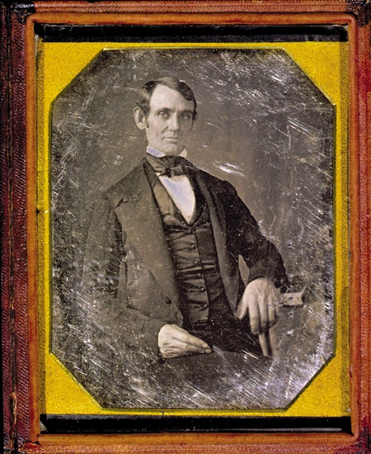
Principle Of Human Worth Compromised
“It has been my experience that
folks with who have no vices have very few virtues!”
ABE LINCOLN LOST 1843 WHIG
CONGRESSIONAL NOMINATION
TO CAMPBELLITE EDWARD BAKER

Slide 60
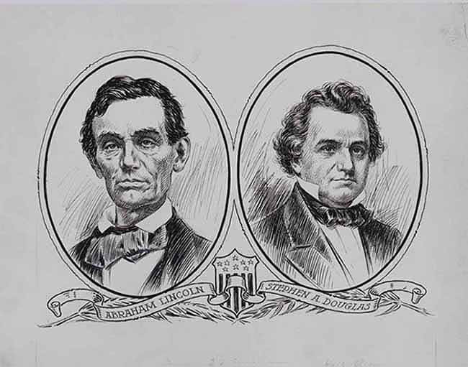
TWO SIDES CONFLICT CHOOSING BETWEEN THE TWO FOUNDING DOCUMENTS
An evenly divided country with insufficient majorities for amending proposal(2/3) and ratification(3/4).

Slide 61
A philosophical question…
What is man like in his “natural state?”
This question fascinated thinkers around the late 17th century, the high point of the Scientific Revolution.
Without any society or laws or learned behaviors… how would people act?
Do you believe it would be chaotic and warlike? Or would it be a society of people cooperating and aiming at common goals?

Slide 62
All in the Fine Print..
Social Contact: An agreement among a society in order to cooperate for social benefits.
Locke: People give up the right to enact justice in exchange for life, liberty and gain the right to impartial protection of property.
Monopoly on violence.

Slide 63
Lincoln defined American greatness through his recognition of how closely bonded political and moral considerations had to be in a democracy. A democracy founded on a proposition can betray that proposition by way of an unspoken tradition or ancestral custom. In the case of the slaveholding South, it can insist that the equality mentioned in that proposition is only an equality of white people.

Slide 64
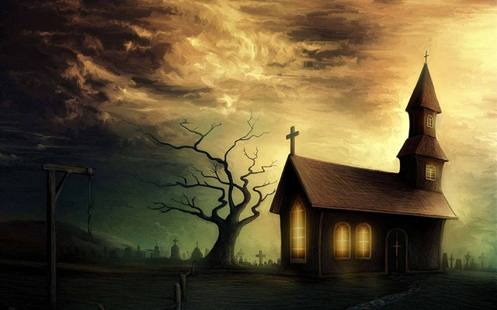
We maintain that no compensation should be given to the planters emancipating their slaves:
Because it would be a surrender of the great fundamental principle,
that man cannot hold property in man; Because slavery is a crime, and therefore is not an article to be sold; Because the holders of slaves are not the just proprietors of what they claim; Freeing the slave is not depriving them of property, but restoring it to its rightful owner; it is not wronging the master, but righting the slave — restoring him to himself!
From the Anti-Slavery Society

Slide 66
Sociology Of Denominationalism Social Sources; H. Richard Niebuhr; 1929
“The social and psychological differences between South and North came to expression in scriptural condemnations & defenses of slavery. It was plain to Southern church- goers that many of the Old Testament heroes they had been taught to venerate had been masters of slaves, that Paul had given his sanction to the institution by counseling obedience to masters and by returning runaway Onesimus to Philemon. The incompatibility of chattel slavery with the counsel of love was no less evident to the Northern church-goer. The South idealized patriarchal relations of kindly lords to child-like servants; the North was more aware of the atrocities of domineering slave-drivers and the brutalities of the slave-market.” [Sectionalism, p. 191]

Slide 67
The Road To Restoration By Bill Humble Three Leaders On Record For The Union
Pardee & Ovid Butler With John Boggs:
“Throughout the 1850’s the abolitionists – Pardee Butler, Ovid Butler, John Boggs & others – demanded that slavery be denounced as a sin and that Southern slave-owners be disfellowshipped. These demands kept the brotherhood - in the north - in turmoil. The Northwestern Christian Magazine, edited by John Boggs, was established in 1854 to champion the abolitionist cause. Abolitionist hostility to the missionary society became so intense that in 1858 they held a convention in Indianapolis & organized a rival society to the Cincinnati society. Organizationally, it was identical to the Cincinnati society, but in its membership requirements was included - ‘No complicity in the crime of American Slavery.’” pg. 47

Slide 68
Redeeming America: Road To War American Ways\Curtis D. Johnson\Pg. 147
“By contrast the Disciples of Christ had no significant North wing pushing them toward abolition & therefore hadn’t seceders seeking to silence anti-slavery sentiment. Instead the Disciples were dominated by conservatives like Alexander Campbell who argued that Scripture did not condemn slavery, that disciplining members for owning slaves was unbiblical & that compensated emancipation and also colonization were the best political solutions to the slavery issue.”
* 1821 American Colonization Society

Slide 69
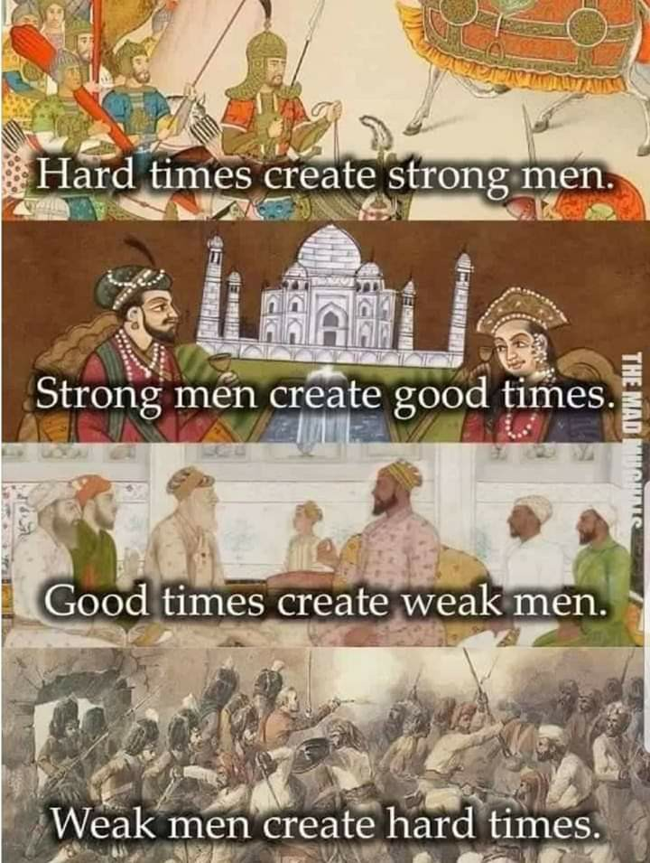

Slide 70
Roots: Ethical Compromise & Slowed Momentum
David Lee Burris: WOULD IT HAVE BEEN POLITICS IN THE PULPIT AS STONE SAID?
In 1849: “There are usually pews for their race in the back of the auditorium.”
Contrast To William Wilberforce Of England Who Considered A Change In His Political Career Along With His New Christianity But Was Encouraged To Work Within The System For Change – He Talked The British Empire Into Abolishing The Practice Altogether!
“Now, if I could speak to all the slaves on this continent, I would say to them, Be Faithful and obedient servants not only to masters good and gentle, but even to the froward and perverse.”
“Masters of the South, you will find that I am not visionary on this subject. Nor have I a desire to see you lose one dollar, nor one hours sleep, nor that you feel one pang of guilty conscience, because of your happening to possess servants white or black.”
Principled Position?
- Alexander Campbell, 1830

Slide 71
Fruit: Ethical Compromise & Slowed Momentum
David Lee Burris: WOULD IT HAVE BEEN POLITICS IN THE PULPIT AS STONE SAID?
Alexander’s Position On This Issue Considerably Convoluted In A Time That Demanded Clarity – Like George Washington(Slave-owner) & James Madison He Supported An Incremental Approach To Solving The Slave Problem Modeled After What The Northern States Had Accomplished Starting With Pennsylvania In 1780; Like Thomas Jefferson He Had Slaves But Fought Against Slavery – Ultimately He Freed His Slaves But Was Against Any Legislated Abolishment Other Than That Graduated “Without Financial Loss To The Owners”; Campbell Carried A Colonization Plan To A 1829 National Political Convention That Would Have Earmarked Ten Mill Annually Out Of The Federal Budget For This Purpose; Put On The Spot - “I Do Not Regard The Slaveholders’ Money As The ‘Price Of Blood’.”; He Called For “A Relaxing Of Public Opinion In The North”
NOTE: After The American Revolution Jefferson Seems To Have Became Quite Comfortable With Slave ownership - Thomas Jefferson’s Subsequent Moderated Position Was Born More Out Of Horror Of What Had Happened To The French In Haiti & Fear That It Might Happen Here!
“In this great crisis of human affairs [Fugitive Slave Act] ‘He that hasteth in his movements erreth.’ Let us show good reason for our course, and a due respect to those who dissent from us, and we shall then, doubtless, ride the storm, control the waves, and finally anchor in a sure and safe haven.”
Sage Advice?
- Alexander Campbell, 1851

Slide 72
Archibald McLean: “Campbell As A Preacher”
Gen. Robert E. Lee on Campbell:
As Said By Symonds, “He was a man in whom were illustriously combined all the qualities that could adorn or elevate the nature to which he belonged; knowledge the most various and extended, virtue that never loitered in her career nor deviated from her course. A man who, if he had been delegated as a representative of his species to one of the many superior worlds, would have suggested a grand idea of the human race.”
Note: WHAT IF…

Slide 73
Edward Hallett Carr On the Study of History How Vs. Why ~ Or ~ Function Versus Cause
“Historians, like other people, sometimes fall into rhetorical language & speak of an occurrence as ‘inevitable’ when they mean merely that the conjunction of events leading one to expect it was overwhelmingly strong.”
Determinism Vs. Free Will. “In practice, historians do not assume that events are inevitable before they’ve taken place. They frequently discuss alternative courses available to the actors in the story on the assumption that the option was open, though they go on quite correctly to explain why one course was eventually chosen rather than the other. Nothing in history is inevitable except in the sense that, for it to have happened otherwise, the antecedent causes would have had to be different.”
Historical Accident Or Arranged Coincidence? “These so-called accidents represent a sequence of cause & effect interrupting historically & clashing – ‘a collision of two independent causal chains’.”
The Historian Marx. “Marx offered an apology for chance in history under three heads. First, it could accelerate or retard but not radically alter the course of events. Second, one chance compensated for another, so that in the end chance cancelled itself out. Third, chance was especially illustrated in the character of individuals.”
Meinecke’s Historical Observation: “The search for causalities in history is impossible without reference to values . . . behind the search for causalities there always lies, directly or indirectly, the search for values.”

Slide 74
Mine eyes have seen the glory of the coming of the Lord. He is trampling out the wine press, where the grapes of wrath are stored, He hath loosed the fateful lightnings of His terrible swift sword, His Truth Is Marching On!

Slide 75
Uncle Tom’s Cabin:
O, church of Christ,
read the signs of the times!
Is not this power
the spirit of HIM whose kingdom is
yet to come?

Slide 76
“A day of grace is yet held out for us.
Both North and South have been guilty before God; and the Christian church has a heavy account to answer.
Not by combining together,
to protect injustice and cruelty,
and making a common capital of sin,
is this Union to be saved,
- but by repentance, justice, and mercy.”
HARRIET BEECHER STOWE

Slide 77
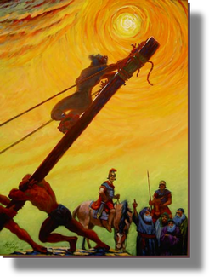
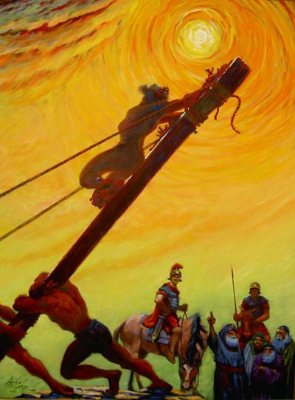
God’s Two Methods
Willing change:
Reflect on the cross
Soften the heart
Yields to God’s way of thinking
Grudging change:
External difficulties
Soften the heart
Yields

Slide 78
Redeeming America: Road To War Curtis D. Johnson, 1993\Pages 164 & 184
“The Disciples of Christ, following the lead of Alexander Campbell, were generally in the postmillennial camp, as were the Baptists…
Millennialism continued to have an enormous influence over the United States on the eve of the Civil War. When the great conflict came, Americans spoke of the war using millennial language. Having been steeped in biblical prophecy and apocalyptic images for decades, it is not surprising that the Civil War generation described the conflict in Armageddon-like terms and tried to fit current events into a broader prophetic context and God’s role in history to make sense of the four years of carnage.”

Slide 79
AN END TIMES MOVEMENT
Christadelphians – Prophesies and Pacifism
Christadelphians, a religious sect, was founded by Dr. John Thomas, son of a British Congregationalist minister. During Thomas’ immigration to the United States in 1832, the ship encountered several violent storms. Thomas vowed that he would devote his life to the study of religion if God would spare his life. Shortly after his arrival in the United States, Thomas briefly associated himself with the Campbellites, while sharing their belief that Jesus Christ would return to earth in 1866. But as he continued study with the Cambellites, he soon disagreed with their teachings, left the group disfellowshipped, and began his own religious sect called the “Brethren of Christ.”

Slide 80
FATALISTIC ATTITUDE
Instead of working to solve problems, they say,
“This is prophecy being fulfilled
The end is here;
there’s no need to do anything.”
By sitting on their hands when they should be actively involved, they fulfill their own prophecies and assure a worse world for their children!

Slide 81
David Lee Burris: 1859 Wall Street Revival Continued With Southern Army & Worldwide To Entire English Speaking World Converting Moody & Spurgeon Leaders Of The Late Century
East – West Divide Spurred Growth While North – South Split Stymied It!

Slide 82
Was Slavery The Primary Reason For Secession?
Almost all professional historians today agree with W.E.B. DuBois, who was astounded that ‘anyone who reads the lives of contemporary statesmen and public characters, North and South, the discourses in the newspapers and accounts of meetings and speeches, [could] doubt that Negro slavery was the cause of the Civil War.’
An obvious example is Confederate Vice President Alexander Stephens, speaking in Savannah, Georgia, just weeks after the Deep South seceded. He stated that slavery was the ‘immediate cause of the present revolution.’ He also said the United States had been founded on the false assumption that all men were created equal, and that the ‘cornerstone of our new Government is founded upon the great truth that the negro is not equal to the white man. This, our new government, is the first, in the history of the world, based upon this great physical, philosophical, and moral truth.’
“The first casualty of war is truth.” – Hiram Johnson

Slide 84
“Whenever I hear anyone arguing for slavery I feel a strong impulse to see it tried on him personally!”
David Lee Burris:
To Our Shame The Social Issues That Concerned The Restoration Movement To The Exclusion Of Slavery Both Thirty Years Prior & Thirty Years After The Civil War Were Recreation Related: Dancing – Card Playing – Horse Racing – Cock Fights – Gambling. Tobacco & Temperance Issues Did Divide. The Only Social Issue Non-Recreational Getting Attention Was That Of Secret Societies – i.e. Masonry.
- Abraham Lincoln

Slide 86
Principle Of Human Worth Christian Compromised
“Tragically, no less than everyone else, the clergy were virtually cheerleaders all. One more easily forgives generals, journalists and soldiers for their moral silence. But clergy – especially the majority Protestant clergy – had traditionally opposed reflexive patriotic rhetoric from the pulpit. They supposedly answered to a higher authority. True, the rare critical voices sounded among the clergy… But these voices are precious few & for one simple reason – nationalism.”
- IN INTRO TO STOUT’S: UPON THE ALTAR OF THE NATION

Slide 87
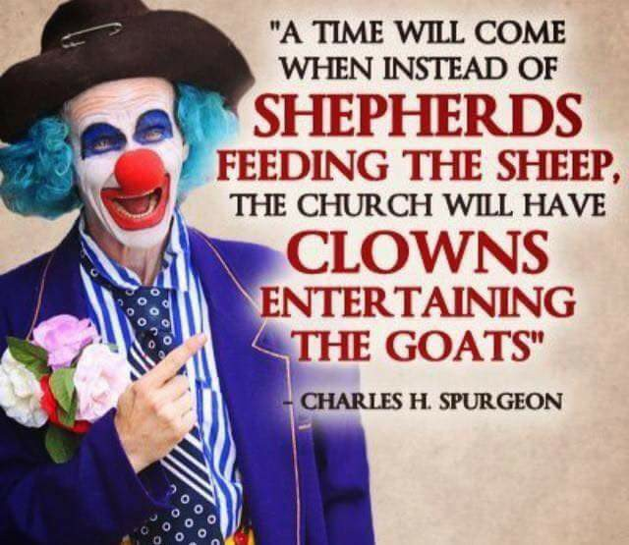

Slide 88
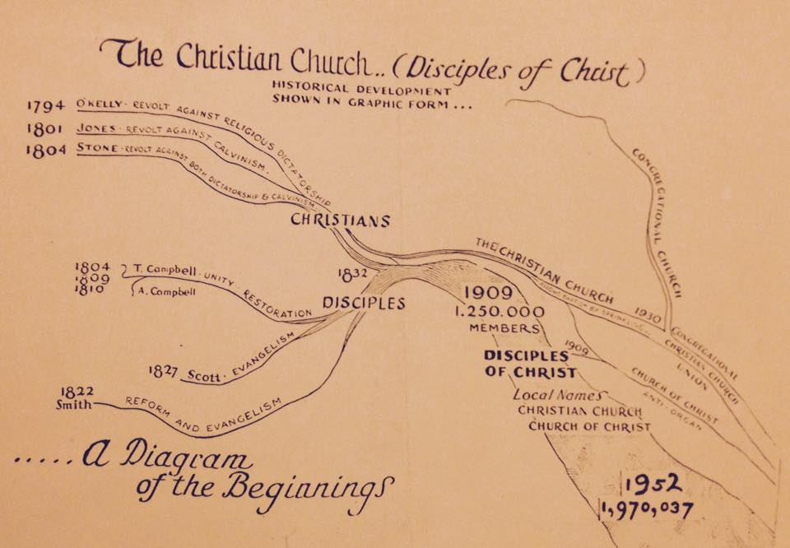
Beyond Annotations & Anecdotal Story: Court Records & Wartime Participation

Slide 89
The Church During The Civil War
Leading Up To The War Discussion Of The Slavery Issue Was Discussed In Journals
Some Like James Shannon In Missouri Were Strong Activists For Slavery
Others Like Pardee Butler Of Kansas Was Equally Strong Activist Against Slavery
Mississippi Preacher, T.W. Caskey Was Involved In Preparation Of The Document Leading To Secession In That State, 1861
During War Many Lost Their Faith
Many Enlisted In The Military, Preachers Became Chaplains
Fanning Visited Atlanta. Dr. A.G. Thomas, A Preacher, Wore A Feather In His Hat And A Glittering Sword In His Right Hand. Fanning Said He Doubted If Thomas Would Be Able To Hold The Word Of Georgia In One Hand And The Sword Of The Spirit In The Other – GA Vol VII, No. 2, Feb. 1861 p.39
W.H. Hopson Resigned His Post At Main Street Church Of Christ Lexington, Kentucky Because Of His Disposition Toward The South. J.W. McGarvey Took His Place, 1862

Slide 90
The Church During The Civil War
250 Boys From Hiram College Joined The Union Forces
James A Garfield Was A Union Officer Acquiring Rank Of Brigadier-General
T.B. Larimore Served With The Southern Forces
B.F. Hall Was Chaplain With The Texas Rangers
Colleges & Publications Sought To Ignore The War Refusing Anti-War Articles To Be Printed
W.D. Carnes Sought To Keep It Out Of Franklin College, But When War Was Began The Entire Student Body Left, Joining The South
1860, Fall Arkansas College Began At Fayetteville, William Baxter President, Battles At Pea Ridge And Prairie Grove Was Fought Nearby. School Burned
Preachers Avoided It In Their Preaching
Many Journals Ceased Publication For Economic Reasons
Biggest Wedge Was When The Missionary Society Condemned The South, Southern Brethren Were Appalled, 1862
Officially The Churches Of Christ Was The Only Church In The US Not To Split During The Civil War

Slide 91
Southern Military
Religious Revival
Cannot Offset Negative Impact

Slide 92
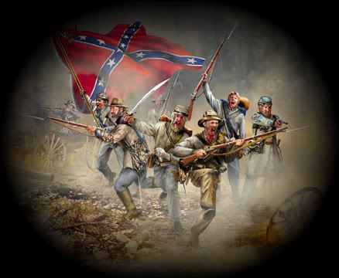
THE REBEL YELL
Southerners attacking with a full cry appeared to their enemies to be demons.
One Billy Yank recalled with dismay ‘that terrible scream & barbarous howl.’
Another union soldier confessed that hearing the rebel yell
- - “made the hair stand up on my head.”

Slide 93
Civil War: Brother Faces Brother From Flaws & Fissures To Faults
David Lee Burris:
Definition: Presentism - “Present-day standards of behavior are used to evaluate people who lived in the distant past – when such standards would have been unthinkable.”; James A. Garfield -
“If there is one thing on this earth that mankind love and admire better than another, it is a brave man; It is the man who dares to look the devil in the face and tell him he is a devil.”; On The Evil Of Slavery Was “Inclined To Believe That The Sin Of Slavery Is One Of Which It May Be Said That Without The Shedding Of Blood There Is No Remission.”
J. W. McGarvey -- “We will not take up arms against, fight and kill the brethren we have labored for twenty years to bring into the kingdom of God.”
“The Texas chaplain told of his friend, Alf Johnson, who when he saw wounded federal soldiers beg for medical help, instead ruthlessly shoot them… Graham asked Hall how he could feel this way toward his brethren in the North, and Hall replied that they were all infidels.”
The Hollywood Epic Length “Gods & Generals” Was Limited Still
Independence Declaration Ideals Constitutionally Compromised
Plus 100 Years: Concept Of National Sin Causes Regional Conflict
Causes Church Loss Of Moral Authority & Divisions North-South
Both Campbell’s & Barton Stone’s Sons Wore Confederate Grey {Campbell Family Slaveholders & After War Stand Stayed Same}
War & Conscience by Allen Isbell on page 189: “…(Future U. S. President) Garfield delivered recruiting speeches on the steps of many churches(of Christ) through the Western Reserve.”

Slide 94
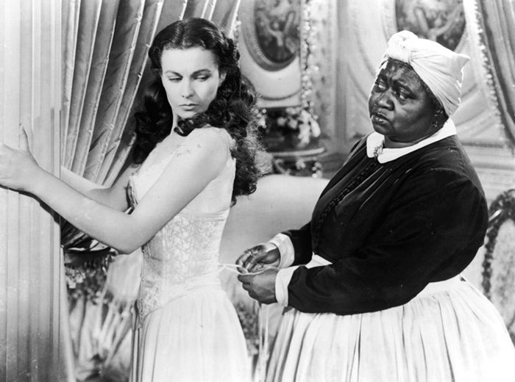
“The south is not just a place, it is, as they proudly tell you, a state of mind,” said Republican consultant Alex Castellanos.
“The North is defined by reason, the South embraces romance and the heart. The North is relativist, the South lives by absolutes.
When the South is right, it is absolutely right. When wrong, it is absolutely, tragically wrong.”

Slide 95
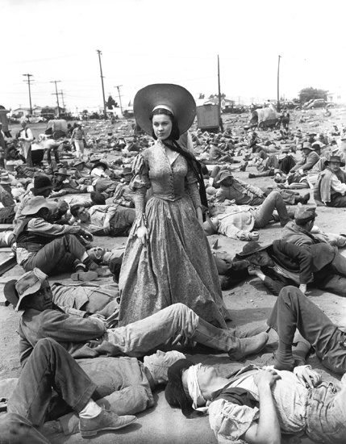
“Death Had A Carnival!”

Slide 96
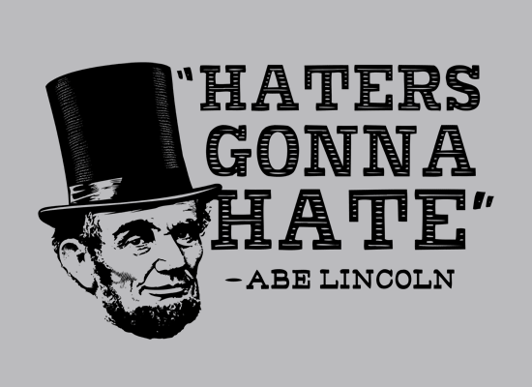

Slide 97
LINCOLN’S DISCIPLE’S BAPTISM?
David Lee Burris:
Our Universe – Perfectly Intelligent & Positively Purposed
Study Of Providence – Critique Of Irreducible Complexity
Providential Polemics – Degree Of Determinism Or Structure Vs. Choice Or Chance
Opposed Schools – Realism & Circumstance Vs. Happenstance & Phenomenalism
Historicity of Lincoln’s Late in Life Believer’s Baptism:
Churches of Christ had a presence (1832) in Illinois in the region where Lincoln’s parents lived(1830)and where he owned property on the Sangamon River (1836). Lincoln’s parents, Thomas and Sarah, became members of the Church of Christ(1830’s)in Coles County, Illinois. Lincoln himself denied religious affiliation in a paper (1846) written15 years before his inauguration as President. Lincoln’s close friend E.D. Baker was a preacher for the Church of Christ and introduced Lincoln at his inauguration in 1861. The following year (1862), Lincoln and his cabinet with a number of union soldiers attended a meeting in Arlington Heights, Virginia, led by W.H. Morris, preacher for the Church of Christ. During a visit with G. M. Weimer in Eureka, Illinois (1866-78) while attending one of the regional meetings of the churches of Christ, the baptism of Lincoln in the Sangamon River was reported by John O’Kane (well-known preacher for the Church of Christ) who baptized him. The above details support the plausibility that Abraham Lincoln was baptized to become a Christian only sometime after the Morris meeting in 1862.
Critique 0f Abe Lincoln Church Membership Claim:
A book by Edward Steers (University Press of Kentucky, 2009) gives three different accounts of the baptism of Lincoln by several Baptists, German Brethren, and the Church of Christ. The latter two groups hold the same view of baptism for the forgiveness of sins, and all three groups practice total immersion. The German Brethren are pacifists and are unlikely to have baptized Lincoln especially on short notice. Since Lincoln’s parents previously became members of the Church of Christ in Illinois, it is most likely he was baptized by the preacher of that group on short notice, as is their custom, in the Sangamon River as all three accounts claim. All three accounts describe the event as a secret baptism at night because of the objections of Lincoln’s wife. Another important reason to keep the event secret was to protect support for the impending vote for the Emancipation amendment.
Notes:
“ Riddle Wrapped In Mystery Inside Enigma”
“Some problems are just too complicated for rational, logical solutions. They admit of insights, not answers.”

Slide 98
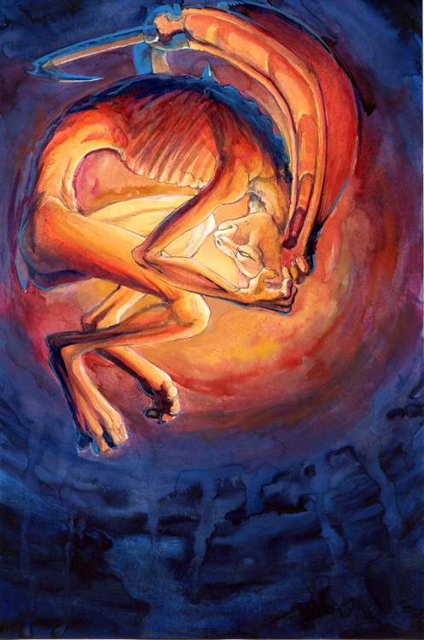
Lincoln Proved Not To Be The Antichrist
But Was The Regional Conflict Providential?

Slide 99
LINCOLN’S WAR THEODICY: YIELDED TO THE MYSTERY
David Lee Burris:
Our Universe – Perfectly Intelligent & Positively Purposed
Study Of Providence – Critique Of Irreducible Complexity
Providential Polemics – Degree Of Determinism Or Structure Vs. Choice Or Chance
Opposed Schools – Realism & Circumstance Vs. Happenstance & Phenomenalism
Theodicy is an attempt to answer the question of why a good(omni-benevolent) all powerful(omni-potent) God permits the manifestation of evil.
April 1864 Abraham Lincoln Said: “When war began neither party, nor any man, anticipated that domestic slavery would be much affected – but much affected it has. So True is That Man Proposes & God Disposes!”
September 1864 Abe Lincoln Wrote: “The purposes of the Almighty are perfect and must prevail, though erring mortals may fail to accurately perceive them in advance – we must acknowledge His wisdom and our own error. Meanwhile, we must work earnestly in the best light He gives us. Surely, He intends some great good to follow this mighty convulsion, which no mortal could make and no mortal could stay.”
March 1865 @Second Inauguration Speech Building on Recent Gettysburg Address:
God’s Hand - “The prayers of both could not be answered; that neither has been answered fully… I claim not to have controlled events, but confess plainly that events have controlled me… Impartial history will find therein new cause to attest & revere the justice & goodness of God!”
Notes:
“ Riddle Wrapped In Mystery Inside Enigma”
“Some problems are just too complicated for rational, logical solutions. They admit of insights, not answers.”

Slide 100
Historic Formula Hinge Factor: The Theory That World History Shaped As Much By Chance & Error As By Courage & Heroism
David Lee Burris:
Arranged Coincidence – “Jehovah-jireh’ or “the Lord will provide”
PRAYER ANSWERED THROUGH
ARRANGED COINCIDENCE

Slide 101
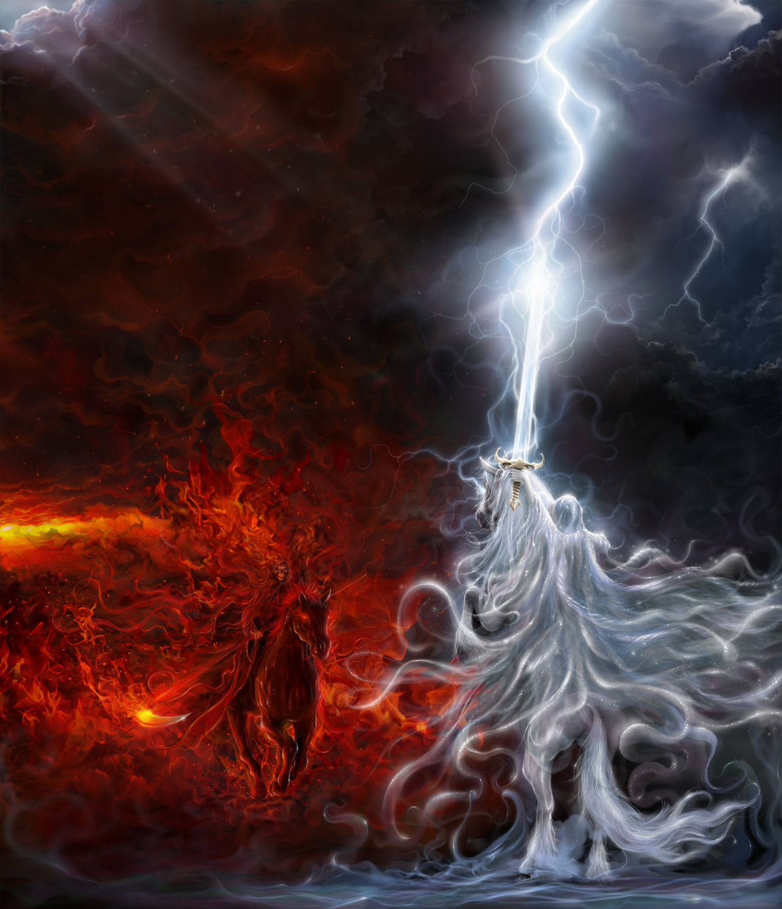
THE THUNDEROUS SILENCE OF GOD!

Slide 102
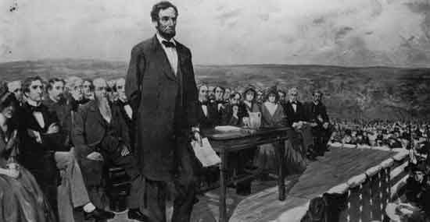
SILENT BATTLE OF GETTYSBURG
British Decide Against Southern Support
South Was To Negotiate End to Hostility
Southern Loss Due to Shadow Acoustic

Slide 103
David Lee Burris: EARLY INDICATORS OF EMERGING PROBLEMS
Extra-Church Alliances: Campbells Opposed American Sunday School Union From The Start But Alexander Eventually Reversed On The American Bible Society Becoming Life Director; Intra-Church Organizing: During Decade Of The 1830’s “Area-Wide Cooperation Meetings” Began To Occur & By The 1840’s There Were Some Statewide Meetings To Coordinate Evangelism & Preacher Support; There Were Two Failed Efforts At National Bible Societies One Inter-Denominational & The Other Internal Each Was Headed By Alexander Campbell;
Alexander Wrote A Series Of 16 Articles Staring in 1849 Insisting On National Organizing To Expedite Efforts Of Evangelism In Terms Of Education – Benevolence – Overseas Missions
American Missionary Society Was Formed In Cincinnati In October Of That Year & With Article Three Of The Society Constitution Controversial In Its Requirement In Dues Of Membership
Alexander Campbell On The Structure Of The Church – “Creative Freedom In Action” & Slogan “Disorganization Is Death.”
CAMPBELL RESERVED THE TITLE ‘BISHOP’ FOR HIMSELF & THUS ‘BISHOP’S PRESS & BISHOP’S COLLEGE IN BETHANY
Until David Lipscomb The Disciples Moved Onward Under The Banner “Whatever Is Good For The Church As A Whole Should Be Done By The Church As A Whole”
Principle Of Human Worth Compromised
To Paraphrase C.S. Lewis:
“THE ACTUAL WORLD WE LIVE IN IS LIKE A CHESS BOARD WHERE HALF THE PIECES ARE INVISIBLE.”

Slide 104
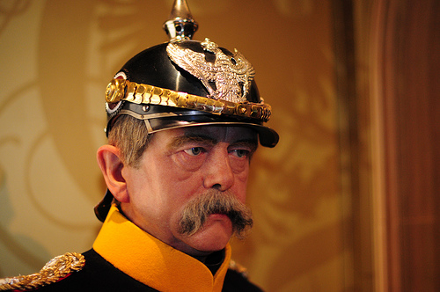
After Our Civil War
“god looks after
alcoholics,
little children,
The Prussian Leader Remarked

Slide 105
After Our Civil War
and the
United
States
Of america!”
The Prussian Leader Remarked

Slide 106
“Because Lincoln held the Union together[in the 19th Century], the United States of America succeeded in saving the world in the twentieth century from the oppressive and tyrannical ideologies of fascism and communism.
Without a Union victory in the Civil War there likely would not have been an Allied victory in World War II and in the Cold War.”
KENNETH SAMPLES SAYS:
Optional Viewing: AMERICA Imagine The World Without Her

Slide 107
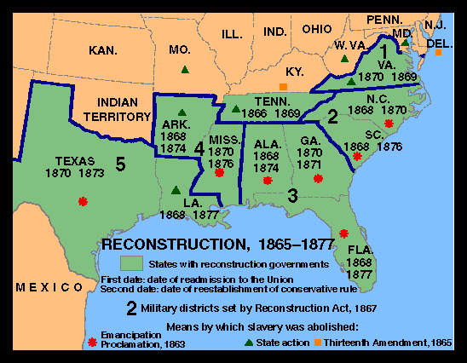
After The Great Awakening
The Great Disappointment

Slide 108
THE MILLENNIAL GLUE IS GONE!

