Slide 1
The Social Gospel Adds To Scripture
By David Lee Burris
free source compiled

Slide 2
SOCIAL GOSPEL: ORIGINS & DEVELOPMENT
in cOUNTER TO DARWIN
The RELIGIOUS HISTORY
Thee CHURCH HISTORY
ROLES & responsibilities
Edification & growth

Slide 3
SOCIAL GOSPEL: ORIGINS & DEVELOPMENT
in cOUNTER TO DARWIN
The RELIGIOUS HISTORY
Thee CHURCH HISTORY
ROLES & responsibilities
Edification & growth

Slide 4
RESPONSE @SOCIAL DARWINISM

Slide 5
Social Darwinism vs. Social Gospel
U.S. History

Slide 6
Key Terms:
Natural Selection:
Process that living things survive due to their favorable traits
Ideology:
An organized collection of ideas.
Social Reform:
Changes in society for the better

Slide 7
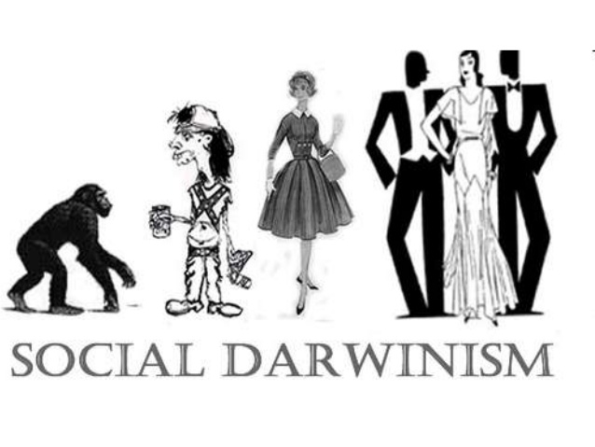
Social Darwinism

Slide 8
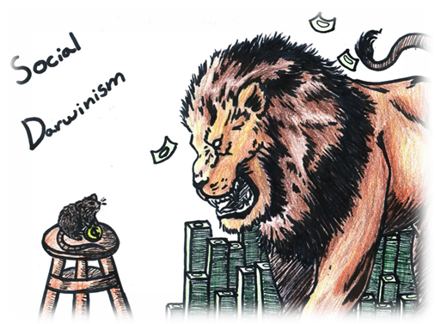
Social Darwinism
Industry leaders embraced Social Darwinism.
Competition would eliminate those who couldn’t adapt.
It was only the “fittest” companies that would survive and grow.

Slide 9
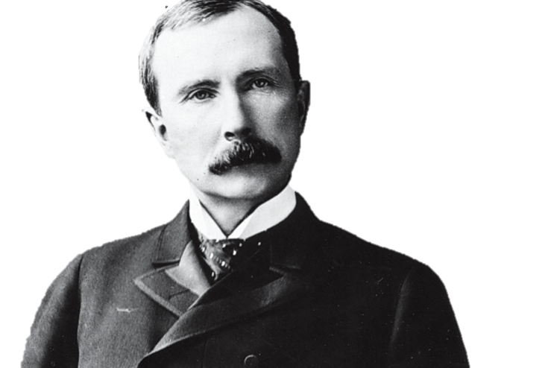
Social Darwinism
Social Darwinism paralleled economic doctrine of laissez-faire - “Hand-off” the economy.
John D. Rockefeller and other industry leaders embraced Social Darwinism.
If a company succeeded, it was because it had best adapted to the business environment.
The rich industrialists used the excuse of Social Darwinism for why they were so rich.

Slide 10
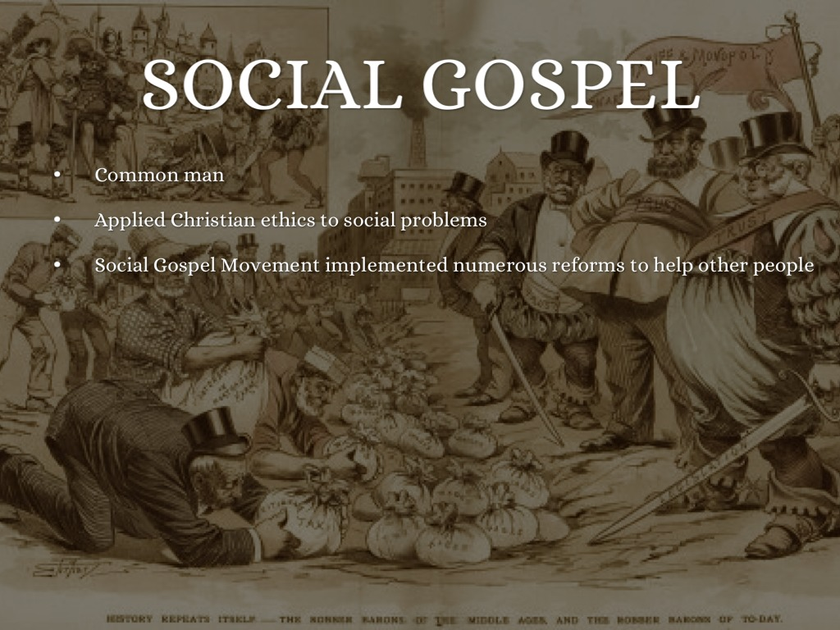

Slide 12
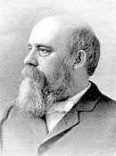
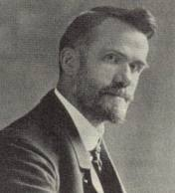
The Social Gospel
Social Gospel – "liberal movement in American Protestantism, prominent in the late 19th century, that sought to apply Christian principles to a variety of social problems engendered by industrialization. Its founders and leaders included clergymen Washington Gladden and Walter Rauschenbusch ..." (Encarta Encyclopedia)
Gladden
Rauschenbusch

Slide 13
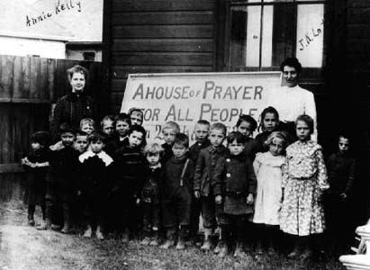
Social Gospel

Slide 15
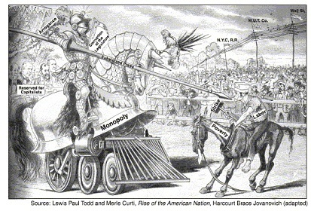

Slide 17
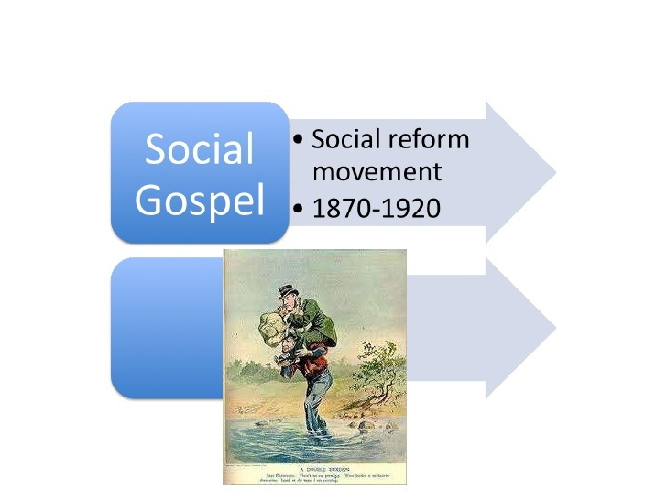

Slide 19
Social Gospel
The Social Gospel movement takes hold from 1870 to 1920.
Churches expand their functions to include social programs to improve:
poor working conditions
problems of society
poor schooling
child labor
crime

Slide 20
“Many political, business, and religious leaders saw social inequalities as simply a natural occurrence. The British philosopher Herbert Spencer believed that human progress depended on a struggle among individuals, whereby through physical strength and intelligence certain individuals and groups would gain wealth and prosperity. Often credited with coining the phrase “survival of the fittest,” Spencer argued that human advancement and social advancement required personal freedom, and that government initiatives to regulate economic practices were misplaced. While many American Protestant leaders did not necessarily embrace the intricacies of Spencer’s social thought, they enthusiastically accepted the idea that religion and the accumulation of wealth went hand in hand. The historian Henry May noted that in the years following the Civil War, “many Protestant spokesmen delighted to point out that the road to success led through Christian living,” whereby a just and benevolent society would emerge through the generosity of the wealthy. Economic disparities went hand in hand with the freedom to work hard, earn wealth, and practice charitable giving. “The poor we have with us always; and this is not the greatest of our hardships, but the choicest of our blessings,” one periodical noted in 1874. “If there is anything that a Christian may feel thankful for, it is the privilege of lifting a little of the load of some of his heavily-burdened neighbors.” This “gospel of wealth” found a hearing among an emerging generation of liberal Protestant preachers.”
Evans, Christopher H.. The Social Gospel in American Religion (pp. 26-28). NYU Press. Kindle Edition.

Slide 23
God teaches Adam and Eve about the consequences of their actions. Each of the consequences discussed in Genesis hold a distinctively relational connotation. The results of their actions will impact not only the way they relate to God, but also the way they relate to themselves internally, to each other, and even to the created order. This is extremely important to keep in mind as we consider this story. The relational fractures which occur as a result of Adam and Eve’s sin run in four directions. First, the human relationship with God was fractured—they hid from God. They had never done that before. Second, the human self-relationship was fractured—they saw that they were naked and felt shame for the first time. Third, their relationship to each other was fractured—Adam tried to blame Eve for the debacle. Fourth, their relationship to the created order was fractured—resulting in increased pain in childbirth, and a ground which bore a curse. The story of the fall from the book of Genesis tells of relational damage in four directions: between the self and God, the self and the self, the self and other people, and the self and the created order.¹³ The gospel story must address and restore all of these fractures for it to be good news.
However, the gospel among evangelicals typically addresses only the fracture of the God-human relationship. The other three parts of the picture are seldom recognized as a vital part of Christ’s work on the cross. The Genesis account of the fall serves as a helpful reminder that our own selfishness and sin does not just affect our relationship to God, but our relationship to ourselves, to each other, and to all of creation.
Therefore, the gospel message deals not just with our broken relationship with God, but with all of those relationships. We need a savior who can atone for the guilt of sin and repair our relationship with God, for sure. But we also need a savior who can repair all of our brokenness and offer redemption in all four directions—the way we relate to God, to ourselves, to other people and to the world we live in. When we tell the gospel in such a way that the whole story seems to be only about privatized salvation, we reduce the gospel and remove the story of God from its relational context in the Scriptures. The good news of God goes much further than individualized salvation. God’s redemption has always been concerned with all of life.
Suttle, T. L. (2011). An evangelical social gospel? finding god’s story in the midst of extremes. Eugene, Oregon: Cascade Books.

Slide 24
Rauschenbusch believed individualism was a real problem when it came to embracing the true gospel, because the true gospel involves a turning to neighbor in love as well. Do you remember how Jesus responded to the question concerning the greatest of the commandments? He emphasized two: love God, love your neighbor. The two are inseparable. Any robust conception of the gospel must take into account Jesus’s teaching about loving God and neighbor. Moreover, Jesus seemed to assume any sincere response to the gospel would have to follow suit. Responding to Jesus involves a turning away from individualism and a turning toward our fellow human beings in love. If the gospel we preach, teach, and follow does not make this demand upon our lives—that we should renounce our radical individualism and embrace to call to love our neighbor—then it is not the same gospel we find in the New Testament. Any sort of personal salvation that does not involve this view is something very different than Jesus envisioned. Rauschenbusch taught that salvation should involve a conversion from individualism to personhood, or what he called the “socializing of the soul.” By this I believe he meant a turning away from focus on the individual with their desires, wants, and needs, toward the whole of a society or social group and a focus on peaceful and “right” relating across the whole group. When Rauschenbusch made this move, he paved the way for many subsequent theologians and philosophers who began to deconstruct individualism in favor of personhood.
Suttle, T. L. (2011). An evangelical social gospel? finding god’s story in the midst of extremes. Eugene, Oregon: Cascade Books.

Slide 25
A Relational View of Personhood
It is important to distinguish the difference between the concept of the individual and the concept of the person. Let me be clear about the way I will use those two terms. The individual is an idea which refers to a distinct entity that is capable of independent existence. The person refers to a human being, as opposed to an animal or a thing, who is defined by their association to the larger group of people. Individuality connotes autonomy while personhood connotes belonging. Conversion to Christ is really about belonging. It’s about leaving behind our individual rights and freedoms and becoming a slave to Christ. It’s about leaving behind our obsessive need to distinguish ourselves so that we can become a part of the people of God—that’s true freedom. This requires a conversion from false individualism to true personhood; from self-referential existence to a way of being which is necessarily constituted in and through relationship. Personhood—and thus salvation—requires us to have a relational view of human agency. The twenty-five cent word for this is ontology, or the nature of “being.” Human ontology is relationally or socially construed. What makes us human is our participation in humanity.
Suttle, T. L. (2011). An evangelical social gospel? finding god’s story in the midst of extremes. Eugene, Oregon: Cascade Books.

Slide 26
This is exactly the Apostle Paul’s view of the community of Christians he addresses in 1 Corinthians 12. He says the church is the body, and the body has many parts; a hand, a foot, a thumb, an eye, etc. A hand is not a person, nor is a foot or an eye a person. This is the biblical analogy of personhood. Just as a hand is worthless without the body, so the individual is worthless without an integral association to the group. The hand finds its proper value in relation to the body as a whole. The individual finds its proper value in relation to humanity as a whole.
This is part of why the gospel cannot be rightly communicated through individualistic categories of thought. Zizioulas once wrote that Christian community, and thus true being, is formed “through a radical conversion from individualism to personhood in baptism.” ⁸ I think he’s right. Following after Jesus involves a conversion from individualism to personhood. This, in fact, is a very healthy way to view our own baptism. Baptism should actually be seen as a renunciation of individualism (or any rival god for that matter), as we join with the people of God and become fully human persons. [In Baptism] the person dies to the old way of being which is marked by selfishness and individuality, and they enjoin a whole new way of being human marked by their identity which is found in and through the community. They renounce their citizenship in the kingdom of the world and the people of God declare that they are citizens of the kingdom community. Having jettisoned the concept of radical individualism as the source of our uniqueness, we can be converted to true personhood. After this conversion we can begin to reconsider how personal salvation and corporate salvation must fit together as one unified gospel message.
Suttle, T. L. (2011). An evangelical social gospel? finding god’s story in the midst of extremes. Eugene, Oregon: Cascade Books.

Slide 27
Rauschenbusch rightly recognized the fear of personal damnation or punishment is in essence an ultimately selfish motivation for salvation. He called it “self interest on a higher level.” But true regeneration, including both the personal and social conversion of the person, must have an eye toward all of humanity and her social institutions to be authentic.
There are many biblical metaphors from which to draw upon to get a picture for what it means to experience salvation in the complete sense. The dominant metaphor in evangelicalism is the one introduced by Paul. It is a forensic term called justification. Justification is a legal metaphor meant to express a change in personal legal status before God. This is an important metaphor. But there are others. The term adoption is used. Adoption comes from the realm of family life. It is an important social metaphor for salvation. The term conversion is used to convey an active break with an old way of being human and a turning to a whole new way of life. It too is a term with social implications. Regeneration is perhaps the strongest term associated with personal salvation. Rauschenbusch wrote, “We call the change ‘regeneration’ when we think of it as an act of God within us, creating a new life.”¹⁹ No single term can dominate the others. Yet in contemporary evangelicalism, justification controls, even mutes all other metaphors. We must come to recognize that all of these terms (and more) are necessary to convey the great mystery that is our salvation through Christ. Moreover, we must come to see how each one can shed light on different social aspects of salvation that can be lost if our only metaphor is justification.
Suttle, T. L. (2011). An evangelical social gospel? finding god’s story in the midst of extremes. Eugene, Oregon: Cascade Books.

Slide 28
Sin as Failure to Image God
Sin is usually viewed individualistically. Typical individualistic notions of sin adopt a “sin as crime” metaphor where sin is viewed as a crime that is committed against God. It is something perpetrated by an individual which requires some sort of punishment in order for the justice of God to be upheld. Thus, the remedy for sin will be construed in individualistic categories, i.e., Jesus as the perfect sinless individual takes the place of the imperfect sinful individual and takes the punishment for the crime. This individualization of sin is a classic example of trying to take a narrative like the Genesis account of the fall and convert it into a system. Narratives, by their very nature, resist that sort of systematization. Perfect, tight systems typically involve some sort of dangerous distortion.
The way to avoid the individualistic distortion of the Scriptures is to do our very best to view the story as a whole. How were we created and what were we created for? How have we failed to be and do those things? These are the questions we should ask when it comes to considering the concept of sin. If the goal of God’s human project is a particular kind of common life, then sin is the failure to engender that vision in the way we live. Sin is most certainly something we hold in common. At its most basic level, sin is a communal phenomenon. Individual transgressions are certainly worthy of being called “sin” but they do not come close to explaining the power of sin in all of its complexities and the ways in which is has been woven into systems and situations of our culture.
God’s call to Abraham and God’s subsequent plans and dreams for the people of Israel directly follow the Noah story and Babel, both of which are examples of corporate sinfulness. God moves not merely in response to individual sins and transgressions, but to corporate sin. When God scatters them and frustrates their language at Babel, it is not a random act of judgment or punishment. It is evidence of God’s resolve that the human vocation must go on. Humans must fulfill their iconic function throughout all of creation. God will not accept the alternative. Humans should live everywhere in creation, to enhance it, order it, and organize it in a way that gives glory to God—that icons God. From this early point in Genesis we can tell sin must be viewed not as merely personal, but as a corporate thing as well. The stories of Noah and Babel clearly have corporate sinfulness in view. God’s response to each is to find a way to move humans without compromise toward the fulfillment of their vocation.
Suttle, T. L. (2011). An evangelical social gospel? finding god’s story in the midst of extremes. Eugene, Oregon: Cascade Books.

Slide 29
Sin is a Web
If we do not take seriously the social aspect of sin, we do not have a robust doctrine of sin. The guilt of sin is not only a stain on the person, but upon the people. Rauschenbusch wrote, “The weakness or the stubbornness of our will and the tempting situations of life combine to weave the tragic web of sin and failure of which we all make experience before we are through with our years.” Sin is a web. This was as keen an insight at the turn of the century as it is today. Sin is not merely the problem of the discrete individual person who willfully sins by what they have done and what they have left undone. Sin is a web of brokenness that permeates the cosmos. It has woven itself into the web of human relationships and social systems, perhaps even into our biological makeup. The reality of sin runs deep into the heart of the created order and it permeates the cosmos like a scarlet thread. It was the web of sin that so defined Rauschenbusch’s view. If we do not carefully consider how sin is woven into our society, we cannot be fully conscious of sin. A lack of consciousness of social sin is a license to commit it.
Individualistic views of sin tend to ignore the way that sin has become bound up in the systems of our societies. Sin characterizes the whole of human relationships, and the fracture runs in all four directions. Individualistic views of sin cannot account for the myriad of ways in which sin pervades our political, economic, and legal systems. Every human system, at least on some level, bears the stain of human sin. It is woven into the foundation of every system’s structure. It is not possible to account for this reality with an individualistic view of human sin. The consciousness of sin must extend beyond the realm of personal transgression, and draw out the web of sin in which we are all involved, and for which we have all cast our vote.
Suttle, T. L. (2011). An evangelical social gospel? finding god’s story in the midst of extremes. Eugene, Oregon: Cascade Books.

Slide 30
The sense and referent of the metaphors
The meaning of the two metaphors salt and light and their connection with the third metaphor, a ‘city on a hill’.
In Isaiah it is Zion which is to be such a city, the community of the redeemed whose light and shining righteousness attracts the nations in the end times (60:1–3; 62:1–3). The ‘irradiated’ ‘inwardly charged, new life’ which shines like a light referred to by Motyer, is, according to the prophets Ezekiel and Jeremiah, brought about by the pouring out of God’s Spirit and the bestowal of new hearts on which are written God’s law (Ezekiel 36:24–32; Jeremiah 31:31–34). It would appear, however, that Jesus is giving the symbols of light and a city a new referent, namely, the poor/prophetic community of his followers. In Isaiah 62:2, the nations (Gentiles) will ‘see the righteousness’ of the redeemed which ‘shines out of them like a torch’. Likewise, the new ‘city’ of the redeemed cannot be hid and their righteous good works (which are to exceed those of the Pharisees), will be seen and result in the offering of praise to God the Father (16). It is by being salt within one’s own circle, calling God’s people to be true to his covenant and being true to it oneself, that the covenant community will influence the world in drawing others to the one true God. It is also from this community that God’s law/word goes into the world as a source of blessing (cf. Isaiah 2:3). This is the raison d’etre of the community: just as a lamp placed on a stand is to illumine the whole house, a hidden lamp is self-defeating, so there can be no retreat from the world for these kingdom people if they are to be a light to the world. It is ‘before men’ that such deeds are performed and so producing a desired doxological effect (5:16).
Tinker, M. (2006). The Servant Solution: The Co-ordination of Evangelism and Social Action. Themelios, 32(2), 19–22

Slide 31
‘Seek the welfare of the city’: social ethics according to 1st Peter
Before a watching world. It was intended that their good works should be observed (epopteuō—2:11–12). They were commanded as sojourners and temporary residents to abstain from carnal conduct in order to present an attractive lifestyle (anastrophē kalē—2:11). This Christian existence consisted not only of personal moral values, but also high-profile good works. The observation of these good works would not only be an eloquent defence against ill-founded allegations against Christians as evil doers, but also be the means by which critics became converts who glorified God ‘in the day of visitation’. Their light was so to shine before men that they would see their good works and glorify their Father in heaven. There were four areas of life where they were called upon to engage in this high-profile activity before the watching non-Christian world of their day, These were (a) in civic life, (b) in the households as Christian servants, (c) in the marriage of a Christian to a non-Christian, and (d) in the flash-point situations where the Christian community appears to have been singled out for discriminatory treatment. It is interesting to note that despite the complexity and far from ideal life situations of the Christians addressed in 1 Peter, there were no extenuating circumstances which exempted them from seeking the blessing of the city. In the face of difficulties they were simply to commit themselves to a faithful Creator by ‘doing good’ (4:19).
Winter, B. (1988). “Seek the Welfare of the City”: Social Ethics according to 1 Peter. Themelios, 13(3), 91–97.

Slide 32
‘Seek the welfare of the city’: social ethics according to 1st Peter
In Civic Life. The Christian citizen’s duties were not simply discharged by obedience to ordinances. The dual function of rulers is epitomized as punishing the law breakers and praising those who did good in the public arena (2:14). The latter referred to the important duty of the official recognition of a public benefactor.¹⁰ The cities of Anatolia and the other regions of the East had long been supported by public benefactors who saved the community from famine, deflated prices of essential commodities in time of scarcity, paid for the installation of water supplies, enhanced the life of the city with fountains, widened roads, erected theatres and public buildings, and provided for child allowances. This method of providing for the needs of the city, which was well established in Greek times, was certainly continued during the early centuries of the Roman empire.¹²
In 2:14–15 Christians of substance were called upon to continue to observe it. Being a benefactor was declared to be ‘the will of God’ and public recognition by rulers the means of silencing the rumors of ill-informed men. There was an established procedure by which the particular gift of a benefactor was recognized with the erection of an inscription commemorating the event, and by the public praising with words of commendation, by being crowned with a crown of gold, and by being allocated a permanent seat of honour in the theatre. The term ‘benefactor’ bestowed status in society.¹⁴ The public declaration that a Christian man was ‘good and noble’ (kalos kai agathos) would have recognized his benefaction and also silenced the ignorant charge of a malicious accuser that he was a doer of public evil and not good.
Winter, B. (1988). “Seek the Welfare of the City”: Social Ethics according to 1 Peter. Themelios, 13(3), 91–97.

Slide 33
‘Seek the welfare of the city’: social ethics according to 1st Peter
Ethics and eschatology. The teaching about seeking the welfare of the city and its peace by the pilgrim people of God in 1 Peter holds together two crucial doctrines, eschatology and social ethics.
There is no sense in which the eschatology of 1 Peter provided the Anatolian Christians with the excuse to abstract themselves from society. Social ethics were clearly assumed as the norm for Christians in 1 Peter. What this general epistle dealt with was the difficulty of fulfilling that responsibility in the unsettled circumstances in which the churches found themselves. This was done within the crucial framework of their future hope.
Underlying the important place given to social ethics within eschatology is the biblical doctrine of the goodness of God. He showers his providential care upon a rebellious and ungrateful world which he knows is passing away. His children can do no other. He does good, because good needs to be done. So must his pilgrim church.
In 1 Peter the good works of Christians were clearly orientated towards the needs of others in the temporal cities in which they lived. Social ethics are thus discussed within the call to a singular focus on the Christian’s eschatological hope. The epistle to Diognetus notes that this is ‘a wonderful and confessedly strange characteristic of the constitution of the heavenly citizenship’.
This ‘constitution’ needs to be grasped afresh today in the discussion of social ethics. To stand in ‘the true grace of God demands a deep commitment to social ethics within the framework of a living eschatological hope. The latter without the former is a distortion of the true Christian framework. The latter enables the Christian to place his own agenda second to the needs of others. The former without the latter may not be a reflection of heavenly mindedness but of earthly mindedness. There is more than one reason for passing by on the other side opportunities to do good.
First Peter shows how it is possible to be truly heavenly minded and of real earthly use to the welfare of the city.
Winter, B. (1988). “Seek the Welfare of the City”: Social Ethics according to 1 Peter. Themelios, 13(3), 91–97.

Slide 34
Container v. Funnel
This complex of rival gods—the unholy trinity—has convinced many evangelicals that what we essentially are is a container. God pours out his blessings upon us and our job is to soak them up. From the day we are born God pours resources into our lives. At first they are simple: a womb, nourishment from a mother, and basic safety. Most of us received incredible gifts from God when we were young: a family, food, shelter, clothing, love, support, and nurture. Most of us received an education, and the example of role models. We were the beneficiaries of countless modes of support, opportunity, and resources. The Christian story tells us that these are all gifts from God. Even simple things like health, friendships, and physical vitality are to be received as a gift. Whether we realize it or not, God is at the center of all of this as its source. Yet, even if we agree that all of life is to be received as a gift, most American Christians are extremely confused as to what sort of vessel these blessings have been poured into. We mistakenly view ourselves as a container.
Most of us think we are a container, as though God pours these resources into us and our job is to protect them at all costs. The container is a lousy metaphor for the person.¹⁰ It is about keeping God’s blessings to ourselves. It is about survival. When God pours his blessing into a container, and the container is plopped down in a world that is about a mile wide and an inch deep, the container does nothing. It just keeps everything inside and has no impact on the culture at large. The container-person is useless to the Kingdom of God.
Suttle, T. L. (2011). An evangelical social gospel? finding god’s story in the midst of extremes. Eugene, Oregon: Cascade Books.

Slide 35
Container v. Funnel – cont.
Humans are not containers, we are funnels. Everything that comes into our lives is meant to flow out the other side. God pours his resources into our lives not so we can contain them, but so we can steward them into the rest of the world. You plop a funnel down into a world that is a mile wide and an inch deep, and as God pours resources through them and into the rest of the world, you’ve got yourself a kingdom building machine. This is how the kingdom comes. We are not containers, we are funnels. God is the source of all of life, our gifts, talents, resources, income, abilities, passions, etc. Our job is not to leverage those to keep our container full. Our job is to let them flow freely through our lives into the lives of others, believing that the source will never dry up.
Ultimately, the goal of life is to die empty, having exhausted ourselves for the life of the world. This is how the kingdom comes. This is the way of Jesus. The unbelievable blessing of living this way of life is that God’s blessings never run dry. Only the way of self-emptying is the way of Jesus. Only the way of self-emptying can help us to live lives which are truly satisfying and peaceful. The reason is that this is how God has made creation to be. When we partake in this way of life, we participate with how God has made creation to be at its very core.
The church is not a container either. The church is a funnel. Our job as the church of Christ is not to survive. Our job is to empty ourselves on behalf of the world. Our job is to die empty, just like Jesus did.
Suttle, T. L. (2011). An evangelical social gospel? finding god’s story in the midst of extremes. Eugene, Oregon: Cascade Books.

Slide 36
God has a mission and God’s mission calls the church into existence. What we are supposed to do is to pour ourselves out for the life of the world. We’re supposed to humble ourselves and empty ourselves for others. Now, something like that doesn’t just happen. That’s just not how things work in our culture. The world we live in is all about being upwardly mobile. More is better, enough is never enough, and whatever you’ve got, you should enjoy it and hold on to it. But the church is supposed to be different. This is what Jesus meant when he said, “If you try to find your life, you will lose it; but if you lose your life for my sake, you will find it.” How does that happen?
The best metaphor I know of for how this works itself out practically is the concept of breathing. Every week God breathes his church into his lungs. It’s a cosmic inhalation that draws the church together every seven days. What happens when the church gathers is of great importance. We gather together around the word and the table to be shaped by God who holds us in his lungs and empowers the entire thing himself. The people of God gather, first and foremost, around the story of God—the Scriptures—and they tell and retell the story in the most creative and imaginative ways possible. Over time they begin to see themselves as living in that story—not the story of our culture, but the story of God—it comes to define them as a people more than any other rival story. And so we give ourselves over to the story of God and begin to organize our common life together in such a way that we can be faithful to that story. In my community we call it transformation. Whatever you want to call it, it is the process through which God draws the church into God’s lungs and shapes us and forms us, enriches us and prunes us. This process is thoroughly corporate and yet always very personal.
Then God exhales. He blows us out of his lungs and into the world. As little transformed agents of redemption we are sent out into the places we always go—our home, our schools, our workplaces, our neighborhoods, our families, etc. We go there as salt and light. We go there as people who do not walk by sight but by faith—pistis—believing allegiance. We are transformed vessels of God’s redemption sent to season all of creation. We image God. So, when people look at us they actually see past us, and get a good look at God. We become caught up in the love of God and become transformed into the kind of people who go out into the world as salt and light and actually image God to all creation because we’re image-bearing people.
Suttle, T. L. (2011). An evangelical social gospel? finding god’s story in the midst of extremes. Eugene, Oregon: Cascade Books.

Slide 37
The "Whole-Man" Concept
Spiritual problems.
Financial problems.
Marital problems.
Psychological problems.
Occupational problems.

Slide 39
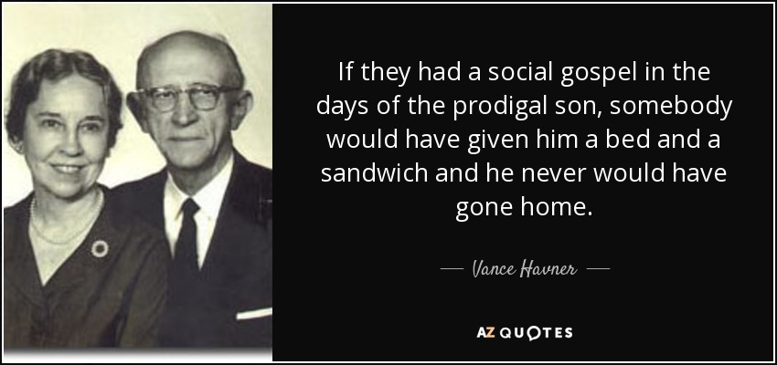
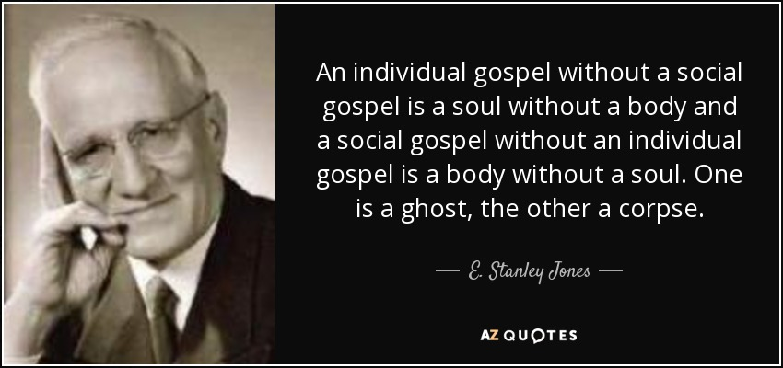

Slide 40
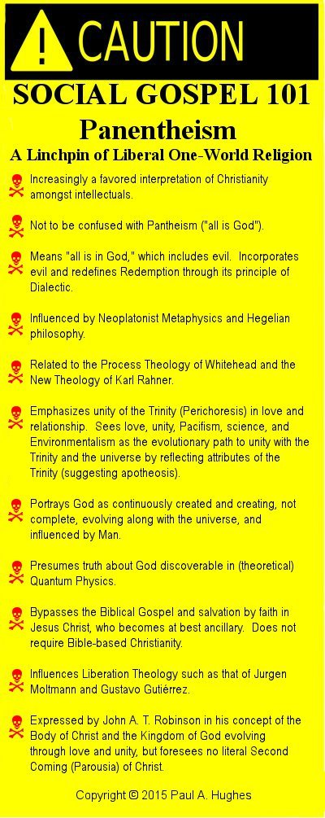

Slide 41
SOCIAL GOSPEL: post-millennial

Slide 42
History of the
Social Gospel Movement
Know of history – better appreciate what is going on now
How it started
How it grew
Its roots (thoughts behind it)
The dangers it poses

Slide 43
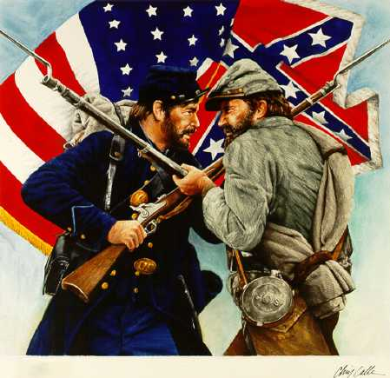
The Social Gospel
Started in America
Years following the Civil War

Slide 44
History of the
Social Gospel Movement
Background of Modernism

Slide 45
Background of Modernism
Modernism: Rejection of Bible fundamentals
Darwin taught the theory of evolution

Slide 46
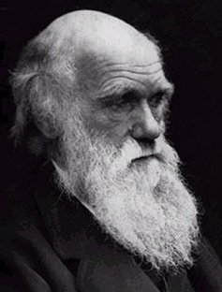
Charles Darwin
(1809 – 1882)
Evolution
(Survival of Fittest)

Slide 47
Background of Modernism
Modernism: Rejection of Bible fundamentals
Darwin taught the theory of evolution
Darwin’s thought undermined & rejected the Genesis account
Some tried to hold to Bible & Evolution (Theistic Evolutionist)
Denies the Bible is inerrant
Rejected idea of verbal inspiration (cf. 1 Cor. 2:13)
“The rise of the social gospel in this country was simultaneous with the rise of Biblical liberalism and modernistic religion” (Dr. David Harrell, FCC Lectures, March 23, 1960)

Slide 48
“It was quite natural that the leaders of the liberal religious movement should become active social gospelers. Indeed, the discovery of the church as a social institution filled a vacuum left by their rejection of the church as a significant spiritual institution. These liberals were also the most widely know clergymen of their day and when historians began to study the social gospel movement it was natural for them to emphasize the importance of the modernist proponents of social reform.”
- Dr. David Harrell, FCC Lectures, March 23, 1960

Slide 49
Background of Modernism
Modernism: Rejection of Bible fundamentals
Darwin taught the theory of evolution
Denies the Bible is inerrant
Present a “real” or “liberal” Jesus: stripped of the miraculous
Strip him of deity (cf. John 1:1)
Result: a watered-down Jesus – a mere human moral teacher
Teachings favor modern progressive social programs

Slide 50
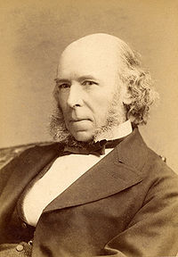
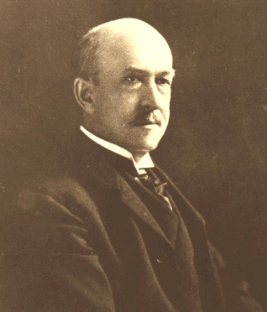
Background of Modernism
Modernism: Rejection of Bible fundamentals
Social Setting of late 1800’s & early 1900’s
“Social Darwinism”
Survival of the fittest - opposed to the social gospel
Argued that proof was seen in wealthiest exceeded in business.
Herbert Spencer (1820-1903) – Progress: Its Law and Causes (1857) argued evolution of mind, culture & society.
William Graham Sumner (1840-1910) – Strongly influenced by Spencer, but later rejected “Social Darwinism”
Idea: All forms of social reform were misguided

Slide 51
Background of Modernism
Modernism: Rejection of Bible fundamentals
Social Setting of late 1800’s & early 1900’s
“Social Darwinism”
Problems of society following the Industrial Revolution
Crime
Poverty
Inequality
Drunkenness
Etc.

Slide 52
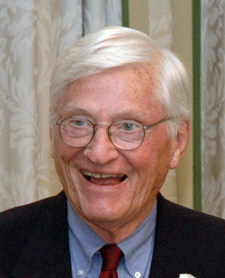
“In the 1870’s and 1880’s the leaders of American society suddenly realized that they were faced with overwhelming social problems. The industrial revolution in this country raised problems in business and political ethics, employer-employee relationships, economic competition, and the nature of poverty and its remedy which shocked many American social philosophers out of a well-worn complacency. No less serious were the social maladjustments connected with the unparalleled rise of high cities. Slums, drunkenness, prostitution, organized crime, juvenile delinquency, abject poverty, and all other problems sprawling, filthy cities were convincing realities that demanded that something be done.”
Dr. David Harrell, FCC Lectures, March 23, 1960

Slide 53
“Out if this setting came the social gospel movement. Religious leaders were not the first to delve into these social evils but in the late 1870’s and in the 1880’s increasing numbers of them from almost every denomination began to offer suggestions for the solution of the new America’s social dilemma.”
Dr. David Harrell, FCC Lectures, March 23, 1960

Slide 54
Background of Modernism
Modernism: Rejection of Bible fundamentals
Social Setting of late 1800’s & early 1900’s
Social Gospel Concept
A / the primary message of the gospel is social justice
Church (institutional manifestation of Christianity) is obligated to do something about the social maladjustments.
Rejected idea: gospel has one primary intent: spiritual
Thus: primary purpose of the social gospel is to improve social circumstances of man

Slide 55
Background of Modernism
Modernism: Rejection of Bible fundamentals
Social Setting of late 1800’s & early 1900’s
Social Gospel Concept
A / the primary message of the gospel is social justice
How it works:
Evangelism /conversion culminates in the promised “kingdom of God” (i.e. better – more perfect society)
Business man converted
Primary concern is not his personal salvation
Change in better business practices
Even more: better business practices of others

Slide 56
Background of Modernism
Modernism: Rejection of Bible fundamentals
Social Setting of late 1800’s & early 1900’s
Social Gospel Concept
A / the primary message of the gospel is social justice
How it works:
Many leaders of movement were post-millennialist: Second Coming will not occur until humankind rids itself of social evils.

Slide 57
Background of Modernism
Modernism: Rejection of Bible fundamentals
Social Setting of late 1800’s & early 1900’s
Social Gospel Concept
Leaders of the Movement
Walter Rauschenbusch (1861-1918)

Slide 58
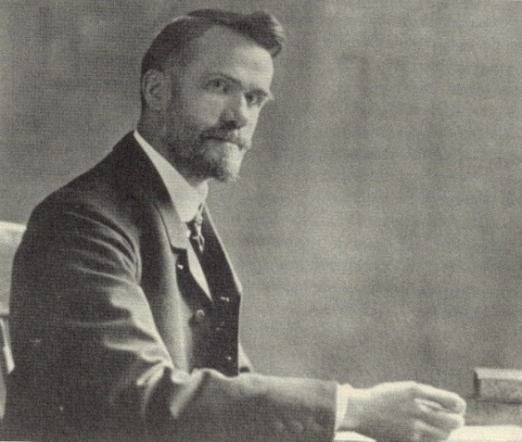
Walter Rauschenbusch
(1861-1918)
Who: Baptist minister
How Thoughts Developed:
Raised as orthodox Protestant – believing in biblical literalism and substitutionary atonement
Later ideas about inerrancy of Bible was “untenable”
Doubted idea of sub. atonement

Slide 59
Walter Rauschenbusch
(1861-1918)
Who: Baptist minister
How Thoughts Developed:
View of Christianity:
Spread of kingdom – not by fire and brimstone – but leading a Christlike life
Death of Christ was to substitute love as basis for human society
Kingdom of God – not about going to heaven, but transforming life on earth into harmony of heaven
Duty of ministers / Christians to improve social conditions

Slide 60
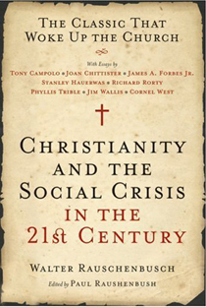
Walter Rauschenbusch
(1861-1918)
“Whoever uncouples the religious and the social life has not understood Jesus. Whoever sets any bounds for the reconstructive power of the religious life over social relations and institutions of men, to that extent denies the faith of the Master.”
1907

Slide 61
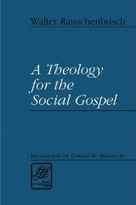
Walter Rauschenbusch
(1861-1918)
For John the Baptist, baptism was “not a ritual act of individual salvation but an act of dedication to a religious and social movement.”
“Jesus did not in any real sense bear the sin of some ancient Briton who beat up his wife in B. C. 56, or of some mountaineer in Tennessee who got drunk in A. D. 1917. But he did in a very real sense bear the weight of the public sins of organized society, and they in turn are causally connected with all private sins.”
1917

Slide 62
Walter Rauschenbusch
(1861-1918)
“The young professor sought to reconcile these two chains of thought into a single concept. As he himself said, “When I had begun to apply my previous religious ideas to the conditions I found, I discovered that they didn’t fit…. I had to go back to the Bible to find out whether I or my [liberal] friends were right. I had to revise my whole study of the Bible…. All my scientific studying of the Bible was undertaken to find a basis for the Christian teaching of a social gospel.” Robert T. Handy goes on to explain, “He found that basis in the doctrine of the kingdom of God, which brought together his evangelical concern for individuals and his social vision of a redeemed society.”
- John A. Battle A Brief History of the Social Gospel, WRS Journal (Quoting Robert Handy).

Slide 63
“The contributions made by Christianity to the working efficiency and the constructive social abilities of humanity in the past have been mainly indirect. The main aim set before Christians was to save souls from eternal woe, to have communion with God now and hereafter, and to live God-fearing lives. It was individualistic religion, concentrated on the life to come. Its social effectiveness was largely a by-product. What, now, would have been the result if Christianity had placed an equally strong emphasis on the Kingdom of God, the ideal social order?” (The Social Principles of Jesus, pp. 73-74).

Slide 64
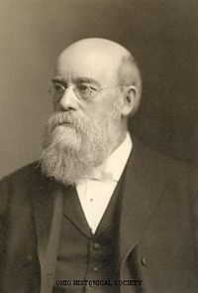
Background of Modernism
Modernism: Rejection of Bible fundamentals
Social Setting of late 1800’s & early 1900’s
Social Gospel Concept
Leaders of the Movement
Walter Rauschenbusch (1861-1918)
Washington Gladden (1836 -1918)
Worked as religious & community leader
Worked for workers unions

Slide 65
Background of Modernism
Modernism: Rejection of Bible fundamentals
Social Setting of late 1800’s & early 1900’s
Social Gospel Concept
Leaders of the Movement
Walter Rauschenbusch (1861-1918)
Washington Gladden (1836 – 1918)
Civil Rights Movement (1950s – 1960s)
National Council of Churches

Slide 66
A Great Shift
Spiritual
Social

Slide 67
History of the
Social Gospel Movement
Background of Modernism
Impact on Denominations

Slide 68
Impact on Denominations
Denominations were influenced by modernism
Changed view of Bible, sin, salvation & heaven
Shift away from salvation to correcting social problems
Shailer Matthews said in 1927, “the old individualism of evangelism is being supplemented by the social evangelism”
In 1908 Denominational Federal Council of Churches adopted a “Social Creed of the Churches”
Notes:
Voice of West End, August 5, 1966, Vol. 7, No. 48

Slide 69
Impact on Denominations
Denominations were influenced by modernism
American churches underwent change following Civil War

Slide 70
“After the Civil War and Reconstruction in the South, American churches underwent great transformation. At the end of the Civil War, the mainline denominations were uniformly orthodox, but within forty years liberal theology and the social gospel had made significant inroads. By the 1930s the social gospel was the predominant theme in many sections of the church. These changes were brought about by several factors, including the demoralization caused by the war, increased immigration of people with different theology and practices, increased participation and influence by laymen (especially wealthy businessmen) in church affairs, the developing progressive or socialistic movement in America, and the importation of liberal biblical criticism and theology from Germany and England. An example of this change is seen in the observance of the Christian Sabbath. After the Civil War, Americans generally attended church and closed their businesses on Sunday; twenty years later Chicago could be described as “a Berlin in the morning and a Paris in the afternoon.”
-John A. Battle A Brief History of the Social Gospel, WRS Journal

Slide 71
Impact on Denominations
Denominations were influenced by modernism
American churches underwent change following Civil War
Nearly all denominations developed social programs
Mission (emphasis) changed from spiritual to social
Examples:
Day Care
Schools / Colleges
Hospitals
Orphan Homes
Nursing Homes
Soup Kitchens
Clothes Closets
Gyms
Youth Ministries

Slide 72
Impact on Denominations
Denominations were influenced by modernism
American churches underwent change following Civil War
Nearly all denominations developed social programs
YMCA (Young Men’s Christian Association)
Started in 1844 in response to the social conditions in the inner cities following the Industrial Revolution

Slide 73
Impact on Denominations
Denominations were influenced by modernism
American churches underwent change following Civil War
Nearly all denominations developed social programs
YMCA (Young Men’s Christian Association)
How did more “conservative” churches get involved?

Slide 74
“Conservative” Denominations Got Involved In Social Gospel
(i.e. Holiness)
“Doctrinally conservative, many of the revivalist leaders of the last century readily adjusted the principles of the social gospel into their conservative theology.”
- Dr. David Harrell, FCC Lectures, March 23, 1960
“Far from disdaining earthly affairs, the evangelists played a key role in the widespread attack upon slavery, poverty, and greed. They thus helped prepare the way both in theory and in practice for what would later become known as the social gospel.”
- Timothy L. Smith, Revivalism and Social Reform in the Mid-Nineteenth Century America, 8

Slide 75
“Conservative” Denominations Got Involved In Social Gospel
“By the 1880’s social gospelism had invaded the restoration movement. Leader of the Disciples of Christ, still Biblically conservative at this junction, such as Isaac Errett, Richard M. Bishop of Cincinnati, and Frederick Power of Washington D.C. participated in the earliest organized efforts of the social gospel leaders in the United States.”
- Dr. David Harrell, FCC Lectures, March 23, 1960

Slide 76
A Great Shift
Spiritual
Social

Slide 77
In The Church must be “laisized,” says Rauschenbusch. The lay forces of the Church must be organized and pressed into service. They especially should carry forward the great work of the Church. And that work must be social rather than individual. The great question for the Church should no more be: How can I minister to the salvation of individuals; but: how can I raise the level of society; how can I inspire men to lead nobler lives? The Church exists for the realization of the Kingdom of God, the complete establishment of which many of the moderns expect in this world. Campbell says The New Theology, p. 246: “I maintain that the Church has nothing whatever to do with preparing men for a world to come; the best way to prepare a man for the world beyond is to get him to live well and truly in this one. The Church exists to make the world a kingdom of God, and to fill it with His love.”
Berkhof, L. (1913). The Church and Social Problems (pp. 14–16). Grand Rapids, MI: Eerdmans-Sevensma Co.

Slide 78
Famous Social “Gospelers”

Slide 79
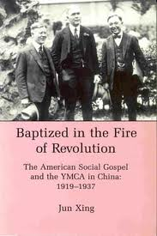
Famous Social “Gospelers”

Slide 80
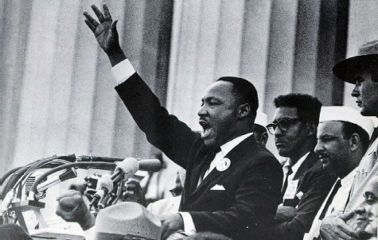
Famous Social “Gospelers”
Walter Rauschenbusch, Christianity and the Social Gospel: “[This book] left an indelible imprint on my thinking.”

Slide 81
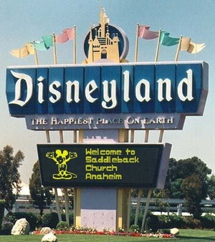
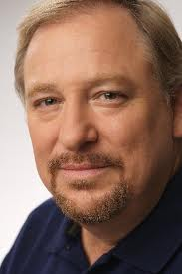
Famous Social “Gospelers”
Rick Warren

Slide 82
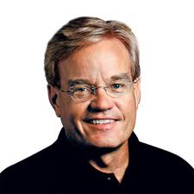
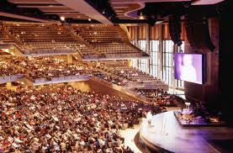
Famous Social “Gospelers”
Bill Hybels

Slide 83
Willow Creek Community Church
A social gospel church – GROWING!
Rented movie theater.
October 12, 1975 (125 people first service)
Three years later ⇨ 2,000 people
Today ⇨ 17,000 people
Bill Hybels

Slide 84
Why are they growing?
Survey: “What would it take to get you to come to church?”
People didn't like being bugged for money.
They found church boring, predictable, and routine.
They always left church feeling guilty.
They didn't think the church was relevant to their lives.

Slide 85
“Irrelevant” issues:
The Godhead
The plan of salvation
Issues of morality
Scriptural worship

Slide 86
“Relevant” issues:
How to have job satisfaction.
How to overcome disillusionment.
How to be happy.
How to improve your home.
How to manage your time.
How to be a friend.
How to make your marriage sizzle.

Slide 87
"We have Alcoholics Anonymous, Al-Anon, Narcotics Anonymous, Emotions Anonymous, [Debtors Anonymous, Over Eaters Anonymous, Incest Survivors Anonymous, Sex Addicts Anonymous, S-Anon (spouses of Sex Addicts
Anonymous), and Nam Vets Anonymous], you-name-it anonymous, I think we have it here. And we have a counseling center, and a food pantry, and a benevolent board that counsels people that are hurting financially; an employment counseling ministry; we are committed to helping a church in the inner-city; a hospital in Haiti; projects through World Vision; and other ministries [one even for women going through menopause]. I believe we are called to arrest the social decay we see happening around us."

Slide 88
"The unimpressive truth is that we made the whole thing up as we went along, trusting the Holy Spirit for each next step, rarely seeing which direction the path ahead would take. It was only by following the voice of God—by listening for his particular call to us—that we could move forward with confidence."'

Slide 89
"The unimpressive truth is that we made the whole thing up as we went along."

Slide 90
Saddleback Community Church

Slide 91
Saddleback Community Church
“Pastor” Rick Warren (“America’s Pastor”)

Slide 92
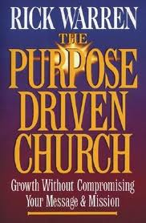
Saddleback Community Church
“Pastor” Rick Warren (“America’s Pastor”)
The Purpose-Driven Church and The Purpose-Driven Life.

Slide 93
Saddleback Community Church
“Pastor” Rick Warren (“America’s Pastor”)
The Purpose-Driven Church and The Purpose-Driven Life.
Warren has trained 300,000 pastors from 100 countries and from over 63 denominations in his church-growth seminar

Slide 94
Saddleback Community Church
“Pastor” Rick Warren (“America’s Pastor”)
The Purpose-Driven Church and The Purpose-Driven Life.
Warren has trained 300,000 pastors from 100 countries and from over 63 denominations in his church-growth seminar
Affiliated with Southern Baptist Convention.

Slide 95
“Building A Purpose-Driven Church”
A contemporary worship service must replace the traditional service.

Slide 96
“Building A Purpose-Driven Church”
A contemporary worship service must replace the traditional service.
The dress must be casual.

Slide 97
"Get comfortable. This is as dressed up as I get in this church. My idea of winter is I put on socks, and obviously I don't think it's winter yet."

Slide 98
“Building A Purpose-Driven Church”
A contemporary worship service must replace the traditional service.
The dress must be casual.
The music must be contemporary.

Slide 99
Contemporary Music:
Instrumental (of course)
Recent lyrics
Style
Sound-system, band, singers, presentation

Slide 100
“I passed out a three-by-five card to everybody in the church, and I said, "You write down the call letters of the radio station you listen to." I wasn't even asking unbelievers. I was asking the people in the church, "What kind of music do you listen to?" When I got it back, I didn't have one person who
said, "I listen to organ music." Not one. I didn't have a single person who said, "I listen to huge choirs on the radio." Not one. In fact, it was 96-97% adult contemporary, middle-of-the-road pop. It wasn't heavy metal rock, but it was something with a beat like you hear most commercials have today on television. So, we made a strategic decision that we are unapologetically a contemporary music church. And right after we made that decision and stopped trying to please everybody, Saddleback exploded with growth.”

Slide 101
“Building A Purpose-Driven Church”
A contemporary worship service must replace the traditional service.
The dress must be casual.
The music must be contemporary.
Stop worrying about what the brotherhood thinks.

Slide 102
“I passed out a three-by-five card to everybody in the church, and I said, "You write down the call letters of the radio station you listen to." I wasn't even asking unbelievers. I was asking the people in the church, "What kind of music do you listen to?" When I got it back, I didn't have one person who
said, "I listen to organ music." Not one. I didn't have a single person who said, "I listen to huge choirs on the radio." Not one. In fact, it was 96-97% adult contemporary, middle-of-the-road pop. It wasn't heavy metal rock, but it was something with a beat like you hear most commercials have today on television. So, we made a strategic decision that we are unapologetically a contemporary music church. And right after we made that decision and stopped trying to please everybody, Saddleback exploded with growth.”

Slide 103
“Building A Purpose-Driven Church”
A contemporary worship service must replace the traditional service.
The dress must be casual.
The music must be contemporary.
Stop worrying about what the brotherhood thinks.
All messages delivered to the church must be only positive.

Slide 104
“Building A Purpose-Driven Church”
Meet the "perceived needs" of those who attend.

Slide 105
“Perceived Needs”
Financial problems
Marital problems
Problems with kids
Problems with parents
Psychological problems
Sexual-identity problems

Slide 106
What about the “need” to evangelize the community?
Warren scoffed at passing out tracts door-to-door.
“Saddleback Sam” is offended by such old-fashioned, outmoded forms of evangelism.

Slide 107
“Building A Purpose-Driven Church”
Meet the "perceived needs" of those who attend.
A spirit of compromise must prevail.

Slide 108
Who has to compromise?
Not: “Saddleback Sam”
Leaders will compromise with “Sam”
Leaders will not compromise with traditional members.

Slide 109
“Be willing to let people leave the church. And I told you earlier the fact that people are gonna leave the church no matter what you do. But when you define the vision, you're choosing who leaves. ... in your church, you may have to have some blessed subtractions before you have any real additions.”

Slide 110
“Building A Purpose-Driven Church”
Meet the "perceived needs" of those who attend.
A spirit of compromise must prevail.
An ecumenical spirit must dominate.

Slide 111
Commitment to “Unity-In-Diversity.”
People are tired of fussing, debating over issues that are “irrelevant.” - Plan of Salvation - Scriptural worship …

Slide 112
"It really doesn't matter your denomination, folks. We're all on the same team if you love Jesus."

Slide 113
“Building A Purpose-Driven Church”
Meet the "perceived needs" of those who attend.
A spirit of compromise must prevail.
An ecumenical spirit must dominate.
The name of the church must be changed to something neutral.

Slide 114
Warren criticized by denominational leaders.
Ecumenical movements minimize doctrinal differences.
“Baptist,” “Bible,” “Presbyterian” – offend some … narrows the groups of visitors.

Slide 115
“The unchurched hang-ups determine our strategy. ... We found a hang-up about denominational labels. I went out. I went door to door and said, "What do you think of when I say
'Southern Baptist'?" They said, "You don't want to know." ... So, we chose a neutral name. Why? Well, it wasn't a theological decision, a compromise. It was an evangelistic strategy decision because we wanted to reach out.”

Slide 116
“Building A Purpose-Driven Church”
Meet the "perceived needs" of those who attend.
A spirit of compromise must prevail.
An ecumenical spirit must dominate.
The name of the church must be changed to something neutral.
Convince the brotherhood that traditional preachers approve of your ministry.

Slide 117
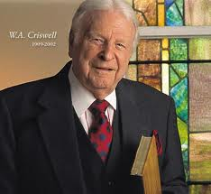
“Sitting catty-corner to me -- I was a little nervous about this -- sitting catty-corner to me was Dr. W. A. Criswell. ... for two hours I'm just telling what's going on at Saddleback. And here’s Criswell in his seventies taking notes as fast as he could, writing things down. And I walked out of there, and I started crying. I was so humbled by that experience, and I realized why he was a great man. He'd never stopped learning.”

Slide 118
What’s wrong with the Social Gospel?

Slide 119
The social gospel:
Confuses individual action with church action.

Slide 120
False doctrine: "If an individual Christian may do something, the church may do it."
Distinction between individual action and church action (Mt 18:15-17).
Some things only individuals may do (1 Tim 5:16).
Some things only the church may do (1 Cor 11:33).
As an individual, may give money to anyone (Gal 6:10; Ja 1:27).
The church gives money only to certain church members (1 Tim 5:16; Acts 6:1-7).
The church never provides recreation or entertainment (Rom 14:17).

Slide 121
The social gospel:
Confuses individual action with church action.
Perverts the treasury of the church.

Slide 122
The collection "for the saints" (1 Cor 16:1-2).
The apostles had money "laid at their feet" (Acts 4:35), to the lame man "silver and gold we have none" (Acts 3:6).
The apostles preached without money (Mt 10:9-10).
When apostles arrived in town, they had no money to offer.
The citizens expected to provide for the needs of the apostles (Mt 10:11-15).
Church money was used only for church members (Acts 11:27-30).

Slide 123
The social gospel:
Confuses individual action with church action.
Perverts the treasury of the church.
Perverts the nature and mission of the church.

Slide 124
Three Jobs of the Church:
Evangelize (Mk 16:15-16; 1 Tim 3:15)
Edify the members (Eph 4:11-16; Acts 2:42)
Benevolence to members who have no help (Acts 6:1-7; Tit 3:14).

Slide 125
Preachers not to leave off preaching to "serve tables" (Acts 6:1-2).
When "tables were served" it was only for certain members (Acts 6:1; 1 Tim 5:16).
Jesus did not heal all the sick (cf. Acts 3:1-2).
Jesus did not feed all the hungry (Jn 6:26-27).
Apostles did not heal all the sick (2 Tim 4:20).
The church did not feed all the hungry (1 Tim 5:16; 2 Th 3:10).
The church "turned the world upside down" (Acts 17:6), with doctrine.

Slide 126
The social gospel:
Confuses individual action with church action.
Perverts the treasury of the church.
Perverts the nature and mission of the church.
Ruins evangelism.

Slide 127
Wrong view of the church:
Help pay rent.
Help pay utilities.
Daycare center.
After-school program.
Recreation center.

Slide 128
Jesus refused bread to people coming just for bread (Jn 6:26-27).
Sinners converted on any other basis than the teachings of Jesus (1 Cor 3:11) ⇨ wrong foundation.
The church of God becomes defiled (1 Cor 3:17).
The sinner himself lost (1 Cor 3:13-15).

Slide 129
The social gospel:
Confuses individual action with church action.
Perverts the treasury of the church.
Perverts the nature and mission of the church.
Ruins evangelism.
Destroys the “one hope” of the gospel.

Slide 130
The “one hope” (Eph 4:4)
Physical return of the Lord (Acts 1:11).
Physical, bodily resurrection from the dead (Acts 24:15).
A home in heaven (Col 1:5).

Slide 131
Social gospel ⇨ “lay up treasures on earth” (Mt 6:19).
Sin cause of death, suffering, scarcity.
Social problems created by sin destroyed only when Jesus returns (1 Cor 15:24-26).

Slide 132
The social gospel:
Confuses individual action with church action.
Perverts the treasury of the church.
Perverts the nature and mission of the church.
Ruins evangelism.
Destroys the “one hope” of the gospel.
Perverts the gospel.

Slide 133
Social gospel ⇨ only positive messages.
Bible ⇨ “reprove, rebuke, exhort” (2 Tim 4:2).
Apostles made people feel guilty (Acts 24:24-25).
“I have not shunned to declare the whole counsel of God” (Acts 20:27).
Do not subtract from the word (Rev 22:19).
Joe Hisle, “People accuse us of preaching on questions no one is asking. …”

Slide 134
The social gospel:
Confuses individual action with church action.
Perverts the treasury of the church.
Perverts the nature and mission of the church.
Ruins evangelism.
Destroys the “one hope” of the gospel.
Perverts the gospel.
Perverts the worship of the church.

Slide 135
Worship is regulated:
"Decently and in order" (1 Cor 14:40).
Based on the doctrines and commandments of God, not men (Mt 15:9).
In spirit and in truth (Jn 4:24) – pattern.
Follow the divine traditions (1 Cor 11:2).
Those traditions delivered by the Lord (1 Cor 11:23).

Slide 136
Worship is God-centered:
The social gospel ⇨ man-centered.
Bible worship ⇨ God-centered (Mt 6:10).

Slide 137
The social gospel:
Confuses individual action with church action.
Perverts the treasury of the church.
Perverts the nature and mission of the church.
Ruins evangelism.
Destroys the “one hope” of the gospel.
Perverts the gospel.
Perverts the worship of the church.
Perverts the music of the church.

Slide 138
OT regulated music:
Num 10:1-8 – Two silver trumpets, made certain way, only Levites.
2 Ch 29:25 – David authorized to made additional instruments.
1 Ch 16:1-6 – Played only by Levites.
Num 10:2; 1 Ch 23:5 – Israel had to "make" instruments not "borrow" from heathen nations. [30]

Slide 139
NT regulates music:
Eph 5:19 – All Christians are told to "sing"
"Sing" ⇨ "make music with the voice"
Instruments forbidden by silence (Col 3:17; Mt 15:9)
Music "made with voice" ⇨ consist of words classified as "songs, hymns and spiritual songs" (Col 3:16).
Vocal instrumentation ⇨ unauthorized because not words classified as "songs, hymns and spiritual songs"
Handclapping ⇨ unauthorized; percussion instrumentation not classified as "sing" ("make music with the voice")

Slide 140
The social gospel:
Confuses individual action with church action.
Perverts the treasury of the church.
Perverts the nature and mission of the church.
Ruins evangelism.
Destroys the “one hope” of the gospel.
Perverts the gospel.
Perverts the worship of the church.
Perverts the music of the church.
Destroys the unity of the church.

Slide 141
"Love the brotherhood" (1 Pet 2:17).
Permissions not pushed division (Rom 14:14-23).
Requirements and prohibitions not ignored. (May not “do evil that good may come”– Rom 3:8).
Unity is to be based on the truth (Eph 4:3).

Slide 142
The social gospel:
Confuses individual action with church action.
Perverts the treasury of the church.
Perverts the nature and mission of the church.
Ruins evangelism.
Destroys the “one hope” of the gospel.
Perverts the gospel.
Perverts the worship of the church.
Perverts the music of the church.
Destroys the unity of the church.
Promotes Unity-In-Diversity.

Slide 143
Why does the social gospel promote Unity-In-Diversity?
When the church gives money ⇨ “fellowship”
The Greek word for “contribution" (koinwniva) (Rom 15:26)
The Greek word for “fellowship" (koinwniva) (1 Jn 1:7)
Give money to a preacher ⇨ fellowship (Phil 4:15).
Give money to needy people ⇨ fellowship (2 Cor 8:1-4).

