Slide 1
The great flood of god’s global uncreation
by David Lee Burris

Slide 3
The great flood of god’s global uncreation
by David Lee Burris

Slide 4
Noahic Flood UN-created & RE-created:
AnteDiluvian Setting of Events
Uncreation Sequence of Events
Evidence Of flood scope: cradle
Evidence of flood scope: global
Gradualism Versus PunCtualism
Who–What–When–Where-HOW?
Buried with water: then & Now!

Slide 5
Noahic Flood UN-created & RE-created:
AnteDiluvian Setting of Events
Uncreation Sequence of Events
Evidence Of flood scope: cradle
Evidence of flood scope: global
Gradualism Versus PunCtualism
Who–What–When–Where-HOW?
Buried with water: then & Now!

Slide 7
“The Biblical record implies that the age between the fall of man and the resultant Deluge was one of comparative quiescence geologically. The waters both above and below the firmament were in large measure restrained, temperatures were equably warm, there were no heavy rains nor winds and probably no earthquakes nor volcanic emissions. Probably a larger ratio of land surface to water surface existed than at present, but the atmosphere was maintained at a comfortable humidity by the low-lying ‘mist’ rising from an intricate network of ‘seas’ (Genesis 1:10) and mildly-flowing ‘rivers’ (Genesis 2:10-14) evidently fed partially or largely by gentle springs.” - Whitcomb and Morris, p. 243

Slide 8
It is theorized by some that the present tilt of the earth’s on its axis (approximately 23 degrees) occurred at the time of the flood. Rehwinkel cites an earth with no axis tilt as one possible theory to explain the uniform, mild climate. No tilt would eliminate the difference of climate at the poles and also the existence of seasons. - Rehwinkel, pp. 9

Slide 9
“The Flood constitutes a sharp line of demarcation between our present world, with its basically uniform cycle of seedtime and harvest, cold and heat, and summer and winter (Gen. 8:22), and the world at that time, with its low-lying, fossil-free and ice-free mountains, its rainless sky and universally warm and humid climate, and its shallow seas. The transformation that ended that world and started this world was as sudden and supernaturally cataclysmic as the change that shall end this present world…”
- Whitcomb, p. 46.

Slide 10
The Antediluvian World
“For this they willfully forget: that by the word of God the heavens were of old, and the earth standing out of water and in the water, by which the world that then existed perished, being flooded with water.”
-- 2nd Peter 3: 5-6
“a veritable paradise compared with the world that followed.”
-- Martin Luther
The physical world
Larger and more usable land mass
A uniform, nearly sub-tropical climate on the earth
A qualitative difference in flora and fauna
Human population
Accumulated over a period of 1,650 years
Longer life spans
Longer period of reproductive ability
Favorable environmental conditions
Could have been on the order of billions of people
Slide Source: Allen Dvorak Lecture

Slide 12
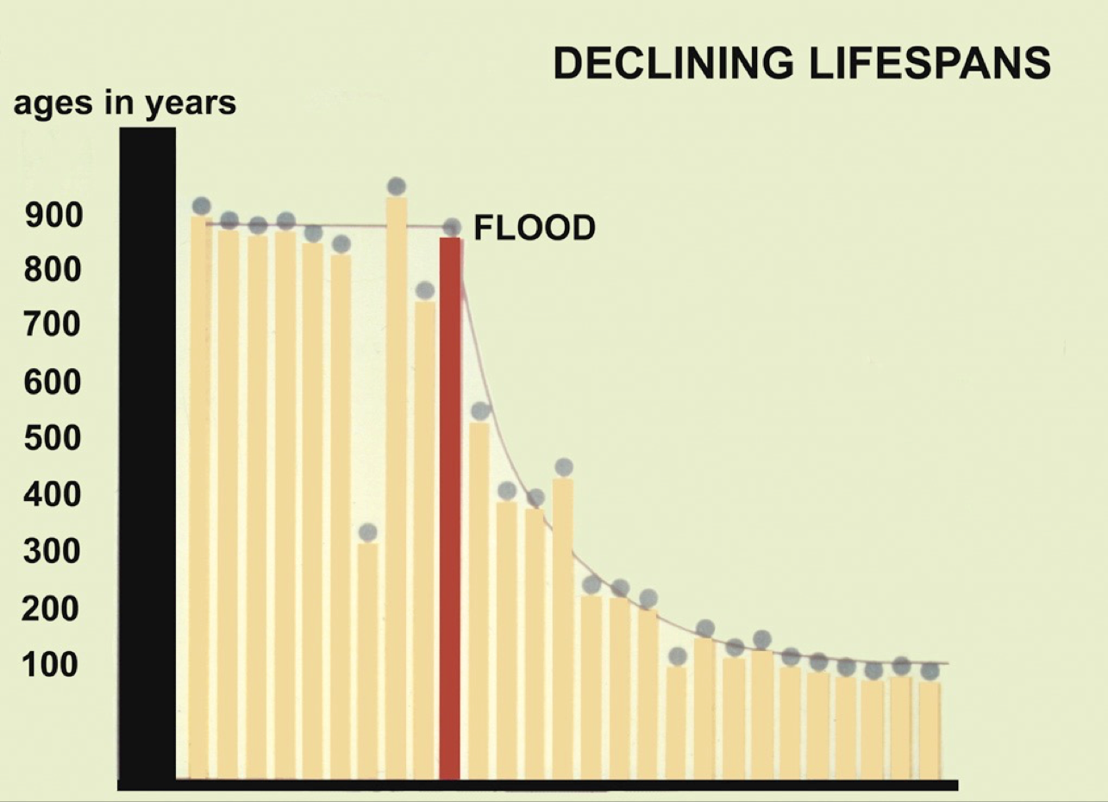

Slide 13
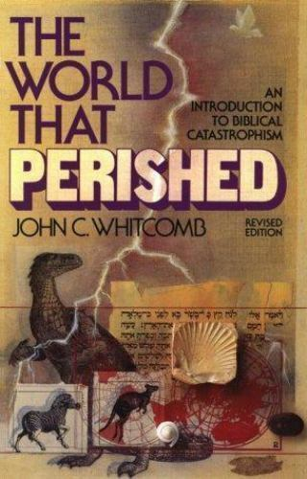

Slide 15
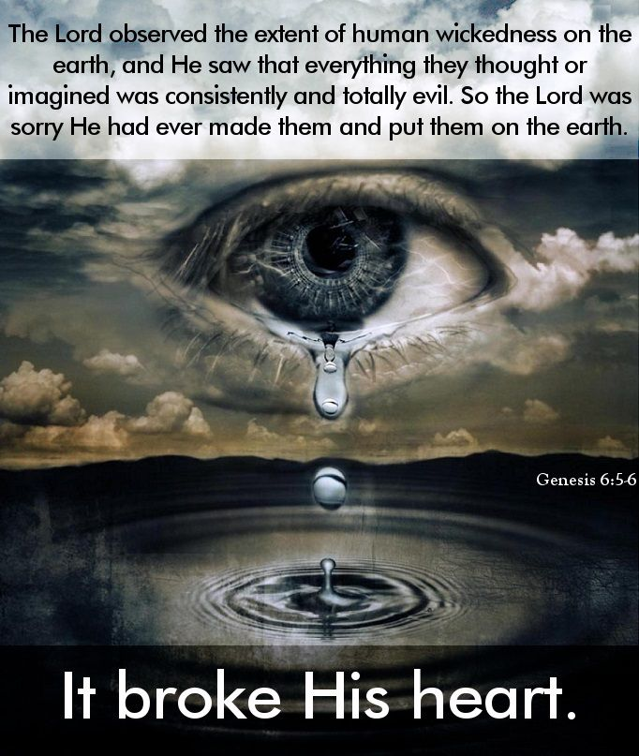

Slide 16
During this waiting period, God’s “Spirit” contended with a works-of-the-flesh-loving mankind for 120 years (Genesis 6:3; cf. Galatians 5:19-21). Notice that when Peter wrote about Noah, his disobedient contemporaries, and the patience of God (1 Peter 3:20), he remarked that “the Spirit” of Christ “went and preached to the spirits in prison” (3:18-19, emp. added). When exactly did the Spirit of Christ do this? When “the Divine longsuffering waited in the days of Noah” (3:20, emp. added). How did God’s Spirit go about His work? We are not informed in all the ways He worked during the years leading up to the Flood, but we do know that Noah was “a preacher of righteousness” (2 Peter 2:5). It may be that Lamech and Methuselah (Noah’s father and grandfather) were also godly preachers through whom God’s Holy Spirit spoke. To whom did the Spirit speak? Peter says, “To the spirits in prison, who formerly were disobedient” (3:19-20). How did the Spirit speak to spirits in prison? Dave Miller explained: “[A]t the time Peter was writing the words, that is where those people were situated. Those who were drowned in the Flood of Noah’s day descended into the hadean realm, where they continued to reside in Peter’s day. This realm is the same location where the rich man was placed (Luke 16:23), as were the sinning angels (“Tartarus”—2 Peter 2:4).”

Slide 17
STRUCTURE OF FLOOD NARRATIVE:
Genesis 6: 9-9:29 forms the section in Genesis known as “The Generations (toledoth) of Noah.”
Largely this section narrates the flood. The outline of the section is as follows:
6:9-13 — God tells Noah of his intention to destroy the world. 6:14-22 — God commands Noah to build an ark, specifying the dimensions. Noah obeyed the Lord’s commandments. 7:1-6 — God commands Noah to enter the ark. 7:7-24 — The Flood waters prevail. 8:1-5 — The Flood waters recede. 8:6-14 — Noah sends out the raven and dove to determine if the ground is dry. 8:15-19 — God commands Noah to depart from the ark. 8:20-22 — Noah offers sacrifice to God. 9:1-17 — God makes covenant never again to destroy with a flood.

Slide 18
THE NOAHIC FLOOD: UNCREATION
In the first creation God divided the upper from the lower waters to make a space for dry land on which human history could be played out (Gen. 1:6–10). Now, as the deluge begins, this creative act is undone. Water comes from above and below; the windows of the sky are opened and the springs or fountains of the great abyss burst forth cancelling distinctions and obliterating everything in between. The deluge is an undoing of what was done in creation, a return to chaos, an obliteration of the precarious space for ordered human life. It is therefore an act of un-creation. This reading of the narrative is confirmed by the manner in which the deluge was brought to an end: the springs of the abyss and the windows of the sky were closed, and God made a wind blow over the earth, the same wind which in the beginning was swirling over the surface of the water (Gen. 1:2). Moreover, we shall see that the new world which met Noah’s gaze when he was able to look out of the ark emerged from the watery chaos on New Year’s Day, corresponding to the New Year’s Day of the first creation (Gen. 8:13).
Blenkinsopp, J. (2011). Creation, Un-Creation, Re-Creation: A Discursive Commentary on Genesis 1–11 (pp. iii–205). London; New York.

Slide 19
STRUCTURE OF FLOOD NARRATIVE:
7 days until the flood comes (7:4) 40 days and 40 nights of rain (7:12) 150 days of the waters prevailing (7:24) God remembered Noah (8:1) 150 days of the waters declining when the ark rested on Ararat (8:3) 40 days of continued drying at the end of which Noah sent out birds (8:6) 7 days after the raven was sent out, Noah sent out the first dove (8:10) 7 days after the first dove, he sent out the second dove (8:12)

Slide 23
Noah and the Flood
Genesis 6:1-9:17

Slide 24
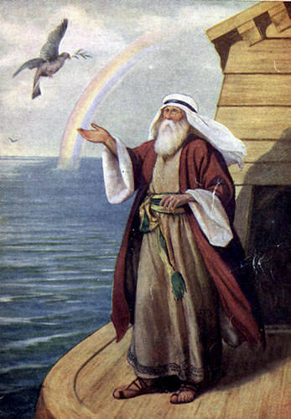
II. The Flood 6:9—8:22
first time the important words "righteous" and "blameless" appear in the Bible
“Noah was a just man”
Noah is described as being “perfect in his generations.”
Noah “walked with God”

Slide 25
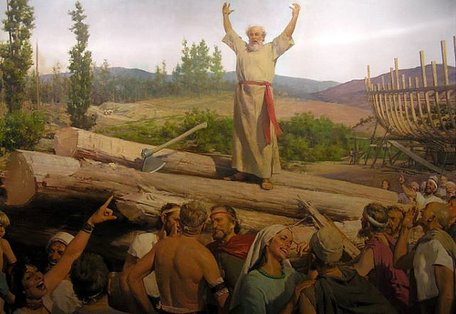
II. The Flood 6:9—8:22
a “probationary period” of 120 years was established by God
Noah preached to the people of his generation (1 Peter 3:18-20) and carried out the commands of God regarding the building of the ark (Genesis 6)

Slide 26
II. The Flood 6:9—8:22
After approximately 100 years, Noah’s work was completed
Noah’s only “converts” appear to have been members of his own family group

Slide 27
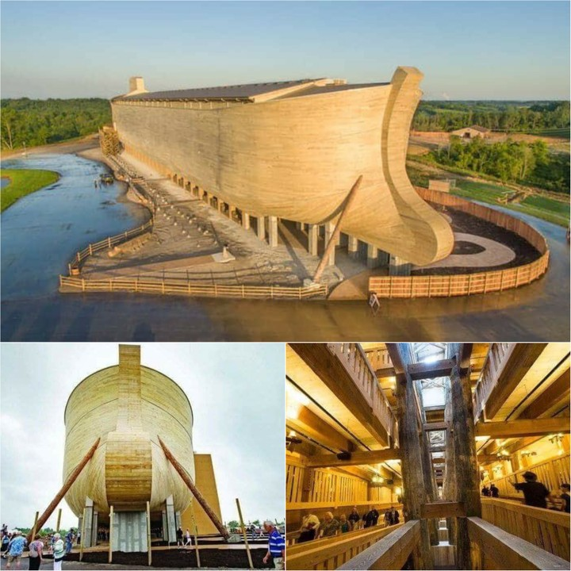
II. The Flood 6:9—8:22
The ark was about 450 feet long, 75 feet, and 45 feet high
the capacity of approximately 569 railroad boxcars

Slide 28
II. The Flood 6:9—8:22
about 35,000 vetebrate animals within Noah’s ship
“kind” is a broader category than a “species”
A standard railroad freight car can accommodate approximately 240 sheep

Slide 29
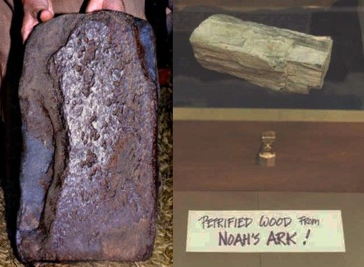
II. The Flood 6:9—8:22
The ark probably looked more like a rectangular box than a ship.
its purpose was to stay afloat, not travel from one destination to another
Modern ocean-going tankers and aircraft carriers have a similar scale of dimensions
type of wood out of which Noah made it is unknown

Slide 32
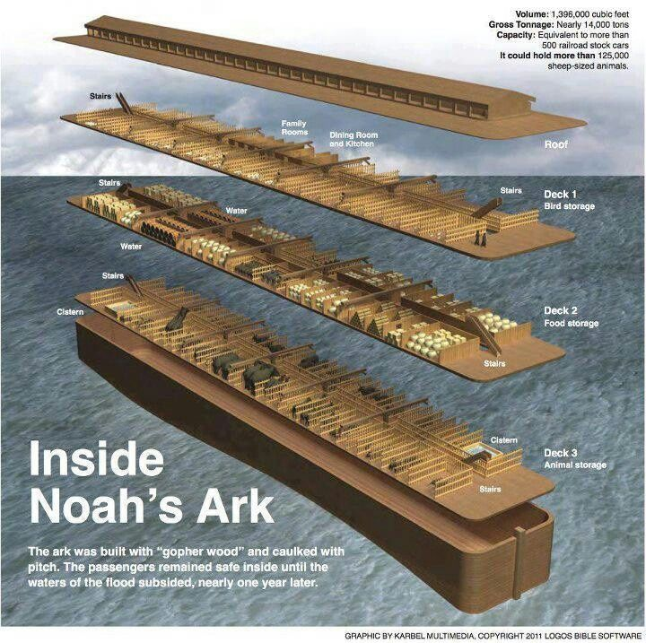

Slide 34
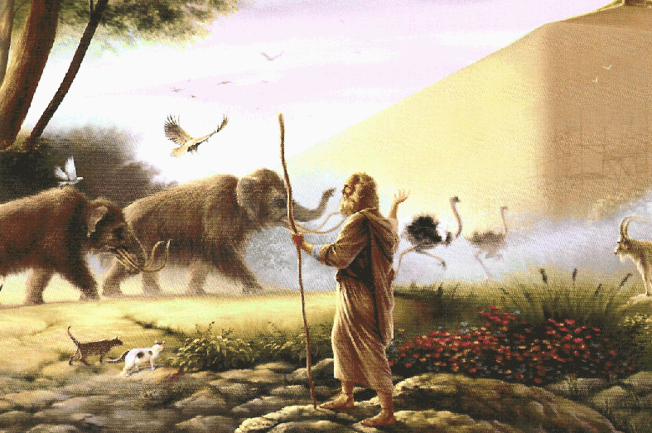
II. The Flood 6:9—8:22
Genesis 6:19-20 makes it clear that God caused the animals to “come unto Noah.”
God graciously invited Noah to enter the ark with his family (7:1).
God extends the invitation to people

Slide 35
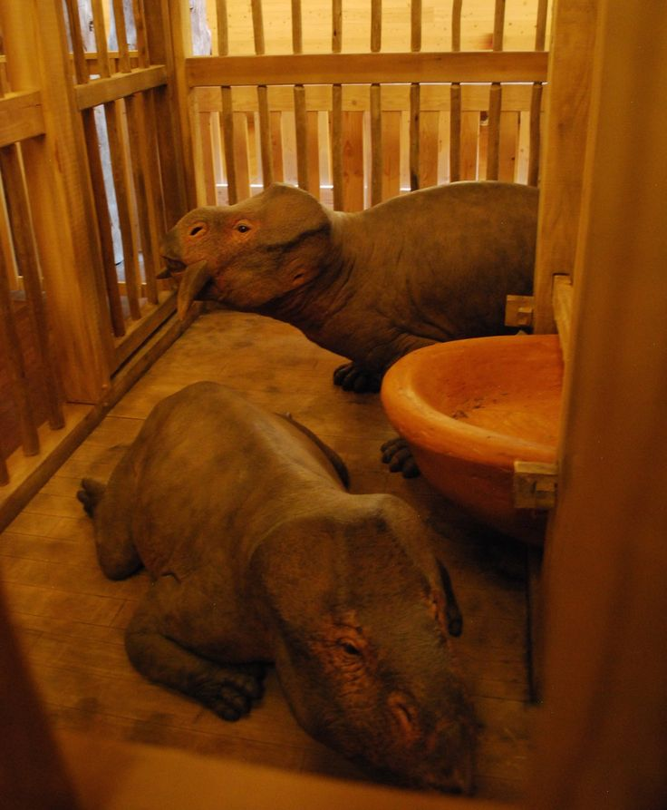
II. The Flood 6:9—8:22
God was “with them” and “remembered them.”
a year-long hibernation process on the animals

Slide 36
KINGDOM

Slide 37
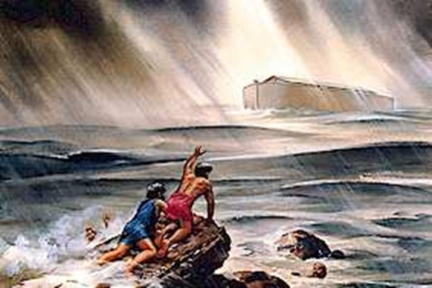
II. The Flood 6:9—8:22
The evidence for a global Flood is overwhelming.
AII the high mountains, that were under the whole heaven were covered. . . And all flesh died that moved upon the earth” (Gen. 7:19,21)
A portion of the Flood waters came as a result of the fountains of “the great deep”

Slide 38
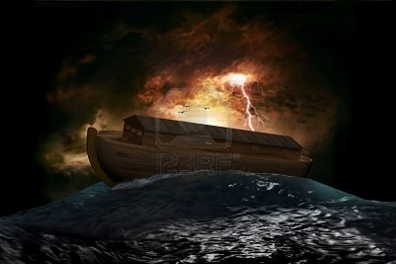
II. The Flood 6:9—8:22
3. Why did God have Noah work for more than a century constructing an Ark?
4. Noah and the other inmates of the Ark were in the vessel for more than a year

Slide 39
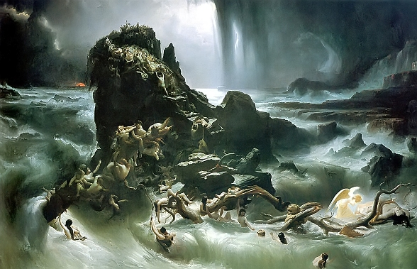
II. The Flood 6:9—8:22
5. Ancient traditions are of a Flood that consumed the entire earth
6. The Flood was designed as a punishment against the worldwide corruption of humanity

Slide 40
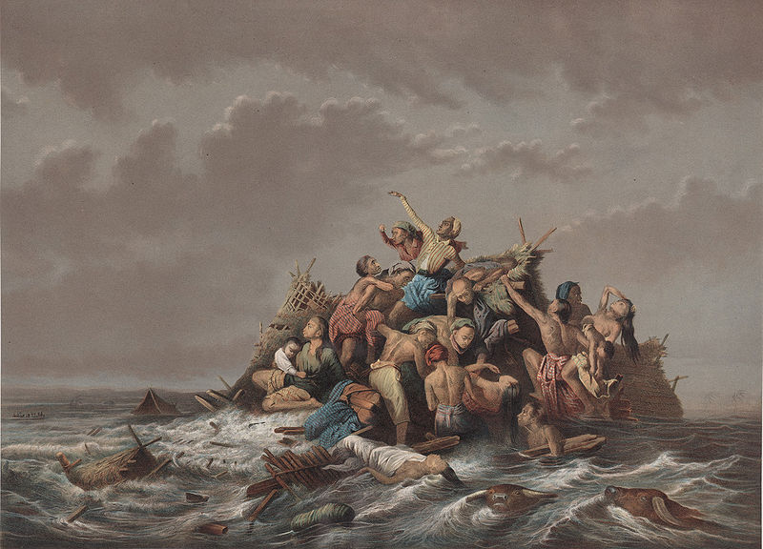
II. The Flood 6:9—8:22
7. God made a covenant with Noah that no flood, of this scope, would occur ever again
8. Peter charges that these scoffers “willfully forget” that the “world that then was, being overflowed with water, perished” (2 Peter 3:6)

Slide 41
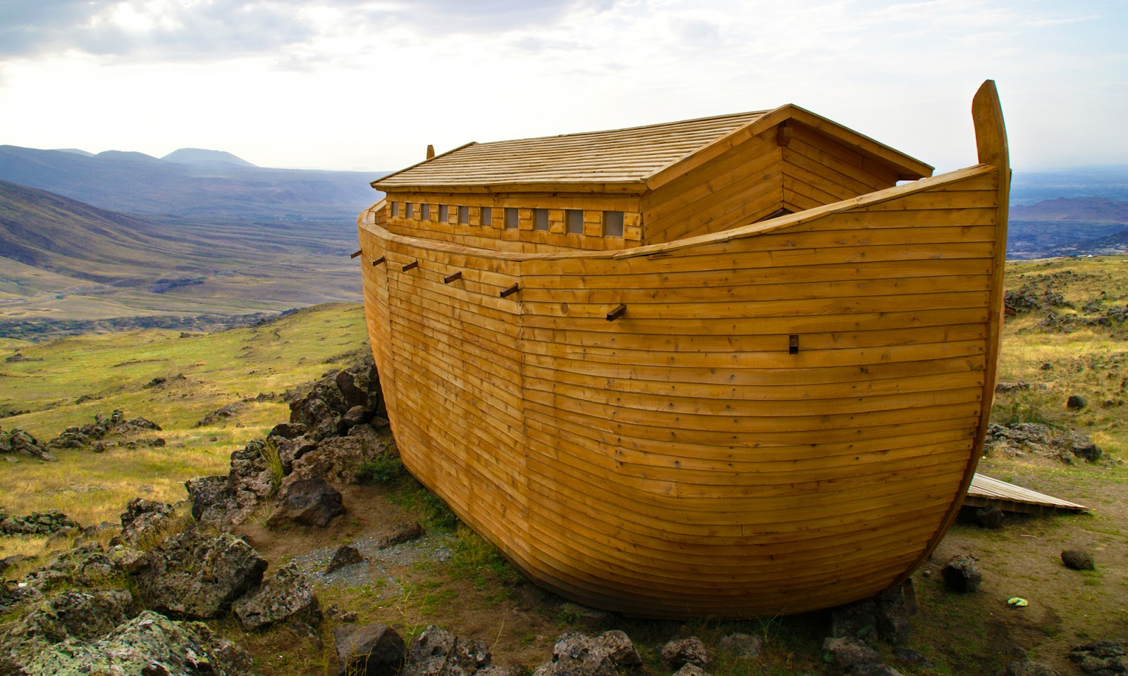
II. The Flood 6:9—8:22
God remembered someone, meant God extended mercy
Mt. Ararat lies on the border between Turkey and Armenia
Noah's "altar" is the first altar mentioned in the Bible
a burnt offering made atonement
Noah's sacrifice represented all humankind

Slide 43
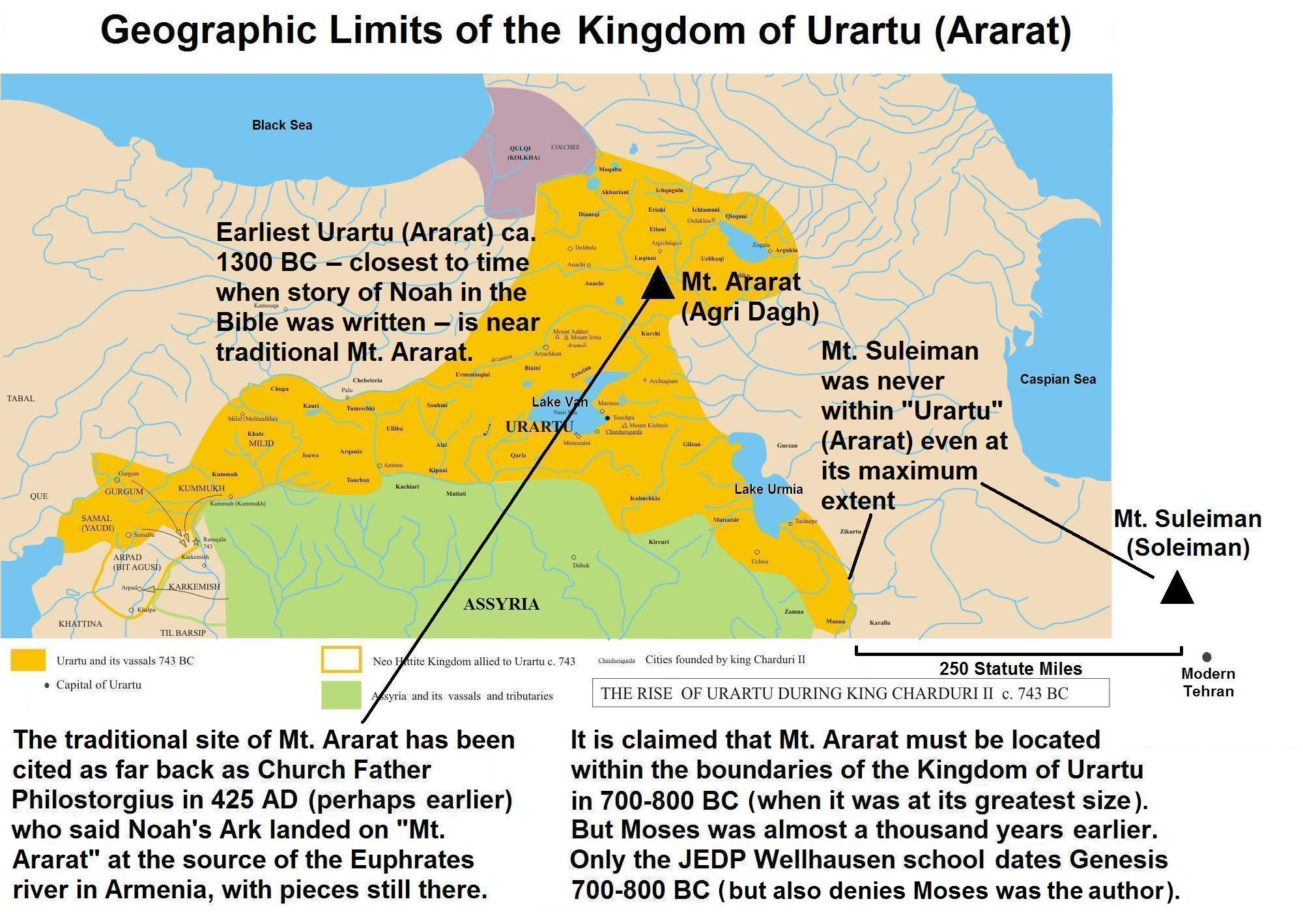

Slide 46
III. THE RAINBOW COVENANT AND ITS IMPLICATIONS
God again commanded Noah and his sons to fill the earth
God gave Noah permission to eat animals (9:3)
prohibit the eating of animal blood

Slide 47
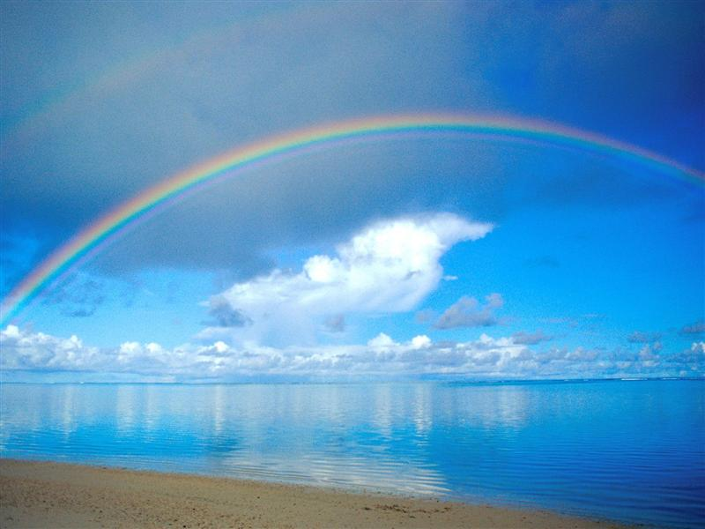
III. THE RAINBOW COVENANT AND ITS IMPLICATIONS
God established human life anew on the earth
He would not destroy His creation again with a flood
a rainbow in the heavens as a sign of the permanency of that promise

Slide 48
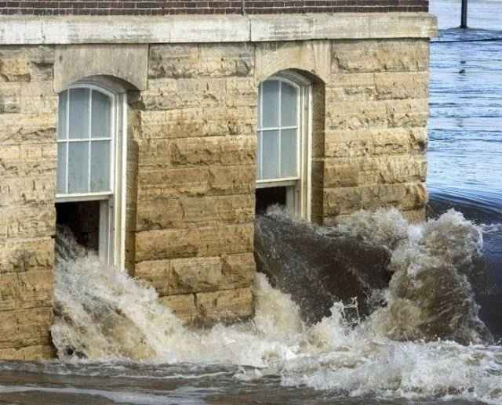
III. THE RAINBOW COVENANT AND ITS IMPLICATIONS
God promised never again to destroy “everything living” and “all flesh” by a flood
He set a rainbow in the heavens
If the Genesis Flood were merely a local event, then God has broken His covenant repeatedly
Advocates of the local flood theory have God breaking His promise

Slide 49
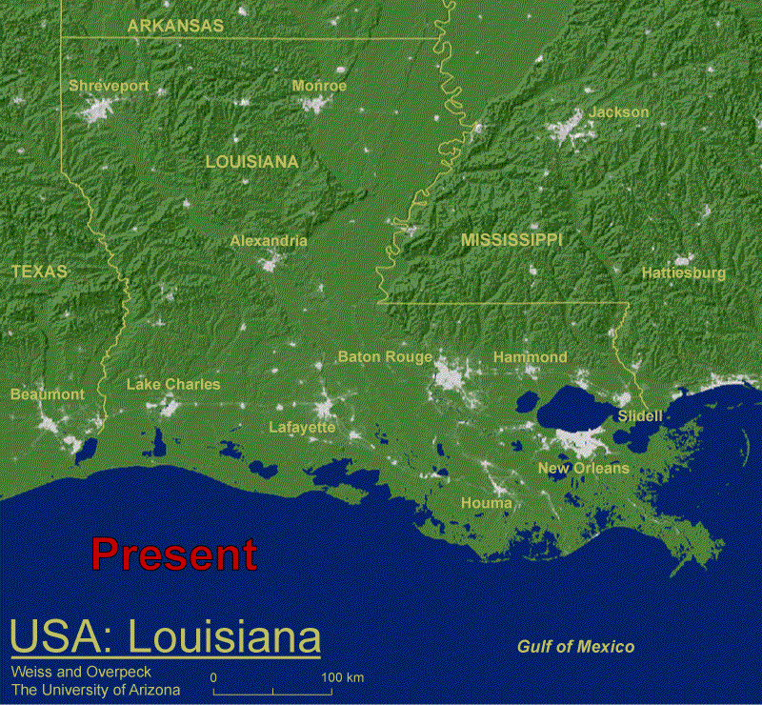

Slide 51
CONCLUSION
the Flood is one of the most prominent stories in the Bible
next to Creation, the Flood of Noah’s day is the greatest single geological event
repeated references to the Flood account within the Old Testament
Jesus and the writers of the New Testament often alluded to Noah and the Flood
there is no other event except the Fall which has had such a revolutionary effect

Slide 52
EVIDENCE OF FLOOD’S SCOPE: CRADLE OF CIVILIZATION

Slide 53
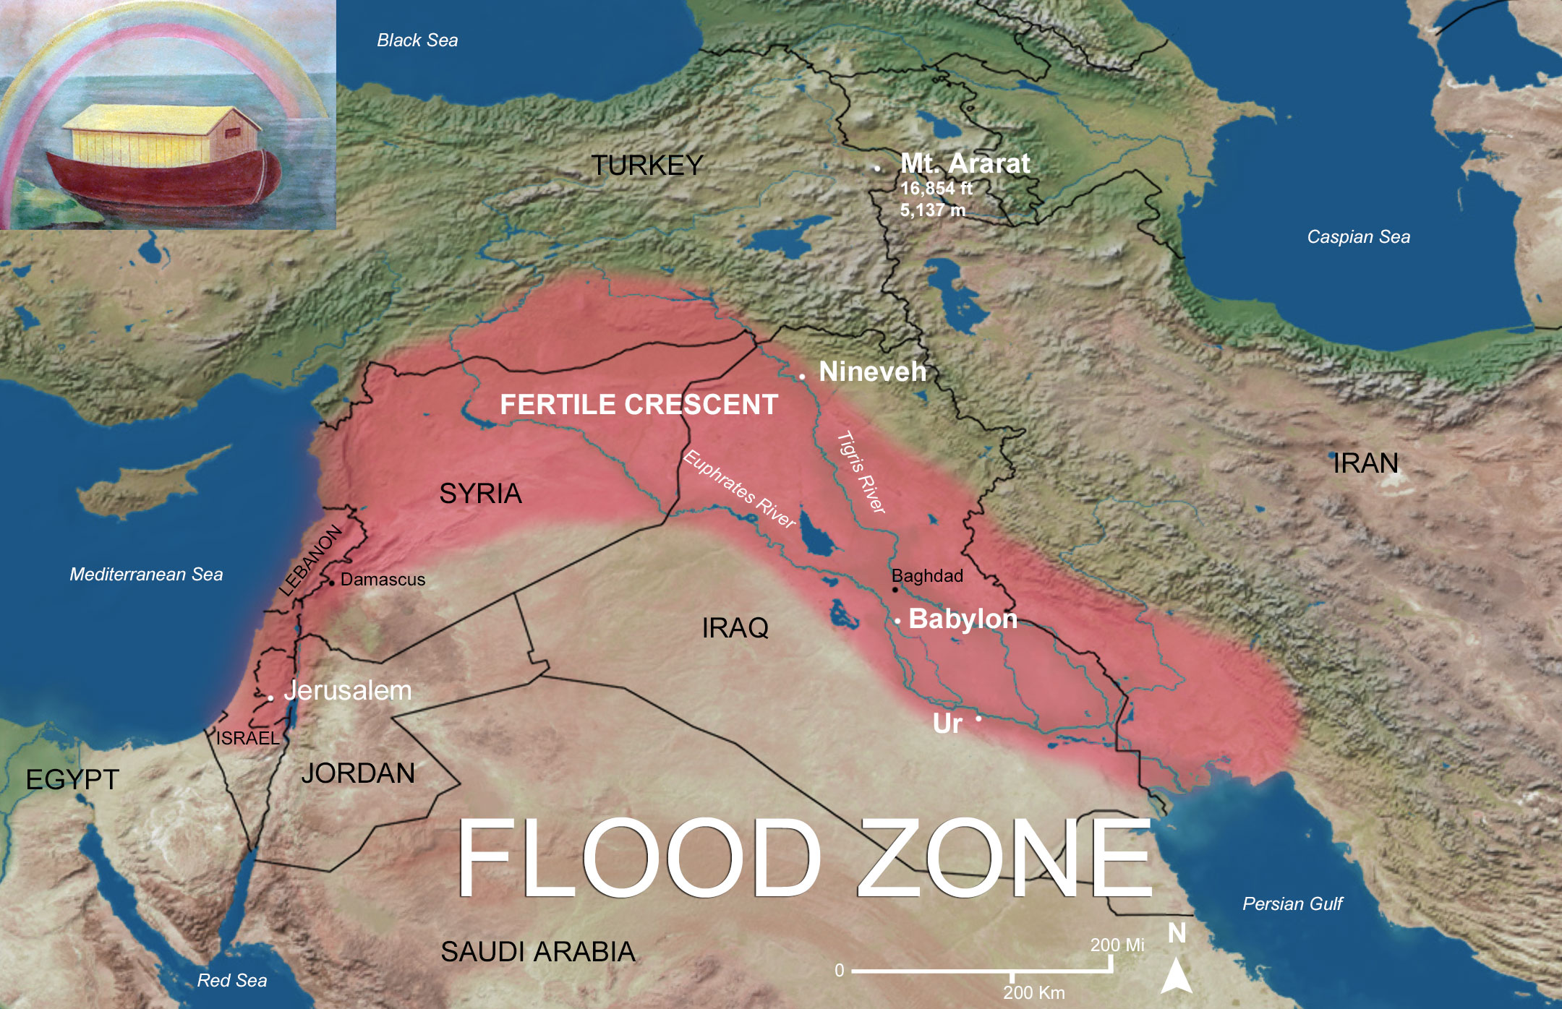

Slide 54
Rainfall
The occurrence of rainfall prior to the flood is implied in a comment that at the time of the creation of Adam, there was no rainfall because there was no man to till the ground (Gen 2:5). Once there was a man to till the ground, the implication is that this brought about rainfall again in Eden (Gen 3:23).

Slide 55
Babylonian Gilgamesh Epic
After the storm, Utnapishtim looks out of the window of the ship and sees on the horizon a stretch of land; the ship sets down on Mount Nişir, a mountain known to Utnapishtim before the flood (XI.139-140). Utnapishtim comments that “all mankind has turned to clay” (XI.133).
After the flood, and after sacrificing to the gods, Utnapishtim says of Enlil, the god who brought about the deluge—“...without reflection he brought on the deluge and consigned my people to destruction” (XI.168-169). His focus is his people.

Slide 56
Babylonian Gilgamesh Epic
There are many details in the Gilgamesh story of the flood that parallel the OT account as well as details that do not correspond.
The similarities are about the sequence of events, story details such as the window, the raven, the sacrifice; the differences are in details such as the size of the ship, the length of the storm and how many were aboard the ship.
L. R. Bailey comments, “The similarities between the biblical and the Mesopotamian flood stories are so striking and so numerous that it is impossible to escape the suspicion that they are somehow related”, Noah: The Person and the Story in History and Tradition (Columbia: University of South Carolina Press, 1989), 20.

Slide 57
The Genesis Flood in Mesopotamia
“Mesopotamia is, geologically speaking, a trough created as the Arabian shield has pushed up against the Asiatic landmass, raising the Zagros Mountains & depressing the land to the southwest of them. Within this trench the Tigris and the Euphrates Rivers & their tributaries have laid down enormous quantities of alluvial sediments, forming the Lower Mesopotamian Plain... Today the Lower Mesopotamian Plain stretches 700 kilometers...to the west of the Euphrates, a low escarpment marks the southwestern boundary of the alluvial plain and the beginning of the Western Desert”.
S. Pollock, Ancient Mesopotamia (Cambridge: Cambridge University Press, 1999), 29.

Slide 58
Under the Whole Heavens
This description of an extensive flood plain satisfies one of the conditions of the physical description of the flood, viz. that it extended beyond the visual horizon of Noah “under the whole heavens”. If we place Noah in the south, on the Delta Plain, between the Tigris and Euphrates rivers, where the Gilgamesh Epic places Utnapishtim, then the “high hills” (Gen 7:19, KJV) on the plain would have been covered “under the whole heaven” from Noah’s vantage point.
As the waters prevailed upon the land by overflowing the river channels of the Tigris and Euphrates and their tributaries in the south, the high hills on the surrounding plain would have been covered. The Hebrew for “hills” is the same as for “mountains” (Gen 7:20), but the use of “mountains” in English versions gives an impression of global proportions for the flood. fails to take into account the question of perspective implied by “high” in relation to a plain. The Hebrew word involved can be equally “hill” or “mountain”.

Slide 59
Fifteen Cubits
The waters “prevailed” upon the land; they increased gradually and lifted up the ark above the ground (Gen 7:17 KJV). The depth of the waters is given as 15 cubits above the high hills, a measure which is a significant indicator of the local proportions of the flood. This sort of measure would be taken by soundings and such a short measure only makes sense in a local situation.
This measure is taken at the point where the ark becomes buoyant. This measure should not be applied by a reader elsewhere in the Mesopotamian Basin, where the river channel, the associated floodplain, and the local topography would have produced different measures. Thus, water may have been deep around the river channel but less so at further distances in other areas.

Slide 60
Mesopotamia

Slide 61
Fifteen Cubits
Hill locates the ark launch point at Shuruppak in the south a city on the Euphrates, following the Gilgamesh Epic. The Bible account does not locate Noah, but such a location would fit the flood account, and in this case the high hills such as levees and city mounds nearest the river are those that would be the ones covered. Hill locates the resting place of the ark in the north near Cizre, which has substantial traditional support, however, the Bible does not state where in the region of Ararat the ark rested.

Slide 62
Water
A local flood satisfying the measure of 15 cubits above the high hills requires a great deal of water in the south. Two sources are stated: rainfall and the “fountains of the deep” (Gen 7:11). This expression “fountains of the deep” has been taken to denote subterranean water but it could additionally indicate tidal wave inundation from the Gulf.
The Arabian Plate is subtended under the Asian plate along the western side of the Gulf (See Illustration 1) and any underwater volcanic activity (or quakes) could have led to tidal wave surges to extend inland over the Delta Plain for a considerable distance.

Slide 63
Water
With rainfall swelling the river system in the north and overflowing river channels in Upper Plain and the River Plain in all directions as it moved south, incoming tidal water (with eroded deposits off the Delta) would have seriously impeded water flow to the Gulf by creating widespread dams. This would have slowed the assuaging of the waters, thereby adding to the depth of the flood waters and their extent in the south on the Delta Plain. The whole delta lowland south of Baghdad is extremely flat and rises only a few metres from the Persian Gulf to Baghdad, so that Baghdad is still less than 10 metres above sea level; in effect the flood would have extended the Gulf.

Slide 64
Eroding the Evidence
As floods leave deposits and erode material, and the Mesopotamian Basin has always been subject to flooding, the physical evidence for Noah’s flood will have been affected in subsequent smaller floods, changes in sea level, and the shifting course of the rivers.
Archaeological digs have found flood deposits in levels for various Delta Plain cities around 2900 BCE, and some have postulated that this may be evidence of Noah’s flood. Others have argued that 3500 BCE is a likely date and have pointed to other flood deposits as evidence.

Slide 65
The End of the Flood
The waters prevailed for 150 days because the waters receded slowly. The Hebrew uses the verb “to go/to walk” in the infinitive (Gen 8:3) to describe the recession, so that we can say, the waters receded walking.
During this period of 150 days the ark travelled to Ararat. For this to have occurred against the flow of water downstream, wind would have to have driven the ark north up the river channels.
Hill, “Quantitative Hydrology of Noah’s Flood”, 137-139, offers an estimate needed for the speed of the wind. The variables are the weight of the ark, the gradient and the flow of the water downstream. He offers 4 possible cases, the “lightest” of which would be for a wind of between 54 mph and 70 mph.

Slide 66
HUGH ROSS THINKS THE FLOOD WAS REGIONAL
Limited Geography
Biblical clues to the geographical limits on human habitation can be found in the place-names Genesis mentions or does not mention. In Genesis 1–9 the text mentions place-names only in the environs of Mesopotamia. From Genesis 10 onward, we encounter references (by name or direction) to places beyond Mesopotamia, in fact, to places covering much of the Eastern hemisphere (see pages 169 to 171).
This sudden shift from narrow to wider geographical range after Genesis 10 strongly suggests that until the time of the Flood, human beings and their animals remained in and around Mesopotamia. Therefore, to fulfill His purpose in sending the deluge, God would need to flood only the Mesopotamian plain and perhaps some adjacent territories.
Ross, H. (2001). (p. 148). Colorado Springs, CO: NavPress.
Ross, H. (2001). The Genesis question: scientific advances and the accuracy of Genesis (p. 148). Colorado Springs, CO: NavPress.

Slide 68
The text speaks only of the region visible to Noah, not of the peaks beyond his horizon. At first, neither the raven nor the dove Noah released could fly far enough to find a landing place. A week later, when Noah sent the dove out again, it recovered a leaf from an olive tree. Olive trees do not grow at Earth’s highest elevations, and yet this tree lived. We can reasonably assume that the har Noah finally saw were low-lying hills or foothills.
Supporting the conclusion that Genesis 7:19 speaks only of the region visible to Noah, we have the contrast in Genesis 8 between Noah and the dove’s perspective on the receding waters of the Flood. In Genesis 8:5 the Flood waters have receded sufficiently for Noah from his perspective on top of the ark to see the hills and/or mountains on his horizon. A little later, in Genesis 8:9 Noah releases a dove. The text records in Genesis 8:9 that from the perspective of the dove “the waters were on the face of the whole earth.” Therefore, right in the context of the Genesis chapters describing the Flood we have a clear example of “the face of the whole earth” meaning much less than the entire surface of planet Earth.
Genesis 8:1 describes how God removed the floodwaters from the land: He sent a wind. This removal technique perfectly suits the requirements of water removal from a gigantic flat plain such as Mesopotamia. Water even tens of feet deep would flow very inefficiently toward the ocean, but a wind would significantly speed up its movement. Wind also speeds natural evaporation. Thus, wind would prove an effective means for removing water from an expansive, low-lying plain. It would prove of little if any use, however, in removing the waters of a global Flood. Such a quantity of water could not possibly recede to any location on or around the planet by the means described in just eleven months. A Flood universal to all of humanity inhabiting one geographical region certainly could, especially with a supernatural assist.
Ross, H. (2001). (pp. 150151). Colorado Springs, CO: NavPress.
Ross, H. (2001). The Genesis question: scientific advances and the accuracy of Genesis (pp. 150–151). Colorado Springs, CO: NavPress.

Slide 69
And there also are problems for the compromising person who accepts “progressive creation” and a “local flood.” His problems come because he is trying to hold to 2 models at the same time. His most serious problems come because he rejects the plain meaning of Scripture, making his exegesis of Scripture look forced & artificial, like the premillennialist who can transform hailstone, fire and sulphur into atomic bombs (Ezek. 38). Such a person believes “though newer interpretations of the biblical narrative did not seem to be ‘the most natural meaning,’ yet if geological facts ‘unequivocally require such an interpretation to harmonize the Bible with nature,’ then ‘science must be allowed to modify our exegesis of Scripture’” (Davis Young, The Biblical Flood: A Case Study of the Church’s Response to Extrabiblical Evidence 146). The compromiser is neither a Bible believer nor accepted by scientists. His naturalist world scientific model is destroyed by his injection of the supernatural, whether by a little or a lot. - Mike Willis, Truth Magazine

Slide 71
EVIDENCE OF FLOOD SCOPE: WORLDWIDE CATASTROPHE

Slide 73
Genesis 1-11
Prevalence of flood traditions
Arguments against the historicity of the Genesis flood story
“The ark was of inadequate size for all the animals and their foodstuffs.”
The logistics of mixing predators and prey – this objection ignores the possibility of supernatural intervention.
The impossibility of gathering all the animals
The inability of eight people to care for the animals on the ark
Brown, p. 40
Myth?
Slide Source: Allen Dvorak Lecture
History!

Slide 74
The Flood: Global!
Evidences from the natural world
Ossiferous fissures, rubble drift and “erratics”
The prevalence of fossils and their distribution
Wooly mammoths – a sticky wicket!
“Exactly why a majority of the huge creatures that once strode in large herds across Eurasia and North America died out towards the end of the last Ice Age has generated fiery debate. Some experts hold that mammoths were hunted to extinction by the species that was to become the planet’s dominant predator – humans. Others argue that climate change was more to blame, leaving a species adapted for frozen climes ill-equipped to cope with a warming world.”
Slide Source: Allen Dvorak Lecture

Slide 75
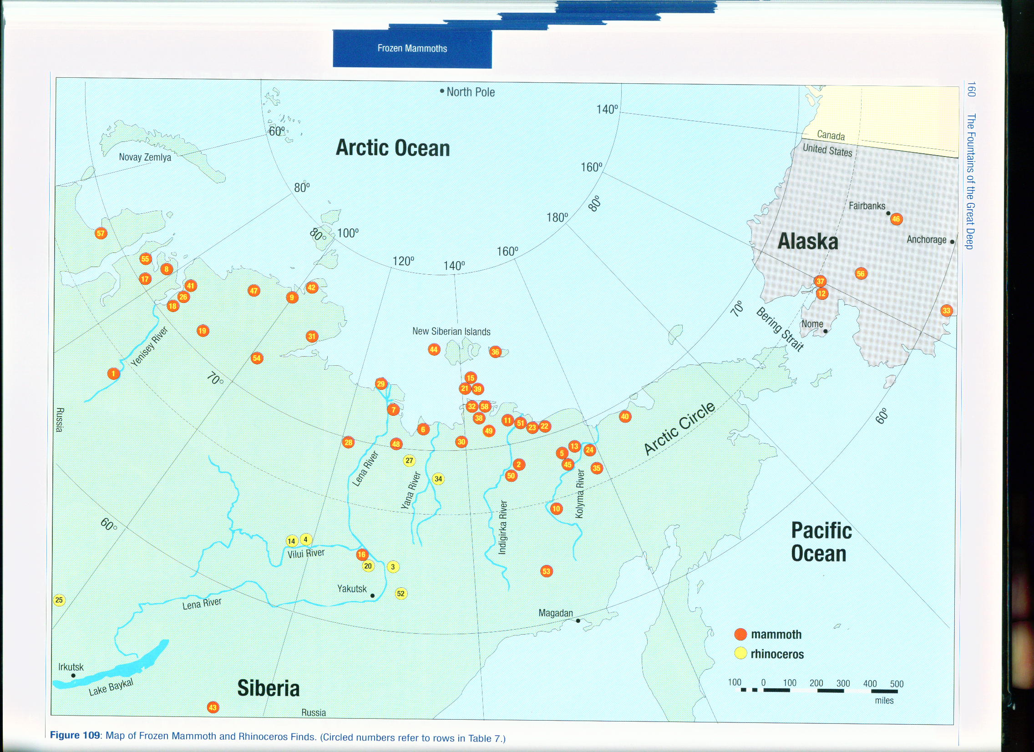
Brown, p. 160

Slide 76
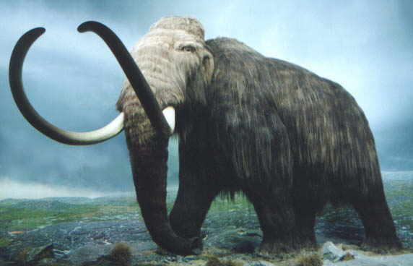
Wooly Mammoths
Not a cold-weather animal
Numerous carcasses (in some cases, of the entire animal) of mammoths have been found in northern Siberia and northwestern Alaska.
The number of mammoths which once lived in the Arctic region is estimated to be in the millions.
Slide Source: Allen Dvorak Lecture

Slide 77
TURN TO PART TWO
EVIDENCE OF FLOOD SCOPE: WORLDWIDE CATASTROPHE

