Slide 1
Providence intersects with our spiritual discipline& prayer life!
By David Lee Burris

Slide 2
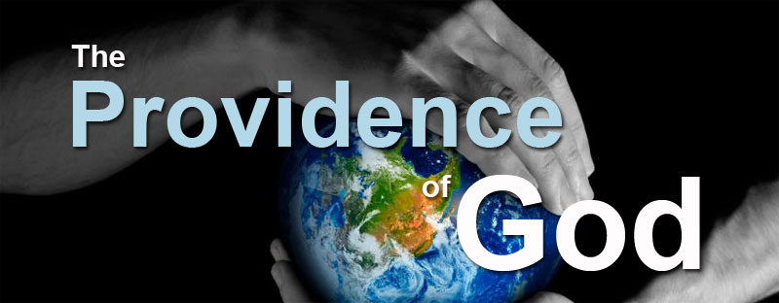

Slide 6
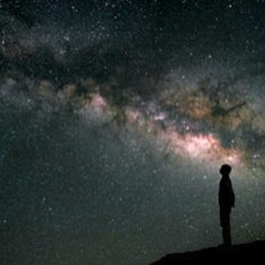
Worship Him Who Controls the Universe
Putting Ourselves Into The Right Mindset To Start Each & Every Day

Slide 9
Divine Providence & Prayer Discipline
THE THEODICY TRIANGLE
TWO CLASSICAL APPROACHES
FOUR CONTEMPORARY MODELS
CONTRADICTIVE IMPOSSIBILITIES
CREATIVE & REDEMPTIVE PURPOSES
Bible stories with moral lesson
PROVIDENTIAL PRESENcE IN PRAYER

Slide 10
Divine Providence & Prayer Discipline
THE THEODICY TRIANGLE
TWO CLASSICAL APPROACHES
FOUR CONTEMPORARY MODELS
CONTRADICTIVE IMPOSSIBILITIES
CREATIVE & REDEMPTIVE PURPOSES
Bible stories with moral lesson
PROVIDENTIAL PRESENCE IN PRAYER

Slide 11
New Testament attitudes
Any sketch of New Testament attitudes to providence must begin with Christ’s teaching to his disciples about their need to be free from care and anxiety. The reason for such freedom, according to Christ, should be the knowledge that God providentially cares for them. He knows their needs; the hairs of their heads are all numbered; they are of more value than many sparrows; it is the Father’s good pleasure to give them the kingdom (Lk. 12:7, 22–32).
One prominent instance is Paul’s response to his ‘thorn in the flesh’ (2 Cor. 12:7). He exhibits an attitude of resignation to the divine will, once that will has been definitively made known to him. Paul recognizes that the providence of God is sometimes unpleasant, but that behind the pain there is a wider purpose. This personal attitude of Paul’s is echoed and supported by more general teaching about the significance and purpose of chastisement (e.g. Heb. 12).
There are also more general statements, such as that in the letter of James:
Now listen, you who say, ‘Today or tomorrow we will go to this or that city, spend a year there, carry on business and make money.’ Why, you do not even know what will happen tomorrow. What is your life? You are a mist that appears for a little while and then vanishes. Instead you ought to say, ‘If it is the Lord’s will, we will live and do this or that’ (Jas. 4:13–15).
Here James reminds his readers that they cannot take tomorrow for granted; not because of fate, or luck, or even human weakness (although that thought is prominent in the passage). Rather, the implication is that whether or not such weakness leads to an inability to do what one wants to do is entirely a matter of the will of God. A recognition of the will of God, therefore, should preface all one’s plans.
But by far the most comprehensive statement of divine providence as it affects both the individual Christian and the church is that of Paul in Romans 8:
And we know that in all things God works for the good of those who love him, who have been called according to his purpose. For those God foreknew he also predestined to be conformed to the likeness of his Son, that he might be the firstborn among many brothers. And those he predestined, he also called; those he called, he also justified; those he justified, he also glorified (Rom. 8:28–30).
This statement occurs in a context in which Paul recognizes the importance of the fact that Christians are called to suffer with Christ as part of their believing union with him. As a believer, a person is united to Christ in his suffering, crucifixion and resurrection. And so Paul stresses that providential suffering is what believers are to expect as part of their joint-heirship with Christ (Rom. 8:17). This does not mean that believers’ sufferings are expiatory, but they are an inevitable part of that obedient following of Christ to which each believer is called (cf. Jn. 15:18–19). Suffering as a Christian has an evangelical character, and an evangelical justification (1 Pet. 4:16).
The statement that Paul is making about all things working together for good is thus not an unconditional statement. It does not hold no matter what. In making it Paul assumes the fulfilling of certain other conditions. Notably, he makes the assumption that the lover of God will desire to please God by obeying him. All things therefore work together for good, not exclusively of any attitude that the believer might take up, but inclusive of his other obedience. Indeed, part of the reason for Paul’s writing this passage is, presumably, to inculcate such obedient and trustful attitudes on the part of the lovers of God, to fortify them in their obedience in a world of setbacks and peril.
One of the striking consequences of Paul’s view is the possibility that there is nothing in the events that befall a lover of God to distinguish him from someone who is not in that position. As we noted earlier, the Teacher claimed that ‘all share a common destiny’ (Ec. 9:2), and this is true of life in general. Some who are godly prosper, while some starve; some ungodly prosper, while some starve; and so on. There is then a clear sense in which Paul envisages God being a ‘hidden’ God; in the midst of the trials and setbacks of life there may be no clear evidence, given those setbacks alone, that God loves the person.
Is it, therefore, either meaningless or irrational to love God in these circumstances? It is neither of these things, according to Paul, since the believers’ attitude to God is grounded not only in what may happen to them from day to day, but chiefly in the overall significance of what is happening to them, in what those events mean. And their significance is to be found both in what has happened in the past (in conversion to God) and in what will happen to them in the future (the consummation of all things in the vision of God). The attitude to God of those who love him is now, or ought to be, rooted in the significance of God’s activity in the past, and in his promised activity in the future.
Helm, P. (1993). The Providence of God. (G. Bray, Ed.) (pp. 114–117). Downers Grove, IL: InterVarsity Press.

Slide 13
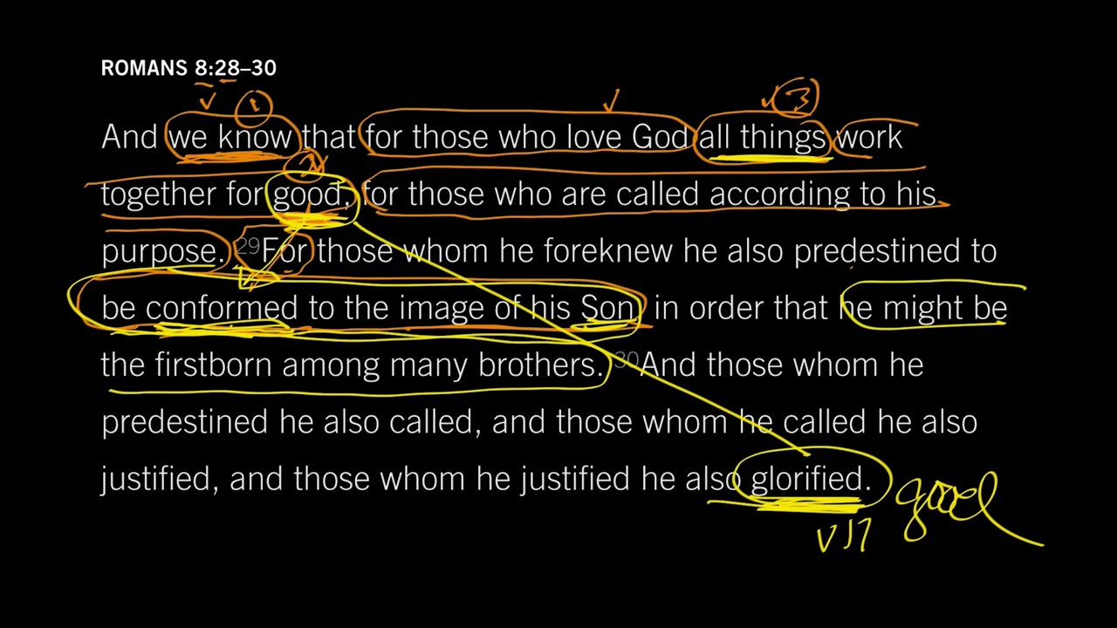

Slide 14
THE PROVIDENCE OF GOD
Notes:
1. Let me give you a New Testament Declaration of the Providence of God.
>>>>>>>>>>>>>>>>>>
2. Many will say that there is no description of the providence of God in the Bible.

Slide 15
Divine providence is thus bound up with the interests of the individual Christian, with the interests of all Christians—the Christian church—and with the interests of the whole of the creation animate and inanimate. No account of divine providence can afford to neglect any one of these contexts, or the relationship between them. One might go further than this and assert that without a recognition of divine providence it is not possible to understand the biblical view of the Christian life, or of the corporate life of the church, or of the universe as a whole. The three contexts are not insulated from each other, however; they have permeable walls. Since Christians are in the universe that he has created, God could hardly exercise care over them without having control over it. Can we be more exact about the character of divine providence? In summary, the essential elements of divine providence are these. God preserves his creation and all that it contains. This is the most fundamental and basic way in which the care we have referred to is expressed. To preserve is to keep in being or in existence. Having brought the creation into being, God keeps it in being. It does not have an inherent power to sustain itself. But if our idea of divine providence were confined merely to God preserving what he has made, it would be quite inadequate when measured against the biblical data. On this view, God would keep things in existence, but what those things did while existing (what they planned, and how they carried out their plans, for example) would be outside the care of God. He would watch what they did, but nothing more.
God therefore sustains his creation. He preserves his creation by sustaining it. While, in any account of providence, justice must be done to divine transcendence, God’s separateness from his creation, his sovereignty over it, so divine immanence, his close involvement in creation, must be equally stressed. Not only is every atom and molecule, every thought and desire, kept in being by God, but every twist and turn of each of these is under the direct control of God. He has not, as far as we know, delegated that control to anyone else. The exact nature of this control, insofar as it is possible for us to be exact in such a matter, will occupy us later.
The thought of men and women being directly controlled raises in some minds the specter of fatalism, of the idea that men and women are blindly destined, perhaps by the stars, for a particular fate irrespective of their own wishes and plans. But such a conception is quite at variance with divine providence. For in providence the controller is not blind, nor is the control exercised apart from what men and women themselves want. The controller is God, who is the supreme purposer of the universe. He exercises his control, as far as men and women are concerned, not apart from what they want to do, or (generally speaking) by compelling them to do what they do not want to do, but through their wills. Divine providence is thus directed, or purposive. In bringing to pass the whole matrix of events, and in sustaining it in all its complexity, God has a certain end or ends in view. These ends will certainly be accomplished, even though it is part of the puzzle of divine providence that it is often extremely difficult to see how what is happening now contributes to those ends. The phrase ‘end or ends’ is used deliberately. From one point of view God has one end in view, namely the manifestation of his own glory in creation and redemption. This one end can be further described as, for example, ends regarding God’s justice and goodness. And these ends can be further refined as they affect particular people in creation, and aspects of the non-human creation both animate and inanimate. But, while these ends differ among themselves, they all cohere in the one divine purpose, the one end.
What we have seen so far is that there are three contexts in which questions about divine providence may arise: (1) personal questions of need, of success or failure, or guidance; (2) the history and destiny of the Christian church, including all those events which are constitutive of her existence, primarily the work of Christ and of his Spirit; and (3) the whole of the animate and inanimate creation in which the life of individuals, and of the church, exists. God’s providence is equally at work in all these areas; there is no sphere in which he is less in control, or less interested, than in some other sphere, no ‘no-go’ areas. In each of these contexts God’s providence is exercised in preserving his creatures, in sustaining them through history, and in directing them to the goals for them which he has in view.
Helm, P. (1993). The Providence of God. (G. Bray, Ed.) (pp. 21–24). Downers Grove, IL: InterVarsity Press.

Slide 16
Providence: A Declaration
A Persuasion
“And we know that all things work together for good to those that love God, to those who are the called according to His purpose” (Romans 8:28).
A Percentage
A Partnership
A Product
A People
A Purpose
Notes:
Do we have any scripture that tells us about the providence of God?
Indeed we do!
1. And we know that all things work together for good to those who love God, to those who are the called according to His purpose. (Romans 8:28)
2. This is a declaration of Providence:
A Persuasion – “And we know…”
A Percentage – “That all things…” = 100%
A Partnership – “Work together…”
A Product – “For good…”
A People – “To them that love God, to them who are the called…”
A Purpose – “According to His purpose…”

Slide 17
A Persuasion – “And we know…”
The word “know” means “to be sure.”
Some promises are “pie crust promises,” but not God’s.
We serve a God who cannot lie (Titus 1:2; Hebrews 10:23) and who is not slack with His promises (2 Peter 3:9; Jeremiah 32:17).
Notes:
A Persuasion – “And we know…”
>>>>>>>>>
1. The word “know” means “to be sure.”
2. We can be sure that all things will work together for good; because God has promised it.
3. A promise is only as good as the one making it.
>>>>>>>>>
5. Some promises are - what Mary Poppins calls “pie crust promises – easily made and easily broken.”
6. Man’s promises often fall into this category, but God’s never do.
>>>>>>>>>
7. We serve a God who cannot lie (Titus 1:2; Hebrews 10:23) and who is not slack with His promises (2 Peter 3:9).
8. We serve a God who has the power to fulfill the promises He makes (Jeremiah 32:17).
9. Paul wrote,
For this reason I also suffer these things; nevertheless I am not ashamed, for I know whom I have believed and am persuaded that He is able to keep what I have committed to Him until that Day. (2 Timothy 1:12)
--------------------------------
10. John recorded that many diciples thought God’s promises were pie crust promises.
From that time many of His disciples went back and walked with Him no more. (John 6:66)

Slide 18
Think about how sure Abraham was that God would keep His promises when he drew back his knife (Hebrews 11:13, 19; Romans 4:20-21).
“Blessed be the LORD, that hath given rest unto his people Israel, according to all that he promised: there hath not failed one word of all his good promise, which he promised by the hand of Moses his servant” (1 Kings 8:56).
“… I know whom I have believed, and am persuaded that he is able to keep that which I have committed unto him against that day” (2 Timothy 1:12; cf. John 6:66).
Notes:
1. Think about how sure Abraham was that God would keep His promises, when he drew back his knife to slay Isaac (Hebrews 11:13, 19; Romans 4:20-21).
2. He obeyed when he didn’t know where, why, or how he was supposed to accomplish God’s given command.
3. We can be assured that not one word will fail of all of this good promise that God has given us.
>>>>>>>>>
1. In First Kings, we read,
“Blessed be the LORD, that hath given rest unto his people Israel, according to all that he promised: there hath not failed one word of all his good promise, which he promised by the hand of Moses his servant” (1 Kings 8:56).
>>>>>>>>>>
2. Paul told Timothy;
“.. … I know whom I have believed, and am persuaded that he is able to keep that which I have committed unto him against that day” (2 Timothy 1:12).
3. Think, for just a moment, just how safe you really are; within the “Providence of God”.

Slide 19
God Will Take Care of You (56)
Be not dismayed what e’er betide,
God will take care of you
Beneath His wings of love abide,
God will take care of you.
God will take care of you,
Thro’ every day, O’er all the way;
He will take care of you,
God will take care of you.
- C. D. Martin
Notes:
1. Remember this 1904 song concerning the “Providence of God”
Be not dismayed what e’er betide,
God will take care of you
Beneath His wings of love abide,
God will take care of you.
God will take care of you,
Thro’ every day, O’er all the way;
He will take care of you,
God will take care of you.
—C. D. Martin
2. This is the product of all things working together for good.

Slide 20
A Percentage – “All things”
Obviously, “all things” would include both good and bad things. Paul knew that God could use the highs & the lows, the good & the bad, and the pleasant & the unpleasant events of His life.
God could use the hatred of Joseph’s brothers and the false accusations of Potiphar’s wife.
Context (Romans 8:31-39) – tribulation, distress, persecution, famine, nakedness, peril, sword.
Notes:
God uses a percentage in His calculations here, that is 100% of it all.
>>>>>>>>
1. Paul says that “all things” work together for good. He didn’t say a “few,” “some,” or even “most” things work together for good.
2. Obviously, “all things” would include both good and bad things.
3. It is in being able to use the bad, to make good, that God shows His power.
4. Paul knew that God could use the highs & the lows, the good & the bad, and the pleasant & the unpleasant events of His life.
>>>>>>>>>
5. He could and did use the hatred of Joseph’s brothers’
a. and the false accusations of Potiphar’s wife,
b. to get Joseph into the necessary position to feed His people (Genesis 50:20).
But as for you, you meant evil against me; but God meant it for good, in order to bring it about as it is this day, to save many people alive. (Genesis 50:20)
>>>>>>>>>
6. Consider some of the “things” that Paul has in mind in the context (Romans 8:31-39) – tribulation, distress, persecution, famine, nakedness, peril, sword.
a. Wouldn’t you agree that those are “bad” things?
b. Yet, God can make them work together for good.

Slide 21
A Partnership – “Work together”
Illustration: Lemon Meringue Pie
God combines the sweet things of life with the sour things of life and makes them work together for good.
Notes:
1. Our trials and tribulations help build a “Partnership”
2. A Partnership - “Work together” (to those who love the Lord!)
3. We likely think of good and bad working against one another. Yet, Paul says that “all things” (good & bad) “work together for good.”
>>>>>>>>>>
4. Illustration: Lemon Meringue Pie – When we combine sweetened condensed milk and lemon juice, they mix and are combined to produce something wonderful; something that never could have been produced if the ingredients are kept apart from each other.
>>>>>>>>>>
5. In like manner, God combines the sweet things of life, with the sour things of life, and makes them work together for the good of all.

Slide 22
A Partnership – “Work together”
“But I would that ye should understand, brethren, that the things which happened unto me have fallen out rather unto the furtherance of the gospel” (Philippians 1:13; 2 Corinthians 11:23-28).
Some brethren were more bold to speak God’s word (Philippians 1:14).
Some doors had closed but others had opened – Caesar’s household (Philippians 4:22).
Notes:
“But I would that ye should understand, brethren, that the things which happened unto me >have fallen out rather unto the furtherance of the gospel” (Philippians 1:13; cf. 2 Corinthians 11:23-28 list the perils that Paul suffered for Christ).
------------------------------
So that my bonds in Christ are manifest in all the palace, and in all other places; (Philippians 1:13)
------------------------------
1. The things that Paul had in mind were bad things. He was writing this inspired letter from his prison cell.
>>>>>>>>>>
2. Some brethren were more bold to speak God’s word than others, therefore a better partnership was formed by working together.
and most of the brethren in the Lord, having become confident by my chains, are much more bold to speak the word without fear. (Philippians 1:14)
>>>>>>>>>>
3. Some doors had closed but others had opened – Caesar’s household, his enemies door, was an open door for Paul to teach and preach.
All the saints greet you, but especially those who are of Caesar's household. (Philippians 4:22)

Slide 23
A Product - “for good”
When we realize that all things work together for good, it helps us to put the problems of our lives into perspective (Romans 8:18).
Notes:
1. Not everything that happens to us will be good.
2. However, the good and bad things of our lives will work together to produce good.
>>>>>>>>>>>>>
Illustration: If I asked you which direction the Mississippi River flows, what you would say; south to the Gulf of Mexico, If so, you would be right because that is the overall direction and where it ends up.
1. However, there is a spot along the way where it actually flows north for a little while (West of Union City, Tenn).
>>>>>>>>
1. When we realize that all things work together for good, it helps us to put the problems of our lives into perspective.
2. Paul wrote,
“For I reckon that the sufferings of this present time are not worthy to be compared with the glory which shall be revealed in us” (Romans 8:18).

Slide 24
A People - “…to them that love God, to them who are the called”
The promise of this passage isn’t for everyone. Often, non-Christians claim the promises of the Bible (Psalm 23), yet, they don’t share our hope (Ephesians 2:12).
It is for those who have been called out of the world by the gospel (2 Thessalonians 2:12; 2 Corinthians 6:17-18; Revelation 22:17; Philippians 4:19).
Notes:
A People - “…to them that love God, to them who are the called”
>>>>>>>>>>>>>>
1. The promise of this passage isn’t for everyone.
2. Often, non-Christians lay claim to the promises of the Bible, believing that faith will save them. (Psalm 23).
Surely goodness and mercy shall follow me all the days of my life: and I will dwell in the house of the LORD for ever. (Psalms 23:6)
----------------------------------
3. Yet, they don’t share our hope (Ephesians 2:12).
that at that time you were without Christ, being aliens from the commonwealth of Israel and strangers from the covenants of promise, having no hope and without God in the world. (Ephesians 2:12)
4. The promise of this passage is for children of God “Only”
>>>>>>>>>>>>>>
It is for those who have been called out of the world by the gospel (2 Thessalonians 2:12; 2 Corinthians 6:17-18; Revelation 22:17).
1. While it is true to say that God sends His rains upon the just and the unjust (Matthew 5:45),
that you may be sons of your Father in heaven; for He makes His sun rise on the evil and on the good, and sends rain on the just and on the unjust.
(Matthew 5:45)
2. it is not to the alien, but to the saint that inspiration; promises:
“But my God shall supply all your need according to his riches in glory by Christ Jesus” (Philippians 4:19).
a. It must be pointed out, of course, that this assuredly does not mean that one’s fidelity to the Lord can be measured in terms of material prosperity.
3. Sometimes the tents of robbers do prosper (Job. 12:6; cf. Psalm 73).
The tents of robbers prosper, And those who provoke God are secure—In what God provides by His hand. (Job 12:6)

Slide 25
The promise of this passage is for those who “love God” (John 14:15; 1 John 5:3; Luke 10:27; cf. James 1:6-8; Revelation 3:15-16).
Notes:
1. The promise of this passage is for those who “love God.”
2. To love God is to keep His commandments (John 14:15; 1 John 5:3).
"If you love Me, keep My commandments. (John 14:15)
----------------------------------------
For this is the love of God, that we keep His commandments. And His commandments are not burdensome. (1 John 5:3)
----------------------------------------
3. Furthermore, other passages teach us that we must love Him with all our heart, soul, mind, and strength (Luke 10:27; cf. James 1:6-8; Revelation 3:15-16).
So he answered and said, "'YOU SHALL LOVE THE LORD YOUR GOD WITH ALL YOUR HEART, WITH ALL YOUR SOUL, WITH ALL YOUR STRENGTH, AND WITH ALL YOUR MIND,' and 'YOUR NEIGHBOR AS YOURSELF.'" (Luke 10:27)
------------------------------------------
But let him ask in faith, with no doubting, for he who doubts is like a wave of the sea driven and tossed by the wind. For let not that man suppose that he will receive anything from the Lord; he is a double-minded man, unstable in all his ways. (James 1:6-8)
--------------------------------------------
"I know your works, that you are neither cold nor hot. I could wish you were cold or hot. So then, because you are lukewarm, and neither cold nor hot, I will vomit you out of My mouth. (Revelation 3:15-16)

Slide 26
A Purpose – “According to His purpose…”
Providence works according to His purposes and not ours. The word “predestinate” means “to determine before.”
Denominationalism claims that God unconditionally elected from all eternity some individuals to be saved and others to be lost. This would make God a respecter of persons (Romans 2:11; Acts 10:34).
The context speaks of those who love God. As already noted, to love God is to keep His commandments (John 14:15). Love is an act of the will. Those who are saved are those who love God and make the choice to answer God’s call (Revelation 22:17).
Notes:
>>>>>>>>>>>>>
1. Providence works according to His purposes and not ours.
2. The next verse in the context speaks of predestination (Romans 8:29).
For whom He foreknew, He also predestined to be conformed to the image of His Son, that He might be the firstborn among many brethren. (Romans 8:29)
3. The word “predestinate” means “to determine before.”
>>>>>>>>>>>>
1. Denominationalism misuses the Bible doctrine of predestination.
2. They claim that God unconditionally elected from all eternity some individuals to be saved and others to be lost.
3. This would make God a respecter of persons (Romans 2:11; Acts 10:34).
For there is no partiality with God. (Romans 2:11)
Then Peter opened his mouth and said: "In truth I perceive that God shows no partiality. (Acts 10:34)
>>>>>>>>>>>>
1. The context speaks of those who love God.
2. As already noted, to love God is to keep His commandments (John 14:15).
3. Love is an act of the will.
4. Those who are saved are those who love God and make the choice to answer God’s call (Revelation 22:17).
And the Spirit and the bride say, "Come!" And let him who hears say, "Come!" And let him who thirsts come. Whoever desires, let him take the water of life freely. (Revelation 22:17)

Slide 27
The Present Crisis
J.R. Lowell,
Careless seems the great Avenger;
history’s pages but record
One death-grapple in the darkness
‘twixt old systems and the Word;
Truth forever on the scaffold,
Wrong forever on the throne—
Yet that scaffold sways the future,
and, behind the dim unknown,
Standeth God within the shadow,
keeping watch above his own.
Notes:
My Rendition of “The Present Crisis"
Careless seems the great Avenger, Jesus; history’s pages but record
One death - the grapple in the darkness ‘twixt’ the old Law and His Word;
Truth forever on the cross, Wrong forever on earth’s throne—
Yet that cross sways the future,
and, behind the dim unknown, Stands God within the shadow,
keeping watch above his own.
Truly, this cross, was the “The Providence of God” at work.

Slide 28
What God determined in advance was that He wanted men to be conformed to the image of His Son (Philippians 2:5; 1 John 2:6; John 13:15; 15:12; Romans 12:1-2).
In the epistle to the Ephesians, Paul said that God predestined that men would be accepted “in the Beloved” (Ephesians 1:6).
He predestined the place – in Christ. Anyone who is willing to leave the world and be baptized into Christ can be saved.
Notes:
1. What God determined in advance was that He wanted men to be conformed to the image of His Son (Philippians 2:5; 1 John 2:6; John 13:15; 15:12; Romans 12:1-2).
Let this mind be in you which was also in Christ Jesus, (Philippians 2:5)
-------------------------------------------------
He who says he abides in Him ought himself also to walk just as He walked. (1 John 2:6)
-------------------------------------------------
For I have given you an example, that you should do as I have done to you. (John 13:15)
-------------------------------------------------
This is My commandment, that you love one another as I have loved you. (John 15:12)
------------------------------------------------
I beseech you therefore, brethren, by the mercies of God, that you present your bodies a living sacrifice, holy, acceptable to God, which is your reasonable service. And do not be conformed to this world, but be transformed by the renewing of your mind, that you may prove what is that good and acceptable and perfect will of God. (Romans 12:1-2)
>>>>>>>>>>>>>>>>>>>>>>>>>>>>
2. In the epistle to the Ephesians, Paul said that God predestined that men would be accepted “in the Beloved” (Ephesians 1:6).
to the praise of the glory of His grace, by which He made us accepted in the Beloved. (Ephesians 1:6)
>>>>>>>>>>>>>>>>
In Conclusion:
1. He predestined the place – and that predestined place is “in Christ”.
2. Anyone who is willing to leave the world and be baptized into Christ can be saved.
Invitation:
1. You have heard the word, do you believe it?
2. Are you compelled to repent of your sins?
3. Will you confess Jesus as the Christ, the Son of God, raised from the dead?
And now why are you waiting? Arise and be baptized, and wash away your sins, calling on the name of the Lord.' (Acts 22:16)

Slide 30
PROVIDENCE AND HUMAN RESPONSIBILITY
In the fourth chapter of Acts, Peter and John are being threatened by the Jewish Sanhedrin not to preach or teach in the name of Jesus Christ. When the two reported the matter to the other disciples, they collectively raised the issue before God in prayer:
“Sovereign Lord,” they said, “who made the heaven and the earth and the sea and everything in them.… both Herod and Pontius Pilate, along with the Gentiles and the peoples of Israel, [did] whatever your hand and your plan had predestined to take place.” (Acts 4:24–28)
But what are they doing with this information? Resigning themselves to a form of fatalistic paralysis? No! They are urgently beseeching the God of heaven to hear them and grant them boldness in their decision of non-compliance: “look upon their threats and grant to your servants to continue to speak your word with all boldness” (Acts 4:29). Their belief in God’s sovereignty (why else would we pray?) made them all the more bold to act. There is no hint in the New Testament that belief in divine sovereignty led to inertia and indecision. As Jerry Bridges puts it:
Prayer assumes the sovereignty of God. If God is not sovereign, we have no assurance that He is able to answer our prayers. Our prayers would become nothing more than wishes. But while God’s sovereignty, along with His wisdom and love, is the foundation of our trust in Him, prayer is the expression of trust.
Theologians and philosophers have coined the word “compatibilism” to describe this relationship between divine sovereignty and human responsibility. Both are true and both need equal stress. C. S. Lewis explained it this way:
In the play Hamlet, Ophelia climbs out on a branch overhanging a river: the branch breaks, she falls and drowns. What would you reply if someone asked, “Did Ophelia die because Shakespeare, for poetic reasons, wanted her to die at that moment—or because the branch broke?” I think that one would have to say, “For both reasons.” Every event in the play happens as a result of other events in the play, but also every event happens because the poet wants it to happen. All the events in the play are Shakespearean events; similarly, all events in the real world are providential events.… “Providence” and Natural causation are not alternatives; both determine every event because both are one.
Thomas, D. W. H. (2008). What Is Providence? (pp. 29–32). Phillipsburg, NJ: P&R Publishing.

Slide 31
Human responsibility
The maintenance of human responsibility is crucial for a Christian understanding of providence. Without personal responsibility for human failure there is no personal sin, and personal sin is an essential precondition of the very idea of redemption.
The issue of responsibility is a subtle and difficult area. A number of complex issues come together: for example, an agent’s knowledge, the amount of control that he or she exercises in a situation; the agent’s freedom from compulsion; the importance of what the agent is doing; and so on. Then there are the associated questions of the degree of responsibility, and the issues of blame and punishment. Should everyone who is blameworthy be blamed? Suppose that one person’s action brings about some change, but only remotely so. Is that person solely responsible, jointly responsible, or what?
Both determinists and indeterminists agree that certain conditions are sufficient to remove responsibility. For example, each allows that if people are compelled to act as they do, then their responsibility is, at the very least, diminished.
Responsibility is a causal concept, and this provides a useful starting point. For one central issue is: under what conditions does the causal link between [animated movement] (or the absence of such movement, in the case of acts of omission) and the action justify the ascription of responsibility to that person? I shall discuss three central conditions.
First, knowledge or awareness. A person who brings about an action, but with no awareness (or a reduced awareness) of what he is doing, is to that degree not a responsible agent. If, for example, we are tricked into doing something or are unaware of any of the likely consequences of our act (as children and the mentally retarded often are), or if we perform the action when asleep or under hypnosis, such facts diminish our responsibility. Why is this? Chiefly because actions have descriptions, and persons with a reduced awareness have a reduced understanding of the actual description of what they are doing, what sort of an act it is (morally speaking), and what its likely outcome is. Obviously, knowledge or awareness of an action is not a sufficient condition for responsibility. What knowledge does is to add a condition to the kind of causal power that is necessary for moral responsibility. The power must be power that is knowingly exercised.
Why is this important? Because it appears to be a basic principle of justice or fairness that people ought not to be held accountable for doing what they did not realize. Though they may be held accountable for failing to realize something which they had the power to realize. This is a condition for responsibility that is commonly recognized both by determinists and indeterminists.
A more fundamental reason for linking knowledge and responsibility brings us to a condition for responsibility which, it has been argued, is sufficient for responsibility, namely, consent. The sufficiency of consent for responsibility would, of course, be denied by an indeterminist who would require, in addition, that the action be performed by an uncaused or self-caused act of the will. Those who bring about some action, or fail to do so, must, in order to be responsible for that action, identify themselves with it. They must make it their own in the sense that it is the action, and the sort of action, that in these circumstances they overridingly want to do. Take the contrasting situations in which we are unknowingly compelled (however this compulsion is to be understood) to do what we do not want to do, and one in which we are similarly compelled to do what we in fact want to do anyway.
The causal story is the same in each case; the line of compulsion is identical. But the attitude of those compelled makes a significant moral difference. In the one case they disown the action as not being the action or the sort of action with which they wish to be associated, and in the other case they identify with it.
This is responsibility based upon character—the character that is exemplified in being willing or otherwise to identify with a particular action, even if that action is not only caused deterministically but also compelled. So, the absence of power to do otherwise is not an automatic ground of exemption from moral responsibility.²⁹
How relevant to our discussion are these claims about compulsion? It should be emphasized that it is not being argued that in ordaining whatever comes to pass in a ‘no-risk’ providential order, God compels everyone to act as in fact they do act. The distinction between acting voluntarily and acting under compulsion remains a valid one; and it is an important fact, about both freedom and providence, that the vast majority of human actions are performed in ignorance of what outcome God ordains for them. Rather, what these claims purport to show is that if responsibility is sometimes compatible with compulsion it is a fortiori compatible with divine ordination.
But in order to be responsible for an action on at least some occasions, should not agents have control over what they do? How is such control to be understood? It is at least the power to produce the outcome at will. A number of factors are involved in such power: the absence of compulsion (as we have already stressed), knowledge of alternatives, and knowledge that, by past experience, more than one of the alternatives are within one’s power.
Helm, P. (1993). The Providence of God. (G. Bray, Ed.) (pp. 185–189). Downers Grove, IL: InterVarsity Press.

Slide 32
Providence, tragedy and fate
Some have held that while God has willed certain end points in human history, he has not willed the means to those ends, but has allowed elasticity in the attainment of them. This was the view of the American philosopher William James. He, as we noted earlier, likened God’s behavior to that of a skillful chess player who was able to counter every move made by countless inferior chess players, integrating their games into one unified, consistent whole—the history of the human race.
The belief in free-will is not in the least incompatible with the belief in Providence, provided you do not restrict the Providence to fulminating nothing but fatal decrees. If you allow him (viz. God) to provide possibilities as well as actualities to the universe, and to carry on his own thinking in those two categories just as we do ours, chances may be there, uncontrolled even by him, and the course of the universe be really ambiguous; and yet the end of all things may be just what he intended it to be from all eternity.
An analogy will make the meaning of this clear. Suppose two men before a chessboard—the one a novice, the other an expert player of the game. The expert intends to beat … But he cannot foresee exactly what any one actual move of his adversary may be. He knows, however, all the possible moves of the latter; and he knows in advance how to meet each of them by a move of his own which leads in the direction of victory. And the victory infallibly arrives, after no matter how devious a course, in the one predestined form of checkmate to the novice’s king.
This is an ingenious analogy. But we have seen that Scripture teaches a particular providence, that not only the ends are ordained by God but also the means to those ends. Not a sparrow falls to the ground without his knowledge; he has the hearts of kings in his hands; even arrows drawn at a venture fly to their destined goals.
This underlines the importance of secondary causes for an understanding of divine providence. The powers of these causes differ greatly. Some are inanimate, such as the powers of chemicals and other physical and organic forces; some are animate, such as the powers of snakes to slither; and some are intelligent, notably the powers of adult human beings as they reason and make up their minds. These different powers are real, not phantom. And God, in bringing to pass what he has ordained, typically works through these powers not against them or in spite of them.
The importance of causal agency in the production of certain events (which serves to mark off Christianity from fatalism) serves also to mark it off from superstitions of other kinds. Some argue that the doctrine of divine providence has a flattening or levelling effect upon our understanding of human life.
Helm, P. (1993). The Providence of God. (G. Bray, Ed.) (pp. 137–142). Downers Grove, IL: InterVarsity Press.

Slide 33
PRAYER AND PROVIDENCE
There are many different kinds of prayer commanded and illustrated in Scripture. We shall be concerned with only two types, petitionary and intercessory prayers. This is not because other kinds of prayer are not important, but because petitionary and intercessory prayers raise questions about providence. How can God respond to prayer by answering it, when his purposes are changeless? And why, if God is wise and all-knowing, does he need to be prayed to?
The pattern of prayer-and-answer forms part of the narrative of the lives of many prominent Bible characters, for example, Moses, David, Elijah and, in a unique way, Jesus Christ. Yet the practice of petitionary prayer was not intended to cease with the closing of the canon of Scripture. For Christ and the apostles taught that the Christian should pray. Petitionary and intercessory prayer are commanded, just as elsewhere such prayers are forbidden (Je. 7:16). So, asking God and being answered by him is also meant to form part of the life story of any disciple of Christ, as well as of the corporate life of the church.
Petitionary prayers, unlike prayers of thanksgiving and worship, are thus to be thought of as having a certain efficacy upon the actions of the one addressed, a kind of causal efficacy. Certain things happen because people pray, and (it is implied) such things would not happen if people were not to pray. In certain aspects of Christ’s teaching, prayer has what might be called a causal threshold. Persistent, importunate prayer is answered in a way that intermittent, half-hearted prayer is not (Lk. 18:7), though elsewhere Christ warns against verbosity and repetition in prayer (Mat. 6:7). The threshold appears to be one of intensity rather than of quantity; efficacy is not in direct proportion to length. Most astonishingly of all, perhaps, on occasion the early disciples were told that their prayers had exceptionless efficacy—whatever they asked for would be granted (Mt. 21:22; Jn. 15:16).
Because they have this influence upon God, and because his answers likewise influence human life, both petitionary and intercessory prayers clearly form part of the order of providence, that great matrix of causes and effects through which God governs the world. If prayer may have this efficacy, then it is reasonable to conclude that God is active in certain ways now only because men and women pray or have prayed for certain things to happen or not to happen.
Such a view raises many interesting questions about the divine wisdom and knowledge (for example)—if God knows what will happen, why are prayers necessary (as it seems) to make him do what the petitioner asks? If God is wise, could he not foresee the need to do what he is asked to do without the need for being asked? Or does God change his mind in response to prayer? There are questions about the exact kind of efficacy that prayer may be said to have; about the relationship between God and humankind that such praying presupposes; and about the moral responsibility of the one who prays.
As we have seen, providence may be thought of as God’s activity now. So, prayer and providence are brought together in considering the question, ‘How does petitionary or intercessory prayer affect God’s activity now?’ or ‘What part do petitionary and intercessory prayers play in God’s activity now?’ We noted earlier that one way in which the link between petitionary prayer and providence is made is in connection with personal guidance. For there appear to be many instances in Scripture of God guiding men and women through the answers he gives to their petitionary and intercessory prayers.
Helm, P. (1993). The Providence of God. (G. Bray, Ed.) (pp. 145–147). Downers Grove, IL: InterVarsity Press.

Slide 34
God, free-will and prayer
One widely made assumption about petitionary prayer is that such prayers can be justified only if both God and human beings possess free wills in the strong sense—the sort that (at least in the case of human beings) seems to be ruled out by a ‘no-risk’ view of divine providence. For it is argued that if a relationship between God and human beings is to be truly personal in character, then both parties must be indeterministically free; neither must coerce the other. Only in such circumstances can there be genuine dialogue, and a genuine response to prayer on God’s part. If they are genuinely free in this sense, then of course God takes risks, and the ‘no-risk’ view of providence would have to be abandoned.
According to one widely held assumption about what constitutes a truly personal relationship between God and human beings, it is impossible for God to manipulate creaturely persons and (more importantly in our present context) impossible for those creaturely persons to manipulate God by whatever means, including prayer. Such manipulative prayer would be a form of magic.
A ‘personal relation’ is difficult to define. Part of the difficulty is that the idea is an abstraction from countless relations between people with differing degrees of power, influence, authority, charisma and so on, over each other. Once this is recognized, and personal relations are not considered in the abstract but in terms of particular examples, then the assumption that coercion or manipulation is logically incompatible with every personal relation becomes questionable. One has to think only of the various ways in which members of a family may influence each other to see that genuine personal relationships need not be, and perhaps cannot be, influence-free and so genuinely free.
At the heart of such claims, when they are applied to the matter of petitionary prayer, appears to be the assumption that prayer is a personal relationship between equals, founded upon a mutual contract between them. This is hardly the biblical picture of God’s relationship to humankind, and in any case there are numerous personal relations which are not founded upon mutual contract. For example, the unchosen obligations that arise in the family, the church and the state are non-contractual. Thus, membership of a family is not a symmetrical relation. Father and son are not equals. Nor, except in very unusual circumstances, does membership of a family depend upon a decision. A parent is in a position of authority, and has certain moral and legal responsibilities for the child, and not vice versa. Does this make it less than a full personal relation, or only a qualified relation? The difficulty with supposing that this is so is that many more personal relations have such asymmetries. For each of us has particular combinations of roles and responsibilities not exactly replicated by others whom we meet and with whom we have personal relations, or at least so we believe. Indeed, one is struck by the fact that a situation in which personal relations are exactly symmetrical constitutes a rare, limiting case of such relations, and is often artificial and abstract.
For this reason, personal relations are consistent with an appreciable element of predictability. In fact, it can plausibly be argued that the closer the relationship between people, (the relation of friend to friend, say), the more predictable the responses of each to the other may become. This is part of what is meant by ‘a stable relationship’. Predictability is necessary for the stability, and stability is generally regarded as a desirable, if not an essential, feature of human relationships.
Helm, P. (1993). The Providence of God. (G. Bray, Ed.) (pp. 147–153). Downers Grove, IL: InterVarsity Press.

Slide 35
The efficacy of petitionary prayer
If there is no objection in principle to prayer in a ‘no-risk’ providential order being a case of an interpersonal relation, then how are we to understand the efficacy of prayer, the way in which it contributes to the unfolding of God’s providential purposes?
The prayer’s efficacy comes through the pre-establishment of warrants, such as promises or threats, which may in turn be informal and tacit. And whether or not the causally sufficient condition is fulfilled can be ascertained only through understanding what is said. But with these provisos, the types of cases cited form a family of cases where causal sufficiency is an integral part of a personal relation and at the same time is not a case of manipulation.
There are instances where God has promised in a uniform or exceptionless way to answer certain prayers, and instances where he has not, but where he has reserved to himself the right to answer or not as he sees fit. In addition, there may be situations where only prayer is efficacious, where God indicates that certain events will take place only if people pray.
One upshot of this discussion is that it is important not to split apart, without sufficient justification, the making of promises from other actions within which the warrant to make petitionary prayers is set. If we do venture to make the split, then there will be different results according to the different circumstances in which the prayer is set.
At one extreme, it is safe to infer that, if the prayer had not been offered, what happened would not have happened. At the other extreme, it may be equally safe to infer that, had the prayer not been offered, the event prayed for would have occurred anyway. But in between these two extreme situations there is a large middle ground in which the cases are not clear one way or the other, and speculation is unsafe.
One consequence of this is that any investigation into the efficacy of petitionary prayer ought not to be conducted as if it were a scientific investigation. The natural sciences are sciences in virtue of the repeatability of experimental situations and the possibility of establishing, by such means, generalizations of timeless regularity. Prayer, however, is not one physical factor—like a chemical or a mechanical force—among many other such forces in a set of physical equations. Prayer is set among divine and human actions and their significance in the one, unrepeatable history of the universe. In this history, the particular matrix of divine and human actions that we choose to isolate for discussion is unique and unrepeatable. It is not, like some aspects of the unfolding history, replicable by scientists virtually at will. Hence, to ask what would have been the case if that unique matrix had been different with respect to a non-repeatable situation is to ask a question that is unanswerable.
This can be expressed in more theological fashion as follows. God, who ordained certain ends, also ordained the means to accomplish those ends. Now in some cases, in God’s wisdom, the means include people warrantably asking him to do certain things. He has so ordered the total matrix that he does some things because people ask him to, and, if they had not asked, the conditions which are otherwise sufficient—apart, that is, from the request—for the production of what is asked for would not have been provided.
This discussion of petitionary prayer also largely applies to intercessory prayer, where God is asked to provide for the needs of others. Among petitionary prayers, however, are prayers for those matters which Christians believe, on the authority of God, will happen unconditionally.
The answer must be that, despite their grammatical appearance, such prayers are not petitions so much as expressions of desire, an affirmation of solidarity with the unfolding will of God.
Helm, P. (1993). The Providence of God. (G. Bray, Ed.) (pp. 153–158). Downers Grove, IL: InterVarsity Press.

Slide 36
Disciple’s discipline of prayer

Slide 40
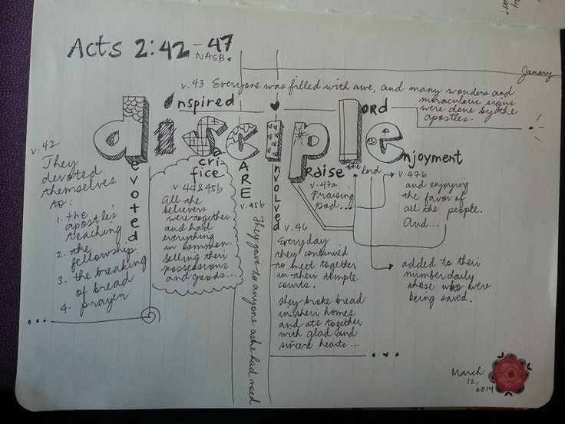

Slide 41
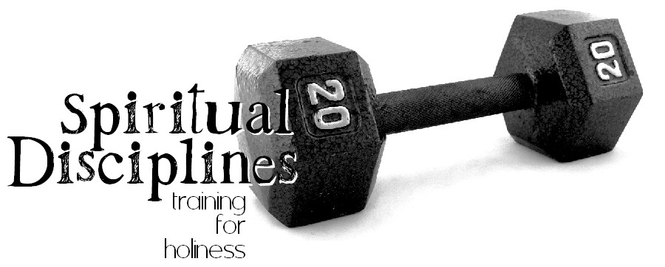

Slide 42
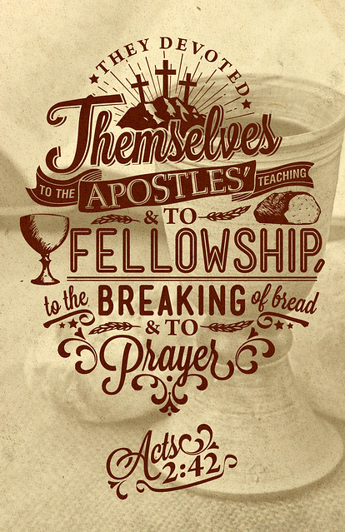

Slide 46
Can We Really Change God’s Mind?

Slide 47
the
OneGod
Deuteronomy 4:35, 39
Deuteronomy 6:4
1 Kings 8:60
1 Chronicles 17:20
Isaiah 43:11
Zechariah 14:9
Galatians 3:20
James. 2:19

Slide 48
Understanding the Dilemma
God is omniscient (1 Jn. 3:20; Heb. 4:12-13; Ps. 139-1:24; Matt. 10:29-30)
God does not change (Ps. 7:11; Mal. 3:6; Num. 23:19; 1 Sam. 15:29; Is. 46:9-11; Ez. 24:14; Jms. 1:17)
God changed or repented in the past (Gen. 6:6-7; Ex. 32:14; Jonah 3:10)
Faithful prayers can make a difference (Jms. 5:16; 1 Pt. 3:10-12; Jn. 15:29; Phi. 1:4; 1 Ths. 5:17; Eph. 6:18; Lk. 2:37, 18:6-8)

Slide 49
Different Response?
Human attempts to explain God’s actions (not literal)
Change?...
…not a change if God already knows what He is going to do! (Is. 46:10-11)

Slide 50
“God’s decrees are not irrecovable, his will is not absolutely inflexible, and his judgments are not arbitrary. On the contrary, His actions exhibit love, concern and pity for man, and are designed to deal with him in a way commensurate with both justice and mercy.”
(Questions & Answers, Vol. 2; Guy N. Woods)

Slide 51
Conditional Warnings & Promises
The warnings and promises of God are often conditional and depend on actions of those to whom they apply:
Save a nation if they turns from evil (Jer. 18:7-10)
Save the cities if there were 10 righteous souls (Gen. 18:22-33)
Implied conditions are just as valid as specific ones!

Slide 52
God Does NOT Change…
God’s Character is Unchanged (Ps. 102:27; Mal. 3:6; Jms. 1:17)
God’s Nature is Unchanged (Heb. 1:12; Acts 17:31)
God’s Purpose is Unchanged (Heb. 6:17; Rom. 9:11; Job 23:13; Ps. 33:11; Is. 46:10)
God’s Promises are Unchanged (Num. 23:19; 1 Sam. 15:29; Rom. 11:29)

Slide 53
Why Should I Pray?
Prayer does not inform God, it involves God
Prayer does not change God, it changes us
Prayer does not get our will done in heaven, it gets God’s will done on earth
Prayer is not because God needs us, but because we need God!

Slide 54
Lessons to Consider
We can trust God and have confidence in all He does!
God does not need to change
We should pray
God is disappointed when we fail to follow his commands

Slide 55
petitioning

Slide 56
When God Does Not Hear!

Slide 57
God Does NOT Change…
God’s Character is Unchanged (Ps. 102:27; Mal. 3:6; Jms. 1:17)
God’s Nature is Unchanged (Heb. 1:12; Acts 17:31)
God’s Purpose is Unchanged (Heb. 6:17; Rom. 9:11; Job 23:13; Ps. 33:11; Is. 46:10)
God’s Promises are Unchanged (Num. 23:19; 1 Sam. 15:29; Rom. 11:29)

Slide 58
Why Should I Pray?
Prayer does not inform God, it involves God
Prayer does not change God, it changes us
Prayer does not get our will done in heaven, it gets God’s will done on earth
Prayer is not because God needs us, but because we need God!

Slide 59
Understanding the Dilemma
Things Which Negate
Though we have these precious revelations that God is concerned about us and willing to fill our needs, many prayers go unanswered because of things in our prayers and things in our lives which negate the prayer.

Slide 60
Seven Conditional Warnings & Promises
I. Lack of faith. Jesus commanded, “Therefore I say to you, all things for which you pray and ask, believe that you have received them, and they shall be granted you” (Mk. 11:24). That faith that God can and will give what we ask, if it be according to His will, is necessary for that prayer to be answered is also seen from this passage: “But if any of you lacks wisdom, let him ask of God, who gives to all men generously and without reproach, and it will be given to him. But let him ask in faith without doubting, for the one who doubts is like the surf of the sea driven and tossed by the wind. For let not that man expect that he will receive anything from the Lord, being a double-minded man, unstable in all his ways” (Jas. 1:5-8). The prayer that is offered without faith is not going to accomplish very much.

Slide 61
Seven Conditional Warnings & Promises
2. Asking amiss. James said, “Ye ask, and receive not, because ye ask amiss, that ye may consume it upon your lusts” (4:3). The word “amiss” is translated from kakos which means “with bad intent” or “for the wrong reason.” The context shows that some asked in prayer for things after which they had lusted and over which they had fought, although they did not want these things for the right reason. So frequently, our prayers are filled with requests designed to fill our inordinate desires for material things. We ask and do not receive and wonder why! We do not receive because we ask for the wrong reasons.

Slide 62
Seven Conditional Warnings & Promises
3. Self-righteousness. The parable of the prayers of the Pharisee and the publican demonstrates that a self-righteous attitude negates prayer (study Lk. 18:9-14). The Pharisee was a haughty man who acted as if his works justified him before God, failing to realize that all of us, no matter how righteous, are sinners before God (Rom. 3:23; Gal. 3:10). If we manifest a similar self-righteous attitude, our prayers will also be negated.

Slide 63
Seven Conditional Warnings & Promises
4. Failure to forgive others. The parable of the unmerciful slave (Mt. 18:21-35) shows that the man who refuses to forgive those who sin against him will not receive forgiveness from our merciful Father above. Jesus said, “But if you forgive men for their transgressions, your heavenly Father will also forgive you. But if you do not forgive men, then your Father will not forgive your transgressions” (Mt. 6:14-15). Regardless of how men have treated us, we must love our enemies (Mt. 5:44) and leave vengeance in the hands of our just God (Rom. 12:19-21).

Slide 64
Seven Conditional Warnings & Promises
5. Sinfulness. The Scriptures teach that God will not hear the prayer of the man who habitually refuses to sub= mit to God’s will. “He who turns away his ear from listening to the law, even his prayer is an abomination” (Prov. 28:9). “If I regard wickedness in my heart, the Lord will not hear” (Isa. 66:18). “Behold, the Lord’s hand is not so short that it cannot save; neither is his ear so dull it cannot hear. But your iniquities have made a separation between you and your God, and your sins have hid His face from you, so that He does not hear” (Isa. 59:1-2). The man who walks in darkness cannot enjoy fellowship with God (1 Jn. 1:5-10).

Slide 65
Seven Conditional Warnings & Promises
6. Praying for a show. Jesus said, “And when you pray, you are not to be as the hypocrites; for they love to stand and pray in the synagogues and on the street corners, in order to be seen by men. Truly I say to you, they have their reward in full” (Mt. 6:5). The word translated “have . . . in full” is apecho. The word was a technical term to refer to an account in business transactions which had been paid in full. What Jesus is saying is this: The man who prays to be seen by men has received full payment for what he has done when he hears mere men saying, “Brother-Piety surely can lead a beautiful prayer.” We must be careful that we offer our prayers because of our devotion to God rather than to be seen of men. Our personal, private devotions to God are a safeguard to worship for show (Mt. 6:6).

Slide 66
Seven Conditional Warnings & Promises
7. Vain repetition. Again, Jesus said, “And when you are praying, do not use meaningless repetition, as the Gentiles do, for they suppose that they will be heard for their many words” (Mt. 6:7). Jesus did not condemn repetition in prayer; indeed, He instructed us to be persistent in presenting our requests to the Lord (Lk. 18:1-8). What He condemned was meaningless or vain repetitions. We must be careful that some of the cliches which we use in prayer not become meaningless (for example, “Thank you Father, for this another beautiful Lord’s day,” “May the speaker have a ready recollection of what he has studied,” “Be with the sick the world over and especially those of the Household of faith,” etc.). Most of our cliches are scriptural things to pray for; we must be careful less they become mere meaningless repetition.

Slide 67
Faithless Petitions Flounder
A lack of faith can certainly hinder one’s prayers. James declares that we must pray “in faith, nothing doubting” (Jas. 1:6). He describes the doubter as being like the restless sea. He has two minds—one of faith and the other of doubt. Hence, shall not receive his requests from the Lord.
Elsewhere we read that true faith requires us to believe that God “is a rewarder of them that seek after him” (Heb. 11:6).
In a world of doubt and confusion, how can we have confidence that God is truly listening and responding to our prayers.
There are at least two reasons. First, since God is almighty (Gen. 17:1) and can do all things (Job 42:2) consistent with his nature and will, he is obviously able to answer prayer.
Second, we should be so glad to have a God who is, at his very nature, a loving God (1 Jn. 4:8). He is, to put it in our crass colloquialism, loaded rich in mercy (Eph. 2:4).
Because of his love and abundant mercy, he longs to answer his children’s requests in harmony with their genuine needs.

Slide 68
Ignorance Impedes Our Invocation
Another reason prayers may be weakened is because of our ignorance.
The disciples once approached Christ as he was praying. They asked: “Lord, teach us to pray, even as John also taught his disciples” (Lk. 11:1).
Doesn’t this reveal that there must be a correct way to pray that comes as a consequence of teaching? It is frequently the case that Christians “know not how to pray” as they ought (Rom. 8:26).
For instance, it may be that some saints do not know of God’s willingness to answer our prayers, hence, they have not because they ask not (Jas. 4:2; cf. Phil. 4:6). Ignorance concerning the purpose of prayer can hinder. For example, prayer should be according to God’s will in order to be heard (1 Jn. 5:24). But how can we pray effectively according to his will if we don’t know his will.
Here’s an example. It is not proper to pray for miracles, since those signs served a unique place in the divine plan (Mk. 16:17-20; Heb.2:2-4) and thus, have been terminated (1 Cor. 13:8-13; Eph. 4:8-16). (See: What Does the Bible Say About Miracles? )
And what about praying that God should save someone—someone we dearly love—but who remains in rebellion to the gospel plan of salvation (1 Jn. 5:16). The more we study and understand God’s will as revealed in his word, the more effectively we can pray.

Slide 69
Impurity Inhibits Intercession
If prayer is to reach the throne of grace, the supplicant must strive with deadly seriousness to conform his life to the holy will of the Lord God. The Bible is replete with instructions to this end.
Isaiah warned Israel of old that Jehovah would not hear them because of their sins (Isa. 59:2). The Savior solemnly taught that we must abide in him and allow his words to abide in us if we would have our petitions fully answered (Jn. 15:7).
Peter declared that “the eyes of the Lord are upon the righteous, and his ears unto their supplication” (1 Pet.3:12). Yes, the prayers of the righteous person avails much (Jas. 5:6).
But the requests of those who deliberately turn away from hearing the Creator’s will are abominable in his sight (Prov. 28:9).

Slide 70
Pride Prohibits Prayer
No one is qualified to approach the great God of the universe with a spirit of smugness.
He is the Lord, God Almighty (Gen. 17:1). We are but dust (Gen. 3:19). He is Creator. We, the created (Psa. 100:3). He is holy (Psa. 9:9), yet we are sinners (Rom. 3:9, 10).
Accordingly, prayer must ever be characterized by a spirit of lowliness.
This lesson is taught in one of the Lord’s parables. Two men went up to the temple to pray (Lk. 18:9ff). One was a Pharisee and the other was a publican. Pride made the difference as to whose prayer was heard.
When the Pharisee arrived at the temple, he struck a pose and eulogized himself. I thank thee, that I am not as the rest of men." He viewed himself as a self-made man, and he adored his creator! In stark relief, however, the publican contritely sought the Lord’s mercy as a sinner. He was justified rather than the other.
The lesson of the parable is this. Arrogance can negate prayer! Humility will bless it!

Slide 71
Unforgiving Attitudes Overthrow Prayer
One of the most utterly devasting things that the Christian can do to hinder, indeed, to virtually cancel the effect of his prayers is to harbor a surly, unforgiving attitude toward others he feels have sinned against him (whether is real or imagined).
Christ taught the disciples to pray: “Forgive us our debts, as we also have forgiven our debtors.” In conclusion he warned: But if ye forgive not men their trespasses, neither will your Father forgive your trespasses (Mt. 6:12, 15). Judgment is without mercy to him that shows no mercy (Jas. 2:13).
Peter once asked the Lord: “How oft shall my brother sin against me, and I forgive him? until seven times?”
The Jewish rabbis felt that three times to forgive was quite sufficient (cf. Barclay, 213). Likely, Peter assumed he was being generous, but the Lord cautioned that forgiveness was to be extended seventy times seven (i.e., limitless!).
Then in order to illustrate the gravity of having an unforgiving spirit, Jesus told the parable of the unmerciful servant. In this divine narrative, the king represents God. The first servant and his vast debt is you and me and the fact that our sins have put us head-over-heels in debt to God. It is debt that we can never pay off by acts of human merit. It must be a matter of forgiveness.
The second indebtedness calls attention to the trespasses others commit against us. How astounding it is that we, who have been given Heaven’s saving grace are sometimes so unwilling to forgive others. The Lord warns that we cannot receive his forgiveness unless we are willing, from the heart, to forgive each other.

Slide 72
The Sabotage of Selfish Prayers
Finally, some short-circuit their prayers due to their own selfishness. James says: “Ye ask, and receive not, because ye ask amiss, that ye may spend it in your pleasures” (Jas. 4:3).
The word for pleasures is hedone. Here it suggests the desire of one who is so wrapped up in the physical world that he has little interest in fulfilling his true purpose on earth (cf. Isa.43:7; Eccl. 12:13). Though “religious,” the individual here considered prays only out of a base spirit of selfishness.
Perhaps we need to analyze the motivation behind our prayers. When we petition for material things, is it that we might use them to the glory of God or that we might be more comfortable?
That the prayers of many members of the church to this end are selfish prayers is clearly evinced by the fact that most of their possessions are employed to accommodate themselves, while only a pittance is offered to the Lord. But if our petitions are directed to the end that we may effectively serve our Savior, God can open the windows of heaven and pour out blessings in abundance (Mal. 3:10; Prov. 3:9, 10; Lk. 6:38).

Slide 73
Don’t Forget To Be Thankful! When Paul wrote to Timothy (1st Timothy 2: 1), he told him that he should offer supplications, prayers, intercessions and giving of thanks for all men. “Supplications” are our requests regarding our needs. “Prayers” are any discourse with God, which would include petitions, praise and thanksgiving. “Intercessions” are our pleas to God on behalf of others. “Thanksgiving” obviously expresses our thanks for the multitude of blessings, both physical and spiritual, which we enjoy in this life. When we offer our prayers, we always want to remember to be thankful for the multitude of blessings God has bestowed upon us. Christians are saved by the grace of God, through the sacrifice of Jesus Christ, and through compliance with the terms and conditions set forth in the New Testament. Someone was concerned enough about us to tell us of the love of God and show us the things that we need to do to be saved. Certainly Christians are thankful for this blessing. But, we are also given great privileges, opportunities and comforts that are physical in their nature and it would be an act of utter ingratitude if we were not thankful for these physical blessings as well.

Slide 75
When God Does Not Answer!

Slide 76
God Does NOT Change…
God’s Character is Unchanged (Ps. 102:27; Mal. 3:6; Jms. 1:17)
God’s Nature is Unchanged (Heb. 1:12; Acts 17:31)
God’s Purpose is Unchanged (Heb. 6:17; Rom. 9:11; Job 23:13; Ps. 33:11; Is. 46:10)
God’s Promises are Unchanged (Num. 23:19; 1 Sam. 15:29; Rom. 11:29)

Slide 77
Why Should I Pray?
Prayer does not inform God, it involves God
Prayer does not change God, it changes us
Prayer does not get our will done in heaven, it gets God’s will done on earth
Prayer is not because God needs us, but because we need God!

Slide 79
Understanding the Dilemma
When we have prayed by Biblical Formula and in the Right Attitude but yet God Remains Silent. How is that to be understood?

Slide 80
Conditional Warnings & Promises
PERSISTENCE
The persistence of the petition is another factor that the Bible indicates has a bearing on the efficacy of prayer. In Luke 18:1, the gospel writer stated: “Then He [Jesus—KB] spoke a parable to them, that men always ought to pray and not lose heart” (emp. added). The parable Jesus told in this context was about a widow who made a request to an unjust judge. Her request was noble and right, but the unjust judge did not feel obligated to comply with her appeal. Due to her persistence, however, and her “continual coming” to the judge, he finally granted her petition. Jesus then commented that if an unjust judge can be swayed by persistence, how much more effective is the persistent prayer of a virtuous person when addressed to the righteous Judge of all the Earth.
Additionally, Jesus told of a man who visited his neighbor at midnight requesting bread to feed a guest. Initially, the neighbor refused the request, but eventually he complied. Jesus stated: “I say to you, though he will not rise and give to him because he is his friend, yet because of his persistence he will rise and give him as many as he needs” (emp. added). Jesus then coupled this parable with the instructions to be persistent in requests to God (vss. 9-13). In fact, throughout the Scriptures, persistence plays a prominent role in effective prayer (see Philippians 1:4; 1 Thessalonians 5:17; Ephesians 6:18; Luke 2:37).

Slide 81
David’s Unanswered Persistent Prayer
Chapters 11 and 12 of 2 Samuel are almost parenthetical, then, as they depict this exceptional period in David's life. This was a time when he was not a “man after God's heart.” And so we find chapter 11 beginning with a description of Israel going to battle, while David stays at home (11:1). We find verses 26-31 of chapter 12 reporting how David showed up for the war, and when it was won, all Israel returned home to Jerusalem. There is a sense of closure, of finality, here, which I think the author intended us to feel. In addition, we find that our text records the death of Bathsheba's first son, followed rather quickly by the account of the birth of the second, Solomon, who was to rule on the throne of his father, David.

Slide 82
David’s Unanswered Persistent Prayer
The tragic death of David’s son is a consequence of David's sin, but it is not the penalty David deserves for his sin. The penalty for adultery and murder is death, on each count. David deserves to die, on two counts: adultery and murder. But Nathan has made it very clear that David's sin has been “taken away.” The death of this child is a painful consequence of David's sin, but it is not punishment for his sin, per se. That punishment has been taken away, borne by the Lord Jesus Christ.

Slide 83
David’s Unanswered Persistent Prayer
God could not look the other way when David sinned, for his disobedience to God's commands was a matter of public knowledge. As his victories and triumphs were known among the Gentiles, so his sins would be widely known as well. By taking the life of this child, conceived in sin, God makes a statement to those looking on. If God does not deal with the sin of His saints, they might reason, then He will not be concerned with mine, either. Thus, they will mock God with the confidence that they can get away with their sin.

Slide 84
David’s Unanswered Persistent Prayer
David mourns as a sign of his repentance as he beseeches God to spare the life of his son.
Is it right for David to beseech God to spare the life of this child when He has already said that He is going to take the life of the child? I believe the answer is “Yes!” David knew that some prophecies were warnings of what God would do unless men repented. God sometimes foretold future judgment, which would come to pass if men did not repent. The hope for divine relenting in response to human repenting is set down in Jeremiah 18:5-8.

Slide 85
David’s Unanswered Persistent Prayer
Is it possible that David felt this child might be the heir to his throne? If this were the case, then David surely had reason to hope that God would spare the child's life.
David was certainly right in his assumption that the life of this child was in God's hands, and that his best course of action was to appeal to God to spare the child's life. David believed in the sovereignty of God, and thus he rested his case with God. David's prayers are not only the expression of his repentance, but the exercise of his faith. Believing in God's sovereignty did not keep David from taking action (fasting and praying); his faith prompted him to act.

Slide 86
David’s Unanswered Persistent Prayer
It is what happens from this point on that perplexes David's servants. While the child was ill they had not been able to get David up from the ground, nor to eat any food. They assumed it would only get worse once he knew the child was dead. Instead, David arose from the ground, washed and anointed himself, changed his clothes, and went into the house of the Lord, where he worshipped. When he had finished worshipping God, he came home and asked for food. When they set it before him, he ate it.

Slide 87
David’s Unanswered Persistent Prayer
The death of this child came as no surprise to David because it had already been foretold by Nathan. Through Nathan God had informed David that this son, the fruit of David's sinful union with Bathsheba, “Uriah’s widow,” would surely die. The death of this child was the revealed will of God. For David to mourn excessively would have been to express his regret over God's will. David's actions indicated that he had accepted the death of this child as God's will.

Slide 88
David’s Unanswered Persistent Prayer
Nathan had already explained the reason for death of this child to David. The purpose for the death of this child was not to punish David. The appropriate punishment for David's sins under the law would have been the death penalty. Nathan has not given David news of a reduced sentence, but of complete forgiveness, because the guilt and punishment for his sins had been “taken away” (12:13). The purpose for this child's death was instructive. It was meant to silence any blasphemy on the part of the “enemies of God.” Lest any might wrongly conclude that Israel's God was oblivious to David's sin in the breaking of God's law, God made it apparent that He would not wink at sin, even the sin of a man after His own heart. The death of David's son was an object lesson to the enemies of God.

Slide 89
David’s Unanswered Persistent Prayer
David's mourning during the child's sickness was an act of repentance, not the mourning of the loss of a loved one:
22 He said, “While the child was still alive, I fasted and wept; for I said, 'Who knows, the LORD may be gracious to me, that the child may live.' 23 “But now he has died; why should I fast? Can I bring him back again? I will go to him, but he will not return to me.”
The death of this child was accepted as God's final answer to David's petitions for the child's life. This is the substance of David's answer to the question posed by his servants. While the child was alive, David fasted, wept, and prayed. But now the child is dead. David has done all that he could. God has given David a clear and final answer: “No.” David sees death as the time to cease those activities which were only appropriate in life. Someone has said, “Where there's life, there's hope.” As far as David's hope for the healing of this child is concerned, God has indicated to David that he should cease his efforts to persuade God to relent concerning this child's death.

Slide 92
Conditional Warnings & Promises
PERSISTENCE
The persistence of the petition is another factor that the Bible indicates has a bearing on the efficacy of prayer. In Luke 18:1, the gospel writer stated: “Then He [Jesus—KB] spoke a parable to them, that men always ought to pray and not lose heart” (emp. added). The parable Jesus told in this context was about a widow who made a request to an unjust judge. Her request was noble and right, but the unjust judge did not feel obligated to comply with her appeal. Due to her persistence, however, and her “continual coming” to the judge, he finally granted her petition. Jesus then commented that if an unjust judge can be swayed by persistence, how much more effective is the persistent prayer of a virtuous person when addressed to the righteous Judge of all the Earth.
Additionally, Jesus told of a man who visited his neighbor at midnight requesting bread to feed a guest. Initially, the neighbor refused the request, but eventually he complied. Jesus stated: “I say to you, though he will not rise and give to him because he is his friend, yet because of his persistence he will rise and give him as many as he needs” (emp. added). Jesus then coupled this parable with the instructions to be persistent in requests to God (vss. 9-13). In fact, throughout the Scriptures, persistence plays a prominent role in effective prayer (see Philippians 1:4; 1 Thessalonians 5:17; Ephesians 6:18; Luke 2:37).

Slide 93
Paul’s Unanswered Persistent Prayer
2nd Corinthians 12: 8
In 2 Corinthians 12, Paul recounts being afflicted with that mysterious “thorn in the flesh,” because of the glorious revelation he’d experienced fourteen years earlier. He states that on three occasions he’d begged “the Lord” to remove it (2 Cor. 12:8).
Who was the Lord?
Let the context speak. The response to Paul’s prayers had been a firm “no” (implied) — with the extension, “My grace is sufficient for you.” The apostle then gloried in the fact that the “power of Christ” would be sufficient for him (2 Cor. 12:9).
Alford Plummer says that the term “besought” (parakaleo) is frequently used of those who asked of Christ’s help, but not when referring to the Father (Plummer, 353; see also Barnett, 571).

Slide 94
Paul’s Unanswered Persistent Prayer
WHAT WAS THE APOSTLE PAUL’S “THORN IN THE FLESH?”
No one knows for sure what Paul's thorn in the flesh was. There have been various theories offered, such as a chronic sickness and bad eyesight. We just don't know because the Bible does not tell us. It doesn't mean we can't offer some educated guesses, but first, let's take a look at the relevant Scripture. Paul said in 2 Corinthians 12:7-8, "Because of the surpassing greatness of the revelations, for this reason, to keep me from exalting myself, there was given me a thorn in the flesh, a messenger of Satan to torment me-to keep me from exalting myself! 8 Concerning this I implored the Lord three times that it might leave me." This problem may very well have been the same one he mentioned in Galatians 4:13-14, "but you know that it was because of a bodily illness that I preached the gospel to you the first time; 14 and that which was a trial to you in my bodily condition you did not despise or loathe, but you received me as an angel of God, as Christ Jesus Himself." Neither verse tells us what the issue was, but the affliction may have been painful as could be designated by the word "thorn." But then again, if it were an issue with his eyesight, that could be considered a thorn in the flesh that was not painful. Let's take a look at that option. In Acts 9:3 Paul says, "As he [Paul] was traveling, it happened that he was approaching Damascus, and suddenly a light from heaven flashed around him." Because of this light, Paul fell to the ground and was blinded for three days (Acts 9:8-9; 22:11). Also, Paul says something very interesting in Galatians 4:15, "Where then is that sense of blessing you had? For I bear you witness that, if possible, you would have plucked out your eyes and given them to me." Could it be that because of the encounter with Christ Paul had been blinded, and this is why the Galatians wanted to, so to speak, pluck their eyes out for him? It seems like a real possibility. At any rate, Paul had asked three times to be delivered of affliction, but God did not heal him. The reason is obvious, as is stated by Paul himself, that it was to keep him humble (2 Cor. 12:7). It is worth noting that our afflictions which are permitted by God are often for the same reason. We cannot see how pervasive sin really is in us, and sometimes we're humbled by our afflictions and return to God and trust him. This, of course, is a good thing. - C.A.R.M. Resources

Slide 95
Paul’s Unanswered Persistent Prayer
WHAT WAS THE APOSTLE PAUL’S “THORN IN THE FLESH?”
There are two other passages of Scripture that those who believe Paul’s thorn in the flesh was sickness have tried to use to verify that. One is Galatians 4:13-15. Here Paul says that he preached the Gospel to these Galatians through an infirmity of the flesh, and in verse 15, he makes reference to these people being willing to poke out their own eyes and give them to him. From this, many commentators have contended that Paul’s thorn was a rare, ancient disease which was characterized by runny, puffy eyes.
The next scripture used to say Paul’s thorn was bad eyes is also in Galatians, chapter 6, verse 11. It says, “Ye see how large a letter I have written unto you with mine own hand.” People have said Paul’s eyes were so bad that he had to write in large letters, and this is what he was making reference to.

Slide 96
Paul’s Unanswered Persistent Prayer
PAUL’S PRAYER NOT ANSWERED BECAUSE OF SIN BUT FOR A HIGHER PURPOSE
There were individuals who possessed faith, and yet were not healed of their ailments. The apostle Paul obviously had plenty of faith. He had an “infirmity” that was so painful that he called it “a thorn in the flesh” and “a messenger of Satan” (2 Corinthians 12:7-10). Yet his earnest prayers to God for relief did not result in his being healed. Timothy was a faithful and effective servant of the Lord. He had “frequent illnesses” and stomach trouble of such severity as to warrant Paul referring to it by inspiration. But rather than simply healing him, or telling him to “pray for healing,” Paul advised him to use a little wine as a tonic (1 Timothy 5:23). Another Christian worker and companion of Paul in his evangelistic travels, Trophimus (Acts 20:4: 21:29), had to be left at Miletus due to his sickness (2 Timothy 4:20). Epaphroditus was an extremely valuable worker in the kingdom of Christ, so much so that Paul referred to him as “my brother and fellow-worker and fellow-soldier…and minister to my need” (Philippians 2:25). When he became sick “nigh unto death” (Philippians 2:27,30)—likely due to his exhausting kingdom activity and service to Paul—Paul did not heal him. These examples demonstrate that personal faith was not prerequisite to the reception of a miracle in the first century. Miracles were inextricably bound to the authentication of the spoken Word of God.

Slide 97
What purposes do our "thorns" serve?
First, they serve as an antidote for pride. And pride, like fat, causes men to swell larger than they ought and is very painful to remove and keep removed.
Second, such thorns nurture our dependency upon God, humbling us and helping us recognize our need for God's help.
Third, these physical problems build strength. A person builds strength purposefully only when he recognizes his weakness. Strength and endurance come only at the price of some suffering. Ask any athlete.
Our suffering in the flesh develops character, temper control and better dispositions, to name just a few things. We must never forget that God's power is made perfect in our weakness. God is glorified most when our personal weakness is evident and his strength shines through in our life despite our personal impotency.
What is your thorn? Is it a sickness when you want to be well to serve the Lord? Or, might it be poverty, when you could wish to have money to help the Lord's cause? An unbelieving spouse? Limited education or abilities?
Remember, God's ways are not our ways. He has at times used the most unlikely men to accomplish his purposes. So, let us recognize that sometimes we may be praying for the removal of something from our lives for which God has a purpose. Taking the burden away may be our answer but God's answer may be giving us the strength to handle the burden, thus increasing our faith and that of others. – Truth Magazine

Slide 98
PRAYERS MUST ACCORD WITH GOD’S WILL
In Jesus’ instructions to His disciples regarding prayer, He explained that they should include in their prayers the idea that God’s will should be done (Matthew 6:10). The apostle John, who would have been well-aware of Jesus’ teaching on prayer, stated: “Now this is the confidence that we have in Him, that if we ask anything according to His will, He hears us. And if we know that He hears us, whatever we ask, we know that we have the petitions that we have asked of Him” (1 John 5:14-15, emp. added). Notice that if we do not include verse 14 of 1 John 5, we could make the passage say, “whatever we ask, we know that we have the petitions that we have asked of Him.” Yet to do that would be to leave off the important qualifying statement that the request should be in accordance with God’s will, and should be offered from a heart that is humble enough to accept God’s will—even if that means that the request is denied. When the skeptic pulls snippets of verses from the gospel accounts concerning prayer, he or she is guilty of leaving off just such important qualifying information.

Slide 99
When we consider the idea of praying “according to God’s will,” we can see how important this qualifier is. No requests will be granted that attempt to violate or circumvent God’s ultimate will. For instance, suppose a person were to pray: “God, please save my mother even though she does not believe in Jesus Christ and refuses to repent of her sins, please let her go to heaven anyway, in Jesus’ name, Amen.” Would God grant that petition? The Bible is clear that He certainly would not, because to do so would be to violate His ultimate will that salvation is through the name of Jesus (Acts 4:12).
Furthermore, certain events and actions in this physical world are required for God to accomplish His will on this Earth. For instance, if one of Jesus’ apostles had asked God to spare the life of Jesus and not let Him die on the cross, that request would not have been in accord with God’s ultimate will and would not have been answered in the affirmative. Mark 8:33 provides an excellent example of this when Peter rebuked Jesus for predicting His own death. Jesus responded to Peter, saying: “Get behind Me, Satan! For you are not mindful of the things of God, but the things of men.” Whereas Peter most likely thought his actions were in accord with God’s will, they were not. To further illustrate, the many events in the life of the Old Testament character Joseph may have seemed unfair at the time. No doubt Joseph prayed to be freed from slavery or to be released from jail. But at the end of Joseph’s life, we see that God’s will was to make him a great leader in Egypt and to save the Jewish nation through him. Joseph recognized this, and said to his brothers who had sold him into Egypt: “Do not be afraid, for am I in the place of God? But as for you, you meant evil against me; but God meant it for good, in order to bring it about as it’s this day, to save many people alive” (Genesis 50:20). Joseph’s slavery & incarceration were the vehicles by which God brought Joseph to power, accomplishing His will.

Slide 101
Conditional Warnings & Promises
“but the Spirit himself makes intercession for us”
The expression “Spirit himself” is emphatic; it expresses an activity of the Holy Spirit personally, rather than what he may accomplish through a representative medium (cf. John 4:2). While the pronoun auto (“itself” – KJV; “himself” – ASV) is a neuter form, it is more appropriate here to render it as a masculine, since the Holy Spirit is a person, not a thing. This has the precedent of Scripture itself (cf. John 14:26 where the masculine ekeinos is used of the “Spirit”—a neuter term).
“with groanings which cannot be uttered”
The term “groanings” (stenagmois) denotes a sigh or groan. It is used (in various forms) more than fifty times in the Greek version of the Old Testament, and it reflects a “human lament” which suffering people are powerless to remedy on their own (Balz and Schneider 1993, 272). For instance, it describes the anguish of the Israelite people under the burdens of Egypt (Exodus 2:23; cf. Acts 7:34).
The notion that the “groanings” refer to “speaking in tongues” is to be rejected totally. Stott comments: “These groans can hardly be glossolalia, since those ‘tongues’ or languages were expressed in words which some could understand and interpret” (1994, 245).
But whose groanings are these? Though some would attribute them to the Holy Spirit, the better view appears to be that they are the Christian’s groanings, which are conveyed on his behalf by the Spirit unto God. Clearly the term refers to the Christian’s plight a few verses earlier in this chapter (v. 23), though a different point of focus is in view.
The context seems to suggest that the groanings originate because “we know not how to pray as we ought” in a knowledgeable and articulate way. It would seem, therefore, more in harmony with the general tenor of the Bible as a whole, then, to conclude that it is the Christian who gives rise to these “mute sighs, the expression of which is suppressed by grief” (Thayer 1958, 25), rather than the groanings issuing from the omnipotent Spirit of God.
Hardeman Nichols observes: “Surely the Holy Spirit who has the ability to completely reveal the mind of God to man would have no difficulty in pleading man’s cause to God” (1980, 350).
It is not impossible, though, that there may be a blending of two thoughts. Some think that the groanings, though originating with the Christian, actually are “shared by the Holy Spirit and the believer” (McComiskey 1976, 424).
John Stott suggests that “the Holy Spirit identifies with our groans,” so that “we and he groan together” (245). One thing is certain: when the groanings reach God, they are perfectly clear to him.
It is imperative, though, that we emphasize this point: it must not be concluded that the Father could not know of our plight apart from the Spirit’s intercession; no, rather, it is the role of the Spirit as a companion in the Christian’s life that is being emphasized. His work has been divinely orchestrated, consistent with the planning of the entire Godhead.
H. Leo Boles wrote: “Since [the Holy Spirit] dwells in Christians, he helps them in the act of prayer. Prayer is to God the Father in the name of Christ, and by the help of the Holy Spirit. Hence, each member of the Godhead is included in acceptable prayer” (1983, 256).

Slide 102
Conditional Warnings & Promises
“and he who searches the hearts”
The heart-searcher of this passage is generally conceded to be God, the Father, mentioned subsequently in the verse. God is said to “search” the heart of man.
The word means to examine, to investigate. It is a form of the figure known as anthropomorphism (representing God with human traits), the design of which, in this text, is to emphasize the all-knowing aspect of deity (cf. 1st Chronicles 28:9; Psalms 7:9; Proverbs 17:3; 1 Thessalonians 2:4). Similar expressions are used both of Christ (Revelation 2:23) and of the Spirit (1st Corinthians 2:10).
The present tense form argues for the concept of a God who is ever aware of our needs. The “heart,” of course, is the soul or spirit of man, the rational, feeling aspect of the human being—that part made in the very image of God himself (Genesis 1:26-27; Daniel 7:15; 1 Corinthians 2:11; Romans 10:9-10).

Slide 103
Conditional Warnings & Promises
“knows what is the mind of the spirit”
Again the verb (oida), employed as a present tense (see above), reveals the fact that the Father and the Spirit are constantly in close communication with one another, if we may express ourselves in the same sort of accommodative language discussed just above. God is ever aware of the Spirit’s insights into our souls, hence can adequately respond to our needs.
Cottrell suggests that Paul’s argument here is one where the reasoning proceeds from the less likely to the more likely: “If God knows what is in the minds of created beings who are qualitatively different from him and relatively independent of him, then surely he knows what is in the mind of the Spirit himself, who is qualitatively equal with God and one in nature with him” (1996, 498).

Slide 104
Conditional Warnings & Promises
“because [that – ASV] he intercedes for the saints”
The present tense of the verb (“intercedes”) depicts the characteristic activity of the Spirit on behalf of the Christian. (For the meaning of “intercede,” see above.)
The term “saints,” as used in the New Testament, is a general term for those who are faithful to God. It is commonly used for the members of various congregations of the Lord’s people (cf. Romans 1:7; 1 Corinthians 1:2; Ephesians 1:1; Philippians 1:1). It is linguistically related to the words “holy” and “sanctified.” It refers to a person who, by virtue of his obedience to the gospel plan of salvation (cf. Ephesians 5:26) and his consecration of life has become “separated unto God” (cf. 1 Thessalonians 4:3-4, 7; Romans 6:19, 22; Hebrews 12:14).
The Holy Spirit is delighted to operate on behalf of a people dedicated to righteousness. The Roman Catholic concept of “sainthood” bears utterly no relationship to the New Testament Scriptures.

Slide 105
Conditional Warnings & Promises
“according to the will of God”
The Greek text simply says, “according to God.” The translators of both the King James Version and the American Standard Version have supplied the words “the will of” (as indicated by the italics) for clarification purposes. God the Father and the Holy Spirit operate in perfect unison in the interest of Christian people.
Perhaps it is not out of place at this point to remind ourselves that, unlike the so-called “gods” of the ancient pagan world, the members of the sacred Godhead are never at variance with one another. They function in absolute harmony.

Slide 107
Hannah’s Prayer

Slide 108
Human Barriers:
The Younger Son

Slide 109
Natural Barriers:
The Barren Woman

Slide 110
PRAYER IN IMITATION OF HANNAH
Has an important request to make
Has an important request to make
Has important purposes to affirm
Has important purposes to affirm
Has important work to pledge
Has important work to pledge
Has important confidence to express
Has important confidence to express
1st Samuel 1
Notes:
VI. Summary/Invitation
A. Who among us does not need to improve his prayer life?
1. Who among us does not need to have as an objective for this year to grow spiritually?
2. One way to accomplish both of these is to have spiritual growth through personal, private prayer.
B. As a practical model for effective prayer we have Hannah. To pray a prayer like Hannah’s prayer, we must:
1. Have an important request to make.
2. Have important purposes to affirm. We must show our commitment to use the results of that prayer in spiritual service.
3. Have some important work to pledge. We must commit to do our part in accomplishing the things we pray for.
4. Believe in results from prayer. To pray a prayer like Hannah’s prayer, we must have confidence in God’s capacity to answer our prayer.
5. May we increasingly strive to pray prayers like Hannah’s prayer.

Slide 111
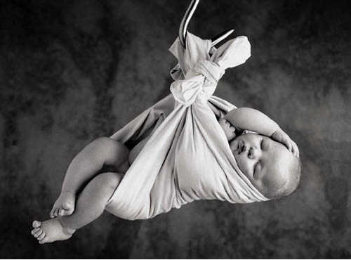
PRAYER IN IMITATION OF HANNAH
God Responds To Prayer!
Has an important request to make
1st Samuel 1
Notes:
VI. Summary/Invitation
A. Who among us does not need to improve his prayer life?
1. Who among us does not need to have as an objective for this year to grow spiritually?
2. One way to accomplish both of these is to have spiritual growth through personal, private prayer.
B. As a practical model for effective prayer we have Hannah. To pray a prayer like Hannah’s prayer, we must:
1. Have an important request to make.
2. Have important purposes to affirm. We must show our commitment to use the results of that prayer in spiritual service.
3. Have some important work to pledge. We must commit to do our part in accomplishing the things we pray for.
4. Believe in results from prayer. To pray a prayer like Hannah’s prayer, we must have confidence in God’s capacity to answer our prayer.
5. May we increasingly strive to pray prayers like Hannah’s prayer.

Slide 112
GOD HEARD HAGAR

Slide 113
What Aileth Thee Hagar?
Gen. 21

Slide 114
Introduction
Picture Hagar in the desert
Gen. 21:

Slide 115
1. What aileth thee Hagar?
She was an outcast – cast of from her home with Abraham
She was destitute – the water and bread were gone
She was helpless

Slide 116
What was her real problem?
She had a very weak faith in God!

Slide 117
Gen. 16:10
And the angel of the LORD said unto her, I will multiply thy seed exceedingly, that it shall not be numbered for multitude.

Slide 118
Gen. 17:20
And as for Ishmael, I have heard thee: Behold, I have blessed him, and will make him fruitful, and will multiply him exceedingly; twelve princes shall he beget, and I will make him a great nation.

Slide 119
She thought the child would die even though God said he would live
LESSON – Look at the misery caused by a weak faith
Weak faith produces worry

Slide 120
She was in despair—she saw no hope

Slide 121
Genesis 21:15-16
And the water was spent in the bottle, and she cast the child under one of the shrubs. And she went, and sat her down over against him a good way off, as it were a bowshot: for she said, Let me not see the death of the child. And she sat over against him, and lift up her voice, and wept.

Slide 122
Have you ever felt deep despair?
Have you ever felt that all was hopeless?
LESSON – God always cares for His own!

Slide 123
“When we do all we can, we should then trust in God to take over. In fact, we have no right to expect God to take over until we have done all we can” W. T. Hamilton

Slide 124
2. Fear not
She faced starvation, the possible death of her son etc. but God said, “fear not, for God hath heard the voice of the lad” (Gen. 21:17)

Slide 125
Her faith had grown weak and weak faith produces fear
God often encouraged His people to “fear not”

Slide 126
Gen. 15:1
After these things the word of the LORD came unto Abram in a vision, saying, Fear not, Abram: I am thy shield, and thy exceeding great reward.

Slide 127
Exodus 14:13
And Moses said unto the people, Fear ye not, stand still, and see the salvation of the LORD, which he will shew to you to day: for the Egyptians whom ye have seen to day, ye shall see them again no more for ever.

Slide 128
LESSON - There is a constant need for us to “fear not”
When we grow old, when we are lonely or sick, when we face death
As we face some crisis in our lives, we need not fear but trust in God

Slide 129
Let each of us make a personal application to our lives today – are we fearful?
Over what?
God can handle it!

Slide 130
3. God heard the voice of the lad
Ishmael was most likely around 17 years of age
He was under a desert bush, dying of thirst, lost in the desert

Slide 131
Ps. 130:1-2
Out of the depths have I cried unto thee, O LORD. Lord, hear my voice: let thine ears be attentive to the voice of my supplications.

Slide 132
Luke 18:13
And the publican, standing afar off, would not lift up so much as his eyes unto heaven, but smote upon his breast, saying, God be merciful to me a sinner.

Slide 133
God saw the potential in the lad
God had promised to make of him a great nation

Slide 134
LESSON – What does God see in us?
God can take you and make something of you!

Slide 135
4. God opened her eyes and she saw a well
There was a well there – it had been there all along
She had simply overlooked the obvious

Slide 136
LESSON – Do we overlook the obvious?
Opportunities to teach
Opportunities to serve (Priest and Levite in Luke 10)

Slide 137
We often do not see a solution to our problems though one is often close by
The world is totally frustrated now – drugs, alcohol, etc. are what so many turn to

Slide 138
LESSON - We must put Jesus first in our lives
This will eliminate guilt, frustration and all the problems brought on by the consequences of sin

Slide 139
Conclusion
“Many who are lost in the desert of sin overlook the well of salvation” Hamilton

Slide 144
GOD HEARD DANIEL

Slide 145
Daniel In The Lions Den
Daniel 6

Slide 146
Introduction
This is one of the most well known of Bible stories
It is in the heart of children who faithfully attend Bible class and worship

Slide 147
I. “An excellent spirit”

Slide 148
6:1-3
King Darius
3 Presidents
Daniel was one of the presidents
Dan. 6:3 --- “Then this Daniel was preferred above the presidents and princes, because an excellent spirit was in him”

Slide 149
Excellent spirit = “Daniel’s God-given abilities, and his faithful use of them, made him stand out as one who was ‘head and shoulders’ above others.” (Charles DiPalma)

Slide 150
II. A spirit of envy and malice – vs. 4-9

Slide 151
Daniel 6:4
[4] Then the presidents and princes sought to find occasion against Daniel concerning the kingdom; but they could find none occasion nor fault; forasmuch as he was faithful, neither was there any error or fault found in him.

Slide 152
The princes and other presidents sought to find something against Daniel
“He was faithful”
“The law of his God”

Slide 153
The decree – for 30 days no one could present a petition to anyone save the king

Slide 154
III. A prayerful spirit – vs. 10-15

Slide 155
Verse 10
[10] Now when Daniel knew that the writing was signed, he went into his house; and his windows being open in his chamber toward Jerusalem, he kneeled upon his knees three times a day, and prayed, and gave thanks before his God, as he did aforetime.

Slide 156
They knew Daniel’s habit of prayer and worship – vs. 11-12
[11] Then these men assembled, and found Daniel praying and making supplication before his God.

Slide 157
[12] Then they came near, and spake before the king concerning the king's decree; Hast thou not signed a decree, that every man that shall ask a petition of any God or man within thirty days, save of thee, O king, shall be cast into the den of lions? The king answered and said, The thing is true, according to the law of the Medes and Persians, which altereth not

Slide 158
Daniel accused
The king seeks to deliver Daniel
V 14
[14] Then the king, when he heard these words, was sore displeased with himself, and set his heart on Daniel to deliver him: and he labored till the going down of the sun to deliver him.

Slide 159
IV. A spirit of remorse and regret vs. 16-18

Slide 160
Dan. 6:18
[18] Then the king went to his palace, and passed the night fasting: neither were instruments of musick brought before him: and his sleep went from him.

Slide 161
“Thy God whom thou servest continually, he will deliver thee.” (v. 16)
The king passed the night in fasting (v. 18)

Slide 162
V. A yearning spirit vs. 19-23

Slide 163
Dan. 6:19
[19] Then the king arose very early in the morning, and went in haste unto the den of lions.

Slide 164
The king got up early
He went to the lions den
“O Daniel, servant of the living God, is thy God, whom thou servest continually, able to deliver thee from the lions?” (v. 20)

Slide 165
6:22-23
[22] My God hath sent his angel, and hath shut the lions' mouths, that they have not hurt me: forasmuch as before him innocency was found in me; and also before thee, O king, have I done no hurt.

Slide 166
[23] Then was the king exceeding glad for him, and commanded that they should take Daniel up out of the den. So Daniel was taken up out of the den, and no manner of hurt was found upon him, because he believed in his God

Slide 167
VI. A spirit of reverence – vs. 24-28

Slide 168
The accusers are killed
The king manifests a deep reverence for Jehovah God

Slide 169
6:26-27
[26] I make a decree, That in every dominion of my kingdom men tremble and fear before the God of Daniel: for he is the living God, and stedfast for ever, and his kingdom that which shall not be destroyed, and his dominion shall be even unto the end.

Slide 170
[27] He delivereth and rescueth, and he worketh signs and wonders in heaven and in earth, who hath delivered Daniel from the power of the lions.

Slide 171
6:28
[28] So this Daniel prospered in the reign of Darius, and in the reign of Cyrus the Persian.

Slide 172
Lessons

Slide 173
1. We must not compromise when it comes to prayer
1 Th. 5:17
“Pray without ceasing”

Slide 174
2. The wicked always seek to catch the Christian in violation of something
Ps. 37:32
“The wicked watcheth the righteous, and seeketh to slay him.”

Slide 175
3. We must guard against rash decisions and impulsive actions
Proverbs 16:20
“He that handleth a matter wisely shall find good: and whoso trusteth in the LORD, happy is he.”

Slide 176
4. We must trust in God even in the very worse situation
Ps. 91:2
“I will say of the LORD, He is my refuge and my fortress: my God; in him will I trust.”

Slide 177
5. We need to take a serious look at the danger others are in
Proverbs 24:17-18
“[17] Rejoice not when thine enemy falleth, and let not thine heart be glad when he stumbleth: [18] Lest the LORD see it, and it displease him, and he turn away his wrath from him”

Slide 178
6. We must learn and teach others that there is NO REASON not to believe in God
Rom. 1:20
“For the invisible things of him from the creation of the world are clearly seen, being understood by the things that are made, even his eternal power and Godhead; so that they are without excuse”

Slide 179
Conclusion
Proverbs 3:5-6
“[5] Trust in the LORD with all thine heart; and lean not unto thine own understanding. [6] In all thy ways acknowledge him, and he shall direct thy paths.”

Slide 180
David Lee Burris:
Balancing Act - Saints & Citizens!
Genre Of Biblical Prayer In Sojourner Motif
Serious Endeavor: Bridge Between Worlds
Prayer Life Is Oriented In Watchfulness
Prayer Life Part Of Righteous Obedience
Prayer Is Learning Experience & Service
Piety Includes Others & Petty Only Self
Partisan Pride & Social Superiority Mocks
Prayer Princely Privilege – Duty & Honor
Prayer Requires Reconciliation Horizontal Before Supplication Vertical
Prayer Requires Honest & Humble Approach
In Prayer We Match God’s Demands Of Justice With Our Intercession Requests For Mercy
Public Prayer Is For The Spiritually Matured

Slide 181
Prayer Is Talking To God
Jesus addressed this prayer to the Father, and in so doing shows that such is the main purpose of prayer. It is not to fulfill a religious exercise or to impress fellow creatures with our beautiful wording!

Slide 182
Prayer Is To Be Done With Reverence
After the salutation, the prayer continues with “hallowed be thy name.” This illustrates that reverence and respect are to be coupled with love and affection!

Slide 183
Spiritual Requests Are The First Things
While most men would start by asking God for personal favors and blessings, Jesus shows us in this prayer that the spiritual must come first. We seek first the kingdom of God and its righteousness!

Slide 184
Effective Prayer Requires Commitment
Jesus applied several expressions that not only were a request but would then involve those of a sincere heart to a life of service. “Thy will be done” would my submitting to God’s will. It would be hypocrisy to pray for such and then live in rebellion to God’s will. Prayer must be in accord with our lives, or rather, our lives must be in accord with our prayers!

Slide 185
Disciple’s Prayer Includes The Material
It has been a source of controversy, but most students of the Bible share in the opinion that the bread of life of which we express our thanks is broad in its application. It is inclusive of our daily bread that physically sustains us. Although our attitude of approach must be toward contentment in circumstance and our focus of prayer primarily spiritual and even though this is a minor point here in the Lord’s formula of prayer - we must keep this in mind. In other words, we must not take for granted either our spiritual nor our physical dependence upon the Almighty each and every day!

Slide 186
Prayer Should Be Constant & Continual
After the prayer’s distilled version ends in Luke chapter 11, verse 4, the teaching of Jesus continues through the chapter. The illustration of a man who would eventually answer a neighbor’s repeated request implies two things. One, that God will also answer our prayers: sometimes by saying yes, sometimes by saying no, sometimes by saying wait awhile. Yet, He hears and answers His child’s prayers. Two, That We Need To Be Prayerful Always & To Be A Prayerful People!
To Pray Only In Distress Is Mocking

Slide 187
Childish Prayers

Slide 188
Successful Communication Requires “Putting Away Our Childish Ways”
David Lee Burris: ASEITY - God Is Not Limited To Anything External To Himself
– Being Himself The Limit Of Everything Else!
Discernment Produces Real Maturity & Noble Purpose Creates Fruitful Lives Of Lasting Happiness.
EVEN THRU THIS MEDIUM GOD STILL CANNOT:
Express Anything Other Than Perfect Love
Be Limited To The Natural World He Created
In Terms Of Space, Time, Matter, Or Energy
Yet, He Imposed Certain Limits Upon Himself!
Do Any Two Counter-Opposite & Mutually
Exclusive Things Both At The Same Time
Harm His Child. Maturity Discerns From Hurt
Be Our Comfortable Parent Or Leave Us Alone
Yet, He Is An Excellent Comforter!
Always Approve Us. Yet, Accepts & Accessible!

Slide 189
“Putting Away Our Childish Ways” This The Best Possible World
Planet Earth Result Of God’s Love Formula:
Human Maxim: “Never Create What You Cannot Control…”
Deity Maxim: “Let’s Make In Our Image”

Slide 190
“Putting Away Our Childish Ways” This The Best Possible World
Planet Earth Result Of God’s Love Formula:
It Is Relational – Compassion Requires Persons Mutually Influential & Capable Of Sympathetic Response
It Has Free Agency – Affections Are A Product Of The Will & Cannot Be Coerced
It Has Multiple Option – Human Choice Between Multiple Possibilities - Each & Every - Value-Laden

Slide 191
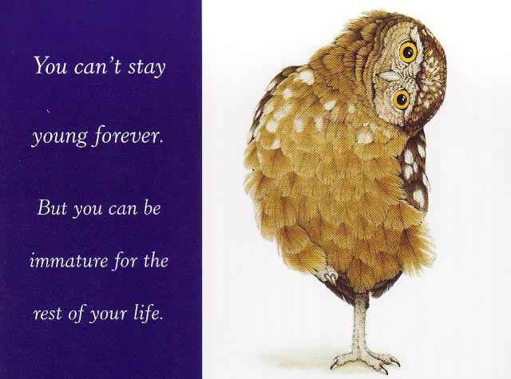
Successful Communication Requires “Putting Away Our Childish Ways”
David Lee Burris: ASEITY - God Is Not Limited To Anything External To Himself
– Being Himself The Limit Of Everything Else!
Discernment Produces Real Maturity & Noble Purpose Creates Fruitful Lives Of Lasting Happiness.
Purpose Driven Author Rick Warren On Life’s Purpose:
“God wants us to practice on earth what we will do forever in eternity.”
“We were made by God and for God, and until you figure that out, life isn’t going to make sense.”
“Life is a series of problems: Either you are in one now, you’re just coming out of one, or you’re getting ready to go into an other one.”
“The reason for this is that God is more interested in your character than your comfort.”
“God is more interested in making your life holy than He is in making your life happy!”

Slide 192
Princely Privilege

Slide 193
CHRISTIAN COUNSELING TODAY; VOLUME 11, NUMBER 4, PAGE 10:
1. Motive. Whenever the insist- -ence is on the point that God will answer prayer, we are off track. The meaning of prayer is that we get hold of God, not of the answer.

Slide 194
CHRISTIAN COUNSELING TODAY; VOLUME 11, NUMBER 4, PAGE 10:
1. Motive. Whenever the insist- -ence is on the point that God will answer prayer, we are off track. The meaning of prayer is that we get hold of God, not of the answer.
2. Method. Every time we pray our horizon is altered, our attitude to things is altered, not sometimes but every time, and the amazing thing is that we don’t pray more.

Slide 195
The prophet spoke of the privilege of entering into God’s presence in the 6th chapter of Isaiah & verse 1:
“Then said I, Woe is me! For I am undone; I am a man of unclean lips, and I dwell in the midst of a people of unclean lips: for mine eyes have seen the King, the Lord of hosts. Then flew one of the seraphim unto me, having a live coal in his hand, which he had taken with the tongs from off the altar and he laid it upon my mouth, and said, Lo, this has touched thy lips and thine iniquity is taken away, and thy sin purged.”

Slide 196
PRAYER: PRINCELY PRIVILEGE
Generally – It Is Devotional Linkage, Mutual
Communion With, & Enjoyed Access Of God
Romans 12:12 “Continuing Instant In Prayer”
Immediate & Confiding ~ Approach & Request
Prayer Enters Into All The Relations Of Our Life
Matt. 5: 23 - Reconciled Horizontal Before Vertical
Prayer Watchfulness Connected – Matthew 26: 41
1st Timothy 2: 1: Christian’s First Of First Things
Personal Prayer Is Cardinal Principle Of Piety
Not The Petty Interests One Person But All Men
Highly Intensive & Restricted Forms Of Prayer:
1) “Supplication” – Non-attenuated Supply Line
2) “Intercession” – For Others Included Answers
Beyond & Above Disciple Duty & Princely Privilege
Instrumental Also As God’s Avenue Of Assistance
Channels Good From God To Man & Men To Men
Belongs Both To The Schools Of Wisdom & Piety

Slide 197
Honesty & Humility

Slide 198
Honesty In Prayer

Slide 199
E. M. Bounds: Prayer & Humility
David Lee Burris: Personal Prayer Unobserved & Unheard Or Else Labeled Hypocritical
Maya Angelou – “When I Say… I Am A Christian…
Humility Is In Retirement From Public Attention
Humility Is In Disposition Given To Others Praise
Humility Is In Being Poor In Inner Spirit, Meek In Outer Behavior, & Lowly In Heart Before God
Parable Of Pharisee & Publican Is A Sermon In Brief On Improper Self-Praise & Proper Humility:
“The Pharisee seemed to be inured to prayer. He leaves business and business hours and walks with steady and fixed steps up to the house of prayer. The position and place are well chosen by him. There is the sacred place, the sacred hour, and the sacred name, each and all invoked by this seemingly praying man. But this praying ecclesiastic, though schooled in prayer, by training and by habit, prays not. Words are uttered by him, but words are not prayer. God hears his words only to condemn him… On the other hand, the publican…a sense of sin and a realization of utter unworthiness has fixed the roots of humility deep down in his soul, and has oppressed self and eye and heart, downward to the dust.”

Slide 200
Providence & Prayer Intersect: Mergence Horizontal & Vertical
Three Wills Of Deity
Decreeative Will, or God As Sovereign.
Preceptive Will, or God’s Will That We React In A Certain Way Although We Are Free To Chose.
3) Dispositional Will, or That Which Pleases God.
.
God W/ Free-Will Man
1) God’s Intentional Will –
Would Be What God Prefers That Would Happen.
2) His Circumstantial Will -Would Be What God Does Due To The Circumstances Evolving He Did Not Intend.
Ultimate Will Of God –What God Can Achieve In Human Circumstances Due To Man’s Sinful Rebellion;
God Can Transform Simple
Evils Into Complex Goods!

Slide 201
King David’s Diagnostic-Confession Prayer Style Turning The Wheels Of The Wills
Psalms 6: 1-3 & 6,7 –
“Every night make I my bed to swim: I water my couch with
my tears.”
Psalms 38: 3 – 9 & 18 –
“My wounds are loathsome and corrupt, because of my
foolishness… Lord, all my desire is before thee; And my
groaning is not hid from thee. For I will declare mine iniquity;
I will be sorry for my sin.”
Psalm 51: 10 – 14 --
“Create in me a clean heart, O God; And renew a right spirit
within me… Restore unto me the joy of thy salvation… And
my tongue shall sing aloud of thy righteousness.”

Slide 202
Transcendent Prayer

Slide 203
David Lee Burris: Absolute Non-Reductive Ontology + Unconditional Non-Dependent Reality = Transcendent Value Noble Norms – Highest Principles - Absolute Standards Of Heavenly Origin & Of Almighty Decree
PRAYER IS TRANSCENDENT
Radical Others In Royal Paradox

Slide 204
Radical Others In Royal Paradox
Transcendence of Otherness. “What is God? Well, the non-spatial, non-temporal, non-causal, non-locatable, non-thing is an enigma wrapped in a puzzle. The side of the imponderable that I want us to focus on right now is this notion that God is radically other, radically transcendent, radically inaccessible to our eyes. In that sense, that sort of transcendence is reciprocal and symmetrical. If God is radically other to us, we are radically other to God. That is the very notion that is at the heart and core of the issue in Plato about how the world of forms, the world of ideas, and the world of appearances can meet and intermix. How can that which is beyond space, time, & causation and which is bound up in space, time, & causation meet? - Prayer! - James Hall, Philosophy of Religion

Slide 205
David Lee Burris: Absolute Non-Reductive Ontology + Unconditional Non-Dependent Reality = Transcendent Value Noble Norms – Highest Principles - Absolute Standards Of Heavenly Origin & Of Almighty Decree
PRAYER IS TRANSCENDENT
TO PRAY IS TRANSFORMATIVE

Slide 206
Level Life LIved

Slide 207
Levels of Life
A musical slideshow

Slide 208
The Levels At Which Our Life Is Lived
The sensual level. Controlled by the senses and what we feel see, hear, taste or smell
It is the normal opus operandi of our pre-Christ state
It is that which leads to carnality in our lives

Slide 209
The Levels At Which Our Life Is Lived
The lateral level is whereby human brain intellect & knowledge, emotional responses to faith and relationships, & the individual will are substituted for dependence on God
It is religion replacing a relationship with the living God
It’s the counterfeit to genuine Christianity
It is often emotionally controlled religion
You can be very religious at this level but have absolutely no relationship with the Lord

Slide 210
The Levels At Which Our Life Is Lived
The spiritual level is where the body is surrendered to God and the mind transformed by the Word of God
It is at this level the Apostle Paul to the Romans admonishes all men to live
It is at this standard of living that God is honored and lives are touched and we make a positive difference.

Slide 211
The Transformation Of The Mind
The world is seeking to shape your thinking
We have the power to nullify this molding by watching what we read, view, hear & with whom associate
The agent of transformation is the Word of God
It needs to become a settled issue for us. We love and trust His word and will obey it without question

Slide 212
How We Are Changed
We are changed Morally
We’re not conformed to the world.(Romans 12:2a)
The word means our outward form does not match the inward reality (suschematizo)
It implies that there is a difference that is visible
Rather than having our morals molded by the world we set the standard by which the world is judged
We do have power to choose what will shape and influence us
The internal pressure changing us is God’s Word!

Slide 213
How We Are Changed
We are changed Mentally
It is the renewal of the mind (2b)
The word used is metamorphoomai and is translated transformed
This word is used only 4 times
in the Bible Matthew 17:2,
Mark 9:2, 1 Corinthians 3:18
The battle ground is the mind

Slide 214
How We Are Changed
We are changed Motivationally (2c)
We will, by obedience experience that God does what He says He will do and is who He says He is (proof testing His metal)
We are never happier and more fulfilled as Christians when we’re doing God’s Will
We will see (Proved by that experience) that God’s will is good, acceptable, and perfect as we do it
The passion of our heart then changes to want nothing more than, and to do nothing else than, the will of God

Slide 215
By changing your thinking, You change your beliefs;
When you change your beliefs, You change your expectations;
When you change your expectations,
You change your attitude;
When you change your attitude, You change your behavior;
When you change your behavior, You change your performance;
When you change your performance; You change your life!

Slide 216
The levels at which our life is lived:
When you change your performance you change your life!

Slide 217
Carnally Minded
Spiritually Minded
Dominated by sinful thoughts
Dominated by The Spirit of God
Living after the flesh
Living thru the Spirit
Brings death
Brings life
Is God’s enemy
Is God’s Friend
Creates turmoil
Generates peace
Not willingly subject
Delights in obedience

Slide 218
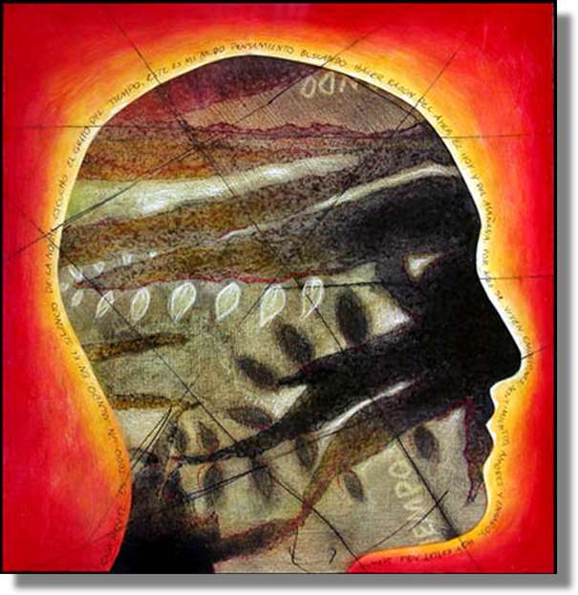
Renewing Your Mind
New Thinking
Leads to
New Doing

Slide 219
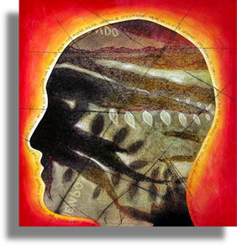
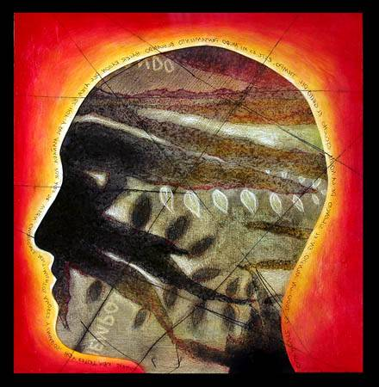
T h e m e
We’ll use Paul’s teachings in Romans
to motivate transformation of your inner values.

Slide 220
P r o p o s e
You’ll become as different from this wicked world…
as you make up your mind to be.

Slide 221
Transformation of the mind is proof of genuine repentance.
It is essential for nobler living.

Slide 222
P o I n t
Do you want your life to become like His?
Transform your thinking and values
so they are like His.

Slide 223
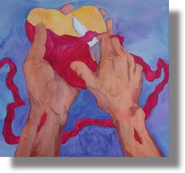
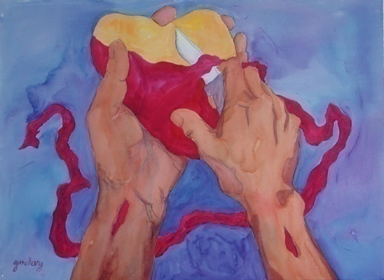
God Renewed Judah
Only a remnant
Three-step recovery:
1. Sit there and remember
2. Understand the damage
3. Hate themselves for it
A new heart from God:
I will give it
Make it yourselves

Slide 224
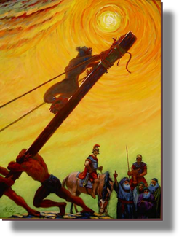
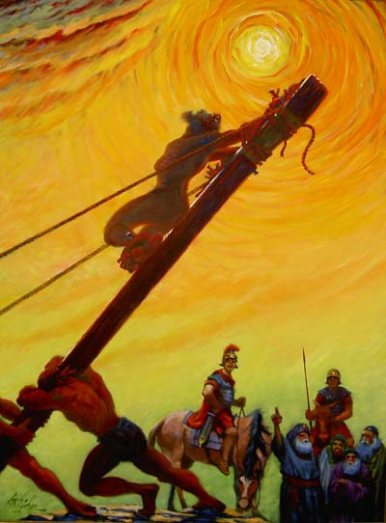
God’s Two Methods
Willing change:
Reflect on the cross
Soften the heart
Yields to God’s way of thinking
Grudging change:
External difficulties
Soften the heart
Yields

Slide 226
You have 3 choices:
You can willingly renew your thinking
You can force God to use harsh measures
You can resist change altogether

Slide 227
P o I n t
Do you want the gentlest route to heaven?
Do the work willingly
Determine to bring your mind-set
into harmony with His.

Slide 228
P r a y e r
The chorus to the 1970's hit song "Day By Day"
came from a prayer of the 13th century
Thanks be to Thee, my Lord Jesus Christ
For all the benefits Thou hast given me,
For all the pains and insults, Thou hast borne for me.

Slide 229
P r a y e r
The chorus to the 1970's hit song "Day By Day"
came from a prayer of the 13th century
O most merciful Redeemer, friend and brother,
May I know Thee more clearly,
Love Thee more dearly,
Follow Thee more nearly,
Day by day.

Slide 232
Where Are You Pointed?
Paradise?
Perdition?

Slide 233
JUDGEMENT PREPARED
FIVE STATES FIVE STEPS
Five States of the Soul:
EXEMPTION:
Ezekiel 18: 20; Matthew 18: 1 – 3
CONDEMNATION:
Galatians 3: 22
JUSTIFICATION:
Romans 5: 1, 2; 8: 1, 2
DAMNATION:
Matthew 23: 3; Mark 16: 16
GLORIFICATION:
Romans 8: 17, 30; II Thess. 1: 7 - 12

Slide 235
JUDGEMENT PREPARED
FIVE STATES FIVE STEPS
Five Steps for Saving:
HEARING:
Romans 10: 17; Matthew 7: 24 - 27
BELIEVING:
Hebrews 11: 6; Mark 16: 15, 16
REPENTING:
Acts 2: 38; 17: 30; Luke 13: 3
CONFESSING:
Matthew 10: 32, 33; Acts 8: 36, 37
BAPTISM:
Romans 6: 3 – 5; Acts 8: 36 - 38

