Slide 1
Ancient Solomon still teaches today
By David Lee Burris

Slide 2


Slide 4


Slide 5
PART ONE
SOLOMON’S LIFE’S LESSONS
Bible Book Intro
Chapter One
Chapter Two
Chapter Three

Slide 6
PARTTWO
SOLOMON’S LIFE’S LESSONS
Chapter four
Chapter five
Chapter six
Chapter Seven
Chapter Eight

Slide 7
iNTRODUCTION

Slide 8


Slide 9
Ancient Wisdom for Modern Life
Ecclesiastes
It’s all a matter of perspective!

Slide 10
TWO VIEWS OF THE WORLD
Secularist
World
View
Theistic
World
View

Slide 11

SECULARIST
WORLDVIEW
A World view without God
Autonomous man
Pursuit of the earthly

Slide 12
Four Realities
A transitory life
+ A meaningless earth cycle
+ An inability to know all
+ Generational discontinuity
Frustration & Hopelessness!

Slide 13


Slide 14
Four Realities
A transitory life
+ A meaningless earth cycle
+ An inability to know all
+ Generational discontinuity
+ God In The Equation
What Is The Outcome?

Slide 15
The Theistic
WORLDVIEW
A world under God’s control
A trusting relationship with the Creator
Pursuit of the spiritual purposes of God

Slide 16
Four Realities
A transitory life
+ A wise God in control
+ A sovereign purpose to fulfill
+ Wisdom to guide us
Satisfaction & hope!

Slide 17
TWO VIEWS OF THE WORLD
Secularist
World
View
Theistic
World
View

Slide 18
Ancient Wisdom for Modern Life
Ecclesiastes
It’s all a matter of perspective!

Slide 19



Slide 20


Slide 21


Slide 22
“Everything is Meaningless”
✤ The word “meaningless” occurs 35 times in the book
✤ The Hebrew word is “Hebel” which is sometimes translated “Vanity”.
✤ It means something that quickly passes, of no lasting value, emptiness, something that is like breath of wind or a puff of smoke that is briefly seen and disappears.

Slide 23


Slide 24
“Under the Sun”
✤ The key to understanding this book is the phrase “under the sun”.
✤ This phrase occurs 29 times.
✤ Ecclesiastes 1:14 (NIV84) “I have seen all things that are done under the sun; they are all meaningless, a chasing after the wind.”
✤ Ecclesiastes is realistic examination of life without the hope of Christ.

Slide 25
“The Teacher”
✤ 1:1 The words of the Teacher, son of David, king in Jerusalem:
✤ 1:12 “I, the Teacher, was king over Israel in Jerusalem.”
✤ Qoheleth = teacher, preacher
✤ Ecclesiastes is Latin for Teacher
✤ Solomon: the man who has done everything and has everything this world can offer and has found it all “meaningless”.

Slide 26
The Search for Meaning: Nature
✤ The natural world is filled with meaningless cycles that just go round and round.
✤ “The sun rises and the sun sets, and hurries back to where it rises. The wind blows to the south and turns to the north; round and round it goes, ever returning on its course. All streams flow to the sea, yet the sea is never full. To the place the streams come from, there they return again.” (Ecclesiastes 1:5–7, NIV84)
✤ “There is nothing new under the sun”.

Slide 27
The Search for Meaning:
Personal Constructions
✤ Great building projects
✤ Parks and irrigated gardens
✤ Beautiful cities and palaces
✤ “Yet when I surveyed all my hands had done and what I had toiled to achieve, everything was meaningless, a chasing after the wind; nothing was gained under the sun.” (Ecclesiastes 2:11, NIV)
✤ He knew that nothing he had built or achieved would last.

Slide 28
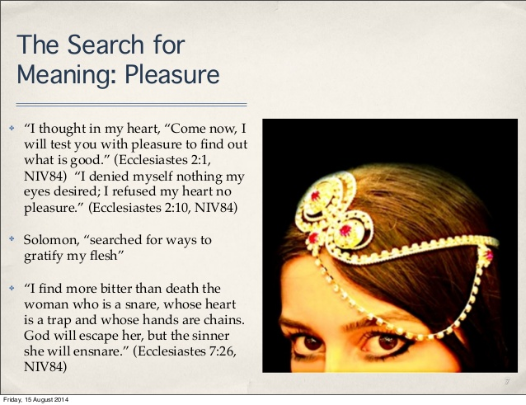

Slide 29
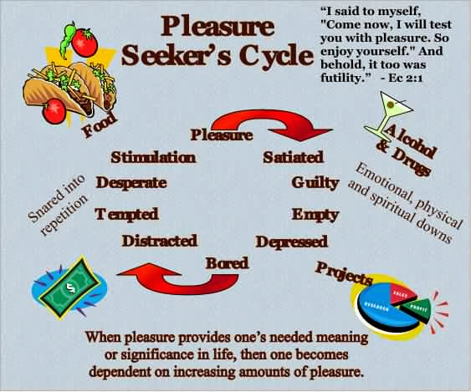

Slide 30
The Search for Meaning:
Wealth and Possessions
✤ Solomon was the wealthiest man in the world of his day.
“King Solomon was greater in riches and wisdom than all the other kings of the earth.”
(1 Kings 10:23, NIV84)
✤ “Whoever loves money never has money enough; whoever loves wealth is never satisfied with his income. This too is meaningless. (Ecclesiastes 5: 10)

Slide 31
The Inescapable Reality of Death
✤ The rich and poor both die.
✤ The fool and the wise both die
✤ The righteous & the wicked both die
✤ “In this meaningless life of mine I’ve seen both of these: a righteous man perishing in his righteousness, and a wicked man living long in his wickedness. Do not be over righteous, neither be over wise— why destroy yourself? Do not be over wicked, and do not be a fool— why die before your time? It is good to grasp the one and not let go of the other. The man who fears God will avoid all extremes.” (Ecclesiastes 7:15–18)

Slide 32
Inescapable Reality of Death – cont.
✤Death strips away any meaning or purpose if our focus is on this world alone. “Life under the sun”.
✤ Anyone who is among the living has hope-even a live dog is better off than a dead lion! For the living know that they will die, but the dead know nothing; they have no further reward, and even the memory of them is forgotten. Their love, hate and their jealousy have long since vanished; never again will they have a part in anything that happens under the sun.”
(Ecclesiastes 9:1–6, NIV84)

Slide 33
Teacher’s View of Life: Self-Centered
✤ “How may I enjoy life.” “How do I find meaning.” His view of life is completely self-centered.
✤ He believes in God, but God only lives on the outer edge of his life. God isn’t the center or focus of his life. This is why he finds all things in this life so meaningless in the end.
✤ “Now all has been heard; here is the conclusion of the matter: Fear God and keep his commandments, for this is the whole duty of man. For God will bring every deed into judgement, including every hidden thing, whether it is good or evil.” (Ecclesiastes 12:13–14, NIV84)

Slide 34
Balancing Our Lives
✤ How much of your life is spent dealing with things which from an eternal forever perspective are meaningless?
✤ What percentage of your life is spent investing in the things of eternal worth?
✤ What will still have meaning in one year’s time? Or 5 year’s time? Or 10 or 20?
✤ What will still have meaning at the hour of your death?
✤ When you depart from this world what will you leave behind that will have meaning for you in eternity?

Slide 35
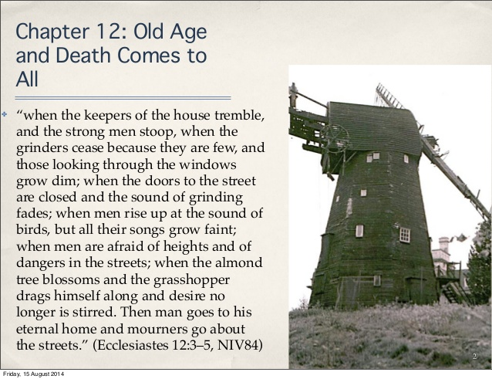

Slide 36


Slide 37
“God has put Eternity in their hearts”
✤ The heart of the problem for the Teacher is that in death “ no man knows whether love or hate awaits him.” (9:1)
✤ The Teacher knows God has created this world and has put an awareness of eternity in man’s heart. But he cannot understand why the world seems to have no meaning,
✤ “He has made everything beautiful in its time. He has also set eternity in the hearts of men; yet they cannot fathom what God has done from beginning to end. I know there is nothing better for men than to be happy and do good while they live. That everyone may eat and drink, and find satisfaction in all his toil—this is the gift of God.
(Ecclesiastes 3:11–14, NIV84)

Slide 38
Why God Sent His Son Jesus
✤ The Teacher lays bare the ultimate emptiness of this life and certainty of judgement.
✤ Life on earth, life under the sun, has no meaning without Jesus and the resurrection.
✤ Suffering, hardship, success, love and pleasures, even righteousness itself are pointless unless Jesus had opened the way to eternal life & salvation from judgement of sin.

Slide 39


Slide 40
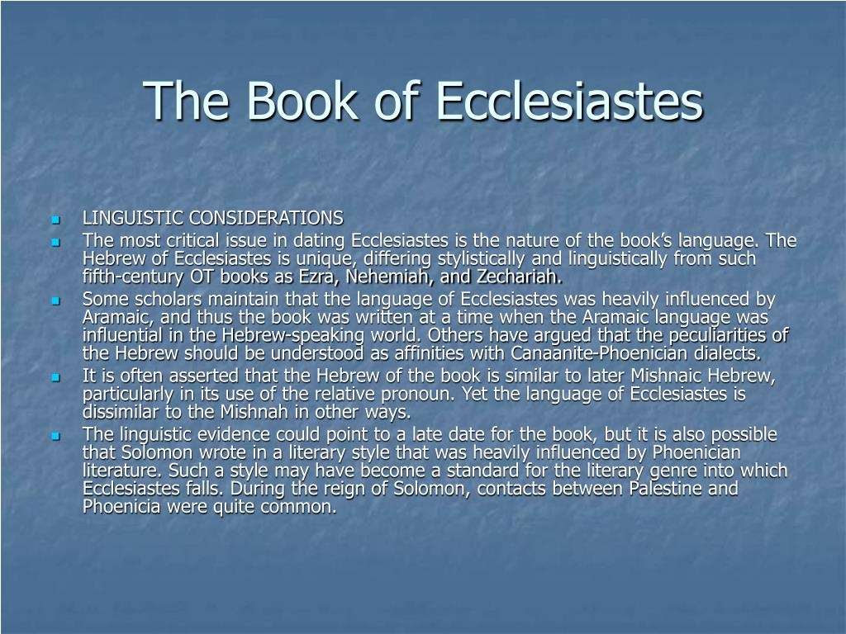

Slide 41
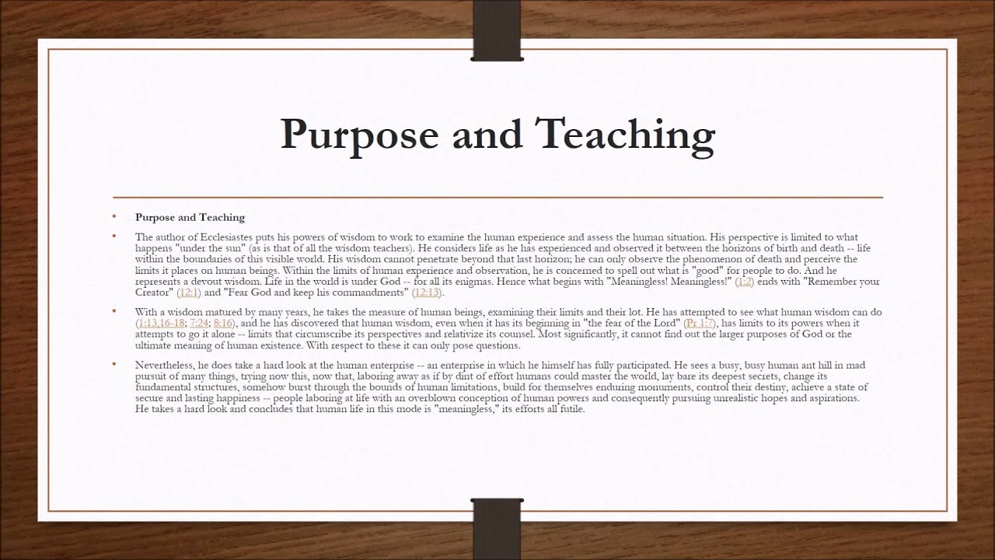

Slide 42
Characteristics
The book of Ecclesiastes has a number of characteristics that distinguish it from the other books of the Holy Scriptures: (A) its genre is wisdom literature, (B) it has a number of literary forms, (C) its theme is reflected in a number of key words.
A. Wisdom Literature—The book of Ecclesiastes is one of several books found in the Old Testament that is classified as “Wisdom Literature”. Also included in this list are the books of Job and Proverbs, with certain psalms (notably Ps 19; 37; 104; 107; 147; 148) as well as some non-canonical Apocrypha literature, such as Ecclesiasticus (Wisdom of Solomon).
B. Literary Forms—There are a number of literary forms and devices used by the author.
1. Aphorisms—Most prominent in literary forms in Ecclesiastes are aphorisms, which are short, pithy sayings, also called proverbs (7:1–8, 10:1–3, 8–15).
2. Didactic Narrative—We can find didactic narrative in Ecclesiastes, which is a short story with a moral (4:13–16, 5:13–17, 9:13–16).
3. Admonitions—We can find passages in Ecclesiastes that admonish the reader by using the imperative, or jussive, constructions within the text (5:1–4).
C. Key Words—The most frequently used words in a book of the Bible will reflect its theme. When we examine the book of Ecclesiastes, we find a number of words that do just that:
“good, better, well, pleasure, precious, joyful, merry” (S 2896) (52 uses),
“vanity” (S 1892) (38 uses),
“I perceived, I know, I discerned” (S 3045) (36 uses),
“under the sun” (29 uses),
“joy, mirth” or “rejoice” (8055 [8], 8057 [8]) (16 uses),
“profit” (S 3504) (10 uses),
“vexation of spirit” (9 uses), and
“I said in my heart” (5 uses).
Everett, G. H. (2011). (p. 14). Gary Everett.
Everett, G. H. (2011). The Book of Ecclesiastes (p. 14). Gary Everett.

Slide 43
Purpose
The purpose in writing the book of Ecclesiastes is to advise young men of the true meaning of life. We know that a young man is characterized by a passion for exploring and experiencing life. For example, he is inclined to equate true wisdom with a vast amount of knowledge experiences. Yet, Solomon had accumulated vast wisdom and found it not to be true. Or, perhaps the young man thought that life is most enjoyed when one is carefree and indulges in wine. But Solomon knew better by experience. Or, maybe some young men felt that life was given to accumulating wealth, or accomplishing great feats of renown. But again, Solomon had experienced this also and did not find satisfaction.
The Preacher attempts to tell his readers that serving the Lord and obeying His commandments is the true essence of life. The Preacher teaches us that we are to live our brief stay here on this earth with joy, and to do this he teaches us how to find purpose in our everyday tasks by walking daily in the fear of the Lord; for we are to acknowledge our gifts in this life of wisdom, mirth, labour and wealth, as blessings from God. The book of Ecclesiastes teaches us how little this world can satisfy the soul of man apart from serving God. It tells us that amidst the injustices, abnormalities and struggles of life that are beyond our control, there is a God who is intervening in the affairs of mankind. We can take comfort in the fact that there will be a day of reckoning for all of mankind. No book of the Holy Scriptures digs deeper into this truth than does Ecclesiastes.
  Everett, G. H. (2011). (pp. 1516). Gary Everett.
Everett, G. H. (2011). The Book of Ecclesiastes (pp. 15–16). Gary Everett.

Slide 44
A. Primary Theme (Foundational)—Poetry: How to Worship the Lord with all our Heart—The common underlying theme of the Hebrew poetry of the Scriptures is “How to Worship the Lord with all our Heart.” Poetry is primarily written to express the mood of man’s heart. When we read these books in the Old Testament, we are emotionally moved as we identify with the poet or psalmist. Although there are many poetic passages in the Scriptures, for the purposes of identifying thematic schemes, this division of the Old Testament includes Job, Psalms, Proverbs, Ecclesiastes, Song of Solomon, and Lamentations, although scholars group this biblical genre differently. The first book of Hebrew poetry we encounter as we read through the Old Testament is the book of Job, which opens with an account of this man worshipping God at an altar of sacrifice (Job 1:5). The Psalms of David show us how to worship the Lord during all seasons of life while the book of Job and Lamentations teaches us how to worship during the times of the greatest tragedies in life. As we journey through this life, we will have times of ecstasy when we are caught up in worship and we will have times of trials when we cry out to God for deliverance. However, most of our days are given to simple routines and decisions that determine our future well-being. We must then look to the book of Proverbs, Ecclesiastes, and Songs for a pattern of how to worship the Lord with our hearts during such uneventful days.
  Everett, G. H. (2011). (p. 16). Gary Everett.
Everett, G. H. (2011). The Book of Ecclesiastes (p. 16). Gary Everett.

Slide 45
B. Secondary Theme (Supportive and Structural)—We are Predestined to Reflect the Image of Christ as We Follow God’s Plan for our Lives (Body)—The secondary theme gives the book its structure, or outline. Mankind has been predestined to reflect the image of Christ by following the plan God has designed for his life. God initiates man’s spiritual journey on earth by subjecting him to vanities. It is God’s intent to burden every man with vanity and the sorrows of this world so that he will look unto God for direction in his life. Through life’s vanities, God appeals to our physical bodies to understand His ways.
  Everett, G. H. (2011). (p. 19). Gary Everett.
Everett, G. H. (2011). The Book of Ecclesiastes (p. 19). Gary Everett.

Slide 46
C. Third Theme (Imperative)—Fear God and Keep His Commandments—The third theme of Ecclesiastes supports its secondary theme by revealing the way in which man labours with the purpose of serving God, which is by the fear of the Lord. This theme is easily seen in Ecclesiastes, which declares that we are to fear God, and keep his commandments: for this is the whole duty of man. The third themes of Ecclesiastes and the book of Proverbs are the same, which is to fear the Lord.
  Everett, G. H. (2011). (p. 20). Gary Everett.
Everett, G. H. (2011). The Book of Ecclesiastes (p. 20). Gary Everett.

Slide 47
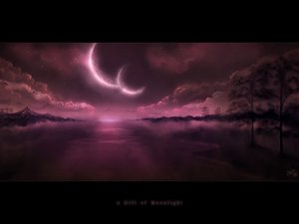
Book Of Ecclesiastes: The Preacher
General Providence: The Lot Of Man
GOD’S NATURAL & NORMAL LAW OF IMPARTIALITY
Total Vanity (Vapor) Or Ephemeral Emptiness Of Mankind’s Every Ambition & Pursuit
Determining Role Of Random Chance In Large Majority Of Human Success Stories & Failures Of Endeavor
No Denying That Luck & Time Happen To All Of Us & This Is Called “The Human Condition”
Nature Repeats Itself In Endless Cycles (Chapter 1) Or In Amoral Alternation Of Opposites (Chapter 3) – Always At Work But Nothing Is Achieved
Beasts Of Field Know No Difference But Humankind Requires Meaningful Objectives & Purposeful Existence
The Creatures Of Intelligence Throughout Human History Have Searched For Answers As To The Positively Purposed End To Man On Earth – Teleological Study Of History

Slide 48
Book Of Ecclesiastes: The Preacher
General Providence: The Lot Of Man
GOD’S NATURAL & NORMAL LAW OF IMPARTIALITY
Successive Generations Of Humans On The Earth Compare In Impact To That Of Goalless Nature
Aging Man Is Metaphorically Compared To An Old House
Then The Lone & Inevitable Certainty Of Each Man’s Death
We Will Not Even Be Remembered By Those That Survive Us
Thus, We Find In (12: 9 – 13) He States We Must Be Prepared To Go To Our Long Home
Chapters One Thru Eight Written In First Person – That Person Claimed As Being King Solomon
His Conclusion – Man Alone Is Not Merely A Number But Neither Are Men Together The Measure
After - Chapter 8: Verse 12 - Written In Third Person & Centers On Advice For Living In The Duration Or That Interval Between House & Home
Recommends “Seizing The Day” & Enjoying Small Pleasures Of This Life & The Three-Fold Chord Of Family.

Slide 49
LESSONS FROM WATER
Sometimes when you feel like your going would leave an unfillable hole,
Just follow this simple instruction and see how it humbles your soul.
Take a bucket and fill it with water, put your hand in it, up to the wrist;
Pull it out; and the hole that’s remaining, is a measure of how you’ll be missed.
You may splash all you please when you enter, you can stir up the water galore,
But stop and you’ll find in a minute, that it looks quite the same as before.
- UNKNOWN AUTHOR
Seasonal Distance From The Sun

Slide 50


Slide 51
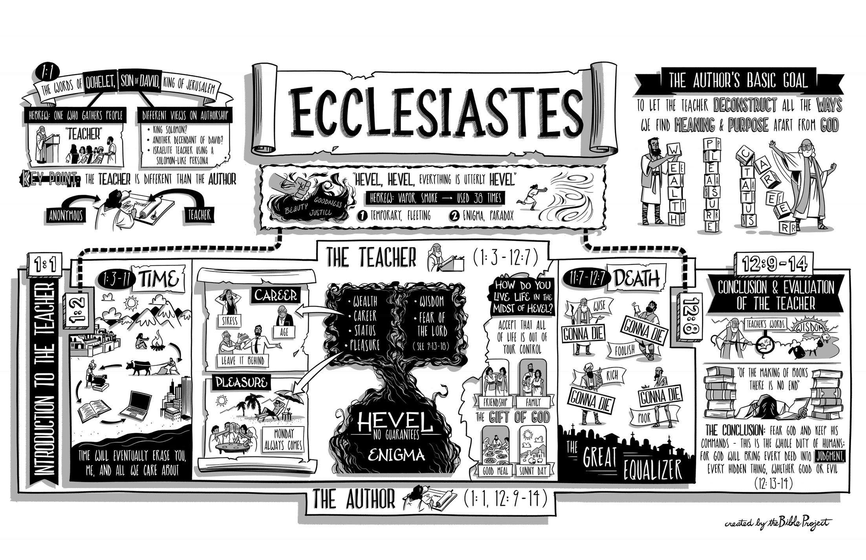

Slide 52
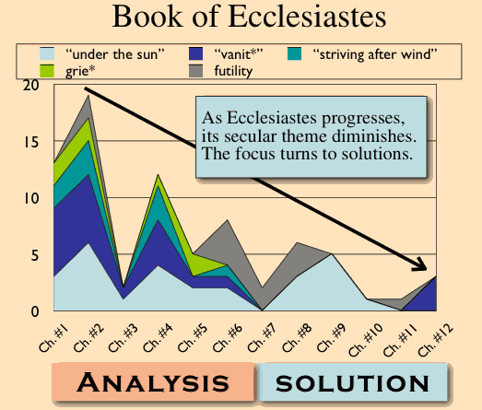

Slide 53
Providence and Its Apparent Problems
Although the term providence is not found in the Bible, it suggests that God’s foresight plays a part in guiding human destiny. But, on the one hand, any attempt to explain God’s control of the world faces serious problems. Wickedness seems to triumph over justice (Ecclesiastes 3:16). If God is in control, why does He allow this to happen? Also, life seems to be hopelessly swallowed up by death (3:19). Is this all there is to life? Moreover, the poor and weak are oppressed by the rich and powerful (4:1). If God answers prayer, why does He not respond to the outcry of human misery?
On the other hand, when one attempts to explain how God guides the lives of individuals on a day-today basis, he faces another set of problems. For one thing, if God desires that people work hard and succeed in life, why are others envious of their success (4:4)? Secondly, why are there so many lonely people in the world who are in desperate need of companionship (4:8)? Thirdly, why are success and popularity so short lived (4:13–16)? In the search for the meaning of life “under the sun,” the truth is “that the righteous and the wise, and their works, are in the hand of God; whether it be love or hatred, man knows not; all is before them” (9:1). Obviously, Ecclesiastes raises these questions concerning God’s providence to make us aware that man, left to himself, has no final solutions.
  Curry, M. (1989). . (D. Bowman, Ed.)Christianity Magazine, 6(7), 21.
Curry, M. (1989). The Providence of God in Ecclesiastes. (D. Bowman, Ed.)Christianity Magazine, 6(7), 21.

Slide 54
Creation, Providence, and Sin
Both the universe (1:5–7) and man (1:4; 7:9) were created by God and, despite the problems stated above, His providential hand may be seen in all things (3:1–8). God made His creation to be “very good” (Genesis 1:31), and He made man to live forever in Paradise; however, sin changed everything. Thus, when we look for God’s providence in a world where sin is present, we must understand that both creation and man are cursed as a consequence of sin, but that both continue under the watchful eye of God and will eventually be delivered from this curse. Indeed, God has provided every human being with the possibility of a new existence free from sin. We are warned, therefore, not to speak too hastily about things that we do not understand and that we cannot change (1:15; 5:2); rather, we must firmly believe that our Creator knows what He is doing (3:14).
Curry, M. (1989). . (D. Bowman, Ed.)Christianity Magazine, 6(7), 21.
Curry, M. (1989). The Providence of God in Ecclesiastes. (D. Bowman, Ed.)Christianity Magazine, 6(7), 21.

Slide 55
God’s Providence in Operation
Several aspects of God’s providence can be detected. In the first place, He keeps His creatures inquiringly ignorant of His activities in this world. This is why “He hath set eternity in their heart, yet so that man cannot find out the work that God hath done from the beginning even to the end” (3:11). Secondly, He makes it possible for men to be content in this life (2:24–26; 3:12; 5:18–19), but never satisfied with what they have (1:8; 5:10). Thirdly, He keeps injustice and oppression somewhat in check by means of civil authorities (5:8), and, more importantly, He holds all men accountable to Himself (3:17; 11:9; 12:14). Fourthly, He has permitted suffering and death to be the lot of all men (2:14–16); “time and chance happeneth to them all” (9:11–12). Ecclesiastes states that God has a purpose in all of this; He has placed prosperity and adversity each “side by side with the other, to the end that man should not find out any thing that should be after him” (7:14).
  Curry, M. (1989). . (D. Bowman, Ed.)Christianity Magazine, 6(7), 21.
Curry, M. (1989). The Providence of God in Ecclesiastes. (D. Bowman, Ed.)Christianity Magazine, 6(7), 21.

Slide 56
Outline of Ecclesiastes
1:1-3 | Solomon’s thesis statement
1:4-18 | The vanity of the world’s natural processes and pursuit of understanding
2 | The vanity of indulgence, human achievement, and materialism
3 | God’s organized way of life for human activity
4 | The vanity of human cruelty, toil, politics
5 | The vanity of careless worship and misused wealth
6 | The vanity of riches
7:1-11:8 | Wise insights in the midst of life’s vanity (mini-realities amid life’s conflicting differences)
11:9-12:7 | Onset of old age when the health and strength of youth passes
12:8-14 | Conclusion: life’s vanity can only be handled by devoting yourself to God

Slide 57
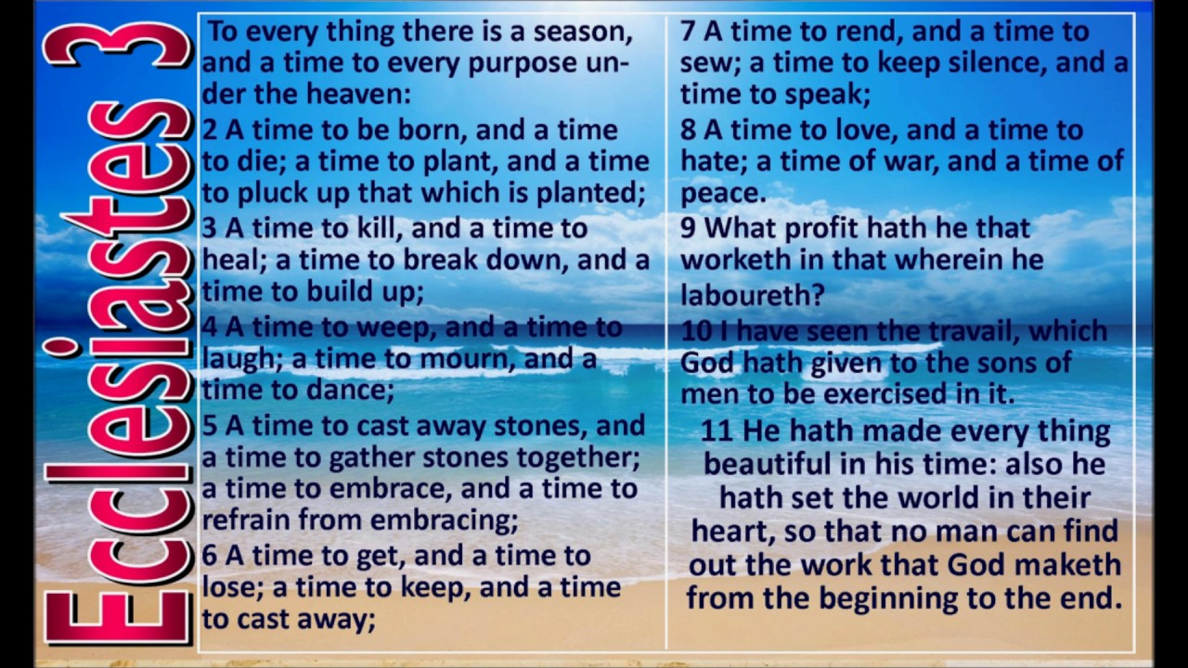

Slide 58


Slide 59
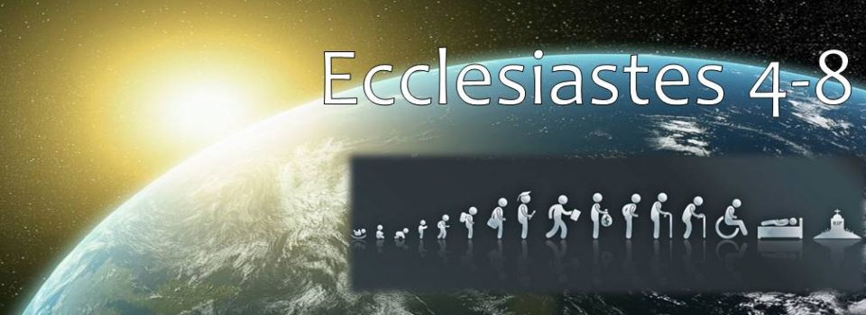

Slide 60

CHAPTER FOUR

Slide 61
The Lonely Whine of the Top Dog
We have been inundated with books, seminars, courses, and speeches on the subject of top-level management and success-oriented leadership. The hype has never been greater nor the lure more effective.

Slide 62
The Lonely Whine of the Top Dog
Indeed, we have largely been convinced that the achievement of an impressive position brings lasting satisfaction and a liberating sense of pleasure. But for the executive, the proverbial pot of gold at the end of the rainbow is not what it appears to be.

Slide 63
The Lonely Whine of the Top Dog
More often than not, managers have head-on collisions with intense pressure, political rivalry, economic anxiety, and inescapable loneliness.

Slide 64
The Lonely Whine of the Top Dog
Centuries ago, King Solomon addressed the emptiness of those who make it to the top of their profession. His words live on today. They can make a difference in our lives if we will hear them well and heed their cry.

Slide 65
Solomon’s Rise to Power

Slide 66
View from the Top
Oppression
Then I looked again at all the acts of oppression which were being done under the sun. And behold I saw the tears of the oppressed and that they had no one to comfort them; and on the side of their oppressors was power, but they had no one to comfort them.
- Ecc. 4:1

Slide 67
View from the Top
Oppression
So I congratulated the dead who are already dead more than the living who are still living.
- Ecc. 4:2

Slide 68
View from the Top
Oppression
But better off than both of them is the one who has never existed, who has never seen the evil activity that is done under the sun.
- Ecc. 4:3

Slide 69
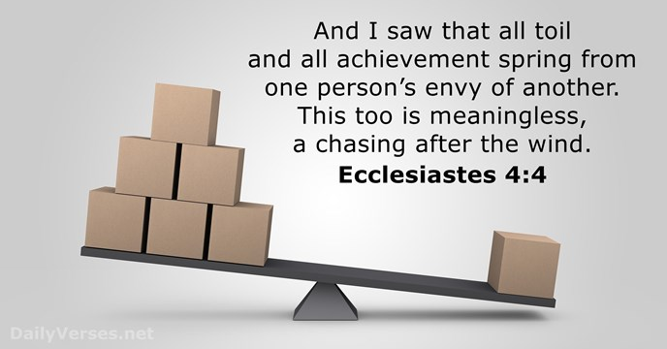

Slide 70
View from the Top
Envy
I have seen that every labor and every skill which is done is the result of rivalry between a man and his neighbor. This too is vanity and striving after wind.
- Ecc. 4:4

Slide 71
View from the Top
Envy
The fool folds his hands and consumes his own flesh.
- Ecc. 4:5

Slide 72
View from the Top
Envy
One hand full of rest is better than two fists full of labor and striving after wind.
- Ecc. 4:6

Slide 73
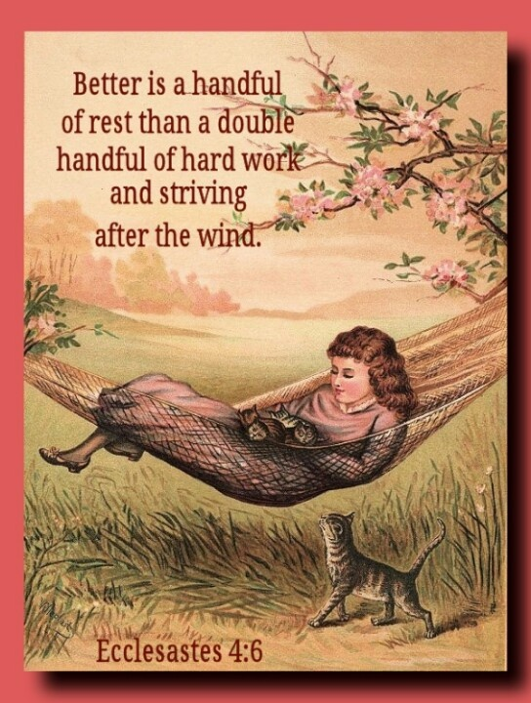

Slide 74
How to be Satisfied
Keep your eyes on your own stuff.

Slide 75
How to be Satisfied
Keep your eyes on your own stuff.
Give thanks for what you have.

Slide 76
How to be Satisfied
Keep your eyes on your own stuff.
Give thanks for what you have.
Ask for what you need instead of complaining about what you don’t have.

Slide 77
What is the source of quarrels and conflicts among you? Is not the source your pleasures that wage war in your members? You lust and do not have; so you commit murder. You are envious and cannot obtain; so you fight and quarrel. You do not have because you do not ask.
- James 4:1-2

Slide 78
You ask and do not receive, because you ask with wrong motives, so that you may spend it on your pleasures.
- James 4:3

Slide 79
View from the Top
Disillusionment
Submit therefore to God. Resist the devil and he will flee from you. Draw near to God and He will draw near to you. Cleanse your hands, you sinners; and purify your hearts, you double-minded.
- Ecc. 4:7-8

Slide 80
Summary
Power Corrupts

Slide 81
Summary
Power Corrupts
The best success is contentment

Slide 82
Summary
Power Corrupts
The best success is contentment
Life at the top is often lonely

Slide 83
Summary
Competition is useful to produce Excellence.

Slide 84
Summary
Competition is useful to produce Excellence.
Power should be used to bless the powerless.

Slide 85
Summary
Competition is useful to produce Excellence.
Power should be used to bless the powerless.
Wealth is a stewardship from God.

Slide 86
Lessons
Aim for contentment
Strive to be useful
Work at being faithful

Slide 87
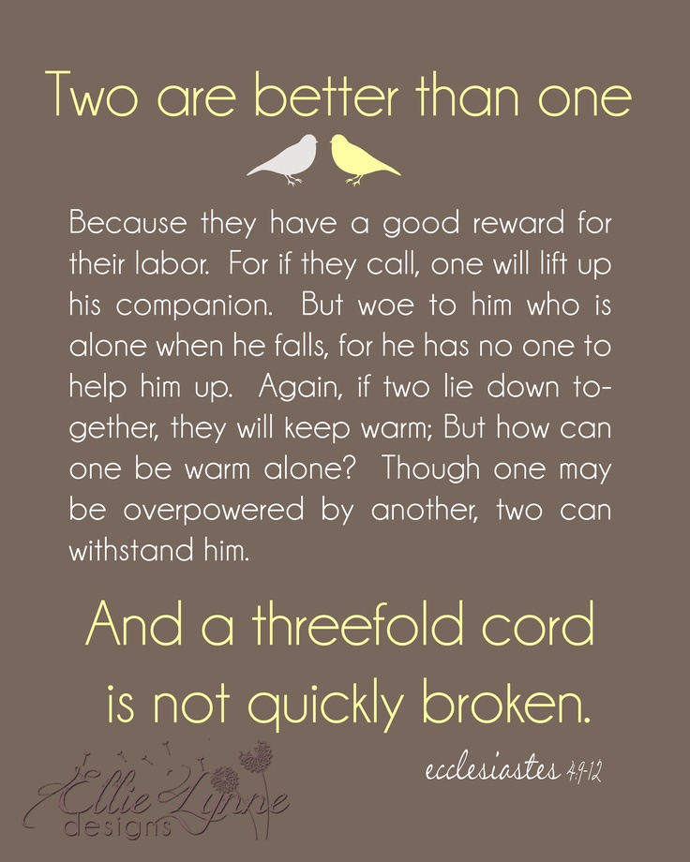

Slide 88
It is lonely at the top.

Slide 89
The emotion felt when lonely is usually dictated by the cause of the separation.

Slide 90
Visiting the island of
Loneliness is normal.

Slide 91
We know we have been on the island too long when we say:
“Why don’t people love/help me?”

Slide 92
We know we have been on the island too long when we say:
“If only other people realized how difficult things are for me?”

Slide 93
We know we have been on the island too long when we say:
“Nobody cares. I’m all alone in this.”

Slide 94
We cannot enjoy life to the fullest as loners!

Slide 95
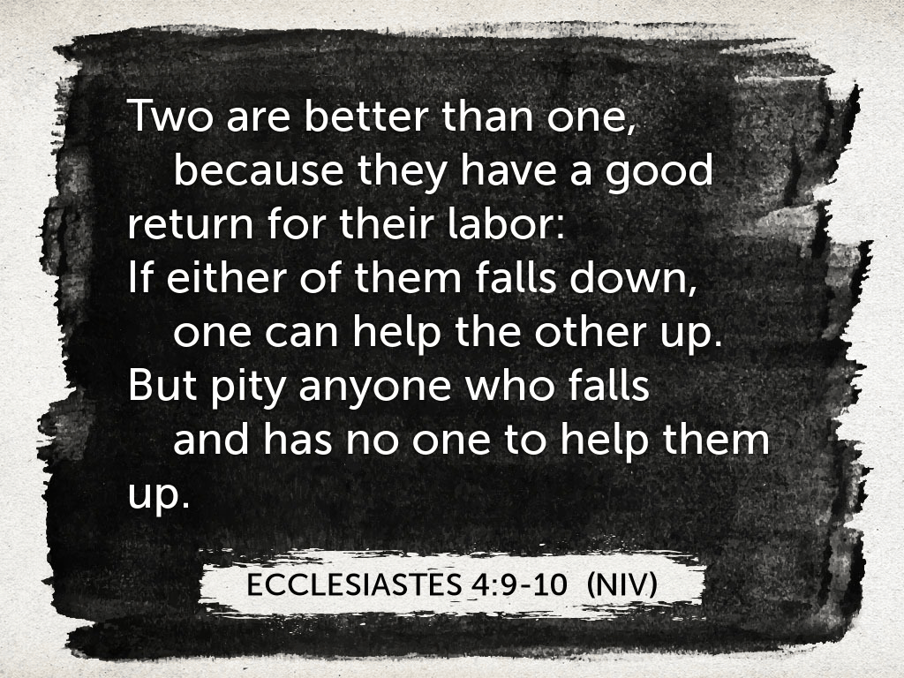

Slide 96
Two are better than one because they have a good return for their labor.
- Ecc. 4:9

Slide 97
For if either of them falls, the one will lift up his companion. But woe to the one who falls when there is not another to lift him up.
- Ecc. 4:10

Slide 98
Furthermore, if two lie down together they keep warm, but how can one be warm alone?
- Ecc. 4:11

Slide 99
And if one can overpower him who is alone, two can resist him.
- Ecc. 4:12a

Slide 100
A cord of three strands is not quickly torn apart.
- Ecc. 4:12a-b

Slide 101
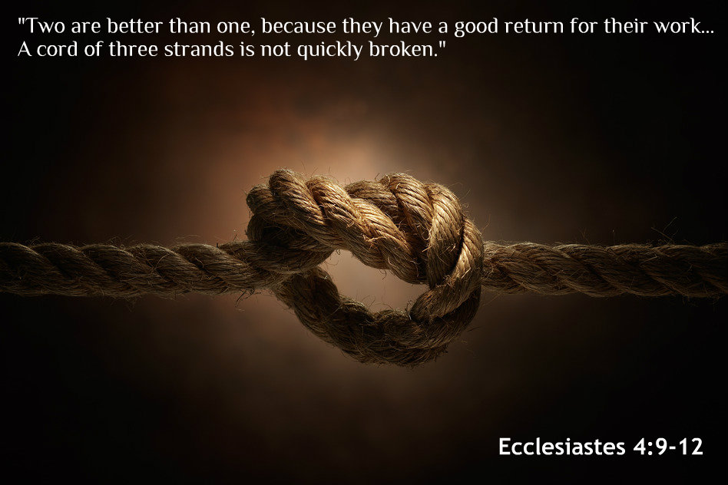

Slide 102
The antidote to loneliness is companionship
Companions help calm the storms of life.

Slide 103
The antidote to loneliness is companionship
Companions reassure us when we are vulnerable or self-conscious.

Slide 104
The antidote to loneliness is
companionship
Companions take our part when others try to take us apart.

Slide 105
When it come to loneliness, one person plus a friend equals survival.

Slide 107
CHAPTER FIVE

Slide 108
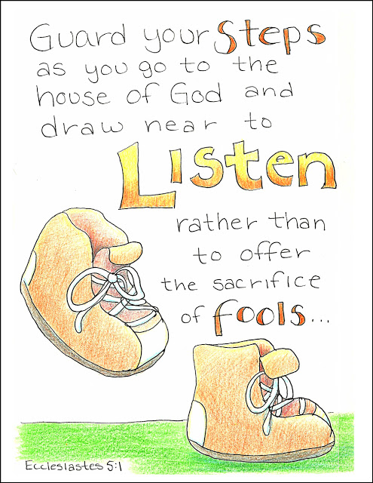

Slide 109
Worship Attitude
Pay Attention
Guard your steps as you go to the house of God and draw near to listen rather than to offer the sacrifice of fools; for they do not know they are doing evil.
-Ecc. 5:1

Slide 110
Worship Attitude
Guard Your Mind
Do not be hasty in word or impulsive in thought to bring up a matter in the presence of God. For God is in heaven an you are on the earth; therefore let your words be few. For the dream comes through much effort and the voice of a fool through many words.
-Ecc. 5:2-3

Slide 111
For in many dreams and in many words there is emptiness. Rather, fear God.
- Ecc. 5:7

Slide 112
Worship Attitude
Keep Your Promises
When you make a vow to God, do not be late in paying it; for He takes no delight in fools. Pay what you vow! It is better that you should not vow than that you should vow and not pay.
-Ecc. 5:4-5

Slide 113
Do not let your speech cause you to sin and do not say in the presence of the messenger of God that it was a mistake. Why should God be angry on account of your voice and destroy the work of your hands?
- Ecc. 5:6

Slide 114
Folly of Riches
Absolute Power Corrupts
If you see oppression of the poor and denial of justice and righteousness in the province, do not be shocked at the sight; for one official watches over another official, and there are higher officials over them. After all, a king who cultivates the field is an advantage to the land.
- Ecc. 5:8-9

Slide 115
Folly of Riches
Greater Wealth Does Not Equal Greater Satisfaction
He who loves money will not be satisfied with money, nor he who loves abundance with its income. This too is vanity.
- Ecc. 5:10

Slide 116
Folly of Riches
More Money = More Worries
When good things increase, those who consume them increase. So what is the advantage to their owners except to look on?
- Ecc. 5:11

Slide 117
The sleep of the working man is pleasant, whether he eats little or much; but the full stomach of the rich man does not allow him to sleep.
- Ecc. 5:12

Slide 118
Folly of Riches
You Can’t Take It With You
There is a grievous evil which I have seen under the sun: riches being hoarded by their owner to his hurt. When those riches were lost through a bad investment and he had fathered a son, then there was nothing to support him.
- Ecc. 5:13-14

Slide 119
As he had come naked from his mother’s womb, so will he return as he came. He will take nothing from the fruit of his labor that he can carry in his hand.
- Ecc. 5:15

Slide 120
Folly of Riches
Live High-Die Hard
This also is a grievous evil—exactly as a man is born, thus will he die. So what is the advantage to him who toils for the wind? Throughout his life he also eats in darkness with great vexation, sickness and anger.
- Ecc. 5:16-17

Slide 121
Right Attitude = 3 Gifts
True Enjoyment
Here is what I have seen to be good and fitting: to eat, to drink and enjoy oneself in all one’s labor in which he toils under the sun during the few years of his life which God has given him; for this is his reward.
-Ecc. 5:18

Slide 122
Right Attitude = 3 Gifts
True Enjoyment
Fulfillment In Your Work
Furthermore, as for every man to whom God has given riches and wealth, He has also empowered him to eat from them and to receive his reward and rejoice in his labor; this is the gift of God.
-Ecc. 5:19

Slide 123
Right Attitude = 3 Gifts
True Enjoyment
Fulfillment In Your Work
General Contentment
For he will not often consider the years of his life, because God keeps him occupied with the gladness of his heart.
-Ecc. 5:20

Slide 125
CHAPTER SIX

Slide 126
There is an evil which I have seen under the sun and it is prevalent among men— a man to whom God has given riches and wealth and honor so that his soul lacks nothing of all that he desires; yet God has not empowered him to eat from them, for a foreigner enjoys them. This is vanity and a severe affliction.
- Ecc. 6:1-2

Slide 127
If a man fathers a hundred children and lives many years, however many they be, but his soul is not satisfied with good things and he does not even have a proper burial, then I say, “Better the miscarriage than he, for it comes in futility and goes into obscurity; and its name is covered in obscurity.
- Ecc. 6:3-4

Slide 128
It never sees the sun and it never knows anything; it is better off than he. Even if the other man lives a thousand years twice and does not enjoy good things—do not all go to one place?”
All a man’s labor is for his mouth and yet the appetite is not satisfied.
- Ecc. 6:5-7

Slide 129
For what advantage does the wise man have over the fool? What advantage does the poor man have, knowing how to walk before the living? What the eyes see is better than what the soul desires. This too is futility and a striving after wind.
- Ecc. 6:8-9

Slide 130
Solomon’s Observations
God is Sovereign
Whatever exists has already been named,
-Ecc. 6:10a

Slide 131
Solomon’s Observations
God is Sovereign
Man is Not Sovereign
and it is known what man is; -Ecc. 6:10b

Slide 132
Solomon’s Observations
God is Sovereign
Man is Not Sovereign
Disputing With God Is A Waste Of Time
for he cannot dispute with him who is stronger than he is. For there are many words which increase futility. What then is the advantage to a man?
-Ecc. 6:10c-11

Slide 133
For who knows what is good for a man during his lifetime, during the few years of his futile life? He will spend them like a shadow. For who can tell a man what will be after him under the sun?
- Ecc. 6:12

Slide 134
Solomon’s Search Has Yielded:
Disillusionment
Discontent
Depression

Slide 135
Solomon begins to search for life “Above the Sun”

Slide 137


Slide 138
CHAPTER SEVEN

Slide 139
Contrasting Parallelism
Shows the Difference
A wise son accepts his father’s discipline, But a scoffer does not listen to rebuke.
- Pr. 13:1

Slide 140
Completive Parallelism
Stacks information to complete
Even in laughter the heart may be in pain, And the end of joy may be grief.
- Pr. 14:13

Slide 141
Comparative Parallelism
Draws a comparison
It is better to live in a corner of the roof Than in a house shared with a contentious woman.
- Pr. 25:24

Slide 142
Ecclesiastes 7:1-15
7 Comparative
1 Contrastive
1 Completive
}
Devices

Slide 143
Wisdom Proverbs
The value of a good name
A good name is better than
a good ointment,
- Ecc. 7:1a

Slide 144
Wisdom Proverbs
Death is better than birth.
And the day of one’s death is better than the day of one’s birth.
- Ecc. 7:1b

Slide 145
Wisdom Proverbs
Funerals are better than weddings
It is better to go to a house of mourning
Than to go to a house of feasting,
Because that is the end of every man,
And the living takes it to heart.
- Ecc. 7:2

Slide 146
Wisdom Proverbs
Sorrow is better than laughter
Sorrow is better than laughter,
For when a face is sad a heart may be happy. The mind of the wise is in the house of mourning, While the mind of fools is in the house of pleasure.
- Ecc. 7:3-4

Slide 147
Wisdom Proverbs
Better a rebuke than listening to foolishness
It is better to listen to the rebuke of a wise man than for one to listen to the song of fools.
- Ecc. 7:5

Slide 148
For as the crackling of thorn bushes under a pot,
So is the laughter of the fool;
And this too is futility.
- Ecc. 7:6

Slide 149
For oppression makes a wise man mad,
And a bribe corrupts the heart.
- Ecc. 7:7

Slide 150


Slide 151
Wisdom Proverbs
The end is better than
the beginning
The end of a matter is better than its beginning;
- Ecc. 7:8a

Slide 152
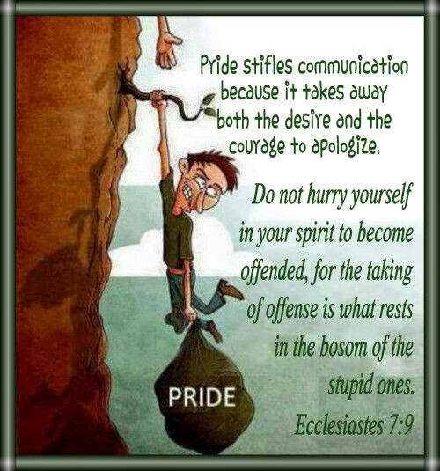

Slide 153


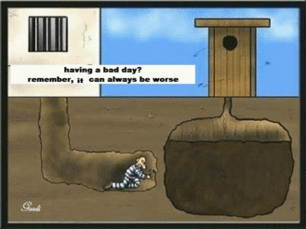

Slide 154
Wisdom Proverbs
A patient spirit is better than a Proud Spirit
Patience of spirit is better than haughtiness of spirit. Do not be eager in your heart to be angry, For anger resides in the bosom of fools. Do not say, “Why is it that the former days were better than these?” For it is not from wisdom that you ask about this.
- Ecc. 7:8b-10

Slide 155
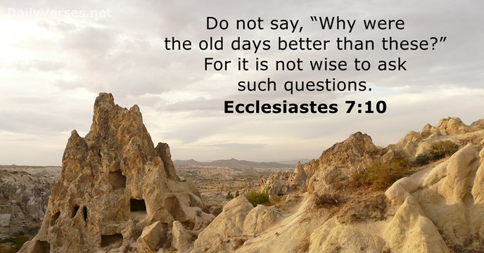

Slide 156
Advantages of Wisdom
Wisdom Guards
Wisdom along with an inheritance is good And an advantage to those who see the sun.
-Ecc. 7:11

Slide 157
For wisdom is protection just as money is protection, But the advantage of knowledge is that wisdom preserves the lives of its possessors.
- Ecc. 7:12

Slide 158
Advantages of Wisdom
Wisdom gives a divine perspective
Consider the work of God, For who is able to straighten what He has bent? In the day of prosperity be happy, But in the day of adversity consider— God has made the one as well as the other So that man will not discover anything that will be after him.
-Ecc. 7:13-14

Slide 159
Wisdom Teaches Us Today…
Seek God
Ask God

Slide 160
Wisdom at Work
Wisdom Provides Balance
I have seen everything during my lifetime of futility; there is a righteous man who perishes in his righteousness and there is a wicked man who prolongs his life in his wickedness. Do not be excessively righteous and do not be overly
wise. Why should you ruin yourself?
- Ecc. 7:15-16

Slide 161
Do not be excessively wicked and do not be a fool. Why should you die before your time? It is good that you grasp one thing and also not let go of the other; for the one who fears God comes forth with both of them.
- Ecc. 7:17-18

Slide 162
Wisdom at Work
Wisdom provides strength
I have seen everything during my lifetime of futility; there is a righteous man who perishes in his righteousness and there is a wicked man who prolongs his life in his wickedness. Do not be excessively righteous and do not be overly wise. Why should you ruin yourself?
- Ecc. 7:19-20

Slide 163
Also, do not take seriously all words which are spoken, so that you will not hear your servant cursing you. For you also have realized that you likewise have many times cursed others.
- Ecc. 21-22

Slide 164
Strength to:
Handle Sin

Slide 165
Strength to:
Handle Sin
Avoid Entrapment

Slide 166
Strength to:
Handle Sin
Avoid Entrapment
Deal with Criticism

Slide 167
Wisdom at Work
Wisdom Provides Balance
Wisdom Provides Strength
Wisdom Provides Insight

Slide 168
Insights From Wisdom
Understanding only comes from God
I tested all this with wisdom, and I said, “I will be wise,” but it was far from me. What has been is remote and exceedingly mysterious. Who can discover it?
- Ecc. 7:23-24

Slide 169
Insights From Wisdom
Sexual adventure is not satisfying
I directed my mind to know, to investigate and to seek wisdom and an explanation, and to know the evil of folly and the foolishness of madness. And I discovered more bitter than death the woman whose heart is snares and nets, whose hands are chains. One who is pleasing to God will escape from her, but the sinner will be captured by her.
- Ecc. 7:25-26

Slide 170
“Behold, I have discovered this,” says the Preacher, “adding one thing to another to find an explanation, which I am still seeking but have not found. I have found one man among a thousand, but I have not found a woman among all these.
- Ecc. 7:27-28

Slide 171
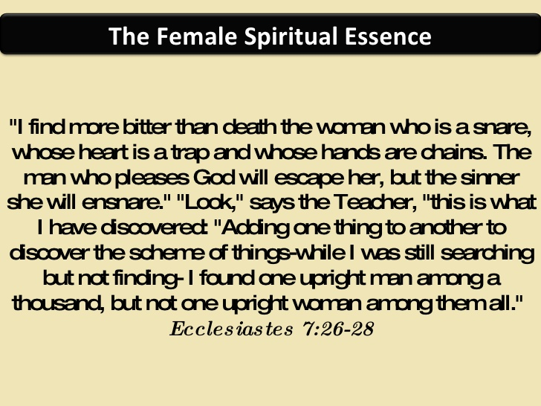

Slide 172
Insights From Wisdom
The problem is from within,
not without
Behold, I have found only this, that God made men upright, but they have sought out many devices.”
- Ecc. 7:29

Slide 175
CHAPTER EIGHT

Slide 176
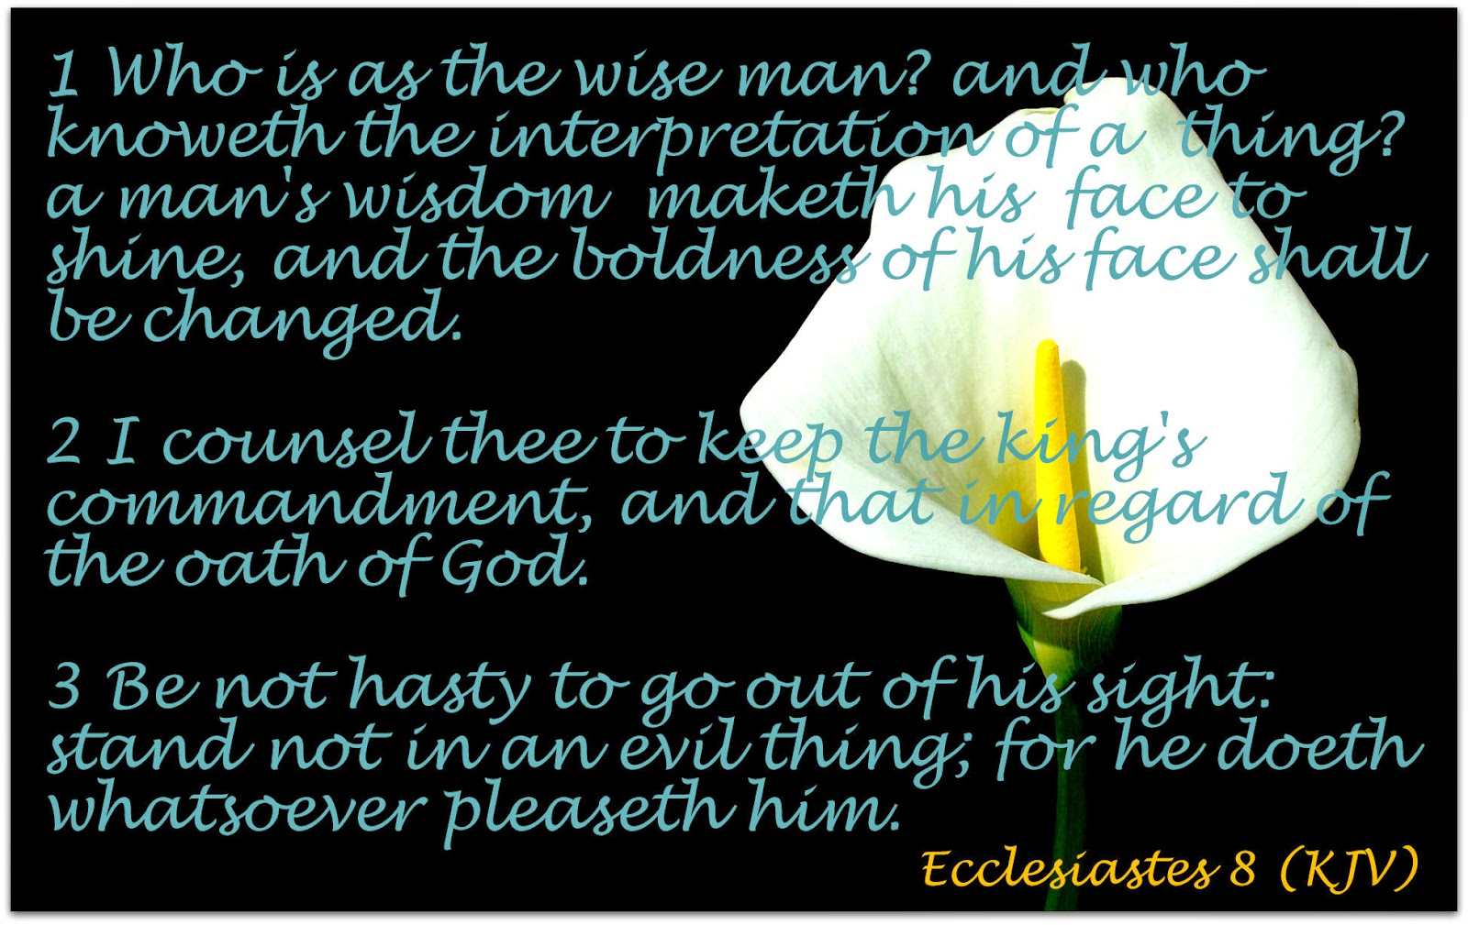

Slide 177
True Wisdom =
}
Balance
+
Strength
+
Insight

Slide 178
Wisdom applied to life provides
Strength, Balance & Insight

Slide 179
Not All Leaders Are Wise
Some promoted beyond their abilities
Some are egotistical

Slide 180
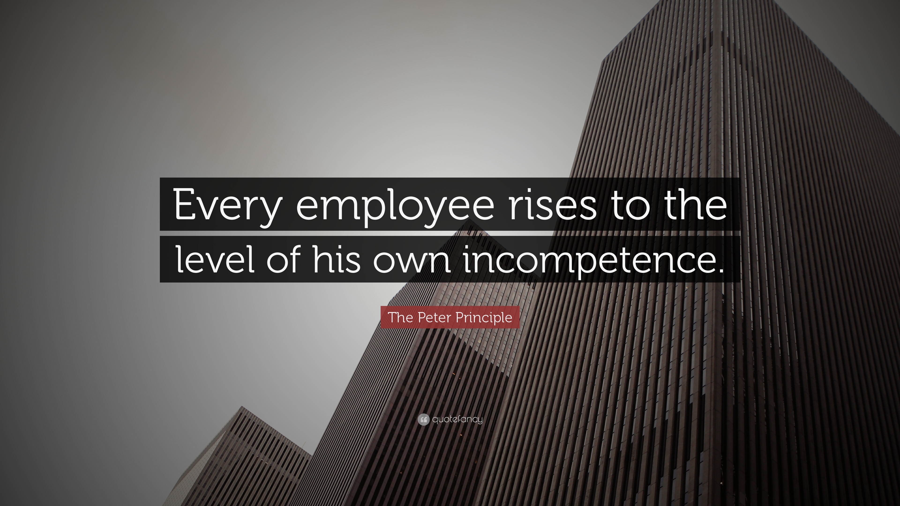

Slide 181
5 Characteristics of Godly Leaders
A Clear Mind
Who is like the wise man and who knows the interpretation of a matter?
-Ecc. 8:1a

Slide 182
5 Characteristics of Godly Leaders
A Clear Mind
A Cheerful Disposition
A man’s wisdom illumines him and causes his stern face to beam.
-Ecc. 8:1b

Slide 183
5 Characteristics of Godly Leaders
A Clear Mind
A Cheerful Disposition
A Discreet Tongue
I say, “Keep the command of the king because of the oath before God. Do not be in a hurry to leave him. Do not join in an evil matter, for he will do whatever he pleases.” Since the word of the king is authoritative, who will say to him, “What are you doing?”
-Ecc. 8:2-4

Slide 184
5 Characteristics of Godly Leaders
A Clear Mind
A Cheerful Disposition
A Discreet Tongue
Keen Judgement

Slide 185
Keen Judgement
He who keeps a royal command experiences no trouble,
-Ecc. 8:5a

Slide 186
Keen Judgement
for a wise heart knows the proper time and procedure. For there is a proper time and procedure for every delight, though a man’s trouble is heavy upon him.
-Ecc. 8:5b-6

Slide 187
Keen Judgement
If no one knows what will happen, who can tell him when it will happen?
-Ecc. 8:7

Slide 188
5 Characteristics of Godly Leaders
A Clear Mind
A Cheerful Disposition
A Discreet Tongue
Keen Judgement
A Humble Spirit
No man has authority to restrain the wind with the wind, or authority over the day of death; and there is no discharge in the time of war, and evil will not deliver those who practice it.
- Ecc. 8:8

Slide 189
All this I have seen and applied my mind to every deed that has been done under the sun wherein a man has exercised authority over another man to his hurt.
- Ecc. 8:9

Slide 190
Mysteries
Some things we don’t understand because:
We have not found them yet.
God has not revealed them yet.
They are and will always be beyond us.

Slide 191
3 Mysteries
The triumph of the unjust.
So then, I have seen the wicked buried, those who used to go in and out from the holy place, and they are soon forgotten in the city where they did thus. This too is futility. Because the sentence against an evil deed is not executed quickly, therefore the hearts of the sons of men among them are given fully to do evil.
- Ecc. 8:10-11

Slide 192
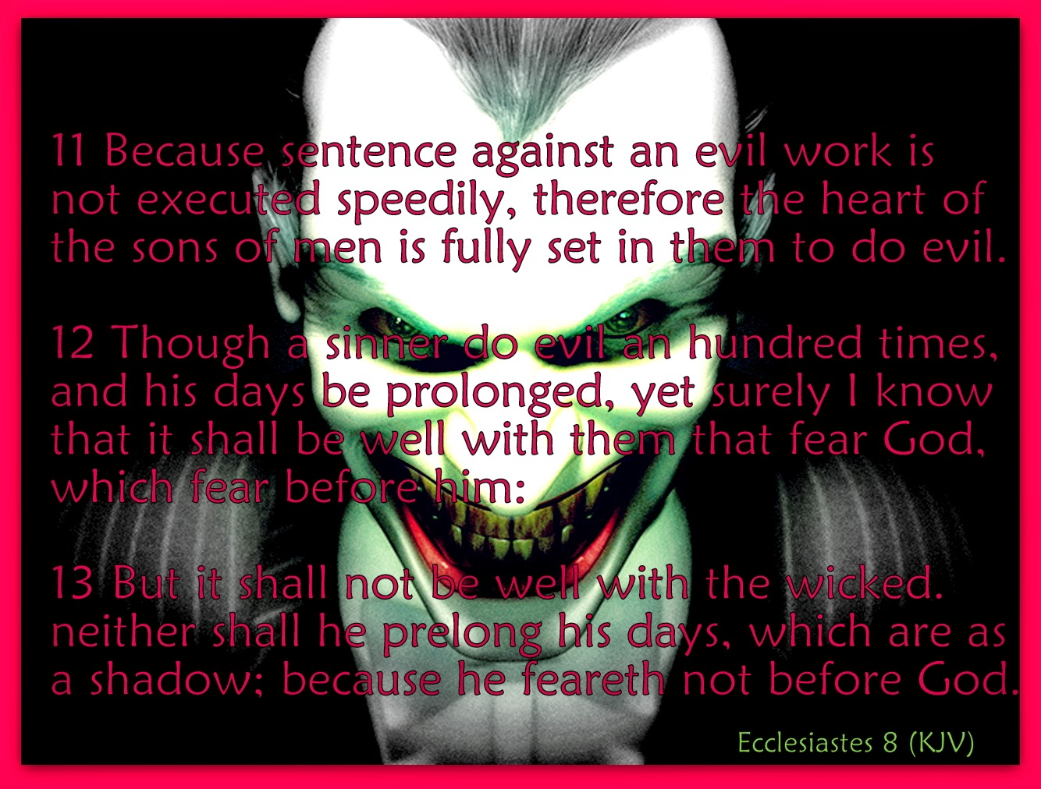

Slide 193
Although a sinner does evil a hundred times and may lengthen his life, still I know that it will be well for those who fear God, who fear Him openly. But it will not be well for the evil man and he will not lengthen his days like a shadow, because he does not fear God.
- Ecc. 8:12-13

Slide 194
3 Mysteries
The triumph of the unjust.
Unfair Consequences
There is futility which is done on the earth, that is, there are righteous men to whom it happens according to the deeds of the wicked. On the other hand, there are evil men to whom it happens according to the deeds of the righteous. I say that this too is futility.
- Ecc. 8:14

Slide 195
3 Mysteries
The triumph of the unjust.
Unfair Consequences
Untimely Pleasure
So I commended pleasure, for there is nothing good for a man under the sun except to eat and to drink and to be merry, and this will stand by him in his toils throughout the days of his life which God has given him under the sun.
- Ecc. 8:15

Slide 196
When I gave my heart to know wisdom and to see the task which has been done on the earth (even though one should never sleep day or night), and I saw every work of God, I concluded that man cannot discover the work which has been done under the sun. Even though man should seek laboriously, he will not discover; and though the wise man should say, “I know,” he cannot discover.
- Ecc. 8:16-17

Slide 198
THREE
PART
SOLOMON’S LIFE’S LESSONS
Chapter nine
Chapter Ten
Chapter Eleven
Chapter Twelve
Tying Together

