Slide 1
Ancient Solomon still teaches today
By David Lee Burris

Slide 2


Slide 4


Slide 5
PART ONE
SOLOMON’S LIFE’S LESSONS
Bible Book Intro
Chapter One
Chapter Two
Chapter Three

Slide 6
PARTTWO
SOLOMON’S LIFE’S LESSONS
Chapter four
Chapter five
Chapter six
Chapter Seven
Chapter Eight

Slide 7
THREE
PART
SOLOMON’S LIFE’S LESSONS
Chapter nine
Chapter Ten
Chapter Eleven
Chapter Twelve
Tying Together

Slide 8
iNTRODUCTION

Slide 9


Slide 10
Ancient Wisdom for Modern Life
Ecclesiastes
It’s all a matter of perspective!

Slide 11
TWO VIEWS OF THE WORLD
Secularist
World
View
Theistic
World
View

Slide 12

SECULARIST
WORLDVIEW
A World view without God
Autonomous man
Pursuit of the earthly

Slide 13
Four Realities
A transitory life
+ A meaningless earth cycle
+ An inability to know all
+ Generational discontinuity
Frustration & Hopelessness!

Slide 14


Slide 15
Four Realities
A transitory life
+ A meaningless earth cycle
+ An inability to know all
+ Generational discontinuity
+ God In The Equation
What Is The Outcome?

Slide 16
The Theistic
WORLDVIEW
A world under God’s control
A trusting relationship with the Creator
Pursuit of the spiritual purposes of God

Slide 17
Four Realities
A transitory life
+ A wise God in control
+ A sovereign purpose to fulfill
+ Wisdom to guide us
Satisfaction & hope!

Slide 18
TWO VIEWS OF THE WORLD
Secularist
World
View
Theistic
World
View

Slide 19
Ancient Wisdom for Modern Life
Ecclesiastes
It’s all a matter of perspective!

Slide 20



Slide 21


Slide 22


Slide 23
“Everything is Meaningless”
✤ The word “meaningless” occurs 35 times in the book
✤ The Hebrew word is “Hebel” which is sometimes translated “Vanity”.
✤ It means something that quickly passes, of no lasting value, emptiness, something that is like breath of wind or a puff of smoke that is briefly seen and disappears.

Slide 24


Slide 25
“Under the Sun”
✤ The key to understanding this book is the phrase “under the sun”.
✤ This phrase occurs 29 times.
✤ Ecclesiastes 1:14 (NIV84) “I have seen all things that are done under the sun; they are all meaningless, a chasing after the wind.”
✤ Ecclesiastes is realistic examination of life without the hope of Christ.

Slide 26
“The Teacher”
✤ 1:1 The words of the Teacher, son of David, king in Jerusalem:
✤ 1:12 “I, the Teacher, was king over Israel in Jerusalem.”
✤ Qoheleth = teacher, preacher
✤ Ecclesiastes is Latin for Teacher
✤ Solomon: the man who has done everything and has everything this world can offer and has found it all “meaningless”.

Slide 27
The Search for Meaning: Nature
✤ The natural world is filled with meaningless cycles that just go round and round.
✤ “The sun rises and the sun sets, and hurries back to where it rises. The wind blows to the south and turns to the north; round and round it goes, ever returning on its course. All streams flow to the sea, yet the sea is never full. To the place the streams come from, there they return again.” (Ecclesiastes 1:5–7, NIV84)
✤ “There is nothing new under the sun”.

Slide 28
The Search for Meaning:
Personal Constructions
✤ Great building projects
✤ Parks and irrigated gardens
✤ Beautiful cities and palaces
✤ “Yet when I surveyed all my hands had done and what I had toiled to achieve, everything was meaningless, a chasing after the wind; nothing was gained under the sun.” (Ecclesiastes 2:11, NIV)
✤ He knew that nothing he had built or achieved would last.

Slide 29
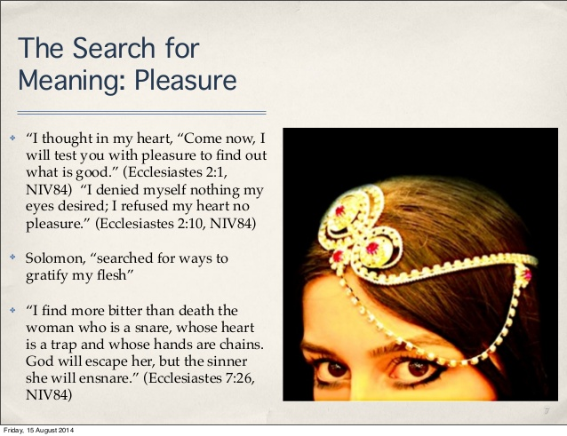

Slide 30
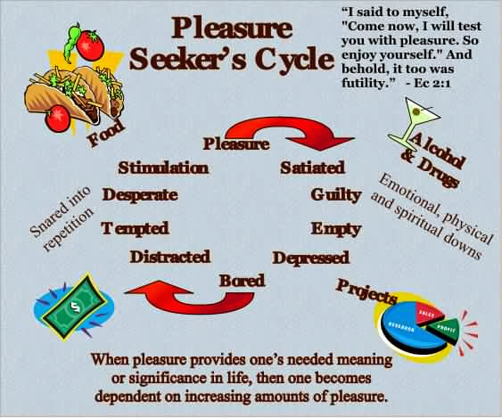

Slide 31
The Search for Meaning:
Wealth and Possessions
✤ Solomon was the wealthiest man in the world of his day.
“King Solomon was greater in riches and wisdom than all the other kings of the earth.”
(1 Kings 10:23, NIV84)
✤ “Whoever loves money never has money enough; whoever loves wealth is never satisfied with his income. This too is meaningless. (Ecclesiastes 5: 10)

Slide 32
The Inescapable Reality of Death
✤ The rich and poor both die.
✤ The fool and the wise both die
✤ The righteous & the wicked both die
✤ “In this meaningless life of mine I’ve seen both of these: a righteous man perishing in his righteousness, and a wicked man living long in his wickedness. Do not be over righteous, neither be over wise— why destroy yourself? Do not be over wicked, and do not be a fool— why die before your time? It is good to grasp the one and not let go of the other. The man who fears God will avoid all extremes.” (Ecclesiastes 7:15–18)

Slide 33
Inescapable Reality of Death – cont.
✤Death strips away any meaning or purpose if our focus is on this world alone. “Life under the sun”.
✤ Anyone who is among the living has hope-even a live dog is better off than a dead lion! For the living know that they will die, but the dead know nothing; they have no further reward, and even the memory of them is forgotten. Their love, hate and their jealousy have long since vanished; never again will they have a part in anything that happens under the sun.”
(Ecclesiastes 9:1–6, NIV84)

Slide 34
Teacher’s View of Life: Self-Centered
✤ “How may I enjoy life.” “How do I find meaning.” His view of life is completely self-centered.
✤ He believes in God, but God only lives on the outer edge of his life. God isn’t the center or focus of his life. This is why he finds all things in this life so meaningless in the end.
✤ “Now all has been heard; here is the conclusion of the matter: Fear God and keep his commandments, for this is the whole duty of man. For God will bring every deed into judgement, including every hidden thing, whether it is good or evil.” (Ecclesiastes 12:13–14, NIV84)

Slide 35
Balancing Our Lives
✤ How much of your life is spent dealing with things which from an eternal forever perspective are meaningless?
✤ What percentage of your life is spent investing in the things of eternal worth?
✤ What will still have meaning in one year’s time? Or 5 year’s time? Or 10 or 20?
✤ What will still have meaning at the hour of your death?
✤ When you depart from this world what will you leave behind that will have meaning for you in eternity?

Slide 36
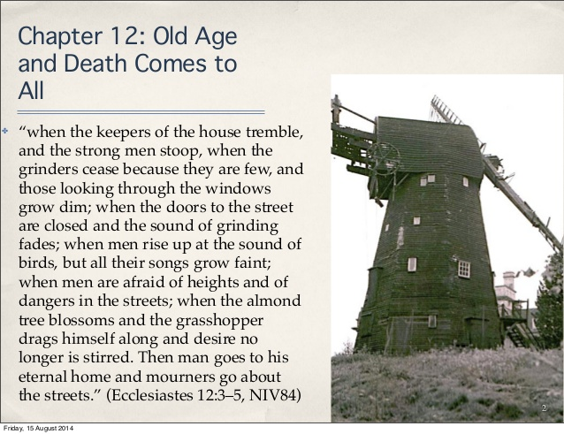

Slide 37
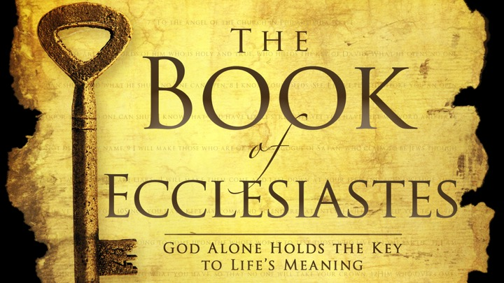

Slide 38
“God has put Eternity in their hearts”
✤ The heart of the problem for the Teacher is that in death “ no man knows whether love or hate awaits him.” (9:1)
✤ The Teacher knows God has created this world and has put an awareness of eternity in man’s heart. But he cannot understand why the world seems to have no meaning,
✤ “He has made everything beautiful in its time. He has also set eternity in the hearts of men; yet they cannot fathom what God has done from beginning to end. I know there is nothing better for men than to be happy and do good while they live. That everyone may eat and drink, and find satisfaction in all his toil—this is the gift of God.
(Ecclesiastes 3:11–14, NIV84)

Slide 39
Why God Sent His Son Jesus
✤ The Teacher lays bare the ultimate emptiness of this life and certainty of judgement.
✤ Life on earth, life under the sun, has no meaning without Jesus and the resurrection.
✤ Suffering, hardship, success, love and pleasures, even righteousness itself are pointless unless Jesus had opened the way to eternal life & salvation from judgement of sin.

Slide 40
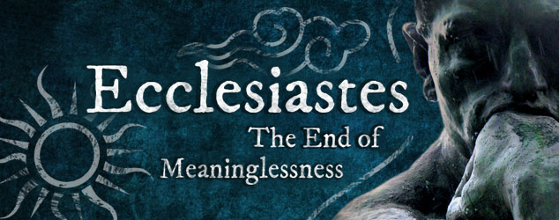

Slide 41
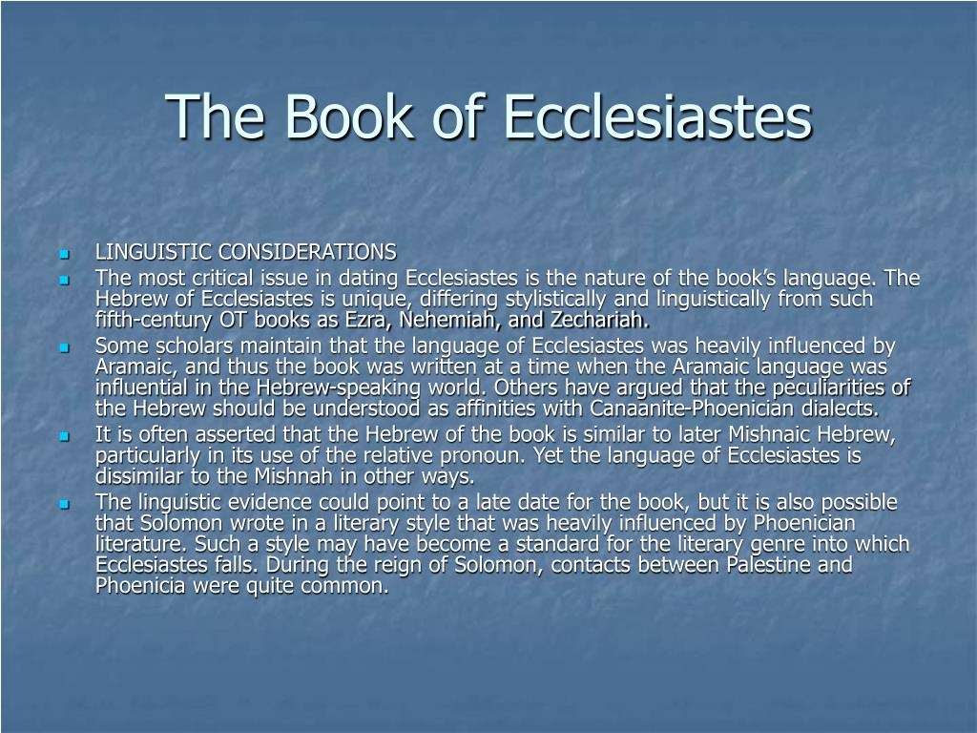

Slide 42
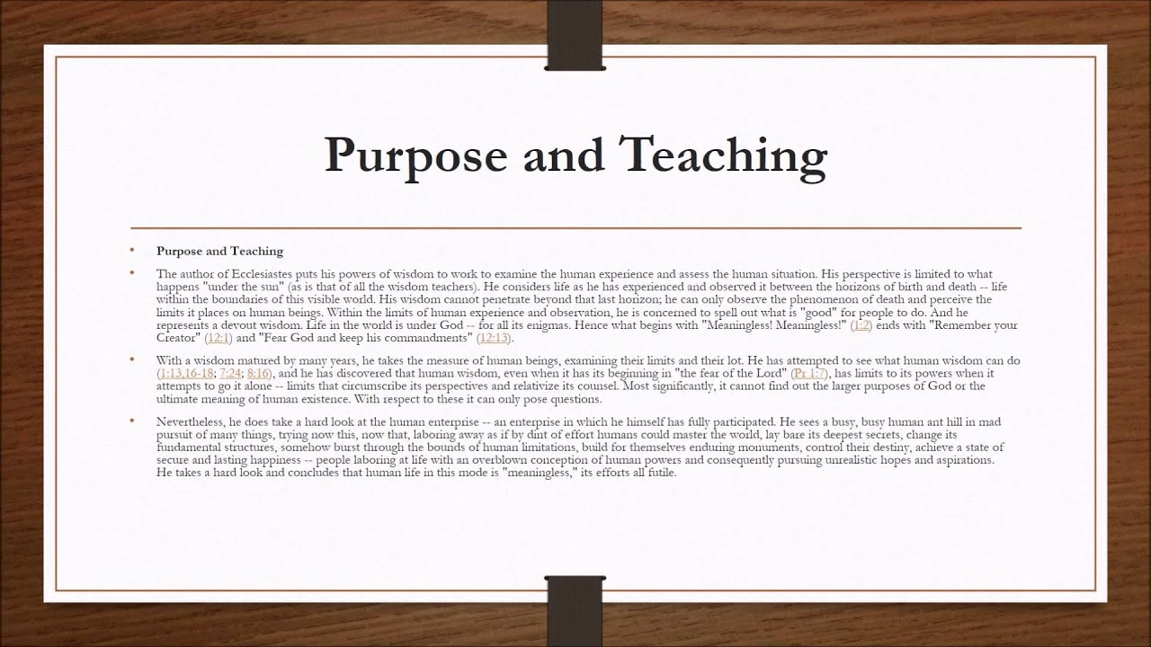

Slide 43
Characteristics
The book of Ecclesiastes has a number of characteristics that distinguish it from the other books of the Holy Scriptures: (A) its genre is wisdom literature, (B) it has a number of literary forms, (C) its theme is reflected in a number of key words.
A. Wisdom Literature—The book of Ecclesiastes is one of several books found in the Old Testament that is classified as “Wisdom Literature”. Also included in this list are the books of Job and Proverbs, with certain psalms (notably Ps 19; 37; 104; 107; 147; 148) as well as some non-canonical Apocrypha literature, such as Ecclesiasticus (Wisdom of Solomon).
B. Literary Forms—There are a number of literary forms and devices used by the author.
1. Aphorisms—Most prominent in literary forms in Ecclesiastes are aphorisms, which are short, pithy sayings, also called proverbs (7:1–8, 10:1–3, 8–15).
2. Didactic Narrative—We can find didactic narrative in Ecclesiastes, which is a short story with a moral (4:13–16, 5:13–17, 9:13–16).
3. Admonitions—We can find passages in Ecclesiastes that admonish the reader by using the imperative, or jussive, constructions within the text (5:1–4).
C. Key Words—The most frequently used words in a book of the Bible will reflect its theme. When we examine the book of Ecclesiastes, we find a number of words that do just that:
“good, better, well, pleasure, precious, joyful, merry” (S 2896) (52 uses),
“vanity” (S 1892) (38 uses),
“I perceived, I know, I discerned” (S 3045) (36 uses),
“under the sun” (29 uses),
“joy, mirth” or “rejoice” (8055 [8], 8057 [8]) (16 uses),
“profit” (S 3504) (10 uses),
“vexation of spirit” (9 uses), and
“I said in my heart” (5 uses).
Everett, G. H. (2011). (p. 14). Gary Everett.
Everett, G. H. (2011). The Book of Ecclesiastes (p. 14). Gary Everett.

Slide 44
Purpose
The purpose in writing the book of Ecclesiastes is to advise young men of the true meaning of life. We know that a young man is characterized by a passion for exploring and experiencing life. For example, he is inclined to equate true wisdom with a vast amount of knowledge experiences. Yet, Solomon had accumulated vast wisdom and found it not to be true. Or, perhaps the young man thought that life is most enjoyed when one is carefree and indulges in wine. But Solomon knew better by experience. Or, maybe some young men felt that life was given to accumulating wealth, or accomplishing great feats of renown. But again, Solomon had experienced this also and did not find satisfaction.
The Preacher attempts to tell his readers that serving the Lord and obeying His commandments is the true essence of life. The Preacher teaches us that we are to live our brief stay here on this earth with joy, and to do this he teaches us how to find purpose in our everyday tasks by walking daily in the fear of the Lord; for we are to acknowledge our gifts in this life of wisdom, mirth, labour and wealth, as blessings from God. The book of Ecclesiastes teaches us how little this world can satisfy the soul of man apart from serving God. It tells us that amidst the injustices, abnormalities and struggles of life that are beyond our control, there is a God who is intervening in the affairs of mankind. We can take comfort in the fact that there will be a day of reckoning for all of mankind. No book of the Holy Scriptures digs deeper into this truth than does Ecclesiastes.
  Everett, G. H. (2011). (pp. 1516). Gary Everett.
Everett, G. H. (2011). The Book of Ecclesiastes (pp. 15–16). Gary Everett.

Slide 45
A. Primary Theme (Foundational)—Poetry: How to Worship the Lord with all our Heart—The common underlying theme of the Hebrew poetry of the Scriptures is “How to Worship the Lord with all our Heart.” Poetry is primarily written to express the mood of man’s heart. When we read these books in the Old Testament, we are emotionally moved as we identify with the poet or psalmist. Although there are many poetic passages in the Scriptures, for the purposes of identifying thematic schemes, this division of the Old Testament includes Job, Psalms, Proverbs, Ecclesiastes, Song of Solomon, and Lamentations, although scholars group this biblical genre differently. The first book of Hebrew poetry we encounter as we read through the Old Testament is the book of Job, which opens with an account of this man worshipping God at an altar of sacrifice (Job 1:5). The Psalms of David show us how to worship the Lord during all seasons of life while the book of Job and Lamentations teaches us how to worship during the times of the greatest tragedies in life. As we journey through this life, we will have times of ecstasy when we are caught up in worship and we will have times of trials when we cry out to God for deliverance. However, most of our days are given to simple routines and decisions that determine our future well-being. We must then look to the book of Proverbs, Ecclesiastes, and Songs for a pattern of how to worship the Lord with our hearts during such uneventful days.
  Everett, G. H. (2011). (p. 16). Gary Everett.
Everett, G. H. (2011). The Book of Ecclesiastes (p. 16). Gary Everett.

Slide 46
B. Secondary Theme (Supportive and Structural)—We are Predestined to Reflect the Image of Christ as We Follow God’s Plan for our Lives (Body)—The secondary theme gives the book its structure, or outline. Mankind has been predestined to reflect the image of Christ by following the plan God has designed for his life. God initiates man’s spiritual journey on earth by subjecting him to vanities. It is God’s intent to burden every man with vanity and the sorrows of this world so that he will look unto God for direction in his life. Through life’s vanities, God appeals to our physical bodies to understand His ways.
  Everett, G. H. (2011). (p. 19). Gary Everett.
Everett, G. H. (2011). The Book of Ecclesiastes (p. 19). Gary Everett.

Slide 47
C. Third Theme (Imperative)—Fear God and Keep His Commandments—The third theme of Ecclesiastes supports its secondary theme by revealing the way in which man labours with the purpose of serving God, which is by the fear of the Lord. This theme is easily seen in Ecclesiastes, which declares that we are to fear God, and keep his commandments: for this is the whole duty of man. The third themes of Ecclesiastes and the book of Proverbs are the same, which is to fear the Lord.
  Everett, G. H. (2011). (p. 20). Gary Everett.
Everett, G. H. (2011). The Book of Ecclesiastes (p. 20). Gary Everett.

Slide 48
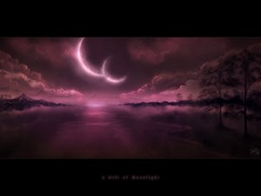
Book Of Ecclesiastes: The Preacher
General Providence: The Lot Of Man
GOD’S NATURAL & NORMAL LAW OF IMPARTIALITY
Total Vanity (Vapor) Or Ephemeral Emptiness Of Mankind’s Every Ambition & Pursuit
Determining Role Of Random Chance In Large Majority Of Human Success Stories & Failures Of Endeavor
No Denying That Luck & Time Happen To All Of Us & This Is Called “The Human Condition”
Nature Repeats Itself In Endless Cycles (Chapter 1) Or In Amoral Alternation Of Opposites (Chapter 3) – Always At Work But Nothing Is Achieved
Beasts Of Field Know No Difference But Humankind Requires Meaningful Objectives & Purposeful Existence
The Creatures Of Intelligence Throughout Human History Have Searched For Answers As To The Positively Purposed End To Man On Earth – Teleological Study Of History

Slide 49
Book Of Ecclesiastes: The Preacher
General Providence: The Lot Of Man
GOD’S NATURAL & NORMAL LAW OF IMPARTIALITY
Successive Generations Of Humans On The Earth Compare In Impact To That Of Goalless Nature
Aging Man Is Metaphorically Compared To An Old House
Then The Lone & Inevitable Certainty Of Each Man’s Death
We Will Not Even Be Remembered By Those That Survive Us
Thus, We Find In (12: 9 – 13) He States We Must Be Prepared To Go To Our Long Home
Chapters One Thru Eight Written In First Person – That Person Claimed As Being King Solomon
His Conclusion – Man Alone Is Not Merely A Number But Neither Are Men Together The Measure
After - Chapter 8: Verse 12 - Written In Third Person & Centers On Advice For Living In The Duration Or That Interval Between House & Home
Recommends “Seizing The Day” & Enjoying Small Pleasures Of This Life & The Three-Fold Chord Of Family.

Slide 50
LESSONS FROM WATER
Sometimes when you feel like your going would leave an unfillable hole,
Just follow this simple instruction and see how it humbles your soul.
Take a bucket and fill it with water, put your hand in it, up to the wrist;
Pull it out; and the hole that’s remaining, is a measure of how you’ll be missed.
You may splash all you please when you enter, you can stir up the water galore,
But stop and you’ll find in a minute, that it looks quite the same as before.
- UNKNOWN AUTHOR
Seasonal Distance From The Sun

Slide 51


Slide 52
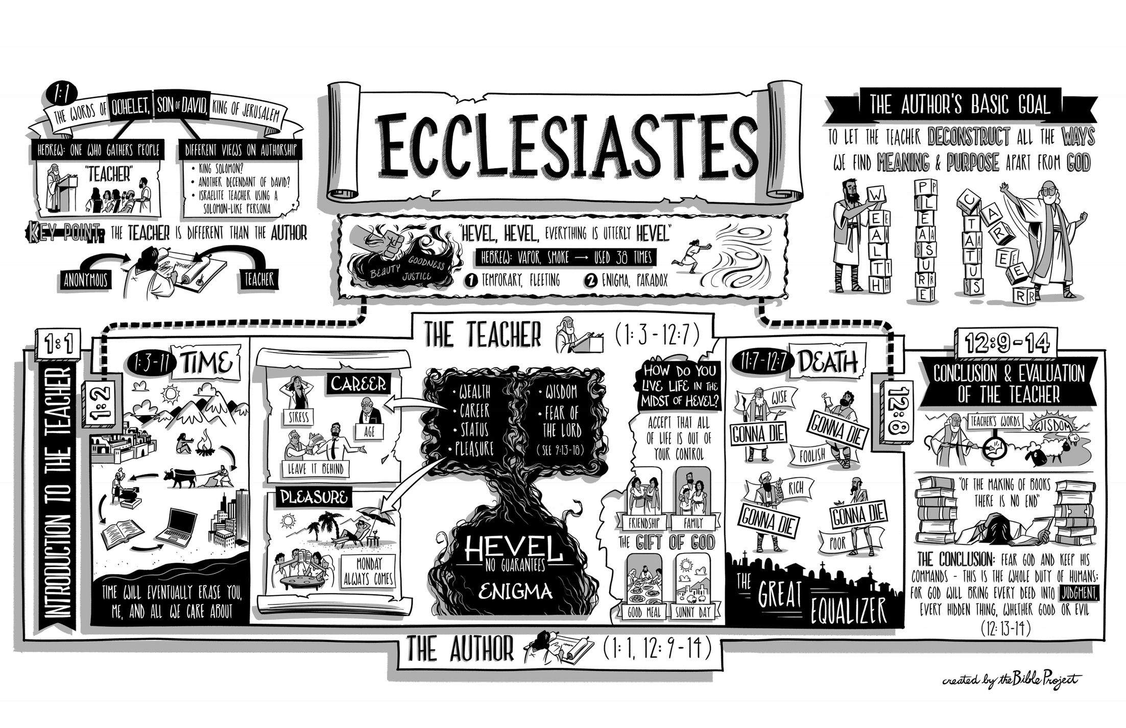

Slide 53
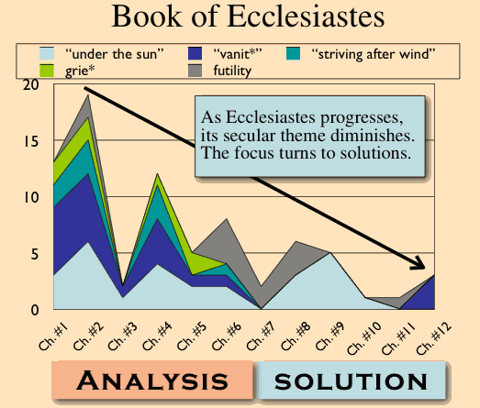

Slide 54
Providence and Its Apparent Problems
Although the term providence is not found in the Bible, it suggests that God’s foresight plays a part in guiding human destiny. But, on the one hand, any attempt to explain God’s control of the world faces serious problems. Wickedness seems to triumph over justice (Ecclesiastes 3:16). If God is in control, why does He allow this to happen? Also, life seems to be hopelessly swallowed up by death (3:19). Is this all there is to life? Moreover, the poor and weak are oppressed by the rich and powerful (4:1). If God answers prayer, why does He not respond to the outcry of human misery?
On the other hand, when one attempts to explain how God guides the lives of individuals on a day-today basis, he faces another set of problems. For one thing, if God desires that people work hard and succeed in life, why are others envious of their success (4:4)? Secondly, why are there so many lonely people in the world who are in desperate need of companionship (4:8)? Thirdly, why are success and popularity so short lived (4:13–16)? In the search for the meaning of life “under the sun,” the truth is “that the righteous and the wise, and their works, are in the hand of God; whether it be love or hatred, man knows not; all is before them” (9:1). Obviously, Ecclesiastes raises these questions concerning God’s providence to make us aware that man, left to himself, has no final solutions.
  Curry, M. (1989). . (D. Bowman, Ed.)Christianity Magazine, 6(7), 21.
Curry, M. (1989). The Providence of God in Ecclesiastes. (D. Bowman, Ed.)Christianity Magazine, 6(7), 21.

Slide 55
Creation, Providence, and Sin
Both the universe (1:5–7) and man (1:4; 7:9) were created by God and, despite the problems stated above, His providential hand may be seen in all things (3:1–8). God made His creation to be “very good” (Genesis 1:31), and He made man to live forever in Paradise; however, sin changed everything. Thus, when we look for God’s providence in a world where sin is present, we must understand that both creation and man are cursed as a consequence of sin, but that both continue under the watchful eye of God and will eventually be delivered from this curse. Indeed, God has provided every human being with the possibility of a new existence free from sin. We are warned, therefore, not to speak too hastily about things that we do not understand and that we cannot change (1:15; 5:2); rather, we must firmly believe that our Creator knows what He is doing (3:14).
Curry, M. (1989). . (D. Bowman, Ed.)Christianity Magazine, 6(7), 21.
Curry, M. (1989). The Providence of God in Ecclesiastes. (D. Bowman, Ed.)Christianity Magazine, 6(7), 21.

Slide 56
God’s Providence in Operation
Several aspects of God’s providence can be detected. In the first place, He keeps His creatures inquiringly ignorant of His activities in this world. This is why “He hath set eternity in their heart, yet so that man cannot find out the work that God hath done from the beginning even to the end” (3:11). Secondly, He makes it possible for men to be content in this life (2:24–26; 3:12; 5:18–19), but never satisfied with what they have (1:8; 5:10). Thirdly, He keeps injustice and oppression somewhat in check by means of civil authorities (5:8), and, more importantly, He holds all men accountable to Himself (3:17; 11:9; 12:14). Fourthly, He has permitted suffering and death to be the lot of all men (2:14–16); “time and chance happeneth to them all” (9:11–12). Ecclesiastes states that God has a purpose in all of this; He has placed prosperity and adversity each “side by side with the other, to the end that man should not find out any thing that should be after him” (7:14).
  Curry, M. (1989). . (D. Bowman, Ed.)Christianity Magazine, 6(7), 21.
Curry, M. (1989). The Providence of God in Ecclesiastes. (D. Bowman, Ed.)Christianity Magazine, 6(7), 21.

Slide 57
Outline of Ecclesiastes
1:1-3 | Solomon’s thesis statement
1:4-18 | The vanity of the world’s natural processes and pursuit of understanding
2 | The vanity of indulgence, human achievement, and materialism
3 | God’s organized way of life for human activity
4 | The vanity of human cruelty, toil, politics
5 | The vanity of careless worship and misused wealth
6 | The vanity of riches
7:1-11:8 | Wise insights in the midst of life’s vanity (mini-realities amid life’s conflicting differences)
11:9-12:7 | Onset of old age when the health and strength of youth passes
12:8-14 | Conclusion: life’s vanity can only be handled by devoting yourself to God

Slide 58
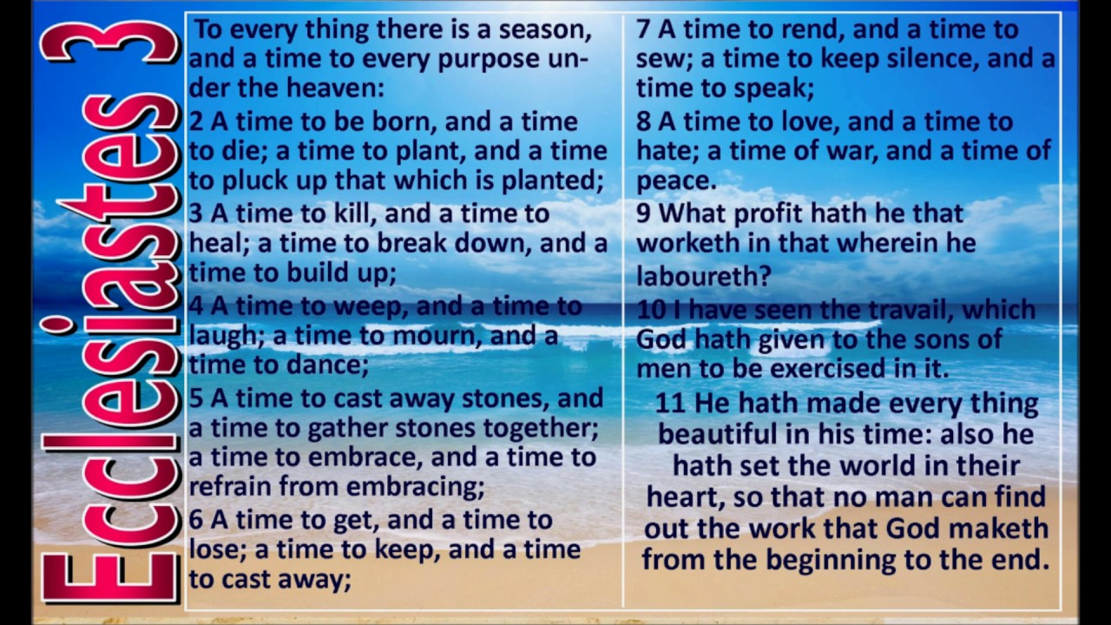

Slide 59


Slide 60
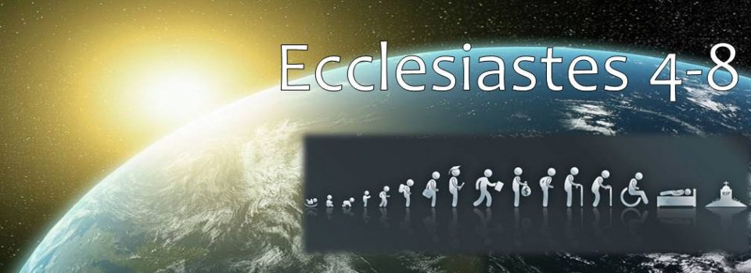

Slide 61


Slide 62

CHAPTER NINE

Slide 63
4 Key Truths
#1 – God is Sovereign
For I have taken all this to my heart and explain it that righteous men, wise men, and their deeds are in the hand of God. -Ecc. 9:1

Slide 64
4 Key Truths
#2 – Death is Certain
It is the same for all. There is one fate for the righteous and for the wicked; for the good, for the clean and for the unclean; for the man who offers a sacrifice and for the one who does not sacrifice. As the good man is, so is the sinner; as the swearer is, so is the one who is afraid to swear. This is an evil in all that is done under the sun, that there is one fate for all men. -Ecc. 9:2-3a

Slide 65
4 Key Truths
#3 – The Heart is Evil
Furthermore, the hearts of the sons of men are full of evil and insanity is in their hearts throughout their lives. Afterwards they go to the dead. -Ecc. 9:3b

Slide 66
4 Key Truths
#4 – Where There is Life, There is Hope
For whoever is joined with all the living, there is hope; surely a live dog is better than a dead lion. For the living know they will die; but the dead do not know anything, nor have they any longer a reward, for their memory is forgotten. -Ecc. 9:4-5

Slide 67
"But the dead know nothing" (v. 5). Let's first consider a parallel passage to illustrate the importance of context. I Samuel 21:39, "the lad knew not anything." This verse is from a passage in which Jonathan gives David a secret signal concerning Saul. To take the phrase out of context and say that the lad was in a state of total unconsciousness would be the ultimate display of ignorance. We realize immediately that the statement about the lad is limited by the context. Likewise, the statement is Ecclesiastes 9 is limited by the context. If "the dead know nothing" is an unconditional absolute truth, then why not also the other two thoughts presented in the same sentence? Let's consider the context of Ecclesiastes 9:5 and see what Solomon was really trying to teach us…
In this passage Solomon is not explaining the spiritual state of the dead. If he was we must deny future reward because he said the dead "have no more reward." Who would believe such a thing? Solomon is saying that now is the time to live and enjoy life. Now is the time to work, devise, think, act wisely and enjoy a successful life because after death the opportunities to acquire success are gone.
Guardian of Truth XXXVI: 12, p. 357

Slide 68
Indeed their love, their hate and their zeal have already perished, and they will no longer have a share in all that is done under the sun.
- Ecc. 9:6

Slide 69
Practical Applications
Contentment
Go then, eat your bread in happiness and drink your wine with a cheerful heart; for God has already approved your works.
- Ecc. 9:7

Slide 70
Practical Applications
Contentment
Purity/Spirituality
Let your clothes be white all the time, and let not oil be lacking on your head. - Ecc. 9:8

Slide 71
Practical Applications
Contentment
Purity/Spirituality
Faithfulness
Enjoy life with the woman whom you love all the days of your fleeting life which He has given to you under the sun; for this is your reward in life and in your toil in which you have labored under the sun.
- Ecc. 9:9

Slide 72
Practical Applications
Contentment
Purity/Spirituality
Faithfulness
Zeal
Whatever your hand finds to do, do it with all your might; for there is no activity or planning or knowledge or wisdom in Sheol where you are going.
- Ecc. 9:10

Slide 73
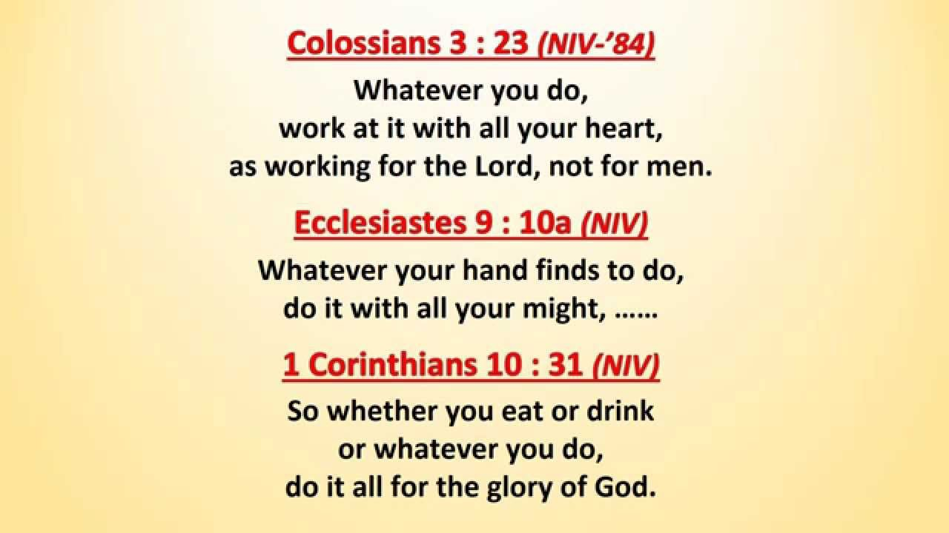

Slide 74
Comments on the Rat Race
The Race is Foolish
I again saw under the sun that the race is not to the swift and the battle is not to the warriors, and neither is bread to the wise nor wealth to the discerning nor favor to men of ability; for time and chance overtake them all.
- Ecc. 9:11

Slide 75
Comments on the Rat Race
Trusting In Your Ability is Foolish
Moreover, man does not know his time: like fish caught in a treacherous net and birds trapped in a snare, so the sons of men are ensnared at an evil time when it suddenly falls on them. Also this I came to see as wisdom under the sun, and it impressed me.
- Ecc. 9:12-13

Slide 76
Comments on the Rat Race
Those who Remain in the Rat Race are Fools
There was a small city with few men in it and a great king came to it, surrounded it and constructed large siege works against it. But there was found in it a poor wise man and he delivered the city by his wisdom. Yet no one remembered that poor man.
- Ecc. 9:14-15

Slide 77
Life in the Fast Lane
Human activity cannot guarantee genuine success
I again saw under the sun that the race is not to the swift and the battle is not to the warriors, and neither is bread to the wise nor wealth to the discerning nor favor to men of ability; for time and chance overtake them all.
- Ecc. 9:11

Slide 78
Life in the Fast Lane
Strength is more impressive yet less effective than wisdom
But there was found in it a poor wise man and he delivered the city by his wisdom. Yet no one remembered that poor man. So I said, “Wisdom is better than strength.”
- Ecc. 9:15-16a

Slide 79
Life in the Fast Lane
Wise counsel is not usually popular, rarely obeyed and seldom remembered
But the wisdom of the poor man is despised and his words are not heeded. - Ecc. 9:16b

Slide 80
Life in the Fast Lane
Human rulers will always shout down wise counselors, and fools like it this way
The words of the wise heard in quietness are better than the shouting of a ruler among fools.
- Ecc. 9:17

Slide 81
Life in the Fast Lane
Wisdom is Better than war
Wisdom is better than weapons of war, but one sinner destroys much good. - Ecc. 9:18

Slide 82
CHAPTER TEN

Slide 83
Wisdom & Folly Contrasted
Advantages & Disadvantages of wisdom
Dead flies make a perfumer’s oil stink, so a little foolishness is weightier than wisdom and honor.
-Ecc. 10:1

Slide 84
A wise man’s heart directs him toward the right, but the foolish man’s heart directs him toward the left.
- Ecc. 10:2

Slide 85
Even when the fool walks along the road, his sense is lacking and he demonstrates to everyone that he is a fool.
- Ecc. 10:3

Slide 86
Wisdom & Folly Contrasted
Humility & Patience vs. Popularity & Partiality
If the ruler’s temper rises against you, do not abandon your position, because composure allays great offenses. -Ecc. 10:4

Slide 87
There is an evil I have seen under the sun, like an error which goes forth from the ruler—folly is set in many exalted places while rich men sit in humble places. I have seen slaves riding on horses and princes walking like slaves on the land.
- Ecc. 10:5-7

Slide 88
Wisdom & Folly Contrasted
Inevitable Risk vs.
Inexcusable Stupidity
He who digs a pit may fall into it, and a serpent may bite him who breaks through a wall. He who quarries stones may be hurt by them, and he who splits logs may be endangered by them. If the axe is dull and he does not sharpen its edge, then he must exert more strength.
-Ecc. 10:8-10a

Slide 89
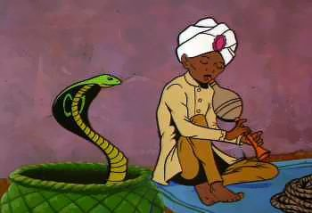
Wisdom has the advantage of giving success. If the serpent bites before being charmed, there is no profit for the charmer.
- Ecc. 10:10b-11

Slide 90
The Character of a Fool
His language is one of disbelief
The fool has said in his heart, “There is no
God.”
They are corrupt, they have committed abominable deeds;
There is no one who does good.
- Ps. 14:1

Slide 91
The Character of a Fool
He loves sin
The wisdom of the sensible is to understand his way,
But the foolishness of fools is deceit.
Fools mock at sin,
But among the upright there is good will.
- Pr. 14:8-9
The foolishness of man ruins his way,
And his heart rages against the Lord.
-Pr. 19:3

Slide 92
Actions of a Fool
Foolish Talk
Words from the mouth of a wise man are gracious, while the lips of a fool consume him; the beginning of his talking is folly and the end of it is wicked madness. Yet the fool multiplies words.
- Ecc. 10:12-14a

Slide 93
Actions of a Fool
Unsure Future
No man knows what will happen, and who can tell him what will come after him?
- Ecc. 10:14b

Slide 94
Actions of a Fool
They are their own worse enemy
The toil of a fool so wearies him that he does not even know how to go to a city. - Ecc. 10:15

Slide 95
Actions of a Fool
They make poor leaders
Woe to you, O land, whose king is a lad and whose princes feast in the morning. Blessed are you, O land, whose king is of nobility and whose princes eat at the appropriate time—for strength and not for drunkenness..
- Ecc. 10:16-17

Slide 96
Actions of a Fool
They waste time & money
Through indolence the rafters sag, and through slackness the house leaks. Men prepare a meal for enjoyment, and wine makes life merry, and money is the answer to everything.
- Ecc. 10:18-19

Slide 97
How to Deal with a Fool
Isolate them
Leave the presence of a fool,
Or you will not discern words of knowledge.
- Pr. 14:7
Do not speak in the hearing of a fool,
For he will despise the wisdom of your words.
-Pr. 23:9

Slide 98
How to Deal with a Fool
Restore them only if there is evidence of repentance and brokenness
Let them give thanks to the Lord for His lovingkindness,
And for His wonders to the sons of men!
Let them also offer sacrifices of thanksgiving,
And tell of His works with joyful singing.
- Ps. 107:10-12

Slide 99
When they are diminished and bowed down
Through oppression, misery and sorrow,
He pours contempt upon princes
And makes them wander in a pathless waste.
- Ps. 107:39-40

Slide 100
How to Deal with a Fool
When restored, proclaim the change.
Let them give thanks to the Lord for His lovingkindness,
And for His wonders to the sons of men!
Let them also offer sacrifices of thanksgiving,
And tell of His works with joyful singing. - Ps. 107:21-22

Slide 101
CHAPTER ELEVEN

Slide 102
4 Keys to Positive Thinking
Key #1
Instead of defense, think offense
Cast your bread on the surface of the waters, for you will find it after many days.
- Ecc. 11:1

Slide 103
4 Keys to Positive Thinking
Key #2
Instead of hoarding, try giving
Divide your portion to seven, or even to eight, for you do not know what misfortune may occur on the earth.
- Ecc. 11:2

Slide 104
4 Keys to Positive Thinking
Key #3
Instead of watching, try doing
If the clouds are full, they pour out rain upon the earth; and whether a tree falls toward the south or toward the north, wherever the tree falls, there it lies. He who watches the wind will not sow and he who looks at the clouds will not reap.
- Ecc. 11:3-4

Slide 105
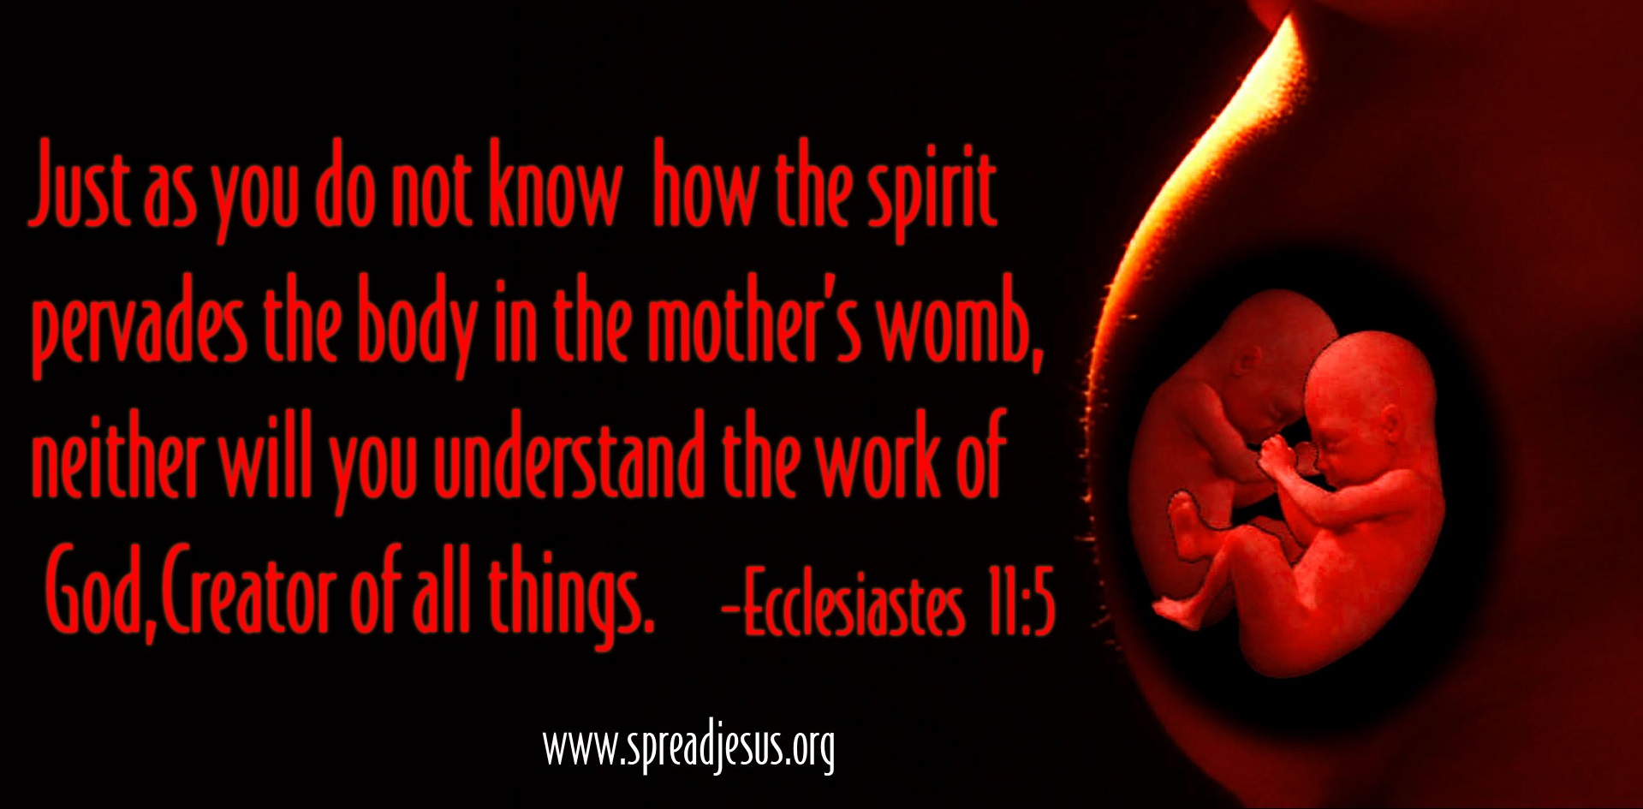

Slide 106
4 Keys to Positive Thinking
Key #4
Instead of doubting, try trusting
Just as you do not know the path of the wind and how bones are formed in the womb of the pregnant woman, so you do not know the activity of God who makes all things.
- Ecc. 11:5

Slide 107
Sow your seed in the morning and do not be idle in the evening, for you do not know whether morning or evening sowing will succeed, or whether both of them alike will be good.
- Ecc. 11:6

Slide 108
Procrastination = a form of Laziness and Self-Centeredness

Slide 109
Procrastination = Form of Greed

Slide 110
Joy & Satisfaction Relationship
with God

Slide 111
SATISFACTION
RELATIONSHIP
- God permits us to enjoy life now
The light is pleasant, and it is good for the eyes to see the sun. Indeed, if a man should live many years, let him rejoice in them all
- Ecc. 11:7-8a

Slide 112
SATISFACTION
RELATIONSHIP
- Take advantage of your blessings now
Rejoice, young man, during your childhood, and let your heart be pleasant during the days of young manhood. And follow the impulses of your heart and the desires of your eyes.
- Ecc. 11:9a

Slide 113
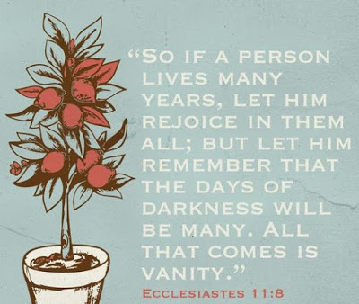

Slide 114
SATISFACTION
RELATIONSHIP
- There are no guarantees
and let him remember the days of darkness, for they will be many. Everything that is to come will be futility. Yet know that God will bring you to judgment for all these things. So, remove grief and anger from your heart and put away pain from your body, because childhood and the prime of life are fleeting.
- Ecc. 11:8b; 9b-10

Slide 115
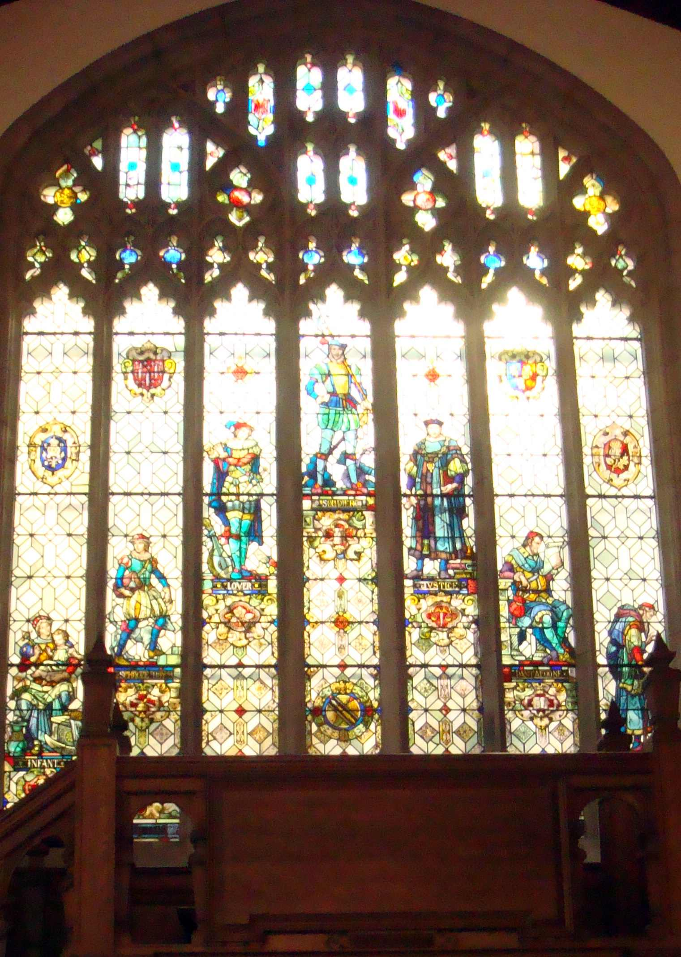
Man’s Ages Are Seven

Slide 116
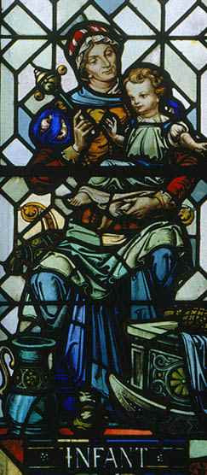
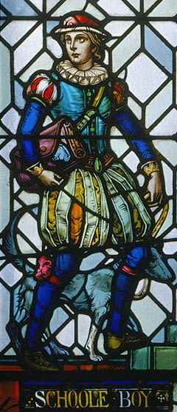
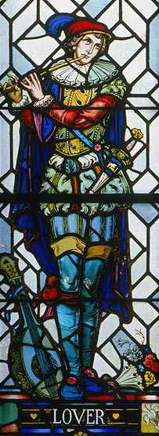
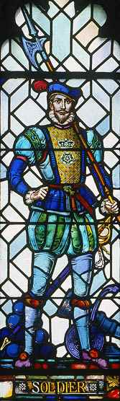

Slide 117
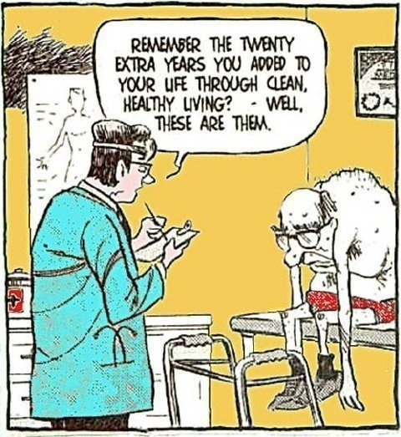
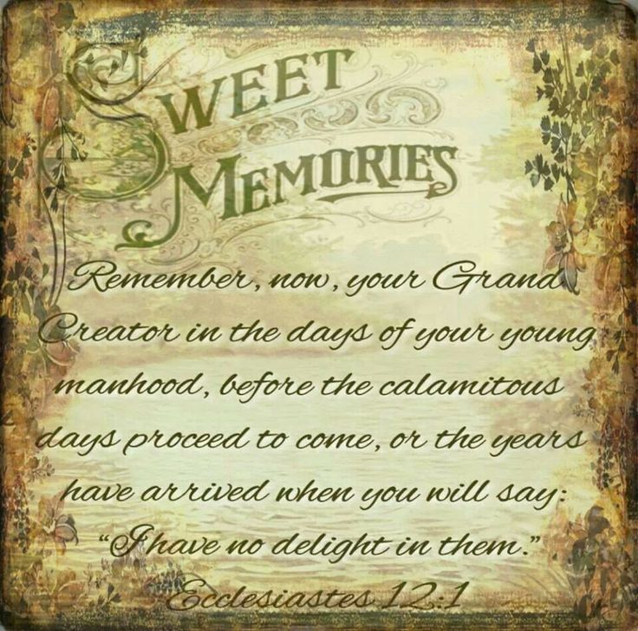

Slide 118
CHAPTER TWELVE

Slide 119
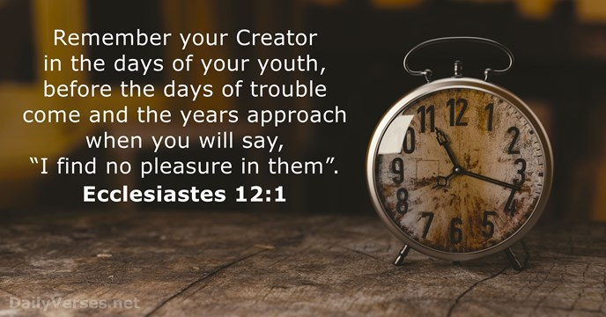

Slide 120


Slide 121
SATISFACTION
RELATIONSHIP
- The essential ingredient for happiness today is to have a relationship with God today
Remember also your Creator in the days of your youth, before the evil days come and the years draw near when you will say, “I have no delight in them”;
- Ecc. 12:1

Slide 122
God’s love and will are the only things you can legitimately desire more and more of without harming yourself.

Slide 123
Growing Old Gracefully
Accept the obvious
before the sun and the light, the moon and the stars are darkened, and clouds return after the rain;
- Ecc. 12:2

Slide 124
in the day that the watchmen of the house tremble, and mighty men stoop, the grinding ones stand idle because they are few, and those who look through windows grow dim; and the doors on the street are shut as the sound of the grinding mill is low, and one will arise at the sound of the bird, and all the daughters of song will sing softly.
- Ecc. 12:3-4

Slide 125
Furthermore, men are afraid of a high place and of terrors on the road; the almond tree blossoms, the grasshopper drags himself along, and the caperberry is ineffective. For man goes to his eternal home while mourners go about in the street.
- Ecc. 12:5

Slide 126
Growing Old Gracefully
Prepare for the obvious
Remember Him before the silver cord is broken and the golden bowl is crushed, the pitcher by the well is shattered and the wheel at the cistern is crushed; then the dust will return to the earth as it was, and the spirit will return to God who gave it.
- Ecc. 12:6-7

Slide 127
The Bible speaks of “the time of your stay upon earth” (1 Peter 1:17, NASB). Like “a stay” at a hotel for a brief period of time, we are all just passing through this world. This planet is not our home, but only a temporary residence. If this physical realm lasts much longer, we are all going to die. But whether we die prior to Jesus’ return or whether He comes in our lifetime (and we avoid physical death), we are all going somewhere forever—we are returning to our Maker (Ecclesiastes 12:7); we are going to Judgment. And then, we are either going to receive eternal life or eternal punishment; we are going to heaven or hell (Matthew 25:46).

Slide 128
Growing Old Gracefully
Acknowledge the obvious
“Vanity of vanities,” says the Preacher, “all is vanity!” In addition to being a wise man, the Preacher also taught the people knowledge; and he pondered, searched out and arranged many proverbs.
- Ecc. 12:8-9

Slide 129
The Preacher sought to find delightful words and to write words of truth correctly.
The words of wise men are like goads, and masters of these collections are like well-driven nails; they are given by one Shepherd. But beyond this, my son, be warned: the writing of many books is endless, and excessive devotion to books is wearying to the body.
- Ecc. 12:10-12

Slide 130
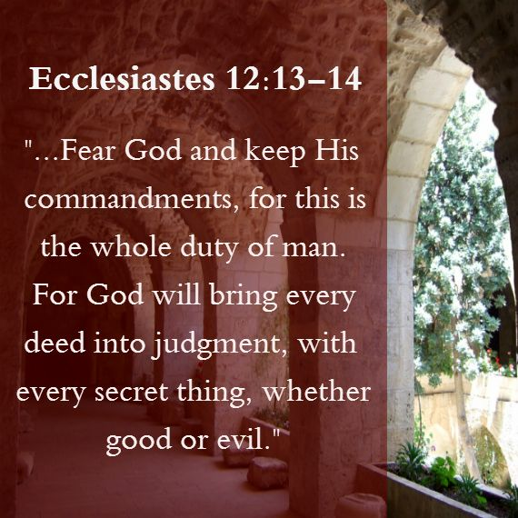

Slide 131
The conclusion, when all has been heard, is: fear God and keep His commandments, because this applies to every person. For God will bring every act to judgment, everything which is hidden, whether it is good or evil.
- Ecc. 12:13-14

Slide 132

Seasonal Distance From The Sun

Slide 133
3 Final Promises
There is satisfaction in each day

Slide 134
3 Final Promises
There is satisfaction in each day
There is a peace regardless of age or position

Slide 135
3 Final Promises
There is satisfaction in each day
There is a peace regardless of age or position
There is hope when life is over

Slide 136


Slide 137
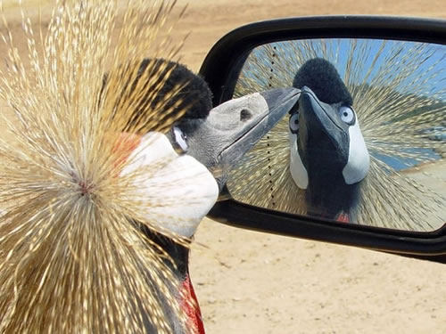
12 Chapters Of Ecclesiastes
E MPTINESS - of accumulating wealth.
C ONCLUSION - of seeking pleasure.
C OMPLETENESS - of God’s timing.
L ABOR - is also a vanity.
E XHORTATIONS - on hoarding wealth.
S IN - is never satisfying.
I NADEQUACY - of being affluent.
A BUSE - of God’s authority.
S AME - end for all.
T EMPORARY - wisdom of man.
E MPTINESS - of godless living.
S ERVING - God brings satisfaction.

Slide 138
SUMMATION

Slide 139
Observations in Ecclesiastes
He notes his own loss of enthusiasm for life
He records his feelings as he searches for meaning
He sets forth final conclusions

Slide 140
And I set my mind to seek and explore by wisdom concerning all that has been done under heaven. It is a grievous task which God has given to the sons of men to be afflicted with. I have seen all the works which have been done under the sun, and behold, all is vanity and striving after wind.
- Ecclesiastes 1:13-14

Slide 141
What Solomon Learned
All lifestyles are meaningless
I have seen all the works which have been done under the sun, and behold, all is vanity and striving after wind.
- Ecc. 1:14

Slide 142
What Solomon Learned
Nothing can be changed
What is crooked cannot be straightened and what is lacking cannot be counted.
- Ecc. 1:15

Slide 143
What Solomon Learned
Knowledge is useless
I said to myself, “Behold, I have magnified and increased wisdom more than all who were over Jerusalem before me; and my mind has observed a wealth of wisdom and knowledge.” And I set my mind to know wisdom and to know madness and folly; I realized that this also is striving after wind. - Ecc. 1:16-17

Slide 144
What Solomon Learned
Desire for knowledge brings pain
Because in much wisdom there is much grief, and increasing knowledge results in increasing pain. - Ecc. 1:18

Slide 145
Conclusions:
For a man without God, life, when examined, will be found useless.

Slide 146
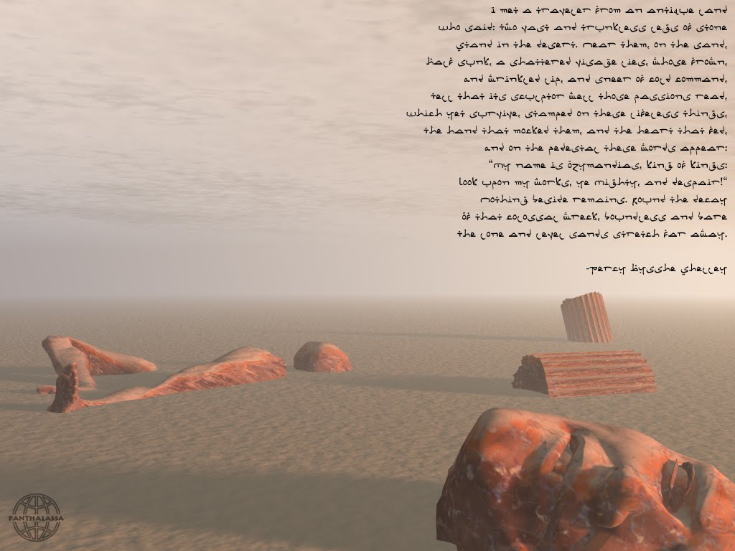

Slide 147
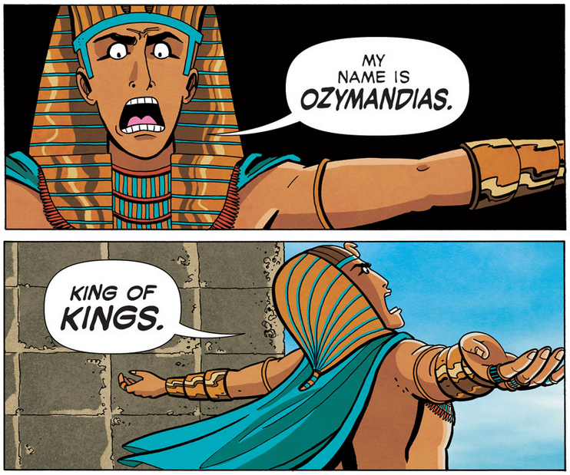

Slide 148
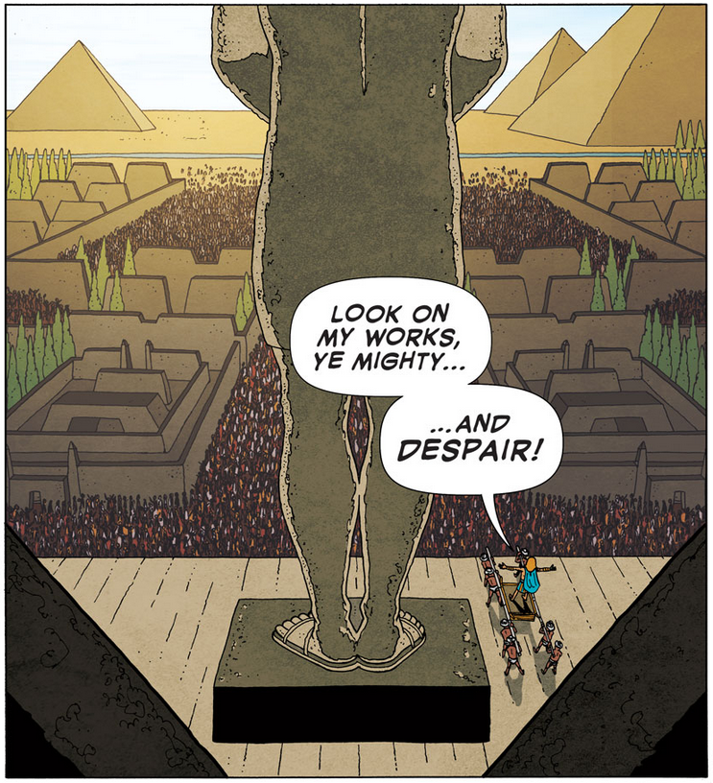

Slide 149
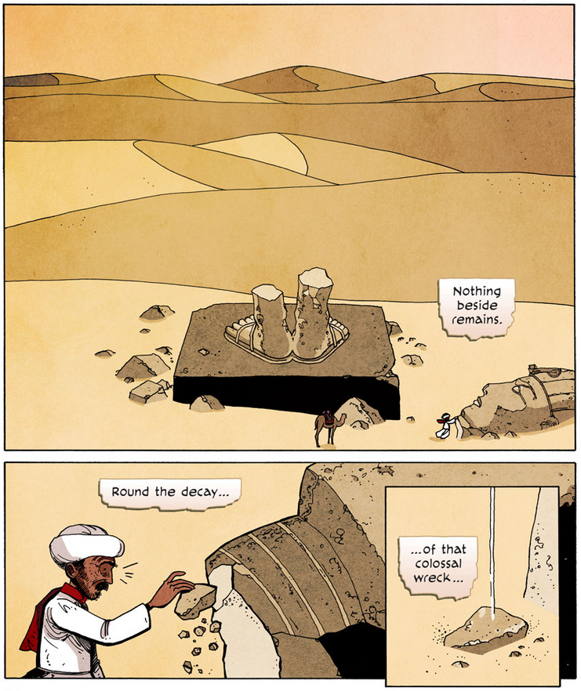

Slide 150
Having noted a range of limits imposed on man's existence and experience and the resultant folly of man's attempt to master his life, Qoheleth reasserts the sage advice that man's lot is to enjoy the life that God gives to him, this is his portion. It is my belief that this theme of enjoyment provides a steady counter point to the main point of vanity, pessimism, and negativity in Ecclesiastes. "Enjoyment" can also be understood as the fruit of negative thinking in the book. That is, enjoyment and the transient pleasures of this life are highlighted in the context of Qoheleth's desperate and dismal declarations. There is a certain power of negative thinking which gives Ecclesiastes its forcefulness, and this negative reflection yields the very positive product of pleasure. Of course, the pursuit of life's pleasures must always be realized in light of God's Covenant (11:9; 12:13-14). Yet Ecclesiastes is concerned ultimately with the enjoyment of the present, not in any hedonistic sense, but in the context of life with all its toil and enigma. This is the life available to man. This is the life that God gives! – Roman Madrigal, Guardian of Truth

Slide 151
Modern “Ecclesiastes”
Materialism
Existentialism
Positivism
Post Modernism

Slide 152
JUDGEMENT PREPARED
FIVE STATES FIVE STEPS
Five States of the Soul:
EXEMPTION:
Ezekiel 18: 20; Matthew 18: 1 – 3
CONDEMNATION:
Galatians 3: 22
JUSTIFICATION:
Romans 5: 1, 2; 8: 1, 2
DAMNATION:
Matthew 23: 3; Mark 16: 16
GLORIFICATION:
Romans 8: 17, 30; II Thess. 1: 7 - 12

Slide 153
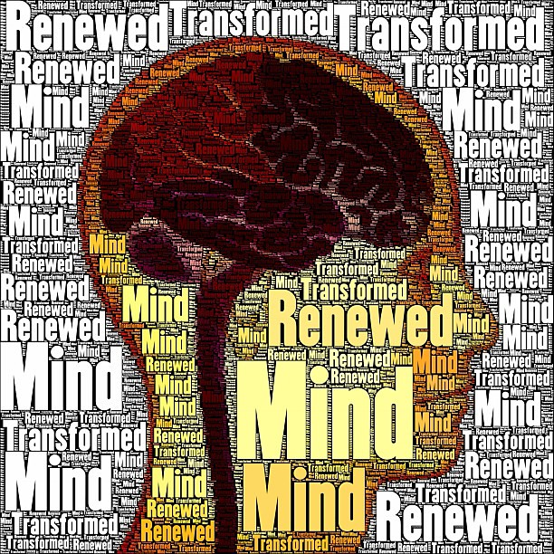

Slide 154
JUDGEMENT PREPARED
FIVE STATES FIVE STEPS
Five Steps for Saving:
HEARING:
Romans 10: 17; Matthew 7: 24 - 27
BELIEVING:
Hebrews 11: 6; Mark 16: 15, 16
REPENTING:
Acts 2: 38; 17: 30; Luke 13: 3
CONFESSING:
Matthew 10: 32, 33; Acts 8: 36, 37
BAPTISM:
Romans 6: 3 – 5; Acts 8: 36 - 38

