Slide 1
The Bible Canon Is Of An Internal Integrity
by David Lee Burris

Slide 2
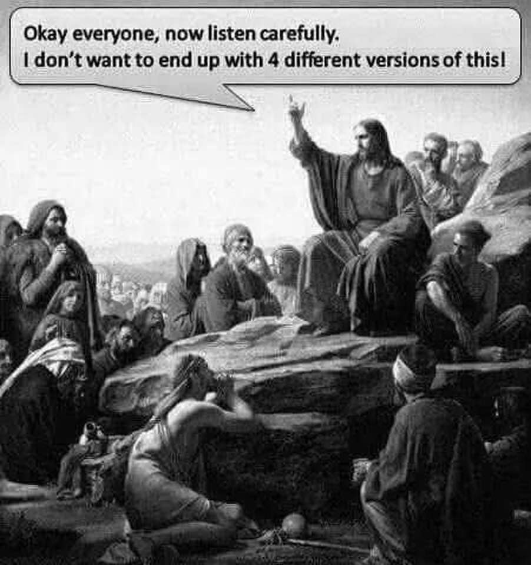

Slide 4
How Authoritative Is The Bible?

Slide 5
Testing a document’s validity
Internal evidence: what the document claims for itself
Bibliographic evidence: from the original documents to the copies we possess today
External evidence: how the document aligns with facts, dates, persons from its own contemporary world

Slide 6
Date of the Gospels Internal Evidence
The gospels prophesy the destruction of the Temple (occurred in AD 70) but never mention its fulfillment.
Matthew 24, Mark 13, Luke 21.
Acts
Luke never mentions the death of Paul and Peter
Paul’s Epistles date AD 48-64.

Slide 7
Internal Evidence – What does the Bible claim for itself?
Consistency of the message
The Bible was written over a period of at least 1500 years (time of the exodus [1400 BC] to NT times [AD 100]) by around 40 authors from many locations (Israel, Babylon, Sinai, Greece, Turkey, and Italy) covering controversy, problems and disagreements, yet unified in its overall message.

Slide 8
Bibliographical Evidence
How do we know that the Bible of today is even close to the original?

Slide 9
Two Key Questions to Ask
How many manuscript copies do we have?
How close are the copies to the original?

Slide 10
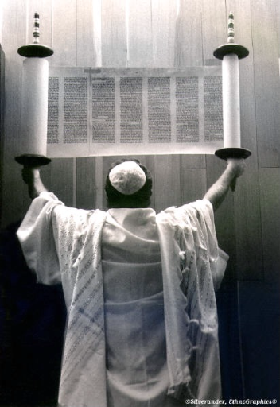
The Old Testament
The Scribes were professionals.
They believed they were transcribing the Word of God and were therefore very careful.
The earliest complete copy of the Old Testament is the Massoretic Text, written in Hebrew, from around 900 A.D.

Slide 11
The Old Testament
When the Massoretes copied a book, they would add up the letters and find the middle letter. If it didn’t match the original, they tore it up and made a new one.

Slide 12
250-100 BC
The Septuagint
The word “Septuagint” means seventy.
Refers to the tradition that
70 or 72 men translated it.
“Septuagint” is often abbreviated LXX,
the Roman numeral for seventy.
1500 BC 500 BC AD 1 AD 500 AD 1000 AD 1500 AD 1900 AD 2000

Slide 13
250-100 BC
The Septuagint
The 53 books of this translation are
arranged by subject.
Torah
History
Poetry
Prophecy
1500 BC 500 BC AD 1 AD 500 AD 1000 AD 1500 AD 1900 AD 2000

Slide 14
250-100 BC
The Septuagint
The Septuagint enabled the many Jews of the Diaspora (their dispersal into lands outside of Israel), who had lost fluency in their ancient language(except for the ceremonial), to read & understand the scriptures.
1500 BC 500 BC AD 1 AD 500 AD 1000 AD 1500 AD 1900 AD 2000

Slide 15
Dating of New Testament Manuscripts
Work Written Copy Time Span
Plato 447 BC 900 AD 1200 years
Gallic Wars 44 BC 900 AD 1000 years
Tacitus 100 AD 1100 AD 1000 years
Aristotle 384 BC 1100 AD 1400 years
Illiad 900 BC 400 BC 500 years
New
Testament 90 AD 125 AD 30 years

Slide 16
Testing a document’s validity: Bibliographical evidence
The New Testament
Over 5600 Greek manuscripts extant
Over 10,000 manuscripts of the Latin Vulgate.
Over 9200 other translations

Slide 17
Greek Manuscripts
The Rylands Papyrus dates to around AD 125 and contains John 18:31-33, 37.
The Codex Vaticanus and Codex Siniaticus are two excellent complete parchment copies of the New Testament that date between AD 325 and AD 450.
The Chester Beatty Papyrus and the Bodmer Papyrus II date from AD 180 and AD 225. From these manuscripts can be constructed all of Luke, John, Romans, 1 and 2 Corinthians, Galatians, Ephesians, Philippians, Colossians, 1 and 2 Thessalonians, Hebrews and portions of Matthew, Mark, Acts, and Revelation.

Slide 18
The New Testament
The fragment of John 18 from 125 A.D.
Luke’s meticulous history has been verified even in places that it was originally thought he got it wrong.
Unique places in Jerusalem from John’s Gospel have been located such as the Pool of Bethesda, Pool of Siloam, and Jacob's Well.
The census of Luke 2 is not known specifically but such censuses were taken at that time and the right rulers are mentioned for that time.

Slide 19
Other Manuscripts
There are over 1,000 copies and fragments of the New Testament in Syriac, Coptic, Armenian, Gothic, and Ethiopic and 8,000 copies of the Latin Vulgate, some dating as far back as Jerome’s original in 384 - 400 A.D.
The entire New Testament can be reconstructed from quotations in the writings of the Church Fathers (95 – 400 A.D.) except for 15-20 verses.

Slide 20
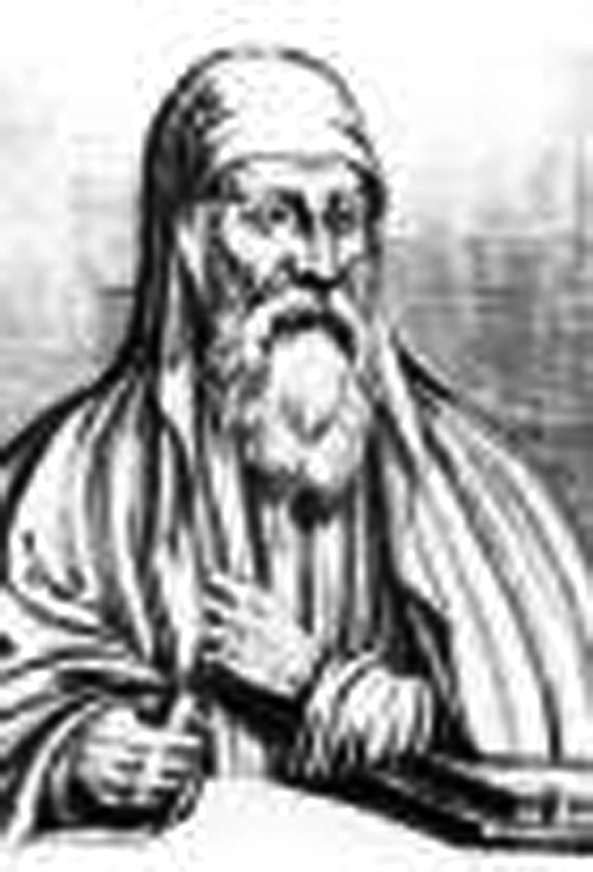
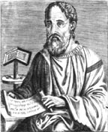
AD 200-300
Canon: Math Metaphor
Origen lists 21 approved New Testament books.
Eusebius lists 22 accepted books.
1500 BC 500 BC AD 1 AD 500 AD 1000 AD 1500 AD 1900 AD 2000

Slide 21
AD 200-300
Church Fathers
Church fathers accept the writings of the Gospels and Paul’s letters as canonical.
Canonical: from a Greek word
referring to the rule of faith and truth
1500 BC 500 BC AD 1 AD 500 AD 1000 AD 1500 AD 1900 AD 2000

Slide 22
Scripture
The Three Requirements for Canonization:
(1) Because the apostles were the trusted eyewitnesses of Jesus’ resurrection, the writing had to be directly connected to an apostle.
(2) The writing had to be “orthodox”—it could not contradict the teachings of the Jewish Scriptures or of the Apostles.
(3) The writing had to be accepted in churches throughout the known world—it could not be accepted only by one group of Christians.¹⁴
Notes:
Links on this slide will be activated in PowerPoint Show mode

Slide 23
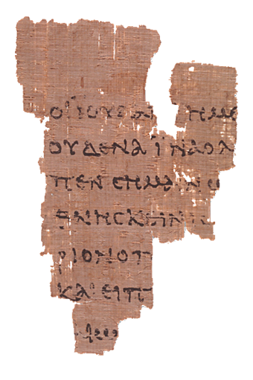
The New Testament Canon
From the very beginning, the churches recognized as authoritative:
The four Gospels
The Acts of the Apostles
The epistles of Paul
At least one of John’s epistles
Portion of John 18
dated approx. AD 110
(image courtesy of CSNTM.org)

Slide 24
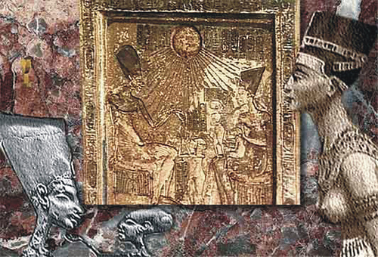
David Lee Burris:
Present Canon: Athanasius (Paschal Letter of 367 – final acceptance in East) – Synod Of Rome (382 – final acceptance in West) – Synod Of Carthage (397 – acceptance by entire church)
BOOKS DEBATED
REASONS GIVEN
HEBREWS
Western Church Thought Forgery
JAMES & JUDE & 2nd PETER
Authorship Questioned
COPTIC CHURCH
CANON INCLUDED
BOOK OF ENOCH
REVELATION
Chiliastic Origins As Per Eusebius
THE SHEPHERD OF HERMAS
Nonapostolic Origin & Late Date
THE DIDACHE
Uncertain Origin & Late Date
REVELATION OF PETER
Authenticity Doubted

Slide 25
David Lee Burris:
Present Canon: Athanasius (Paschal Letter of 367 – final acceptance in East) – Synod Of Rome (382 – final acceptance in West) – Synod Of Carthage (397 – acceptance by entire church)
BOOKS DEBATED
REASONS GIVEN
HEBREWS
Western Church Thought Forgery
JAMES & JUDE & 2nd PETER
Authorship Questioned
ARMENIAN CANON APOCRYPHA INCLUDED PATRIARCHS
12 TESTAMENTS
REVELATION
Chiliastic Origins As Per Eusebius
THE SHEPHERD OF HERMAS
Nonapostolic Origin & Late Date
THE DIDACHE
Uncertain Origin & Late Date
REVELATION OF PETER
Authenticity Doubted

Slide 26
EMPEROR CONSTANTINE’S
COMMITTEE OF CANON

Slide 27
The New Testament Canon
Some disagreements persisted for several years over whether the other NT books could be clearly connected to eyewitnesses of Jesus.
By the late 4th century, the “New Testament canon” had been settled.
Portion of John 18
dated approx. AD 110
(image courtesy of CSNTM.org)

Slide 28
David Lee Burris:
Present Canon: Athanasius (Paschal Letter of 367 – final acceptance in East) – Synod Of Rome (382 – final acceptance in West) – Synod Of Carthage (397 – acceptance by entire church)
BOOKS DEBATED
REASONS GIVEN
HEBREWS
Western Church Thought Forgery
JAMES & JUDE & 2nd PETER
Authorship Questioned
REVELATION
Chiliastic Origins As Per Eusebius
THE SHEPHERD OF HERMAS
Nonapostolic Origin & Late Date
THE DIDACHE
Uncertain Origin & Late Date
REVELATION OF PETER
Authenticity Doubted

Slide 29
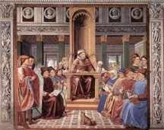
AD 400
The Canon
By AD 400, the standard of 27 New Testament books is accepted in the East and West as confirmed by:
Athanasius
Jerome
Augustine
Three church councils
Augustine
1500 BC 500 BC AD 1 AD 500 AD 1000 AD 1500 AD 1900 AD 2000

Slide 30
AD 200-300
The Canon
The Early Years Of Canonization by Victor Eskew:
“The canonization of the Scripture was always an important concern of the church. In addition, the early church had ways given to it by God to determine which books belonged in the New Testament canon without any possibility of error.”
1500 BC 500 BC AD 1 AD 500 AD 1000 AD 1500 AD 1900 AD 2000

Slide 31
AD 200-300
The Canon
The Early Years Of Canonization by Victor Eskew:
Colossians Chapter Four & Verse Sixteen indicates that the inspired messages were circulating throughout first century churches. In 2nd Peter 3: 16, Peter refers to all Paul’s epistles as “scripture.” The early church was aware of the inspired writings, recognized them & accepted them as the Word of God.
1500 BC 500 BC AD 1 AD 500 AD 1000 AD 1500 AD 1900 AD 2000

Slide 32
AD 200-300
The Canon
The Early Years Of Canonization by Victor Eskew:
The question now arises concerning the second, third and even fourth centuries. The apostles were all dead. (But) they (early Christians) had a fool-proof way of knowing which books were inspired and which were not. The apostles of Christ had the ability to distribute miraculous gifts…
1500 BC 500 BC AD 1 AD 500 AD 1000 AD 1500 AD 1900 AD 2000

Slide 33
AD 200-300
The Canon
The Early Years Of Canonization by Victor Eskew:
The question now arises concerning the second, third and even fourth centuries.
The powers that were distributed to these new converts are referred to as the gifts of the Holy Spirit. There are nine gifts listed in 1st Corinthians 12: 7-11. Each person received a gift at the discretion of the Spirit.
1500 BC 500 BC AD 1 AD 500 AD 1000 AD 1500 AD 1900 AD 2000

Slide 34
AD 200-300
The Canon
The Early Years Of Canonization by Victor Eskew:
The question now arises concerning the second, third and even fourth centuries.
These gifts served numerous functions. They furnished these young churches with the revelation they needed to function as the body of Christ. They would also enable them to be able to determine which writings that came to them were divinely inspired & which were not.
1500 BC 500 BC AD 1 AD 500 AD 1000 AD 1500 AD 1900 AD 2000

Slide 35
AD 200-300
The Canon
The Early Years Of Canonization by Victor Eskew:
The question now arises concerning the second, third and even fourth centuries.
Three of the gifts are of particular value to this study: the word of wisdom, the word of knowledge & discerning of spirits. Let’s briefly define each of these gifts.
1500 BC 500 BC AD 1 AD 500 AD 1000 AD 1500 AD 1900 AD 2000

Slide 36
AD 200-300
The Canon
The Early Years Of Canonization by Victor Eskew:
Let’s briefly define each of these gifts:
The gift of Wisdom involved the ‘skill and discretion in imparting Christian truth’ (Strong). ‘Wisdom is intelligence, then practical action in accord with it. Here it is speech full of God’s wisdom (1Co. 2:7) under impulse of God’s Spirit’ (Robertson)
1500 BC 500 BC AD 1 AD 500 AD 1000 AD 1500 AD 1900 AD 2000

Slide 37
AD 200-300
The Canon
The Early Years Of Canonization by Victor Eskew:
Let’s briefly define each of these gifts:
The gift of Knowledge had to do with insight into ‘things lawful and unlawful for Christians’ (Strong). Robertson says: ‘This gift is insight (illumination) according to (kata) the same Spirit.’
1500 BC 500 BC AD 1 AD 500 AD 1000 AD 1500 AD 1900 AD 2000

Slide 38
AD 200-300
The Canon
The Early Years Of Canonization by Victor Eskew:
Let’s briefly define each of these gifts:
The gift of Discerning of Spirits dealt with the ability to distinguish and to judge. Vincent notes that it was the ability to so distinguish ‘between the different prophetic utterances, whether to proceed from true or false spirits. See – 1st Timothy 4:1; 1st John 4: 1 & 2
1500 BC 500 BC AD 1 AD 500 AD 1000 AD 1500 AD 1900 AD 2000

Slide 39
AD 200-300
The Canon
The Early Years Of Canonization by Victor Eskew:
The question now arises concerning the second, third and even fourth centuries.
It is not difficult to see how these three gifts would be of great value in determining whether a letter sent to the church was inspired or not. These miraculous abilities enabled the early churches to collect, as authoritative, only those writings which God desired for them to have.
1500 BC 500 BC AD 1 AD 500 AD 1000 AD 1500 AD 1900 AD 2000

Slide 40
AD 200-300
The Canon
The Early Years Of Canonization by Victor Eskew:
The question now arises concerning the second, third and even fourth centuries.
Individuals who had received these miraculous gifts lived well into the 2nd century. Polycarp, a disciple of John, became a martyr in A.D. 166. When we read the writings of men of that period, they quote from all of the 27 books found within our present New Testament. The quotes of these writers are intended to be taken as authoritative statements.
1500 BC 500 BC AD 1 AD 500 AD 1000 AD 1500 AD 1900 AD 2000

Slide 41
AD 200-300
The Canon
The Early Years Of Canonization by Victor Eskew:
WE NOW COME TO OUR THIRD POINT
In the 2nd century, the Muritorian Fragment was written. ‘The Moritorian Fragment is the oldest known list of New Testament books. It was found by Ludovico Antonio Muratori in a manuscript in the Ambrosian Library in Milan, and published by him in 1740. It is called a fragment because the beginning is missing…
1500 BC 500 BC AD 1 AD 500 AD 1000 AD 1500 AD 1900 AD 2000

Slide 42
AD 200-300
The Canon
The Early Years Of Canonization by Victor Eskew:
WE NOW COME TO OUR THIRD POINT
Although the manuscript in which it appears was copied during the seventh century, the list itself is dated to about 170 because its author refers to the episcopate of Pius One of Rome (died 157) as recent’. There are two things that are of importance about this fragment -
1500 BC 500 BC AD 1 AD 500 AD 1000 AD 1500 AD 1900 AD 2000

Slide 43
AD 200-300
The Canon
The Early Years Of Canonization by Victor Eskew:
WE NOW COME TO OUR THIRD POINT
The two items of focus about this fragment are
First, the date is important. The fragment
dates back to A.D. 170.
Second, the list is important. This was a
list of books the church considered to be
divinely inspired and authoritative.
1500 BC 500 BC AD 1 AD 500 AD 1000 AD 1500 AD 1900 AD 2000

Slide 44
AD 200-300
The Canon
The Early Years Of Canonization by Victor Eskew:
WE NOW COME TO OUR THIRD POINT
In an article on the Muratorian Partial by James R. Adair, we find which books were included on this list. Mr. J.R. Adair writes; ‘The fragment begins with what is probably a mutilated reference to Mark, and Luke and John are mentioned as the third & fourth gospels - It is probable that Matthew’s gospel was mentioned in a missing portion of the original document. …
1500 BC 500 BC AD 1 AD 500 AD 1000 AD 1500 AD 1900 AD 2000

Slide 45
The Early Years Of Canonization by Victor Eskew:
AD 200-300
The Canon
In an article on the Muratorian Partial by James R. Adair, we find which books were included on this list. Mr. Adair continues, …Thirteen letters are attributed to Paul and are enumerated in the following order: Corinthians/Ephesians/Philippians/Colossians/Galatians Thessalonians, Romans, Philemon, Titus, and Timothy (the two letters to the Corinthians, Thessalonians, and Timothy are acknowledged). …Finally, Jude and the two letters of John are mentioned approvingly, as also are the Wisdom of Solomon, and the apocalypses of John and Peter (although the latter is said to be rejected by some)’. Every book of our New Testament, except for Hebrews & one of the letters of John is on this list!
1500 BC 500 BC AD 1 AD 500 AD 1000 AD 1500 AD 1900 AD 2000

Slide 46
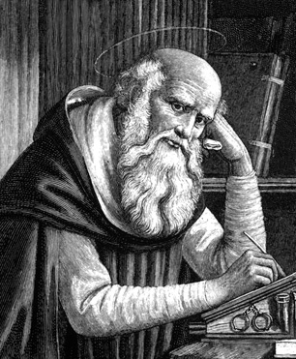
AD 400
Jerome
Jerome starts translating the Scriptures into Latin in
AD 410 and finishes 25 years later. This translation, called the Latin Vulgate, remains the basic Bible for many centuries.
Jerome
1500 BC 500 BC AD 1 AD 500 AD 1000 AD 1500 AD 1900 AD 2000

Slide 47
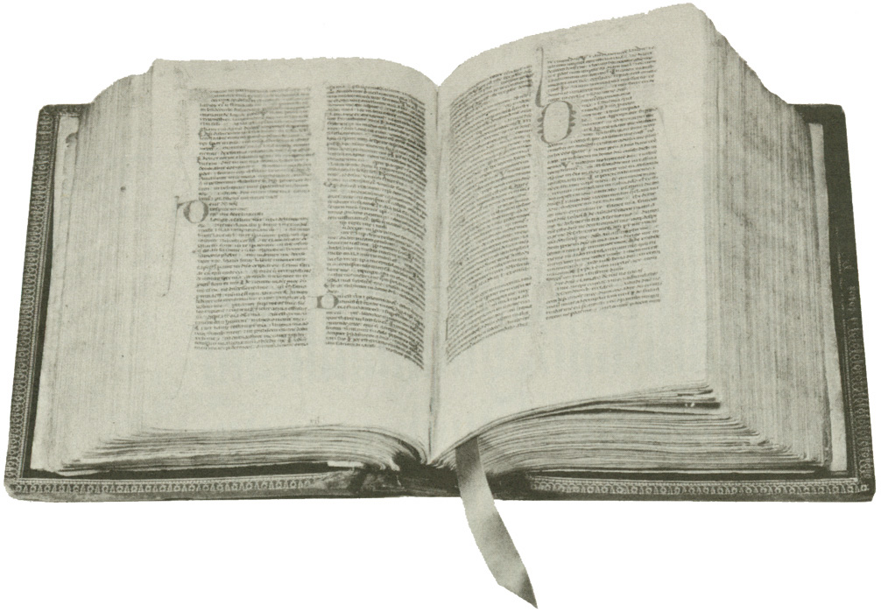
Jerome Follows Origen & His Columned Hexapla.
Pope Damasus of Rome assigns his secretary Jerome of Aquileia the task of translating the Bible into a standard – or vulgate – version.
The entrenched local usage and propagation of numerous & variegated versions in the Old Latin created controversy.
In translating the Old Testament, Jerome forgoes the Septuagint Greek for the ancient Hebrew, causing him to run into conflict with Augustine of Hippo. Jerome regarded the Hebrew language as superior to the Greek version & preferred the shorter Hebrew Canon of Scripture.
THIS DECISION HAD ENORMOUS CONSEQUENCES HISTORICALLY!
The Latin Vulgate

Slide 48
BISHOP SUPREMACY
ROMAN ADVANTAGE
POPULATION CITY OF ROME
Size Of City
Size Of Church
IMPERIAL CAPITAL
After Milan Edict Emperors’ Advisor
LANGUAGE
Latin Lesser Ability Express Subtle Nuance
LOCATION
Of The Five Patriarchs Only Rome In The West
MISSIONARY OUTREACH
West Converted Tribes Eastern Persians Not
BARBARIAN INVASIONS
Western Empire Falls Church Only Stability

Slide 49
Jerome and the Latin Vulgate
The Latin text that Jerome finished in AD 405 became known as the “Vulgate” (or “Common”) Bible.
For nearly 1,500 years, the Vulgate was the Bible of the Roman Catholic Church.

Slide 51
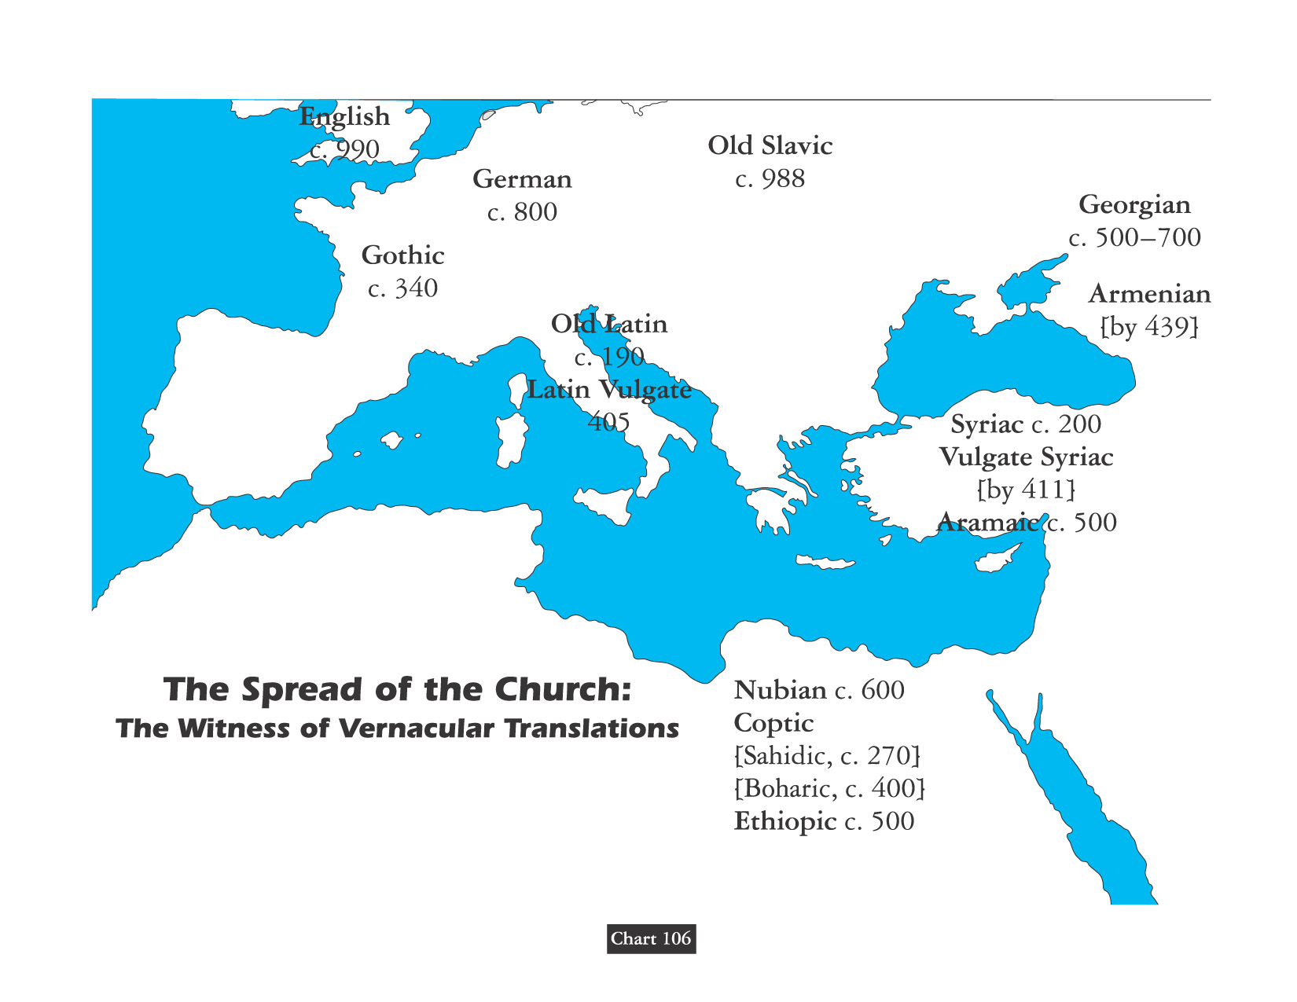
“Translation it is that openeth the window, to let in the light.” – Miles Smith

Slide 52
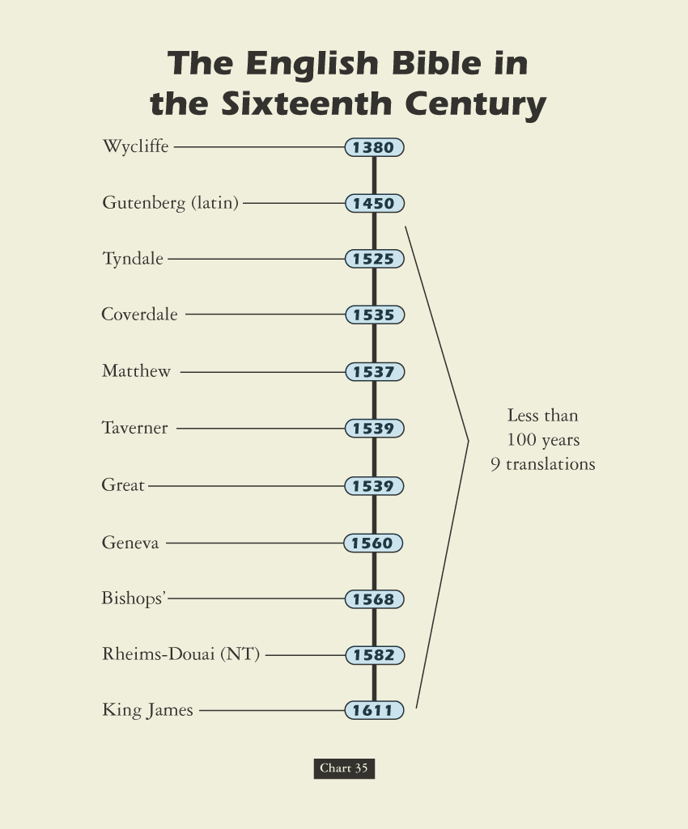
David Lee Burris:
The Bible is a book of stories; but the Bible as a book has a fascinating story of its own.

Slide 53
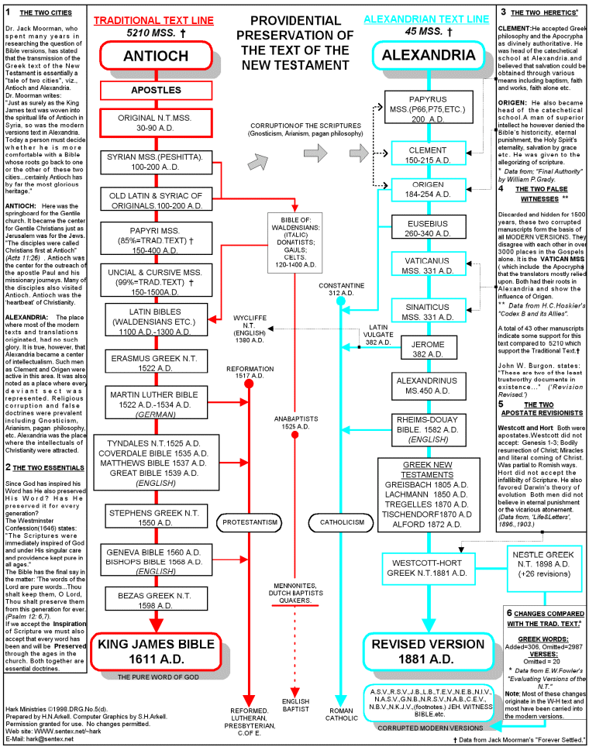

Slide 54
TODAY
Accuracy & Precision
For most the time the Bible has been in existence, manuscripts were copied by hand. Many times the words being copied are very close in appearance, and it is easy to make a mistake in a handwritten manuscript.
COPYIST
ERRORS
DO EXIST!
1500 BC 500 BC AD 1 AD 500 AD 1000 AD 1500 AD 1900 AD 2000

Slide 55
TODAY
Accuracy & Precision
The number 4, for example, is rbh in Hebrew while the number 40 is rbym. In the King James translation of 1st Kings 4:26, we are told that Solomon had 12,000 horses. Second Chronicles says there were 4,000 stalls and 1st Kings says there were 40,000 stalls. Any honest reader is going to realize that 40,000 stalls for 12,000 horses does not make much sense. Thus, somewhere in copying there was an error made as the words rbym and rbh were confused and the error copied.
COPYIST
ERRORS
DO EXIST!
1500 BC 500 BC AD 1 AD 500 AD 1000 AD 1500 AD 1900 AD 2000

Slide 56
TODAY
Translation Typology
The word-for-word versions most accurately follow the Hebrew, Aramaic and Greek texts. Generally speaking, the King James Version and its modern counterpart, the New Kings James Version, are word-for-word translations. About 98% of the 4,500 Greek manuscripts known agree with the basic text of the King James Bible. Even the variations that do exist rarely affect the basic meaning of the remaining two percent of those manuscripts.
WORD-FOR-WORD
1500 BC 500 BC AD 1 AD 500 AD 1000 AD 1500 AD 1900 AD 2000

Slide 57
TODAY
Translation Typology
The thought-for-thought translation is helpful in conveying the point of ancient figures of speech – idioms – that would make sense to us in our modern language.
In general, meaning-to-meaning versions use up-to-date language and thus are easier to understand – although they are not the best choice for establishing doctrine because they at times involve some interpretation of what the original writers intended to say.
Meaning-to-Meaning
1500 BC 500 BC AD 1 AD 500 AD 1000 AD 1500 AD 1900 AD 2000

Slide 58
TODAY
Translation Typology
We should be cautious working with these because the authors exercised considerable ‘poetic license’ in interpreting biblical terms and passages according to their own personal religious ideas.
Paraphrased types often can be consulted to better grasp the story flow but should also be considered inadequate sources for accurately determining the meaning of a text.
Paraphrased Editions
1500 BC 500 BC AD 1 AD 500 AD 1000 AD 1500 AD 1900 AD 2000

Slide 59
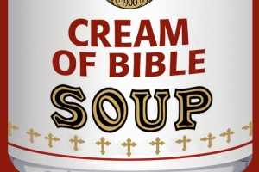
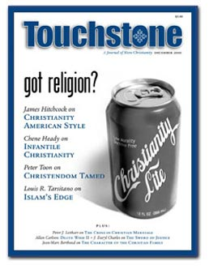

Slide 60
Robert R. Taylor Jr. Wrote in a 2010 Church Bulletin:
“Many of the modern translations have added by putting denominational creeds into the very text of the Bible. They were dangerous enough when they were in separate books. They became even more dangerous when these creeds became footnotes at the bottom of pages in the Catholic Bibles. Now they are infused into the very text itself. Calvinism, sectarianism, modernism, millennialism – all have been brought into the Bible.

Slide 61
Robert R. Taylor Jr. Wrote in a 2010 Church Bulletin:
Subtraction is the characteristic of the Reader’s Digest Bible. It’s makers, including Bruce Metzger, cut out about 50% of the O.T. and about 25% of the N.T. This makes for about a 40% reduction. They left out over 300,000 words of the 775,000 words of Divine revelation. Yet I have heard people say, ‘One of the reasons I love the new Bibles is because they contain so much more truth.’ How naïve such an assessment is! The truth is that they, the new Bibles, get shorter and shorter. Like sermons, many people prefer shorter ones rather than longer ones! The devil surely votes for shorter ones.

Slide 62
Robert R. Taylor Jr. Wrote in a 2010 Church Bulletin:
Translators have tampered with Truth by addition, reduction, modification, alteration and substitution. They have tampered with it when they have left their post of translation and become interpreters. Many times they want to tell us what they think it means – not what it says in the original Hebrew, Aramaic, and Greek.

Slide 63
Robert R. Taylor Jr. Wrote in a 2010 Church Bulletin:
They have tampered with it by making it contradict itself. Any number of them, including the highly heralded English Standard Version, will have Christ declare in Matthew 5 & verse 17 that He did not come to abolish or annul Mosaic law and yet have the apostle Paul affirm in Ephesians 2:15 that Christ did abolish or annul it.
They have tampered with the marvelous word monogenes of John 1:14, 18; 3:16 & 1st John 4, verse 9. Older translations like the KJV and the ASV retain ‘only begotten.’ So does the new King James Version, which is a fairly new version. The newer ones will have Jesus as the ‘only’ Son or the ‘One and only’ Son. This deals with the ‘mono’ portion of the word. Mono means one or only. What does genes mean? It has to mean something, else it would not have been used. I have traced and researched this word in the first century, among the anti-Nicene fathers, the post-Nicene fathers, the Reformation greats, the Restoration scholars… ‘Only begotten’ received the favorable vote of countless hundreds of
such Bible students. Jesus Christ is God’s only begotten Son, but
He is not God’s only Son. John 1:12 tells us how we may become the sons of God. John in 1st John 3:1 calls the saints of God the ‘sons of God.’

