Slide 1
Chinese Alphabet Speaks Volumes Biblically
Open Source Edited
by David Lee Burris

Slide 2
The Chinese Language
Is the oldest, continuous written language in the World
First written over 4,500 years ago
The inventors of the written language drew pictures to express words or ideas
Simple pictures were combined to make more complex thoughts
Notes:
Goals of this lesson:
Demonstrate the bible is not just an English book but refers to their history as well. It applies to them.
Tie the two languages together.
Give them a foundation of understanding and build their faith
Build their faith in the Bible as God’s word
Ensure the Chinese people read the bible in their language and work with them on the English as appropriate

Slide 3
Simple pictures were combined to make more complex thoughts
For Example…..
+
=
Mouth
Man (legs)
Older Brother
The “mouth man” or “spokes person” for the family was usually the oldest son or brother
Notes:
Building blocks
Why did they choose these two words to mean this?
I’m going to give a guess, you’re free to give your own. The older brother or the oldest is the spokes person.
A book was written by a chinese man named C.H. Kang called “The Discovery of Genesis” (Concordia publishing. Kang/Nelson)

Slide 4
Simple pictures were combined to make more complex thoughts
Well known history and
common everyday things were
used to make a word so people
could remember it
For Example…..
+
=
Mouth
Man (legs)
Older Brother
The “mouth man” or “spokes person” for the family was usually the oldest son or brother
Notes:
In building the chinese language originally, they would select items and pictures which everyone understood and were common in their era.

Slide 5
Long before Buddha, the Chinese people worshipped the same God described in the Bible!!!!
The Proof is in the Ancient Chinese Characters

Slide 6
Long before Buddha, the Chinese people worshipped the same God described in the Bible!!!!
The Proof is in the Ancient Chinese Characters
2000 A.D.
2500 B.C.
1400 B.C.
600 B.C.
30 A.D.
Chinese language first written
Buddha
Death of Jesus
Today
First five books of Bible written
Notes:
Approx 1500 years after the flood

Slide 7
Long before Buddha, the Chinese people worshipped the same God described in the Bible!!!!
The Proof is in the Ancient Chinese Characters
2000 A.D.
2500 B.C.
600 B.C.
30 A.D.
Chinese language first written
Buddha
Death of Jesus
Today
“Shang Di” was the god of China before Buddha. He was the creator God and animal sacrifice was offered to him.

Slide 8
Long before Buddha, the Chinese people worshipped the same God described in the Bible!!!!
Shang Di
2000 A.D.
2500 B.C.
600 B.C.
30 A.D.
Chinese language first written
Buddha
Death of Jesus
Today
During the first three dynasties of China: Hsia, Shang, Chou, ……
the Chinese people worshiped Shang Di
Notes:
Shaw, Shung, Chou are the phonetic pronunciations

Slide 9
Long before Buddha, the Chinese people worshipped the same God described in the Bible!!!!
Buddha
Shang Di
2000 A.D.
2500 B.C.
600 B.C.
30 A.D.
Chinese language first written
Buddha
Death of Jesus
Today
Worship of Buddha came to China from India in about 50 B.C.
The god of the Bible was re-introduced to China when foreigners came from Europe
Notes:
The purpose of this slide is to demonstrate that Jehova/Shang Di/I am has been God in China much longer than Buddha. And Buddha is a fairly recent god.

Slide 10
Many in China Today believe that the Bible is a Western book
They believe it is simply myth and fable written by western men
They think of it as an English book
HOWEVER!

Slide 11
The Bible is not a Western Book
The Bible was not written in English but in Hebrew & Greek
It’s first writers were from Egypt & Babylon (Iraq)
The first five books were written by Moses, an adopted son of the king of Egypt (1400 B.C.)
These five books focus on the beginning of the nation of Israel; but the first 11 chapters of the Bible records the history that all nations have in common

Slide 12
We will prove that the
Ancestors of the modern Chinese
knew the same stories that are
in the first part of the Bible
We will now examine some stories in the Bible
Then
Show Chinese Characters which demonstrate the same story
Notes:
Emphasize that it is the stories not the bible that the ancient chinese knew

Slide 13
How Nations & our Languages became Divided
Now the whole earth used the same language and the same words. And it came about as they journeyed east, that they found a plain in the land of Shinar (Babylon) and settled there. And they said to one another, "Come, let us make bricks and burn them thoroughly." And they used brick for stone, and they used tar for mortar. And they said, "Come, let us build for ourselves a city, and a tower whose top will reach into heaven, and let us make for ourselves a name; lest we be scattered abroad over the face of the whole earth.“ (Continued)
Notes:
Get your bible out here and go through these verses with them in chinese

Slide 14
How Nations & our Languages became Divided
And the LORD came down to see the city and the tower which the sons of men had built. And the LORD said, "Behold, they are one people, and they all have the same language. And this is what they began to do and now nothing which they purpose to do will be impossible for them. "Come, let Us go down & there confuse their language, that they may not understand one another's speech." So the LORD scattered them abroad from there over the face of the whole earth; and they stopped building the city.
Therefore its name was called Babel, because there the LORD confused the language of the whole earth; and from there the LORD scattered them abroad over the face of the whole earth. (Genesis 11:1-9 NASB)

Slide 15
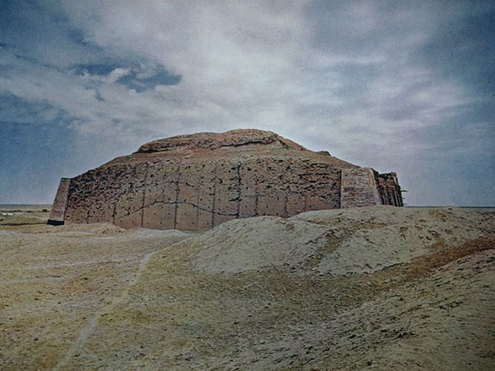
Ziggurat remains at Ur

Slide 16
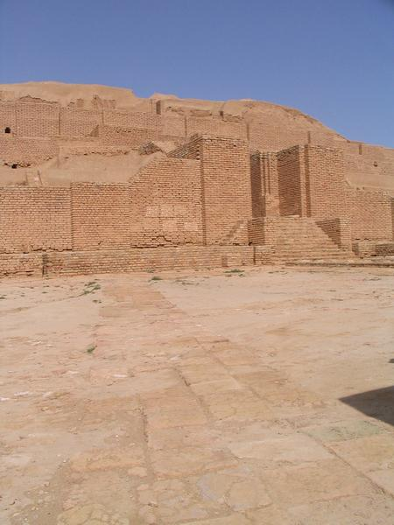
Ziggurat of Babylon

Slide 17
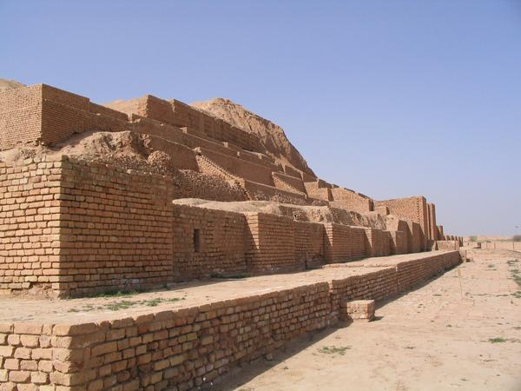
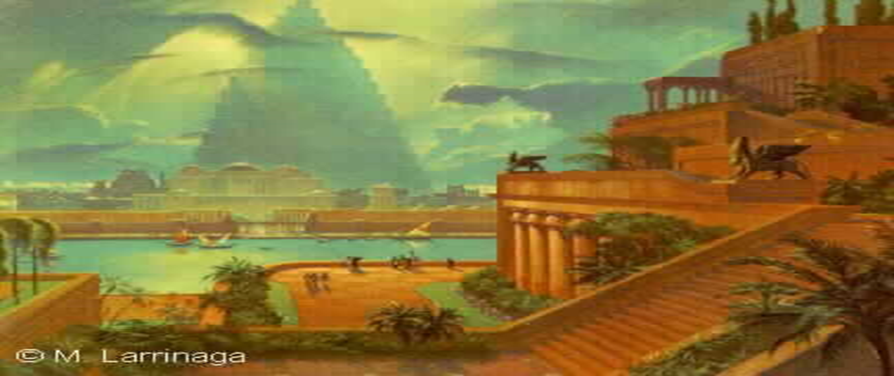
Ziggurat of Babylon

Slide 18
Notice the main points of this story in the Bible
Took place 5000 years ago
World’s oldest written language (Chinese) is more that 4500 years old
Languages were divided
People were scattered

Slide 19
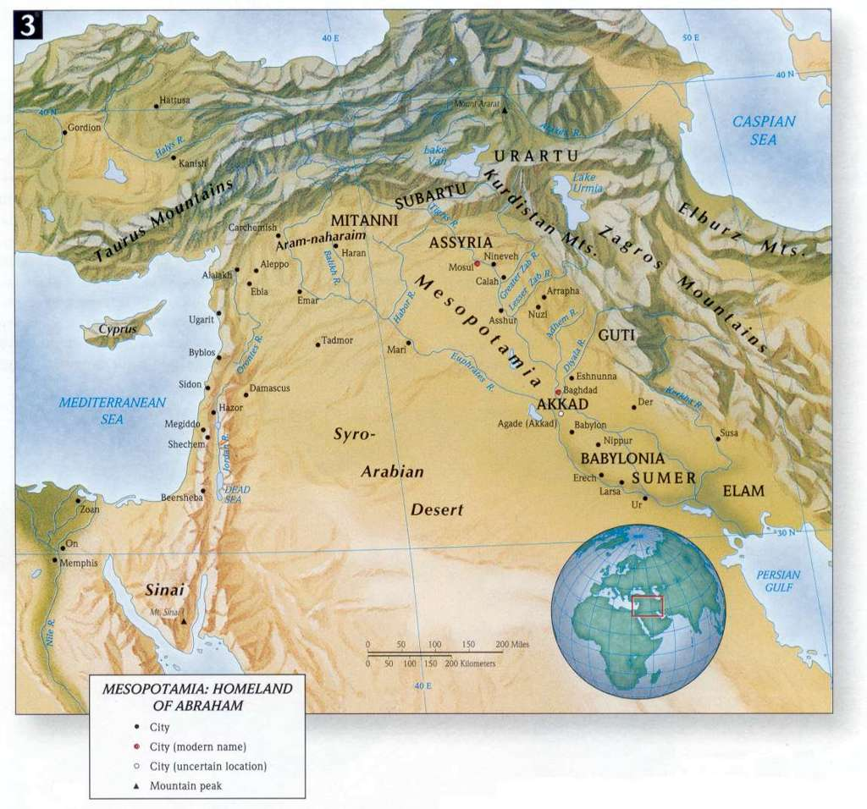
Location of the Tower of Babylon
2500-3000 B.C. Today it is Iraq

Slide 20
If the Bible is true, all nations migrated or moved from Babylon

Slide 21
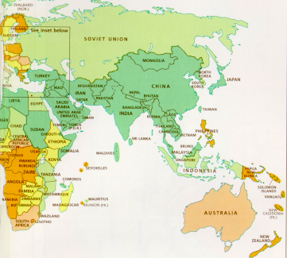
The Chinese would have migrated or walked from the west to China
N
W
E
S

Slide 22
The Chinese
walked from the
west after a
great division
To Migrate, to Move
+
+
=
+
Great
Division
West
Walk
Migrate
Notes:
NOTICE: the character above for migrate is quite ancient. Some people will not recognize it, but they will not deny it typically.
You might want to ask if they recognize it.
Mention it may be coincidence. But you let me know when you no longer believe it is a coincidence.

Slide 23
GOD CREATED
Then the LORD God formed man of dust from the ground, and breathed into his nostrils the breath of life; and man became a living being. (Genesis 2:7)

Slide 24
Then the LORD God CREATED man of dust from the ground, and breathed into his nostrils the breath of life; and man became a living being. (Genesis 2:7)
+
+
=
DUST BREATH ALIVE TO TALK
MOUTH
+
=
TO TALK WALKING TO CREATE
Notes:
Bring up the fact that the word mouth over time came to represent the whole body or the whole person – a “man”.
Thus this is a “Dust Man”. He did breath. Thus a “Living Dust Man”
Note that the slash for alive is also ancient and is seldom used by itself. You may need to explain this to the younger kids.
Many of these ancient characters where dropped when the Chinese language was simplified over time. The latest simplification occurred under “Mau – See – Tongue” (Mauste Tung) in approx 1971.

Slide 25
According to the Bible The First Man was a Living Dust Man
+
+
=
ALIVE
DUST
MAN
FIRST
According to the Chinese Language, 4500 years ago this was also believed in China

Slide 26
Happiness or Blessing
+
+
+
God
One
Man
Garden
In the beginning God and the man had close fellowship, this leads to true happiness!
Notes:
Nice word. It has the word Shan-Di. For example, necklaces have this word on them.

Slide 27
FELLOWSHIP IS LOST
Man sins and has to leave the garden
SIN
GOD
MAN
Man’s guilt separates him from God
Notes:
Emphasize the rest of the bible is about restoring fellowship that was lost with this sin.

Slide 28
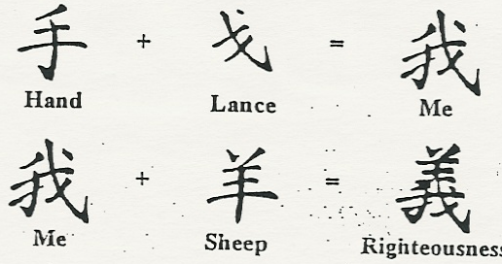
Righteousness or “not Guilty”
Notes:
It is difficult to know when to do this slide. It is powerful but must be used when they are ready for it. It should typically brought in when talking about recompense and forgiveness through baptism.

Slide 29
Garden of Eden
Eden was east for Moses
West
N
W
E
S
Notes:
What you want to show the Chinese with this slide is that the people in China who came from the tower of babel would get asked by their kids where they came from they would say west and point toward the tower of babel.

Slide 30
And God planted a garden eastward, in Eden; and there he put the man whom he had formed.
+
+
=
One, First
Person
Enclosure Garden
West

Slide 31
The First Man Needs a Woman
And the Lord God said, It is not good for the man to be by himself: I will make one like himself as a help to him And from the earth the Lord God made every beast of the field and every bird of the air, and took them to the man to see what names he would give them: and whatever name he gave to any living thing, that was its name. And the man gave names to all cattle and to the birds of the air and to every beast of the field; but Adam had no one like himself as a help. And the Lord God sent a deep sleep on the man, and took one of the bones from his side while he was sleeping, joining up the flesh again in its place: And the bone which the Lord God had taken from the man he made into a woman, and took her to the man. And the man said, This is now bone of my bone and flesh of my flesh: let her name be Woman because she was taken out of Man. For this cause will a man go away from his father and his mother and be joined to his wife; and they will be one flesh. (Genesis 2:18-24 BBE)
Notes:
Read this out of the chinese bible
One thing to emphasize here is that god told man to name all the animals. You can see that the man is looking at all these animals but there is not one that is like him. So what does god do? Made a woman. So this woman was necessary for him. He desired her more than the animals so let’s look at some words for necessary, desire and want

Slide 32
And God said, It is not good that the man should be alone; I will make him a helper suited for him. (Genesis 2:18)
+
=
West
Woman
To want, to desire, necessary
+
+
=
Man
Garden
One
Notes:
Before going on to the bottom line, ask them Why would the people putting the language together originally? Why not choose north or south or another word to go with woman to make desire/want/necessary.
But if you break it down, the west really is first man in the garden. So you can see why they didn’t choose west, they chose one man in the garden with a woman was necessary. Look how important the woman was – she was necessary to hold up the man… ☺
Still coincidence? Or do you see something here. Let’s go on and see.

Slide 33
And God said, It is not good that the man should be alone; I will make him a helper suited for him. (Genesis 2:18)
+
=
Two
People
Beginning, First

Slide 34
And the Lord God made a garden in the east, in Eden; and there he put the man whom he had made. And out of the earth the Lord made every tree to come, delighting the eye and good for food; and in the middle of the garden, the tree of life and the tree of the knowledge of good & evil. (Genesis 2:8-9 BBE)
How many special trees were in the middle of the garden?
TWO TREES
Notes:
This is real important when you set this up. Try to get them to read it out of their chinese bible.
You’ve got to establish that God made all the trees but emphasize that god mad two special trees in the middle of the garden.

Slide 35
And the Lord God gave the man orders, saying, You may freely take of the fruit of every tree of the garden: But of the fruit of the tree of the knowledge of good and evil you may not take; for on the day when you take of it, death will certainly come to you. (Genesis 2:16-17 BBE)
Man was forbidden to eat one of the two trees -- if he ate the forbidden tree the other would be taken from him also.
+
=
Two Trees
Command
Forbidden
Notes:
From time to time go back and re-iterate the time line and the fact that these characters where written before the bible, and many years after these stories but not so long after that the stories were forgotten.

Slide 36
The Woman & the Forbidden Fruit
Now the snake was wiser than any beast of the field which the Lord God had made. And he said to the woman, Has God truly said that you may not take of the fruit of any tree in the garden? And the woman said, We may take of the fruit of the trees in the garden: But of the fruit of the tree in the middle of the garden, God has said, If you take of it or put your hands on it, death will come to you. And the snake said, Death will not certainly come to you: For God sees that on the day when you take of its fruit, your eyes will be open, and you will be as gods, having knowledge of good and evil. (Genesis 3:1-5)
Notes:
Get them to read through verse 11 in their bible then come back and read in English.

Slide 37
The Woman & the Forbidden Fruit
When the woman saw that the tree was good for food, and that it was a delight to the eyes, and that the tree was desirable to make one wise, she took from its fruit and ate; and she gave also to her husband with her, and he ate. Then the eyes of both of them were opened & they knew that they were naked; and they sewed fig leaves together and made themselves loin coverings. (Genesis 3:6-8 NASB)
+
=
Two Trees
Woman
To Covet, desire
Notes:
Emphasize the read points above. Make it fun. She looked up and saw that tree and Uummmmmm. It looked good. This character also is one used with sexual connotations of lust and desire.

Slide 38
The Chinese people 4500 years ago associated the devil with a garden and two trees
+
+
+
=
Life or Motion
Secret, private
Garden
Man
Devil, Satan
=
+
+
Tempter
Devil
Two Trees
Cover
Notes:
Note without mentioning that the chinese call white western people the word devil/satan
NOTE: the first two characters above are ancient and more modern chinese people may not be familiar with them.
IMPORTANT: Emphasize before going to the next slide “ Now what did the man and woman realize once they ate from the forbidden tree” . Make them say the word “Naked”

Slide 39
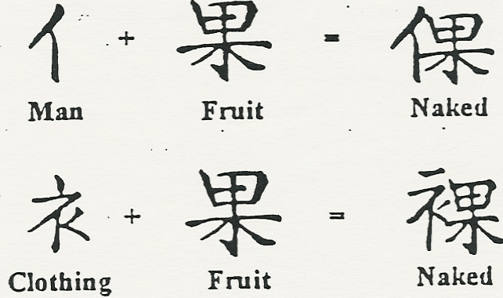
After Eating the Fruit they realized they were naked
D
D
Notes:
Isn’t it interesting that in the bible the word fruit and the word naked are connected. Can you think of any other reason or explanation for why your ancestors would connect fruit and man/clothing into the word naked.

Slide 40

Notes:
Isn’t it interesting that in the bible the word fruit and the word naked are connected. Can you think of any other reason or explanation for why your ancestors would connect fruit and man/clothing into the word naked.

Slide 41
Genesis 3:6 … she took of the fruit thereof, and did eat; ...
Genesis 3:16 Unto the woman he said, I will greatly multiply thy pain and thy conception; in pain thou shalt bring forth children; and thy desire shall be to thy husband, and he shall rule over thee.
+
=
A piece
Two Trees
Pain

Slide 42
Man’s Punishment with weeds & thorns
And to Adam he said, Because you gave ear to the voice of your wife and took of the fruit of the tree which I said you were not to take, the earth is cursed on your account; in pain (Sorrow) you will get your food from it all your life. Thorns and weeds will come up, and the plants of the field will be your food; With the hard work of your hands you will get your bread till you go back to the earth from which you were taken: for dust you are and to the dust you will go back. (Genesis 3:17-19 BBE)

Slide 43
GENESIS 3:17-19
+
=
ANCIENT WEEDS SORROW
Notes:
Why weeds in the word sorrow?

Slide 44
The First Murder
The Older Brother,
Cain, killed the
Younger brother Abel
And the man had connection with Eve his wife, and she became with child and gave birth to Cain, and said, I have got a man from the Lord. Then again she became with child and gave birth to Abel, his brother. And Abel was a keeper of sheep, but Cain was a farmer. And after a time, Cain gave to the Lord an offering of the fruits of the earth. And Abel gave an offering of the young lambs of his flock and of their fat. And the Lord was pleased with Abel's offering; But in Cain and his offering he had no pleasure. And Cain was angry and his face became sad. And the Lord said to Cain, Why are you angry? and why is your face sad? If you do well, will you not have honour? and if you do wrong, sin is waiting at the door, desiring to have you, but do not let it be your master. And Cain said to his brother, Let us go into the field: and when they were in the field, Cain made an attack on his brother Abel and put him to death. (Genesis 4:1-8)
Notes:
Have them read through v 15 in their own bible. Ask probing questions and clarifying questions to make sure they understand including who was the murderer and the fact that he was the OLDER brother. Emphasize that God put a mark on Cain to keep people from killing Cain. Note that one of the chinese translations mentions that the mark was on the forehead.

Slide 45
And the Lord said, Truly, if Cain is put to death, seven lives will be taken for his. And the Lord put a mark on Cain so that no one might put him to death. (Gen. 4:15)
The First Older Brother
in the Bible was violent
The words for “elder son”
and “violent” are both
Pronounced “SHUN”
+
=
MOUTH MAN ELDEST SON
Cruel,Violent
Notes:
Note the mark. Further note that the pronunciation of older brother and violent is the same “Shun”. You may want them to say both.

Slide 46
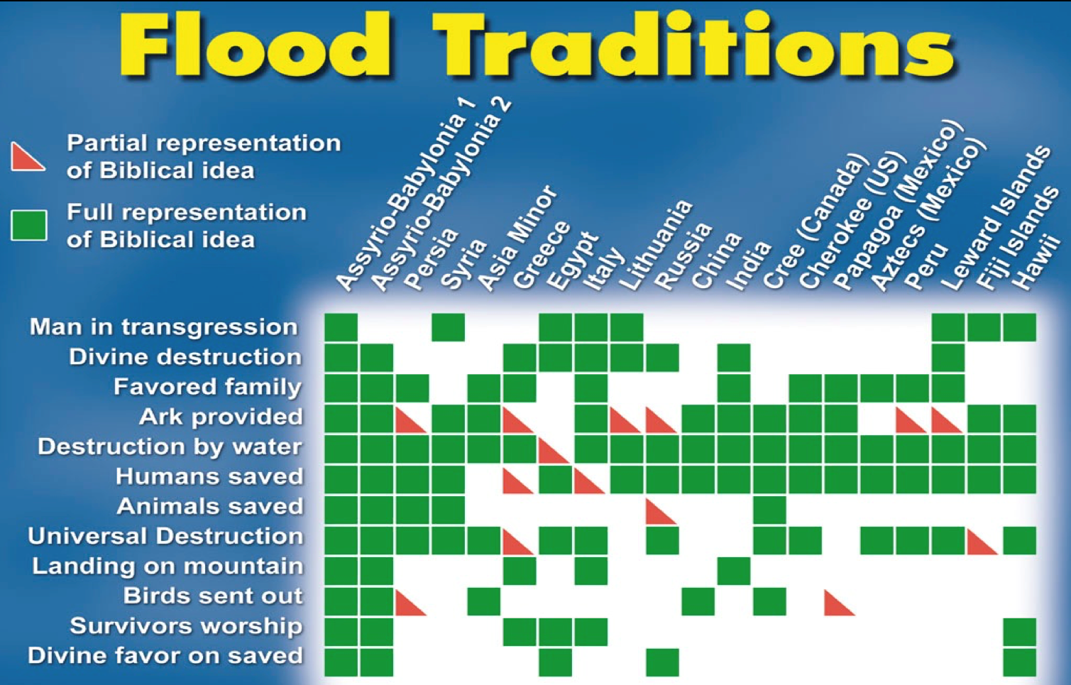

Slide 47
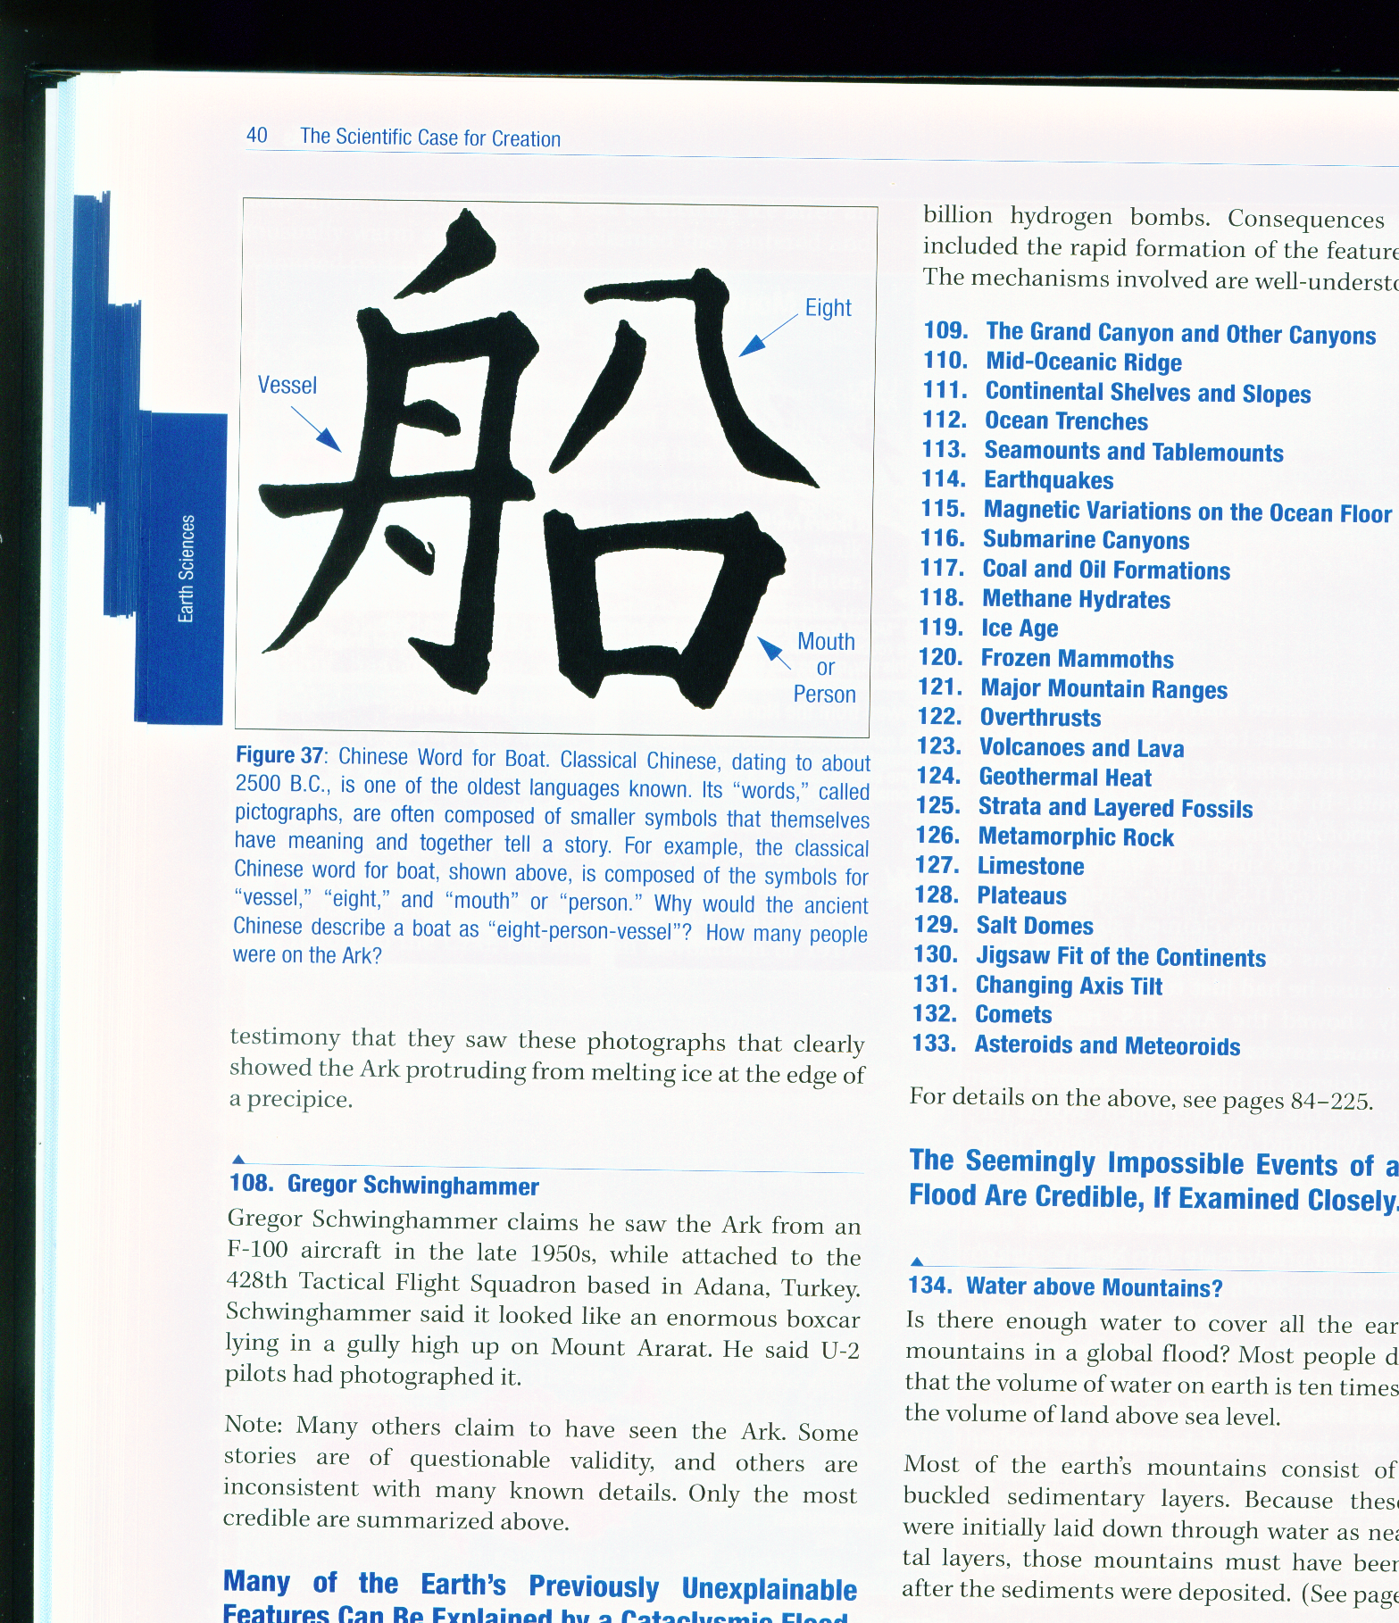
Genesis 1-11
Prevalence of flood traditions
Myth?
History!

Slide 48
The Great World Flood
Noah, his wife, three sons, and their wives
Eight people
On the boat
And the earth was evil in God's eyes and full of violent ways. And God, looking on the earth, saw that it was evil: .…And God said to Noah, The end of all flesh has come; ….and now I will put an end to them with the earth. Make for yourself an ark of gopher wood with rooms in it, and make it safe from the water inside and out. …..For truly, I will send a great flood of waters over the earth, …everything on the earth will come to an end. But with you I will make an agreement; and you will come into the ark, you and your sons and your wife and your sons' wives with you. (Genesis 6:11-18 BBE)
Notes:
Tell the story and make sure they understand it. Ask them how many were on the boat - 8

Slide 49
GENESIS 6:5-8; 7:7
+
+
=
Person
Eight
Boat
Large Ship
Notes:
Eight person boat = large ship

Slide 50
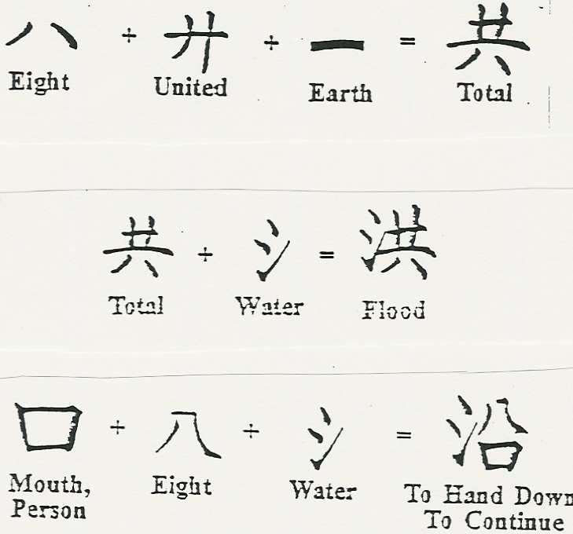

+
+
=
Person
Large Ship
Eight
Boat
How did the ancient people
Of China know these things?
They did not have a Bible!
A

Slide 51
+
+
=
Person
Large Ship
Eight
Boat
Notes:
Before showing this slide ask them the total population of the earth if the flood actually occurred.
Note the bible was handed down by eight people in a boat/water.

Slide 52
Confucius Say:
Use your
“God Given Wisdom” Wisely !

Slide 53
Wisdom Is A Gift Of God
1 Kings 3:4-5 At Gibeon the LORD appeared to Solomon in a dream by night; and God said, "Ask! What shall I give you?"
1 Kings 3:6 And Solomon said: "You have shown great mercy to Your servant David my father, because he walked before You in truth, in righteousness, and in uprightness of heart with You;

Slide 54
Solomon was really thinking
1 Kings 3:6-9 Now, O LORD my God, You have made Your servant king instead of my father David, but I am a little child; I do not know how to go out or come in. 8 And Your servant is in the midst of Your people whom You have chosen, a great people, too numerous to be numbered or counted. 9 Therefore give to Your servant an understanding heart to judge Your people, that I may discern between good and evil. For who is able to judge this great people of Yours?"

Slide 55
Solomon was really thinking
1 Kings 3:10-14 The speech pleased the LORD, that Solomon had asked this thing. 11 Then God said to him: "Because you have asked this thing, and have not asked long life for yourself, nor have asked riches for yourself, nor have asked the life of your enemies, but have asked for yourself understanding to discern justice, 12 behold, I have done according to your words; see, I have given you a wise and understanding heart, so that there has not been anyone like you before you, nor shall any like you arise after you. 13 And I have also given you what you have not asked: both riches and honor, so that there shall not be anyone like you among the kings all your days. 14 So if you walk in My ways, to keep My statutes and My commandments, as your father David walked, then I will lengthen your days."

Slide 56

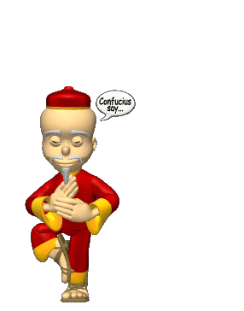
Do you think you have wisdom today ?

Slide 57

Here is a test for wisdom?
Do you really consider carefully the
decisions you make each day?
Do you take care to make sure
God’s word is considered before
any decision is reached?
Do you always decide to do what
You know is right to do?

Slide 58
Here is a test for wisdom?
Do you have a clear conscience
once a decision is made?
Are your decisions about what
you want or what is correct?
Do you consider what other
people think of your decisions?
Do you run your big decisions
by someone you have confidence
in to make sure you have not made
a mistake in judgment?

Slide 59
What happens when we lack proper wisdom?
In Solomon’s case he had to judge
between his people
Poor judgment on his part
would create a whirlwind of
troubles between his people

Slide 60
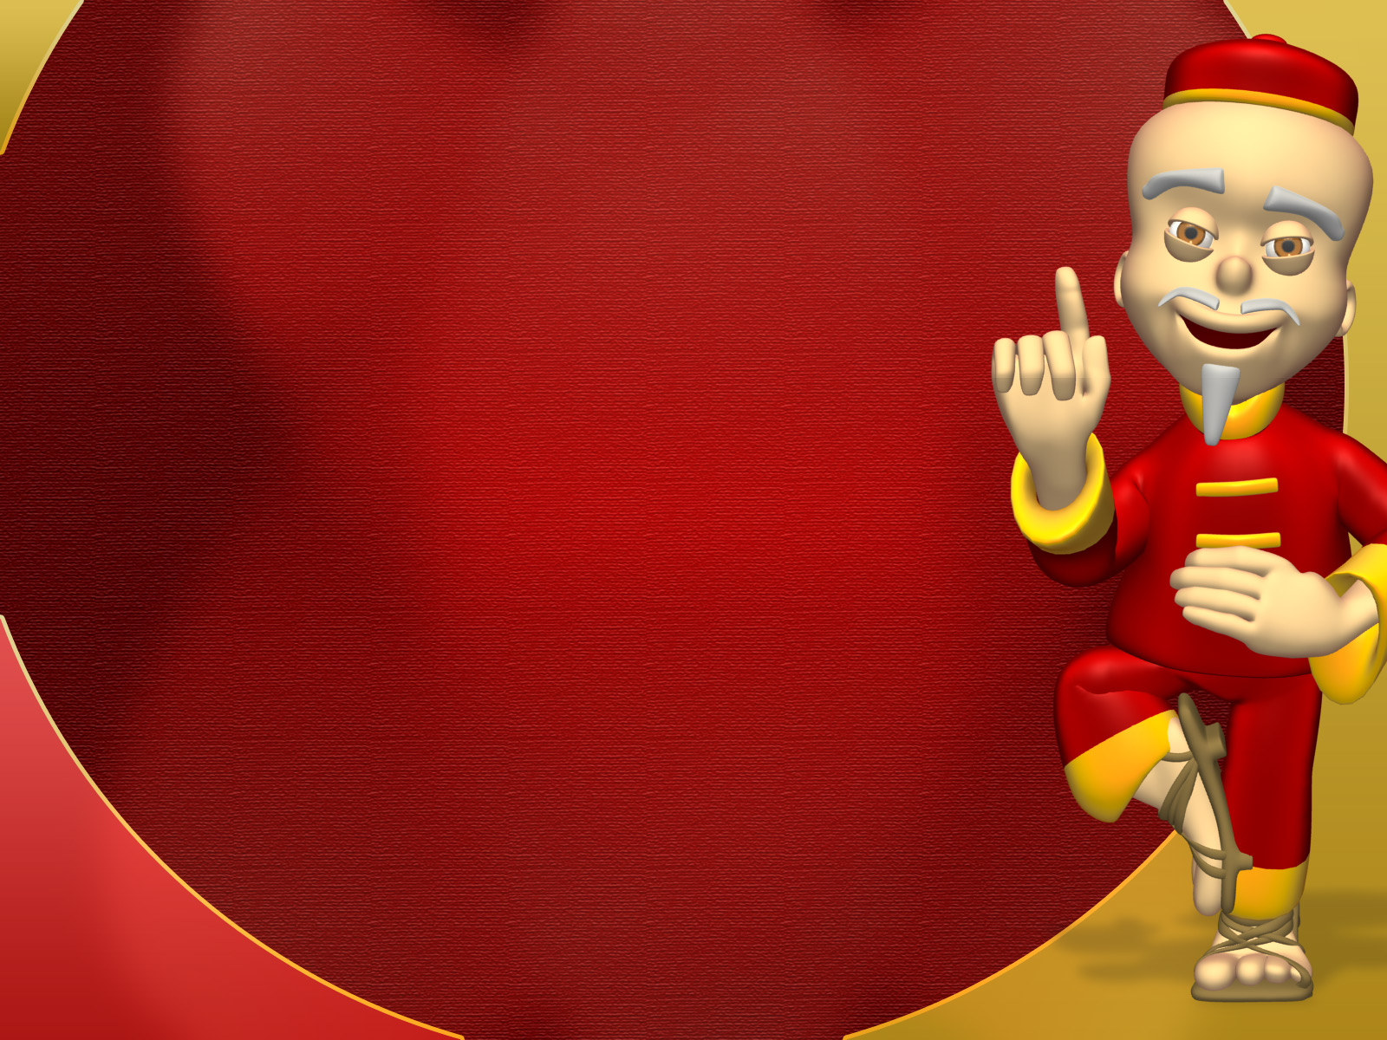
Can we resist using the wisdom we have?
Prov 9:10 "The fear of the LORD is the beginning of wisdom ,And the knowledge of the Holy One is understanding.
Prov 10:13 Wisdom is found on the lips of him who has understanding But a rod is for the back of him who is devoid of understanding.
Prov 10:21 The lips of the righteous feed many, But fools die for lack of wisdom .

Slide 61
People fail to use it daily ?
Prov 11:12 He who is devoid of wisdom despises his neighbor, But a man of understanding holds his peace.
Prov 12:8 A man will be commended according to his wisdom , But he who is of a perverse heart will be despised.
Prov 13:10 By pride comes nothing but strife, But with the well-advised is wisdom .

Slide 62
What’s the difference ?
Prov 13:11 Wealth gained by dishonesty will be diminished, But he who gathers by labor will increase.
Prov 13:13 He who despises the word will be destroyed, But he who fears the commandment will be rewarded.
Prov 13:15 Good understanding gains favor, But the way of the unfaithful is hard.

Slide 63
What’s the difference ?
Prov 14:6 A scoffer seeks wisdom and does not find it, But knowledge is easy to him who understands.
Prov 14:8 The wisdom of the prudent is to understand his way, But the folly of fools is deceit.
Prov 14:9 Fools mock at sin,
But among the upright there is favor.

Slide 64
Prov 19:8-9 He who gets wisdom loves his own soul;
He who keeps understanding will find good. 9 A false witness will not go unpunished, And he who speaks lies shall perish.
Prov 21:30 There is no wisdom or understanding Or counsel against the LORD.
Prov 23:23 Buy the truth, and do not sell it, Also wisdom and instruction and understanding.
Prov 29:15 The rod and rebuke give wisdom ,
But a child left to himself brings shame to his mother.
Eccl 1:13 And I set my heart to seek and search out by wisdom concerning all that is done under heaven; this burdensome task God has given to the sons of man, by which they may be exercised

Slide 65
How do I become a person of wisdom ?
Ezra 7:24-25 And you, Ezra, according to your God-given wisdom
Ex 36:2 Then Moses called Bezalel and Aholiab, and every gifted artisan in whose heart the LORD had put wisdom , everyone whose heart was stirred, to come and do the work
1 Kings 4:29 And God gave Solomon wisdom and exceedingly great understanding, and largeness of heart like the sand on the seashore.
1 Kings 4:34 And men of all nations, from all the kings of the earth who had heard of his wisdom , came to hear the wisdom of Solomon.

Slide 66
It is up to me to use what God has given ?
Job 34:1-4 Elihu further answered and said: 2 "Hear my words, you wise men; Give ear to me, you who have knowledge. 3 For the ear tests words As the palate tastes food. 4 Let us choose justice for ourselves; Let us know among ourselves what is good.
Job 34:34-35 "Men of understanding say to me, Wise men who listen to me: 35'Job speaks without knowledge, His words are without wisdom .' 36 Oh, that Job were tried to the utmost, Because his answers are like those of wicked men!
37 For he adds rebellion to his sin; He claps his hands among us, And multiplies his words against God."

Slide 67
And not to think more of myself than God ?
Job 38:1-6 Then the LORD answered Job out of the whirlwind, and said: 2 "Who is this who darkens counsel
By words without knowledge? 3 Now prepare yourself like a man; I will question you, and you shall answer Me. 4 "Where were you when I laid the foundations of the earth? Tell Me, if you have understanding. 5 Who determined its measurements? Surely you know! Or who stretched the line upon it? 6 To what were its foundations fastened? Or who laid its cornerstone,
Job 40:1-2 Moreover the LORD answered Job, and said:
2 "Shall the one who contends with the Almighty correct Him? He who rebukes God, let him answer it." 3Then Job answered the LORD and said: 4 "Behold, I am vile;
What shall I answer You? I lay my hand over my mouth. 5 Once I have spoken, but I will not answer; Yes, twice, but I will proceed no further."

Slide 68
Confucius Say:
Use your
God Given Wisdom Wisely,
Because Our Eternity
Is Based On How
You Use What You Have !

Slide 69


