Slide 1
R. H. Boll & 20th Century Pre-Millennial Congregational Cleansing of the Churches of Christ
Edited by David Lee Burris

Slide 2
From the very beginning of our Restoration Movement the doctrine of premillennialism was taught and embraced. None other than the “Father of the Restoration Movement”- Alexander Campbell- was a believer. (In post-millennialism- thanks BV- His second major periodical was not named the Millennial Harbinger for nothing!)
Later Restoration luminaries such as David Lipscomb and James A. Harding continued the premillennial tradition. This doctrine only increased in popularity among Churches of Christ in the early twentieth century thanks to the work of a prominent Nashville Bible School product, R. H. Boll and to J.N. Armstrong who was the first president of Harding College.
Eventually though this doctrine and those who taught it came under attack led by Foy E. Wallace, Jr. and H. Leo Boles. At one point the very future of Harding College hung in the premillennial wind. Ultimately the Wallace’s and Boles of our fellowship had their way and the “damnable doctrine” of premillennialism was pushed to the margins of our movement. – Levy Church of Christ Bulletin

Slide 3
In the early 20th Century
- R.H. Boll of the Gospel Advocate
– convinced the human heart unregenerate
- preached a Semi-Pentecostalism.

Slide 4
Robert H. Boll
1875-1956
Divisive influence @CANE RIDGE SEMI-Pentecostalism COUPLED WITH RESTORATION HERITAGE PRE-MILLENNIALISM

Slide 5
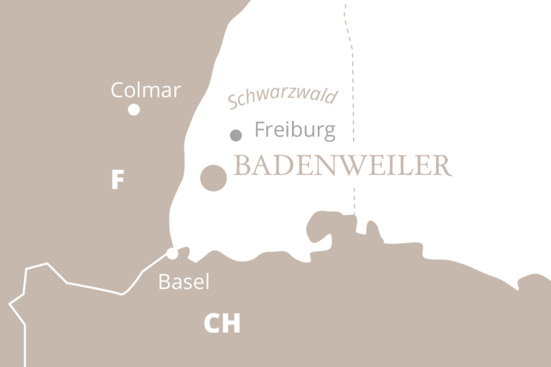
Life in Germany – 1875-1890
Robert H Boll born on June 7, 1875 in Baderweiler, Germany, a well known spa town of the Black Forest.
France
Switzerland

Slide 6
Life in Germany – 1875-1890
His parents (Max Boll and Magdalena Uhlmann) were ardent Roman Catholics. Christened in the RC on 20 June 1875.
Family moved to Basil, Switzerland in 1878. Then back to Germany
His mother wanted him to be a priest—for a while he shared that desire.
His father died when he was 9 yrs old; his 20 yr old sister had died 2 months earlier and mother remarried—step-father did not care for him

Slide 7
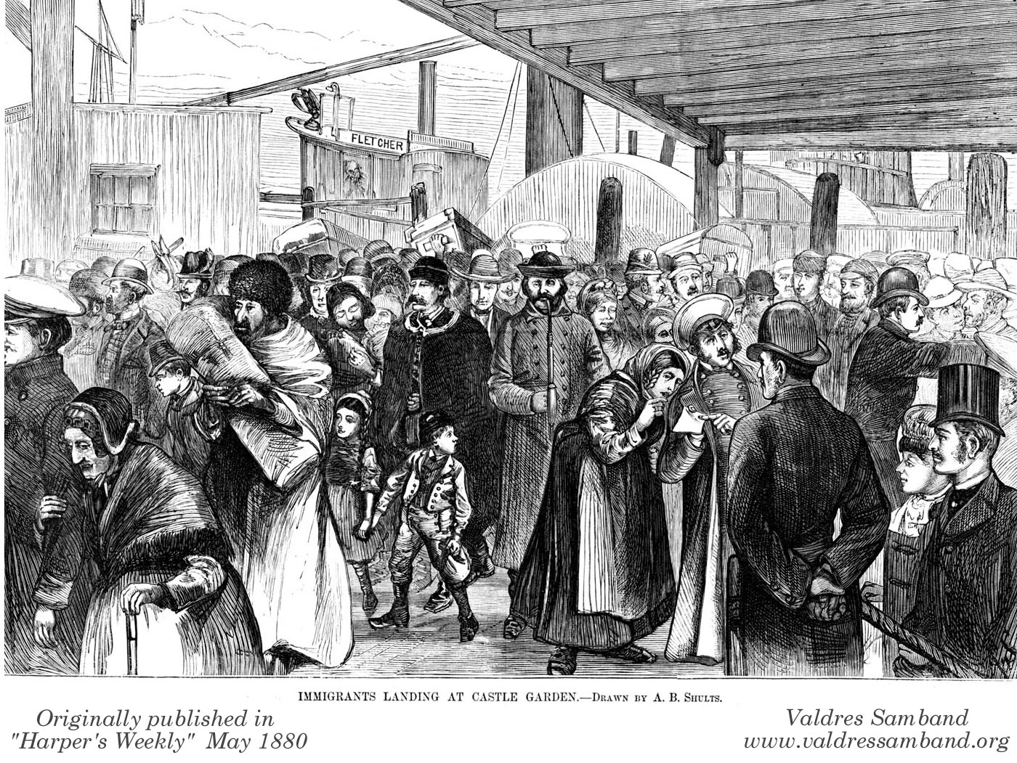
Life in Germany – 1875-1890
September 1890– He sailed for America with and aunt by marriage– arrived at Castle Garden (NYC)
He would not see his mother again-she died in 1897

Slide 8
Castle Garden to Middle Tennessee
He worked for a short time on the docks in NYC
Worked as a Bell-hop in Zanesville, OH
Worked in Columbus (Jan 1892)and Cincinnati (May 1892)– places where there was a large Catholic community.
Tell how he made it to Middle Tennessee (Rollman Article in Restoration Quarterly. (Page 15)

Slide 9
Events in Tennessee –Mid 1890’s
1892-- Working as a farm laborer – near Smyrna, TN
Baptized into Christ April 14, 1895
He was known for reading a lot-plow then rest and read- Mrs. Gooch told him he needed to go to school instead of farm work
Walked about 25 miles in rain to Nashville to ask Bro. Harding about coming to school. Refer to Word and Work, June 1922
Entered Nashville Bible School that year.

Slide 10
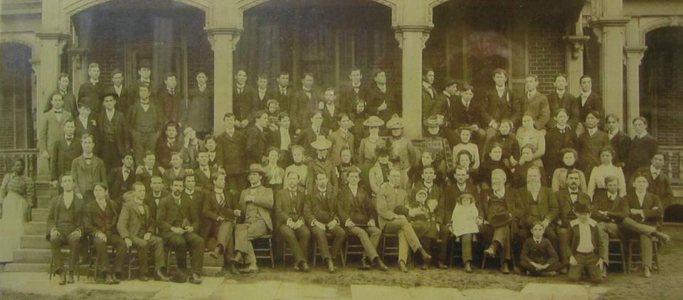
Events 1895-1904
Held first meeting in 1896 at a schoolhouse called “Accident.” (May 1956 WW)
Was a student at NBS till 1900– also taught there in 1900

Slide 11
Prophecy as a Motivation For Holy Living
Eschatological imminence as a powerful motivator in spiritual formation came early in his life
For him the recovery of eschatological imminence became part of the scriptural restorationist mandate to recover Christian origins.
Our steadfastness and perseverance depend on perpetual expectation of our Lord’s return (Christian Leader & The Way, 20 Sept. 1904)

Slide 12
“Boll was convinced that the neglect of eschatology among Churches of Christ in his day contributed to a lack of devotion and an apathy towards missions. “In his teaching,” writes Hans Rollmann, “R.H. Boll emphasized a premillennialism similar to that of Cyrus I. Scofield and William E. Blackstone, joining to it at the center of his thought a pronounced doctrine of grace and the personal indwelling of the Holy Spirit. Boll’s interest in eschatology was guided by his effort to restore to the church this vital dimension of early Christian life and thought and maintaining it as motivation for Christian spirituality and foreign missions.” His views were met with enthusiasm in some quarters; in others he met vehement opposition. Boll stayed his course, however, and continued to publish, to teach and to preach.” – Internet Search

Slide 13
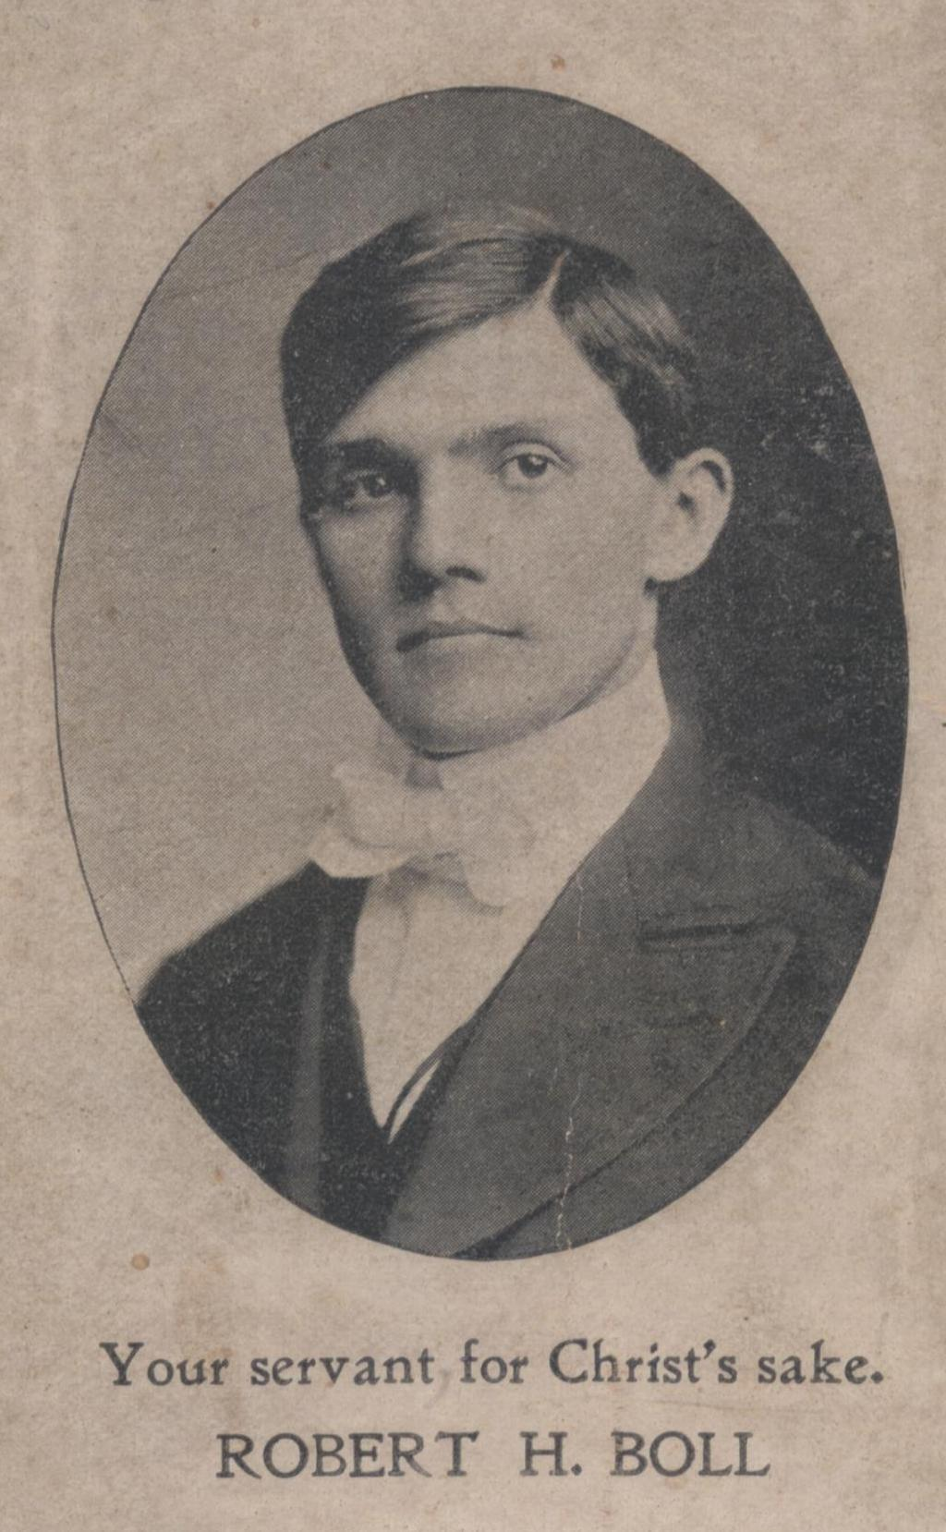
Events 1900-1904
1900-1903 – travelling evangelist
Summer 1903, along with G. W. Riggs preached in a 6 week tent meeting that helped start the Church in Los Angeles, CA.
Spent his time based in the Sherman, TX and the Area around Gallatin, TN in evangelistic work.

Slide 14
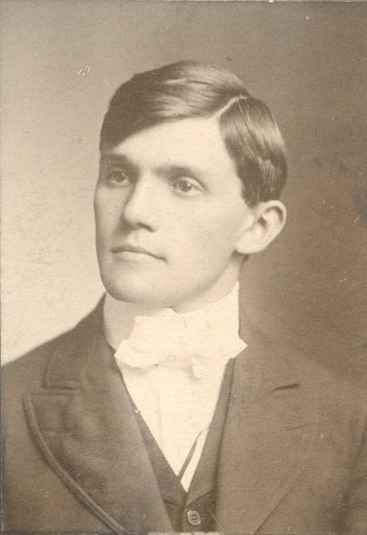
Journals Associated with 1900-1915
1899-1915 – wrote for the Gospel Advocate
1899-1904- Wrote for “The Way.”
1903-1904 – Co-Editor, along with Joe Warlick, of “Gospel Review,” Editor was Jesse P. Sewell
1909-1915 – Front Page Editor of “Gospel Advocate.
Also wrote for “The Gospel Herald,” and other papers such as “The Christian Leader.”

Slide 15
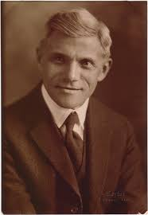
Preaching and Teaching—1904-1920
1903-first time preached at Portland Ave Church of Christ.—
1904-Started preaching at Portland Ave. Would remain there except for little over a year (1910-11) until his death in 1956.
1909-He and E L Jorgenson preached in meetings in Cincinnati, OH

Slide 16
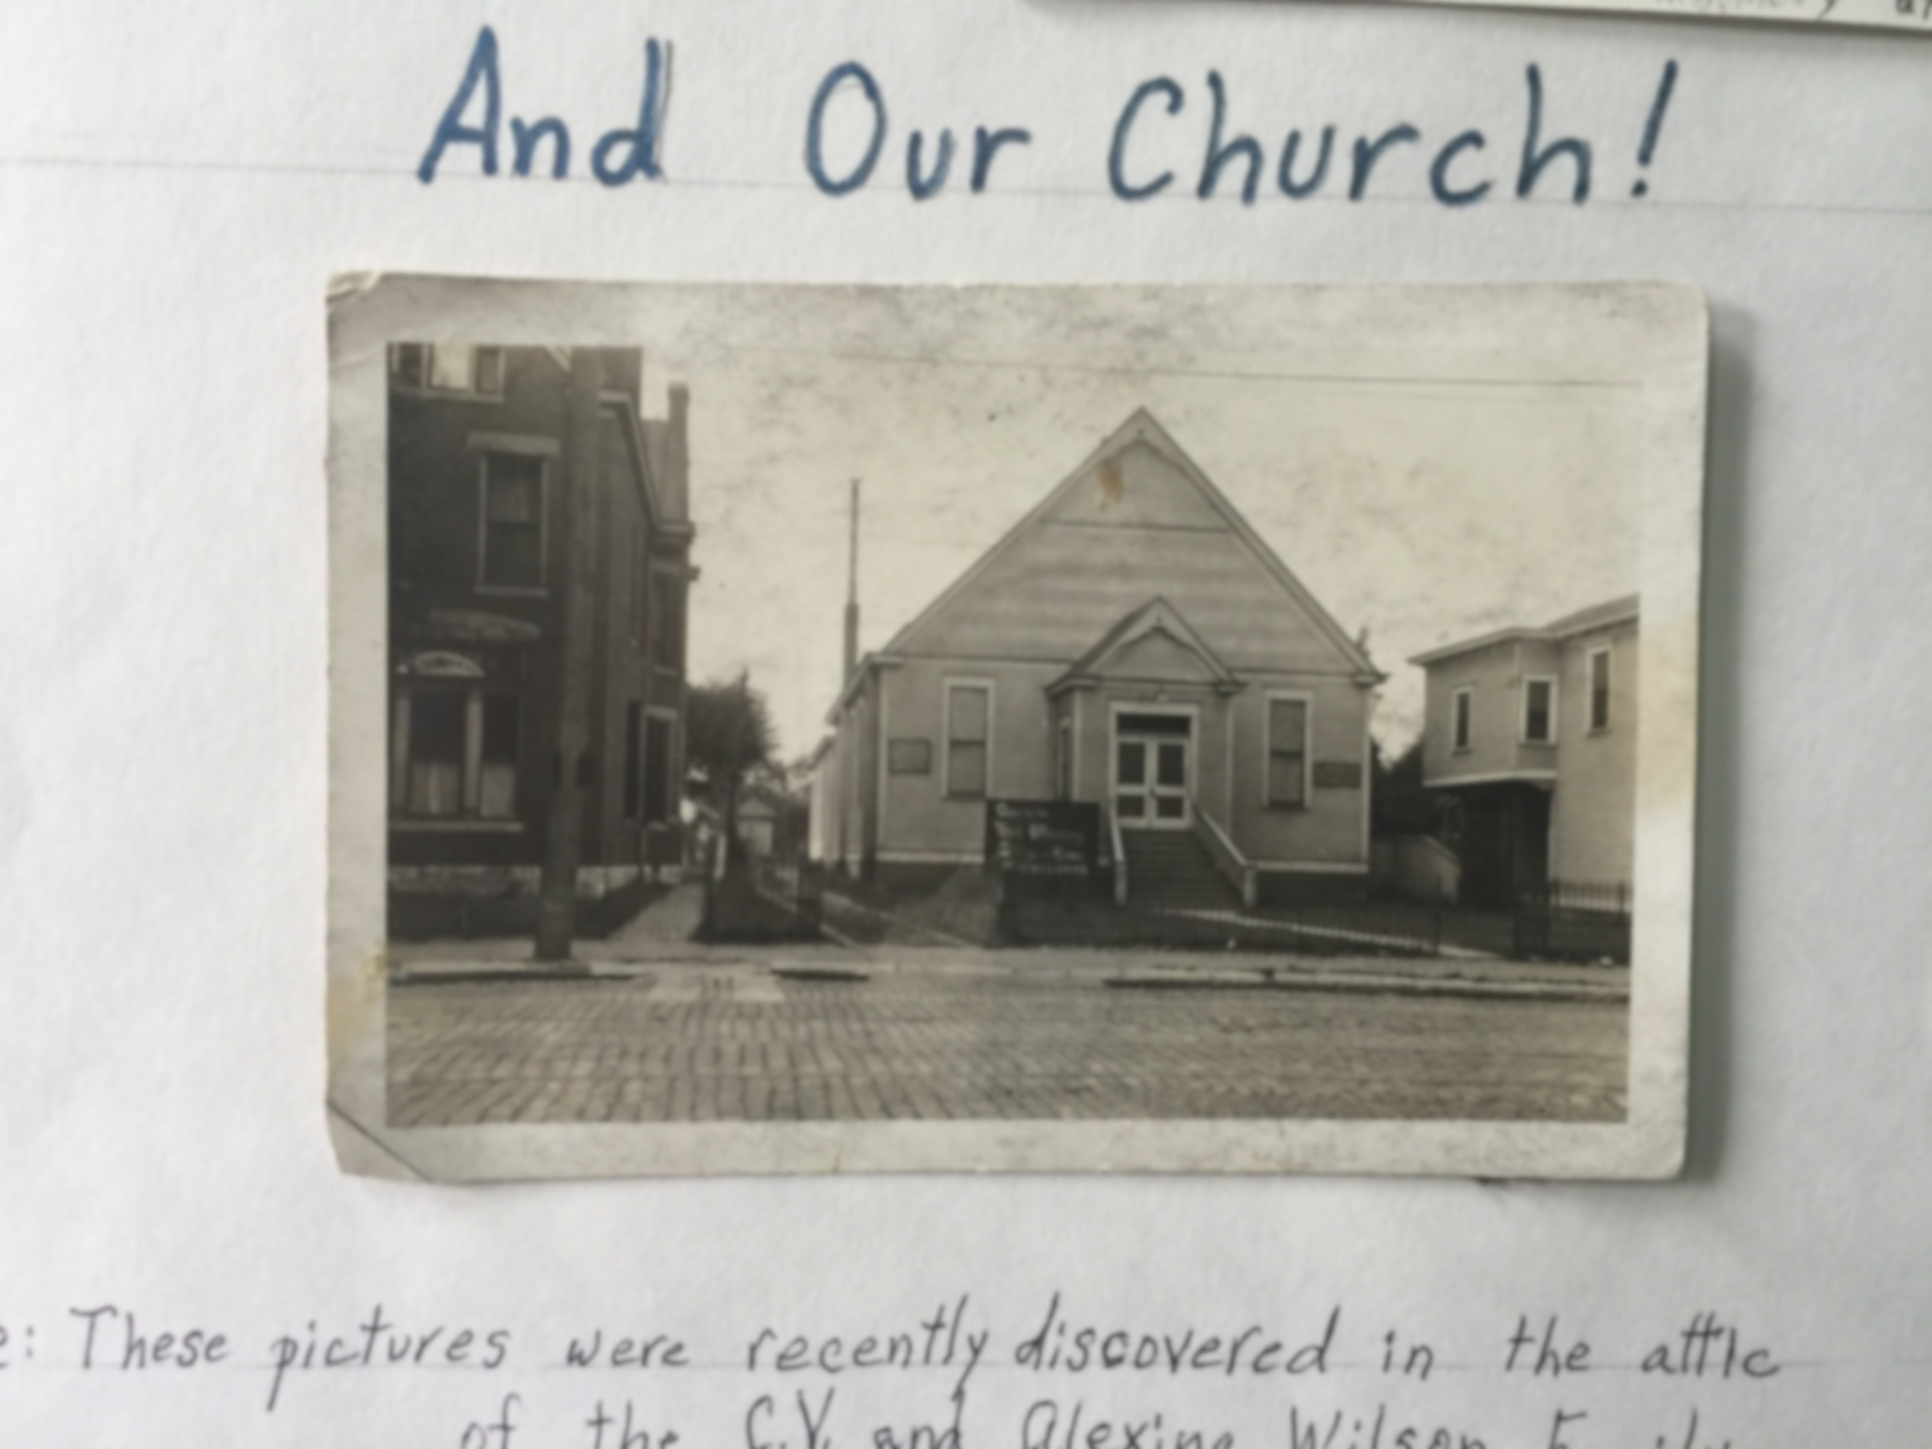
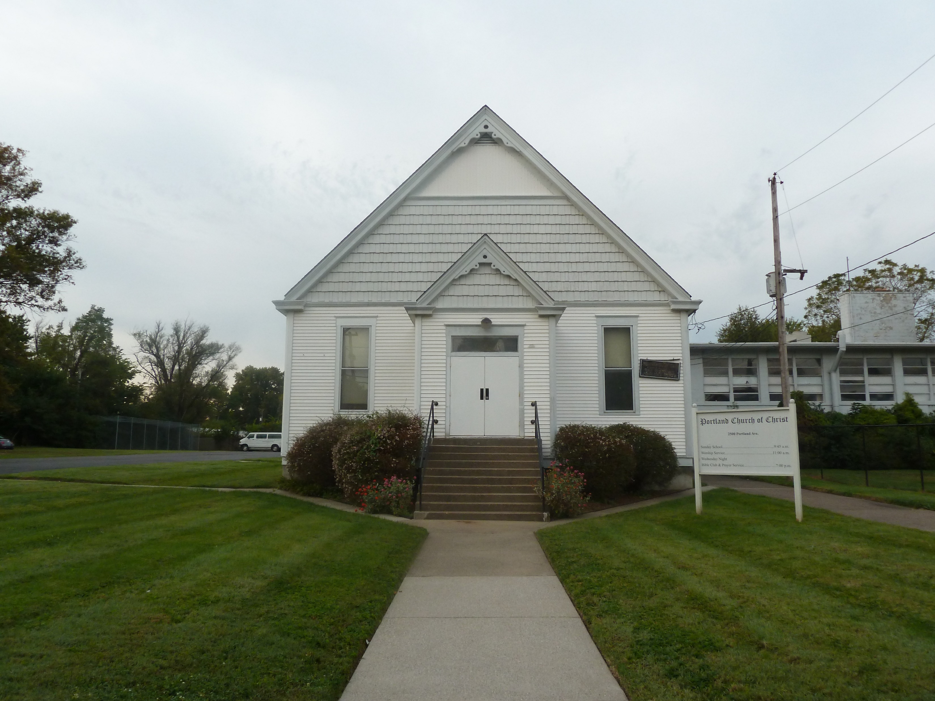
Portland Avenue Church of Christ

Slide 17
An account of Boll's exposure to Jehovah's Witnesses theology has been described by one detractor:
F. L. Rowe, editor of the Christian Leader, was seeking to arrange a debate between one of our preachers and the notorious Charles Taze Russell, founder of the Millennial Dawn/Jehovah's Witness cult. Upon the recommendation of Bro. Boll and M. C. Kurfees, Bro. L. S. White of Denton, Texas was chosen to meet Russell. The debate was conducted in Cincinnati in 1908. Rowe wrote of Russell, he "is a man of pleasing manner, and his mild, soft tones were admired by many." Kurfees judged that White did an excellent job of upholding the truth and refuting Russell. But Boll was enamored with Russell's style and embraced his millennial heresy. Bro. G. W. Riggs recalled that while visiting Boll, he found him eagerly reading one of Russell's books. Like most other premillennialists, Boll developed his own version. - WIKIPEDIA
Non-Restoration Inspired Bollism

Slide 18
Events of 1915
1909-1915 Front Page editor of Gospel Advocate
1915-began writing some articles on Bible Prophecy. He had dealt with this earlier
Many in Restoration Movement-had held Pre-Mil views such as Barton W. Stone, James A Harding, Dr. T W Brents and others.
It was not a test of fellowship until this time.
Bro. Boll dropped from Advocate (fired) late 1915.

Slide 19
"Jesus had been to earth and returned to heaven. Heaven must receive him, until the times of restoration of all things. Then the times of restoration of all things must be when Jesus returns again to earth—the restoration of all things to their original relation to God. The relation which the world originally sustained to God was broken when man, the ruler, rebelled against God. That destruction of the world's relation to God was more far-reaching and destructive than we realize. The whole material creation shared in the evil. Briars, thistles, thorns grew in the material world, as in the spiritual. Sickness, death, mortality afflicted the material world. When man rebelled against his Maker, the under creation rebelled against man. The laws of the natural world were disordered. The germs of vegetation put forth; biting frosts or burning heat destroys them. Disorder in the laws of the material world came as a result of man's sin against his Maker. When Jesus comes again the will of God will be done on earth as it is in heaven, and all things in the world will be restored to harmonious relations with God, the Supreme Ruler of the universe." And it is edifying to note how brethren of the old days, as seen in the Millennial Harbinger, freely voiced their understanding on both sides of this, without even a thought of mutual excommunication. – R.H. Boll Quotes David Lipscomb

Slide 20
In an article appearing in the Leader, Boll said that the return of Christ was one of the blessings promised by Peter as he preached at Solomon’s porch (Acts 3). "The two other blessings of their repentance would be: Seasons of refreshing from the presence of the Lord; and the coming of Christ - their great Messiah who was appointed for the people of Israel. Had Israel repented nationally, even then, Christ would have come and fulfilled all their glorious expectations which the prophets had kindled in their hearts." (Boll, Acts, 1). Boll affirmed that Peter’s reference to the second coming was a motive to repentance on the part of his listeners. "The particular point in which the inducement lay was this, that upon the Lord’s return the great “restoration of all things whereof God spake by the mouth of his holy prophets that have been of old” should take place." (Ibid.). But the distinction Boll was making was that the “times of restoration” would accompany the Lord’s return, not precede it. Otherwise the return of Jesus would not be a motivation for repentance on the part of Israel. "The word “until” limits the Lord’s sojourn in heaven. He stays there until the times of restoration - not during the times of restoration, not until after, but until those times, until the day the earth’s grand jubilee shall break." (Ibid.). Boll said that passages from the prophets (Isa. 11; 35; 65. etc.) and New Testament passages (Rom. 8:18-25; Rev. 20:1-6) were pictures of what that “grand jubilee” would be like. Boll then quoted Lipscomb as proof of his position regarding the “times of restoration.”(Lipscomb, Restoration, 360).

Slide 21
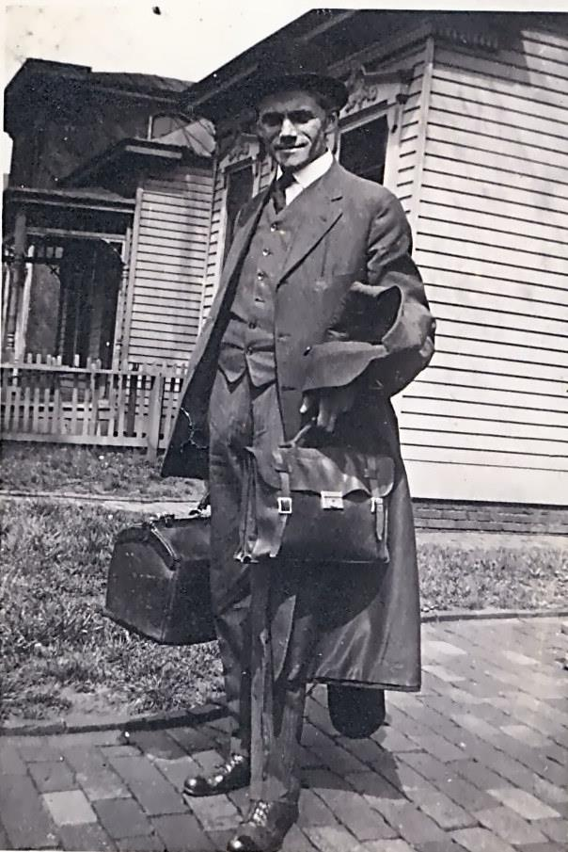
Evangelistic Endeavors
He held meetings all over the country. Photo is of him getting ready to go to TX and LA in 1919.
Normally his meetings were between April and October.

Slide 22
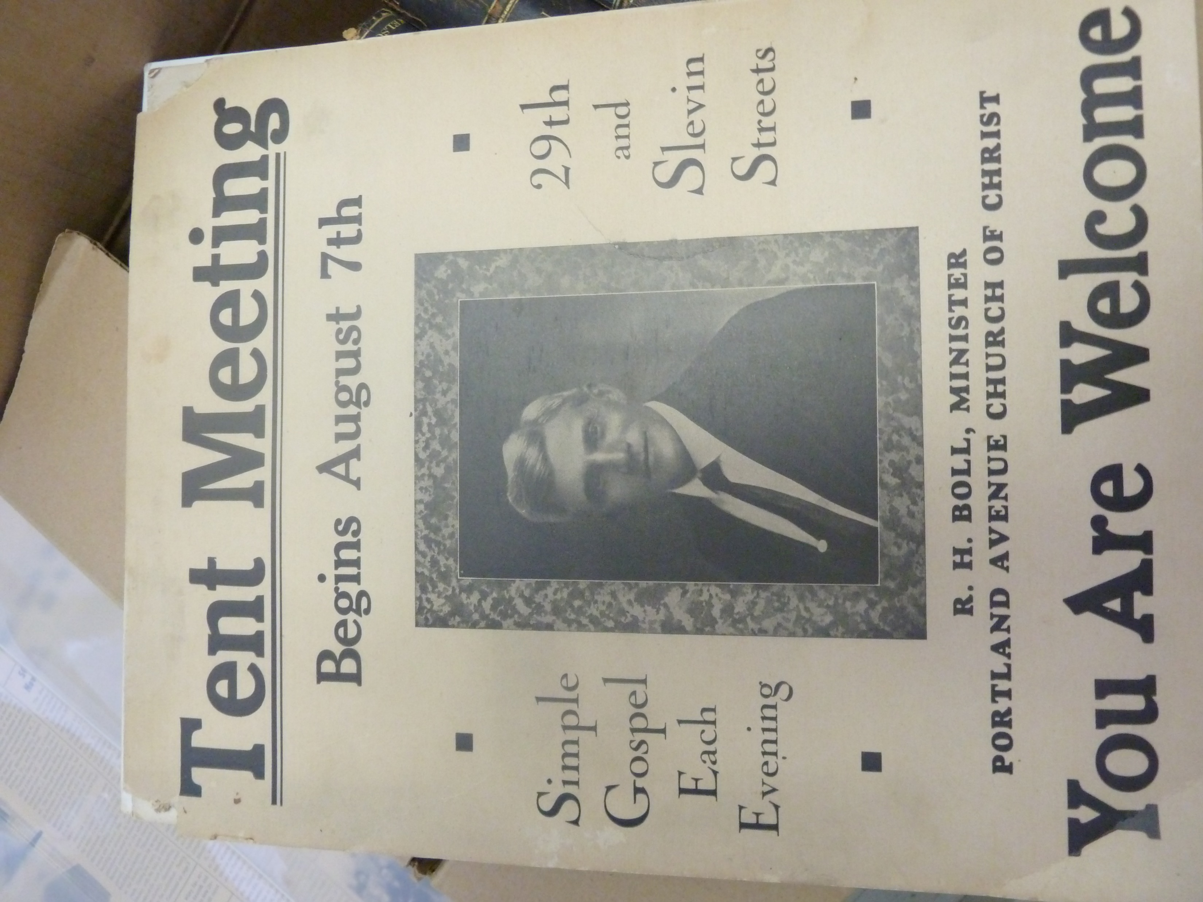
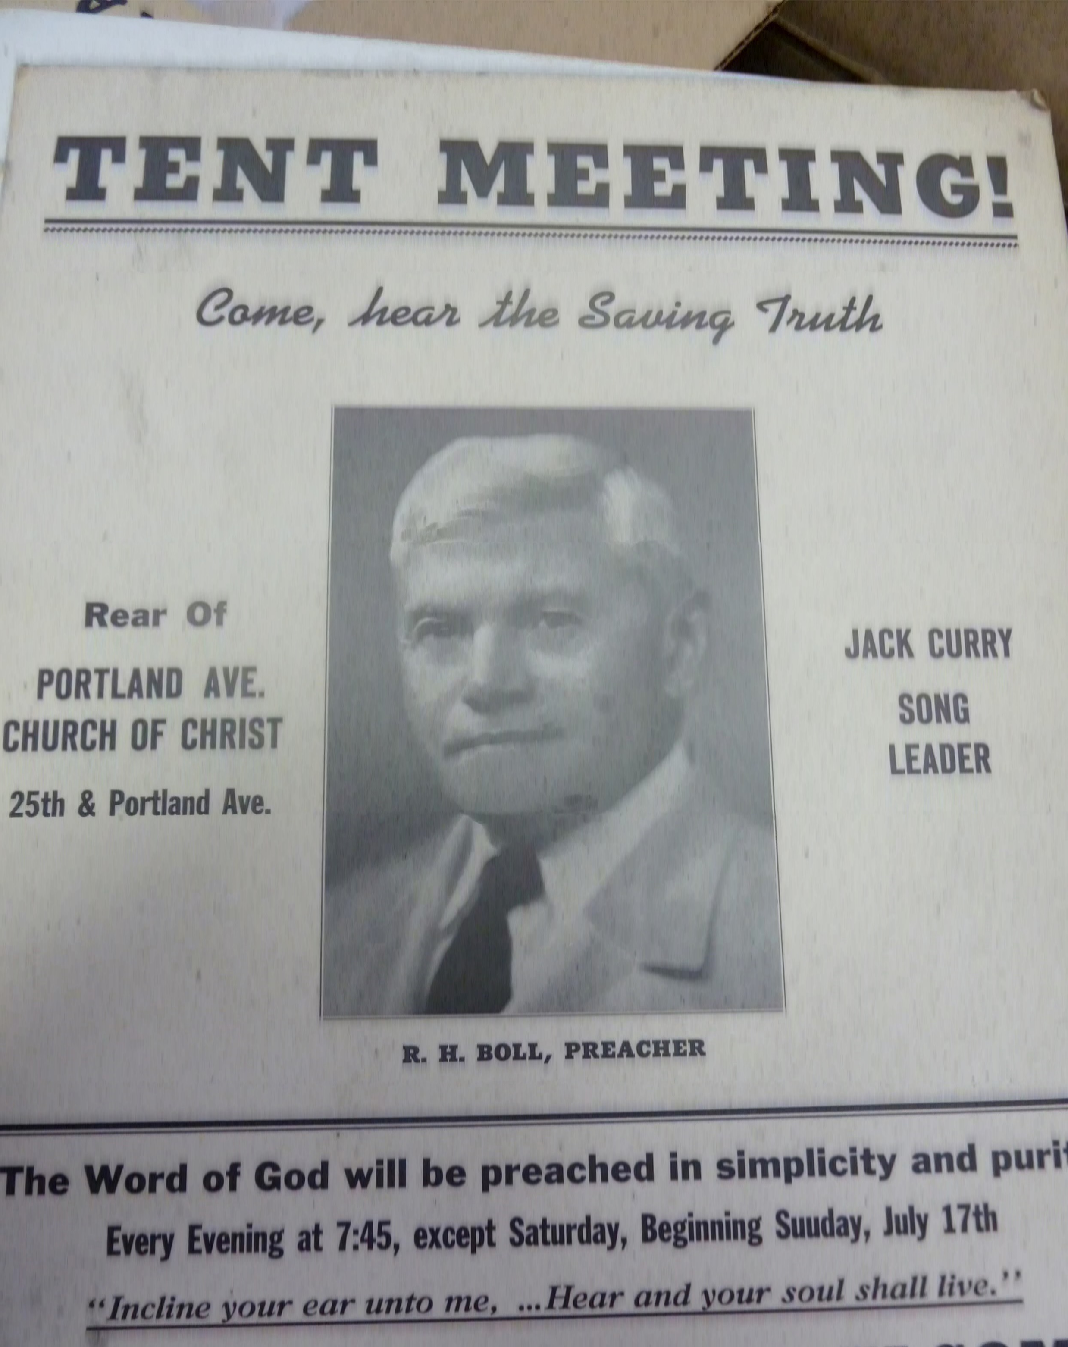
Evangelistic Endeavors

Slide 23
Boll denied that investigation of the prophetic teachings was divisive. Christians should be able to “bear the strain of differences of view” among themselves. If our unity was “so precarious” that everyone must keep still on “all but the most essential matters” then there would never be any “growth and advancement in the word of truth.” Boll pointed out that David Lipscomb’s teaching on civil government was “not one of the essentials.” It was also a subject on which many had disagreed with Lipscomb. But Boll believed that the free study and discussion on the subject had not resulted in division. Too many Christians, according to Boll, were engaged in passive listening: accepting the preacher’s interpretation as authoritative as the Word of God. Boll encouraged his readers to follow the imperatives of 1 Thess. 5:21: “Prove all things, hold fast that which is good.” Studying “unfulfilled prophecy” was important because “it holds the key to much of the motive power of the Christian life, and to intelligent co-operation with the plans of God so far as he has revealed them to us.” - Bruce Daugherty

Slide 24
The H.L.boles vs. R.H. boll
1928 debate

Slide 25
RESTORATION OF ISRAEL.
______
Proposition: "The Scriptures teach that Israel (fleshly descendants of Abraham through Jacob) shall be nationally restored."
R. H. Boll affirms; H. Leo Boles denies.

Slide 26
PROPOSITION II.
THE KINGDOM OF GOD.
_______
Proposition: "The Scriptures teach that the event signified by the smiting and destruction of the image in Dan. 2:35, 44 began to take place on the day of Pentecost.”
H. Leo Boles affirms; R. H. Boll denies.

Slide 27
PROPOSITION III.
______
THE REIGN OF CHRIST.
Third Proposition: "The Scriptures teach that after his coming Christ will with his saints reign over all the earth.“
R. H. Boil affirms; H. Leo Boles denies.

Slide 28
PROPOSITION IV.
CHRIST ON DAVID'S THRONE.
_________
Fourth Proposition: "The Scriptures teach that Christ is now on David's throne.“
H. Leo Boles, affirms; R. H. Boll Denies.

Slide 29
PROPOSITION V.
_______
CHRIST'S COMING PREMILLENNIAL/IMMINENT
_______
Fifth Proposition: "The Scriptures teach that the coming of Christ is premillennial and imminent."
R. H. Boll affirms; H. Leo Boles denies.

Slide 30
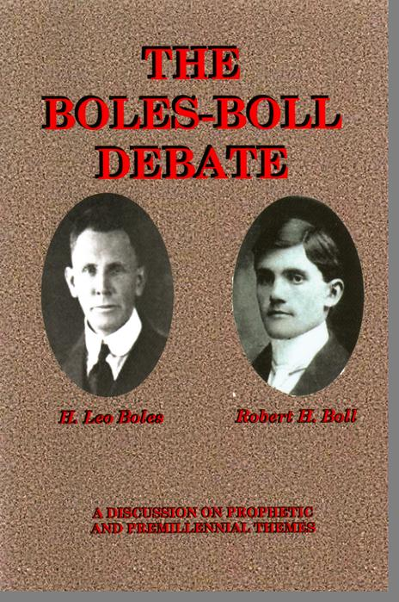
Often Quoted Debate Highlight:
“I am not debating about the millennium as such, though I believe in it, I am merely seeking to show that before there is or could be such a period, Christ must come… Call it ‘millennium’ or whatever you please, let it be on earth or in heaven, let it be a thousand years or longer, the one and only point is that that future time of final triumph of the Saints and universal glory and bliss cannot be before the coming of Christ.” Boll > Boles

Slide 31
The purge begins in earnest

Slide 32
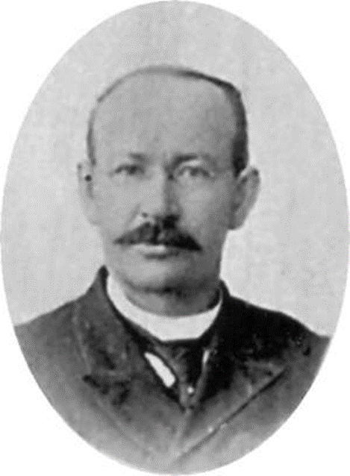
Ira Moore affirmed his belief in the return of Christ, but denied that he was to come and reign as an earthly king as taught by Boll. Boll’s theory, that the kingdom prophesied by Daniel had not yet been set up, misunderstood the nature of the rule of Christ according to Moore. Moore countered, "It is a clear, complete and unreasonable reversal of a government and citizens thereof to say that the citizenship has been established, but that the government has not yet become a reality, and will not until Jesus comes again." (Moore, Report, 4). Moore pointed out that David’s prophecy (Ps. 110:1-3) spoke of the willing offering of Christ’s subjects to his rule. To Moore, this implied that “at no time, either now or in the future, will Christ conquer any one and bring him into submission and service by the exercise of any other than moral or spiritual persuasive power.” As further prophetic proof of Christ’s reign, Moore turned to the imagery of the Priest-King (Zechariah 6:13). Christ held the two offices of King and Priest at the same time. Moore pressed the point, “And he who admits that Christ is now Priest, must also admit that he is King.”(Ibid.). Moore seemed to be more concerned with Boll’s doctrine as it pertained to Christ’s rule rather than what it said about the Church.
The Crew

Slide 33
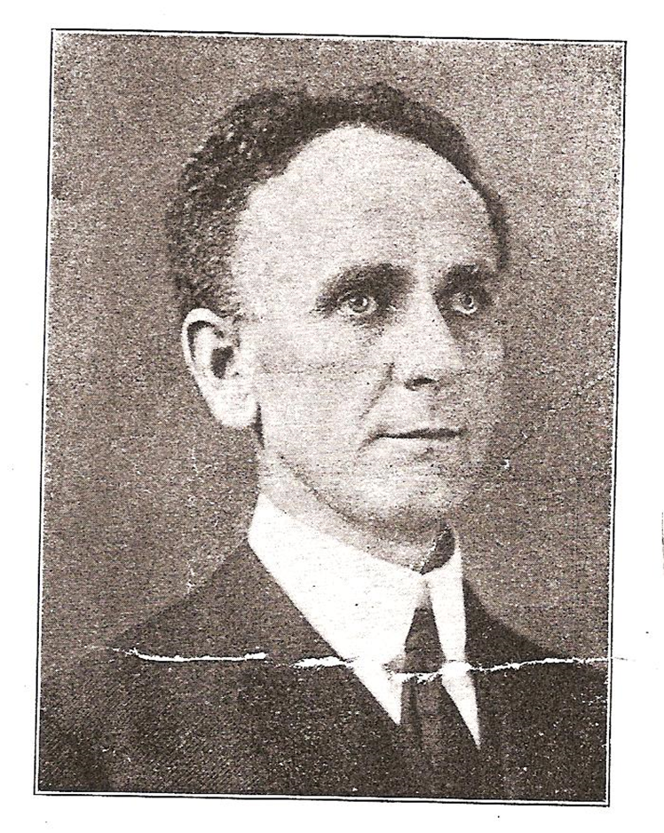
Thad Hutson was an early opponent of the millennial teachings proposed by Charles Neal, a writer in Boll’s paper Word and Work. Hutson and Neal engaged in a 15 month exchange of articles in the Leader discussing features of the millennium as taught in Neal’s small book, Lessons on the Kingdom.(Neal, 3). Neal and Hutson mostly argue past each other but the importance of Hutson’s opposition lay in the fact that it was early, before the full fledged battle of the thirties, and that Hutson believed Neal added features which had not been elaborated on by previous Restoration teaching on the millennium: two resurrections, a literal thousand years’ reign, the return of the Jews to Palestine, etc. "Hence all this twaddle about two literal resurrections and a thousand years of a personal reign of Christ on earth is based on what the Scripture does not say." (Hutson, 1914, 9).
The Crew

Slide 34
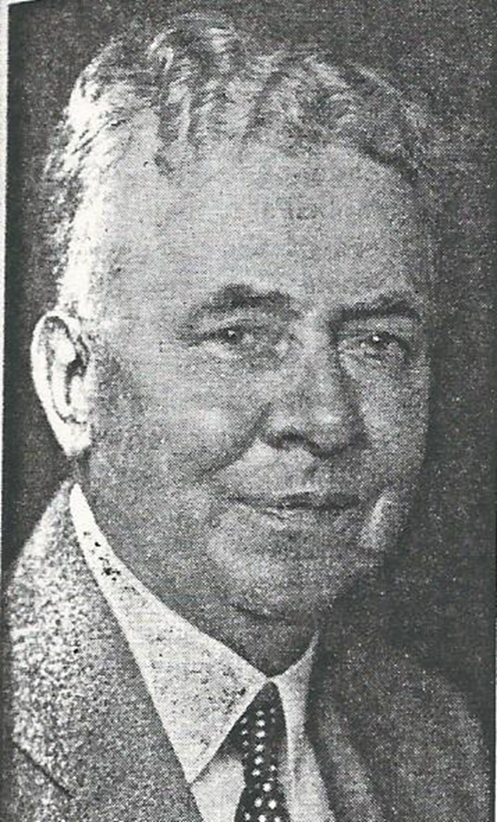
As the controversy progressed, T. Q. Martin noted tendencies exhibited by the men in Boll’s camp. Martin said, “One of the greatest dangers to which a preacher or writer is subjected, is that of becoming wedded to a theory, and then persuading himself that he finds that theory in almost every chapter in the old book.”(Follow, 5). After giving a recent example from Word and Work, Martin said that in an age of “wild exegesis” some were making “wilder and wilder guesses” in dealing with God’s word, but not wanting to be questioned about their views. When questioned, the premillennial defenders would say, “You do not believe in the second coming” or “the church has lost her belief in the return of her Lord.” Martin denied that claim as he asserted, “I believe there is a general, almost universal agreement among professed Christians that Jesus is coming again.” Martin said that instead of troubling others over “guesses about things not clearly revealed” Christians should emphasize the truth of Jesus’ coming and being ready for it.
The Crew

Slide 35
When C. R. Nichol and R. L. Whiteside published a review of R. H. Boll’s teaching in a little booklet entitled Christ and His Kingdom, (Debate, 7). Thad Hutson heartily endorsed its appearing: "I have read carefully R. H. Boll on the coming of Christ and the coming Kingdom. But, oh boys, you should read the review of it, by Bros. Whiteside and Nichols (sic), both of Texas . . . Bros. Whiteside and Nichols (sic) have done the cause of truth a great good in this review. It encourages me greatly. May God speed it." (Hutson, Commendation, 9). Another endorsement of the booklet said that Boll’s theories could no longer be looked at as “speculations” or “harmless guesses.” The anonymous paragraph stated, “It is a violent wrestling of prophecies from their proper setting and fulfillment to make them do service in some fantastic dream of the future.” (Theories, 2).
The Crew

Slide 36
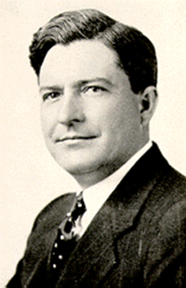
In 1933 Foy E. Wallace, Jr. accepted Charles Neal’s challenge to debate in Winchester, Kentucky. The Leader gave ample space to the reporting of the debate.(Baumer, 8 & Hutson Millennium, 10-11). The proposition for the debate was: “The Bible clearly teaches that after the second coming of Christ and before the final resurrection and judgement, there will be an age or dispensation of one thousand years, during which Christ will reign on the earth.” Neal affirmed the proposition and Wallace denied it. Later, both men would meet again in debate in Chattanooga, Tennessee. When the debate came out in book form as published by the Gospel Advocate, Ira Moore gave it a review: "The speakers were pretty evenly matched in several particulars, pleasant and smooth speakers and interesting. Our candid judgement is, based upon much reading and studying of the Scriptures and all I could get to read on the theme involved, that Brother Neal undertook a most unusual and untenable task, but if anyone in the Brotherhood can defend that proposition and make it “stick,” he can. But Brother Wallace showed himself equal to every occasion and need, and, as we candidly think, fully and fairly met and defeated his respondent on everything that pertained to the proposition and met some emergencies that did not." (Moore, 4).
The Crew

Slide 37
The debate pushed Foy E. Wallace, Jr. to the forefront in opposing premillennialism. When Wallace began the Gospel Guardian to counter the teaching propagated by Word and Work, F. L. Rowe encouraged writers to send their articles on premillennialism to Wallace for publication. (Rowe, Guardian, 9). For some time Rowe had been urging the publication of a brotherhood quarterly that would discuss controversial subjects aimed for preachers and allow papers like the Leader to be more suited for edification purposes of average members.
Though Fred Rowe had invited R. H. Boll to take a place on the Leader staff, opposition to the premillennial teachings of Boll and others was present in the Leader from the beginning of the period being studied. Thad Hutson, Ira Moore, and T. Q. Martin, along with many others, challenged the details of premillennial theories while they defended their belief in the return of Christ.
The Crew

Slide 38
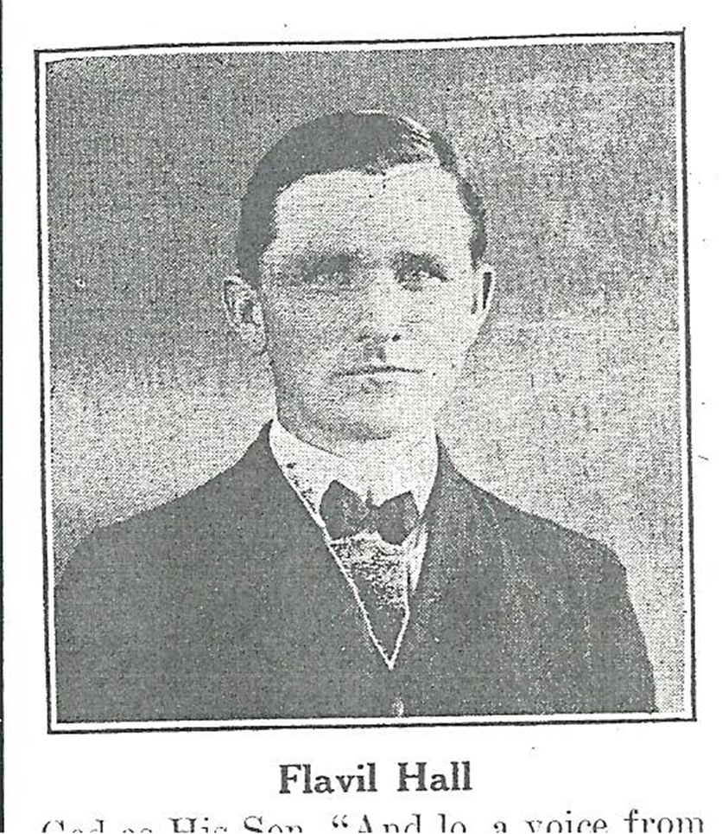
But the premillennial controversy exposed a division within the Leader regarding the issue. Despite the opposition of Hutson, Martin, Moore, and Rowe to Boll’s theories, Flavil Hall and Ben Elston became apologists for Boll and others to hold their opinions on the subject without them being a barrier to fellowship. Hall and Elston had both contributed to Word and Work when it was published out of New Orleans by Stanford Chambers. It is this writer's opinion that both men's personal ties to Chambers, Boll, and Neal were additional factors in their defense of the premillennialists. Elston had baptized Charles M. Neal and considered him his "true child in the faith."
The Crew

Slide 39
Hall did not hold pre-millennial views, but he defended Boll’s right to them: "I do not think the editor of Word and Work has changed in his views very radically since he began writing for the Gospel Advocate, not less than twenty years ago. His writings were then tinged with the imminent coming of Christ idea, and if it was not pernicious then, it is not now; and if it was not pernicious for Bro. John T. Poe to take the position that the kingdom is yet to be established, it is not pernicious for another brother to take the same position, if he try not to build a party on this and kindred ideas." (Hall, Combine, 6). Hall’s defense of the right to opinion was fixed to three ideas: 1) individuals had liberty to hold differences on matters that did not interfere with faith, obedience, and Christian living; 2) people in the past had held similar positions yet were esteemed, not condemned; 3) if readers were going to condemn those whose opinions differed, consistency demanded they oppose all whose opinions were different, not just premillennialists. Time and again Hall brought up the names of the past, who in his judgement, held positions similar to Boll. J. A. Harding, T. W. Brents, Alexander Campbell, Robert Milligan, and J. W. McGarvey were among the names Flavil Hall dropped before his readers to stir their minds to see the inconsistency being practiced toward Boll. (Hall, 1932, 6).
The Crew

Slide 40
For Ira Moore, the real problem of the premillennialists, was the discord and disharmony their views were causing. Moore could not believe that Hall continued to defend the Word &Work editors over something they admitted was a “nonessential.” Moore said, "It would be far more to their credit to regard their teaching on the millennium as absolutely essential to successful Christian life, than to proclaim it a nonessential, yet push it to the disruption of fellowship and peace. And Brother Hall would be engaged in a far more commendable effort were he using his excellent abilities to induce them to cease their contention and return to sanity and Christian consistency." Hall and Elston’s defense of the premillennialists led to their removal from the Leader masthead and estrangement from the paper in 1935. Hall and Elston were a microcosm of the problem that faced J. N. Armstrong at Harding College. Armstrong sought to give his position in several articles that appeared in the Christian Leader. (Armstrong, Thousand, 1). The Leader also carried Foy Wallace's rebuttal to Armstrong's arguments. (Wallace, 6). H. Leo Boles gave a truly insightful article in the Gospel Guardian. (Boles, 5).
The Crew

Slide 41
Robert Boll transformed the millennial eschatology he had received from Harding and Lipscomb. In the controversy which ensued, it is too bad that Boll didn’t pursue what David Lipscomb had said about unity and opinions with as much diligence as he pursued the future return of Christ…
"If one man’s opinion is ground for action in church affairs, another man’s is likewise, and every man’s is. As we differ in opinion, then we must adopt diverse & different rules of action. And different rules of action in a church will bring conflict in action. It will necessarily produce strife and confusion and lead to division. It cannot possibly be avoided." (Lipscomb, 11).
The Crew

Slide 42
The sixth street church of christ port Arthur, Tx. Gospel meeting of November 1937 With Foy Wallace

Slide 43
“Late period (1932-38), opposition to premillennialism is intensified by the entry of Foy E. Wallace, jr.
Open calls for disfellowship of Boll and others are pursued, as premillennialism is denounced as false, divisive and digressive in nature.” - Bruce Daugherty

Slide 44
THE WIDENING BREACH
“The brotherhood has been treated to another manifesto. The present manifesto issues from the same office, having the same seal. The author of these daring decrees is R.H. Boll, editor & publisher of the Word (of discord) and Work (of division.) His publication appears to be devoted to the cause of sowing discord among the churches of Christ on millennial theories. It was the issuance of the first Louisiana decree that precipitated the vigorous opposition to this new party in a series of drastic editorials in the Gospel Advocate. The Winchester and Chattanooga discussions followed. It was generally conceded that these debates contributed much toward retiring this system of theories advocated by this group of brethren to their rightful place – the realm of human opinion. It was, therefore, hoped that the agitation of these theories would cease, that the churches might have peace. But now comes R. H. Boll…”
SOURCE: GOSPEL MEETING HANDOUT

Slide 45
THE VIRGIL SMITH COMPROMISE
“In his description of Smith’s ‘work and experience,’ Brother Boll says that though Smith believed the ‘supernatural manifestations’ were the result of the ‘baptism of the Spirit,’ he would yield to Brother Boll’s suggestion and call it being ‘filled with the Spirit in accordance with Ephesians 5:18.’ Two things are here revealed: first, that ‘filled with the Spirit’ to Smith means the baptism of the Spirit, and his yielding to the suggestion to call it something else was purely political – mere diplomacy; second, that to Brother Boll, Ephesians 5:18 means a ‘supernatural manifestation’ of the Holy Spirit, and he does not regard Smith as unsound.”
SOURCE: GOSPEL MEETING HANDOUT

Slide 46
THE SECT HAS EMERGED
“The one ‘view’ set forth by Brother Boll that is not a vagary is found in his declaration that a sect has emerged. Verily, it is a fact. But the seat of the sect is in Louisville, Ky. The formation of the party seems very definite. R.H. Boll is head of it. E.L. Jorgenson is secretary of the interior, and Don Carlos Janes is secretary of foreign affairs. Charles M. Neal is ex-secretary of war, having resigned at the battle of Chattanooga, and the job vacancy has not been filled. Subject to call when the chief needs assistance in issuing triple manifesto are Stanford Chambers and H.L. Olmstead. There is also the school to disseminate their tenets, the paper to spread their party propaganda, the missionary agency to foster their sectarian theories in foreign fields, and scattered devotees everywhere to create and promote sentiment in favor of these men around whose personalities this party has grown.” – Foy E. Wallace Jr.
SOURCE: GOSPEL MEETING HANDOUT

Slide 47
THE SECT HAS EMERGED (cont.)
“These brethren bewail being disfellowshipped, yet they have themselves virtually disfellowshipped every gospel preacher in the land who opposes their system of teaching. The fellowship they demand is one-sided.
The Boll movement represents a definite and immediate danger before the churches… The millennialists have already taken the denominations, and are making inroads within the Christian Church. Shall we now submit to this Louisville party and let them take the churches of Christ – the one and only body of people free of human interpretations and opinionism? The issue must be met with courage, decision, and finality!
SOURCE: GOSPEL MEETING HANDOUT

Slide 48
Given the course correction of the Post-Foy Wallace Era – it’s by simple extension of the current rationale – that we can state with certainty that – the Exegetical School of David Lipscomb is no longer found acceptable within the Modern Restoration Movement. Furthermore, the Barton Stone of Cane Ridge & the Alexander Campbell of the Millennial Harbinger would likely receive similar congregational discipline as did R.H. Boll & associates - if not outright refused at local church identification.

Slide 49
brotherhood periodicals exchange

Slide 50
Word and Work Magazine
1908-Word and Work established in New Orleans by Dr. D. L. Watson, assisted by Stanford Chambers.
1913-1915-Bro. Chambers Editor.
Late 1915-Chambers held meeting at Portland Avenue.. It was decided to sell WW to Bro. Boll and bring it to Louisville, KY. Bro. Boll Edited till 1956 when he died.

Slide 51
The Bollistic Chattanooga Document asserts that Romans 8: 18-23 contains the "essential point in premillennial teaching" by assuming that when the "groaning" is lifted from "the whole creation" it will be the millennium! That depends, at least in part, on the meaning of "the creature" and "the creation," and the "bondage" and the "adoption" and "redemption" which are referred to in the text.
1. The creation does not include the children of God, because v. 19 says it waits for the manifestation of the children of God, and verse 21 also mentions it in contrast with the children of God.
2. The creation does not include Paul, because in verse 23 he says "but ourselves also," thus referring to the creation in contrast with & over against himself. And he further states that it shall be delivered into the liberty of the children of God, which couldn’t mean that the children of God will be delivered into themselves.
3. The "creation" doesn’t refer to mankind since Paul holds himself & the children of God over against and in contrast with the creation by saying "not only so, but we ourselves." If it means mankind, then Paul and the children of God would be no part of mankind.
4. It doesn’t refer to the sinner for sinners will not be "delivered from the bondage of corruption into the glorious liberty of the children of God."
a. The conclusion is that the creation refers to the world, apart from humanity, in its cursed state, represented as "groaning" (figuratively) until the time the children of God shall be delivered from the earthly, corruptible existence into the liberty of the incorruptible, resurrection or eternal state.

Slide 52
Beginning with the 15th verse of the chapter the apostle assures the Roman Christians, living under the yoke of the virtual slavery of a pagan power, that they had not received the spirit of slaves, as before their conversion, to serve in fear, but the spirit of children, who by adoption can claim all the privileges of a child, and an heir. The Holy Spirit and their own spirit, through divine revelation, had united in a conjoint testimony, one giving and the other receiving the witness to this fact (verse 16). But if we are to be joint-heirs with Him, shall we be exempted from His sufferings? No; joint-heirship must be had upon the condition of joint suffering--if we are heirs with him, we must suffer with him (v. 17). But these sufferings are insignificant when compared with the benefits of the resurrection state which shall be so much greater and which shall be "revealed in us" in the resurrection from the grave (verse 18). But during this "present time" the world itself is under the blight of sin and suffers corruption and decay (vs 19, 20), until the children of God receive their new adoption--the redemption of the body from death & corruption (vs 21-22), when they shall be manifested in the resurrection without the bondage of earthly existence (verse 23) in the "new heavens and the new earth" (II Pet. 3:13).!
The apostle then declares that we are saved in this hope (verse 24) of deliverance from the grave and the glory that follows: and we are willing to wait and suffer in this world for such a redemption (verse 25).
For premillennialists to insist that there will be a millennium between the "redemption of the body" and the "new heavens and the new earth" is but another example of arbitrary assertion. Premillennialists themselves put "the new heavens and the new earth" in their scheme of things, after the millennium. (See Neal's "Light in a Dark Place" and Tingley's "Unveiling the Future.") Their order is: (1) the second coming; (2) the first resurrection; (3) the millennium; (4) the second resurrection; (5) the "new heavens and earth," the final or eternal state. In their own order of things, therefore, "when the groaning of creation shall cease" can refer to the "new heavens and the new earth" just as well as it can refer to their manufactured millennium--and that is the truth of the matter in Rom. 8, as in II Pet. 3. The admissions of premillennialists on this point are fatal to their theory, and when Rom. 8:18-23 is paralleled with II Cor. 4:17 to 5:1-4, and II Pet. 3:3-13, it can be readily seen that these grand passages set forth the glories of the eternal state in the home of the soul, and not an earthly state robbed of its earthliness here on this earth and in this world. – Bible Banner June 1943

Slide 53
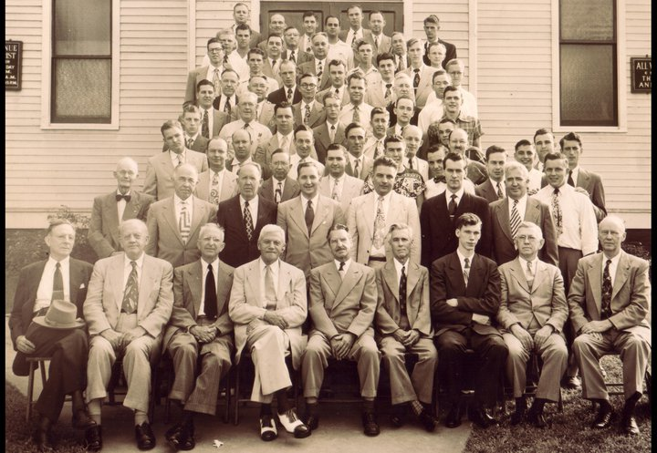
1951 Louisville Bible Conference

Slide 55
My informed opinion is that most of the H.R. Boll Churches of Christ Semi-Pentecostal Movement MEMBERS ended UP in the Pentecostal Church Which Had It’s Greatest Growth In the late 1930’s & Early 1940’s.

