Slide 1
MASS OR MEMORIAL
by David Lee Burris

Slide 2
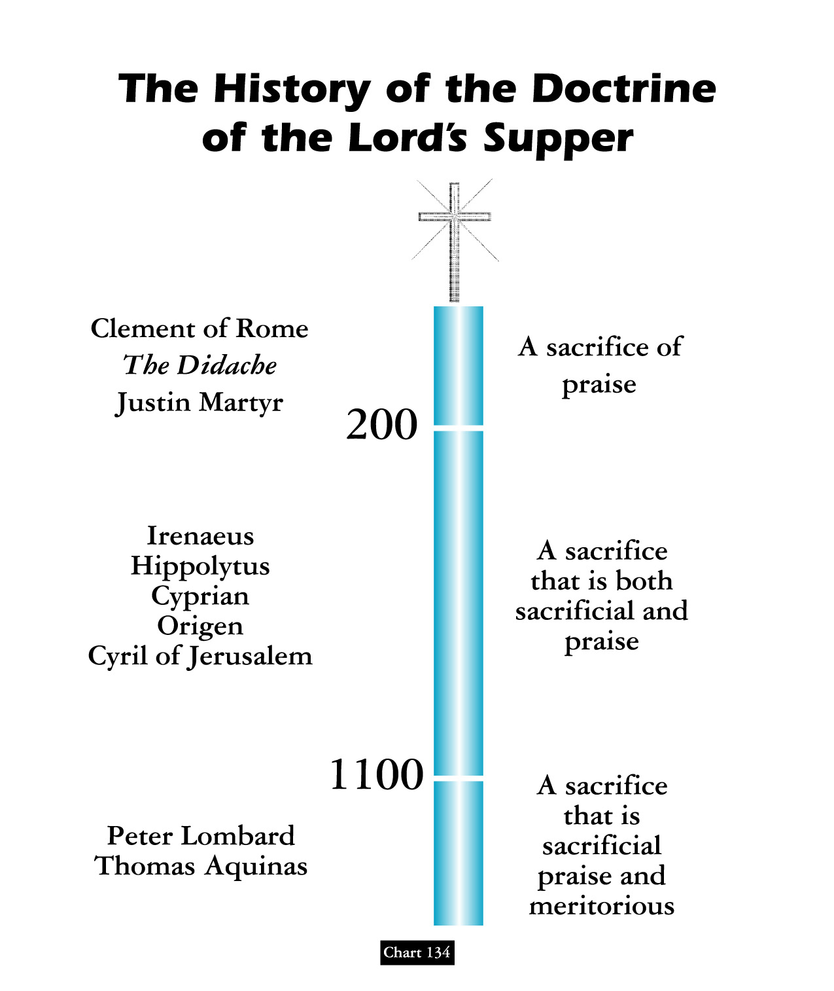
David Lee Burris:
“Maranatha” said at the end of communion service in the early church meant “Our Lord, come”

Slide 3
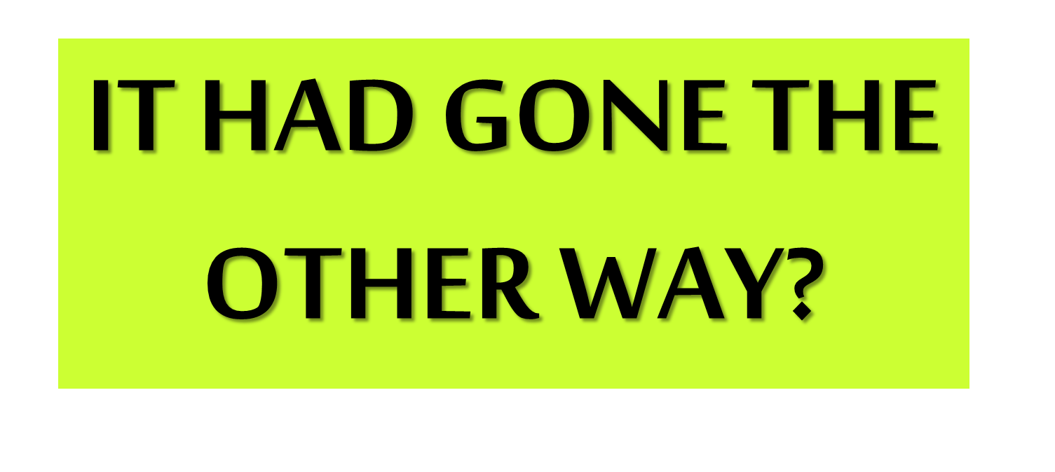
WHAT IF….
EARLY CLUNIAC REFORM

Slide 4
From The Modern Scholar Course Guide: “One, Holy, Catholic, & Apostolic”
EARLY CLUNIAC REFORM
“The German Emperor Henry III sought to enact the first reform measure to purify the Church, In 1046, he deposed the three competing popes and appointed his own reform popes. With the support of the emperor, these non-Roman popes were able to enact reforms. Reform popes brought to Rome reform-minded clerics from across Europe to staff church offices.”
“The Cluniacs produced a new kind of specialized monk, a military monk who rode on horse, upheld codes of chivalry & was an effective killing machine when necessary.”

Slide 5
CHURCH EUCHARIST DEBATE
THE YEAR OF OUR LORD 1059
“The age of scholasticism had dawned, and in the struggle to merge the ancient Greek heritage of Aristotle with medieval Christian dogma, the stakes were high: the future of Christian theology hung in the balance.
How much of Christian thought would operate in the pagan modes of logic and reason, and how much would retain the elements of faith and revelation.”
“When fish are in schools they sometimes… take debate!”

Slide 6
CHURCH EUCHARIST DEBATE
THE YEAR OF OUR LORD 1059
“The question was exploding across Christendom, and the hottest point of contention was the ‘real presence’ of Christ in the bread of the Eucharist. Belief in His real presence was a dogma. But the Eucharist debate opened the church door to using Aristotle’s logic as a way to make theology more rational. Until now, most theological assertion was based on citing authority: the Bible, Saint Augustine, the Creeds, or the early church fathers. The liberal arts had introduced new tools, and these included the trivium of grammar, rhetoric & logic.
Questioned: What did the Bible mean when Christ said he was the Bread?

Slide 7
CHURCH EUCHARIST DEBATE
THE YEAR OF OUR LORD 1059
“In the great Eucharist debate, the logical question was how the spiritual Christ and the physical bread could occupy the same space. The rhetorical or semantic question was, ‘What did the Bible mean when Christ said he was the bread?’
The debate came to a head at the Council of Rome in 1059. The church called in two advocates, one orthodox and the other innovative. The first was Lanfranc, who defended the orthodox position of transubstantiation: that the bread turned into the body of Christ, even though it looked like bread to human eyes. The other disputant was Berengar of Tours, a respected theologian who defended a contrary position.
Questioned: What did the Bible mean when Christ said he was the Bread?

Slide 8
CHURCH EUCHARIST DEBATE
THE YEAR OF OUR LORD 1059
The rhetorical or semantic question was, ‘What did the Bible mean when Christ said he was the bread?’
“Berengar had stirred the theological crisis by his insistence on grammatical logic. He contended that both Christ and the bread occupied the same reality, for that was the literal claim of the phrasing in the Bible and in early church writings. Words had real meanings, Berengar argued. Having two things occupy one space was indeed a mystery; but the ‘real presence’ of Christ in bread is just that, a mystery.
Lanfranc was no less logical in his solution, but he had chosen to draw upon the logical ‘categories’ of Aristotle, not the semantic argument. The Categories defined real things as having a permanent essence or a ‘substance.’ No two substances could share the same space!”

Slide 9
SACERDOTALISM
“The emphasis in the Roman Catholic tradition, especially as proclaimed in the Middle Ages, on the powers of earthly priests as essential mediators between God and humankind.”
* Dictionary Of Theological Terms, Grenz & Guretzki

Slide 10
SACRAMENTALISM
“A term used pejoratively of persons or church traditions that see the essence of Christianity as participation in the sacraments rather than as inner transform- -ation and personal piety.”
* Dictionary Of Theological Terms, Grenz & Guretzki

Slide 11
ORDINANCE
“Literally, an authoritative decree or law. Certain free-church groups refer to baptism & Lord’s Supper as ordinance rather than sacraments. In so doing highlight the voluntary nature of these rites.”
* Dictionary Of Theological Terms, Grenz & Guretzki

Slide 12
Doctrine Of The Mass
Acceptance of the concept of the Lord’s Supper as a sacrifice by the priest was a gain for the power of the papacy because it was the pope who headed the hierarchy of clergymen who alone had the power to perform the miracle of the mass.

Slide 13
TRANSUBSTANTIATION
About 831 A.D., Pascha Radbertus, a monk in the monastery of Corbie near the city of Amiens, began to teach that by a divine miracle the substance of the bread and the wine was actually changed into the body & blood of Christ. He set forth these views in a book entitled - ‘Of The Body & Blood Of The Lord.’

Slide 14
Church
History
The Apostasy
Doctrines Enacted at Church Councils
Clergy/Laity System
Sprinkling for Immersion
Infant Baptism
Celibacy
Instrumental Music
Transubstantiation
Indulgences
Worship of Mary
Veneration of Relics
Purgatory
Confessionals
Images
Penance
Extreme Unction
Confirmation
Nuns, Primacy of Peter
Forbidding to Eat Meats
Religious Holidays

Slide 15
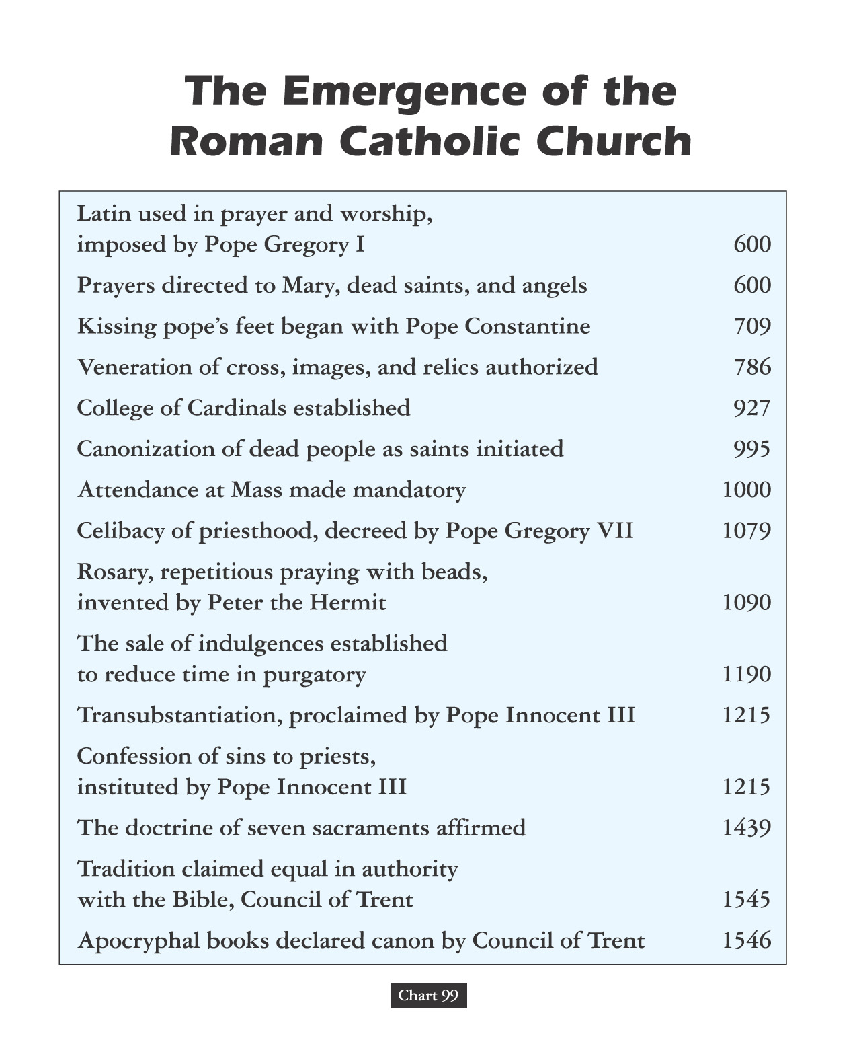

Slide 17
CONCOMITANCE
“In Roman Catholic theology, the belief that Christ is physically present in the eucharistic elements of bread (body) and wine(blood). The doctrine was eventually used to prevent laity from partaking of the wine in case it should be accidentally spilled, desecrating Christ himself.”
* Dictionary Of Theological Terms, Grenz & Guretzki

Slide 19
David Lee Burris:
PLAY KELLS ICONIC CLIP HERE
During Mass Flys Were Kept From
Body Of Transubstantiated Christ
By Parchment Swatter Or Feathered
FLABELLUM
Notes:
Heavenly Angels Flying Above Virgin Mother & Child Jesus Depicted In Era Art As Carrying/Utilizing Such Similar Flyswatters!

Slide 21
Transubstantiation Doctrine From The Heresy of Eutyches:
400
“As the symbols of the Lord’s body & blood are one thing before their consecration by the Priest, but after their consecration are physically changed and become quite another thing; so the Lord’s material body, after assumption, was physically changed into the divine essence.”

Slide 22
Gelasius, the Fifth Century
BISHOP OF ROME:
400
“Certainly the sacraments of the body and blood of the Lord, which we receive, are a divine thing, because by these we are made partakers of the divine nature. Nevertheless, the nature or substance of the bread and the wine ceases not to exist.”

Slide 23
754
ICONIC DEBATE LINKAGE The Council Of Constantinople
“Christ chose no other shape or type under heaven by which to represent his incarnation but the sacrament, which he delivered to his Ministers for type & effectual commemoration; commanding the substance of bread to be offered, which did not in any way resemble the form of man, that no occasion might be given to bring in idolatry.”

Slide 24
787
ICONIC DEBATE LINKAGE The Second Council Of Nice
The Second Nicene Council ordered that the sacrament is not the image or anti-type of Christ’s body and blood but is properly his body and blood. So it was - that - the doctrine of the corporeal presence in the sacrament was first introduced to support the Roman practice of image-worship!

Slide 25
Benedictine Monk Paschasius “Concerning The Body & Blood Of Christ”
831
1st – That after the consecration of the bread and wine in the Lord’s Supper, nothing remains of these symbols but the outward figure, under which the body and blood were locally present. 2nd – That the body & blood of Christ, thus present in the eucharist, was the same body as was born of the Virgin, that suffered on the cross, and was raised from the dead.

Slide 26
Benedictine Monk Paschasius THE QUESTION OF STERCORIANISM
831
Paschasius later asserted, “that bread & wine in the sacrament are not under the same laws with our other food, as they pass into our flesh & substance without any evacuation.”

Slide 27
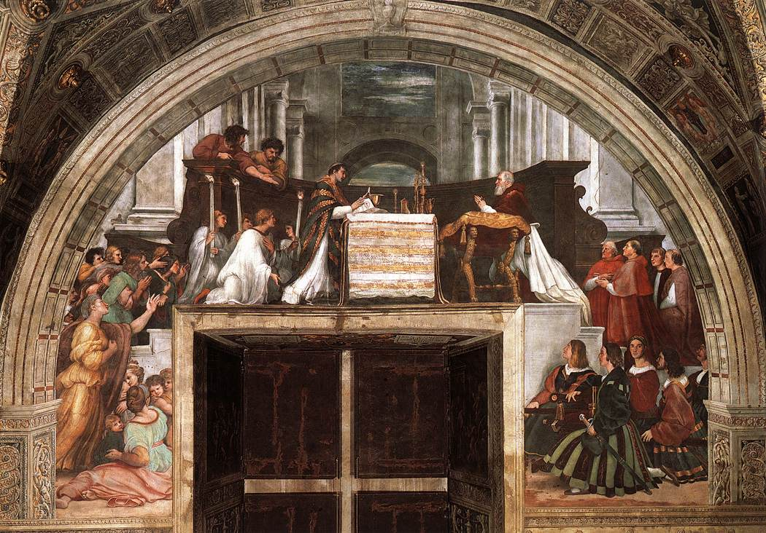
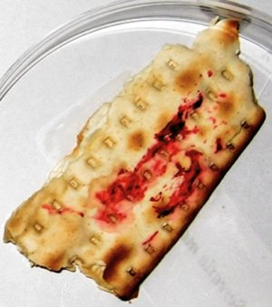
Raphael’s “Mass at Bolsena,” depicting the miracle of transubstantiation, in which the bread began to “bleed.”
The Serratia bug also has a fondness for starchy foods, and it was recognized as early as the sixth century BCE, when the philosopher and mathematician Pythagoras noted the presence of what appeared to be unusual spots of crimson blood forming on bread. It has been proposed that Serratia’s proclivity for starch may have contributed to the Catholic doctrine of transubstantiation, wherein the bread of the Eucharist represents the body of Christ.
Serratia growing on a chunk of bread

Slide 28
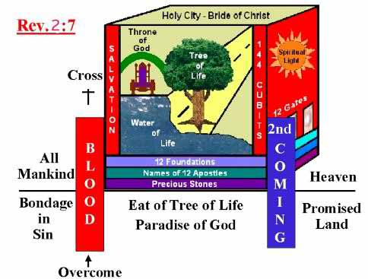
“A memorial is a way that communities make promises to the future about the past.”

Slide 30
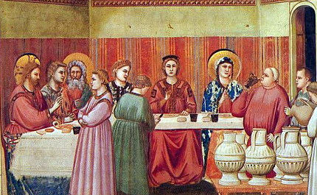
FIRST MIRACLE EARLY INDICATOR
Water to Wine or Reserved to Common
“Jesus must have looked around to see what resources could be utilized, not just to please mom as well as the bridal party, host family and all the guests, but also to convey the message he had come to share.
He spotted, tucked away in a protective place, six stone water jars that were explicitly reserved for the Jewish rites of purification. These jars were, that is, sacred equipment. But Jesus tells the waiters from the reception to fill these holy vessels with plain old water from the tap – not blessed or baptized water, mind you.
We can imagine that the waiters could have been reluctant to do what Jesus had instructed. After all, to follow the orders would in some way be an act of profaning what was sacred. But they had heard Mother Mary tell them quite clearly, "Do whatever he tells you."
So the waiters did it. Following Jesus' orders, they filled each of those sacred jars – "each holding 20 or 30 gallons" – to the brim with plain-ol' profane water.”

Slide 31
Unleveled Leavened Memorials
“Already in the Rabbinic period, the rabbis made a connection between the yeast that causes the forbidden grains to rise with the inclination to do evil that is in each person, that causes one to be puffed up and haughty and arrogant, and to rise up against God’s will.”

Slide 32
When Is An Example Binding?
The rule of harmony. An example is never to be taken in such a way as to violate the teaching of undoubted Scripture in direct statements. The teaching of scripture is harmonious @who/what/when/where/how etc.
The rule of uniformity. Uniformity in essential details must be present in any example for the action involved to be considered binding.
The rule of universality. No example of action is to be regarded as binding when it cannot be universally applied.
The rule of materiality. To be binding, an example must have a material connection or relation to the situation under consideration. (Acts chapter 20: verses 1 - 17.)

Slide 33
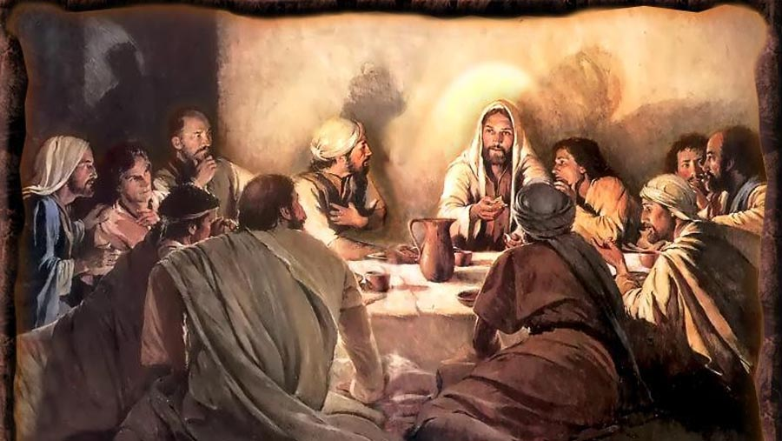
RESTORED SABRE SHINES ON:
Yeast Of Pharisee
- Versus -
Feast Of Communion

Slide 34
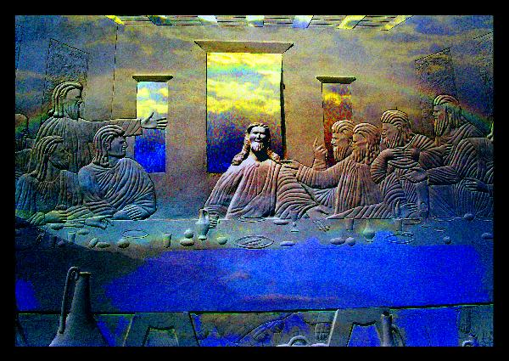
David Lee Burris:
N.T. Passover Blood & Manna Of Life To Nurture Chosen People Of The Marriage Banquet?
life
LOVE

Slide 35
Face Napkin Folded As Dinner Napkin Master Signaling His Servant
John 20: 7
“I’ll Be Back”

Slide 36
Explaining Resurrection
“Resurrection stands as an essential element of the biblical and historical witness of the Christian Community. Without the resurrection, Jesus is not the Living Lord but a dead person held in memory. Without the resurrection, God is not the God of the Living, not the one who has the power to conquer death. Without the resurrection, humankind has no ultimate hope for the, ‘last enemy,’ death, wins.” – W. Willis

Slide 37
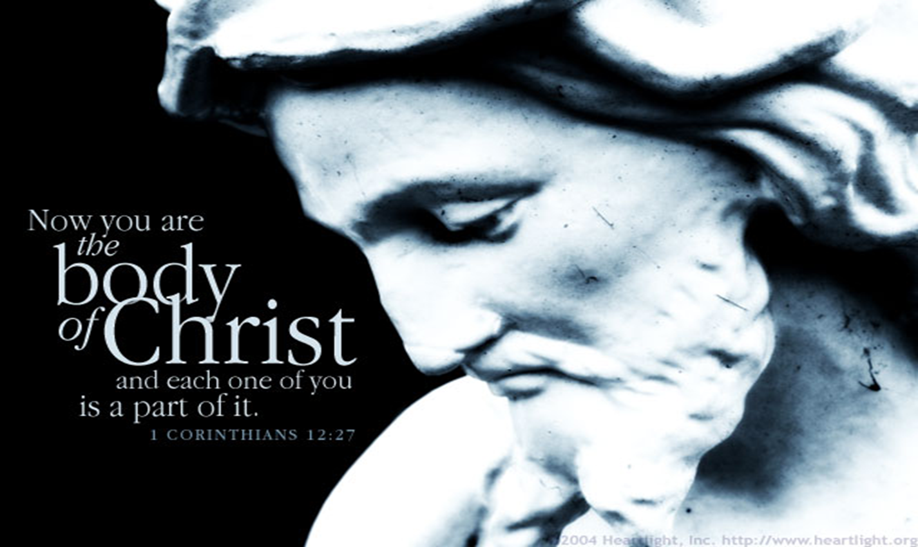

Slide 38
A BODY BROKEN FOR A BROKEN PEOPLE
“The full power to be a witness to Christ, which is given to the church and to all its members, has been converted into the claim that the church is the rich and gracious mediator of grace and salvation. Thus the church has become blind to its essential poverty… [Jesus] is present to the failing and broken disciples of all places and all times.”

Slide 39
“In an effort to be entirely faithful to Torah, many Jews had begun to accentuate the need to separate themselves from contamination. Right standing with God increasingly became a matter of keeping oneself unstained by actions, by things, and by people who did not adequately keep Torah. You didn’t gather with them, you didn’t consort with them, and you most certainly did not eat with them. So if you were proclaiming a kingdom not about separation but about reconciliation, how would you go about doing that? Well, you could start by having dinner with people. [In a culture obsessed with honor and shame, which considered eating with the disreputable as a blow to one’s own standing] Jesus constantly stepped around the politics of holiness, daring to interact with the unclean and the disenfranchised. He did so with the presumption not that their uncleanness would taint him, but that his purity would renew them.”

Slide 40
Eating & Drinking With Jesus – Craig Watts
“The very life of the church is to be a sign of the future. The Lord’s Supper foreshadows this grand future. It speaks of the world-embracing invitation of God & protests against the hostile divisions & persistent injustice that plagues human- -kind. When Jesus instituted the Lord’s Supper he called upon his followers to set their eyes forward to the time when they would eat and drink at Jesus’ table in the divine kingdom.”

Slide 41
The Lord’s Supper
David Lee Burris:
Imminent Room – Last Meal & Family Visitation
Catholic Church’s Meal Ticket!
Protestant Church’s Last Meal!
Restoration Movement Impetus!

Slide 42
The Sealing Blood Of The Covenant Of Grace The Mass Or Memorial Debate
Matthew 26: 28 - “My Blood Of The Covenant”
In ancient times, covenants were ratified in different ways; sometimes, for instance, the contracting parties were held to be bound by eating salt together; sometimes by partaking together of a sacrificial meal; sometimes by passing between the divided pieces of slaughtered animals; and especially by the use, still prevalent in many parts of the world, of blood, as by each of the parties tasting each other’s blood, or smearing himself with it, or letting it be mingled with his own etc., or by dipping their hands in the blood of the slaughtered animal.
* Source: "The Lord's Supper" by James M. Tolle

Slide 43
ROMAN MASS OR PROTESTANT MEMORIAL THE COMMUNION IN ONE KIND
“We observe that this decree of the Council of Constance, although making a law of communion in one kind for the laity of the Roman Catholic Church, plainly admits that the practice of the primitive church was of all Christians receiving both the bread and the cup, even as was ordained by Christ. This is an inadvertent admission that the dogma of communion in one kind is of human & not divine origin and that, therefore, the Roman Catholic Church has departed from the practice of the primitive church. We can see from this definition {Cardinal Gibbons} that the dogmas of transubstantiation and communion in one kind are ingeniously connected together, that the Roman Catholic Church teaches that Christ, whole and entire, His soul, body, divinity, is contained in either species. To support this unscriptural doctrine, what is purported to be the Lord’s Supper is cut in half; transubstantiation justifies communion in one kind, and communion in one kind proves transubstantiation.”
* Source: "The Lord's Supper" by James M. Tolle

Slide 44
ROMAN MASS OR PROTESTANT MEMORIAL THE COMMUNION IN ONE KIND
Concerning the necessity of each communicant partaking of the cup at the Lord’s table, Adam Clark observed,
“With respect of the bread, Jesus had before simply said, ‘Take, eat, this is my body’; but concerning the cup, he says, ‘Drink you all of this’; for as this pointed out the very essence of the institution, the blood of the atonement, it was necessary that each should have a particular application of it; therefore he said, Drink Ye All Of This By this we are taught that the cup is essential to… the Lord’s supper; so that they who deny the cup to the people, sin against God’s institution and they who receive not the cup, are not partakers of the body and blood of Christ.”
* Source: "The Lord's Supper" by James M. Tolle

Slide 45
COMMUNION IN combination TRAY CUPS 100 YR. TRADITION: Until THEN memorial PRACTICE MIXED THE ELEMENTS IN one CUP communal cup CIRCULATED & EACH DUNKED piece bread as a sop to the fruit of the vine.

Slide 46
ROMAN MASS OR PROTESTANT MEMORIAL SACRAMENT OR SACRIFICE
“The Word of God teaches us plainly that there is no other sacrifice for sin than the perfect sacrifice of Jesus. And yet Rome teaches that the Lord’s Supper is a sacrifice for sin – not a sacrament only, as Protestant churches teach, but a sacrifice. A sacrament is a sign and seal of the grace of God, but a sacrifice is the offering to God of a living body (man or animal) to wipe out our guilt in the sight of God, and thus to make possible our deliverance from the death we have deserved because of our sins. There is a very important difference between a sacrament and a sacrifice. A sacrament can never make atonement for our sin and thus cover our guilt in the sight of God. A sacrifice, if ordained by God, as were the sacrifices of Old Testament, can make atonement for sin.”
* Source: "What Rome Teaches" by Edward J. Tanis

Slide 47
ROMAN MASS OR PROTESTANT MEMORIAL SACRAMENT OR SACRIFICE
“Now Rome teaches that the Lord’s Supper is much more than a sacrament – it is nothing less than a sacrifice for sin! And Rome teaches that she is the only Church that has such a sacrifice for sin, hence the only Church that offers salvation to the people. At this point Rome is very logical. If we need the Lord’s Supper as a sacrifice for sin, the we must be members of the Roman Church. Cardinal Gibbons said ‘the Mass is another Calvary – which it is in reality.’ The mass is not identical with the conscious, suffering, bleeding, agonizing Christ of Calvary. To say that the bread on the Roman Catholic altar is the broken, bleeding body of Christ – when nobody can see that it is – is the greatest deception ever imposed upon mankind. When Jesus Christ changed the water into wine, it was wine. All the people present at the wedding in Cana of Galilee could see that the water had been changed into wine…”
* Source: "What Rome Teaches" by Edward J. Tanis

Slide 48
SOTERIOLOGY
“Literally, ‘the study of salvation.’ This topic within the corpus of systematic theology deals with the work of the triune God in bringing creation, and especially humans, to enjoy the divine purpose for existence; ‘objective’ soteriology speaks of the life, death, resurrection & exaltation of Christ in relation to human salvation; ‘subjective’ soteriology deals with the process whereby individuals are brought to God’s saving goals.”
* Dictionary Of Theological Terms, Grenz & Guretzki

Slide 49
Religious
Soteriological Exclusivity
Divergence

Slide 50
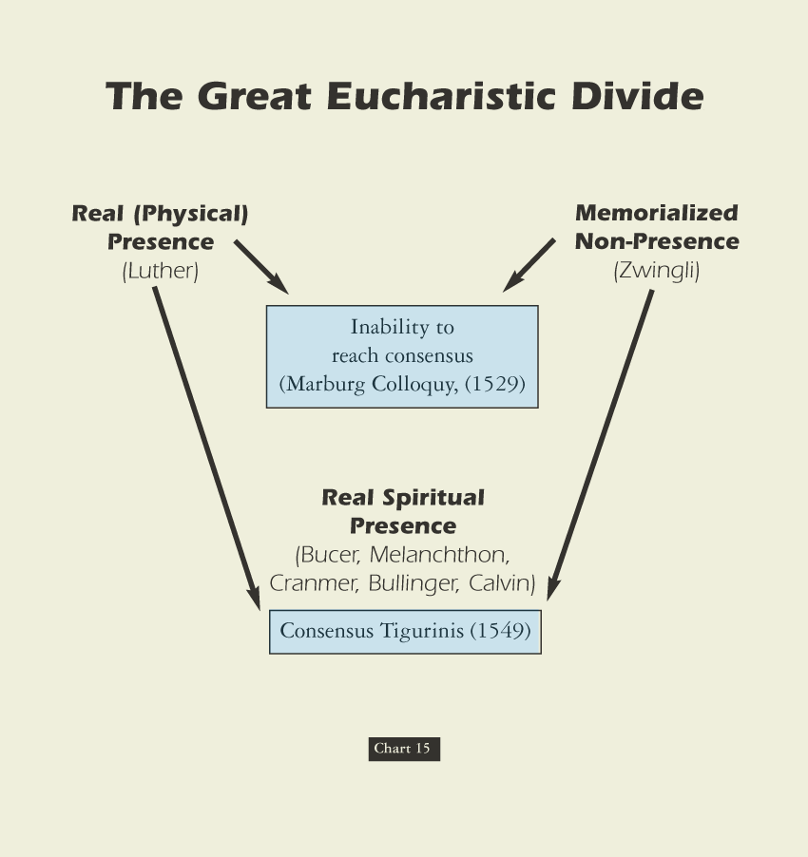
David Lee Burris:
Luther was coupled with milder Oecolampadius of Basel & Zwingli with Melanchthon

Slide 51
Swiss Reformers & Lutherans Separate Over Lord’s Supper
David Lee Burris: Zwingli Had Just Bested The Local Catholic Bishop In Debate
Latin “Hocus Pocus” Or Aristotelian Principle Debate?; Catholics Crucify Anew At Mass?
Agreement Then Holding Today Over Three Sola’s:
- Sola Fida = by faith alone, apart from works - Sola Gratia = by grace alone, without merit - Sola Scriptura = by scripture alone, without add
Protestantism Landscape Of State & Territorial Churches With Swiss & German Branches
Swiss Reform Movement Soon Split Into Three: Puritan, Presbyterian, & Congregational Variants
Had Historic 1529 Meeting Worked – One Protestant Reform Church
Long List Agreed All But Item Of Nature Of Elements In Communion: Luther Materialist; Zwingli Memorialism
Both Seriously Thought The Lord’s Supper One Of The Two Marks Of The True Church Differing Christlogical Not Sacramental
Debate Centers Over Interpretive Differences Relating To The Relative Symbolism Or Literalness Of John 6: 63.

Slide 52
Swiss Reformers & Lutherans Separate Over Lord’s Supper
David Lee Burris:
Both Lutheran & Catholic Arguments Pointless With Recent Translations Of 1Cor. 10: 16;
For Luther, the bread was the body of Christ. That is what Christ said. Luther wrote on the velvet cloth “Hoc est corpus meum!” The Swiss reminded Luther that Christ also called Himself the vine and the door. Oecolampadius asked, “Martin, how is Christ any more present in the sacrament if He is corporeally present than He is when spiritually and dynamically? “I don’t know,” answered Luther, “but if Christ told me to eat dung I’d do it knowing it was good for me.” Not to believe Christ’s words was to be of another spirit!
TWO IRONIC POSTSCRIPTS:
Luther later saw a copy of Calvin’s writings on the Lord’s Supper (essentially like Oecolampadius’ views) and seemed to agree with it
Manschreck, a Melanchthon authority, says that it was Melanchthon who stiffened Luther against the Swiss view of the Eucharist, fearing it would make reunion with Rome impossible!
Agreement Then Holding Today Over Three Sola’s:
- Sola Fida = by faith alone, apart from works - Sola Gratia = by grace alone, without merit - Sola Scriptura = by scripture alone, without add
Zwingli Focused On Contextual Understanding Of Apostles Present For The Omnipresence Of His Fleshly Body
Latter Lutherans Later Label: of extra Calvinisticum or contrary position “Christ is God outside flesh”
Luther’s case described as “distinctive ubiquity” or that “Christ’s human body or corporal presence everywhere”
Connected to Doctrine of Communicatio Idiomatum or sharing of properties and the “blessed exchange”
Theologians Explain As Emphasis Disagreement Since Orthodox Agree One Person Of Two Natures: Emphasis Either On Differences Or Similarities; Position Of Swiss Reformers: Luther Denatures Jesus’ Body

Slide 53
Incarnate Substance Trans-mutes To Communion Presence Debate
Roman Catholic Church: Transubstantiation of the elements’ substance into Jesus’s real flesh & blood regardless of appearance.
German Lutheran Reform: Consubstantiation of the elements’ substance that stays the same & coexists w/ the real flesh & blood.
Eastern Greek Orthodox: Theosis Images Doctrine views the elements types of Christ’s 2 natures that transport to His presence.
Swiss Reformer Position: Memorial Remembrance representation & symbol not of the divine substance or presence of His body.

Slide 54
“Things fall apart, the centre cannot hold.
The blood-dimmed tide is loosed, and
everywhere the ceremony of
innocence is drowned.”
Everything Falls Apart
19th Century

Slide 55
The Principle Of Godly Worth
The meaning of worship. “The formation of ‘worship’ is a key to its meanings and how they developed. The word is formed of worth and –ship, and its original meaning in Old English (about 888) was ‘the condition of being worthy, worthiness.’ This meaning was extended in late Old English (about 1000) to ‘the respect and honor shown someone worthy,’ found in such phrases as to do worship ‘to pay respect or show honor,’ and to have or hold in worship ‘to show honor to,’ always referring to a person of distinction.” - Semantic Antics

Slide 56
The Spiritual Dynamic Of The Lord’s Supper
A SYMBOLIC FEAST
A MEMORIAL FEAST
A COMMUNION FEAST
A COVENANT FEAST
A PROCLAMATION FEAST
A UNITY FEAST

Slide 57
The question of worthiness. By Luther’s lifetime, the phrase for the communion ceremony and host had been altered & with it a change of emphasis. The term Eucharistia, which means thanksgiving, had been replaced with Missa, which means the dismissal of the unworthy. Worthiness itself had metamorphized in meaning from a subjective and introspective responsibility to an objective meaning measured by works.
psychoanalysis & History
YOUNG MAN LUTHER
By Erik H Erikson
Significant Development Influencing German-Swiss Reformation & Scottish Restoration

Slide 58
Communion Concession & Conscience Crisis: 1st Corinthians 11: 27-29 KJV Misinterpreted
David Lee Burris:
N.T. Worthiness Of Manner Consistent With O.T. Passover Practice.
Proper grammatical reading of these verses is difficult from the older versions and translations. The term “unworthily”
occurs twice – each time an adverb modifying an action verb – eat & drink or eateth & drinketh. Contextually in this
sense “unworthily” relates to manner of partaking – not of the people partaking. Verses 27 & 29 similarly admonish as
how serious this remembrance celebration is to the heart of God. Neglecting to so somberly discern the symbolic nature
of communion elements is to share guilt in the cruel death of His Son – we crucify Christ afresh and consume eternal
death rather than eternal life. None are “worthy” and this is where our thoughts should be per our Verse 28 – so that
we can partake in a “worthy manner.” Luther – Zwingli – John Calvin – all seemed to miss this very simple Bible truth.
As we related earlier Luther & Zwingli agree on how to resolve 14 of 15 items of difference between them. The contentious 15th item is that of the Lord’s Supper. Although their discussion on this occasion obsessed on the eucharist – Luther objected as well to the memorial practice of open communion. Luther referred to this practice as “manducatio indignorum” or “eating by the unworthy.” According to this Lutheran Doctrine the unworthy receive Christ’s body to their own harm – this behavior is not among those deemed harmless and therefore indifferent to God.
The nature of the disagreement between the two reform camps is difficult to determine. First, the two sides disagree as to how important the disagreement is – Luther has it as highest priority demanding conformity while Zwingli wants a “soul freedom” of opinion on the issue. Second, there is an underlying disagreement about basic spirituality and the power of external things. This disagreement goes all the way down to a basic dispute about the person of our Lord and Savior Jesus Christ, and the universal or limited nature of His atonement sacrifice.
In follow-up, not giving up, the Strasbourg reformer Martin Bucer worked out a compromise with the Lutherans in 1536 called the Wittenberg Concord, but the agreement did not last because it was ambiguous on the issue of “manducatio indignorum.”
Furthermore, in a third attempt, Calvin makes another compromise proposal with the Lutherans which endorses the functional language of sacrament and - in effect - its related aspect of closed communion.

Slide 59
Communion Concession & Conscience Crisis: 1st Corinthians 11: 27-29 KJV Misinterpreted
Proper grammatical reading of these verses is difficult from the older versions and translations. The term “unworthily”
occurs twice – each time an adverb modifying an action verb – eat & drink or eateth & drinketh. Contextually in this
sense “unworthily” relates to manner of partaking – not of the people partaking. Verses 27 & 29 similarly admonish as
how serious this remembrance celebration is to the heart of God. Neglecting to so somberly discern the symbolic nature
of communion elements is to share guilt in the cruel death of His Son – we crucify Christ afresh and consume eternal
death rather than eternal life. None are “worthy” and this is where our thoughts should be per our Verse 28 – so that
we can partake in a “worthy manner.” Luther – Zwingli – John Calvin – all seemed to miss this very simple Bible truth.
The Backdrop Setting To This Background Material – Considering The Separate Motivations Of The Major Players:
Luther is more concerned with preserving the priesthood administered sacramental system existing since the fourth century than he is in merger with the Swiss Church or any group which actually practices the “priesthood of all believers.” From his publication on “The Babylonian Captivity Of The Church” he only criticized the abuses of the sacramental system and questioned the specific interdict and special excommunication powers of the papal office. Of the seven sacraments then in practice – he did recognize only two – baptism & communion. Luther redefines the standard threshold using a modified version of the traditional Augustinian definition of sacrament. Since the sacraments are founded on Christ’s promise - they are to be received only by faith – faith of family or faith of persons. The other five “sacraments” are reduced simply to church practices – except for penance which he places in an uncertain status. As regards communion – it is only for those recognized by the church as being faithful.
In his heart simply a reformer – his motivation is the eventual re-unification with the Catholic Church – making it once again into that which is truly Catholic in meaning. The Lutheran Church has the mission of preserving this golden age pattern of the fourth century for the duration.
Calvin just like Zwingli desires the dream of one Protestant church entity - totally rejecting further attempts at reunification or even reform of the Catholic Church. Calvin learns from reports of Zwingli’s meeting with Luther that hopes of progress and eventual realization of this dream require the ending of avoidance and focused attention on this communion controversy.

Slide 60
Communion Concession & Conscience Crisis: 1st Corinthians 11: 27-29 KJV Misinterpreted
Proper grammatical reading of these verses is difficult from the older versions and translations. The term “unworthily”
occurs twice – each time an adverb modifying an action verb – eat & drink or eateth & drinketh. Contextually in this
sense “unworthily” relates to manner of partaking – not of the people partaking. Verses 27 & 29 similarly admonish as
how serious this remembrance celebration is to the heart of God. Neglecting to so somberly discern the symbolic nature
of communion elements is to share guilt in the cruel death of His Son – we crucify Christ afresh and consume eternal
death rather than eternal life. None are “worthy” and this is where our thoughts should be per our Verse 28 – so that
we can partake in a “worthy manner.” Luther – Zwingli – John Calvin – all seemed to miss this very simple Bible truth.
Through triangulation Calvin formulates an intermediate position between that of his predecessor and Luther that for all intents and purposes accommodates Luther on his major point of sacramental language - making of the memorial itself the “means of grace.” John Calvin considers this a minor point on a not so important tangential issue. However, it has the significant effect of closing the self-examined communion – with church officials being allowed to start to share in that examination of worthiness.
In other words, neither the Ideologue Reformers Luther and Zwingli or the Ideologue Systematizer Calvin are purists – by the evidence of their doctrinal disconnects they can all be defined more precisely as compromisers to a greater or lesser degree. As is so often the case these weaknesses of message at a base level correspond at to huge flaws of character. These leaders evidenced over time less of a desire to glorify God than to aggrandize themselves. As a group they paved the way for rightly convicted, sincerely motivated, and uncompromisingly dedicated leaders.
The doctrinal outcomes of these egregious errors throughout the Protestant world was to harden denominational boundaries and reinforce judgmental attitudes. Through their theological traditions everyone seems to have passed over the middle verse of the proof text.
Zwingli’s outward badge of participation in the Christian community had devolved to literalistic badges of identification – a mark of worthiness prerequisite to participation. This Protestant tradition of judging the faith of another was and is as abusive as the Catholic point system of penance which determined participation in the communion sacrament.

Slide 61
Communion Concession & Conscience Crisis: 1st Corinthians 11: 27-29 KJV Misinterpreted
Proper grammatical reading of these verses is difficult from the older versions and translations. The term “unworthily”
occurs twice – each time an adverb modifying an action verb – eat & drink or eateth & drinketh. Contextually in this
sense “unworthily” relates to manner of partaking – not of the people partaking. Verses 27 & 29 similarly admonish as
how serious this remembrance celebration is to the heart of God. Neglecting to so somberly discern the symbolic nature
of communion elements is to share guilt in the cruel death of His Son – we crucify Christ afresh and consume eternal
death rather than eternal life. None are “worthy” and this is where our thoughts should be per our Verse 28 – so that
we can partake in a “worthy manner.” Luther – Zwingli – John Calvin – all seemed to miss this very simple Bible truth.
Both major religious bodies had accomplished the establishment of closed communion as a universal norm. The communion practices of the four major Protestant offshoots of the Swiss Reform movement were just variations on this courtroom theme. It Was Time Overdue To Reconcile This Remembrance Ceremony To That Of The Spirit Of The New Covenant!
The communal nature of communion has been taken out – that which was intended to unite man with man and them together with God had been perversely twisted. In the Be-atitudes Christ speaks to this ideal in Matthew 5: 23–26.
These effects taken as a whole paved the way for one with a healing message of brotherly love - worship that is in doctrinal rather than dogmatic conformity – preaching lifestyle of collective submission where there is Biblical authority and the ideal of respect for personal opinions and choices where there is no direct scripture or obvious example of necessary application.
Bible Students With Sensitive Consciences Are Ripened & Ready For Change When They Hear Alexander Campbell. But first he has to have his own heart pricked as we see happen in the opening scene of our docu-drama. We witness the moment when Alexander Campbell comes to the fundamental realization that – although the human creation as a whole has performed miserably thus not being worthy of reward - yet without any merit of our own – God has made us all worthy!
He Did Not Send His Son For Some Persons And Not For Others!
CHRIST DIED ON THE CRUEL CROSS SO THE ENTIRE HUMAN RACE COULD BE SAVED!

Slide 62
Restoration
Closed Communion
Divergence

Slide 63
The Principle Of Human Worth
The question of worthiness. By Luther’s lifetime, the phrase for the communion ceremony and host had been altered & with it a change of emphasis. The term Eucharistia, which means thanksgiving, had been replaced with Missa, which means the dismissal of the unworthy. Worthiness itself had metamorphosed in meaning from a subjective introspective responsibility to an objective meaning measured by works.
Catholic hierarchs determine individual worthiness.
Reform churches each establish closed communions as evidencing their determinations of individual worth.
Restoration churches teach human worth as God given intrinsic and in the memorial supper - inner examined.

Slide 64
“Wrestling With God”

Slide 65
The Spiritual Dynamic Of The Lord’s Supper
“Another week with all its cares hath flown, Another day of rest and peace is here; Sweet day on which our wearied hearts are drawn In holy fellowship to Jesus near.”
“Jesus, our great High Priest, our Sacrifice, Our Passover, rich gift of love divine, With Thee we would in holiest rise, Communing with Thee in the bread and wine.”
“O what a feast ineffable is this, Thy table spread with more than angels food! Angels the highest never taste the bliss, The dear communion of Thy flesh and blood.”
“May we as servants joy to do Thy will, As sons the honor of Thy house maintain, As soldiers stand prepared for conflict still, And count all suff’ring borne of thee as gain.”
- G. Y. TICKLE

