Slide 1
Pilate Asked
Pilate asked almost as many questions in a few hours that Christ asked over three years.

Slide 2
Introduction
Pontius Pilate stands as one of the worst villains in Scripture, perhaps undeservedly.
Arguably second only to Judas Iscariot in infamy.
His misdeed was more passive than Judas’, however.
He could have said NO!, but he let others influence him.
Truly, he was a man with more questions than answers.
And wanting to know allows Pilate to stand out above many others.
However, his curiosity may be more of a reflection of that of the Emperor Tiberius – Pilate’s Father-In-Law - as to the personage of Jesus Christ – to whom he would give report regarding this episode.
Moreover, since Pontius Pilate had been dumped in Palestine as a career punishment for previous administrative mistakes – being on probation - especially for use of excessive force in crowd control – all 13 of his questions reflected extreme caution in this scenario that combined both categories for which he had been warned.

Slide 3
“WHAT ACCUSATION DO YOU BRING AGAINST THIS MAN?”
John 18:29
It was most reasonable for the Governor to ask the accusers “to specify the charges against him
Festus spoke to Agrippa a similar thing.
Acts 25:24-27.
So, here are the accusations: Matthew 26:61, 63-64; Luke 23:1-2

Slide 4
“WHAT ACCUSATION DO YOU BRING AGAINST THIS MAN?”
Sadly, that question brings to the light the reality that the accusations were most disharmonious.
Was Jesus under indictment for threatening to destroy the temple, for claiming to be the Son of God, or for forbidding payment of taxes?
It seems His accusers could not agree on the charges. Thus, these were sham legal proceedings.

Slide 6
“ARE YOU THE KING OF THE JEWS?”
Luke 23:3 Pilate inquired as to whether Jesus is King.
John 18:36-37 The Lord did not deny it, but He did clarify the nature of His kingdom.
It is not in competition with Caesar’s, but in superiority over it, for His kingdom is not an earthly one.
Mark 9:1 His kingdom came within that generation. It is, evidently, a spiritual one.

Slide 7
High Priest Caiaphas
David Lee Burris:
Or Messiah Or Deliverer In Context Of Gamaliel @ Acts 5: 36, 37 & Rebels Period Taxing Census
Legal Question Dangerous Lunacy:
“Are You The Christ?”

Slide 8
Prefect Pontius Pilate
David Lee Burris:
John 19: 11 - Those That Handed Over Committed The Greater Sin!
Legal Question Harmless Lunacy:
“Are You The Jewish King?”

Slide 9
Rome’s Twelve Tables
David Lee Burris:
Earthly Rulers Do Not Jeopardize Themselves For Their Inferiors – Food Servants Taste Their Meals & Bodyguards Take Their Injuries;
Christ Could Command Angel Legions To Protect Him & Impose His Will
Non Compos Mentis
The Roman Insanity Defense:
“In the very concept of crime and punishment – crime being mens rae – there has to be the power within to frame the evil act.”
pilate

Slide 10
Jesus Christ
David Lee Burris:
Pilate & Jesus On Origin Of Power – Angels Would Have Saved In Both Temptation & Crucifixion Oriental Culture Of Baltic Rim Certified Lunacy & Protected It – i.e. Great Pyramid Legally Prohibited From Measure – Westerner Dressed In Pink Ballet Outfit – “Don’t Touch My TuTu”
Judicial Authorities Queried Accused Madmen As To Their Self-Identity & Thought Rationality
Crafted Answer Preventing Protection:
"You Say It!"
* John's Version Extended

Slide 11
“DO YOU NOT HEAR HOW MANY THINGS THEY TESTIFY AGAINST YOU?”
Matthew 27:13 Similar to the first question, Pilate here reminded Christ that the testimony against Him was multifaceted.
Mark 14:56, 59 Perjury was suborned, but one witness’s testimony was incongruous with another’s.
Exodus 20:16 Since at least the Ten Commandments, God’s people have known the wickedness of bearing false witness.
Proverbs 18:17 We should be slow to believe the first version of events we are told.

Slide 12
“DO YOU ANSWER NOTHING?”
Mark 15:3-5 Jesus declined to speak in His own defense.
First, this demonstrates acceptance of the course of events unfolding – a willingness to die.
Second, it demonstrates the wisdom in silence.
Matthew 26:62-63; Luke 23:8-9 Not only before Pilate, but also before the priests, and before Herod, Jesus had nothing to say. He was consistently mute.
Isaiah 42:1-2; 53:7 This fulfilled prophecy concerning the anointed one.

Slide 14
“DO YOU ANSWER NOTHING?”
Ecclesiastes 3:1, 7 It is wise to know when to speak and when not to.
John 8:6 The silence of Christ was not without precedent. Jesus found it prudent on a prior occasion to withhold answer.
Colossians 4:6 Christians are enjoined to learn how to answer.
This will include learning whether to answer.

Slide 15
“WHOM DO YOU WANT ME TO RELEASE TO YOU? BARABBAS, OR JESUS WHO IS CALLED CHRIST?”
Matthew 27:17 Considering Barabbas was a thief, insurrectionist, and murderer – a most unsympathetic prisoner, it seems likely Pilate was attempting to increase the probability of Jesus being chosen by the crowd for release.
Acts 3:13-15 Alas, the multitudes chose poorly, dragging a weak leader into a reprehensible decision.
Hebrews 2:9; Galatians 3:13 When evil Barabbas deserved to die for his heinous actions, Christ died instead.
Truly, His death spared all sinners who obey Him from our deserved second death.

Slide 16
Jesus Christ
In John 4: 40, 41
“But you are not willing to come to Me that you might have life,
I do not receive honor from men.”

Slide 17
Savior’s Rejection
Explained In John 12: 43
“For they loved the
praise of men more than the praise of God.”

Slide 18
“WHAT THEN SHALL I DO WITH JESUS WHO IS CALLED CHRIST?”
Matthew 27:22 What to do about Jesus is the most basic question there is and it is still relevant today.
Romans 10:17; Acts 16:31; Romans 10:9-10; Galatians 3:27; Acts 2:38 In brief, the answer is to learn about Him, believe Him, confess Him, repent of sins as He commanded, and be baptized into Him.
But we know Pilate had a different reason for asking.

Slide 20
“WHY? WHAT EVIL HAS HE DONE?
Mark 15:14 Having heard multiple, contradicting accusations against Jesus, Pilate remained unconvinced that He had perpetrated any crime.
Luke 23:15; John 19:4 Pilate’s repeated conclusion was that Jesus was no outlaw.
John 14:30; Matthew 4:1-11; Hebrews 4:15 The Lord claimed that the devil had nothing in Him. It was true, for when they met face-to-face, when Christ was in a most weakened condition, Satan failed to turn Him. Having faced all temptations, Jesus never sinned.
Hebrews 7:26; 1st John 3:5 Christ is sinless. Even the Governor who issued His death sentence knew it.

Slide 21
“WHERE ARE YOU FROM?”
John 19:9a; Luke 23:6-11 Pilate was not trying to become better acquainted with a new friend. He was curious to know where Jesus was from so he could be rid of Him, pawning Him off on the tetrarch of Galilee. Of course, that’s irrelevant since, even though Jesus was a Galilean, His alleged crimes took place in Judea. Herod returned Him to Pilate.
Matthew 27:24 Pilate was desperate to evade his duty as Governor to release an innocent man.
Exodus 4:13 Shirking responsibility angers God. Moses did not please Jehovah when he offered excuses as to why he should not be the messenger to Pharaoh.
Jonah 1:2-3 Jonah displeased the Lord when he fled away from Nineveh after God had summoned him to preach repentance there.

Slide 22
“AM I A JEW?”
John 18:35 Pilate sensed that what transpired between Jesus and His accusers was not his business since he was not a Jew.
Romans 10:12-13; Galatians 3:28 Being a Jew is irrelevant now. In Christ there is equality between Jew and Gentile.
Romans 9:6-8; Galatians 6:16 Because not every Israelite is legitimate anymore, Christians have become the true “Israel of God”.

Slide 23
“WHAT IS TRUTH?”
John 18:38 Whether he was sincere or flippant, Pilate’s question was a most appropriate one.
John 17:17; Psalm 119:160 The answer to the question asked, “What is truth?”, is God’s word, Scripture.
Psalm 31:5; John 14:6; 1st John 5:6 The answer to another, unasked question, Who is truth?, is Jehovah, Christ, and the Spirit.

Slide 24
Pythagorus
In Sixth Century B.C. Wrote:
“Truth is so great a perfection, that if God would render Himself visible to men, He would chose light for His body & truth for His soul.”

Slide 25
Thomas Sowell
“There are only two ways of telling the complete truth – anonymously & posthumously.”

Slide 26
Pontius Pilate
David Lee Burris:
Notice - Jewish Leaders Are To Pilate Being Both Obsequious & Appealing Pandectic
“What Is Truth?”

Slide 27
Liar
Everything that we know about Jesus discourages us from selecting this option. It is incomprehensible that the One who spoke of truth and righteousness was the greatest deceiver of history. He cannot be a great moral teacher and a liar at the same time.

Slide 28
“DO YOU KNOW THAT I HAVE POWER TO CRUCIFY YOU?”
John 19:10-11 Trying to intimidate His prisoner, Pilate reminded Jesus he had power to release or execute Him. Jesus did not disagree, but taught His interrogator where that power came from.
Acts 25:11 Under similar circumstances, on trial for his life before a Roman governor, Paul did not deny or question the validity of the death penalty, only the appropriateness of using it against an innocent man.
Romans 13:1, 4 God establishes government for the upholding of good and the punishment of evil. It is an abject failure when government upholds evil and punishes good.
1st Timothy 2:1-2 The people of God ought to pray for government leaders to leave us all in peace.
Proverbs 29:2 Pray for righteous leadership!

Slide 29
Lunatic
In his interview with psychologist Gary Collins, Lee Strobel reports Collins listing a litany of Jesus characteristics that indicate his overall mental health including appropriate emotions, contact with reality, logical conversation, and deep and abiding relationships. All of these together in the same person would never be expected of one suffering from mental illness.
Lee Strobel, The Case for Christ, p. 144-154.

Slide 30
Lunatic
“He was loving but didn’t let his compassion immobilize him; he didn’t have a bloated ego, even though he was often surrounded by adoring crowds; he maintained balance despite an often demanding lifestyle; he always knew what he was doing and where he was going; he cared deeply about people, including women and children, who weren’t seen as being important back then; he was able to accept people while not winking at their sin; he responded to individuals based on where they were at and what they uniquely needed. . . . All in all, I just don’t see signs that Jesus was suffering from any known mental illness.”
Gary Collins in The Case for Christ, p. 147

Slide 31
“What Is Truth?”
Messiah
Willingly
Obliged!

Slide 32
“SHALL I CRUCIFY YOUR KING?”
John 19:15 The question Pilate here asked is one we are capable of answering.
Hebrews 6:4-6 When we forsake Christ for sin, it is a renewed crucifixion.
After all, He suffered the pain of death to save us from sin, so to sin again is like driving new nails into His flesh.

Slide 33
Legend
The greatest difficulty with this option is the issue of time. Legends take time to develop. Yet most of the New Testament, including Matthew, Mark, Luke, Acts, and all of Paul’s Epistles were written by A.D. 68.
The creed in 1 Corinthians 15:3-8 dates to at least A.D. 51 and some trace back to as early as A.D. 33-34. There simply is no time for a legend to develop.

Slide 34
Pontius Pilate
David Lee Burris:
Notice - Jewish Leaders Are To Pilate Being Both Obsequious & Appealing Pandectic
“What Is Truth?”

Slide 35
“HE ASKED HIM IF HE HAD BEEN DEAD FOR SOME TIME”
Mark 15:43-44 It surprised Pilate to know that Jesus had expired as swiftly as He did.
Apparently, crucifixion was so horrible that a six hour death was regarded as brief.
Hebrews 5:5-7 The relative brevity of His death, therefore, substantiates the idea that God answered Jesus’ prayers.
Matthew 26:37-39 He prayed for deliverance, and, to a limited extent, was granted what He requested.
1st Peter 1:6-7 God does not deliver us from all suffering, but He does deliver us through that suffering.

Slide 36
Who moved the stone?

Slide 38
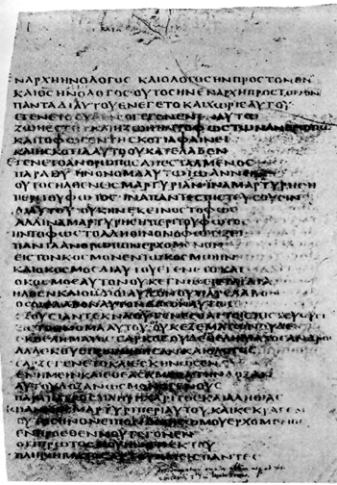
There is an interesting parenthetical in the Bezae manuscripts.
“And when He was laid there, he put against the tomb a stone which twenty men could not roll away.”
* Double Bound Spice-Soaked Body Wrap Weighed 75 lbs

Slide 39
Lord
In his book, Mere Christianity, C. S. Lewis said, “A man who was merely a man and said the sort of things Jesus said would not be a great moral teacher. He would either be a lunatic—on a level with the man who says he is a poached egg—or else he would be the Devil of Hell. You must make your choice. Either this man was, and is, the Son of God, or else a madman or something worse. . . .

Slide 40
Lord
You can shut Him up for a fool, you can spit at Him and kill Him as a demon, or you can fall at His feet and call Him Lord and God. But let us not come with any patronizing nonsense about His being a great moral teacher. He has not left that open to us. He did not intend to.”

Slide 41
The Resurrection of Jesus
Jesus clearly pointed to His bodily resurrection as the authenticating sign by which He would confirm His own unique claims. Later on, the Apostle Paul, in speaking of the importance of this event to the faith of a Christian would say, “If there is no resurrection of the dead, then not even Christ has been raised; and if Christ has not been raised, then our preaching is vain, your faith is also vain. . .if Christ has not been raised, your faith is worthless; you are still in your sins” (1 Cor. 15:13–17).

Slide 42
The Empty Tomb
The tomb of Jesus Christ was found empty on the third day.
From the beginning Christians have argued that the tomb was empty on the third day.
Even the opponents of Christianity believed that the tomb was empty.

Slide 43
The Empty Tomb
If the tomb had not been empty, it probably would have been treated as a shrine.
If the tomb was occupied, what would make the disciples of Jesus risk their lives by saying that it was empty?
The tomb of Jesus was empty because He had been resurrected from the dead.

Slide 44
The Empty Tomb
“In the face of the facts, they (critics) have been impotent to put Jesus body back in the tomb. They flounder, they struggle, they snatch at straws, they contradict themselves, they pursue desperate and extraordinary theories to try and account for the evidence. Yet each time, in the end, the tomb remains vacant. . . . ‘The empty tomb, then, forms a veritable rock on which all rationalistic theories of the resurrection dash themselves in vain.’” Lee Strobel, The Case for Christ, p. 223.

Slide 45
Jesus Rose from the Dead
Did the disciples steal the body?
Were the disciples deceived?
Did the Jewish leaders take it?

Slide 46
Jesus Rose from the Dead
Did Jesus really die?
Jesus was raised from the dead!

Slide 47
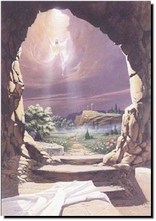
Jesus Rose from the Dead
Alternative explanations are inadequate, and eyewitnesses were put to death because they continued to maintain that Jesus had been raised from the dead. Christianity exists because these people truly believed in the resurrection, and their testimony continues to be the most reasonable explanation for the empty tomb of Jesus Christ.

Slide 48
Jesus Rose from the Dead
“We did not follow cleverly invented stories when we told you about the power & coming of our Lord Jesus Christ, but we were eye-witnesses of his majesty.”
2 Peter 1:16

Slide 49
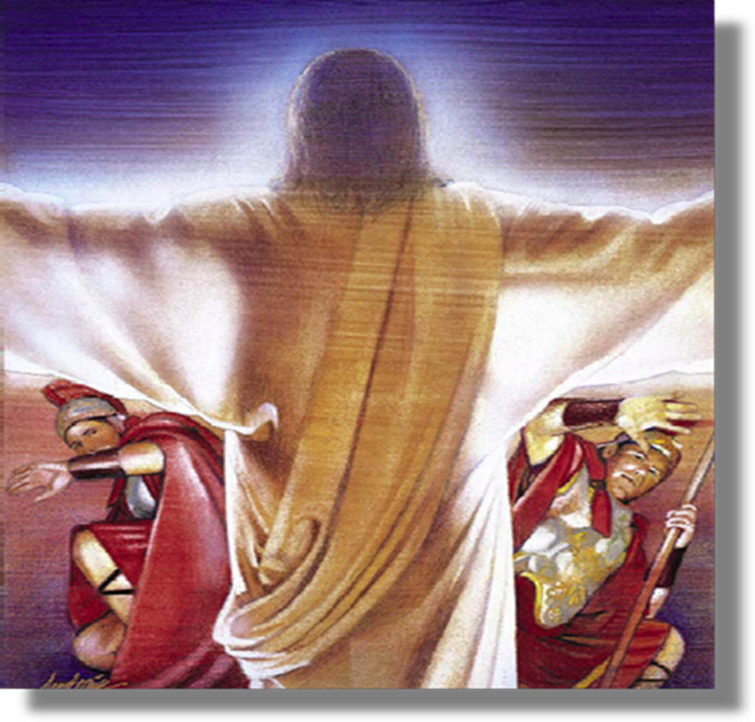
"To Tiberius Caesar, Emperor of Rome. Noble Sovereign, Greeting: The events of the last few days in my province have been of such a character that I will give the details in full as they occurred, ‘He said that about the beginning of the fourth watch they saw a soft and beautiful light over the sepulchre. He at first thought that the women had come to embalm the body of Jesus, as was their custom, but he could not see how they could have gotten through the guards. While these thoughts were passing through his mind, behold, the whole place was lighted up, and there seemed to be crowds of the dead in their grave clothes. All seemed to be shouting and filled with ecstasy, while all around and above was the most beautiful music he had ever heard; and the whole air seemed to be voices praising God’.” - p. pilate

Slide 50
Conclusion
So many of the questions that Pilate asked are still just as relevant today.
We sometimes sing the song “what will you do with Jesus”.
Those questions are for each of us to answer.
Pilate was wrong for allowing an innocent man to suffer the penalty of death. And he knew it.
Will you also allow the death of Christ to mean nothing to you?

