Slide 1
What Is TRUTH?
by David Lee Burris

Slide 2
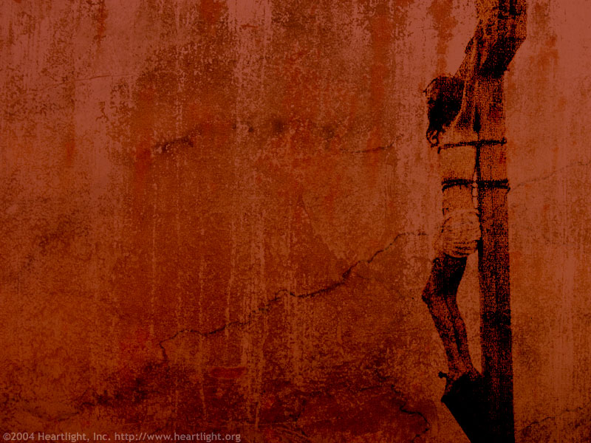

Pontius Pilate
David Lee Burris:
Notice - Jewish Leaders Are To Pilate Being Both Obsequious & Appealing Pandectic
“What Is Truth?”

Slide 3

Philosophy Investigates:
Abstract Concepts
Absolute Truth
Nature Of Reality

Slide 4


Axiological Analysis Of Values Views
Axiology: Transdisciplinary & Broad Field Research Resourced Of Cognitive Concepts @ Aesthetic – Epistemic - Ethical Construct

Slide 5
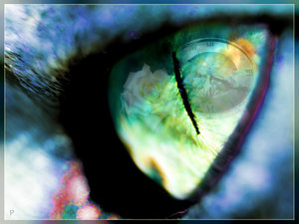
Axial Model Between 200 - 600 B.C.
Lifeview: Personal Journey & Movement
PROCESS TRANSFORMABLE & PROGRESS INCOMMUNICABLE
From Lower To Higher Realm
From Knowledge To Wisdom
From Appearance To Reality
From Bondage To Liberation
From Confusion To Insight
From Darkness To Light

Slide 6
Axial Model Between 200 - 600 B.C.
Two Methods Of Inquiry:
Major Logic – Ontology
Major Logic – Epistemic
Minor Logic – Inductive
Minor Logic – Deductive

Slide 7
Axial Model Between 200 - 600 B.C.
Deliberate Structure Three Tier:
PROPOSITIONAL LOGIC
FORMALIZED PROOFS
TRUTH TREE MAPING

Slide 8
Axial Model Between 200 - 600 B.C.
THREE QUERIES RAISED:
What Can We Know?
What Ought We To Do?
For What Can We Hope?

Slide 9
Axial Model Between 200 - 600 B.C.
Worldview Answers Four Questions:
What Is Human Origin?
What Is Life’s Meaning?
What Is A Moral Action?
What Is Man’s Destiny?

Slide 10
Axial Model Between 200 - 600 B.C.
THREE WORLDVIEW TYPE:
PANTHEISM – “All Is One”
NATURALISM – “Matter In Motion”
THEISM – “God Is Governing”

Slide 11
Axial Model Between 200 - 600 B.C.
Western Society Dual Divide:
Humanism & Materialism
DIVINITY & SUPERNATURAL

Slide 12
David Lee Burris:
Note: Lifeview + Worldview = Faith Foundation
Axial Model Between 200 - 600 B.C.
Precondition Of Intelligibility:
Essential assumptions required to
make sense of human experience.
WHICH WORLDVIEW QUALIFIES?

Slide 13
Axial Model Between 200 - 600 B.C.
Evidential Category | Standard Measure
EXPERIMENT | UNEQUIVOCAL
RATIONALE | NON-CIRCULAR
AUTHORITY | RECOGNIZED
REVELATION | RELEVANCE

Slide 14

Our Decision Making To Individual Advantage
Our Learning Not Program But Hardwired Neural Network?

Slide 15
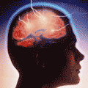
Mathematical Reductionists Claim:
Game Theory Was Both Pioneered & Developed By Our Government As Methodological Tool For Superpower Negotiation During The Cold War.
Subsequently, The Games Became Iterated, Concepts Expanded & Application Extended To Other Areas Of Public Policy – i.e. Social Issues In General & Crisis Situations In Particular.
Ultimately, Assessments Were Being Made & Conclusions Reached About The Larger Values.
A Model & Specific Game Was The Focus Of The Study That Led To This Growth & Generalization.
The Prisoner’s Dilemma - Dual-Play Zero-Sum - Was Thought To Capture An Essential Tension Between Collective Good & Individual Advantage.

Slide 16
Statistical Ground Unsound:
Wrongful Application &
Inappropriate Mean Use.
The Biased Sample.
Mindless Extrapolation.
Fallacious Reasoning.
Selective Reporting.

Slide 17
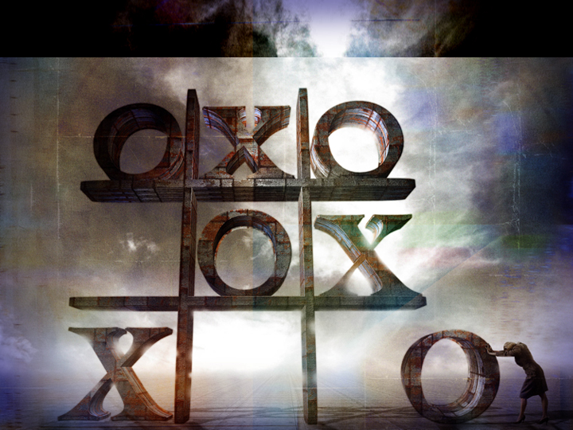
reductio ad absurdum

Slide 18

reductio ad absurdum

Slide 19
Pontius Pilate
David Lee Burris:
Notice - Jewish Leaders Are To Pilate Being Both Obsequious & Appealing Pandectic
“What Is Truth?”

Slide 20

Excerpts: “A History Of Truth” by Felipe Fernandez-Armesto
From Rock To Rubble: The Philosopher’s Stones
Three Ways Proposed For Rescuing Truth From Relativism
Without Necessarily Committing To Belief In A Truth-World:
Correspondence Theory - Or Treating Truth As A Common Sense & Reliable Description Of Reality.
Coherence Theory - Or Axiomatic Construction Of Truth Propositions & Their Demonstrated Proof.
Consensus Theory - Or Pragmatic Utilitarianism Of Received Knowledge & Traditional Interpretation.

Slide 21
Excerpts: “A History Of Truth” by Felipe Fernandez-Armesto
Everyone’s attempt to be good – every attempt to construct happy relationships and thriving societies – starts with two questions: How do I tell right from wrong? And how can I tell truth from falsehood? There is no social order without trust and no trust without truth or, at least, without agreed truth-finding procedures. The options on which society depends – such as mutual respect, adhesion to contracts, obedience to laws, devolution of individual strength to the community – have to be commended on convincing grounds. (Page 3)

Slide 22

INSPIRATION, REASON, & CONSENSUS
Christopher Burns in Deadly Decisions on How We Decide What is True:
“Thousands of years ago, whenever information or ideas grew so complex and ambiguous that their truth could not be determined, villages relied on inspiration. As long as the source remained unimpeachable, the charismatic pronouncements were accepted as true, whether or not they were particularly consistent or in accord with the evidence. Priests and prelates, oracles and emperors multiplied, rising in a splendid hierarchy of increasing infallibility that reached all the way to God.
But as people began to write down these revelations, inconsistencies became apparent and reason suggested a better set of rules. The truth of any ambiguous or new statement could be tested by comparing it logically to other statements that were known to be accurate. Finally, after several centuries of torture & deception, those whose office it was to interpret the new rules mounted to power, wielding reason like a sword.
The age of science has offered a third test of truth: consensus. A statement is true if it explains most(but not necessarily all) of the evidence. A theory is true within the context of a current paradigm, although it may not be true tomorrow when the paradigm shifts. An idea is true, according to William James, if it provides a successful basis for action. This is not just a triumph of complexity over common sense; consensus is a genuinely new standard for truth.
In each truth regime, authority took charge and the priests, the professors, and the politicians stabilized the system and ran the process in a manner that allowed the group to act successfully in the real world.”

Slide 23
INSPIRATION, REASON, & CONSENSUS
Christopher Burns in Deadly Decisions on How We Decide What is True:
“The age of science has offered a third test of truth: consensus. A statement is true if it explains most(but not necessarily all) of the evidence. A theory is true within the context of a current paradigm, although it may not be true tomorrow when the paradigm shifts. An idea is true, according to William James, if it provides a successful basis for action. This is not just a triumph of complexity over common sense; consensus is a genuinely new standard for truth.
In each truth regime, authority took charge and the priests, the professors, and the politicians stabilized the system and ran the process in a manner that allowed the group to act successfully in the real world…
In addition to size and structure, there is a third element affecting the success of a group’s decision, the organization’s truth system. Most groups function primarily as information-processing societies. They have standards for determining what is true (inspiration, reason, and consensus). They have a specialized language including acronyms, buzzwords, and unique phrases that make some things easier to say than others. They have a process for sharing information: sometimes it is very hierarchical; sometimes it is collegial. Groups have concepts – existing descriptions of reality on which all the members agree but which may or may not be true. And they have values – goals, biases, and shared visions of the future. Finally, there is usually a commitment to speak truthfully to each other in the name of some greater objective.

Slide 24
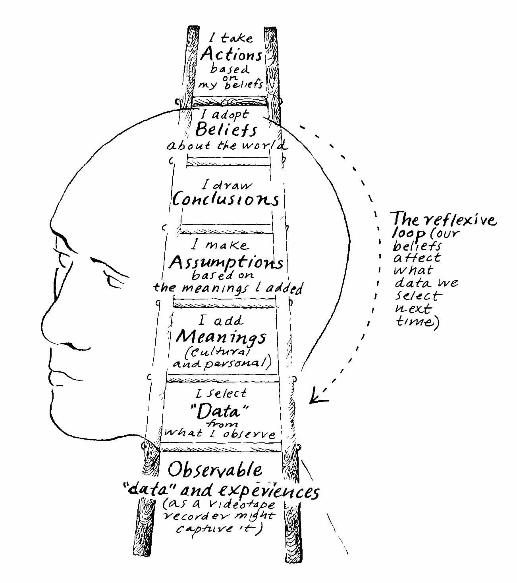

Slide 25
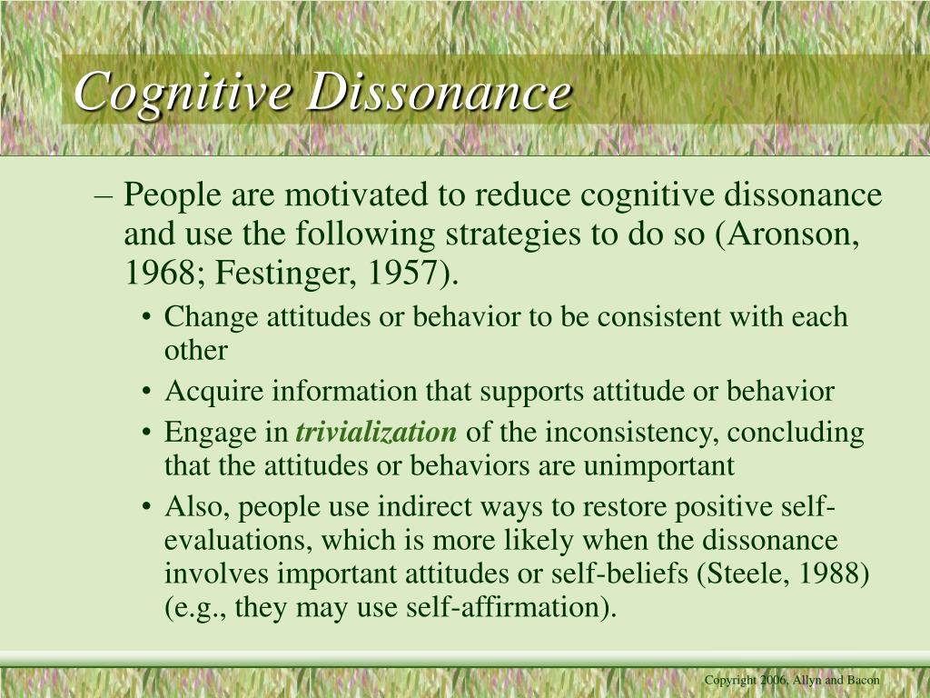

Slide 26
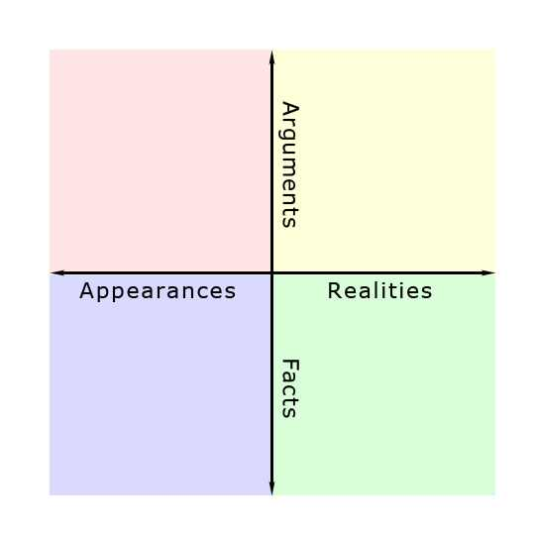

Slide 27
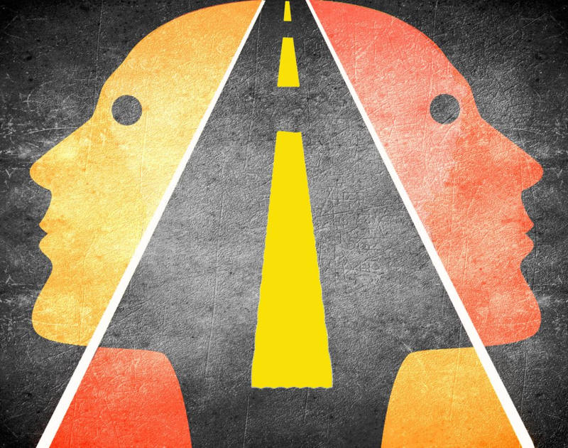
Building Potemkin Villages
Of The Human Mind

Slide 28
POTEMKIM VILLAGE
In an apocryphal story, Gregory Potemkin, lover of Catherine the Great of Russia, is said to have built fake portable villages to impress Catherine during her visit to Crimea in 1787.
Crimea had been annexed by Russia from the Ottoman Empire in 1783. Devastated by the war and with the Muslim inhabitants under suspicion from the Russians, it’s said that Potemkin set up these mobile villages along the route of Catherine’s visit and populated them with his own men dressed as (happy, smiling) peasants.

Slide 29
MENTAL CONTAMINATION
The Halo Effect & Its Pitchfork Opposite
Irrelevant Redirection & Focusing Illusion
Arbitrary Anchoring & Answer Adjusting
Group Prejudice & Familiar Attachments

Slide 30
DISTORTIONS OF ABSOLUTE RIGHT
“Because of distortions and for no other reason, the
average person thinks there is an occasional distinction
between logical right and expedient right, between logical
right and moral right, and also between expedient right and
moral right. Despite widespread misconceptions, it seems
almost too prosaic to say that there is not. There is no
distinction in the word itself; the distinction is only in the
modifier used before the word, and the modifier designates
an ingredient rather than a distinction. Right is certainly not
absolute unless it has all the ingredients.” - HUMANETICS

Slide 31
BIAS ASSIMILATION
No matter what we humans think about, we tend to pay more attention to stuff that fits in with our beliefs than stuff that might challenge them. Psychologists call this ‘confirmation bias.’ When we have embraced a theory, large or small, we tend to be better at noticing evidence that supports it than evidence that might run counter to it.

Slide 32
MOTIVATED REASONING
Wait Wait ... Don’t Tell Me!
Our tendency to accept what we wish to believe (what we are motivated to believe) with much less scrutiny than what we do not want to believe is a bias known as ‘motivated reasoning,’ a kind of flip side to confirmation bias. Whereas confirmation bias is automatic tendency to notice data that fit with our beliefs, motivated reasoning is the complementary tendency to scrutinize ideas more carefully if we don’t like them than if we do.

Slide 33
Corrupted Procrustean Methodology
THEORY INFLUENCES OBSERVATION
OBSERVER CHANGES THE OBSERVED
ANECDOTAL STORY ≠ VALID STUDY
BOLD STATEMENTS ≠ A TRUE CLAIM
MOST AFTER THE FACTS REASONING
MOST FAILURES ARE RATIONALIZED

Slide 34
HIGH LEVEL RESISTANCE
Bill Moyers on University of Michigan study on the power of information:
“Suffice it to say that, while ‘most of us like to believe that our opinions have been formed over time by careful, rational consideration of facts & ideas and that the decisions based on those opinions, therefore, have the ring of soundness and intelligence,’ the research found that actually ‘we often base our opinions on our beliefs and rather than facts driving beliefs, our beliefs can dictate the facts we chose to accept. They can cause us to twist facts so they fit better with our preconceived notions.’
These studies help to explain why America seems more and more unable to deal with reality. So many people inhabit a closed belief system on whose door they have hung the ‘Do Not Disturb’ sign, that they pick and choose only those facts that will serve as building blocks for walling them off from uncomfortable truths.”

Slide 35
Pontius Pilate
David Lee Burris:
Notice - Jewish Leaders Are To Pilate Being Both Obsequious & Appealing Pandectic
“What Is Truth?”

Slide 36
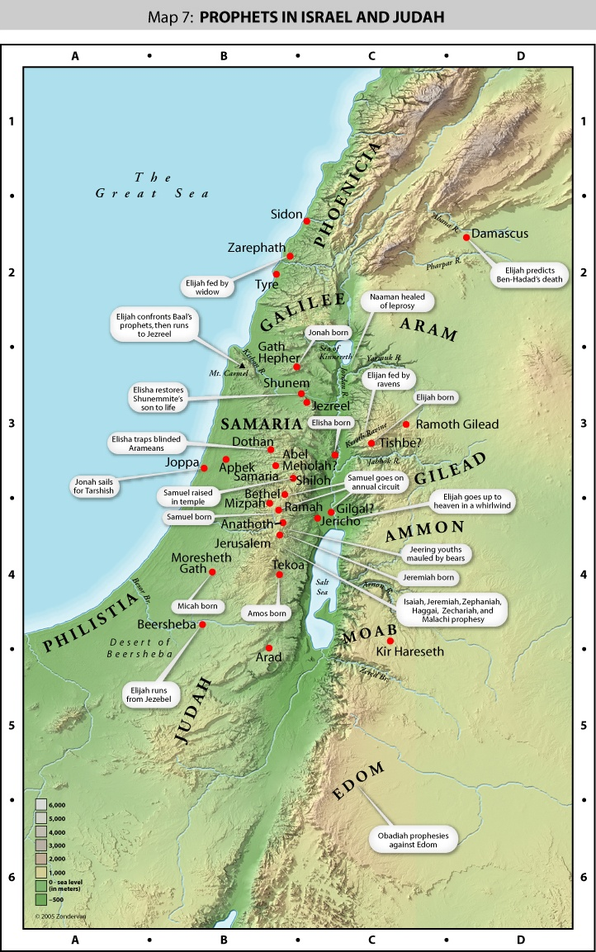

Slide 37
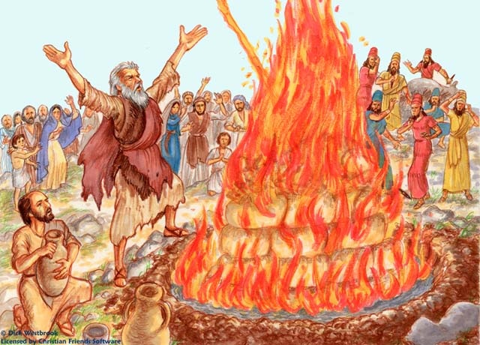
Mount Carmel
O.T. Battles For Truth

Slide 38
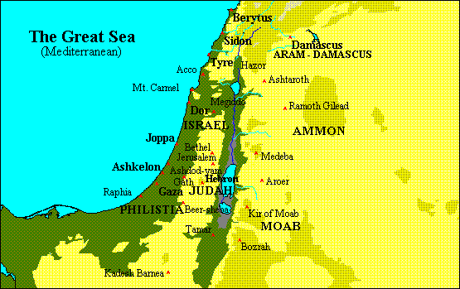
The Divided Kingdom

Slide 40
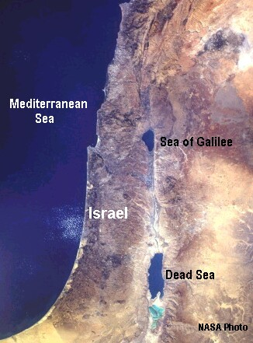

Slide 41
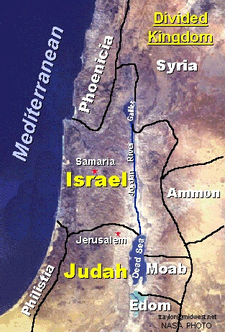

Slide 42
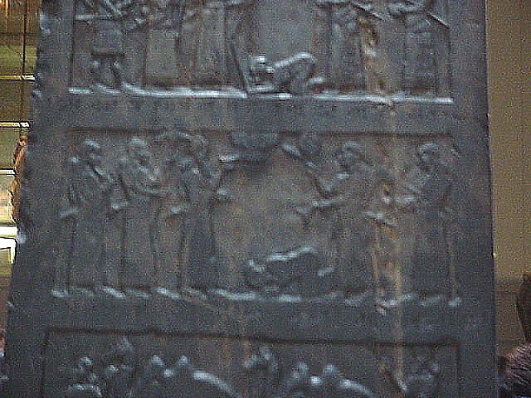
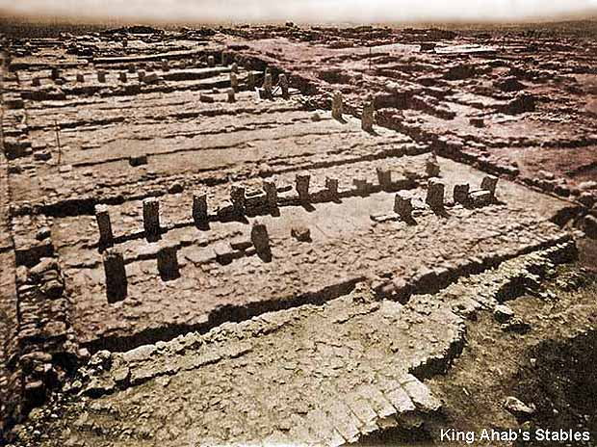
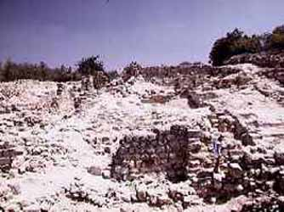
Ahab or a representative

Slide 43
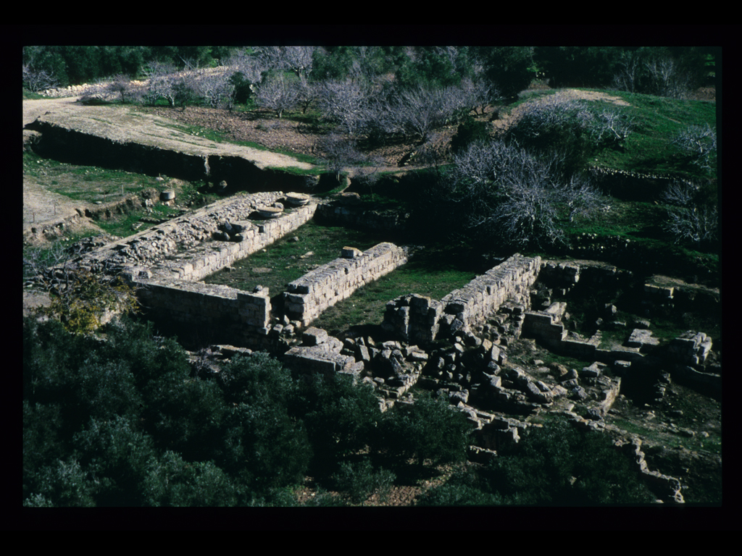

Slide 44
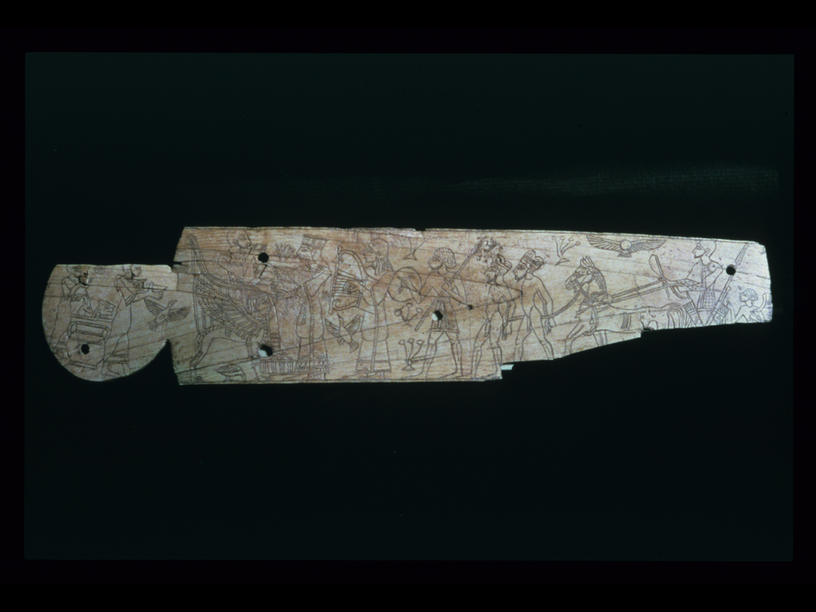

Slide 45
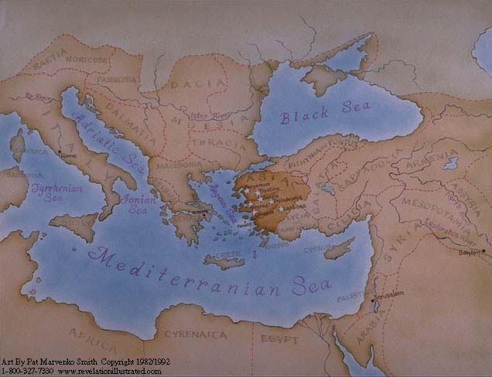
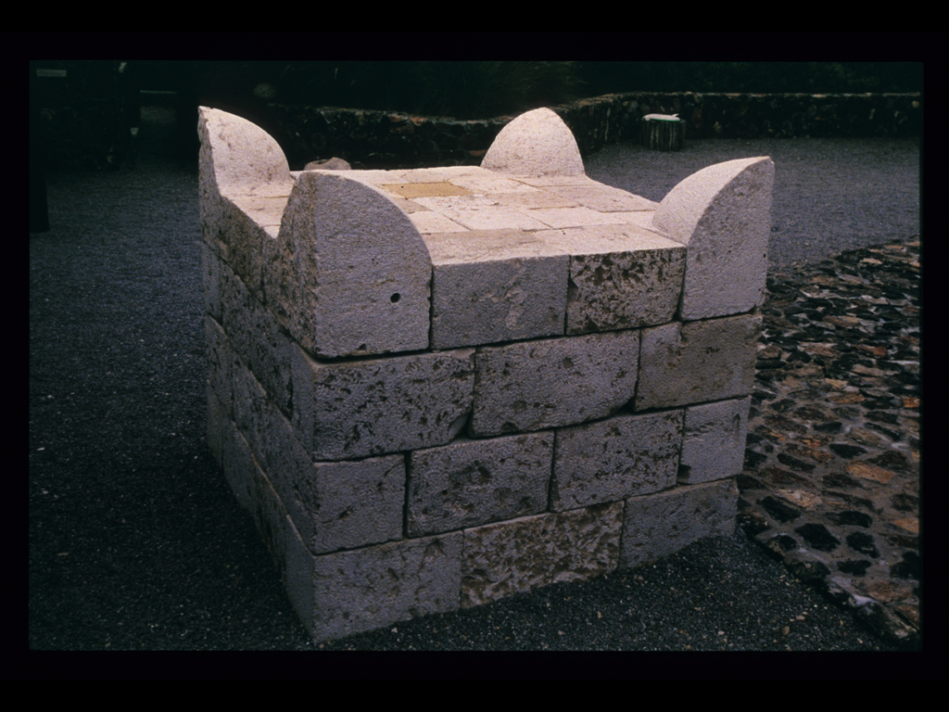
Altar With Horns

Slide 46
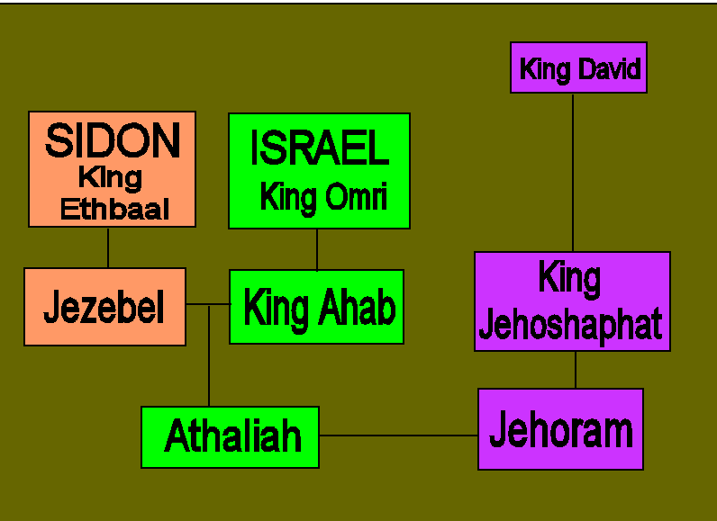
Watch those family connections!

Slide 47
1. When Jehoshaphat of Judah goes to Samaria. Ahab of Israel urges him to join him in attacking the Syrians at Ramoth Gilead.
2. Ahab consults his court prophets. All predict success, except for Micaiah, who has a reputation for bad news. He tells Ahab that his army will soon be scattered, without a leader.
3. Ahab throws Micaiah into prison until his safe return, and then heads for battle alongside Jehoshaphat.
4. During the battle, 32 chariots have orders to seek out and kill Ahab. They fail to find him, but a stray arrow finds a gap in Ahab’s armor and fatally wounds him.
5. Ahab pulls back from the front line. But he stays in the battle, to reassure his soldiers.
6. At sunset, Ahab dies and his army is scattered, as predicted by Micaiah.

Slide 48
four attitudes
towards truth

Slide 49
AHAB HATED THE TRUTH
He decided what he wanted to do before he even consulted truth - (1 Kings 22: 3)
He gathered the prophets together who would approve what he already decided - (1 Kings Chapter 22: Verse 6)
He did not want to consult Micaiah, because he knew that the prophet would not tell him what he desired so to hear - (1 Kings Chapter 22: Verse 8)

Slide 50
He had rejected the truth when Micaiah gave it to him, because it wasn’t what he wanted to hear - (1 Kings 22: 17 - 18)
He soothed his bad conscience by getting rid of the messenger of truth - (1 Kings 22: 26, 27)

Slide 51
PROPHETS WILLINGLY PERVERTED THE TRUTH
Zedekiah and the other prophets were willing to tell the king what he wanted to hear to gain his favor (1 Ki. 22:6, 11-12).
The messenger who went to summon Micaiah pleaded with him to confirm the words of the other prophets, because he was more concerned about pleasing the king than telling the truth (1 Ki. 22:13).

Slide 52
JEHOSHAPHAT WANTED THE TRUTH ON HIS SIDE
Unlike Old Ahab, Jehoshaphat did want to consult and consider the truth (Ch 22: 5, 7); but Jehoshaphat was only interested in truth if it supported what he already wanted to do.
Jehoshaphat had already determined what he was going to do before suggesting that they inquire for the word of the Lord [v. 4].

Slide 53
MICAIAH WANTED TO BE ON SAME SIDE AS THE TRUTHS
“It is one thing to wish to have truth on our side, and another to wish sincerely to be on the side of truth.” - Richard Whately
{Difficulties in Writing of the Apostle Paul}

Slide 54
MICAIAH WANTED TO BE ON SAME SIDE AS THE TRUTHS
Micaiah loved the truth, and he was willing to speak the truth regardless of the sacrifice, or the pain it caused, or the real consequences – Chapter 22: Verse 14
Plus, he had to pay a price for loving the truth.
  Zedekiah struck him and mocked him [v. 24]
  He was imprisoned - {1 Kings 22: 26 – 27}

Slide 55
Pythagorus
In Sixth Century B.C. Wrote:
“Truth is so great a perfection, that if God would render Himself visible to men, He would chose light for His body & truth for His soul.”

Slide 56
Pontius Pilate
David Lee Burris:
Notice - Jewish Leaders Are To Pilate Being Both Obsequious & Appealing Pandectic
“What Is Truth?”

Slide 57
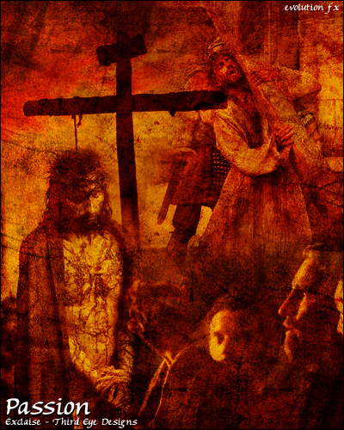

Slide 58
Thomas Sowell
“There are only two ways of telling the complete truth – anonymously & posthumously.”

Slide 59
Pontius Pilate
David Lee Burris:
Notice - Jewish Leaders Are To Pilate Being Both Obsequious & Appealing Pandectic
“What Is Truth?”

Slide 60


Slide 61
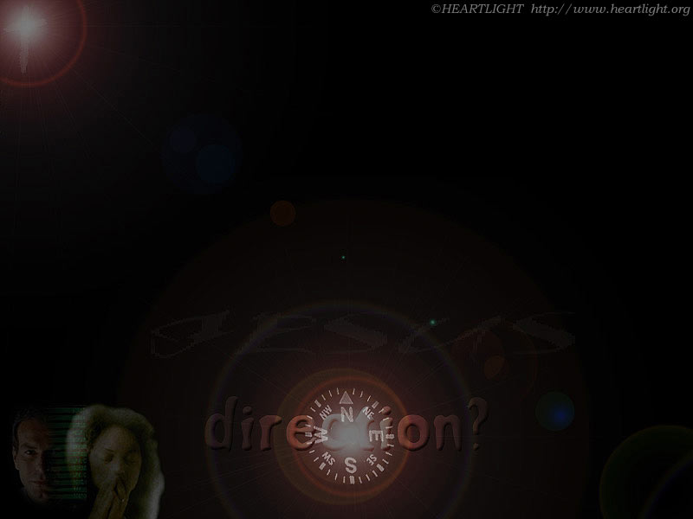

Where Are You Pointed?
Paradise?
Perdition?

Slide 62
JUDGEMENT PREPARED
FIVE STATES FIVE STEPS
Five States of the Soul:
EXEMPTION:
Ezekiel 18: 20; Matthew 18: 1 – 3
CONDEMNATION:
Galatians 3: 22
JUSTIFICATION:
Romans 5: 1, 2; 8: 1, 2
DAMNATION:
Matthew 23: 3; Mark 16: 16
GLORIFICATION:
Romans 8: 17, 30; II Thess. 1: 7 - 12

Slide 63
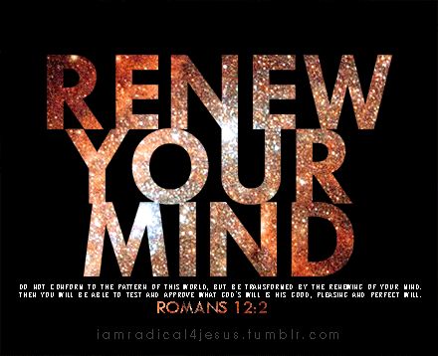

Slide 64
JUDGEMENT PREPARED
FIVE STATES FIVE STEPS
Five Steps for Saving:
HEARING:
Romans 10: 17; Matthew 7: 24 - 27
BELIEVING:
Hebrews 11: 6; Mark 16: 15, 16
REPENTING:
Acts 2: 38; 17: 30; Luke 13: 3
CONFESSING:
Matthew 10: 32, 33; Acts 8: 36, 37
BAPTISM:
Romans 6: 3 – 5; Acts 8: 36 - 38

