Slide 1
JESUS WAS REAL!
Edited by David Lee Burris

Slide 2
The Jesus Myth Myth
Is the biblical Jesus an interpolated “Christian” myth?
Adonis (Greek)
Osiris (Egypt)
Tammuz (Egypt)
Dionysus (Greek)
Mithra (Persia)
Krishna (India)
Appolonius of Tyana
Peregrinus
Empodocles
Attis
Hercules
Romulus
Baal

Slide 3
Who Said Jesus was a Myth!?
Source: Evidences for Christianity

Slide 4
2 Peter 1:16
?
“For we did not follow cleverly devised myths when we made known to you the power and coming of our Lord Jesus Christ, but we were eyewitnesses of his majesty.”
Notes:
This ENTIRE presentation centers on whether or not Peter was lying here.
We can’t say that he thought Jesus was real but wasn’t
Peter’s “eyewitness” testimony is attested by Luke, John, and Paul

Slide 5
Overview
Historians don’t talk about mythical people as if they actually existed.
Mythical stories are not said to have occurred in the context of historical events.
The stories of Jesus contain actual people.
Osiris and Mithras look nothing like Jesus!

Slide 6
Historians don’t talk about mythical people as if they actually existed.

Slide 7
Historians
Flavius Josephus
Publius Cornelius Tacitus

Slide 8
Flavius Josephus
Now there was about this time Jesus, a wise man, if it be lawful to call him a man; for he was a doer of wonderful works, a teacher of such men as receive the truth with pleasure. He drew over to him both many of the Jews and many of the Gentiles. He was Christ. And when Pilate, at the suggestion of the principal men amongst us, had condemned him to the cross, those that loved him at the first did not forsake him; for he appeared to them alive again the third day; as the divine prophets had foretold these and ten thousand other wonderful things concerning him. And the tribe of Christians, so named from him, are not extinct at this day. (Antiquities of the Jews, Book 18, Chapter 3, Verse 3)
Now there was about this time Jesus, a wise man, if it be lawful to call him a man; for he was a doer of wonderful works, a teacher of such men as receive the truth with pleasure. He drew over to him both many of the Jews and many of the Gentiles. He was Christ. And when Pilate, at the suggestion of the principal men amongst us, had condemned him to the cross, those that loved him at the first did not forsake him; for [they reported that] he appeared to them alive again the third day; as the divine prophets had foretold these and ten thousand other wonderful things concerning him. And the tribe of Christians, so named from him, are not extinct at this day. (Antiquities of the Jews, Book 18, Chapter 3, Verse 3)
Notes:
Josephus was…
a Jewish Historian
Born in AD 37
What is the difference between a Christian and a Jew?
A Jew doesn’t believe that Jesus is the Messiah
Messiah -> Mashiach -> Christos -> Christ
“Now there was ABOUT THIS TIME Jesus, a wise man…”
Josephus was talking about Pontius Pilate before this
The “Christian sounding” parts are easy to bracket.

Slide 9
Arabic Version
At this time there was a wise man who was called Jesus. And his conduct was good, and he was known to be virtuous. And many people from among the Jews and the other nations became his disciples. Pilate condemned him to be crucified and to die. And those who had become his disciples did not abandon his discipleship. They reported that he had appeared to them after his crucifixion and that he was alive; accordingly, he was perhaps the Messiah concerning whom the prophets have recounted wonders. (Arabic summary, presumably of Antiquities 18.63. From Agapios’ Kitab al-’Unwan (“Book of the Title,” 10th c.). See also James H. Charlesworth, Jesus Within Judaism, (http://ccat.sas.upenn.edu/~humm/Topics/JewishJesus/josephus.html).
Notes:
Found in 1971

Slide 10
Flavius Josephus
…Albinus was but upon the road; so he assembled the Sanhedrim of judges, and brought before them the brother of Jesus, who was called Christ, whose name was James, and some others… (Antiquities of the Jews, Book 18, Chapter 3, Verse 3)

Slide 11
From Josephus
Jesus was alive while Pilate was the procurator of Judea.
Jesus had a brother named James
Jesus was a wise teacher.
Many Jews and Gentiles followed him.
Pilate condemned him to the cross.
His followers reported that they had seen him alive after his death.
The Christian movement was still in existance when Josephus wrote.

Slide 12
Cornelius Tacitus
...Nero fastened the guilt and inflicted the most exquisite punishments on a class hated for their disgraceful acts, called Christians by the populace. Christ, from whom the name had its origin, suffered the extreme penalty (i.e., Crucifixion) during the reign of Tiberius at the hands of one of our procurators, Pontius Pilatus, and a most mischievous superstition, thus checked for the moment, again broke out not only in Judea, the first source of the evil, but even in Rome, where all things hideous and shameful from every part of the world find their center and become popular.
Notes:
Tacitus:
Born in AD 56 (around the same time Paul was writing 1 Corinthians).
Here is writing about the fire that broke out in Rome, late in the summer of AD 64.
Nobody knew for sure who started that fire, but it was rumored that Emperor Nero himself did it.
According to Tacitus, Nero framed the Christians

Slide 13
Cornelius Tacitus
Accordingly, an arrest was first made of all who pleaded guilty; then, upon their information, an immense multitude was convicted, not so much of the crime of firing the city, as of hatred against mankind. (Tacitus, Annals 15.44)
Notes:
Tacitus:
Born in AD 56 (around the same time Paul was writing 1 Corinthians).
Here is writing about the fire that broke out in Rome, late in the summer of AD 64.
Nobody knew for sure who started that fire, but it was rumored that Emperor Nero himself did it.
According to Tacitus, Nero framed the Christians

Slide 14
From Tacitus
There was a group known as "Christians"
They were named after someone named "Christ"
He was executed under Pontius Pilate during the reign of Tiberius Caesar
The Romans considered the Christians superstitious
The Christians were hated and were alleged to perform "abominations"
The movement originated in Judea
The movement spread to Rome
By AD 64 there was a vast multitude of them in Rome.

Slide 15
Paul
For what I received I passed on to you as of first importance: that Christ died for our sins according to the Scriptures, that he was buried, that he was raised on the third day according to the Scriptures, and that he appeared to Cephas, and then to the Twelve. After that, he appeared to more than five hundred of the brothers and sisters at the same time, most of whom are still living, though some have fallen asleep. Then he appeared to James, then to all the apostles, and last of all he appeared to me also, as to one abnormally born. (1 Corinthians 15:3-8)
Notes:
1 Corinthians was written in AD 55
The oral tradition is much earlier.
Robert Price thinks that this section of the scripture is an interpolation

Slide 16
Mythical stories are not said to have occurred in the context of historical events.

Slide 17
Historical Context
In the fifteenth year of the reign of Tiberius Caesar—when Pontius Pilate was governor of Judea, Herod tetrarch of Galilee, his brother Philip tetrarch of Iturea and Traconitis, and Lysanias tetrarch of Abilene— during the high-priesthood of Annas and Caiaphas, the word of God came to John son of Zechariah in the wilderness. (Luke 3:1)
In what year was Mithras born?
Notes:
Tiberius was a co-emperor with Augustus from 12 AD to 14 AD before Tiberius became the sole emperor. This means that “the word of God came to John” during the 13th year of Tiberius’ sole reign. Luke includes the 2 years where he was reigning along side Augustus.
12+15=27
This means that Jesus was baptized by John and started his ministry in 27 AD.
This book was written around 55 AD which means that there was not enough time for legends to creep into Luke’s Gospel.

Slide 18
The stories of Jesus contain people that actually existed.

Slide 19
Real People
John the Baptist
Pontius Pilate
Gamaliel

Slide 20
John the Baptist
Jesus’ relative
Baptized Jesus

Slide 21
John the Baptist
“Now some of the Jews thought that the destruction of Herod’s army came from God, and that very justly, as a punishment of what he did against John, that was called the Baptist: for Herod slew him, who was a good man, and commanded the Jews to exercise virtue, both as to righteousness towards one another, and piety towards God, and so to come to baptism. (Josephus, Antiquities of the Jews, XVIII, 5:2)

Slide 22
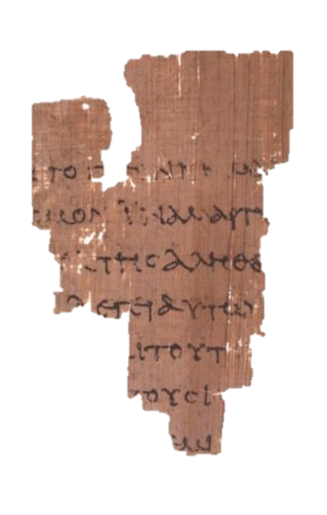
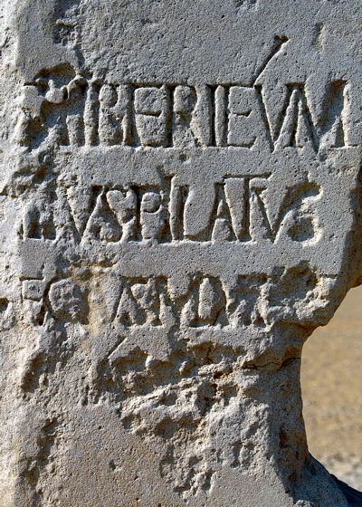
Pontius Pilate
Spoke to Jesus
(Matthew 27:11-26, Mark 15:1-15, Luke 23:1-25, John 18:28-40)
Notes:
“Pontius Pilate, prefect of Judea, has restored the Tiberieum of the Seaman (or possibly, of the Caesareans)”
This stone was discovered in June 1961 by an archaeology team led by Dr. Antonio Frova while excavating an ancient theater which is thought to be built by the decree of Herod the Great in 30 B.C.

Slide 23
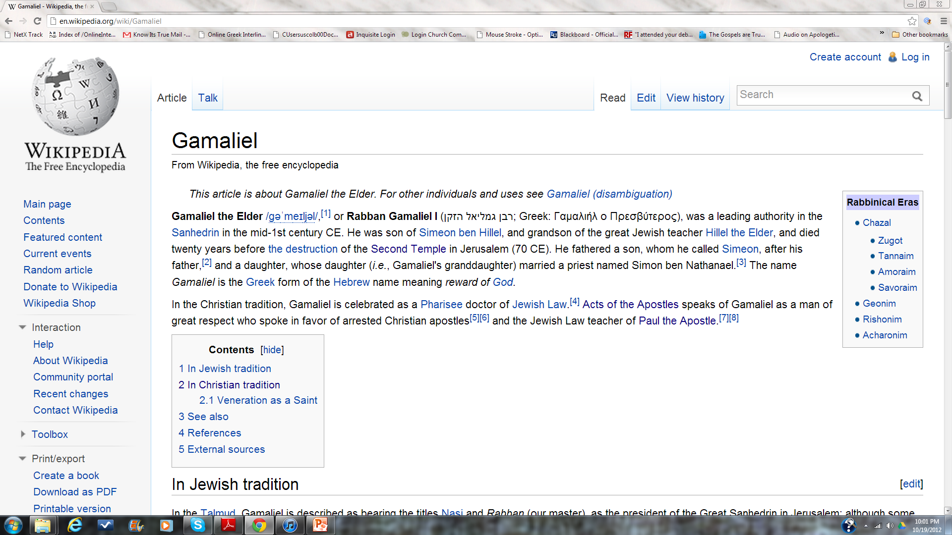
Gamaliel
Pharisee and teacher of the law (Acts 5:34)
The teacher of the Apostle Paul (Acts 22:3)
Notes:
Google his name

Slide 24
Osiris and Mithras look nothing like Jesus!

Slide 25
Mithras
Born of a virgin
Born on Dec 25th
12 disciples
Performed Miracles
Dead for 3 days
Resurrected

Slide 26
Mithras was born from a solid rock as an adult.
BUSTED
Mithras was born of a virgin?

Slide 27
BUSTED
Mithras was born on December 25th?
Many ancient gods were celebrated on December 25th.
Jesus was not one of them!

Slide 28
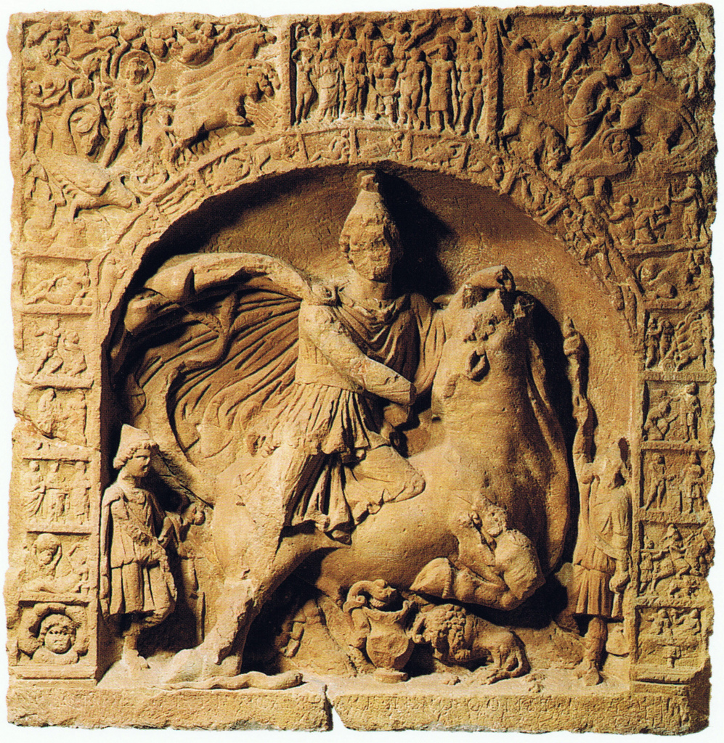
BUSTED
Mithras had 12 disciples?
Let’s look at the evidence supporting this claim…

Slide 29
BUSTED
Mithras never died.
Mithras was crucified?

Slide 30
BUSTED
Mithras rose from the dead?
Mithras never died.

Slide 31
Osiris

Slide 32
Osiris' brother, Set fooled Osiris into getting into a box, which Set then shut, sealed with lead, and threw into the Nile. Osiris' wife, Isis, searched for his remains until she finally found him. She managed to open the box, but Osiris was already dead.
She used a magic spell she learned from her father and brought him back to life so he could impregnate her. Afterwards he died again and she hid his body in the desert. Months later, she gave birth to Horus. While she raised Horus, Set was hunting one night and came across the body of Osiris.
In a fit of rage, Set tore the body into fourteen pieces and scattered them throughout the land. Isis gathered up 13 of the 14 pieces (the missing piece was his penis, which was eaten by a cat fish) and bandaged them together for a proper burial. Osiris then went on to become the zombified lord of the underworld.
Notes:
Does that sound at all like Jesus?

Slide 33
Appolonius of Tyana
A miracle worker. A Pythagorean in the city of Tyana in 1st century AD. Saves a friend in Corinth. Predicts a plague in Ephesus. Says: stone this beggar to death to end the plague. The do so, and when they remove the stones they find a large dog alive and well. Appolonius disappears and is never seen again.
No death. No resurrection. No ascension.
Only one very unreliable source. 100+ years after he died. No eye witness testimony. Which story is mythical?

Slide 34
2 Peter 1:16
“For we did not follow cleverly devised myths when we made known to you the power and coming of our Lord Jesus Christ, but we were eyewitnesses of his majesty.”
Notes:
This ENTIRE presentation centers on whether or not Peter was lying here.
We can’t say that he thought Jesus was real but wasn’t
Peter’s “eyewitness” testimony is attested by Luke, John, and Paul

Slide 35
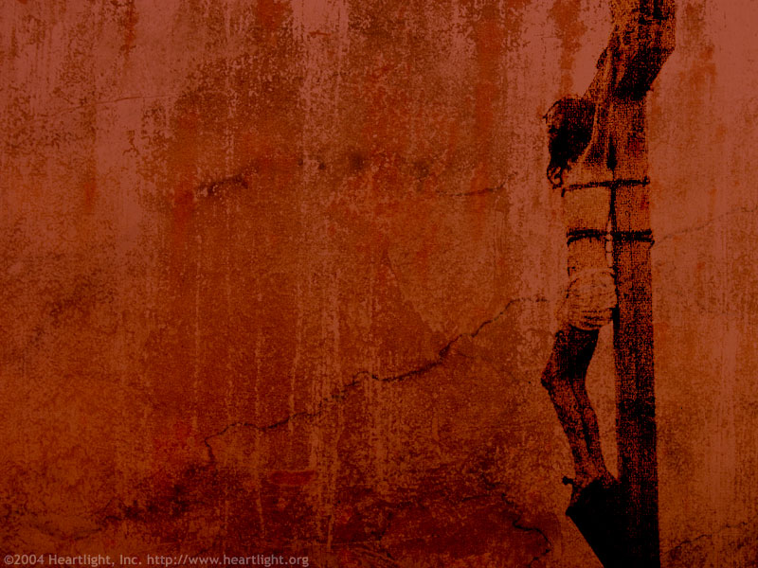

Pontius Pilate
David Lee Burris:
Notice - Jewish Leaders Are To Pilate Being Both Obsequious & Appealing Pandectic
“What Is Truth?”

Slide 36
Who Was Jesus?
Sage
Prophet
Liar
Crazy person
Messiah
Son of Man
God in the flesh
Legend/Myth
Man (ie. mere man)
An important religious leader among many

Slide 37
JESUS’ CLAIMS ABOUT HIMSELF IN THE BOOK OF JOHN
Claim of Jesus | Scripture | Hearer’s Response
Fulfilled all the O.T. prophecies of the Messiah | John 5:39 | Refused to come to him
I am the bread of life | John 6:35 | Grumbled
A life without sin | John 8:46 | Jesus is demon-possessed (crazy)
I AM God | John 8:58 | Attempted to stone him
I and the Father are one | John 10:30 | Attempted to stone him
I am the resurrection and the life | John 11:25 | Plotted to murder him
I am the only way to God | John 14:6 | No negative response (Jesus talking to disciples)

Slide 38
I. Jesus and Extra-Biblical Sources
Roman (7)
Jewish (2)
Christian (33)

Slide 39
Cornelius Tacitus approx AD 114
Not all the relief that could come from the man, not all the bounties that the prince could bestow, nor all the atonements which could be presented to the gods, availed to relieve Nero from the infamy of bbeing believed to have ordered the conflagration, the fire of Rome. Therefore, to squelch the rumor, Nero created scapegoats and subjected to the most refined tortures those whom the common people called ‘Christians,’ [a group] hated for their abominable crimes. Their name comes from Christ, who, during the reign of Tiberius, had been executed by the procurator Pontius Pilate. Suppressed for the moment, the deadly superstition broke out again, not only in Judea, the land which originated this evil, but also in the city of Rome, where all sorts of horrendous and shameful practices, from every part of the world converge and are fervently cultivated.
Annals 15.44

Slide 40
Josephus AD 38-100
About this time there lived Jesus, a wise man, if indeed one ought to call him a man. For he was one who wrought surprising feats and was a teacher of such people as accept the truth gladly. He won over many Jews and many of the Greeks. He was the Messiah. When Pilate, upon hearing him accused by men of the highest standing amongst us, had condemned him to be crucified, those who had in the first place come to love him did not give up their affection for him. On the third day he appeared to them restored to life, for the prophets of God had prophesied these and countless other marvelous things about him. And the tribe of Christians, so called after him, has still to this day not disappeared.
Antiquities 18:3:3

Slide 41
Thallus AD 50
We know of Thallus from a third century Christian historian named Julius Africanus. Thallus wrote a world history in the 50s AD. In discussion the darkness at the time of the resurrection of Jesus, Julius Africanus tells us that in his history, Thallus mentions the darkness and calls it an eclipse of the sun. Africanus believes that Thallus is wrong. This quote seems to support the idea that non-Christians were aware of the resurrection as early as the 50s AD—at about the time the first book of the NT was written. It also shows that Christians in the 50s AD believed that this darkness had occurred at Jesus’ death.

Slide 42
Mara Bar Serapion
A Syrian stoic philosopher from the late first century who described Socrates, Pythagorus and Jesus as great men who were killed by their people and that their people were punished for the deed. He says the destruction of Jerusalem was just punishment for Jesus’ treatment. Jesus is called the “wise king” of the Jews.

Slide 43
Talmud (1st and 2nd Century AD)
On the eve of Passover they hung Yeshu and the crier went forth for forty days beforehand declaring that "[Yeshu] is going to be stoned for practicing witchcraft, for enticing and leading Israel astray. Anyone who knows something to clear him should come forth and exonerate him." But no one had anything exonerating for him and they hung him on the eve of Passover. Ulla said: Would one think that we should look for exonerating evidence for him? He was an enticer and G-d said (Deuteronomy 13:9) “Show him no pity or compassion and do not shield him.” him? He was an enticer and G-d said (Deuteronomy 13:9) "Show him no pity or chow him no pity or compassion,”
Babylonian Sanhedrin 43a-b

Slide 44
Seutonius (about AD 120)
"As the Jews were making constant disturbances at the instigation of Chrestus, he (Claudius about AD 50) expelled them from Rome”

Slide 45
Lucian of Samosata
The Christians, you know, worship a man to this day—the distinguished personage who introduced their novel rites, and was crucified on that account… You see, these misguided creatures start with the general conviction that they are immortal for all time, which explains the contempt of death and voluntary self-devotion which are so common among them; and then it was impressed on them by their original lawgiver that they are converted, and deny the gods of Greece, and worship the crucified sage, and life after his laws.
(Lucian The Death of Peregrine)

Slide 46
Pliny the Younger AD 112
Those who denied that they were or had been Christians, when they invoked the gods in words dictated by me, offered prayer with incense and wine to your image, which I had ordered to be brought for this purpose together with statues of the gods, and moreover cursed Christ — none of which those who are really Christians, it is said, can be forced to do — these I thought should be discharged. Others named by the informer declared that they were Christians, but then denied it, asserting that they had been but had ceased to be, some three years before, others many years, some as much as twenty-five years. They all worshiped your image and the statues of the gods, and cursed Christ

Slide 47
Jesus Fulfilled Historical Foreshadows
Prophet, Priest and King
One like Moses (Deut 18:17-19)
Genesis 22 Abraham and Isaac
  Raised from the dead on the 3rd day 1 Cor 15:4 , Heb 11:19
Moses and the snake (Numbers 21:4-9)
Jonah (Matthew 12:39-40)
Joseph
David

Slide 48
Messianic Prophecies Fulfilled
Isaiah 53:1-12. Despised, rejected, silent when accused and pierced.
Micah 5:2 Born in Bethlehem.
Isaiah 9:1 From the land of Zebulun and Naphtali
Psalms 22:14-18 crucified, garments divided and gambled over
Zechariah 11:12-13 betrayed for 30 pieces of silver, money thrown to the potter.
Daniel 9:24-25 The Messiah to come to Jerusalem about AD 33.

Slide 49
Prophecies of the Messiah

Slide 50
You diligently study the Scriptures becauseyou think that by them you possess eternal life. These are the Scriptures that testify about me, yet you refuse to come to me to have life. John 5:39,40
He said to them, “This is what I told you while I was still with you: Everything must be fulfilled that is written about me in the Law of Moses, the Prophets and the Psalms. Luke 24:44

Slide 51
Question #1: How do I know these prophecies were written hundreds of years before they happened?
Septuagint translation of the Old Testament into Greek 220-150 BC
Dead Sea Scrolls.250-50 BC

Slide 52
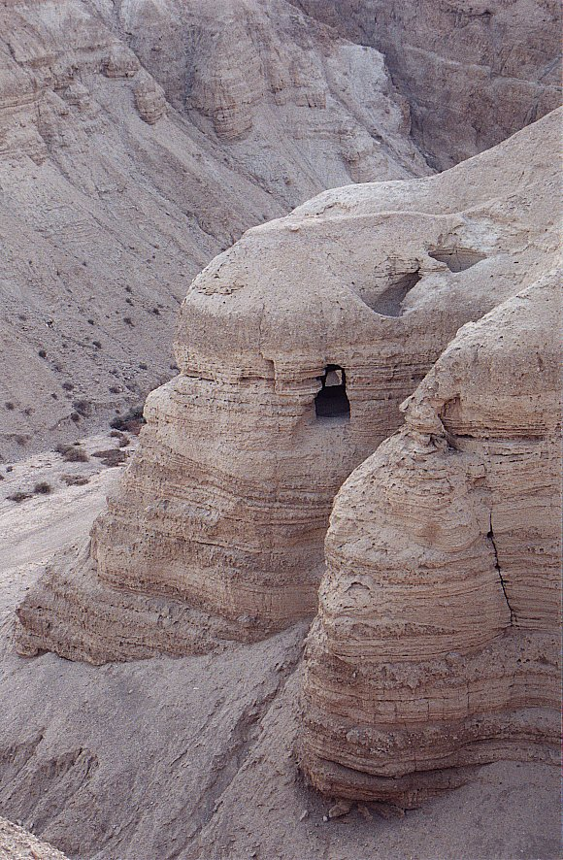
Qumran
Cave #4

Slide 53
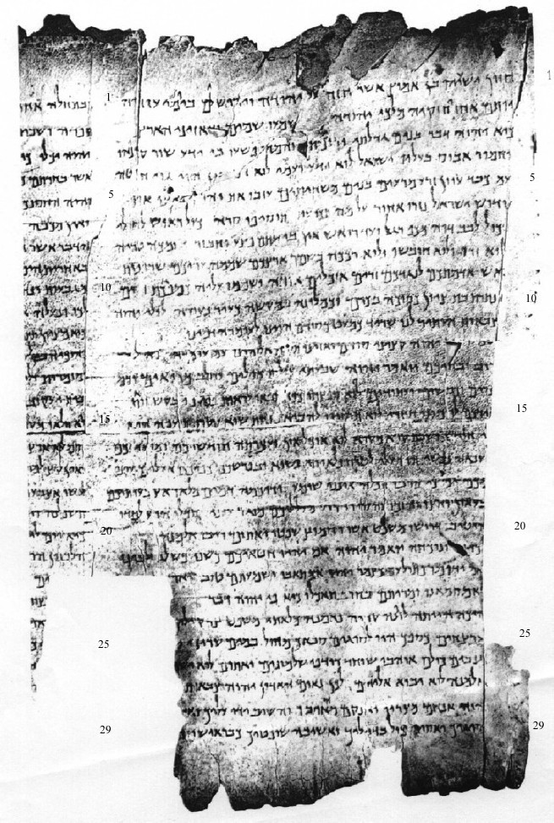
Column I
The Great Qumran Isaiah Scroll
150 BC

Slide 54
Question #2: How do I know these things really happened?
Josephus: “When Pilate, at the suggestion of the principal men among us, had condemned him to the cross, those that loved him at the first did not forsake him… And the tribe of Christians so named from him are not extinct to this day.”
Cornelius Tacitus: “Hence, to suppress the rumor, [Nero] falsely charged with the guilt and punished with the most exquisite tortures, the persons commonly called Christians, who were hated for their enormities. Christus, the founder of the name, was put to death by Pontius Pilate, procurator of Judea in the reign of Tiberius…
Jewish Talmud “On the eve of the Passover they hanged Yeshu and the herald went before him for forty days saying Yeshu… has practiced sorcery and beguiled and led astray Israel.

Slide 55
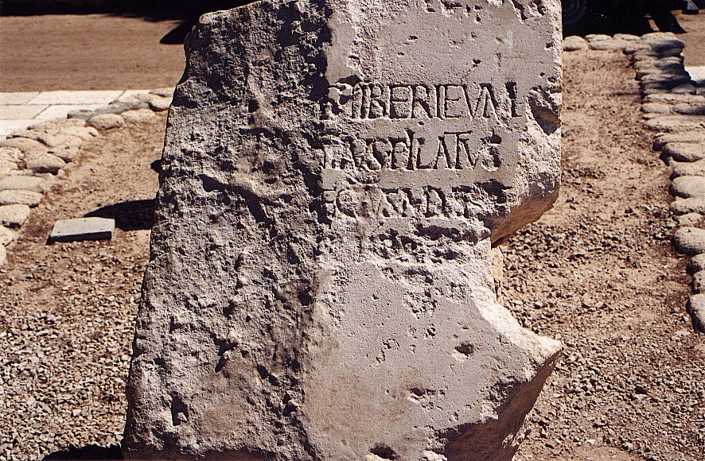

Slide 56
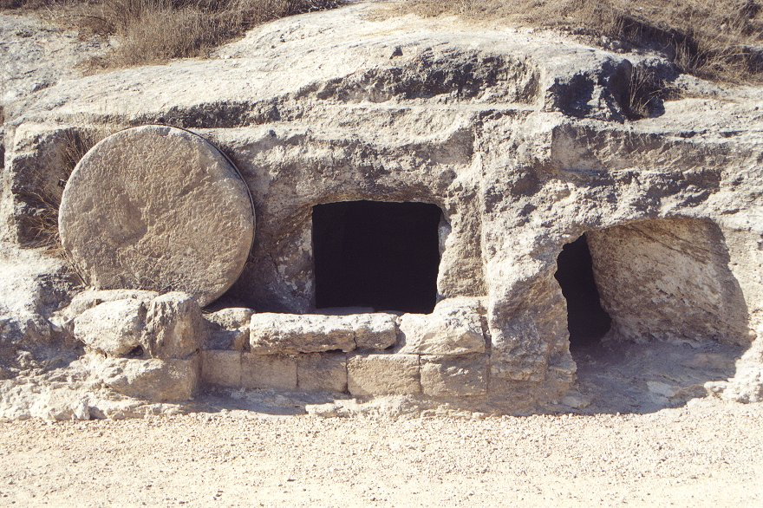

Slide 57
Question #3 Could Jesus, planning on deceiving the people into believing he was the Messiah, have read the Old Testament and tried to fulfill all the prophecies?

Slide 58
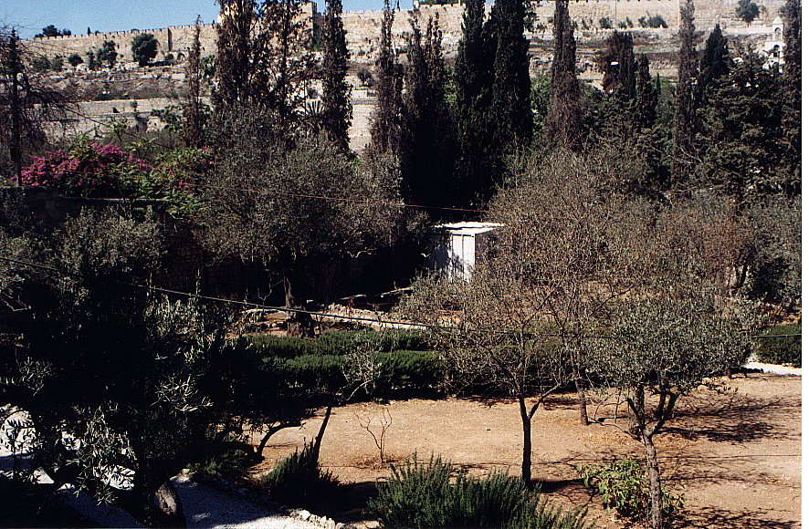
Garden of Gethsemane Mount of Olives
12/18/2001
Israel 1999 Expedition

Slide 59
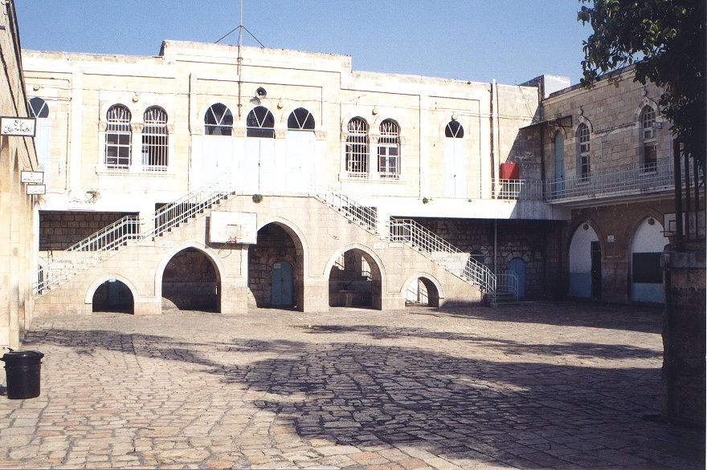
Fortress Antonia – Where Jesus was condemned
12/18/2001
Israel 1999 Expedition

Slide 60
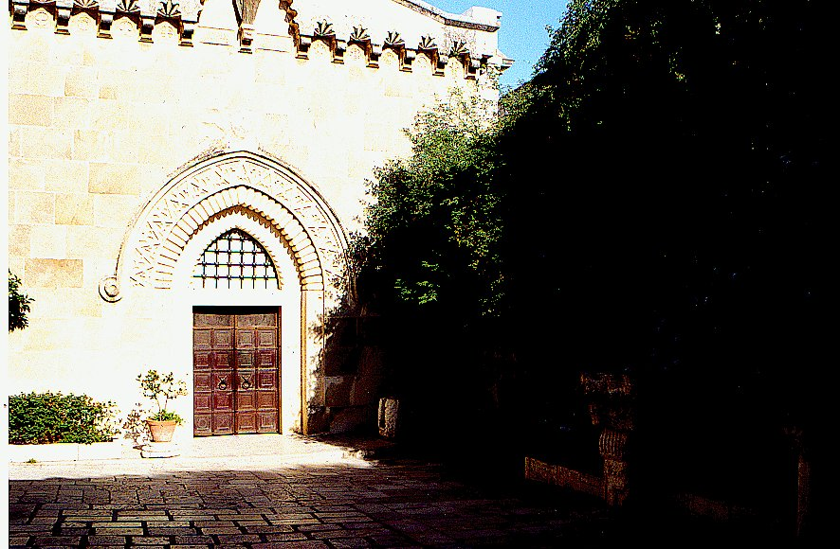
Courtyard of Flagellation: Where Jesus was scourged
12/18/2001
Israel 1999 Expedition

Slide 61
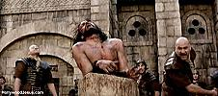

Slide 62
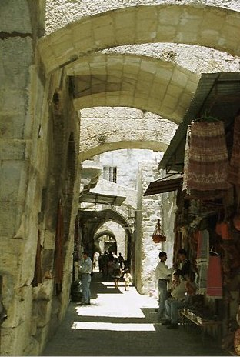
Old City Streets
12/18/2001
Israel 1999 Expedition

Slide 63
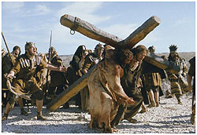

Slide 64
Isaiah 53:1-13:
He was despised and rejected by men, a man of sorrows, familiar with suffering. (v. 3)
But he was pierced for our transgressions, he was crushed for our iniquities; the punishment that brought us peace was upon him, and by his wounds we are healed. (v. 5)
He was oppressed and afflicted, yet he did not open his mouth; he was led like a lamb to the slaughter and as a sheep before her shearers is silent, so he did not open his mouth. (v. 7)

Slide 65
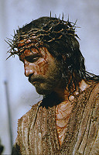

Slide 66
Micah 5:2
But you, Bethlehem Ephathrah, though you are small among the clans of Judah, out of you will come for me one who will be ruler over Israel, whose origins are from old, from ancient times.
Isaiah 9:1,6
In the past he humbled the land of Zebulun and the land of Naphtali, but in the future he will honor Galilee of the Gentiles, by the way of the sea, along the Jordan…. For to us a child is born… And he will be called Wonderful Counselor, Mighty God, Everlasting Father, Prince of Peace.

Slide 67
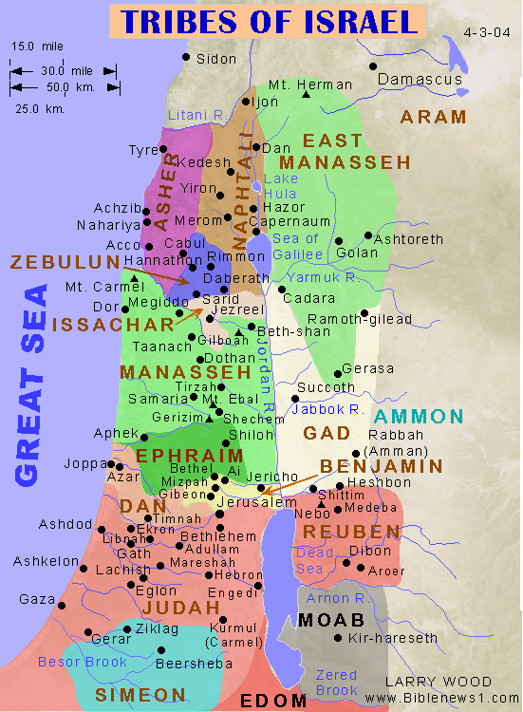

Slide 68
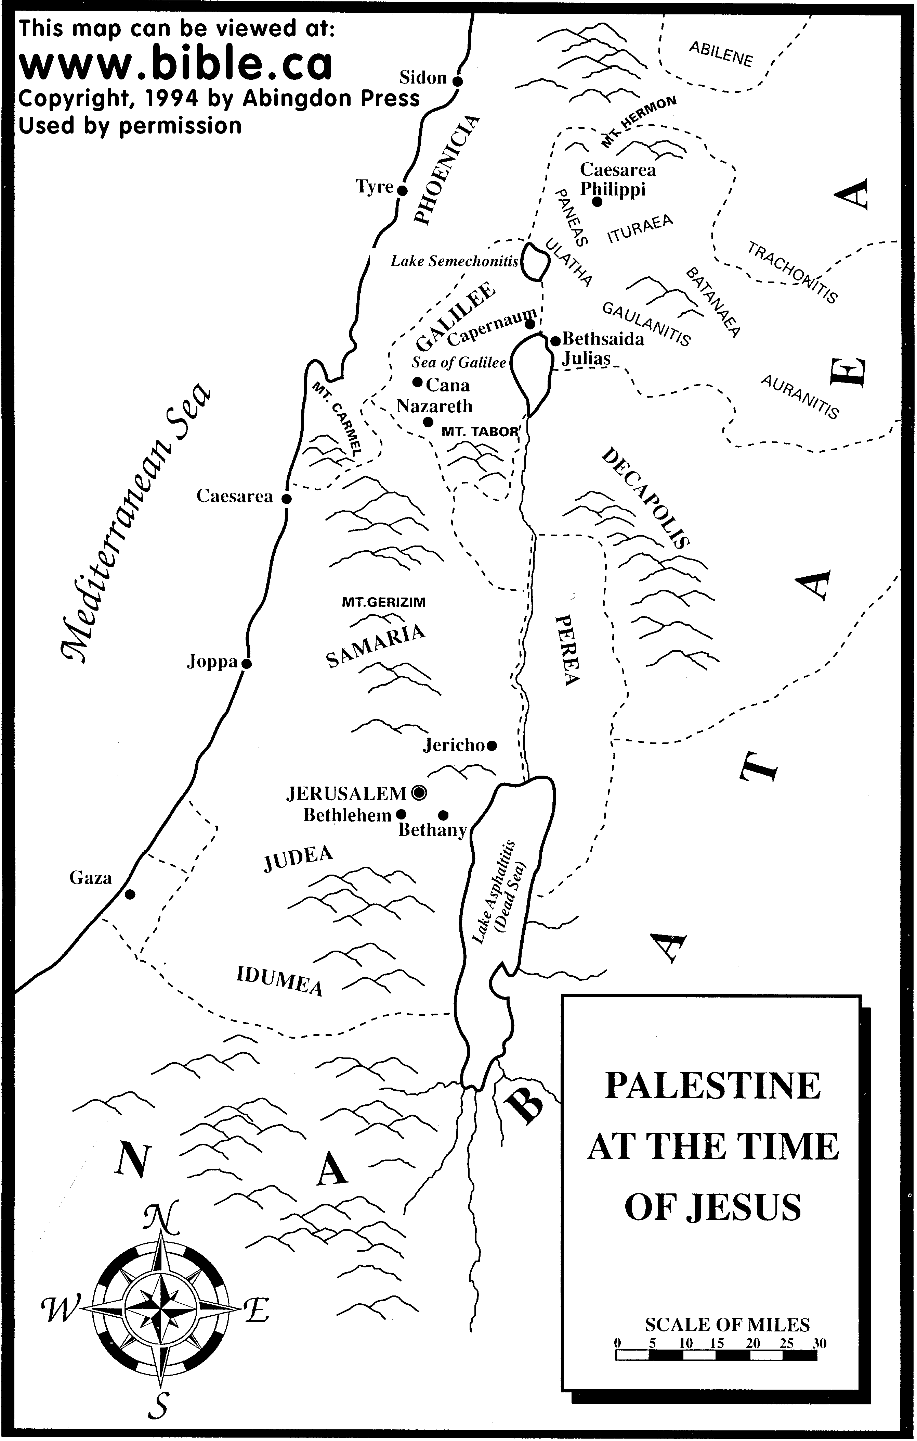

Slide 69
Psalm 22:16-18
Dogs have surrounded me;
a band of evil men have encircled me,
they have pierced my hands and my feet.
I can count all my bones; (John 19:3-37)
people stare and gloat over me.
They divide my garments among them
and cast lots for my clothing. (John 19:23,24)

Slide 70
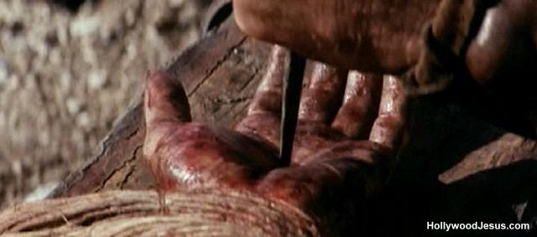

Slide 71
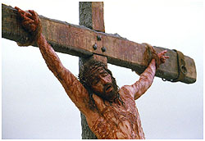

Slide 72
Zechariah 11:12,13
I told them, “If you think it best, give me my pay; but if not, keep it.” so they payed me thirty pieces of silver. (Matthew 26:14-16)
And the Lord said to me, “Throw it to the potter”—the handsome price at which they priced me! So I took the thirty pieces of silver and threw them into the house of the Lord, to the potter. (Matthew 27:3-8)

Slide 73
Daniel 9:24-26
Seventy ‘sevens’ are decreed for your people and your holy city to finish transgression, to put an end to sin, to atone for wickedness, to bring in everlasting righteousness, to seal up vision and prophecy and to anoint the most holy.
Know and understand this: From the issuing of the decree to restore and rebuild Jerusalem, until the Anointed One, the ruler comes, there will be seven ‘sevens’ and sixty two ‘sevens’
Decree of Artaxerxes (Ezra 7:12-26) 458 BC
458 BC + 490 years = AD 33!!! (no zero BC)

Slide 74
According to the Old Testament, the Messiah must:
Be born in Bethlehem
Be raised in Galilee near Nazareth
Be despised and rejected by men
Be meek and silent before his accusers
Be “pierced”
Be crucified
Have his garments divided and gambled over
Be betrayed for 30 pieces of silver
Come to Jerusalem to make atonement for sin in about AD 33
And many more….
Was all this an accident, or did God plan all along for the Passion of the Christ for forgiveness of sins? What do you think?

Slide 75
II. Jesus and Miracles
Four Possibilities:
  He neither worked miracles nor claimed to work miracles
  He claimed to work miracles, but he was a charlatan.
  He worked genuine miracles, but as a sorceror/by the power of Satan.
  He worked genuine miracles and his claims about himself are validated by those miracles.

Slide 76
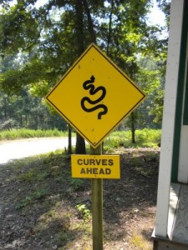
Miracles: Acts 2:22
Jesus… accredited by… miracles, wonders and signs.
miracle = dunamis “Power or ability, physical or moral, residing in a person or thing.”
wonder = teras “Something strange… a marvel”
sign = semeion “Sign or signal”
In apologetics we are most interested in the third definition.

Slide 77
Reasons to believe Jesus worked miracles
1. A great number of the miracles were done publicly, often in front of the
greatest skeptics and harshest critics of Jesus.
2. There were tens of thousands of eyewitnesses from every background to
these events.
3. The apostles openly proclaimed that Jesus worked a great variety of
miracles during the lifetime of those who could have refuted the claims.
4. Both Roman and Jewish histories report at least the general fact that
Jesus worked “wonders.”
5. Pharisees and Rabbis did not deny miracles, but instead claimed Jesus
did his signs by the power of demons.
6. Those who recorded the miracles as eye-witnesses (the gospel writers
except Luke) have every appearance of being credible.

Slide 78
Josephus AD 38-100
About this time there lived Jesus, a wise man. For he was one who wrought surprising feats and was a teacher of such people as accept the truth gladly. He won over many Jews and many of the Greeks. When Pilate, upon hearing him accused by men of the highest standing amongst us, had condemned him to be crucified, those who had in the first place come to love him did not give up their affection for him. For the prophets of God had prophesied these and countless other marvelous things about him. And the tribe of Christians, so called after him, has still to this day not disappeared.
Antiquities 18:3:3

Slide 79
Talmud (1st and 2nd Century AD)
On the eve of Passover they hung Yeshu and the crier went forth for forty days beforehand declaring that "[Yeshu] is going to be stoned for practicing witchcraft, for enticing and leading Israel astray. Anyone who knows something to clear him should come forth and exonerate him." But no one had anything exonerating for him and they hung him on the eve of Passover. Ulla said: Would one think that we should look for exonerating evidence for him? He was an enticer and G-d said (Deuteronomy 13:9) “Show him no pity or compassion and do not shield him.” him? He was an enticer and G-d said (Deuteronomy 13:9) "Show him no pity or chow him no pity or compassion,”
Babylonian Sanhedrin 43a-b

Slide 80
Why Did Jesus Do Miracles?
Because he had compassion. Matt 14:14
To fulfill prophecy. Matt 12:40
To validate his message. John 10:36-39
Because of people’s faith. Matt 15:21-28
To create faith in people. John 20:30-31
Because his mom asked him to. John 2:1-11

Slide 81
Reference | Miracle
John 1:1–4 | The miracle of creation
John 2:1–11 | Water into wine
John 4:46–54 | Healing of the official’s son
Mark 1:21–28 | Casting out evil spirit
Mark 1:29–34 | Healing Peter's mother-in-law
Mark 1.35–39 | Miscellaneous healings
John 5 | Healing man lame from birth
Luke 5:1–11 | Miraculous catch of fish
Mark 1:40–45 | Healing leprosy
Mark 2.1–12 | Healing the paralytic
Matthew 8:5–13 | Healing the Centurion's servant
Luke 7:11–17 | Raising the widow's son
Mark 3:20–30 | Healing the blind mute
Matthew 8:23–27 | Rebuking the wind and waves
Mark 5:1–20 | The pig incident
Mark 5:21–43 | Raising of Jairus' daughter
Mark 5:25 | Healing the bleeding woman
Matthew 9:27–34 | Blind men
The
Miracles
of
Jesus

Slide 82
Mark 7:24–30 | Healing the Canaanite's daughter
Mark 7.31–37 | Healing the deaf mute
Matthew 14:13, Mark 6:30, Luke 9:10, John 6.1 | Feeding the multitudes
Mark 8:22–26 | Healing the blind man
Matthew 17:1, Mark 9:2, Luke 9:28 | The Transfiguration
Matthew 17:14, Mark 9:14, Luke 9:37 | Healing the deaf mute boy
Matthew 17:24–27 | The coin in the fish's mouth
Luke 13:10 | Healing the crippled woman
John 9 | Man born blind
Luke 14:1–2 | Healing of the man dropsy”
John 11 | Raising Lazarus
Luke 17:11 | The ten lepers
Matthew 20:29–34, Mark 10:46, Luke 18:35 | Healing Bartimaeus and his friend
Mt 21:18, Mk 11:12 | Cursing the fig tree
Luke 22:51 | Healing the soldier's ear
John 21 | Resurrection
Mark 16:9, John 20:11 | Appearance miracles
John 21:1 | Miraculous catch of fish reprised
The
Miracles
of
Jesus

Slide 83
The Miracles of Jesus
Why he did it
What it tells us about Jesus
Go and report to John what you hear and see: The blind receive sight, the lame walk, those who have leprosy are cured, the deaf hear, the dead are raised, and the good news is preached to the poor. Matthew 11:4-5

Slide 84

John 2:1-11 Water to Wine
Jesus the Creator
Why? To meet a need and because his mom asked him to.

Slide 85
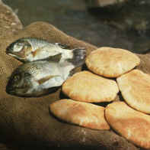
John 6:1-14 Feeding 5000
Surely this is the Prophet!
Jesus the creator and the sustainer of life
Jesus is “the bread of life”
Jesus is spiritual food
Jesus the source of eternal life

Slide 86
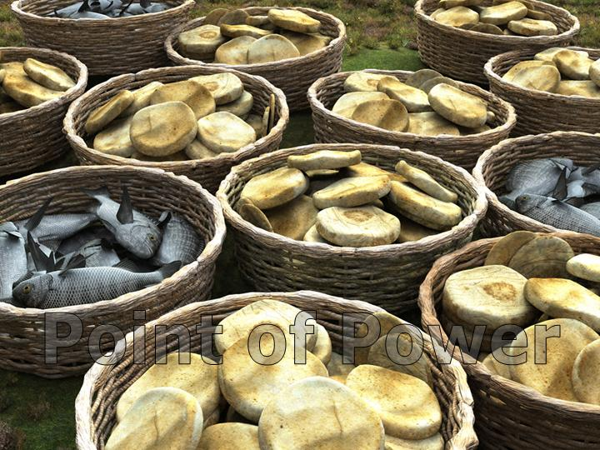
Jesus, Miracle Worker
John 6:35 “I am the bread of life. He who comes to me will never go hungry, and he who believes in me will never be thirsty”
John 6:1-15 Jesus feeds 5000 men, plus women and children.

Slide 87
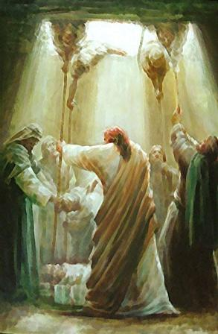
Mark 2:1-12 Healing of the Paralytic
Why? Because of the faith of the friends.
Jesus controls our health.
Jesus can forgive sin.

Slide 88
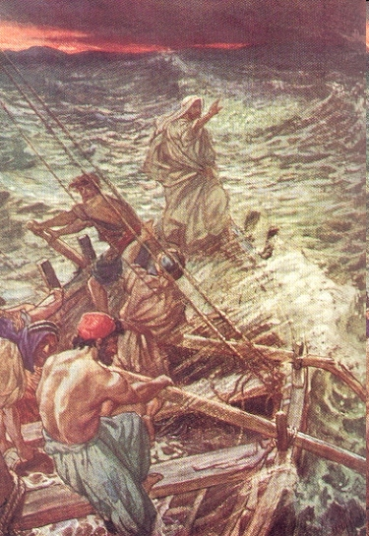
Matthew 8:23-27 Jesus Calms the Storm
Why? To save the apostles from death.
Jesus rules the physical universe
“What kind of man is this?” The apostles now realized Jesus is God.

Slide 89
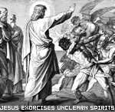
Mark 1:21-28 Jesus Drives Out An Evil Spirit
Jesus has control over the demon world.

Slide 90
John 1:46-49 Jesus Knows Nathanael
Jesus knows the thoughts and the heart of Nathanael.
Jesus knows our thoughts and our hearts.
“When you were under the fig tree, I saw you.”
“Rabbi, you are the King of Israel.”

Slide 91
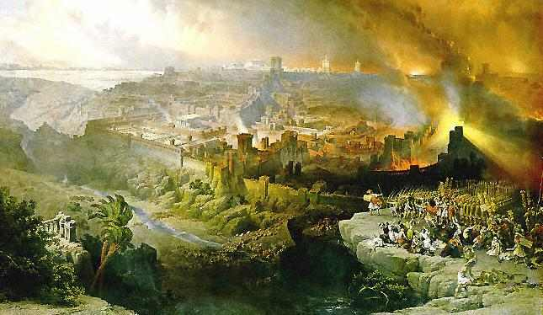
Luke 21:20-21 Jesus Predicts the Future
“When you see Jerusalem surrounded by armies, you will know that its desolation is near.”
Jesus, knows and by implication, controls the future

Slide 92
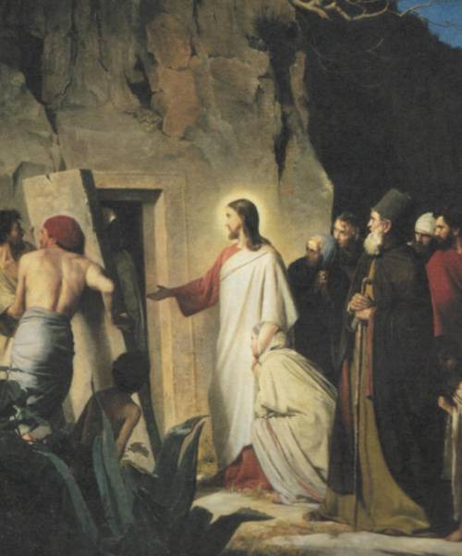
John 11:1-53 Jesus Raises Lazarus
Jesus is the resurrection and the life.
Jesus will raise those who put their faith in him.
  Hundreds present
  The smell of death was strong
  Lazarus came out
  Look at the responses. There are only two rational responses to Jesus the miracle-worker.

Slide 93
The Miracles Jesus Did Not Do
Meeting his own needs.
Working miracles in order to convince the hard-hearted.
Working a miracle because he was challenged to do so by an unbeliever.
A miracle to take revenge or in judgment.
Forcing the will of someone—taking away free will.
Jesus did not prevent the crucifixion.

Slide 94
Ill. Other Pictures of Jesus
A. The Jehovah Witness Jesus.
B. The Mormon Jesus.
C. The Muslim Jesus.
D. The Hindu Jesus/New Age Jesus
Q: Why are these problematic?

Slide 95

The Jehovah’s Witness Jesus
Jesus is the first and greatest of God’s creation. He is a created being and not God. He is the Archangel Michael.
.“Michael the great prince is none other than Jesus Christ Himself” (The Watchtower, Dec, 1984, p 29.)
The heresy of Arius of Alexandria 4th century.
Charles Taze Russel

Slide 96
Proof-texts
John 1:1 …. The Word was a god…
Coll 1:15-17 The first-born of (vs over) all creation.
Jn 14:28 The Father is greater than I
Response:
John 1:1, John 8:58, John 10:31-32, John 20:28, Coll 1:15-20, Coll 2:9, Titus 2:13 and many more.

Slide 97
The Mormon Jesus
Jesus is a “god” but so was Adam and so can we be in the future.

Slide 98
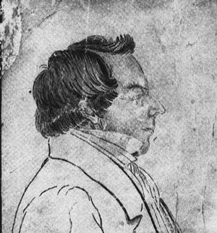
Joseph Smith 1805-1844
Diviner
Treasure Hunter
Religious Fraud

Slide 99
MORMON TEACHINGS ABOUT JESUS
1. The Father, the Son and the Holy Ghost are three separate gods.
2. There are many gods. D&C 76:58, Abraham 3.
3. The Father and the Son, in heaven, have physical flesh-and-blood bodies. D&C 130:1-3, 32.
4. Eternal Progression. Humans in the highest level of the celestial kingdom can be glorified and become gods, eventually even over a planet of their own. D&C 93, 139:10, Abraham 3.

Slide 100
Mormon Teachings About Jesus
5. Jesus and Satan were spiritual brothers. Abraham 3:25-28.
6. Jesus was conceived through God having sexual relations with Mary. This makes God the Father a polygamist. Most modern Mormons do not accept this belief.

Slide 101
We are all gods.
The Father, Jesus Christ and the Holy Spirit are three separate gods.
Mormonism is polytheistic.
  “I will preach on the plurality of gods. I have always declared God to be a distinct personage, Jesus Christ a separate and distinct personage from God the Father, and the Holy Ghost was a distinct personage and a Spirit: and these three constitute three distinct personages and three Gods.” Teachings of Joseph Smith, p. 370.
  From Joseph Smith’s most famous sermon: “God himself was once as we are now, and is an exalted man, and sits enthroned in yonder heavens!... I am going to tell you how God came to be God. We have imagined and supposed that God was God from eternity. I will refute that idea, and take away the veil so that you may see… He was once a man like us; yea that God himself, the Father of us all, dwelt on an earth, the same as Jesus Christ himself did.

Slide 102
The Muslim Jesus
Born of Virgin Mary
A prophet
Will come again
NOT crucified
NOT God
Childhood miracles, similar to Gospel of Thomas

Slide 103
New Testament Corrupt?
Sura 4:157 And for their saying: We have killed the Messiah, Jesus, son of Mary, the messenger of Allah, and they killed him not, nor did they cause his death on the cross, but he was made to appear to them as such.
Question: When was the New Testament (injil) corrupted?
John 1:1 If Jesus is not God, when was John 1:1-18 corrupted?
Rylands Papyrus, Washington Manuscript, Codex Alexandrinus
There is NO ANSWER to this question.

Slide 104
What About the Qur’an?
Uthman burned all competing manuscripts about AD 650
Ibn Masud Codex (Kufa) 150 variants in Sura 2 alone
Sana’a Manuscript about AD 710 missing suras
Irony and circular reasoning.
Muslims avoid all study of Qur’an manuscripts and history. What are they afraid of?

Slide 105
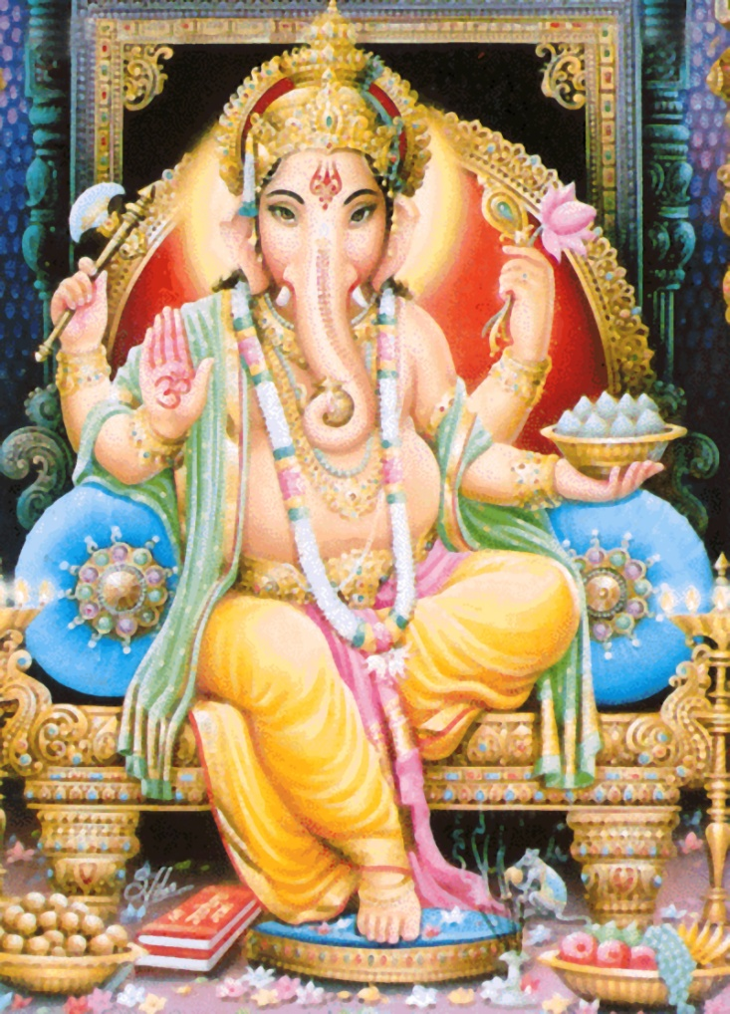

The Hindu/New Age Jesus
Jesus is divine but so were Krishna and Rama and so are we, if we will only accept it.

Slide 106
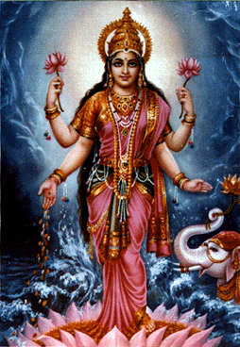
Principle gods of Hinduism
Lakshmi
Brahma Chief god of the pantheon.
Shiva God of destruction. Worshipped
as a male phalus.
Vishnu Preserver and protector.
Krishna The eighth emanation of Vishnu.
Rama Seventh incarnation of Vishnu. Hero of the Ramayana.
Devi Chief female deity. The power (shakti) that animates the cosmos.
Lakshmi Female consort of Vishnu. Godess of prosperity.

Slide 107
The Greatest Miracles of All: The Incarnation.
C. S. Lewis Miracles
“The central miracle asserted by Christians is the Incarnation.”
The apostle John:
“The Word became flesh and lived for a while among us.” (John 1:14)

Slide 108
The Incarnation: A Miracle on Many Fronts
It fulfilled prophecy. Isaiah 7:14 “The Lord himself will give you a sign. Behold the virgin will be with child and will give birth to a son and will call him Immanuel.”
  Mary believed in Jesus.
It fulfilled a prefigure.
  Joseph left the right hand of his father and became a slave in Egypt. He saved Israel.
  Moses left the right hand of Pharaoh to become a slave in Egypt and save Israel.
It was a physical miracle.
It proves God can create human life ex nihilo.

Slide 109
The Resurrection of Jesus
Is it the Central Event in Human History?
Or
Is it a fraud?

Slide 110
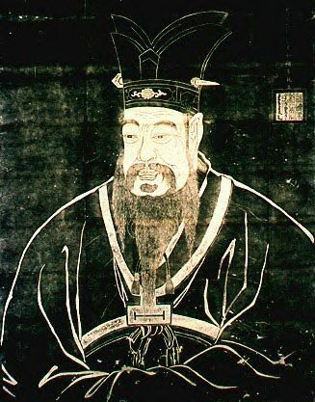
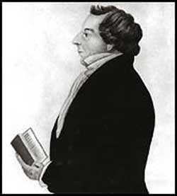
Is Jesus just one of many similar religious leaders?
Confucius
Joseph Smith

Slide 111
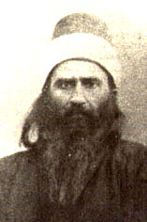
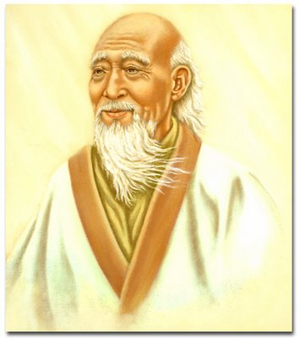
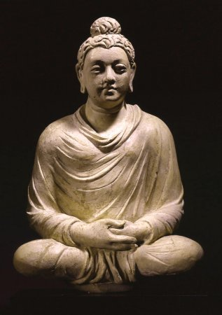
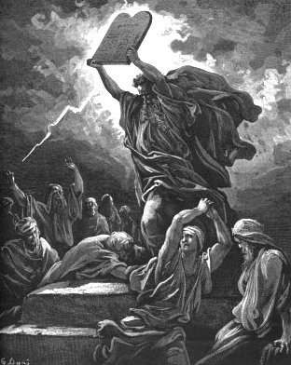
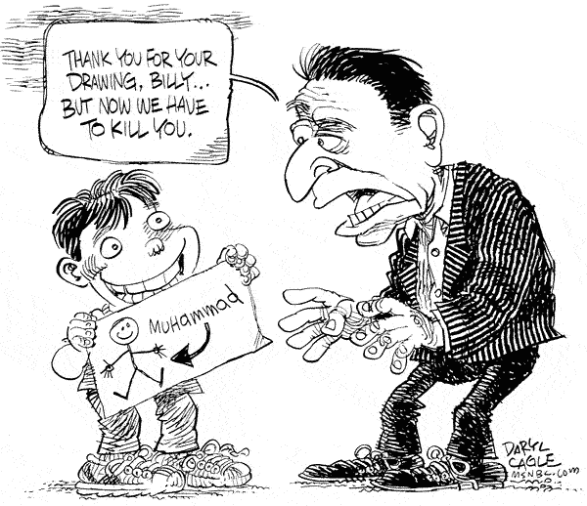
Lao Tzu
Baha’u’llah
Buddha
Moses
Is Jesus a Guru?
A Great Prophet?
One of Many Important Spiritual Leaders?
Muhammad?

Slide 112
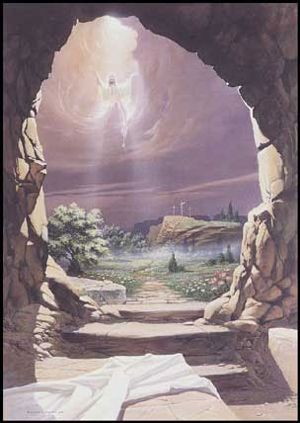
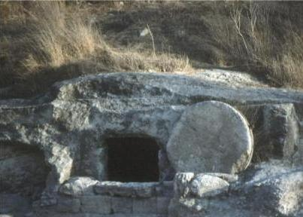
The Ultimate Miracle: The Resurrection of Jesus

Slide 113
“Extraordinary claims require extraordinary proof”
David Hume

Slide 114
Fact #1
Jesus of Nazareth was crucified under Pontius Pilate in Jerusalem

Slide 115
Fact #2
From the very beginning, the church unanimously claimed that Jesus was resurrected

Slide 116
Fact #3
The tomb was empty

Slide 117
Fact #1
Jesus of Nazareth was crucified under Pontius Pilate in Jerusalem

Slide 118
Josephus AD 38-100
About this time there lived Jesus, a wise man. For he was one who wrought surprising feats and was a teacher of such people as accept the truth gladly. He won over many Jews and many of the Greeks. When Pilate, upon hearing him accused by men of the highest standing amongst us, had condemned him to be crucified, those who had in the first place come to love him did not give up their affection for him. The prophets of God had prophesied these and countless other marvelous things about him. And the tribe of Christians, so called after him, has still to this day not disappeared.
Antiquities 18:3:3

Slide 120
Cornelius Tacitus approx. AD 114
To squelch the rumor [that he had started the Great fire in Rome], Nero created scapegoats and subjected to the most refined tortures those whom the common people called ‘Christians,’ [a group] hated for their abominable crimes. Their name comes from Christ, who, during the reign of Tiberius, had been executed by the procurator Pontius Pilate.
Annals 15.44

Slide 121
Talmud (1st and 2nd Century AD)
On the eve of Passover they hung Yeshu
Babylonian Sanhedrin 43a-b

Slide 122
Thallus
We know of Thallus only from a third century Christian historian named Julius Africanus who wrote a three-volume treatise of world history in the 50s AD. In discussion the darkness at the time of the resurrection of Jesus, Julius Africanus mentions that in the 3rd book of Thallus’ history, he mentions the darkness and calls it an eclipse of the sun. Africanus believes that Thallus is wrong. Whether or not this source proves the darkness at the time of Jesus’ crucifixion is dubious, but it does seem to support the idea that even non-Christians were aware of the resurrection as early as the 50s AD—at about the time the first book of the NT was written. It also supports the claim, not necessarily of the darkness having occurred, but of the darkness having been claimed and believed by the Christians. Because we do not have Thallus’ history and because we have a Christian interpreting rather than quoting it, this is rather dubious support to Christian claims.

Slide 123
Fact #2
From the very beginning, the church unanimously claimed that Jesus was resurrected
Acts 2:24 But God raised him from the dead…
How else to explain the growth of the church?

Slide 124
Fact #3
The tomb was empty
If not….
They could not have preached the resurrection

Slide 125
Question:
What is the most reasonable explanation of the facts?
Jesus’ body was taken from the tomb.
Jesus did not actually die (swoon theory).
Jesus was bodily resurrected from the dead.

Slide 126
The Stolen Body Theory
Who would have stolen the body?
  The Jews?
  The Romans?
  The disciples?
Could they have stolen the body?
Did they, in fact, steal the body?

Slide 127
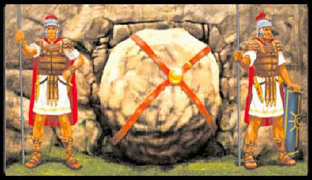
Matthew 27:62-66

Slide 128
The Swoon Theory
Beaten to the point of near death.
No food or water for more than two days.
Crucified and died.
Pierced with a sword.
Separated blood and “water” (plasma)

Slide 129
The Mass Hallucination Theory
The women at the tomb.
Peter and John.
The twelve apostles, including doubting Thomas.
Many other appearances.
Over 500 witnesses. (1 Cor 15:3)
Do hallucinations eat fish? (John 21:12)

Slide 130
The Resurrection of Jesus
We should have known it was coming…

Slide 131
The Resurrection of the Messiah was prophesied
Jonah 1:7 Jonah was raised from the dead on the third day. (Matthew 11:40 For as Jonah was three days and three nights….)
Genesis 22:1-12 Abraham received Isaac back from the dead on the third day. (Hebrews 11:17-19)

Slide 132
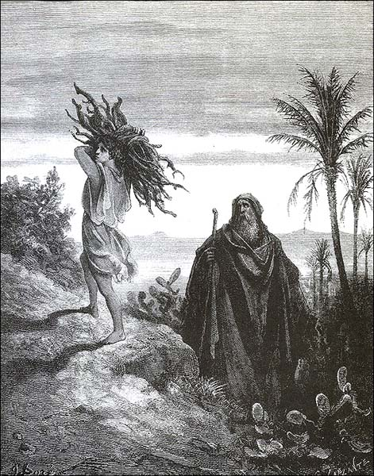
Resurrection on the 3rd day

Slide 133
Prophecies of the Resurrection
Feast of Firstfruits. Lev 23:9-14
Jesus is the firstfruit from among the dead. His resurrection is a promise of ours. Colossians “the first fruit from the dead.”
Romans 6:2-7 If we have been united with him in his death, we will certainly also be united with him in his resurrection.

Slide 134
1 Cor 15:23 But now Christ has been raised from the dead, the firstfruits of those who have fallen asleep. For since death came through a man, the resurrection of the dead also comes through a man. For just as in Adam all die, so also in Christ all will be made alive. But each in his own order: Christ, the firstfruits; afterward, at his coming, the people of Christ. Then comes the end, when he hands over the kingdom of God the father, when He abolishes all rule and all authority and power.

Slide 135
The Message of the Resurrection
You, too, will rise from the dead. John 11:25-26
Repent! Acts 17:30-31

Slide 136
Implications of the Resurrection:
Validates the claims of Jesus
  John 11 I am the resurrection and the life
It confirms that we, too, will be resurrected.
  1 Peter 1:3-4
It confirms that there will be a judgment day.
  Acts 17:31.
Our doubts become much less significant.
  What about…. Jesus was raised from the dead!

Slide 137
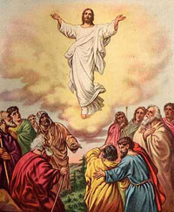
Ultimate Miracle #2: The Ascension of Jesus

Slide 138
The Ascension
After he said this, he was taken up before their very eyes, and a cloud hid him from their sight. They were looking intently up into the sky as he was going, when suddenly two men dressed in white stood beside them. “Men of Galilee,” they said, “why do you stand here looking into the sky? This same Jesus, who has been taken from you into heaven, will come back in the same way you have seen him go into heaven.” (Acts 1:9–11)
If nothing else, it was a physical miracle: violating the law of gravity.
It tells us that Jesus will come back in the same way he came.

Slide 139
Pontius Pilate
David Lee Burris:
Notice - Jewish Leaders Are To Pilate Being Both Obsequious & Appealing Pandectic
“What Is Truth?”

Slide 140
ANSWER:
David Lee Burris:
Notice - Jewish Leaders Are To Pilate Being Both Obsequious & Appealing Pandectic
HE DIED FOR YOU!

Slide 141
JUDGEMENT PREPARED
FIVE STATES FIVE STEPS
Five States of the Soul:
EXEMPTION:
Ezekiel 18: 20; Matthew 18: 1 – 3
CONDEMNATION:
Galatians 3: 22
JUSTIFICATION:
Romans 5: 1, 2; 8: 1, 2
DAMNATION:
Matthew 23: 3; Mark 16: 16
GLORIFICATION:
Romans 8: 17, 30; II Thess. 1: 7 - 12

Slide 142


Slide 143
JUDGEMENT PREPARED
FIVE STATES FIVE STEPS
Five Steps for Saving:
HEARING:
Romans 10: 17; Matthew 7: 24 - 27
BELIEVING:
Hebrews 11: 6; Mark 16: 15, 16
REPENTING:
Acts 2: 38; 17: 30; Luke 13: 3
CONFESSING:
Matthew 10: 32, 33; Acts 8: 36, 37
BAPTISM:
Romans 6: 3 – 5; Acts 8: 36 - 38

