Slide 1
HELPING THOSE HURTING
Edited by David Lee Burris

Slide 2
The Bible Should Not Be Presented As A Textbook

Slide 3
The Bible Should Be Presented As The Book of Life!

Slide 4
The Origins of Interpretive Hermeneutics
In Greek Mythology Hermes was the Son of Zeus
His heavenly mission was as Cosmic World Travel Guide.
As tour guide to the underworld he included information on entities seen & unseen – events conscious & unconscious.
His traveler’s tour highlights of the underworld included most famously the Story of Pandora’s Box.
Near the top of the lid to escape once opened was all the suffering, sorrows, and misfortunes of life.
Kept open too long also escaping was would be Hope.

Slide 5

YOU
?
ARE

Slide 6
The Origins of Interpretive Hermeneutics
Hope is the Gateway to Faith.
Hope = Faith + Expectation
Doctors Get Patients to Process Unpleasant Information By Holding Out Hope FIRST!
THE GREAT PHYSICIAN WANTS US TO DO THE SAME WITH ULTIMATE SPIRITUAL REALITIES – FIRST HOPE!

Slide 7


Hope!
God makes life livable

Slide 8


Theme:
Three episodes in Jesus’ ministry…
filled people with hope

Slide 9


Hope…
Commonly → wish, desire
Sometimes → expectation
In Bible:
  Man’s desire
  Filled with expectation
Occasionally → confidence

Slide 10

Important?
Hope’s absence
has an amazing capacity to eat away at the whole structure of life

Slide 11
Important?
What oxygen is for the lungs,
such is hope for the meaning of human life

Slide 12
Important?
W/O hope → despair
Eph. 2¹²
  No hope
  Without God

Slide 13
Hope is critical to life
Anticipation drives us
Without hope…
nothing to live for!

Slide 14
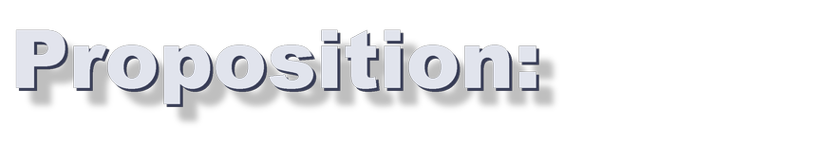
Proposition:
God puts expectation into your desire…
and calls it hope

Slide 15

Three Variations
Desire, accompanied by confident expectation
Thing hoped for or desired
One who is source or reason for hope

Slide 16
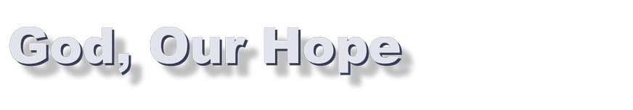
God, Our Hope
On His throne; in control
The hope of Israel
  Healer
  Savior
  Source & object of praise

Slide 17

Born Again
Last week → He gives life
2 weeks → He overturns death
New life:
  Through resurrection
  Living hope!

Slide 18
We have hope because of God!
Who He is & how He feels toward us…
means we can expect good!

Slide 19

Point:
Do you want hope?
Look to God
Forget despair;
God is your source of blessings

Slide 20


A Marvelous Catch
Setting:
  Multitudes came to listen
  Out in the boat
Put out…to catch
  No hope, but…
  Nets began to burst
Fear became commitment:
  Fishers of men

Slide 21
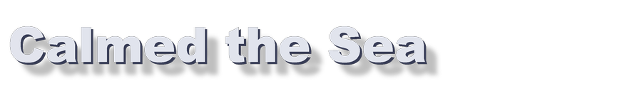
Calmed the Sea
Crossing over:
  Fierce gale
  Jesus sleeping
Don’t you care?
Hush, be still!
Have faith = trust Me

Slide 22

Walked on Water
They crossed over:
  Storm battered their little boat
  He came walking (after prayer)
It is I
Peter came:
  Panicked, but looked to Jesus
Jesus: “Why doubt?”
  Nature obeys Him!

Slide 23
Jesus’ control over our environment…
means we can expect good in our lives!

Slide 24
Point:
Do you want Him to fill your life with hope?
Be like Peter
Look to Him
Trust His love

Slide 25
Hope

Slide 26
“The days are coming”, declares the Lord, “when I will fulfill the gracious promise I made to the house of Israel and to the house of Judah.

Slide 27
“In those days and at that time I will make a righteous Branch sprout from David’s line; he will do what is just and right in the land.

Slide 28
In those days Judah will be saved and Jerusalem will live in safety. This is the name by which it will be called: The Lord Our Righteousness.”
(Jeremiah 33:14-16, NIV)

Slide 29
To you, O Lord, I lift up my soul; in you I trust, O my God.
Do not let me be put to shame, nor let my enemies triumph over me.

Slide 30
No one whose hope is in you will ever be put to shame…
Show me your ways, O Lord, teach me your paths;

Slide 31
Guide me in your truth and teach me, for you are my God my Savior, and my hope is in you all day long. Remember, O Lord, your great mercy and love, for they are from of old.

Slide 32
Remember not the sins of my youth and my rebellious ways; according to your love remember me, for you are good, O Lord.

Slide 33
Good and upright is the Lord; therefore he instructs sinners in his ways. He guides the humble in what is right and teaches them his way.

Slide 34
All the ways of the Lord are loving and faithful for those who keep the demands of his covenant. (Psalm 25:1-10, NIV)

Slide 35
FAITH

Slide 36
Getting A Few Foundations Laid
You can’t separate hope and faith. Faith produces hope and hope produces faith
We receive in life from God through our faith and hope “the best is yet to come”
We have a choice to make, fear/faith, hope or despair

Slide 37
Hope
Noun
The feeling that what is wanted can be had or that events will turn out for the best: to not give up hope.
A particular instance of this feeling: the hope of winning.

Slide 38
Hope
Verb (used without object)
3. To feel that something desired may happen: We hope for an early spring.
4. Archaic: to place trust; rely (usually followed by in ).
Idiom
5. Hope against hope, to continue to hope, although the outlook doesn’t warrant it.

Slide 39
What Is Hope?
In the Hebrew the two words most often translated hope are Kawah, (to wait or expect) and Batah (to be full of confidence or to trust,)
Jeremiah 17:13 O Lord the hope of Israel
Psalm 38:15 My hope is in you
Psalm 43:5 Why are you downcast hope in God.

Slide 40
What Does It Mean
The Greek word for hope is elpis (Noun) or elpezein (Verb) It is translated hope. The expectation of a favorable future. It was not used positively outside of the scriptures.
Hope was seen by secular writers in the ancient world not as a virtue but merely an temporary illusion. They did not see hope as a virtue but use epithets such as faint, trembling, feeble, desperate, or phantom as adjectives or descriptions of hope.

Slide 41
2 Thessalonians 2:16 Now may our Lord Jesus Christ Himself, and God, even our Father, who has loved us and has given us everlasting consolation and good hope through grace,
Hebrews 6:18 so that by two immutable things, in which it was impossible for God to lie, we might have a strong consolation, who have fled for refuge to lay hold upon the hope set before us,
1Peter 1:21 those believing in God through Him, He who raised Him up from the dead and gave Him glory, so that your faith and hope might be in God.

Slide 42
1Peter 3:15 but sanctify the Lord God in your hearts, and be ready always to give an answer to everyone who asks you a reason of the hope in you, with meekness and fear;
Titus 1:2 on hope of eternal life, which God, who cannot lie, promised before the eternal times,
Titus 2:13 looking for the blessed hope, and the glorious appearance of our great God and Savior Jesus Christ,
Titus 3:7 that being justified by His grace, we should become heirs according to the hope of eternal life.

Slide 43
New Testament Usage
Paul and other New Testament writers used this word differently. It means “The expectation of a favorable future under God’s direction.”
Hope is described as one of the three essential virtues that are foundational in our Christian life. It is linked in scripture with love and faith. This threefold combination is found in 1st Thess.1:3, 5:8 Gal.5:5-6, 1st Cor. 13:13, Hebrews 6:10-12.

Slide 44
Hope’s Relationships
Hope cannot exist without faith in someone or something that gives hope the confidence it needs.
Therefore faith in God was always foundational to having a hope that does not disappoint. The word for faith in the Old Testament is also used to define hope.

Slide 45
What Does It Mean To Be Lost
Paul describes spiritual lostness as being “without hope”. If fact he states specifically to be without hope is to be without God in this World. Eph. 2:12, I Thess. 4:13

Slide 46
HOPE AND FAITH TOGETHER
God’s plans for us is to give us not only direction but hope Jeremiah. 29:11
Hope is an anchor for our soul Hebrews 6:19
We have an anchor that keeps the soul, Steadfast and sure while the billows roll, Fastened to the Rock which cannot move ~ Grounded firm and deep in the Savior’s love.

Slide 47
Hope has two beautiful daughters:
Their names are anger and courage.
Anger that things are the way they are.
Courage to make them the way they ought to be.
* Augustine of Hippo

Slide 48
Helping Those Experiencing Pain & Suffering
What do you say to people
under these conditions?

Slide 49
Friends
“When Job’s three friends, Eliphaz…Bildad …Zophar…heard about all the trouble that had come upon him, they set out from their homes and met together by agreement to go and sympathize with him and comfort him.”
Job 2:11

Slide 50
Everyone Needs Friends
“When they saw him from a distance, they could hardly recognize him; they began to weep aloud, and they tore their robes and sprinkled dust on their heads. Then they sat on the ground with him for seven days and seven nights. No one said a word to him, because they saw how great his suffering was.” Job 2:12-13

Slide 51
But Not Friends Like These
“A despairing man should have the devotion of his friends, even though he forsakes the fear of the Almighty.
But my brothers are as undependable as intermittent streams, as the streams that overflow when darkened by thawing ice and swollen with melting snow but that cease to flow in the dry season.” Job 6:14-17a

Slide 52
The Unrelenting Love Of God

Slide 53
Lord, How Have you Loved Us?
Have you ever asked that question?

Slide 54
Malachi 1:2
“I have loved you,” says the Lord.
But you ask, “How have you loved us?”
“Was not Esau Jacob’s brother?” the Lord says. “Yet I loved Jacob, but Esau I have hated.”

Slide 55
The Lament (Psalm 77:1-3)
“I cried out to God for help; I cried out to God to hear me. When I was in distress, I sought the Lord; at night I stretched out untiring hands and my soul refused to be comforted. I remembered you, O God, and I groaned; I mused, and my spirit grew faint.”

Slide 56
The Questions (Psalm 77:7-9)
“Will the Lord reject forever? Will he never show his favor again? Has his unfailing love vanished forever? Has his promise failed for all time? Has God forgotten to be merciful? Has he in anger withheld his compassion?”

Slide 57
Our Questions
Do we ask….
  Where is God’s love?
  How have you loved us?
  How can we know you love us?

Slide 58
Remember
“Was not Esau Jacob’s brother?” the Lord says. “Yet I loved Jacob, but Esau I have hated.”
Malachi 1:2

Slide 59
Reflection (Psalm 77:10-12)
Then I thought, “This is my anguish; But I will remember the years of the right hand of the Most High. I will remember the deeds of the Lord; yes, I will remember your miracles of long ago. I will meditate on all your works and consider all your mighty deeds.”

Slide 60
Remember
Remember God created you out of love.
Remember God’s loving creation of Israel,
Deuteronomy 7:7-9
Remember God’s loving pursuit of Israel.
Hosea 3:1; 11:8-9

Slide 61
Where Do We Find God’s Love?
Do we find it in . . .
    our health?
    our prosperity?
    our employment?
    our happiness?

Slide 62
We Find God’s Love in Jesus
“For I am convinced that neither death nor life, neither angels nor demons, neither the present nor the future, nor any powers, neither height nor depth, nor anything else in all creation, will be able to separate us from the love of God that is in Christ Jesus our Lord.”
Romans 8:38-39

Slide 63
We Remember . . .
that God loved us relentlessly, even when we were his enemies
that God loved us empathetically in Jesus Christ, even sharing our experience
that God loved us sacrificially, even to death on a cross

Slide 64
The Inviting Presence of God

Slide 65
Lord, Are You Listening?
When Prayer Speaks the Heart

Slide 66
Not the Way It is Supposed To Be
God created life, but now there is death.
God created peace, but now there is chaos.
God created community, but now there is fragmentation and segregation.

Slide 67
Lament over Fallenness
Lament over sickness, disease and pain.
Lament over sin, injustice and oppression.
Lament over alienation and death.

Slide 68
The Lament of Psalm 13
Complaint: How Long? (13:1-2)
Petition: Look at Me, Answer Me! (13:3-4)
Praise: I Trust You (13:5-6)

Slide 69
The Complaint of Psalm 13:1-2
How long, O Lord? Will you forget me forever?
How long will you hide your face from me?
How long must I wrestle with my thoughts and every day have sorrow in my heart?
How long will my enemy triumph over me?

Slide 70
Questions of Complaint
“My soul is in anguish.
How long, O Lord, how long?” Psalm 6:3
“Why, O Lord, do you stand afar off?
Why do you hide yourself in times of trouble?” Psalm 10:1

Slide 71
Pouring Out Our Complaints
“I cry aloud to the Lord;
I lift up my voice to the Lord for mercy.
I pour out my complaint before him;
before him I tell my trouble.”
Psalm 142:1-2

Slide 72
May We Lament?
The angels in heaven lament.
Zechariah 1:12
Jesus Christ lamented on the cross.
      Matthew 27:46
The saints in heaven lament.
    Revelation 6:9-10

Slide 73
The Function of Lament
Communal Sympathy and Empathy
Engaging God Honestly with the Heart
Spiritual Therapy through Divine Presence

Slide 74
The Petition of Lament: Redeem Me
Psalm 44
We have heard of your past history, God.
But now we don’t see you.
Your people are slaughtered as sheep.
But we will not forget you.
“Rise up and help us; redeem us because of your unfailing love.”

Slide 75
We Trust His Redeeming Love
Paul quotes Psalm 44:22 in Romans 8:36,
and then writes:
“No, in all these things we are more than conquerors through him who loved us.”

Slide 76
Divine Comfort and Hope
May the God of hope fill you with all joy and peace as you trust in him, so that you may overflow with hope by the power of the Holy Spirit.” Romans 15:13

Slide 77
Biblical Story as Lens
The models of lament in Scripture are paradigmatic for our own experience of suffering and subsequent comfort.

Slide 78
The Caring Empathy of God

Slide 79
Lord, You Don’t Understand!
How can the cosmic Creator understand our pain and hurt?

Slide 80
The Sympathy of God
God weeps over evil in the world.
God weeps over death in the world.
God weeps over suffering in the world.

Slide 81
God Weeps Over the Wicked
Jeremiah 48:36, “So my heart laments for Moab like a flute; it laments like a flute for the men of Kir Hareseth.”
Isaiah 16:9, “So I weep, as Jazer weeps…O Heshbon, O Elealeh, I drench you with tears.”

Slide 82
God Weeps Over His People
“O Jerusalem, Jerusalem, you who kill the prophets and stone those sent to you, how often I have longed to gather your children together, as a hen gathers her chicks under her wings, but you were not willing.”
Matthew 23:37

Slide 83
The Empathy of God
Does God Understand?
Does God understand an unfaithful spouse?
Does God understand a rebellious child?
Does God understand disappointment?
Does God understand the grief of death?

Slide 84
But Does God Understand...
what it is like to be tempted?
what it is like to be hungry or thirsty?
what it is like to live in the flesh?
what it is like to die?

Slide 85
God Comes Near
We do not serve a distant God who insulates himself from our hurt and pain.
We serve a God who comes near to our pain and joins us in our suffering.
We serve a God who suffers with us.

Slide 86
In Jesus, God Understands
Jesus understands how it feels to hunger and thirst.
Jesus understands what is like to be tempted.
Jesus understands what it is like to weep by the tomb of a friend.
Jesus understands what it is like to die.

Slide 87
In Jesus, God Understands
“Therefore, since we have a great high priest who has gone through the heavens, Jesus the Son of God, let us hold firmly to the faith we profess. For we not have a high priest who is unable to sympathize with our weaknesses, but we have one who has been tempted in every way, just as we are--yet without sin.” Hebrews 4:14-15

Slide 88
The Son Became One of Us
“But we see Jesus, who was made a little lower than the angels, now crowned with glory and honor because he suffered death, so that by the grace of God he might taste death for everyone…he too shared in their humanity so that by his death he might destroy him who holds the power of death.”
Hebrews 2:9, 14

Slide 89
Suffering Perfects Jesus
“…make the author of their salvation perfect through suffering...Because he himself suffered when he was tempted, he is able to help those who are being tempted.” Hebrews 2:10,18
“Although he was a son, he learned obedience from what he suffered and, once made perfect, became the source of eternal salvation for all who obey him.” Hebrews 5:8-9

Slide 90
So, Confidence!
“Let us then approach the throne of grace with confidence, so that we may receive mercy and grace to help us in our time of need.”
Hebrews 4:16

Slide 91
Our Confidence
God unrelentingly pursues us in love
God listens patiently to our laments over our pain.
God understands our pain because he has himself experienced it.

Slide 92
What Do We Say to Sufferers?
God loves you and he has demonstrated this in Jesus: “Keep your eyes on the cross.”
God hears your lament and weeps with you: “Tell God all your troubles.”
God understands your suffering because he himself has suffered: “God is sitting with you on your mourning bench.”

Slide 93
Because….
Because God loves,
Because God listens,
Because God understands,
“Cast all your anxiety on him because he cares for you.” 1 Peter 5:7

Slide 94
God’s Tough Love Is Incomprehensible!

Slide 95
Lord, Why This? Why Now?
God reigns over his world in order to bring us into communion with him and fulfill his original creative intent.

Slide 96
God Values Authenticity
God created freedom in freedom.
God yearns for authentic reciprocity.
God seeks integrity in our faith response.

Slide 97
God Tests the Heart
“I know, my God, that you test the heart and are pleased with integrity.”
1 Chronicles 29:17

Slide 98
The Testing of Job
The story of Job is a cosmic “integrity check.”
Do we serve God for profit?
Do we endure when there are no props?
Do we trust even when we cannot see?

Slide 99
The Sovereignty of God in Job
“The Lord gave and the Lord has taken away.” Job 1:21
Lord says: “though you incited me against him to ruin him without any reason.” Job 2:3.
“They comforted and consoled hm over all the trouble the Lord had brought upon him.” Job 42:11.

Slide 100
The Questions of Job:
Job Complains
Why is life given to those in misery (3:20)?
Why has God made Job his target (7:20)?
Why does God hide his face (13:24)?
Why do the wicked prosper (21:7)?
Why does not God judge the world (24:1)?

Slide 101
The Victory of Job
He maintained his integrity before God; he didn’t admit to a false self-incrimination.
Job 27:5-6
He maintained his faith in God; he did not curse God.
Job 19:25-27

Slide 102
The Trusting Faith of Job
“But he knows the way that I take;
when he has tested me, I will come forth as gold.
My feet have closely followed his steps;
I have kept to his way without turning aside.
I have not departed from the command of his lips;
I have treasured the words of his mouth more than
my daily bread.”
Job 23:10-12

Slide 103
God’s Goal
God is more interested in our faith than our pleasure; in the joy of communion than temporal pleasures.

Slide 104
The Testing Motif in Scripture
The Divine Act of Testing
Genesis 22:1; Psalms 7:9; 11:4-5
The Divine Motive for Testing
- To Reveal the Heart (Deuteronomy 8:2)
The Divine Goal in Testing
- Character-Building (Deuteronomy 8:5)

Slide 105
The Intent of Testing
“The Lord your God is testing you to find out whether you love him with all your heart and with all your soul.”
Deuteronomy 13:3
“God left him to test him and to know everything that was in his heart.”
2 Chronicles 32:31

Slide 106
The Trust Factor
God is the listening empathetic friend.
God is the sovereign Lord.
Human Response: We trust that God is at work to accomplish his purposes, even when his ways are hidden from us.

Slide 107
The Hidden God on the Cross
The suffering of the cross is paradigmatic for the hiddenness of the meaning of suffering.

Slide 108
The Revealed God in the Cross
God reveals his love through the weakness of suffering and acts to reconcile the world to himself.

Slide 109
God is Sovereign over Suffering
“We know that God is at work in everything for the good of those who love him, who have been called according to his purpose.” Romans 8:28

Slide 110
The Goal of God’s Sovereignty:
What is the “Good” God Desires?
“For those God foreknew he also predestined to be conformed to the likeness of his Son, that he might be the firstborn among many brothers.” Romans 8:29

Slide 111
God Conforms Us to His Son
God is at work in everything to shape us into the image of his Son in order to enjoy eternal communion with us.

Slide 112
The Biblical Story as Lens
While the meaning of suffering is often hidden from us, we are confident that God is at work in order to accomplish his purpose for us.

Slide 113
God Of The Valleys
A message for all those
Whose everyday is not a 10!

Slide 114
1 Kings 20:21-29
The king of Israel went out and struck the horses and chariots, and killed the Arameans with a great slaughter.
Then the prophet came near to the king of Israel and said to him, “Go, strengthen yourself and observe and see what you have to do; for at the turn of the year the king of Aram will come up against you.”

Slide 115
Now the servants of the king of Aram said to him, “Their gods are gods of the mountains, therefore they were stronger than we; but rather let us fight against them in the plain, and surely we will be stronger than they.
“Do this thing: remove the kings, each from his place, and put captains in their place,
and muster an army like the army that you have lost, horse for horse, and chariot for chariot. Then we will fight against them in the plain, and surely we will be stronger than they.” And he listened to their voice and did so.

Slide 116
The Presenting Situation
Israel under Ahab had been in a long standing battle with the Syrian Army
Syria under Ben-Hadad had just experienced a phenomenal defeat in the mountains.
The commanders ask the king if he would rearm them to previous strength for a new battle, horse for horse, man for man
They believe if they can fight in the valley they will defeat Israel
They believe the God of Israel is the God of the mountains not the God of the valleys

Slide 117
At the turn of the year, Ben-hadad mustered the Arameans and went up to Aphek to fight against Israel.
The sons of Israel were mustered and were provisioned and went to meet them; and the sons of Israel camped before them like two little flocks of goats, but the Arameans filled the country.

Slide 118
Then a man of God came near and spoke to the king of Israel and said, “Thus says the LORD, ‘Because the Arameans said, “The LORD is a god of the mountains, but He is not a god of the valleys,” therefore I will give all this great multitude into your hand, and you shall know that I am the LORD.’”
So they camped one over against the other seven days. And on the seventh day the battle was joined, and the sons of Israel killed of the Arameans 100,000 foot soldiers in one day.

Slide 119
God Of The Mountains
(and the valley’s too)
Life is easy, when you are up on the mountain
You’ve got peace of mind like you’ve never known
But things change, when you’re down in the valley
Don’t lose faith, for you’re never alone

Slide 120
For the God of the mountains
Is still God in the valleys
When things go wrong He’ll make them right
And the God of the good times
Is still God in the bad times
The God of the day is still God in the night

Slide 121
We talk of faith, way up on the mountain
Talk comes so easy when life’s at its best
Now its down in the valleys
With trials and temptations
That where your faith is really put to the test

Slide 122
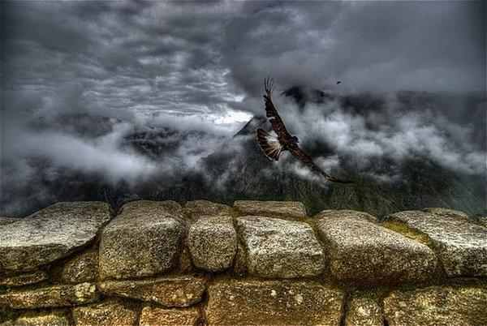

Slide 123


Mountain Tops
They are a place of great perspective
They are a place of strength and victory
Examples
  Abraham and Isaac
  Moses and the 10 commandments
  Elijah and the prophets of Baal
  Jesus and the Devil
  The Mount of Transfiguration
  A Hill Called Mount Calvary
They are temporary, most of life isn’t lived on the mountain top

Slide 124
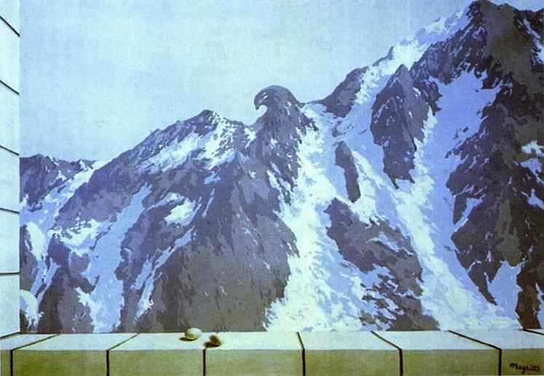

Slide 125
The Valley’s of Scripture
Valley of the shadow of death, Psalm 23:4
Valley of dry bones, Ezekiel 37:1
Valley of the castaways, Psalm 60:1
Valley of giants, Joshua 15:8, 2 Samuel 5:22
Valley of weeping, Psalm 84:6
Valley of slaughter, Jeremiah 19:6
Valley of graves, Ezekiel 39:15
Valley of trouble, Joshua 7:26
Valley of decision, Joel 3:14

Slide 126
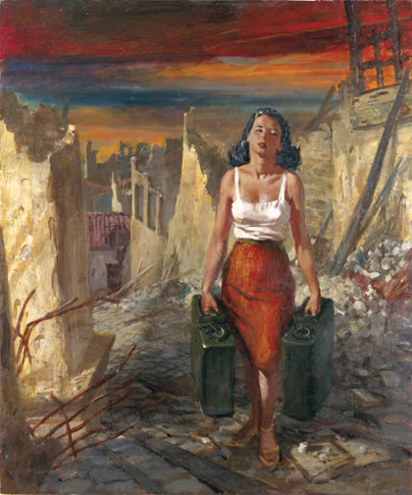

Slide 127
God’s Perspective!
(hopefully ours a well)
God tells Ahab to prepare for the battle
He assures Ahab the He is also the God of the valleys
There has never been a situation in this world or in your life and mine where God our heavenly Father is not greater
He will defend the honor of His name against any enemy that comes against you.

Slide 128
God’s Perspective!
(hopefully ours a well)
Satan has a vested interest in getting you to believe that there is a place where you will always be defeated because your God can’t help you there
God has a vested interest in your victory (He wants the world to see what He’s like thru what He does for you in your valleys)
God already sees you as having come through this valley you are in

Slide 129
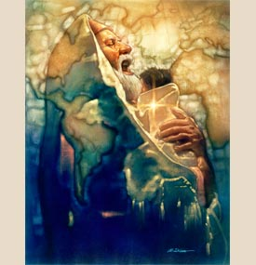

Slide 130
Living In the Valley
7 Principles

Slide 131

You Are With Me
We get overwhelmed in the valley when we believe we are all alone
The fact that He is with me means there is no enemy that can defeat me, no problem that is too difficult to solve, and no impossible situations. Do you really understand who is with you?
His promise “I will never leave you or forsake you”

Slide 132
No, in all these things we are more than conquerors through him who loved us.
For I am convinced that neither death nor life, neither angels nor demons, neither the present nor the future, nor any powers,
neither height nor depth, nor anything else in all creation, will be able to separate us from the love of God that is in Christ Jesus our Lord.

Slide 133
Your Rod And Staff Give Me Comfort
The Rod: A short heavy club-like stick that could be thrown or used as a club. A deadly weapon in the hands of a skilled shepherd.
Staff: A curved stick that was used to give guidance, support and to rescue
We have a shepherd in our valleys who can conquer any any enemy, rescue us from any situation, support us through any trial, and guide us no matter how dark and confusing the future

Slide 134
You Give Me A Prepared Table In the Presence Of My Enemies
The table speaks of nourishment that will come when the battle is at its worst
The nourishment we need for our valleys includes
  The peace that passes all understanding
  The promises that assure us that what we need he will supply
  The indwelling Holy Spirit
You will experience God as manna for your situation at a real level in your valley
  Its hard to know him as Jehovah Rapha our healer until you’ve been sick

Slide 135
You Anoint My Head With Oil
Anointing has 3 truths
  It is a confirmation of standing
  It is the balm of healing (do you have battle wounds?)
  It is a sign of empowerment (Holy Spirit)
We need to open ourselves up to let God work all things together for our good. Less try and more trust!

Slide 136
My Cup Is Full To Overflowing
When I’m running on empty I can cry: Fill my cup Lord, fill it up Lord, Come and quench this thirsting soul of mine
He supplies not only our daily needs and necessary subsistence but much more May you be able to comprehend with all saints what is the breadth & length & depth & height, that you might be filled with the fullness of God. Now to Him who is able to do exceeding abundantly above all that we ask or think, according to the power that works in us, Ephesians 3:18-20
God wants to move us beyond a life of survival to a life of abundance

Slide 137
Goodness and Mercy Will Follow Me Everyday Of My Life
The reality for children of the King is we have not been given what we deserve, His waves of mercy have flowed on a sea of goodness
It is this pattern of His goodness and mercy in my past that gives to me the calm assurance that no matter what valley I’m going through right now the goodness of God and the mercy of my Savior will be poured out on me
My tomorrow will be better than my today because my present situation is not to be confused with my final destination

Slide 138
I Will Dwell In The House Of The Lord Forever
The theme of eternity and its bliss runs throughout scripture. It’s a part of that great hope which sustains in the now
I live in time but I have been destined for eternity and it is eternity that gives me the perspective to handle today
He can be trusted for life and death
“No eye has seen, no ear has heard, and no mind has imagined what God has prepared for those who love him.” 1 Corinthians 2:9

Slide 139

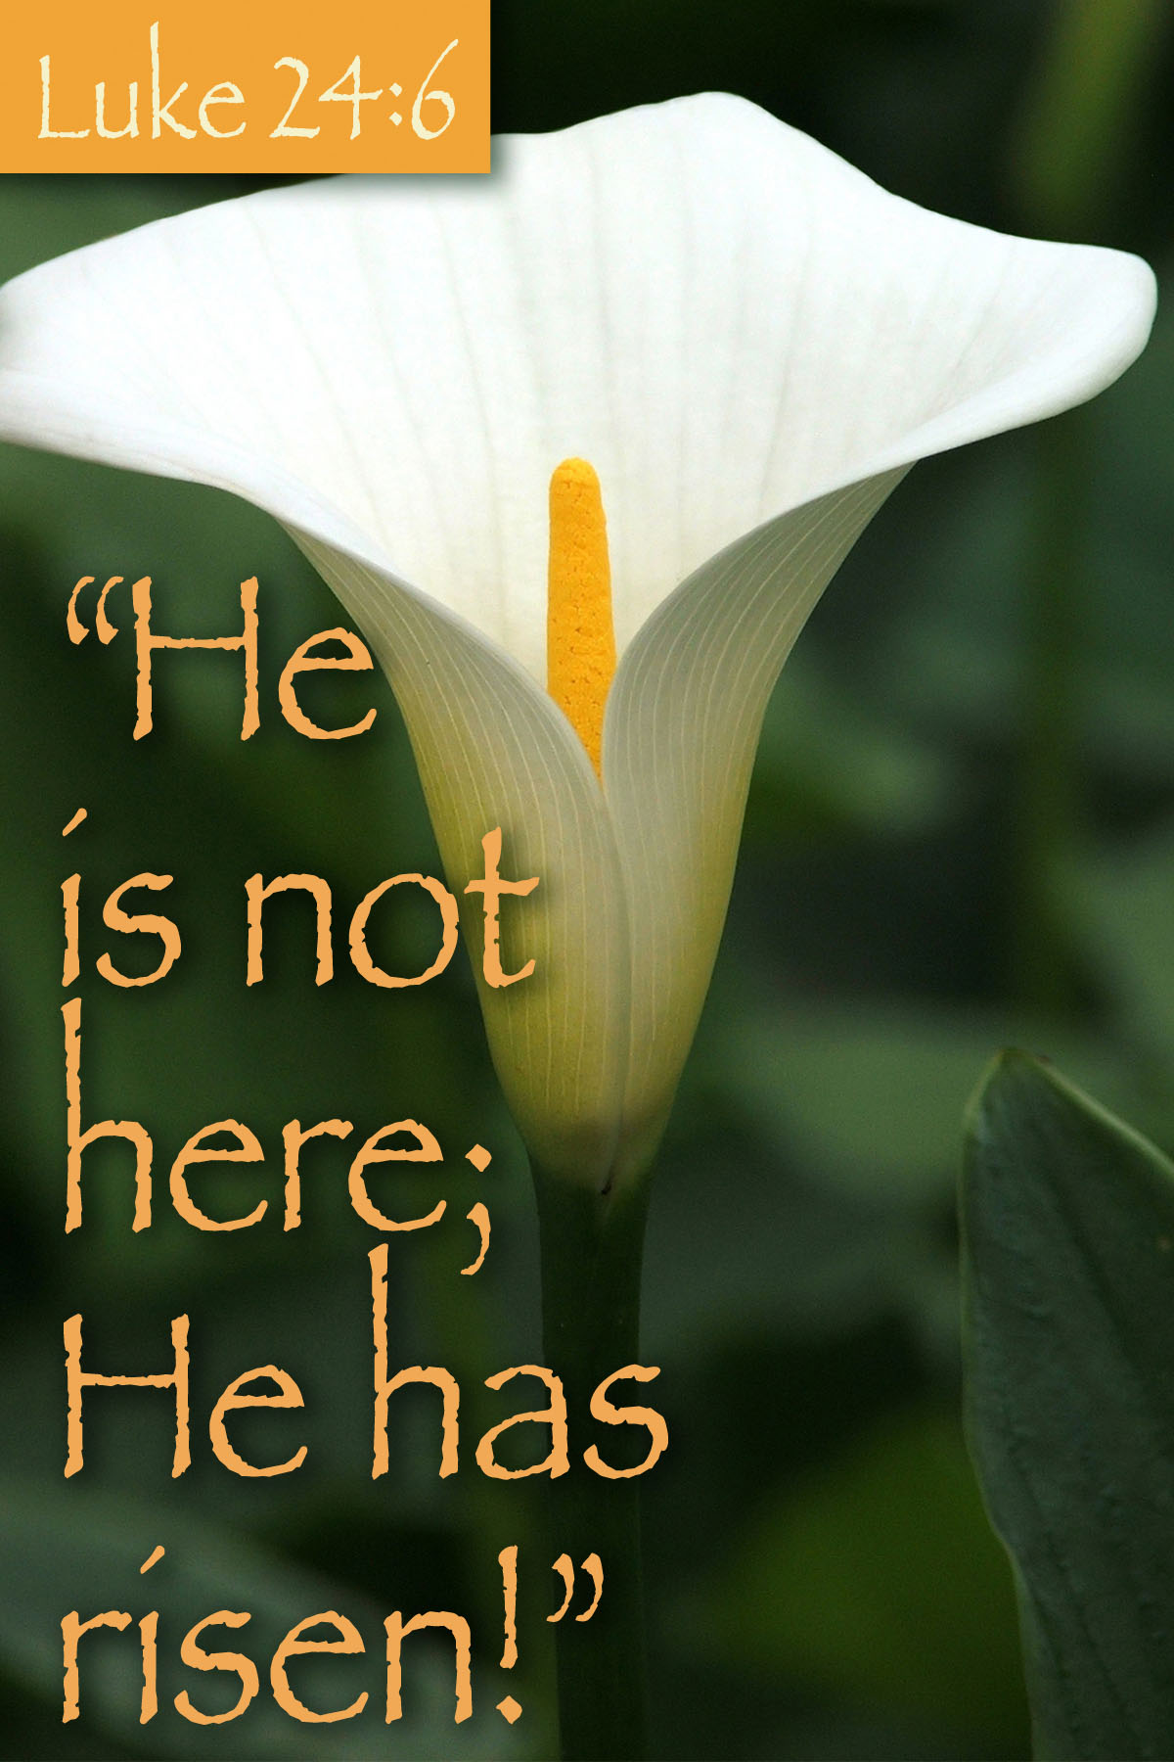
An Invitation and Promise
Whatever you are going through, you are going to go through it
The God who took to the mountain is also the God who will never leave in whatever valley you are going through
It’s hard to experience the blessings of God in your valley if you don’t have a relationship with Him. If you have never given your life to the Lord or have drifted away from Him come to Him for the first time or return by way of a radical recommitment this very day
There is a picture of Christ we can take with us as we sleep tonight. He is the Lily of the Valley

Slide 140
Thinking A Second Time
About the Familar
Psalm 23

Slide 141
Psalm 23
The LORD is my Shepherd; I shall not want.
He makes me to lie down in green pastures; He leads me beside the still waters.
He restores my soul; He leads me in paths of righteousness for His name’s sake.
Yea, though I walk through the valley of the shadow of death, I will fear no evil; for You are with me;

Slide 142
Your rod and Your staff, they comfort me.
You prepare a table for me in the presence of my enemies;
You anoint my head with oil; my cup runs over.
Surely goodness and mercy shall follow me all the days of my life; and I shall dwell in the house of the LORD forever.

Slide 143
David’s Life Experience
This is a testimony Psalm. It is written by David in a distressed state most likely in exile in the forest of Hareth (1Sam.22:5)
Life was not a bed of Roses as David penned this psalm
David was a shepherd and he knew what a good shepherd did
He was experiencing God’s goodness in one of life’s darkest moments
David has moved experientially from the Lord being “a shepherd” to knowing him as “my shepherd”

Slide 144
Several Assumptions
We are all going to face situations in our lives for which nothing in our frame of reference can prepare us
Human strength and wisdom, while helpful, will at some point in our lives be inadequate or run out
Dependency on God is not a sign of weakness but an act of worship
God delights to show himself strong on behalf of his children especially in their time of weakness and need

Slide 145
Several Assumptions
God is willing and able to help us no matter how dire our situation He’s good for our good times as well as tough times
You have never been, currently are, or will be, in a situation where you heavenly Father is not greater
We tend to think comfort, God thinks character

Slide 146
Several Assumptions
We need to build our wall of defense in our time of peace so we have resources available in our time of storm
It’s not about the big “I”. God desires that He be glorified in you and I no matter what.

Slide 147
Looking At Psalm 23
As a relational testimony
As a description of God’s character
As principles for daily living

Slide 148
Understanding the Text
hwhy yeh-ho-vaw,Jehovah, and her ra`ah raw-aw from the root Rohe Shepherd
There is no is in the original Hebrew.
It is a combination name; Jehovah-Shepherd
In the possessive it is Jehovah, my shepherd
It is to be seen and experienced relationally rather than didactically
David knew that because Jehovah, my shepherd was with him he had everything he needed

Slide 149
Looking At the Shepherd’s Psalm Relationally
Jehovah My Shepherd
When I have needs that are unmet…
When I need nourishment for my dry parched soul…
When trials and temptations seem more than I can bear…
When I have been beat up and hammered by life’s vicissitudes…
Jehovah My Shepherd
Jehovah My Shepherd
Jehovah My Shepherd

Slide 150
Looking At the Shepherd’s Psalm Relationally
Jehovah My Shepherd
When I am down, who lifts me up
When I am really hurting who understands and feels my pain
When I am troubled, who can give me peace
Jehovah My Shepherd
Jehovah My Shepherd

Slide 151
Looking At the Shepherd’s Psalm Relationally
Jehovah My Shepherd
When I face the scariest of circumstances…
When the enemies come in like a flood…
When this life is over and I die…
Jehovah My Shepherd
Jehovah My Shepherd

Slide 152
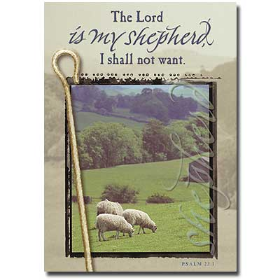
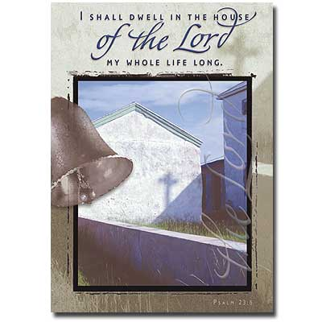
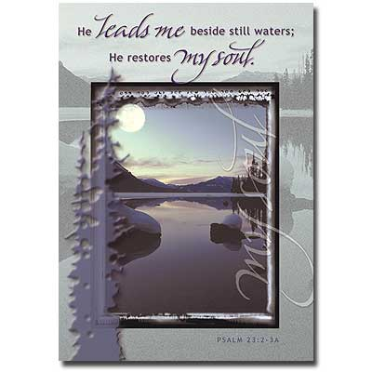
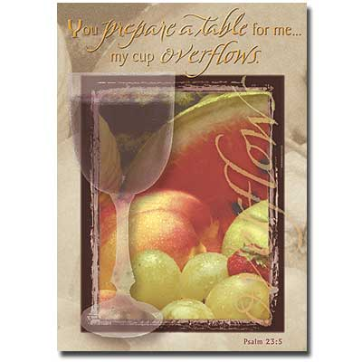
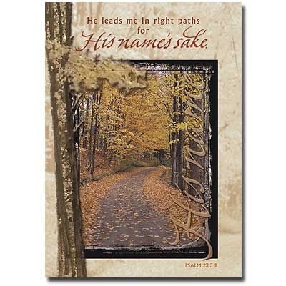

Slide 153
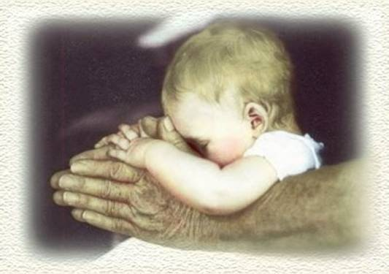

Slide 154
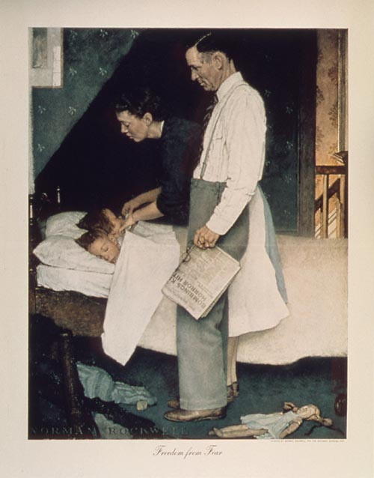

Slide 155
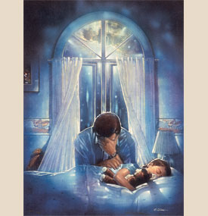

Slide 156

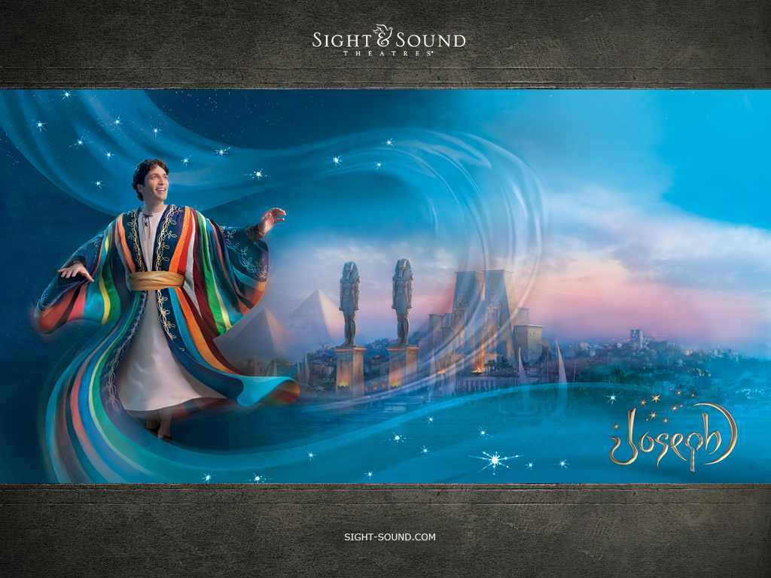
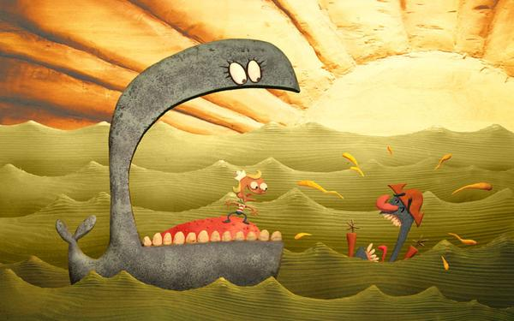
Providence & Prayer Intersect: Mergence Horizontal & Vertical
Three Wills Of Deity
Decreeative Will, or God As Sovereign.
Preceptive Will, or God’s Will That We React In A Certain Way Although We Are Free To Chose.
3) Dispositional Will, or That Which Pleases God.
.
God W/ Free-Will Man
1) God’s Intentional Will –
Would Be What God Prefers That Would Happen.
2) His Circumstantial Will -Would Be What God Does Due To The Circumstances Evolving He Did Not Intend.
Ultimate Will Of God –What God Can Achieve In Human Circumstances Due To Man’s Sinful Rebellion;
God Can Transform Simple
Evils Into Complex Goods!

Slide 157
Psalm 23 Revised
The clock is my dictator, I shall not rest.
It makes me lie down only when exhausted.
It leads me into great depression, it hounds my soul.
It lead me in circles of frenzy, for activity sake.
Even though I run frantically from task to task, I’ll never get it all done.
For “my ideal” is with me; deadlines and need for approval, they drive me.

Slide 158
Psalm 23 Revised
They demand performance from me beyond the limits of my schedule.
They anoint my head with migraines, my in-basket overflows.
Surely fatigue and time pressure shall follow me all the days of my life.
And I will dwell in the bonds of frustration forever.

Slide 159
God’s Purpose for Stress

Slide 160
Haggai 1:5-7
“Give careful thought to your way. You have planted much, but harvested little. You eat, but never have enough. You drink, but never have your fill. You put on clothes, but are not warm. You earn wages, only to put them in a purse with holes in it.”

Slide 161
God and Stress
To get our attention.
To help refine our priorities.
To draw us to Himself.
To discipline us.
To strengthen our faith.

Slide 162
Psalm 46:
A Psalm for the Stressed

Slide 163
Psalm 46
Born in the context of severe stress.
Is a balm for the stress-ridden.
Was the context for Martin Luther’s famous hymn: “A Mighty Fortress is Our God.”

Slide 164
Psalm 46
Theme is the first verse.
God is our help in trouble.
“Trouble” - restricted, narrow place.
Between a rock and a hard place.
God is your refuge and strength.

Slide 165
Psalm 46
Upheaval in nature (vs 1-3)
    I will not fear
Civil unrest (vs 4-7)
    I will not fall
Post-battle fatigue (vs 8-11)
    I will be still

Slide 166
Psalm 46:1-3
“God is our refuge and strength, A very present help in trouble. Therefore we will not fear, though the earth should change. And though the mountains slip into the heart of the sea; Though its waters roar & foam, Though the mountains quake at its swelling pride.”

Slide 167
Conquering fear (1-3)
Earthquakes, fires, tornadoes.
Isaiah 41:10 - Do not fear, for I am with you, Do not anxiously look around you for I am your God.”
Joshua 1:9 - “Be strong and courageous.”
Psalm 21:1 - “The Lord is my light and salvation; Whom shall I fear? The Lord is the defense of my life; Whom shall I dread.”

Slide 168
Psalm 46:4-7
“There is a river whose streams make glad the city of God, The holy dwelling places of the Most High. God is in the midst of her, she will not be moved; God will help her when morning dawns. The nations made an uproar, the kingdoms tottered; He raised His voice, the earth melted. The LORD of hosts is with us; The God of Jacob is our stronghold.”

Slide 169
Standing fast (4-7)
Hebrew word “moved” means “to totter and shake.”
Football term - shaken up on the play.
Holy Place was safe, but even it fell to Babylon.
God is a stronghold and a fortress.

Slide 170
Psalm 46:8-11
“Come, behold the works of the LORD, Who has wrought desolations in the earth. He makes wars to cease to the end of the earth; He breaks the bow & cuts the spear in two; He burns the chariots with fire. Cease striving & know that I am God; I will be exalted among the nations, I will be exalted in the earth. The LORD of hosts is with us; The God of Jacob is our stronghold.”

Slide 171
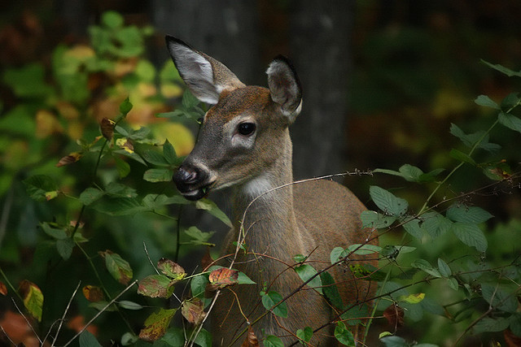
God’s Purpose for Stress

Slide 172
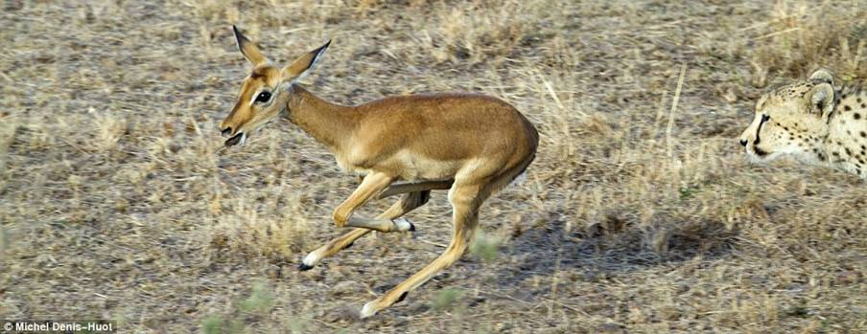

Slide 173
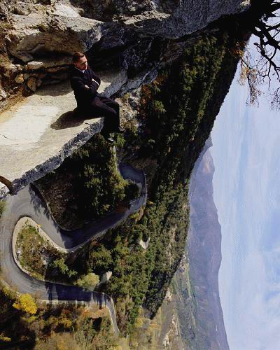
Jesus’ prayer @John 17: 14

Slide 174
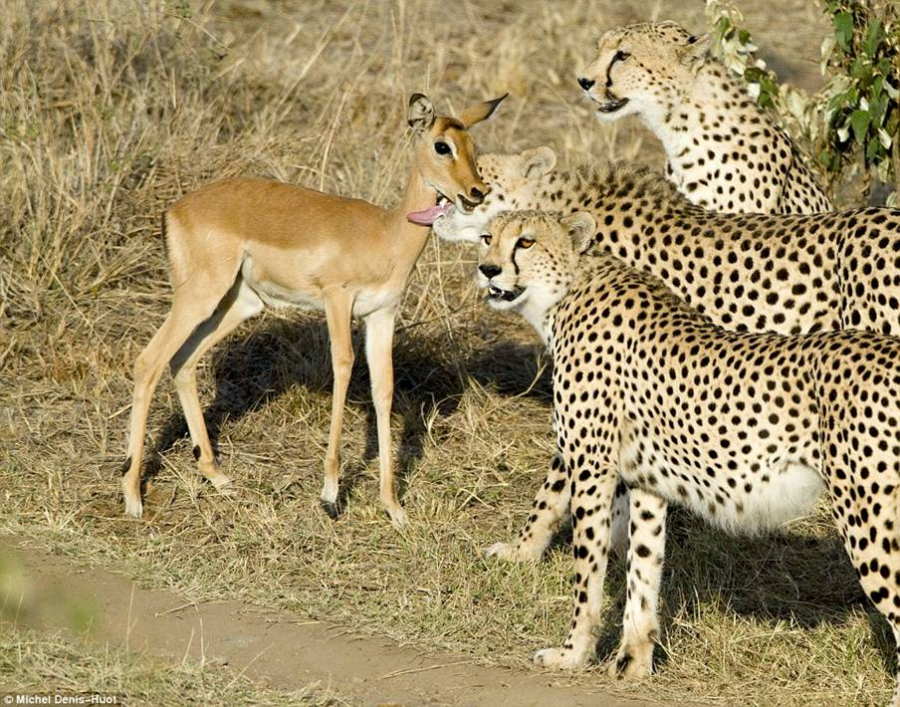

Slide 175
WEANING FROM THIS WORLD

Slide 176

“It’s in the Valleys I Grow”
Remake by Brenda
Music: Walking in Sunshine by Roger Miller

Slide 177
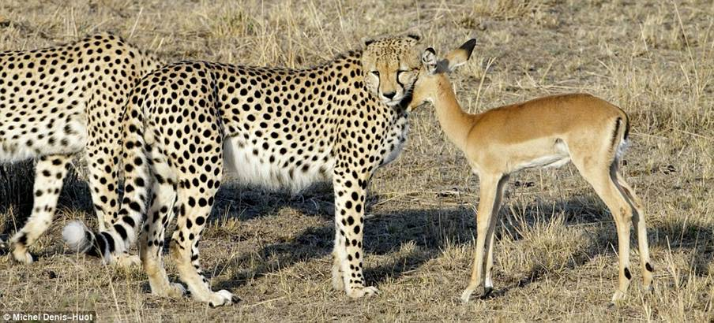

Slide 178
“It’s in the Valleys I Grow”
Sometimes life seems hard to bear,
Full of sorrow, trouble and woe.
It’s then I have to remember,
That it’s in the valley I grow.
If I always stayed on the mountain top
And never experienced pain,
I would never appreciate God’s love,
And would be living in vain.

Slide 179
“It’s in the Valleys I Grow”
I have so much to learn,
And my growth is very slow.
Sometimes I need the mountain tops,
But it’s in the valley I grow.
I do not always understand
Why things happen as they do,
But I am very sure of one thing:
My Lord will see me through.

Slide 180
“It’s in the Valleys I Grow”
My little valleys are nothing,
When I picture Christ on the cross.
He went through the valley of death;
His victory was Satan’s loss.
Forgive me Lord, for complaining,
When I’m feeling so very low.
Just give me a gentle reminder,
That’s it’s in the valley I grow.

Slide 181
“It’s in the Valleys I Grow”
Continue to strengthen me, Lord,
And use my life each day
To share they love with others
And help them find their way.
We thank thee for the valleys, Lord,
For this one thing I know:
The mountain tops are glorious,
But it’s in the valleys I grow!!

Slide 182
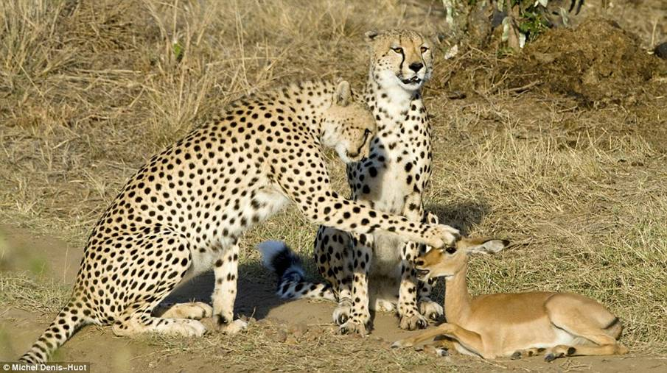

Slide 183
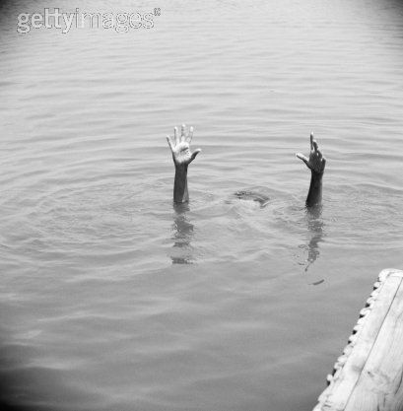
Really!
The Best Also Is Yet To Come

Slide 184
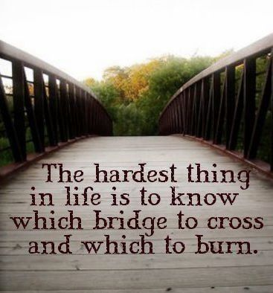

Slide 185
Isaiah 43:18-21
“Forget the former things; do not dwell on the past.
See, I am doing a new thing! Now it springs up; do you not perceive it? I am making a way in the desert and streams in the wasteland.
The wild animals honor me, the jackals and the owls, because I provide water in the desert and streams in the wasteland, to give drink to my people, my chosen,
the people who I formed for myself that they may proclaim my praise.

Slide 186
The Context
Israel had been in both moral and spiritual decline for years
Their lifestyle was almost indistinguishable from their heathen contemporaries
Their worship (temple) attendance was in decline and it had become form without function, style with out substance

Slide 187
The Context
They had remembered what they were supposed to forget and forgot those things which they should have remembered
They had lost their sense of “why”. It’s was not about the me individually or the we corporately

Slide 188
Realities
(for them and us)
They and us are God’s chosen people
God does not deal with us based on our past but our potential
Our worthiness to receive blessings is not the issue, we never are worthy. All the worthiness we have is imputed. We are blessed because we are loved not because we are worthy

Slide 189
Realities
(for them and us)
God can always do more than our resources or experience would predict. He doesn’t have our limitations
Our past performance is past. God deals with us based on the plans He has for us and the destiny He has in store for us
The text is clear “our best days are still to come”

Slide 190
The Exhortation
Do not remember the former things and do not consider the things of old. Don’t turn them into an idol
When things are not as they used to be our tendency is to:
  Idealize the past and see its propagation or recreation as the best plan for the future
  To live life looking in the rear view mirror
  To focus on all our problems and forget all the promises

Slide 191
Where are your best days?
Past
Present
Future
Your
Heavenly Father
Experience
Resources
In What Or Who Are you Placing Your Trust?

Slide 192
Why Focus On The Promises Of God
God is creative. It’s His nature to give new mercies, new ideas, new hope “morning by morning new mercies I see”
God has a plan. Failing to change is saying that God is finished with us, that we’ve arrived, that His plan for us, in us, and through us is complete

Slide 193
Why Focus On The Promises Of God
The past is not all God wants to do for us. God sees potential “something good is about to happen something good is on its way”
When we lose site of His promises we live with complacency and get so wrapped up in ourselves that God has difficulty working in us
God wants to stretch us and change us and He knows its good for us

Slide 194
Why Focus On The Promises Of God
Growth and development in the kingdom of God is natural. Decline and decay is abnormal
Staying where we are, and doing what we’ve always done empties the gospel of its power “By your traditions you make of no effect the word of God”
Although the world has changed God already knew it was going to happen and already knows what we need to do about it. God isn’t caught by surprise, ever!

Slide 195
Begging the Question
What about the past, do we just forget it and move on?
This text and others urge us to “remember not the former things” “forgetting those things which are behind
The key word here is “things”

Slide 196
Understanding Things
Hebrew:”ree-shone” (185 times)
  former (of time) (Our former when)
  Ancestors (our former who)
  former things, way of doing (our former how)
  foremost (of location) (Our former where)
Greek
  “opiso” (36 Times) back, behind, after, former
  of place: things that are behind
  of time
If we are clear on what it is we are to forget it will help us clarify what we are to remember

Slide 197
The Promise
God has a plan for us and He is sure it will happen; “For I know the plans I have for you,” says the LORD. “They are plans for good and not for disaster, to give you a future and a hope.” Jeremiah 29:11
God’s perspective on us is based on what He sees in us not on what we presently are or believe we are
The best days for all of us are still to come

Slide 198
The Ultimate Victory of God

Slide 199
How Long, O Lord?
Faith means waiting on the Lord’s timing for his ultimate victory.

Slide 200
Romans 8:18-27

Slide 201
The “Not Yet” Revealed
The resurrection of Jesus tells us what the future will be and assures us of the victory of God over fallenness.

Slide 202
Back to the Future
The resurrection of Jesus is an act of God which comes from the future.
The resurrection of Jesus is the final event of history.
We have a preview of the end.

Slide 203
His Resurrection is Ours
“But Christ has indeed been raised from the dead, the firstfruits of those who have fallen asleep. For since death came through a man, the resurrection of the dead comes also through a man. For as in Adam all die, so in Christ all will be made alive. But each in his own turn: Christ, the firstfruits; then, when he comes, those who belong to him.”
1 Corinthians 15:20-23

Slide 204
Our Resurrection Body
1 Corinthians 15:42-49

Slide 205
To Be Like Christ
“But our citizenship is in heaven. And we eagerly await a Savior from there, the Lord Jesus Christ, who,by the power that enables him to bring everything under his control, will transform our lowly bodies so that they will be like his glorious body.”
Philippians 3:20-21

Slide 206
The Spirit At Work On Us Now
“And we, who with unveiled faces all reflect the Lord’s glory, are being transformed into his likeness with ever-increasing glory, which comes from the Lord, who is the Spirit.”
2 Corinthians 3:18

Slide 207
The Connection
“And if the Spirit of him who raised Jesus from the dead is living in you, he who raised Christ from the dead will also give life to your mortal bodies through his Spirit, who lives in you.”
Romans 8:11

Slide 208
Already Waiting for Glory
“…we ourselves, who have the firstfruits of the Spirit, groan inwardly as we wait eagerly for our adoption as sons, the redemption of our bodies….we wait for it patiently.” Romans 8:23, 25.
Also: 1 Cor. 1:7; Gal. 5:5; Phil. 3:20; Titus 2:13

Slide 209
Hoping and Waiting
“And we rejoice in the hope of the glory of God. Not only so, but we also rejoice in our sufferings, because we know that suffering produces perseverance; perseverance, character; and character, hope. And hope does not disappoint us, because God has poured out his love into our hearts by the Holy Spirit, whom he has given us.”
Romans 5:2b-5

Slide 210
What Do We Say to Sufferers?
God loves you and he has demonstrated this in Jesus: “Keep your eyes on the cross.”
God hears your lament and weeps with you: “Tell God all your troubles.”
God understands your suffering because he himself has suffered: “God is sitting with you on your mourning bench.”

Slide 211
What Do We Say to Sufferers?
God is at work in everything to accomplish his goal for us: “God is in control; trust him.”
God has demonstrated his victory over death in Jesus Christ: “It will not always be this way.”

Slide 212
Because….
Because God loves,
Because God listens,
Because God understands,
Because God reigns,
Because God wins,
“Cast all your anxiety on him because he cares for you.” 1 Peter 5:7

