Slide 1

The Rise & Fall Of Peoples
By David Lee Burris

Slide 2
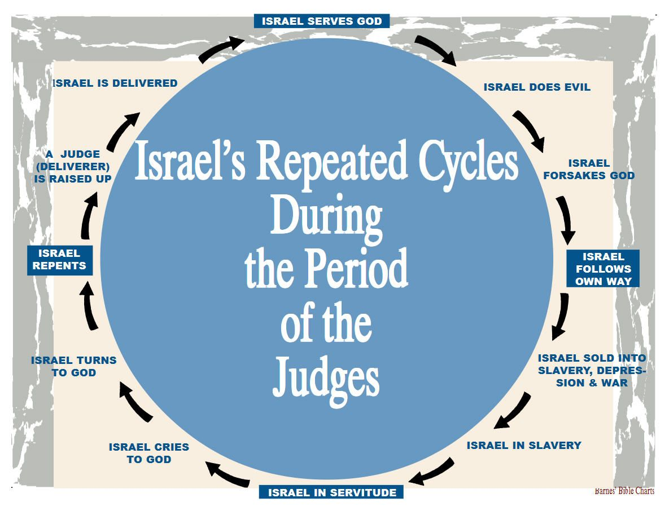

Slide 4
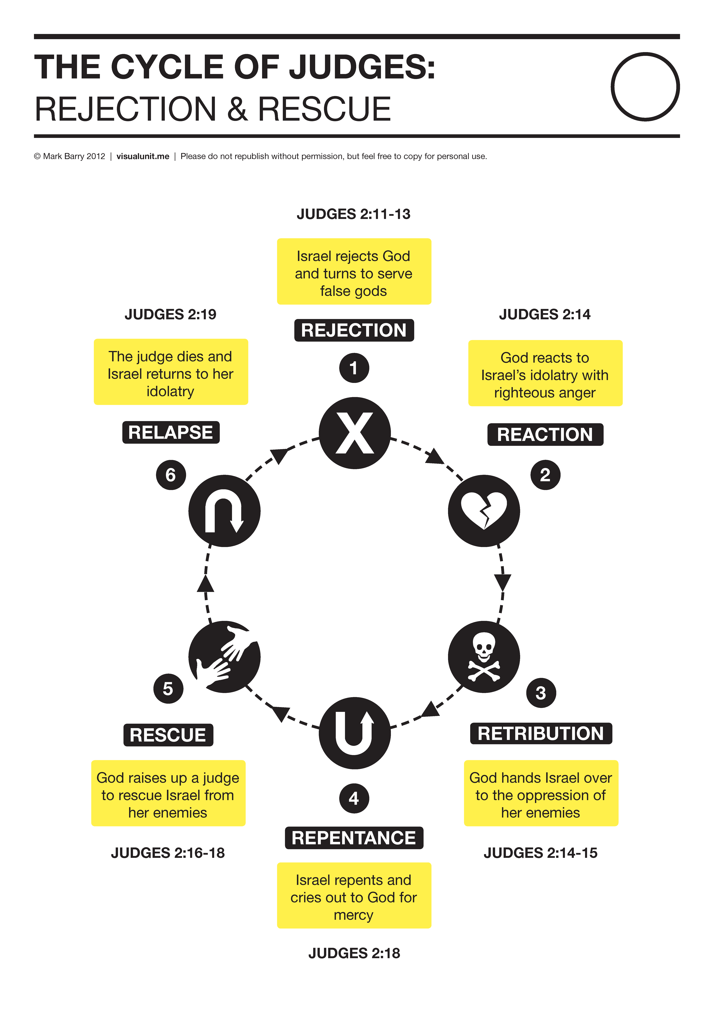

Slide 5
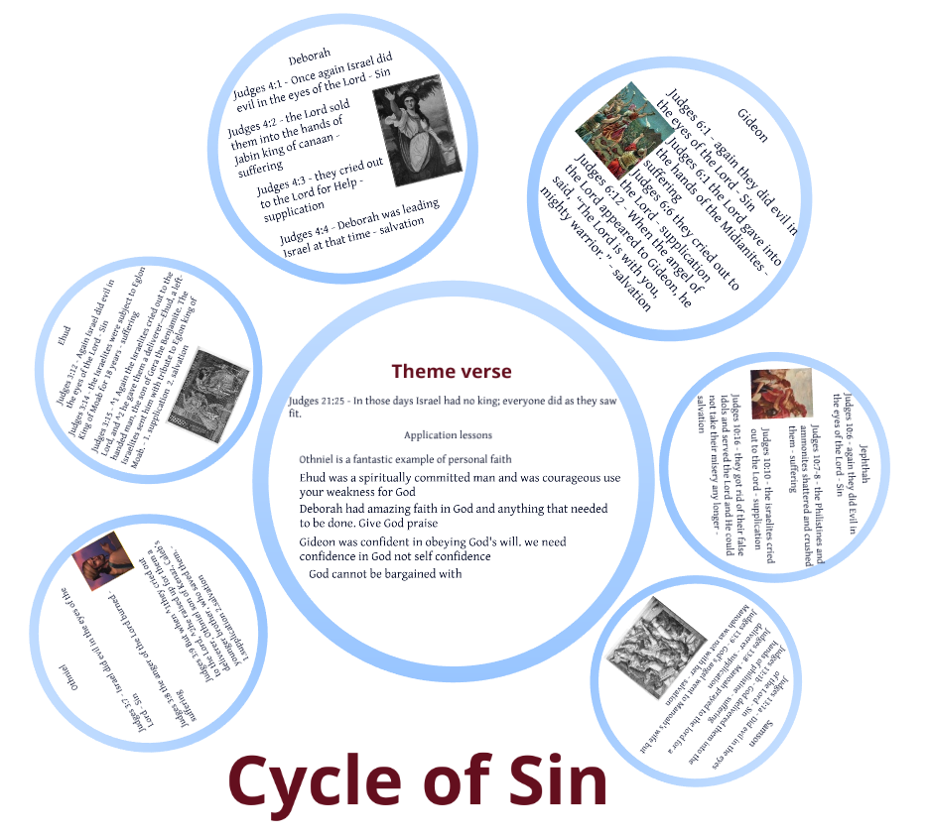

Slide 6

The real battle is internal – Danger’s within not without!

Slide 7
The Rise & Fall of Civilizations
MILITARY
ECONOMIC
SOCIAL
POLITICAL

Slide 8
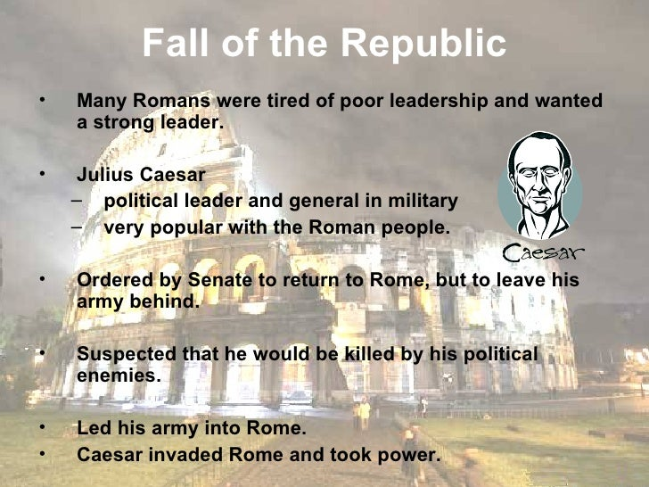

Slide 9
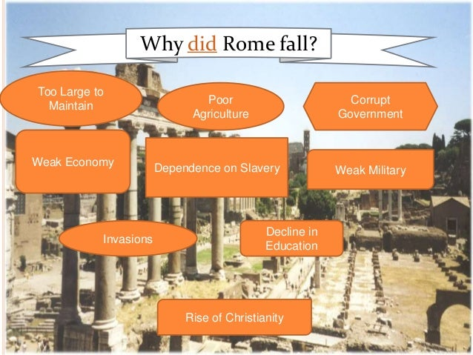

Slide 10
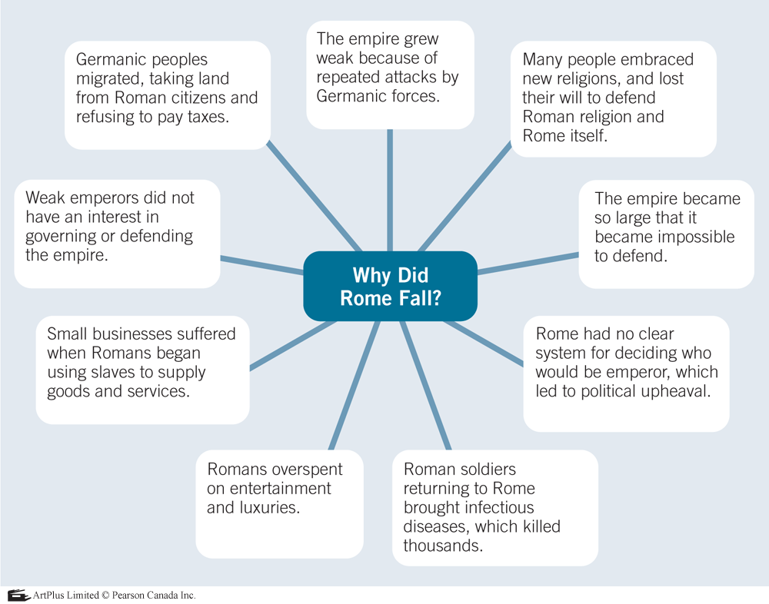

Rome Took Longer To Fall Than Some Empires Existed

Slide 11
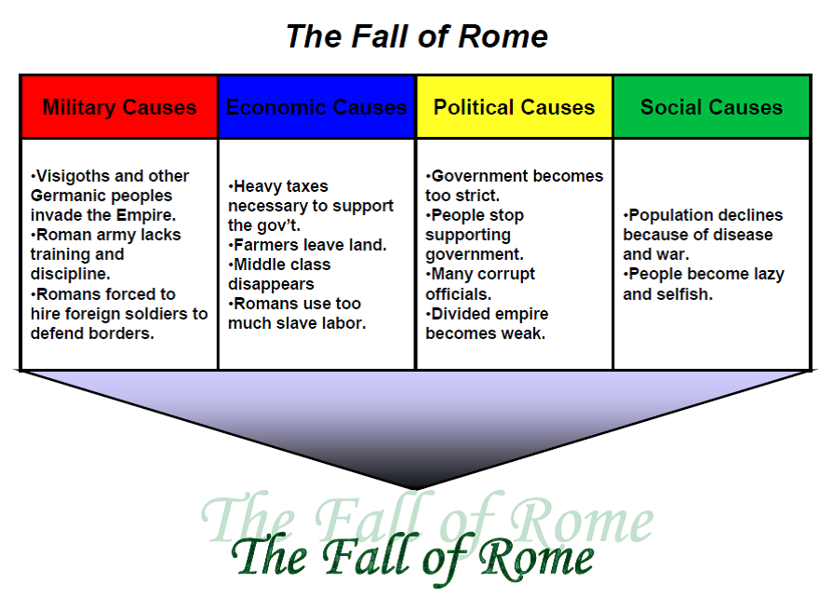
Deep Dive Into The Fall Of Rome

Slide 12
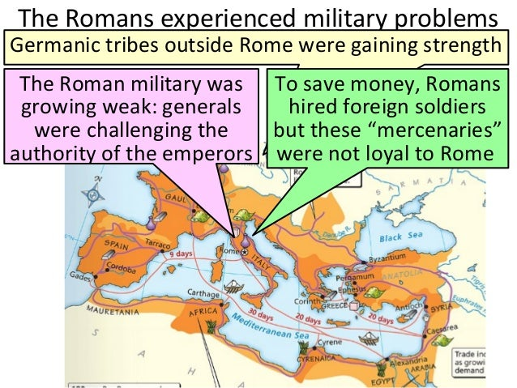

Slide 13
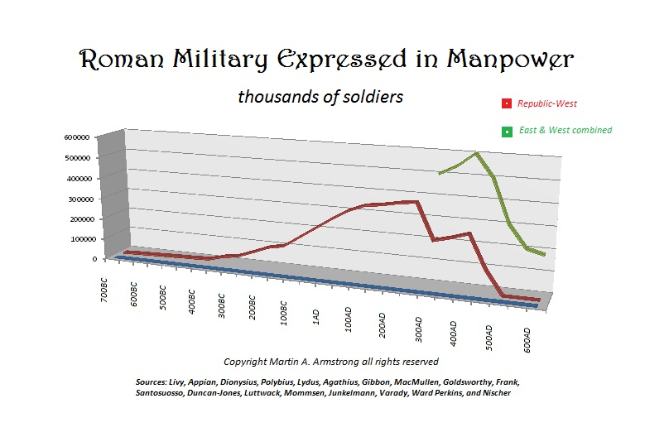

Slide 14
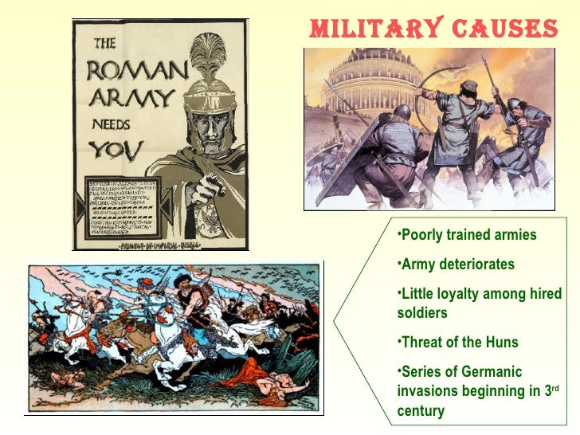

Slide 15
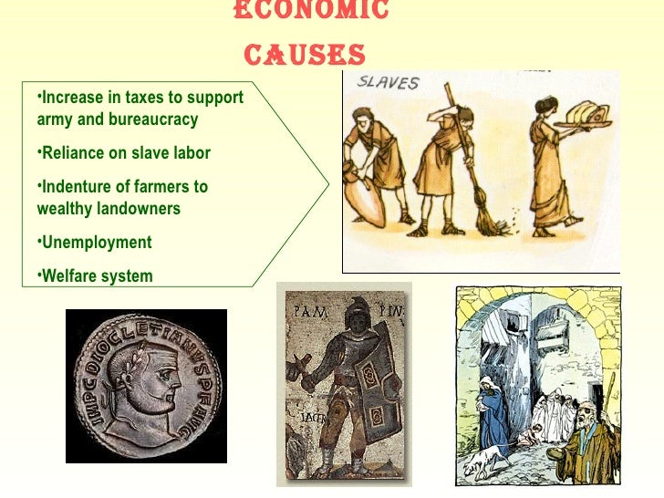

Slide 16
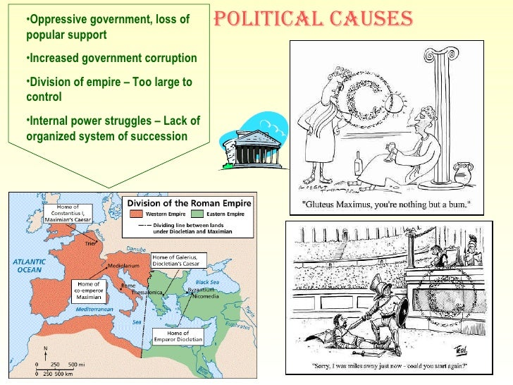

Slide 17
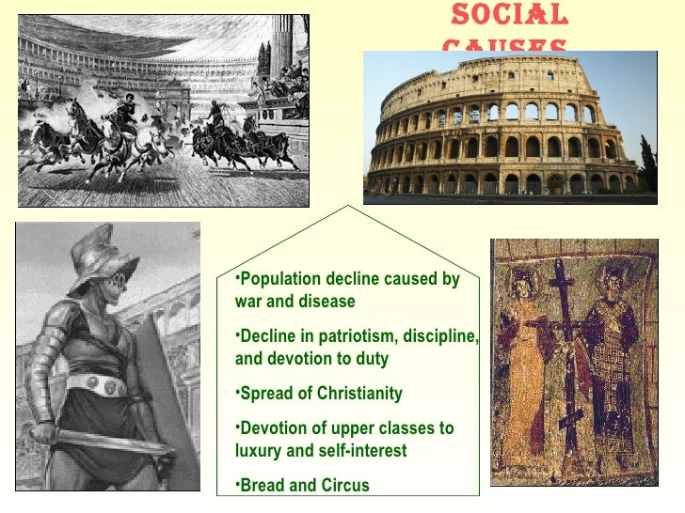

Slide 18
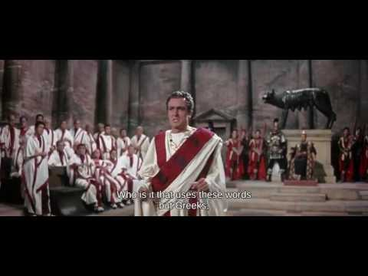
The Fall of the Roman Empire
MOVIE CLIP

Slide 20
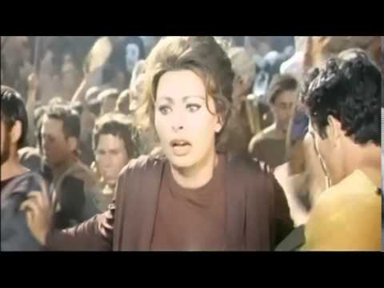
The Fall of the Roman Empire
MOVIE CLIP

Slide 21

The Fall of the Roman Empire
History Channel
Docu-Drama

Slide 23
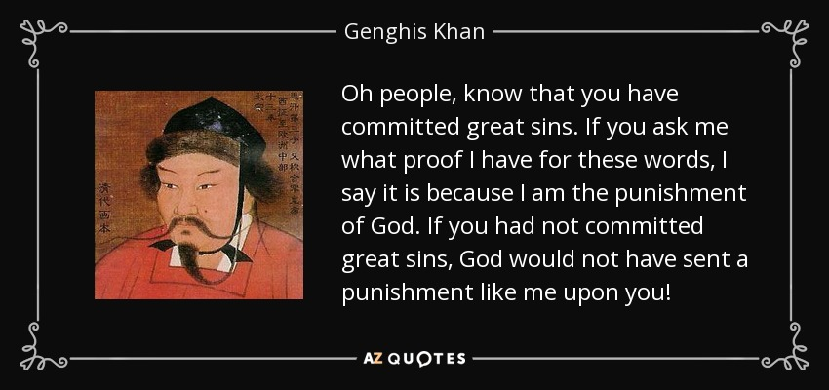

Slide 25

Collapse Of Complex Societies
You Tube Vid

Slide 26
Models of Societal Response To Societal Collapse and Civilizational Decline
According to Joseph Tainter (1990), too many scholars offer facile explanations of societal collapse by assuming one or more of the following three models in the face of collapse:
The Dinosaur, a large-scale society in which resources are being depleted at an exponential rate, but nothing is done to rectify the problem because the ruling elite are unwilling or unable to adapt to those resources' reduced availability. In this type of society, rulers tend to oppose any solutions that diverge from their present course of action but favor intensification and commit an increasing number of resources to their present plans, projects, and social institutions.
The Runaway Train, a society whose continuing function depends on constant growth (cf. Frederick Jackson Turner's Frontier Thesis). This type of society, based almost exclusively on acquisition (such as pillaging or exploitation), cannot be sustained indefinitely. The Assyrian, Roman and Mongol Empires, for example, all fractured and collapsed when no new conquests could be achieved.
The House of Cards, a society that has grown to be so large and include so many complex social institutions that it is inherently unstable and prone to collapse. This type of society has been seen with particular frequency among Eastern Bloc and other communist nations, in which all social organizations are arms of the government or ruling party, such that the government must either stifle association wholesale (encouraging dissent and subversion) or exercise less authority than it asserts (undermining its legitimacy in the public eye).

Slide 27
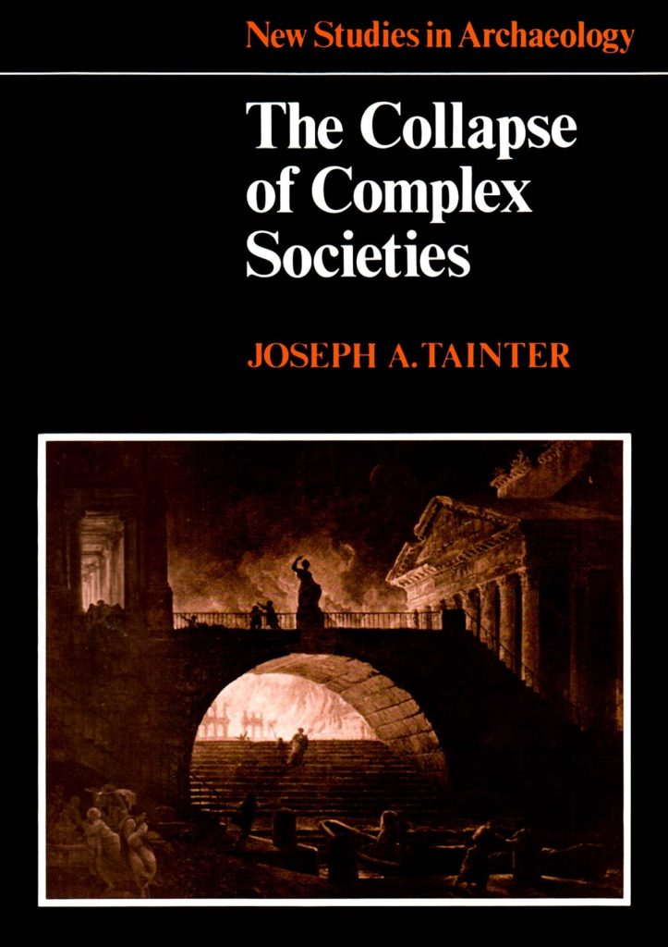
Models of Societal Response To Societal Collapse and Civilizational Decline - continued
Tainter's critique: Tainter argues that those models, though superficially useful, cannot severally or jointly account for all instances of a societal collapse. Often, they are seen as interconnected occurrences simply reinforcing one another.
Tainter considers that social complexity is a recent & comparatively-anomalous occurrence, requiring constant support. He asserts that collapse is to be best understood by grasping four axioms. In his own words (p. 194):
human societies are problem-solving organizations;
sociopolitical systems require energy for their maintenance;
increased complexity carries with it increased costs per capita;
investment in socio-political complexity as a problem-solving response reaches a point of declining marginal returns.

Slide 28


Slide 29
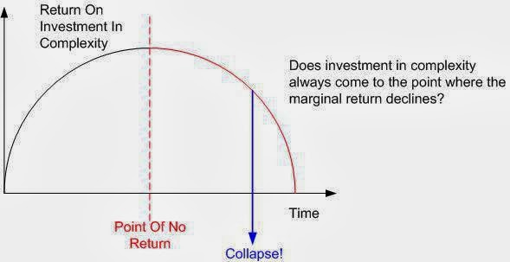

Slide 30

Howe-Strauss 4-Generation 80 Yr Turnings
You Tube Vid

Slide 31
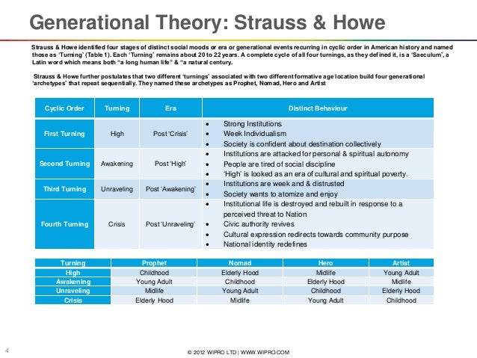

Slide 32
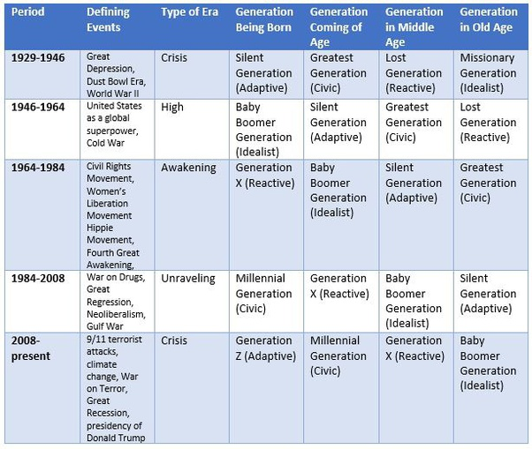

Slide 33
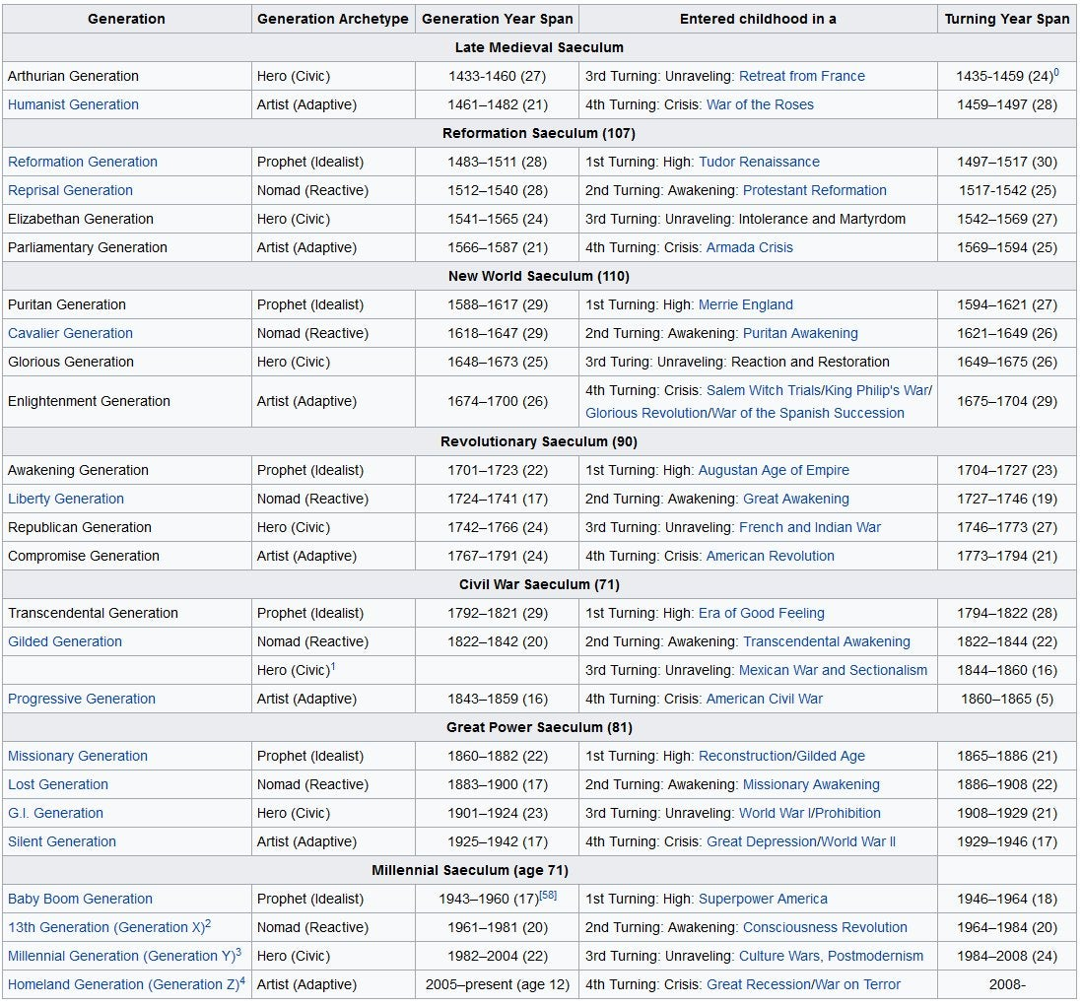

Slide 34
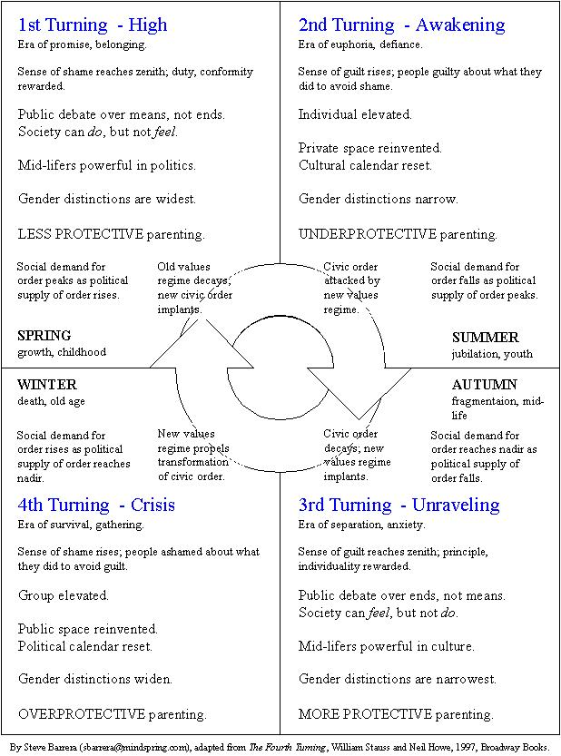

Slide 35
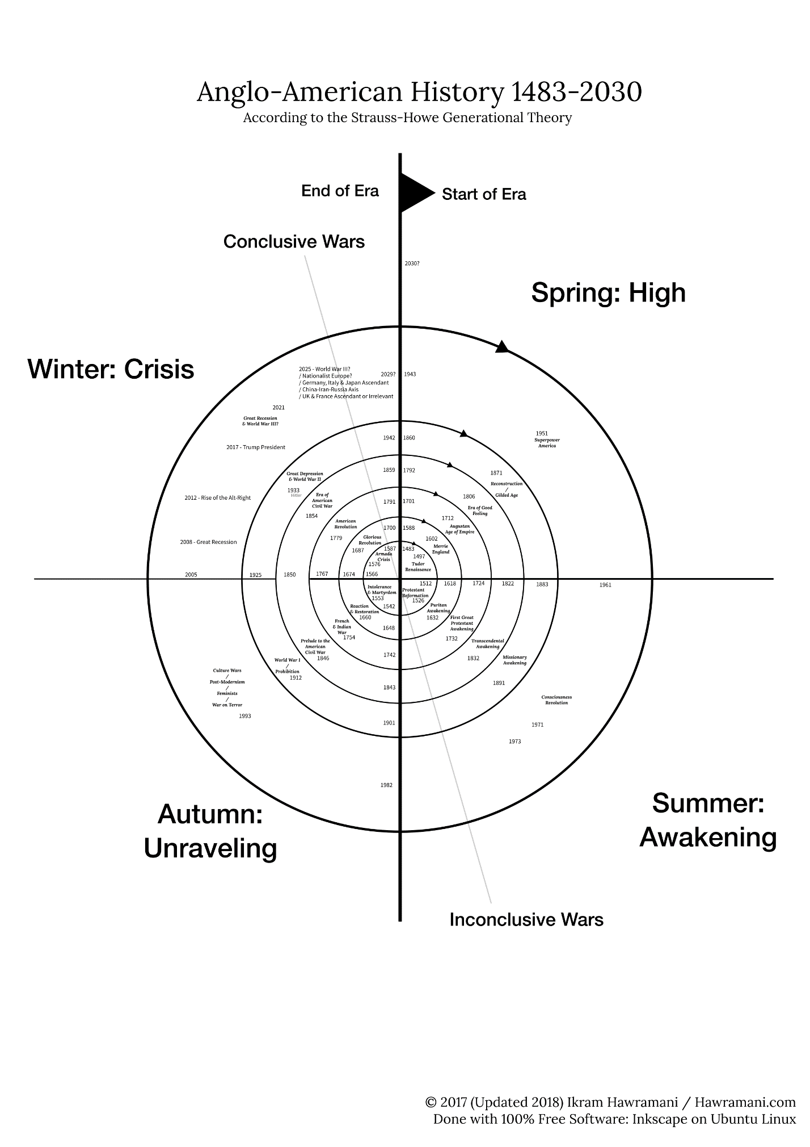

Slide 36
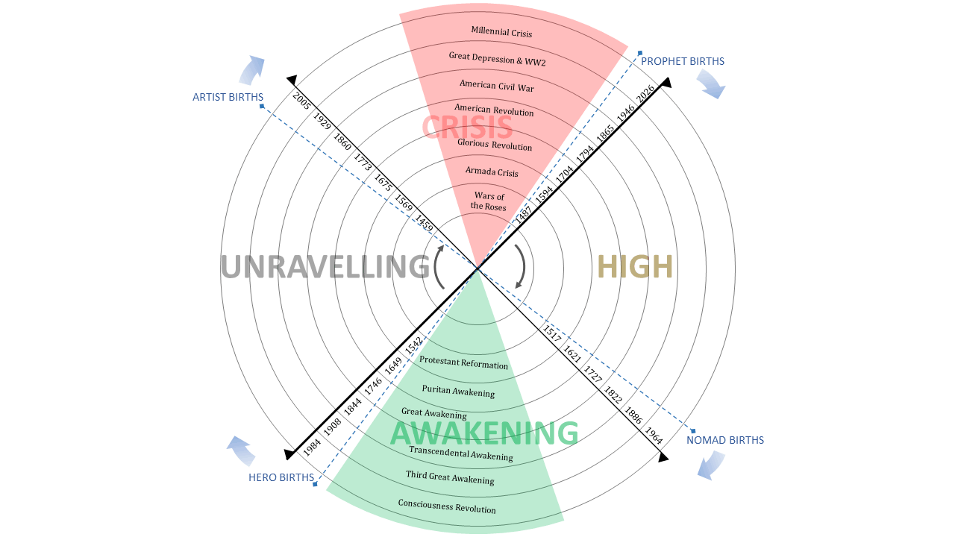

Slide 37
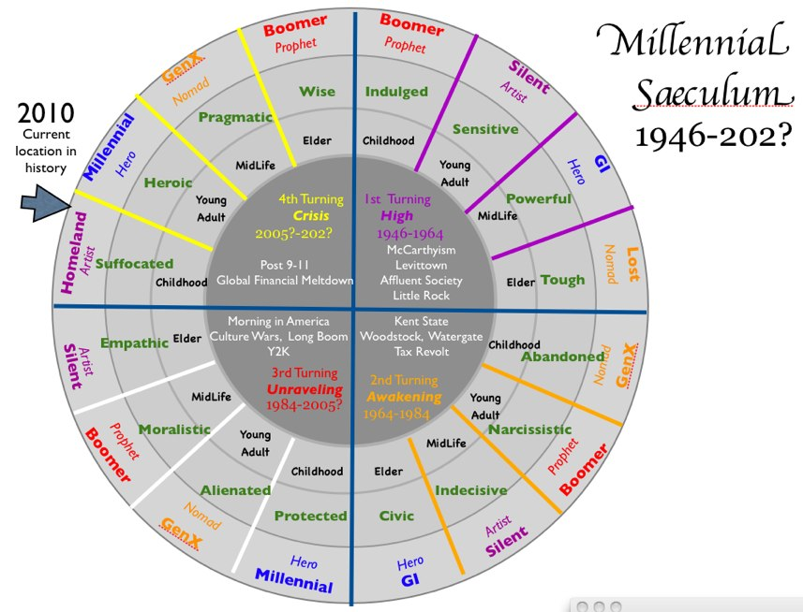

Slide 38
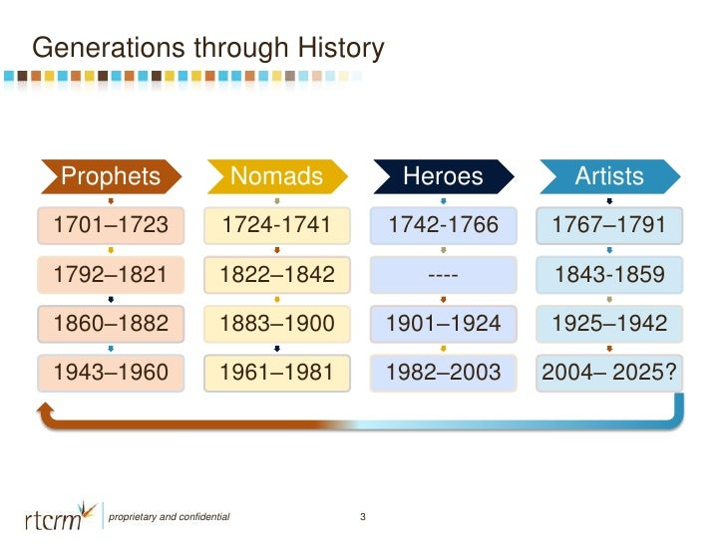

Slide 39
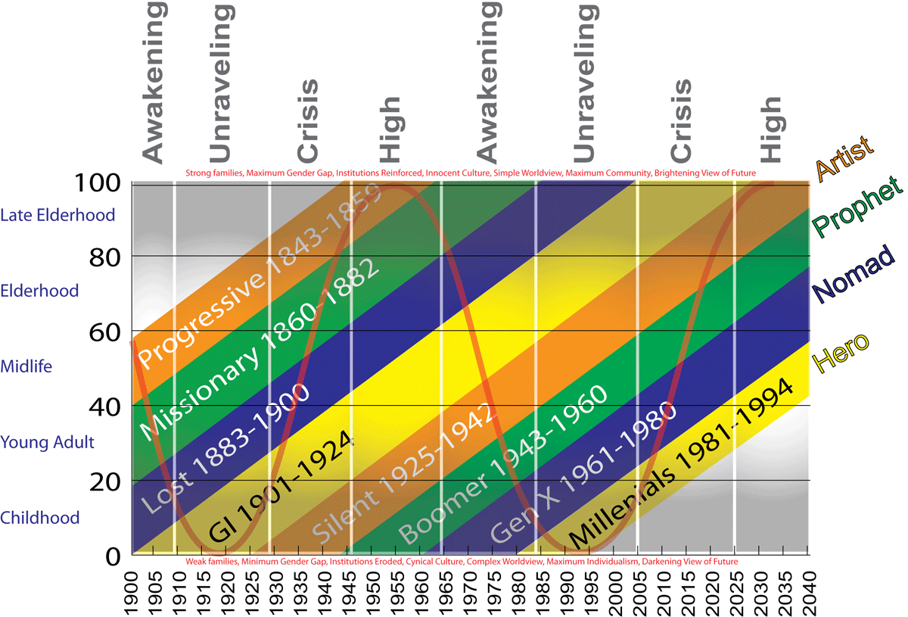

Slide 40
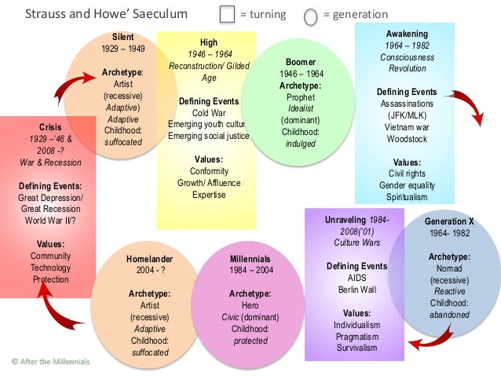

Slide 41
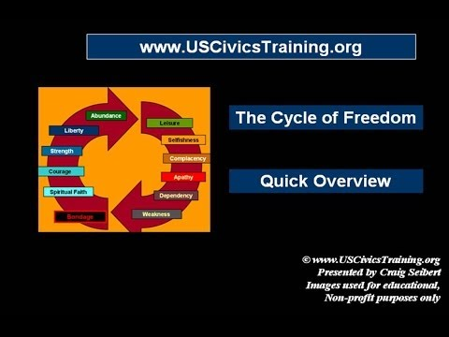
Cycle Of Republic
You Tube Vid

Slide 42
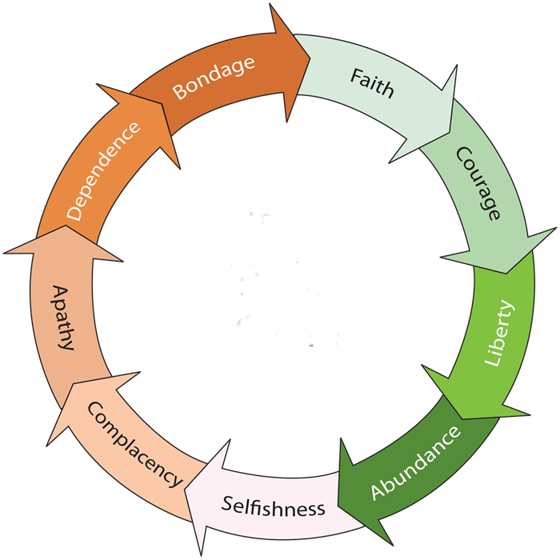
Cycle of Freedom

Slide 43
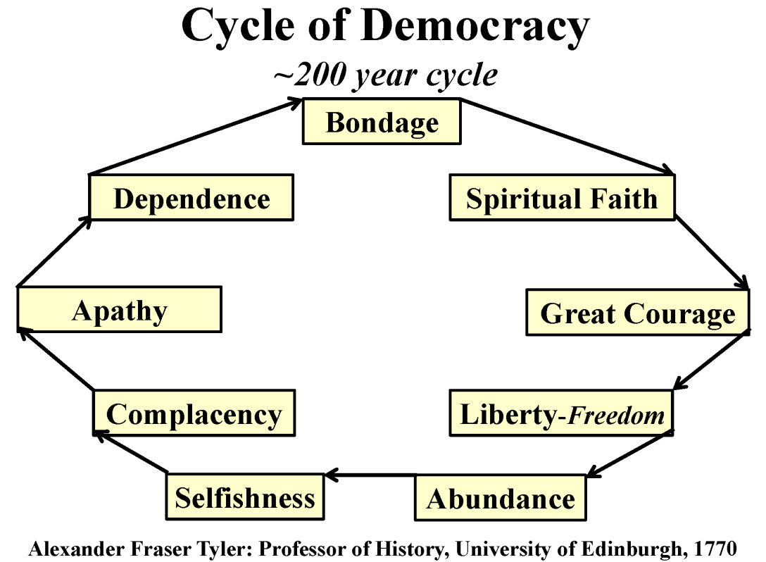

Slide 44
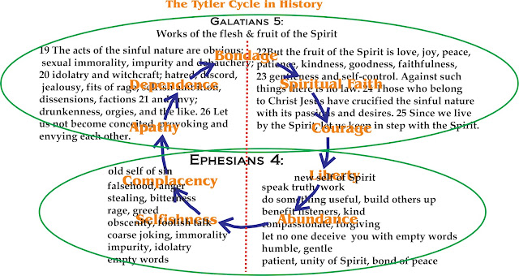

Slide 45

Theory: Civilization.Corruption.Christians
Nations rise and fall. Greatness ebbs and flows. A people at any given time may have their exalted place on the world stage, but are only too soon replaced by another. C.S. Lewis pithily noted this persistent pattern in Mere Christianity: ‘Terrific energy is expended – civilizations are built up – excellent institutions are devised; but each time something goes wrong. Some fatal flaw always brings the selfish and cruel people to the top and all sides back into misery and ruin.’

Slide 46
Theory: Civilization.Corruption.Christians
Nations rise and fall. Greatness ebbs and flows. A people at any given time may have their exalted place on the world stage, but are only too soon replaced by another.
J.D. Unwin studied some eighty societies. He examined the developmental status and energy they manifested. Was the culture growing – demonstrating what he called ‘expansive energy’ – and then, later in its history, was it improving on what it built – what he called ‘productive energy.’

Slide 47
Theory: Civilization.Corruption.Christians
Nations rise and fall. Greatness ebbs and flows. A people at any given time may have their exalted place on the world stage, but are only too soon replaced by another.
J.D. Unwin studied some eighty societies. The historical evidence showed no society displaying great energy for any appreciable period unless its absolutely monogamous.
In the negative side, however, was what happened when a people began to trans- -gress its own codes. Across the board, Unwin saw such cultures start to decline.

Slide 48
Theory: Civilization.Corruption.Christians
Nations rise and fall. Greatness ebbs and flows. A people at any given time may have their exalted place on the world stage, but are only too soon replaced by another.
Cultural writer Neil Postman in his critical book ‘Amusing Ourselves to Death’ claims that when social success is achieved in a culture the process of outward expansion can wane and the fruits are then enjoyed – energy is expended inwardly on self-gratification, and the culture becomes self-centered and weak. Individuals consider their own appetites as the highest goods. Thus it is not simply a moral dissipation that is causing decline in creative energy, but rather a luxury lifestyle of distracted dissipation.

Slide 49
Theory: Civilization.Corruption.Christians
Nations rise and fall. Greatness ebbs and flows. A people at any given time may have their exalted place on the world stage, but are only too soon replaced by another.
In his 1956 work on the Sexual Revolution Harvard’s Pitirim Sorokin examined this phenomenon as well. He concluded that ‘the greater the number of profligates, and the more debauched their behavior , the graver are the consequences for the whole society. Moreover if moral ‘anarchists compose any considerable proportion of its membership, they eventually destroy the society itself.’

Slide 50
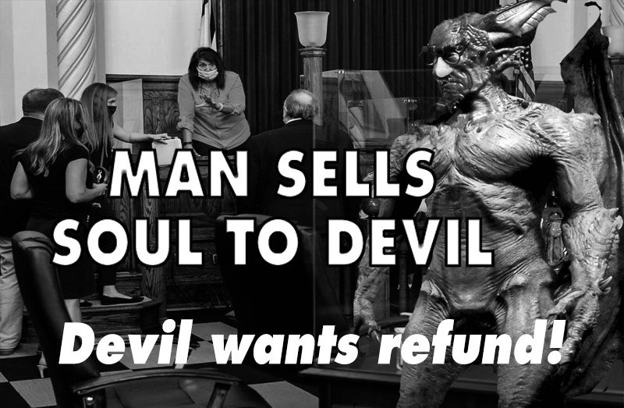

Slide 52
The real battle is internal – Danger’s within not without!

Slide 53
Theory: Civilization.Corruption.Christians
Nations rise and fall. Greatness ebbs and flows. A people at any given time may have their exalted place on the world stage, but are only too soon replaced by another.
Unwin and Sorokin both believed this process of cultural decay could be resisted and reversed. The key to success, however, seemed to lie with at least a single stratum of the decaying society that stood firmly against the tide until they were able to show their fellow citizens the way back to moral sanity. ‘Though by the law of polarization… a minor part of the population tends to become more religious, sexually continent, and morally heroic in the periods of disorders and great calamities,’ Sorokin said.

Slide 54
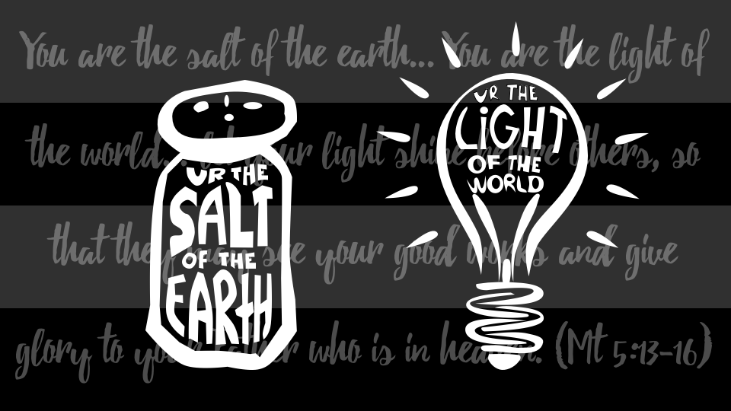

Slide 55



Time as snakewheel
Fortune as
a wheel

