Slide 1
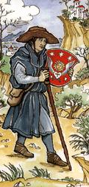
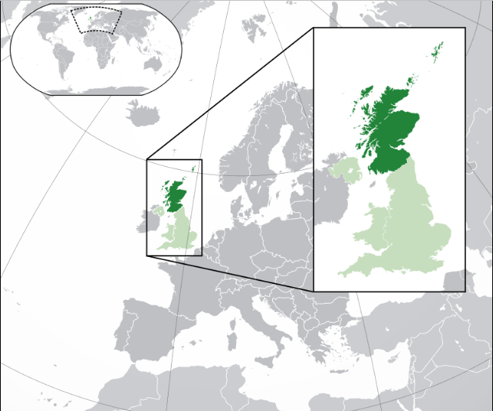
Reformation & Restoration Coming Out Of Scotland
by D.L. Burris, Editor & Contributor
Source: Wikipedia graphics

Slide 2
THERE ARE LIMITS!
Limits are needful in order to avoid an anything goes mindset; Israel serves as prime example of what we can expect in outcome when we only consider “right” what is pleasing to our own selves
In reference to issue guidance/guideline
In purpose of the unified work of mission; The closer we work together - the more in sync our common boundaries become.

Slide 3
Math Beyond Revelation 22: Multiplication & Division
Multiplying By Way Of
Accountability Toward
Multiple Hierarchies &
Governing Institutions

Slide 5
Math Beyond Revelation 22: Multiplication & Division
Dividing By Way Of
Leadership Loyalty
& Human Opinions

Slide 6
“If, like the truth, falsehood had only one face, we should know better where we go, for we should then take the opposite of what a liar said to be the truth. But the opposite of a truth has a hundred thousand shapes and a limitless field.” Michel Montaigne

Slide 7
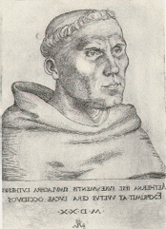
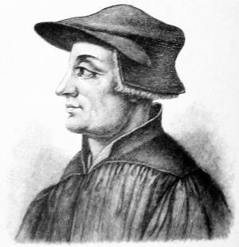
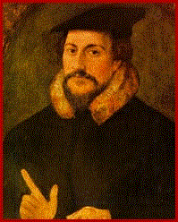
The Reformation Fathers
Martin Luther
1483-1546
German
Ulrich Zwingli
1484-1531
Swiss
John Calvin
1509-1569
French

Slide 8
GRAFTING DEADWOOD!

Slide 9
New Multiple
PROTESTANT
ORTHODOXIES

Slide 10
New Multiple
PROTESTANT
ORTHOPRAXIES

Slide 11
Multiple Branches Of One Vine?

Slide 12
YOUNG'S SECOND LAW:
It's the dead wood that
holds up the tree!

Slide 13
The Butterfly Effect Of Religious & Church History
Sensitive Dependence On Initial Conditions
Small variations in initial condition of a non-linear dynamical system may produce large variations in long term behavior of the system.
Each Iteration Amplifies The Initial Departure

Slide 14
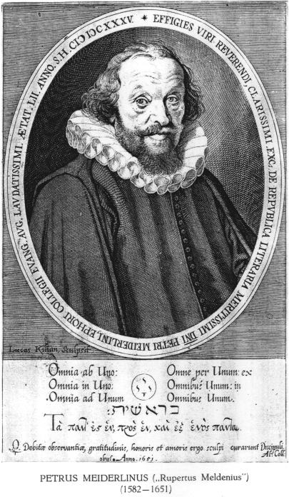
Protestants Revisit Initial Ideals
Lutheran Meiderlin’s Famous Quote:

Slide 15
Protestants Revisit Initial Ideals
“We would be in the best shape if we…

Slide 16
Protestants Revisit Initial Ideals
Kept in the essentials, Unity;

Slide 17
Protestants Revisit Initial Ideals
In the non-essentials, Liberty;

Slide 18
Protestants Revisit Initial Ideals
And in both – Charity!

Slide 19
BASIS FOR UNITY
FUNDAMENTALS
A Person
Jesus Christ
A Principle
Restoration
A Privilege
Just Christians
A Platform
One Faith
A Plan
Simply Obey
A Power
The Gospel

Slide 20
EXCLUSIVITY
“Just as there are as many ‘faiths’ or acceptable systems of belief through which a person living today can be saved as there are Gods – and there is only one: “One God and Father of all, who is above all, and through all, and in you all” (Eph. 4: 4). - just as there are as many bodies of saved people or churches as there are Gods in heaven. There is one and only one. The reason is because the same text affirms, ‘There is one body.’”
*
* Getwell Church Of Christ Bulletin 4-16-07

Slide 21
ONENESS LESSON
SCRIPTURE REFERENCE
“My Church”
Matthew 16: 18
“The Church”
Ephesians 1: 22
“One Body”
Ephesians 4: 4
“One Fold”
John 10: 16
“One Family”
1st Timothy 3: 15
“No Divisions”
1st Cor. 1: 10

Slide 22
Church Identifiers
Proof Texts
Founder/Foundation Jesus Christ
Matthew 16: 18
Member Profile Baptism Added
Acts 2: 41
Action Focus Save Souls
Phil 4: 14-18
Professed Doctrine The New Testament
Ephesians 2: 20
Organic Structure Local Congregation
Acts 14: 23
Physical Location All The Nations
Matt 28: 18-20

Slide 23
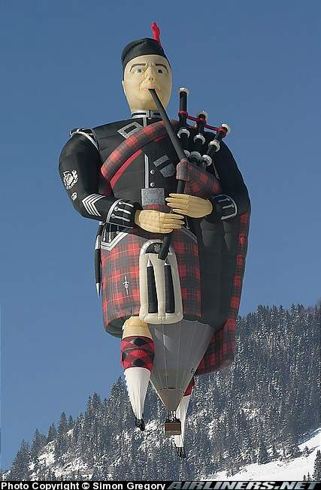

Slide 24
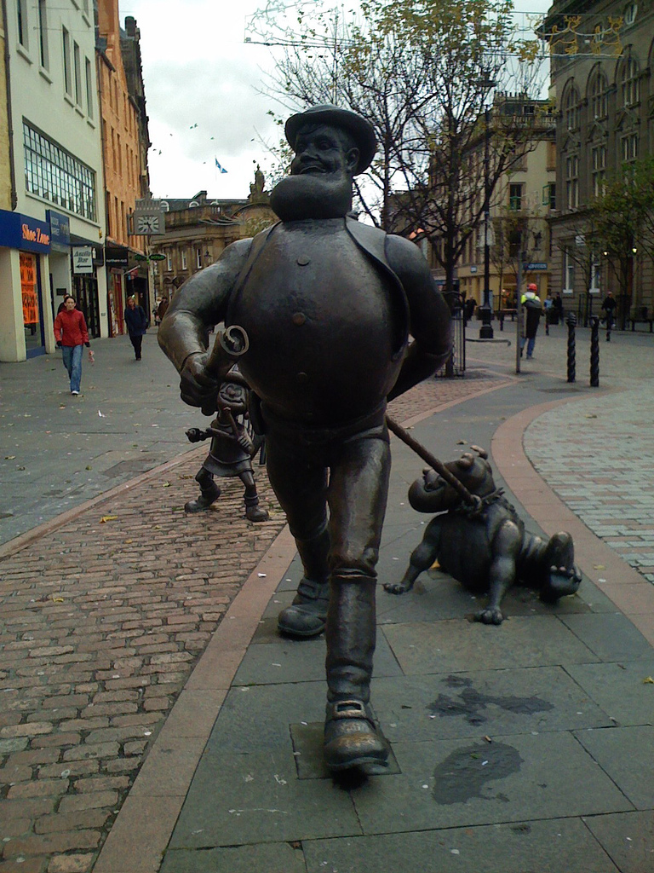
Location: Dundee, Scotland.

Slide 25
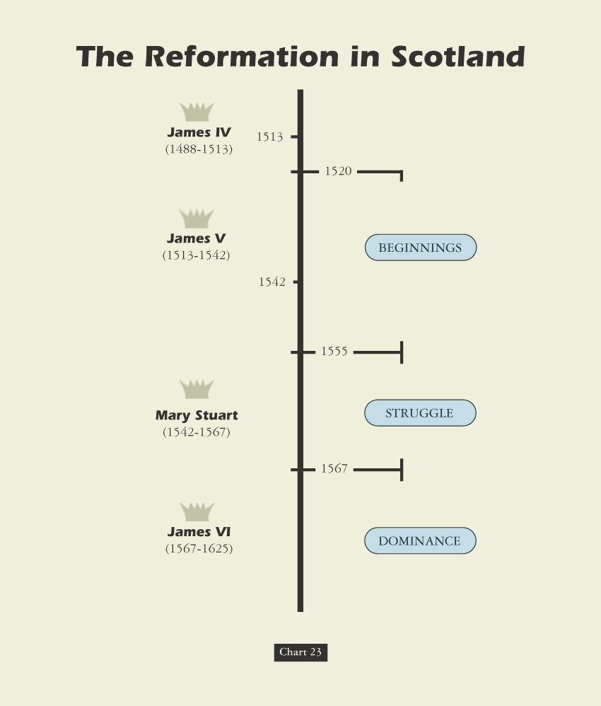

Slide 26
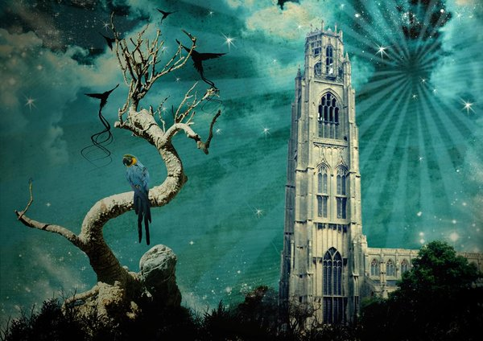

Slide 27
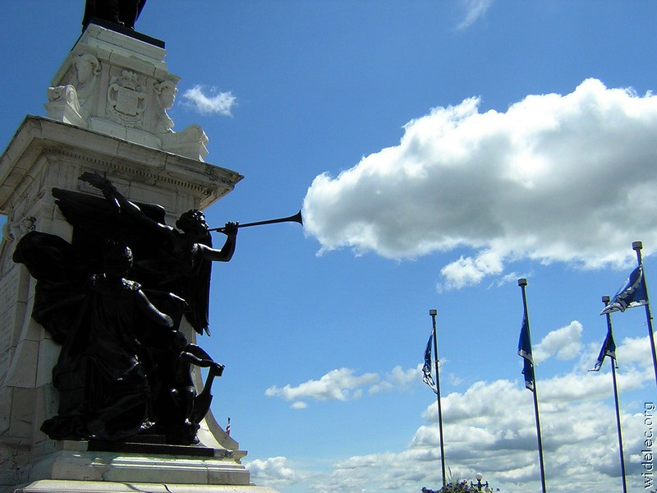

Slide 28
Edward Hallett Carr On the Study of History How Vs. Why ~ Or ~ Function Versus Cause
“The true historian, confronted with this list of causes, would feel a professional compulsion to reduce it to order, to establish some hierarchy of causes which would fix their relation to one another, perhaps to decide which cause, or which category of causes, should be regarded as the cause of all causes.”
“Historians, like other people, sometimes fall into rhetorical language and speak of an occurrence as ‘inevitable’ when they mean merely that the conjunction of events leading one to expect it was overwhelmingly strong.”
Determinism Vs. Free Will. “In practice, historians do not assume that events are inevitable before they have taken place. They frequently discuss alternative courses available to the actors in the story on the assumption that the option was open, though they go on quite correctly to explain why one course was eventually chosen rather than the other. Nothing in history is inevitable except in the formal sense that, for it to have happened otherwise, the antecedent causes would have had to be different.”
Historical Accident Or Arranged Coincidence? “These so-called accidents in history represent a sequence of cause and effect interrupting historically and clashing – ‘a collision of two independent causal chains’.”
The Historian Marx. “Marx offered an apology for chance in history under three heads. First, it could accelerate or retard but not radically alter the course of events. Second, one chance compensated for another, so that in the end chance cancelled itself out. Third, chance was especially illustrated in the character of individuals.”
Meinecke’s Historical Observation: “The search for causalities in history is impossible without reference to values . . . behind the search for causalities there always lies, directly or indirectly, the search for values.”

Slide 29
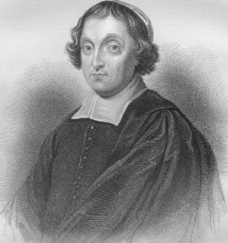
Scottish Catholicism: Contributing Factors Bringing About Reform
Graphic source: wikipedia.com
Cardinal David Beaton Archbishop Of St. Andrews Church, Scotland 1494-1546
Graphic source: wikipedia.com
See More At http://www.TheRestorationMovement.com/

Slide 30
Cardinal David Beaton 1494-1548
Bishop and politician. Born in Balfour (Fife) and educated at St. Andrews and Glasgow Universities. He negotiated both marriages of King James V (1512-1542) with the French court. As Abbot of Arbroath, Beaton sat in the Scottish parliament from 1525.
Beaton was effectively the last Archbishop of St. Andrews, appointed to this position in 1539.
Opposed by John Knox, Beaton was murdered by Protestant reformers in the same year as he executed George Wishart.

Slide 31
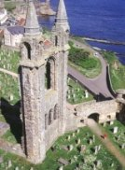
Scottish Catholicism: Contributing Factor To Reform
Cardinal Beaton, Archbishop Of St. Andrews Had Nine Children
Bishop Hepburn Had 10 Children All By Different Mothers
1558 Catholic General Provincial Council Tried To Clean Up Their Act By Refusing To Pay For Illegitimate Children, Too Little Too Late
Catholic Leadership Was Immoral & Incompetent, Causing Many To Move Away From Catholicism Refusing To Attend Mass
The 1558 Council Passed Laws Of Punishment To Those Who Missed Mass
Internal Moral Decay In Scottish Catholic Leadership Brought On More Desire For Reform Than Anything
Cardinal David Beaton Archbishop Of St. Andrews Church, Scotland 1494-1546

Slide 32
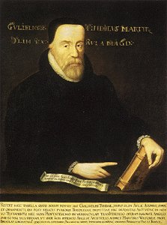
Early Plantings Of Scottish Reform
By 1530 – Tyndale’s English Translation of 1525 Was Being Widely Used In Scotland
See More At http://www.TheRestorationMovement.com/

Slide 33
Scotland’s Influence On Restoration
Background
14th Century – John Wycliffe Led A Reform Movement In England
16th Century – Lutheranism Introduced In Scotland By Patrick Hamilton & George Wisehart
1559 – John Knox Introduces The Reform Church Into Scotland

Slide 34
Early Plantings Of Scottish Reform
1365 – One Year Prior To John Wyclif’s Resignation From Oxford, 81 Passports Were Granted To Scottish Students To Study At Oxford
1415 –Scottish Theologian, Jean Gerson (1363-1429), Complained About The Uprise Of Wyclif Ideas In Scotland
1525 – Luther’s Writings So Infiltrated Scotland That Scottish Parliament Banned Import Of Any Luther Material

Slide 35
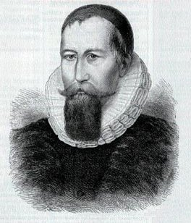
Early Reformers In Scotland
Patrick Hamilton
1504-1528
See More At http://www.TheRestorationMovement.com/

Slide 36
Early Reformers In Scotland
Patrick Hamilton (1504-1528)
Ordained Priest Who Led First Reformation
Spent 6 Months With Luther In Germany
Debated Alexander Alesius, Catholic Envoy Converting Him
Cardinal David Beaton, Archbishop Of St Andrews, Invited Him To Preach In Scotland. After A Week He Was Arrested For Heresy

Slide 37
Early Scottish Reformation
Was Of Religious Warfare

Slide 38
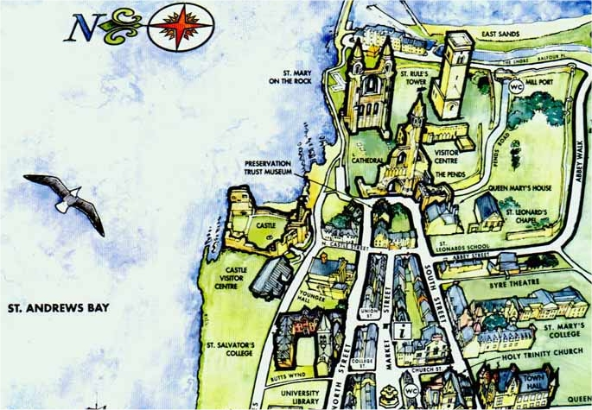
St. Andrews, Fife, Scotland
Cardinal David Beaton 1494-1548
See More At http://www.TheRestorationMovement.com/

Slide 39
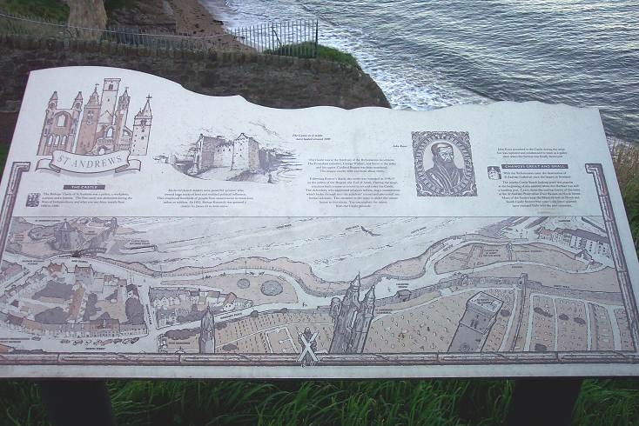
The Bishop’s Castle Of St. Andrews

Slide 40
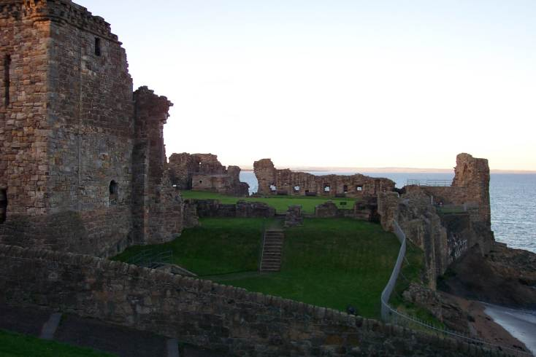
The Bishop’s Castle Of St. Andrews
For A Time John Knox Lived In The Castle, And It Served As A Church As Well As A Stronghold For The Protestants

Slide 41
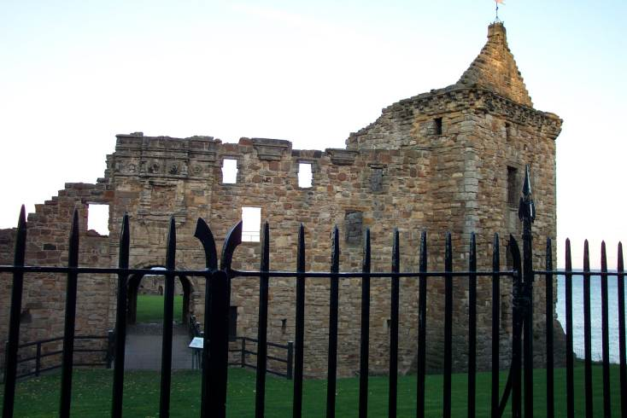
The Bishop’s Castle Of St. Andrews
These are ruins of the second castle, the first one of which was destroyed during the wars of independence from 1400 to 1560.
During the Protestant Reformation, the forces of John Knox overtook the forces of Cardinal Beaton in late 1546
See More At http://www.TheRestorationMovement.com/

Slide 42
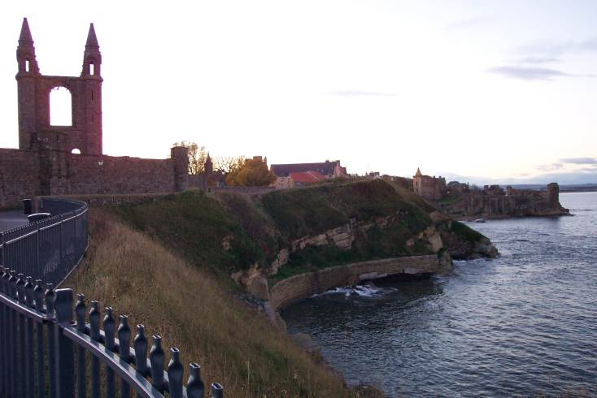
The St. Andrews Cathedral
Once The Largest Abbey In All Of Scotland

Slide 43
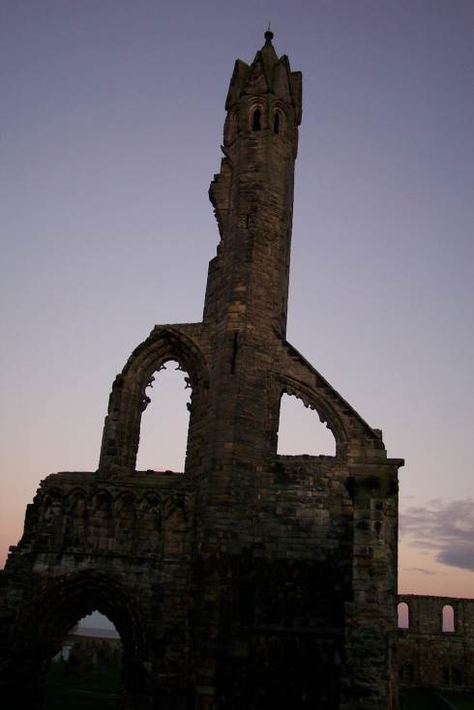
The St. Andrews Cathedral
Destoyed By Protestants When Seeking To Overtake The Catholic Stronghold

Slide 44
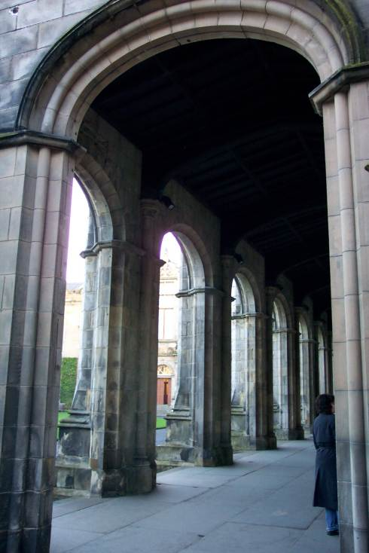
The St. Andrews Church Cloisters
The Old Church Is Open To The Public

Slide 45
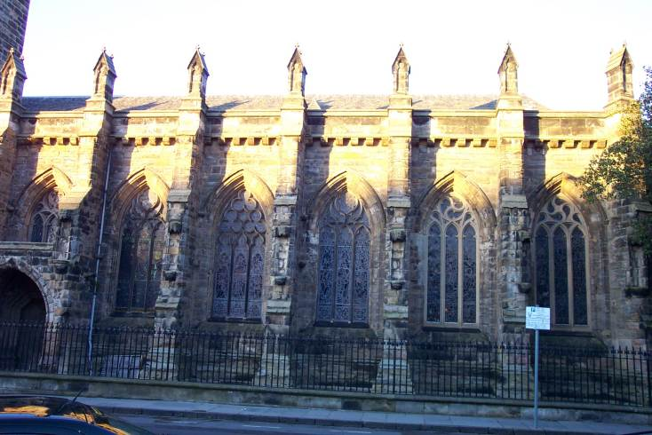
The St. Andrews Church
St. Andrews Church Is Located On The Campus Of St. Andrews College
See More At http://www.TheRestorationMovement.com/

Slide 46
Hamilton’s Demise
Taught Against Celibacy, Pressing The Point By Marrying
Accused Of Teaching Against Pilgrimages, Purgatory, Prayers To Saints, Prayers For The Dead
Burned At The Stake. It Was Gruesome, As It Took 6 Hours To Burn Him. The First Fire Went Out While He Writhed In Pain – February 29, 1528
Resulted With Deep Resentment & Resistance From Scottish People.

Slide 47
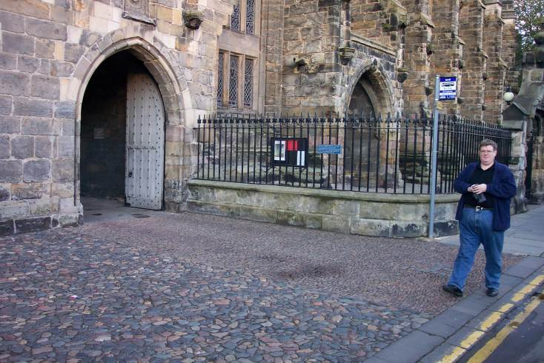
The Death Of Patrick Hamilton
Location Where Patrick Hamilton Was Burned At The Stake
See More At http://www.TheRestorationMovement.com/

Slide 48
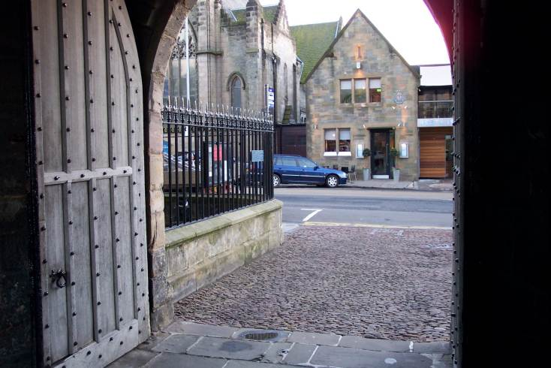
The Death Of Patrick Hamilton
A Marker Still Shows The Spot Where Hamilton Died
See More At http://www.TheRestorationMovement.com/

Slide 49
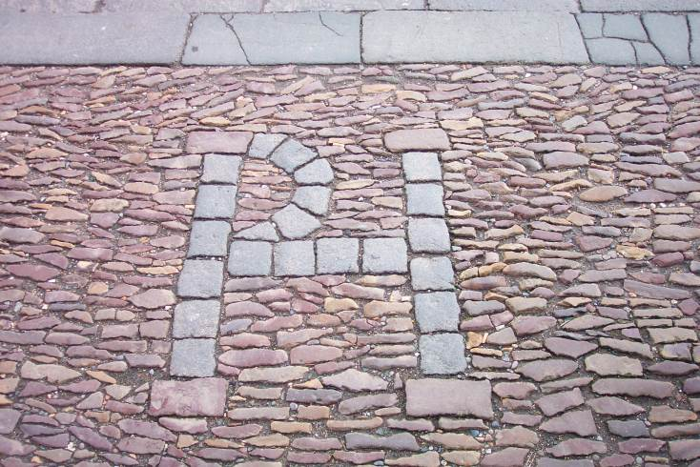
The Death Of Patrick Hamilton
See More At http://www.TheRestorationMovement.com/

Slide 50
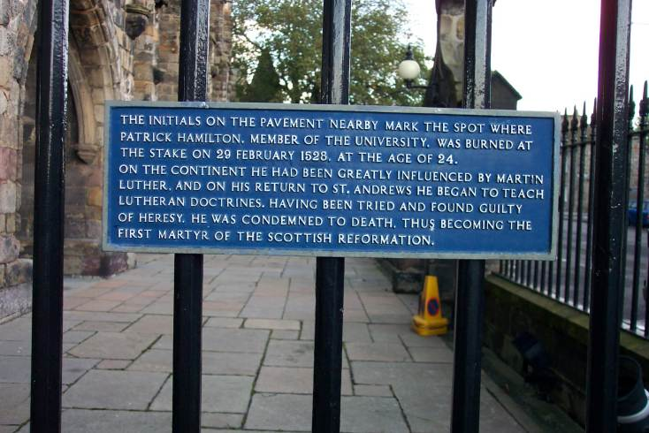
The Death Of Patrick Hamilton
See More At http://www.TheRestorationMovement.com/

Slide 51
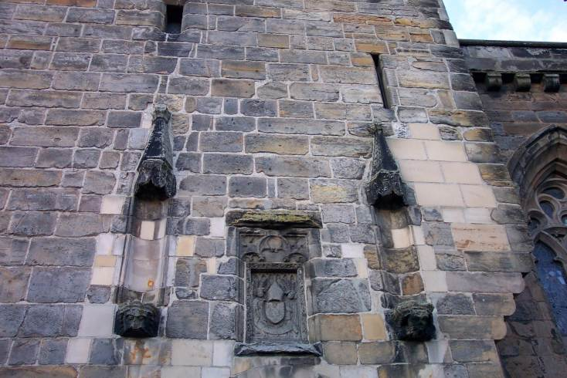
The Death Of Patrick Hamilton
The Heat Of The Fire That Burned Hamilton Was Said To Be So Hot That It Permanently Burned His Face Into The Stone Of The Church That Stood Closeby
See More At http://www.TheRestorationMovement.com/

Slide 52
The Death Of Patrick Hamilton
See More At http://www.TheRestorationMovement.com/

Slide 53
George Wishart 1513-1546
See More At http://www.TheRestorationMovement.com/

Slide 54
George Wishart 1513-1546
1538 Forced Into Exile By Catholic Church: Fled To Strasbourg & On To Zurich - Influence By Swiss Reformers
Close Friend And Confidant Of John Knox
Held To Biblical Authority For Faith And Practice – Taught Greek – N.T. Was His Text
1544 - Returned To Scotland; Preached Protestantism; Calvinism; Authority Of The Scriptures; Presbyterian Form Of Church Government; Local Autonomy Of Congregations

Slide 55
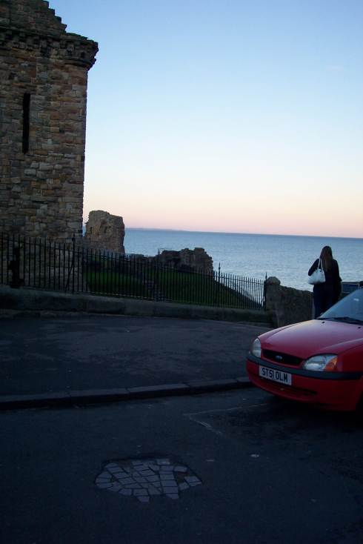
1544-1546 – Began Influencing John Knox – Was Present When Wishart Was Arrested Jan. 16, 1546
Wishart Defended Himself Before His Accusers As 18 Articles Were Read Against Him
He Was Against Purgatory, Mass, Transubstantiation, the Sacraments, Veneration Of Saints, & Celibacy
Burned At Stake In Front Of Bishops Castle, By Cardinal David Beaton.

Slide 56
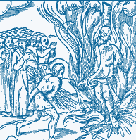
The Death Of George Wishart
Burning Religious Leaders At The Stake Only Fueled The Fire Of The Spirit Of Reformation In Scotland As In All Of Europe
See More At http://www.TheRestorationMovement.com/

Slide 57
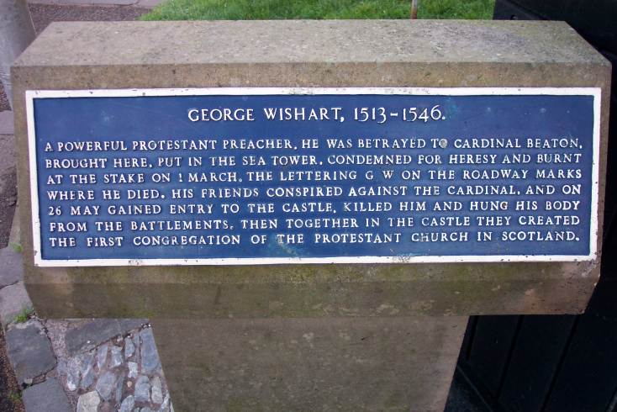
The Death Of George Wishart
Furious Response Of People - Beaton Was Hung By Wishart Loyalists May 28, 1546 In Retaliation
One Of The Earliest Congregations Of The Church Of Scotland Was In The Castle Where Wishart Was Martyred

Slide 58
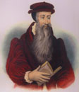
The Reformation Fathers
Martin Luther
1483-1546
German
Ulrich Zwingli
1484-1531
Swiss
John Knox
1505-1572
Scottish
John Calvin
1509-1569
French

Slide 59
John Knox 1505-1572
Graphic source: wikipedia.com
Graphic source: wikipedia.com
See More At http://www.TheRestorationMovement.com/

Slide 60
John Knox

Slide 61
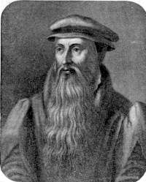
John Knox 1505-1572
Ordained Priest After Attending University of Glasgow & St. Andrews
Sat At Feet Of Swiss Reformers
1546 — Follower Of George Wisehart
1547 – Entered The Then Protestant Stronghold At St. Andrews After Death Of Cardinal Beaton
July, Captured By Catholics/ Spent 19 Months In The Galley Of A French Ship As Slave – Released In 1549
1549 – Received Protestant License To Preach From English King Edward VI, Son Of Henry VIII
1553 – Queen Mary Came To Throne And He Fled To Geneva, Influenced By Calvin – Close Friend Of Calvin Until Death In 1564
1559 – Returned To Scotland, With Elizabeth On The Throne In England

Slide 63
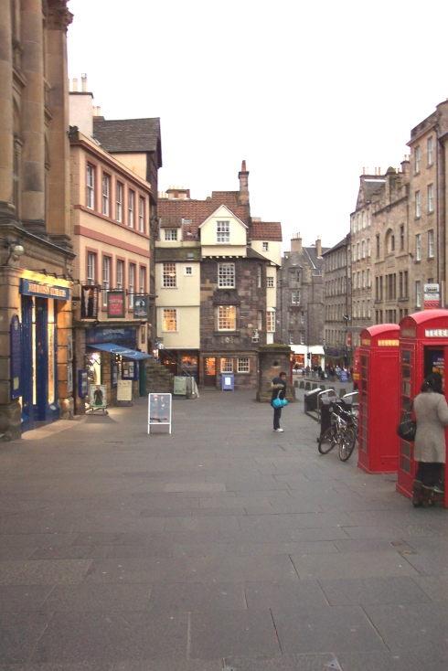
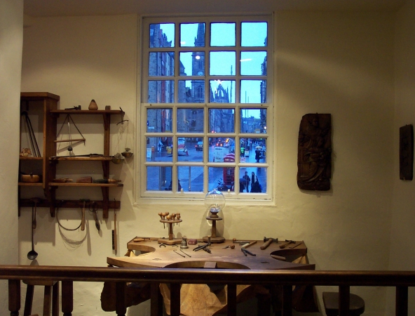
John Knox Home In Edinburgh
See More At http://www.TheRestorationMovement.com/

Slide 64
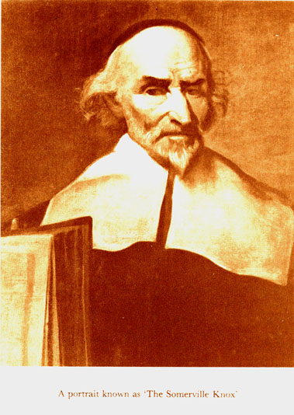
John Knox: Scotland’s Thunder
After Henry VIII’s break with Rome, King James V of Scotland strengthens Scotland’s traditional political alliance with France and in marrying Mary of Guise moves even closer to Rome.
With the death of King James the 5th in 1542, the Pro-English Protestant faction got its chance to act. The heir to the throne was a one-week old baby girl, the little infant Mary Stewart, her mother being French, whereas the heir presumptive to the throne was James Hamilton, Earl of Arran. This James favored the prospect of an English alliance and openly supported certain pro-Protestant measures at that time.

Slide 65
John Knox: Scotland’s Thunder
The support for Protestantism that began under the Earl of Arran in 1543 was known as “Arran’s godly fit.” Besides permitting the vernacular Bible and the sanctioning of Protestant preachers, there were attacks on several monasteries. Also, on the political front, Arran negotiated a deal with Henry VIII pledging the infant Mary Stewart as the future bride and wife of Prince Edward, Henry VIII’s son.
In 1546 & ’47, Cardinal Beaton, the Archbishop of St. Andrews, spearheaded a backlash against Protestantism, accompanied by a political pendulum swing back away from England and towards France.

Slide 66
John Knox: Scotland’s Thunder
As a result of this backlash the marriage deal with England was off, and it was then pledged that Mary Stewart would marry into the French royal family. She herself, as part of the political dealings at the time, was sent to France in 1548 where she grew up.
As part of Archbishop Beaton’s actions against Protestantism, the leading Calvinist preacher in the kingdom, George Wishart, was captured, tried, and burned as a heretic in St. Andrew’s in March of 1546. This, of course, deprived the Protestant movement of its chief leader at that very crucial juncture… The high drama continued in retaliatory fashion.

Slide 67
The Death Of George Wishart
Burning Religious Leaders At The Stake Only Fueled The Fire Of The Spirit Of Reformation In Scotland As In All Of Europe
See More At http://www.TheRestorationMovement.com/

Slide 68
John Knox: Scotland’s Thunder
Responding to the execution of Wishart, several of his supporters murdered Cardinal Beaton in May of 1546, two months later. They then took over St. Andrews castle. The castle was besieged, but its Protestant occupiers held out for over a year before they were finally broken with the help of French troops.
Small numbers of Protestants, though, persisted. Among those militant Protestants who occupied St. Andrew’s castle after Beaton’s murder was John Knox. He was a zealously committed preacher and Protestant advocate. Moreover, he was the single most important religious leader & catalyst of the Scottish Reformation.

Slide 69
John Knox: Scotland’s Thunder
Even among all the numerous Protestant champions of Bible scripture in the Reformation era, Knox stands out for his burning zeal & for pushing sola scriptura to its extremes. He maintained, for example, that the law of the Old Testament was a legal code still binding on “modern day,” 16th-century Scotland & England.
After the French captured St. Andrews castle, Knox spent the next two years as a French galley slave, chained to an oar aboard a French ship. This was an utterly miserable existence, a situation many galley prisoners did not survive. Knox did, but it filled him with a passionate hatred for both the French & Catholicism.

Slide 70
John Knox: Scotland’s Thunder
After his release from the French galley, Knox traveled to England in 1549, which functioned while under Edward’s reign as a sort of refuge for besieged Protestants.
We can infer a few things about the particular character of John Knox’s Protestant commitments at the time, insofar as he declined the offer of a bishopric. He also opposed ceremonial practices like kneeling during the communion of the Lord’s Supper, and he also opposed the 1552 English Prayer Book of Thomas Cranmer. These were simply manifestations of his unwillingness to compromise with what he considered “unbiblical remnants” of Catholicism.

Slide 71
John Knox: Scotland’s Thunder
When Catholic Mary Tutor became Queen of England in 1553, Knox was among the exiles who went to the continent. He spent some time in Frankfurt, but the key experience for Knox was that the greatest part of his time was spent in Calvin’s Geneva. He admired the city & its institutions tremendously. He absorbed and learned firsthand from Calvin & and was inspired by him. John Knox’s Scottish dream was of a similar theocratic commonwealth based on scriptural precepts and with rulers God-fearing. Calvin’s emphasis was on the constructive role of Bible ordinance, distinct from Luther’s view juxtaposing the law & New Testament Gospel.

Slide 72
John Knox: Scotland’s Thunder
With this Christendom concept of Christian commonwealth in mind, John Knox returned to England in 1555. He slides in during Mary’s reign, marries, and then goes to Scotland. He was warmly received there by influential Protestants. By this time, the numbers of Protestant Scottish Calvinists were starting to grow once more, compared to the crackdown in the late 1540’s. One big reason for this growth was that Mary of Guise, Mary Stewart’s mother, had to leave protestants relatively unmolested because she needed their nobles’ active support for the anticipated marriage between her daughter and the French prince.

Slide 73
John Knox: Scotland’s Thunder
Knox took advantage of several months during his Scotland visit to criss-cross the lower part of the country to help knit together scattered Protestant groups and committed individuals. The state clergy got wind that he was there, however, and they forced him to return to Geneva in July of 1556.
In his absence, he was burned in effigy as a heretic. Energized, though, by his trip to Scotland, and inspired by his Swiss revisit, Knox turned his attention toward a series of political treatises that addressed Calvin’s anti-Catholic resistance theory. These articles were published in Geneva in 1558.

Slide 74
John Knox: Scotland’s Thunder
The most famous of John Knox’s 1558 treatises was the notoriously entitled First Blast of the Trumpet Against the Monstrous Regiment of Women. It was targeted against Mary Tutor of England, but also against Scotland’s Queen Mother, Mary of Guise. This tome both combined Knox’s virulent anti-Catholicism with a sharp attack on what was, in his opinion, the inherently unnatural perversion of women ruling over men. Knox soon regretted he had ever put pen to ink on this specific subject.
In 1557, a common French-Scot nationality was created. Foreign Frenchmen were filling positions in the Scottish government.

Slide 76
Knox & The Church Of Scotland
See More At http://www.TheRestorationMovement.com/

Slide 77
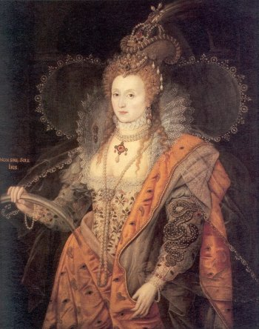
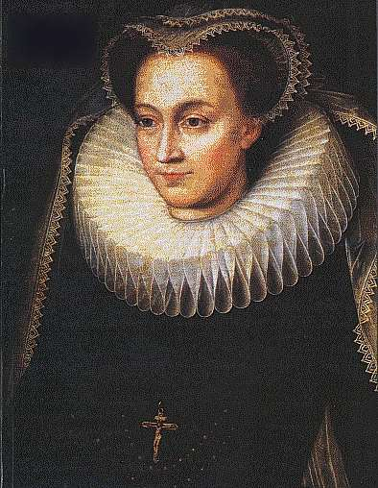
Political Setting At This Time
1558 Elizabeth Came English Throne
Mary, Queen Of Scots Had Recently Been Named Queen Of France
Catholic
She Was Believed To Be The Rightful Heir To The English Throne (Her Mother Was Sister To Henry VIII)
French/Catholics Were Planning To Use Scotland As A Base To Invade England
Protestants In Scotland Aided Elizabeth In Keeping Mary From Taking The Throne
Result: Elizabeth Rewarded Protestants For Their Faithfulness To The Throne

Slide 78
John Knox: Scotland’s Thunder
The most famous of John Knox’s 1558 treatises was the notoriously entitled First Blast of the Trumpet Against the Monstrous Regiment of Women. It was targeted against Mary Tutor of England, but also against Scotland’s Queen Mother, Mary of Guise. This tome both combined Knox’s virulent anti-Catholicism with a sharp attack on what was, in his opinion, the inherently unnatural perversion of women ruling over men. Knox soon regretted he had ever put pen to ink on this specific subject.
In 1557, a common French-Scot nationality was created. Foreign Frenchmen were filling positions in the Scottish government.

Slide 79
KNOX PREACHING BEFORE THE LORDS

Slide 80
John Knox: Scotland’s Thunder
However, alliance with France against the English was one thing. The prospect of becoming a mere French dependency was another.
Everything changed dramatically was the death of Queen Mary in November of 1558. The accession of Elizabeth to the English throne means that suddenly England had a Protestant monarch. This event assisted the anti-French political backlash in Scotland coalesce with the growing Protestantism.
In Geneva, Knox heard the news about the death of Mary along with the coronation of Elizabeth, and wanted nothing more than to return to England. However, his just published tract got in his way having outraged Queen Elizabeth.

Slide 81
John Knox: Scotland’s Thunder
Instead of going back to England, Knox headed for his native land. He arrived in Scotland during May of 1559 amid ferment, and his harsh anti-Catholic preaching stoked into a Protestant rebellion. It fused, and carried to a high pitch, Calvinism and anti-French sentiment. Furthermore, France was not in a position to defend their own interest in the region because they were dealing with the death of their own monarch.
At this point, in early 1560, Elizabeth showed herself to be shrewd. Despite her distaste for Knox, she seized the possibility of prying Scotland away from France and sent an English army into Scotland in March of 1560.

Slide 82
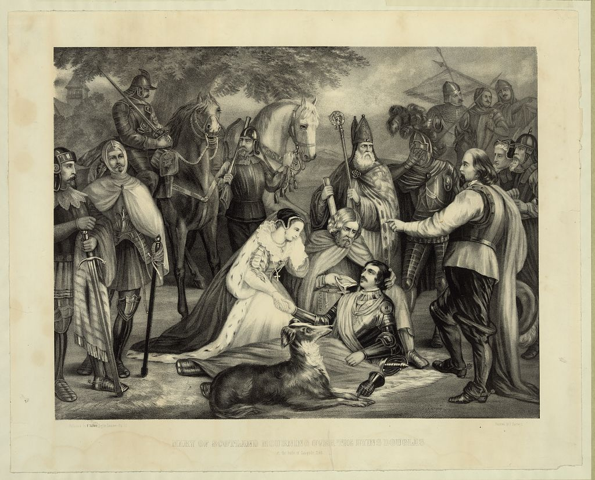

Slide 83
John Knox: Scotland’s Thunder
In June, 1560 there was yet one more crucial death, this time of Queen Mother, Mary of Guise. English military support, coupled with Mary’s death, paved the way for a Scottish Reform Parliament. It met in August of 1560 and it adopted Calvinist Protestantism as Scotland’s religion.
Technically, the measures of the Scottish Reformation Parliament were illegal. The Parliament was expressly forbidden to consider religious issues, and those issues it undertook were not formally approved by Mary Stewart. They went forth anyway, in absence of the new queen, who had gone to France in in 1548 to be brought up and was still there.

Slide 84
Knox & The Church Of Scotland
The True Church Had 3 Distinct Marks
True Preaching Of The Word Of God
Church Discipline To Be Administered According To The Bible
Correct Administration Of The Sacraments Of Christ
Reform Church Of Scotland Began – 1560
Abolished Papal Rule In Scotland
Abolished All Contrary To New Doctrine
Forbade Celebration Of Mass

Slide 85
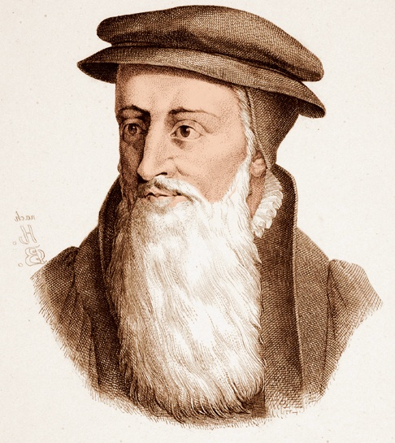
1541
John Knox starts the Calvinist Reformation in Scotland
Scottish Protestants become known as Presbyterians because elders (“presbyters”) make decisions for churches, not one person
John Knox

Slide 86
John Knox: Scotland’s Thunder
After her husband’s death in December of 1560, Mary Stewart decided to return to her native Scotland for the first time in 13 years. Yet, she did not arrive, until August of 1561, a full year after the Scottish Reformation Parliament had met. That gave Protestant nobles and leaders a whole year to centralize and to consolidate their new order. This was a crucial passage of time.
When Mary arrived back in Scotland, at the ripe age of 18, she remained Catholic and she maintained Catholicism at her court, but she accepted the new Calvinist church order for the nation. This was unprecedented as a compromise to the reformers.

Slide 87
King James Did Not Use KJV!
David Lee Burris:
Calvin’s Emphasis On God’s Sovereignty & Our Ultimate Loyalty In Cases Caused Revolution!
King James Of The Puritans – “I shall make them conform or I will harry them out of the land, or else do worse.”
The Puritan & Calvinist heirs of the Reformation continued to use the Geneva Bible version. They would not have taken a KJV if given to them free. The King James version was a government publication purposed in part to deny common people those marginal notes written by John Knox & John Calvin. However, King James’s scheme did not work out for his descendants; Both the Puritan Pilgrims landing at Plymouth Rock that took their Genevas with them and those Puritan Roundheads who supported the Parliament during the English Civil War took to heart those terrible marginal notes in the Geneva qualifying – if not challenging – the undeniable “divine right of the King.”
James was a devout believer in the “divine right of kings”; This meant that since a king’s power came from God, the king then had to answer to no one but God.
James was a sodomite as well as a sadist. While King Of Scotland he assisted in the duress of the heretical examinations and supervised the peculiars & particulars of the tortures. History has it that James was also a great coward that “fouled his breeches in fear” around any serious swordplay.
In short, King James was the sort of despicable creature honorable men loathed, Christians would not associate with, and the Bible itself in the Old Testament orders to be put to death. * See Notes
O.T. marginal notes in the Book of Exodus in the Geneva Bible and that in the entire 20th chapter of Leviticus - - especially bothered the king & his mother Mary.
Therefore, in an account corrected with his own hand - dated on February 10, 1604, he ordained:
“That a translation be made of the whole Bible & this to be set out & printed without any marginal notes.”
Notes:
Georgie Porgie, pudding and pie, Kissed the girls & made them cry; When the boys came out to play, Georgie Porgie ran away! The nursery rhyme is said to mock both James 1 and George Villiers over their open romantic interest in each other. In fact, the king even proclaimed to the Privy Council that ‘you may be sure that I love the Duke of Buckingham more than anybody else & I wish not to have it thought to be a defect.’ It is now believed by historians studying court diaries that the pair were indeed lovers. The king even called Georgie ‘my sweet child and wife’ as if to emphasize the point.
But George Villiers was also known to be partial to both sexes and had affairs with the young ladies & wives at court, causing resentment all around. He often took advantage and forced his affections, causing outrage while managing to avoid confrontation.

Slide 88
Knox Was Called Before The Queen
Queen: “You are not the church that I will nurse, I will defend the church of Rome, for it is the true church of God.”
Knox: “Madam, your will or reason cannot make that Roman harlot to be the true and immaculate bride of Jesus Christ. Do not be surprised when I call Rome a harlot. That church is polluted with all kinds of spiritual fornication in doctrine and customs. I believe, Madam, that the Jewish synagogue which crucified the Son of God wasn’t as far degenerated from the statutes that God gave by Moses and Aaron to His people, as the church of Rome has degenerated in five hundred years from the purity of the religion which the apostles taught and planted.”

Slide 89
Knox Was Called Before The Queen
Queen: “My conscience doesn’t admit that.”
Knox: “Conscience requires knowledge and you have no knowledge.”
Queen: “I have both heard and read.”
Knox: “The Jews who crucified Christ Jesus read both the law and the prophets and had it interpreted the way they wished. Have you heard anyone teach anything but what the pope and cardinals allow? No one will speak anything that will jeopardize their lives or their property.”
Queen: “You interpret the Scripture in one way, they in another. Whom shall I believe? Who shall be the judge? You are too much for me, but if those were here who taught me, they could answer you.”
Knox: “No learned papist will ever come in your presence to have the foundation of his religion searched out… they never dare dispute unless they’re both judge & jury.”

Slide 90
In the Aftermath Of John Knox
David Lee Burris:
Toward the end – his marriage to a 16 year old - costs Knox some influence in later life!
The compromise arrangement of a life monarch maintaining a different religion than the official religion of the nation persisted until 1567, when Queen Mary was forced to abdicate in favor of her infant son, James VI, also the future James I of England.
Scotland faced a struggle in the next several decades as it tried to create a Calvinist church order opposed by bishops’ supporters resisting such a consistorial order as favored by Calvinist followers.
They also faced problems as they dealt with giving the new church uniformity, direction, and well-trained ministers versed in both the First Book of Discipline & the Book of Common Order.

Slide 91
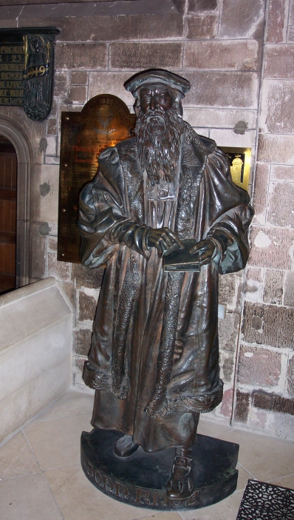
By End Of 1560 The General Assembly For The Reformed Church Of Scotland Was Formed
Wrote Two Disciplines
The Book Of Discipline – 1560: Teaching That Baptism And Lord’s Supper Could Be Administered Where The Word Of God Is Preached
The Second Book Of Discipline - 1575

Slide 92
A Serious Scotland After John Knox
David Lee Burris:
Toward the end – his marriage to a 16 year old - costs Knox some influence in later life!
The exemplary sentence was one of fine or rebuke for that of the non-sexual offender. The most frequent in this category was the “sabbath breach,” a sin committed by doing almost anything on a Sunday except going to church. People were fined for “sleeping in the meadows in time of sermon,” for travelling, arguing either with family or with servants, even harvesting crops or seasonal salmon fishing in the Tay.
In 1574, it was ordained that on every Sunday a magistrate and an elder with two deacons, should patrol St. Andrews at time of the services, seeking out sinners and any sluggards; and by 1600, they had brought 286 persons before the city session for breaches of sabbath.
Sabbath
breach

Slide 94
Scottish Reformation Heritage
As far back as the late fourteenth century, John Wyclif taught the absolute authority of the Scriptures and condemned Roman doctrines not found in the Bible. This tradition of Sola Scriptura continued and found controversial new voice in John Knox who taught the supreme authority of God’s Holy Word as contained in canonical Scriptures.
Several Derivatives Of Scottish Emphasis On Sola Scriptura:
Ecclesiastical Independence Of Local Churches
In Scotland the move for religious independence was closely connected to Scottish Nationalism.
Presbyter Government Form Within Local Autonomy Context
Presbyterianism was introduced into Scotland by John Knox who was influenced by John Calvin’s presbyterian church-state structure in Geneva.
John Knox’s Scottish Adoption-Adaptation Of Calvin’s Theology
The aspects adopted were those especially colored by John Calvin’s legal background as a lawyer. This manner of thought stresses such major concepts as God’s sovereignty, man’s depravity, faith and eternal destination as acts of God, and a legal obligation to keep God’s commands.

Slide 95
John Knox: Scotland’s Thunder
“Baptism is the sign of our first entrance into the household of God, our Father, by which it is signified, that we are received into fellowship with Him, that we are clad with the righteousness of Christ, our sins and filthiness being washed away in His blood. If Christ’s justice be inviolable and the covenant of God be constant and sure, it’s not necessary, that the sign which represents to me, and in some manner proves, that I am received into a covenant with God & as such am clothed with Christ’s justice, be received oftener than once. For the repetition of it would imply, that prior to that I was a stranger from God, and never had been publicly received into His household.”
On Baptism

Slide 96
THE REFORMER IS ALWAYS RIGHT ABOUT WHAT IS WRONG. HE IS GENERALLY WRONG ABOUT WHAT IS RIGHT!
G. K. CHESTERTON

Slide 97
The Butterfly Effect Of Religious & Church History
Sensitive Dependence On Initial Conditions
Small variations in initial condition of a non-linear dynamical system may produce large variations in long term behavior of the system.
Each Iteration Amplifies The Initial Departure

Slide 98
PRIMITIVE

Slide 99
British Pre-Restoration
English Lake District

Slide 101
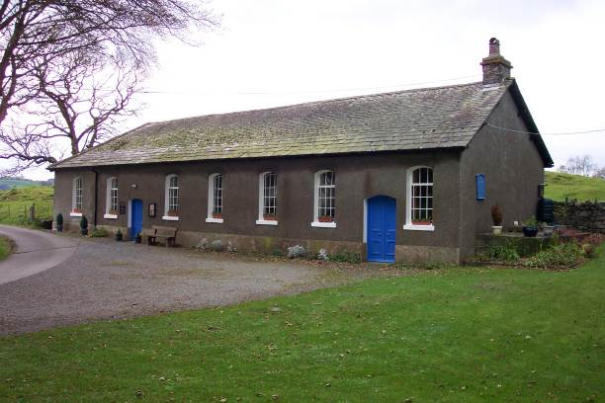
Tottlebank Church
A Church of Christ
-Early As 1669

Slide 102
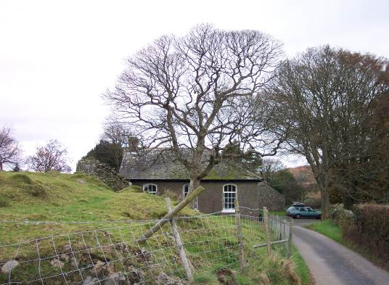
Attempting Restoration
In 1669, Charles II had been on the English throne for nine years.
Despite Charles’ inclination toward toleration, the early years of his reign were marked by a series of repressive measures, collectively known as the Clarendon Code.
Under the Clarendon Code grave disabilities were placed on those who sought to worship outside the boundaries placed on them by the English church.
In particular the Conventicle Act banished any meetings of more than five people in addition to the household for worship other than in the prescribed form and location.

Slide 103
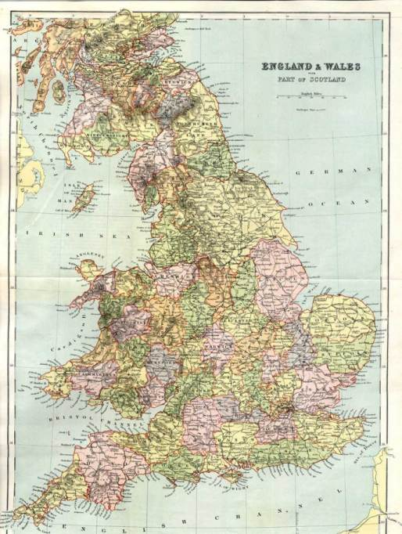
Escape To Remote Areas
Seven fled, two of whom had suffered severe penalties for violation, sought seclusion & solitude from London’s watchful eye!
They settled in England’s Northern Lake District, 200 miles to the NW of London

Slide 104
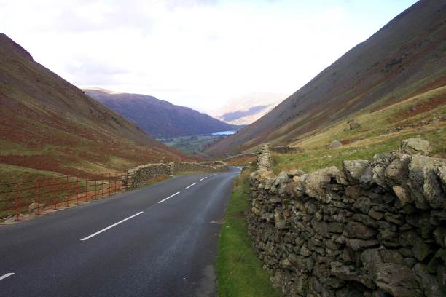
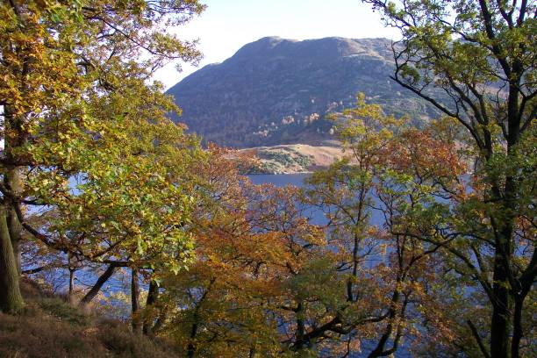
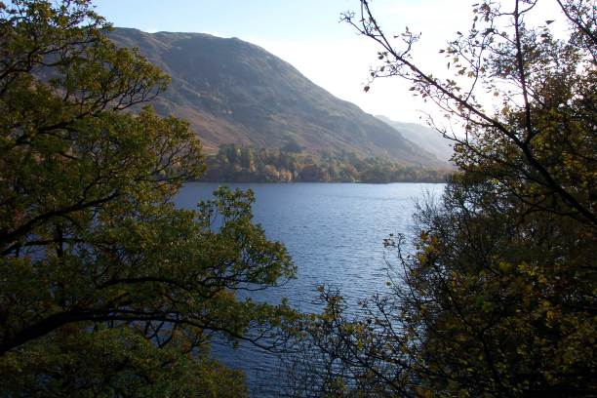
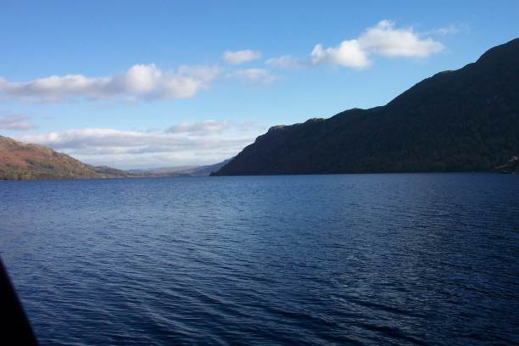
England’s Lake District
In 1669 the Convenicle Act ran out, and during the brief period before its re-enactment the group drew up their articles of organization as follows:

Slide 105
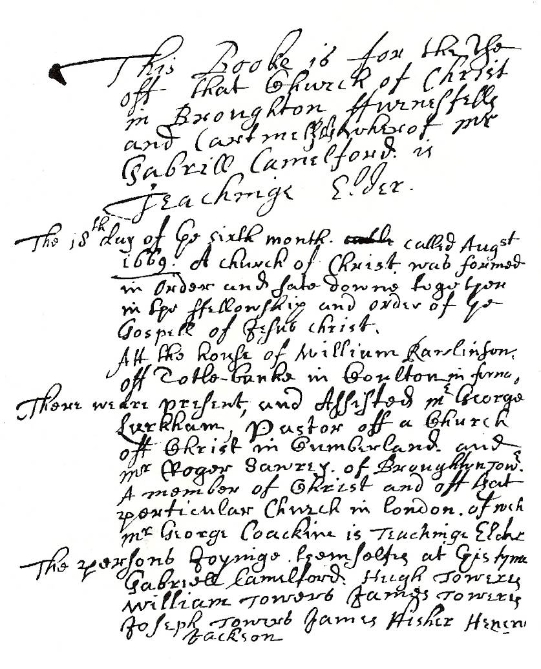
The Ledger
This booke is for the use of that Church of Christ in Broughton furnessfell and Cartmell whereof Mr. Gabrill Camelford is Teachinge Elder
The 18th day of ye sixth month called August 1669 A church of Christ was formed in order and sate down together in the fellowship and order of ye Gospel of Jesus Christ. Att the house of William Rawlinson off Totle-banke in Coulton in furness.

Slide 106
The Ledger
There were present and assisted Mr Geroge Larkham Pasto off a Church off Christ in Cumberland and Mr Roger Sawrey of Broughton Tower a member of Christ and off that particular Church in London of wych Mr George Coackine is Teaching Elder
The persons joyning themselves at this time Gabriel Camelford, Hugh Towers, William Towers, James Towers, Joseph Towers, James Fisher, Henery Jackson

Slide 107
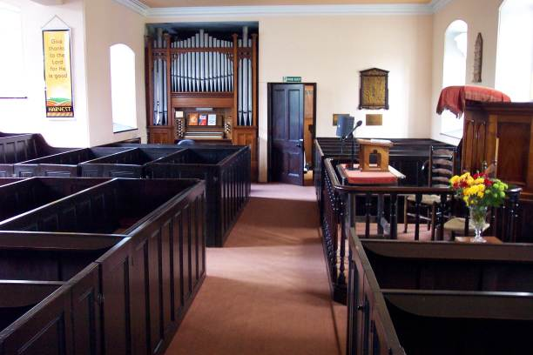
Organization
On 9th of November, 1669, articles of faith were drawn up.
“The Confession off ffaith held forth by the Church off Christ . . .”
Some Things The Lengthy document claims:
“The way of Separation from the world is the way off god.”
“with us is a door wide enough to entertaine every Sonn of ye lord of glory, we dare not barr the dore against any honest soule …desieringe much that we may all be helpful to each other…our table is large enough and provision suited for children, younge men and ffathers amonge the flock of Christ that shall consent with us and desier to sit down with us or amongst us.”

Slide 108
Organization
Seven Basic Principles Of Faith Were Listed According To Tottlebank Historian Foster Sutherland, 1969:
Repentance, Faith, Baptism of water and the spirit, laying on of hands, resurrection of the dead and eternal judgement.
Thankfulness to God and willingness to be the praise of His grace.
Dear love and affection to all saints.
The chiefest tie and bond is the bond of love, Christian, heavenly and unfeigned love.
The word of Christ is the utmost boundary of liberty.
“We desire and expect to receive help in our weakness and from another by the watchful aid of one another and the faithful reprehension and admonition one of another.”
Everything is to be referred to God and Christ, and when all is done they are to say, “Not unto us but unto Thy name be praise.”

Slide 109
Organization
Infant baptism vs. adult baptism isn’t discussed in the book of faith.
They claimed church autonomy, having rights to its own affairs, claiming freedom to choose its own officers, to examine disagreements or “matters of scandall any way arrising amonge themselfes,”and to discipline if necessary by suspension, “on occation of obstinace and wilfull persistinge in any ennormous sinn,” with exclusion as the final resort.

Slide 110
Outside Influences
1695 — London Minister, David Crossley introduced Baptist Theology, and the church became identified as a Baptist church, and is so to the present.

Slide 111
The Kirkby Church Planted
The Tottlebank church planted a church near the west coast that for years remained in fellowship with them.

Slide 112
Kirkby Church of Christ
By 1824 a church after the ancient order was serving the Lord at Kirkby.
It was 30 years before anyone heard of Barton W. Stone or of Alexander Campbell

Slide 113
Kirkby Part In Digression
When the battle over the instrument raged, the Kirkby church added the instrument to its services
Today Kirkby church is known as the Wall End Christian Church.
It is the oldest continuous restoration church in Great Britain

