Slide 1
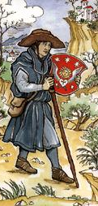
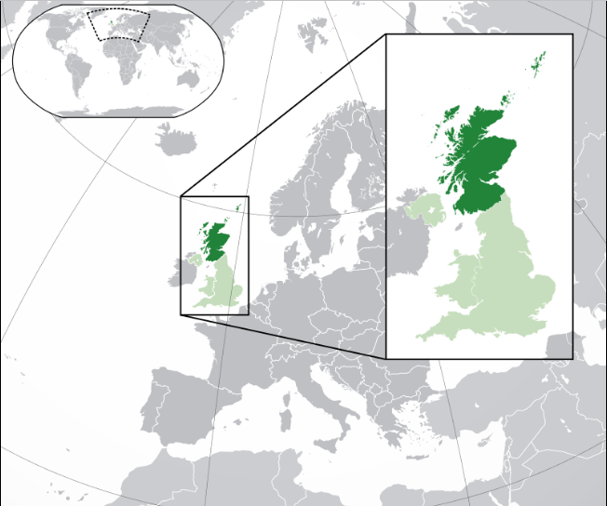
Scotland’s Reformation & Restoration Continued
by D.L. Burris, Editor & Contributor
Source: Wikipedia graphics

Slide 2
PRIMITIVE

Slide 3
British Pre-Restoration
English Lake District

Slide 5
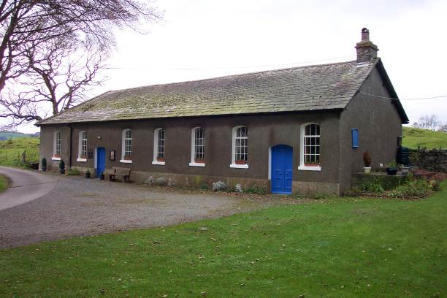
Tottlebank Church
A Church of Christ
-Early As 1669

Slide 6
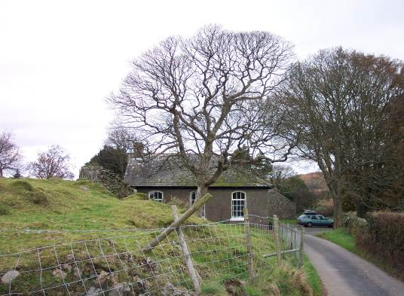
Attempting Restoration
In 1669, Charles II had been on the English throne for nine years.
Despite Charles’ inclination toward toleration, the early years of his reign were marked by a series of repressive measures, collectively known as the Clarendon Code.
Under the Clarendon Code grave disabilities were placed on those who sought to worship outside the boundaries placed on them by the English church.
In particular the Conventicle Act banished any meetings of more than five people in addition to the household for worship other than in the prescribed form and location.

Slide 7
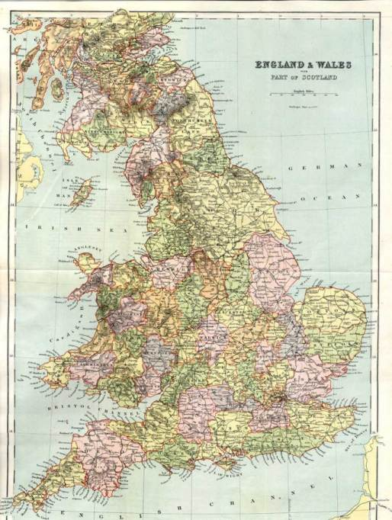
Escape To Remote Areas
Seven fled, two of whom had suffered severe penalties for violation, sought seclusion & solitude from London’s watchful eye!
They settled in England’s Northern Lake District, 200 miles to the NW of London

Slide 8
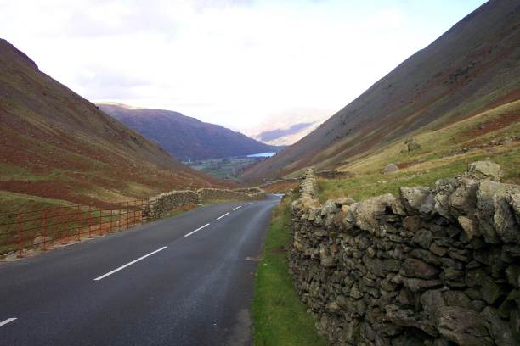
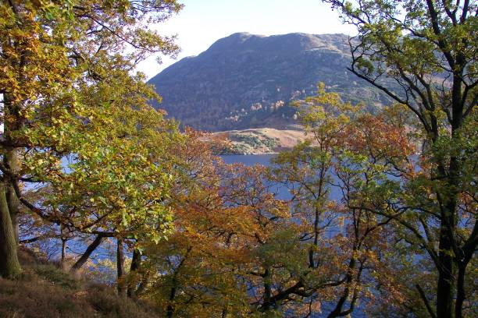
England’s Lake District
In 1669 the Convenicle Act ran out, and during the brief period before its re-enactment the group drew up their articles of organization as follows:

Slide 9
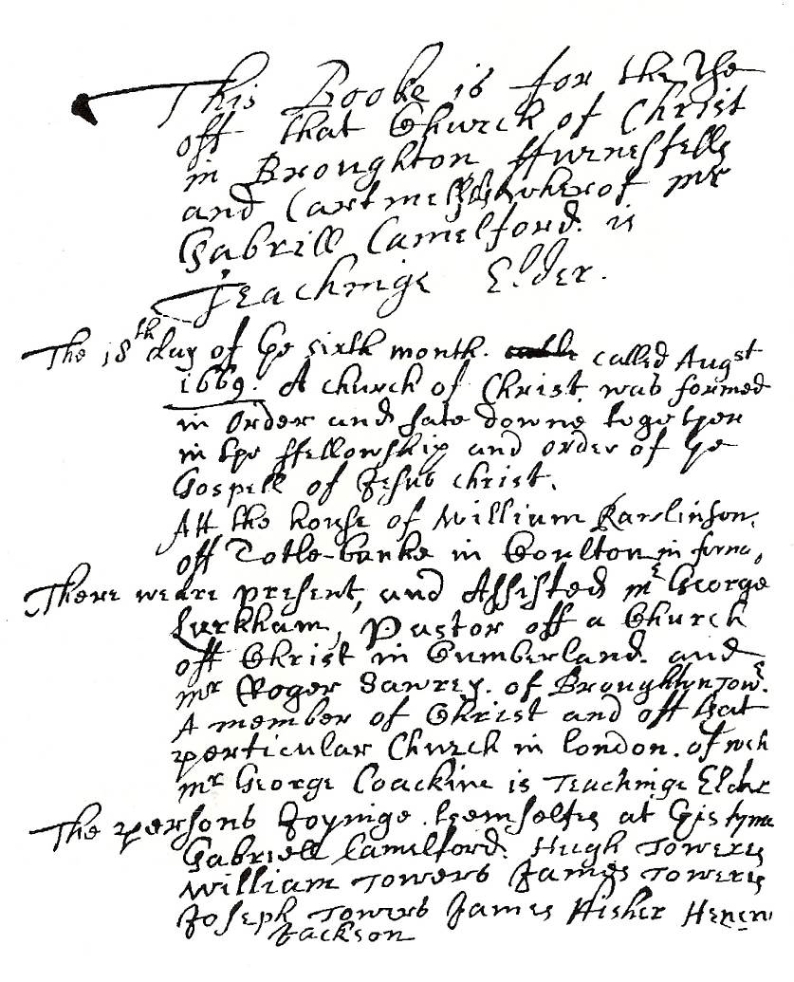
The Ledger
This booke is for the use of that Church of Christ in Broughton furnessfell and Cartmell whereof Mr. Gabrill Camelford is Teachinge Elder
The 18th day of ye sixth month called August 1669 A church of Christ was formed in order and sate down together in the fellowship and order of ye Gospel of Jesus Christ. Att the house of William Rawlinson off Totle-banke in Coulton in furness.

Slide 10
The Ledger
There were present and assisted Mr Geroge Larkham Pasto off a Church off Christ in Cumberland and Mr Roger Sawrey of Broughton Tower a member of Christ and off that particular Church in London of wych Mr George Coackine is Teaching Elder
The persons joyning themselves at this time Gabriel Camelford, Hugh Towers, William Towers, James Towers, Joseph Towers, James Fisher, Henery Jackson

Slide 11
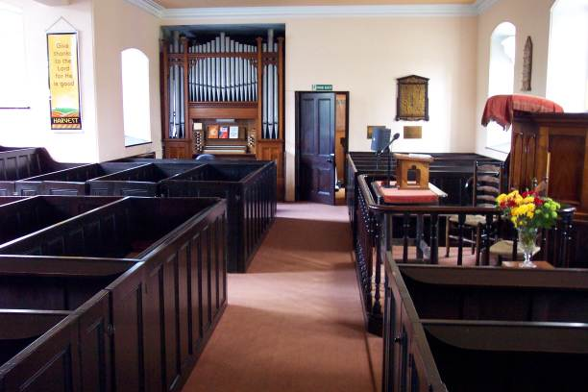
Organization
On 9th of November, 1669, articles of faith were drawn up.
“The Confession off ffaith held forth by the Church off Christ . . .”
Some Things The Lengthy document claims:
“The way of Separation from the world is the way off god.”
“with us is a door wide enough to entertaine every Sonn of ye lord of glory, we dare not barr the dore against any honest soule …desieringe much that we may all be helpful to each other…our table is large enough and provision suited for children, younge men and ffathers amonge the flock of Christ that shall consent with us and desier to sit down with us or amongst us.”

Slide 12
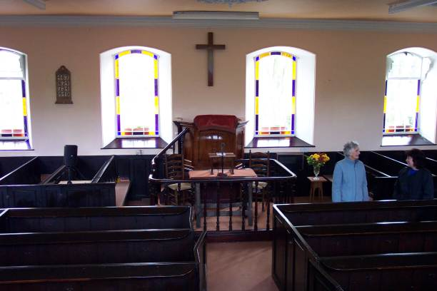
Organization
Seven Basic Principles Of Faith Were Listed According To Tottlebank Historian Foster Sutherland, 1969:
Repentance, Faith, Baptism of water and the spirit, laying on of hands, resurrection of the dead and eternal judgement.
Thankfulness to God and willingness to be the praise of His grace.
Dear love and affection to all saints.
The chiefest tie and bond is the bond of love, Christian, heavenly and unfeigned love.
The word of Christ is the utmost boundary of liberty.
“We desire and expect to receive help in our weakness and from another by the watchful aid of one another and the faithful reprehension and admonition one of another.”
Everything is to be referred to God and Christ, and when all is done they are to say, “Not unto us but unto Thy name be praise.”

Slide 13
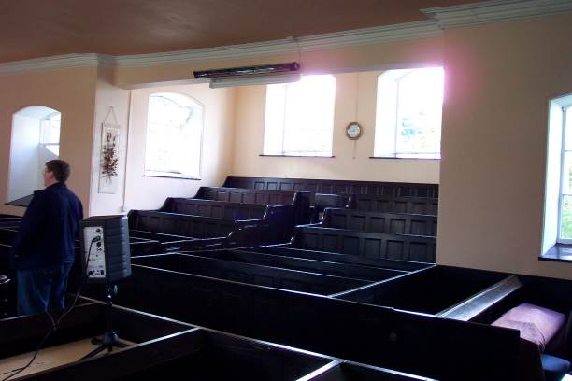
Organization
Infant baptism vs. adult baptism isn’t discussed in the book of faith.
They claimed church autonomy, having rights to its own affairs, claiming freedom to choose its own officers, to examine disagreements or “matters of scandall any way arrising amonge themselfes,”and to discipline if necessary by suspension, “on occation of obstinace and wilfull persistinge in any ennormous sinn,” with exclusion as the final resort.

Slide 14
Outside Influences
1695 — London Minister, David Crossley introduced Baptist Theology, and the church became identified as a Baptist church, and is so to the present.

Slide 15
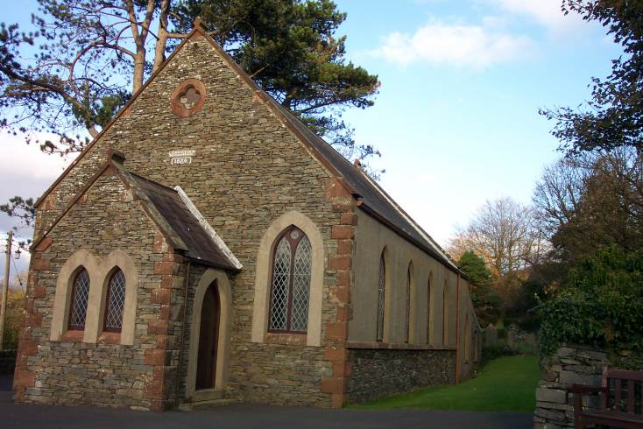
The Kirkby Church Planted
The Tottlebank church planted a church near the west coast that for years remained in fellowship with them.

Slide 16
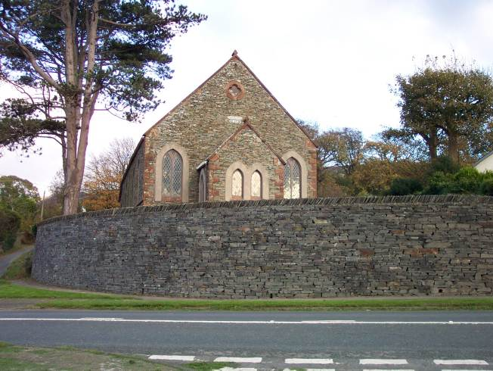
Kirkby Church of Christ
By 1824 a church after the ancient order was serving the Lord at Kirkby.
It was 30 years before anyone heard of Barton W. Stone or of Alexander Campbell

Slide 17
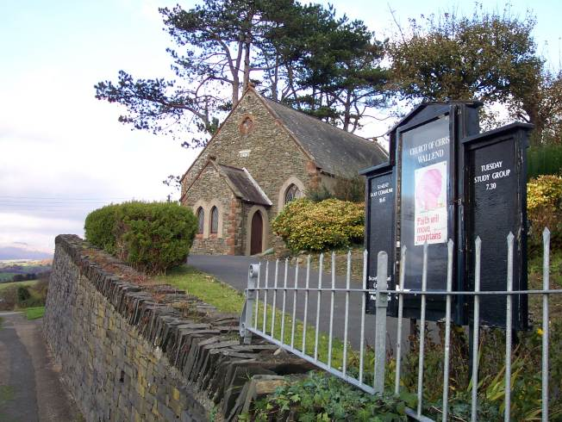
Kirkby Part In Digression
When the battle over the instrument raged, the Kirkby church added the instrument to its services
Today Kirkby church is known as the Wall End Christian Church.
It is the oldest continuous restoration church in Great Britain

Slide 18
Enlightenment Rationalism: Ideals Political & Religious
Intellectual Movement With Focus On Inner Self
Legitimate Authority Is Not Of Church Or Clergy
Reason vs. Revealed: Self - Defines & Discovers
Kant Religion: Moral Givenness / Imperative Duty
Theology : Experience-based - Subjective / Private
Descartes: Our Knowledge Of Divine Deductive
Locke Empiricism: All Knowledge Is Inductive
Labeled: “Scottish Common Sense Philosophy”
Know: Reflection, Reduction, Analysis, Analogy
Scottish Entitlement Theories : Politics & Religion
John Locke: “The Reasonableness of Christianity”

Slide 19
Enlightened Rationalism
The Enlightenment refers to the political and social theories that developed primarily in France during the 18th century.
John Locke, an Englishman, proposed the radical idea of natural rights.
Locke claimed that the purpose of government was to protect the natural rights of “life, liberty, and property.”

Slide 20
Enlightened Rationalism
The French expanded this idea in the work of Frenchmen like Rousseau, Voltaire, and Montesquieu.
Rousseau argued that people have the right and responsibility to rebel against a ruler who fails to protect their natural rights while Voltaire advocated that people have the right to freedom of speech, press, and religion.

Slide 21
Enlightened Rationalism
The French expanded this idea in the work of Frenchmen like Rousseau, Voltaire, and Montesquieu.
Montesquieu set about describing the perfect government system where three branches of government have separate powers that check and balance each other.
The French nobles didn’t like these radical ideas but several American readers did.

Slide 22
Enlightenment Rationalism: Ideals Political & Religious
Intellectual Movement With Focus On Inner Self
Legitimate Authority Is Not Of Church Or Clergy
Reason vs. Revealed: Self - Defines & Discovers
Kant Religion: Moral Givenness / Imperative Duty
Theology : Experience-based - Subjective / Private
Descartes: Our Knowledge Of Divine Deductive
Locke Empiricism: All Knowledge Is Inductive
Labeled: “Scottish Common Sense Philosophy”
Know: Reflection, Reduction, Analysis, Analogy
Scottish Entitlement Theories : Politics & Religion
John Locke: “The Reasonableness of Christianity”

Slide 23
Enlightenment Rationalism: Ideals Political & Religious
Intellectual Movement With Focus On Inner Self
Legitimate Authority Is Not Of Church Or Clergy
Reason vs. Revealed: Self - Defines & Discovers
Kant Religion: Moral Givenness / Imperative Duty
Theology : Experience-based - Subjective / Private
Descartes: Our Knowledge Of Divine Deductive
Locke Empiricism: All Knowledge Is Inductive
Labeled: “Scottish Common Sense Philosophy”
Know: Reflection, Reduction, Analysis, Analogy
Scottish Entitlement Theories : Politics & Religion
John Locke: “The Reasonableness of Christianity”

Slide 24
Scottish Enlightenment Setting
Roots: Erigena & Early Celtic Christianity
Roots: Dark Age Asceticism/Monasticism
Roots: Elizabeth Ousts French Catholic Regent
Roots: Scotch Calvinist Faith Confession (1560)
Roots: Reformed Churches Of Exiled John Knox
Roots: Reform Both Geographic & Theological
Roots: Reform England Motivated Most Political
Roots: Parliament Protestant Major Reform Party
Roots: Church-State “Common Bond” In Reform
Roots: Less Official Policy More Pure Principle
Roots: Less Episcopal More Presbyter In Form
Roots: Church Of Scotland Later Presbyterian

Slide 25
New Math Of HUMAN TRADITION
Conceptually Deficient Naturalistic Ethic
Start Point Not Human Value
Value-free Circular Reasoning
Parasitic Of Cultural Heritage
Subjective Preference System
Moral Equation Without Evil

Slide 26
Edward Hallett Carr On the Study of History How Vs. Why ~ Or ~ Function Versus Cause
“The true historian, confronted with this list of causes, would feel a professional compulsion to reduce it to order, to establish some hierarchy of causes which would fix their relation to one another, perhaps to decide which cause, or which category of causes, should be regarded as the cause of all causes.”
“Historians, like other people, sometimes fall into rhetorical language and speak of an occurrence as ‘inevitable’ when they mean merely that the conjunction of events leading one to expect it was overwhelmingly strong.”
Determinism Vs. Free Will. “In practice, historians do not assume that events are inevitable before they have taken place. They frequently discuss alternative courses available to the actors in the story on the assumption that the option was open, though they go on quite correctly to explain why one course was eventually chosen rather than the other. Nothing in history is inevitable except in the formal sense that, for it to have happened otherwise, the antecedent causes would have had to be different.”
Historical Accident Or Arranged Coincidence? “These so-called accidents in history represent a sequence of cause and effect interrupting historically and clashing – ‘a collision of two independent causal chains’.”
The Historian Marx. “Marx offered an apology for chance in history under three heads. First, it could accelerate or retard but not radically alter the course of events. Second, one chance compensated for another, so that in the end chance cancelled itself out. Third, chance was especially illustrated in the character of individuals.”
Meinecke’s Historical Observation: “The search for causalities in history is impossible without reference to values . . . behind the search for causalities there always lies, directly or indirectly, the search for values.”

Slide 27
New Math Of HUMAN TRADITION
Conceptually Sufficient Theistic Ethic
Bible Explains Moral Origins
Christian Belief Solid Ground
Theism Answers Moral Nature
Message Solves Moral Problem
Moral Imperative & Obligation
Dimension Of Moral Fulfillment

Slide 28
Calvin and (Thomas) Hobbes
Thomas Hobbes: Authored The Leviathan(1651)
Held the belief that people in a nutshell were stupid…
Well intentioned, but stupid.
Citizens need a strong leader to tell them what to do.
Given the chance, they will mess up society.
In nature…“no society; and which is worst of all, continual fear, and danger of violent death; and the life of man, solitary, poor, nasty, brutish, and short.”

Slide 29
All in the Fine Print..
Social Contact: An agreement among a society in order to cooperate for social benefits.
Locke: People give up the right to enact justice in exchange for life, liberty and gain the right to impartial protection of property.
Monopoly on violence.

Slide 30
Enlightenment Rationalism: Ideals Political & Religious
Intellectual Movement With Focus On Inner Self
Legitimate Authority Is Not Of Church Or Clergy
Reason vs. Revealed: Self - Defines & Discovers
Kant Religion: Moral Givenness / Imperative Duty
Theology : Experience-based - Subjective / Private
Descartes: Our Knowledge Of Divine Deductive
Locke Empiricism: All Knowledge Is Inductive
Labeled: “Scottish Common Sense Philosophy”
Know: Reflection, Reduction, Analysis, Analogy
Scottish Entitlement Theories : Politics & Religion
John Locke: “The Reasonableness of Christianity”

Slide 31
Locke in Your Rights
John Locke: Author of Second Treatise on Government (1689)
Coined the term “Natural Rights”
Rights that every human has from their birth.
Right to happiness, life, freedom etc.
His writings inspired social, political and even religious reform movements.

Slide 32
Scottish Movement
PRE-RESTORATION

Slide 33
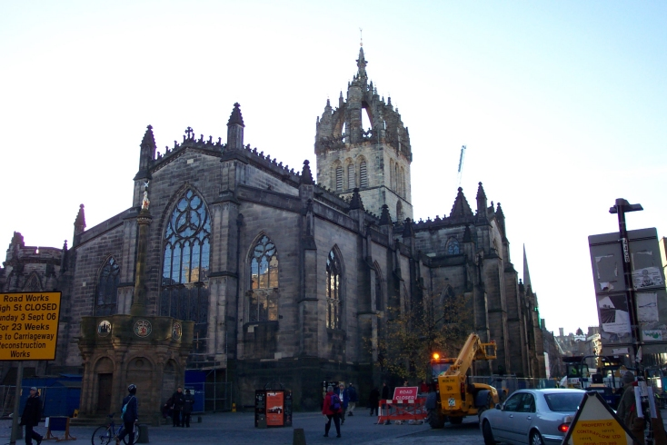
St. Giles Church: Home Of The Church Of Scotland

Slide 34
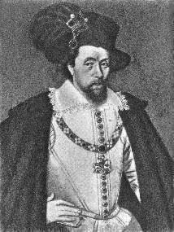
Reform After Knox
May, 1597, King James VI Of Scotland Became Involved In Reformed Church Affairs: John Knox Preached At His Coronation
1603 – Ascended To English Throne As King James I
Sought To Unite Scottish Reform With English Church
Authorized An English Version Of The Bible To Be Translated – King James Version - 1611
In August 1647 The General Assembly Of Edinburgh Adopted “Westminster Confession Of Faith” Binding The Churches Of Britain

Slide 36
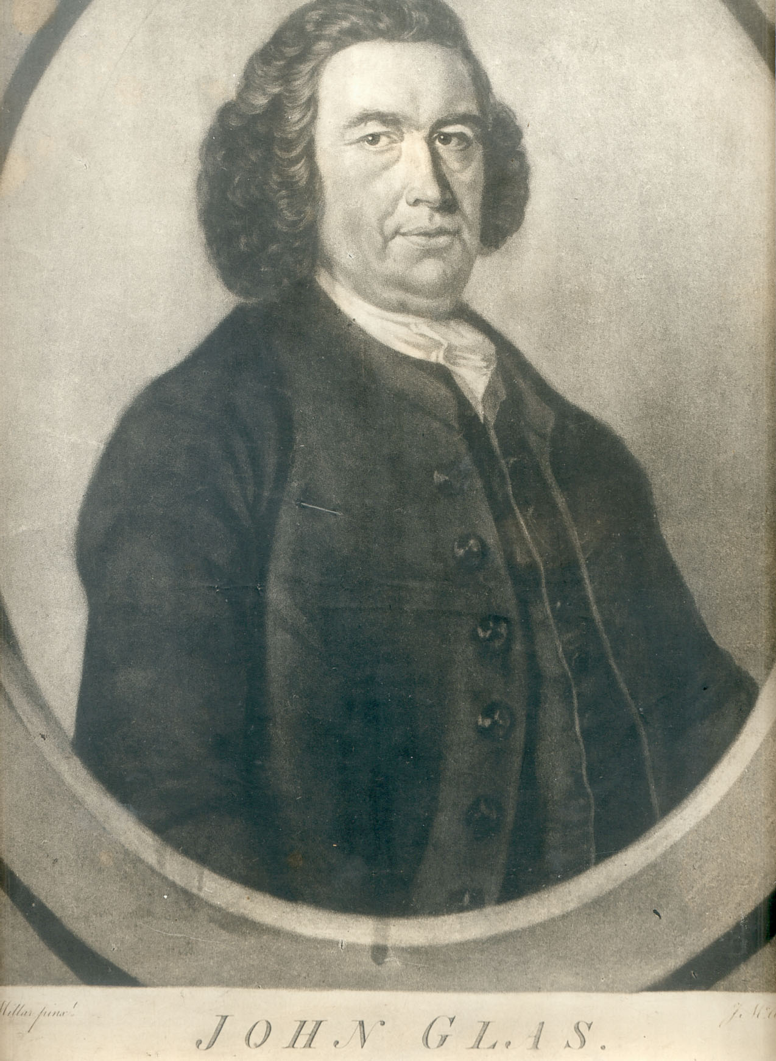
John Glas 1695-1773
See More At http://www.TheRestorationMovement.com/

Slide 37
John Glas 1695-1773
Born September 21, 1695
His Father, Thomas Was Minister Of The Church of Scotland
Attended Grammar School At Perth, Later Attending St. Leonard’s College at St. Andrews. Received M.A. May 6, 1713
Then Attended University Of Edinburgh
Received A Calvinistic Education Both At Home & University
Licensed As A Presbyterian Minister At Dunkeld Presbytery On May 20, 1718, Later At Tealing In Forfarshire May 6, 1719
At Tealing Presbyterian Church 5 Years

Slide 38
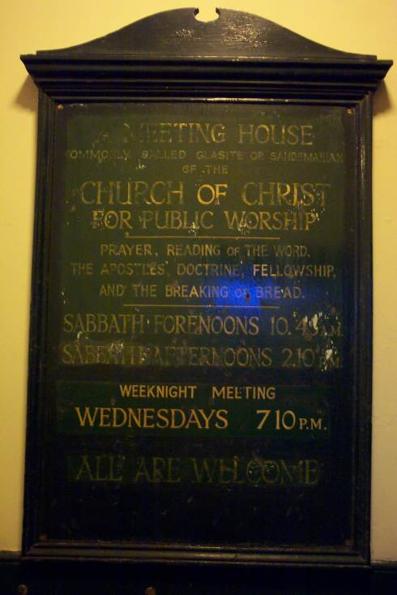
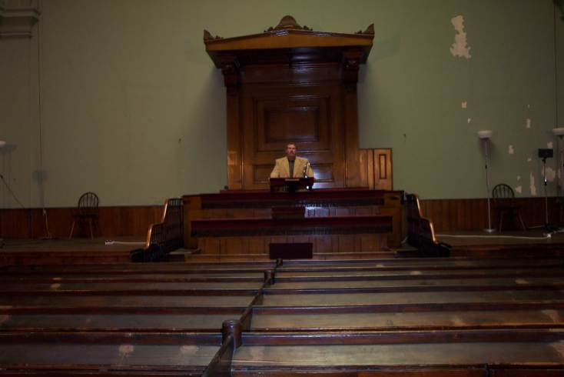
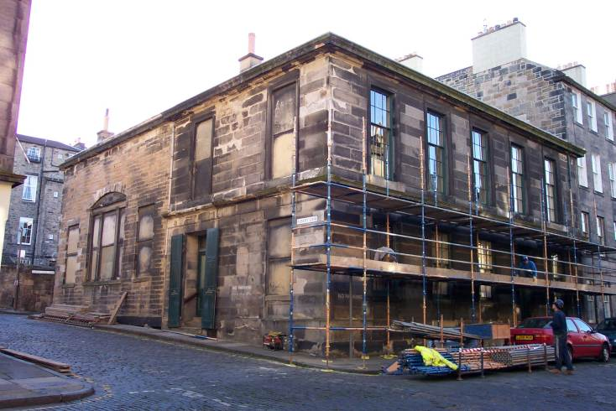
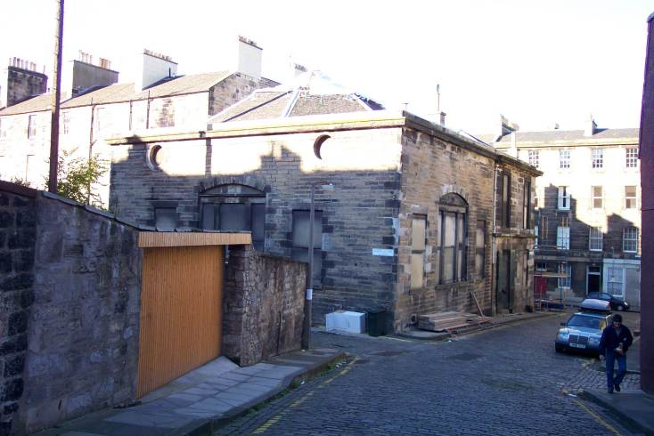
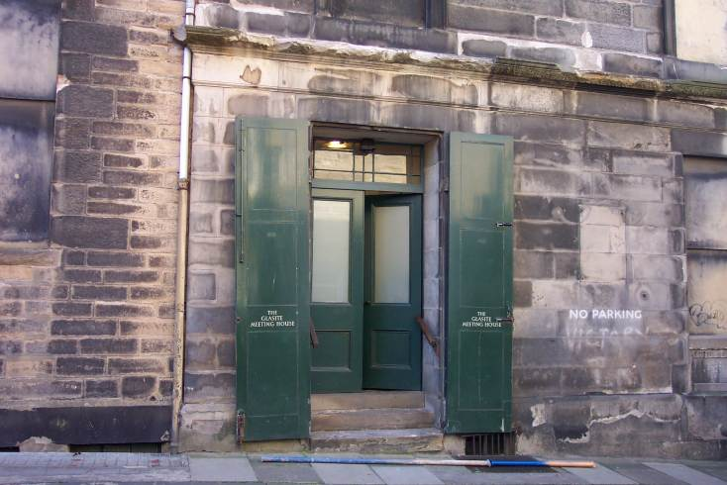
Glasite Church In Edinburgh
See More At http://www.TheRestorationMovement.com/

Slide 39
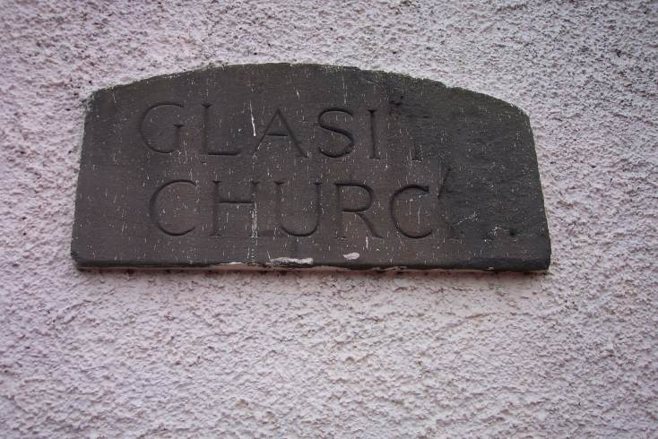
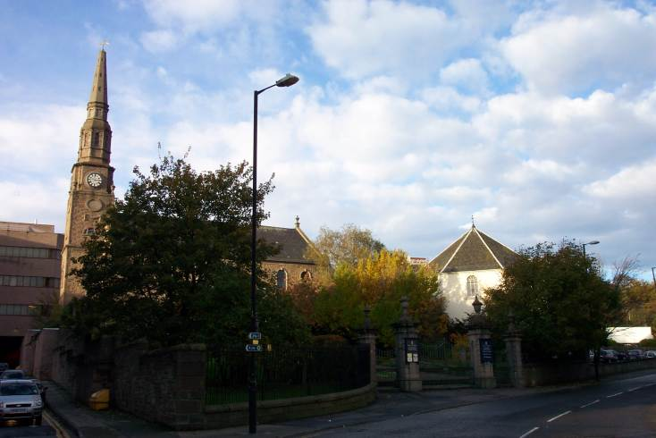
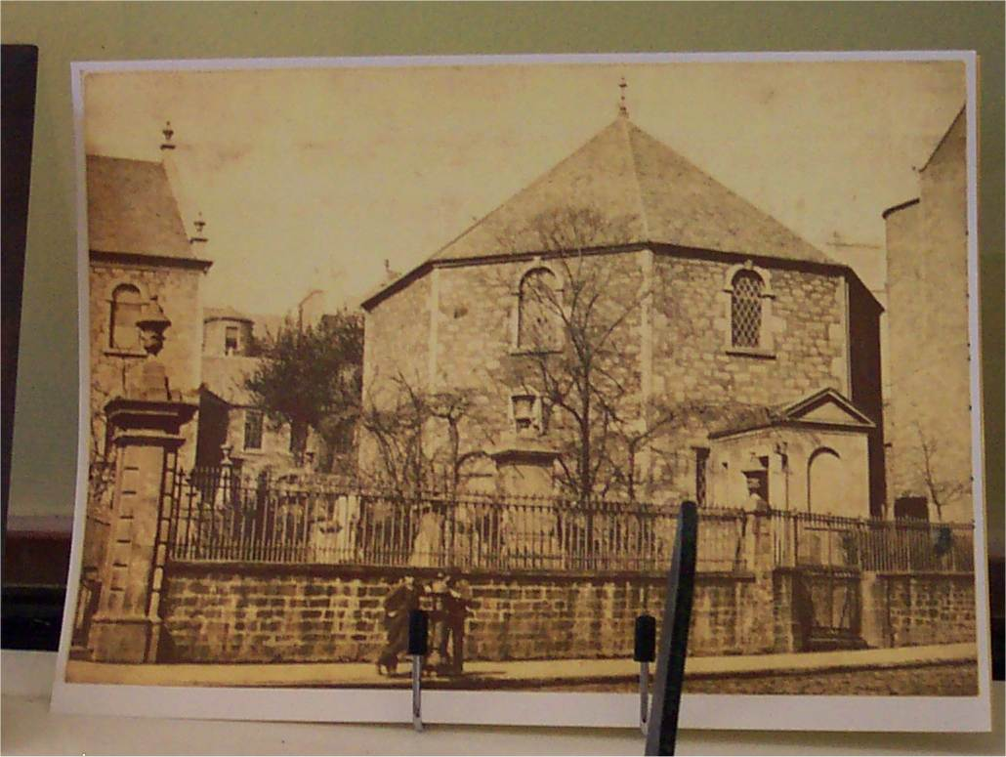
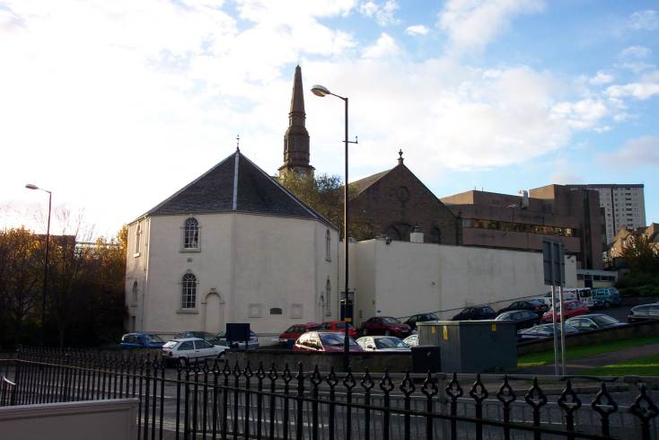
Glasite Church - Dundee

Slide 40
Glasite Church - Dundee
See More At http://www.TheRestorationMovement.com/

Slide 41
John Glas 1695-1773
1727 – Wrote The Testimony Of The King Of Martyrs Concerning The Kingdom
Against State Churches &
Intervention Of Civil Authorities In Church Matters
Believed:
The Church Is Made Up Of Those Who Experienced The Grace Of Christ
Separated Themselves From The World
Gathered Themselves In The Church
Therefore, No Place For Civil Affairs
Separated From Tealing Church, July 13, 1725, Starting An Independent Church
100 People Followed
Agreed To Follow Christ As Lord
Subjected Themselves To Glas’ Leadership
Observed The Lord’s Supper Monthly (Not Quarterly Like Scottish Church)
Followed Matthew 18 – Church Discipline
Formed A Society Of Believers

Slide 42
John Glas 1695-1773
Divisions Continue
August 6, 1726 – At Strathmartine
Taught John 18:36,37 – Christ’s Kingdom Is Not Of This World
No Earthly Civil Designation Of Authority (Against Physical Kingdom Teaching In That Day)
Close To Treason
Brought Before A Number Of Synods
Aug. 1726 – Synod of Angus & Mearns
Sept. 6, 1726 – Synod Of Dundee
Oct. 1727 – Synod of Montrose
April, 1728 – Synod Of Angus & Mearns
Members Submitted 26 Questions To Glas And His Reply Was Discussed
Glas Was Suspended As Presb. Minister
Appeal To General Assembly At Edinburgh May 2, 1728

Slide 43
John Glas 1695-1773
Still More Presbyterian Synods
Oct. 17, 1728 – Synod Of Dundee
Should They Suspend Or Depose Glas?
He Was Deposed
Mar. 12, 1730 – Appealed To Highest Presbyterian Court Who Confirmed The Sentence To Depose Him
1739 The General Assembly Broke Precedence And Revoked The Sentence Of Deposition
Though It Restored Glas As A Minister, It Did Not Restore Him As A Minister In The Church of Scotland
Glas Never Requested This, But Its Happening Showed A Sign Of Softening Against Congregationalism

Slide 44
John Glas - 1695-1773
Last Years Of Ministry
1730 – Continued To Minister To New Tealing Society
Moved To Dundee To Support Himself By Opening A Bookstore
Moved To Perth In 1733
His Independent Reputation Was Not Quickly Accepted
When Opening A New Meetinghouse There Some In Town Threw Mud At Attendees
George Miller, The Town Clerk Intervened And Kept The Meetinghouse From Destruction
1734 Established A Congregational Church in Edinburgh
Met Robert Sandeman There
Later Became His Son-In-Law
Died November 2, 1773 – 78 Years Old
Survived By 15 Children, Wife Died In 1749
Most Of Family Buried At Dundee In “Old Howff” Cemetery

Slide 45
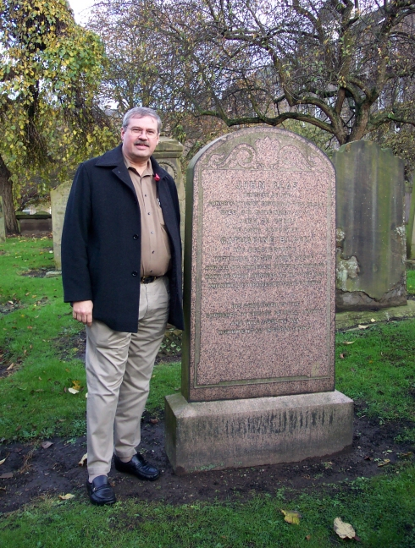
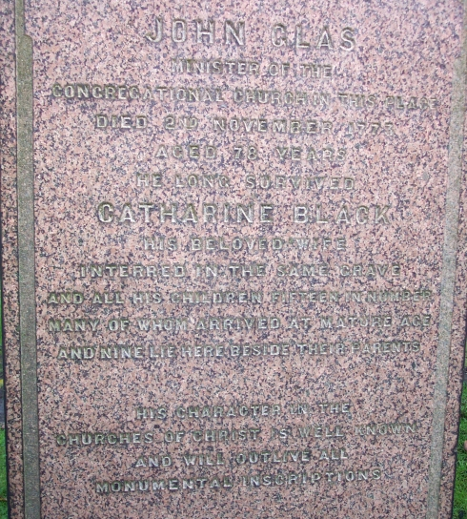
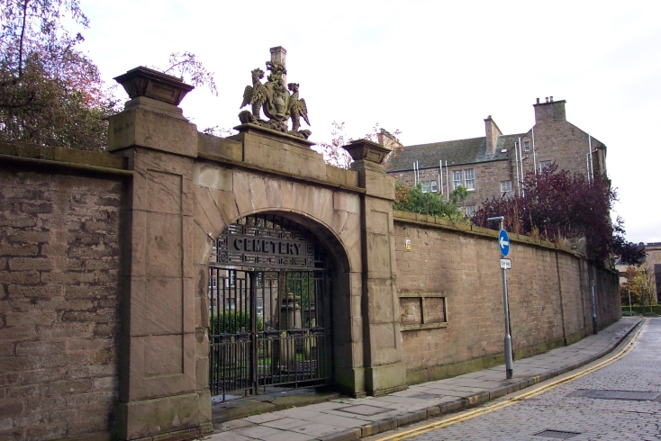
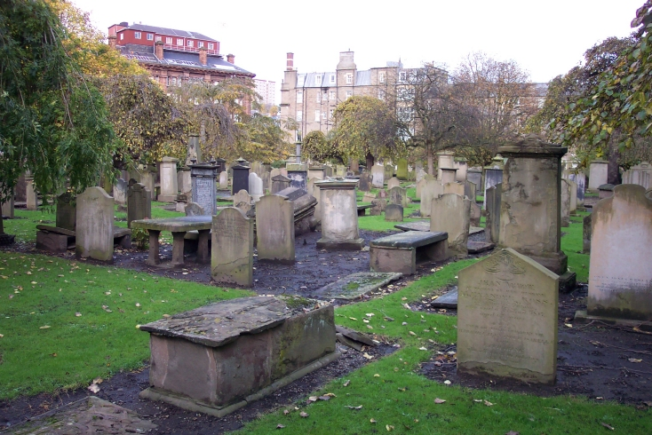
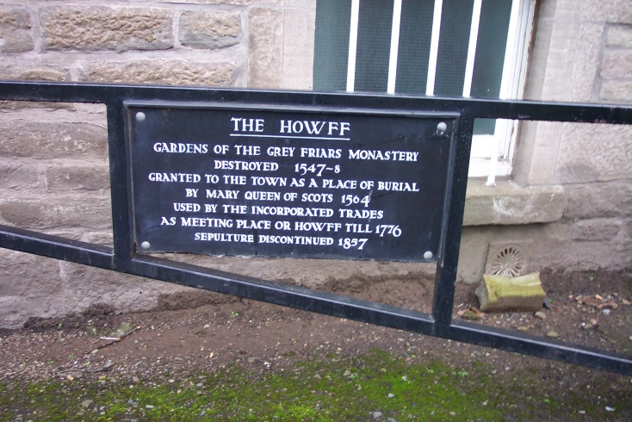
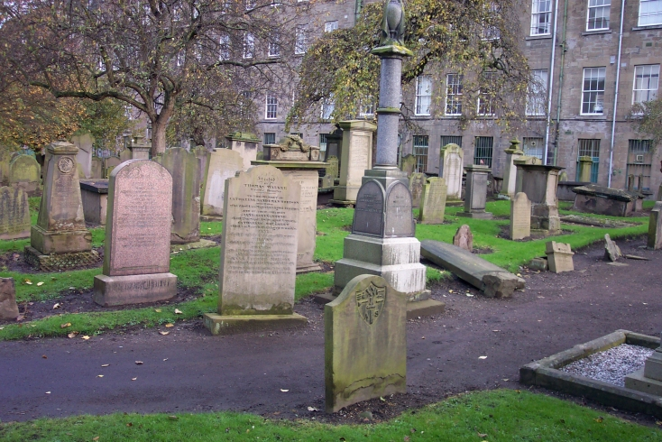
John Glas – Buried In Howff
See More At http://www.TheRestorationMovement.com/

Slide 46
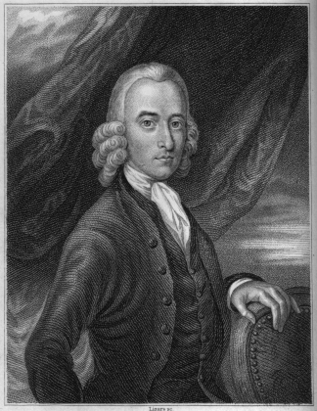
Robert Sandeman 1718-1771
See More At http://www.TheRestorationMovement.com/

Slide 47
Robert Sandeman 1718-1771
Born April 19, 1718
Father, David, A Linen Merchant And Magistrate In Perth
Attended University Of Edinburgh To Prepare For The Ministry In Church Of Scotland 0 1734
As A Youth He Became Acquainted With Glas Ideas
1735 Choosing To Give Up Ministry Idea, He Returned To Perth To Begin An Apprenticeship In Weaving Business
1737 He Married Katherine, Daughter Of John Glas
1740 Set Up A Weaving Business
1756 His Brother Married Another Of Glas’ Daughters

Slide 48
Robert Sandeman 1718-1771
1744, Age 26 – Became Elder Of Perth Congregational Church
Preached For Next 16 Years At Perth, Dundee & Edinburgh
1757 – Wrote 2 Volume Work, Letters On Theron And Aspasio Against James Harvey’s Teachings On Calvinism
James Hervey Had Written An Apologetic Of Calvinism Called Theron And Aspasio – 1755
As A Result Of Letters On … Many English Congregational Churches Began Appearing
1761 – He And Brother William Went To London To Teach His Congregational Ideas
By 1766 Many Congregational Churches Are In England

Slide 49
Some Beliefs Of The Glasites/Sandemanians
Believed They Could Reenact 1st Century Order In Christianity
Denied Tenets Of Calvinism
Had Lord’s Supper Every Sunday
Observed Love Feasts
Had Foot-Washings
Mutual Exhortations
Casting Lots, etc.

Slide 50
Robert Sandeman 1718-1771
American Influence
1760 – Letters On Theron And Aspasio Appear In Colonies
1763 – He Receives A Letter Urging A Visit To America
August 30, 1764 Sandeman Departs Scotland Arriving In Boston Harbor, Oct. 18, 1764
Glas/Sandemanian Churches Established In Connecticut, Rhode Island, Massachusetts, & Other New England States
Sandeman Died In Danbury, Connecticut, April 2, 1771 At 53 Years Of Age, Two Years Before Glas In Scotland

Slide 51
A. Campbell & B. Stone Water Seeds Sown & Soils Cultivated Robert Sandeman’s Groundwork
Sandeman of Scotland makes his reputation as a Biblical scholar both at home and in England when - before the Revolutionary War - in the middle of the great debate between the Calvinists and the evangelicals – he has his dispute with well-respected James Harvey over imputation and justification. He joined the ranks of John Wesley in proclaiming faith as the start of salvation not the sign of achieved accomplishment.
“Correspondence with God” was Sandeman’s way of referring the saving relationship which he felt began with man’s faith toward God. That faith was strengthened and completed by divine activity on the soul. The atonement was not limited to the few elect but extended to all and the choice for salvation within man rather than with God’s predestination.
His greatest inroads and impact with this message was among those considered Congregationalists.
The man and message almost single-handedly started the Welsh Reformation movement and over time through his writings – influenced an entire generation of influential society – including war leaders the likes of Lloyd George.

Slide 52
A. Campbell & B. Stone Water Seeds Sown & Soils Cultivated Robert Sandeman’s Groundwork
Sandeman of Scotland makes his reputation as a Biblical scholar both at home and in England when - before the Revolutionary War - in the middle of the great debate between the Calvinists and the evangelicals – he has his dispute with well-respected James Harvey over imputation and justification. He joined the ranks of John Wesley in proclaiming faith as the start of salvation not the sign of achieved accomplishment.
Sandeman came to the British Colonies before the later movement leaders and established the first church of Christ on American soil on May 4, 1765 at Portsmouth, New Hampshire.
His church planting was very successful until stymied by his counsel of loyalty to the King during the Revolution.
He is buried at Danbury, Connecticut with this tombstone epitaph: “Who in the face of continual opposition, from all sorts of men, long and boldly contended for the ancient faith; That the bare work of Jesus Christ, without a deed or thought on the part of man, is sufficient to present the chief of sinners spotless before God.”

Slide 53
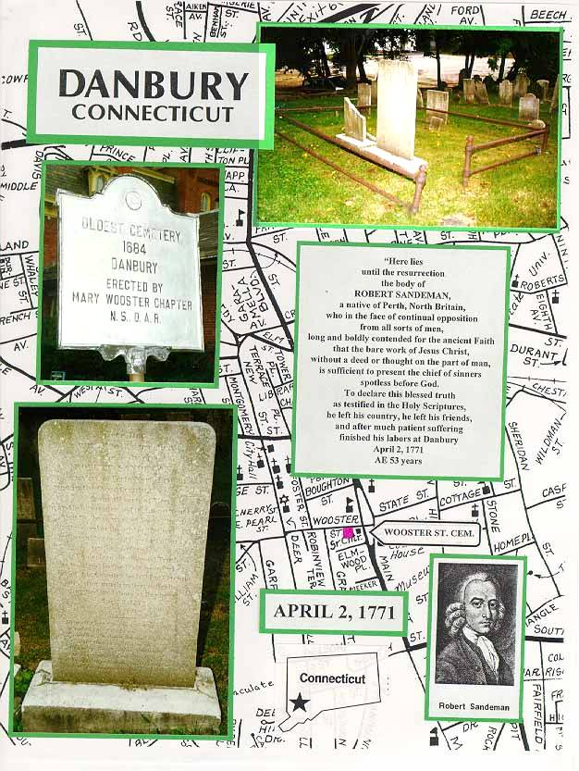
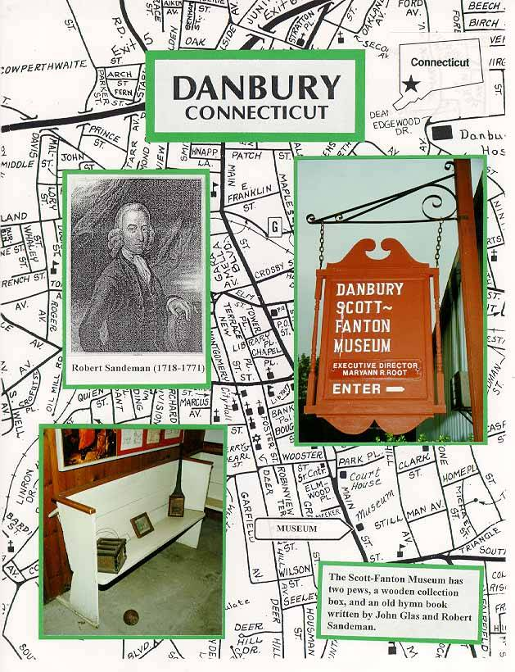
Robert Sandeman, Danbury, Conn.
See More At http://www.TheRestorationMovement.com/

Slide 54
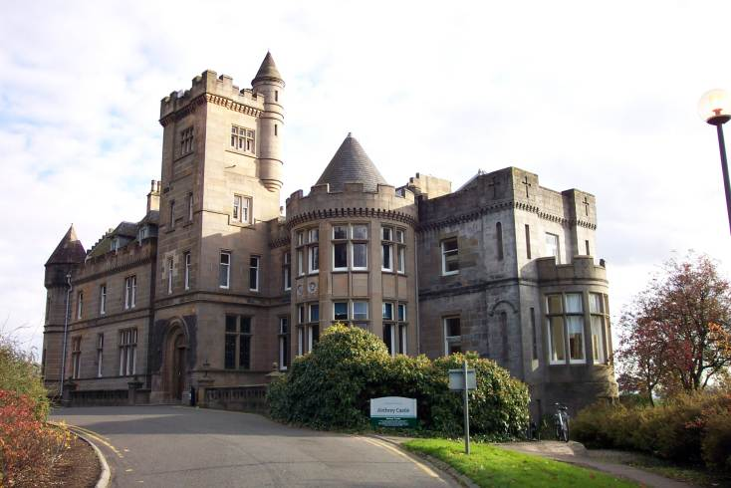
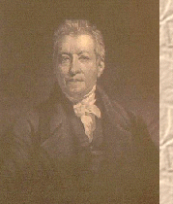
Robert & James Haldane - Airthrey Castle, Sterling -
James Haldane 1768-1851
See More At http://www.TheRestorationMovement.com/

Slide 55
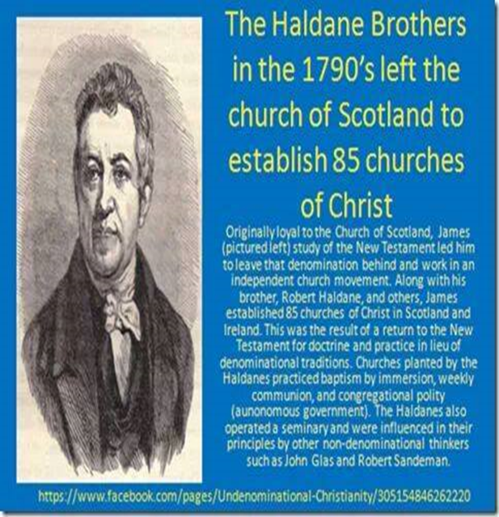
Robert & James Haldane
1798 – Started A Church In England After The Order Of Glas/Sandeman
The Tabernacle Church – Began 1799 With 310 People
Lord’s Supper Was Administered Every Sunday
Weekly Collections Were Taken
Haldane Brothers Operated Schools Throughout England
Close Friends To Greville Ewing
Associated With Baptists
James Haldane 1768-1851

Slide 56
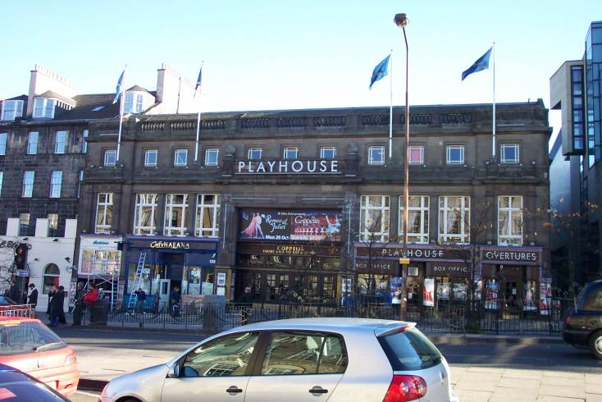
Haldane Tabernacle - Edinburgh
See More At http://www.TheRestorationMovement.com/

Slide 57
Tabernacle Church Teaching
N.T. Contained The Pattern For All Christian Service
Apostolic Church Model Provided Church Model For All Ages
Thus Teaching “Restoration” Or “Restitution”
Congregational Autonomy
Elders Served In Each Congregation, Teaching & Ruling
Each Church Had Its Own Deacons & Minister
Civil Authorities Had No Right In Church Matters
Weekly Observance Of The Lord’s Supper
By 1808 Both Haldanes Believed That Immersion Was The Only Proper Mode Of Baptism
Haldanes Differed With Glas Over Discipline, Took A More Loving Approach

Slide 58
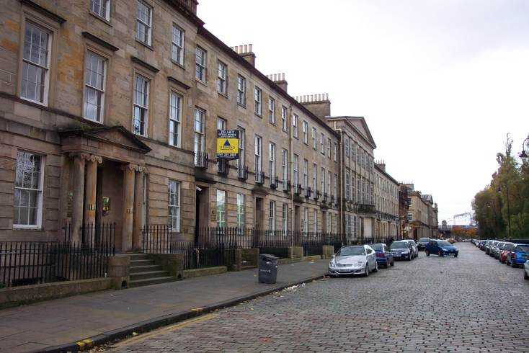
Greville Ewing
1767-1841
Street Where Ewing Lived In Glasgow Facing The River Clyde
See More At http://www.TheRestorationMovement.com/

Slide 59
Greville Ewing
1767-1841- Born In Edinburgh, Scotland
Supported Mission & Congregationalism In Scotland
Founding Member & Secretary Of Edinburgh (Later Scotland) Missionary Society, March, 1796
Street Where Ewing Lived In Glasgow

Slide 60
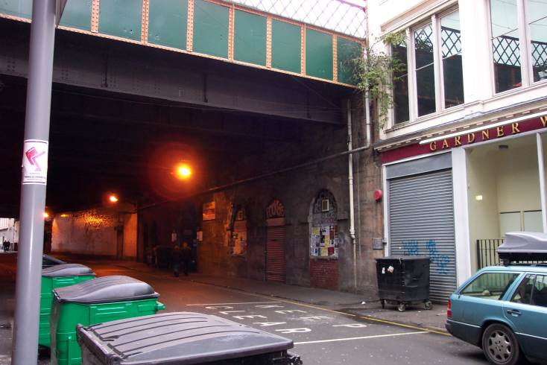
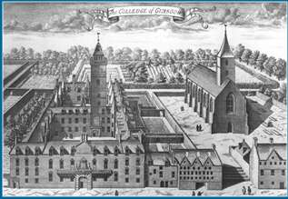
Influence Of Greville Ewing
Met And Worked With Haldane Brothers Until 1808 Teaching In Schools, Preaching
1800-1839 – Minister Of Mother Church of Scottish Congregationalism, Glasgow, Scotland
Instructed At University of Glasgow
One Of His Students 1808 - 1809 School Year Was A Young Alexander Campbell
The Haldane Church In Glasgow Where
Ewing
Preached
Old Glasgow University

Slide 61
Church
History
The Restoraton
Four Basic Principles of the Restoration
New Testament as the Only Authoritative Rule of Faith and Practice.
Renunciation of All Human Creeds; Human Creeds Are Divisive by their Very Nature.
Restore Apostolic or New Testament Concept of the Church in the Minds of Men.
Union of All Christians upon the Basis of the Bible.

Slide 62
Restoration Valued Tradition Descriptively Not Normatively
“I believe the Christian religion in the West, as it habitually read the Bible backwards through the [Greek -influenced] lenses of later Christians, largely lost track of the frontward story line of Adam, Abraham, Moses, and so on, within which Jesus had emerged. It unwittingly traded its true heritage through Jesus from Judaism for an alien heritage drawn from Greek philosophy and Roman politics. Thru this profound & unconscious syncretism (or mixing of sources), biblical data was reframed by the Greco-Roman narrative.”
– Recent from Author Brian McLaren

Slide 63
Church
History
The Restoraton
Five Cardinal Principles
The Lord Jesus Christ as the Only Head of the Church.
The name Christian to the exclusion of all party and sectarian names.
The Holy Bible, or the Scriptures of the Old and New Testaments as the only creed, and a sufficient rule of faith and practice.
Christian character, or vital piety, the only test of church fellowship and membership.
The right of private judgment and the liberty of conscience, the privilege and duty of all.

Slide 64
Reformation Of Thomas Campbell
Thomas became a member of the the church of the Secession, which broke off from the church of England in 1733. This particular group of Seceders had broken with the Scotland church and were thus known as the “Seceder Presbyterian Church.” Thomas believed that God was to be worshipped as “it is written rather than an act of parliament” & the religious switch displeased his father. Thomas Campbell placed membership with the Old Light Anti-Burgher Church in the town where he had been born. This is also where he first preached. In this city Thomas met and married a French Hugenot girl named Jane Corneigle, who attended there where Thomas preached. Their first son, Alexander, was born similarly in Antrip, a year later on September 12, 1788.

Slide 65
Reformation Of Thomas Campbell
After his marriage, Thomas preached for the church in Ahorey and settled on a small farm near Rich Hill. His ministerial duties included the visiting of membership twice a year to examine the families’ Bible knowledge. Families were always expected to keep the Lord’s day holy, and upon returning home from worship, all members were quizzed upon the main points of the sermon. These exercises were done out of love, rather than as a mere duty.
After reading John Locke’s Letters Concerning Toleration & The Reasonableness of Christianity, Thomas spoke pleading for church unity at the 1805 Belfast Presbyterian Summit. The early 1800’s were troublesome times in Scotland & Ireland. On one occasion Welsh guardsmen surrounded the Ahorey church and the troops captain marched into the building while Thomas was preaching. Thomas recited the 46th Psalm & the officer left without a word. Although ultimately his union efforts would bear fruit, he was then frustrated and had became exhausted; it was then that his personal physician suggested a short term change of climate.

Slide 67
Formation Of Alexander Campbell
Alex Campbell was born near Ballymena County, Antrip, Ireland, on September 12, 1788. His boyhood was spent on a farm near Rich Hill, ten miles from the town of Newry where his father Thomas, lived while preaching for the Seceder Presbyterian church at Ahorey. This area is in the northeastern section of Ireland, approximately thirty miles from Belfast.
Alexander’s education began at Market Hill and continued in an academy taught by his uncles Enos and Archibald Campbell. In his youthful days Alexander was not inclined toward study. A stout and vigorous lad, he was a lover of God’s great outdoors. He was fond of fishing and trapping wild animals. Athletics had more attraction for him than education. A friend of the family, James Foster, says that the first time he saw Alexander, he had a long pole in his hand with a net attached to one end catching small birds under the eaves of houses on the outskirts of town. Alex was fifteen years old at the time.

Slide 68
Formation Of Alexander Campbell
The youthful Alexander worked as a laborer on the family farm. The physical labor helped develop his strong body which served him well in the rigorous schedule of later life. It was not long after the Telemachus episode when the physical energy of the boy began to be converted into the intellectual powers of a man. John Locke’s Letters of Toleration and his Essay on the Human Understanding were the first books that profoundly impressed his mind. Alexander soon lost interest in his former activities and became ‘one of the best scholars in the kingdom.’
Under his father’s guidance he read extensively in literature, philosophy, and religion. He also studied Latin and Greek under his father’s tutelage.
His memory became remarkably retentive. On one occasion he memorized sixty lines of blank verse in fifty-two minutes without missing a word.

Slide 69
“It’s fundamental thesis is the author’s conviction that the Christian faith, as he understands it, stripped of the superfluous and confusing dogmatic accretions of creeds and theologies, appeals to reason & common sense.”
JOHN LOCKE'S "THE REASONABLENESS OF CHRISTIANITY"

Slide 70
Formation Of Alexander Campbell
Alexander Campbell grew up in a home that had respect for the Bible. The Seceder Presbyterian church required each family to have daily family worship. Thomas and Jane Campbell required each family member to memorize portions of the scriptures during the day to be recited at the evening devotion. All the passages learned during the week were to be repeated again on the Lord’s day. Later in life Alexander commented on his parents, ‘to my mother as well as my father, I am indebted for having memorized in early life almost all the writings of King Solomon, his Proverbs, his Ecclesiastes, and many of the Psalms of his father David.’
As a teenager Alex truly became interested in spiritual matters. Like his father, he was expecting some peculiar assurance of forgiveness, such as dreams, visions, voices, & emotional tugs, this being the teaching from every pulpit.

Slide 71
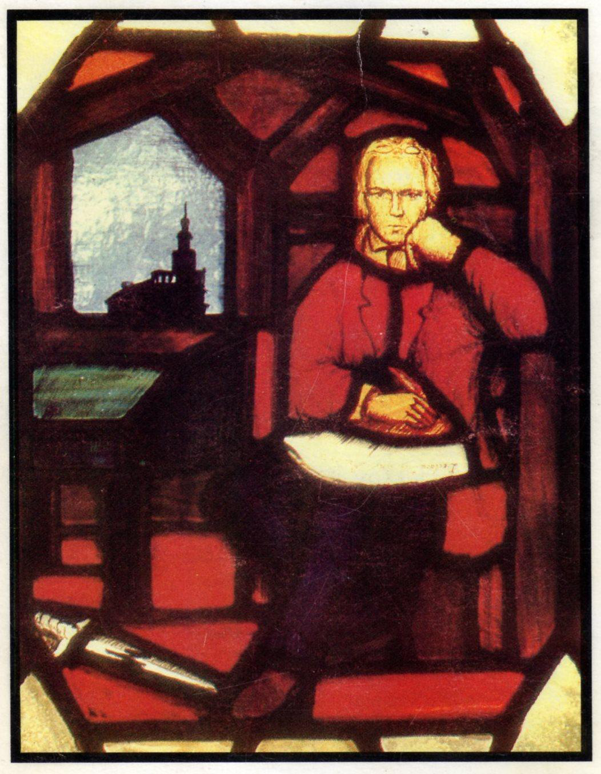

Slide 72
Father-Son Campbells Movement Part 1: Father Thomas Campbell
David Lee Burris:
Scottish Seceders Only Took Communion Once Every Six Months
Although Originally Of Northern Ireland Member Of Scottish Seceder Presbyterians
Taught Plural Elders & Free Will Offering
Studied Scottish Common Sense Reasoning
Worked For Wider Christian Fellowship – Deeper Piety – The Early Simple Practices
Against Member Creeds & Faith Confessions
Fired For Not Only Congregation Communion
Denomination Disciplined - Formed Society – Issued Statement Of “Declaration & Address”:
“Where the Scriptures speak, we speak; and
where the Scriptures are silent, we are silent.”

Slide 73
PROTESTANT PRELUDE “Second Great Awakening”
Francis Asbury North American Bishop
METHODIST
Thomas Campbell of Scotland
PRESBYTERIAN
Timothy Dwight of Massachusetts
CONGREGATIONAL

Slide 74
Father-Son Campbells’ Movement Part 2: Son Alexander Campbell
David Lee Burris:
Creeds Were Inadequate To Unite Because They Limit Fellowship. Creeds Are Illogical Because Since They Claim To Mirror Bible Truth They Are Unnecessarily Redundant. However, these claims are false – they either add or subtract from the gospel message!
Within Weeks Of The “Declaration & Address” Thomas & Son Alexander End Their Separation
As A Matter Of Conscience He Has Similarly Severed Himself From The Seceder Brotherhood
He Had Questions For Which He Found No Answers – This In Turn Led Him To Conclude The Church Itself Had Wandered From Its Source
He Was Especially Incensed That They Would Not Tolerate The Healing Of Religious Divisions.
While Enrolled At Glasgow, Scotland University He Also Attends Independent Haldane Seminary; Here He Is Exposed To Glas & Sandeman’s Ideas
Faith In Clergy, Creeds, & Confessions Is Altered: “Nothing That Was Not As Old As the New Testament Should Be Made An Article Of Faith.”
He Felt Creeds Sectarian & Clergy Self-Serving. Creed – “Root Of Bitterness Apples Of Discord.”
He Felt Career Clergy Had Erected Fences Of Legalistic Dogma & Had Positioned Themselves As The Gatekeepers. He believed the title “Reverend” belongs only to God.
His New Wife Suggested From Ecclesiastes 3:3 That The Season For Breaking Down Fences Was Over & Was Time To Transcend Fences.
Firmed For Congregational Autonomy, Each Week Communion, & Only Believers Baptism
His Dad & He Conclude The Church Is Corrupt & Bigoted Both Old World & New; Alexander Especially Dedicated Fulfilling First Of Thirteen Propositions In Dad’s Declaration – “Polar Star” Of Christian Unity: “(Church) Is Essentially, Intentionally, & Constitutionally One.”
They Both Think God Has Sent Them To This Place Of Freedom Of Conscience & Thoughtful Expression As An Outworking Of Providence
Even Under Frontier Conditions Religious Issues Like Infant Baptism Were Divisive To The Degree That Nearby Neighbors Had Not Spoken In Many Years

Slide 75
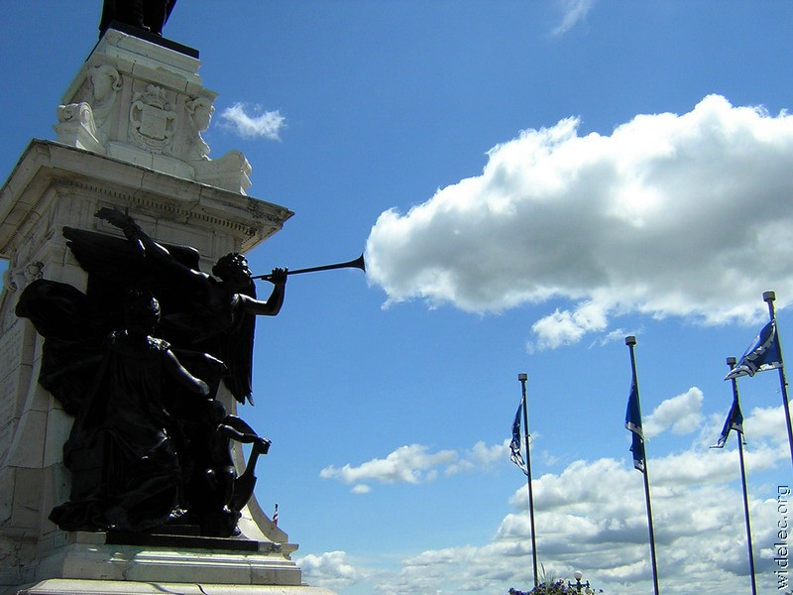
SCOTLAND EXPORTS THE RESTORATION MOVEMENT

Slide 76
American Frontier
PRE-RESTORATION

Slide 77
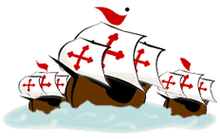

Slide 78
COLUMBUS' DISCOVERY OF AMERICA
& THE BEGINNING OF THE REFORMATION
25 YEARS APART!

Slide 79
According to Columbus’ private ships’ log:
On 9 October, after 67 days at sea, he was forced to promise his restless crew
That if land were not spotted within three days, he would turn back for home.
On the morning of the third day, 12 October, his lookout announced landfall.

Slide 80
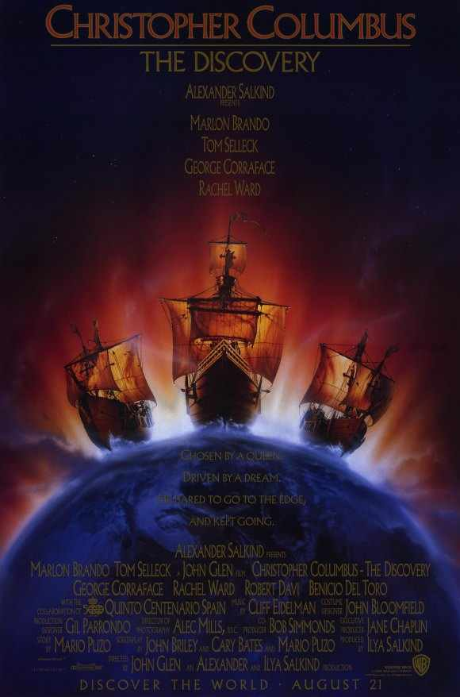
SHIP’S LOG ENTRY 11OCT1492 @10PM:
First seen is a glimmering light that has come out of the sea;
It dances up & down before us & pulsates as it passes beside.
The last note of this light moving before the ship was four hours before sight of land!

Slide 81
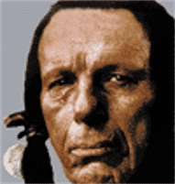
New Canaan Land? Indians Told Pilgrims:
David Lee Burris:
American Indians did not have a concept of religion as something separate from their approach to all aspects of life. Despite intertribal differences, most Indian spiritual ideas shared several characteristics and among them was a belief in a Great Spirit who presides over the whole world; English Account Of Causes Of The Rebellion - “It would appear that political liberty originated with the Iroquois Confederacy. Where else would an obedient Englishman get such an idea, anyway.”
“Mugwumps” – Mugwump was one of the Algonquian words in Elliot’s translation of the Bible, came into the American language in the 1880’s. In Elliot’s Bible a mugwump was a great chief, such as Joshua, Gideon, or Joab. Later New Englanders used the word in mockery for a self-conceited politician and then in general use from 1884 to mean an political independent.
Massachusetts Bay Colony Seal Had The Picture Of An Indian & The Words Of The Macedonian Call!
To teach the Indians about hell Spanish friars roasted live cats and dogs in a portable oven!
CHIEF JOSEPH LATER STATED:
"The white man's god gave
him dominion over the beasts,
the woods, and the red man,
for some special purpose,
but that destiny is a
mystery to the red man."
“We heard you were a
people that came from
under the world to take
our world from us!”

Slide 82
New Canaan Land? Indians Told Pilgrims:
David Lee Burris:
American Indians did not have a concept of religion as something separate from their approach to all aspects of life. Despite intertribal differences, most Indian spiritual ideas shared several characteristics and among them was a belief in a Great Spirit who presides over the whole world; English Account Of Causes Of The Rebellion - “It would appear that political liberty originated with the Iroquois Confederacy. Where else would an obedient Englishman get such an idea, anyway.”
“Mugwumps” – Mugwump was one of the Algonquian words in Elliot’s translation of the Bible, came into the American language in the 1880’s. In Elliot’s Bible a mugwump was a great chief, such as Joshua, Gideon, or Joab. Later New Englanders used the word in mockery for a self-conceited politician and then in general use from 1884 to mean an political independent.
Massachusetts Bay Colony Seal Had The Picture Of An Indian & The Words Of The Macedonian Call!
To teach the Indians about hell Spanish friars roasted live cats and dogs in a portable oven!
SITTING BULL SPEAKS ABOUT THE WHITE MAN:
“The love of possession is a disease with them.
These people have made many rules that
the rich may break but the poor may not.
They take their taxes from the poor & weak
to support the rich and those who rule.”
“We heard you were a
people that came from
under the world to take
our world from us!”

Slide 83
New Canaan Land? Indians Told Pilgrims:
David Lee Burris:
American Indians did not have a concept of religion as something separate from their approach to all aspects of life. Despite intertribal differences, most Indian spiritual ideas shared several characteristics and among them was a belief in a Great Spirit who presides over the whole world; English Account Of Causes Of The Rebellion - “It would appear that political liberty originated with the Iroquois Confederacy. Where else would an obedient Englishman get such an idea, anyway.”
“Mugwumps” – Mugwump was one of the Algonquian words in Elliot’s translation of the Bible, came into the American language in the 1880’s. In Elliot’s Bible a mugwump was a great chief, such as Joshua, Gideon, or Joab. Later New Englanders used the word in mockery for a self-conceited politician and then in general use from 1884 to mean an political independent.
Massachusetts Bay Colony Seal Had The Picture Of An Indian & The Words Of The Macedonian Call!
To teach the Indians about hell Spanish friars roasted live cats and dogs in a portable oven!
CHIEF RED JACKET IN 1805 SAID:
“Brother, you say you are sent to instruct us
how to worship the Great Spirit agreeably to his mind, and
if we do not take hold the religion which you white people teach,
we shall be unhappy hereafter; you say that you are right,
And we are lost; how do we know this to be true?”
“We heard you were a
people that came from
under the world to take
our world from us!”

Slide 84
New Canaan Land? Indians Told Pilgrims:
David Lee Burris:
American Indians did not have a concept of religion as something separate from their approach to all aspects of life. Despite intertribal differences, most Indian spiritual ideas shared several characteristics and among them was a belief in a Great Spirit who presides over the whole world; English Account Of Causes Of The Rebellion - “It would appear that political liberty originated with the Iroquois Confederacy. Where else would an obedient Englishman get such an idea, anyway.”
“Mugwumps” – Mugwump was one of the Algonquian words in Elliot’s translation of the Bible, came into the American language in the 1880’s. In Elliot’s Bible a mugwump was a great chief, such as Joshua, Gideon, or Joab. Later New Englanders used the word in mockery for a self-conceited politician and then in general use from 1884 to mean an political independent.
Massachusetts Bay Colony Seal Had The Picture Of An Indian & The Words Of The Macedonian Call!
To teach the Indians about hell Spanish friars roasted live cats and dogs in a portable oven!
CHIEF RED JACKET IN 1805 SAID:
“Brother, you say there is but one way to worship
and serve the Great Spirit; if there is but one religion,
why do you white people differ so much about it?
Why do you not agree, as you can all read the book?”
“We heard you were a
people that came from
under the world to take
our world from us!”

Slide 85
Alice laughed:
‘There’s no use trying,’ she said;
‘one can’t believe impossible things.’
‘I daresay you haven’t had much practice,’
Said the Queen. ‘When I was younger,
I always did it for half an hour a day.
Why, sometimes I’ve believed as many as
six impossible things before breakfast!’

Slide 86
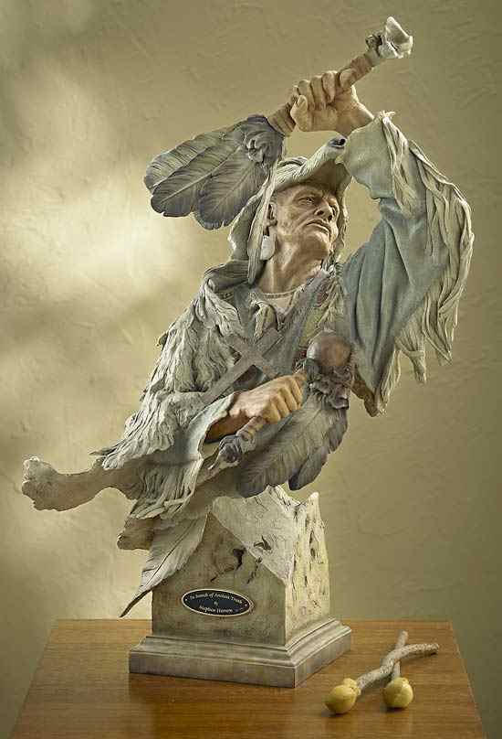

Slide 87
Father-Son Campbells’ Movement Part 2: Son Alexander Campbell
David Lee Burris:
Creeds Were Inadequate To Unite Because They Limit Fellowship. Creeds Are Illogical Because Since They Claim To Mirror Bible Truth They Are Unnecessarily Redundant. However, these claims are false – they either add or subtract from the gospel message!
Within Weeks Of The “Declaration & Address” Thomas & Son Alexander End Their Separation
As A Matter Of Conscience He Has Similarly Severed Himself From The Seceder Brotherhood
He Had Questions For Which He Found No Answers – This In Turn Led Him To Conclude The Church Itself Had Wandered From Its Source
He Was Especially Incensed That They Would Not Tolerate The Healing Of Religious Divisions.
While Enrolled At Glasgow, Scotland University He Also Attends Independent Haldane Seminary; Here He Is Exposed To Glas & Sandeman’s Ideas
Faith In Clergy, Creeds, & Confessions Is Altered: “Nothing That Was Not As Old As the New Testament Should Be Made An Article Of Faith.”
He Felt Creeds Sectarian & Clergy Self-Serving. Creed – “Root Of Bitterness Apples Of Discord.”
He Felt Career Clergy Had Erected Fences Of Legalistic Dogma & Had Positioned Themselves As The Gatekeepers. He believed the title “Reverend” belongs only to God.
His New Wife Suggested From Ecclesiastes 3:3 That The Season For Breaking Down Fences Was Over & Was Time To Transcend Fences.
Firmed For Congregational Autonomy, Each Week Communion, & Only Believers Baptism
His Dad & He Conclude The Church Is Corrupt & Bigoted Both Old World & New; Alexander Especially Dedicated Fulfilling First Of Thirteen Propositions In Dad’s Declaration – “Polar Star” Of Christian Unity: “(Church) Is Essentially, Intentionally, & Constitutionally One.”
They Both Think God Has Sent Them To This Place Of Freedom Of Conscience & Thoughtful Expression As An Outworking Of Providence
Even Under Frontier Conditions Religious Issues Like Infant Baptism Were Divisive To The Degree That Nearby Neighbors Had Not Spoken In Many Years

Slide 88
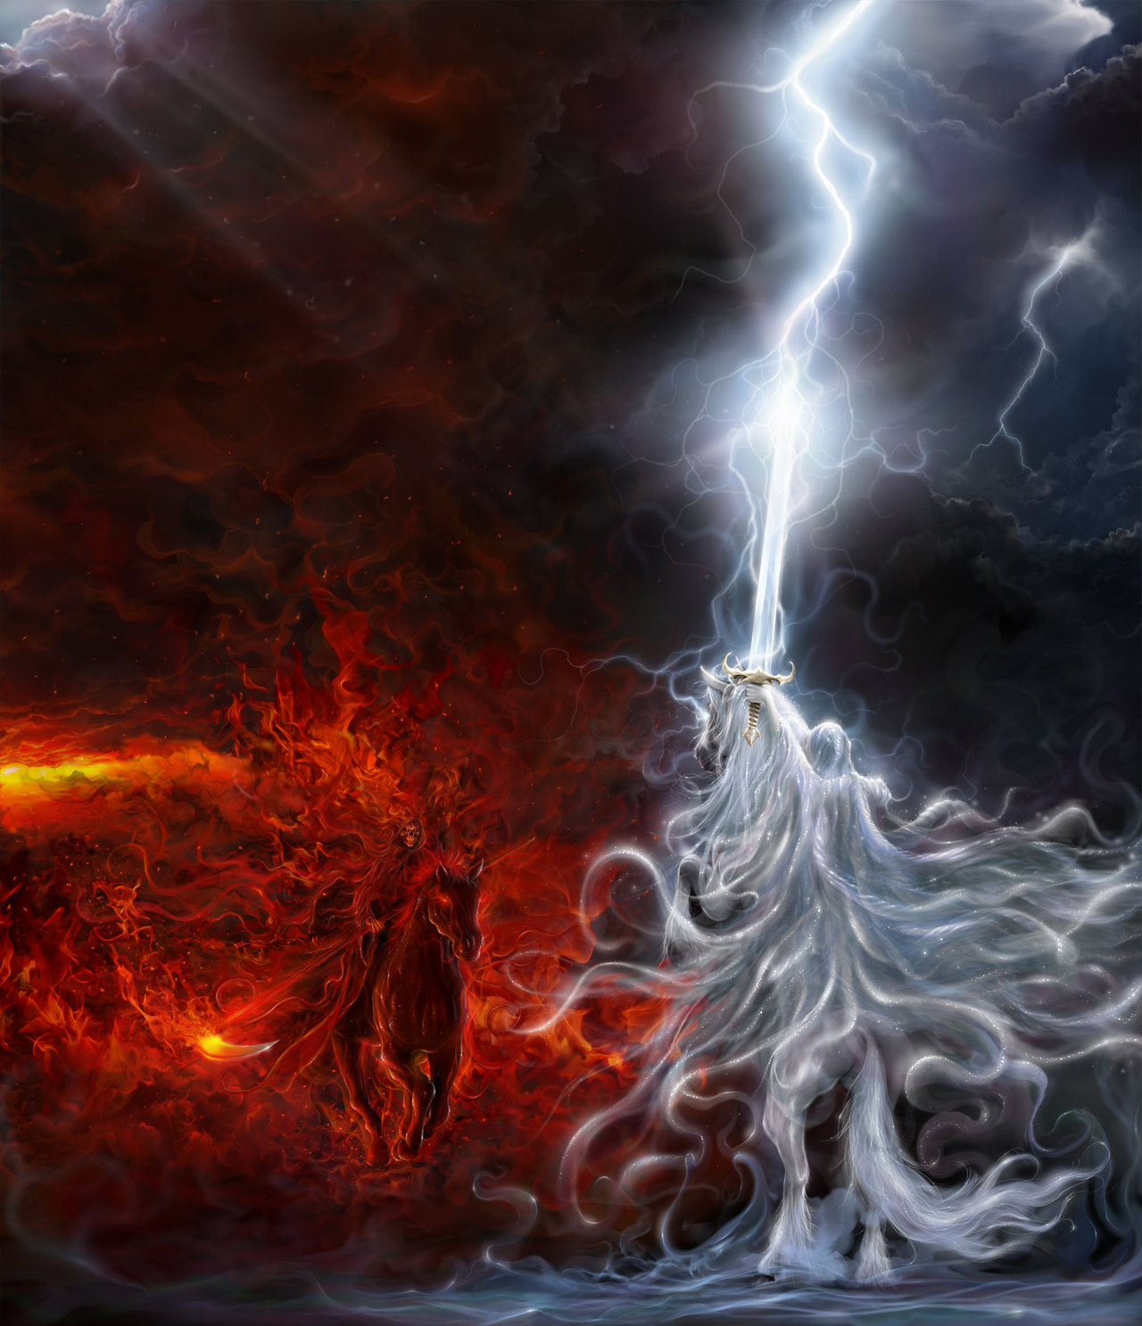
THE THUNDEROUS SILENCE OF SCRIPTURE!
“The Thunderous Silence of God” Was Thomas Campbell’s Slogan!

Slide 89
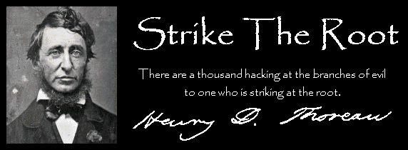
Churches Of Christ In The United States

