Slide 1
WHERE WERE THE THREE NATIONS OF GENESIS TEN
David Burris Supplemented

Slide 2
THE PATIENT WAITING
Ark Rests
Mount. Tops
Opens Window
Waits 7 Days
Waits 7 Days
7th mo., 17th d.
10th mo., 1st d.
11th mo., 10th d.
11th mo., 17th d.
11th mo., 24th d.
Removes Cover
1st mo., 1st d.
Exits Ark
2nd mo., 27th d.
Gen. 8:4
Gen. 8:5
Gen. 8:6
Gen. 8:10
Gen. 8:12
Gen. 8:13
Gen. 8:14-16
3 mo., 23 days
5 ½ mo.
7 mo., 10 days
Notes:
1. The ark comes to a halt and rests on a mountain in Ararat in the seventeenth day of the seventh month (Gen. 8:4). Note: Appreciate the Bible uses months and days to show this is the language of real history. While the ark had come to rest, it is still in deep water.
2. About 2 ½ months later on the first day of the tenth month the tops of the mountains become visible (8:5). What is Noah doing? He is still waiting.
3. Forty more days pass (8:6). This would place us in the eleventh month, tenth day, nearly four months since the ark came to rest. Noah is still waiting on the Lord. Everyone is still in the ark. We don’t hear of any protests either of Noah’s family or the animals. All are simply waiting in the ark. The waters are gradually subsiding outside the ark. Noah doesn’t kick the door down and sprint outside but is patiently waiting. He opens the window of the ark and experiments with two distinct kinds of birds: a raven and a dove. The raven is an unclean bird (Lev. 11:15). He leaves and evidently does not come back inside the ark but is content to go to and fro. A dove on the other hand, is a clean bird and was used for sacrifice (Lev. 1:14). The dove Noah sent out was more selective as to where she would place her foot. She returned into the ark to him finding no such suitable place.
4. Next we see our key word “waited” (8:10). He waited another seven days to send her out again. This seven days period is a literal as the seven day creation period. What one is the other is. This time the dove brings a freshly plucked olive leaf which gave Noah the understanding that the water had receded.
5. We see our word again (8:12). This time the dove did not return.
6. He continues to wait and now we reach the first month, first day of the month (8:13). Noah has been in the ark about 5 ½ months since the ark rested. What does Noah do? He continues to wait almost another 2 months until the 27th day of the second month (8:14). Noah waited seven months and ten days inside the ark after it came to a standstill. Why? It is simple, God had told him when to enter the ark (Gen. 7:1). Noah was not going to exit until the Lord permitted him. Noah was a very patient man. What would you have done if you were Noah? What if you were his wife? What if you were his son or daughter in law? Notice the word “then” in 8:15. Then God said “Go out of the ark.”

Slide 3
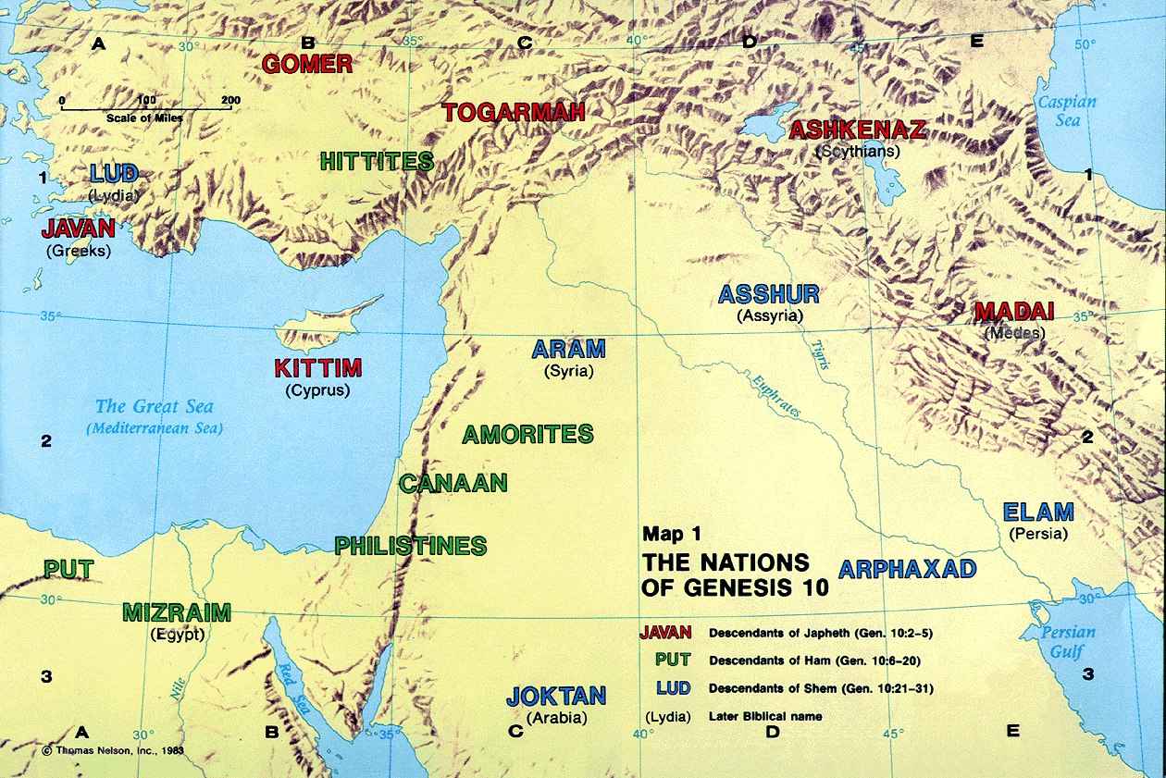

Slide 4
The Sons of Japheth
Gen 10:2-5 The sons of Japheth were Gomer, Magog, Madai, Javan, Tubal, Meshech, and Tiras. 3 The sons of Gomer were Ashkenaz, Riphath, and Togarmah. 4 The sons of Javan were Elishah, Tarshish, Kittim, and Dodanim. 5 From these the coastland peoples of the Gentiles were separated into their lands, everyone according to his language, according to their families, into their nations.

Slide 6
The Sons of Ham
Gen 10:6-7 The sons of Ham were Cush, Mizraim, Put, and Canaan. 7 The sons of Cush were Seba, Havilah, Sabtah, Raamah, and Sabtechah; and the sons of Raamah were Sheba and Dedan.

Slide 7
Gen 10:8-14 Cush begot Nimrod; he began to be a mighty one on the earth. 9 He was a mighty hunter before the LORD; therefore it is said, "Like Nimrod the mighty hunter before the LORD." 10 And the beginning of his kingdom was Babel, Erech, Accad, and Calneh, in the land of Shinar. 11 From that land he went to Assyria and built Nineveh, Rehoboth Ir, Calah, 12 and Resen between Nineveh and Calah (that is the principal city). 13 Mizraim begot Ludim, Anamim, Lehabim, Naphtuhim, 14 Pathrusim, and Casluhim (from whom came the Philistines and Caphtorim).

Slide 8
Gen 10:15-20 Canaan begot Sidon his firstborn, and Heth; 16 the Jebusite, the Amorite, and the Girgashite; 17 the Hivite, the Arkite, and the Sinite; 18 the Arvadite, the Zemarite, and the Hamathite. Afterward the families of the Canaanites were dispersed. 19 And the border of the Canaanites was from Sidon as you go toward Gerar, as far as Gaza; then as you go toward Sodom, Gomorrah, Admah, and Zeboiim, as far as Lasha. 20 These were the sons of Ham, according to their families, according to their languages, in their lands and in their nations.

Slide 10
The Sons of Shem
Gen 10:21-29 And children were born also to Shem, the father of all the children of Eber, the brother of Japheth the elder. 22 The sons of Shem were Elam, Asshur, Arphaxad, Lud, and Aram. 23 The sons of Aram were Uz, Hul, Gether, and Mash. 24 Arphaxad begot Salah, and Salah begot Eber. 25 To Eber were born two sons: the name of one was Peleg, for in his days the earth was divided; and his brother's name was Joktan. 26 Joktan begot Almodad, Sheleph, Hazarmaveth, Jerah, 27 Hadoram, Uzal, Diklah, 28 Obal, Abimael, Sheba, 29 Ophir, Havilah, and Jobab. All these were the sons of Joktan.

Slide 11
Gen 10:30-31 And their dwelling place was from Mesha as you go toward Sephar, the mountain of the east. 31 These were the sons of Shem, according to their families, according to their languages, in their lands, according to their nations.

Slide 13
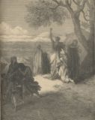
Gen 10:32 These were the families of the sons of Noah, according to their generations, in their nations; and from these the nations were divided on the earth after the flood.

Slide 14
Did Anything Happen To Effect The Future Events
Gen 9:20-27 And Noah began to be a farmer, and he planted a vineyard. 21 Then he drank of the wine and was drunk, and became uncovered in his tent. 22 And Ham, the father of Canaan, saw the nakedness of his father, and told his two brothers outside. 23 But Shem and Japheth took a garment, laid it on both their shoulders, and went backward and covered the nakedness of their father. Their faces were turned away, and they did not see their father's nakedness. 24 So Noah awoke from his wine, and knew what his younger son had done to him. 25 Then he said: "Cursed be Canaan; A servant of servants He shall be to his brethren." 26 And he said: "Blessed be the LORD, The God of Shem, And may Canaan be his servant. 27 May God enlarge Japheth And may he dwell in the tents of Shem; And may Canaan be his servant."

Slide 15
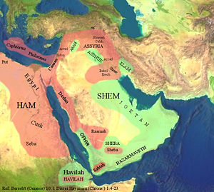

Slide 16
Prophesy of Gen 10
Curse upon Canaan the son of Ham
Why him? What did this mean?
800 years later Israel defeated Canaan in battle
Josh 9:22-23 Then Joshua called for them, and he spoke to them, saying, "Why have you deceived us, saying,'We are very far from you,' when you dwell near us? 23 Now therefore, you are cursed, and none of you shall be freed from being slaves — woodcutters and water carriers for the house of my God."

Slide 17
Judg 1:28 And it came to pass, when Israel was strong, that they put the Canaanites under tribute, but did not completely drive them out.
The Canaanites were under the curse of slavery
God blesses Shem – Why?
He blesses Japeth – Why?
What is the difference between them?
27 May God enlarge Japheth And may he dwell in the tents of Shem;
Jews will end up being God’s people for a time, then the Jews and the Gentiles will be blessed as one in the church many years later

Slide 18
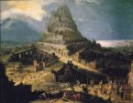
The Tower of Babel
Gen 11:1-4 Now the whole earth had one language and one speech. 2 And it came to pass, as they journeyed from the east, that they found a plain in the land of Shinar, and they dwelt there. 3 Then they said to one another, "Come, let us make bricks and bake them thoroughly." They had brick for stone, and they had asphalt for mortar. 4 And they said, "Come, let us build ourselves a city, and a tower whose top is in the heavens; let us make a name for ourselves, lest we be scattered abroad over the face of the whole earth."

Slide 19
Gen 11:5-9 But the LORD came down to see the city and the tower which the sons of men had built. 6 And the LORD said, "Indeed the people are one and they all have one language, and this is what they begin to do; now nothing that they propose to do will be withheld from them. 7 Come, let Us go down and there confuse their language, that they may not understand one another's speech." 8 So the LORD scattered them abroad from there over the face of all the earth, and they ceased building the city. 9 Therefore its name is called Babel, because there the LORD confused the language of all the earth; and from there the LORD scattered them abroad over the face of all the earth.

Slide 20
Shem’s Decendents
Gen 11:27-32 This is the genealogy of Terah: Terah begot Abram, Nahor, and Haran. Haran begot Lot. 28 And Haran died before his father Terah in his native land, in Ur of the Chaldeans. 29 Then Abram and Nahor took wives: the name of Abram's wife was Sarai, and the name of Nahor's wife, Milcah, the daughter of Haran the father of Milcah and the father of Iscah. 30 But Sarai was barren; she had no child. 31 And Terah took his son Abram and his grandson Lot, the son of Haran, and his daughter-in-law Sarai, his son Abram's wife, and they went out with them from Ur of the Chaldeans to go to the land of Canaan; and they came to Haran and dwelt there. 32 So the days of Terah were two hundred and five years, and Terah died in Haran.

Slide 21
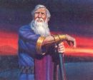
God’s Promise to Abram
Gen 12:1-3 Now the LORD had said to Abram: "Get out of your country, From your family And from your father's house, To a land that I will show you. 2 I will make you a great nation; I will bless you And make your name great; And you shall be a blessing. 3 I will bless those who bless you, And I will curse him who curses you; And in you all the families of the earth shall be blessed."

Slide 22
God’s Covenant With Abram
Gen 15:1-6 After these things the word of the LORD came to Abram in a vision, saying, "Do not be afraid, Abram. I am your shield, your exceedingly great reward." 2 But Abram said, "Lord GOD, what will You give me, seeing I go childless, and the heir of my house is Eliezer of Damascus?" 3 Then Abram said, "Look, You have given me no offspring; indeed one born in my house is my heir!" 4 And behold, the word of the LORD came to him, saying, "This one shall not be your heir, but one who will come from your own body shall be your heir." 5 Then He brought him outside and said, "Look now toward heaven, and count the stars if you are able to number them." And He said to him,"So shall your descendants be." 6 And he believed in the LORD, and He accounted it to him for righteousness.

Slide 23
Why God Chose Shem’s Decendent Instead of Ham or Japheth
Heb 6:13-16 For when God made a promise to Abraham , because He could swear by no one greater, He swore by Himself, 14 saying, "Surely blessing I will bless you, and multiplying I will multiply you." 15 And so, after he had patiently endured, he obtained the promise.

Slide 24
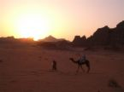
Heb 11:8-10 By faith Abraham obeyed when he was called to go out to the place which he would receive as an inheritance. And he went out, not knowing where he was going. 9 By faith he dwelt in the land of promise as in a foreign country, dwelling in tents with Isaac and Jacob, the heirs with him of the same promise; 10 for he waited for the city which has foundations, whose builder and maker is God.

Slide 25
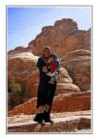
Heb 11:11-12 By faith Sarah herself also received strength to conceive seed, and she bore a child when she was past the age, because she judged Him faithful who had promised. 12 Therefore from one man, and him as good as dead, were born as many as the stars of the sky in multitude — innumerable as the sand which is by the seashore.

Slide 26
Heb 11:17-19 By faith Abraham , when he was tested, offered up Isaac, and he who had received the promises offered up his only begotten son, 18 of whom it was said, "In Isaac your seed shall be called," 19 concluding that God was able to raise him up, even from the dead, from which he also received him in a figurative sense.

Slide 27
What We Learn From Gen 10
God knows who are truly his
People show their true being over time but God can see our hearts
God’s plan for man’s salvation began a long time ago
God’s providence can be seen though all these generations
God loved those that loved and reverenced him back in Gen 10 and continues to love them today

