Slide 1
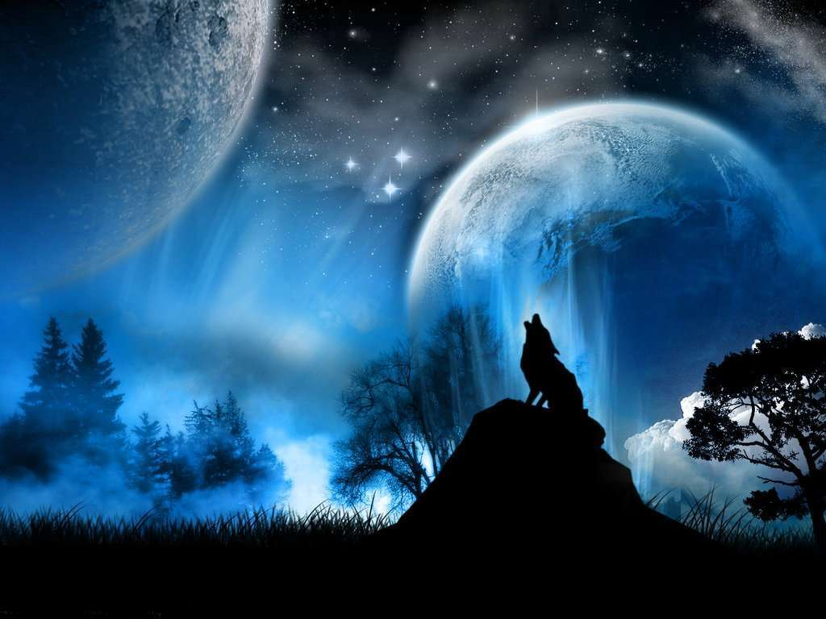
Children’s Story’s About Wolves Also Cautionary Tales for Mature Christians
By David Lee Burris

Slide 2
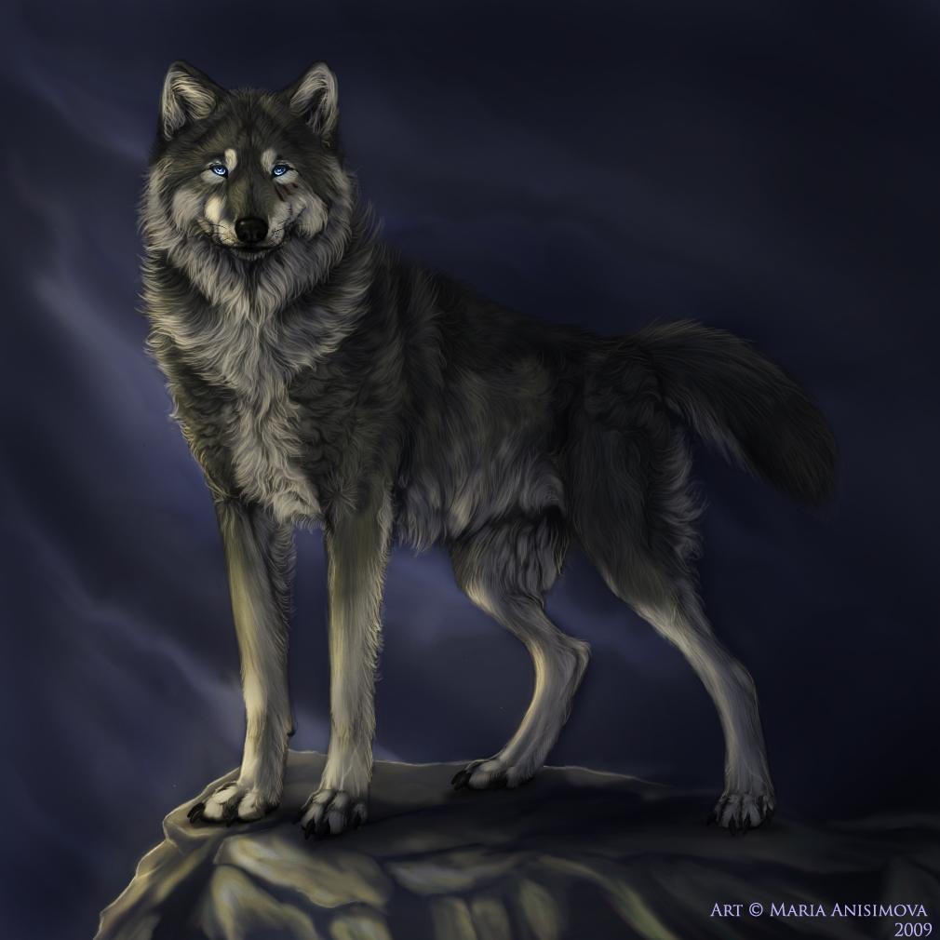

Slide 3


Slide 4

David Lee Burris:
Clipping The Wool From The Sheep’s Eyes – “This is a bad thing because a sheep with wool over his eyes doesn’t do good. He doesn’t see where he is going; he doesn’t find his food easily; he strays out from the rest and is more apt to be caught by a coyote.” - L. E. Lindsted
David Lee Burris:
Retained Imperial Titles & Terminology Such As Pontiff.

Slide 5
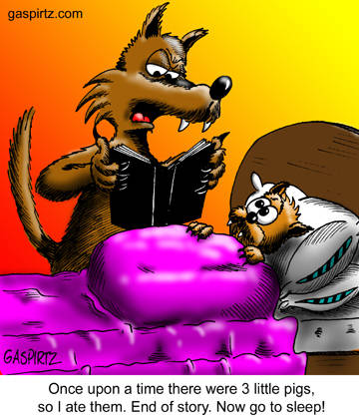
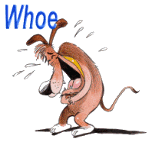
True Tales

Slide 6
Dancing With Wolves
Our Lord Jesus Christ warned us about the dangers of fellowshipping those with whom He called wolves.

Slide 7
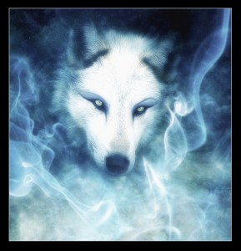
Wolves of White

Slide 8
Matthew 7:15-16 (NASB)
"Beware of the false prophets, who come to you in sheep's clothing, but inwardly are ravenous wolves. {16} You will know them by their fruits… “

Slide 9
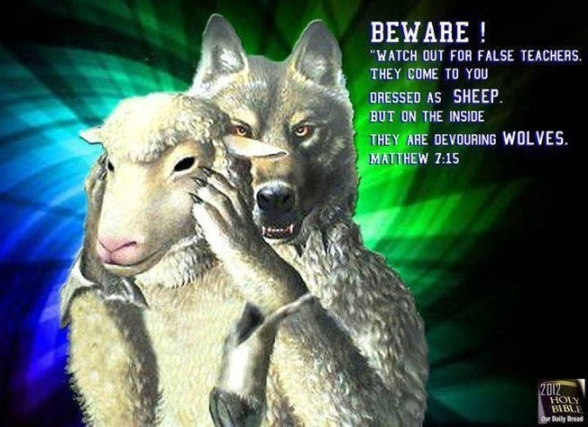

Slide 10
Jesus also recognized the nature of man when He sent out the twelve apostles.
Matthew 10:16 (NASB)
"Behold, I send you out as sheep in the midst of wolves; therefore be shrewd as serpents, and innocent as doves."
A similar account happened when Jesus sent out seventy others. The statement was very similar.
Luke 10:3 (NASB)
"Go your ways; behold I send you out as lambs in the midst of wolves."

Slide 11
The apostle Paul also warned the Ephesian elders about this danger, even exposing some in their own midst.
Acts 20:28-30
"Be on guard for yourselves and for all the flock, among which the Holy Spirit has made you overseers, to shepherd the church of God which He purchased with His own blood. {29} I know that after my departure savage wolves will come in among you, not sparing the flock; {30} and from among your own selves men will arise, speaking perverse things, to draw away the disciples after them.

Slide 12
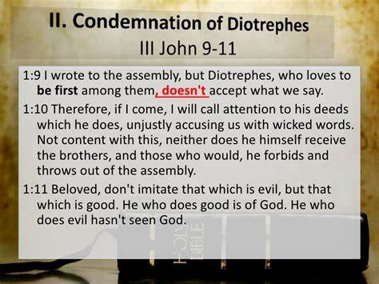

Slide 13
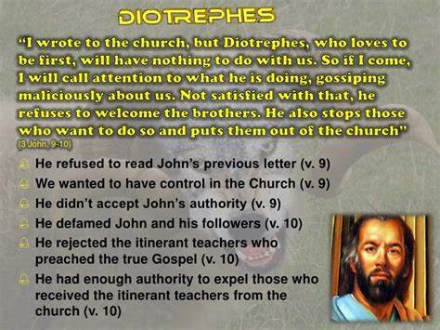

Slide 14

COLLEGIAL SYSTEM
FIRST CENTURY
FIRST CENTURY
FIRST CENTURY
SINGLE ELDER
SINGLE ELDER
SINGLE ELDER

Slide 15



MONARCHICAL EPISCOPACY: Monos (Sole) Archos (Ruler) Episcopacy (Bishop)
David Lee Burris:
Abe Lincoln – “It is common enough that we triumph under adversity, but, if you truly wish to test a man’s character – Give him power!”
“Although the words elder and bishop are used interchangeably in Scripture there is a difference in their meanings. Elder has reference to age or maturity and bishop to oversight & guardian- ship. This difference in meaning is important to an understanding of the change that developed. In the early church all elders were bishops or overseers and each congregation had a plurality of them. However, as the elders had their meetings to discuss the work of the church someone had to be chairman of the meetings. The chair -manship apparently became a permanent position and the word bishop was reserved for the one who occupied the position. He was sometimes called the “president” of the church and gradually assumed the responsibilities that had originally rested upon all the elders. This position, by the year 150, had developed into the monarchical bishop arrangement.” F. W. Mattox, Eternal Kingdom
* Organization Changes Increase As Biblical Criteria Are Lowered!

Slide 16

PRESIDING ELDER
SECOND CENTURY
SECOND CENTURY
SECOND CENTURY
SINGLE ELDER
SINGLE ELDER
SINGLE ELDER

Slide 17
You have heard of the expression "wolves in sheep's clothing". This is what happens when these false teachers disguise themselves. Paul told the Corinthian church about these people.
2 Corinthians 11:13-15 (NASB)
For such men are false apostles, deceitful workers, disguising themselves as apostles of Christ. {14} And no wonder, for even Satan disguises himself as an angel of light. {15} Therefore it is not surprising if his servants also disguise themselves as servants of righteousness; whose end shall be according to their deeds."

Slide 18
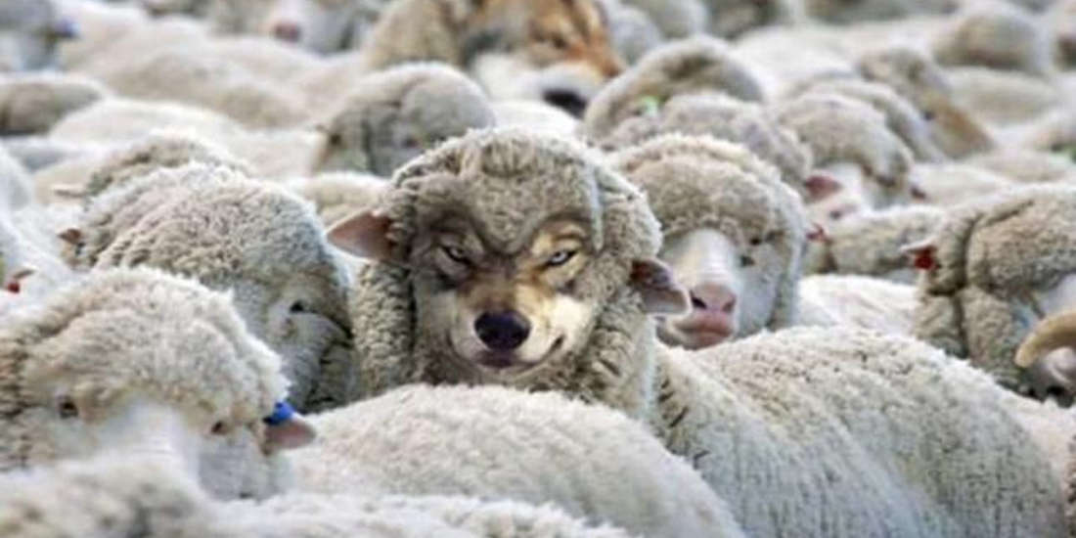

Slide 19
They look innocent enough, but they have a way to destroy the flock of God's people. Therefore all of God's people are to watch out for the welfare of each other. This means that if there is a wolf in their midst, then they need to announce it to the rest. If we learn of a wolf in another congregation, we should warn them.

Slide 20
How To Identify The Wolves
How did Little Red Riding Hood Identify?
If a fairy tail character can identify a wolf, so should the Christian.

Slide 21
An Allegory of Generational Continuity
“When the youthful girl gets a hood from her grandmother, we can say the life forces are passing from older (going) to younger (coming) generation. The red color is, of course, the color of life and blood.”

Slide 22
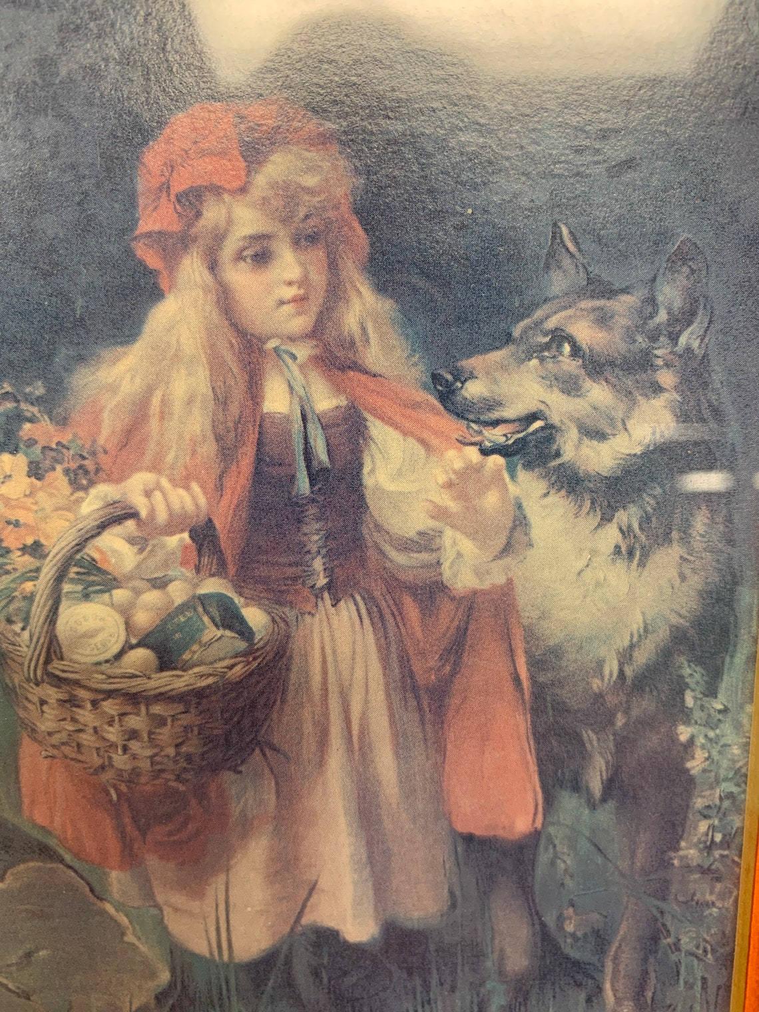

Slide 23
An Allegory of Careless Consequence
“Little Red Riding Hood learned that people (wolves) are not always as they seem; people with evil motives can masquerade as friendly advisers. A third strong theme in the story comes through when we consider the misgivings Red Riding Hood experiences when she enters her grandmother's house and how she fails to act on those instincts.”

Slide 24
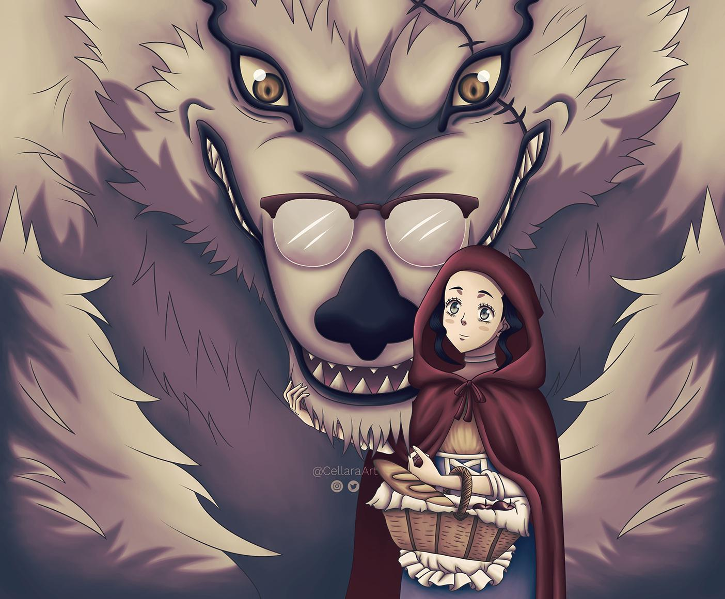

Slide 25
An Allegory of Resurrection, Death, and Rebirth
“An extremely important part of Little Red Riding Hood is the ending, where the huntsman opens the wolf's stomach and saves the girl and her granny. This can be explained as an allegory on resurrection in Christianity. Both women died but are saved by a higher power, represented by the huntsman. When Red Riding Hood and her grandmother come out of the stomach, they are symbolically born again—and we know Perrault and the Grimms were zealous Christians.”

Slide 27
How To Identify The Wolves
How did Little Red Riding Hood Identify?
If a fairy tail character can identify a wolf, so should the Christian.
Identify them by their fruits.
Fruits may appear to be doing good works, but looks are deceiving.

Slide 28
Ephesians 5:11 (NKJV)
And have no fellowship with the unfruitful works of darkness, but rather expose them.
Romans 16:17-18 (NASB)
Now I urge you, brethren, keep you eye on those who cause dissensions and hindrances contrary to the teaching which you learned, and turn away from them. {18} For such men are slaves, not of our Lord Christ but of their own appetites; and by their smooth and flattering speech they deceive the hearts of the unsuspecting.

Slide 29
The word of God is the Bible. It is the standard to follow in order to have salvation. The Bible also instructs us how to identify false teachers. When we learn the truth, we will know what error is, and expose those who teach error.
John 17:17 (NKJV)
"Sanctify them by Your truth. Your word is truth".
2 Timothy 3:16-17 (NASB)
All scripture is inspired by God and profitable for teaching, for reproof, for correction, for training in righteousness; {17} that the man of God may be adequate, equipped for every good work.

Slide 30
We are not to have fellowship with error or sin. We must identify false teachers and expose them. We cannot give them aid or show them partiality. When we determine that a brother is wrong in his teaching (even if only in one subject area), then he must be admonished. If he does not repent, then he is to be marked out for warning. Instead of dancing with these wolves, we should be exposing them for what they really are. False Teachers!
Those who choose to dance with wolves now, will certainly be dancing with them in Hell.

Slide 31
What Is The Motive Of a Wolf
John 12:43 (NKJV)
for they loved the praise of men more than the praise of God.
Galatians 1:10 (NKJV)
For do I now persuade men, or God? Or do I seek to please men? For if I still pleased men, I wouldn’t be a bondservant of Christ.

Slide 32
What Happens When A Wolf Is Exposed?
Since our Lord described these individuals as being wolves. We will look to see what would happen if you trapped a real wolf. If you ever had an opportunity to corner a wild animal you would know that you made a big mistake. These animals, though small, become vicious. They will use any tool available to them for their own defense. They will bite, claw, scratch, kick, and charge their enemies.

Slide 33
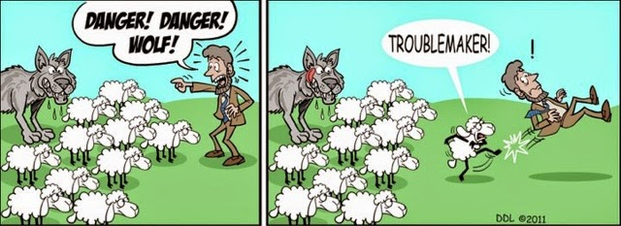
WHEN WE CRY WOLF

Slide 34
These people try to hide their false doctrine as much as possible, but eventually it comes out. When that does, they become very defensive. They start to use any means at their disposal to protect themselves. It is usually those who trapped them that get hurt the most.

Slide 35
We cannot fellowship these people. We should not even call them brothers (unless you call them digressive and/or false teachers, unrepentant, etc). If we accept any part of their false teaching, then we have accepted the truth with the error.

Slide 36
James 2:10 (NASB)
For whoever keeps the whole law and yet stumbles in one point, he has become guilty of all.
2 John 10-11
If anyone comes to you and does not bring this teaching, do not receive him into your house, and do not give him a greeting; {11} for the one who gives him a greeting participates in his evil deeds."

Slide 37
Let us not be so stupid to think that we are exempt from these rules. Let us be aware that false teachers can even come from our own midst. The scriptures teach us they will approve false doctrine
1 Timothy 4:1-2
But the Spirit explicitly says that in later times some will fall away from the faith, paying attention to deceitful spirits and doctrines of demons, {2} by means of the hypocrisy of liars seared in their own conscience as with a hot iron,

Slide 38
We must be aware that there are thousands if not millions of false teachers. Most are easily identified. But some come close to home and disguise themselves in order to deceive us.
2 Timothy 3:1-5 (NASB)
But realize this, that in the last days difficult times will come {2} For men will be lovers of self, lovers of money, boastful, arrogant, revilers, disobedient to parents, ungrateful, unholy, {3} unloving, irreconcilable, malicious gossips, without self-control, brutal, haters of good, {4} treacherous, reckless conceited, lovers of pleasure rather than lovers of God; {5} holding to a form of godliness, although they have denied its power; and avoid such men as these.

Slide 39
And It Will Only Get Worse
2 Timothy 3:13 (NKJV)
But evil men and impostors will grow worse and worse, deceiving and being deceived.
2 Peter 2:1 (NASB)
But false prophets also arose among the people, just as there will also be false teachers among you, who will secretly introduce destructive heresies, even denying the Master who bought them, bringing swift destruction upon themselves.

Slide 40
Why Will It Get Worse?
It will get worse because of ignorance on the part of the people of God. Because they do not love the truth, they will desire the lies and God will let them believe them. Therefore, they will have to get teachers who teach what they want. They will not want teachers who teach the truth.

Slide 41
2 Timothy 4:3-4 (NASB)
For the time will come when they will not endure sound doctrine; but wanting to have their ears tickled, they will accumulate for themselves teachers in accordance to their own desires; {4} and will turn away their ears from the truth, and will turn aside to myths.
2 Peter 2:2 (NKJV)
And many will follow their destructive ways, because of whom the way of truth will be blasphemed.

Slide 42
Conclusion
Let us all sound a warning to the brotherhood that there are false teachers among us.
Friends that we have known for years have denied the truth faith of the doctrine of Christ.
If we choose to fellowship them here on earth.
We will spend eternity with them in the place where false teachers go.

Slide 43
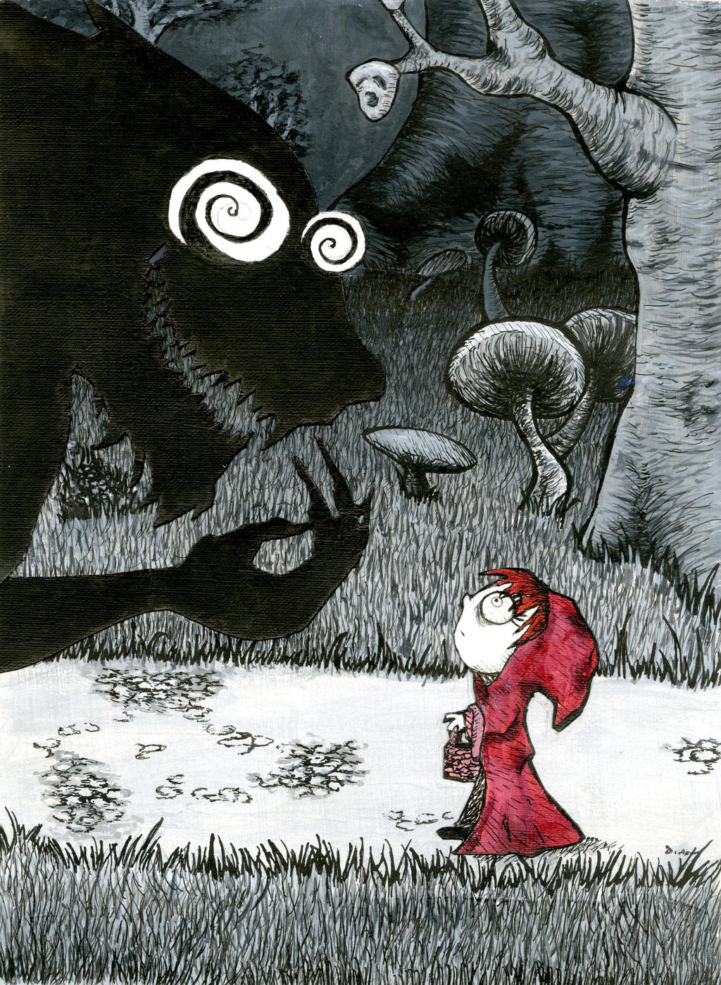
“Stay On The Path!”

