Slide 1
Did He Use a Framing Hammer?
LUTHER SETTING
By David Lee Burris

Slide 2
The Catholic World Magazine Endorsement
1st Edition Chamberlin’s “The Bad Popes”
Note: The Pope Allowed the Archive Assist

Slide 3
Or Was He?

Slide 4
The Study of History
To be ignorant of what occurred before you were born is to remain always a child!
– Marcus Tullius Cicero
Notes:
Continued on next slide.

Slide 5
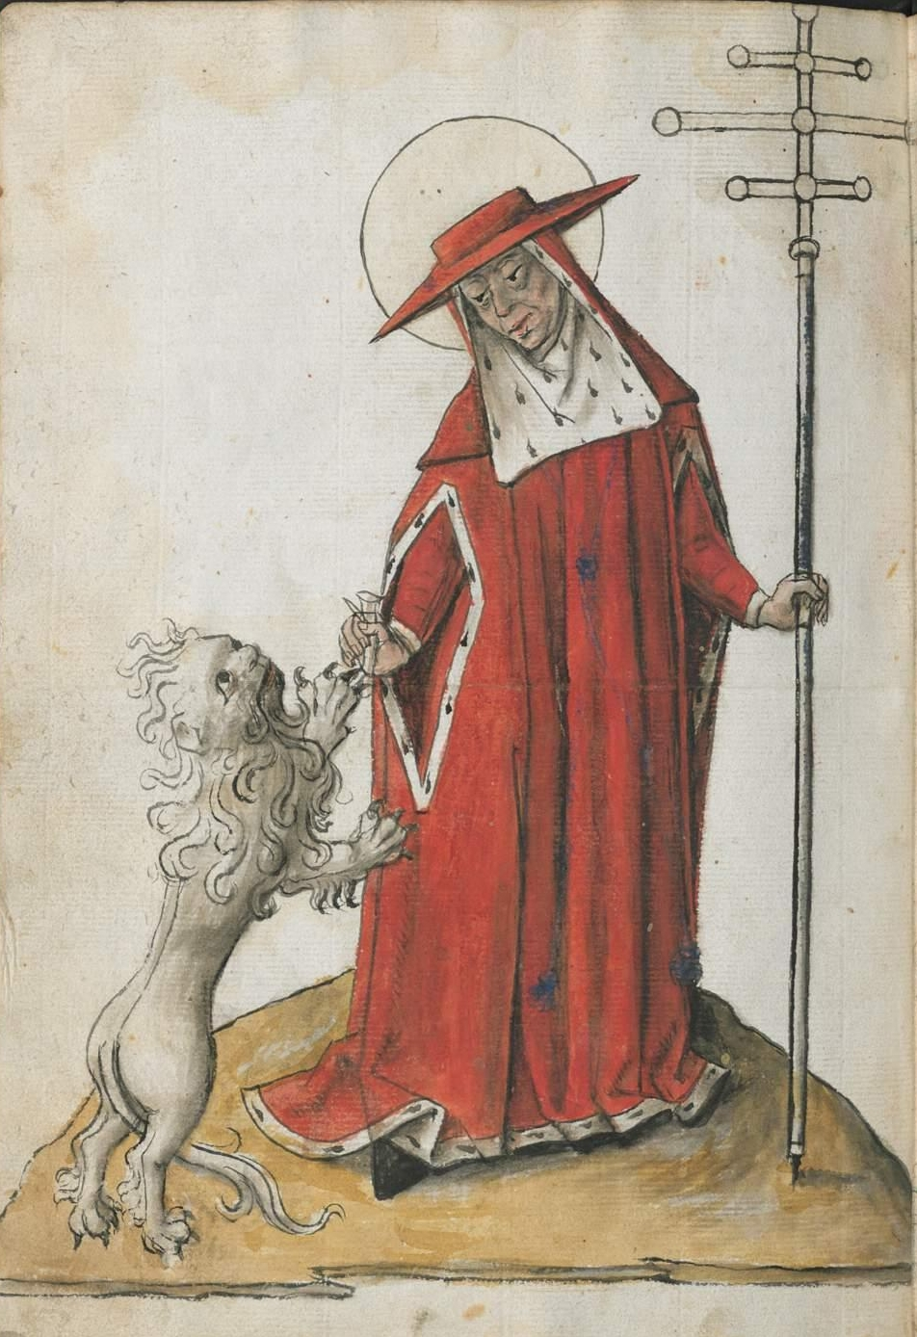
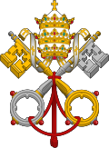
UNTO KING'S SCEPTER
FROM SHEPHERD'S STAFF
Notes:
THE PAPAL TRADITION OF CHOOSING A NEW NAME STARTS WITH MERCURIUS IN A.D. 533 RENAMING HIMSELF JOHN THE SECOND. THIS PRACTICE WAS PRIOR ASSOCIATED WITH ROYAL DYNASTY.

Slide 6
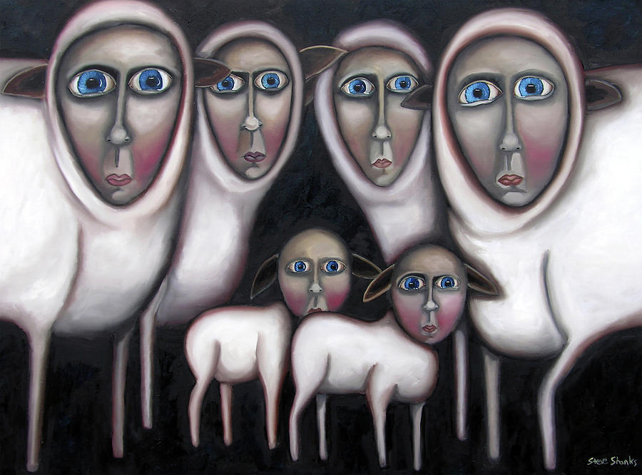
BY HOOK OR BY CROOK
Negative Connotation: Shepherds rounded up flocks by means of a crook, a long staff with curved end. A shepherd would chase after a reluctant lamb and hook it with his staff by any mean by hook or crook.

Slide 7
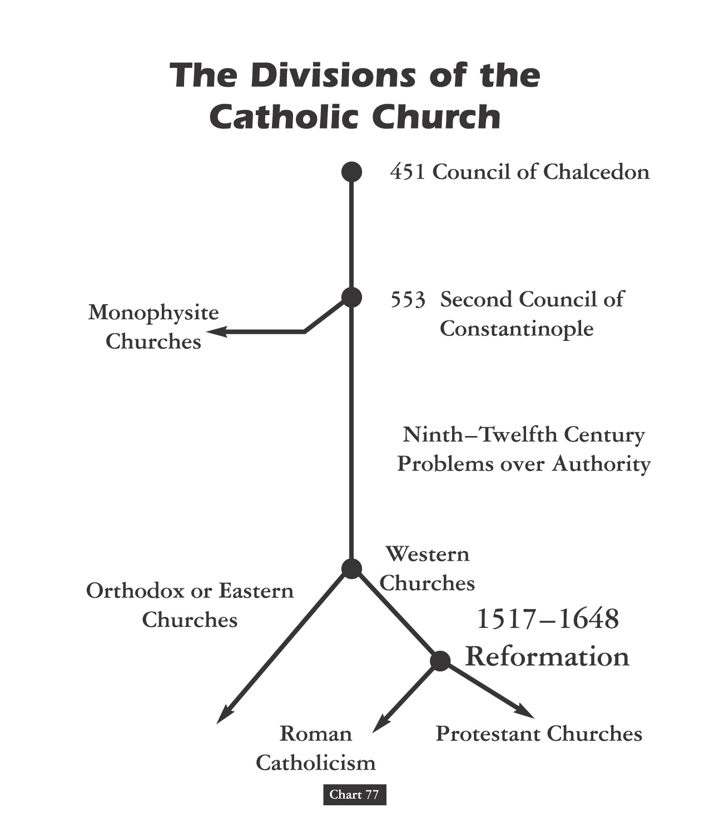

Slide 9
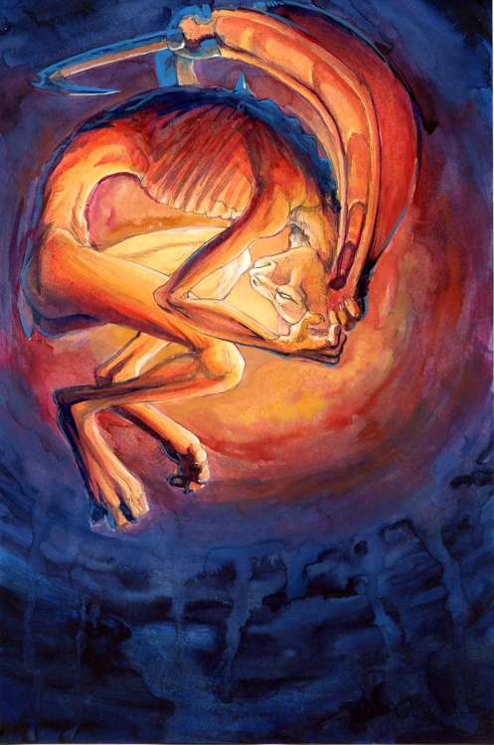
Christian Divisions Costs Half The World
“Christian divisions go far toward explaining the swift collapse of the Roman position in the Middle East, where popular sentiment leaned so heavily toward either the Monophysite or Nestorian churches. Repeatedly, writers from these traditions describe the relief which local inhabitants greeted the Arab conquerors, who promised an end to the heavy-handed regime of the Roman Empire, and the Chalcedonian order.
At least in the early decades of the new order, most Christians saw little reason to change their opinion. Muslims cared nothing for the sectarian divisions among their Christian subjects, provided they respected Muslim authority and paid their taxes on time.
The first century or so after the conquest marked something like a golden age for the Christian communities, who were now free of Roman oppression.”
Source: Pages 263-4, Philip Jenkins’ “Jesus Wars”

Slide 10
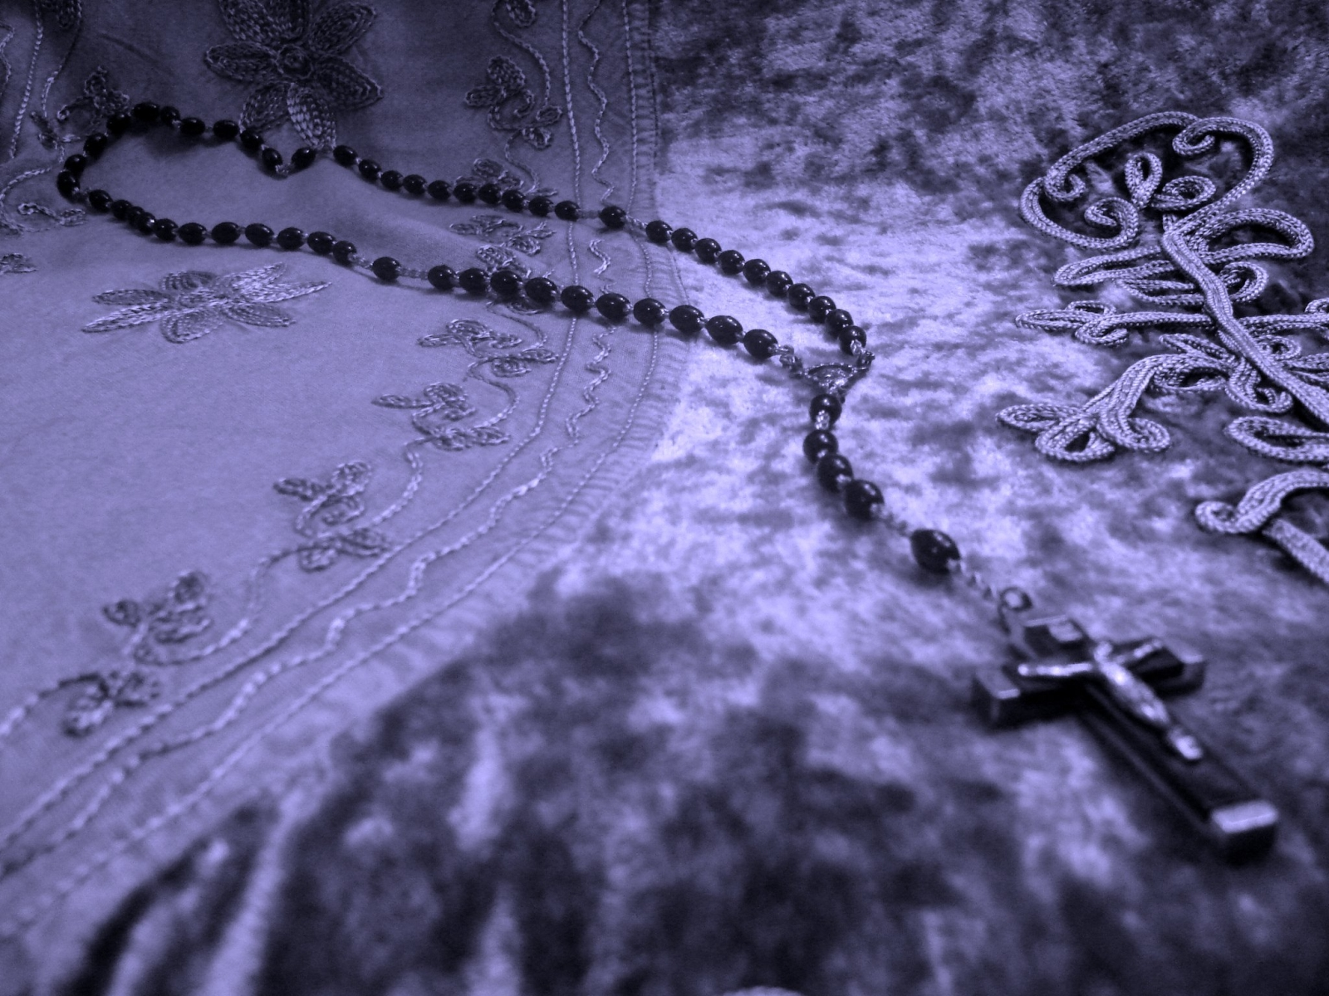
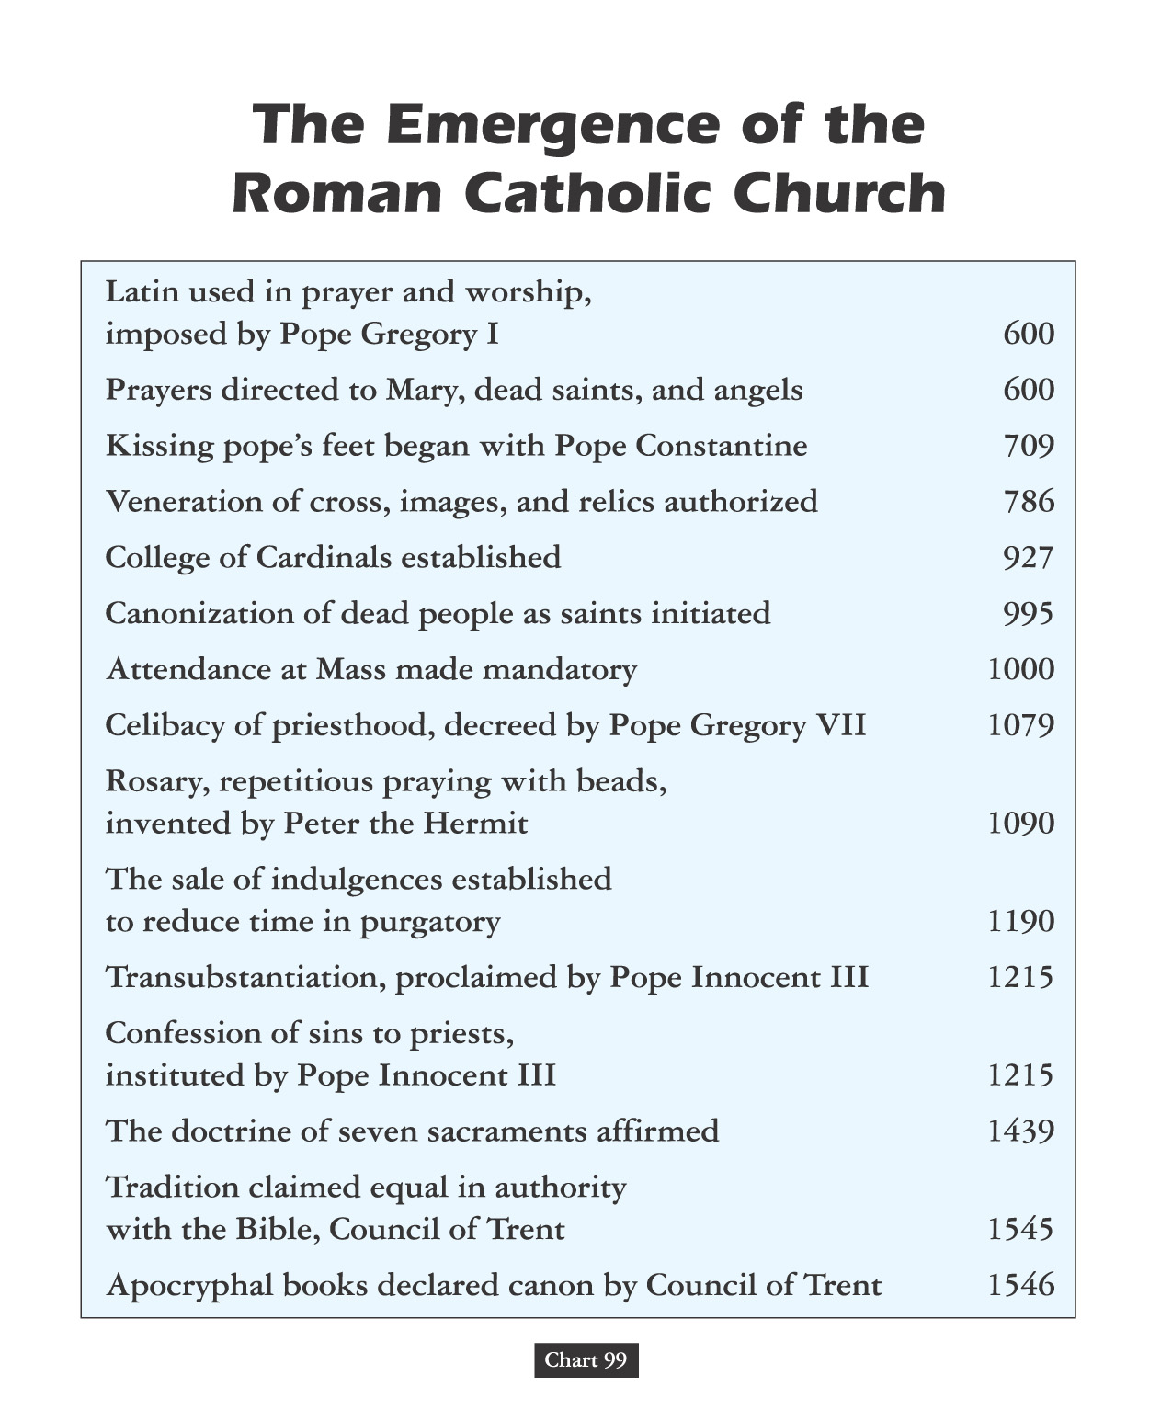
Vain Repetition

Slide 11
Freud was fascinated by this sinister side of the repetition compulsion, which is why he ultimately decided that the cause of our urge to repeat was directly linked to what he called "the death drive," or the urge to cease existing. After all, he reasoned, the ultimate "earlier state of things" is a state of non-existence before we were born. With each repetition, we act out our desire to go back to a pre-living state. Maybe that's why so many people have the urge to repeat actions that are destructive, or unproductive.

Slide 12
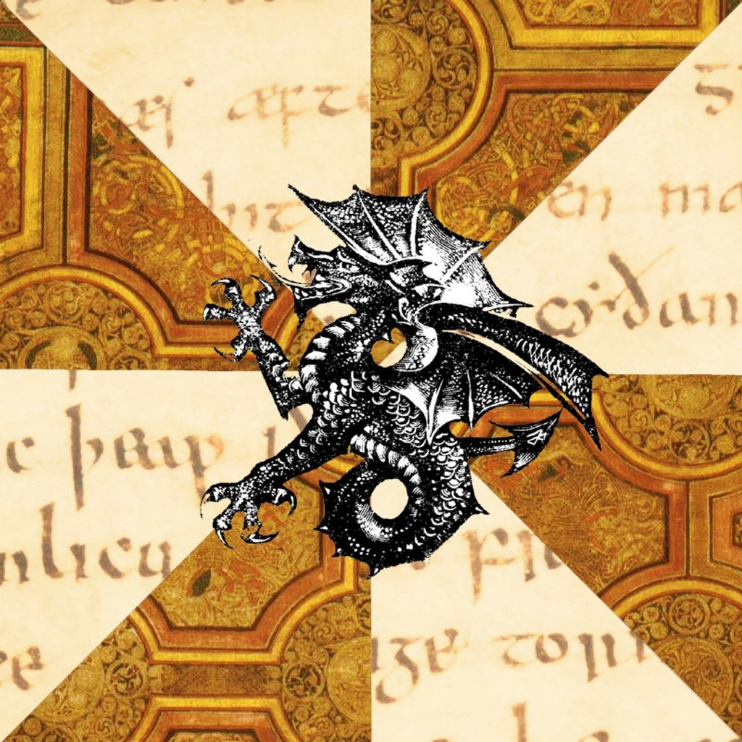
Those Who Do Not Study History Are Doomed To Repeat It!
Those That Do Study History Are Doomed
To Watch The World Repeat It!!

Slide 13
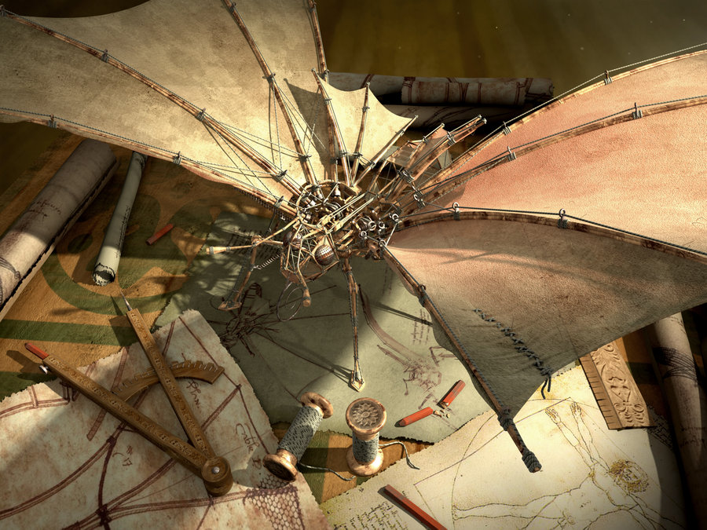
Early Middle Ages
AGES THEORY

Slide 14
Joachim Of Fiore

Slide 15
“During the Late Middle Ages, an Italian mystic by the name of Joachim of Fiore created a scheme in which history was divided into the Age of the Father, the Age of the Son, and the Age of the Spirit.”
Joachim Of Fiore

Slide 16
“The Old Testament, corresponding to this first age, is distinguished by its cruel, harsh deity who ordered the slaughters of entire people groups.”
Joachim Of Fiore

Slide 17
“We know the Age of the Son as the period in which the ‘good God,’ Jesus Christ, softened the harsher features of the Jewish deity and the church was founded with its material way of worshipping.”
Joachim Of Fiore

Slide 18
“But an even greater stage of historical development yet awaited: the Age of the Spirit, when the institutional church would be eclipsed by the universal brotherhood of man.”
Joachim Of Fiore
- modern reformation nov/dec 1994, pg. 4

Slide 19
HISTORY OF THE CHRISTIAN AGE
THE AGE OF JESUS & THE APOSTLES
THE AGE OF EARLY CHRISTIANITY
THE AGE OF STATE RECOGNITION
THE AGE OF OFFICIAL DOMINANCE
THE AGE OF HOLY ROMAN EMPIRE
THE AGE OF PROTESTANT REFORM

Slide 20
DEATH WAS EVERYWHERE

Slide 21
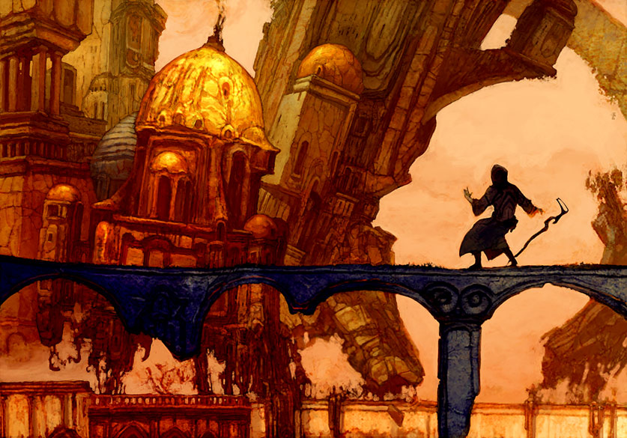
What on Earth Was Happening?
During the final centuries of the Middle Ages, the world was wracked with war, famine, plague, and political upheaval.

Slide 22
Throughout the mediterranium rim

Slide 23
13th Century Cannibalism
There was no longer any hope that the Nile would rise; and as a result the cost of provisions had already gone up. The provinces were ravaged by drought. The inhabitants foresaw a state of dearth as inevitable, and fear of famine led to disturbances. Those who lived in villages and in the countryside left for the main provincial towns. A great number emigrated to Syria, the Maghreb, Hejaz and the Yemen....
A vast multitude sought refuge in Misr and Cairo, where they were to meet with frightful famine and appalling mortality; for, when the sun entered the sign of Aries, the air became corrupt, and pestilence and a deadly contagion began to take their toll, and the poor, under the pressure of ever-growing want, ate carrion, corpses, dogs, excrement, and animal dung. They went further, and reached the stage of eating little children. It was not unusual to find people [selling] little children, roasted or boiled. The commandant of the city guard ordered that those who committed this crime should be burned alive, as should those who ate such meats.
I myself saw a little roast child in a basket. It was brought to the commandant, and led in at the same time were a man and woman who were the child's father and mother. The commandant condemned them to be burned alive.
In the month of Ramadan a corpse was found at Misr with all the flesh stripped off for food, and its legs tied like a sheep trussed for cooking....
When the poor first began to eat human flesh, the horror and astonishment that such extraordinary meals aroused were such that these crimes formed the topic of every conversation. No one could stop talking about them. But eventually people grew accustomed, and some conceived such a taste for these detestable meats that they made them their ordinary provender, eating them for enjoyment and even laying in supplies. They thought up a variety of preparation methods. And the custom being once introduced, it spread in the provinces so that there was no part of Egypt where one did not see examples of it. Then it no longer caused surprise. The horror people had felt at first vanished entirely; one spoke of it, and heard it spoken of, as a matter of everyday indifference.
I saw one day a woman with a head wound being dragged, by some labourers, through the market. They had seized her while she was eating a small roast child, which they also carried with them. The people in the market paid not the slightest attention to this sight, but went on with their business. I saw in them no sign of astonishment or horror – which surprised me rather more than the crime itself. Their indifference sprang, really, only from the fact that the sight of such cruelties had already struck them a great many times, so that it fell into the category of things they had become accustomed to and no longer had the power to startle them.
Two days before, I had seen a child nearing the age of puberty, who had been found roasted. The two young people who had been found with it confessed that it was they who had killed the child, cooked it, and eaten part of it.

Slide 24
13th Century Cannibalism
It happened one night that a young slave girl was playing with a newly weaned infant, the child of a rich private citizen. While the child was by her side, a beggar-woman seized the very moment when the slave's eyes were turned away, tore open the child's stomach, and began to eat the flesh, quite raw. Many women have told me of people flinging themselves at them in order to snatch their children, and that they have had to use all their strength to save them.
Talking one day to a woman who carried a newly-weaned and very chubby child, I admired it and recommended her to take good care of it. She then told me that, when she had walking on the canal bank, a sturdy ruffian had attacked her and tried to snatch the child from her; that she had found no other way of sheltering it than to throw herself to the ground, holding the child beneath her, until a horseman happened to pass by, which forced the man to retreat. She added that the rascal had watched avidly of the chance of getting a grip on any of the child's limbs that might stray out from their shelter, so that he might eat it. The child was ill for some time afterwards as a result of the mauling he had suffered in the tug-of-war between the robber and herself, one trying to snatch him and the other to hold on to him.
The children of the poor, those who were young or already grown and had no one at all to care for them or look after them, were scattered though all parts of the town, even in the narrowest side streets, like locusts in the countryside. The poor, men and women alike, lay in wait for these unhappy children, carried them off and ate them. The guilty were rarely caught in the act, and only when they were careless. It was usually the women who were caught with the proof of their crime, a circumstance which in my opinion arose from the fact that women are less crafty than men and cannot so readily flee to escape pursuit. In only a few days, at Misr, thirty women were burned, among whom there was none who did not admit to having eaten several children. I saw one of them taken to the commandant with a roast child hung round her neck. She was given more than two hundred lashes to make her confess her crime, but they elicited no response from her. You would have said that she had lost all human faculties. Then someone pulled her roughly, to lead her away, and she expired on the spot.
When some unfortunate who had been convicted of eating human flesh was burned alive, the corpse was always found to have been devoured by the following morning. People ate it the more willingly, for the flesh, being fully roasted, did not need to be cooked.
This mania for eating other people became so common among the poor that the majority of them perished that way. Some rich people, in decent circumstances, also shared in this detestable barbarism. Among them, some were reduced to it by need, others did it out of greed and to satisfy a taste for it. One man told me he had a friend who had been reduced to poverty by the calamities of that year, but that the friend one day invited him to come and eat with him as he had often done in former times. When he arrived at the house, he found assembled there a set of people whose appearance was wholly wretched. Before them was a fricassée containing a great deal of meat, but there was no bread at all to eat with it. This made him suspicious, and when he went to relieve himself and noticed a storeroom full of human bones and fresh flesh, he was seized with terror and took to his heels.
Among these rascals there were some who used all kinds of tricks and pretexts to entice men, unsuspectingly, to their homes. This was what happened to three of the doctors I was associated with. One told me that his father had gone out one day and never reappeared. Another was asked by a woman, who gave him two pieces of silver, to come with her to see an invalid for whom she was responsible. This woman having led him through several narrow alleys, the doctor became uneasy and refused to follow further. When he remonstrated strongly with her, she departed hurriedly without reclaiming her two pieces of silver.

Slide 25
13th Century Cannibalism
The third doctor was approached by a man to accompany him to the home of an invalid who lived, he said, on the city's main thoroughfare. As they walked along, the man distributed some small coins as alms, saying each time ‘Today is the day of retribution, and a recompense double the good that has been done; let those who act, act with a view to such a reckoning.’ This was repeated so often that the doctor began to suspect the man of being up to something. However, the good opinion he had formed of him outweighed his alarms; moreover, the desire for profit urged him on. He allowed himself to be taken into the entry of a half-ruined apartment block. The look of the place kindled his fears again, and he stopped on the stairs while his companion went ahead to open the door. Then the man's crony came to meet him and said: ‘After taking so long about it, have you at least brought some good game?’ These words struck terror into the doctor's heart. He hurled himself through a window which, by good fortune, he chanced to see, and landed in a stable. The master of the stable came to him and asked what was going on, but the doctor was wary of telling him, as he did not dare trust him. Then this man said: ‘I know what has happened to you. The people who lodge there entrap men and kill them.’
At Atfih, a grocery store was found to contain jars full of human flesh pickled in water and salt. The man was asked why he had amassed such a large quantity, and replied that he had thought that, if the dearth continued, men in future would become too skinny to eat. A great many of the poor had retreated to the Isle of Raudha, where they remained hidden in earthen huts and watched out for passers-by whom they could kidnap. The authorities were warned of this and decided to wipe them out, but they fled. In their huts were found an enormous number of human bones. I have it from a trustworthy source that 400 skulls were counted.
The following story, which was recounted by the commandant himself, received at the time great publicity. A woman came one day to see him; she had her face uncovered and appeared to be in the grip of extreme horror. She told him that she was a midwife and had been invited in her professional capacity to the home of certain women. There, someone had given her a place of sicbadj, very well made and perfectly seasoned. She had noticed that, in it, there was a lot of meat different from the kind usually used in a sicbadj, and this had given her a distinct distaste for it. Contriving to draw a little girl aside, she asked her what kind of meat it was, and the child said: ‘Miss So-and-so – the very fat one – came to pay us a visit and my father killed her; she is in here, jointed and hung.’ She then entered a storeroom and found stocks of meat. When the commandant heard what the woman had to say, he sent some men with her to raid the house and arrest everyone they found there. But the master of the house saved himself and eventually did so well that he won pardon by secretly donating 300 pieces of gold.
Here again is another example of these barbarities. The wife of a military man who was rich and enjoyed all the comforts of life was pregnant, and her husband was away on service. Her neighbours were worthless creatures, but having sniffed the aroma of a fricassée which was coming from their house she asked to eat some of it – because of one of those craving women are subject to during pregnancy. Finding it very agreeable she asked for more, but they told her it had all been eaten. Then she wanted to know how the dish was made, and they confessed that it was with human flesh. She then settled with them that they should try to kidnap little children for her, promising generous recognition of their efforts. A constant diet of such food made her quite ferocious and roused in her the instincts of a carnivorous beast, until her servants, who feared she might make an attempt on their lives, denounced her. As a result, the law descended on her house and found there a quantity of flesh and bones that proved the truth of the accusations. She was put in irons and thrown into prison; but capital punishment was deferred, as much out of regard for her husband as to save the child she was carrying.

Slide 26
13th Century Cannibalism
If I were to record all the acts of this kind that I have heard of, or seen with my own eyes, I would risk being suspected of exaggeration or taxed with chattering too much. All the facts I have reported being an eye-witness to came under my eye without any design on my part, and without my having intentionally frequented places where such things might be expected to occur. Chance alone was responsible. Far from looking for such sights, I most often avoided them, so great was the horror they inspired in me. People who, in contrast, stayed on duty at the commandant's headquarters, saw all kinds of tragic scenes throughout the day and night. Two or three children, even more, would be found in a single cooking pot. One day, they found a pot with ten hands cooking in it, prepared like sheep's trotters. Another time, they discovered a large cauldron with an adult's head and some of his limbs simmering with wheat grains. There were parallels without number.
Near the mosque of Ahmad ibn Touloun there were people who kidnapped men. One bookseller with whom I dealt, an elderly and corpulent man, fell into their net and escaped with great difficulty and almost at his last gasp. One of the officials of the Misr mosque similarly fell into the hands of another bunch of rascals at Karafa. Other people happening to come on the scene, he escaped and ran for his life. But there were many others who, having left their family to go out, never returned home again.
One person whom I know to be scrupulously truthful has assured me that, passing a forsaken spot, she saw a woman with a bloated and decomposing corpse in front of her; that the woman was eating flesh from the thighs of the corpse; and that when she reproached the woman with the horror of such a deed, she replied that the corpse was that of her husband. Nothing was more commonplace than to hear people who were eating human flesh say that it was the body of their son, their husband, or some other close relative. An old woman eating a tiny child would excuse herself by saying that it was her daughter's son, not an infant she did not know, and this it was better that she should eat him than that someone else should do so.
Nothing was more common than this kind of thing, and it would be difficult to find in the length and breadth of Egypt, even among people who live cloistered in monasteries, or women who spend their lives in the zenana, anyone who has not been eye-witness to such atrocities. Moreover, everybody knows that there were grave-robbers who ate or sold the bodies they dug up.
This hideous calamity I have just described struck the whole of Egypt. There was not a single inhabited spot where eating people was not extremely common. Syene, Kush, Fayum, Mahalleh, Alexandria, Damietta, and every other part of Egypt witnessed these scenes of horror.
A merchant friend of mine, a man you can count on, came from Alexandria and told me of a great many events of this kind that he had seen for himself. Most remarkable of what he told me was that he had seen five children's heads in a single cauldron, cooked with the choicest spices.
But that is enough of this subject, on which – though I have dwelt on it at length – I have still been too brief.
Dr. Abd al-Latif, Relation de l'Égypte par Abd-Allatif, Médecin arabe de Bagdad, Paris, 1810 (written 1201-1207). In Reay Tannahill, Flesh and Blood: A History of the Cannibal Complex, London, 1975

Slide 27
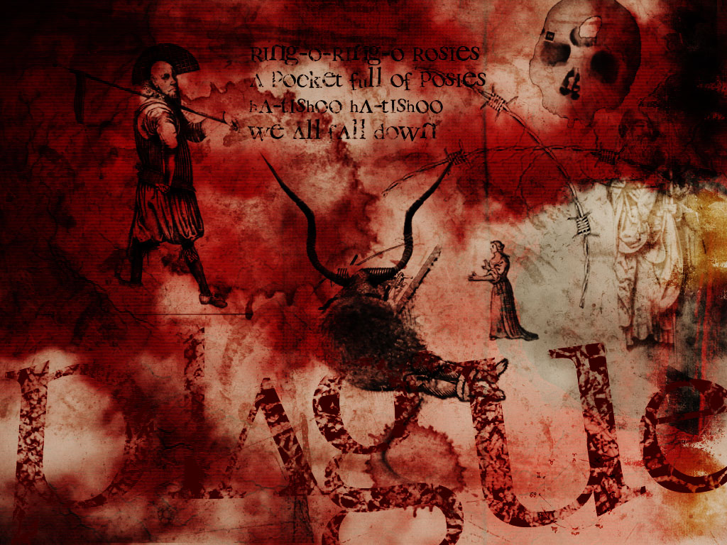

Slide 28
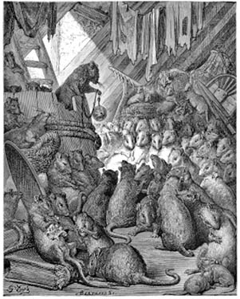
The Black Plague
Papal struggles weren’t the only problems in the fourteenth century.
The Black Plague or “bubonic plague” struck Europe in 1347, probably spreading from a flea on a rat.
Notes:
“The Council Held by Rats,” engraving by Gustave Dore (1870)

Slide 29
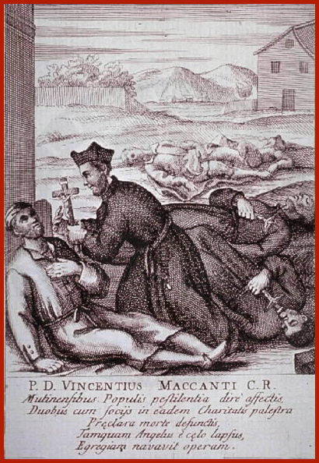
The Bubonic Plague Ever since the first bubonic plague hit Europe in 1348, epidemics struck various regions about every thirty years. Italy had the best health care in Europe, but it was hard to contain a plague when no one understood the cause. The bacterium yersinia pestis, which lives in the stomachs of infected fleas, would not be discovered until 1894. Fleas feasted on rich and poor alike throughout the year. The papal government understood, however, that the plague spread from one sick individual to another. During an epidemic, doctors visited every house in a given neighborhood to ferret out the sick and cart them off to a pesthouse. Many people, believing they were merely getting a cold, refused to enter the contagious miasmas of the plague hospital where, if they didn’t have plague already, they would surely catch it. Their relatives tried to hide them in the basement behind wine barrels or in the thatched roof over the attic, but the doctors, aware of these tricks, usually plucked them out and carted them off. Still, many Romans died at home, and grave diggers were supposed to collect the bodies and bury them. Some of them grew tired of hauling the non-stop cartloads of dead bodies far out of town and burying them eight feet under; it was easier to bury them closer to town. Sometimes as a joke they would dump the bodies in shallow graves next to the homes of people they didn’t like. Additionally, gravediggers were supposed to burn the contagious clothing and bedding of the deceased, but they often sold them, along with the bubonic fleas they harbored.

Slide 30
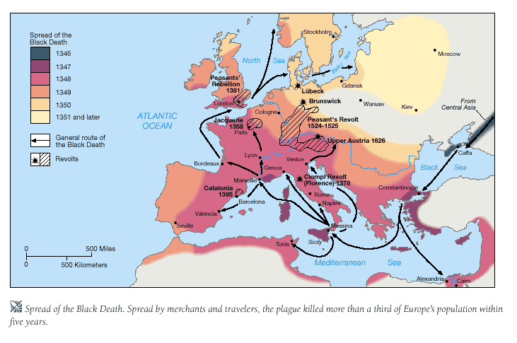
From The Modern Scholar Course Guide: “One, Holy, Catholic, & Apostolic”
G O D I S A N G R Y !
“Europeans naturally looked to the Church for answers to the Black Death, yet few were forthcoming. Everyone agreed that God was angry, but the reason for this anger was debated. Church leaders ordered fasts, prayer, and solemn processions of relics. Flagellants began to organize, attempting to atone for the sins of Christendom. They traveled in large groups, whipping each other in various rituals. City leaders occasionally made deals with saints or Mary to save them from plague, resulting in the building of great churches. Many fingers also pointed to a wealthy Church and a pope who no longer lived in Rome.”
From Bubonic Unto Pneumonic Peak

Slide 31
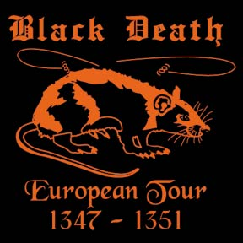
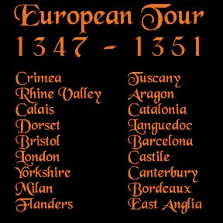

Slide 32
From “The Black Death” by Sean Martin: Chronicler Gabriel de Mussis Quote
G O D I S A N G R Y !
“God sees the human race wallowing in the mire of manifold wickedness. God then pronounces judgment on humanity. ‘May your joys be turned to mourning , your prosperity be shaken by adversity, the course of your life be passed in never-ending terror. Behold the image of death. Behold I open the infernal floodgates… Let the sharp arrows of sudden death have dominion throughout the world. Let no one be spared… Let the innocent perish with the guilty and no one escape.’”
From Pneumonic Peak To Septicaemic Black

Slide 33
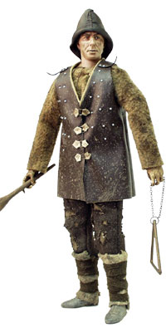
“BRING OUT YOUR DEAD”

Slide 34
The Black Plague
The Black Plague took 23 million lives in Europe and Asia Minor.
In Constantinople, 88% of the population perished.
At one point, 800 people were dying every day in Paris.

Slide 35
A DIVINE HOUSEKEEPING @ REVELATION CHAPTER 6?

Slide 36
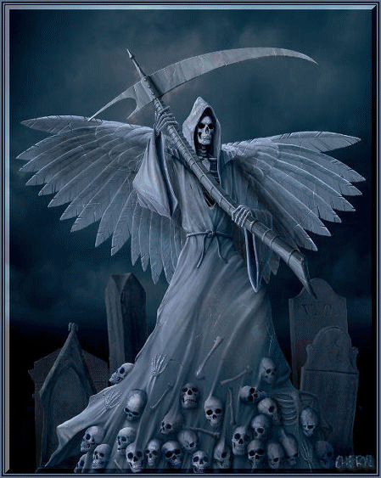

Slide 37
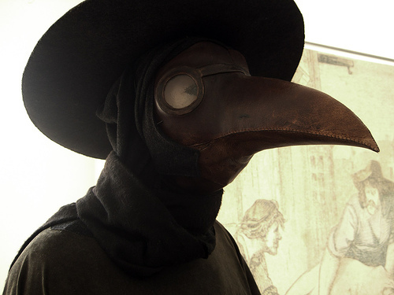
During the plague in the Middle Ages, some doctors wore a primitive form of biohazard suit called “plague suits” (pictured above). The mask included red glass eyepieces, which were thought to make the wearer impervious to evil. The beak of the mask was often filled with strongly aromatic herbs and spices to overpower the miasmas or “bad air” which was thought to carry the plague.

Slide 38
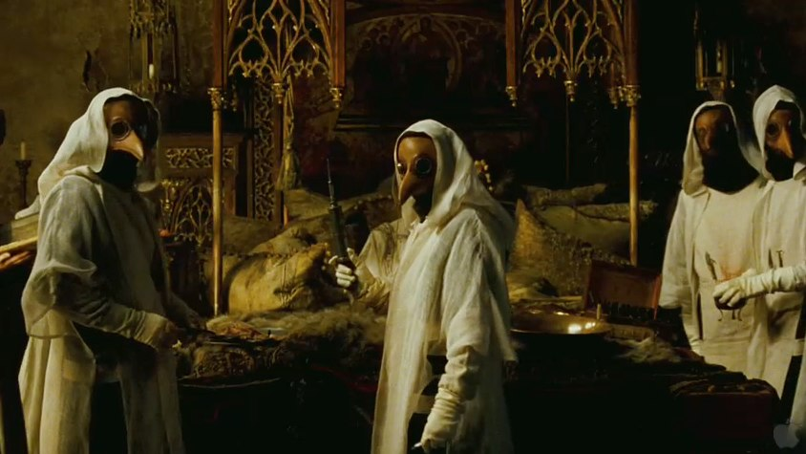

Slide 39
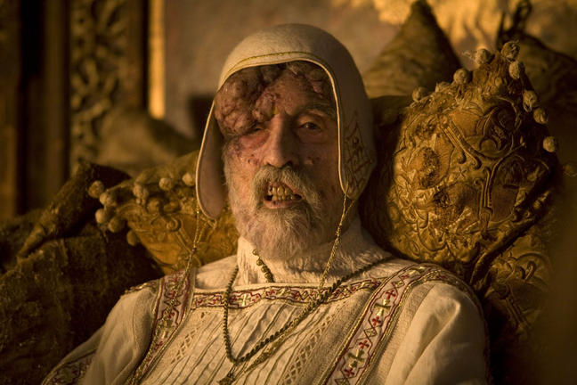

Slide 40
WITH DEATH EVERYWHERE WHERE WAS GOD?

Slide 41
“Oh people, know that you have committed great sins.
If you ask me what proof I have for these words, I say it is because I am the punishment of God. If you had not committed great sins, God would not have sent a punishment like me upon you.”
- GENGHIS KAHN
THE HORSE OF DEATH

Slide 42
What on Earth Was Happening?
During the final centuries of the Middle Ages, the world was wracked with war, famine, plague, and political upheaval.
New challenges brought new perspectives on the nature and function of the church.
These new perspectives eventually led to the Protestant Reformation.

Slide 43
In crisis The church sees opportunity

Slide 44
The false 1st Cent Clement decrees
claimed unusual authority for the Roman Bishop.
The pope had freedom from secular oversight,
independence from the state,
and exemption from civil courts.
Pious Papal Frauds
Pseudo-Isidorian Decretals
THE PAPAL TRADITION OF CHOOSING A NEW NAME STARTS WITH MERCURIUS IN A.D. 533 RENAMING HIMSELF JOHN THE SECOND. THIS PRACTICE WAS PRIOR ASSOCIATED WITH ROYAL DYNASTY.

Slide 45
The Donation of Constantine was a document of great importance in the Middle Ages. It was used by the Church to support its claim of supreme rule over even earthly powers. It supposedly was given by Emperor Constantine to Pope Sylvester I in the 4th century, when Constantine relocated his capital in Constantinople, granting the pope (therefore the Roman Church) dominion over all Italy, as well as over Jerusalem, Constantinople, and Alexandria. It also claimed that Constantine had bestowed upon the papacy supreme control over all clergy, and, more significantly, a great deal of political power (though Sylvester had, apparently, humbly refused to accept from Constantine the Imperial Crown!).
For centuries the Donation was accepted by all, giving the popes great political clout. However, in the 15th century it was proven by Nicholas of Cusa, a German cardinal and scholar, to be a forgery.
Apparently it had been forged during the Frankish Empire in the 8th or 9th century. In that period the papacy was in a constant struggle for control with the powerful Carolingian rulers (such as the Holy Roman Emperor Charlemagne). The Church at Rome, seeing its power threatened, devised the idea, and produced the document that came to be known as The Donation.
The Waldensians (unaware that the document was a forgery) considered Sylvester’s supposed acceptance of worldly political power as a denial of the humility and poverty fundamental to obedient followers of Christ and the Apostles. They believed that from the 4th century on, the Church had compromised with the world, and therefore had denied Christ. And the power and luxury they saw in the Church seemed to support their claim.

Slide 46
FABRICATED CONSTANTINE DONATION

Slide 47
CITED PRECEDENT MELDING

Slide 48
SPIRITUAL & TEMPORAL SWORDS

Slide 49
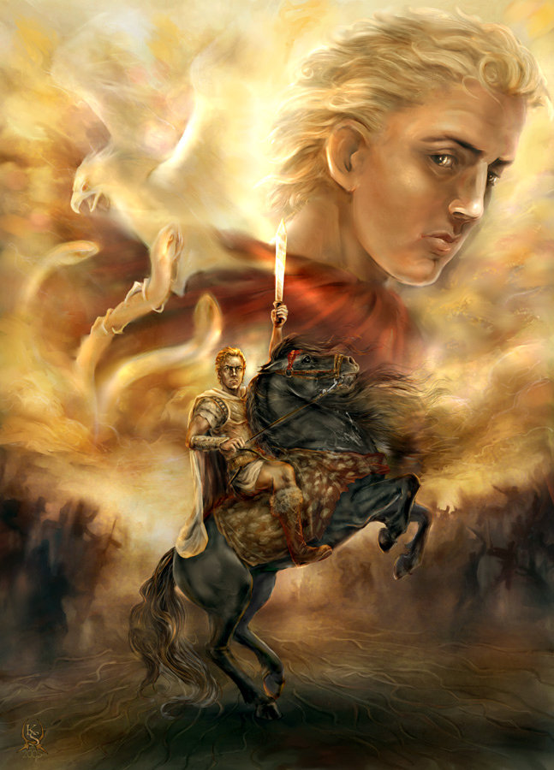
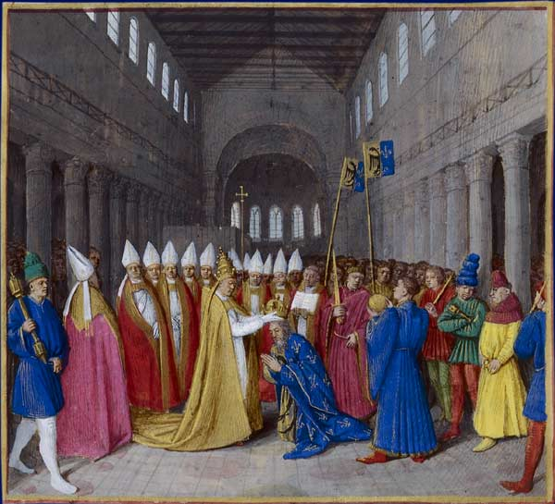
INSTITUTIONAL CHURCH ORDAINS GOVERNMENTS

Slide 50
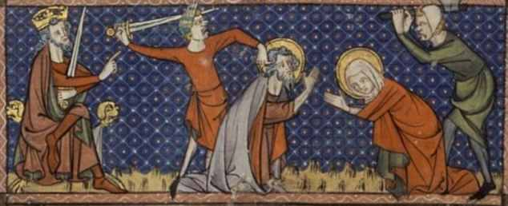
HOLY ROMAN EMPIRE
NEITHER - EMPIRE
NEITHER-ROMAN
And Not In The Least
H O L Y !

Slide 51
POPESS JOHN VIII HISTORICITY
The first time mention by Scottish Monk Marianus Scotus in his 1058 book Universal Chronicle: “Leo the pope died on the 1st of August. To him succeeded John, who, as it is asserted, was a woman, and sat for two years, five months, and four days.”
In 1276, after ordering a thorough search of the papal records, Pope John XX changed his own title to John XXI in official recognition of Joan’s reign as Pope John XIII.
In Tuscany, around 1400, her face was carved among the papal busts in the cathedral at Siena. It remained there, travelers said, until its replacement by the bust of a male pope two centuries later.
In 1601, under command of Pope Clement VIII, her statues and busts suddenly “metamorphosed” into those of Pope Zacharias.
Pope Joan first appeared on the Tarot Card Deck about the 13th Century. Moreover, Pope Joan was a card game once very popular in Scotland. Although it involved gambling, it was popular during the Victorian era as a social activity.
Joan’s Story was included in the official guidebook to Rome used for 300 years.
Frederick Spanheim, the learned German historian who conducted an extensive study of these events, cites no fewer than 500 ancient manuscripts containing accounts of Joan’s papacy, including those of such acclaimed authors as Petrarch.
J.N.D. Kelly writes in his Oxford Dictionary Of Popes: “The story of a pope named Joan was accepted without question in Catholic circles for centuries.”
Another striking piece of historical evidence is found in the well-documented 1413 trial of Jan Hus for heresy. Hus was condemned for preaching the heretical doctrine that the Pope is fallible. In his defense Hus cited many examples of Popes who had committed crimes against the Church. To each charge his ecclesiastical court judges and jury replied in detail denying. Only one Huss charge went unchallenged: “Many times have the Popes fallen into sin and error, for instance when Joan was elected Pope, who was a woman.”

Slide 52
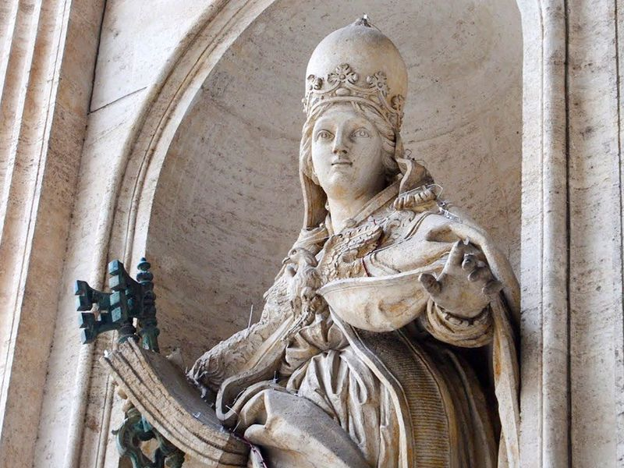

Slide 53
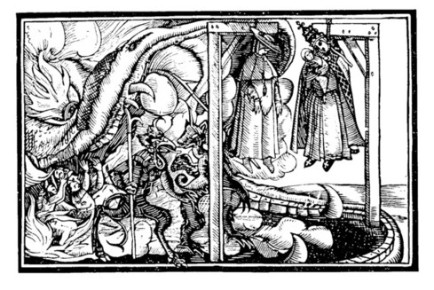
POPESS JOHN VIII HISTORICITY
The Sequence Of Events per Friar Martin of Troppau writing in 1265 A.D. -- The female pope reportedly was born in Germany of English missionary parents and grew up unusually bright in an era when learned women were considered unnatural if not dangerous. To break the glass ceiling, it was said she pretended to be male. At 12, she was taken in masculine attire to Athens by a monk described as her teacher. Disguised in the sexless garb of a cleric she made much progress in her studies eventually giving a scholarly lecture at the Trivium in Rome and ultimately staying to climb the church hierarchy to the high rank of cardinal. Here her knowledge of the scriptures so impressed her colleagues in the College Of Cardinals that they elected her Pope John Anglicus in 855 A.D..
Papal Momma. According to most versions, spectators watched in horror as the pope, trying to mount a horse, went into labor and gave birth to a son. Hierarchs who were profoundly devoted to the Holy See sought to save the day and change horror and disgust to amazement by crying out – “A miracle” – bellowing loudly for for the faithful to kneel and worship. They were quite unsuccessful. Moments later, reports said, the crowd tied her feet to the horse’s tail, then stoned her to death as she was dragged along the street. {Marginal notes in a 15th century document refer to a statue erected close by the Lateran called - “The Woman Pope With Her Child.”}
Groping Chair. There is circumstantial evidence difficult to explain if there never was a female Pope. The most important part of the medieval papal consecration ceremony for almost 600 years was the so-called chair exam. Each newly elected Pope after Joan sat on the sella stercoraria (literally, “dung seat”), pierced in the middle like the classic Roman public toilet, where his genitals were examined to give proof of his manhood. Afterward the examiner solemnly informed those gathered, “Mas nobis nominus est” – “Our nominee is a man.” Only then was the Pope handed the keys of St. Peter. The ceremony continued until the sixteenth century. In his excellent 1999 book, The Legend Of Pope Joan, British writer Peter Stanford reports in visiting the basements of Vatican inspecting an unusual chair that meets this description; He has convincing photo evidence included inside this publication.
After Pope Joan the 10th Century Marozia Pornocracy

Slide 54
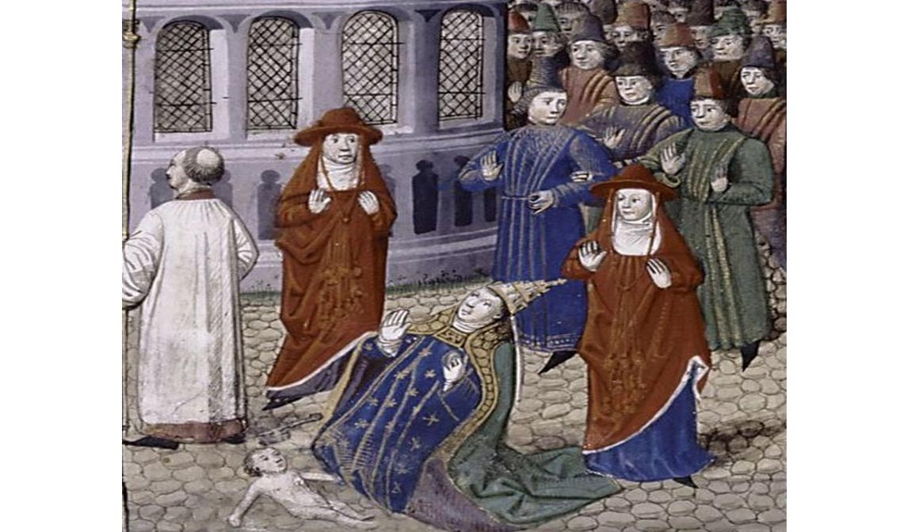

Slide 55
NETWORK SPECIAL ON THE WOMAN POPE

Slide 56
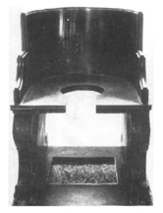
TESTICULAR VERIFICATION OF GENDER

Slide 57
David Lee Burris:
Like The Beatles Song?
To Make Sure The Pope's Death!
SILVER HAMMER OF SUCCESSION

Slide 58
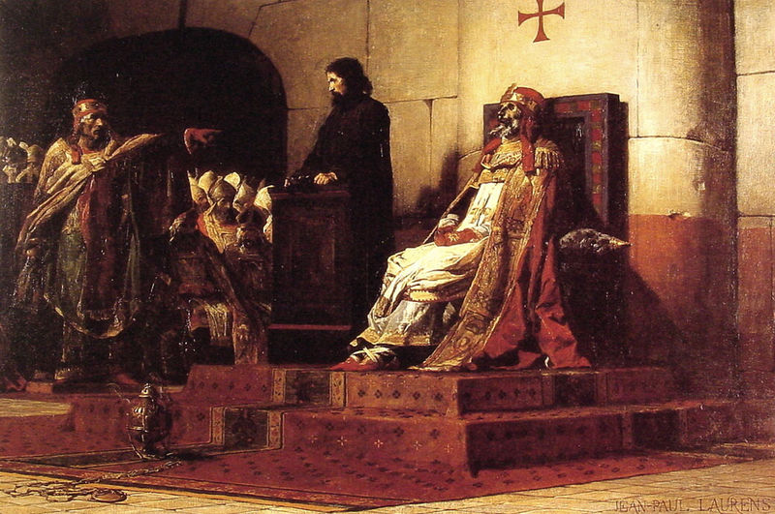
March 0f 896: The Synod Horrenda Quoting Pages 19 - 20, The Bad Popes by E. R. Chamberlin
Said Of Author & Book By The Catholic World Magazine:
“John XII, the dissolute, satyr-like Roman prince; Benedict IX, who subjected the Papacy to its greatest indignity; Boniface
VIII, ruthless in his insatiable hunger for absolute power; Urban VI, the wild man from Naples whose grotesque savageries
widened the Great Schism; Alexander VI, who brought Borgia intrigues and debauchery to the See of Peter; Leo X, ruler of
Rome at the height of its glory and corruption; Clement VII, the unskillful fox who brought ruin to the city and almost to his
Church. Seven different Popes, each of whom precipitated a crisis in the Church – they stole, plundered, gambled, killed,
fornicated. …E. R. Chamberlin’s in-depth approach adds much to the honesty of Church history and carries out Leo XIII’s
injunction at the opening of the Vatican archives to tell the truth.” Cover Page Endorsement Along With Washington Post
“In that month(March) the triumphant faction, whose leader now ruled briefly as Pope
Stephen VII, set in motion a solemn trial of the late Pope Formosus, quondam leader
of the rival faction. The act of judgment was no mere formality. The corpse itself was
dragged from the tomb where it had rested for eight months and, dressed again in its
sacerdotal robes, was brought into the council chamber. There it was propped up in
the throne that it had occupied in life while, in a parody of legal form, the ‘trial’ went
its blasphemous way. The corpse was provided with a council, who wisely kept silent
while Pope Stephen raved and screamed his insults at it.”
Notes:
Pope Joan & Synod Horrenda Discussed Fully & Examined Fairly In ABC Special Of 12/29/05 - “The Mystery Of Pope Joan”

Slide 59
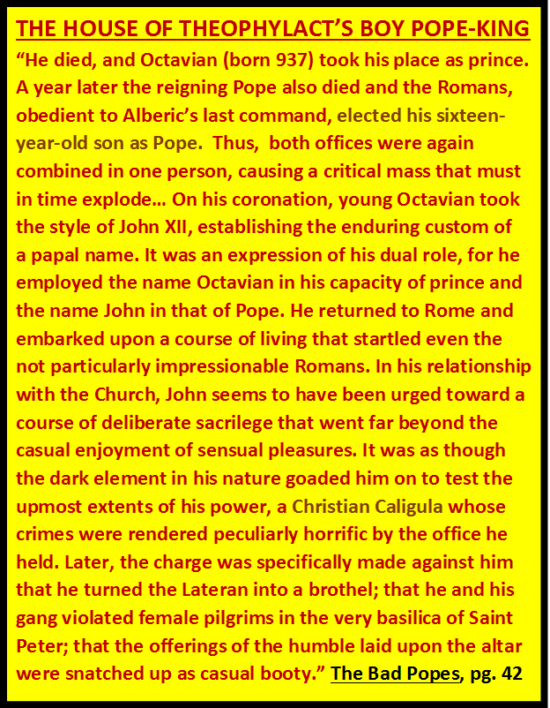

Slide 60
From The Modern Scholar Course Guide: “One, Holy, Catholic, & Apostolic”
EARLY CLUNIAC REFORM
“The German Emperor Henry III sought to enact the first reform measure to purify the Church, In 1046, he deposed the three competing popes and appointed his own reform popes. With the support of the emperor, these non-Roman popes were able to enact reforms. Reform popes brought to Rome reform-minded clerics from across Europe to staff church offices.”
“The Cluniacs produced a new kind of specialized monk, a military monk who rode on horse, upheld codes of chivalry & was an effective killing machine when necessary.”

Slide 61
From The Modern Scholar Course Guide: “One, Holy, Catholic, & Apostolic”
Papal Election Decree Of 1059
“Henry III{German Holy Roman Emperor} died in 1056, leaving a regent government. This provided the opportunity for the well- established reformers in Rome to implement the second phase of reform. As with others, the bishop of Rome would be chosen by the leading clergy of his see without interference. The cardinals would henceforth elect popes. Emperors and all other secular authorities would stay out.”

Slide 62
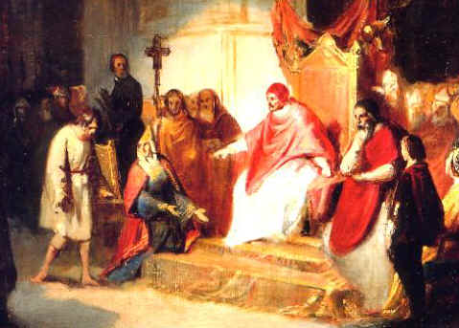
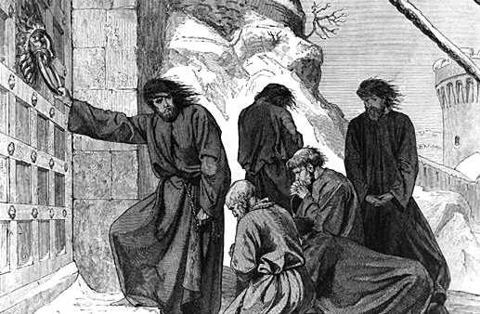
From The Modern Scholar Course Guide: “One, Holy, Catholic, & Apostolic”
Investiture Controversy Of 1075
“In 1075, in a synod in Rome, Gregory formally forbid lay investiture of clerical authority. Henry IV assembled disgruntled German bishops at Worms in 1076 and wrote an extraordinary letter, claiming that Gregory was no pope, that he wielded religion as a tool of violence, and that he should step down. Gregory’s response was a letter to St. Peter. In it, he deposed Henry and absolved his subjects from oaths of fealty. Thus began the Investiture Controversy. Henry’s empire began to fall apart. He was forced to travel to Canossa in 1077 to beg forgiveness from the pope.”

Slide 63
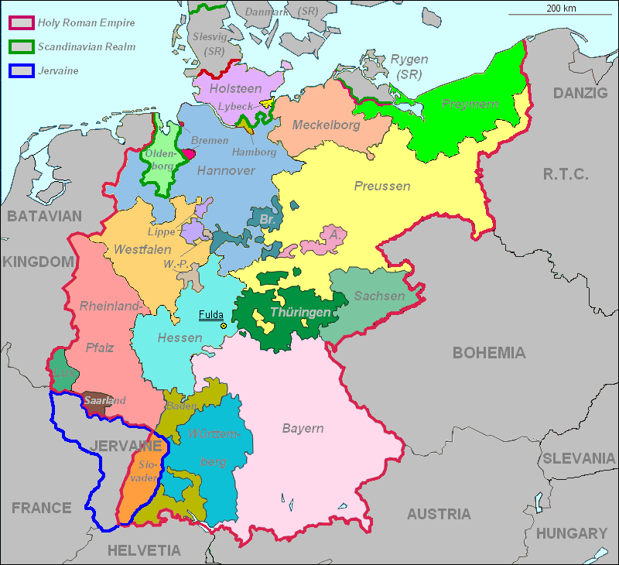
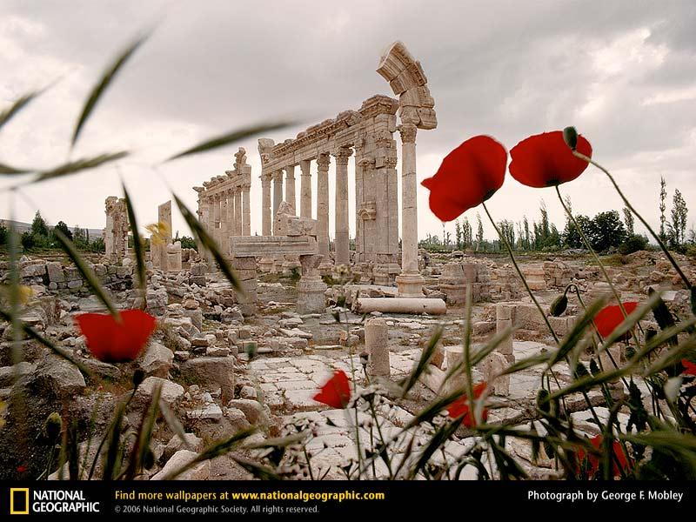
“As Pope Gregory, Hildebrand invented the modern papacy.
He created a legal monarchy and elevated canon law above secular codes. He changed the papacy from ‘vicar of Peter’ to ‘vicar of Christ’ and his Dictatus papae decreed twenty-seven truths, among them the dictate that ‘only the pope’s feet are to be kissed by all princes’ and not the feet of kings or emperors.” - pg. 6, The Proof of God
THE HOLY ROMAN EMPIRE!

Slide 64
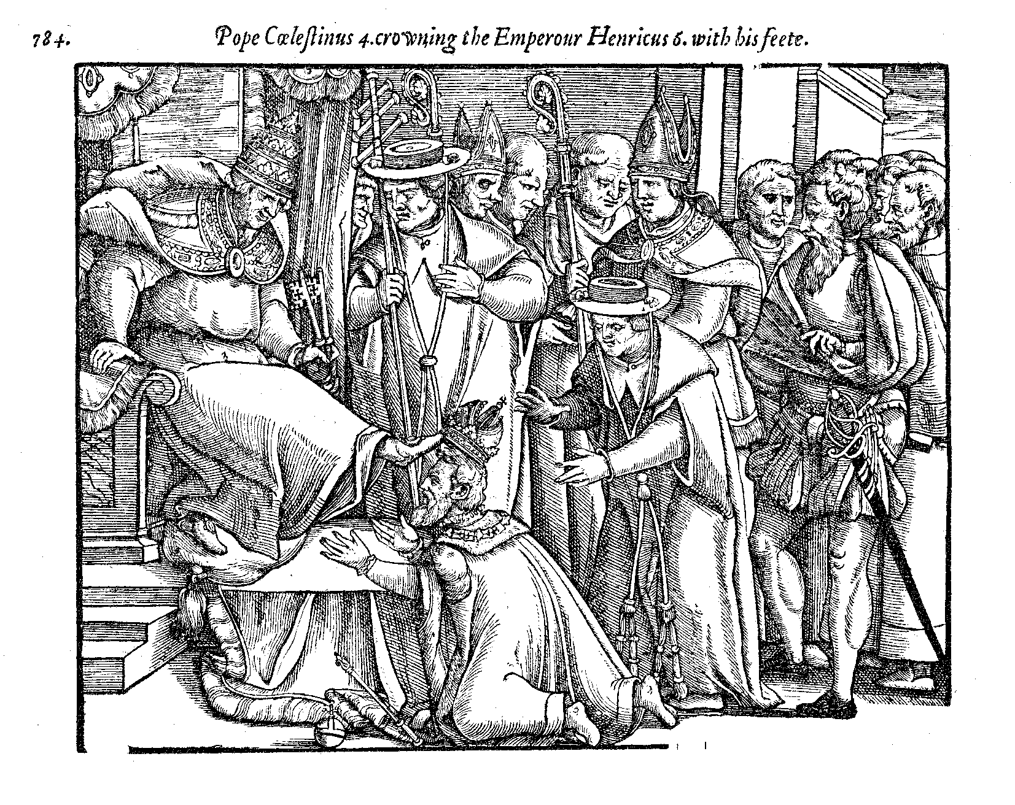
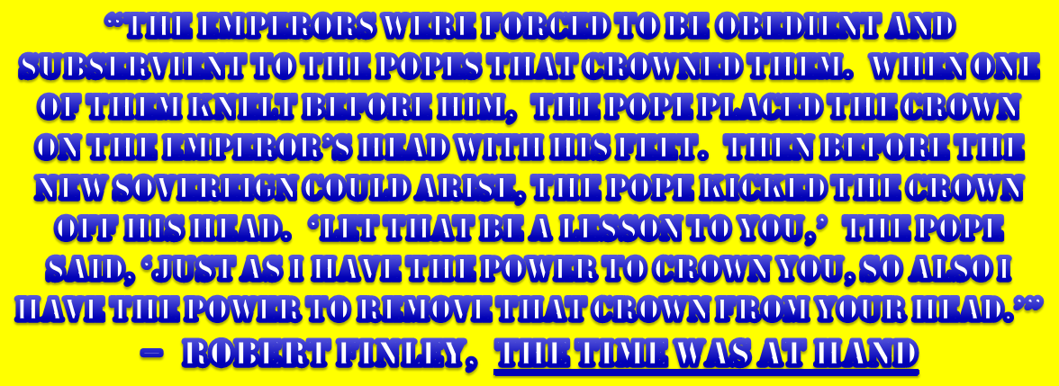

Slide 65
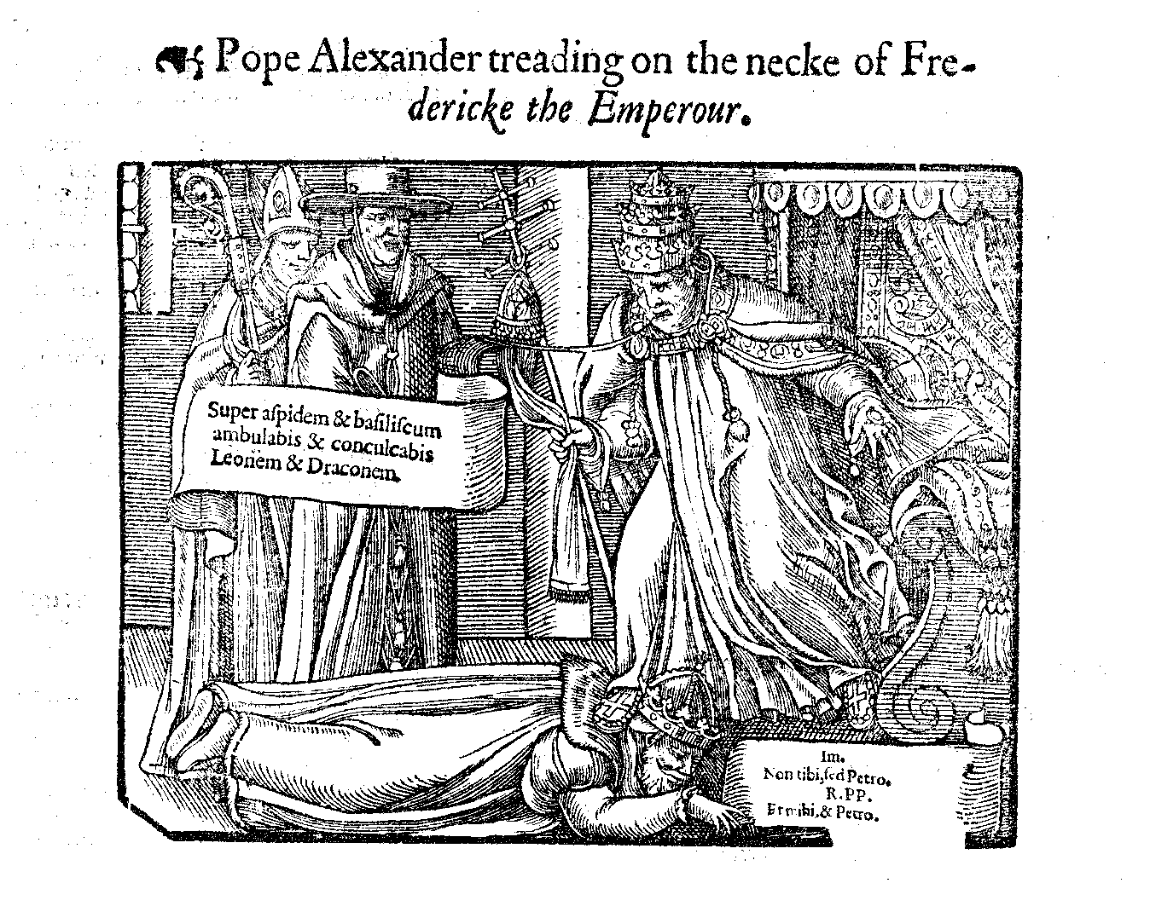

Slide 67
UNTO KING'S SCEPTER
FROM SHEPHERD'S STAFF

Slide 69
From The Modern Scholar Course Guide: “One, Holy, Catholic, & Apostolic”
UNAM SANCTAM OF 1302
“Unum Sanctum in 1302 laid out completely Philip’s, and every other Christian’s, duty to obey the pope in matters of sin. ‘There is only one Holy, Catholic, and Apostolic Church.’ The pope as the Vicar of Christ is the head of that Church. Those who deny that aren’t of the Church. The two swords are given by God to the Church for the service of his people and salvation of souls. The spiritual must act when the temporal moves to sin. ‘It is altogether necessary to salvation for every human creature to be subject to the Roman Pontiff.’ Philip was given a year to repent. Philip called councils of French clergy, who then condemned Boniface as a murderer and heretic. Troops entered Anagni in Sept. 1303, just before the pope was to excommunicate Philip, and arrested the pope. He died shortly thereafter.”

Slide 70
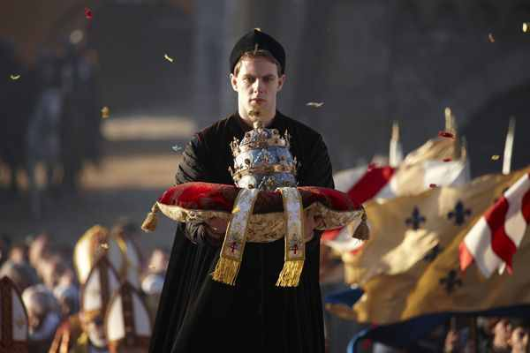
1334
1334-1342 Pope Benedict XII
“The Pope’s Three Crowns” became evident with Benedict. The first crown symbolizes (every) pope’s universal episcopate, second his supremacy or jurisdiction and the third his temporal influence – father of princes and kings, ruler of the world, Vicar of our Savior Jesus Christ”(New Catholic Dictionary)

Slide 72
ANOTHER PERIOD OF TRANSITION
Holy Empire Contest With Thee Church

Slide 73
Two dynasties stand out as rulers of the empire. The Hohenstaufens led the empire during the Crusades. In fact, it was because of the Crusades that Frederick II dubbed his empire “Holy.” In the 13th century, however, the Hohenstaufens were replaced by the Hapsburgs, who were all over the thrones of Europe for the next 800 years. In the process, they won the history reward as the most thoroughly inbred royal family there ever was!
THE END OF AN EMPIRE

Slide 74
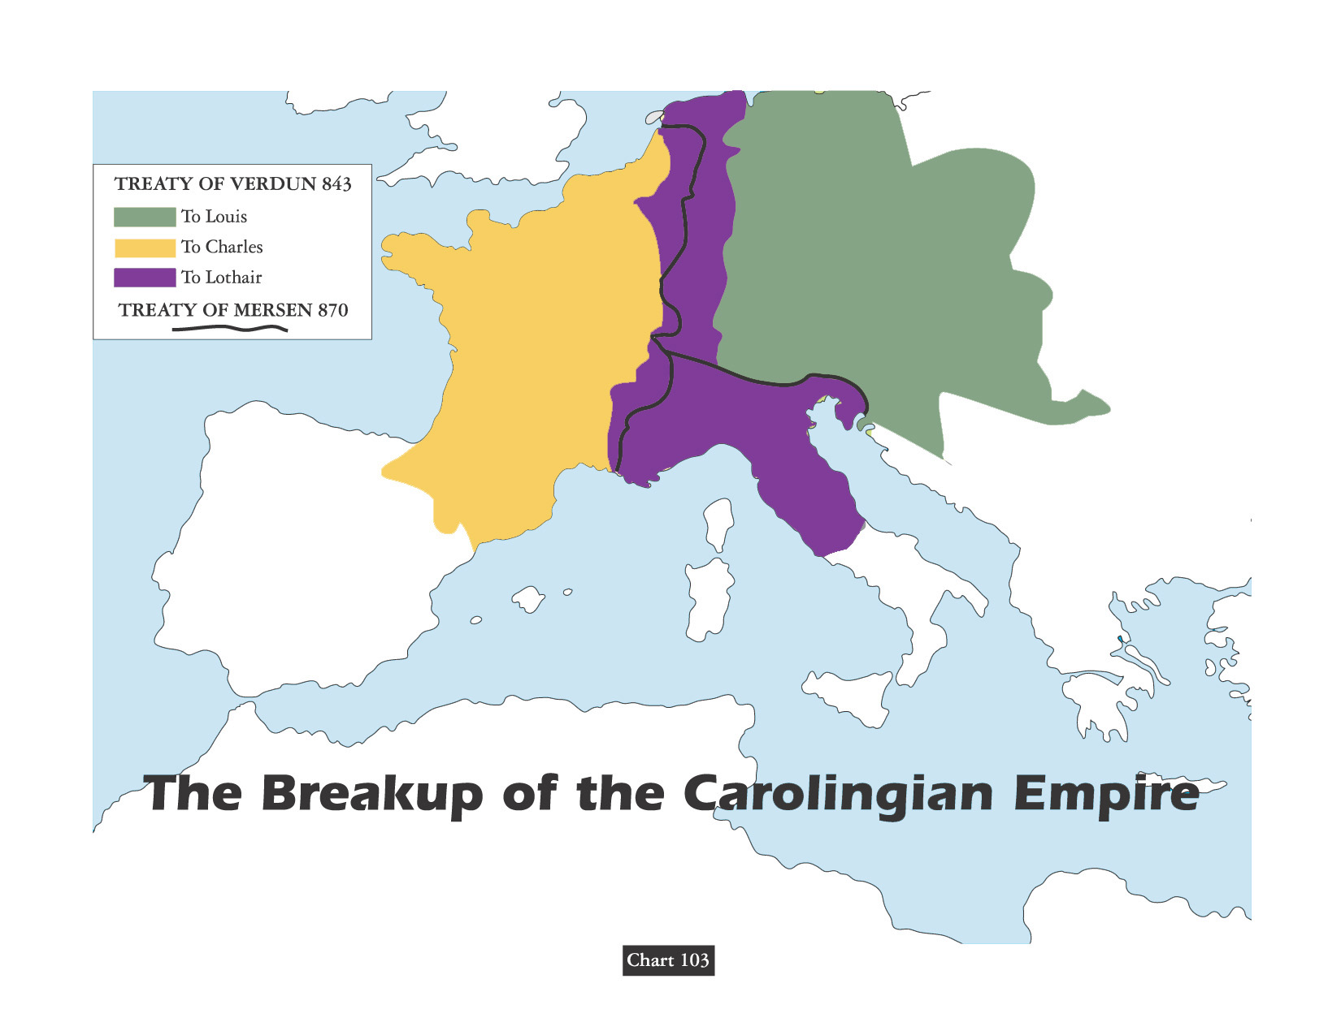
Teutonic Inheritance Principle
The most important factor in the decline of the Frankish phase of the Holy Roman Empire was the fragmentation fatally introduced into the imperial structure by the Teutonic principle that prescribed the division of lands of the father among his sons. Concepts of an invisible empire, held by the Romans, was foreign to the Teutonic mind.

Slide 75
“To his friends, Frederick Hohenstaufen was the stupor mundi or ‘world wonder.’ To his enemies, he was the Antichrist. Of course, to the people of Sicily & the Holy Roman Empire, he was simply the king & skilled warlord. As a linguist, he wrote scientific tracts in a dozen languages. He was an early advocate of the experimental method and performed rather interesting (highly unethical) experiments – such as raising children in silence to see if they would speak a ‘natural language.’”
THE LAST HOHENSTAUFEN

Slide 76
“FRED [HOHENSTAUFEN] WAS BEST KNOWN FOR HIS DECADENT LIFESTYLE – ENAMORED OF ISLAMIC CULTURE & PHILOSOPHY, HE KEPT A HAREM OF NUBILE YOUNG LADIES AT HIS BECK AND CALL.”
THE LAST HOHENSTAUFEN
- Mental Floss, Forbidden Knowledge

Slide 77
Emperor Wenzel (1378-1419) had the margins of his German Bible translation decorated with pictures of himself being bathed and his hair washed by comely attendants wearing transparent white dresses.
Sacred illustration
- Kay Ashenburg, Unsanitized History

Slide 78
In theory the Holy Roman Empire was a continuation of the ancient Roman Empire. The fathers of the church had maintained that when the Roman Empire finally collapsed it would signal collapse of the great cycle of empires and begin the reign of the Antichrist.
WHITE ROBE BLACK ROBE
Politics Of Indulgences
by Charles Mee
See - PAGE 170 - The Time Was At Hand by ROB fINLEY

Slide 79
In truth, all that remained of the old empire was a bit of magic in the imperial name. The emperor labored in vain to keep his electors under the impression that they were his vassals. Where once the empire had seemed strong because all its enemies were weak, now the newly united nations of England, France and Spain defied the empire with impunity.
WHITE ROBE BLACK ROBE
Politics Of Indulgences
by Charles Mee

Slide 80
The Holy Roman Empire had no discernible boundaries & no center!
The emperor couldn’t collect taxes, keep standing army, or support a police force.
For that matter, it is a moot point just what laws police could have enforced. There was an imperial court of justice, but it had the scantiest of funds & few obeyed its mandates in any case.
The emperor was an infamous figure, scourge of innkeepers, because he could never afford to pay his bills. His empire was an omnium-gatherum that added up to a web of family ties and hopeless confusion.
WHITE ROBE BLACK ROBE
Politics Of Indulgences
by Charles Mee

Slide 81
The Medieval Church Scandals chapter in book by charles franklin
“Another custom of the medieval period was the so-called ‘right of the first night’ (jus primae noctis) whereby the lord of the manor under his ‘driot de seigneur’ could enjoy a bride on the first night of her marriage, before the husband had carnal knowledge of his wife. This right was often exercised by clerical higher-ups, and a few monasteries made this a steady practice. All brides-to-be, married under the auspices of such an institution, were required to make pilgrimage to the monastery, there to be deflowered. In some localities, it was customary for the bride to bring a gift to the cleric who was scheduled to take her virginity.”

Slide 82
The Medieval Church Scandals chapter in book by charles franklin
“Under Sir Ecgbert’s code of 729, a monk who fornicated with a woman was required to fast for three years. But if a child was born, the deprivation would extend to four years; and if they slew the child, retribution extended to seven years.”
“St. Ecgbert also ordained that a habitually homosexual bishop would have a similar penance for 14 years; and that a bishop who fornicated with cattle should be punished by a eight-year fast for a first offense, and by a ten-year fast for repeated malfeasance.”

Slide 83
The Medieval Church Scandals chapter in book by charles franklin
“Similar codes existed through the centuries. Nevertheless, offenders among the clergy often went unscathed – first because such men were part of the very establishment which administered the laws, and secondly because the Church could not afford to lose the services of every capable man who was guilty of sexual misdeeds. An offender, though sometimes deposed from his exalted station, was more often merely transferred to an equally lucrative benefice.”
“During Gregory VII’s reign, a number of priests who had married were caught up by the mob and castrated and then exposed in their mutilated state to the public. Gregory’s successor, Urban II, simply offered the wives of priests as slaves to any nobleman who would accept them.”

Slide 84
The Medieval Church Scandals chapter in book by charles franklin
“In 836, the Council of Aix-la-Chapelle openly declared that many abbesses were to blame for running their convents as bawdy-houses. The Council directed future architects to be sure that there would be no ‘dark corners’ in convents that could be used for immoral purposes. (Upon the dissolution of the convents in England under Henry VIII the bones of newborn babies were found ‘all over the place,’ in convents, for it was much more difficult for nuns than for priests to get their bastards accepted in the outside world.)”

Slide 85
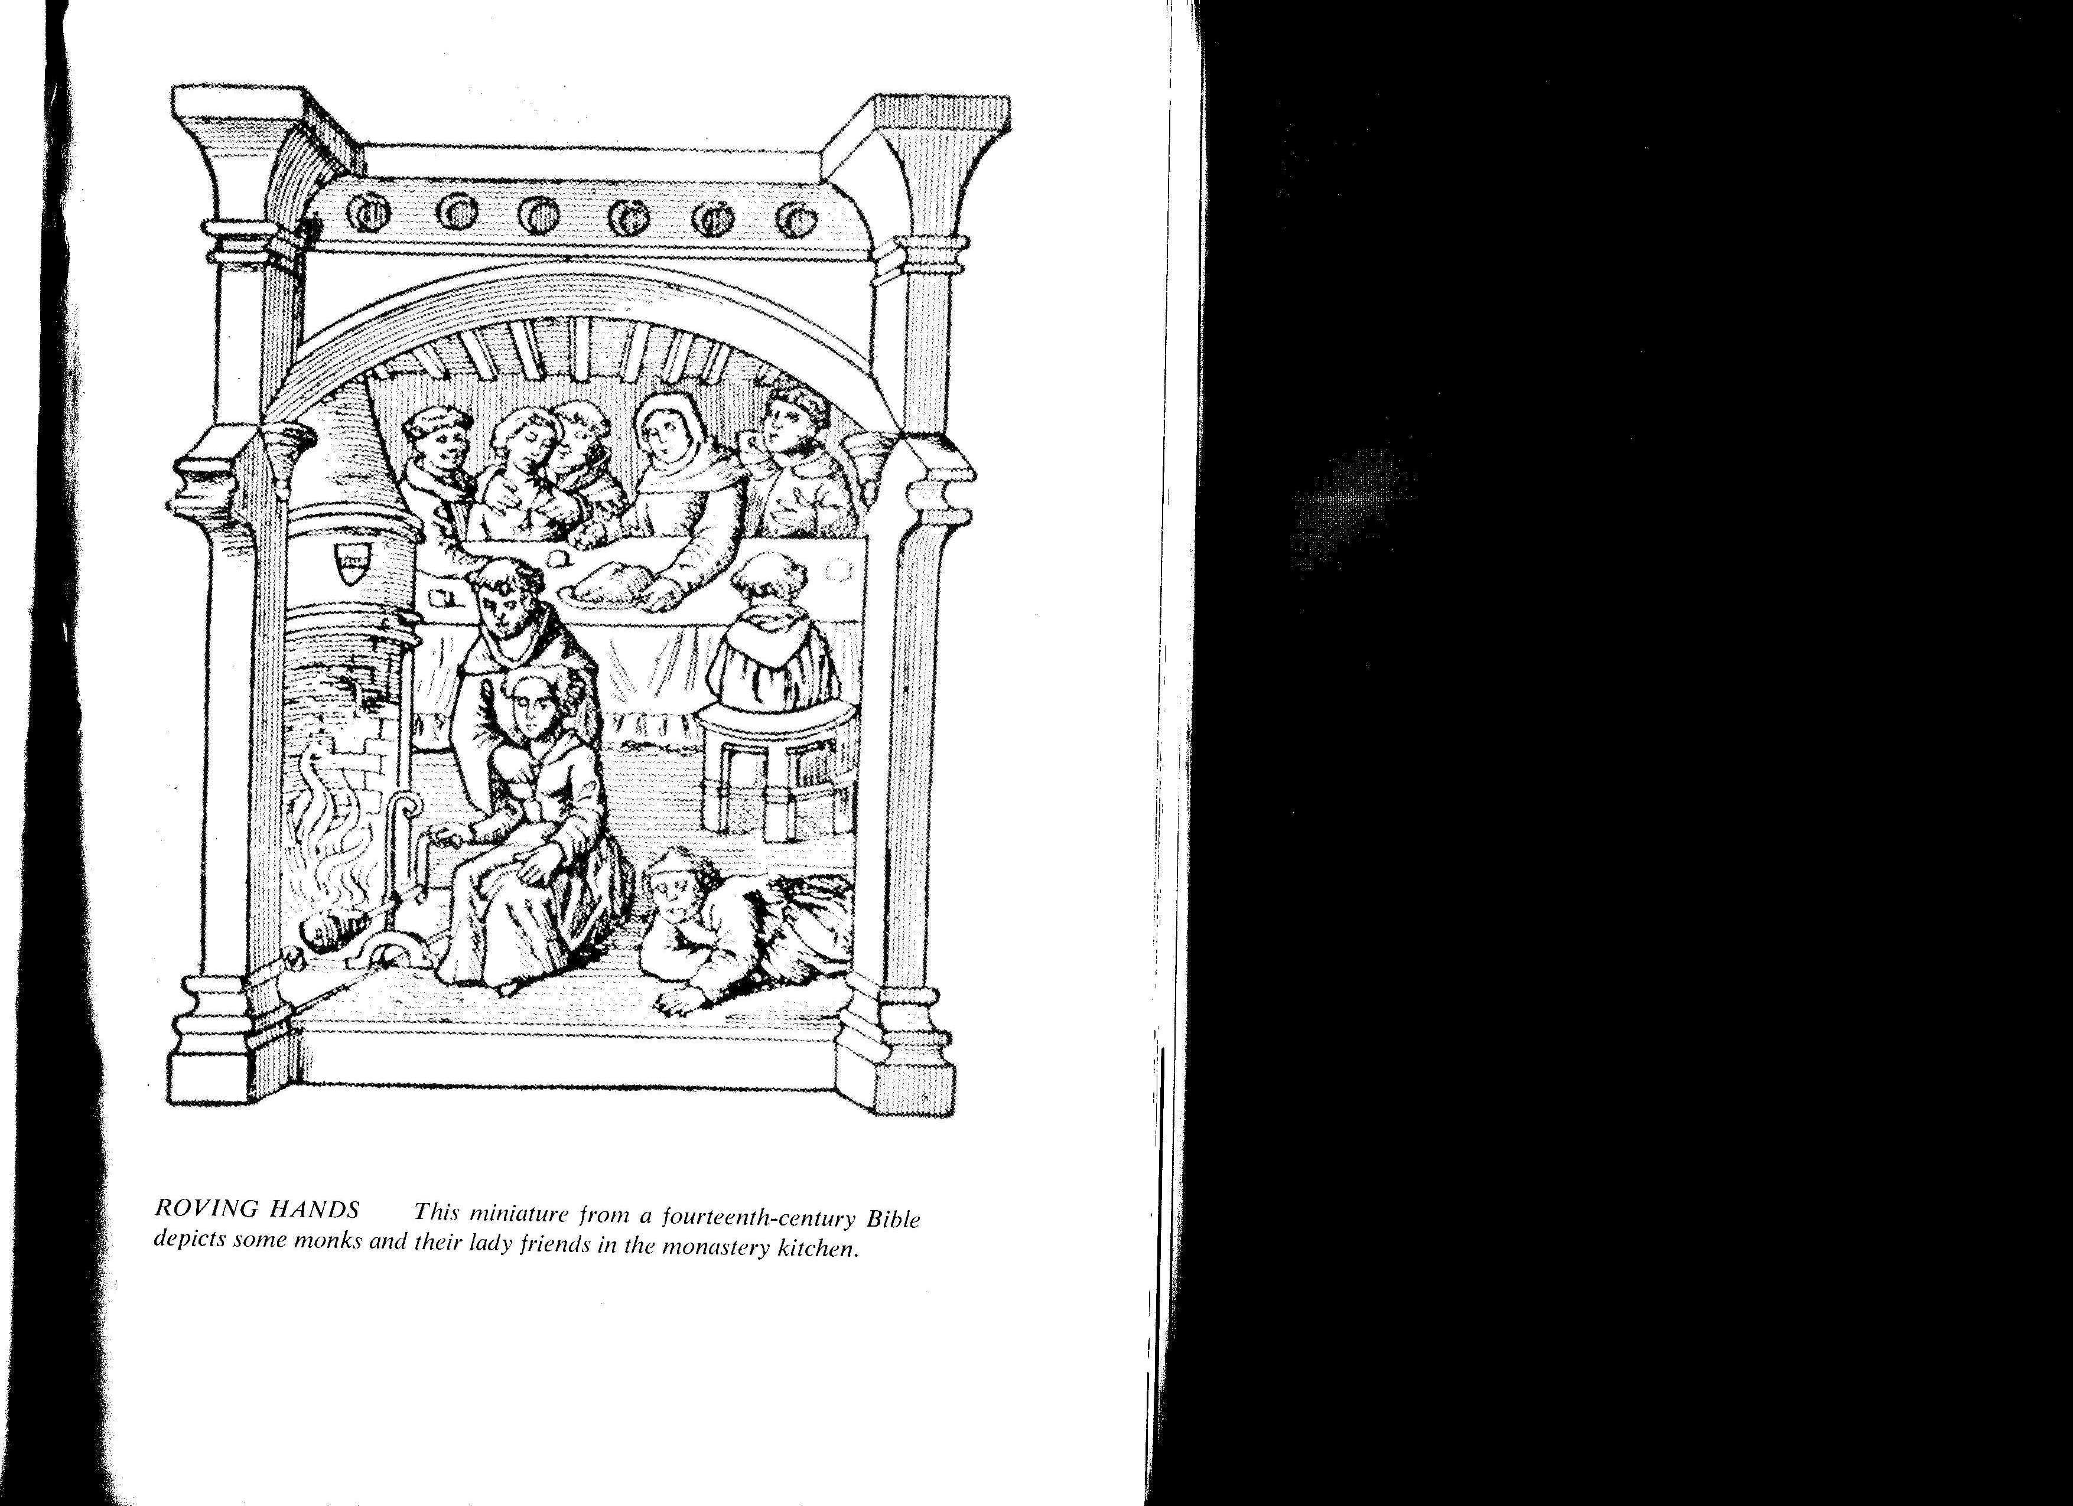
The Medieval Church Scandals chapter in book by charles franklin
“Looking back on this period, the scholar Erasmus wrote that chastity was more endangered in the cloister than out of it; and Thomas Fuller philosophically mused that ‘Virginity is least kept where it is most constrained.’ ”
“During the 10th century, loose federations of monks and nuns were established which led to the building of ‘double monasteries’ with only a wall between monks & nuns - this innovation notoriously unsuccessful, nearly all the nuns becoming pregnant.”

Slide 86
The Medieval Church Scandals chapter in book by charles franklin
“Pope John XII, who ruled from 955 to 964, kept a harem in the Lateran Palace. This man, who became Pope at the age of 18 through the influence of his family, was deposed on grounds of perjury, murder, sacrilege, and incest.”
“In 1126, Cardinal Giovanni of Cremona was sent by Pope Honorius II to restore discipline among the English clergy. He called a meeting of the London Synod and denounced concubinage among British priests. That very night, however, he was himself surprised in bed with a prostitute.”

Slide 87
The Medieval Church Scandals chapter in book by charles franklin
“Many archbishops and abbots installed, not only hawks and hounds, but women – either in abbeys or other residences. Illegitimate children were legion. In 1171, one Clarembald, abbot of St. Augustine’s foundation at Canterbury, boasted that he had fathered 17 bastards in one village alone. The Prince Bishop of Liege similarly admitted having achieved the paternity of 14 bastards in 22 months. In Germany, the word Pfaffenkind (literally, ‘priest’s child’) became the commonly used word for any child born out of wedlock.”

Slide 88
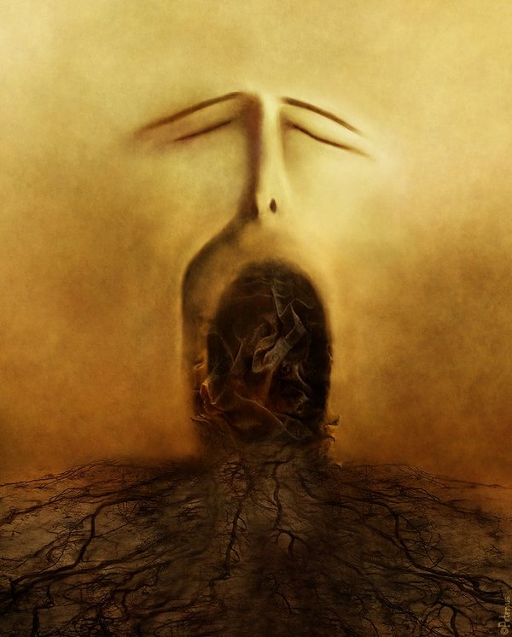
SACRAMENTALISM
The Confessional
“A term used pejoratively of persons or church traditions that see the essence of Christianity as participation in the sacraments rather than as inner transform- -ation and personal piety.”
* Dictionary Of Theological Terms, Grenz & Guretzki

Slide 89
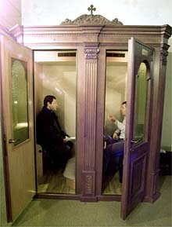

Slide 90
The Medieval Church Scandals chapter in book by charles franklin
“I cannot with a safe conscience commit the confessions of the laity to you. Ye lead women behind the altar under pretence of confession and there ye deal as the sons of Eli dealt at the door of the tabernacle, which is horrible to relate and more horrible to do.”
In 1261, at the Council of Ravenna, the presiding archbishop said:

Slide 91
The Priest the Woman and the Confessional chapter in book by Father Charles Chiniquy
“There is not a single one of the Roman Catholic authors, who have written on that subject for the priests, who has not deplored their innumerable & degrading sins against purity, on account of the auricular confession; but those very men will be the first to try to prove the very contrary when they write books for the people.”

Slide 92
A little girl, being asked by a priest to attend religious services,
refused, saying that it was against her father's wishes.
The priest said she should obey him, for he was "Father."
"Oh, no, for Jesus said,
'Call no man your father upon the earth,
for one is your father, which is in heaven,' " the girl replied.
The priest was not anxious to lose a religious discussion
with so small a girl, so he said,
"You have no business reading the Bible."

Slide 93
"Then why did Jesus tell me to search the scriptures,' "
she said. The priest answered,
"That is only for clergy.
You understand that a child
cannot know the scriptures."
"Then why," she asked,
"did Paul tell Timothy that
'from a child thou hast known the holy scriptures,
which are able to make thee wise unto salvation?' "
"Timothy was being trained to be bishop and was
being taught by church authorities," the priest countered.
"That cannot be," the girl replied,
"for he was taught by his mother and grandmother,
Eunice and Lois. At least that is what Paul wrote."

Slide 94
The priest turned away,
and someone heard him mumble something about
"that girl knows enough about the Bible
to poison a whole parish!"

Slide 95
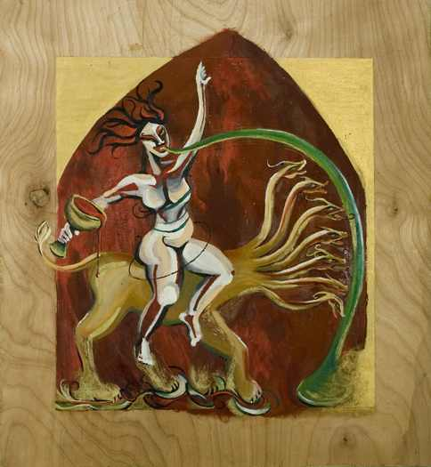
The Medieval Church Scandals chapter in book by charles franklin
David Lee Burris:
Starting With Alexander VI In 1492 - Borgias Regarded The Holy See As Tool To Improve Temporal Power Of Their Family – Their Relatives Including Women Lived At Vatican – Borgia Women Were Political Pawns & Public Mistresses Connected To Other Bad Popes .
GIROLAMO SAVONAROLA’S BONFIRE
JOHN XXIII ARRIVING AT CONSTANCE
LIFE AT THE PAPAL COURT
BAPTISM – SPRINKLED NUDE
ROVING HANDS
ORGY IN A MONASTERY
TAKING A BATH – MIXED BATHING
ALTAR CARVING
DISCIPLINARY MEASURES
GIFT FROM HUBBY – CHASTITY BELTS
MONEY–CHANGERS RESTORED TO POWER
TRAFFIC IN REDEMPTION
TETZEL: SUPER SALESMAN
HANDBILL ADVERTISING INDULGENCES
VOMIT CHURCH
Chapter
Subheadings

Slide 96
The Medieval Church Scandals chapter in book by charles franklin
“Another custom of the medieval period was the so-called ‘right of the first night’ (jus primae noctis) whereby the lord of the manor under his ‘driot de seigneur’ could enjoy a bride on the first night of her marriage, before the husband had carnal knowledge of his wife. This right was often exercised by clerical higher-ups, and a few monasteries made this a steady practice. All brides-to-be, married under the auspices of such an institution, were required to make pilgrimage to the monastery, there to be deflowered. In some localities, it was customary for the bride to bring a gift to the cleric who was scheduled to take her virginity.”

Slide 97
Annual Feast Of Salome

Slide 98
The popes brought marriage under clerical control and forbade divorce for the common people, but they also declared marriage under five or six degrees of kindred to be invalid. The result was that divorce now took the form of “discovering,” when the parties wanted a divorce, that there had never been any marriage because they were related, say, through their great-great-great-grandparents.
DISCOVERY
DIVORCE
THROUGH

Slide 99
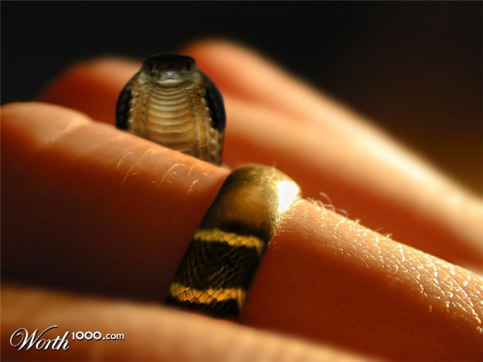
Queen Eleanor got a divorce from the very religious king of France on that precise ground. Procedurally, you paid your abbots or bishops to scan the genealogical tree. But because relationship was counted by sponsorship at baptism as well as by blood or marriage, you could almost always discover it. It made a mockery of marriage and set unlawful desires free!
The Rich Compounded Fortunes Marrying Within
DISCOVERY
DIVORCE
THROUGH
DISCOVERY WAS EASY & DIVORCE WAS EASY!

Slide 100
DEVIL MARRIES MONIED!

Slide 101
Forerunners Of Luther: PETER OF BRUYS
1126 A.D.
This influential leader preached in the south of France, he contended that the New Testament is our only and highest authority. He denied infant baptism, refused to address prayers for the dead & rejected transubstantiation, he even mocked the mass and dismissed formal religion in general. In the end, Peter was burned to death for his “heresy.”

Slide 102
Forerunners Of Luther: PETROBRUSIANS
1126 A.D.
Named from Peter of Bruis, their founder, they became very numerous in Southern France. From Roman Catholic writers we learn the Petrobrusians taught a remarkably evangelical doctrine. They insisted on only the supreme authority of scripture, and refused to acknowledge the authority of Fathers and councils. They held that the baptism of infants is a meaningless form, and that only believers should receive baptism. They said that God could be worshiped as well in wood and field, or in private houses, as in churches. That the cross ought not to be adored; that bread and wine are not changed into the body and blood of Christ in the Lord’s Supper; that prayers, alms, and other good works for the dead do not profit them at all. For these and other like “errors,” the official Church persecuted these heretics with great severity.

Slide 103
Forerunners Of Luther: ARNOLD OF BRESCIA
1141 A.D.
We know little of Arnold before he began his work, except that he had been a pupil of Abelard at Paris. About the year 1130 his eloquence made a great stir in his native city. He denounced the corruptions of the Church, the vices of then clergy, and urged men to live after the precepts of Christ. The clergy, he said, should renounce their worldly possessions, for the root of the evils in the Church was its connection with the State. He was banished and forbidden to preach. He joined his former teacher and was condemned with Abelard at the Council of Sens, in 1141.

Slide 104
Forerunners Of Luther: ARNOLD OF BRESCIA
1145 A.D.
Arnold appeared in Rome in 1145, at the time of revolution, and became the leader in an attempt to restore the old Roman republic, in which Church and State should be separate. By the intervention of Emperor Frederick II, Rome was retaken and the pope was restored, and Arnold was put to death, his body being burned and his ashes cast into the Tiber. Italy was not then ripe for such a civil and religious revolution as he had advocated, but the teachings of Arnold were never forgotten. His followers, called Arnoldists, remained in Italy for some time.

Slide 105
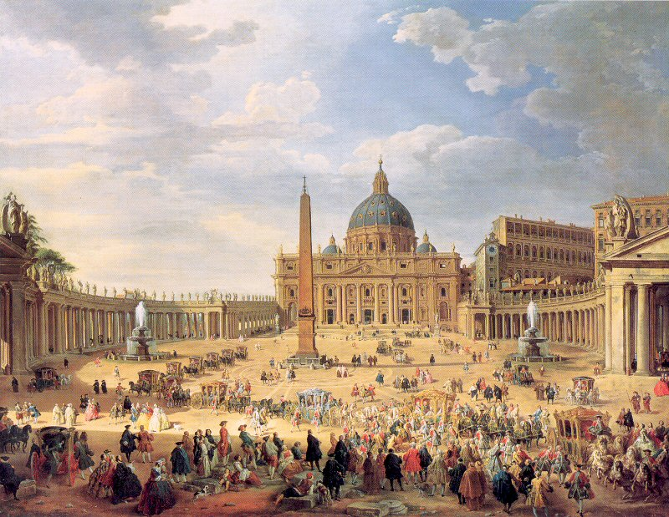
ROMAN CHURCH OF THE MIDDLE AGES
MENDICANTS VS. MATERIALISTS

Slide 106
Medieval Materialists & Materialism
“Ever since Eve believed the serpent’s lie that physically eating the forbidden fruit would turn her into a god, her descendants have been materialists. Materialism has carried over into everything man touches. It has turned love into physical lust… Human beings imagine that happiness and possessions are what make life worth living. The lives of many men and women are consumed with acquiring physical things and the money that purchases them… Jesus said a man’s life does not consist in the abundance of things that he possesses!” - David Hunt, The Berean Call, 10/2009

Slide 107
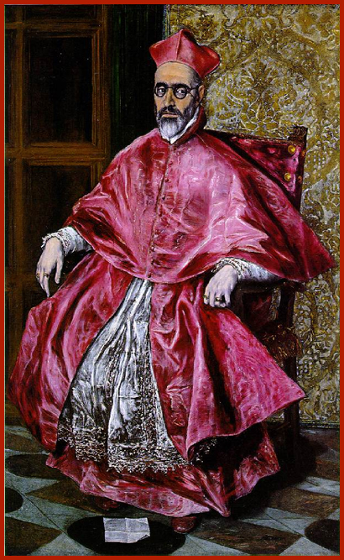
Cardinals, Princes of the Church One of the pope’s most important duties was to appoint the right men as cardinals. But the pontiff was often limited in his choices. France, Spain, and the Holy Roman Emperor would squawk to have their supporters made cardinals, and threaten to withhold church revenues, or even wage war, if the pope did not agree. A new pope was expected to create a cardinal from the family of the pope who had made him a cardinal, years earlier. Additionally, he had to give “the red hat” to someone in every family that had married into his own family. Sometimes these candidates were poorly suited to the religious life. Only after all these requirements had been fulfilled could the pope look around for truly intelligent, devout churchmen.
Cardinals drew income from owning benefices, or church lands. Though canon law decreed that each churchman could own only one benefice and must reside there to look after it, this decree was blithely ignored when it came to cardinals “to assist them to bear the burden of expense which their office imposed on them,” according to a 1507 bull. In 1503 the church declared that “having to perform higher duties so ought they to enjoy greater privileges than the other servants of Christ.”
Rustling in several layers of dark red satin, with just a touch of lace, the cardinal presented a majestic and powerful figure. Cardinals had not always worn special robes but had dressed as regular priests until the reign of Pope Innocent IV (1243-1254) who invented the impressive red cap as a mark of distinction.
By the reign of Boniface IX (1389-1404)), cardinals usually wore red robes as a sign of their willingness to be martyred for the church, though by the seventeenth century the color was mostly appreciated for its ability to conceal wine stains. On days of mourning – the forty days of Lent, All Saints’ Day, and the ten days immediately following the death of a pope – cardinals wore fuchsia. On two feast days a year – the third Sunday in Advent right before Christmas, and the fourth Sunday of Lent – they wore rose.
Etiquette regarding the princes of the church was extremely exacting down to the most minor detail. Cardinals had to be seated in identical chairs. It would have been a gross insult to the church for one cardinal to have a lower seat than his colleague, or for one to have the honor of arms on his chair and the other to be dishonored by a chair with no arms. And it would have been unthinkable for one cardinal to sit disconsolately on a cushion with mere silver tassels, while his counterpart exulted in a cushion tasseled in gold.

Slide 108
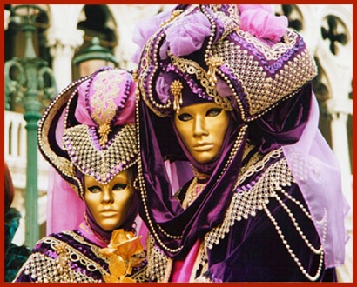
Carnival The Roman Carnival was an uproarious celebration right before Ash Wednesday. Carnival was permitted by papal edict for a specific number of days – usually ten – but permission was withheld if the Papal States were suffering from plague, war, or famine. A sorrowful face, liberally bedaubed with ashes, was more likely to win God’s forgiveness than a jester’s hat with jingling bells.
Carnival began with the tolling of a bell on a Saturday and a procession of city officials. Two days later naked Jews were forced to race along the Corso, the main thoroughfare of Rome and the heart of Carnival, to the cheering of thousands of spectators who pelted them with eggs, vegetables, and dead cats. But this was not meant as a special denigration to Jews. On other days there were naked races of old men, cripples, little boys, whores, buffaloes, jackasses, and of riderless horses with tacks stuck in their backs to make them run faster, and everyone got pelted. Called palios, the races were considered great fun for all – except, perhaps, for the horses – and the prizes were valuable bolts of cloth. One race was reserved for naked hunchbacks, “very remarkable for the variety of their humps.”
A popular parade featured the king of the defecators, hoisted aloft on a toilet chair and farting loudly. Horses, decked out with jingling silver bells and tall feathered headdresses, pulled extravagantly decorated floats through town. Carts rolled through the streets, some with musicians, and others with costumed revelers. Jousts were held in large piazzas, including the Piazza Navona, along with mock naval battles as ships drawn on wheels shot firecrackers at each other. At night the entire city was illuminated with lanterns and torches, and fireworks were set off.
Day and night, costumed revelers thronged the Corso and surrounding streets and squares. Some paraded as doctors, lawyers, Jews, animals, and devils. Some men dressed as women, and some women dressed as men. All wore masks, and many were armed with syringes – the seventeenth-century version of a water pistol – which they squirted at each other. They also pelted passers-by with oranges and painted eggs filled with scented powder, jam, perfume, or water. One popular prank was to pour honey out of an upper window onto the heads of pedestrians below.
On Ash Wednesday the boisterous extravagance of Carnival disappeared, replaced by the funereal atmosphere of Lent, which commemorated Jesus’ forty days in the desert. During this time, Romans wore black, ate no meat, attended no festivities, and meditated on the sacrifice of Jesus on the cross. One Turkish ambassador visiting Rome was absolutely perplexed by the riotous Carnival followed by the sudden solemnity of Ash Wednesday. He wrote the Sultan in Constantinople that Carnival was a ten-day mania which afflicted the Christians annually and was only cured by the application of ashes to the face.

Slide 109
Outward & Visible Sign of an Inward & Spiritual Grace?

Slide 110
THE MEDIEVAL CATHOLIC WORLD
“…was kleptocratic; everyone from the lowliest servant up to the pope’s august relatives unblushingly stole as much as they possibly could. Nepotism was rampant, and popes gave away huge sums & principalities to nephews instead of helping the poor. Dead pontiffs were left naked on the Vatican floor because servants had pilfered the bed and stripped the corpse…” - Eleanor Herman

Slide 111
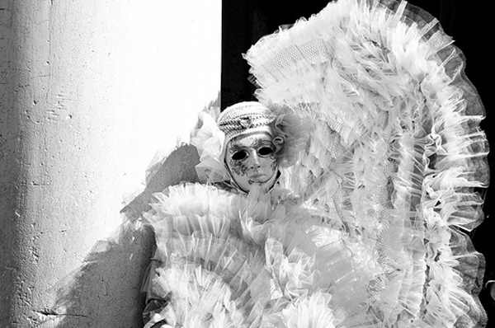

Slide 112
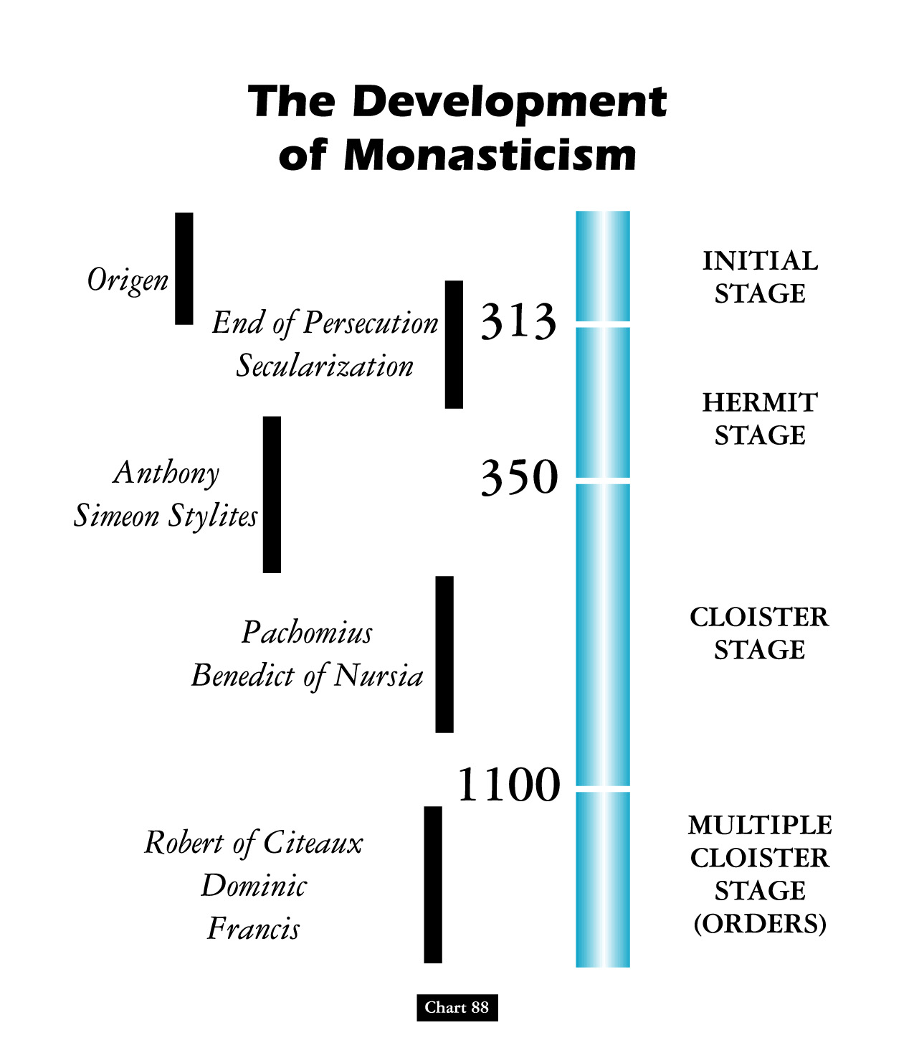
David Lee Burris:
Monasteries – parlatorium – claustrum cloister – chapter hall – refectory – dormitory - church
VITA APOSTOLICA POVERTY MOVEMENTS

Slide 113
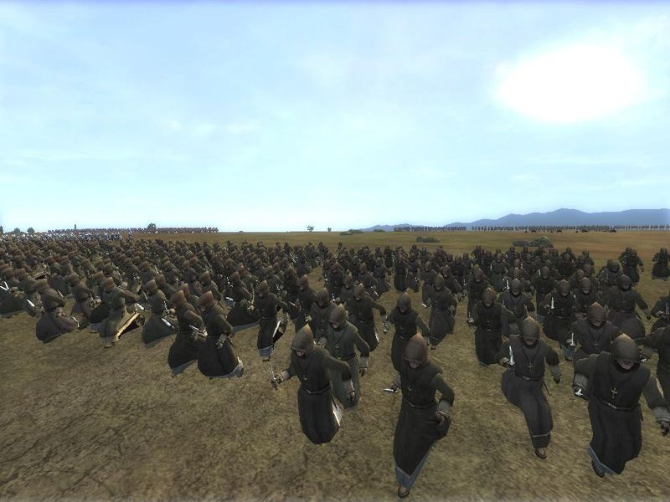
3 Knot Cincture:
OBEDIENCE
CHASTITY
POVERTY

Slide 114
THE MIDDLE AGES: THE AGE OF MAMMON
MENDICANTS VS. MATERIALISTS
DEBATE ENDS IN BULL OF 1323
CUM INTER NONNULLOS MAKES
POVERTY OF CHRIST A HERESY

Slide 115
The Roman Church Comes Full Circle
RELIGIOUS FAITH & MORAL BEHAVIOR NOW NON-SEQUITUR
NEW BOUNDARIES OF PUBLIC PROFESSION & PRIVATE PRACTICE

Slide 116
“Rich beyond the dream of avarice.”

Slide 117
In The Imitation of Christ

Slide 118
Foundations for Renewal
In the late 1300s and early 1400s, the “Common Life Movement” arose among Christians in Holland.
The Brothers of the Common Life blended scholarship with deep—even mystical—devotion.
The most famous Brother of the Common Life was Thomas A’Kempis, who authored “The Imitation of Christ.”

Slide 119
The Imitation of Christ?
MONEY CHANGERS
IN THE CHURCH!

Slide 122
“Instead of the bare feet of the apostles, the snowy coursers of brigands fly past us, the horses decked in gold and fed on gold, soon to be shod with gold, if the Lord does not check this slavish luxury.” - Petrarch

Slide 123
Case Of The Church-State Theocrat: Being Better Judge Than Jesus
David Lee Burris: The Religion Of The Crutch & The Placebo Human Weakness Requires Religious Subordination? The Grand Inquisitor Says Of Jesus’ Temptation: “You made a mistake. You should have listened to what he said!”
Dostoevsky’s Grand Inquisitor To A Returned Christ:
“I awakened and would not serve madness. I turned back
and joined the ranks of those who have corrected thy work.”
Three Powers Accepted By Then “Universal Church”
Rejected In His Worldly Temptation By World Savior
The Power Over Three Forces Of Human Influence:
Force Of Magic, Mystic, Miracle
Force Of Ecclesiastic Hierarchy
Force Of Established Hegemony

Slide 124
Historical Theology
“The division of the theological discipline that seeks to understand and delineate how the church interpreted scripture & developed doctrine throughout its history and to show the origin & development of beliefs held in the present day.”
* Dictionary Of Theological Terms, Grenz & Guretzki

Slide 125
Borders Of God’s Word

Slide 126
Departure Principle: The Law Of Expediency
First Corinthians - Chapter Six - Verse Twelve:
“ALL THINGS ARE LAWFUL UNTO ME, BUT ALL THINGS ARE NOT EXPEDIENT: ALL THINGS ARE LAWFUL FOR ME, BUT I WILL NOT BE BROUGHT UNDER THE POWER OF ANY!”

Slide 127
Departure Principle: The Law Of Expediency
First Corinthians Chapter Six & Verse Twelve States - The Lawful Expediency Must Meet Certain Criteria: First, it must be lawful. For something to be lawful, it must stand on: command, approved example, or necessary conclusion. If there is no means of showing where God commands it, the apostles practiced it, or draw a scriptural conclusion, it is outside the bounds of authority per 2nd John 9!.

Slide 128
Departure Principle: The Law Of Expediency
First Corinthians - Chapter Six - Verse Twelve:
Therefore, Two Principles Are Apparent: Expedients Cannot (1) Be an addition to the word of God - or – (2) be a substitution for God’s ways. A true expedience, therefore, neither adds to or changes the plan of God!

Slide 129
Departure Principle: The Law Of Expediency
First Corinthians Chapter Six & Verse Twelve States - The Lawful Expediency Must Meet Certain Criteria: Secondly, it cannot be explicitly stated. This is an evident conclusion from the first point. When God speaks, man is not left to use his judgment & reasoning ability to determine if he is going to act. When God speaks, obedience by faith must be forthcoming from man, and he cannot decide if he wants to do what God has commanded or not. Yet, with the area of thoughtful expediency, human wisdom can be utilized in that realm where God has left man free to use his own individual and collective judgment.

Slide 130
Departure Principle: The Law Of Expediency
First Corinthians Chapter Six & Verse Twelve States - The Lawful Expediency Must Meet Certain Criteria: Thirdly, to be an expedience, it must edify the church. Per 1st Corinthians 14: 26 - We can see that when matters of personal judgment pierce the Lord’s body, then we had better examine our Bibles & hearts for the correct answers!

Slide 131
Departure Principle: Primary Vs. Delegated Authority
Besides the generic and specific classification, there are two kinds of authority: primary and delegated. Primary authority is the original source of all power or authority. It is the authority that resides in the person by right of his relationship to those who are subject to his authority. All divine authority begins with God, the Father!

Slide 132
Departure Principle: Primary Vs. Delegated Authority
Besides the generic and specific classification, there are two kinds of authority: primary and delegated. Delegated authority is that which is given to another by the one who has the primary authority. All authority of God has been delegated to his Son, Jesus Christ, and not one single word has been delegated to mankind. In utilizing this authority delegated to the Son, Christ has delegated or granted certain power to others in administering his authority. The apostles received this power. All authority comes from the Son!

Slide 134
SACERDOTALISM
“The emphasis in the Roman Catholic tradition, especially as proclaimed in the Middle Ages, on the powers of earthly priests as essential mediators between God and humankind.”
* Dictionary Of Theological Terms, Grenz & Guretzki

Slide 135
SACRAMENTALISM
“A term used pejoratively of persons or church traditions that see the essence of Christianity as participation in the sacraments rather than as inner transform- -ation and personal piety.”
* Dictionary Of Theological Terms, Grenz & Guretzki

Slide 136
SOTERIOLOGY
“Literally, ‘the study of salvation.’ This topic within the corpus of systematic theology deals with the work of the triune God in bringing creation, and especially humans, to enjoy the divine purpose for existence; ‘objective’ soteriology speaks of the life, death, resurrection & exaltation of Christ in relation to human salvation; ‘subjective’ soteriology deals with the process whereby individuals are brought to God’s saving goals.”
* Dictionary Of Theological Terms, Grenz & Guretzki

Slide 137
SUPEREROGATION
“EXCESS SUPPLY OF GOOD WORKS BY SOME SOULS CAN BE APPLIED TO OTHERS!”

Slide 139
“Dumb-Ox” to Scholastic Doctor
Thomas Aquinas’ parents tried to keep him from becoming a monk.
But he became both a monk and the supreme scholar of his era.
His Summa Theologica, though never finished, fills more than 4,000 pages.
Thomas Aquinas (1225–1274)
Notes:
“Portrait of St. Thomas” by Joos van Ghent (c. 1475)

Slide 140
David Lee Burris:
Summa Theologica discusses 512 theological points, including whether an angel can sin!
Summa Theologica: Harmony Of Reason & Revelation

Slide 146
Salvation A Free Gift
Or A Treasury Of Merit?

Slide 147
by Bob Taylor of the Firm Foundation
Five points of John Calvin
Along With All Catholicism
3. Rationale Fallacious Grounded
There is no coattail righteousness in the Bible - The righteousness of other people is not imputed to us. I am not a child of God simply because someone else is; I am not sober, righteous, and godly because someone else is. I am not on my way to heaven simply because somebody else is. There is no coattail righteousness taught in the Bible. In the realm of politics a man might sweep into lesser office by catching hold of the coattail of a much more popular politician. But no one is going to heaven by hanging onto the righteousness of another.

Slide 148
by Bob Taylor of the Firm Foundation
Five points of John Calvin
Along With All Catholicism
3. Rationale Fallacious Grounded
There is no coattail righteousness in the Bible - Transferred or borrowed righteousness is not taught in Holy Writ. The foolish virgins in Matthew 25 thought they could borrow righteousness, preparation and readiness from the wise five in that famed, familiar parable. They requested of the wise five what couldn’t be transferred or transmitted – righteousness and readiness to meet the Lord in peace!
It is also an egregious error, yet one widely held, that Deity transfers to us the personal righteousness of God the Father or the personal righteousness of Jesus Christ.

Slide 149
by Bob Taylor of the Firm Foundation
Five points of John Calvin
Along With All Catholicism
3. Rationale Fallacious Grounded
There are only two ways a person might be justified or counted righteous. I know of no 3rd alternative. (1) If a person never sinned & always maintained absolutely perfect obedience, he would be counted as righteous or justified simply upon the basis that he had never violated a single statute of the Lord’s will. Were this ever the case, then man might well glory and boast that he had earned or merited his heavenly salvation. His justification then would be a matter of debt–not of grace or favor. (2) The second way is for God to declare man justified by grace (God’s part) through an obedient faith (man’s part).

Slide 150
by Bob Taylor of the Firm Foundation
Five points of John Calvin
Along With All Catholicism
3. Rationale Fallacious Grounded
Righteousness is not something transferred to us. We do not inherit it – nor - we do not borrow it from those we think have a superabundance of it.
Peter told the first Gentiles to be converted under God’s glorious Gospel that acceptance to God comes from fearing (respecting) God and working righteousness. God’s plan of righteousness is revealed in the Gospel from “faith to faith” (Romans 1:16, 17). Those at Corinth had become righteous when they came into Christ Jesus (1st Cor. 1:30). They had become a washed, a sanctified, and a justified people (1st Cor. 6:11). This is how they became righteous. They remained in a righteous, justified or saved state as long as they did the Father’s will.

Slide 151
From Augustine Unto Aquinas
Church history short courses have sometimes reduced the process of church reform and counter reform to a conflict between establishment Catholic Thomism & reactive Conservative Augustinianism. Medieval religious history cannot be so simplified. However, it is true that the church of the middle ages adopted Thomas Aquinas’ philosophy. Moreover, It emphasized his teaching that man’s will was not totally corrupted. By faith and utilizing the means of grace held within the sacraments dispensed by the hierarchy, man could achieve salvation. Augustine believed that man’s will was so totally depraved that he could do nothing toward his own salvation.

Slide 152
David Lee Burris:
Summa Theologica discusses 512 theological points, including whether an angel can sin!
Summa Theologica: Harmony Of Reason & Revelation

Slide 153
Which famous theologian turned away from theology toward the end of his life, declaring,“All my books are worthless”?
TERTULLIAN
ORIGEN
JEROME
THOMAS AQUINAS
X

Slide 154
Church
History
The Apostasy
Doctrines Enacted at Church Councils
Clergy/Laity System
Sprinkling for Immersion
Infant Baptism
Celibacy
Instrumental Music
Transubstantiation
Indulgences
Worship of Mary
Veneration of Relics
Purgatory
Confessionals
Images
Penance
Extreme Unction
Confirmation
Nuns, Primacy of Peter
Forbidding to Eat Meats
Religious Holidays

Slide 155
Dominant Augustinian Paradigm Doctrine Of Indulgences
Pope Urban & Recruitment For The First Crusade :
“The year 1095 provided an opportunity for replacing the penances of the early Church, whereby the wearing of sackcloth and ashes or some public sign of contrition became practically a way of life. In order to successfully launch the First Crusade, Pope Urban had a brainwave. He promised a remission of all punishment for those who set out to liberate the Holy Land. From that time onwards, such ‘indulgences’ came to be granted more and more freely. The pope delegated the power to grant them to the bishops and other lower clergy. Indulgences could be limited in time, as for so many days, or they could be ‘plenary’.”
- Gerald Noel, The Renaissance Popes

Slide 156
What did People believe at the Time of The Reformation?
If you died with a dirty Soul you would go to either Purgatory or straight to hell.
You had to go to Church and get the Priest to clean your Soul.
If you died with a clean Soul you would go to heaven.
Notes:
I would use the zoom facility of my interactive whiteboard to zoom in on the different sections of this picture.
If you haven’t got this facility then you could crop the picture to the scene you prefered

Slide 158
What did People believe at the Time of The Reformation?
If you went on a Crusade or a Pilgrimage you could earn time out of Purgatory
You could buy a special letter from the Pope called an Indulgence which was like a get out of jail for free card but for Purgatory.
Notes:
This would be a good point to play the Blackadder video: The Archbishop of Canterbury – The scene to do with the selling of relics

Slide 160
WAGES OR A GIFT?

Slide 161
THE TRIFECTA OF RELICS:
Medieval Churches
FIRST CLASS RELICS – ACTUAL BODY PARTS OF A SAINT
SECOND CLASS RELICS – CLOTHING WORN BY A SAINT
THIRD CLASS RELICS – CLOTH ITEM TOUCHING A SAINT
FOURTH CLASS RELIC – CLOTH ITEM TAKEN TO SHRINE

Slide 162
One of Martin Luther’s beefs with the Catholic Church was the veneration of false relics and the belief that doing so would confer on the visitor a get-out-of-Purgatory-free card. Until Luther’s followers tossed them in the trash, one German church boasted a feather from the wing of the angel Gabriel, and the Bishop of Mainz had a magically solidified flame from Moses’ burning bush. Even today, the cathedral at Aachen has Jesus’ diaper and the loincloth he wore on the cross. Most of all, Luther was disturbed that eighteen disciples were buried on German soil, when Christ had had only twelve.
The multiplication of relics didn’t disturb Romans, however. If a visitor to Italy politely asked a priest how there could be, for instance, two heads or three feet of a particular saint, he would smile, shrug, and say, “It’s a miracle!” One Italian church reportedly had the head of John the Baptist, as a child.

Slide 163
In 74 AD, Emperor Vespasian (pictured here) had run out of money due to a war of rebellion. In order to raise funds, he created the world’s first public pay toilets. When his son Titus criticized him for it, Vespasian pointed out that money (even earnt through urine) did not smell. This gave rise to the common saying “Pecunia non olet” – “money does not smell”.
Relics Failed The “Smell” Test!

Slide 164
Catholics believe that the body parts of saints retain the essence of holiness that can perform miracles, or bring good luck. Saints’ bones, blood, hair, skin, teeth, skin, and even clothing and household items are treasured as miracle-working totems, encased in gold and crystal and studded with diamonds.
The royal family of Spain was fortunate to possess entire saintly cadavers which, if a member of the dynasty became gravely ill, would be put into the sickbed. Sometimes the royal four-poster became a charnel house of moldering corpses, and peering out from beneath them, the bright eyes of a feverish prince or princess. Oddly, miracle corpses sometimes affected a cure. Or perhaps, if that experience didn’t kill the invalid, nothing would.

Slide 165
Penance
Purgatory

Slide 166
Dominant Augustinian Paradigm The Doctrine Of Penance
Jesuit Writer On The Tariffed Penitential System:
“Tariffed Penance was the successor to canonical Penance, and got its name from the fact that every sin earned a pre- -arranged amount of penance, or a tariff. It differed from the ancient system in many ways, but one point of divergence stands out above all the rest: tariffed Penance was repeatable. The new tariffed system almost certainly developed in Ireland, about the sixth century – hence its other name – Celtic penance – but spread from there across Europe, until it had virtually replaced the ancient Penance form. Tariffed Penance grew out of the early forms of confession practiced by the desert fathers.”
- Kevin Donovan, S.J.

Slide 168
Borders Of God’s Word

Slide 170
AD 1560
Apocrypha
The Apocrypha refers to several books and additions that were included in the early Greek and Latin translations of the Old Testament. The Septuagint contained the Apocrypha in 100 BC.
By the first century AD, writers Philo and Josephus indicate that the Hebrew canon did not include the Apocrypha. This evidence leads to its removal from the 1640 Geneva Bible. By AD 1827, the Apocrypha is omitted from most English versions of the Bible.
1500 BC 500 BC AD 1 AD 500 AD 1000 AD 1500 AD 1900 AD 2000

Slide 171
Purgatory
“Roman Catholics make a distinction based on a sin’s severity. The biggies – murder, adultery, sacrilege – are called mortal sins because they put your soul in jeopardy of damnation. Die with one of those on your docket and your pretty much screwed. The lesser sins that we commit every day – well, those are venial sins. Confession and absolution free your soul from sin, but if you die with some venial demerits, your off to Purgatory, table for one.”

Slide 173
Purgatory
“Purgatory is a place of punishment whereby your soul is cleansed. While theologians vary on the kind and severity of Purgatorial ‘punishment,’ some say the agony of waiting for Heaven’s rewards is punishment enough. Folks still living can pray for your soul to shorten your time there. Of course, once it’s all shiny and sin free your soul goes to Heaven to be in the presence of God, seeing God in a ‘beatific vision.’ Whereupon there is much rejoicing.”

Slide 174
HERE IS THE CHURCH & HERE ARE THE SHEEPLE!

Slide 175
Purgatory vs. Limbo
“By definition, limbo is where the souls of those who are righteous or innocent, but not baptized (and therefore still stained by Adam’s Original Sin), spend eternity deprived of joy.
But there are actually two limbos. The first is limbus patrum (limbo of the fathers), where the souls of the just who predated Jesus Christ hung out until he freed us all from sin. The other, limbus infantium, is just what it sounds like – a home for the souls of babies who die before they can be baptized. It’s a place of happiness, but free from the beatific vision, so ultimately a place of punishment for the sin of Adam (stupid fruit!)” - Mental Floss/What’s the Difference?

Slide 176
INHERITING ORIGINAL SIN THE BLAST FROM THE PAST
Posterity’s Uncritical Acceptance Of Augustine’s Christian Platonism
Their understanding of conception, shaped by a patriarchal culture, would have been some variation of the dominant Aristotelian theory. On this view, the male semen provides the formative principle for life. The female menstrual blood supplies the matter for the fetus, and the womb the medium for the semen’s nurture. The man’s seed transmits his logos (rational cause) and pneuma (vital heat/animating spirit), for which the woman’s body is the receptacle. In this way the male functions as the active, efficient cause of reproduction, and the female functions as the provider of the matter to which the male seed gives definition. In short, the bodily substance necessary for a human fetus comes from the mother, while the life force originates with the father.

Slide 177
INHERITING ORIGINAL SIN THE BLAST FROM THE PAST
Posterity’s Uncritical Acceptance Of Augustine’s Christian Platonism
Platonists believed that all physical objects are simply copies of eternal, immaterial templates or Forms. This means that two objects of the same kind have a sort of connection because they both depend on the same Form. So the terrible taint of Adam can spread to those who share his Form, the Form of humanity. This inheritance concept of fatalistic disposition and consequence can similarly be linked to classic theories of genetics. It was believed that everything children inherit is received from the father alone. The mother contributed nothing material to fetal development and served simply as an incubator. It was considered a matter of simple common sense that embryo existed entire in seed form within the male before implantation. The father once existed in seed form in his father too, and so on – and so on - all the way back to the Garden of Eden - similar to a set of Russian Dolls.

Slide 178
Ideological Development: Christian Religion
Julian Defended Origen Against Augustine:
“[God] it is, you say who judges in this way; he is the persecutor of newborn children; he it is who sends tiny babies to eternal flames. It would be right and proper to treat you as beneath argument: you have come so far from religious feeling, from civilized feeling, so far indeed from mere common sense, in that you think that your Lord is capable of committing a crime against justice such as is hardly conceivable even among the barbarians.”

Slide 179
Borders Of God’s Word

Slide 180
David Lee Burris:
Christian Emperor Theodosius invited Thessalonians to free games but sent his troops into the circus with orders to kill the 10,000 men, women, and children.
“The first recorded instance of Christians killing Pagans occurred shortly after {status change year 313}. In short order, the militant church extended its power by conquering lands & peoples throughout Europe, compelling them to become baptized Christians or die… As Charlemagne instructed his Christian troops in their conquest of the Saxons: ‘If there is anyone of the Saxon people lurking among them unbaptized, and if he scorns to come to baptism & stay a pagan - let him die’”.
Original Error @ ORIGINAL SIN
Inter-Generational Sinful Consequence (Exodus 34: 7)
Not Sin Inherent - Or - Guilt Imputed
(Ezekiel 18: 19 – 32)
- Gregory Boyd, Myth Of A Christian Nation
JESUS REVISITS MISCONCEPTION @JOHN 9: 1 - 5

Slide 181
Taking The Cheese
Of Accountability!

Slide 182
RELIGIOUS SURROGACY

Slide 183
Sumerians had statues of themselves made and left them in the temples to pray when they could not be there in person.

Slide 184
You’ve never been lost until
you’ve been lost at Mach 3!
* TEST PILOT PROVERB

Slide 185
Everything Falls Apart
1294 –1517

Slide 186
“Things fall apart, the centre cannot hold.
The blood-dimmed tide is loosed, and
everywhere the ceremony of
innocence is drowned.”
1294 –1517

Slide 189
Problems for the Papacy
In 1294, an aged Franciscan monk who loved common people became the new pope.
He entered Rome barefoot, and took the name “Celestine V.”
A reluctant Celestine V becoming the Pope
Notes:
“Pope Celestine V” Artist Unknown (15th century)

Slide 190
Problems for the Papacy
Five months later, he stripped himself of the papal position and returned to his monastic life.
He died in 1296, possibly murdered.
A reluctant Celestine V becoming the Pope
Notes:
“Pope Celestine V” Artist Unknown (15th century)

Slide 191
Problems for the Papacy
Pope Boniface VIII replaced Celestine V and claimed power over all Europe’s kings and lords.
Boniface died after being kidnapped by the king of France.
Pope Boniface VIII
Notes:
From “A Popular History of France from the Earliest Times.” Illustration by A. De Neuville

Slide 192
Problems for the Papacy
The next pope fled to Avignon, a village on the French border.
For more than 70 years, the popes lived it up in Avignon.
This dark period of corruption would later become known as the “Babylonian Captivity” of the Roman Catholic Church.

Slide 194
1349
William of Ockham argued for the independence of church and state
He claimed that the Church had absolute authority in spiritual matters only
He denied the right of the pope to interfere in civil affairs
Sketch from Ockham’s ‘Summa Logicae’ (1341)
* Contemporary of the Poet Dante

Slide 195
1338
Electors of the Holy Roman Empire declare that they can select an emperor without approval from the pope
1349
Death of William of Ockham (English philosopher called “the first Protestant”)
William of Ockham
* Contemporary of the Poet Dante

Slide 196
Ockham & Dante Contemporaries

Slide 197
THE THINKER LOOKING INTO THE INFERNO
Will Cook Of Dante's Inferno:
"It provides a picture, literally,
of sinners in the afterlife getting
what they wanted back on Earth.
They wanted to be out of control
& that is what they get."

Slide 198
THE THINKER LOOKING INTO THE INFERNO
Dante Controversial In The
Consigning Of Popes To Hell

Slide 199
Okham's Razor
“Main axiom of nominalist philosopher William of Occam, namely, that principles employed to explain phenomenon should not be multiplied without necessity… O’ razor was used to eliminate the supernatural from view!”
* Dictionary Of Theological Terms, Grenz & Guretzki

Slide 200
* Ockham had to answer charges not as to his belief but as to his definitions.
Specifically, how did he defined necessary and contingent as to what was possible or impossible for God?

Slide 201
He had to answer charges not as to
his belief but as to his definitions.
What Was Really Going On?
Ockham had moved beyond the Aristotelian Categorical Modal Logic & was in the process of pioneering something labeled Trinary Logic.

Slide 202
In logic, a three-valued logic (also trivalent, ternary, or trinary logic, sometimes it is abbreviated 3VL) is any of several many-valued logic systems in which there are three truth values indicating true, false and some indeterminate third value.
This is contrasted with the more commonly known bivalent logics (such as classical sentential or Boolean logic) which provide only for true and false.

Slide 203
“The judge should promise that he will be merciful, with the mental reservation that he means he will be merciful to himself or the State; for whatever is done for the safety of the State is merciful.”

Slide 204
Backgrounds Of The Inquisitions. Foundations for the Inquisitions were laid down before the actual persecutions actually began. The Inquisitions were, in fact, an attempt by the Medieval Church to exterminate religious heresy. The Church in the ancient period of its existence had dealt with heretics in different ways: some were put to death; some were exiled by Imperial command; and others were excommunicated from the Church without exile. The repressive measures became more severe as time continued, until they culminated in the 13th century into very drastic measures. Schaff says, ‘The measures for the repression and extermination of heresy culminated in the organized system, known as the Inquisition.
- Morris Womack, The Church Through The Ages

Slide 205
Chapters Of The Inquisitions. In the first period, we find the State taking an active part in the punishment of heretics. Kings felt that a united Church was necessary for a united kingdom. Thus, many were persecuted by the State and later put to death. ‘King Robert of France had thirteen heretics publically burned at Orleans in 1022; this is the first known case of capital punishment of heresy since the secular execution of Priscillian in 385.’ However, bishops entered into persecuting heretics prior to the thirteenth century. They did not hunt out heresy but punished those who were reported to them by the people; hence, they cannot rightly be called ‘inquisitors’ in the sense that we use that term.
- Morris Womack, The Church Through The Ages

Slide 206
Chapters Of The Inquisitions. It was in 1185 that, Pope Lucius III, dissatisfied with the negligence of the bishops in pursuing heresy, ordered them to visit their parishes at least once a year, to arrest all suspects, to reckon as guilty all who would not swear full loyalty to the Church and to hand over such recalcitrants to the secular arm. [As Augustine before them] Innocent III and Thomas Aquinas were two churchmen who advocated Inquisitorial actions and Frederick II and Louis IX were enlightened rulers who also advocated it. Heresy, so the theory and definitions ran, was a crime the Church couldn’t tolerate. It was Satan’s worst blow.
- Morris Womack, The Church Through The Ages

Slide 207
The Wisdom of Wycliffe
An English theologian named John Wycliffe suggested that the church was not built on popes or councils or sacraments.
Instead, the church, in its essence, was the people of God.
John Wycliffe
Notes:
Illustration by Stephen Hesselman

Slide 208
People inspired by Wycliffe (derisively called “Lollards”), translate the entire Bible into English (1382) from Latin, and call it the Wycliffe Bible
This is the first translation of the Bible into English.
The beginning of the Gospel of John in a copy of the Wycliffe Bible

Slide 209
AD 1300
The Wycliffe Bible
The first English Bible is translated from Latin in AD 1382. It is called the Wycliffe Bible in honor of priest and Oxford scholar
John Wycliffe.
Page from Wycliffe Bible
1500 BC 500 BC AD 1 AD 500 AD 1000 AD 1500 AD 1900 AD 2000

Slide 210
AD 1300
The Wycliffe Bible
During his lifetime, Wycliffe had wanted common people to have the Bible. He also criticized a number of church practices and policies.
John Wycliffe
1500 BC 500 BC AD 1 AD 500 AD 1000 AD 1500 AD 1900 AD 2000

Slide 211
AD 1300
The Wycliffe Bible
His followers, derisively called Lollards (meaning “mumblers”), include Wycliffe’s criticisms in the preface to the Wycliffe Bible.
Wycliffe Bible, AD 1384
1500 BC 500 BC AD 1 AD 500 AD 1000 AD 1500 AD 1900 AD 2000

Slide 212
1370
John Wycliffe, English priest and diplomat, proposes limiting papal taxation and civil powers
John Wycliffe
1370
John Ball, outspoken English priest and follower of Wycliffe, preaches equality and freedom of all, “crazy notions” which would form the founding philosophy of two revolutions and a new nation many years later.

Slide 213
John Wycliffe challenges several church doctrines, including that of transubstantiation.
He believes Scripture should be available to the people in their own language.
Wycliffe Bible

Slide 214
1377
Pope Gregory XI issues five bulls denouncing Wycliffe
Wycliffe placed under house arrest
1382
Council known as Blackfriars Synod condemns Wycliffe’s writings, followed by persecution of Wycliffites at Oxford, England

Slide 215
The Wisdom of Wycliffe
According to Wycliffe, a person’s actions showed whether he or she truly belonged to God (James 2: 14).
Wycliffe urged every believer to seek truth in the Scriptures.
John Wycliffe
Notes:
Illustration by Stephen Hesselman

Slide 216
James 2:14
“What good is it, my brothers, if someone says he has faith but does not have works? Can that faith save him?

Slide 217
The Wisdom of Wycliffe
Wycliffe died of a stroke in 1384.
Because of his influence on later Reformers, Wycliffe was known as the “Morning Star of the Reformation.”

Slide 218
AD 1408
The Wycliffe Bible
In AD 1408, in England, it becomes illegal to translate or read the Bible in common English without permission from a bishop.
1500 BC 500 BC AD 1 AD 500 AD 1000 AD 1500 AD 1900 AD 2000

Slide 219
AD 1428
The Wycliffe Bible
In AD 1415, the Wycliffe Bible is banned and burned. Forty years after Wycliffe’s death, in AD 1428, his bones are exhumed and burned for heresy.
1500 BC 500 BC AD 1 AD 500 AD 1000 AD 1500 AD 1900 AD 2000

Slide 220
“Things fall apart, the centre cannot hold.
The blood-dimmed tide is loosed, and
everywhere the ceremony of
innocence is drowned.”
1294 –1517

Slide 221
Would the Real Pope Please Stand Up?
Even after the plague died out in 1350, problems with the papacy didn’t.
In 1377, at the urging of Catherine of Siena, Pope Gregory XI returned to Rome.
Catherine of Siena
Notes:
Image: © Clara

Slide 222
Would the Real Pope Please Stand Up?
When Pope Gregory XI died, cardinals appointed an Italian pope to appease citizens of Rome.
When the Italian pope Urban VI refused to do what the cardinals wanted, they replaced him with a bishop from France.

Slide 223
Would the Real Pope Please Stand Up?
Unfortunately for the cardinals, the Italian pope Urban VI refused to be replaced by the French bishop Clement VII.
The result? Two popes, in what later became known as the Western Schism!

Slide 224
Would the Real Pope Please Stand Up?
In 1409, in an effort to end the double papacy, the cardinals gathered at the Council of Pisa to agree on one pope.
According to the Council of Pisa, “The Church’s oneness does not depend on or come from the pope’s oneness.”

Slide 225
Would the Real Pope Please Stand Up?
The Council agreed to dismiss both current popes and elect a new pope.
The problem? Both previous popes refused to resign.
The results? Not two popes, but three!!!
Another Council in Constance was called to settle the situation.

Slide 226
From The Modern Scholar Course Guide: “One, Holy, Catholic, & Apostolic”
Conciliarist Councils: 1409 - 1431
“No one doubted the authority and necessity of the pope – but how could anyone judge someone who could not be judged? Monarchs, princes, and ecclesiastical leaders across Europe sought a solution. The popes and cardinals themselves worked to find a solution. Each death of a pope brought the possibility that the other cardinals would elect the rival. Conciliarism had a number of intellectual heavy- weights behind it. Most were moderates, holding that only a council could judge in matters of extremity – i.e. two popes, colleges, curie… Some were radicals claiming that all power should reside with the council, retaining the pope as only as a figurehead or simply as only more bishop.”

Slide 227
From The Modern Scholar Course Guide: “One, Holy, Catholic, & Apostolic”
Council Decree Haec Sancta
“This holy synod of Constance legitimately assembled in the Holy Spirit, forms a general council representing the Catholic Church militant. It derives its powers immediately from Christ and everyone of whatever position or rank, even the papacy itself, is bound to obey it in all things pertaining to the faith, to the healing of the schism and to the general reform of the Church of God in head and members.”

Slide 228
The Medieval Church Scandals chapter in book by charles franklin
“The Council of Constance (1414 – 1418), called to institute church reform, must have been quite a lively gathering. Lasting four years, it was attended, according to the contemporary chronicler G. Dacher, by 18,000 priests, 83 wine merchants, 346 ‘clowns, dancers, and jugglers,’ and 700 undisguised whores. These were the 700 prostitutes whose addresses G. Dacher was able to obtain. A list drawn up in Vienna lists 1,500 (meretrices vagabundae) or ‘common harlots’ present at the Council.”

Slide 229
1408
In England, it becomes illegal to translate or read the Bible in English without permission of a bishop
1413
John Hus of Bohemia writes De Ecclesia, which supports ideas popularized by Wycliffe
John Hus

Slide 230
Jan Hus the Unhushable
Jan Hus embraced Wycliffe’s teaching and began to preach them from a pulpit in Prague.
In 1415, the Council of Constance had Hus burned alive at the stake for his teachings—then they had Wycliffe’s bones unearthed and burned and ashes scattered!

Slide 231
The Church Across The Ages
of people, events
life and faith from
Glimpses
John Hus & Hussites:
"Faithful Unto Death"
“’We’ll cook his goose.’ Believe it or not, that phrase originated as a reference to a man whose last name means (in his native language, Czech) ‘goose’ – John Hus. He was literally cooked – burned at the stake – but in being cooked he lit a fire of both nationalism and church reform.
John, Jan in Czech, was born in 1374 to a humble family. He was ordained a priest in 1401 and spent much of his career teaching at Charles University in Prague, Bohemia (in what is now the Czech Republic). He was also the preacher at the Bethlehem Chapel in Prague. Three thousand people packed in to hear his sermons there.”

Slide 232
The Church Across The Ages
of people, events
life and faith from
Glimpses
John Hus & Hussites:
"Faithful Unto Death"
“Hus lived before the printing press & had to painstakingly copy books for his own use. After the reform–centered writings of Wyclif made their way to Bohemia, Hus made copies of his work. Like Wyclif, Hus emphasized personal piety and purity of life. Huss stressed also the role of the Bible as authority in the church, and consequently, he lifted biblical preaching to a high status in church services.
Bethlehem Chapel itself was a artistic illustration of Hus’s teachings. On its walls were paintings contrasting the bad behavior of the popes and that of Christ. For example, the pope rode a horse while Christ walked barefoot, and Jesus washed the apostles’ feet while the pope had his kissed.”

Slide 233
HUS PREACHING

Slide 234
The Church Across The Ages
of people, events
life and faith from
Glimpses
John Hus & Hussites:
"Faithful Unto Death"
“The archbishop of Prague told Hus to stop preaching and asked the university to burn Wyclif’s writings. Hus refused to comply, and the archbishop condemned him. Meanwhile Hus preached against the sale of indulgences, which were being used to finance the pope’s expedition against the king of Naples. The pope excommunicated Hus and placed Prague under an interdict – roughly meaning that the entire city was excommunicated and couldn’t receive sacraments. To relieve this situation, Hus left Prague, but he continued to preach in institutional settings and in the open air. And, like Jesus, ‘the common people heard him gladly.’”

Slide 235
The Church Across The Ages
of people, events
life and faith from
Glimpses
John Hus & Hussites:
"Faithful Unto Death"
“Why was the hierarchy so opposed to Hus? Not only did he denounce the often immoral and extravagant lifestyles of the clergy (including the pope himself), but he also made the bold claim that Christ alone is head of the church. In his book On the Church he defended the authority of the clergy but claimed that God alone can forgive sins. He additionally claimed that no pope or bishop could establish doctrine contrary to the Bible, nor could any true Christian obey a clergyman’s order if it was plainly wrong.
Hus could only meet with trouble for such teachings. In 1415 he was summoned to the Council of Constance to defend his teachings.”

Slide 236
The Church Across The Ages
of people, events
life and faith from
Glimpses
John Hus & Hussites:
"Faithful Unto Death"
“In being conducted to Constance to defend himself he was victim of one of the worse tricks ever played on a Christian. He was promised safe conduct by the Emperor Sigismund. And he had the papal assurance: ‘Even if he had killed my own brother… he must be safe while he is at Constance.’ Yet, Hus was arrested soon after arrival. He was confined in a cell under a Dominican convent. His cell was located right next to the sewer system. In effect, the Council had already made up its mind about this rebel Hus. This same Council condemned the teachings of Wyclif, and Hus was condemned for supporting those teachings. What he was especially under fire for was his statement that when a pope or bishop is in mortal sin he has ceased to hold that office.”

Slide 237
The Church Across The Ages
of people, events
life and faith from
Glimpses
John Hus & Hussites:
"Faithful Unto Death"
“The council had been called to settle the scandalous situation of having two popes, one in Italy, one in France. This ‘Great Schism’ (1378 – 1417) had to be dealt with. It was at this Council Of Constance. Naturally, the type of council that restored the authority of one pope wasn’t about to acquit a rebel who questioned the pope’s authority. Hus’s goose was indeed cooked!”

Slide 238
The Church Across The Ages
of people, events
life and faith from
Glimpses
John Hus & Hussites:
"Faithful Unto Death"
“Hus, sick and physically wasted by very long imprisonment, illness, and lack of sleep, protested his innocence and refused to renounce his alleged errors unless he could be shown otherwise from Scripture. To the council he said, ‘I would not, for a chapel full of gold, recede from the truth.’
Formally condemned, he was handed over to the secular authorities to be burned at the stake on the 6th of July 1415.”

Slide 239
The Church Across The Ages
of people, events
life and faith from
Glimpses
John Hus & Hussites:
"Faithful Unto Death"
“On the way to the place of execution, he passed a church--yard and saw a bonfire of his books. He laughed and told the bystanders not to believe the lies circulated about him. Arriving at the place of execution, he was asked by the empire’s marshal if he would finally retract his views. Hus replied, ‘God is my witness that the evidence against me is false. I have never thought nor preached except with one intention of winning men, if possible, from their sins. Today I will gladly die.’ The fire was lit. As the flames engulfed him, Hus began to sing in Latin a Christian chant: ‘Christ, Thou Son of the Living God, have mercy on me.’”

Slide 241
The Church Across The Ages
of people, events
life and faith from
Glimpses
John Hus & Hussites:
"Faithful Unto Death"
“Hus had long been popular with the lay-people, and his heroic death only increased his prestige. His followers came out in open rebellion, both against the Catholic church & against the German dominated empire with which they wanted no part. Despite repeated efforts of popes & rulers to stamp out the movement, it survived as an independent church, known as the Unitas Fratrum or rather the Unity of the Brethren.”

Slide 242
Burning of John Hus at the stake at Council of Constance, Konstanzer Konzil (1415)

Slide 243
1414
Lollard Rebellion, led by Sir John Oldcastle, follower of Wycliffe and friend of the king, is suppressed
1417
Sir John Oldcastle is burned at the stake.

Slide 244
"You are now roasting a goose
but in a hundred years
you will raise up a swan,
whom you shall not roast or scorch;
him, will men hear sing, him,
God willing, they will let live.“
- JOHN HUS

Slide 245
Forerunners Of Luther: John Wycliff And John Hus
Luther never called himself a Wyclifite - but a Hussite!
Though Hus was a foreign disciple of Wyclif, it was he who suffered martyrdom at the Council of Constance for principles Luther would later adopt.
Hus had caught the Gospel contagion from Wyclif, but his focus was a laity demand for the communion cup.
The “utraquists” (communion in both kinds) could not be tolerated by the church, though Christ had himself so instituted the Supper.
The principle of the Reformation is now alive: Individuals discovering for themselves bible truth and parting with their lives willingly in defense of that truth.
* Source: Ligonier Ministries Church History Handouts

Slide 246
1428
At papal command, the remains of Wycliffe are dug up, burned, and scattered on the river
Popular superstition claimed dismembered corpses and scattered remains makes future bodily resurrection quite impossible.
John Wycliffe’s bones being burnt, from John Foxe’s book (1563)

Slide 248
The Church Across The Ages
Glimpses
of people, events
life and faith from
Quote About Wycliff:
“They burnt his bones to ashes
And cast them into the Swift,
A neighboring brook running hard by.
The brook hath conveyed his ashes into Avon,
Avon into Severn; Severn into the narrow seas;
And they into the main ocean.
And thus the ashes of Wycliffe are the emblem
Of his doctrine which now is
dispersed the world over.”

Slide 250
David Lee Burris:
The Pirate Cossa Became Pope John XXIII
1450
c. 1450 Beginning of the Renaissance
The popes of the Renaissance (1447-1521) are notable more for their intrigues and quest for power than for their pastoral care or desire for reform.
Pope Julius II (1503-1513)
Pope Leo X (1513-1521)

