Slide 1
Did He Use a Framing Hammer?
LUTHER TENSION
By David Lee Burris

Slide 2
The Catholic World Magazine Endorsement
1st Edition Chamberlin’s “The Bad Popes”
Note: The Pope Allowed the Archive Assist

Slide 3
Or Was He?

Slide 4
The Study of History
To be ignorant of what occurred before you were born is to remain always a child!
– Marcus Tullius Cicero
Notes:
Continued on next slide.

Slide 5
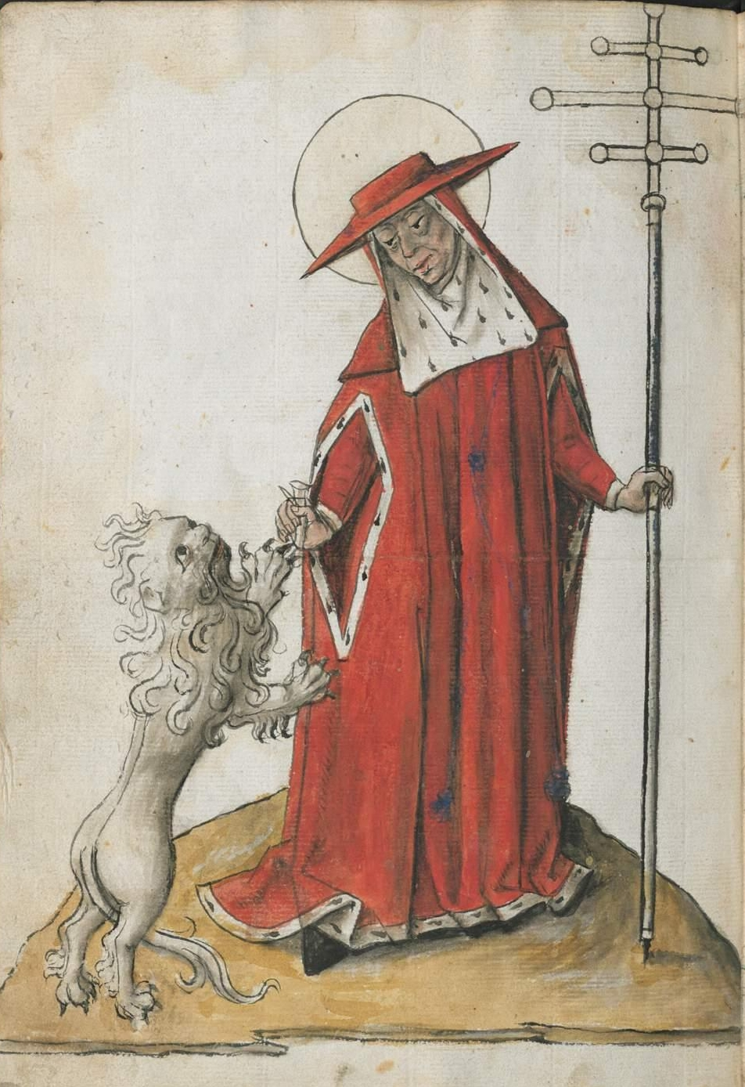
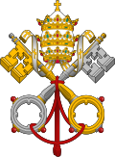
UNTO KING'S SCEPTER
FROM SHEPHERD'S STAFF
Notes:
THE PAPAL TRADITION OF CHOOSING A NEW NAME STARTS WITH MERCURIUS IN A.D. 533 RENAMING HIMSELF JOHN THE SECOND. THIS PRACTICE WAS PRIOR ASSOCIATED WITH ROYAL DYNASTY.

Slide 6
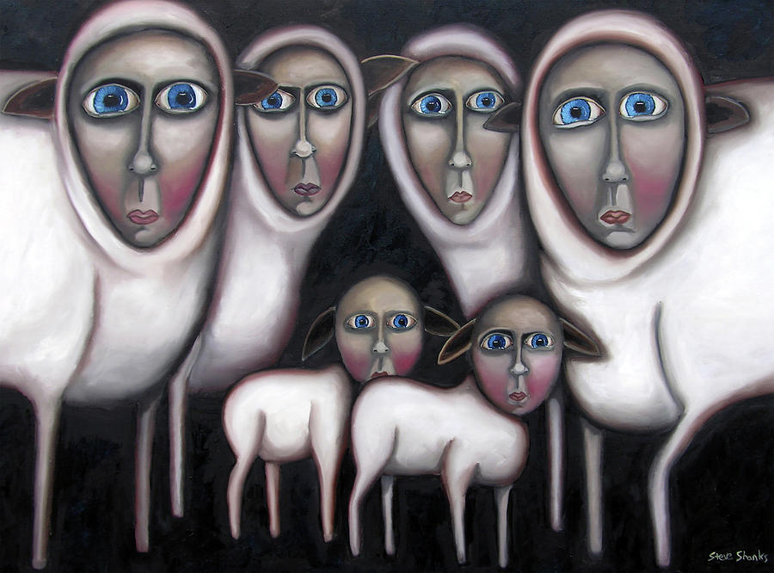
BY HOOK OR BY CROOK
Negative Connotation: Shepherds rounded up flocks by means of a crook, a long staff with curved end. A shepherd would chase after a reluctant lamb and hook it with his staff by any mean by hook or crook.

Slide 7
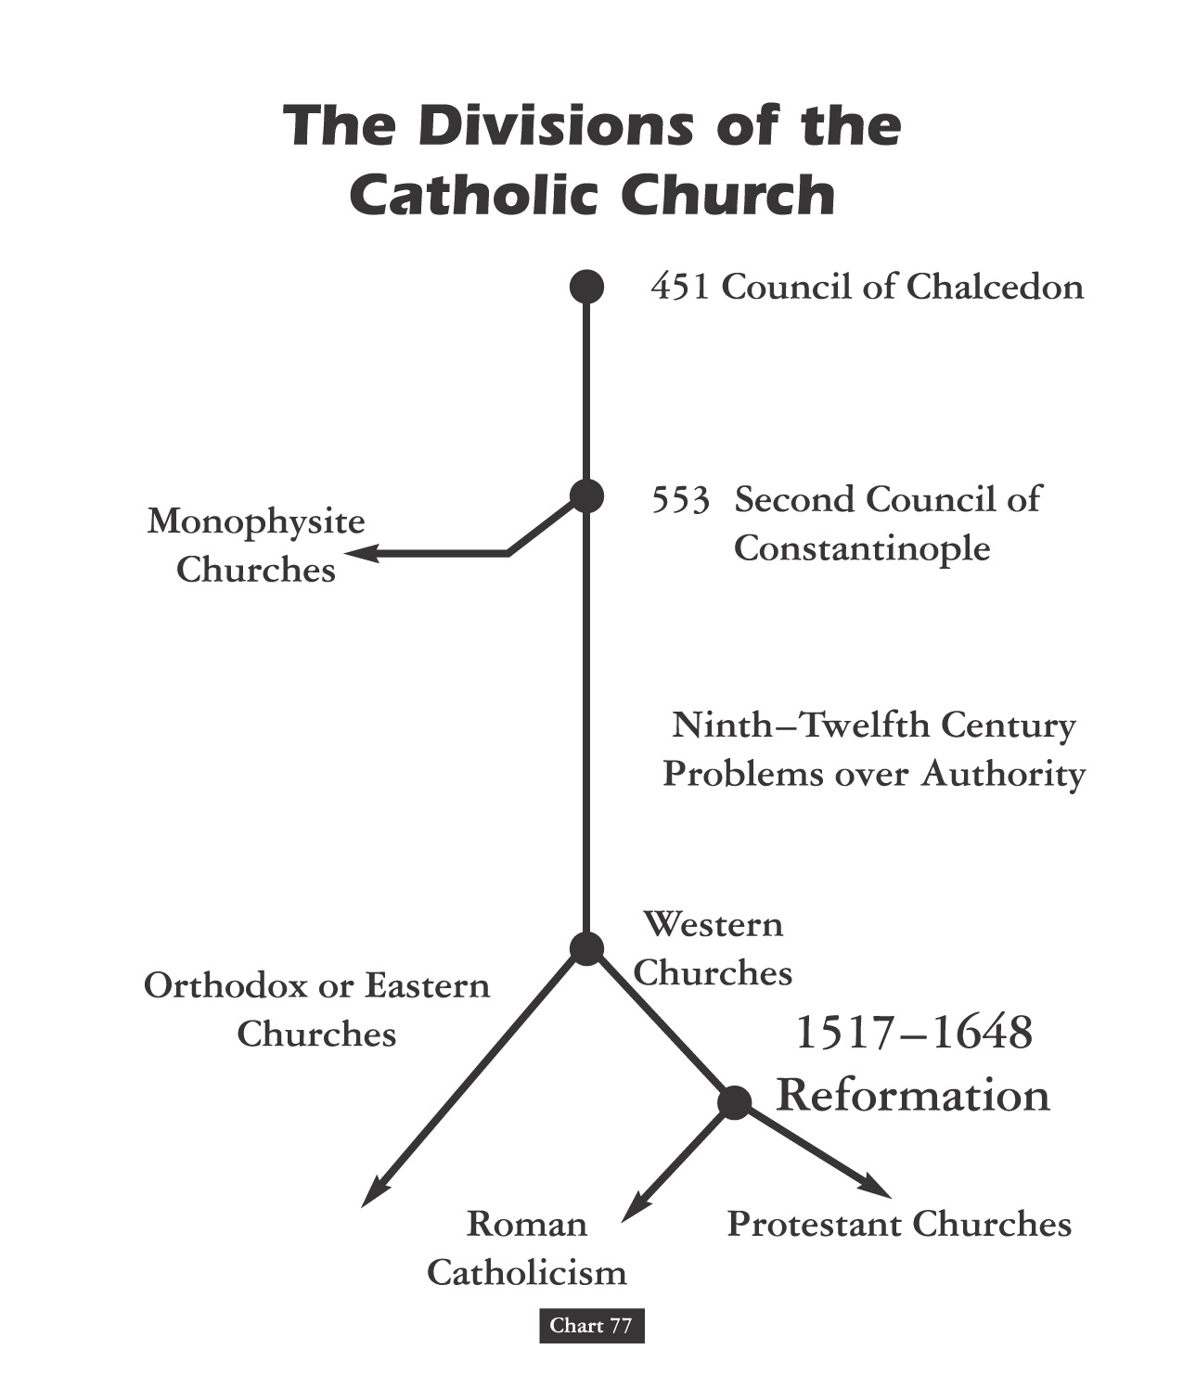

Slide 9
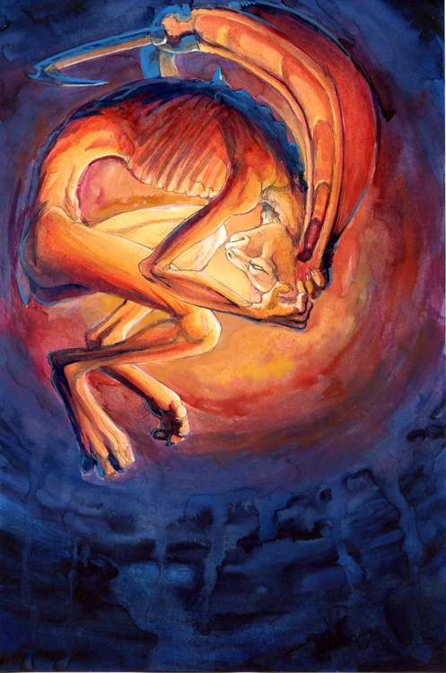
Christian Divisions Costs Half The World
“Christian divisions go far toward explaining the swift collapse of the Roman position in the Middle East, where popular sentiment leaned so heavily toward either the Monophysite or Nestorian churches. Repeatedly, writers from these traditions describe the relief which local inhabitants greeted the Arab conquerors, who promised an end to the heavy-handed regime of the Roman Empire, and the Chalcedonian order.
At least in the early decades of the new order, most Christians saw little reason to change their opinion. Muslims cared nothing for the sectarian divisions among their Christian subjects, provided they respected Muslim authority and paid their taxes on time.
The first century or so after the conquest marked something like a golden age for the Christian communities, who were now free of Roman oppression.”
Source: Pages 263-4, Philip Jenkins’ “Jesus Wars”

Slide 10
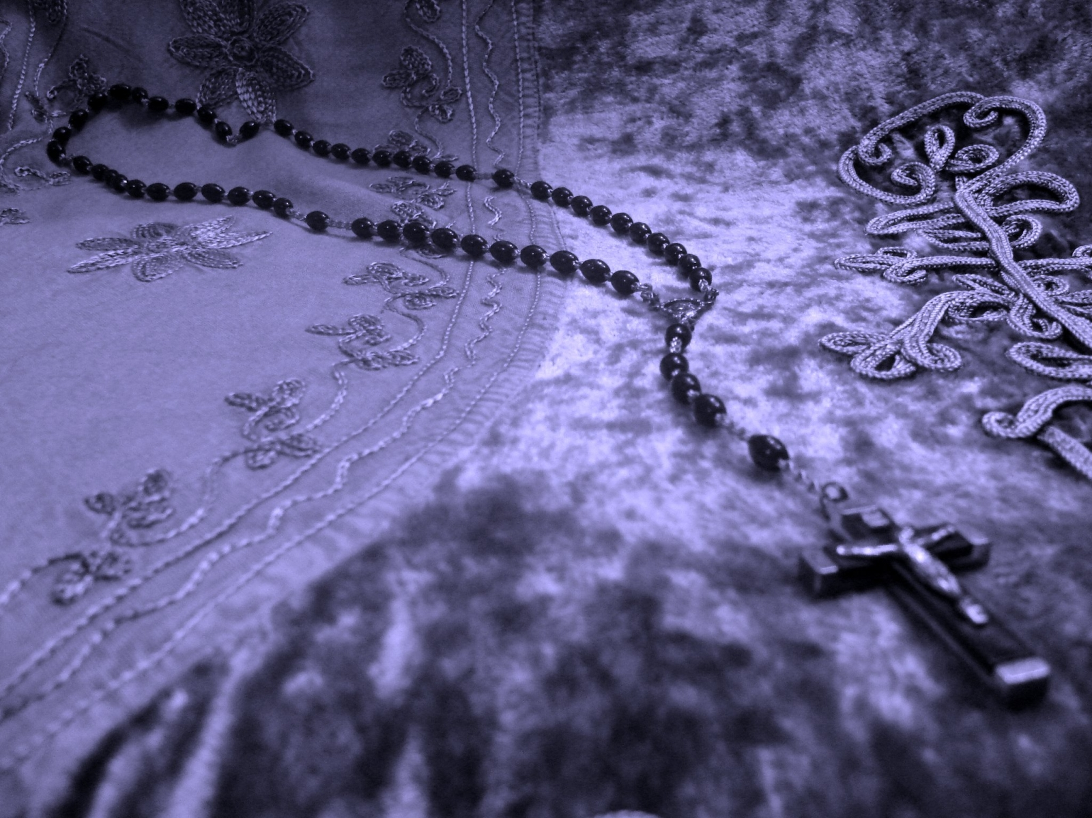
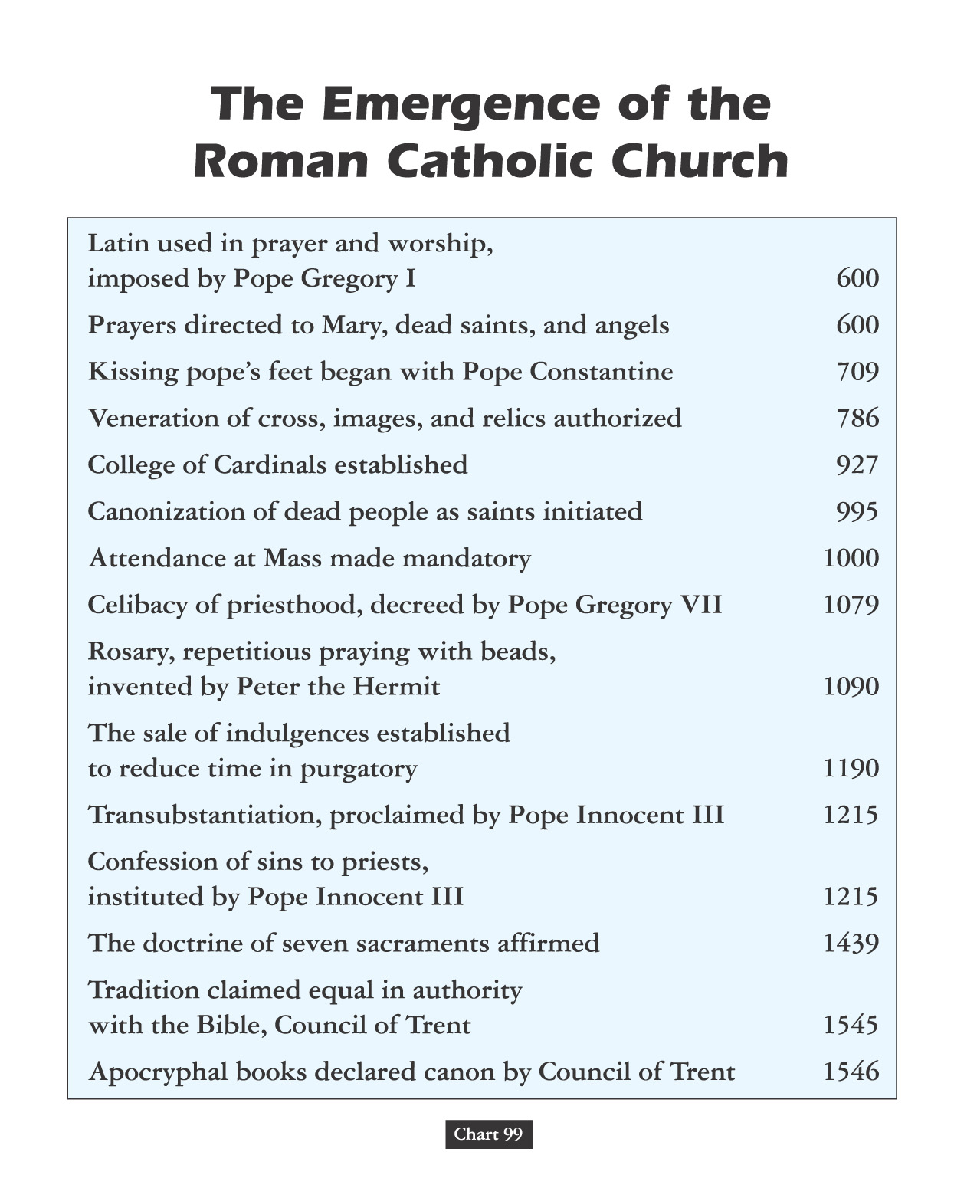
Vain Repetition

Slide 11
Freud was fascinated by this sinister side of the repetition compulsion, which is why he ultimately decided that the cause of our urge to repeat was directly linked to what he called "the death drive," or the urge to cease existing. After all, he reasoned, the ultimate "earlier state of things" is a state of non-existence before we were born. With each repetition, we act out our desire to go back to a pre-living state. Maybe that's why so many people have the urge to repeat actions that are destructive, or unproductive.

Slide 12
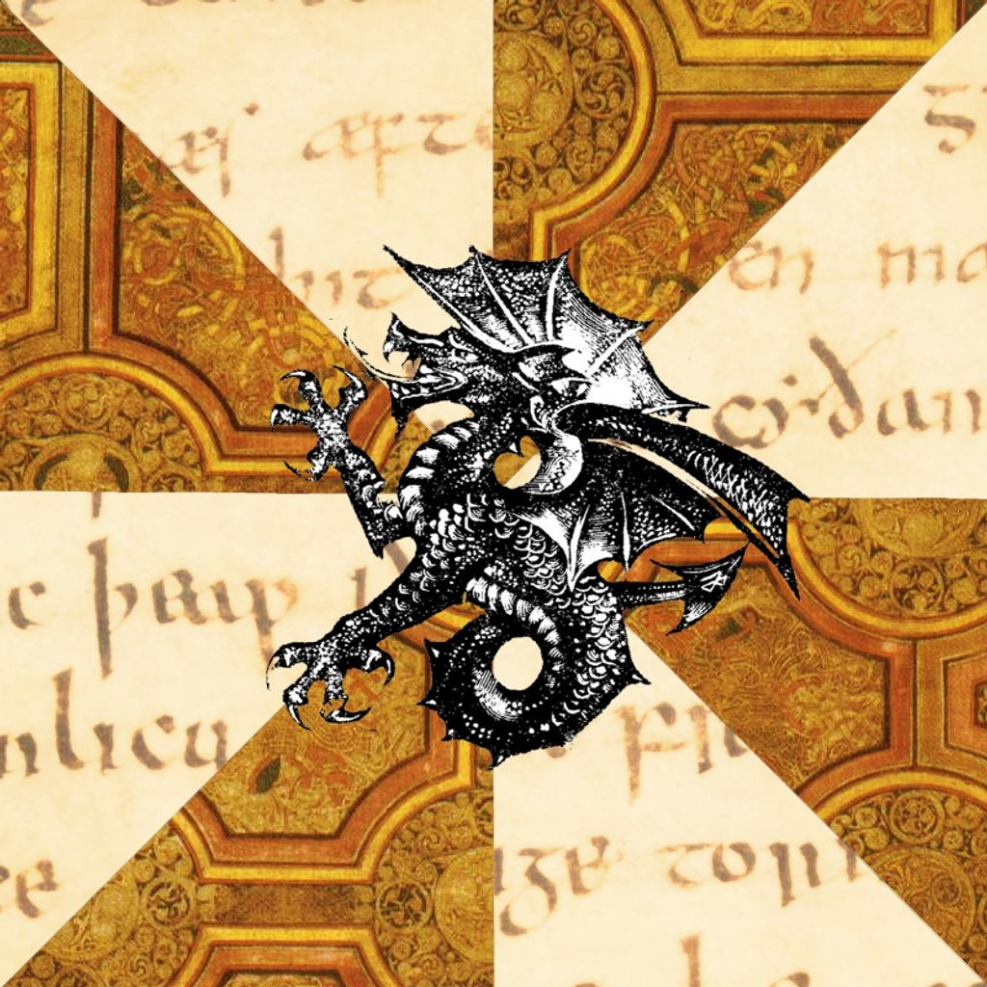
Those Who Do Not Study History Are Doomed To Repeat It!
Those That Do Study History Are Doomed
To Watch The World Repeat It!!

Slide 13
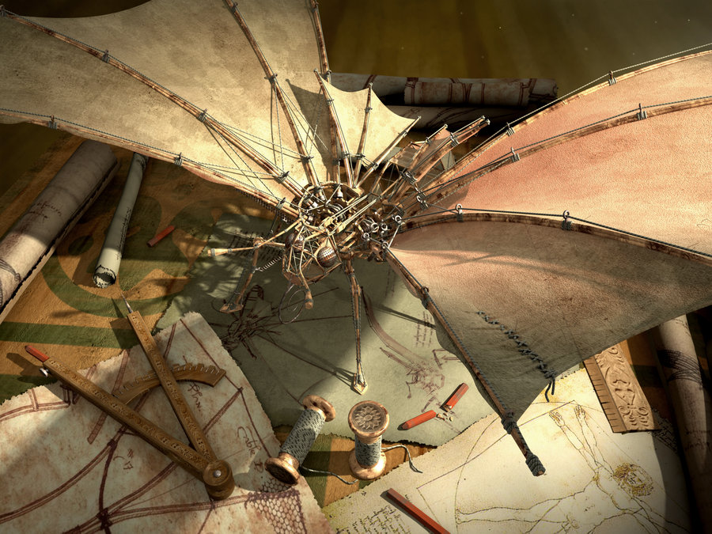
Early Middle Ages
AGES THEORY

Slide 14
Joachim Of Fiore

Slide 15
“During the Late Middle Ages, an Italian mystic by the name of Joachim of Fiore created a scheme in which history was divided into the Age of the Father, the Age of the Son, and the Age of the Spirit.”
Joachim Of Fiore

Slide 16
“The Old Testament, corresponding to this first age, is distinguished by its cruel, harsh deity who ordered the slaughters of entire people groups.”
Joachim Of Fiore

Slide 17
“We know the Age of the Son as the period in which the ‘good God,’ Jesus Christ, softened the harsher features of the Jewish deity and the church was founded with its material way of worshipping.”
Joachim Of Fiore

Slide 18
“But an even greater stage of historical development yet awaited: the Age of the Spirit, when the institutional church would be eclipsed by the universal brotherhood of man.”
Joachim Of Fiore
- modern reformation nov/dec 1994, pg. 4

Slide 19
HISTORY OF THE CHRISTIAN AGE
THE AGE OF JESUS & THE APOSTLES
THE AGE OF EARLY CHRISTIANITY
THE AGE OF STATE RECOGNITION
THE AGE OF OFFICIAL DOMINANCE
THE AGE OF HOLY ROMAN EMPIRE
THE AGE OF PROTESTANT REFORM

Slide 20
Crusaders Returned With Aristotle In Hand!

Slide 21
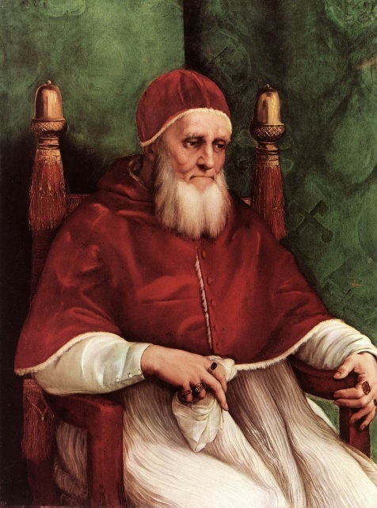
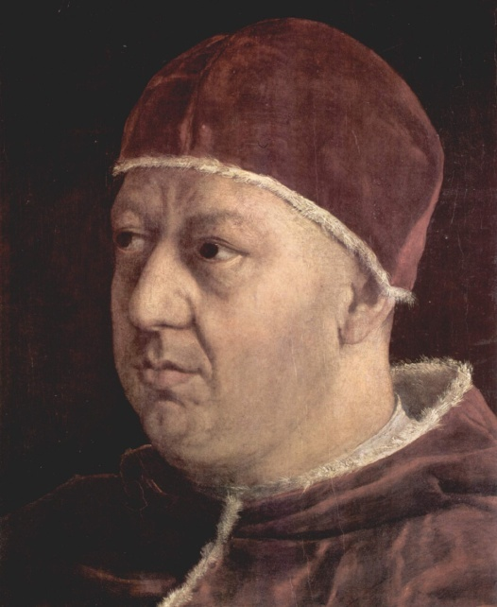
David Lee Burris:
The Pirate Cossa Became Pope John XXIII
1450
c. 1450 Beginning of the Renaissance
The popes of the Renaissance (1447-1521) are notable more for their intrigues and quest for power than for their pastoral care or desire for reform.
Pope Julius II (1503-1513)
Pope Leo X (1513-1521)

Slide 22
A Year that Changed History
The Hundred Years’ War ended in 1453, with England retreating to the British Isles.
That same year, Ottoman Muslims conquered the last remnant of the Eastern Roman Empire, the ancient city of Constantinople.

Slide 23
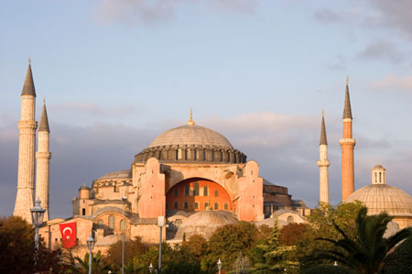
A Year that Changed History
On May 28, 1453, Orthodox and Catholic church members gathered for Communion in the Hagia Sophia in Constantinople.
The next day, the church became a mosque; and later, a museum.
Hagia Sophia, today a museum in Istanbul, Turkey
Notes:
Image: © adrian beesley

Slide 24
A Year that Changed History
Many Christian scholars from Constantinople fled west, in the direction of Rome.
Among the valued items they took with them were manuscripts, especially New Testament manuscripts in the original Greek language.

Slide 25
A Year that Changed History
This influx of Greek manuscripts influenced a renaissance of interest in ancient rhetoric, art, and writing.
Renaissance scholars were known as “humanists” because they focused on practical human actions and interests.
Among Christian scholars, the Renaissance led to a renewed interest in the original text of the New Testament.

Slide 26
Dominant Augustinian Paradigm Secular & Sectarian Applications
DIFFERENT RENAISSANCE EXPERIENCES:
The Italian Renaissance -
Fascination With Greek Classics
The Teutonic Renaissance -
Fascination With Greek Gospels

Slide 28
Dominant Augustinian Paradigm Secular & Sectarian Applications
DIFFERENT RENAISSANCE EXPERIENCES:
The Italian Renaissance -
Continuing Expressions Of Explicit Support
The Teutonic Renaissance -
Break In Tacit Contract Of Systemic Support

Slide 29
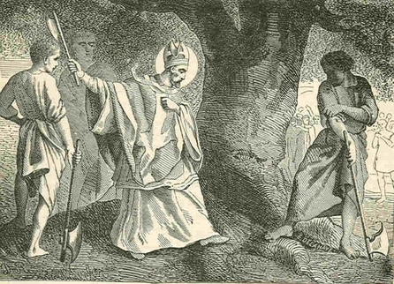
REVERSING BONIFACE: CHOPPING DOWN THE ROMAN TREE OF RELIGIOUS TRADITION!

Slide 30
Dominant Augustinian Paradigm 1,000 Year Fruit: Italy & Germany
14th Cent. Curia Def: Fool = “a good christian”
Bembo Quotes Gospel & Pope Leo X Remarks:
“How very profitable this fable of Christ has been to us through the ages.” Vatican Archives
Christendom Polars: Cynical Italians/Anxious Germans
Roman Catholic Fear: Mortal Sin Before Sudden Death
Lutheran Pious Angst: Whether God Will Be Gracious
Swiss Reform Obsess: Whether They Have True Faith

Slide 31
David Lee Burris:
Catholic Opposition Statement - “Even tailors and shoemakers, indeed women and other simple idiots, who had accepted this new Lutheran Gospel – though they could read only a little German – read it eagerly as if it were a foundation of all truth. Some carried it in their bosoms and learned it by heart. Thus they claimed within a few months such skill and experience that without timidity they debated not only with Catholic laymen, but also with priest and monks.”

Slide 32
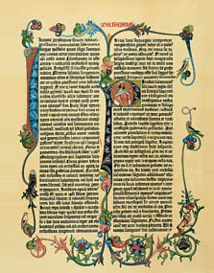
A Year that Changed History
Also in 1453, Johann Gutenberg pioneered the use of movable metal type to print books.
New printing methods supplied humanists with mass-produced books.
Greek and Roman classics, and the Bible, flooded Europe.
Gutenberg Bible Page
Notes:
Image from North Wind Pictures Archives

Slide 34
AD 400
Bible Copies
Fine quality animal skins from calves or antelope (vellum) and sheep or goats (parchment) are used for over 1,000 years to make copies of the Bible. (approximately AD 300-1400)
1500 BC 500 BC AD 1 AD 500 AD 1000 AD 1500 AD 1900 AD 2000

Slide 35
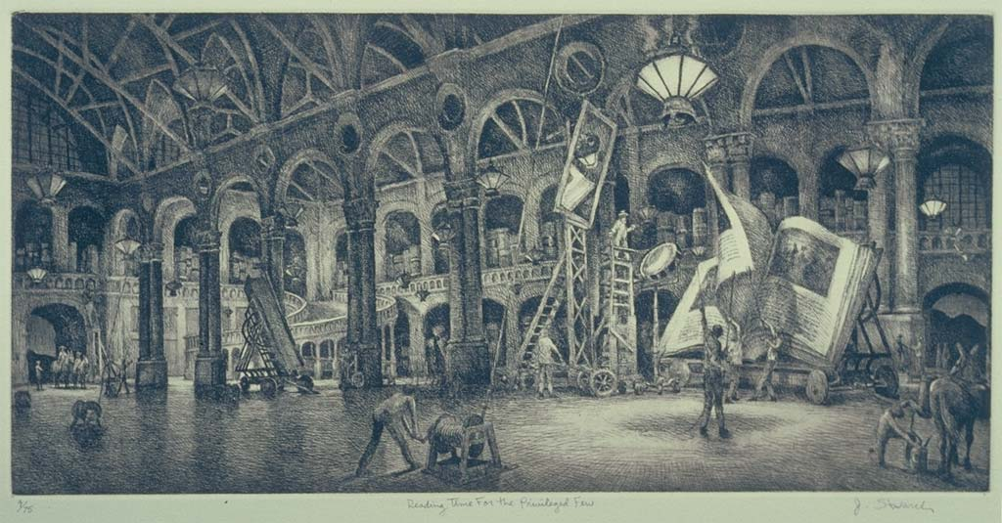
produced individual
books only for the rich

Slide 36
“As a kind of productive penance, monks with good penmanship spent hours making new copies of old books, a tireless, hand-cramping, and frustrating task.
They illuminated manuscripts with colorful glosses and drawings. The monasteries raised the animals whose skins produced the best vellum parchment: baby calves and sheep were best, but there were also deer, antelope, goat, and piglet for small sheets.”

Slide 37
“Monks split and scraped skins, producing several grades of parchment, remarkably durable showing a rich grain and hair markings that gave it its valued texture and warmth.
With parchment, they made both sacred and profane books, preserving the works of church fathers – Augustine, Ambrose, Bebe, Cassian, Eusebius – and Greek and Roman pagans alike.”

Slide 38
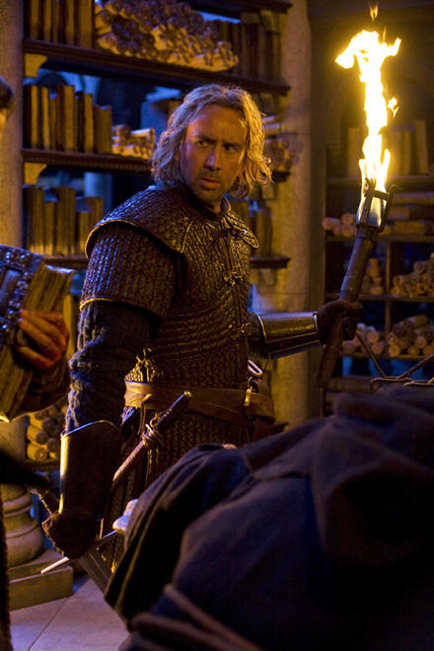
“They first pressed pages between the boards, and then invented covers and bindings, which made it possible to stack books on shelves.”

Slide 39
“Books were precious. At a wealthy monastery, a monk might be issued one book per year, while the others were chained to desks. The arduous copying filled monasteries with the greatest works of the past millennium. Those monasteries that failed to thrive became tombs, hiding their treasures in dank stone rooms and wooden cabinets. When the musty tombs were finally opened in the fifteenth century, the books spawned the Renaissance.”
- Pages 18 &19, The Proof of God

Slide 40
AD 400
Bible Copies
Two of the oldest vellum
copies (AD 325-350) that
exist today are the:
Vatican Codex
Sinaitic Codex
1500 BC 500 BC AD 1 AD 500 AD 1000 AD 1500 AD 1900 AD 2000

Slide 41
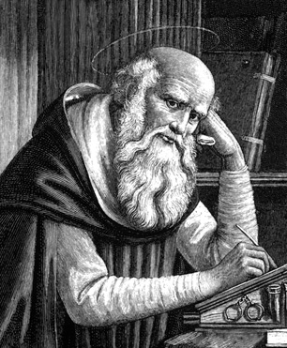
AD 400
Jerome
Jerome starts translating the Scriptures into Latin in
AD 410 and finishes 25 years later. This translation, called the Latin Vulgate, remains the basic Bible for many centuries.
Jerome
1500 BC 500 BC AD 1 AD 500 AD 1000 AD 1500 AD 1900 AD 2000

Slide 42
PAPER FOR THE NEW PRINTING PRESS

Slide 43
Based On Those
That Press Wine

Slide 44
Gutenberg Invention
Fused Four Separate
TECHNOLOGIES

Slide 45
David Lee Burris:
Called 42 line Bible
Metallurgy
Oil Based Inks
Metal Type Mold Casting
Advanced Technology Printing Press

Slide 46
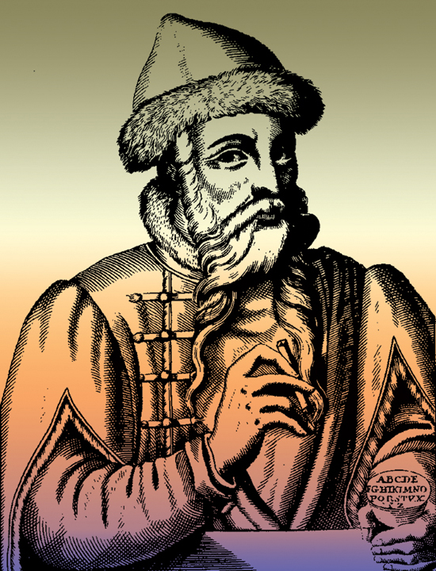
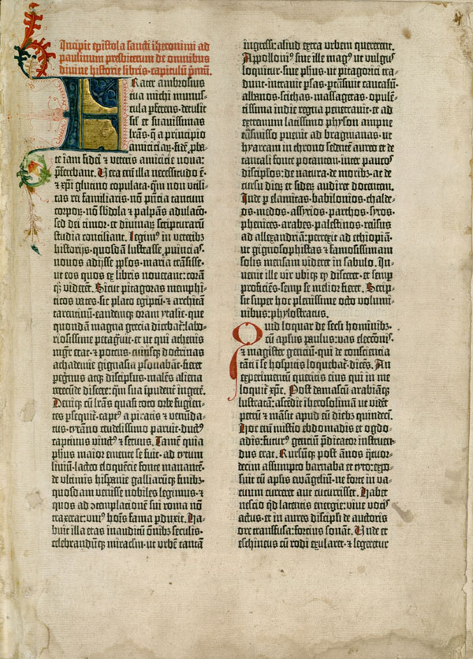
1456
Johann Gutenberg prints the Jerome Bible (Latin Vulgate), the first book printed in Europe using movable metal type
Johann Gutenberg
Page from the Gutenberg Bible

Slide 47
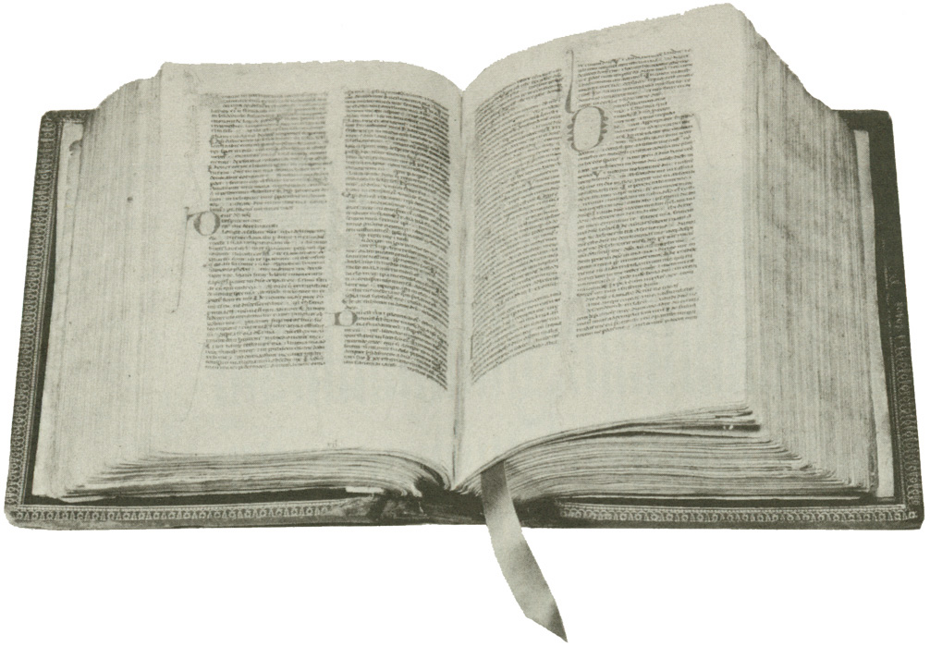
The Latin Vulgate

Slide 48
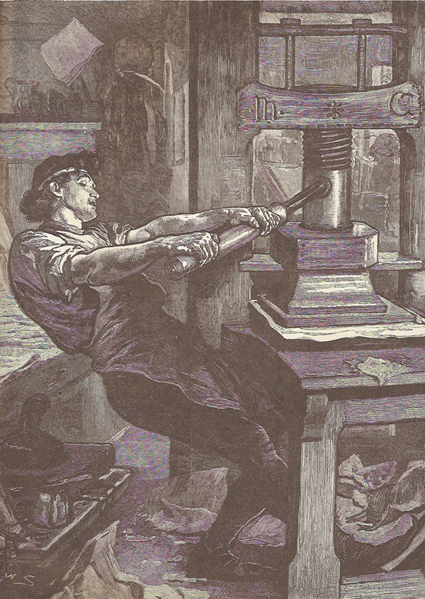
The invention of a printing press with movable metal type in Mainz, Germany, makes the Bible accessible to more people who previously could not afford handmade copies, which cost a year’s wage.

Slide 50
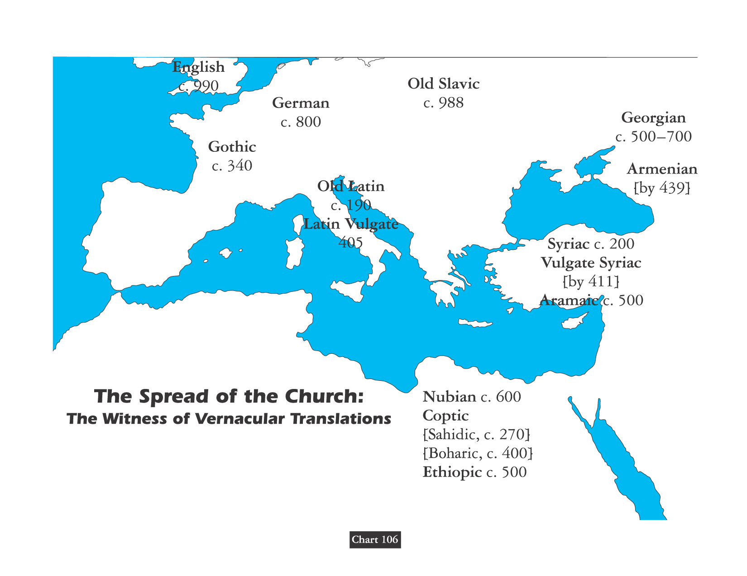
“Translation it is that openeth the window, to let in the light.” – Miles Smith

Slide 51
Level Two: Interpretation/Relevance

Slide 53
“Restricting the body of knowledge to a small group deadens the philosophical spirit of a people and leads to spiritual poverty.”
- Albert Einstein

Slide 54
Catholic Theologian Johann Cochlaeus:
“The New Testament translated into the vulgar tongue, is in truth the food of death, the fuel of sin, the veil of malice, the pretext of false liberty, the protection of disobedience, the corruption of discipline, the depravity of morals, the termination of concord, the death of honesty, the well-spring of vice, the disease of virtues, the instigation of rebellion, the milk of pride, the nourishment of contempt, the death of peace, the destruction of charity, the enemy of unity, the murderer of truth.”

Slide 55
Pretext: Text Outside Of Context
David Lee Burris:
Hubris Followed By Nemesis – God Of Arrogance Precedes Goddess Of Vengeance
Webster’s Definition Of Pretext: A purpose or motive alleged or an appearance assumed in order to cloak the real intention or state of affairs.
Previous To Pretext: Fear & Pride

Slide 56
The Fear & Pride That Self - Justifies :
You know that feeling of crazy emptiness you get when you realize that something you believed isn't actually true? And then things feel even more weird when you realize that actually, the thing you believed might be true and might not — and you'll never really know? That's aporia. The term comes from ancient Greek, but is also beloved of post-structuralist theorists.
A FEAR APORIA

Slide 57
POSSESSING A VERNACULAR VERSION WAS PUNISHABLE BY DEATH

Slide 58
The Imitation of Christ?
MURDER
IN THE
CHURCH!

Slide 59
“On a Sunday in 1478, a gang led by Francesco de` Pazzi attacked the Medici brothers, Lorenzo and Giuliano, during high mass in Florence’s cathedral. The attack on the city’s rulers seemed marginally successful as Pazzi and his pals stabbed Giuliano to death while his other conspirators tried to kill Lorenzo. Wounded Lorenzo Medici managed to flee the scene.” “Amazingly, Pazzi’s conspirators were wide-ranging, and included the archbishop of Pisa, the duke of Urbino, and Pope Sixtus IV (who wisely stayed in Rome).”
- Mental Floss, Forbidden Knowledge

Slide 60
In The Imitation of Christ

Slide 61
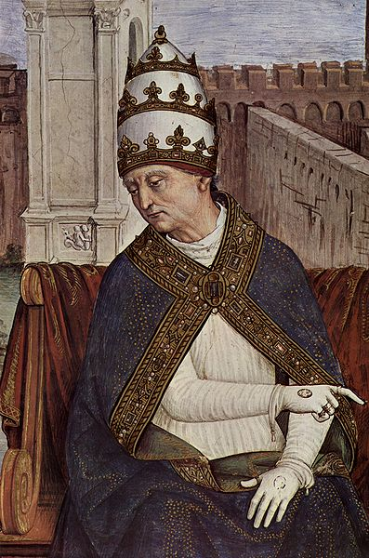
The best selling book of the 15th century was an erotic book called The Tale of the Two Lovers – it is even still read today. The author of this book was none other than Aeneas Sylvius Piccolomini – otherwise known as Pope Pius II (pictured here) who reigned from 1458 – 1464.

Slide 62
“BUGGERY WAS THE BESETTING SIN OF NO LESS THAN FIVE OF THE POPES OF THE BORGIA AGE. BRACCIOLINI WROTE OPENLY IN PRAISE OF SODOMY.”
- Gerald Noel

Slide 63
Foundations for Renewal
In the late 1300s and early 1400s, the “Common Life Movement” arose among Christians in Holland.
The Brothers of the Common Life blended scholarship with deep—even mystical—devotion.
The most famous Brother of the Common Life was Thomas A’Kempis, who authored “The Imitation of Christ.”

Slide 64
The Imitation of Christ
“Even if you know the whole Bible by heart and the sayings of the philosophers, what does it profit you unless you also love God?... Truly, humble farmers who serve God are greater than proud philosophers who neglect [their need for God].” —Thomas A’Kempis

Slide 65
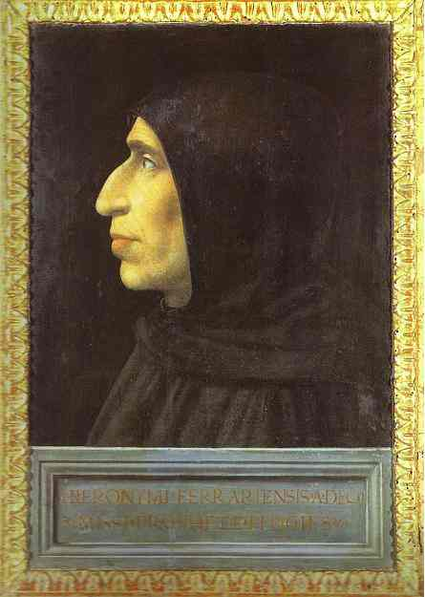
1497
1497-1498 Dominican friar Savonarola preaches reform
Savonarola encourages the people of Florence, Italy, to turn from lifes of luxury & entertainment & toward serving Christ & following His example.
Girolamo Savonarola, Fra Bartomeo (1498)

Slide 66
Forerunners Of Luther: The Dominican Monk Savonarola
Savonarola was a one-man movement starting out like Luther’s but with quite a different ending.
Like Luther, Savonarola was a monk, but Dominican.
Like Luther, his opposition to the church hierarchy’s indifference to Christian thought and lifestyle was surprisingly successful, as Florence “The City Of The Medicis” overnight became quite zealous and moral, burning their vanities and soberly reforming.
The Reformer of Florence had threatened God’s divine judgment on the city’s sins. He even became specific, saying it would be by the King of France.
The French invasion of Charles was not only successful but the experience was sobering to the Italians.
* Source: Ligonier Ministries Church History Handouts

Slide 67
Forerunners Of Luther: The Dominican Monk Savonarola
The city’s population saw this as divine confirmation of Savonarola. They repented wholesale!
Pope Alexander felt that if the Florentines could be impressed by one false claim, they might be influenced by another & dangerous false claim – one of threat to the papacy. He put the city under interdict, threatened the people, and excommunicated and arrested Savonarola.
Savonarola’s last words as being burned may have been his greatest of insight: “You may cut me off from the church militant here below, but you cannot cut me off from the church triumphant above.”
* Source: Ligonier Ministries Church History Handouts

Slide 68
Savonarola sells church property and gives proceeds to the poor.
Despite his initial popularity with the common people, he is caught in a political conflict with Pope Alexander VI and is excommunicated.
His popularity wanes and later he is executed for heresy.
https://www.youtube.com/watch?v=O3Cp5owExIY&t=139s

Slide 69
Reform Process
“People who love soft methods & hate iniquity forget this, that reform consists in taking a bone from a dog!”
- John Jay Chapman

Slide 70
ANOTHER PERIOD OF TRANSITION
NEW NATIONS COMPETE WITH ROMAN EMPIRE & ROMAN CHURCH

Slide 71
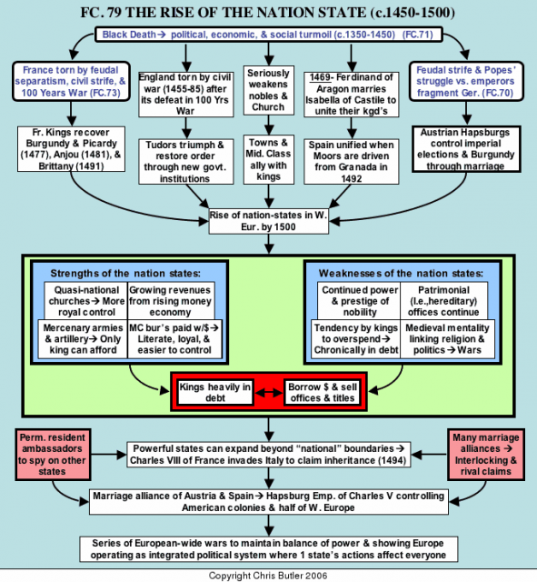

Slide 72
Shaping 16th Century Dynasties:
As Europe approached 1500, a generation of stronger monarchs arose. Their goal was to suppress baronial rebellions & subordinate the church and aristocracy. They wanted really to make themselves more secure & ultimately absolute.
They would establish the modern conception of the nation-state with unitary loyalty owed to that state!

Slide 73
Shaping 16th Century Dynasties:
Let’s look at the founders of these family firms – All across Europe, new dynasties emerged from the carnage of war!
In England, out of the Wars of the Roses Civil War emerged first, the Yorkists under Edward IV in 1461 and then, more permanently, Henry VII established the Tudors in 1485.
In France, the Valois family reestablished themselves after the many disasters of the Hundred Years War. First, Charles VII and then Louis XI ruled France from 1422 -1483.

Slide 74
Shaping 16th Century Dynasties:
Let’s look at the founders of these family firms – All across Europe, new dynasties emerged from the carnage of war!
In the Holy Roman Empire, the Habsburg power revived under Maximilian I, who ruled from 1493 to 1519.
Spain was united by Ferdinand and Isabella; Isabella predeceased Ferdinand, who ruled until 1516.
Even Portugal united under the House of Aviz and in Hungary under Matthias Corvinus.

Slide 75
How was Permanent Family Dynasty established?
MARRIAGES MADE OF CONVENIENCE.
SUPPRESSION OF THE BARON ARMIES.
ALLY WITH CITIES FOR LOANS & MONEY.
WORK WITH MERCHANT ASSEMBLIES.
KEEP APPROVAL OF ROMAN CHURCH.
PROTECT FROM THE FOREIGN INVADER, CONSOLIDATE HOLDINGS AND IMPOSE WITH FORCE A RELIGIOUS UNIFORMITY!

Slide 76
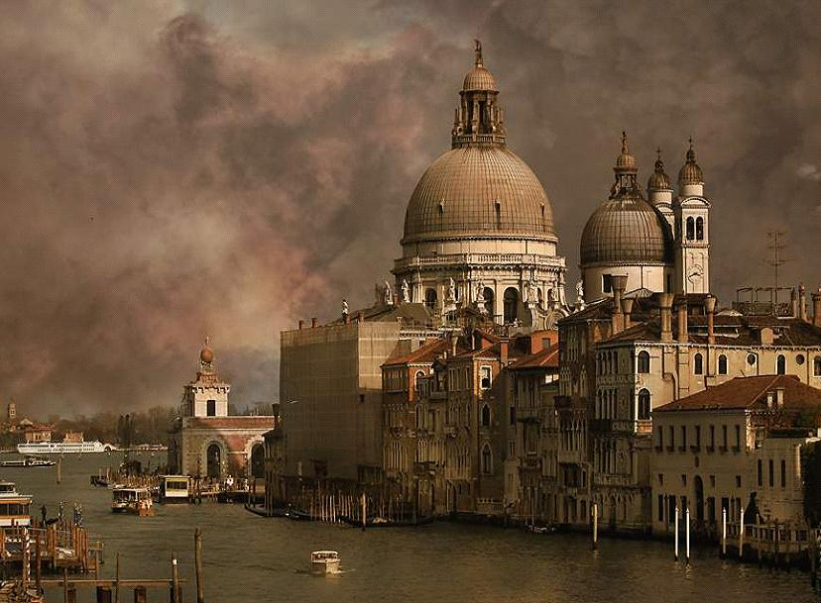
ITALY

Slide 77
Berlín

Slide 78
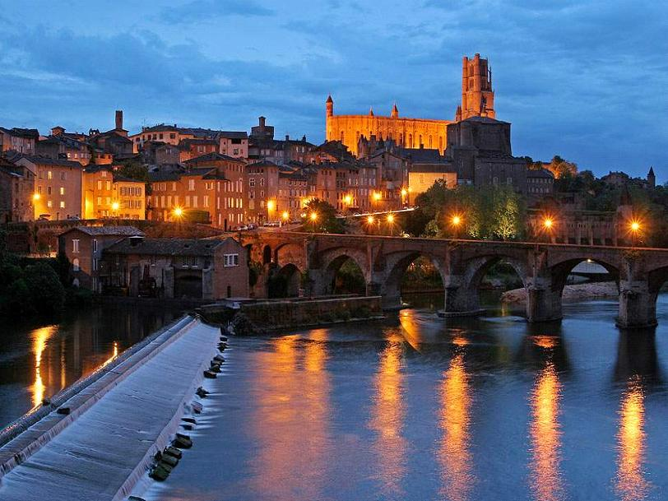
Frankreich

Slide 79
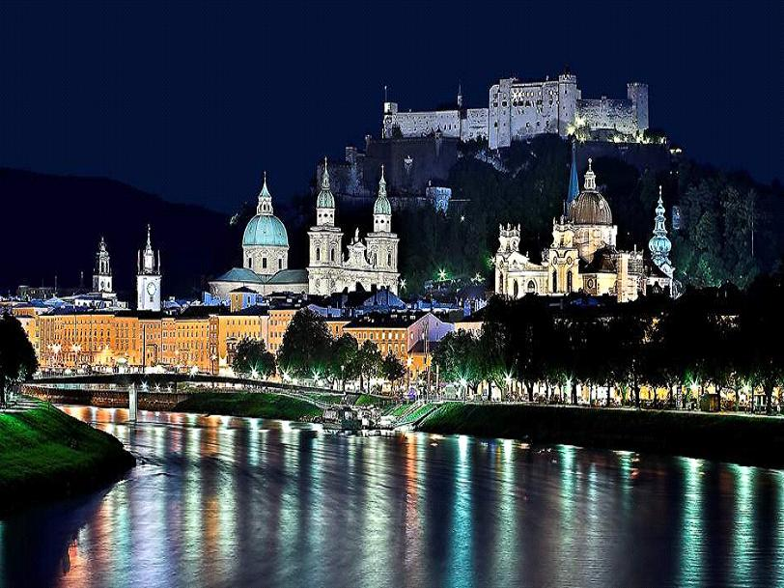
Salzburg

Slide 80
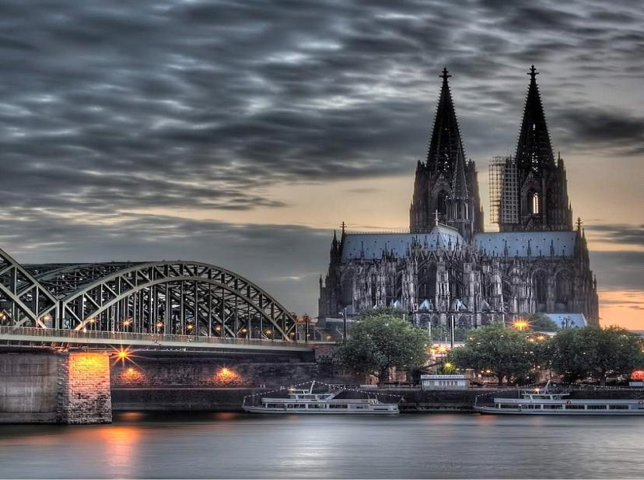

Slide 82
David Lee Burris:
Sometimes They Found Alliance Sometimes They Worked Apart!
Humanism & Nationalism Emergence

Slide 83
The New Mindset Of Non-Institutional Individualism!

Slide 84
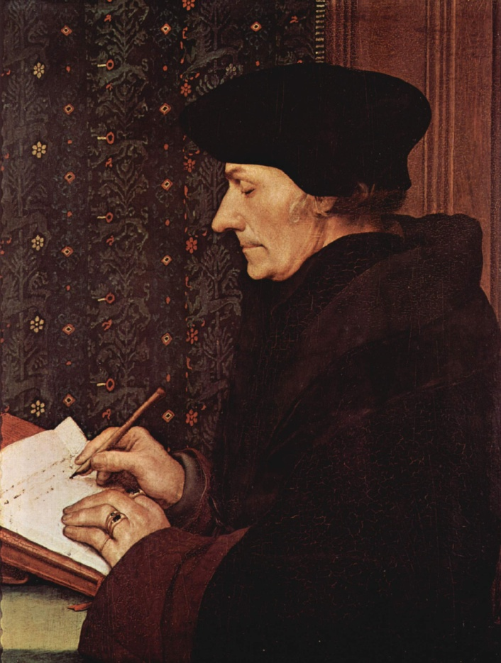
1502
Erasmus, leader of German humanism, future priest, philosopher, writer, and Greek scholar, writes Enchiridion (“The Handbook of the Christian Soldier”), promoting a Christianity based on the Sermon of the Mount
Erasmus, Hans Holbein (1523)

Slide 85
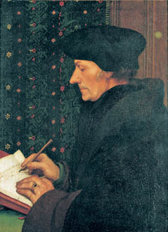
Erasmus, Christian Humanist
As a young man, Erasmus had been taught by Brothers of the Common Life.
These teachers whetted Erasmus’ taste for the Greek language.
Erasmus
Notes:
“Erasmus” by Hans the Younger Holbein (1523)

Slide 86
Erasmus, Christian Humanist
In 1516, Erasmus edited and published a Greek New Testament.
Now the original words of the apostles were available to anyone.
Erasmus was a faithful Catholic priest and scholar, yet his Greek New Testament became the tool that would launch the Protestant Reformation.

Slide 87
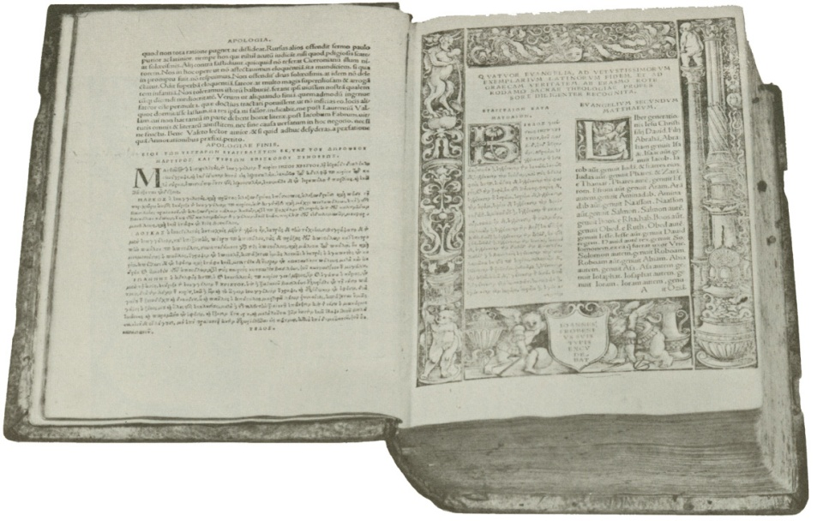
1516
Erasmus publishes a Greek translation of the New Testament
Later editions of his Greek text form the basis of the textus receptus and are used by Martin Luther, William Tyndale, and the King James Bible (Authorized Version) translators.
Greek New Testament of Erasmus

Slide 88
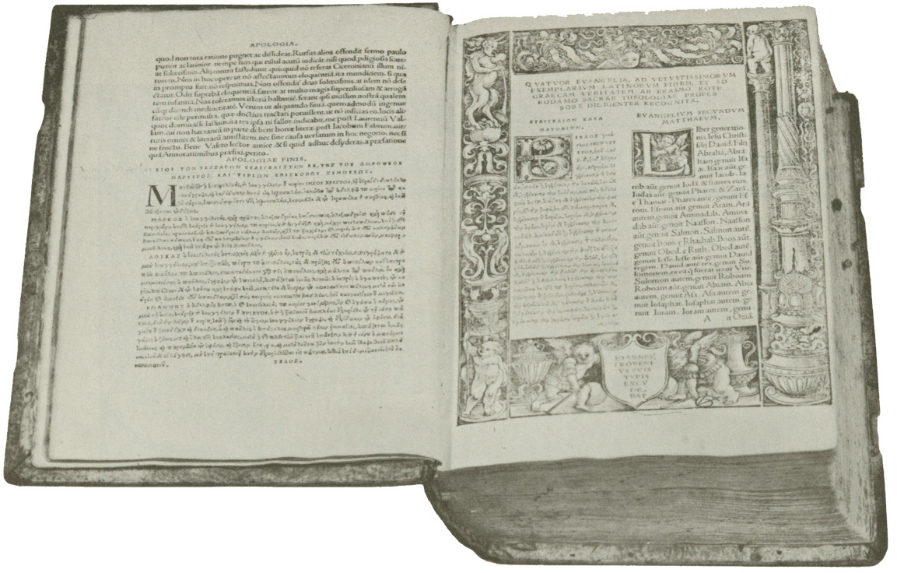
The Greek New Testament of Erasmus AD 1516

Slide 89
AD 1516
Erasmus
Erasmus’s goal was that everyone be able to read the Bible, “from the farmer in the field to the weaver at the loom.”
His Greek text forms the basis of the Textus Receptus or received text.
The Textus Receptus is used later by
Martin Luther, William Tyndale, and the King James translators.
1500 BC 500 BC AD 1 AD 500 AD 1000 AD 1500 AD 1900 AD 2000

Slide 90
Forerunners Of Luther: Valla - Ockham - Erasmus
One does not always think of these men, who never broke with the church, as forerunners of the Reformers.
But they were children of the Renaissance if not the Reformation, and there is some question whether there could have been a Reformation without a Renaissance.
Renaissance meant rebirth, referring to Greek and Latin culture, which was largely lost thru years of invasion.
Natural man can and often does cultivate the things of the mind and will, however sinfully motivated. Knowledge puffs up but it is useful, as seen in art, music, literature, and general culture. The Renaissance mind can gain the whole world while losing its soul, but for those with souls spiritually alive, its culture can be creatively utilized.
* Source: Ligonier Ministries Church History Handouts

Slide 91
Forerunners Of Luther: Valla - Ockham - Erasmus
So it was that Nicolas of Lyra played the lyre to which Luther danced. Meaning to say, that Nicholas’ great biblical scholarship producing volumes of exceptional & learned treatises taught Luther how he could use the scholastic tools in his own profound penetration through commonly accepted traditional interpretations of verse.
Lorenzo Valla, closer to Luther’s time, by his critical researches on the forged “Donation of Constantine” and commentaries on scripture showed Luther the way of necessary biblical exegesis and/or exposition from the original languages. Next, Erasmus completes Valla.
* Source: Ligonier Ministries Church History Handouts

Slide 92
Forerunners Of Luther: Valla - Ockham - Erasmus
David Lee Burris:
Erasmus Pioneered Ideas Of Human Dignity & Innate Goodness That Were Ahead Of His Time
Saying Erasmus, whose life overlapped Martin Luther’s, laid the egg Luther then hatched seems especially strange inasmuch as Erasmus’ and Luther’s theology were polemically opposed. Yet it was clearly Erasmus’ biblical scholarship that shaped Martin Luther.
* Source: Ligonier Ministries Church History Handouts

Slide 94
humanist criticism:
Erasmus

Slide 95
THE HATCHLING

Slide 97
Forerunners Of Luther: Valla - Ockham - Erasmus
David Lee Burris:
Erasmus Pioneered Ideas Of Human Dignity & Innate Goodness That Were Ahead Of His Time
Saying Erasmus, whose life overlapped Luther’s, laid the egg Luther hatched seems especially strange inasmuch as Erasmus’ and Luther’s theology were polemically opposed. Yet it was Erasmus’ biblical scholarship that formed and shaped the man Luther.
Probably the greatest non-reformational forerunner of Luther’s Reformation was William of Ockham, an English Franciscan monk whose unsound philosophical and theological principles started the thought processes that ultimately led Luther onto his history making path.
* Source: Ligonier Ministries Church History Handouts

Slide 98
NOMINALISM
“The theory of knowledge that denies the objective reality of universal principles, maintaining that ‘universals’ are mere concepts with no reality apart from their existence in the mind of the individual.”
* Dictionary Of Theological Terms, Grenz & Guretzki

Slide 99
THE NOMINAL CHURCH

Slide 100
Martin Luther Was Trained Philosophically In Nominalism!

Slide 104
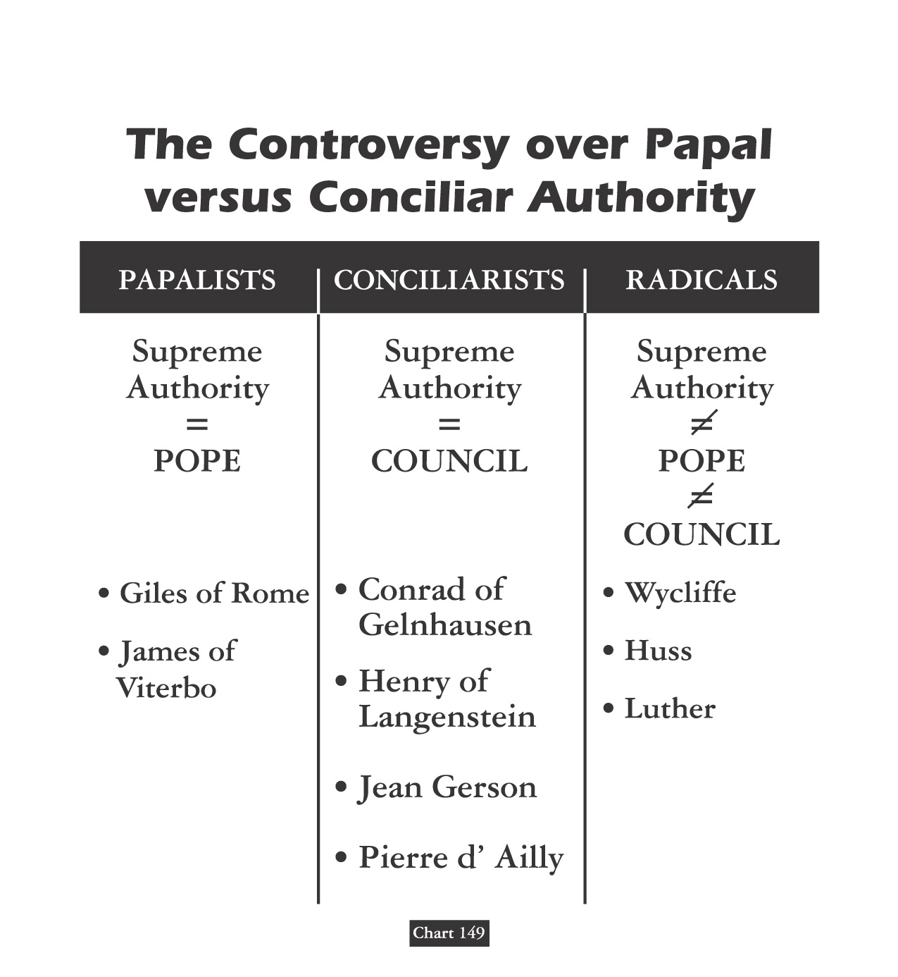
MARTIN LUTHER AGREED
WITH THE RULES OF 1417
COUNCIL OF CONSTANCE
the pope, however divinely instituted his office, was not an absolute monarch but in some sense a constitutional ruler;
the pope possessed merely a ministerial authority delegated to him by the community of the faithful and for the good of the whole church;

Slide 105
MARTIN LUTHER AGREED
WITH THE RULES OF 1417
COUNCIL OF CONSTANCE
the community of the faithful had not exhausted its inherent authority in the mere act of electing its ruler but had retained whatever residual power was necessary to prevent its own subversion or destruction;
The community of the faithful could exercise power via its representatives assembled in a general council – even, in certain critical cases, against the wishes of the current pope and, if need be, it could judge, chastise and even depose a pope.

Slide 106
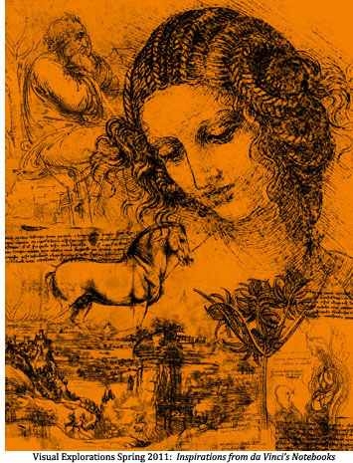

Slide 107
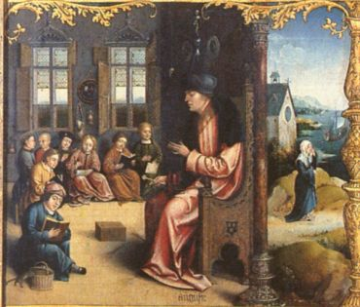
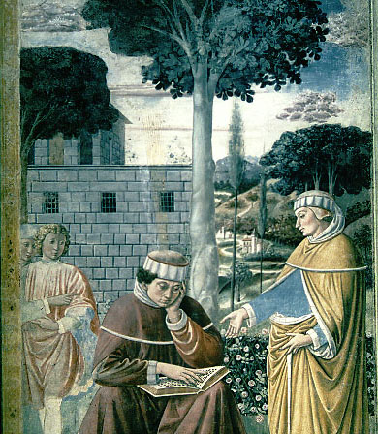
Augustinian Iconography I

Slide 108
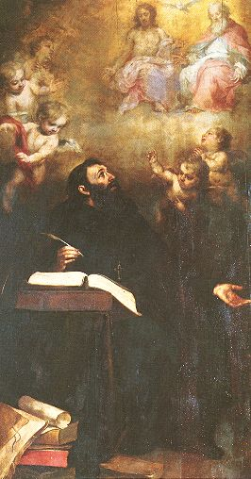
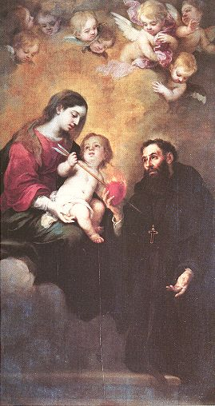
Augustinian Iconography II

Slide 109
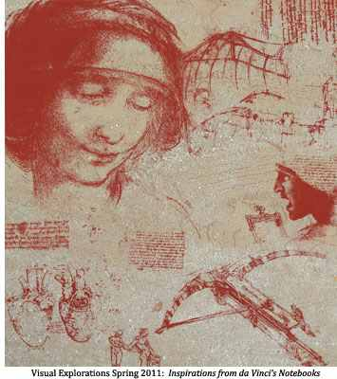

Slide 110
Augustinian Spirituality Setting Paradigm
Story: Earthly Pilgrimage To Eternal Happiness
Morality: Those Virtues To Travel Beatific Road
Start: Accept Received Faith Until Seeing For Self
Move: Drive Engine Love Both Propels / Attracts
Human Free-Will Incapable Love Overwhelming
Counterfactual Test Proves Love – Gift Of Grace
Compatibilists: God’s Grace & Man’s Free Will
Doctrine Of Grace Includes Human Merit Concept
Anselm’s Augustinian Prayer Seeks Grace & Faith
Private Confession Created Penitential Conscience {No Preaching/Pastoral Care – 24/7 Paid Prayers}
Piety Focus: Habits Of Heart / Art Of Dying Well
Salvation: Inner Examination & Outer Experience

Slide 111
IT LIVES
IT GROWS
IT THRIVES

Slide 113
PLATO | ARISTOTLE
Idealism | Realism
Republic | Politics
The “Ideal” State | A Working Government
TRANSCEND Human Selfishness | ACKNOWLEDGE Human Selfishness
Social Unity | Balance

Slide 114
ARISTOTLE THRU THE AGES
Aristotle will always be significant to scholars as the most famous student of Plato.
His works on logic are among the classics. He basically believed our existence is related to substance and that everything is caused by something else – uniform theory.
His practical philosophy proved more controversial. He states that our souls are formed by habits, skills, and virtues. These same virtues are like skills in that they are formed by practice – by working at it. The other way our souls are shaped is through perception.
Aristotle has remained an ageless figure and forever thought provoking as regards his postulation - in purely physical terms - of an “Unmoved Mover” – an irreducible final cause to the universe.

Slide 115
Debate Begins With Aristotle: How Are People Changed Within?
“To Be Is To Do” - Or - “To Do Is To Be”
“Excellence is an art won by training and habituation. We do not act rightly because we have virtue or excellence, but rather we have those because we have acted rightly. We are what we repeatedly do… Excellence, then is not an act but a habit.”
* Disputing Human Nature!

Slide 116
Luther Critique’s Clairvaux: Spiritual Maturity & Progress
FIRST – Love Of Self For Your Own Sake.
SECOND – Love Of God For Your Own Sake.
THIRD – Love Of God For God’s Sake.
FOURTH – Love Of Self For God’s Sake.

Slide 117
Luther On The Gravity Of Sin: Mankind Is Incurvatus In Se
Humanity Has Curved In Upon Itself
With Meaning Twisted
& Our Ideals Warped
* Spiritual Physics Of Heavy Mass

Slide 118
COUNTERING THE COUNTERFACTUAL TEST
Bible Says You Are In Charge Of Your Own Heart
Jeremiah 4: 4 – “Remove the foreskin of your hearts”
Jeremiah 9: 13 – “Stubbornly followed their hearts”
Jeremiah 18: 11 – “Act according to his evil heart”
Ezekiel 18:31 – “Make Yourselves A New Heart & A New Spirit!”

Slide 119
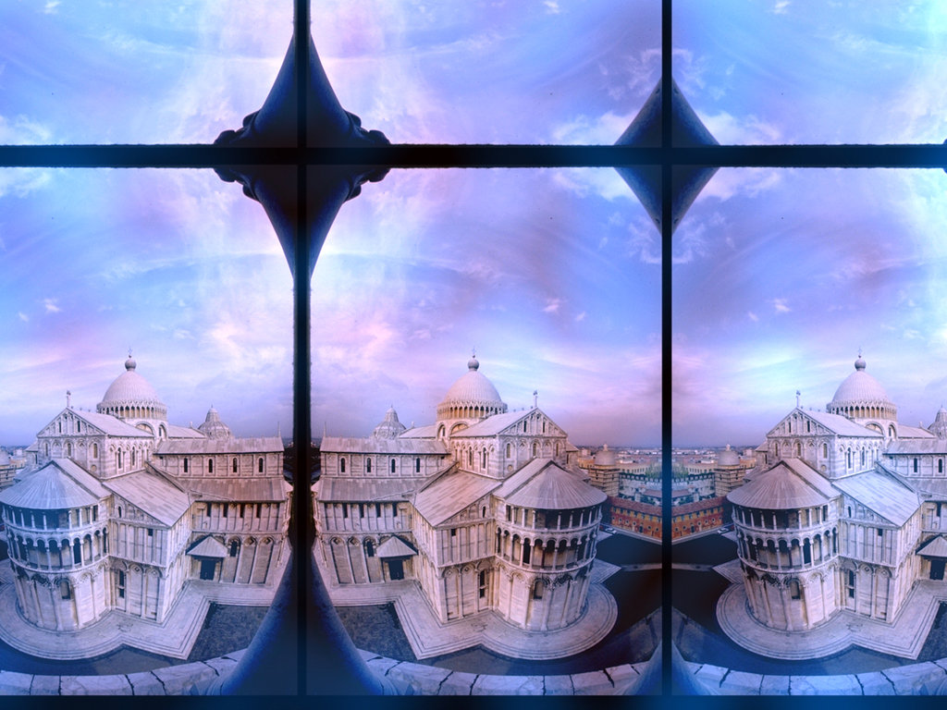
THE AUGUSTINIAN UNIVERSITY Pursuit Of Knowledge: Mixed Message
Why Did The Western Church Consider Scholarship
& The Making Of New Discovery A Divine Calling?
The idea came from the Bible via Augustine. He taught that God was a rational being & the human mind (not just the human “soul”) was made in God’s image. Therefore, our rationality was qualitatively different from that in the animal brain. God gave us a mind like His own so that we might know Him and understand & govern his creation as his children. For Augustine this meant that, according to the Bible, to be godly required us to cultivate our minds – the instrument of knowing God and his creation.

Slide 120
IT LIVES
IT GROWS
IT THRIVES

Slide 121
THESIS & ANTI-THESIS THEOLOGY
PLATO(Teacher) VERSUS ARISTOTLE(Student)
IRENAEUS(2nd Cent) VERSUS AUGUSTINE (4th)
AUGUSTINIAN VERSUS PELAGIAN NEMESIS
AUGUSTINIAN(Old)/THOMISM(New Church)

Slide 122
Dominant Augustinian Paradigm 1,000 Year Fruit: Italy & Germany
14th Cent. Curia Def: Fool = “a good christian”
Bembo Quotes Gospel & Pope Leo X Remarks:
“How very profitable this fable of Christ has been to us through the ages.” Vatican Archives
Christendom Polars: Cynical Italians/Anxious Germans
Roman Catholic Fear: Mortal Sin Before Sudden Death
Lutheran Pious Angst: Whether God Will Be Gracious
Swiss Reform Obsess: Whether They Have True Faith

Slide 123
IN THE BOOK OF JOB

Slide 124
GOD’S LIGHTNING ARE CHARGED ARROWS!

Slide 125
THE THUNDER IS HIS VOICE!

Slide 126
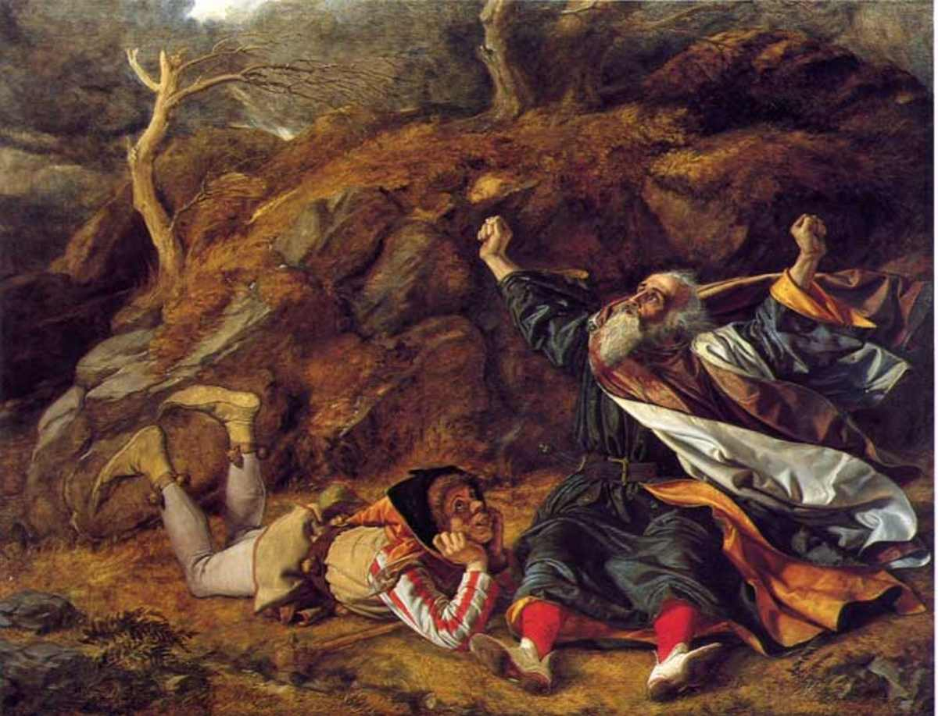
Fool in the Storm

Slide 127
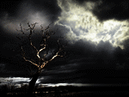

Slide 128
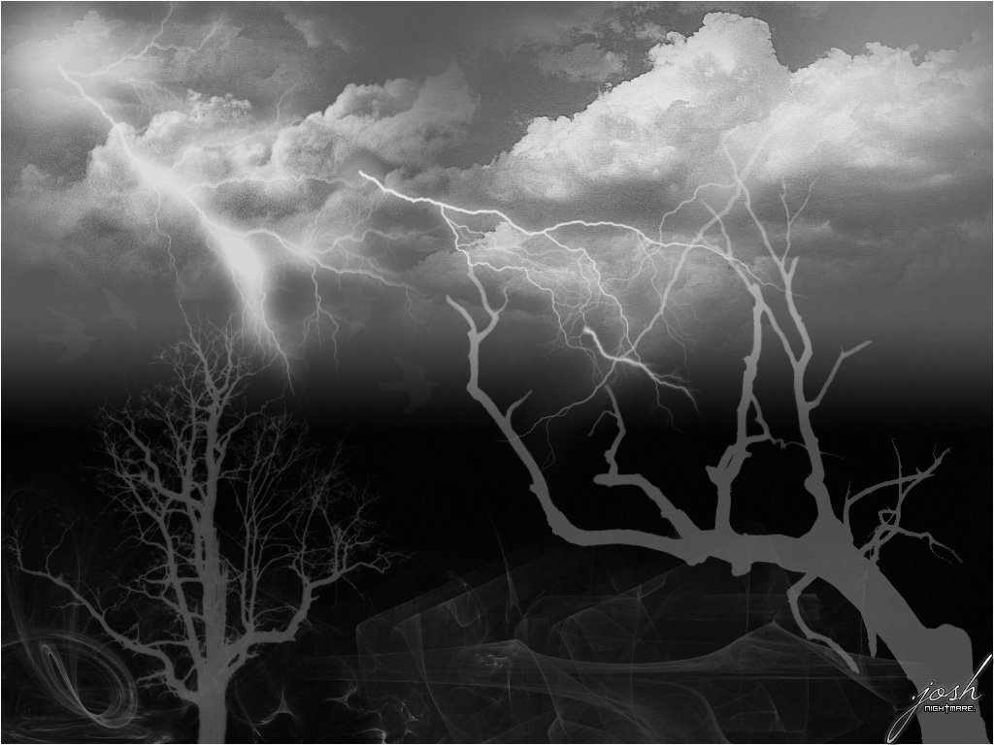
CLASSICAL SUPERSTITION

Slide 129
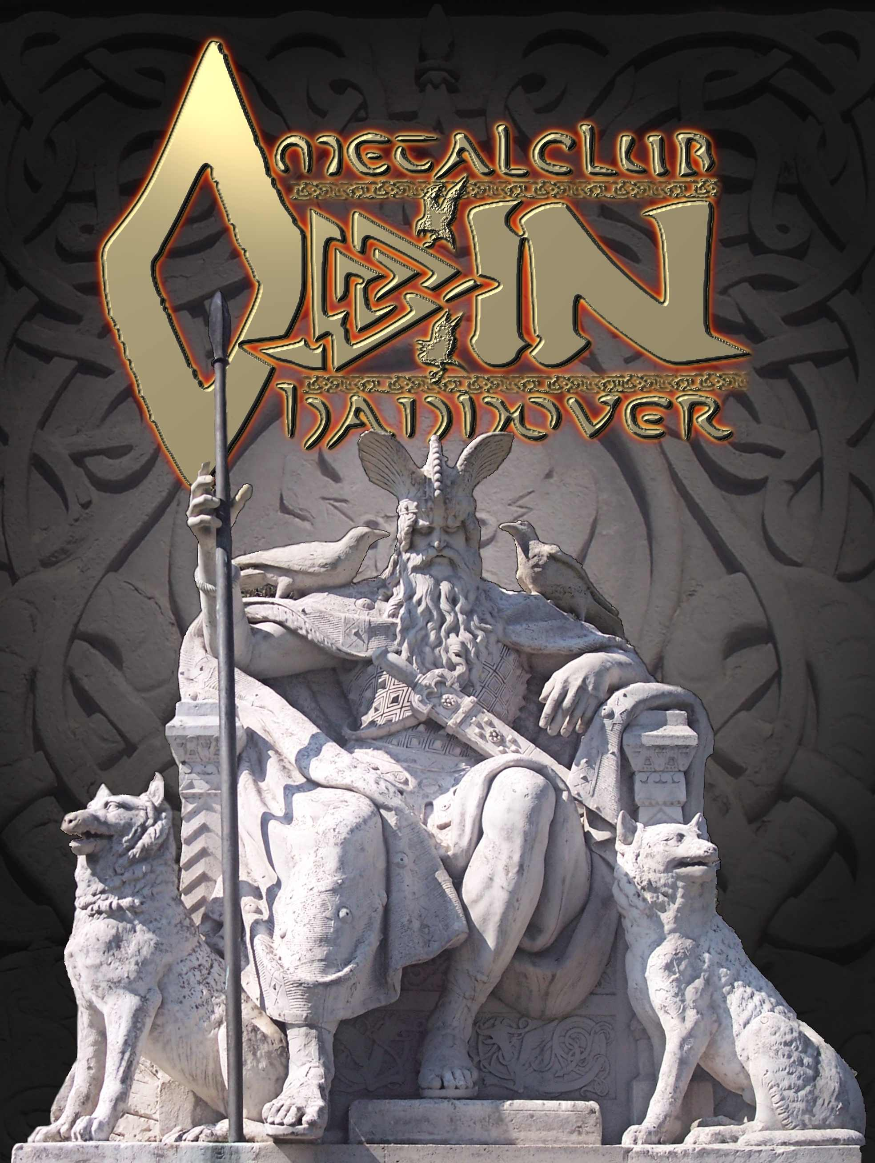
Luther blends holy bible
with german myth!
Reference: Fred Ferre’s "Hellfire & Lightning Rods"

Slide 130
Lutherans Claimed Pauline Damascus Road Comparison!

Slide 131
His Father Thought The Devil Had Deluded Him!

Slide 132
Martin Luther: Epic Life & Tale
David Lee Burris:
Later Strong German Resistance To Practical Application Of Lightening Rod Points To Particular Problem Referencing Teutonic Culture.
Thunderous Close Call Thinks Divine Numinous With Deliverance – Change Career Choice: From Legal Study To Mendicant Scholar
Bad News Theology Gospel Of Condemnation Salvation: Self-Accusation
Rome Road Trip - Trip
Tower Study Event Good News Of Promise Justification: Faith / Grace
Luther Three Stages 1516 – Negative Young 1520 – Positive Mature Late Life – Regression

Slide 133
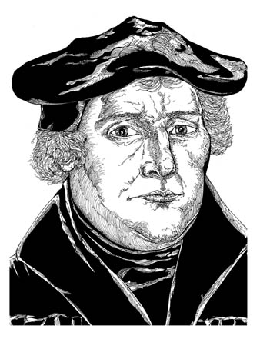
Martin Luther the Monk
Martin Luther had studied to become a lawyer, but during an unexpected storm, Luther vowed to become a monk.
Even as a monk, he could not escape his deep awareness of his own sin and God’s righteousness.
Martin Luther
Notes:
Illustration by Stephen Hesselman

Slide 134
The Crazy Change History
The fit in the choir. Three of young Luther’s contemporaries report that sometime during his early or middle twenties, he suddenly fell to the ground in the choir of the monastery at Erfurt, “raved” like one possessed, and roared with the voice of a bull: “Ish bin’s nit! Non Sum!” or “I am not!” & “It isn’t me!”
Confessional Compulsion. In confessing transgressions in the order of the five senses, Luther was so meticulous in his attempt to be truthful that he spelled out every intention as well as every deed; he splintered acceptable purities into smaller and smaller impurities; he reported temptations in historical sequence, starting back in childhood; and having confessed for hours, he would ask for special appointments in order to correct previous statements. His obsession in this regard was both so very chronic and acute as to warrant his preceptor to threaten punishment for upsetting the monastic order through obstruction of confession.
psychoanalysis & History
YOUNG MAN LUTHER
By Erik H Erikson

Slide 135
The Crazy Change History
The first mass. At this moment, when he was to mediate between the father and The Father, he still felt torn in his obedience to both. In front of him was the Eucharist’s uncertain grace; behind him his father’s potential wrath.
The question of worthiness. By Luther’s lifetime, the phrase for the communion ceremony and host had been altered & with it a change of emphasis. The term Eucharistia, which means thanksgiving, had been replaced with Missa, which means the dismissal of the unworthy. Worthiness itself had metamorphosed in meaning from a subjective and introspective responsibility to an objective meaning measured by works.
psychoanalysis & History
YOUNG MAN LUTHER
By Erik H Erikson
Significant Development Influencing German-Swiss Reformation & Scottish Restoration

Slide 136
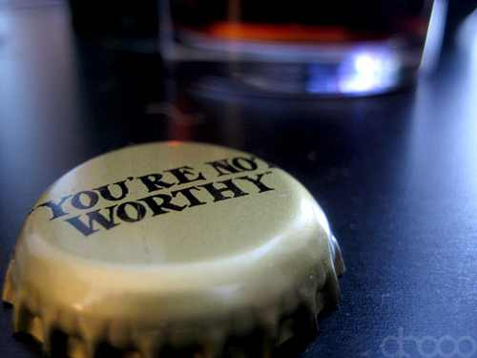
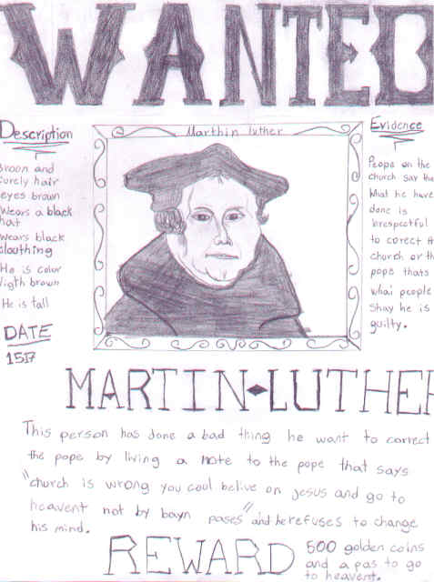

Slide 137
1507
Martin Luther is ordained as a priest and celebrates his first Mass
1509
John Calvin—Swiss reformer, greatest of Protestant theologians, and perhaps, after St. Augustine, the most widely-followed Western theologian—is born in France
1515
William Tyndale is ordained as a priest but refuses to enter monastic orders

Slide 138
Tower Antics & Angst
The model professor, though his students may not have realized it, was battling with the Devil in his tower room every night. For Luther was plagued by fear and doubt and the Devil, by his own anger, his hostile feelings toward God, his rebelliousness – and by constipation. Somehow, getting rid of one problem was linked to getting rid of them all. In his tower study the Devil would throw black ink at Luther, and Luther would throw black ink back at the Devil as he contended with the righteousness of God. When he was more confident he would say, ‘I can drive away the Devil with a single fart!’
WHITE ROBE BLACK ROBE
Righteousness Of God
by Charles Mee

Slide 139
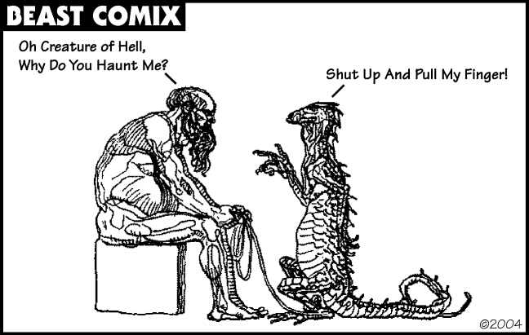
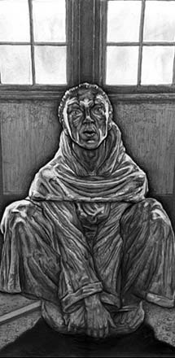
THE YOUNG MAN LUTHER SHOWS SIGNS OF MENTAL ILLNESS

Slide 140
The Crazy Change History
Anal Fixation. The behind is the devil’s magic face. He imprints it on a location as his official signature, he exposes it to man’s view to provoke him. To show man’s behind, then, is the upmost of defiance, as any number of colloquialisms in Luther’s expanding rhetoric suggest.
Allness Or Nothingness. The outstanding quality is totalism, a to be or not to be which makes every matter of differences really a matter of mutually exclusive essences; every question mark a matter of forfeited existence; every error or oversight, eternal treason. “Though this be madness, yet there is method in’t.”
By Erik H Erikson
psychoanalysis & History
YOUNG MAN LUTHER

Slide 141
It is the supreme art of the devil that he can make the law out of the gospel. If I can hold on to the distinction between law & gospel, I can say to him any and every time that he should kiss my backside!
Martin Luther

Slide 142
FROM ‘YOUNG MAN LUTHER’ PAGE 216:
“Luther had recourse to massive totalisms from which he derived the foundation stones for a new wholeness. The whole person includes certain total states in his balances: we are, Luther proclaimed, totally sinners (totus homo peccator) and totally just (totus homo justus), always both damned and blessed, both alive and dead.
We thus cannot strive, by hook or by crook, to get from one absolute stage into another; we can only use our God-given organs of awareness in the here and now to encompass the paradoxes of the human condition. This means that at any given moment, and in any given act or thought, we are codetermined to a degree which can never become quite conscious by our drives and by our conscience.”

Slide 143
Martin Luther: SIN BOLDLY! Written in 1521 to Melanchthon
David Lee Burris:
What Real Difference In Attitude With This Verse – “Free from the law – oh happy condition, we may sin as we please & still have remission”?
“God does not save those who are only imaginary sinners. Be a sinner, and let your sins be strong, but let your trust in Christ be stronger… No sin can separate us from Him, even if we were to kill or commit adultery thousands of times each day. Pray hard for you are quite a sinner.” *
* The Mythical Relationship of Odin’s Sons Thor & Loki

Slide 144
THE PRIVATE PREFERENCE TOOL IN EXCHANGES OF COMMUNICATION BETWEEN THOSE OF AN EXTREME INTELLIGENCE IS OFTEN A FORM OF HIGH SARCASM.
THIS TYPE OF EXPRESSION IS THE WRONG CHOICE FOR A LARGE AUDIENCE & SERIOUS MATTERS!

Slide 146
HISTORY IS THE RECORD OF AN ENCOUNTER BETWEEN CHARACTER & CIRCUMSTANCE!
Donald Creighton

Slide 147
The Italians of the Day were Called:
“…not obedient sheep, meek and innocent’, but rather, “proud lions, cruel bears, rapacious wolves, dishonest pigs, and other wild beasts.”
-- Archbishop Antoninus

Slide 148
The popes themselves had become rather decadent and worldly with luxury, non-celibacy, and the exercising of secular power.
Pope Alexander VI (1492 – 1503) has been described as the worse pope ever. While this man was serving as a cardinal his morality was such that his uncle, the Pope, Pius II, wrote:
“Beloved Son,
We have heard that, four days ago, several ladies of Siena – women entirely given over to worldly frivolities – were assembled in the gardens of Giovanni I Bichis and that you, quite forgetful of the high office with which you are invested, were with them from the seventeenth to the twenty-second hour. With you was one of your colleagues whose age alone, if not the dignity of his office, ought to have recalled him to his duty. We have heard that the most licentious dances were indulged in, none of the allurements of love were lacking and you conducted yourself in a wholly worldly manner. Shame forbids mention of all that took place – not only the acts themselves but their very names are unworthy of your position. In order that your lusts might be given free rein the husbands, fathers, brothers and kinsmen of the young women were not admitted. All Siena is talking about this orgy. Our displeasure is beyond words.”

Slide 149
The popes themselves had become rather decadent and worldly with luxury, non-celibacy, and the exercising of secular power.
Pope Alexander VI (1492 – 1503) has been described as the worse pope ever. Moreover, while serving as pope in his own right – he was not of double standard in his decision-making as applied to either fellow clergy or secular rulers.
An important historical precedent was established when Louis XII (King of France after Charles VIII) appealed to Alexander to dissolve his marriage to ‘an ailing and unattractive woman to marry a beautiful and attractive heiress.’ Pope Alexander readily agreed if he would do a favor for him and arrange a marriage of royalty with his son.

Slide 150
The popes themselves had become rather decadent and worldly with luxury, non-celibacy, and the exercising of secular power.
The papacy was also increasingly political as powerful families competed to put their relatives on the throne of St. Peter.
Pope Leo X (the pope from 1513 thru 1521), for example, was Lorenzo the Magnificent’s second son. He continued the Medici ways of luxury and patronage, but with Church money.
Upon being elected, he said, “Since God has given us the papacy, let us enjoy it.” And he did… he nearly bankrupted the Church which was no small feat.

Slide 151
Pope Leo X

Slide 152
The (almost) next pope was Clement VII, Leo X’s cousin and Lorenzo’s nephew/adopted son (His brother had been killed as a result of an assassination plot that nearly got Lorenzo too).

Slide 153
Pope Clement VII
Look familiar?

Slide 157
Pope Leo X

Slide 158
wellington's law of command
"The cream rises to the top. So does the scum."

Slide 161
Later Church Timeline Separates & Intersects
Catholic - Lutheran Faceoff

Slide 162
ive hundred years ago, a monk in Germany made a list of 95 issues that he wanted the theologians of the Roman Catholic Church to discuss.
Little did he know that his list, called the Ninety-Five Theses, would spark the Reformation.
The Reformation became a movement that would split the church and form a new kind of Christianity: Protestantism.

Slide 163
David Lee Burris:
Alexander VI - who had four children with his primary mistress, known as the Queen of Rome. His teenage mistress convinced him to make her brother a cardinal.
Adrian VI - was so unpopular that after he died. happy Romans carried his doctor through the streets because they thought he had helped to kill the pontiff.
Julius II - took his name to honor Julius Caesar and was known as the “Warrior Pope” preferring the smell of gunpowder to incense!
he story really begins much earlier.
Years of power struggles within the Church as well as between religious and civil leaders had weakened the reputation of the clergy.
Early sixteenth-century popes sold government and church positions, made their illegitimate children cardinals, authorized murder, and increased their families’ fortunes by abusing their power.

Slide 164
Clerics Claimed Choice Of Cardinals Were Angel Communicated To Popes In Dreams

Slide 165
he Renaissance (1447-1521) brought education, wealth, and revitalization to the common people.
Also during this time, greed, abuse of power, and immorality ran rampant in the Church.
All these factors brought desire for reform to a boiling point.

Slide 166
he monk responsible for the Ninety-Five Theses was Martin Luther.
His debate caused the boiling pot of discontent to erupt all over Europe!
In Luther’s wake, the new shape of Western faith was revealed, leading even later to a new kind of nation!

Slide 167
The Protestant Reformation In Lutheran Historical Perspective

Slide 168
Of Disputes Over Bibliology & Christology Develop
Divisions Over Soteriology & Ecclesiology

Slide 169
Martin Luther: Epic Life & Tale
David Lee Burris:
Later Strong German Resistance To Practical Application Of Lightening Rod Points To Particular Problem Referencing Teutonic Culture.
Thunderous Close Call Thinks Divine Numinous With Deliverance – Change Career Choice: From Legal Study To Mendicant Scholar
Bad News Theology Gospel Of Condemnation Salvation: Self-Accusation
Rome Road Trip - Trip
Tower Study Event Good News Of Promise Justification: Faith / Grace
Luther Three Stages 1516 – Negative Young 1520 – Positive Mature Late Life – Regression

Slide 170
MARTIN LUTHER VISITS ROME

Slide 171
Church
History
The Apostasy
Doctrines Enacted at Church Councils
Clergy/Laity System
Sprinkling for Immersion
Infant Baptism
Celibacy
Instrumental Music
Transubstantiation
Indulgences
Worship of Mary
Veneration of Relics
Purgatory
Confessionals
Images
Penance
Extreme Unction
Confirmation
Nuns, Primacy of Peter
Forbidding to Eat Meats
Religious Holidays

Slide 172
MARTIN LUTHER @RELICS

Slide 173
The Poet Dante Has Had Influence Beyond Those of the 13th Century

Slide 174
MARTIN LUTHER @PURGATORY

Slide 175
Dominant Augustinian Paradigm 1,000 Year Fruit: Italy & Germany
Norse Viking & Old World German
Afterlife & Underworld
CLASSIC MYTHOLOGY
14th Cent. Curia Def: Fool = “a good christian”
Bembo Quotes Gospel & Pope Leo X Remarks:
“How very profitable this fable of Christ has been to us through the ages.” Vatican Archives
Christendom Extremes: Cynical Italians & Anxious Germans
Roman Catholic Fear: Mortal Sin Before Sudden Death
Lutheran Pious Angst: Whether God Will Be Gracious
Swiss Reform Obsess: Whether They Have True Faith

Slide 177
Luther was anti-establishment on the sale of indulgences.
According to Catholic theology at the time, if one sinned, you could repent and be given the sacrament of penance. While the blame for the sin is gone, the sin is not erased and you must still be punished for it through temporal punishment on earth or in purgatory. God’s justice demands it.
You can, however, lessen the amount of punishment by performing acts of merits.
You can also be spiritually designated merit by the Church via its treasury of merit. This is typically done through prayers. This transfer of merit is an indulgence.

Slide 178
Indulgences were certificates that freed their owners from performing the acts of penance that the church required to show sorrow for certain sins.
An indulgence from Johann Tetzel (1517)

Slide 179
The Confessional Form “Let it be clear to all who will examine this letter, how (name), son of (name) of the diocese of (name) made the proper contribution. By the authority of our sovereign Lord, the Pope, he has the power to secure for himself an appropriate confessor of the regular or secular clergy, who, when he has diligently heard his confession, may absolve him with complete authority from all the excesses and sins committed by him, whatever and however enormous they might be. And in the hour of death, he is granted a plenary remission of all his sins and absolution. As a pledge and testimony of this matter, I, Brother(name, of the (name) cloister of the (name) order in (name) city, deputed by apostolic authority, have placed the present letter with the seal of the Cross. In the year of our Lord, (date).”
Selling indulgences in Germany

Slide 180
The Form Of Absolution “God Almighty have mercy upon you. May our Lord Jesus Christ absolve you through his faithful mercy. And by his authority and that of the blessed apostles Peter and Paul and our Most holy lord, the Pope, committed unto me and granted to you, I absolve you from the bond of excommunication, if you have incurred it, and I restore you to the sacraments of the Church and to the union & participation of the faithful. And by the same authority I absolve you from all and several of your committed crimes and your sins, however serious and enormous they might be. Also if there were such for which the apostolic see ought to be consulted, and concerning them by the same authority I confer upon you plenary indulgence and remission, in the name of the Father & of the Son & of the Holy Ghost. AMEN.”
Selling indulgences in Germany

Slide 181
Martin Luther and Indulgences
In 1517, Pope Leo X allowed alms to be given to the Church in exchange for “indulgences.”
It was believed that indulgences released Christians from the temporal punishments for their sins.
Pope Leo X
Notes:
Image: Pope Leo X, File:Ara Coeli (12).jpg available at www.wikipedia.com

Slide 182
In Luther’s time, indulgences were being abused.
Johann Tetzel, a Dominican friar, was given authority by the Medici Pope Leo X to sell indulgences in order to build the current St. Peter’s Basilica in the Vatican.
Luther was very upset & felt a call to action!
"The Holy Trade"
A 1517 indulgence from Tetzel that reads, “By the authority of all the saints, and in mercy towards you, I absolve you from all sins and misdeeds and remit all punishments for ten days.
Tetzel

Slide 183
Produced by Printing Press

Slide 184
Indulgences were supposed to express people’s inner desire to turn from sin.
However, many medieval priests and popes distorted that stated purpose.
Selling indulgences in Germany

Slide 185
The (Tetzel) salesmen hit town with the hoopla of a traveling circus. The front men went out ahead with the message ‘The grace of God and the Holy Father is at your gates,’ and the town’s church bells rang and priests and nuns led the welcoming procession with their lighted candles to the edge of town. Leading the way was the papal bull of the day, held aloft on a velvet cushion.
Politics Of Indulgences
by Charles Mee
WHITE ROBE BLACK ROBE

Slide 187
Once he (the salesman) had worked the parishioners up to the proper state of mind, he set them on the confessionals. In the confessionals the priests charged with this aspect of the campaign asked, ‘Tell me, on your conscience, how much money you can give away, in order that you might obtain so complete a pardon?’ Indulgences were priced according to economic class & specific sin. Different preachers varied their prices based on what they thought traffic would bear. The money was placed in heavily girded boxes with iron bands.
Politics Of Indulgences
by Charles Mee
WHITE ROBE BLACK ROBE

Slide 188
‘Indulgences ,’ Tetzel proclaimed from the pulpit, ‘are the most precious and the sublimest gift of God. ‘That cross,’ he would intone, pointing to the red cross, ‘has no less efficacy than the very cross of Jesus Christ. Come forward, and I will give you sealed letters, in virtue of which even the sins which you may have a wish to commit in future, will all be forgiven. I would not exchange privileges with St. Peter in heaven; for I have saved more souls by my indulgences than the apostle ever did by his preaching. There is no sin so great but that the indulgence may procure its remission; nay, should anyone, an impossibility no doubt, should anyone have done violence to the holy Virgin Mary, mother of God, let him but pay and it will be forgiven him.’
Politics Of Indulgences
by Charles Mee
WHITE ROBE BLACK ROBE

Slide 189
Having sold all indulgences he thought he could to the living, he then turned to their deceased relatives, who could be sent to heaven instantly. ‘Once you hear the money’s ring, the soul from purgatory is free to spring.’
Then Tetzel would advance a selfless theme to touch the religious feelings of his audience. ‘Know you wherefore our most holy Lord distributes this grace among you? It is intended that the ruined church of St. Peter and St. Paul should be rebuilt. That church contains the bodies of the holy apostles, Peter and Paul, and a multitude of martyrs. These holy bodies, in consequence of the present sate of the building, are now, alas!… continually knocked about, put under water, soiled, dishonored, and reduced to rottenness by the rain and by the hail… Ah, shall these sacred ashes remain any longer in mud and in disgrace?’
Politics Of Indulgences
by Charles Mee
WHITE ROBE BLACK ROBE

Slide 190
TRUE STORY: TETZEL IS TRICKED!
CATHOLICISM AND THE SALE OF INDULGENCES,
...Wayne Jackson wrote the following...
Pope Leo X (A.D. 1475-1521) commissioned John Tetzel, a Dominican monk, to travel throughout Germany selling indulgences on behalf of the Church. Tetzel declared that as soon as the coins “clinked” in his money chest, the souls of those for whom the indulgences had been purchased would fly out of purgatory.
These indulgences not only bestowed pardon for sins committed already, they were used to license the commission of future transgressions as well. In the classic volume, The Life and Times of Martin Luther, noted historian Merle D’Aubigne relates an amusing episode relative to this practice.
A certain Saxon nobleman heard John Tetzel proclaiming his doctrine of indulgences, and the gentleman was much aggravated at this perversion of truth. Accordingly, he approached the monk one day and inquired as to whether he might purchase an indulgence for a sin he intended to commit.
“Most assuredly,” replied Tetzel, “I have received full powers from his holiness for that purpose.” After some haggling, a fee of thirty crowns was agreed upon, and the nobleman departed.
Together with some friends, he hid himself in a nearby forest. Presently, as Tetzel journeyed that way, the knight and his mischievous companions fell upon the papal salesman, gave him a light beating, and relieved him of his money, apparently taking no pains to disguise themselves.
Tetzel was enraged by the foul deed and filed suit in the courts. When the nobleman appeared as the defendant, he produced the letter of exemption containing John Tetzel’s personal signature, which absolved the Saxon of any liability. When Duke George (the judge before whom the action was brought) examined the document, exasperated though he was, he ordered the accused to be released.
Sources
D’Aubigne, J.H. Merle, The Life and Times of Martin Luther (Chicago: Moody, 1955), p. 103.

Slide 191
Those who failed to make some contribution were harassed, insulted, threatened; and those few, those very few, who dared criticize were given a ready retort:
‘Those who criticize my sermons & indulgences will have their heads ripped off and kicked bleeding into hell; …heretics I will have burned until smoke billows over the walls!’
Politics Of Indulgences
by Charles Mee
WHITE ROBE BLACK ROBE

Slide 193
The Protest-ant Principle
“The Protestant principle suggests that believers ought to read & seek to understand the scriptures, and that church practice ought be continually subjected to the scrutiny of Scripture.”
The Roman Pope Thought The German Luther Intoxicated!
* Dictionary Of Theological Terms, Grenz & Guretzki

Slide 194
Martin Luther, the Wild Pig
Martin Luther wanted to debate the validity of indulgences.
On October 31, 1517, Luther nailed a list of 95 theses (topics for debate) on a chapel door in Wittenberg, Germany.
In response Pope Leo X declared, “Arise, O Lord. A wild (alcoholic) pig has invaded the Lord’s vineyard!”
Notes:
Image: © David Crooks

Slide 195
THE AUGUSTINIAN MONASTERY Inevitable Crisis Of Ultimate Authority
The Augustinian theological assumption enabled the West to put confidence in human logic, language and rational knowledge (all the way from intuition and empirical observations to doctrines and creeds). During the Middle Ages, the medieval (Augustinian) monasteries began doing something that became unique to Christianity. When a young man devoted his life to seek and serve God, the monastery required him to spend years studying religious discipline, religious & secular law, philosophical logic, theological rationale, speech rhetoric, languages, literature, mathematics, music, and practical arts such as agriculture, animal husbandry, medicine and metallurgy. Therefore, the monastery – which was an institution for cultivating religious life – began producing a peculiarly rational person, capable of thinking, researching, developing technology, writing books, developing capitalism, science and complex, rational legal and political systems.
MARTIN LUTHER OVERSAW TEN AUGUSTINIAN MONASTERIES & THE AUGUSTINIANS AT TWO UNIVERSITIES

Slide 196
Martin Luther Was Trained Philosophically In Nominalism!

Slide 197
MARTIN LUTHER MAKES FIRST POST TO GO VIRAL GERMANY TO SPAIN IN 2 WKS.

Slide 198
MARTIN LUTHER DISPUTES

Slide 199
Questions are a burden to others. Answers are a prison for oneself.
VILLAGE SAYING PRISONER SERIES

Slide 200
THE TILT & PIVOT POINT
TRANSFORMATION OF
THEORETICAL SCHISM
TO PRACTICAL SCHISM

Slide 201
1518
At a meeting in Heidelberg, Germany, Luther defends his theology
Later he appears before Cardinal Cajetan at Augsburg, Germany, but refuses to recant (take back or say one no longer has an opinion or belief)
Frederick the Wise protects Luther from being handed over to Rome
Behind Scene Political Theatre

Slide 202
Sentence Launching Reformation Public Papal Reply Sending Luther Over The Edge Luther Responds: “The Pope’s The Anti-Christ”
Following Written Faith Belief Profession In The Not Yet
Developed Or Formulated Papal Infallibility Doctrine We
Find These Words From S. Prierias - Rome’s Theologian:
“If the Pope were so scandalously bad that he led multitudes of souls to the Devil, still he could not be removed from office.”

Slide 204
In his translation of the Book of Revelation Martin Luther portrays the Catholic Church as the Whore of Babylon!

Slide 205
1519
Martin Luther questions papal infallibility (belief that the pope is preserved from error in matters of faith and morals) and begins New Testament sermon series, starting a new era of preaching
Martin Luther
Ulrich Zwingli begins New Testament sermons, thus ushering in the Swiss reformation
Ulrich Zwingli

Slide 206
INFALLIBILITY
“The characteristic of being incapable of failing to accomplish a predetermined purpose. In Protestant theology infallibility is usually associated with Scripture. In Roman Catholic theology infallibility is also extended to the teaching of the church magisterium under the authority of the pope.”
* Dictionary Of Theological Terms, Grenz & Guretzki

Slide 207
1519
Martin Luther questions papal infallibility (belief that the pope is preserved from error in matters of faith and morals) and begins New Testament sermon series, starting a new era of preaching
Martin Luther
Ulrich Zwingli begins New Testament sermons, thus ushering in the Swiss reformation
Ulrich Zwingli

Slide 208
SACERDOTALISM
“The emphasis in the Roman Catholic tradition, especially as proclaimed in the Middle Ages, on the powers of earthly priests as essential mediators between God and humankind.”
* Dictionary Of Theological Terms, Grenz & Guretzki

Slide 209
Priesthood Of Believers
“The Reformation principle that declares the privilege & freedom of all believing Christians is to stand before God in personal communion through Christ, directly receiving forgiveness without the necessary recourse to human intermediaries.”
* Dictionary Of Theological Terms, Grenz & Guretzki

Slide 212
WHERE DID THEY COME FROM? Pulpit System & Chorus Music
Altar Replaced With Pulpit:
Luther had the entire area ripped out of the front of the church. High up on one of the pillars of the church was a rostrum or pulpit which the Catholic priest had climbed up by means of a circular staircase to read dutifully the weekly announcements to the faithful flock below. Luther had one of those pulpits placed in the front & center of the building, where the altar had been. That was new. Brand new. And so, was born the Protestant pulpit!
Congregational Singing
Martin Luther and his followers understood the importance that music can play in spiritual health and encouraged church singing.
They also stressed the importance of hymns sung in the worshipers’ native languages as a means for facilitating greater personal involvement for churchgoers.
This led to the creation of a new kind of music, called the chorale.

Slide 213
WHERE DID THEY COME FROM? ORDER OF WORSHIP
WITTENBURG RITE
STARTING SONG
1ST PRAYER
THREE SONGS
2ND PRAYER
OFFERTORY
ANOTHER SONG
THE SERMON
BENEDICTION

Slide 214
Martin Luther, the Wild Pig
Martin Luther wanted to debate the validity of indulgences.
On October 31, 1517, Luther nailed a list of 95 theses (topics for debate) on a chapel door in Wittenberg, Germany.
In response Pope Leo X declared, “Arise, O Lord. A wild (alcoholic) pig has invaded the Lord’s vineyard!”
Notes:
Image: © David Crooks

Slide 215
1520
The Pope publishes a bull (sealed declaration by the pope) giving Martin Luther 60 days to recant or be excommunicated
Luther burns the document
BLOODY BULLS
Luther burns the document

