Slide 1
Did He Use a Framing Hammer?
LUTHER CONFLICT
By David Lee Burris

Slide 2
The Catholic World Magazine Endorsement
1st Edition Chamberlin’s “The Bad Popes”
Note: The Pope Allowed the Archive Assist

Slide 3
Or Was He?

Slide 4
The Study of History
To be ignorant of what occurred before you were born is to remain always a child!
– Marcus Tullius Cicero
Notes:
Continued on next slide.

Slide 5
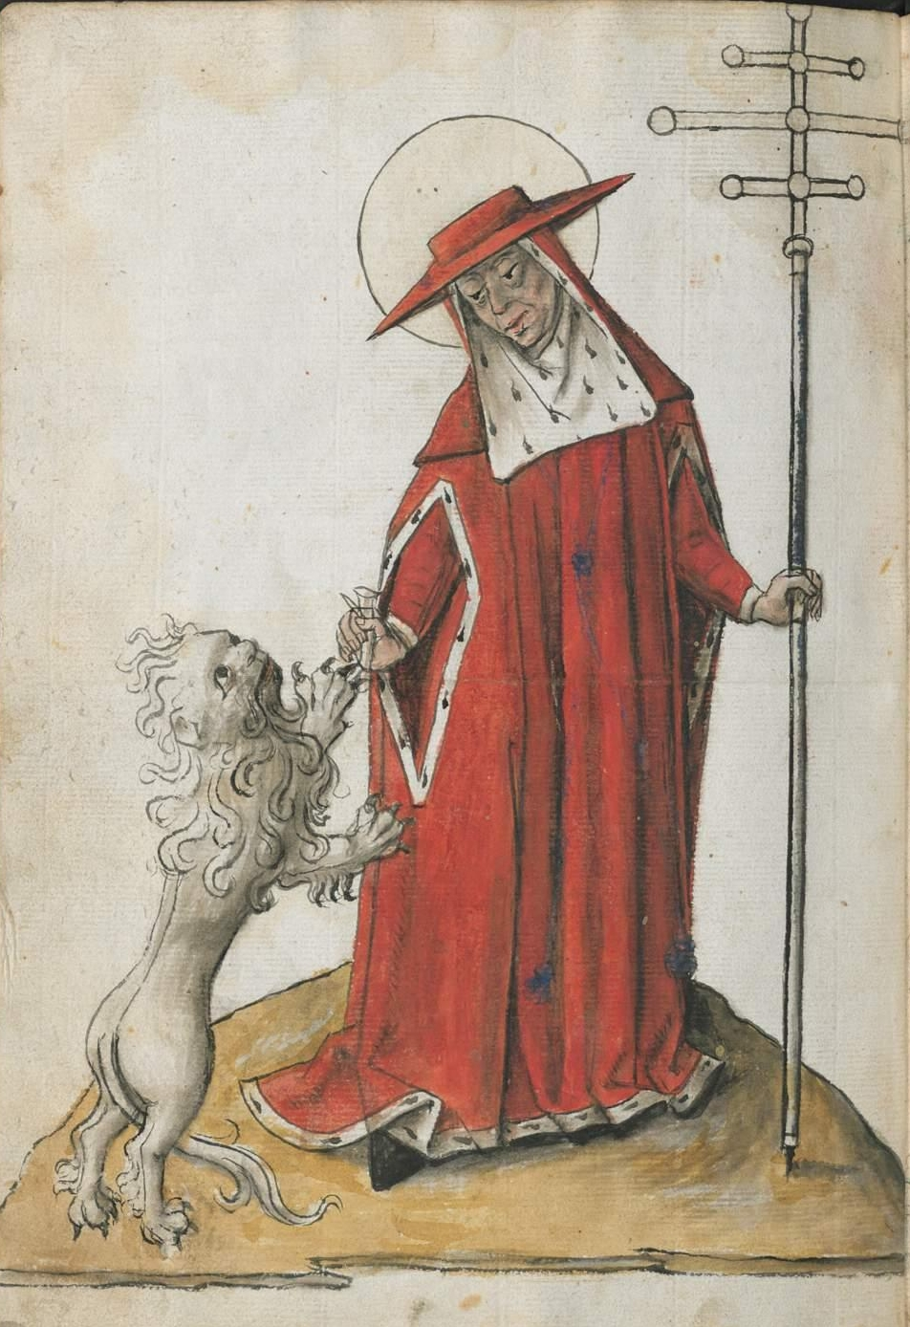
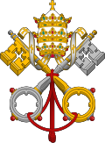
UNTO KING'S SCEPTER
FROM SHEPHERD'S STAFF
Notes:
THE PAPAL TRADITION OF CHOOSING A NEW NAME STARTS WITH MERCURIUS IN A.D. 533 RENAMING HIMSELF JOHN THE SECOND. THIS PRACTICE WAS PRIOR ASSOCIATED WITH ROYAL DYNASTY.

Slide 6
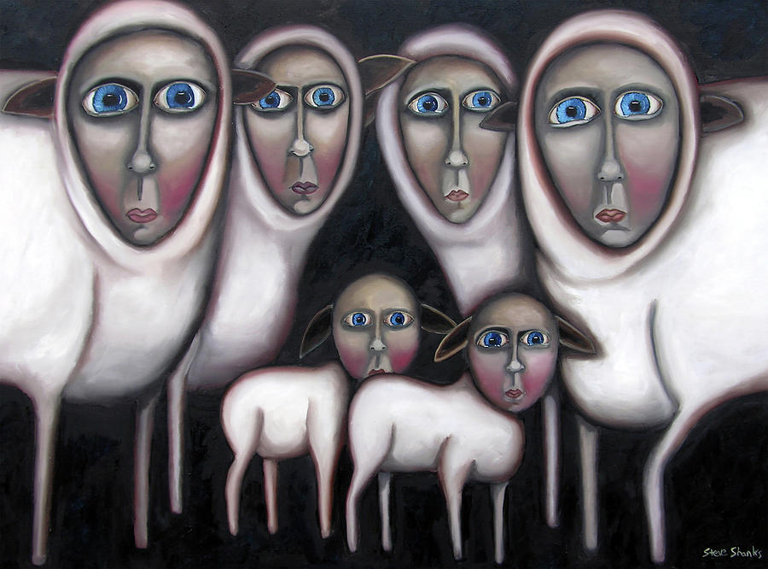
BY HOOK OR BY CROOK
Negative Connotation: Shepherds rounded up flocks by means of a crook, a long staff with curved end. A shepherd would chase after a reluctant lamb and hook it with his staff by any mean by hook or crook.

Slide 7
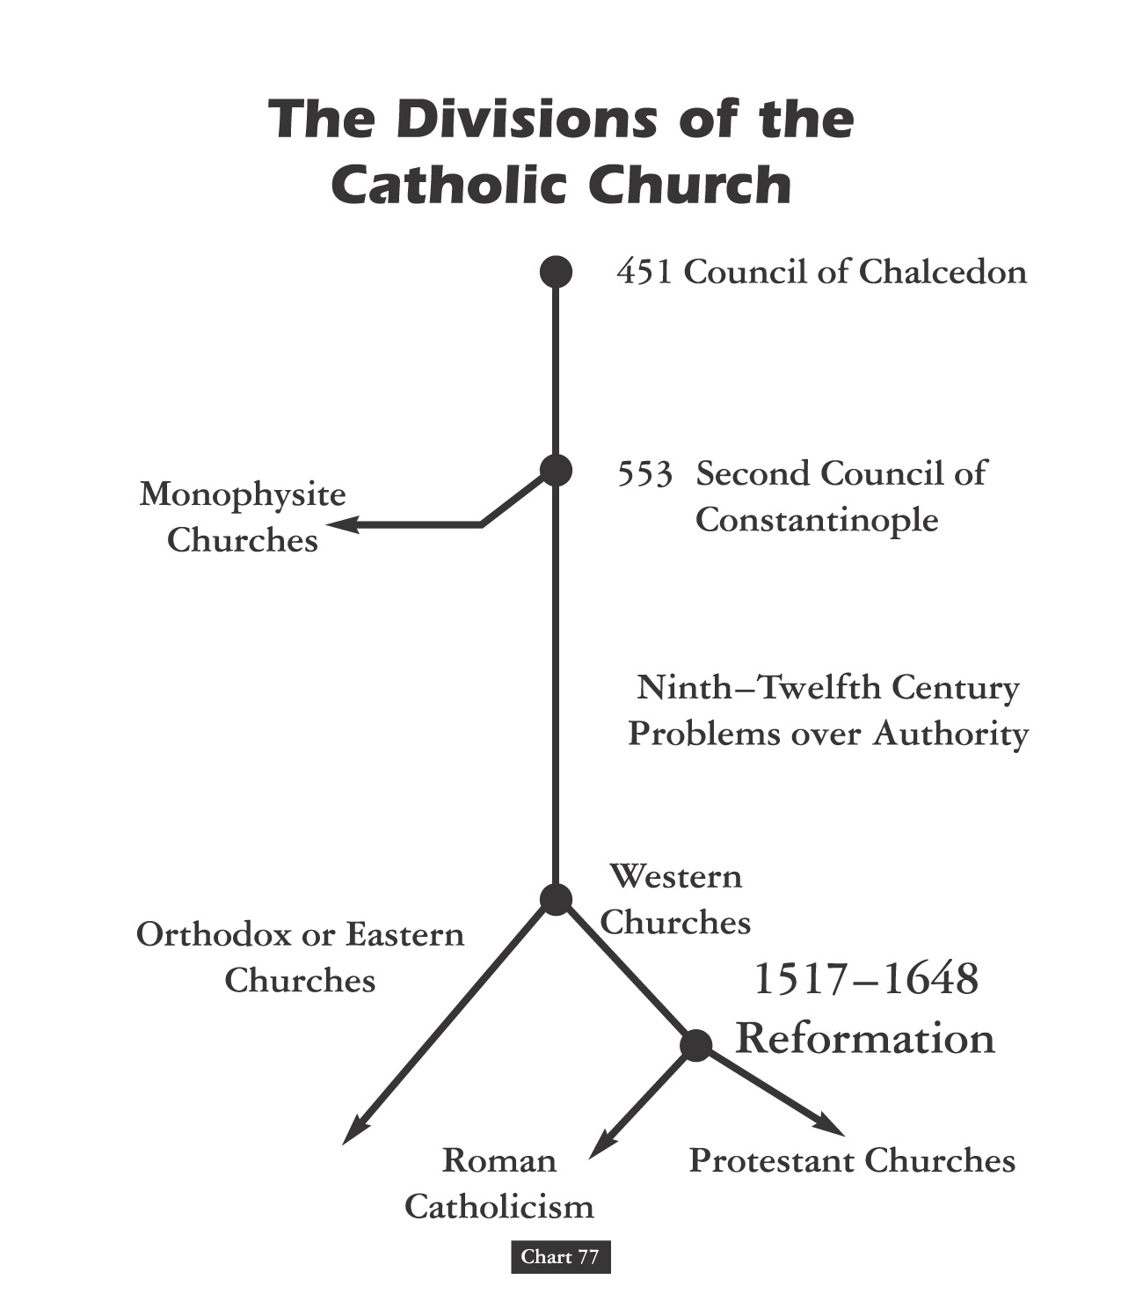

Slide 9
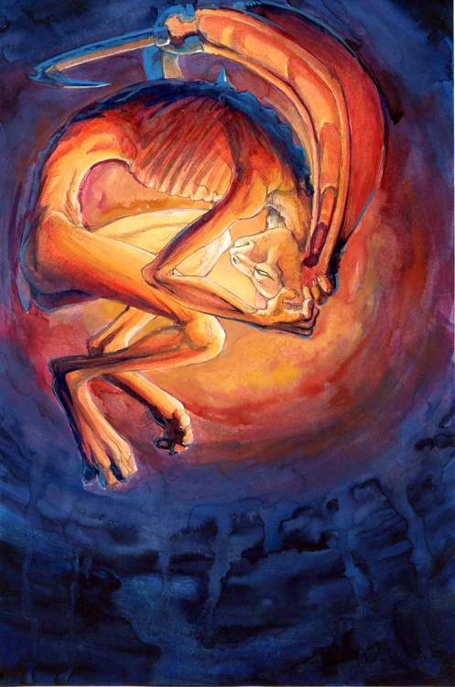
Christian Divisions Costs Half The World
“Christian divisions go far toward explaining the swift collapse of the Roman position in the Middle East, where popular sentiment leaned so heavily toward either the Monophysite or Nestorian churches. Repeatedly, writers from these traditions describe the relief which local inhabitants greeted the Arab conquerors, who promised an end to the heavy-handed regime of the Roman Empire, and the Chalcedonian order.
At least in the early decades of the new order, most Christians saw little reason to change their opinion. Muslims cared nothing for the sectarian divisions among their Christian subjects, provided they respected Muslim authority and paid their taxes on time.
The first century or so after the conquest marked something like a golden age for the Christian communities, who were now free of Roman oppression.”
Source: Pages 263-4, Philip Jenkins’ “Jesus Wars”

Slide 10
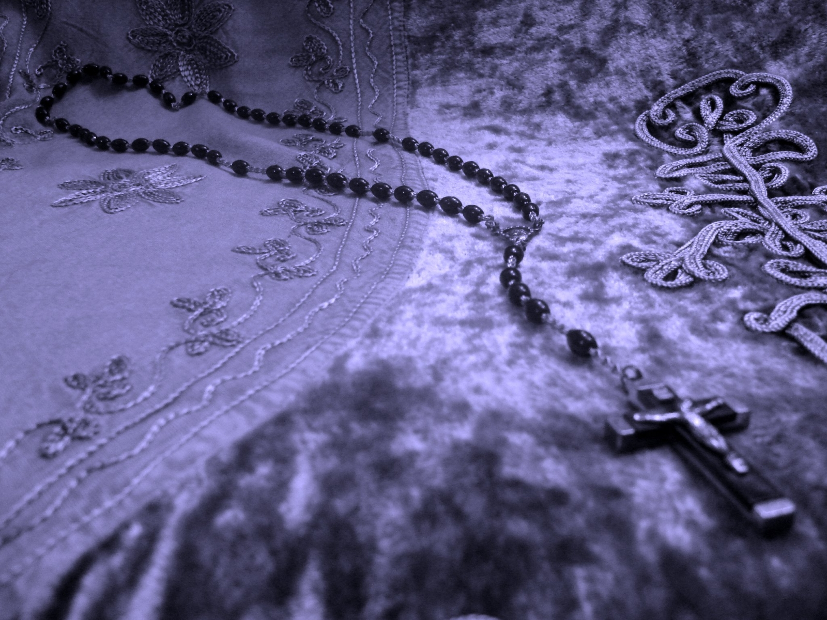
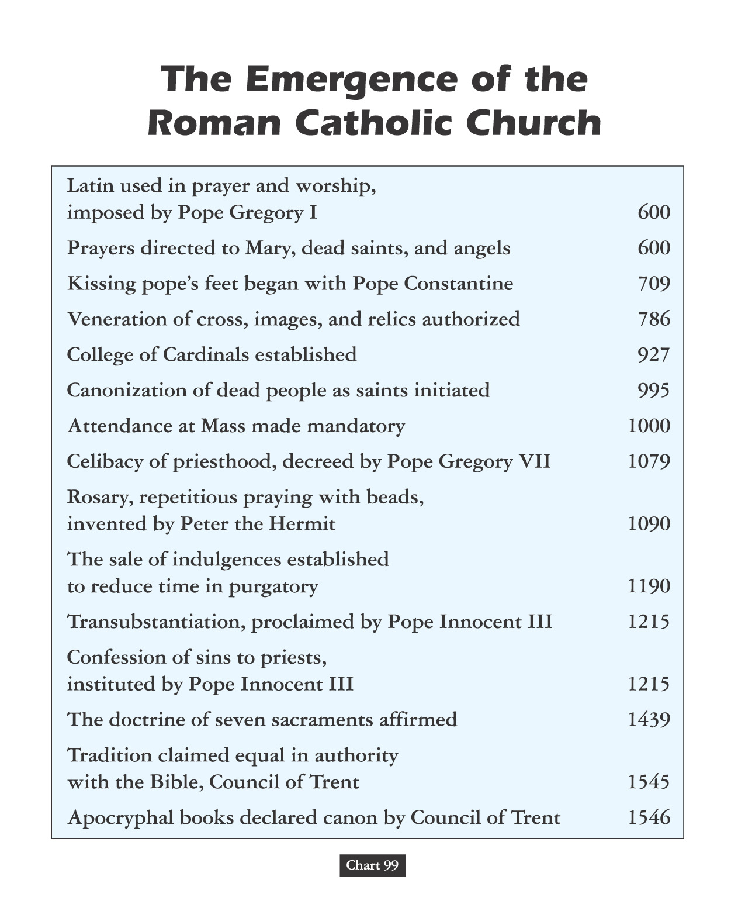
Vain Repetition

Slide 11
Freud was fascinated by this sinister side of the repetition compulsion, which is why he ultimately decided that the cause of our urge to repeat was directly linked to what he called "the death drive," or the urge to cease existing. After all, he reasoned, the ultimate "earlier state of things" is a state of non-existence before we were born. With each repetition, we act out our desire to go back to a pre-living state. Maybe that's why so many people have the urge to repeat actions that are destructive, or unproductive.

Slide 12
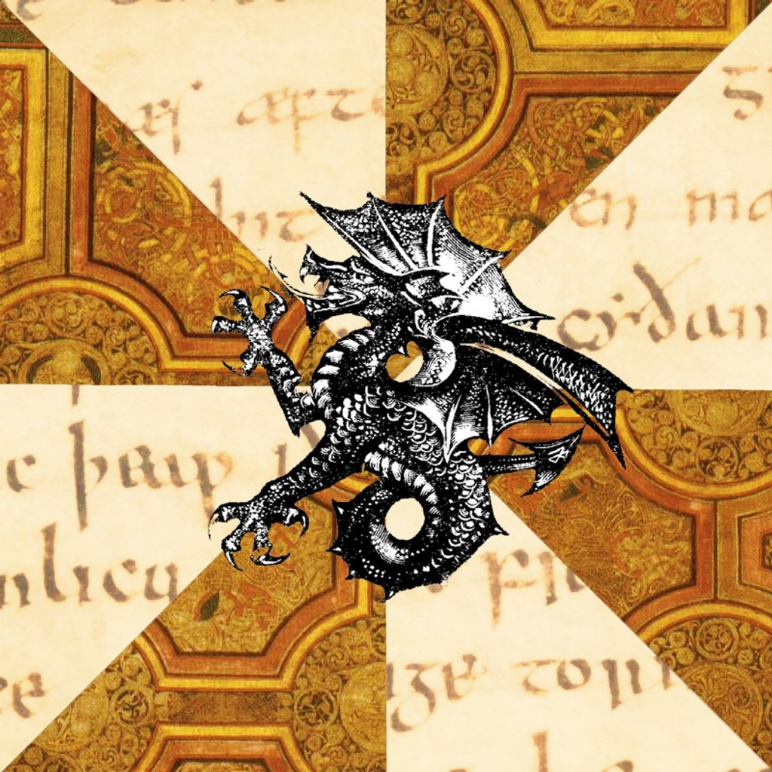
Those Who Do Not Study History Are Doomed To Repeat It!
Those That Do Study History Are Doomed
To Watch The World Repeat It!!

Slide 13
Early Middle Ages
AGES THEORY

Slide 14
Joachim Of Fiore

Slide 15
“During the Late Middle Ages, an Italian mystic by the name of Joachim of Fiore created a scheme in which history was divided into the Age of the Father, the Age of the Son, and the Age of the Spirit.”
Joachim Of Fiore

Slide 16
“The Old Testament, corresponding to this first age, is distinguished by its cruel, harsh deity who ordered the slaughters of entire people groups.”
Joachim Of Fiore

Slide 17
“We know the Age of the Son as the period in which the ‘good God,’ Jesus Christ, softened the harsher features of the Jewish deity and the church was founded with its material way of worshipping.”
Joachim Of Fiore

Slide 18
“But an even greater stage of historical development yet awaited: the Age of the Spirit, when the institutional church would be eclipsed by the universal brotherhood of man.”
Joachim Of Fiore
- modern reformation nov/dec 1994, pg. 4

Slide 19
HISTORY OF THE CHRISTIAN AGE
THE AGE OF JESUS & THE APOSTLES
THE AGE OF EARLY CHRISTIANITY
THE AGE OF STATE RECOGNITION
THE AGE OF OFFICIAL DOMINANCE
THE AGE OF HOLY ROMAN EMPIRE
THE AGE OF PROTESTANT REFORM

Slide 20
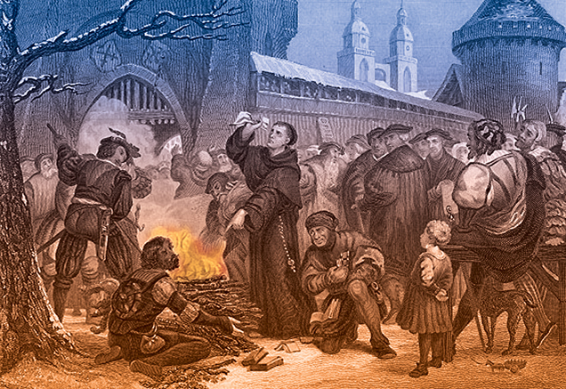
Comes the Perfect Storm
BLOODY BULLS
Luther burns the document

Slide 21
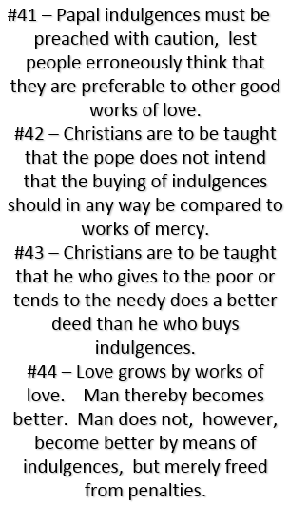
Martin Luther Was Trained Philosophically In Nominalism!

Slide 22
MARTIN LUTHER MAKES FIRST POST TO GO VIRAL GERMANY TO SPAIN IN 2 WKS.

Slide 23
MARTIN LUTHER DISPUTES

Slide 24
Questions are a burden to others. Answers are a prison for oneself.
VILLAGE SAYING PRISONER SERIES

Slide 25
THE TILT & PIVOT POINT
TRANSFORMATION OF
THEORETICAL SCHISM
TO PRACTICAL SCHISM

Slide 26
1518
At a meeting in Heidelberg, Germany, Luther defends his theology
Later he appears before Cardinal Cajetan at Augsburg, Germany, but refuses to recant (take back or say one no longer has an opinion or belief)
Frederick the Wise protects Luther from being handed over to Rome
Behind Scene Political Theatre

Slide 27
Sentence Launching Reformation Public Papal Reply Sending Luther Over The Edge Luther Responds: “The Pope’s The Anti-Christ”
Following Written Faith Belief Profession In The Not Yet
Developed Or Formulated Papal Infallibility Doctrine We
Find These Words From S. Prierias - Rome’s Theologian:
“If the Pope were so scandalously bad that he led multitudes of souls to the Devil, still he could not be removed from office.”

Slide 29
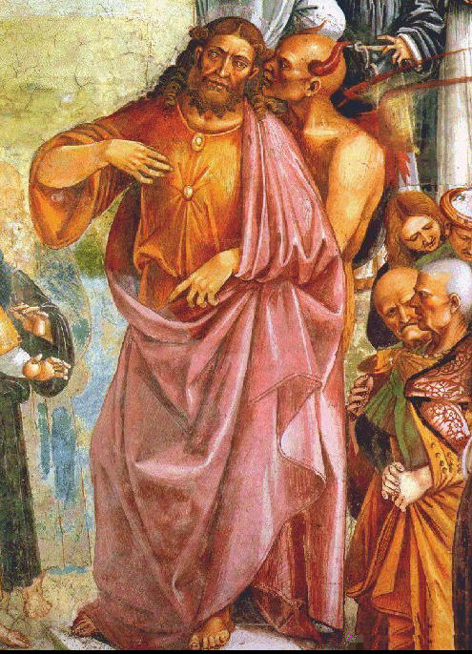
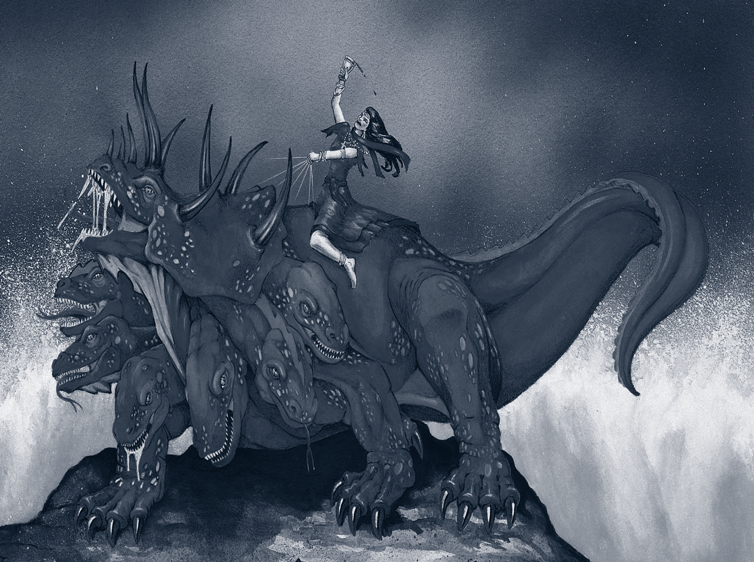
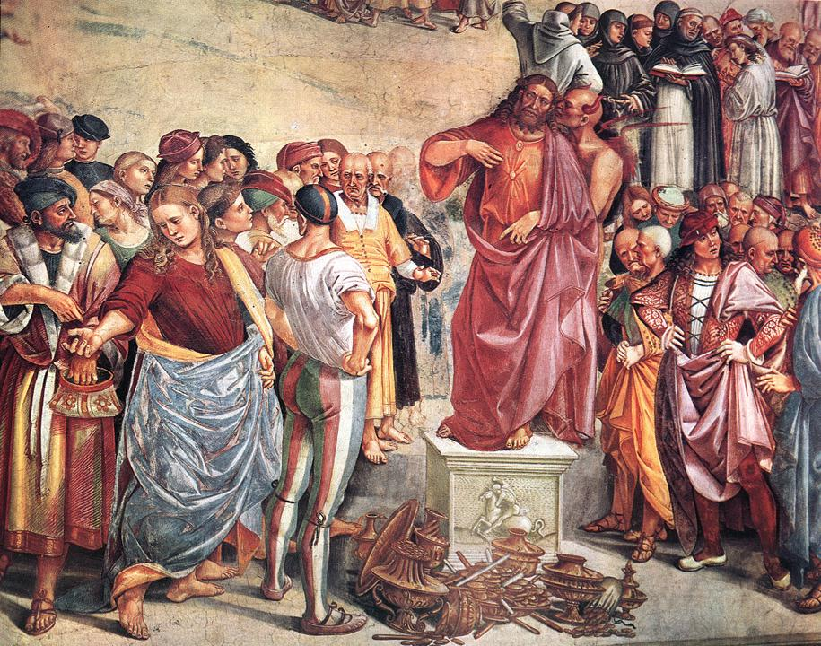
In his translation of the Book of Revelation Martin Luther portrays the Catholic Church as the Whore of Babylon!

Slide 30
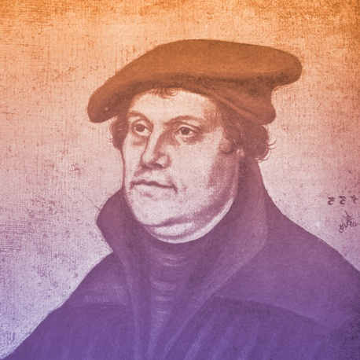
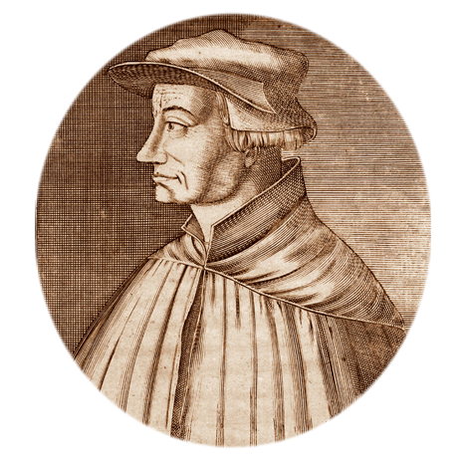
1519
Martin Luther questions papal infallibility (belief that the pope is preserved from error in matters of faith and morals) and begins New Testament sermon series, starting a new era of preaching
Martin Luther
Ulrich Zwingli begins New Testament sermons, thus ushering in the Swiss reformation
Ulrich Zwingli

Slide 31
INFALLIBILITY
“The characteristic of being incapable of failing to accomplish a predetermined purpose. In Protestant theology infallibility is usually associated with Scripture. In Roman Catholic theology infallibility is also extended to the teaching of the church magisterium under the authority of the pope.”
* Dictionary Of Theological Terms, Grenz & Guretzki

Slide 32
1519
Martin Luther questions papal infallibility (belief that the pope is preserved from error in matters of faith and morals) and begins New Testament sermon series, starting a new era of preaching
Martin Luther
Ulrich Zwingli begins New Testament sermons, thus ushering in the Swiss reformation
Ulrich Zwingli

Slide 33
SACERDOTALISM
“The emphasis in the Roman Catholic tradition, especially as proclaimed in the Middle Ages, on the powers of earthly priests as essential mediators between God and humankind.”
* Dictionary Of Theological Terms, Grenz & Guretzki

Slide 34
Priesthood Of Believers
“The Reformation principle that declares the privilege & freedom of all believing Christians is to stand before God in personal communion through Christ, directly receiving forgiveness without the necessary recourse to human intermediaries.”
* Dictionary Of Theological Terms, Grenz & Guretzki

Slide 35
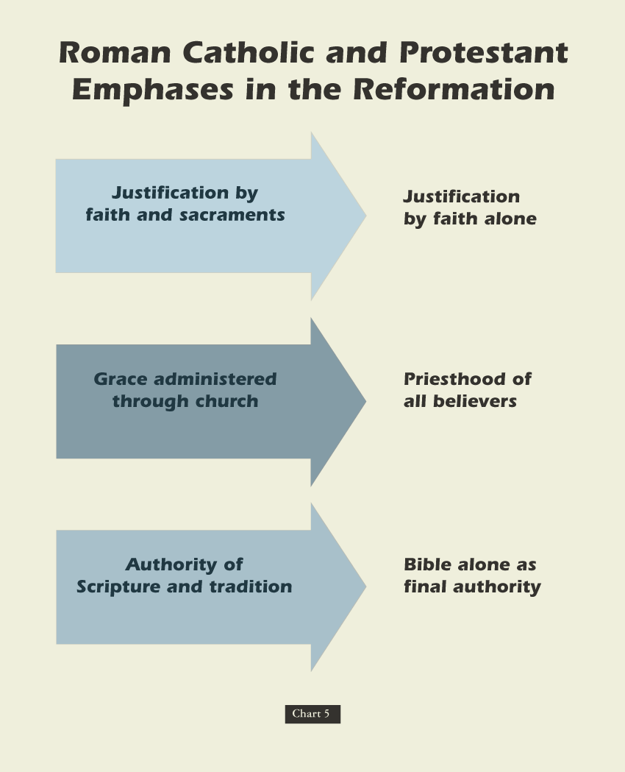

Slide 37
WHERE DID THEY COME FROM? Pulpit System & Chorus Music
Altar Replaced With Pulpit:
Luther had the entire area ripped out of the front of the church. High up on one of the pillars of the church was a rostrum or pulpit which the Catholic priest had climbed up by means of a circular staircase to read dutifully the weekly announcements to the faithful flock below. Luther had one of those pulpits placed in the front & center of the building, where the altar had been. That was new. Brand new. And so, was born the Protestant pulpit!
Congregational Singing
Martin Luther and his followers understood the importance that music can play in spiritual health and encouraged church singing.
They also stressed the importance of hymns sung in the worshipers’ native languages as a means for facilitating greater personal involvement for churchgoers.
This led to the creation of a new kind of music, called the chorale.

Slide 38
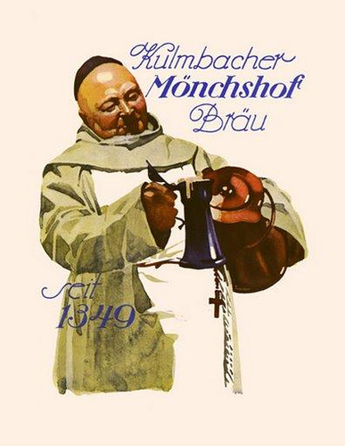
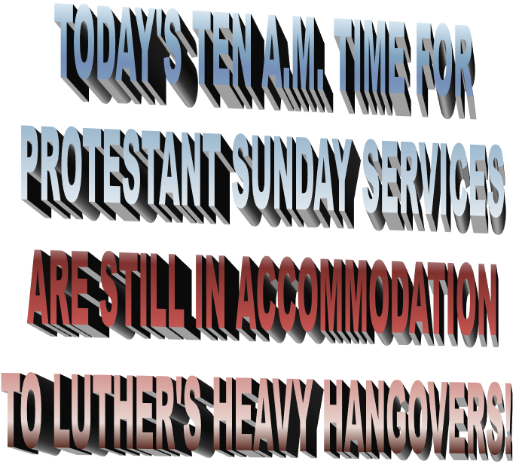
WHERE DID THEY COME FROM? ORDER OF WORSHIP
WITTENBURG RITE
STARTING SONG
1ST PRAYER
THREE SONGS
2ND PRAYER
OFFERTORY
ANOTHER SONG
THE SERMON
BENEDICTION

Slide 39
Martin Luther, the Wild Pig
Martin Luther wanted to debate the validity of indulgences.
On October 31, 1517, Luther nailed a list of 95 theses (topics for debate) on a chapel door in Wittenberg, Germany.
In response Pope Leo X declared, “Arise, O Lord. A wild (alcoholic) pig has invaded the Lord’s vineyard!”
Notes:
Image: © David Crooks

Slide 40
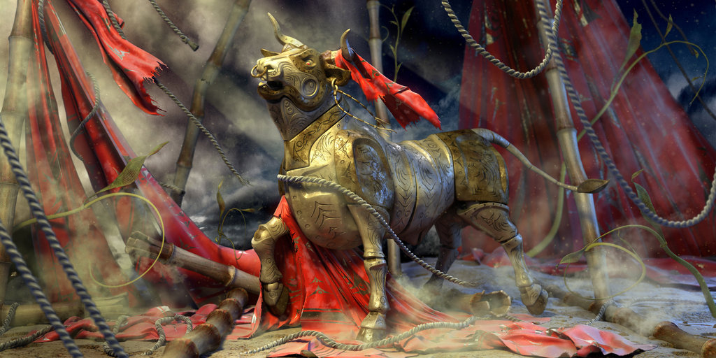
1520
The Pope publishes a bull (sealed declaration by the pope) giving Martin Luther 60 days to recant or be excommunicated
Luther burns the document
BLOODY BULLS
Luther burns the document

Slide 41
LUTHER REFUSES RECANT!

Slide 43
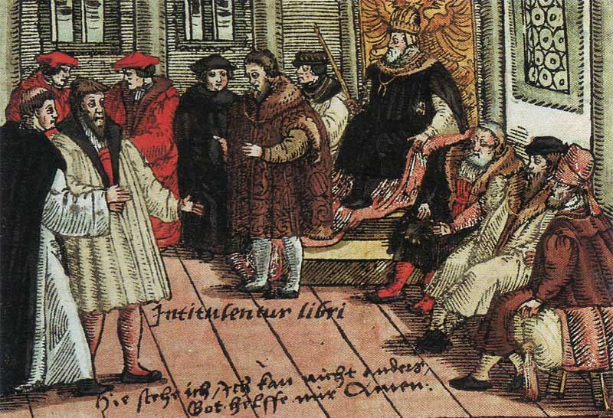
The Edict of Worms banned the reading or possession of Luther’s writings.
It condemned Luther as a heretic and an outlaw, permitting anyone to kill Luther without legal consequence.
The edict was not enforced.
Luther in Worms

Slide 45
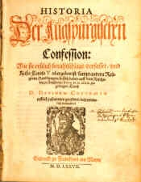
The Diet of Augsburg attempts to calm rising tension between Protestantism and Roman Catholicism.
* Like Occam Before Him, Luther Princely Protected
Luther, being an outlaw, cannot attend.
Philipp Melanchthon, Luther’s friend and collaborator on the German Bible translation, presents the Augsburg Confession, a statement of Lutheran beliefs.
The Augsburg Confession

Slide 46
Castle With Nut!

Slide 48
1521
For safety’s sake and to avoid assassins - Luther isolates in castle for one year
Luther then begins a project of translating the Bible into German

Slide 49
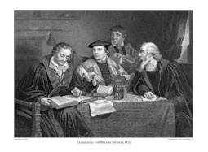
Martin Luther Translating From Vulgate Into Vernacular

Slide 50
Fifth Century Latin Vulgate Reflected Errors Of Early Church

Slide 51
David Lee Burris:
Over 5,000 Greek Manuscripts Available To The Translators!
Vulgate Reflected Errors Of Two Linguistic Shifts

Slide 52
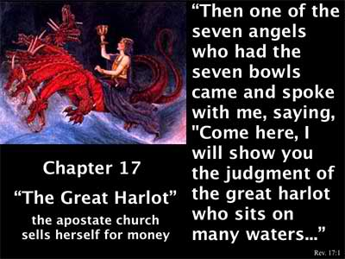
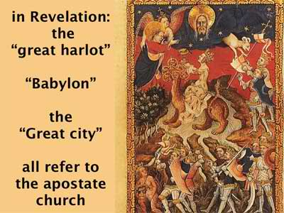
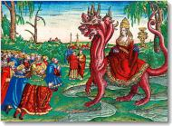
She wears the Three Tiered Papal Crown as Illustrated in Luther’s Bible Revelation Translation.

Slide 53
THESIS & ANTI-THESIS THEOLOGY
PLATO(Teacher) VERSUS ARISTOTLE(Student)
IRENAEUS(2nd Cent) VERSUS AUGUSTINE (4th)
AUGUSTINIAN VERSUS PELAGIAN NEMESIS
AUGUSTINIAN(Old)/THOMISM(New Church)
DESIDERIUS ERASMUS VS. MARTIN LUTHER

Slide 54
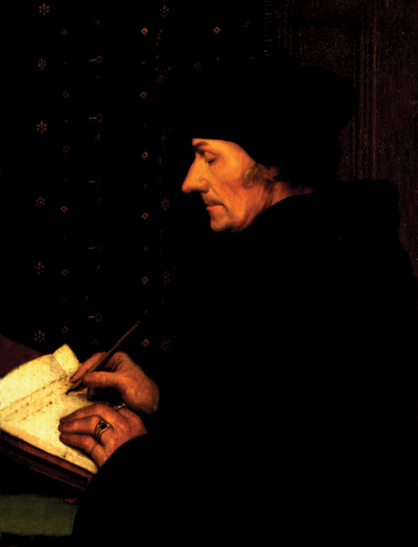
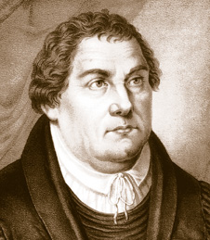
AD 1524
Luther & Erasmus
Erasmus
1500 BC 500 BC AD 1 AD 500 AD 1000 AD 1500 AD 1900 AD 2000

Slide 55
QUESTIONS OF
HUMAN WILL

Slide 56
Erasmus publishes On Freedom of the Will, his famous attack on Luther’s denial of free will
1524

Slide 57
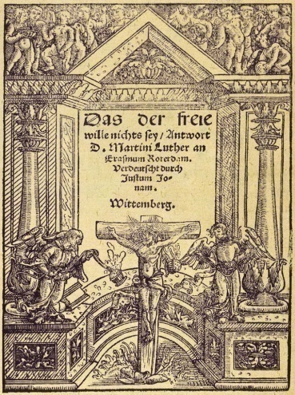
1525
Martin Luther writes Bondage of the Will (a response to Erasmus)
Bondage of the Will
Luther’s work describes the absolute inability of humankind in our fallen state to act morally, a clear opposite to Erasmus’ humanistic ideal.
1526
HERESY IS ALL AROUND: To read the work of a heretic is an excommunicable criminal offense!

Slide 58
LUTHER - & / V. – ERASMUS Neo-Platonist - New Humanist From Friends Unto Enemies
Erasmus was the leading representative of Renaissance Humanism self-dedicated in the recovery of classical languages and literature – Old Latin, Greek, Hebrew. Learning Greek and Hebrew helped both the secular humanists like Erasmus & church reformers like Luther.
Erasmus discovered documentation of the Donation of Constantine fake & fraud.
His criticism of superstitious reverence for religious images was of major influence to Zwingli.
He satirized individual popes, not the office of the papacy. He similarly wrote against abuses of the office. This made him a favorite of Luther who went further by attacking persons & principles.
In Luther’s opinion, the central problem was that the Pope was now an anti-Christ; In Erasmus’s opinion, the central problem was an environment of worldly corruption that had too long permeated Christendom and had finally worked its way to the top church official.

Slide 59
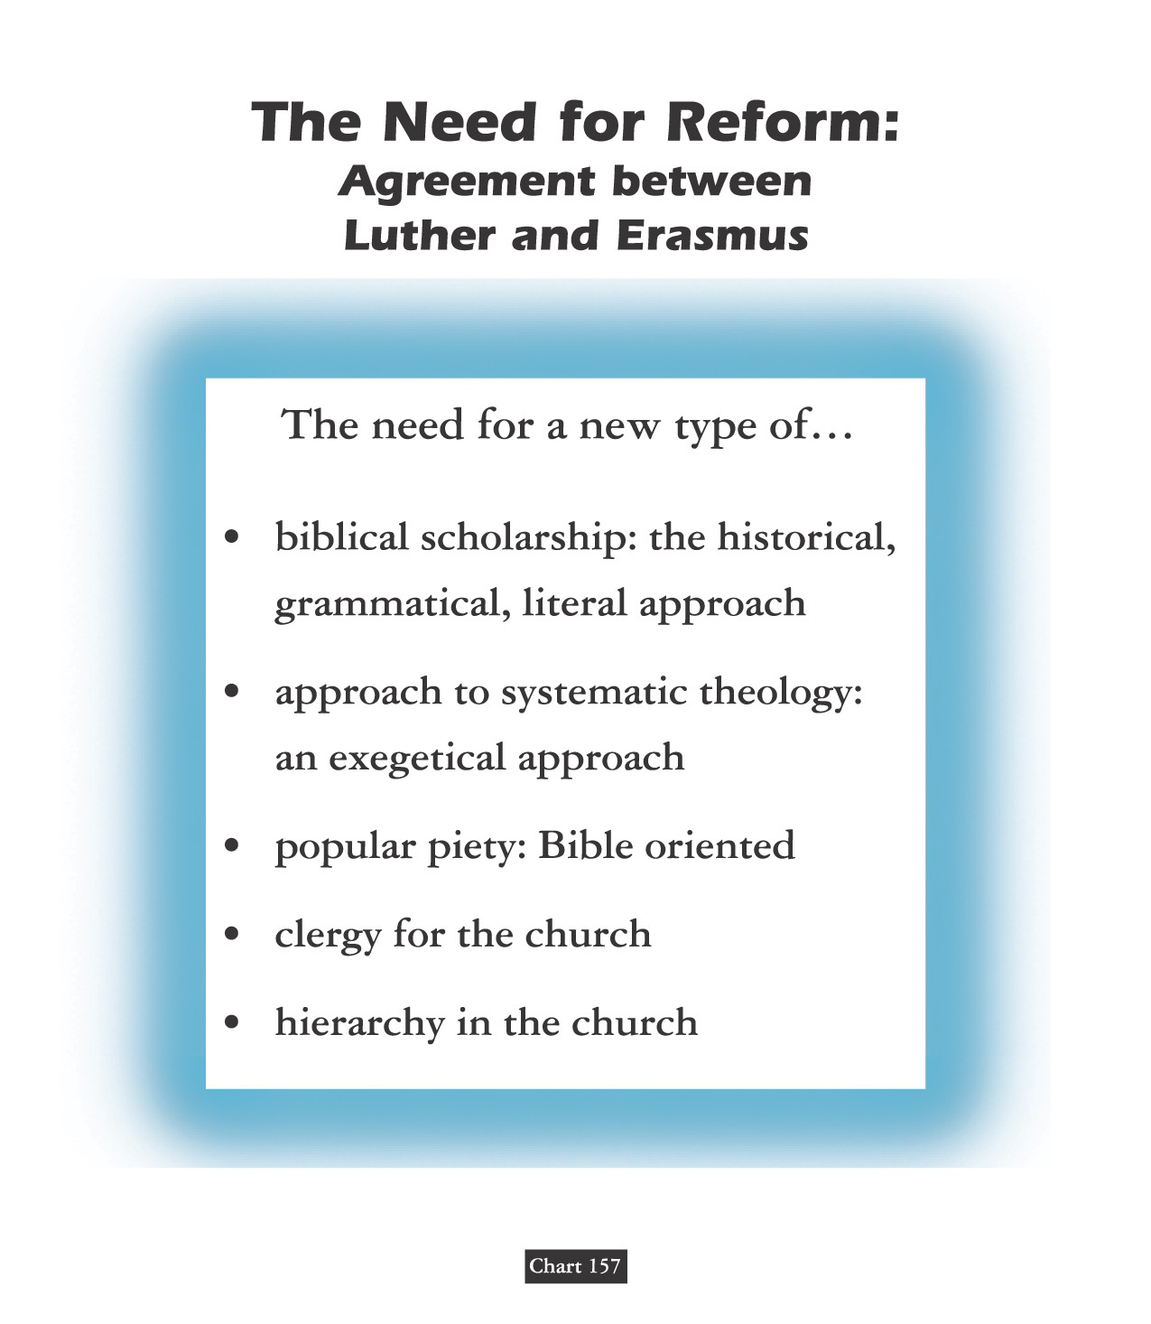
Clear Text & Pure Faith

Slide 60
LUTHER - & / V. – ERASMUS Neo-Platonist - New Humanist From Friends Unto Enemies
Erasmus was the leading representative of Renaissance Humanism self-dedicated in the recovery of classical languages and literature – Old Latin, Greek, Hebrew. Learning Greek and Hebrew helped both the secular humanists like Erasmus & church reformers like Luther.
He could not join his admirer Luther for these reasons - ultimately pressured by the Catholic Church to take a loyal stand - specifically to apply his skills of composition to counter those of Luther - he then wrote in literary disagreement with Luther on the subject of free will.
Erasmus posited that grace restores free will. Luther insists on equating our free will with one-sided “willfulness.”
Luther replies in print the next year - by way of - On The Bondage Of The Will – it is essentially self-explanatory by his selection of the title as it relates to the state of our human rebellion against Almighty God.

Slide 61
AD 1524
Luther & Erasmus
131 Christians Everyone Should Know:
Before the turning point – which would eventually consume the humanist (which at the time meant student of the humanities, not one who praises humanity above all else) – Erasmus became famous for his other writings. He said he wrote to ‘correct the errors of those whose religion is usually composed of ceremonies and observances of a material sort and neglect the things that conduce to piety.’ He became famous for his biting satire, In Praise of Folly, which attacked monastic and ecclesiastic corruption. He lambasted miracles supposedly performed by images, indulgences, and what he felt were useless church rites.
Erasmus
1500 BC 500 BC AD 1 AD 500 AD 1000 AD 1500 AD 1900 AD 2000

Slide 62
AD 1524
Luther & Erasmus
Erasmus’s enemies accused him of inspiring the schismatic Luther. And indeed, Erasmus found much he liked in the German’s writings, describing him to Leo X as a ‘mighty trumpet of gospel truth.’ At the same time he privately told his printer to stop printing Luther’s writings because he didn’t want his own efforts tangled with the Reformer’s. For four years, Erasmus pleaded moderation to both sides. But when pressed, he sided with the pope. ‘I am not so made as to fly in the face of the Vicar of Christ,’ he assured Leo. Still, he hated the bickering and intolerance of both sides: ‘I detest dissension because it goes both against the teachings of Christ and against a secret inclination of nature. I doubt that either side in the dispute can be suppressed without grave loss. It is clear that many of the reforms for which Luther calls are urgently needed.’
Erasmus
1500 BC 500 BC AD 1 AD 500 AD 1000 AD 1500 AD 1900 AD 2000

Slide 64
AD 1524
Luther & Erasmus
“Between Scylla & Charybdis”
His mediating position, however, didn’t satisfy either side: ‘My only wish is that now that I am old, I be allowed to enjoy the results of my efforts,’ he wrote. ‘But both sides reproach me & seek to coerce me. Some claim that since I do not attack Luther I agree with him, while the Lutherans declare that I am a coward who has forsaken the gospel.’ Indeed, Luther attacked him as a ‘Moses who would die in the wilderness ‘without entering the promised land.’ And the Roman Catholic church forbade his writings. ‘Had I not seen it, nay, felt it myself,’ he wrote, ‘I should never have believed anyone who said theologians could become so insane!”
Erasmus
1500 BC 500 BC AD 1 AD 500 AD 1000 AD 1500 AD 1900 AD 2000

Slide 65
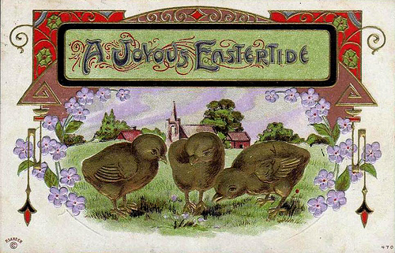
LUTHER HATCHES ERASMUS' EASTER EGGS!

Slide 66
David Lee Burris: Salvation Is ~ EXTRA NOS ~ “Outside Of Ourselves”
Even Elect’s Sin Of Disbelief Forgiven Beforehand
Luther Versus Erasmus
Nature Of Jesus'
RESURRECTION

Slide 68
David Lee Burris: Salvation Is ~ EXTRA NOS ~ “Outside Of Ourselves”
Even Elect’s Sin Of Disbelief Forgiven Beforehand
Luther Versus Erasmus
Monergistic
Synergistic
Controversy

Slide 69
SALVATION:
A L L
O F
G O D ?

Slide 73
SEMI-PELAGIANISM: The Cassian Controversy
************** News 529 A.D. *************** Moderate Augustinianism Prevailed This Year When Bishops Of Rome At The Orange Synod Rejected The Mediating Position Of John Cassion.
- CAUSATIVE COOPERATIVE ABILITY - Salvation As A Second Act Of Grace: This view argues that God’s action may at times follow the sinner’s repentance and at other times precede it.

Slide 74
SEMI-PELAGIANISM
1. The God Who Draws
Calvinists believe that unregenerate people are so depraved that, left to themselves, they would never repent, believe and follow Jesus. And they are absolutely correct on that point. Jesus Christ said, ‘No man can come to Me unless the Father who sent me draws him’ [John 6: 44]
Contrary to what some Calvinist theologians try to tell us, however, the word draw doesn’t actually mean drag in the Greek language - per lexicon.

Slide 75
SEMI-PELAGIANISM
1. The God Who Draws
And if God ‘draws’ people, that clearly indicates that people have a say in the matter of whether or not they will yield to His drawing. Thus, Christ not only affirmed that our salvation requires the work of God’s grace from the very start, but He also affirmed that each person will use his or her God-given ability to either resist or not resist God’s gracious drawing.

Slide 76
SEMI-PELAGIANISM
1. The God Who Draws
As I’ve already stated, Calvinists believe that God draws only those whom He has allegedly predestined, and that He draws them so strongly that they can’t resist. He supposedly draws them ‘irresistibly.’
Non-Calvinists, on the other hand, believe that God could draw people irresistibly, but that He doesn’t. If He did, those who are irresistibly drawn, having no choice in the matter, would be virtual robots, and it could hardly be said they love God, as love is predicated on free choice. One wonders what God would desire with a group of robots. It could hardly be said that they have a relationship with them.

Slide 77
SEMI-PELAGIANISM
1. The God Who Draws
Non-Calvinists see the Bible as a book about people who resist God’s drawing. The Old Testament, in particular, is a story of people who resisted Him, and most of them, as descendants of Israel, were specifically chosen by Him. They were chosen by Him yet they resisted Him.
And when God sent His Son into the world ‘that it might be saved’ the majority whom He came to save rejected Him – even the Bible students. [John 1: 11]

Slide 78
SEMI-PELAGIANISM
1. The God Who Draws
Calvinists sometimes point out special people in the Bible, like the Apostle Paul, who certainly had a strong drawing from God the day he came to Christ. But because Saul(Paul) was struck down on the road to Damascus by a blinding light, does that prove his personal will had no part to play in his salvation? Could he have ignored his experience and continued his plan to persecute Christians? Of course he could. [See - Hebrews 13: 5; 1st Corinthians 9:27]

Slide 79
SEMI-PELAGIANISM
1. The God Who Draws
May I also point out that God’s very strong drawing of Paul is not typical, and so it can’t rightly serve as a typical example of how God generally deals with people. Moreover, God’s strong drawing of Paul was a manifestation of God’s drawing of you, me, and everyone else who ever heard Paul’s words quoted in the gospel. God did not strongly draw Paul just for Paul’s sake, but to draw you as well!

Slide 80
SEMI-PELAGIANISM
1. The God Who Draws
Moreover, Paul believed he was specially singled out by God because he was the foremost sinner, so that ‘Jesus Christ might demonstrate His perfect patience, as example for those who would believe in Him for eternal life’ (1st Timothy 1:16) That is, God wanted every sinner to have hope because of His great mercy towards Paul. Thus Paul’s special drawing does not buttress the idea of God’s alleged pre-selection of a few; rather, it affirms God’s universal love and mercy offered to every sinner.

Slide 81
In Their Own Words
JOHN WESLEY
“Natural free-will, in the present state of mankind, I do not understand: I only assert that there is a measure of free-will supernaturally restored to every man, together with the that supernatural light which ‘enlightens every man that cometh into the world.’ ”

Slide 82
Doesn’t The Spirit Draw?
God Does Everything?
Individuals Play No Part?

Slide 83
CONVICTION: PREVENIENT GRACE
“The word ‘prevenient’ is based upon two Latin words which mean ‘to come before.’ Thus prevenient or preliminary grace refers to the operation of God’s grace before we turn to God. Implied is the concept that God’s drawing grace precedes the human response of faith.”

Slide 84
David Lee Burris: Salvation Is ~ EXTRA NOS ~ “Outside Of Ourselves”
Even Elect’s Sin Of Disbelief Forgiven Beforehand
Class Discussion Question:
Does Synergism
Dilute The Doctrine
Of Divine Initiative?

Slide 86
TEACHES TO ALL SEEKERS!

Slide 87
PROVISION:
A L L
O F
G O D !

Slide 88
German & Swiss Reformationists Profess: “All Faith Passive & All Sin Disbelief”
Lutheran Adventure The Great Monolithic Bifurcation Of The Middle Ages – Two Sides With Two Golden Age Reset Points: Pope & Catholic Loyalists To Charlemagne The Great; Luther & German Reformers To Constantine
Protestant Reform Churches Of Two Types: Princely Top-Down & Grassroots Movement Lutheranism Categorized @Magisterial Reform

Slide 89
PART I. - LUTHER’S GOSPEL Story Not Journey Metaphor
Luther’s Gospel is essentially something all Christians believe: the story of Christ dying for us sinners. What is new & controversial is Luther’s doctrine about the Gospel - about how we are changed simply by believing it.
Definition: The gospel is the good news about Christ, a story containing his promises. The four gospels are different ways of telling this one story.
Content: What the gospel says is what is summarized in the creed. The content of the gospels is included in the O. T. because it prophesies and promises Christ’s coming.
Doctrines In The Gospel: The Gospel contains teachings.
Doctrines About The Gospel: Teachings as to how the Gospel of Christ saves us.
Gospel As Promise: According to Luther’s doctrine about the Gospel, it is not only a story, but also a promise contained in the story, about how Christ is given to believers.
Pro me: Faith in the Gospel means not just believing that the story is true – fides historica – but also believing that what Christ did he did “for me.” The “pro me” aspect does not mean the story is all about me but that I am included because He died “for me.”

Slide 90
event

Slide 92
Subtext IB: Hearing The Gospel Christ The Gift Not The Road
For the mature Luther, the Gospel includes a divine promise of forgiveness, which forbids us from regarding ourselves as God’s enemies. In The Freedom of a Christian, Luther described this as a wedding vow that gives us a divine bridegroom, together with all that is his.
Modifies the Augustinian paradigm of spirituality, because Christ is not just the way, the road we take on our pilgrimage to God, but God coming to us and making Himself ours.
Gospel and Law are two different genres with two different purposes and two different effects on those that believe them.
The Law tells us what to do and cannot by itself save us. Its first purpose is “civil” to restrain and punish evil outwardly. Its second purpose is in its causal relation to our “evangelical despair” which in turn humbles and prepares us to receive gladly the gospel of good news.
Whereby Law is about ritual ceremony and proper technique or obedience and what we do, Gospel is about what Christ does. The Gospel is not so much for gleaning practical advice as it is for having a practical effect.
The Gospel contains words that change those that believe them from the inside out. Thus, In its effect, God’s Gospel – cheers, comforts, & consoles.

Slide 93
Middle Eastern Bride

Slide 94
"Ordo Salutis"
“Latin, meaning ‘order of salvation,’ that is, succession of events in God’s salvific program. Although both the Catholic and Reformed traditions believe salvation comes only through Christ, they diverge dramatically regarding the ordo salutis.”
* Dictionary Of Theological Terms, Grenz & Guretzki

Slide 95
Subtext IB: Hearing The Gospel Christ The Gift Not The Road
For the mature Luther, the Gospel includes a divine promise of forgiveness, which forbids us from regarding ourselves as God’s enemies. In The Freedom of a Christian, Luther described this as a wedding vow that gives us a divine bridegroom, together with all that is his.
Luther’s Famous Motto: “Believe It & You Have It!” -- Words That Do What They Say!
Explanatory Follow-up: “The promise[of God] gives what the commandment requires.”
However, we are at the same time righteous and sinners.
Because all our righteousness comes by faith, all sin is unbelief.
Love of God is less like a longing and desire for our heavenly home and more like gladness and gratitude for a gift already received.
Lutherans separated from Catholics even in such spiritual disciplines as corporate and personal prayer.

Slide 96
ASSENSUS
“A latin term referring to the intellectual assent to or acceptance of a theological truth. While the biblical concept of faith includes the idea of assensus, it should not be equated with saving faith… for, as James notes, ‘even the demons believe’, that is, they give intellectual assent while not exercising saving faith in Christ.”
* Dictionary Of Theological Terms, Grenz & Guretzki

Slide 100
Faith Only - Without Works Free Of Self-Chosen Works
David Lee Burris: Internally Disputed With George Major. Luther’s Two Main Points Were Ideas With Consequence – Ultimate Success Achieved Spiritual Progress Ceased – Ultimate Paradise Proximate Idealism – Peasant Revolt Against Feudalism With 100,000 Casualties Duration Between State Religions
Luther distinguishes Law and Gospel: one is God’s commandment telling us what to do, the other is His promise of what He does for us. Since salvation comes simply by believing, a question arises: what need is there for good works? Treatise On Good Works answers this.
God saves us through faith in order to give us in love to our neighbors.
The gift of Christ fills us to the brim and overflows in gifts and service to other people.
We Become Christ To One Another: Luther calls this our “proper righteousness” the imperfect but real change in our lives as a result of the “alien righteousness.”
To Clarify Relation Between Faith & Works Luther Distinguishes Different Kinds Of Righteousness: A. The crucial distinction between person and work, who we are and what we do – symbolized by tree and fruit. B. As the tree must be good before the fruit is, so the person must be righteous before he can do good works. C. What makes a person good is alien – of another – righteousness – which is Christ in the heart making us a new creature. D. Alien righteousness is passive, it is God’s doing, not ours; proper righteousness is active because it consists of works we do.
Luther’s Two Main Points On Faith & Good Works: 1. “A Christian is perfectly free, lord of all, subject to none” because Christians are inwardly freed by faith from sin, death, and the devil. 2. “A Christian is a perfectly dutiful servant of all, subject to all” because Christians serve their neighbors outwardly with works of love.
Self-chosen works include any moralism or spirituality that adds extra than the 10 Commandments.

Slide 102
II. FAITH IS NOT THE GIFT SALVATION IS THE GIFT Exposition of Ephesians 2:8
David Lee Burris: Internally Disputed With George Major. Luther’s Two Main Points Were Ideas With Consequence – Ultimate Success Achieved Spiritual Progress Ceased – Ultimate Paradise Proximate Idealism – Peasant Revolt Against Feudalism With 100,000 Casualties Duration Between State Religions
“And that not of yourselves; it is the gift of God. Which of the two things is meant – salvation or faith? The grammatical structure and the analogy of the passage favor the former view, ‘Your salvation is not of yourselves,’…” – The Pulpit Commentary
“The words, ‘through faith’ speak of the instrument or means whereby the sinner avails himself of this salvation which God offers him in pure grace… The word ‘that’ is touto, ‘this,’ a demonstrative pronoun of the neuter gender. The Greek word ‘faith’ is feminine in gender and therefore touto could not refer to ‘faith’…” – Word Studies from the Greek New Testament
“What is the meaning of ‘this,’ which is given of God and is not from yourselves? Since ‘faith’ is a word of feminine gender, and ‘this’ & ‘it’ are neuter gender, normal grammar disallows referring back to ‘faith.’ Ken Boles
* In other words, this verse reaffirms tenet that although salvation unmerited – it is not without condition.

Slide 104
III. Grace & Justification
David Lee Burris:
Catholic View – Intrinsic Justification - God Infuses
Protestant View – Extrinsic Justification - God Imputes
The doctrine of justification - how one becomes right before God – is the most characteristic legacy of the Reformation. Luther’s position can be contrasted with both the Catholic doctrine of sanctifying grace and the Reformed emphasis on forensic or imputed justification.
Catholicism Combines Augustinian Grace Doctrine W/ Aristotelian Virtue Theory: In Catholic doctrine, grace is both a divine gift (Augustine) & part of our very souls (Aristotle). Aristotle taught that virtues are like skills formed by practice. The Catholic doctrine of justification teaches that grace is necessary because the virtues of faith, hope, and love are not acquired by practice.
This grace is itself a form in our souls called created grace to distinguish it from uncreated grace which is God Himself in action.
Reasons Protestant Reformers Reject Catholic Created Grace Doctrine: Grace is the term for God’s action toward us not the thing created. Grace is not a habit or something to be possessed. Specifically, it is not the building block of earned merit. Furthermore, it is not acquired as a skill thru repetition. Finally, the product of the process, souls inwardly formed, is by its assumptions rejected.

Slide 106
III. Grace & Justification
The doctrine of justification - how one becomes right before God – is the most characteristic legacy of the Reformation. Luther’s position can be contrasted with both the Catholic doctrine of sanctifying grace and the Reformed emphasis on forensic or imputed justification.
Justification Event Not Process: Protestants delimit justification solely to the remission of personal sins;. Instead they utilize the term sanctification for those transformative spiritual changes occurring within the individual but that happen shortly after justification.
Two Protestant Schools Of Thought On Justification: Luther held to Aristotle’s second way of soul formation – through perception – an eye is informed by what it sees – in this case – the ear in hearing the Gospel reforms the soul from the bottom up. The Swiss Reformers held to a courtroom verdict type imputation of innocence.
According to Luther the conscience can be either unaware or awakened. Hearing the precepts of God makes men anxious or fearful but hearing the Gospel comforts & quiets them. Lastly, Luther claimed men are born with God inside but located by looking beyond the self.

Slide 108
HAMARTOLOGY
“The term used to refer to the theological investigation of sin(from Greek hamartia, ‘sin’). Hamartology concerns itself with understanding the origin, nature, extent, and consequences of sin. Furthermore, hamartology seeks to understand how sin is transmitted throughout the human race and how sin opposes God’s purposes for creation.”
* Dictionary Of Theological Terms, Grenz & Guretzki

Slide 109
(Pre)determined & Destined God Of Love, Care, Mercy?
How does the pessimism of Luther’s predestination form from his optimistic view on grace? The deep concept here is the doctrine of election or God’s choice to be gracious to some undeserving sinners & not others & thus to transform the gospel good news into the bad news of - some chosen instead of others – rather than – some for the sake of others
Augustine defines predestination as God’s eternal knowledge of how he will distribute the gift of grace. He insists also that even the making of the choice to receive grace is encompassed in the gift of grace.
The continuing controversy surrounding such reasoning is not the philosophical problem about determinism and free will as much as the theological doctrine of election.
Augustine, Luther, and Calvin all affirm the compatibility of divine determinism and free will: God controls all earthly events and all human choices without undermining the free will of the creature of conscience and intellect.
The Augustinian Tradition argues that God’s distribution of grace is unequal but not unjust. No one gets worse than they deserve but some get degrees of better.

Slide 111
(Pre)determined & Destined God Of Love, Care, Mercy?
How does the pessimism of Luther’s predestination form from his optimistic view on grace? The deep concept here is the doctrine of election or God’s choice to be gracious to some undeserving sinners & not others & thus to transform the gospel good news into the bad news of - some chosen instead of others – rather than – some for the sake of others
Faith to the highest degree can be recognized in those who are without doubt and question but simply trust God’s good mercy as much as the justice of His judgment.
Luther addressed the related pastoral problems and clergy concerns by several suggestions: a) Do not be preoccupied with the subject of predestination. b) The eternal decree of “hidden God” (Deus absconditus) is none of our business. c) Stay focused on the “revealed God” or Jesus Christ. c) Since you have faith which is a gift – you have the assurance of salvation as well. {Note: Dutch & English Calvinists later split on an “State of Grace Evidentiary Test” – whether either proving lifestyle change or testimony of subjective experience is enough.}
All three writers critically misread the Apostle Paul in his mention of Jacob & Esau in Romans 9. Contextually, Paul should be understood as referring to the two nations that ultimately descended from them – Israel & Edom.
Genesis 12 states Israel was chosen as a blessing of others. This should be self-evident when we observe Christ as the chosen one of God.

Slide 114
Church
History
The Apostasy
Doctrines Enacted at Church Councils
Clergy/Laity System
Sprinkling for Immersion
Infant Baptism
Celibacy
Instrumental Music
Transubstantiation
Indulgences
Worship of Mary
Veneration of Relics
Purgatory
Confessionals
Images
Penance
Extreme Unction
Confirmation
Nuns, Primacy of Peter
Forbidding to Eat Meats
Religious Holidays

Slide 115
German & Swiss Reformationists Profess: “All Faith Passive & All Sin Disbelief”
Lutheran Adventure The Great Monolithic Bifurcation Of The Middle Ages – Two Sides With Two Golden Age Reset Points: Pope & Catholic Loyalists To Charlemagne The Great; Luther & German Reformers To Constantine
Protestant Reform Churches Of Two Types: Princely Top-Down & Grassroots Movement German Reform Categorized @Magisterial Geneva Reform Categorized @Magisterial

Slide 116
THESIS & ANTI-THESIS THEOLOGY
PLATO(Teacher) VERSUS ARISTOTLE(Student)
IRENAEUS(2nd Cent) VERSUS AUGUSTINE (4th)
AUGUSTINIAN VERSUS PELAGIAN NEMESIS
AUGUSTINIAN(Old)/THOMISM(New Church)
DESIDERIUS ERASMUS VS. MARTIN LUTHER
ZWINGLI & CALVIN VS. MARTIN LUTHER

Slide 117
Catholics & Protestants disagree over communion host

Slide 118
SOTERIOLOGY
“Literally, ‘the study of salvation.’ This topic within the corpus of systematic theology deals with the work of the triune God in bringing creation, and especially humans, to enjoy the divine purpose for existence; ‘objective’ soteriology speaks of the life, death, resurrection & exaltation of Christ in relation to human salvation; ‘subjective’ soteriology deals with the process whereby individuals are brought to God’s saving goals.”
* Dictionary Of Theological Terms, Grenz & Guretzki

Slide 119
Doctrine Of The Mass
Acceptance of the concept of the Lord’s Supper as a sacrifice by the priest was a gain for the power of the papacy because it was the pope who headed the hierarchy of clergymen who alone had the power to perform the miracle of the mass.

Slide 120
CONCOMITANCE
“In Roman Catholic theology, the belief that Christ is physically present in the eucharistic elements of bread (body) and wine(blood). The doctrine was eventually used to prevent laity from partaking of the wine in case it should be accidentally spilled, desecrating Christ himself.”
* Dictionary Of Theological Terms, Grenz & Guretzki

Slide 121
TRANSUBSTANTIATION
About 831 A.D., Pascha Radbertus, a monk in the monastery of Corbie near the city of Amiens, began to teach that by a divine miracle the substance of the bread and the wine was actually changed into the body & blood of Christ. He set forth these views in a book entitled - ‘Of The Body & Blood Of The Lord.’

Slide 122
Religious
Soteriological Exclusivity
Divergence

Slide 123
ROMAN MASS OR PROTESTANT MEMORIAL THE COMMUNION IN ONE KIND
“We observe that this decree of the Council of Constance, although making a law of communion in one kind for the laity of the Roman Catholic Church, plainly admits that the practice of the primitive church was of all Christians receiving both the bread and the cup, even as was ordained by Christ. This is an inadvertent admission that the dogma of communion in one kind is of human & not divine origin and that, therefore, the Roman Catholic Church has departed from the practice of the primitive church. We can see from this definition {Cardinal Gibbons} that the dogmas of transubstantiation and communion in one kind are ingeniously connected together, that the Roman Catholic Church teaches that Christ, whole and entire, His soul, body, divinity, is contained in either species. To support this unscriptural doctrine, what is purported to be the Lord’s Supper is cut in half; transubstantiation justifies communion in one kind, and communion in one kind proves transubstantiation.”
* Source: "The Lord's Supper" by James M. Tolle

Slide 124
ROMAN MASS OR PROTESTANT MEMORIAL THE COMMUNION IN ONE KIND
Concerning the necessity of each communicant partaking of the cup at the Lord’s table, Adam Clark observed,
“With respect of the bread, Jesus had before simply said, ‘Take, eat, this is my body’; but concerning the cup, he says, ‘Drink you all of this’; for as this pointed out the very essence of the institution, the blood of the atonement, it was necessary that each should have a particular application of it; therefore he said, Drink ye All Of This By this we are taught that the cup is essential to… the Lord’s supper; so that they who deny the cup to the people, sin against God’s institution and they who receive not the cup, are not partakers of the body and blood of Christ.”
* Source: "The Lord's Supper" by James M. Tolle

Slide 125
The Sealing Blood Of The Covenant Of Grace The Mass Or Memorial Debate
Matthew 26: 28 - “My Blood Of The Covenant”
In ancient times, covenants were ratified in different ways; sometimes, for instance, the contracting parties were held to be bound by eating salt together; sometimes by partaking together of a sacrificial meal; sometimes by passing between the divided pieces of slaughtered animals; and especially by the use, still prevalent in many parts of the world, of blood, as by each of the parties tasting each other’s blood, or smearing himself with it, or letting it be mingled with his own etc., or by dipping their hands in the blood of the slaughtered animal.
* Source: "The Lord's Supper" by James M. Tolle

Slide 126
ROMAN MASS OR PROTESTANT MEMORIAL SACRAMENT OR SACRIFICE
“The Word of God teaches us plainly that there is no other sacrifice for sin than the perfect sacrifice of Jesus. And yet Rome teaches that the Lord’s Supper is a sacrifice for sin – not a sacrament only, as Protestant churches teach, but a sacrifice. A sacrament is a sign and seal of the grace of God, but a sacrifice is the offering to God of a living body (man or animal) to wipe out our guilt in the sight of God, and thus to make possible our deliverance from the death we have deserved because of our sins. There is a very important difference between a sacrament and a sacrifice. A sacrament can never make atonement for our sin and thus cover our guilt in the sight of God. A sacrifice, if ordained by God, as were the sacrifices of Old Testament, can make atonement for sin.”
* Source: "What Rome Teaches" by Edward J. Tanis

Slide 127
ROMAN MASS OR PROTESTANT MEMORIAL SACRAMENT OR SACRIFICE
“Now Rome teaches that the Lord’s Supper is much more than a sacrament – it is nothing less than a sacrifice for sin! And Rome teaches that she is the only Church that has such a sacrifice for sin, hence the only Church that offers salvation to the people. At this point Rome is very logical. If we need the Lord’s Supper as a sacrifice for sin, the we must be members of the Roman Church. Cardinal Gibbons said ‘the Mass is another Calvary – which it is in reality.’ The mass is not identical with the conscious, suffering, bleeding, agonizing Christ of Calvary. To say that the bread on the Roman Catholic altar is the broken, bleeding body of Christ – when nobody can see that it is – is the greatest deception ever imposed upon mankind. When Jesus Christ changed the water into wine, it was wine. All the people present at the wedding in Cana of Galilee could see that the water had been changed into wine…”
* Source: "What Rome Teaches" by Edward J. Tanis

Slide 128
Church
History
The Apostasy
Doctrines Enacted at Church Councils
Clergy/Laity System
Sprinkling for Immersion
Infant Baptism
Celibacy
Instrumental Music
Transubstantiation
Indulgences
Worship of Mary
Veneration of Relics
Purgatory
Confessionals
Images
Penance
Extreme Unction
Confirmation
Nuns, Primacy of Peter
Forbidding to Eat Meats
Religious Holidays

Slide 130
Transubstantiation Doctrine From The Heresy of Eutyches:
400
“As the symbols of the Lord’s body & blood are one thing before their consecration by the Priest, but after their consecration are physically changed and become quite another thing; so the Lord’s material body, after assumption, was physically changed into the divine essence.”

Slide 131
Gelasius, the Fifth Century
BISHOP OF ROME:
400
“Certainly the sacraments of the body and blood of the Lord, which we receive, are a divine thing, because by these we are made partakers of the divine nature. Nevertheless, the nature or substance of the bread and the wine ceases not to exist.”

Slide 132
754
ICONIC DEBATE LINKAGE The Council Of Constantinople
“Christ chose no other shape or type under heaven by which to represent his incarnation but the sacrament, which he delivered to his Ministers for type & effectual commemoration; commanding the substance of bread to be offered, which did not in any way resemble the form of man, that no occasion might be given to bring in idolatry.”

Slide 133
787
ICONIC DEBATE LINKAGE The Second Council Of Nice
The Second Nicene Council ordered that the sacrament is not the image or anti-type of Christ’s body and blood but is properly his body and blood. So it was - that - the doctrine of the corporeal presence in the sacrament was first introduced to support the Roman practice of image-worship!

Slide 134
Benedictine Monk Paschasius “Concerning The Body & Blood Of Christ”
831
1st – That after the consecration of the bread and wine in the Lord’s Supper, nothing remains of these symbols but the outward figure, under which the body and blood were locally present. 2nd – That the body & blood of Christ, thus present in the eucharist, was the same body as was born of the Virgin, that suffered on the cross, and was raised from the dead.

Slide 136
Benedictine Monk Paschasius THE QUESTION OF STERCORIANISM
831
Paschasius later asserted, “that bread & wine in the sacrament are not under the same laws with our other food, as they pass into our flesh & substance without any evacuation.”

Slide 137
Protestant division over memorial or mass

Slide 138
The Church Across The Ages
of people, events
life and faith from
Glimpses
ZWINGLI & LUTHER !
“The reforms under Luther in Germany and Zwingli in Switzerland had many parallels, and the two agreed on most essential points of doctrine.
Phillip Landgrave of the city of Hesse was eager to join their movements in political, military, and religious unity, thereby strengthening the Protestant front against the growing Catholic pressure.
He brought the two of them together to meet in doctrinal discussion at Marburg. Fifteen articles of faith were on the agenda and agreement was quickly reached on fourteen of them. But on the last item – the Eucharist – no concord could be reached and the trading of insults turned ugly!”

Slide 139
1536
Luther agrees to the Wittenberg Concord defining the Lord’s Supper in an attempt to resolve differences with other reformers, but the Swiss Zwinglians reject the document
The Wittenberg Concord (covenant) was signed by Reformed and Lutheran leaders to resolve different beliefs about the Real Presence of Christ’s body and blood in the Eucharist.

Slide 140
The Church Across The Ages
of people, events
life and faith from
Glimpses
ZWINGLI & LUTHER !
“Zwingli interpreted the presence of Christ in the Eucharist in a more spiritual & more metaphorical way than Luther could accept. Thus a significant opportunity for expanded unity within the reform Protestant movement ended in division. Argument over the Lord’s Supper – a sign of the oneness of God’s people, rather than bringing together these two stalwart defenders of Scripture, instead drove a mean wedge between them!”

Slide 141
Luther’s “Con” Substantiation
TRANS - Substantiation
Last Supper Memorial

Slide 142
Swiss Reformers & Lutherans Separate Over Lord’s Supper
David Lee Burris: Zwingli Had Just Bested The Local Catholic Bishop In Debate
Latin “Hocus Pocus” Or Aristotelian Principle Debate?; Catholics Crucify Anew At Mass?
Agreement Then Holding Today Over Three Sola’s:
- Sola Fida = by faith alone, apart from works - Sola Gratia = by grace alone, without merit - Sola Scriptura = by scripture alone, without add
Protestantism Landscape Of State & Territorial Churches With Swiss & German Branches
Swiss Reform Movement Soon Split Into Three: Puritan, Presbyterian, & Congregational Variants
Had Historic 1529 Meeting Worked – One Protestant Reform Church
Long List Agreed All But Item Of Nature Of Elements In Communion: Luther Materialist; Zwingli Memorialism
Both Seriously Thought The Lord’s Supper One Of The Two Marks Of The True Church Differing Christlogical Not Sacramental
Debate Centers Over Interpretive Differences Relating To The Relative Symbolism Or Literalness Of John 6: 63.

Slide 143
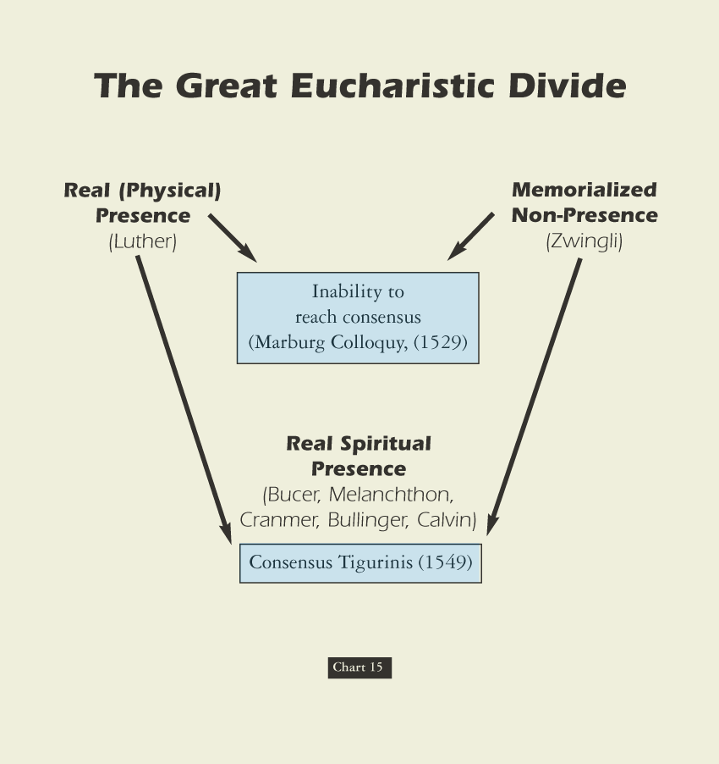
David Lee Burris:
Luther was coupled with milder Oecolampadius of Basel & Zwingli with Melanchthon

Slide 144
Swiss Reformers & Lutherans Separate Over Lord’s Supper
David Lee Burris:
Both Lutheran & Catholic Arguments Pointless With Recent Translations Of 1Cor. 10: 16;
For Luther, the bread was the body of Christ. That is what Christ said. Luther wrote on the velvet cloth “Hoc est corpus meum!” The Swiss reminded Luther that Christ also called Himself the vine and the door. Oecolampadius asked, “Martin, how is Christ any more present in the sacrament if He is corporeally present than He is when spiritually and dynamically? “I don’t know,” answered Luther, “but if Christ told me to eat dung I’d do it knowing it was good for me.” Not to believe Christ’s words was to be of another spirit!
TWO IRONIC POSTSCRIPTS:
Luther later saw a copy of Calvin’s writings on the Lord’s Supper (essentially like Oecolampadius’ views) and seemed to agree with it
Manschreck, a Melanchthon authority, says that it was Melanchthon who stiffened Luther against the Swiss view of the Eucharist, fearing it would make reunion with Rome impossible!
Agreement Then Holding Today Over Three Sola’s:
- Sola Fida = by faith alone, apart from works - Sola Gratia = by grace alone, without merit - Sola Scriptura = by scripture alone, without add
Zwingli Focused On Contextual Understanding Of Apostles Present For The Omnipresence Of His Fleshly Body
Latter Lutherans Later Label: of extra Calvinisticum or contrary position “Christ is God outside flesh”
Luther’s case described as “distinctive ubiquity” or that “Christ’s human body or corporal presence everywhere”
Connected to Doctrine of Communicatio Idiomatum or sharing of properties and the “blessed exchange”
Theologians Explain As Emphasis Disagreement Since Orthodox Agree One Person Of Two Natures: Emphasis Either On Differences Or Similarities; Position Of Swiss Reformers: Luther Denatures Jesus’ Body

Slide 145
Incarnate Substance Trans-mutes To Communion Presence Debate
Roman Catholic Church: Transubstantiation of the elements’ substance into Jesus’s real flesh & blood regardless of appearance.
German Lutheran Reform: Consubstantiation of the elements’ substance that stays the same & coexists w/ the real flesh & blood.
Eastern Greek Orthodox: Theosis Images Doctrine views the elements types of Christ’s 2 natures that transport to His presence.
Swiss Reformer Position: Memorial Remembrance representation & symbol not of the divine substance or presence of His body.

Slide 146
The Principle Of Godly Worth
The meaning of worship. “The formation of ‘worship’ is a key to its meanings and how they developed. The word is formed of worth and –ship, and its original meaning in Old English (about 888) was ‘the condition of being worthy, worthiness.’ This meaning was extended in late Old English (about 1000) to ‘the respect and honor shown someone worthy,’ found in such phrases as to do worship ‘to pay respect or show honor,’ and to have or hold in worship ‘to show honor to,’ always referring to a person of distinction.” - Semantic Antics

Slide 147
The question of worthiness. By Luther’s lifetime, the phrase for the communion ceremony and host had been altered & with it a change of emphasis. The term Eucharistia, which means thanksgiving, had been replaced with Missa, which means the dismissal of the unworthy. Worthiness itself had metamorphized in meaning from a subjective and introspective responsibility to an objective meaning measured by works.
psychoanalysis & History
YOUNG MAN LUTHER
By Erik H Erikson
Significant Development Influencing German-Swiss Reformation & Scottish Restoration

Slide 148
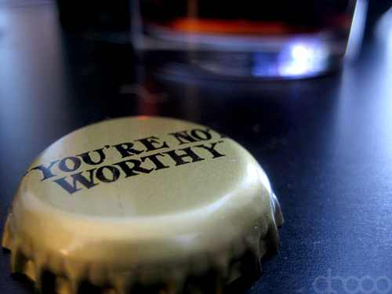
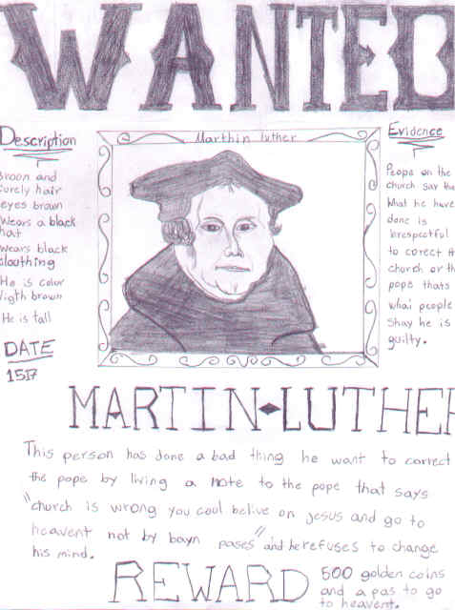

Slide 149
Borders Of God’s Word

Slide 150
Communion Concession & Conscience Crisis: 1st Corinthians 11: 27-29 KJV Misinterpreted
David Lee Burris:
N.T. Worthiness Of Manner Consistent With O.T. Passover Practice.
Proper grammatical reading of these verses is difficult from the older versions and translations. The term “unworthily”
occurs twice – each time an adverb modifying an action verb – eat & drink or eateth & drinketh. Contextually in this
sense “unworthily” relates to manner of partaking – not of the people partaking. Verses 27 & 29 similarly admonish as
how serious this remembrance celebration is to the heart of God. Neglecting to so somberly discern the symbolic nature
of communion elements is to share guilt in the cruel death of His Son – we crucify Christ afresh and consume eternal
death rather than eternal life. None are “worthy” and this is where our thoughts should be per our Verse 28 – so that
we can partake in a “worthy manner.” Luther – Zwingli – John Calvin – all seemed to miss this very simple Bible truth.
As we related earlier Luther & Zwingli agree on how to resolve 14 of 15 items of difference between them. The contentious 15th item is that of the Lord’s Supper. Although their discussion on this occasion obsessed on the eucharist – Luther objected as well to the memorial practice of open communion. Luther referred to this practice as “manducatio indignorum” or “eating by the unworthy.” According to this Lutheran Doctrine the unworthy receive Christ’s body to their own harm – this behavior is not among those deemed harmless and therefore indifferent to God.
The nature of the disagreement between the two reform camps is difficult to determine. First, the two sides disagree as to how important the disagreement is – Luther has it as highest priority demanding conformity while Zwingli wants a “soul freedom” of opinion on the issue. Second, there is an underlying disagreement about basic spirituality and the power of external things. This disagreement goes all the way down to a basic dispute about the person of our Lord and Savior Jesus Christ, and the universal or limited nature of His atonement sacrifice.
In follow-up, not giving up, the Strasbourg reformer Martin Bucer worked out a compromise with the Lutherans in 1536 called the Wittenberg Concord, but the agreement did not last because it was ambiguous on the issue of “manducatio indignorum.”
Furthermore, in a third attempt, Calvin makes another compromise proposal with the Lutherans which endorses the functional language of sacrament and - in effect - its related aspect of closed communion.

Slide 151
Communion Concession & Conscience Crisis: 1st Corinthians 11: 27-29 KJV Misinterpreted
Proper grammatical reading of these verses is difficult from the older versions and translations. The term “unworthily”
occurs twice – each time an adverb modifying an action verb – eat & drink or eateth & drinketh. Contextually in this
sense “unworthily” relates to manner of partaking – not of the people partaking. Verses 27 & 29 similarly admonish as
how serious this remembrance celebration is to the heart of God. Neglecting to so somberly discern the symbolic nature
of communion elements is to share guilt in the cruel death of His Son – we crucify Christ afresh and consume eternal
death rather than eternal life. None are “worthy” and this is where our thoughts should be per our Verse 28 – so that
we can partake in a “worthy manner.” Luther – Zwingli – John Calvin – all seemed to miss this very simple Bible truth.
The Backdrop Setting To This Background Material – Considering The Separate Motivations Of The Major Players:
Luther is more concerned with preserving the priesthood administered sacramental system existing since the fourth century than he is in merger with the Swiss Church or any group which actually practices the “priesthood of all believers.” From his publication on “The Babylonian Captivity Of The Church” he only criticized the abuses of the sacramental system and questioned the specific interdict and special excommunication powers of the papal office. Of the seven sacraments then in practice – he did recognize only two – baptism & communion. Luther redefines the standard threshold using a modified version of the traditional Augustinian definition of sacrament. Since the sacraments are founded on Christ’s promise - they are to be received only by faith – faith of family or faith of persons. The other five “sacraments” are reduced simply to church practices – except for penance which he places in an uncertain status. As regards communion – it is only for those recognized by the church as being faithful.
In his heart simply a reformer – his motivation is the eventual re-unification with the Catholic Church – making it once again into that which is truly Catholic in meaning. The Lutheran Church has the mission of preserving this golden age pattern of the fourth century for the duration.
Calvin just like Zwingli desires the dream of one Protestant church entity - totally rejecting further attempts at reunification or even reform of the Catholic Church. Calvin learns from reports of Zwingli’s meeting with Luther that hopes of progress and eventual realization of this dream require the ending of avoidance and focused attention on this communion controversy.

Slide 152
Communion Concession & Conscience Crisis: 1st Corinthians 11: 27-29 KJV Misinterpreted
Proper grammatical reading of these verses is difficult from the older versions and translations. The term “unworthily”
occurs twice – each time an adverb modifying an action verb – eat & drink or eateth & drinketh. Contextually in this
sense “unworthily” relates to manner of partaking – not of the people partaking. Verses 27 & 29 similarly admonish as
how serious this remembrance celebration is to the heart of God. Neglecting to so somberly discern the symbolic nature
of communion elements is to share guilt in the cruel death of His Son – we crucify Christ afresh and consume eternal
death rather than eternal life. None are “worthy” and this is where our thoughts should be per our Verse 28 – so that
we can partake in a “worthy manner.” Luther – Zwingli – John Calvin – all seemed to miss this very simple Bible truth.
Through triangulation Calvin formulates an intermediate position between that of his predecessor and Luther that for all intents and purposes accommodates Luther on his major point of sacramental language - making of the memorial itself the “means of grace.” John Calvin considers this a minor point on a not so important tangential issue. However, it has the significant effect of closing the self-examined communion – with church officials being allowed to start to share in that examination of worthiness.
In other words, neither the Ideologue Reformers Luther and Zwingli or the Ideologue Systematizer Calvin are purists – by the evidence of their doctrinal disconnects they can all be defined more precisely as compromisers to a greater or lesser degree. As is so often the case these weaknesses of message at a base level correspond at to huge flaws of character. These leaders evidenced over time less of a desire to glorify God than to aggrandize themselves. As a group they paved the way for rightly convicted, sincerely motivated, and uncompromisingly dedicated leaders.
The doctrinal outcomes of these egregious errors throughout the Protestant world was to harden denominational boundaries and reinforce judgmental attitudes. Through their theological traditions everyone seems to have passed over the middle verse of the proof text.
Zwingli’s outward badge of participation in the Christian community had devolved to literalistic badges of identification – a mark of worthiness prerequisite to participation. This Protestant tradition of judging the faith of another was and is as abusive as the Catholic point system of penance which determined participation in the communion sacrament.

Slide 153
Communion Concession & Conscience Crisis: 1st Corinthians 11: 27-29 KJV Misinterpreted
Proper grammatical reading of these verses is difficult from the older versions and translations. The term “unworthily”
occurs twice – each time an adverb modifying an action verb – eat & drink or eateth & drinketh. Contextually in this
sense “unworthily” relates to manner of partaking – not of the people partaking. Verses 27 & 29 similarly admonish as
how serious this remembrance celebration is to the heart of God. Neglecting to so somberly discern the symbolic nature
of communion elements is to share guilt in the cruel death of His Son – we crucify Christ afresh and consume eternal
death rather than eternal life. None are “worthy” and this is where our thoughts should be per our Verse 28 – so that
we can partake in a “worthy manner.” Luther – Zwingli – John Calvin – all seemed to miss this very simple Bible truth.
Both major religious bodies had accomplished the establishment of closed communion as a universal norm. The communion practices of the four major Protestant offshoots of the Swiss Reform movement were just variations on this courtroom theme. It Was Time Overdue To Reconcile This Remembrance Ceremony To That Of The Spirit Of The New Covenant!
The communal nature of communion has been taken out – that which was intended to unite man with man and them together with God had been perversely twisted. In the Be-atitudes Christ speaks to this ideal in Matthew 5: 23–26.
These effects taken as a whole paved the way for one with a healing message of brotherly love - worship that is in doctrinal rather than dogmatic conformity – preaching lifestyle of collective submission where there is Biblical authority and the ideal of respect for personal opinions and choices where there is no direct scripture or obvious example of necessary application.
Bible Students With Sensitive Consciences Are Ripened & Ready For Change When They Hear Alexander Campbell. But first he has to have his own heart pricked as we see happen in the opening scene of our docu-drama. We witness the moment when Alexander Campbell comes to the fundamental realization that – although the human creation as a whole has performed miserably thus not being worthy of reward - yet without any merit of our own – God has made us all worthy!
He Did Not Send His Son For Some Persons And Not For Others!
CHRIST DIED ON THE CRUEL CROSS SO THE ENTIRE HUMAN RACE COULD BE SAVED!

Slide 156
EXEMPLARISM
“The belief that Jesus’ life and ministry is primarily an example to humans of how to live uprightly before God rather than as a means of providing something that humans cannot gain on their own.”
* Dictionary Of Theological Terms, Grenz & Guretzki

Slide 157
EXPIATION
“The belief that sin is cancelled out by being covered over. For Christians, expiation suggests that Christ’s death covers our sin.”
* Dictionary Of Theological Terms, Grenz & Guretzki

Slide 158
IMPUTATION
“A transfer of benefit or harm from one individual to another. In theology imputation may be used negatively to refer to the transfer of sin and guilt of Adam to the rest of humankind. Positively, imputation refers to the righteousness of Christ transferred to those who believe on him for salvation.”
* Dictionary Of Theological Terms, Grenz & Guretzki

Slide 159
PROPITIATION
“Atoning Sacrifice; An offering that turns away the wrath of God directed against sin.”
* Dictionary Of Theological Terms, Grenz & Guretzki

Slide 160
Vicarious Atonement
“Literally, ‘in place of.’ Hence in that Jesus died ‘for us,’ that is, took upon himself the consequences of human sin.”
* Dictionary Of Theological Terms, Grenz & Guretzki

Slide 161
The act by which God restores a relationship of harmony and unity between Himself and human beings. The word can be broken into three parts which express this great truth in simple but profound terms: "at-one-ment." Through God's atoning grace and forgiveness, we are reinstated to a relationship of at-one-ment with God, in spite of our sin.

Slide 162
Purpose-Fact-Focus-Result
David Lee Burris:
Without Proper Theology Of God Religion Degenerates Into Both Superstition & Legalism
Views Of The Atonement
Abelard | No Need | Optional | Virtue | Imitation
Socinian | No Need | Optional | Repent | Repent
Ransom to Satan | Liberate | Required | Payment To Satan | BondageRelease
Grotian | Govern | Optional | Virtue | Stop Sin
Arminian | & Save | Required | Retribute | Past Sin
Anselm | & Save | Required | Retribute | All Sin

Slide 163
ATONEMENT THEORIES
DESCRIPTION
Moral Influence
A Positive Example Of Love In Action
Ransoming
Buys Lost From Sin Gains The Victory!
Satisfaction
Appease God’s Honor Robbed By Our Sin
Penal Substitution
He’s Legal Stand-In He Bears Our Guilt

Slide 164
ROLE
REVERSAL

Slide 165
He was numbered with transgressors
in public reputation.
He was numbered with transgressors
in the courts of law.
The whole mob numbered Him with
transgressors when He was on trial.
He bears the transgressor’s scourging.
He also bears the felon’s cross.
From: Spurgeon's Sermon On Isaiah 53

Slide 166
He trades places so He could better
become the transgressor’s advocate.
He trades places that He might plead
with the transgressor.
He trades places so that sinners may
feel drawn to Him.
He on the transgressor’s list that we
might be written in the roll of saints.
He trades places to challenge Justice.

Slide 167
1541
Conference of Regensburg, Germany, attempts to reach doctrinal agreement between Protestants and Catholics, but Luther and official Rome reject their work

Slide 168
The Diet of Augsburg attempts to calm rising tension between Protestantism and Roman Catholicism.
* Like Occam Before Him, Luther Princely Protected
Luther, being an outlaw, cannot attend.
Philipp Melanchthon, Luther’s friend and collaborator on the German Bible translation, presents the Augsburg Confession, a statement of Lutheran beliefs.
The Augsburg Confession

Slide 169
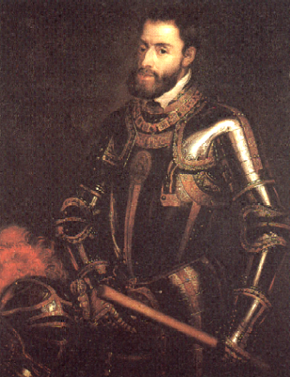
1555
Peace of Augsburg (Germany) allows each ruler to determine religion of his region
The Peace of Augsburg was a treaty signed between Charles V and Protestant princes; it established the first permanent legal basis for the dual existence of Lutheranism and Catholicism in Germany.
Charles V

Slide 170
Or Was He?

Slide 172
Luther translates to correlate with his predetermined interpretationS

Slide 173
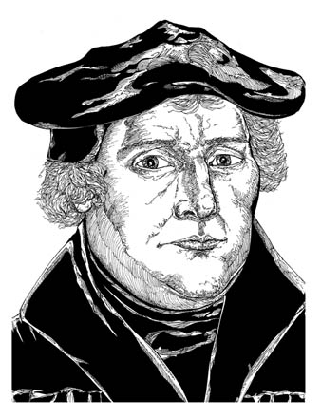
Martin Luther the Monk
While studying the Greek New Testament, Luther saw that God imputes his righteousness to anyone who truly trusts Jesus.
“The passage of Paul,” Luther said, “became my gateway to heaven.”
Martin Luther
Notes:
Illustration by Stephen Hesselman

Slide 174
Romans 1:17
“For in [the Gospel] the righteousness of God is revealed from faith for faith, as it is written,‘The righteous shall live by faith.’”

Slide 175
Translating From Vulgate Into Vernacular
LUTHER ADDS "ALONE" TO TEXT OF ROMANS 3:28!
LUTHER INSERTS "ONLY" IN 3:20 & 4:15!

Slide 176
LUTHER DOES NOT PREACH THE NARROW WAY!

Slide 177
FROM HUMBLE MONKERY UNTO ARROGANT MOCKERY!
HE SAYS: "MY WILL IS THE REASON & I AM DETERMINED TO HAVE IT!"
LUTHER CALLS HIS CRITICS HERE DONKEYS!
Translating From Vulgate Into Vernacular

Slide 178
OF JAMES 2: "BEFORE GOD JUSTIFIED BY FAITH ALONE"
OF JAMES 2: "BEFORE PEOPLE JUSTIFIED THRU WORKS"
Translating From Vulgate Into Vernacular

Slide 179
Battle For The Book Of James
250 A.D. - Origen quotes James extensively.
350 A.D. – Eusebius acknowledges James as both canonical and orthodox. However, he categorizes it along with other of the catholic epistles as “disputed texts” – i.e. the “universal letters” of James 1 & 2, Peter 1 & 2, 3rd John, and the Book of Jude.
450 A.D. – Church Bishops reject all universal letters.
Book Of James Considered Canon For 1,000 Years!
1500 A.D. – Erasmus’ Commentary Doubted James!
German & Swiss Reformer Consider N.T. Apocrypha!

Slide 182
David Lee Burris:
Quaker Saying - “I lift thee up – thou lift me up – and together we ascend to heaven!”
The Book Of James, The First Chapter…
“Pure & undefiled religion before God & the Father is this: to visit orphans and widows in their trouble, and to keep oneself unspotted from the world.”

Slide 183
JAMES CHAPTER TWO

Slide 184
Part One: Faith Presented Unbiased
The setting is that of an assembly of the saints where two men enter, one rich and dressed accordingly and the other poor and typically dressed. The presentation of faith observers will note is seen in the treatment these two visitors receive. When the two men are treated differently, the royal law, “Thou shalt love thy neighbor as thyself” has been violated and the faith has been shamefully misrepresented.

Slide 185
Part Two: The Law Of Liberty
No point of the law may be violated with impunity. Christians must speak and act in harmony with the law of liberty. “We must be uniform in our practice of faith.” … The primary reason is because judgment is coming! Mercy will be sought & found by those extending mercy to others and denied those lacking in such compassion extended toward their fellowman.

Slide 186
Part Three: Justification By Works
The three main points within this chapter are unified by its theme of “the demonstration of faith.” Salvation is emptied out of a faith void of demonstration(v. 14). An obvious requirement of daily sustenance left unsupplied constitutes a “dead faith” (vv. 15-17). James wrote, “Yea, a man may say, Thou hast faith, and I have works: show me thy faith without thy works, and I will show thee my faith by my works” (v.18). The existence of faith is verified in the corresponding actions it generates. Moreover, the only time the term ‘faith only’ appears in the Bible is verse 24: “Ye see then how that by works a man is justified, and not by faith only!”
...not by faith only!

Slide 187
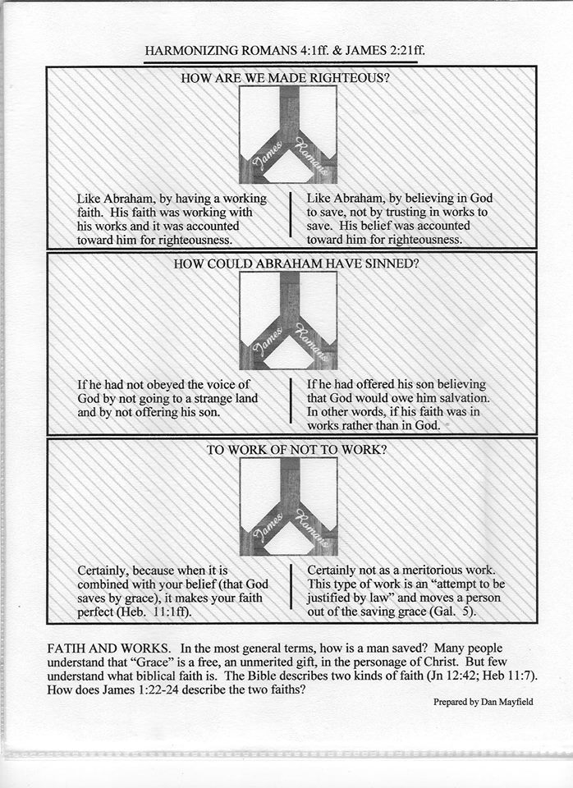

Slide 188
Part Four: Necessary Conclusions
The royal law and the law of liberty find expression in the subject of justification by works. The law of God establishes the rule of conduct or action and limits behaviors & activities to the standard of acceptability as authorized by the revealed word of God, the Bible. Thus, we must be unbiased in our presentation of faith, vv. 1–9. We must be uniform in our practice of faith, vv. 10-13. Finally, we must also be undaunted in our performance of faith, vv. 14-26. Together, this is the “demonstration of faith” about which James wrote.

Slide 191
Or Was He?

Slide 192
“First, their synagogues should be set on fire,…
their homes should be destroyed and they should be put under one roof,
or in a stable, like Gypsies, in order that they may realize
that they are not masters in our land.
But if still considered too dangerous after this,
then these ‘poisonous bitter worms’
should be stripped of their belongings
which they have extorted usuriously from us
And be driven out of the country for all time.”

Slide 193
Questions of character

Slide 194
David Lee Burris:
Southern German peasants remained in the Roman Catholic Church partly because of this apparent betrayal of them by Luther.
AT THE LEAST
100000 DEATHS
1524 ~ 1525
German Peasant's Revolt

Slide 195
“Smite, Stab, and Slay the Peasants!”
Martin Luther to the German Princes

Slide 197
Lutheranism After Luther Philip Melanchthon & Lutheran Slippage
We all know the proverbial pun that the man is head of the family and the wife the neck, but it is the neck that turns the head.
It was something like that in Melanchthon’s relationship to Luther. He not only helped Luther but was in awe of him.
Nevertheless, as we have seen, it was probably Melanchthon and not Luther who turned the Reformation against the Swiss, causing the first great division in Protestantism.
Moreover, it was Melanchthon and not Luther who wrote the first Lutheran systematic theology. Loci Communes (commonplaces) was the first Protestant theology and it was Melanchthon who negotiated with Roman Catholicism at Augsburg in 1530, though Luther was in the background keeping his associate in line.
* Source: Ligonier Ministries Church History Handouts

Slide 198
Lutheranism After Luther Philip Melanchthon & Lutheran Slippage
Nevertheless, Melanchthon never agreed with Luther’s profound Augustinianism, though he never dared differ with him openly while Luther lived.
After Luther’s death in 1546, immediately and openly Melanchthon differed, and Lutheranism gradually slipped back to medieval semi-Augustinianism adopting a more synergistic view of salvation.
After the controversies within Lutheranism settled and the Book of Concord was adopted in 1580, the Lutheran movement had become Luther-anism, not Lutherism.
They agreed with the Reformed up to the point that regeneration preceded faith but then made that faith resistible – a thought alien to the mind of Luther!
* Source: Ligonier Ministries Church History Handouts

Slide 200
The Only One Protestant Denomination
Named After Catholic Church Reformer

Slide 202
Islam Stopped at the Gates Of Vienna

Slide 203
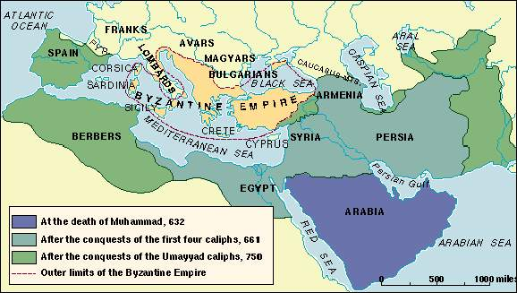
09-11-1653

