Slide 1

HISTORICAL THEOLOGY OF THE CHRISTIAN ERA
FROM APOSTLE TO APOSTATE PATTERN
READ ALOUD – ACTS 20: 28 – 30
READ ALOUD – 1ST TIM. 4: 1 - 3

Slide 2

Medo-Persia
Cyrus’s edict allows Jews to return to Jerusalem. 538 BC
King Xerxes (Ahasuerus) of Persia makes Esther queen. c. 478 BC
Xerxes II
Darius III
Arses
Cyrus
Cambyses
Darius
Xerxes
Artaxerxes
Darius II
Artaxerxes II
Artaxerxes III
500 BC
450 BC
400 BC
350 BC
Gauls sack Rome. 386 BC
Roman Republic established. 509 BC
Peloponnesian War between Athens and Sparta. 431–404 BC
Jewish temple is rebuilt. 536–516 BC
c. = approximately

Slide 3
Greece
Alexander the Great conquers Egypt and Palestine, Hellenization begins. 332 BC
Septuagint (Scriptures translated into Greek in Alexandria). 255 BC
The temple in Jerusalem is rededicated. 164 BC
Alexander the Great
Ptolemies of Egypt
Seleucids of Syria
Hasmonean Dynasty
300 BC
200 BC
100 BC
Judas Maccabeus leads Jewish revolt against the Seleucids. 167 BC
The temple in Jerusalem defiled. 167 BC
Alexandrian Empire divided:
Ptolemy rules Egypt,
Seleucus rules Persia and Syria,
Antigonus rules Macedonia and Greece,
Attalids rule Pergamum. 323 BC.

Slide 4
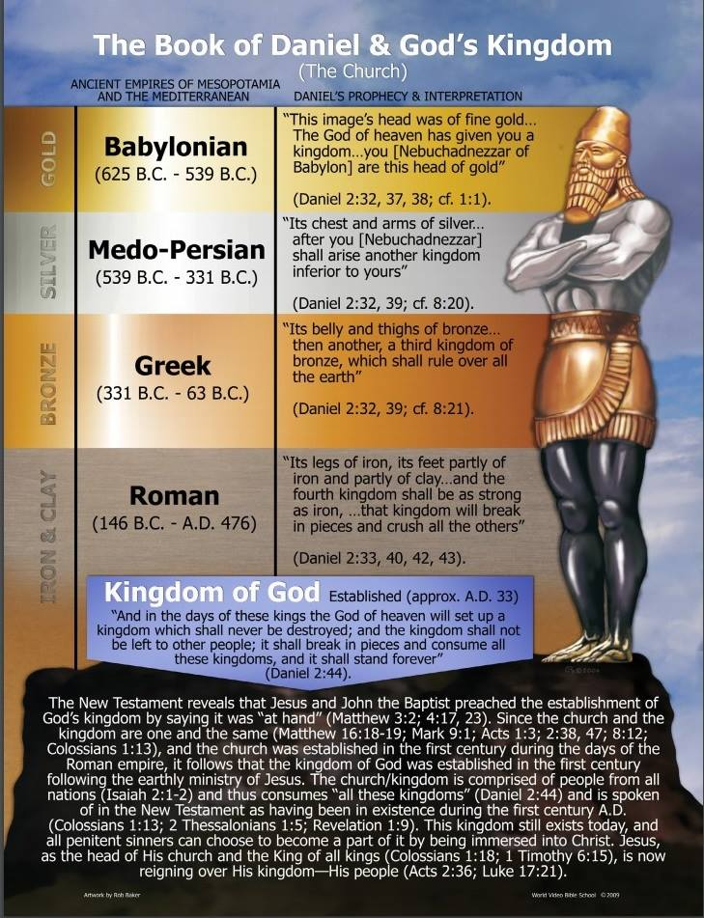

Slide 5
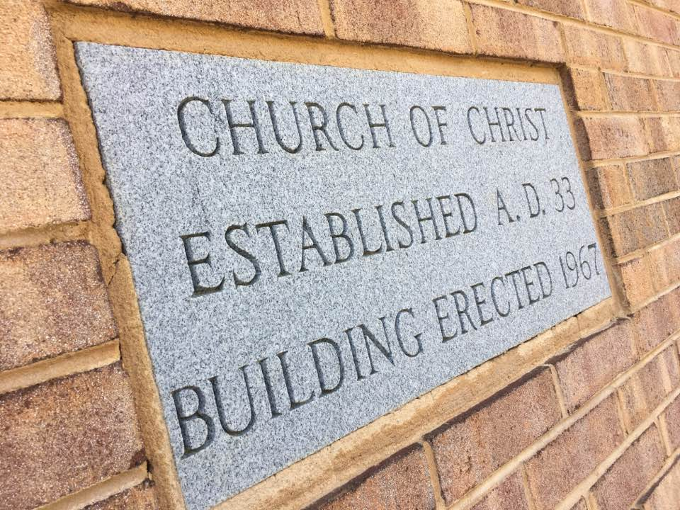

Slide 6
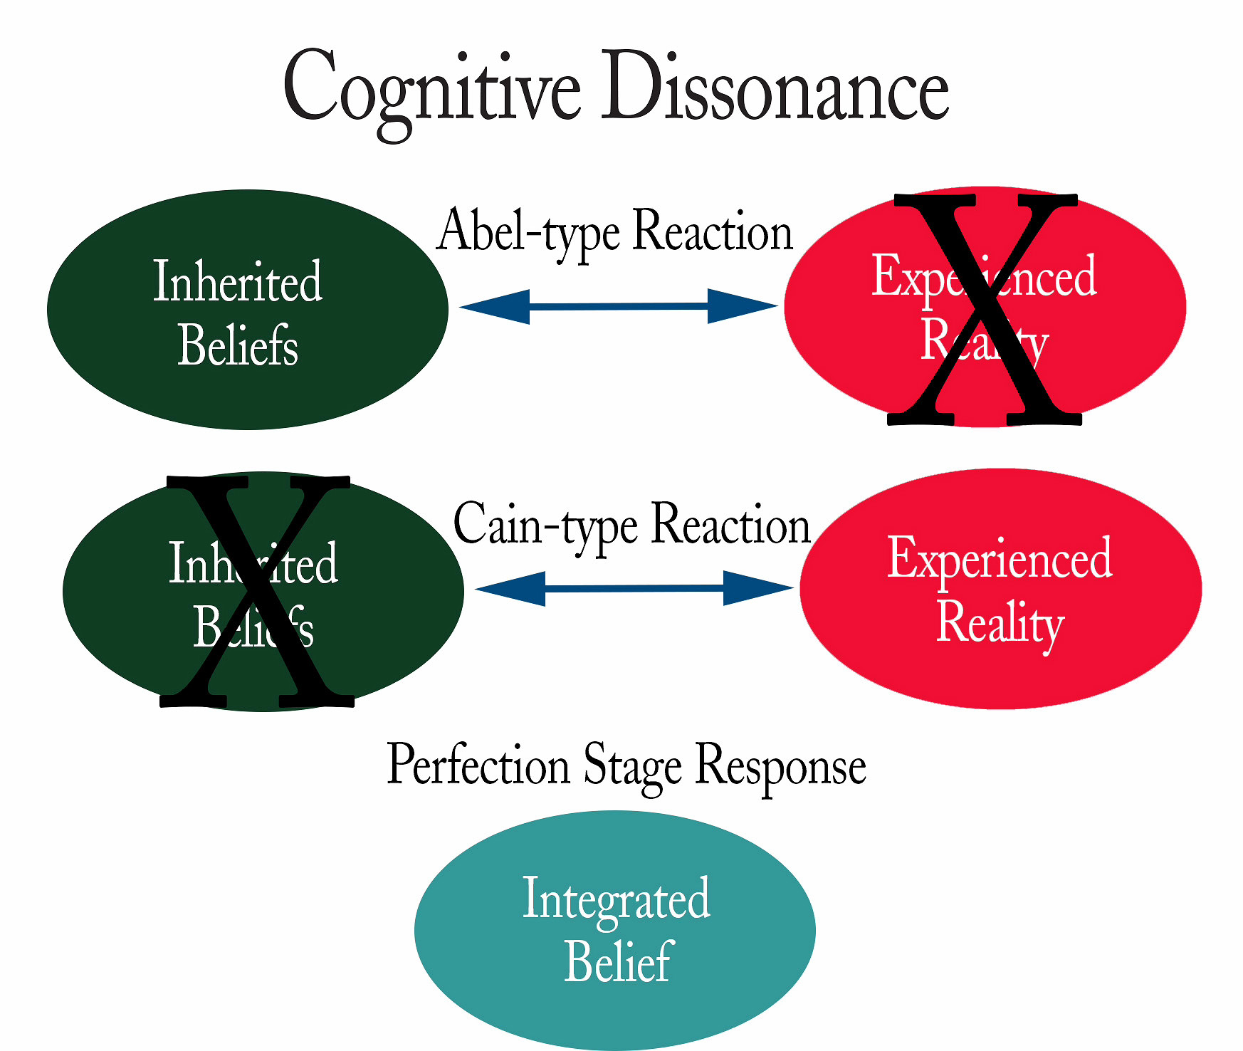
OVERVIEW: APOSTLE TO APOSTATE PATTERN
1ST CENTURY CONTINUITY AS ANALYSIS HAS SHORTCOMING
SINGLE POINT ANALYSIS IS WRONG WITH SERIAL DILUTION
BRO. DAVID HARRELL’S SECT-TO-DENOMINATION PROCESS
CHURCH HISTORY TOPICAL-CHRONOLOGICAL THREADLINE
EXEGETICAL THEOLOGY IS VERSE-PASSAGE-STORY ANALYSIS
BIBLICAL THEOLOGY IS CROSS DISPENSATIONAL TOPIC ANALYSIS
HOMILECTICAL THEOLOGY: CONTEXTUALIZATION & APPLICATION
SYSTEMATIC/PRACTICAL THEOLOGY: ORTHODOXY/ORTHOPRAXY
HISTORICAL THEOLOGY IN W. LINEAR & E. CIRCULAR TIME ANALYSIS
DEBATE SOCIETY W/ ACTION GROUP: DOCTRINE MORPHS DOGMA
DOCTRINE VERSUS DOGMA H.T. IN “BIG T” TRADITIONAL PRACTICE
DOCTRINE VERSUS DOGMA H.T. IN “little t” TRADITIONAL THOUGHT
TWO SCHOOLS OF LATE JEWISH THEOLOGY
Babylonian Expatriot Influence @Antioch
Hellenistic Greek Influence @Alexandria
Authority
Ambiguity
ACCEPTANCE

Slide 7

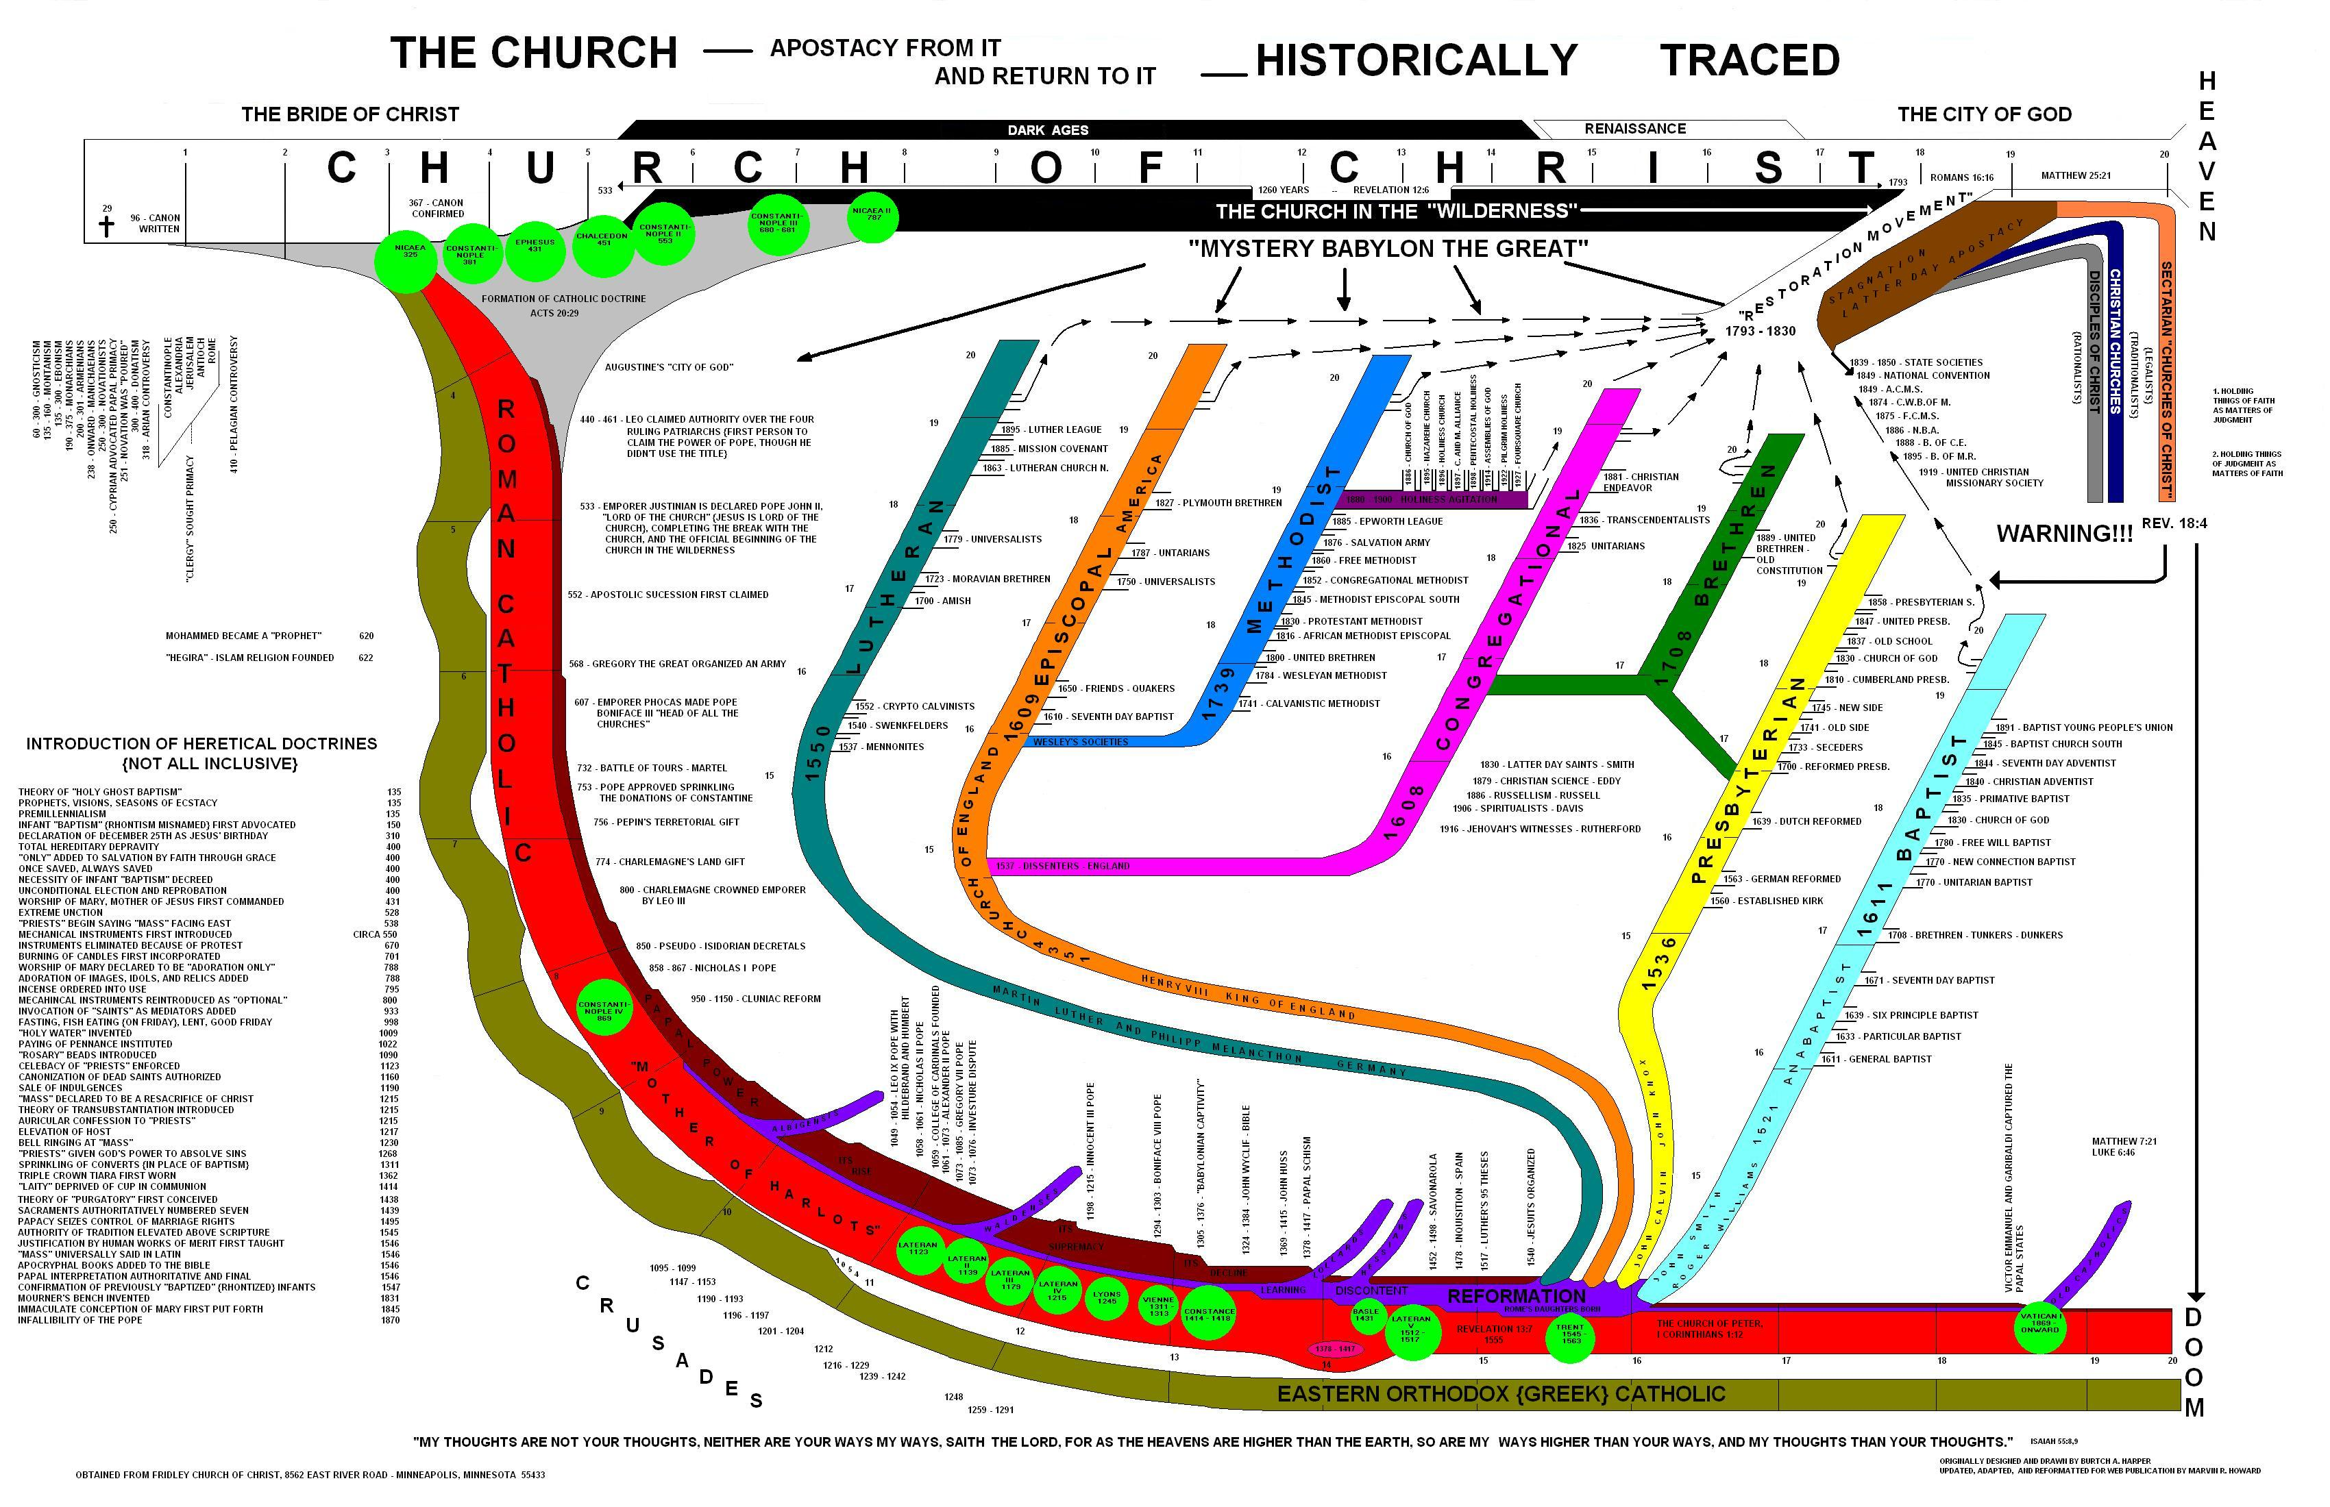

Slide 8
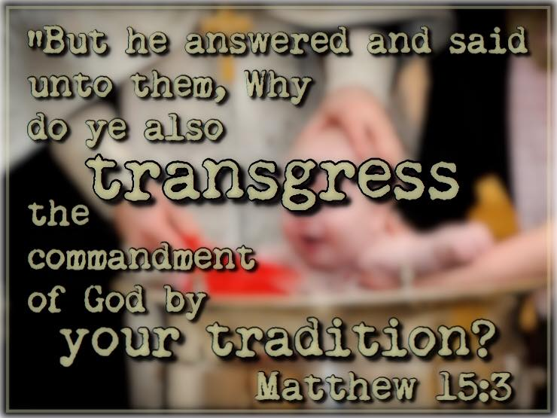

Slide 9
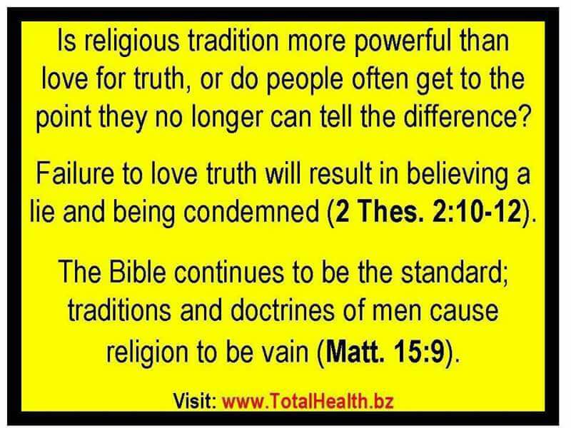

Slide 10
Doctrine Versus Dogma
Distinguishing dogma and doctrine. "A doctrine is often the direct, naive, expression of a religious truth. It is not necessarily formulated with scientific precision and when it is, may be merely the formulation of a single person. A religious dogma, on the other hand, is a religious truth based on authority and officially formulated by some ecclesiastical assembly." Dogmas, in this sense, are not found in Scripture. "They are the fruit of human reflection, the reflection of the Church, often occasioned or intensified by theological controversies."
In summary: "A dogma may be defined as a doctrine, derived from Scripture, officially defined by the Church, and declared to rest upon divine authority. This definition partly names and partly suggests its characteristics. Its subject-matter is derived from the Word of God and is therefore authoritative. It is not mere repetition of what is found in Scripture, but the fruit of dogmatic reflection. And it is officially defined by a competent ecclesiastical body, and declared to rest upon divine authority. It has social significance, because it is the expression, not of a single individual, but of a community. And it has traditional value, since it passes the precious possessions of the Church on to future generations." Dogma arises from the reflection on the "truths of revelation" by the "body of believers" and through the formulations of "competent representative bodies" of the Church. "Since the reflection of the Church is often determined and deepened by doctrinal controversies, the formulations to which Church Councils or Synods are finally led under the guidance of the Holy Spirit often bear the earmarks of past struggles. They are not infallible but yet have a high degree of stability. And they are authoritative, not merely because they are proposed by the Church, but *formally* as defined by the Church and *materially* as based on the Word of God."

Slide 11


Borders Of God’s Word

Slide 12
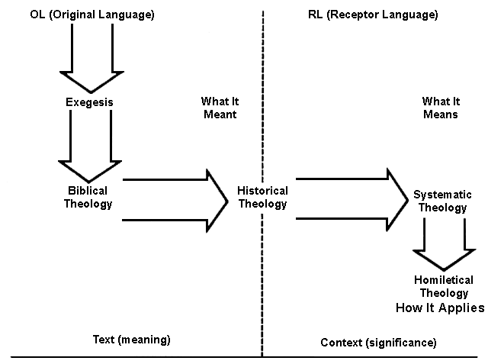

Slide 13


Systematic Theology
“The attempt to summarize religious truth or the belief system of a religious group through an organized system of thought carried out within a particular cultural and intellectual context.”
* Dictionary Of Theological Terms, Grenz & Guretzki

Slide 14
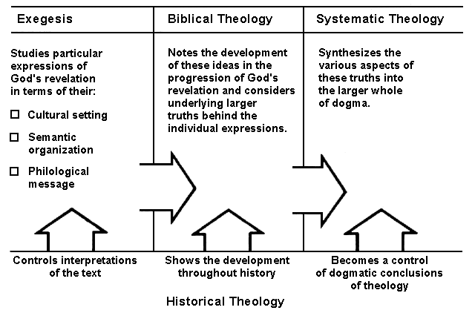

Slide 15
OVERVIEW: APOSTLE TO APOSTATE PATTERN
1ST CENTURY CONTINUITY AS ANALYSIS HAS SHORTCOMING
SINGLE POINT ANALYSIS IS WRONG WITH SERIAL DILUTION
BRO. DAVID HARRELL’S SECT-TO-DENOMINATION PROCESS
CHURCH HISTORY TOPICAL-CHRONOLOGICAL THREADLINE
EXEGETICAL THEOLOGY IS VERSE-PASSAGE-STORY ANALYSIS
BIBLICAL THEOLOGY IS CROSS DISPENSATIONAL TOPIC ANALYSIS
HOMILECTICAL THEOLOGY: CONTEXTUALIZATION & APPLICATION
SYSTEMATIC/PRACTICAL THEOLOGY: ORTHODOXY/ORTHOPRAXY
HISTORICAL THEOLOGY IN W. LINEAR & E. CIRCULAR TIME ANALYSIS
DEBATE SOCIETY W/ ACTION GROUP: DOCTRINE MORPHS DOGMA
DOCTRINE VERSUS DOGMA H.T. IN “BIG T” TRADITIONAL PRACTICE
DOCTRINE VERSUS DOGMA H.T. IN “little t” TRADITIONAL THOUGHT
TWO SCHOOLS OF LATE JEWISH THEOLOGY
Babylonian Expatriot Influence @Antioch
Hellenistic Greek Influence @Alexandria

Slide 16
Historical Theology
“The division of the theological discipline that seeks to understand and delineate how the church interpreted scripture & developed doctrine throughout its history and to show the origin & development of beliefs held in the present day.”
* Dictionary Of Theological Terms, Grenz & Guretzki

Slide 17
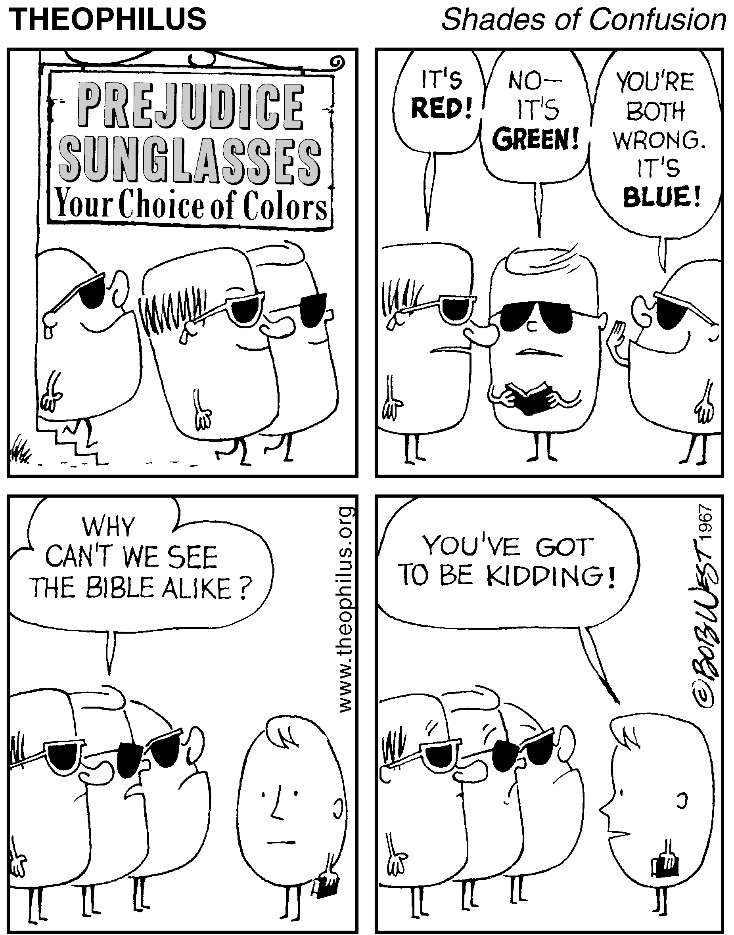
  “We converse with history’s greats by first trying on their blindfolds.”

Slide 18
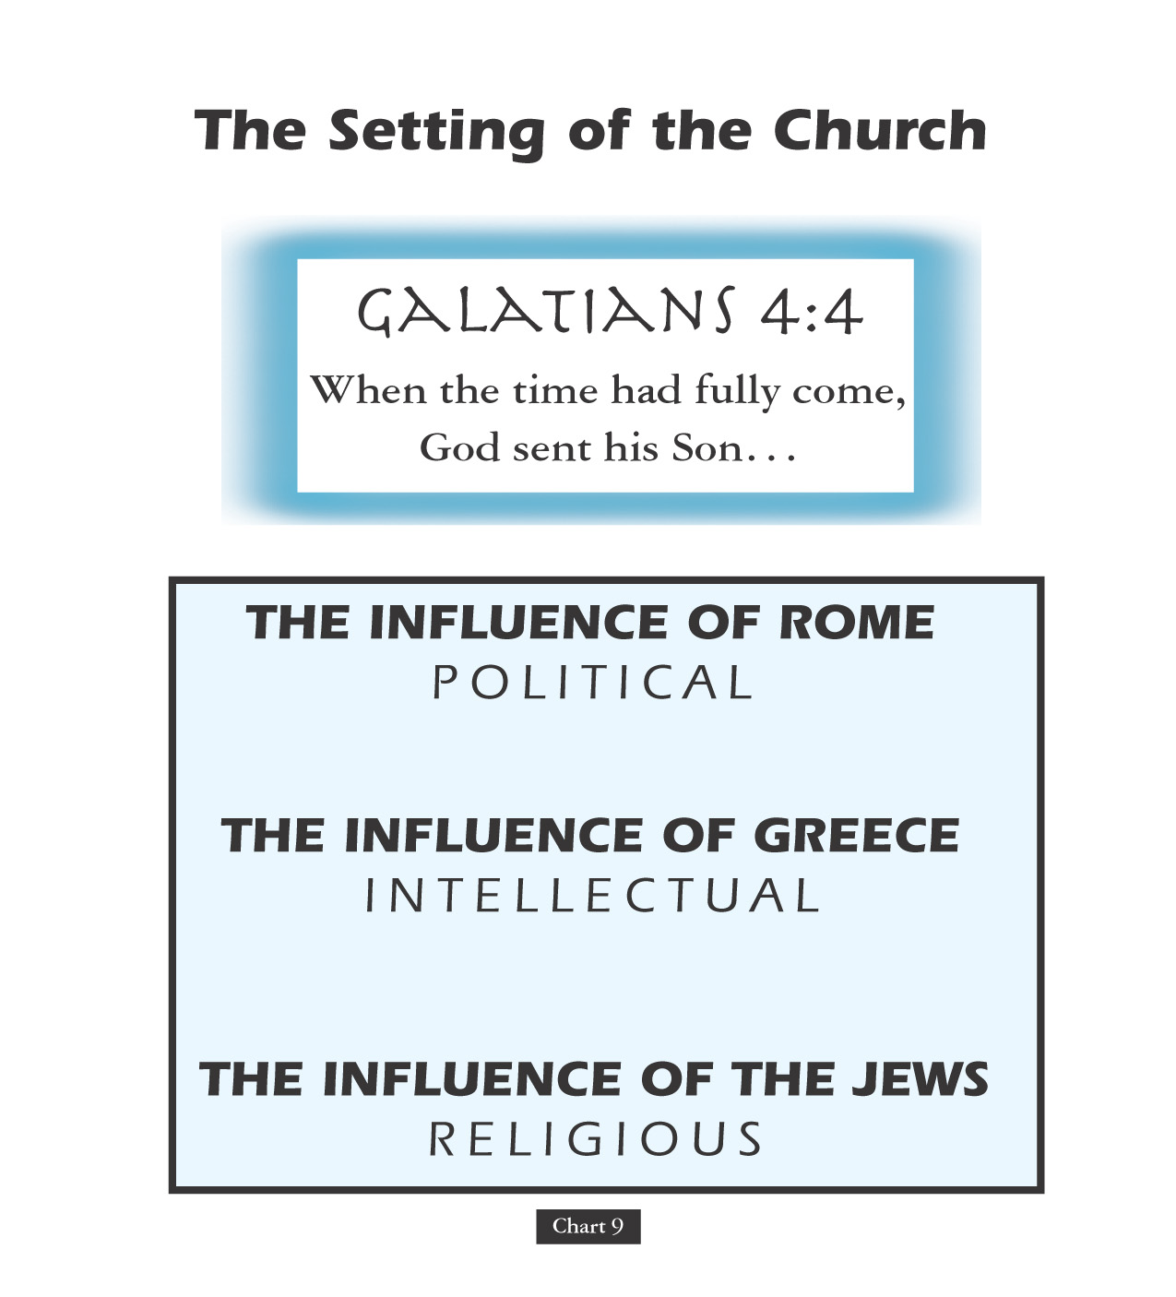

Slide 19

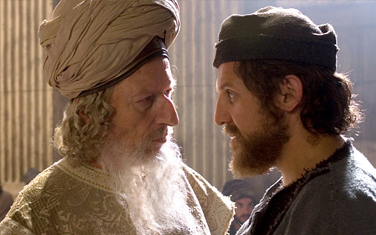
The Sect Of The Sadducees Stressed The Temple Seasonal Observances & Priestly Intercession Rather Than Moral Lessons, Personal Lifestyle Or Any Identifiable Individual Applications Of Scripture!
Sadducees..
Halakhic Letter Lists 22 Disputes W/ Pharisees

Slide 20
The Sect Of The Sadducees Stressed The Temple Seasonal Observances & Priestly Intercession Rather Than Moral Lessons, Personal Lifestyle Or Any Identifiable Individual Applications Of Scripture!
Sadducees..
FROM DISPUTES OVER WRITTEN O.T. LAW VERSUS MOSAIC ORAL LAW
UNTO DEBATES OVER RABBINIC WRITING VERSUS ORAL AUTHORITY

Slide 21

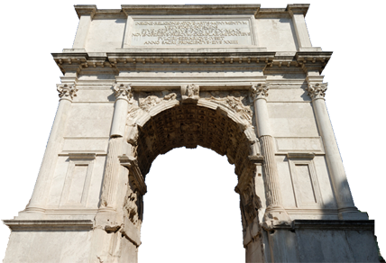
Destruction of Temple—AD 70
After the destruction of the Jewish temple, the Jewish and Christian faiths each became more distinct as
Judaism became
less diverse.
The Arch of Titus commemorates the destruction of the temple
Notes:
Image: © pippa west

Slide 22


The Church Across The Ages
of people, events
life and faith from
Glimpses
Population Statistics
Researcher David Barrett chronicles that by the year 300, or nine generations after Christ, the world was only 10.4% Christian with 66.4% of these believers Non-whites. The scriptures had been translated into ten languages. More than 410,000 individuals, representative of one in every 200 believers from the time of Christ, had given their all dying as martyrs for the faith.

Slide 23
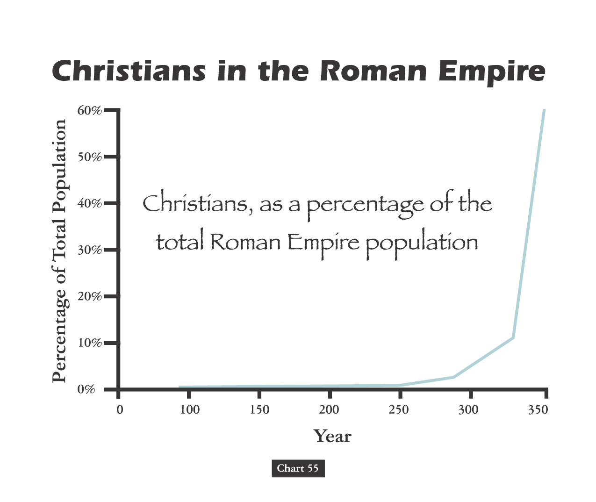

Slide 24
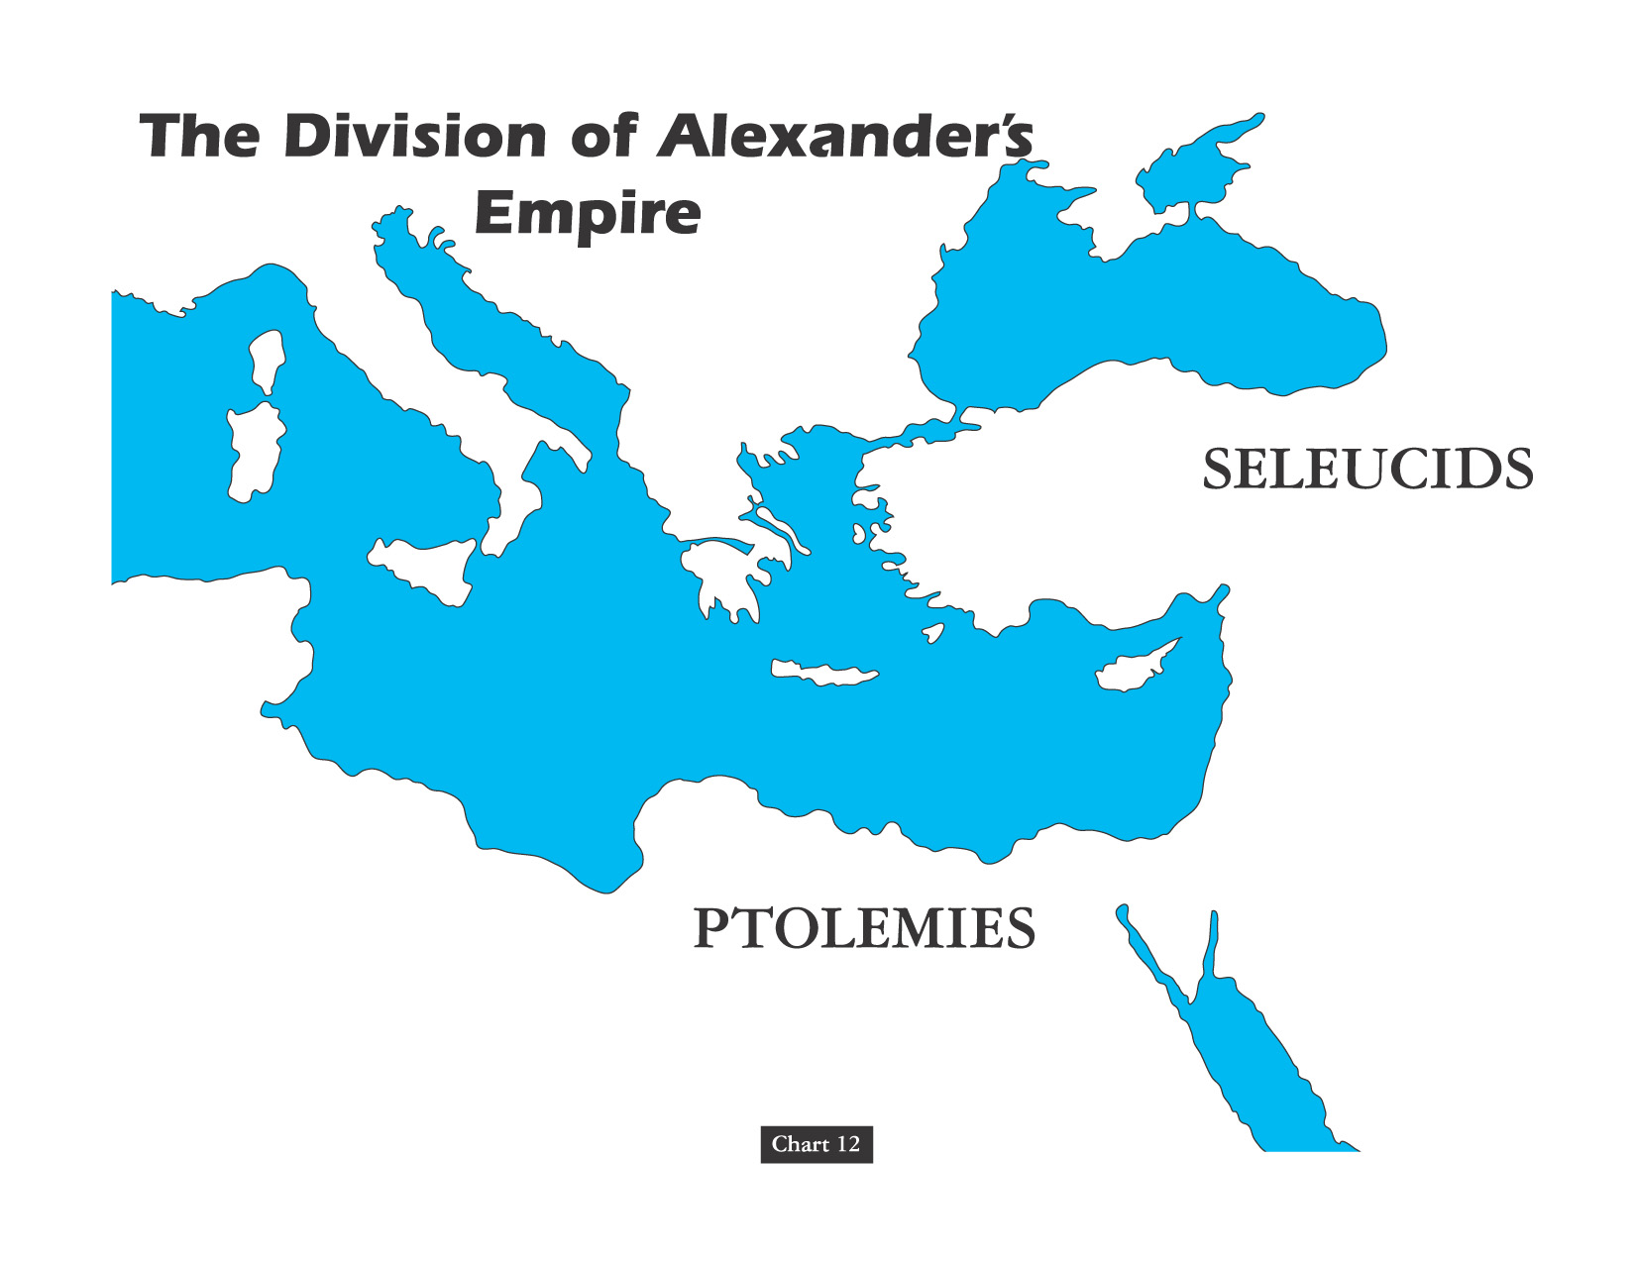
The Basic Division Over Time

Slide 25
OVERVIEW: APOSTLE TO APOSTATE PATTERN
2 CHRISTIAN SCHOOLS OF BIBLE INTERPRETATION
Antioch’s Historical & Alexandrian Allegorical
Typological-Allegorical @O.T. Type & Anti-type
Typological-Allegorical @Redemptive Archetype
Adopted Aristotle’s Thesis - Anti-Thesis Dialectic
ILLUSTRATION: Alexandria’s Origen @Purgatory
ORIGINAL ERROR @ORIGINAL INHERENT SIN
CHANGES IN ORGANIZATION & BROTHERHOOD
CHANGES IN ASSEMBLY & AUDITORIUMS
ILLUSTRATION: Return of the Mose’s Seat
CHANGES IN PARTICIPATORY WORSHIP
ILLUSTRATION: Memorial of the “Missa”
1st Clement: Only Elders Served “Worthy”
CHANGES IN PARTICIPATORY THEOLOGY
ILLUSTRATION: Catechetical Preparation
EARLY ERROR BUILT ON THREE FALSE ASSUMPTIONS
#1 Assumption: Paul Convert Clement Received As Apostle
#2 Assumption: Origen Explains Trinity Concept Sequential
#3 Assumption: Irenaeus Portrays Jesus Mother @Anti-Eve

Slide 26
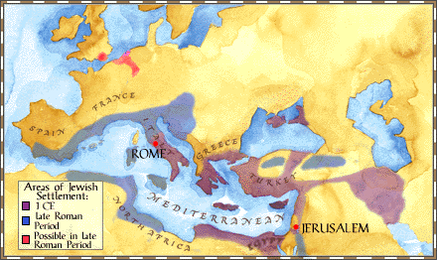
The Antiochene School Of Theology Practiced An Approach To Scriptural Interpretation With Literal Emphasis Rather Than Spiritual Meanings Not Immediately Evident From The Text
Antioch Center Of Christian Theology

Slide 27
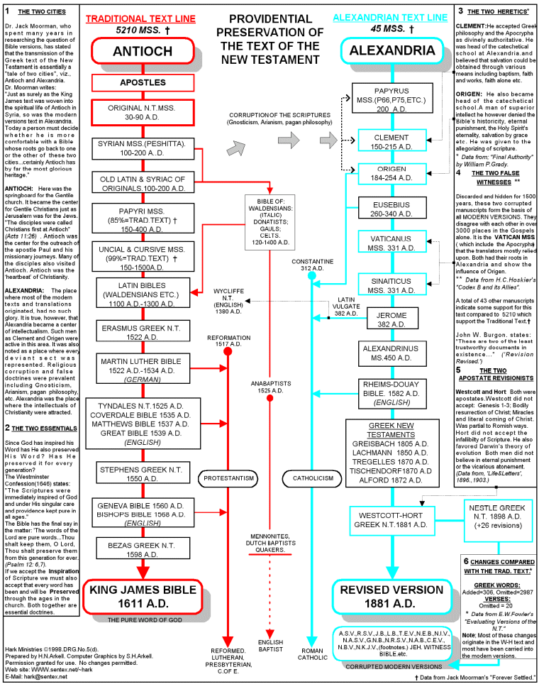

Slide 28
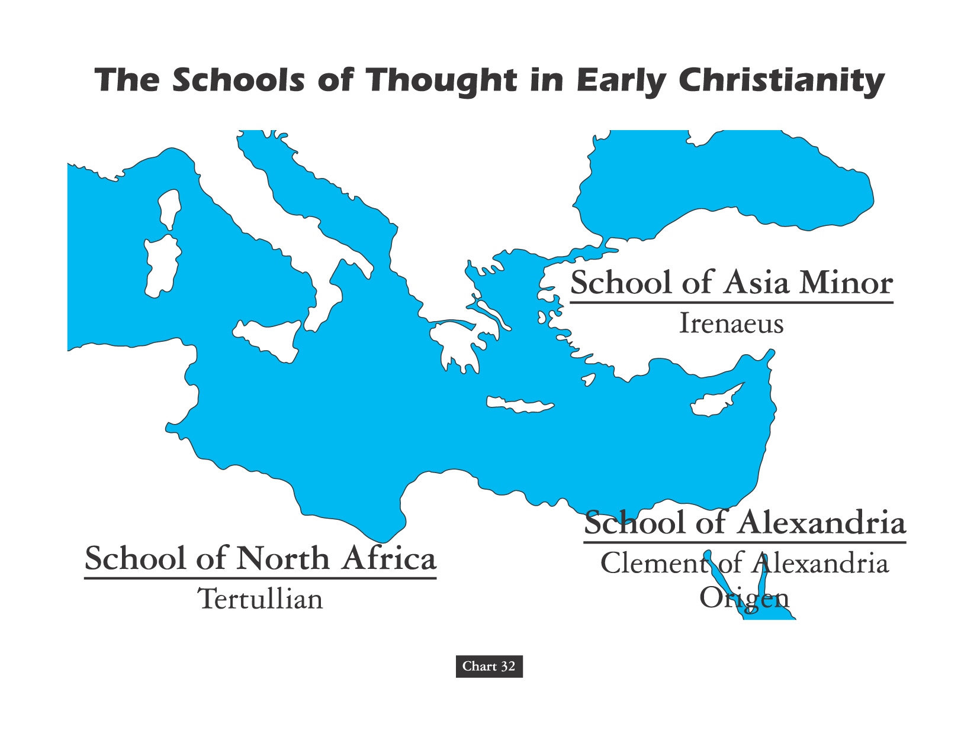

Slide 29
The Alexandrian School Was Influenced By Plato’s Philosophy & Basically Believed That The Bible Was Best Understood As An Allegorical Morality Rather Than As A Literal Interpretation.
Alexandria Center Of Christian Theology

Slide 30

David Lee Burris:
End First Century – 7% Of World Population Jewish & Christian Numbers In 100,000’s
Didache An Early Christian Document That Warned About Trickery Of Some Traveling Preachers – It Said To Feed Such Preachers & House Them But If They Ask For Money Ask Questions; Didache 7 Also Adds By Insistence On Living OR Moving Water
ONLY 100 YEARS AFTER APOSTLES: Preaching Crucifixion to Catechetical Teaching
Egypt’s Alexandria was the center of early learning, having a large university with a voluminous library. In the last quarter of the second century, churchmen established a catechetical (learning by the questioning process) school in Alexandria. Two great luminaries shine as leaders of that school in the persons of Clement of Alexandria and Origen. Both interpreted the Scriptures allegorically rather than historically, as was the method of interpretation from Antioch.
Didache: Simple Obedience No Longer An Event But A Convoluted Process

Slide 31
David Lee Burris:
End First Century – 7% Of World Population Jewish & Christian Numbers In 100,000’s
Didache An Early Christian Document That Warned About Trickery Of Some Traveling Preachers – It Said To Feed Such Preachers & House Them But If They Ask For Money Ask Questions; Didache 7 Also Adds By Insistence On Living OR Moving Water
ONLY 100 YEARS OR ONE CENTURY: Preaching Crucifixion to Catechetical Teaching
Egypt’s Alexandria was the center of early learning, having a large university with a voluminous library. In the last quarter of the second century, churchmen established a catechetical (learning by the questioning process) school in Alexandria. Two great luminaries shine as leaders of that school in the persons of Clement of Alexandria and Origen. Both interpreted the Scriptures allegorically rather than historically, as was the method of interpretation from Antioch.
200 Yrs: Baptism Ceremonial Event & Immersion Of Critical Exemption

Slide 32
In Athens Paul Preaches Of Another Hill
400 YRS: REFINED GOLD MEAN
TO DIALECTIC MATERIALISM
THESIS
SYNTHESIS
ANTI-THESIS

Slide 33

Ideological Development: Christian Religion
David Lee Burris:
Apokatastasis: A Greek word loosely translated as “Restoration.” In the OT the Hebrew equivalent of the term referred to the return of Israel from exile(see Jeremiah 16:15). In the NT it speaks of a future time when God in Christ will restore all things in creation according to God’s original intention. Some theologians have taken this to mean that at the end of history all humankind (and perhaps Satan & his demons) will be saved.
Jerome Reported Of Origen’s Teachings
“Origen’s teaching states that all rational, invisible, non-corporeal creatures [here angels], if they are careless, little by little slide toward the depths. From the matter toward which they descend, they take on airy, ethereal bodies with human flesh. Meanwhile, if the demons, who by their own decision under the Devil’s leadership fell away from the Lord’s service, had just barely come to their senses, they also would be dressed in human flesh, so that, each one having done his penance, they would begin to rise in the same circular movement by which they first entered the flesh and would be returned to nearness to God, whereupon they would shed their airy ethereal bodies. And then all things would kneel to the God of the heavens, the earth & the underworld, and God with us, would be everything.”

Slide 35


David Lee Burris:
Christian Emperor Theodosius invited Thessalonians to free games but sent his troops into the circus with orders to kill the 10,000 men, women, and children.
“The first recorded instance of Christians killing Pagans occurred shortly after {status change year 313}. In short order, the militant church extended its power by conquering lands & peoples throughout Europe, compelling them to become baptized Christians or die… As Charlemagne instructed his Christian troops in their conquest of the Saxons: ‘If there is anyone of the Saxon people lurking among them unbaptized, and if he scorns to come to baptism & stay a pagan - let him die’”.
Orthodox Versus HERETIC
Heresies are inaccurate choices in light of non-negotiable realities: “Heresy is an opinion or doctrine in philosophy, politics, science, art, etc., at variance with those generally accepted as authoritative” (Oxford English Dictionary) Heresies are incorrect choices, based on some generally accepted authority. From a Christian perspective, heresies are claims contradicting the clear objective truths described in the Bible. Irenaeus (the ancient apologist and disciple of Ignatius and Polycarp) made careful distinctions between heresies and apostolic truth. In “Against Heresies”, Irenaeus laid out the heretical claims of some of his errant contemporaries, and compared these claims to the truths he had been taught by Polycarp (the disciple of the Apostle John). Irenaeus referred to his own beliefs as “orthodox”. This word is derived from two Greek root words: Orthodox = Ortho (Right) + Dox (Belief) In essence, Irenaeus used the word to describe those beliefs supported by the apostolic, Biblical teaching. The idea of a “right belief” presumes there are objectively accurate Christian truths, and the Bible is the authority upon which we discover these “right beliefs”. Like all humans, Christians ground truths in an authoritative text. - COLD CASE CHRISTIANITY
- Gregory Boyd, Myth Of A Christian Nation

Slide 36
Irenics Vs. Polemics
“The practice of debating and discussing Christian doctrine with other Christians with whom there are matters of genuine theological disagreement. It involves the friendly rigorous task of doing theological reflection together within the community of faith.”
* Dictionary Of Theological Terms, Grenz & Guretzki

Slide 37

????????????

Slide 38
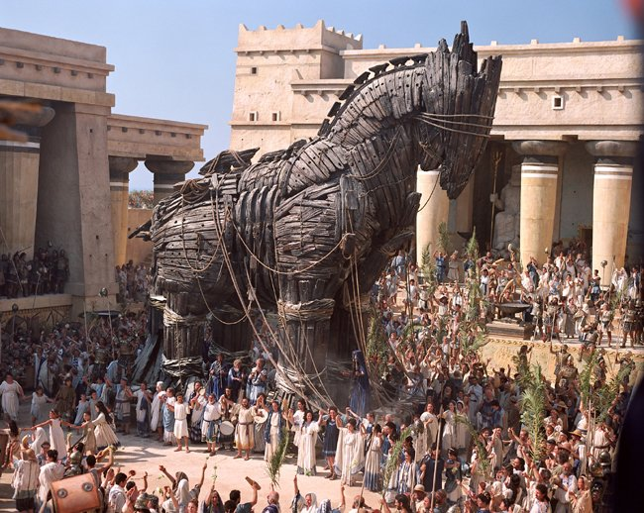
Sinon’s Story…
Construction Actually A Holy Offering To Benefit The Greeks & The Horse Built Huge So As Not To Be Brought Within The City Gates Benefiting The Trojans Instead.

Slide 39
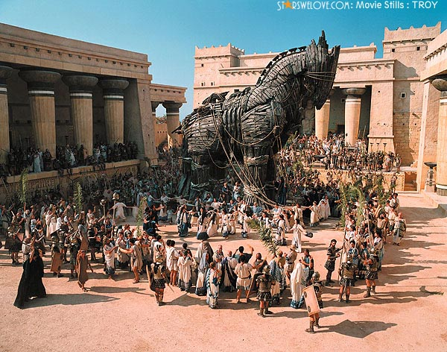
The Trojan Response:
They put wheels under it and break down a wall and, using ropes, haul the trophy inside the city, to the temple of the goddess it was dedicated.

Slide 40
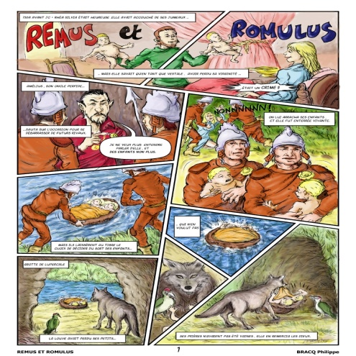
Classical Romans Trace Their Mythical Founding & Ancestry To The Trojan Prince Aeneas!

Slide 41

DEFENDING THE FAITH
EXEGETES
APOLOGISTS
DOGMATISTS
CREEDAL
Eastern School
WESTERN
While understanding the powerful influence of philosophy – particular Platonism and Stoicism - on the morality and conduct of Rome’s ruling classes was critical to overcoming official obstacles – reaching the masses required Christians giving answer to their pagan critics.
Exploring both Christianity’s pagan critics and its apologists reveals not only an evolution in pagan understanding of the new faith but a corresponding increase in the sophistication of the writings set forth by those defending it.

Slide 42
DEFENDING THE FAITH
EXEGETES
APOLOGISTS
DOGMATISTS
CREEDAL
Eastern School
WESTERN
The 2nd Book of Marcus Aurelius Meditations Emperor A.D. 138-161 – Marcus Aurelius believed that the way to the meaning in our lives lies in first understanding that we have a soul, and that soul partakes of the essence of God, that soul partakes in of the essence that fate, through God, has decreed for each one of us, for each of us has a destiny.

Slide 43
DEFENDING THE FAITH
EXEGETES
APOLOGISTS
DOGMATISTS
CREEDAL
Eastern School
WESTERN
The Stoic philosophical school had played a major role in the concept of God. The Stoics taught a noble idea: God is the universe. And in the words of the Stoic thinker and poet Cleanthes, ‘God is all-good, all-beneficent , all-knowing. God is perfection, and that God has decreed for the universe all the stars that move, every creature in that universe. He has given to each individual a soul, and decreed for that soul a fate.’ It is a monotheistic idea. An idea that paved the way for the ultimate triumph of Christianity.

Slide 44
Doctrinal Developments & Theological Threadlines
The Minority Church: Exegesis & Apologetics
Socratic Dialogue & Apologetic Platoism
The Dogma of the Dominant Religion:
Exegetes-Apologists-Theological Systemists
Process: Thesis - Anti-Thesis - Greek Golden Mean

Slide 45
OVERVIEW: APOSTLE TO APOSTATE PATTERN
EARLY ERROR A RESULT OF ONGOING GREEK INFLUENCE
EXEGETES, DOGMATISTS & APOLOGISTS; POLEMICS & IRENICS
FULLTIME FUNCTIONAL SEPARATION & PROFESSIONAL CLERGY
ACADEMY EDUCATION & SEMINARY SYSTEMS STUDY
NICOLAITAN DOCTRINE MORPHS INTO LIBERTINE GNOSTIC
EARLY ERROR AN OUTCOME OF ONGOING GNOSTIC DEBATE
CONTROLING GNOSTICS BY CREATING CHURCH HIERARCHY
COMBATING GNOSTICS BY COUNCILS, CANONS, & CREEDS
EMPIRE WIDE PAGAN PERSECUTION IN THIRD CENTURY
NOTE: Auricular (Readmission) Confession to Decius Martyrs
EUSEBIUS @Caesarea: Chiliast Eschatology Major Viewpoint
FOURTH CENTURY & DARK AGE: REFORMERS RESET POINT

Slide 46

“Teaching As Doctrines The Traditions Of Men”
WORSHIP & BAPTISM
David Lee Burris:
For Four Centuries Christians Believed Celebrating Children’s Birthdays Worldly & Pagan Ritual – Only Celebrated “Birthdays” Of Martyrs Death - Early Christians Definitely Didn’t Celebrate Christ’s Bethlehem Birth!
Justin Martyr: “Bread is presented and wine and water” Common practice - dilute wine with water - counter potency.
Division in the worship service between the part that all could attend (Scripture reading/ preaching) & that part only the faithful could attend (Lord’s Supper), called the disciplina arcani (“rule of secrecy”) occurred in the third century.
Ante-Nicene writings began to consider that the communion prayers were the congregations corporate thank-offering to the Lord, hence the usual designation was ‘eucharist” (thanksgiving).
Ideas related to this concept developed:
The Eucharist imparts divine life of itself, reflected in the descriptive phrase “medicine of immortality” (Ignatius).
The elements are a sacrifice offered by the priest (Cyprian).
Lastly, there is a real presence of Christ (Irenacus).
POURING was permitted by the Didache and practiced in regard to one on his sickbed (Cyprian), but the normal practice was immersion, in fact, trine (3 times) immersion (Tertullian).
THE EFFICACY of baptism in bringing the remission of sins was not questioned, hence many put off baptism as long as possible, lest such a powerful act be wasted before one’s life of sin was over.
Great elaboration in the BAPTISM RITUAL took place (Tertullian, On Baptism and Hippolytus, Apostolic Tradition), testifying to the high regard the ceremony was held.
The earliest definitive reference to INFANT BAPTISM is in Tertullian, who opposed the practice, but it became common in the third century and was advocated by Cyprian.

Slide 47
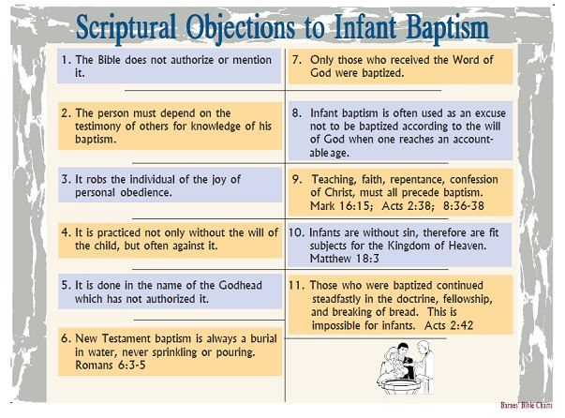

Slide 48
David Lee Burris:
Christian Emperor Theodosius invited Thessalonians to free games but sent his troops into the circus with orders to kill the 10,000 men, women, and children.
“The first recorded instance of Christians killing Pagans occurred shortly after {status change year 313}. In short order, the militant church extended its power by conquering lands & peoples throughout Europe, compelling them to become baptized Christians or die… As Charlemagne instructed his Christian troops in their conquest of the Saxons: ‘If there is anyone of the Saxon people lurking among them unbaptized, and if he scorns to come to baptism & stay a pagan - let him die’”.
Original Error @ ORIGINAL SIN
Inter-Generational Sinful Consequence (Exodus 34: 7)
Not Sin Inherent - Or - Guilt Imputed
(Ezekiel 18: 19 – 32)
- Gregory Boyd, Myth Of A Christian Nation
JESUS REVISITS MISCONCEPTION @JOHN 9: 1 - 5

Slide 49

INHERITING ORIGINAL SIN
THE BLAST FROM THE PAST
Posterity’s Uncritical Acceptance Of Augustine’s Christian Platonism
Platonists believed that all physical objects are simply copies of eternal, immaterial templates or Forms. This means that two objects of the same kind have a sort of connection because they both depend on the same Form. So the terrible taint of Adam can spread to those who share his Form, the Form of humanity. This inheritance concept of fatalistic disposition and consequence can similarly be linked to classic theories of genetics. It was believed that everything children inherit is received from the father alone. The mother contributed nothing material to fetal development and served simply as an incubator. It was considered a matter of simple common sense that embryo existed entire in seed form within the male before implantation. The father once existed in seed form in his father too, and so on – and so on - all the way back to the Garden of Eden - similar to a set of Russian Dolls.

Slide 50
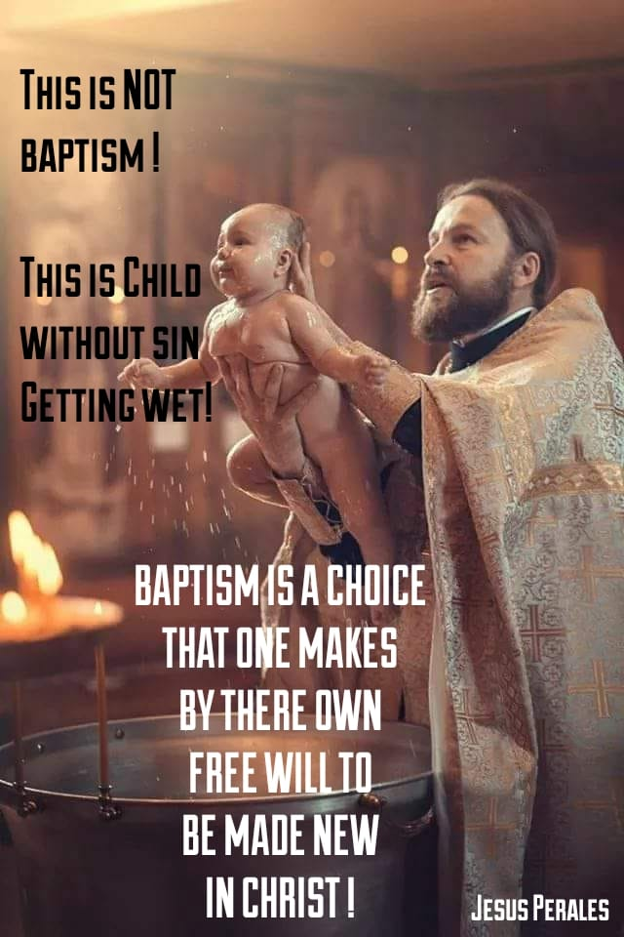

Slide 51
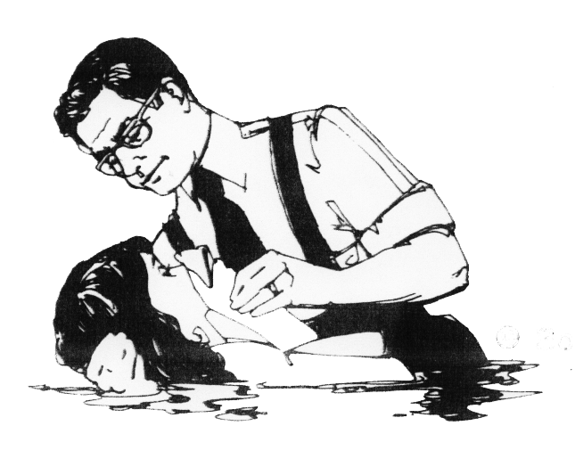
CHANGES IN AUTHORITY
Salvation
Sins Washed
Union Christ
Faith
Repentance

Slide 52
Dialectic Rationale: Conclusions Of Consequence
"Baptism must not always be immersion,
because some do not have access to
enough water to be immersed."
CONVENIENCE NULLIFICATION

Slide 53
Dialectic Rationale: Conclusions Of Consequence
"Baptism must not always be immersion,
because some do not have access to
enough water to be immersed."
The Damp Cloth

Slide 54
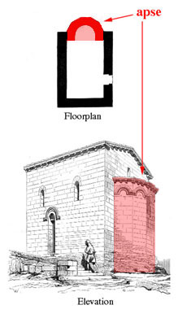
Church Administration Digression & Christian Doctrinal Accretions Architecturally Evidenced
Development In Designs:
From House Church To General Public Building To Basic Roman Temple
Constantine’s Edict of Milan in 313 soon influenced the buildings used for Christian worship. He built St. John Lateran, a church designed on the plan of a basilica, a Roman public building used for courts, etc. The basilica was a rectangular building with a semi-circular niche or “apse” opening off one of the shorter ends. This plan provided much more space for the larger congregations worshiping after 313.
The apse, where judges or other officials sat in public buildings, now became the area where the clergy sat. A throne was set up in the center of the apse for the bishop. We can see this seat in the apse of the preserved fifth-century built church in Gardo, Italy.
The arrangement of the basilica with the clergy in a separate area made for a distinct barrier between clergy and laity – hardening a broad trend begun in the 4th century. Gone were the friendly, intimate services which the Christian had held in their home.

Slide 55
The Church Across The Ages
of people, events
life and faith from
Glimpses
More Than A Building
The earliest Christians did not have church buildings. They typically met in homes. [The first actual church building to be found is at Dura Europos on the Euphrates, dating about 231.] They did not have public ceremonies that would introduce them to the public. They had no access to the mass media of their day. So how can we account for their steady and diverse expansion over the first three centuries?
After the Apostle Paul, we do not run across many “big names” as missionaries in the first few hundred years of Christian history. Instead the faith spread through a large multitude of humble, ordinary believers whose names have been long forgotten.

Slide 56
Church Administration Digression & Christian Doctrinal Accretions Architecturally Evidenced
- The upper end of the building held the porch where catechumens and those under discipline (penitents) were restricted.
In the building center – between the columns – is the nave – where the choir & lower clergy sang together.
The remainder – what was considered the congregation – tended to be confined to the side aisles with men on one side and women on the other.
About this time the liturgy changed from being a service in which all participated into one said by the clergy and sung by the choir while others listened.
Correspondent uniform wearing of priestly vestment and ritual robes of rank started around this time too.
Note: The modern Greek or Eastern Orthodox Church has been defined as a frozen clock - stuck in time to these very coordinates of the 4th thru 5th Centuries. For example: The Orthodox churches still use the old Julian Calendar of the original Roman Empire for both routine religious observances and special celebrations. In other words, many of these described design features from back then can be seen in the present church buildings and church services of that church group today.

Slide 57
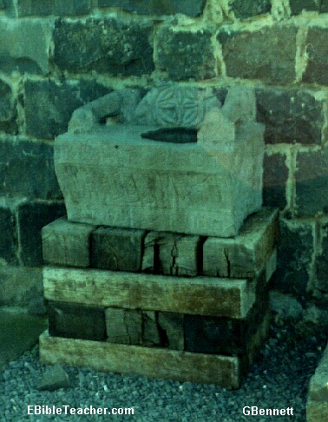

Did Judaizers Win?
David Lee Burris:
Special Days – Passover Continued With Judaizers -Celebrated Instead With Christ As The Passover Lamb – This Developed Into Easter – Then This Judaizing Accommodation As Precedent For Later Pagan Accommodation With Religious Holidays
MOSES SEATS
- & -
Sedia Gestatoria

Slide 58
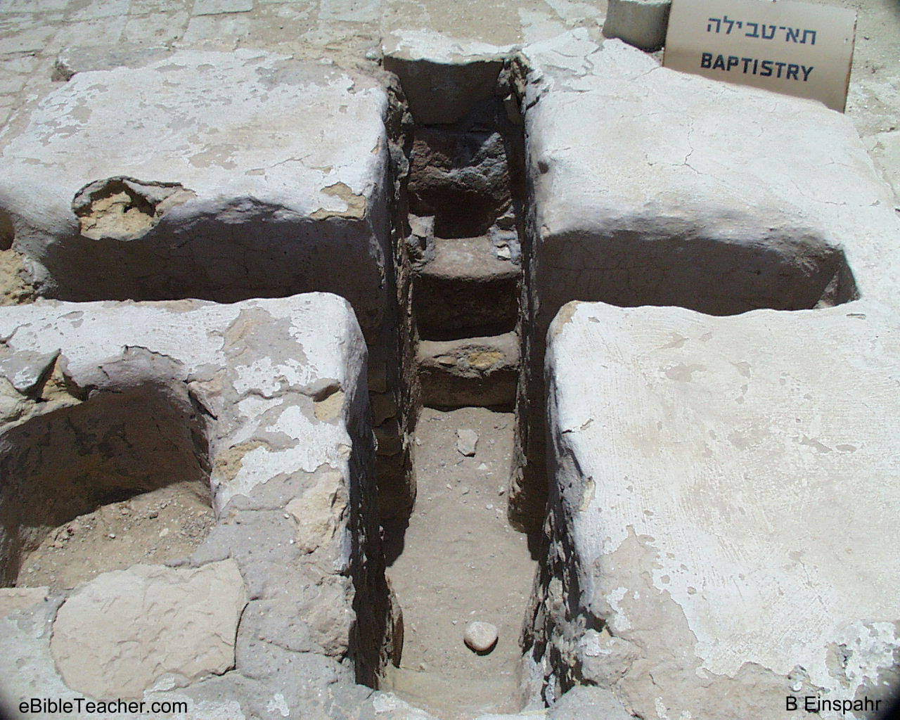
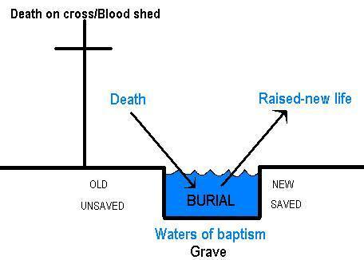
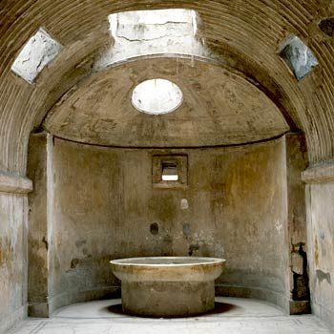
David Lee Burris:
Old Law - Man-Made Purification Ponds Held ~ 17,000 Gallons
Didache Document
Design Features Of Ritual Rite
Tertullian Guidance
HYGIENIC BODY BATH
THEN STEP DOWN
IMMERSED PURIFYING

Slide 59

BAPTISTRY WENT FROM
BEING THE IN–HOUSED
CONSTRUCTED TO
BEING A DEDICATED
ANNEX TO BEING
THE FORGOTTEN
FIXTURE !!!!!!!!!

Slide 60
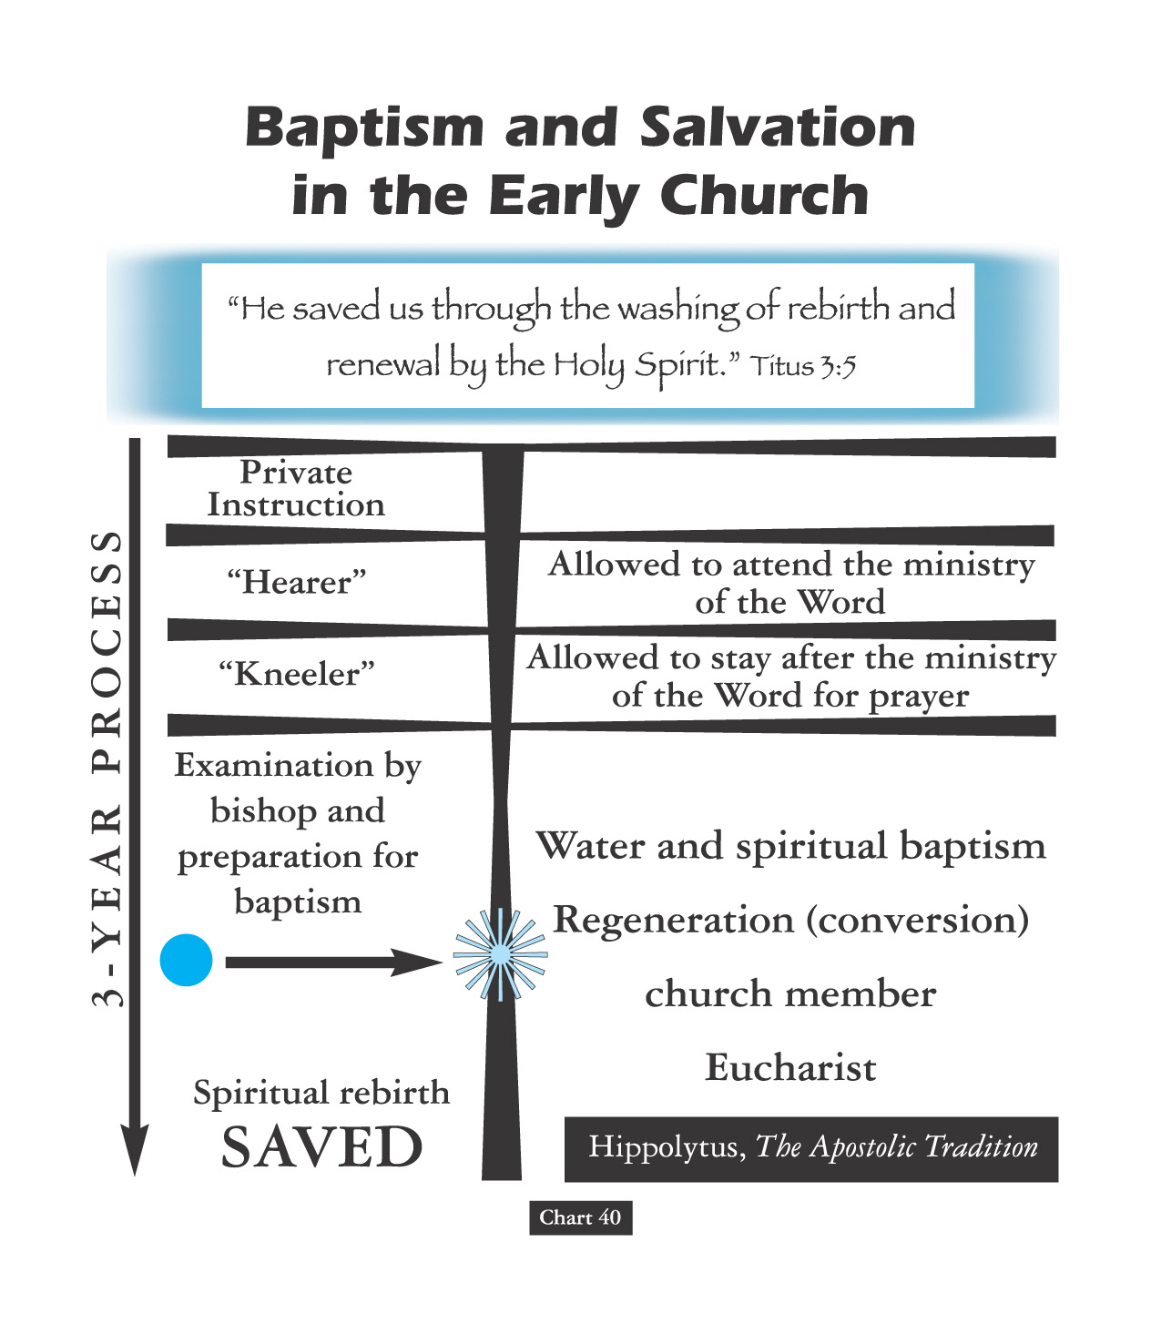
Personal Behavior Was Under Close Scrutiny For Three Years!

Slide 61
OVERVIEW: APOSTLE TO APOSTATE PATTERN
EARLY ERROR A RESULT OF ONGOING GREEK INFLUENCE
EXEGETES, DOGMATISTS & APOLOGISTS; POLEMICS & IRENICS
FULLTIME FUNCTIONAL SEPARATION & PROFESSIONAL CLERGY
ACADEMY EDUCATION & SEMINARY SYSTEMS STUDY
NICOLAITAN DOCTRINE MORPHS INTO LIBERTINE GNOSTIC
EARLY ERROR AN OUTCOME OF ONGOING GNOSTIC DEBATE
CONTROLING GNOSTICS BY CREATING CHURCH HIERARCHY
COMBATING GNOSTICS BY COUNCILS, CANONS, & CREEDS
EMPIRE WIDE PAGAN PERSECUTION IN THIRD CENTURY
NOTE: Auricular (Readmission) Confession to Decius Martyrs
EUSEBIUS @Caesarea: Chiliast Eschatology Major Viewpoint
FOURTH CENTURY & DARK AGE: REFORMERS RESET POINT

Slide 62

The Filioque Controversy
  Eastern Christians recited, “The Holy Spirit … proceeds from the Father.”
  Western Christians recited, “The Holy Spirit … proceeds from the Father and the Son.”
THE ABSOLUTE TRUTH IS THAT BOTH CHURCHES WERE VERY WRONG.
NEITHER SON NOR SPIRIT WERE LIKE ANGELS OF SPECIAL CREATION, & NEITHER PROCEEDED FROM GOD.

Slide 63
From Origen A False Controversy
Origen believed that God the Father, the Christ logos, and the Holy Spirit represent three aspects of the godhead. He thought of them as having a hierarchical relationship; that is, the Father generates the Son, who generates the Holy Spirit. The image he liked to use was an eternal torch, one lighting the other. That effort [book Timaeus] was to reconcile Christian thought with the three realities of Plato.
  Churches in western Europe had added the word filioque (“and the Son”) to the Nicene Creed in the AD 500s

Slide 64
OVERVIEW: APOSTLE TO APOSTATE PATTERN
2 CHRISTIAN SCHOOLS OF BIBLE INTERPRETATION
Antioch’s Historical & Alexandrian Allegorical
Typological-Allegorical @O.T. Type & Anti-type
Typological-Allegorical @Redemptive Archetype
Adopted Aristotle’s Thesis - Anti-Thesis Dialectic
ILLUSTRATION: Alexandria’s Origen @Purgatory
ORIGINAL ERROR @ORIGINAL INHERENT SIN
CHANGES IN ORGANIZATION & BROTHERHOOD
CHANGES IN ASSEMBLY & AUDITORIUMS
ILLUSTRATION: Return of the Mose’s Seat
CHANGES IN PARTICIPATORY WORSHIP
ILLUSTRATION: Memorial of the “Missa”
CHANGES IN PARTICIPATORY THEOLOGY
ILLUSTRATION: Catechetical Preparation
EARLY ERROR BUILT ON THREE FALSE ASSUMPTIONS
#1 Assumption: Paul Convert Clement Received As Apostle
#2 Assumption: Origen Explains Trinity Concept Sequential
#3 Assumption: Irenaeus Portrays Jesus Mother @Anti-Eve

Slide 65
OVERVIEW: APOSTLE TO APOSTATE PATTERN
Christology Debate: Theoanthropic Gnosticism
Ebonites
Processionists
Subordinationism
Monarchianism
Cerinthianism
Adoptionism
Modalism
Sabellianism
Patripassianism

Slide 66
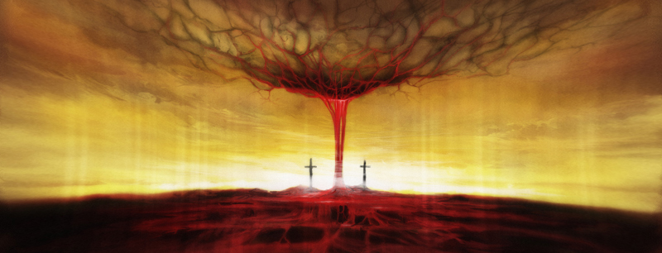
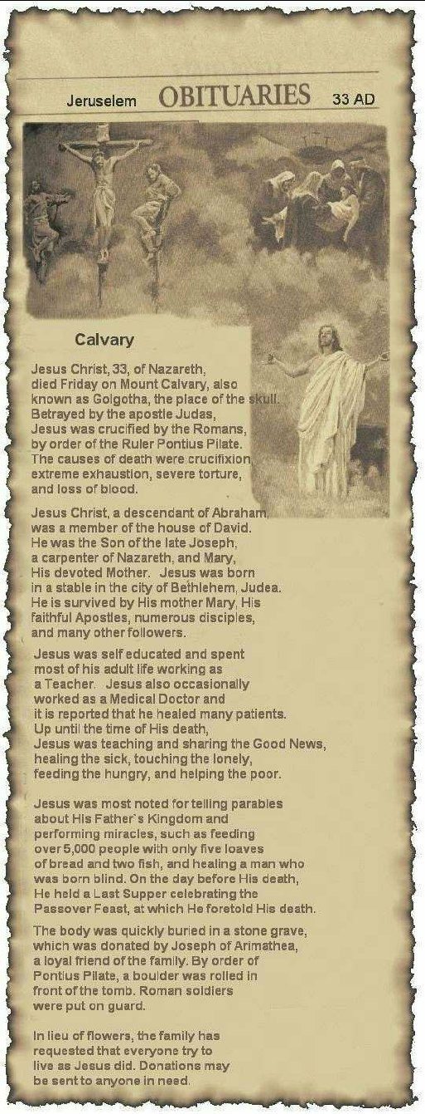

Slide 67
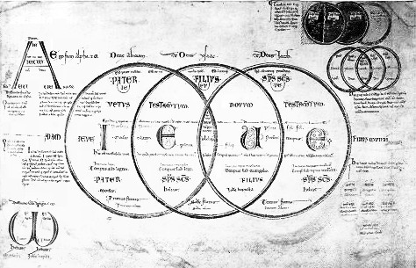
Explaining Resurrection
“Resurrection stands as an essential element of the biblical and historical witness of the Christian Community. Without the resurrection, Jesus is not the Living Lord but a dead person held in memory. Without the resurrection, God is not the God of the Living, not the one who has the power to conquer death. Without the resurrection, humankind has no ultimate hope for the, ‘last enemy,’ death, wins.” – W. Willis

Slide 68
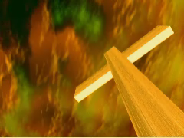

ATONEMENT THEORIES
DESCRIPTION
Moral Influence
A Positive Example Of Love In Action
Ransoming
Buys Lost From Sin Gains The Victory!
Satisfaction
Appease God’s Honor Robbed By Our Sin
Penal Substitution
He’s Legal Stand-In He Bears Our Guilt

Slide 69
OVERVIEW: APOSTLE TO APOSTATE PATTERN
Christology Debate: Theoanthropic Gnosticism
Marcionism
Docetism
Ditheism
Manicheaism
Catharism
ARIANISM
Apollinarianism
Nestorianism

Slide 70
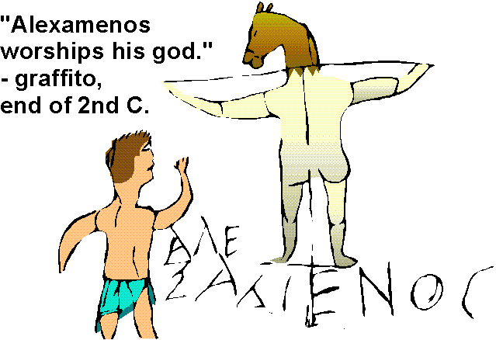

Slide 71
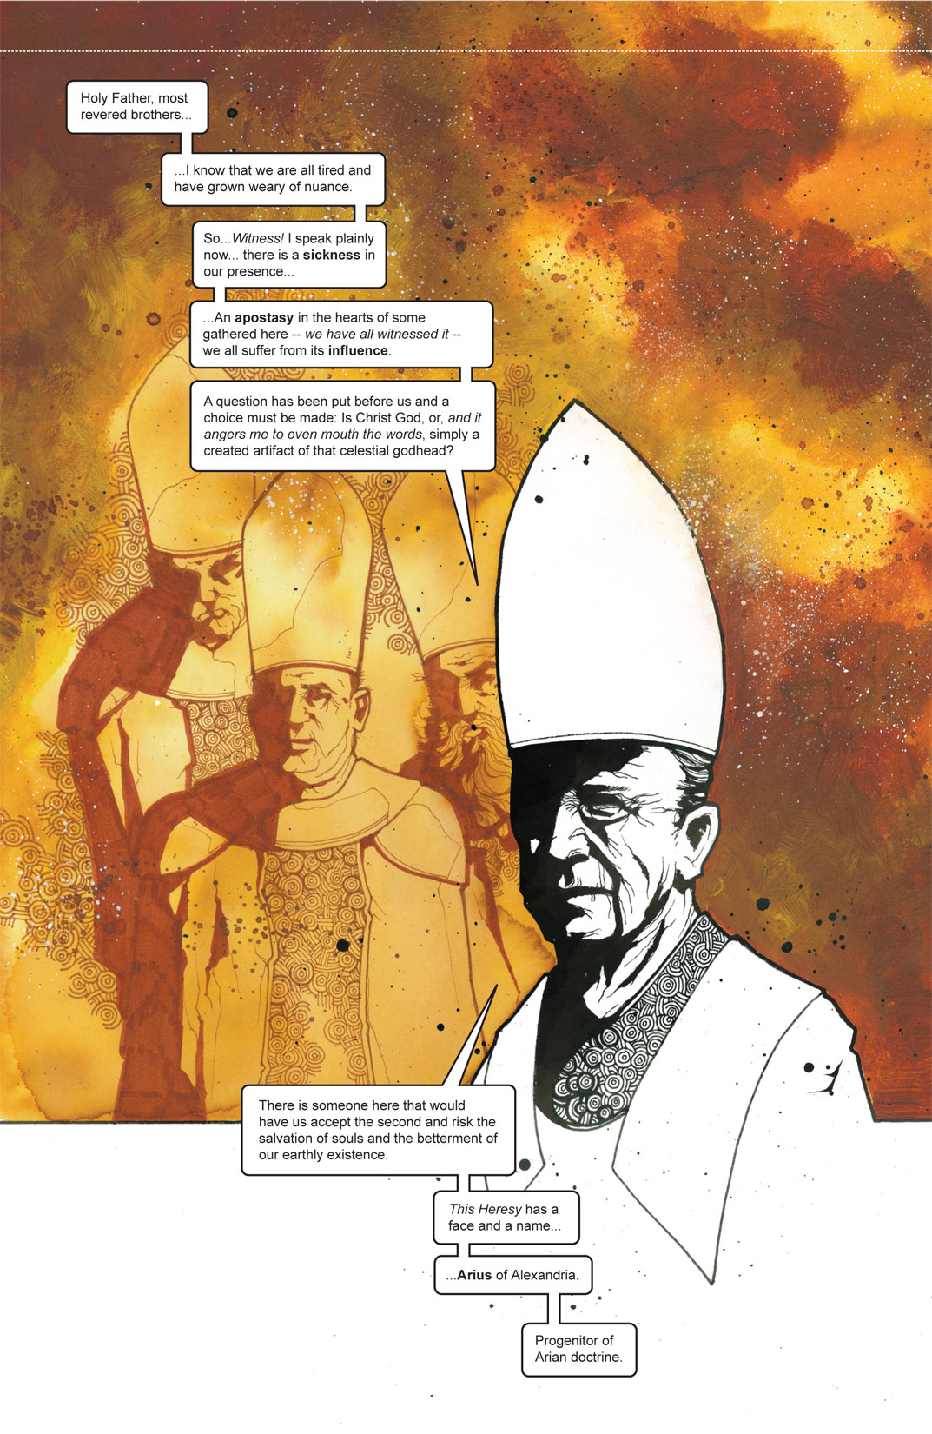

Slide 72
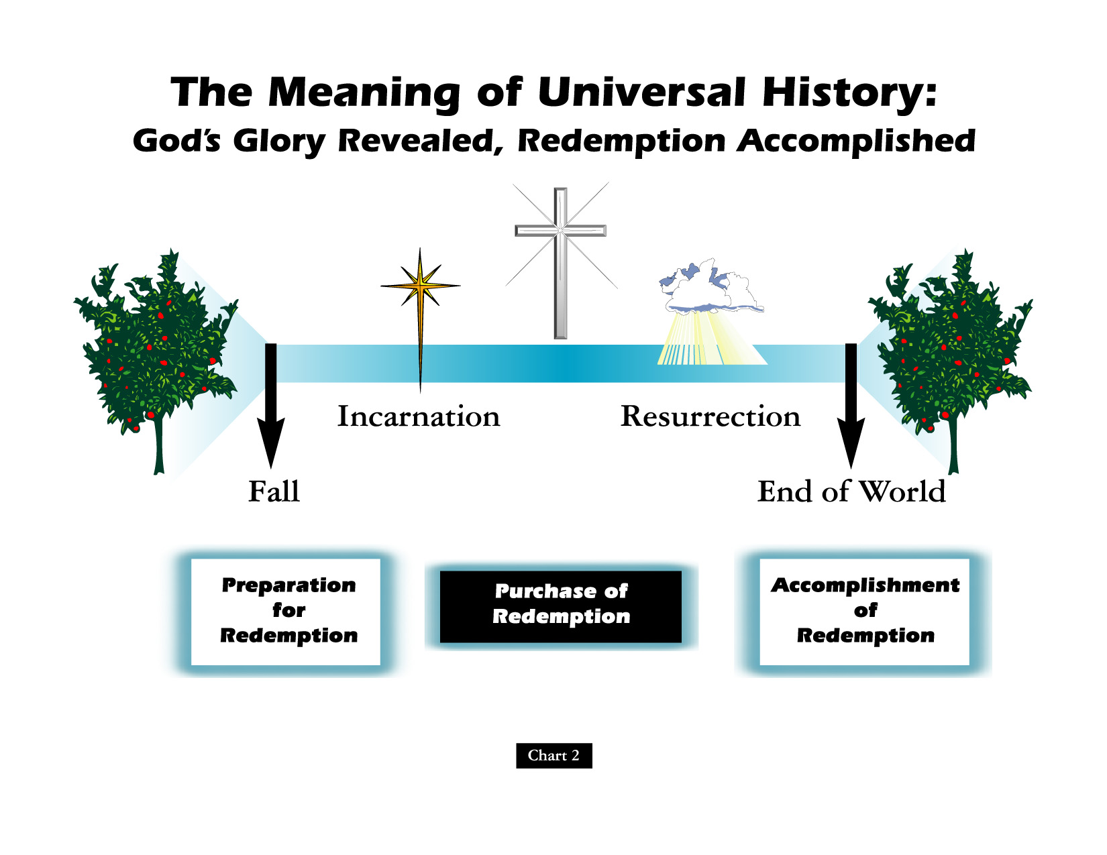

Slide 73
Battle Over An “i”:
Homoousios or Homoiousios?
David Lee Burris:
Begins Innocent Enough But Ends Questioning Bible’s Inclusion Of Birth Narrative
Father God & God’s Son “Identical or Similar”? Gregory of Nyssa said of Constantinople in 378: “In this city if you ask anyone for change, he will discuss with you whether the Son is begotten …
AriansWatchword: “dissimilar” (anomoios)
Semi-Arians Watchword: “similar” (homoios)
Nicaeans Watchword: “of identical substance” (homoousios)
Cappadocians Watchword: “of like substance” (homoiousios)

Slide 74
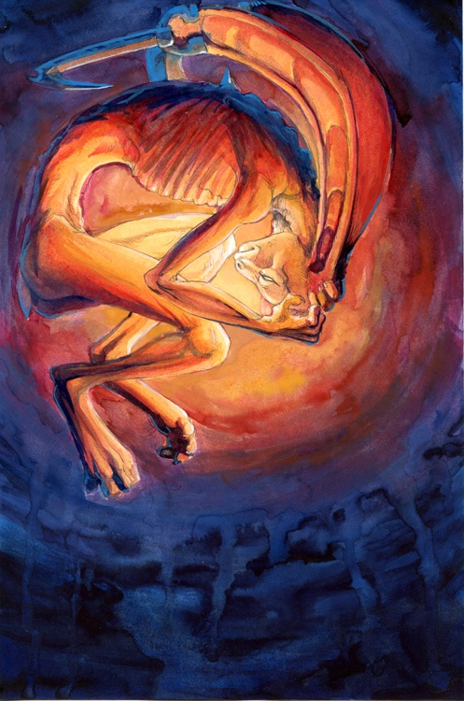
Christian Divisions Costs Half The World
“Christian divisions go far toward explaining the swift collapse of the Roman position in the Middle East, where popular sentiment leaned so heavily toward either the Monophysite or Nestorian churches. Repeatedly, writers from these traditions describe the relief which local inhabitants greeted the Arab conquerors, who promised an end to the heavy-handed regime of the Roman Empire, and the Chalcedonian order.
At least in the early decades of the new order, most Christians saw little reason to change their opinion. Muslims cared nothing for the sectarian divisions among their Christian subjects, provided they respected Muslim authority and paid their taxes on time.
The first century or so after the conquest marked something like a golden age for the Christian communities, who were now free of Roman oppression.”
Source: Pages 263-4, Philip Jenkins’ “Jesus Wars”

Slide 75
OVERVIEW: APOSTLE TO APOSTATE PATTERN
EARLY ERROR A RESULT OF ONGOING GREEK INFLUENCE
EXEGETES, DOGMATISTS & APOLOGISTS; POLEMICS & IRENICS
FULLTIME FUNCTIONAL SEPARATION & PROFESSIONAL CLERGY
ACADEMY EDUCATION & SEMINARY SYSTEMS STUDY
NICOLAITAN DOCTRINE MORPHS INTO LIBERTINE GNOSTIC
EARLY ERROR AN OUTCOME OF ONGOING GNOSTIC DEBATE
CONTROLING GNOSTICS BY CREATING CHURCH HIERARCHY
COMBATING GNOSTICS BY COUNCILS, CANONS, & CREEDS
EMPIRE WIDE PAGAN PERSECUTION IN THIRD CENTURY
NOTE: Auricular (Readmission) Confession to Decius Martyrs
EUSEBIUS @Caesarea: Chiliast Eschatology Major Viewpoint
FOURTH CENTURY & DARK AGE: REFORMERS RESET POINT

Slide 76
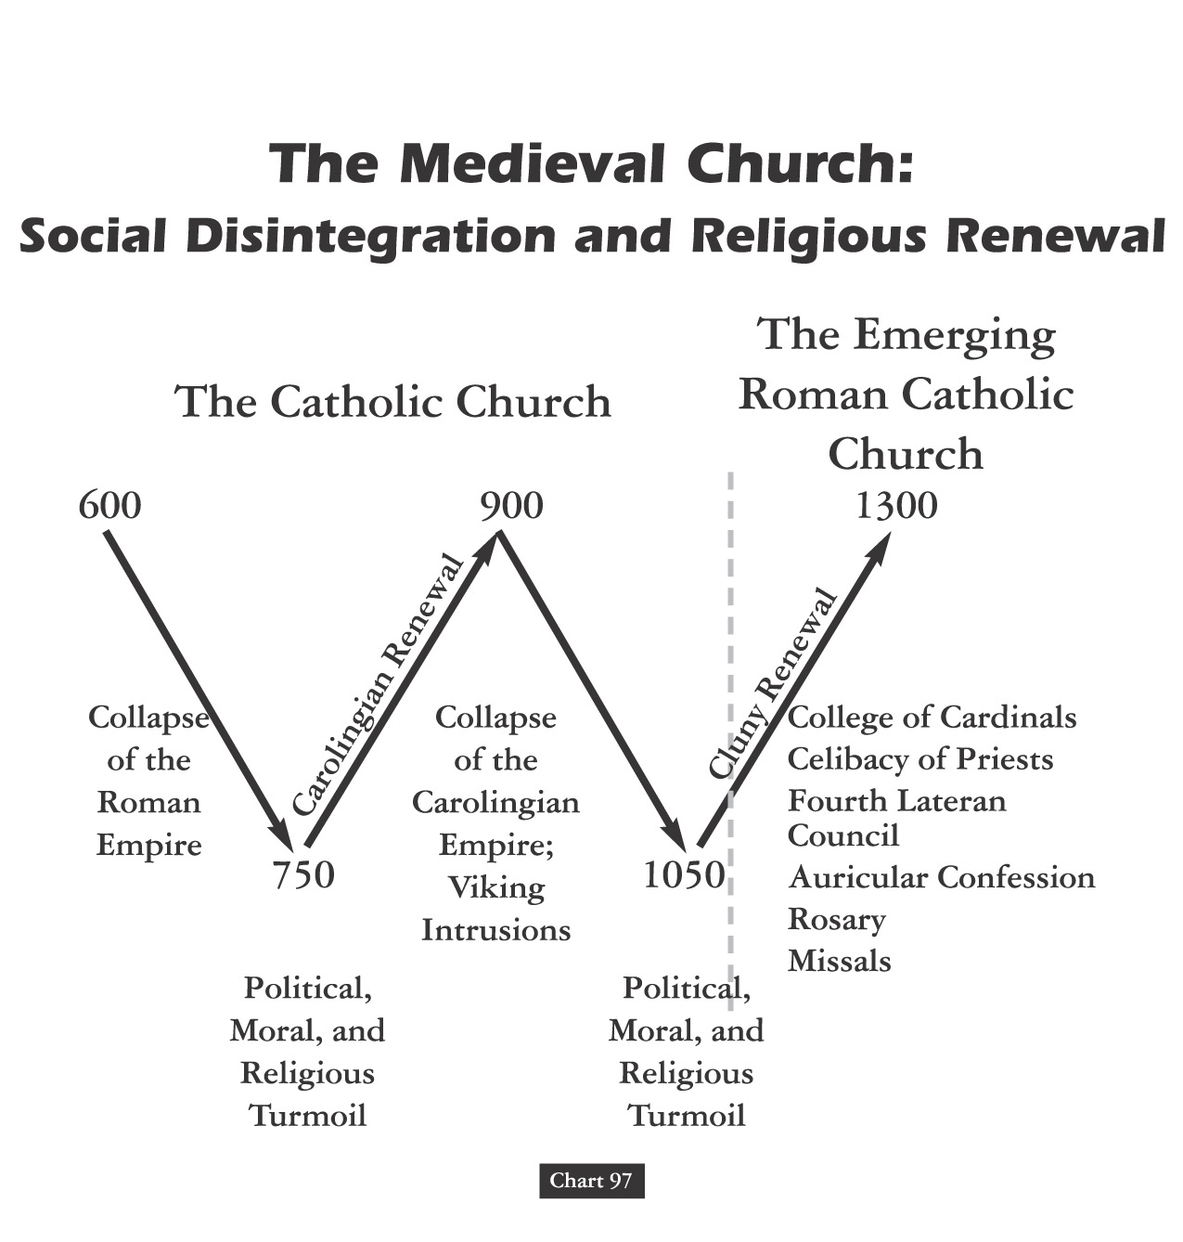
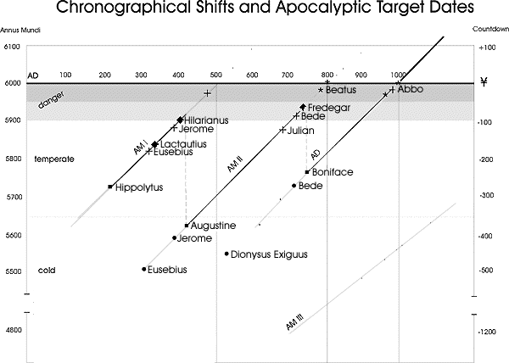

Slide 77
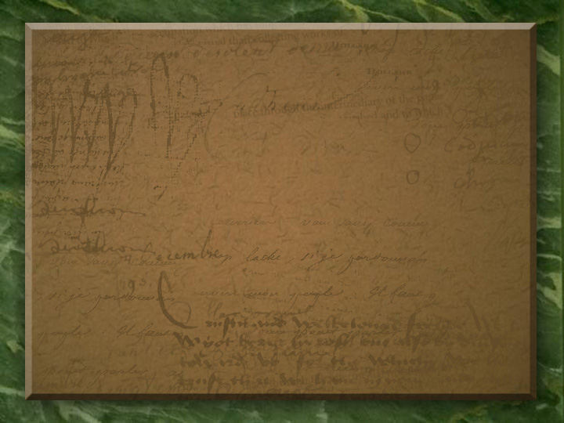
Roman Persecution: “Getting Certified”
“There were two all-out empire-wide persecutions intended to utterly destroy the church. The first, under Decius, began in December, 249. Everyone in the empire had to get a certificate from a government officer verifying that he or she had offered a sacrifice to the gods – an act that most Christians in good conscience could not do.”

Slide 78
Hubris Event Is Historically Explanatory:
Treasury Of Merit & Auricular Confession
Decius’s persecution exposed weakness in the church after years of prosperity. When the decree was announced in Antioch, thousands of Christians surged forward in their eagerness to absolve themselves. In one North African town, there were so many applicants on the appointed day that officials had to ask many of them to return the next day.

Slide 79
Hubris Event Is Historically Explanatory:
Treasury Of Merit & Auricular Confession
“Decius’s persecution had caught the Christian community flat-footed, and many had renounced the faith. In some cases, like in the city of Carthage in North Africa, it may have been the majority of the Christians. Now many of those people were clamoring to get back in the church. The situation was unprecedented in its scope.”

Slide 80
Hubris Event Is Historically Explanatory:
Treasury Of Merit & Auricular Confession
“The problem was compounded by the fact that a new kind of martyr came out of the Decian persecution. Because Decius was trying to break people rather than kill them, many people were arrested and tortured but never executed. In previous persecutions, the number of such persons, called confessors, was relatively small. Under Decius, the number of confessors was quite large.”

Slide 81
Hubris Event Is Historically Explanatory:
Treasury Of Merit & Auricular Confession
“Because of the close relationship between the martyr and Christ in the eyes of the church, many people who were seeking forgiveness for egregious sins would go to the martyrs. Usually, with the martyr’s seal of approval on someone’s repentance, they were allowed back into the church.”

Slide 82
SUPEREROGATION
“EXCESS SUPPLY OF GOOD WORKS BY SOME SOULS CAN BE APPLIED TO OTHERS!”

Slide 83
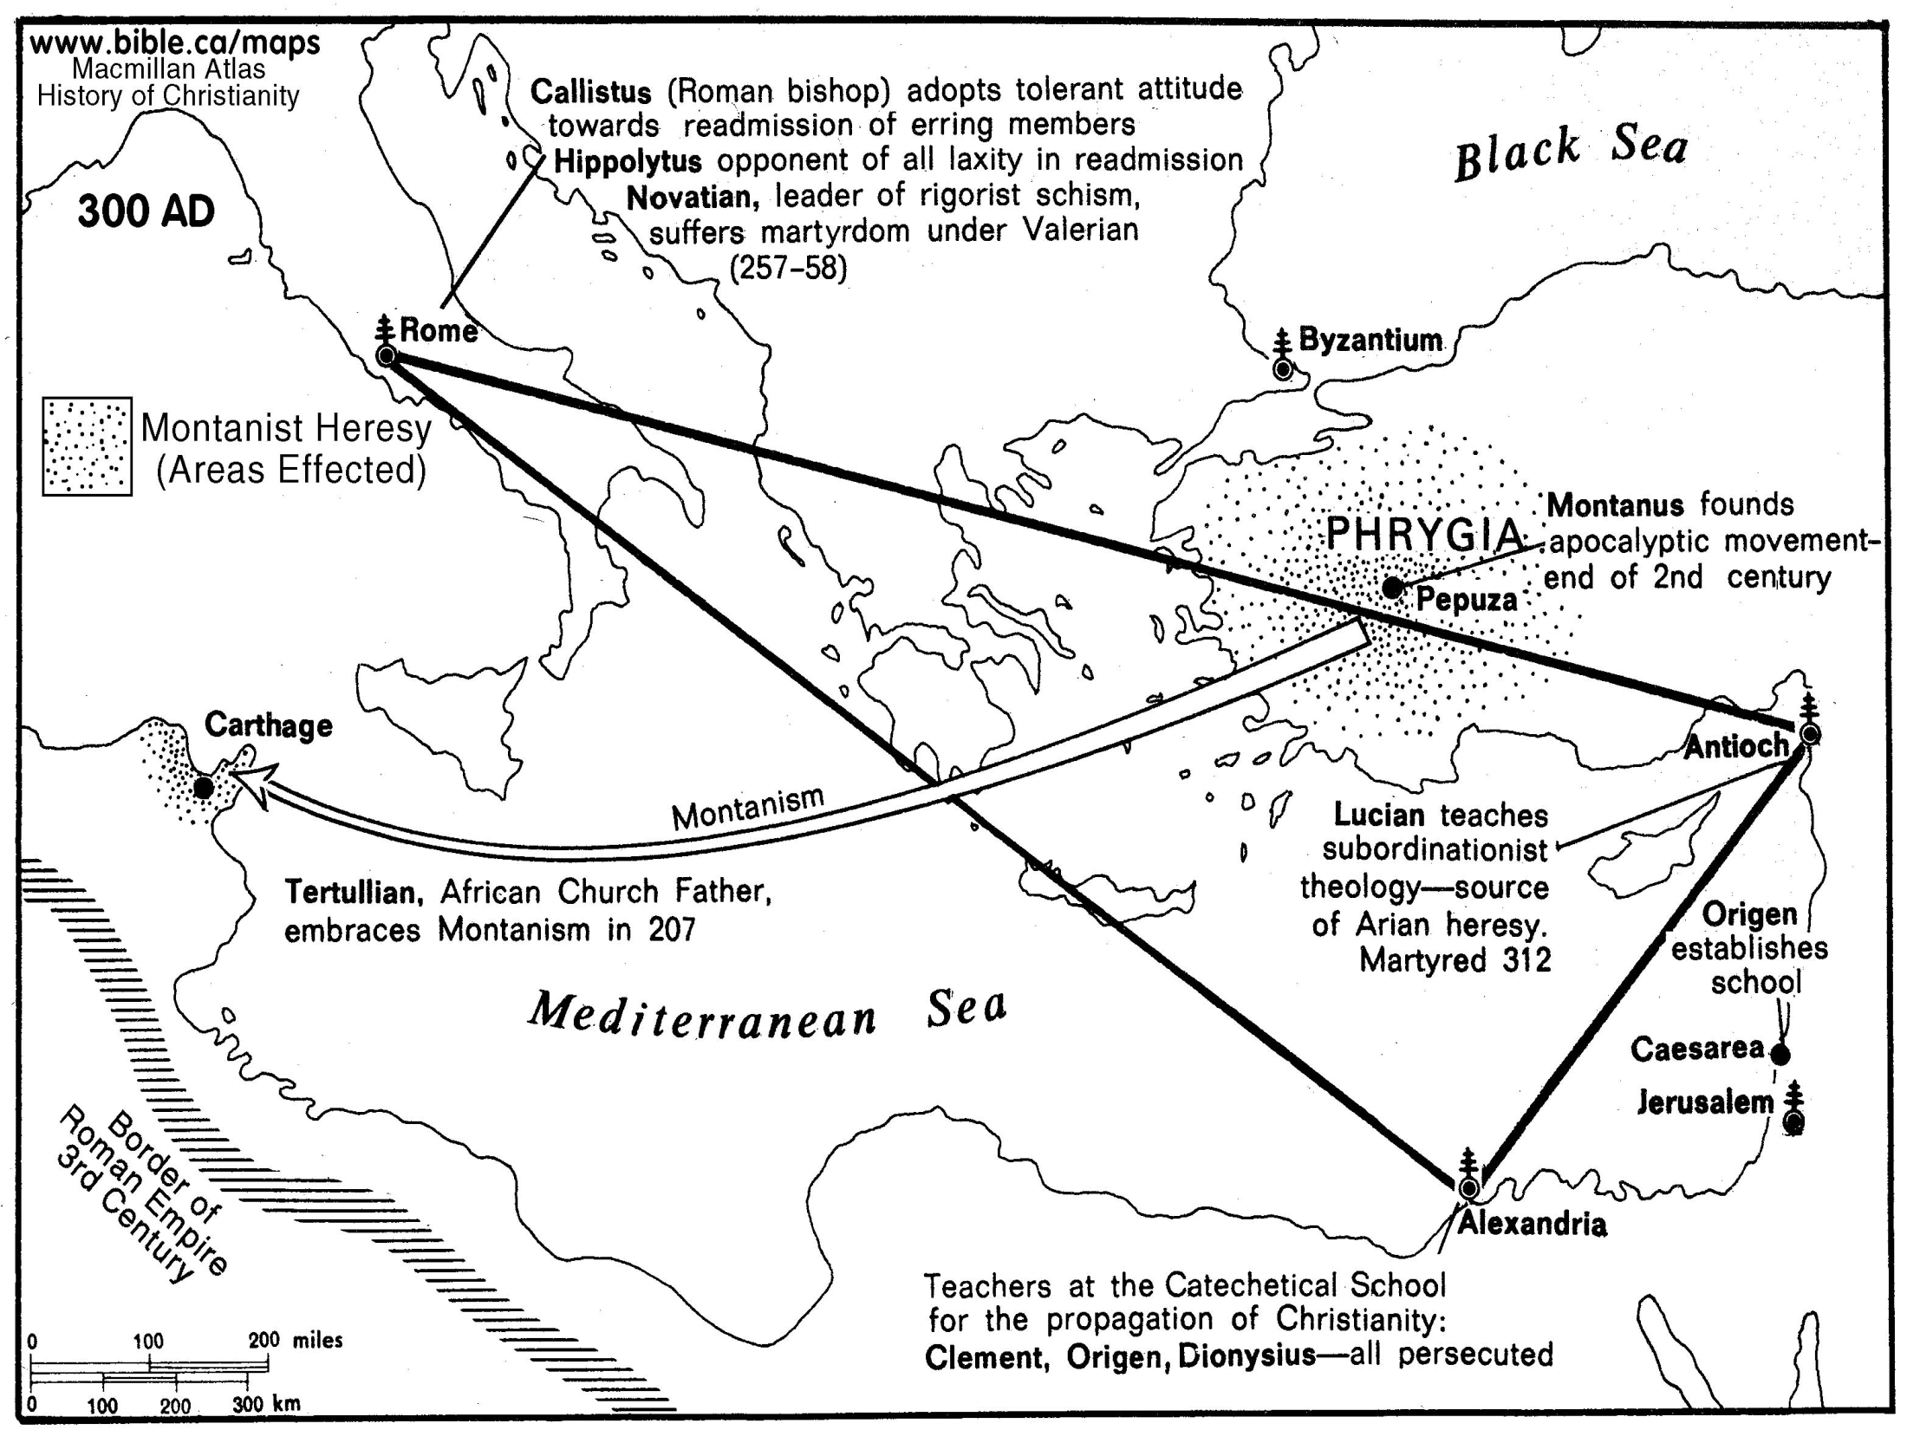

Slide 84
OVERVIEW: APOSTLE TO APOSTATE PATTERN
EARLY ERROR A RESULT OF ONGOING GREEK INFLUENCE
EXEGETES, DOGMATISTS & APOLOGISTS; POLEMICS & IRENICS
FULLTIME FUNCTIONAL SEPARATION & PROFESSIONAL CLERGY
ACADEMY EDUCATION & SEMINARY SYSTEMS STUDY
NICOLAITAN DOCTRINE MORPHS INTO LIBERTINE GNOSTIC
EARLY ERROR AN OUTCOME OF ONGOING GNOSTIC DEBATE
CONTROLING GNOSTICS BY CREATING CHURCH HIERARCHY
COMBATING GNOSTICS BY COUNCILS, CANONS, & CREEDS
EMPIRE WIDE PAGAN PERSECUTION IN THIRD CENTURY
NOTE: Auricular (Readmission) Confession to Decius Martyrs
EUSEBIUS @Caesarea: Chiliast Eschatology Major Viewpoint
FOURTH CENTURY & DARK AGE: REFORMERS RESET POINT
EMPEROR ABANDONS PONTIFIX MAXIMUS TO ROME BISHOP
GOVERNMENT STATE CHURCH RECOGNITION/INTERVENTION
STATE WITH CHURCH RELIGIOUS MINORITIES PERSECUTION
EMPIRE & CHURCH SPLIT EAST & WEST – IDOLS VS. ICONS
REGIONAL SPLITS: FLAG BY COUNCILS/CANONS/CREEDS
DUEL(ING) AUTHORITIES - & - DUEL(ING) THEOCRACIES

Slide 85


WHAT IF….
EARLY CLUNIAC REFORM

Slide 86
From The Modern Scholar Course Guide:
“One, Holy, Catholic, & Apostolic”
EARLY CLUNIAC REFORM
“The German Emperor Henry III sought to enact the first reform measure to purify the Church, In 1046, he deposed the three competing popes and appointed his own reform popes. With the support of the emperor, these non-Roman popes were able to enact reforms. Reform popes brought to Rome reform-minded clerics from across Europe to staff church offices.”
“The Cluniacs produced a new kind of specialized monk, a military monk who rode on horse, upheld codes of chivalry & was an effective killing machine when necessary.”

Slide 87
CHURCH EUCHARIST DEBATE
THE YEAR OF OUR LORD 1059
“The age of scholasticism had dawned, and in the struggle to merge the ancient Greek heritage of Aristotle with medieval Christian dogma, the stakes were high: the future of Christian theology hung in the balance.
How much of Christian thought would operate in the pagan modes of logic and reason, and how much would retain the elements of faith and revelation.”
“When fish are in schools they sometimes… take debate!”

Slide 88
CHURCH EUCHARIST DEBATE
THE YEAR OF OUR LORD 1059
“The question was exploding across Christendom, and the hottest point of contention was the ‘real presence’ of Christ in the bread of the Eucharist. Belief in His real presence was a dogma. But the Eucharist debate opened the church door to using Aristotle’s logic as a way to make theology more rational. Until now, most theological assertion was based on citing authority: the Bible, Saint Augustine, the Creeds, or the early church fathers. The liberal arts had introduced new tools, and these included the trivium of grammar, rhetoric & logic.
Questioned: What did the Bible mean when Christ said he was the Bread?

Slide 89
CHURCH EUCHARIST DEBATE
THE YEAR OF OUR LORD 1059
“In the great Eucharist debate, the logical question was how the spiritual Christ and the physical bread could occupy the same space. The rhetorical or semantic question was, ‘What did the Bible mean when Christ said he was the bread?’
The debate came to a head at the Council of Rome in 1059. The church called in two advocates, one orthodox and the other innovative. The first was Lanfranc, who defended the orthodox position of transubstantiation: that the bread turned into the body of Christ, even though it looked like bread to human eyes. The other disputant was Berengar of Tours, a respected theologian who defended a contrary position.
Questioned: What did the Bible mean when Christ said he was the Bread?

Slide 90
CHURCH EUCHARIST DEBATE
THE YEAR OF OUR LORD 1059
The rhetorical or semantic question was, ‘What did the Bible mean when Christ said he was the bread?’
“Berengar had stirred the theological crisis by his insistence on grammatical logic. He contended that both Christ and the bread occupied the same reality, for that was the literal claim of the phrasing in the Bible and in early church writings. Words had real meanings, Berengar argued. Having two things occupy one space was indeed a mystery; but the ‘real presence’ of Christ in bread is just that, a mystery.
Lanfranc was no less logical in his solution, but he had chosen to draw upon the logical ‘categories’ of Aristotle, not the semantic argument. The Categories defined real things as having a permanent essence or a ‘substance.’ No two substances could share the same space!”

Slide 91

When Institutional Independent “Paulicians” Took To Public Debate Byzantine Monks They Reported:
“
“Only the New Testament was accepted among them as rule for faith and church practice; they rejected the worship of the Mother of God and of the saints… each Sunday they assembled in places of prayer which are not worthy to be named thus, since they use neither altar or wall for pictures of the saints, nor a place for keeping the holy vessels; they use neither incense nor chrism oil. They despise and scorn the baptism of the church and say infants have no faith.”

Slide 92
OVERVIEW: APOSTLE TO APOSTATE PATTERN
EARLY ERROR BUILT ON TWO INTENTIONAL FRAUDS
FRAUD ONE: APOSTLE PETER CHIEF APOSTLE & FIRST POPE
FRAUD TWO: THE CROWN DONATION OF CONSTANTINE
* Forgery Was Not Written In Fourth Century Old Latin
THEOLOGICAL TENSIONS: ARIAN OR NICEAN CHRISTOLOGY
ILLUSTRATION: “Atanasius Against The (Eastern)World.”
PAULICIANS DEBATE SCRIPTURE W/BYZANTINE MONKS
PIVOT POINT: Church Court Eucharist Debate (1059)
THEOLOGICAL TENSIONS: AUGUSTINE VS. PELAGIUS
NINTH CENTURY: 800 A.D HOLY ROMAN (WEST)EMPIRE
HRE: NOT ROMAN OR EMPIRE NOR IN THE LEAST HOLY
FEUDAL CHAIN OF BEING & DIVINE RIGHT OF KINGS
12TH CENTURY: FROM CANON FORM TO CANON LAW
13TH CENTURY: FROM CANON LAW, COURTS & CURIA
MIDDLE MIDDLE AGES: SAINTS NOT JUST CHRISTIANS
HRE: FRENCH DYNASTY UNTIL TWELTH CENTURY
LATE MIDDLE AGES: HRE @GERMAN DYNASTIES

Slide 93
Augustinian–Pelagian Controversy AUGUSTINE - and/or - PELAGIUS
David Lee Burris: PRE-FIGURE OF FRAME OF ARGUMENTATION
Augustine Pre-Orthodox Protestant Monergism & Pelagius Catholic Synergism
An Abbreviated Augustine:
Augustine argued that by Adam’s first sin, by which the entire human race participated, sin came into the world, corrupting every person both physically and morally. Everyone, being of Adam, is born into the world with a nature that is so corrupted that they can do nothing but sin – the exercise of the will is limited to only evil options (freedom being defined as the capacity to make choices in conformity with one’s desires). Therefore, for Augustine, the need for grace was central. We are heirs of a disfigured condition that has clouded the capacity of our wills as to even an awareness of Christ – much less – a desire for Him. The effect of the unmerited favor of God is twofold: 1st – God reveals the wonder of His Son’s redeeming mercies; 2nd He strengthens the will so that humankind can freely embrace Christ as the sinner’s only hope of forgiveness. This grace is irresistible. Because we cannot be saved against our will – the wills of men are made complaint.
Three Basic Postulates:
Monk Pelagius taught that there was no connection between what Adam did & the state wherein we are born; Ours’ also is a voluntary condition - the same as that of Adam before his fall. He and his followers opposed the doctrines of Adamic Unity & guilt by birth inheritance.
The doctrine of inherited inability discarded, the corollary was embraced – the freedom of humanity’s will. Although the human will is inhibited by negative example we retain the ability to choose between good & evil. The will is defined as a determining power, not a selecting agent of the presented available options.
Grace is an assisting gift that is availed from God by way of human choice. This “illuminating grace” influences humankind toward voluntary cooperation with God; it is a resistible grace.

Slide 94
FORMED FRAMED FATALLY FLAWED
CREATED CONGENITAL COMPLETE
Versus

Slide 95
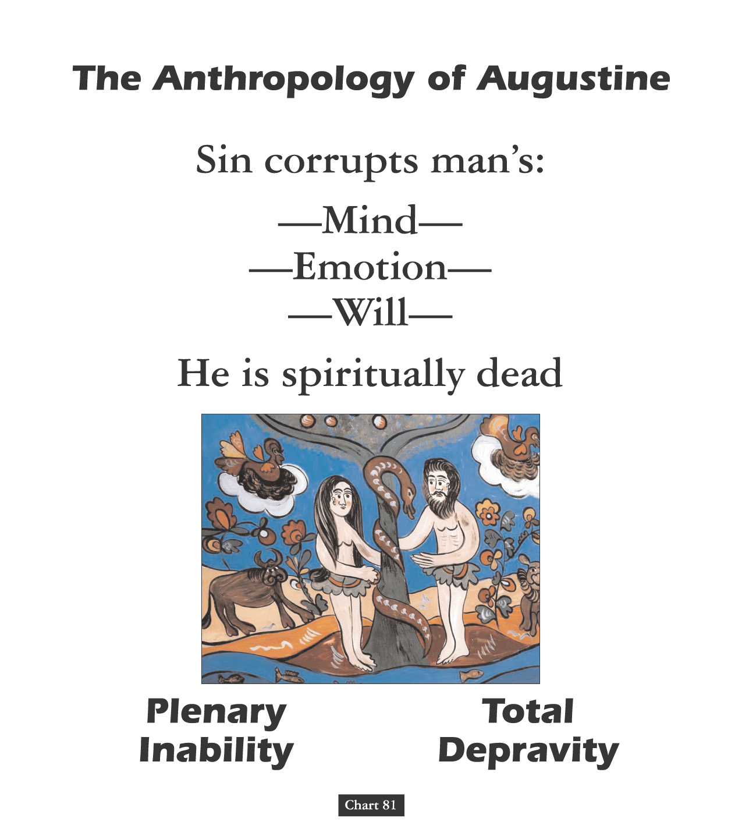

Slide 96
ORIGINAL STATE INNATE CORRUPTION
ORIGINAL STATE INNATE PERFECTION
Versus

Slide 97
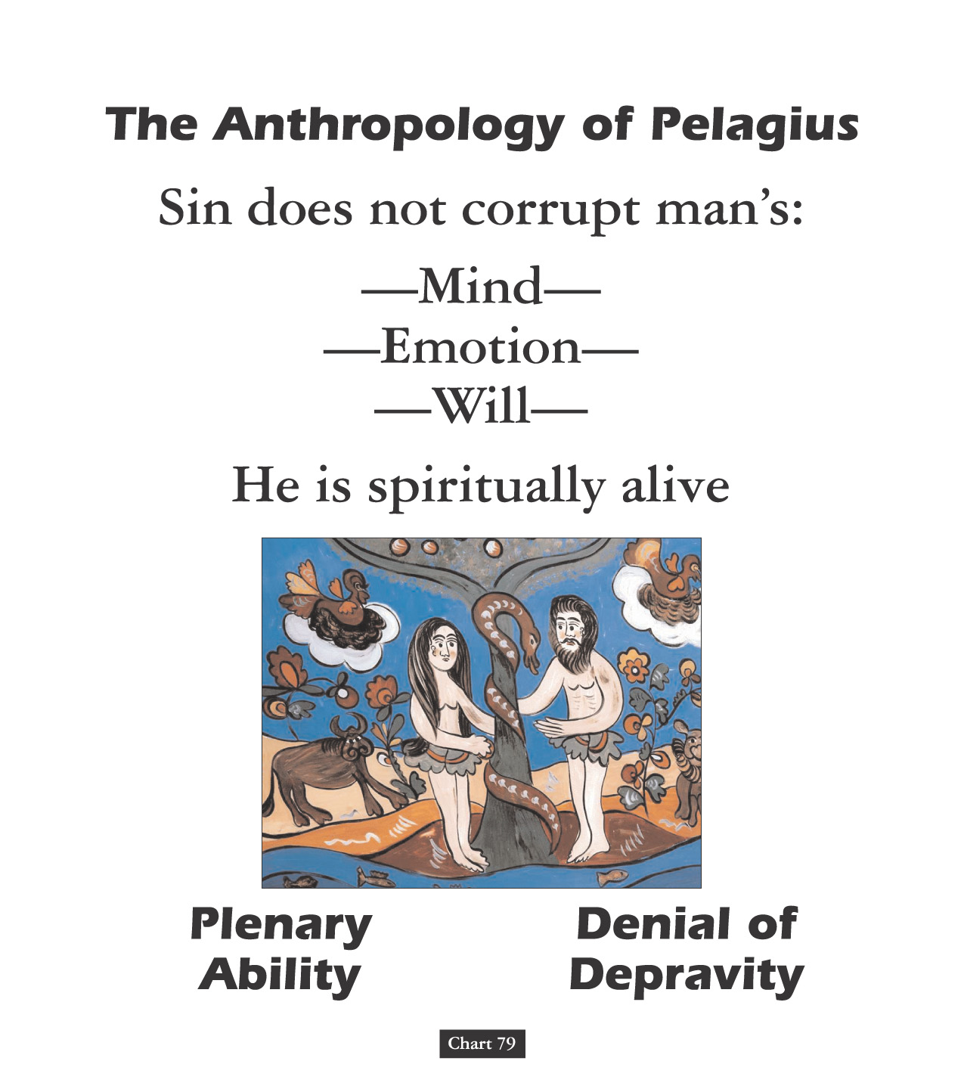

Slide 98

Drawing From A Polluted Stream
Sir Robert Anderson stated: “Of all the errors that later centuries developed in the teachings of the church, scarcely one cannot be found in embryo in ‘his’ writings.”
B.B. Warfield states: “Augustine [not an inspired writer] determined for all time the doctrine of grace.”

Slide 99
Ancient Romans Had Old maxim
THE EXPRESSION
OF ONE THING IS
THE EXCLUSION
OF ALL OTHERS!

Slide 100
OVERVIEW: APOSTLE TO APOSTATE PATTERN
EARLY ERROR BUILT ON TWO INTENTIONAL FRAUDS
FRAUD ONE: APOSTLE PETER CHIEF APOSTLE & FIRST POPE
FRAUD TWO: THE CROWN DONATION OF CONSTANTINE
* Forgery Was Not Written In Fourth Century Old Latin
THEOLOGICAL TENSIONS: ARIAN OR NICEAN CHRISTOLOGY
ILLUSTRATION: “Atanasius Against The (Eastern)World.”
PAULICIANS DEBATE SCRIPTURE W/BYZANTINE MONKS
PIVOT POINT: Church Court Eucharist Debate (1059)
THEOLOGICAL TENSIONS: AUGUSTINE VS. PELAGIUS
NINTH CENTURY: 800 A.D HOLY ROMAN (WEST)EMPIRE
HRE: NOT ROMAN OR EMPIRE NOR IN THE LEAST HOLY
FEUDAL CHAIN OF BEING & DIVINE RIGHT OF KINGS
12TH CENTURY: FROM CANON FORM TO CANON LAW
13TH CENTURY: FROM CANON LAW, COURTS & CURIA
MIDDLE MIDDLE AGES: SAINTS NOT JUST CHRISTIANS
HRE: FRENCH DYNASTY UNTIL TWELTH CENTURY
LATE MIDDLE AGES: HRE @GERMAN DYNASTIES

Slide 101
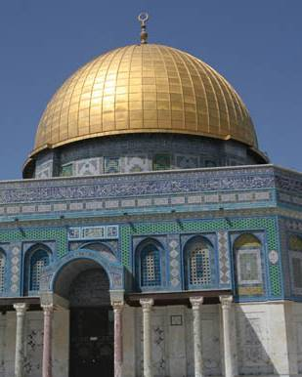
Islam and Iconoclasm
After Muhammad’s death, Muslims conquered Arabia, North Africa, the Holy Land, and Spain.
In 732, Charles Martel stopped their advance at the Battle of Tours.
Muslims believe that Muhammad journeyed into the heavens from the Dome of the Rock
Notes:
Image: © David Mckee

Slide 102
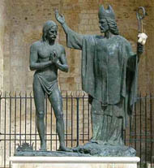
Franks Become the Top Dogs
The Franks had conquered much of the former western Empire.
In 496, Clovis, chief of the Franks, accepted the Nicene Creed and supported the Roman church.
Baptism of Clovis

Slide 103
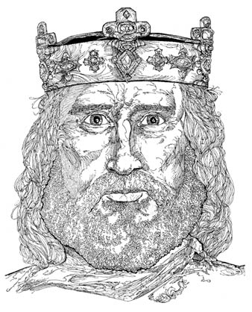
Charles in Charge
Charles became king of the Franks in 768; he strongly supported the Roman Catholic Church.
King Charles later became known
as “Charlemagne” or “Charles the Great.”
Charlemagne
Notes:
Illustration by Stephen Hesselman

Slide 104
Charles in Charge
In 799, power-hungry Italian nobles accused Pope Leo III of embezzlement.
Leo III fled to King Charles; on December 23, 800, Charles acquitted the pope of all charges.
Charlemagne
Notes:
Illustration by Stephen Hesselman

Slide 105
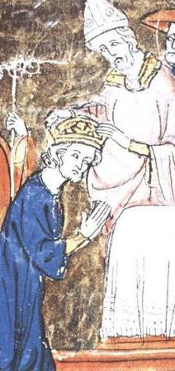
Charles in Charge
On Christmas Day, 800, Pope Leo III dubbed Charles “Holy Roman Emperor,” in continuity with the rulers of ancient Rome.
The church had created an emperor.

Slide 106
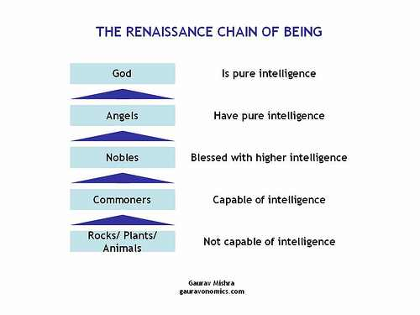
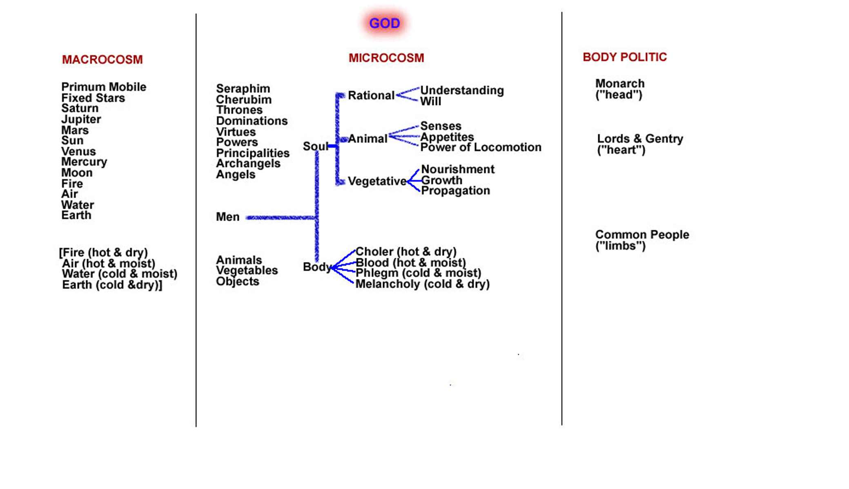

Slide 107

The Vortex of Reform:
1. Changes in Authority Relationships
2. Changes Conceptual @Physical Matter
3. Changing Attitudes @Diversity & Pluralism

Slide 108
Pretext: Text Outside Of Context
David Lee Burris:
Hubris Followed By Nemesis – God Of Arrogance Precedes Goddess Of Vengeance
Webster’s Definition Of Pretext: A purpose or motive alleged or an appearance assumed in order to cloak the real intention or state of affairs.
Previous To Pretext: Fear & Pride

Slide 109
An Open Letter From Nadab and Abihu
Brethren,
It is with the utmost humility that we inform you of a change of worship practices in your normal sacrificing.
Be assured that we are bringing about this change only after much prayer and study.
We have recently concluded an in-depth study of the Law as delivered by our brother Moses that covered 400 days. (We might note that is ten times the length of time it took the Lord to impart this Law.)
We have decided to bring about a change in the type of fire used in worship.

Slide 110
An Open Letter From Nadab and Abihu
We are aware that there is a standing tradition of using only one source of fire, but we, as holy priests, do not feel obligated to blindly follow tradition.
Numerous polls of our worshipping clientele indicate the overwhelming opinion that they do not care where we get the fire used for their sacrifices as long as the service is conducted in a respectful and meaningful way.
We are in agreement with this growing majority, as we cannot see how a change in fire will affect anything in the least about our sacrifices.
The animal is still properly cooked, the incense burned.
We are of the mind that were we to secretly substitute a different fire it would be impossible for any of the worshippers to know a change had taken place.

Slide 111
An Open Letter From Nadab and Abihu
Besides all this, we became aware of the fact that nowhere in the Law does the Lord forbid the use of what some of our detractors have referred to as “strange fire.”
We feel that the lack of such a restriction was meant to give us freedom. For those who disagree, we would ask you to show us any place in the Law that tells us we cannot do something the Lord has not seen fit to condemn. We are simply asking, “Where does it say we cannot do this?”
We also wish to point out that the congregation of Israel is the only religious group in the known world that willingly limits itself to only one kind of fire.
We have become the laughingstock of the land of Canaan and have been ridiculed openly by many groups.
This “only-one-fire” self-righteous policy has alienated us from everyone else. We believe this change will open up many fellowship opportunities.

Slide 112
An Open Letter From Nadab and Abihu
Now, to set the minds of some of you at ease, we will continue to offer a traditional service using the old-fashion fire as well as this progressive service with the new fire.
As a matter of fact, we may occasionally use the old fire in our progressive service for special feast days.
In this way we hope that our older citizens are still comfortable even though they dogmatically insist on a worship style which is declining and we believe to be stunting our growth.
Consider the freedom this new practice affords us!
We will no longer have the expense of maintaining a constant fire in one location.
This will also make it possible to appeal to a younger audience as we discover more entertaining ways to “light the fire” of our assemblies. (We hope you caught the little play on words there!)

Slide 113
An Open Letter From Nadab and Abihu
For those that still oppose the use of new fire, we ask you not to be judgmental of new ideas.
We also hope you will not use this change as a excuse to divide our people or stir up trouble within the congregation.
We remind you that this has been well thought out and the majority of elders have signed on with us.
It is true we have not included our father Aaron in this deliberation; but we were well aware of his tradition-bound views and still plan to leave him in charge of doing the traditional service anyway.
We also have not consulted Moses, but his humility is well known and we are confident he will want to uphold the majority decision in this effort to improve our worship.
- David Brassfield, Forthright Magazine

