Slide 1

War Between States DIVIDES NATION&Splits RESTORATION MOVEMENT
By David Lee Burris

Slide 2



The Restoration Movement: An American Theology
“From the early to mid-1800’s, the Restoration Movement became the fastest growing religion on the American frontier & remained one of America’s largest indigenous religious movements. While many factors contributed to its success, one of the most important was a shift in the way Americans were coming to understand the nature of man and his relation to God. This new attitude is most succinctly put forward in the Declaration of Independence and helps explain the movement’s growth. Written only 25 years before the American Restoration Movement, the Declaration of Independence was a theological document as well as political.”

Slide 3

The Restoration Movement: An American Theology
“More than announcing separation from England, it offers a theological justification for rejecting the doctrine of the Divine Right of Kings. This was a theory that certain kings were chosen by God to rule & that they were accountable to no person except God. Rebellion against England’s King George meant that the American colonies would be arrayed against divinely appointed government. The American leaders, however, understood a different principle to be at work. America was a new continent. It was as if God had provided a new Eden and given humanity a fresh start. Accordingly, they appealed to Nature and a biblical understanding of creation whereby every person bears the image of God. In creation, all are equal & have inherited certain divine rights which no king can take away. If he does, he is a despot whose disobedience to God gives the people the right to depose him.” {Columbus Reported He Had Rediscovered Actual Eden}

Slide 4
The Restoration Movement: An American Theology
“This finds its way into the the Declaration of Independence in the statement: ‘We hold these truths to be self-evident, that all men are created equal & that they are endowed by their Creator with certain inalienable rights…’ The American political leaders rested their case for independence and democracy on this biblical foundation. The success of the American experiment worked to legitimize this new populist theology and move it beyond America and beyond politics. Now the church would have to wrestle with its implications. Twenty-five years after the U.S. Declaration of Independence, fourteen years after the Constitution was ratified, and ten years after the Bill of Rights, the Restoration movement began. It arose in an atmosphere of religious revivalism propelled by a heady idealism about the nature of man with earnest hopes for a utopian future.”

Slide 5
The Restoration Movement: An American Theology
The equal justice of God. “For the leaders of the American Restoration Movement, God is just & rules according to immutable laws. He is neither arbitrary, capricious, nor partial. Each human being has equal standing before Him & is equally amenable to His laws. Those laws are not hidden. They are revealed in a written and unchanging constitution: the New Testament. Moreover, they aren’t understood thru subjective human experience, but normal objective reasoning.”

Slide 6
The Restoration Movement: An American Theology
The sovereignty of the individual. “Since God is impartial and all humans are equal before Him, the Calvinist doctrine of election, whereby God chooses who will receive salvation, was rejected. Each person is free to participate in one’s own destiny, to accept or reject salvation!”

Slide 7
The Restoration Movement: An American Theology
The people’s government of the church. “Since God is no respecter of persons, but all have equal standing, there is no separate calling or class for clergy. All are ‘clergy’, and all are ‘laity.’ All Christians share the responsibility to promote the church & see to its good order. There is no divinely chosen hierarchy that stands over the church. The members of each congregation choose their leaders and select those who preach & teach for them. Thus, communion responsibility, preaching & prayers was placed in the hands of the common people.” – Carson Stephens

Slide 8
The Restoration Movement: An American Theology
Believer’s Baptism: Freedom Of The Will. “Once, while conducting a meeting at Slate Creek, Kentucky, a Methodist preacher was in a meeting across town. Smith attended a service by the side of the creek when the Methodist preacher applied water to a screaming infant. When ‘Racoon’ had a baptism the next day, the Methodist preacher was nearby standing on the bank. After the ceremony, Smith approached the preacher and began to pull him toward the creek. The Methodist preacher asked him what he was doing. ‘I am going to baptize you, Sir,’ replied Smith. ‘But I do not wish to be baptized.’ ‘Do you not believe?’ said Smith. ‘Certainly I do,’ stated the Methodist preacher. ‘Then come along, Sir,’ said Smith. ‘But,’ said the man, ‘I am not willing to go. It certainly would do me no good to be baptized against my will.’…”

Slide 9
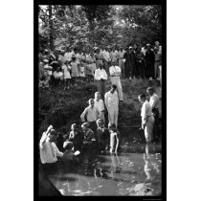
The Restoration Movement: An American Theology
Believer’s Baptism: Freedom Of The Will.
“… Racoon Then Stated, Did you not but yesterday baptize a helpless babe against its will? Did you get consent first, Sir? Come along with me, for you must be baptized.’ But the man protested and Smith released him.”
– Dabney Phillips

Slide 10

Edward Hallett Carr On the Study of History
How Vs. Why ~ Or ~ Function Versus Cause
“The true historian, confronted with this list of causes, would feel a professional compulsion to reduce it to order, to establish some hierarchy of causes which would fix their relation to one another, perhaps to decide which cause, or which category of causes, should be regarded as the cause of all causes.”
“Historians, like other people, sometimes fall into rhetorical language and speak of an occurrence as ‘inevitable’ when they mean merely that the conjunction of events leading one to expect it was overwhelmingly strong.”
Determinism Vs. Free Will. “In practice, historians do not assume that events are inevitable before they have taken place. They frequently discuss alternative courses available to the actors in the story on the assumption that the option was open, though they go on quite correctly to explain why one course was eventually chosen rather than the other. Nothing in history is inevitable except in the formal sense that, for it to have happened otherwise, the antecedent causes would have had to be different.”
Historical Accident Or Arranged Coincidence? “These so-called accidents in history represent a sequence of cause and effect interrupting historically and clashing – ‘a collision of two independent causal chains’.”
The Historian Marx. “Marx offered an apology for chance in history under three heads. First, it could accelerate or retard but not radically alter the course of events. Second, one chance compensated for another, so that in the end chance cancelled itself out. Third, chance was especially illustrated in the character of individuals.”
Meinecke’s Historical Observation: “The search for causalities in history is impossible without reference to values . . . behind the search for causalities there always lies, directly or indirectly, the search for values.”

Slide 11
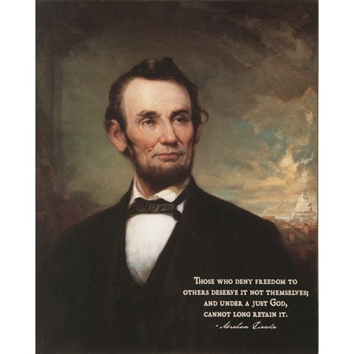
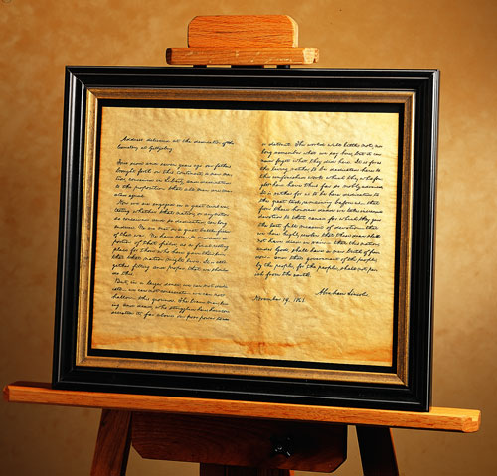
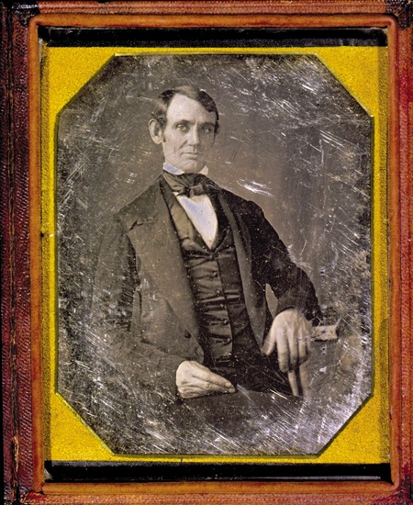

Principle Of Human Worth Compromised
“It has been my experience that
folks with who have no vices have very few virtues!”
ABE LINCOLN LOST 1843 WHIG
CONGRESSIONAL NOMINATION
TO CAMPBELLITE EDWARD BAKER

Slide 12
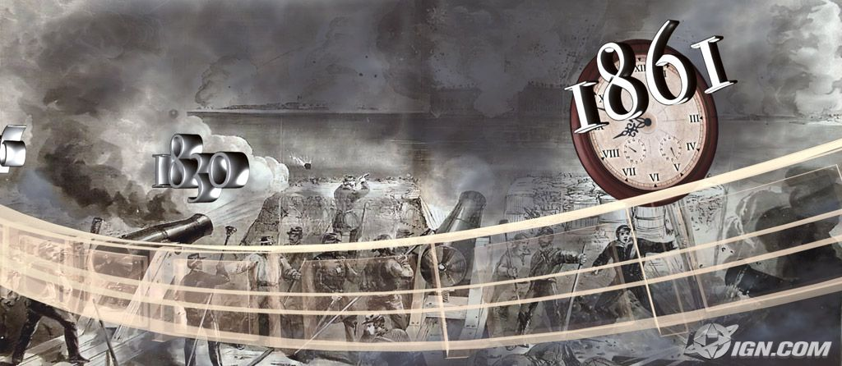
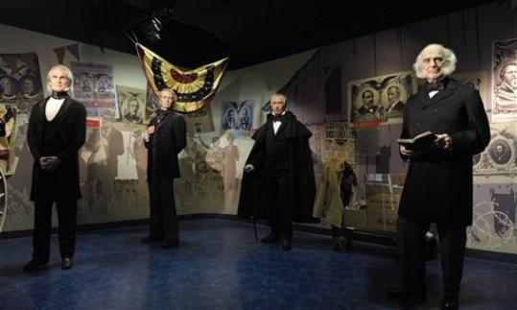
David Lee Burris: 1859 Wall Street Revival Continued With Southern Army & Worldwide To Entire English Speaking World Converting Moody & Spurgeon Leaders Of The Late Century
East – West Divide Spurred Growth While North – South Split Stymied It!

Slide 13
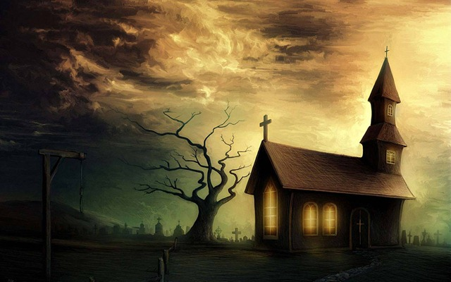
“In thinking of America, I sometimes find myself admiring her bright blue sky-her grand old woods-her fertile fields-her beautiful rivers-her mighty lakes and star-crowned mountains. But my rapture is soon checked when I remember that all is cursed with the infernal spirit of slave-holding and wrong; When I remember that with the waters of her noblest rivers, the tears of my brethren are borne to the ocean, disregarded and forgotten; That her most fertile fields drink daily of the warm blood of my outraged sisters, I am filled with unutterable loathing.” - Frederick Douglass

Slide 14
“Every Fourth of July, our Declaration of Independence is produced, with the sublime indignation, to set forth the tyranny of the mother country and to challenge the admiration of the world. But what a pitiful detail of grievances does this document present, in comparison with the wrongs which our slaves endure!”
– William Lloyd Garrison

Slide 15
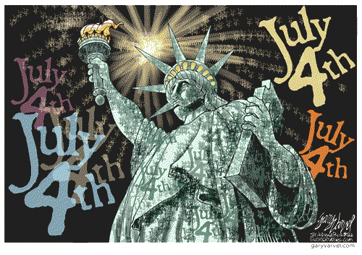

Slide 16
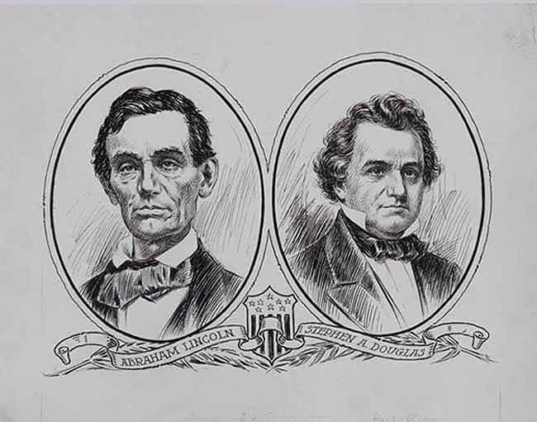
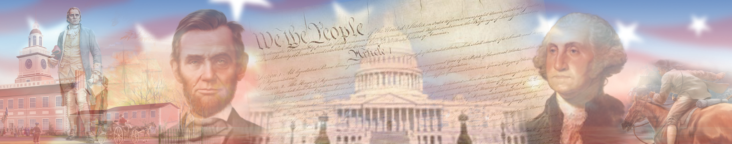
TWO SIDES CONFLICT CHOOSING BETWEEN THE TWO FOUNDING DOCUMENTS
An evenly divided country with insufficient majorities for amending proposal(2/3) and ratification(3/4).

Slide 17
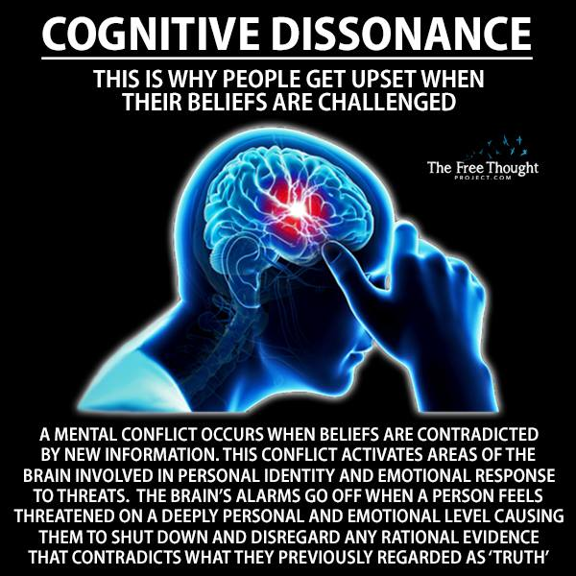

Slide 18
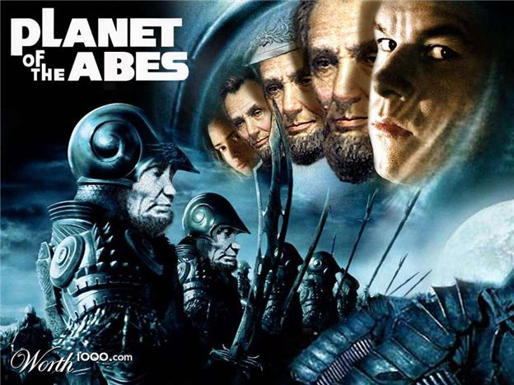


Slide 19
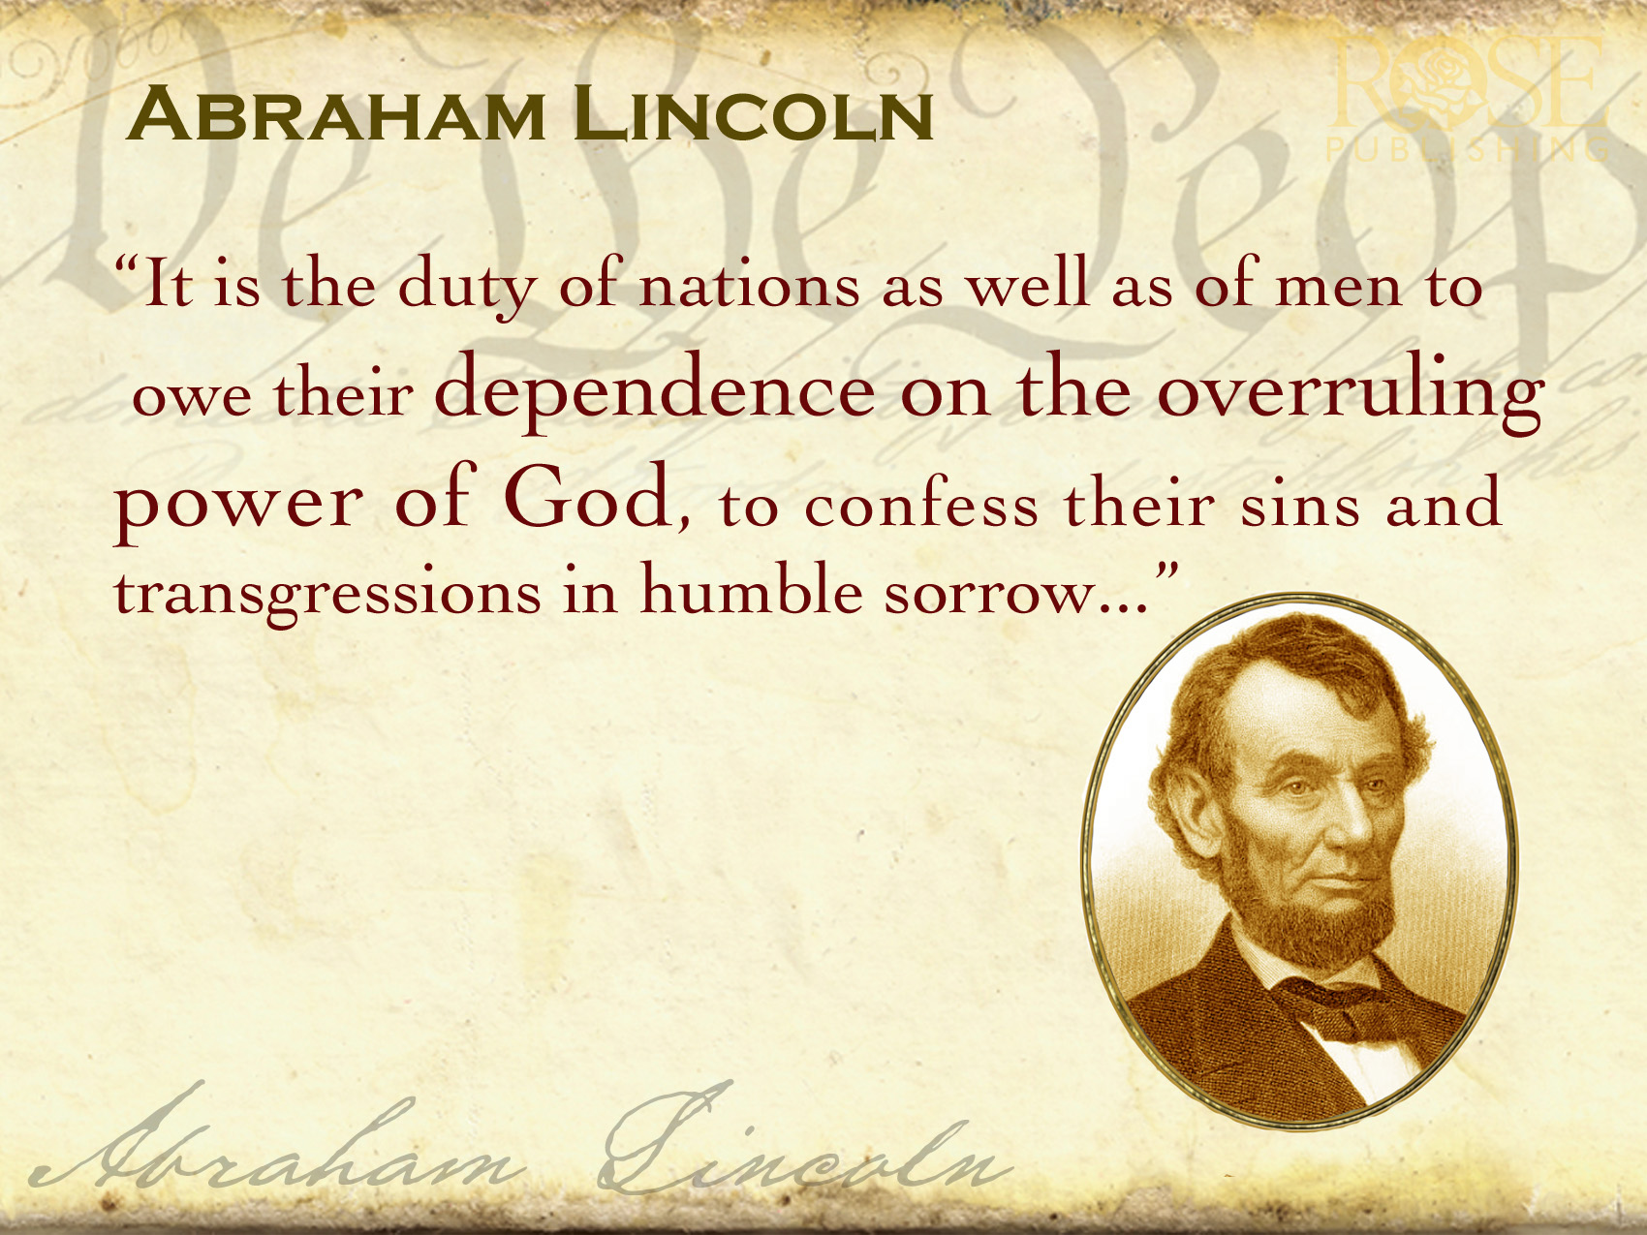

Lincoln defined American greatness through his recognition of how closely bonded political and moral considerations had to be in a democracy. A democracy founded on a proposition can betray that proposition by way of an unspoken tradition or ancestral custom. In the case of the slaveholding South, it can insist that the equality mentioned in that proposition is only an equality of white people.

Slide 20
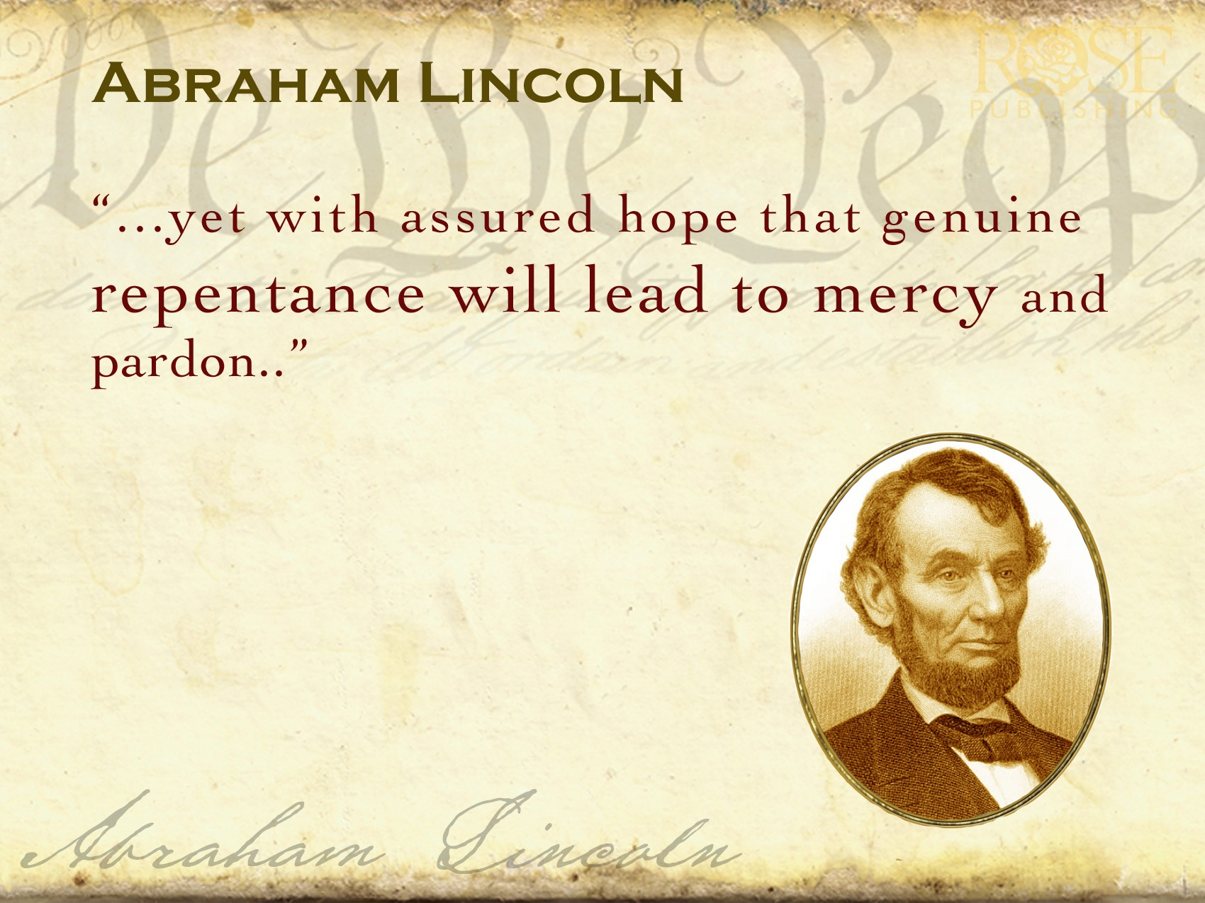
Lincoln saw that as much as politics, religion and morality do not always make for a good marriage, they make for an even worse divorce. For this secular man, who never joined a church, there was still no way to speak in America of equality and politics that did not conform to the internal principles of right and wrong. Nor did Lincoln hesitate to chart a path for a political future that he did not live to realize by reminding people that ‘the future had to be seen under the dictates of the justice of God’. – Professor Allen Guelzo

Slide 21
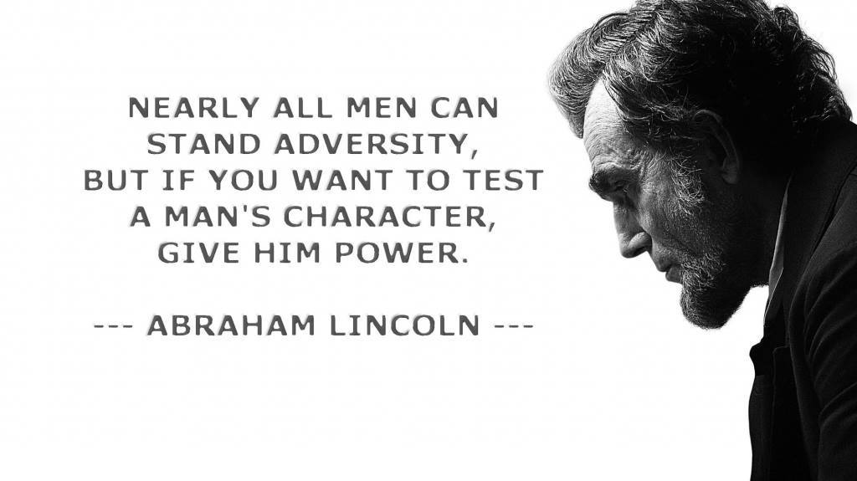

Slide 22



"Power always thinks it has a
great soul and vast views beyond
the comprehension of the weak;
and that it is doing God's service
when it is violating all his laws."
~ John Adams

Slide 23
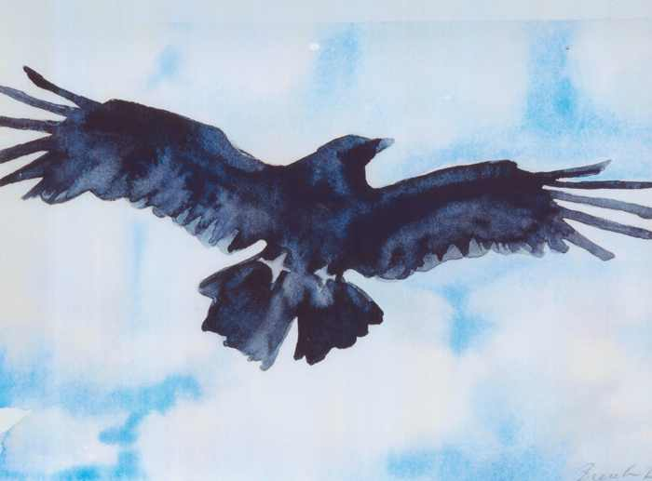
Lincoln’s Favorite Author - POE
Lincoln’s Favorite Poem - RAVEN

Slide 24
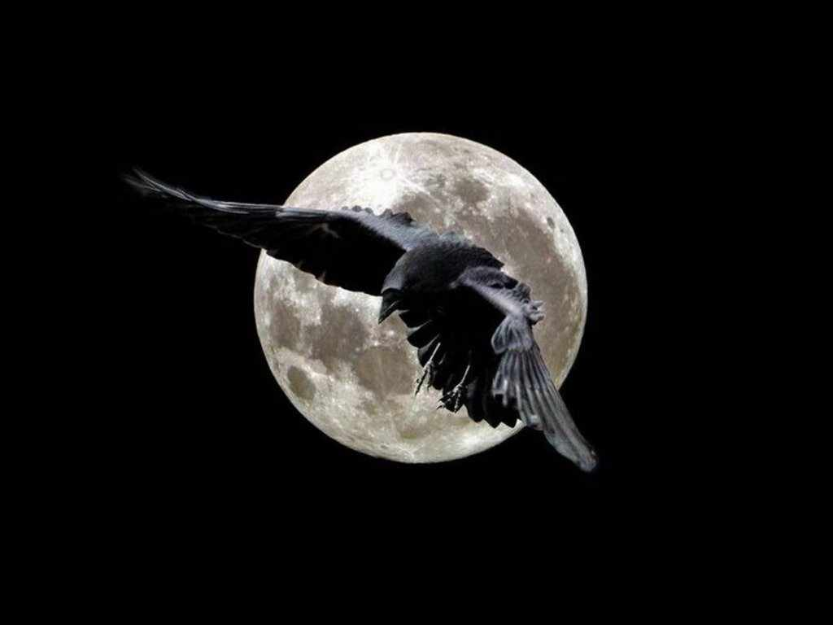
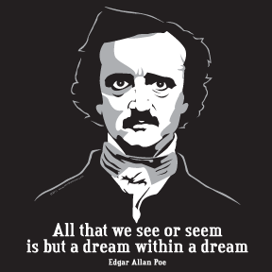
NIGHTMARE

Slide 25
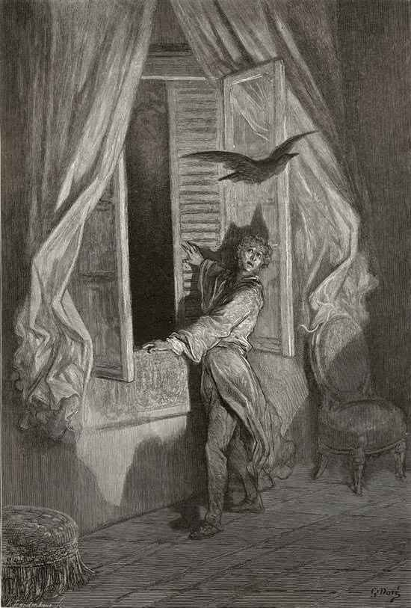
But the raven, sitting lonely on the placid bust, spoke only
That one word, as if his soul in that one word he did outpour.
Nothing farther then he uttered — not a feather then he fluttered —
Till I scarcely more than muttered, "Other friends have flown before —
On the morrow he will leave me, as my hopes have flown before."
Quoth the raven, "Nevermore."
Wondering at the stillness broken by reply so aptly spoken,
"Doubtless," said I, "what it utters is its only stock and store,
Caught from some unhappy master whom unmerciful Disaster
Followed fast and followed faster — so, when Hope he would adjure,
Stern Despair returned, instead of the sweet Hope he dared adjure —
That sad answer, "Nevermore!"

Slide 26
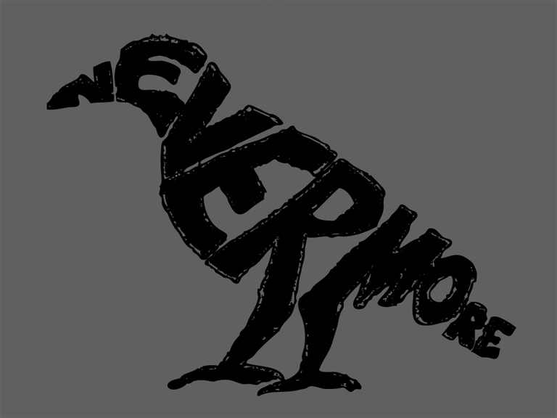

Slide 27
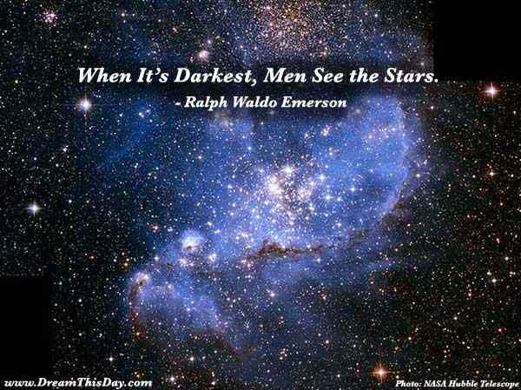
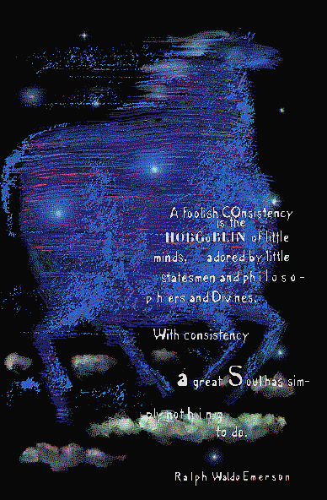

Slide 28
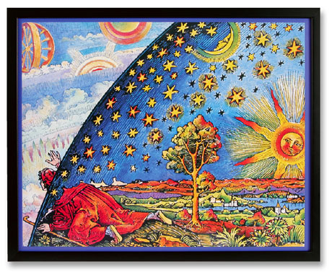
WAR WAS ON THE HORIZON

Slide 29
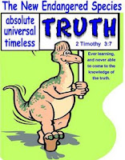
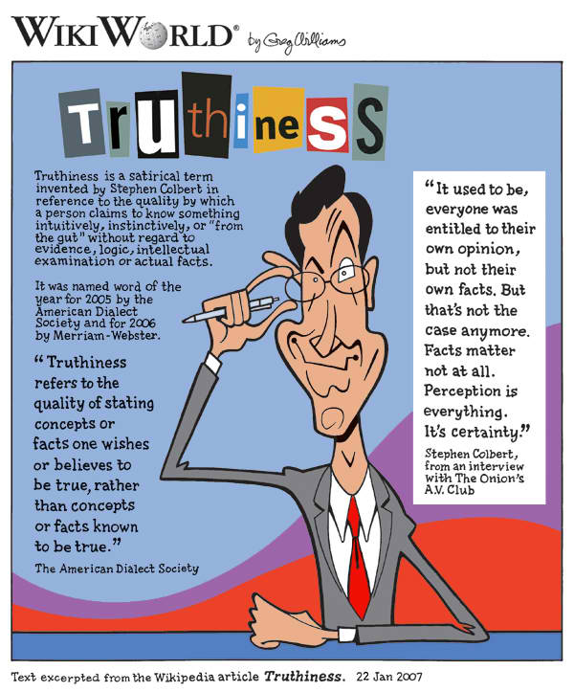
DISTORTIONS OF ABSOLUTE RIGHT
“Because of distortions and for no other reason, the average person thinks there is an occasional distinction between logical right and expedient right, between logical right and moral right, and also between expedient right and moral right. Despite widespread misconceptions, it seems
almost too prosaic to say that there is not. There is no distinction in the word itself; the distinction is only in the modifier used before the word, and the modifier designates an ingredient rather than a distinction. Right is certainly not absolute unless it has all the ingredients.” - HUMANETICS

Slide 30

The Principle Of Human Worth
The question of worthiness. By Luther’s lifetime, the term for thanksgiving, had been replaced with Missa, which means the dismissal of the unworthy.
Catholic hierarchs determine individual worthiness.
Reform churches each establish closed communions as evidencing their determinations of individual worth.
Restoration churches teach human worth as God given intrinsic and in the memorial supper - inner examined.

Slide 31
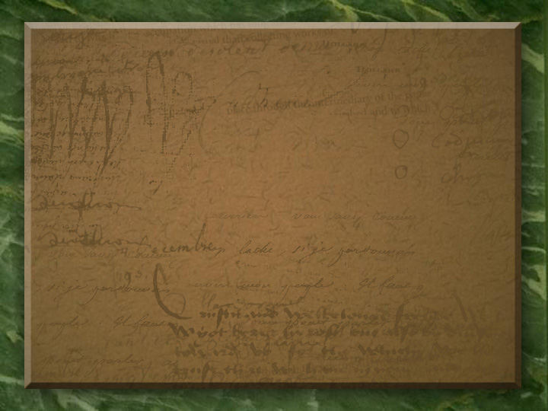
Living With Biblical Tensions by Klyne Snodgrass:
“Christians have always wrestled with the fact that our faith gives us two or more realities that stand in tension or seeming contradiction to each other. ‘Double-truth’ issues have dominated theological thinking throughout the church’s history. Throughout Christian history, heresy has resulted not from someone wanting to be evil or heretical but from someone taking a piece of truth to an extreme and not doing justice to other truths as well.”

Slide 32
David Lee Burris:
Lawyer’s Maxim: “The big print giveth, the small print taketh away!”
Approach
Freedom
Responsibility
Legalism
No
Yes
License
Yes
No
Liberty
Yes
Yes

Slide 33

Concepts Of Liberty & Freedom In Balance
THE NEW RESTORATION OF HUMAN WORTH
Latinate Origins Of Term “Liberty” Implies States Both Of Separation & Independence
Root Meaning Of “Freedom” Connotes Friendship & Attachment Or The Right Of Belonging In A Community Of Free People

Slide 34



Sociology Of Denominationalism Social Sources; H. Richard Niebuhr; 1929
THE BEATIFIC VISION!
“Compromises of the absolute good are doubly evil when they are unacknowledged, when the emasculation of the Christian ideal remains undiscovered and when, in consequence, men take pride, as in an achievement, in a defeat of the essential gospel… So it produces at last a spurious gospel unaware of its departure from the faith once delivered to the saints. Denominationalism in the Christian church is such an unacknowledged hypocrisy… It is a compromise, made far too lightly, between Christianity and the world. It represents the accommodation of Christianity to the caste-system of human society. It draws the color line in the church of God; it fosters the misunderstandings, the self-exaltations, the hatreds of jingoistic nationalism by continuing in the body of Christ the spurious differences of provincial loyalties; it seats the rich and poor apart at the table of the Lord…” p. 5

Slide 35
“The period of nationalism was followed by the period of the growth of sectionalism. In this era slavery divided the nation, and it also divided the Church. Churches began to emphasize their own denominational interests at the expense of inter-denominational and national interests.
Loyalty to the denomination came now to be the great emphasis, as loyalty to the North or South came to be characteristic in politics. Interdenominational societies gave way to denominational; churches were divided into antislavery and proslavery groups, while doctrinal schisms added to the confusion!”

Slide 36
Sociology Of Denominationalism Social Sources; H. Richard Niebuhr; 1929
“The social and psychological differences between South and North came to expression in scriptural condemnations & defenses of slavery. It was plain to Southern church- goers that many of the Old Testament heroes they had been taught to venerate had been masters of slaves, that Paul had given his sanction to the institution by counseling obedience to masters and by returning runaway Onesimus to Philemon. The incompatibility of chattel slavery with the counsel of love was no less evident to the Northern church-goer. The South idealized patriarchal relations of kindly lords to child-like servants; the North was more aware of the atrocities of domineering slave-drivers and the brutalities of the slave-market.” [Sectionalism, p. 191]

Slide 37
Sociology Of Denominationalism Social Sources; H. Richard Niebuhr; 1929
“Many ideas that cannot be described as rationalizations in the sense described {theological opinions} are yet evidently secondary in character, representing the intellectual reflections of more fundamental social and cultural as well as religious conditions. An evident illustration of this relationship of ideas to underlying social conditions may be found in the attitude of Christians toward such institutions as private property, democracy, and slavery. Advancing and defending their positions on the basis of proof-texts drawn from the scriptures, it has been possible for various sects to take antithetical views of the Christian or un-Christian character of these institutions. Only the purest novice in history will seek the explanation of such opinions in the proof-texts from which they purport to derive. In similar fashion opinions as to church polity, varying from denomination to denomination, have been based in theory on New Testament reports of primitive church organization… What is true of ethics and polity is true of theology. Less directly, but none the less effectively, theological opinions have their roots in the relationship of the religious life to the cultural and political conditions prevailing in any group of Christians…” page 14

Slide 38
Redeeming America: Road To War American Ways\Curtis D. Johnson\Pg. 147
“By contrast the Disciples of Christ had no significant North wing pushing them toward abolition & therefore hadn’t seceders seeking to silence anti-slavery sentiment. Instead the Disciples were dominated by conservatives like Alexander Campbell who argued that Scripture did not condemn slavery, that disciplining members for owning slaves was unbiblical & that compensated emancipation and also colonization were the best political solutions to the slavery issue.”
* 1821 American Colonization Society

Slide 39
The Road To Restoration By Bill Humble Three Leaders On Record For The Union
Pardee & Ovid Butler With John Boggs:
“Throughout the 1850’s the abolitionists – Pardee Butler, Ovid Butler, John Boggs & others – demanded that slavery be denounced as a sin and that Southern slave-owners be disfellowshipped. These demands kept the brotherhood - in the north - in turmoil. The Northwestern Christian Magazine, edited by John Boggs, was established in 1854 to champion the abolitionist cause. Abolitionist hostility to the missionary society became so intense that in 1858 they held a convention in Indianapolis & organized a rival society to the Cincinnati society. Organizationally, it was identical to the Cincinnati society, but in its membership requirements was included - ‘No complicity in the crime of American Slavery.’” pg. 47

Slide 40
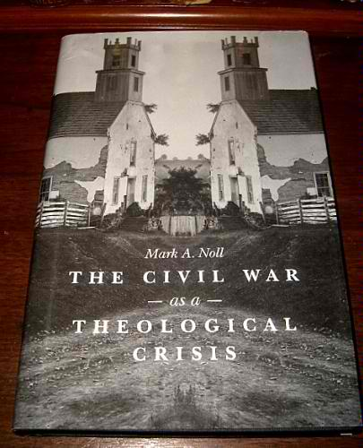
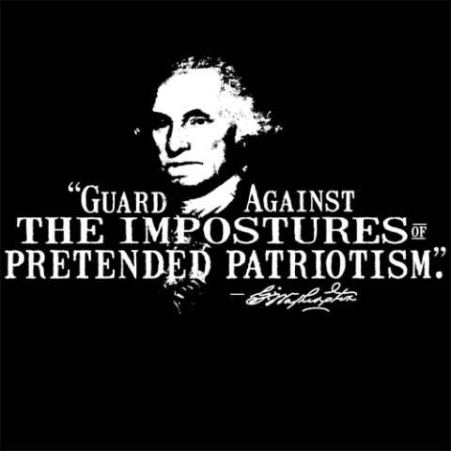
William Blake Said:
The Civil War was a major turning point in American religious thought, argues Mark A. Noll. Although Christian believers agreed with one another that the Bible was authoritative and that it should be interpreted through commonsense principles, there was rampant disagreement about what Scripture taught about slavery. Furthermore, most Americans continued to believe that God ruled over the affairs of people and nations, but they were radically divided in their interpretations of what God was doing in and through the war. In addition to examining what white and black Americans wrote about slavery and race, Noll surveys commentary from foreign observers. Protestants and Catholics in Europe and Canada saw clearly that no matter how much the voluntary reliance on scriptural authority had contributed to the construction of national civilization, if there were no higher religious authority than personal interpretation regarding an issue as contentious as slavery, the resulting public deadlock would amount to a full-blown theological crisis. By highlighting this theological conflict, Noll adds to our understanding of not only the origins but also the intensity of the Civil War.
“Both read the Bible day and night, but thou readst black where I read white.”

Slide 41
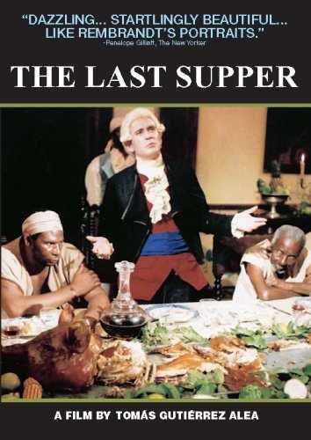
A plantation slaveowner convinces (himself) that he
is moral and benevolent. Imagining himself in the Christ role, the slaveowner stages a formal dinner - a last supper - by inviting 12 black slaves to dine with him.
Why stage this dinner? The slave master believes the blacks will thank him for his "goodness." Instead, the plantation owner lets loose the Africans' passions, hatred, and desperation for freedom. A slave revolt follows. In response, the slave owner forgets all about Christ as he ruthlessly hunts and punishes the rebellious blacks...

Slide 42
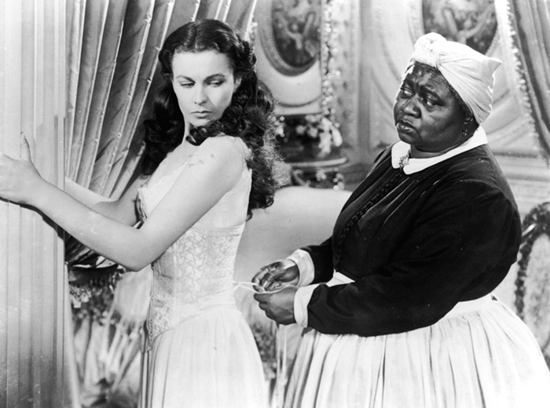
“The south is not just a place, it is, as they proudly tell you, a state of mind,” said Republican consultant Alex Castellanos.
“The North is defined by reason, the South embraces romance and the heart. The North is relativist, the South lives by absolutes.
When the South is right, it is absolutely right. When wrong, it is absolutely, tragically wrong.”

Slide 43
David Lee Burris: 1859 Wall Street Revival Continued With Southern Army & Worldwide To Entire English Speaking World Converting Moody & Spurgeon Leaders Of The Late Century
East – West Divide Spurred Growth While North – South Split Stymied It!

Slide 44
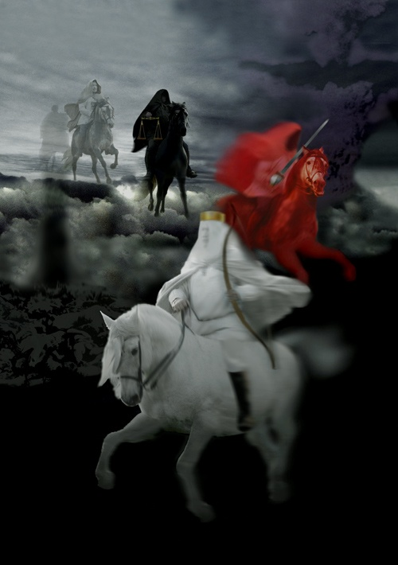
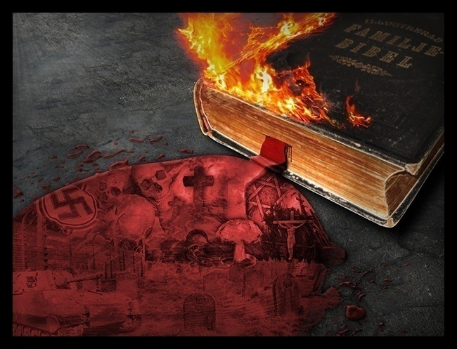
God's Will That Man Lives In Communities Of Justice
Consequences Violating God's Moral Laws!

Slide 45


Slide 46

Archibald McLean: “Campbell As A Preacher”
Gen. Robert E. Lee on Campbell:
As Said By Symonds, “He was a man in whom were illustriously combined all the qualities that could adorn or elevate the nature to which he belonged; knowledge the most various and extended, virtue that never loitered in her career nor deviated from her course. A man who, if he had been delegated as a representative of his species to one of the many superior worlds, would have suggested a grand idea of the human race.”

Slide 47
“There is a growing taste for opinionism in the Reformation ranks. This must be quashed out or there is an end to all moral and religious improvement. It has ever been the harbinger of schism, the forerunner of all discord and vain jangling.
It has been the plague of Christendom.
What is an opinion? Persuasion without proof, say some of our lexicographers. It is speculation built on probable evidence. It is neither knowledge or faith; but in the absence of these, it is an inference, a conclusion to which the mind assents according to its information or mode of reasoning…
To walk by opinions rather than faith is effectually to make the Book of God of no authority!”
- Alexander Campbell in 1837

Slide 48
EPISODES & EVENTS: ALEXANDER CAMPBELL
1816 – Alexander Campbell @Baptist Redstone Congregation Delivers “Sermon on the Law”
NOTE: Thomas & Alexander Campbell Expelled for Teaching The Gospel Greater Than The Law.
1820 – Alexander Campbell Debates Presbyterian John Walker on the Topic of Infant Baptism.
1823 – Alexander Campbell Debates Presbyterian Will McCalla on the Topic of Infant Baptism.
1829 – Then Baptist Alexander Campbell Debates Atheist Robert Owen on the Topic of “Religion the Cause Not the Answer to Social Problems.” (paraphrased)
NOTE: Because Campbell Alone Had Answered the British Atheist Challenge To America’s Preachers – His Argumentation was Nationwide Media Followed As If He Represented Christian America. He Gained A Type Of National Hero Status!
Because Of the Explosive Growth Of The Restoration Movement On The American Frontier – After Success Of The Owen Debate & With Campbell’s New Celebrity Status – Ex-Presidents & Current Serving U.S Presidents – While Traveling – Routinely Stopped By & Often Stayed Overnight At The Campbell Family Guest House!

Slide 49
EPISODES & EVENTS: ALEXANDER CAMPBELL
1816 – Alexander Campbell @Baptist Redstone Congregation Delivers “Sermon on the Law”
NOTE: Thomas & Alexander Campbell Expelled for Teaching The Gospel Greater Than The Law.
1820 – Baptist Alexander Campbell Debates Presbyterian John Walker on the Topic of Infant Baptism.
1823 – Baptist Alexander Campbell Debates Presbyterian Will McCalla on the Topic of Infant Baptism.
1829 – Baptist Alexander Campbell Debates the Scotland Atheist Robert Owen on the Topic of “Religion the Cause Not the Answer to Social Problems.” (paraphrased)
NOTE: Alexander Campbell’s Argumentation was Nationwide Media Followed Representing Christian America
1830 – Unaffiliated Alexander Campbell Debates Presbyterian Obadiah Jennings on the Topic of “The Cult or Sect of Campbellism.”
1837 – (Christian Only) Alexander Campbell Debates Catholic Bishop John Purcell on the Topic of “Protestantism Versus Catholicism.”
1843 – (Christian Only) Alexander Campbell Debates Presbyterian Rice on the Topic of the “Operation of the Holy Spirit.”
1847 – Alexander Campbell Arrested During Scotland Tour Speaking on Slave Controversy.
1848 – Alexander Campbell Speaks Before U.S. Congress on the Subject of Carnal Warfare.

Slide 50
Alexander Campbell Speech @Congress 1848:
”We have all a deep interest in the question; we can all do something to solve it; and it is everyone's duty to do all the good he can. We must create a public opinion on this subject. We should inspire a pacific spirit and urge on all proper occasions the chief objections to war. In the language of the eloquent Grimke, we must show that "the great objection to war is not so much the number of lives and the amount of property it destroys, as its moral influence on nations and individuals. It creates and perpetuates national jealousy, fear, hatred, and envy. It arrogates to itself the prerogative of the Creator alone - to involve the innocent multitude in the punishment of the guilty few. It corrupts the moral taste and hardens the heart; cherishes and strengthens the base and violent passions; destroys the distinguishing features of Christian charity - its universality and its love of enemies; turns into mockery and contempt the best virtue of Christians - humility; weakens the sense of moral obligation; banishes the spirit of improvement, usefulness, and benevolence; and inculcates the horrible maxim that murder and robbery are matters of state expediency."

Slide 51
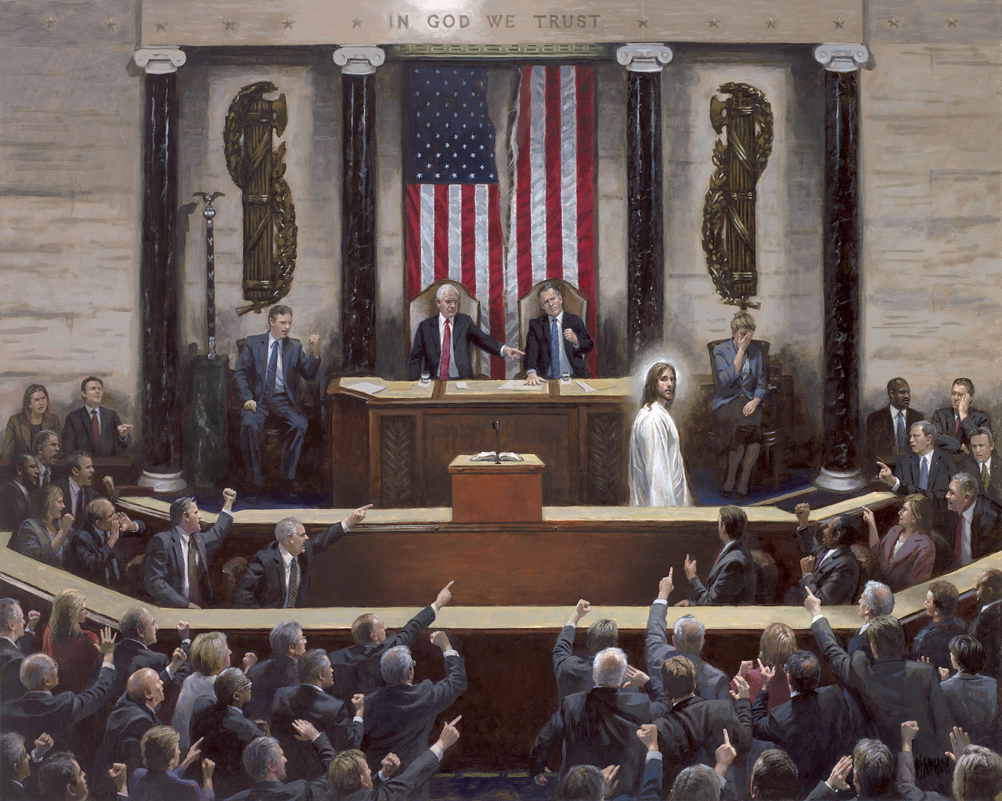

Slide 52

MATURE MINDSET:
Ultimate Causation

Slide 53
Principle Of Human Worth Compromised
“It has been my experience that folks with who have no vices have very few virtues!”
ABE LINCOLN LOST 1843 WHIG
CONGRESSIONAL NOMINATION
TO CAMPBELLITE EDWARD BAKER
WHAT IF - ANOTHER APPROACH?

Slide 54
MATURE MINDSET:
“One is astonished in the study of history at the recurrence of the idea that evil must be forgotten, distorted, skimmed over. We must forget that George Washington was a slave owner and simply remember the things we regard as creditable and inspiring. The difficulty, of course, with this philosophy is that history loses it value as an incentive and example; it paints perfect men and noble nations, but it does not tell the truth.”
- W. E. B. Du Bois

Slide 55
NEXT: A Great & Good Man
Plato’s Republic defined the noble lie as a myth or an untruth told by the elite to preserve social harmony or the position of the elite. It’s a lie that those who govern choose to tell under the delusion that they’re doing so for the greater good.
& A Not So Noble Lie!

Slide 56
Roots: Ethical Compromise & Slowed Momentum
David Lee Burris: WOULD IT HAVE BEEN POLITICS IN THE PULPIT AS STONE SAID?
In 1849: “There are usually pews for their race in the back of the auditorium.”
Contrast To William Wilberforce Of England Who Considered A Change In His Political Career Along With His New Christianity But Was Encouraged To Work Within The System For Change – He Talked The British Empire Into Abolishing The Practice Altogether!
“Now, if I could speak to all the slaves on this continent, I would say to them, Be Faithful and obedient servants not only to masters good and gentle, but even to the froward and perverse.”
“Masters of the South, you will find that I am not visionary on this subject. Nor have I a desire to see you lose one dollar, nor one hours sleep, nor that you feel one pang of guilty conscience, because of your happening to possess servants white or black.”
Principled Position?
- Alexander Campbell, 1830

Slide 57
Fruit: Ethical Compromise & Slowed Momentum
David Lee Burris: WOULD IT HAVE BEEN POLITICS IN THE PULPIT AS STONE SAID?
Alexander’s Position On This Issue Considerably Convoluted In A Time That Demanded Clarity – Like George Washington(Slave-owner) & James Madison He Supported An Incremental Approach To Solving The Slave Problem Modeled After What The Northern States Had Accomplished Starting With Pennsylvania In 1780; Like Thomas Jefferson He Had Slaves But Fought Against Slavery – Ultimately He Freed His Slaves But Was Against Any Legislated Abolishment Other Than That Graduated “Without Financial Loss To The Owners”; Campbell Carried A Colonization Plan To A 1829 National Political Convention That Would Have Earmarked Ten Mill Annually Out Of The Federal Budget For This Purpose; Put On The Spot - “I Do Not Regard The Slaveholders’ Money As The ‘Price Of Blood’.”; He Called For “A Relaxing Of Public Opinion In The North”
NOTE: After The American Revolution Jefferson Seems To Have Became Quite Comfortable With Slave ownership - Thomas Jefferson’s Subsequent Moderated Position Was Born More Out Of Horror Of What Had Happened To The French In Haiti & Fear That It Might Happen Here!
“In this great crisis of human affairs [Fugitive Slave Act] ‘He that hasteth in his movements erreth.’ Let us show good reason for our course, and a due respect to those who dissent from us, and we shall then, doubtless, ride the storm, control the waves, and finally anchor in a sure and safe haven.”
Sage Advice?
- Alexander Campbell, 1851

Slide 58

Archibald McLean: “Campbell As A Preacher”
Gen. Robert E. Lee on Campbell:
As Said By Symonds, “He was a man in whom were illustriously combined all the qualities that could adorn or elevate the nature to which he belonged; knowledge the most various and extended, virtue that never loitered in her career nor deviated from her course. A man who, if he had been delegated as a representative of his species to one of the many superior worlds, would have suggested a grand idea of the human race.”
Note: WHAT IF…

Slide 59
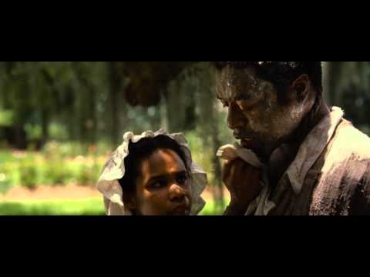
12 Years Slave: Campbellite Slaveowner Treatment

Slide 60
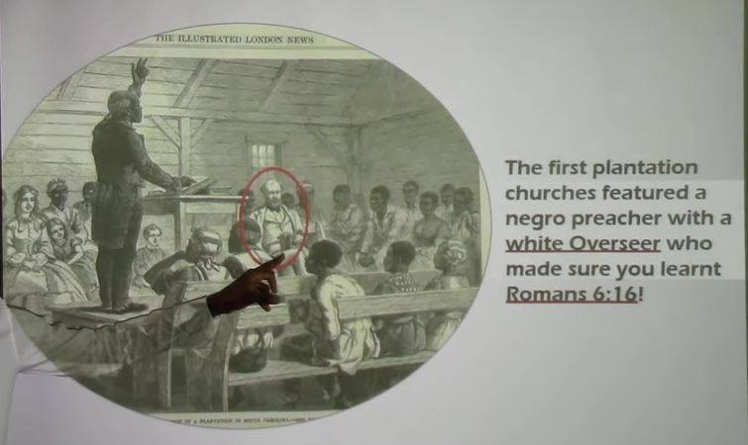

Slide 61
Churches of Christ History Can’t Be
CAMPBELLS HAGIOGRAPHY
HIGHER LAW = HIGHER LOVE
Principle Of Human Worth
Was Compromised

Slide 62
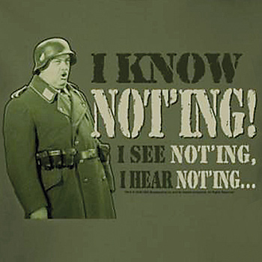

FROM MARTIN LUTHER:
“If I profess with the loudest voice and clearest expression every portion of the truth of God, except precisely that little point which the world and the devil are at that moment attacking, I am not confessing Christ, however boldly I might be professing Christ.”

Slide 63
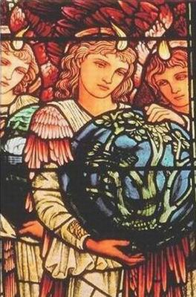


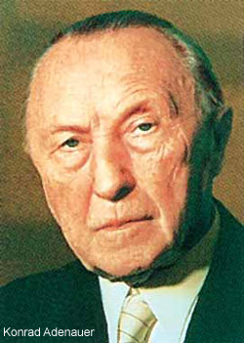
“History is the sum total of things that could have been avoided.”
  Konrad Adenauer

Slide 64
Was Slavery The Primary Reason For Secession?
Almost all professional historians today agree with W.E.B. DuBois, who was astounded that ‘anyone who reads the lives of contemporary statesmen and public characters, North and South, the discourses in the newspapers and accounts of meetings and speeches, [could] doubt that Negro slavery was the cause of the Civil War.’
An obvious example is Confederate Vice President Alexander Stephens, speaking in Savannah, Georgia, just weeks after the Deep South seceded. He stated that slavery was the ‘immediate cause of the present revolution.’ He also said the United States had been founded on the false assumption that all men were created equal, and that the ‘cornerstone of our new Government is founded upon the great truth that the negro is not equal to the white man. This, our new government, is the first, in the history of the world, based upon this great physical, philosophical, and moral truth.’
“The first casualty of war is truth.” – Hiram Johnson

Slide 65
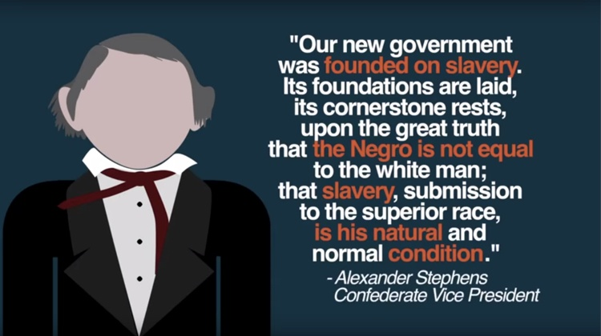
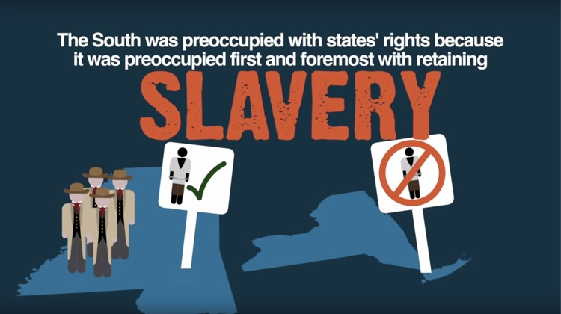

Slide 66
The Confederate Constitution & The Slavery Issue
The radicals wanted to reinstitute the slave trade with Africa, to send a legal signal that there was no shame in the institution. But moderates wanted nothing to do with the slave trade. They did not want to offend European powers, especially England, which they hoped would recognize their country and take their side if it came to war. They also resisted because they were still trying to entice the people of the Upper South and the Border States into the Confederacy. Even slaveholders might object to the revival of the African trade, because it would depress the price of their slaves, and it would offend many Southerners who approved of slavery but not the brutal transport of slaves across the Atlantic.

Slide 67
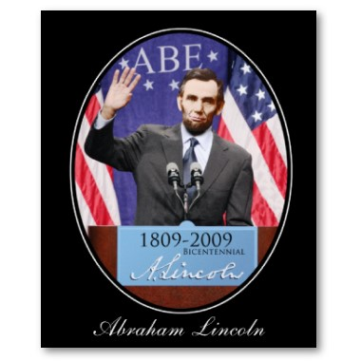
“WE KNOW NOTHING OF WHAT HAPPENS IN THE FUTURE BUT BY THE ANALOGY OF EXPERIENCE.” - Abraham Lincoln

Slide 68
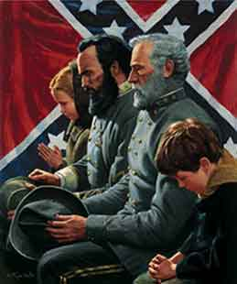
“Whenever I hear anyone arguing for slavery I feel a strong impulse to see it tried on him personally!”
David Lee Burris:
To Our Shame The Social Issues That Concerned The Restoration Movement To The Exclusion Of Slavery Both Thirty Years Prior & Thirty Years After The Civil War Were Recreation Related: Dancing – Card Playing – Horse Racing – Cock Fights – Gambling. Tobacco & Temperance Issues Did Divide. The Only Social Issue Non-Recreational Getting Attention Was That Of Secret Societies – i.e. Masonry.
- Abraham Lincoln

Slide 69
“A day of grace is yet held out for us.
Both North and South have been guilty before God; and the Christian church has a heavy account to answer.
Not by combining together,
to protect injustice and cruelty,
and making a common capital of sin,
is this Union to be saved,
- but by repentance, justice, and mercy.”
HARRIET BEECHER STOWE

Slide 70
The Thunder-Cloud
Thy thunder pealeth o’er us,
God of the earth and sky!
And o’er the gloomy heavens,
The clouds roll dark and high;
But oh! there lieth brooding
A cloud more dark and dread,
Above our guilty nation,
In fearful portent spread.

Slide 71
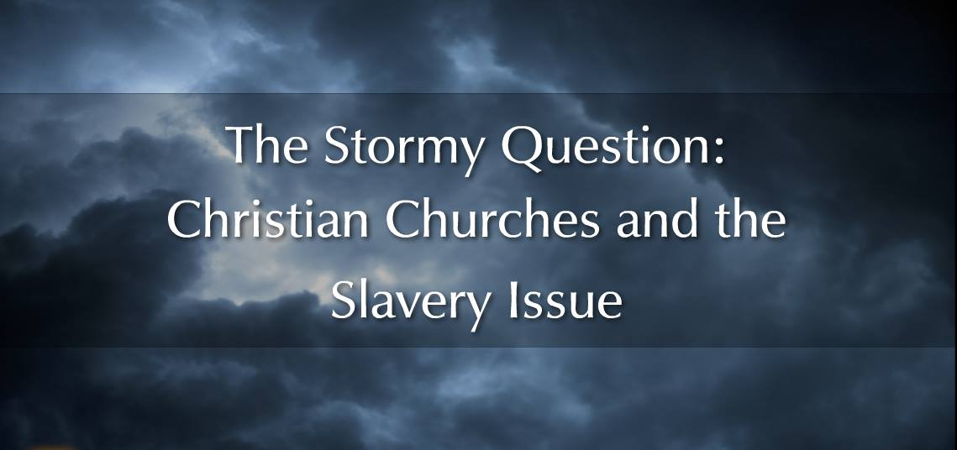


Slide 72
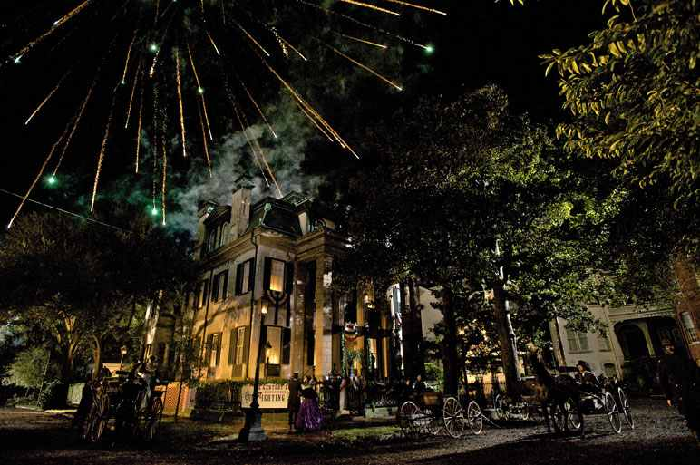
“That reminds me,” remarked Mr. Lincoln one day, “of a farmer who lost his way on the Western frontier. Night came on, and the embarrassments of his position were increased by a furious tempest which suddenly burst upon him. To add to his discomfort, his horse had given out, leaving him exposed to all the dangers of the pitiless storm.
“The peals of thunder were terrific, the frequent flashes of lightning affording the only guide on the road as he resolutely trudged onward, leading his jaded steed. The earth seemed fairly to tremble beneath him in the war of elements. One bolt threw him suddenly upon his knees.
“Our traveler was not a prayerful man, but finding himself involuntarily brought to an attitude of devotion, he addressed himself to the Throne of Grace in the following prayer for his deliverance:
“‘O God! hear my prayer this time, for Thou knowest it is not often that I call upon Thee. And, O Lord! if it is all the same to Thee, give us a little more light and a little less noise.’ ”

Slide 73
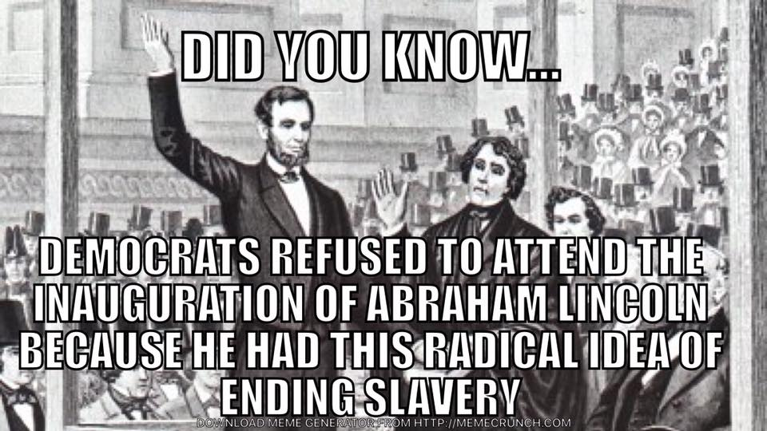

Slide 74
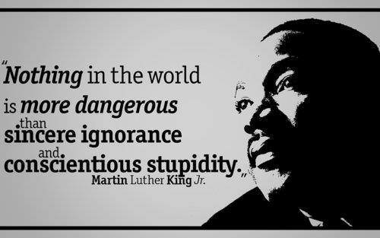

Slide 75
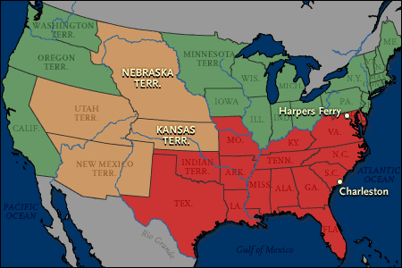
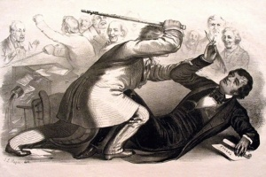
American History
Again Intersects
Church History

Slide 76
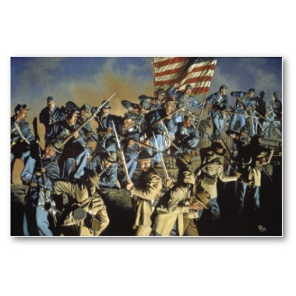
Southern people speak so lightly of war… War is a terrible thing!
Where are your men & appliances of war? The North can make a steam engine, locomotive or railway car; hardly a yard of cloth or pair of shoes can you make…

Slide 77
You are rushing into war with one of the most powerful, ingeniously mechanical, and determined people on earth – right at your doors.
You are bound to fail!”
- William Tecumseh Sherman

Slide 78
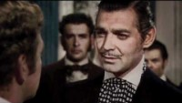

Slide 79



Gov. Sam Houston-Texas-
Let me tell you what is coming. After the sacrifice of countless millions of treasure and hundreds of thousands of lives you may win Southern independence, but I doubt it. The North is determined to preserve this Union. They are not a fiery, impulsive people as you are, for they live in colder climates. But when they begin to move in a given direction, they move with the steady momentum and perseverance of a mighty avalanche.

Slide 80


Slide 81

Family History From Family Bibles: Physical Births & Spiritual Rebirths
EVER OPENED UP someone else’s old photo album?
Grandparents, aunts, second cousins, old Ford Model Ts, big hats. Or boat cars and poodle skirts. People smiling into long-vanished sunsets and sunrises. At first, it seems confusing. Maybe you can pick out an era, but these aren’t your grandparents and your second cousins, your stories, or your inside jokes.
But then you talk to the people who own the photo album. You listen to their stories and the photos come alive. You learn what it meant to be part of that family in all its struggles and heartaches and joys. What it meant to live at that moment in history.
What does this photo album teach the rest of us? Things we already knew, but things it is good to remember. The centrality of the Bible. The centrality of the body of Christ. How American culture and the Christian message influenced each other.
And how difficult it is to be “simply Christian.” Even when you go whole hog. Traditions and human constructions can turn out to be, in the end, inescapable. But also inescapable, in the end, is the grace of God. Thanks be to God, who redeems all constructions. – Editoral Notes Christian History Special Issue Stone-Campbell Movement

Slide 82
Uncle Tom’s Cabin:
O, church of Christ,
read the signs of the times!
Is not this power
the spirit of HIM whose kingdom is
yet to come?

Slide 83
Does God Exist?\Oct90\Revolution Or Evolution?\Cecil Hook
David Lee Burris:
Notes On Roman Stylized Slavery: “Legally claiming personal bankruptcy opened the door for many to make their fortunes handling the affairs of the great houses of the prominent families of the cities. Slowly but surely these temporary slaves became essential to the maintenance of the household and then the dependency relationship would be reversed. Shortly thereafter these skilled individuals would buy out their contract and become manor caretakers – in other words – they went from self-enslavement to quoting their own salary in short order!” Myself
Was it sinful for christians to own slaves?
Would it have been proper to buy a slave?
What about one person enslaving another?
“Paul insists, ‘Do not become slaves of men?’ (1st Cor 7:23). If it is wrong for me to become a slave, it is wrong for me to enslave someone else. Through the working out of the Golden Rule, this great social change was to evolve…”

Slide 84
Does God Exist?\Oct90\Revolution Or Evolution?\Cecil Hook
David Lee Burris:
Notes On Roman Stylized Slavery: “Legally claiming personal bankruptcy opened the door for many to make their fortunes handling the affairs of the great houses of the prominent families of the cities. Slowly but surely these temporary slaves became essential to the maintenance of the household and then the dependency relationship would be reversed. Shortly thereafter these skilled individuals would buy out their contract and become manor caretakers – in other words – they went from self-enslavement to quoting their own salary in short order!” Myself
Was it sinful for christians to own slaves?
Would it have been proper to buy a slave?
What about one person enslaving another?
“Paul insists, ‘Do not become slaves of men?’ (1st Cor 7:23). If it is wrong for me to become a slave, it is wrong for me to enslave someone else. Through the working out of the Golden Rule, this great social change was to evolve…”
“God wants change in all individuals and societies. He does not, however, demand or expect that change to be an immediate leap from depravity to perfection. Conduct of a mature disciple is not demanded of a newborn in Christ; neither is infancy an acceptable standard for those who have had time and opportunity to grow toward the fullness of Christ!”

Slide 85
The Moral Change Process: Cognitional & Conceptual Developments
1st Level: Pre-Conventional Is Structured In Terms Of An Obedience To Tools & Rules.
2nd Level: Critical Reflection Of Rule Roles & Basic Conventions; Accepted Tool Of Social Relation & Maintenance Of Social Order.
3rd Level: Post-Conventional Individual & Minority Focus On Rights & Universal Principles - Natural Law & Analogic Method
Source: Kohlberg, Psychology Of Moral Development

Slide 86
Symbiontic
What
People
Value
Must Match
How
Value
People

Slide 87




God’s Two Methods
Willing change:
  Reflect on the cross
  Soften the heart
  Yields to God’s way of thinking
Grudging change:
  External difficulties
  Soften the heart
  Yields

Slide 88


Slide 89

IN THE providential BOOK OF JOB

Slide 90
GOD’S LIGHTNING ARE CHARGED ARROWS!

Slide 91
THE THUNDER IS HIS VOICE!

Slide 92


Slide 94
Powerless in the face of authority
No man has authority to restrain the wind with the wind, or authority over the day of death; there’s no discharge in the time of war, and evil will not deliver those who practice it. (Ecl 8:8)

