Slide 1
Salvation by Faith Only? Obedient Faith & the Necessity of Baptism
By Dr. Ken Pepper

Slide 2
The Question…
"Faith only" advocates say we are saved by faith before baptism, so a person is baptized after he has already been saved. But we have learned that salvation by faith includes the conditions that are necessary to receive forgiveness.
Is baptism one of the conditions one must meet to receive forgiveness, or does baptism come after forgiveness?

Slide 3
God’s Word Gives the Answer…
Key Verses:
Acts 22:16
Mark 16:15-16
Acts 2:38
Romans 6:3-4 & Galatians 3:26-27
1 Peter 3:20-21
Colossians 2:12-13 & Ephesians 2:4-9

Slide 4
The Pattern for Our Lesson:
Read
1
Read a key passage from the Bible regarding baptism.
Introduce
2
Introduce arguments used by “Faith Only” advocates respective to the passage under consideration.
Expose
3
Expose the failure in the opposing logic.

Slide 5
Acts 22:16
16 And now why tarriest thou? arise, and be baptized, and wash away thy sins, calling on his name.

Slide 6
The Conversion of Paul (Acts 22:16)
This is the conversion of Paul, that apostle who preached so much about "salvation by faith." Surely, he knew whether salvation by faith includes or excludes baptism. What about his own conversion? Was baptism essential to his forgiveness?
On the road to Damascus, he saw Jesus and believed in him (22:5-10). During the following three days, he was praying (9:11). If people are saved by "faith alone," then surely, he must have been saved. But was he?

Slide 7
The Conversion of Paul (Acts 22:16)
Jesus instructed Paul that, in the city he would be told all things that he must do (22:10; 9:6). What was he told? Ananias said to arise and be baptized and wash away his sins (22:16). If salvation is by "faith alone" before baptism, then Paul would have had no sins at this point. But he did have sins, and he remained in sin till he was baptized.
The passage clearly places forgiveness, not before baptism, but as a result of it. Surely nothing Paul later taught should be taken to contradict what he himself did to be saved. He knew that salvation by faith includes and requires baptism; it does not exclude it.

Slide 8
Mark 16:15-16
15 And he said unto them, Go ye into all the world, and preach the gospel to the whole creation. 16 He that believeth and is baptized shall be saved; but he that disbelieves shall be condemned.

Slide 9
The Argument…
Faith Only says:
He that believes is saved and may then be baptized. Jesus said: He that believes and is baptized shall be saved.
Note a comparison of two passages:
Romans 10:9 and Mark 16:16

Slide 10
Comparison of Romans 10:9 & Mark 16:16
Romans 10:9
because if thou shalt confess with thy mouth Jesus as Lord, and shalt believe in thy heart that God raised him from the dead, thou shalt be saved:
Mark 16:16
He that believeth and is baptized shall be saved; but he that disbelieveth shall be condemned.

Slide 11
The Argument…
Faith Only says:
"But it says, 'He who disbelieves shall be condemned.' It doesn't say he who disbelieves and is not baptized shall be condemned."

Slide 12
The Reply…
So, some conclude that only faith is essential. But we have already seen that baptism alone will not save. Both faith and baptism are required. A lack of faith is enough to condemn a person, whether he gets baptized or not. Baptizing such a person would accomplish nothing (cf. John 3:18).
Can you find a verse that says, "He who disbelieves and does not confess shall be condemned"? If not, does that prove confession is not essential?

Slide 13
The Reply…
Faith is prerequisite to both confession and baptism; both are worthless without faith. But that does not prove we can be saved by faith alone without confession and baptism.
Confession
Faith
Baptism
Prerequisite

Slide 14
The Reply…
What is it that, if disbelieved, causes a person to be condemned? It is the gospel (v15; cf. Mark 1:15; Romans 1:16). What does the gospel say? It says right here (and elsewhere) that we must both believe and be baptized to be saved!

Slide 15
The Argument…
Faith Only says:
"It's like saying 'He who gets on a plane and sits down will arrive at California.' Getting on is essential, but sitting down is not."

Slide 16
The Reply…
Try this illustration on Romans 10:9: "If you confess ... and believe ... you will be saved." Is this like, "If you get on the plane and sit down, you will arrive at California"? If so, then on Romans 10:9 the illustration proves that faith is not essential! Why does the illustration work on Mark 16:16, but not on the parallel language in Rom. 10:9?

Slide 17
The Reply…
A better illustration would be: "If you buy a ticket and get on the plane, you shall go to California." Buying the ticket parallels faith (it gives the right to become a child of God - John 1:12), and getting on the plane parallels being baptized into Christ (Romans 6:3). Both are essential to arrive at the destination.

Slide 18
Acts 2:38
38 And Peter said unto them, Repent ye, and be baptized every one of you in the name of Jesus Christ unto the remission of your sins; and ye shall receive the gift of the Holy Spirit.

Slide 19
The Argument…
Faith Only says:
"'For remission' means because you already have it - like a man receives a ticket 'for speeding.'"

Slide 20
The Reply…
No reputable translation ever translates Acts 2:38 "because of remission of sins." This is because, while the English "for" can look backward meaning "because of" a previous event, the Greek word used here does not. Some translations show that the correct meaning is: "unto remission" (ASV), "so that your sins may be forgiven" (NIV), or "in order to have your sins forgiven" (Goodspeed).

Slide 21
The Reply…
Try the "because of" argument on these passages:
Matthew 26:28 - My blood ... is shed for many for (EIS) the remission of sins.
2 Corinthians 7:10 - Repentance to (EIS) salvation.
Romans 10:10 - ... confession is made to (EIS) salvation.
Hebrews 10:39 - ... believe to (EIS) the saving of the soul.

Slide 22
The Reply…
Do these verses mean that we should believe, repent, and confess - in fact, Jesus even died - because we already have remission?! Are all these things non-essential, coming after we have been forgiven? If not, then why should we believe that is what "for" means in Acts 2:38?
The arguments used against baptism, if consistently applied, would invariably prove that confession is not essential to salvation, and most of the arguments would prove faith and repentance are not essential! Surely such arguments are invalid.

Slide 23
The Reply…
To see what "for" in Acts 2:38 means, note the context.
Consider who is being addressed. These people had been convicted of sin (v23,36), and had just asked what to do as a result (v37). Peter told them to "repent and be baptized." Who needs to repent: people who have already been forgiven, or people who need to obtain it? Obviously people do not need to repent, unless they are in sin.
Clearly Peter is not telling saved people how to show they are saved. He is telling lost sinners how to receive remission. Therefore, baptism is necessary in order to receive remission of sins.

Slide 24
Romans 6:3-4 & Galatians 3:26-27
Romans 6:3-4
3 Or are ye ignorant that all we who were baptized into Christ Jesus were baptized into his death? 4 We were buried therefore with him through baptism into death: that like as Christ was raised from the dead through the glory of the Father, so we also might walk in newness of life.
Galatians 3:26-27
26 For ye are all sons of God, through faith, in Christ Jesus. 27 For as many of you as were baptized into Christ did put on Christ.

Slide 25
The Argument…
Some Faith Only advocates say:
Gal. 3:26,27; Rom. 6:3,4; and Col. 2:12 refer, not to water baptism, but to Holy Spirit baptism.

Slide 26
The Reply…
However:
Where do the contexts of these verses say they refer to a baptism in the Spirit?
Holy Spirit baptism was a promise made to a few individuals for special purposes.
Some people say these verses refer to Spirit baptism, but they also practice water baptism. That makes two baptisms (cf. Matt. 3:11). But Ephesians 4:3-6 says there is only one baptism for today.

Slide 27
The Reply…
The baptism of Rom. 6:3,4 and Col. 2:12,13 involves a burial and a resurrection from the element, like Jesus. This fits water baptism. But if this is Spirit baptism, do people leave the Spirit after being immersed in Him? (Cf. Romans 8:9.)
When arguing against sprinkling or pouring, "faith only" advocates often say Rom. 6:4 and Col. 2:12 refer to water baptism as an immersion. When arguing against the necessity of baptism, they say these verses refer to Spirit baptism. Which is it? It cannot be both ways!

Slide 28
The Reply…
Baptism in water is the baptism of the Great Commission. It is performed by human agents acting in the name of God, and is essential to salvation for all people (Mark 16:15,16; Matt. 28:19; Acts 2:38; 8:36-39; 10:47,48). It is necessary to come into Christ, into His death, and thereby become a child of God.

Slide 29
1 Peter 3:20-21
20 Which sometime were disobedient, when once the longsuffering of God waited in the days of Noah, while the ark was a preparing, wherein few, that is, eight souls were saved by water.
21 The like figure whereunto even baptism doth also now save us (not the putting away of the filth of the flesh, but the answer of a good conscience toward God,) by the resurrection of Jesus Christ:

Slide 30
Consider Noah and Naaman

Slide 31
The Argument…
Some Faith Only advocates say:
Noah was never in the water, so water did not save him.

Slide 32
The Argument…
Or they say:
"Baptism is just a figure or picture of salvation; it is not necessary in order to receive it."

Slide 33
Consider the Comparison of Two Passages:
Ephesians 2:4-9
and
Colossians 2:12-13
Both describe “Salvation by Grace Through Faith”.

Slide 34
Ephesians 2:4-9
4 But God, who is rich in mercy, out of the great love with which he loved us, 5 even when we were dead through our trespasses, made us alive together with Christ (by grace you have been saved), 6 and raised us up with him, and made us sit with him in the heavenly places in Christ Jesus, 7 that in the coming ages he might show the immeasurable riches of his grace in kindness toward us in Christ Jesus. 8 For by grace you have been saved through faith; and this is not your own doing, it is the gift of God— 9 not because of works, lest any man should boast.

Slide 35
Colossians 2:12-13
12 and you were buried with him in baptism, in which you were also raised with him through faith in the working of God, who raised him from the dead. 13 And you, who were dead in trespasses and the uncircumcision of your flesh, God made alive together with him, having forgiven us all our trespasses,

Slide 36
Both Passages Describe “Salvation by Grace Through Faith”
Ephesians 2:4-9
Colossians 2:12-13
4 But God, who is rich in mercy, out of the great love with which he loved us, 5 even when we were dead through our trespasses, made us alive together with Christ (by grace you have been saved), 6 and raised us up with him, and made us sit with him in the heavenly places in Christ Jesus, 7 that in the coming ages he might show the immeasurable riches of his grace in kindness toward us in Christ Jesus. 8 For by grace you have been saved through faith; and this is not your own doing, it is the gift of God— 9 not because of works, lest any man should boast.
12 and you were buried with him in baptism, in which you were also raised with him through faith in the working of God, who raised him from the dead. 13 And you, who were dead in trespasses and the uncircumcision of your flesh, God made alive together with him, having forgiven us all our trespasses,

Slide 37
Note the parallel between Ephesians 2 and Colossians 2…
Ephesians 2:4-9
Colossians 2:12-13
Dead in sin (trespasses)
By God's grace
through faith
Made alive (quickened)
By being raised with Jesus
Not of self, not of works
Dead in sin (trespasses)
By God's operation
through faith
Made alive (quickened)
By being raised with Jesus
IN baptism

Slide 38
Colossians Adds Other Information…
12 Buried with him in baptism, “wherein” also ye are risen with him through the faith of the operation of God, who hath raised him from the dead.…
“wherein”…
i.e.
In what way…
OR
In what respect…

Slide 39
Salvation by faith INCLUDES obedience!
So, while Ephesians 2 says works do not save, the parallel in Colossians 2 shows this was never intended to eliminate the need for baptism. On the contrary, it expressly includes baptism. Salvation by faith includes obedience. This is here shown to include baptism, and in a passage that is clearly parallel to Eph. 2:8-9!

Slide 40
Compare Romans 6:3-7
3 Do you not know that all of us who have been baptized into Christ Jesus were baptized into his death? 4 We were buried therefore with him by baptism into death, so that as Christ was raised from the dead by the glory of the Father, we too might walk in newness of life.
5 For if we have been united with him in a death like his, we shall certainly be united with him in a resurrection like his. 6 We know that our old self was crucified with him so that the sinful body might be destroyed, and we might no longer be enslaved to sin. 7 For he who has died is freed from sin.

Slide 41
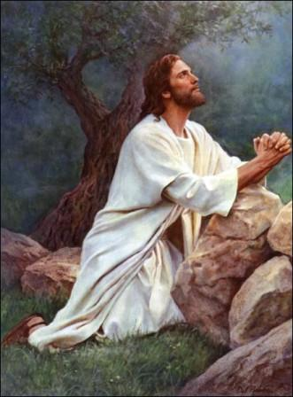
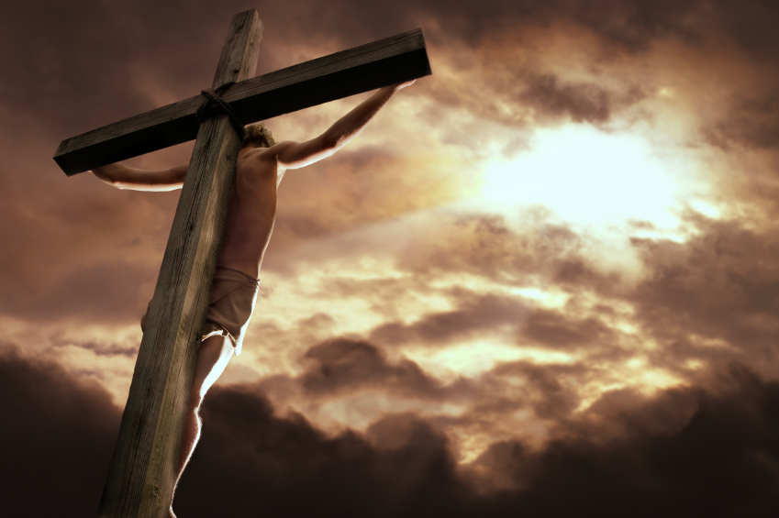
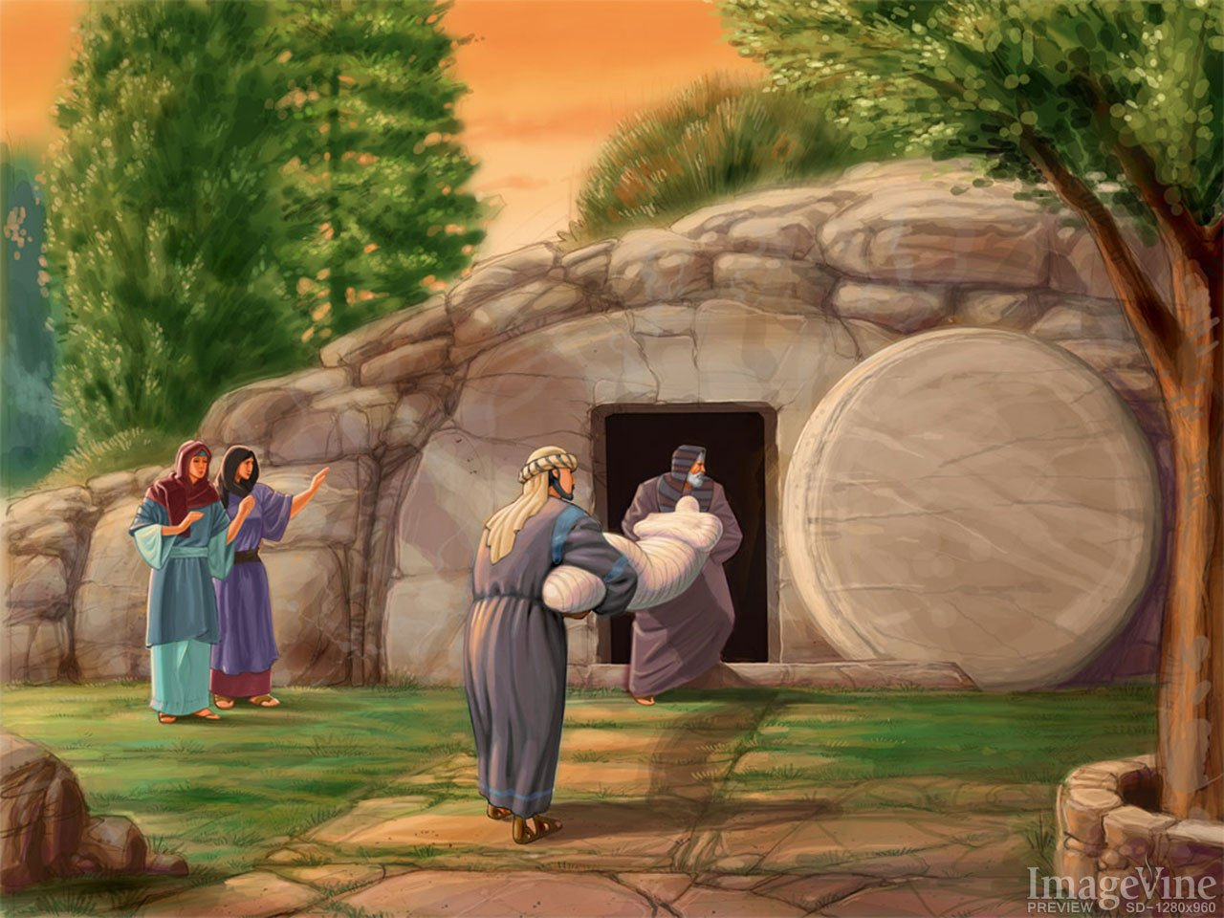
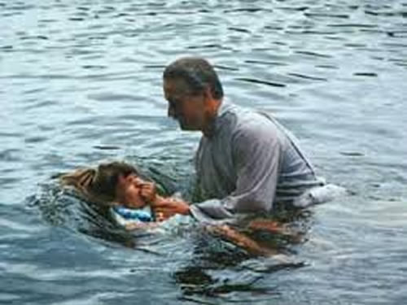
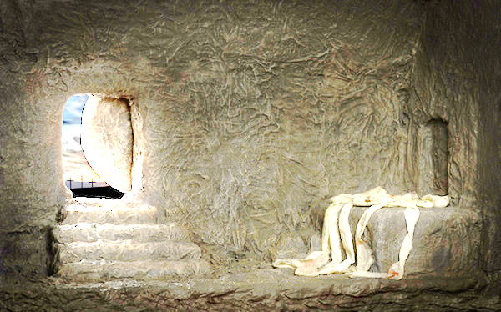
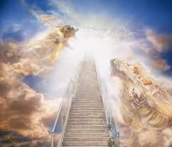
Why is baptism such a fitting emblem?
Jesus
Us

Slide 42
Gideon illustrates deliverance by grace through faith (see Hebrews 11:32).
God did not want Israel to boast that they had saved themselves:
Judges 7:2, And Jehovah said unto Gideon, The people that are with thee are too many for me to give the Midianites into their hand, lest Israel vaunt themselves against me, saying, Mine own hand hath saved me.
God said He delivered the people (v9,15). But the people still had to act (verses 3-7, and 16-25). Without obedience, they would never have been saved. But God designed their action so that it was clearly not sufficient to earn or deserve deliverance. The action was simply a test of their faith.

Slide 43
Note the parallel to Ephesians 2:8-9…
In salvation from sin we cannot boast that we save ourselves or we deserve salvation. We are saved by grace through faith. But this nowhere disproves the need for obedience, any more than in Gideon's case.

Slide 44
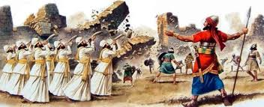
The fall of Jericho in Joshua is also similar.
This too was an example of "faith," but Israel had to act to receive the blessing (Hebrews 11:30). Yet God said He gave Jericho to Israel.
Joshua 6:2 – “And Jehovah said unto Joshua, See, I have given into thy hand Jericho, and the king thereof, and the mighty men of valor.”

Slide 45
The fall of Jericho in Joshua is also similar.
If a thing is a "gift," some say there is nothing to do to receive it. But God's gifts are often conditional. We must act, but our actions are inadequate to earn or merit the result.

Slide 46
The fall of Jericho in Joshua is also similar.
Israel received Jericho as a gift from God "by faith," but they still had to obey to receive it. Likewise, Ephesians 2:8-9 says salvation is a gift from God "by faith." This does not prove there is nothing to do. It just proves that our actions do not earn the gift, so we cannot boast.
Salvation by grace through faith does not exclude baptism. It requires it!

