Slide 1

Salvation by Faith Only?
Obedient
Faith
Faith
Obedience
by Dr. Ken Pepper

Slide 2
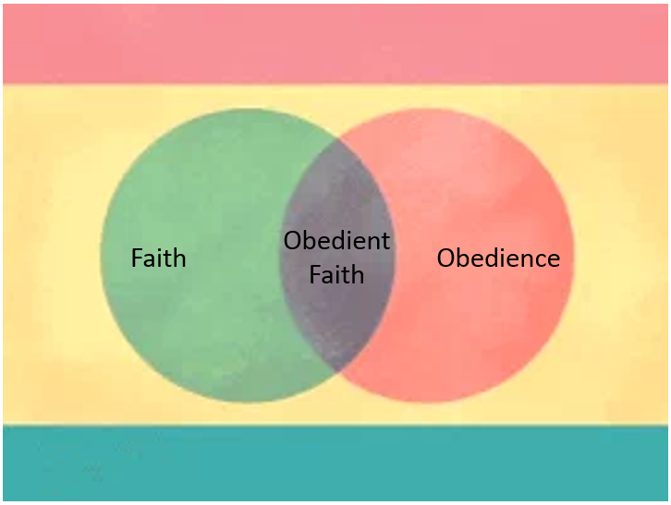
Lesson Objectives
Consider man’s doctrine
regarding “Faith Only”
What does God’s word
teach us regarding this
doctrine?
Biblical examples of those who lived by Faith

Slide 3
Statements of the
Doctrine
Faith
Only
"Wherefore, that we are justified by faith, only, is a most wholesome doctrine and very full of comfort" - The Book of Discipline of the United Methodist Church, 1972 Edition, p. 55.

Slide 4
Statements of the
Doctrine
Faith
Only
"Baptism is not essential to salvation...; but it is essential to obedience, since Christ has commanded it. It is also essential to a public confession of Christ before the world, and to membership in the church..." - Standard Manual for Baptist Churches by Hiscox, p. 21 (via Handbook of Religious Quotations).

Slide 5
Statements of the
Doctrine
Faith
Only
"...faith is the sole condition to experiencing the new birth ... Water baptism is ... administered only to those who have already been saved. ...faith alone, without the added step of baptism, assures the forgiveness of sin, the promise of the indwelling Holy Spirit and the gift of everlasting life ... [B]aptism ... has nothing to do with washing away sin or with a person's justification" - Sermon by an advocate of "faith only."

Slide 6
Statements of the
Doctrine
Faith
Only
So, sin is believed to be forgiven "the moment the sinner trusts Christ as his Savior," and faith is the only condition one must meet. Obedience is not required, especially not water baptism; baptism comes after one has been forgiven.

Slide 7


What Difference Does it Make?
Is this doctrine
true?
What does the
Bible say about
the conditions
for salvation?
Faith
?
Obedience

Slide 8
Faith is Essential to Salvation

Slide 9
Faith is essential to salvation…
John 3:16
Romans 1:16
Ephesians 2:8
For God so loved the world that he gave his only Son, that whoever believes in him should not perish but have eternal life.
For I am not ashamed of the gospel: it is the power of God for salvation to every one who has faith, to the Jew first and also to the Greek.
For by grace you have been saved through faith; and this is not your own doing, it is the gift of God—

Slide 10
Faith is essential to salvation…
See also:
Acts 16:31; 10:43; 15:9; 13:39; John 8:24; 3:36; 5:24; 6:40; 20:30,31; Romans 3:22-28; 4:3,16
We conclude that faith is essential to salvation, and without faith no man can be saved!

Slide 11
But no passage says we are saved by faith alone!
We are told that verses like those above prove that faith is necessary but not baptism, since faith is mentioned but baptism is not. But which passage says we are saved by "faith only," or that faith is the sole condition for salvation, or that we are saved without baptism or without obedience? None of them so state. They teach we are saved by faith, but they do not teach we are saved by faith alone without obedience.

Slide 12
But no passage says we are saved by faith alone!
By the same reasoning, many verses mention faith but do not mention repentance or confession. Shall we conclude these too are unnecessary? Someone says, "It's just understood that, to have saving faith, you must repent and confess." Yes, but how do you understand this? We know repentance and confession are essential, because other passages say so. But if there are also other verses that say baptism is essential, should we not likewise recognize the necessity of baptism?

Slide 13
But no passage says we are saved by faith alone!
We will soon see that many things are essential to salvation. People misuse Scripture when they conclude some things are essential because some verses mention them, but they ignore other verses that say other things are essential.

Slide 14

Other verses show that, by itself, inward faith will not save!
John 12:42-43
42 Nevertheless many even of the authorities believed in him, but for fear of the Pharisees they did not confess it, lest they should be put out of the synagogue: 43 for they loved the praise of men more than the praise of God.
People “believed” in Jesus but
would not confess Him,
because they loved the
praises of men more than
the praises of God.
Were they saved?
Faith

Slide 15
Other verses show that, by itself, inward faith will not save!
James 2:19-20
19 You believe that God is one; you do well. Even the demons believe — and shudder. 20 Do you want to be shown, you shallow man, that faith apart from works is barren?
Even devils
believe…
Are they saved?
Faith

Slide 16
Other verses show that, by itself, inward faith will not save!
James 2:14-24
14 What does it profit, my brethren, if a man says he has faith but has not works? Can his faith save him? 15 If a brother or sister is ill-clad and in lack of daily food, 16 and one of you says to them, “Go in peace, be warmed and filled,” without giving them the things needed for the body, what does it profit? 17 So faith by itself, if it has no works, is dead.
Can faith save
Without
obedience?
Faith

Slide 17
Other verses show that, by itself, inward faith will not save!
James 2:14-24
(cont’d)
18 But some one will say, “You have faith and I have works.” Show me your faith apart from your works, and I by my works will show you my faith. 19 You believe that God is one; you do well. Even the demons believe — and shudder. 20 Do you want to be shown, you shallow man, that faith apart from works is barren? 21 Was not Abraham our father justified by works, when he offered his son Isaac upon the altar?
Can faith save
Without
obedience?
Faith

Slide 18
Other verses show that, by itself, inward faith will not save!
James 2:14-24
(cont’d)
22 You see that faith was active along with his works, and faith was completed by works, 23 and the scripture was fulfilled which says, “Abraham believed God, and it was reckoned to him as righteousness”; and he was called the friend of God. 24 You see that a man is justified by works and not by faith alone.
Can faith save
Without
obedience?
No, that is a
dead faith.
Faith

Slide 19
Other verses show that, by itself, inward faith will not save!
James 2:14-24
NOTE: Man is not justified by "faith only." This is the only passage that mentions "faith only," and it says we are not justified by it! Men say justification by faith only is a wholesome, comforting doctrine; but the Bible flatly says we are not justified by faith only!
Faith

Slide 20
Other verses show that, by itself, inward faith will not save!
Some say these people
were unsaved because
they have the wrong
kind of faith: They
have intellectual
conviction, but they
do not trust Jesus to
save them. We are
making progress!
We now agree that faith is essential to salvation, but there are different kinds of faith! Faith is necessary, but there are kinds of faith that do not save, even when people believe in God and Jesus.
Faith

Slide 21
Other verses show that, by itself, inward faith will not save!
The issue then is: What kind of faith saves, and what does that saving faith include? Does it include repentance, confession, obedience to divine commands, and even baptism? Before answering, let us add more information.
?
Faith

Slide 22
Many Things are Essential to Salvation

Slide 23
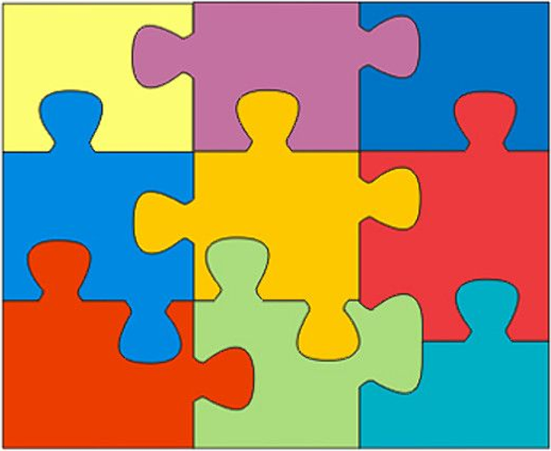
Some things that are essential to
Salvation…
God’s Grace
Jesus’ Death
and Resurrection
Obedience
Hebrews 5:9
Eph. 2:4-10
Romans 5:6-10
Learning
God’s
Will
Repentance
2 Cor. 7:10
The Gospel
Acts 11:14
Hope
Romans 8:24
Acts 11:4
Love
1 Cor. 16:22
Faithfulness
Matt. 10:22
Church
Membership
Acts 2:47
Confession of Christ
Matthew 10:32
Baptism
Acts 2:38

Slide 24

We must accept all that the Bible requires…
Accepting some requirements, while ignoring others, leads to error and contradiction.
If a verse requires faith, that does not eliminate the other things that are required elsewhere. Likewise, many passages mention grace, blood, repentance, etc., but do not mention faith. Should we conclude this proves faith is unnecessary? No, but that would be as reasonable as concluding we can be saved without obedience or without baptism, just because these are not mentioned in some passages about faith.

Slide 25
We must accept all that the Bible requires…
Salvation by "faith only" (excluding baptism and obedience) is as unreasonable and unscriptural as salvation by repentance only, hearing only, or baptism only. We are not saved by any one thing alone, to the exclusion of other things required elsewhere.

Slide 26

Instead, we should accept everything the Bible requires.
We must hear all Jesus says, or we will be destroyed.
If we take away part of God's word, He takes away our reward.
Rev. 22:18-19
Acts 3:22-23
Acts 20:20-27
James 2:10
Matt. 28:20
Matt. 4:4-7
Live by every word God speaks, not just part of it.
We must never isolate a passage from the overall teaching of the Bible.

Slide 27
Obedience is Essential to Salvation

Slide 28
Many passages say obedience is necessary…
Obedience
1 Peter 1:22,23 - We purify our souls in obeying the truth.
Romans 6:17,18 - Servants of sin must obey from the heart in order to be made free from sin.
Hebrews 5:9 - Jesus is the author of eternal salvation to all who obey Him.

Slide 29
Many passages say obedience is necessary…
Obedience
James 2:24 - Man is justified by works, not by "faith only."
Acts 11:14; 10:34,35 - Peter told Cornelius words whereby he would be saved. But the first words He said were that, to be accepted by God, people must work righteousness. This is true for all people, for God shows no partiality!
Matthew 7:21-27; Luke 6:46 - To accept Jesus as Lord (ruler, master) and enter the kingdom of heaven, we must do what He says. We may believe and confess Him yet be rejected, because we did not obey.

Slide 30
Many passages say obedience is necessary…
Obedience
2 Thessalonians 1:8,9; Romans 2:6-10 - Receiving eternal life requires us to do good. Those who do not obey will be destroyed.
1 John 5:3; John 14:15,21-24 - Loving God requires us to keep His commands. If we do not obey, we do not love Him. Can one be saved if he does not love God (cf. 1 Corinthians 16:22; Matthew 22:37-39)?

Slide 31
Many passages say obedience is necessary…
Obedience
The doctrine of "faith only" denies the necessity for all obedience to commands. All the passages we have just studied show that such a view is false doctrine. (See also Rev. 20:12-15; John 5:28,29; 1 John 2:17.)

Slide 32

If Obedience Is Not Essential,
Consider the Consequences.…
Obedience
Matthew 22:37-39 - Love is the greatest of all commands. If obeying commands is not necessary to salvation, then love is not necessary! Yet note 1 Corinthians 16:22.
Acts 17:30 - Repentance is a command. If keeping commands is not necessary, then repentance is not necessary to salvation! Yet note Acts 2:38; 3:19; Luke 13:3; 2 Peter 3:9.

Slide 33
If Obedience Is Not Essential,
Consider the Consequences.…
Obedience
Romans 10:9,10 - Confession with the mouth is a command. If obeying commands is not essential to salvation, then confession is not essential! Yet the Bible says it is essential. And it is not just an inner act; it is an outward act done with the mouth, in contrast to faith in the heart. Like baptism, here is an outward, physical action that is essential to salvation. (See also Matthew 10:32,33.)
1 John 3:23; John 6:28,29 - Faith itself is a command; it is a work God tells people to do. If works and obedience are not necessary, then faith itself is not necessary! But if faith is essential, then we must abandon the view that obedience and works are not essential!

Slide 34
Some claim that John 6:29 says faith is a work God does for us, not something we do. However:
Obedience
1 John 3:23 still says believing is a command to us (cf. Mark 16:15,16).
John 6:29 answers the question asked in v28: "What shall we do, that we might work the works of God?" So "works of God" here means works men do in obedience to God's commands.

Slide 35
Some claim that John 6:29 says faith is a work God does for us, not something we do. However:
Obedience
(3) 1 Corinthians 15:58 is parallel - the "work of the Lord" is work we abound in - our labor in the Lord (cf. "love of God" in 1 John 5:3).
(4) If faith is entirely a work God does for us, then God is responsible for unbelievers. He causes some people to believe, but not others. This makes God a respecter of persons in contradiction to Acts 10:34,35 and Romans 2:11. Hence, John 6:29 says faith is something we do, which is essential to salvation.

Slide 36
The Bible Describes Different Kinds of Works...
Obedience
But what about the passages where the Bible says we are not saved by works? Many passages say obedience is necessary, yet other verses say we are not saved by "works." Since God's word does not contradict itself, we must conclude that there are different kind of works, just as there are different kinds of faith. Faith saves, but there are kinds of faith that do not save. So obedience is essential, but there are kinds of works that do not save.

Slide 37
Consider different kinds of works described in the Bible…
Obedience
Works of the flesh or of darkness
These are sins, which do not save but condemn. (See Galatians 5:19-21; Romans 13:12-14.)

Slide 38
Consider different kinds of works described in the Bible…
Obedience
2. Works of Old Testament law or of human righteousness by which one earns salvation
The Old Testament is not binding today (Gal. 3:23-25; Heb. 10:9,10; Eph. 2:14-16; Col. 2:14-17; Rom. 7:1-7). However, it never could save, because it provided no lasting forgiveness (Hebrews 10:3,4).
The only way to be justified by that law, or any similar law, would be to live ones whole life without ever sinning (Galatians 3:10; James 2:10; Romans 3:20,23). Then one could boast that he had saved himself without needing forgiveness. He would earn his righteousness as a matter of debt, not grace.
But such works will save no one, because we all sin (Romans 3:23; 1 John 1:8,10; 3:4). Therefore, we all need a system of grace, whereby we can be forgiven, though we do not deserve it. This is the point of Romans 4:4; 3:27; 11:6; Ephesians 2:8,9; Titus 3:5; 2 Timothy 1:9; etc.
(See also Galatians 2:16; 3:11 - cf. 4:21-25; 5:3; Acts 13:39.)

Slide 39
Consider different kinds of works described in the Bible…
Obedience
3. Works of obedience to meet conditions of forgiveness.
These works of obedience are essential to salvation, as we have studied. But they are not works of human righteousness, whereby we earn eternal life by a sinless life. Instead, we admit we are sinners and come to God for forgiveness by His mercy and grace. Yet we must believe in Him enough to meet whatever conditions He lays down.

Slide 40
Consider different kinds of works described in the Bible…
Obedience
3. Works of obedience to meet conditions of forgiveness (cont’d).
These conditions include faith, repentance, and confession. But baptism is not a work of human righteousness whereby we earn eternal life, any more than are these other acts. All are simply necessary conditions in order for God's grace to forgive unworthy sinners by Jesus' blood.

Slide 41
Consider different kinds of works described in the Bible…
Obedience
3. Works of obedience to meet conditions of forgiveness (cont’d).
So when verses say we are not saved by "works," they are not referring to faith, repentance, confession, or baptism. These works are all included in the obedience that is essential to receive forgiveness.

Slide 42
Consider different kinds of works described in the Bible…
Obedience
Interestingly, even "faith only" advocates usually give people something to do, so they can identify a "point of contact" when they contact God's forgiving power. They say, "Pray the sinner's prayer," or "Put your hand on the radio," or "Tell Jesus that you are trusting Him to save you." In all these examples the sinner does something to receive forgiveness.

Slide 43
Consider different kinds of works described in the Bible…
Obedience
So even "faith only" advocates admit that one may do something to receive salvation yet not earn it. The problem is that they have eliminated the activity that God commands and have substituted other activities of their own human invention. This is clearly forbidden in Matthew 15:9; Galatians 1:8,9; 2 John 9; Revelation 22:18,19.

Slide 44
Saving Faith Requires Obedience
Faith
Obedient
Faith
Obedience

Slide 45
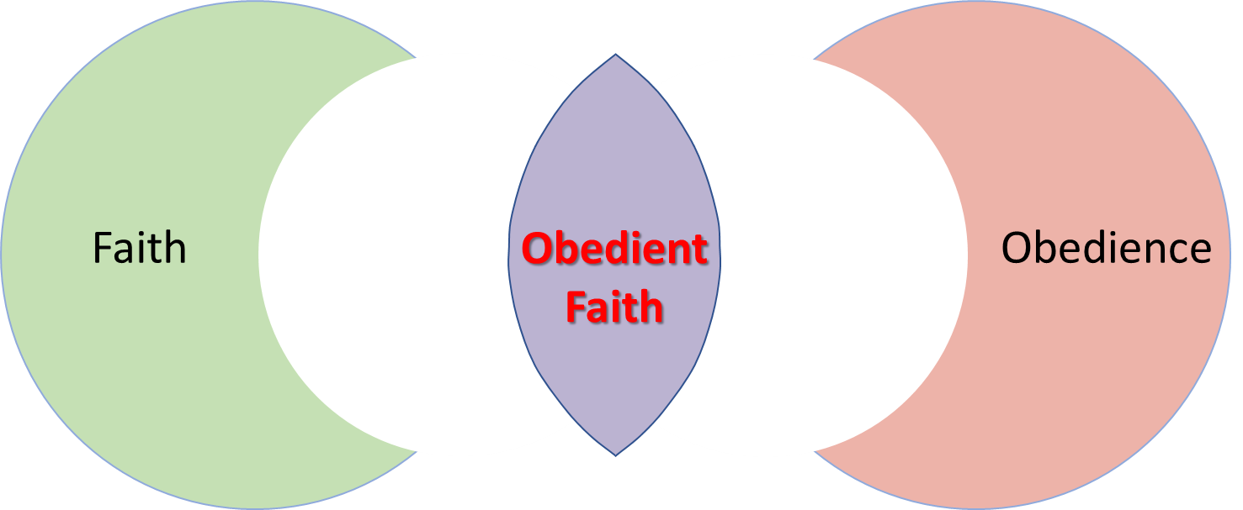
We now know that saving faith includes repentance and confession, and we know that obedience is essential. We will now proceed to show that the reason saving faith includes repentance and confession is that saving faith includes obedience. We are saved by faith when that faith leads us to obey God's required instructions - not before.

Slide 46
Looking to Hebrews 10:39 & Chapter 11…
Hebrews 10:39 But we are not of those who shrink back and are destroyed, but of those who have faith and keep their souls.
Obedient
Faith

Slide 47
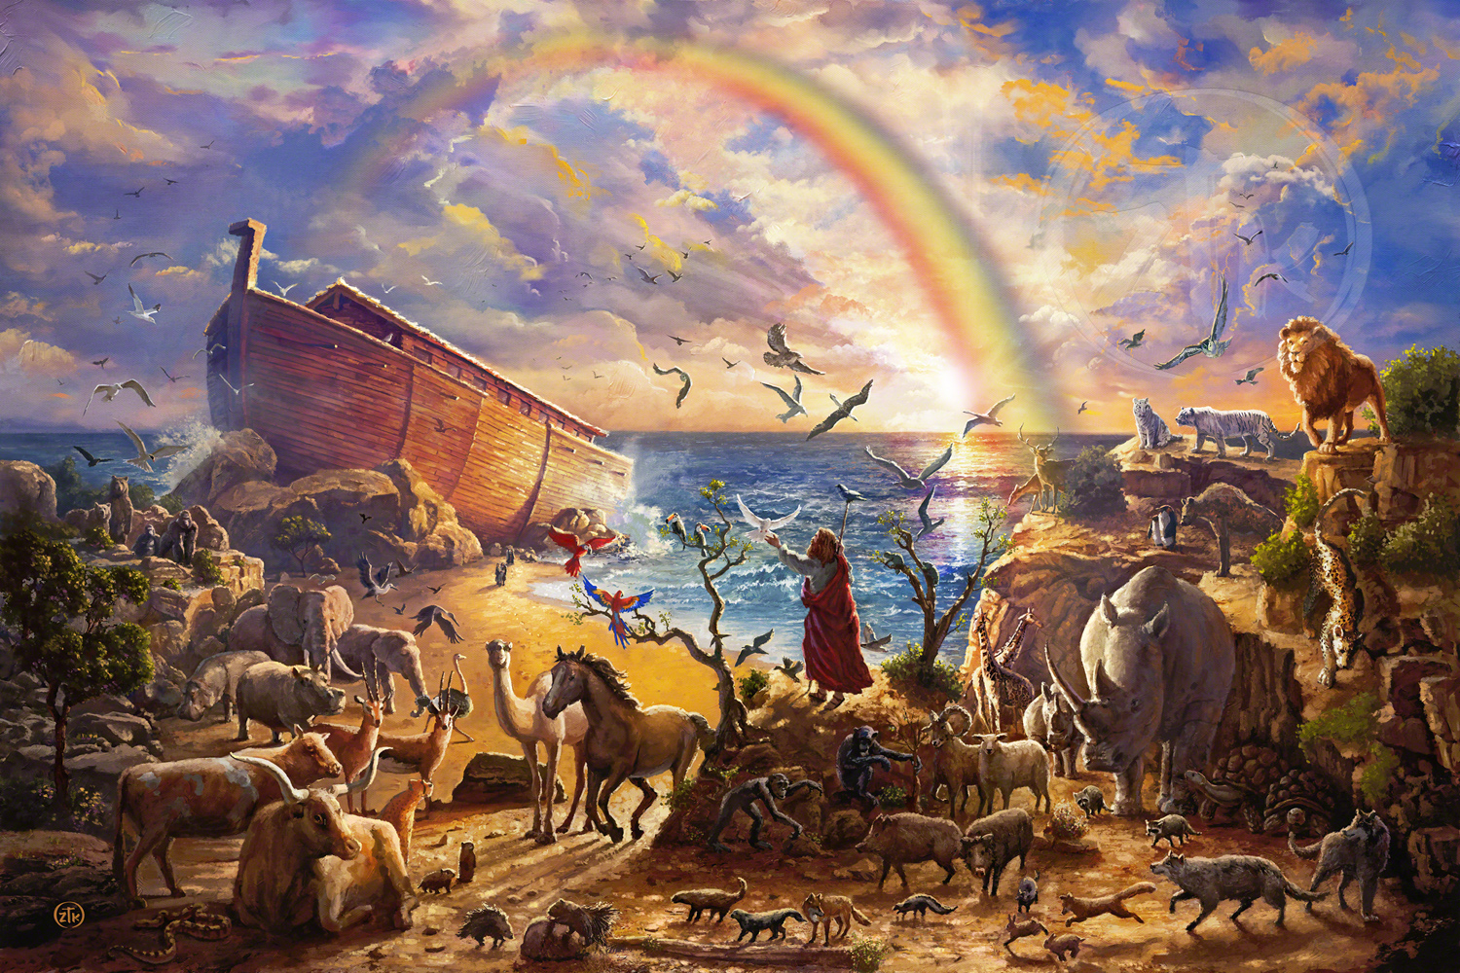
Hebrews Chapter 11…
Noah (Hebrews 11:7) - By faith Noah prepared an ark to save his house and become heir of righteousness according to faith. Was he saved by faith before he obeyed, or did God save him from the flood only after he
obeyed? Would he
have been saved if
he had not obeyed?
Obedient
Faith

Slide 48
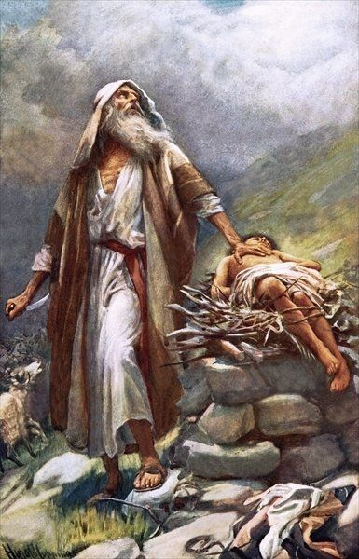
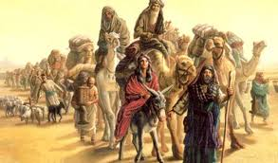
Hebrews Chapter 11…
Abraham (Hebrews 11:8) - By faith he obeyed God and went to the place God eventually showed him. Did God reward him before he obeyed, or only after he obeyed?
Obedient
Faith

Slide 49
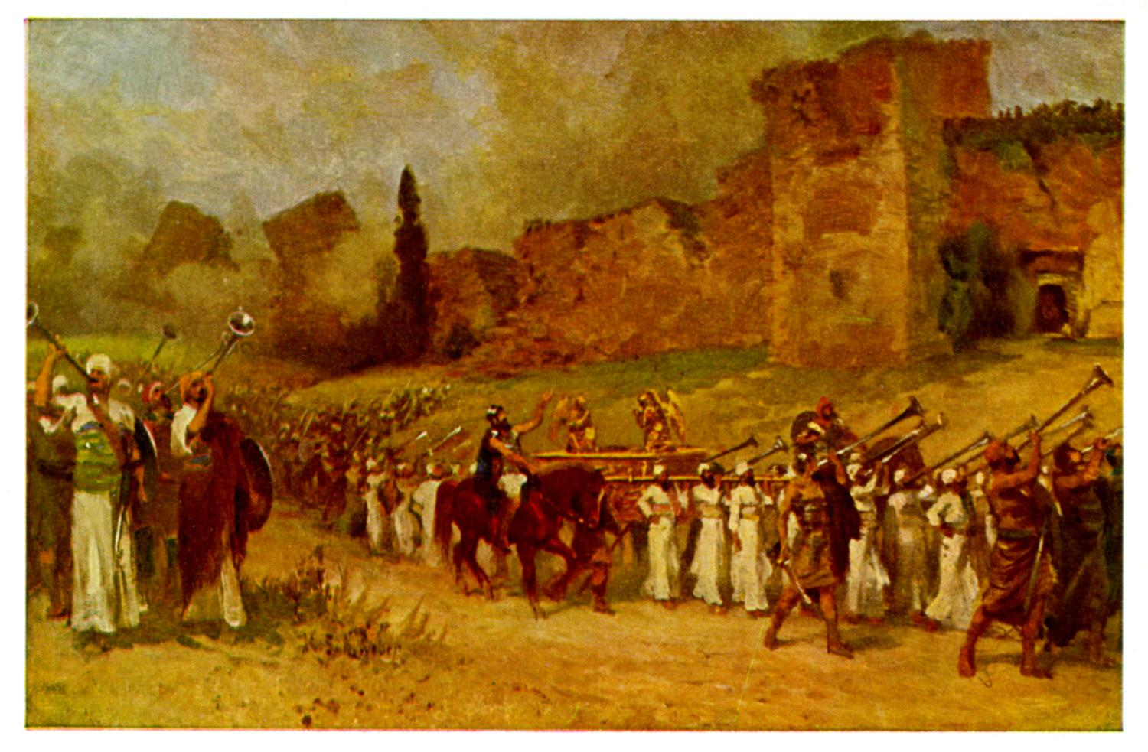
Hebrews Chapter 11…
Israel at Jericho (Hebrews 11:30) - By faith the walls of Jericho fell. Did they fall before the people did what God said, or afterwards? Would the walls have fallen had the people not obeyed? The verse says the
walls fell "after they were
compassed about.“
(See also 11:4,17,24, etc.)
Obedient
Faith

Slide 50

In every case, God rewarded people for obedient faith.
They received the blessing "by faith," not before they obeyed or without obedience, but only after or as a result of their obedience. Yet when faith led to obedience, they received the reward "by faith.“
Saving faith is faith that obeys. If your faith says that obedience is not necessary or that God will "save your soul" before you obey, then you have a faith that will not save.

Slide 51
Consider the following chart…
Blessings Received "by Faith"
Noah built the ark then his house was saved Abraham obeyed to go then received inheritance Israel marched then the walls fell We obey conditions then receive forgiveness
Obedience comes first, then comes the blessing!

Slide 52

Looking to James 2:14-26…
14 What does it profit, my brethren, if a man says he has faith but has not works? Can his faith save him? 15 If a brother or sister is ill-clad and in lack of daily food, 16 and one of you says to them, “Go in peace, be warmed and filled,” without giving them the things needed for the body, what does it profit? 17 So faith by itself, if it has no works, is dead.

Slide 53
Looking to James 2:14-26 (cont’d)…
18 But some one will say, “You have faith and I have works.” Show me your faith apart from your works, and I by my works will show you my faith. 19 You believe that God is one; you do well. Even the demons believe—and shudder. 20 Do you want to be shown, you shallow man, that faith apart from works is barren? 21 Was not Abraham our father justified by works, when he offered his son Isaac upon the altar? 22 You see that faith was active along with his works, and faith was completed by works,

Slide 54
Looking to James 2:14-26 (cont’d)…
23 and the scripture was fulfilled which says, “Abraham believed God, and it was reckoned to him as righteousness”; and he was called the friend of God. 24 You see that a man is justified by works and not by faith alone. 25 And in the same way was not also Rahab the harlot justified by works when she received the messengers and sent them out another way? 26 For as the body apart from the spirit is dead, so faith apart from works is dead.

Slide 55
Looking to James 2:14-26 (cont’d)…
Remembering that some kinds of faith do not save, we are here asked: Can we be saved by the kind of faith that does not have works (v14)? James does not discuss merely what we demonstrate before people, but whether or not we can be saved (v14) or justified (v24).
The answer is that faith that does not work is dead, like a body without a spirit (v17,20,26). We are justified by works, not by "faith only" (v24). Faith without works will not save, nor will works without faith. Both faith and works must operate together (v21-23). Only then do we have faith that saves!

Slide 56
Looking to James 2:14-26 (cont’d)…
Some say that Abraham pleased God before the event mentioned here (offering Isaac), but he also obeyed God long before this particular event. Hebrews 11:8-10,17-19 and James 2:21-23 make the same point: Abraham illustrates the kind of faith that God rewards. It is faith that obeys, and God rewards us only when we have obeyed. So both faith and works are needed in order to be saved (v14) or justified (v24).
The passage flatly denies that we can be saved or justified by a faith that does not obey. Such a faith is dead. Can a dead faith save us?

Slide 57
Looking to
Galatians 5:6…
“For in Christ Jesus neither circumcision nor uncircumcision is of any avail, but faith working through love.”

Slide 58
Looking to
Galatians 5:6…
In Jesus' view, the faith that avails is faith that works by love. So again, a working faith is required.
See also:
2 Cor. 5:7
1 Thessalonians 1:3
Galatians 2:20
2 Thessalonians 1:11
Romans 1:5; 16:26

Slide 59
OBSERVATIONS

Slide 60
Faith can have different meanings…
"Faith" sometimes has a specific meaning, referring to inward conviction and trust, as distinguished from the acts of obedience that follow (cf. Romans 10:9,10). This "faith" is essential, but it will not save by itself, without the obedience. "Faith" can also have a more general or inclusive sense, so it includes all a person does to be forgiven of sins - including repentance, confession, and (we will soon see) baptism.
The same is true of the term "love." "Love" sometimes refers specifically to an attitude of good will toward others, as distinguished from acts people do (1 Corinthians 13:1-3; Galatians 5:6). In other cases "love" is said to be or to include the obedience that it produces (1 John 5:3).

Slide 61
Faith can have different meanings…
We do similar things in everyday speech. We tell sick people, "You could get better if you would go to the doctor." Now "go to the doctor" could refer to the specific act of transporting yourself to where the doctor is. But in our illustration, it is understood that we mean all that is involved in being cured by the doctor, including what we do in response to his instructions (get a prescription filled, take medicine, etc.) Likewise "faith" can be used specifically or inclusively.
We have seen that some people admit saving faith includes repentance and confession, but they deny it includes baptism. But if faith includes repentance and confession, then that it must be true that faith includes obedience, since repentance and confession are acts of obedience. Confession is even an outward, physical act. So if "faith" can include these commands, then it could also include other commands such as baptism. So we need to determine whether or not there are other verses that say baptism is essential.

Slide 62
Some folks reply: "You're trusting your own works to save you, instead of trusting Jesus."
The truth is just the opposite. Noah was saved "by faith" when he obeyed God. Do you accuse him of trusting his own works instead of trusting God? When Abraham and Israel pleased God by faithful obedience, did they trust their own works or God (Hebrews 11)? When people repent and confess to be forgiven, are they trusting in works or in Jesus?

Slide 63
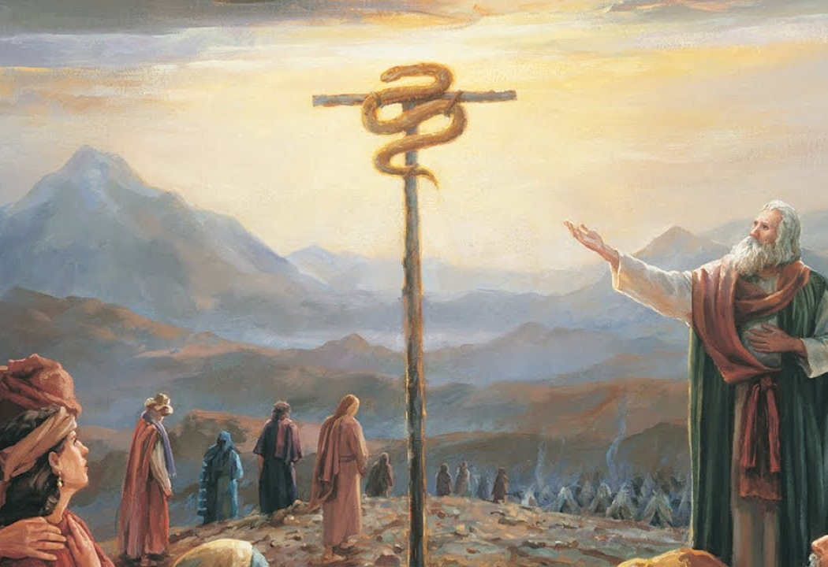
Some folks reply: "You're trusting your own works to save you, instead of trusting Jesus."
Consider the bronze serpent Moses made to spare Israel from death. The people had to do something to be saved - they had to look at the serpent (Num. 21:9). Yet John 3:14-16 uses this to illustrate salvation by faith through Jesus. So even John 3:16 shows that saving faith includes obedience, it does not exclude it.

Slide 64
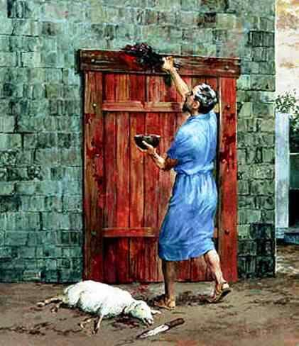
Some folks reply: "You're trusting your own works to save you, instead of trusting Jesus."
Consider when the congregation of Israel had to strike the blood of a lamb on their doorposts so that the Lord would not destroy their firstborn child. The people had to do something to avoid the death of their first born child - they had to strike the blood of a lamb on their doorpost (Exodus 12). Again, in this example, saving faith includes obedience, it does not exclude it.

Slide 65
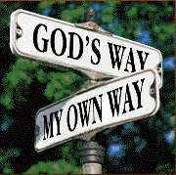
The truth is that saving faith leads people to obey Jesus because they trust Him, and they are not saved until their faith has produced the required obedience. When people think they can be saved without obeying what Jesus says, those are the ones who have a faith that will not save.
Matthew 6:24

