Slide 1
WORLDVIEWS & LIFEVIEWS
By David Lee Burris
Slides 95-119 ACU/CRC

Slide 2
WORLDVIEWS & LIFEVIEWS
WORLDVIEW INTRODUCTION
COMPARATIVE WORLDVIEWS
AMERICAN EXCEPTIONALISM
DYNAMIC: STATIC VS. FLUID

Slide 3




INTRODUCTION

Slide 4

What is a worldview?
“A worldview is an integrated, interpretive, set of confessional perspectives on reality which underlies, shapes, motivates, and gives direction and meaning to human activity.”
BJ van der Walt, The Liberating Message: A Christian Worldview for Africa, p. 39.

Slide 5
What is a worldview?
“A worldview is a set of presuppositions . . . which we hold (consciously or subconsciously) about the basic makeup of our world.”
-- James Sire

Slide 6
What is a worldview?
Everyone has a worldview whether one can explain it or not. It can be likened to a pair of glasses through which one views the world. It is important to have the right prescription or reality will be distorted. Modern man is faced with a supermarket of world views all of them claiming to be true.

Slide 7

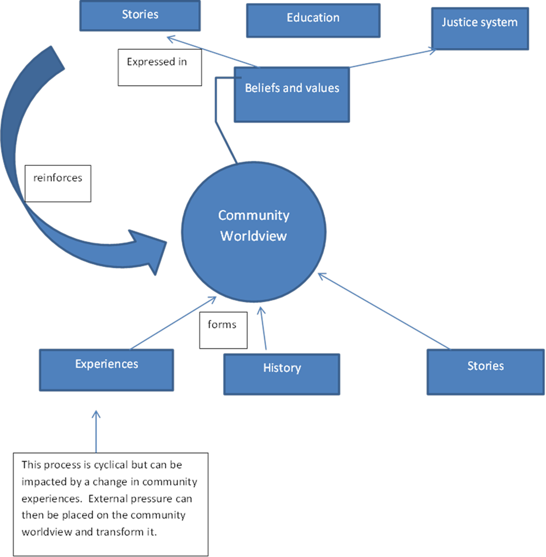
How are worldviews formed?

Slide 8

Axiological Analysis Of Values Views
Axiology: Transdisciplinary & Broad Field Research Resourced Of Cognitive Concepts @ Aesthetic – Epistemic - Ethical Construct

Slide 9
Axiological Analysis Of Values Views
Dictionary: “An area of inquiry that studies the nature, criteria, implications and applications of value judgments.”

Slide 10

Axial Model Between 200 - 600 B.C.
Lifeview: Personal Journey & Movement
PROCESS TRANSFORMABLE & PROGRESS INCOMMUNICABLE
From Lower To Higher Realm
From Knowledge To Wisdom
From Appearance To Reality
From Bondage To Liberation
From Confusion To Insight
From Darkness To Light

Slide 11
Axial Model Between 200 - 600 B.C.
Two Methods Of Inquiry:
Major Logic – Ontology
Major Logic – Epistemic
Minor Logic – Inductive
Minor Logic – Deductive

Slide 12
Axial Model Between 200 - 600 B.C.
Deliberate Structure Three Tier:
PROPOSITIONAL LOGIC
FORMALIZED PROOFS
TRUTH TREE MAPING

Slide 13
Axial Model Between 200 - 600 B.C.
Rationalists Theories Of Reality
Logically Inconsistent Deficiencies:
Self-Referential Incoherence
Self-Assumptive Incoherence
Self-Performable Incoherence

Slide 14
Axial Model Between 200 - 600 B.C.
Entered Evidence Irrelevant
AD VERICUNDIUM – An Appeal To Position
AD POPULUM – An Appeal To Popularity
AD BACULUM – An Appeal To Force
AD MISERICORDIAM – An Appeal To Pity
AD HOMINEM – Argument Personal Direct

Slide 15
Axial Model Between 200 - 600 B.C.
Evidential Category | Standard Measure
EXPERIMENT | UNEQUIVOCAL
RATIONALE | NON-CIRCULAR
AUTHORITY | RECOGNIZED
REVELATION | RELEVANCE

Slide 16
Axial Model Between 200 - 600 B.C.
THREE QUERIES RAISED:
What Can We Know?
What Ought We To Do?
For What Can We Hope?

Slide 17
Axial Model Between 200 - 600 B.C.
Worldview Answers Four Questions:
What Is Human Origin?
What Is Life’s Meaning?
What Is A Moral Action?
What Is Man’s Destiny?

Slide 18
Questions which reveal one’s worldview
Why is there something rather than nothing?
How do you explain human nature?
How do you know that you know?
What happens to a person at death?
How do you determine what is right or wrong?
What is the meaning of history?

Slide 19
Axial Model Between 200 - 600 B.C.
Viable Worldview Answers Adequate
WHAT KIND OF GOD,
IF ANY, EXISTS?
Ultimate Reality Question

Slide 20
Axial Model Between 200 - 600 B.C.
Viable Worldview Answers Adequate
IS THERE ANYTHING BEYOND THE COSMOS?
External Reality Question

Slide 21
Axial Model Between 200 - 600 B.C.
Viable Worldview Answers Adequate
WHAT CAN BE KNOWN &
HOW CAN WE KNOW IT?
The Knowledge Question

Slide 22
Axial Model Between 200 - 600 B.C.
Viable Worldview Answers Adequate
OF WHERE DID I COME?
The Origins Question

Slide 23
Axial Model Between 200 - 600 B.C.
Viable Worldview Answers Adequate
WHO AM I?
The Identity Question

Slide 24
Axial Model Between 200 - 600 B.C.
Viable Worldview Answers Adequate
WHERE AM I?
The Location Question

Slide 25
Axial Model Between 200 - 600 B.C.
Viable Worldview Answers Adequate
WHAT IS THE MEANING &
DIRECTION OF HISTORY?
Past/Present Question

Slide 26
Axial Model Between 200 - 600 B.C.
Viable Worldview Answers Adequate
WILL I SURVIVE THE DEATH OF MY BODY AND, IF SO, IN WHAT STATE?
THE DESTINY QUESTION

Slide 27
Axial Model Between 200 - 600 B.C.
Viable Worldview Answers Adequate
HOW SHOULD I LIVE?
The Morality Question

Slide 28
Axial Model Between 200 - 600 B.C.
Viable Worldview Answers Adequate
WHAT IS IT THAT I
SHOULD CONSIDER
OF GREAT WORTH?
The Values Question

Slide 29
Axial Model Between 200 - 600 B.C.
Viable Worldview Answers Adequate
WHAT IS HUMANITY’S FUNDAMENTAL PROBLEM?
PREDICAMENT QUESTION

Slide 30
Axial Model Between 200 - 600 B.C.
Viable Worldview Answers Adequate
HOW CAN HUMANITY’S
PROBLEM BE SOLVED?
RESOLUTION QUESTION

Slide 31
Inescapable Truths
Something exists.
All people have absolutes.
Something can’t be true and false at the same time.
All people exercise faith.

Slide 32
What Are the Three Major Worldviews?
Three Worldviews: Theism, Naturalism, and Pantheism
It’s important to understand the worldviews because they are the foundation of all religions and philosophies.

Slide 33
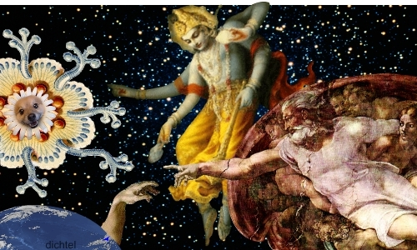

Slide 34
The Major Worldviews: Pantheism
god

Slide 35

Pantheism
There is no transcendent god.
Truth is internal, not external.
“We are all gods.”

Slide 36
Foundations of a
Pantheistic Worldview
Monism
Pantheism
Human Divinity
Cosmic Consciousness
Reincarnation
Moral Relativism
god

Slide 37


What Are the Tenets of Pantheism?
God Is In All!
God – Monism: All is one, Pantheism - all is god
World - Evolution
Human Nature - Human “divinity”
Knowledge - Intuition; cosmic consciousness
Man’s Destiny – Reincarnation/Absorption
Ethics - Moral relativism/Karma
History - History is cyclical
god
Notes:
Out on a limb video for human divinity

Slide 38
Christianity/Theism in Worldview Contexts
Pantheism
Everything is god. Everything material is an illusion. Humans are gods. Knowledge is getting in touch with the cosmic consciousness. One of the favorite terms you’ll hear from pantheists is “enlightenment.” History is cyclical and men are reincarnated until they realize their own divinity. This worldview is the basis for Hinduism, Buddhism, Christian Science, and New Age teaching.

Slide 39
The Major Worldviews: Naturalism
MAN

Slide 40
Foundations of a
Naturalistic Worldview
Atheism/Deism
Evolution
Materialism
Human Autonomy
Human Reason
Science
MAN

Slide 41
What Are the Tenets of Naturalism?
God - Atheistic
The World - Evolution (Materialism)
Human Nature – Evolved Social Animal/Autonomy
Knowledge - Human reason/ Scientific method
Man’s Destiny - Death brings extinction
Ethics – Whatever works
History - Linear history; no goal
MAN

Slide 42
Naturalism
There Is No God!
There is no God.
“The cosmos is all that is or ever was or ever will be.”
“Man is the measure of all things.”
Carl Sagan

Slide 43
Christianity/Theism in Worldview Contexts
Naturalism (Modernism)
There is no God. There is no supernatural. We live in a closed system and the world and mankind just evolved. Men are just the product of their environment. Morality is decided by man. Reason and science are basis of authority and pursued for the good of mankind. There is no purpose to history; it just happens. When you die, you cease to exist.

Slide 44
The Major Worldviews: Christian Theism
GOD
MAN

Slide 45
Foundations of a
Christian Worldview
Monotheism
Creation ex nihilo
Supernaturalism
Revelation
Man’s Need
Man’s Nature
Man’s Destiny
GOD
MAN

Slide 46
What Are the Tenets of Christian Theism?
God - Monotheistic/ Supernaturalistic
The World - Creation ex nihilo ( Gen. 1:1; Col. 1:13-17)
Human Nature - Made in God’s image but fallen (Gen. 1:26-27)
GOD
MAN

Slide 47
What Are the Tenets of Christian Theism?
Knowledge - Reason/ Experience/ Authority/ Revelation (Dt. 29:29; I Cor. 2:6-11)
Man’s Destiny - Separation from God or life with God (Heb. 9:27-28; I Cor. 15:50-58)
GOD
MAN

Slide 48
What Are the Tenets of Christian Theism?
God Is Above All!
Ethics - Nature/ Conscience/ Scripture – revealed absolutes (Rom. 2:14-15; Ex. 20:2-17)
History - Linear/ Beginning and end defined by the center (Gen. 1:1; Rev. 21-22)
GOD
MAN

Slide 49
Christianity/Theism in Worldview Contexts
Theism
Theism is the belief that there is a personal God outside of time and space who created the universe out of nothing and is involved in events (supernaturally). He reveals himself to man through nature and through the Bible (Christians) or the TANAK = Old Testament (Jews) or the Koran (Muslims). He sets the rules for mankind. And there will be eternal consequences for breaking the rules. Deism a form of theism. God created everything, but is no longer involved in creation.

Slide 50
Comparative Worldviews

Slide 51
David Lee Burris:
Note: Lifeview + Worldview = Faith Foundation
Axial Model Between 200 - 600 B.C.
Precondition Of Intelligibility:
Essential assumptions required to
make sense of human experience.
WHICH WORLDVIEW QUALIFIES?

Slide 52
Axial Model Between 200 - 600 B.C.
THREE WORLDVIEW TYPE:
PANTHEISM – “All Is One”
NATURALISM – “Matter In Motion”
THEISM – “God Is Governing”

Slide 53
Axial Model Between 200 - 600 B.C.
Precondition Of Intelligibility:
Essential assumptions required to
make sense of human experience.
Faith Origin Or Answer To:
EMOTIONAL EMPTINESS
SUFFERING HUMANITY

Slide 54
Axial Model Between 200 - 600 B.C.
East-West Spiritual Divide:
PANTHEISM – “All Is One”
THEISM – “God Governs”

Slide 55
Axial Model Between 200 - 600 B.C.
Solution For The Suffering
PANTHEISM – “All Is One” Addresses The Problem By Way Of Bodily Withdrawal Suggesting Insignificance

Slide 56
Axial Model Between 200 - 600 B.C.
Solution For The Suffering
THEISM – “God Governs” Addresses The Problem By Way Of Divine Participation

Slide 57
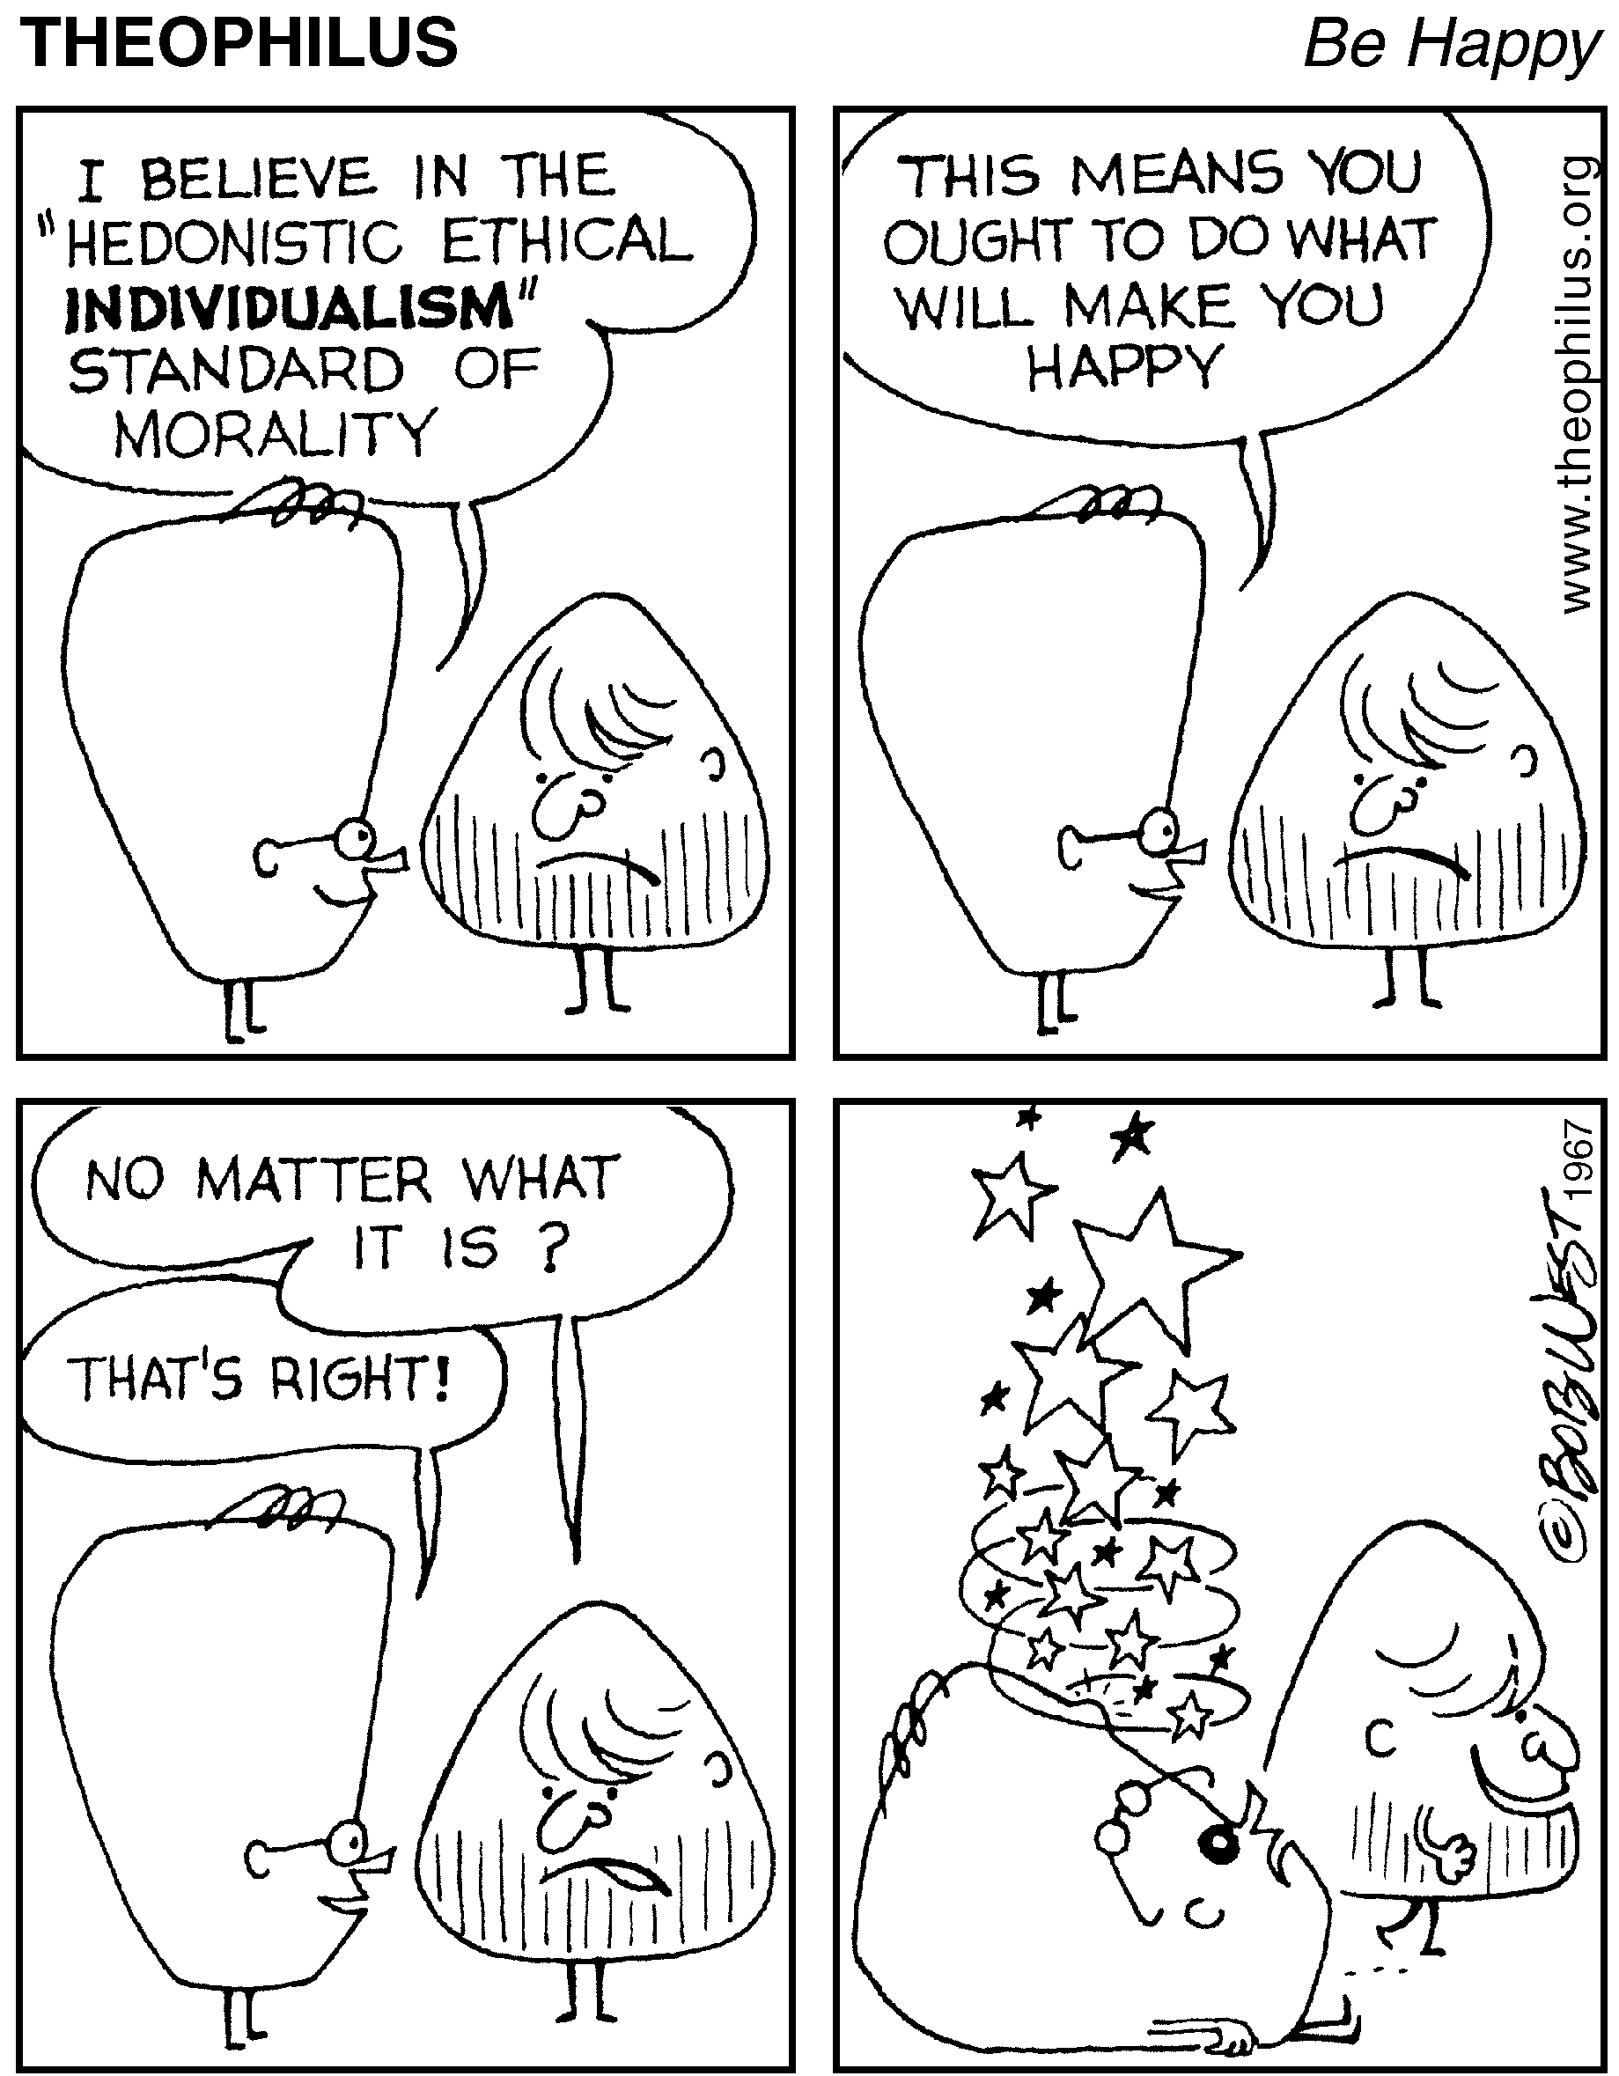

Slide 58
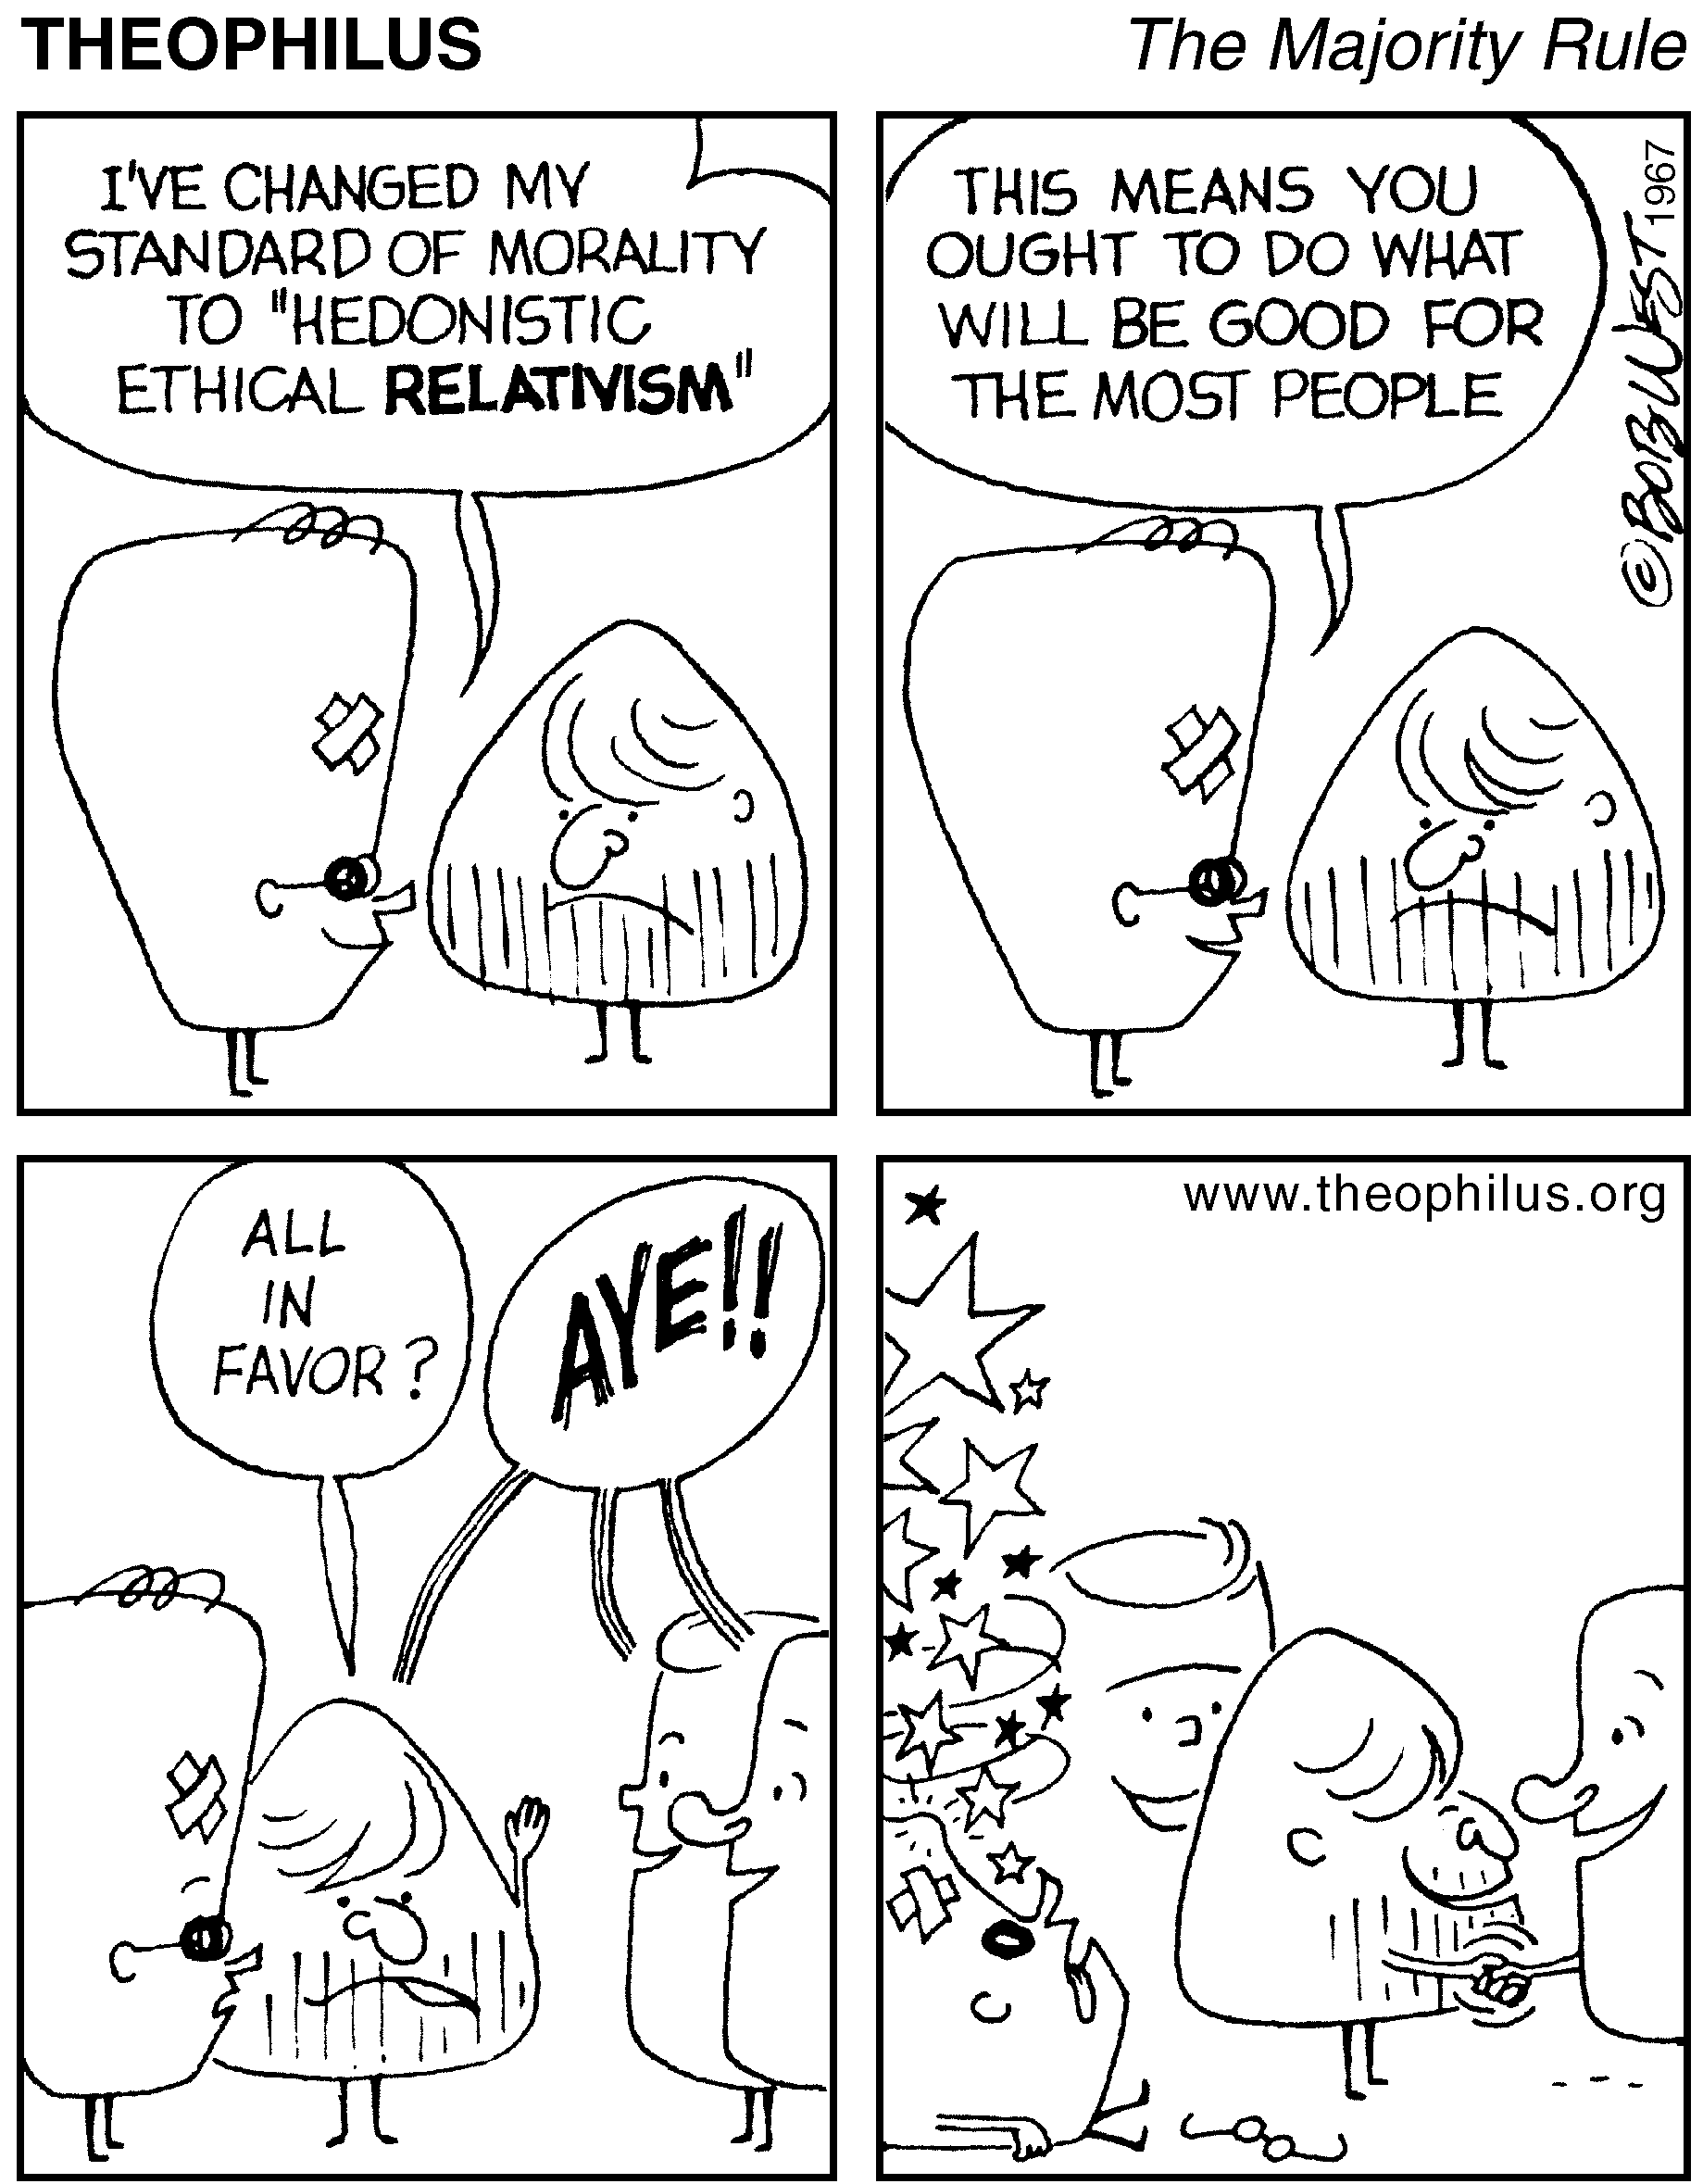

Slide 59
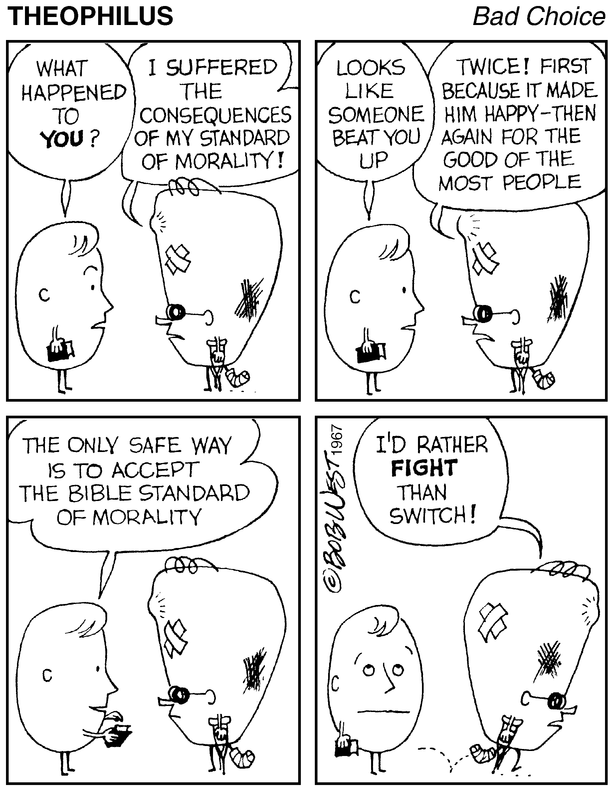

Slide 60
Axial Model Between 200 - 600 B.C.
Intelligent Interactive Involvement:
Effective capacity and compassionate
expression of otherworldly dimension.
WHICH VIEW DO YOU PREFER?

Slide 61
What are some worldview tests?
Reason – A worldview should be consistent and coherent
Experience – A worldview should match the facts of our experience
Explanation – A worldview should be comprehensive in scope and be able to explain the world around us.
Practice A worldview should be livable.
Notes:
The Bible is internally consistent
Buddhism gives a moral law with no reference point for its origin. There is no God. No coherence.
Naturalism cannot explain the origin of the first particle. Not comprehensive.
If pantheism suggests that physical reality is an illusion, then why not meditate on railroad tracks? Doesn’t match experience.

Slide 62
Comparison of Worldviews

Slide 63
Christianity/Theism in Worldview Contexts
 | Theism | Pantheism | Naturalism (Modernism) | Pluralism (Postmodernism)
God | Personal | Impersonal | Non-existent | Non-existent
World | Creation | Spiritual | Evolution | Evolution
Man | Like God | Is God | Like Animals | Like Animals
Immortality | Resurrection | Reincarnation | Annihilation | Annihilation Reincarnation
Destiny | Glorification | Absorption | Extinction | Extinction
Authority | Divine Revelation | Spiritual Enlightenment | Human Reason | Culture
Truth | Absolute | Personal | Objective /Science | Relative/Cultural
Evil | Rebellion/Sin | Illusion | Ignorance | Culturally Defined
History | Linear | Cyclical | Chaotic | Re-Defined

Slide 64
Traditional Religions
God – one creator with many lower gods and spirits
World – nature (life force) is an integrated unity/harmony
Human Nature – community of eternal souls seeking to survive by seeking spiritual harmony, life is religious
Knowledge – Experience, accumulated through ages or from spirits and ancestors
Destiny – live for today but eternal existence with ancestors/no heaven or hell
Ethics – Communally derived, live in harmony with spirits
History – Repetitive and cyclical

Slide 65
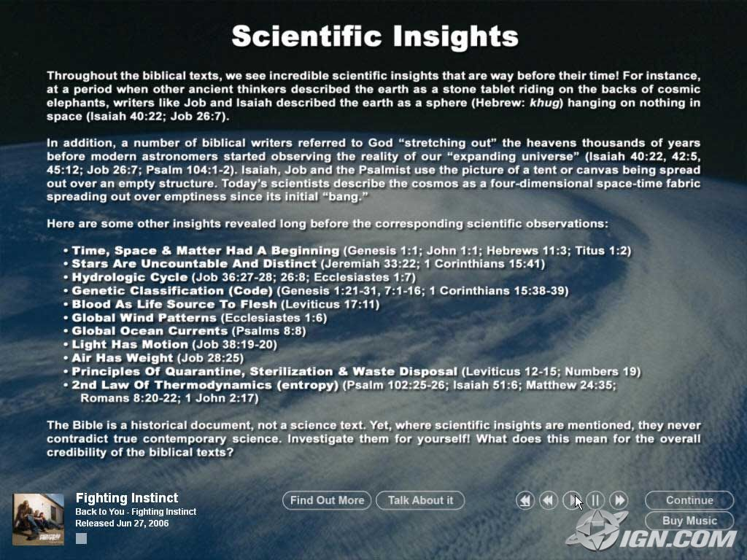
Axial Model Between 200 - 600 B.C.
Evidential Category | Standard Measure
EXPERIMENT | UNEQUIVOCAL
RATIONALE | NON-CIRCULAR
AUTHORITY | RECOGNIZED
REVELATION | RELEVANCE

Slide 66
Axial Model Between 200 - 600 B.C.
Western Society Dual Divide:
MATERIALISTIC HUMANISM
TRANSCENDENT THEISM

Slide 67
WHAT IS LIFE?
John Maynard Smith
“Life is any population of entities with the properties of multiplication, heredity, and variation.”

Slide 68
WHAT IS LIFE?
Alexandir Oparin: “Life may be recognized in bodies which have particular characteristics not seen in the world of the dead. First, there is definite structure or organization – there is the ability of the organisms to metabolize, to reproduce others like themselves & also their response to stimulation.”

Slide 69
WHAT IS LIFE?
John D. Bernal:
“Life is a partial, continuous, progressive, multiform, and conditionally interactive, self-realization of the potentialities of atomic electron states.”

Slide 70
WHAT IS LIFE?
Stuart Kauffman:
“Life is an expected, collectively self-org- -anized property of catalytic polymers.”

Slide 71
WHAT IS LIFE?
Gerald Joyce:
“Life is self-sustained chemical system able to undergo Darwinian evolution.”

Slide 72
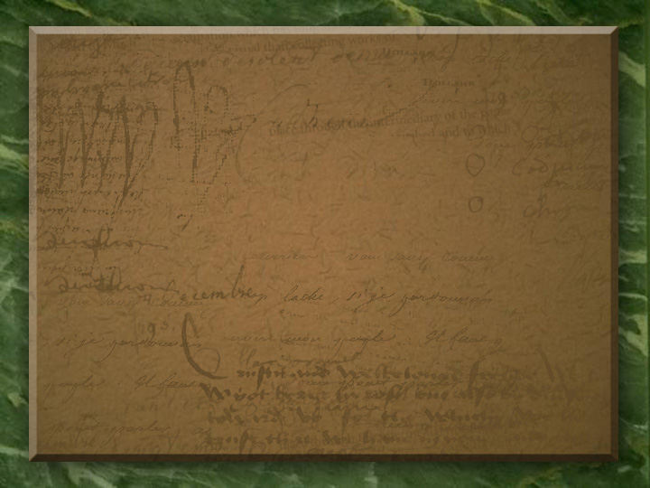

Honest Statement By Nobel Prize Winner
“There are only two possible explanations as to how life arose. Spontaneous generation arising to evolution or a supernatural creative act of God. There is no other possibility. Spontaneous gener- -ation was scientifically disproved 120 years ago by Louis Pasteur and others, but that just leaves us with only one other possibility…that life came as a supernatural act of creation by God, but I cannot accept that philosophy because I do not want to believe in God. I choose to believe in that which I know is scientifically impossible, spontaneous generation leading to evolution.”
~ George Wald (1906 – 1997)

Slide 73


Slide 74
Ancient Wisdom for Modern Life
Ecclesiastes
It’s all a matter of perspective!

Slide 75
TWO VIEWS OF THE WORLD
Secularist
World
View
Theistic
World
View

Slide 76

SECULARIST
WORLDVIEW
A World view without God
Autonomous man
Pursuit of the earthly

Slide 77
Four Realities
A transitory life
+ A meaningless earth cycle
+ An inability to know all
+ Generational discontinuity
Frustration & Hopelessness!

Slide 78


Slide 79
Four Realities
A transitory life
+ A meaningless earth cycle
+ An inability to know all
+ Generational discontinuity
+ God In The Equation
What Is The Outcome?

Slide 80
The Theistic
WORLDVIEW
A world under God’s control
A trusting relationship with the Creator
Pursuit of the spiritual purposes of God

Slide 81
Four Realities
A transitory life
+ A wise God in control
+ A sovereign purpose to fulfill
+ Wisdom to guide us
Satisfaction & hope!

Slide 82
TWO VIEWS OF THE WORLD
Secularist
World
View
Theistic
World
View

Slide 83
Ancient Wisdom for Modern Life
Ecclesiastes
It’s all a matter of perspective!

Slide 84
The test of explanatory power
“The explanatory power of theism is based . . . on the cumulative case one gets by reflecting on the existence of the universe, the order of the universe, and the facts of human rationality, moral consciousness, and religious experience.” -- Ronald Nash

Slide 85
A Quiz
Name that worldview!

Slide 86
Why is there something rather than nothing?
Everything had an impersonal beginning (spirit or energy).
Matter has always existed.
Everything had a personal beginning.

Slide 87
What is the ultimate source of knowledge?
Reason -- (Rationalism)
Experience -- (Empiricism)
Intuition -- (Mysticism)
Revelation

Slide 88
How do you explain human nature?
Blank slate
Inherently good
Socially constructed
Manifestation of “God”
Created image-bearer with a fallen nature

Slide 89
How do you determine what is right or wrong?
Everything is relative
Everything is determined
An “is” is an “ought”
Might makes right
Revealed absolutes

Slide 90
What is the meaning of human history?
History is determined as part of a mechanistic universe.
History is cyclical.
History is going forward, and it is meaningful.
History is decided by the historian.

Slide 91
History is both Linear & Meaningful
Rev. 1:8; 22:13
Gen. 1:1
Rev. 21-22
Rev. 1:4-8

Slide 92
What happens to a person at death?
People merely cease to exist.
People are reincarnated
Death is the gate to life with God or separation from God.
Whatever a person believes will happen is what matters.

Slide 93
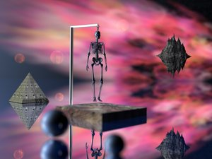
All But One View
Falsely Values Man

Slide 94

AMERICAN EXCEPTIONALISM

Slide 95
The Root Crisis?
America has a Worldview Crisis

Slide 96
Worldview Realities
Everyone has a worldview
Your worldview is the filter through which you experience and respond to the world –
  the filter through which you make decisions
Because your worldview enables you to make sense of the world, you need a worldview to survive

Slide 97
Worldview Realities
Your worldview is the accumulation of your most important beliefs
Those beliefs determine your behavior
Key principle: you do what you believe
Therefore, worldview is the combination of your core beliefs and their resulting behaviors

Slide 98
Worldview Development
In the U.S., a person’s worldview starts to develop at 15-18 months of age
Our worldview is almost fully formed by age 13
It is then refined into final form during teens and twenties
Research: Most Americans die with the same basic worldview they had at age 13 – expanded and better articulated, but essentially unchanged

Slide 99
The Four Phases Of Worldview Experience
Ages 1-12
Experimentation
Development
Ages 13-24
Refinement
Ownership
Ages 25-59
Consistency
Transmission
Ages 60+
•Reflection
•Reconsideration
• Nurture
Filtering
Testing
Application

Slide 100
Where Did Your
Worldview Come From?
Every decision you make is based on your worldview
Your worldview is shaped by many external influences
Those influences expose us to many different worldviews

Slide 101
Significant Sources Of Influence
Vary By Age Group
Children | Teens | Adults
Arts & Entertainment | Arts & Entertainment | Arts & Entertainment
News & Info Media | News & Info Media | News & Info Media
Public policy/laws | Public policy/laws | Public policy/laws
Family | Family | Family
Peers | Peers | Books
School | Celebrities/Athletes | Affinity Groups

Slide 102
How We Develop Our Worldview
Faced with numerous options, we pick and choose whichever options seem reasonable or comfortable to us
Our worldview: a patchwork of complementary, conflicting, contradictory beliefs and behaviors
We weave those choices together into a custom blend that becomes our philosophy of life
Because we cut and paste our worldview together, nobody has a pure, singular, perfectly consistent worldview – no matter which worldview dominates

Slide 103
Contributing Worldviews
Your
Worldview
Biblical Theism
Secular Humanism
Eastern Mysticism
Moralistic Therapeutic Deism
Postmodernism
Marxism
Nihilism
Existentialism

Slide 104
One Option: The Biblical Worldview
Americans’ worldviews are a personal and unique synthesis of many different worldviews
One of those options is the Biblical Theism – better known as the Biblical Worldview
A biblical worldview is a way of experiencing, interpreting, and responding to reality consistent with biblical perspectives
The biblical worldview allows you to be a disciple of Jesus Christ by enabling you to think like Jesus so you can live like Jesus

Slide 105
Seeking Genuine Christianity

Slide 106
Biblical Worldview Incidence
Is On a Steady Decline
12 PERCENT TO 6 PERCENT

Slide 107
America’s Worldview Crisis
(% with the biblical worldview)
Source: Cultural Research Center @ Arizona Christian University
6% of all
adults 18+
19% of theologically-defined born again Christians
4% of Millennials
21% who attend an evangelical church
1% of Catholics

Slide 108
Worldview Incidence in the U.S.

Slide 109

Does Worldview Really Matter?
Worldview Measure | Have BWV | No BWV | Ratio
There is no such thing as absolute moral truth | 5% | 55% | 11:1
Success: consistent obedience to God | 98% | 18% | 5:1
Wealth: from God, manage for kingdom | 81% | 17% | 5:1
Having sex, if in love, expect to get married, still not OK | 97% | 23% | 4:1
History is God’s story, constantly moving toward fulfilling His plan | 98% | 25% | 4:1
Having faith matters more than which faith | 26% | 78% | 3:1
Marriage: 1 man to 1 woman, God’s only plan, across all cultures | 93% | 33% | 3:1

Slide 110
Consider the Cultural
Implications of Worldview
People view pornography … because of their worldview
People embrace socialism … because of their worldview
People support LGBTQ lifestyles … because of their worldview
People get married … because of their worldview
People choose an abortion … because of their worldview
People help the poor … because of their worldview
People trust science … because of their worldview
People homeschool their children … because of their worldview

Slide 111
Worldview Isn’t Just a Game Changer…
It’s the Game!
How?
Because we do what we believe…
And what we believe enables us to think like Jesus…
Which enables us to live like Jesus.
That produces genuine disciples…

Slide 112

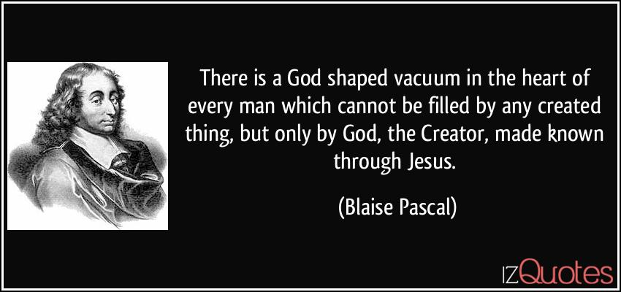
Purpose Comes from God
Purpose: Know , love and serve God with all our heart, mind, strength and soul

Slide 113
Mental Health
A majority (54%) admit to often feeling anxious, depressed, or fearful.
  the real number likely even higher
  go-to solution = medication
  other struggles: self-confidence, fear of conflict
NIMH: 21% of adults have some form of mental illness
  18-25: 29% have some type of mental disorder
  9% have a severe mental illness
  49.5% of 13-18 have one or more types of mental illness
30% identify as LGBTQ (39% among 18-24s)
  Path to acceptance and belonging > living the lifestyle
  Reflection of identity confusion

Slide 114
Mental Health & Worldview
Their mental health challenges relate to an ill-conceived perspective about self
  Self-centered
  Unrestricted moral agents
  Draw their identity from the attributes they choose to embrace and emphasize
    gender, age, race, intelligence, education, income, etc.
    seen as factors that will define/elevate their place in the world
  Consequence: our value constantly changes as the world shifts the attributes it values and its assessment of us
  Result: identity and human value become moving targets

Slide 115
Mental Health & Worldview
  Mental health challenges mitigated by biblical truth
    We become a new creation in Christ, never lose value
    God determined our identity: sexual and otherwise
    we have no authority or competence to make that choice
  Anxiety, depression, fear are put in context
    Jesus provides peace that passes all understanding
    He has determined our value
    We must fear only God
    This wisdom is unknown to the world but revealed in His words
    Anxiety, depression, and fear come from alternative worldviews
  BWV gives us the hope, power, authority, wisdom, a reason, and a way to live abundantly

Slide 116
Relationships
Difficulty developing meaningful, lasting relationships
  fluid friendships - a revolving door of intimates and acquaintances
  low level of trust toward all people and roles
  unwilling to make lasting commitments
  situational intolerance and disrespect
  rampant conflict avoidance
  low view of the value of human life
  Redefining family: low rates of marriage, high rates of cohabitation and divorce, disconnection from children
  reliance on technology prohibits deeper and more permanent ties

Slide 117
Relationships & Worldview
Prevailing U.S. Syncretism
Biblical Worldview
Narcissistic relationships: must always satisfy personal needs
Intolerance, disrespect of opposing ideas
Indifference to the Golden Rule
Love is a feeling
Human beings lack intrinsic value, thus no investment justified
Shared experiences, meet others’ needs
Respect without compromise; all made in His image, given free will
Christ-like treatment of others
Love is a commitment, seeks best outcomes for others, involves sacrifice
God created humans, life is His gift, Jesus died to protect it

Slide 118
Faith & Worldview
Misperceptions about life spring from inadequate spiritual foundation
  eliminating God, the Bible, truth, sin, salvation through Christ provides no hope or purpose; resulting in a lack of knowledge and understanding
Inadequate spiritual foundation produces a terrifying life
  Seeking immediate comfort rather than lasting truth and peace
  Experiencing moral chaos due to lack of coherent/pragmatic religious instruction, moral reflection
  Suffering identity confusion – spiritual, sexual, sense of purpose
  Poor self-image built on self-centeredness, self-reliance, independence
Syncretism is detrimental to everyone’s well-being

Slide 119
Treat the Cause, Not the Symptoms
We cannot afford to be distracted by the symptoms:
  the absence of a sense of purpose, meaning and vision
  emotional and mental health challenges
  spiritual turbulence
  relational hardships and dissatisfaction
  expansive identity crisis
It all comes down to worldview – the cause of the symptoms
  A bad worldview produces bad decisions

Slide 120
Static Versus Fluid

Slide 121
Bricolage nature of worldviews
Van der Kooij et al (2013)
Draws key distinctions between ‘personal’ worldviews, with norms, values, ideals and practices, and ‘organised’ worldviews.
Personal worldviews can be based on an organised religious worldview but can be eclectic and idiosyncratic.
‘Bricolage’ (Hervieu-Leger, 2006) - a ‘mishmash’ of ideas, symbols and practises from different traditions which moulded together to construct a personal religious profile (2013:213-214).
Whilst not rejecting Valk’s model Van der Kooij et al claim that this distinction needs to be made explicit.
Notes:
Van der Kooij et al (2013) add a further dimension in drawing key distinctions between ‘personal’ worldviews, with norms, values, ideals and practices, and ‘organised’ worldviews. These personal worldviews can be based on an organised religious worldview but can be eclectic and idiosyncratic. Indeed, he borrows the term ‘bricoleurs’ from Hervieu-Leger (2006). ‘Bricolage’ is described as a ‘mishmash’ of ideas, symbols and practises from different traditions which moulded together to construct a personal religious profile (2013:213-214). They challenge the debate on definitions of worldview and examine elements of worldviews in an attempt to find consensus to form ‘organised’ worldviews (2013:214). Whilst not rejecting Valk’s model Van der Kooij et al claim that this distinction needs to be made explicit.

Slide 122
Dynamic and evolving worldviews
‘A world view is a system of co-ordinates or a frame of reference in which everything presented to us by our diverse experiences can be placed. It is a symbolic system of representation that allows us to integrate everything we know about the world and ourselves into a global picture, one that illuminates reality as it is presented to us within a certain culture.’ (Aerts et al, 2007:7)

Slide 123


How are worldviews perpetuated?
INTRINSIC PURPOSEFUL
GUIDED EXPOSURE
EXPERIENTIAL INTERPRETATION
SCREENING OF EXPERIENCES

Slide 124
Lifeview & Worldview Change
Organic Complex: Whole Value In No Relation To Parts
Positive Paradox: Tension Total Of Two Goods Better
Negative Paradox: Tension Total Of Two Evils Worse
Negative Complex: Complex Evil From Simple Goods
Positive Complex: Complex Good From Simple Evils

Slide 125
Lifeview & Worldview Change
Decision Of Pragmatism. Question: Does This Still Work?
Decision Of Propriety. Question: Proper For Problems?
Decision Of Process. Question: Given Enough Time?

Slide 126

What’s Practical & Right?
Does The Bible Speak To The Topic?
What Is The Conventional Wisdom?

Slide 127


Notes:
If you had to make big changes your life today in order to avoid death tomorrow, could you do it? Statistics say there’s a 9 to 1 probability that you can’t.. How does lasting change happen?

Slide 128
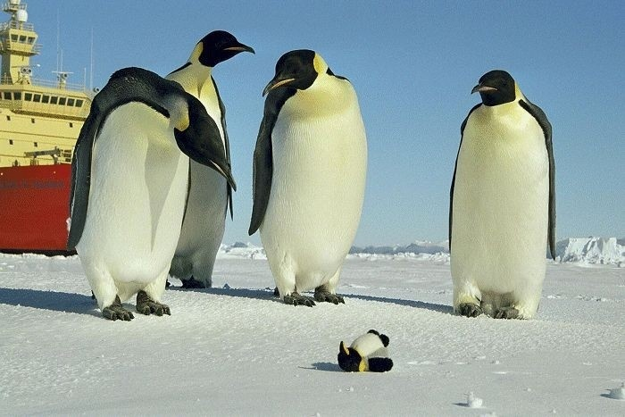
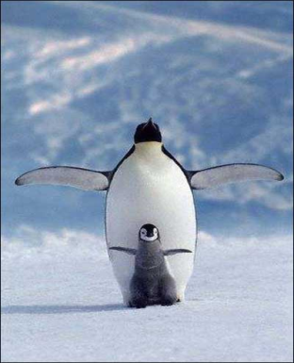
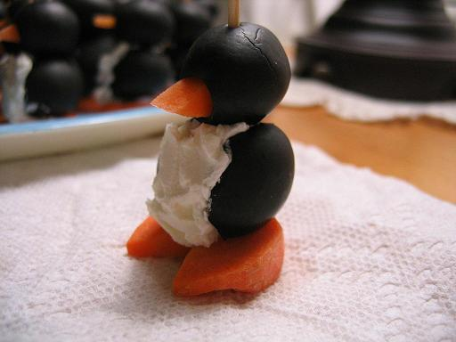

Slide 129
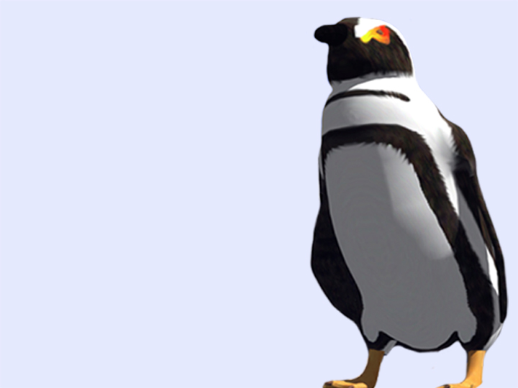

Change is not just something we do.
Notes:
So, if even a crisis like impending and imminent death can’t force us to change, are we completely lost? Are we doomed to ultimate failure?
Well, no. The good news is that change does work for some people and institutions. There are people, few though they may be, who are able to engage in lasting, healthy change for themselves and their families or organizations. Change is tough, but not impossible. How do we do it?
The answer lies in understanding the nature of change itself. Part of the problem is that we most often view change as something we do —an activity or habit that must be altered. We tend to approach change issues as heart disease or other behaviors with facts, analysis, and information — with the left brain. We think about changing something in ourselves, but thinking is only one part of the process.

Slide 130



To create change we must reframe our thinking.
Notes:
What we’re missing, says John Kotter, a Harvard Business School professor and expert on organizational change, is the right brain. “Behavior change happens mostly by speaking to people’s feelings,” he says. “In highly successful change efforts, people find ways to help others see the problems or solutions in ways that influence emotions, not just thought.”
Dr. Dean Ornish, founder of the Preventative Medicine Research Institute in California, agrees. Rather than tell a heart patient to change or die — the conventional approach — Ornish focuses on helping them tap into their emotions. He realizes that death is too frightening to think about for most people, so denial and depression are the cognitive result. After all, who wants to live longer if they feel sick and depressed? On the other hand, Ornish convinces his patients that feeling better is the goal, believing that those who feel better live longer. “Joy is a more powerful motivator than fear,” he says.
What we need in order to make real change is the ability to “reframe” our thinking. For example, many organizations operate with a military framework — with hierarchy, rules, policies, and standard operating procedures. Change happens rarely and, if at all, very slowly. Reframe the organization as a family or community, however, where relationships are paramount and it makes people view the organization very differently.

