Slide 1
GNOSTICS OLD & NEW
By David Lee Burris

Slide 5
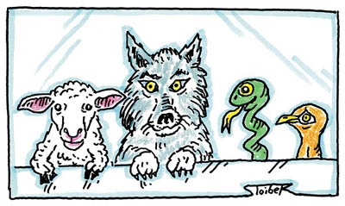
Background Information:

Slide 6
Overview of Gnosticism
Dr. Ehrman offers the following overview:
Reality consists of matter (which is evil) and spirit (which is good).
The supreme God was completely spirit.
This God propagated other deities (aeons).
One of these deities gave birth to an imperfect divine being.
Notes:
1. This is a form of “dualism”.
2. The supreme God was completely spirit and hence, completely good. This God was the source and origin of all things.
3. This is sometimes thought of in terms of “emanations”. Other deities emanated from the one supreme God.
4. Because of this being’s imperfection, it was removed from the divine realm. This imperfect deity was the one who created this evil, material world. This deity was sometimes thought of as the “Jewish” God of the OT.

Slide 7
Overview of Gnosticism
This imperfect being captured the mother deity and imprisoned her in human bodies.
Some humans have a divine spark within them.
Liberation of this spark is achieved through secret knowledge.
This knowledge can only come from a divine emissary (Christ, in some gnostic systems).
Notes:
1. In some gnostic myths, the mother deity is cut up into a million pieces and imprisoned in human bodies.
2. This spark comes from the mother deity who was imprisoned in human bodies.
3. This knowledge enables the gnostic to return to the divine realm after death and be re-united with “God”.
4. This knowledge can’t be had by simply looking around the evil material world. For many gnostics, we cannot have knowledge of God and the divine realm unless it is revealed to us from a divine being. In gnostic systems influenced by Christianity, this divine being was generally believed to be Christ. This partly explains why the gnostics loved the Gospel of John so much.
* This outline comes from Bart D. Ehrman, Lost Christianities: Christian Scriptures and the Battles over Authentication, (Chantilly, Virginia: The Teaching Company: Course Guidebook, Part 1, 2002), 20-21.

Slide 14
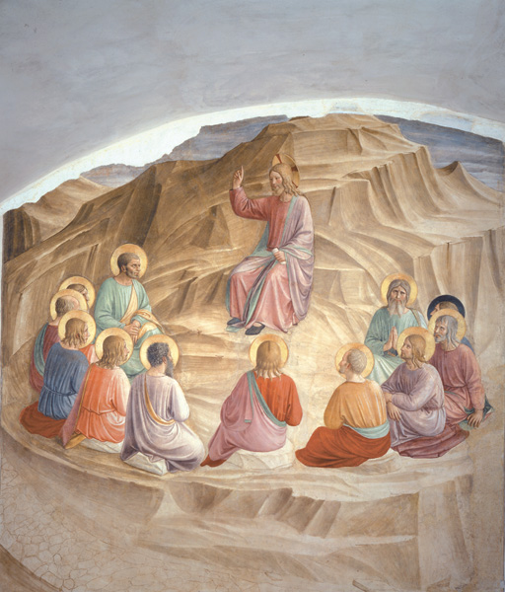
Gnostic Rabbinic Model:
Rejects Gospels Message
Within Innermost Apostles
Without Insider Information

Slide 15
GNOSTICS OPPOSED MONISTS
MONISTS BELIEVE MIND & BRAIN ARE ONLY OF A PHYSICAL PROCESS – THERE IS NO SOUL!

Slide 16
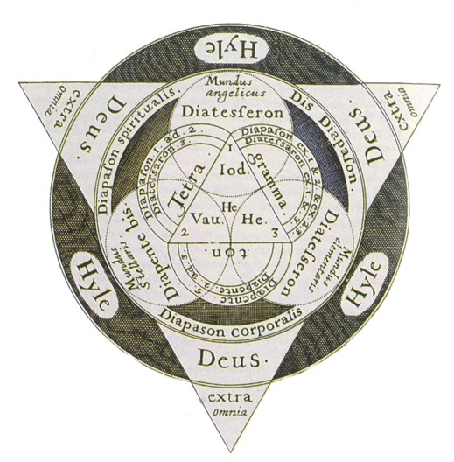

Slide 17
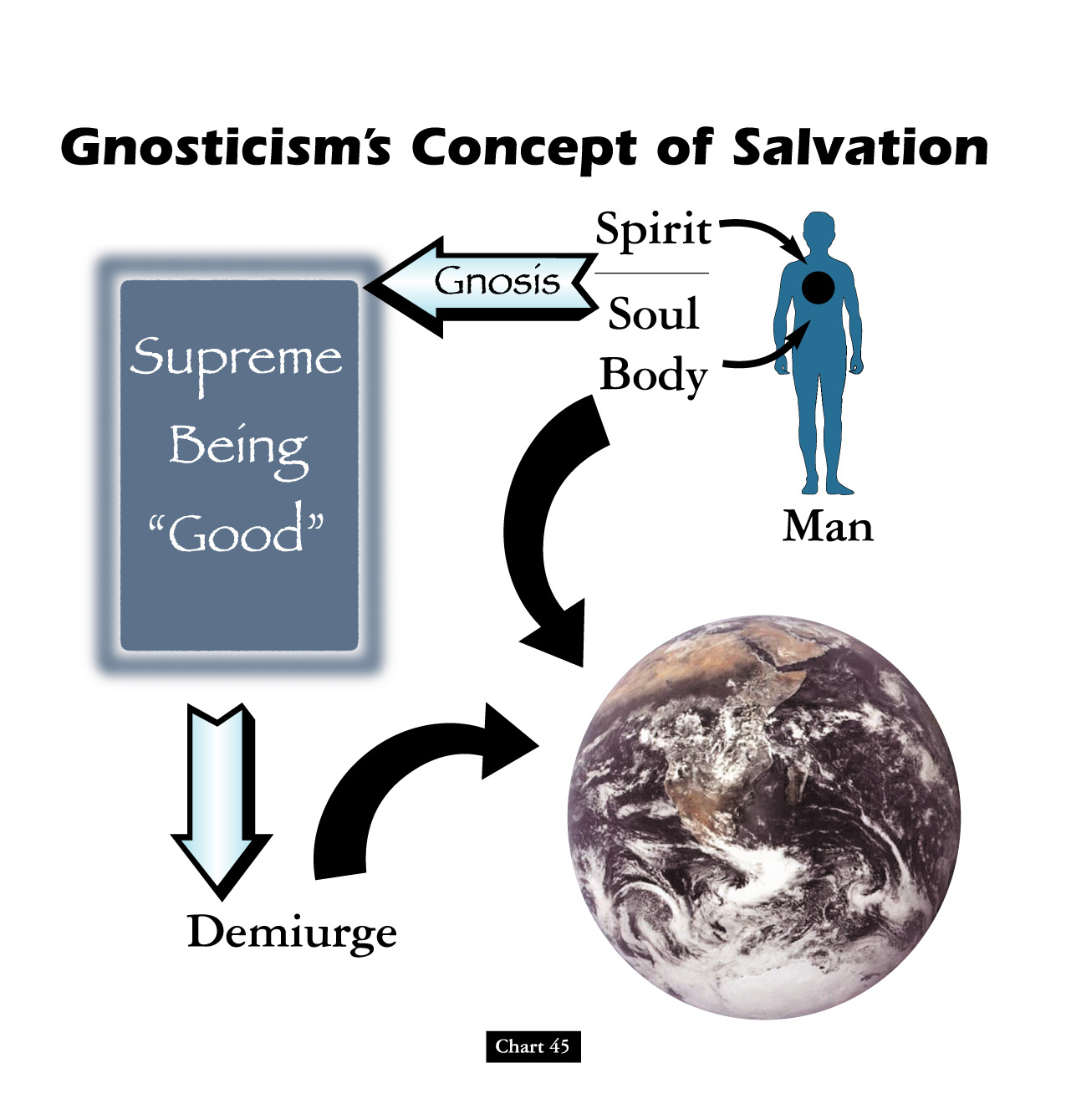

Slide 19
THE HIVE MIND

Slide 20
BASILIDES

Slide 21
Recurrent Resurgent Gnosticism

Slide 22
The term “Gnosticism” is taken from the Greek word for knowledge (gnosis).
Whereas the Apologists utilized philosophy to defend Christianity, Gnosticism used philosophy to reinterpret Christianity.
Gnosticism refers to a blended religious philosophy that invaded Paganism, Judaism, and Christianity.
A beginning form of Gnosticism, mixed with Judaism, existed in the Apostolic Period.
In the second century, a more developed Gnosticism threatened the church.
Fighting the Gnostic heresy was a major preoccupation of church leaders and authors in the early church.

Slide 24
There were certain different Gnostic systems,
but they all had certain common features:
Radical dualism of spirit and matter.
Matter is totally independent of God and irremedially evil. God could not have created the evil world of matter; its origin is accounted for by a series of divine emanations (called aeons) by which the nature of Deity is progressively weakened to the point where it could endure contact with matter. “Pleroma” (fullness) was the term for the higher aeons. What they call evil comes from this fall of Pleroma.

Slide 25
There were certain different Gnostic systems,
but they all had certain common features:
Concern for a personal salvation.
Salvation is the release of man’s spirit from the bondage and prison of the flesh (there is not any resurrection). The means of salvation is “gnosis,” or intuitive knowledge of one’s true self. Salvation is sometimes mediated by certain rites and special ceremonies.

Slide 26
There were certain different Gnostic systems,
but they all had certain common features:
Conduct of the “saved.”
Gnostic principles involved a denial of the flesh and a living of the life of the spirit. To some this meant extreme asceticism, to others the opposite – the libertinism of the Carpocrates !

Slide 27
VALENTINUS

Slide 28
“Even his detractors had a hard time criticizing Valentinus’s intellect. Following in the footsteps of his older contemporary, Basilides, Valentinus pursed the goal of creating a truly Hellenistic form of Christianity, reimagined through the lens of Plato’s philosophy.
What made Valentinian gnosticism so powerful was its subtlety. Valentinus & his followers were able to remain within the larger Christian community long after other gnostic groups had either voluntarily split or been forced out. Valentinus taught from the same sacred texts as mainstream Christians and utilized many of the same worship practices; only in private gatherings were Valentinians instructed in the hidden or secret meanings to all of these practices.”

Slide 29
“Because of this circumspect behavior, Valentinus was able not only to remain in the larger Christian community, but to aspire to leadership. Apparently, when elections were held to determine the next bishop of Rome after the death of Hyginus around 143, Valentinus was nominated to take his place and reportedly lost by only a handful of votes. Later, it seems, he either broke with the Roman church or was expelled. There is evidence that he (both) left Rome & died around 160. With him, the golden age of Christian gnosticism came to a close.
While their teachings would continue to have influence for centuries to come, Christian gnostics were never again as creative or as productive as they were during the middle years of the second century.”

Slide 30
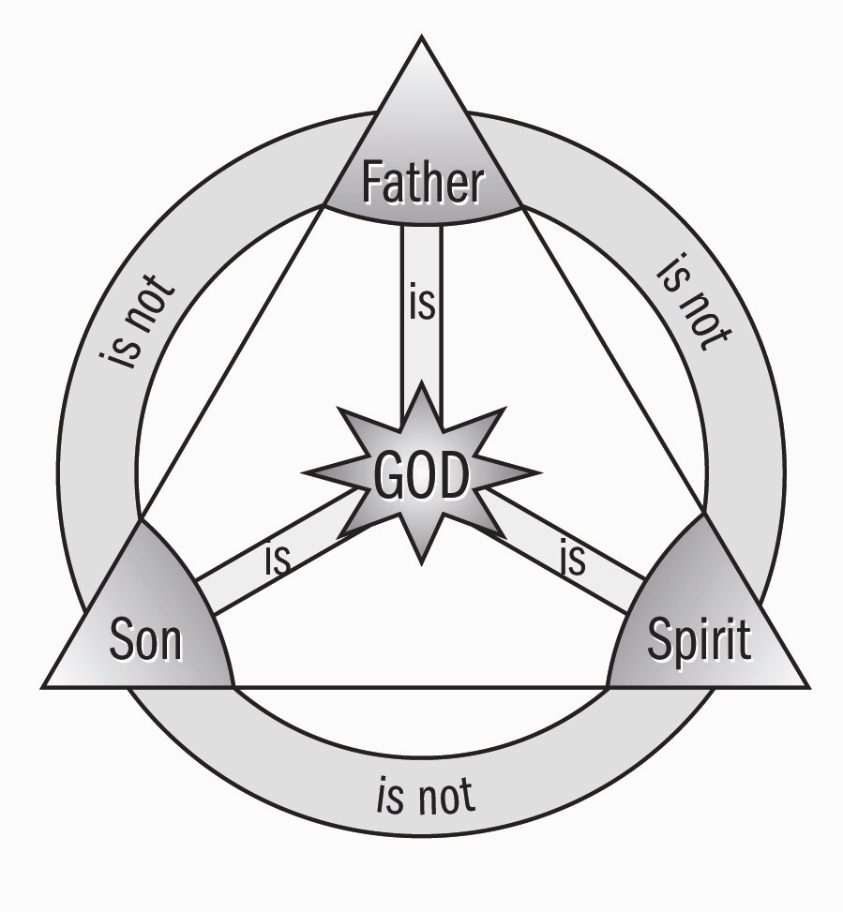
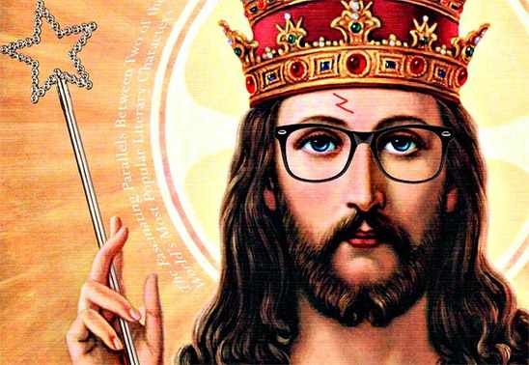
"My Echo, My Shadow, & Me" ?
The Theoanthropic Debate Reframes

Slide 31
THE NEW GNOSTICS

Slide 32
Future Historical Situational Context Of 21st Century Churches Of Christ
CONTEMPORARY OF RESURGENT GNOSTICISM
Science, Politics and Gnosticism by Eric Voegelin:
“The loss of meaning that results from the breakdown of institutions, civilizations & ethnic cohesion evokes attempts to regain understanding of the meaning of human existence in the given conditions of the world. Among these efforts, which vary in depth of insight & substantive truth, are to be found: the Stoic reinterpretation of man as the polites of the cosmos, the Polybian vision of a pragmatic ecumene destined to be created by Rome, the mystery religions, the Heliopolitan slave cults, Hebrew apocalyptic, Christianity, and Manichaeism. And in this sequence, as one of the most grandiose of the new formulations of the meaning of existence, belongs gnosticism. The gnostic’s flight from a dreadful, confusing & oppressive state of the world is understandable. But the order of the ancient world was renewed by that movement which strove through loving action to revive – that is, by Christianity.”

Slide 33
THE NEW HIVE MIND

Slide 34
IT’S EITHER DÉJÀ VU,
DEMENTIA OR BOTH!

Slide 38
HIGHER CRITICISMS:
NEW SCHOLARSHIP &
NEW ENLIGHTENMENT

Slide 39
10 BIBLE INTERPRETING METHODS:
Source Criticism
Form Criticism
Redaction Criticism
History of Religions
Rhetorical Criticism

Slide 40
10 BIBLE INTERPRETING METHODS:
6) Canon Criticism
7) Narrative Criticism
8) Reader-Response Criticism
9) Feminist Hermeneutics
10) Post-colonial Hermeneutics

Slide 41
Dangers of Historical Criticism:
Much of modern biblical criticism springs forth from unbiblical philosophical presuppositions, such as deism, materialism, skepticism, agnosticism, idealism (Hegelianism), and existentialism.
It is based on an unjustified anti-supernatural bias which it super-imposes on the biblical documents.

Slide 42
Dangers of Historical Criticism:
It either neglects or minimizes the role of the apostles and eyewitnesses who recorded the events.
It assumes wrongly that the New Testament writers did not distinguish between their own words and those of Jesus.

Slide 43
Dangers of Historical Criticism:
It incorrectly assumes that the New Testament stories are like folklore and myth.
It undermines the integrity of the New Testament writers by claiming that Jesus never really said (or did) what they claim he said (or did).

Slide 44
Dangers of Historical Criticism:
It is based on the implausible premise that the early church had no real biographical interest.
It neglects the role of the Holy Spirit in activating the memories of the eyewitnesses.

Slide 45
Sixfold Influence - New Hermeneutic – Churches of Christ
Changes in the Types of Music
Changes in the Role of Women
Changes in the Doctrine of Grace
Changes in the Elder’s Authority
Changes in the Memorial Supper
Changes in the Fellowship Circle
Optional Viewing: “The New Hermeneutic” Dave Miller Lessons; biblestudy@wvbs.org

Slide 46
1990’S: ARE THESE MUTUALLY EXCLUSIVE?
PREACH euangelizo |  | TEACH didasko
GOSPEL euangelion |  | DOCTRINE didaskalia
JUSTIFICATION (basis of fellowship) |  | SANCTIFICATION (unity in diversity)

Slide 47
The Jesus Seminar
“…if you read them horizontally and comparatively, focusing on this or that unit and comparing it across two, three, or four version, it is disagreement rather than agreement that strikes you most forcibly. And those divergences stem not from the random vagaries of memory and recall but from the coherent and consistent theologies of the individual texts.”
John Dominic Crossan, Jesus: A Revolutionary Biography
* "The Jesus Wars" - Jesus Seminar Teaches Jesus' Body Not Resurrected But Eaten By Dogs.

Slide 48
Assertions Made by the Liberal Scholars
The gospels were recorded well after the lifetime of the eyewitnesses and have been embellished over time
The church created a picture of Christ that would portray him as the divine Son of God.
The idea that Christ is divine was not taught till the Council of Nicea in the 4th Century AD

Slide 49
Assertions Made by the Liberal Scholars
Of the “80” gospels available, the church chose only four of the gospels and even these four present a distorted portrait of Christ as the Divine Son of God.
The gospels were not transmitted accurately through the years so what we have is not accurate to the original texts.
Contradictions in the text confirm the inaccuracy of the gospels.

Slide 50
Reason for Differences
Differences do not equate to errors.
The reason for the variations is that each author is writing for a different audience and from a unique perspective.
We would expect these differences between four independent accounts.
If they were identical, we would suspect the writers of collaboration with one another.
The four gospels actually give us a fuller and richer picture of Jesus

Slide 51
THE JESUS SEMINAR UTILIZES
LAERTIUS’ CRITERIA REJECTING
AUTHENTICITY OF PLATO’S WORK

Slide 52
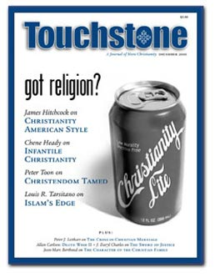
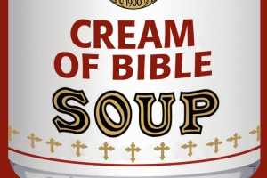

Slide 53
WHO DO YOU SAY THAT I AM?

Slide 54
The question which according to the Gospels Jesus himself was the first to pose to his disciples, has long been at the center of Christian life, worship, and theology. It has also led to bitter controversies and lasting divisions among Christians.

Slide 55
PRIOR TO CONSTANTINE THERE WAS NO RECOURSE TO THE POWER OF THE STATE TO SETTLE RELIGIOUS ARGUMENT.

Slide 56
PRIOR TO THE MONOLITHIC & IMPERIAL INSTITUTION OF THE ROMAN RELIGION THERE WAS NO BRUTE FORCE TO IMPOSE A SETTLEMENT!

Slide 57
WE HAVE RETURNED AGAIN TO THE FIRST CENTURY ERA FULL CIRCLE TO A SIMPLE POWER OF PERSUATION!

Slide 58
WHO DO YOU SAY THAT I AM?

Slide 60
New Canon questions

Slide 61
The Secret Gospels

Slide 62
Introducing The Da Vinci Code
Approximately seven million copies sold.
Ron Howard directed the movie version.
But why has this novel caused such a stir?
Notes:
Ron Howard is reportedly teaming up with the same trio that brought us “A Beautiful Mind”. The film is currently scheduled to be released sometime in 2005. Read more about it at http://www.filmrot.com/articles/filmrot_news/004089.php (March 4, 2004).

Slide 63
Introducing The Da Vinci Code
Story begins with a murder in the Louvre.
The Priory of Sion guards an ancient secret that could discredit biblical Christianity.
The location and identity of the Holy Grail.
Notes:
1. The curator, Jacques Sauniere, is murdered. But this curator isn’t just interested in art; he’s also the Grand Master of a secret society known as the Priory of Sion.
2. So what’s the secret, you ask?
3. But in Brown’s novel, the Grail is not the cup allegedly used by Christ at the Last Supper. Rather, it’s the person of Mary Magdalene, the wife of Jesus, who carried on the royal bloodline of Christ by giving birth to his child! The Priory of Sion carefully guards the secret location of Mary’s tomb and serves to protect the bloodline of Jesus that has continued to this day!

Slide 64
Why be concerned with a novel?
First word: “FACT”
“All descriptions of artwork, architecture, documents, and secret rituals in this novel are accurate” (Dan Brown).
“We were only able to find one prominent art historian who. . . believed the figure might be a woman” (Elizabeth Vargas).
Notes:
1. Why should we be concerned about a novel? Isn’t this just a work of fiction? It’s true that The Da Vinci Code is a work of fiction. However, a great deal of the novel’s content is presented as fact. Indeed, the very first word of the novel, in bold uppercase letters, is the word “FACT.”
2. Shortly thereafter Brown writes, “All descriptions…” (see slide). And the average reader, with no special knowledge or training in these areas, will assume the statement is true. But it’s not. And many articles have been written specifically documenting some of Brown’s inaccuracies in these areas. For example, see Sandra Miesel, Dismantling the Da Vinci Code, at http://www.crisismagazine.com/september2003/feature1.htm and James Patrick Holding, Not InDavincible: A Review and Critique of The Da Vinci Code, at http://www.answers.org/issues/davincicode.html. To give just two examples, Dan Brown says that the Dead Sea Scrolls were discovered in the 1950’s (p. 234). But the first of the scrolls were actually found in 1947. He also says the Louvre pyramid was made of 666 panes of glass (21). Actually, it is made of 673 (http://www.louvre.or.jp/louvre/presse/en/activites/archives/anniv.htm). Furthermore, many of Brown’s interpretations of artwork (e.g. The Last Supper) are suspect.
3. Most art historians believe the figure to the right of Jesus in “The Last Supper” is the Apostle John. In the ABC special, “Jesus, Mary, and Da Vinci,” Elizabeth Vargas says that John’s face looks feminine. Jack Wasserman, of Temple University, replies, “Most representations of the last supper in Florence, he looks like, he’s a very, very young man.” This is the predominant view among art historians.

Slide 65
Why be concerned with a novel?
The novel’s theories about the Bible, Jesus and the early church are put in the mouths of the two most educated characters.
“I began as a skeptic . . . I became a believer.” Dan Brown
Notes:
1. These are Leigh Teabing, a British royal historian and Robert Langdon, a Harvard professor of Religious Symbology. This gives readers the impression that the theories espoused by Teabing and Langdon are true.
2. This quote comes from the ABC special: “Jesus, Mary, and Da Vinci.” Dan Brown says he began his research on The Da Vinci Code as a skeptic about the ideas presented in the novel. But, he says, his research made a believer out of him.

Slide 67
Excerpts from The Da Vinci Code
“The Bible is a product of man, my dear. Not of God. The Bible did not fall magically from the clouds. Man created it as a historical record of tumultuous times, and it has evolved through countless translations, additions, and revisions. History has never had a definitive version of the book.” (p. 231)

Slide 68
Excerpts from The Da Vinci Code
“Jesus Christ was a historical figure of staggering influence, perhaps the most enigmatic and inspirational leader the world has ever seen.…Understandably, His life was recorded by thousands of followers across the land. More than 80 gospels were considered for the New Testament, and yet only a relative few were chosen to be included: Matthew, Mark, Luke, and John among them.” (p. 231)

Slide 70
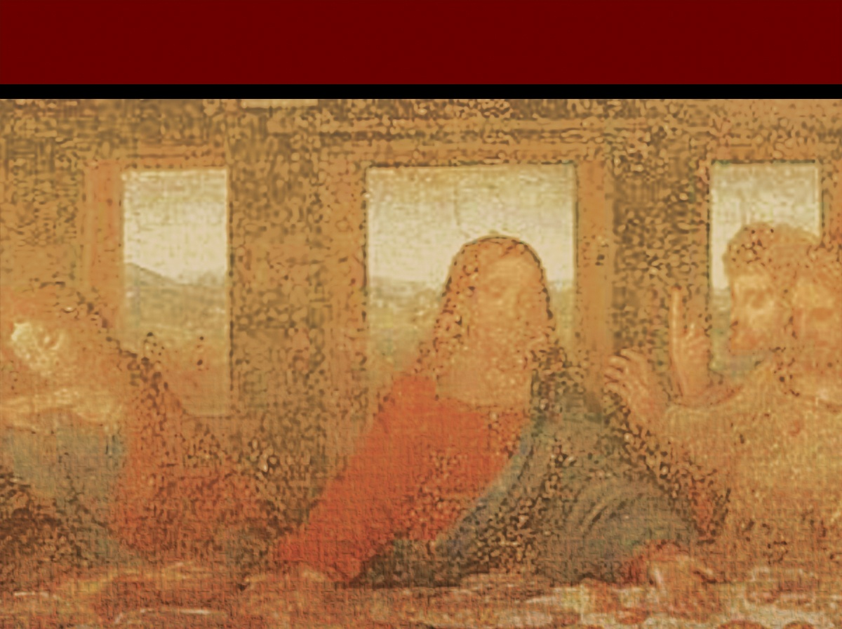
A Closer Look at The Da Vinci Code

Slide 71
The Nature of Jesus
Was the recognition of Jesus as God really the result of a vote?
Notes:
Links on this slide will be activated in PowerPoint Show mode

Slide 72
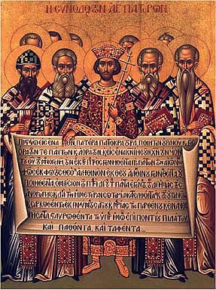
The Nature of Jesus
Jesus as God
The Fiction:
In The Da Vinci Code, a character claimed that the recognition of Jesus as divine was the result of a vote, and “a relatively close vote at that.” (DVC p. 233)
The First Ecumenical Council of Nicaea (325 AD)
Notes:
Links on this slide will be activated in PowerPoint Show mode

Slide 73
The Nature of Jesus
Jesus as God
The Facts:
A council of more than 300 church leaders met in the city of Nicaea, nearly 300 years after Jesus’ death.
Their purpose was not to declare Jesus divine.
Notes:
Links on this slide will be activated in PowerPoint Show mode

Slide 74
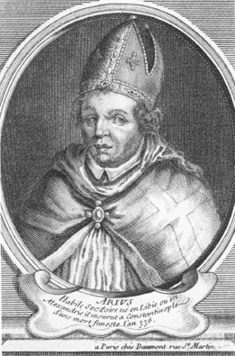
The Nature of Jesus
The Facts:
Around AD 320, a North African elder named Arius claimed that Jesus was a created being, not God in human flesh.
Arius
Notes:
Links on this slide will be activated in PowerPoint Show mode

Slide 75
The Nature of Jesus
The Facts:
In response to the claims of Arius, the bishops gathered in Nicaea.
They summarized their shared commitment to a belief that Christians had embraced from the beginning—the belief that Jesus was uniquely God.
Notes:
Links on this slide will be activated in PowerPoint Show mode

Slide 76
The Nature of Jesus
The Facts:
The vote wasn’t close.
The Nicene Creed was a document that described Jesus as “true God.”²
Out of more than 300 church leaders present at the Council of Nicaea, only two refused to sign the Creed of Nicaea.³
Notes:
Links on this slide will be activated in PowerPoint Show mode

Slide 77
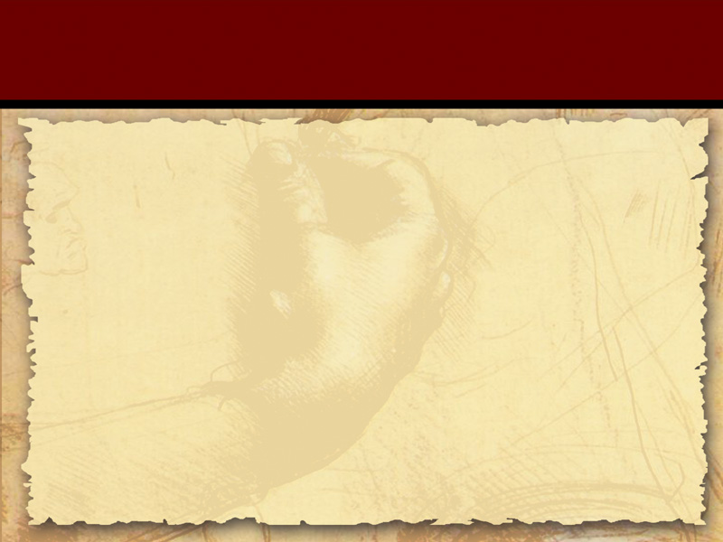
Scripture
Was the New Testament, as we know it, compiled and edited by men who possessed “a political agenda … to solidify their own power base”? (DVC p. 234)
Notes:
Links on this slide will be activated in PowerPoint Show mode

Slide 78
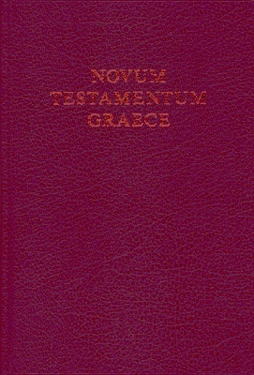
Scripture
The Canon
The Fiction:
According to The Da Vinci Code, the New Testament, as we know it, was compiled and edited by men who possessed “a political agenda … to solidify their own power base.” (DVC p. 234)
The Greek
New Testament
Notes:
Links on this slide will be activated in PowerPoint Show mode

Slide 79
Scripture
The Canon
The Facts:
The New Testament underwent a compilation process referred to as canonization, from the Greek word kanon (“measuring stick”).
Notes:
Links on this slide will be activated in PowerPoint Show mode

Slide 80
Scripture
The Facts:
To be included in the Christian Scriptures, writings had to meet three requirements.
These three requirements specifically prevented the manipulation of the canon by any single group.
1
2
3
Notes:
Links on this slide will be activated in PowerPoint Show mode

Slide 81
Scripture
The Three Requirements for Canonization:
(1) Because the apostles were the trusted eyewitnesses of Jesus’ resurrection, the writing had to be directly connected to an apostle.
(2) The writing had to be “orthodox”—it could not contradict the teachings of the Jewish Scriptures or of the Apostles.
(3) The writing had to be accepted in churches throughout the known world—it could not be accepted only by one group of Christians.¹⁴
Notes:
Links on this slide will be activated in PowerPoint Show mode

Slide 82
Scripture
THE RELIABILITY OF SCRIPTURE
The interval between the dates of the original composition [of Matthew, Mark, Luke, and John] and the earliest extant evidence [is] so small as to be negligible, and the last foundation for any doubt that the Scriptures have come down to us substantially as they were written has now been removed.¹⁵
—Sir Frederic Kenyon, former director of the British Museum
Notes:
Links on this slide will be activated in PowerPoint Show mode

Slide 83
Excerpts from The Da Vinci Code
“These are photocopies of the Nag Hammadi & the Dead Sea Scrolls,… the earliest Christian records. Troublingly, they do not match up with the gospels in the Bible.”

Slide 84
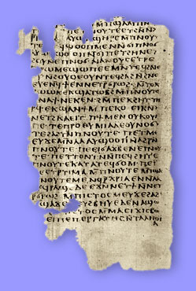
What’s the Evidence?
“The Nag Hammadi scrolls . . . tell . . . an alternative history of the time of Jesus and Mary Magdalene” (Dan Brown)
Teabing calls these texts “the earliest Christian records” (245) and the “unaltered gospels” (248).
Notes:
1. Many scholars would question whether the stories about Jesus and Mary Magdalene in the Nag Hammadi texts were ever intended (by their original Gnostic authors) to be understood as literal history. Many scholars believe these texts were intended to be understood symbolically - not as literal history. However, Brown is correct in noting that these texts tell an “alternative history” or “histories” about Jesus and Mary.
2. Is Teabing correct in saying that these texts are “the earliest Christian records”? What do we know about these texts? When were they discovered? And who wrote them?

Slide 85
What are the Nag Hammadi Documents?
Dr. Bart Ehrman tells the following story:
Accidentally discovered in 1945 near the Egyptian village of Nag Hammadi.
Six bedouin camel drivers were digging for fertilizer when one of them uncovered a human skeleton buried next to an earthenware jar.
Notes:
1. This is in upper Egypt.
2. Dr. Bart Ehrman, a New Testament scholar at the University of North Carolina at Chapel Hill, tells how the bedouin were initially reluctant to smash the sealed jar open because they feared that an evil genie might be inside. However, after thinking the matter over, they decided that there might also be gold inside! So the smashed the jar open and found…
3. Dr. Ehrman tells this story in a lecture series produced by The Teaching Company, Lost Christianities: Christian Scriptures and the Battles over Authentication, (Chantilly, Virginia: Parts 1 and 2, 2002).

Slide 86
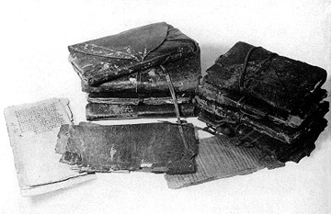
What are the Nag Hammadi Documents?
Inside the jar, they found thirteen leather-bound volumes containing fifty-two treatises.
Notes:
This is now known as “The Nag Hammadi Library”.

Slide 87
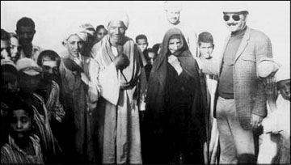
What are the Nag Hammadi Documents?
The leader of this group, Mohammed Ali, took the volumes to his home.
Notes:
Mohammed Ali offered to divide the booty with his friends. They, however, were not interested in the books. So Mohammed Ali took them home. That night, it is said, his mother used a few pages from the books to kindle the fire to cook the evening meal!

Slide 88
What are the Nag Hammadi Documents?
Believing the books might be worth something, Mohammed Ali wanted to put them someplace safe.
He gave the books to a local priest.
Over time, antiquities dealers became aware of the find.
Notes:
1. Dr. Bart Ehrman says that Mohammed Ali and his brothers were involved in a “blood feud”. They were told that the man who had murdered their father was not too far away. They found the man asleep on the side of the road and reportedly murdered him, hacked him apart, and tore out his heart and ate it as an act of blood vengeance against the man! Mohammed Ali knew that he would be a prime suspect in the investigation into the murder. Since he thought the books might be valuable, he wanted to put them somewhere safe so that the police would not confiscate them.
2. This priest had a brother-in-law who was a traveling teacher. He confirmed that the books might indeed be valuable.
3. The books were eventually sold to...

Slide 89
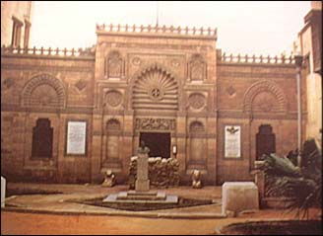
What are the Nag Hammadi Documents?
The books were sold to the Museum of Antiquities in Cairo.
Notes:
Among the fifty-two tractates found in the Nag Hammadi library were mystical reflections on the origin of the gods, the origin of the world, and the origin of the human race. But there are many books with titles similar to those in the New Testament.

Slide 90
What are the Nag Hammadi Documents?
The books included Gospels (e.g. Thomas, Philip), Acts (e.g. Peter and the Twelve Apostles), letters (e.g. Peter to Philip) and Apocalypses (e.g. Paul, Peter).
Why aren’t these books in the Bible?
Notes:
This naturally raises questions about the nature of the New Testament canon. What is the “canon”? And what sort of criteria did the early church fathers apply as helpful aids in recognizing those writings which were truly inspired by God?

Slide 91
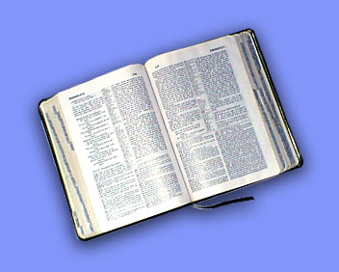
Criteria of Canonicity
“The canon is the list of those writings which are acknowledged by the church as documents of the divine revelation.” F.F. Bruce
Dr. Ehrman offers four criteria:
Ancient
Apostolic
Orthodox
Accepted
Notes:
1. What is the “canon”? F.F. Bruce says this: “The canon…”
2. What sort of criteria did the early church fathers use to help them determine whether or not a particular writing was truly inspired by God?
A. Ancient = The book had to be written near the time of Jesus and His original followers. This tends to exclude any writings dated after the first century A.D.
B. Apostolic = The book had to be written by an apostle or a companion of an apostle. Consider our four gospels.
C. Orthodox = The book had to be consistent with the teachings already accepted as having come from Jesus and His original followers.
D. Accepted = The book had to be widely recognized and accepted by a large proportion of the orthodox Christian church.
* I take these criteria from Bart D. Ehrman, Lost Christianities: Christian Scriptures and the Battles Over Authentication (Chantilly, Virginia: The Teaching Company: Course Guidebook, part 2, 2002), 37.

Slide 92
When were the Nag Hammadi texts written?
Teabing claims that the Nag Hammadi texts are “the earliest Christian records” (245).
But every book in the NT is earlier.

Slide 93
When were the Nag Hammadi texts written?
All the books in the NT were written in the first century A.D.
The Nag Hammadi texts were written in the second and third centuries A.D.
Notes:
Think about what this means. This means that the Nag Hammadi texts do not meet the criteria of being ancient or apostolic.

Slide 94
Who wrote these documents?
The Gnostics (Gr. Gnosis = (knowledge”)
Key tenet: Salvation comes through secret, esoteric knowledge.
Notes:
We see evidence for this key tenet in what is probably the best known of the Nag Hammadi texts, The Gospel of Thomas.

Slide 95
Who wrote these documents?
“These are the secret sayings which the living Jesus spoke and which Didymos Judas Thomas wrote down. And he said, “Whoever finds the interpretation of these sayings will not experience death” Gospel of Thomas; 1
Notes:
Notice the emphasis on “the secret sayings” of Jesus. Unlike the canonical gospels, The Gospel of Thomas says nothing about the necessity of the death and resurrection of Jesus for human salvation. Rather, this gospel teaches that salvation comes through a correct interpretation of the “secret sayings” of Jesus. This is consistent with the gnostic character of this document.

Slide 96
The Gospel Of Thomas:
Simon Peter said to them: “Make Mary leave us, for females don’t deserve life.”
Jesus said: “Look, I will guide her to make her male, so that she too may become a living spirit resembling you males. For every female who makes herself male will enter the domain of Heaven!” (114)
Notes:
Notice the emphasis on “the secret sayings” of Jesus. Unlike the canonical gospels, The Gospel of Thomas says nothing about the necessity of the death and resurrection of Jesus for human salvation. Rather, this gospel teaches that salvation comes through a correct interpretation of the “secret sayings” of Jesus. This is consistent with the gnostic character of this document.

Slide 97
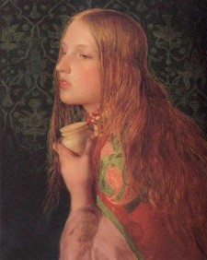
The Gnostic “Gospels” of Philip and Mary Magdalene
Leigh Teabing says that these gospels either teach or imply the following:
Mary was the wife of Jesus.
The mother of His child.
She was to lead the church after Jesus’ death (244-48).
Notes:
Let’s now focus our attention on those gnostic “gospels” specifically mentioned by Dan Brown in The Da Vinci Code. We’ll begin with The Gospel of Mary [Magdalene].

Slide 98
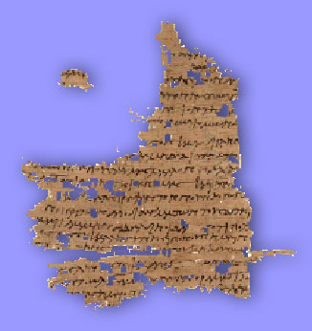
The “Gospel” of Mary
After an appearance of Christ to his disciples, Peter asks Mary to tell them the words of the Savior that she knows, but that they do not.
She describes a vision of the ascent of the soul past four ruling powers to its rest.
Notes:
1. To help us better understand the quotation from this gospel in Brown’s novel, let me briefly set the stage with a few remarks about the context in which the quotation occurs.
2. This is part of gnostic mythology and need not detain us here.

Slide 99
The “Gospel” of Mary
Andrew rejects the revelation, not believing it came from Christ.
“And Peter said, ‘Did the Saviour really speak with a woman without our knowledge? Are we to turn about and all listen to her? Did he prefer her to us?”
Notes:
2. The words of Peter begin the quotation in Brown’s novel.
3. Although not quoted in Brown’s novel, immediately after Peter speaks we read the following in The Gospel of Mary: “Then Mary wept and said to Peter, ‘My brother Peter, what do you think? Do you think that I thought this up myself in my heart, or that I am lying about the Savior?”

Slide 100
The “Gospel” of Mary
“And Levi answered, ‘Peter, you have always been hot-tempered. Now I see you contending against the woman like an adversary. If the Saviour made her worthy, who are you indeed to reject her? Surely the Saviour knows her very well. That is why he loved her more than us” (247).
Notes:
What is this all about?

Slide 101
The “Gospel” of Mary What does this text teach?
Mary received a special revelation from Jesus that the male disciples did not.
Levi implies that Jesus (who knows her very well) considered her worthy.
Jesus loved Mary more than his male disciples.
Notes:
1. Let’s first think very carefully about what this text actually teaches.
2. In the first place, it teaches that Mary received…
3. Second, Levi implies…
4. And finally, it says that Jesus loved...

Slide 102
The “Gospel” of Mary What does this text NOT teach?
That Mary was Jesus’ wife.
That Mary was the mother of Jesus’ child.
That Mary was to lead the church.
Notes:
But what does this text NOT teach? It doesn’t teach any of the things affirmed by Teabing in the novel! Nowhere does this gospel state:
1. That Mary was Jesus’ wife… etc.

Slide 103
The “Gospel” of Mary What does this text mean?
It’s possibly symbolic. Peter may represent “Orthodoxy”; Mary “Gnosticism”.
If this is so, then “Mary” (Gnostics) are claiming special revelation even if “Peter” (Orthodox) can’t believe it.
Notes:
What does this gospel mean? How should we understand it? How should it be interpreted?
1. In the first place, it’s possibly symbolic. The use of figurative, or symbolic, language is common in gnostic literature.
When was this text written?

Slide 104
The “Gospel” of Mary
Composed in the late second century - one hundred years after NT gospels.
It’s almost certainly not historically reliable.
But doesn’t The Gospel of Philip indicate that Mary and Jesus were married?
Notes:
1. Contrary to what the novel implies, this text could not have been written by Mary Magdalene - or any of Jesus’ other original followers. They would have been long dead by the time this gospel was written.
2. Most likely the original author was not even interested in recording accurate history. As I mentioned previously, the text should probably be read non-literally.

Slide 105
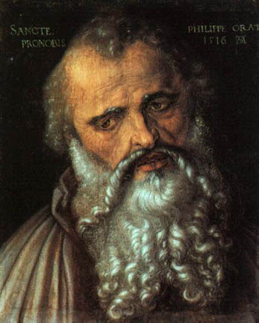
The “Gospel” of Philip
“And the companion of the Saviour is Mary Magdalene. Christ loved her more than all the disciples and used to kiss her often on her mouth. The rest of the disciples were offended by it and expressed disapproval. They said to him, ‘Why do you love her more than all of us?’” (246).
Notes:
What are we to make of this? This passage provides the strongest textual evidence for the marriage of Jesus thesis.
1. Notice the very first sentence. In the novel, Teabing clinches his argument that Mary and Jesus were married by stating… (see next slide).

Slide 106
The “Gospel” of Philip
“As any Aramaic scholar will tell you, the word companion, in those days, literally meant spouse” (246).
This gospel was originally written in Greek.
Notes:
1. This sounds like pretty strong evidence. Were Mary and Jesus actually married after all?
2. It’s important to point out that this gospel was originally written in Greek. Therefore, what the term “companion” may have meant in Aramaic is irrelevant. The gospel wasn’t written in Aramaic; it was written in Greek.

Slide 107
The “Gospel” of Philip
Even the Coptic translation, found at Nag Hammadi, uses a Greek loan word for “companion” - koinonos.
This term can mean “wife” in a spiritual sense, but it’s not the common Greek term for wife.
Notes:
1. Thus, we need to ask about the meaning of the Greek term, koinonos.
2. Dr. Darrell Bock points out that this term can mean...

Slide 108
The “Gospel” of Philip
Koinonos is most often used in the NT of a “partner”.
Luke uses this term to describe James and John as Peter’s business “partners” (5:10).
Contrary to Teabing’s claim, the statement that Mary was Jesus’ companion does not at all prove that she was His wife.
Notes:
1. Or “sharer”.
2. At most, the statement proves that Mary was Jesus’ “companion” or ministry “partner” - something we already knew from the canonical gospels (e.g. Luke 8:1-3; etc.).

Slide 109
The “Gospel” of Philip
But what about the statement: “Christ loved her more than all the disciples and used to kiss her often on the mouth.”
This portion of the manuscript is damaged. We don’t actually know where Christ kissed Mary.
Notes:
2. Some scholars have suggested that the terms “forehead” or “cheek” would also fit in the break.

Slide 110
The “Gospel” of Philip
The kissing is likely symbolic.
“For it is by a kiss that the perfect conceive and give birth. For this reason we also kiss one another” (Philip).
“Jesus said, ‘He who will drink from my mouth will become like me” (Thomas, 108).
This gospel was composed in the second half of the third century.
Notes:
1. This is a common feature of gnostic texts. Indeed, it is a common feature of gnostic interpretations even of the canonical gospels. That is, gnostics often interpreted the canonical gospels non-literally, in accordance with their own theological views. If the “kiss” in Philip is symbolic, it is likely being used as a metaphor for the communication of spiritual truth(s).
2. If we interpret this statement literally, we have to assume that the author of this gospel was ignorant of “the birds and the bees”! Again, the “kiss” is probably a metaphor for the communication of spiritual truth(s).
3. Again, this statement should not be understood literally. Rather, Jesus is saying that the one who “drinks” in his teaching (I.e. receives his teaching) will become like him (I.e. possibly meaning re-united with him in the gnostic pleroma, or divine realm).
4. Thus, it could not have been written by Philip - or any of Jesus’ other original followers. It is, therefore, not based on eyewitness testimony. Also, the original author was probably not intending to record actual historical events. Rather, the text should probably be read symbolically. We have no good reason to believe that this text preserves historically reliable information about Jesus and Mary Magdalene.

Slide 111
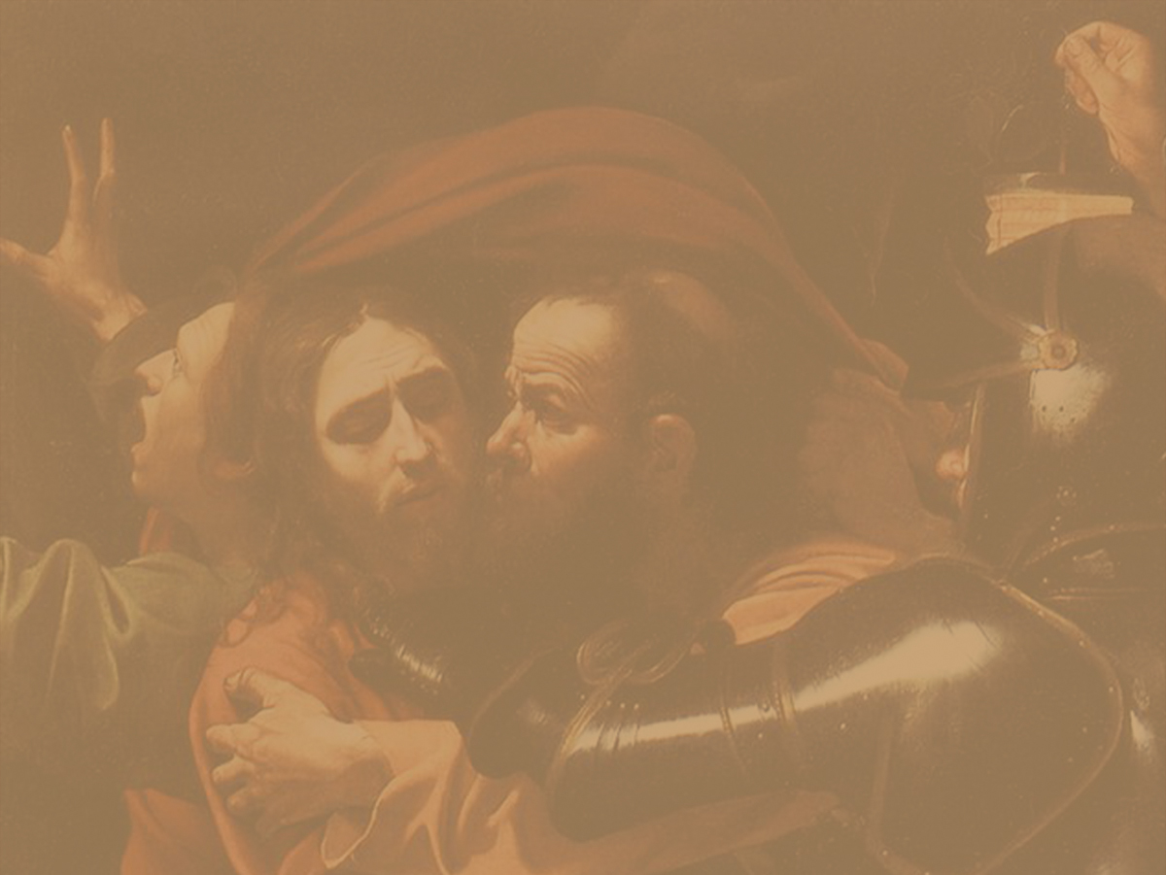

Slide 112
What is the Gospel of Judas?
Gospel of Judas is a Gnostic gospel that presents Judas positively.
Gnosticism taught that one’s spirit needs to escape from the prison of the human body.
The book suggests that the betrayal of Jesus was done out of obedience to Jesus’ specific instructions; Judas helped Jesus’ spirit escape.

Slide 113
What is the Gospel of Judas?
Where it was found: El Minya, Egypt
Date it was written: AD 160 to AD 180, over 130 years after Judas died.
Who is the author: Unknown
What is the style: Gnostic
What is the theme: The loyalty of Judas

Slide 114
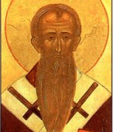
When was Gospel of Judas written?
Historians have known about Gospel of Judas since AD 180.
Rejected by church father Irenaeus of Lyons in AD 180
Irenaeus

Slide 115
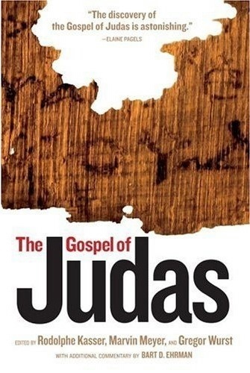
When was Gospel of Judas written?
In 2006, scholars reconstructed most of the text from recently-published fragments.
The book was originally written in Greek, but available fragments come from a third-century Coptic translation.

Slide 116
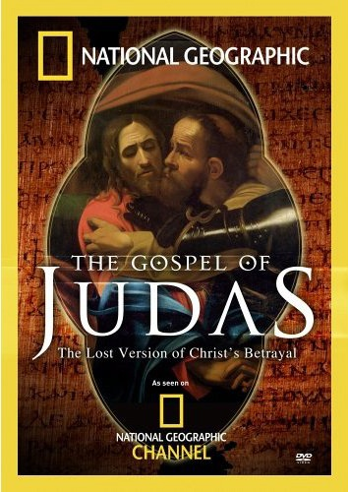
When was Gospel of Judas written?
Many Coptic words in the book stem from Greek terms that were current from AD 150 to AD 200.
This is more than a century after Judas’s death!
(National Geographic Society)

Slide 117
When was Gospel of Judas written?
Gospel of Judas seems to have been written after the Gnostic teachings of Valentinus had spread through many of the Christian communities.
Valentinus died around AD 160.
Therefore, the book was most likely written between AD 160 and 180.

Slide 118
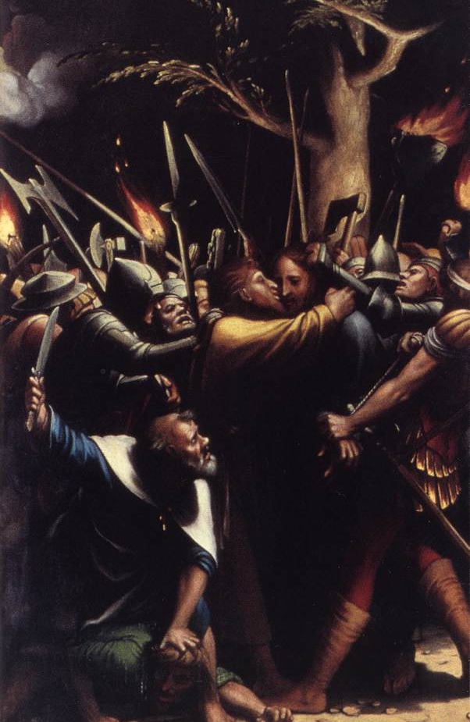
Who wrote Gospel of Judas?
Although the text presents Judas in a positive light, Gospel of Judas never claims to have been written by Judas.
The Passion (detail) Han the Younger Holbein (1524-25)

Slide 119
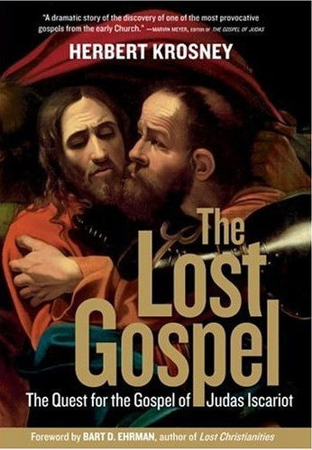
Who wrote Gospel of Judas?
Even if the book had claimed Judas as its author, the book could not have been written by Judas.
In fact, Gospel of Judas could not have been written by any eyewitness of the life and ministry of Jesus.

Slide 120
Who wrote Gospel of Judas?
The actual author of the Gospel of Judas was anonymous and is still unknown today.
It is evident, however, that the author was influenced greatly by Gnostic teachings of the second century.

Slide 121
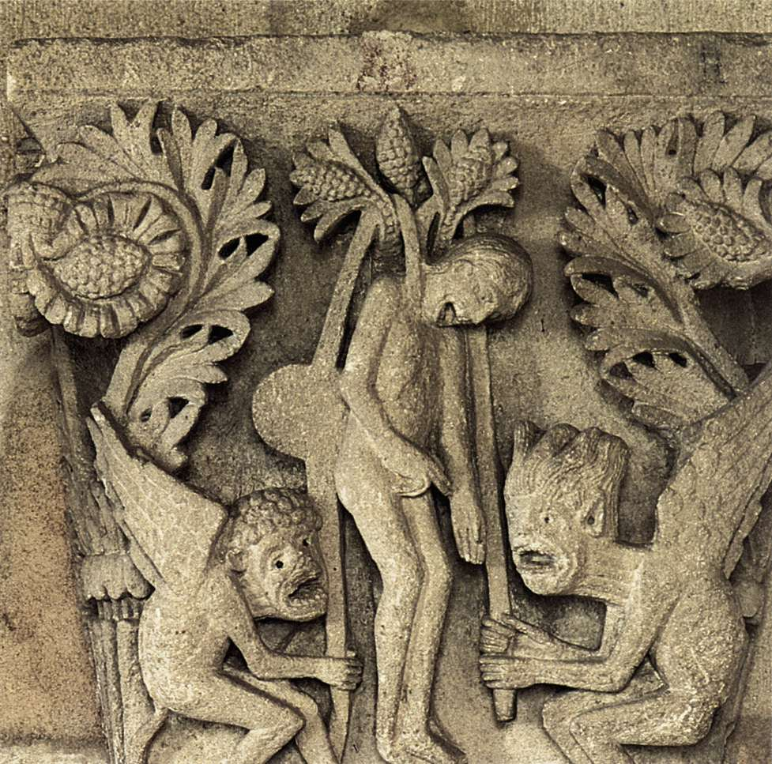
What does Gospel of Judas suggest?
According to Gospel of Judas, Jesus supposedly told Judas, “You will be cursed for generations, … but you will eventually rule over all of them. … For what you are sacrificing is merely the man in whom I am clothed.”
Suicide of Judas Gislebertus (1120-30)

Slide 122
What does Gospel of Judas suggest?
Like many Gnostic texts of the mid-second century AD, Gospel of Judas claims that Jesus only seemed to be human.
Where The Da Vinci Code claims that Jesus was not God, but just a “mortal prophet”, Gospel of Judas claims Jesus wasn’t mortal at all, but God “clothed” in human form.

Slide 123
Concluding Rationale
What can we say about the non-canonical Gnostic gospels to which Brown appeals for support of his theories?
Not ancient
Not apostolic
Not orthodox
Not accepted
Don’t support his theories!
Notes:
2. These gospels (unlike the four canonical gospels) were not written during the time of Jesus and His earliest followers (I.e. in the first century). Rather, they are later, second and third century productions.
3. These gospels were written neither by apostles, nor by companions of the apostles. All of these people were dead by the time these documents were written.
4. These gospels are not orthodox in their theology. They teach a different view of God, Christ, man, salvation, and what happens to a person after death. These gospels are not consistent with the original teachings of Jesus and His earliest followers.
5. Unlike the four canonical gospels, these gospels were never widely accepted or recognized as authentic and inspired by the early Christian church.
6. Finally, even the non-canonical gospels cited by Brown, when examined very carefully, are seen NOT to support his theories. Nowhere do these gospels actually teach that Jesus was married to Mary Magdalene. Nowhere do they teach that he fathered a child by her. And nowhere do they teach that Jesus intended Mary to lead the church after his death. These gospels simply don’t support Brown’s theories in the novel.

Slide 124
Concluding Rationale
What can we say about the non-canonical Gnostic gospels to which Brown appeals for support of his theories?
Notes:
2. These gospels (unlike the four canonical gospels) were not written during the time of Jesus and His earliest followers (I.e. in the first century). Rather, they are later, second and third century productions.
3. These gospels were written neither by apostles, nor by companions of the apostles. All of these people were dead by the time these documents were written.
4. These gospels are not orthodox in their theology. They teach a different view of God, Christ, man, salvation, and what happens to a person after death. These gospels are not consistent with the original teachings of Jesus and His earliest followers.
5. Unlike the four canonical gospels, these gospels were never widely accepted or recognized as authentic and inspired by the early Christian church.
6. Finally, even the non-canonical gospels cited by Brown, when examined very carefully, are seen NOT to support his theories. Nowhere do these gospels actually teach that Jesus was married to Mary Magdalene. Nowhere do they teach that he fathered a child by her. And nowhere do they teach that Jesus intended Mary to lead the church after his death. These gospels simply don’t support Brown’s theories in the novel.

Slide 125
WHO DO YOU SAY THAT I AM?

Slide 126
THE POST-MODERN PRESENT

Slide 127
Why the New Woke Progressives Are Gnostic
What do the Gnostics and new progressives have in common? Both believe they possess valuable secrets. As noted:
Wokeness is grounded in a Gnostic understanding of the world, which distinguishes between appearances accessible to everyone and the reality perceptible only to a certain few. To join the community of those who recognize this ultimate reality, one must undergo a kind of “awakening” — or, in identity-politics parlance, “become woke.”
Gnostics saw Jesus as the great revealer. It was through gnosis, knowledge, that humans can be saved. Most importantly, the knowledge that this world is created by a demiurge, not the true God (the universal virgin spirit). But in that respect, the two movements aren’t different from other forms of religion or politics. Other early Christians also believed themselves to be possessing metaphysical secrets. Apostle Paul, whose writings are Christian canon, emphasized the idea that he possessed a secret that was only now being revealed:
Now to him who is able to establish you in accordance with my gospel, the message I proclaim about Jesus Christ, in keeping with the revelation of the mystery hidden for long ages past, but now revealed and made known through the prophetic writings by the command of the eternal God, so that all the Gentiles might come to the obedience that comes from faith—to the only wise God be glory forever through Jesus Christ!
Romans, 16.25-27

Slide 128
We can sharpen the similarities by focusing on Gnosticism and progressivism’s shared rejection of institutions, epistemology, androgyny, and interior nature.
First, there is a distrust of institutions, especially of traditional media, corporate, and government bodies. This mirrors the fundamental Gnostic distrust of the material plane, but is not as extreme. The Gnostic attitude is more fundamental. Take your favorite golden age and the Gnostic sees a corpse.
In the Gnostic view, the world is worse than fake, it is the material that holds our spirit back from salvation. There are parallels to the Marxist idea of superstructure here: the dominant ideology, the prism, through which we see the world, is almost inescapably determined by economic and class dynamics. The progressive version of this world moves beyond the purely economic, taking gender, race, and other factors into account. We inhabit an ideological world created by factors that are divorced from truth.
A second similarity is emphasis on experience. Progressives place experiential ways of knowing over the other forms of empirical science. In its worst form, perceiving offense is sufficient for something being offensive. Pushing back against this just compounds the problem. One’s experience is to be trusted over findings from third parties.
Gender offers a third parallel, but this is a complicated story. The Gnostics may not have been early feminists. Gnostic texts paint Mary Magdalene as a close companion of Jesus. Someone to be trusted, in contrast with the angry apostle Peter.
The fourth & most significant similarity between Gnosticism and progressivism, however, is the focus on the internal and interior.

Slide 129
The Gnostic places significant focus on the internal & interior. Knowledge is not a matter of action, but experience. Salvation is through our internal spirit. This Gnostic secret knowledge is world-negating. Therefore, Salvation involves transcending this world as a spirit.
How does this compare with the new woke progressivism? Progressivism seeks to shape politics. But much of it is an individual & personal matter. In order to be good, one must recognize one’s privilege. In comparison with [traditional politics] it is more therapeutic. Far more attention is spent on feelings as is evident by the stress placed on creating and maintaining safe spaces, language, and media. The discourse is full of movement like acknowledging injustice, validating other’s experience, and spreading awareness. This is the stuff of gnosis, not shaping the world.
Racial equality, for example: understood as a political and social principle, it would reach its goal by dropping out of our consciousness. It would become part of the world around us.
If racial equality is a valuable principle, it seems that we should be vividly aware of it. According to the logic of experience, the goal should be intensity, not naturalness.
In other words, justice demands a change in the spirit, not merely the material. – Caleb Ontiveros

