Slide 1
CATHOLIC MILITANCY: CRUSADING
By David Lee Burris

Slide 2

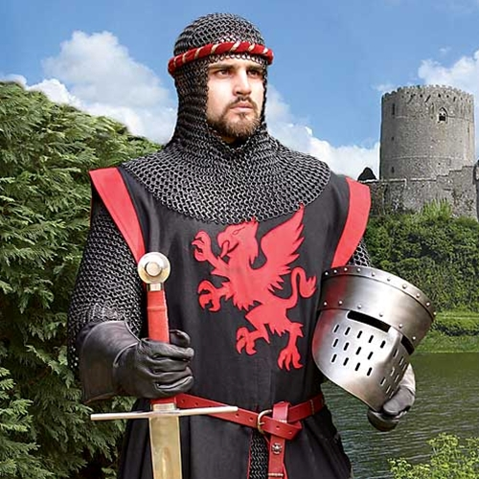
“Prior to the Crusades, Christians generally viewed war as an evil, on occasion the lesser of two evils. Augustine held that there might be a ‘just war’ in which the more loving thing to do is to kill those who commit great evil, rather than let them take over – just as amputating a gangrenous limb is better than letting the gangrene spread. In the fourth century, Martin, bishop of Tours, refused to take up arms after his conversion and is often quoted as saying, ‘I am a soldier of Christ, I am not allowed to fight.’”
“But Pope Gregory VII reversed this long standing policy & the ‘soldiers of Christ’ (militia Christi) came to designate armed warriors whose meritorious Christian duty included battle. A few years later, Pope Urban II motivated the Crusaders, promising that God would hold them guiltless of any blood shed while securing the Holy Land. Indeed, Urban promised a ‘plenary indulgence’ from purgatory for all who went on the crusade.”
- Cornerstone Magazine, The Crusades, Holy War

Slide 3
“Urban brought together the strands leading to a concept of Christian warfare. These were: (1) The development of the idea of a Christian’s participation in warfare. In the ante-Nicene period some participated in the army as an act distinct from the religious life and as part of man’s duty to the State to preserve order. The number of these grew in the third century despite the fact that the prevailing opinion had been that Christians were soldiers of one Emperor and were to inflict no harm. Under the convert Constantine all of the functions of the State came to be thought of as within the sphere of a Christian’s activities. Eusebius of Caesarea was one of the first to suggest the righteousness of war as directed against demonic forces or barbarians. At a council at Arles in 314 Christians were called upon to participate in the army under the Christian ruler… but the idea that war was sin continued on even beyond the Carolingian period.”
- Everett Ferguson, Church History Early & Medieval, pg. 83-84

Slide 4
“Urban brought together the strands leading to a concept of Christian warfare. These were: (2) The devolution of the right of sacred warfare from imperial ruler to king to knights. Charlemagne & his successors had claimed the warfare right for the emperor alone. But feudalism increasingly placed the burden of keeping order on local nobles. Under the code of chivalry the knight possessed a hallowed sword he was free to use according to his understanding of justice.”
- Everett Ferguson, Church History Early & Medieval, pg. 83-84

Slide 5
“Urban brought together the strands leading to a concept of Christian warfare. These were: (3) The papalization of warfare. Gregory VII had asserted the superiority of the Church over the state; the Church decides what is a just war. With Urban II the Church as such engaged in warfare. The Crusade wasn’t only a just war, but holy. One fought not just as a Christian, but because he was a Christian and so must retake the Holy Land from the infidels. In this theory only the pope as head of Christendom could engage in a universal holy war. Pilgrims at first had been forbidden to carry arms. Then they carried them for self-defense. Finally, they took the offensive against the Moslems. The Crusade was then a military pilgrimage! In the papalization of warfare we may perhaps see one of the ultimate influences of Moslem thought on the Medieval Church!”
- Everett Ferguson, Church History Early & Medieval, pg. 83-84

Slide 6
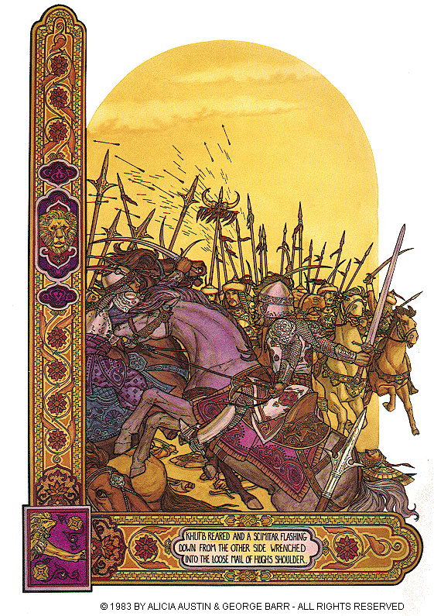
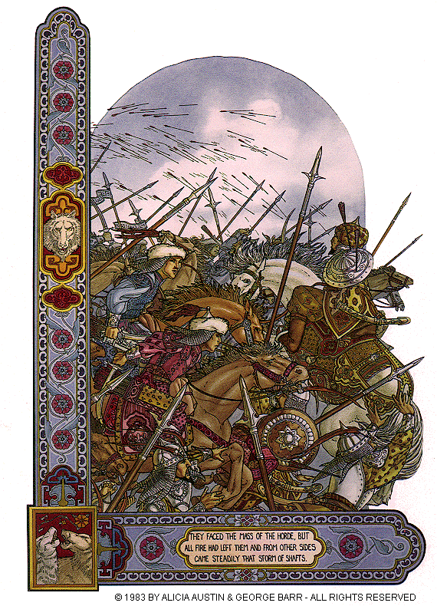

Slide 7
David Lee Burris:
Since 638 Muslims had been in control of Jerusalem. Although Muslim rule did not permit the evangelization of Muslims or the building of new churches, existing churches in Jerusalem could continue and Christian pilgrims were given unobstructed access to their sacred sites. This accommodation occurred because the Qur’an looks upon Christians & Jews as “people of the book.” i.e. Monotheists who are to be treated differently than idolaters and unbelievers – that is until the conquering Seljuk Turks made the scene around the time of the first millennium!
“In 1071, the Seljuks stunningly defeated the Byzantine army in Armenia, capturing the Eastern emperor. They went on to capture Antioch in Syria (where the disciples were first called Christians) in 1085 and Nicaea (site of the First Ecumenical Council) in 1092. With a raging Islamic army virtually on the doorstep of the city of Constantinople, in the spring of year 1095, the Byzantine Emperor Alexius Comnenus swallowed his pride & appealed to the pope for assistance. Constantinople was the capital of the Eastern Empire, and churches contained priceless treasures, manuscripts, and relics from the beginning of Christianity. Though an earlier pope had expelled the Orthodox church four decades earlier, Pope Urban could hardly stand to see this keystone city lost to an army of marauders.”
- Cornerstone Magazine, The Crusades, The Direct Cause

Slide 8
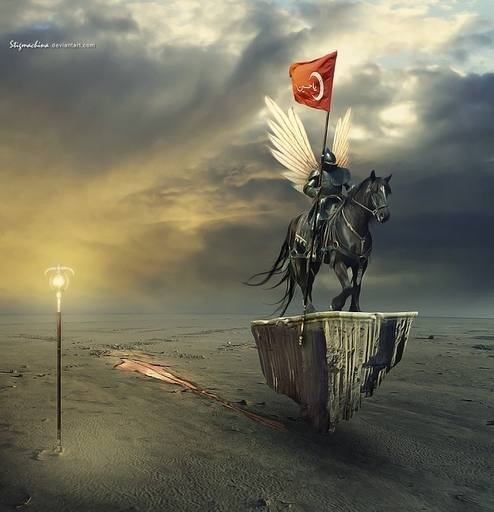

Slide 9
“The Crusades were a series of military expeditions to wrest Jerusalem and other parts of the Holy Land from Muslim control, conducted under the banner of the cross. The word crusade comes from the Latin word crucesignatus, ‘one signed by the cross.”
‘The Crusades began at the instigation of Pope Urban II in 1095, drawing armies from all over Europe and lasting nearly 200 years. They stopped shortly before 1300. Some historians extend the Crusades another 200 to 400 years, to include as well - military actions against Christian heretics and pagan threats in Europe.”
- Cornerstone Magazine, The Crusades, Soldiers Of The Cross?

Slide 10
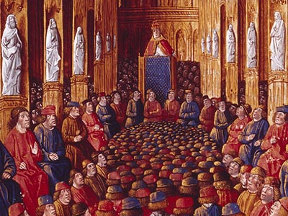
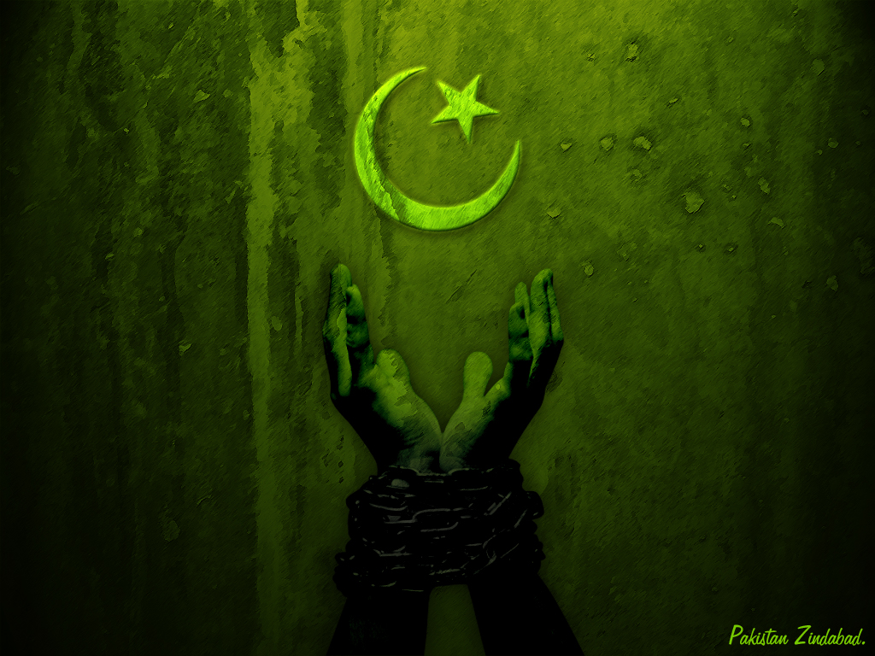

The Pope Preaching External Crusade!
Council Of Clermont

Slide 11
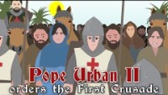

Slide 12
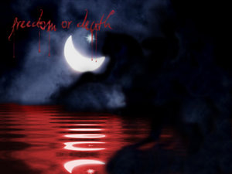
David Lee Burris:
The Council of Clermont, France was convened by Pope Urban II on November 18, 1095. Present were 14 archbishops, 250 bishops, 400 abbots, and thousands of observers. On the ninth day of the Council, Pope Urban gave his famous appeal. The pope declared that the church must immediately aid their persecuted brothers in the East, since the Turks (”an accursed race”) had devastated the kingdom of God. He promised the cancellation of debts, exemption from taxes, and a crown of eternal life to all participants. He said that Christ Himself would lead the armies across the sea and mountain. The crowd cried back, “Deus vult, Deus vult” 9God wills it, God wills it), Pope Urban replied affirmatively. “Yes! Let these words be your war-cry when you unsheath your sword. You are soldiers of the cross. Wear on your breasts or shoulders the blood-red sign of the cross. Some branded a cross on their chest soon after taking the crusader vows.
The Pope Preaching Crusade!
ISLAMIC EMERGENCE &
THE RISE OF THE TURK
REINFORCED THE IDEA
THAT GOD WAS ANGRY!

Slide 13
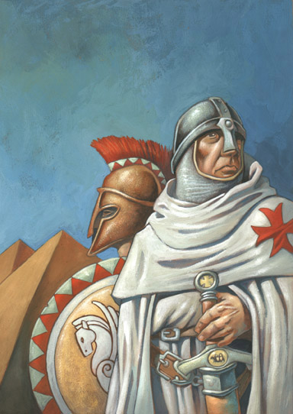
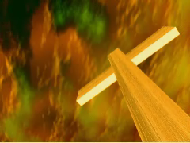

CRUSADE CHOICE
CONTRIBUTING FACTORS
#1 MOTIVATION
Effect Of Literature In Medieval Society
#2 MOTIVATION
Middle Age Fascination With Relics & Objects
#3 MOTIVATION
Pilgrimage Itself Was A Source Of Virtue
#4 MOTIVATION
Miracles, Millennialism & End Times Madness

Slide 14
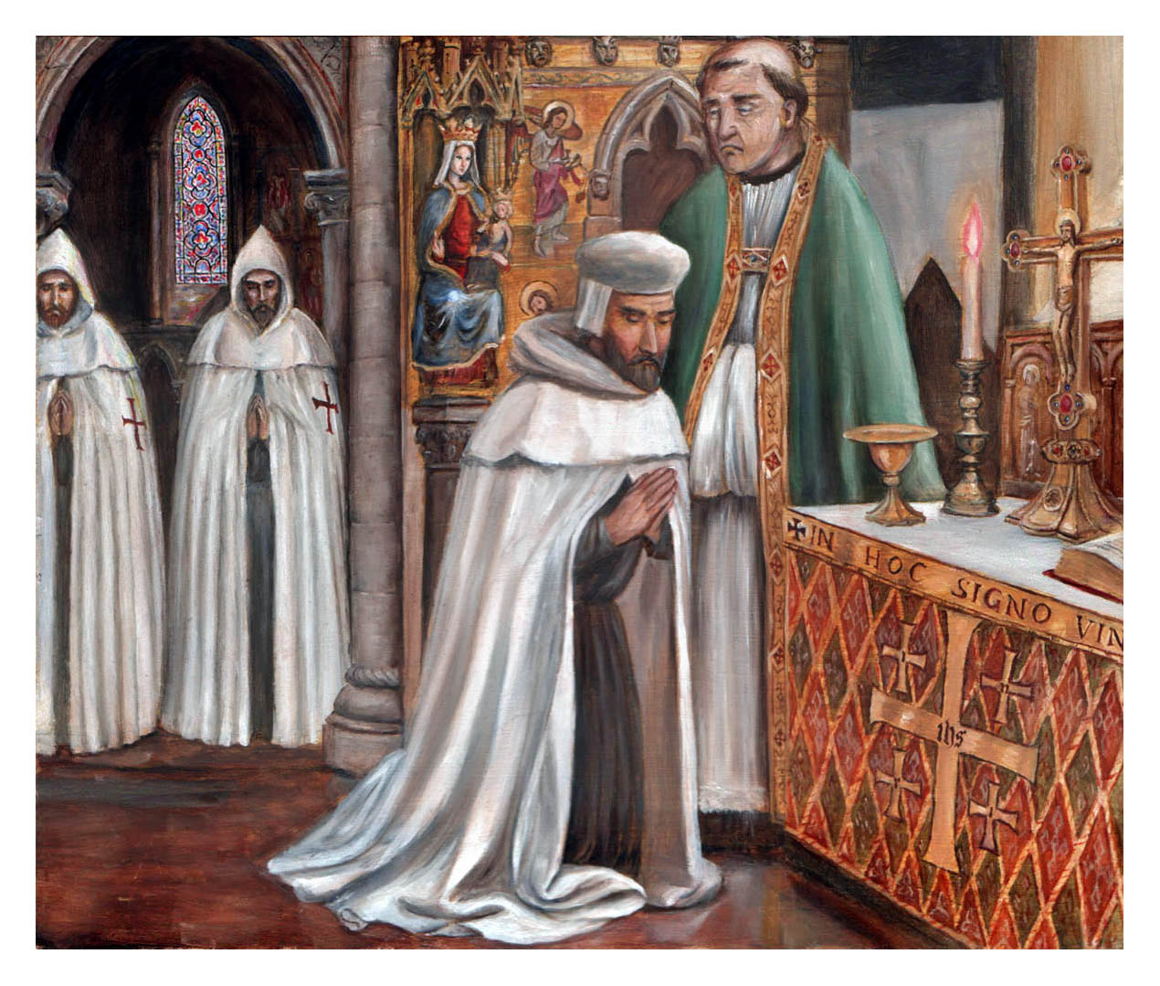
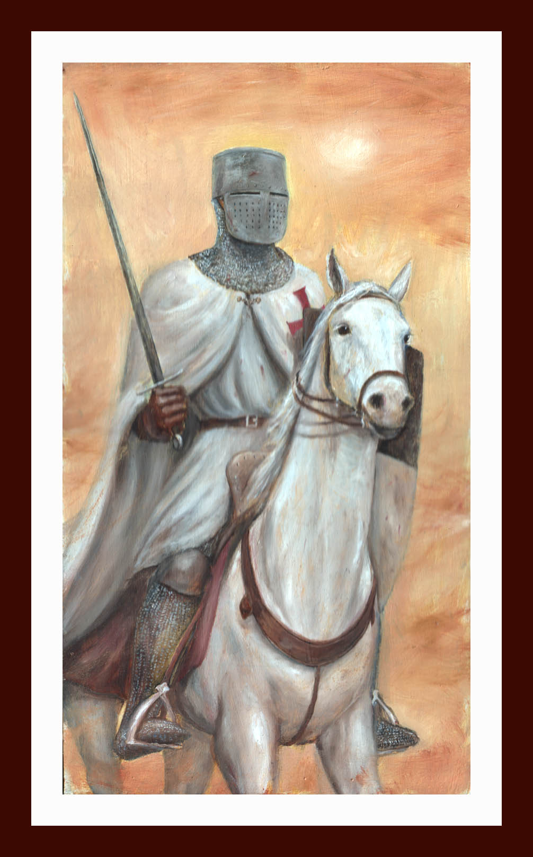

Slide 15
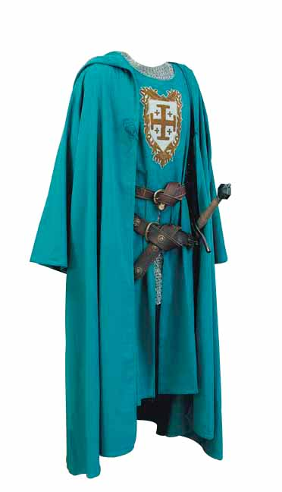
Jerusalem Cloak &Cape

Slide 16
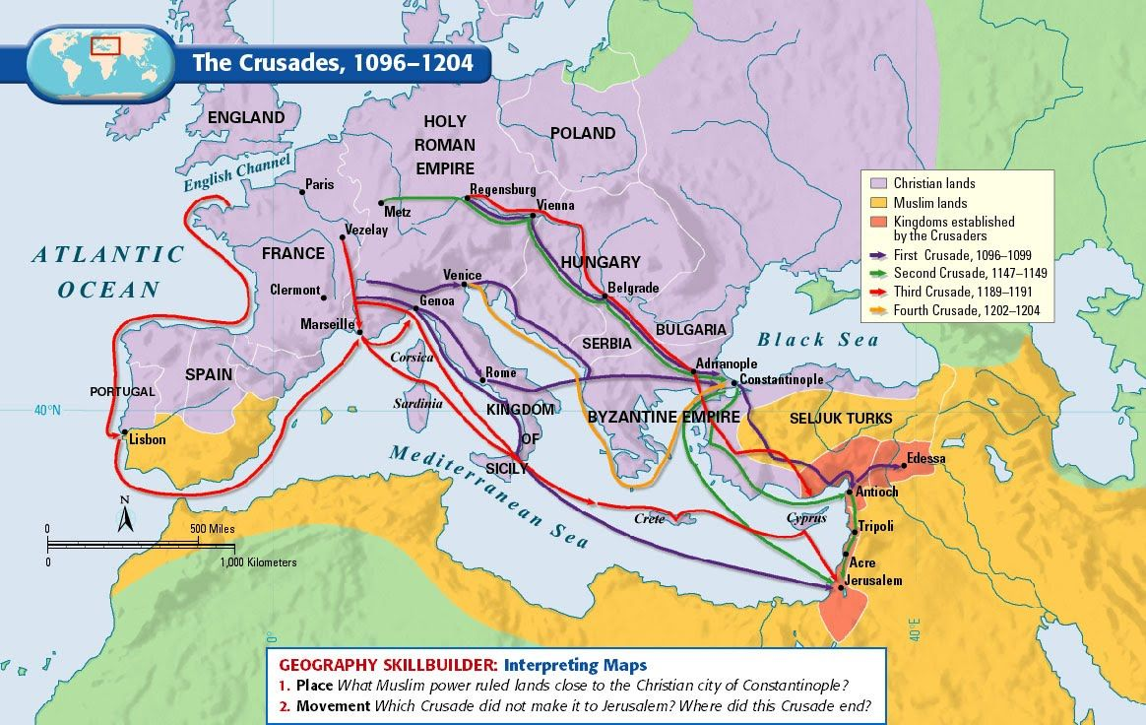

Slide 17
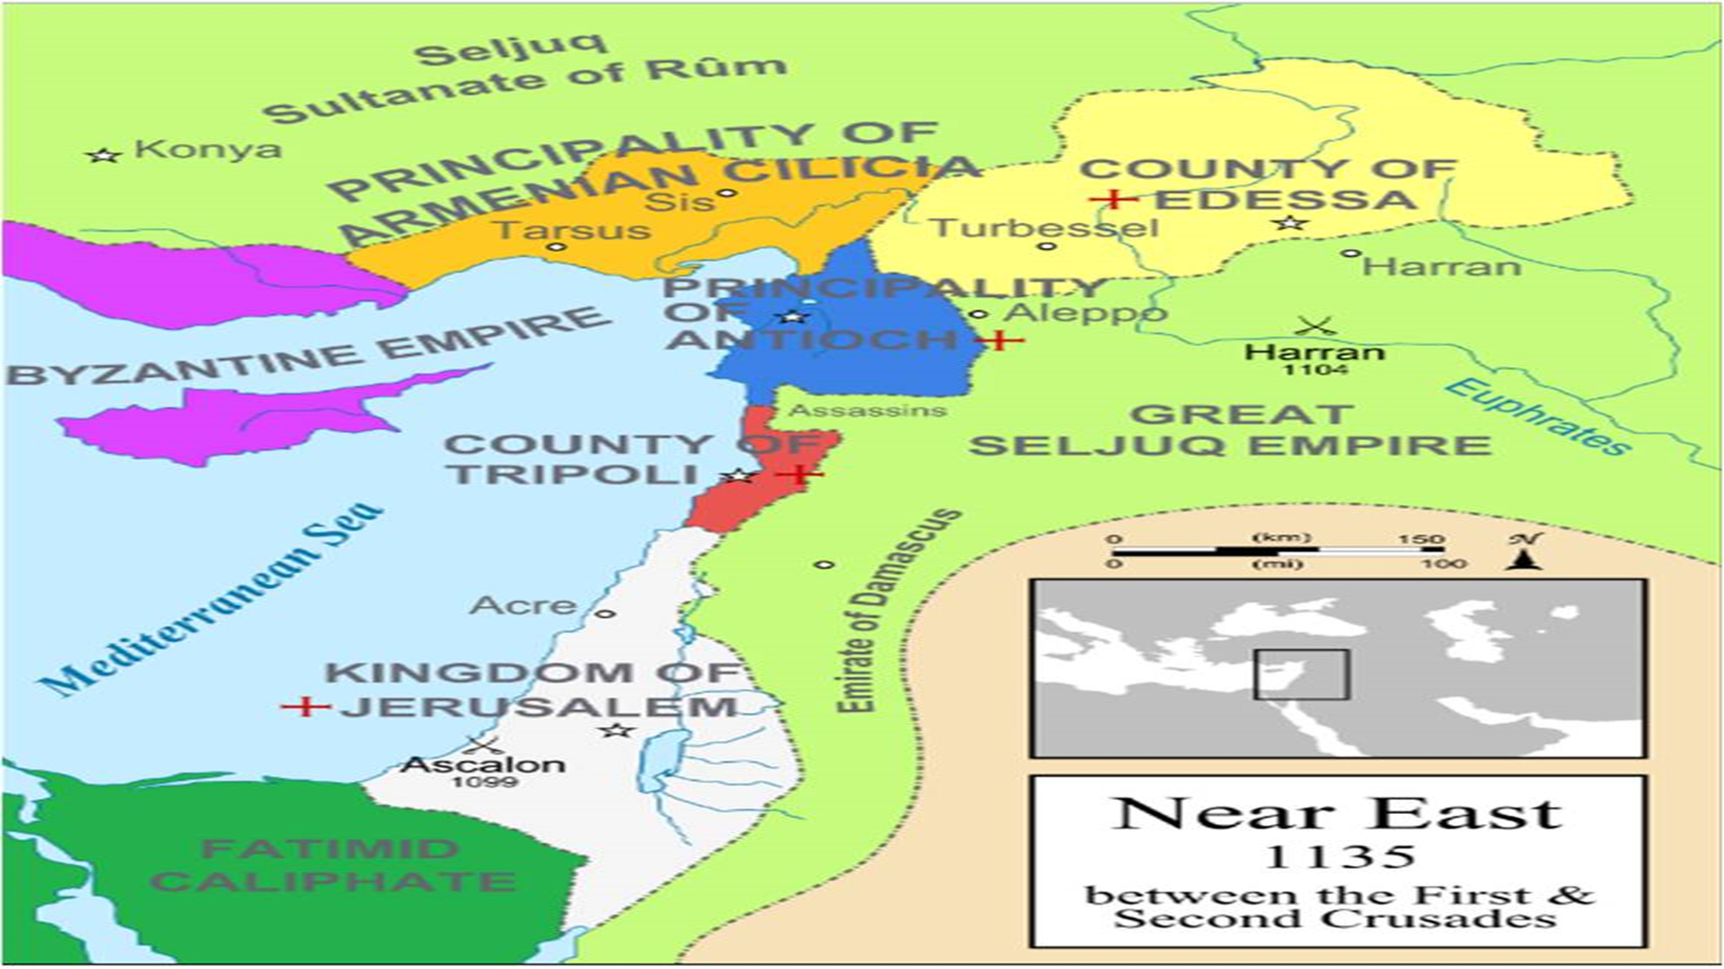

Slide 18
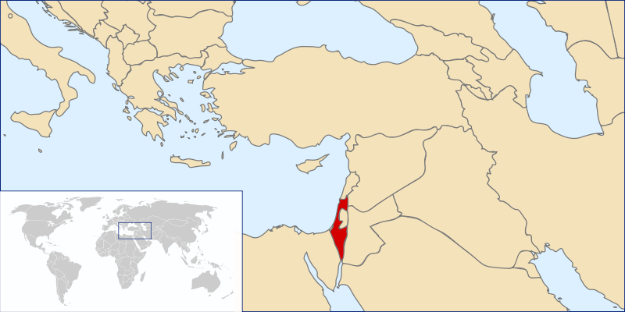
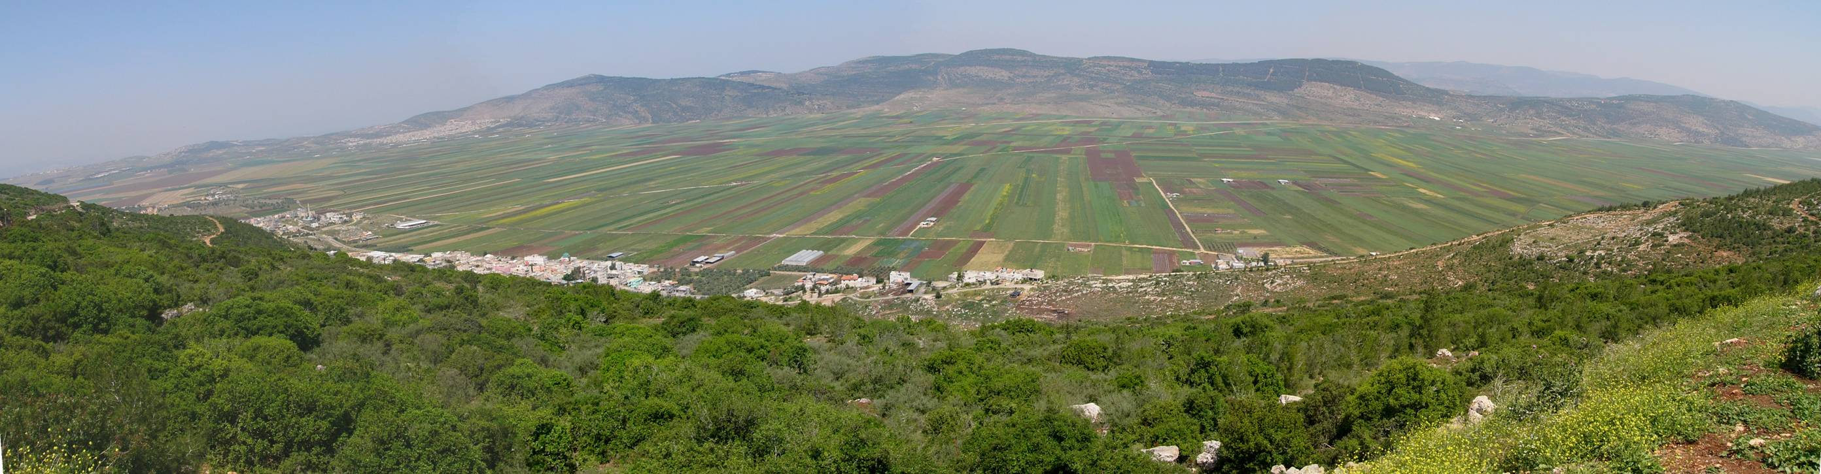
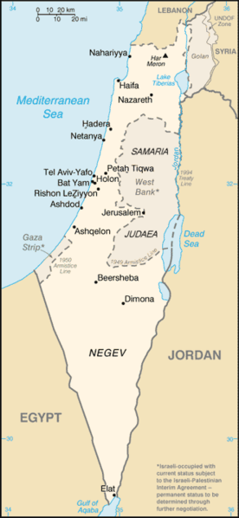
Forever
Don’t Click
Location: Middle East

Slide 19


Slide 20
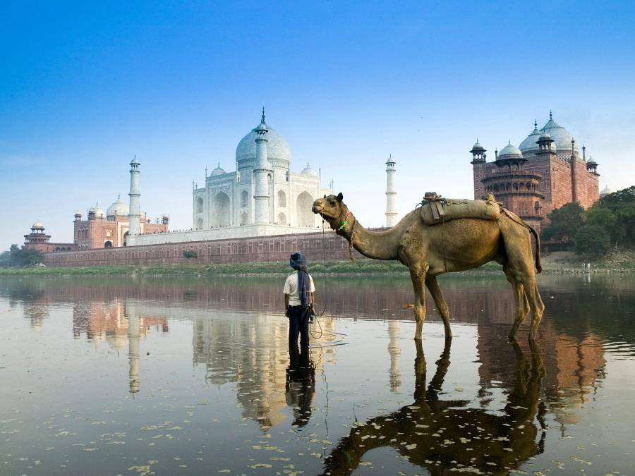

Slide 21
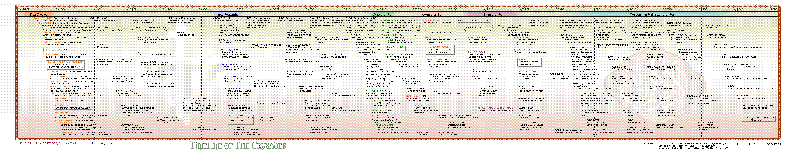

Slide 22
David Lee Burris:
The mutual excommunications of the Great Schism had taken place two generations prior and meaningful communication was virtually non-existent at this crucial juncture.
“The cross-waving soldiers of the 1st Crusade, motivated by Pope Urban II’s promise of instant entrance into heaven without suffering purgatory for those who died, slaughtered Jews all along their path to Jerusalem. In 1096, not one of the 1,600 Jews living in Worms, Germany, survived when the Crusaders passed through that city. About half were hunted down in their homes and on the streets. Those who fled to the bishop’s palace were given temporary shelter, provided they converted by baptism. Locked into a large room to contemplate their decision, all 800 killed themselves rather than convert. In the process of ‘liberating’ Jerusalem, the Jews were chased into the synagogue, which was set ablaze, incinerating all those within its walls.”

Slide 23
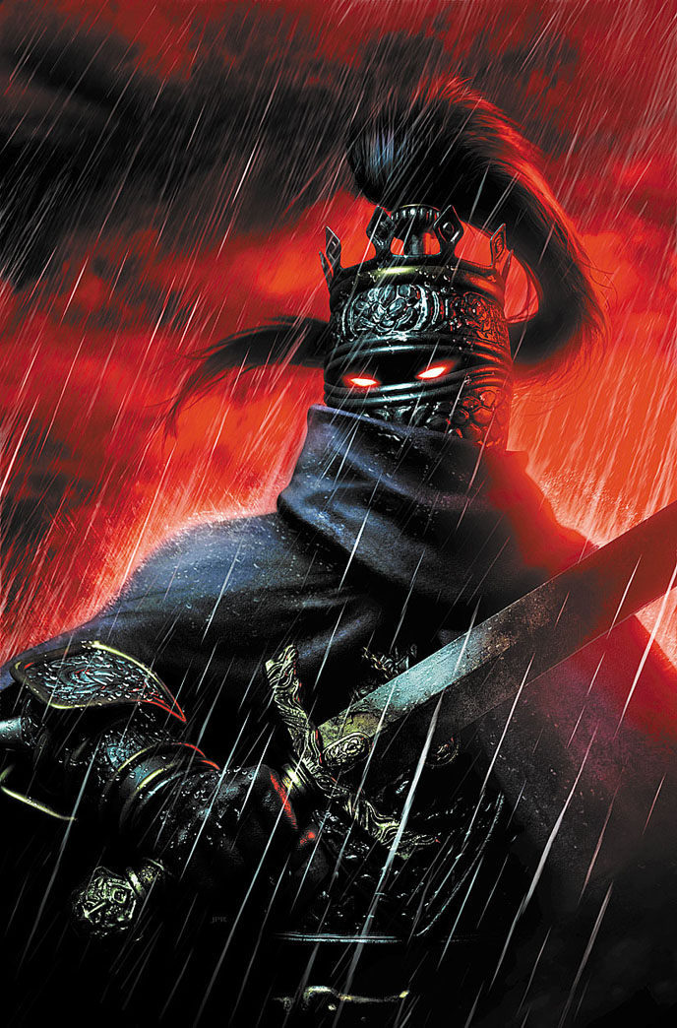
David Lee Burris:
The mutual excommunications of the Great Schism had taken place two generations prior and meaningful communication was virtually non-existent at this crucial juncture.
“Over the next 150 years in the Near East, the victims of the Crusaders included Greek Orthodox as well as Jews and Muslims. The Crusaders engaged in torture, mutilation of prisoners, and mass murder. Crusade historian Fred Wright notes, ‘Crusaders in their excess had a world view that allowed them to carry out acts of murder, rape, looting and pillaging because in their mental world they were not dealing with a group of people who were considered within the same categories as themselves.”
- Cornerstone Magazine, The Crusades, Holy War

Slide 24
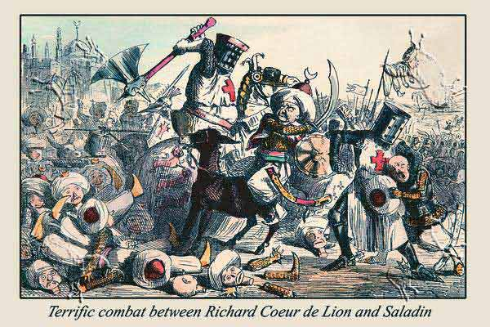
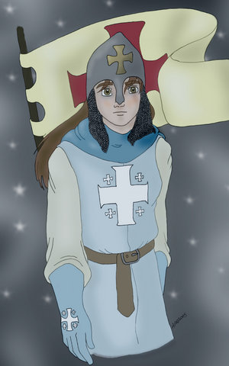
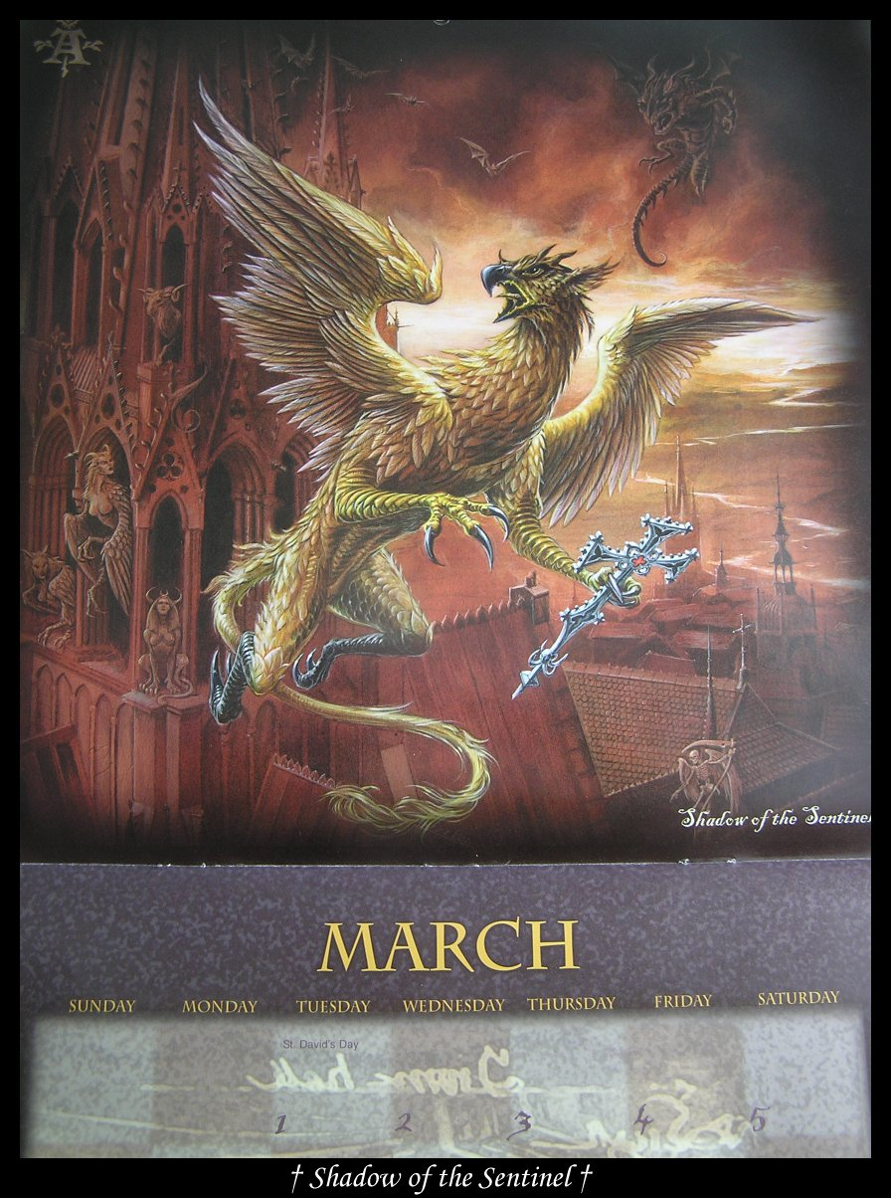
David Lee Burris:
“Christian” shipowners sold most of the children crusaders to the Moslems as slaves!
SPECIAL DISPENSATION
Children Crusade

Slide 25
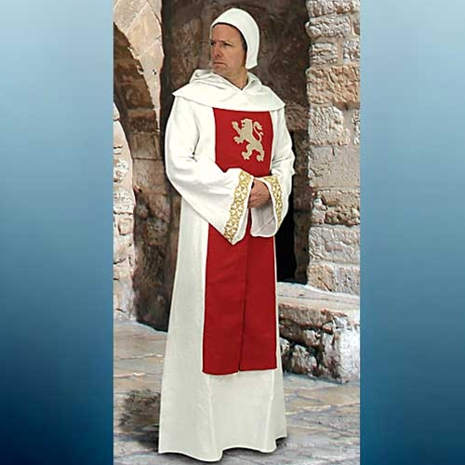
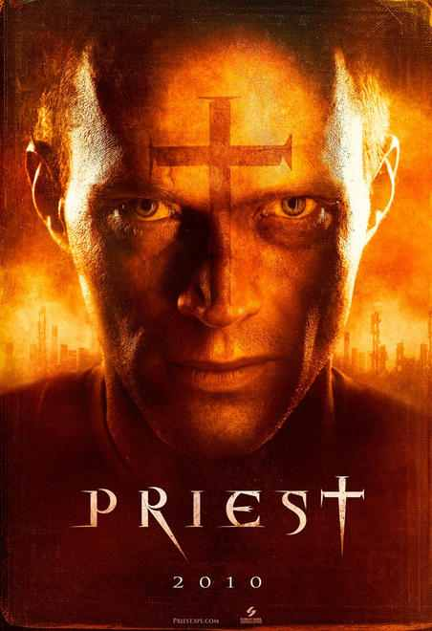

Slide 26


Slide 27
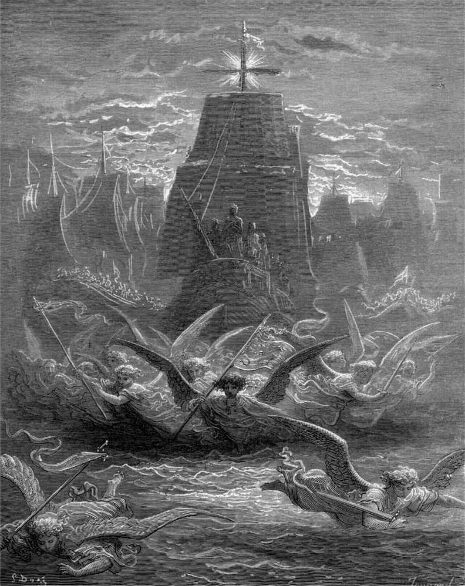

Slide 28
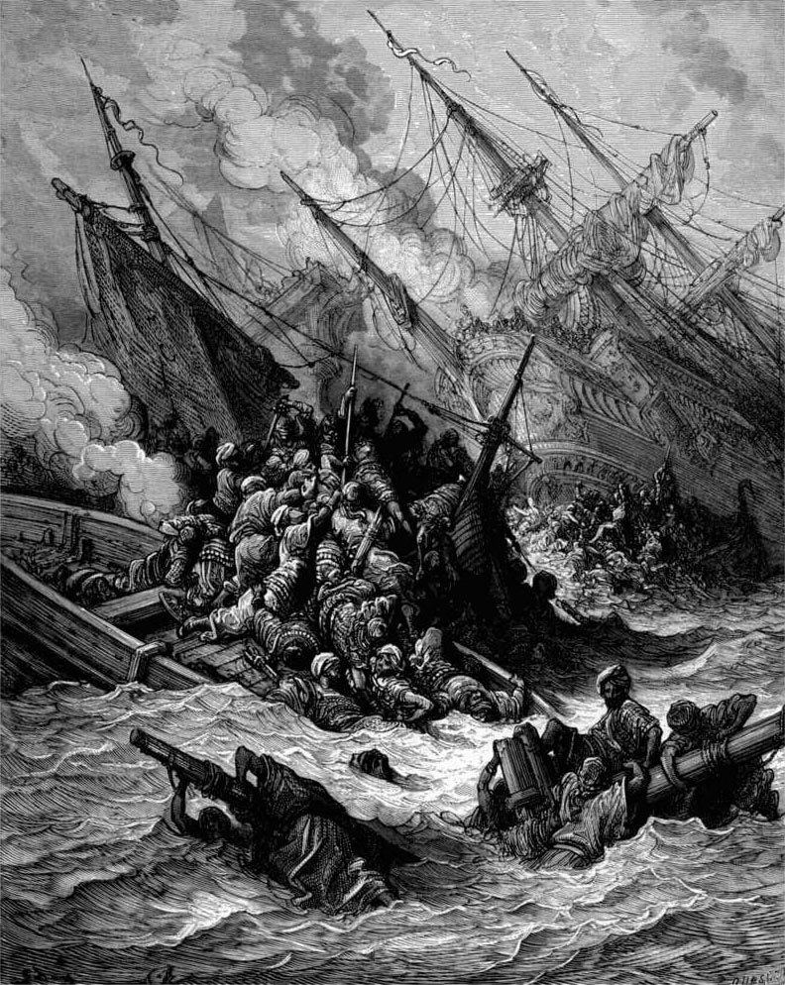

Slide 29
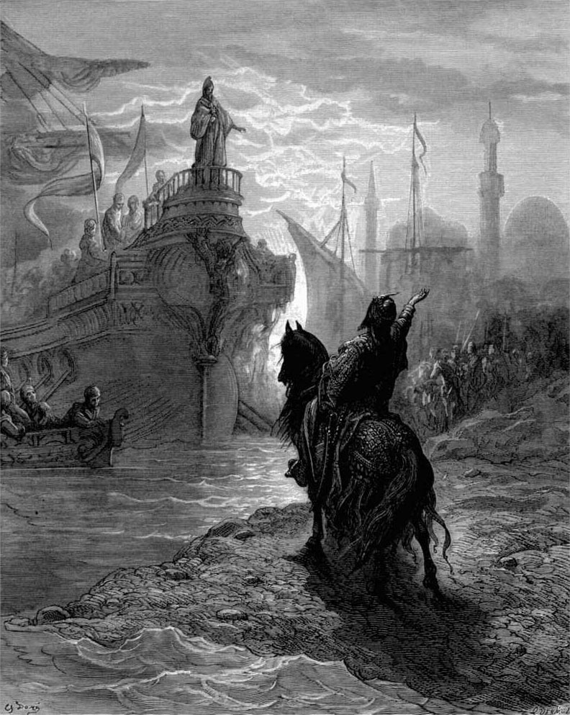

Slide 30
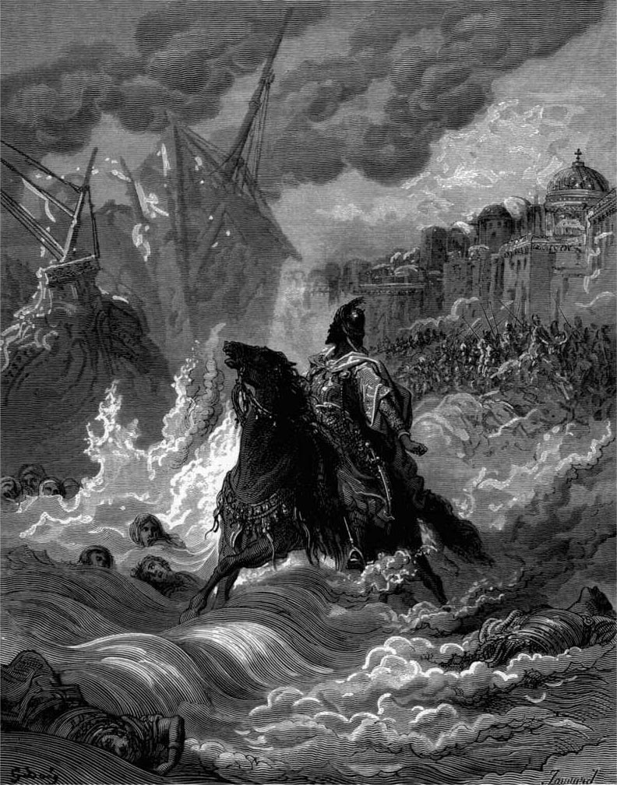

Slide 31
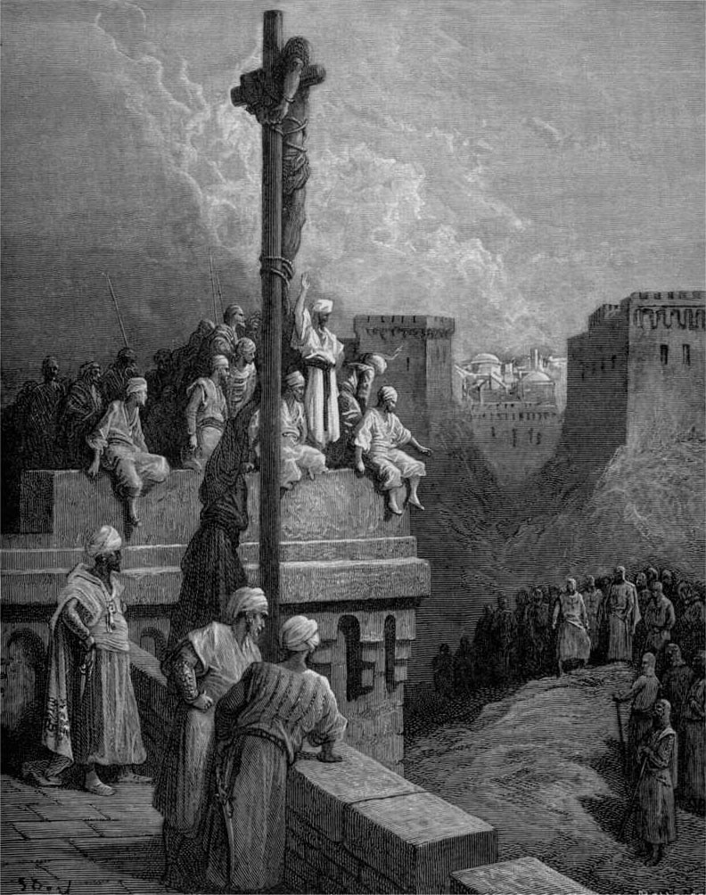

Slide 32
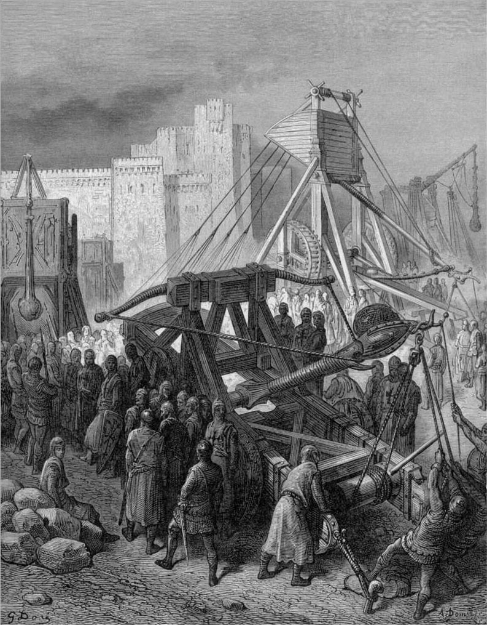

Slide 33
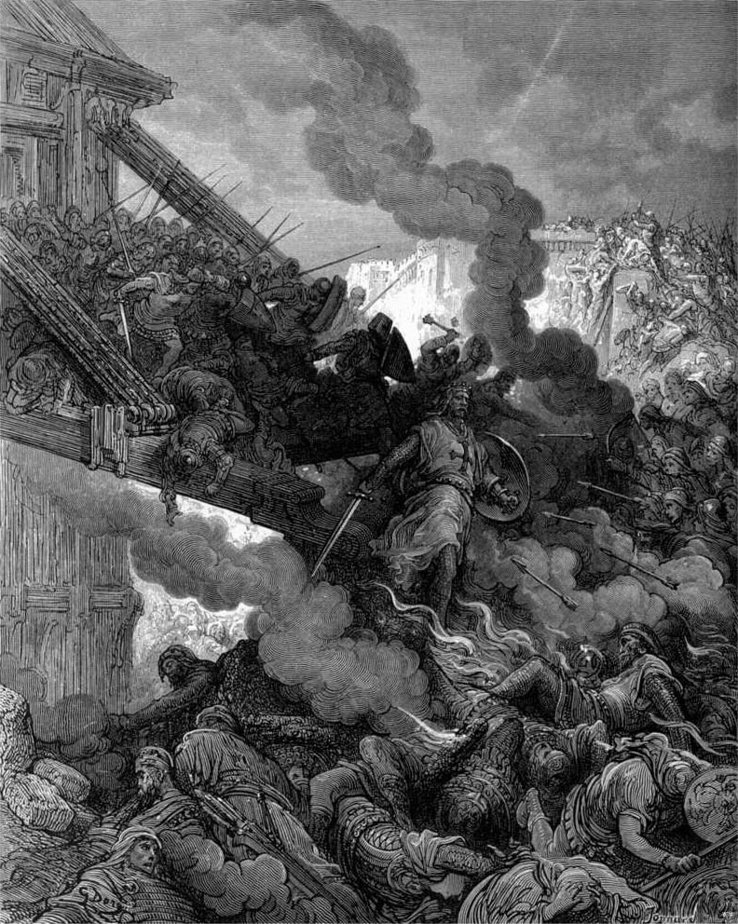

Slide 34
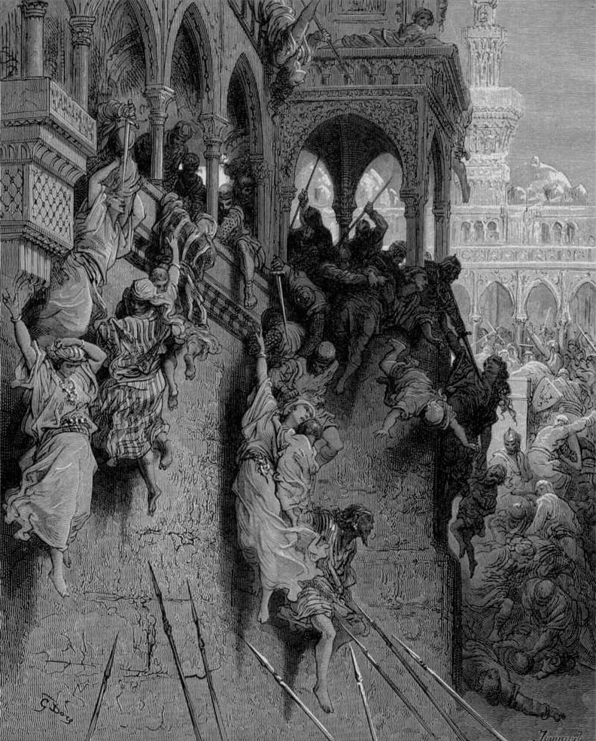

Slide 35
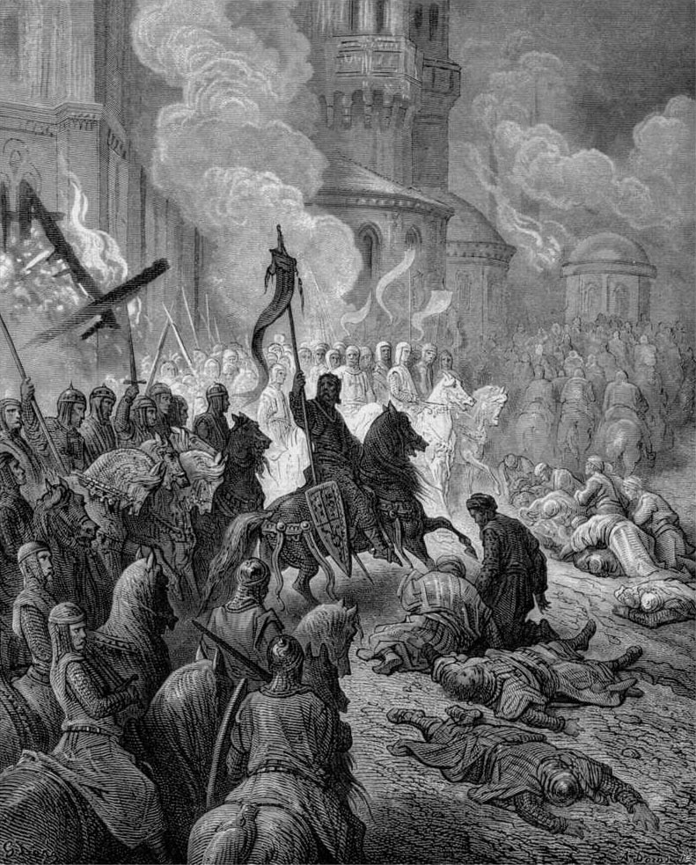

Slide 36
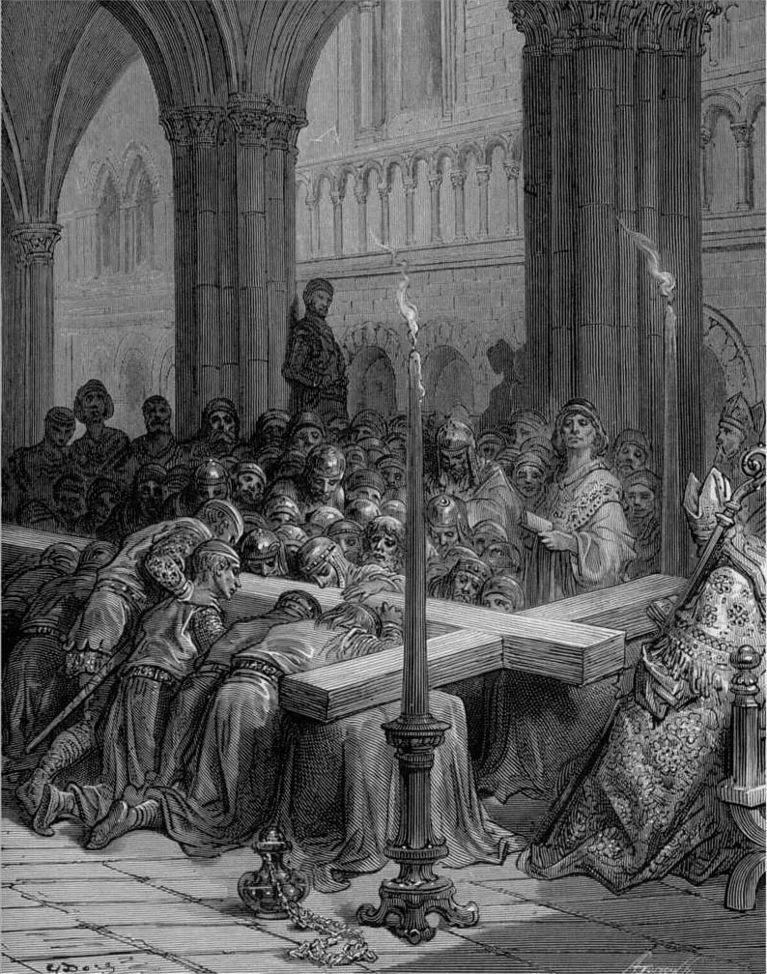

Slide 37
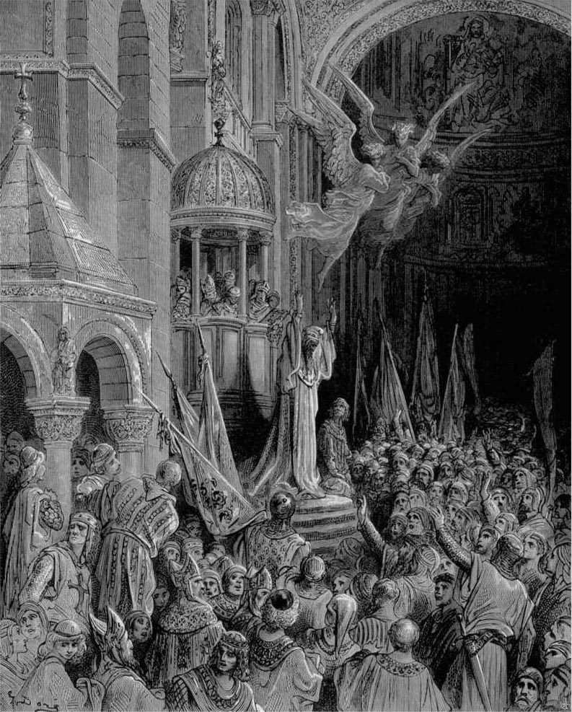

Slide 38
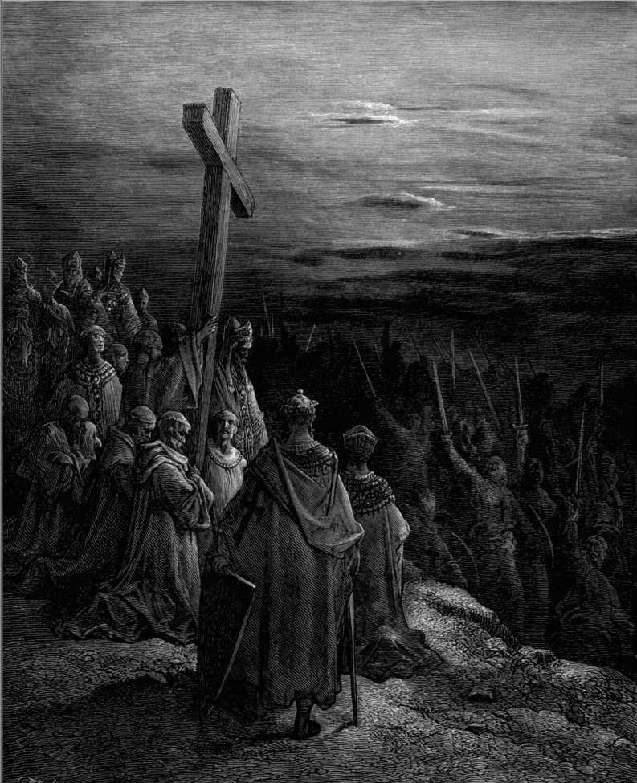

Slide 39
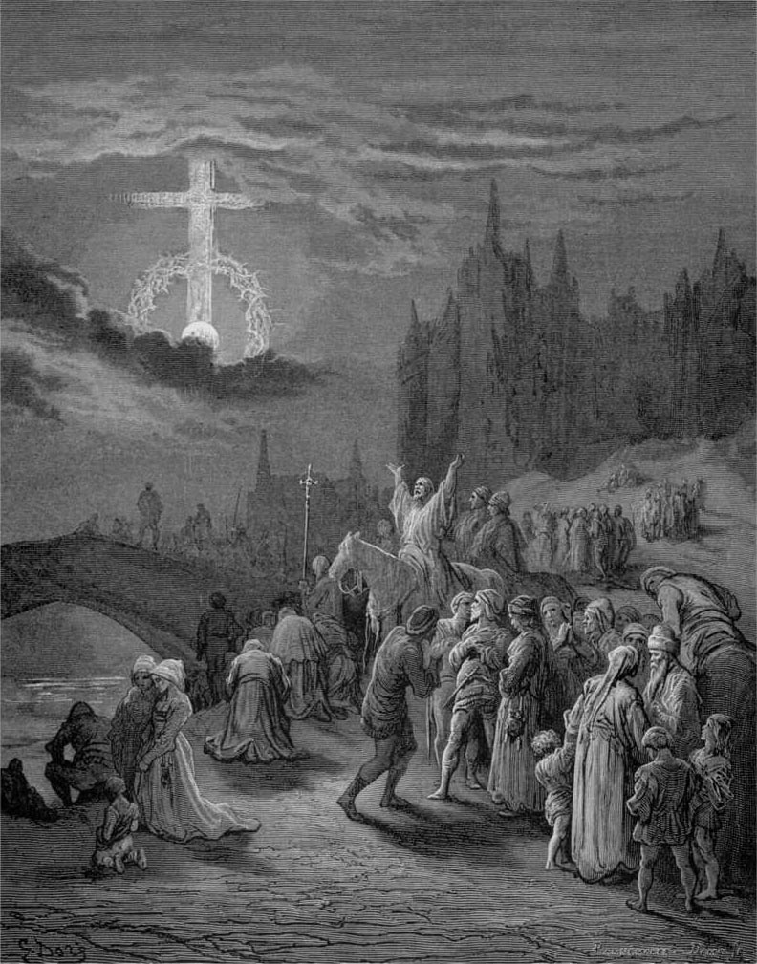

Slide 40
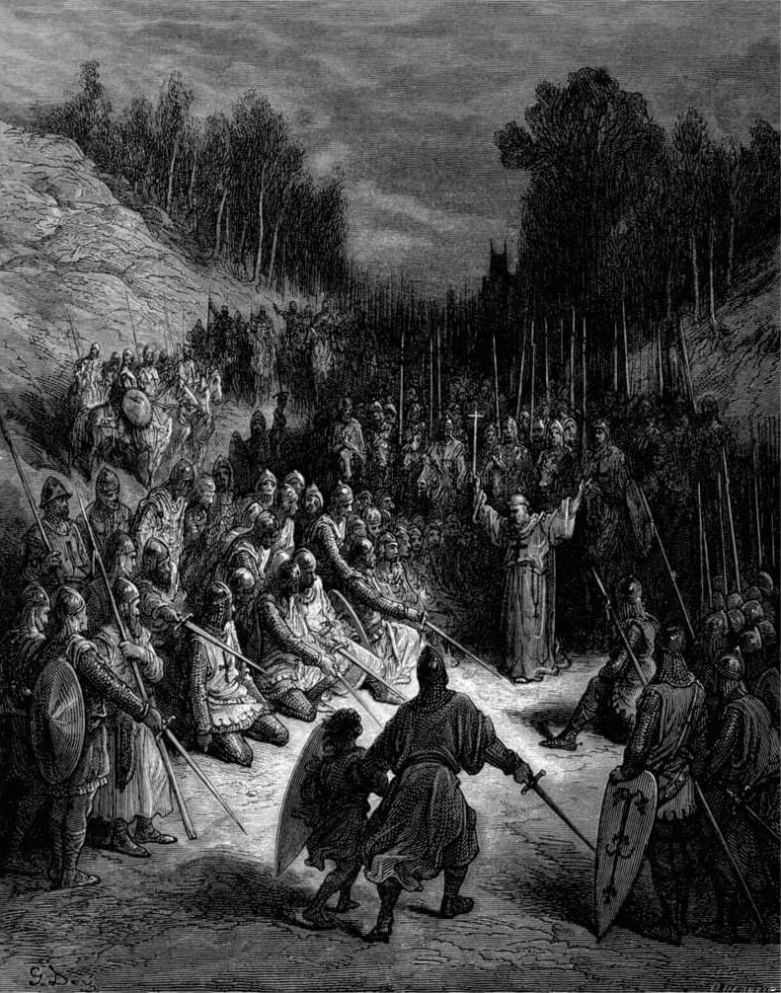

Slide 41
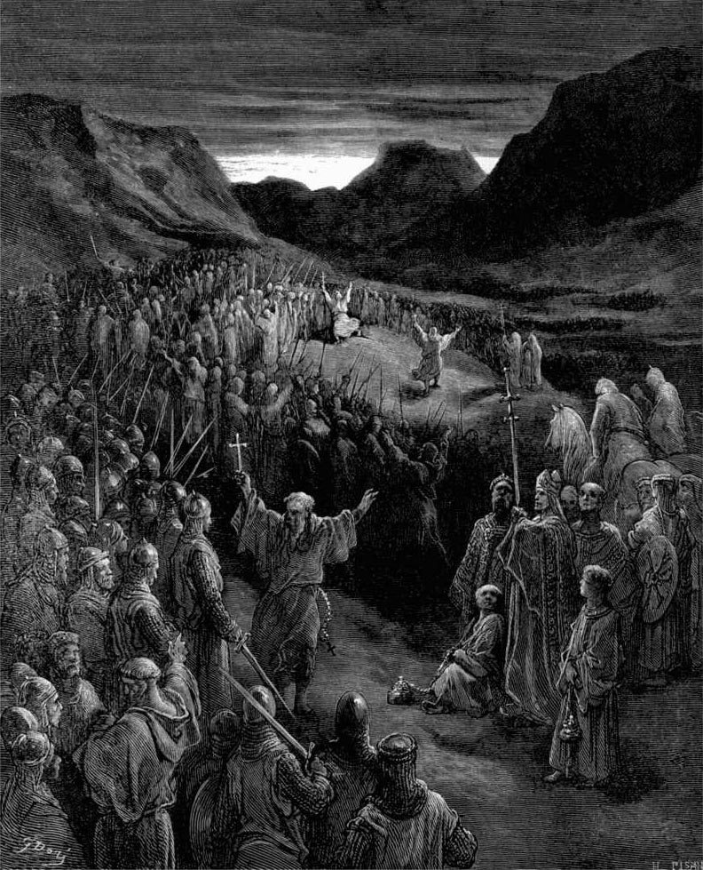

Slide 42
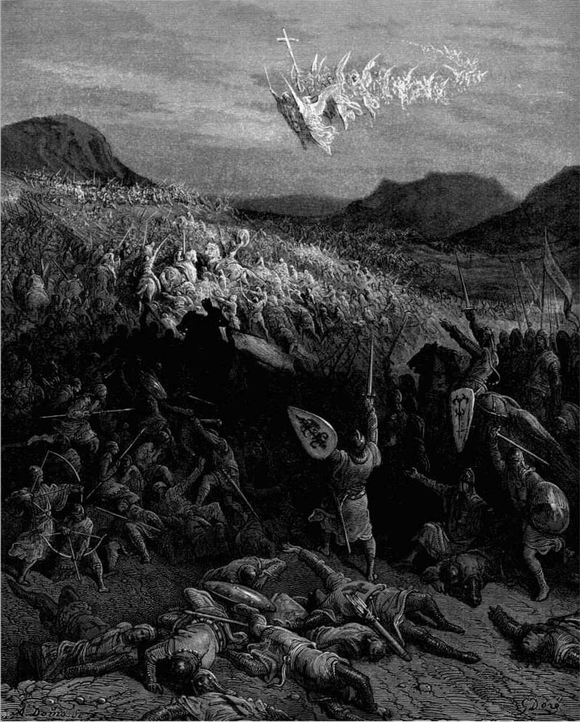

Slide 43
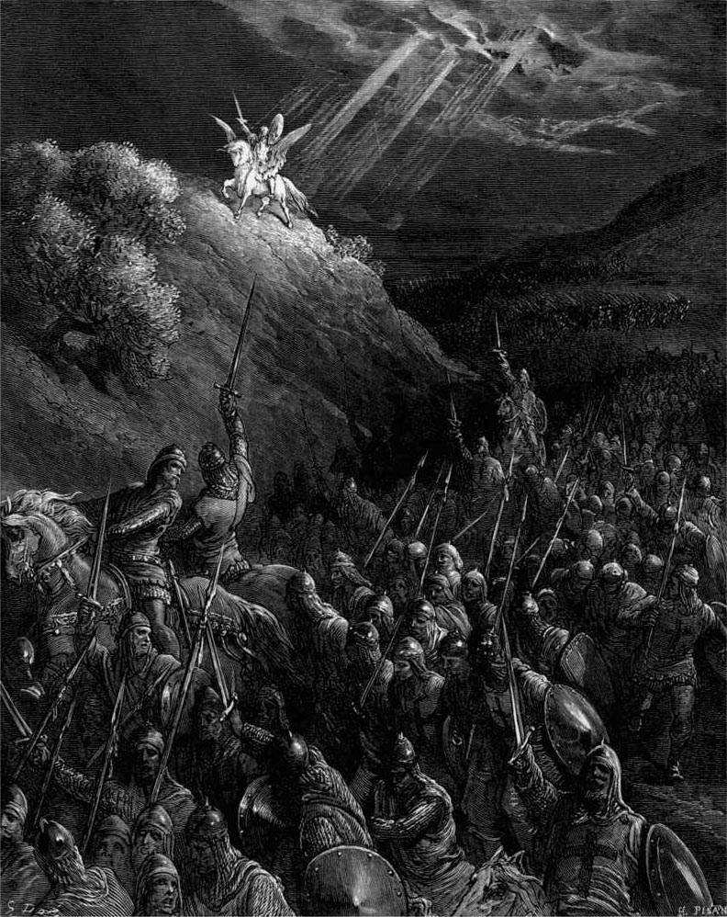

Slide 44
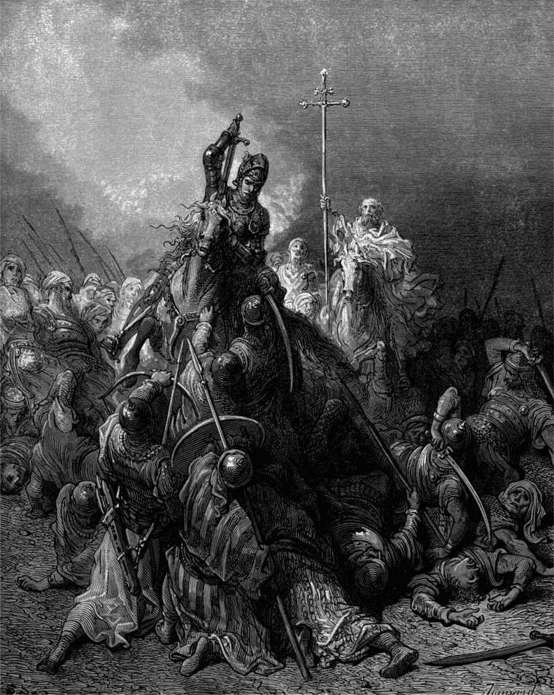

Slide 45
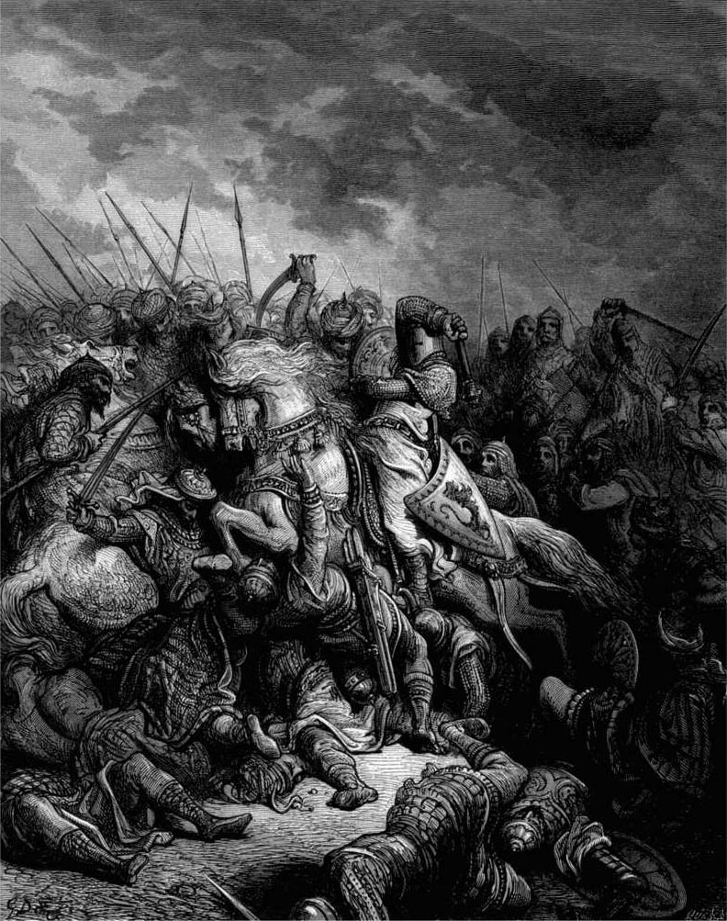

Slide 46
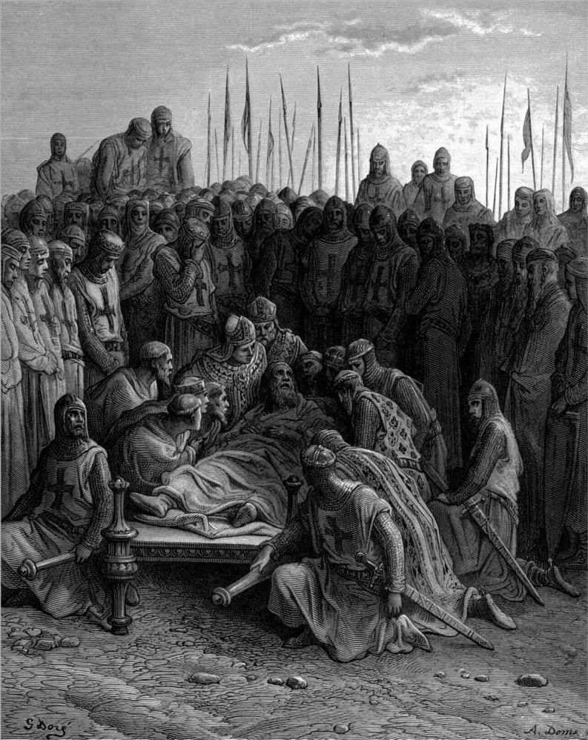

Slide 47
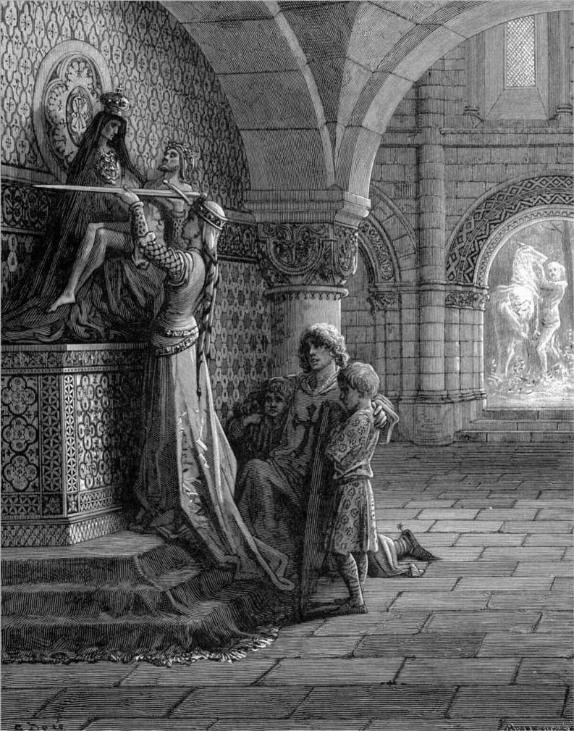

Slide 48
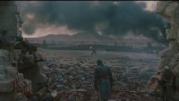
Right Click Red Fringe To Stop The Music

Slide 49
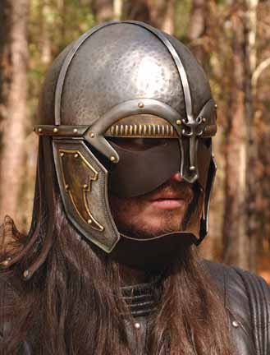
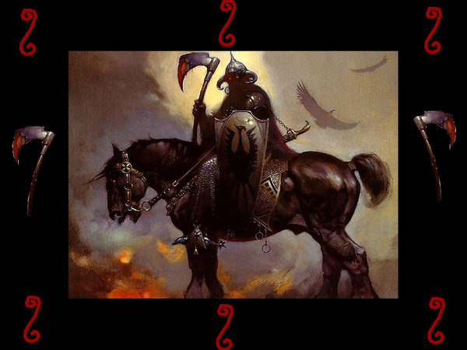

Internally Conflicted
Barbarians Advance

Slide 50


eastern capitol renamed
By the ottoman empire turks
constantinople becomes istanbul

Slide 51


Dhimmis & Dhimmitude

Slide 52


Slide 53

Christian Divisions Costs Half The World
“Christian divisions go far toward explaining the swift collapse of the Roman position in the Middle East, where popular sentiment leaned so heavily toward either the Monophysite or Nestorian churches. Repeatedly, writers from these traditions describe the relief which local inhabitants greeted the Arab conquerors, who promised an end to the heavy-handed regime of the Roman Empire, and the Chalcedonian order.
At least in the early decades of the new order, most Christians saw little reason to change their opinion. Muslims cared nothing for the sectarian divisions among their Christian subjects, provided they respected Muslim authority and paid their taxes on time.
The first century or so after the conquest marked something like a golden age for the Christian communities, who were now free of Roman oppression.”
Source: Pages 263-4, Philip Jenkins’ “Jesus Wars”

Slide 54

Islam Stopped at the Gates Of Vienna

Slide 55



09-11-1653

Slide 56




1522
Ignatius Loyola while recovering in the hospital reads Saints’ Lives & develops a “military” vision of Christianity whereby God’s armies represented by the ancient Catholic Church are at war with the armies of the devil, represented by the Protestants!
Ignatius Loyola

Slide 57
1534
Roman Catholic priest Ignatius Loyola founds Society of Jesus (Jesuits) in Paris to spread Counter-Reformation and to evangelize
Ignatius Loyola

Slide 58
1534
The religious society became known as the Jesuit order of monks. It is the missionary order of present-day Catholicism!
Ignatius Loyola

Slide 59
The three main ideas of Jesuitism are:
“Intentionalism” – the end justifies the means.
“Mental Reservation” – one is not bound to state the whole truth when on oath.
“Probabilism” - if a thing is probable, it is good.
1534
Ignatius Loyola

Slide 60
The Doctrine Of Mental Reservation:
According to this teaching, one could conform outwardly to some requirement without giving consent of the mind, if this seemed expedient for advancing some “higher purpose” and not be held responsible for the outward act or word.
1534
Ignatius Loyola

Slide 61
THE DOCTRINE OF PROBABILISM:
According to this teaching, if, in a given situation calling for an ethical decision any one authoritative writer in the church’s tradition defended a course of action, that advice had enough probability of being right to make it a basis of action. Since it is possible to find this type authority for almost any act in given circumstances, their system is of a situational ethic.
Aristotelian Modal Model of Probability Is Abused!
1534
Ignatius Loyola

Slide 62

PROPAGANDA AND/OR COERCION
The Roman Church had two weapons of coercion to back up the propaganda of the Jesuits - the Inquisition and the Index. The Index was a list of books the faithful were not permitted to read. It was called the Roman Index of Prohibited Books & a special Congregation of the Index, created in 1571, was charged by the pope with the task of keeping the list up-to-date.
1534
Ignatius Loyola
The Jesuits Carried Romanism & Religious Inquisition To Asia & The Americas!

Slide 63

PROPAGANDA AND/OR COERCION
The Roman Church had two weapons of coercion to back up the propaganda of the Jesuits - the Inquisition and the Index. The Index was a list of books the faithful were not permitted to read. It was called the Roman Index of Prohibited Books & a special Congregation of the Index, created in 1571, was charged by the pope with the task of keeping the list up-to-date.
1534
Church Defended Enslaving Cannibal Cultures!
Ignatius Loyola

Slide 64


Slide 65


Jesuits Justified Enslaving Practitioners Of Human Sacrifice!
PROPAGANDA AND/OR COERCION
The Roman Church had two weapons of coercion to back up the propaganda of the Jesuits - the Inquisition and the Index. The Index was a list of books the faithful were not permitted to read. It was called the Roman Index of Prohibited Books & a special Congregation of the Index, created in 1571, was charged by the pope with the task of keeping the list up-to-date.
1534
Ignatius Loyola

Slide 66


Slide 67


Slide 68



Slide 69

THE NOBLE WARRIORS TO DEFEND THEIR HEAD WEAR THINGS LIKE HEADS OF SERPENTS, OR TIGERS, OR LIONS OR WOLVES AND THE MAN’S HEAD LIES INSIDE THE ANIMAL’S JAWS AS THOUGH IT WERE DEVOURING HIM.” – AN ANONYMOUS CONQUISTADOR

Slide 70



Slide 71
‘Their deer,’ which is how the messengers interpreted the horses brought by the conquistadors, ‘carry them on their backs wherever they wish to go. These deer, our lord, are as tall as the roof of a house.’ ‘Their dogs,’ the messengers continued, referring to the fighting hounds and mastiffs brought along by the Spaniards as live weapons of war, are enormous, with flat ears and long, dangling tongues. They are tireless and very powerful. They bound here and there, panting, with their tongues hanging out. And they are spotted like an ocelot..’ Another Aztec echoed , these ‘wild animals on leashes’ were ‘so ferocious that they ate people.’

Slide 72


Slide 73


Slide 74



Slide 75
“O the strange bestiality of these people,
In many things they have good discipline, government, understanding, capacity and polish but, in others, strange bestiality and blindness!” – Diego Duran

Slide 76
Montezuma welcomed Cortes with words that mixed customary hospitality with submissiveness. ‘Our lord, he said through interpreters, ‘you must be tired, you have experienced fatigue, but you have arrived at your city.’ He then told Cortes of ‘the lord who brought us, the Mexica, to Tenochtitlan,’ and explained the Aztec belief that ‘those who descended from him would one day come back… and take us as vassals.’ Linking Cortes with that sacred progenitor, Montezuma went on, ‘So be assured that we will obey and hold you as our lord, in the stead of that great lord… And in all the lands which I hold in my power you can command as you will, for you will be obeyed.’

Slide 77
Given this [Heron] symbolism, the Mexica valued albinos and people with very white skin as special creatures – part human, part divine. Gathered into the house where Montezuma kept his most important and sacred birds, as well as his personal treasury of gold, silver, jewels, and feather work, these precious captives were attended by keepers and regularly admired by their owner, who seems to have been untroubled by enclosing humans in a zoo;
What made the zoo still more unsettling to the Spaniards was its human denizens. As Cortes wrote in amazement, Montezuma kept ‘many deformed men and women… dwarfs and hunchbacks… and each manner of monstrosity had a room to itself; and likewise there were people to look after them.’

Slide 78
The Spaniards apparently found it barbaric to keep humans in cages. Yet anomalous humans at Montezuma’s zoo received better treatment than noble warriors the Mexica captured in war and offered up to their bloodthirsty gods. Of course the Spaniards themselves at that very time were heading the Inquisition in Europe and feeling few qualms about burning heretics and torturing suspected religious subversives.

Slide 79
Human sacrifice – abhorred by the Spaniards and constantly invoked by them as evidence of the Mexica’s beastliness – stood at the heart of the Aztec religion. According to the Mexica foundation myth, the gods had sacrificed themselves for the good of humankind – the deities Nanauatzin and Tecuciztecatl threw themselves into a raging bonfire to create the sun and the moon, and Quetzalcoatl spilled his own blood to give birth to people – so humans were in divine debt. Sacrifice was a prerequisite for bringing forth new life.

Slide 80
Gods accepted human blood in various ways. On regular days, to appease the divinities, certain individuals drew their own blood, usually with sharp maguey thorns. Rulers regularly performed performed autosacrifice by piercing their earlobes or upper ears. Common people performed their own bloodletting at some point in their lives to ask for special favor from the gods, and priests engaged in autosacrifice every night. The offering of a human heart, however, was the supreme ritual performed during holidays associated with the eighteen monthly ceremonies of the Aztec calendar.

Slide 81
And so the sacrificed human repeated the original selfless act of the gods and helped save the world. Some sacrifices also involved flaying the bodies, after which the priests donned the victims’ skins. On certain ritual occasions portions of the bodies were eaten. Bernardino de Sahagun, a Franciscan friar who assiduously studied native culture through local informants, reported that the emperor received the thighs of sacrificed victims. The warriors who had captured them in battle took the rest. Cooking the flesh in a special stew with dried maize and beans, they served it at a family feast, thereby ingesting courage and strength.

Slide 82

Thousands of people met this fate every year. The Spaniards were revolted and appalled.
The Aztecs justified so much blood with the same rationale that fueled their constant warfare: it was a sacred cosmic duty required by the gods, especially Huitzilopochtli, whose chosen people they were!

Slide 83
With this exaltation of war and human sacrifice, were the Aztecs just bloodthirsty savages? Perhaps they were ruthless opportunists who used religion as an excuse to wage highly profitable wars and to discourage foreign and domestic subjects from resistance. Or were they deeply faithful people with complex and fatalistic religious beliefs?
Cortes and his men, fired by crusading zeal as well as their own ambitions, tended toward one of the first two interpretations and saw it as their duty to obliterate the devilish Aztec rituals while converting the natives to Christianity. – Marina Belozerskaya

Slide 84



Slide 85


Slide 86


Slide 87


Slide 88


Slide 89
Old World Meets New in South America When Cortez rebuked the Aztec Chief Montezuma for offering human sacrifices, he responded with an amazing insight @Transubstantiation: “At least we do not eat the flesh & drink the blood of our god!”

Slide 90



The Catholic Inquisition
CHRISTIAN CANNIBALISM
@ Galatians 5: 15

Slide 91

CATHAR CASTLE BATTLES

Slide 92


Slide 93

From The Modern Scholar Course Guide:
“One, Holy, Catholic, & Apostolic”
Catharism & Internal Crusade
“An ancient heresy, continued in the East primarily in port cities. It spread to the Balkans in the ninth century, known there as Bogomilism. Brought by merchants, it began to spread in Northern Italian cities and then found fertile ground in southern France – particularly in the area of Albi. The heresy became a favorite with sophisticates. Those that did not achieve perfection in this life must be reborn. Jesus’ message was warped by the church – the evil servant. Catharism survived because it was well organized, with bishops and clergy. Prefects were clergy, ordained by a consolamentum, ministering to the faithful and living according to strictest regulations.“
“In March 1208, Innocent III proclaimed a Albigensian crusade to capture the lands of those lords either heretic or refused to combat it. Innocent decreed that 40 days of service constituted the fulfillment of the crusade vow. The response in northern France was tremendous. The Albigensian crusade did not extinguish Catharism, but it did remove the aristocracy that allowed it to grow.”

Slide 94
Albigensian crusaders requested clarification of engagement:
We cannot distinguish the good from the wicked, what shall we do?

Slide 95

Piously echoing the words of paul in his letter to timothy:
“kill them all, the lord knows those who are his own!”

Slide 96



Catholic Inquisition: BIG PIC
Erasing Entire People Populations
Cathar Cleansing

Slide 97

1655
Waldensians come to reject practice of indulgences & purgatory doctrine breaking from Roman Catholicism and embracing Protestantism
Catholics launch persecution
Waldensians are burned

Slide 98

MATSCH’S LAW
IT'S BETTER TO
HAVE A HORRIBLE ENDING
THAN TO HAVE
HORRORS WITHOUT END!

Slide 99


David Lee Burris:
“The past is a foreign country: they do things differently there.” - L. P. Hartley
“The further back you can look the further forward you can see.” - W. Churchill
Life is paradise, and we are all in paradise, but we won’t see it;
if we would, we should have heaven on earth the next day…
Everyone is really responsible to all men
for all men and for everything!
RATHER THAN REALIZING GOD’S RULE
THE TENDENCY HAS BEEN TOWARD
THE DEVIL & HIS HELL ON EARTH!
DOSTOEVSKY

Slide 100

The Crusades
The Fourth Crusade (1202–1204)
  Never reached the Holy Land and became entangled in a series of financial and political issues which brought the Crusaders to Constantinople.
  On Good Friday, 1204, the western Crusaders broke through the walls of Constantinople.
  For three days, the Crusaders killed, tortured, and raped eastern Christians in the name of Christ.

Slide 101

Hitler Goes To Church!

Slide 102
NAZIS FIND COMMON CAUSE WITH THE CATHOLIC CHURCH!

Slide 103


CATHOLIC CHURCH FINDS COMMON CAUSE WITH THE NAZI.

Slide 104
CATHOLIC CRUSADE CLEANSING BALKANS OF GREEK ORTHODOX HAD NAZI PARTNERS

Slide 105


Slide 106


Slide 107



Slide 108



Slide 109






Slide 110
David Lee Burris:
“The past is a foreign country: they do things differently there.” - L. P. Hartley
“The further back you can look the further forward you can see.” - W. Churchill
Life is paradise, and we are all in paradise, but we won’t see it;
if we would, we should have heaven on earth the next day…
Everyone is really responsible to all men
for all men and for everything!
RATHER THAN REALIZING GOD’S RULE
THE TENDENCY HAS BEEN TOWARD
THE DEVIL & HIS HELL ON EARTH!
DOSTOEVSKY

