Slide 1
CATHOLIC MILITANCY: INQUISITION
By David Lee Burris

Slide 2
Flashback From Tempting Thought Satan Revisit In Matthew 16: 21
(22) “Far be it from You, Lord; this[crucifixion] shall not happen to You!”
(23) “Get behind Me, Satan! You are an offense to Me, for you are not mindful of the things of God, but the things of men.”

Slide 3
Nature Of This Temptation: Shortcut That Avoids Death

Slide 4
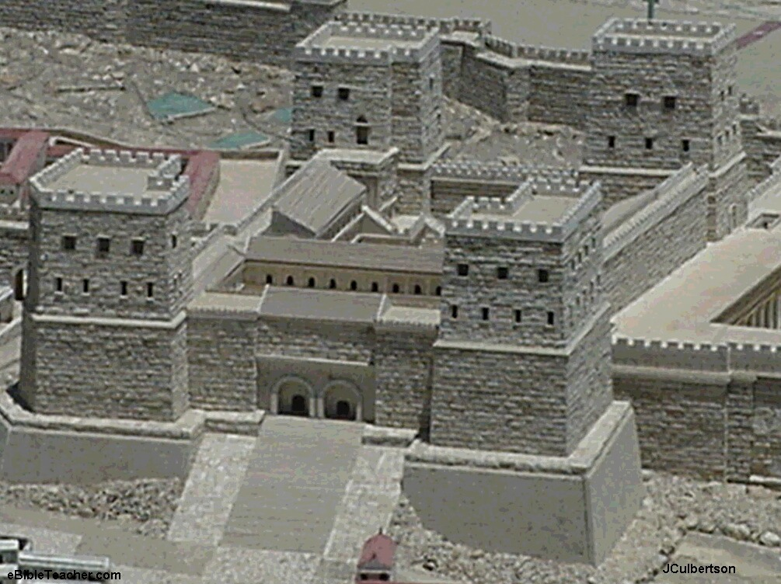
1^{st.} Obvious Outside & Alternative Agency

Slide 5
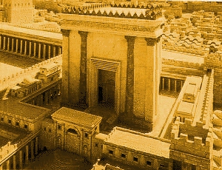
2^{nd.} God Would Allow Him Other Venue

Slide 6
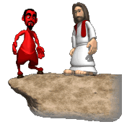

Slide 7
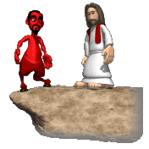
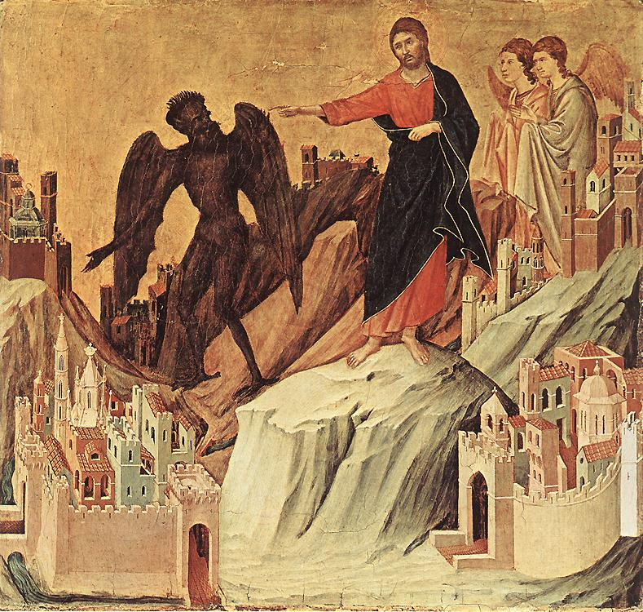
Luke 4: 6 – “I give it to whomever I wish.”

Slide 8
Flashback From Tempting Thought Satan Revisit In Matthew 16: 21
(23) “Get behind Me, Satan! You are an offense to Me, for you are not mindful of the things of God, but the things of men.”
“Peter is to get behind him, opiso mu, which means to follow, do not dictate, and so Peter’s proper position is to be with Jesus and follow where he is going, not to determine the conditions under which Jesus is going to be the Messiah!” - Tim Johnson

Slide 9
Case Of The Church-State Theocrat: Being Better Judge Than Jesus
David Lee Burris: The Religion Of The Crutch & The Placebo Human Weakness Requires Religious Subordination? The Grand Inquisitor Says Of Jesus’ Temptation: “You made a mistake. You should have listened to what he said!”
Dostoevsky’s Grand Inquisitor To A Returned Christ:
“I awakened and would not serve madness. I turned back
and joined the ranks of those who have corrected thy work.”
Three Powers Accepted By Then “Universal Church”
Rejected In His Worldly Temptation By World Savior
The Power Over Three Forces Of Human Influence:
Force Of Magic, Mystic, Miracle
Force Of Ecclesiastic Hierarchy
Force Of Established Hegemony

Slide 10
Case Of The Church-State Theocrat: Always Against Actual Authority
David Lee Burris:
Today – The Jesus Seminar – Redefines The Historic Christ – Because – Like Then – THE PROBLEM IS MANKIND DOES NOT WANT THE REAL JESUS!
Dostoevsky’s Grand Inquisitor To A Returned Christ:
“If anyone has ever deserved our fires, it is thou!”
OUR SAVIOR HAS FOREVER
SATIATED ALL BLOODLUST
FOR THE DEATH OF GOD!

Slide 11
To Take The Shortcut Would Short. Human Historical Consequences:
Relationship Regime Continuance:
Of Religion Ascribed Over Faith Consented
Of Shallow Shadow Over Spiritual Substance
Of Partiality Of Truth Over Purity Of Truth

Slide 12
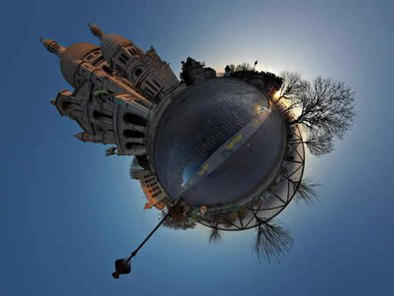
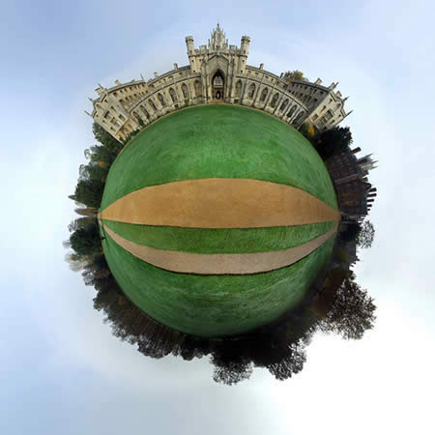
Worldview Collision

Slide 14
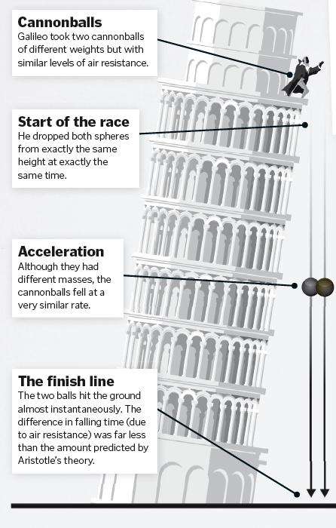
“A” Is For Aristotle

Slide 15
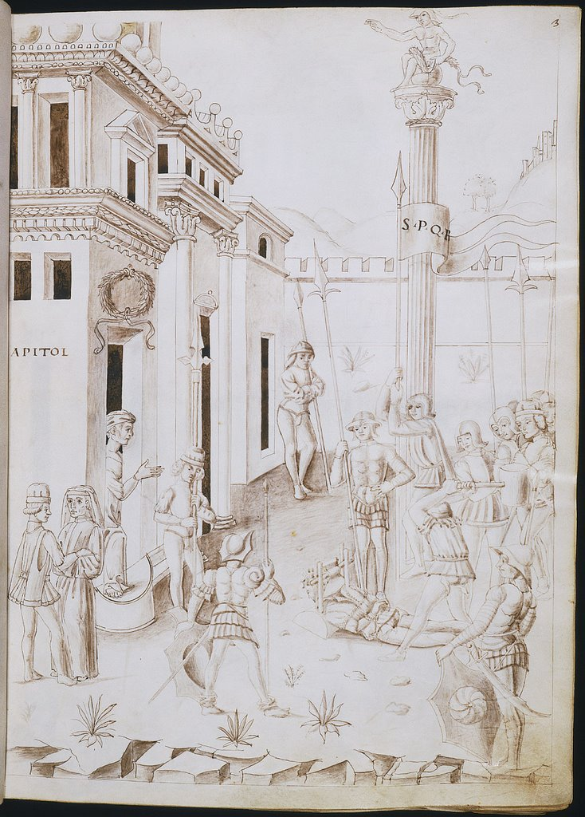
"B" Is For Beheadings

Slide 16
Pope (Exhausted):
It is clearly understood: he is not to be tortured.

Slide 17
(Pause ) Pope:
at the very most, he may be shown the instruments!

Slide 18
Inquisitor:
That will be adequate, your holiness. Mr. galileo understands machinery!

Slide 19
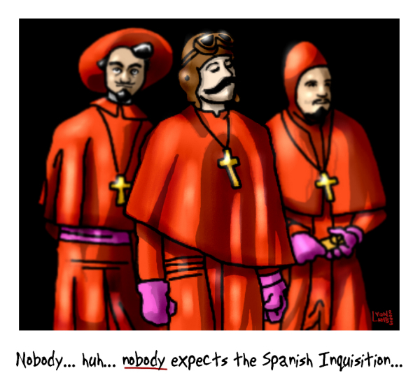
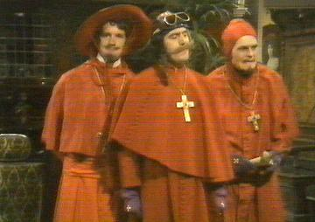
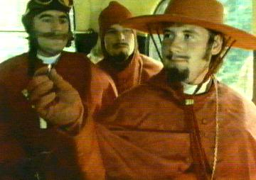
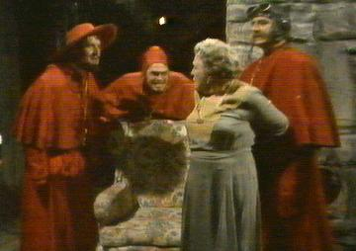
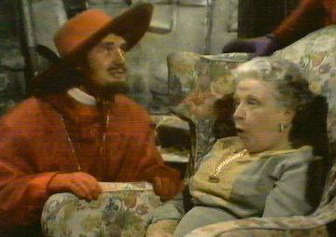
Monty Python Parody Grand Inquisitor Outs Self-Referentials

Slide 20
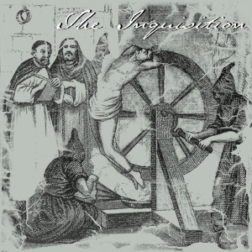
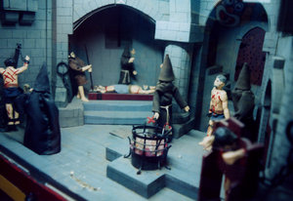
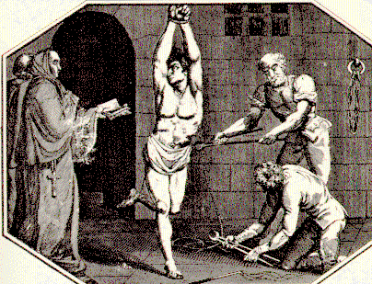
Holy Inquisition Far From Funny

Slide 21
The Catholic Inquisition

Slide 22
DOCTOR OF THE CHURCH
“Augustine was the first theologian to align the church in an official way with the use of the sword, & it happened to be against a fellow Christian group, the Donatists. Among other things, the Donatists believed the alliance between the church & state that had been forged since Constantine was undermining the purity and integrity of the church and they wanted to keep the church pure. Though Augustine had previously spoken against use of coercion for religious purposes, his ongoing battle with the Donatists led him to reverse his view.”
- Gregory Boyd, Myth Of A Christian Nation

Slide 23
“Augustine now justified the use of force by arguing that inflicting temporal pain to help someone avoid eternal pain is justified. Since God had given the church the power of the sword, Augustine reasoned, it had a responsibility to use it to further God’s purposes in the world just as a stern father has a responsibility to beat his child for his own good. Since God sometimes uses terror for the good of humans, we who are God’s representatives on earth – the church – may use terror for the sake of the gospel. If the end justifies it, the use of violence as a means to that end is justified. (Page 78)
- Gregory Boyd, Myth Of A Christian Nation

Slide 26
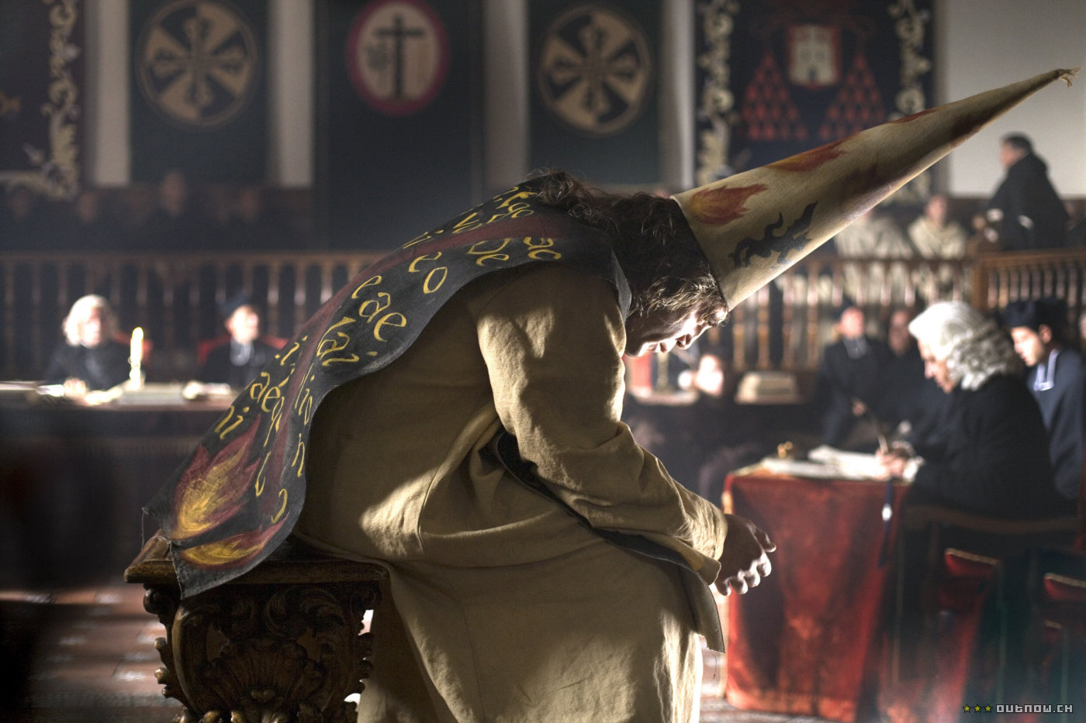
PUBLIC VERSUS
PRIVATE FAITH:
"Inquiring Minds
WANT TO KNOW"

Slide 27
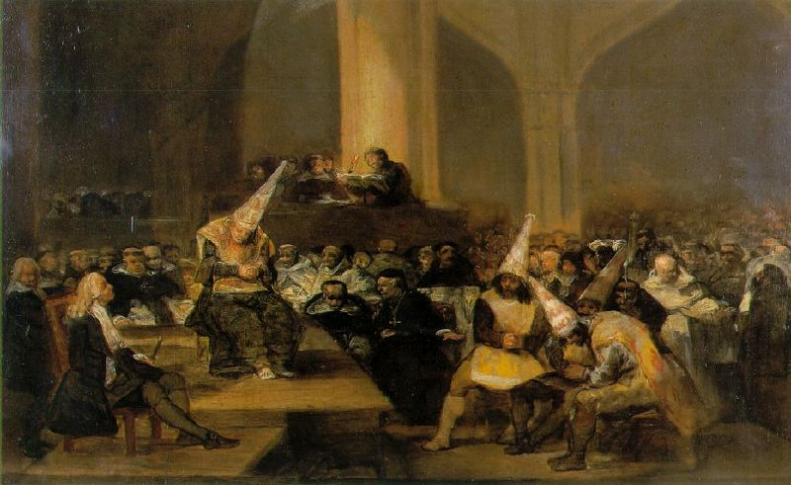
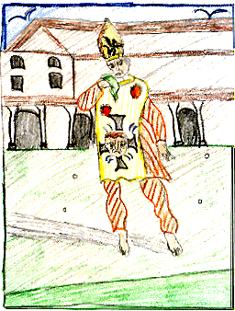
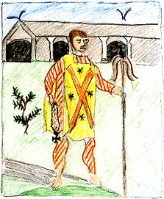

Slide 28
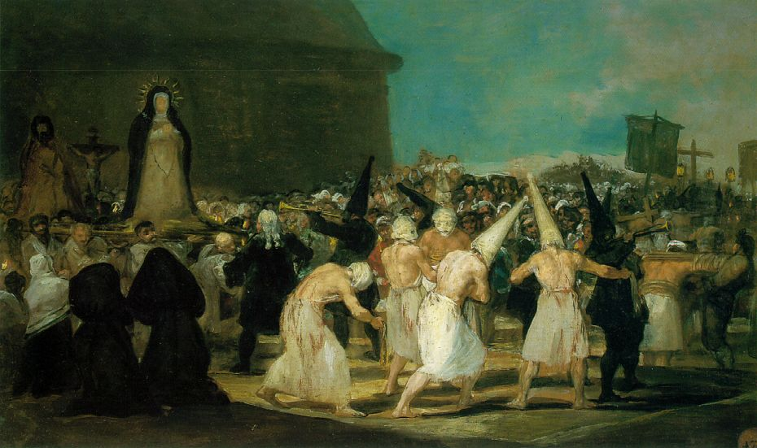

Slide 29
“The burning of [DEFUNCT HERETICS] (DISINTERRED) DEAD BODIES, LIKE THE WEARING OF YELLOW CROSSES OR THE PUBLIC SCOURGING OF CONVICTED HERETICS ON FEAST DAYS, WAS INTENDED TO MAKE A POINT ABOUT THE REACH & POWER OF THE INQUISITION AND ITS LONG MEMORY & STRONG WILL.”
- Jonathan kirsch

Slide 30
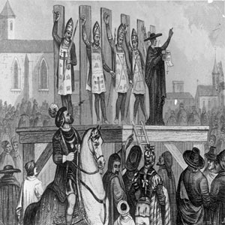

Slide 31
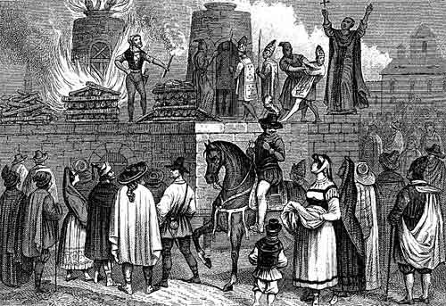

Slide 33
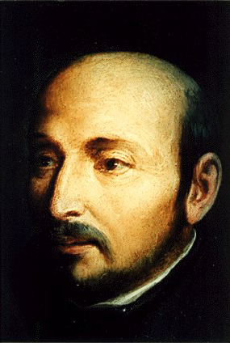
1522
Ignatius Loyola while recovering in the hospital reads Saints’ Lives & develops a “military” vision of Christianity whereby God’s armies represented by the ancient Catholic Church are at war with the armies of the devil, represented by the Protestants!
Ignatius Loyola

Slide 34
1534
Roman Catholic priest Ignatius Loyola founds Society of Jesus (Jesuits) in Paris to spread Counter-Reformation and to evangelize
Ignatius Loyola

Slide 35
1534
The religious society became known as the Jesuit order of monks. It is the missionary order of present-day Catholicism!
Ignatius Loyola

Slide 36
The three main ideas of Jesuitism are:
“Intentionalism” – the end justifies the means.
“Mental Reservation” – one is not bound to state the whole truth when on oath.
“Probabilism” - if a thing is probable, it is good.
1534
Ignatius Loyola

Slide 37
The Doctrine Of Mental Reservation:
According to this teaching, one could conform outwardly to some requirement without giving consent of the mind, if this seemed expedient for advancing some “higher purpose” and not be held responsible for the outward act or word.
1534
Ignatius Loyola

Slide 38
THE DOCTRINE OF PROBABILISM:
According to this teaching, if, in a given situation calling for an ethical decision any one authoritative writer in the church’s tradition defended a course of action, that advice had enough probability of being right to make it a basis of action. Since it is possible to find this type authority for almost any act in given circumstances, their system is of a situational ethic.
Aristotelian Modal Model of Probability Is Abused!
1534
Ignatius Loyola

Slide 39
POSSESSING A VERNACULAR VERSION WAS PUNISHABLE BY DEATH

Slide 40
Catholic Theologian Johann Cochlaeus:
“The New Testament translated into the vulgar tongue, is in truth the food of death, the fuel of sin, the veil of malice, the pretext of false liberty, the protection of disobedience, the corruption of discipline, the depravity of morals, the termination of concord, the death of honesty, the well-spring of vice, the disease of virtues, the instigation of rebellion, the milk of pride, the nourishment of contempt, the death of peace, the destruction of charity, the enemy of unity, the murderer of truth.”

Slide 41
PROPAGANDA AND/OR COERCION
The Roman Church had two weapons of coercion to back up the propaganda of the Jesuits - the Inquisition and the Index. The Index was a list of books the faithful were not permitted to read. It was called the Roman Index of Prohibited Books & a special Congregation of the Index, created in 1571, was charged by the pope with the task of keeping the list up-to-date.
1534
Ignatius Loyola

Slide 42
Backgrounds Of The Inquisitions. Foundations for the Inquisitions were laid down before the actual persecutions actually began. The Inquisitions were, in fact, an attempt on the part of the Medieval Church to exterminate heresy. The Church in the ancient period of its existence had dealt with heretics in different ways: some were put to death; some were exiled by Imperial command; and others were excommunicated from the Church without exile. The repressive measures became more severe as time continued, until they culminated in the 13th century into very drastic measures. Schaff says, ‘The measures for the repression and extermination of heresy culminated in the organized system, known as the Inquisition.’
- Morris Womack, The Church Through The Ages

Slide 43
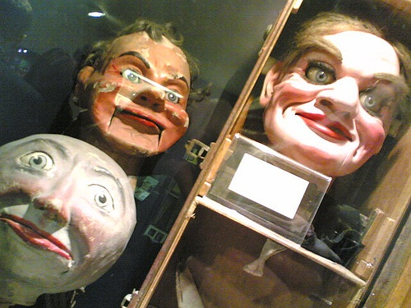
The Source Of Inquisitions. It has been argued that the Church didn’t actually put the victims to death; the Church only excommunicated them. This is nothing more than a rationalization. For the Church authorities knew that the civil authorities would put to death those who were excommunicated. Furthermore, it has been suggested that the Inquisitions were never intended for the populace who were not members of the Church. But, it should be remembered that the Roman Church had authority over all persons – Christian and non-Christian. Thus, anyone who did not follow the dictates of the Church may have stood in jeopardy.
“We relinquish him now to secular judgment and, by the authority which we wield, we not only condemn him as a heretic, but also we bind him with the chain of excommunication as fautors, receivers, and defenders of heretics all persons who knowingly henceforth either harbor or defend him or lend him counsel, aid or favor.”
- Morris Womack, The Church Through The Ages

Slide 44
Chapters Of The Inquisitions. In the first period, we find the State taking an active part in the punishment of heretics. Kings felt that a united Church was necessary for a united kingdom. Thus, many heretics were persecuted by the State and later put to death. ‘King Robert of France had thirteen heretics burned at Orleans in 1022; this is the first known case of capital punishment of heresy since the secular execution of Priscillia in 385.’ Yet, bishops entered into persecuting heretics prior to the 13th century. They did not hunt out heresy but punished those who were reported to them by the people; hence, they can’t rightly be called ‘inquisitors’ in the sense we use that term.
- Morris Womack, The Church Through The Ages

Slide 45
Chapters Of The Inquisitions. It was in 1185 that, Pope Lucius III, dissatisfied with the negligence of the bishops in pursuing heresy, ordered them to visit their parishes at least once a year, arrest all suspects, to reckon as guilty all who would not swear full loyalty to the Church and to hand over all such recalcitrants to the secular arm. Innocent III and Thomas Aquinas were two churchmen who advocated Inquisitorial actions & Frederick II and Louis IX were enlightened rulers who advocated it. Heresy, so the theory and definitions ran, was a crime the Church could not tolerate. It was Satan’s worst blow.
- Morris Womack, The Church Through The Ages

Slide 46
Pope Innocent IV: Ad Extirpanda
David Lee Burris:
Tribunals Operated Twenty Years Without Torture Common To Secular Court System; Recant Denial - Refused Testimony – Non-Cooperation Increasing
"Putting The Question"
* Papal Decree Of 1252 *
Permission For Utilizing Torture Procedural Investigation Of Truth

Slide 48
CONFIRM BY CAULDRON & HOT IRON “God proves you are telling the truth either by outright protecting from injury the hand holding the hot iron, or the bare feet walking on hot plowshares, or by making the wounds heal quickly and cleanly, which is apparent when the bandaged limb or limbs are unwrapped and inspected three days after the ordeal.”
David Lee Burris:
Apologetic Defense In Analogy To O.T. Story Of Nebuchadnezzar’s Seven Fold Hot Fiery Furnace.
Source: Concise Book Of Lying

Slide 49
“The judge should promise that he will be merciful, with the mental reservation that he means he will be merciful to himself or the State; for whatever is done for the safety of the State is merciful.”

Slide 50
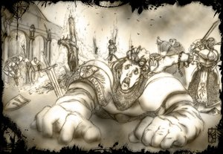
Church councils reduced The age of responsibility to 7 years.
Starting at the age of 14, a boy or girl could be lawfully subjected to torture during interrogation.

Slide 51
The Inquisition
By the 12th century, the Church suddenly realized the sword is actually a lot mightier than the pen.
The first implementations of this policy were the Crusades, which involved sending armies out to forcibly convert those who didn't agree with the Pope (specifically the Muslims inhabiting the Holy Lands). The first Crusade went really well, but subsequent efforts to recapture the magic were miserable failures.
After a series of embarrassing setbacks, the Church turned its attention inward, busying itself with the task of rooting out the disloyal and misguided within its own domains, primarily Europe.
That's when the Inquisition was born.
Technically, the Inquisition is an ongoing function of the church (more on this below), but when people talk about "the Inquisition," they're usually referring to one of two historically notable incidents: the Albigensian Inquisition, or the Spanish Inquisition.
The Abigensian Inquisition was the first major operation of the sort put on by the Catholic Church. In southern France, a Christian sect known as the Cathars arose around the 12th century.
The Cathars become popular in the Languedoc region of France by living a chaste and ascetic lifestyle which was considerably more in the teachings of Jesus than the local clergy, who were at the time a motley crew of fornicating, corrupt money-grubbers.
The pope, motivated in large part by a lust for the wealth and lands of Languedoc, ordered a Crusade and subsequently an Inquisition in the region to stamp out the heretics and assume ownership of their property. The Crusade was very transparently about wealth and political power, so it failed to actually root out the alleged enemy, namely the Cathars. Once the mainstream Catholics had taken control of the region, they moved belatedly to squash the actual believers.

Slide 52
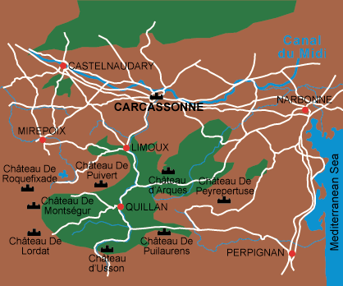
CATHAR CASTLE BATTLES

Slide 53
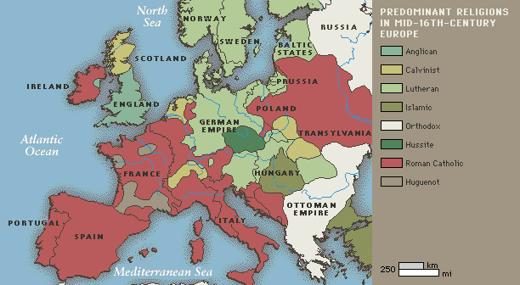
THE WORSE EXCESSES OF THE INQUISITION WERE EXCUSED AS THE PARDONABLE SINS OF SOLDIERS ENGAGED IN A HOLY WAR AGAINST HERESY!

Slide 54
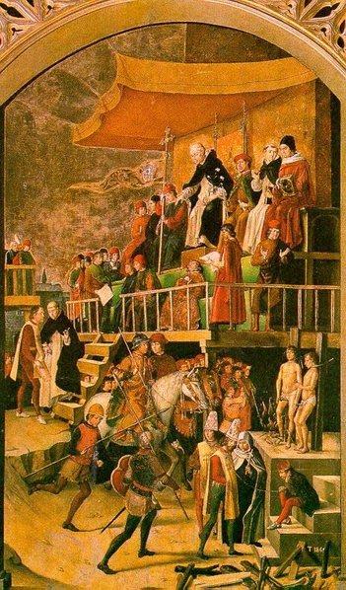
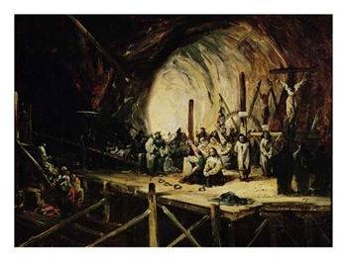
Catholic Inquisition: BIG PIC Erasing Entire People Populations
Cathar Cleansing

Slide 55
Albigensian crusaders requested clarification of engagement:
We cannot distinguish the good from the wicked, what shall we do?

Slide 56
Piously echoing the words of paul in his letter to timothy:
“kill them all, the lord knows those who are his own!”

Slide 57
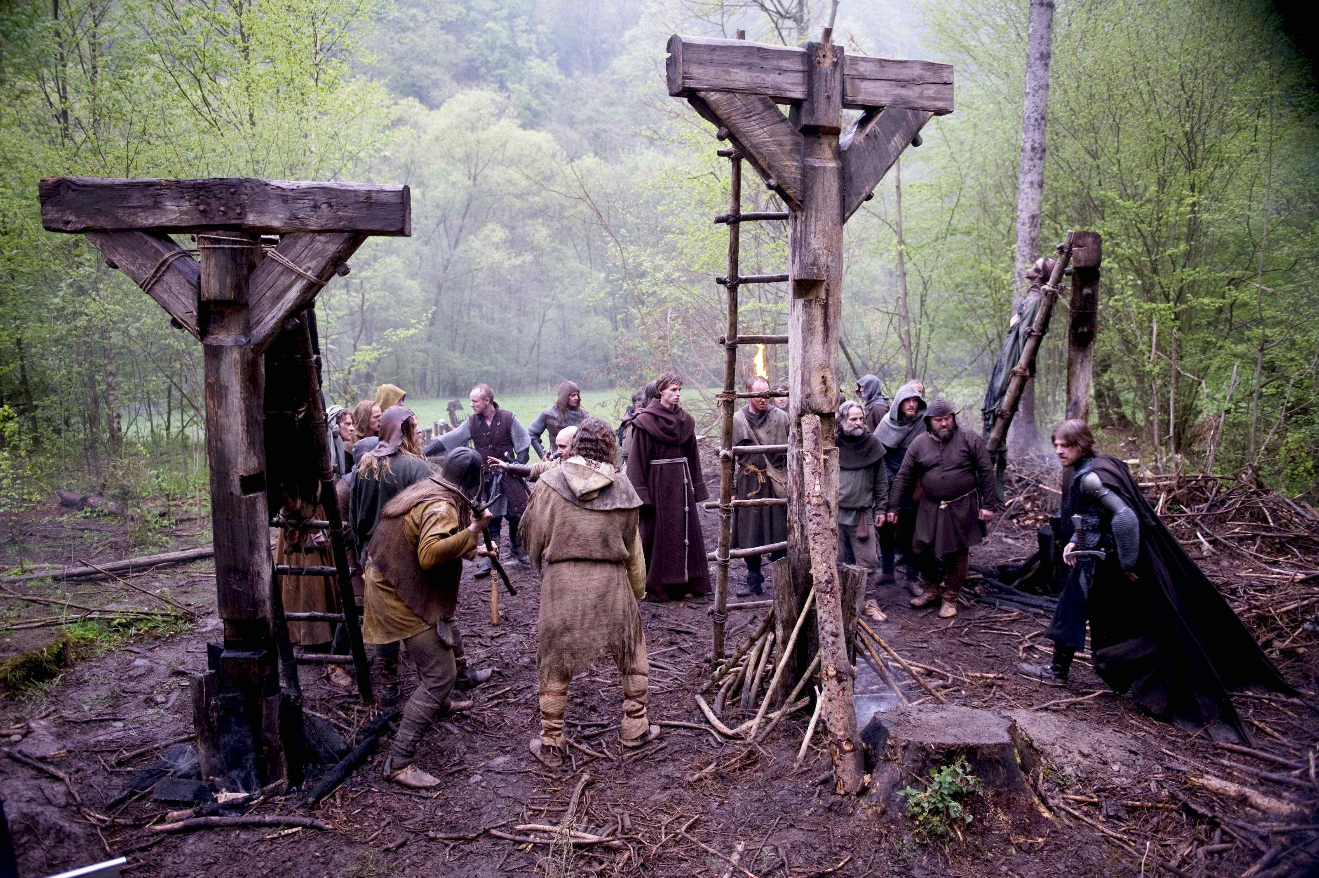

Slide 58
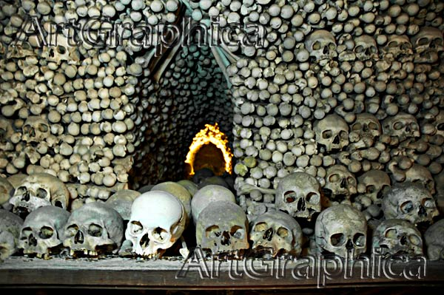
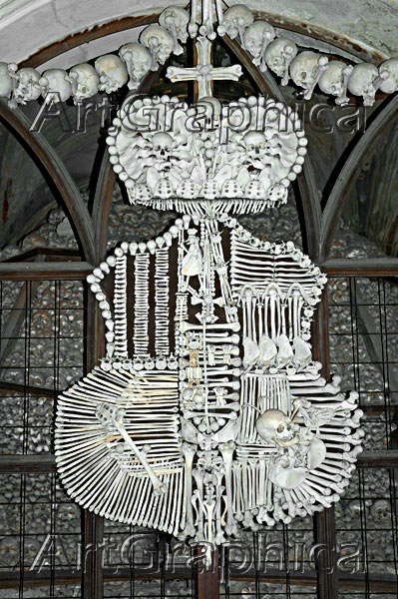
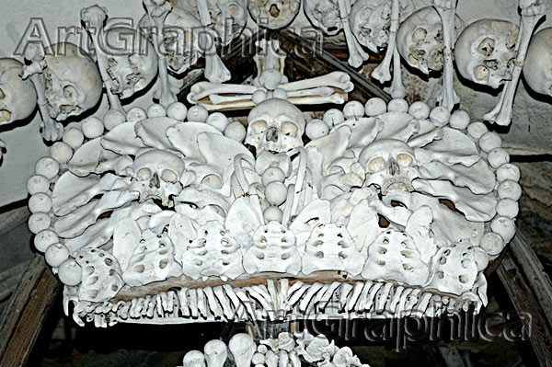
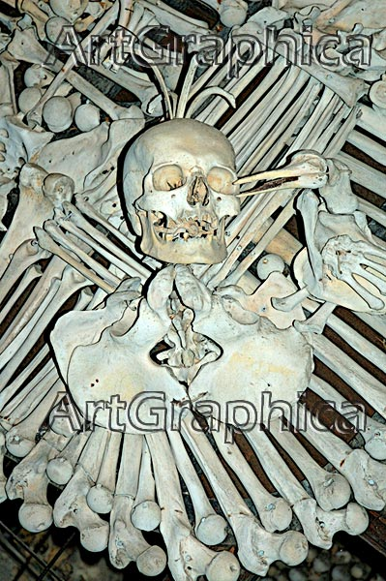
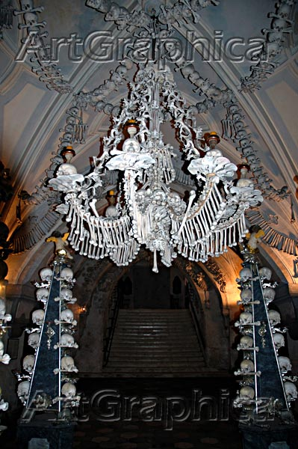
Prague Church Hussite Martyr Bone Commemoration

Slide 59
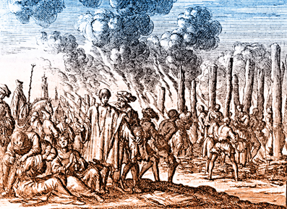
1655
Waldensians come to reject practice of indulgences & purgatory doctrine breaking from Roman Catholicism and embracing Protestantism
Catholics launch persecution
Waldensians are burned

Slide 60
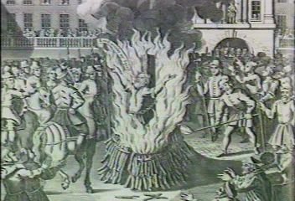
In 1233, Pope Gregory IX pronounced the official beginning of "The Inquisition," and send a cadre of disciplined Dominican monks to carry it out. When they arrived in town, the Inquisitors laid out a deadline: Everyone had one month to confess all your warped, evil beliefs and come back into the fold, with only a minimal punishment.
When the month expired, all hell broke loose. The monks began staging trials, with the support of the local government. Any accusation of heresy was enough to start a trial going, and the names of the accusers were kept secret. The trials themselves were held in secret. After a brief flirtation with the concept of a "right to an attorney," all due process was dispensed with. The only appeal of a guilty verdict was to the pope.
The monks decided that the only way you could really be sure if someone was a heretic was to torture them extensively and creatively, just like Jesus would have wanted. Although the later Inquisitors would become far more creative in the use of machinery to support their efforts, the Dominicans were only subject to the papally decreed limit of citra membri diminutionem et mortis periculum, which meant "don't kill 'em" and "no amputations."
The medieval inquisition went on for a couple of centuries, during which time a lot of scores were settled in the South of France. Everyone and anyone with a grudge could hand over their friends, families, enemies and business rivals to the Inquisitors, who were anxious to meet their quotas. The punishment for a guilty verdict in an Inquisitorial trial could range from loss of property to prison to burning at the stake. And the verdict was almost always guilty.
In addition to uncounted numbers of completely innocent people, the Inquisition did succeed where the Albigensian Crusade had failed. By the time it was over, there were no more Cathars. There were also no more Knights Templar. The Knights had been a particularly wealthy and powerful secret society based in the region. The Catholics may have had other motives for killing them.
You probably didn't expect that we would now discuss the Spanish Inquisition. But then, nobody expects the Spanish Inquisition! In the late 15th century, a new branch of the Inquisition was formed in Spain. The Spanish Inquisition was founded on the somewhat ludicrous notion that Jews and Muslims were pretending to covert to Catholicism in order to undermine the church in Spain.
The Inquisition

Slide 61
The Inquisition
Since the determination of what someone secretly believes in their heart is complicated by the lack of external and incontrovertible evidence, the Spanish Inquisition quickly became notorious for a) extremely creative use of torture and b) its tendency to be unleashed on just about anyone at any time, for any reason, or for no reason at all (thus the "nobody expects" element).
Although you might have a picture of a quaint medieval hysteria, the Spanish Inquisition went on for THREE HUNDRED YEARS, lasting well into the 1800s. The first five years of the Spanish Inquisition were basically rampant mayhem with no appreciable diminishment of the "threat" from the fake Catholics. As a result, Tomas de Torquemada was appointed to, uh, whip the Inquisition into shape.
He succeeded beyond the Church's wildest nightmares. Thousands and thousands of "heretics" were burned at the stakes throughout the duration of the Spanish Inquisition (the exact numbers are unknown). There was no such thing as an "alleged" heretic under the Inquisitions reign of terror; there were only "repentant" and "unrepentant" heretics.
"Repentant" heretics were those who confessed their heresy and agreed to shell over big bucks to the Church. Poor people accused of heresy (who were relatively fewer) could only save themselves with full confessions and by naming the names of other heretics.

Slide 62
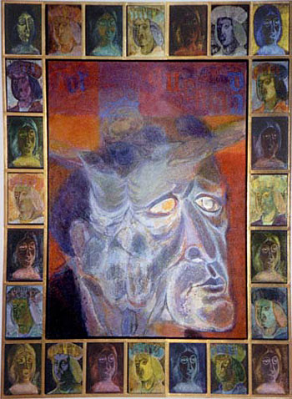
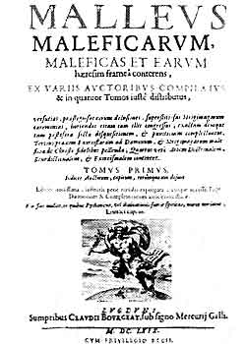
Pope Innocent IV: Ad Extirpanda
David Lee Burris:
Tribunals Operated Twenty Years Without Torture Common To Secular Court System; Recant Denial - Refused Testimony – Non-Cooperation Increasing
"Putting The Question"
torquemadade
* Papal Decree Of 1252 *
Permission For Utilizing Torture Procedural Investigation Of Truth

Slide 63
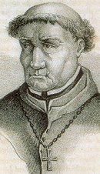
Why did the chicken cross the road? Give Torquemada ten minutes alone with the chicken and he'll find out. The first official Confessor of the Spanish Inquisition, Torquemada presided over the burning of over 2,000 Jews and numerous other heretics. Primarily targeted were Spain’s conversos, or Jews who had been baptized into Catholicism. But it turns out that Jewish blood is so filthy that even the sacrament of baptism is incapable of rendering it pure. If you were more than one sixty-fourth Jew, if you weren't sangre limpia, look out. Observant historians will note that Torquemada was one sixty-fourth Jew. Stories about Jews murdering Christian children, otherwise known as blood libel, had been circulating throughout Europe for centuries. The accounts exist entirely without evidence, arguably the result of paranoia, propaganda and anti-semitism - but the murder of Jews by Christians is equally documented, and Torquemada was absolutely convinced that Jews would be the ruination of Catholic Spain. He was an excellent precursor to modern ethnic cleansing. The Pope agreed to allow the Inquisition in 1481, and those arrested and given four choices. They could confess, pay a penalty, endure public torture, or be burned at the stake. Quite often, those arrested were subjected to all of the above. Torquemada's own grandmother was a converso, but he continued to elevate the level of his Inquisition to that of an ethnic cleansing or a full-blown massacre. Important to the religiously-motivated Inquisitors was that "no blood be spilt," which meant the act torturing confessions out of people required a special science. The favored techniques were flogging, the rack, and red coals applied to the feet. Also popular at the time was the strappado, in which you're suspended by the wrists and incrementally heavier weights are wrapped around your ankles or looped among your toes. Laying a framework of paranoia were Secret Accusers, people who'd tell on their neighbors or exact revenge against those they carried a grudge. Denying heresy meant torture, and confession led to death. Honesty did not pay during Torquemada's Inquisition, and no lawyer could assist you. Papal degrees provided a loophole: torture could not be repeated, but it could be continued. Burning at the stake was performed publicly as an auto-da-fé, or act of faith. If the condemned kissed the Holy Cross, they were garroted before the fire was set. If they merely apologized, they were burnt at the stake death with quick-burning Dura-logs. If the accused continued to be stubborn, they were incinerated with slow-burning fresh green wood. Anywhere from 13,000 to 50,000 people were killed. To Torquemada's credit, a large percentage of his victims were very wealthy. They were saddled with exhaustive fines, court costs, and jail time. Confinement decimated a significant portion of the upper class. Moneys traveled up the hierarchy of church officials. Torquemada lived a long life surrounded by comfort before dying of natural causes at the age of 78.
Thomas de Torquemada
( 1420-1498 )

Slide 64
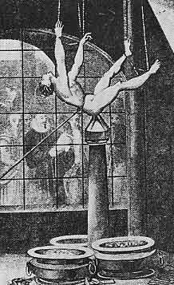
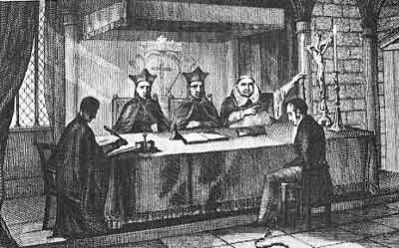
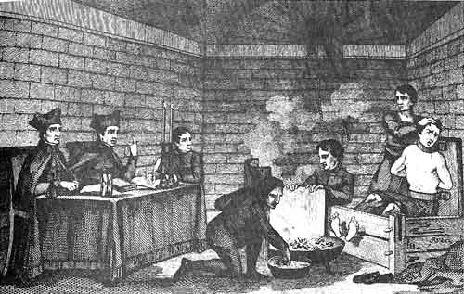
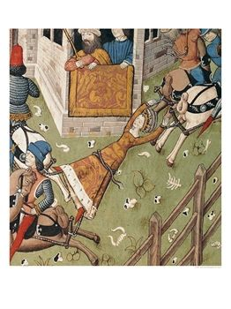
Religious Heresy Was Viewed
As A Communicable Disease
The Grand Inquisitors As
"Doctors Of The Soul"

Slide 65
Methods & Penalties.
The punishments at times bordered on the brutality illustrated in the State’s tortures of criminals. The State had used punishments such as breaking on the wheel, burning in oil, flaying alive, & quartering with horses. At first the punishment meted by the Inquisitors was more mild: imprisonment or the confiscation of property. But later they began applying torture to countless victims or heretics & pronouncing upon them a sentence which, they knew, involved perpetual prison or death in the flames. For the mercy of Jesus Christ the Roman Church authorities, who should have represented him, substituted relentless cruelties. The bishops and Inquisitors were known to share in the expenditures of erecting & enlarging prisons to take care of heretics.
- Morris Womack, The Church Through The Ages

Slide 66
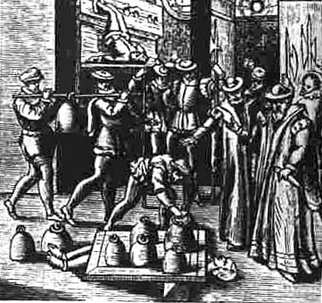

Slide 67
Methods & Penalties.
The accused were always presumed guilty till they proved their innocence; they were never confronted with their accusers; they could be made to testify against themselves; & could be tortured to extract a confession. If sentenced, they were punished by loss of property, imprisonment, or burning at the stake, unless they confessed & recanted. These punishments were carried out by the secular authorities under the watchful eye of the inquisitors.
- Earle Cairns, Christianity Through The Centuries

Slide 68
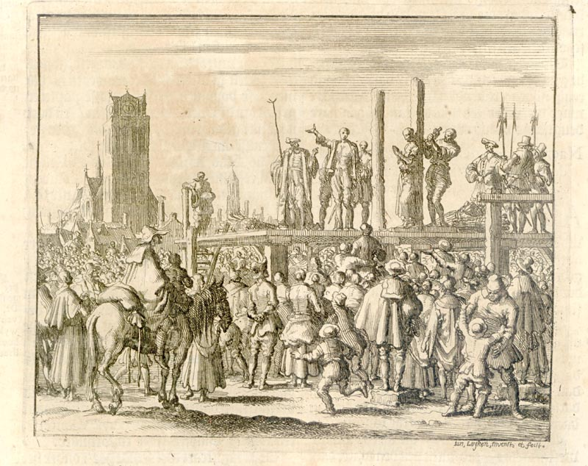
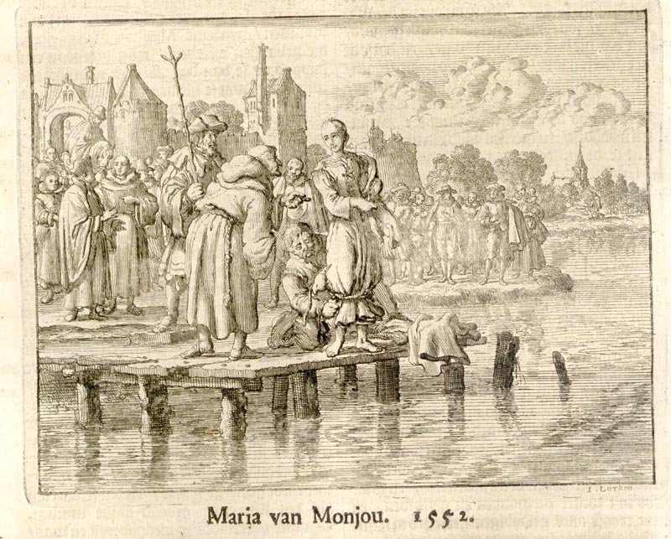
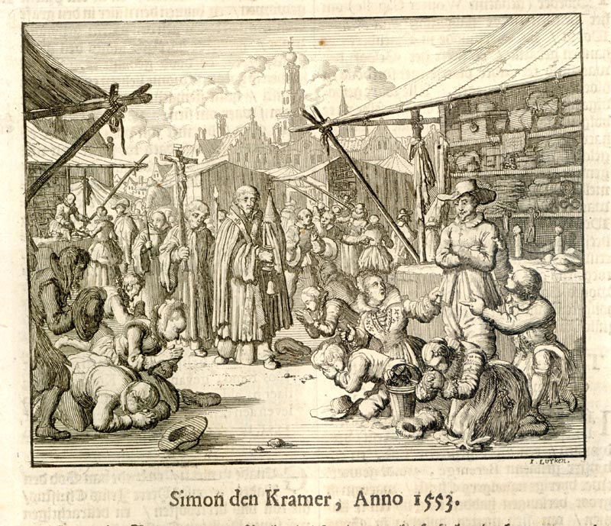
DOCTORS OF THE SOUL

Slide 73
The Inquisition
To assist people in repenting, the Inquisitors used any torture method they could think of, with the theoretical restriction that they couldn't break the skin. The Inquisitors came up with numerous gadgets to work within this restriction. They included:
The Judas Chair: This was a large pyramid-shaped "seat." Accused heretics were placed on top of it, with the point inserted into their anuses or genitalia, then very, very slowly lowered onto the point with ropes. The effect was to gradually stretch out the opening of choice in an extremely painful manner.
The Head Vice: Pretty straightforward concept. They put your head into a specially fitted vice, and tighten it until your teeth are crushed, your bones crack and eventually your eyes pop out of their sockets.
The Pear: A large bulbous gadget is inserted in the orifice of choice, whether mouth, anus or vagina. A lever on the device then causes it to slowly expand whilst inserted. Eventually points emerge from the tips. (Apparently, internal bleeding doesn't count as "breaking the skin.")
The Wheel: Heretics are strapped to a big ol' wheel, and their bones are clubbed into shards. Not very creative, but quite effective.

Slide 75
http://mr_sedivy.tripod.com/shame3.html

Slide 77
Medieval Cartography Revealed People’s Beliefs
Medieval Cartography Revealed Deep Fears

Slide 78
ORDEAL BY SANCTIFIED WATER “He who seeks to conceal the truth by a lie is unable to sink into the waters over which the voice of the majesty of the Lord has thundered, because the pure nature of the water does not receive a human nature which has been cleansed of all deceit by the water of baptism but has subsequently been reinfected by lies.”
David Lee Burris:
Result Product Of Personal Body Fat & Saline Content Of Holy Water.
Source: Concise Book Of Lying

Slide 79
THE BOOK OF DAYS

Slide 81
The Inquisition
To assist people in repenting, the Inquisitors used any torture method they could think of, with the theoretical restriction that they couldn't break the skin. The Inquisitors came up with numerous gadgets to work within this restriction.
Methods of execution weren't much better. Since death was the eventual outcome, the skin-breaking point was rendered largely moot. While burning at the stake was the most widely used method, being cost-effective and providing a fun spectacle for the whole family, there were other approaches used in special cases:
Sawing: Heretics were hung upside-down and sawed apart down the middle, starting at the crotch.
Disembowelment: Not the nice kind of disembowelment, where a samurai slits you wide open like a fish and you die in moments. No, that's not good enough for the Inquisition. A small hole is cut in the gut, then the intestines are drawn out slowly and carefully, keeping the victim alive for as much of the process as possible.
The Stake: Depending on how unrepentant a heretic might be, the process of burning at the stake could vary wildly. For instance, a fairly repentant heretic might be strangled, then burned. An entirely unrepentant heretic could be burned over the course of hours, using green wood or simply by placing them on top of hot coals and leaving them there until well done.

Slide 83
PHYSICAL SEVERING
WAS THOUGHT REMEDY PREVENTING ANY LATER
SPIRITUAL RESURRECTION
FLAYED ALIVE!

Slide 84
1564
The term “Puritan” is first used for Protestants who want to “purify” the Church of England of ceremony and ritual not found in the Bible
John Calvin dies
Bishops Bible, Church of England translation, is printed
Queen Elizabeth I is excommunicated by the pope, and in turn persecutes Catholics
St. Bartholomew’s Day Massacre
twenty thousand deaths
1568
1570
1572
COMMEMORATION

Slide 85
1564
The term “Puritan” is first used for Protestants who want to “purify” the Church of England of ceremony and ritual not found in the Bible
"And what I most commend is the resolution taken
by his Majesty to exterminate this vermin..."
John Calvin dies
Bishops Bible, Church of England translation, is printed
Queen Elizabeth I is excommunicated by the pope, and in turn persecutes Catholics
St. Bartholomew’s Day Massacre
1568
- Pope Gregory XIII per Catholic Encyclopedia XIII, 337
1570
1572

Slide 89
The 18th Century Invented the Idea of Progress
Optimism Has Its Limits
But…
1780 – 1914

Slide 90
THE HOLY ROMAN EMPIRE IS OFFICIALLY DISSOLVED IN 1806

Slide 91
David Lee Burris:
Final defeat by Guiseppi Garibaldi – Italian patriot under King Victor Emmanuel – destroyed the Catholic forces in 1859!
Vatican City has railway, electric plant, courts, and jails.
papal states from eighth century until 19th

Slide 92
Resisting the Modern Age: Papal State Inquisition
“On July 26, 1826, fully six centuries after the first heretic was burned by the newly created Inquisition, the inquisitors took their last human life. A schoolteacher named Cayetano Ripoll was charged as a heretic because he professed the principles of Deism, and he was “relaxed” like countless thousands before him. The last of the inquisitors could not bring themselves to burn him alive & the death sentence was administered by strangling him with a garrote. To affirm their solidarity with the old and enduring traditions of the Inquisition, however, the dead body was stuffed into a wooden barrel decorated with painted red flames and buried in unconsecrated ground.” - J. Kirsch, Grand Inquisitor’s Manual

Slide 93
Resisting the Modern Age: Papal State Stockyard Execution
Mazzatello (abbreviated mazza) was a method of capital punishment used by the Papal States from the late 18th century to 1870. The method was named after the implement used in the execution: a large, long-handled mallet or pole-ax. The condemned would be led to a scaffold in a public square of Rome, accompanied by a priest (the confessor of the condemned); the platform also contained a coffin and the masked executioner, dressed in black. A prayer would first be said for the condemned’s soul. Then, the mallet would be raised, and swung in the air to gain momentum, and then brought down on the head of the prisoner, similar to a contemporary method of slaughtering cattle in stockyards. Because this procedure could merely stun the condemned rather than killing him instantly, the throat of the prisoner would then be slit with a knife.

Slide 94
Resisting the Modern Age: Papal State Rat Torture
A cheap and effective way to torture someone was with the use of rats. There were many variants, but the most common was to force a rat through a victim's body (usually the intestines) as a way to escape. This was done as follows: The victim was completely restrained & tied to the ground or on any horizontal surface. A rat was then placed on his stomach covered by a metallic container. As the container was gradually heated, the rat began to look for a way out - through the victim's body. Digging a hole usually took a few hours of agonizing pain for the victim. This almost invariantly resulted in death.

Slide 95
MATSCH’S LAW
IT'S BETTER TO
HAVE A HORRIBLE ENDING
THAN TO HAVE
HORRORS WITHOUT END!

Slide 96
Pope Still Appoints Grand Inquisitor

