Slide 1
CHRISTIAN CITIZENSHIP
By David Lee Burris​

Slide 2
The world in which our lord lived
A World of Slavery
A World of Absolute Rulers
A World of High Taxes
A World of Persecution

Slide 3
The solution given by jesus christ
Christ did not come to seek social change or overthrow the government.
The problems of His day were far more severe than ours.
We must honor those that have authority over us.

Slide 4
what is civil government?
It is not moral government.
It doesn’t legislate morality, but rather what’s civil in society.

Slide 5
Rationale:
If the government were to adopt the gospel as the code of civil law, then it would be the duty of the courts to forgive every murder or felon without respect of persons.
That would destroy civil government completely.

Slide 6
Rationale:
Likewise, if the legal and penal statutes of civil government were adopted religiously, it would destroy the blessings of the gospel.

Slide 7
Our duty to the civil government during nero’s reign
Paul makes no distinction between good rulers and evil rulers.
Paul makes no distinction between fair laws and unfair laws.

Slide 8
Our duty to the civil government during nero’s reign
Paul was not saying to compromise our consciences.
Paul was saying that in most aspects of life it is possible for Christians to live according to the laws of the land.

Slide 9
Our duty to the civil government during nero’s reign
  WE ARE TO PRAY FOR THOSE IN AUTHORITY {1st Timothy 2:1-4}
  WE ARE NOT TO SPEAK EVIL OF OUR LEADERS {Titus 3:1-2}
  WE MUST PAY OUR TAXES {Romans 13:6-7}

Slide 10
Our duty to the civil government during nero’s reign
  WE SHOULD FASHION OURSELVES SIMILAR TO THE APOSTLES – PERCEIVING & CONSIDERING OURSELVES AMBASSADORS ON FOREIGN SOIL!
  AN AMBASSADOR TO ANOTHER COUNTRY KEEPS THE LOCAL LAWS IN ORDER TO WELL REPRESENT THE AUTHORITY THAT SENT HIM!

Slide 11
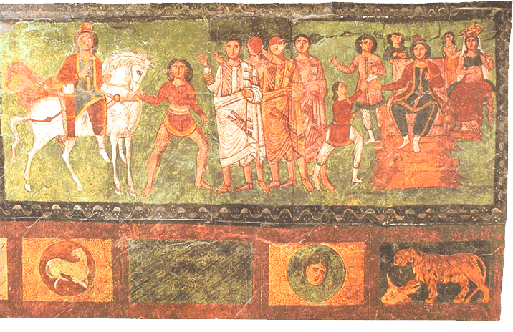

Slide 12


Slide 13

AN AMBASSADOR
An Accurate Mind
An Artful Method
An Attractive Manner
KNOWLEDGE
WISDOM
CHARACTER

Slide 14
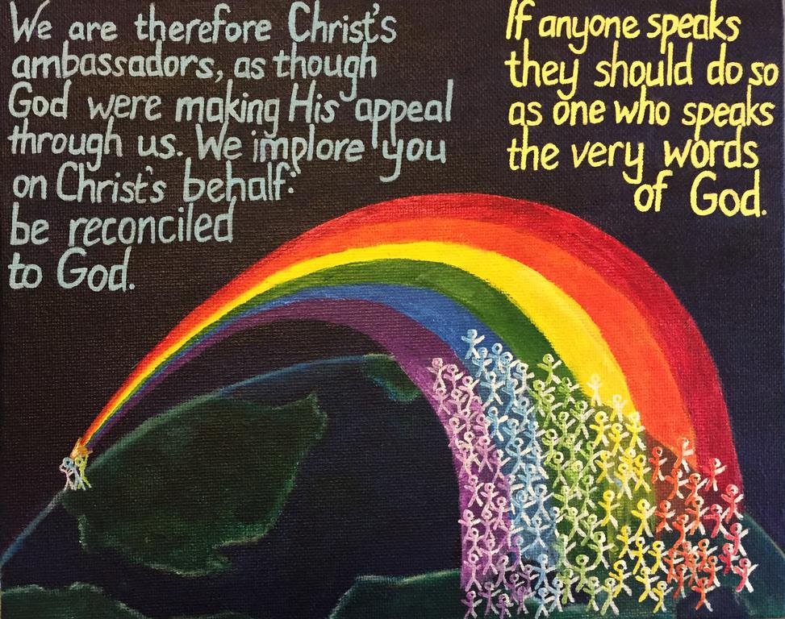

Slide 15
Romans 13: Initial Thoughts
Human government was allowed & instituted by God when his direct rule over people was rejected!
James Madison In Federalist # 51:
“If angels were to govern men, neither external nor internal controls of government would be necessary!”

Slide 16
Initial Thoughts Continued
The people of Israel had moral, civic, and ceremonial law and obligations to all
We as Christians have both a religious and moral duty to God and a civic duty to our society
Our city, country, and world would be a better place if more people believed in and practiced the Christian faith

Slide 17


Slide 18
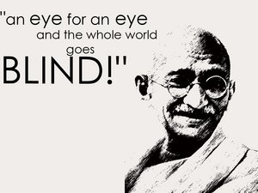
David Lee Burris: Lead Into Last Powerpoint Presentation
MLK: “Force begets force; hate begets hate; toughness begets toughness. And it is all a descending spiral, ultimately ending in destruction for all and everybody. Somebody must have sense enough and morality enough to cut the chain of hate and the chain of evil in the universe.”
We Are A People
Of Irenic Values
Proverbs 16: 19

Slide 19
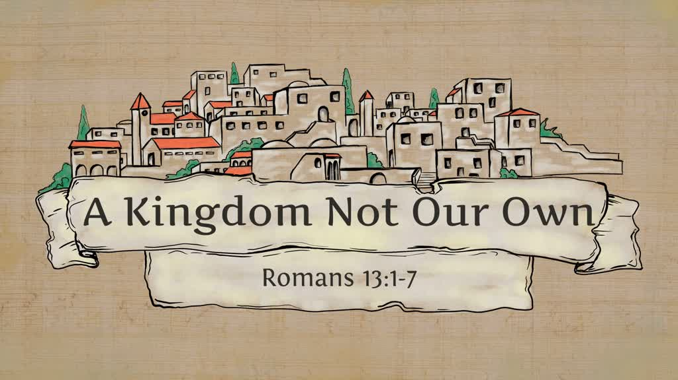

Slide 20


Slide 21
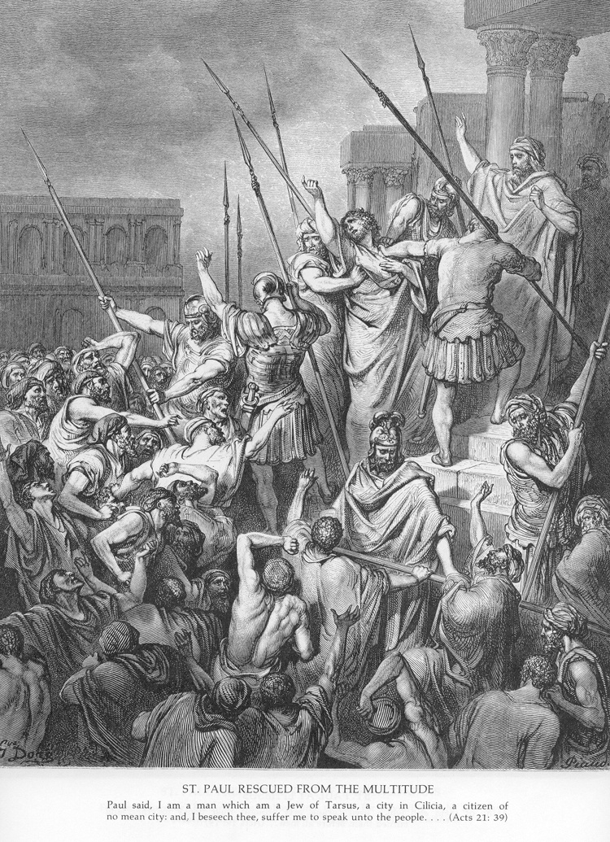

Slide 22
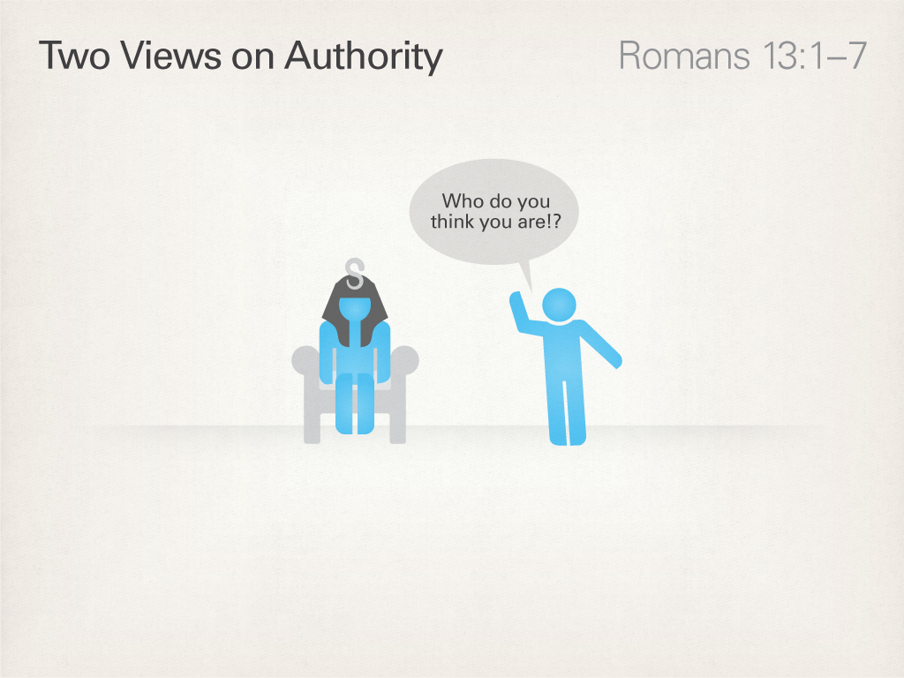

Slide 23
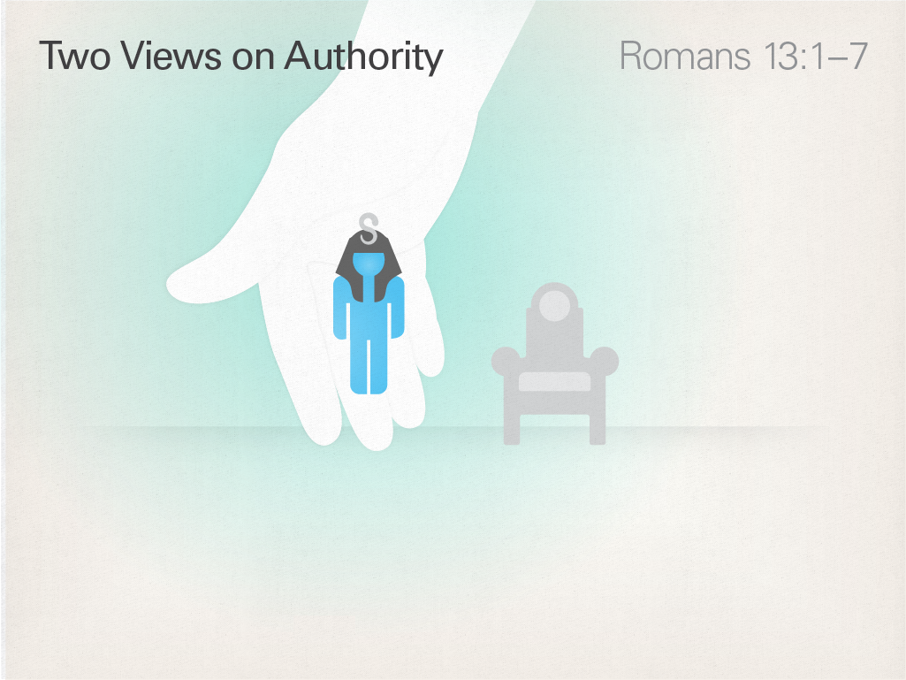

Slide 24
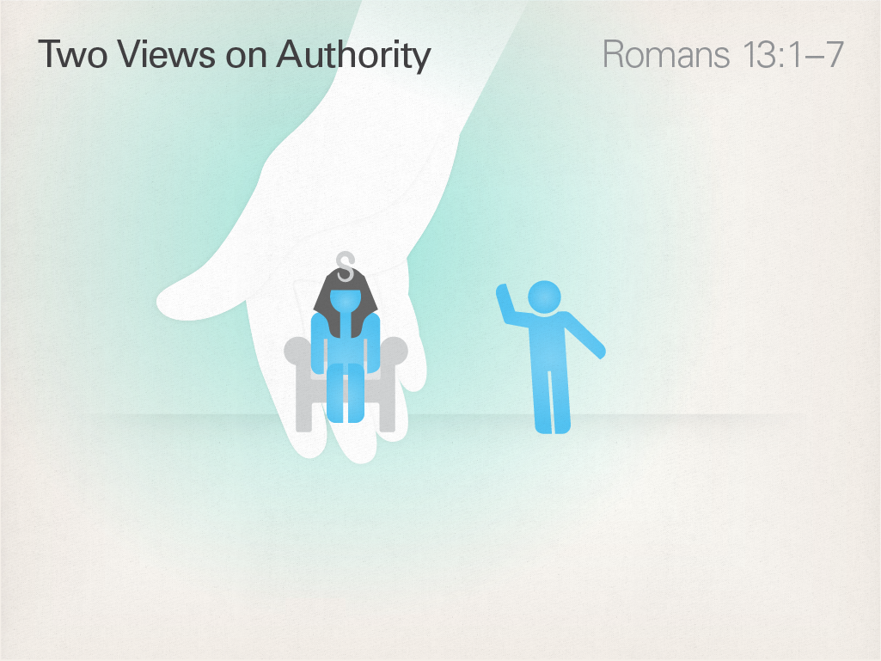

Slide 25
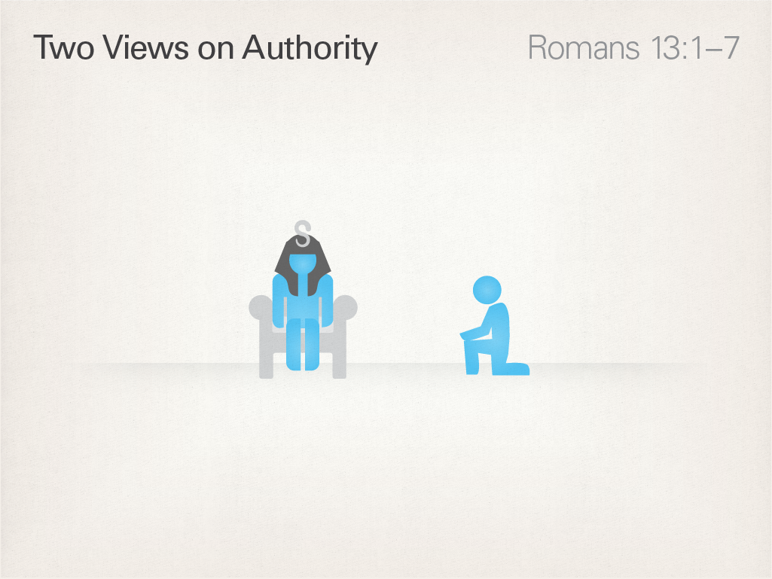

Slide 26
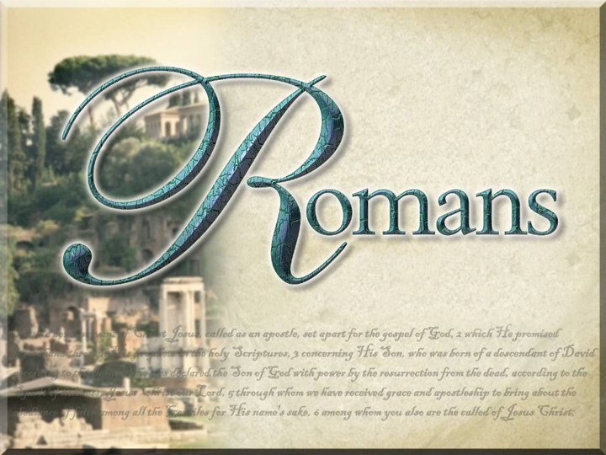

Slide 27
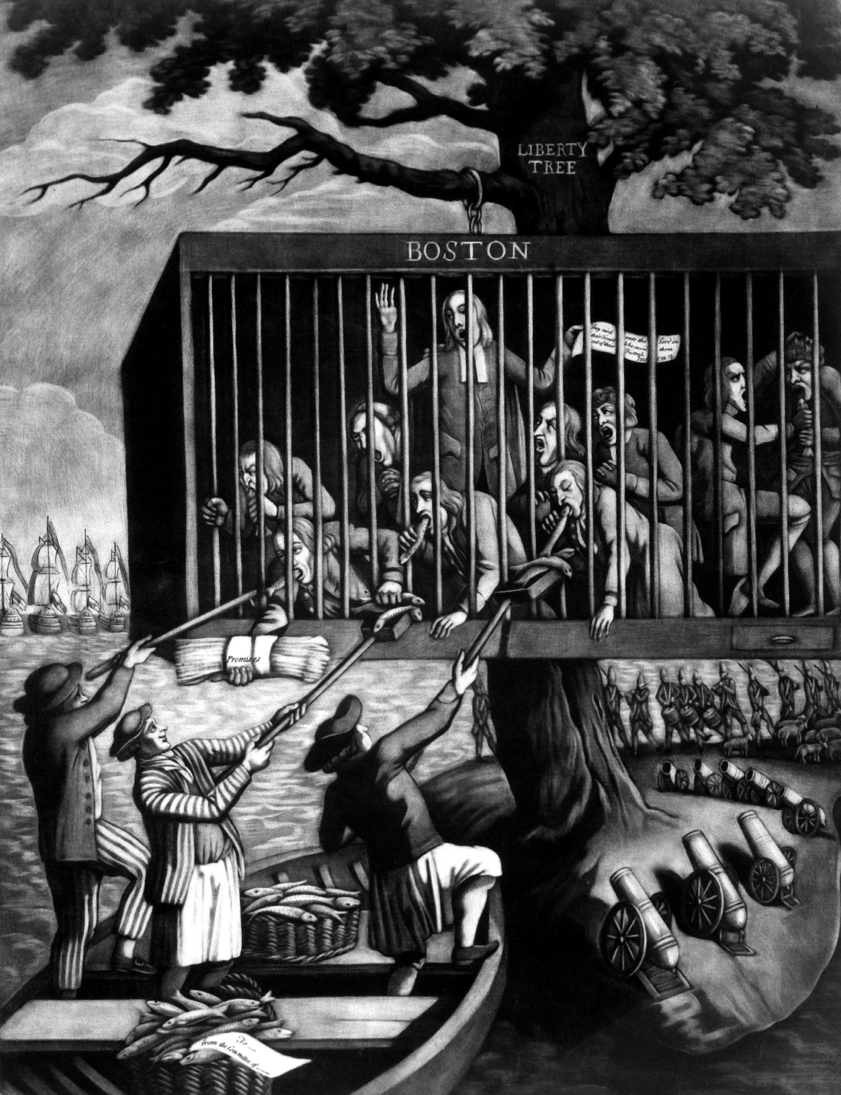
British Cartoon

Slide 28
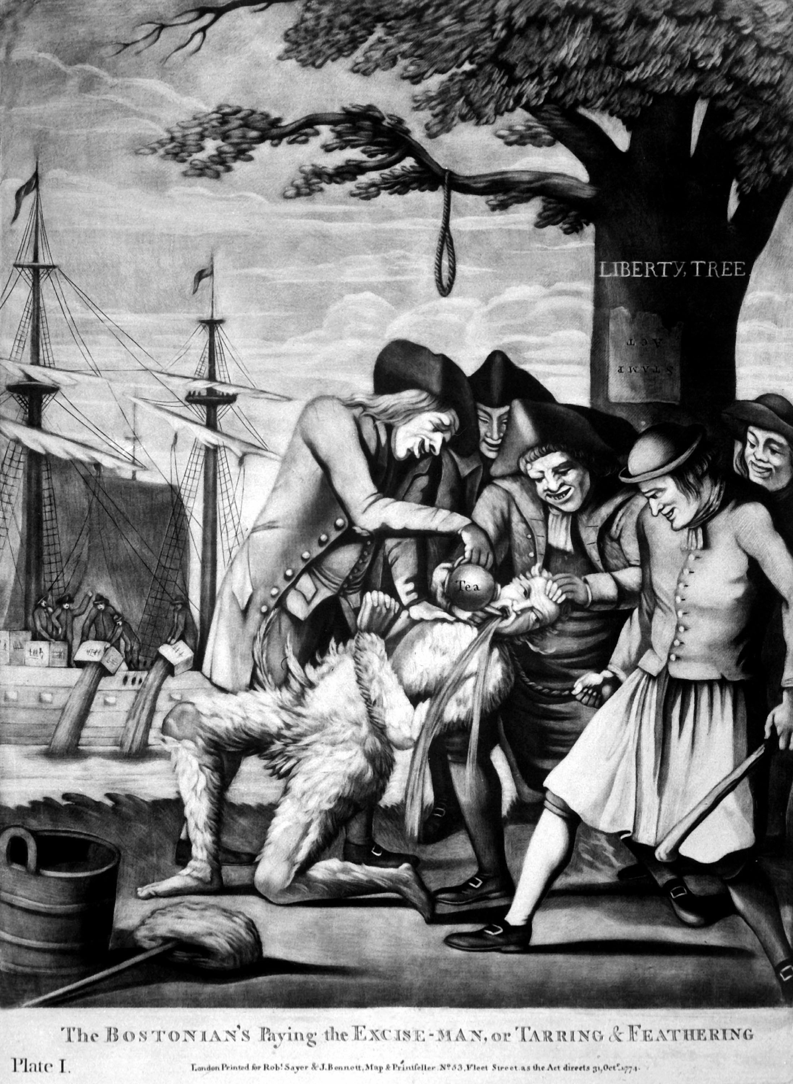
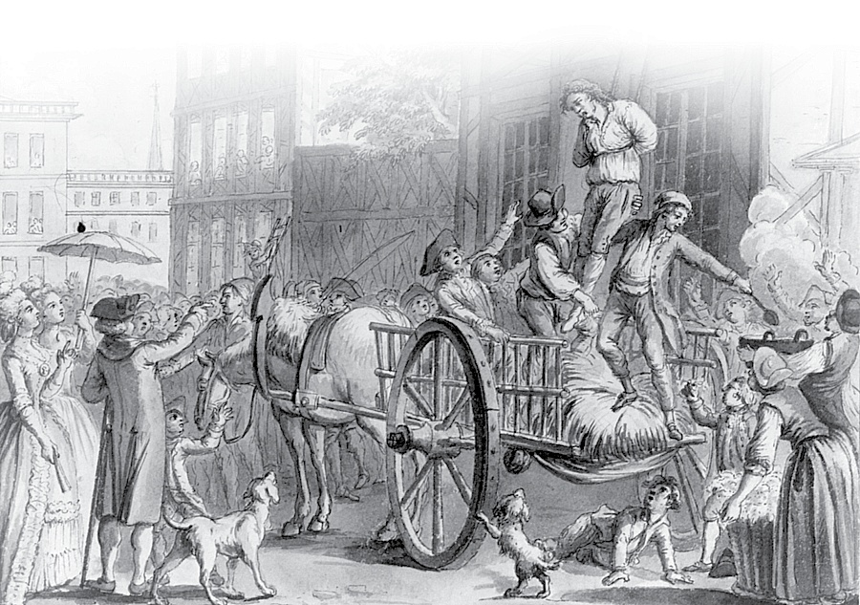

Slide 29
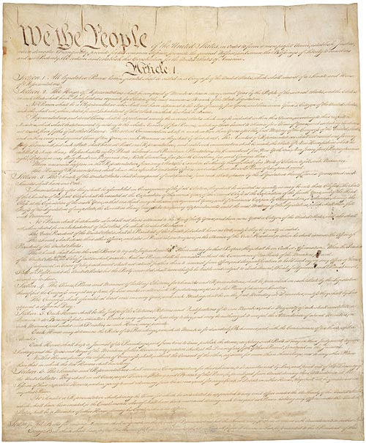
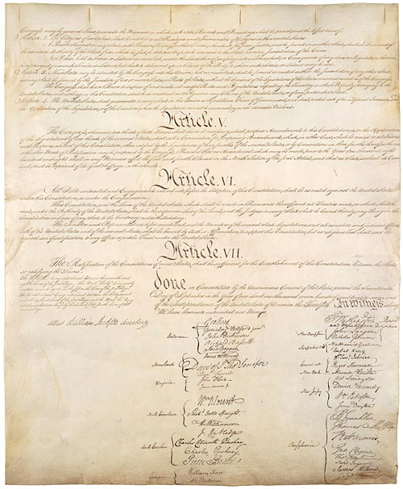

Slide 30
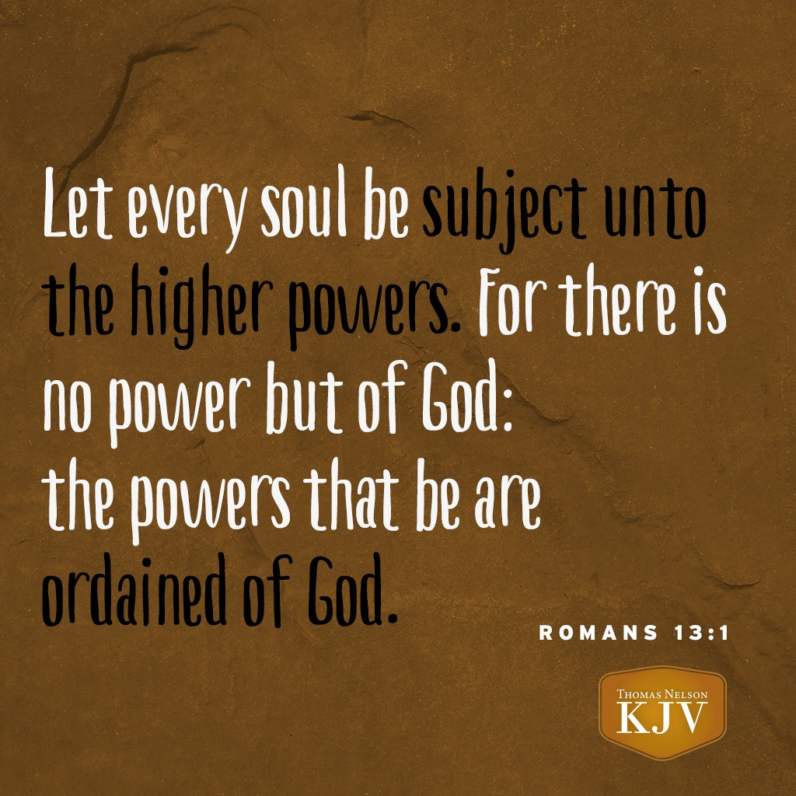

Slide 31
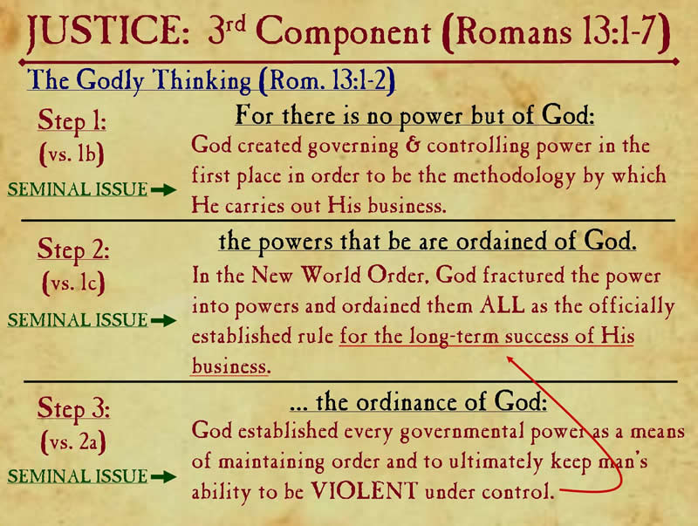

Slide 32
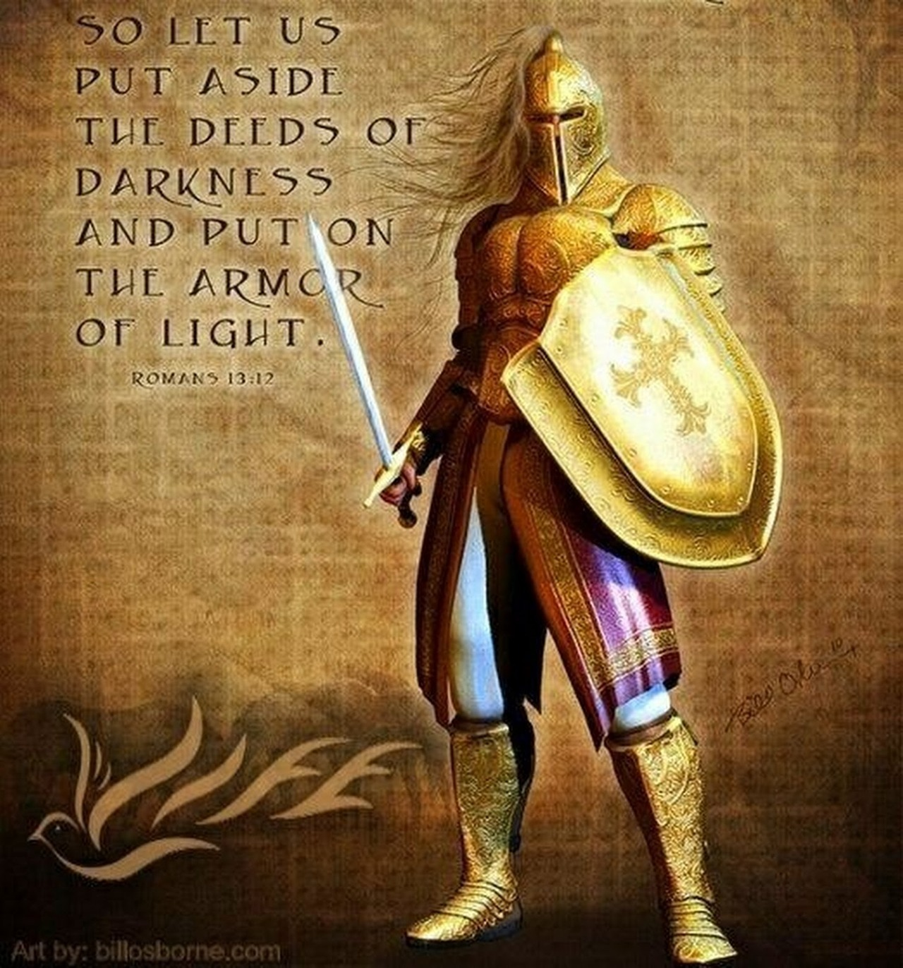

Slide 33
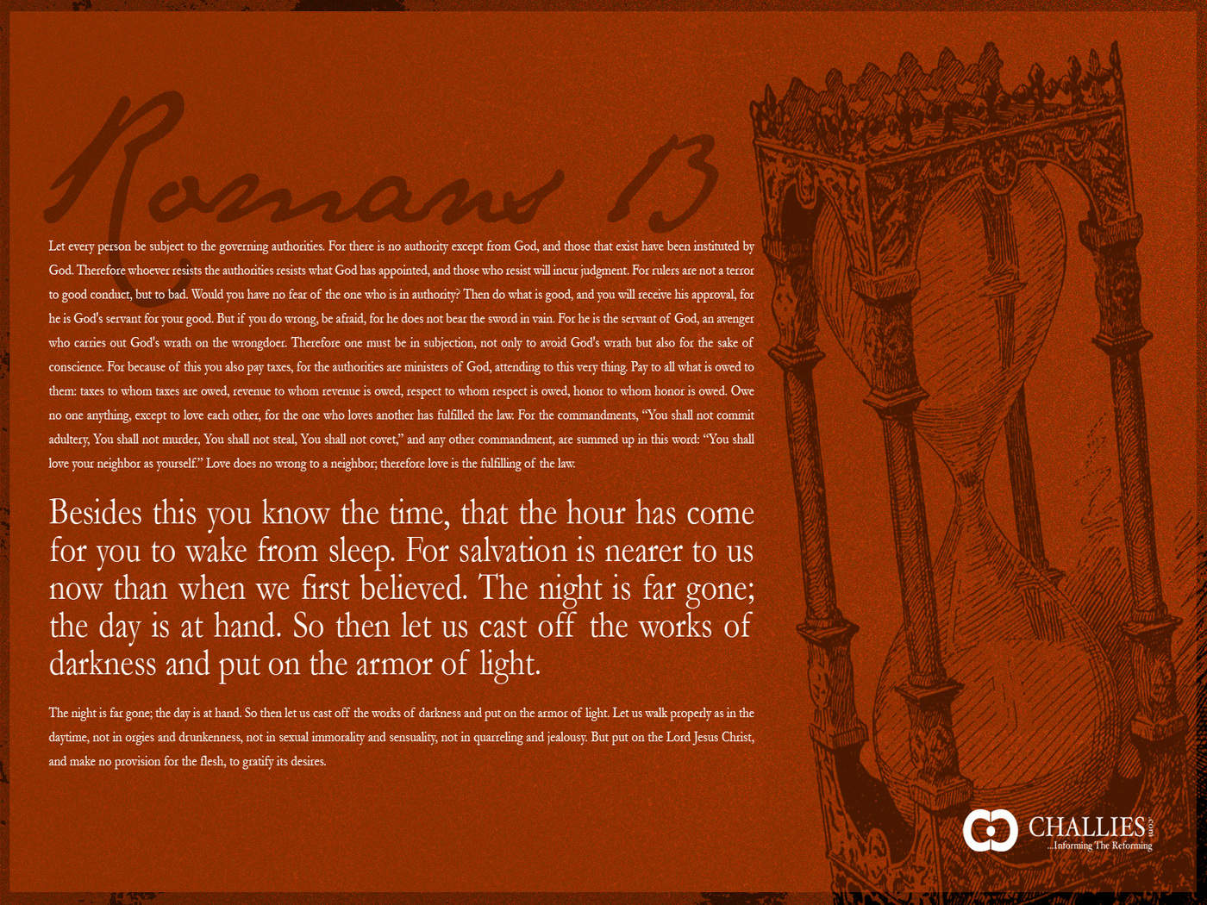

Slide 34
Submission
The Ability to Recognize and Accept Authority:
  Person
  System
  Circumstances

Slide 35
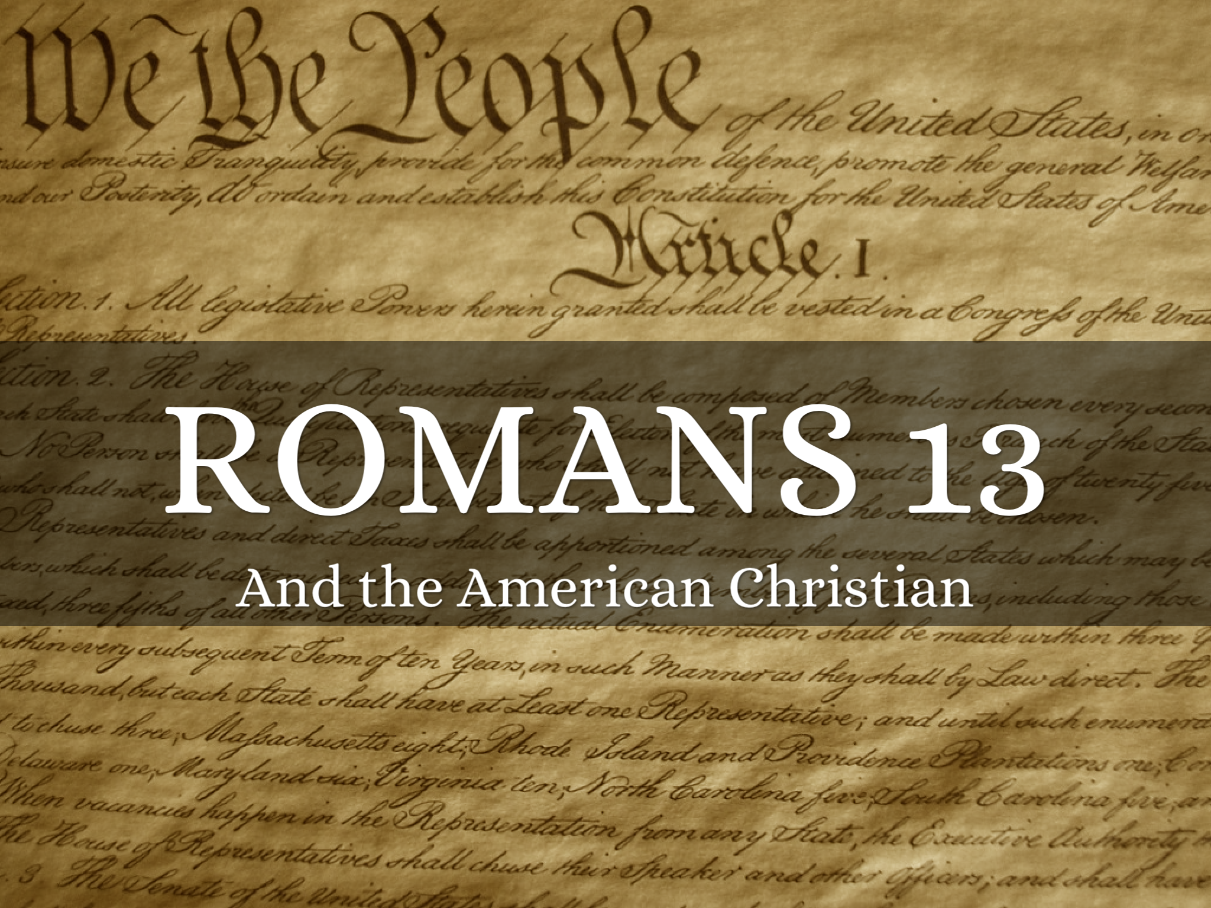

Slide 36
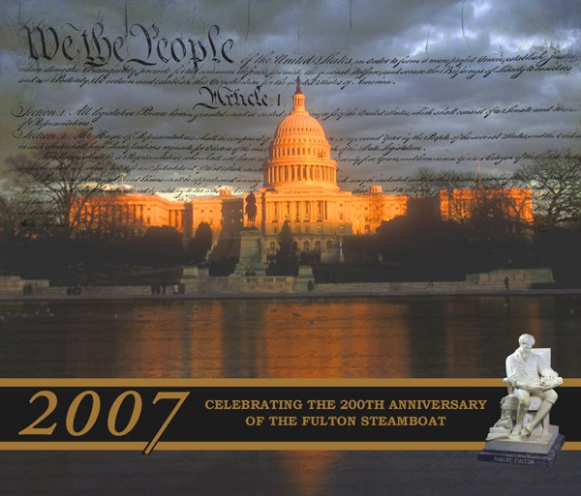


Slide 37
Civil
Government

Slide 38


Slide 39
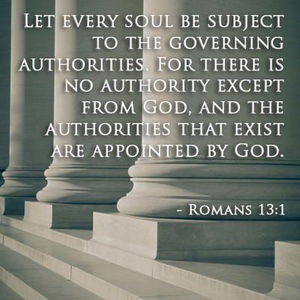

Slide 40
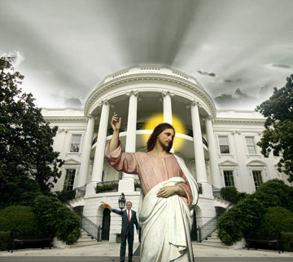
The Christian and Civil Government
David Lee Burris:
William James – “The art of being wise is the art of knowing what to overlook.” Plato – “The punishment which the wise suffer who refuse to take part in government, is to live under the government of worse men.”
Charles Colson – “The Christian, therefore, follows two commandments: to live by Christ’s teaching in the Sermon on the Mount, modeling the values of God’s Kingdom – the one yet to come in its fullness – and at the same time to support government’s role in preserving order as a witness to God’s authority over the present kingdoms of this world. So while the Christian is not to return evil for evil, he may participate in the God-ordained structure that restrains the evil and chaos of the fallen world by the use of force.”
Gregory A. Boyd “The Myth Of A Christian Nation” - ‘In his teachings, Jesus gave Christians a vision of the kingdom of God as a state where greatness is defined by sacrifice and service. This ‘power-under’ model is not found in the ‘power-over’ governments of the world. The two are not reconcilable.”

Slide 41
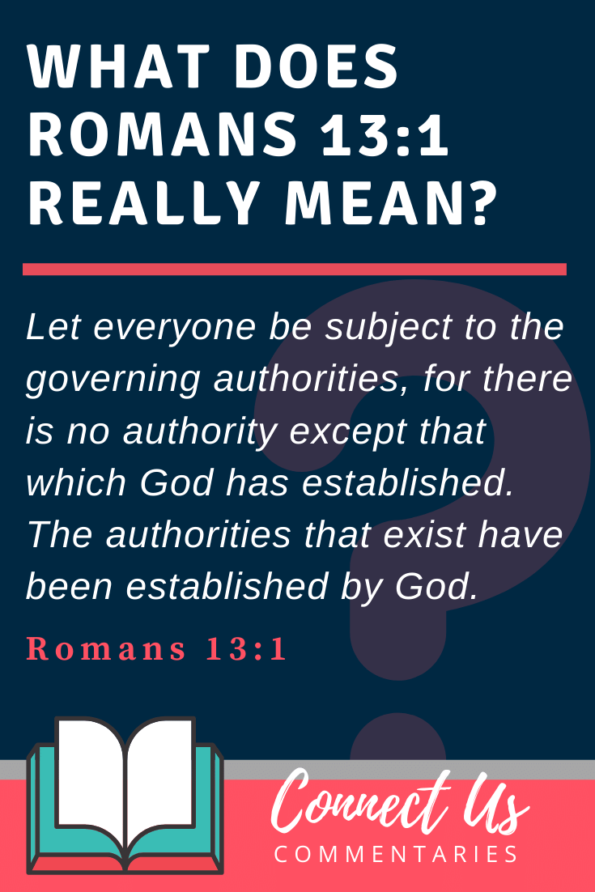

Slide 42
The Context
The Christian religion was destined to go all over the world and by that very occurrence would find itself in places where the whole government was opposed to God and the gospel and Christians would be persecuted
Christians have been everywhere encouraged & commanded that their supreme allegiance is to the Lord Jesus Christ
The question of import to Christians then as now is to what degree are we to offer our allegiance & submission to human government

Slide 43
The kingdoms of the world were then pagan Kingdoms. The laws were made by pagans, and were adapted to the prevalence of heathenism. Those kingdoms had been generally founded in conquest, and bloodshed, and oppression. Many of the monarchs were blood-stained warriors; were unprincipled men; and were polluted in their private, and oppressive in their public character. Whether Christians were to acknowledge the laws of such kingdoms, and of such men, was a serious question, and one which could not but occur very early. It would occur also very soon, in circumstances that would be very affecting and trying. Soon the hands of these magistrates were to be raised against Christians in the fiery scenes of persecution; and the duty and extent of submission to them became a matter of very serious inquiry (Barnes)

Slide 44
The Context
Jewish converts had long been oppressed by the Romans whose whole governing system was built on idolatry. Question: To what extent should our submission go? How far can we socially blend & bend?
Moreover, since the state was so intertwined with the official religion when a Gentile convert viewed their government they saw the idolatry they just left. The assumption was that government is bad and to be resisted
God has sometimes utilized & may still use bad government to do His good work

Slide 45
The Context
There are cases where it is right to disobey the law. When the issues are Biblical and moral we are to take a stand even in the midst of persecution “We will obey God”
Where do we draw the line? We can err in unbridled submission where our principles are violated, and with refused submission where the laws of the land are willfully disobeyed. These are the two type ditches in the road
Since Christians were to be an important part of society their influence was to be felt. Where the government didn’t violate God’s laws, submit, where the issues are biblical and moral obeying God comes first

Slide 46
ROMANS CHAPTER 13 VERSES 1 - 7
Observing God’s Order. Several details in Romans 13 need elaboration for Paul’s ethical instruction to become clear for the modern reader. The chapter’s opening sentences twice affirm that government authority is put in place by God (v. 1).²¹ God has established a hierarchy of civil authority to regulate the otherwise strong tendency toward unruliness in human society. Anyone who rebels against this ordering of authority, therefore, is rebelling against God’s design (v. 2). Paul’s vocabulary clarifies his point. Paul describes civil authority as part of the way God “orders” the world. This idea of God’s ordering, organizing, appointing or arranging is central to the passage, with several derivatives of the verbal root “to order” appearing five times in three verses (vv. 1 [twice], 2 [twice], 5 [once]). It is clearly Paul’s key concept. God “establishes/orders/institutes governing authorities” (v. 1) not by bringing any particular leader to power—though he may at times also do that—but by providentially creating structures of governing authority that exercise responsibilities delegated by God. When Paul says that “there is no authority except that which God has established” (v. 1), he is not claiming that divine providence places all rulers in their specific positions of power. He is saying that the various stations of authority that make up civil government are put in place by God’s providential ordering of human society.²³
Understanding Paul’s use of “ordering” vocabulary helps to answer long-standing questions about Christian obedience to tyrannical rulers. The problematic logic, based on Romans 13, usually goes like this: If every governing authority is put in place by God, so that disobeying the authority is the equivalent of disobeying God, then even a man must have been put in place by God, and disobeying becomes the equivalent of disobeying God. Paul’s emphasis on ordering rather than personnel makes it clear that God establishes positions of authority, positions that are occupied at different times by different leaders of greater or lesser ability, wisdom, and moral fiber. Paul does not make God responsible for ordaining every leader who ever fills an office. Christians are obligated to respect the role of government per se in their lives, but that is a far cry from being obligated to obey, much less enthusiastically endorse, every wretched leader braying for national allegiance to his every foolish decision.
Crump, D., & Rah, S.-C. (2018).
I pledge allegiance: a believer’s guide to kingdom citizenship in twenty-first-century america. Grand Rapids, MI: Eerdmans.

Slide 47
ROMANS CHAPTER 13 VERSES 1 - 7
Subordination vs. Obedience. A second—equally important—matter of vocabulary arises once we notice that Paul does not command believers always “to obey” the governing authorities (Rom.13:1). Translations that render Romans 13:1 along the lines of “obey the government” (Living Bible, Contemporary English Version, Good News Translation, Worldwide English) seriously misrepresent Paul’s words. Instead of commanding obedience, Paul tells the church “to be subject/to submit” to the way God has “ordered” governing authority. If Paul had intended for the church always to obey the government, he could have used the common word hupokouō (obey) to make his point. But he doesn’t do that; instead, Paul stays with the “order” word group and directs believers to be “subordinate” (vv. 1, 5) to the authorities that “have been ordered” by God. In effect, he is reiterating the need for believers to cooperate with God’s design in ordering human society.
Following the logic of verse 3 is crucial for understanding the full significance of Paul’s refusal to tell the church that they must always obey the government. Notice that Paul’s description of civil authority is utterly idealistic, in so far as he assumes that the church can always count on the government to faithfully enforce God’s expectations. “Rulers are not a terror to those who do what is right but to those who do wrong. If you don’t want to be afraid of the one in authority, do what is right and the authority will praise you” (my translation). Had Paul intended to deliver a lesson on Christian obedience, he missed a perfect opportunity to do so. Notice that he does not say, “Shed your fear of authority by doing what you are told; be obedient.” Instead, Paul counsels the church to free itself from any fear of authority by always “doing what is right.”
At least two assumptions are at work in this statement. First, Paul’s argument assumes that government authorities will never be corrupt. Their judgments will always faithfully reflect God’s judgments concerning what is good and bad, right and wrong, just and unjust. But we all know better. The claim that “rulers are not a terror to those who do what is right but to those who do wrong” is not always true, and Paul knew it. It is no secret to us or to Paul that rulers can easily reward those who do wrong and become a terror to those who do what is right, but Paul is describing the ideal, the way things are supposed to be, for the sake of his argument.

Slide 48
ROMANS CHAPTER 13 VERSES 1 - 7
Paul’s second assumption is that when government functions as it should, citizens never need to be afraid about doing what is right because “the right” is always what governing authorities will want from their citizens. Those who do what is right can be confident in their Christian obedience because they are simultaneously being submissive to authority, as God requires. In an ideal world, a believer’s act of submission will be synonymous with obedience because the perfect, incorruptible government will never ask its citizens to disobey God. Unpacking these assumptions at the root of Paul’s idealization of earthly authority also exposes the prick hidden in his argument. Paul knows that the Roman government does not measure up to this ideal. He cannot possibly instruct the Roman church always to obey a government that made public sacrifice to the Roman pantheon a civic responsibility; but he can tell them always to do what is right.
When Christians act on what they know is right and those actions coincide with the government’s expectations, Paul’s argument predicts the happy outcome—“do what is right and the authorities will praise you.” But when doing what is right puts the believer on a collision course with government expectations, Paul’s instructions take on even greater significance: “Still do what is right.” As long as Jesus’s disciples live in this world, however, they must anticipate times when the governing authorities will not praise them for doing what they believe is right in the sight of God.
Christians are not commanded always to obey their government or its laws. The church is told to be submissive and always do what is right. Obedience is one way of showing submission to authority, but submission and obedience are not synonymous. In some circumstances the submission God requires will work itself out as disobedience to governing authority. When a government expects believers to do things that the latter believe are wrong, things that will compromise their relationship with Christ, things that will violate their kingdom citizenship, then godly adherence to what is right demands conscientious disobedience against the government. At that point, faithful disciples remain submissive to misguided governmental authority, not by compromising their Christian conscience, but by freely submitting themselves to whatever punishment the authorities threaten to impose for disobedience. Living out the values of the kingdom of God always comes first for the followers of Jesus.
Crump, D., & Rah, S.-C. (2018).
I pledge allegiance: a believer’s guide to kingdom citizenship in twenty-first-century america. Grand Rapids, MI: Eerdmans.

Slide 49
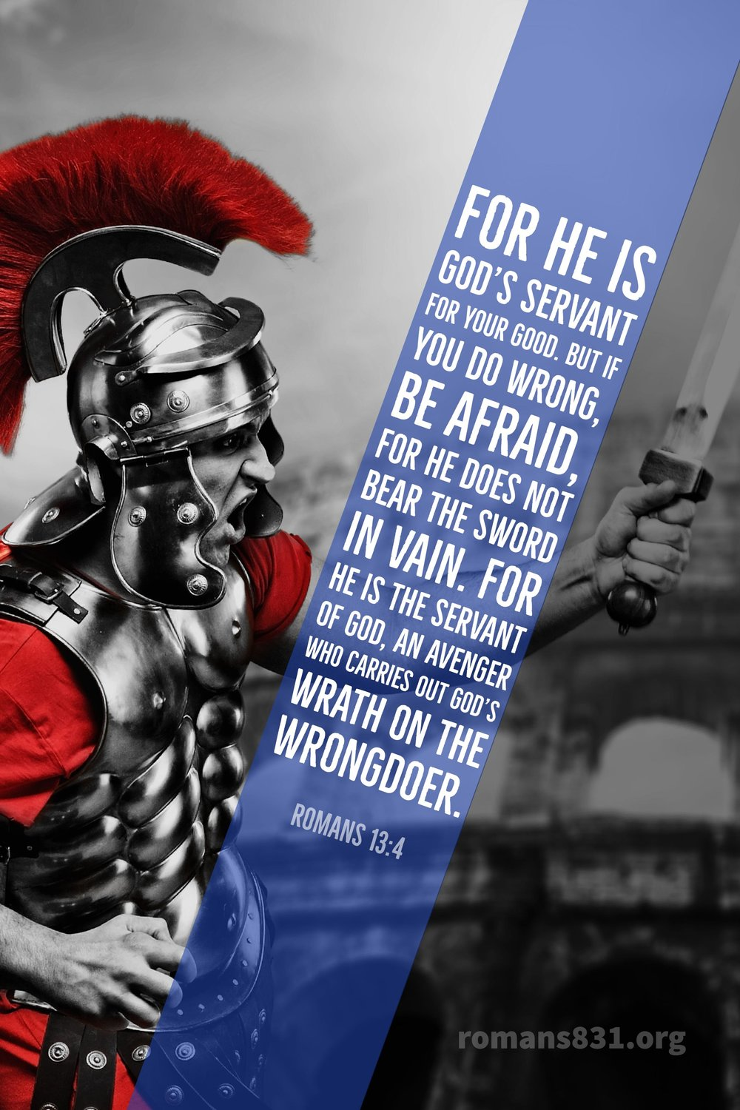
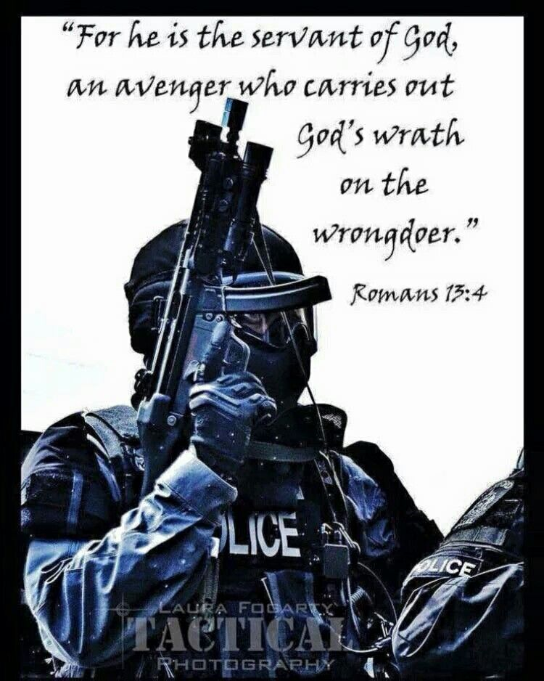

Slide 50
ROMANS CHAPTER 13 VERSES 1 - 7
“Moving to the New Testament, which reveals God’s will this side of the cross, the matter of capital punishment is treated virtually the same. The New Testament clearly teaches that capital punishment is God’s will for human civilization. Consider, for example, Romans 13:1-4. Let every soul be subject to the governing authorities. For there is no authority except from God, and the authorities that exist are appointed by God. Therefore whoever resists the authority resists the ordinance of God, and those who resist will bring judgment on themselves. For rulers are not a terror to good works, but to evil. Do you want to be unafraid of the authority? Do what is good, and you will have praise from the same. For he is God’s minister to you for good. But if you do evil, be afraid; for he does not bear the sword in vain; for he is God’s minister, an avenger to execute wrath on him who practices evil.
This passage clearly affirms that the state—civil government—has the God-ordained responsibility to keep law and order, and to protect its citizens against evildoers. The word “sword” in this passage refers to capital punishment. God wants duly constituted civil authority to invoke the death penalty upon citizens who commit crimes worthy of death. The apostle Paul, himself, articulated the correct attitude when he stood before Porcius Festus and defended his actions by stating, “If I am an offender, or have committed anything worthy of death, I do not object to dying” (Acts 25:11). Paul was acknowledging that the state properly possesses the power of life and death in the administration of civil justice. Peter held the same position as that of Paul. He enjoined obedience to the government that has been sent by God “for the punishment of evildoers” (1 Peter 2:14; cf. Titus 3:1). Jesus implied the propriety of capital punishment when He told the Parable of the Pounds. Those who rebelled against the king were to be brought and executed in his presence (Luke 19:27). Compare that parable with the one He told about the wicked husbandmen in Luke 20:15-16 in which He indicated that the owner of the vineyard would return and destroy the husbandmen.” – Apologetics Press

Slide 51
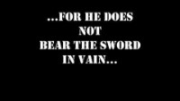

Slide 52

Righteous Citizens
Romans 13:1-7

Slide 53
Righteousness Applied
Big idea (12:1-2)
  present yourself to God
  do not be conformed to the world
  become transformed
Specific Steps...
  Use your gifts to serve (12:3-8)
  Love one another (12:4-13)
  Love even your enemies (12:14-21)

Slide 54
Submit to Governing Authorities
“Submit”
to place under authority of another
here: voluntary choice
involves behavior, words, attitudes

Slide 55
Submit to Governing Authorities
“Submit” = to recognize, respect, and obey those in authority over you
1 Peter 2:13
Submit yourselves for the Lord’s sake to every human institution...

Slide 56
Submit to Governing Authorities
“Submit” = to recognize, respect, and obey those in authority over you
1 Peter 2:18
Servants, be submissive to your masters with all respect, not only to those who are good and gentle, but also to those who are unreasonable.

Slide 57
Submit to Governing Authorities
“Submit” = to recognize, respect, and obey those in authority over you
Only exception: directly contradicts a clear command of God
God
Government
Me

Slide 58
Submit to Governing Authorities
Exodus 1:15–17
Then the king of Egypt spoke to the Hebrew midwives... “When you are helping the Hebrew women to give birth... if it is a son, then you shall put him to death; but if it is a daughter, then she shall live.” But the midwives feared God, and did not do as the king of Egypt had commanded them, but let the boys live.

Slide 59
Submit to Governing Authorities
Acts 5:27–29
...The high priest questioned them, saying, “We gave you strict orders not to continue teaching in this name, and yet, you have filled Jerusalem with your teaching and intend to bring this man’s blood upon us.” But Peter and the apostles answered, “We must obey God rather than men.”

Slide 60
Submit to Governing Authorities
“Submit” = to recognize, respect, and obey those in authority over you
Only exception: directly contradicts a clear command of God
God
Government
Me

Slide 61
Submit to Governing Authorities
Why? Because...
their authority is ordained by God (v1-2)
Daniel 4:32
‘...the Most High is ruler over the realm of mankind and bestows it on whomever He wishes.’

Slide 62
Submit to Governing Authorities
Why? Because...
their authority is ordained by God (v1-2)
Romans 9:17
For the Scripture says to Pharaoh, “For this very purpose I raised you up, to demonstrate My power in you...”

Slide 63
Submit to Governing Authorities
Why? Because...
their authority is ordained by God (v1-2)
  13:4 (2x) – “minister of God to you”
  1 Pet 2:13 – “submit yourselves for the Lord’s sake to every human institution...”

Slide 64
Submit to Governing Authorities
Why? Because...
their authority is ordained by God (v1-2)
they exist to promote good and punish evil (v3-4)

Slide 65
Submit to Governing Authorities
How? Application in a Democracy
Obey the law
Pay your taxes
Matthew 22:17,21
...Is it lawful to pay taxes to Caesar, or not? ... “render to Caesar the things that are Caesar’s, and to God the things that are God’s.”

Slide 66
Submit to Governing Authorities
How? Application in a Democracy
Obey the law
Pay your taxes
Give honor & reverence
1 Timothy 2:1–2
...I urge that supplications, prayers, intercessions, and thanksgivings be made for all people, for kings and all who are in high positions...

Slide 67
Submit to Governing Authorities
How? Application in a Democracy
Obey the law
Pay your taxes
Give honor & reverence
Exercise your authority wisely
  Be an informed citizen

Slide 68
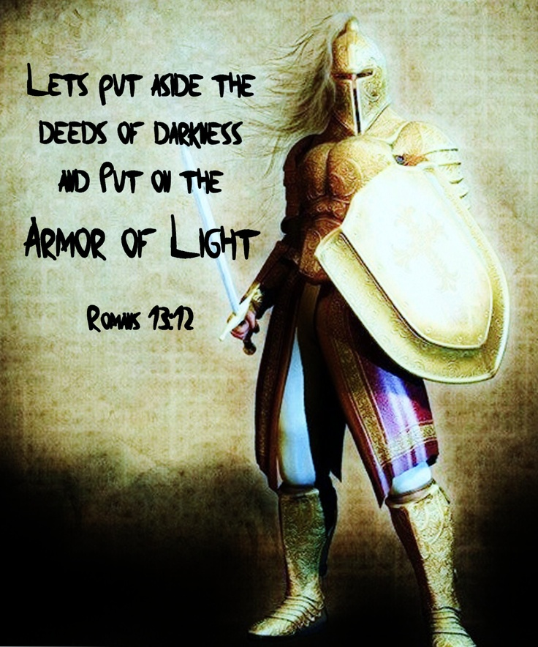

Slide 69
The transformed disciple recognizes the authority behind civil government.
Insight into the transformed life..

Slide 70
Let every person be in subjection to the governing authorities. For there is no authority except from God, and those which exist are established by God. He who resists authority has opposed the ordinance of God; and they who have opposed will receive condemnation upon themselves. (Romans 13:1-2)

Slide 71
Since God is the source of all authority, then the authority of government must originate in the God Almighty Himself.
“And surely I will require your lifeblood; from every beast I require it. And from every man, from every man’s brother I will require the life of man. Whomever sheds man’s blood, by man his blood shall be shed, for in the image of God He made man. (Genesis 9:5-6)

Slide 72
God is sovereign ruler over all the governments of this world.
“This sentence is by the decree of the angelic watchers, and the decision is a command of the holy ones, in order that the living may know that the Most High is ruler over the realm of man, and bestows it on whom He wishes, and sets over it the lowliest of men.” (Daniel 4: 17)

Slide 73
The converted and transformed disciple acknowledges the authorized functions of civil government.
Insight into the transformed life..

Slide 74


Slide 75
The converted and transformed disciple obeys the law of the land.
Let every person be in subjection to the governing authorities. (Romans 13: 1)

Slide 76
“Submit”
hupotasso
  to individually subordinate
  to subject one's self, obey
A Greek military term meaning "to arrange [troop divisions] in a military fashion under the command of a leader". In non-military use, it was "a voluntary attitude of giving in, cooperating, assuming responsibility, & carrying a burden".
The attitude or action of understanding the value and/or necessity of placing ourselves as citizens under earthly human authority
With Caveat: The Rebel Is Un-Christ Like!

Slide 77
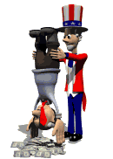
The converted transformed disciple renders to their civil government all that is due it.
Insight into the transformed life..

Slide 78
For rulers are not a cause of fear for good behavior, but for evil. Do you want to have no fear of authority? Do what is good, and you will have praise from the same; for it is a minister of God to you for good. But if you do what is evil, be afraid; for it does not bear the sword for nothing; for it is a minister of God, an avenger who brings wrath upon the one who practices evil… (Romans 13: 3 - 4)

Slide 79
Hidden Principle
If we are to be persecuted and prosecuted let it be for righteousness sake
There is an assumption that there are good laws and fair rules for societal betterment that have been initiated & instituted by ungodly people

Slide 80
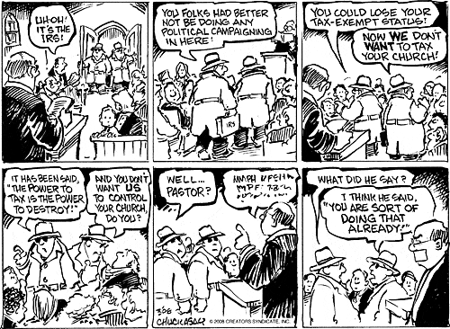

Slide 81
The transformed disciple renders to every government official their due.
For because of this you also pay taxes, for rulers are servants of God, devoting themselves to this very thing. Render to all what is due them: tax to whom tax is due; custom to whom custom; fear to whom fear; and honor to whom honor. (Romans 13:6-7)

Slide 82

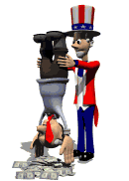
The converted transformed disciple renders to their civil government all that is due it.
Insight into the transformed life..

Slide 83
The motivations for obedience
Because of judgement — Because of our being punished!
Because of conscience — Because it is the right thing to do!

Slide 84
David Lee Burris:
Abraham Lincoln – “The true rule, in determining to embrace, or reject any thing, is not whether it have any evil in it; but whether it have more of evil, than of good. Almost anything, especially of government policy, is an inseparable compound of the two…”
The Christian submits to all civil governments, not just to representative democracies.
The Christian must submit to civil government even when he may disagree with its policies or even when its rulers are morally reprobate.
The Christian may use civil government for justice and protection as long as its use does not hinder the cause of Christ.

Slide 85
The Christian is not obligated to obey what is contrary to the will of God.
The Christian may not resist the state by force of arms to defend his faith.
God will in His way and in His time remove those governments that do defy His authority and His purposes.

Slide 86
Spiritual Transformation:
Benchmark To Hallmark
Overcoming Evil With Good

Slide 87
The transformed disciple seeks to overcome evil with good.
Insight into the transformed life..
But How?

Slide 88


Slide 89

We Want Comfortable Discipleship
We want our discipleship compartmentalized
  Express faith Sunday fervent
  Restrict the spiritual to times & places of least discomfort
  Preside as Kings & Queens of mental castles with very many rooms & areas out of bounds

Slide 90
We Want Comfortable Discipleship
We consumerize our discipleship
  “What’s in it for me?” & “What have you done for me recently?” questions are always in mind.
  Unconsciously, we project continuously our cost calculating culture of benefit & burden analysis
  We seem to say: “Ask not what can we do for God but what can He do for us.” Each new day, by this attitude we reflect an inner corruption desirous of an inverted relationship with God.

Slide 91
We Want Comfortable Discipleship
We are complacent disciples
  We prefer to have events occur such that they cause minimal trouble and bother to our established patterns
  We assume that if it is God’s Will that something happens in our world He can do that thing without our taking part
  We presume our being contented is a goal accepted & destiny approved

Slide 92
We Want Comfortable Discipleship
We want our discipleship casual
  What would happen with our lives, our families, our neighborhood & employment, and especially to our churches, if we took God seriously
  Routine & regime “Christianity lite”
  The fear of being labeled fanatics prevents us being fans of God’s plan
  Avoidance of these images instead hinder integrity to professed faith

Slide 93
We Want Comfortable Discipleship
We have compromised our discipleship
  We claim to love God but still love sin
  We assume we are allowed some sin because we retain our human nature
  We excuse the actions of the flesh by pointing to it’s evident weakness
  We fail to understand or appreciate the significance of spiritual “being”

Slide 94
We Want Comfortable Discipleship
We become conceited disciples
  We believe we know better than God
  We equate either years in the faith or years in the church with maturity
  Our actions & words – our say and our do relate little with each other
  This arrogance amounts to an inner wall & low ceiling to further growth

Slide 95

We Want Comfortable Discipleship
We are conditional disciples
  We have assigned duty to God as if arranged in one-sided contract
  We keep that which we don’t want included out of the negotiations
  We attribute to God the role play of trapped tight “genie” in bottle

Slide 96


This Comfort Zone
DANGER ZONE

