Slide 1
Greek Classic Philosophy
By David Lee Burris

Slide 2
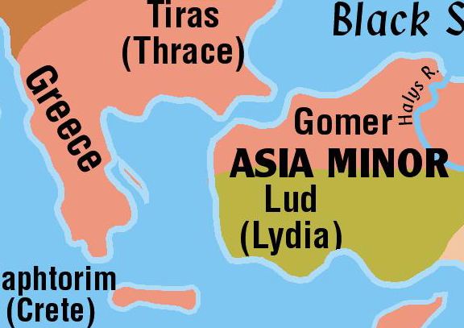
Greece
By New Testament times the emphasis shifts from Egypt and Mesopotamia to the Mediterranean world
Judah is under Persian control when the Old Testament closes
Their capital was East of the Tigris River
During the period between Malachi and Matthew, the Persians were defeated by the Greeks
Greek army under the leadership of Alexander the Great
Conquered all the way to the Indus River on the edge of India
The Greek language, customs, culture spread all the way to India

Slide 3
The architects of the Parthenon, to achieve the optical illusion of perfect straightness, angled the building’s columns so that extended they meet one and a quarter miles above the temple’s roof – over its exact center.
Classical Greece

Slide 5
What Is Man?
“Man is nature’s sole mistake.”
--W. S. Gilbert
“[Man] is a brute, only more intelligent than the other brutes; a blind prey to impulses.”
--Thomas A. Huxley

Slide 6
What Is Man?
“Man is God’s highest present development. He is the latest thing in God.”
--Samuel Butler
“Man—a creature made at the end of the week’s work when God was tired.”
--Mark Twain

Slide 7
What Is Man?
“Man is the measure of all things.”
--Protagoras
“Man is a blind, witless, low-brow anthropocentric clod who inflicts lesions on the earth.”
--Ian McHarg

Slide 8
What Is Man?
“Man . . . of all the beasts of prey [is] . . . the only one that preys systematically on its own species.”
--William James

Slide 9
What Is Man?
The Psalmist understands by the Spirit:
We are made by God
We are only a little lower than the heavenly beings such as angels
We are crowned with glory and honor

Slide 11
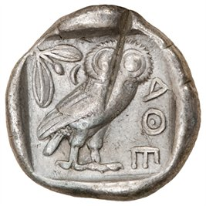
The Importance Of Thinking Rightly
Line 927 Of Aeschylus’ Agamemnon:
“And not to think wrongly is the greatest gift of God.”

Slide 12
Greek Classic Philosophers
Anaxagoras –
The first philosopher to reside in Athens, Anaxagoras rejected the four elements of Empedocles and posits a concept of seeds, elemental particles of every known quality.

Slide 13
Greek Classic Philosophers
Anaximander –
Possibly a student of Thales, he believed the primary source of all things was very indefinite. He made advances in astronomy by charting the paths of the Sun and Moon.

Slide 14
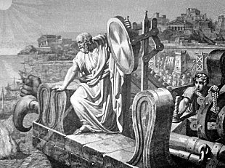
Greek Classic Philosophers
Anaximenes –
The youngest of the Milesian philosophers, Anaximenes believed that arche, the first principle or origin, of everything was air and not water, as Thales believed.

Slide 15
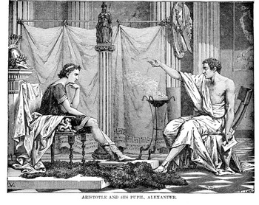
Greek Classic Philosophers
Aristotle –
A student of Socrates, he was the first thinker to divide intellectual inquiry into distinct subjects such as biology, psycho-logy, political science, ethics, & physics. After tutoring Alexander the Great, he returned to Athens and opened his own school, the Lyceum.
* Aristotle Tutored Alexander @ Age 13

Slide 16
Greek Classic Philosophers
Democritus –
Democritus devised the first atomistic view of the world; he believed that the world was composed of only atoms & void.

Slide 17
Greek Classic Philosophers
Empedocles –
A pluralist, he believed that there are four root elements: fire, air, water, and earth. These four elements, governed by the two basic forces in the universe – love and strife – compose everything in existence.

Slide 18
Greek Classic Philosophers
Gorgias –
A rhetorician whose impressive oratorical style brought him influence in Athens. One of the first great Sophists, his work brought forth harsh criticism from Plato & Aristotle.

Slide 19
Greek Classic Philosophers
Heraclitus –
The most radical of the pre-Socratics, he believed that nothing was stable or permanent. His enigmatic writing used contradictions to describe the world flux.

Slide 20
Greek Classic Philosophers
Hippias –
A very prominent early Sophist and self-described authority on all subjects, he lectured on poetry, grammar, history, politics, archaeology, math, and astronomy.

Slide 21
Greek Classic Philosophers
Parmenides –
The pre-Socratic philosopher was the first of Western philosophy in focusing explicitly on questions of Being. As a pure rationalist, he believed that the physical world we perceive is filled with change, multiplicity, and major contradictions making it unreliable. As result, he was the first philosopher to emphasize the separation of appearance from reality.

Slide 22
Greek Classic Philosophers
Philolaus –
A pre-Socratic philosopher, he was the first to publish the Pythagorean notion that this world is an orderly whole and constituted by numbers.

Slide 23
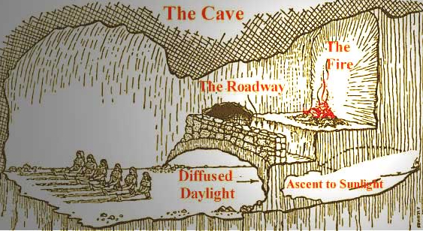
Greek Classic Philosophers
Plato –
A student of Socrates, he immortalized his teacher by using him as the protagonist in his incredibly influential writings. Plato is widely credited with starting a school of philosophy known as “The Academy.”

Slide 24
Greek Classic Philosophers
Prodicus –
A prominent Sophist, Prodicus taught pupils for both domestic and civic affairs. Unlike previous philosophers centered on rhetoric, he focused study on ethics as the concentration of his curriculum.

Slide 25
Greek Classic Philosophers
Protagoras –
He was not interested in nature, rather he believed that human beings were the center of all reality. Thus, Protagoras was the first Humanist in the West.

Slide 26
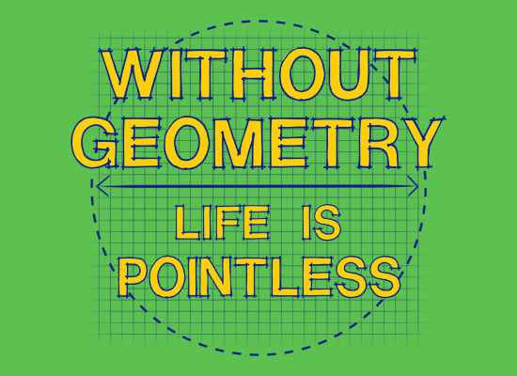
Greek Classic Philosophers
Pythagoras –
While none of his original writing has survived, there are nonetheless many indirect references to his important work from the religious group, the Pythagoreans, which he initiated. The group belief system was formulated from his overall general opinion of an universal harmony that is mathematically derived.

Slide 27
Greek Classic Philosophers
Thales –
Traditionally regarded as the very first Western philosopher, He was one of the legendary Seven Sages. He originated natural philosophy, utilizing rationality to explain nature. According to Herodotus, he even predicted the 585 B.C. solar eclipse.

Slide 28
Greek Classic Philosophers
Thrasymachus –
A Sophist who analyzed the role emotions played in persuasion, but is more well known for his famous discussion with Socrates in Plato’s Republic.

Slide 29
Greek Classic Philosophers
Xenophanes –
A religious thinker, he offered a basic & balanced critique of polytheism. This the initial monotheist amongst philosophers proclaimed that God is permanent & He does not move but enables everything else to both movement and motion.

Slide 30
Greek Classic Philosophers
SOCRATES –
The first great Athenian philosopher, he had no positive teaching but excelled at refutation. His purposeful discourse & targeted questions often centered on social ethical & civic political values; these same queries placed him on public trial on charges of neglecting the designated deities of the city and corrupting youth; his challenging of conventional wisdom cost him his life by poison.

Slide 31
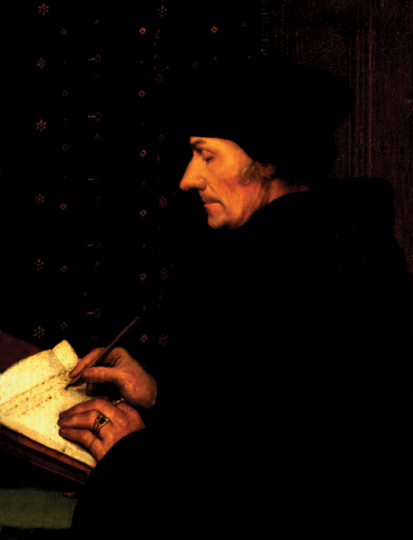
16th Century
Socrates & Erasmus
“The notion that humans are growing increasingly dumb has been around for millennia. Socrates, in his Unapologia, noted how his fellow Athenians did not know their ‘arse from an urn.’ Desiderius Erasmus was equally appalled by the ignorance of his Dutch neighbors. Not only were they all going to hell, he said, but they would probably get lost along the way.”
Erasmus
1500 BC 500 BC AD 1 AD 500 AD 1000 AD 1500 AD 1900 AD 2000

Slide 32
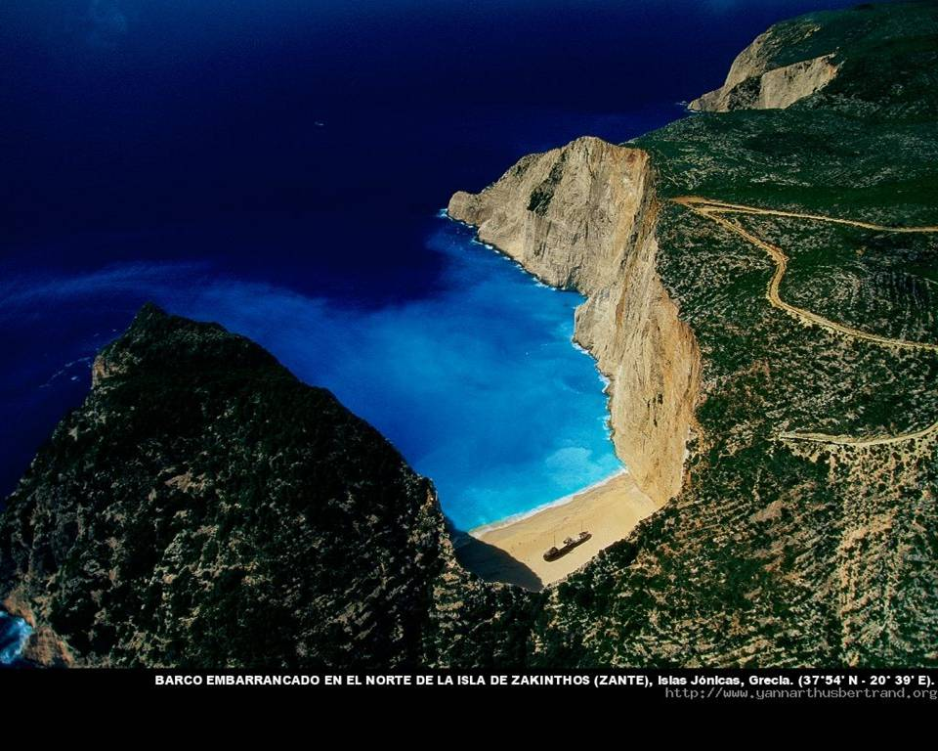
Ionian Islands, Greece

Slide 33
“they discovered the human mind” by professor marvin perry
“The first speculative philosophers in human history emerged in the sixth century B.C. in the Greek cities of Ionia. Curious about the essential composition of nature and dissatisfied with earlier creation legends, the Ionians sought physical, rather than mythico-religious explanations for natural occurrences. In the process, they arrived at a new concept of nature and a new method of inquiry. They maintained that nature was not manipulated by arbitrary and willful gods and that it was not governed by blind chance; rather, nature followed principles of order, general laws that were ascertained by the human mind.”

Slide 34
“they discovered the human mind” by professor marvin perry
“The Ionian cosmologists – Thales, Anaximander, Anaximenes – revolutionized thought when they attempted physical rather than mythico-religious explanations of natural occurrences. Their achievement made possible theoretical thought and the systemati- -zation of knowledge – as distinct from the mere observation and collection of data. What conditions enabled the Greeks to make the breakthrough? Perhaps the poets’ conception of human behavior subject to universal Destiny was extended into the philosophers’ belief that nature was governed by law. Perhaps the breakthrough was postured by the Greeks’ freedom from a priesthood & religious doctrines that limit thought. Perhaps Greek speculative thought was an offspring of the polis, because if law governed human affairs, providing balance & order, shouldn’t the universe also be regulated by principles of order?”

Slide 35
“they discovered the human mind” by professor marvin perry
“In their effort to understand the external world, the cosmologists had created the tools of reason. Greek thinkers then turned away from the world of nature and attempted a rational investigation of man and society. Exemplifying this shift in focus was the Sophists, who wandered from city to city teaching rhetoric, grammar, poetry, gymnastics, mathematics, and music. The Sophists insisted that it was futile to speculate about the first principles of the universe because such knowledge was beyond the grasp of the human mind; they urged instead that individuals improve themselves and their cities by applying reason to the task of citizenship. In applying reason to human affairs, the Sophists attacked the traditional religious and moral values of Athenian society. Some Sophists taught that speculation about the divine was useless; others went further and asserted that religion was just a human invention to ensure obedience to traditions and laws.”

Slide 36
“they discovered the human mind” by professor marvin perry
“Socrates was the pivotal figure in the development of Greek philosophy. Socrates felt that the Sophists taught skills, but that they had no insights into questions that really mattered: What is the purpose of life? What are the values by which man should live? How does man perfect his character? Here the Sophists failed, said Socrates; they taught the ambitious to succeed in politics, but persuasive oratory and clever reasoning do not instruct a man in the art of living. Socrates’ central concern was the perfection of individual character, the achievement of moral excellence. Moral values were attained when the individual regulated his life according to objective standards arrived at through rational reflection; that is, when reason became the formative, guiding and ruling agency of the soul. For Socrates, true education meant the shaping of character according to values discovered through the active and critical use of reason. Socrates believed that reason was the only proper guide to the most crucial problem of human existence – the question of good and evil.”

Slide 37
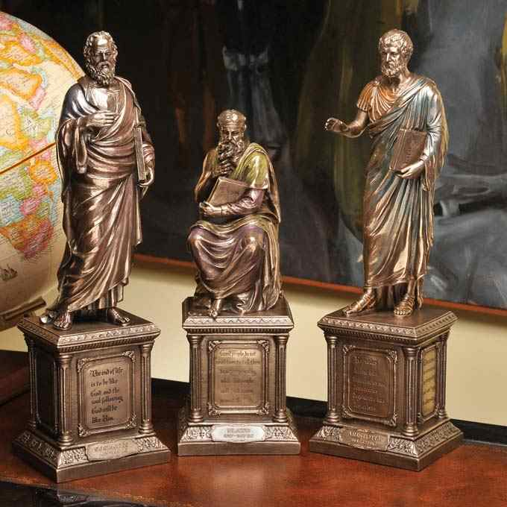
PLATO
Grecian Culture Everywhere

Slide 38
Greek Classic Philosophers
Plato –
A student of Socrates, he immortalized his teacher by using him as the protagonist in his incredibly influential writings. Plato is widely credited with starting a school of philosophy known as “The Academy.”

Slide 39
Greek Classic Philosophers
Aristotle –
A student of Plato, he was the first thinker to divide intellectual inquiry into distinct subjects such as biology, psycho-logy, political science, ethics, & physics. After tutoring Alexander the Great, he returned to Athens and opened his own school, the Lyceum.
* Aristotle Tutored Alexander @ Age 13

Slide 41
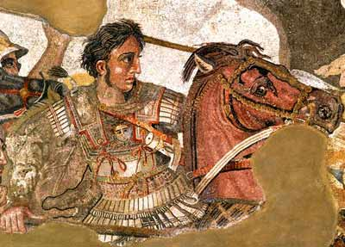
Macedonia Unites Greece

Slide 42
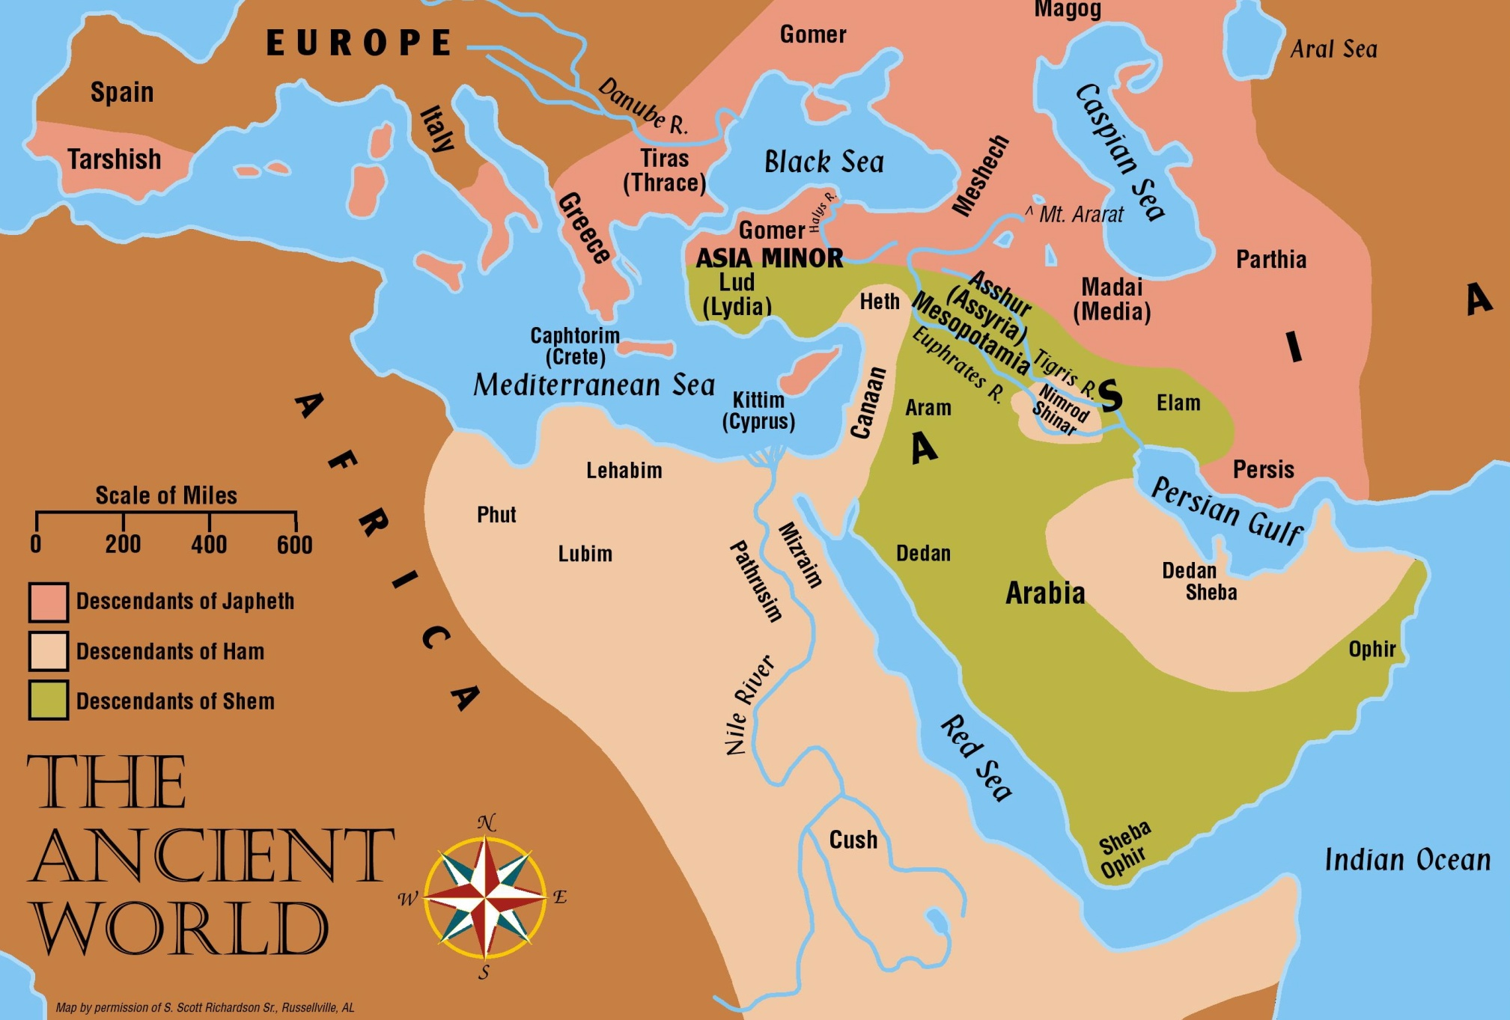
Alexander the Great

Slide 43
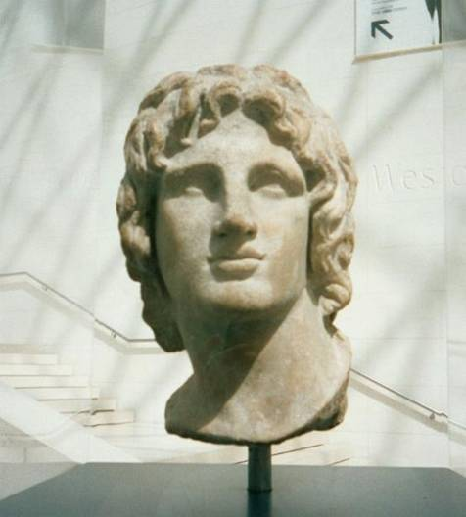
Alexander the Great (356-323 BC)
“And a mighty king will arise, and he will rule with great authority and do as he pleases. (Dan. 11:3)

Slide 44
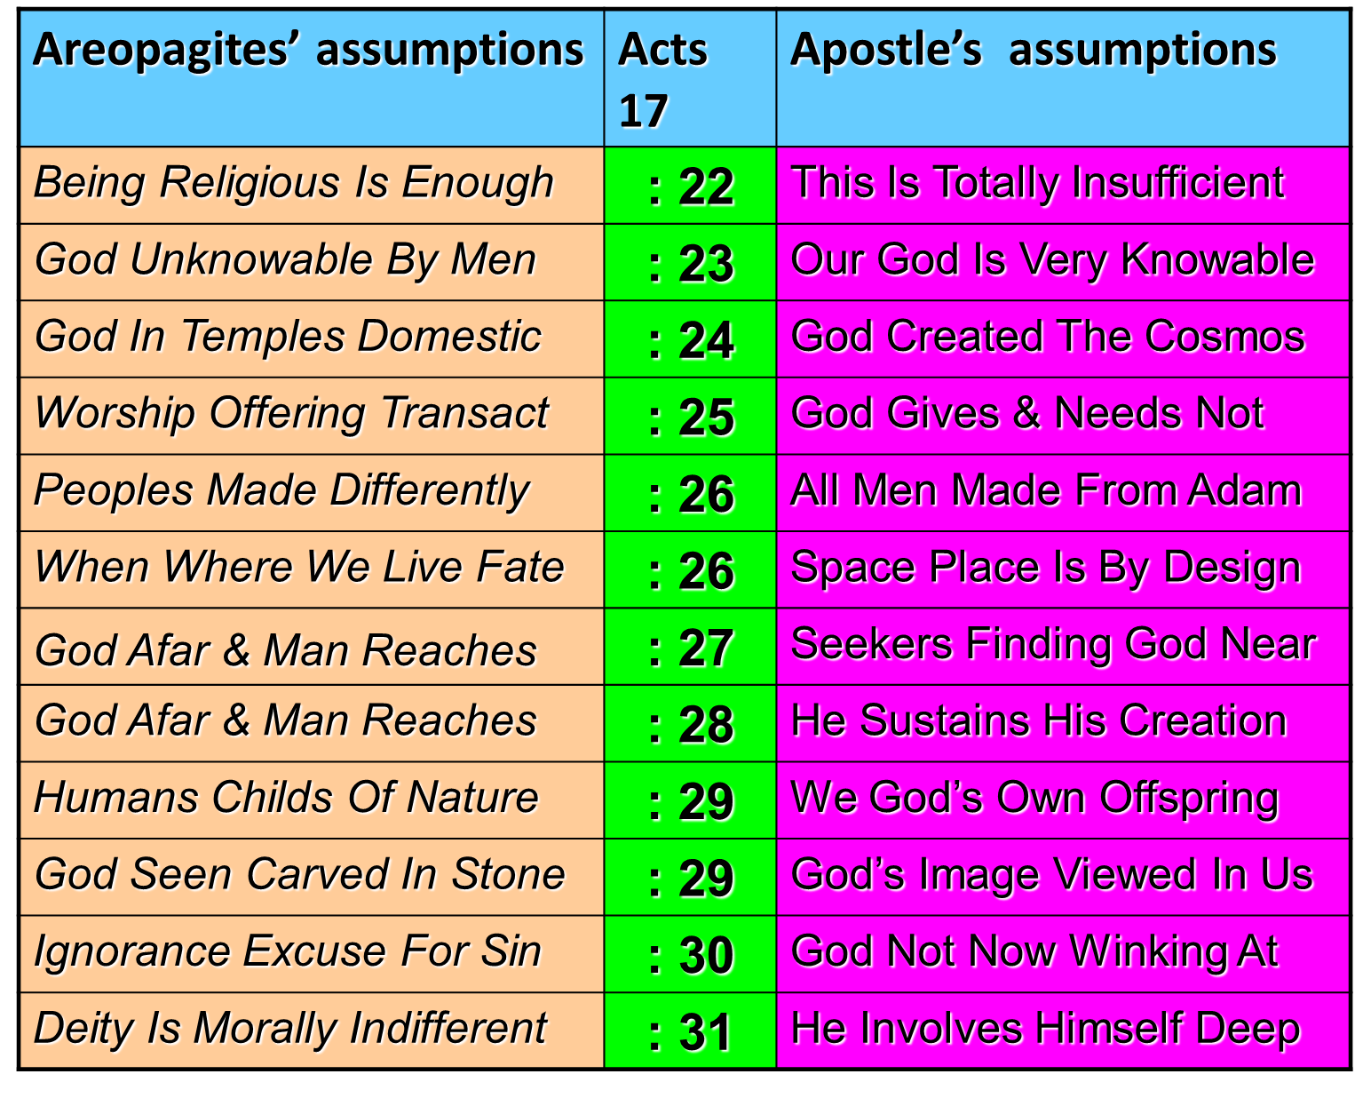

Slide 45
PLATO | ARISTOTLE
Idealism | Realism
Republic | Politics
The “Ideal” State | A Working Government
TRANSCEND Human Selfishness | ACKNOWLEDGE Human Selfishness
Social Unity | Balance

Slide 46
PLATO WAS RIGHT ABOUT
THE BEATIFIC VISION!

Slide 47
THE DARK CAVE
Just as the vision of the Beautiful itself (the eternal Form) rather than beautiful things (temporary figures) dominated Platonism, the Christian objective is internalizing the Beatific Vision.

Slide 49
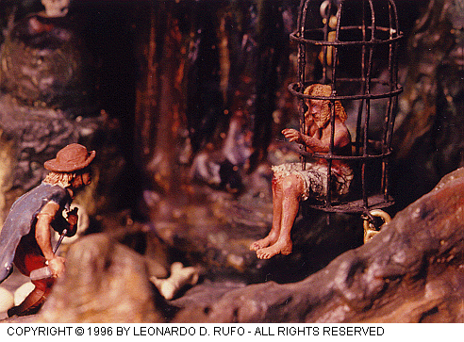
THE DARK CAVE
THE WORLD OF OUR SIGHT IS LIKE
THE HABITATION IN PRISON,
THE FIRELIGHT THERE
TO THE SUNLIGHT HERE!

Slide 50
THE DARK CAVE
Much of modern secularism is due to the fact that the “other world” of Plato’s transcendence was swallowing up “this world” of historical existence. Today’s problem is the opposite - the situation has been reversed – whereby the secular reality has encroached & crowded out our beautiful horizon!

Slide 51
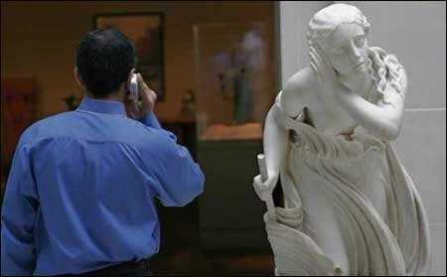

Slide 52
THE DARK CAVE
THE FOCUS LOCUS BETWEEN
THE DARKENED SHADOWS
OF VISIBLE AUTHORITY
& INVISIBLE CHURCH
MYOPICALLY WALL US
WITHIN THE CAVE
OF PLATO'S SHADOWS!

Slide 53
“they discovered the human mind” by professor marvin perry
“Dialectics affirmed the acquisition of knowledge was a creative act. Dialogue implied that reason was meant to be used in relations between human beings & that they could learn from each other, help each other, teach each other, and improve each other. It implied further that the human mind could and should make rational choices. Through thought as dialogue, people could make ethical choices, impose rules on themselves & give form to their existence. For Socrates, the ethical way of life required as a prerequisite - conscious choice!”

Slide 54
Greek Influence: Self-Defined Hellenism
Of Isocrates’ Panegyricus In 4th Century B.C.
He says that the term ‘Hellenes’ is no longer a race but a form of intellectual comprehension; and he follows this with the statement that what Hellene now encompasses are all ‘who share our culture, rather than those who share our blood.’
It is those sharing paideia. The word translates as ‘culture,’ but in a wider and deeper sense of an overall philosophical and aesthetic outlook. ‘Those who come together with us, in what we take to be the most significant aspects of life – aspects that find a limited creature committed to the doomed but defining task of self-perfection, are Hellenes.’ [Here, then, is a statement of the birth of philosophy.]

Slide 55
David Lee Burris:
Deep Damage - Both Hardware & Software Programs Of Correspondence & Communication;
Pagan Incorporations - Primitive Rites/Rituals, Feasts/Festivals, Customs/Celebrations & Female Deity/Myth Demigods
Church
WALLS
Greek
GIFTS

Slide 56
Truth Lies Between The Extremes
Ancient Greek mythology tells the tale of Odysseus, the heroic king of Ithaca whose 10-year journey home after the Trojan War became one of the world's most famous epics. At one point in the journey, his ship was heading straight for two deadly hazards -- on one side was Scylla, a six-headed monster disguised as a giant rock, and on the other side was Charybdis, a sinister whirlpool born from the sea god Poseidon. The perils were close enough to pose an inescapable threat to ships passing through, forcing the captain to choose between the two evils. A Latin proverb from this story, "incidit in scyllam cupiens vitare charybdim" (he runs on Scylla, wishing to avoid Charybdis), is in modern English "between a rock and hard place.”

Slide 57
400 YRS: REFINED GOLD MEAN
TO DIALECTIC MATERIALISM
THESIS
SYNTHESIS
ANTI-THESIS

Slide 58
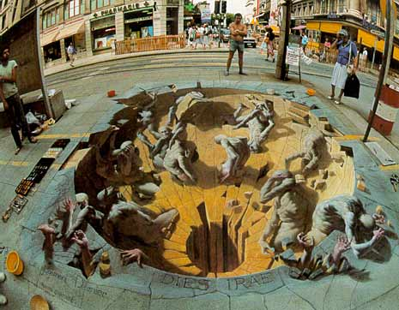
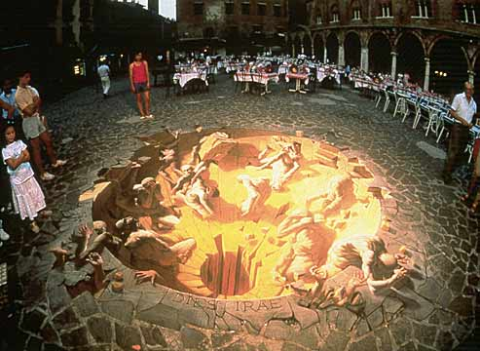
The Golden Mean!

Slide 59
SYNCRETISM
“The attempt to assimilate differing or opposite doctrines and practices, especially between philosophical and religious systems, resulting in a new system altogether in which the fundamental structure & tenets of each have been changed. Syncretism of the gospel occurs when its essential character is confused with elements from the culture.”
* Dictionary Of Theological Terms, Grenz & Guretzki

Slide 61
“What indeed does Athens to do with Jerusalem? What agreement is there between the Academy and the Church? What between heretics and Christians? Our instruction comes from ‘the porch of Solomon,’ who had himself taught that ‘the Lord should be sought in simplicity of heart.’ Away with all attempts to produce a mottled Christianity of Stoic, Platonic, and dialectic composition!”
TERTULLIAN

Slide 62
Three Trends of Early Errors
Apostle Paul’s Convert Clement Is Received As If He Were An Apostle
Alexandria School Through Origen Defines Trinity Concept Sequential
Asia Minor School Thru Its Irenaeus Explains Mary By Contrasting To Eve
Organization Pattern
Doctrinal Pattern
Worshiping Pattern

Slide 63
EARLY ERROR BUILT ON THREE FALSE ASSUMPTIONS
#1 Assumption: Paul Convert Clement Received As Apostle
#2 Assumption: Origen Explains Trinity Concept Sequential
#3 Assumption: Irenaeus Portrays Jesus Mother @Anti-Eve

Slide 64
PROCESSION
“A term in Christian trinitarian thought that designates the way the Son and Spirit originate from the Father. The Son’s procession from Father is called generation, or filiation, whereas procession of the Spirit from Father is called spiration.”
* Dictionary Of Theological Terms, Grenz & Guretzki

Slide 65
From Origen A False Controversy
Origen believed that God the Father, the Christ logos, and the Holy Spirit represent three aspects of the godhead. He thought of them as having a hierarchical relationship; that is, the Father generates the Son, who generates the Holy Spirit. The image he liked to use was an eternal torch, one lighting the other. That effort [in the book Timaeus] was to reconcile Christian thought with the three realities of Plato.
Churches in western Europe had added the word filioque (“and the Son”) to the Nicene Creed in the AD 500s

Slide 66
From The Modern Scholar Course Guide: “One, Holy, Catholic, & Apostolic”
THE PHOTIAN SCHISM
“Pope Nicholas ridiculed the concept of a Roman emperor who could not even speak Latin and reminded him that the authority of the see of St. Peter existed before Constantinople was founded and would continue long after the emperors were gone. In 867, Constantinople’s Patriarch Photius excommunicated the pope on the basis of insertion of the Filioque Clause in the creed, which asserted that the Holy Spirit proceed from both the Father and the Son. This argument, that the pope was himself a heretic, would be used with increased regularity in the East.”

Slide 67
The Filioque Controversy
Churches in western Europe had added the word filioque (“and the Son”) to the Nicene Creed in the AD 500s.
Eastern Christians recited, “The Holy Spirit … proceeds from the Father.”
Western Christians recited, “The Holy Spirit … proceeds from the Father and the Son.”

Slide 68
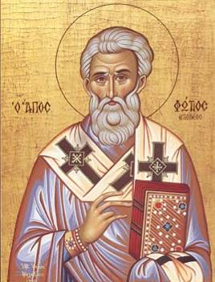
The Filioque Controversy
Photius, bishop of Constantinople, spoke out against the added phrase in 867.
Photius declared the phrase to be heretical and excommunicated Pope Nicholas, bishop of Rome.
Photius of Constantinople

Slide 69
The Filioque Controversy
Eastern Christians recited, “The Holy Spirit … proceeds from the Father.”
Western Christians recited, “The Holy Spirit … proceeds from the Father and the Son.”
THE ABSOLUTE TRUTH IS THAT BOTH CHURCHES WERE VERY WRONG.
NEITHER SON NOR SPIRIT WERE LIKE ANGELS OF SPECIAL CREATION, & NEITHER PROCEEDED FROM GOD.

Slide 70
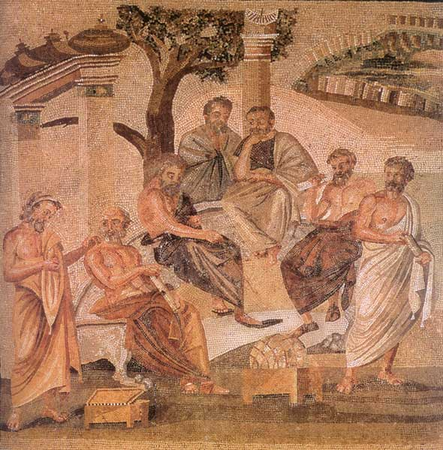
Post-Nicene Christian Thinkers Reopen Plato’s Greek Academy
Christians of the fourth century and beyond were attracted to this concept of “The One” equating it to “The Godhead” and incorporating “The Son” by renaming the World Soul “The Logos.” The same consensus seeming to reject the unqualified proposition of simple evil in single dimension as an absence of good – accepting instead a concept of complex evil and complicated suffering . The concept of graduated degrees or shades of good and evil has had a mixed reception over the generations among different Christian audiences; Completely rejected by dual determinists - acceptance seems to be correlated to an similar acceptance of the related doctrine of degreed reward & punishment.
As those personally familiar with the Apostles and those intimate with them in turn passed from the religious scene – the church transitioned from the Apologists to the Theologians – doctrine systematists and polemic writers that by the Dark Ages managed to so convolute and complicate the simple scripture as first received that Theology had become the “queen science” and Theologians regarded as the most learned of scholars. This next era witnessed within the field of theological science the shift from a scripture systemizing process of text to that of a synthesis process with philosophical tenet. Thus, with the move from apology to theology we have the marriage of Holy Scripture with Human Philosophy and the birth of Christian Platonism – the religious landscape would never be the same.

Slide 71
ARISTOTLE THRU THE AGES
Aristotle will always be significant to scholars as the most famous student of Plato.
His works on logic are among the classics. He basically believed our existence is related to substance and that everything is caused by something else – uniform theory.
His practical philosophy proved more controversial. He states that our souls are formed by habits, skills, and virtues. These same virtues are like skills in that they are formed by practice – by working at it. The other way our souls are shaped is through perception.
Aristotle has remained an ageless figure and forever thought provoking as regards his postulation - in purely physical terms - of an “Unmoved Mover” – an irreducible final cause to the universe.

Slide 72
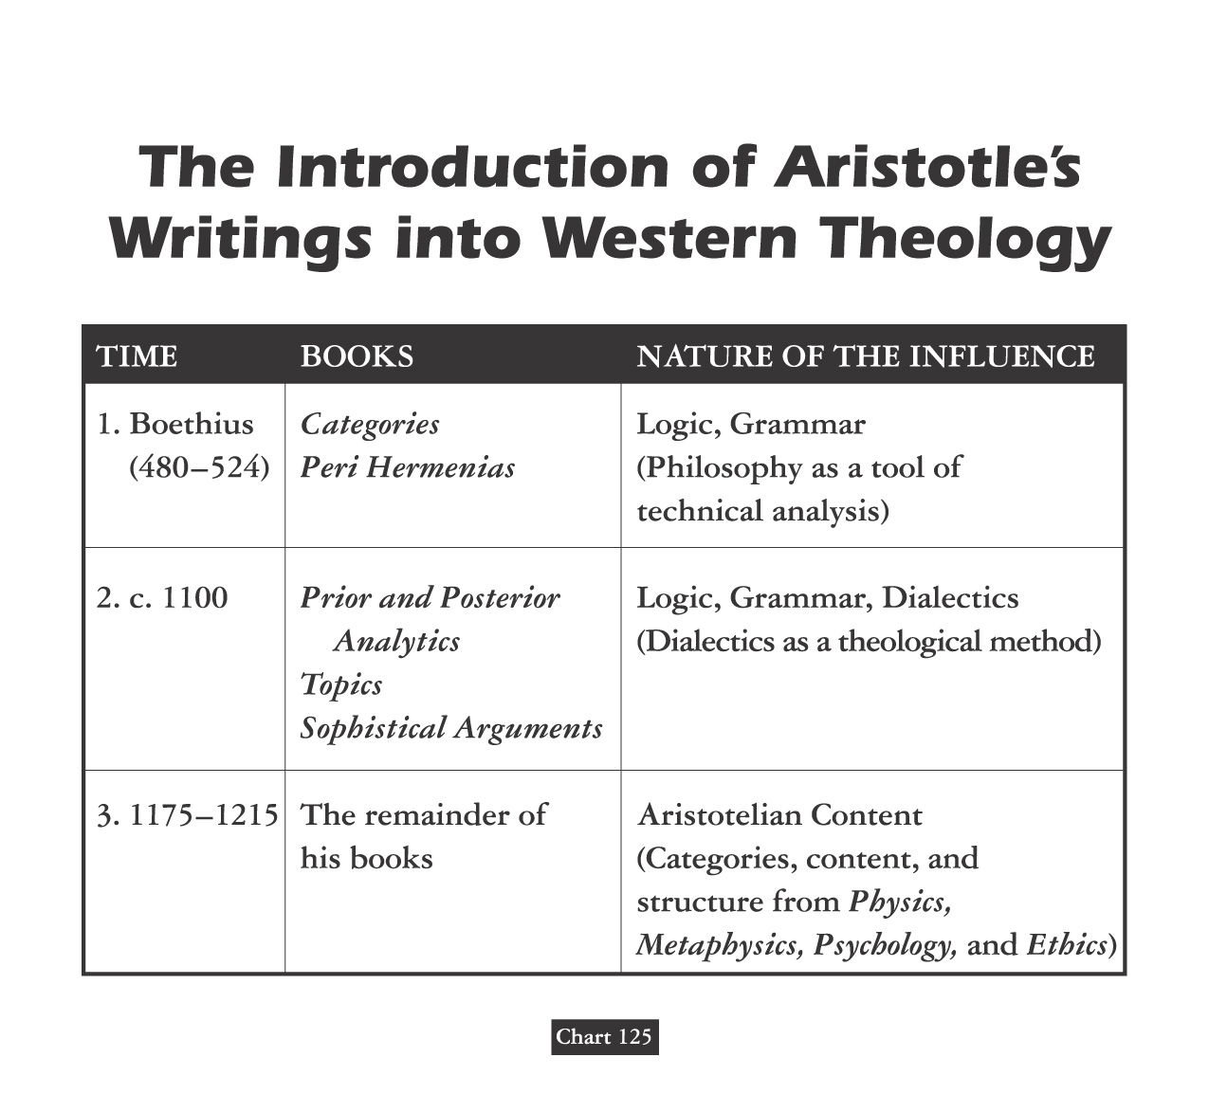

Slide 73
Debate Begins With Aristotle: How Are People Changed Within?
“To Be Is To Do” - Or - “To Do Is To Be”
“Excellence is an art won by training and habituation. We do not act rightly because we have virtue or excellence, but rather we have those because we have acted rightly. We are what we repeatedly do… Excellence, then is not an act but a habit.”
* Disputing Human Nature!

