Slide 1
Love & Unity
By David Lee Burris

Slide 2
David Lee Burris:
Lawyer’s Maxim: “The big print giveth, the small print taketh away!”
Approach
Freedom
Responsibility
Legalism
No
Yes
License
Yes
No
Liberty
Yes
Yes

Slide 3

Concepts Of Liberty & Freedom In Balance
THE NEW RESTORATION OF HUMAN WORTH
Latinate Origins Of Term “Liberty” Implies States Both Of Separation & Independence
Root Meaning Of “Freedom” Connotes Friendship & Attachment Or The Right Of Belonging In A Community Of Free People

Slide 4
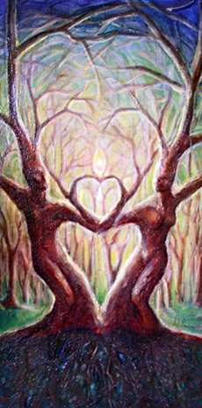
Thomas Jefferson: “The Liberty Tree Is Refreshed By Blood!”
THE TREE OF LIFE IS REFRESHED BY LOVE!

Slide 5

Quotes
“It is needful [to] come to a clear distinction between those basic doctrines on which we unite … [and] differences on which we are not in agreement while yet standing true to the essence of biblical Christianity.”
—Carl F.H. Henry

Slide 6

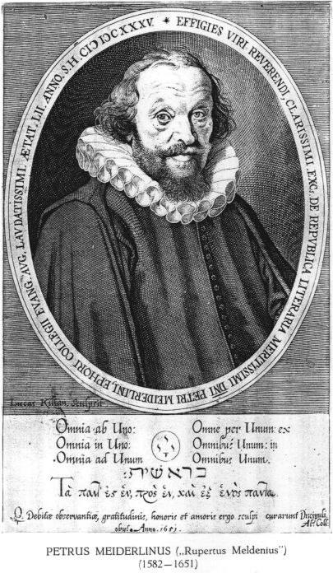
The Protestants
Lutheran Meiderlin’s Famous Quote:

Slide 7
The Protestants
“We would be in the best shape if we…

Slide 8
The Protestants
Kept in the essentials, Unity;

Slide 9
The Protestants
In the non-essentials, Liberty;

Slide 10
The Protestants
CHARITY MEANS LOVE!
And in both – Charity!

Slide 11
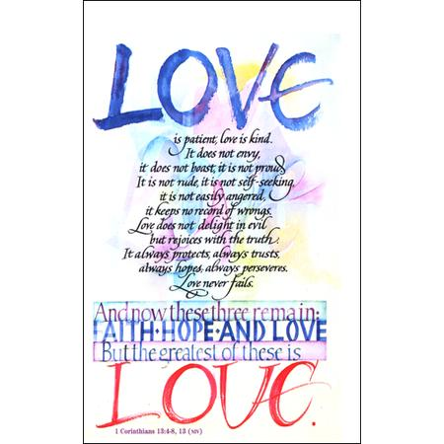


Slide 12
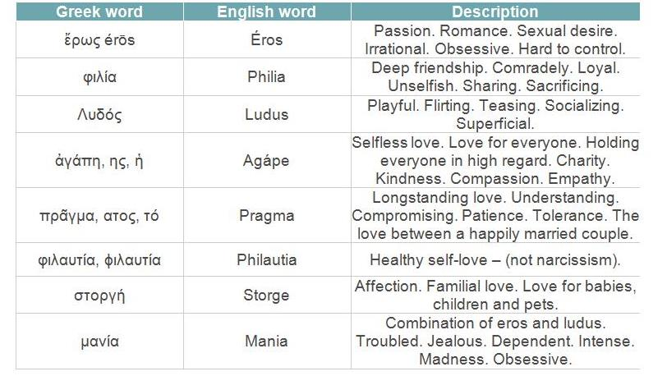

Slide 13
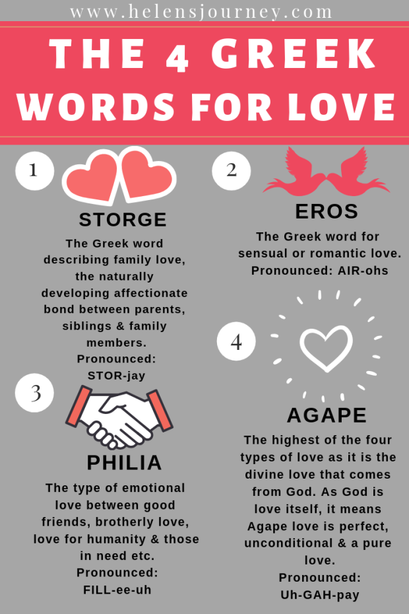

Slide 14
Philia
Philia is friendship love. This word is used in the Bible. As C. S. Lewis wrote in his book, The Four Loves, ‘To the Ancients, Friendship seemed the happiest and most fully human of all loves.’ Philia occurs from bonding over similar interests. Whereas lovers are both preoccupied with each other, friends are both preoccupied with the same things. Friends, of course, care about one another, but it is similar interests that attract them to one another. ‘Philia’ is the opposite of ‘phobia,’ literally meaning that those experiencing philia are drawn to one another.
Philia is often overlooked in modern culture, but it is exhorted in the Bible. In Romans 12:10, Paul urges the believers to be devoted to one another in brotherly philia. Philia can be strongly associated with agape as well. In John 15:13, Jesus said that there is no greater agape than to lay down one’s life for one’s friends.
Agape
Agape could be defined as charity. However, we often think of charity nowa-days as giving away money or things, which which doesn’t encompass all what agape is about. Agape love is unconcerned with the self and concerned with the greatest good of another. Agape is not born just out of emotions, feelings, familiarity, or attraction but from the will and as a choice. Agape requires faithfulness, commitment, and sacrifice not expecting anything in return.
This is the type of love the Bible speaks about the most. The New Testament references agape over 200 times.

Slide 15
What Agape Means in the Bible
To the Greeks, proper agape meant a general empathy or lovingkindness for all people. Though in the Bible, Christians are indeed expected to care for all in the name of Christ, Christianity took this a step further. Biblical writers used God as the standard for true agape.
Agape love, in the Bible, is love that comes from God. God’s love isn’t sentimental; it’s part of His character. God loves from an outpouring of who He is. As 1st John 4:8 states, ‘God is love [agapos],’ meaning He is the source of agape love. His love is undeserved, gracious, and sacrificial.
We are to love God and others with agape love. Agape is a choice, a deliberate striving for another’s highest good, and is demonstrated through action. God set the standard for agape love in sending Jesus to die for us while we were still sinners.” Christianity Today Magazine

Slide 16
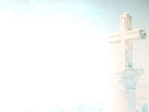
Exodus 20: 1-17
The 10 Commandments
Towards God
  Commands 1-2 deals with our thoughts
  Command # 3 deals with our words
  Commands 4-5 deals with our deeds

Slide 17
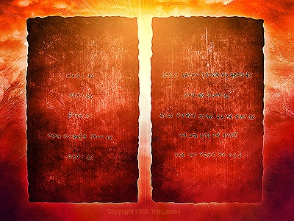

Slide 18
Exodus 20: 1-17
The 10 Commandments
Towards Others
  Commands 6, 7, 8 deal with deeds
  Command 9 deals with our words
  Command 10 deals with thoughts

Slide 19
Love

Slide 20

KNOWING GOD
& -
DOING JUSTICE

Slide 21
The First & Second Tables Of The Law Are In The N.T.

Slide 22
THE TORAH IN A
2 Pt Summary
DOUBLE LOVE

Slide 23
2 Point Summary
Deuteronomy 6:5
Leviticus 19:18
Matthew 22

Slide 24
THE TORAH IN A
1 Pt Summary
NEGATIVE RULE

Slide 25
1 Point Summary
2nd Table Whole
Luke 6: 31

Slide 26
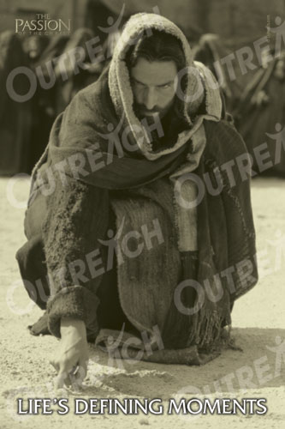

Slide 27
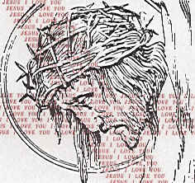
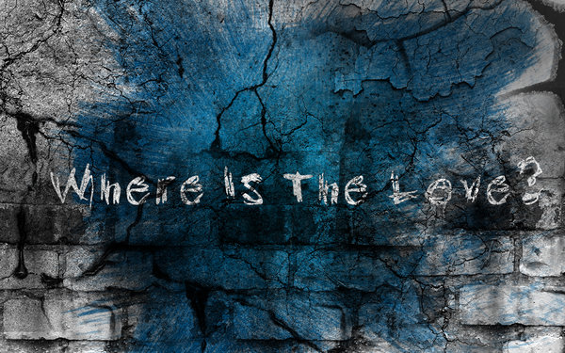
If one man declares a person to be charming, fascinating, or delightful, and another pronounces him disgusting, repulsive, or intolerable, who makes the more profound impression? The language of enthusiasm is emasculate compared with that of hatred or contempt. A sufficient reason for the undemonstrative nature of the English-speaking race lies in the effeminate quality of the adjectives that denote admirable traits. Some of them can hardly be uttered without a consciousness of a loss of virility. One has only to contrast with them the hearty gusto of our vocabulary of dislike and depreciation to perceive the tremendous advantage that the cynic enjoys.
His very name supports his pretensions to a superior intelligence. “Cynic,” for all that it meant originally “doglike,” is an aristocratic word. The word is erudite and Greek; the presumption is that the man designated by a term of such distinguished lineage is of education and intelligence. We have a habit of deriving ideas in this illogical way. -- Manvotional: Cynicism

Slide 28
C. S. Lewis Explains The Central Theme of Love in the Bible:
“So here the likeness, and in that sense nearness, to Himself which God has conferred upon certain creatures and certain states of those creatures is something finished, built in. What is near Him by likeness is never, by that fact alone, going to be any nearer. But nearness of approach is, by definition, increasing nearness. And whereas the likeness is given to us— and can be received with or without thanks, can be used or abused— the approach, however initiated and supported by Grace, is something we must do. Creatures are made in their varying ways images of God without their own collaboration or even consent. It is not so that they become sons of God. And the likeness they receive by sonship is not that of images or portraits. It is in one way more than likeness, for it is unison or unity with God in will; but this is consistent with all the differences we have been considering. Hence, as a better writer has said, our imitation of God in this life— that is, our willed imitation as distinct from any of the likenesses which He has impressed upon our natures or states— must be an imitation of God incarnate: our model is the Jesus, not only of Calvary, but of the workshop, the roads, the crowds, the clamorous demands and surly oppositions, the lack of all peace and privacy, the interruptions. For this, so strangely unlike anything we can attribute to the Divine life in itself, is apparently not only like, but is, the Divine life operating under human conditions.” - Lewis, C.S.. The Four Loves

Slide 29
Summation: Seven Significant Statements:
Godly Love. There are both spiritual dangers and forever consequences in either over-simplification or over-complication of the Bible message.
Heartfelt Religion. Precept & Principle Equal Components. Neither aspect is to be sacrificed in observing the other.
Mature Christians Evidence a Higher Love. Such a higher love is less of mixed motive and more pure as to intention.
Image Deo. Adding to the Acquired Image of God – Adding to Godlikeness Through Free Will Imitation.
Two Types & Four Levels of Agape Command in Three Dimensions of Compliance. In the Parable of the Good Samaritan [Luke 10: 23 - 37] The Master Teacher Outlines How Our Multiple Relationships [Family/Friends/Enemies] Do Not Ordinarily Conflict In Order To Demonstrate Love.
Duty Plus Love. Seeking the Highest Good or the Salvation of All Mankind Does Not Require Liking All Persons Equally.
Words Versus Deeds. Salvation is From Faith in Action!

Slide 31


Godly Love in Horizontal Relationship
“The great twelfth century Dominican writer Thomas Aquinas picked up on this strand of biblical teaching and made the startling assertion that love was more than the goal of Christian perfection: it is the fundamental power behind the created order.
In the end, Aquinas argued, everything is grounded in love, since all creation reflects the character of the one who made it. He suggested that we are not only made to love, we are made of love.”

Slide 32
Godly Love in Horizontal Relationship
“In the end, Aquinas argued, everything is grounded in love, since all creation reflects the character of the one who made it. He suggested that we are not only made to love, we are made of love.
Well-ordered and directed to the right ends, love can transform lives, inseparably unite people with one another and God, and act as the harmonious and creative power which holds all creation in being. But misdirected-allowed to turn in on itself, allowed to run wildly on the heels of any and every desire of our misguided hearts-love can become a horrifyingly destructive force, tearing apart the world from under our feet.”

Slide 33
Godly Love in Horizontal Relationship
“The twelfth century Cistercian writer Bernard of Clairvaux had a clearer picture. In his short but brilliant work ‘On Loving God,’ he argued that love at its least perfected is inwardly focused, seeking only its own good. And all this self-love is not true love at all, merely the power of love corrupted into pride and vanity. As grace begins to reorder our hearts, though, some of that love starts to turn outward, towards God and neighbor, drawing us beyond ourselves – even if initially only because of the selfish benefits we derive from others.”

Slide 34
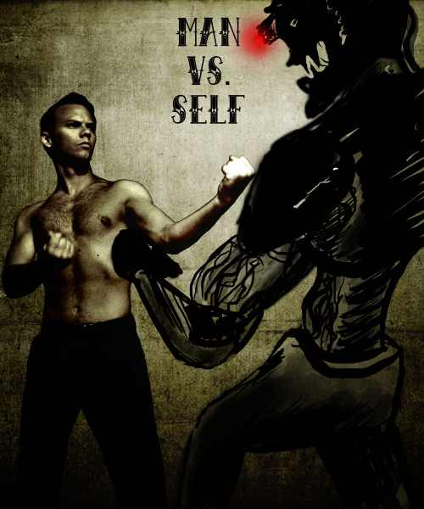
Godly Love in Horizontal Relationship
“A yet more well-ordered heart is able to love God and others for their own sake. And finally, says Bernard, we then truly learn what it means to love ourselves: to be grateful for the gift of ourselves, the only thing we truly have to offer to God and those around us, to express love. Growth in holiness ends in a proper love of self by turning outward to others, not by turning inward on ourselves.”
- Becoming Like Jesus, Christopher Webb

Slide 35
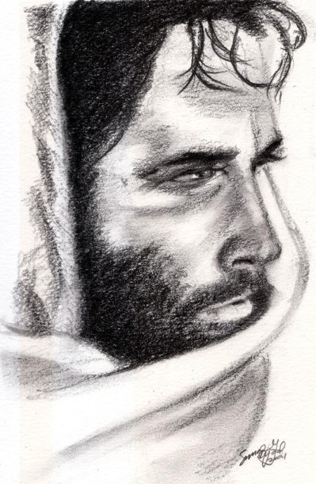
The Duty Of Love
David Lee Burris
Tolstoy On Change - “Everyone thinks of changing the world, but no one thinks of changing himself.”
The 10 commandments are broken into 2 sections
  The lord thy God (our duty God-ward)
  You shall/shall not (duty man-ward)
Jesus reduced all the commands to these basic 2
  Love God
  love your neighbor

Slide 36
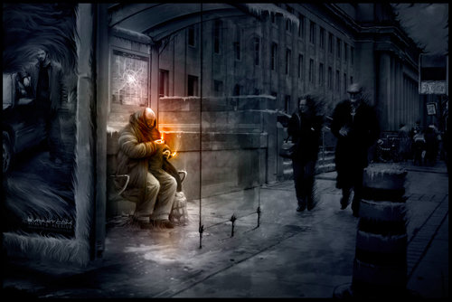

Slide 37
Love’s Duty Versus Pure & True Love
“Duty is forced, like a pump; love is spontaneous, like a fountain.
Duty is prescribed and formal; it is part of the red tape of life.
It means running on moral rails.
Analyze, if you will, any of the great historic instances
of loyalty to duty, and whenever they ring true you will find
the presence of the real element that made the act almost divine.
It was duty — plus love.
Duty is a hard, mechanical process for making men do
things that love would make easy. It is a poor understudy to love.
It is not a high enough motive with which to inspire humanity.
Duty is the body to which love is the soul!

Slide 38
Love’s Duty Versus Pure & True Love
Duty is a hard, mechanical process for making men do things that love would make easy.
It is a poor understudy to love. It is not a high enough motive with which
to inspire humanity. Duty is the body to which love is the soul.
Love, in the divine alchemy of life, transmutes all duties into privileges,
all responsibilities into joys. The workman who drops his tools at the stroke of twelve, as suddenly as if he had been struck by lightning may be doing his duty
— but he is doing nothing more.
No man has made a great success of his life or a fit preparation for immortality
by doing merely duty. He must do that & more. If he puts love into his work,
the ‘more’ will be easy.” – William George Jordan

Slide 39
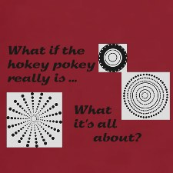
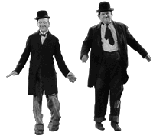
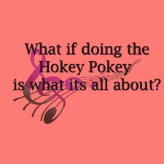
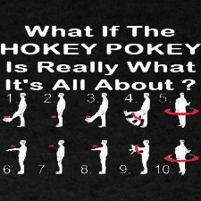

Slide 40
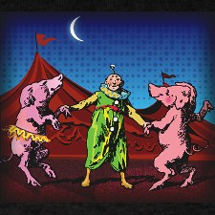
The Hokey Pokey is a corruption of the ‘hocus pocus’ beloved of magicians, an expression that derives, in turn, from the words of the Catholic Mass, hoc corpus meum, ‘this is my body,’ indicating the conversion of the Communion ‘bread’ into the body of Christ. The Puritans, against anything that could be construed as idolatrous, mocked the accompanying words as a kind of magical incantation.

Slide 41
The dance that goes along with the song – in which the participants all dance in a ring, putting the relevant limb in and out, and then shaking it about – goes back a fair way, too.
‘The Hokey Pokey’ would appear to parody the religious rituals of the Shakers(so named for their jerky movements while in worship), who both danced and sang during their services. - Albert Jack

Slide 42
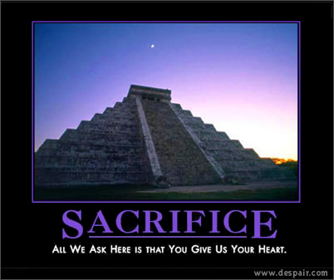

Slide 43
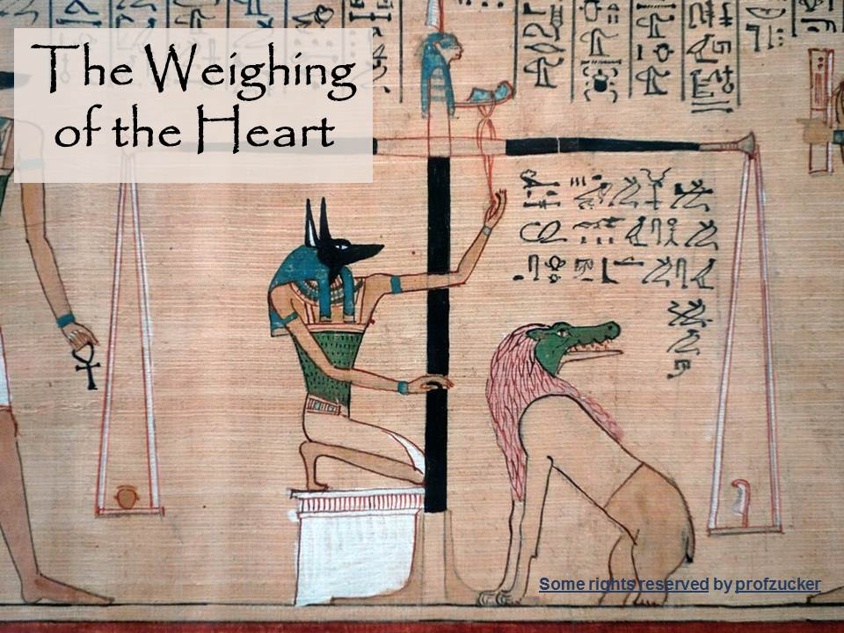

Slide 44
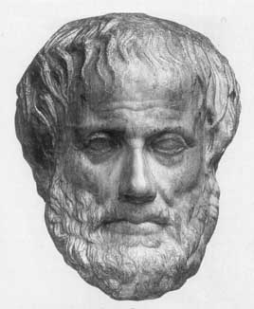
ARISTOTLE THRU THE AGES
Aristotle will always be significant to scholars as the most famous student of Plato.
His works on logic are among the classics. He basically believed our existence is related to substance and that everything is caused by something else – uniform theory.
His practical philosophy proved more controversial. He states that our souls are formed by habits, skills, and virtues. These same virtues are like skills in that they are formed by practice – by working at it. The other way our souls are shaped is through perception.
Aristotle has remained an ageless figure and forever thought provoking as regards his postulation - in purely physical terms - of an “Unmoved Mover” – an irreducible final cause to the universe.

Slide 45

Debate Begins With Aristotle: How Are People Changed Within?
“To Be Is To Do” - Or - “To Do Is To Be”
“Excellence is an art won by training and habituation. We do not act rightly because we have virtue or excellence, but rather we have those because we have acted rightly. We are what we repeatedly do… Excellence, then is not an act but a habit.”
* Disputing Human Nature!

Slide 46

Luther Critique’s Clairvaux: Spiritual Maturity & Progress
  FIRST – Love Of Self For Your Own Sake.
  SECOND – Love Of God For Your Own Sake.
  THIRD – Love Of God For God’s Sake.
  FOURTH – Love Of Self For God’s Sake.

Slide 47
Luther On The Gravity Of Sin: Mankind Is Incurvatus In Se
  Humanity Has Curved In Upon Itself
  With Meaning Twisted
  & Our Ideals Warped
* Spiritual Physics Of Heavy Mass

Slide 48

COUNTERING THE COUNTERFACTUAL TEST
Bible Says You Are In Charge Of Your Own Heart
Jeremiah 4: 4 – “Remove the foreskin of your hearts”
Jeremiah 9: 13 – “Stubbornly followed their hearts”
Jeremiah 18: 11 – “Act according to his evil heart”
Ezekiel 18:31 – “Make Yourselves A New Heart & A New Spirit!”

Slide 50


Slide 51


Slide 52


Slide 53

“LOVE DOESN’T MAKE THE WORLD GO ‘ROUND.
LOVE IS WHAT MAKES THE TRIP WORTHWHILE!”

Slide 54


Slide 55


Slide 56


Slide 58


Slide 59
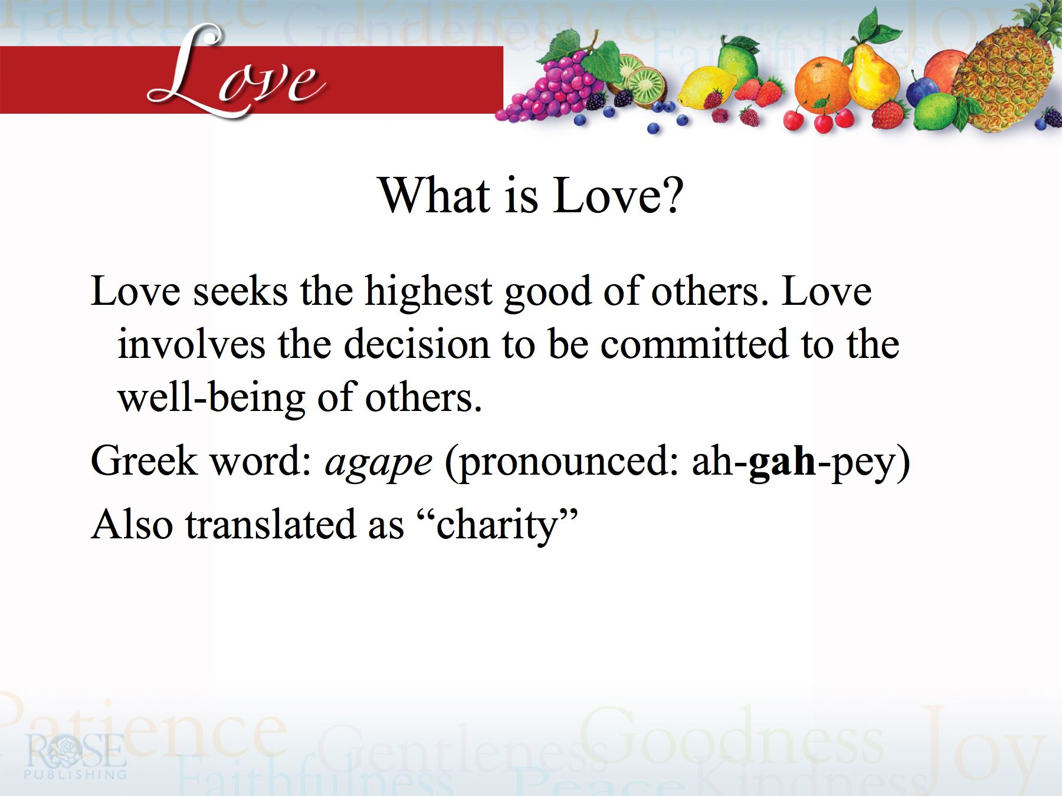

Slide 60
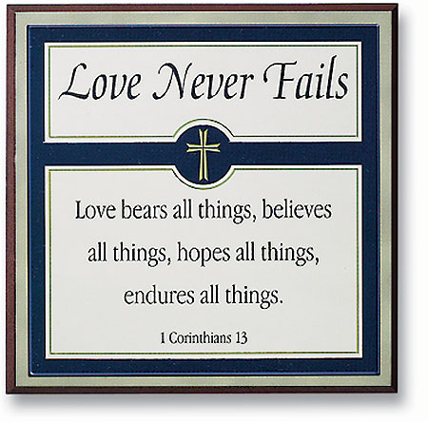

Slide 61
And coming up one of the scribes heard them reasoning, knowing that He had answered them well, he asked Him, Which is the first commandment of all?
And Jesus answered him, The first of all the commandments is, “Hear, O Israel, the Lord our God is one Lord;
and you shall love the Lord your God with all your heart, and with all your soul, and with all your mind, and with all your strength.” This is the first commandment.
And the second is like this: You shall love your neighbor as yourself. There is no other commandment greater than these.
Mark 12: 29-31

Slide 62
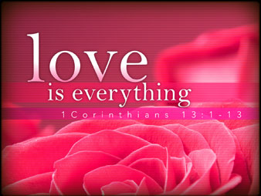

Slide 63


Slide 64


Romans 12:9-10

Slide 65
Let love be without hypocrisy. Abhor what is evil. Cling to what is good.
NLT Don’t just pretend that you love others. Really love them. Hate what is wrong. Stand on the side of the good.
Be kindly affectionate to one another with brotherly love, in honor giving preference to one another;
NLT Love each other with genuine affection, and take delight in honoring each other.

Slide 66

The Gold Standard Of Christian Character
There is no higher calling than the calling to love as we have been loved by the Lord Himself
If we cannot love one another how will we ever reach the many others that Jesus died for
Its an easy subject to talk about and a tougher issue to live out

Slide 67
Understanding the Command
Let love be without hypocrisy vs. 9(a)
Love (Agape) is the God type of love which does that which is caring and helpful for the other regardless of the cost or consequence to oneself. It is will based although involving our total person
It is the decision made by those who have given themselves totally to the Lord for it is practiced as He lives in and through us
It is not fake, (we are not just pretending) it’s the real thing

Slide 68

Understanding the Command
Without Hypocrisy (anupokritos)
  Used of persons playing a part, actors (their reverted state is different than the part they play)
  Impersonators of the authentic or real (Matthew 7:21-24)
  To pretend or to simulate
  Speaking that which is untrue
  That which is not considered really a part of the person’s character
  That state of mind which prejudges
  That which is not the actual 24/7

Slide 70
MODERN PARODY: 1ST COR. 13
Though I have taken three years of Greek and Hebrew, if I have not love, I have become a scholarly windbag, and though I teach a Bible class, and attend every gathering of the Saints, and though I have missed only one week of visitation (when I was sick), if I have not love, I am nothing.
And though I give liberally of my means, and always have my Bible lesson done on time, and have driven bunches of kids to VBS, and though I invited the preacher’s family to dinner just last month, if I have not love, the whole thing means nothing.

Slide 71
Understanding the Command
It is a common problem that we have a “say” disassociated from the “do”
We have a disconnect of our acts from the fruit of our actions (love does have fruit) Galatians 5:22-24
We assume getting people over to our point of view is of more importance than loving. (People usually aren’t simply argued into the Kingdom or into compliance with God’s will)
We presume that loving those that love us – family & friends - is sufficient. (We have trouble getting out of our comfort zone)

Slide 72
A Great Truth
Tom Wolfe
There are only 2 reasons people don’t become Christians
  They’ve never seen a Christian

Slide 73

We ARE Jesus Presenters
We ARE Jesus Presenters and fortunately we are not alone.
✓ Our “association” is the church
✓ Power of God’s Word works thru us
✓ Holy Spirit comforts & assists
Notes:
We are Jesus Presenters.
Fortunately, we do not function alone or in isolation. Like Homer Sewell, we also have an “association,” an association of Jesus Presenters we call the church.
From this body we get guidance and encouragement and discipline and inspiration, plus the odd and enlightening experience of hanging around with a large group of people who are trying to project the same persona.
We certainly don’t all look the same, as is the case with a convention of 117 Abes in stovepipe hats, but we certainly can learn from one another, especially if we treat each other with kindness and mutual respect.
Even more importantly, we do our work knowing that the power of God is working through us. Jesus continues to be active in our lives, promising that he will do whatever we ask in his name, meaning that he will answer us when we ask for help in revealing the power and character of God.
We are asked to perform the works of Jesus, and through these works to reveal the power and character of God to the world.
If we accept this invitation, people will look at us and say, “Jesus.”
Source:
Schultz, Connie. “It’s not Christian to champion hate,” The Cleveland Plain Dealer, November 13, 2003.

Slide 74
From Unawareness:
Unto Christianity:
STEP ONE -
Gospel Awareness
STEP TWO -
Gospel Receptivity
STEP THREE -
Controlled Attention
STEP FOUR -
RELATIONSHIPS
STEP FIVE -
COMMITMENT
STEP SIX -
Characterization

Slide 75


David Lee Burris:
Quaker Saying - “I lift thee up – thou lift me up – and together we ascend to heaven!”
From Louis Nizer…
“True religion is the life we lead, not the creed we profess.”

Slide 76


Slide 77


Slide 78
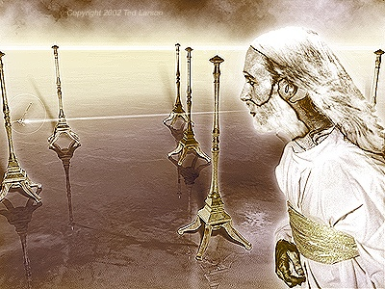
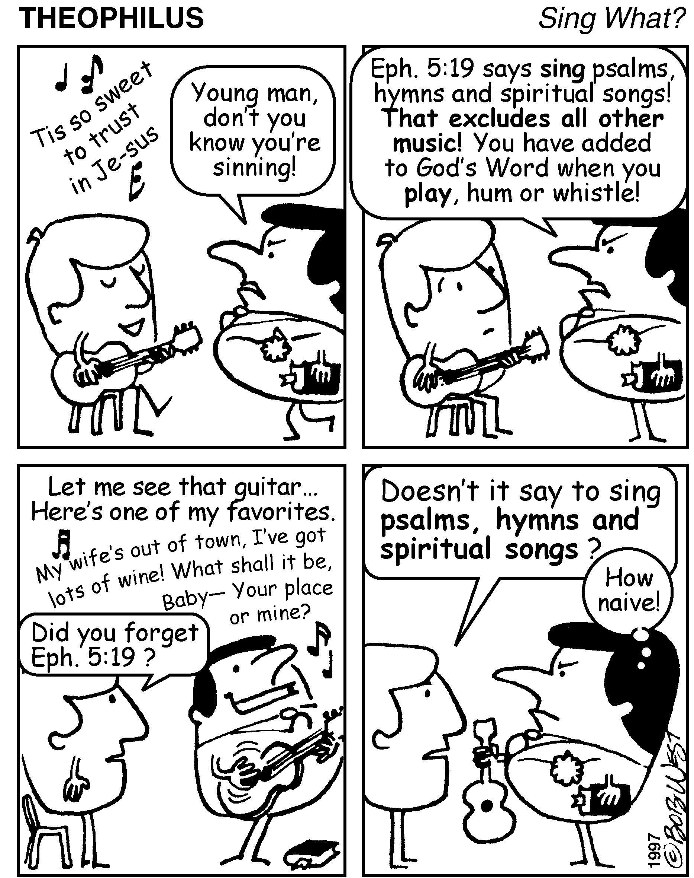

Slide 79
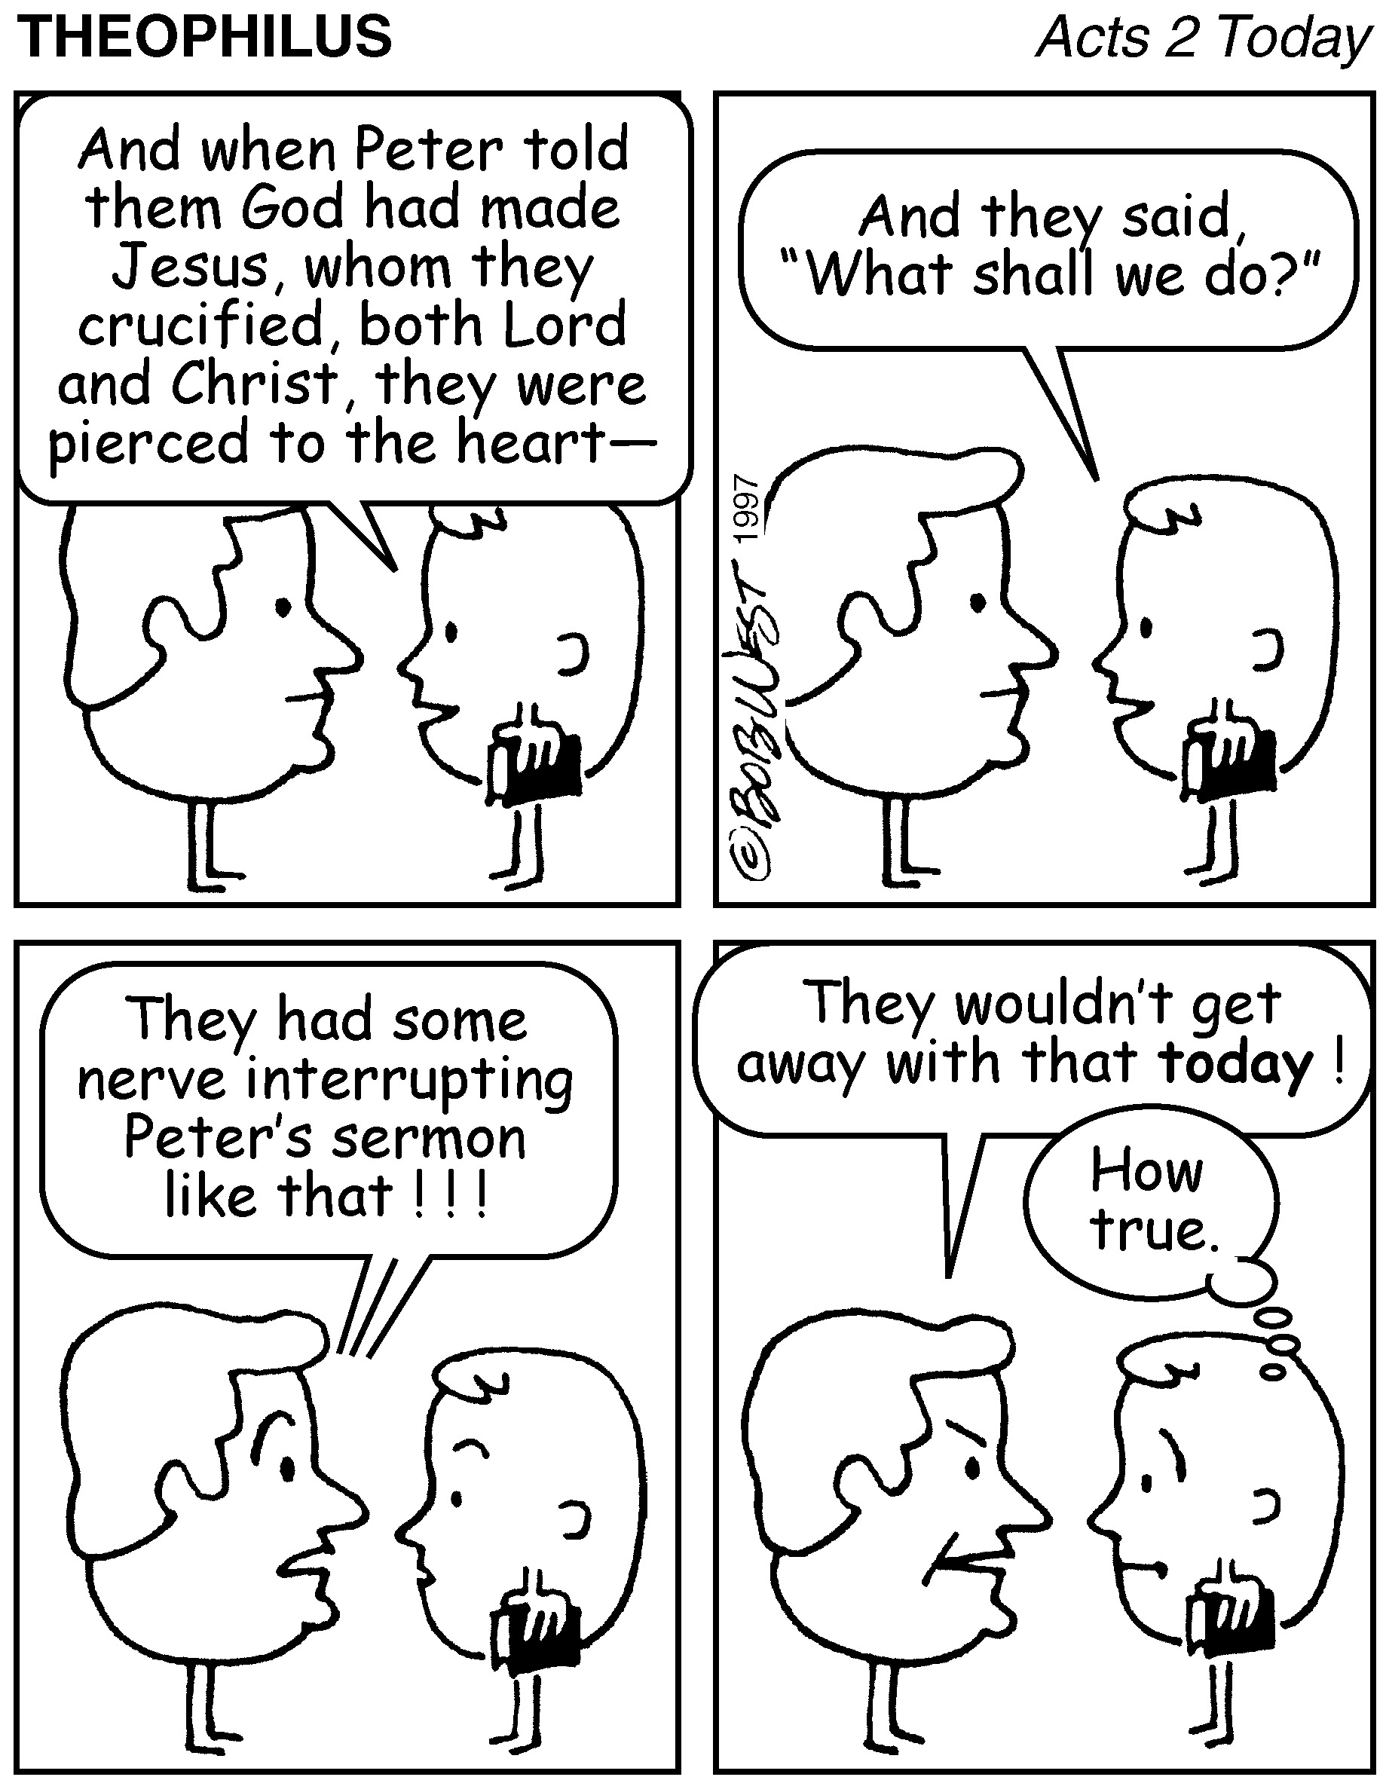

Slide 80
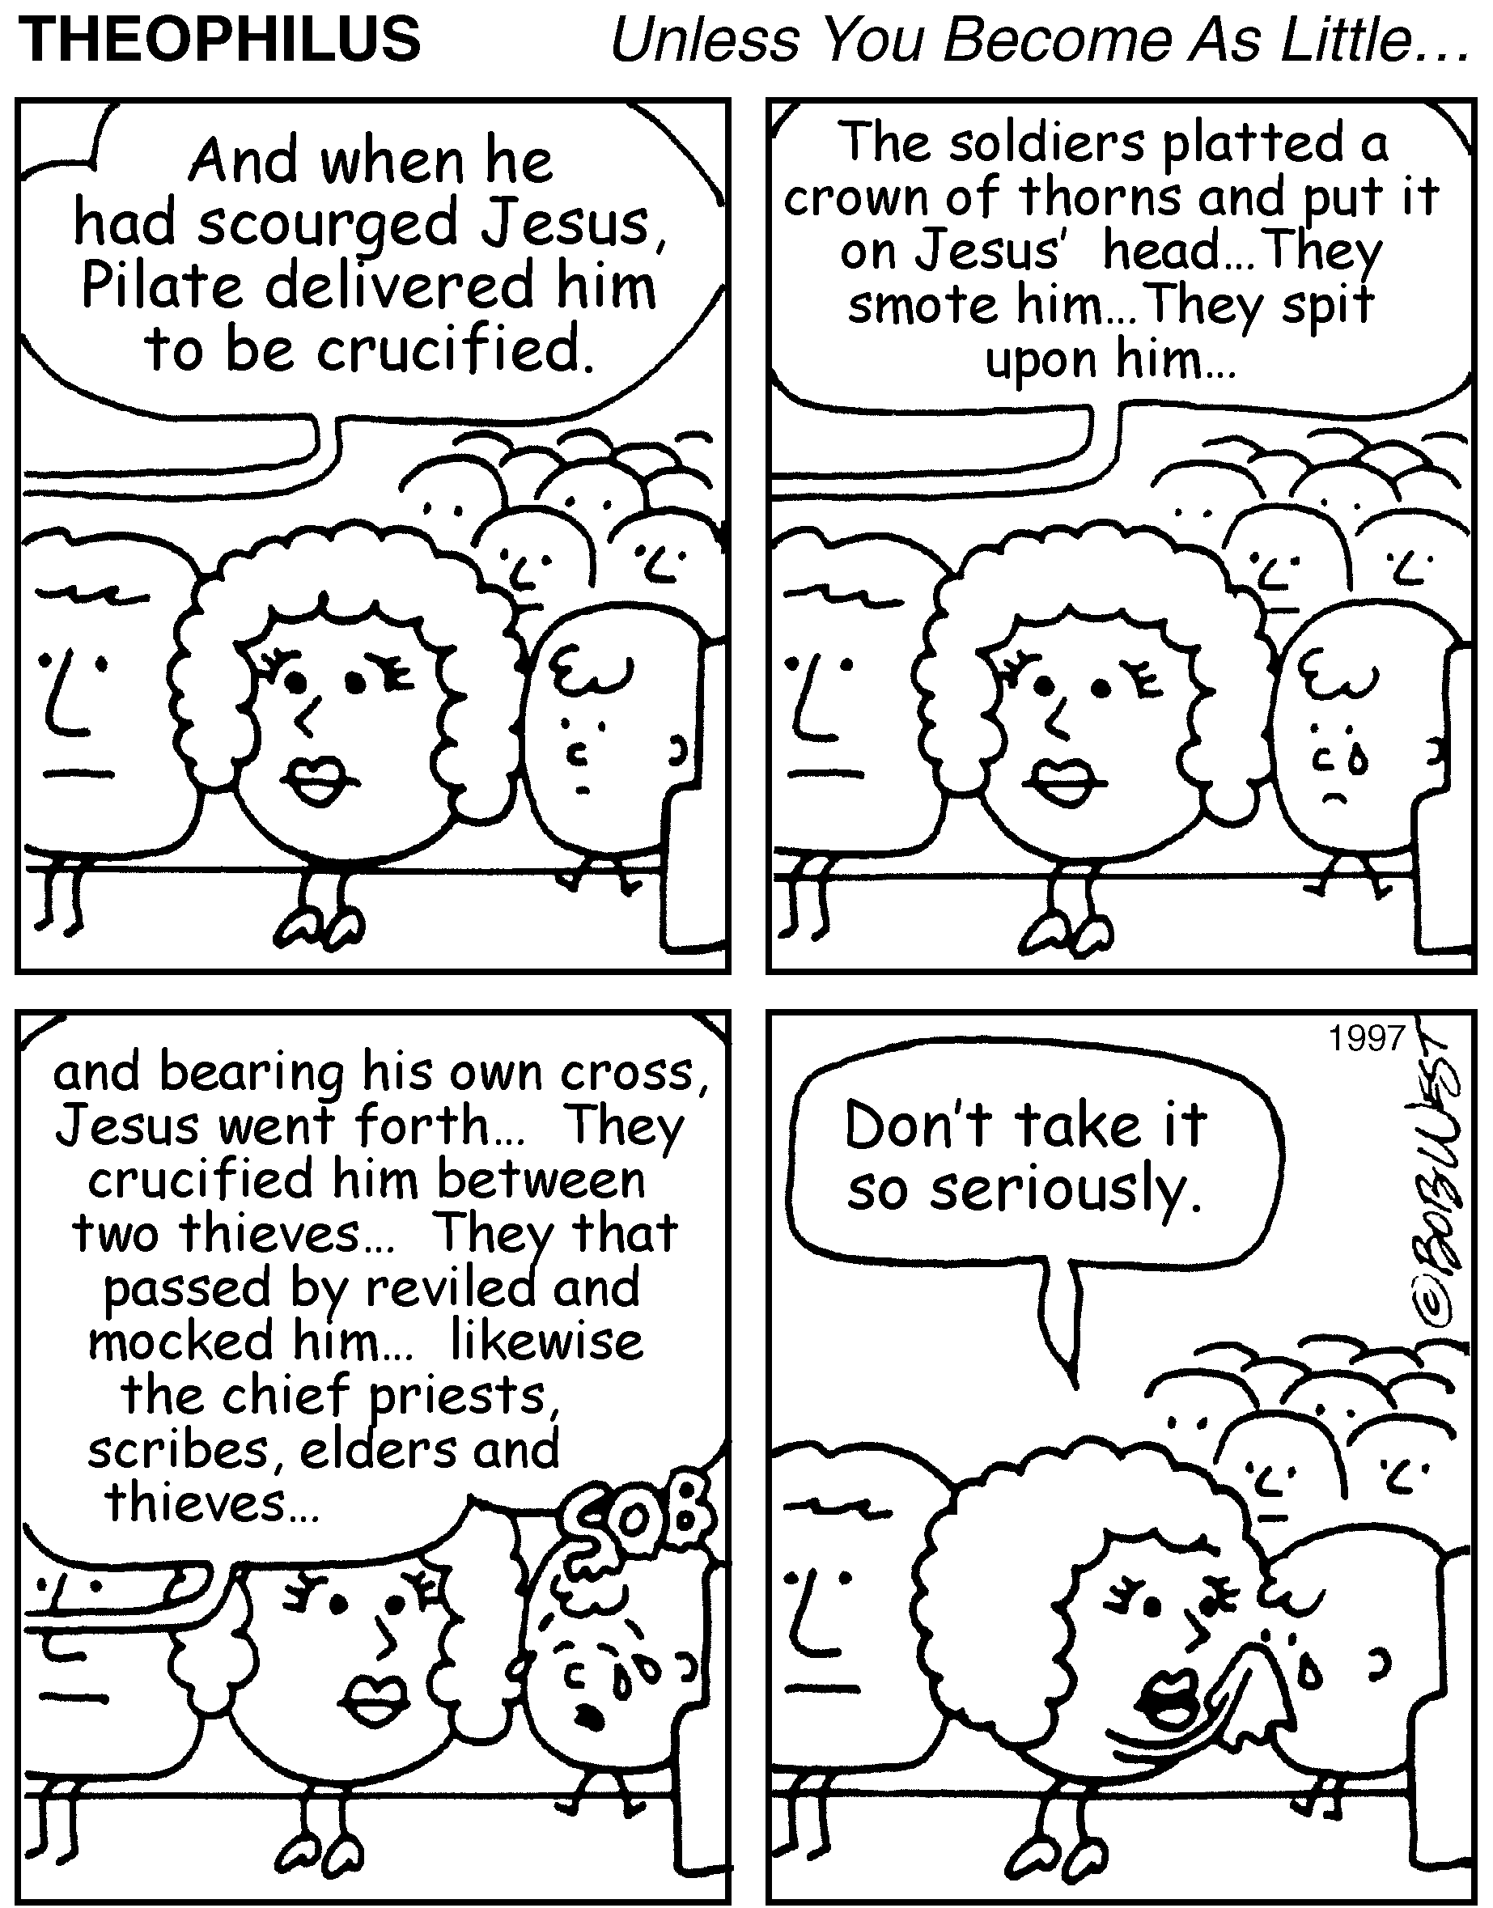

Slide 81
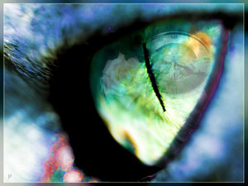
A Fundamentalist
Is Someone
Who Hates Sin
More Than He
Loves Virtue.
John Schaar

Slide 82

“A recent survey demonstrated Christians are perceived low on love – when asked to rank people groups in terms of respectability, ‘evangelical Christians’ were ranked one notch above bottom, just above prostitutes.” pg. 134
- Gregory Boyd, Myth Of A Christian Nation

Slide 83
A Great Truth
Tom Wolfe
There are only 2 reasons people don’t become Christians
  They’ve never seen a Christian
  They have seen a Christian

Slide 84

Are Christians Worldly?

Slide 85
Christian Marriage
Have been divorced (among those who have been married)
Non-Christians - 23%
Born-again Christians - 27%

Slide 86
Reading Habits
Read all or part of a book for pleasure, in the past week
Non-Christians - 57%
Born-again Christians - 50%

Slide 87
Christian Giving
Donated to a non-profit organization within the last month.
Non-Christians - 48%
Born-again Christians - 47%

Slide 88
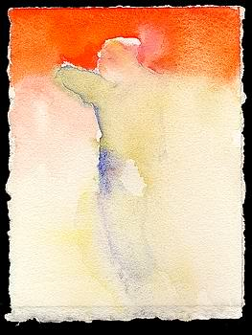
HEAD + HEART?
H. L. MENCKEN @
HONOR & MORALS

Slide 89
HEAD + HEART?
“Man, at his best, remains a sort of one-lunged animal, never completely rounded and perfect, as a cockroach, say, is perfect. If he shows one valuable quality, it is almost unheard of for him to show any other. Give him a head, and he lacks a heart. Give him a heart of a gallon capacity & his head holds scarcely a pint… In all my years of search in this world, from the Golden Gate in the West to the Vistula in the East, and from the Orkney Islands in the North to the Spanish Main in the South, I have never met a thoroughly moral man who was honorable!”

Slide 90
I have noted that
persons with bad
judgment are most
insistent that we do
what they think best!
Lionel Abel

Slide 91
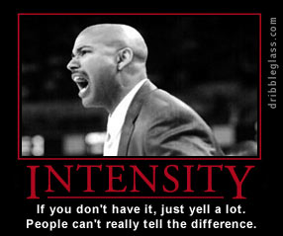
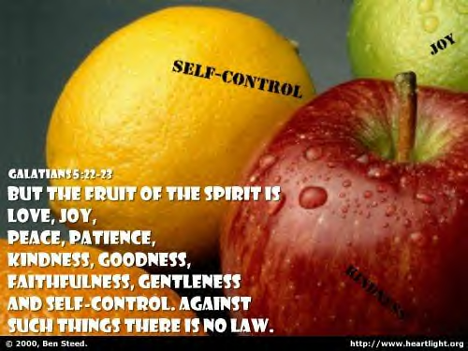

Slide 92
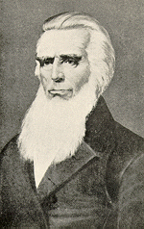
March 4
At 11:45 P.M
Campbell Finishes His Course
K.I.S.S.
On his death bed Campbell asked:
“What think ye of Christ?
Of His divine nature?
Of His glorious mission?”

Slide 93
The Protestants
Lutheran Meiderlin’s Famous Quote:

Slide 94
The Protestants
“We would be in the best shape if we…

Slide 95
The Protestants
Kept in the essentials, Unity;

Slide 96
The Protestants
In the non-essentials, Liberty;

Slide 97
The Protestants
CHARITY MEANS LOVE!
And in both – Charity!

Slide 98

An Awakening Of
Brotherly Love
“Me lift thee,
And thee lift me,
And we’ll both
Ascend together.”

Slide 99


Slide 100

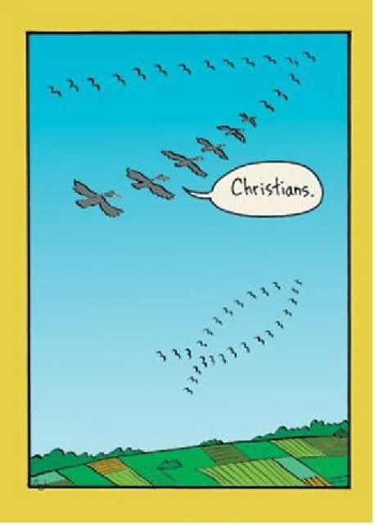

A LESSON FROM GEESE
AUTHOR UNKNOWN
♫ Turn on your speakers!
CLICK TO ADVANCE SLIDES

Slide 101

Have you ever wondered why migrating geese fly in a V formation?
As with most animal behavior, God had a good reason for including that in their instincts.

Slide 102

As each bird flaps its wings, it creates uplift for the bird following.
In a V formation, the whole flock adds at least 71% more flying range than if each bird flew alone.

Slide 103

Whenever a goose falls out of formation, it suddenly feels the drag and resistance of trying to fly alone…
…and quickly gets back into formation.

Slide 104
Like geese…
… people who share a common direction and sense of community can get where they are going quicker and easier than those who try to go it alone.

Slide 105

When a goose gets tired, it rotates back into the formation and another goose flies at the point position. If people had as much sense as geese, they would realize that ultimately their success depends on working as a team, taking turns doing the hard tasks, and sharing leadership.

Slide 106

Geese in the rear of the formation honk to encourage those up front to up their speed. It is important that our “honking from behind” be encouraging. Otherwise it’s just - well - honking.

Slide 107
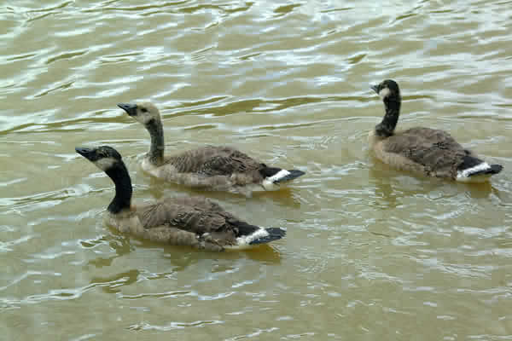
When a goose gets sick or wounded, two other geese drop out of formation and follow it down to help and provide protection.
They stay with the unhealthy member of the flock until it is either able to fly again or dies.

Slide 108

Then they launch out again with another passing flock or try to catch up with their own.
May we be so sacrificial, that we may be worthy of such friends in our time of need.

Slide 109

YOU DON’T HAVE TO BE A SCIENTIST...
…To learn from God’s marvelous creation; you only need to stop long enough to observe and let God reveal His wonders to you.

Slide 110

“Ask the beasts, and they will teach you; and the birds of the air, and they will tell you; or speak to the earth, and it will teach you; and the fish of the sea will explain to you. Who among all these does not know that the hand of the Lord has done this?”
JOB 12:7-9
SOMEONE “ASKED” THE GEESE
PLEASE PASS THIS MESSAGE ON TO OTHERS!

Slide 111
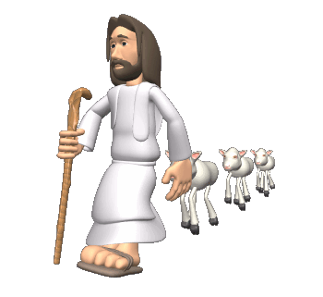
The Shift from Us to Them…
A Different Vantage Point

Slide 112
David Lee Burris:
Quaker Saying - “I lift thee up – thou lift me up – and together we ascend to heaven!”
From Henry David Thoreau…
“Friends do not live in harmony merely,
as some say, but in melody.”

Slide 113
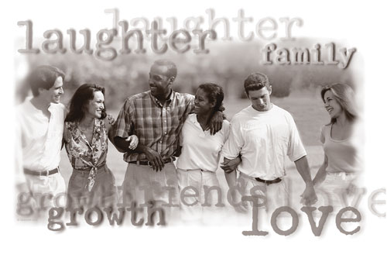

Slide 114
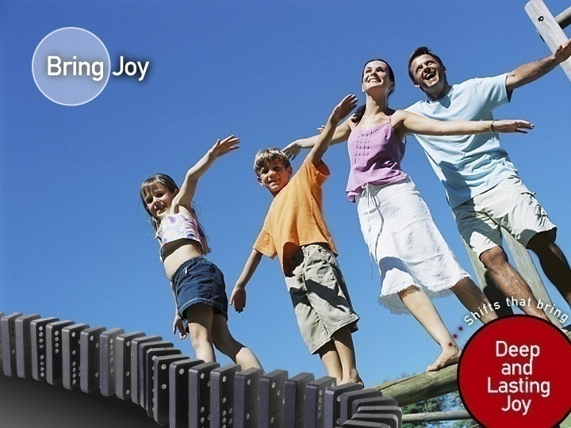


Slide 115

WITH
God's Love In
Domino Effect

Slide 116
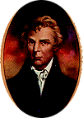
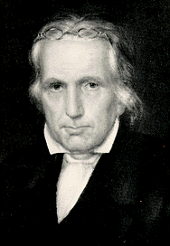
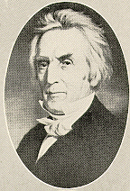
A Restoration Plea:
"In Doctrine, Unity."
"In Option, Liberty."
"In All Things, Love!"
* Restoration Plea Same As Augustine on “Essentials”

Slide 117

MOVING TO RESTORE THE NON-DENOMINATIONAL CHURCH

Slide 118


Slide 119
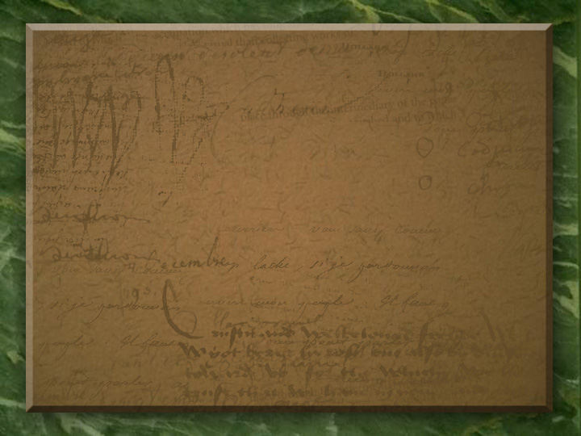
Integrity\Why Body Schisms\October 1995:
“The most disruptive of peace and unity is a misunderstanding of the nature of God’s church. The word ‘church’ is here used in the accommodative sense, because it does not translate the Greek word ‘ecclesia.’ The word ‘church’ is a seventeenth century word used to designate a religious organization. The Greek word ‘ecclesia’ was used merely to designate a group or assembly & did not have a religious, ecclesiastical connotation [on its own]. For example, in Acts 19 ‘ecclesia’ is used to describe an angry and confused mob of unbelievers. ‘Ecclesia’ is a ‘people’ word and Paul used it to refer to the saved in a given locality, not to an institution with independent entity. The Holy Spirit did not assign a proper noun name to God’s children but rather used descriptive terms and/or phrases, such as ‘assembly, congregation, family, house’. Early assemblers had organization, but they were not an organization.”

Slide 120
The Examiner\Corporate Church Power Servants\Curtis Dickinson\March 1990
“When Jesus said, ‘I will build my church,’ it is doubtful that He had in mind the kind of institution which we know today as the church, with its various officers, committees, professionals, regularly scheduled business meetings, etc. This kind of corporate organization has been copied from the world and put in place as a substitute from the real function of Christians as servants of Christ.”
“The early church was a functioning body in which all were to serve according to each one’s ability… There were no professionals in the early church. Every Christian was a minister, which is another word for servant. There was no distinction of clergy and laity; all were the same level in Christ.”

Slide 121
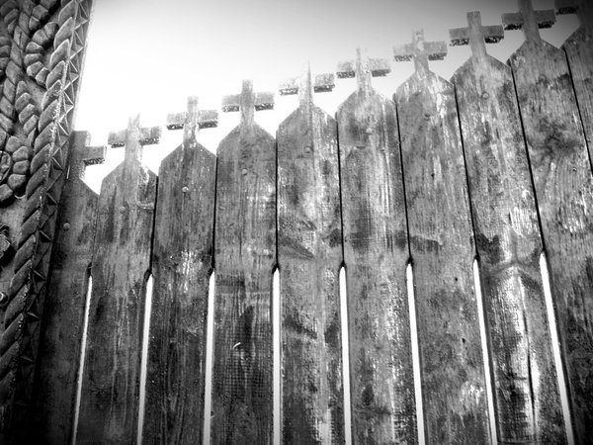
EXAMINER\ROSE IS A ROSE\JACK BOAL
“We build buildings and call them churches. We form denominations & call them church. In this day, a church is a building. A community is a body of people. A church is a place you visit occasionally. A community is something you are. A church is used only on special occasions of religious significance. A community is people whose religion lives with them every day in all occasions of life. A church is made of lifeless stone and wood. A community is made of living, active believers in Christ. A church is constructed by men to serve their purposes.
A community is established by Christ to do His will. A building must be maintained against deterioration by the labor of men. A community is sustained & renewed by the power of the Spirit in the midst of the body. A church will eventually crumble to ruin. The Body of Christ will be lifted up to Him forever. A church is known by its facility, doctrine, friendliness, pastor’s ability to preach or lead. A community is known by its love! Christ said, ‘By this shall the world know that you are my disciples, if you love one another.’ ”

Slide 122
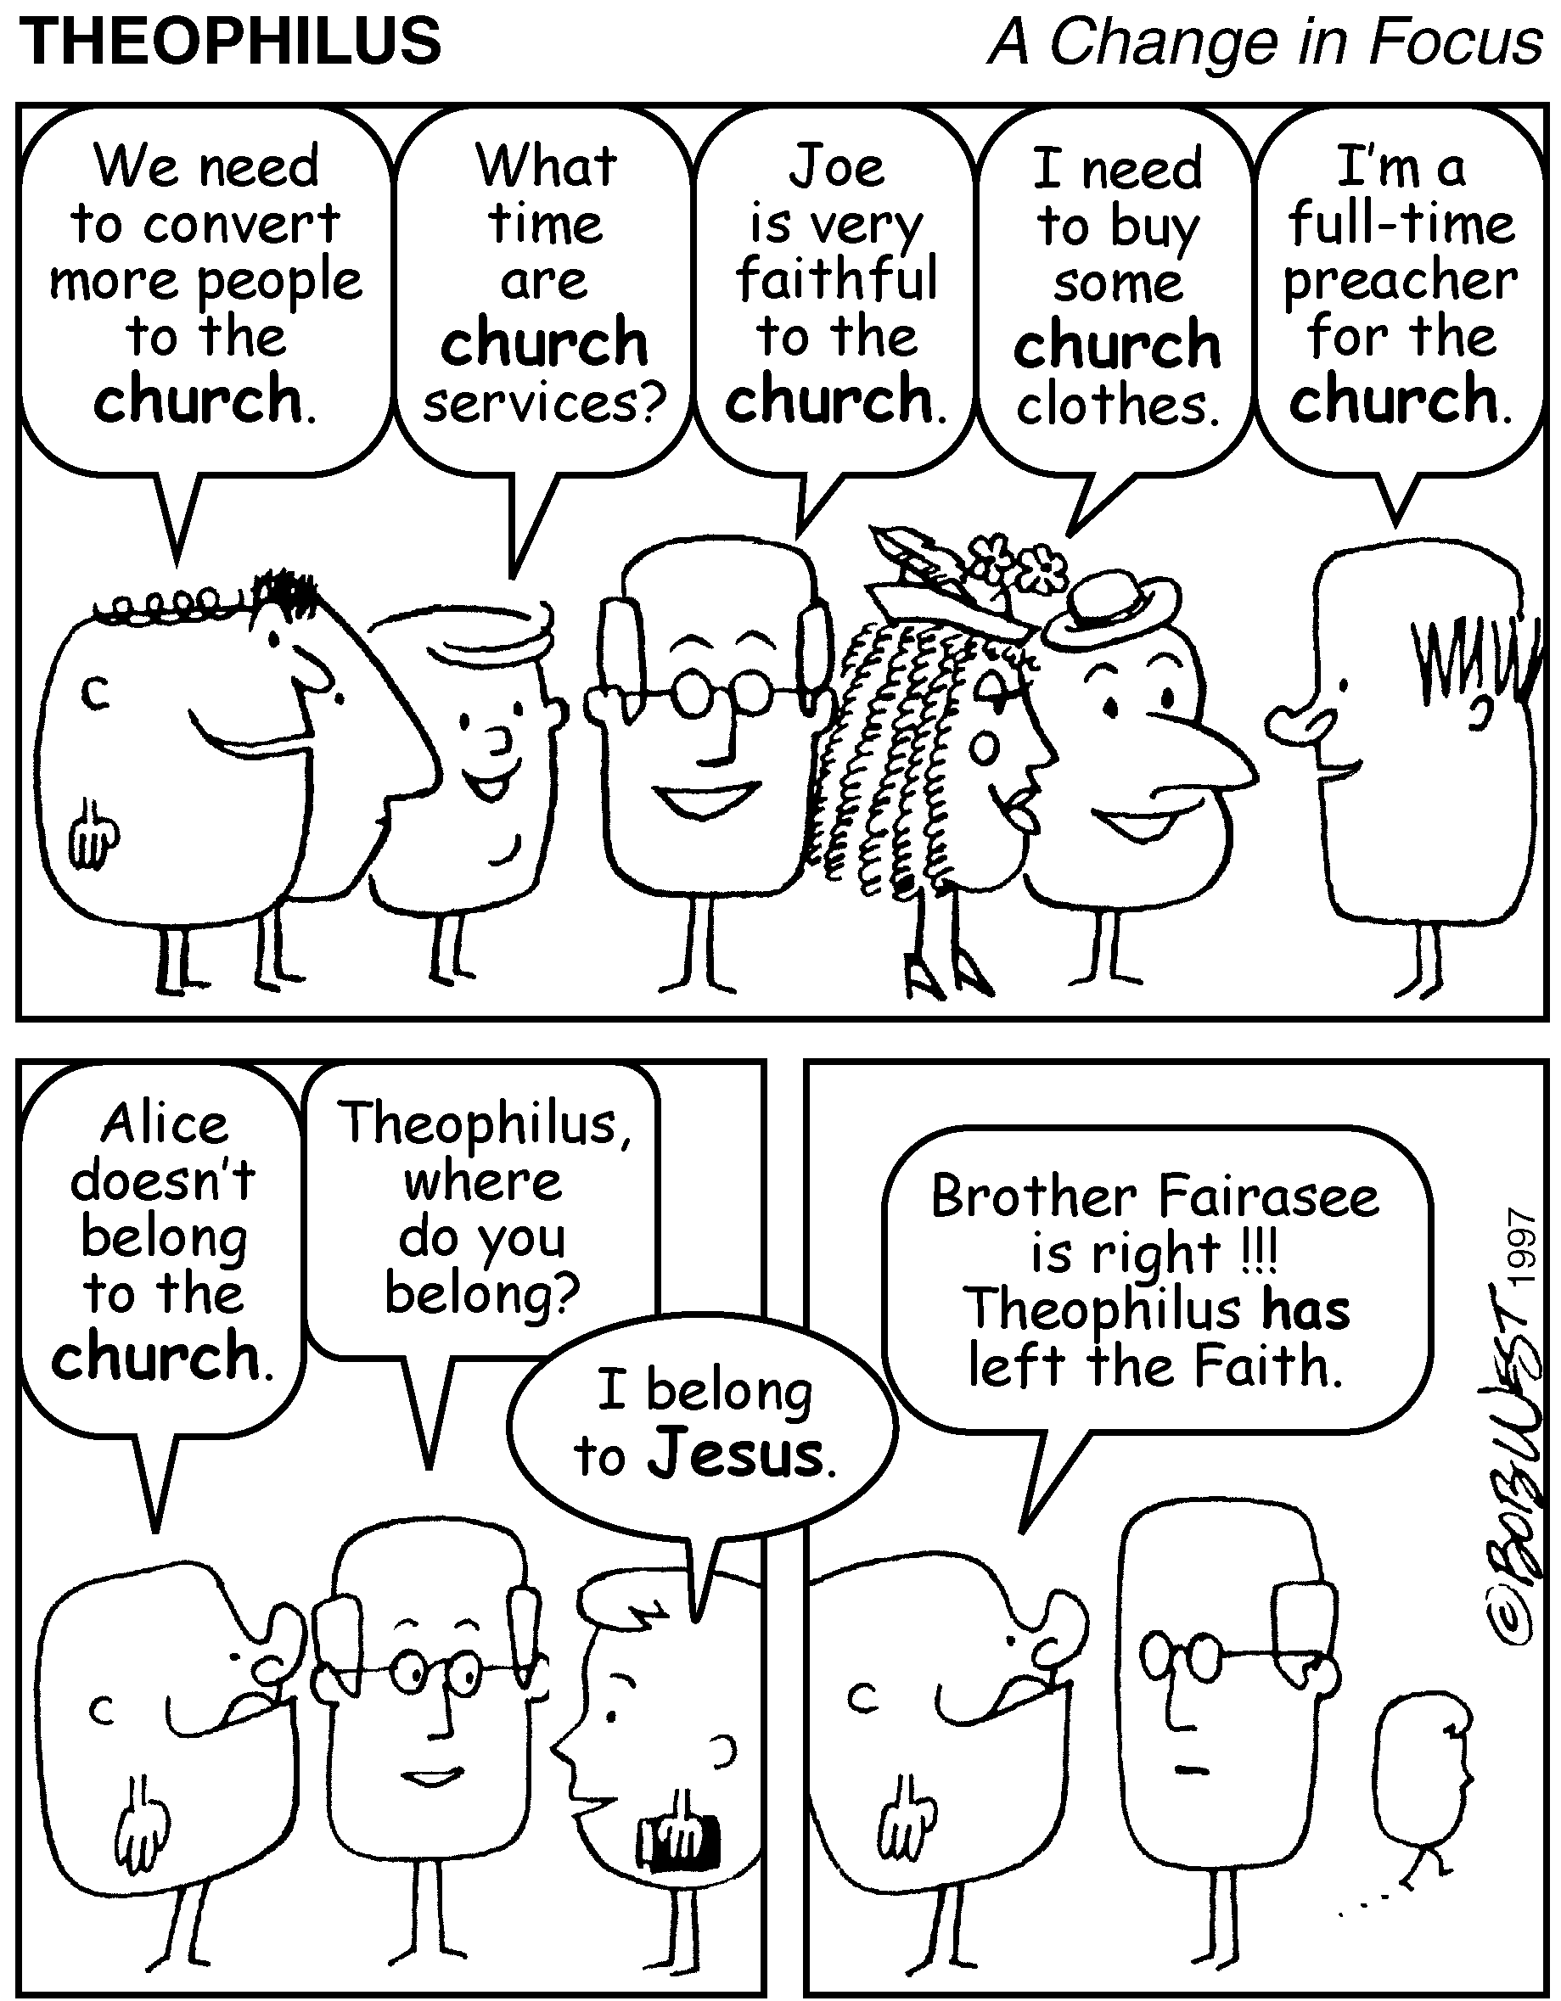

Slide 123
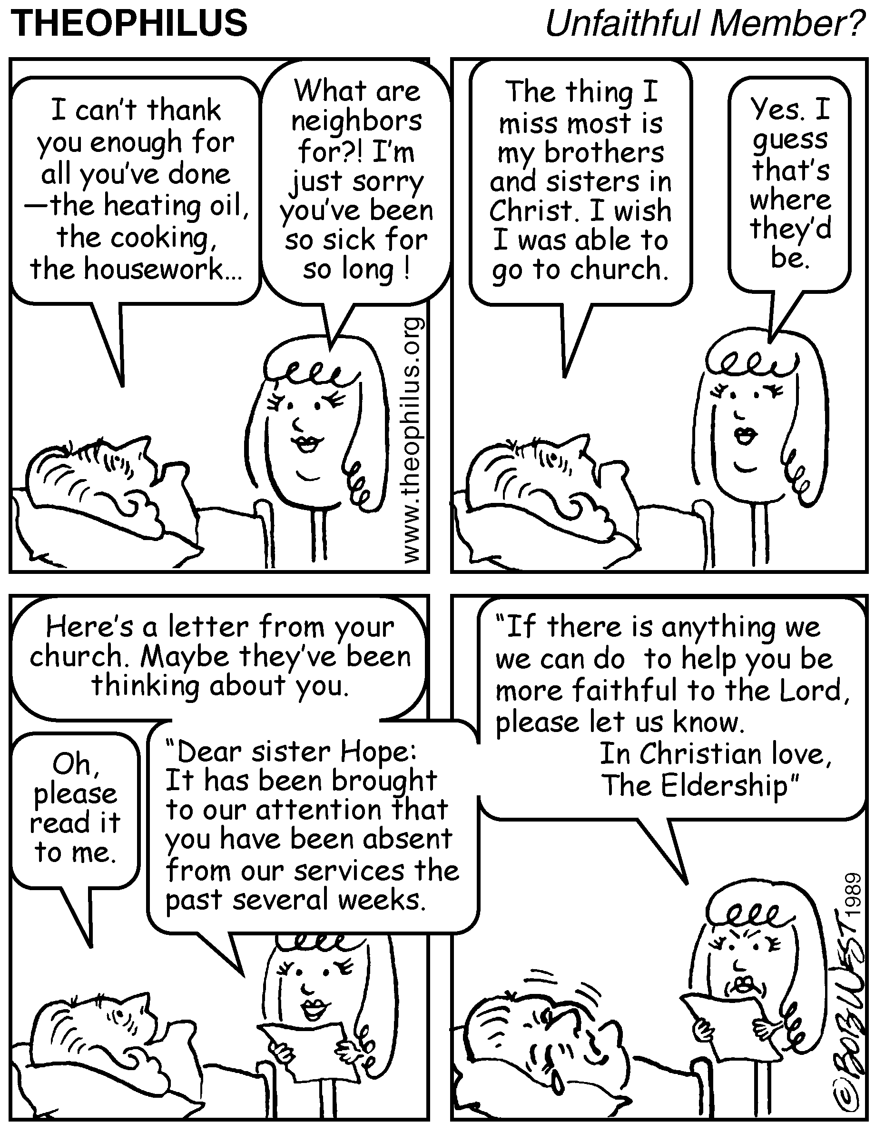

Slide 124

BELIEFS RECEIVED & LEARNED RELIGION:
“If the source of our learning is corrupt, our learning will be no better! It’s not enough to be taught. We must concern ourselves with where and by whom we were taught – 2 Timothy 1:5. In order for one’s religion to be learned, there must be a process of teaching, learning, and knowing. Concerning Christianity – we are taught of God and learned of the Father – John 6: 44, 45. As Christians , we should ask ourselves why we believe as we do. Where did we learn it? We should be able to go to the scriptures and say, ‘Here is why I believe as I do. I learned it from the Bible!’” - - Marlin Kilpatrick

Slide 125
RENOVARE’ PERSPECTIVE @ JULY 2008
More Than A Textbook - -
“Reading the Bible for interior transformation is a far different endeavor than reading the Bible for historical knowledge, literary appreciation, or religious instruction. In the latter case we learn head knowledge; in the former knowledge of the heart. To allow the Bible to infiltrate us with the Life God offers – piercing us like a two-edged sword dividing ‘soul from spirit, joints from marrow… {judging the thoughts and intentions of the heart}’ – we must bring to the Bible our whole selves, expectantly, attentively, and humbly.”

Slide 126
RENOVARE’ PERSPECTIVE @ JULY 2008
More Than A Textbook - -
“Reading the Bible for spiritual transformation is tantamount to inviting a Damascus road experience. If we venture onto ancient roads of the Bible’s world with an open mind and an inquiring heart, we can expect to encounter the living God. The Bible is far more than just a resource text, which we can use to shape our theology or ethics. It is God’s living and active voice & every time we open its covers we expose ourselves to the possibility of a life-changing encounter with Jesus Christ!”

Slide 127
NEW WINESKINS\MARCH 2002\PAGE 18
Ironic Trend. “The Restorationist Movement has often been very liberating because it frees converts from the restraints of dead traditionalism. Yet the regular pattern of such pietistic movements has been repeated for the followers of Stone and Campbell as well. The insights or practices that made possible the original liberation sometimes become a set of calcified standard procedures and automatically expected beliefs. The result for 2nd and 3rd generation Restorationists can be restriction of spontaneity and an end to real freedom.”

Slide 128
NEW WINESKINS\MARCH 2002\PAGE 18
Ironic Trend. “Restorationist movements sometimes are marked by considerable self-congratulation at having broken through the stultifying bonds of human tradition. Yet when such reform groups proceed to establish the particular forms of their restoration as ‘traditionless traditions,’ they can become as every bit inflexible as the supposedly corrupt traditions that these movements came into existence to overcome.”

Slide 129

“Teaching As Doctrines The Traditions Of Men”
David Lee Burris:
For Four Centuries Christians Believed Celebrating Children’s Birthdays Worldly & Pagan Ritual – Only Celebrated “Birthdays” Of Martyrs Death - Early Christians Definitely Didn’t Celebrate Christ’s Bethlehem Birth!
Justin Martyr: “Bread is presented and wine and water” Common practice - dilute wine with water - counter potency.
“In every church, in every institution, there is something which sooner or later works against the very purpose for which it came into existence.”
- C.S. Lewis

Slide 130
David Lee Burris:
For Four Centuries Christians Believed Celebrating Children’s Birthdays Worldly & Pagan Ritual – Only Celebrated “Birthdays” Of Martyrs Death - Early Christians Definitely Didn’t Celebrate Christ’s Bethlehem Birth!
Justin Martyr: “Bread is presented and wine and water” Common practice - dilute wine with water - counter potency.
“Teaching As Doctrines The Traditions Of Men”
THE EMERGENCE OF
TRADITIONLESS
TRADITIONS!

Slide 131
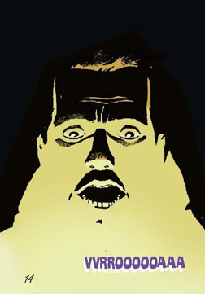
THE ENGLISH WORDS FOR “TRAITOR” OR “TREASON” & FOR “TRADITION” BOTH ORIGINATE FROM THE LATIN ROOT TRADITORE

Slide 132

Dangers Of Group Think
“Several factors in the church may make it susceptible. To the degree we are sensitive to the destructive effects of conforming to the larger society, some church people may want to isolate themselves from outside contact. Attacks on the church from outside, if there have been any, may contribute to cohesiveness within – a sense of ‘us’ against ‘them’ – and make church unity an end in itself. We reason that only a united church can defend itself against those attacks, survive and grow. We believe that only a church free of conflict can provide a strong and vital witness to the world. We view quiet dissent and disagreement as disruptive, and open conflict as destructive, as though it might shake stability and endanger the very existence of the church. Ironically, in our press for unity within the church, we may lose the very strength and vitality we seek – the vigor that healthy and loving conflict can bring!” - - The Human Connection - pg. 98

Slide 133
Dangers Of Group Think
“Another factor which may contribute to groupthink in the church is the false idea that faith is antagonistic to exercising critical judgment on any issue. This distorted perspective implies that the rational analysis of a problem, a careful search for information and independent analytical thinking may well be proper for solving problems in government, business and education, but they are not appropriate for resolving issues within the church; in fact, such analysis is diametrically opposed to trusting God.”
“We don’t encourage loyalty to God by a faith that refuses to exercise critical judgment. Such refusal readily leads to groupthink. Our own initial ideas or impulses become identified with God’s will and we create an illusion of invulnerability and a belief in our own inherent morality. Alternatives are either not examined or quickly dismissed. Suggestions to review or reconsider, to delay temporarily or exercise caution are rationalized as reflecting a lack of faith.” - The Human Connection

Slide 134
Research & Opportunities In Science & Theology\Religion & Life\07-03\Page 8
Being Sick Religiously. “The first symptom of dysfunctional religion is rigidity. Rigidity of the individual, and of the system, is characterized by being uncritical and lacking an ability for self-criticism. ‘Except that two agree, they can’t walk together’ is a quote that’s been used to seek conformity of beliefs. The capacity for genuine self-reflection is greatly hindered by isolation and intensity of the rigid personality, and would lead to beliefs that some would consider bizarre.”

Slide 135
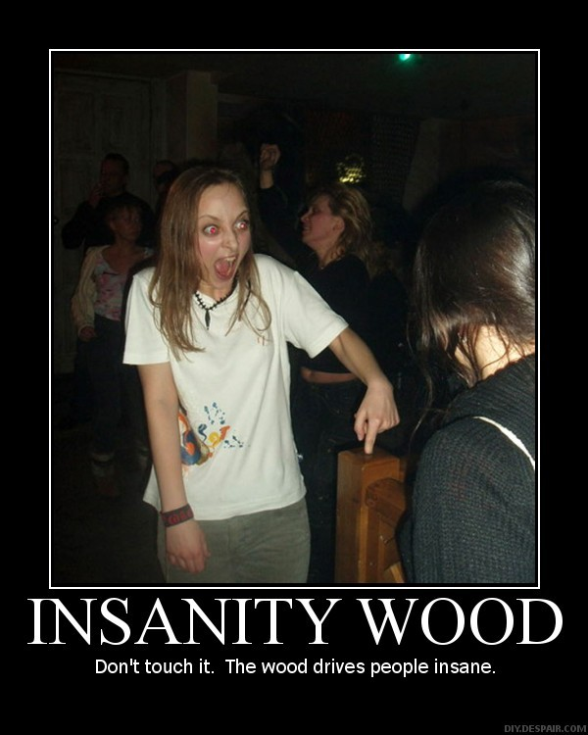

Slide 136
Research & Opportunities In Science & Theology\Religion & Life\07-03\Page 8
Religious Thought Unbalanced:
“When personal responsibility’s abdicated, and we are unable to accept ourselves as partners of the creator’s plan & everything becomes the act of a divine entity, then we move closer to the realm of sick religion.”

Slide 137
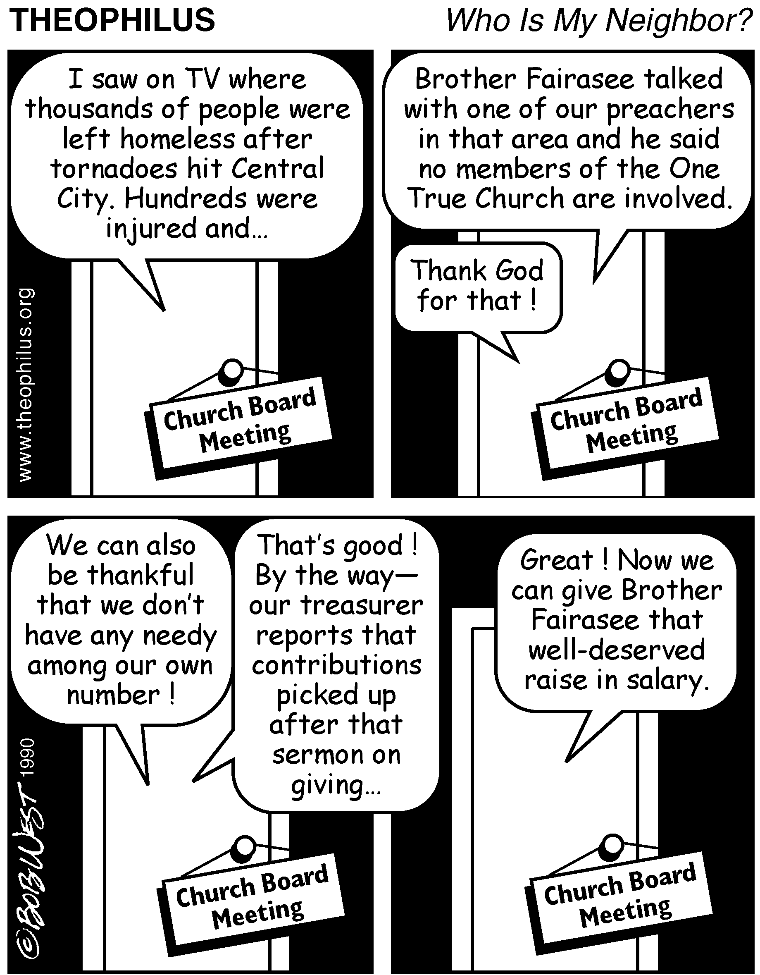

Slide 138
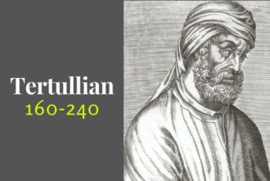
“Even if we have a kind of treasury, this is not filled up from a sense of obligation, as of a hired religion. Each member adds a small sum once a month, or when he pleases, and only if he is willing and able, for no one is forced, but each contributes of his own free will. For these are the deposits as if were made by devotion…

Slide 139
“For that sum is disbursed not on banquets nor drinking bouts nor unwillingly on eating-houses, but on the supporting and burying of the poor, and on boys and girls deprived of property and parents, and on aged servants of the house, also on shipwrecked persons, and any, who are in the mines, or on islands or in prisons, provided it be for the cause of God’s religion, who thus become pensioners of their confession.”

