Slide 1


Matthew 24: Jesus Returning in Judgement of Jerusalem
Compiled by David Lee Burris

Slide 2
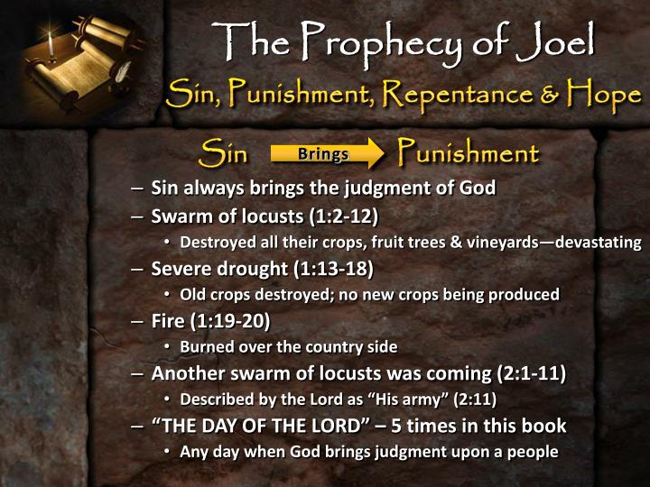
The Sin Cycle Is Over
No More Forgiveness!

Slide 3
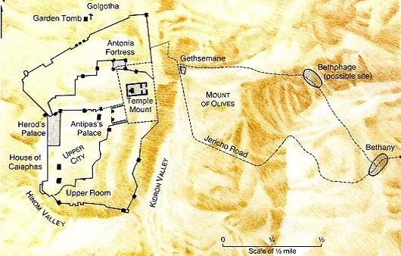
Jesus Last Week Travels – Monday
?
Barren Fig Tree
?
Jesus Laments
Jesus Christ
Spends Night
Matthew 21:17

Slide 4
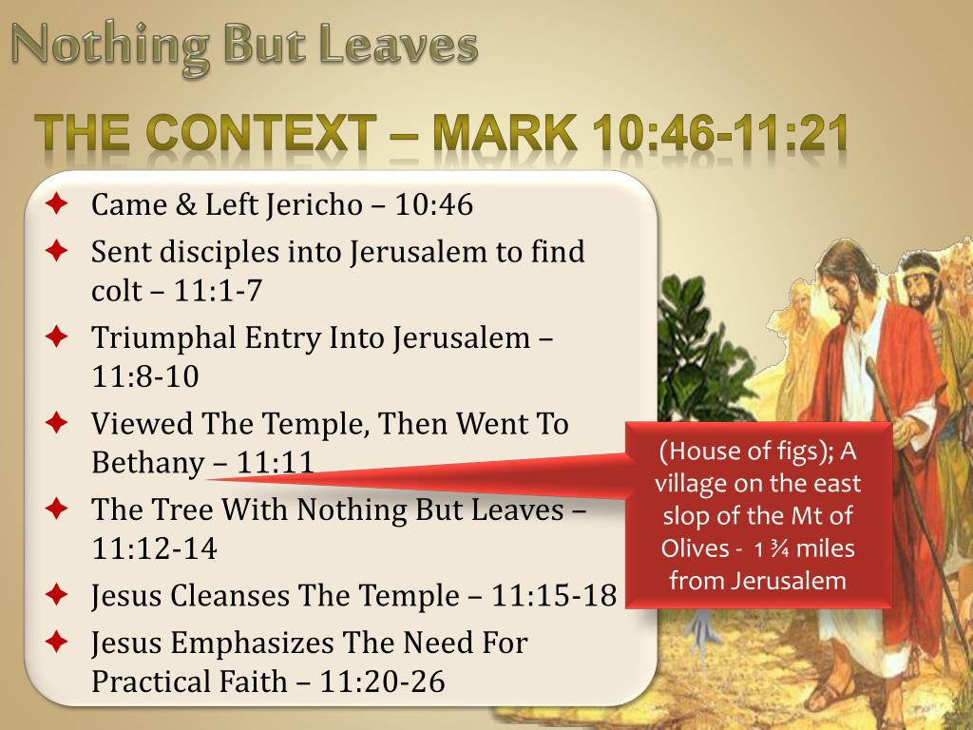

Slide 5
Matthew 21:13 “My House”
“It is written, ‘My house shall be called a house of prayer,’ but you have made it a ‘den of thieves.’”

Slide 6
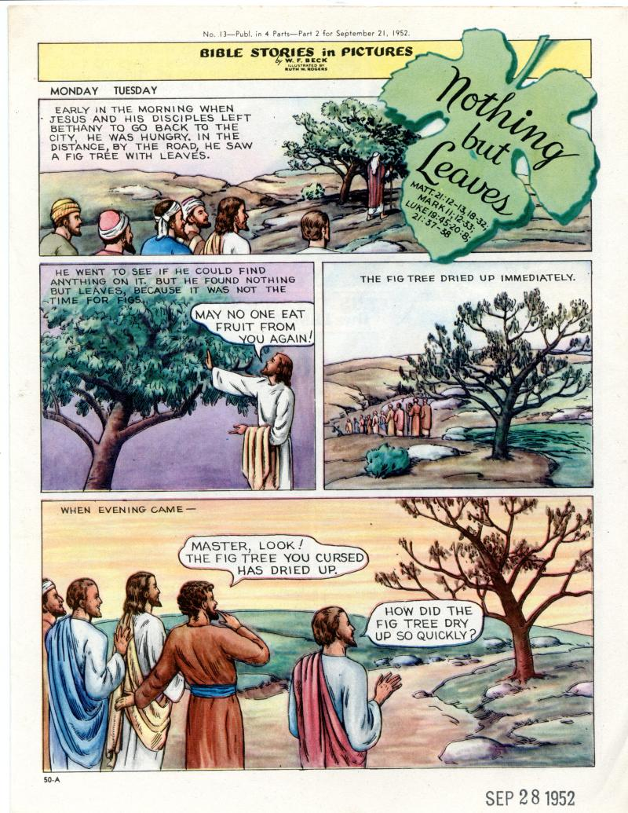

Slide 7
A Day of Rejection
Mk 11:12-14
  Mt 21:19, Fig tree immediately withers
  Similar to a Parable
    Lk 13:1-9, unless you repent you shall likewise perish
    Jesus’ last year of his Ministry
    Given opportunity
  This latter was not
The Barren Fig Tree
Rejected by the King

Slide 8
A Day of Rejection
Lesson
  Time for repentance was past
  Time for “judgment”
    Mt 23:34-39
  But one day…
The Barren Fig Tree
Rejected by the King

Slide 9

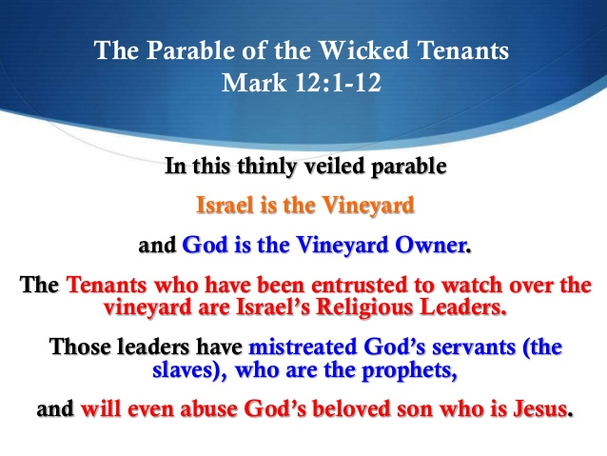

Slide 10
Matthew 23:38 “Your House”
See! Your house is left to you desolate

Slide 11
A comparison
(Matthew 21:13)
And He said to them, “It is written, ‘My house shall be called a house of prayer,’ but you have made it a ‘den of thieves.’”
(Matthew 23:38)
See! Your house is left to you desolate; ³⁹ for I say to you, you shall see Me no more till you say, ‘Blessed is He who comes in the name of the Lord!’ ”
Notice the change from “My house” to “your house”

Slide 12
A Day of Rejection
Mk 11:20-24
  The Next Day (Tuesday)
  Vs. 20, The fig tree is Dried up
  Have Faith in God
    To Move Mountains
      Disciple had a weak faith
      Mt 17:14-21, healing of the son who had a devil
      Lk 17:5-6, move trees
Dead Fig Tree
Notes:
We have skipped the cleaning of the temple, next weeks lesson.

Slide 13
A Kings Rejection
Barren Fig Tree
  Opportunity had Past – Time of Judgment
  Fulfill God’s Purpose
    Bear Fruit – Or be Rejected
    Have Faith
    Forgive – Or be Rejected

Slide 14
Mark 11:14 - Why Was the Fig Tree Cursed?
This incident is related by Mark and, in a more compressed form, by Matthew. According to Mark, Jesus and his disciples spent the night following his entry into Jerusalem in Bethany. Next morning they returned to Jerusalem. On the way he felt hungry, and “seeing in the distance a fig tree in leaf, he went to find out if it had any fruit. When he reached it, he found nothing but leaves, because it was not the season for figs.” Then Jesus cursed the tree: “May no one ever eat fruit from you again.” They continued on their way into Jerusalem, where that day he cleansed the temple; in the evening they returned to Bethany. Next morning, as they passed the same place, they saw the fig tree withered away to its roots. And Peter remembered and said to him, “Rabbi, look! The fig tree you cursed has withered!” (Mk 11:20–21). Was it not unreasonable to curse the tree for being fruitless when, as Mark expressly says, “it was not the season for figs”? The problem is most satisfactorily cleared up in a discussion called “The Barren Fig Tree” published many years ago by W. M. Christie, a Church of Scotland minister in Palestine under the British mandatory regime. He pointed out first the time of year at which the incident is said to have occurred (if, as is probable, Jesus was crucified on April 6th, a.d. 30, the incident occurred during the first days of April). “Now,” wrote Christie, “the facts connected with the fig tree are these. Toward the end of March the leaves begin to appear, and in about a week the foliage coating is complete. Coincident with [this], and sometimes even before, there appears quite a crop of small knobs, not the real figs, but a kind of early forerunner. They grow to the size of green almonds, in which condition they are eaten by peasants and others when hungry. When they come to their own indefinite maturity they drop off.” These precursors of the true fig are called taqsh in Palestinian Arabic. Their appearance is a harbinger of the fully formed appearance of the true fig some six weeks later. So, as Mark says, the time for figs had not yet come. But if the leaves appear without any taqsh, that is a sign that there will be no figs. Since Jesus found “nothing but leaves”—leaves without any taqsh—he knew that “it was an absolutely hopeless, fruitless fig tree” and said as much. But if that is the true explanation of his words, why should anyone trouble to record the incident as though it had some special significance? Because it did have some special significance. As recorded by Mark, it is an acted parable with the same lesson as the spoken parable of the fruitless fig tree in Luke 13:6–9. In that spoken parable a landowner came three years in succession expecting fruit from a fig tree on his property, and when year by year it proved to be fruitless, he told the man in charge of his vineyard to cut it down because it was using up the ground to no good purpose. In both the acted parable and the spoken parable it is difficult to avoid the conclusion that the fig tree represents the city of Jerusalem, unresponsive to Jesus as he came to it with the message of God, and thereby incurring destruction. Elsewhere Luke records how Jesus wept over the city’s blindness to its true well-being and foretold its ruin “because you did not know the time of your visitation” (Luke 19:41–44 RSV). It is because the incident of the cursing of the fig tree was seen to convey the same lesson that Mark, followed by Matthew, recorded it.
Kaiser, W. C., Jr., Davids, P. H., Bruce, F. F., & Brauch, M. T. (1996). Hard sayings of the Bible (pp. 441–442). Downers Grove, IL: InterVarsity.

Slide 15
Jerusalem would fall!
Matthew 23:37-38
“O Jerusalem, Jerusalem, the one who kills the prophets and stones those who are sent to her! How often I wanted to gather your children together, as a hen gathers her chicks under her wings, but you were not willing! ³⁸ See! Your house is left to you desolate

Slide 16
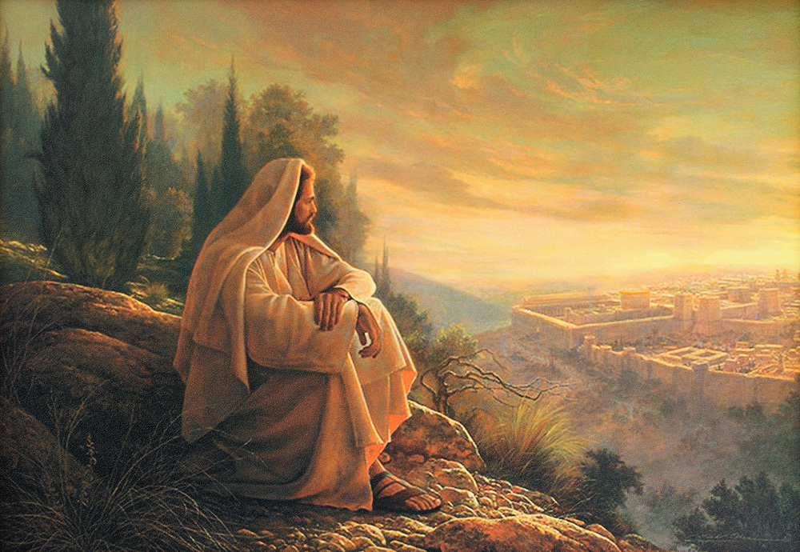
O’ Jerusalem, Jerusalem!

Slide 17
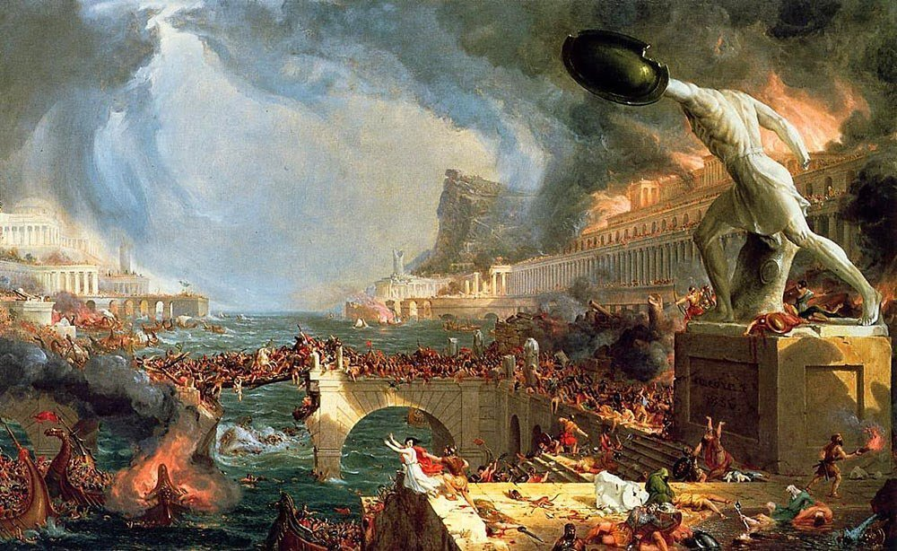
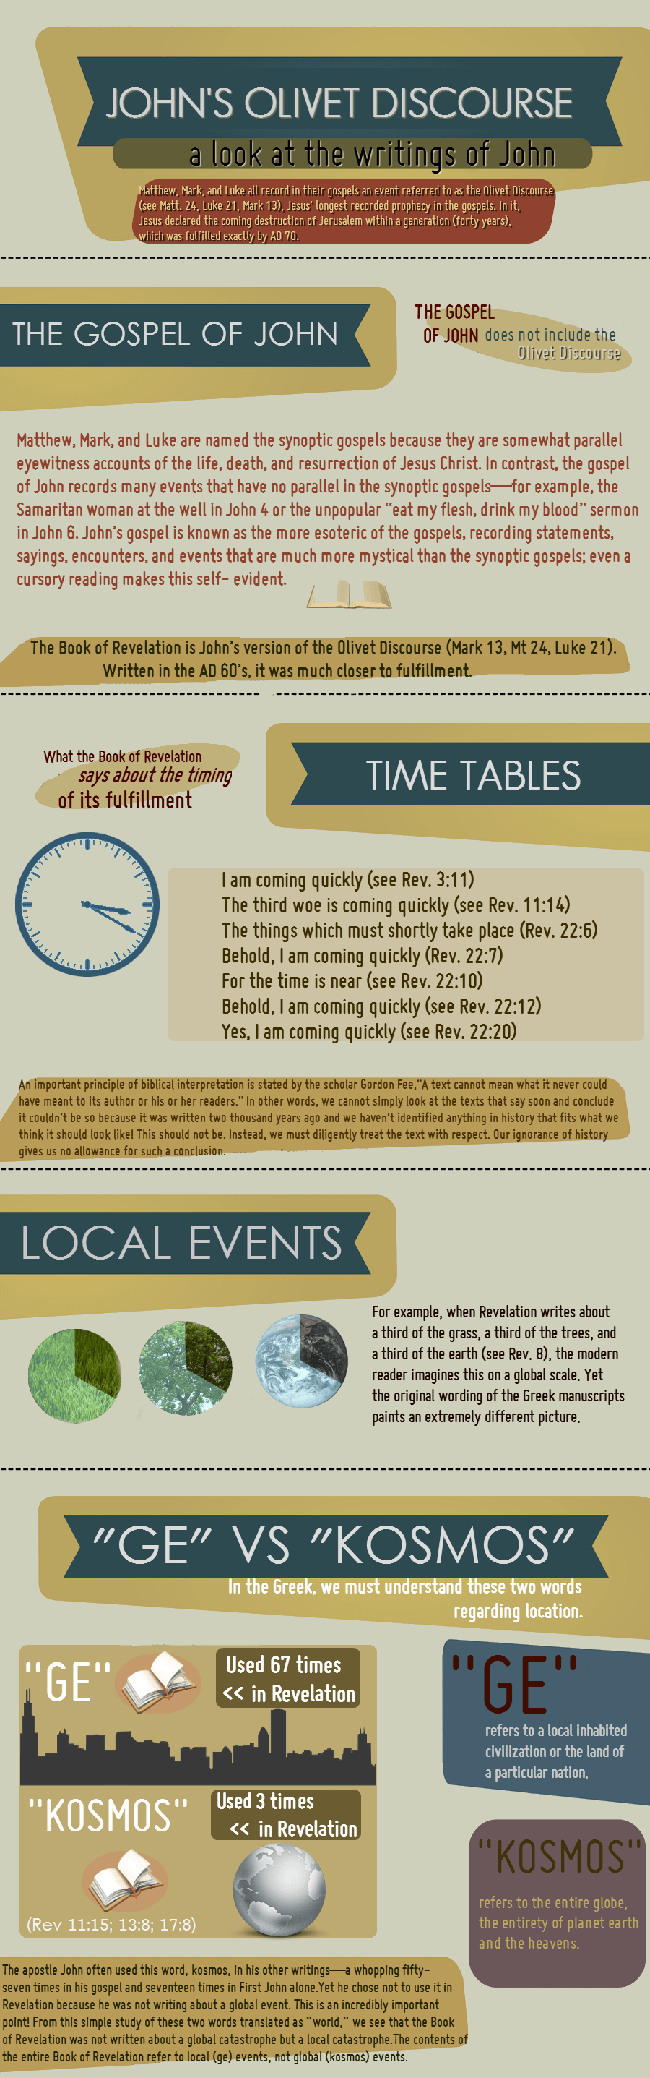

Slide 18
Matthew 24:
Signs Of The End Of The
World??

Slide 19
Matt. 24: Signs Of The End?
Matt. 24 Interesting Discourse
Delivered by Jesus to His apostles
It was given on Tuesday before His death on Friday.
Mt. of Olives was setting for message
East of Jerusalem, which could be seen
Temple was in full view
Peter, James, John & Andrew-present

Slide 20
Matt. 24: Signs Of The End?
Misunderstanding of Matt. 24
The first 34 verses apply to the destruction of Jerusalem and events dealing with it.
Jerusalem was destroyed in 70AD by the Roman army, under the leadership of General Titus.

Slide 21
Matt. 24: Signs Of The End?
II. Keys of understanding Matt. 24
Mark 13 & Luke 21 reveal same story
Mistake to take one chapter and ignore the other two.
Saul’s conversion is in Acts 9, 22, 26.
Have to study all 3 to get the full account.

Slide 22
Matt. 24: Signs Of The End?
II. Keys of understanding Matt. 24
Luke 21:20 (A key verse)
“And when ye shall see Jerusalem compassed with armies, then know that the desolation thereof is nigh.”
This verse reveals what He is talking about.

Slide 23
Matt. 24: Signs Of The End?
Misunderstanding of Matt. 24
Possibly the most misunderstood chapter in the New Testament.
Jesus was not speaking of events which would happen in the 21st century.
When one tries to apply the first 34 verses to the end of world, it is a serious misunderstanding!

Slide 24
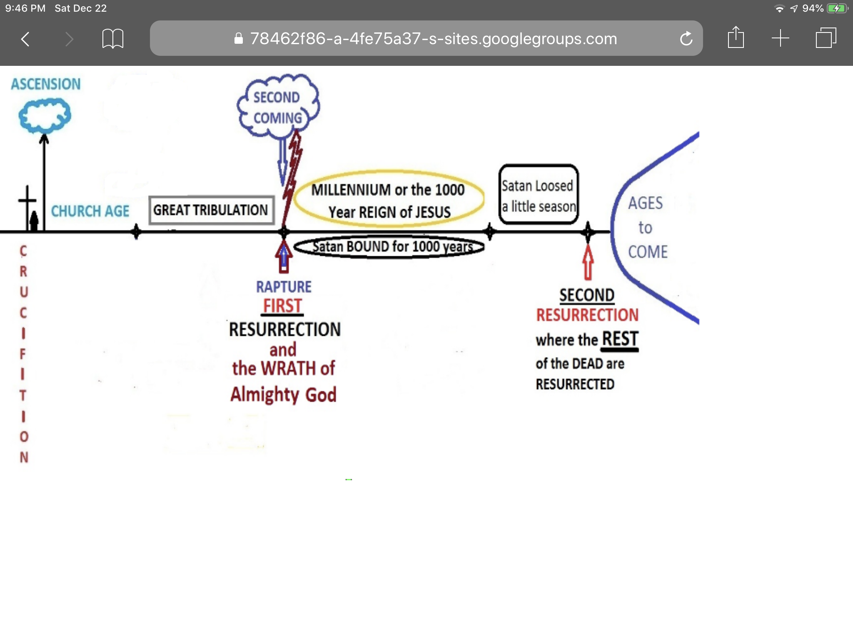
Matthew 24 Misunderstood

Slide 25
Matt. 24: Signs Of The End?
II. Keys of understanding Matt. 24
Matt. 24:34 (key verse)
“Verily I say unto you, This generation shall not pass, till all these things be fulfilled.”
Matt. 24:36 (key verse)
“But of that day and hour knoweth no man, no, not the angels of heaven, but my Father only.”

Slide 26

Matthew 24 Misunderstood

Slide 27
Matt. 24: Signs Of The End?
III. Questions asked by disciples.
Matt. 24:1-2
“And Jesus went out, and departed from the temple: and his disciples came to him for to show him the buildings of the temple. And Jesus said unto them, See ye not all these things? verily I say unto you, There shall not be left here one stone upon another, that shall not be thrown down.”

Slide 28
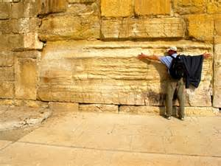
These Things?
The Temple was still under construction at this time, and the disciples must have been curious onlookers at the massive stones.
But Jesus said it would be destroyed!
“These things” referred to the destruction of the Jerusalem.

Slide 29
Deuteronomy 18:21-22
And if you say in your heart, ‘How shall we know the word which the Lord has not spoken?’— ²² when a prophet speaks in the name of the Lord, if the thing does not happen or come to pass, that is the thing which the Lord has not spoken; the prophet has spoken it presumptuously; you shall not be afraid of him.

Slide 30
Jesus’ Prophecy
Both Matthew and Mark note that the conversation began between the disciples and Jesus as they were leaving the temple. Herod the Great’s rebuilding and restoration of the Jerusalem temple had transformed it into one of the wonders of the ancient world. The disciples’ admiration would have been similarly expressed by any Greek, Roman, or Jewish visitor to the temple. The disciples’ amazement is shared even by modern visitors who see the huge blocks in the remaining Herodian walls, and these were only the substructure, not the temple proper. Herod was quite famous for a provincial client king at the time, and the temple dramatically increased Greek and Roman tourism, particularly because it was built in such a way that non-Jews had partial access through the court of Gentiles.
Josephus, the most important Jewish historian of the first century, described the beauty and magnificence of the temple in these words:
The exterior of the building wanted nothing that could astound either mind or eye. For, being covered on all sides with massive plates of gold, the sun was no sooner up than it radiated so fiery a flash that persons straining to look at it were compelled to avert their eyes, as from the solar rays. To approaching strangers, it appeared from a distance like a snow-clad mountain; for all that was not overlaid with gold was of purest white. From its summit protruded sharp golden spikes to prevent birds from settling upon and polluting the roof. Some of the stones in the building were forty-five cubits in length, five in height and six in breadth.
The Jerusalem temple was a magnificent sight and an astounding architectural achievement: “Easily the tallest structure in the city, it dominated the urban landscape. At about 1,550,000 square feet (thirty-five acres), it was also the largest sanctuary site in the ancient world.”
The religious importance of the temple for the Jewish people cannot be overestimated. This was the place where worship took place and God could be entreated. This was the ultimate symbol of God’s election of the Jewish people and of his commitment and promises to them: “The temple was thus regarded as the place where YHWH lived and ruled in the midst of Israel, and where, through the sacrificial system which reached its climax in the great festivals, he lived in grace, forgiving them, restoring them, and enabling them to be cleansed of defilement and so to continue as his people.”
Jesus’ departure from the temple represents the end of his teaching ministry in Jerusalem. It is possible that this departure symbolizes judgment and the temple’s abandonment by God in the same way that the glory of God left the temple and came to rest on the mountain east of the city in Ezekiel’s vision (10:18–19; 11:22–23), but neither Matthew nor Mark make this explicit while Luke doesn’t mention Jesus’ departure at all.
The disciples would have been shocked by Jesus’ prophetic response. In reply to their awe at the temple’s grandeur, Jesus prophesied that it would be razed to the ground. Jesus’ prophecy of the temple’s destruction would have made a profound impact on his Jewish listeners, many of whom viewed the temple as indestructible. During Jesus’ trial later that week, false witnesses distorted this prophecy and claimed that Jesus had personally threatened to destroy the temple (Matt. 26:61; 27:40). This is reminiscent of the way in which King Jehoiakim had the prophet Uriah killed for prophesying the destruction of Jerusalem (Jer. 26:20–23) and Jewish priests and prophets wanted Jeremiah killed for prophesying against the city (Jer. 26:11).
Köstenberger, A. J., Stewart, A. E., & Makara, A. (2017). Jesus and the Future: Understanding What He Taught about the End Times (pp. 34–37). Bellingham, WA: Lexham Press.

Slide 31
Jesus’ Prophecy – cont.
Jesus’ prophecy of the temple’s destruction was used at his trial to support the death sentence. This charge continued to linger after Jesus’ death and was also leveled against Stephen, one of his followers (Acts 6:13–14). For some Jews, Jesus’ prophecy of the temple’s destruction was enough to discredit him and his followers in subsequent generations. Jesus’ original listeners, of course, would have been familiar with Old Testament prophecies of the destruction of Solomon’s temple that had occurred in 586 BC, but they wouldn’t have viewed the current temple as susceptible to such judgment (Jer. 7:11–14; 26:1–23; Micah 3:12).
The statement that not “one stone” would be left “upon another” indicates utter destruction that reverses the building process (Hag. 2:15). Some stones still rest upon another from the substructure and retaining wall of the temple Mount (the Wailing Wall), so Jesus was either referring to the temple buildings or was using prophetic hyperbole to stress the reality of total and irreversible destruction. His prophetic statement receives extra weight by the phrase “Truly, I say to you,” which prefaces it in Matthew’s Gospel. Jesus’ statement is emphatic and final: The temple is going to be destroyed.
This prophecy is significant for at least three reasons. First, by predicting the temple’s demise Jesus made clear to his disciples that he was fully aware of what lay ahead. His power to predict the future was also evident in his foreknowledge of Judas’s betrayal and Peter’s denial. Jesus was not merely guessing, and he certainly didn’t simply prophesy things people were itching to hear. He was a genuine prophet; in fact, he was “the” prophet of whom Moses spoke:
The LORD your God will raise up for you a prophet like me from among you, from your brothers—it is to him you shall listen—just as you desired of the LORD your God at Horeb on the day of the assembly, when you said, “Let me not hear again the voice of the LORD my God or see this great fire any more, lest I die.” And the LORD said to me, “They are right in what they have spoken. I will raise up for them a prophet like you from among their brothers. And I will put my words in his mouth, and he shall speak to them all that I command him. And whoever will not listen to my words that he shall speak in my name, I myself will require it of him.” (Deut. 18:15–18)
Second, the fact that no Gospel writer mentions the fulfillment of this prophecy suggests that these accounts were written before Jerusalem fell and the temple was destroyed by the Romans in AD 70. If any of them had known about the prophecy’s fulfillment, he would surely have commented on it. The Gospel writers weren’t making up prophecies after the fact (vaticinia ex eventu) but recording a legitimate prophecy uttered before the events transpired.
Third, and perhaps most importantly, this prophecy sets the stage for the entire Olivet Discourse. Any interpretation of Matthew 24, Mark 13, and Luke 21 that doesn’t relate in some way to the historical destruction of the temple is on the wrong track. This prophecy sets the topic for the discourse. This doesn’t mean that Jesus couldn’t talk about other things beyond the destruction of Jerusalem in the Olivet Discourse, but this event is surely the starting point as we seek to understand what else Jesus might have said about the future.
Köstenberger, A. J., Stewart, A. E., & Makara, A. (2017). Jesus and the Future: Understanding What He Taught about the End Times (pp. 34–37). Bellingham, WA: Lexham Press.

Slide 32
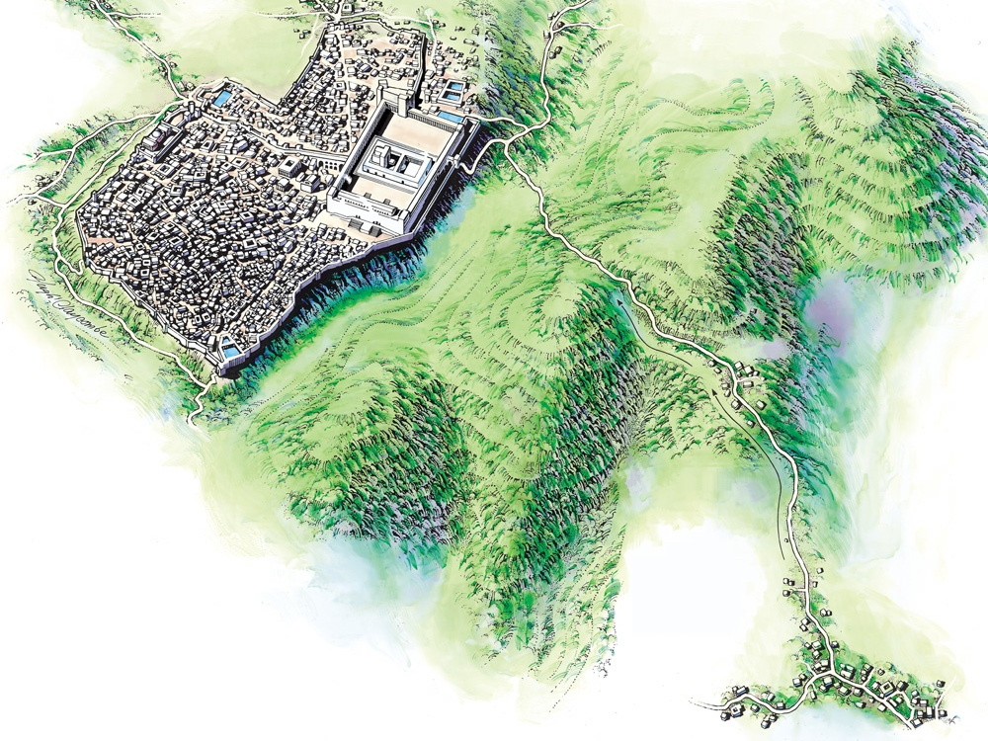

Mt. of Olives
Bethphage
Jerusalem
Bethany
Jesus Came to the Mount of Olives
Notes:
Links on this slide will be activated in PowerPoint Show mode

Slide 33
Matt. 24: Signs Of The End?
III. Questions asked by disciples.
Matt. 24:3
“And as he sat upon the mount of Olives, the disciples came unto him privately, saying, Tell us, when shall these things be? and what shall be the sign of thy coming, and of the end of the world?”

Slide 34
Matt. 24: Signs Of The End?
III. Questions asked by disciples.
Matt. 24:3
“And as he sat upon the mount of Olives, the disciples came unto him privately, saying, Tell us, when shall these things be? and what shall be the sign of thy coming, and of the end of the world?”

Slide 35
From Matthew 24:3
The disciples of Jesus privately asked Jesus later on Mt. Olives three questions:
1) When will these things be?
2) What will be the sign of Your coming?
3) What will be the sign of the end of the age?

Slide 36
When? It is near!
Using a parable of a fig tree showing its leaves before dropping its fruit, Jesus said “these things” (destruction of Jerusalem) would be near.
He even qualifies it further – the fall of Jerusalem would take place within the current generation. Generally, a generation is considered to be 30-40 years. If Jesus spoke these words in ~ AD 30, that would give a range of AD 30 – 70.

Slide 37
Olivet Context: The Waste of Space Fig Tree
When Will These Things Happen?
Learn from the fig tree (vs. 32-35)
Just as plants spout leaves and begin to be fruitful tells us that summer is near, so also these signs will note that the destruction of Jerusalem is near. Notice verse 34, “I assure you: This generation will not pass away until these things take place.” Premillennialists take this passage as the second coming and the coming tribulation that will occur after the rapture. If that is true, then that generation must still be alive somewhere. Is there somewhere nearly 2000 year old people? Ridiculous! What Jesus was saying here is that within that generation’s lifespan, these things would happen. It would not be something for a really long time, not far into the future, but shortly these things would happen. Everything else may pass away, but his words about this event would surely occur. There was no doubt.

Slide 38
There are several reasons to think that with the parable of the fig tree Jesus is briefly transitioning back to conclude his answer to the disciples’ question about when the temple will be destroyed and not talking about the second coming. First, we noted above that the language of “these things” and “all these things” intentionally mirrors the question of the disciples at the beginning of the Olivet Discourse. This is an indication that Jesus is concluding his answer to that question and not necessarily pointing to everything said in the Olivet Discourse up to that point (i.e., the “these things” and “all these things” do not include the second coming). Second, the parable of the fig tree is used as an illustration of how signs indicate the approach of a given event. In the case of the fig tree, the sprouting of leaves indicates the approach of summer. By analogy, Jesus explained that when his followers would see certain things, they would know that a given event was near. The language mirrors the language used earlier in the Olivet Discourse concerning the abomination of desolation, which would be a sign indicating the destruction of Jerusalem.
  Köstenberger, A. J., Stewart, A. E., & Makara, A. (2017). Jesus and the Future: Understanding What He Taught about the End Times (p. 74). Bellingham, WA: Lexham Press.

Slide 39
These two verbal connections—“these things” and “when you see”—are strong indications that Jesus is here concluding his answer to the question about when the temple would be destroyed. This conclusion helps with a translation difficulty. The Greek text in Matthew and Mark only uses a third person singular verb, so the context must determine whether he, she, or it is near. If the translator thinks Jesus is using the fig tree parable to describe his second coming, the context would suggest “he” (as in the ESV throughout), but if the translator thinks Jesus is referring to the destruction of Jerusalem, “it” would be a better translation. When the disciples were going to witness the events Jesus had predicted, particularly the ritual desecration of the temple—the abomination of desolation—and the approach of Roman armies, they would know that “it [the destruction of the city] was near.”
This conclusion is confirmed by Jesus’ plain answer to the question about the timing of the temple’s destruction: It would take place within that generation. The various attempts to explain “this generation” as a general way to describe the present age, the race of the Jews, or the final generation living when Jesus returns are rendered unlikely by the way in which Jesus regularly used the phrase “this generation” throughout the Gospels to describe the generation of people alive at the time.
Köstenberger, A. J., Stewart, A. E., & Makara, A. (2017). Jesus and the Future: Understanding What He Taught about the End Times (p. 75). Bellingham, WA: Lexham Press.

Slide 40
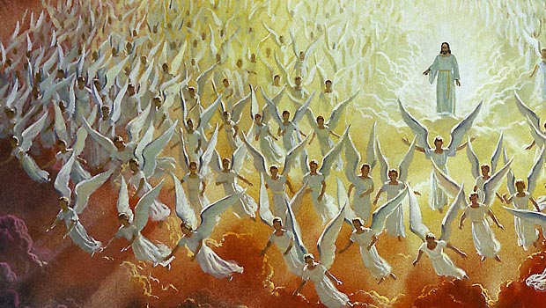
Matthew 24 Misunderstood
Matthew 24 is very often misunderstood and misused by premillennialists who teach that there will be “signs” pointing to Jesus’ return and 1,000 year reign
The word “signs” (24:3, 30) and the word “tribulation” (24:9, 21, 29) mentioned in Matthew 24 are widely used by premillenialists to teach this false doctrine
What exactly was Jesus trying to say when He left for us Matthew chapter 24?

Slide 41

Matthew 24:1-14 [1] Then Jesus went out and departed from the temple, and His disciples came up to show Him the buildings of the temple. [2] And Jesus said to them, "Do you not see all these things? Assuredly, I say to you, not one stone shall be left here upon another, that shall not be thrown down." [3] Now as He sat on the Mount of Olives, the disciples came to Him privately, saying, "Tell us, when will these things be? And what will be the sign of Your coming, and of the end of the age?" [4] And Jesus answered and said to them: "Take heed that no one deceives you. [5] For many will come in My name, saying, 'I am the Christ,' and will deceive many. [6] And you will hear of wars and rumors of wars. See that you are not troubled; for all these things must come to pass, but the end is not yet. [7] For nation will rise against nation, and kingdom against kingdom. And there will be famines, pestilences, and earthquakes in various places. [8] All these are the beginning of sorrows. [9] "Then they will deliver you up to tribulation and kill you, and you will be hated by all nations for My name's sake. [10] And then many will be offended, will betray one another, and will hate one another. [11] Then many false prophets will rise up and deceive many. [12] And because lawlessness will abound, the love of many will grow cold. [13] But he who endures to the end shall be saved. [14] And this gospel of the kingdom will be preached in all the world as a witness to all the nations, and then the end will come.
Do you see Jesus here?
NO!

Slide 42
Matthew 24:15-28 [15] "Therefore when you see the 'abomination of desolation,' spoken of by Daniel the prophet, standing in the holy place" (whoever reads, let him understand), [16] "then let those who are in Judea flee to the mountains. [17] Let him who is on the housetop not go down to take anything out of his house. [18] And let him who is in the field not go back to get his clothes. [19] But woe to those who are pregnant and to those who are nursing babies in those days! [20] And pray that your flight may not be in winter or on the Sabbath. [21] For then there will be great tribulation, such as has not been since the beginning of the world until this time, no, nor ever shall be. [22] And unless those days were shortened, no flesh would be saved; but for the elect's sake those days will be shortened. [23] "Then if anyone says to you, 'Look, here is the Christ!' or 'There!' do not believe it. [24] For false christs and false prophets will rise and show great signs and wonders to deceive, if possible, even the elect. [25] See, I have told you beforehand. [26] "Therefore if they say to you, 'Look, He is in the desert!' do not go out; or 'Look, He is in the inner rooms!' do not believe it. [27] For as the lightning comes from the east and flashes to the west, so also will the coming of the Son of Man be. [28] For wherever the carcass is, there the eagles will be gathered together.
Do you see Jesus here?
NO!

Slide 43
Matthew 24:29-35 [29] "Immediately after the tribulation of those days the sun will be darkened, and the moon will not give its light; the stars will fall from heaven, and the powers of the heavens will be shaken. [30] Then the sign of the Son of Man will appear in heaven, and then all the tribes of the earth will mourn, and they will see the Son of Man coming on the clouds of heaven with power and great glory. [31] And He will send His angels with a great sound of a trumpet, and they will gather together His elect from the four winds, from one end of heaven to the other. [32] "Now learn this parable from the fig tree: When its branch has already become tender and puts forth leaves, you know that summer is near. [33] So you also, when you see all these things, know that it is near-at the doors! [34] Assuredly, I say to you, this generation will by no means pass away till all these things take place. [35] Heaven and earth will pass away, but My words will by no means pass away.
[34] Assuredly, I say to you, this generation will by no means pass away till all these things take place.
Do you see Jesus here?
NO!

Slide 44
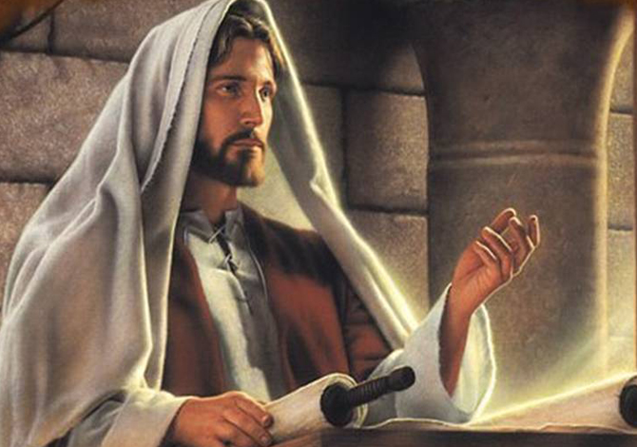
The Setting
Jesus has been teaching in the temple during his last week in Jerusalem before going to the cross (21:12, 17-18, 23)
Jesus prophesies that the Jews’ “house” (temple) will be made desolate (23:37-39; see Lk. 13:34-35; 19:41-44)
Jesus’ disciples show him the beautiful temple stones (24:1; see Josephus’ Antiquities of the Jews 15.11)
Jesus predicts the fall of Jerusalem (24:2)

Slide 45
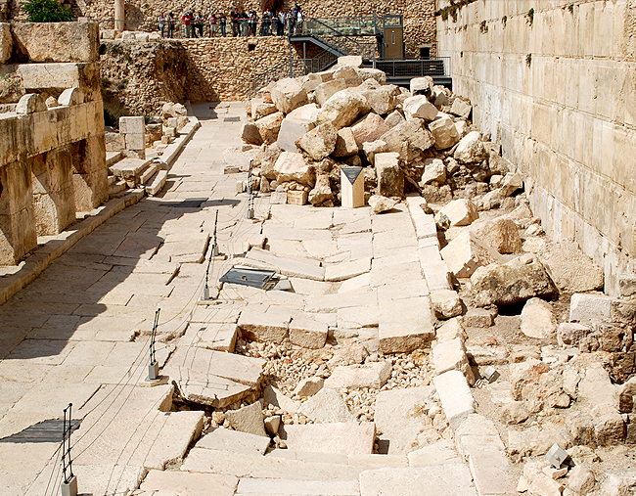
The Setting
The disciples asked Jesus when these things will be and Jesus answers them (24:3 – 25:46; see 26:1)
When shall these things be?
What shall be the sign of your coming (presence)?
What shall be the sign of the end of the world?

Slide 46
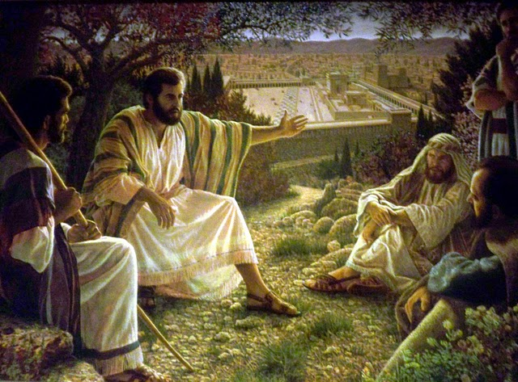
The Setting
Jesus’ disciples asked three questions but had one event in mind.
In their mind, the fall of Jerusalem, the coming of Christ, and the end of the world would all happen at the same time.
They wanted to know the TIME (when?) and the SIGN (what?) for the fall of Jerusalem (Mt. 24:3; Mk. 13:4; Lk. 21:7).
Jesus will, in fact, discuss not one, but two comings, two ends, and two worlds
Many now days like the disciples, they are confused and don’t know what the application of Matthew 24 is and what application we must give!

Slide 47
The Setting
The disciples ask Jesus when these things will be and Jesus answers them (24:3 – 25:46; see 26:1)
When shall these things be?
What shall be the sign of your coming (presence)?
What shall be the sign of the end of the world?
Very intriguing questions everyone.
Same like them many at Northside probably are asking the same, regarding Matthew 24.

Slide 48
The Setting
There are two extremes relative to Matthew 24 which must be addressed.
First, there is the notion, advocated by the proponents of “realized eschatology,” that all Bible prophecy, including everything within Matthew 24 (e.g., the second coming of Christ, the judgment day, and the end of the world), was fulfilled in the event of Jerusalem’s destruction by the Romans in A.D. 70.
Second, that all Matthew 24 is talking about is the destruction of Jerusalem. That’s not true.
Third: Remember, the disciples are asking 3 questions:
In their mind, the fall of Jerusalem, the coming of Christ, and the end of the world would all happen at the same time.
Jesus will, in fact, discuss not one, but two comings, two ends, and two worlds

Slide 49
3 Questions – 3 Answers!
Unfortunately, many today try to roll these three questions into one event.
Such was the premise behind the landmark book written in 1970 by Hal Lindsey called * “The Late Great Earth”.
This book is the centerpiece of the Pre-Millennial Dispensation theory so prevalent in the religious world today.

Slide 50
Matthew 24 Timeline
A.D. 33
A.D. 40’s – 60’s
A.D. 66-70
Matthew 24:1-3
The Setting
Jesus predicts
the temple
Destruction
(note the
“bookends”
23:36 and 24:34)
Matthew 24:4-14
The Beginning
Deceivers
Wars
Famines
Earthquakes
Tribulation
False prophets
Gospel preached
Matthew 24:15-35
The Tribulation
Surrounding army
Flee Jerusalem
Great tribulation
More deceivers
More false proph.
Son of Man comes
All accomplished

Slide 51
Four Contrasts in Matthew 24
Destruction of Jerusalem (vv. 4-35)
Heaven and Earth … Pass Away (vv. 36-51; 25:1-46)
1. “Those days” (vv. 19,22,29)
1. “That day” (vv. 36,38,42,44,50; 25:13)
2. “Know”
(vv. 32-33; Lk. 21:20)
2. “Know not”
(vv. 36,39,42,43,50; 25:13)
3. “These things” (unusual activity - vv. 4-29)
3. “Days of Noah” (normal activity - vv. 37-51; 25:1-30)
4. “You see … standing in the holy place” (local judgment – vv. 15,16, 34)
4. “The flood came” (universal judgment – vv. 37-39; see also 25:31-46)

Slide 52
Two Questions Contrasted
Destruction of Jerusalem (vv. 4-35)
Heaven and Earth … Pass Away (vv. 36-51; 25:1-46)
1. When? – a question of TIME: this generation (v. 34)
1. When? – question of TIME: only the Father knows (v. 36)
2. What? – a question of SIGNS: when you see all these things (v. 33)
2. What? – a question of SIGNS: none given

Slide 53
Separation In Jesus Response to Apostle’s Questions

Slide 54
From Matthew 24:3
The disciples of Jesus privately asked Jesus later on Mt. Olives three questions:
1) When will these things be?
2) What will be the sign of Your coming?
3) What will be the sign of the end of the age?

Slide 55
Matt. 24: Signs Of The End?
III. Questions asked by disciples.
When shall these things be?
What shall be the sign of thy coming?
What shall be the sign of the end of the world?
Christ’s answer to question #1, goes through verse 34.
Question #2 & 3 are answered together.

Slide 56
The Disciples’ Questions
Luke doesn’t comment on the location, but Matthew and Mark indicate that Jesus and his followers had moved to the Mount of Olives, about halfway to where they were spending the night in Bethany. During the walk, the disciples were probably still processing the shock of Jesus’ prophecy and couldn’t wait to ask for more details. Jesus had made clear that the temple would be destroyed but didn’t specify the time or sign that would precede its destruction. This naturally led to the questions posed by the disciples: When would these things happen? What sign would indicate that they were about to take place? In Mark and Luke, the disciples’ dual question doesn’t seem to go beyond Jesus’ prophecy about the temple’s destruction. They wanted to know when it would take place and what sign would precede the catastrophe.
However, the way in which the question is expanded in Matthew’s account seems to point beyond the destruction of the temple toward Jesus’ second coming. In Matthew, the disciples ask: “Tell us, when will these things be [the destruction of the temple as in Mark and Luke], and what will be the sign of your coming and of the end of the age?”
It is likely that the disciples would have understood the temple’s demise as a cataclysmic event that would take place only at the end of the present evil age and the dawning of the promised age to come. They would have thought of one, not two, events separated by thousands of years, so from the perspective of the original disciples the question in Matthew is the same as that in Mark and Luke. For now, it will suffice to note that many interpreters think that Matthew is in fact distinguishing two separate events with his expanded question. First, when will these things take place (i.e., when will the temple be destroyed?). Second, what will be the sign of Jesus’ second coming and of the end of the age? If this is correct, it suggests that Jesus in the Olivet Discourse is discussing two distinct historical events separated from each other by a certain amount of time. This is rendered more likely in Matthew by the additional material he features at the end of his version of the discourse that is not included in Mark and Luke (most of Matt. 24:37–25:46). This unique Matthean material pertains to the future second coming.
The Main Interpretive Question
The question to keep in mind as we move forward is bound up with these two main events: When is Jesus prophesying about the destruction of Jerusalem and the temple by the Romans in the year 70, and when is he prophesying about his second coming? The initial question asked by the disciples focused on the timing of the destruction of the temple, so it would make sense for Jesus to begin by responding to that question first.
Köstenberger, A. J., Stewart, A. E., & Makara, A. (2017). Jesus and the Future: Understanding What He Taught about the End Times (pp. 37–39). Bellingham, WA: Lexham Press.

Slide 57
Jesus Begins His Response
Question 3:
Answer: Found in vv.4-31
What will be the sign of the end of the age?

Slide 58
Matt. 24: Signs Of The End?
III. Questions asked by disciples.
Matt. 24:4-5
“And Jesus answered and said unto them, Take heed that no man deceive you. For many shall come in my name, saying, I am Christ; and shall deceive many.”
Josephus wrote of the no. of false Messiahs

Slide 59
False Messiahs
NON-BIBLICAL
Menahem
Simon the Proselyte
BIBLICAL
Theudas of Judea
Judas of Galilee
“The Egyptian”

Slide 60
Acts 5:33-34 Theudas & Judas
For some time ago Theudas rose up, claiming to be somebody. A number of men, about four hundred, joined him. He was slain, and all who obeyed him were scattered and came to nothing.
³⁷ After this man, Judas of Galilee rose up in the days of the census, and drew away many people after him. He also perished, and all who obeyed him were dispersed.

Slide 61
Acts 21:38 “The Egyptian”
Are you not the Egyptian who some time ago stirred up a rebellion and led the four thousand assassins out into the wilderness?”

Slide 62
Messianic Pretenders: AD 30–70
1. An unnamed Samaritan (AD 36): “The Samaritan nation too was not exempt from disturbance. For a man … rallied them, bidding them go in a body with him to Mount Gerizim, which in their belief is the most sacred of mountains.… But before they could ascend, Pilate blocked their projected route up the mountain with a detachment of cavalry and heavy-armed infantry.… Many prisoners were taken, of whom Pilate put to death the principal leaders and those who were most influential among the fugitives” (Josephus, Antiquities 18.85–87).
2. Theudas (AD 44–46): “During the period when Fadus was procurator of Judaea, a certain imposter named Theudas persuaded the majority of the masses to take up their possessions and to follow him to the Jordan River. He stated that he was a prophet and that at his command the river would be parted and would provide them an easy passage. With this talk he deceived many. Fadus, however, did not permit them to reap the fruit of their folly, but sent against them unexpectedly, slew many of them and took many prisoners. Theudas himself was captured, whereupon they cut off his head and brought it to Jerusalem” (Josephus, Antiquities 20.97–99; cf. Acts 5:36).
3. Unnamed imposters (AD 52–58): “In Judaea matters were constantly going from bad to worse. For the country was again infested with bands of brigands and imposters who deceived the mob. Not a day passed, however, but that Felix captured and put to death many of these imposters and brigands” (Josephus, Antiquities 20.160–61).
4. Other unnamed imposters (AD 52–58): “Moreover, imposters and deceivers called upon the mob to follow them into the desert. For they said that they would show them unmistakable marvels and signs that would be wrought in harmony with God’s design. Many were, in fact, persuaded and paid the penalty for their folly; for they were brought before Felix and he punished them” (Josephus, Antiquities 20.167–68).
5. The Egyptian (AD 52–58): “At this time there came to Jerusalem from Egypt a man who declared that he was a prophet and advised the masses of the common people to go out with him to the mountain called the Mount of Olives, which lies opposite the city at a distance of five furlongs. For he asserted that he wished to demonstrate from there that at his command Jerusalem’s walls would fall down, through which he promised to provide them an entrance into the city. When Felix heard of this he ordered his soldiers to take up their arms. Setting out from Jerusalem with a large force of cavalry and infantry, he fell upon the Egyptian and his followers, slaying four hundred of them and taking two hundred prisoners. The Egyptian himself escaped from the battle and disappeared” (Josephus, Antiquities 20.169–72; cf. Acts 21:38).
6. Another unnamed imposter (AD 59–62): “Festus also sent a force of cavalry and infantry against the dupes of a certain imposter who had promised them salvation and rest from troubles, if they chose to follow him into the wilderness. The force which Festus dispatched destroyed both the deceiver himself and those who had followed him” (Josephus, Antiquities 20.188).
7. Leaders of the Jewish Revolt (AD 66–70): Several leaders of the Jewish revolt likely presented themselves as messianic figures. Menahem raided Masada for weapons and “returned like a veritable king to Jerusalem” (Josephus, Jewish War 2.434). John of Gischala acted like a tyrant (Jewish War 2.585–89; 4.121–27). And Simon bar-Giora changed the coinage from “The Freedom of Zion” to read “The Redemption of Zion,” indicating a probable messianic aspect to his propaganda and self-presentation (Jewish War 4.503–83; 7.26–32).
8. Vespasian (AD 70): Although Vespasian did not claim messiahship for himself, Josephus presented him in such terms: “But what more than all else incited them to the war was an ambiguous oracle, likewise found in their sacred scriptures [Num. 24:17–19?], to the effect that at that time one from their country would become ruler of the world. This they understood to mean someone of their own race, and many of their wise men went astray in their interpretation of it. The oracle, however, in reality signified the sovereignty of Vespasian, who was proclaimed Emperor on Jewish soil” (Josephus, Jewish War 6.312–13; cf. Suetonius, Life of Vespasian 4.5; Tacitus, Histories 5.13).
Köstenberger, A. J., Stewart, A. E., & Makara, A. (2017). Jesus and the Future: Understanding What He Taught about the End Times (pp. 42–44). Bellingham, WA: Lexham Press.

Slide 63
False Prophets
Jude 4
For certain men have crept in unnoticed, who long ago were marked out for this condemnation, ungodly men, who turn the grace of our God into lewdness and deny the only Lord God and our Lord Jesus Christ.

Slide 64
Jesus began his answer to the disciples’ question concerning the timing of the destruction of Jerusalem and the end of the age by giving a series of non-signs. These are persons or events (false messiahs, wars, famines, and earthquakes) that will appear or take place but won’t indicate that the end is near and won’t constitute the sign for which they were asking. It’s interesting that even though many think these verses describe signs prior to the end, Jesus explicitly warned the disciples against being deceived, cautioning them that these things don’t yet constitute the end. They mark only the beginning of “birth pains.” The metaphor of birth pains may indicate that these things will increase in intensity as time goes on, though this isn’t explicitly stated.
Yet what “end” is in view: the destruction of Jerusalem and the temple or Jesus’ second coming? At this point, it’s not necessary to distinguish between the two since Jesus isn’t listing signs of the end but rather persons or events that could trouble or confuse his followers but were just an ordinary part of unfolding history. They are not signs of the end, and his followers must be on guard not to be deceived and think that these things are signaling the end. Even as these things have been evident through history, they were all also fulfilled between the years 30 and 70, so the non-signs don’t necessarily point beyond the cataclysmic events of the year 70.
First, Jesus warned that some would claim to be the Messiah and deceive many. It’s not that these people would claim to be Jesus but that they would claim to be the true Jewish Messiah. If a Christian were to follow one of these false messianic claimants, it would involve a rejection of trust in Jesus as Messiah. Any followers of these false messiahs would also share their fate.
Köstenberger, A. J., Stewart, A. E., & Makara, A. (2017). Jesus and the Future: Understanding What He Taught about the End Times (pp. 41–42). Bellingham, WA: Lexham Press.

Slide 65
Falling Away
1 Timothy 1:18-19
This charge I commit to you, son Timothy, according to the prophecies previously made concerning you, that by them you may wage the good warfare, ¹⁹ having faith and a good conscience, which some having rejected, concerning the faith have suffered shipwreck

Slide 66
Wars and Rumors of Wars
The time of Jesus was part of what the Romans called “Pax Romana”, or the “Roman Peace”. It was a time of great stability in the Empire.
This would all change by the year AD 68, when there were extensive civil wars raging across the Empire during the so-called “Year of the Four Emperors”.

Slide 67
Matt. 24: Signs Of The End?
III. Questions asked by disciples.
Matt. 24:7
“…there shall be famines, and pestilences, and earthquakes, in divers places.”
Four decades 30 to 70 AD, were filled with famines, plagues, pestilence & earthquakes.
Acts 11:27-30 Agabus predicts famine

Slide 68
Acts 11:27-28
Then one of them, named Agabus, stood up and showed by the Spirit that there was going to be a great famine throughout all the world, which also happened in the days of Claudius Caesar.

Slide 69
Earthquakes
AD 46 Crete
AD 51 Rome
AD 53 Apamaia
AD 60-62 Laodicea, Colossae, Hierpolis
AD 62 Campania
AD 63 Pompeii

Slide 70
Second, Jesus warned of wars and rumors of wars. In the 30s and early 60s there were disturbances and conflicts with the Parthian empire to the East. The Parthians were a long-standing threat to Rome, and Palestine was a buffer and pawn throughout the long conflict. Apart from the Parthians, there was constant unrest within Palestine itself. Finally, the Jewish revolt against the Romans began in the year 66. Apart from actual fighting, there would have been constant rumors of war during the years 30–70.
Third, famine was a constant threat in the ancient world, and first-century Roman emperors often minted coins featuring Ceres (the goddess of agriculture and grain crops) and Annona (the goddess of grain supply) as imperial propaganda to assure citizens that the emperor could guarantee a steady supply of food. The emperors were primarily concerned with the supply of grain to the city of Rome and to the legions, and the provinces often had to fend for themselves as best they could. Josephus describes a terrible famine that took place in the years 46 to 48: “It was in the administration of Tiberius Alexander that the great famine occurred in Judaea, during which Queen Helena bought grain from Egypt for large sums and distributed it to the needy” (Josephus, Antiquities 20.101; cf. Antiquities 3.320; 20.51–53). This was a significant famine, and Luke described how Agabus prophesied about it with the result that the church in Antioch raised support and sent it to the Judean Christians through Barnabas and Saul (Acts 11:28–30).
Fourth, Jesus prophesied that there would be earthquakes. Earthquakes were known in the ancient world but were not scientifically understood and often caused considerable alarm. Josephus describes an earthquake that took place during the Jewish War of the years 66–70:
For in the course of the night a terrific storm broke out: the winds blew a hurricane, rain fell in torrents, lightning was continuous, accompanied by fearful thunder-caps and extraordinary rumblings of earthquake. Such convulsion of the very fabric of the universe clearly foretokened destruction for mankind, and the conjecture was natural that these were portents of no trifling calamity. In this the Idumaeans and the city folk were of one mind: the former being persuaded that God was wroth at their expedition and that they were not to escape retribution for bearing arms against the metropolis, Ananus and his party believing that they had won the day without a contest and that God was directing the battle on their behalf. (Josephus, Jewish War 4.286–88)
According to Josephus, many interpreted the cosmic upheaval (storm, wind, lightning, thunder, earthquake) as a sign of impending doom, while some of the defenders interpreted it as a sign that God would destroy their enemies…
It is important to keep in mind that Jesus didn’t list these things—false messiahs, wars, famines, earthquakes—so that his followers could know that the end was near but that they wouldn’t be unduly concerned or alarmed by the occurrence of these things. They weren’t signs of the end, and Jesus distanced these ordinary but destructive events of human history from “the end.” In the Old Testament, the metaphor of “birth pains” is often connected with the destruction of a city, so “end” here likely relates to the destruction of Jerusalem and the temple in the year 70.
Köstenberger, A. J., Stewart, A. E., & Makara, A. (2017). Jesus and the Future: Understanding What He Taught about the End Times (pp. 44–46). Bellingham, WA: Lexham Press.

Slide 71
What Are Not the Signs
It is noteworthy that people are being told today that the end is near due to the following "signs". And yet, Jesus specifically said—these are not the signs! 1. False Messiahs (24:4-5): Josephus records that the governor of Judea (Felix: A.D. 53-60), put to death many Messianic impostors. "And now these impostors and deceivers persuaded the multitude to follow them into the wilderness and pretended that they would exhibit manifest wonders and signs" (Ant,. Of The Jews, Book 20,8, pp. 5-6). 2. Wars and rumors of wars(24:6): During the lifetime of Jesus peace had prevailed in the Empire, but shortly after His death, Palestine and the Empire experienced strife and many insurrections. In Rome, four emperors came to violent deaths in a period of 18 months. Jewish insurrections took place in the reign of Claudius (A.D. 41-54) and Nero (A.D. 55-68). During these years the Parthians were a continual source of trouble to Rome. 24:6 "but that is not the end". But how often are people today told that such things are proof that the end is near? 3. Famines and earthquakes (24:7): Famines (Acts 11:28). Four famines are recorded as taking place between the years A.D. 41-54 and many earthquakes are mentioned as happening prior to A.D. 70. Earthquakes struck Crete, Smyrna, Miletus, Chios, Samos, Laodicea, Hierapolis, Colossae, Rome and Judea. "But all these things are merely the beginning of birth pangs".

Slide 72
Matt. 24: Signs Of The End?
IV. “Then shall the end come.” V-14
Matt. 24:14
“And this gospel of the kingdom shall be preached in all the world for a witness unto all nations; and then shall the end come.”
Not the end of world, but temple
Gospel was to be preached to all.

Slide 73
Spreading of the Gospel
After the Day of Pentecost, the Church grew rapidly. By the writing of the book of Colossians (in approximately AD 60-62), the Apostle Paul felt comfortable enough to declare that the Gospel had been taught to “every creature under heaven”. (Colossians 1:23)

Slide 74
Colossians 1:5-6
…because of the hope which is laid up for you in heaven, of which you heard before in the word of the truth of the gospel, ⁶ which has come to you, as it has also in all the world

Slide 75
MATTHEW 24:14 – “And this gospel of the kingdom will be preached in all the world as a witness to all the nations, and then the End will come.”

Slide 76
Did all this come to pass?
It is imperative to understand the timing of the New Testament.
ALL DATES ARE APPROXIMATE!
33-Death of Jesus
35-Death of Stephen
40-Conversion of Cornelius
49-Jerusalem Conference
62-James killed in Jerusalem
64-Temple completed
64-Nero’s persecution
64-Traditional date of Peter’s death
66-Traditional date of Paul’s death
70-Jerusalem destroyed
The majority of the New Testament was written BEFORE the fall of Jerusalem, and serves as a historical guide.

Slide 77
Signs of the end of the (Jewish) age
In the years following the life of Jesus, all of the signs that He predicted had come true. There was no excuse for the Christian NOT to know what was coming!

Slide 78
Matt. 24: Signs Of The End?
IV. “Then shall the end come.” V-14
Isa. 13:7-8
“Therefore shall all hands be faint, and every man's heart shall melt: And they shall be afraid: pangs and sorrows shall take hold of them; they shall be in pain as a woman that travaileth: they shall be amazed one at another; their faces shall be as flames.”

Slide 79
Matt. 24: Signs Of The End?
IV. “Then shall the end come.” V-14
Isa. 13:9
“Behold, the day of the LORD cometh, cruel both with wrath and fierce anger, to lay the land desolate: and he shall destroy the sinners thereof out of it.”
This was speaking of the destruction of Jerusalem by Babylon’s army.

Slide 80
Matt. 24: Signs Of The End?
IV. “Then shall the end come.” V-14
Matt. 24:15
“When ye therefore shall see the abomination of desolation, spoken of by Daniel the prophet, stand in the holy place, (whoso readeth, let him understand:)”

Slide 81
Matt. 24: Signs Of The End?
IV. “Then shall the end come.” V-14
Mark 13:14
“But when ye shall see the abomination of desolation, spoken of by Daniel the prophet, standing where it ought not, (let him that readeth understand,) then let them that be in Judaea flee to the mountains:”

Slide 82
Matt. 24: Signs Of The End?
IV. “Then shall the end come.” V-14
Luke 21:20
“And when ye shall see Jerusalem compassed with armies, then know that the desolation thereof is nigh.”
Christians were told to flee into the mountains.
Why, If End Of World?

Slide 83
The “Signs” of Matthew Twenty-four
Our major thrust now will be to argue the case that the “signs” of Matthew 24:4ff do not find their fulfillment in the final return of Christ.
First, whereas dispensationalists argue for a twentieth-century fulfillment of these signs, accompanied by a nuclear holocaust (Lindsey 1970, 135-57), contextual indicators clearly reflect the fact that Jesus had reference to an ancient and local situation. Consider the following factors.
The impending destruction would involve the Jewish temple—“the holy place” (24:15), and the city of Jerusalem (Luke 21:20)—not New York, Paris, etc., as alleged by Lindsey and others. The temple has lain in ruins for more than nineteen centuries, and there is no evidence that it will ever be rebuilt.
The Jerusalem disciples were warned to flee unto the mountains (v. 16)—hardly efficacious advice if a nuclear attack were envisioned. However, according to Eusebius, the early Christians understood this admonition, and fled to Pella, beyond the Jordan, when the Romans advanced toward the city (Ecclesiastical History III.5).
Christ warned: “Let him that is on the housetop not go down to take out the things that are in his house” (v. 17). Again, such instruction hardly would be appropriate under the conditions of a nuclear assault. “On the house top” is the last place one would want to be! But the admonition made perfect sense in view of the fact that the houses of old Jerusalem were flat-roofed and situated close to one another. Accordingly, Christians might proceed, by way of “the road of roofs,” to the edge of the city, thus escaping the invading soldiers (Edersheim 1957, 93).
.

Slide 84
The “Signs” of Matthew Twenty-four – cont.
Jesus urged: “Pray ye that your flight be not in the winter” nor “on a sabbath” (v. 20). This anticipates primitive conditions when winter travel could be rigorous; moreover, the gates of Jerusalem would be closed on the sabbath (Nehemiah 13:19), which would make escape more difficult.
Second, though the destruction of Jerusalem was seen as a sort of “coming” of Christ (cf. Matthew 10:23; 24:30,33; Luke 21:27)—i.e., in judgment upon the Hebrew nation—such was emphatically distinguished from the event known as the “second” coming (cf. Hebrews 9:28). The Lord cautioned that if any false teacher should attempt to proclaim his visible coming in connection with Jerusalem’s fall, the bogus prophet was to be ignored, because the second coming would be apparent universally (vv. 23-27), whereas the destruction of Jerusalem was but a local event. Jerusalem’s fall would only reflect a sign of Christ’s providential coming in destructive judgment upon the holy city (vv. 29-31), not the Savior’s visible, final coming.
Third, it is very significant that the Lord, in connection with his discussion of the destruction of Jerusalem, introduced the remarkable prophecy that had been given five centuries earlier to the prophet Daniel. Jesus said:
When therefore ye see the abomination of desolation, which was spoken of through Daniel the prophet, standing in the holy place (let him that readeth understand), then let them that are in Judea flee (24:15,16).

Slide 85
The Great Tribulation.
First, they will see the abomination of desolation standing in the holy place (24:15)

Slide 86
The Abomination of Desolation
This phrase comes originally from the book of Daniel and was understood to mean that the Temple (and especially the altar of sacrifice) was to be desecrated by pagans. The rabbis had associated this prophecy with an event that occurred in 167 BC.
However, Jesus uses the image again to speak of a future event – at least subsequent to AD 30.

Slide 87
Daniel 12:11
“And from the time that the daily sacrifice is taken away, and the abomination of desolation is set up, there shall be one thousand two hundred and ninety days.

Slide 88
Benson Commentary
Daniel 12:11-12. And from the time that the daily sacrifice shall be taken away — It is here declared, that the whole time that these calamities would last, should run somewhat beyond a time, times, and half a time, namely, thirty days beyond it; for a time, times, and a half signify only twelve hundred and sixty days, whereas here twelve hundred and ninety is mentioned as the term of duration; for which space of time, but not longer, the daily sacrifice should be taken away, or prohibited, and an idol be placed in the temple.

Slide 89
John Levi of Gischala “was the key man in the destruction of Jerusalem, the greatest instigator of the tribulation upon the Jews in the city, and an ‘abomination’ himself as he ‘sat’ in power in the Temple itself. And he was the cause of the ceasing of the daily sacrifices three and one half years after Vespasian came against the city. So far as the people were concerned, he had taken the place of God in the Temple!”
Following the first-century historian Josephus, Bray offers compelling historical evidence for his opinion, everything from murder to defilement of the temple.
Mireille Hadas-Lebel recounts John’s lawless deeds:
Crimes against men were accompanied by what Josephus considered crimes against God. John of Gischala was especially guilty of these latter. Early in the siege he had used timber intended for the Temple to construct war machines. Next, he had all the sacred vessels melted down, including precious vases offered by the emperor Augustus and his wife. Then he had dipped into the Temple reserves of oil and wine.
John Levi of Gischala was a prominent figure during the temple siege. John Levi’s occupation of the temple followed surrounding of Jerusalem by armies. – G. DeMar

Slide 90
A comparison
(Matthew 24:15)
“Therefore when you see the ‘abomination of desolation,’ spoken of by Daniel the prophet, standing in the holy place”
(Luke 21:20)
“But when you see Jerusalem surrounded by armies, then know that its desolation is near.
The ‘abomination of desolation” = “surrounded by armies”.

Slide 91
What was the “abomination of desolation”?
Apparently, it was not a single event, but was rather a culmination of events dealing with the destruction of Jerusalem by the Roman armies. It ended with the removal of artifacts of the Temple by the Romans, and the slaughter of the Jews.
The Jewish way of life and religion effectively ended at this time.

Slide 92
The Great Tribulation.
Matthew 24:15 NKJV[15] "Therefore when you see the 'abomination of desolation,' spoken of by Daniel the prophet, standing in the holy place" (whoever reads, let him understand),
Mark 13:14 NKJV[14] "So when you see the 'abomination of desolation,' spoken of by Daniel the prophet, standing where it ought not" (let the reader understand), "then let those who are in Judea flee to the mountains.
Luke 21:20 NKJV[20] "But when you see Jerusalem surrounded by armies, then know that its desolation is near.

Slide 93
Jesus adopted this well-known language of “abomination of desolation” to prophesy a future similar ritual pollution of the temple. His reference to Daniel indicates that the desolation of 167 BC didn’t complete the fulfillment of Daniel’s prophecies. This could be understood in terms of double fulfillment or in terms of typology by which the earlier prophesied desecration of 167 BC was a type of the later more extensive and final desecration of the year 70. The comment by Matthew and Mark, “Let the reader understand,” likely points to the continuity between Daniel, the abomination of desolation of 167 BC, and the future abomination of desolation: The temple would be ritually polluted.
Although many interpretations have been proposed, there are two main but related possibilities with regard to the fulfillment of the abomination of desolation, the sign that the temple was about to be destroyed. First, the pollution of the temple by the Zealot defenders of Jerusalem around the years 67–68 is the fulfillment, perhaps involving the appointment of the unqualified Phanni as high priest (Josephus, Jewish War 4.147–57). This would have happened early enough to be a sign for Christians to flee before all possibility of escape was cut off. This is quite likely and related to the second possibility.
Second, Luke helpfully provides clarification for readers who may have been confused by the mention of the abomination of desolation in Matthew and Mark. When Luke wrote his Gospel, he had access to Matthew, Mark, or both. Perceiving the possibility of confusion among his Gentile readers regarding the abomination of desolation, he clarified: “When you see Jerusalem surrounded by armies, then know that its desolation has come near” (Luke 21:20, emphasis added). He retains the key word “desolation” but tells us what Jesus meant by it: all that will transpire during the siege of Jerusalem by the Romans. The Roman siege itself didn’t desecrate the temple (although Titus and the Romans certainly did once they got access to it in the year 70), but, as mentioned, the war against the Romans in Judea was well underway when the Zealots desecrated the temple. Luke indicates that there will still be time to flee the city (21:21), so he has in mind the beginning of the advance of the Roman armies against Jerusalem before they had dug a trench and erected a wall around the city to cut off flight. Luke’s insights must not be ignored at this point; he provides an early, canonical, and inspired description of what Jesus meant by “the abomination of desolation” in its original historical context.
The desecration of the temple by the Zealots and their pseudo-high priest and the approach of Roman armies were signs for Jesus’ followers to flee from Judea without any delay to gather material possessions. Most of the inhabitants of Judea fled to Jerusalem for safety from the Roman armies, and according to Josephus, the city’s population swelled to over one million people (Jewish War 6.420). In contrast, Jesus instructed his followers to leave the city and flee to the mountains. As with all situations involving displacement, it would be a particularly precarious time for pregnant and nursing mothers, which could be exacerbated by bad wintry weather. Matthew highlights the extra difficulty escape on the Sabbath would present for the Jewish Christians in Judea (24:20).
According to church tradition, the early Christians fled Jerusalem, not to the mountains, but to Pella in Perea. The ancient church historian Eusebius (AD 260–340) reported the following:
The people of the church in Jerusalem had been commanded by a revelation, vouchsafed to approved men there before the war, to leave the city and to dwell in a certain town of Perea called Pella. And after the flight of those who believed in Christ, the Justice of God then visited upon them all their acts of violence to Christ and his apostles, by destroying that generation of wicked persons root and branch from among men.
Köstenberger, A. J., Stewart, A. E., & Makara, A. (2017). Jesus and the Future: Understanding What He Taught about the End Times (pp. 55–57). Bellingham, WA: Lexham Press.

Slide 94
What was the catalyst for the Jewish Revolt of AD 66? Believe it or not, money. The Roman procurator, Gessius Florus, was stationed in Caesarea. Funds were running low, so Gessius helped himself to a large amount of silver from the Temple Treasury.
This led to a backlash from the Jews, who began to mock and deride Gessius. In response, troops were sent into Jerusalem and 3,600 Jews were massacred – mainly civilians. In response, two men emerged as leaders of the Jewish people, Eleaser and Menahem. Eleaser was the son of Ananias the priest, and held the title of the captain of the Temple. Menahem was a more violent person, and he believed that God would raise up a Messiah to defeat the Roman army and preserve Jerusalem and the Temple.
Menahem took troops south of Jerusalem to the strongly guarder Roman garrison at Masada, and somehow was able to rout the Romans! He returned to Jerusalem as a conquering hero, and began to assume control of the city and the Temple, even claiming to be the Messiah. He was killed by Eleaser on the Temple grounds in a bitter power struggle.
This was only the start of problems for the Jews. Word soon reached the Roman governor Cestius Gallus, who ruled from Antioch, some 300 miles from Jerusalem. In an attempt to quell this latest Jewish uprising, he gathered together some 20,000 Roman troops and began the march to Jerusalem.

Slide 95

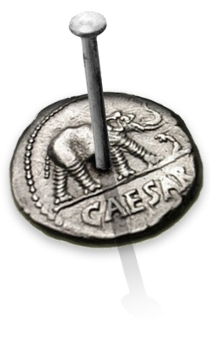
Christians Did Not Side With
The Jews In Their Rebellion
Against Rome Starting 66 A.D.

Slide 96
The Jews Rebel Against Rome
Josephus claims that a dispute between Jews and Greeks in Caesarea was the spark that ignited the war in 66 A.D.
Hostilities between Jews and Greeks quickly spread to many of the mixed cities in the entire region, even as far away as Alexandria.
The rebellion itself broke out in 66 A.D. with a symbolic act: The daily sacrifice for the welfare of the Emperor ceased to be offered. The Roman governor of Syria, Cestius Gallus, was dispatched to quell the rebellion, but the rebels had taken over Jerusalem.

Slide 97
The Jews Rebel Against Rome
In the winter of 66 – 67 A.D. , the rebels prepared for full-fledged military invasion. They divided the country into districts, each under the command of a specific military leader.
The Galilee district fell to the command of Josephus, who proved to be an absolute failure. After defeat in his one major battle and defaulting on a suicide pact, Josephus crossed over to the Roman side and eventually made his way to Rome, where he produced his various histories.
Yet, Rome could not accept anything less than a total suppression of the uprising.

Slide 98
The Jews Rebel Against Rome
Three full legions were dispatched to the province, led by Vespasian, who chose first to overcome the pockets of rebel resistance in the outlying districts. By the autumn of 67 A.D. the Galilee district had fallen to Roman forces; one year later most of Judea was in their hands.
As each section of the country fell under Roman control, the remaining rebels and other fugitives sought haven in Jerusalem, where mutual hatred among these groups equaled the common enmity shared towards the Romans.

Slide 99
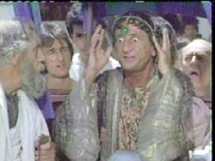
Jewish Soothsayers Were Wrong!

Slide 100
The Jerusalem Defenders Think They Can Win
“It then happened that Cestius was not conscious either how the besieged despaired of success, nor how courageous the people were for him; and so he recalled his soldiers from the place, and by despairing of any expectation of taking it, without having received any disgrace, he retired from the city, without any reason in the world. But when the robbers perceived this unexpected retreat of his, they resumed their courage, and ran after the hinder parts of his army, and destroyed a considerable number of both their horsemen and footmen; and now Cestius lay all night at the camp which was at Scopus; and as he went off farther next day, he thereby invited the enemy to follow him, who still fell upon the hindmost, and destroyed them” Flavius Josephus, Wars, 2.19.7

Slide 101
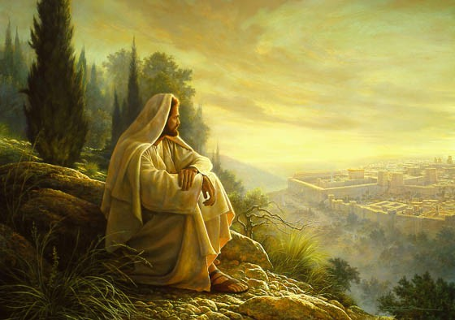


O Jerusalem
matt 24: 15
luke 19: 43

Slide 102

Military History Quarterly Summer 2005
Roman Siege of Jerusalem. “Josephus had striven mightily to organize and drill his Galileans, yet at the approach of the Romans most his army deserted and fled to fortified places. This humiliation is significant because of it, as well as the unruliness of the Jews throughout the war and their fierce internal battles, provides the context for Josephus’ one-dimensional evaluation of the Roman army. To Josephus - the army of the Roman Empire excelled because of its relentless, realistic training and the exact obedience to orders that the training inculcated.”

Slide 103
Military History Quarterly Summer 2005
Roman Siege of Jerusalem. “The Romans exploited the variations in virtus or courage [among their foreign-born auxiliaries] and disciplina or discipline [among their citizen soldiers]. . . The Roman legions coming to be valued and used for their competitive disciplina, the auxiliaries valued for their competitive virtus . . .”
“Roman victory came from mixing civilized competition in duty, training, and restraint with savage courage, from joining the dark forest to the shining city.”

Slide 104
The Jews Rebel Against Rome
A respite in the fighting took place in the summer of 68 A.D. with the death of Emperor Nero. When Vespasian returned to Rome as emperor a year later, he left the completion of the Judean war in the hands of his son Titus.
On Passover of the year 70 A.D., Titus laid siege to Jerusalem, confident that much of his work was being accomplished through the internecine strife within the walls of the city. By August of that year the Temple itself was taken and immediately destroyed. Mopping up operations continued for another 3 years, until the fall of the last rebel outpost, Masada.

Slide 105
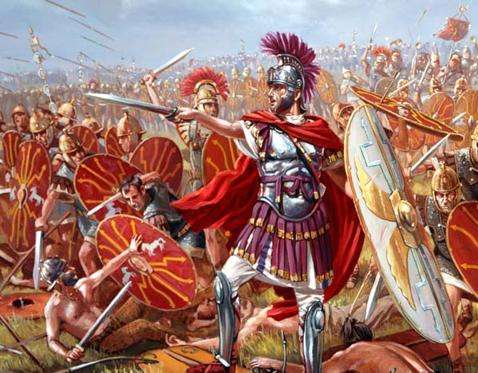
The Historical Fulfillment
The abomination of desolation standing in the holy place (24:15)
The “abomination of desolation” predicted by Daniel was the Roman army that brought about desolation to Jerusalem (Lk. 21:20-21; see also Dan. 9:27; 11:31; 12:11)
The Roman army, under General Titus, laid siege to Jerusalem, c. A.D. 68 to 70; Romans brought in the “abomination” of idolatrous worship with them (see 1 Kings 11:5; 2 Kings 23:13)

Slide 106

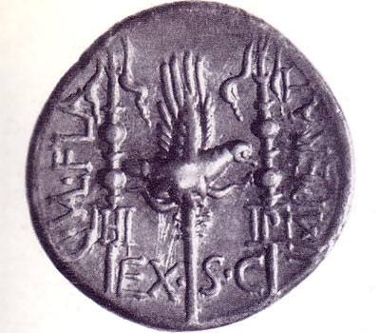


David Lee Burris: DEFEATED PEOPLES LEADERS KISSED THE STANDARD!
Christianity Not Fit As Association Assimilate Into Social Structure {orgeones – thiasoi – collegia – sodales}
coinage
“The Abomination Of Desolation”

Slide 107
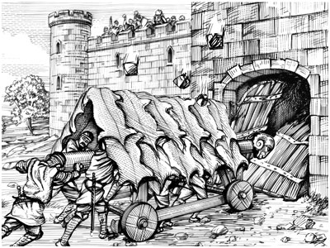
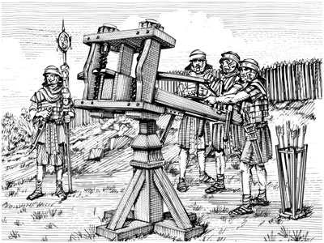

Slide 108
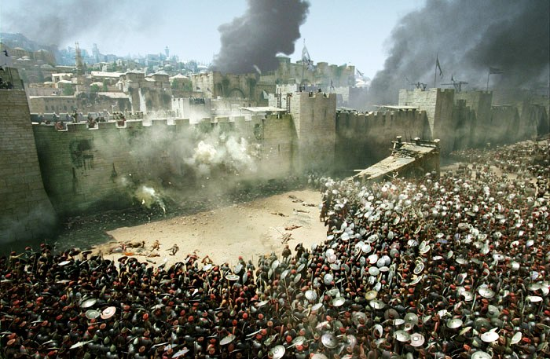
The Fall of Jerusalem
AD 66- 70

Slide 109
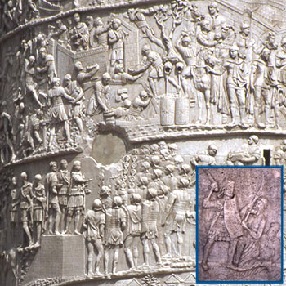


Slide 110
The Historical Fulfillment
“But Titus, intending to pitch his camp nearer to the city than Scopus, placed as many of his choice horsemen and footmen as he thought sufficient opposite to the Jews, to prevent their sallying out upon them, while he gave orders for the whole army to level the distance, as far as the wall of the city. So they threw down all the hedges and walls which the inhabitants had made about their gardens and groves of trees, and cut down all the fruit trees that lay between them and the wall of the city, and filled up all the hollow places and the chasms, and demolished the rocky precipices with iron instruments; and thereby made all the place level from Scopus to Herod's monuments, which adjoined to the pool called the Serpent's Pool” Flavius Josephus, Wars of the Jews, 5.3.2

Slide 111
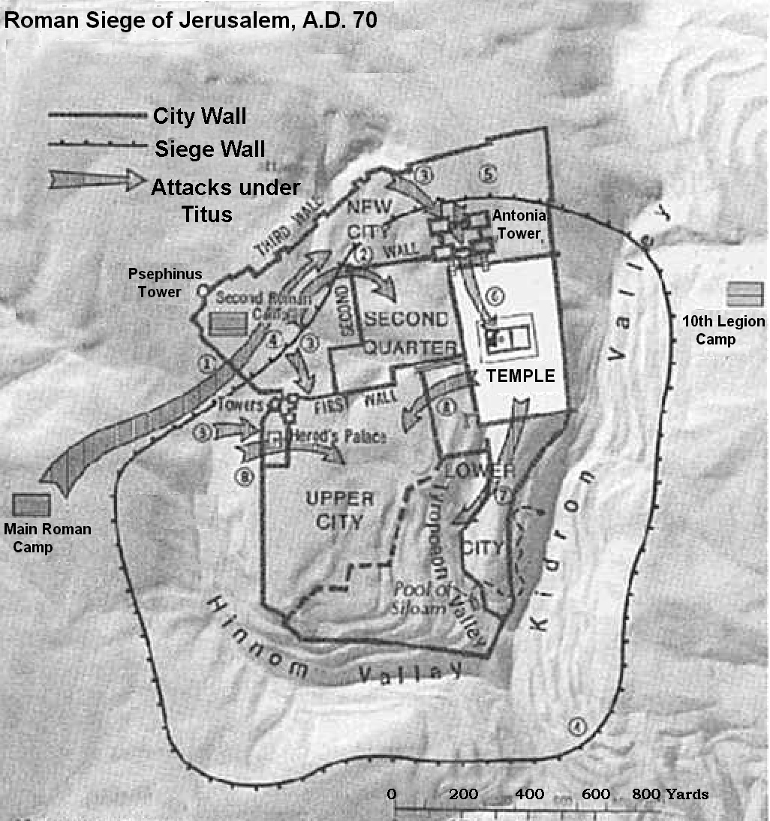
The Historical Fulfillment

Slide 112
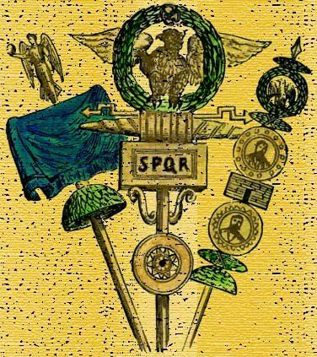

Slide 113
The Great Tribulation.
First, they will see the abomination of desolation standing in the holy place (24:15)
Second, they will experience great tribulation (24:16-22)

Slide 114
Matt. 24: Signs Of The End?
IV. “Then shall the end come.” V-14
Matt. 24:16-18
“Then let them which be in Judaea flee into the mountains: Let him which is on the housetop not come down to take any thing out of his house: Neither let him which is in the field return back to take his clothes.”

Slide 115
Matt. 24: Signs Of The End?
IV. “Then shall the end come.” V-14
Matt. 24:16-18
“Then let them which be in Judaea flee into the mountains: Let him which is on the housetop not come down to take any thing out of his house: Neither let him which is in the field return back to take his clothes.”

Slide 116
Matt. 24: Signs Of The End?
IV. “Then shall the end come.” V-14
Matt. 24:16-18
“Then let them which be in Judaea flee into the mountains: Let him which is on the housetop not come down to take any thing out of his house: Neither let him which is in the field return back to take his clothes.”

Slide 117
Matt. 24: Signs Of The End?
IV. “Then shall the end come.” V-14
Matt. 24:16-18
“Then let them which be in Judaea flee into the mountains: Let him which is on the housetop not come down to take any thing out of his house: Neither let him which is in the field return back to take his clothes.”

Slide 118
The Great Tribulation.
Matthew 24:16-22 NKJV[16] "then let those who are in Judea flee to the mountains. [17] Let him who is on the housetop not go down to take anything out of his house. [18] And let him who is in the field not go back to get his clothes. [19] But woe to those who are pregnant and to those who are nursing babies in those days! [20] And pray that your flight may not be in winter or on the Sabbath. [21] For then there will be great tribulation, such as has not been since the beginning of the world until this time, no, nor ever shall be. [22] And unless those days were shortened, no flesh would be saved; but for the elect's sake those days will be shortene.
Mark 13:15-19 NKJV[15] Let him who is on the housetop not go down into the house, nor enter to take anything out of his house. [16] And let him who is in the field not go back to get his clothes. [17] But woe to those who are pregnant and to those who are nursing babies in those days! [18] And pray that your flight may not be in winter. [19] For in those days there will be tribulation, such as has not been since the beginning of the creation which God created until this time, nor ever shall be.
Luke 21:20 NKJV[20] "But when you see Jerusalem surrounded by armies, then know that its desolation is near.

Slide 119
Luke 21:22
For these are the days of vengeance, that all things which are written may be fulfilled.
The Roman armies surrounding Jerusalem were nothing more than an instrument of God’s judgment. Israel had broken their covenant, and God was going to punish them with vengeance.

Slide 120
The Historical Fulfillment
“So all hope of escaping was now cut off from the Jews, together with their liberty of going out of the city. Then did the famine widen its progress, and devoured the people by whole houses and families; the upper rooms were full of women and children that were dying by famine, and the lanes of the city were full of the dead bodies of the aged; the children also and the young men wandered about the market-places like shadows, all swelled with the famine, and fell down dead, wheresoever their misery seized them. As for burying them, those that were sick themselves were not able to do it; and those that were hearty and well were deterred from doing it by the great multitude of those dead bodies, and by the uncertainty there was how soon they should die themselves” Flavius Josephus, Wars, 5.12.3

Slide 121
The Historical Fulfillment
“Children and youths, swollen with the famine, wandered about the market-places like shadows, and fell down wherever the death agony overtook them. The sick were not strong enough to bury even their own relatives, and those who had the strength hesitated because of the multitude of the dead and the uncertainty as to their own fate. Many, indeed, died while they were burying others, and many betook themselves to their graves before death came upon them” Eusebius, Ecclesiastical History, 3.6.14

Slide 122
Matt. 24: Signs Of The End?
IV. “Then shall the end come.” V-14
Matt. 24:19-20
“And woe unto them that are with child, and to them that give suck in those days! But pray ye that your flight be not in the winter, neither on the sabbath day:”
Matt. 24:21-28 still speaking of Jerusalem

Slide 123
Matt. 24: Signs Of The End?
IV. “Then shall the end come.” V-14
Matt. 24:19-20
“And woe unto them that are with child, and to them that give suck in those days! But pray ye that your flight be not in the winter, neither on the sabbath day:”
Matt. 24:21-28 still speaking of Jerusalem

Slide 124
Luke 23:28-30
But Jesus, turning to them, said, “Daughters of Jerusalem, do not weep for Me, but weep for yourselves and for your children. ²⁹ For indeed the days are coming in which they will say, ‘Blessed are the barren, wombs that never bore, and breasts which never nursed!’ ³⁰ Then they will begin ‘to say to the mountains, “Fall on us!” and to the hills, “Cover us!”’

Slide 125
Matt. 24: Signs Of The End?
IV. “Then shall the end come.” V-14
Matt. 24:19-20
“And woe unto them that are with child, and to them that give suck in those days! But pray ye that your flight be not in the winter, neither on the sabbath day:”
Matt. 24:21-28 still speaking of Jerusalem

Slide 126
Matt. 24: Signs Of The End?
IV. “Then shall the end come.” V-14
Zech. 14:1-2
“Behold, the day of the LORD cometh, and thy spoil shall be divided in the midst of thee. For I will gather all nations against Jerusalem to battle; and the city shall be taken, and the houses rifled, and the women ravished; and half of the city shall go forth into captivity, and the residue of the people shall not be cut off from the city.

Slide 127
Why not on the Sabbath?
(Nehemiah 13:19) So it was, at the gates of Jerusalem, as it began to be dark before the Sabbath, that I commanded the gates to be shut, and charged that they must not be opened till after the Sabbath.
Thankfully, the Christians that saw the signs were able to escape beforehand. Tradition holds that most fled to Pella.

Slide 128
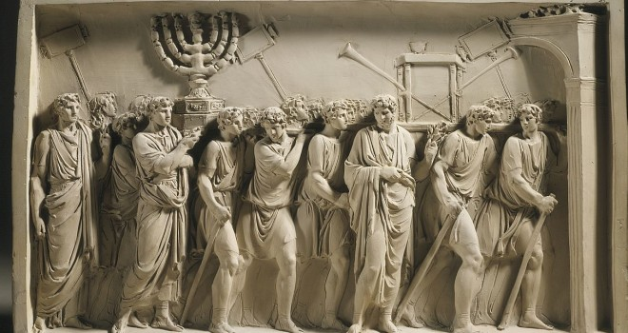
The Historical Fulfillment
The great tribulation (24:16-22)
The flight from Jerusalem was to be in haste and may be difficult; the advice to flee would be the opposite of what many Jews would have thought who believed in the security of their city
Flight with an infant would be difficult; flight in the winter would be faced with cold, rainy, and muddy conditions; flight on a Sabbath day would be faced with Jewish regulations and restrictions

Slide 129
The Historical Fulfillment
The great tribulation (24:16-22)
  During the siege (Lk. 19:41-44; 23:27-31), there was torture and crucifixion from without by the Romans for anyone trying to escape; tribulation within the city from Jews: death, torture, robbery, gangs, famine, starvation, cannibalism, unburied dead, etc. (the final siege lasted 5 months, April to Sept. 70 A.D.)

Slide 130
The Olivet Discourse
Jesus spoke of ‘great tribulation, such as was not since the beginning of the world to this time, no nor ever shall be’ (Matt. 24: 21). This implies that time will continue after ‘this time,’ but there is no sense in saying, ‘nor shall ever be’ if the end of the world and the (final) judgment were being studied. The same argument can be made from the next verse (Matthew 24: 22). Those days evidently will ‘be shortened;’ they will end, and the elect shall be saved because of it. But if the end of the world were in view, the elect would be saved whether the days were shortened or not.

Slide 131
The Great Tribulation.
First, they will see the abomination of desolation standing in the holy place (24:15)
Second, they will experience great tribulation (24:16-22)
Third, they will need to beware of more deceivers and false prophets (24:23-27)

Slide 132
The Great Tribulation.
Matthew 24:23-27 NKJV[23] "Then if anyone says to you, 'Look, here is the Christ!' or 'There!' do not believe it. [24] For false christs and false prophets will rise and show great signs and wonders to deceive, if possible, even the elect. [25] See, I have told you beforehand. [26] "Therefore if they say to you, 'Look, He is in the desert!' do not go out; or 'Look, He is in the inner rooms!' do not believe it. [27] For as the lightning comes from the east and flashes to the west, so also will the coming of the Son of Man be
Mark 13:21-23 NKJV[21] "Then if anyone says to you, 'Look, here is the Christ!' or, 'Look, He is there!' do not believe it. [22] For false christs and false prophets will rise and show signs and wonders to deceive, if possible, even the elect. [23] But take heed; see, I have told you all things beforehand

Slide 133
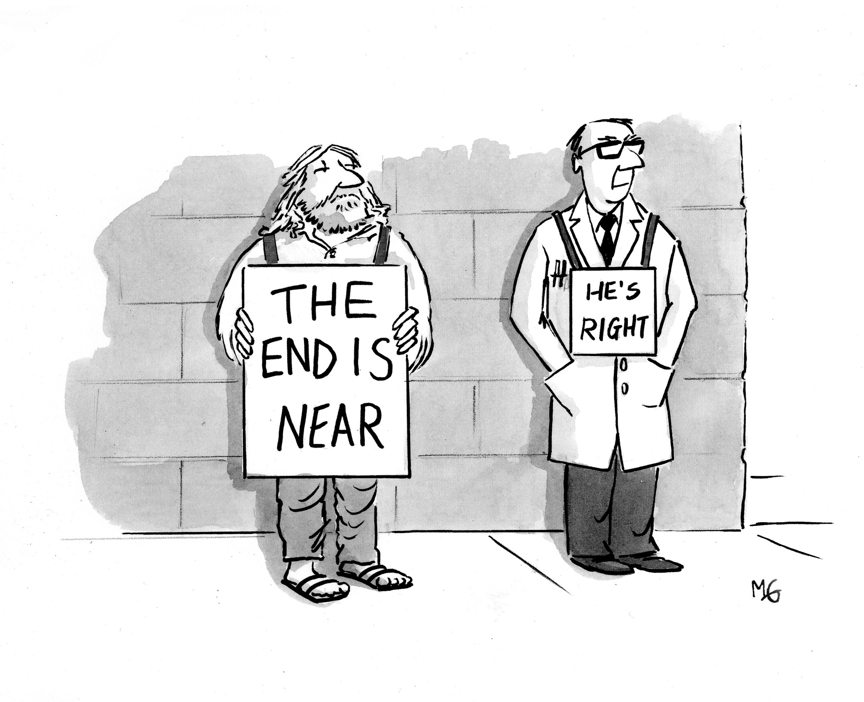
The Historical Fulfillment
The deceivers and false prophets (24:23-27)
The great tribulation and the besieging of Jerusalem by the Roman army would cause the Jews to look for a deliverer and redeemer – a Messiah (24:23-26)
When the Son of Man came in judgment upon Jerusalem, his presence would be manifest to all; there would be no secret judgment; everyone will know it (24:27)

Slide 134
The Historical Fulfillment
“There was also another body of wicked men gotten together, not so impure in their actions, but more wicked in their intentions, which laid waste the happy state of the city no less than did these murderers. These were such men as deceived and deluded the people under pretense of Divine inspiration, but were for procuring innovations and changes of the government; and these prevailed with the multitude to act like madmen, and went before them into the wilderness, as pretending that God would there show them the signals of liberty. But Felix thought this procedure was to be the beginning of a revolt; so he sent some horsemen and footmen both armed, who destroyed a great number of them.” Flavius Josephus, Wars of the Jews, 2.13.4

Slide 135
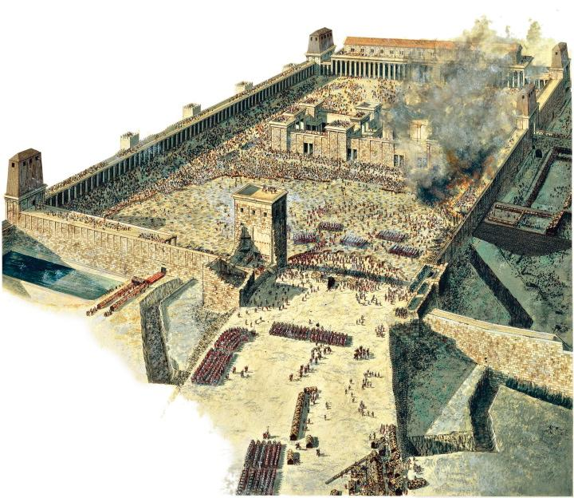
The Fall of Jerusalem

Slide 136
The Historical Fulfillment
“But when they went in numbers into the lanes of the city with their swords drawn, they slew those whom they overtook without and set fire to the houses whither the Jews were fled, and burnt every soul in them, and laid waste a great many of the rest; and when they were come to the houses to plunder them, they found in them entire families of dead men, and the upper rooms full of dead corpses, that is, of such as died by the famine; they then stood in a horror at this sight, and went out without touching any thing. But although they had this commiseration for such as were destroyed in that manner, yet had they not the same for those that were still alive, but they ran every one through whom they met with, and obstructed the very lanes with their dead bodies” Flavius Josephus, Wars, 6.8.5

Slide 137
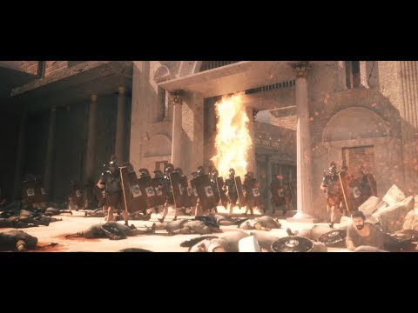

Slide 138
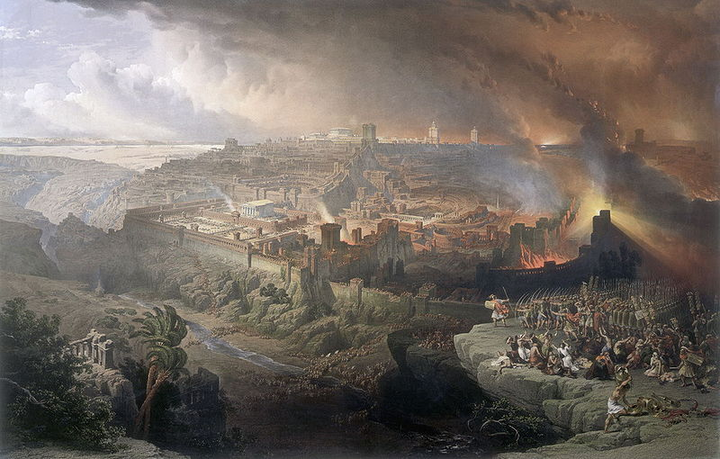
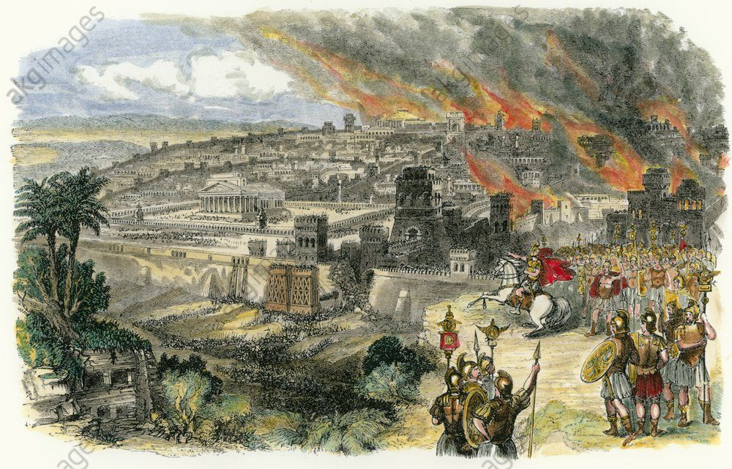

Slide 139
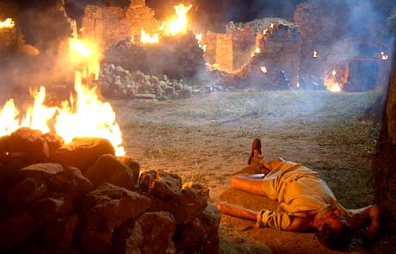

Slide 140
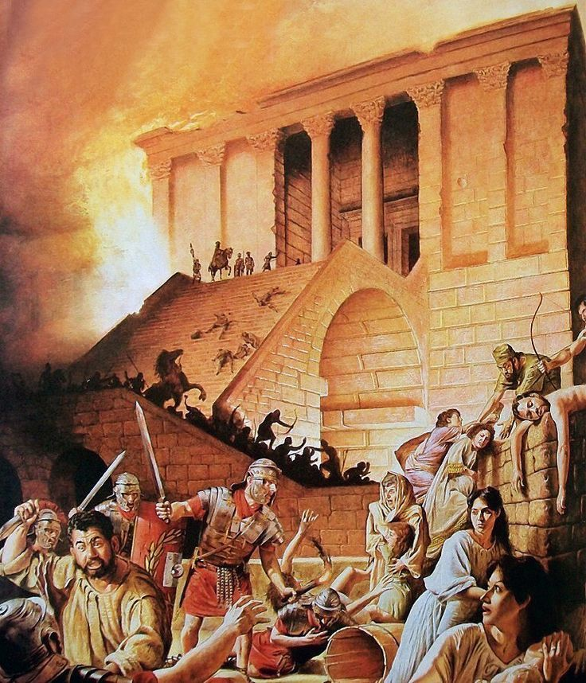

Slide 141
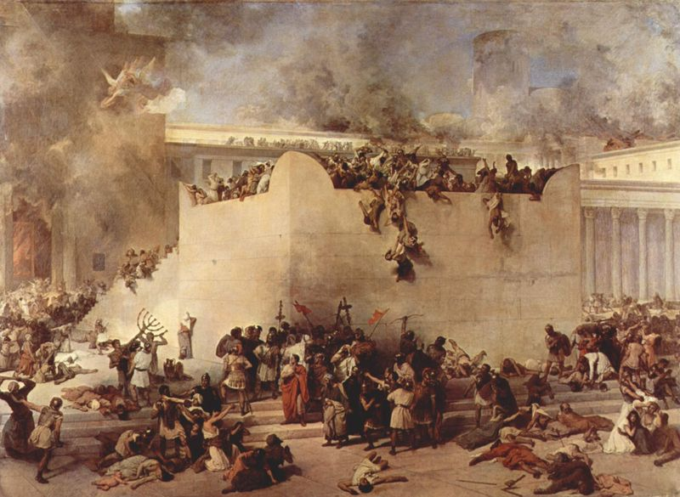
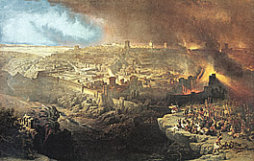

jerusalem
TEMPLE

Slide 142
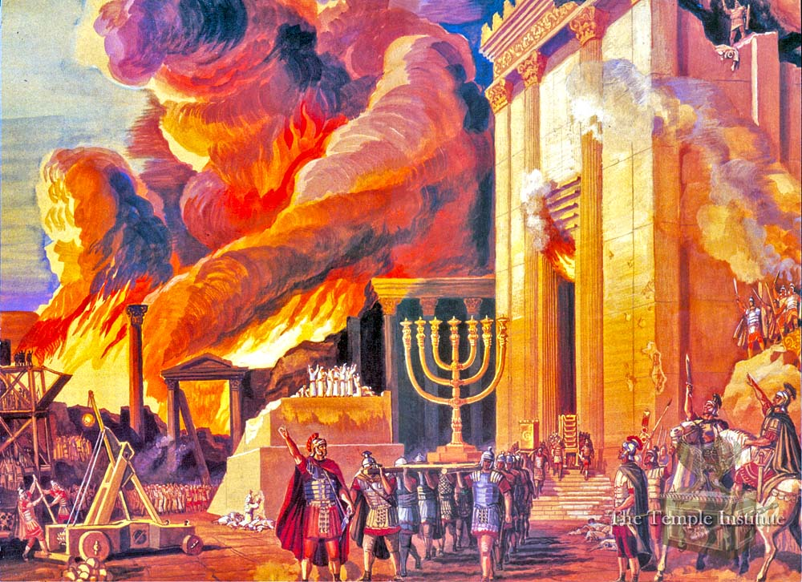

Slide 143
The Historical Fulfillment
“And now the Romans, upon the flight of the seditious into the city, and upon the burning of the holy house itself, and of all the buildings round about it, brought their ensigns to the temple and set them over against its eastern gate; and there did they offer sacrifices to them, and there did they make Titus imperator with the greatest acclamations of joy.” Flavius Josephus, Wars of the Jews, 6.6.1

Slide 144
From Josephus
Approximately 100,000 Jews were taken captive
Nearly 1.2 million Jews died in the siege
The city was destroyed, as well as the Temple
The carnage was made worse by the strong belief of the Jews that God would protect and spare His Temple. Instead of leaving the city like the Christians, the Jews flocked to Jerusalem for safety.
Only one problem with their logic…

Slide 145
The Great Tribulation.
First, they will see the abomination of desolation standing in the holy place (24:15)
Second, they will experience great tribulation (24:16-22)
Third, they will need to beware of more deceivers and false prophets (24:23-27)
Fourth, they will see Jerusalem as a dead carcass (24:28)

Slide 146
The Great Tribulation.
Matthew 24:28 NKJV[28] For wherever the carcass is, there the eagles will be gathered together.

Slide 147
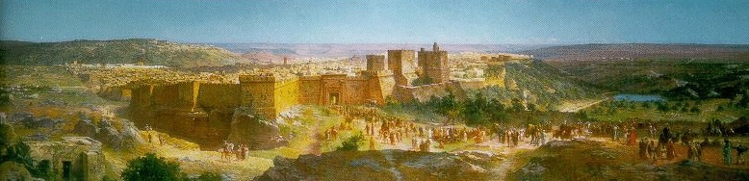
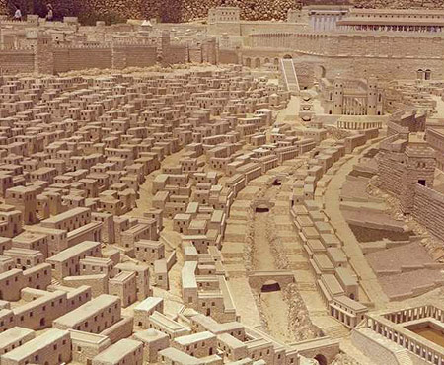
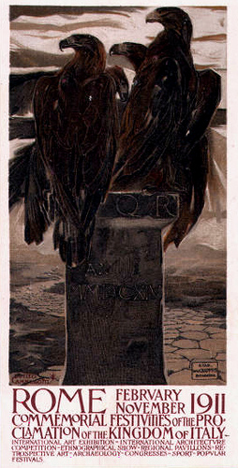
Roman Abomination
Jerusalem

Slide 148
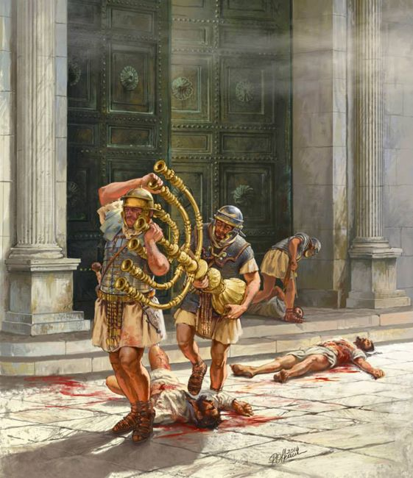
The Historical Fulfillment
The dead carcass (24:28)
  Jesus had just condemned the Jewish leaders for their sins; Jerusalem was morally and spiritually dead like a carcass (see Mt. 23:27, 33, 37-38; Lk. 13:31-34)
  Jerusalem’s spiritual death attracted God’s judgment like a dead carcass attracts a bird of prey (see Hab. 1:8)

Slide 149
There the eagles will be….
There are two basic interpretations to this passage.
The Roman emblem was an eagle
Would be better translated “vulture”

Slide 150
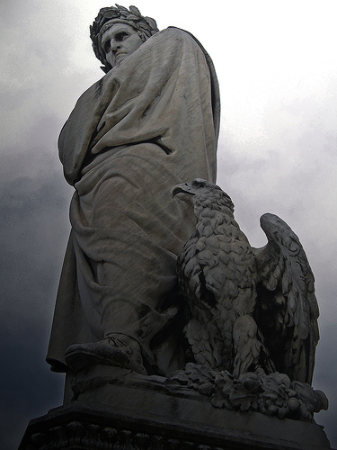

Slide 151
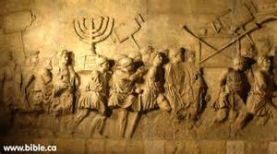
Arch of Titus in Rome

Slide 152
Matt. 24: Signs Of The End?
IV. “Then shall the end come.” V-14
Matt. 24:29
“Immediately after the tribulation of those days shall the sun be darkened, and the moon shall not give her light, and the stars shall fall from heaven, and the powers of the heavens shall be shaken:”

Slide 153
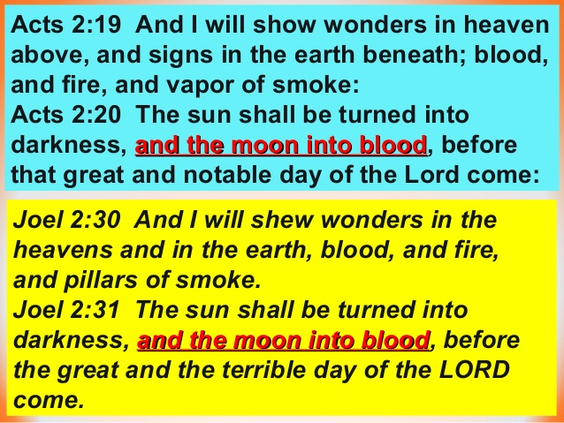

Slide 154
Signs from Heaven
Sun darkened
Moon darkened
Stars fall from heaven
Powers of earth shaken

Slide 155
Isaiah 13:9-10 (Babylon)
Behold, the day of the Lord comes,
Cruel, with both wrath and fierce anger,
To lay the land desolate;
And He will destroy its sinners from it.
¹⁰ For the stars of heaven and their constellations
Will not give their light;
The sun will be darkened in its going forth,
And the moon will not cause its light to shine.
THERE ARE SEVERAL OTHER EXAMPLES OF THIS TYPE OF FIGURATIVE LANGUAGE IN THE OLD TESTAMENT!

Slide 156
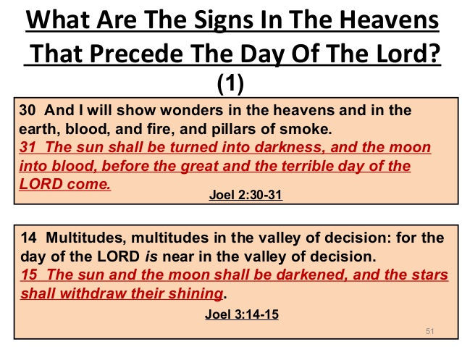

Slide 157
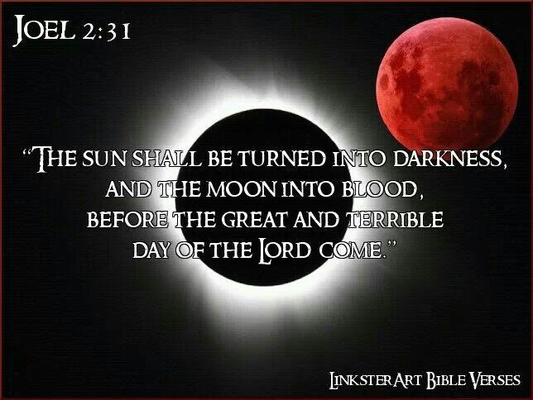

Slide 158
Matt. 24: Signs Of The End?
IV. “Then shall the end come.” V-14
Matt. 24:30
“And then shall appear the sign of the Son of man in heaven: and then shall all the tribes of the earth mourn, and they shall see the Son of man coming in the clouds of heaven with power and great glory.”

Slide 159
Sign of the Son of man
NKJV: Then the sign of the Son of Man will appear in the heaven…
Berry’s Interlinear: And then shall appear the sign of the Son of Man in the heaven…
It appears that “heaven” is the location of the Son of Man, not the sign!

Slide 160
Revelation 14:14
Then I looked, and behold, a white cloud, and on the cloud sat One like the Son of Man, having on His head a golden crown, and in His hand a sharp sickle.
This is an image of divine judgment. Notice the similar language!

Slide 161
“Tribes” and “they”
Notice carefully the words Jesus used in verse 30. It is specifically noted that the “tribes” would mourn – not the whole world but rather just the Jews.
Likewise, “they” would see the Son of Man coming on the clouds.
This is not in reference to the 2nd coming, but rather the divine judgment that was being exhibited.

Slide 162
Who are the “Elect”?
While the Jews would see their Temple be destroyed (and consequently their entire religion), the “elect” would be gathered together from all over the world.
Elect = Church

Slide 163
Colossians 3:1, 12
If then you were raised with Christ…
…Therefore, as the elect of God, holy and beloved

Slide 164
Matt. 24: Signs Of The End?
IV. “Then shall the end come.” V-14
Keep in mind what the Lord said
Matt. 24:34
“Verily I say unto you, This generation shall not pass, till all these things be fulfilled.”

Slide 165

The Historical Fulfillment

Slide 166
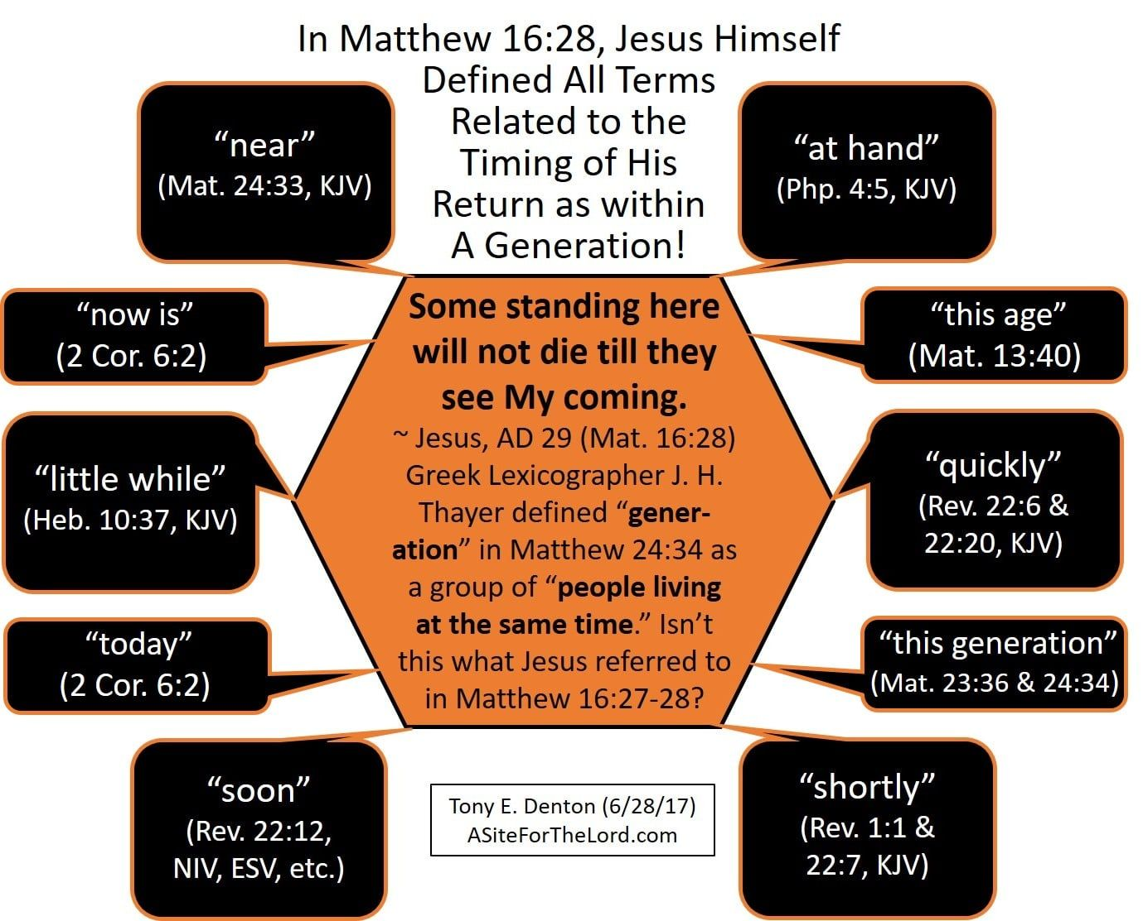

Slide 167
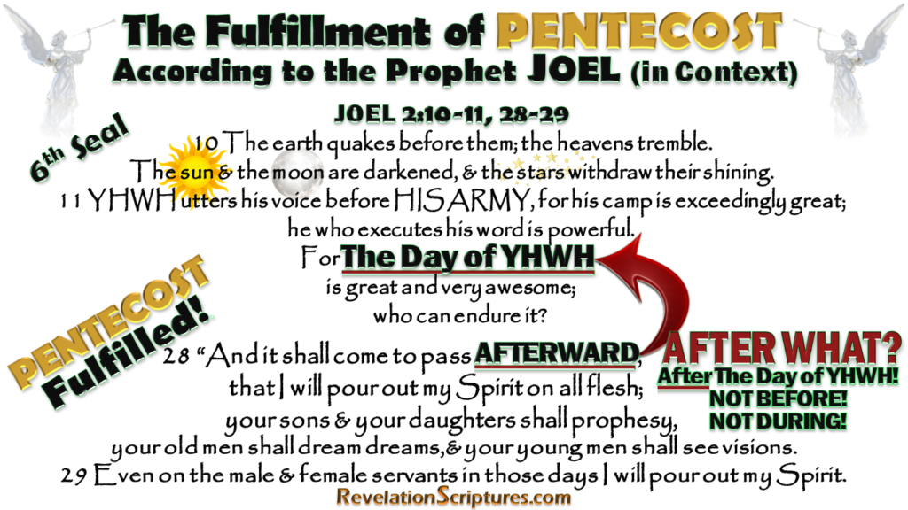

Slide 168
Jesus Continues His Answer
Question 1:
Answer: Found in vv.32-35
When will these things be?

Slide 169
THE KEY: VERSE 34
Assuredly, I say to you, this generation will by no means pass away till all these things take place.

Slide 170
Jesus didn’t just listen to the disciples’ question about the temple and give them an entirely unrelated answer; he answered their question with a threefold prophetic description of (1) events that wouldn’t constitute the sign (false messiahs, wars, famines, earthquakes, persecutions, etc.), (2) the sign itself (the abomination of desolation), and (3) the terrible suffering and tribulation of the judgment on Jerusalem that would lead to the destruction of the temple.
Everything Jesus described so far in the Olivet Discourse was fulfilled during the years 30–70. There is nothing in the Olivet Discourse up to this point indicating that Jesus has begun to talk about a distant future event unrelated to the destruction of Jerusalem and the temple in the year 70. There is no indication that he is referring to the end-time rapture, a seven-year period of tribulation, or the destruction of a rebuilt Jerusalem. The discourse is solidly grounded in Jesus’ original historical situation as a response to his disciples’ question as to when the current temple would be destroyed. However, there are good reasons to think that Jesus transitioned to answer the second question (included only in Matthew’s Gospel) about his coming and the end of the age.
Köstenberger, A. J., Stewart, A. E., & Makara, A. (2017). Jesus and the Future: Understanding What He Taught about the End Times (pp. 62–63). Bellingham, WA: Lexham Press.

Slide 171
Jesus Concludes His Answer
Question 2:
Answer: Found in vv.36-44
What will be the sign of Your coming?

Slide 172
Matthew 24:
Cautions Warning of the Suddenness of Jesus’ Final Coming

Slide 173
Matt. 24: No Signs Of The End!
V. Lord’s Second Coming.
The second & third question answered
Matt. 24:36-37
“But of that day and hour knoweth no man, no, not the angels of heaven, but my Father only. But as the days of Noah were, so shall also the coming of the Son of man be.”

Slide 174
The Son of Man Coming
First, Jesus speaks of “that day and hour” (24:36)

Slide 175
The Son of Man Coming
Matthew | Mark | Luke
24:36 "But of that day and hour no one knows, not even the angels of heaven, but My Father only. | 13:32 "But of that day and hour no one knows, not even the angels in heaven, nor the Son, but only the Father.

Slide 176
Matt. 24: No Signs Of The End!
V. Lord’s Second Coming.
The second & third question answered
Matt. 24:36-37
“But of that day and hour knoweth no man, no, not the angels of heaven, but my Father only. But as the days of Noah were, so shall also the coming of the Son of man be.”

Slide 177
The Son of Man Coming
First, Jesus speaks of “that day and hour” (24:36)
Second, Jesus compares his coming to the days of the Noah (24:37-39)

Slide 178
The Son of Man Coming
Matthew | Mark | Luke
24:37-39 [37] But as the days of Noah were, so also will the coming of the Son of Man be. [38] For as in the days before the flood, they were eating and drinking, marrying and giving in marriage, until the day that Noah entered the ark, [39] and did not know until the flood came and took them all away, so also will the coming of the Son of Man be.

Slide 179
Matt. 24: No Signs Of The End!
V. Lord’s Second Coming.
The second & third question answered
Matt. 24:38
“For as in the days that were before the flood they were eating and drinking, marrying and giving in marriage, until the day that Noah entered into the ark,”

Slide 180
Life as usual…
1) As the days of Noah
2) Eating and drinking
3) Giving in marriage
4) Oblivious
The contrast between the two events without a doubt shows that Jesus was referring to two separate events: the fall of Jerusalem in AD 70 and his 2nd coming.

Slide 181
Matt. 24: No Signs Of The End!
V. Lord’s Second Coming.
The second & third question answered
Matt. 24:39, 44
“And knew not until the flood came, and took them all away; so shall also the coming of the Son of man be.”
“Therefore be ye also ready: for in such an hour as ye think not the Son of man cometh.”

Slide 182
The Son of Man Coming
First, Jesus speaks of “that day and hour” (24:36)
Second, Jesus compares this coming to the days of the Noah (24:37-39)
Third, Jesus teaches his disciples the importance of watchful vigilance and readiness (24:40 – 25:30)

Slide 183
A contrast
Fall of Jerusalem
Signs
Prolonged
Days
Local
“Know”
Abnormal
2nd Coming
No signs
Immediate
Day
Universal
“Know not”
Normal

Slide 184
No one knows!
While the end of the (Jewish) age and the fall of Jerusalem and the Temple would be preceded by many signs, there will be no such signs for the 2nd coming of Jesus Christ.

Slide 185
The Son of Man Coming
First, Jesus speaks of “that day and hour” (24:36)
Second, Jesus compares this coming to the days of the Noah (24:37-39)
Third, Jesus teaches his disciples the importance of watchful vigilance and readiness (24:40 – 25:30)
  Thief breaking in (24:40-44)

Slide 186
The Son of Man Coming
Matthew | Mark | Luke
24:40-42 [40] Then two men will be in the field: one will be taken and the other left. [41] Two women will be grinding at the mill: one will be taken and the other left. [42] Watch therefore, for you do not know what hour your Lord is coming.

Slide 187
THE KEY: VERSE 42
Watch therefore, for you do not know what hour your Lord is coming.

Slide 188
The Son of Man Coming
Matthew | Mark | Luke
24:43-44 [43] But know this, that if the master of the house had known what hour the thief would come, he would have watched and not allowed his house to be broken into. [44] Therefore you also be ready, for the Son of Man is coming at an hour you do not expect.

Slide 189
Matt. 24: No Signs Of The End!
V. Lord’s Second Coming.
The second & third question answered
II Peter 3:10
“But the day of the Lord will come as a thief in the night; in the which the heavens shall pass away with a great noise, and the elements shall melt with fervent heat, the earth also and the works that are therein shall be burned up.”

Slide 190
The Son of Man Coming
First, Jesus speaks of “that day and hour” (24:36)
Second, Jesus compares this coming to the days of the Noah (24:37-39)
Third, Jesus teaches his disciples the importance of watchful vigilance and readiness (24:40 – 25:30)
  Thief breaking in (24:40-44)
  Wise and evil servant (24:45-51)

Slide 191
The Son of Man Coming
Matthew | Mark | Luke
24:45-47 [45] "Who then is a faithful and wise servant, whom his master made ruler over his household, to give them food in due season? [46] Blessed is that servant whom his master, when he comes, will find so doing. [47] Assuredly, I say to you that he will make him ruler over all his goods. | 13:33-34 [33] Take heed, watch and pray; for you do not know when the time is. [34] It is like a man going to a far country, who left his house and gave authority to his servants, and to each his work, and commanded the doorkeeper to watch.

Slide 192
The Son of Man Coming
Matthew | Mark | Luke
24:48-51 [48] But if that evil servant says in his heart, 'My master is delaying his coming,' [49] and begins to beat his fellow servants, and to eat and drink with the drunkards, [50] the master of that servant will come on a day when he is not looking for him and at an hour that he is not aware of, [51] and will cut him in two and appoint him his portion with the hypocrites. There shall be weeping and gnashing of teeth. | 13:35-37 [35] Watch therefore, for you do not know when the master of the house is coming-in the evening, at midnight, at the crowing of the rooster, or in the morning- [36] lest, coming suddenly, he find you sleeping. [37] And what I say to you, I say to all: Watch!"

Slide 193
The Olivet Discourse
The desolation and annihilation of ‘the buildings of the temple’ were to be seen by signs. ‘When ye shall see these things, know it is near, even at the doors… But of that day and hour knoweth no man, no, not the angels of heaven, but My Father Only’ (Matthew 24: 33, 36).
At least three times, Jesus specifically indicated that He was giving tangible evidence of the destruction of Jerusalem (Matthew 24: 8, 25, 33) but the second coming and the judgment were to be sudden, unknown, as when a thief strikes (Matthew 24: 42, 44, 50; 25: 13; 1st Thessalonians 5: 2 – 4; 2nd Peter 3; 10).

Slide 194
The Olivet Discourse
Signs Versus Suddenness: Brother Larry Ray Hafley writes – “Jesus told of the signs preceding the destruction of Jerusalem; namely, ‘false Christs and false prophets,’ and wars and rumors of wars, famines and earthquakes – ‘all these are the beginnings of sorrows’ (Matthew 24: 6 – 8). Further He told them of ‘the abomination of desolation’ (Roman Eagle Standard), the Roman army (Matthew 24: 15; Luke 21: 20). ‘Then know that the desolation thereof is nigh’ (Luke 21: 20). They could ‘know’ the destruction of Jerusalem was ‘nigh,’ but the Coming of the Son of Man and the consequent Judgment were to be without warning (Matthew 24: 42, 43, 50; 25: 13). Compare ‘then know’ with ‘know not’ (Luke 21: 20; Matthew 24: 39). ‘So shall also the Coming of the Son of Man be.’

Slide 195
Conclusion
3 Questions and 3 Separate Answers:
1) When will these things be?
Near – within a generation (AD 30-70)
2) What will be the sign of Your coming?
None!
3) What will be the sign of the end of the age?
Several (vv.4-31)

Slide 196
We’ve reached the end of the Olivet Discourse and can succinctly summarize our position about which sections relate to the events of the year 70 and which relate to the second coming. We have argued that Mark 13:5–23 (and parallels in Matthew and Luke) relate to the destruction of the temple, 13:24–27 refers to the future second coming of Jesus as traditionally understood, 13:28–31 provides a parable about the destruction of the temple and concludes that topic, and 13:32–37 provides a parable about the second coming and concludes that topic. This understanding of the Olivet Discourse seems to be the best interpretation of all the available evidence.
In the Olivet Discourse, Jesus thus focuses on two future events. One of these events, the destruction of the temple, was in Jesus’ near future (his current generation) and is in our past. The other event, Jesus’ return, has not yet taken place and is still future. Every generation of Christians must remain vigilant and be active in the Father’s work because that day will come unexpectedly, and when it comes, there will be no time to prepare.
Several conclusions arise from the reading of the Olivet Discourse argued for above. First, readers who view the Olivet Discourse as referring exclusively to events associated with a seven-year period of tribulation between the rapture and Jesus’ second coming may want to reconsider their view of Jesus’ reference to “this generation” and the way in which the Olivet Discourse is a specific answer to a question from the disciples about when the temple would be destroyed. Jesus didn’t ignore their question or give them an entirely unrelated answer. Nothing in the Olivet Discourse indicates that Jesus taught a future rapture of believers that would be followed by a seven-year period of tribulation centered on the Jewish people and Jerusalem. Jesus’ comments about the tribulation and destruction of Jerusalem and the temple relate to the terrible judgment of the year 70.
Second, conversely, readers who seek to interpret all of the Olivet Discourse as referring to the destruction of the temple in the year 70 unduly minimize the importance of Matthew’s expanded question at the beginning of the discourse and the way in which Jesus’ words in the discourse about cosmic upheaval and the coming of the Son of Man were understood by the earliest Christians (or at least by Paul and Matthew).
We have argued that Jesus answered both questions at the beginning of Matthew’s Gospel concerning when the temple would be destroyed and when Jesus would come and the current age would come to an end. Luke guides us in knowing when Jesus transitioned from speaking about the destruction of the temple to his future coming. An indefinite period, called “the times of the Gentiles,” separates the two events (Luke 21:24). This is the period in which we continue to live as we wait for Jesus’ return.
Köstenberger, A. J., Stewart, A. E., & Makara, A. (2017). Jesus and the Future: Understanding What He Taught about the End Times (pp. 85–86). Bellingham, WA: Lexham Press.

Slide 197
The Son of Man Coming
First, Jesus speaks of “that day and hour” (24:36)
Second, Jesus compares this coming to the days of the Noah (24:37-39)
Third, Jesus teaches his disciples the importance of watchful vigilance and readiness (24:40 – 25:30)
  Thief breaking in (24:40-44)
  Wise and evil servant (24:45-51)
  Ten virgins (25:1-13)
  The talents (25:14-30)

Slide 198
The Olivet Discourse
Finally, Matthew 25 supplements Matthew 24: 35 – 51. The judgment of Matthew 25 involves and includes ‘all nations’ (Matthew 25: 32). It is the final judgment (Matthew 25: 34, 41, 46). The ten virgins parable says, ‘be prepared,’ ‘watch.’ The parable of the talents stresses the necessity of diligence and faithfulness (Matthew 25: 21, 23, 26 linking @Matthew 24: 42–51).

Slide 199
The Olivet Discourse
Millennialism Impacts Christian Watchfulness. The Olivet Discourse is easiest understood by observing that the Apostles were asking the typical ethno-centric question of the end of the world as they knew it (TEOTWAWKI) but truth be told - they were asking two basic questions – one of the destruction of the temple along with the city of Jerusalem - and the other as regards the end of the world. The fact that Christ gave His answer in two-part – the pivotal passage at Matthew 24: 34 – is of greatest illumination to our subject today. If we consider that Matthew 24: 3 – 34 parallels the events described in Revelation 20: 1, 2 to the End of that Age and Matthew 24: 35 – Matthew 25: 13 parallel events afterwards and until the End of Satan’s Story or End of the World - we can then observe the following contrasts: Events Local Versus Events Global; “This Generation” Versus “The Days of Your Fathers”; “That Day” Versus “Those Days”; and Signs Versus Suddenness.

Slide 200
- END FOLLOWED BY NEW BEGINNING –
ACTS 1:21 – “And it shall come to pass That whosoever shall call upon the name of the LORD Shall be saved.”
-- Links to Christ’s Call -
Acts 1:8c - “Witnesses to Me … To the End of the Earth.”

Slide 201
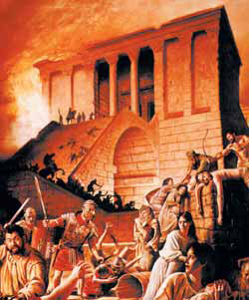

jerusalem
OLD TEMPLE
The New Temple

