Slide 1
Post-Modern Worldview
By David Lee Burris

Slide 2
Theism vs. post-modernism
WORLDVIEW INTRODUCTION
naturalism versus theism
modern versus post-modern
Post-modernist versus theist

Slide 3




INTRODUCTION

Slide 4

What is a worldview?
“A worldview is an integrated, interpretive, set of confessional perspectives on reality which underlies, shapes, motivates, and gives direction and meaning to human activity.”
BJ van der Walt, The Liberating Message: A Christian Worldview for Africa, p. 39.

Slide 5
What is a worldview?
“A worldview is a set of presuppositions . . . which we hold (consciously or subconsciously) about the basic makeup of our world.”
-- James Sire

Slide 6
What is a worldview?
Everyone has a worldview whether one can explain it or not. It can be likened to a pair of glasses through which one views the world. It is important to have the right prescription or reality will be distorted. Modern man is faced with a supermarket of world views all of them claiming to be true.

Slide 7

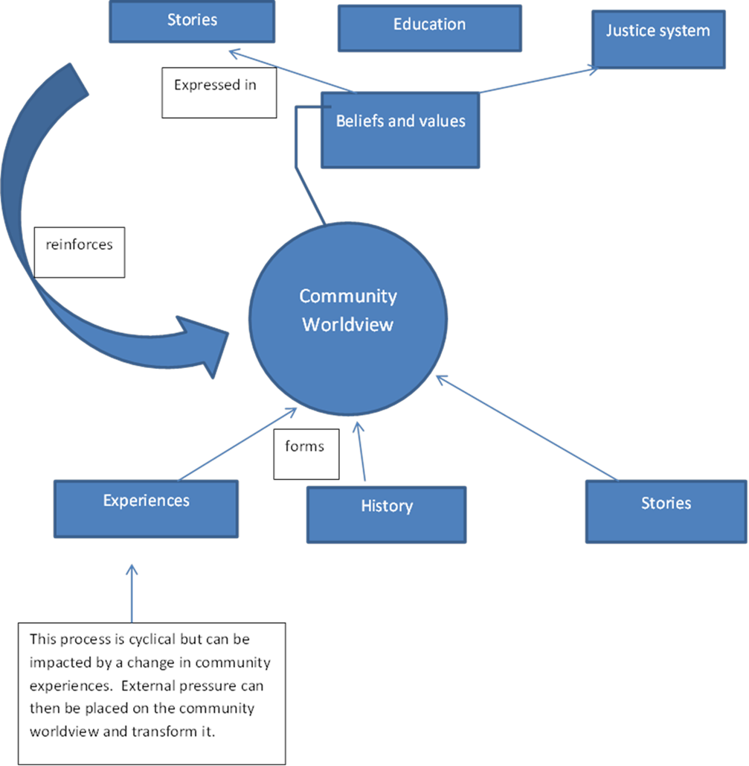
How are worldviews formed?

Slide 8

Axiological Analysis Of Values Views
Axiology: Transdisciplinary & Broad Field Research Resourced Of Cognitive Concepts @ Aesthetic – Epistemic - Ethical Construct

Slide 9
Axiological Analysis Of Values Views
Dictionary: “An area of inquiry that studies the nature, criteria, implications and applications of value judgments.”

Slide 10

Axial Model Between 200 - 600 B.C.
Lifeview: Personal Journey & Movement
PROCESS TRANSFORMABLE & PROGRESS INCOMMUNICABLE
From Lower To Higher Realm
From Knowledge To Wisdom
From Appearance To Reality
From Bondage To Liberation
From Confusion To Insight
From Darkness To Light

Slide 11
Axial Model Between 200 - 600 B.C.
Two Methods Of Inquiry:
Major Logic – Ontology
Major Logic – Epistemic
Minor Logic – Inductive
Minor Logic – Deductive

Slide 12
Axial Model Between 200 - 600 B.C.
Deliberate Structure Three Tier:
PROPOSITIONAL LOGIC
FORMALIZED PROOFS
TRUTH TREE MAPING

Slide 13
Axial Model Between 200 - 600 B.C.
Rationalists Theories Of Reality
Logically Inconsistent Deficiencies:
Self-Referential Incoherence
Self-Assumptive Incoherence
Self-Performable Incoherence

Slide 14
Axial Model Between 200 - 600 B.C.
Entered Evidence Irrelevant
AD VERICUNDIUM – An Appeal To Position
AD POPULUM – An Appeal To Popularity
AD BACULUM – An Appeal To Force
AD MISERICORDIAM – An Appeal To Pity
AD HOMINEM – Argument Personal Direct

Slide 15
Axial Model Between 200 - 600 B.C.
Evidential Category | Standard Measure
EXPERIMENT | UNEQUIVOCAL
RATIONALE | NON-CIRCULAR
AUTHORITY | RECOGNIZED
REVELATION | RELEVANCE

Slide 16
Axial Model Between 200 - 600 B.C.
THREE QUERIES RAISED:
What Can We Know?
What Ought We To Do?
For What Can We Hope?

Slide 17
Axial Model Between 200 - 600 B.C.
Worldview Answers Four Questions:
What Is Human Origin?
What Is Life’s Meaning?
What Is A Moral Action?
What Is Man’s Destiny?

Slide 18
Questions which reveal one’s worldview
Why is there something rather than nothing?
How do you explain human nature?
How do you know that you know?
What happens to a person at death?
How do you determine what is right or wrong?
What is the meaning of history?

Slide 19
Axial Model Between 200 - 600 B.C.
Viable Worldview Answers Adequate
WHAT KIND OF GOD,
IF ANY, EXISTS?
Ultimate Reality Question

Slide 20
Axial Model Between 200 - 600 B.C.
Viable Worldview Answers Adequate
IS THERE ANYTHING BEYOND THE COSMOS?
External Reality Question

Slide 21
Axial Model Between 200 - 600 B.C.
Viable Worldview Answers Adequate
WHAT CAN BE KNOWN &
HOW CAN WE KNOW IT?
The Knowledge Question

Slide 22
Axial Model Between 200 - 600 B.C.
Viable Worldview Answers Adequate
OF WHERE DID I COME?
The Origins Question

Slide 23
Axial Model Between 200 - 600 B.C.
Viable Worldview Answers Adequate
WHO AM I?
The Identity Question

Slide 24
Axial Model Between 200 - 600 B.C.
Viable Worldview Answers Adequate
WHERE AM I?
The Location Question

Slide 25
Axial Model Between 200 - 600 B.C.
Viable Worldview Answers Adequate
WHAT IS THE MEANING &
DIRECTION OF HISTORY?
Past/Present Question

Slide 26
Axial Model Between 200 - 600 B.C.
Viable Worldview Answers Adequate
WILL I SURVIVE THE DEATH OF MY BODY AND, IF SO, IN WHAT STATE?
THE DESTINY QUESTION

Slide 27
Axial Model Between 200 - 600 B.C.
Viable Worldview Answers Adequate
HOW SHOULD I LIVE?
The Morality Question

Slide 28
Axial Model Between 200 - 600 B.C.
Viable Worldview Answers Adequate
WHAT IS IT THAT I
SHOULD CONSIDER
OF GREAT WORTH?
The Values Question

Slide 29
Axial Model Between 200 - 600 B.C.
Viable Worldview Answers Adequate
WHAT IS HUMANITY’S FUNDAMENTAL PROBLEM?
PREDICAMENT QUESTION

Slide 30
Axial Model Between 200 - 600 B.C.
Viable Worldview Answers Adequate
HOW CAN HUMANITY’S
PROBLEM BE SOLVED?
RESOLUTION QUESTION

Slide 31
Naturalism Versus T heism

Slide 32
Axial Model Between 200 - 600 B.C.
Western Society Dual Divide:
MATERIALISTIC HUMANISM
TRANSCENDENT THEISM

Slide 33
Axial Applied Approach
Practical Philosophy
Wilhelm Hegel
Human Spirit – Human Rights A Historical Progression
Friedrich Nietzsche
Moralities Of Slave & Master An Interpretive Nihilism
Sigmund Freud
Our Salvations - Work & Love A Humanistic Psychology
Martin Heidegger
Being-Doing – Of No Meaning Regressive Dehumanizing
Sartre & Camus
Human Situational Optimizing Freedoms = Sentences
Foucault & Habermas
Constructs: Power & Reason Meaningful Modification

Slide 34



Naturalism
There Is No God!
There is no God.
“The cosmos is all that is or ever was or ever will be.”
“Man is the measure of all things.”
Carl Sagan

Slide 35
Christianity/Theism in Worldview Contexts
Naturalism (Modernism)
There is no God. There is no supernatural. We live in a closed system and the world and mankind just evolved. Men are just the product of their environment. Morality is decided by man. Reason and science are basis of authority and pursued for the good of mankind. There is no purpose to history; it just happens. When you die, you cease to exist.

Slide 36
WHAT IS LIFE?
John Maynard Smith
“Life is any population of entities with the properties of multiplication, heredity, and variation.”

Slide 37
WHAT IS LIFE?
Alexandir Oparin: “Life may be recognized in bodies which have particular characteristics not seen in the world of the dead. First, there is definite structure or organization – there is the ability of the organisms to metabolize, to reproduce others like themselves & also their response to stimulation.”

Slide 38
WHAT IS LIFE?
John D. Bernal:
“Life is a partial, continuous, progressive, multiform, and conditionally interactive, self-realization of the potentialities of atomic electron states.”

Slide 39
WHAT IS LIFE?
Stuart Kauffman:
“Life is an expected, collectively self-org- -anized property of catalytic polymers.”

Slide 40
WHAT IS LIFE?
Gerald Joyce:
“Life is self-sustained chemical system able to undergo Darwinian evolution.”

Slide 41
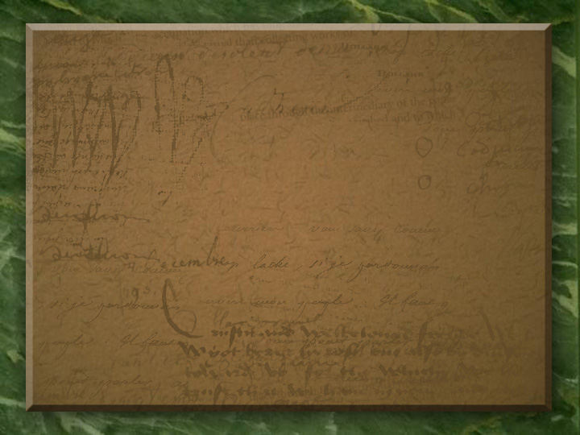

Honest Statement By Nobel Prize Winner
“There are only two possible explanations as to how life arose. Spontaneous generation arising to evolution or a supernatural creative act of God. There is no other possibility. Spontaneous gener- -ation was scientifically disproved 120 years ago by Louis Pasteur and others, but that just leaves us with only one other possibility…that life came as a supernatural act of creation by God, but I cannot accept that philosophy because I do not want to believe in God. I choose to believe in that which I know is scientifically impossible, spontaneous generation leading to evolution.”
~ George Wald (1906 – 1997)

Slide 42
What Are the Tenets of Christian Theism?
God Is Above All!
Ethics - Nature/ Conscience/ Scripture – revealed absolutes (Rom. 2:14-15; Ex. 20:2-17)
History - Linear/ Beginning and end defined by the center (Gen. 1:1; Rev. 21-22)
GOD
MAN

Slide 43
Christianity/Theism in Worldview Contexts
Theism
Theism is the belief that there is a personal God outside of time and space who created the universe out of nothing and is involved in events (supernaturally). He reveals himself to man through nature and through the Bible (Christians) or the TANAK = Old Testament (Jews) or the Koran (Muslims). He sets the rules for mankind. And there will be eternal consequences for breaking the rules. Deism a form of theism. God created everything, but is no longer involved in creation.

Slide 44


Slide 45
Ancient Wisdom for Modern Life
Ecclesiastes
It’s all a matter of perspective!

Slide 46
TWO VIEWS OF THE WORLD
Secularist
World
View
Theistic
World
View

Slide 47

SECULARIST
WORLDVIEW
A World view without God
Autonomous man
Pursuit of the earthly

Slide 48
Four Realities
A transitory life
+ A meaningless earth cycle
+ An inability to know all
+ Generational discontinuity
Frustration & Hopelessness!

Slide 49


Slide 50
Four Realities
A transitory life
+ A meaningless earth cycle
+ An inability to know all
+ Generational discontinuity
+ God In The Equation
What Is The Outcome?

Slide 51
The Theistic
WORLDVIEW
A world under God’s control
A trusting relationship with the Creator
Pursuit of the spiritual purposes of God

Slide 52
Four Realities
A transitory life
+ A wise God in control
+ A sovereign purpose to fulfill
+ Wisdom to guide us
Satisfaction & hope!

Slide 53
TWO VIEWS OF THE WORLD
Secularist
World
View
Theistic
World
View

Slide 54
Ancient Wisdom for Modern Life
Ecclesiastes
It’s all a matter of perspective!

Slide 55

Modernism Versus POST-MODERNISM

Slide 56

21st Century
FUTURE SHOCK
“Future Shock is the shattering stress and disorientation that we induce in individuals by subjecting them to too much change in too short a time.”
- Alvin Toffler (1970)

Slide 57


Debate Begins With Aristotle: How Are People Changed Within?
“To Be Is To Do” - Or - “To Do Is To Be”
“Excellence is an art won by training and habituation. We do not act rightly because we have virtue or excellence, but rather we have those because we have acted rightly. We are what we repeatedly do… Excellence, then is not an act but a habit.”
* Disputing Human Nature!

Slide 58

POSTMODERNISM: Scientific Advancement Technological Progress With Ethical Moral Lag

Slide 59
“The chief problem about death, incidentally, is the fear that there may be no afterlife – a depressing thought, particularly for those who have bothered to shave. Also, there is the fear that there is an afterlife but no one will know where it’s being held.” - movie quote

Slide 60
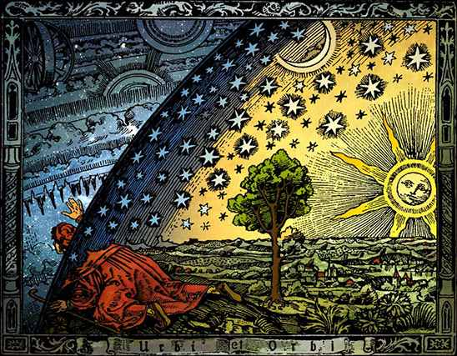

Slide 61

What is Postmodernism?

Slide 62

FROM THE FAILURE OF WESTERN
RATIONALISM & ENLIGHTENMENT
UNTO THE AGE OF FRAGMENTATION

Slide 63
Francis Schaeffer: An Introduction to his Apologetics
The age of fragmentation: Failure of the humanist base
Truth
Radical empiricism/ logical positivism: Attempt to reduce all truth to propositions verified by science.
Loss of any absolutes
"We can now see why it is impossible to find a criterion for determining the validity of ethical judgments. It is not because they have an absolute validity which is mysteriously independent of ordinary sense experience, but because they have no objective validity whatsoever. If a sentence makes no statement at all, there is obviously no sense in asking whether what it says is true or false." -- A.J. Ayer, Language, Truth and Logic
"The existentialist, on the contrary, thinks it is very distressing that God does not exist, because all possibility of finding values in a heaven of ideas disappears along with Him; there can no longer be an objective Good, since there is no infinite and perfect consciousness to think it. Nowhere is it written that the Good exists, that we must be honest, that we must not lie; because the fact is we are on a plane where there are only men. Dostoevsky said, ‘If God didn’t exist, everything would be possible.’" -- Jean-Paul Sartre, "Existentialism Is Humanism"
Reality
Kant’s noumenal/phenomenal distinction
Reality as it is cannot be apprehended, only interpreted
Man
Dilemma: Reason says man is a machine, but there remains a quest for inner meaning and significance and definition. What is man? How is the individual connected to ultimate reality?
"Has existence significance at all? This is the question which will require a couple of centuries even to be completely heard in all its profundity." -- Fredrich Nietzsche, Joyful Wisdom
"The fact that God could create free beings vis-à -vis of Himself is the cross which philosophy could not carry, but remained hanging therefrom." -- Soren Kierkegaard, Aphorisms
How Should We Then Live, "The Age of Fragmentation"
Discussion
  What are the logical conclusions of humanist presuppositions?
  Where is man in tension with rationalistic presuppositions?
  How do we "take the roof off"?
From fragmentation to postmodernism
Ideological shift to postmodernism
Why ideology matters

Slide 64
Francis Schaeffer: His Apologetic Approach
Truth
Paradigms: From "metanarrative" to "local knowledge"
Power substitutes for truth
"The best we can hope to do is convert someone from their set of beliefs to ours. This is persuasion. It has nothing to do with transcendent truth or knowledge. It is an art, as the old rhetoricians knew. Fortunately, our belief structures contain within themselves the possibility of alteration, of adopting a new opinion." -- Stanley Fish, Atlantic Monthly, March 1991
Propositional truth is out. Words do not convey meaning
Some thoughts on "Words are Useless"
Reality
A story of three umpires
Reality is socially constructed
  No common ground
  Openness and tolerance are the only (arbitrary) absolutes
Man
Human personhood as a "social construct”

Slide 65
Schaeffer’s Apocalyptic Analysis
The Posthuman
Human nature
  Product of Darwinian evolution
  Self is a social construct, thus it is possible to "reinvent" one’s self by artificial evolution.
  Computers and biotechnology make this possible..
  There is no correct or true model of the self.
  Postmodern era is a period of disintegrated selves.
Reality
  There is a "multiplicity of possible realities."
  Reality is rooted in perception.
  Reality appears to be increasingly irrational.
Values
  Should we take control of our bodies? Is it right to artificially control evolution?
  Are genetic manipulations "improvements"?
  There is a sense that we are advancing, but not progressing.
  Okatu represent a new view of social interaction, relating to machines over people.
  Traditional norms of gender, sexuality and self-identity need to be explored.
  Will the posthuman era produce increased freedom or manipulation?
TRUTH
  Absolute truth no longer applies. There are numerous ways to look at the world, and numerous equally valid standards of behavior.
  There is little sense of past or future.
  Absolutes no longer apply in political and social contexts.
  New technologies lead to new structures of thinking. Deductive rational structures are eclipsed by electronic media’s compressed sense of time. Images replace deduction.
  Patterns of thinking are becoming less rational.
  Hierarchical belief systems are being replaced by perceptual, multifaceted ones.

Slide 66
Francis Schaeffer: An Introduction to his Apologetics
Creation of God---->Machine------------------------>Flux------------------> Social construct
Open system of cause and effect | Closed system of cause and effect, manipulatable | Chaotic, less machine-like | Culturally relative paradigms
Image of God-----------------------------> Rational------------------------> Machine
Both intrinsically valuable and fallen Man is fragmented | Man the machine Autonomy collapses into social Darwinism | There is no unifying basis for man

Slide 67
Francis Schaeffer: An Introduction to his Apologetics
Image of God-----------> Rational------------------> Machine-----------> Social construct
Both intrinsically valuable and fallen | Man the machine Autonomy collapses into social Darwinism | Fragmented No unifying basis for man | No human essence. Defined by cultural determinism.
Objective---------------> Objective------------> Limited knowledge----> Constructivism
Reason & revelation | Reason Correspondence | Technology and science | Subjective, relative. Desire, experience, and power

Slide 68
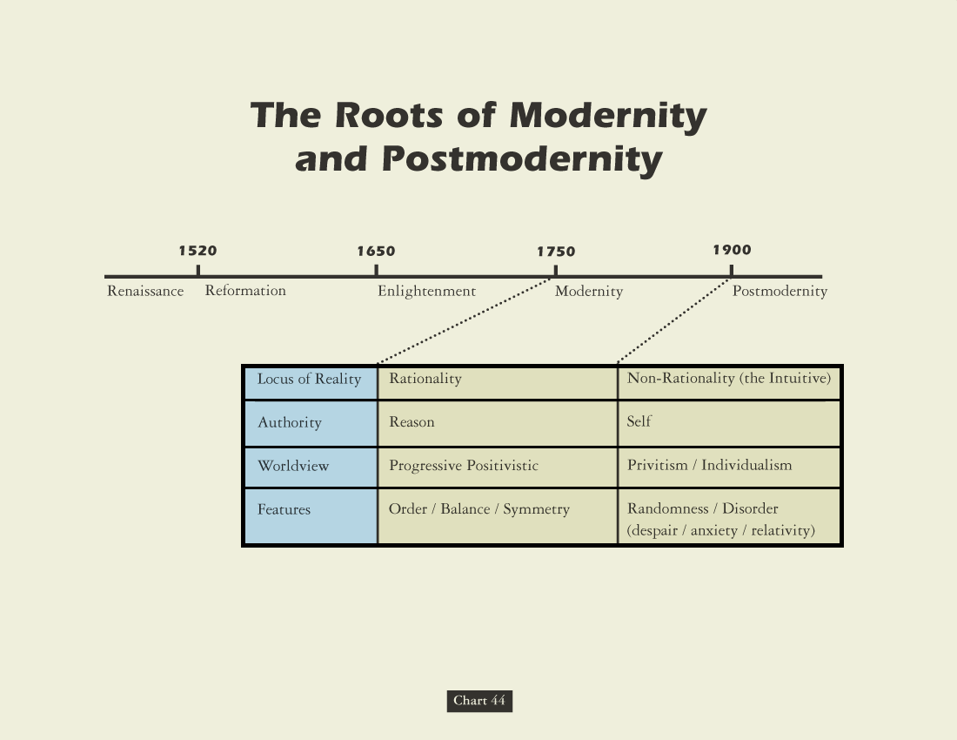

Slide 69


Three Umpires
“There’s balls and there’s strikes, and I call ‘em the way they are.”
“There’s balls and there’s strikes, and I call ‘em the way I see ‘em.”
“There’s balls and there’s strikes, and they ain’t nothing until I call them.”
Truth Is Stranger Than It Used to Be (1995)

Slide 70
Three Views of Truth
Pre-modernism – God-centered universe, revelation, truth is absolute.
Modernism (1850-1945) – Enlightenment, science, truth is relative.
Postmodernism (1945+) – loss of hope for truth, truth is created.

Slide 71
Modernism
Modernism – is the belief that the world can be explained through scientific examination.
Modernists see the world as one big machine.
They have faith in rationality, in empiricism, and in science.

Slide 72
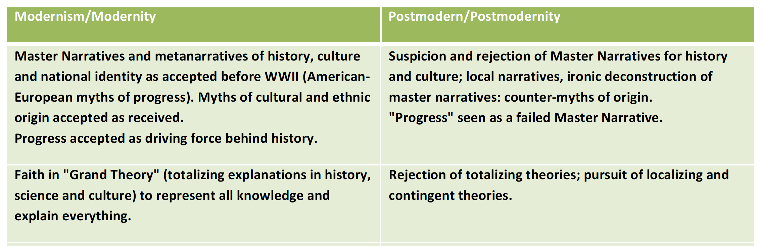

Slide 73
What Is Postmodern?
“Its central "doctrines" all seem to spring from a denial that there are any rules for anything. So the postmodernists say that "There is no such thing as truth," "Reality is merely a political construction" and "morality is meaningless.”
– John Ray

Slide 74


Slide 75
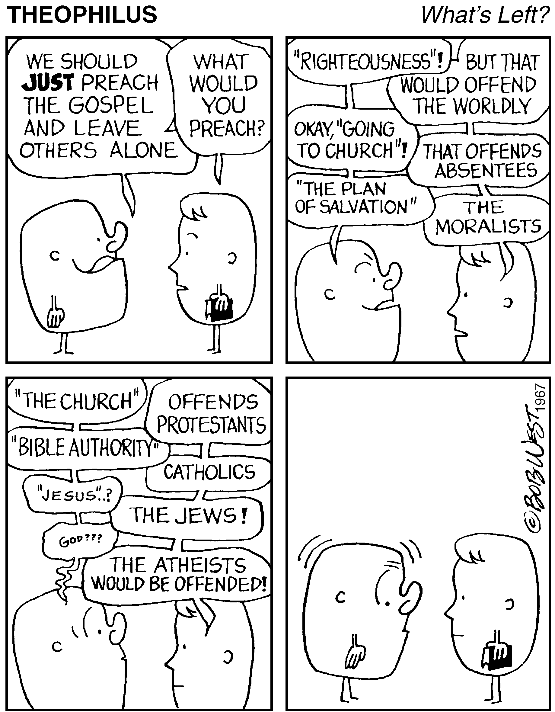

Slide 76
Who Is The Postmodernist?
"Postmodernists claim that there is no objective truth, that there is only interpretation, and that it all depends on who is in power. According to the postmodernists, we are so biased by our race, class, and gender that knowledge is impossible. The postmodernists allow freedom of speech only for those who share their Leftist political views. They hire and fire on the basis of ideology rather than scholarship & they try to prevent speakers of whose views they don't approve from appearing on campus.”
– Joe Willingham

Slide 77


Slide 78
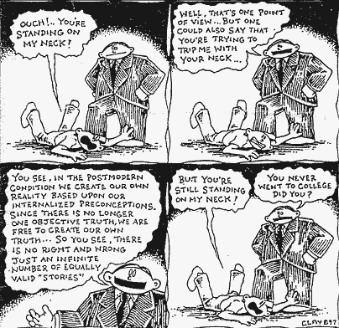

Slide 79
The Major Worldviews: Postmodernism
“Whatever”

Slide 80
What is Postmodernism?
“Whatever”
The last gasp of modernism
God and the World – same as naturalism
Human Nature – Culturally determined
Knowledge - confidence in the knowledge of truth is lost -- truth is “true for me” (or “us”); “Truth” is what works.
Ethics – Culturally determined
History – Meaningless and unknowable except as a study of power by one group over another

Slide 81
What is Postmodernism?
“Whatever”
Thus,
  There is no “transcultural objectivity.”
  We can’t think independently because we are defined by our culture.
  Truth is what works.
  Ethics is whatever the social group decides.
  Power is a key issue.

Slide 82
What is Postmodernism?
“Whatever”
“It has deconstructed its entire universe. So all that are left are pieces. All that remains to be done is to play with the pieces. Playing with the pieces—that is postmodern.”
--Jean Baudrillard

Slide 83
Axial Applied Approach
Practical Philosophy
Wilhelm Hegel
Human Spirit – Human Rights A Historical Progression
Friedrich Nietzsche
Moralities Of Slave & Master An Interpretive Nihilism
Sigmund Freud
Our Salvations - Work & Love A Humanistic Psychology
Martin Heidegger
Being-Doing – Of No Meaning Regressive Dehumanizing
Sartre & Camus
Human Situational Optimizing Freedoms = Sentences
Foucault & Habermas
Constructs: Power & Reason Meaningful Modification

Slide 84
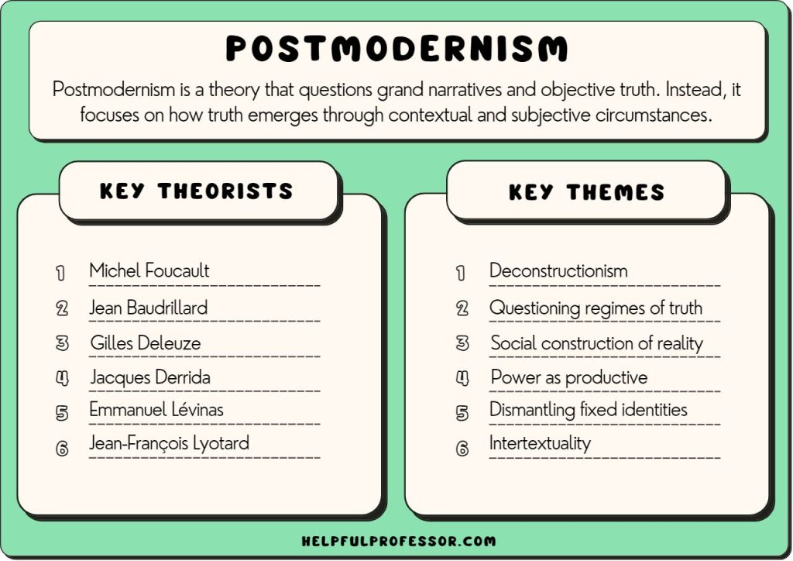

Slide 85
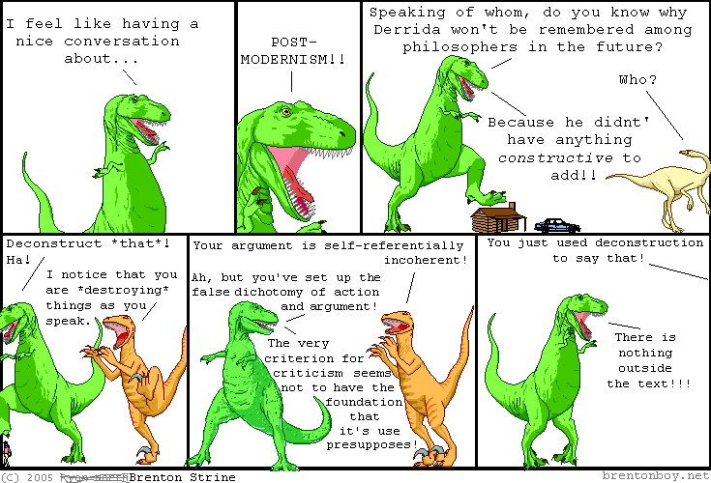

Slide 86
Postmodernism
Postmodernism – is the belief that truth is not discovered but created.
It is the belief that truth doesn’t exist except as the individual wants it to exist.
Truth isn’t objective or absolute.
Truth is personal and relative.

Slide 87
Postmodernism
Postmodernism – isn’t really a set of doctrines or truth claims.
It is a completely new way of dealing with the world of ideas.
Literature, history, politics, education, law, sociology, linguistics, even the sciences.

Slide 88
Postmodernism
It is skeptical of people (e.g., Christians) who claim to know truth.
But it does not actually seem hostile to religion or spirituality.
Postmodernists have no problem with religion unless it makes certain claims about its religion.

Slide 89
Postmodernism
Postmodernists tolerate religion as long is it makes no claim to universal truth and has no authority.
They are very critical of Christian missionaries because they believe they are “destroyers of culture.”

Slide 90
Other Key Terms
Religious pluralism – the belief that every religion is true.
Relativism – the belief that there are no criteria by which one can tell which worldview is true or best.

Slide 91
Self-defeating Propositions
Assert that all worldviews have an equal claim to the truth (deny absolute truth).
Denial of absolute truth is self-defeating.
Claim that relativism is true for everyone, everywhere, at all times.
But that itself is an absolute truth.

Slide 92
Is Truth Exclusive?
Law of Non-contradiction – A and the opposite of A cannot both be true.
Many believe that truth claims are “both/and” rather than “either/or.”
Mutually exclusive propositions cannot both be true (square circles).
|FROM TRUTH UNTO TOLERANCE EMPHASIS|

Slide 93
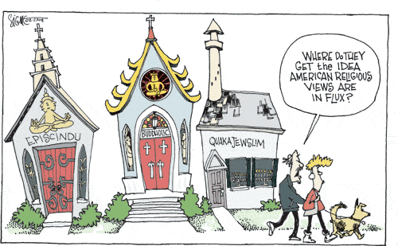
POSTMODERN SYNCRETISM

Slide 94
1st Century Christianity
We Understand . . .
Jesus said he would build His church. Matt. 16:18
That Church was established on 1st Pentecost after the D.B. & R. of Christ. Acts 2.
To be a part of that church we must emulate it in every way through devotion to Biblical Authority.
  Follow its teaching on salvation.
  Follow its teaching on church organization.
  Follow its teaching on God-centered worship.
  Follow its teaching on daily Christian living.

Slide 95
1st Century Christianity In A
Postmodern World Avoids:
Relativism – John 8:32; Rom. 1:16; 2 Tim. 4:1-5
  Jesus is the same, yesterday today and forever
  We will speak where the Bible speaks and remain silent where the Bible is silent.
  See the subtle movement in the church to move away from this mentality
  With relativism there is no sin — But Jesus — Luke 19:10
Materialism – Matt. 6: 25-31
Individualism – Matt. 16:26; - God’s way is right, not man’s.
Denominationalism – 1 Cor. 1 – Be one, Speak the same things, etc.

Slide 96


POST-MODERN PARADIGM?

Slide 97
POST-MODERNIST VERSUS THE THEIST

Slide 98
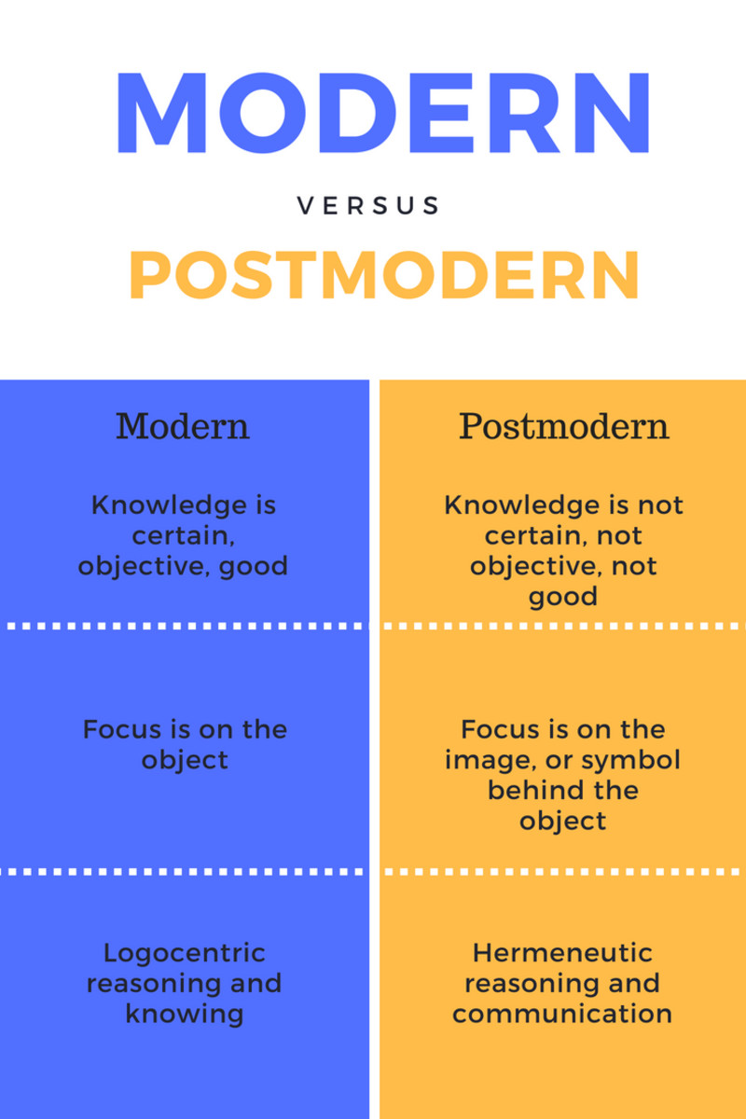

Slide 99

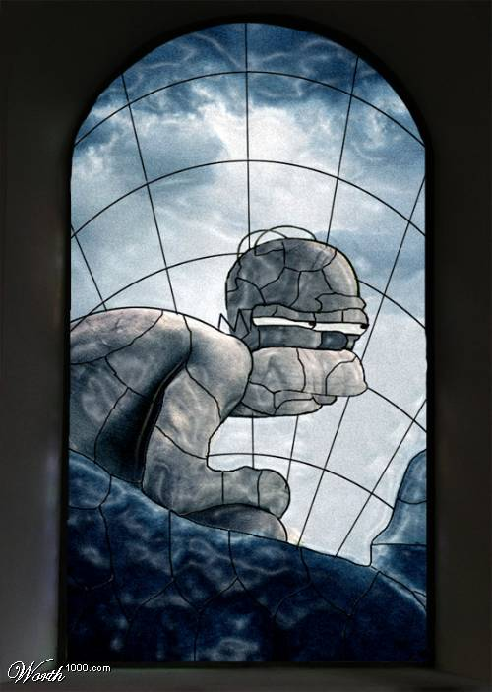
Future Historical Situational Context Of 21st Century Churches Of Christ
“Philosophy” is defined as a “search for a general understanding of values and reality by chiefly speculative rather than observational means.” The Apostle Paul cautioned, “Beware lest any man spoil you through philosophy and vain deceit, after the tradition of men, after the rudiments of the world, and not after Christ” (Col. 2: 8). The best & most succinct statement of the meaning specifically of “post-modernism” was in a recent article of The Spiritual Sword:
“Postmodernism is the latest philosophy to take center stage, and it
unquestionably is one of the most dangerous. As the name suggests, it
is - ‘post’ or ‘after’ - modernism and differs dramatically from the old
‘modernism’. Modernism subjected the Bible to rationalism & elevated
human reasoning above divine revelation. Post-modernism accepts all
religions as true, provided no one of them claims to be exclusively true.
{Similar to situation of Acts 17: 23.} The greatest sin in Postmodernism
is to believe that one is ‘right’ and that all others are ‘wrong’.”

Slide 100
Future Historical Situational Context Of 21st Century Churches Of Christ
CONTEMPORARY OF RESURGENT GNOSTICISM
Science, Politics and Gnosticism by Eric Voegelin:
“The loss of meaning that results from the breakdown of institutions, civilizations & ethnic cohesion evokes attempts to regain understanding of the meaning of human existence in the given conditions of the world. Among these efforts, which vary in depth of insight & substantive truth, are to be found: the Stoic reinterpretation of man as the polites of the cosmos, the Polybian vision of a pragmatic ecumene destined to be created by Rome, the mystery religions, the Heliopolitan slave cults, Hebrew apocalyptic, Christianity, and Manichaeism. And in this sequence, as one of the most grandiose of the new formulations of the meaning of existence, belongs gnosticism. The gnostic’s flight from a dreadful, confusing & oppressive state of the world is understandable. But the order of the ancient world was renewed by that movement which strove through loving action to revive – that is, by Christianity.”

Slide 101
The Problem Of Authority In Our Post-Modern Age
Post-modernism was initially labeled as deconstruction
which is more descriptive and which for purposes of
analysis is the best term. Norman Geisler on this topic:
Deconstruction is a form of hermeneutics, of interpreting a text. As such it
can be distinguished from other interpretive approaches. (It does not destroy
but reconstructs meaning.) It is not negation that dismantles a text, but
criticism that remodels it. It stands against fixed rules of analysis…
Deconstruction embraces conventionalism. All meaning is relative to a culture and situation. There is no meaning prior to language.
Deconstruction accepts perspectivalism. All truth is conditioned by one’s perspective.
Deconstruction holds a form of referentialism. There is no perfect reference or one-to-one correspondence between words & the meanings they confer. Meaning, therefore is ultimately untransferrable between writer and reader. We constantly change the context through which we view symbols. The context is limited. We cannot know from an infinite perspective.
Deconstruction is different-tialism. All rational structures leave some- -thing out. The reader approaches the text with suspicion, looking for the “difference,” the unknown something that is not there.

Slide 102
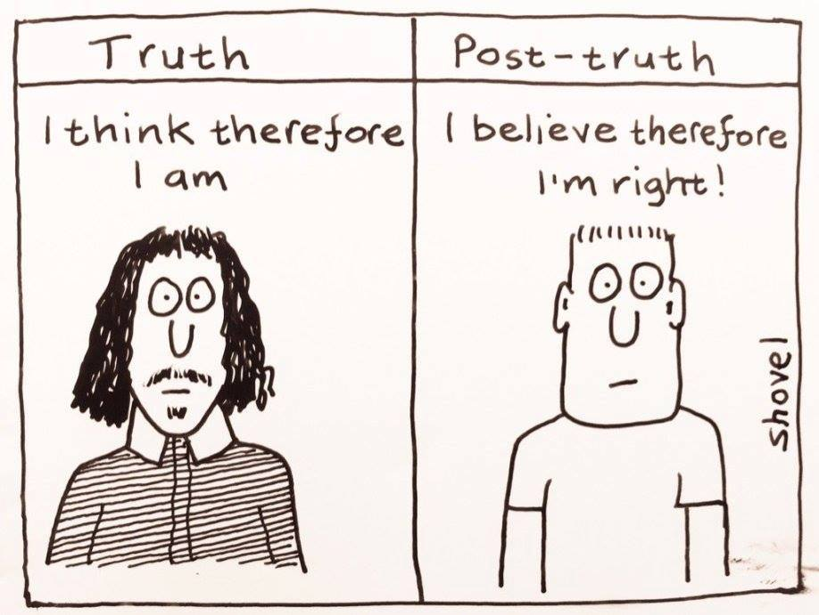

Slide 103
THEY ARE INTELLECTUALLY DISARMED! Per Premier Issue Salvo Magazine
Seven Things You Can’t Do As Moral Relativist:
Relativists Can’t Accuse Others Of Wrongdoing!
Relativists Can’t Complain About Evil As A Problem!
Relativists Can’t Place Blame Or Accept Praise!
Relativists Can’t Claim Anything Is Unfair Or Unjust!
Relativists Can’t Improve Their Morality!
Relativists Can’t Hold Meaningful Moral Discussions!
Relativists Can’t Promote Toleration As Requirement!

Slide 104
From Unawareness:
Unto Christianity:
STEP ONE -
Gospel Awareness
STEP TWO -
Gospel Receptivity
STEP THREE -
Controlled Attention
STEP FOUR -
RELATIONSHIPS
STEP FIVE -
COMMITMENT
STEP SIX -
Characterization

Slide 105

“LOGIC IS A SYSTEMATIC METHOD OF COMING TO THE WRONG CONCLUSION CONFIDENTLY.”
LOGIC DEFINED

Slide 106
Preaching Style & Church Growth
48 Congregations Net Growth Rate
Negative Approach
Positive Approach
HIGH
2
14
1
MEDIUM
13
3
LOW
12
4
2
(1) Campbell Conversational Or Non-Manipulative Dialogue
(2) Information Transmission Or Manipulative Monologue
* Source: "Why Churches Grow" By - Flavil Yeakley

Slide 107
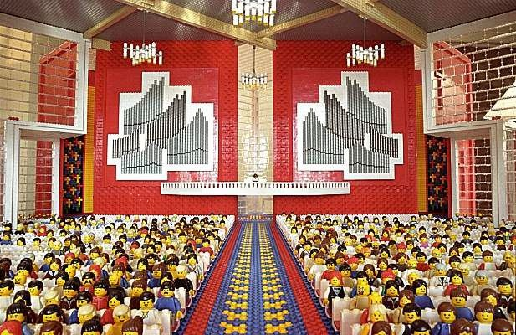


POSTMODERN RESPONSE: SEEKING THE SEEKERS
THEY HIDE FROM HERE!

Slide 108
Religious Involvement
Weekly 1990 2000 2010
Attend Church 49% 40% 35%
Read Bible 45% 40% 32%
Prayed 88% 83% 78%

Slide 109
Post-Modern De-construction: A Period Of Unprecedented Fluidity!
Report From The Capital, Committee Newsletter, 2003/08:
“A massive, groundbreaking new study of the American religious landscape shows that Protestants are losing their share of the nation’s population – and that the nation’s broad diversity is paired with great religious dynamism.
The Pew Forum on Religion & Public Life released the 2007 survey in February. The study – the first in recent years to combine a huge sample size with in depth questioning on American religious affiliations – showed 28% of adult respondents have left the faith of their childhood for another religious tradition or no religion at all. When those who have moved from one Protestant denomination to another are included, the figure leaps to 44%. Among its most striking findings is that Protestants now comprise a slim majority – 51 percent – of U.S. adults. As recently as the 1980’s, similar surveys showed Protestants comprised nearly two-thirds of the population.”

Slide 110


FORM FOLLOWS FUNCTION

Slide 111

The Limits of Argument
Some would say that the appeal of argument is limited in these postmodern times. People today seem content with contradiction. They are adept
at slipping out of the logical traps that apologetic preachers like to set for them. Given this type of phenomenon, is there a limit to the usefulness of argument in preaching today? What are the pros and cons of using argument?

Slide 112
Debates Of Semantical Exploitation
HARTZ'S LAW
OF RHETORIC
ANY ARGUMENT CARRIED FAR ENOUGH WILL END UP IN SEMANTICS!

Slide 113
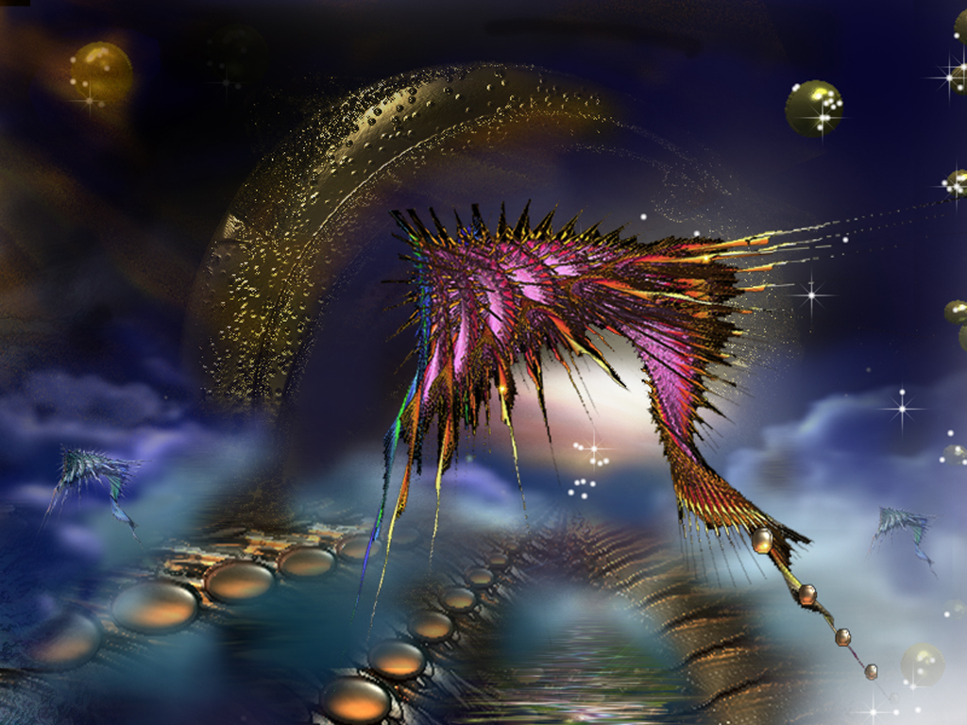


Slide 114

Faith: Authentic & Counterfeit
Legalism: Moral Code Or Living Savior?
Formalism: Empty Ritual Or Heartfelt Worship?
Humanitarianism: Mere Service Or True Care?
Heroism: Super Saints Or Humble Believers?
Enthusiasm: External Signs Or Internal Reality?
Eclecticism: Many Truths Or One?

Slide 115
David Lee Burris: ORGANIC UNION
Believers Organically Grafted In Union With Christ
Organic Commandments
Decision - is the virtue of the WILL!
Sincerity - is the virtue of the MIND!
Courage - is the virtue of the SPIRIT!
Love - is the virtue of the HEART!

Slide 116
Confront Evangelism
Lifestyle Evangelism
Commitment
Discipleship
Canned Presentation
Flexible Agenda
Command Oriented
Relationship Oriented
Training Emphasis
Fellowship Focus
Organized Visitation
Friends Association
Local Church Activity
Individual Christians

Slide 117
The Three Layers Of Culture
David Lee Burris:
Complimentary Statements Of The Great Commission Complete In Matthew 28: 18 – 20 & Luke 24: 46 – 49 ~ The Authority – The Enablement – The Sphere – The Message – The Activities
SOCIETAL
ETHNOLOGICAL
Ideology
Cosmology
Worldview
VALUES & MORES
INSTITUTIONS

Slide 118

SOURCE CULTURE MESSAGE DIMENSION
RESPONDENT VARIABLES
Worldviews
Ways Of Perceiving The World
Cognitive Processes
Ways Of Thinking
Linguistic Forms
Ways Of Expressing Ideas
Behavioral Patterns
Ways Of Acting
Social Structures
Ways Of Interacting
Motivational Resources
Ways Of Deciding

Slide 119
APPROACH
TYPOLOGY
Christ Against Culture
Radical Christians
Christ & Culture In Paradox
Dualists
Christ Transforms Culture
Conversionists
Christ Above Culture
Synthesists
The Christ Of All Cultures
Culturalists
CHRIST & CULTURE

Slide 120
MODERNIST
POST-MODERNIST
Evangelism As Argument
Evangelism As Conversation
Win/Lose
Win/Win
Sales & Conquest
Friendship
Pressure To Make A Decision
Patience As One Considers The Gospel
Trying To Convert Someone
Joining Someone’s Spiritual Journey
Punctilliar Conversion
Salvation As A Process

Slide 121

“What’s Past Is Prologue.”

Slide 122
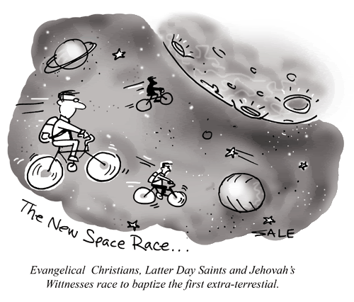

I CAN SEE THINGS TO COME
It’s 2:53 PM
Tuesday, June 27, 2023.
Let’s Quantum Leap Forward

Slide 123
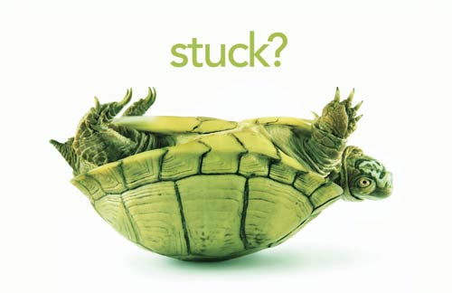
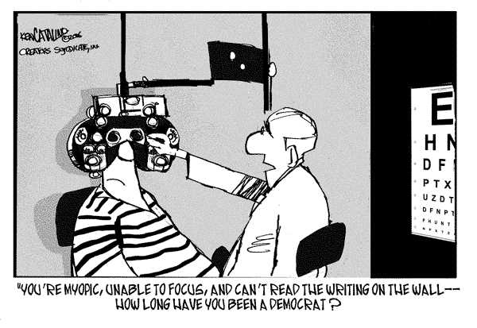


Slide 124
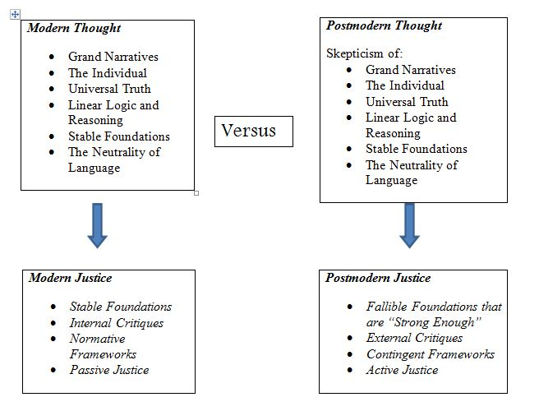

Slide 125
Images and Ideas
Are ideas more important than images, or are the two roughly equal in their expressive power?
Is there something dangerous about an image without an idea? What about an idea without a corresponding image?

Slide 126
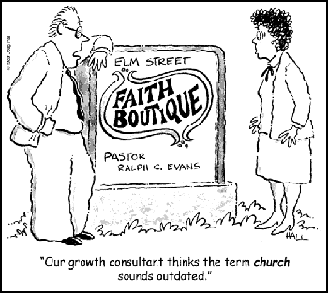


Slide 127
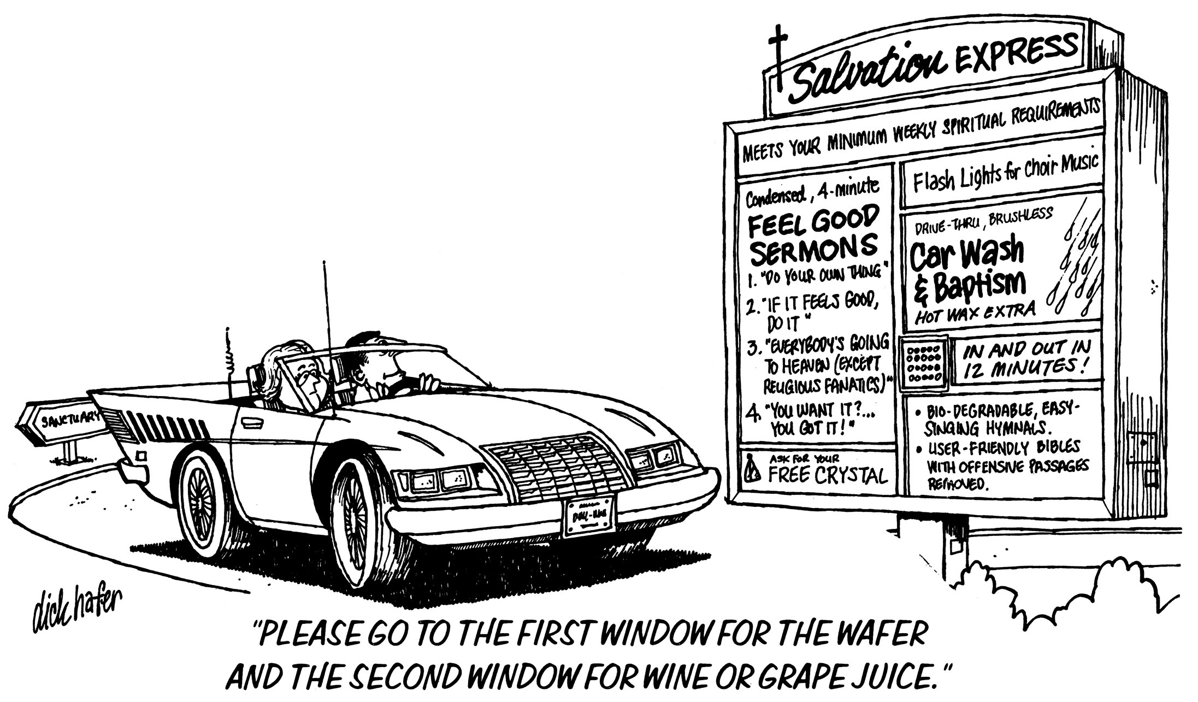

Slide 128
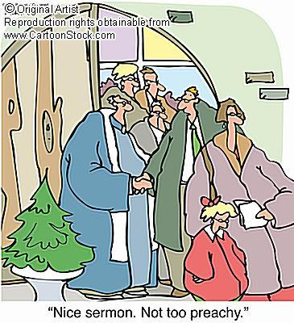

Slide 129
EMPTY WORDS
Ephesians 5: 6 – The apostle uses the adjective ‘empty’ to describe the kind of words by which one may be deceived. The literal term refers to someone or something possessing no material substance such as an empty cistern or one sent away empty handed. (Genesis 31:42; 37:24) There exists, however, a figurative extension of this meaning in the New Testament. In this sense it pertains to someone or something lacking intellectual, moral or spiritual merit. For example, the ‘vain’ man supposes faith saves in the absence of works (James 2: 20). Also, without the reality of Christ’s resurrection, Paul views his preaching as ‘vain’ and his converts as possessing worthless faith of the same sort (1 Corinthians 15:14). When Paul uses the term here with reference to the message of the false teachers it carries the idea of without content, without any basis, or without truth.
Grammatically, the noun ‘words’ is the dative case. This case usage indicates the means by which the action of the verb is carried out. It’s necessary for translators to supply the terms ‘with’ or ‘by means of’ to express this instrumentality involved with the indirect object. The construction answers the question ‘how?’ Christians may be deceptively lead astray from the truth by false teachers. And, just how do heretics achieve this accomplishment?
Answer: through the instrumentality of words used to convey something other than biblical truth. Words are vehicles of concepts. God discloses His truth through verbally inspired words which we have embodied in written form on the pages of the New Testament. False preachers likewise have at their disposal the means by which to dispense their heretical views: ‘words of flattery, feigned words, great swelling words of vanity, and empty words.

Slide 130
WILKIE’S LAW
A GOOD SLOGAN
CAN STOP ANALYSIS
FOR OVER FIFTY YEARS!

Slide 131
David Lee Burris:
“The past is a foreign country: they do things differently there.” - L. P. Hartley
SAPIR-WHORF HYPOTHESIS
The Sapir-Whorf hypothesis says the structure of a language determines cognition, which is the way we think about the world. The hypothesis has two variants: a strong version and a weak version.
The strong version is also called linguistic determinism, and it claims that linguistic structures – vocabulary and grammar – determine the way a person can think. Probably the best example of this comes to us from George Orwell’s novel 1984. In it, the language of Newspeak was developed to enforce the ideology of the dystopian society described. In Newspeak, language literally determined thought.
The weak version of the hypothesis, called linguistic relativity, is much more palatable. This concept states there is relationship between language and thought, and each influences the other.

Slide 132
