Slide 1
SACRED HISTORIES & THE WORD
By David Lee Burris

Slide 2
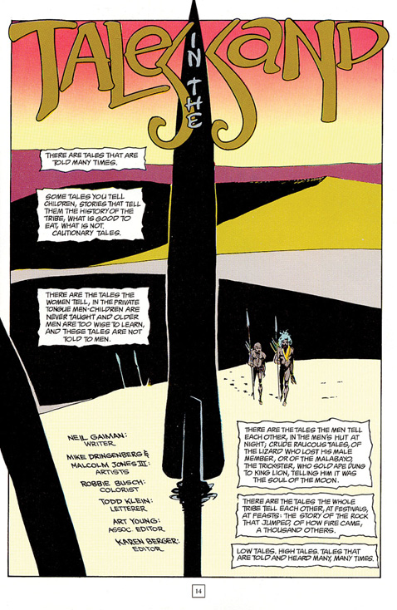
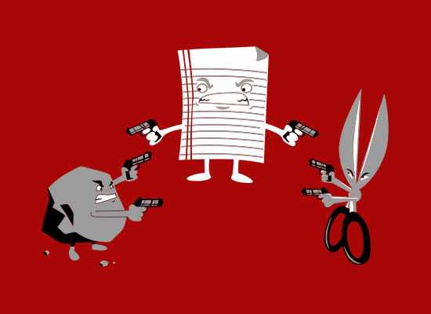

Primitive
Histories

Slide 3
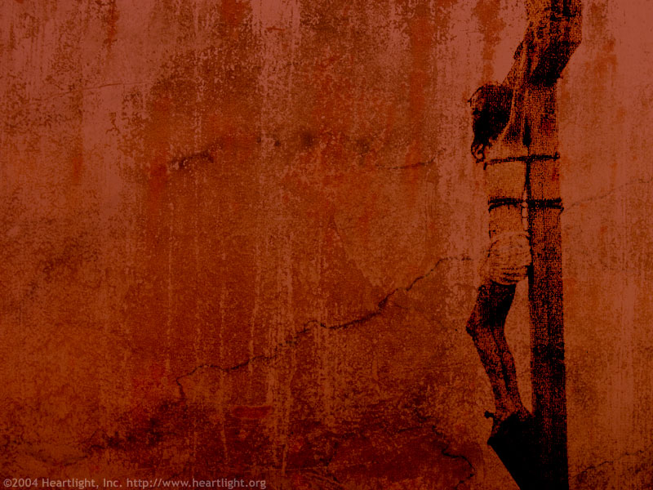




Establishment Perspective
Famous Cicero Quote:
“All our beliefs about the gods have been fabricated by wise men so that people will be persuaded by religion to be good citizens.”

Slide 4
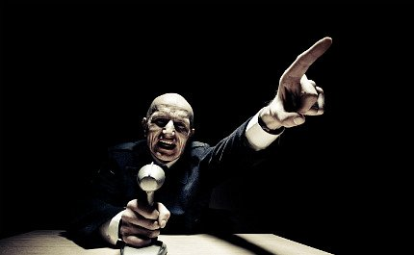
THE TRIPLET OF OPACITY:

Slide 5

(1) The illusion of understanding - how everyone thinks he knows what is going on in a world that is more complicated than they realize;
(2) The retrospective distortion, or how we can access matters only after the fact, as they were in a rearview mirror;
(3) Overvaluation of factual information and handicap of authoritative and learned people, particularly when they create categories.

Slide 6
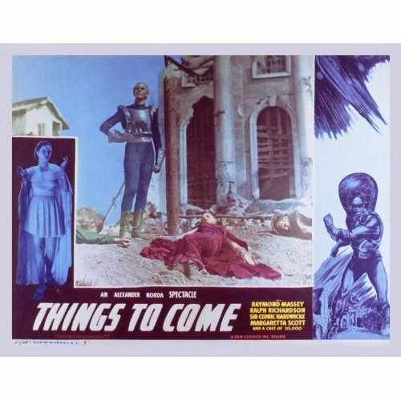



Slide 7
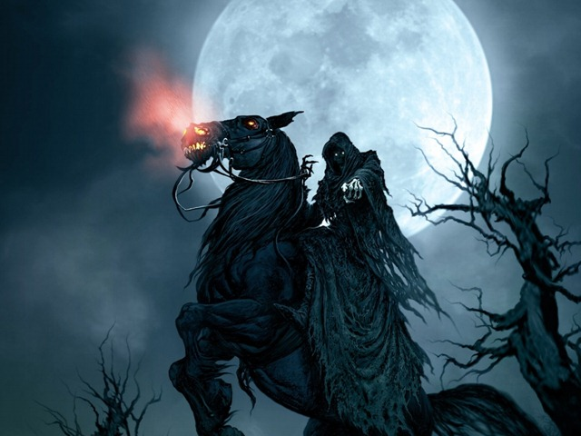
Tali Sharot's new book, The Optimism Bias, argues that the human brain has an in-built tendency to discount negative information about the future. This is probably a survival adaptation: Optimists live longer, are healthier, and have more drive to reach their goals.
"It's something you see again and again," says Sharot, "When you give people negative information about the future, they don't really use that information to change their beliefs. But when you give them unexpectedly positive information about the future, they can immediately uptake that information and change their beliefs."
The only danger with irrational optimism is that people won't take proper precautions.

Slide 8
“The great enemy of the truth is very often not the lie – deliberate, contrived, & dishonest – but the myth – persistent, persuasive, & unrealistic.” - JFK

Slide 9

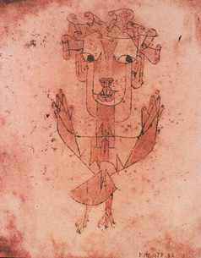
The Angel of History

Slide 10
Responding in 1940 to the unfolding catastrophes perpetrated by the rise of fascism in Germany, Walter Benjamin, a German Jewish philosopher and literary critic, wrote his now famous "Thesis on the Philosophy of History." In the ninth thesis, Benjamin comments on Paul Klee's painting "Angelus Novus." He writes:
"Angelus Novus" shows an angel looking as though he is about to move away from something he is fixedly contemplating. His eyes are staring, his mouth is open, his wings are spread. This is how one pictures the angel of history. His face is turned toward the past. Where we perceive a chain of events, he sees one single catastrophe which keeps piling wreckage upon wreckage and hurls it in front of his feet. The Angel would like to stay, awaken the dead and make whole what has been smashed. But a storm is blowing from Paradise; it has got caught in his wings with such violence that the angel can no longer close them. The storm irresistibly propels into the future to which his back is turned, while the pile of debris before him grows skyward. This storm is what we call progress.(2)

Slide 11
The meaning and significance of Benjamin's angel of history has been the subject of varied interpretations by philosophers, literary critics, and others.(3) Yet, it still offers us a powerful lesson about a set of historical conditions marked by a "catastrophe that keeps piling wreckage upon wreckage."(4) In this instance, catastrophe both undermined any hope of democracy in Europe and gave rise to the dark forces of a brutal authoritarianism and the industrialization of death. In the midst of such a crisis, Benjamin's angel is frozen in time, paralyzed by a storm called "progress" that pulls him into the future without being able to "awaken the dead" or mend the catastrophe at his feet.
For Benjamin, the storm of progress was a mode of modernity gone askew and a deceit that made a claim on happiness rather than the horrors of destruction, constituting a set of conditions that unleashed a barrage of unimaginable carnage and suffering in the 1930s and 1940s. The utopian belief in technologically assisted social improvement had given way to a dystopian project of mad violence that would inevitably produce the context for Benjamin to take his own life in 1940. According to Benjamin, the horrors of the past made it difficult to believe in progress as a claim on and history as a narrative of the advancement of human civilization. In fact, as Zygmunt Bauman has pointed out, the overdetermined force of history was not just at stake in Benjamin's narrative, but also the notion that "we are pulled forward by future happiness - [when] in fact, [as Benjamin noted], we are pushed from behind by the horror of destruction we keep perpetrating on the way."(5)

Slide 12
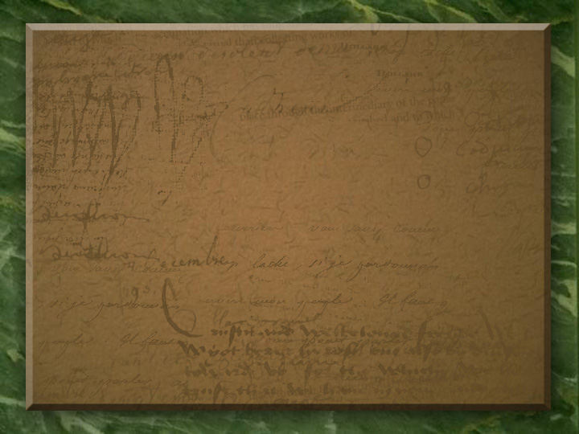
Herodotus & History’s Lamp:
The lamp of history is what illuminates beyond the reader’s desk, the reader’s village, the oceans that surround the reader’s nation. When constructed properly, the lamp of history – the study of history – illuminates the very commonalities that constitute human nature itself.
What is taught is this: There is a root humanity that is reached by such events and that will allow us to predict how we are likely to behave under certain conditions and how those conditions, therefore should either be promoted or shunned depending upon whether our behavior is to be laudable or reprehensible.
Cicero Oration – “O tempora! O mores!” = “Oh, the times, oh, the customs!”

Slide 13
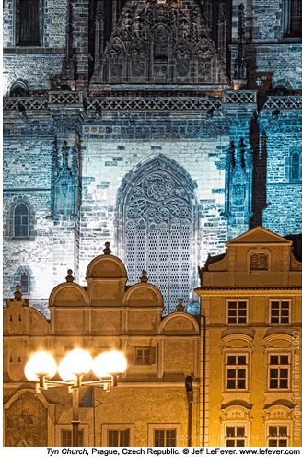
The Epochal events of sacred history

Slide 14
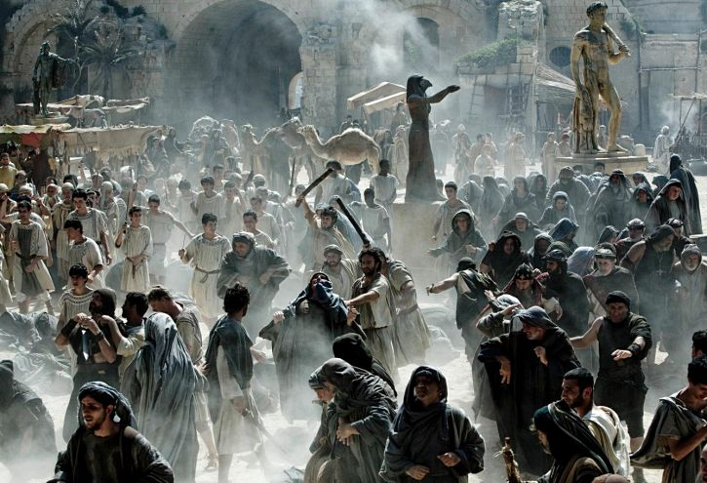
“In the midst of all governments
that decide the fate of men;
in the bosom of so many states,
the majority of them despotic,
Governed by sovereigns whose authority exceeds people & property,
There exists a certain empire which holds sway only over the mind …”

Slide 15
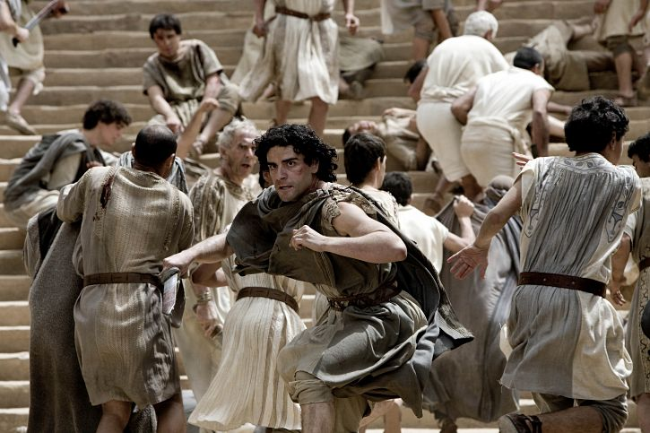

Slide 16
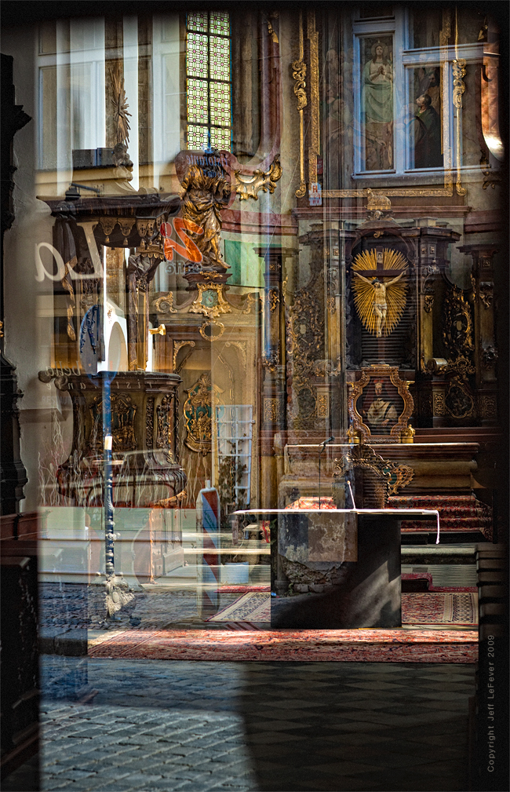
“Eyes and hearts enlightened by the ‘word of truth, the gospel’(Ephesians 1:13,18) know that history was not – is not – left to the caprices of men. Allowing for and accommodating man’s will and folly, the Almighty led Bible history ‘unto a dispensation of the fullness of the times, to sum up all things in Christ, the things in the heavens, and the things upon the earth(10). ‘When the fullness of the time came’ not a minute sooner or later – ‘God sent forth his son, born of a woman, born under the law’ (Galatians 4:4).

Slide 17
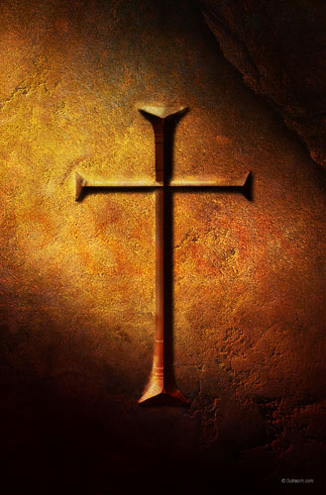
HUMAN DESTINY AT THE CROSSROADS
For Our Salvation A Perfect Sacrifice

Slide 18
“Bible history is sacred history because God steered and used it to His glory and purpose. One of the great marvels of God in His dealings with His creature, man, is the perfect symmetry of human will on the one hand, and the divine sovereignty on the other.
Even as God unfolded and guided the gospel plan through the intricacies of human history, it was a plan, a purpose, ‘which none of the rulers of this world[knew], for had they known it, they wouldn’t have crucified the Lord of glory’ (1st Corinthians 2: 8).

Slide 20
“From the perspective of human will, the ‘rulers of this world’ could have done differently. Equally true, though, is the fact that the rulers of this world, such as ‘Herod and Pontius Pilate gathered together to do whatsoever [God’s] hand & council foreordained to come to pass’ (Acts 4:27,28). Men involved in sacred history could have done differently; yet, they did precisely as God foreordained. Only the Almighty could make both of these things be true.

Slide 21
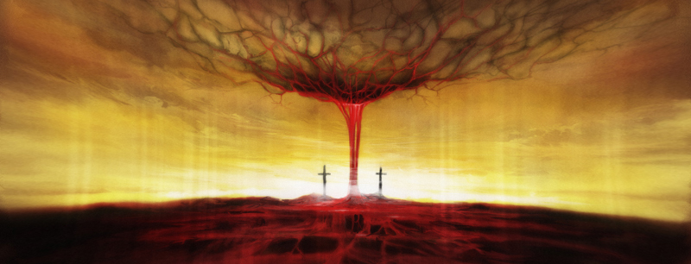
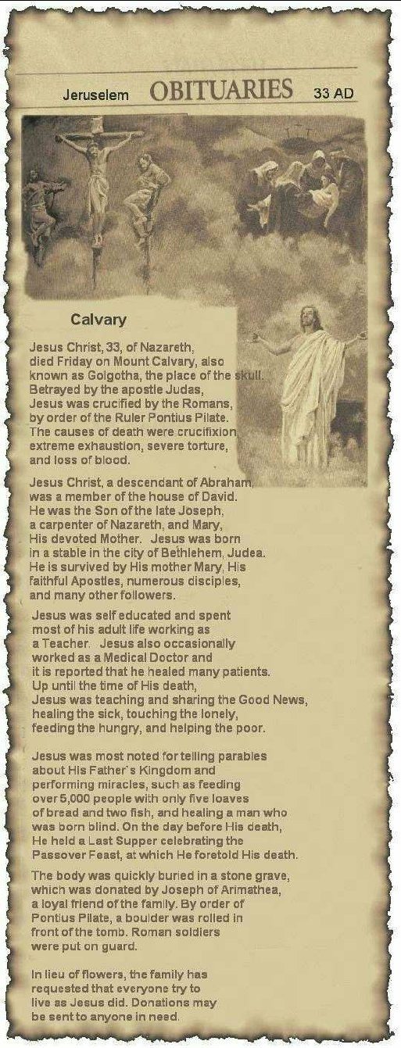

Slide 22
“This sacred history can be quantified in terms of epochs – ‘times and events marked by an event that begins a new period or development’ – or, to quote the Lord, ‘Times or seasons which the Father has set within His own authority’ (Acts 1:7). These epochal events include all of those from the ‘beginning’ and up to the birth of Jesus. They include events surrounding the life and work of Jesus, as well as events related to the gospel being ‘preached in all creation under heaven’ Colossians 1:23). For that matter they even include foretold events like the destruction of Jerusalem in A.D. 70 & the Fall of Rome.” – Lectureship Advertisement

Slide 23

Theory: Civilization.Corruption.Christians
Nations rise and fall. Greatness ebbs and flows. A people at any given time may have their exalted place on the world stage, but are only too soon replaced by another. C.S. Lewis pithily noted this persistent pattern in Mere Christianity: ‘Terrific energy is expended – civilizations are built up – excellent institutions are devised; but each time something goes wrong. Some fatal flaw always brings the selfish and cruel people to the top and all sides back into misery and ruin.’

Slide 24
Theory: Civilization.Corruption.Christians
Nations rise and fall. Greatness ebbs and flows. A people at any given time may have their exalted place on the world stage, but are only too soon replaced by another.
J.D. Unwin studied some eighty societies. He examined the developmental status and energy they manifested. Was the culture growing – demonstrating what he called ‘expansive energy’ – and then, later in its history, was it improving on what it built – what he called ‘productive energy.’

Slide 25
Theory: Civilization.Corruption.Christians
Nations rise and fall. Greatness ebbs and flows. A people at any given time may have their exalted place on the world stage, but are only too soon replaced by another.
J.D. Unwin studied some eighty societies. The historical evidence showed no society displaying great energy for any appreciable period unless its absolutely monogamous.
In the negative side, however, was what happened when a people began to trans- -gress its own codes. Across the board, Unwin saw such cultures start to decline.

Slide 26
Theory: Civilization.Corruption.Christians
Nations rise and fall. Greatness ebbs and flows. A people at any given time may have their exalted place on the world stage, but are only too soon replaced by another.
Cultural writer Neil Postman in his critical book ‘Amusing Ourselves to Death’ claims that when social success is achieved in a culture the process of outward expansion can wane and the fruits are then enjoyed – energy is expended inwardly on self-gratification, and the culture becomes self-centered and weak. Individuals consider their own appetites as the highest goods. Thus it is not simply a moral dissipation that is causing decline in creative energy, but rather a luxury lifestyle of distracted dissipation.

Slide 27
Theory: Civilization.Corruption.Christians
Nations rise and fall. Greatness ebbs and flows. A people at any given time may have their exalted place on the world stage, but are only too soon replaced by another.
In his 1956 work on the Sexual Revolution Harvard’s Pitirim Sorokin examined this phenomenon as well. He concluded that ‘the greater the number of profligates, and the more debauched their behavior , the graver are the consequences for the whole society. Moreover if moral ‘anarchists compose any considerable proportion of its membership, they eventually destroy the society itself.’

Slide 28
Theory: Civilization.Corruption.Christians
Nations rise and fall. Greatness ebbs and flows. A people at any given time may have their exalted place on the world stage, but are only too soon replaced by another.
Unwin and Sorokin both believed this process of cultural decay could be resisted and reversed. The key to success, however, seemed to lie with at least a single stratum of the decaying society that stood firmly against the tide until they were able to show their fellow citizens the way back to moral sanity. ‘Though by the law of polarization… a minor part of the population tends to become more religious, sexually continent, and morally heroic in the periods of disorders and great calamities,’ Sorokin said.

Slide 29

A QUESTION OF
GOD'S PROVIDENCE:

Slide 30
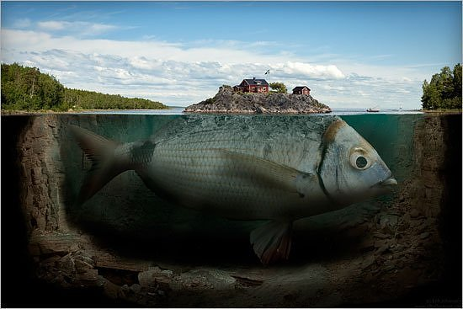
“Absence of evidence
- IS NOT -
evidence of absence.”
- Carl Sagan

Slide 31


Catholic Teaching Regarding Fasting & Friday Fish
Combined With Rapidly Growing Catholic Population
That Forced The North Atlantic Fishermen Further South
Eventually To Winter Waters Of Cod Off The Coast Of Maine

Slide 32
COLUMBUS' DISCOVERY OF AMERICA
& THE BEGINNING OF THE REFORMATION
25 YEARS APART!

Slide 33
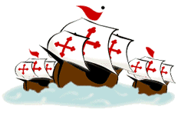

Slide 34
According to Columbus’ private ships’ log:
On 9 October, after 67 days at sea, he was forced to promise his restless crew
That if land were not spotted within three days, he would turn back for home.
On the morning of the third day, 12 October, his lookout announced landfall.

Slide 35
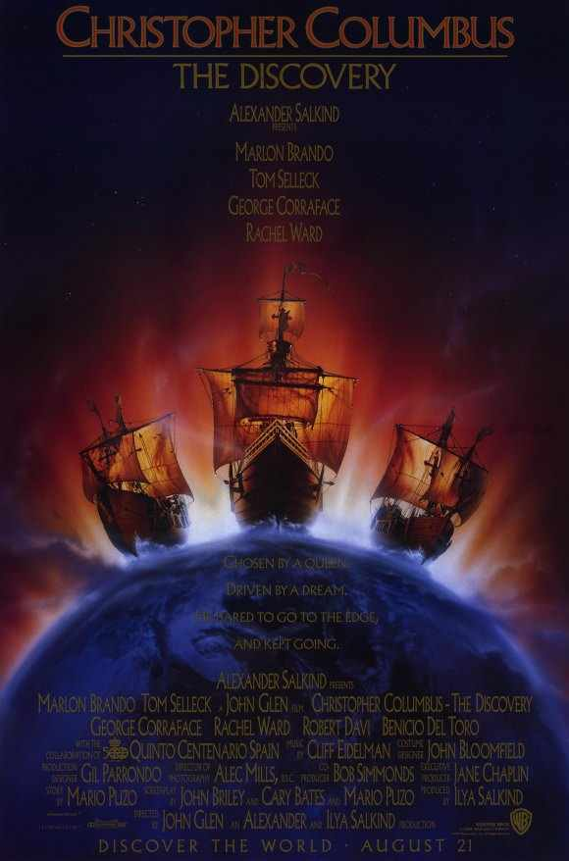

SHIP’S LOG ENTRY 11OCT1492 @10PM:
First seen is a glimmering light that has come out of the sea;
It dances up & down before us & pulsates as it passes beside.
The last note of this light moving before the ship was four hours before the sight of land.

Slide 36

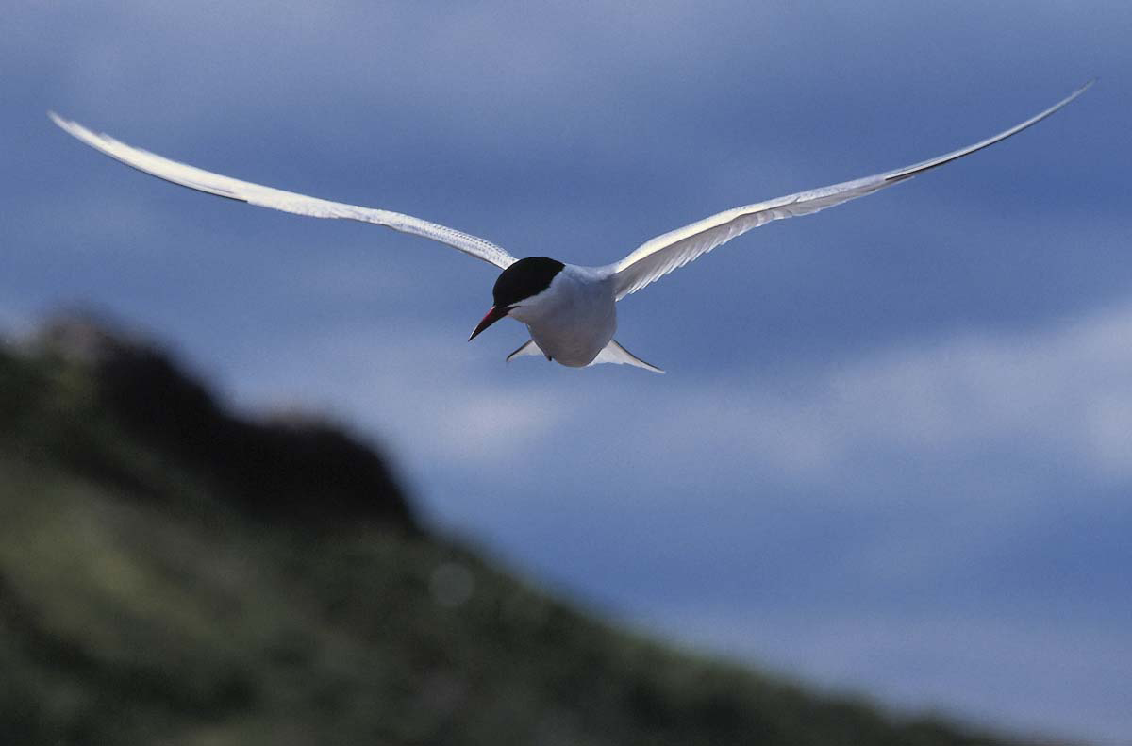

Slide 37

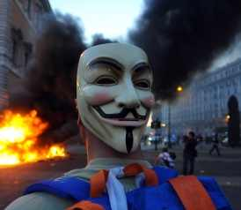
200 Year Civilization Expectancy:
David Lee Burris:
Freedom Not Free!
From Bondage To Spiritual Faith
From Spiritual Faith To Great Courage
From Courage To Liberty
From Liberty To Abundance
From Abundance To Complacency
From Complacency To Apathy
From Apathy To Dependence
From Dependence Back To Bondage

Slide 38
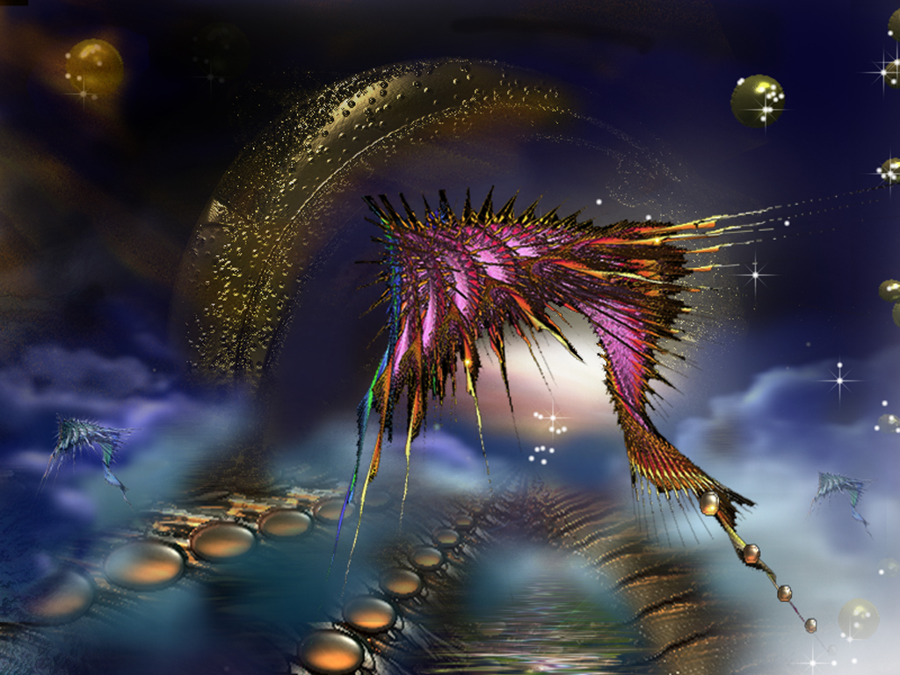
Edward Hallett Carr On the Study of History
How Vs. Why ~ Or ~ Function Versus Cause
“The true historian, confronted with this list of causes, would feel a professional compulsion to reduce it to order, to establish some hierarchy of causes which would fix their relation to one another, perhaps to decide which cause, or which category of causes, should be regarded as the cause of all causes.”
“Historians, like other people, sometimes fall into rhetorical language and speak of an occurrence as ‘inevitable’ when they mean merely that the conjunction of events leading one to expect it was overwhelmingly strong.”
Determinism Vs. Free Will. “In practice, historians do not assume that events are inevitable before they have taken place. They frequently discuss alternative courses available to the actors in the story on the assumption that the option was open, though they go on quite correctly to explain why one course was eventually chosen rather than the other. Nothing in history is inevitable except in the formal sense that, for it to have happened otherwise, the antecedent causes would have had to be different.”
Historical Accident Or Arranged Coincidence? “These so-called accidents in history represent a sequence of cause and effect interrupting historically and clashing – ‘a collision of two independent causal chains’.”
The Historian Marx. “Marx offered an apology for chance in history under three heads. First, it could accelerate or retard but not radically alter the course of events. Second, one chance compensated for another, so that in the end chance cancelled itself out. Third, chance was especially illustrated in the character of individuals.”
Meinecke’s Historical Observation: “The search for causalities in history is impossible without reference to values . . . behind the search for causalities there always lies, directly or indirectly, the search for values.”

Slide 39
MENTAL CONTAMINATION
The Halo Effect & Its Pitchfork Opposite
Irrelevant Redirection & Focusing Illusion
Arbitrary Anchoring & Answer Adjusting
Group Prejudice & Familiar Attachments

Slide 40
DISTORTIONS OF ABSOLUTE RIGHT
“Because of distortions and for no other reason, the
average person thinks there is an occasional distinction
between logical right and expedient right, between logical
right and moral right, and also between expedient right and
moral right. Despite widespread misconceptions, it seems
almost too prosaic to say that there is not. There is no
distinction in the word itself; the distinction is only in the
modifier used before the word, and the modifier designates
an ingredient rather than a distinction. Right is certainly not
absolute unless it has all the ingredients.” - HUMANETICS

Slide 41
BIAS ASSIMILATION
No matter what we humans think about, we tend to pay more attention to stuff that fits in with our beliefs than stuff that might challenge them. Psychologists call this ‘confirmation bias.’ When we have embraced a theory, large or small, we tend to be better at noticing evidence that supports it than evidence that might run counter to it.

Slide 42

MOTIVATED REASONING
Wait Wait ... Don’t Tell Me!
Our tendency to accept what we wish to believe (what are motivated to believe) with much less scrutiny than what we don’t want to believe is a bias known as ‘motivated reasoning,’ a flip side to confirmation bias. Whereas confirmation bias is an automatic tendency to closely notice data that fit with our beliefs, motivated reasoning is the complementary tendency to scrutinize ideas more carefully if we do notlike them than if we do.

Slide 43
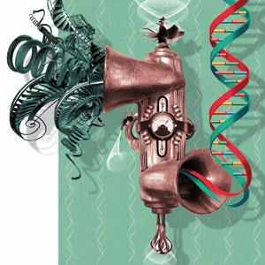
Corrupted Procrustean Methodology
THEORY INFLUENCES OBSERVATION
OBSERVER CHANGES THE OBSERVED
ANECDOTAL STORY ≠ VALID STUDY
BOLD STATEMENTS ≠ A TRUE CLAIM
MOST AFTER THE FACTS REASONING
MOST FAILURES ARE RATIONALIZED

Slide 44
HIGH LEVEL RESISTANCE
Bill Moyers on University of Michigan study on the power of information:
“Suffice it to say that, while ‘most of us like to believe that our opinions have been formed over time by careful, rational consideration of facts & ideas and that the decisions based on those opinions, therefore, have the ring of soundness and intelligence,’ the research found that actually ‘we often base our opinions on our beliefs and rather than facts driving beliefs, our beliefs can dictate the facts we chose to accept. They can cause us to twist facts so they fit better with our preconceived notions.’
These studies help to explain why America seems more and more unable to deal with reality. So many people inhabit a closed belief system on whose door they have hung the ‘Do Not Disturb’ sign, that they pick and choose only those facts that will serve as building blocks for walling them off from uncomfortable truths.”

Slide 45
Hope

Slide 46
To you, O Lord, I lift up my soul; in you I trust, O my God.
Do not let me be put to shame, nor let my enemies triumph over me.

Slide 47
No one whose hope is in you will ever be put to shame…
Show me your ways, O Lord, teach me your paths;

Slide 48
Guide me in your truth and teach me, for you are my God my Savior, and my hope is in you all day long. Remember, O Lord, your great mercy and love, for they are from of old.

Slide 49
Remember not the sins of my youth and my rebellious ways; according to your love remember me, for you are good, O Lord.

Slide 50
Good and upright is the Lord; therefore he instructs sinners in his ways. He guides the humble in what is right and teaches them his way.

Slide 51
All the ways of the Lord are loving and faithful for those who keep the demands of his covenant. (Psalm 25:1-10, NIV)

Slide 52
Hope
Noun
The feeling that what is wanted can be had or that events will turn out for the best: to not give up hope.
A particular instance of this feeling: the hope of winning.

Slide 53
Hope
Verb (used without object)
3. To feel that something desired may happen: We hope for an early spring.
4. Archaic: to place trust; rely (usually followed by in ).
Idiom
5. Hope against hope, to continue to hope, although the outlook doesn’t warrant it.

Slide 54
What Is Hope?
In the Hebrew the two words most often translated hope are Kawah, (to wait or expect) and Batah (to be full of confidence or to trust,)
Jeremiah 17:13 O Lord the hope of Israel
Psalm 38:15 My hope is in you
Psalm 43:5 Why are you downcast hope in God.

Slide 55
What Does It Mean
The Greek word for hope is elpis (Noun) or elpezein (Verb) It is translated hope. The expectation of a favorable future. It was not used positively outside of the scriptures.
Hope was seen by secular writers in the ancient world not as a virtue but merely an temporary illusion. They did not see hope as a virtue but use epithets such as faint, trembling, feeble, desperate, or phantom as adjectives or descriptions of hope.

Slide 56
1Peter 3:15 but sanctify the Lord God in your hearts, and be ready always to give an answer to everyone who asks you a reason of the hope in you, with meekness and fear;
Titus 1:2 on hope of eternal life, which God, who cannot lie, promised before the eternal times,
Titus 2:13 looking for the blessed hope, and the glorious appearance of our great God and Savior Jesus Christ,
Titus 3:7 that being justified by His grace, we should become heirs according to the hope of eternal life.

Slide 57
2 Thessalonians 2:16 Now may our Lord Jesus Christ Himself, and God, even our Father, who has loved us and has given us everlasting consolation and good hope through grace,
Hebrews 6:18 so that by two immutable things, in which it was impossible for God to lie, we might have a strong consolation, who have fled for refuge to lay hold upon the hope set before us,
1Peter 1:21 those believing in God through Him, He who raised Him up from the dead and gave Him glory, so that your faith and hope might be in God.

Slide 58
Hope has two beautiful daughters:
Their names are anger and courage.
Anger that things are the way they are.
Courage to make them the way they ought to be.
* Augustine of Hippo

Slide 59
FAITH

Slide 60
Getting A Few Foundations Laid
You can’t separate hope and faith. Faith produces hope and hope produces faith
We receive in life from God through our faith and hope “the best is yet to come”
We have a choice to make, fear/faith, hope or despair

Slide 61
New Testament Usage
Paul and other New Testament writers used this word differently. It means “The expectation of a favorable future under God’s direction.”
Hope is described as one of the three essential virtues that are foundational in our Christian life. It is linked in scripture with love and faith. This threefold combination is found in 1st Thess.1:3, 5:8 Gal.5:5-6, 1st Cor. 13:13, Hebrews 6:10-12.

Slide 62
Hope’s Relationships
Hope cannot exist without faith in someone or something that gives hope the confidence it needs.
Therefore faith in God was always foundational to having a hope that does not disappoint. The word for faith in the Old Testament is also used to define hope.

Slide 63
What Does It Mean To Be Lost
Paul describes spiritual lostness as being “without hope”. If fact he states specifically to be without hope is to be without God in this World. Eph. 2:12, I Thess. 4:13

Slide 64
HOPE AND FAITH TOGETHER
God’s plans for us is to give us not only direction but hope Jeremiah. 29:11
Hope is an anchor for our soul Hebrews 6:19
We have an anchor that keeps the soul, Steadfast and sure while the billows roll, Fastened to the Rock which cannot move ~ Grounded firm and deep in the Savior’s love.

Slide 65
“If they get you asking the wrong questions, they don’t have to worry about the answers.” Thomas Pynchon

Slide 66

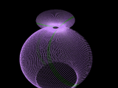
The Butterfly Effect Of
Christian & Church History
Sensitive Dependence On Initial Conditions
Small variations in initial condition of a non-linear dynamical system may produce large variations in long term behavior of the system.
Each Iteration Amplifies The Initial Departure

Slide 67
“An error is the more dangerous the more truth it contains.” Henri Amiel

Slide 68

Enlightenment Couplets
Information & Knowledge
Explanation & Understanding
Experience & Belief System
Wisdom & Truth!

Slide 69

Excerpts: “A History Of Truth” by Felipe Fernandez-Armesto
From Rock To Rubble: The Philosopher’s Stones
Three Ways Proposed For Rescuing Truth From Relativism
Without Necessarily Committing To Belief In A Truth-World:
Correspondence Theory - Or Treating Truth As A Common Sense & Reliable Description Of Reality.
Coherence Theory - Or Axiomatic Construction Of Truth Propositions & Their Demonstrated Proof.
Consensus Theory - Or Pragmatic Utilitarianism Of Received Knowledge & Traditional Interpretation.

Slide 70

Pontius Pilate
David Lee Burris:
Notice - Jewish Leaders Are To Pilate Being Both Obsequious & Appealing Pandectic
“What Is Truth?”

Slide 71
“Facts are stubborn things, and whatever may be our wishes, our inclinations, or the dictates of our passions, they cannot alter the state of facts and evidence.” John Adams

Slide 72
INSPIRATION, REASON, & CONSENSUS
Christopher Burns in Deadly Decisions on How We Decide What is True:
“Thousands of years ago, whenever information or ideas grew so complex and ambiguous that their truth could not be determined, villages relied on inspiration. As long as the source remained unimpeachable, the charismatic pronouncements were accepted as true, whether or not they were particularly consistent or in accord with the evidence. Priests and prelates, oracles and emperors multiplied, rising in a splendid hierarchy of increasing infallibility that reached all the way to God.
But as people began to write down these revelations, inconsistencies became apparent and reason suggested a better set of rules. The truth of any ambiguous or new statement could be tested by comparing it logically to other statements that were known to be accurate. Finally, after several centuries of torture & deception, those whose office it was to interpret the new rules mounted to power, wielding reason like a sword.
The age of science has offered a third test of truth: consensus. A statement is true if it explains most(but not necessarily all) of the evidence. A theory is true within the context of a current paradigm, although it may not be true tomorrow when the paradigm shifts. An idea is true, according to William James, if it provides a successful basis for action. This is not just a triumph of complexity over common sense; consensus is a genuinely new standard for truth.
In each truth regime, authority took charge and the priests, the professors, and the politicians stabilized the system and ran the process in a manner that allowed the group to act successfully in the real world.”

Slide 73
INSPIRATION, REASON, & CONSENSUS
Christopher Burns in Deadly Decisions on How We Decide What is True:
“The age of science has offered a third test of truth: consensus. A statement is true if it explains most(but not necessarily all) of the evidence. A theory is true within the context of a current paradigm, although it may not be true tomorrow when the paradigm shifts. An idea is true, according to William James, if it provides a successful basis for action. This is not just a triumph of complexity over common sense; consensus is a genuinely new standard for truth.
In each truth regime, authority took charge and the priests, the professors, and the politicians stabilized the system and ran the process in a manner that allowed the group to act successfully in the real world…
In addition to size and structure, there is a third element affecting the success of a group’s decision, the organization’s truth system. Most groups function primarily as information-processing societies. They have standards for determining what is true (inspiration, reason, and consensus). They have a specialized language including acronyms, buzzwords, and unique phrases that make some things easier to say than others. They have a process for sharing information: sometimes it is very hierarchical; sometimes it is collegial. Groups have concepts – existing descriptions of reality on which all the members agree but which may or may not be true. And they have values – goals, biases, and shared visions of the future. Finally, there is usually a commitment to speak truthfully to each other in the name of some greater objective.

Slide 74
“Doctrine is nothing but the skin of truth set up & stuffed.”
Henry Ward Beecher

Slide 75
Ephesians 5: 9
“for the fruit of the Spirit is in all goodness, righteousness, & truth.” (NKJ)

Slide 76
Ephesians 6: 14
“Stand therefore, having girded your waist with truth, having put on the breastplate of righteousness.”(NKJ)

Slide 77
John 8: 32
“And you shall know the truth, and the truth shall make you free.” (NKJ)

Slide 78
John 14: 6
Jesus said to him, ‘I am the way, the truth, and the life. No one comes to the Father except through Me.’ (NKJ)

Slide 79
Psalms 108: 4
“For Your mercy is great
above the heavens,
And Your truth
reaches to the
clouds.” (NKJ)

Slide 80
Excerpts: “A History Of Truth” by Felipe Fernandez-Armesto
Today, equivocation has disappeared from the witness-stand. Equivocation was a necessary resource against interrogation in a world of strong conviction, when deponents were not in any serious doubt about the truth or falsehood of what they said. Today instead of equivocating, you can dodge the interrogator’s probes by the relativist’s evasion: ‘what is true for you is not true for me’. Or you can give him an answer true, you think, in a different sense from that of the truth he wants to hear; or you can offer him truth of a different type, which you can choose to call a higher type; or you can console yourself that you are not lying to the judge – merely using a different language from him, or interpreting differently the words you have in common, or ‘deferring’ or denying their meaning; or you can reject the distinction he assumes between truth and falsehood as invalid, or tendentious, or oppressive. (164)

Slide 81
Pontius Pilate
David Lee Burris:
Notice - Jewish Leaders Are To Pilate Being Both Obsequious & Appealing Pandectic
“What Is Truth?”

Slide 82
Jesus Christ
In John 4: 40, 41
“But you are not willing to come to Me that you might have life,
I do not receive honor from men.”

Slide 83
Savior’s Rejection
Explained In John 12: 43
“For they loved the
praise of men more than the praise of God.”

Slide 84
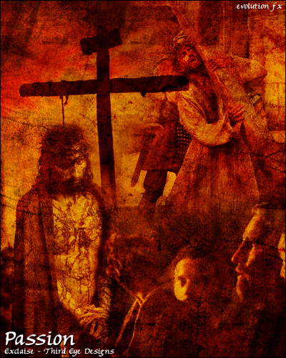

Slide 85
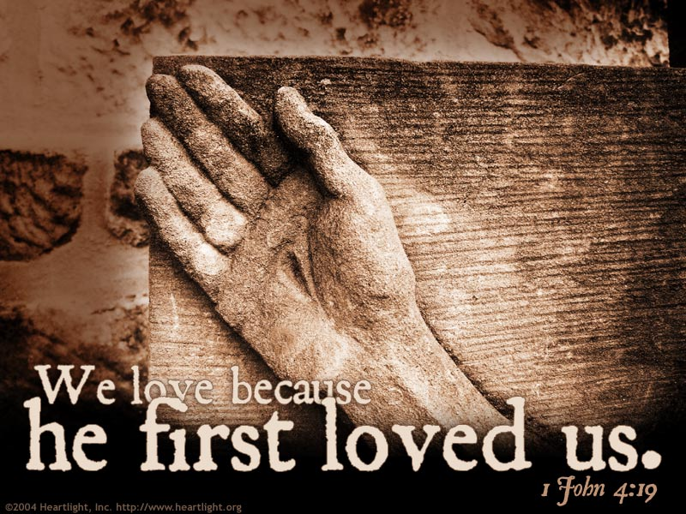
Piercing Through To The Truth!

Slide 86
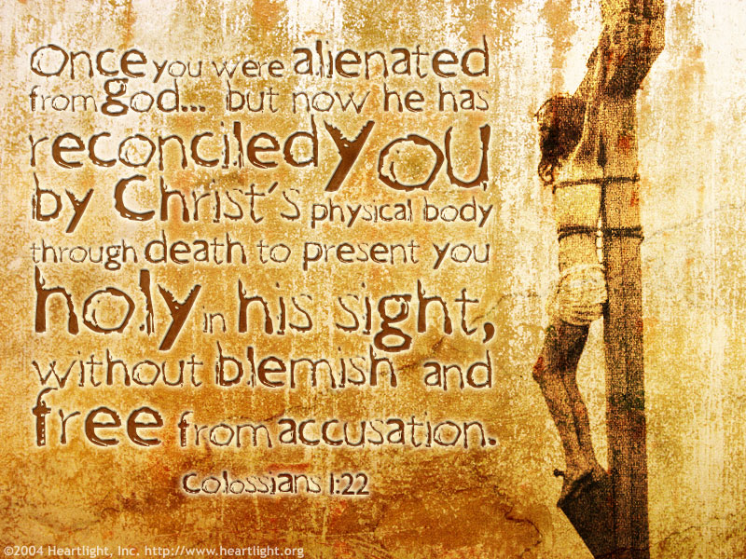
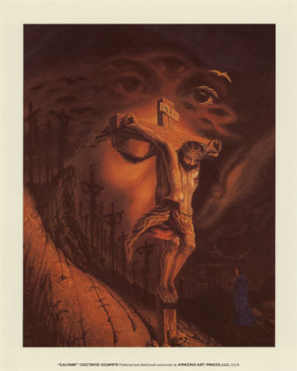

Slide 87
Thomas Sowell
“There are only two ways of telling the complete truth – anonymously & posthumously.”

Slide 88


Truth Does Not Count Legally.
The Concern Of Law Is Proof.
Of God's Love
THE TREE
Christ’s Death On Calvary’s Tree
Is Proof Of Gods Love For Man

Slide 89
Pontius Pilate
David Lee Burris:
Notice - Jewish Leaders Are To Pilate Being Both Obsequious & Appealing Pandectic
“What Is Truth?”

Slide 90
THE HINGE OF HISTORY
The Incarnation of Jesus Christ

Slide 91
Pythagorus
In Sixth Century B.C. Wrote:
“Truth is so great a perfection, that if God would render Himself visible to men, He would chose light for His body & truth for His soul.”

Slide 92
The Word Became Flesh
“Far and away the most startling affirmation of God’s pleasure in this physical world, however, is found in the event which biblical writers came to see as the hinge of history: the incarnation of Jesus. ‘In the beginning was the Word,’ writes John at the opening of his Gospel, ‘and the Word was with God, and the Word was God’ (John 1:1).
The Incarnation of Jesus Christ

Slide 93
The Word Became Flesh
In the Greek culture which John addressed, this Word would immediately be understood as something fundamentally intellectual and spiritual, dwelling far above the grimy realities of this earth. Jewish readers, meanwhile would have heard allusions to the Wisdom of God.
But John proceeds to make a series of claims for this ‘Word’ which would have shaken the minds of both Jew and Greek alike.
The Incarnation of Jesus Christ

Slide 94
The Word Became Flesh
First, says John, this ‘Word’ is intimately bound up in the material, physical world which surrounds us: ‘All things come into being through him, and without him not one thing came into being. What has come into being in him was life, and the light of all people’ (John 1:3-4).
He writes about the logos not as some mysterious, impersonal force which patterns creation, but rather as a person, one who lives and brings life, one with whom we might enter into relationship.
The Incarnation of Jesus Christ

Slide 95
The Word Became Flesh
While this would have made perfect sense to John’s Jewish readers, who would immediately have understood John as writing about the Creator, philosophical Greek writers would have been rather startled. The idea that one could enjoy a relationship with the logos was entirely new to Greek thinking. And then John pushes his readers further still.
‘The Word became flesh,’ he writes, ‘and dwelt among us, full of grace and truth; we have beheld his glory, glory as of the only Son from the Father’ (John 1:14)
At this point John’s Jewish readers would also have been shocked. While they might have been comfortable with the idea of identifying the logos with the action of God in creation, the idea that God might become flesh – that the ordering principle of the cosmos might not only be a divine ‘person’ with whom we might be able to experience relationship but might choose to enter into his own created world in human flesh – was an astounding surprise.
The Incarnation of Jesus Christ

Slide 96
The Word Became Flesh
And Greek readers would have been somewhat disconcerted; despite their long tradition of story myths in which the gods entered this world disguised as people or animals (or even natural forces) there was no precedent for the assertion that a divine creator might voluntarily surrender his exalted place in the heavens in order to live out a limited, vulnerable human life here on earth.”
- Christopher S. Webb, Renovare`
The Incarnation of Jesus Christ

Slide 97
Excerpts: “A History Of Truth” by Felipe Fernandez-Armesto
Until Lord Acton died in 1902, historians claimed to detect a moral purpose or final end in history – some historians still talk as if history had a course, which is close to saying that it behaves like a creature with a mind. People still ask about the ‘purpose of life’. This sort of language is usually underpinned by notions of Providence: God is the conscious agent assumed to be guiding history or investing life with purpose… (Page 144)

Slide 98
Pontius Pilate
David Lee Burris:
Notice - Jewish Leaders Are To Pilate Being Both Obsequious & Appealing Pandectic
“What Is Truth?”

Slide 99
Excerpts: “A History Of Truth” by Felipe Fernandez-Armesto
Truth, said Democritus around the turn of the fifth and fourth centuries BC, ‘lies in the depths’. It could not be consistent with the way things seen to our senses; it is hidden by outward appearance. When a Greek artist depicted its discovery, he showed a disrobing. We shall speak of truth as ‘naked’… (Page 120)

Slide 100
Pontius Pilate
David Lee Burris:
Notice - Jewish Leaders Are To Pilate Being Both Obsequious & Appealing Pandectic
“What Is Truth?”

Slide 101
ANSWER TO PILATE:
David Lee Burris:
Notice - Jewish Leaders Are To Pilate Being Both Obsequious & Appealing Pandectic
You are face-to-face with Truth Personified!

Slide 102

Countering The Historical Butterfly Effect Of
Bible Distortion & Scripture Misrepresentation

Slide 103
The Anvil? God’s Word.
Last eve I passed beside a blacksmith’s door
And heard the anvil ring the vesper chime:
Then looking in, I saw upon the floor
Old hammers, worn with beating years of time.

Slide 104
The Anvil? God’s Word.
“How many anvils have you had,” said I,
“To wear and batter all these hammers so?”
“Just one,” said he, and then, with twinkling eye,
“The anvil wears the hammers out, you know.”

Slide 105
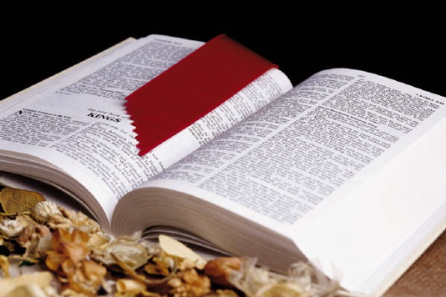
The Anvil? God’s Word.
And so, thought I, the anvil of God’s word,
For ages skeptic blows have beat upon;
Yet though the noise of falling blows was heard,
The anvil is unharmed ... the hammer’s gone.
Author unknown
Certainly the Bible is the most accurate and attested document of the ancient world. To reject it as God’s Word is far more likely due to personal bias than the evidence.

Slide 106
“Truth can
be denied,
but it can’t
be avoided.”
- Author Unknown

Slide 107

“This book contains the mind of God, the state of men, the way of salvation, the doom of sinners, and the happiness of believers. Its doctrine is holy, its precepts are binding, its histories are true, and its decisions are immutable.
Read it to be wise, believe it to be safe, and practice it to be holy. It contains light to direct you, food to support you, and comfort to cheer you.
It is the traveler’s map, the pilgrim’s staff, the pilot’s compass, the soldier’s sword, and the Christian’s charter. Here Paradise is restored, heaven opened, and the ways of hell disclosed. Christ is its grand object, our good its design, & the redemption of man its end. It should fill the memory, rule the heart, and guide the feet. It’s a mine of wealth, a paradise of glory, and river of pleasure.
It is given you in life, will be open in judgment, and be remembered forever. It involves the highest responsibilities, will reward the greatest labor, and condemn all who trifle with its sacred contents.” @ unknown

