Slide 1
THE JESUS WARS
By David Lee Burris

Slide 3
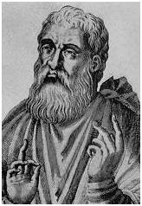
Testimony of the Early Church Fathers
Justin Martyr (100-165 AD): "...the Father of the universe has a Son; who being the logos and First-begotten is also God" (First Apology 63:15).
Irenaeus (130-200 AD): (referencing Jesus) "...in order that to Christ Jesus, our Lord, and God, and Savior, and King, according to the will of the invisible Father, . . ." (Against Heresies I, x, 1)

Slide 4
Testimony of the Early Church Fathers
Clement of Alexandria (150-215 AD): "Both as God and as man, the Lord renders us every kind of help and service. As God He forgives sin, as man He educates us to avoid sin completely" (Christ the Educator, chapter 3.1). In addition, "Our educator, O children, resembles His Father, God, whose son He is. He is without sin, without blame, without passion of soul, God immaculate in form of man accomplishing His Father's will" (Christ the Educator Chapter 2:4).

Slide 5
Testimony of the Early Church Fathers
Hippolytus (170-236 AD): "And the blessed John in the testimony of his gospel, gives us an account of this economy and acknowledges this word as God, when he says 'In the beginning was the Word, and the Word was with God and the Word was God.' If then the Word was with God and was also God, what follows? Would one say that he speaks of two Gods? I shall not indeed speak of two Gods, but of one; of two persons however, and of a third economy, the grace of the Holy Ghost“ (Against the Heresy of One Noetus. 14).

Slide 6
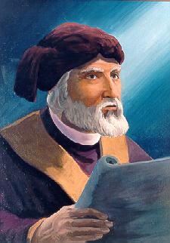
Testimony of the Early Church Fathers
Tertullian (150-225 AD): "...the only God has also a Son, his Word who has proceeded from himself, by whom all things were made and without whom nothing has been made: that this was sent by the Father into the virgin and was born of her both man and God. Son of Man, Son of God, ..." (Against Praxeas, 2).

Slide 7
Conclusion of the Church Fathers
All the church fathers before Nicea acknowledged the deity of Christ
The church fathers often defended the deity of Christ against the heresies that denied it
Nicea formalized what the Church already believed and was defending.

Slide 8
“DUST & DEITY” – by Jean Hall
HE WEDDED DUST AND DEITY –
ON WINDING COUNTRY ROADS.
IN A MANGER, IN A WOOD SHOP,
GOD WAS WRAPPED IN HUMAN ROBES.
IN THE MARKET, AT THE TEMPLE,
IN A GARDEN ON HIS KNEES,
ON A MOUNTAIN, NEAR A FOUNTAIN,
HE FELT OUR HUMAN NEEDS.

Slide 9
“DUST & DEITY” – by Jean Hall
ETERNITY KISSED THE TEMPORAL -
IN THE COURTYARDS, IN THE SAND.
THE FATHER MET THE FALLEN,
CROSSED THE GULF,
STRETCHED OUT HIS HAND.
DEITY IN SURRENDER CONQUERED HELL -
THAT WEDDING DAY.
HE WEDDED DUST AND DEITY -
TO WALK THE CALVARY WAY!

Slide 12
“I am the Alpha and the Omega,” says the Lord God, “who is, and who was, and who is to come, the Almighty.”
—Revelation 1:8

Slide 14
Let us fix our eyes on Jesus, the author and perfecter of our faith, who for the joy set before him endured the cross, scorning its shame, and sat down at the right hand of the throne of God.
—Hebrews 12:2

Slide 16
Then Jesus declared, “I am the bread of life. He who comes to me will never go hungry, and he who believes in me will never be thirsty.”
—John 6:35

Slide 18
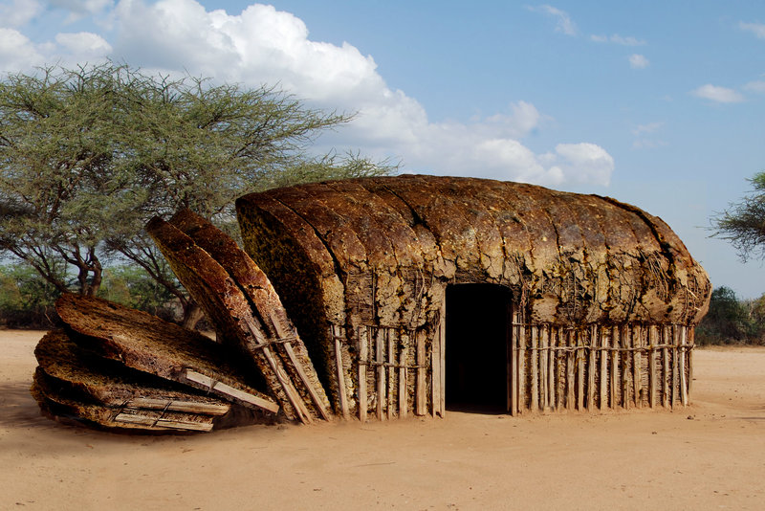

Slide 19
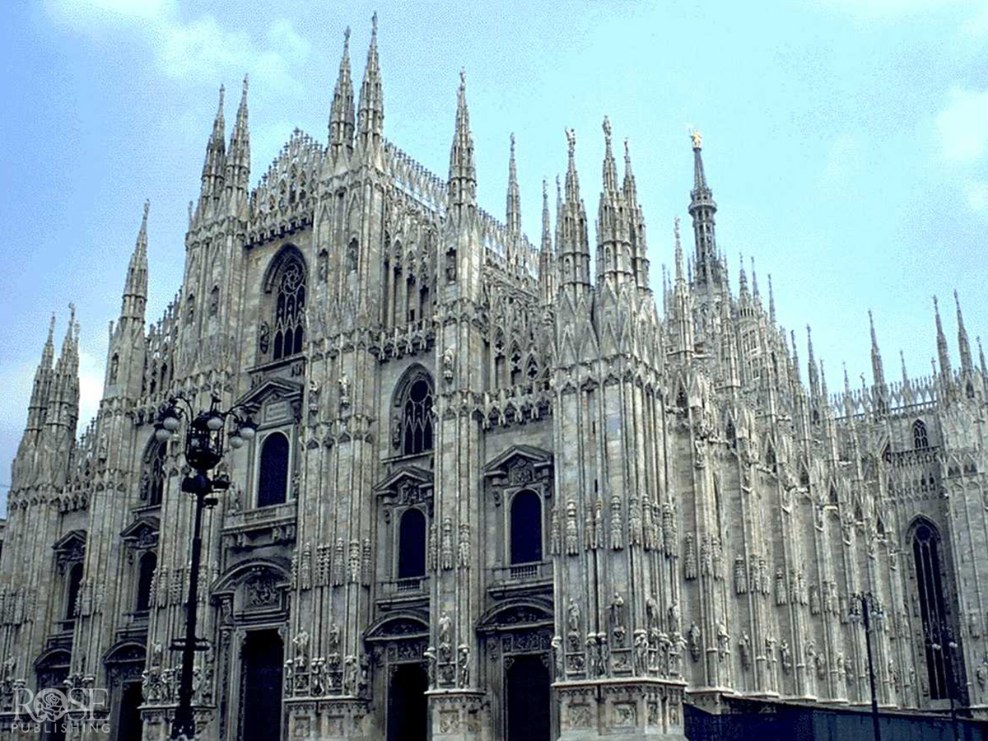

Slide 20
Built on the foundation of the apostles and prophets, with Christ Jesus himself as the chief cornerstone.
—Ephesians 2:20

Slide 22
Jesus is God with us.

Slide 23
Therefore the Lord himself will give you a sign: The virgin will be with child and will give birth to a son, and will call him Immanuel.
—Isaiah 7:14

Slide 25
In the beginning was the Word, and the Word was with God, and the Word was God.
—John 1:1

Slide 26
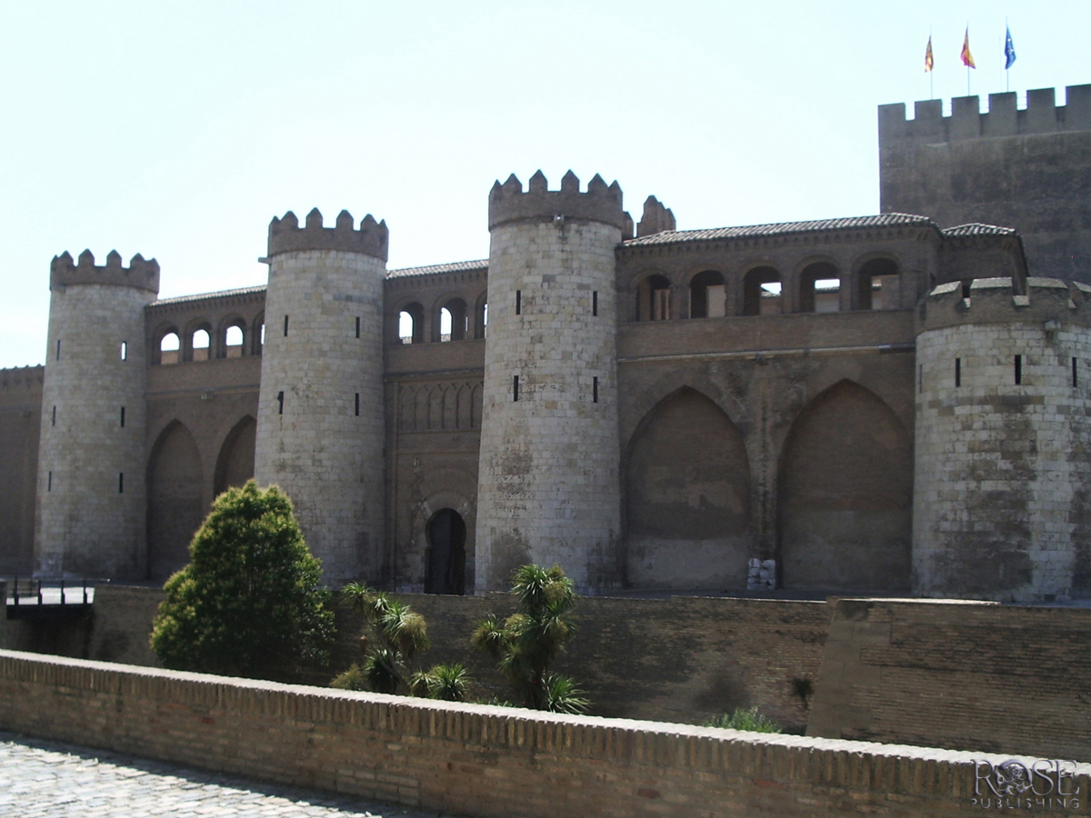

Slide 27
“They will make war against the Lamb, but the Lamb will overcome them because he is Lord of lords and King of kings and with him will be his called, chosen and faithful followers.”
—Revelation 17:14

Slide 28
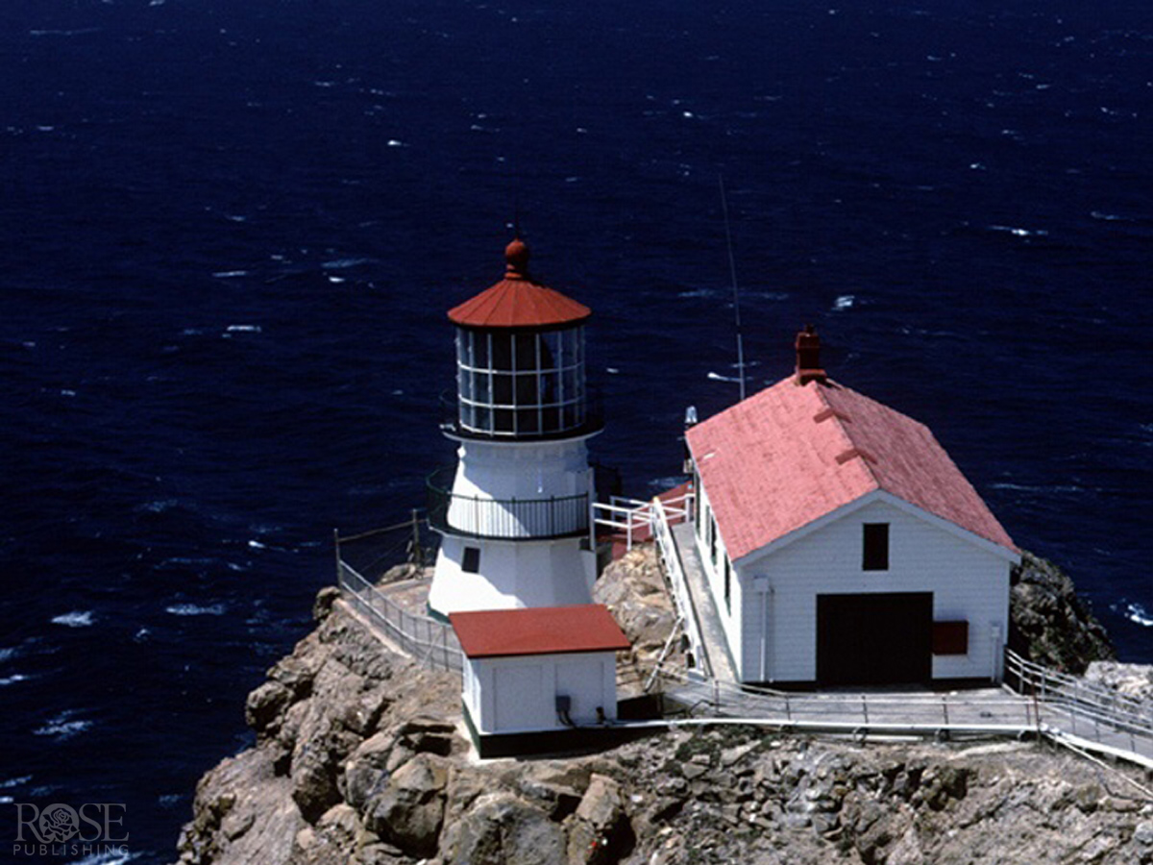

Slide 29
When Jesus spoke again to the people, he said, “I am the light of the world. Whoever follows me will never walk in darkness, but will have the light of life.”
—John 8:12

Slide 31
On his robe and on his thigh he has this name written: KING OF KINGS AND LORD OF LORDS.
—Revelation 19:16

Slide 32
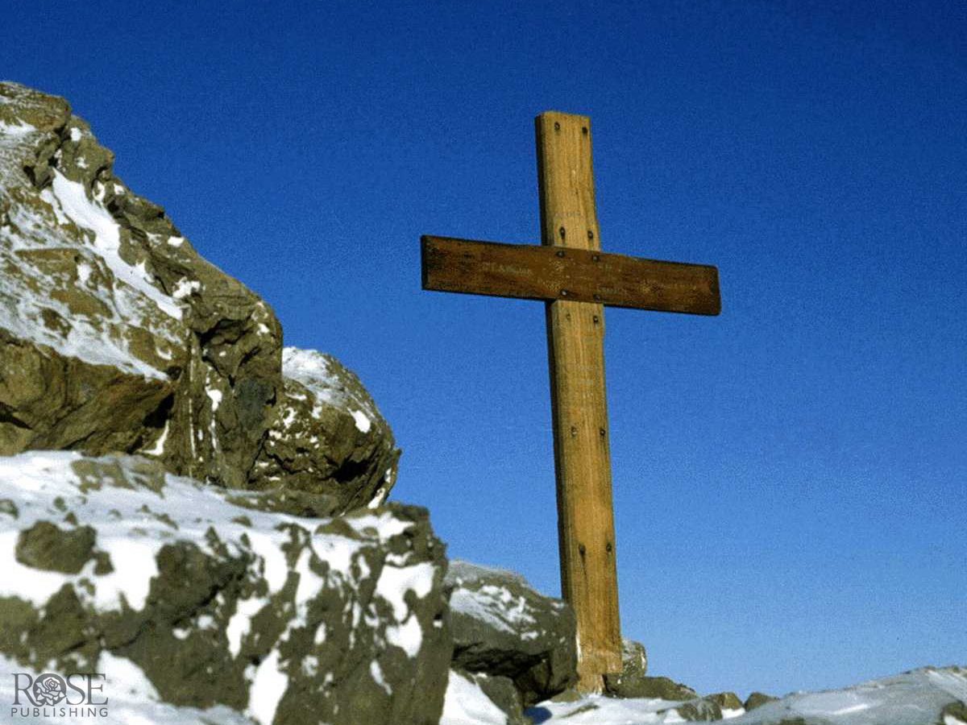

Slide 33
I know that my Redeemer lives, and that in the end he will stand upon the earth.
—Job 19:25

Slide 35
Jesus said to her, “I am the resurrection and the life. He who believes in me will live, even though he dies.”
—John 11:25

Slide 37
And we have seen and testify that the Father has sent his Son to be the Savior of the world.
—1 John 4:14

Slide 39
Jesus answered, “I am the way and the truth and the life. No one comes to the Father except through me.” —John 14:6

Slide 41
The Word became flesh and made his dwelling among us. We have seen his glory, the glory of the One and Only, who came from the Father, full of grace and truth. —John 1:14

Slide 43
A voice of one calling: “In the desert prepare the way for the LORD; make straight in the wilderness a highway for our God.” —Isaiah 40:3

Slide 44
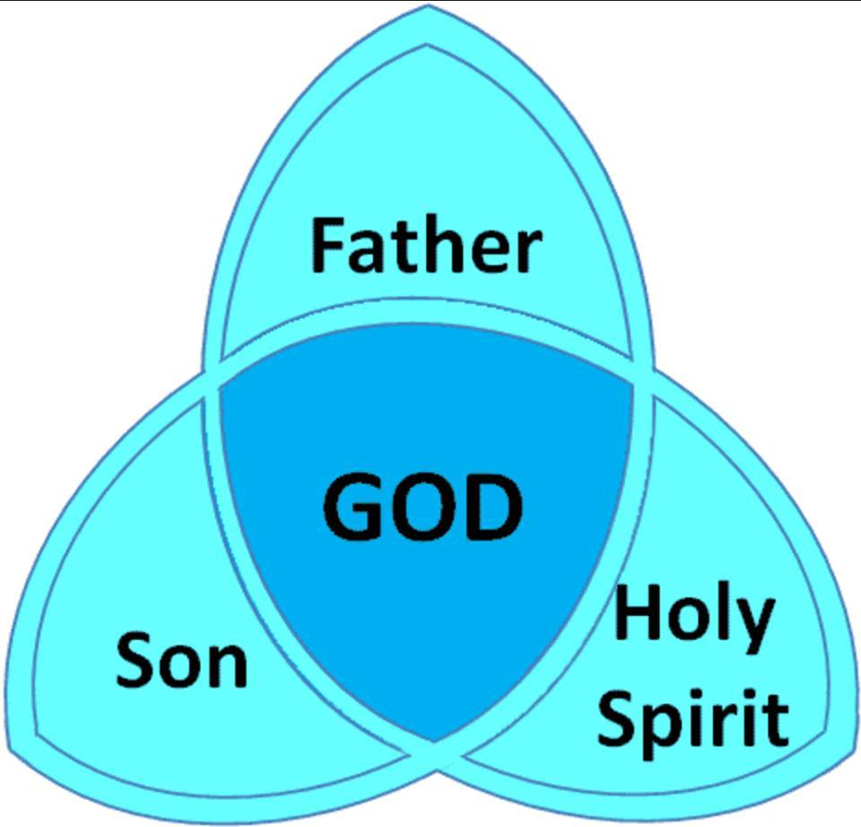

Slide 45
EARLY
JESUS
WARS

Slide 46
Pivotal to these ancient Jesus Wars were the four great questions that, to different degrees,
have shaped all subsequent
debates within Christianity.

Slide 47
Foremost is the deceptively simple question posed by Jesus himself: Who do you say that I am?

Slide 48
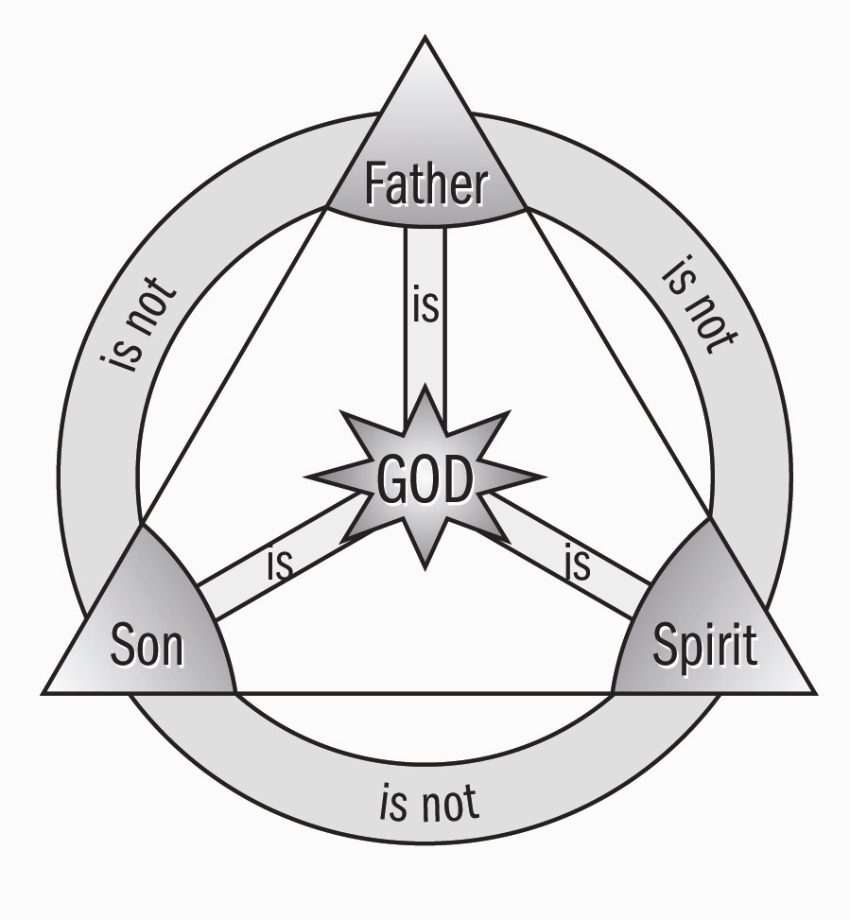
"My Echo, My Shadow, & Me" ?
The Theoanthropic Debate Begins

Slide 50
Greek philosophers used “Word” (Logos) as a name for the cosmic reason behind the universe. The Ephesian philosopher Heraclitus said the Word is a mysterious power that “always exists” & that makes “all things happen.”

Slide 52
CENTER CONCENTRATE

Slide 53
1st Corinthians 1: 23 - The Comic Greek Mind!

Slide 55
CERINTHIANISM
“The theory that the Christ-spirit inhabited the human Jesus between his baptism and crucifixion.”

Slide 56
ADOPTIONISM
“The theory that asserts that God adopted Jesus of Nazareth as his Son. In other words, Jesus was born human but became God’s Son at a particular point in his life.”
* Dictionary Of Theological Terms, Grenz & Guretzki

Slide 57
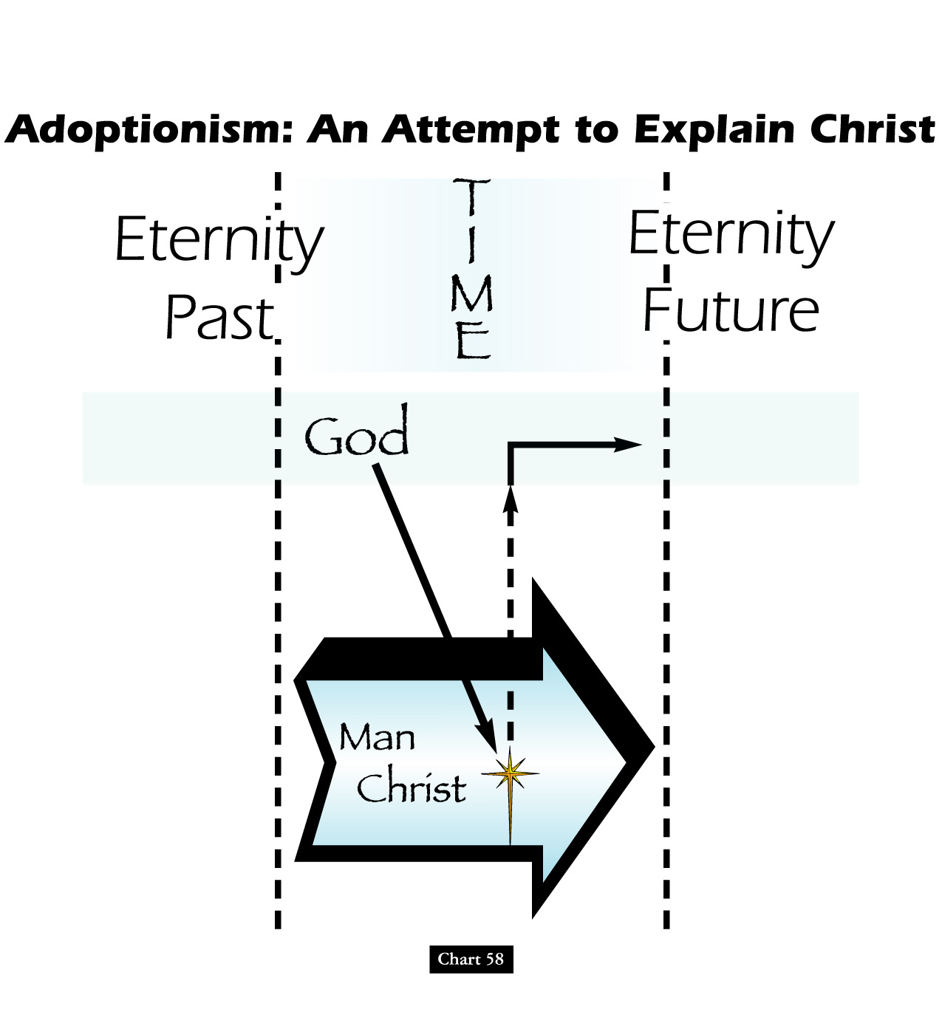
Ebionite Adoptionists

Slide 58
Two Gospel Books Of Ebionites:
THE GOSPEL OF THE EBIONITES
A gospel that appears to have been a conflation of several stories found in Matthew, Mark, & Luke renditions & was originally composed in Greek. Their version of this Gospel taught that Jesus was the Jewish Savior & Gentiles must conform to Judaism.

Slide 59
Judaism Of Limited Illumination!

Slide 60
Two Gospel Books Of Ebionites:
THEIR THEOLOGY TAUGHT:
A REPLACEMENT RESURRECTION TO THE TRIBAL TRADITIONAL TERRITORIES!

Slide 61
ENTRANCE SPIRITUAL ISRAEL

Slide 62
Two Gospel Books Of Ebionites:
THE GOSPEL OF THE NAZAREANS
A gospel used by the Ebionites that appears to have been very much like our Matthew, minus the first two chapters, written either in Hebrew or Aramaic.

Slide 64
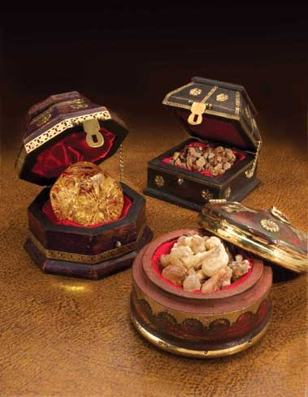
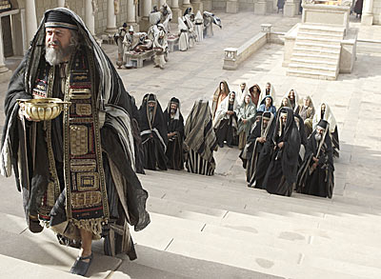
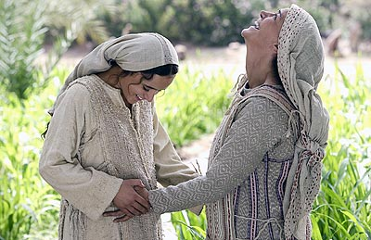
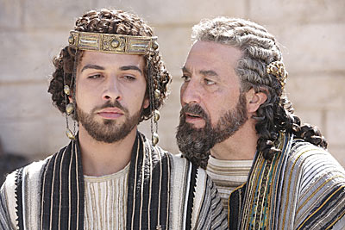
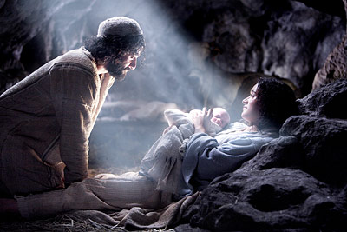
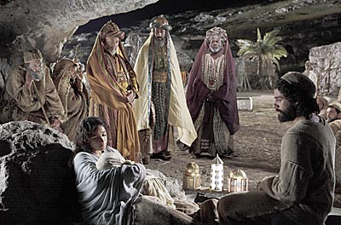
Gift For King
Gift For Priest
Gift For Prophet
Matthew 1 & 2

Slide 65
"My Echo, My Shadow, & Me" ?
Jesus: A Case of Homo Superioris
Words Of Jesus'
Natural Brother
Early Ebionism
Telekinesis
Levitation
Telepathy
Healing
The Theoanthropic Debate Begins

Slide 67
David Lee Burris:
“Docet” – from the Greek term “to seem” or “to appear”
"My Echo, My Shadow, & Me" ?
MARCIONITE
DOCETISM
The Theoanthropic Debate Begins

Slide 68
Marcion and Early Gnosticism
Marcion was the son of a pastor; he gained great success in the shipping business.
In the mid-second century, Marcion developed a theology that mingled a negative view of the physical world with a heretical understanding of the Christian tradition.

Slide 69
Marcion and Early Gnosticism
When he refused to repent, Marcion was excluded from fellowship in his father’s church.
He fled to Rome where he donated a substantial sum to the church.
In Rome, Marcion developed his theology into a full-fledged system that borrowed from Gnostic ways of thinking.

Slide 70
Marcion and Early Gnosticism
According to Marcion:
The God of the Old Testament and the Father of Jesus Christ were two different deities.
The physical world was evil; therefore, Jesus only seemed to have a physical body, and the Father of Jesus would not resurrect anyone’s physical body.
The Christian life should deny all physical pleasures, even sexual relations between spouses.

Slide 71
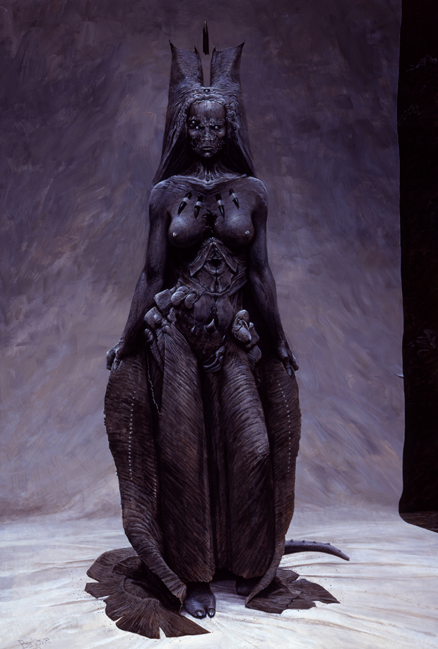
Marcion and Early Gnosticism
According to Marcion:
The Christian life should deny all physical pleasures, even sex between spouses.
[Woe]man & [Flee]male:
The Spiritual Succubus

Slide 73
Marcion and Early Gnosticism
The teachings of several apostolic texts contradicted Marcion’s teachings.
In response, Marcion created a canon—or “authoritative list”—of writings for his followers.
Marcion’s list included only 11 books: An edited version of Luke’s Gospel and ten of Paul’s letters.

Slide 75
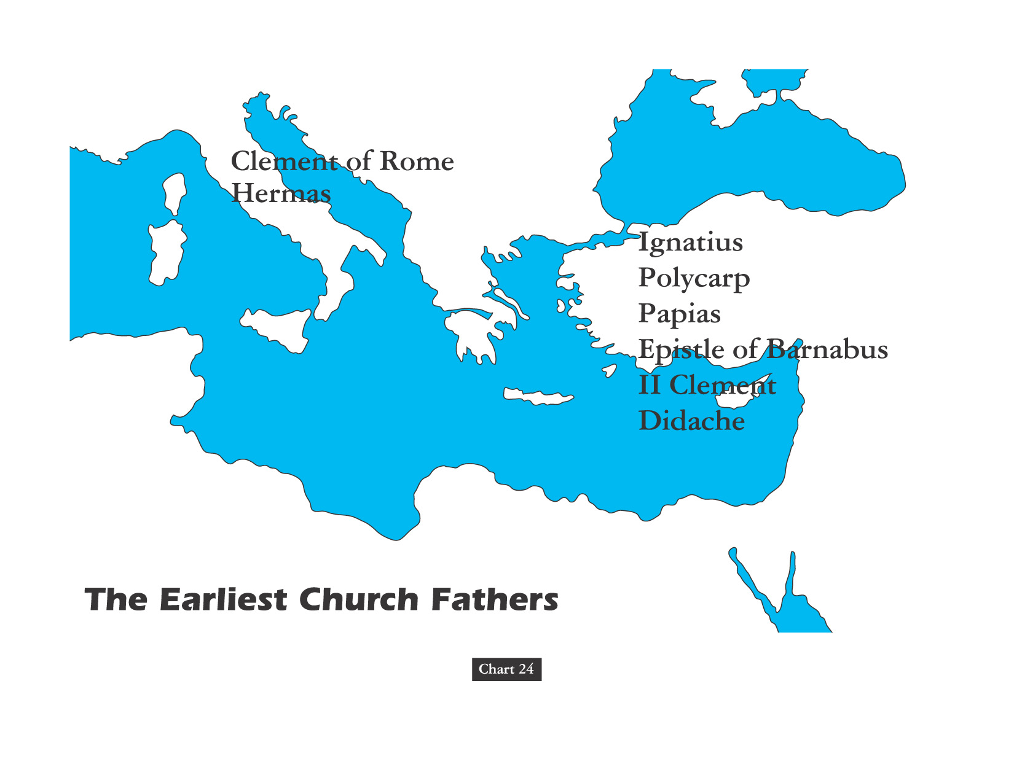
THE PATRISTIC ERA

Slide 76
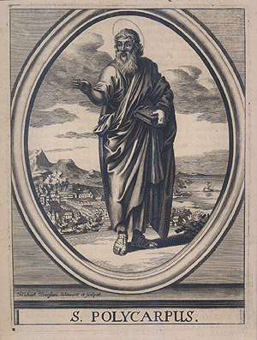
“Polycarp himself, when Marcion once met him and said, ‘Do you know us,?’ replied, ‘I know the first born of Satan.’” – Eusebius of Caesarea, Church History

Slide 77
The Church Across The Ages
David Lee Burris: Did Not Celebrate Christmas!
Early Christians celebrated the martyrdom dates annually of Polycarp & others!
of people, events
life and faith from
Glimpses
Polycarp's Powerful Witness!
“Polycarp was a personal disciple of the Apostle John. As an old man, he was the bishop of the Church at Smyrna in Asia Minor (present–day Turkey). Persecution against the Christians broke out there and believers were being fed to the wild beasts in the arena. The crowd began to call for the Christians’ leader, Polycarp. So the authorities sent out a search party to bring him in. They tortured two slave boys to reveal where Polycarp was being hidden.
It was a Friday afternoon, Polycarp was resting upstairs in a country home. They came in like a posse, fully armed as if they were arresting a dangerous criminal. Polycarp’s friends wanted to sneak him out, but he refused, saying, ‘God’s will be done.’”

Slide 78
The Church Across The Ages
David Lee Burris:
Early Christians celebrated the martyrdom dates annually of Polycarp & others!
of people, events
life and faith from
Glimpses
Polycarp's Powerful Witness!
“In one of the most touching instances of Christian grace imaginable, Polycarp welcomed his captors as if they were friends, talked with them and ordered that food and drink be served to them. Then Polycarp made one request: one hour to pray before they took him away. The officers over- -hearing his prayers (that went on for two hours) began to have second thoughts. What were they doing arresting an old man like this?
Despite the cries of the crowd, the Roman authorities saw the senselessness of making this aged man a martyr. So when Polycarp was brought into the arena, the pro-consul pled with him: ‘Curse Christ and I will release you.’”

Slide 79
The Church Across The Ages
David Lee Burris:
Early Christians celebrated the martyrdom dates annually of Polycarp & others!
of people, events
life and faith from
Glimpses
Polycarp's Powerful Witness!
“Despite the cries of the crowd, the Roman authorities saw the senselessness of making this aged man a martyr. So when Polycarp was brought into the arena, the pro-consul pled with him: ‘Curse Christ and I will release you.’
Reply: Eighty-six years I have served Him. He never done me wrong! How then can I blaspheme my King who has saved me?”

Slide 80
The Church Across The Ages
David Lee Burris:
Early Christians celebrated the martyrdom dates annually of Polycarp & others!
of people, events
life and faith from
Glimpses
“The proconsul reached for an acceptable way out: ‘Then do this, old man. Just swear by the genius of the emperor & that will be sufficient.’ (The ‘genius’ was the ‘spirit’ of the emperor. To do this would be recognition of the pagan religion.)
Reply: ‘If you imagine for a moment that I would do that, then I think you pretend that you don’t know who I am. Hear it plainly. I am a Christian!’
The Proconsul Threatened Him With Wild Beasts
Reply: ‘Bring them forth… I would change my mind if it meant going from the worse to the better, but not to change from the right to the wrong.’”

Slide 81
The Church Across The Ages
David Lee Burris:
Early Christians celebrated the martyrdom dates annually of Polycarp & others!
of people, events
life and faith from
Glimpses
“The proconsul’s patience was gone:
‘I Will Have You Burned Alive!’
Reply: ‘You threaten fire that burns for an hour and is over. But the judgment on the ungodly is forever!’
The fire was prepared. Polycarp lifted his eyes to heaven & prayed: ‘Father, I bless you that you have deemed me worthy of this day and hour, that I might take a portion of the martyrs in the cup of Christ… Among these may I today be welcome before thy face as a rich and acceptable sacrifice.’”

Slide 82
The Church Across The Ages
David Lee Burris:
Early Christians celebrated the martyrdom dates annually of Polycarp & others!
of people, events
life and faith from
Glimpses
Polycarp's Powerful Witness!
“As the fire engulfed him, the believers noted that it smelled not so much like flesh burning as a loaf baking. He was finished off with the stab of a dagger. His followers gathered his remains like precious jewels & buried them on Feb 22, a day set aside to be remembered.”

Slide 83
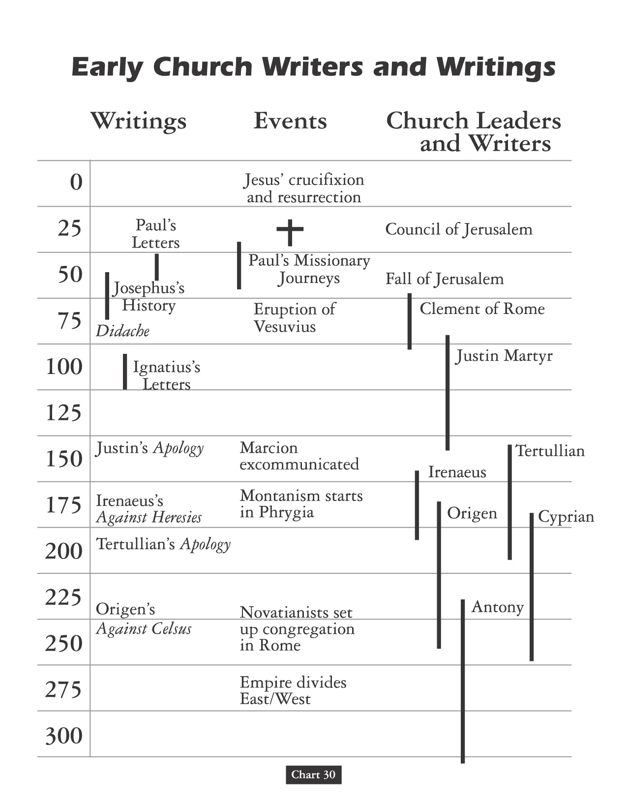

Slide 85
David Lee Burris:
Charismatic group that relied heavily on the visions of the man Montanus and two female associates.
MONTANISM
“Second century prophetic movement that emphasized the imminent return of Christ and imposed a strict morality on the faithful as they waited and prepared for the end of the world. Although its leaders did not intend their prophecies to undermine spiritual authority, the movement was nonetheless considered heretical. The church father Tertullian eventually joined the Montanists.”
* Dictionary Of Theological Terms, Grenz & Guretzki

Slide 86
The Church Across The Ages
of people, events
life and faith from
Glimpses
Tertullian: Colorful & Controversial
Tertullian boldly taunted the might of the Roman empire, courage- -ously defended oppressed believers & harshly reprimanded those Christians compromising. He was also the pacesetter as the church expanded its teaching and influence into the Latin speaking world, breaking new and fertile ground in theological understanding. For example, he coined the word Trinity, a word that does not appear anywhere in the Bible, to help us to understand the New Testament teaching about what God is like.
“Quintus Septimius Florens Tertullianus was born about 150 A.D. in Carthage, North Africa, the city considered second in importance only to Rome in his time. His father was the captain of a Roman legion and provided Tertullian with the education and training to become a lawyer. When he was about 40, Tertullian was converted to Christianity. He exuberantly embraced the gospel and ably used his legal skills to defend Christianity from pagan attackers.”

Slide 87
The Church Across The Ages
of people, events
life and faith from
Glimpses
Tertullian: Colorful & Controversial
“Thirty-one of Tertullian’s writings remain, touching on all areas of human life. His works include apologetic treatises, controversial attacks on heresies, and moral writings. His Apology defending the Christian faith contains one of the earliest and most eloquent pleas for religious liberty. He argued that the church was self-supporting & provided the most peaceful citizens to the state. The government should be protecting such citizens, not persecuting them. Tertullian also saw, however, that the persecution of the church by the Roman authorities actually strengthened the Church of Christ: ‘It is bait that wins men for (our) school. Then oftener we are mown down by you, the more in number we grow: the blood of Christians is seed [of the church].’”

Slide 88
The Church Across The Ages
of people, events
life and faith from
Glimpses
Tertullian: Colorful & Controversial
“Tertullian believed the Christian’s conscience should be sensitive to the idolatry associated with the gladiatorial shows, violent games, plays, literature, administration, and even business guilds. ‘Our Lord Christ has surnamed Himself Truth, not Custom.’ The spirit of Christianity, wrote Tertullian, is of meekness, peace, and purity, while the public shows and sporting events only excite the wild and furious passions of anger and lust. Licentious speech is condemned by God, and what a man should not say he should not hear.
Tertullian disagreed with Justin Martyr concerning the compatibility of Christian theology and pagan philosophy. He said many times – ‘What has Athens to do with Jerusalem?’ Specifically, he disputed Socrates’ contribution – ‘Socrates was actuated by a different spirit.’”

Slide 90
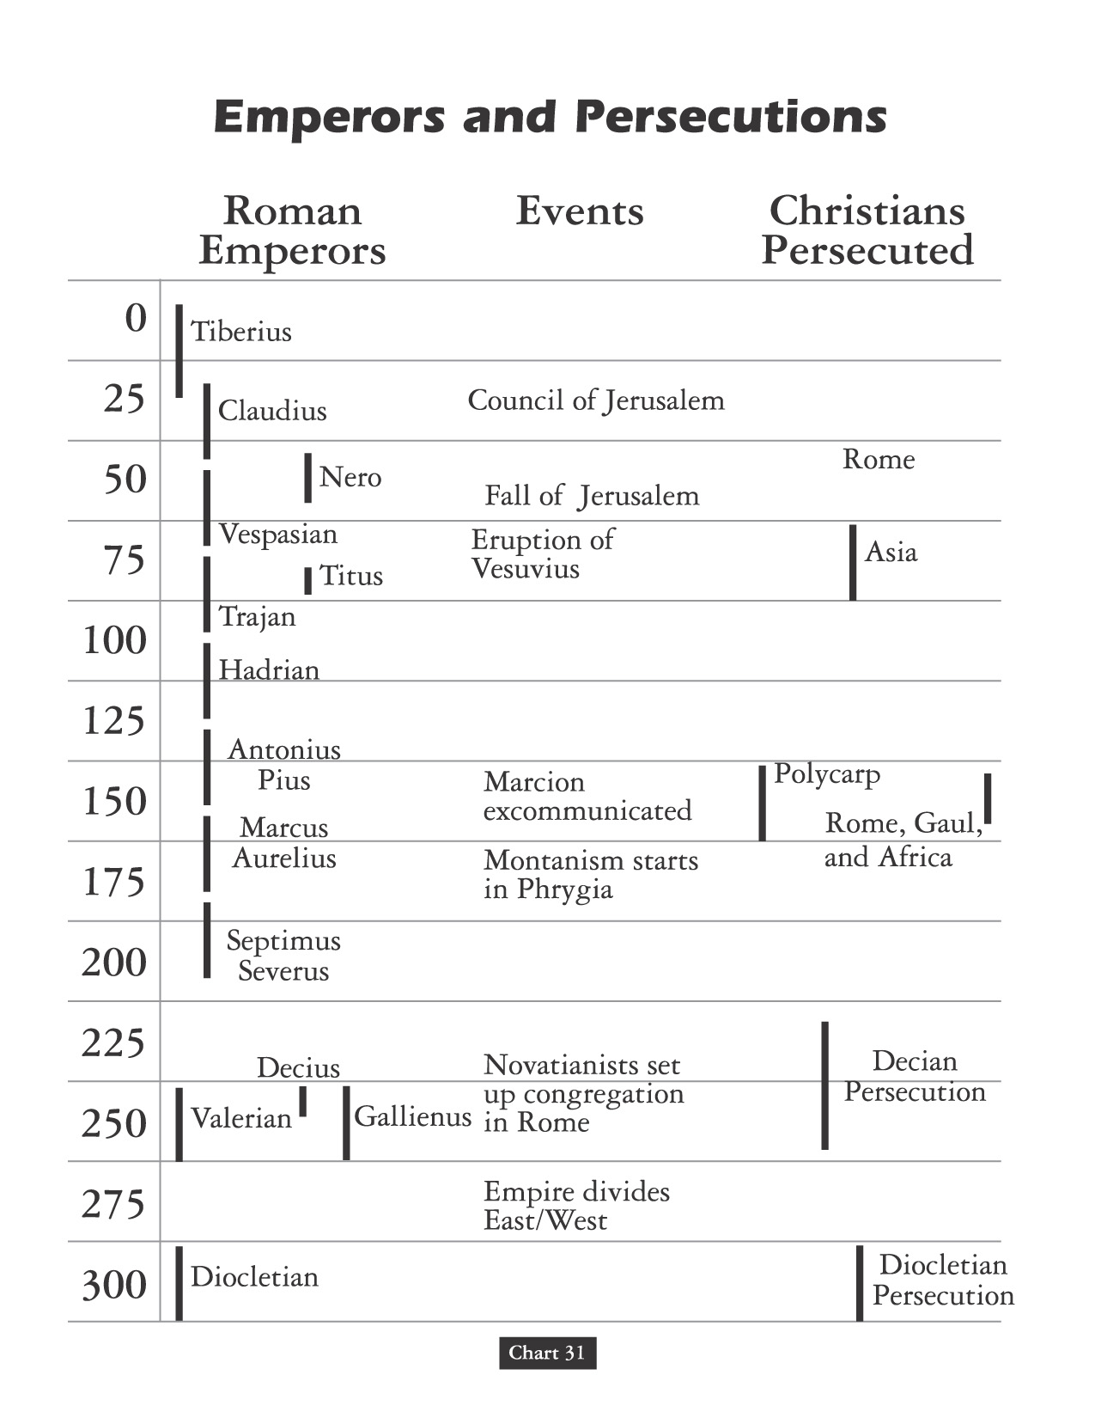

Slide 91
TRINITY SEQUENTIAL SEPARATED & EXPLAINED IN TERMS OF PROCESS

Slide 92
The Church Across The Ages
of people, events
life and faith from
Glimpses
The Sharpening Stone Of Origen
Have you ever met someone who loved Christ so much that as a teenager he was ready to voluntarily die for the faith? Or so brilliant that he kept seven secretaries busy recording the torrent of wisdom that gushed from his hyperactive mind? Or one so eager to walk close to the Lord that every Wednesday and Friday he fasted? Origen was a man of rare brilliance and was probably the most prolific author of the ancient world, writing literally thousands of works.

Slide 93
The Church Across The Ages
of people, events
life and faith from
Glimpses
The Sharpening Stone Of Origen
“Born in Alexandria, Egypt about 185, Origen was raised in a Christian home. His father, Leonides, was a teacher who recognized his son’s brilliance & provided him with the best Greek education possible. Moreover, he also had Origen memorize Scripture every day; even as a little boy Origen knew whole sections of the Bible from memory. When Leonides was imprisoned for his faith about 202, under the reign of Septimius Severus, Origen wrote his dad a letter of encouragement not to deny Christ. Origen was eager to join his father in prison & death if necessary; he was prevented from this only by his mother hiding his clothes when he wanted to give himself up to the heathen authorities. Leonides was martyred; his property was confiscated; & his wife left helpless with seven children.”

Slide 94
The Church Across The Ages
of people, events
life and faith from
Glimpses
The Sharpening Stone Of Origen
“A wealthy matron assisted Origen, and he then began giving instruction in the Greek language and copying manuscripts. When he was 18, in 203, bishop Demetrius of Alexandria nominated Origen to become president of the catechetical school in Alexandria. There Origen was the one responsible for the instruction of all new converts to the faith. As Origen instructed new converts, he learned he had to counter arguments of heretics within the faith as well as Jews and pagans that were without. He studied with the leading neo-platonist philosopher of his day to better refute pagan arguments against the Christian faith.”

Slide 95
The Church Across The Ages
of people, events
life and faith from
Glimpses
The Sharpening Stone Of Origen
“Origen led a very disciplined life and devoted himself solely to the service of the gospel. By strictly following Jesus’ admonition in Matthew 10: 10, he had only one coat, no shoes, and took no thought for the next day. He refused any gifts or pay from his students, ate no meat, drank no wine, and slept on the bare floor. His nights were mostly spent in prayer & study. It was to literally follow Matthew 19: 12 that Origen had himself castrated, thereby removing any hint of sandal as he taught young women in the catechetical school (an act he later came to see as ill-advised).”

Slide 96
The Church Across The Ages
of people, events
life and faith from
Glimpses
The Sharpening Stone Of Origen
“During his early years at Alexandria , Origen wrote on First Principles, the first systematic theology ever written. For twenty-eight years he worked on his Hexapla, which was a massive work of Old Testament textual analysis. Origin was one of the few churchmen before the Reform movement who learned Hebrew to better study the Old Testament. His Hexapla was written as a parallel edition of the Old Testament Hebrew text with a transliteration and four different translations into Greek. This method of interpreting Scripture greatly influenced the Middle Ages. He interpreted Scripture with three levels of meaning: the literal, the moral, and the allegorical. Origen especially used his allegorical interpretations of Scripture to reveal Christ in the Old Testament.”

Slide 97
The Church Across The Ages
of people, events
life and faith from
Glimpses
The Sharpening Stone Of Origen
Origen paradoxically has been called the father of orthodoxy & the father of heresy. He labored at a time when the church was still seeking to interpret and define its basic doctrines. Origen made foundational contributions that would help theologians for centuries. His ceaselessly fertile and active mind also led him into uncharted areas and some speculations that the wisdom of the collective Church had to reject. Bishop Demetrius of Alexandria charged Origen with foreign speculations. Two church councils held in 231 and 232 enacted motions against Origen, and he was excommunicated. Instead, Origen found refuge and acceptance with churches in Palestine and Arabia until his pupil Dionysius became bishop of Alexandria. During the Decian persecution, he was cast into prison, tortured, and condemned to the stake. He died instead from wounds suffered at the hands of his torturers at the age of 69 in the year 254.

Slide 98
“But God, who is the beginning of all things, is not to be regarded as a composite being, lest perchance there should be found to exist elements prior to the beginning itself, out of which everything is composed, whatever that be which is called composite.” Origen

Slide 99
Three Trends of Early Errors
Apostle Paul’s Convert Clement Is Received As If He Were An Apostle
Alexandria School Through Origen Defines Trinity Concept Sequential
Asia Minor School Thru Its Irenaeus Explains Mary By Contrasting To Eve
Organization Pattern
Doctrinal Pattern
Worshiping Pattern

Slide 100
SUBORDINATIONISM
“A second and third century heresy that held that because the Son and the Spirit proceed from the Father, they are not equal to the Father and are thus not fully divine.”
* Dictionary Of Theological Terms, Grenz & Guretzki

Slide 101
PROCESSION
“A term in Christian trinitarian thought that designates the way the Son and Spirit originate from the Father. The Son’s procession from Father is called generation, or filiation, whereas procession of the Spirit from Father is called spiration.”
* Dictionary Of Theological Terms, Grenz & Guretzki

Slide 102
From Origen A False Controversy
Origen believed that God the Father, the Christ logos, and the Holy Spirit represent three aspects of the godhead. He thought of them as having a hierarchical relationship; that is, the Father generates the Son, who generates the Holy Spirit. The image he liked to use was an eternal torch, one lighting the other. That effort [in the book Timaeus] was to reconcile Christian thought with the three realities of Plato.
Churches in western Europe had added the word filioque (“and the Son”) to the Nicene Creed in the AD 500s

Slide 103
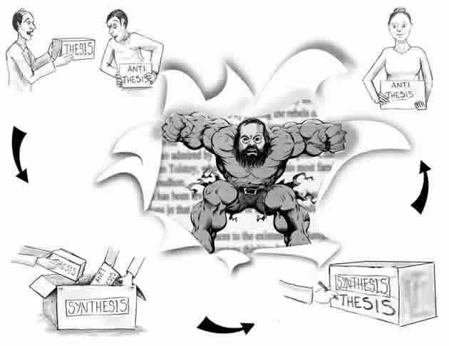

Slide 104
The Filioque Controversy
Churches in western Europe had added the word filioque (“and the Son”) to the Nicene Creed in the AD 500s.
Eastern Christians recited, “The Holy Spirit … proceeds from the Father.”
Western Christians recited, “The Holy Spirit … proceeds from the Father and the Son.”

Slide 105
From The Modern Scholar Course Guide: “One, Holy, Catholic, & Apostolic”
THE PHOTIAN SCHISM
“Pope Nicholas ridiculed the concept of a Roman emperor who could not even speak Latin and reminded him that the authority of the see of St. Peter existed before Constantinople was founded and would continue long after the emperors were gone. In 867, Constantinople’s Patriarch Photius excommunicated the pope on the basis of insertion of the Filioque Clause in the creed, which asserted that the Holy Spirit proceed from both the Father and the Son. This argument, that the pope was himself a heretic, would be used with increased regularity in the East.”

Slide 106
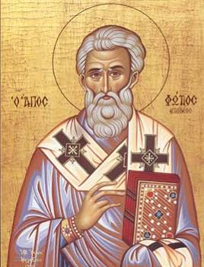
The Filioque Controversy
Photius, bishop of Constantinople, spoke out against the added phrase in 867.
Photius declared the phrase to be heretical and excommunicated Pope Nicholas, bishop of Rome.
Photius of Constantinople

Slide 107
The Filioque Controversy
Eastern Christians recited, “The Holy Spirit … proceeds from the Father.”
Western Christians recited, “The Holy Spirit … proceeds from the Father and the Son.”
THE ABSOLUTE TRUTH IS THAT BOTH CHURCHES WERE VERY WRONG.
NEITHER SON NOR SPIRIT WERE LIKE ANGELS OF SPECIAL CREATION, & NEITHER PROCEEDED FROM GOD.

Slide 108
EARLY ERROR BUILT ON THREE FALSE ASSUMPTIONS
#1 Assumption: Paul Convert Clement Received As Apostle
#2 Assumption: Origen Explains Trinity Concept Sequential
#3 Assumption: Irenaeus Portrays Jesus Mother @Anti-Eve

Slide 109
MONARCHIANISM
“A movement in the second & third centuries that attempted to safeguard monotheism and the unity of the Godhead. By denying the personal reality of the Son and the Spirit as separate from the Father, however, this defensive attempt resulted in an antitrinitarian heresy. Two forms of monarchianism developed – Dynamic Adoptionist & Sabellian Modalism.”
* Dictionary Of Theological Terms, Grenz & Guretzki

Slide 110
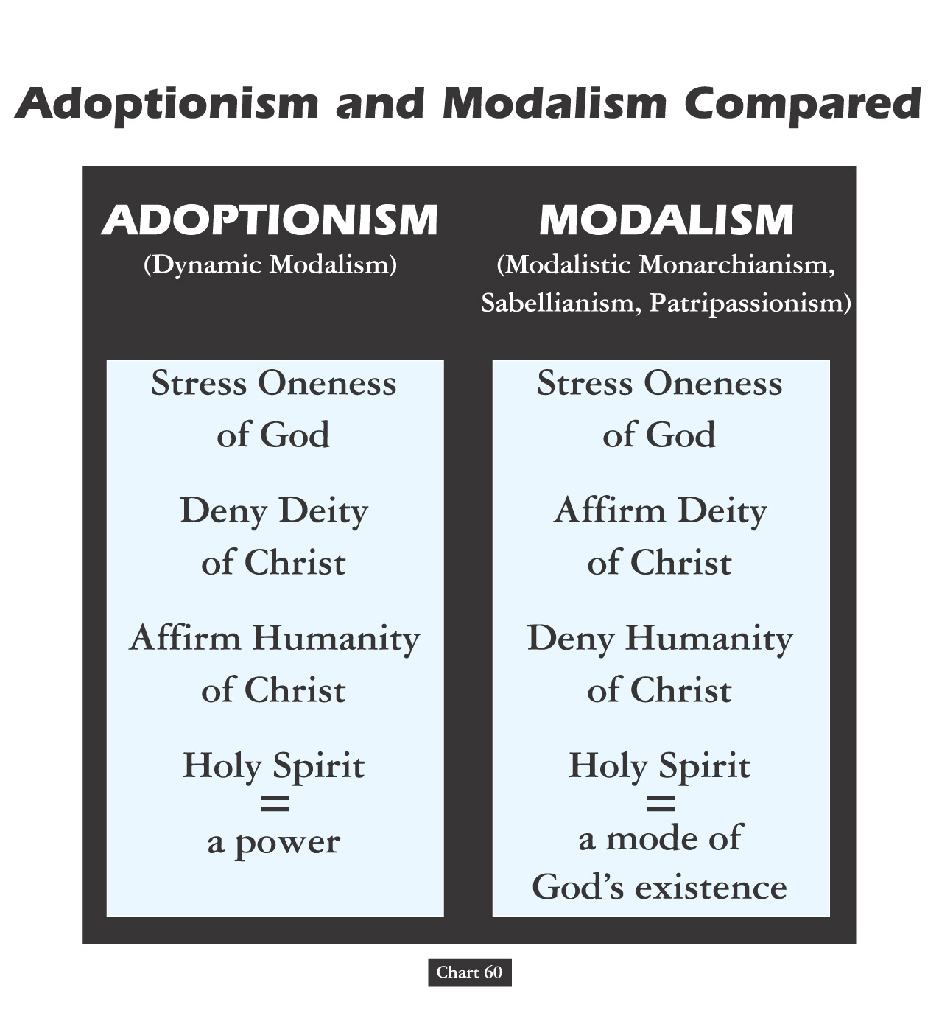

Slide 111
MODALISM
“Also called ‘Sabellianism,’ the trinitarian heresy that does not view as three ‘persons in relation’ but merely as three modes or manifestations of the one divine person of God. Thus God comes in salvation history as Father to create and give the law, as Son to redeem and as Spirit to impart grace.”
* Dictionary Of Theological Terms, Grenz & Guretzki

Slide 112
PATRIPASSIANISM

Slide 113
DITHEISM

Slide 114
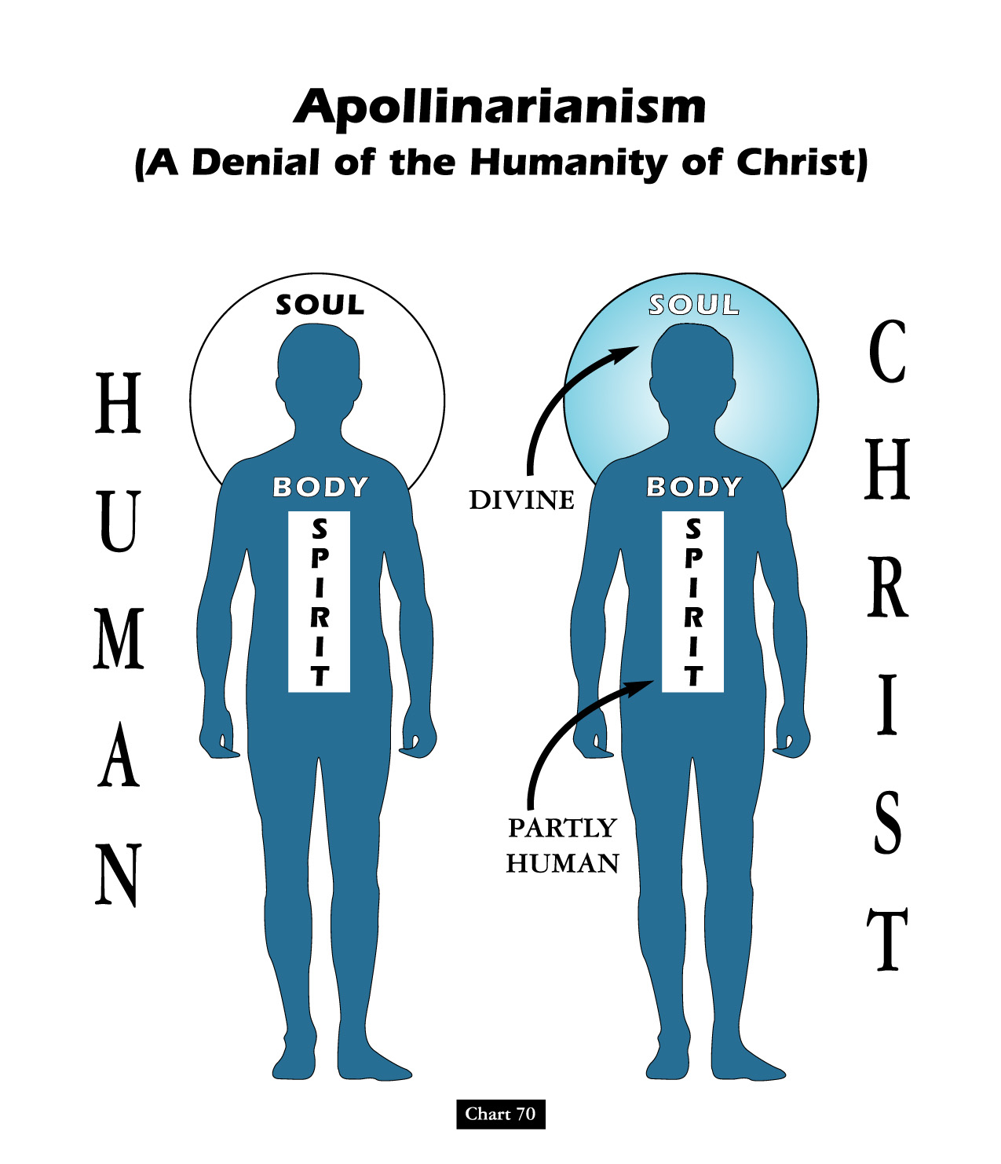
David Lee Burris:
Docetism – The teaching that Jesus was fully God but only appeared to be human.

Slide 115
CIRCUMINCESSION
“The theological concept, also referred to as perichoresis, affirming that the divine essence is shared by each of the three persons of the Trinity in a manner that avoids blurring the distinctions between them. Circumincession also affirms that the actions of one of the persons of the Trinity is also fully the action of the other two.”
* Dictionary Of Theological Terms, Grenz & Guretzki

Slide 117
David Lee Burris:
Constantinople II – Excommunicated Wig-Wearing Christians!

Slide 118
“Philip opened his mouth, and beginning at this Scripture, preached Jesus to him.”

Slide 119
THIS MESSAGE WAS OVER TIME MISUNDERSTOOD & CONVEYED INCORRECT IN COPTIC CHURCHES!
David Lee Burris:
Gnostic Gospels Became Labeled “Coptic”
Three Great Monotheistic Religions Abraham’s Legacy!

Slide 120
"My Echo, My Shadow, & Me" ?
A R I A N I S M
The Theoanthropic Debate Begins

Slide 121
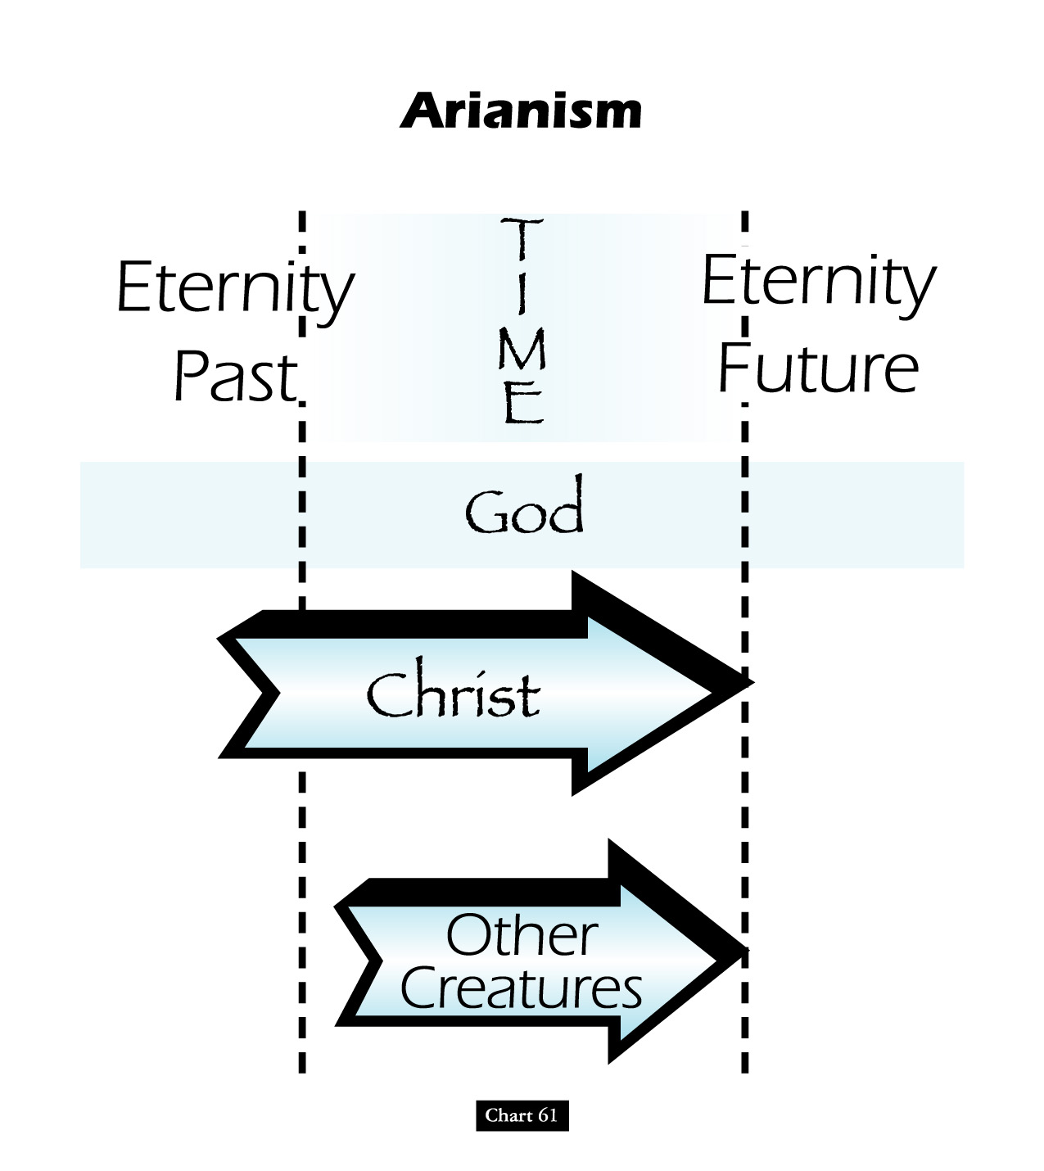

Slide 122
Battle Over An “i”: Homoousios or Homoiousios?
David Lee Burris:
Begins Innocent Enough But Ends Questioning Bible’s Inclusion Of Birth Narrative
Father God & God’s Son “Identical or Similar”? Gregory of Nyssa said of Constantinople in 378: “In this city if you ask anyone for change, he will discuss with you whether the Son is begotten …
AriansWatchword: “dissimilar” (anomoios)
Semi-Arians Watchword: “similar” (homoios)
Nicaeans Watchword: “of identical substance” (homoousios)
Cappadocians Watchword: “of like substance” (homoiousios)

Slide 123
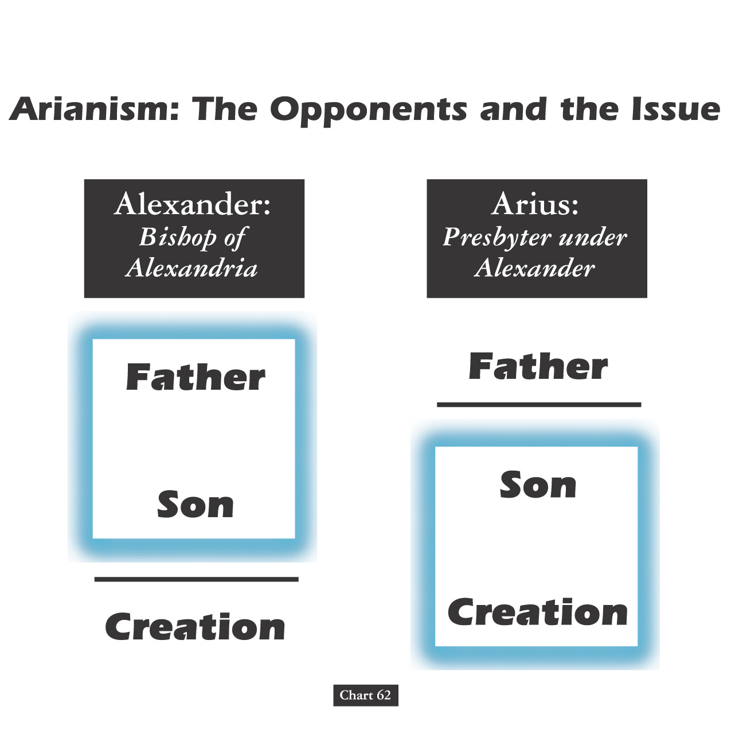

Slide 124
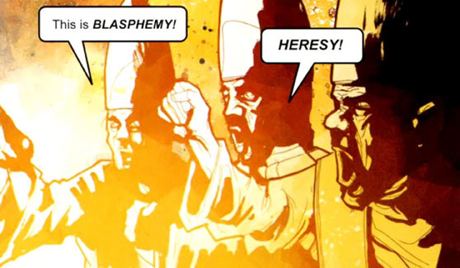

Slide 126
Arian Or Nicaean “Or Else”: The Debate “Unto Death”
David Lee Burris:
Shakespeare – “We Few, We Happy Few, We Band Of Brothers; For Whoever Has Shed His Blood With Me Shall Be My Brother” [Henry V]; It Is About Christ’s Blood Not Ours
Foxes Book Of Martyrs Notes From 363 a.d.:
“In Alexandria, innumerable were the martyrs who suffered by the sword, burning, crucifixion, and stoning. In Arethusa, several were ripped open & corn being put in their bellies, swine were brought to feed therein, which in devouring the grain, likewise devoured the entrails of the martyrs…”

Slide 127
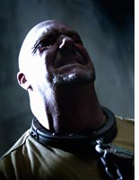
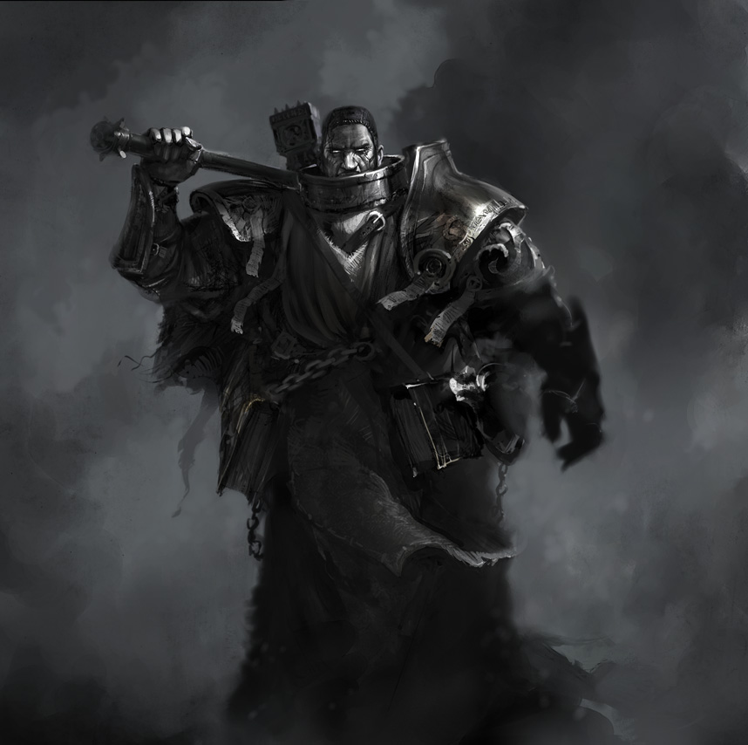

Slide 129
The Council of Nicaea—AD 325
In the early 4th century, Arius of Alexandria began to teach that Jesus was not eternal God.
The followers of Arius sang in the streets, “There was a time when the Son did not exist!”

Slide 130
The Council of Nicaea—AD 325
Those who rejected Arius responded with the Gloria Patri: “Glory be to the Father and to the Son and to the Holy Ghost; as it was in the beginning, is now and ever shall be, world without end.”
To maintain peace, Constantine convened a council in the village of Nicaea, in northern Asia Minor.
More than 300 bishops made their way to Nicaea; many elders and deacons—including Athanasius of Alexandria—were also present.

Slide 131
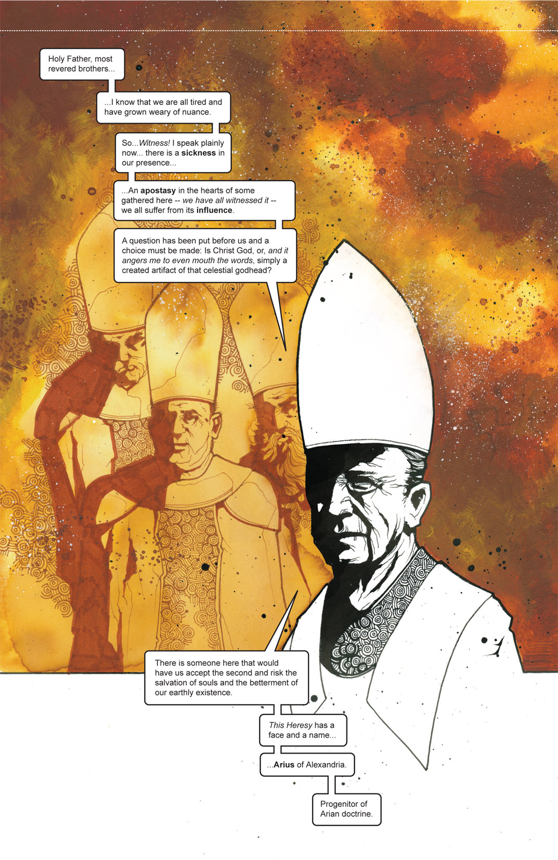

Slide 132
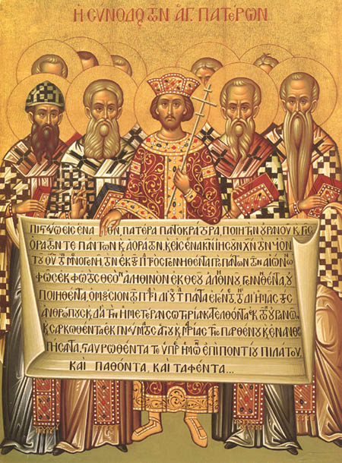
The Council of Nicaea—AD 325
On July 4, 325, Constantine called the council to order and declared himself a bishop and an apostle.
When Arius stated that Jesus had not existed eternally, all but two bishops agreed that this contradicted Scripture.
The Nicaea Council Creed responded to Arius’ heresy.
Emperor Constantine and the First Council of Nicaea

Slide 133
History of the Nicene Creed
In 325A.D. Emperor Constantine the Great called together a Council at a city called Nicaea (present-day northwest Turkey ). The task assigned to this council was to address a controversy brought up by a man named Arius who said that Jesus Christ was only a man, not true God.
The words of the Nicene Creed, therefore, highlight the fact that Jesus Christ is true God. This Creed describes Jesus as “God from God, Light from light; true God from true God… of one being with the Father.” It focuses on who Jesus is: he is not a separate entity from God or an addition to God. He is the true God.
Since this Creed highlights who Jesus is, we speak the Creed on Communion Sundays when we partake of the true body and blood of Christ in, with, and under the bread and wine. Both in the Supper and in the Nicene Creed we confess that Jesus Christ is “God in flesh.”

Slide 134
NICENE CREED 325 A.D.
I believe in one God, the Father Almighty, Maker of heaven and earth, and of all things visible and invisible.
And in one Lord Jesus Christ, the only-begotten Son of God, begotten of the Father before all worlds; God of God, Light of Light, very God of very God; begotten, not made, being of one substance with the Father, by whom all things were made.
Who, for us men for our salvation, came down from heaven, and was incarnate by the Holy Spirit of the virgin Mary, and was made man; and was crucified also for us under Pontius Pilate; He suffered and was buried; and the third day He rose again, according to the Scriptures; and ascended into heaven, and sits on the right hand of the Father; and He shall come again, with glory, to judge the quick and the dead; whose kingdom shall have no end.
And I believe in the Holy Ghost, the Lord and Giver of Life; who proceeds from the Father and the Son; who with the Father and the Son together is worshipped and glorified; who spoke by the prophets. And I believe one holy catholic and apostolic Church. I acknowledge one baptism for the remission of sins; and I look for the resurrection of the dead, and the life of the world to come. Amen. (from Creeds of the Church)

Slide 135
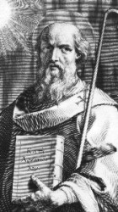
ARIUS VERSUS ATHANASIUS

Slide 137
Touchstone Magazine: A Journal Of Mere Christianity Athanasius Contra Mundum Or “Athanasius Against The World”
“For most of his almost 50 years as bishop of Alexandria, he truly was arrayed against the full breadth of the Roman Empire, defiantly defending the Nicene doctrine of the Trinity against pagans and Arian heretics. Arius, an often admirable church leader, denied that Christ was eternally co-existent with the Father. For him, Christ was a creature, not the Creator. As the Arian slogan went, ‘There was a time when he was not.’ Athanasius, a young priest and protégé of the orthodox Bishop Alexander of Alexandria, stubbornly resisted Arius’ theological innovations. Of course, Athanasius, who would soon succeed his mentor to the bishopric, prevailed at the Nicaea Council in 325. It was a crushing victory, the bishops closing their creed with the declaration that ‘those who say, there was when he was not, and, before being born was not - the Catholic Church anathematizes.’”

Slide 138
Athanasius was driven in his rebuttal of Arianism by its practical implication. In other words, in this finely nuanced theological debate he was concerned about the implications of this heresy on salvation. Two of Athanasius’ writings reflect his practical and pastoral concerns. On the Incarnation outlines the fact that in the incarnation, God the Word, Jesus Christ, became human to renew what was human, to sanctify what had become corrupt in Adam.
In Against the Arians, he asserts that God alone initiates & accomplishes salvation, and he argues that it was necessary for our Savior to be both fully human (to renew humanity) and fully divine (to accomplish reconciliation).

Slide 139
Touchstone Magazine: A Journal Of Mere Christianity Athanasius Contra Mundum Or “Athanasius Against The World”
“No less vexing were most of the empire’s bishops, almost none of whom, at least outside Athanasius’ own native Egypt, were willing to share in the persecutions the orthodox endured. Bishops in both East & West joined in synods and councils that denounced the arch- -bishop of Egypt, hurled accusations against his theology and his character, and attempted to replace him, imprison him, and even kill him. They often had at their disposal the armies of the emperor, which occupied Egypt’s cathedrals and churches but never managed to apprehend the elusive bishop, who found refuge in the desert, in the monasteries, or in the homes of faithful supporters during his nearly twenty years of intermittent exile. Whether from his bishop’s throne or from an obscure hiding place, he never compromised on the essentials or fell silent, his writings penetrating the far reaches of the empire even when the bishop himself was elusive. Although Arianism would endure beyond the life of Athanasius, its ultimate defeat within Christendom was achieved only because of his witness and exertions.”

Slide 140
351 a.d.
A council of church bishops
Gathered in sirmium of serbia
rejecting the nicaea decision

Slide 141
VALENTINUS

Slide 142
“Even his detractors had a hard time criticizing Valentinus’s intellect. Following in the footsteps of his older contemporary, Basilides, Valentinus pursed the goal of creating a truly Hellenistic form of Christianity, reimagined through the lens of Plato’s philosophy.
What made Valentinian gnosticism so powerful was its subtlety. Valentinus & his followers were able to remain within the larger Christian community long after other gnostic groups had either voluntarily split or been forced out. Valentinus taught from the same sacred texts as mainstream Christians and utilized many of the same worship practices; only in private gatherings were Valentinians instructed in the hidden or secret meanings to all of these practices.”

Slide 143
“Because of this circumspect behavior, Valentinus was able not only to remain in the larger Christian community, but to aspire to leadership. Apparently, when elections were held to determine the next bishop of Rome after the death of Hyginus around 143, Valentinus was nominated to take his place and reportedly lost by only a handful of votes. Later, it seems, he either broke with the Roman church or was expelled. There is evidence that he (both) left Rome & died around 160. With him, the golden age of Christian gnosticism came to a close.
While their teachings would continue to have influence for centuries to come, Christian gnostics were never again as creative or as productive as they were during the middle years of the second century.”

Slide 144
Touchstone Magazine: A Journal Of Mere Christianity Athanasius Contra Mundum Or “Athanasius Against The World”
David Lee Burris:
Arius wrote songs popularizing his ideas with the common people.
“But though he prevailed at the council, Athanasius still faced a half-century of theological combat, as the Arians attempted to gain by practice what they could not gain in a council. The zealous bishop of Alexandria nearly single-handedly championed theological orthodoxy when it seemed all Christendom was succumbing to Arius’ alternative brand of religion. Athanasius was expelled from his throne five times and spent 20 years as an exile or fugitive. Edward Gibbon chronicled how Athanasius contended with successive Roman emperors, who usually sided against the quarrelsome archbishop of Alexandria. The monarchs either supported Arianism or preferred political compromise over fidelity to the creed of Nicaea. The list of Roman princes against whom Athanasius contended ran from the great Constantine, through Constantine’s three ‘degenerate’ sons, to Julian the Apostate, who recognized that orthodoxy and not Arianism represented the chief threat to his pagan revival, to Jovian, whose benign and brief reign offered Athanasius a brief respite, and finally to the cruel Valentinian and his brother Valens, an Arian who finally yielded to the more forceful Athanasius.”

Slide 145
The Church Across The Ages
David Lee Burris:
Christian Emperor Theodosius invited the Thessalonians to free games but instead sent his troops into the circus with orders to kill the 10,000 men, women, and children.
of people, events
life and faith from
Glimpses
Ambrose: Servant Leader
Arianism was the teaching that Jesus was not fully God but was a creature of the Father. Justina, mother of the Roman Emperor Valentinian II was a strong Arian, and she sought to increase the Arian influence in the empire. She met her match in Ambrose, the bishop of Milan.
Ambrose was born in 329, a son of the Roman praetorian prefect of Gaul (which then included Britain, France, and parts of Africa). He received a good Roman education and at the age of 34 became the governor of North Italy. This was the period of the barbarian invasions of the empire & the emperor for a while moved his imperial seat to Milan to better resist the invaders. Ambrose’s position as the governor was an important one. Soon he was to receive an even more important posting.

Slide 146
The Church Across The Ages
of people, events
life and faith from
Glimpses
Ambrose: Servant Leader
“In 374, the Archbishop of Milan died. The people at that time elected the bishops, but there was a great division among them as to who the new bishop should be. The crowd became disorderly, and it appeared riots were about to break out. Governor Ambrose came to encourage the people to conduct themselves in an orderly and Christian manner. A little child cried out, ‘Let Ambrose be our bishop,’ and the crowd picked up the cry. Ambrose was chosen. Up to this point in his life, Ambrose was only a nominal Christian, but he was obviously changed after his election. In a little more than a week he was baptized, taken into Christian ministry, and made a bishop.”

Slide 147
The Church Across The Ages
of people, events
life and faith from
Glimpses
Ambrose: Servant Leader
“Once Ambrose took office, he parted with all of his fortune and distributed it to the poor. This was in keeping with the ideal of practical Christianity of that time – unbounded charity and personal poverty. Throughout his life, Ambrose was known for his charity, justice, and humanity. When a man left a large legacy to the church while leaving his sister poor and penniless, Ambrose gave the legacy to the poor woman. On several occasions he refused money which had been given to the church grudgingly or for the wrong reasons. Once he took the valuable communion vessels of the cathedral and converted them into money to redeem some Illyrian captives. When he was criticized for this he asked: Is it better to preserve our gold or the souls of men? Has the Church no higher mission to fulfill than to guard the ornaments made by men’s hands, while the faithful are suffering in exile? Ambrose knew the Church had a spiritual mission and it was not to be tied down by the things of this world. Such was the man the Roman Empress soon found herself up against.”

Slide 148
The Church Across The Ages
David Lee Burris:
Christian Emperor Theodosius invited the Thessalonians to free games but instead sent his troops into the circus with orders to kill the 10,000 men, women, and children.
of people, events
life and faith from
Glimpses
Ambrose: Servant Leader
Bishop Ambrose of Milan was a great hymn writer and powerful preacher. He was also a pace-setter in confronting political authorities on behalf of the church. In addition to resisting the emperor’s mother, he also confronted the emperor Theodosius, refusing him entry to the church because of a massacre at Thessalonica.
The proper relationship between Christianity & secular government has been an item of controversy since the earliest days of the church. In the fourth century, the controversy was inflamed by government attempting to force Arian beliefs on the church.

Slide 149
* Massacre of an angry crowd when their favorite charioteer was arrested and imprisoned for homosexual behavior.

Slide 150
The Church Across The Ages
of people, events
life and faith from
Glimpses
Ambrose: Servant Leader
“In order to spread her Arian views, the emperor’s mother wanted Ambrose to debate the topic of Arianism in the palace. Ambrose refused to debate. He said that the spiritual authority did not lie with the state and that religious controversy should be kept within the church. So, she sent soldiers to eject Ambrose from the city. Ambrose could have encouraged his supporters to resist, but he knew he was fighting a spiritual war which should be waged with spiritual weapons. Ambrose went to his church and prayed. His people went to him, and the soldiers would not enter the church. Ambrose and his people stayed in the church for days, surrounded by soldiers. They prayed, sang psalms, and listened to Ambrose preach. During this time Ambrose developed an antiphonal chant which was to be used in the church for centuries. It was a form of congregational singing in which two groups of the congregation sang alternately. When Ambrose would not compromise Christian truth, the Empress ordered the soldiers to seize Ambrose and the church.The soldiers refused; there was disorder in the city; and the Emperor stepped in to recall the soldiers. Ambrose had won the spiritual battle by using spiritual weapons, especially Christian hymns.”

Slide 152
The Church Across The Ages
of people, events
life and faith from
Glimpses
Ambrose: Servant Leader
Ambrose’s hymn on the birth of Christ, Veni, Redemptor Gentium, is most often considered his best hymn. It is a strong statement of Ambrose’s own orthodoxy against the Arianism of he encountered:
From God the Father He proceeds,
To God the Father back He speeds:
Proceeds - as far as very hell:
Speeds back - to light ineffable.

Slide 153
The Church Across The Ages
of people, events
life and faith from
Glimpses
Ambrose: Servant Leader
Ambrose’s hymn on the birth of Christ, Veni, Redemptor Gentium, is most often considered his best hymn. It is a strong statement of Ambrose’s own orthodoxy against the Arianism of he encountered:
O equal to the Father, Thou!
Gird on Thy fleshly mantle now
The weakness of our mortal state
With deathless might invigorate!

Slide 154
The Church Across The Ages
of people, events
life and faith from
Glimpses
Ambrose: Servant Leader
WORTHY MENTION: Neither Arian Nor Ambrose Used Musical Instruments!

Slide 155
The Church Across The Ages
of people, events
life and faith from
Glimpses
Ambrose: Servant Leader
“Ambrose’s personal, private ministry to individuals was probably more important than his public bouts with the emperor. When Augustine was stumbling in darkness, he was drawn to Ambrose by his life and character. Ambrose spent time with the unconverted Augustine. Augustine loved Ambrose’s eloquence and came to embrace the truth he taught. Ambrose baptized Augustine in Milan in 387. One story says the two spontaneously composed and sang We Praise Thee O God at the baptism.”

Slide 156
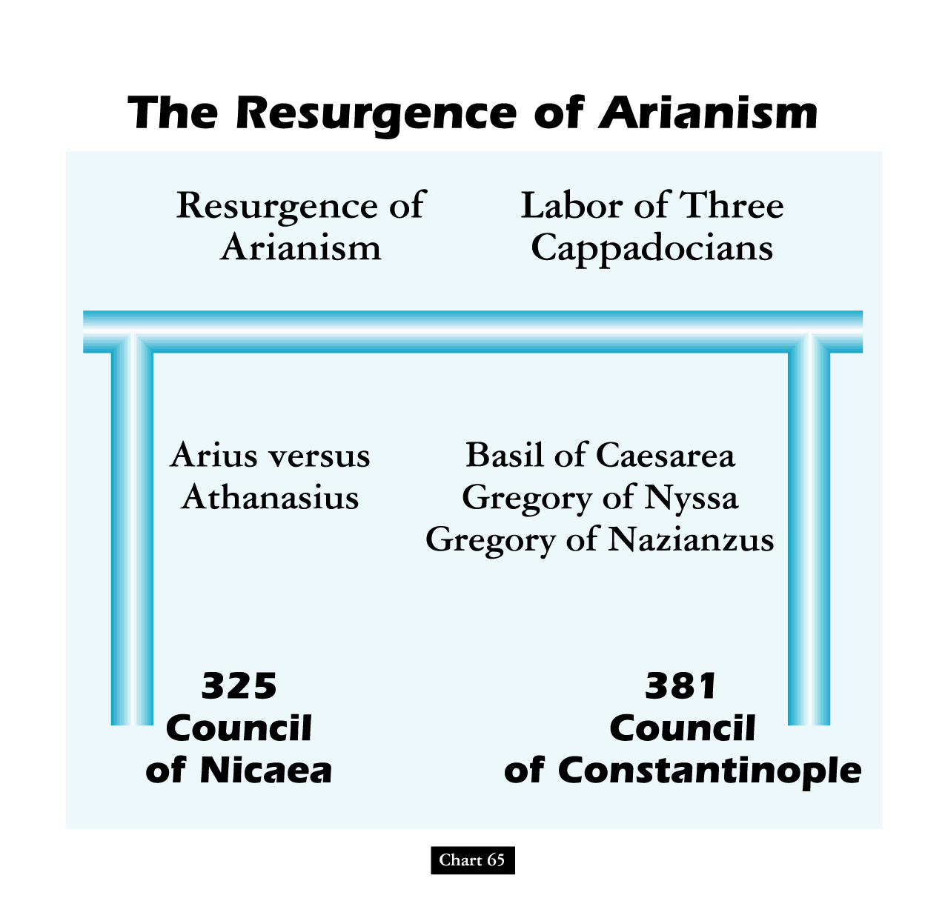
snowball effect

Slide 159
Council of Chalcedon (451)
Why? Monophysites claimed that Jesus’ divine nature swallowed up his human nature.
What happened? Bishops affirmed that Jesus was one person with two natures: “Christ [is] ... recognized in two natures, without confusion, division, or separation ... but not as if Christ were parted into two persons.”

Slide 161
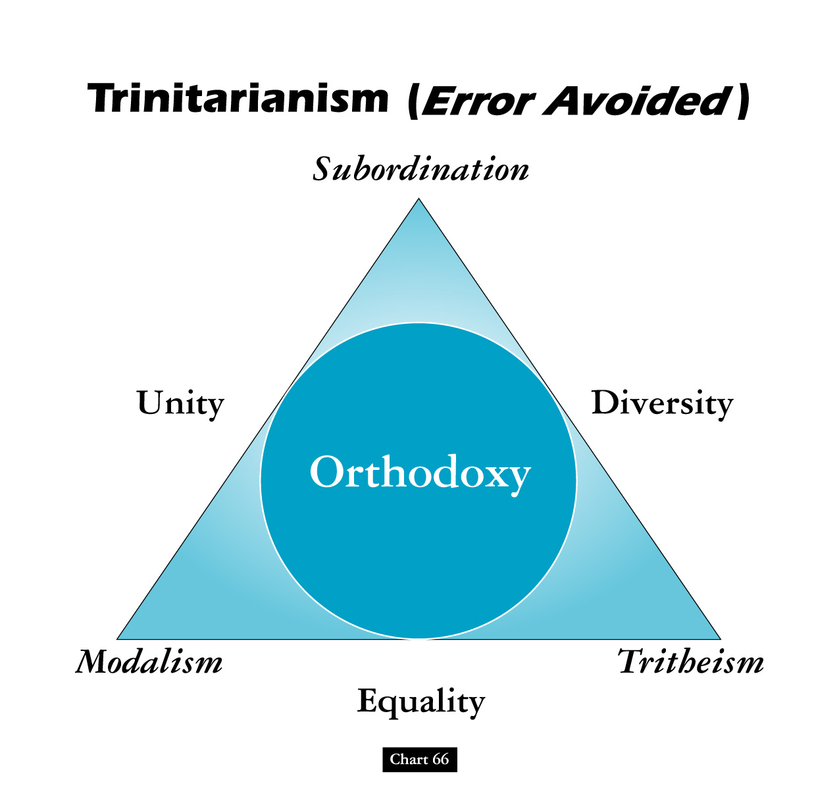

Slide 162
snowball effect

Slide 163
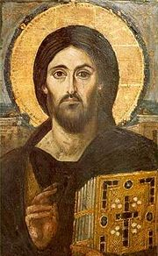
Council of Constantinople II (Again 553)
Why? Monophysite theology became popular again.
What happened? The council denounced both Nestorians and Monophysites.

Slide 164
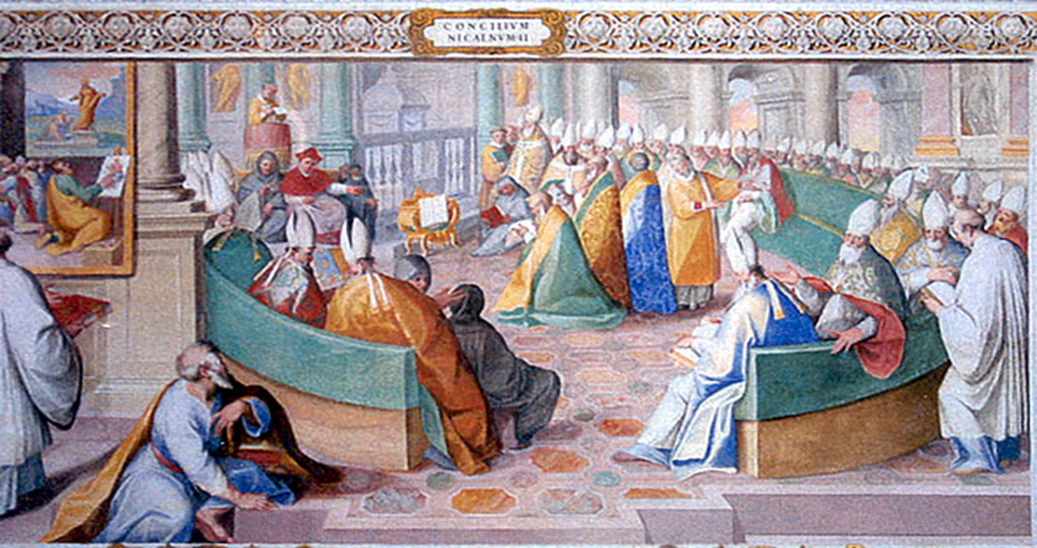
* After 1123, Councils Are For Purposes Of The Pope
* 2nd Nicaea Last Ecumenical Of Eastern Church

Slide 165
Different Eastern Churches Accept Different Councils
THE GREEK ORTHODOX CHURCHES RECOGNIZE THE FIRST SEVEN
ARMENIAN ORTHODOX CHURCHES RECOGNIZE THE FIRST THREE
THE ETHIOPIAN COPTIC CHURCHES RECOGNIZE THE FIRST THREE
SCHISMATIC NESTORIAN CHURCHES RECOGNIZE THE FIRST TWO

Slide 166
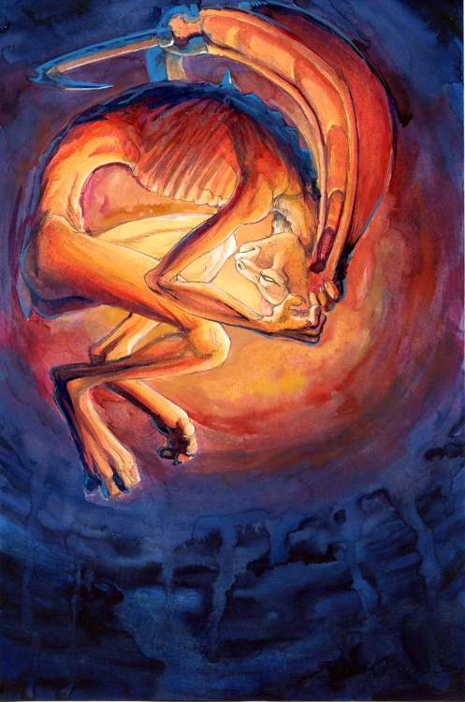
Christian Divisions Costs Half The World
“Christian divisions go far toward explaining the swift collapse of the Roman position in the Middle East, where popular sentiment leaned so heavily toward either the Monophysite or Nestorian churches. Repeatedly, writers from these traditions describe the relief which local inhabitants greeted the Arab conquerors, who promised an end to the heavy-handed regime of the Roman Empire, and the Chalcedonian order.
At least in the early decades of the new order, most Christians saw little reason to change their opinion. Muslims cared nothing for the sectarian divisions among their Christian subjects, provided they respected Muslim authority and paid their taxes on time.
The first century or so after the conquest marked something like a golden age for the Christian communities, who were now free of Roman oppression.”
Source: Pages 263-4, Philip Jenkins’ “Jesus Wars”

Slide 169
3 COUNCILS W/ 3 CREEDS
David Lee Burris:
Trials Of Belief; Synod = Court Of Jesus
@ NICAEA(325 a.d.) Arius Found Heretic
@ Constantinople (381 a.d.) East Evolve Triune Conventional
@ Chalcedon(451) Rome Second Class
Separate Christologies: Incarnate Terminology
Nicene Creed: Ancient Addition To Apostles; In 3 part for Godhead.
Formal Adoption Of Refined Creedal Of Athanasius Of Egypt.
Creed Further Formulated: Phrase “in two natures”; East word person=nature;
Start Point Church Split: Chalcedonian/Eutychian

Slide 170
The Athanasian Creed was the last of the three Ecumenical Creeds to be written. This Creed, like the Nicene Creed, was written in defense of the true teachings of Scripture and to reject doctrinal errors that were present at the time. This Creed is a strong statement that the faith of the Christian rests on the clear statements of Scripture alone even when we are not able to rationalize them. The following is a brief history of how the Athanasian Creed came to be and a short explanation of why it was written.

Slide 171
ATHANASIAN CREED
Named after Athanasian but not thought that he penned it
Written between 450 and 670 AD
Written in defense of the Triune of God
Written also to prove that Jesus was both divine and human
Written to give assurance of the redemption of man by Christ
Whoever wishes to be saved must, above all else, hold true to the Christian faith. Whoever does not keep this faith true in all points will certainly perish forever.

Slide 172
ATHANASIAN CREED
1 Whosoever will be saved, before all things it is necessary that he hold the catholic faith; 2. Which faith except every one do keep whole and undefiled, without doubt he shall perish everlastingly. 3. And the catholic faith is this: That we worship one God in Trinity, and Trinity in Unity; 4. Neither confounding the persons nor dividing the substance. 5. For there is one person of the Father, another of the Son, and another of the Holy Spirit. 6. But the Godhead of the Father, of the Son, and of the Holy Spirit is all one, the glory equal, the majesty coeternal. 7. Such as the Father is, such is the Son, and such is the Holy Spirit. 8. The Father uncreated, the Son uncreated, and the Holy Spirit uncreated. 9. The Father incomprehensible, the Son incomprehensible, and the Holy Spirit incomprehensible. 10. The Father eternal, the Son eternal, and the Holy Spirit eternal. 11. And yet they are not three eternals but one eternal. (from Creeds of the Church)
So if you want to be saved, you have to hold to the catholic faith which faith except every one do keep whole and undefiled, without doubt
he shall perish everlasting !
And they say, we think we are the only ones going to heaven ?

Slide 173
12. As also there are not three uncreated nor three incomprehensible, but one uncreated and one incomprehensible. 13. So likewise the Father is almighty, the Son almighty, and the Holy Spirit almighty. 14.And yet they are not three almighties, but one almighty. 15. So the Father is God, the Son is God, and the Holy Spirit is God; 16. And yet they are not three Gods, but one God. 17. So likewise the Father is Lord, the Son Lord, and the Holy Spirit Lord; 18. And yet they are not three Lords but one Lord. 19. For like as we are compelled by the Christian verity to acknowledge every Person by himself to be God and Lord; 20.So are we forbidden by the catholic religion to say; There are three Gods or three Lords.
(from Creeds of the Church)
So we are forbidden by the
Catholic Church …..

Slide 174
21. The Father is made of none, neither created nor begotten. 22. The Son is of the Father alone; not made nor created, but begotten. 23. The Holy Spirit is of the Father and of the Son; neither made, nor created, nor begotten, but proceeding. 24. So there is one Father, not three Fathers; one Son, not three Sons; one Holy Spirit, not three Holy Spirits. 25. And in this Trinity none is afore or after another; none is greater or less than another. 26. But the whole three persons are coeternal, and coequal. 27. So that in all things, as aforesaid, the Unity in Trinity and the Trinity in Unity is to be worshipped. 28. He therefore that will be saved must thus think of the Trinity. 29. Furthermore it is necessary to everlasting salvation that he also believe rightly the incarnation of our Lord Jesus Christ.
(from Creeds of the Church)
Clever words should not
influence the minds of
followers of our Lord.
People everywhere should
devote themselves to learning
the will of God for themselves

Slide 175
30. For the right faith is that we believe and confess that our Lord Jesus Christ, the Son of God, is God and man. 31. God of the substance of the Father, begotten before the worlds; and man of substance of His mother, born in the world. 32. Perfect God and perfect man, of a reasonable soul and human flesh subsisting. 33. Equal to the Father as touching His Godhead, and inferior to the Father as touching His manhood. 34. Who, although He is God and man, yet He is not two, but one Christ. 35. One, not by conversion of the Godhead into flesh, but by taking of that manhood into God. 36. One altogether, not by confusion of substance, but by unity of person. 37. For as the reasonable soul and flesh is one man, so God and man is one Christ;
(from Creeds of the Church)
If you believe the Bible, you already believe all these things.
Why Not Make It Simple and teach, “Just Believe The Bible” !

Slide 176
You should believe it because it is the “Catholic Faith” or because it is
“The Word Of GOD”!
38. Who suffered for our salvation, descended into hell, rose again the third day from the dead; 39. He ascended into heaven, He sits on the right hand of the Father, God, Almighty; 40. From thence He shall come to judge the quick and the dead.41. At whose coming all men shall rise again with their bodies; 42 and shall give account of their own works. 43. And they that have done good shall go into life everlasting and they that have done evil into everlasting fire. 44. This is the catholic faith, which except a man believe faithfully he cannot be saved.
(from Creeds of the Church)

Slide 177
CLASSROOM
PRESENTATION

Slide 178
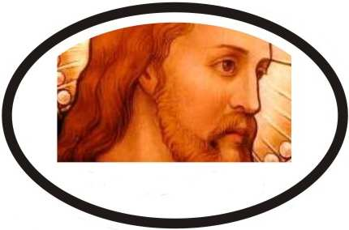
The Mind of Christ
Lesson One

Slide 179
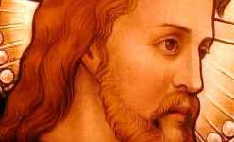
LESSON ONE – I AM
KEY VERSE: "I tell you the truth," Jesus answered, "before Abraham was born, I am!" – John 8:58

Slide 180
LESSON ONE – I AM
"Friend, your sins are forgiven." – Luke 5:20

Slide 181
LESSON ONE – I AM
"Who is this fellow who speaks blasphemy? Who can forgive sins but God alone?" – Luke 5:21

Slide 182
LESSON ONE – I AM
"Who is this? Even the wind and the waves obey him!" – Mark 4:41

Slide 183
LESSON ONE – I AM
"Who is this who even forgives sins?" – Luke 7:49

Slide 184
LESSON ONE – I AM
"I beheaded John. Who, then, is this I hear such things about?" – Luke 9:9

Slide 185
LESSON ONE – I AM
"The whole city was stirred and asked, "Who is this?"" – Matthew 21:10

Slide 186
LESSON ONE – I AM
The Jews answered him, "Aren't we right in saying that you are a Samaritan and demon-possessed?" "I am not possessed by a demon," said Jesus, "but I honor my Father and you dishonor me. I am not seeking glory for myself; but there is one who seeks it, and he is the judge. I tell you the truth, if anyone keeps my word, he will never see death." At this the Jews exclaimed, "Now we know that you are demon-possessed! – John 8:48-59 (1 of 3)

Slide 187
LESSON ONE – I AM
Abraham died and so did the prophets, yet you say that if anyone keeps your word, he will never taste death. Are you greater than our father Abraham? He died, and so did the prophets. Who do you think you are?" Jesus replied, "If I glorify myself, my glory means nothing. My Father, whom you claim as your God, is the one who glorifies me. Though you do not know him, I know him. If I said I did not, I would be a liar like you, but I do know him and keep his word. – John 8:48-59 (2 of 3)

Slide 188
LESSON ONE – I AM
Your father Abraham rejoiced at the thought of seeing my day; he saw it and was glad." "You are not yet fifty years old," the Jews said to him, "and you have seen Abraham!" "I tell you the truth," Jesus answered, "Before Abraham was born, I am!" At this, they picked up stones to stone him, but Jesus hid himself, slipping away from the temple grounds. – John 8:48-59 (3 of 3)

Slide 189
LESSON ONE – I AM
1. "I AM" IS EQUAL WITH GOD

Slide 190
LESSON ONE – I AM
God said to Moses, “I AM WHO I AM. This is what you are to say to the Israelites: 'I AM has sent me to you.'" – Exodus 3:14

Slide 191
LESSON ONE – I AM
"This is my name forever, the name by which I AM to be remembered from generation to generation." – Exodus 3:15

Slide 192
LESSON ONE – I AM
"Anyone who blasphemes the name of the LORD must be put to death. The entire assembly must stone him. Whether an alien or native-born, when he blasphemes the Name, he must be put to death." – Leviticus 24:16

Slide 193
LESSON ONE – I AM
Was even calling God his own Father, making himself equal with God. – John 5:18

Slide 194
LESSON ONE – I AM
Who, being in very nature God, did not consider equality with God something to be grasped. – Philippians 2:6

Slide 195
LESSON ONE – I AM
2. "I AM" IS ETERNAL WITH GOD

Slide 196
LESSON ONE – I AM
"I tell you the truth, if anyone keeps my word, he will never see death.“ – John 8:51

Slide 197
LESSON ONE – I AM
"Abraham died and so did the prophets... Are you greater than our father Abraham?... Who do you think you are?" Jesus replied,“Your father Abraham rejoiced at the thought of seeing my day; he saw it and was glad.” – John 8:56

Slide 198
LESSON ONE – I AM
"You are not yet fifty years old," the Jews said to him, "and you have seen Abraham!“ – John 8:57

Slide 199
LESSON ONE – I AM
"I tell you the truth," Jesus answered, "before Abraham was born, I am! – John 8:58

Slide 200
LESSON ONE – I AM
In the beginning was the Word, and the Word was with God and the Word was God. – John 1:1

Slide 201
LESSON ONE – I AM
(Jesus) existed in the form of God. – Philippians 2:6

Slide 202
LESSON ONE – I AM
In Him all the fullness of Deity dwells in bodily form. – Colossians 2:9

Slide 203
LESSON ONE – I AM
"For I have come down from heaven." – John 6:38

Slide 204
LESSON ONE – I AM
"You are from below; I am from above. You are of this world; I am not of this world.“ – John 8:23

Slide 205
LESSON ONE – I AM
"I and the Father are one." – John 10:30

Slide 206
LESSON ONE – I AM
"Father, glorify me in your presence with the glory I had with you before the world began." – John 17:5

Slide 207
LESSON ONE – I AM
3. "I AM" IS ESSENTIAL WITH GOD

Slide 208
LESSON ONE – I AM
"He who believes in me will live, even though he dies; and whoever lives and believes in me will never die." – John 11:26

Slide 209
LESSON ONE – I AM
“Salvation is found in no one else, for there is no other name under heaven given to men by which we must be saved.“ – Acts 4:12

Slide 210
LESSON ONE – I AM
"I am the way and the truth and the life. No one comes to the Father except through me." – John 14:6

Slide 211
LESSON ONE – I AM
"I give them eternal life, and they shall never perish; no one can snatch them out of my hand." – John 10:28

Slide 212
DISCUSSION QUESTIONS
1. What is the fundamental question in Christianity?

Slide 213
DISCUSSION QUESTIONS
2. Why is it so important to be able to answer the above question correctly?

Slide 214
DISCUSSION QUESTIONS
3. If Jesus was not fully God what would that say about the salvation of those who have placed their faith in Him?

