Slide 1
Three Threads Of Early Error
By David Lee Burris

Slide 2
Three Trends of Early Errors
Apostle Paul’s Convert Clement Is Received As If He Were An Apostle
Alexandria School Through Origen Defines Trinity Concept Sequential
Asia Minor School Thru Its Irenaeus Explains Mary By Contrasting To Eve
Organization Pattern
Doctrinal Pattern
Worshiping Pattern

Slide 4
Three Trends of Early Errors
Apostle Paul’s Convert Clement Is Received As If He Were An Apostle

Slide 5
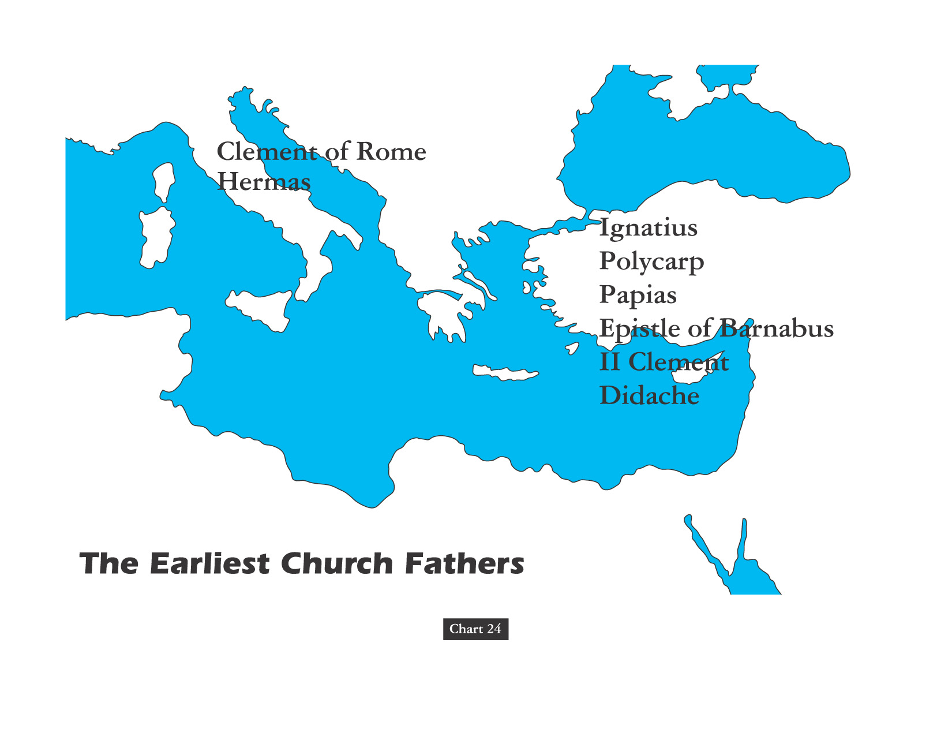
THE PATRISTIC ERA

Slide 6
The Church Across The Ages
of people, events
life and faith from
Glimpses
Clement: Paul's Convert
“Can you imagine what it would have been like to be taught personally about Jesus by the apostle Paul? Clement of Rome was a first century convert who had that privilege.
If you look back in your New Testament at Philippians 4: 3 you will see a Clement referred to who very well could be the same Clement we are now looking at.
After Paul was martyred at Rome, Clement became a leader, in fact, bishop, of the church there. You can visit the Church of San Clemente in Rome today, thought to be built over Clement’s house.
Tradition has it that about the year 100 A.D. he was martyred by being cast into the sea tied to an anchor.”

Slide 7
The Church Across The Ages
of people, events
life and faith from
Glimpses
Clement: Paul's Convert
“Clement’s letter or epistle to the church at Corinth may be the earliest document we have outside of the New Testament.
Yes, Corinth Again. Remember how the Apostle Paul had to write letters to the church at Corinth dealing with terrible problems tearing apart the young church in that notoriously carnal city? Well their problems persisted.
Discord in Corinth had apparently flared up when a group of younger church leaders removed some of those leaders older; factions and petty arguments had developed around the two groups. Clement was writing them addressing and attempting to deal with the squabbles.”

Slide 8
The Church Across The Ages
of people, events
life and faith from
Glimpses
Clement: Paul's Convert
“Clement’s letter is permeated with Scriptural references (over 150 quotes from both Old & New Testaments), and he skillfully wove the Scriptural quotes together to encourage them to return to their holy calling, to ‘attend to what is good, pleasing, and acceptable in the sight of Him who formed us.’
Clement warned that strife within the church is caused by envy, and the Scriptures show what evil envy produces – envy caused Cain to slay Abel, Joseph’s brothers to sell him into bondage, Saul to pursue David: ‘Envy has alienated wives from their husbands,,, have overthrown great cities and rooted up mighty nations.’”

Slide 9
The Church Across The Ages
of people, events
life and faith from
Glimpses
Clement: Paul's Convert
“With love & compassion, Clement urged his readers to… be of humble mind, laying aside all haughtiness, and pride, and foolishness, and angry feelings… being especially mindful of the words of the Lord Jesus which He spoke, teaching us meekness and long-suffering.”

Slide 10
The Church Across The Ages
of people, events
life and faith from
Glimpses
Clement: Paul's Convert
“Clement reasoned that since none of our thoughts are hidden from God, we should seek to obey Him rather than follow the human leaders of any faction. Because we hope in the resurrection, we should live lives of purity and righteousness.
Clement then encouraged the young men in Corinth to repent of their strife and disruption which had discouraged many within the church.”

Slide 11
The Church Across The Ages
David Lee Burris:
Clement’s Letter was read in the Corinthian church as Sunday routine for many years. It was shared with and then circulated among many other early congregations as well.
of people, events
life and faith from
Glimpses
Clement: Paul's Convert
“Clement further urged the Corinthians to ‘pray for those who have fallen into sin, that meekness and humility may be given to them, so that they may submit, not unto us, but to the will of God.’
Clement Concluded With His Own Prayer: ‘May God, who seeth all things, and who is the Ruler of all spirits and the Lord of all flesh – who chose our Lord Jesus Christ and us through Him to be a peculiar people – grant to every soul that calleth upon His glorious and holy Name, faith, fear, peace, patience, long-suffering, self-control, purity, and sobriety, to the well-pleasing of His Name, through our High Priest and Protector, Jesus Christ, by whom be to Him glory, and majesty, and power, and honor, both now and forevermore. Amen.’”

Slide 12
HOW DID WE GET TO THE PAPACY? Gregory The Great Wrote John The Faster:
“I pray you, therefore, reflect that by your bold presumption the peace of the whole Church is troubled, and that you are at enmity with that grace which was given to all in common. The more you grow in grace, the more humble you will be in your own eyes; you will be the greater in proportion as you are further removed from usurping this extravagant and vainglorious title. You will be the richer as you seek less to despoil your brethren to your profit. Therefore, dearly beloved brother, love humility with all your heart. It is that which insures peace among the brethren, and which preserves unity in the Holy Catholic Church.”

Slide 13
BISHOP SUPREMACY
ROMAN ADVANTAGE
POPULATION CITY OF ROME
Size Of City
Size Of Church
IMPERIAL CAPITAL
After Milan Edict Emperors’ Advisor
LANGUAGE
Latin Lesser Ability Express Subtle Nuance
LOCATION
Of The Five Patriarchs Only Rome In The West
MISSIONARY OUTREACH
West Converted Tribes Eastern Persians Not
BARBARIAN INVASIONS
Western Empire Falls Church Only Stability

Slide 14
Three Trends of Early Errors
Apostle Paul’s Convert Clement Is Received As If He Were An Apostle
Alexandria School Through Origen Defines Trinity Concept Sequential
Organization Pattern

Slide 15
TRINITY SEQUENTIAL SEPARATED & EXPLAINED IN TERMS OF PROCESS

Slide 16
The Church Across The Ages
of people, events
life and faith from
Glimpses
The Sharpening Stone Of Origen
Have you ever met someone who loved Christ so much that as a teenager he was ready to voluntarily die for the faith? Or so brilliant that he kept seven secretaries busy recording the torrent of wisdom that gushed from his hyperactive mind? Or one so eager to walk close to the Lord that every Wednesday and Friday he fasted? Origen was a man of rare brilliance and was probably the most prolific author of the ancient world, writing literally thousands of works.

Slide 17
The Church Across The Ages
of people, events
life and faith from
Glimpses
The Sharpening Stone Of Origen
“Born in Alexandria, Egypt about 185, Origen was raised in a Christian home. His father, Leonides, was a teacher who recognized his son’s brilliance & provided him with the best Greek education possible. Moreover, he also had Origen memorize Scripture every day; even as a little boy Origen knew whole sections of the Bible from memory. When Leonides was imprisoned for his faith about 202, under the reign of Septimius Severus, Origen wrote his dad a letter of encouragement not to deny Christ. Origen was eager to join his father in prison & death if necessary; he was prevented from this only by his mother hiding his clothes when he wanted to give himself up to the heathen authorities. Leonides was martyred; his property was confiscated; & his wife left helpless with seven children.”

Slide 18
The Church Across The Ages
of people, events
life and faith from
Glimpses
The Sharpening Stone Of Origen
“A wealthy matron assisted Origen, and he then began giving instruction in the Greek language and copying manuscripts. When he was 18, in 203, bishop Demetrius of Alexandria nominated Origen to become president of the catechetical school in Alexandria. There Origen was the one responsible for the instruction of all new converts to the faith. As Origen instructed new converts, he learned he had to counter arguments of heretics within the faith as well as Jews and pagans that were without. He studied with the leading neo-platonist philosopher of his day to better refute pagan arguments against the Christian faith.”

Slide 19
The Church Across The Ages
of people, events
life and faith from
Glimpses
The Sharpening Stone Of Origen
“Origen led a very disciplined life and devoted himself solely to the service of the gospel. By strictly following Jesus’ admonition in Matthew 10: 10, he had only one coat, no shoes, and took no thought for the next day. He refused any gifts or pay from his students, ate no meat, drank no wine, and slept on the bare floor. His nights were mostly spent in prayer & study. It was to literally follow Matthew 19: 12 that Origen had himself castrated, thereby removing any hint of scandal as he taught young women in the catechetical school (an act he later came to see as ill-advised).”

Slide 20
The Church Across The Ages
of people, events
life and faith from
Glimpses
The Sharpening Stone Of Origen
“During his early years at Alexandria , Origen wrote on First Principles, the first systematic theology ever written. For twenty-eight years he worked on his Hexapla, which was a massive work of Old Testament textual analysis. Origin was one of the few churchmen before the Reform movement who learned Hebrew to better study the Old Testament. His Hexapla was written as a parallel edition of the Old Testament Hebrew text with a transliteration and four different translations into Greek. This method of interpreting Scripture greatly influenced the Middle Ages. He interpreted Scripture with three levels of meaning: the literal, the moral, and the allegorical. Origen especially used his allegorical interpretations of Scripture to reveal Christ in the Old Testament.”

Slide 21
The Church Across The Ages
of people, events
life and faith from
Glimpses
The Sharpening Stone Of Origen
Origen paradoxically has been called the father of orthodoxy & the father of heresy. He labored at a time when the church was still seeking to interpret and define its basic doctrines. Origen made foundational contributions that would help theologians for centuries. His ceaselessly fertile and active mind also led him into uncharted areas and some speculations that the wisdom of the collective Church had to reject. Bishop Demetrius of Alexandria charged Origen with foreign speculations. Two church councils held in 231 and 232 enacted motions against Origen, and he was excommunicated. Instead, Origen found refuge and acceptance with churches in Palestine and Arabia until his pupil Dionysius became bishop of Alexandria. During the Decian persecution, he was cast into prison, tortured, and condemned to the stake. He died instead from wounds suffered at the hands of his torturers at the age of 69 in the year 254.

Slide 22
From Origen A False Controversy
Origen believed that God the Father, the Christ logos, and the Holy Spirit represent three aspects of the godhead. He thought of them as having a hierarchical relationship; that is, the Father generates the Son, who generates the Holy Spirit. The image he liked to use was an eternal torch, one lighting the other. That effort [in the book Timaeus] was to reconcile Christian thought with the three realities of Plato.
Churches in western Europe had added the word filioque (“and the Son”) to the Nicene Creed in the AD 500s

Slide 23
PROCESSION
“A term in Christian trinitarian thought that designates the way the Son and Spirit originate from the Father. The Son’s procession from Father is called generation, or filiation, whereas procession of the Spirit from Father is called spiration.”
* Dictionary Of Theological Terms, Grenz & Guretzki

Slide 24
From The Modern Scholar Course Guide: “One, Holy, Catholic, & Apostolic”
THE PHOTIAN SCHISM
“Pope Nicholas ridiculed the concept of a Roman emperor who could not even speak Latin and reminded him that the authority of the see of St. Peter existed before Constantinople was founded and would continue long after the emperors were gone. In 867, Constantinople’s Patriarch Photius excommunicated the pope on the basis of insertion of the Filioque Clause in the creed, which asserted that the Holy Spirit proceed from both the Father and the Son. This argument, that the pope was himself a heretic, would be used with increased regularity in the East.”

Slide 25
The Filioque Controversy
Churches in western Europe had added the word filioque (“and the Son”) to the Nicene Creed in the AD 500s.
Eastern Christians recited, “The Holy Spirit … proceeds from the Father.”
Western Christians recited, “The Holy Spirit … proceeds from the Father and the Son.”

Slide 26
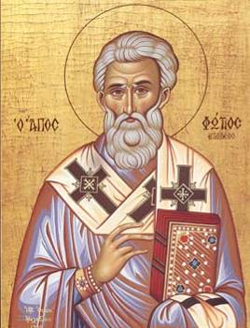
The Filioque Controversy
Photius, bishop of Constantinople, spoke out against the added phrase in 867.
Photius declared the phrase to be heretical and excommunicated Pope Nicholas, bishop of Rome.
Photius of Constantinople

Slide 27
The Filioque Controversy
Eastern Christians recited, “The Holy Spirit … proceeds from the Father.”
Western Christians recited, “The Holy Spirit … proceeds from the Father and the Son.”
THE ABSOLUTE TRUTH IS THAT BOTH CHURCHES WERE VERY WRONG.
NEITHER SON NOR SPIRIT WERE LIKE ANGELS OF SPECIAL CREATION, & NEITHER PROCEEDED FROM GOD.

Slide 28
EARLY ERROR BUILT ON THREE FALSE ASSUMPTIONS
#1 Assumption: Paul Convert Clement Received As Apostle
#2 Assumption: Origen Explains Trinity Concept Sequential
#3 Assumption: Irenaeus Portrays Jesus Mother @Anti-Eve

Slide 29
“What indeed does Athens to do with Jerusalem? What agreement is there between the Academy and the Church? What between heretics and Christians? Our instruction comes from ‘the porch of Solomon,’ who had himself taught that ‘the Lord should be sought in simplicity of heart.’ Away with all attempts to produce a mottled Christianity of Stoic, Platonic, and dialectic composition!”
TERTULLIAN

Slide 30
Doctrine Versus Dogma
Distinguishing dogma and doctrine. "A doctrine is often the direct, naive, expression of a religious truth. It is not necessarily formulated with scientific precision and when it is, may be merely the formulation of a single person. A religious dogma, on the other hand, is a religious truth based on authority and officially formulated by some ecclesiastical assembly." Dogmas, in this sense, are not found in Scripture. "They are the fruit of human reflection, the reflection of the Church, often occasioned or intensified by theological controversies."
In summary: "A dogma may be defined as a doctrine, derived from Scripture, officially defined by the Church, and declared to rest upon divine authority. This definition partly names and partly suggests its characteristics. Its subject-matter is derived from the Word of God and is therefore authoritative. It is not mere repetition of what is found in Scripture, but the fruit of dogmatic reflection. And it is officially defined by a competent ecclesiastical body, and declared to rest upon divine authority. It has social significance, because it is the expression, not of a single individual, but of a community. And it has traditional value, since it passes the precious possessions of the Church on to future generations." Dogma arises from the reflection on the "truths of revelation" by the "body of believers" and through the formulations of "competent representative bodies" of the Church. "Since the reflection of the Church is often determined and deepened by doctrinal controversies, the formulations to which Church Councils or Synods are finally led under the guidance of the Holy Spirit often bear the earmarks of past struggles. They are not infallible but yet have a high degree of stability. And they are authoritative, not merely because they are proposed by the Church, but *formally* as defined by the Church and *materially* as based on the Word of God."

Slide 31
Three Trends of Early Errors
Apostle Paul’s Convert Clement Is Received As If He Were An Apostle
Alexandria School Through Origen Defines Trinity Concept Sequential
Organization Pattern
Doctrinal Pattern

Slide 32
Three Trends of Early Errors
Apostle Paul’s Convert Clement Is Received As If He Were An Apostle
Alexandria School Through Origen Defines Trinity Concept Sequential
Asia Minor School Thru Its Irenaeus Explains Mary By Contrasting To Eve
Organization Pattern
Doctrinal Pattern

Slide 33
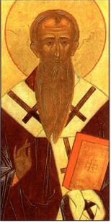
When was Gospel of Judas written?
Historians have known about Gospel of Judas since AD 180.
Rejected by church father Irenaeus of Lyons in AD 180.
Irenaeus
IRENAEUS REDIRECTED FROM SOME
FALSE DOCTRINE & STARTS ANOTHER

Slide 34
FROM EMPHASIS ON EVE TO THE FOCUS ON MARY
“So the Lord now manifestly came to his own, and, born by his own created order which he himself bears, he by his obedience on the tree renewed [and reversed] what was done by disobedience in [connection with] a tree; and [the power of] that seduction by which the virgin Eve, already betrothed to a man, had been wickedly seduced was broken when the angel in truth brought good tidings to the Virgin Mary, who already [by her betrothal] belonged to a man. As the human race was subjected to death through [the act of] a virgin, so was it saved by a virgin, and thus the disobedience of one virgin was precisely balanced by the obedience of another.”

Slide 35
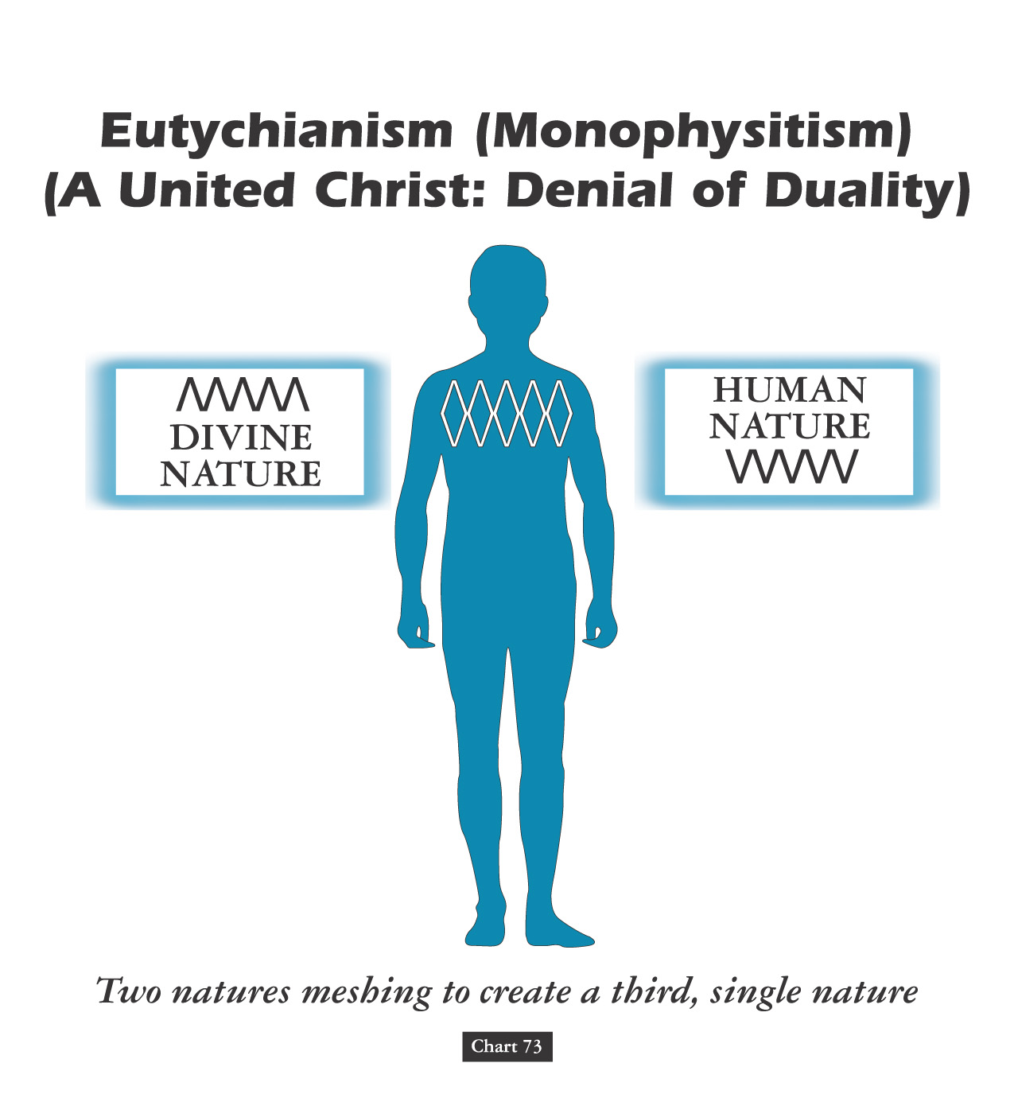
Significant & Important:
David Lee Burris:
Both Philosophy & Paganism Combine to Produce The Mariology We Know Today!
DEBATES ABOUT JESUS’ NATURE TRACK THAT OF MARY’S STATUS

Slide 36
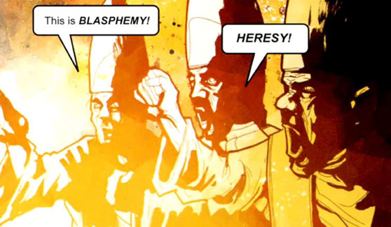
Counter-Christology: MARIOLOGY

Slide 37
EARLY ERROR BUILT ON THREE FALSE ASSUMPTIONS
#1 Assumption: Paul Convert Clement Received As Apostle
#2 Assumption: Origen Explains Trinity Concept Sequential
#3 Assumption: Irenaeus Portrays Jesus Mother @Anti-Eve
READ – Romans 5: 12 – 21 & 1st Corinthians 15: 20 -24, 45 - 48

Slide 38
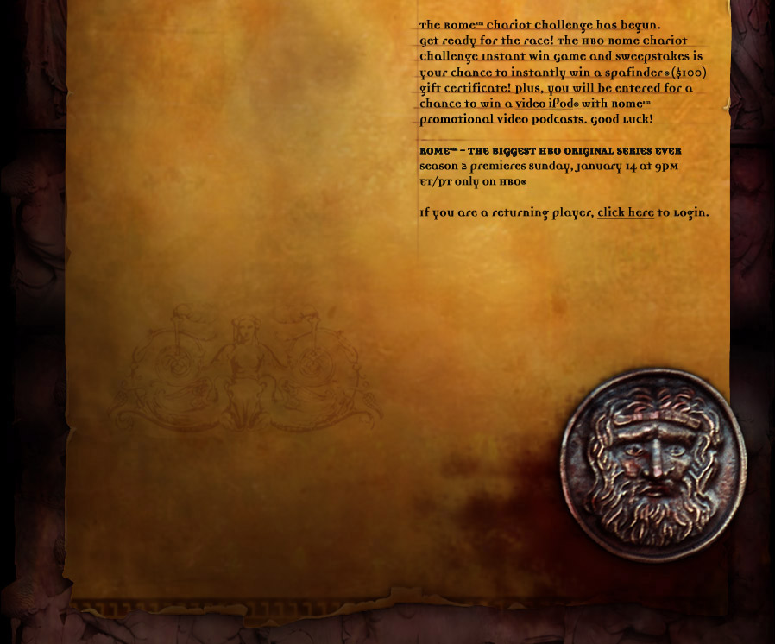
The veneration of Mary, the mother of Jesus,
which was to lead to the adoption of the
doctrines of her immaculate conception in 1854
and her miraculous assumption to heaven in 1950,
developed rapidly by 590*.
The Nestorian and other Christological
controversies of the fourth century
resulted in the acceptance of her as
the 'Mother of God' and entitled her to
special honors in the liturgy.
* From the Non-Canonical
ProtoEvangelium of James

Slide 39
THE HELL HARROWING
“The descent motif common to most mythologies about hell also usually contains an element of “harrowing,” or distressing, of hell. This is where a hero or savior has to go to hell and shut it down, or defeat its ruler or bring somebody back… This is what the line in the Apostle’s Creed is about ‘He descended into Hell, the third day he arose again from the dead.’…After Jesus had been crucified he went to hell – not to suffer, but to battle with the Devil, whom he defeated. He chained up Satan and cast him into a fiery pit where he was to stay for a thousand years. As well as closing down hell, Jesus rescued Adam & other ancient souls...” Craze, Hell

Slide 40
THE HELL HARROWING
According to tradition, Jesus closed hell for a thousand years. However, this caused problems for theologians and for believers. If hell is closed what happens to the souls of the wicked? - “The early Christians were obligated to introduce the concept of a sort of waiting room, where souls would stay for the thousand years until hell was open again. They found a ready-made idea – limbo – that they freely borrowed from the Romans, who had borrowed it from the Greeks. This was all fine until the year 1000AD, when Satan’s banishment was supposed to end… But nothing happened. The theologians set to work and said that Satan was now out and about in the world – tempting and tormenting – and that hell was still closed but that there was another place where sinners would be punished. This was purgatory. It was a cross between limbo and hell. But if Satan was absent, who was to run it? Jesus’ mother, the Virgin Mary, was called back from heaven, where she had been asleep (the Dormition). She was given the keys of to look after, & the running of purgatory. She does not administer any punishments – in fact, her main job seems to be protecting the souls of the sinners from the wrath of her son…”
- Richard Craze, Hell, pages 44, 45

Slide 41
INHERITING ORIGINAL SIN THE BLAST FROM THE PAST
Posterity’s Uncritical Acceptance Of Augustine’s Christian Platonism
Further testimony is borne to the heinousness of this doctrine in the fact that Protestants and Catholics make Jesus exempt from original sin. Of course, it would heap outrage upon outrage for them not to do so, but their having to do it only makes their error all the more conspicuous. Catholics have also seen fit to make Mary an exception to the rule by virtue of the doctrine of immaculate conception. If it is right for God to transfer Adam’s sin nature to his descendants, why would it be wrong for Him to do so in the case of Jesus? The practical need to make Jesus an exception is quite understandable, but the query is directed at the moral right to make Jesus an exception to that which blights all men. If it would have been wrong to transfer Adam’s sin nature to Jesus, why is it right for Him to do so in the cases of other men? How is it right to do to men what it would be wrong to do to Jesus? It appears that there is a double standard. The Catholics simply issue what amounts to an ipse dixit about it in the case of Mary. If God could arrange for Jesus to be born without original sin, why couldn’t He have arranged the very same thing for all men? Is God “a respector of persons”(Acts 10: 34)? Moreover, if Jesus had to be made like His brethren in all things(Hebrews 2) & was tempted in all things they are (chap. 4), how is it that He was preserved from the very thing that compels them to sin? If God gave to men that from which He preserved Jesus, then Jesus is different from His brethren in a most radical, fundamental, and irreconcilable way! The Hebrews writer’s claim becomes nothing.

Slide 42
INHERITING ORIGINAL SIN THE BLAST FROM THE PAST
Posterity’s Uncritical Acceptance Of Augustine’s Christian Platonism
Proponents of original sin sense this difficulty and try to resolve it by saying that Jesus’ virgin birth was necessitated by the need to preserve Him from original sin. For several reasons this solution falls short of its aim: (1) It would not resolve the moral dilemma for Calvinists, even if it were true! (2) Nowhere in the Scriptures is a doctrine of original sin assigned as a basis for Jesus’ virgin birth! (3) Sinfulness, or a sinful nature, is not genetically transferable anyway! (4) Even though Jesus was virgin-born, He was still a physical descendant of Adam because His mother was! Finally, when all is said and done, it may be observed that the real problem of original sin lies not in how it is transmitted but by the very fact that it is transmitted at all! No conceivable answer can absolve God from the responsibility He would have to bear for the sins of men if He creates them with sinful natures that compel them to sin. Calvinism is rotten at its taproot! Original sin, since it defies and defiles the very nature of God, is as fundamentally wrong as any false doctrine could be!

Slide 44
The Marian Medieval World
“Jesus is almost always portrayed as a babe in Mary’s arms and even appears as a babe in acclaimed apparitions, which are then honored in shrines in many countries. There are nearly a thousand such shrines in France alone. One would have to search long and hard throughout the world to discover more than a handful of Catholic shrines honoring Jesus.”

Slide 45
Mary Saves By Her Scapular
Our Lady gave St. Simon a scapular for the Carmelites with the following promise, saying : Receive, My beloved son, this habit of thy order: this shall be to thee and to all Carmelites a privilege, that whosoever dies clothed in this shall never suffer eternal fire .... It shall be a sign of salvation, a protection in danger, and a pledge of peace. Another important aspect of wearing the Scapular is the Sabbatine Privilege. This concerns a promise made by Our Lady to Pope John XXII. In a papal letter he issued, he recounted a vision that he had had. He stated that the Blessed Virgin had said to him in this vision, concerning those who wear the Brown Scapular: "I, the Mother of Grace, shall descend on the Saturday after their death and whomsoever I shall find in Purgatory, I shall free, so that I may lead them to the holy mountain of life everlasting."

Slide 46
THE NEW IRENIC MEDIATRIX ORTHODOXY:
The Second Major Mariology Dogma: Mary’s Perpetual Virginity’
This Council of Lateran 649 A.D. Decision Determined that
Jesus Christ was without siblings. See – Matt 12:46; 13:55
The Second Major Mariology Doctrine Was Pronounced
By Pope Pius December 8, 1854 @ “Ineffabilis Deus”
Mother Mary Was Born Without Original Sin!

Slide 47
Church
History
The Apostasy
Doctrines Enacted at Church Councils
Clergy/Laity System
Sprinkling for Immersion
Infant Baptism
Celibacy
Instrumental Music
Transubstantiation
Indulgences
Worship of Mary
Veneration of Relics
Purgatory
Confessionals
Images
Penance
Extreme Unction
Confirmation
Nuns, Primacy of Peter
Forbidding to Eat Meats
Religious Holidays

Slide 49
1860 PIUS IX PAPACY: The Pope & Mary Deified
The Papacy’s Pretorian Black-Robed Jesuit Order
Papal States as Church-State Establishment Model
Pius Supports the South in the American Civil War
Series of Events Leading to Papal Infallibility Tenet
Series of Events Leading to Designation as Royalty
Mariology’s Benchmark : Immaculate Conception

Slide 50
Three Trends of Early Errors
Apostle Paul’s Convert Clement Is Received As If He Were An Apostle
Alexandria School Through Origen Defines Trinity Concept Sequential
Asia Minor School Thru Its Irenaeus Explains Mary By Contrasting To Eve
Organization Pattern
Doctrinal Pattern
Worshiping Pattern

