Slide 1
Puritan-Pilgrim Founder-Framer Worldview Shifts
By David Lee Burris

Slide 2
Church-State Worldview Shift
Medieval Worldview Setting
Old World Shift: Renaissance
Rebel Puritans & Exile Pilgrims
New World Shift: Enlightenment
Rebel Founders & Nation Framers

Slide 3




INTRODUCTION

Slide 4

What is a worldview?
“A worldview is an integrated, interpretive, set of confessional perspectives on reality which underlies, shapes, motivates, and gives direction and meaning to human activity.”
BJ van der Walt, The Liberating Message: A Christian Worldview for Africa, p. 39.

Slide 5
What is a worldview?
“A worldview is a set of presuppositions . . . which we hold (consciously or subconsciously) about the basic makeup of our world.”
-- James Sire

Slide 6
What is a worldview?
Everyone has a worldview whether one can explain it or not. It can be likened to a pair of glasses through which one views the world. It is important to have the right prescription or reality will be distorted. Modern man is faced with a supermarket of world views all of them claiming to be true.

Slide 7

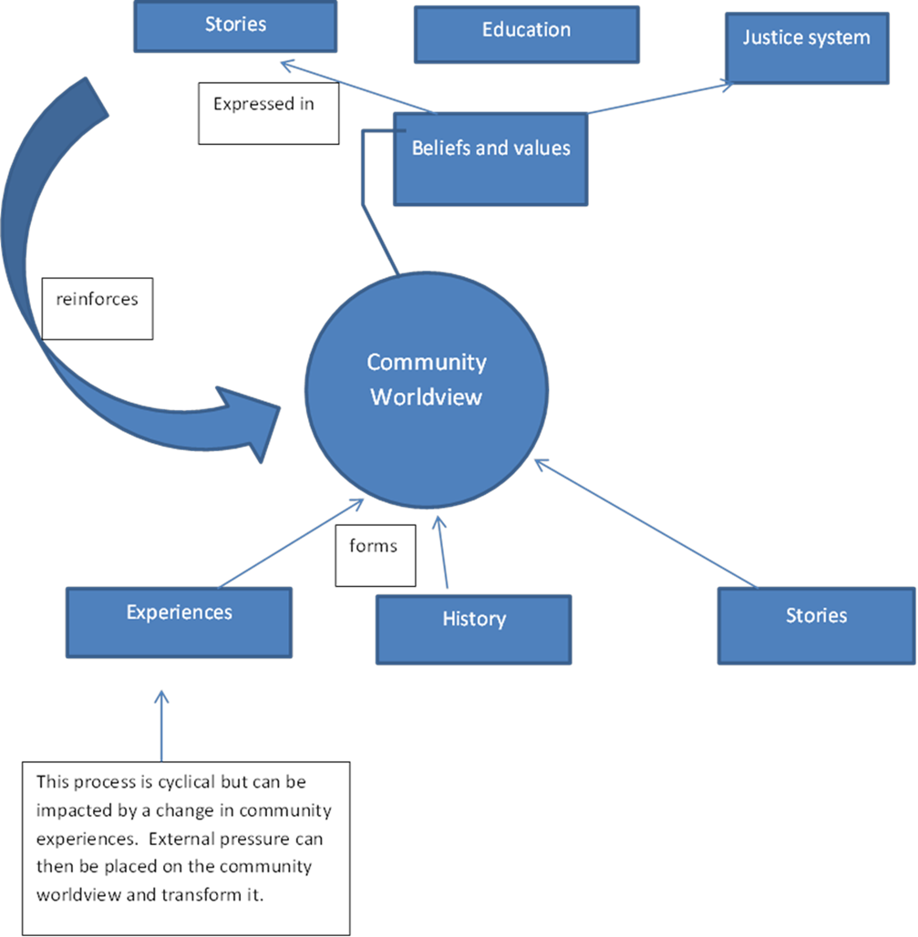
How are worldviews formed?

Slide 8

Axiological Analysis Of Values Views
Axiology: Transdisciplinary & Broad Field Research Resourced Of Cognitive Concepts @ Aesthetic – Epistemic - Ethical Construct

Slide 9
Axiological Analysis Of Values Views
Dictionary: “An area of inquiry that studies the nature, criteria, implications and applications of value judgments.”

Slide 10
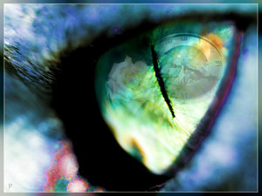
Axial Model Between 200 - 600 B.C.
Lifeview: Personal Journey & Movement
PROCESS TRANSFORMABLE & PROGRESS INCOMMUNICABLE
From Lower To Higher Realm
From Knowledge To Wisdom
From Appearance To Reality
From Bondage To Liberation
From Confusion To Insight
From Darkness To Light

Slide 11
Axial Model Between 200 - 600 B.C.
Two Methods Of Inquiry:
Major Logic – Ontology
Major Logic – Epistemic
Minor Logic – Inductive
Minor Logic – Deductive

Slide 12
Axial Model Between 200 - 600 B.C.
Deliberate Structure Three Tier:
PROPOSITIONAL LOGIC
FORMALIZED PROOFS
TRUTH TREE MAPING

Slide 13
Axial Model Between 200 - 600 B.C.
Rationalists Theories Of Reality
Logically Inconsistent Deficiencies:
Self-Referential Incoherence
Self-Assumptive Incoherence
Self-Performable Incoherence

Slide 14
Axial Model Between 200 - 600 B.C.
Entered Evidence Irrelevant
AD VERICUNDIUM – An Appeal To Position
AD POPULUM – An Appeal To Popularity
AD BACULUM – An Appeal To Force
AD MISERICORDIAM – An Appeal To Pity
AD HOMINEM – Argument Personal Direct

Slide 15
Axial Model Between 200 - 600 B.C.
Evidential Category | Standard Measure
EXPERIMENT | UNEQUIVOCAL
RATIONALE | NON-CIRCULAR
AUTHORITY | RECOGNIZED
REVELATION | RELEVANCE

Slide 16
Axial Model Between 200 - 600 B.C.
THREE QUERIES RAISED:
What Can We Know?
What Ought We To Do?
For What Can We Hope?

Slide 17
Axial Model Between 200 - 600 B.C.
Worldview Answers Four Questions:
What Is Human Origin?
What Is Life’s Meaning?
What Is A Moral Action?
What Is Man’s Destiny?

Slide 18
Questions which reveal one’s worldview
Why is there something rather than nothing?
How do you explain human nature?
How do you know that you know?
What happens to a person at death?
How do you determine what is right or wrong?
What is the meaning of history?

Slide 19
Axial Model Between 200 - 600 B.C.
Viable Worldview Answers Adequate
WHAT KIND OF GOD,
IF ANY, EXISTS?
Ultimate Reality Question

Slide 20
Axial Model Between 200 - 600 B.C.
Viable Worldview Answers Adequate
IS THERE ANYTHING BEYOND THE COSMOS?
External Reality Question

Slide 21
Axial Model Between 200 - 600 B.C.
Viable Worldview Answers Adequate
WHAT CAN BE KNOWN &
HOW CAN WE KNOW IT?
The Knowledge Question

Slide 22
Axial Model Between 200 - 600 B.C.
Viable Worldview Answers Adequate
OF WHERE DID I COME?
The Origins Question

Slide 23
Axial Model Between 200 - 600 B.C.
Viable Worldview Answers Adequate
WHO AM I?
The Identity Question

Slide 24
Axial Model Between 200 - 600 B.C.
Viable Worldview Answers Adequate
WHERE AM I?
The Location Question

Slide 25
Axial Model Between 200 - 600 B.C.
Viable Worldview Answers Adequate
WHAT IS THE MEANING &
DIRECTION OF HISTORY?
Past/Present Question

Slide 26
Axial Model Between 200 - 600 B.C.
Viable Worldview Answers Adequate
WILL I SURVIVE THE DEATH OF MY BODY AND, IF SO, IN WHAT STATE?
THE DESTINY QUESTION

Slide 27
Axial Model Between 200 - 600 B.C.
Viable Worldview Answers Adequate
HOW SHOULD I LIVE?
The Morality Question

Slide 28
Axial Model Between 200 - 600 B.C.
Viable Worldview Answers Adequate
WHAT IS IT THAT I
SHOULD CONSIDER
OF GREAT WORTH?
The Values Question

Slide 29
Axial Model Between 200 - 600 B.C.
Viable Worldview Answers Adequate
WHAT IS HUMANITY’S FUNDAMENTAL PROBLEM?
PREDICAMENT QUESTION

Slide 30
Axial Model Between 200 - 600 B.C.
Viable Worldview Answers Adequate
HOW CAN HUMANITY’S
PROBLEM BE SOLVED?
RESOLUTION QUESTION

Slide 31
Naturalism Versus T heism

Slide 32
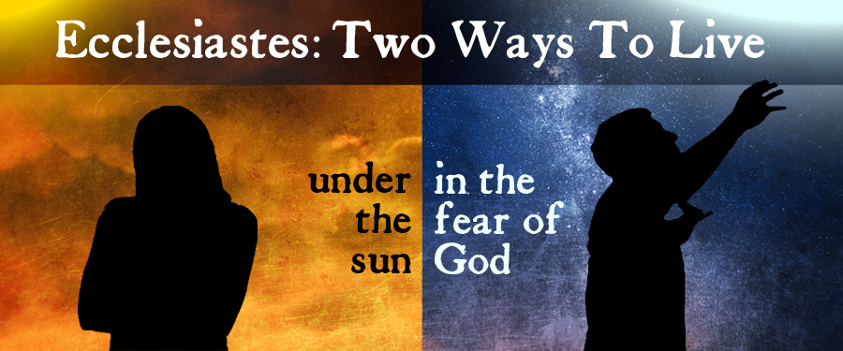

Slide 33
Ancient Wisdom for Modern Life
Ecclesiastes
It’s all a matter of perspective!

Slide 34
TWO VIEWS OF THE WORLD
Secularist
World
View
Theistic
World
View

Slide 35

SECULARIST
WORLDVIEW
A World view without God
Autonomous man
Pursuit of the earthly

Slide 36
Four Realities
A transitory life
+ A meaningless earth cycle
+ An inability to know all
+ Generational discontinuity
Frustration & Hopelessness!

Slide 37


Slide 38
Four Realities
A transitory life
+ A meaningless earth cycle
+ An inability to know all
+ Generational discontinuity
+ God In The Equation
What Is The Outcome?

Slide 39
The Theistic
WORLDVIEW
A world under God’s control
A trusting relationship with the Creator
Pursuit of the spiritual purposes of God

Slide 40
Four Realities
A transitory life
+ A wise God in control
+ A sovereign purpose to fulfill
+ Wisdom to guide us
Satisfaction & hope!

Slide 41
TWO VIEWS OF THE WORLD
Secularist
World
View
Theistic
World
View

Slide 42
Ancient Wisdom for Modern Life
Ecclesiastes
It’s all a matter of perspective!

Slide 43
MEDIEVAL SETTING:
POWER & TRUTH

Slide 44
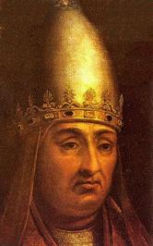
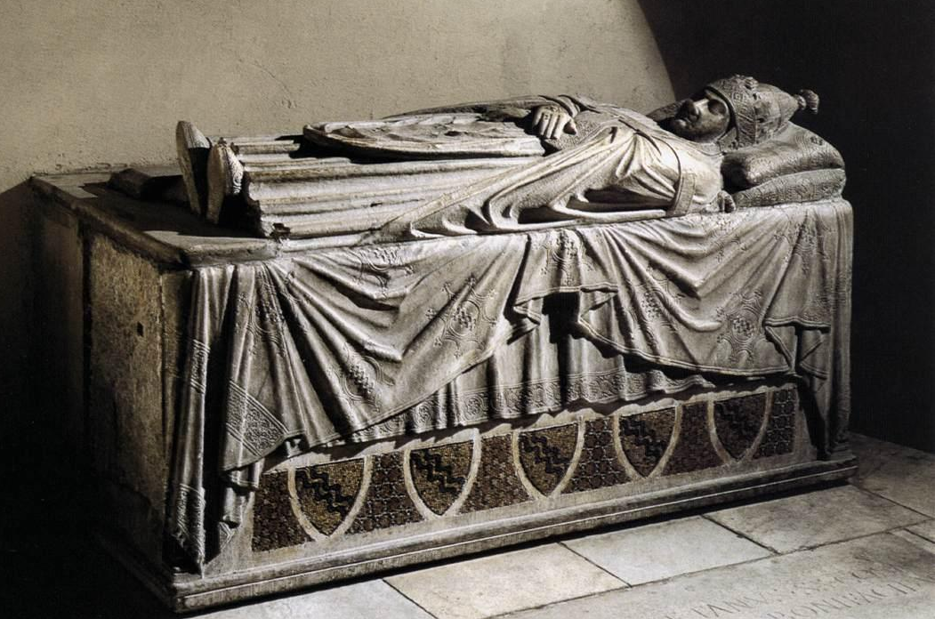

1302
Pope Boniface VIII claims that the pope has supremacy over every human being, in his bull Unam Sanctam (Latin for “the One Holy,” that is, the Church)
Pope Boniface VIII

Slide 45
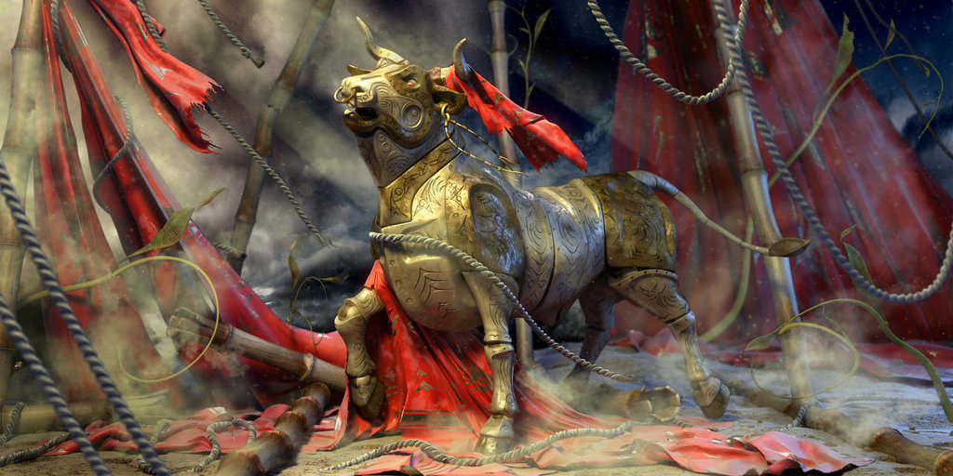
BLOODY BULLS

Slide 46
A “bull” is a sealed declaration by a pope. The bull “Unam Sanctam” declared that:
There is only one true Church, outside of which there is no salvation; the church has one
head, not two.
2. That head is Christ and His representative, the Roman pope.

Slide 47
The bull “Unam Sanctam” declared that:
3. There are two swords (forms of power), the spiritual and the temporal (earthly or civic).
Spiritual power is borne by the Church.
Temporal power is borne for the Church under the direction of
the clergy.

Slide 48
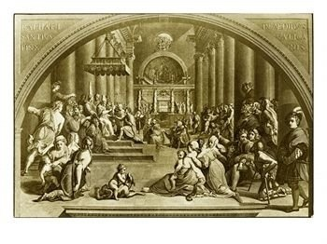
Genesis 1: 16 – Church Of Light Direct
David Lee Burris:
Understood Better During Age Of Alchemy – Sun Gold & Represented By Full Circle – Moon Silver & Represented By Half-Circle

Slide 49
Genesis 1: 16 – State Of Reflected Light

Slide 50
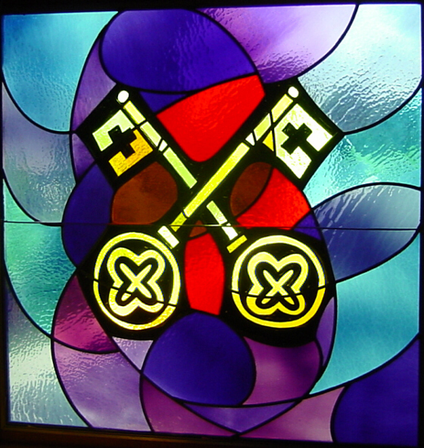

Donation Of Constantine Fraud

Slide 51
FABRICATED CONSTANTINE DONATION

Slide 52
CITED PRECEDENT MELDING

Slide 53
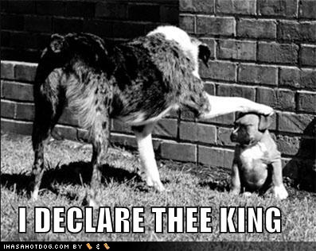
SPIRITUAL & TEMPORAL SWORDS

Slide 54

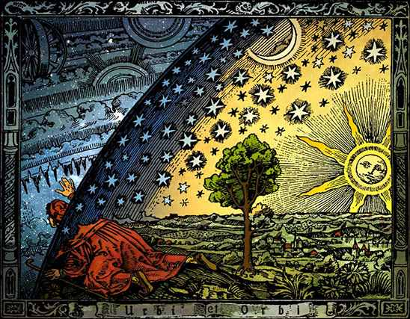

Slide 55
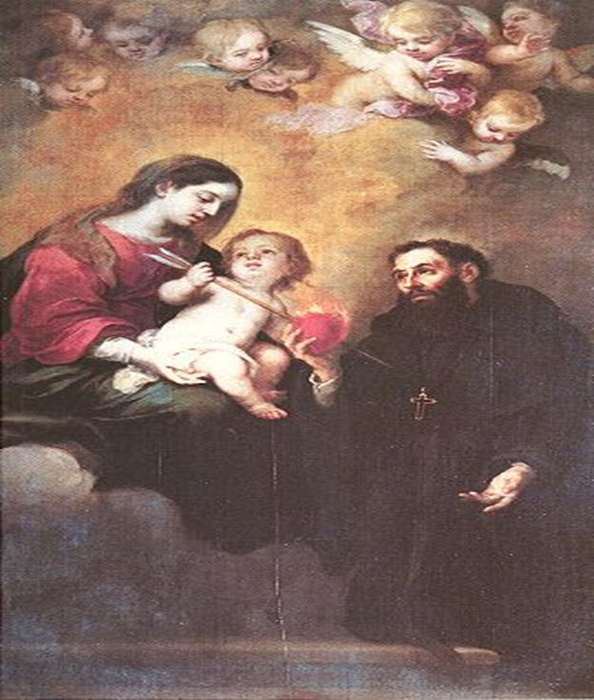
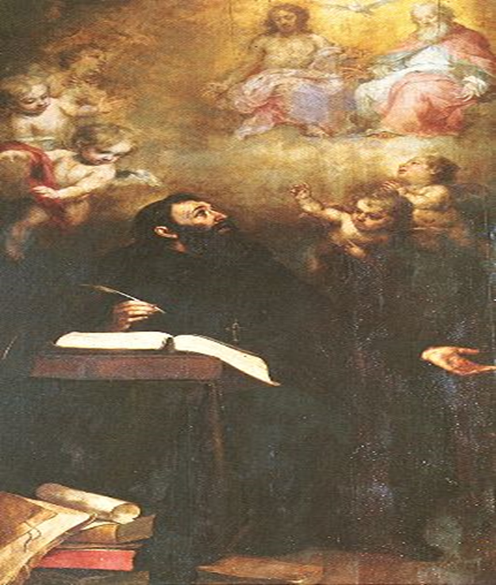
“A” Is For Augustine

Slide 56

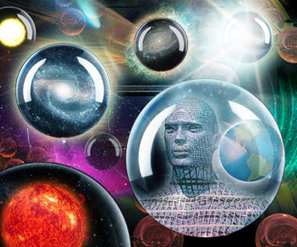
The Nature of Man

Slide 57
NATURAL LAW & NATURAL MAN
Paul’s Usage of the term Psuchikos Anthroopos
Biblically, in each of the five cases that “psuchikos” is used the term is contrasted with “pneumatikos” or with the spiritual. The contrast in 1st Corinthians 2: 14 is between a man inspired of God and one who has no such revelation (1Cor.2.12ff).
Paul seems to have adopted the Jewish understanding which denoted physical life as opposed to the supernatural life.

Slide 58
NATURAL LAW & NATURAL MAN
Paul’s Usage of the term Psuchikos Anthroopos
Paul seems to have adopted the Jewish understanding which denoted physical life as opposed to supernatural life.
The scriptural context of the Biblical term, “psuchikos anthroopos” is inspiration not salvation. The “natural man” tried to find, by his own wisdom, the “things” of God, but such must be revealed. Reference:
2nd Corinthians Chapter Two & Verse Ten

Slide 59
NATURAL LAW & NATURAL MAN
Paul’s Usage of the term Psuchikos Anthroopos
Paul seems to have adopted the Jewish understanding which denoted physical life as opposed to supernatural life.
The scriptural context of the Biblical term, “psuchikos anthroopos” is inspiration not salvation. The “natural man” tried to find, by his own wisdom, the “things” of God, but such must be revealed. Reference:
2nd Corinthians Chapter Two & Verse Ten

Slide 60
Augustine’s Theodicy
The Fall and Original Sin
Adam and Eve were made in the image of God: like God they were rational beings and had a moral nature
In their state of original blessedness, Adam and Eve, like the angels, had free will, and could choose to do what is good, and had the ability not to sin.
They were also blessed more with gifts of immortality & an immediate knowledge of God.

Slide 61
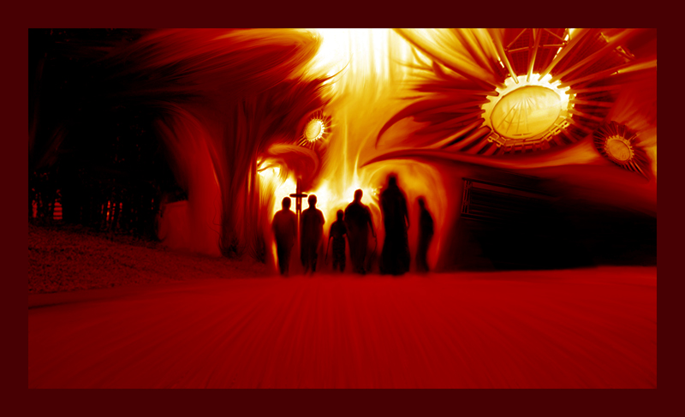
  THE NATURE OF EVIL:
  Chaos in the Moral Order

Slide 62
Augustine’s Theodicy
The Fall and Original Sin
Evil first appeared among those creatures who had free will
The Fall:
  First some angels rebelled against the God, the Supreme Good
  These fallen angels in turn tempted Adam and Eve to rebel against God

Slide 63
ORIGINAL STATE INNATE CORRUPTION
ORIGINAL STATE INNATE PERFECTION
Versus

Slide 64
Augustine’s Theodicy
The Fall and Original Sin
Consequences of Adam and Eve’s Sin
  The image of God in Adam & Eve was damaged, although not destroyed
  Because of their sin, Adam and Eve became less real, had less being and less goodness
    Became less human
  Augustine believed human nature was transmitted in the sexual act. The corruption of Adam’s moral nature and the guilt of his sin (= Original Sin) was passed on to his children through his seed, and so on to all subsequent generations
    Baptism removes the guilt of the Original Sin, but not the corruption of the human moral nature

Slide 65
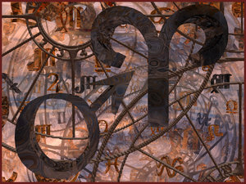
Ideological Development: Christian Religion
Julian Defended Origen Against Augustine:
“[God] it is, you say who judges in this way; he is the persecutor of newborn children; he it is who sends tiny babies to eternal flames. It would be right and proper to treat you as beneath argument: you have come so far from religious feeling, from civilized feeling, so far indeed from mere common sense, in that you think that your Lord is capable of committing a crime against justice such as is hardly conceivable even among the barbarians.”

Slide 66


David Lee Burris:
Christian Emperor Theodosius invited Thessalonians to free games but sent his troops into the circus with orders to kill the 10,000 men, women, and children.
“The first recorded instance of Christians killing Pagans occurred shortly after {status change year 313}. In short order, the militant church extended its power by conquering lands & peoples throughout Europe, compelling them to become baptized Christians or die… As Charlemagne instructed his Christian troops in their conquest of the Saxons: ‘If there is anyone of the Saxon people lurking among them unbaptized, and if he scorns to come to baptism & stay a pagan - let him die’”.
Original Error @ ORIGINAL SIN
Inter-Generational Sinful Consequence (Exodus 34: 7)
Not Sin Inherent - Or - Guilt Imputed
(Ezekiel 18: 19 – 32)
- Gregory Boyd, Myth Of A Christian Nation
JESUS REVISITS MISCONCEPTION @JOHN 9: 1 - 5

Slide 67
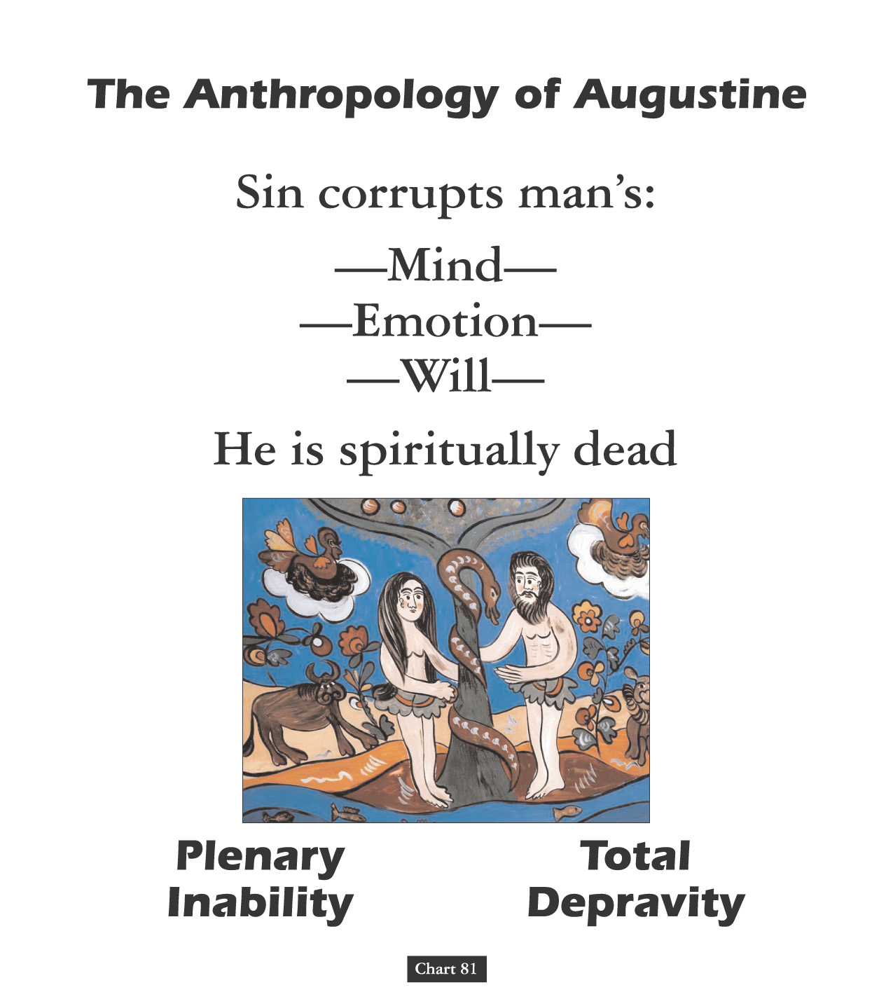

Slide 68
Augustine’s Theodicy
The Fall and Evil
Consequences of Adam and Eve’s Sin (“Original Sin”) for humanity:
  Death: loss of the gift of immortality
  Ignorance: loss of the knowledge & intimacy with God
  Moral Evil:
    Corruption of our moral nature, causing loss of the inner harmony between reason and the passions.
    The passions now dominated rational thought (concupiscence), inclining one to sin.
    The ability not to sin was replaced by an inability not to sin.
    This corrupted moral nature and the guilt of the original sin is bequeathed to our progeny
  Natural Evil:
    Part of God’s punishment for Adam’s and Eve’s sin:
      “nature red in tooth and claw”
      Earthquakes, storms, etc.

Slide 69
David Lee Burris:
Christian Emperor Theodosius invited Thessalonians to free games but sent his troops into the circus with orders to kill the 10,000 men, women, and children.
C. S. LEWIS @FALLEN NATURE:
VERTICAL CONSCIOUSNESS & COMMUNION
“The first recorded instance of Christians killing Pagans occurred shortly after {status change year 313}. In short order, the militant church extended its power by conquering lands & peoples throughout Europe, compelling them to become baptized Christians or die… As Charlemagne instructed his Christian troops in their conquest of the Saxons: ‘If there is anyone of the Saxon people lurking among them unbaptized, and if he scorns to come to baptism & stay a pagan - let him die’”.
“That man in a perfect state of living to bring glory to God and having dominion over all the things including physical functions and animals, attempts to assert his own will against God’s and thus is reduced to living by the rules of nature and not by the spirit. So, a new type of “man” sinned himself into being. A man who lives according to the rules of nature.”
- Gregory Boyd, Myth Of A Christian Nation

Slide 70
  THE NATURE OF EVIL:
  Evil as Part of Our Nature

Slide 71
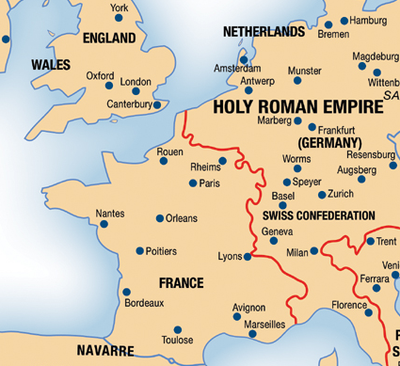
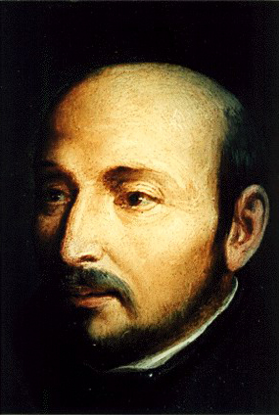
PROPAGANDA AND/OR COERCION
The Roman Church had two weapons of coercion to back up the propaganda of the Jesuits - the Inquisition and the Index. The Index was a list of books the faithful were not permitted to read. It was called the Roman Index of Prohibited Books & a special Congregation of the Index, created in 1571, was charged by the pope with the task of keeping the list up-to-date.
1534
Ignatius Loyola

Slide 72

2. The Story Of Human History: From Simple To Complex Truth
Product Of Pain Purposed Torture
Judicial Ordeal

Slide 73
Backgrounds Of The Inquisitions. Foundations for the Inquisitions were laid down before the actual persecutions actually began. The Inquisitions were, in fact, an attempt on the part of the Medieval Church to exterminate heresy. The Church in the ancient period of its existence had dealt with heretics in different ways: some were put to death; some were exiled by Imperial command; and others were excommunicated from the Church without exile. The repressive measures became more severe as time continued, until they culminated in the 13th century into very drastic measures. Schaff says, ‘The measures for the repression and extermination of heresy culminated in the organized system, known as the Inquisition.’
- Morris Womack, The Church Through The Ages

Slide 74
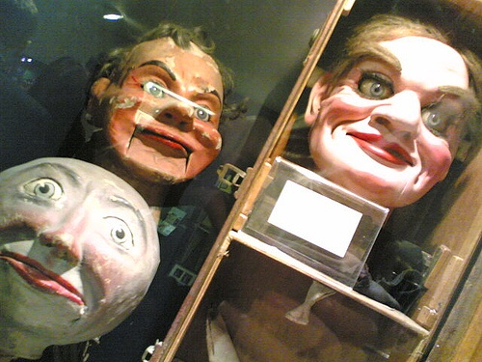
The Source Of Inquisitions. It has been argued that the Church didn’t actually put the victims to death; the Church only excommunicated them. This is nothing more than a rationalization. For the Church authorities knew that the civil authorities would put to death those who were excommunicated. Furthermore, it has been suggested that the Inquisitions were never intended for the populace who were not members of the Church. But, it should be remembered that the Roman Church had authority over all persons – Christian and non-Christian. Thus, anyone who did not follow the dictates of the Church may have stood in jeopardy.
“We relinquish him now to secular judgment and, by the authority which we wield, we not only condemn him as a heretic, but also we bind him with the chain of excommunication as fautors, receivers, and defenders of heretics all persons who knowingly henceforth either harbor or defend him or lend him counsel, aid or favor.”
- Morris Womack, The Church Through The Ages

Slide 75
Chapters Of The Inquisitions. In the first period, we find the State taking an active part in the punishment of heretics. Kings felt that a united Church was necessary for a united kingdom. Thus, many heretics were persecuted by the State and later put to death. ‘King Robert of France had thirteen heretics burned at Orleans in 1022; this is the first known case of capital punishment of heresy since the secular execution of Priscillia in 385.’ Yet, bishops entered into persecuting heretics prior to the 13th century. They did not hunt out heresy but punished those who were reported to them by the people; hence, they can’t rightly be called ‘inquisitors’ in the sense we use that term.
- Morris Womack, The Church Through The Ages

Slide 76
Chapters Of The Inquisitions. It was in 1185 that, Pope Lucius III, dissatisfied with the negligence of the bishops in pursuing heresy, ordered them to visit their parishes at least once a year, arrest all suspects, to reckon as guilty all who would not swear full loyalty to the Church and to hand over all such recalcitrants to the secular arm. Innocent III and Thomas Aquinas were two churchmen who advocated Inquisitorial actions & Frederick II and Louis IX were enlightened rulers who advocated it. Heresy, so the theory and definitions ran, was a crime the Church could not tolerate. It was Satan’s worst blow.
- Morris Womack, The Church Through The Ages

Slide 77
Methods & Penalties.
The accused were always presumed guilty till they proved their innocence; they were never confronted with their accusers; they could be made to testify against themselves; & could be tortured to extract a confession. If sentenced, they were punished by loss of property, imprisonment, or burning at the stake, unless they confessed & recanted. These punishments were carried out by the secular authorities under the watchful eye of the inquisitors.
- Earle Cairns, Christianity Through The Centuries

Slide 78
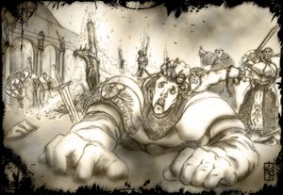
Church councils reduced The age of responsibility to 7 Yrs.
Starting at the age of 14, a boy or girl could be lawfully subjected to torture during interrogation.

Slide 79
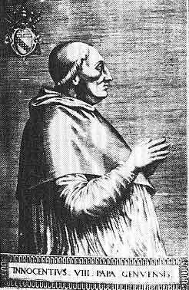
“The judge should promise that he will be merciful, with the mental reservation that he means he will be merciful to himself or the State; for whatever is done for the safety of the State is merciful.”

Slide 80
Pope Innocent IV: Ad Extirpanda
David Lee Burris:
Tribunals Operated Twenty Years Without Torture Common To Secular Court System; Recant Denial - Refused Testimony – Non-Cooperation Increasing
"Putting The Question"
* Papal Decree Of 1252 *
Permission For Utilizing Torture Procedural Investigation Of Truth

Slide 81
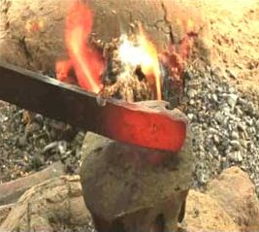

Slide 82

CONFIRM BY CAULDRON & HOT IRON
“God proves you are telling the truth either by outright protecting from injury the hand holding the hot iron, or the bare feet walking on hot plowshares, or by making the wounds heal quickly and cleanly, which is apparent when the bandaged limb or limbs are unwrapped and inspected three days after the ordeal.”
David Lee Burris:
Apologetic Defense In Analogy To O.T. Story Of Nebuchadnezzar’s Seven Fold Hot Fiery Furnace.
Source: Concise Book Of Lying

Slide 83
MEDIEVAL SETTING:
Order & Station

Slide 84

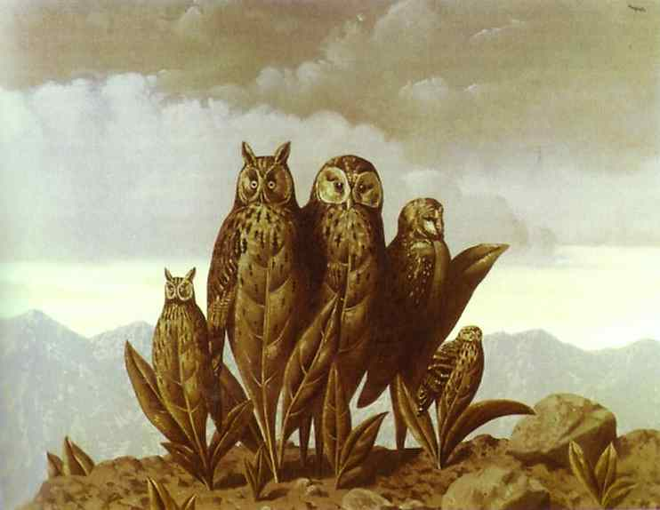
"Vestigium Dei"
“Latin for ‘vestiges of God,’ the view that there are vestiges, or evidences, of the one God in the created order and that God has revealed the divine being analogously in creation.”
* Dictionary Of Theological Terms, Grenz & Guretzki

Slide 85
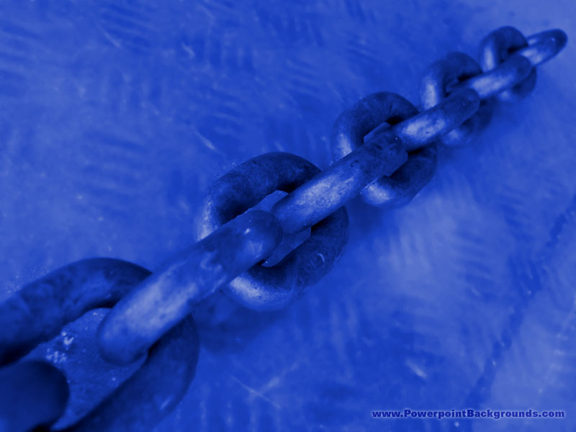
THE EUROPEAN CHAIN OF BEING

Slide 86
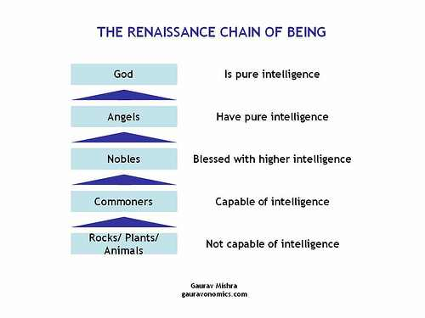
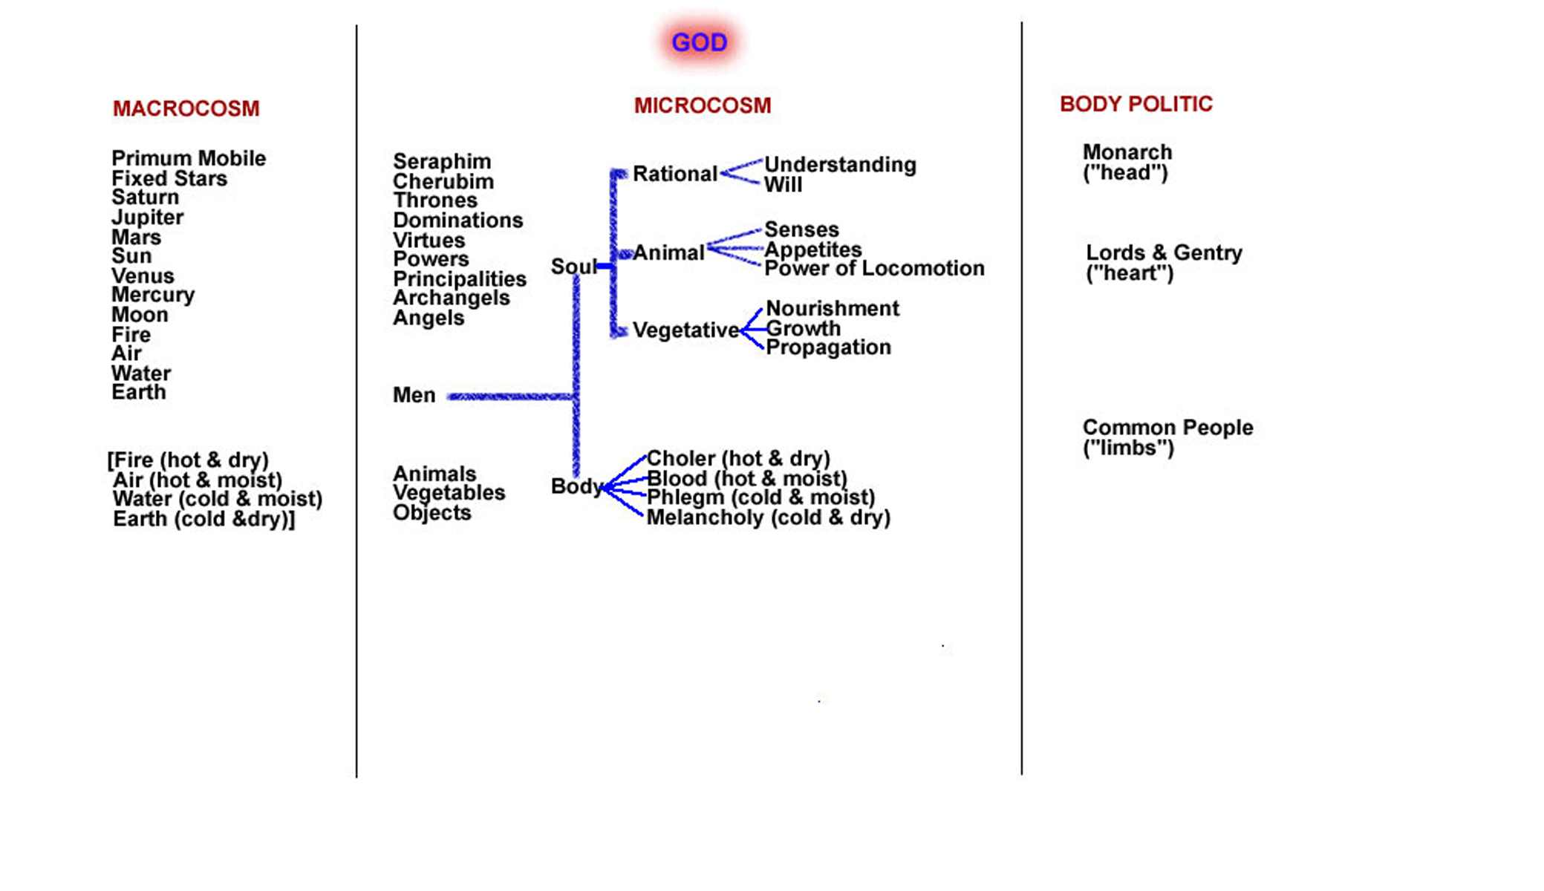

Slide 87
“THE CHAIN OF BEING”
In 1500, most European men and women were what we would call Roman Catholic, at least in western Europe. That was to change during the sixteenth century, thanks to the Protestant Reformation. Even in the 17th century, however, both Protestants and Catholics shared or reacted against a common set of assumptions dating back to the Middle Ages.
All European men, women, and children were taught about and, so far as we know believed in God. Atheists were virtually unknown; perhaps it wasn’t thought of, or perhaps it was just a very dangerous opinion to express. All Europeans believed, further that God created the universe, ordered it, and was active in its daily working.

Slide 88
“THE CHAIN OF BEING”
All European men, women, and children were taught about and, so far as we know believed in God. Atheists were virtually unknown; perhaps it wasn’t thought of, or perhaps it was just a very dangerous opinion to express. All Europeans believed, further that God created the universe, ordered it, and was active in its daily working.
‘There’s a special providence in the fall of every sparrow,’ as William Shakespeare would have it. A comprehensive metaphor, for it took into account God and all the creatures in his universe, was the one that later historians dubbed ‘The Great Chain of Being.’ When late medieval and early modern men thought about the universe, they thought of it as the Ptolemaic universe; that is, as a series of concentric spheres with Earth in the middle center.

Slide 89
“THE CHAIN OF BEING”
The Hierarchy of the Universe. In 1500, most people believed that, moving from the outer sphere inward, there were the stars, the planets, the sun, the moon, and the center, Earth. At the center of Earth were the flames of hell. This implies that they thought of a hierarchy arranged as follows: God, who dwelt everywhere but especially beyond the stars; angels, who traversed the heavens between God and man; man, who dwelt erect on the Earth; animals, on the Earth cut closer to it; plants, closer still; finally stones, which are literally on the Earth.
  Those at top of this hierarchy were closer to God than were those at the bottom. Thus, church steeples aspired to heaven. Thus, when one attends a royal palace, one ascends to meet the sovereign.

Slide 90
“THE CHAIN OF BEING”
The Hierarchy of the Universe. In 1500, most people believed that, moving from the outer sphere inward, there were the stars, the planets, the sun, the moon, and the center, Earth. At the center of Earth were the flames of hell. This implies that they thought of a hierarchy arranged as follows: God, who dwelt everywhere but especially beyond the stars; angels, who traversed the heavens between God and man; man, who dwelt erect on the Earth; animals, on the Earth cut closer to it; plants, closer still; and finally stones, which are literally on the Earth.
  The second thing about the Chain is that humankind is half-way down the Chain, suspended between the angels and the animals. Contemporaries thought that each rank in the Chain partook a little bit of the rank above it and below it. Therefore, man was both half angel and half beast.
  The third thing about the Chain is that, apart from God, each of the ranks in the Chain could be further divided. Thus, medieval theologians did not just think of angels. There are seraphim, cherubim, thrones, denominations, virtues, powers, principalities, archangels, and angels. The animal hierarchy, too, could be similarly divided. Is not the lion the king of the beasts? Is not the eagle nobler than the sparrow? Etc. And so, also with man.

Slide 91
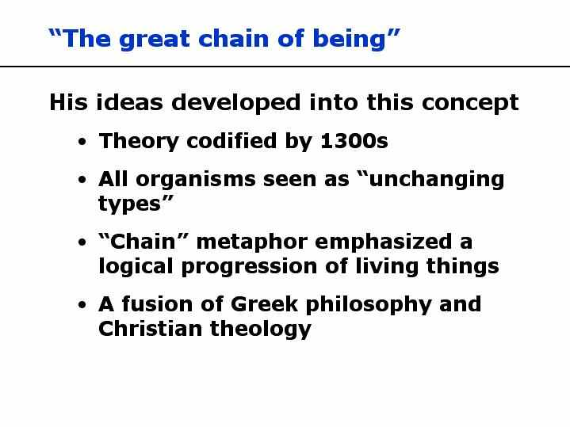

Slide 92
“THE CHAIN OF BEING”
The Higher & Lower Ranks of Man.
  The second thing about the Chain is that humankind is half-way down the Chain, suspended between the angels and the animals. Contemporaries thought that each rank in the Chain partook a little bit of the rank above it and below it. Therefore, man was both half angel and half beast.
  The third thing about the Chain is that, apart from God, each of the ranks in the Chain could be further divided. Thus, medieval theologians did not just think of angels. There are seraphim, cherubim, thrones, denominations, virtues, powers, principalities, archangels, and angels. The animal hierarchy, too, could be similarly divided. Is not the lion the king of the beasts? Is not the eagle nobler than the sparrow? Etc. And so, also with man.
  The fourth thing about the Great Chain of Being is that the top of the Chain is analogous to the head of the whole Chain: God himself. In other words, the king in the country, the father in the family, the lion among beasts, and, of course, the professor in the classroom all represent God and are placed at the top of their respective chains by God. They wield God’s power in his stead and so are to be obeyed as God himself.

Slide 93

RENAISSANCE REFORMATION

Slide 94

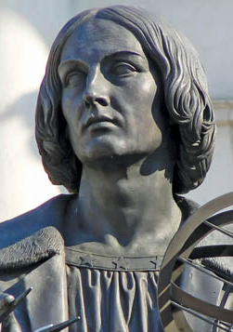
What’s at the Center?
Ancient Greeks had already suggested the possibility of a sun-centered universe.
Copernicus realized that a sun-centered universe made more mathematical sense than an earth-centered universe.
Copernicus
Notes:
Image: © laurent dambies

Slide 95
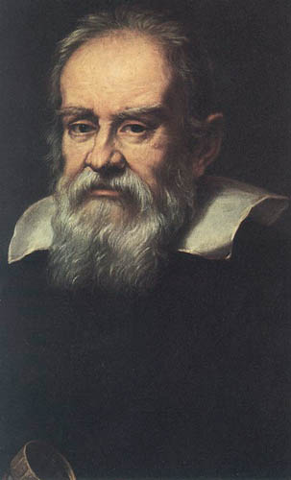
What’s at the Center?
Galileo carried
Copernicus’ ideas from
speculation to science.
Due to changes in the
political climate, the
Inquisition placed
Galileo on trial.
Some church leaders believed, based on Joshua 10: 12-13, that the sun moved, not the earth.
Galileo
Notes:
“Portrait of Galileo Galilei” by Justus sustermans (1597–1681)

Slide 96
INDUCTIVE THINKING
At the start of the 17th century, the Church’s authority over intellectual life was absolute!
Society considered science skeptical & Knowledge was classic & deductive.
By the end of the century, this status quo had been largely overthrown!

Slide 97
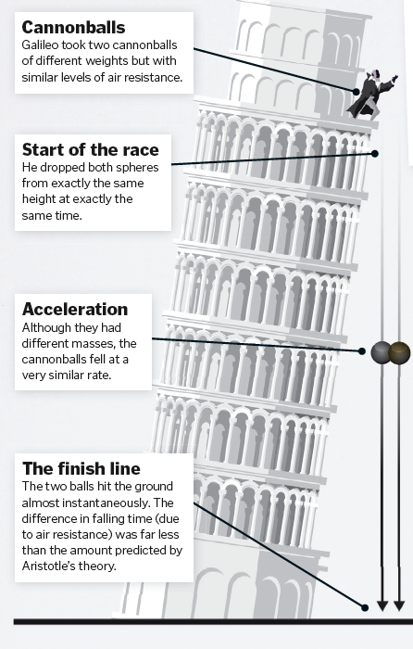
“A” Is For Aristotle

Slide 98
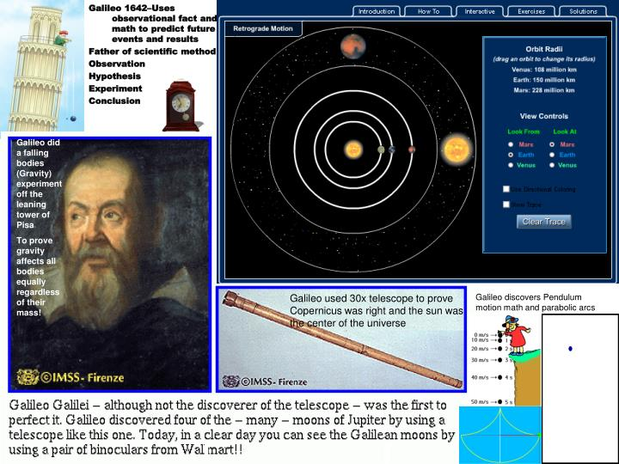

Slide 99
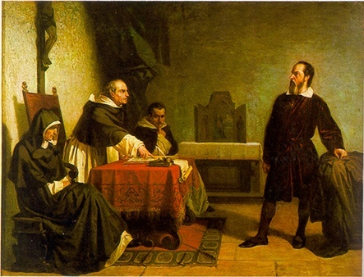
Pope (Exhausted):
It is clearly understood: he is not to be tortured.

Slide 100
(Pause ) Pope:
at the very most, he may be shown the instruments!

Slide 101
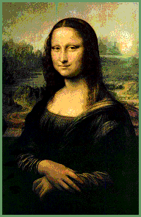
Inquisitor:
That will be adequate, your holiness. Mr. galileo understands machinery!

Slide 102
What’s at the Center?
However, the reason that
Galileo was convicted
was because he lied
under oath.
In the end, Galileo was
sentenced to house
arrest in a luxuriant villa.
There, Galileo carried out
scientific research for the remainder of his life.
Galileo
Notes:
“Portrait of Galileo Galilei” by Justus sustermans (1597–1681)

Slide 103
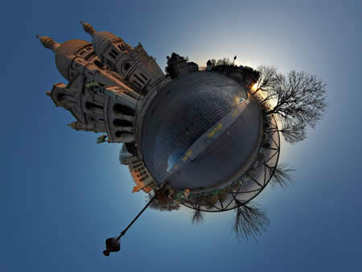
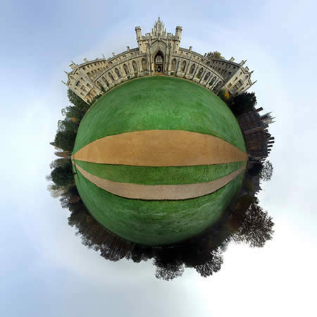
Worldview Collision

Slide 104
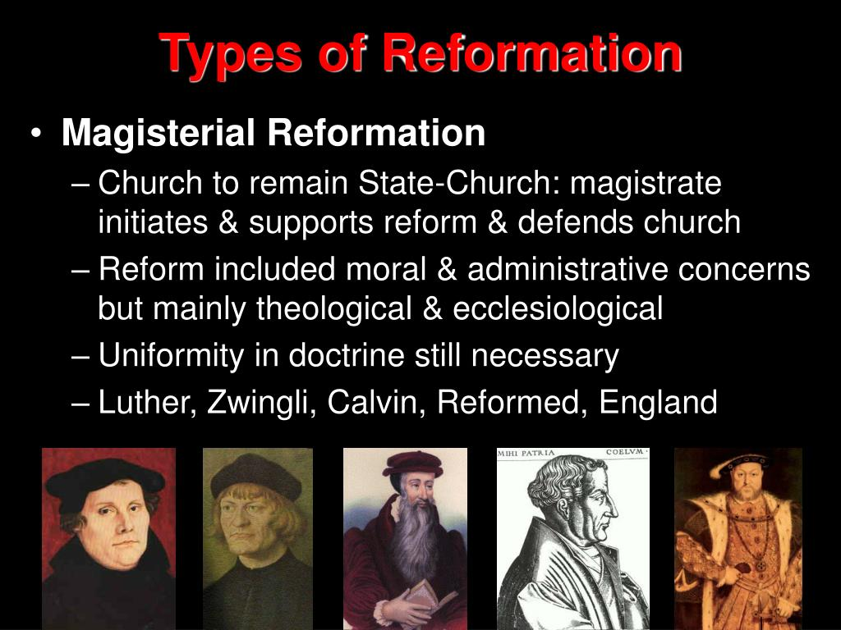

Slide 105
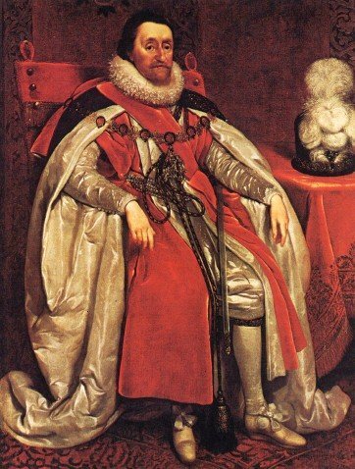
Meanwhile in England …
In 1604, King James I met with a group of reformers at Hampton Court.
These reformers wanted to purify the Church of England of all practices not found in Scripture.
As a result, they became known as “Puritans.”
King James I
Notes:
“King James I of England” by Daniel Mytens (1621)

Slide 106
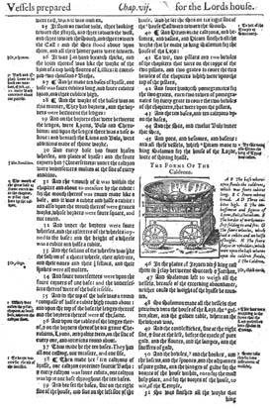
King James I and the Puritans
King James I disliked the Puritans’ Geneva Bible because of its Calvinistic study notes.
When one Puritan suggested a new Bible translation, James quickly agreed.
Geneva Bible with study notes

Slide 107
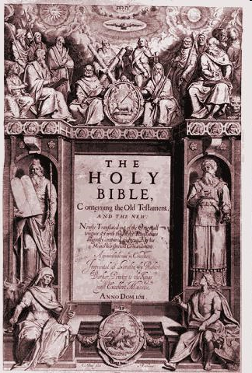
King James I and the Puritans
King James I gathered 54 scholars who worked 33 months on a new Bible translation.
For six years, six teams of scholars using the Textus Receptus, Bishops Bible, and Tyndale’s Bible, complete the new version in AD 1611.
King James’ translation of the Bible

Slide 108
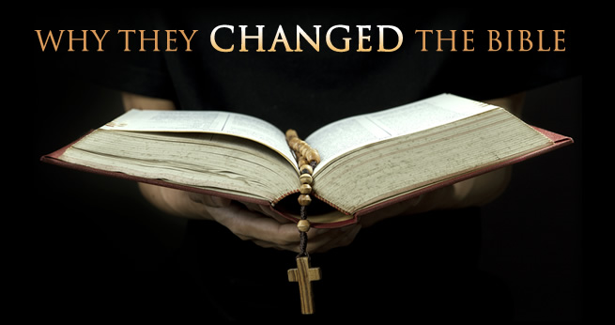
King James Did Not Use KJV!
David Lee Burris:
Calvin’s Emphasis On God’s Sovereignty & Our Ultimate Loyalty In Cases Caused Revolution!
King James Of The Puritans – “I shall make them conform or I will harry them out of the land, or else do worse.”
The Puritan & Calvinist heirs of the Reformation continued to use the Geneva Bible version. They would not have taken a KJV if given to them free. The King James version was a government publication purposed in part to deny common people those marginal notes written by both John Knox and Calvin. However, King James’s scheme did not work out for his descendants; Both the Puritan Pilgrims landing at Plymouth Rock that took their Genevas with them and those Puritan Roundheads who supported the Parliament during the English Civil War took to heart those terrible marginal notes in the Geneva qualifying – if not challenging – the undeniable “divine right of the King.”
James was a devout believer in the “divine right of kings”; This meant that since a king’s power came from God, the king then had to answer to no one but God.
James was a sodomite as well as a sadist. While King Of Scotland he assisted in the duress of the heretical examinations and supervised the peculiars & particulars of the tortures. History has it that James was also a great coward that “fouled his breeches in fear” around any serious swordplay.
In short, King James was the sort of despicable creature honorable men loathed, Christians would not associate with, and the Bible itself in the Old Testament orders to be put to death.
O.T. marginal notes in the Book of Exodus in the Geneva Bible and that in the entire 20th chapter of Leviticus - - especially bothered the king & his mother Mary.
Therefore, in an account corrected with his own hand - dated on February 10, 1604, he ordained:
“That a translation be made of the whole Bible & this to be set out & printed without any marginal notes.”

Slide 109

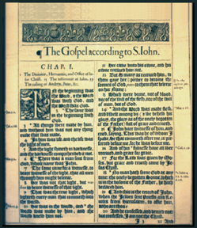
AD 1611
King James Version
The King James Version is also called the “Authorized Version,” even though King James never gave the finished version his royal approval. It uses the best known manuscripts available at the time and it is revised several times.
King James Bible
Page from 1611 version
1500 BC 500 BC AD 1 AD 500 AD 1000 AD 1500 AD 1900 AD 2000

Slide 110
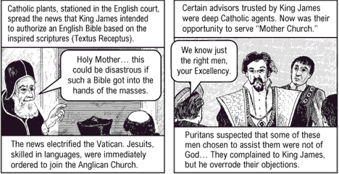
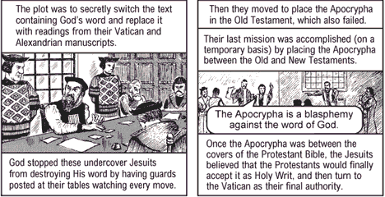
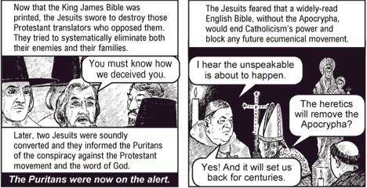

Slide 111
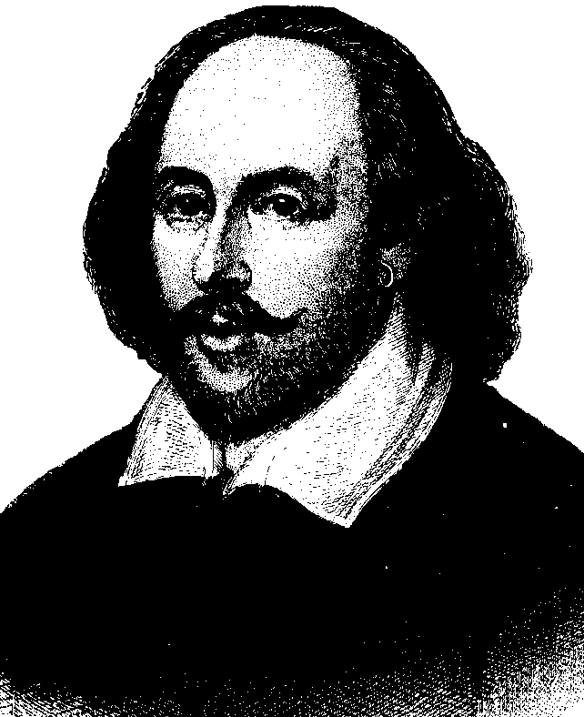
AD 1560
The Geneva Bible
This is the Bible of Shakespeare and the one carried to America by the Pilgrims in AD 1618.
The AD 1640 edition is the
first English Bible to omit
the Apocrypha.
William Shakespeare
1500 BC 500 BC AD 1 AD 500 AD 1000 AD 1500 AD 1900 AD 2000

Slide 112


Slide 113
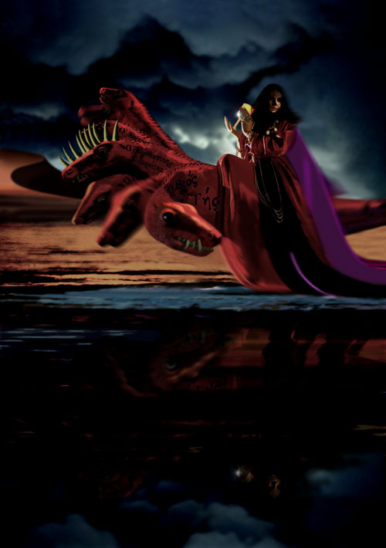
"Come out of her, my people..."

Slide 114
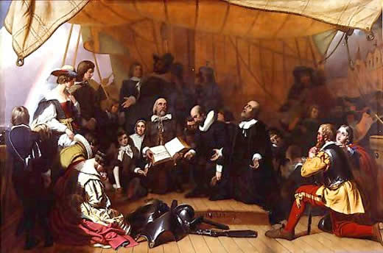
1618
Separatists (“Pilgrims”) reject the Church of England and sail to America on the Mayflower. Note: Separatist Sermons typical 7 hours
Later Puritans, who wish to cleanse the church,
arrive in
America
and start
colonies
Embarkation of the Pilgrims, Robert W. Weir, 1844
Secret Passage – King James Forbid Their Leaving!

Slide 115
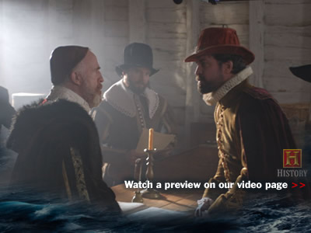
The Mayflower Compact
"In the Name of God, Amen.
We, whose names are underwritten,
the Loyal Subjects of our dread Sovereign Lord King James,
by the Grace of God, of Great Britian, France, and Ireland...
Having undertaken for the Glory of God,
and Advancement of the Christian Faith,
and the Honour of our King and Country...
A Voyage to plant the first colony
in the northern parts of Virginia..."
Embarkation of the Pilgrims, Robert W. Weir, 1844

Slide 116

Coming To America

Slide 117
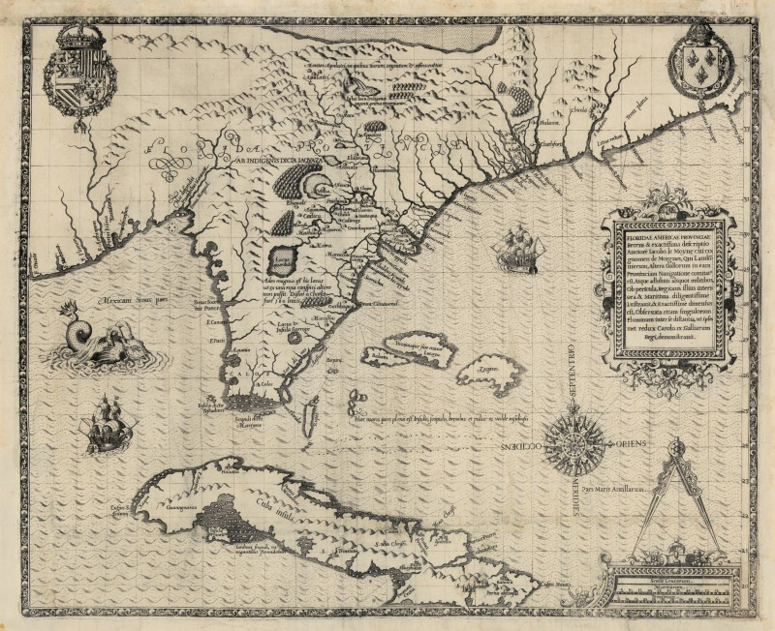
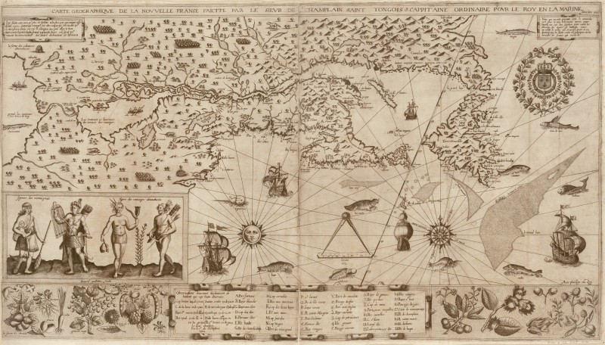
French Huguenots Are The
First To Colonize In Florida

Slide 118

INDIGENOUS
PEOPLES

Slide 119



Slide 120

Jamestown Factoid Trivia:
“After talking to local tribes, the English were convinced the name of the country was Wingandacoa which they wrote on all official paperwork. Later, they discovered this meant ‘You’ve got nice clothes’.’’

Slide 121


New Canaan Land? Indians Told Pilgrims:
David Lee Burris:
American Indians did not have a concept of religion as something separate from their approach to all aspects of life. Despite intertribal differences, most Indian spiritual ideas shared several characteristics and among them was a belief in a Great Spirit who presides over the whole world; English Account Of Causes Of The Rebellion - “It would appear that political liberty originated with the Iroquois Confederacy. Where else would an obedient Englishman get such an idea, anyway.”
“Mugwumps” – Mugwump was one of the Algonquian words in Elliot’s translation of the Bible, came into the American language in the 1880’s. In Elliot’s Bible a mugwump was a great chief, such as Joshua, Gideon, or Joab. Later New Englanders used the word in mockery for a self-conceited politician and then in general use from 1884 to mean an political independent.
Massachusetts Bay Colony Seal Had The Picture Of An Indian & The Words Of The Macedonian Call!
To teach the Indians about hell Spanish friars roasted live cats and dogs in a portable oven!
CHIEF JOSEPH LATER STATED:
"The white man's god gave
him dominion over the beasts,
the woods, and the red man,
for some special purpose,
but that destiny is a
mystery to the red man."
“We heard you were a
people that came from
under the world to take
our world from us!”

Slide 122
Objective
Observation:
Social Justice

Slide 123
New Canaan Land? Indians Told Pilgrims:
David Lee Burris:
American Indians did not have a concept of religion as something separate from their approach to all aspects of life. Despite intertribal differences, most Indian spiritual ideas shared several characteristics and among them was a belief in a Great Spirit who presides over the whole world; English Account Of Causes Of The Rebellion - “It would appear that political liberty originated with the Iroquois Confederacy. Where else would an obedient Englishman get such an idea, anyway.”
“Mugwumps” – Mugwump was one of the Algonquian words in Elliot’s translation of the Bible, came into the American language in the 1880’s. In Elliot’s Bible a mugwump was a great chief, such as Joshua, Gideon, or Joab. Later New Englanders used the word in mockery for a self-conceited politician and then in general use from 1884 to mean an political independent.
Massachusetts Bay Colony Seal Had The Picture Of An Indian & The Words Of The Macedonian Call!
To teach the Indians about hell Spanish friars roasted live cats and dogs in a portable oven!
SITTING BULL SPEAKS ABOUT THE WHITE MAN:
“The love of possession is a disease with them.
These people have made many rules that
the rich may break but the poor may not.
They take their taxes from the poor & weak
to support the rich and those who rule.”
“We heard you were a
people that came from
under the world to take
our world from us!”

Slide 124
Post-Renaissance PURITAN-PILGRIM

Slide 125


Slide 126
Puritans Win War

Slide 127

David Lee Burris:
Oliver Cromwell unleashed his Puritan armies to eliminate Christmas. For 18 years, Puritan firepower closed churches and forced shops to stay open. In 1647 an observer at an Oxford Christmas celebration noted – “…there was a world of skull-breaking, and at Ipswich the festival was celebrated by some loss of life.” The clash between the faithful and Cromwell’s Puritans saw the Mayor Of Canterbury beaten, during an anti-Christmas riot.
1642
Power struggles between Charles I and the English Parliament lead to civil war in England
Puritan Member of Parliament, Oliver Cromwell, defeated the king’s troops.
Later as Lord Protector, Oliver Cromwell sought tolerance for many Protestant groups.
Oliver Cromwell

Slide 128



1642
Power struggles between Charles I and the English Parliament lead to civil war in England
Puritan Member of Parliament, Oliver Cromwell, defeated the king’s troops.
Oliver Cromwell

Slide 129


Slide 130

1642
Power struggles between Charles I and the English Parliament lead to civil war in England
In the English Civil War (1642-1651), short hair was seen by some as a sign of rebellion and intolerance and long hair as a sign of vanity and a bourgeoisie perspective.
The war pitted the long-tressed royal army of Charles 1 against Oliver Cromwell’s close-cropped Puritan parliamentary forces (whom the Royalists simply called ‘roundheads’). Cromwell prevailed and so now the style is relatively short.

Slide 131

WHIGS & WIGS!

Slide 132
The history of wigs goes all the way back to antiquity. In ancient Egypt it was common to shave ones head and wear wigs because of the prevalence of head lice. Since only the Wealthy and Well Born could afford to do this, wigs became a status symbol. This picked up again during the Renaissance, when antiquity began to be rediscovered and explored anew. And once again, only the wealthy and well born could afford wigs. Thus what started out as a hygienic tool became a status symbol. Except for very high ceremonial and court functions, the use of wigs as fashion statements largely died out in the 1790s due to the French Revolution and the rise of republican simplicity as an alternative fashion statement.

Slide 133


THE KING JUDGED TRAITOR

Slide 134


Slide 135


Slide 136


Slide 137


Slide 138


Slide 139


Slide 140


Slide 141

DIVINE RIGHT OF KINGS ON TRIAL

Slide 142

1642
Power struggles between Charles I and the English Parliament lead to civil war in England
Puritan Member of Parliament, Oliver Cromwell, defeated the king’s troops.
The Execution vote was 68 to 67
Oliver Cromwell

Slide 143




Slide 144




Slide 145
John Harrington told us around about 1600. "Treason doth never prosper: what's the reason? Why, if it prosper, none dare call it treason."

Slide 146


Slide 147
Solzhenitsyn Said Centuries Later:
“Confronted by the pit into which we are about to toss those who have done us harm, we halt, stricken dumb: it is after all only because of the way things worked out that they were the executioners & we weren’t.”

Slide 148

1647
Westminster Confession is accepted as the statement of Presbyterianism in Scotland and England
Beginnings of
the Quaker movement
(the Society of Friends) under preacher
George Fox
George Fox

Slide 149
1647
The Westminster Confession is accepted as the statement of Presbyterianism in Scotland and England

Slide 150
The Westminster Catechism (excerpt)
Question 1: What is the chief and highest end of man?
Answer: Man's chief and highest end is to glorify God, and fully to enjoy him forever.
Question 2: How does it appear that there is a God?
Answer: The very light of nature in man, and the works of God, declare plainly that there is a God; but his Word and Spirit only do sufficiently and effectually reveal him unto men for their salvation.
Question 3: What is the Word of God?
Answer: The holy Scriptures of the Old and New Testaments are the Word of God, the only rule of faith and obedience.

Slide 151

David Lee Burris:
Oliver Cromwell unleashed his Puritan armies to eliminate Christmas. For 18 years, Puritan firepower closed churches and forced shops to stay open. In 1647 an observer at an Oxford Christmas celebration noted – “…there was a world of skull-breaking, and at Ipswich the festival was celebrated by some loss of life.” The clash between the faithful and Cromwell’s Puritans saw the Mayor Of Canterbury beaten, during an anti-Christmas riot.
1648
The Presbyterians in Parliament had not paid as much attention to the army as they should have; It was now Congregationalist in sentiment – an organization outlawed.
Congregationalist Cromwell ordered a Colonel Pride to “purge parliament’ in 1648. Thereafter, there was a rump rule under the new Lord Protector!
Oliver Cromwell

Slide 152
David Lee Burris:
Oliver Cromwell unleashed his Puritan armies to eliminate Christmas. For 18 years, Puritan firepower closed churches and forced shops to stay open. In 1647 an observer at an Oxford Christmas celebration noted – “…there was a world of skull-breaking, and at Ipswich the festival was celebrated by some loss of life.” The clash between the faithful and Cromwell’s Puritans saw the Mayor Of Canterbury beaten, during an anti-Christmas riot.
1653
CROMWELL DISSOLVES PARLIAMENT
“It is high time for me to put an end to your sitting in this place, which you have dishonored by your contempt of all virtue and defiled by your practice of every vice. Ye are a factious crew and enemies of all good government. Ye are a pack of mercenary wretches and would, like Esau, sell your country for a mess of pottage; and like Judas, betray your God for a few pieces of money. Is there a single virtue now remaining amongst you?”
Oliver Cromwell

Slide 153
David Lee Burris:
Oliver Cromwell unleashed his Puritan armies to eliminate Christmas. For 18 years, Puritan firepower closed churches and forced shops to stay open. In 1647 an observer at an Oxford Christmas celebration noted – “…there was a world of skull-breaking, and at Ipswich the festival was celebrated by some loss of life.” The clash between the faithful and Cromwell’s Puritans saw the Mayor Of Canterbury beaten, during an anti-Christmas riot.
1653
CROMWELL DISSOLVES PARLIAMENT
“Is there one vice you do not possess? Ye have no more religion than my horse! Gold is your God. Which of you have not bartered your conscience for bribes? Is there a man amongst you that has the least care for the good of the Commonwealth? Ye sordid prostitutes! Ye have grown intolerably odious to the whole nation. Ye, who were deputed here by the people to get grievances redressed, are your-selves become the greatest grievance.”
Oliver Cromwell

Slide 154
David Lee Burris:
Oliver Cromwell unleashed his Puritan armies to eliminate Christmas. For 18 years, Puritan firepower closed churches and forced shops to stay open. In 1647 an observer at an Oxford Christmas celebration noted – “…there was a world of skull-breaking, and at Ipswich the festival was celebrated by some loss of life.” The clash between the faithful and Cromwell’s Puritans saw the Mayor Of Canterbury beaten, during an anti-Christmas riot.
1653
CROMWELL DISSOLVES PARLIAMENT
“Your country therefore calls upon me to cleanse the Augean Stable, by putting a final period to your iniquitous proceedings in this House, and which by God’s help, and the strength He’s given me, I am come to do.”
“I command ye, therefore, upon peril of your lives, to depart immediately out of this Place. Go! Get out! Make haste, ye venal slaves, begone! So, take away that fool’s bauble there[referring to the Mace] and lock up the doors. Ye have stayed here too long for the good you do. In the name of God, go!
Oliver Cromwell

Slide 155

David Lee Burris:
Oliver Cromwell unleashed his Puritan armies to eliminate Christmas. For 18 years, Puritan firepower closed churches and forced shops to stay open. In 1647 an observer at an Oxford Christmas celebration noted – “…there was a world of skull-breaking, and at Ipswich the festival was celebrated by some loss of life.” The clash between the faithful and Cromwell’s Puritans saw the Mayor Of Canterbury beaten, during an anti-Christmas riot.
1648
The Presbyterians in Parliament had not paid as much attention to the army as they should have; It was now Congregationalist in sentiment – an organization outlawed.
Congregationalist Cromwell ordered a Colonel Pride to “purge parliament’ in 1648. Thereafter, there was a rump rule under the new Lord Protector!
“WARTS & ALL”
Oliver Cromwell

Slide 156


Slide 157


Slide 158
1658
The near anarchy after Cromwell’s death in 1658 led Presbyterians & Episcopalians to unite in restoring monarchy under King Charles II (1600-85).
Oliver Cromwell

Slide 159


children of charles ist
second

Slide 160


Slide 161


Slide 162


The Required Dress As To Station
Indicates Significant Moral Decline

Slide 163


Slide 164
1662
The newly passed Act of Uniformity & other severe mandates drove the party of the Puritans outside the Church of England. Separate Presbyterian, Congregational, and other churches were the result (all known as “Dissenters” from church establishment)
X
Oliver Cromwell

Slide 165

JOHN BUNYAN IS ARRESTED
WHILE IN PRISON WRITES
“PILGRIM’S Progress”
Charles II Conventicle Act Forbade Household Gatherings Of Five Excess

Slide 166


Slide 167
Puritan Pilgrims

Slide 168

From European Churches Of Territorial Treaty

Slide 169
Unto American Churches Of Official Religion

Slide 170

Similarities Between Henotheism Of Pagans & The Old World Church
Similarities Between Henotheism Of Pagans & Official Recognition Or AN ESTABLISHMENT OF RELIGION!

Slide 171
A henotheistic system worships one god, usually a national god that is committed to its people’s protection, although other gods are believed to exist.

Slide 172

Governor's Chair @ Colonial Church

Slide 173


Slide 174


Slide 175



Slide 176

ONE COLONIST, ROGER WILLIAMS,
VERY EARLY, ACTUALLY QUESTIONED
WHETHER THE ENGLISH HAD THE RIGHT
TO TAKE LAND FROM NATIVE AMERICANS

Slide 177


Slide 178


Thee Church Within The Church

Slide 179

1637
Antinomianism:
The doctrine that
faith in Christ
frees Christians
from obeying
Old Testament
moral law.
Anne Hutchinson on Trial
ANNE HUTCHINSON LEAVES TO LIVE IN ROGER WILLIAMS NEW COLONY OF RHODE ISLAND AT PEACE WITH THE LOCAL TRIBES & IN A CLIMATE OF TOLERATION

Slide 180


Slide 181


Slide 182
“The facts are as follows. The Mayflower colony at Plymouth Rock, Massachusetts, was a very homogeneous grouping of settlers that sought an utopia through a purist Anglican theocracy. These Pilgrim Puritans came here primarily for the freedom to run their own community. That included the freedom of the collective to coerce in matters of conscience. In other words, cultural pluralism was considered religiously incorrect. Catholics, Anabaptists, and even Quakers were religiously “cleansed” or physically removed. Socio-religious conformance was legally enforceable! However, there was another colony of Christians located at Jamestown, Virginia, that were a more heterogeneous people with more diversity of thought. At the Constitutional Convention the Madison and Jefferson Virginians joined forces with the Hamiltons of New York – a state which had recently incorporated religious toleration into its law. . .” - DLB

Slide 183
Between Renaissance & Enlightenment

Slide 184
Between Colonial Founding & American Revolution

Slide 185
Between Independence Declaration & Constitutional Convention

Slide 186
THE PLYMOUTH MODEL RECEDES

Slide 187


BEFORE PLYMOUTH ROCK
THERE WAS JAMESTOWN

Slide 188
THE JAMESTOWN MODEL PROCEEDS

Slide 189
David Lee Burris:
Religious Establishment Had Meant: Limiting citizenship to members of specific religious sects – Limiting public office to official church members – The employment & appointment of clergy by the state – The State ownership of church property – The licensing of religious ministers who did not belong to the official state church & the regulation of when and where those ministers could preach
From State Church Unto Freedom Of Conscience

