Slide 1
Puritan-Pilgrim Founder-Framer Worldview Shifts
By David Lee Burris

Slide 2
Church-State Worldview Shift
Medieval Worldview Setting
Old World Shift: Renaissance
Rebel Puritans & Exile Pilgrims
New World Shift: Enlightenment
Rebel Founders & Nation Framers

Slide 3




INTRODUCTION

Slide 4

What is a worldview?
“A worldview is an integrated, interpretive, set of confessional perspectives on reality which underlies, shapes, motivates, and gives direction and meaning to human activity.”
BJ van der Walt, The Liberating Message: A Christian Worldview for Africa, p. 39.

Slide 5
What is a worldview?
“A worldview is a set of presuppositions . . . which we hold (consciously or subconsciously) about the basic makeup of our world.”
-- James Sire

Slide 6
What is a worldview?
Everyone has a worldview whether one can explain it or not. It can be likened to a pair of glasses through which one views the world. It is important to have the right prescription or reality will be distorted. Modern man is faced with a supermarket of world views all of them claiming to be true.

Slide 7

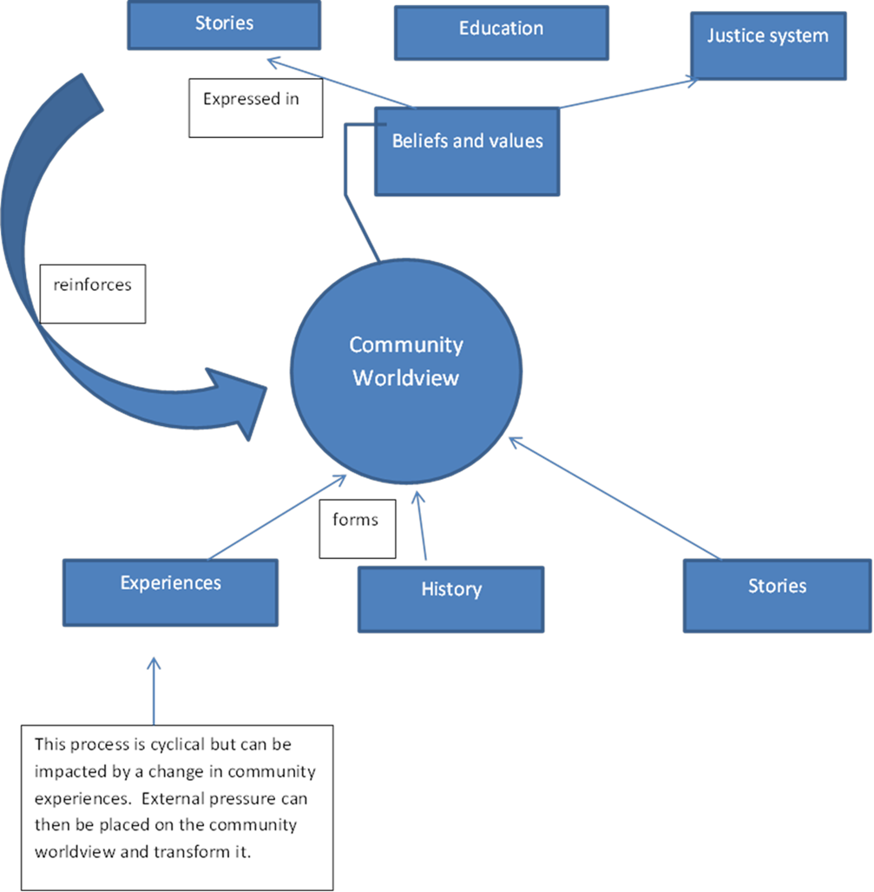
How are worldviews formed?

Slide 8

Axiological Analysis Of Values Views
Axiology: Transdisciplinary & Broad Field Research Resourced Of Cognitive Concepts @ Aesthetic – Epistemic - Ethical Construct

Slide 9
Axiological Analysis Of Values Views
Dictionary: “An area of inquiry that studies the nature, criteria, implications and applications of value judgments.”

Slide 10

Axial Model Between 200 - 600 B.C.
Lifeview: Personal Journey & Movement
PROCESS TRANSFORMABLE & PROGRESS INCOMMUNICABLE
From Lower To Higher Realm
From Knowledge To Wisdom
From Appearance To Reality
From Bondage To Liberation
From Confusion To Insight
From Darkness To Light

Slide 11
Axial Model Between 200 - 600 B.C.
Two Methods Of Inquiry:
Major Logic – Ontology
Major Logic – Epistemic
Minor Logic – Inductive
Minor Logic – Deductive

Slide 12
Axial Model Between 200 - 600 B.C.
Deliberate Structure Three Tier:
PROPOSITIONAL LOGIC
FORMALIZED PROOFS
TRUTH TREE MAPING

Slide 13
Axial Model Between 200 - 600 B.C.
Rationalists Theories Of Reality
Logically Inconsistent Deficiencies:
Self-Referential Incoherence
Self-Assumptive Incoherence
Self-Performable Incoherence

Slide 14
Axial Model Between 200 - 600 B.C.
Entered Evidence Irrelevant
AD VERICUNDIUM – An Appeal To Position
AD POPULUM – An Appeal To Popularity
AD BACULUM – An Appeal To Force
AD MISERICORDIAM – An Appeal To Pity
AD HOMINEM – Argument Personal Direct

Slide 15
Axial Model Between 200 - 600 B.C.
Evidential Category | Standard Measure
EXPERIMENT | UNEQUIVOCAL
RATIONALE | NON-CIRCULAR
AUTHORITY | RECOGNIZED
REVELATION | RELEVANCE

Slide 16
Axial Model Between 200 - 600 B.C.
THREE QUERIES RAISED:
What Can We Know?
What Ought We To Do?
For What Can We Hope?

Slide 17
Axial Model Between 200 - 600 B.C.
Worldview Answers Four Questions:
What Is Human Origin?
What Is Life’s Meaning?
What Is A Moral Action?
What Is Man’s Destiny?

Slide 18
Questions which reveal one’s worldview
Why is there something rather than nothing?
How do you explain human nature?
How do you know that you know?
What happens to a person at death?
How do you determine what is right or wrong?
What is the meaning of history?

Slide 19
Axial Model Between 200 - 600 B.C.
Viable Worldview Answers Adequate
WHAT KIND OF GOD,
IF ANY, EXISTS?
Ultimate Reality Question

Slide 20
Axial Model Between 200 - 600 B.C.
Viable Worldview Answers Adequate
IS THERE ANYTHING BEYOND THE COSMOS?
External Reality Question

Slide 21
Axial Model Between 200 - 600 B.C.
Viable Worldview Answers Adequate
WHAT CAN BE KNOWN &
HOW CAN WE KNOW IT?
The Knowledge Question

Slide 22
Axial Model Between 200 - 600 B.C.
Viable Worldview Answers Adequate
OF WHERE DID I COME?
The Origins Question

Slide 23
Axial Model Between 200 - 600 B.C.
Viable Worldview Answers Adequate
WHO AM I?
The Identity Question

Slide 24
Axial Model Between 200 - 600 B.C.
Viable Worldview Answers Adequate
WHERE AM I?
The Location Question

Slide 25
Axial Model Between 200 - 600 B.C.
Viable Worldview Answers Adequate
WHAT IS THE MEANING &
DIRECTION OF HISTORY?
Past/Present Question

Slide 26
Axial Model Between 200 - 600 B.C.
Viable Worldview Answers Adequate
WILL I SURVIVE THE DEATH OF MY BODY AND, IF SO, IN WHAT STATE?
THE DESTINY QUESTION

Slide 27
Axial Model Between 200 - 600 B.C.
Viable Worldview Answers Adequate
HOW SHOULD I LIVE?
The Morality Question

Slide 28
Axial Model Between 200 - 600 B.C.
Viable Worldview Answers Adequate
WHAT IS IT THAT I
SHOULD CONSIDER
OF GREAT WORTH?
The Values Question

Slide 29
Axial Model Between 200 - 600 B.C.
Viable Worldview Answers Adequate
WHAT IS HUMANITY’S FUNDAMENTAL PROBLEM?
PREDICAMENT QUESTION

Slide 30
Axial Model Between 200 - 600 B.C.
Viable Worldview Answers Adequate
HOW CAN HUMANITY’S
PROBLEM BE SOLVED?
RESOLUTION QUESTION

Slide 31
Naturalism Versus T heism

Slide 32


Slide 33
Ancient Wisdom for Modern Life
Ecclesiastes
It’s all a matter of perspective!

Slide 34
TWO VIEWS OF THE WORLD
Secularist
World
View
Theistic
World
View

Slide 35

SECULARIST
WORLDVIEW
A World view without God
Autonomous man
Pursuit of the earthly

Slide 36
Four Realities
A transitory life
+ A meaningless earth cycle
+ An inability to know all
+ Generational discontinuity
Frustration & Hopelessness!

Slide 37


Slide 38
Four Realities
A transitory life
+ A meaningless earth cycle
+ An inability to know all
+ Generational discontinuity
+ God In The Equation
What Is The Outcome?

Slide 39
The Theistic
WORLDVIEW
A world under God’s control
A trusting relationship with the Creator
Pursuit of the spiritual purposes of God

Slide 40
Four Realities
A transitory life
+ A wise God in control
+ A sovereign purpose to fulfill
+ Wisdom to guide us
Satisfaction & hope!

Slide 41
TWO VIEWS OF THE WORLD
Secularist
World
View
Theistic
World
View

Slide 42
Ancient Wisdom for Modern Life
Ecclesiastes
It’s all a matter of perspective!

Slide 43

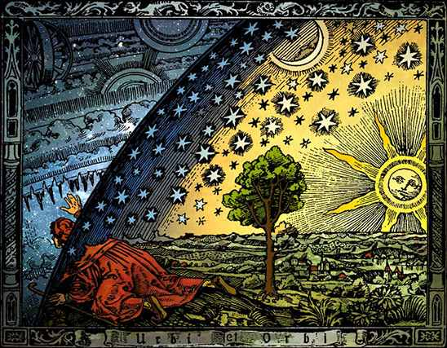

Slide 44

Enlightenment Shift
Human Nature Natural Law

Slide 45
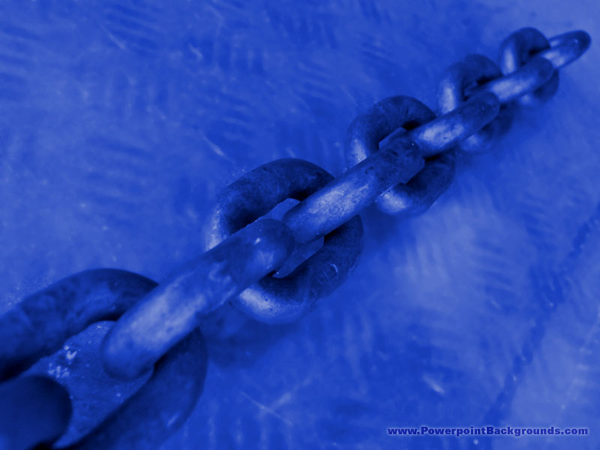
Enlightenment Rationalism:
Ideals Political & Religious
Intellectual Movement With Focus On Inner Self
Legitimate Authority Is Not Of Church Or Clergy
Reason vs. Revealed: Self - Defines & Discovers
Kant Religion: Moral Givenness / Imperative Duty
Theology : Experience-based - Subjective / Private
Descartes: Our Knowledge Of Divine Deductive
Locke Empiricism: All Knowledge Is Inductive
Labeled: “Scottish Common Sense Philosophy”
Know: Reflection, Reduction, Analysis, Analogy
Scottish Entitlement Theories : Politics & Religion
John Locke: “The Reasonableness of Christianity”

Slide 46
The Origins Of SOCIAL THEORY
Relations To Power & Religious Roleplay

Slide 47
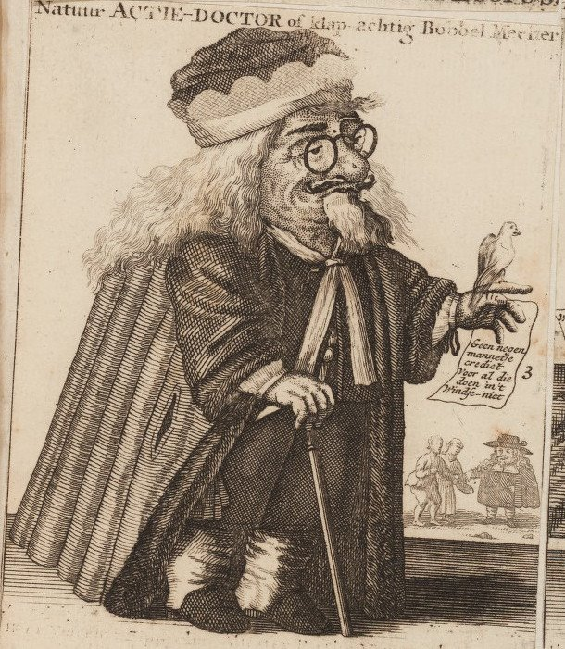
Royal Society Division:
Science Becomes Equal
Truth Searching Contender
Joining Philosophy & Religion

Slide 48
Western Practical Philosophy: Utility Theories Of The Good
Question: What Makes A Life A Good Life?
Paradigm Shift: Descriptive Not Normative.
Good Base Theory Of Derivative Hierarchy:
1. At the base are the things of genuine good value.
2. Actions are good in terms of whether they produce these things
of good category.
3. Actions motivated by attempt to produce the good are right acts.
4. Traits of character that result in right action are virtues.
Natural Law Majoritarian Jeremy Bentham;
Founder Equates “Desires” & “Oughts” In Utility:
“Nature has placed mankind under the governance of two sovereign
masters, pain and pleasure. It is for them alone to point out what
we ought to do, as well as to determine what we shall do…”

Slide 49

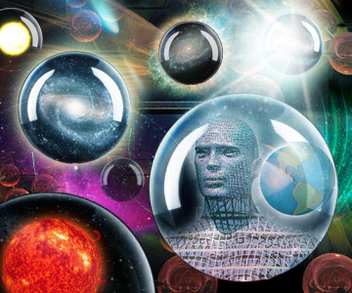
The Nature of Man

Slide 50
NATURAL LAW & NATURAL MAN
Paul’s Usage of the term Psuchikos Anthroopos
Biblically, in each of the five cases that “psuchikos” is used the term is contrasted with “pneumatikos” or with the spiritual. The contrast in 1st Corinthians 2: 14 is between a man inspired of God and one who has no such revelation (1Cor.2.12ff).
Paul seems to have adopted the Jewish understanding which denoted physical life as opposed to the supernatural life.

Slide 51
NATURAL LAW & NATURAL MAN
Paul’s Usage of the term Psuchikos Anthroopos
Paul seems to have adopted the Jewish understanding which denoted physical life as opposed to supernatural life.
The scriptural context of the Biblical term, “psuchikos anthroopos” is inspiration not salvation. The “natural man” tried to find, by his own wisdom, the “things” of God, but such must be revealed. Reference:
2nd Corinthians Chapter Two & Verse Ten

Slide 52
NATURAL LAW & NATURAL MAN
Paul’s Usage of the term Psuchikos Anthroopos
Paul seems to have adopted the Jewish understanding which denoted physical life as opposed to supernatural life.
The scriptural context of the Biblical term, “psuchikos anthroopos” is inspiration not salvation. The “natural man” tried to find, by his own wisdom, the “things” of God, but such must be revealed. Reference:
2nd Corinthians Chapter Two & Verse Ten

Slide 53
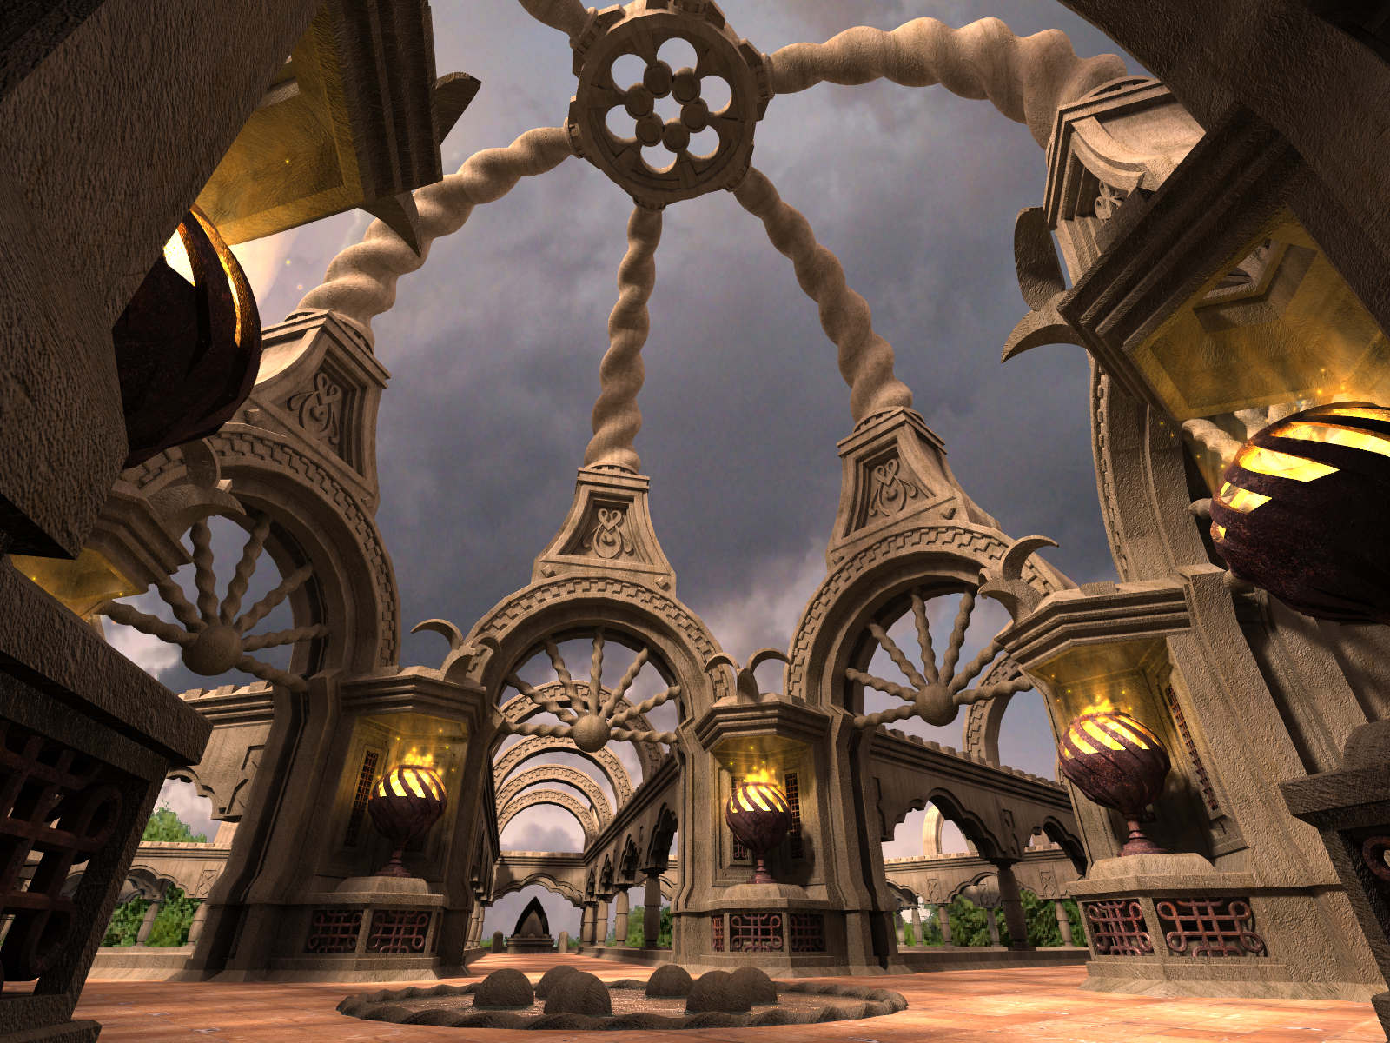
Natural Revelation
No Longer Same As

Slide 54
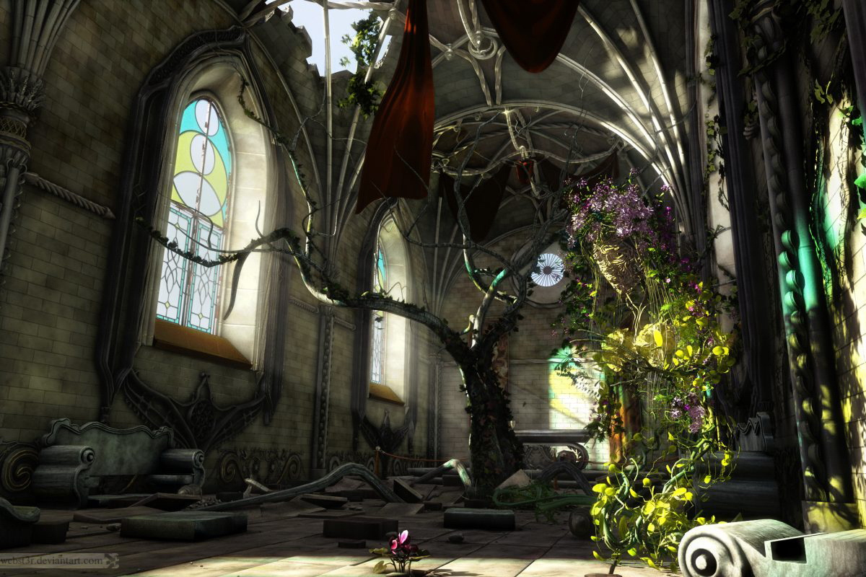

NATURAL LAW

Slide 55
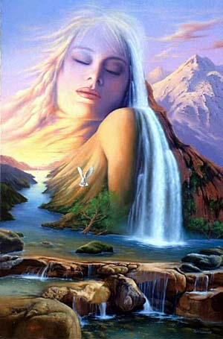
BLIND NATURE NOT BLIND JUSTICE

Slide 56
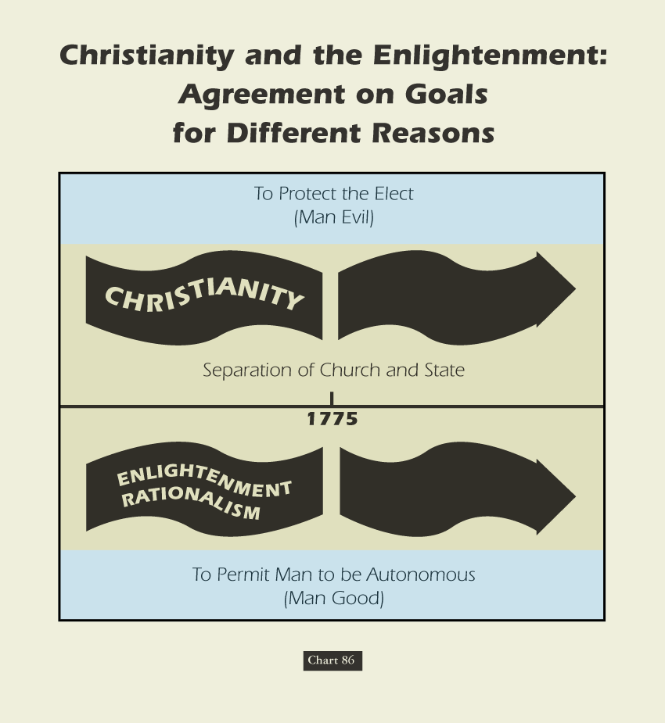

Slide 57
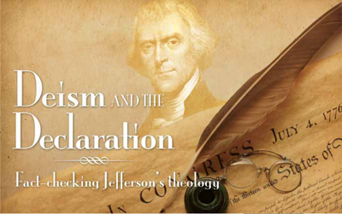

Slide 58

Revolution in Human Reason
Many Enlightenment thinkers embraced Deism.
Deism searched for a universal foundation on which all religions could agree.
Most Deists believed that a divine being had created the universe and natural laws, but this being was revealed to humanity primarily through the created order.

Slide 59
Revolution in Human Reason
Deists saw value in Jesus and in his teachings—but only as the supreme expressions of someone who lived and taught according to the laws that God had embedded in the natural order.
For such Deists, to be Christian was simply to live according to Christ’s ethics.

Slide 60
Revolution in Human Reason
Inspired by new possibilities of scientific reasoning, later thinkers developed new perspectives on how to seek and discover truth.
The result was the Enlightenment.
The Enlightenment focused on individual reasoning, words, science, and natural order.

Slide 61
Revolution in Human Reason
Individual reason was advocated in Western philosophy and cultural life as the primary source and legitimacy for authority:
  “With human reason and the five senses crowned as king, mystery—including the twin mystery of tradition and authority—is banished. A god who intervenes in human history is viewed as irrelevant.” Brian Hobbs
* Tom Hobbes’ utilitarian viewpoint
that came to be called “Hobbism.”

Slide 62
Enlightened Rationalism
The Enlightenment refers to the political and social theories that developed primarily in France during the 18th century.
John Locke, an Englishman, proposed the radical idea of natural rights.
Locke claimed that the purpose of government was to protect the natural rights of “life, liberty, and property.”

Slide 63
Human Nature

Slide 64
Calvin and (Thomas) Hobbes
Thomas Hobbes: Authored The Leviathan(1651)
Held the belief that people in a nutshell were stupid…
  Well intentioned, but stupid.
Citizens need a strong leader to tell them what to do.
  Given the chance, they will mess up society.
In nature…“no society; and which is worst of all, continual fear, and danger of violent death; and the life of man, solitary, poor, nasty, brutish, and short.”

Slide 65
All in the Fine Print..
Social Contract: An agreement among a society in order to cooperate for social benefits.
  Locke: People give up the right to enact justice in exchange for life, liberty and gain the right to impartial protection of property.

Slide 66
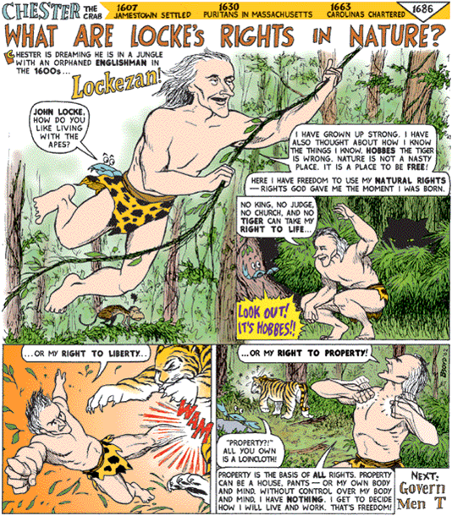

Slide 67
Two Treatises on Government, John Locke
1690 England (after Glorious Revolution); CONSTITUTIONALISM
In NATURAL STATE of MAN…
• People are naturally good & peaceful.
- Gov’t is largely unnecessary. Only need comes about because a very small # of people are not honest, and will steal.
- Person who was stolen from cannot set punishment, as they will take it too personal. Might want death for person who stole their bread.

Slide 68
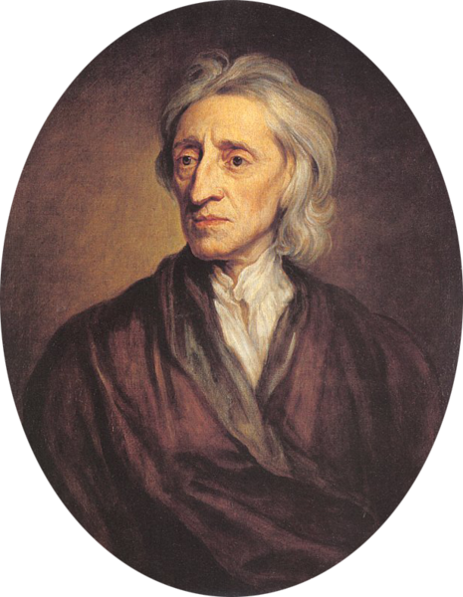
Life
Liberty
Property

Slide 69
Thus, to Locke, Government is created to settle disputes where individual people might act irrationally (like in a property dispute). Government’s job is to preserve people’s rights:
• Have NATURAL Rights: Life, liberty and Property
- Remember American Declaration of Independence? Life, liberty and happiness? Thomas Jefferson got it from Locke… in fact, Jefferson’s first draft said the 3 rights above… but property didn’t sound quite right as justification for revolt. Happiness was more idealistic.

Slide 70
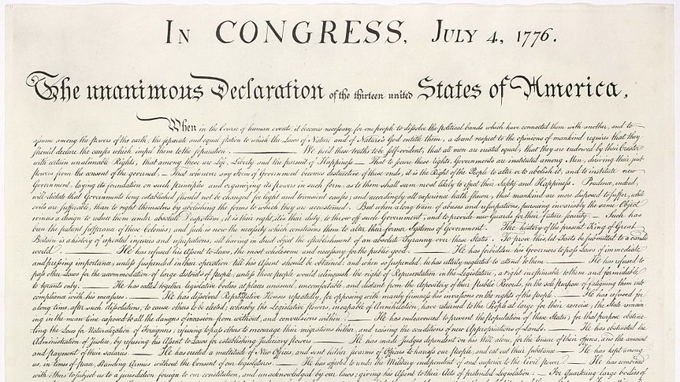
Right of
Revolution

Slide 71
Another Cool Thing About Locke...
• If gov’t. does not uphold their rights,
people have Right to Overthrow Gov’t
- Think about what this saying. In Absolutism, the king answers Only to God. Locke says that if a king doesn’t respect the wishes of his people, he’s out of a job. This was the idea behind Parliament appointing William and Mary… James II had not protected the rights of his people, so they (Parliament) had the right to depose him.
- Interestingly, the American colonists clung to this idea when it came time for independence. Seemed the British king wasn’t following Locke’s laws in 1760s/1770s, so they had a right to overthrow him.

Slide 72
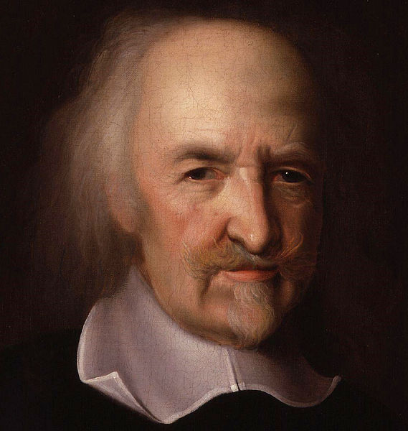
HOBBES
vs
LOCKE

Slide 73
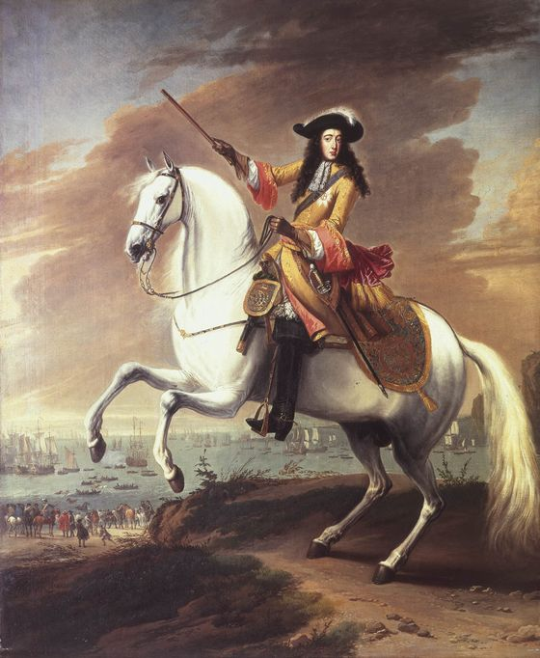
Backdrop
GLORIOUS
AND [ALMOST] BLOODLESS REVOLUTION

Slide 74
Thomas Hobbes
Leviathan (1651)
Defense of Philosophical Absolutism

Slide 75
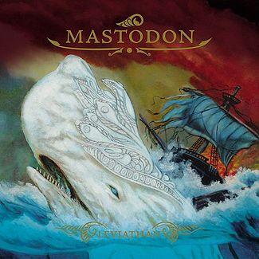

Slide 76
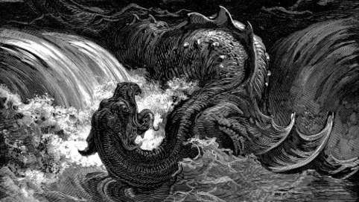
leviathan

Slide 77
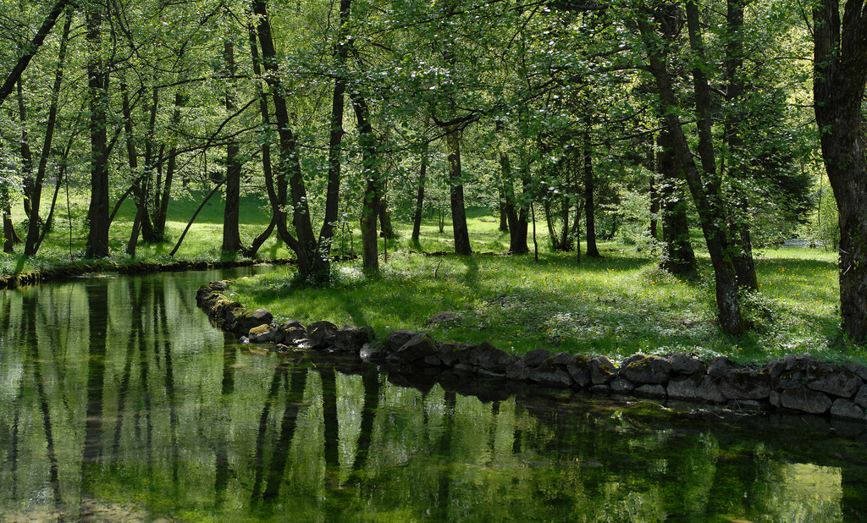
State of Nature
Some rights reserved by Rudolf Getel

Slide 78
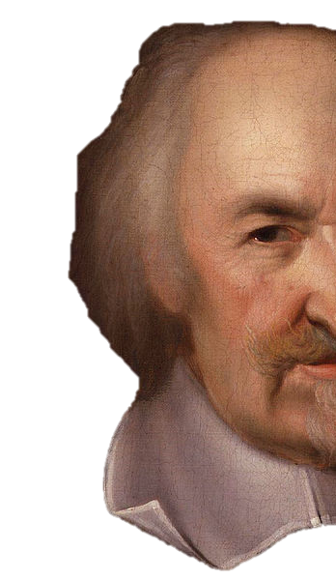
State of War
WAR OF ALL AGAINST ALL

Slide 79
State of War
bellum omnium contra omnes

Slide 80
Solitary
Poor
Nasty
Brutish
Short

Slide 81
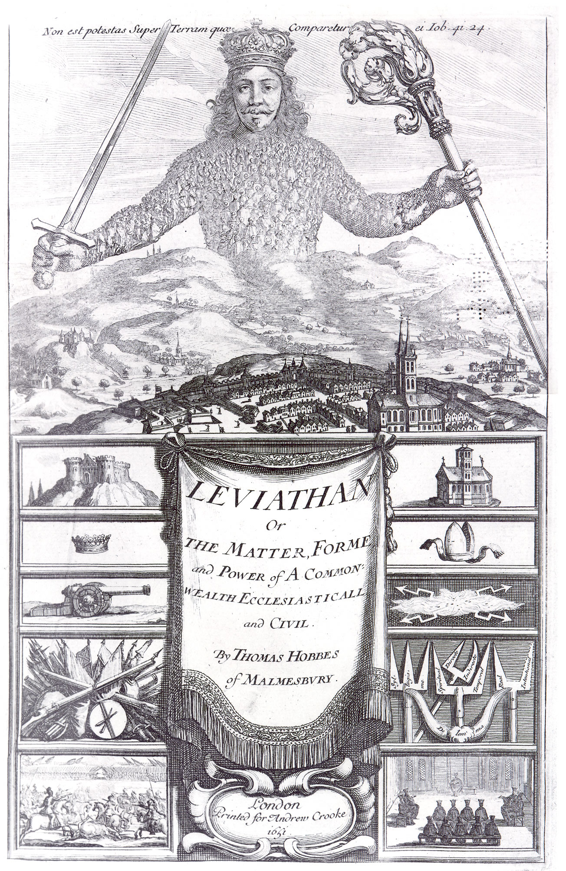
LEVIATHAN

Slide 82
Job 41
CLICK to Read

Slide 83
BEHOLD, THE HOPE OF HIM IS IN VAIN:
SHALL NOT ONE BE CAST DOWN
EVEN AT THE SIGHT OF HIM?
NONE IS SO FIERCE THAT DARE STIR HIM UP:
WHO THEN IS ABLE TO STAND BEFORE ME?

Slide 84
OUT OF HIS MOUTH GO BURNING LAMPS, AND SPARKS OF FIRE LEAP OUT.
OUT OF HIS NOSTRILS GOETH SMOKE, AS OUT OF A SEETHING POT OR CALDRON.

Slide 85
HIS HEART IS AS FIRM AS A STONE…

Slide 86
LEVIATHAN
A ruler should be powerful enough to be beyond challenge.

Slide 87
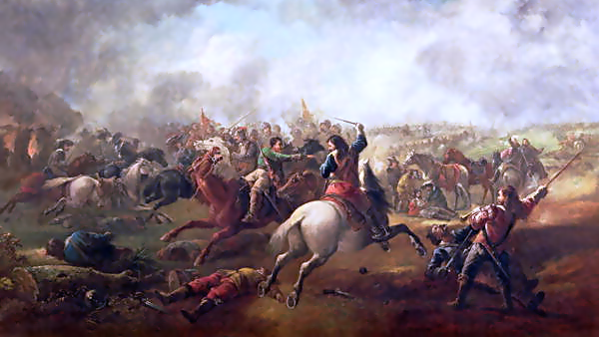
To keep us from destroying each other.

Slide 88
The Backdrop
Hobbes wrote Leviathan in the midst of the English Civil War

Slide 89

Hobbes vs. Locke
Question | HOBBES | LOCKE | Agree?
The Original State of Humankind
Divine Right or Social Contract?
State of NATURE
SOCIAL Contract
COMPARE (How are they similar?)

Slide 90
John Locke
Tw o Treatises
of Government (1689)
Defense of Constitutionalism

Slide 91
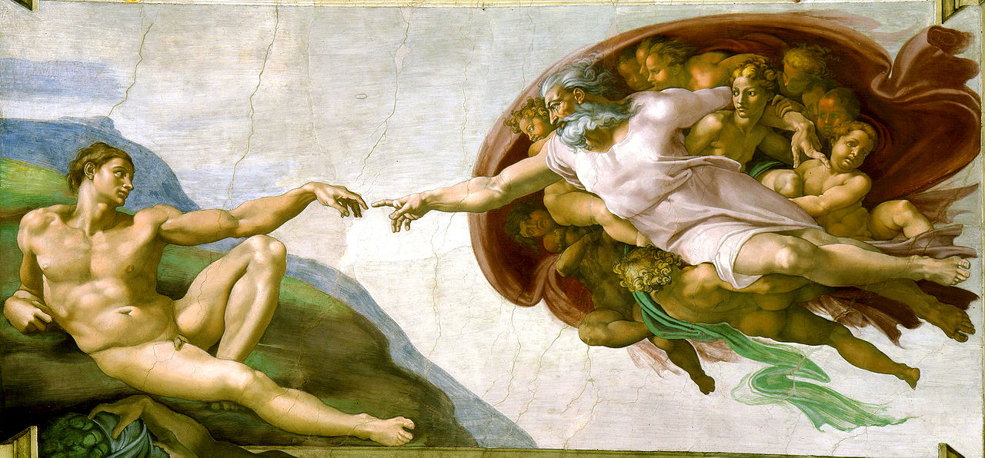
Natural Rights

Slide 92
Life
Liberty
Property

Slide 93
Right of
Revolution

Slide 94
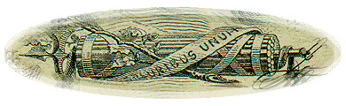
“When Thomas Jefferson, following John Locke, derived the doctrine of natural rights from natural law, he was more concerned with the power of transcendental statements than with their origin, divine or secular. In the Declaration of Independence he blended secular & religious presumptions in one transcendentalist sentence, thus deftly covering all bets: ‘We hold these Truths to be self-evident, that all Men are created equal, that they are endowed by their Creator with certain unalienable Rights, that among these are Life, Liberty, & the Pursuit of Happiness.’ That assertion became the cardinal premise of America’s civil religion & it endures as the central ethic binding together the diverse peoples of the U.S.A.”
- James Q. Wilson

Slide 95

Hobbes vs. Locke
Question | HOBBES | LOCKE | Agree?
WHY Government?
Where does sovereignty reside?
Can a government’s power be limited?
Right of REVOLUTION?
To Protect us
FROM OURSELVES
To Protect
NATURAL RIGHTS
The MONARCH
The PEOPLE
NO
YES
NO
YES
CONTRAST (How do they differ?)

Slide 96
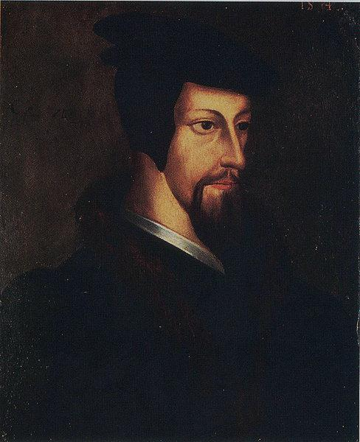
CALVIN & HOBBES
Questioning & Doubting Divine Right Of Kings & Divine Chain of Being!

Slide 97
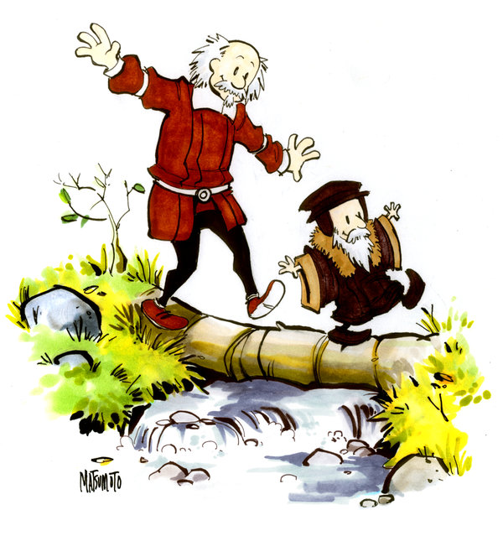

Slide 98
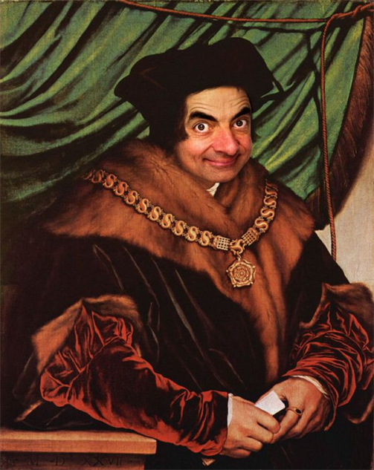
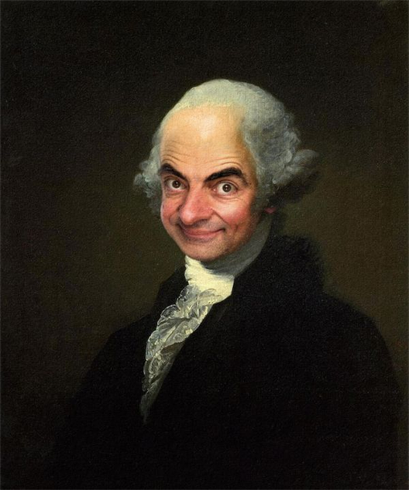

Slide 99
Enlightenment Shift FOUNDER-FRAMER

Slide 100
National Founders

Slide 101
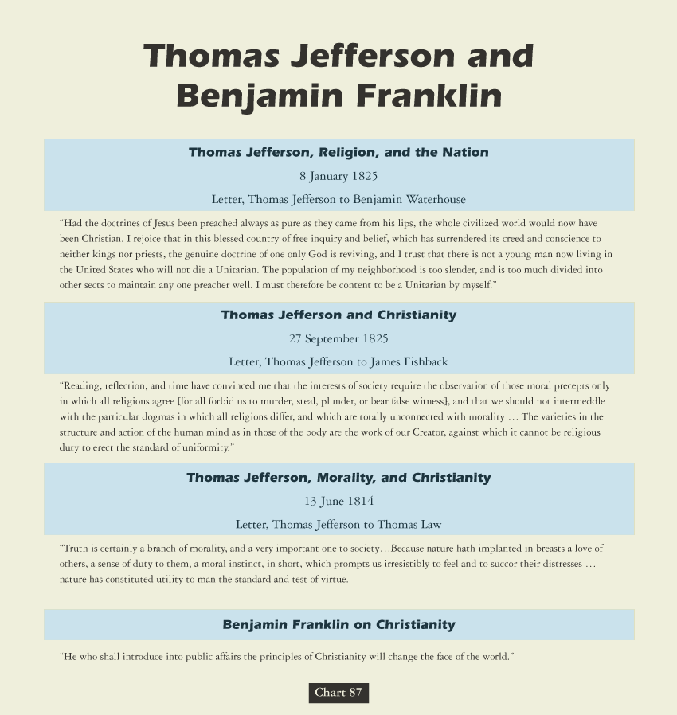

Slide 102
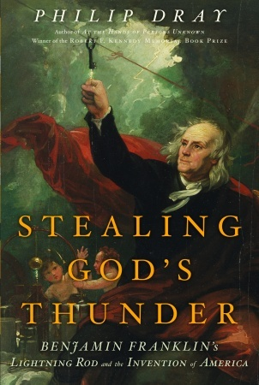

Slide 103
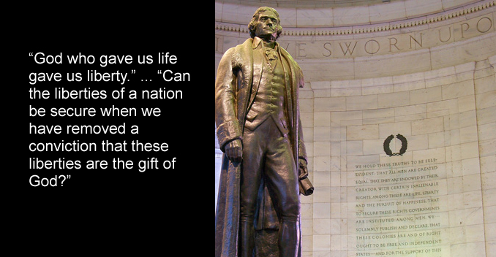

Slide 104
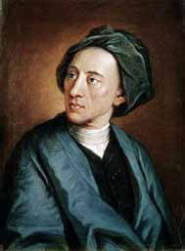
The poet Alexander Pope (1688–1744)
describes an 18th Century Deist as a
Slave to no sect, who takes no private
road, but looks through nature up to God.
Deists still needed God to explain the
origin of nature, the predictability of
the universe, the source of moral laws,
and the way to account for the
reasonability of reason.

Slide 105
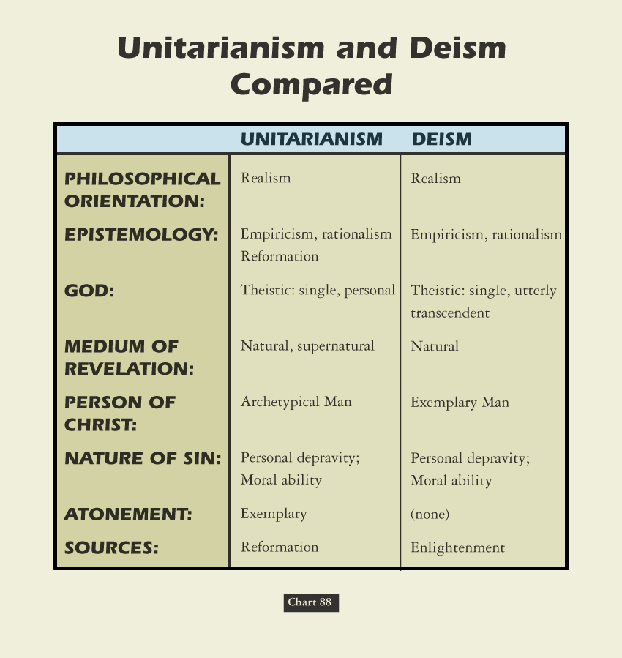

Slide 106
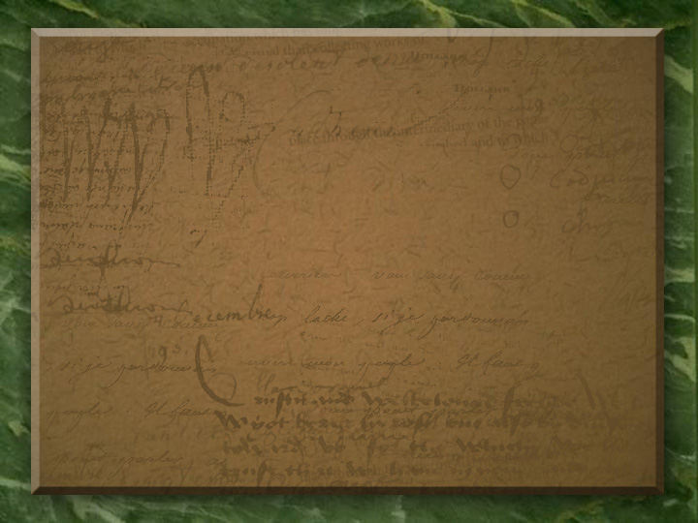
A LONG HABIT OF NOT
THINKING A THING BEING WRONG
GIVES IT A SUPERFICIAL APPEARANCE
OF BEING THOUGHT RIGHT.
- Thomas Paine

Slide 107
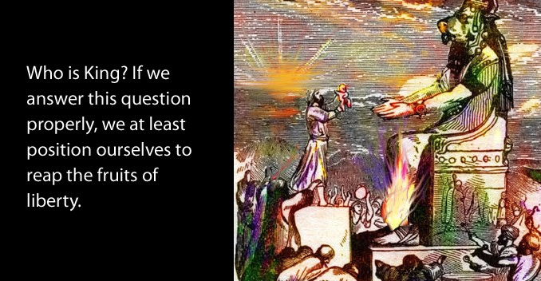

Slide 108
But it’s Paine who is most singled out as America’s true philosophical founder. Paine’s Common Sense did put forth arguments for independence from Great Britain, but how did Paine argue his case? What were his sources? Did he follow deistic lines of argumentation similar to those of the French revolutionaries? “He constructed his arguments from materials that were familiar to the average colonist, favoring allusions to popular history, nature, and scripture rather than Montesquieu, Tacitus, and Cicero.” There is no hint of Deism in Common Sense.
A. J. Ayer remarks that “the first argument that Paine brings against the institution of kingship is scriptural.” Paine declared that “government by kings was first introduced into the world by the Heathens, from which the children of Israel copied the custom. . . As the exalting of one man so greatly above the rest cannot be justified on the equal rights of nature, so neither can it be defended on the authority of scripture; for the will of the Almighty, as declared by Gideon and the prophet Samuel, expressly disapproves of government by kings. All anti-monarchical parts of scripture have been smoothly glossed over in monarchical governments, but they undoubtedly merit the attention of countries which have their governments yet to form. ‘Render unto Caesar the things which are Caesar’s’ is the scriptural doctrine of courts, yet it is no support of monarchical government, for the Jews at that time were without a king, and in a state of vassalage to the Romans.”

Slide 109
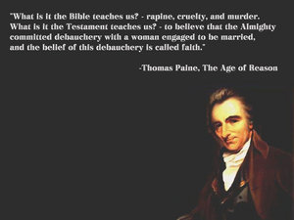

Founding Patriot
BROTHERHOOD
THEISTS & DEISTS

Slide 110
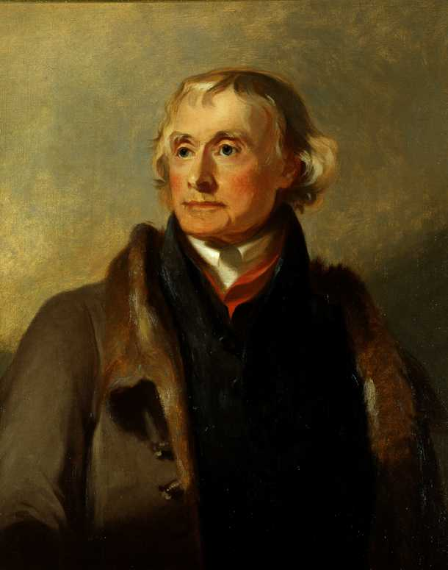
Jefferson Privately Compared Jesus
Christ to the Philosopher Socrates His Indian Bible Omitted Miracles

Slide 111
David Lee Burris:
EXITS: “Thomas Paine never complained about the intensity of his suffering during his last months, though the pain became so great at times he would cry out involuntarily ‘Oh, Lord help me!.’”
“In what might be called the period of incubation of reform-ideas, the first half of the 18th Century, the reformers were all Deists. The Encyclopedists who brought together and developed their ideas in the middle of the century were mostly Atheists, and, like Jefferson, who got his ideas from them, dogmatic Materialists. The leaders of the Revolution in its early constructive years, who first drew up a state-program of reform, also were mostly Atheists!”
- J. McCabe @ Christianity's social record

Slide 112
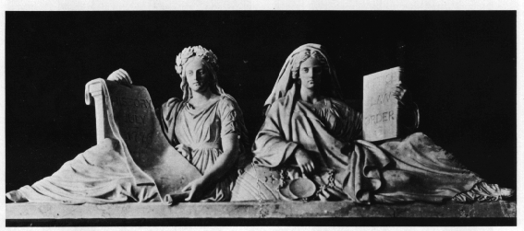
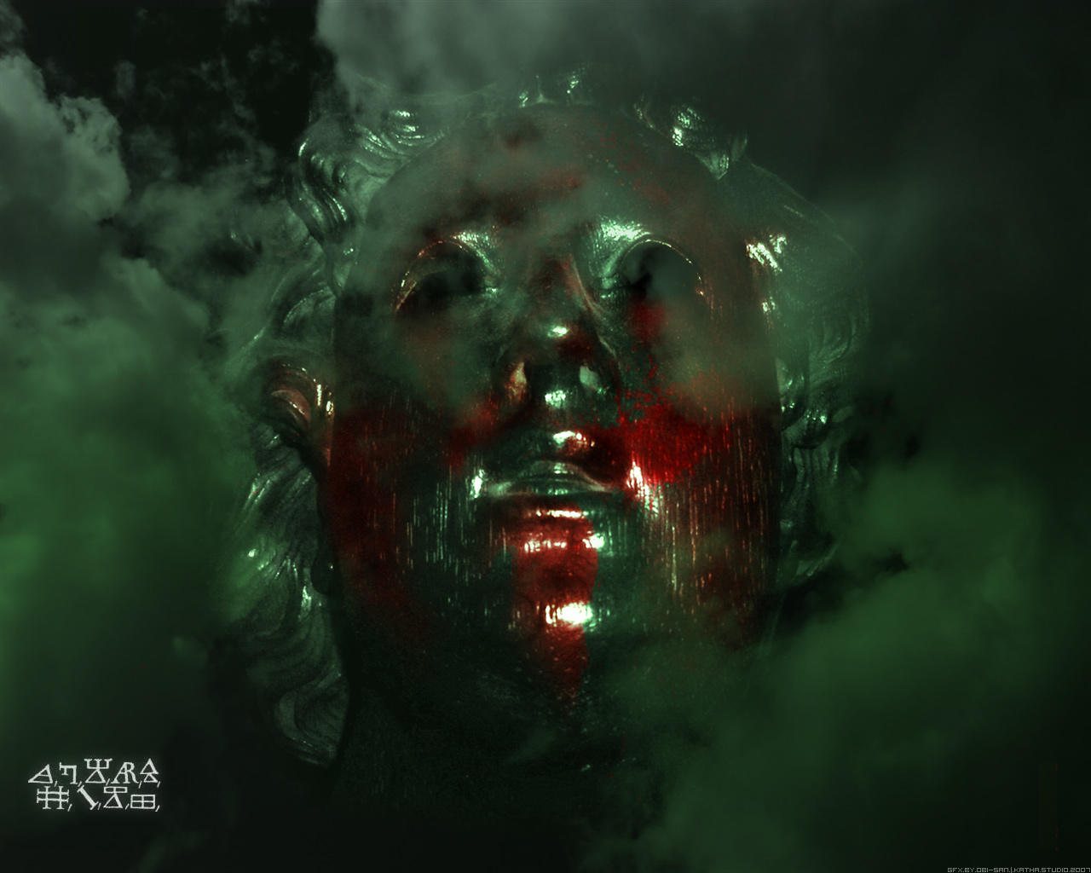
history intersects justice
The American Revolution

Slide 113

DEIST GOD ONLY OBSERVER:
“Freedom is never granted, it is won. Justice is never given, it is exacted… Freedom and justice must be struggled for by the oppressed of all lands and races and the struggle must be continuous…”

Slide 114
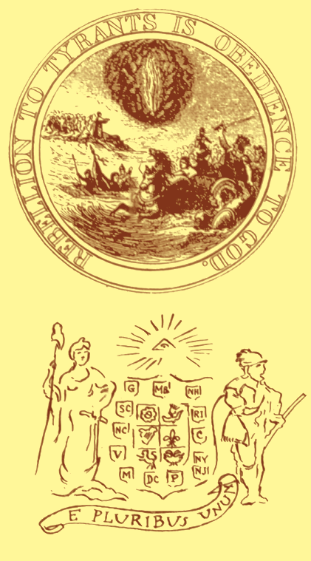
AN OBSERVER GOD!
“Resistance to tyrants is obedience to God!”
- Thomas Jefferson

Slide 115
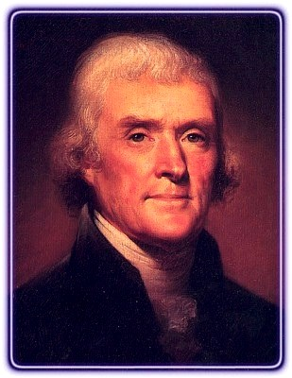
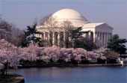
Jefferson Memorial
“Those who hammer their guns into plows, will plow for those who do not.” Thomas Jefferson
Thomas Jefferson
President 1801 -1809

Slide 116
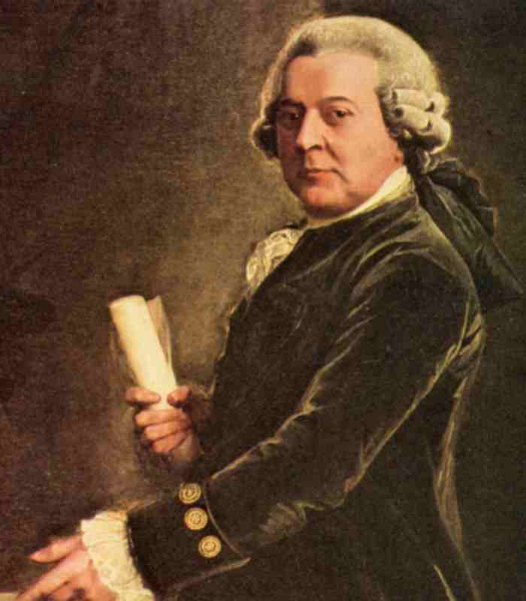

“Those who trade liberty for Security shall have neither.”
John Adams
John Adams
President 1797 - 1801

Slide 117

SELF-DETERMINATION

Slide 118
THIS LAND IS YOUR LAND
By Woody Guthrie
Sung by The Kingston Trio
Chorus:
This land is your land, this land is my land
From California, to the New York Island
From the redwood forest, to the gulf stream waters
This land was made for you and me
As I was walking a ribbon of highway
I saw above me an endless skyway
I saw below me a golden valley
This land was made for you and me
Chorus
I've roamed and rambled and I've followed my footsteps
To the sparkling sands of her diamond deserts
And all around me a voice was sounding
This land was made for you and me
Chorus
The sun comes shining as I was strolling
The wheat fields waving and the dust clouds rolling
The fog was lifting a voice come chanting
This land was made for you and me
Chorus (2x) Click to exit.

Slide 119

BRITISH BEATLES:
You say you want a revolution
Well, you know
We all want to change the world
You tell me that it's evolution
Well, you know
We all want to change the world
But when you talk about destruction
Don't you know that you can count me out?
You say you've got a real solution
Well, you know
We'd all love to see the plan
You ask me for a contribution
Well, you know
We are doing what we can
But if you want money for people with minds that hate
All I can tell is, brother, you'll have to wait

Slide 120
AN OBSERVER GOD?
Is resistance to
tyrants really an
obedience to God?

Slide 121
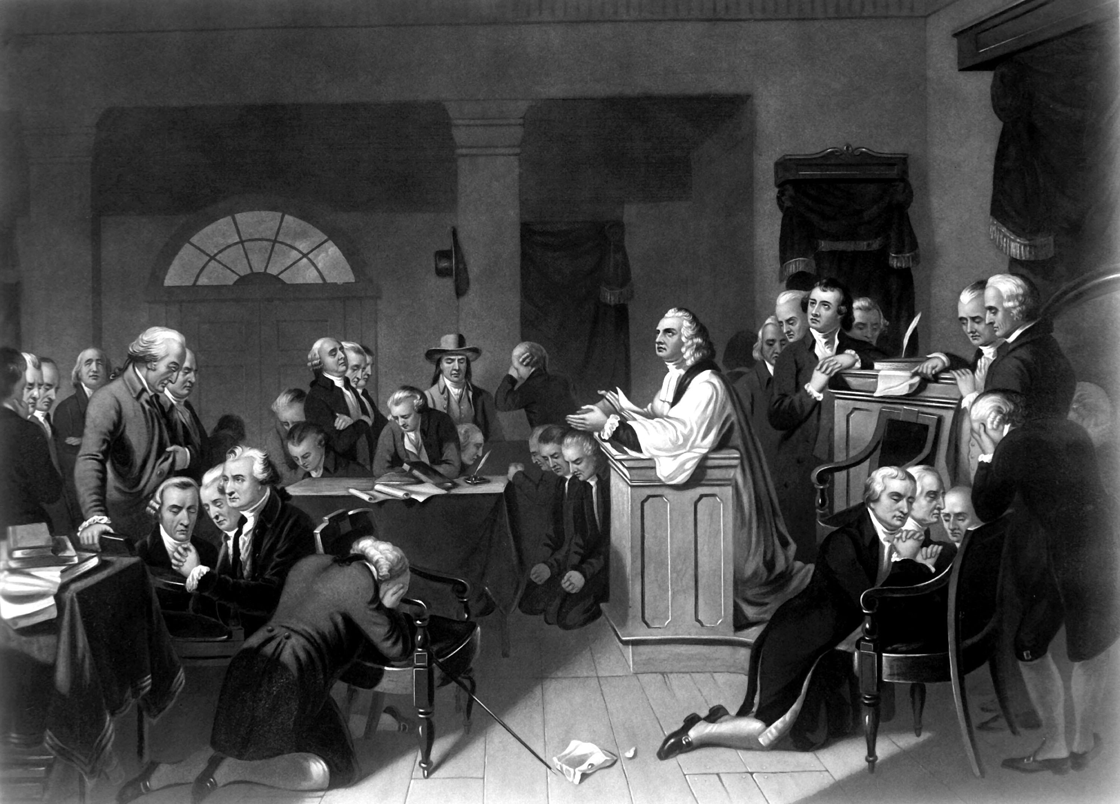
Revolutionary Continental Congress
1st Prayer In 1774 Led By Jacob Duche
"O Lord,
look down in mercy,
we beseech Thee,
on these American States,
who have fled to Thee
from the rod of the oppressor
and thrown themselves
on Thy gracious protection."

Slide 122
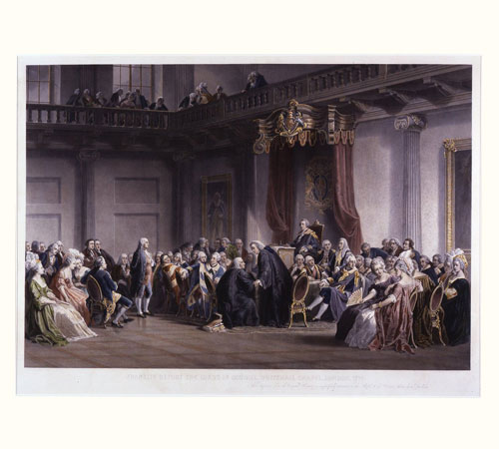
During the session of [the First Continental] Congress, a gentlemen, residing in the city of Philadelphia, anxious to learn the chief of the strangers who had assembled from the several colonies, observed to Mr. Secretary Thomson, that he had heard much of Mr. Washington from Virginia, and would be glad to know how he could distinguish him. Mr. Thomson replied, "You can easily find him when Congress goes to prayers—Mr. Washington is the gentleman who kneels down." Thus, in the prime of life, did this gentleman, who was as noted for his modesty as for his merit, manifest to the world his sense of the overruling providence of God, and of the power of prayer with him who giveth to all men liberally and upbraideth not. (p. 51-52)

Slide 123
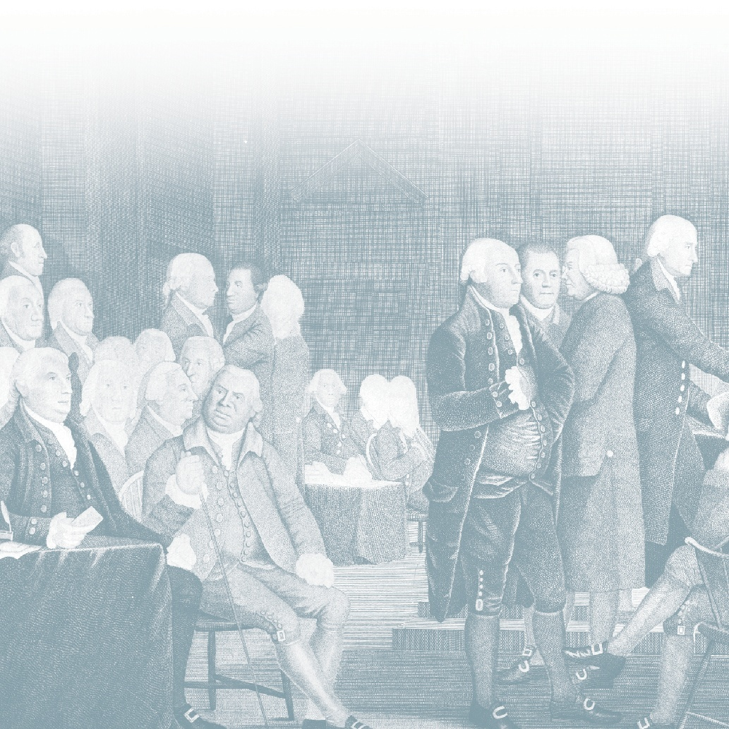
Manly Hall described a rousing speech delivered by a mysterious “unknown speaker” before the signing of the Declaration of Independence. The “strange man,” wrote Hall, invisibly entered and exited the locked doors of the Philadelphia statehouse on July 4th, 1776, delivering an oration that bolstered the wavering spirits of the delegates. “God has given America to be free!” commanded the mysterious speaker, urging the men to overcome their fears of the noose, axe, or gibbet, and to seal destiny by signing the great document. Newly emboldened, the delegates rushed forward to add their names. They looked to thank the stranger only to discover that he had vanished from the locked room.

Slide 124
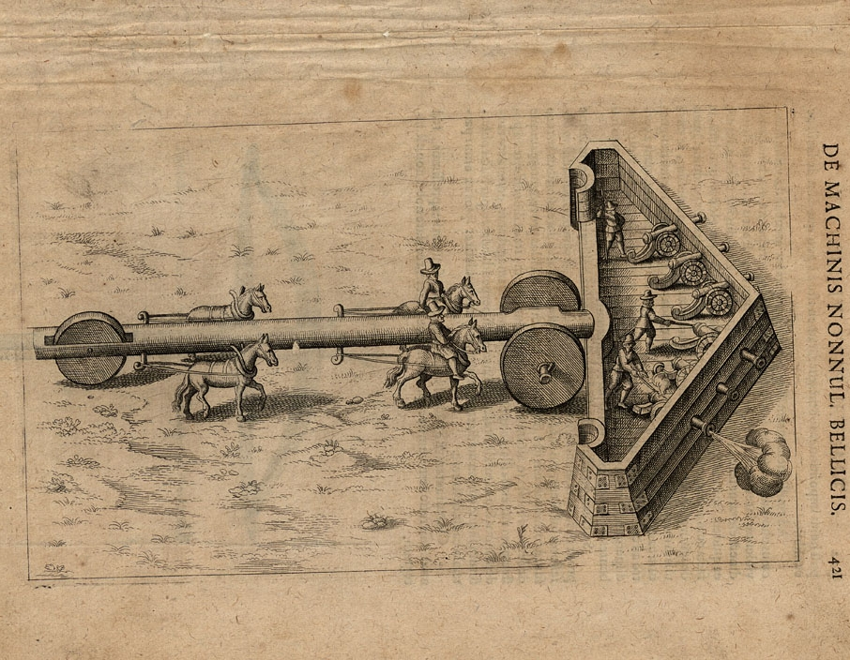

Slide 125
Although looking to the horizon of
individual lives history appears
quite predictable and linear
- this is a false perception.

Slide 126
In reality, events are continually curved generationally
trending in terms of regression or social progress
and analyzed as circular over the centuries.

Slide 127
The normative exceptions in historical observation
are what Nassim Nicholas Taleb calls Black Swans -
where as he says “History does not crawl, it jumps.”

Slide 128
These world class epic events include the
Wittenburg Hammer heard round the world
Lexington Bridge Shot heard round the world.

Slide 129
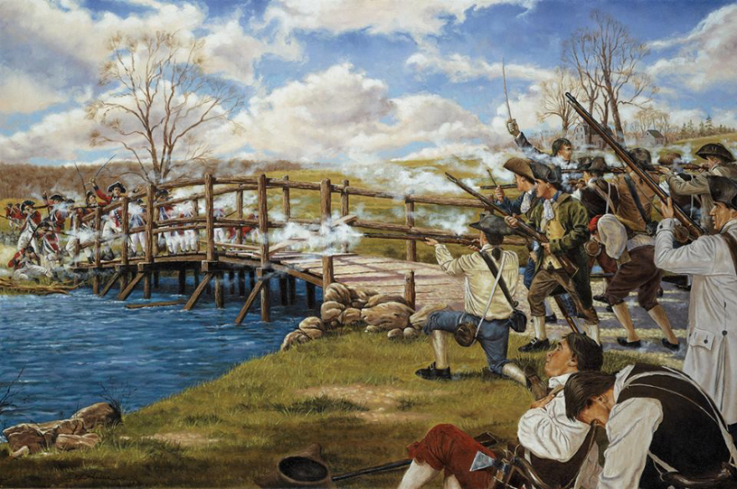

Slide 130
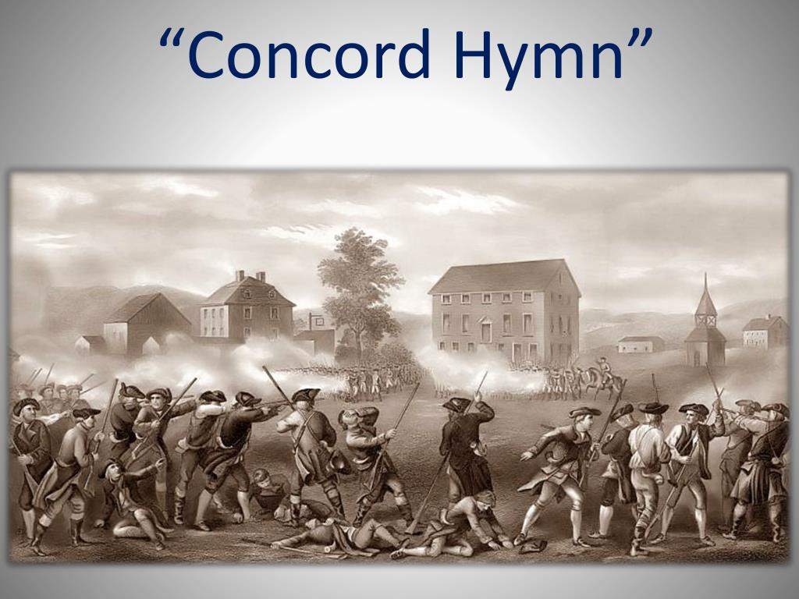

Slide 131
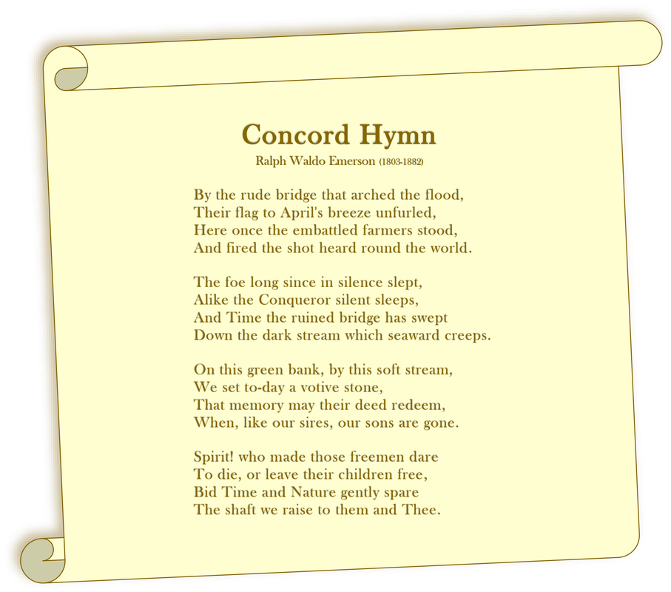

Slide 132
“We have it in our power,”
Thomas Paine declared,
“to begin the world over again!”

Slide 133
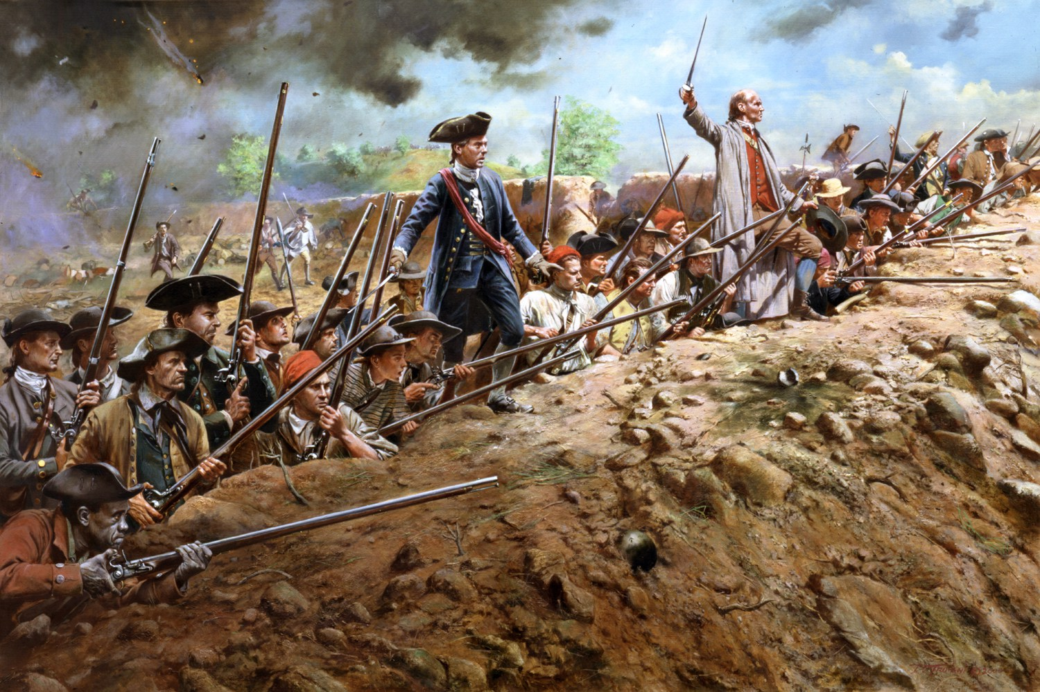

Slide 134


The American Revolution
1776
Notes:
Instructor Note:
These slides contain animated objects. This presentation is intended to be viewed in “Slide Show”. Each click of the mouse will move an object, make an object appear/disappear or show an arrow. Each bulleted line in the Notes Pages correspond the sequential order of each “action” and describes that action.
The accompanying Word analysis document has analysis for each slide.

Slide 135

1776:
British Options
Notes:
COA 1: invade the colonies in the south.
COA 2: invade the Mid-Atlantic Colonies through either the Delaware or Chesapeake Bays
COA 3: invade New York.

Slide 136

xxxx
The Invasion of New York
22 August 1776 –
25 January 1777
xxxx
Notes:
Late June – July: General Howe assembles 32,000 troops on Staten Island
American Distribution:
3 Divisions in Southern Manhattan
1 Division at Northern Tip of Manhattan (Fort Washington)
(Arrows) Washington recognizes that Brooklyn Heights dominate his main forces on Manhattan therefore:
1 Division (under Putnam) placed on Long Island to deny the British access to these Heights

Slide 137

Notes:
Putnam’s Disposition of Forces. Takes advantage of protective terrain formed by Heights of Guian and fortifies the gaps with his troops:
To the West, at Gowanus Road – Lord Sterling with 1,600 troops
In the center at Flatbush and Bedford Passes – Sullivan with 1,500 troops
Putnam leaves the Jamaica Pass to the West unguarded.
22 August – Howe lands 15,000 troops near Gravesend Bay
British conduct a demonstration at Flatbush Gap
26 August – MG Grant attacks Lord Sterling along the Gowanus Pass with 5,000 troops – he does not press his attack – his intent is to keep the American Right flank fixed.
Howe maneuvers the British Main Body(10,000) around the American left flank, through the unguarded Jamaica Gap. Sullivan is forced to withdraw from his fortifications and try to stop the British envelopment.
Greatly outnumbered, Sullivan’s forces break and withdraw back to fortifications at Brooklyn Heights.
Howe completes the trap with Sterling’s forces who capitulate.
Washington personally takes over the Americans at Brooklyn Heights and reinforces the Americans to 9,500 (still ½ of the British Forces).
Howe constructs siege lines (normal for this period to attack enemy fortifications this way)
August 29 – Washington identifies the futility of his position and evacuates the night of 29 August. For the Long Island Campaign:
American Losses: 1,012
British Losses: 392
Howe offers Washington a peace proposal from London. Washington refuses.

Slide 138
The Invasion of New York
22 August 1776 –
25 January 1777
Notes:
15 September – Howe Lands troops at Kips Bay to cut off Putnam’s Southern troops
Putnam abandons NYC and occupies Harlem Heights
16 September – Pursuing British troops repulsed at Harlem Heights
18 October – Howe attempts to outmaneuver Washington and lands troops at Pell’s Point
Washington had already decided to abandon Manhattan and fell back to White Plains. He left 2,800 (Col McGraw) at Fort Washington and 3,000 (General Greene) at Fort Lee on the West side of the Hudson. The intent was to attempt to disrupt British attempts to use the Hudson.
28 October – Howe defeats Washington at White Plains
Washington force to withdraw – Positions 6,000 troops (General Lee) at Castle Hill to prevent further British movement north. Washington takes the remainder of the Army to Peekskill.
10 November – Washington crosses the Hudson and moves south. Howe decides not to pursue and instead moves south and captures Fort Washington (loss of 2,800 American Troops)
20 November – Greene joins Washington’s force just as General Cornwallis (sent by Howe) moves to take Fort Lee. At this point, Washington is down to 3,500 effectives (he lost 2,000 to expiring enlistments).
Washington retreats to the safety of the West side of the Delaware River. Cornwallis pursues him all the way, with 10,000 troops. The two forces face each other on 8 December at Trenton, Washington protected by a still unfrozen Delaware River.
Howe is satisfied with the campaign and moves his troops into winter quarters on 14 December. The British establish garrisons from Trenton all the way back to NY. Howe Returns to NYC and Cornwallis prepares to return to England on leave.

Slide 139

Historic Formula Hinge Factor:
The Theory That World History Shaped As Much By Chance & Error As By Courage & Heroism
David Lee Burris:
College Course Quote – “The social scum and religious eccentrics England had sent there [America] proved to be so unpredictably resourceful that the mother country was beginning to sustain an unfavorable balance of trade with America.”
PRAYER ANSWERED THROUGH
ARRANGED COINCIDENCE

Slide 140


Slide 141


Slide 142
The Invasion of New York
22 August 1776 –
25 January 1777
Notes:
25 Dec – Washington crosses the Delaware with 2,400 men. He attacks the Hessian Garrison at Trenton with the following result:
4 Americans Killed
Hessians: 22 Killed/918 Captured/500 escape
Cornwallis gathers 8,000 troops to attack Washington (he leaves 1,200 troops at Princeton and another 1,200 to his immediate rear) and enters Trenton on 1 January. He faces dug in Americans to the South East of the City.
Washington slips away that night and moves to the North East. He defeats the British Rear Guard at Princeton. The final casualty figures for Princeton action:
Americans: 23 Killed
British: 28 Killed/58 wounded/323 captured
With exhausted troops, Washington finally moves into winter quarters at Morristown
With Washington in a threatening position to cut off the New Jersey outposts – Howe is forced to withdraw his garrisons from New Jersey and return to NY.

Slide 143
18th Cent
Divine Providence:
Old world & New world
“Alle Kunst ist umsunst Wenn ein Engel auf das Zundloch brunzt!”
FROM GERMAN TO ENGLISH:
“All skill is in vain if an angel pees down your musket’s touch-hole!”

Slide 144

The American Revolution
Saratoga - 1777

Slide 145

British Plans
June-October 1777
x
xxx
xxxx

Slide 146
Burgoyne’s Expedition
June-October 1777
1777
x
30
25
20
15
10
5
30
25
20
15
10
5
30
25
20
15
10
5
30
25
20
15
10
5
30
25
20
15
10
5
xxx
Oct
Sept
Aug
x
x
x
x
xxx
July
xxxx
June

Slide 147
Sword’s House
Burgoyne’s Plan of Attack
To Saratoga
Great Ravine
Barber House
Freeman’s Farm
Middle Ravine
British Bridge of Boats
N
Neilson’s House
Mill Creek
Gates’ HQ
Bemis Heights
Hudson River
Bemis Tavern
American Bridge of Boats
Miles
To Albany
0
1/2
1

Slide 148
Sword’s House
Riedesel
Freeman’s Farm
September 19, 1777
Hamilton
Fraser
To Saratoga
Great Ravine
Barber House
Freeman’s Farm
Middle Ravine
British Bridge of Boats
N
Neilson’s House
Mill Creek
Gates
Gates’ HQ
Bemis Heights
Hudson River
Bemis Tavern
American Bridge of Boats
Miles
To Albany
0
1/2
1

Slide 149

Burgoyne’s Expedition
June-October 1777
1777
30
25
20
15
10
5
30
25
20
15
10
5
30
25
20
15
10
5
30
25
20
15
10
5
30
25
20
15
10
5
Oct
Sept
Aug
xxx
xxx
July
xxx
June

Slide 150
Sword’s House
Barber’s Wheatfield &
Breymann’s Redoubt
October 7, 1777
Breymann’s Redoubt
To Saratoga
Great Ravine
Barber House
Balcarres’ Redoubt
Freeman’s Farm
Middle Ravine
British Bridge of Boats
N
Neilson’s House
Mill Creek
Gates
Gates’ HQ
Bemis Heights
Hudson River
Bemis Tavern
American Bridge of Boats
Miles
To Albany
0
1/2
1

Slide 151

The American Revolution
Southern Campaign – 1780-1781
Notes:
Instructor Note:
These slides contain animated objects. This presentation is intended to be viewed in “Slide Show”. Each click of the mouse will move an object, make an object appear/disappear or show an arrow. Each bulleted line in the Notes Pages correspond the sequential order of each “action” and describes that action.
The accompanying Word analysis document has analysis for each slide.

Slide 152


Notes:
-April 1780 – Clinton lays siege to American Forces under General Benjamin Lincoln in Charleston. The city falls 12 May with the loss of 5,000 troops.
The British establish a series of outposts to control South Carolina
Congress (w/o consulting Washington) appointed Gates (‘Hero’ of Saratoga) to take command of the Southern Troops. His campaign results in the Battle of Camden (16 Aug) The American Army is destroyed (Greatest American Defeat of the war on the heels of their greatest loss in troops – Charleston)
7 October 1780 – Kings Mountain. Cornwallis initially plans a 3 prong advance into NC. However, his left wing under Major Patrick Ferguson is destroyed by a hastily assembled force of various Militia. Cornwallis is forced to consolidate his forces vicinity of Winnsboro.
Washington appoints Nathanael Greene as the new Southern Cdr. With very few troops, he divides his forces. He controls the main force at Cheraw Hill and sends the remainder to Cowpens under the Cmd of Daniel Morgan.
With this risky deployment, the British cannot attack one force w/o allowing the other to get into the British rear. Cornwallis therefore decides to split his forces into three elements. One force to move vic. Camden to hold Greene, one force under LTC Tarleton to attack Morgan and Cornwallis commanded the main force which moved into North Carolina between the two forces. His plan was to defeat Morgan at Cowpens with Tarleton, and destroy the retreating Americans with his main force. He would then turn on Greene.

Slide 153
Washington
Morgan
Hill
N
Coulter’s Ferry Road
Militia
Reforming
The Swale
VaM
17
VaST
Howard
Triplett
Hammond
North Head
NCST
VaLt
1Md
2Md
Del
3Md
Legion
7
Suck Creek
McDowell
Legion
Light
71
McDowell
Roebuck
Thomas
Hayes
Brandon
South Head
Legion
Hammond
71(-)
Maple
Swamp
1
Green River Road
Hayes
Rise
West Ravine
McDowell
Hammond
Rising
Ground
Legion
7
17
153
The Rivulet
Legion
Light
1
71
120 meters
Notes:
-Morgan’s plan – 3 lines of defense. The first line (Militia) were sharpshooters who will fire and force the British to deploy. They will fall back to the second line (Militia). This line will also fire two shots at the approaching British. They were to then retire behind the main American line (that was anchored in the center by the Continental troops). The small American Cavalry under Washington was to be the reserve.
The British deploy with artillery in the center, with infantry on each side. The flanks were covered by mounted units. There were also 200 Legion Dragoons in the British rear, but these would never enter the battle.
Skirmishers conduct a fighting withdrawal as the British advance and fall back to the flanks of the second line.
The British pursue and are met with two volleys from the second line. Estimated 60% of the officers are hit.
The Militia fall back behind the American third line and begin to reform.
The British pursue an attack the 3rd line. The Legion Dragoons and a company from 1-71st attack McDowell’s Militia on the flank, while the 17th Light Dragoons attempted to pursue the American Militia in the rear of the third line.
Washington counters this move and the 17th Light Dragoons withdraw.
McDowell’s militia breaks and falls back. The Legion Dragoons then attack the American Right Flank and the North Carolina Militia break and fall back.
The VA Continentals have been given the order to refuse the right, but confuse the order and begin to fall back. The rest of the American line follows suit, in good order.

Slide 154
VaLt
VaST
Morgan
Hill
VaM
N
Coulter’s Ferry Road
Howard
Militia
Reforming
1
71
1Md
2Md
Del
3Md
Washington
7
The Swale
Triplett
Hammond
North Head
Legion
Legion
Light
7
Legion
Light
Suck Creek
71
South Head
71(-)
Maple
Swamp
1
Green River Road
Hayes
Rise
West Ravine
Rising
Ground
154
The Rivulet
120 meters
Notes:
On orders from LTC John Howard, the American line turns and fires into the pursuing British Troops. The British were stunned by this action (they were under the misunderstanding that the Americans had broken and were in retreat).
The Results:
Washington’s Cavalry Stops the Legion Cav and Envelops the British left.
The 1-71st withdraw and finally surrender. The artillery is also captured.
The 7th foot and the right side of the British line withdraw from the field.
****NOTE: Events of Washington’s Dragoons and the Militia’s Actions at the end of the battle are based on the most recent study of the battle (A Devil of a Whipping, Lawrence Babits)

Slide 155
1781
Notes:
Although Morgan has defeated Tarleton, the Americans are still not strong enough to defeat the main British force. They therefore fall back into North Carolina and rejoin at Guilford Courthouse. After some further maneuver and gathering of more forces, Green establishes a triple defense line similar to Cowpens which Cornwallis attacks on March 15 1781.
While Greene was driven from the field, Cornwallis suffered 30% casualties. Since he also had burned his supplies to try to catch Morgan, he withdrew to Wilmington to get re-supplied by sea. Greene initially followed, but then diverted south back into South Carolina. The British Commander in South Carolina, General Rawdon, had 8,000 troops, but they were dispersed throughout the countryside(25,000 square miles to control). The largest (900) was in the vicinity of Camden, and Greene attacked that force at Hobkirk’s Hill on April 25. Although Rawdon defeated Greene, Greene’s Army was still in tact.
Knowing he would not have been able to withstand another attack from Greene, and knowing his outposts were vulnerable, Rawdon called for a general withdrawal back to Charleston while Cornwallis headed into Virginia.
British units then either withdrew from their outposts, or were besieged and fell to American patriots.
The final British outpost at Ninety-Six required Greene to conduct a siege with his force. However, Rawdon rescued the outpost with a relief force.
Greene again attacked the British main force located at Eutaw springs in September 8, and once again, lost. But the British were once again forced to withdraw to Charleston and Savannah. Greene was to never win a battle, but, with his forces in tact, drove the British from the Carolina’s.

Slide 156

R
W
CL
L
CW
The Road to Yorktown
May 1779-
September 1781
Notes:
1779-1781 – Cornwallis is convinced VA is the key to the south and convinces Clinton to send an expedition to VA. British forces (to include a force under the American traitor, Arnold) wreck havoc in VA.
March 1781 - Washington sends a small force under Lafayette to attempt to check the destruction (and possibly capture Arnold).
May 1781 – Cornwallis arrives in VA from his campaign in the Carolinas
Summer of 1781 – French Army under Rochambeau arrives in Newport, RI (4,000). The French also promise the use of their fleet to conduct and all out effort in 1781. July 1781- Rochambeau moves to mass forces with Washing in NY. Both Washington and Clinton envision a large battle in New York/ Pennsylvania area. However, DeGrasse, the Admiral of the main French Fleet, informs Washington he will move only as far north as the Chesapeake Bay, and will leave prior to October (Hurricane Season)
Aug-Sept 81 – Washington leaves a small force to cover NYC, conducts deception operations and moves his combined American/French Army to VA to trap Cornwallis.
British Admiral Hood, departing the Caribbean, and looking for Degrasse’s Fleet, arrives at Chesapeake bay first, found an empty bay, and moved on to New York.
Since he had stopped in Havana, Degrasse’s fleet was 5 days behind Hood, and by luck, arrived in the empty Chesapeake Bay on 30 August. Degrasse delivers 3,000 troops.
Admiral Graves, with Hood’s fleet, moved back to the Chesapeake Bay and attacked the French Fleet in the inconclusive Battle of Virginia Capes. (Sept 5)
A French Squadron slips into Chesapeake Bay during a lull in the naval battle to deliver siege cannon.
The combined French fleet numbered 35 vs. the 19 English Ships, who thus depart back to NY. Cornwallis is trapped by land and by sea.

Slide 157


Slide 158


Slide 159






American Revolution Era Flags
The American Revolution would never have happened with gun control

Slide 160

What is a "Three Percenter"?
During the American Revolution, the active forces in the field against the King's tyranny never amounted to more than 3% of the colonists. They were in turn actively supported by perhaps 10% of the population. In addition to these revolutionaries were perhaps another 20% who favored their cause but did little or nothing to support it. Another one-third of the population sided with the King (by the end of the war there were more Americans fighting FOR the King than in the field against him) & the final third took no side, blew with the wind & took what came.

Slide 161


Slide 162





Private John Burris
2nd North Carolina Regiment
With Washington’s Army @ Valley Forge
Typical NC
Militiaman

Slide 163

David Lee Burris:
Six States Established Church Anglican
ANGLICANS & WESLEYANS WERE TORY

Slide 164
David Lee Burris:
Three States Established Church Congregationalist
Four Remaining Without Church Establishment
The Revolutionaries Were Religiously:
Baptist - Presbyterian - Congregationalist

Slide 165

The Foundation
"The Hand of providence has been so conspicuous in all this, that he must be worse than an infidel that lacks faith, and more than wicked, that has not gratitude enough to acknowledge his obligations." -- George Washington

Slide 166
“We have it in our power,”
Thomas Paine declared,
“to begin the world over again!”

Slide 167
Founder Framers

Slide 168


Slide 169



Locke’s Political Writings Informed The American Revolution
Insistence upon the spiritual equality of men
led to an insistence upon their political equality.
In this way the acceptance of Calvinistic principles
promoted the rise of democracy in both the Church and state.
- Christianity Through The Centuries

Slide 170


Slide 171

Jefferson Corrects Himself

Slide 172
Locke’s Political Writings Informed The American Revolution

Slide 173
“When Thomas Jefferson, following John Locke, derived the doctrine of natural rights from natural law, he was more concerned with the power of transcendental statements than with their origin, divine or secular. In the Declaration of Independence he blended secular & religious presumptions in one transcendentalist sentence, thus deftly covering all bets: ‘We hold these Truths to be self-evident, that all Men are created equal, that they are endowed by their Creator with certain unalienable Rights, that among these are Life, Liberty, & the Pursuit of Happiness.’ That assertion became the cardinal premise of America’s civil religion & it endures as the central ethic binding together the diverse peoples of the U.S.A.”
- James Q. Wilson

Slide 174


Jefferson was a writer at heart, but he was also a scientist. He studied the syllogistic method at the College of William and Mary, so it was natural for him to approach the Declaration as a lesson in logic, justifying a revolution through reasoning. “I did not consider it part of my charge to invent new ideas altogether,” Jefferson explained. Rather, his goal was “to place before mankind the common sense of the subject.” He drew from years of studying government and philosophy, particularly the ideas of John Locke, the English philosopher who had questioned the divine right of kings and argued that people were born with certain natural rights!

Slide 175
The preamble, the most famous section of the Declaration today, remained virtually untouched. Cognizant of rhythm, cadence, and timing, Thomas Jefferson crafted its five sentences using a lofty and majestic tone, drawing from the 18th-century “Style Periodique” method. The preamble also followed a syllogistic format: five propositions built one upon the other, ultimately establishing the right of revolution. Jefferson created a universal application; not once did he refer to the states or England in the preamble. Instead, he outlined the general philosophy behind the right of revolution. What was novel about the document then, and especially the preamble, is that for the first time in history, human rights was used as the basis for a republic.

Slide 176


Slide 177


Slide 178


Slide 179

“Miracles do not cluster. Hold on to the Constitution of the United States and to the Republic for which it stands – what has happened once in 6,ooo years may never happen again!” – Daniel Webster

Slide 180
Perfect Setting For The
Restoration Movement

Slide 181

INDIGENOUS
PEOPLES

Slide 182
Objective
Observation:
Denomination

Slide 183


New Canaan Land? Indians Told Pilgrims:
David Lee Burris:
American Indians did not have a concept of religion as something separate from their approach to all aspects of life. Despite intertribal differences, most Indian spiritual ideas shared several characteristics and among them was a belief in a Great Spirit who presides over the whole world; English Account Of Causes Of The Rebellion - “It would appear that political liberty originated with the Iroquois Confederacy. Where else would an obedient Englishman get such an idea, anyway.”
“Mugwumps” – Mugwump was one of the Algonquian words in Elliot’s translation of the Bible, came into the American language in the 1880’s. In Elliot’s Bible a mugwump was a great chief, such as Joshua, Gideon, or Joab. Later New Englanders used the word in mockery for a self-conceited politician and then in general use from 1884 to mean an political independent.
Massachusetts Bay Colony Seal Had The Picture Of An Indian & The Words Of The Macedonian Call!
To teach the Indians about hell Spanish friars roasted live cats and dogs in a portable oven!
CHIEF RED JACKET IN 1805 SAID:
“Brother, you say you are sent to instruct us
how to worship the Great Spirit agreeably to his mind, and
if we do not take hold the religion which you white people teach,
we shall be unhappy hereafter; you say that you are right,
And we are lost; how do we know this to be true?”
“We heard you were a
people that came from
under the world to take
our world from us!”

Slide 184
New Canaan Land? Indians Told Pilgrims:
David Lee Burris:
American Indians did not have a concept of religion as something separate from their approach to all aspects of life. Despite intertribal differences, most Indian spiritual ideas shared several characteristics and among them was a belief in a Great Spirit who presides over the whole world; English Account Of Causes Of The Rebellion - “It would appear that political liberty originated with the Iroquois Confederacy. Where else would an obedient Englishman get such an idea, anyway.”
“Mugwumps” – Mugwump was one of the Algonquian words in Elliot’s translation of the Bible, came into the American language in the 1880’s. In Elliot’s Bible a mugwump was a great chief, such as Joshua, Gideon, or Joab. Later New Englanders used the word in mockery for a self-conceited politician and then in general use from 1884 to mean an political independent.
Massachusetts Bay Colony Seal Had The Picture Of An Indian & The Words Of The Macedonian Call!
To teach the Indians about hell Spanish friars roasted live cats and dogs in a portable oven!
CHIEF RED JACKET IN 1805 SAID:
“Brother, you say there is but one way to worship
and serve the Great Spirit; if there is but one religion,
why do you white people differ so much about it?
Why do you not agree, as you can all read the book?”
“We heard you were a
people that came from
under the world to take
our world from us!”

Slide 185


Slide 186


PRIMITIVE

Slide 187
Among
Americans

Slide 188


Slide 189
Locke’s Political Writings Informed The American Revolution

Slide 190

Locke’s Religious Writings Inspired For Freedom of Conscience

Slide 191
EACH MAN BORN A BLANK SLATE WITHOUT GUILT OF ORIGINAL SIN BOTH REASONABLE & TOLERANT

Slide 192
Locke’s Religious Writings Informed The American Restoration

Slide 193

The Restoration Movement: An American Theology
“From the early to mid-1800’s, the Restoration Movement became the fastest growing religion on the American frontier & remained one of America’s largest indigenous religious movements. While many factors contributed to its success, one of the most important was a shift in the way Americans were coming to understand the nature of man and his relation to God. This new attitude is most succinctly put forward in the Declaration of Independence and helps explain the movement’s growth. Written only 25 years before the American Restoration Movement, the Declaration of Independence was a theological document as well as political.”

Slide 194


The Restoration Movement: An American Theology
“More than announcing separation from England, it offers a theological justification for rejecting the doctrine of the Divine Right of Kings. This was a theory that certain kings were chosen by God to rule & that they were accountable to no person except God. Rebellion against England’s King George meant that the American colonies would be arrayed against divinely appointed government. The American leaders, however, understood a different principle to be at work. America was a new continent. It was as if God had provided a new Eden and given humanity a fresh start. Accordingly, they appealed to Nature and a biblical understanding of creation whereby every person bears the image of God. In creation, all are equal & have inherited certain divine rights which no king can take away. If he does, he is a despot whose disobedience to God gives the people the right to depose him.”

Slide 195
The Restoration Movement: An American Theology
“This finds its way into the the Declaration of Independence in the statement: ‘We hold these truths to be self-evident, that all men are created equal & that they are endowed by their Creator with certain inalienable rights…’ The American political leaders rested their case for independence and democracy on this biblical foundation. The success of the American experiment worked to legitimize this new populist theology and move it beyond America and beyond politics. Now the church would have to wrestle with its implications. Twenty-five years after the U.S. Declaration of Independence, fourteen years after the Constitution was ratified, and ten years after the Bill of Rights, the Restoration movement began. It arose in an atmosphere of religious revivalism propelled by a heady idealism about the nature of man with earnest hopes for a utopian future.”

Slide 197
The Restoration Movement: An American Theology
The equal justice of God. “For the leaders of the American Restoration Movement, God is just & rules according to immutable laws. He is neither arbitrary, capricious, nor partial. Each human being has equal standing before Him & is equally amenable to His laws. Those laws are not hidden. They are revealed in a written and unchanging constitution: the New Testament. Moreover, they aren’t understood thru subjective human experience, but normal objective reasoning.”

Slide 198
The Restoration Movement: An American Theology
The sovereignty of the individual. “Since God is impartial and all humans are equal before Him, the Calvinist doctrine of election, whereby God chooses who will receive salvation, was rejected. Each person is free to participate in one’s own destiny, to accept or reject salvation!”

Slide 199


Slide 200
The Restoration Movement: An American Theology
The people’s government of the church. “Since God is no respecter of persons, but all have equal standing, there is no separate calling or class for clergy. All are ‘clergy’, and all are ‘laity.’ All Christians share the responsibility to promote the church & see to its good order. There is no divinely chosen hierarchy that stands over the church. The members of each congregation choose their leaders and select those who preach & teach for them. Thus, communion responsibility, preaching & prayers was placed in the hands of the common people.” – Carson Stephens

Slide 201
The Restoration Movement: An American Theology
Believer’s Baptism: Freedom Of The Will. “Once, while conducting a meeting at Slate Creek, Kentucky, a Methodist preacher was in a meeting across town. Smith attended a service by the side of the creek when the Methodist preacher applied water to a screaming infant. When ‘Racoon’ had a baptism the next day, the Methodist preacher was nearby standing on the bank. After the ceremony, Smith approached the preacher and began to pull him toward the creek. The Methodist preacher asked him what he was doing. ‘I am going to baptize you, Sir,’ replied Smith. ‘But I do not wish to be baptized.’ ‘Do you not believe?’ said Smith. ‘Certainly I do,’ stated the Methodist preacher. ‘Then come along, Sir,’ said Smith. ‘But,’ said the man, ‘I am not willing to go. It certainly would do me no good to be baptized against my will.’…”

Slide 202

The Restoration Movement: An American Theology
Believer’s Baptism: Freedom Of The Will.
“… Racoon Then Stated, Did you not but yesterday baptize a helpless babe against its will? Did you get consent first, Sir? Come along with me, for you must be baptized.’ But the man protested and Smith released him.”
– Dabney Phillips

