Slide 1
Blood & Sand Of Colosseum Cultural Glue Cruel Empire
By David Lee Burris

Slide 2
the
Colosseum Symbolized
“Life is A Combat” ROMAN CONQUEST
Roman Dominance
Radiating Authority
Don’t Test This Power Testing: Criminal Death
Myth Over Monotheism Slaves Can Become Heroes
The Rise & Fall Of The Empire

Slide 3
Colosseum Was The Societal Glue
Center Of The Theocratic Shift To The Cult Of The Emperor
Idle Masses Kept Occupied & Entertained

Slide 4
“We who are about to die”
BACKGROUND & SETTING
BREAD & CIRCUS DISTRACT
MYTHOLOGICAL DRAMATIC
MONOTHEIST MARTYRDOM

Slide 5
BACKGROUND

Slide 7
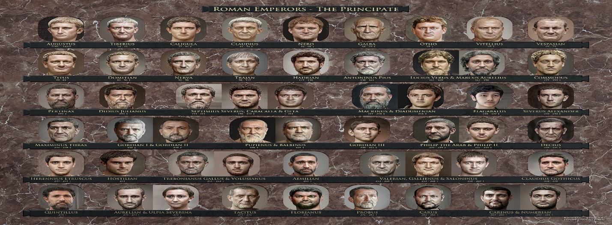

Slide 11
And when Paul and Barnabas had great dissension and debate with them, the brethren determined that Paul and Barnabas and some others of them should go up to Jerusalem to the apostles & elders concerning this issue.
- Acts 15:2

Slide 12
CHAPTER 15 J. W. McGarvey’s Acts Commentary
VERSE 5
This party is here identified as converts from the old sect of the Pharisees. We have had no account hitherto of any large accessions to the Church from this party; but this incidental remark shows that some of these obstinate opposers of the truth had yielded, and were now occupying positions of influence in the congregation. Paul now once more meets some of his companions in the persecution of the disciples, not to harmonize with them, nor to dispute with them in the synagogues concerning the claims of Christ; but to contend, within the Church itself, against that same disposition to perpetuate the law which had made them formerly fight against the gospel. He had a bad opinion of some of them, which must have been well-founded, or he would not have given the public utterance to it which he did at a subsequent period. He styles them, in the Epistle to the Galatians, “False brethren, unawares brought in, who came in privily to spy out our liberty which we have in Christ Jesus, that they might bring us into bondage.” Having witnessed a rapid increase of the congregations under the pressure of the persecutions and disputations to which they had formerly resorted, these wily enemies of the truth determined at length to corrupt and destroy, under the guise of friendship, a cause whose progress they could not impede by open enmity. They well knew, what some of the brethren had failed to discover, that the doctrine of Christ would be rendered powerless if it could only be hampered by bondage to the law.
McGarvey, J. W. (1872). A commentary on Acts of Apostles (p. 182). Lexington, KY: Transylvania Printing and Publishing Co.

Slide 14
AFTER THE TEMPLE IS DESTROYED BOTH ISSUES BEFORE THE “COUNCIL” ARE SETTLED FOR ALL TIME & WITH JERUSALEM’S DESTRUCTION A SHIFT IN THE RELIGIOUS CENTER

Slide 16
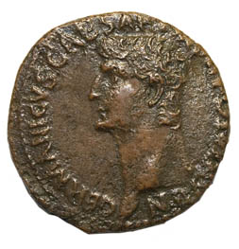
Who Were the Christians?
In AD 54, Emperor Claudius expelled from Rome all persons practicing the Jewish religion.
This edict of Claudius included Jewish believers in Jesus (Acts 18: 2).
Coin with image of Emperor Claudius
Notes:
Image: © Lagui
Click on the bottom right corner to go to a map of the world of the first Christians.

Slide 18
Intolerance for Christians
Why did Romans despise Christians?
Christians rejected the traditional Roman gods.
Romans misunderstood many Christian customs, especially the Lord’s Supper.

Slide 19
EARLY CHURCH PRE-TEST
David Lee Burris:
Christians Were Very Anti-Abortion Which Was A Common Practice. The Romans Would Also Abandon Their Young & Christian Rescue Of The Abandoned Was Misinterpreted. Pagan Rescue Of Another’s Abandoned Was For Immoral Purposes. Source: Justin Martyr
Which Of The Following Did Romans Accuse Their Christian Neighbors Of?
ATHEISM
INCEST
TREASON
HURT FAMILY
CANNIBALISM

Slide 20
EARLY CHURCH PRE-TEST
Which Of The Following Did Romans Accuse Their Christian Neighbors Of?
ATHEISM
INCEST
TREASON
HURT FAMILY
CANNIBALISM
Claimed by Cornelius Fronto a Second Century Court Tutor

Slide 21
Intolerance for Christians
Why did Romans despise Christians?
Christians valued children and women in ways that challenged the social order.
Christianity seemed like a new religion; Romans were suspicious of new traditions.
“Let Hercules himself do what he may / The cat will mew and dog will have his day.”

Slide 22
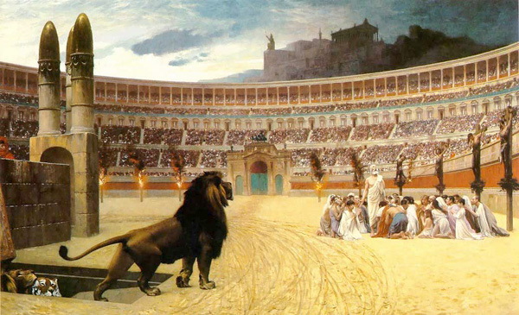
David Lee Burris: More On Marcus Aurelius: 177 @ Lyon, France For Holiday Entertainment Of Visiting Governor Torture Cheaper Than Valuable Gladiator Games Human BBQ On “The Hot Seat” More On Septimus Severus: Perpetua was educated Roman woman fluent in Latin & Greek and Felicitas was her slave girl. She would not surrender her faith even with her father’s pleading. She kept her modesty while the wild beasts brutalized her. Somehow the animals could not kill her off so trembling soldiers were sent in to finish the job – she guided their swords. Before dying she shouted to the anonymous Christians in the crowd – “You must all stand fast in the faith and love one another and do not be weakened by what we have gone through.” Two centuries later, Augustine pointed out the significance of the names of these two martyrs taken together – perpetua felicitas means “everlasting happiness” which is exactly what they received! More On Decius: Given certificate of sacrifice if did so – if not – executed on the spot. There were approximately 2 mill professed believers at that time. Some commentators suggest that most Christians recanted and offered sacrifice and that the number of faithful were reduced from millions to the thousands.
Socially Christianity Was Considered A Threat To The Organization Of Society
ROMAN PERSECUTION
Christianity Politically Intolerable Viewed As State Within A State
NATURE & EXTENT
Aurelius: 161-180
Christians Blamed For Natural Disasters
Septimus: 202-211
The Conversion To Christianity Forbidden
- ROMAN OUTLOOK -
Maximinus: 235-236
Clergy Executed That Supported Predecessor
Decius: 249-251
All Empire Total Terror Forced Emperor Worship
Valerian: 257-260
Property Confiscation No Right Of Assembly
Diocletian: 303-311
Churches & Bibles Burn; Compulsive Sacrificing

Slide 23
Roman Persecution Causation: Sociological
“The Christian ethic lived out became itself a criticism of pagan life. Meals at heathen feasts and social parties began with a liquid offering and a prayer to the pagan gods. As such, serious Christians would not participate in them. By such actions, the early Christians were frequently labeled as being unsociable, prudish, non-tolerant, boorish. . .” - Darkness To Light; Vol. V, Issue 22
Roman Cliché – “Conspicuous By Their Absence”

Slide 24
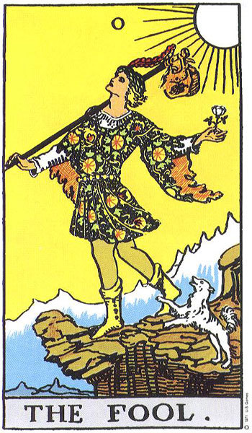
Roman Persecution Causation: Sociological
“You see, these misguided creatures start with the general conviction that they are immortal for all time, which explains the contempt of death and voluntary self-devotion which are so common among them; and when it was impressed on them by their original lawgiver that they are all brothers, from the moment they are converted, and deny the gods of Greece, and worship that crucified sage, and live after his laws. All this they take quite on trust, with the result that they despise all worldly goods alike, regarding them merely as common property. Now an adroit, unscrupulous fellow, who has seen the world, has only to get among these simple souls, & his fortune is pretty soon made; he plays with them.” - Lucian of Samosata, The Death of Peregrinus

Slide 25
Roman Persecution Causation: Polity/Economy
David Lee Burris:
Tailors & Masons had particular difficulty working in their chosen profession; Tertullian even forbade a Christian to be a schoolteacher.
“There was a balance of power Rome insisted upon holding when questions of loyalty to the imperial authorities were concerned. With a unifying political force of ‘Caesar worship’ having become the new ‘keystone’ of imperial policy, several accusations were brought on Christians. They were looked upon as being unpatriotic and potential sources of chaos to an already faltering political and economic system.” – Darkness To Light; Vol V, Issue 22

Slide 26
Roman Persecution Causation: Value System
“Francis Schaeffer additionally presents a philosophical pre-suppositional perspective. He views the antagonism as key to the whole consideration. The worldview expressed by the official Roman elite was a combination of ideas from many sources. The only ‘absolute’ clearly distinguishable concerned the support of the city-state. All values had meaning only in reference to the polis. Christians were thus not killed because they worshipped Jesus, but because they would not worship Jesus and Caesar. As such, they were considered rebels.” - Darkness To Light; Volume V, Issue 22

Slide 27
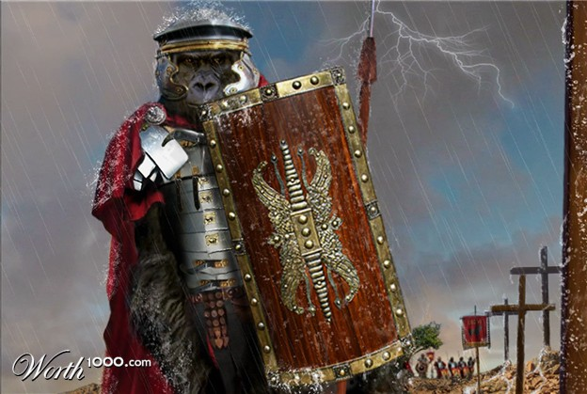
Historically Counterproductive: Herodotus
Herodotus composed his Histories to explain the ways of the gods to men, seeking to understand thru history & its moral dimensions why nations rise and fall. He found his explanation in the concept of hubris, the outrageous abuse of power that leads nations and individuals to disaster!
Cicero Oration – “O tempora! O mores!” = “Oh, the times, oh, the customs!”

Slide 28
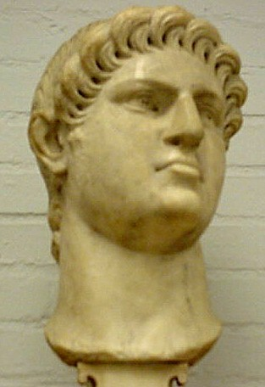
Head of God Nero

Slide 29
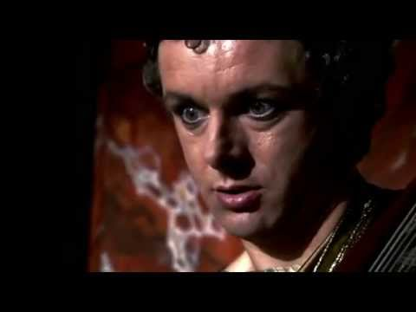

Slide 30
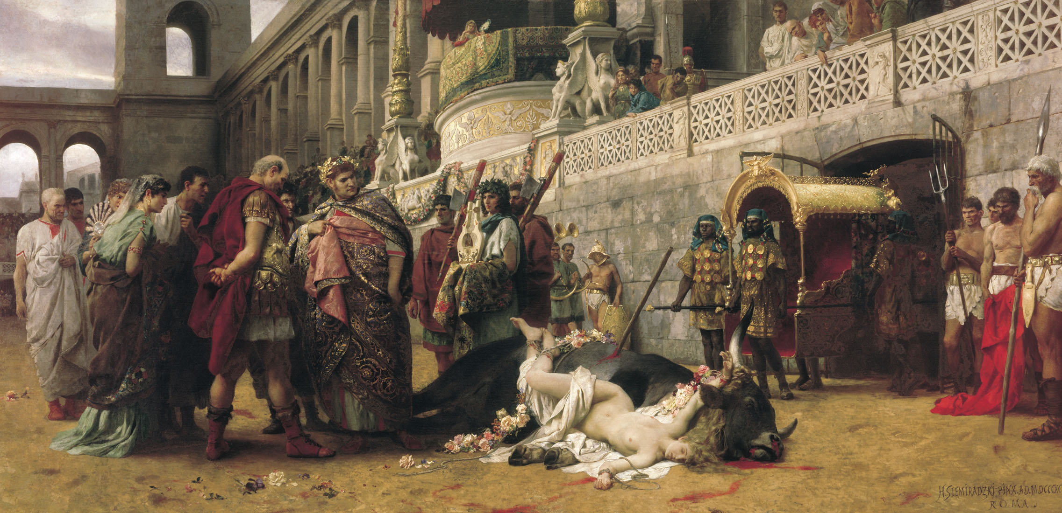

Slide 31
Who Were the Christians?
Tragedies in two cities led to changes in perceptions of Christianity.
AD 64: A fire destroyed 10 districts in Rome.
AD 70: The Roman army destroyed the Jerusalem temple.

Slide 32
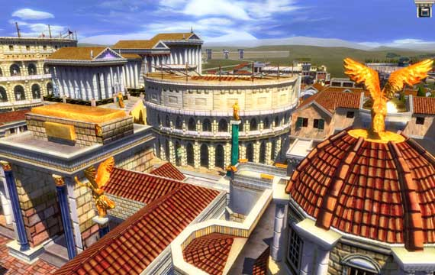
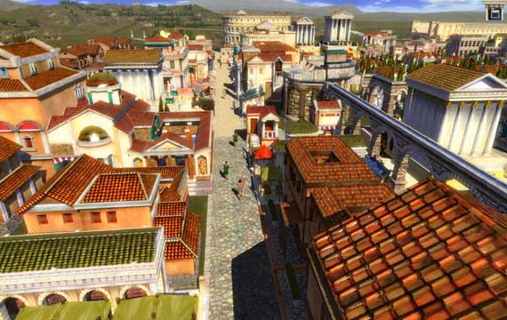
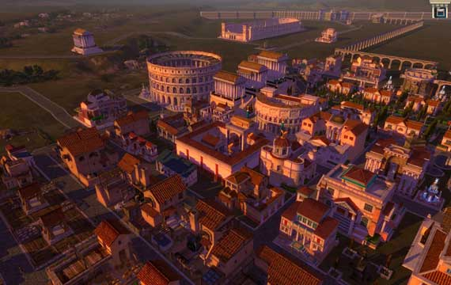
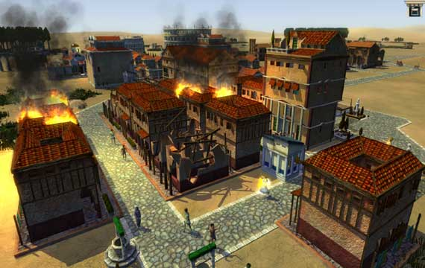

Slide 33
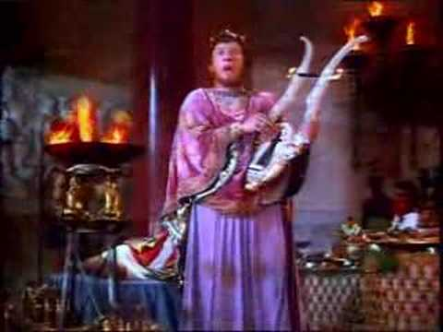

Slide 34
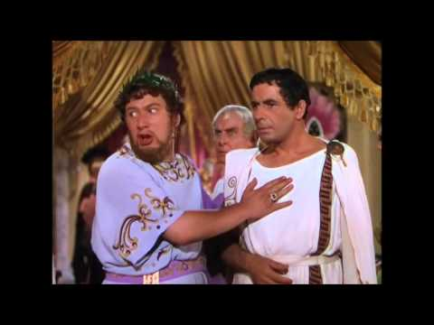

Slide 35
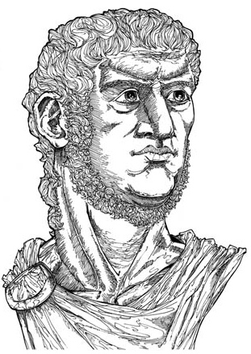
The Fire in Rome—AD 64
The fire probably began by accident in an oil warehouse.
Many Romans claimed that Emperor Nero started the fire.
To stop the rumors, Nero blamed the Christians.
Emperor Nero
Notes:
Illustration by Stephen Hesselman

Slide 37
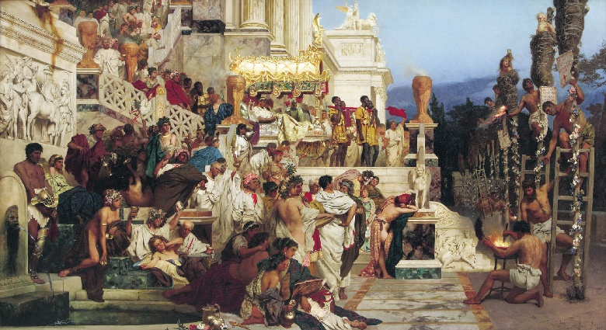
How Christ & Christians Were Viewed By Romans
From Page 344 The “Annals Of Tacitus”:
“Consequently, to get rid of the (fire) report, Nero fastened the guilt & inflicted the most exquisite tortures on a class hated for their abominations, called Christians by the populace. Christus, for whom the name had its origin, suffered the extreme penalty during Tiberius’ reign at the hands of one of our procurators, Pontius Pilatus, and a most mischievous superstition, thus checked for the moment, again broke out not only in Judaea, the first source of the evil, but even in Rome, where all things hideous and shameful from every part of the world find their centre and become popular. Accordingly, an arrest was first made of all who pleaded guilty; t hen upon their information, an immense multitude was convicted, not so much of the crime of firing the city, as of hatred against mankind.”
Nero’s RESCRIPT night lights

Slide 38
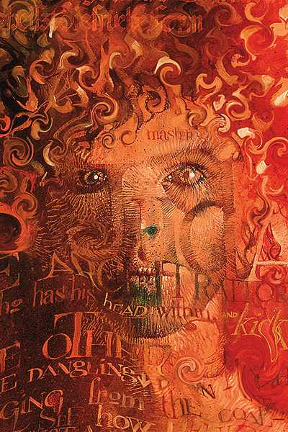

Slide 40
Tertullian 196 AD: Pagans Backlash
“The Christians are to blame for every disaster and every misfortune that befalls the people. If the Tiber rises to the walls, if the Nile fails to rise and flood the fields, if the sky withholds its rain, if there is earthquake or famine or plague, straightway the cry arises: ‘The Christians To The Lions!’”

Slide 41
Pagans’ Scapegoats
David Lee Burris:
Greek Object Relations Theory Combined With Roman Hubris

Slide 42
Who Were the Christians?
Tragedies in two cities led to changes in perceptions of Christianity.
AD 64: A fire destroyed 10 districts in Rome.
AD 70: The Roman army destroyed the Jerusalem temple.

Slide 44
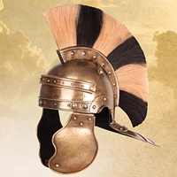
Destruction of Temple—AD 70
The destruction of the Jewish temple also affected perceptions of the Christian faith.
In AD 66, a group of Jewish insurrectionists took Galilee and Judea from the Romans.

Slide 45
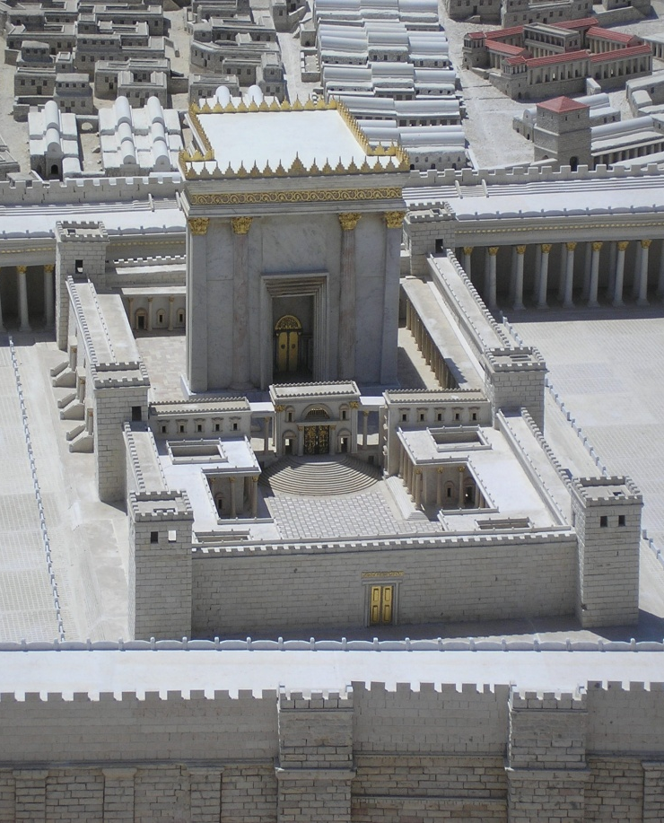
Destruction of Temple—AD 70
Emperor Vespasian sent his son Titus to retake the rebel provinces.
In AD 70, Titus destroyed the Jewish temple.
Jesus predicted this event (Mark 13: 1–2).
Model of the temple that the Romans destroyed in AD 70
Notes:
Image: © Boris Diakovsky

Slide 47
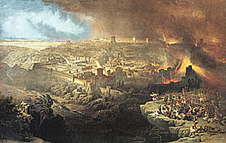
jerusalem
TEMPLE

Slide 48
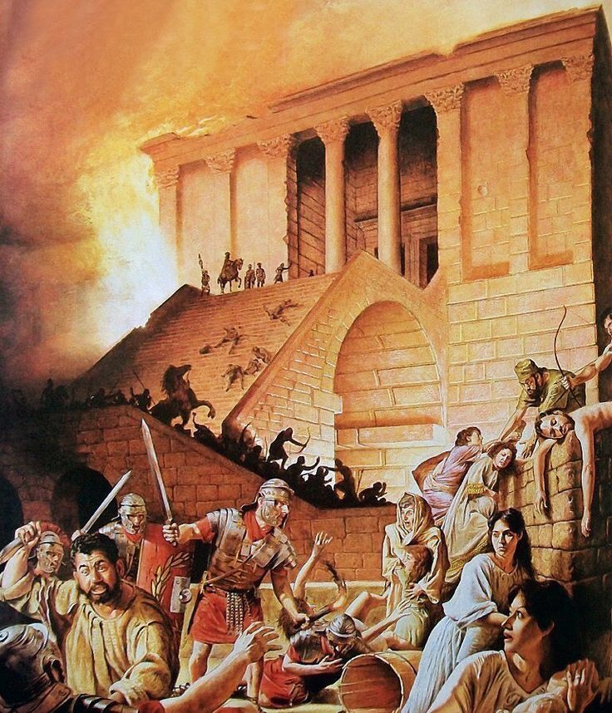

Slide 49
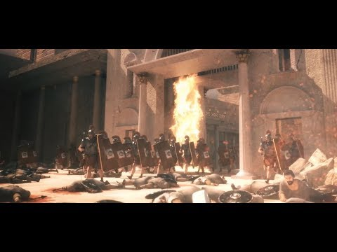

Slide 50
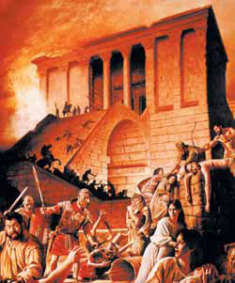
jerusalem
OLD TEMPLE
The New Temple

Slide 51
MATTHEW 24:14 – “And this gospel of the kingdom will be preached in all the world as a witness to all the nations, and then the End will come.”

Slide 52
The Root Problem Here Is That The Judaizing Christians & Even The Inspired Apostles Has But Incomplete Understanding of Matthew 24. The Olivet Discourse is easiest understood by observing that the Apostles were asking the typical ethno-centric question of the end of the world as they knew it (TEOTWAWKI) but truth be told - they were asking two questions – one of the destruction of the temple along with the city of Jerusalem - and the other as regards the end of the world. The fact that Christ gave His answer in two-part – the pivotal passage at Matthew 24: 35 – is of greatest illumination to our subject today. If we consider that Matthew 24: 3 – 34 parallels the events described in Revelation 20: 1, 2 to the End of that Age & Matthew 24: 35 – Matthew 25: 13 parallel events afterwards and until the End of Satan’s Story or End of the World - we can then observe the following contrasts: Events Local Versus Events Global; “This Generation” Versus “The Days of Your Fathers”; “That Day” Versus “Those Days”; and Signs Versus Suddenness.
Signs Versus Suddenness: Brother Larry Ray Hafley writes – “Jesus told of the signs preceding the destruction of Jerusalem; namely, ‘false Christs and false prophets,’ and wars and rumors of wars, famines and earthquakes – ‘all these are the beginnings of sorrows’ (Matthew 24: 6 – 8). Further He told them of ‘the abomination of desolation’ (Roman Eagle Standard), the Roman army (Matthew 24: 15; Luke 21: 20). ‘Then know that the desolation thereof is nigh’ (Luke 21: 20). They could ‘know’ the destruction of Jerusalem was ‘nigh,’ but the Coming of the Son of Man and the consequent Judgment were to be without warning (Matthew 24: 42, 43, 50; 25: 13). Compare ‘then know’ with ‘know not’ (Luke 21: 20; Matthew 24: 39). ‘So shall also the Coming of the Son of Man be.’
The desolation and annihilation of ‘the buildings of the temple’ were to be seen by signs. ‘When ye shall see these things, know it is near, even at the doors… But of that day and hour knoweth no man, no, not the angels of heaven, but My Father Only’ (Matthew 24: 33, 36).
At least three times, Jesus specifically indicated that He was giving tangible evidence of the destruction of Jerusalem (Matthew 24: 8, 25, 33) but the second coming and the judgment were to be sudden, unknown, as when a thief strikes (Matthew 24: 42, 44, 50; 25: 13; 1st Thessalonians 5: 2 – 4; 2nd Peter 3; 10).
Jesus spoke of ‘great tribulation, such as was not since the beginning of the world to this time, no nor ever shall be’ (Matthew 24: 21). This implies that time will continue after ‘this time,’ but there is no sense in saying, ‘nor shall ever be’ if the end of the world and the (final) judgment were being studied. The same argument can be made from the next verse (Matthew 24: 22). Those days evidently will ‘be shortened;’ they will end, and the elect shall be saved because of it. But if the end of the world were in view, the elect would be saved whether the days were shortened or not.
Finally, Matthew 25 supplements Matthew 24: 36 – 51. The judgment of Matthew 25 involves and includes ‘all nations’ (Matthew 25: 32). It is the final judgment (Matthew 25: 34, 41, 46). The ten virgins parable says, ‘be prepared,’ ‘watch.’ The parable of the talents stresses the necessity of diligence and faithfulness (Matthew 25: 21, 23, 26 linking @Matthew 24: 42 – 51).
– David Burris Satan Bounded Article This Same Site

Slide 53
THE END OF DAYS REFERENCED IN MATTHEW 24:3-34 AND ACTS 1:20 IS THE ELIMINATION OF PHYSICAL ISRAEL ALONG WITH JERUSALEM AS RELIGIOUS CAPITOL & CENTER OF MOSAIC SYSTEM OBSERVANCE

Slide 54
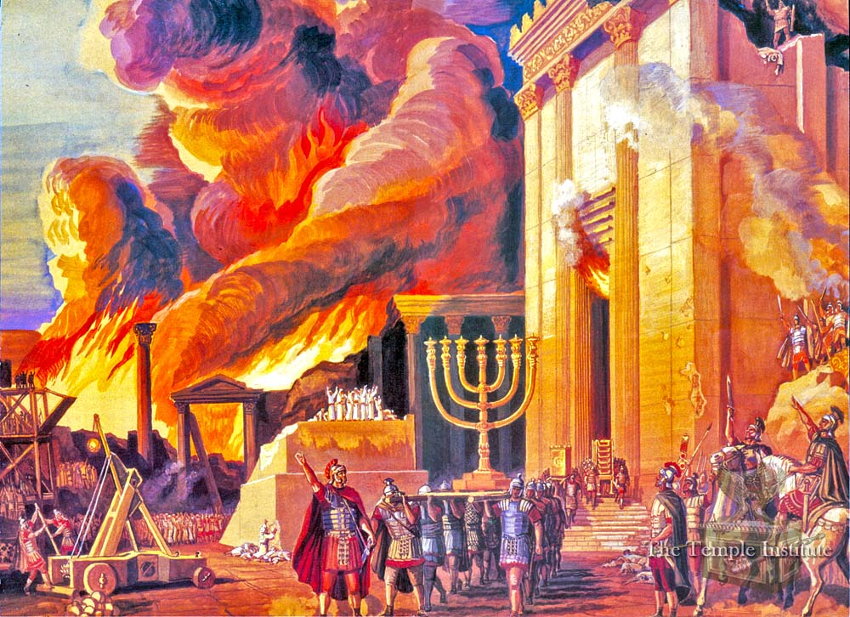

Slide 55
- END FOLLOWED BY NEW BEGINNING –
ACTS 1:21 – “And it shall come to pass That whosoever shall call upon the name of the LORD Shall be saved.”
-- Links to Christ’s Call -
Acts 1:8c - “Witnesses to Me … To the End of the Earth.”

Slide 56
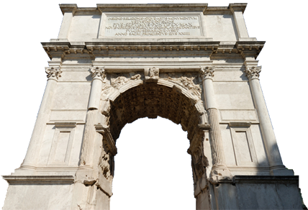
Destruction of Temple—AD 70
After the destruction of the Jewish temple, the Jewish and Christian faiths each became more distinct as Judaism became less diverse.
The Arch of Titus commemorates the destruction of the temple
Notes:
Image: © pippa west

Slide 57
Center Of The Theocratic Shift To The Cult Of The Emperor

Slide 58
Post-Temple Destruction—AD 70
ROME COLOSSEUM FUNDED BY SEIZED TREASURE TAKEN FROM DESTROYED TEMPLE OF HEROD!
The Arch of Titus commemorates the destruction of the temple
Notes:
Image: © pippa west

Slide 59
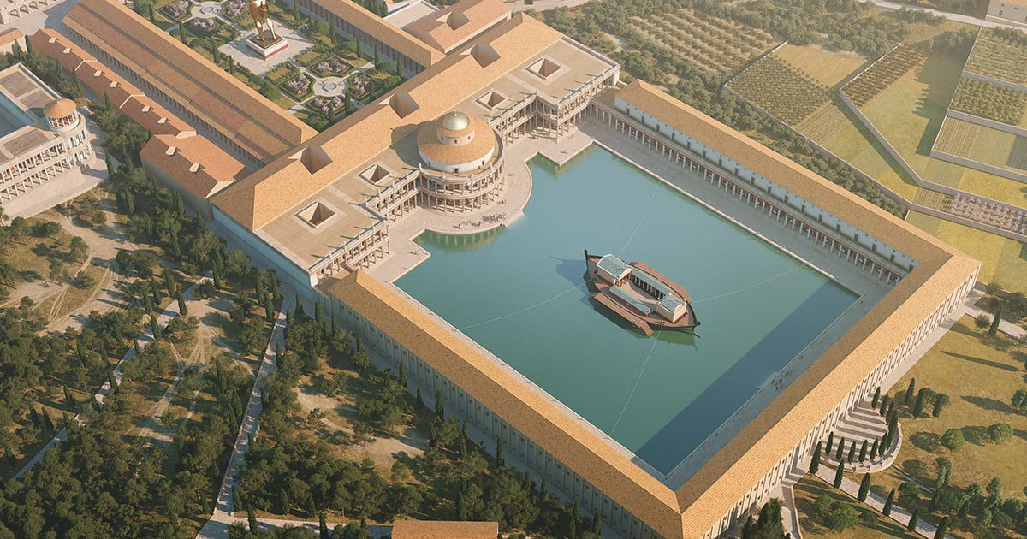
Post-Temple Destruction—AD 70
ROME COLOSSEUM FUNDED BY SEIZED TREASURE TAKEN FROM DESTROYED TEMPLE OF HEROD!
NEW FLAVIAN DYNASTY BUILT NEW GAMES COLOSSEUM OVER NERO’S NOW DEMOLISHED GOLDEN PALACE AND FILLED-IN ARTIFICIAL LAKE!!
Notes:
Image: © pippa west

Slide 64
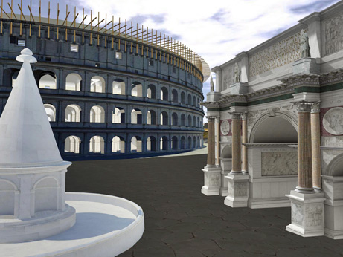

Slide 65
David Lee Burris:
Colosseum held 50,000 was last used in early sixth century; Velarium was a massive, retractable, fabric canopy tensioned by a system of ropes and pulleys operated by sailors.

Slide 66
Center Of The Theocratic Shift To The Cult Of The Emperor
Idle Masses Kept Occupied & Entertained

Slide 67
Bread & Circus

Slide 68
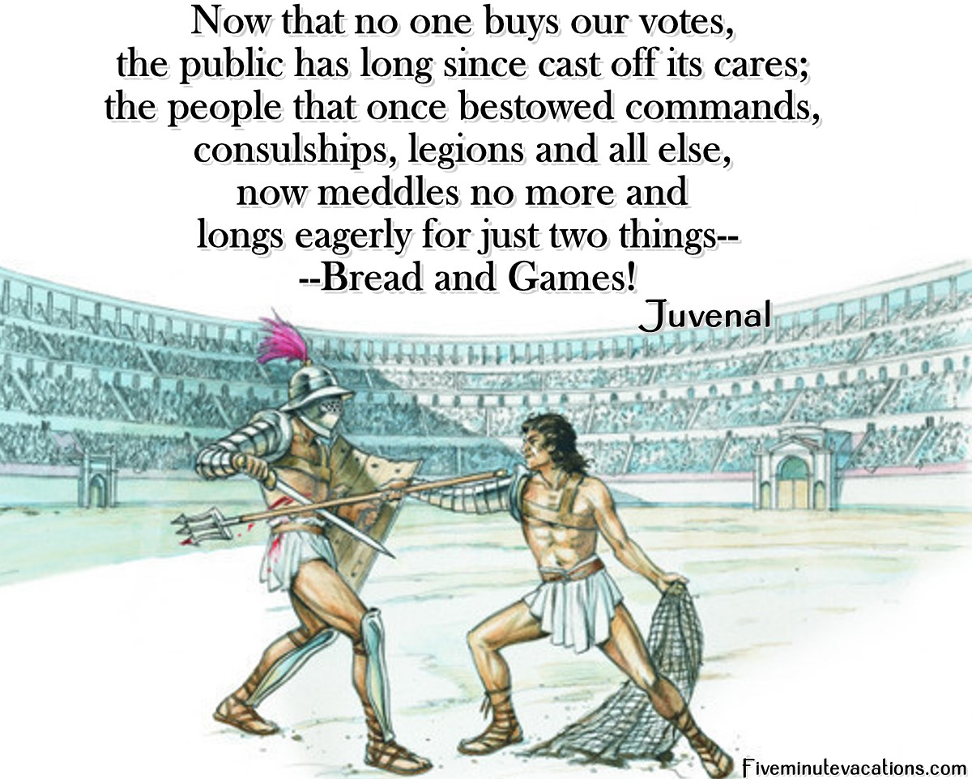

Slide 72
Bread & Circuses
Elimination Cycled
End Process Loaded
User Fee Tax Financed

Slide 73
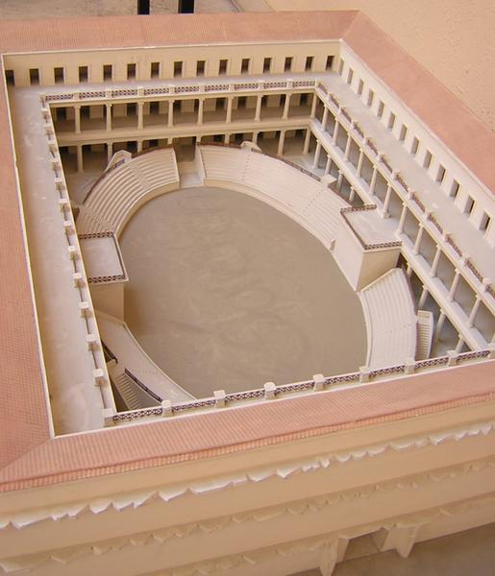
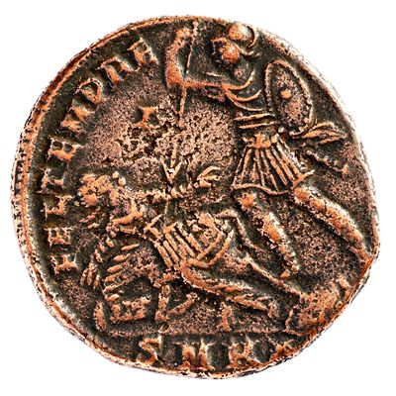
THE JEWISH WAR HAD BEEN EXPENSIVE
NEW PUBLIC FACILITIES NEEDED NEW FORMS OF REVENUE FLOW
BUDGET “BOTTOM-LINE” LINKED USER FEES FOR PAY TOILETS
The Arch of Titus commemorates the destruction of the temple
Notes:
Image: © pippa west

Slide 74
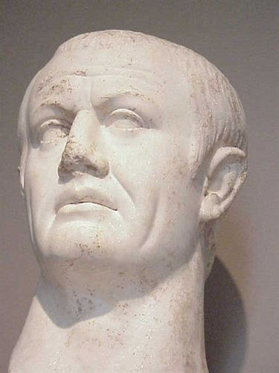
In 74 AD, Emperor Vespasian (pictured here) had run out of money due to a war of rebellion. In order to raise funds, he created the world’s first public pay toilets. When his son Titus criticized him for it, Vespasian pointed out that money (even earnt through urine) did not smell. This gave rise to the common saying “Pecunia non olet” – “money does not smell”.

Slide 75
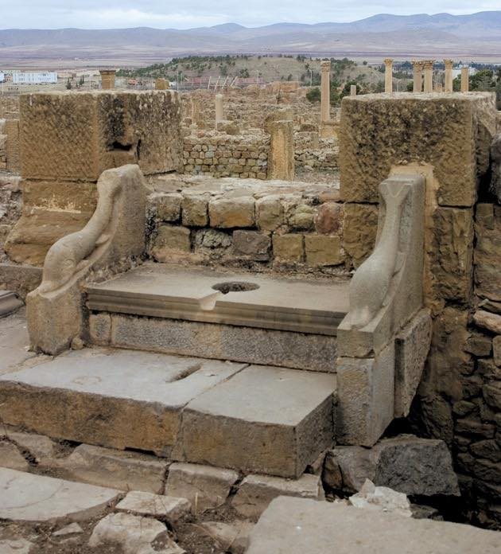

Slide 76
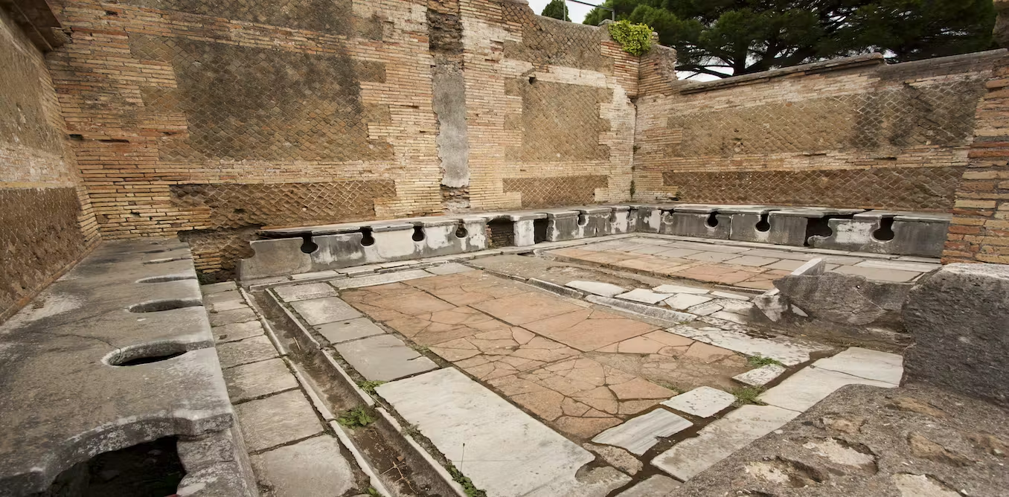

Slide 77
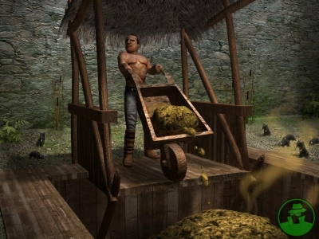

Slide 81
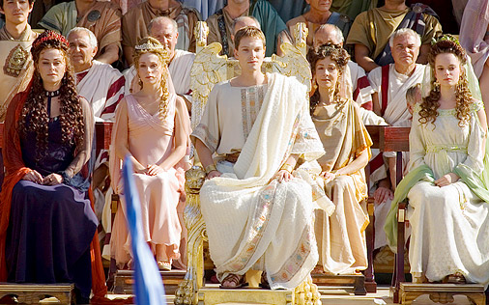

Slide 82
Gladiators Were Captive Slaves Fighting To Satisfy Bloodlust!

Slide 83
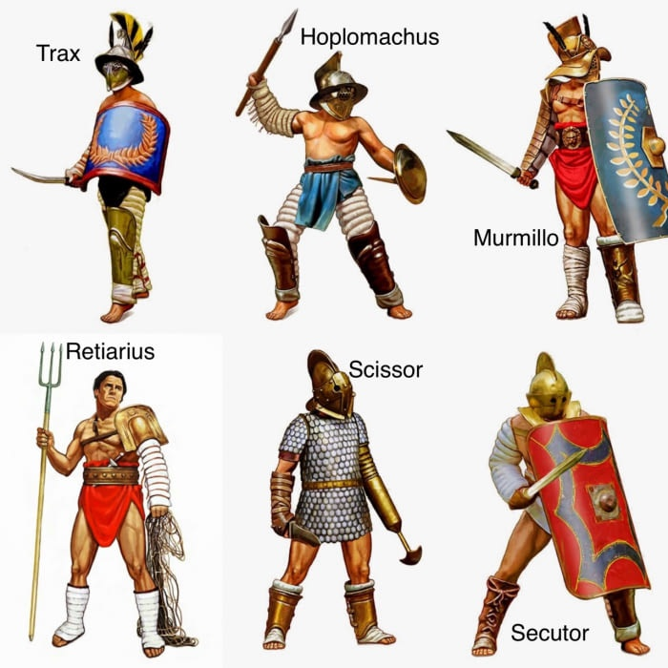

Slide 84
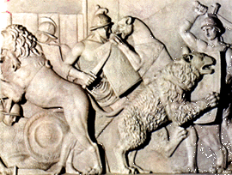
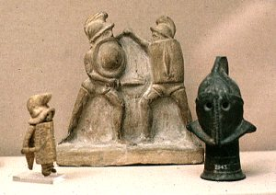

Slide 88
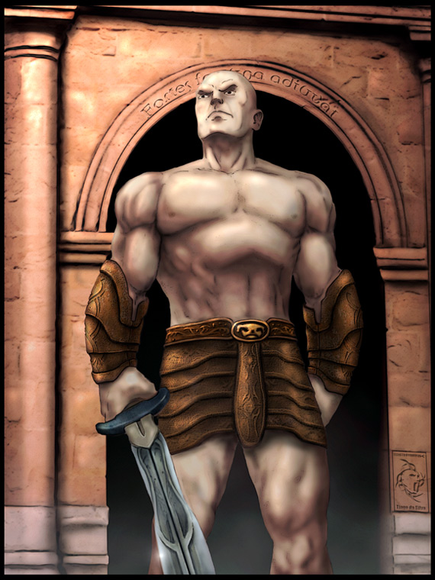
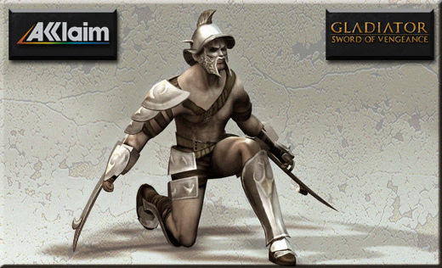
David Lee Burris:
Translation - “Pain Is Temporary, Glory Is Eternal!”
DOLOR TEMPORARIUS
First Holders of Doctor Title -
Those That Trained Gladiators
GLORIA AETERNA

Slide 89
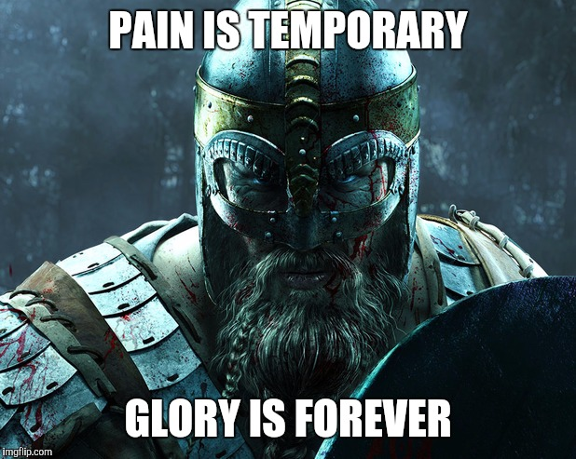

Slide 90
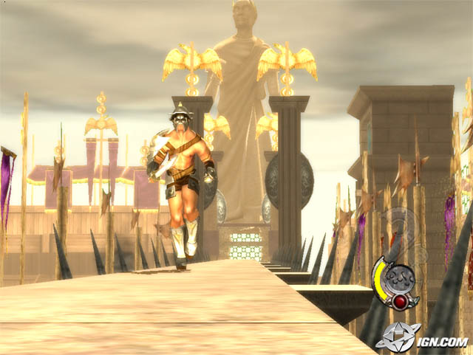
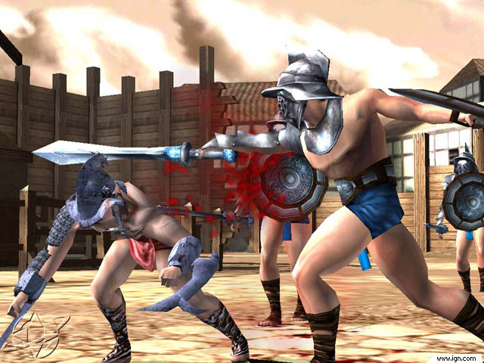
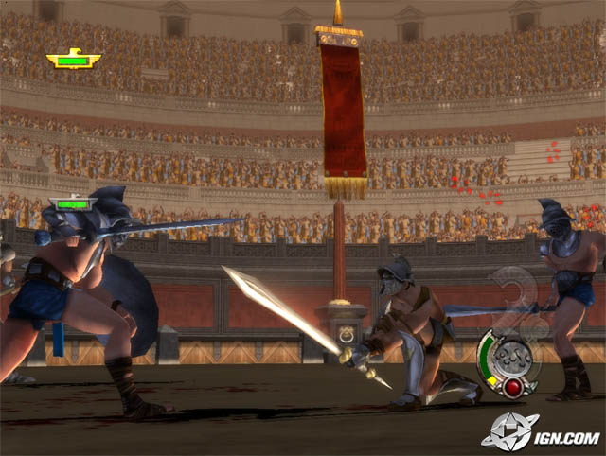
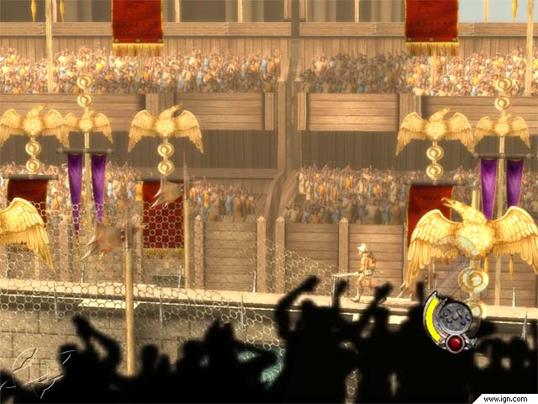
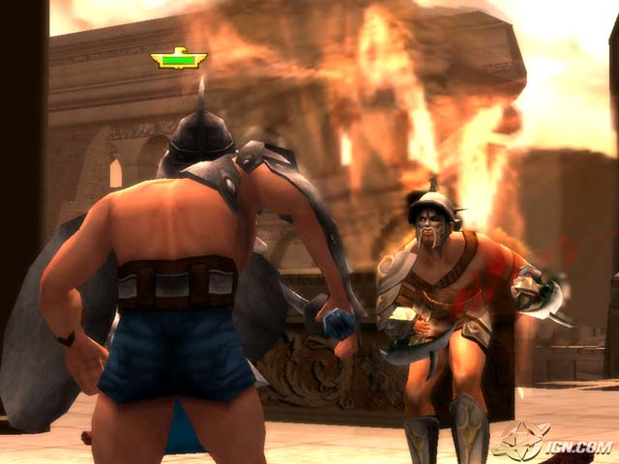
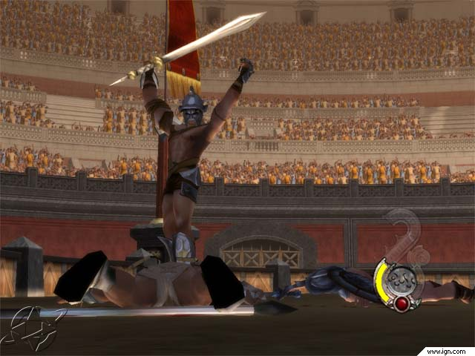

Slide 91
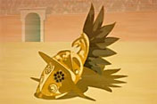
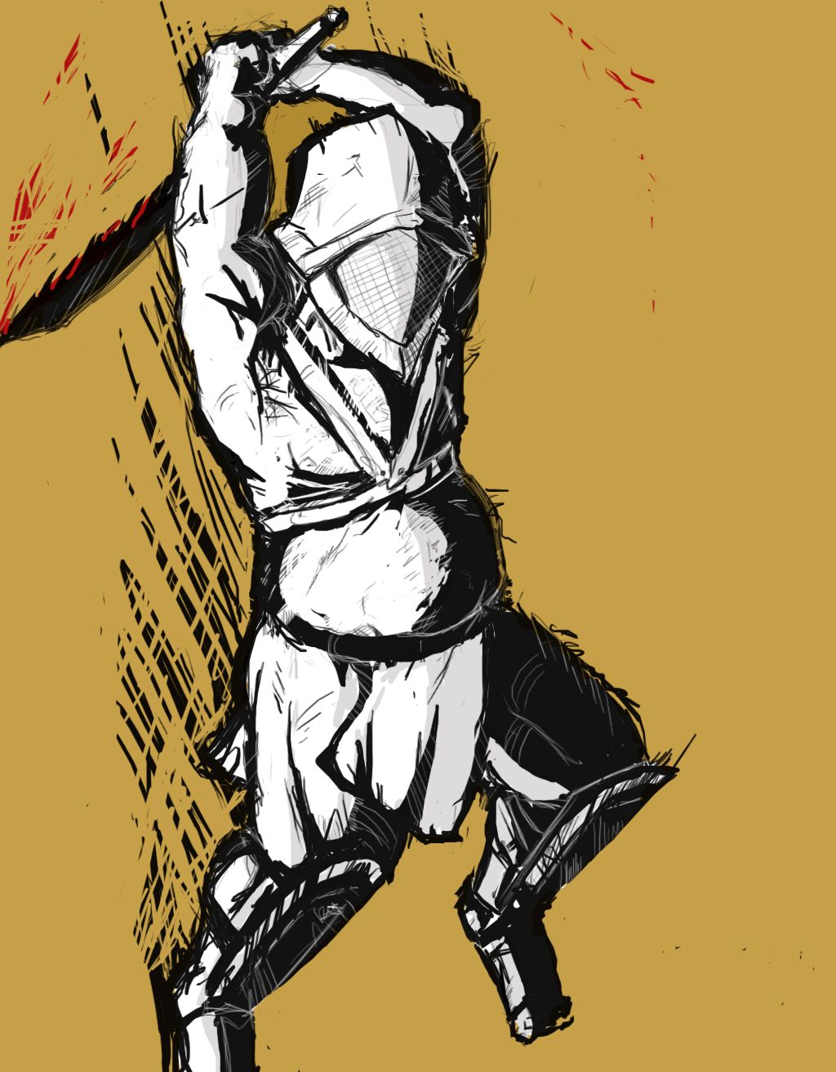
David Lee Burris:
Colosseum held 50,000 was last used in early sixth century; Velarium was a massive, retractable, fabric canopy tensioned by a system of ropes and pulleys operated by sailors.

Slide 92
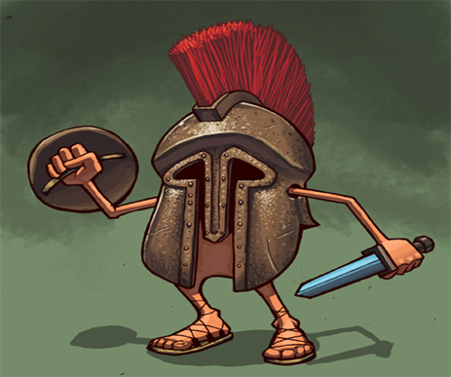

Slide 94
THE WOODEN RUDIS:
The Fake Sword of Roman Freedom

Slide 97
THUMBS UP & DOWN MEANT OPPOSITE TO ROMANS
Must of us have got his wrong. It is widely believed that the thumbs up gesture originates from the gladiatorial fights of ancient Rome, in which the destiny of a losing gladiator was decided by the crowd. Thumbs up, he lived, thumbs down -he died. If this is what you believe – then you would be wrong, and here’s why.
Thumbs down, signified “swords down,” which meant the losing gladiator was worth more to them alive and was to be spared to fight another day.
The belief that the ‘thumbs-up’ and ‘thumbs-down’ gestures gave approval or disapproval respectively entered the public consciousness with Jean-Léon Gérôme’s 1872 painting ‘Pollice Verso’. The ‘thumbs down’ gestures of the crowd in Gérôme’s popular picture were falsely interpreted by the 19th century public as signs of disapproval. Actually, the artist probably never intended that, as ‘pollice verso’ just means turned thumb. . . .

Slide 98
THUMBS UP & DOWN MEANT OPPOSITE TO ROMANS
Scholars before Gérôme gave support to the view that “thumbs down” among the Romans, meant the hapless gladiator was to be spared, not killed.
The gesture meant “Throw your sword down”. A 1601 translation of Pliny equates the gesture with “assent” or “favor”, and John Dryden’s 1693 version of Juvenal’s Satires gives the thumb being bent back,not down, as the death signal.
Whenever a combatant was seriously wounded, the presiding judge, or referee, was called upon to determine whether the man should live or die, depending on how well he had put up a fight.
Bit like modern day ‘talent shows’ a judge usually based his decision on the passions expressed by the crowds in the stadium; whether they would cheer, applaud, and give the thumbs down if they liked the man,. If they didn’t then they would give the thumbs up and his opponent would dispatch the fatal blow. Some scholars suggest that the thumbs up meant to thrust a sword up into the downed gladiator’s heart. - Nick Knight

Slide 99
Mythological Dramatization

Slide 100
Significant Differences
GREEK ANTHROPOMORPHIC FAITH VERSUS ROMAN NUMINA RELIGION
CITY GREEKS WERE XENOPHOBIC IMPERIAL ROMANS COSMOPOLITAN
GREEK ENTERTAIN BLOODLESSLY ROME HAD APPETITE FOR VIOLENCE

Slide 101
Psychopompus Underworld Soul Conductor Stood on One Side in Black Dress with Red-Hot Caduceus Making The Death Final
The Soul Conductor Opposite Dressed as Rhadamanthus, Judge of the Underworld.
Wearing tall dark boots, tunic, and raven’s mask, he claimed with each tap of mallet the now officially defunct gladiator souls.

Slide 104
DOLOR BREVIS
GLORIA AETERNA

Slide 105
Adult Conversion Considered An Alien Concept
TO THE
IMPERIAL
POLYTHEIST

Slide 106
Text-Based Religion Wins Over
A Practice-Based Paganism

Slide 107
Persecution of the Monotheist
The New Stench of Rome Spreads
Religious persecution
Notes:
Image: © Danilo Ascione

Slide 108
David Lee Burris:
Tacitus - Nero had the believers “torn by dogs, nailed to crosses, …even used as human torches to illuminate his gardens at night.”

Slide 109
EARLY CHURCH PRE-TEST
There were several relatively good emperors who nevertheless persecuted Christians. What were their reasons?
Unite The Empire Under Pagan Religion
The Christians Were Considered Disloyal, Not Serving In The Army
To Demand Full, Worshipful Allegiance To The Emperor
The Christians Were Secretly Plotting To Assassinate The Emperor

Slide 110
EARLY CHURCH PRE-TEST
There were several relatively good emperors who nevertheless persecuted Christians. What were their reasons?
Unite The Empire Under Pagan Religion
The Christians Were Considered Disloyal, Not Serving In The Army
To Demand Full, Worshipful Allegiance To The Emperor
The Christians Were Secretly Plotting To Assassinate The Emperor

Slide 111
David Lee Burris:
More On Marcus Aurelius: 177 @ Lyon, France For Holiday Entertainment Of Visiting Governor Torture Cheaper Than Valuable Gladiator Games Human BBQ On “The Hot Seat”
More On Septimus Severus: Perpetua was educated Roman woman fluent in Latin & Greek and Felicitas was her slave girl. She would not surrender her faith even with her father’s pleading. She kept her modesty while the wild beasts brutalized her. Somehow the animals could not kill her off so trembling soldiers were sent in to finish the job – she guided their swords. Before dying she shouted to the anonymous Christians in the crowd – “You must all stand fast in the faith and love one another and do not be weakened by what we have gone through.” Two centuries later, Augustine pointed out the significance of the names of these two martyrs taken together – perpetua felicitas means “everlasting happiness” which is exactly what they received!
More On Maximus:
It began as an attempt to rid Cappadocia of Christians.
More On Decius: Given certificate of sacrifice if did so – if not – executed on the spot. There were approximately 2 mill professed believers at that time. Some commentators suggest that most Christians recanted and offered sacrifice and that the number of faithful were reduced from millions to the thousands.
More On Aurelia:
A whole legion of soldiers that professed Christianity were killed for not taking the Antichristian oath. In 274 AD, all 6,666 men were killed!
More on Diocletian:
It is related that 17,000 were slain in one month and in Egypt alone 144,000 died by the violence of their persecutors and 700,000 died through the fatigues of banishment or punishment.
ROMAN PERSECUTION
NATURE & EXTENT
Aurelius: 161-180
Christians Blamed For Natural Disasters
Septimus: 202-211
The Conversion To Christianity Forbidden
Maximinus: 235-236
Clergy Executed That Supported Predecessor
Decius: 249-251
All Empire Total Terror Forced Emperor Worship
Valerian: 257-260
Property Confiscation No Right Of Assembly
Diocletian: 303-311
Churches & Bibles Burn; Compulsive Sacrificing

Slide 112
Tertullian 196 AD: Pagans Backlash
“The Christians are to blame for every disaster and every misfortune that befalls the people. If the Tiber rises to the walls, if the Nile fails to rise and flood the fields, if the sky withholds its rain, if there is earthquake or famine or plague, straightway the cry arises: ‘The Christians To The Lions!’”

Slide 114
The Parthian Shot. The Parthians were a Persian tribe that developed the cavalry tactic of retreating in order to draw their enemy after them, whereupon they would turn in the saddle and fire a barrage of arrows.

Slide 115
Maybe Roman Emperor Today Parthian Footstool Tomorrow

Slide 116
Pax Romana Ends & Christians Scapegoated
MILITARY & NATURAL DISASTERS:
Food Shortages & Antonine Plague
Brought Back by Parthian War Vets

Slide 117
Colosseum Was The Societal Glue
Center Of The Theocratic Shift To The Cult Of The Emperor
Idle Masses Kept Occupied & Entertained

Slide 118
Court Astrologers Convince Severus to Establish Sun Worship as Imperial Official Religion

Slide 119
Adult Conversion Considered An Alien Concept
TO THE
IMPERIAL
POLYTHEIST

Slide 120
Monotheist Martyrdom

Slide 121
David Lee Burris:
More On Marcus Aurelius: 177 @ Lyon, France For Holiday Entertainment Of Visiting Governor Torture Cheaper Than Valuable Gladiator Games Human BBQ On “The Hot Seat”
More On Septimus Severus: Perpetua was educated Roman woman fluent in Latin & Greek and Felicitas was her slave girl. She would not surrender her faith even with her father’s pleading. She kept her modesty while the wild beasts brutalized her. Somehow the animals could not kill her off so trembling soldiers were sent in to finish the job – she guided their swords. Before dying she shouted to the anonymous Christians in the crowd – “You must all stand fast in the faith and love one another and do not be weakened by what we have gone through.” Two centuries later, Augustine pointed out the significance of the names of these two martyrs taken together – perpetua felicitas means “everlasting happiness” which is exactly what they received!
More On Maximus:
It began as an attempt to rid Cappadocia of Christians.
More On Decius: Given certificate of sacrifice if did so – if not – executed on the spot. There were approximately 2 mill professed believers at that time. Some commentators suggest that most Christians recanted and offered sacrifice and that the number of faithful were reduced from millions to the thousands.
More On Aurelia:
A whole legion of soldiers that professed Christianity were killed for not taking the Antichristian oath. In 274 AD, all 6,666 men were killed!
More on Diocletian:
It is related that 17,000 were slain in one month and in Egypt alone 144,000 died by the violence of their persecutors and 700,000 died through the fatigues of banishment or punishment.
Spiritual Law Of
Thermodynamics
ROMAN PERSECUTION
NATURE & EXTENT
Aurelius: 161-180
Christians Blamed For Natural Disasters
Septimus: 202-211
The Conversion To Christianity Forbidden
Maximinus: 235-236
Clergy Executed That Supported Predecessor
Decius: 249-251
All Empire Total Terror Forced Emperor Worship
Valerian: 257-260
Property Confiscation No Right Of Assembly
Diocletian: 303-311
Churches & Bibles Burn; Compulsive Sacrificing

Slide 122
EARLY CHURCH PRE-TEST
Why were early Christian martyrs sometimes wrapped in animal skins?
So dogs would attack them
Because they “ate flesh & drank blood”
To show they were “like the Lamb”
To show they were no better than beasts
x

Slide 123
DOLOR BREVIS
GLORIA AETERNA

Slide 124
EARLY CHURCH PRE-TEST
What was Ignatius’ comment about facing wild beasts in the coliseum where he would be martyred?
“Better animal beasts than soldier beasts”
“If God wills, the lions will lie before the Lamb”
“I shall coax them to devour me promptly”
“I shall not be facing the wildest beasts. They all sit in the coliseum bleachers”
x

Slide 125
IGNATIUS OF ANTIOCH LETTER: “I am writing to all churches and am insisting to everyone that I die for God of my own free will – unless you hinder me. I implore you: do not be unseasonably kind to me. Let me be food for the wild beasts, through whom I can reach God. I am God’s wheat and I am being ground by the teeth of the wild beasts, so I may prove to be pure bread.”

Slide 126
HE SET EXAMPLE TO NOT SHOW HOMAGE NOT SALUTING THE ROMAN EMPEROR

Slide 130
DOLOR BREVIS
GLORIA AETERNA

Slide 133
CHRISTIAN CONTEMPT FOR THE FLESH & FOR DEATH: “For their contempt of death, and of what comes after death, is patent to us every day, and likewise their restraint in co-habitation.” - Galen

Slide 134
David Lee Burris:
More On Marcus Aurelius: 177 @ Lyon, France For Holiday Entertainment Of Visiting Governor Torture Cheaper Than Valuable Gladiator Games Human BBQ On “The Hot Seat”
More On Septimus Severus: Perpetua was educated Roman woman fluent in Latin & Greek and Felicitas was her slave girl. She would not surrender her faith even with her father’s pleading. She kept her modesty while the wild beasts brutalized her. Somehow the animals could not kill her off so trembling soldiers were sent in to finish the job – she guided their swords. Before dying she shouted to the anonymous Christians in the crowd – “You must all stand fast in the faith and love one another and do not be weakened by what we have gone through.” Two centuries later, Augustine pointed out the significance of the names of these two martyrs taken together – perpetua felicitas means “everlasting happiness” which is exactly what they received!
More On Maximus:
It began as an attempt to rid Cappadocia of Christians.
More On Decius: Given certificate of sacrifice if did so – if not – executed on the spot. There were approximately 2 mill professed believers at that time. Some commentators suggest that most Christians recanted and offered sacrifice and that the number of faithful were reduced from millions to the thousands.
More On Aurelia:
A whole legion of soldiers that professed Christianity were killed for not taking the Antichristian oath. In 274 AD, all 6,666 men were killed!
More on Diocletian:
It is related that 17,000 were slain in one month and in Egypt alone 144,000 died by the violence of their persecutors and 700,000 died through the fatigues of banishment or punishment.
Spiritual Law Of
Thermodynamics
ROMAN PERSECUTION
NATURE & EXTENT
Aurelius: 161-180
Christians Blamed For Natural Disasters
Septimus: 202-211
The Conversion To Christianity Forbidden
Maximinus: 235-236
Clergy Executed That Supported Predecessor
Decius: 249-251
All Empire Total Terror Forced Emperor Worship
Valerian: 257-260
Property Confiscation No Right Of Assembly
Diocletian: 303-311
Churches & Bibles Burn; Compulsive Sacrificing

Slide 135
David Lee Burris:
More On Marcus Aurelius: 177 @ Lyon, France For Holiday Entertainment Of Visiting Governor Torture Cheaper Than Valuable Gladiator Games Human BBQ On “The Hot Seat”
More On Septimus Severus: Perpetua was educated Roman woman fluent in Latin & Greek and Felicitas was her slave girl. She would not surrender her faith even with her father’s pleading. She kept her modesty while the wild beasts brutalized her. Somehow the animals could not kill her off so trembling soldiers were sent in to finish the job – she guided their swords. Before dying she shouted to the anonymous Christians in the crowd – “You must all stand fast in the faith and love one another and do not be weakened by what we have gone through.” Two centuries later, Augustine pointed out the significance of the names of these two martyrs taken together – perpetua felicitas means “everlasting happiness” which is exactly what they received!
More On Maximus:
It began as an attempt to rid Cappadocia of Christians.
More On Decius: Given certificate of sacrifice if did so – if not – executed on the spot. There were approximately 2 mill professed believers at that time. Some commentators suggest that most Christians recanted and offered sacrifice and that the number of faithful were reduced from millions to the thousands.
More On Aurelia:
A whole legion of soldiers that professed Christianity were killed for not taking the Antichristian oath. In 274 AD, all 6,666 men were killed!
More on Diocletian:
It is related that 17,000 were slain in one month and in Egypt alone 144,000 died by the violence of their persecutors and 700,000 died through the fatigues of banishment or punishment.
Spiritual Law Of
Thermodynamics
ROMAN PERSECUTION
NATURE & EXTENT
Aurelius: 161-180
Christians Blamed For Natural Disasters
Killing The Catechumens
“Earlier persecutions had tended to focus on the leaders of the Christian community. Essentially pagan in their outllook, Roman authorities were used to facing religious institutions with a professional hierarchy of priests and a larger body of believers. If you take out the priests, they reasoned, the believers really have nowhere to go with their faith. They hadn’t reckoned on the essentially non-hierarchical nature of Christian spirituality. This time, Rome did different. Severus decreed it was converts who would be punished!”
Septimus: 202-211
The Conversion To Christianity Forbidden
Maximinus: 235-236
Clergy Executed That Supported Predecessor
Decius: 249-251
All Empire Total Terror Forced Emperor Worship
Valerian: 257-260
Property Confiscation No Right Of Assembly
Diocletian: 303-311
Churches & Bibles Burn; Compulsive Sacrificing

Slide 136
“Overt persecution is a sign of the failure of the persecutors. Failure to keep believers quiet leads to overt persecution – so overt persecution is an indication that believers have refused to be quiet!
Overt persecution authenticates the faith within resistant cultures. Overt persecution gives faith value in the eyes of those who watch believers and marvel at their willingness to suffer and die in Jesus’ name.” – Nik Ripken

Slide 137
Roman Persecution: “Getting Certified”
“There were two all-out empire-wide persecutions intended to utterly destroy the church. The first, under Decius, began in December, 249. Everyone in the empire had to get a certificate from a government officer verifying that he or she had offered a sacrifice to the gods – an act that most Christians in good conscience could not do.”

Slide 138
Prior Warned Of Lethal Consequence Pliny Asked, “Are You A Christian?” To Say Yes Three Times Meant Death Real Nature Of The Offense Unsure:
“Whatever the nature of their creed, stubbornness & inflexible obstinacy surely deserve to be punished!”

Slide 139
WHAT DOES IT TAKE TO SEPARATE OUT TRUE BELIEF?
PHINY TOLD THE EMPEROR: Decorate Official Quarters With The Roman Gods & Invite Their Sacrifice Then Require Them Curse The Christ

Slide 140
“None of which those who are really Christians, it is said, can be forced to do!”

Slide 141
Roman Persecution: “The Great Persecution”
“The second, called ‘The Great Persecution,’ began on Feb 23, 303 under Emperor Diocletian. Galerius, the empire’s second-in-command, was behind this persecution policy and continued it after Diocletian’s death. For eight long years, official decrees ordered Christians out of public office, scriptures confiscated, church buildings destroyed, leaders arrested, & pagan sacrifices required. All the reliable methods of torture were mercilessly employed – wild beasts, burning, stabbing, crucifixion, the rack. But they were all to no avail. The penetration of the faith across the empire was so pervasive the church couldn’t be intimidated nor could it be destroyed. In 311, the same Galerius, shortly before his death, weak & diseased, issued an ‘edict of toleration.’ This included the statement that it was the duty of Christians - ‘to pray to their god for our good estate.’”

Slide 142
Historically Counterproductive: Herodotus
Herodotus composed his Histories to explain the ways of the gods to men, seeking to understand thru history & its moral dimensions why nations rise and fall. He found his explanation in the concept of hubris, the outrageous abuse of power that leads nations and individuals to disaster!
Cicero Oration – “O tempora! O mores!” = “Oh, the times, oh, the customs!”

Slide 143
THE HOLY MAN TELEMACHUS SHUTS DOWN
THE COLOSSEM GAMES IN THE YEAR 370 A.D.

Slide 146
From Foxes Book Of Martyrs:
“A rudely clad, robed figure appeared for a moment among the audience, and then boldly leaped down into the arena. Without hesitating an instant he advanced upon two gladiators engaged in a life-and-death struggle, and laying his hand upon one of them sternly reproved him for shedding innocent blood, and then turning toward the thousands of angry faces ranged about him, called upon them in a solemn, deep-toned voice which resounded through the deep enclosure.

Slide 148
From Foxes Book Of Martyrs:
“‘Do not require God’s mercy in turning away the swords of your enemies by murdering each other.’ Angry shouts and cries at once drowned his voice: ‘This is no place for preaching!’ Thrusting aside the stranger, the gladiators would again have attacked each other, but the man stood between holding them apart, and trying in vain to be heard. ‘Sedition! sedition! down with him!’ was the cry; and the gladiators, at once, stabbed him to death, and he perished, in the midst of the arena. He had died, but not in vain, for the shock of such a death before their eyes turned the hearts of the people: they saw the hideous aspects of their favorite vice; and no other fight of gladiators was ever held there.”

Slide 153
THE WOODEN RUDIS:
The Fake Sword of Roman Freedom

Slide 155
Colosseum Was The Societal Glue
Center Of The Theocratic Shift To The Cult Of The Emperor
Idle Masses Kept Occupied & Entertained

Slide 156
The Fall of the Roman Empire
Herodotus composed his Histories to explain the ways of the gods to men, seeking to understand through history and its moral dimensions why nations rise and fall. He found his explanation in the concept of hubris, the absolutely outrageous abuse of power that leads nations and individuals to disaster!
the
Colosseum
Symbolized

Slide 157
"A great civilization is not destroyed from without
until it has destroyed itself from within!"

Slide 159
DOLOR BREVIS
GLORIA AETERNA

