Slide 1
Magisterial Reformation Religious Wars DISILLUSIONING!
By David Lee Burris

Slide 2
Augustine’s Just War Doctrine
JWD Non-Practitioners
The Hussite Religious War
Swiss Religious & Civil War
holiday Massacre & Armada
30-Years War & Pietist Exodus

Slide 3
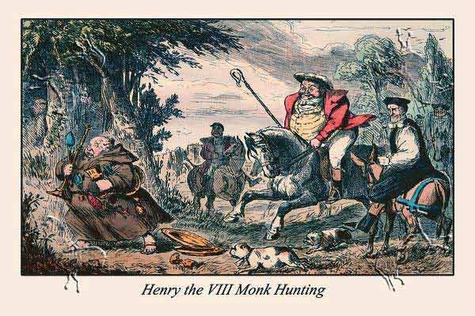
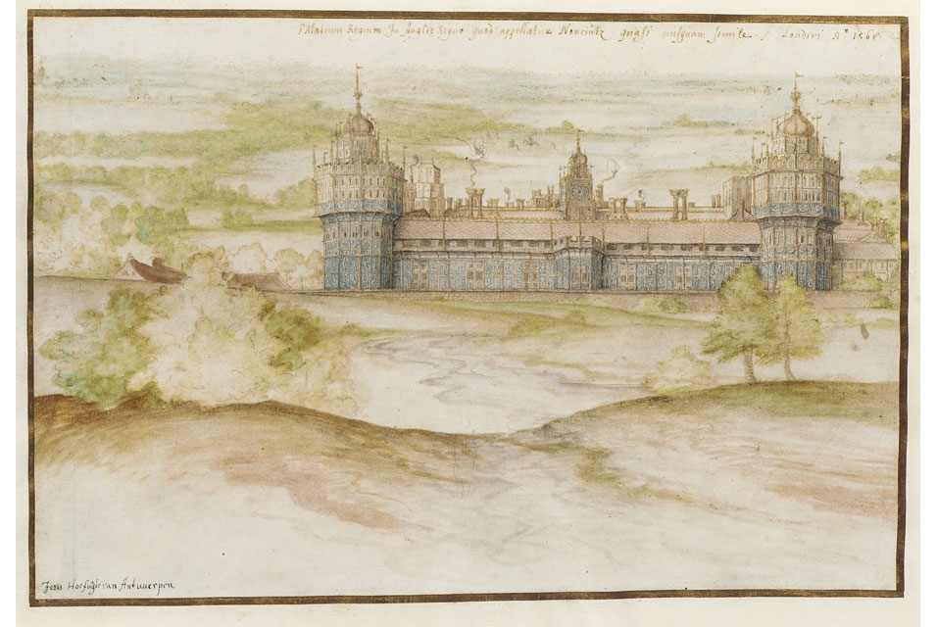
Magisterial Reformation
“The designation for the Lutheran, Zwinglian, and Calvinist wings of the 16th century Protestant movement, in contrast to the Anabaptist wing designated ‘radical.’ In contrast to the Anabaptist leaders, who acted apart from sponsorship of political rulers, the magisterial Reformers were convinced that political power ought to be employed to advance ecclesiastical reform.”
* Dictionary Of Theological Terms, Grenz & Guretzki

Slide 4
BACKGROUND:@ Augustine

Slide 5
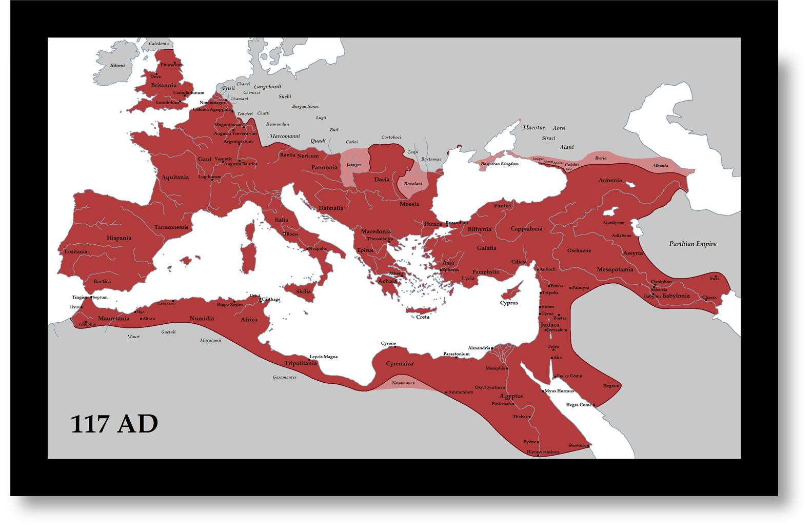

Slide 6
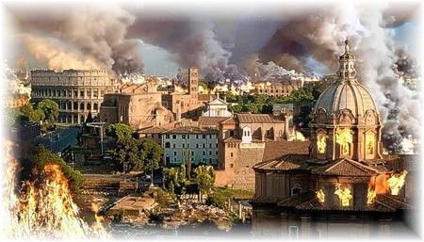
The Fall of Rome: 476 CE
Rome is no longer in real control over Western Europe.
By the 300’s, Constantine had created a new capital in Byzantium; emperors here remain in power for a while longer.
Rome didn’t fall in one catastrophic event, but over centuries.
The primary causes: masses of barbarians overflowed the northern and eastern borders; political and economic instability

Slide 7
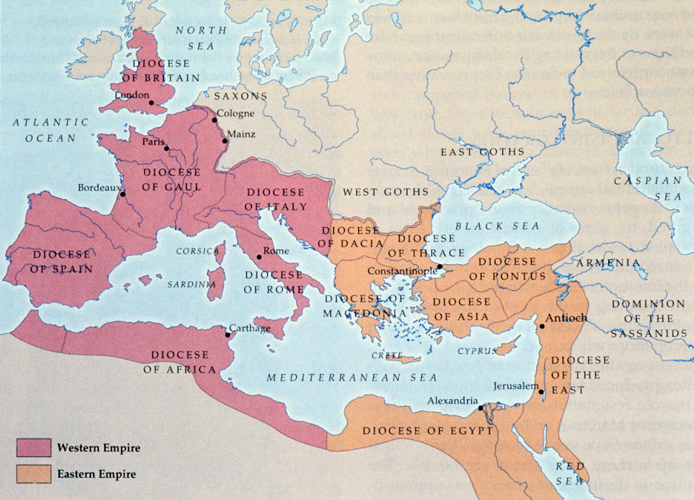
Introduction
Fall of Rome (Divided)

Slide 9
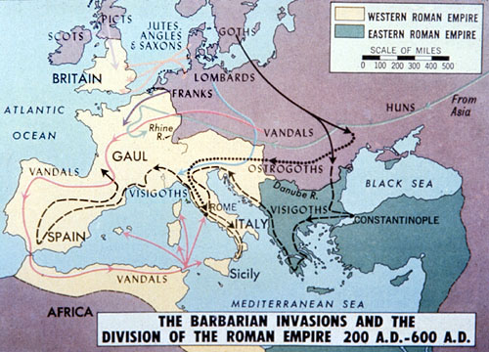
Introduction
Fall of Rome (Attacked)

Slide 10
The Fall of Rome
The city of Rome symbolized the strength of the Roman Empire.
Germanic tribes—known as “barbarians”—had been migrating south for decades, seeking farmland in the Empire.
In AD 410, the unthinkable occurred: The city of Rome fell to the barbarian Goths.

Slide 11
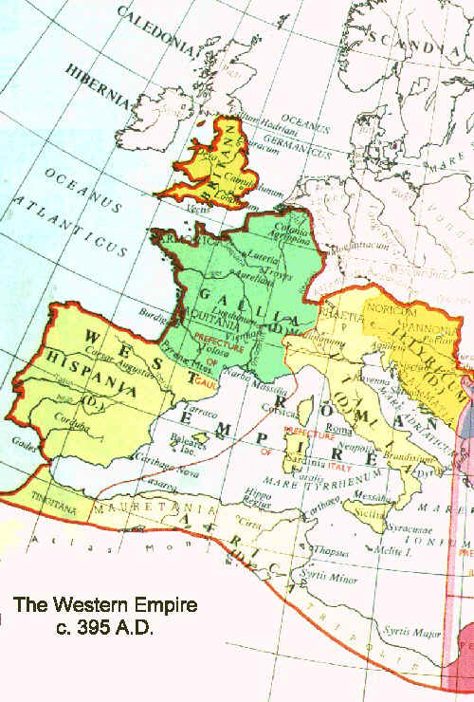
A nobleman of the Visigoths, a Germanic tribe living in Central Europe, Alaric fought for the Roman emperor Theodosius 1st against the rebel Eugenius. The brilliant decision to hire Alaric, though, gave the cunning nobleman an insider’s view of the empire’s weaknesses.

Slide 12
When Theodosius died in 395, the empire was divided into eastern and western halves ruled by quarreling sons – and Alaric decided to take advantage of the opportunity.
Alaric marched on Constantinople and ravaged the Thracian countryside, capturing most of Greece before the Roman general Stilicho forced him to withdraw.
He invaded Italy itself in 401 and by 410 had become the first barbarian conqueror of Rome!

Slide 13
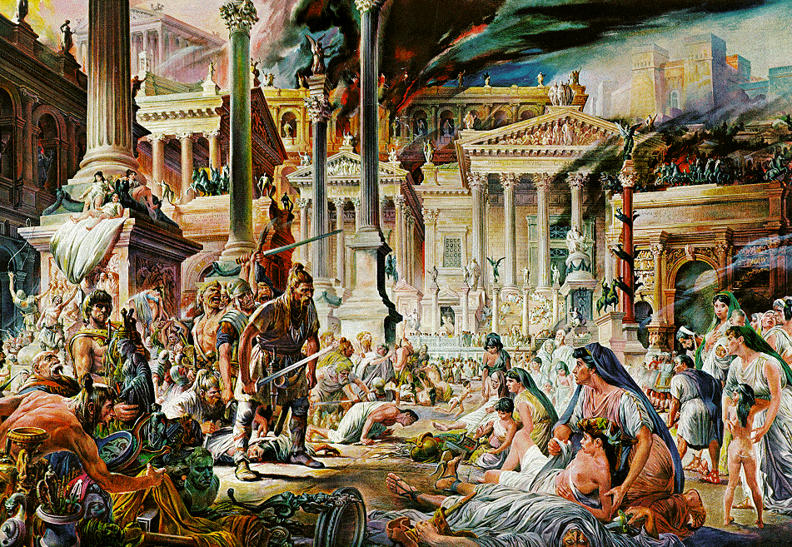
Introduction
Fall of Rome (Sacked 410 AD)

Slide 14
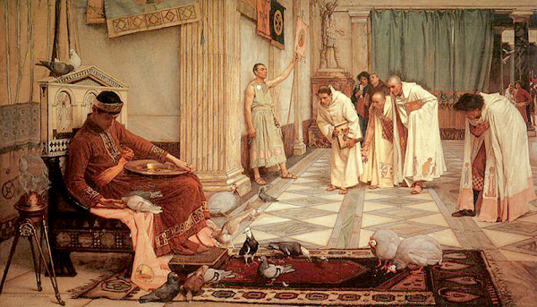
Emperor in East to Fall of West
"At that time they say that the Emperor Honorius in Ravenna received the message from one of the eunuchs, evidently a keeper of the poultry, that Rome had perished. And he cried out and said, 'And yet it has just eaten from my hands!' For he had a very large cock, Rome by name; and the eunuch comprehending his words said that it was the city of Rome which had perished at the hands of Alaric, and the emperor with a sigh of relief answered quickly: 'But I, my good fellow, thought that my fowl Rome had perished.' So great, they say, was the folly with which this emperor was possessed."
Procopius, The Vandalic War (III.2.25-26)

Slide 15
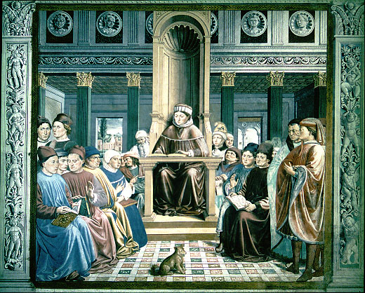
Augustine Of Hippo
Wrote commentaries, homilies, & treatises on a vast variety of subjects. He especially pioneered two types of religious literature. 1st - Remarks as to personal relationships, emotional development, spiritual insight, and individual journey. In the West, in the hands of the medievals and the Reformers, Christianity would become a religion of the individual. Even modern Western philosophy and science rest ultimately on this strong distinction between the subjective self and the objective world. 2nd - After Rome was ransacked by the barbarian horde in the year 410, Christianity once more came under attack, creating circumstances productive of the classic Augustine volumes on the “City Of God.” With this work in particular - he generated an entire new genre. When he had finished, he had given the definitive treatment to the nature of Christianity in relation to the political and societal order.

Slide 16
An Allover Apocalytic Angst

Slide 17
Augustine Of Hippo Womack’s – “Church Through The Ages”
“When Rome fell, many blamed Christianity for it. The Roman citizens were coming to Christianity in large numbers; The rulers of the Empire were impressing upon the people that the reason for the collapse of Rome was the desertion of the Roman religion by these converts to Christianity. From this came the threat of a number who might return to the Roman religion. Fisher records, ‘In 410, a thrill of dismay went through the empire at the news of the capture & sack of Rome by Alaric the Goth. The foundations of the world seemed to be shaken by the fall of the eternal city. Complaints broke out with renewed vehemence against the religion whose God had failed to shield Rome…’ Augustine wrote his famous City of God in answer to these accusations that Christianity was detrimental to man and especially to Rome. He both answered the charge and presented the people with the presence of two cities; the city of man (or the city of the world) and the city of God (or the Church).”

Slide 18
The Teaching of Augustine of Hippo
According to Augustine, two realms seem to mingle on earth: the City of God and the City of Mankind.
God’s reign cannot ultimately be identified with any human regime; the City of Mankind will fall but only God’s reign in his people’s hearts will remain.

Slide 19
Augustine’s Two-Part just war doctrine

Slide 20
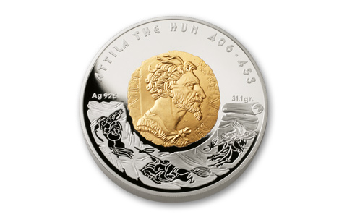
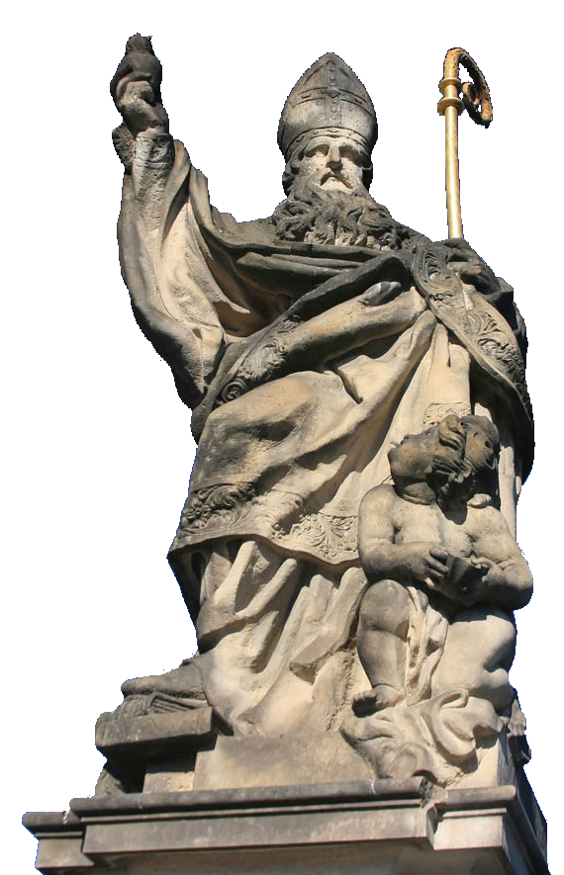
On Man’s Other Inescapable Behavior
According to Augustine, most notable, was making war. It had gone on since time immemorial and was therefore, according to him, natural to mankind.
Thus evolved the theory of “just war,” whose successful establishment completed a virtual revolution in the Christian overview of right and wrong, and ushered in centuries of mass killings and destruction.
Political language is designed to make lies sound truthful and murder respectable. – G. Orwell
Augustine of Hippo
Notes:
Image © Tiberiu Stan

Slide 24
Principles of a Just War
jus ad bellum
“on the way to war”
jus in bello
“in the midst of war”
Just cause
Just intention
Last resort
Formal declaration
Limited objectives
Proportionate means
Noncombatant immunity

Slide 25
Principles of a Just War
jus ad bellum
“on the way to war”
jus in bello
“in the midst of war”
Limited objectives
Proportionate means
Noncombatant immunity

Slide 26
Augustine contradicts augustine

Slide 27
The Donatist Controversy
Emperor Constantine granted favors to churches and to church leaders.
In AD 312, a group of church leaders asked Constantine to settle a dispute in the churches regarding whether Donatus had been correct.

Slide 28
The Donatist Controversy
Constantine decided against the followers of Donatus and established a precedent of imperial involvement in church decisions.
The Donatist controversy would emerge again later, in the 5th century.

Slide 29
DOCTOR OF THE CHURCH
“Augustine was the first theologian to align the church in an official way with the use of the sword, & it happened to be against a fellow Christian group, the Donatists. Among other things, the Donatists believed that the alliance between the church and the state that had been forged since Constantine was undermining the purity and integrity of the church, and they wanted to keep the church pure. Though Augustine had previously spoken against the use of coercion for religious purposes, his ongoing battle with the Donatists led him to reverse his view.”
- Gregory Boyd, Myth Of A Christian Nation

Slide 30
“Augustine now justified the use of force by arguing that inflicting temporal pain to help someone avoid eternal pain is justified. Since God had given the church the power of the sword, Augustine reasoned, it had a responsibility to use it to further God’s purposes in the world just as a stern father has a responsibility to beat his child for his own good. Since God sometimes uses terror for the good of humans, we who are God’s representatives on earth – the church – may use terror for the sake of the gospel. If the end justifies it, the use of violence as a means to that end is justified. Page 78
- Gregory Boyd, Myth Of A Christian Nation

Slide 31
Drawing From A Polluted Stream
Sir Robert Anderson stated: “Of all the errors that later centuries developed in the teachings of the church, scarcely one cannot be found in embryo in ‘his’ writings.”
B.B. Warfield states: “Augustine [not an inspired writer] determined for all time the doctrine of grace.”

Slide 32
EACH SIDE OF EVERY SCHISM DEBATES
AUGUSTINE NOT GOD'S HOLY WORD!

Slide 33
CARNAL WARFARE & CHRISTIAN PARTICIPATION
Religious & Civil Wars
Are Historically Unjust

Slide 34
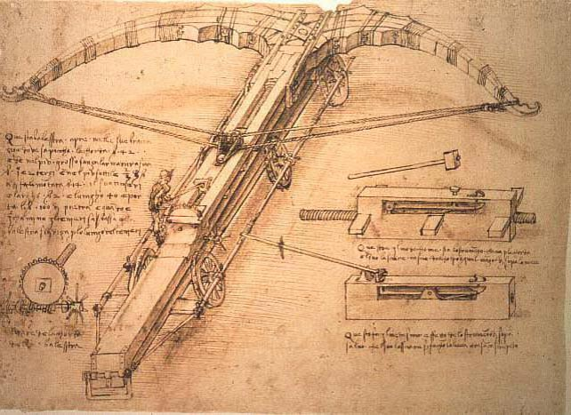
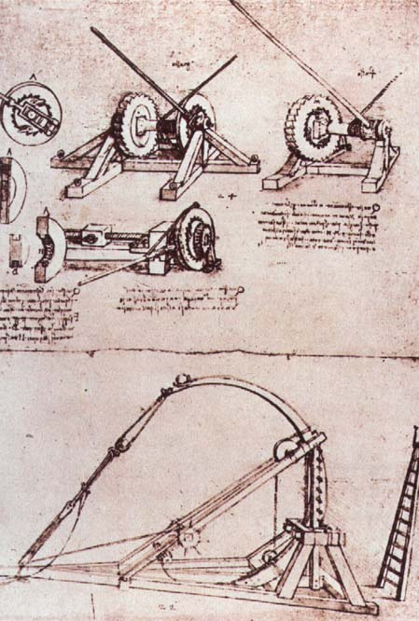
THE WARS OF RELIGION
Epic Tales
Of Nemesis
Antagonists
Protagonists
Contemporary
Intergenerational
Intragenerational

Slide 35
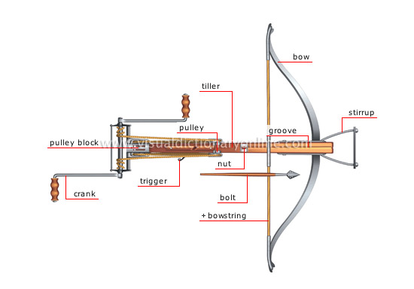
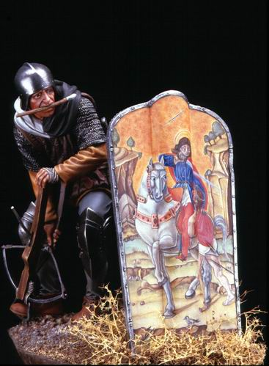

Slide 37
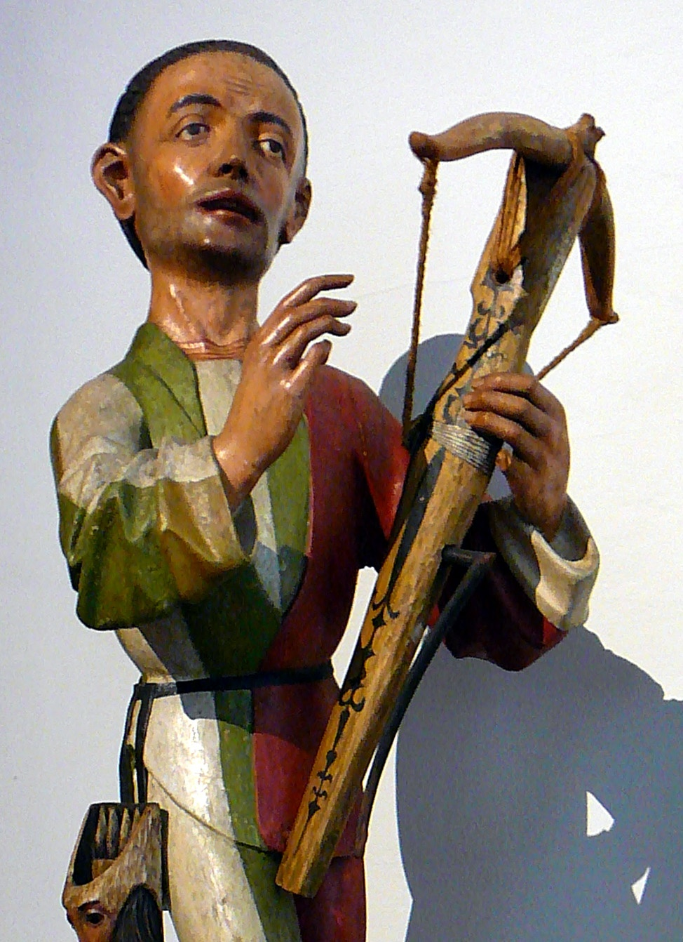

Slide 38
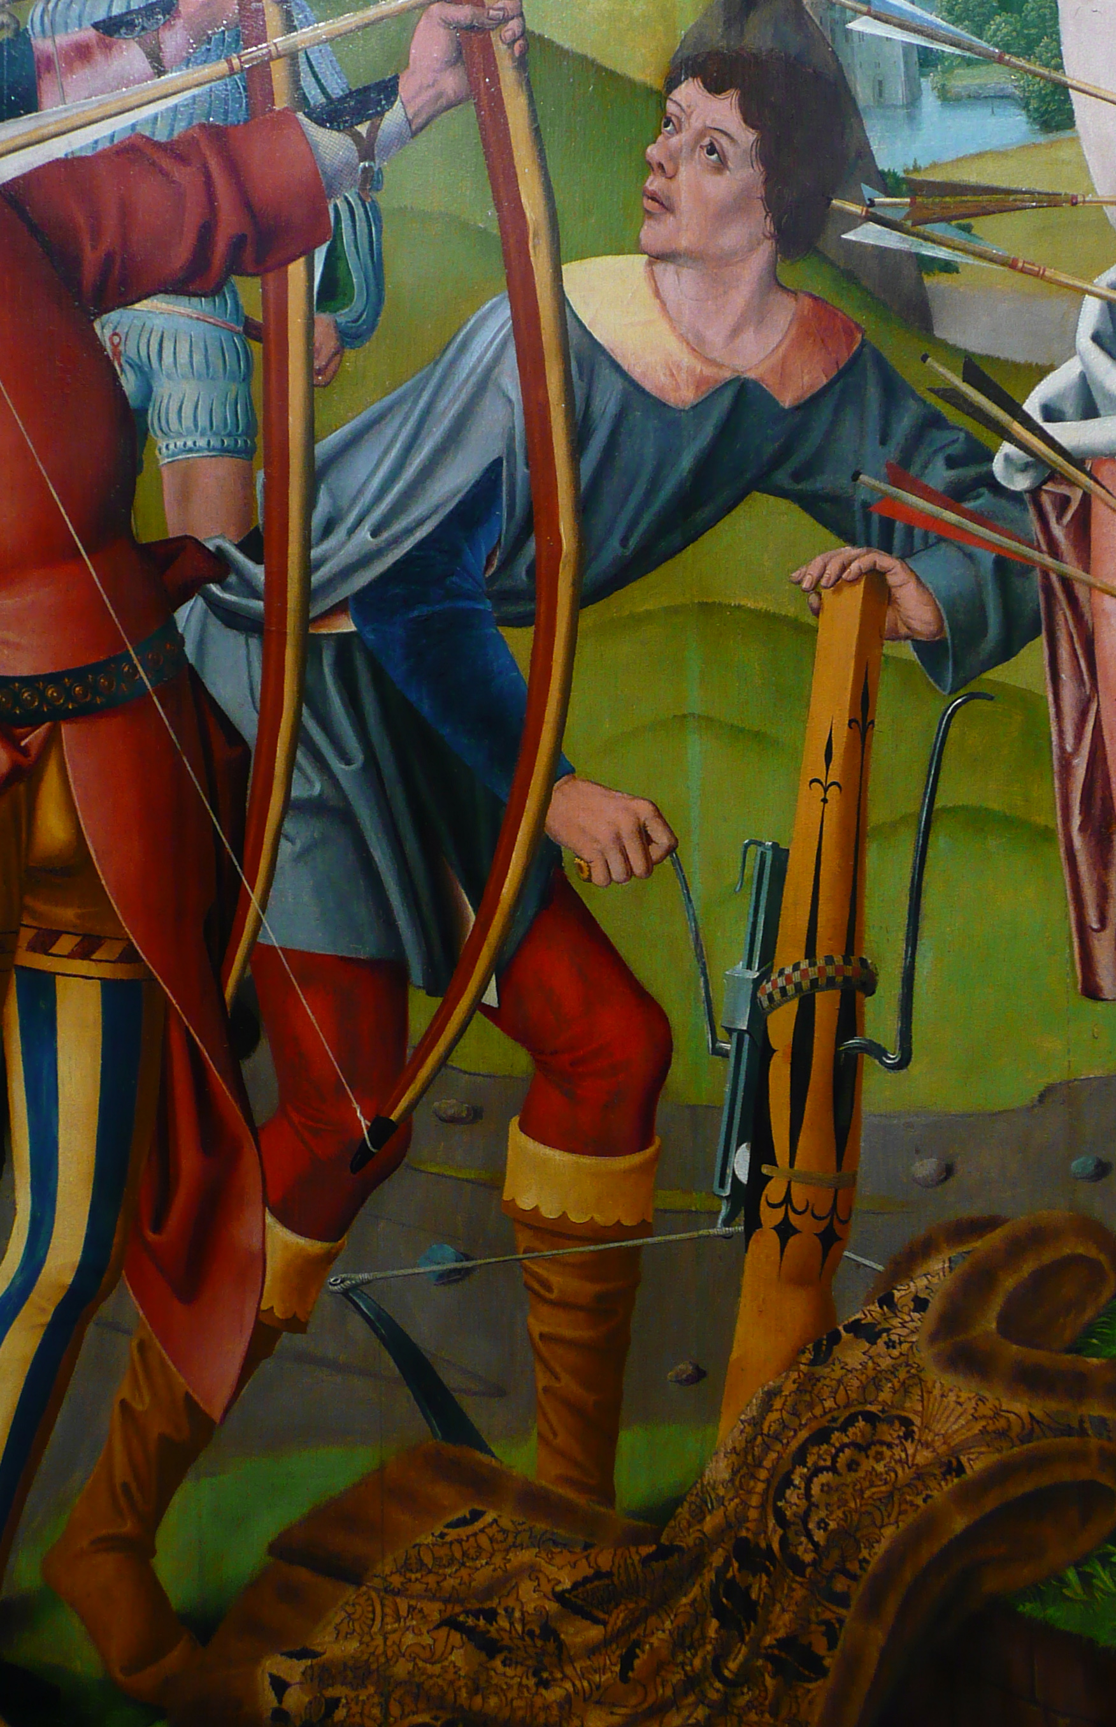

Slide 39
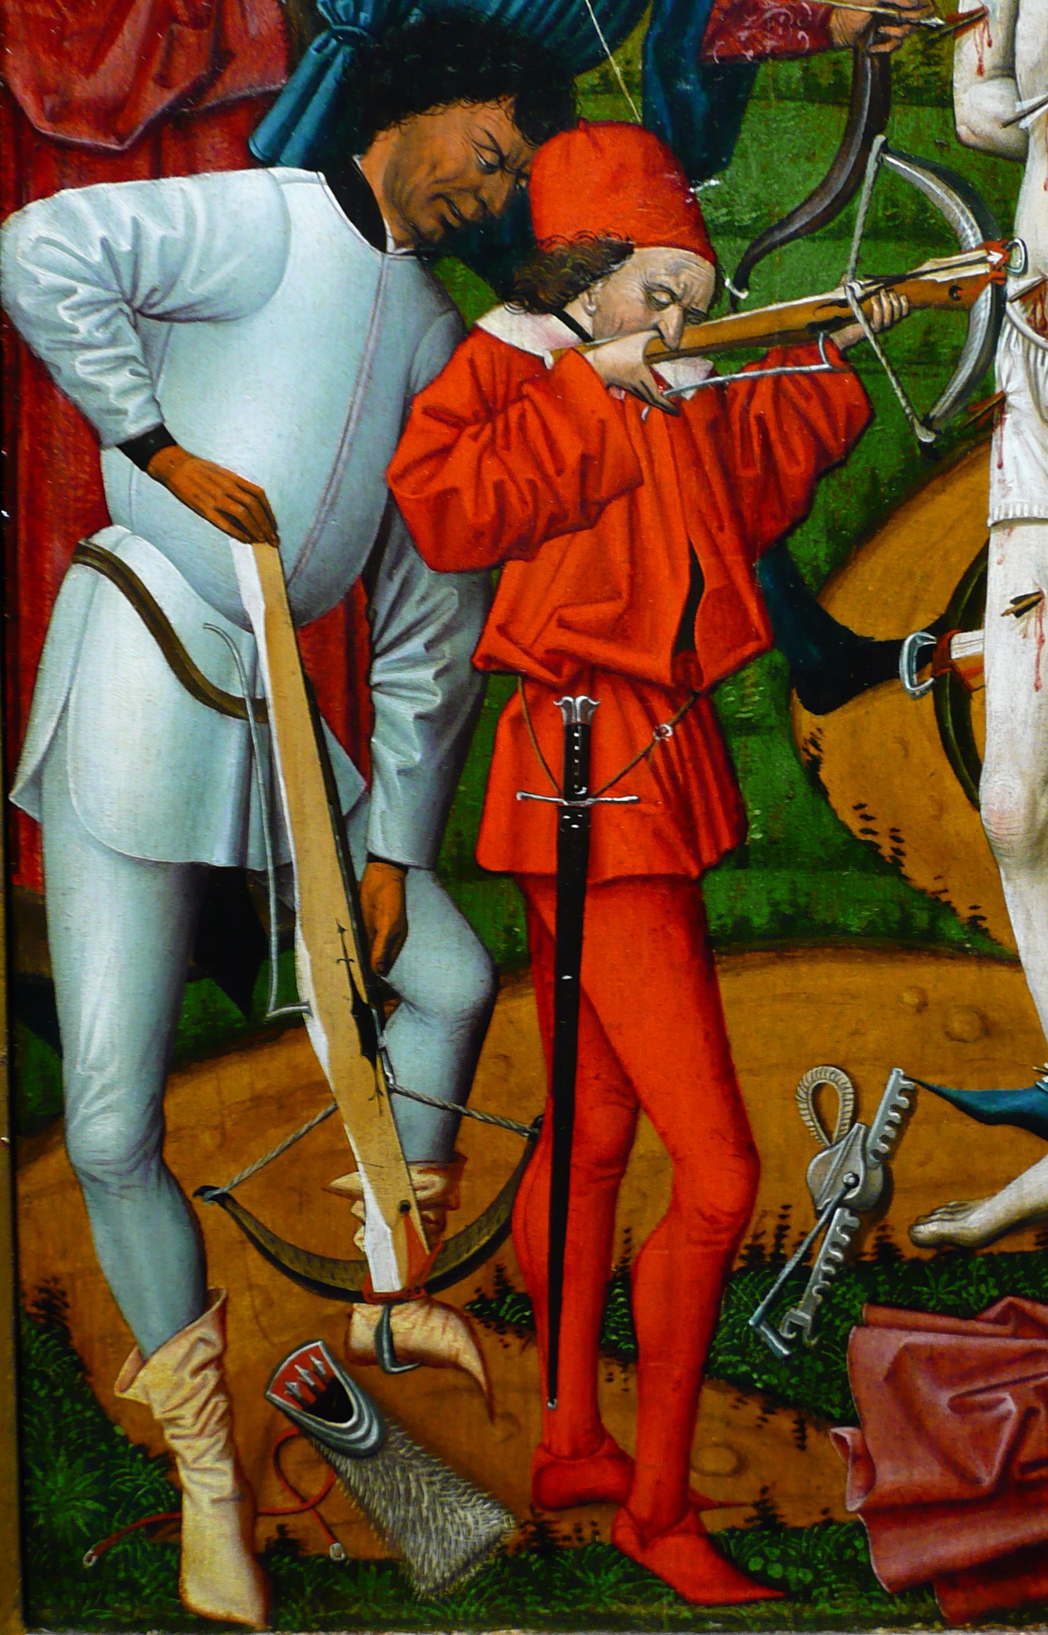

Slide 40
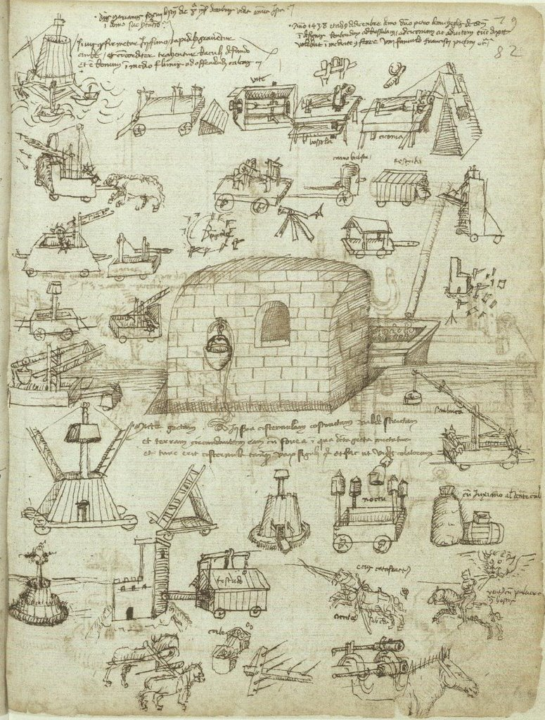
Epic Tales
Of Nemesis
Antagonists
Protagonists
Contemporary
Intergenerational
Intragenerational

Slide 41
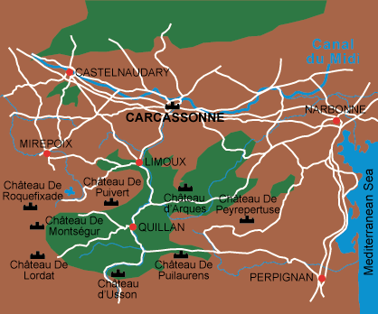
CATHAR CASTLE BATTLES

Slide 42
From The Modern Scholar Course Guide: “One, Holy, Catholic, & Apostolic”
Catharism & Internal Crusade
“An ancient heresy, continued in the East primarily in port cities. It spread to the Balkans in the ninth century, known there as Bogomilism. Brought by merchants, it began to spread in Northern Italian cities and then found fertile ground in southern France – particularly in the area of Albi. The heresy became a favorite with sophisticates. Those that did not achieve perfection in this life must be reborn. Jesus’ message was warped by the church – the evil servant. Catharism survived because it was well organized, with bishops and clergy. Prefects were clergy, ordained by a consolamentum, ministering to the faithful and living according to strictest regulations.“
“In March 1208, Innocent III proclaimed a Albigensian crusade to capture the lands of those lords either heretic or refused to combat it. Innocent decreed that 40 days of service constituted the fulfillment of the crusade vow. The response in northern France was tremendous. The Albigensian crusade did not extinguish Catharism, but it did remove the aristocracy that allowed it to grow.”

Slide 43
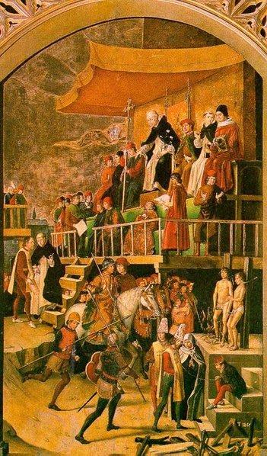
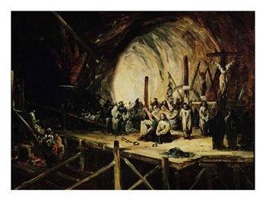
Catholic Inquisition: BIG PIC Erasing Entire People Populations
Cathar Cleansing

Slide 45
Albigensian crusaders requested clarification of engagement:
We cannot distinguish the good from the wicked, what shall we do?

Slide 46
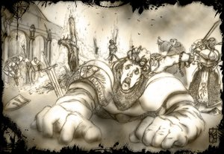
Piously echoing the words of paul in his letter to timothy:
“kill them all, the lord knows those who are his own!”

Slide 47
All sides for & against reform Claim Augustine

Slide 48
From Augustine Unto Aquinas
Church history short courses have sometimes reduced the process of church reform and counter reform to a conflict between establishment Catholic Thomism & reactive Conservative Augustinianism. Medieval religious history cannot be so simplified. However, it is true that the church of the middle ages adopted Thomas Aquinas’ philosophy. Moreover, It emphasized his teaching that man’s will was not totally corrupted. By faith and utilizing the means of grace held within the sacraments dispensed by the hierarchy, man could achieve salvation. Augustine believed that man’s will was so totally depraved that he could do nothing toward his own salvation.

Slide 49
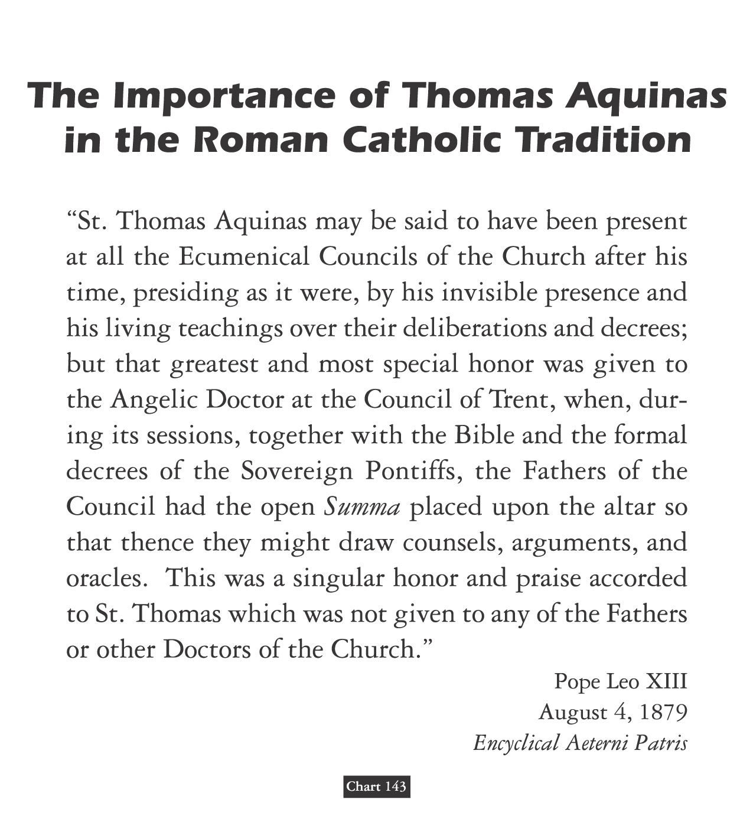
David Lee Burris:
Summa Theologica discusses 512 theological points, including whether an angel can sin!
Summa Theologica: Harmony Of Reason & Revelation

Slide 50
Which famous theologian turned away from theology toward the end of his life, declaring, “All my books are worthless”?
TERTULLIAN
ORIGEN
JEROME
THOMAS AQUINAS
X

Slide 51
Dominant Augustinian Paradigm Secular & Sectarian Applications
DIFFERENT RENAISSANCE EXPERIENCES:
The Italian Renaissance -
Fascination With Greek Classics
The Teutonic Renaissance -
Fascination With Greek Gospels

Slide 52
Dominant Augustinian Paradigm Secular & Sectarian Applications
DIFFERENT RENAISSANCE EXPERIENCES:
The Italian Renaissance -
Continuing Expressions Of Explicit Support
The Teutonic Renaissance -
Break In Tacit Contract Of Systemic Support

Slide 53
augustinians ignore the jwd: Hussite Wars

Slide 54
Principles of a Just War
jus ad bellum
“on the way to war”
jus in bello
“in the midst of war”
Limited objectives
Proportionate means
Noncombatant immunity

Slide 55
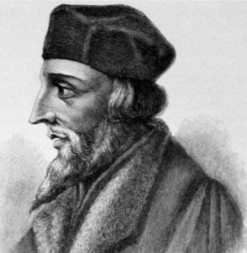
1408
In England, it becomes illegal to translate or read the Bible in English without permission of a bishop
1413
John Hus of Bohemia writes De Ecclesia, which supports ideas popularized by Wycliffe
John Hus

Slide 56
The Church Across The Ages
of people, events
life and faith from
Glimpses
John Hus & Hussites:
"Faithful Unto Death"
“’We’ll cook his goose.’ Believe it or not, that phrase originated as a reference to a man whose last name means (in his native language, Czech) ‘goose’ – John Hus. He was literally cooked – burned at the stake – but in being cooked he lit a fire of both nationalism and church reform.
John, Jan in Czech, was born in 1374 to a humble family. He was ordained a priest in 1401 and spent much of his career teaching at Charles University in Prague, Bohemia (in what is now the Czech Republic). He was also the preacher at the Bethlehem Chapel in Prague. Three thousand people packed in to hear his sermons there.”

Slide 58
HUS PREACHING

Slide 59
The Church Across The Ages
of people, events
life and faith from
Glimpses
John Hus & Hussites:
"Faithful Unto Death"
“Hus lived before the printing press & had to painstakingly copy books for his own use. After the reform–centered writings of Wyclif made their way to Bohemia, Hus made copies of his work. Like Wyclif, Hus emphasized personal piety and purity of life. Huss stressed also the role of the Bible as authority in the church, and consequently, he lifted biblical preaching to a high status in church services.
Bethlehem Chapel itself was a artistic illustration of Hus’s teachings. On its walls were paintings contrasting the bad behavior of the popes and that of Christ. For example, the pope rode a horse while Christ walked barefoot, and Jesus washed the apostles’ feet while the pope had his kissed.”

Slide 60
The Church Across The Ages
of people, events
life and faith from
Glimpses
John Hus & Hussites:
"Faithful Unto Death"
“The archbishop of Prague told Hus to stop preaching and asked the university to burn Wyclif’s writings. Hus refused to comply, and the archbishop condemned him. Meanwhile Hus preached against the sale of indulgences, which were being used to finance the pope’s expedition against the king of Naples. The pope excommunicated Hus and placed Prague under an interdict – roughly meaning that the entire city was excommunicated and couldn’t receive sacraments. To relieve this situation, Hus left Prague, but he continued to preach in institutional settings and in the open air. And, like Jesus, ‘the common people heard him gladly.’”

Slide 61
The Church Across The Ages
of people, events
life and faith from
Glimpses
John Hus & Hussites:
"Faithful Unto Death"
“Why was the hierarchy so opposed to Hus? Not only did he denounce the often immoral and extravagant lifestyles of the clergy (including the pope himself), but he also made the bold claim that Christ alone is head of the church. In his book On the Church he defended the authority of the clergy but claimed that God alone can forgive sins. He additionally claimed that no pope or bishop could establish doctrine contrary to the Bible, nor could any true Christian obey a clergyman’s order if it was plainly wrong.
Hus could only meet with trouble for such teachings. In 1415 he was summoned to the Council of Constance to defend his teachings.”

Slide 62
The Church Across The Ages
of people, events
life and faith from
Glimpses
John Hus & Hussites:
"Faithful Unto Death"
“In being conducted to Constance to defend himself he was victim of one of the worse tricks ever played on a Christian. He was promised safe conduct by the Emperor Sigismund. And he had the papal assurance: ‘Even if he had killed my own brother… he must be safe while he is at Constance.’ Yet, Hus was arrested soon after arrival. He was confined in a cell under a Dominican convent. His cell was located right next to the sewer system. In effect, the Council had already made up its mind about this rebel Hus. This same Council condemned the teachings of Wyclif, and Hus was condemned for supporting those teachings. What he was especially under fire for was his statement that when a pope or bishop is in mortal sin he has ceased to hold that office.”

Slide 63
The Church Across The Ages
of people, events
life and faith from
Glimpses
John Hus & Hussites:
"Faithful Unto Death"
“The council had been called to settle the scandalous situation of having two popes, one in Italy, one in France. This ‘Great Schism’ (1378 – 1417) had to be dealt with. It was at this Council Of Constance. Naturally, the type of council that restored the authority of one pope wasn’t about to acquit a rebel who questioned the pope’s authority. Hus’s goose was indeed cooked!”

Slide 64
The Church Across The Ages
of people, events
life and faith from
Glimpses
John Hus & Hussites:
"Faithful Unto Death"
“Hus, sick and physically wasted by very long imprisonment, illness, and lack of sleep, protested his innocence and refused to renounce his alleged errors unless he could be shown otherwise from Scripture. To the council he said, ‘I would not, for a chapel full of gold, recede from the truth.’
Formally condemned, he was handed over to the secular authorities to be burned at the stake on the 6th of July 1415.”

Slide 65
The Church Across The Ages
of people, events
life and faith from
Glimpses
John Hus & Hussites:
"Faithful Unto Death"
“On the way to the place of execution, he passed a church--yard and saw a bonfire of his books. He laughed and told the bystanders not to believe the lies circulated about him. Arriving at the place of execution, he was asked by the empire’s marshal if he would finally retract his views. Hus replied, ‘God is my witness that the evidence against me is false. I have never thought nor preached except with one intention of winning men, if possible, from their sins. Today I will gladly die.’ The fire was lit. As the flames engulfed him, Hus began to sing in Latin a Christian chant: ‘Christ, Thou Son of the Living God, have mercy on me.’”

Slide 66
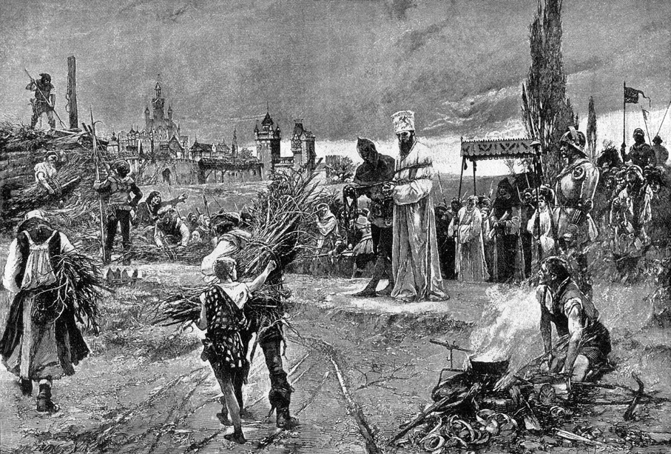
Burning of John Hus at the stake at Council of Constance, Konstanzer Konzil (1415)

Slide 67
"You are now roasting a goose
but in a hundred years
you will raise up a swan,
whom you shall not roast or scorch;
him, will men hear sing, him,
God willing, they will let live.“
- JOHN HUS

Slide 68
The Church Across The Ages
of people, events
life and faith from
Glimpses
John Hus & Hussites:
"Faithful Unto Death"
“Hus had long been popular with the lay-people, and his heroic death only increased his prestige. His followers came out in open rebellion, both against the Catholic church & against the German dominated empire with which they wanted no part. Despite repeated efforts of popes & rulers to stamp out the movement, it survived as an independent church, known as the Unitas Fratrum or rather the Unity of the Brethren.”

Slide 70
Epic Tales
Of Nemesis
Antagonists
Protagonists
Contemporary
Intergenerational
Intragenerational

Slide 71
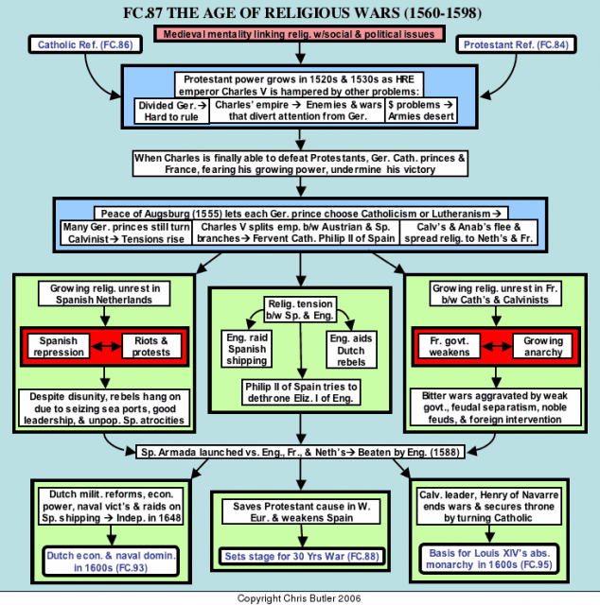

Slide 72
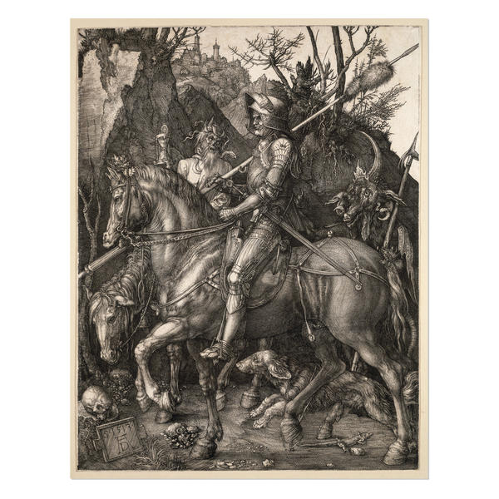

Slide 73
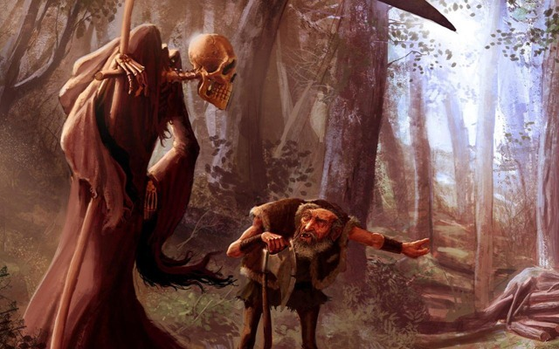

Slide 74
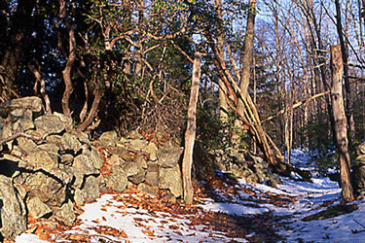

Slide 75
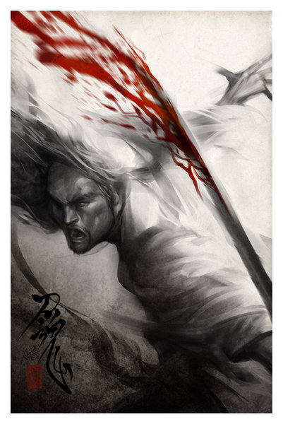

Slide 76
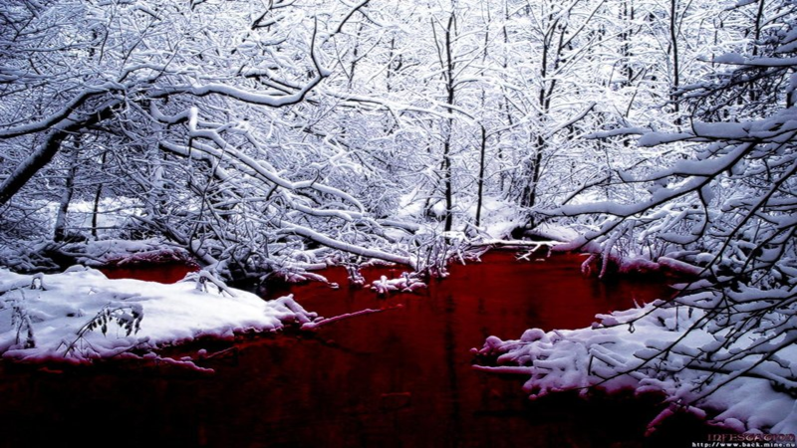

Slide 77
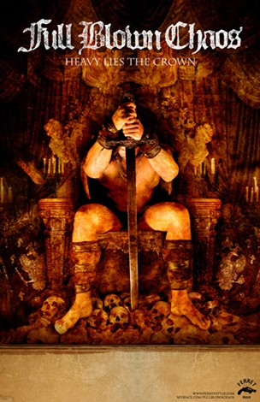

Slide 79
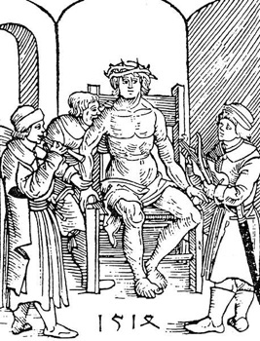
György Dózsa, Székely man-at-arms and a Hussite revolt peasant leader in Hungary, was condemned to sit on a red-hot iron throne with a red-hot iron crown on his head and a red-hot sceptre in his hand (mocking at his ambition to be king), by Hungarian landed nobility in Transylvania. While Dózsa was still alive, he was set upon and his partially roasted body was eaten by six of his fellow rebels, who had been starved for a week beforehand.

Slide 81
MATSCH’S LAW
IT'S BETTER TO
HAVE A HORRIBLE ENDING
THAN TO HAVE
HORRORS WITHOUT END!

Slide 82
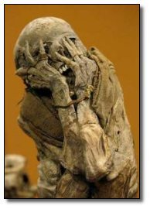

Slide 83
Epic Tales
Of Nemesis
Antagonists
Protagonists
Contemporary
Intergenerational
Intragenerational

Slide 84
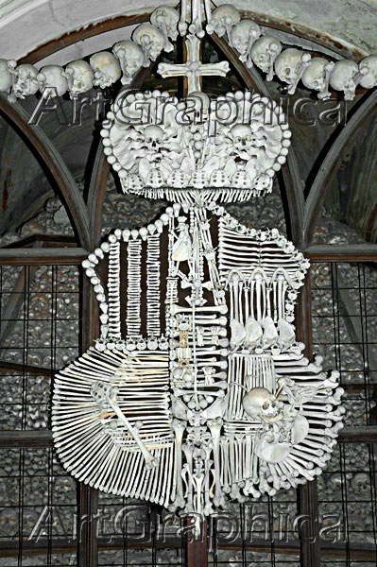
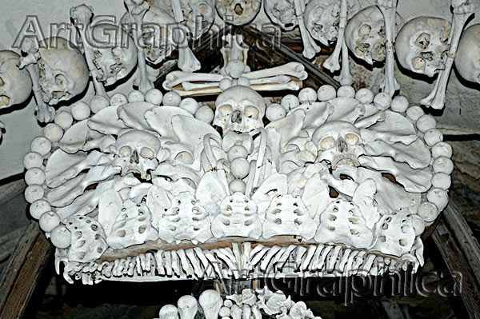
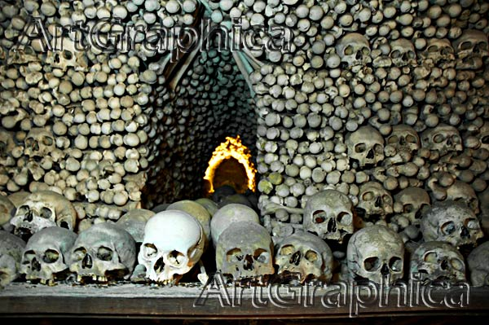
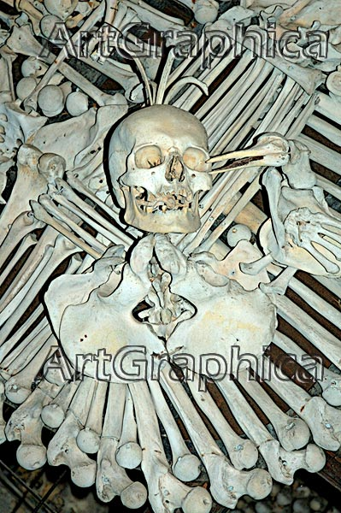
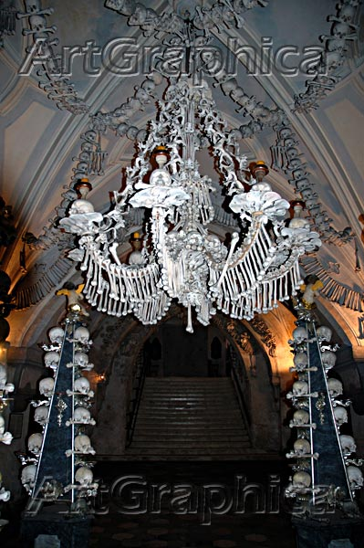
Prague Church Hussite Martyr Bone Commemoration

Slide 86
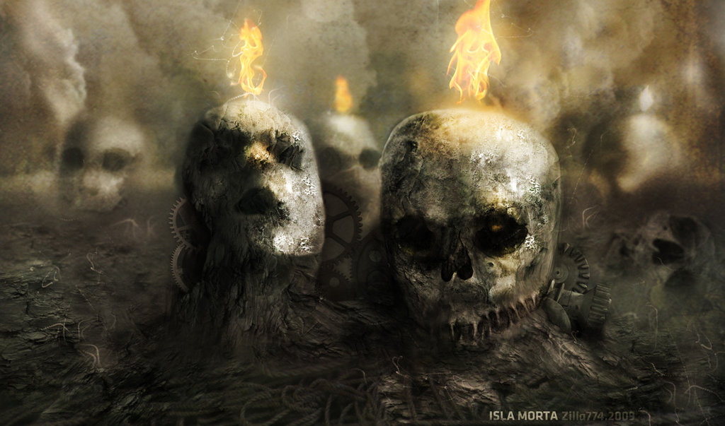

Slide 87
augustinians ignore the jwd: Swiss Civil War

Slide 88
Principles of a Just War
jus ad bellum
“on the way to war”
jus in bello
“in the midst of war”
Limited objectives
Proportionate means
Noncombatant immunity

Slide 89
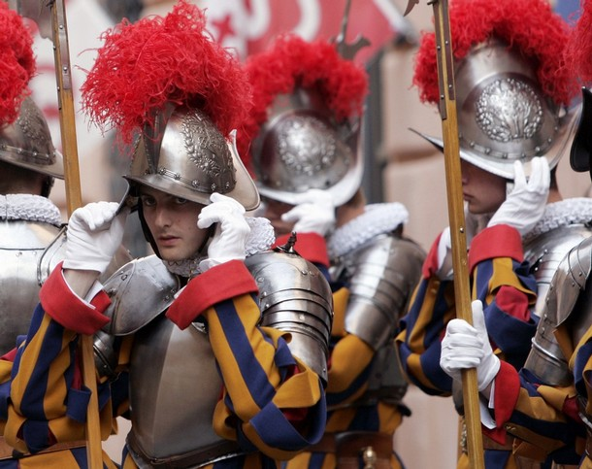
FAREWELL TO THOSE WHO WANT AN ENTIRELY PURE AND PURIFIED CHURCH. THIS IS PLAINLY WANTING NO CHURCH AT ALL!
Martin Luther

Slide 90
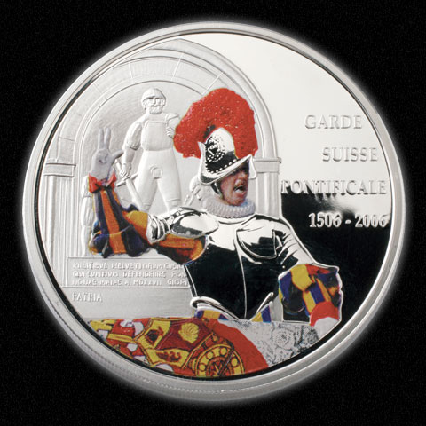
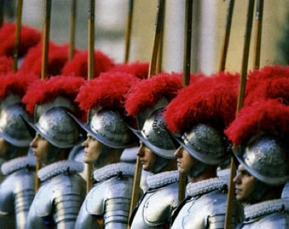
Rome was sacked by the troops of the Holy Roman Empire under Emperor Charles V in 1527. When the troops, mostly rabble and mercenaries, of the empire breached the city, they immediately ignored the orders of Charles and pretty much everyone else in command and made straight for Vatican Hill intent on pillaging the richest treasures in Christendom. They also had murder on their mind and Pope Clement VII was high on the list of targets. The famous Swiss Guards, who used to do more than just stand around looking pretty for tourists, formed a fighting square on the steps of St. Peter’s Basilica to face upwards of 20,000 bloodthirsty troops who were storming the city. Only 189 Guardsmen remained after the fighting to take the city, but these troops chose to make their stand in hopes of buying Clement time to escape the city through one of the warrens of tunnels under Rome. Clement made good his escape as the Guard managed to hold the porch of the church and prevent the doors from falling, but only 42 Swiss Guards survived and none of them were uninjured. This event once more proves that when the Swiss decide not to be neutral, they aren’t a bunch to take lightly.

Slide 91
The Church Across The Ages
David Lee Burris:
European Royal Dynasties – including Louie & Marie – related across national boundaries – uniformly used personal Swiss Body Guards – lacking basic trust in their own countrymen!
of people, events
life and faith from
Glimpses
ZURICH REFORM UNDER ZWINGLI
“Born in Wildhaus, Switzerland, on New Year’s Day in 1484, Zwingli received a good education in the classics and was ordained a priest in 1506. He served as parish priest in Glarus from 1506 to 1516.
A key event during that period aroused his patriotic fervor and perhaps began to undermine his confidence in the Roman church. One of the major industries for the Swiss then was mercenary service. They would hire out their young men to fight in others wars, including battles for the pope. (You can see the Swiss Guard today policing the Vatican in their colorful uniforms.) Zwingli accompanied the Swiss troops as chaplain in September of 1515, and saw 6000 of his young countrymen slaughtered in the service of the pope at the Battle of Marignan in Italy. He returned home determined to abolish the mercenary practice of ‘selling blood for gold.’ It would cost him his parish at Glarus but helped pave the way for his call to Zurich later.”

Slide 93
The Church Across The Ages
of people, events
life and faith from
Glimpses
ZURICH REFORM UNDER ZWINGLI
“The rituals & doctrines of the Church did not square with his reading of Scripture. He preached what he found in the Bible – even when it meant going against long-accepted church teachings. As a result, controversy spread. A public debate was held on disputed matters of faith and doctrine by the Zurich city council. On January 29, 1523, the council issued a ruling backing Zwingli and issued a decree that he and the other pastors in the region were ‘to preach nothing but what can be proved by the holy gospel and the pure holy scriptures.’
Reforms were implemented, Catholic images removed, the mass replaced with a simplified service emphasizing preaching, and communion celebrated more as a‘spiritual’ reception of Christ.”

Slide 94
Epic Tales
Of Nemesis
Antagonists
Protagonists
Contemporary
Intergenerational
Intragenerational

Slide 95
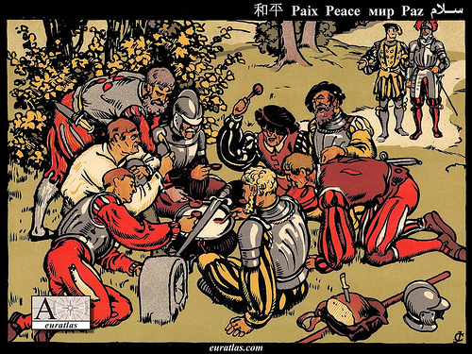
The first war of Kappel was a conflict in 1529 between the Protestant and the Catholic cantons of the Swiss Confederacy. It ended, without any battle, with the first peace of Kappel. Under the lead of Ulrich Zwingli, the Protestant canton and city of Zürich had concluded with the other Protestant cantons a defence alliance. The Catholic cantons in response had formed an alliance with Austria. After numerous minor incidents and provocations from both sides, Zürich declared war on 8 June and marched to Kappel at the border to Zug. By mediation of the Federal Council, open war was barely avoided. Legend has it that instead of fighting, the two armies peacefully shared a milk soup, the Kappeler Milchsuppe, cooked in a pot placed exactly on the cantonal border between Zürich and Zug, while a peace was negotiated. The Catholics provided the milk, the Protestants the bread.

Slide 96
The Church Across The Ages
of people, events
life and faith from
Glimpses
ZURICH REFORM UNDER ZWINGLI
“Catholic resistance in the rural cantons could not be overcome and eventually resulted in actual fighting. When war came, Zwingli joined the Zurich troops as an armed soldier against the Catholics in what is known as the 2nd Kappell War. The same Zwingli who had worked so hard to eliminate the mercenary service and had earlier even condemned war itself now took up arms, convinced it was necessary in the service of God and the Gospel. He was killed in battle on October 11, 1531, his body hacked to pieces and disgraced by his enemies.” (Protestant Reformer Martin Luther reportedly rejoiced at news of these events.)

Slide 97
THE RE-MIXED CHURCH “Boundaries Drawn & Limits Set”
THE IMPORTANCE OF ULRICH ZWINGLI:
In the introduction of a book by Edward Peters: “Like Erasmus and Luther, Zwingli influenced the thought of reformers & Catholics alike, and the dissident strains of the Zurich reform movement influenced many communities and touched the reformation of England & Scotland. With Erasmus and Luther, Zwingli represents both traditional and novel strains of thought and programs for ecclesiastical and social reform.”

Slide 98
MAJORITARIAN
MAGISTERIALS

Slide 99
ALL CONSIDERED
ADULT CONVERSION
AS CULTURALLY ALIEN

Slide 100
1528
The Count Of Alzey in area of the Palatinate, after he had 350 Anabaptists executed, exclaimed:
“What shall I do, the more I kill, the greater becomes their number!”

Slide 101
1529
The Same Diet Of Spires – Which Protested Restrictions Of Religious Liberty – Condemned Anabaptists:
“Every Anabaptist and rebaptized person of either sex should be put to death by fire, sword, or some other way.”

Slide 102
The Church Across The Ages
of people, events
life and faith from
Glimpses
ZURICH REFORM UNDER ZWINGLI
“Despite this vote of confidence, Zwingli could expect that the Catholic loyalists would resist him, and they did. He did not expect that perhaps his greatest trials would come from within – some of his closest followers were not content with the speed at which he was pressing the church reforms. They became known as Anabaptists. They were particularly agitated over the practice of infant baptism, which they rejected. Another public debate was called to consider the issue. The Zurich council ruled against the Anabaptists, so these ‘radicals’ defied the council. They ‘re-baptized’ themselves as adult believers. When they continued in their legal defiance, some were put to death.”

Slide 103
Anabaptist Uprisings
& Civil Insurrections:
MUNSTER
FRIESLAND
AMSTERDAM

Slide 106
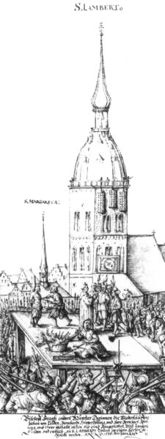
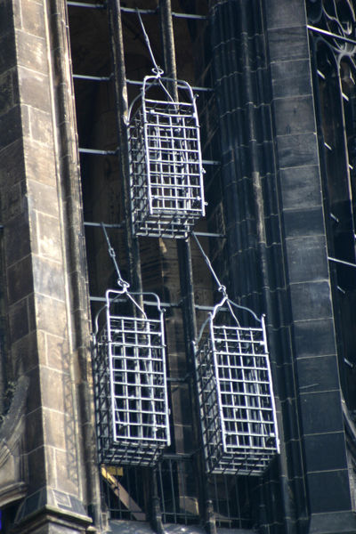
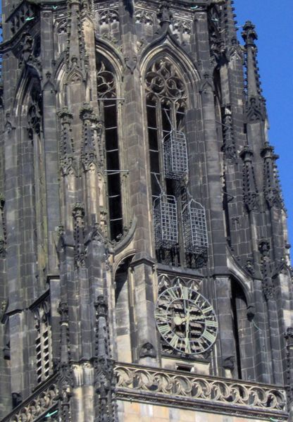
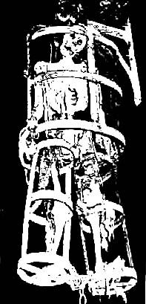

Slide 107
1535
The Münster Rebellion: Anabaptists take over the city of Münster and are slaughtered by Catholic residents previously expelled
Later, under Menno Simons, Anabaptists adopt pacifism
Menno Simons

Slide 108
1551
The Diet Of Augsburg Decreed:
“Judges and jurors who have scruples against pronouncing the death sentence on Anabaptists will be removed from office and punished by fine and imprisonment.”

Slide 109
LATER CHURCH PRE-TEST
In the early 1500’s, Anabaptist leader Felix Manz practiced adult baptism. How did Reformation leader Ulrich Zwingli have him punished?
A FINE
EXILE
HANGING
DROWNING
X

Slide 110
THE M I L L S T O N E
MATTHEW EIGHTEEN: VERSE SIX
OFTEN APPLIED LITERALLY
IN PROTESTANT INQUISITION

Slide 112
augustinians ignore the jwd: Holiday Massacre

Slide 113
Martin Luther: “First, their synagogues should be set on fire,…
their homes should be destroyed and they should be put under one roof,
or in a stable, like Gypsies, in order that they may realize
that they are not masters in our land.
But if still considered too dangerous after this,
then these ‘poisonous bitter worms’
should be stripped of their belongings
which they have extorted usuriously from us
And be driven out of the country for all time.”

Slide 115
1564
The term “Puritan” is first used for Protestants who want to “purify” the Church of England of ceremony and ritual not found in the Bible
John Calvin dies
Bishops Bible, Church of England translation, is printed
Queen Elizabeth I is excommunicated by the pope, and in turn persecutes Catholics
St. Bartholomew’s Day Massacre
twenty thousand deaths
1568
1570
1572
COMMEMORATION

Slide 116
THE CHURCH BELLS WERE THE SIGNAL TO SLAUGHTER!

Slide 117
1564
The term “Puritan” is first used for Protestants who want to “purify” the Church of England of ceremony and ritual not found in the Bible
"And what I most commend is the resolution taken
by his Majesty to exterminate this vermin..."
John Calvin dies
Bishops Bible, Church of England translation, is printed
Queen Elizabeth I is excommunicated by the pope, and in turn persecutes Catholics
St. Bartholomew’s Day Massacre
1568
- Pope Gregory XIII per Catholic Encyclopedia XIII, 337
1570
1572

Slide 118
No More Tears Now,
I will think about revenge!
- Mary Queen of Scots

Slide 120
No More Tears Now,
I will think about revenge!
- Mary Queen of Scots
Arise, O Lord, &
Vindicate Thy Cause!

Slide 121
KING PHILLIP, QUEEN MARY & THE SPANISH ARMADA

Slide 123
“GOD BLEW & THEY WERE SCATTERED!”

Slide 124
Rain, rain, go away,
Come back another day;
Little Johnny wants to play.
Rain, rain, go to Spain,
Never show your face again!

Slide 125
Firestorms & Weather Storms

Slide 127
Political Firestorms & Sea Changes

Slide 128
augustinians ignore the jwd: Thirty yrs. war

Slide 129
Principles of a Just War
jus ad bellum
“on the way to war”
jus in bello
“in the midst of war”
Just cause
Just intention
Last resort
Formal declaration
Limited objectives
Proportionate means
Noncombatant immunity

Slide 131
1555
Peace of Augsburg (Germany) allows each ruler to determine religion of his region
The Peace of Augsburg was a treaty signed between Charles V and Protestant princes; it established the first permanent legal basis for the dual existence of Lutheranism and Catholicism in Germany.
Charles V

Slide 132
NETHERLANDS:
Catholic Spain had isolated the non-Catholic population both politically and geographically. Thus the Protestants concentrated in what is now Holland which became the last holdout against the Spanish power. The leaders of the revolt established Protestantism as the dominant religious form of the country. The turning point was the battle for Leyden in 1574.

Slide 134
The
Thirty
Years
War

Slide 135
THE THIRTY YEARS WAR Decades Of Horror: 1618-1648
The Reformation and Trent having settled the doctrinal issues decisively, nothing was left but to settle existence issues on the field of battle.
Christianity was not yet ready to let heresy and truth live side-by-side until the Day of Judgment.
The war was brought about in Germany by the supposed “Defenestration Of Prague,” which being interpreted meant that an unwelcome Roman Catholic official was thrown out a window in Protestant territory(Prague 1618).
* Source: Ligonier Ministries Church History Handouts

Slide 137
The Thirty Years War
THE BOHEMIAN PHASE
1618 - 1625

Slide 138
The Thirty Years War
THE DANISH PHASE
1625 - 1630

Slide 139
SWEDEN:
In 1527 the Vasa family broke away from Denmark as an act of rebellion and established Sweden as a Lutheran country. Later, in 1630, it was the Swedish King, Gustavus Adolphus, a sincere champion of Lutheranism, who marched his army out of Sweden and into Germany against the Emperor to protect Protestant Germany with his force of arms.

Slide 140
The Thirty Years War
THE SWEDISH PHASE
1631 - 1634

Slide 141
DENMARK:
In 1536 the Protestant party of nobles overthrew the Danish dynasty – an act of “civil disobedience” with accompanying strife. They then set up a new government and a new dynasty and established Lutheranism in the country.

Slide 143
The Thirty Years War
THE FRENCH PHASE
1635 - 1648

Slide 148
Principles of a Just War
jus ad bellum
“on the way to war”
jus in bello
“in the midst of war”
Limited objectives
Proportionate means
Noncombatant immunity

Slide 149
THE THIRTY YEARS WAR Decades Of Horror: 1618-1648
Rome declared war and Protestantism had to defend itself – which it did very poorly at first. The Roman General Wallenstein virtually romped across Europe.
The battle would have been soon over and even the Reformation almost erased were it not for Sweden’s Gustavus Adolphus. Almost an even century after the Reformation’s most basic creed, the Augsburg Confession, was drawn up in 1530, the Swedes – only partly for religious reasons – invaded Europe.
The King lost his life but won the battle for the North.
From the truce or “Peace of Westphalia” in 1648 to this day, Protestantism has dominated Northern Europe and Romanism, Southern Europe. Romanism has never been able to take the North nor Protestantism the South.
* Source: Ligonier Ministries Church History Handouts

Slide 150
THE THIRTY YEARS WAR Decades Of Horror: 1618-1648
The cost of settlement was high. The population of Germany was cut by two thirds with the loss of several million lives. Property had been destroyed in the numerous battles and sackings of towns and villages. It took decades before Germany recovered from the devastation of property, the loss of life and the breakdown of morals incurred in the Thirty Years War.
* Source: Christianity Through The Centuries by Earle Cairns

Slide 152
1648
After the end of the Thirty Years’ War, Catholics and Protestants are given equal rights in most of the Holy Roman Empire
The emergence of Pietism from the devastation of the Thirty Year’s War.
By war’s end, countless villages, cities, and churches had been destroyed.
Torture, maiming, and murder of civilians had become commonplace; in some places even cannibalism.
Hungry & Diseased Displaced Populations
The cultural & spiritual damage often worse!
1648~

Slide 153
1648
After the end of the Thirty Years’ War, Catholics and Protestants are given equal rights in most of the Holy Roman Empire

Slide 155
The emergence of Pietism from the devastation of the Thirty Year’s War:
Large numbers of the surviving population were left distrustful of all official religion.
Germany, which felt the brunt of the war, was left divided into over 300 territorial states controlled by regional princes to whom Luther and Melanchthon had turned for support.
In reaction to the war, two major alternatives to doctrinal disputation and religious conflict emerged. Many turned from theological disputes of revealed religion to Deism, preferring the seemingly rational objectivity of nature’s God, accessible to reason and science.
From the ashes of war also arose Pietism!
1648

Slide 157
1648
After the end of the Thirty Years’ War, Catholics and Protestants are given equal rights in most of the Holy Roman Empire
The emergence of Pietism from the devastation of the Thirty Year’s War.
1648~

Slide 158
PIETISM
“A Bible-oriented, experiential approach to Christian life that emphasizes personal appropriation of faith and a lifestyle of holiness as more important than the formal structures of theology and church order. Initially Pietism was a movement within the Lutheran Church in Germany that sought to correct the focus on mere assent to doctrine, which the Pietists believed led to ‘dead orthodoxy’.”
* Dictionary Of Theological Terms, Grenz & Guretzki

Slide 159
1648
The emergence of Pietism from the devastation of the Thirty Year’s War.

Slide 160
1648~
The emergence of Pietism from the devastation of the Thirty Year’s War.
Positively – Pietism subordinated theology to the holy word. It involved laity in the spiritual disciplines and in scripture reading. It stressed heartfelt religion & charity.

Slide 161
1648~
The emergence of Pietism from the devastation of the Thirty Year’s War.
Negatively – Pietism deteriorated into subjectivism. It’s initial anti-authoritarian approach abounded into a broader anti-intellectualism.

Slide 165
Escaping Old World Intolerance BY Coming To America

