Slide 1
Church History Q & A
By David L. Burris

Slide 2
QUESTIONS

Slide 3
EARLY CHURCH PRE-TEST Q-1
Which Of These Was The Earliest Term Used To Describe The 1st Century Church?
Christians
Followers Of The Way
Catholics
Nazarenes
All Of The Above
X

Slide 4
Jesus answered, “I am the way and the truth and the life. No one comes to the Father except through me.” —John 14:6
BACK

Slide 5
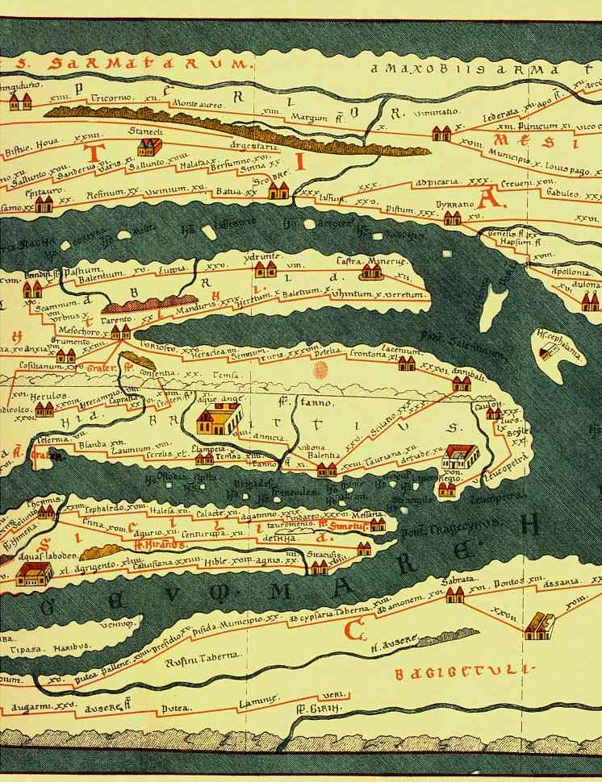
EARLY CHURCH PRE-TEST Q-2
In many ways, the first century was an ideal time in which to spread the Gospel. What made it so?
33’ Wide Roads Built By The Roman Army
A Common Language, Called Koine Greek
The Translation Of The Old Testament Into Greek
The Roman Control Of Mediterranean Sea Travel
Jewish Settlements In Most Of The Major Imperial Cities
Increasing Religious Curiosity In Rome & Its Empire
The New Miracle Sandal Made Walking A Breeze

Slide 6
EARLY CHURCH PRE-TEST Q-2
In many ways, the first century was an ideal time in which to spread the Gospel. What made it so?
33’ Wide Roads Built By The Roman Army
A Common Language, Called Koine Greek
The Translation Of The Old Testament Into Greek
The Roman Control Of Mediterranean Sea Travel
Jewish Settlements In Most Of The Major Imperial Cities
Increasing Religious Curiosity In Rome & Its Empire
The New Miracle Sandal Made Walking A Breeze

Slide 7
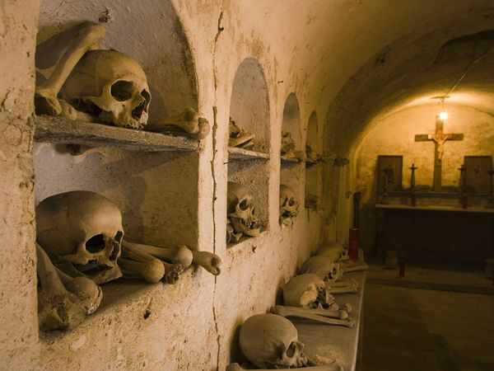
EARLY CHURCH PRE-TEST Q-3
THE CATACOMBS WERE:
Where the early Christians lived.
Where the early Christians held their regular worships services.
Where the early church held weddings.
Where the early church held funeral services.
Where the early church held seeker services.
X

Slide 8
EARLY CHURCH PRE-TEST Q-4
Scholars have long been interested in the way Christianity spread all thru the Roman Empire, despite persecution. How do they explain it?
The Christians’ proclamation of the one God in a polytheistic society.
The Christians’ exemplary moral lifestyle.
The Christians’ demonstration of love for each other.
The Christians’ willingness to be martyred for their faith.
The Christians’ willingness to give as they prospered.

Slide 9
EARLY CHURCH PRE-TEST Q-4
Scholars have long been interested in the way Christianity spread all thru the Roman Empire, despite persecution. How do they explain it?
The Christians’ proclamation of the one God in a polytheistic society.
The Christians’ exemplary moral lifestyle.
The Christians’ demonstration of love for each other.
The Christians’ willingness to be martyred for their faith.
The Christians’ willingness to give as they prospered.

Slide 10
EARLY CHURCH PRE-TEST Q-5
David Lee Burris:
Christians Were Very Anti-Abortion Which Was A Common Practice. The Romans Would Also Abandon Their Young & Christian Rescue Of The Abandoned Was Misinterpreted. Pagan Rescue Of Another’s Abandoned Was For Immoral Purposes. Source: Justin Martyr
Which Of The Following Did Romans Accuse Their Christian Neighbors Of?
ATHEISM
INCEST
TREASON
HURT FAMILY
CANNIBALISM

Slide 11
EARLY CHURCH PRE-TEST Q-5
Which Of The Following Did Romans Accuse Their Christian Neighbors Of?
ATHEISM
INCEST
TREASON
HURT FAMILY
CANNIBALISM
Claimed by Cornelius Fronto _ a Second Century Court Tutor

Slide 12
EARLY CHURCH PRE-TEST Q-6
There were several relatively good emperors who nevertheless persecuted Christians. What were their reasons?
Unite The Empire Under Pagan Religion
The Christians Were Considered Disloyal, Not Serving In The Army
To Demand Full, Worshipful Allegiance To The Emperor
The Christians Were Secretly Plotting To Assassinate The Emperor

Slide 13
EARLY CHURCH PRE-TEST Q-6
There were several relatively good emperors who nevertheless persecuted Christians. What were their reasons?
Unite The Empire Under Pagan Religion
The Christians Were Considered Disloyal, Not Serving In The Army
To Demand Full, Worshipful Allegiance To The Emperor
The Christians Were Secretly Plotting To Assassinate The Emperor

Slide 14
EARLY CHURCH PRE-TEST Q-7
Which of the following best describes the early progress of Christianity in the Roman Class City?
Started In Synagogues & Spread Out To Gentiles
Started In Gentile Markets & Ended In Synagogues
Started In Forums – Amphitheater – Then Homes
Started In Catacomb & Cavern & Continued To Villa
Started At Chariot Race & Finished At The Domicile
X

Slide 15
EARLY CHURCH PRE-TEST Q-8
Polycarp was… ?
A Roman emperor who ordered persecution of Christians
A Christian bishop burned at the stake for his faith
A region of North Africa known for its fierce persecution of Christians
Parrot food made from fish
x

Slide 16
EARLY CHURCH PRE-TEST Q-9
This 4th Century bishop in Milan reintroduced congregational singing?
TIMOTHY
AMBROSE
BERNARD OF CLAIRVAUX
BILL GAITHER
x

Slide 17
EARLY CHURCH PRE-TEST Q-10
How many churches are we aware of that were recorded from both Bible & early church history by the year 100?
12
42
112
242
x

Slide 18
EARLY CHURCH PRE-TEST Q-11
After Constantine became a Christian supporter, what did he have done to his wife and son?
He Had Them Murdered
He Had Them Baptized
He Divorced Wife & Disinherited Son Because They Wouldn’t Convert
He Made Son Bishop & Wife Deaconess
x

Slide 19
EARLY CHURCH PRE-TEST Q-12
The church at Rome in the fifth century divided its income four ways, with one-fourth going to the bishop. Which of the following did not receive a one-fourth share?
Other Clergymen
Building Maintenance
Missions & Evangelism
The Sick & Poor
x

Slide 20
EARLY CHURCH PRE-TEST Q-13
In western Europe in the late 4th century, what portion of one’s inheritance was traditionally left to the church at death?
One-tenth
One-fifth
Everything {If Children 21}
Amount Left To Another Child If They Had Had Another Birth
x

Slide 21
EARLY CHURCH PRE-TEST Q-14
David Lee Burris:
Issue 37 - Christian History Magazine – Page 3: “When worship ended, Christians took home the consecrated bread so that those who couldn’t attend worship could partake of the Lord’s Supper.”
According to Justin Martyr, in A.D. 150, was Communion taken to people who could not attend church?
No, That Wasn’t Necessary
Only If No Blood Relations Taken
Yes, If Sick Or In Prison
Yes, But Only After 28 Days
x

Slide 22
EARLY CHURCH PRE-TEST Q-15
According to the Didache, how often were early Christians asked to fast?
Every Saturday
Every Wednesday & Friday
Sunup To Sundown If Serious Sin
Not So Often – It Was Being Abused As Confession Substitution
x

Slide 23
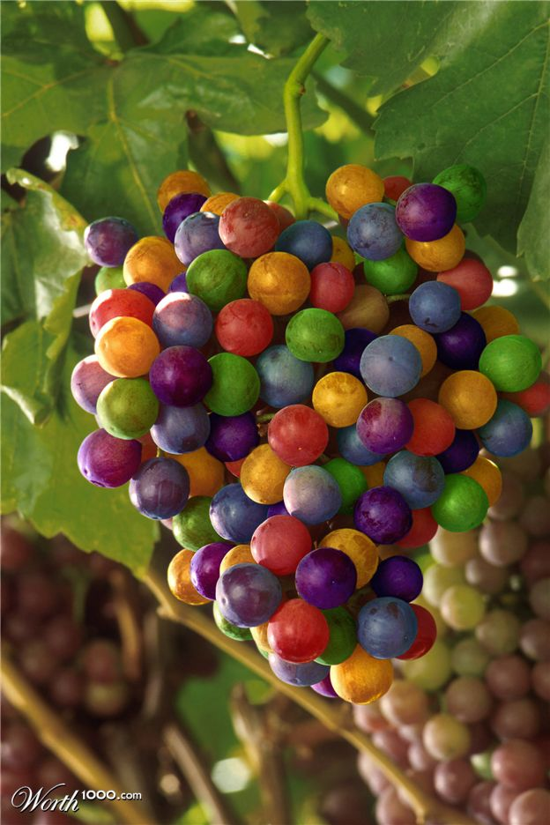
EARLY CHURCH PRE-TEST Q-16
Which of the following has not been a Communion issue over which Christians have killed one another?
Should people get both bread and cup or just the cup?
Should bread or a cracker be used?
Does the bread contain Christ’s body or merely represent Christ’s body?
May white grapes be used, or must they be purple grapes as in Palestine?
x

Slide 24
EARLY CHURCH PRE-TEST Q-17
1st Clement, written ~ A.D. 90, contains several items of interest, including all of the following except which?
An observation that the local church had more than one bishop
Earliest note of Apostle’s martyrdom
The statement that the Lord’s Supper should be served only by elders
An admonishment against women used in public instruction at the marketplace.
x

Slide 25
EARLY CHURCH PRE-TEST Q-18
One of the earliest writers to try to explain Christ’s relationship to God the Father was Tertullian. How did he do it?
Christ Is To God As A Ray Is To The Sun
Christ Is To God As A Drop Of Water Is To The Ocean
Christ Is To God As A Kernel Of Corn Is To The Stalk
Christ Is To God As Spring Is To Winter
x

Slide 26
EARLY CHURCH PRE-TEST Q-19
What is the“Johannine comma”?
Koine Greek had no comma until grammatically in John’s Gospel
John was the first to use commas to mark off verse divisions
In 1st John 5: 7 words were added to manuscripts, and are still in the King James Version, to “prove” the Trinity
Calvin was grammatically obsessive
x

Slide 27
EARLY CHURCH PRE-TEST Q-20
Why were early Christian martyrs sometimes wrapped in animal skins?
So dogs would attack them
Because they “ate flesh & drank blood”
To show they were “like the Lamb”
To show they were no better than beasts
x

Slide 28
EARLY CHURCH PRE-TEST Q-21
What early church father thought the church should kill heretics?
Justin Martyr
Tertullian
Athanasius
Augustine
x

Slide 29
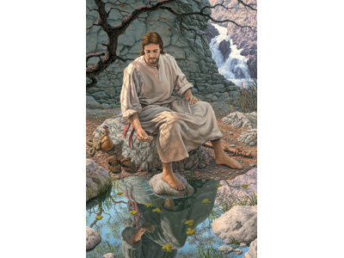
EARLY CHURCH PRE-TEST Q-22
Early Christians preferred to baptize in “living water” What did they mean by that?
Running Water (such as a stream)
Water Blessed By A Bishop
Hot Or Cold Water Rather Warm
Immersion Rather Than Pouring
x

Slide 30
EARLY CHURCH PRE-TEST Q-23
What was the standard church practice in 400 A.D. regarding ordination of slaves?
It Was Forbidden!
Theoretically, it was permissible; practically, slaves weren’t expedient
If an owner didn’t want his slave ordained, the church ordained him anyway and provided compensation
The Owner Could Prevent!
x

Slide 31
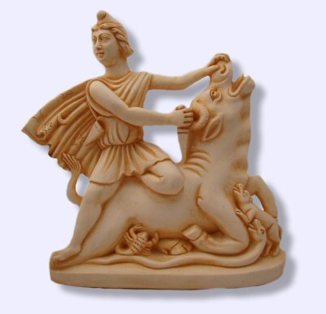
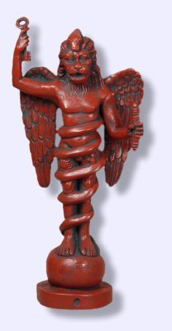
EARLY CHURCH PRE-TEST Q-24
What early religion competed with Christianity for supremacy and, remarkably, centered around an incarnation, resurrection, baptism, communion, and final judgment?
Mithraism
Zoroastrism
Platoism
Stoicism
x
As the Jews were conditioned for Christianity through purification rites,
the initiation rites of the Mystery Cults prepared Gentiles.
Mithraism – Major Roman Religion – Female Gender Exclusive

Slide 32
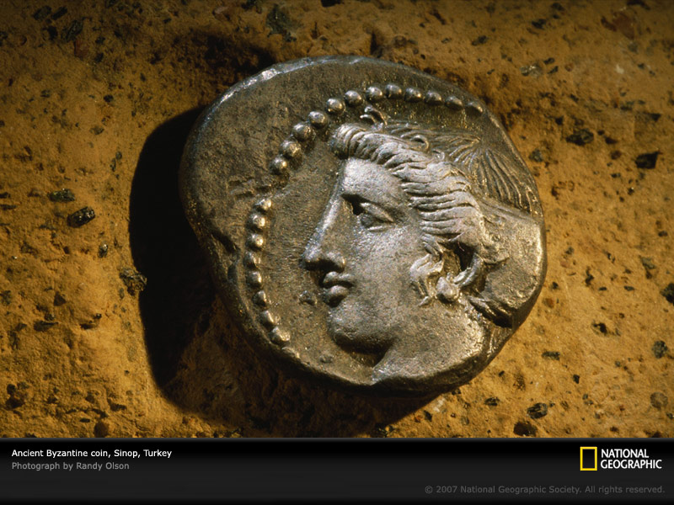
EARLY CHURCH PRE-TEST Q-25
After Constantine officially became a Christian, whose faces did he put on coinage?
Apostles Peter & Paul
Roman gods Mars & Jupiter
He & His Family Members
Bishops Athanasius & Malodorous
x

Slide 33
EARLY CHURCH PRE-TEST Q-26
David Lee Burris:
Public Sin Or Penitent Status Did Disqualify
There were three prerequisites for receiving Communion around A.D. 150, according to Justin. Which of the following were not one of them?
BELIEF
BAPTISM
MORAL PURITY
CORRECT THEOLOGY
x

Slide 34
EARLY CHURCH PRE-TEST Q-27
According to the Didache, what did the early Christians wear when being baptized?
Usual Clothes
White Loincloth
A Red Veil
Nothing At All!
x

Slide 35
EARLY CHURCH PRE-TEST Q-28
In A.D. 250 the church in Rome had one bishop. How many elders & deacons did it have?
One Elder & Sixty-six Deacons
Forty-six Elders & Seven Deacons
Seven Elders & Forty-six Deacons
One Hundred Twenty Deacons – The Office Of Elder Was Eliminated
x

Slide 36
EARLY CHURCH PRE-TEST Q-29
What repeated punishment did Athanasius get of his church because he believed in the Trinity?
He was stoned three times
He was whipped five times
He was exiled seven times
He was shaved nine times
x

Slide 37
EARLY CHURCH PRE-TEST Q-30
Clovis, king of the Franks, became a Christian about 500. A typical conversion of royalty in that period, it involved all the following except which?
Clovis said he’d become a Christian if God would help him win an important battle
He forced 3,000 of his soldiers to be baptized right away
He continued to engage regularly in treachery and murder
He took over all church lands and buildings within his territory
x

Slide 38
EARLY CHURCH PRE-TEST Q-31
Approximately how much time elapsed between the last major persecution of Christians by pagans and the first major persecution of pagans by Christians?
10 YEARS
80 YEARS
240 YEARS
550 YEARS
x

Slide 39
EARLY CHURCH PRE-TEST Q-32
What was the last book generally accepted as part of the New Testament?
HEBREWS
JAMES
2nd Peter
3rd John
x

Slide 40
EARLY CHURCH PRE-TEST Q-33
According to Augustine, the world will end when the total number of people saved equals what amount?
The number killed by the Flood
The number of Adam’s sins
The number of fallen angels
The number of Jews since the time of Christ who haven’t believed
x

Slide 41
EARLY CHURCH PRE-TEST Q-34
Why did Tertullian argue in A.D. 200 that teenagers should not be baptized?
They do not realize the depth of the commitment required
Jesus was not baptized till He was thirty
Teenagers sin a lot. Postponed baptism can forgive more sins
According to legend, the youngest of the twelve apostles (John) was twenty-one when he was called
x

Slide 42
EARLY CHURCH PRE-TEST Q-35
What was Ignatius’ comment about facing wild beasts in the coliseum where he would be martyred?
“Better animal beasts than soldier beasts”
“If God wills, the lions will lie before the Lamb”
“I shall coax them to devour me promptly”
“I shall not be facing the wildest beasts. They all sit in the coliseum bleachers”
x

Slide 43
EARLY CHURCH PRE-TEST Q-36
When forty Roman soldiers in fourth-century Asia Minor became Christians, how were they martyred, and with what temptation to give in?
Drown or walk forward in 7 ft. of water
Spears were thrown but shields on ground
Starved to death but food beside door out
Placed naked on frozen lake with shore fire
x

Slide 44
EARLY CHURCH PRE-TEST Q-37
The two up-and-coming religions in the Roman Empire were Christianity & Mithraism, which both initiated converts by baptism. What liquid was used for Mithraic baptisms?
COLD GOAT MILK
WARM CAMEL URINE
LUKEWARM WINE
HOT BULL BLOOD
x

Slide 46
EARLY CHURCH PRE-TEST Q-38
In what period was Codex Sinaiticus, the oldest complete New Testament manuscript, copied?
Around 100 - 150
Around 200 - 250
Around 300 - 350
Around 400 - 450
x

Slide 47
EARLY CHURCH PRE-TEST Q-39
Approximately when does the first mention of infant sprinkling occur in the writings of the church fathers?
90
190
290
390
x

Slide 48
EARLY CHURCH PRE-TEST Q-40
After the Bible was divided into chapters, how many years passed before it was divided into verses?
None - Done Within Year
TEN
100
300
x

Slide 49
EARLY CHURCH PRE-TEST Q-41
In the fourth and fifth centuries, when people asked for baptism, how long were they generally required to wait?
Baptized that day
The following Sunday
The next Easter
Three years later
x

Slide 50
EARLY CHURCH PRE-TEST Q-42
When Christianity became established as the Roman religion in the fourth century, how long did a typical church service last?
3 hours
6 hours
9 hours
1 hour (10 – 11am)
x

Slide 51
EARLY CHURCH PRE-TEST Q-43
What did Cardinal Hugo de Sancto Caro do to the Bible in A.D. 1250?
Digested It Smaller
First Tribal Translation
Banned From Papal State
Divided It Into Chapters
x

Slide 52
EARLY CHURCH PRE-TEST Q-44
David Lee Burris:
The reader has to go over his agonizing at having stolen pears as a youth from a neighbor’s tree!
What type of literary work did Augustine produce that appears to be the first of its kind in history?
Volume Bound Sermons
Petrarchan Sonnet Book
Interior Autobiography
Completed Commentary
x

Slide 53
EARLY CHURCH PRE-TEST Q-45
The worship of Mary began to take shape in the third through fifth centuries. All the following practices framed then except this?
Mary Never Died Or Doctrine Of Heavenly Assumption
The Term “Mother Of God”
The Belief Mary Was Sinless
The Belief Mary Never Sexual
x

Slide 54
EARLY CHURCH PRE-TEST Q-46
How far back does the oldest church building go?
A.D. 232
A.D. 332
A.D. 432
A.D. 532
x

Slide 55
EARLY CHURCH PRE-TEST Q-47
What aspect of modern church seating would most likely astonish a fourth-century Christian?
People sit during the sermon
The mixing of men & women
The mixing of child & adult
Remote Communion Table
x

Slide 56
EARLY CHURCH PRE-TEST Q-48
What is the earliest mention of a church choir?
107
307
507
707
x

Slide 57
EARLY CHURCH PRE-TEST Q-49
What is the literal meaning of the Latin “a cappella”?
Without A Cloak
Without A Building
Without Instruments
Without A Cap
x

Slide 58
EARLY CHURCH PRE-TEST Q-50
In A.D. 70 an event occurred that tended to loosen the church from its Jewish roots. What was that event?
Rome then forbid Sabbath observance
Jewish nation began Christian persecution
The Temple was destroyed
New Testament Was Complete
x

Slide 59
QUESTIONS

Slide 60
LATER CHURCH PRE-TEST Q-1
For several years in the fourteenth and fifteenth centuries there were two popes. When the Council of Pisa met in 1409 to resolve this situation, what happened?
They had one pope killed
They let God decide & one died
Deposed both & Council ruled 40 yrs
Selected Another – Then There Three
X

Slide 61
LATER CHURCH PRE-TEST Q-2
In what century was celibacy first enforced upon the clergy?
THIRD
SEVENTH
ELEVENTH
FIFTEENTH
X

Slide 62
LATER CHURCH PRE-TEST Q-3
An average of how many new churches were being built per decade in eleventh-century France?
NONE
Twelve
Forty-five
1 6 0
X

Slide 63
LATER CHURCH PRE-TEST Q-4
In England many priests took multiple churches (getting government pay for each) while only serving one. At the worse of this abuse, what percentage of local churches had no clergy?
THREE
TEN
THIRTY
FIFTY-FIVE
X

Slide 64
LATER CHURCH PRE-TEST Q-5
What does the Latin word “haeresis,” from which we get heresy, mean?
EVIL
CHOICE
ORIGINAL
INSANE
X

Slide 65
LATER CHURCH PRE-TEST Q-6
In medieval England, what was a “neck verse”?
If a person committed a crime he had to wear around his neck the Bible verse condemning
It was a nickname for the stocks
If a clergyman committed a hanging offense he was spared by reading an assigned verse
Heretical Branding For Jews
X

Slide 66
LATER CHURCH PRE-TEST Q-7
What alleged relic, kept at Canterbury, England, did the medieval church claim was the oldest relic in the world?
The club with which Cain killed Abel
The apple core from which Adam & Eve took bites
Bone splinter of Adam’s rib
The clay that God had left over from making Adam
X
READ: Peter Manseau, Rag & Bone , Chapter 3 – One, Two, Three Foreskin

Slide 67
LATER CHURCH PRE-TEST Q-8
In the 1660’s Britain tried to control unofficial religions by the Conventicle Act, which forbade meetings of a certain size without authorization. What size?
MORE THAN SINGLE PERSON
MORE THAN FOUR PERSONS
MORE THAN FIFTY PEOPLE
ONLY CAPACITY OF 150
X

Slide 68
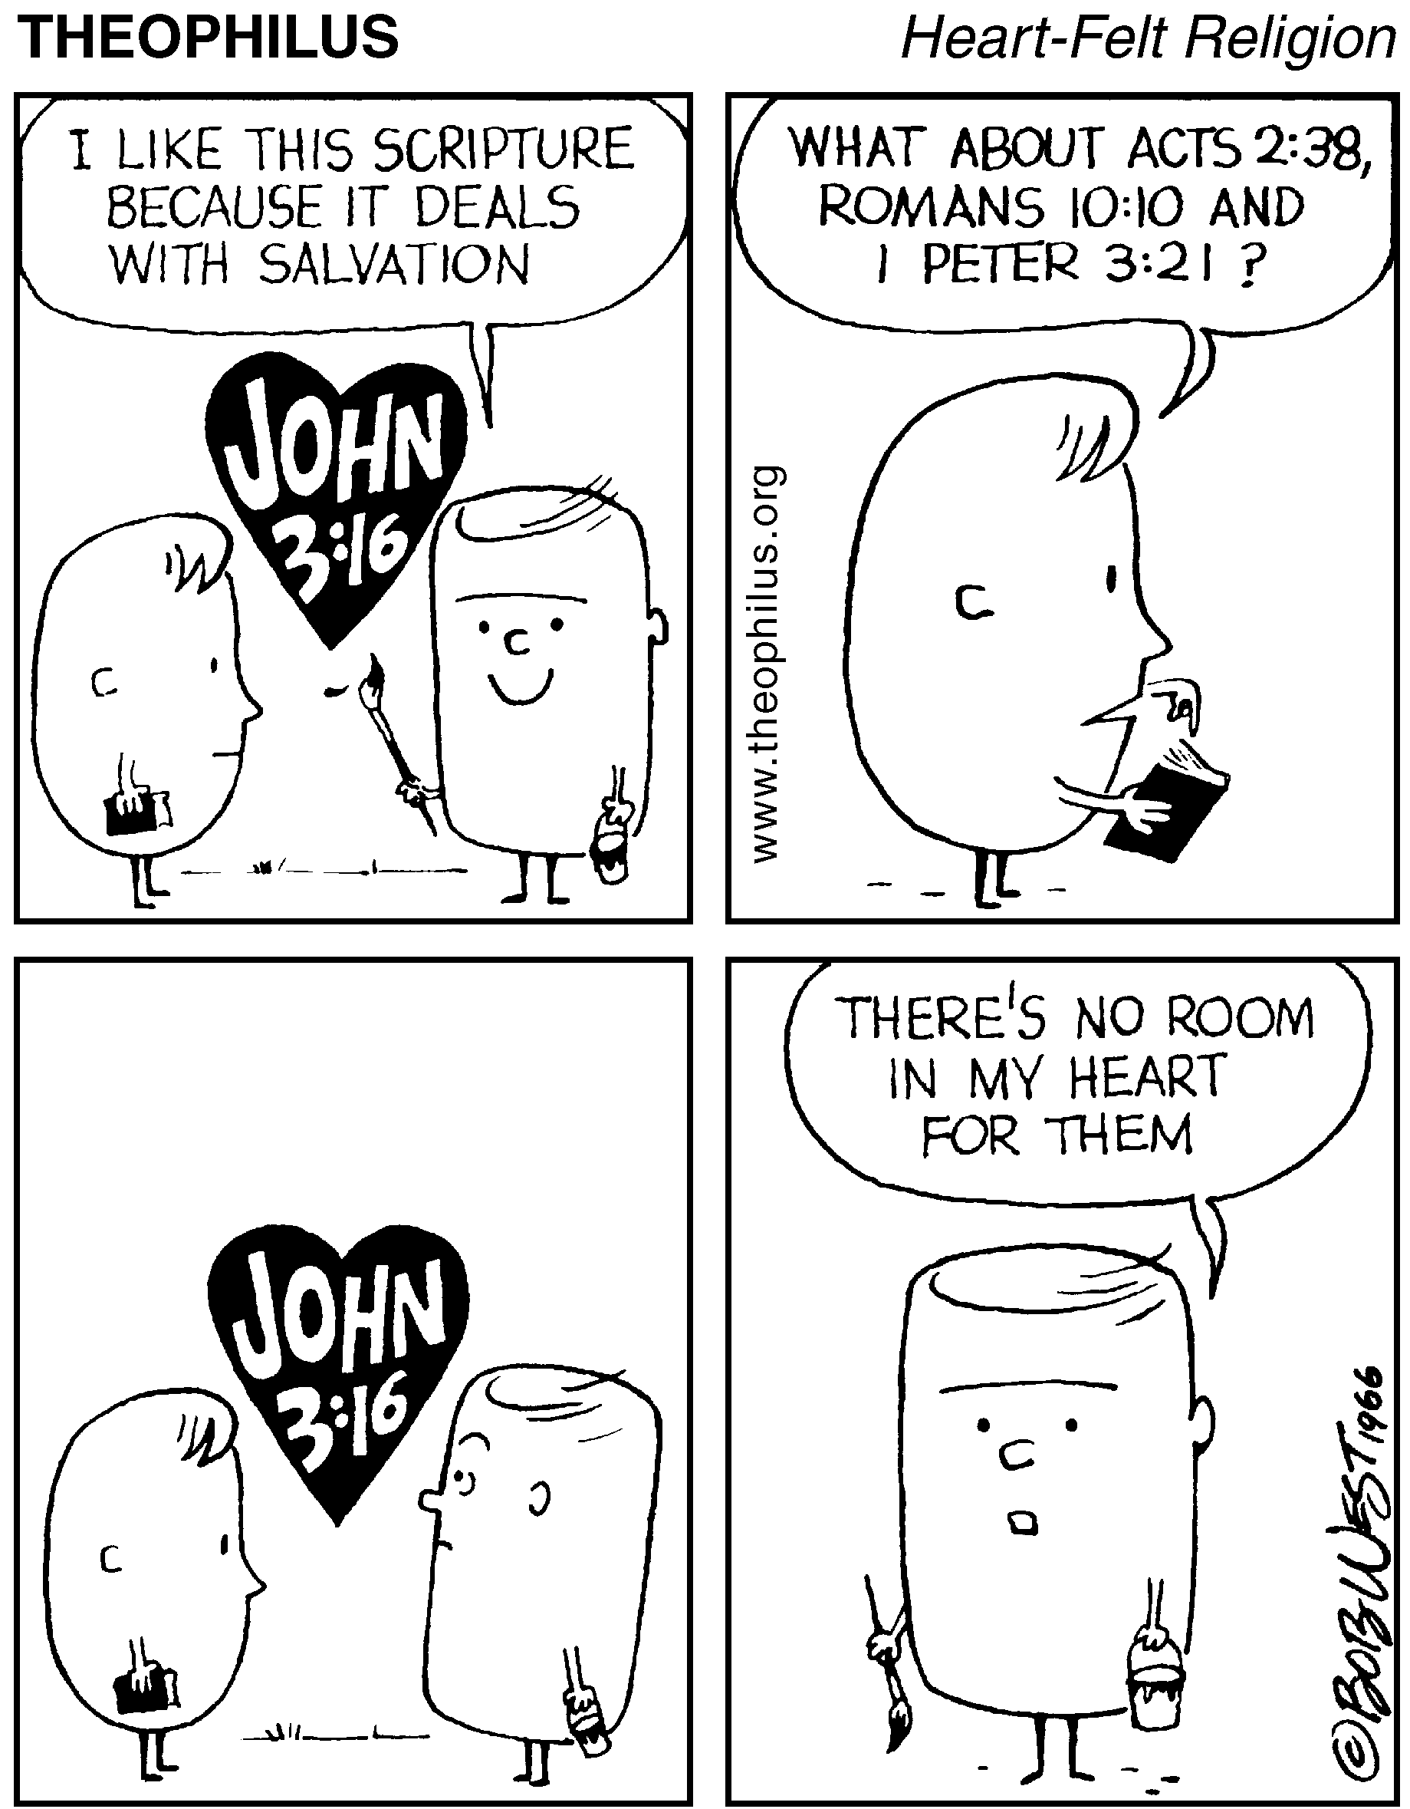
LATER CHURCH PRE-TEST Q-9
Early Calvinists naturally wanted to know if they were of “the elect.” Calvin gave three ways to determine whether one was elect; which of the following was not one?
BEING BAPTIZED
TAKING COMMUNION
TELL BELIEF IN CHRIST
LIVING RIGHTEOUSLY
X

Slide 69
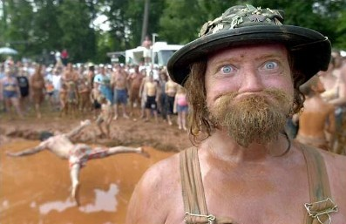
LATER CHURCH PRE-TEST Q-10
What was the Anabaptist analogy showing why they required a change of life before receiving baptism rather than after?
You can’t tan a hide while it’s on the deer
You can’t wash a cabbage while its down in the dirt
You can’t roller skate in a buffalo herd
You don’t give away your merchandise until you see the buyer’s money
X

Slide 70
LATER CHURCH PRE-TEST Q-11
Early medieval Bible study wasn’t very scholarly. As an example, who did the well-educated theologian Bonaventura state wrote the Book of Psalms?
ADAM
NOAH
JESUS
MARY
X

Slide 71
LATER CHURCH PRE-TEST Q-12
Roger Bacon, the 13th century friar, was probably the greatest scientist of his century. What was his scientific goal?
To find evidence of the genesis creation account
To determine the location of heaven & hell
Muslim Doomsday Weapon
Relic Authentication Device
X

Slide 72
LATER CHURCH PRE-TEST Q-13
In the Renaissance many people believed it to be for the best that Adam & Eve sinned, because otherwise we’d never have known the extent of God’s mercy. What is this concept called?
The Excellent Expulsion
The Fortunate Fall
The Purifying Punishment
The Gateway Of Grace
X

Slide 73
LATER CHURCH PRE-TEST Q-14
When a playing-card maker in Geneva criticized John Calvin, what did Calvin make him do?
Walk around town without pants
Become a Catholic
Eat an entire suit of cards
Apologize, Confess & Beg For Calvin’s Prayers In His Behalf
X

Slide 74
LATER CHURCH PRE-TEST Q-15
What did Henry IV say when he switched from Protestant to Catholic to become king of France?
“Easy come, easy go”
“Paris is well worth a mass”
“I shall do so much for God that He will not care a franc”
“Luther is dead; the pope is alive. Which do you think will come to my aid when necessary”?
X

Slide 75
LATER CHURCH PRE-TEST Q-16
In the early 1500’s, Anabaptist leader Felix Manz practiced adult baptism. How did Reformation leader Ulrich Zwingli have him punished?
A FINE
EXILE
HANGING
DROWNING
X

Slide 76
LATER CHURCH PRE-TEST Q-17
What is the unusual feature about the hymn “Faith of Our Fathers”?
It was originally “Faith of Our Mothers”
It was written as an anti-Protestant hymn, but has been sung more often by Protestants
The fifth verse about teaching children is not popular & left out
The author, Frederick Faber, was a pencil manufacturer who wrote no other hymns
X

Slide 77
LATER CHURCH PRE-TEST Q-18
What recurrent physical problem did Martin Luther claim was caused by Satan during his period in the tower?
Migraines
Incontinence
Spinal Fusion
Constipation
X

Slide 78
LATER CHURCH PRE-TEST Q-19
What is the tonsure (monk’s haircut) intended to represent?
Christ’s Crown of Thorns
Halo of Canonization
Halo of Heaven
Bald Spot = Purity
X

Slide 79
LATER CHURCH PRE-TEST Q-20
In the early 1500’s, the Bishop of Constance absolved Swiss priests of fornication if they did what?
Left priesthood & married
Repeated ten “Hail Mary’s”
Paid a fine of four guilders
Drew the line @ wives & nuns
X
NOTE: He Raised ~ 8,000G Annually

Slide 80
LATER CHURCH PRE-TEST Q-21
When Philip of Hesse wanted to end his marriage and marry another woman, what was Martin Luther’s controversial advice?
As head of the wife he could take her life in order to end the marriage
Philip could get divorce without Catholic Church or Pope’s consent
Send his present wife into exile
Divorce wrong – commit bigamy!
X

Slide 81
LATER CHURCH PRE-TEST Q-22
What occurs during auto-da-fe ceremony?
“Holy Water” Is Put On Autos
Feet Are Washed & Anointed
Funeral Rite For Unbelieving
Heretics Are Burned!
X

Slide 82
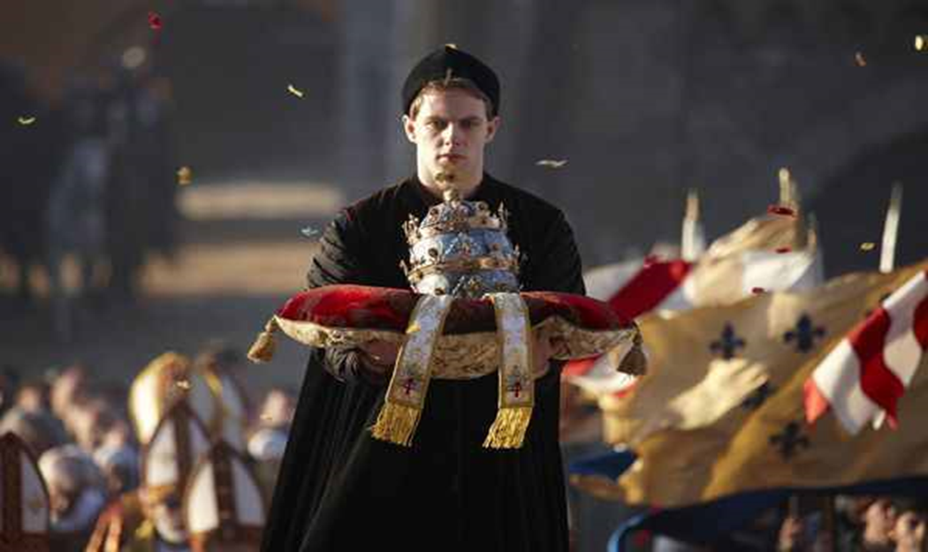
LATER CHURCH PRE-TEST Q-23
What religious item had forty-eight rubies, seventy-two sapphires, forty-five emeralds, and sixty-six pearls?
Crystal Cathedral Communion Set
Holy Roman Emperor’s Crown
Papal Crown of Pope Boniface VIII
Knights Templar Communion Set
X

Slide 83
LATER CHURCH PRE-TEST Q-24
John Wyclif was the first European to identify the Catholic pope with what biblical character?
PETER
GOD
CHRIST
ANTI-CHRIST
X

Slide 84
LATER CHURCH PRE-TEST Q-25
When the pope claimed the power to release people from purgatory, what was Martin Luther’s comment?
“Then why doesn’t he empty the place”?
“He’s putting me through purgatory every day; why won’t he release me”?
“His death will release more people from purgatory than anything else he can do”
“I have the same power; Therefore, I declare purgatory nonexistent”
X

Slide 85
LATER CHURCH PRE-TEST Q-26
Why was an hourglass found on English pulpits during the reformation period?
To keep sermons from lasting more than hour
To keep sermons from lasting less than hour
To symbolize the sands of life running out
Cromwell government condemned clocks
X

Slide 86
LATER CHURCH PRE-TEST Q-27
When the pope (referring to the Vatican’s wealth) said to Dominic, “The church can no longer say,‘Silver & Gold Have I Not’” what was Dominic’s reply?
“Not to mention diamonds, and onyx, and rubies, and…”
“Neither can it now say, ‘Rise Up & Walk’ ”
“Peter gave us the keys to the treasury”
“Would His Holiness be interested in making a small loan?”
X

Slide 87
LATER CHURCH PRE-TEST Q-28
Why was an armed guard placed around the deathbed of Francis of Assisi?
To get more relics, some churches had started cutting off body parts before the saints expired
There was a prophecy that at death his body would be possessed by the anti-Christ
Toward the end, the extremely meek & mild mannered Assisi had become violently insane
To keep the wild animals he had domesticated away from his dying body
X
* “Don’t be too quick to canonize me. I am perfectly capable of fathering a child.”

Slide 88
LATER CHURCH PRE-TEST Q-29
To humble the argumentative King Henry IV of Germany, Pope Gregory VII made Henry stand barefoot in the snow outside his (Pope’s) castle in the Alps. How long?
ONE HOUR
SIX HOURS
ALL DAY
THREE DAYS
X

Slide 89
LATER CHURCH PRE-TEST Q-30
What was the only restriction that Henry VIII placed on oral Bible-reading in 1543?
It could only be done in church
It could only be done for the families of nobles
It had to be from the King James
It could only be New Testament
X

Slide 90
LATER CHURCH PRE-TEST Q-31
In a typical English city centuries ago, less than one percent of seats in Anglican churches were what?
Used on Sunday
Free
Wooden
Hygienic
X
Origin of the Official Usher

Slide 91
LATER CHURCH PRE-TEST Q-32
Who did Luther angrily say “wishes to reverse the entire science of astronomy; scripture tells us that Joshua commanded the sun to stand still, not the earth”?
GALILEO
NEWTON
COPERNICUS
ERASMUS
X

Slide 92
LATER CHURCH PRE-TEST Q-33
What English women were told to leave their homes under Henry VIII, get married under Edward VI, leave their husbands under Mary I, and return to their husbands under Elizabeth I?
Members Of The Royal Court
Quakers
Female Preachers
Nuns
X

Slide 93
LATER CHURCH PRE-TEST Q-34
Where did Bernard say all “murderers, rapists, adulterers, perjurers, and all other criminals” should go?
To Church
To Hell
To Monasteries
To the Crusades
X

Slide 94
LATER CHURCH PRE-TEST Q-35
Who, during the German Peasants’ War, encouraged rulers to “smite, slay, and stab” peasants like mad dogs?
Menno Simons
Philip Melancthon
Desiderius Erasmus
Martin Luther
X

Slide 95
LATER CHURCH PRE-TEST Q-36
Medieval wars were often interrupted by the “Truce of God.” What was that?
Christian countries were not allowed to fight on Sundays
Camp revivals caused military leaders to negotiate grievances
Natural disasters interpreted as Divine disapproval
Just War Doctrine Enforcing
X

Slide 96
LATER CHURCH PRE-TEST Q-37
In fourteenth-century England, what was unusual about the way the “kiss of peace” was handled in churches?
For the first time, the kiss was replaced with the handshake
Enemies specially selected to kiss or both excommunicated
Instead of kissing each other, kissed a paddle & passed it on
Abandoned With The Plague
X

Slide 97
LATER CHURCH PRE-TEST Q-38
What is the difference between monks and friars?
Monks live in the rural areas, friars in the cities
Friars are required to perform manual labor, but not monks
Monks withdraw from the world; friars live in society
Friar is simply a higher rank
X

Slide 98
LATER CHURCH PRE-TEST Q-39
Approximately how many people went off on the First Crusade?
5,000
50,000
500,000
5,000,000
X

Slide 99
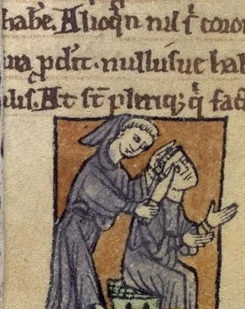
LATER CHURCH PRE-TEST Q-40
Which of these was an issue causing the Roman Catholic & Greek Orthodox churches to separate in 1054?
Should a monk wear a hair shirt?
Should a friar wear shoes?
Should a priest wear a beard?
Should a bishop wear head gear?
X

Slide 100
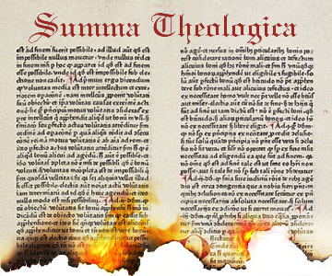
LATER CHURCH PRE-TEST Q-41
Which famous theologian turned away from theology toward the end of his life, declaring, “All my books are worthless”?
TERTULLIAN
ORIGEN
JEROME
THOMAS AQUINAS
X

Slide 101
LATER CHURCH PRE-TEST Q-42
When a young man in John Calvin’s Geneva struck his parents, how did the city fathers respond?
They asked him to apologize
They required him to read the Old Testament books seven times
They had him flogged!
They had him beheaded!
X

Slide 102
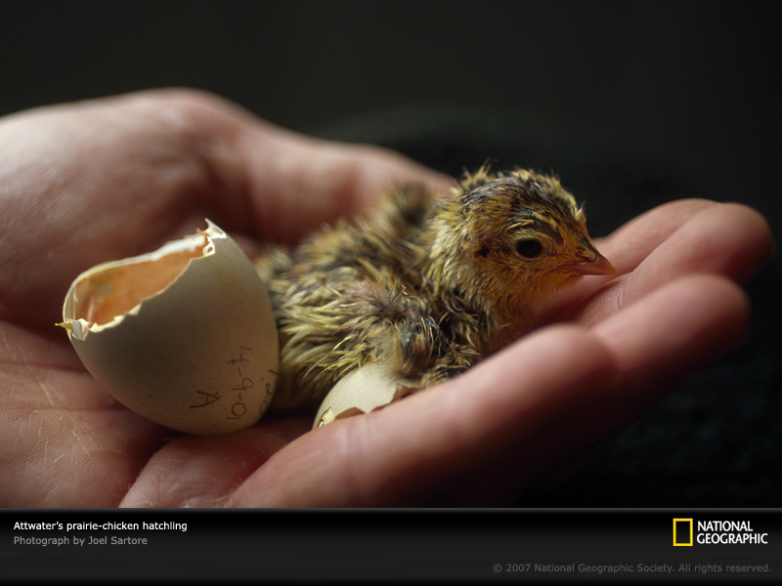
LATER CHURCH PRE-TEST Q-43
Many Catholics accused Erasmus of starting the Reformation because of his coming out with the New Testament in Greek. How did Erasmus respond?
“Paul & John produced Greek before I did; blame them”
“I don’t understand this Reformation; it’s Greek to me”
“I laid a hen egg, but Luther hatched it into a rooster”
“I gave men a lamp for their feet; Luther pushed it into their eyes so that they can’t see”
X

Slide 103
LATER CHURCH PRE-TEST Q-44
When the Greek Orthodox Church left the Roman Catholic Church, what was Pope Leo IX’s reaction?
“I hope they’ll be very happy”
“Let them be forever damned. Amen. amen. & amen.”
“The Lord promises vengeance. We shall be His instruments”
“The body of our Lord remained whole on the cross. Now, a thousand years later, it is torn”
X

Slide 104
LATER CHURCH PRE-TEST Q-45
The Council of 1512 ordered priests not to attend the weddings of whom?
People that were excommunicated
Practicing Protestants
Former priests
Their known illegitimate children
X

Slide 105
LATER CHURCH PRE-TEST Q-46
According to Catholic doctrine, the pope is infallible when speaking “ex-cathedra.” What, originally, was a cathedra?
The chair a bishop sat in to decide church cases
The scepter a bishop waved to call for silence
The room the emperor sealed law
Church Council Spokesperson
X

Slide 106
LATER CHURCH PRE-TEST Q-47
Ignatius Loyola, Jesuit founder, set up a “five-finger plan” for self-examination. Steps One - Four are: Give Thanks – Ask For Light – Look At Yourself – Be Sorry. What’s # 5?
Give thanks again
Ask forgiveness
Be Constructive
Do Not Remember Sins
X

Slide 107
LATER CHURCH PRE-TEST Q-48
According to Pope Innocent III, what is the relationship of a king to the pope like?
A drop of water in the ocean
The moon to the sun
A shadow to the sun
Regular to Communion Wine
X

Slide 108
LATER CHURCH PRE-TEST Q-49
A person paying to view all the relics in Wittenberg would escape how many years in purgatory?
200
2,000
200,000
2,000,000
X

Slide 109
LATER CHURCH PRE-TEST Q-50
What in the 9th century was an iconoclast?
One who says their prayers in reverse order
What those persons who broke religious statues were called
Layman who insists on taking of the communion wine
Name for pillar sitting hermits
X

Slide 110
CHURCH DEVELOPS BEYOND:
David Lee Burris:
Tonsure: Origins In Persecuted Church; Roman Mockery To Shave Heads As Slave Property
JEWISH ROOTS
GREEK ETHOS
ROMAN BASE

