Slide 1
Telescopic Astronomy To Microscopic Biology
by David Lee Burris

Slide 2
Different Cosmologies

Slide 3
POWERS OF 10
ZOOM
FROM MICRO TO MACRO COSMOS
.

Slide 4
This is a trip at high speed, jumping distances by a factor of 10.
We’ll start with 10⁰ (equivalent to 1 meter), and will increase the size by a factor of 10, or 10¹ (10 meters), 10² (10x10 = 100 meters, 10³ (10x10x10 = 1,000 meters), 10⁴ (10x10x10x10 = 10,000 meters), so on, until we reach the limit of our imagination in the direction of the macro cosmos.
Later we’ll return, a little faster, back to the point where we started & continue our trip in the opposite direction reducing distances of travel by factors of 10 into the micro cosmos.
We will observe the constancy of the laws of the universe ...

Slide 5
BON VOYAGE!

Slide 6
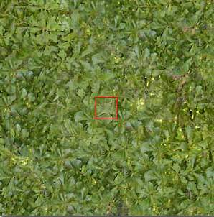
10⁰
^{1 meter}
Distance to a bunch of leaves in the garden

Slide 7
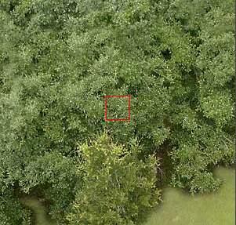
10¹
10 meters
Starting our trip upwards .... We can see the foliage.

Slide 8
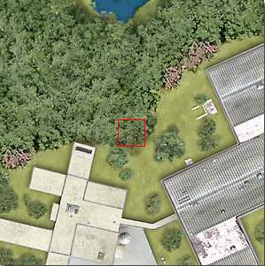
10²
100 meters
At this distance we can see the limits of the forest and the edifications

Slide 9
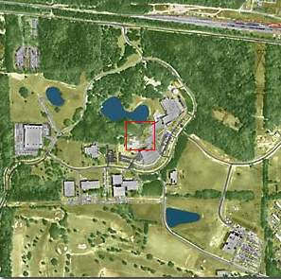
10³
1 km
We will pass from meters to kilometers..
Now it is possible to jump with a parachute ...

Slide 10
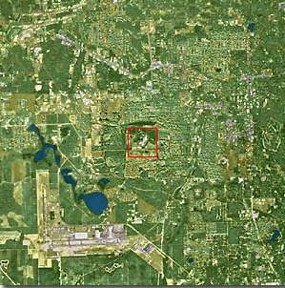
10⁴
10 km
The city could be observed but we really can’t see the houses

Slide 11
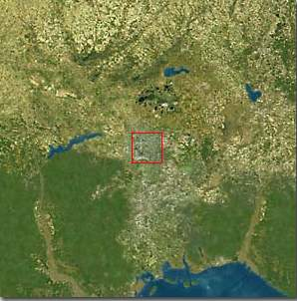
10⁵
100 km
At this height, the state of Flórida - USA, is just coming into view ...

Slide 12
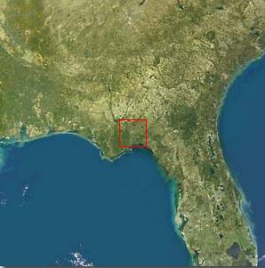
10⁶
1,000 km
Typical sight from a satellite

Slide 13
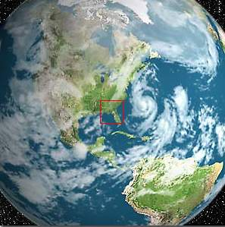
10⁷
10,000 km
The northern hemisphere of Earth, and part of South America

Slide 14
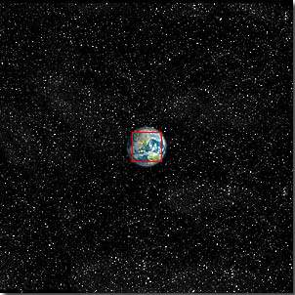
10⁸
100,000 km
The Earth starts looking small...

Slide 15
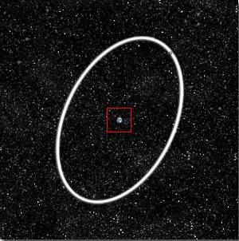
10⁹
1 Millión km
The Earth and the Moon’s órbit in white....

Slide 16
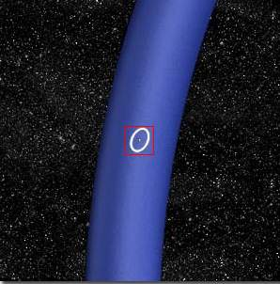
10¹⁰
10 Million km
Part of the Earth’s Orbit in blue

Slide 17
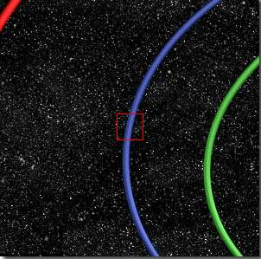
10¹¹
100 Million km
Órbits of: Venus and Earth...

Slide 18
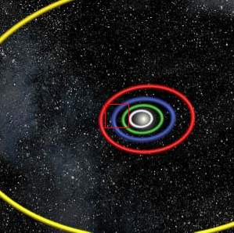
10¹²
1 Billión km
Órbits of: Mercury, Venus, Earth, Mars and Júpiter.

Slide 19
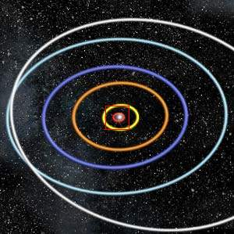
10¹³
10 Billion km
At this height of our trip, we could observe the Solar System and the orbits of the planets

Slide 20
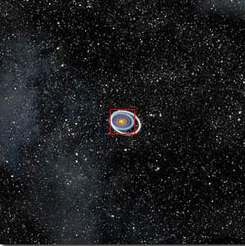
10¹⁴
100 Billion km
The Solar System starts looking small...

Slide 21
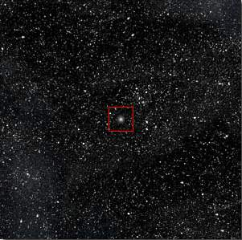
10¹⁵
1 Trillión km
The Sun now is a small star in the middle of thousands of stars...

Slide 22
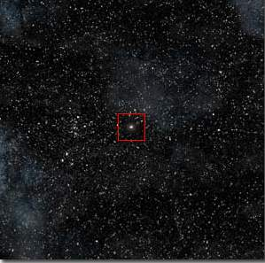
10¹⁶
1 light-year
At one light-year the little Sun star is very small

Slide 23
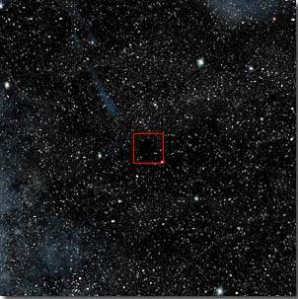
10¹⁷
10 light-years
Here we will see nothing in the infinity....

Slide 24
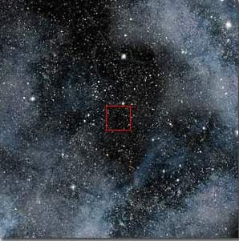
10¹⁸
100 light-years
“Nothing” Only stars and Nebulae...

Slide 25
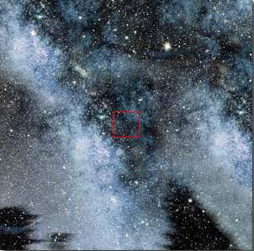
10¹⁹
1,000 light-years
At this distance we are travelling in the Via-Láctea (Milky Way), our galaxy.

Slide 26
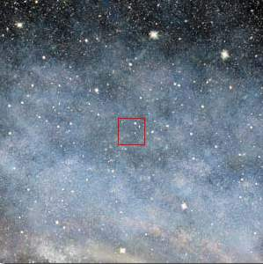
10²⁰
10,000 light-years
We continue our travel inside the Via-Láctea (Milky Way)

Slide 27
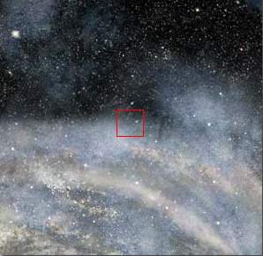
10²¹
100,000 light-years
We begin reaching the periphery of the Via-Láctea (Milky Way)

Slide 28
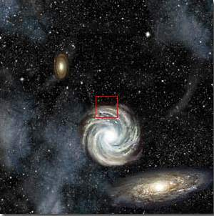
10²²
1 Millión light-years
At this tremendous distance we can see the entire Via-Láctea (Milky Way) & other galáxies as well ...

Slide 29
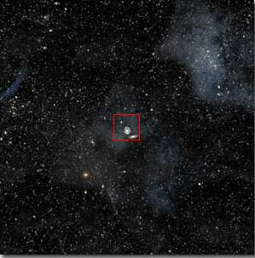
10²³ - 10 Million light-years
From this distance, all the galaxies look small with immense empty spaces in between. The same laws are ruling all bodies of the Universe. We could continue traveling upwards with our imagination, but now let’s return home quickly

Slide 30
10²²

Slide 31
10²¹

Slide 32
10²⁰

Slide 33
10¹⁹

Slide 34
10¹⁸

Slide 35
10¹⁷

Slide 36
10¹⁶

Slide 37
10¹⁵

Slide 38
10¹⁴

Slide 39
10¹³

Slide 40
10¹²

Slide 41
10¹¹

Slide 42
10¹⁰

Slide 43
10⁹

Slide 44
10⁸

Slide 45
10⁷

Slide 46
10⁶

Slide 47
10⁵

Slide 48
10⁴
Questions that come to mind ...
Who are we? Where are we going? Where did we come from?

Slide 49
10³
Or... What do we represent in the Universe?

Slide 50
10²
In this trip “upwards” we went to the power of 23 of 10

Slide 51
10¹
Now we are going to dig inside of matter in a reverse (inverse) trip...

Slide 52
10⁰
We arrive at our starting point. We could touch it with our hands ...

Slide 53
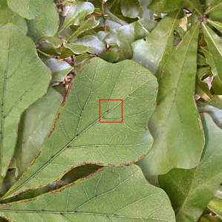
10⁻¹
10 Centímeters
Getting closer at 10 cm ...
We can delineate the leaves.

Slide 54
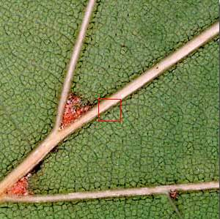
10⁻²
1 Centímeter
At this distance it is possible to observe the structure of the leaf.

Slide 55
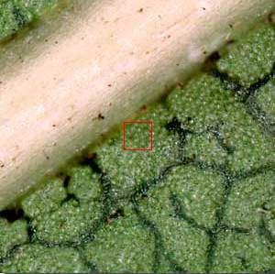
10⁻³
1 Millímeter
The cellular structures begin to show...

Slide 56
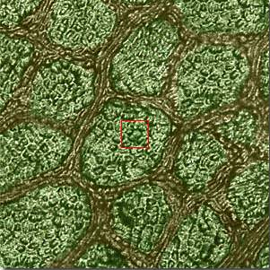
10⁻⁴
100 microns
The cells can be delineated. You can see the union between them.

Slide 57
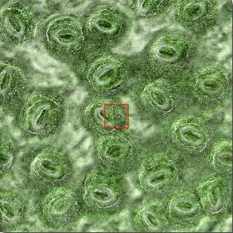
10⁻⁵
10 microns
Starting our trip inside the cell ...

Slide 58
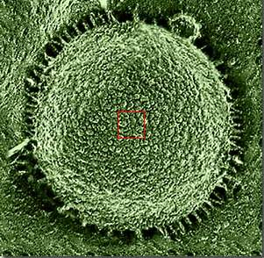
10⁻⁶
1 micrón
The nucleus of the cell is visible.

Slide 59
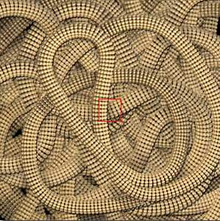
10⁻⁷
100 Nanometers
Again we changed the measuring unit to adapt to the miniscule size. You can see the chromosomes.

Slide 60
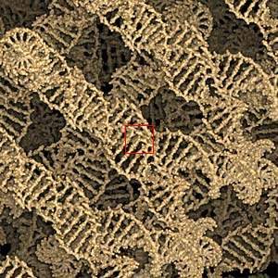
10⁻⁸
10 Nanometers
In this microcosmic universe the DNA chain is visible.

Slide 61
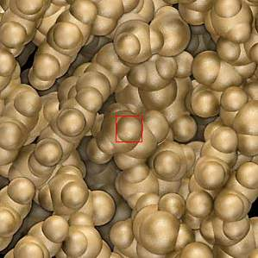
10⁻⁹
1 Nanometer
...chromosóme blocks can be observed.

Slide 62
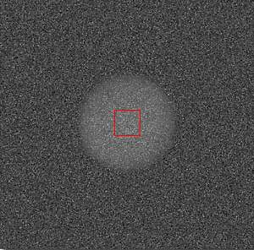
10⁻¹⁰
1 Angstrom
It appears like clouds of electrons... These are carbon átoms that formed our world.
You should notice the resemblance of the micro cosmos with the macro cosmos ...

Slide 63
10⁻¹¹
10 Picometers
In this miniature world we could observe the electrons orbiting the atoms.

Slide 64
10⁻¹²
1 Picómeter
An immense empty space between the nucleus and the electron orbits...

Slide 65
10⁻¹³
100 Femtómeters
At this incredible and minuscule size we could observe the nucleus of the atom.

Slide 66
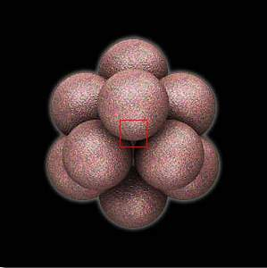
10⁻¹⁴
10 Femtómeters
Now we could observe the nucleus of the carbon atom

Slide 67
10⁻¹⁵
1 Femtómeter
Here we are in the field of the scientific imagination, face to face with a proton.

Slide 68
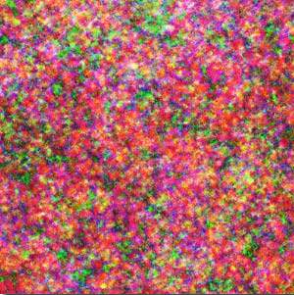
10⁻¹⁶
100 Attómeters
Examine the ‘quark’ partícules
There is nowhere further to go... We are at the limits of current scientific knowledge . This is the limit of matter...

Slide 69
That’s the macro-micro cosmic trip. Next follows the animated cell trip:

Slide 71
WHAT IS LIFE?
Alexandir Oparin: “Life may be recognized in bodies which have particular characteristics not seen in the world of the dead. First, there is definite structure or organization – there is the ability of the organisms to metabolize, to reproduce others like themselves & also their response to stimulation.”

Slide 72
WHAT IS LIFE?
John Maynard Smith
“Life is any population of entities with the properties of multiplication, heredity, and variation.”

Slide 73
WHAT IS LIFE?
John D. Bernal:
“Life is a partial, continuous, progressive, multiform, and conditionally interactive, self-realization of the potentialities of atomic electron states.”

Slide 74
WHAT IS LIFE?
Stuart Kauffman:
“Life is an expected, collectively self-org- -anized property of catalytic polymers.”

Slide 75
WHAT IS LIFE?
Gerald Joyce:
“Life is self-sustained chemical system able to undergo Darwinian evolution.”

Slide 76
NOT EVERYTHING THAT
CAN BE COUNTED COUNTS AND
NOT EVERYTHING THAT COUNTS
CAN BE COUNTED.
- Albert Einstein

Slide 77
THE MONOLITH
Particles To People?

Slide 78
THE MONOLITH
GOO TO YOU?

Slide 80
Stasis Point Of Debate
David Lee Burris:
Numinous Vicissitude & Divine Interest In Human Affairs
Pivot Point: Philosophy & Religion

Slide 81
Research News & Opportunities In Science & Theology; Sept. 2003; Volume Four, No. 1; Page 22
“Traditionally, almost all religions and philosophies read the universe as a revelation of order or purpose. Reading the universe was not an exercise taken lightly, however. For beneath the nature’s surface lurked layer upon layer of mystery and meaning. In the process of penetrating to the world’s inner substance, the interpreter would have to undergo a purifying trans- -formation. One could not really come to know the universe without being changed in the process.”

Slide 82
Research News & Opportunities In Science & Theology; Sept. 2003; Volume Four, No. 1; Page 22
“The universe no longer works this way for most of us. With the help of science, we can now read it quite competently – or so it seems – but we are seldom significantly changed in the process. We have laid bare nature’s atomic and molecular alphabet, its genetic lexicon and its evolutionary grammar; yet, we are less confident than ever that any profound teaching lies beneath its surface.”

Slide 83
Research News & Opportunities In Science & Theology; Sept. 2003; Volume Four, No. 1; Page 22
“Scientifically educated people today, generally speaking, do not read the cosmos as a text bearing any deep meaning at all. To some, the universe is a swirl of meaningless matter on which a patina of life and mind now glimmers for a cosmic instant before fading out forever. To others, it is a blank tablet onto which we may inscribe our own human meanings. Today, ‘cosmic purpose’ is scarcely mentioned in learned circles – a hush not only tolerated but, at times, even celebrated in the academic world.”
?

Slide 84
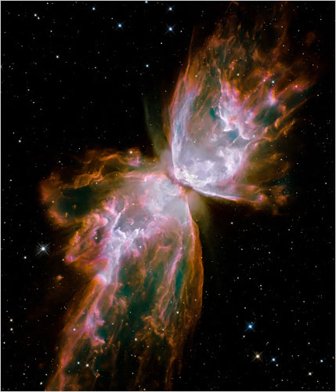

Slide 85
Research News & Opportunities In Science & Theology; Sept. 2003; Volume Four, No. 1; Page 22
“What could it possibly mean to say that the universe has a purpose? ‘Purpose’ usually means the ‘goal’ or ‘end’ toward which a set of events is oriented. Deeper, purpose implies that something of great value is in the process of being realized.”
!

Slide 86
“God Of The Gaps” Or Abductive Argument?

Slide 87
“God Of The Gaps” Or Abductive Argument?
“Regardless of the course taken by naturalists, most sophisticated Christian theists don’t engage in a god-of-the-gaps form of reasoning. Rather, Christian scholars appeal to God as an inference to the best explanation. In logic, this approach is known as abductive reasoning. Like inductive arguments, the abductive form of thinking yields only probable truth. Unlike induction, however, abductive arguments don’t attempt to predict future possibilities . This careful thought process moves from the data, facts, evidence, & phenomena of the world to draw the most consistent & plausible explanation for these realities.”
- Kenneth Samples

Slide 88
Different Cosmologies

Slide 89
Darwinist Search For Missing Link Versus Creationist Search For The Causal Joint!

Slide 90
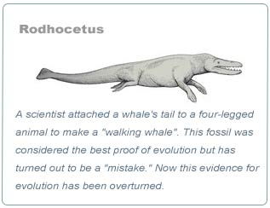
TRANSITIONAL BRIDGE SPECIE

Slide 91
“God Of The Gaps” Or Quantum Uncertainty?
“A ‘joint’ is by definition, the place where two things meet or are linked. In this case it would be the meeting at a location of God’s action and the physical phenomena that are utilized to effect that action in the natural world. Therefore the claim that such a joint can be known is tantamount to the claim that some part of God can be actually known, since this part is directly involved in the joint. I question whether we can ever know or understand God that well.
Although it is not quite the same issue, I sense that the treasure hunt for a causal joint is rather similar to the appeal to a God-of-the-gaps.
Throughout history, science closed many gaps. Theological arguments have convincingly shown the ‘gaps’ concept to be an unreasonable basis for invoking God’s action.”

Slide 92
“God Of The Gaps” Or Quantum Uncertainty?
“In particular, I believe that the gaps concept does a disservice to theology because there is often just as much mystery implicit in the scientifically explained phenomena of nature as there is to the unexplained. Nevertheless, subject to qualifications the God-of-the-gaps concept may have some limited validity. For an example, physicists tell us the gap underneath the veil specified by the Heisenberg Uncertainty Principle hasn’t been penetrated.
I believe such gaps are legitimate for theological speculation. Some may see these gaps as possible locales for divine action, as do Russell and Murphy.

Slide 93
“God Of The Gaps” Or Quantum Uncertainty?
However, I hold that the inaccessible physical regime that characterizes these gaps is some kind of physical analogy for divine presence – a kind of pointer to what God’s all-embracing transcendence might be like.
I am left with the words of M. Eckhart, a 13th century Dominican mystic who said, ‘The highest and loftiest thing that one can let go of is to let go of God for the sake of God.’ Respecting micromanaging & quests for causal joints, I feel it might be time to consider giving God a little rest.”
- Lawrence Fagg

Slide 94
“God Of The Gaps” Vs. The Cosmic Micromanager?

Slide 95
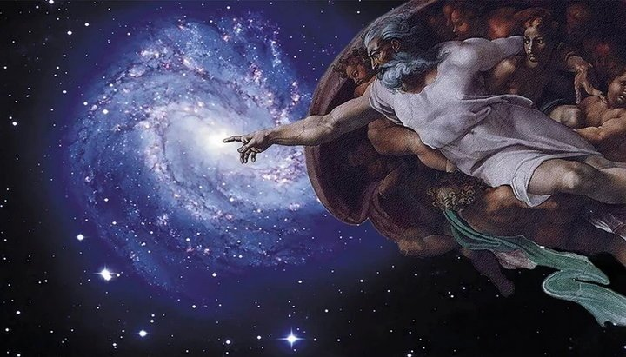

Slide 96
Research News & Opportunities In Science & Theology; Sept. 2003; Volume Four, No. 1; Page 22
“What could it possibly mean to say that the universe has a purpose? ‘Purpose’ usually means the ‘goal’ or ‘end’ toward which a set of events is oriented. Deeper, purpose implies that something of great value is in the process of being realized.”
!

Slide 100
RAINBOW FIRE

Slide 103
HE IS
HERE

