Slide 1
01. RELIGIOUS HISTORY OF THE CHRISTIAN ERA
by David Lee Burris

Slide 2
Put the following events in correct chronological order, beginning from the earliest event
____ Plagues in Egypt
____ Babylonian captivity
____ Giving of the law of Moses
____ Conquest of Canaan
____ Creation
____ Judges
____ Birth of Jesus
____ Divided Kingdom
____ Tower of Babel
____ Establishment of the church
____ Promises to Abraham
____ The return from captivity
____ Flood
____ United Kingdom
____ Years of Biblical silence
____ Wandering in the wilderness
____ Destruction of Jerusalem by Romans
____ Paul’s preaching journeys
____ Roman persecution of church
____ Assyrian captivity
____ Paul in prison in Rome
5
14
13
2
6
10
8
15
1
7
9
21
16
11
18
3
20
17
12
4
19
How did you do? Don’t be overly concerned if you did not do well.

Slide 3
Events placed in correct chronological order
Creation
Flood
Tower of Babel
Promises to Abraham
Plagues in Egypt
Giving of the law of Moses
Wandering in the Wilderness
Conquest of Canaan
Judges
United Kingdom
Divided Kingdom
Assyrian Captivity
Babylonian Captivity
The return from captivity
Years of Biblical silence
Old Testament Concludes
Birth of Jesus
Establishment of the church
Paul’s preaching journeys
Paul in prison in Rome
Roman persecution of the church
Destruction of Jerusalem by the Romans

Slide 4
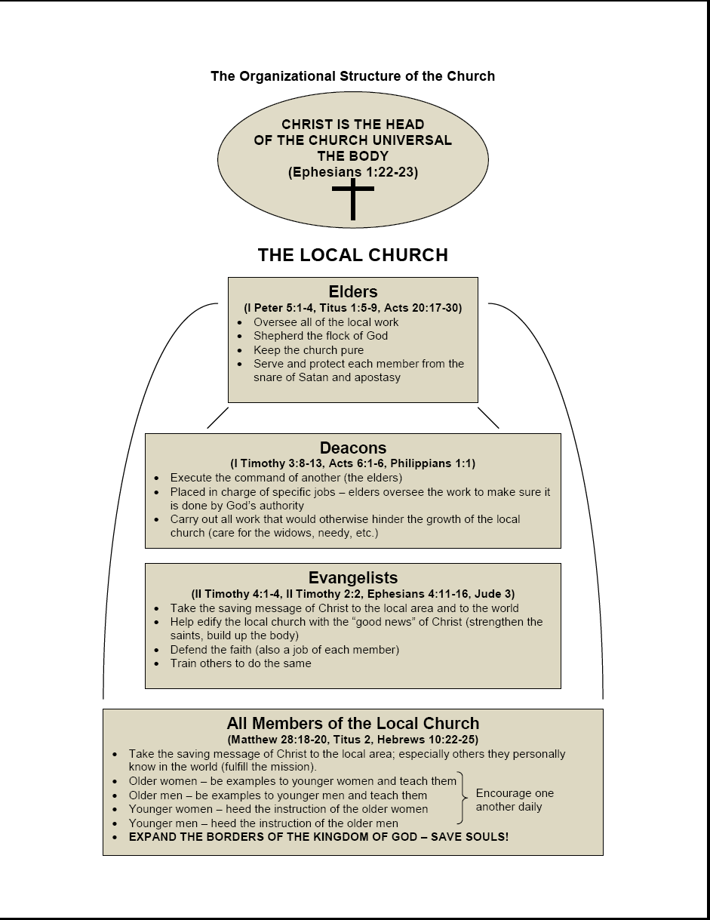

Slide 5
Any Apostate Church Indicators?
David Lee Burris:
Predicted Departure From The Faith – Holy Spirit Predicted – From Truth Unto Fables Because They Could Not Endure Sound Doctrine – Speaking {Knowing} Lies In Hypocrisy – Their Consciences Over Time Become Without Feeling.
Vatican Built Upon Roman Racetrack & Circus & Next To Nero’s Gardens – Scenes Of Christian Persecution & Entertainment Execution!
To Proof Text Peter At Rome The Catholic Church Says 1st Peter 5: 13 Refers to Rome When Referencing Babylon & Clement Of Alexandria Makes The Same Application!
- - IMPROBABLE:
Fourth Kingdom of Daniel 2: 40, 41
Little Horn on Fourth Beast of Daniel 7: 8 – 25
Ten Horns on Dragon & Leopard of Revelation 12 & 13
Babylon – Mother & Daughters of Revelation 17 & 18
-- PROBABLE: Acts 20: 28 - 30: “grievous wolves among you”
Matthew 4: 1 – 3: “…in the latter times some will depart… giving heed to… doctrines of demons. … forbidding to marry and commanding to abstain from foods … created to be received with thanks

Slide 6
Relgious History of the Christian Era Ppt. Series
Papacy
Monarchical Episcopacy
Sacraments
Five Worship Activities
Denominations
Theological Debates

Slide 7
THE PATH TO POPE
Gnosticism Is The Spark

Slide 8
Ancient Romans Had Old Proverb
BEWARE
The First Step

Slide 9
Departure Principle: Primary Vs. Delegated Authority
Besides the generic and specific classification, there are two kinds of authority: primary and delegated. Primary authority is the original source of all power or authority. It is the authority that resides in the person by right of his relationship to those who are subject to his authority. All divine authority begins with God, the Father!

Slide 10
Departure Principle: Primary Vs. Delegated Authority
Besides the generic and specific classification, there are two kinds of authority: primary and delegated. Delegated authority is that which is given to another by the one who has the primary authority. All authority of God has been delegated to his Son, Jesus Christ, and not one single word has been delegated to mankind. In utilizing this authority delegated to the Son, Christ has delegated or granted certain power to others in administering his authority. The apostles received this power. All authority comes from the Son!

Slide 11
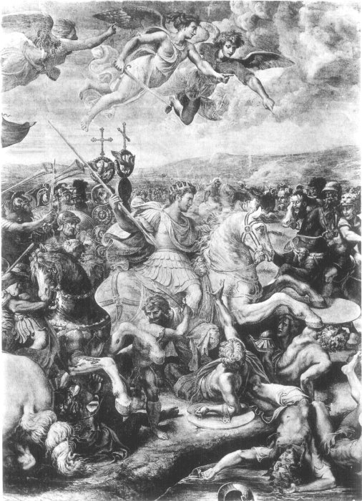
THE TEMPTATION TO POWER

Slide 12
Giving In To The Temptation Of Power
“You all know what the third temptation of Jesus was. It was the temptation of power. One of the greatest ironies of the history of Christianity is that its leaders constantly gave in to the temptation of power – political power, military power, economic power, or moral and spiritual power even though they continued to speak in the name of Jesus, who did not cling to divine power but emptied self & and became as we are.”

Slide 13
Giving In To The Temptation Of Power
David Lee Burris:
The Roman Empire established the office of the censor back in 443 B.C. The censor not only went around and counted everybody’s head, he was also responsible for policing everybody’s morals. There was fear of the censor!
“The temptation to consider power an apt instrument for the proclamation of the Gospel is the greatest of all. We keep hearing from others, as well as saying to ourselves, that having power – provided that it is used in the service of God and your fellow human beings – is a good thing. With this rationalization, crusades took place; inquisitions organized; Indians were enslaved; positions of great influence were desired; episcopal palaces, splendid cathedrals, and opulent seminaries were built; and much moral manipulation of conscience was engaged in.” - In The Name Of Jesus

Slide 14
Organizing to Oppose Growing Gnosicism: 2nd & 3rd Century Patterns of Practice & Precursors of New Testament Departure

Slide 15
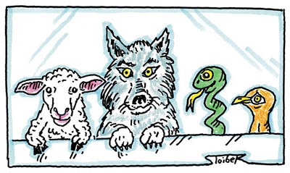
Background Information:

Slide 16
GNOSTICS OPPOSED MONISTS
MONISTS BELIEVE MIND & BRAIN ARE ONLY OF A PHYSICAL PROCESS – THERE IS NO SOUL!

Slide 18
Recurrent Resurgent Gnosticism

Slide 19
The term “Gnosticism” is taken from the Greek word for knowledge (gnosis).
Whereas the Apologists utilized philosophy to defend Christianity, Gnosticism used philosophy to reinterpret Christianity.
Gnosticism refers to a blended religious philosophy that invaded Paganism, Judaism, and Christianity.
A beginning form of Gnosticism, mixed with Judaism, existed in the Apostolic Period.
In the second century, a more developed Gnosticism threatened the church.
Fighting the Gnostic heresy was a major preoccupation of church leaders and authors in the early church.

Slide 21
There were certain different Gnostic systems,
but they all had certain common features:
Radical dualism of spirit and matter.
Matter is totally independent of God and irremedially evil. God could not have created the evil world of matter; its origin is accounted for by a series of divine emanations (called aeons) by which the nature of Deity is progressively weakened to the point where it could endure contact with matter. “Pleroma” (fullness) was the term for the higher aeons. What they call evil comes from this fall of Pleroma.

Slide 22
There were certain different Gnostic systems,
but they all had certain common features:
Concern for a personal salvation.
Salvation is the release of man’s spirit from the bondage and prison of the flesh (there is not any resurrection). The means of salvation is “gnosis,” or intuitive knowledge of one’s true self. Salvation is sometimes mediated by certain rites and special ceremonies.

Slide 23
There were certain different Gnostic systems,
but they all had certain common features:
Conduct of the “saved.”
Gnostic principles involved a denial of the flesh and a living of the life of the spirit. To some this meant extreme asceticism, to others the opposite – the libertinism of the Carpocrates !

Slide 24
VALENTINUS

Slide 25
“Even his detractors had a hard time criticizing Valentinus’s intellect. Following in the footsteps of his older contemporary, Basilides, Valentinus pursed the goal of creating a truly Hellenistic form of Christianity, reimagined through the lens of Plato’s philosophy.
What made Valentinian gnosticism so powerful was its subtlety. Valentinus & his followers were able to remain within the larger Christian community long after other gnostic groups had either voluntarily split or been forced out. Valentinus taught from the same sacred texts as mainstream Christians and utilized many of the same worship practices; only in private gatherings were Valentinians instructed in the hidden or secret meanings to all of these practices.”

Slide 26
“Because of this circumspect behavior, Valentinus was able not only to remain in the larger Christian community, but to aspire to leadership. Apparently, when elections were held to determine the next bishop of Rome after the death of Hyginus around 143, Valentinus was nominated to take his place and reportedly lost by only a handful of votes. Later, it seems, he either broke with the Roman church or was expelled. There is evidence that he (both) left Rome & died around 160. With him, the golden age of Christian gnosticism came to a close.
While their teachings would continue to have influence for centuries to come, Christian gnostics were never again as creative or as productive as they were during the middle years of the second century.”

Slide 27
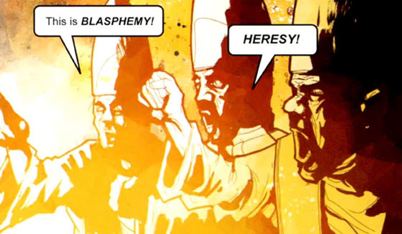
Replacement Christology: ECCLESIOLOGY

Slide 28
THE PATH TO POPE
Gnosticism Is The Spark
Monarchical Episcopacy

Slide 29
MONARCHICAL EPISCOPACY: Monos (Sole) Archos (Ruler) Episcopacy (Bishop)
David Lee Burris:
Abe Lincoln – “It is common enough that we triumph under adversity, but, if you truly wish to test a man’s character – Give him power!”
“Although the words elder and bishop are used interchangeably in Scripture there is a difference in their meanings. Elder has reference to age or maturity and bishop to oversight & guardian- ship. This difference in meaning is important to an understanding of the change that developed. In the early church all elders were bishops or overseers and each congregation had a plurality of them. However, as the elders had their meetings to discuss the work of the church someone had to be chairman of the meetings. The chair -manship apparently became a permanent position and the word bishop was reserved for the one who occupied the position. He was sometimes called the “president” of the church and gradually assumed the responsibilities that had originally rested upon all the elders. This position, by the year 150, had developed into the monarchical bishop arrangement.” F. W. Mattox, Eternal Kingdom
* Organization Changes Increase As Biblical Criteria Are Lowered!

Slide 30
COLLEGIAL SYSTEM
FIRST CENTURY
FIRST CENTURY
FIRST CENTURY
SINGLE ELDER
SINGLE ELDER
SINGLE ELDER

Slide 31
PRESIDING ELDER
SECOND CENTURY
SECOND CENTURY
SECOND CENTURY
SINGLE ELDER
SINGLE ELDER
SINGLE ELDER

Slide 32
EACH CHURCH ONE BISHOP
The Cyprianic Principle Of
APOSTOLIC SUCCESSION

Slide 33
Did Judaizers Win?
David Lee Burris:
Special Days – Passover Continued With Judaizers -Celebrated Instead With Christ As The Passover Lamb – This Developed Into Easter – Then This Judaizing Accommodation As Precedent For Later Pagan Accommodation With Religious Holidays
MOSES SEATS
- & -
Sedia Gestatoria

Slide 34
PRESIDENT BISHOP
Late Second Century
Late Second Century
Late Second Century
SINGLE ELDER
SINGLE ELDER
SINGLE ELDER

Slide 35
HEAVEN’S HDQRS.
1st & 2nd Centuries
1st & 2nd Centuries
1st & 2nd Centuries
Eldership
Eldership
Eldership

Slide 36
LOCAL AUTONOMY
Is Interpreted As
AREA AUTONOMY

Slide 37
Office Of Metropolitan
THE 3RD CENT
THE 3RD CENT
THE 3RD CENT
Country Bishop
CITY BISHOP
Country Bishop

Slide 38
Greek Synod/Roman Council
The Fourth Cent
The Fourth Cent
The Fourth Cent
Region Metropolitan
Patriarchal Church
Region Metropolitan

Slide 39
THE PATH TO POPE
Gnosticism Is The Spark
Monarchical Episcopacy
By Process of Elimination

Slide 40
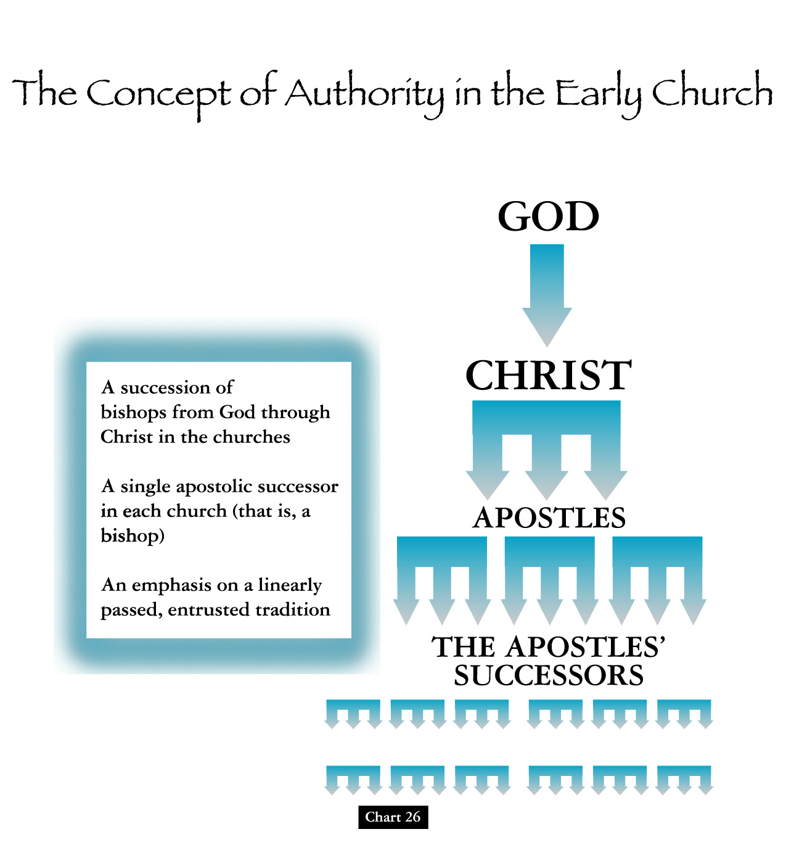
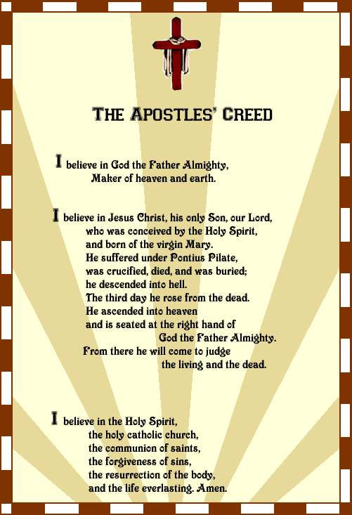
David Lee Burris:
Apostle’s Creed Developed By Middle Of Second Century

Slide 41
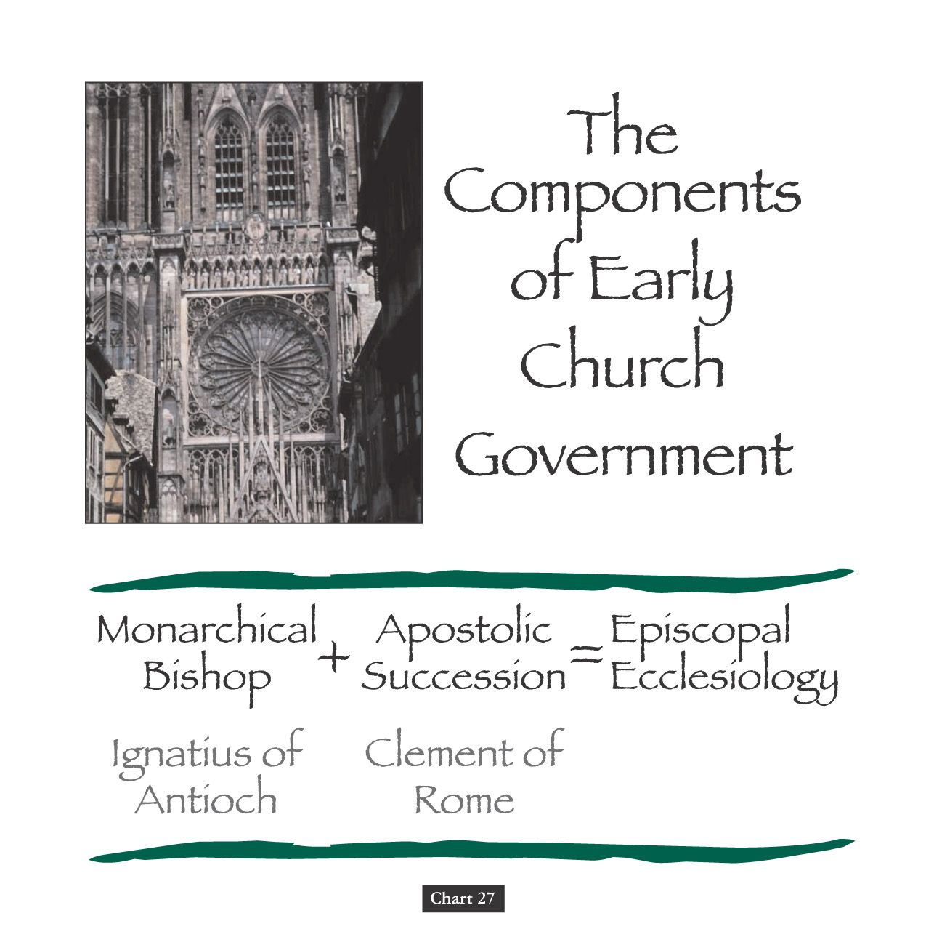

Slide 42
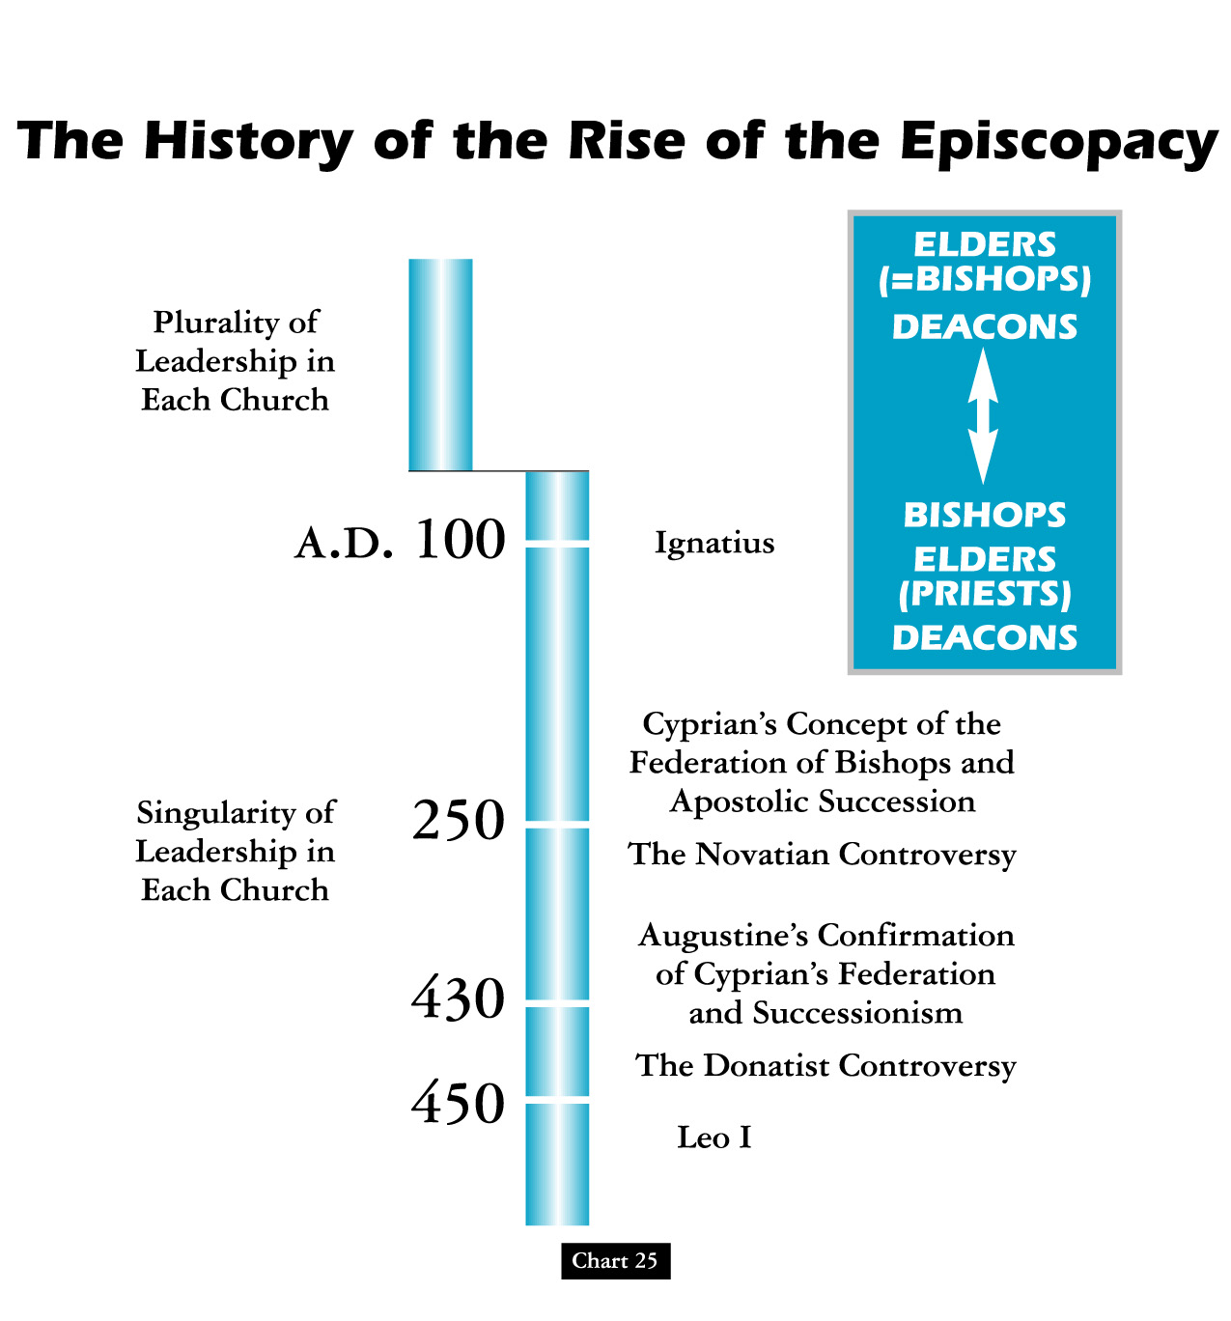
Note: Cyprian Invalidates Good Baptisms Performed By Bad Men

Slide 43
BISHOP SUPREMACY
ROMAN ADVANTAGE
POPULATION CITY OF ROME
Size Of City
Size Of Church
IMPERIAL CAPITAL
After Milan Edict Emperors’ Advisor
LANGUAGE
Latin Lesser Ability Express Subtle Nuance
LOCATION
Of The Five Patriarchs Only Rome In The West
MISSIONARY OUTREACH
West Converted Tribes Eastern Persians Not
BARBARIAN INVASIONS
Western Empire Falls Church Only Stability

Slide 44
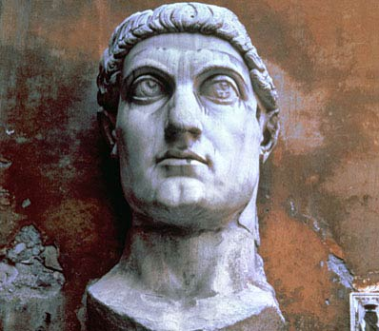
David Lee Burris: Sincere Christian, God’s Appointed Agent, Or Apostate Catalyst
Constantine The Son Of One Of Diocletian’s Co-Rulers;
Story Told To Eusebius By Constantine:
After Prolonged Personal Prayer Words Across The Sky At High Noon
“In This Sign You Will Win”
THE WHOLE ARMY WITNESSED AS WELL!
“Constantinian Christianity” Brought New Temptations & Raised Questions About The Nature Of The Church
Constantine’s Mom The First “Christian Archeologist”
Theocratic Apostle Of Institutional Christianity
Christian Contemporaries Called Constantine The Thirteenth Apostle

Slide 45
PONTIFEX MAXIMUS
“’Supreme Bridge-builder,’ was the head of the College of Pontiffs, in Rome, apex of Roman religious life. From Augustus on, it was a title and a role adopted by the emperors. Bridges were serious business in Rome, and they had a certain religious significance, but they were also metaphors. “

Slide 46
PONTIFEX
MAXIMUS

Slide 47
PONTIFEX MAXIMUS
“In essence, the pontiffs were those who built bridges between the world of humans and the world of the gods. In the late 300s, the emperor Gratian abandoned the title in favor of Pope Damasus I, and from that time it has become one of the hereditary titles of the bishop of Rome, the pope.”

Slide 48
“When the emperor moved to Constantinople, it gave the Roman bishop properties and powers never before experienced in the Christian world. With the fall of the Western Empire in 451 AD practically all hindrances were removed from the Roman bishop having all religious & political power. The eastern churches were still politically subservient to their political rulers. Constantine gave the bishop of Rome the Lateran Palace – legend says for being cleansed of leprosy. Sylvester was then the bishop of Rome. Constantine also began the excavation of St. Peter’s Basilica as per legend. The probable truth is that the bishops of Rome horded the spoils left by the emperor convincing others they were gifts of Constantine.”
"History & Evolution Of The Church"
By Dr. Houston Hamby, on page 18:

Slide 49
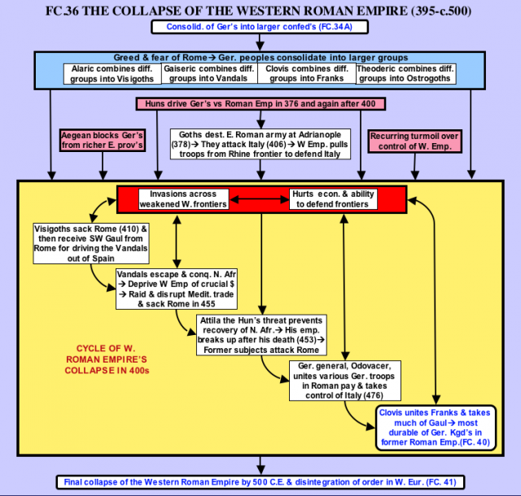

Slide 51
HOW DID WE GET TO THE PAPACY?
David Lee Burris:
The Letter of 1 Clement as Church Father written from the Christian Church of Rome to the church in Corinth in reaction to a power struggle. The Corinth church’s elders had been deposed by new figures of authority, and the letter seeks to restore the former elders.
MON-EPISCOPACY (One Church & One Overseer) first found - early second century - Asia Minor – Ignatius letter.
APOSTOLIC SUCCESSION was stated by Irenaeus as a useful argument against the Gnostics. After the demise of those Church Fathers of personal relationship to the original Apostles - the bishops (one each) of churches “founded by Apostles” (churches of honor) were considered as the bequeathed “depository of Apostolic Tradition” and hence as referential authorities to the truth and validity of doctrinal teachings and their accurate applications. Significantly, the church at Rome was regarded of “double honor” having been planted by Paul and supposedly by - Peter.
CLERGY & LAITY DISTINQUISHED DIFFERENT appears clearly in the terminology of Tertullian. The term “clergy” (kleros), which first signified the lot by which office was assigned (Acts 1: 17, 25), and later the persons holding that office, was transferred from Christians generally as God’s chosen heritage (I Peter 5: 3) to ministers only.
EPISCOPAL (by a bishop) ORDINATION is described in the Apostolic Tradition by Hippolytus in the early third century. The power of conferring an ecclesiastical office through ordination was reserved for the Bishop.
PRIESTLY VIEW OF THE MINISTRY finds clear expression in Cyprian. Officiating at the Lord’s Supper (considered as a sacrifice), and re-admitting penitents to communion. By priest Cyprian means the bishop, who was regarded as the “bearer of the Holy Spirit.” The Bishop in a sense had become the church, and “if anyone is not with the Bishop he is not in the Church.” {The spiritual discipline of Auricular Confession relates to this priestly office evolution. However, lifestyle practice of Sacerdotal Celibacy was more commercial & financially linked – that specific to providing for sales continuity of lifetime benefices.}
DIFFERENTIATION IN THE BISHOPS RANK occurred in the third and fourth centuries. On the lowest level were the bishops of country churches – chorepiscopoi. Bishops of the provincial capital cities known as metropolitans, presided at provincial synods & ordained other bishops in their province.

Slide 52
HOW DID WE GET TO THE PAPACY?
PRE-EMINANCE OF ROME - Prestige of the “apostolic churches” became the germ of the patriarch system – the great fourth century “sees” - Rome, Antioch, Jerusalem, & Constantinople. Over time the City Of Rome became the natural focal point because it was the Imperial Capital City as well; because of Paul’s Roman Epistle; because it was the only remaining “apostolic” founded church in the Western Empire; because of the reputation of the Roman Church for doctrinal orthodoxy; and because of their bishops administrative abilities.
PAPAL PRIMACY OF ROME based on a misreading of Matthew 16: 18. When Jesus said, “Thou are Peter” he used the masculine gender (petros), signifying detached & small stone. When he added “upon this rock I will build my church” he used the feminine gender (petra), which signifies instead a rock cliff. This has all proved an historic stumbling stone.
In the year 588 A.D. the Constantinople Bishop proclaimed himself the “universal bishop of the church.” Replying, Gregory the Great, Bishop of Rome responded with most of Matthew 23 quoted – commenting especially on that passage part: “call no man your father” (“pope” means father). It was and still is an improper relationship.
Only some short eighteen years later – his successor - Boniface III – adorned himself with the word “pope” - formally for the first time and in an absolute universal sense. Prior to this event the relational term was not a title nor had it been linked to the Office of Bishop except in isolated situations and informal circumstances.
All of this was of long-term planned and in self-interest purposed to transition from part-time preacher to professional priest of civic religion; to transfer from outcast apologist to sophisticate theologian of scholarly status; to transform from small house churches to great ceremonial cathedrals; and organize from the local & limited unto that hierarchical and pyramidal. By way of an extended rationale, the emergence of the universal or “Catholic” Bishop was inevitable.

Slide 53
HOW DID WE GET TO THE PAPACY? Gregory The Great Wrote John The Faster:
“I pray you, therefore, reflect that by your bold presumption the peace of the whole Church is troubled, and that you are at enmity with that grace which was given to all in common. The more you grow in grace, the more humble you will be in your own eyes; you will be the greater in proportion as you are further removed from usurping this extravagant and vainglorious title. You will be the richer as you seek less to despoil your brethren to your profit. Therefore, dearly beloved brother, love humility with all your heart. It is that which insures peace among the brethren, and which preserves unity in the Holy Catholic Church.”

Slide 54
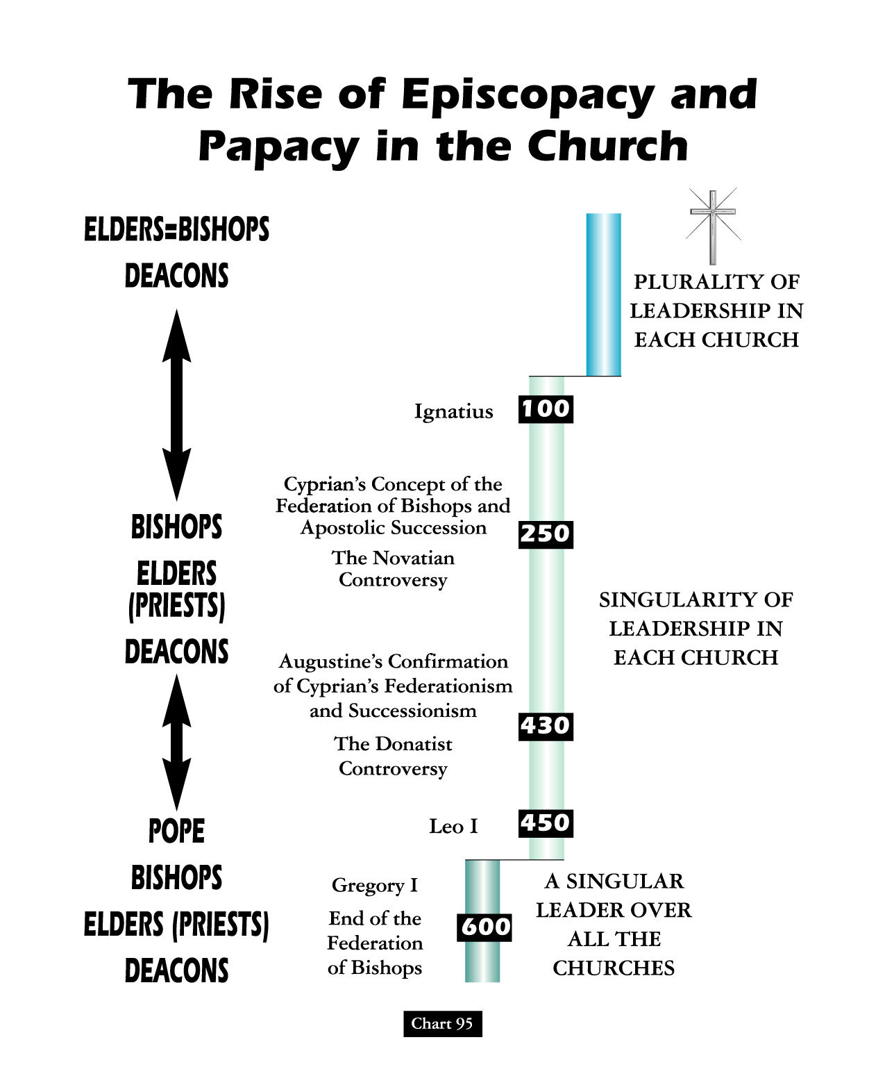
Pope Gregory Pins “Pastoral Care” For Bishops Christianizing The Civic Ethos

Slide 55
David Lee Burris:
Christian Emperor Theodosius invited Thessalonians to free games but sent his troops into the circus with orders to kill the 10,000 men, women, and children.
“The first recorded instance of Christians killing Pagans occurred shortly after {status change year 313}. In short order, the militant church extended its power by conquering lands & peoples throughout Europe, compelling them to become baptized Christians or die… As Charlemagne instructed his Christian troops in their conquest of the Saxons: ‘If there is anyone of the Saxon people lurking among them unbaptized, and if he scorns to come to baptism & stay a pagan - let him die’”.
“The Church Triumphant was quite different from the Church of the Martyrs. The small groups of early Christians consisted generally of simple men who accepted the simple message of Christ in the face of terrible risks, and they lived their faith, striving to emulate the life of the Master. But after the Edict of Milan it became advantageous to join the victorious religion, and easy conversion helped to increase the numbers of the ‘faithful’ geometrically.”
- Gregory Boyd, Myth Of A Christian Nation

Slide 56
David Lee Burris:
Christian Emperor Theodosius invited Thessalonians to free games but sent his troops into the circus with orders to kill the 10,000 men, women, and children.
“The first recorded instance of Christians killing Pagans occurred shortly after {status change year 313}. In short order, the militant church extended its power by conquering lands & peoples throughout Europe, compelling them to become baptized Christians or die… As Charlemagne instructed his Christian troops in their conquest of the Saxons: ‘If there is anyone of the Saxon people lurking among them unbaptized, and if he scorns to come to baptism & stay a pagan - let him die’”.
“It was difficult now to separate the saints from the self-seekers, or the devotees from the Laodiceans. To the great majority of these ‘converts in prosperity’ conversion meant no significant change in their old ways of life. Old practices and superstitions were translated into the new religion. The hosts of saints took the place of the pagan gods, and many of the ancient deities suffered only a change of name. The date of Christmas was set on the birthday of Mithras, the most joyous celebration of the pagan world, and several other Christian celebrations were created to replace popular pagan feasts and holidays.”
- Gregory Boyd, Myth Of A Christian Nation

Slide 57
THE PATH TO POPE
Gnosticism Is The Spark
Monarchical Episcopacy
By Process of Elimination
Arius Versus Athanasius

Slide 58
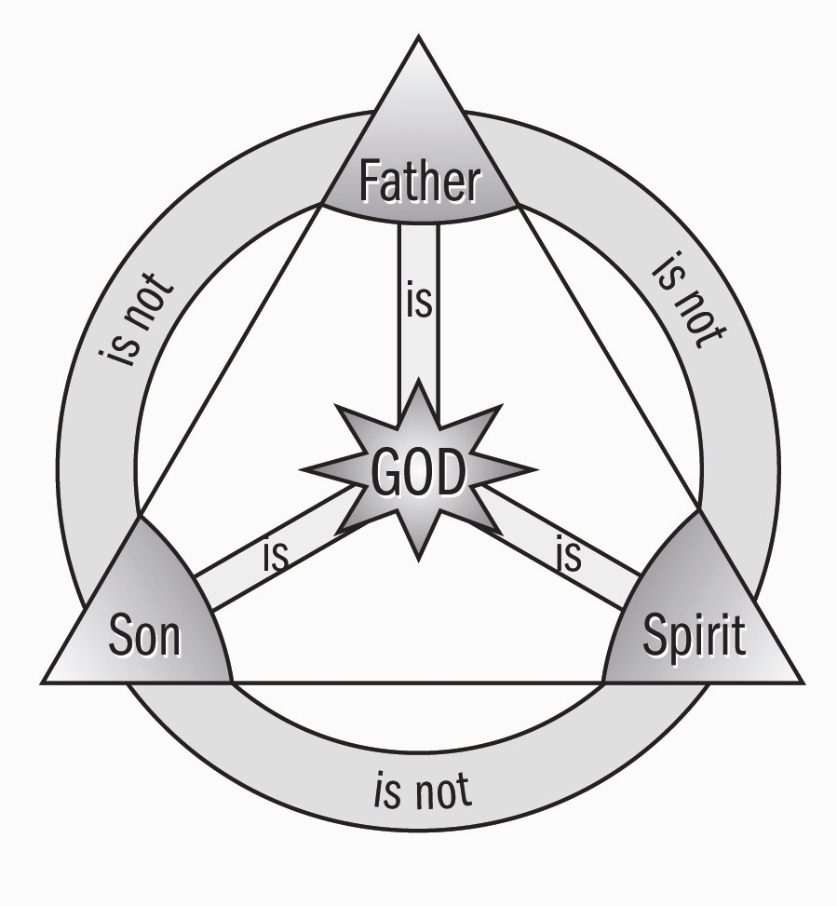
"My Echo, My Shadow, & Me" ?
The Theoanthropic Debate Begins

Slide 59
Pivotal to these ancient Jesus Wars were the four great questions that, to different degrees,
have shaped all subsequent
debates within Christianity.

Slide 60
Foremost is the deceptively simple question posed by Jesus himself: Who do you say that I am?

Slide 61
And building on this are the 3 follow-ups: What is the church?

Slide 62
And building on this
are the follow-ups:
By what authority do you do this?
And, what must I do to be saved?

Slide 63
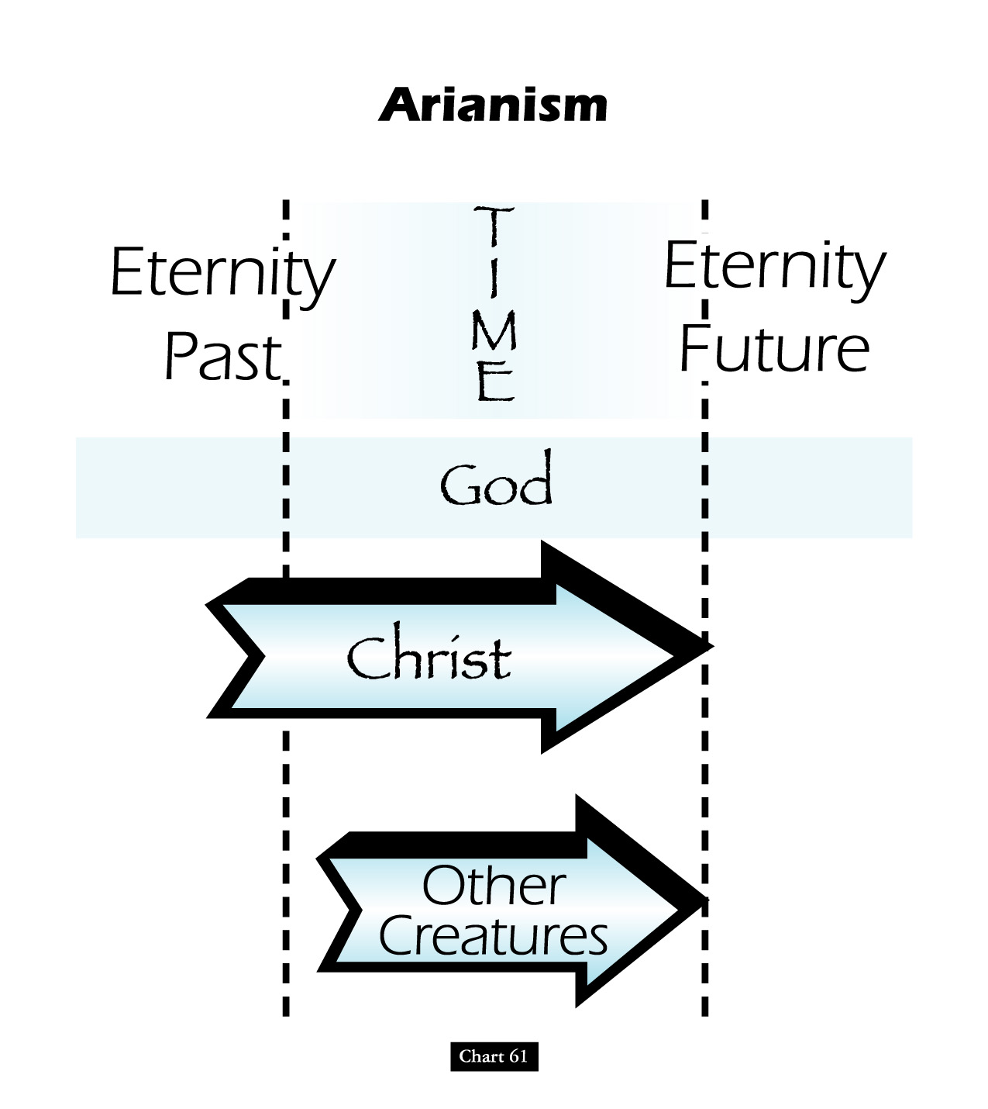

Slide 64
Battle Over An “i”: Homoousios or Homoiousios?
David Lee Burris:
Begins Innocent Enough But Ends Questioning Bible’s Inclusion Of Birth Narrative
Father God & God’s Son “Identical or Similar”? Gregory of Nyssa said of Constantinople in 378: “In this city if you ask anyone for change, he will discuss with you whether the Son is begotten …
AriansWatchword: “dissimilar” (anomoios)
Semi-Arians Watchword: “similar” (homoios)
Nicaeans Watchword: “of identical substance” (homoousios)
Cappadocians Watchword: “of like substance” (homoiousios)

Slide 65
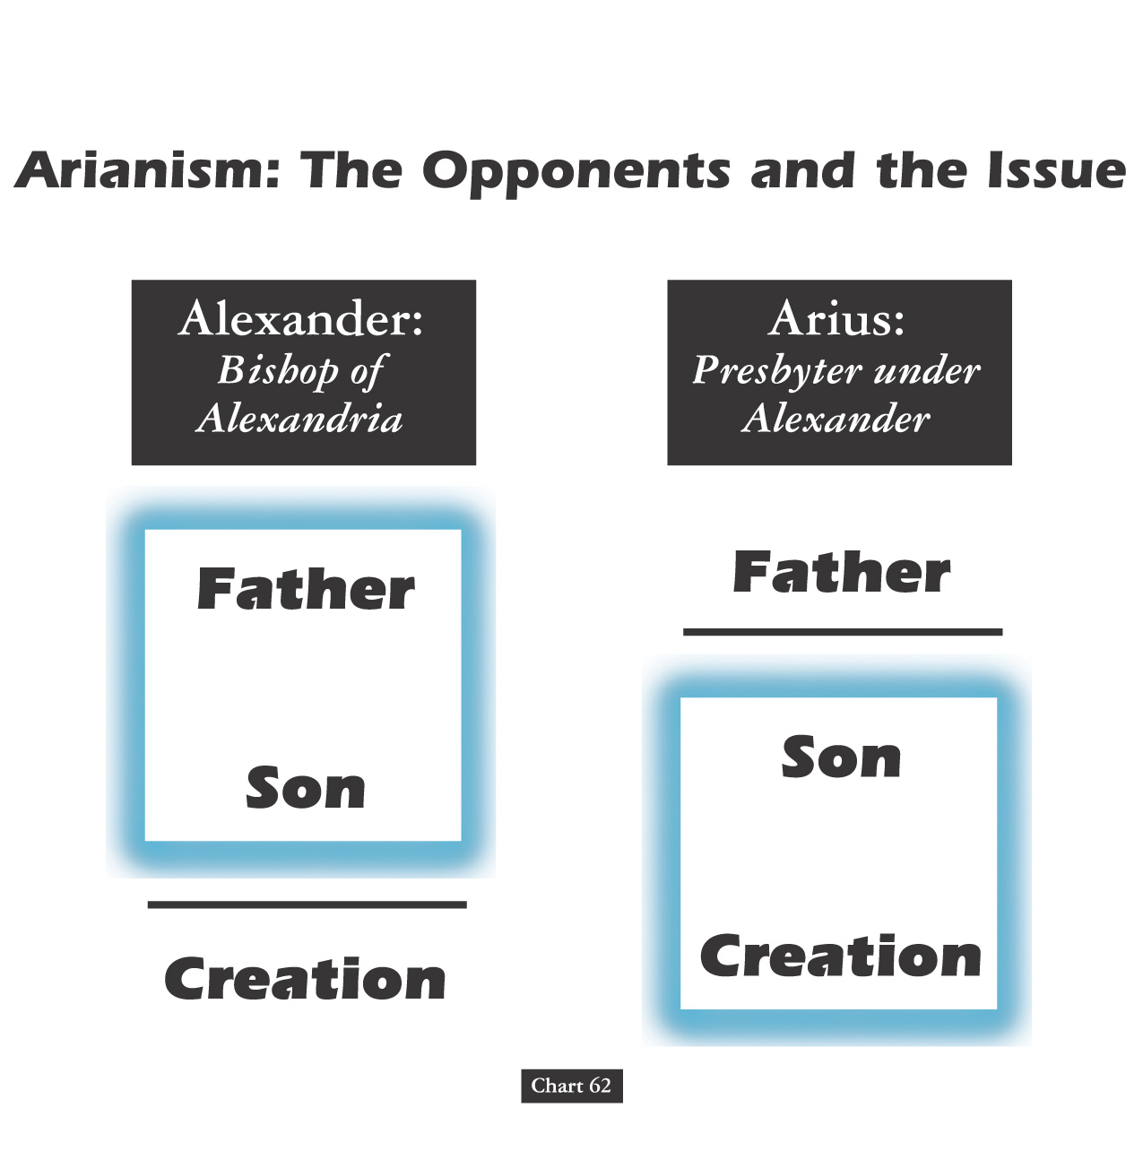

Slide 66
“Philip opened his mouth, and beginning at this Scripture, preached Jesus to him.”

Slide 67
THIS MESSAGE WAS OVER TIME MISUNDERSTOOD & CONVEYED INCORRECT IN COPTIC CHURCHES!
David Lee Burris:
Gnostic Gospels Became Labeled “Coptic”
Three Great Monotheistic Religions Abraham’s Legacy!

Slide 68
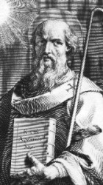
ARIUS VERSUS ATHANASIUS

Slide 69
Touchstone Magazine: A Journal Of Mere Christianity Athanasius Contra Mundum Or “Athanasius Against The World”
“For most of his almost 50 years as bishop of Alexandria, he truly was arrayed against the full breadth of the Roman Empire, defiantly defending the Nicene doctrine of the Trinity against pagans and Arian heretics. Arius, an often admirable church leader, denied that Christ was eternally co-existent with the Father. For him, Christ was a creature, not the Creator. As the Arian slogan went, ‘There was a time when he was not.’ Athanasius, a young priest and protégé of the orthodox Bishop Alexander of Alexandria, stubbornly resisted Arius’ theological innovations. Of course, Athanasius, who would soon succeed his mentor to the bishopric, prevailed at the Nicaea Council in 325. It was a crushing victory, the bishops closing their creed with the declaration that ‘those who say, there was when he was not, and, before being born was not - the Catholic Church anathematizes.’”

Slide 70
Touchstone Magazine: A Journal Of Mere Christianity Athanasius Contra Mundum Or “Athanasius Against The World”
David Lee Burris:
Arius wrote songs popularizing his ideas with the common people.
“But though he prevailed at the council, Athanasius still faced a half-century of theological combat, as the Arians attempted to gain by practice what they could not gain in a council. The zealous bishop of Alexandria nearly single-handedly championed theological orthodoxy when it seemed all Christendom was succumbing to Arius’ alternative brand of religion. Athanasius was expelled from his throne five times and spent 20 years as an exile or fugitive. Edward Gibbon chronicled how Athanasius contended with successive Roman emperors, who usually sided against the quarrelsome archbishop of Alexandria. The monarchs either supported Arianism or preferred political compromise over fidelity to the creed of Nicaea. The list of Roman princes against whom Athanasius contended ran from the great Constantine, through Constantine’s three ‘degenerate’ sons, to Julian the Apostate, who recognized that orthodoxy and not Arianism represented the chief threat to his pagan revival, to Jovian, whose benign and brief reign offered Athanasius a brief respite, and finally to the cruel Valentinian and his brother Valens, an Arian who finally yielded to the more forceful Athanasius.”

Slide 71
351 a.d.
A council of church bishops
Gathered in sirmium of serbia
rejecting the nicaea decision

Slide 72
Touchstone Magazine: A Journal Of Mere Christianity Athanasius Contra Mundum Or “Athanasius Against The World”
“No less vexing were most of the empire’s bishops, almost none of whom, at least outside Athanasius’ own native Egypt, were willing to share in the persecutions the orthodox endured. Bishops in both East & West joined in synods and councils that denounced the arch- -bishop of Egypt, hurled accusations against his theology and his character, and attempted to replace him, imprison him, and even kill him. They often had at their disposal the armies of the emperor, which occupied Egypt’s cathedrals and churches but never managed to apprehend the elusive bishop, who found refuge in the desert, in the monasteries, or in the homes of faithful supporters during his nearly twenty years of intermittent exile. Whether from his bishop’s throne or from an obscure hiding place, he never compromised on the essentials or fell silent, his writings penetrating the far reaches of the empire even when the bishop himself was elusive. Although Arianism would endure beyond the life of Athanasius, its ultimate defeat within Christendom was achieved only because of his witness and exertions.”

Slide 73
Athanasius was driven in his rebuttal of Arianism by its practical implication. In other words, in this finely nuanced theological debate he was concerned about the implications of this heresy on salvation. Two of Athanasius’ writings reflect his practical and pastoral concerns. On the Incarnation outlines the fact that in the incarnation, God the Word, Jesus Christ, became human to renew what was human, to sanctify what had become corrupt in Adam.
In Against the Arians, he asserts that God alone initiates & accomplishes salvation, and he argues that it was necessary for our Savior to be both fully human (to renew humanity) and fully divine (to accomplish reconciliation).

Slide 74
Arian Or Nicaean “Or Else”: The Debate “Unto Death”
David Lee Burris:
Shakespeare – “We Few, We Happy Few, We Band Of Brothers; For Whoever Has Shed His Blood With Me Shall Be My Brother” [Henry V]; It Is About Christ’s Blood Not Ours
Foxes Book Of Martyrs Notes From 363 a.d.:
“In Alexandria, innumerable were the martyrs who suffered by the sword, burning, crucifixion, and stoning. In Arethusa, several were ripped open & corn being put in their bellies, swine were brought to feed therein, which in devouring the grain, likewise devoured the entrails of the martyrs…”

Slide 75
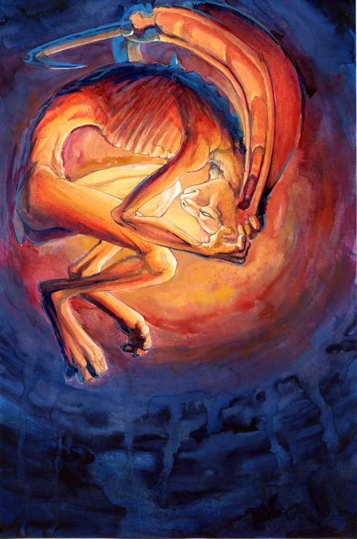
Christian Divisions Costs Half The World
“Christian divisions go far toward explaining the swift collapse of the Roman position in the Middle East, where popular sentiment leaned so heavily toward either the Monophysite or Nestorian churches. Repeatedly, writers from these traditions describe the relief which local inhabitants greeted the Arab conquerors, who promised an end to the heavy-handed regime of the Roman Empire, and the Chalcedonian order.
At least in the early decades of the new order, most Christians saw little reason to change their opinion. Muslims cared nothing for the sectarian divisions among their Christian subjects, provided they respected Muslim authority and paid their taxes on time.
The first century or so after the conquest marked something like a golden age for the Christian communities, who were now free of Roman oppression.”
Source: Pages 263-4, Philip Jenkins’ “Jesus Wars”

Slide 76
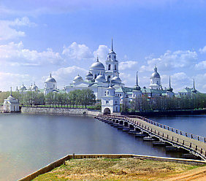
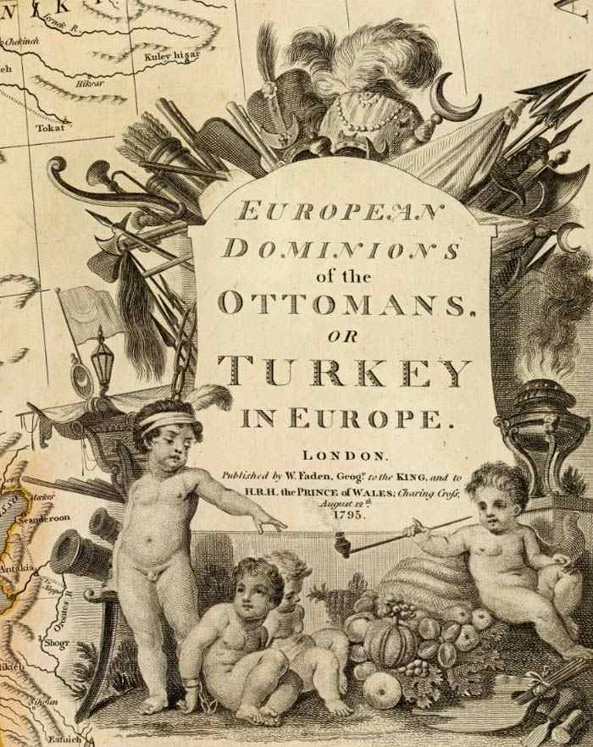
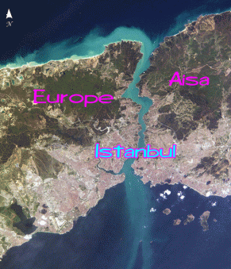
eastern capitol renamed
By the ottoman empire turks
constantinople becomes istanbul

Slide 77
Civic Institution Church Of Inherited Religion
THE MAN OF SIN BELIEVED REVEALED
2nd Thessalonians Chapter 2: 3 – 12
DUAL APP: 2ND TIME ZONE REFERENCE
“The Antichrist, Muhammad, came in the Seventh Century. He was not ‘against Christ’ but rather took the place of Christ, as an ‘anti-climax’ replaces a climax. Muhammad’s cumulative influence over 13 centuries has been a 1000 times greater than all other antichrists put together: past, present, & future.”
“The first beast of Revelation 13 was the Roman Empire. It was ‘wounded unto death’ by barbarian invaders, then revived by the 2nd beast (the Papal Dynasty) in 800 A.D. as the Holy Roman Empire.”
– Robert Finley, The Time Was At Hand

Slide 78
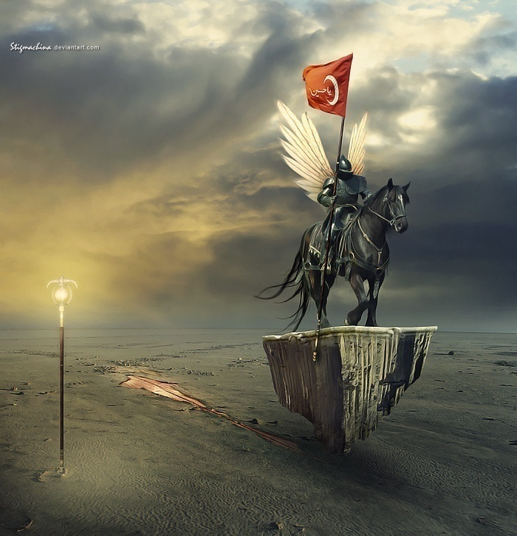

Slide 79
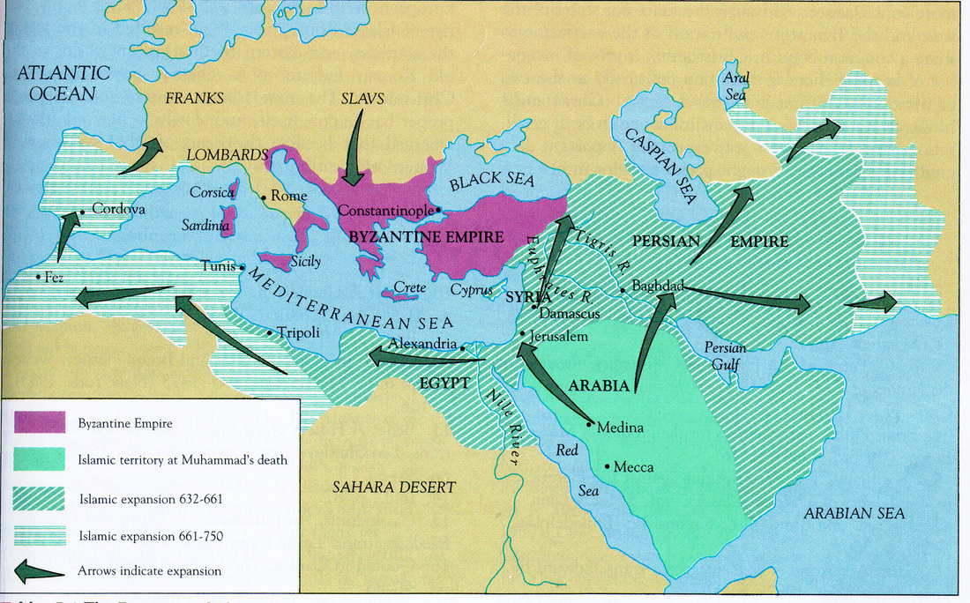
09-11-1653

Slide 80
Replacement Christology: APOTHEOSIS

Slide 81
PONTIFEX MAXIMUS
“In essence, the pontiffs were those who built bridges between the world of humans and the world of the gods. In the late 300s, the emperor Gratian abandoned the title in favor of Pope Damasus I, and from that time it has become one of the hereditary titles of the bishop of Rome, the pope.”

Slide 82
Papacy: Tracing Through Titles
Bishop Of Rome
Roman Province Metropolitan
Primate Of Italy
Patriarch of the West
Successor of Prince of the Apostles
Sovereign Pontiff Universal Church
Vicar Of Christ

Slide 83
THE PAPAL TRADITION OF CHOOSING A NEW NAME STARTS WITH MERCURIUS IN A.D. 533 RENAMING HIMSELF JOHN THE SECOND. THIS PRACTICE WAS PRIOR ASSOCIATED WITH ROYAL DYNASTY.

Slide 84
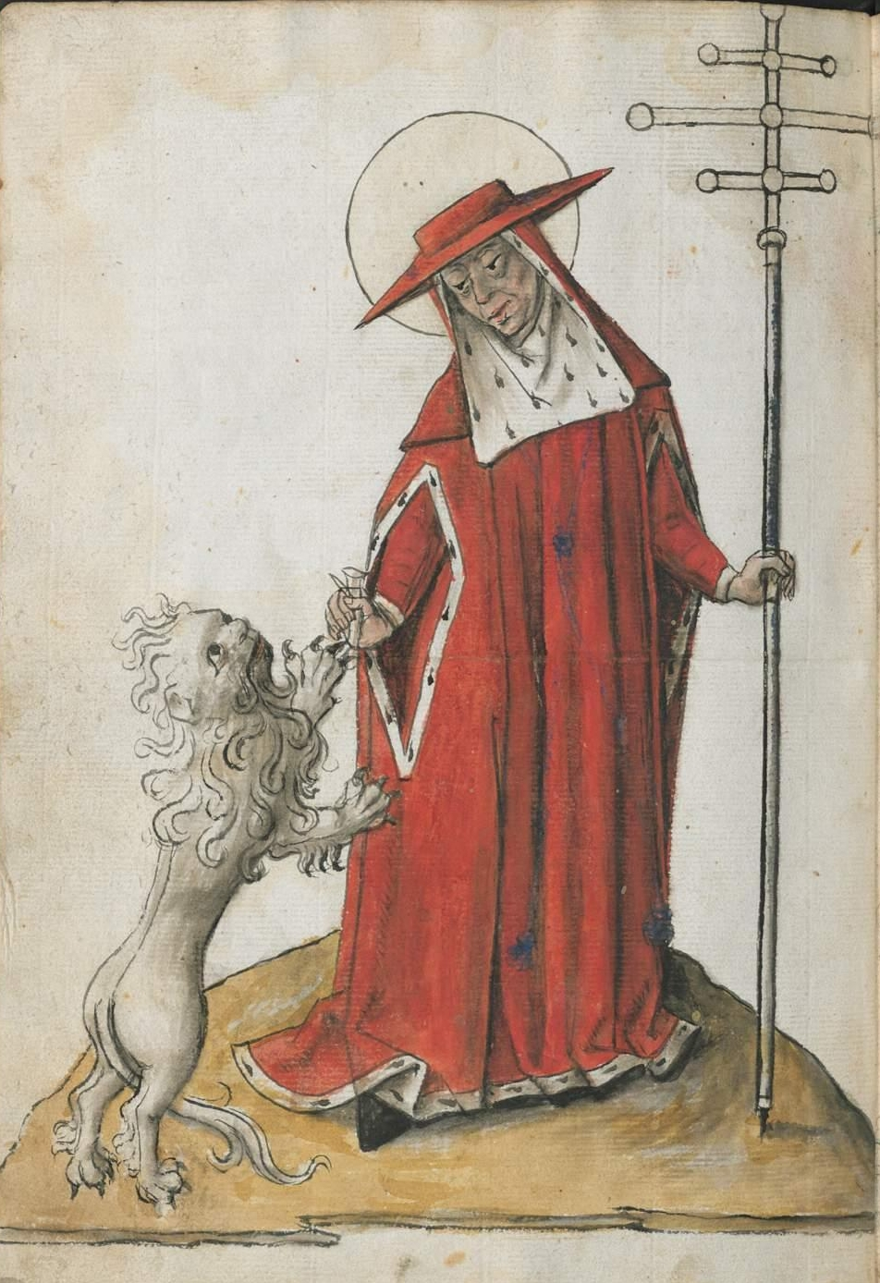
UNTO KING'S SCEPTER
FROM SHEPHERD'S STAFF

Slide 85
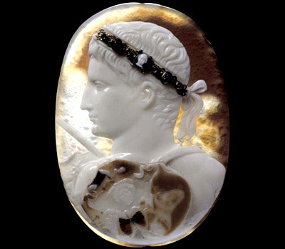
Emperor
APOTHEOSIS

Slide 86
THE PATH TO POPE
Gnosticism Is The Spark
Monarchical Episcopacy
By Process of Elimination
Arius Versus Athanasius
Traditions Trump Scripture

Slide 87
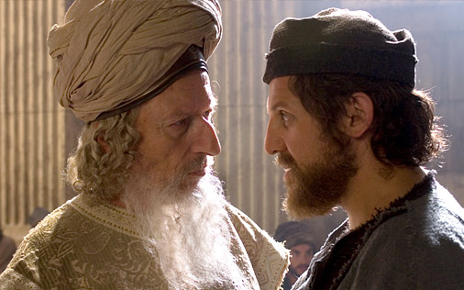
The Sect Of The Sadducees Stressed The Temple Seasonal Observances & Priestly Intercession Rather Than Moral Lessons, Personal Lifestyle Or Any Identifiable Individual Applications Of Scripture!
Sadducees..
FROM DISPUTES OVER WRITTEN O.T. LAW VERSUS MOSAIC ORAL LAW
UNTO DEBATES OVER RABBINIC WRITING VERSUS ORAL AUTHORITY

Slide 88
CHANGES IN AUTHORITY
Catholic Concept Of Oral
HISTORY & TRADITION

Slide 89
Catholic Concept Of Oral
HISTORY & TRADITION
Most Of What We Know About Early Church Father Figures Is From The Recorded Praises In Panegyric Type Sermon Speech.

Slide 90
Catholic Concept Of Oral
HISTORY & TRADITION
PAPIAS OF HIERAPOLIS ~150 AD
“And again, on any occasion when a person came (in my way) who had been a follower of the Elders, I would inquire about the discourses of the elders – what was said by Andrew, or by Peter, or by Thomas or James, or by John or Matthew or any other of the Lord’s disciples, and what Aristion and the Elder John, the disciples of the Lord, say. For I did not think that I could get so much profit from the contents of books as from the utterances of a living and abiding voice.”

Slide 91
Catholic Dictionary Defines Tradition:
“Tradition is a source of theological teaching distinct from Scripture, and it is infallible. It is therefore to be received with the same internal assent as Scripture, for it is the word of God. Whereas much of the teaching of Scripture could not be determined without Tradition, Tradition would suffice without scripture; it is the safeguard of Scripture.”

Slide 92
THE ENGLISH WORDS FOR “TRAITOR” OR “TREASON” & FOR “TRADITION” BOTH ORIGINATE FROM THE LATIN ROOT TRADITORE

Slide 93
OVERVIEW: APOSTLE TO APOSTATE PATTERN
EARLY ERROR BUILT ON THREE FALSE ASSUMPTIONS
#1 Assumption: Paul Convert Clement Received As Apostle
#2 Assumption: Origen Explains Trinity Concept Sequential
#3 Assumption: Irenaeus Portrays Jesus Mother @Anti-Eve

Slide 94
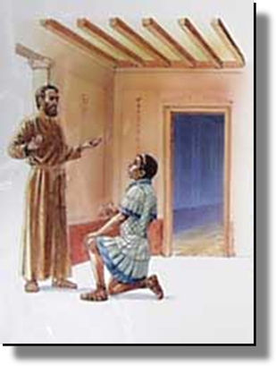
ACTS 10: 26
PETER: "Stand up, I myself am also a man!"

Slide 95
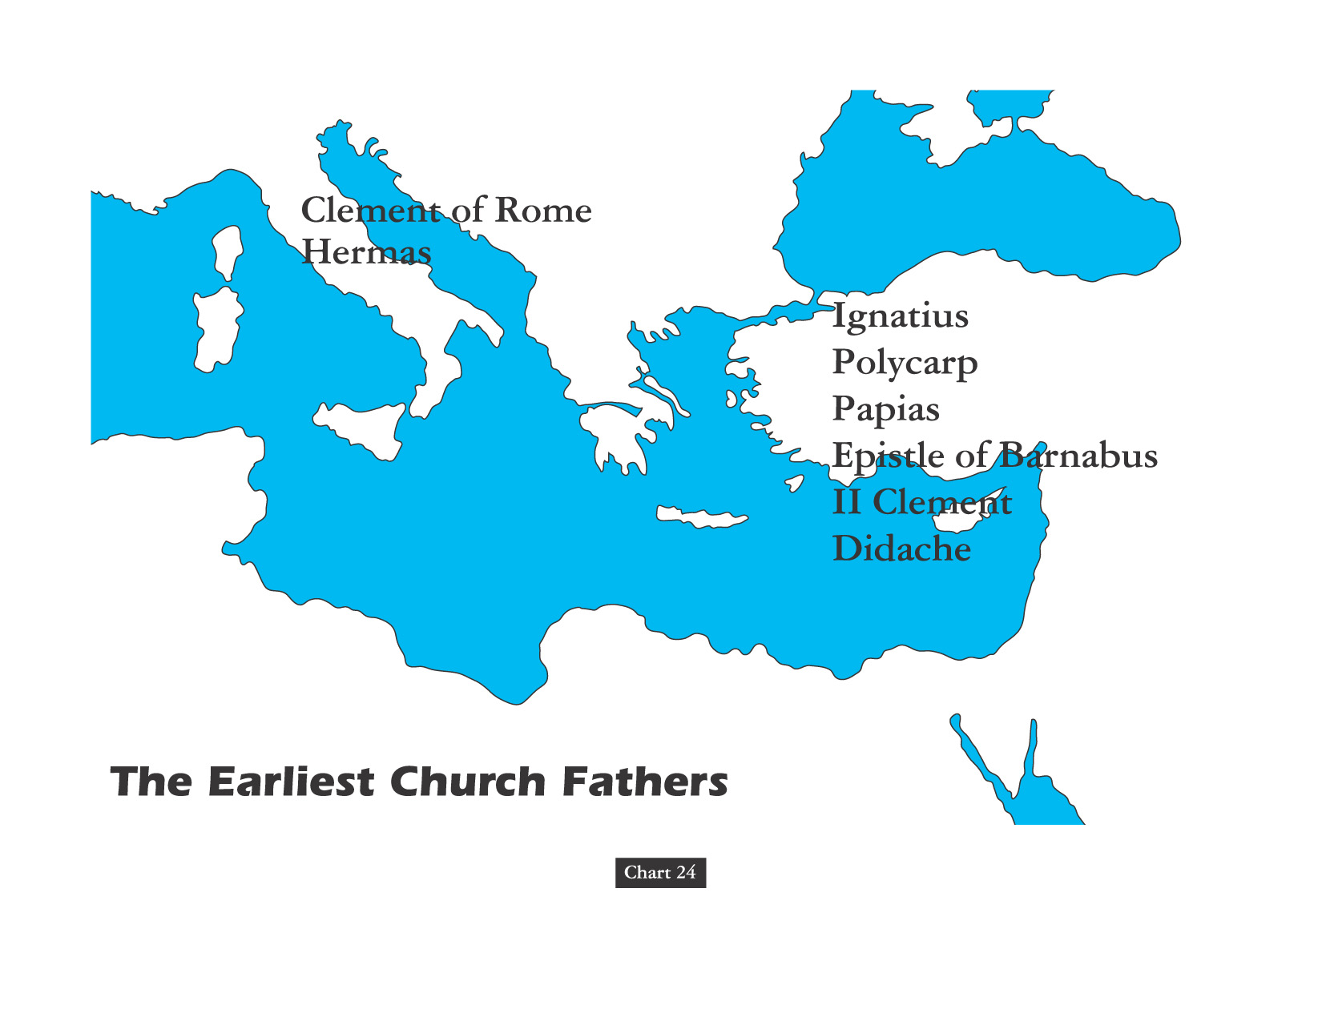
THE PATRISTIC ERA

Slide 96
The Church Across The Ages
of people, events
life and faith from
Glimpses
Clement: Paul's Convert
“Clement’s letter or epistle to the church at Corinth may be the earliest document we have outside of the New Testament.
Yes, Corinth Again. Remember how the Apostle Paul had to write letters to the church at Corinth dealing with terrible problems tearing apart the young church in that notoriously carnal city? Well their problems persisted.
Discord in Corinth had apparently flared up when a group of younger church leaders removed some of those leaders older; factions and petty arguments had developed around the two groups. Clement was writing them addressing and attempting to deal with the squabbles.”

Slide 97
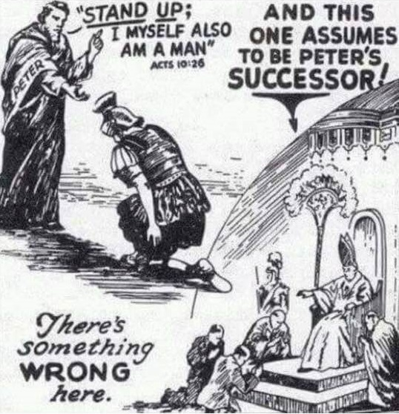

Slide 98
Papacy: Did It Start With Peter?
That a place of primacy was assigned to one of the apostles of Christ is a supposition that is contrary to the whole tenor of Christ’s teaching. On more than one occasion the disciples fell into a discussion as to who would be greatest in the kingdom of heaven
And each time they were taught by the Lord that such a question was unworthy of their consideration.

Slide 99
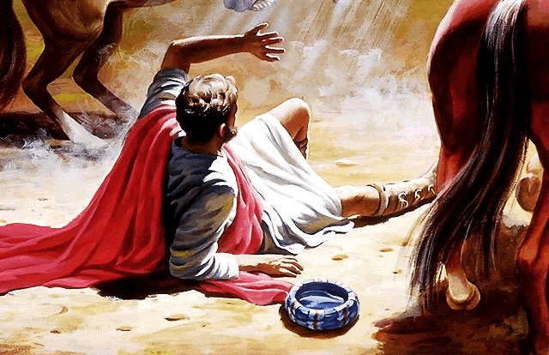
CLOSE ENCOUNTER OF THE FIRST KIND

Slide 100
Papacy: Did It Start With Peter?
A far better case could be made out for the Primacy of Paul than any Catholic can establish for Peter. Paul had the care of all churches upon him. (2 Cor. 11: 28) He labored more abundantly than the rest of the apostles. (1 Cor. 15: 9-11) He was not a whit behind the chiefest of the apostles. (2 Cor. 12: 11) He rebuked Peter to the face before them all when he did wrong. (Gal. 2: 11)

Slide 102
Matthew 16: 13 - 20
Translated Greek: “Thou art Petros(single rock or small pebble) & on this Petra (large solid rock, foundation rock, or rock bed) I will build my church.”
Greek Contextual: Peter’s Confession of Faith an Archtype
Transliterated Aramaic: Pauline Letters Peter & Rock Same
Original Spoken Aramaic Allowed Lesson Form Word Play
In Summation, Building a Church upon a Pebble would be obviously ridiculous and therefore could not be Christ’s real meaning. When Peter acknowledges that Jesus was the Messiah, Jesus showed His agreement that He (Jesus) is indeed the Son of God & the Rock of Ages. Peter compares himself as only a stone when referencing Christ’s Role as The Rock & Chief Cornerstone of the Church - 1st Peter 2: 5 & 6.
In other words – Salvation is not based on an institutional connection with the Apostle Peter but by way of a personal relationship with Jesus Christ!

Slide 103
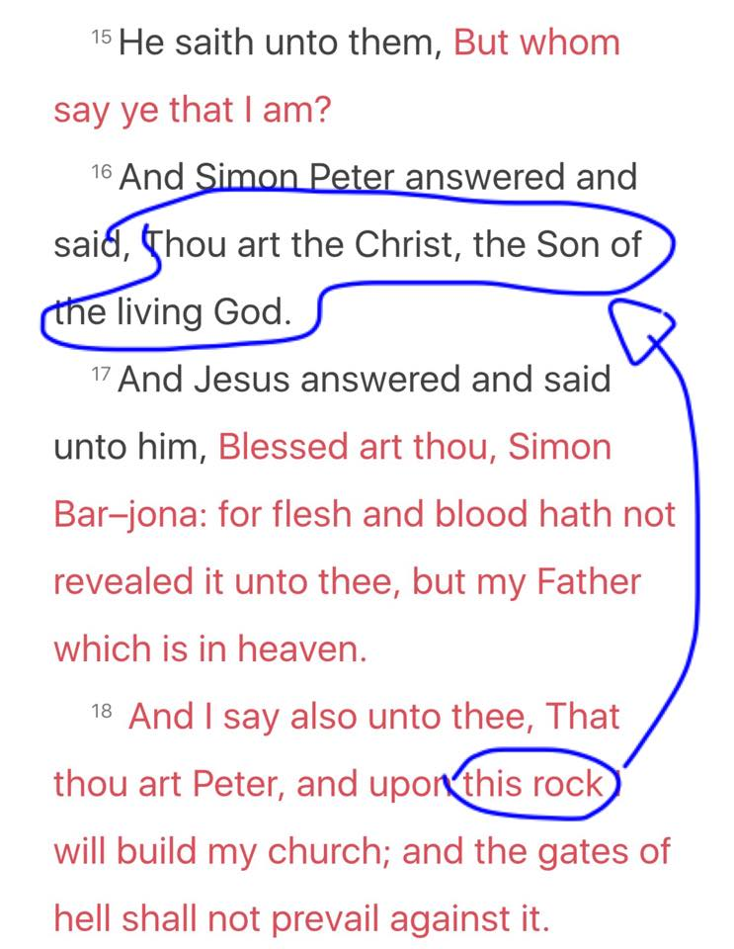

Slide 106
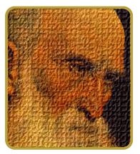
Peter
Simon, son of Jonah Cephas (“rock” or stone)
“BINDING & LOOSING” CONTEXTED
Matt 16:19 - An Apostle Audience Addressed: “Whatsoever ye shall bind on earth shall be bound in heaven and whatsoever ye shall loose on earth shall be loosed in heaven.” [KJV]
It does not at all indicate they had the freedom to bind (make laws) and loose (cancel laws) on earth and God would then bind and loose those same laws in heaven.
Even Jesus himself didn’t have that power – John 12:49.
Notes:
Links on this slide will be activated in PowerPoint Show mode

Slide 107
Peter
Simon, son of Jonah Cephas (“rock” or stone)
“BINDING & LOOSING” CONTEXTED
Even Jesus himself didn’t have that power – John 12:49
As Jesus spoke only that which the Father commanded, the Spirit spake only what He was given – John 16: 13.
Similarly, the apostles did not speak of their own wills but from that of God the Father. Refer – 1st Cor. 2: 13
Early Greek Text of Matthew 16: 19 Clearly Indicates
Contextual Greek: What the apostles “bound on earth” “had already been bound” in heaven & that which was “loosed” on earth “had already been loosed” in heaven.
Notes:
Links on this slide will be activated in PowerPoint Show mode

Slide 108
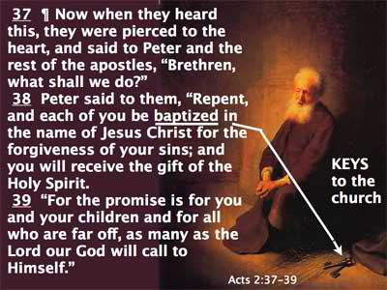

Slide 110
Was Peter the First Pope?
David Lee Burris:
Oldest Continuously Functioning Institution In World Still Can’t Trace Origins To Apostles!
This tradition that the Apostle Peter held the papal office from A.D. 42 to A.D. 67 started early in the third century.
26 church congregants are noted by their names in the first fifteen verses of Paul’s Letter to the Romans in chapter 16. Peter is not even casually mentioned although this point of time overlaps with that of his supposed service term there.
Acts 12 – Peter was held this period in prison in Jerusalem.
“But it is said on all sides , Was not St. Peter at Rome? Was he not crucified with his head down? Are not the pulpits in which he taught, the altars at which he said the mass, in this eternal city? St. Peter having been in Rome, my venerable brethren, rest only on tradition… Scaliger, one of the most learned of men, has not hesitated to say St. Peter’s episcopate and residence at Rome ought to be classed with ridiculous legends.” 1870 Vatican Council; Bishop Strossmayer

