Slide 1

02. RELIGIOUS HISTORY OF THE CHRISTIAN ERA
by David Lee Burris

Slide 2
Relgious History of the Christian Era Ppt. Series
Papacy
Monarchical Episcopacy
Sacraments
Five Worship Activities
Denominations
Theological Debates

Slide 3
SACRAMENTS & SOTERIOLOGY
Classic Apologetics to Theological Systematizing
Alexandrian School Versus Antiochene School
Changes in Worship: Lord’s Supper @Sacrament
Changes in Doctrine: Believer Baptism @Salvation
Historicity: Catholic Confessional-Treasury of Merit
The Godhead Three: Thee Trinitarian Controversy
Orthodoxy/Orthopraxy Brand Vs. Heretical Label
Magisterium: Canon Text–Law–Courts–Legal Curia
CONTAMINATE – CONTAINMENT - CORRUPTION

Slide 4

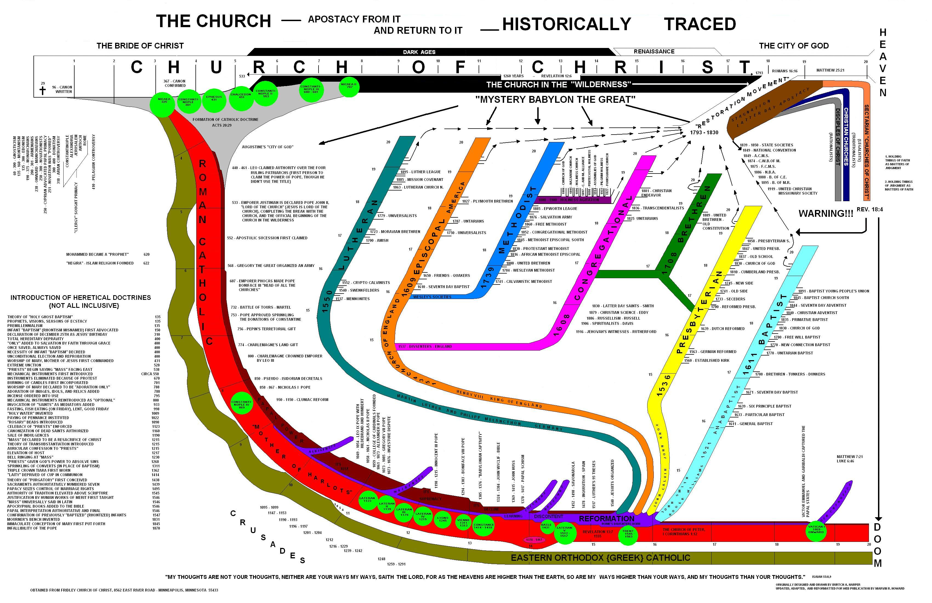

Slide 5


Borders Of God’s Word

Slide 6
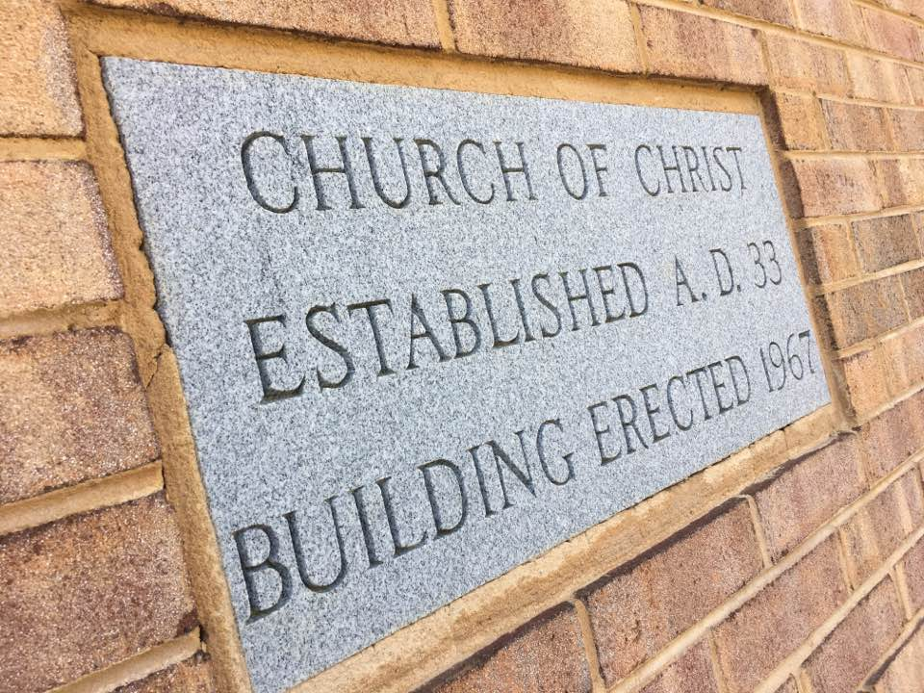

Slide 7

Early Church Struggles Were With:
David Lee Burris:
Tonsure: Origins In Persecuted Church; Roman Mockery To Shave Heads As Slave Property
CANON
CREED
CLERGY

Slide 8
EARLY CHURCH PRE-TEST Q-1
THE CATACOMBS WERE:
Where the early Christians lived.
Where the early Christians held their regular worships services.
Where the early church held weddings.
Where the early church held funeral services.
Where the early church held seeker services.
X

Slide 9
EARLY CHURCH PRE-TEST Q-2
David Lee Burris:
Christians Were Very Anti-Abortion Which Was A Common Practice. The Romans Would Also Abandon Their Young & Christian Rescue Of The Abandoned Was Misinterpreted. Pagan Rescue Of Another’s Abandoned Was For Immoral Purposes. Source: Justin Martyr
Which Of The Following Did Romans Accuse Their Christian Neighbors Of?
ATHEISM
INCEST
TREASON
HURT FAMILY
CANNIBALISM

Slide 10
EARLY CHURCH PRE-TEST Q-2
Which Of The Following Did Romans Accuse Their Christian Neighbors Of?
ATHEISM
INCEST
TREASON
HURT FAMILY
CANNIBALISM
* Claimed by Cornelius Fronto a Second Century Court Tutor

Slide 11
EARLY CHURCH PRE-TEST Q-3
1st Clement, written ~ A.D. 90, contains several items of interest, including all of the following except which?
An observation that the local church had more than one bishop
Earliest note of Apostle’s martyrdom
The statement that the Lord’s Supper should be served only by elders
An admonishment against women used in public instruction at the marketplace.
x

Slide 12
EARLY CHURCH PRE-TEST Q-4
How many churches are we aware of that were recorded from both Bible & early church history by the year 100?
12
42
112
242
x

Slide 13
EARLY CHURCH PRE-TEST Q-5
Early Christians preferred to baptize in “living water” What did they mean by that?
Running Water (such as a stream)
Water Blessed By A Bishop
Hot Or Cold Water Rather Warm
Immersion Rather Than Pouring
x

Slide 14
EARLY CHURCH PRE-TEST Q-6
According to the Didache, what did the early Christians wear when being baptized?
Usual Clothes
White Loincloth
A Red Veil
Nothing At All!
x

Slide 15
EARLY CHURCH PRE-TEST Q-7
According to the Didache, how often were early Christians asked to fast?
Every Saturday
Every Wednesday & Friday
Sunup To Sundown If Serious Sin
Not So Often – It Was Being Abused As Confession Substitution
x

Slide 16
EARLY CHURCH PRE-TEST Q-8
David Lee Burris:
Issue 37 - Christian History Magazine – Page 3: “When worship ended, Christians took home the consecrated bread so that those who couldn’t attend worship could partake of the Lord’s Supper.”
According to Justin Martyr, in A.D. 150, was Communion taken to people who could not attend church?
No, That Wasn’t Necessary
Only If No Blood Relations Taken
Yes, If Sick Or In Prison
Yes, But Only After 28 Days
x

Slide 17
EARLY CHURCH PRE-TEST Q-9
Which of the following has not been a Communion issue over which Christians have killed one another?
Should people get both bread and cup or just the cup?
Should bread or a cracker be used?
Does the bread contain Christ’s body or merely represent Christ’s body?
May white grapes be used, or must they be purple grapes as in Palestine?
x

Slide 18
EARLY CHURCH PRE-TEST Q-10
What is the earliest mention of a church choir?
107
307
507
707
x

Slide 19
EARLY CHURCH PRE-TEST Q-11
Approximately when does the first mention of infant sprinkling occur in the writings of the church fathers?
90
190
290
390
x

Slide 20
EARLY CHURCH PRE-TEST Q-12
Why did Tertullian argue in A.D. 200 that teenagers should not be baptized?
They do not realize the depth of the commitment required
Jesus was not baptized till He was thirty
Teenagers sin a lot. Postponed baptism can forgive more sins
According to legend, the youngest of the twelve apostles (John) was twenty-one when he was called
x

Slide 21
EARLY CHURCH PRE-TEST Q-13
How far back does the oldest church building go?
A.D. 232
A.D. 332
A.D. 432
A.D. 532
x

Slide 22
EARLY CHURCH PRE-TEST Q-14
In A.D. 250 the church in Rome had one bishop. How many elders & deacons did it have?
One Elder & Sixty-six Deacons
Forty-six Elders & Seven Deacons
Seven Elders & Forty-six Deacons
One Hundred Twenty Deacons – The Office Of Elder Was Eliminated
x

Slide 23
EARLY CHURCH PRE-TEST Q-15
This 4th Century bishop in Milan reintroduced congregational singing?
TIMOTHY
AMBROSE
BERNARD OF CLAIRVAUX
BILL GAITHER
x

Slide 24
EARLY CHURCH PRE-TEST Q-16
What aspect of modern church seating would most likely astonish a fourth-century Christian?
People sit during the sermon
The mixing of men & women
The mixing of child & adult
Remote Communion Table
x

Slide 25
EARLY CHURCH PRE-TEST Q-17
In the fourth and fifth centuries, when people asked for baptism, how long were they generally required to wait?
Baptized that day
The following Sunday
The next Easter
Three years later
x

Slide 26
EARLY CHURCH PRE-TEST Q-18
The worship of Mary began to take shape in the third through fifth centuries. All the following practices framed then except this?
Mary Never Died Or Doctrine Of Heavenly Assumption
The Term “Mother Of God”
The Belief Mary Was Sinless
The Belief Mary Never Sexual
x

Slide 27
EARLY CHURCH PRE-TEST Q-19
In western Europe in the late 4th century, what portion of one’s inheritance was traditionally left to the church at death?
One-tenth
One-fifth
Everything {If Children 21}
Amount Left To Another Child If They Had Had Another Birth
x

Slide 28
EARLY CHURCH PRE-TEST Q-20
The church at Rome in the fifth century divided its income four ways, with one-fourth going to the bishop. Which of the following did not receive a one-fourth share?
Other Clergymen
Building Maintenance
Missions & Evangelism
The Sick & Poor
x

Slide 29
EARLY CHURCH PRE-TEST Q-21
After Constantine officially became a Christian, whose faces did he put on coinage?
Apostles Peter & Paul
Roman gods Mars & Jupiter
He & His Family Members
Bishops Athanasius & Malodorous
x

Slide 30
EARLY CHURCH PRE-TEST Q-21
After Constantine became a Christian officially*, what did he have done to his wife and son?
He Had Them Murdered
He Had Them Baptized
He Divorced Wife & Disinherited Son Because They Wouldn’t Convert
He Made Son Bishop & Wife Deaconess
x
* Not unusual for adults to wait until late in life for baptism.

Slide 31
EARLY CHURCH PRE-TEST Q-22
Approximately how much time elapsed between the last major persecution of Christians by pagans and the first major persecution of pagans by Christians?
10 YEARS
80 YEARS
240 YEARS
550 YEARS
x

Slide 32
EARLY CHURCH PRE-TEST Q-23
What early church father thought the church should kill heretics?
Justin Martyr
Tertullian
Athanasius
Augustine
x

Slide 33
EARLY CHURCH PRE-TEST Q-24
What did Cardinal Hugo de Sancto Caro do to the Bible in A.D. 1250?
Digested It Smaller
First Tribal Translation
Banned From Papal State
Divided It Into Chapters
x

Slide 34
EARLY CHURCH PRE-TEST Q-25
After the Bible was divided into chapters, how many years passed before it was divided into verses?
None - Done Within Year
TEN
100
300
x

Slide 35
CHURCH DEVELOPS BEYOND:
David Lee Burris:
Tonsure: Origins In Persecuted Church; Roman Mockery To Shave Heads As Slave Property
JEWISH ROOTS
GREEK ETHOS
ROMAN BASE

Slide 36
SACRAMENTS & SOTERIOLOGY
Classic Apologetics to Theological Systematizing

Slide 37
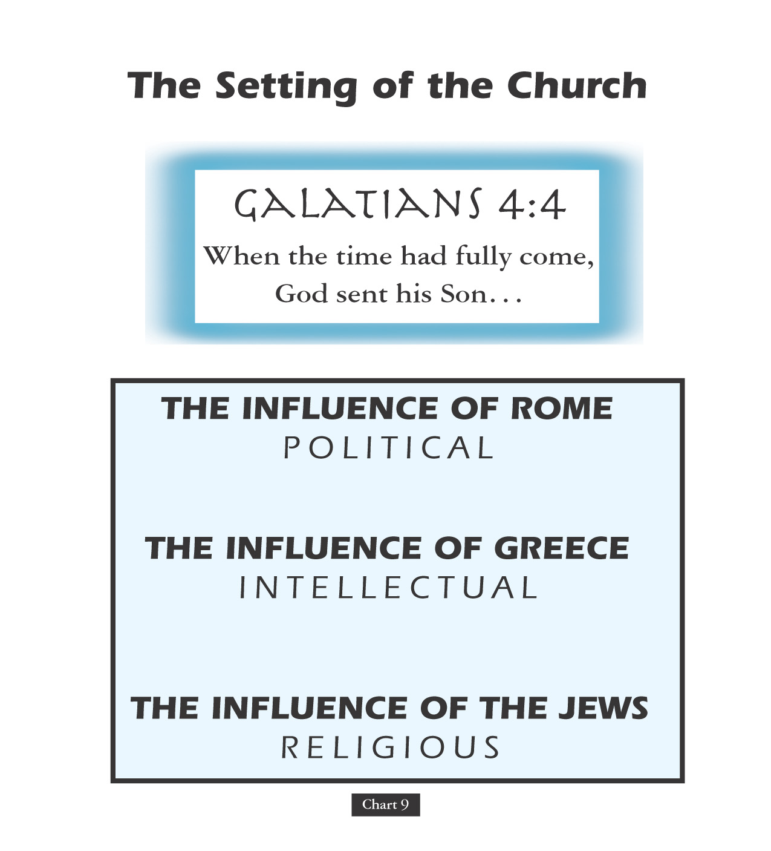

Slide 38
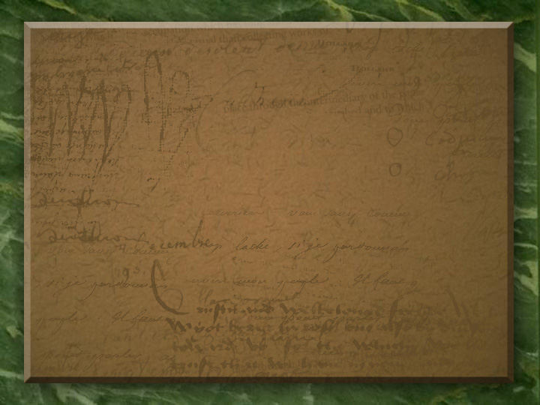
Text-Based Religion Wins Over
A Practice-Based Paganism

Slide 39

ADVANCING THE TRUTH
POLEMICISTS
POLEMICISTS
POLEMICISTS
TRANSLATIONAL
THEOLOGICAL
TAXONOMICAL

Slide 40
TYPOLOGICAL INTERPRETATION
Apostolic Father
Apostolic Father
Apostolic Father
EPISTOLARY
APOCALYPTIC
CATECHETICAL

Slide 41


Systematic Theology
“The attempt to summarize religious truth or the belief system of a religious group through an organized system of thought carried out within a particular cultural and intellectual context.”
* Dictionary Of Theological Terms, Grenz & Guretzki

Slide 42
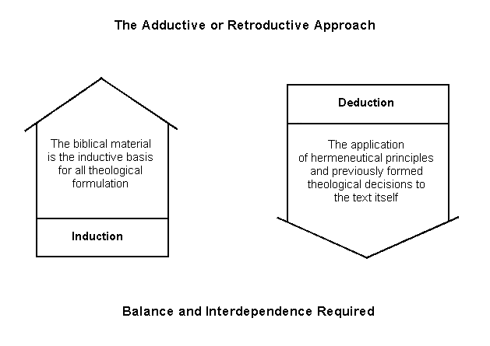

Slide 43

Level One: Meaning/Interpretation

Slide 44

Level Two: Interpretation/Relevance

Slide 45
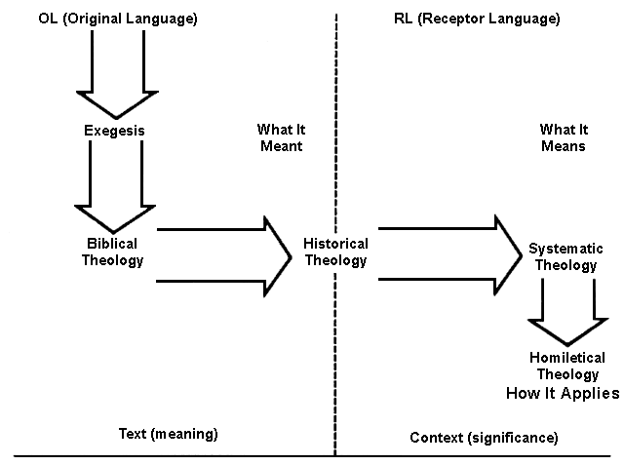

Slide 46
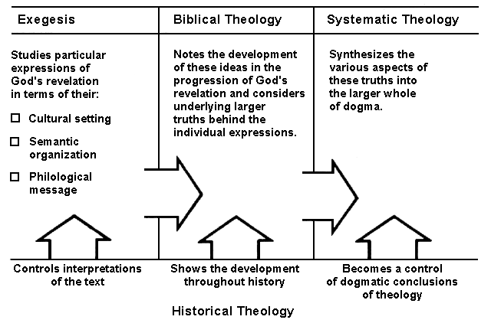

Slide 47
Historical Theology
“The division of the theological discipline that seeks to understand and delineate how the church interpreted scripture & developed doctrine throughout its history and to show the origin & development of beliefs held in the present day.”
* Dictionary Of Theological Terms, Grenz & Guretzki

Slide 48
DEFENDING THE FAITH
EXEGETES
APOLOGISTS
DOGMATISTS
CREEDAL
Eastern School
WESTERN
While understanding the powerful influence of philosophy – particular Platonism and Stoicism - on the morality and conduct of Rome’s ruling classes was critical to overcoming official obstacles – reaching the masses required Christians giving answer to their pagan critics.
Exploring both Christianity’s pagan critics and its apologists reveals not only an evolution in pagan understanding of the new faith but a corresponding increase in the sophistication of the writings set forth by those defending it.

Slide 49
DEFENDING THE FAITH
EXEGETES
APOLOGISTS
DOGMATISTS
CREEDAL
Eastern School
WESTERN
The 2nd Book of Marcus Aurelius Meditations Emperor A.D. 138-161 – Marcus Aurelius believed that the way to the meaning in our lives lies in first understanding that we have a soul, and that soul partakes of the essence of God, that soul partakes in of the essence that fate, through God, has decreed for each one of us, for each of us has a destiny.

Slide 50
DEFENDING THE FAITH
EXEGETES
APOLOGISTS
DOGMATISTS
CREEDAL
Eastern School
WESTERN
The Stoic philosophical school had played a major role in the concept of God. The Stoics taught a noble idea: God is the universe. And in the words of the Stoic thinker and poet Cleanthes, ‘God is all-good, all-beneficent , all-knowing. God is perfection, and that God has decreed for the universe all the stars that move, every creature in that universe. He has given to each individual a soul, and decreed for that soul a fate.’ It is a monotheistic idea. An idea that paved the way for the ultimate triumph of Christianity.

Slide 51
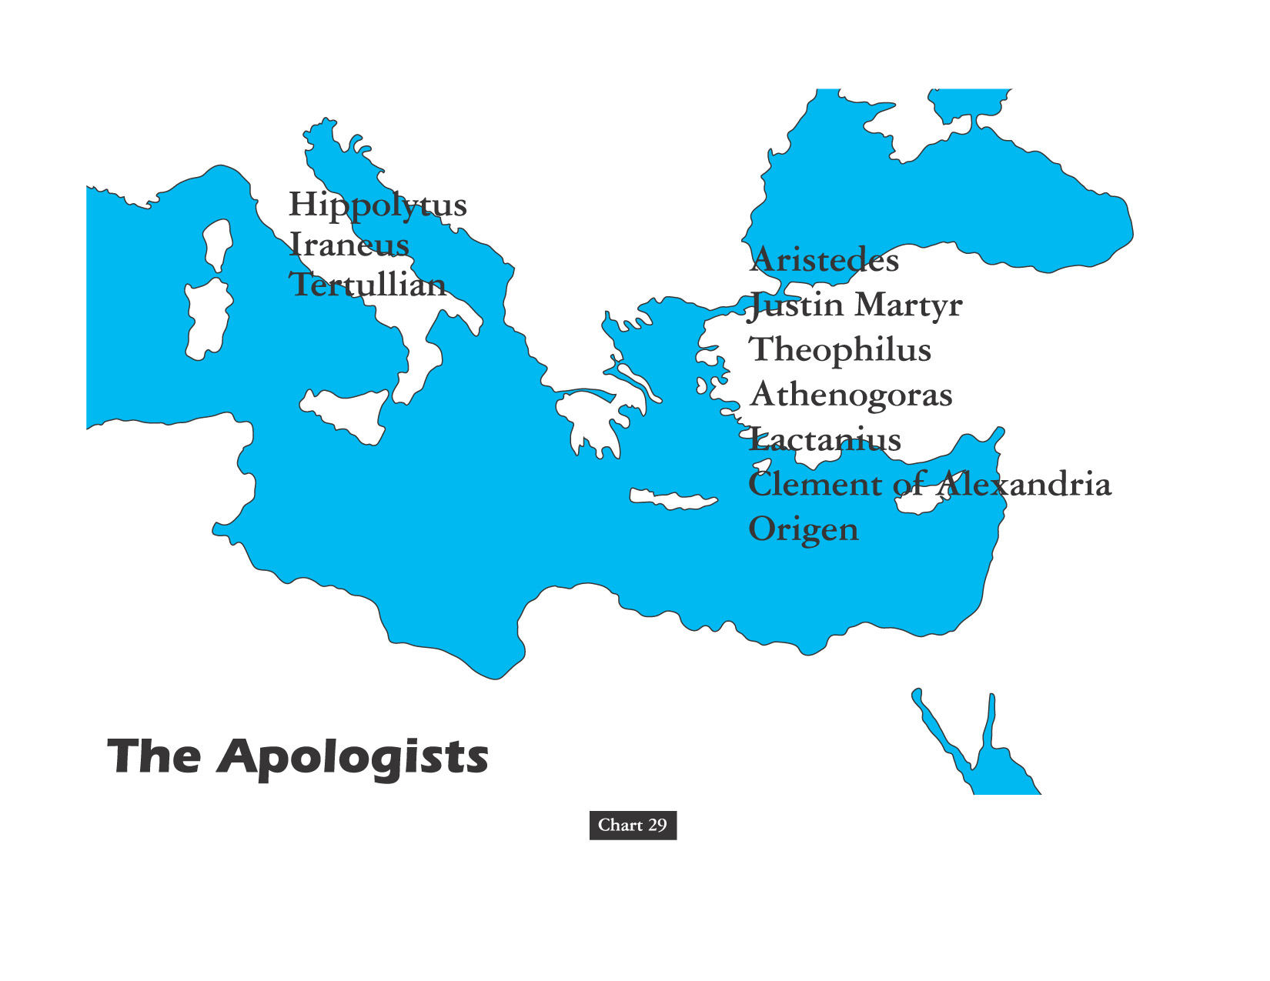
Greco-Roman

Slide 52

PAGAN ARGUMENTS
APOLOGIST RESPONSE
Resurrection Absurd
There Were Many Eyewitnesses
Bible Contradictions
Tatian’s Harmony Diatessaron
Christians Worship Crucified Criminal
Trial Of Jesus Violated Law
Christianity Strange & New Novelty
Eternal Preparation Antedated Philosophy
Christians Are Not Good Patriots
Obey All Laws Not Violating Conscience
Christians Practice Gross Perversion
Personally Observe Actual Lifestyles

Slide 53
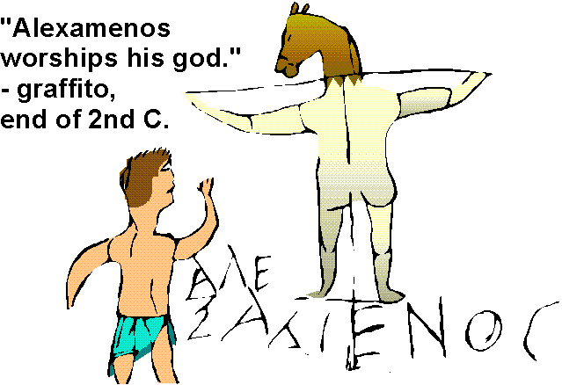

Slide 54

Greek philosophers used “Word” (Logos) as a name for the cosmic reason behind the universe. The Ephesian philosopher Heraclitus said the Word is a mysterious power that “always exists” & that makes “all things happen.”

Slide 55
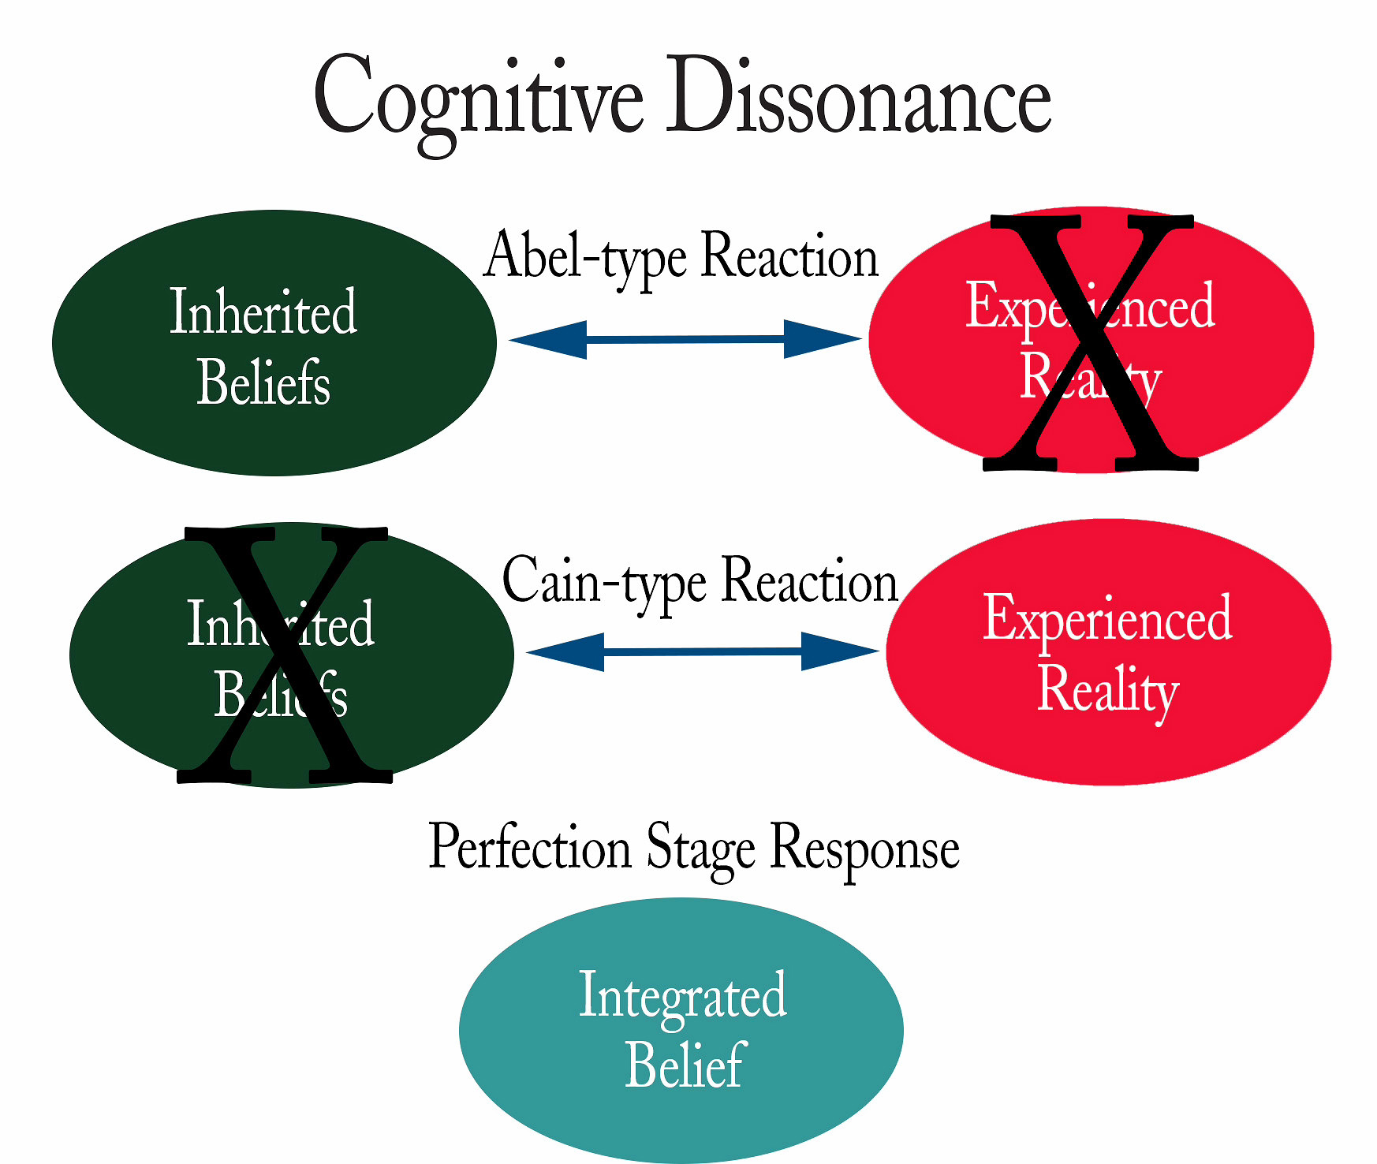
OVERVIEW: APOSTLE TO APOSTATE PATTERN
1ST CENTURY CONTINUITY AS ANALYSIS HAS SHORTCOMING
SINGLE POINT ANALYSIS IS WRONG WITH SERIAL DILUTION
BRO. DAVID HARRELL’S SECT-TO-DENOMINATION PROCESS
CHURCH HISTORY TOPICAL-CHRONOLOGICAL THREADLINE
EXEGETICAL THEOLOGY IS VERSE-PASSAGE-STORY ANALYSIS
BIBLICAL THEOLOGY IS CROSS DISPENSATIONAL TOPIC ANALYSIS
HOMILECTICAL THEOLOGY: CONTEXTUALIZATION & APPLICATION
SYSTEMATIC/PRACTICAL THEOLOGY: ORTHODOXY/ORTHOPRAXY
HISTORICAL THEOLOGY IN W. LINEAR & E. CIRCULAR TIME ANALYSIS
DEBATE SOCIETY W/ ACTION GROUP: DOCTRINE MORPHS DOGMA
DOCTRINE VERSUS DOGMA H.T. IN “BIG T” TRADITIONAL PRACTICE
DOCTRINE VERSUS DOGMA H.T. IN “little t” TRADITIONAL THOUGHT
TWO SCHOOLS OF LATE JEWISH THEOLOGY
Babylonian Expatriot Influence @Antioch
Hellenistic Greek Influence @Alexandria
Authority
Ambiguity
ACCEPTANCE

Slide 56
Doctrine Versus Dogma
Distinguishing dogma and doctrine. "A doctrine is often the direct, naive, expression of a religious truth. It is not necessarily formulated with scientific precision and when it is, may be merely the formulation of a single person. A religious dogma, on the other hand, is a religious truth based on authority and officially formulated by some ecclesiastical assembly." Dogmas, in this sense, are not found in Scripture. "They are the fruit of human reflection, the reflection of the Church, often occasioned or intensified by theological controversies."
In summary: "A dogma may be defined as a doctrine, derived from Scripture, officially defined by the Church, and declared to rest upon divine authority. This definition partly names and partly suggests its characteristics. Its subject-matter is derived from the Word of God and is therefore authoritative. It is not mere repetition of what is found in Scripture, but the fruit of dogmatic reflection. And it is officially defined by a competent ecclesiastical body, and declared to rest upon divine authority. It has social significance, because it is the expression, not of a single individual, but of a community. And it has traditional value, since it passes the precious possessions of the Church on to future generations." Dogma arises from the reflection on the "truths of revelation" by the "body of believers" and through the formulations of "competent representative bodies" of the Church. "Since the reflection of the Church is often determined and deepened by doctrinal controversies, the formulations to which Church Councils or Synods are finally led under the guidance of the Holy Spirit often bear the earmarks of past struggles. They are not infallible but yet have a high degree of stability. And they are authoritative, not merely because they are proposed by the Church, but *formally* as defined by the Church and *materially* as based on the Word of God."

Slide 57
DOGMA MEANS THE SERIOUS SATISFACTION OF THE MIND!
G. K. CHESTERTON

Slide 58
DOGMA DOES NOT MEAN THE ABSENCE OF THOUGHT, BUT THE END OF THOUGHT!
G. K. CHESTERTON

Slide 59

SACRAMENTS & SOTERIOLOGY
Classic Apologetics to Theological Systematizing
Alexandrian School Versus Antiochene School

Slide 60
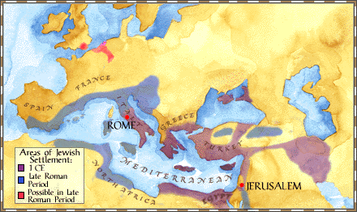
The Antiochene School Of Theology Practiced An Approach To Scriptural Interpretation With Literal Emphasis Rather Than Spiritual Meanings Not Immediately Evident From The Text
Antioch Center Of Christian Theology

Slide 61
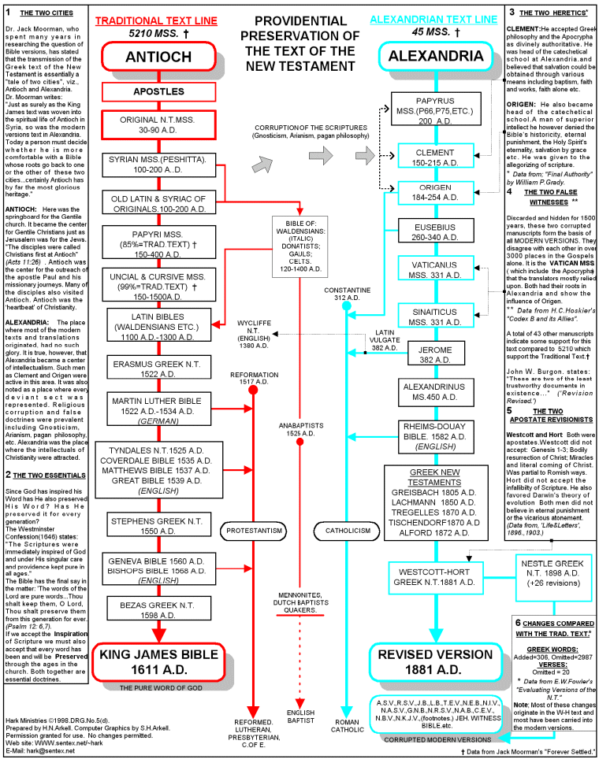

Slide 62

David Lee Burris:
End First Century – 7% Of World Population Jewish & Christian Numbers In 100,000’s
Didache An Early Christian Document That Warned About Trickery Of Some Traveling Preachers – It Said To Feed Such Preachers & House Them But If They Ask For Money Ask Questions; Didache 7 Also Adds By Insistence On Living OR Moving Water
ONLY 100 YEARS AFTER APOSTLES: Preaching Crucifixion to Catechetical Teaching
Egypt’s Alexandria was the center of early learning, having a large university with a voluminous library. In the last quarter of the second century, churchmen established a catechetical (learning by the questioning process) school in Alexandria. Two great luminaries shine as leaders of that school in the persons of Clement of Alexandria and Origen. Both interpreted the Scriptures allegorically rather than historically, as was the method of interpretation from Antioch.
Didache: Simple Obedience No Longer An Event But A Convoluted Process

Slide 63
In Athens Paul Preaches Of Another Hill
400 YRS: REFINED GOLD MEAN
TO DIALECTIC MATERIALISM
THESIS
SYNTHESIS
ANTI-THESIS

Slide 64
The Alexandrian School Was Influenced By Plato’s Philosophy & Basically Believed That The Bible Was Best Understood As An Allegorical Morality Rather Than As A Literal Interpretation.
Alexandria Center Of Christian Theology

Slide 65

  “We converse with history’s greats by first trying on their blindfolds.”

Slide 66


Slide 67
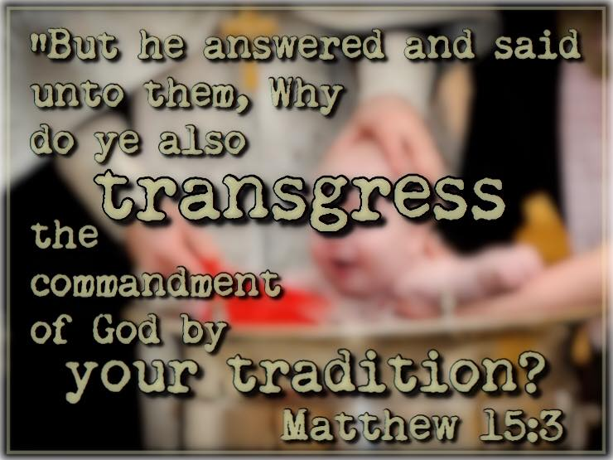

Slide 68
CHANGES IN AUTHORITY
Catholic Concept Of Oral
HISTORY & TRADITION

Slide 69
Catholic Concept Of Oral
HISTORY & TRADITION
Most Of What We Know About Early Church Father Figures Is From The Recorded Praises In Panegyric Type Sermon Speech.

Slide 70
Catholic Concept Of Oral
HISTORY & TRADITION
PAPIAS OF HIERAPOLIS ~150 AD
“And again, on any occasion when a person came (in my way) who had been a follower of the Elders, I would inquire about the discourses of the elders – what was said by Andrew, or by Peter, or by Thomas or James, or by John or Matthew or any other of the Lord’s disciples, and what Aristion and the Elder John, the disciples of the Lord, say. For I did not think that I could get so much profit from the contents of books as from the utterances of a living and abiding voice.”

Slide 71

Catholic Dictionary Defines Tradition:
“Tradition is a source of theological teaching distinct from Scripture, and it is infallible. It is therefore to be received with the same internal assent as Scripture, for it is the word of God. Whereas much of the teaching of Scripture could not be determined without Tradition, Tradition would suffice without scripture; it is the safeguard of Scripture.”

Slide 72

THE ENGLISH WORDS FOR “TRAITOR” OR “TREASON” & FOR “TRADITION” BOTH ORIGINATE FROM THE LATIN ROOT TRADITORE

Slide 73
SACRAMENTS & SOTERIOLOGY
Classic Apologetics to Theological Systematizing
Alexandrian School Versus Antiochene School
Changes in Worship: Lord’s Supper @Sacrament

Slide 74
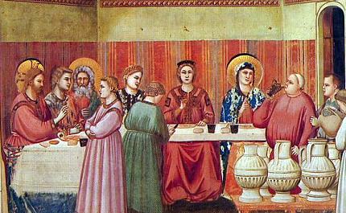
FIRST MIRACLE EARLY INDICATOR
Water to Wine or Reserved to Common
“Jesus must have looked around to see what resources could be utilized, not just to please mom as well as the bridal party, host family and all the guests, but also to convey the message he had come to share.
He spotted, tucked away in a protective place, six stone water jars that were explicitly reserved for the Jewish rites of purification. These jars were, that is, sacred equipment. But Jesus tells the waiters from the reception to fill these holy vessels with plain old water from the tap – not blessed or baptized water, mind you.
We can imagine that the waiters could have been reluctant to do what Jesus had instructed. After all, to follow the orders would in some way be an act of profaning what was sacred. But they had heard Mother Mary tell them quite clearly, "Do whatever he tells you."
So the waiters did it. Following Jesus' orders, they filled each of those sacred jars – "each holding 20 or 30 gallons" – to the brim with plain-ol' profane water.”

Slide 75
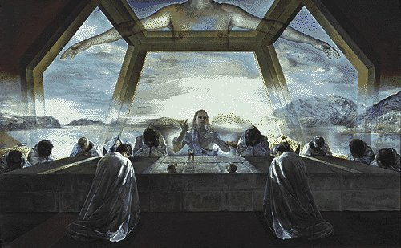
Face Napkin Folded As Dinner Napkin Master Signaling His Servant
John 20: 7
“I’ll Be Back”

Slide 76
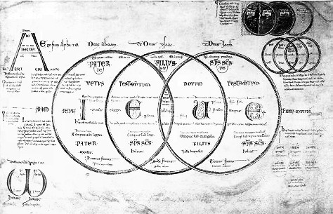
Explaining Resurrection
“Resurrection stands as an essential element of the biblical and historical witness of the Christian Community. Without the resurrection, Jesus is not the Living Lord but a dead person held in memory. Without the resurrection, God is not the God of the Living, not the one who has the power to conquer death. Without the resurrection, humankind has no ultimate hope for the, ‘last enemy,’ death, wins.” – W. Willis

Slide 77
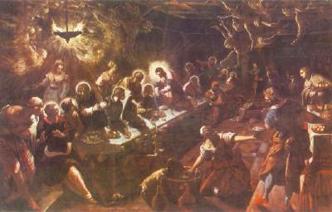
Eating & Drinking With Jesus – Craig Watts
“The very life of the church is to be a sign of the future. The Lord’s Supper foreshadows this grand future. It speaks of the world-embracing invitation of God & protests against the hostile divisions & persistent injustice that plagues human- -kind. When Jesus instituted the Lord’s Supper he called upon his followers to set their eyes forward to the time when they would eat and drink at Jesus’ table in the divine kingdom.”

Slide 78
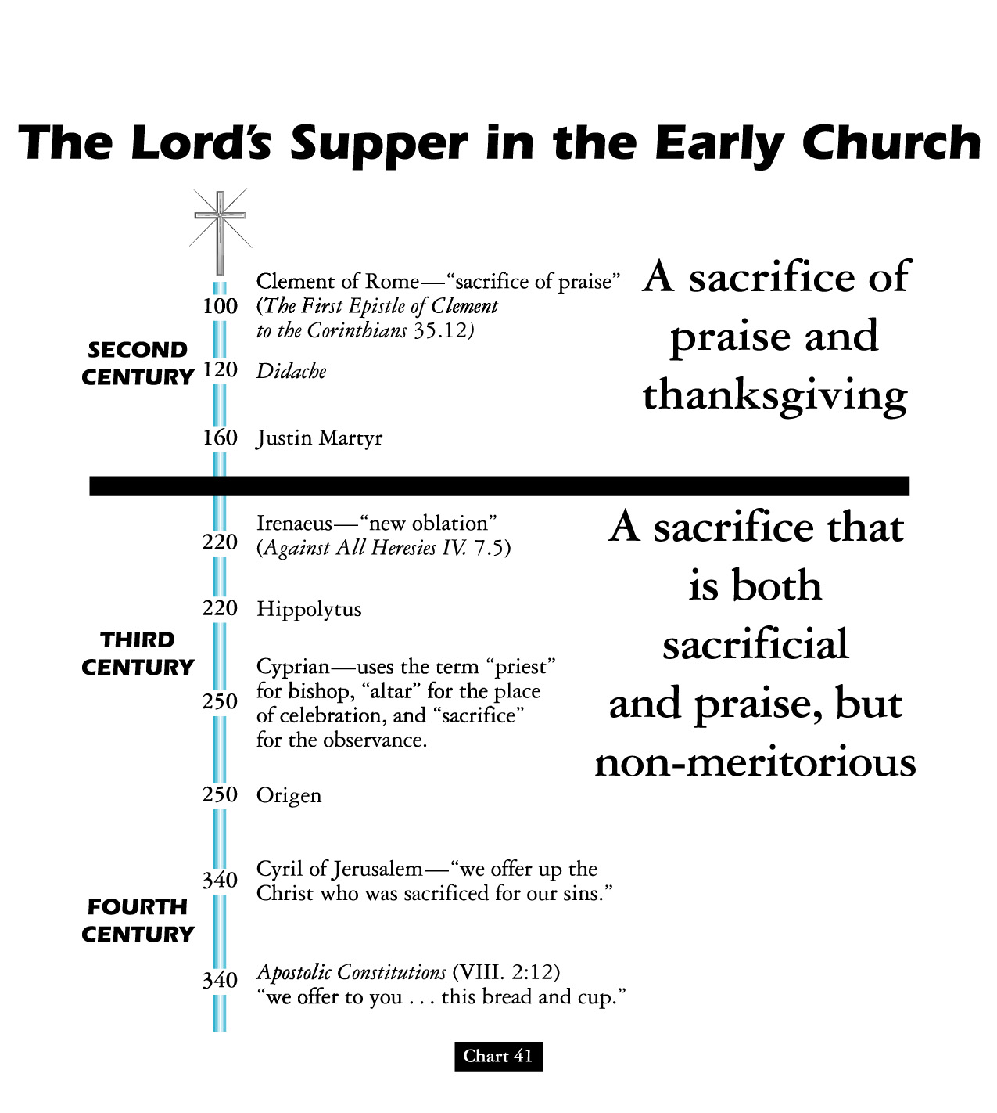

Slide 79

“Teaching As Doctrines The Traditions Of Men”
WORSHIP & BAPTISM
David Lee Burris:
For Four Centuries Christians Believed Celebrating Children’s Birthdays Worldly & Pagan Ritual – Only Celebrated “Birthdays” Of Martyrs Death - Early Christians Definitely Didn’t Celebrate Christ’s Bethlehem Birth!
Justin Martyr: “Bread is presented and wine and water” Common practice - dilute wine with water - counter potency.
Division in the worship service between the part that all could attend (Scripture reading/ preaching) & that part only the faithful could attend (Lord’s Supper), called the disciplina arcani (“rule of secrecy”) occurred in the third century.
Ante-Nicene writings began to consider that the communion prayers were the congregations corporate thank-offering to the Lord, hence the usual designation was ‘eucharist” (thanksgiving).
Ideas related to this concept developed:
The Eucharist imparts divine life of itself, reflected in the descriptive phrase “medicine of immortality” (Ignatius).
The elements are a sacrifice offered by the priest (Cyprian).
Lastly, there is a real presence of Christ (Irenacus).

Slide 80
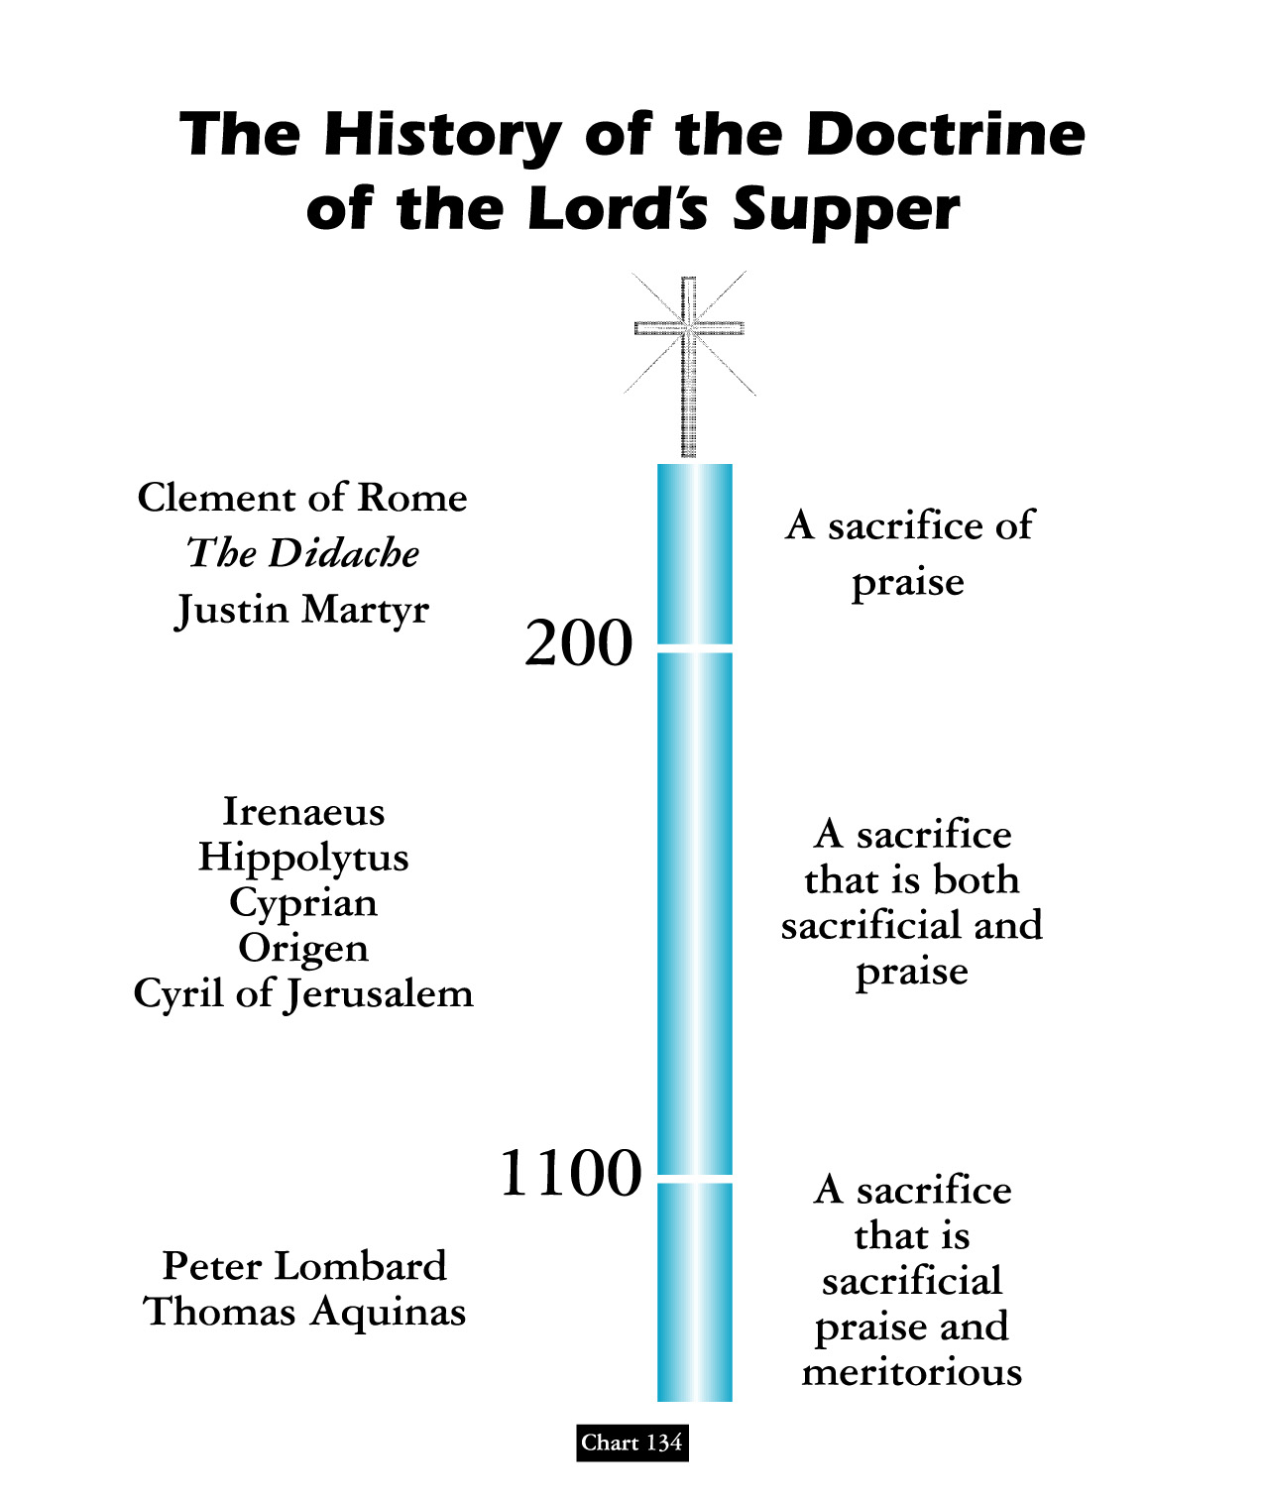
David Lee Burris:
“Maranatha” said at the end of communion service in the early church meant “Our Lord, come”

Slide 81


WHAT IF….
EARLY CLUNIAC REFORM

Slide 82
From The Modern Scholar Course Guide:
“One, Holy, Catholic, & Apostolic”
EARLY CLUNIAC REFORM
“The German Emperor Henry III sought to enact the first reform measure to purify the Church, In 1046, he deposed the three competing popes and appointed his own reform popes. With the support of the emperor, these non-Roman popes were able to enact reforms. Reform popes brought to Rome reform-minded clerics from across Europe to staff church offices.”
“The Cluniacs produced a new kind of specialized monk, a military monk who rode on horse, upheld codes of chivalry & was an effective killing machine when necessary.”

Slide 83
CHURCH EUCHARIST DEBATE
THE YEAR OF OUR LORD 1059
“The age of scholasticism had dawned, and in the struggle to merge the ancient Greek heritage of Aristotle with medieval Christian dogma, the stakes were high: the future of Christian theology hung in the balance.
How much of Christian thought would operate in the pagan modes of logic and reason, and how much would retain the elements of faith and revelation.”
“When fish are in schools they sometimes… take debate!”

Slide 84
CHURCH EUCHARIST DEBATE
THE YEAR OF OUR LORD 1059
“The question was exploding across Christendom, and the hottest point of contention was the ‘real presence’ of Christ in the bread of the Eucharist. Belief in His real presence was a dogma. But the Eucharist debate opened the church door to using Aristotle’s logic as a way to make theology more rational. Until now, most theological assertion was based on citing authority: the Bible, Saint Augustine, the Creeds, or the early church fathers. The liberal arts had introduced new tools, and these included the trivium of grammar, rhetoric & logic.
Questioned: What did the Bible mean when Christ said he was the Bread?

Slide 85
CHURCH EUCHARIST DEBATE
THE YEAR OF OUR LORD 1059
“In the great Eucharist debate, the logical question was how the spiritual Christ and the physical bread could occupy the same space. The rhetorical or semantic question was, ‘What did the Bible mean when Christ said he was the bread?’
The debate came to a head at the Council of Rome in 1059. The church called in two advocates, one orthodox and the other innovative. The first was Lanfranc, who defended the orthodox position of transubstantiation: that the bread turned into the body of Christ, even though it looked like bread to human eyes. The other disputant was Berengar of Tours, a respected theologian who defended a contrary position.
Questioned: What did the Bible mean when Christ said he was the Bread?

Slide 86
CHURCH EUCHARIST DEBATE
THE YEAR OF OUR LORD 1059
The rhetorical or semantic question was, ‘What did the Bible mean when Christ said he was the bread?’
“Berengar had stirred the theological crisis by his insistence on grammatical logic. He contended that both Christ and the bread occupied the same reality, for that was the literal claim of the phrasing in the Bible and in early church writings. Words had real meanings, Berengar argued. Having two things occupy one space was indeed a mystery; but the ‘real presence’ of Christ in bread is just that, a mystery.
Lanfranc was no less logical in his solution, but he had chosen to draw upon the logical ‘categories’ of Aristotle, not the semantic argument. The Categories defined real things as having a permanent essence or a ‘substance.’ No two substances could share the same space!”

Slide 87
Church
History
The Apostasy
Doctrines Enacted at Church Councils
Clergy/Laity System
Sprinkling for Immersion
Infant Baptism
Celibacy
Instrumental Music
Transubstantiation
Indulgences
Worship of Mary
Veneration of Relics
Purgatory
Confessionals
Images
Penance
Extreme Unction
Confirmation
Nuns, Primacy of Peter
Forbidding to Eat Meats
Religious Holidays

Slide 88
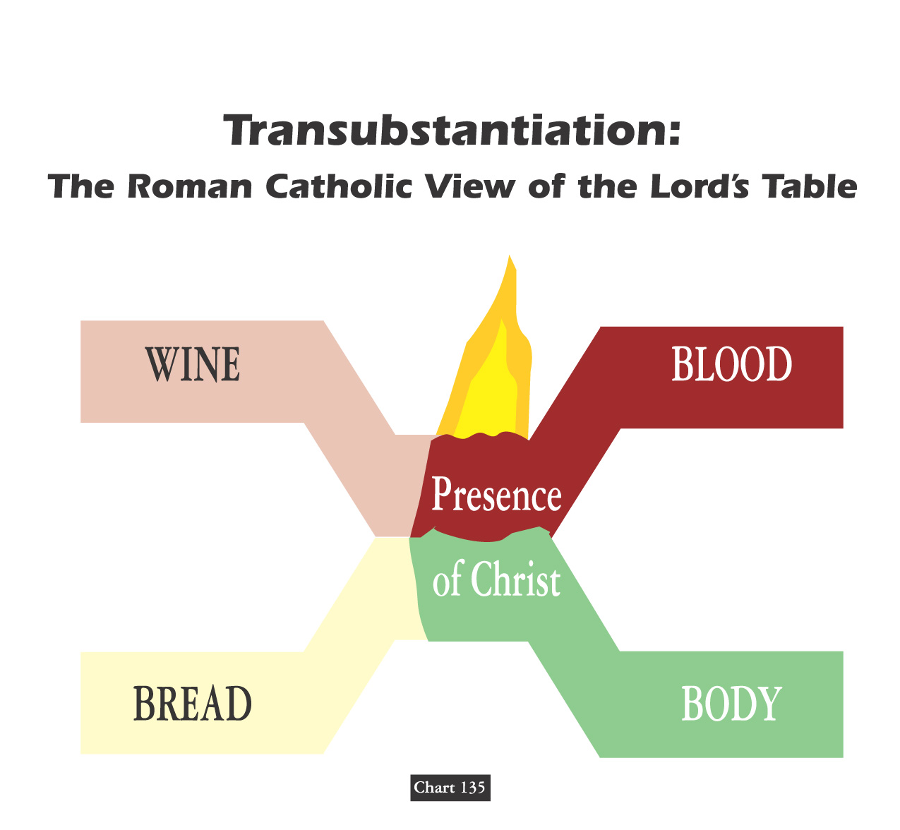


Slide 89
SACERDOTALISM
“The emphasis in the Roman Catholic tradition, especially as proclaimed in the Middle Ages, on the powers of earthly priests as essential mediators between God and humankind.”
* Dictionary Of Theological Terms, Grenz & Guretzki

Slide 90
SACRAMENTALISM
“A term used pejoratively of persons or church traditions that see the essence of Christianity as participation in the sacraments rather than as inner transform- -ation and personal piety.”
* Dictionary Of Theological Terms, Grenz & Guretzki

Slide 91
ORDINANCE
“Literally, an authoritative decree or law. Certain free-church groups refer to baptism & Lord’s Supper as ordinance rather than sacraments. In so doing highlight the voluntary nature of these rites.”
* Dictionary Of Theological Terms, Grenz & Guretzki

Slide 92
Doctrine Of The Mass
Acceptance of the concept of the Lord’s Supper as a sacrifice by the priest was a gain for the power of the papacy because it was the pope who headed the hierarchy of clergymen who alone had the power to perform the miracle of the mass.

Slide 93
CONCOMITANCE
“In Roman Catholic theology, the belief that Christ is physically present in the eucharistic elements of bread (body) and wine(blood). The doctrine was eventually used to prevent laity from partaking of the wine in case it should be accidentally spilled, desecrating Christ himself.”
* Dictionary Of Theological Terms, Grenz & Guretzki

Slide 94
TRANSUBSTANTIATION
About 831 A.D., Pascha Radbertus, a monk in the monastery of Corbie near the city of Amiens, began to teach that by a divine miracle the substance of the bread and the wine was actually changed into the body & blood of Christ. He set forth these views in a book entitled - ‘Of The Body & Blood Of The Lord.’

Slide 95
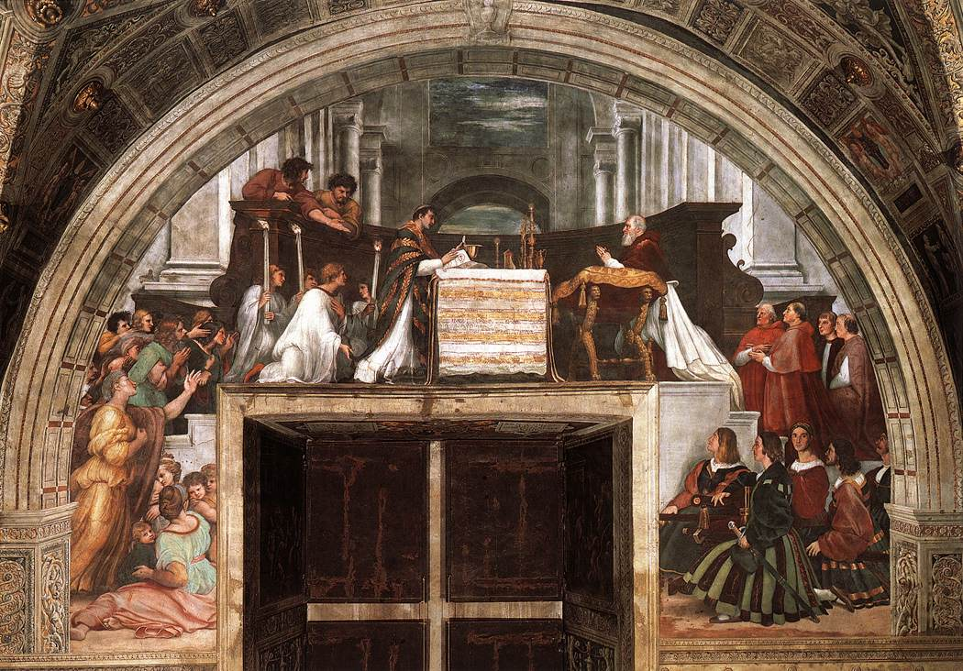
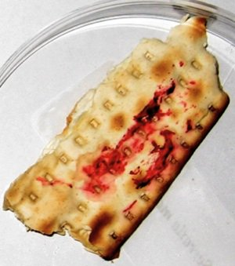
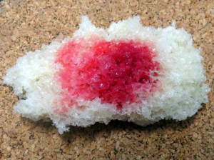
Raphael’s “Mass at Bolsena,” depicting the miracle of transubstantiation, in which the bread began to “bleed.”
The Serratia bug also has a fondness for starchy foods, and it was recognized as early as the sixth century BCE, when the philosopher and mathematician Pythagoras noted the presence of what appeared to be unusual spots of crimson blood forming on bread. It has been proposed that Serratia’s proclivity for starch may have contributed to the Catholic doctrine of transubstantiation, wherein the bread of the Eucharist represents the body of Christ.
Serratia growing on a chunk of bread

Slide 96
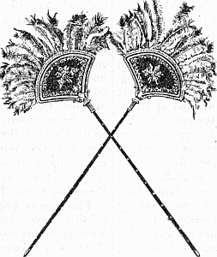
David Lee Burris:
PLAY KELLS ICONIC CLIP HERE
During Mass Flys Were Kept From
Body Of Transubstantiated Christ
By Parchment Swatter Or Feathered
FLABELLUM
Notes:
Heavenly Angels Flying Above Virgin Mother & Child Jesus Depicted In Era Art As Carrying/Utilizing Such Similar Flyswatters!

Slide 97
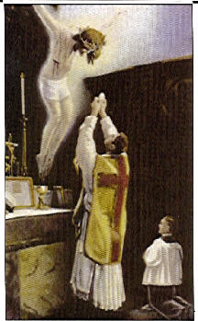



Slide 98
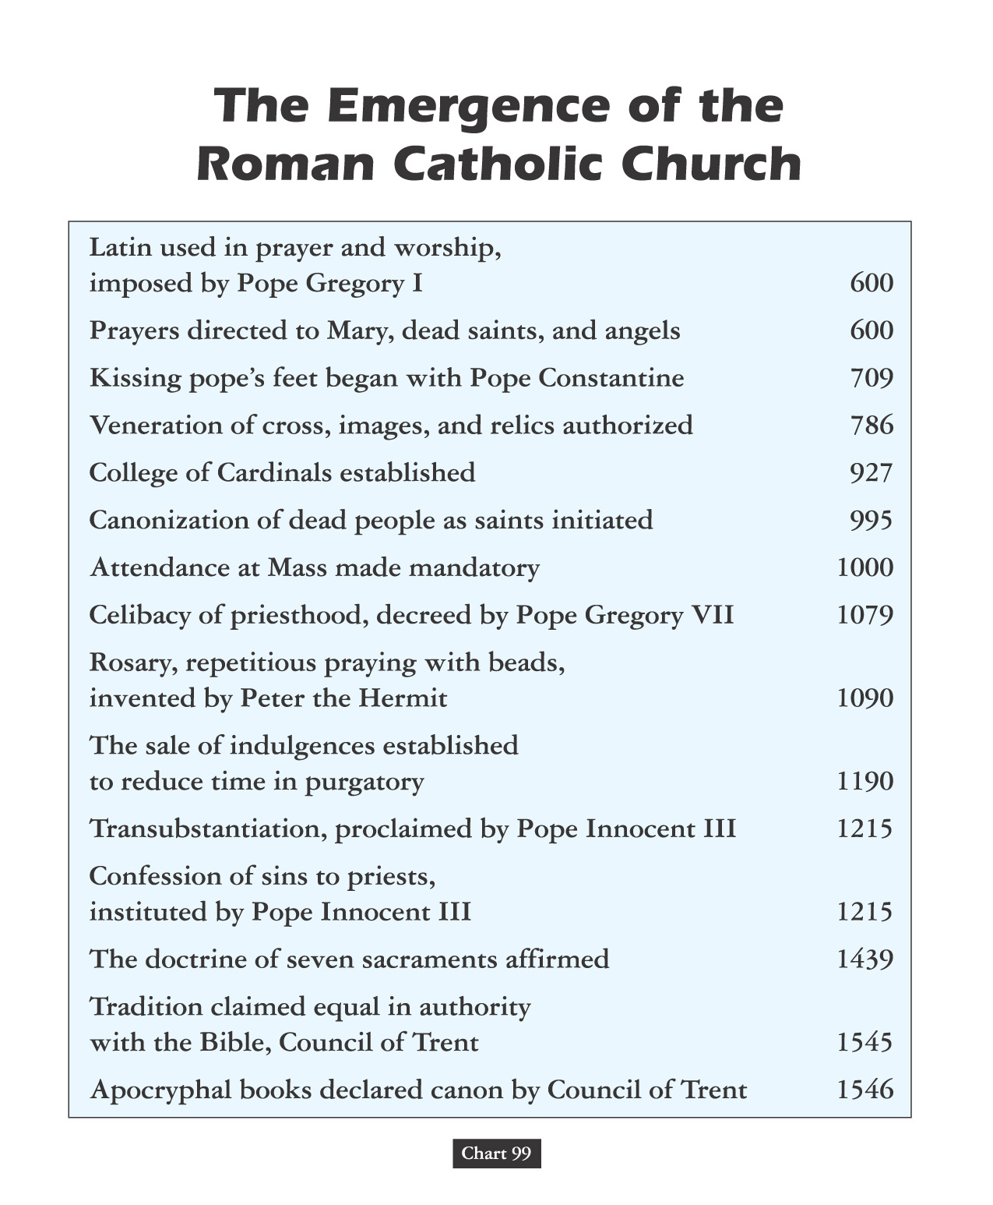

Slide 99
Transubstantiation Doctrine From The Heresy of Eutyches:
400
“As the symbols of the Lord’s body & blood are one thing before their consecration by the Priest, but after their consecration are physically changed and become quite another thing; so the Lord’s material body, after assumption, was physically changed into the divine essence.”

Slide 100
Gelasius, the Fifth Century
BISHOP OF ROME:
400
“Certainly the sacraments of the body and blood of the Lord, which we receive, are a divine thing, because by these we are made partakers of the divine nature. Nevertheless, the nature or substance of the bread and the wine ceases not to exist.”

Slide 101
754
ICONIC DEBATE LINKAGE The Council Of Constantinople
“Christ chose no other shape or type under heaven by which to represent his incarnation but the sacrament, which he delivered to his Ministers for type and effectual commemoration; commanding the substance of bread to be offered, which did not in any way resemble the form of man, that no occasion might be given to bring in idolatry.”

Slide 102
787
ICONIC DEBATE LINKAGE The Second Council Of Nice
The Second Nicene Council ordered that the sacrament is not the image or anti-type of Christ’s body and blood but is properly his body and blood. So it was - that - the doctrine of the corporeal presence in the sacrament was first introduced to support the Roman practice of image-worship!

Slide 103
Benedictine Monk Paschasius “Concerning The Body & Blood Of Christ”
831
1st – That after the consecration of the bread and wine in the Lord’s Supper, nothing remains of these symbols but the outward figure, under which the body and blood were locally present. 2nd – That the body & blood of Christ, thus present in the eucharist, was the same body as was born of the Virgin, that suffered on the cross, and was raised from the dead.

Slide 104
Benedictine Monk Paschasius THE QUESTION OF STERCORIANISM
831
Paschasius later asserted, “that bread & wine in the sacrament are not under the same laws with our other food, as they pass into our flesh & substance without any evacuation.”

Slide 105

The Sealing Blood Of The Covenant Of Grace The Mass Or Memorial Debate
Matthew 26: 28 - “My Blood Of The Covenant”
In ancient times, covenants were ratified in different ways; sometimes, for instance, the contracting parties were held to be bound by eating salt together; sometimes by partaking together of a sacrificial meal; sometimes by passing between the divided pieces of slaughtered animals; and especially by the use, still prevalent in many parts of the world, of blood, as by each of the parties tasting each other’s blood, or smearing himself with it, or letting it be mingled with his own etc., or by dipping their hands in the blood of the slaughtered animal.
* Source: "The Lord's Supper" by James M. Tolle

Slide 106
ROMAN MASS OR PROTESTANT MEMORIAL
THE COMMUNION IN ONE KIND
“We observe that this decree of the Council of Constance, although making a law of communion in one kind for the laity of the Roman Catholic Church, plainly admits that the practice of the primitive church was of all Christians receiving both the bread and the cup, even as was ordained by Christ. This is an inadvertent admission that the dogma of communion in one kind is of human & not divine origin and that, therefore, the Roman Catholic Church has departed from the practice of the primitive church. We can see from this definition {Cardinal Gibbons} that the dogmas of transubstantiation and communion in one kind are ingeniously connected together, that the Roman Catholic Church teaches that Christ, whole and entire, His soul, body, divinity, is contained in either species. To support this unscriptural doctrine, what is purported to be the Lord’s Supper is cut in half; transubstantiation justifies communion in one kind, and communion in one kind proves transubstantiation.”
* Source: "The Lord's Supper" by James M. Tolle

Slide 107
ROMAN MASS OR PROTESTANT MEMORIAL
THE COMMUNION IN ONE KIND
Concerning the necessity of each communicant partaking of the cup at the Lord’s table, Adam Clark observed,
“With respect of the bread, Jesus had before simply said, ‘Take, eat, this is my body’; but concerning the cup, he says, ‘Drink you all of this’; for as this pointed out the very essence of the institution, the blood of the atonement, it was necessary that each should have a particular application of it; therefore he said, Drink Ye All Of This By this we are taught that the cup is essential to… the Lord’s supper; so that they who deny the cup to the people, sin against God’s institution and they who receive not the cup, are not partakers of the body and blood of Christ.”
* Source: "The Lord's Supper" by James M. Tolle

Slide 108
ROMAN MASS OR PROTESTANT MEMORIAL SACRAMENT OR SACRIFICE
“The Word of God teaches us plainly that there is no other sacrifice for sin than the perfect sacrifice of Jesus. And yet Rome teaches that the Lord’s Supper is a sacrifice for sin – not a sacrament only, as Protestant churches teach, but a sacrifice. A sacrament is a sign and seal of the grace of God, but a sacrifice is the offering to God of a living body (man or animal) to wipe out our guilt in the sight of God, and thus to make possible our deliverance from the death we have deserved because of our sins. There is a very important difference between a sacrament and a sacrifice. A sacrament can never make atonement for our sin and thus cover our guilt in the sight of God. A sacrifice, if ordained by God, as were the sacrifices of Old Testament, can make atonement for sin.”
* Source: "What Rome Teaches" by Edward J. Tanis

Slide 109
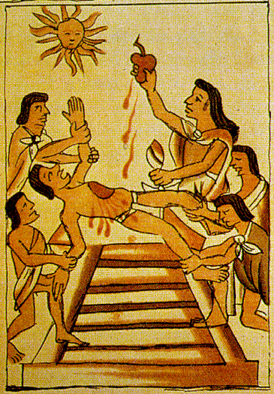
When Cortez rebuked the Aztec chief Montezuma for offering human sacrifices,
he responded with an amazing insight:
“At least we don’t eat the flesh and drink the blood of our god!”

Slide 110
ROMAN MASS OR PROTESTANT MEMORIAL SACRAMENT OR SACRIFICE
“Now Rome teaches that the Lord’s Supper is much more than a sacrament – it is nothing less than a sacrifice for sin! And Rome teaches that she is the only Church that has such a sacrifice for sin, hence the only Church that offers salvation to the people. At this point Rome is very logical. If we need the Lord’s Supper as a sacrifice for sin, the we must be members of the Roman Church. Cardinal Gibbons said ‘the Mass is another Calvary – which it is in reality.’ The mass is not identical with the conscious, suffering, bleeding, agonizing Christ of Calvary. To say that the bread on the Roman Catholic altar is the broken, bleeding body of Christ – when nobody can see that it is – is the greatest deception ever imposed upon mankind. When Jesus Christ changed the water into wine, it was wine. All the people present at the wedding in Cana of Galilee could see that the water had been changed into wine…”
* Source: "What Rome Teaches" by Edward J. Tanis

Slide 111
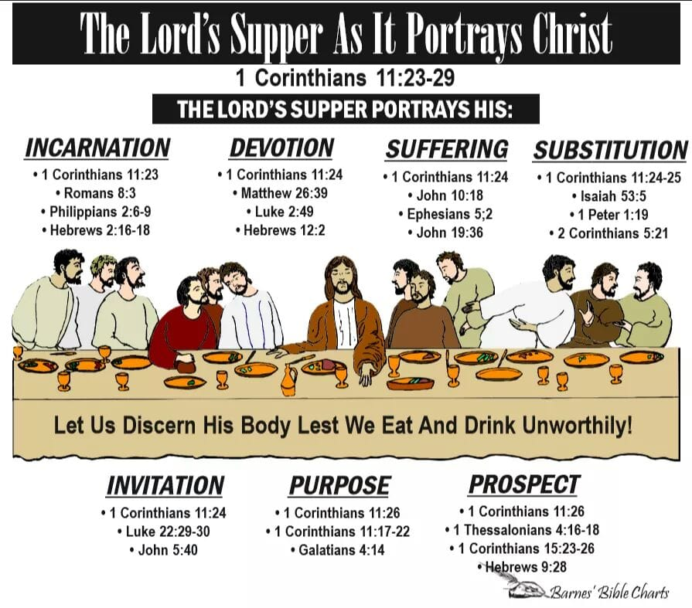

Slide 112
SACRAMENTS & SOTERIOLOGY
Classic Apologetics to Theological Systematizing
Alexandrian School Versus Antiochene School
Changes in Worship: Lord’s Supper @Sacrament
Changes in Doctrine: Believer Baptism @Salvation

Slide 113
“Teaching As Doctrines The Traditions Of Men”
WORSHIP & BAPTISM
David Lee Burris:
For Four Centuries Christians Believed Celebrating Children’s Birthdays Worldly & Pagan Ritual – Only Celebrated “Birthdays” Of Martyrs Death - Early Christians Definitely Didn’t Celebrate Christ’s Bethlehem Birth!
Justin Martyr: “Bread is presented and wine and water” Common practice - dilute wine with water - counter potency.
POURING was permitted by the Didache and practiced in regard to one on his sickbed (Cyprian), but the normal practice was immersion, in fact, trine (3 times) immersion (Tertullian).
THE EFFICACY of baptism in bringing the remission of sins was not questioned, hence many put off baptism as long as possible, lest such a powerful act be wasted before one’s life of sin was over.
Great elaboration in the BAPTISM RITUAL took place (Tertullian, On Baptism and Hippolytus, Apostolic Tradition), testifying to the high regard the ceremony was held.
The earliest definitive reference to INFANT BAPTISM is in Tertullian, who opposed the practice, but it became common in the third century and was advocated by Cyprian.

Slide 114
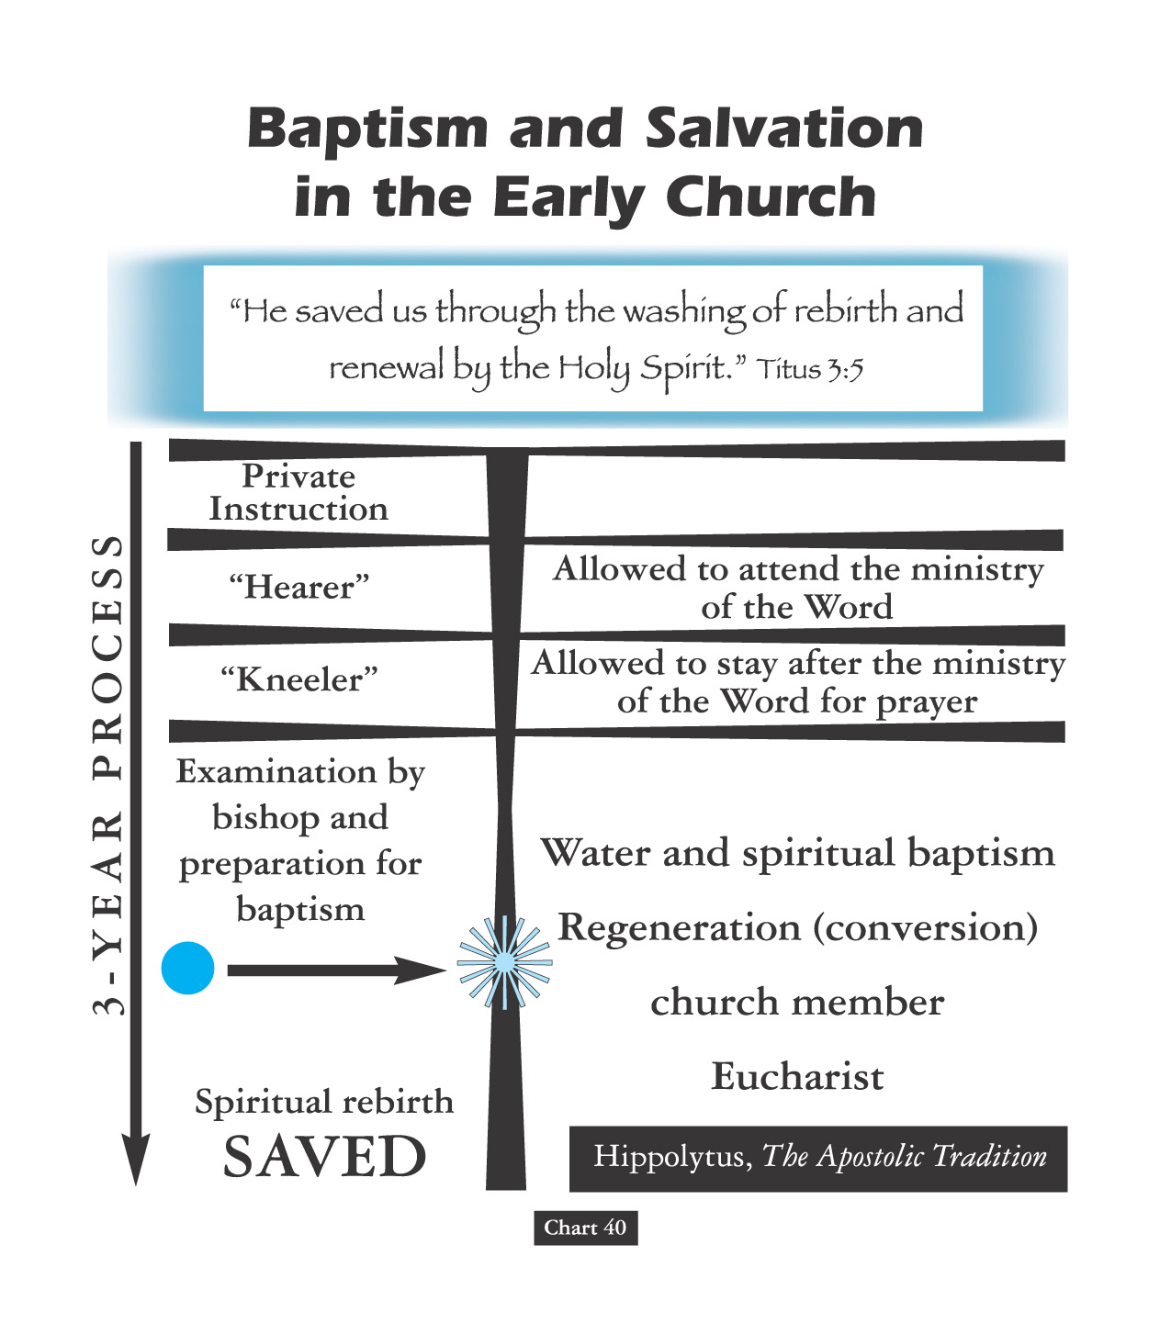
Personal Behavior Was Under Close Scrutiny For Three Years!

Slide 115
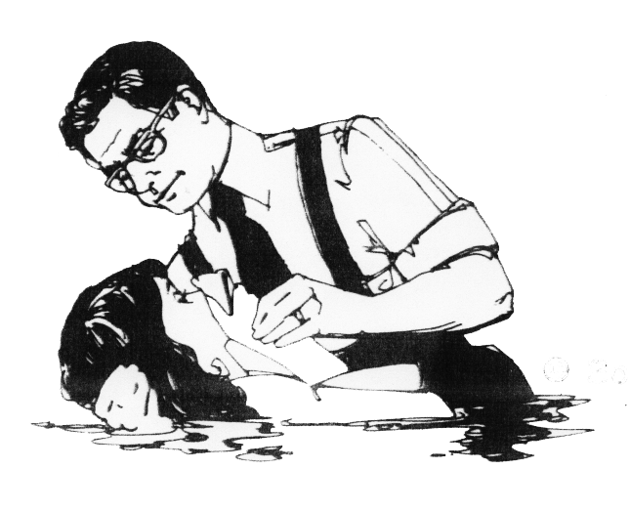
“Teaching As Doctrines The Traditions Of Men”
WORSHIP & BAPTISM
David Lee Burris:
For Four Centuries Christians Believed Celebrating Children’s Birthdays Worldly & Pagan Ritual – Only Celebrated “Birthdays” Of Martyrs Death - Early Christians Definitely Didn’t Celebrate Christ’s Bethlehem Birth!
Justin Martyr: “Bread is presented and wine and water” Common practice - dilute wine with water - counter potency.
From Everett Ferguson’s
Baptism in the Early Church
POURING was permitted by the Didache and practiced in regard to one on his sickbed (Cyprian), but the normal practice was immersion, in fact, trine (3 times) immersion (Tertullian).
THE EFFICACY of baptism in bringing the remission of sins was not questioned, hence many put off baptism as long as possible, lest such a powerful act be wasted before one’s life of sin was over.
Great elaboration in the BAPTISM RITUAL took place (Tertullian, On Baptism and Hippolytus, Apostolic Tradition), testifying to the high regard the ceremony was held.
The earliest definitive reference to INFANT BAPTISM is in Tertullian, who opposed the practice, but it became common in the third century and was advocated by Cyprian.
In the third century, Cyprian insisted that HERETICAL BAPTISM (i.e. administered by one not a member of the catholic church) was not valid but Bishop Stephen responded of Rome’s view that it is valid (if performed with the trinitarian formula) prevailed.
“Infant baptism appears in the latter half of the second century, likely developing from emergency baptisms of seriously ill infants and children.
Still, the practice was not the norm in the fourth century and was questioned into the fifth century, when Augustine’s doctrine of original sin provided it theological support in the West.”

Slide 116
“Teaching As Doctrines The Traditions Of Men”
WORSHIP & BAPTISM
David Lee Burris:
For Four Centuries Christians Believed Celebrating Children’s Birthdays Worldly & Pagan Ritual – Only Celebrated “Birthdays” Of Martyrs Death - Early Christians Definitely Didn’t Celebrate Christ’s Bethlehem Birth!
Justin Martyr: “Bread is presented and wine and water” Common practice - dilute wine with water - counter potency.
From Everett Ferguson’s
Baptism in the Early Church
POURING was permitted by the Didache and practiced in regard to one on his sickbed (Cyprian), but the normal practice was immersion, in fact, trine (3 times) immersion (Tertullian).
THE EFFICACY of baptism in bringing the remission of sins was not questioned, hence many put off baptism as long as possible, lest such a powerful act be wasted before one’s life of sin was over.
Great elaboration in the BAPTISM RITUAL took place (Tertullian, On Baptism and Hippolytus, Apostolic Tradition), testifying to the high regard the ceremony was held.
The earliest definitive reference to INFANT BAPTISM is in Tertullian, who opposed the practice, but it became common in the third century and was advocated by Cyprian.
In the third century, Cyprian insisted that HERETICAL BAPTISM (i.e. administered by one not a member of the catholic church) was not valid but Bishop Stephen responded of Rome’s view that it is valid (if performed with the trinitarian formula) prevailed.
“In time, as fewer converts were Jewish or familiar with the Old Testament, more attention was given to instruction and the ceremony evolved to convey baptism’s meaning (unclothing and re-clothing). Partial or complete nudity was practiced early on [suggesting childhood innocence, & pre-fall conditions.]”

Slide 117
“Teaching As Doctrines The Traditions Of Men”
WORSHIP & BAPTISM
David Lee Burris:
For Four Centuries Christians Believed Celebrating Children’s Birthdays Worldly & Pagan Ritual – Only Celebrated “Birthdays” Of Martyrs Death - Early Christians Definitely Didn’t Celebrate Christ’s Bethlehem Birth!
Justin Martyr: “Bread is presented and wine and water” Common practice - dilute wine with water - counter potency.
From Everett Ferguson’s
Baptism in the Early Church
POURING was permitted by the Didache and practiced in regard to one on his sickbed (Cyprian), but the normal practice was immersion, in fact, trine (3 times) immersion (Tertullian).
THE EFFICACY of baptism in bringing the remission of sins was not questioned, hence many put off baptism as long as possible, lest such a powerful act be wasted before one’s life of sin was over.
Great elaboration in the BAPTISM RITUAL took place (Tertullian, On Baptism and Hippolytus, Apostolic Tradition), testifying to the high regard the ceremony was held.
The earliest definitive reference to INFANT BAPTISM is in Tertullian, who opposed the practice, but it became common in the third century and was advocated by Cyprian.
In the third century, Cyprian insisted that HERETICAL BAPTISM (i.e. administered by one not a member of the catholic church) was not valid but Bishop Stephen responded of Rome’s view that it is valid (if performed with the trinitarian formula) prevailed.
“By the third century, triple immersion was common. Laying on of hands, practiced early, was possibly a functional gesture receiving other meanings over time, (prayer for the Holy Spirit, anointing, or marking with the sign of the cross).”

Slide 118
“Teaching As Doctrines The Traditions Of Men”
WORSHIP & BAPTISM
David Lee Burris:
For Four Centuries Christians Believed Celebrating Children’s Birthdays Worldly & Pagan Ritual – Only Celebrated “Birthdays” Of Martyrs Death - Early Christians Definitely Didn’t Celebrate Christ’s Bethlehem Birth!
Justin Martyr: “Bread is presented and wine and water” Common practice - dilute wine with water - counter potency.
From Everett Ferguson’s
Baptism in the Early Church
POURING was permitted by the Didache and practiced in regard to one on his sickbed (Cyprian), but the normal practice was immersion, in fact, trine (3 times) immersion (Tertullian).
THE EFFICACY of baptism in bringing the remission of sins was not questioned, hence many put off baptism as long as possible, lest such a powerful act be wasted before one’s life of sin was over.
Great elaboration in the BAPTISM RITUAL took place (Tertullian, On Baptism and Hippolytus, Apostolic Tradition), testifying to the high regard the ceremony was held.
The earliest definitive reference to INFANT BAPTISM is in Tertullian, who opposed the practice, but it became common in the third century and was advocated by Cyprian.
In the third century, Cyprian insisted that HERETICAL BAPTISM (i.e. administered by one not a member of the catholic church) was not valid but Bishop Stephen responded of Rome’s view that it is valid (if performed with the trinitarian formula) prevailed.
“While anointing is attested in the late second century, indications are that it was not from the apostolic era. Mid-second century on, baptisms concluded with the newly baptized joining the church for communion - in some cases accompanied with milk and honey (symbolic of newborn purity as well as the promised land).”

Slide 119
“Teaching As Doctrines The Traditions Of Men”
WORSHIP & BAPTISM
David Lee Burris:
For Four Centuries Christians Believed Celebrating Children’s Birthdays Worldly & Pagan Ritual – Only Celebrated “Birthdays” Of Martyrs Death - Early Christians Definitely Didn’t Celebrate Christ’s Bethlehem Birth!
Justin Martyr: “Bread is presented and wine and water” Common practice - dilute wine with water - counter potency.
From Everett Ferguson’s
Baptism in the Early Church
POURING was permitted by the Didache and practiced in regard to one on his sickbed (Cyprian), but the normal practice was immersion, in fact, trine (3 times) immersion (Tertullian).
THE EFFICACY of baptism in bringing the remission of sins was not questioned, hence many put off baptism as long as possible, lest such a powerful act be wasted before one’s life of sin was over.
Great elaboration in the BAPTISM RITUAL took place (Tertullian, On Baptism and Hippolytus, Apostolic Tradition), testifying to the high regard the ceremony was held.
The earliest definitive reference to INFANT BAPTISM is in Tertullian, who opposed the practice, but it became common in the third century and was advocated by Cyprian.
In the third century, Cyprian insisted that HERETICAL BAPTISM (i.e. administered by one not a member of the catholic church) was not valid but Bishop Stephen responded of Rome’s view that it is valid (if performed with the trinitarian formula) prevailed.
“By the fourth century, post-baptismal re-clothing in white represented purity and eschatological identity!”

Slide 120
“Teaching As Doctrines The Traditions Of Men”
WORSHIP & BAPTISM
David Lee Burris:
For Four Centuries Christians Believed Celebrating Children’s Birthdays Worldly & Pagan Ritual – Only Celebrated “Birthdays” Of Martyrs Death - Early Christians Definitely Didn’t Celebrate Christ’s Bethlehem Birth!
Justin Martyr: “Bread is presented and wine and water” Common practice - dilute wine with water - counter potency.
From Everett Ferguson’s
Baptism in the Early Church
POURING was permitted by the Didache and practiced in regard to one on his sickbed (Cyprian), but the normal practice was immersion, in fact, trine (3 times) immersion (Tertullian).
THE EFFICACY of baptism in bringing the remission of sins was not questioned, hence many put off baptism as long as possible, lest such a powerful act be wasted before one’s life of sin was over.
Great elaboration in the BAPTISM RITUAL took place (Tertullian, On Baptism and Hippolytus, Apostolic Tradition), testifying to the high regard the ceremony was held.
The earliest definitive reference to INFANT BAPTISM is in Tertullian, who opposed the practice, but it became common in the third century and was advocated by Cyprian.
In the third century, Cyprian insisted that HERETICAL BAPTISM (i.e. administered by one not a member of the catholic church) was not valid but Bishop Stephen responded of Rome’s view that it is valid (if performed with the trinitarian formula) prevailed.
“Regional differences guided other developments. The West began separating post-baptismal confirmation from baptism. Syrian practice associated the Holy Spirit with anointing before baptism. Other practices included foot-washing & spitting in renunciation of the devil!”

Slide 121
“Teaching As Doctrines The Traditions Of Men”
WORSHIP & BAPTISM
David Lee Burris:
For Four Centuries Christians Believed Celebrating Children’s Birthdays Worldly & Pagan Ritual – Only Celebrated “Birthdays” Of Martyrs Death - Early Christians Definitely Didn’t Celebrate Christ’s Bethlehem Birth!
Justin Martyr: “Bread is presented and wine and water” Common practice - dilute wine with water - counter potency.
From Everett Ferguson’s
Baptism in the Early Church
POURING was permitted by the Didache and practiced in regard to one on his sickbed (Cyprian), but the normal practice was immersion, in fact, trine (3 times) immersion (Tertullian).
THE EFFICACY of baptism in bringing the remission of sins was not questioned, hence many put off baptism as long as possible, lest such a powerful act be wasted before one’s life of sin was over.
Great elaboration in the BAPTISM RITUAL took place (Tertullian, On Baptism and Hippolytus, Apostolic Tradition), testifying to the high regard the ceremony was held.
The earliest definitive reference to INFANT BAPTISM is in Tertullian, who opposed the practice, but it became common in the third century and was advocated by Cyprian.
In the third century, Cyprian insisted that HERETICAL BAPTISM (i.e. administered by one not a member of the catholic church) was not valid but Bishop Stephen responded of Rome’s view that it is valid (if performed with the trinitarian formula) prevailed.
“Regional differences develop...
The mode of baptism was submersion in the East and ‘only slightly less certain’ in the West.
Small baptisteries, once taken to suggest infant baptisms, are now understood to reflect a manner of submersing adults. That is, candidates standing, sitting, or kneeling in small baptisteries were bent forward to submerge their heads under water by a ‘baptizer’ outside the baptistery.”

Slide 122


Ancient Romans Had Old Proverb
BEWARE
The First Step

Slide 123
CHANGES IN AUTHORITY
Salvation
Sins Washed
Union Christ
Faith
Repentance

Slide 124
Dialectic Rationale: Conclusions Of Consequence
"Baptism must not always be immersion,
because some do not have access to
enough water to be immersed."
CONVENIENCE NULLIFICATION

Slide 125

Dialectic Rationale: Conclusions Of Consequence
"Baptism must not always be immersion,
because some do not have access to
enough water to be immersed."
The Damp Cloth

Slide 126

The Church Across The Ages
of people, events
life and faith from
Glimpses
More Than A Building
The earliest Christians did not have church buildings. They typically met in homes. [The first actual church building to be found is at Dura Europos on the Euphrates, dating about 231.] They did not have public ceremonies that would introduce them to the public. They had no access to the mass media of their day. So how can we account for their steady and diverse expansion over the first three centuries?
After the Apostle Paul, we do not run across many “big names” as missionaries in the first few hundred years of Christian history. Instead the faith spread through a large multitude of humble, ordinary believers whose names have been long forgotten.

Slide 127
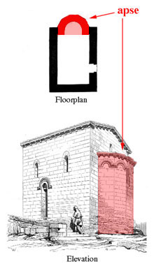
Church Administration Digression & Christian Doctrinal Accretions Architecturally Evidenced
Development In Designs:
From House Church To General Public Building To Basic Roman Temple
Constantine’s Edict of Milan in 313 soon influenced the buildings used for Christian worship. He built St. John Lateran, a church designed on the plan of a basilica, a Roman public building used for courts, etc. The basilica was a rectangular building with a semi-circular niche or “apse” opening off one of the shorter ends. This plan provided much more space for the larger congregations worshiping after 313.
The apse, where judges or other officials sat in public buildings, now became the area where the clergy sat. A throne was set up in the center of the apse for the bishop. We can see this seat in the apse of the preserved fifth-century built church in Gardo, Italy.
The arrangement of the basilica with the clergy in a separate area made for a distinct barrier between clergy and laity – hardening a broad trend begun in the 4th century. Gone were the friendly, intimate services which the Christian had held in their home.

Slide 128
Church Administration Digression & Christian Doctrinal Accretions Architecturally Evidenced
- The upper end of the building held the porch where catechumens and those under discipline (penitents) were restricted.
In the building center – between the columns – is the nave – where the choir & lower clergy sang together.
The remainder – what was considered the congregation – tended to be confined to the side aisles with men on one side and women on the other.
About this time the liturgy changed from being a service in which all participated into one said by the clergy and sung by the choir while others listened.
Correspondent uniform wearing of priestly vestment and ritual robes of rank started around this time too.
Note: The modern Greek or Eastern Orthodox Church has been defined as a frozen clock - stuck in time to these very coordinates of the 4th thru 5th Centuries. For example: The Orthodox churches still use the old Julian Calendar of the original Roman Empire for both routine religious observances and special celebrations. In other words, many of these described design features from back then can be seen in the present church buildings and church services of that church group today.

Slide 129
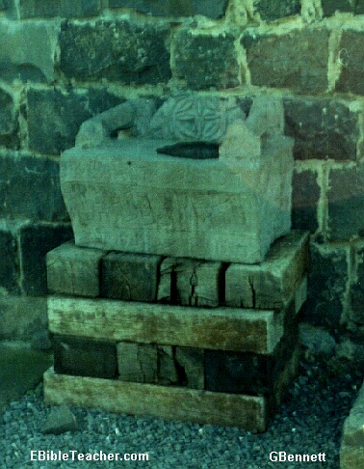

Did Judaizers Win?
David Lee Burris:
Special Days – Passover Continued With Judaizers -Celebrated Instead With Christ As The Passover Lamb – This Developed Into Easter – Then This Judaizing Accommodation As Precedent For Later Pagan Accommodation With Religious Holidays
MOSES SEATS
- & -
Sedia Gestatoria

Slide 130
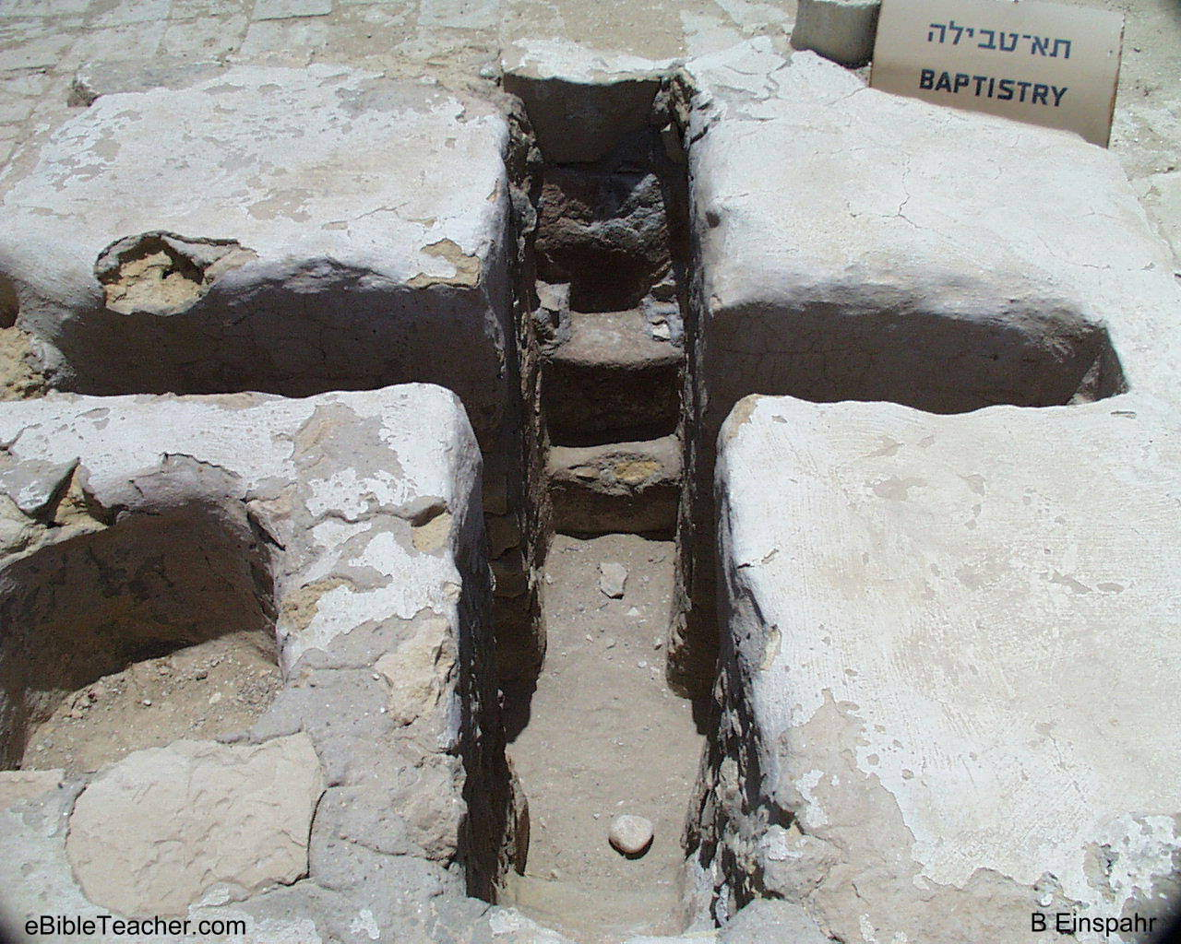
David Lee Burris:
Old Law - Man-Made Purification Ponds Held ~ 17,000 Gallons
Renounced Satan &
Baptized Three Times
Design Features Of Ritual Rite
~ 200 Hippolytus Wrote That Those That Were Baptized Then Put On New Robe & Anointed
Coptic Church Ceremony: Newly Baptized Given Milk & Honey!

Slide 131
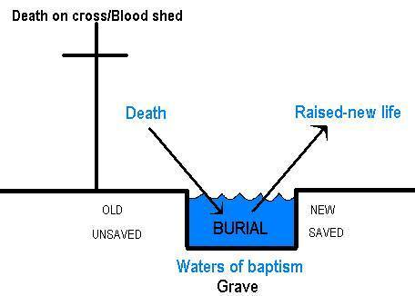
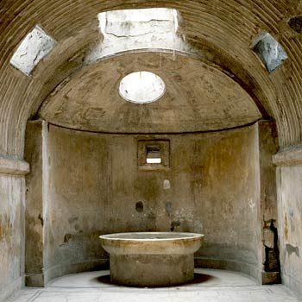
David Lee Burris:
Old Law - Man-Made Purification Ponds Held ~ 17,000 Gallons
Didache Document
Design Features Of Ritual Rite
Tertullian Guidance
HYGIENIC BODY BATH
THEN STEP DOWN
IMMERSED PURIFYING

Slide 132

BAPTISTRY WENT FROM
BEING THE IN–HOUSED
CONSTRUCTED TO
BEING A DEDICATED
ANNEX TO BEING
THE FORGOTTEN
FIXTURE !!!!!!!!!

Slide 133
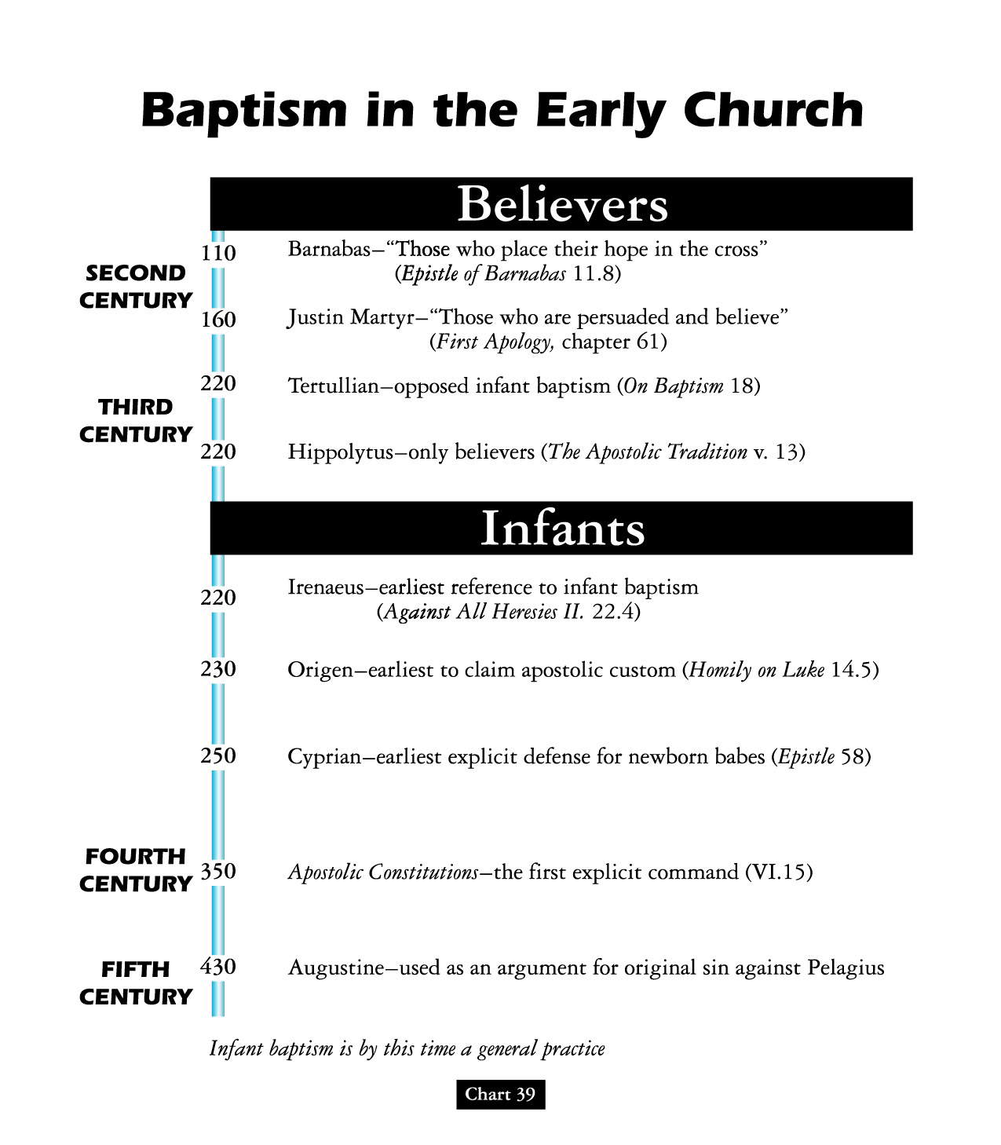

Slide 134
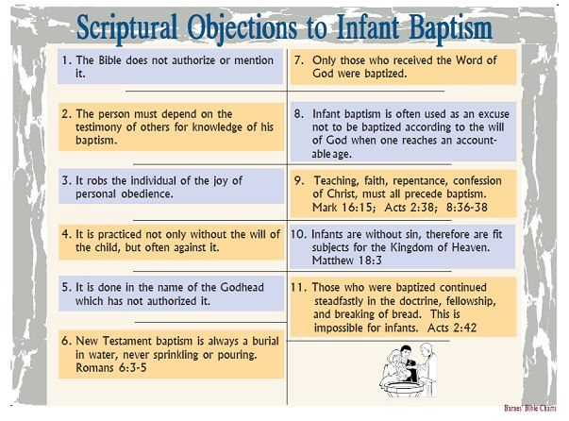

Slide 135


Slide 136


David Lee Burris:
Christian Emperor Theodosius invited Thessalonians to free games but sent his troops into the circus with orders to kill the 10,000 men, women, and children.
“The first recorded instance of Christians killing Pagans occurred shortly after {status change year 313}. In short order, the militant church extended its power by conquering lands & peoples throughout Europe, compelling them to become baptized Christians or die… As Charlemagne instructed his Christian troops in their conquest of the Saxons: ‘If there is anyone of the Saxon people lurking among them unbaptized, and if he scorns to come to baptism & stay a pagan - let him die’”.
Original Error @ ORIGINAL SIN
Inter-Generational Sinful Consequence (Exodus 34: 7)
Not Sin Inherent - Or - Guilt Imputed
(Ezekiel 18: 19 – 32)
- Gregory Boyd, Myth Of A Christian Nation
JESUS REVISITS MISCONCEPTION @JOHN 9: 1 - 5

Slide 137

INHERITING ORIGINAL SIN
THE BLAST FROM THE PAST
Posterity’s Uncritical Acceptance Of Augustine’s Christian Platonism
Platonists believed that all physical objects are simply copies of eternal, immaterial templates or Forms. This means that two objects of the same kind have a sort of connection because they both depend on the same Form. So the terrible taint of Adam can spread to those who share his Form, the Form of humanity. This inheritance concept of fatalistic disposition and consequence can similarly be linked to classic theories of genetics. It was believed that everything children inherit is received from the father alone. The mother contributed nothing material to fetal development and served simply as an incubator. It was considered a matter of simple common sense that embryo existed entire in seed form within the male before implantation. The father once existed in seed form in his father too, and so on – and so on - all the way back to the Garden of Eden - similar to a set of Russian Dolls.

Slide 138


Slide 139
“Teaching As Doctrines The Traditions Of Men”
WORSHIP & BAPTISM
David Lee Burris:
For Four Centuries Christians Believed Celebrating Children’s Birthdays Worldly & Pagan Ritual – Only Celebrated “Birthdays” Of Martyrs Death - Early Christians Definitely Didn’t Celebrate Christ’s Bethlehem Birth!
Justin Martyr: “Bread is presented and wine and water” Common practice - dilute wine with water - counter potency.
Division in the worship service between the part that all could attend (Scripture reading/ preaching) & that part only the faithful could attend (Lord’s Supper), called the disciplina arcani (“rule of secrecy”) occurred in the third century.
Ante-Nicene writings began to consider that the communion prayers were the congregations corporate thank-offering to the Lord, hence the usual designation was ‘eucharist” (thanksgiving).
Ideas related to this concept developed:
The Eucharist imparts divine life of itself, reflected in the descriptive phrase “medicine of immortality” (Ignatius).
The elements are a sacrifice offered by the priest (Cyprian).
Lastly, there is a real presence of Christ (Irenacus).
POURING was permitted by the Didache and practiced in regard to one on his sickbed (Cyprian), but the normal practice was immersion, in fact, trine (3 times) immersion (Tertullian).
THE EFFICACY of baptism in bringing the remission of sins was not questioned, hence many put off baptism as long as possible, lest such a powerful act be wasted before one’s life of sin was over.
Great elaboration in the BAPTISM RITUAL took place (Tertullian, On Baptism and Hippolytus, Apostolic Tradition), testifying to the high regard the ceremony was held.
The earliest definitive reference to INFANT BAPTISM is in Tertullian, who opposed the practice, but it became common in the third century and was advocated by Cyprian.

Slide 140
SACRAMENTS & SOTERIOLOGY
Classic Apologetics to Theological Systematizing
Alexandrian School Versus Antiochene School
Changes in Worship: Lord’s Supper @Sacrament
Changes in Doctrine: Believer Baptism @Salvation
Historicity: Catholic Confessional-Treasury of Merit

Slide 141

Persecution and Aftermath
This persecution ended with the death of Emperor Decius in AD 251.
The effects of the persecution lasted for decades:
  During the persecution, many church members sacrificed to Roman gods.
  Others obtained fake sacrifice certificates.
  Still others fled and hid from persecution.

Slide 142
Persecution and Aftermath
What about church members who obtained false certificates?
CYPRIAN SAID … | DONATUS SAID …
These church members should be given a second chance; re-admit them to the church after they show the authenticity of their repentance through prayer and fasting. | These church members were never true believers; furthermore, if one of them had been a pastor, every baptism or ordination ever performed by that pastor was invalid.

Slide 143
The Last Roman Persecution
In the early 4th century, Emperor Galerius recognized that, despite harsh persecution, most Christians still refused to worship the gods.
On his deathbed in AD 311, Galerius declared that it was legal for Christians to worship Jesus alone “as long as they don’t disturb the public order.”

Slide 144
Roman Persecution: “Getting Certified”
“There were two all-out empire-wide persecutions intended to utterly destroy the church. The first, under Decius, began in December, 249. Everyone in the empire had to get a certificate from a government officer verifying that he or she had offered a sacrifice to the gods – an act that most Christians in good conscience could not do.”

Slide 145
Hubris Event Is Historically Explanatory:
Treasury Of Merit & Auricular Confession
Decius’s persecution exposed weakness in the church after years of prosperity. When the decree was announced in Antioch, thousands of Christians surged forward in their eagerness to absolve themselves. In one North African town, there were so many applicants on the appointed day that officials had to ask many of them to return the next day.

Slide 146
Hubris Event Is Historically Explanatory:
Treasury Of Merit & Auricular Confession
“Decius’s persecution had caught the Christian community flat-footed, and many had renounced the faith. In some cases, like in the city of Carthage in North Africa, it may have been the majority of the Christians. Now many of those people were clamoring to get back in the church. The situation was unprecedented in its scope.”

Slide 147
Hubris Event Is Historically Explanatory:
Treasury Of Merit & Auricular Confession
“The problem was compounded by the fact that a new kind of martyr came out of the Decian persecution. Because Decius was trying to break people rather than kill them, many people were arrested and tortured but never executed. In previous persecutions, the number of such persons, called confessors, was relatively small. Under Decius, the number of confessors was quite large.”

Slide 148
Hubris Event Is Historically Explanatory:
Treasury Of Merit & Auricular Confession
“Because of the close relationship between the martyr and Christ in the eyes of the church, many people who were seeking forgiveness for egregious sins would go to the martyrs. Usually, with the martyr’s seal of approval on someone’s repentance, they were allowed back into the church.”

Slide 149
SUPEREROGATION
“EXCESS SUPPLY OF GOOD WORKS BY SOME SOULS CAN BE APPLIED TO OTHERS!”

Slide 150

The Confessional

Slide 151
‘Penance’ as taught by the Roman Catholics involves all the sins one has committed since one’s last confession. These sins are both public and private transgressions. They can involve behavioral sins and sins one commits within the heart.

Slide 152
The Catholic Confession also involves what is referred to as ‘satisfaction.’ In the Catechism, we read he must also ‘make amends’ or ‘expiate’ his sins – mere confession isn’t enough – there must be a payment.
- Victor M. Eskew

Slide 153

Dominant Augustinian Paradigm
The Doctrine Of Penance
Jesuit Writer On The Tariffed Penitential System:
“Tariffed Penance was the successor to canonical Penance, and got its name from the fact that every sin earned a pre- -arranged amount of penance, or a tariff. It differed from the ancient system in many ways, but one point of divergence stands out above all the rest: tariffed Penance was repeatable. The new tariffed system almost certainly developed in Ireland, about the sixth century – hence its other name – Celtic penance – but spread from there across Europe, until it had virtually replaced the ancient Penance form. Tariffed Penance grew out of the early forms of confession practiced by the desert fathers.”
- Kevin Donovan, S.J.

