Slide 1
03. RELIGIOUS HISTORY OF THE CHRISTIAN ERA
by David Lee Burris

Slide 2
Relgious History of the Christian Era Ppt. Series
Papacy
Monarchical Episcopacy
Sacraments
Five Worship Activities
Denominations
Theological Debates

Slide 3
SACRAMENTS & SOTERIOLOGY
Classic Apologetics to Theological Systematizing
Alexandrian School Versus Antiochene School
Changes in Worship: Lord’s Supper @Sacrament
Changes in Doctrine: Believer Baptism @Salvation
Historicity: Catholic Confessional-Treasury of Merit
The Godhead Three: Thee Trinitarian Controversy
Orthodoxy/Orthopraxy Brand Vs. Heretical Label
Magisterium: Canon Text–Law–Courts–Legal Curia
CONTAMINATE – CONTAINMENT - CORRUPTION

Slide 4
SACRAMENTS & SOTERIOLOGY
Classic Apologetics to Theological Systematizing
Alexandrian School Versus Antiochene School
Changes in Worship: Lord’s Supper @Sacrament
Changes in Doctrine: Believer Baptism @Salvation
Historicity: Catholic Confessional-Treasury of Merit

Slide 5
Persecution and Aftermath
This persecution ended with the death of Emperor Decius in AD 251.
The effects of the persecution lasted for decades:
During the persecution, many church members sacrificed to Roman gods.
Others obtained fake sacrifice certificates.
Still others fled and hid from persecution.

Slide 6
Persecution and Aftermath
What about church members who obtained false certificates?
CYPRIAN SAID … | DONATUS SAID …
These church members should be given a second chance; re-admit them to the church after they show the authenticity of their repentance through prayer and fasting. | These church members were never true believers; furthermore, if one of them had been a pastor, every baptism or ordination ever performed by that pastor was invalid.

Slide 7
The Last Roman Persecution
In the early 4th century, Emperor Galerius recognized that, despite harsh persecution, most Christians still refused to worship the gods.
On his deathbed in AD 311, Galerius declared that it was legal for Christians to worship Jesus alone “as long as they don’t disturb the public order.”

Slide 8
Roman Persecution: “Getting Certified”
“There were two all-out empire-wide persecutions intended to utterly destroy the church. The first, under Decius, began in December, 249. Everyone in the empire had to get a certificate from a government officer verifying that he or she had offered a sacrifice to the gods – an act that most Christians in good conscience could not do.”

Slide 9
Hubris Event Is Historically Explanatory: Treasury Of Merit & Auricular Confession
Decius’s persecution exposed weakness in the church after years of prosperity. When the decree was announced in Antioch, thousands of Christians surged forward in their eagerness to absolve themselves. In one North African town, there were so many applicants on the appointed day that officials had to ask many of them to return the next day.

Slide 10
Hubris Event Is Historically Explanatory: Treasury Of Merit & Auricular Confession
“Decius’s persecution had caught the Christian community flat-footed, and many had renounced the faith. In some cases, like in the city of Carthage in North Africa, it may have been the majority of the Christians. Now many of those people were clamoring to get back in the church. The situation was unprecedented in its scope.”

Slide 11
Hubris Event Is Historically Explanatory: Treasury Of Merit & Auricular Confession
“The problem was compounded by the fact that a new kind of martyr came out of the Decian persecution. Because Decius was trying to break people rather than kill them, many people were arrested and tortured but never executed. In previous persecutions, the number of such persons, called confessors, was relatively small. Under Decius, the number of confessors was quite large.”

Slide 12
Hubris Event Is Historically Explanatory: Treasury Of Merit & Auricular Confession
“Because of the close relationship between the martyr and Christ in the eyes of the church, many people who were seeking forgiveness for egregious sins would go to the martyrs. Usually, with the martyr’s seal of approval on someone’s repentance, they were allowed back into the church.”

Slide 13
SUPEREROGATION
“EXCESS SUPPLY OF GOOD WORKS BY SOME SOULS CAN BE APPLIED TO OTHERS!”

Slide 14
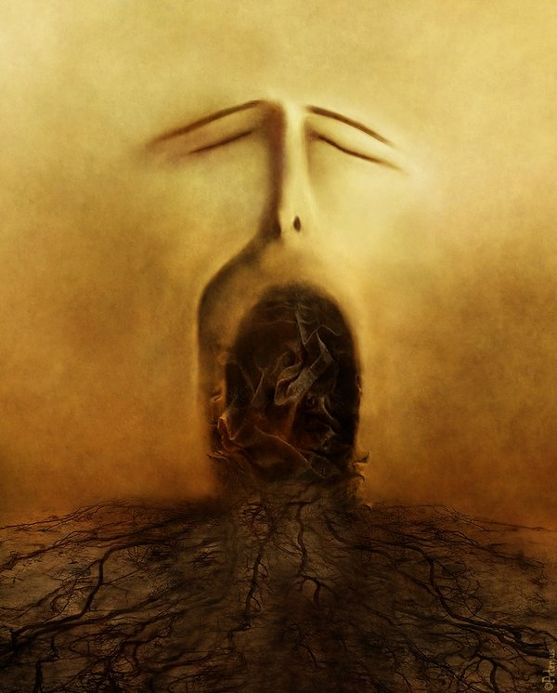
The Confessional

Slide 15
‘Penance’ as taught by the Roman Catholics involves all the sins one has committed since one’s last confession. These sins are both public and private transgressions. They can involve behavioral sins and sins one commits within the heart.

Slide 16
The Catholic Confession also involves what is referred to as ‘satisfaction.’ In the Catechism, we read he must also ‘make amends’ or ‘expiate’ his sins – mere confession isn’t enough – there must be a payment.
- Victor M. Eskew

Slide 17
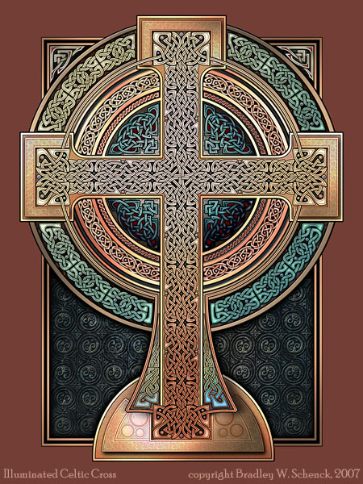
Dominant Augustinian Paradigm The Doctrine Of Penance
Jesuit Writer On The Tariffed Penitential System:
“Tariffed Penance was the successor to canonical Penance, and got its name from the fact that every sin earned a pre- -arranged amount of penance, or a tariff. It differed from the ancient system in many ways, but one point of divergence stands out above all the rest: tariffed Penance was repeatable. The new tariffed system almost certainly developed in Ireland, about the sixth century – hence its other name – Celtic penance – but spread from there across Europe, until it had virtually replaced the ancient Penance form. Tariffed Penance grew out of the early forms of confession practiced by the desert fathers.”
- Kevin Donovan, S.J.

Slide 18
SACRAMENTS & SOTERIOLOGY
Classic Apologetics to Theological Systematizing
Alexandrian School Versus Antiochene School
Changes in Worship: Lord’s Supper @Sacrament
Changes in Doctrine: Believer Baptism @Salvation
Historicity: Catholic Confessional-Treasury of Merit
The Godhead Three: Thee Trinitarian Controversy

Slide 20
THE HINGE OF HISTORY
The Incarnation of Jesus Christ

Slide 21
“Eyes and hearts enlightened by the ‘word of truth, the gospel’(Ephesians 1:13,18) know that history was not – is not – left to the caprices of men. Allowing for and accommodating man’s will and folly, the Almighty led Bible history ‘unto a dispensation of the fullness of the times, to sum up all things in Christ, the things in the heavens, and the things upon the earth(10). ‘When the fullness of the time came’ not a minute sooner or later – ‘God sent forth his son, born of a woman, born under the law’ (Galatians 4:4).

Slide 22
The Word Became Flesh
“Far and away the most startling affirmation of God’s pleasure in this physical world, however, is found in the event which biblical writers came to see as the hinge of history: the incarnation of Jesus. ‘In the beginning was the Word,’ writes John at the opening of his Gospel, ‘and the Word was with God, and the Word was God’ (John 1:1).

Slide 23
The Word Became Flesh
In the Greek culture which John addressed, this Word would immediately be understood as something fundamentally intellectual and spiritual, dwelling far above the grimy realities of this earth. Jewish readers, meanwhile would have heard allusions to the Wisdom of God.
But John proceeds to make a series of claims for this ‘Word’ which would have shaken the minds of both Jew and Greek alike.

Slide 24
The Word Became Flesh
First, says John, this ‘Word’ is intimately bound up in the material, physical world which surrounds us: ‘All things come into being through him, and without him not one thing came into being. What has come into being in him was life, and the light of all people’ (John 1:3-4).
He writes about the logos not as some mysterious, impersonal force which patterns creation, but rather as a person, one who lives and brings life, one with whom we might enter into relationship.

Slide 25
The Word Became Flesh
While this would have made perfect sense to John’s Jewish readers, who would immediately have understood John as writing about the Creator, philosophical Greek writers would have been rather startled. The idea that one could enjoy a relationship with the logos was entirely new to Greek thinking. And then John pushes his readers further still.
‘The Word became flesh,’ he writes, ‘and dwelt among us, full of grace and truth; we have beheld his glory, glory as of the only Son from the Father’ (John 1:14)
At this point John’s Jewish readers would also have been shocked. While they might have been comfortable with the idea of identifying the logos with the action of God in creation, the idea that God might become flesh – that the ordering principle of the cosmos might not only be a divine ‘person’ with whom we might be able to experience relationship but might choose to enter into his own created world in human flesh – was an astounding surprise.

Slide 26
The Word Became Flesh
And Greek readers would have been somewhat disconcerted; despite their long tradition of story myths in which the gods entered this world disguised as people or animals (or even natural forces) there was no precedent for the assertion that a divine creator might voluntarily surrender his exalted place in the heavens in order to live out a limited, vulnerable human life here on earth.”
- Christopher S. Webb, Renovare`

Slide 27
Historical Theology of the Christian Era
Orthopraxy & Orthodoxy:
A Cradle, A Cross & A Crown
The Third Thru Fifth Centuries:
Dueling Authorities & Dual Theologies
Opposed Kings & Popes; Arius vs. Athanasius
Doctrinal Developments:
Canon, Creeds, & Councils
Reference Review Justin Holcomb Books – “Know The Heretics & Creeds/Councils”

Slide 28
“Philip opened his mouth, and beginning at this Scripture, preached Jesus to him.”

Slide 30
IMPUTATION
“A transfer of benefit or harm from one individual to another. In theology imputation may be used negatively to refer to the transfer of sin and guilt of Adam to the rest of humankind. Positively, imputation refers to the righteousness of Christ transferred to those who believe on him for salvation.”
* Dictionary Of Theological Terms, Grenz & Guretzki

Slide 31
EXEMPLARISM
“The belief that Jesus’ life and ministry is primarily an example to humans of how to live uprightly before God rather than as a means of providing something that humans cannot gain on their own.”
* Dictionary Of Theological Terms, Grenz & Guretzki

Slide 32
EXPIATION
“The belief that sin is cancelled out by being covered over. For Christians, expiation suggests that Christ’s death covers our sin.”
* Dictionary Of Theological Terms, Grenz & Guretzki

Slide 33
PROPITIATION
“Atoning Sacrifice; An offering that turns away the wrath of God directed against sin.”
* Dictionary Of Theological Terms, Grenz & Guretzki

Slide 34
Vicarious Atonement
“Literally, ‘in place of.’ Hence in that Jesus died ‘for us,’ that is, took upon himself the consequences of human sin.”
* Dictionary Of Theological Terms, Grenz & Guretzki

Slide 36
THIS MESSAGE WAS OVER TIME MISUNDERSTOOD & CONVEYED INCORRECT IN COPTIC CHURCHES!
David Lee Burris:
Gnostic Gospels Became Labeled “Coptic”
Three Great Monotheistic Religions Abraham’s Legacy!

Slide 37
ATONEMENT THEORIES
DESCRIPTION
Moral Influence
A Positive Example Of Love In Action
Ransoming
Buys Lost From Sin Gains The Victory!
Satisfaction
Appease God’s Honor Robbed By Our Sin
Penal Substitution
He’s Legal Stand-In He Bears Our Guilt

Slide 38
The act by which God restores a relationship of harmony and unity between Himself and human beings. The word can be broken into three parts which express this great truth in simple but profound terms: "at-one-ment." Through God's atoning grace and forgiveness, we are reinstated to a relationship of at-one-ment with God, in spite of our sin.

Slide 40
OVERVIEW: APOSTLE TO APOSTATE PATTERN
EARLY ERROR BUILT ON THREE FALSE ASSUMPTIONS
#1 Assumption: Paul Convert Clement Received As Apostle
#2 Assumption: Origen Explains Trinity Concept Sequential
#3 Assumption: Irenaeus Portrays Jesus Mother @Anti-Eve

Slide 41
From Origen A False Controversy
Origen believed that God the Father, the Christ logos, and the Holy Spirit represent three aspects of the godhead. He thought of them as having a hierarchical relationship; that is, the Father generates the Son, who generates the Holy Spirit. The image he liked to use was an eternal torch, one lighting the other. That effort [book Timaeus] was to reconcile Christian thought with the three realities of Plato.
Churches in western Europe had added the word filioque (“and the Son”) to the Nicene Creed in the AD 500s

Slide 42
The Filioque Controversy
Eastern Christians recited, “The Holy Spirit … proceeds from the Father.”
Western Christians recited, “The Holy Spirit … proceeds from the Father and the Son.”
THE ABSOLUTE TRUTH IS THAT BOTH CHURCHES WERE VERY WRONG.
NEITHER SON NOR SPIRIT WERE LIKE ANGELS OF SPECIAL CREATION, & NEITHER PROCEEDED FROM GOD.

Slide 43
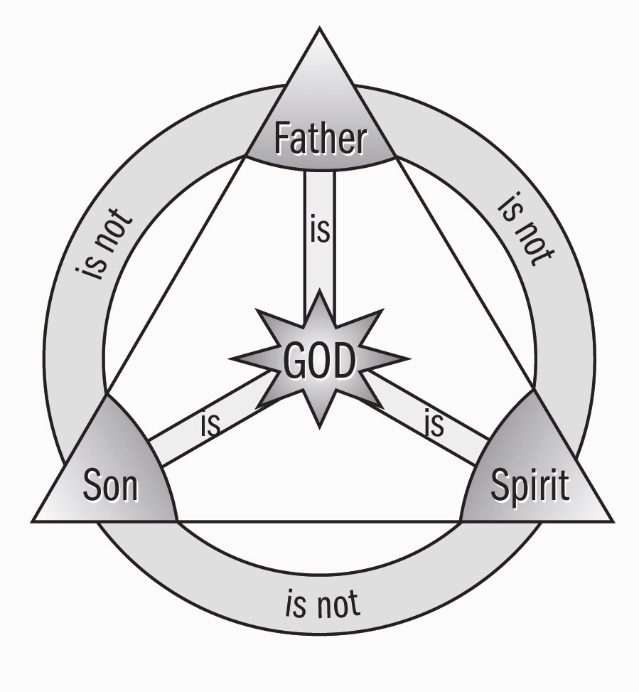
"My Echo, My Shadow, & Me" ?
The Theoanthropic Debate Begins

Slide 44
OVERVIEW: APOSTLE TO APOSTATE PATTERN Christology Debate: Theoanthropic Gnosticism
Ebonites
Processionists
Subordinationism
Monarchianism
Cerinthianism
Adoptionism
Modalism
Sabellianism
Patripassianism

Slide 45
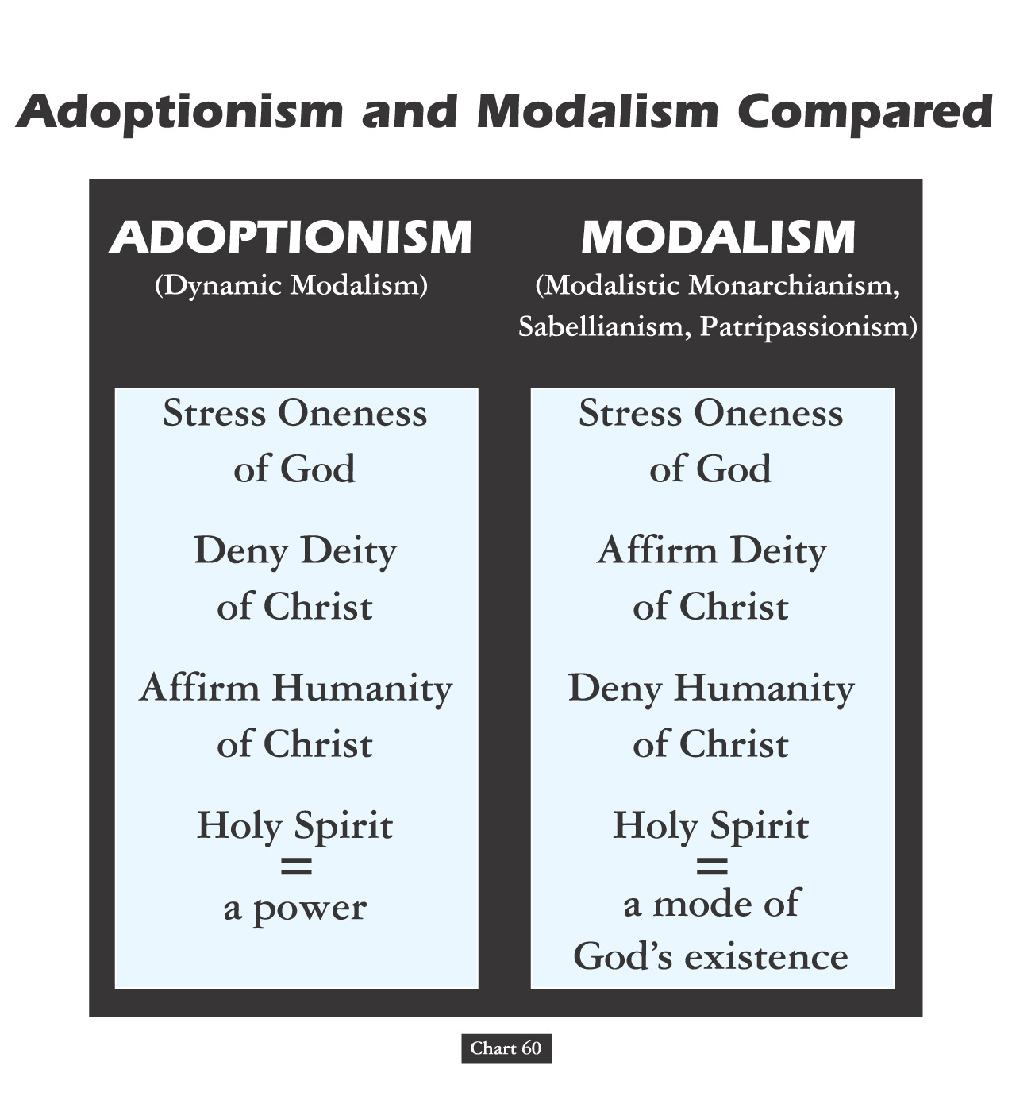

Slide 46
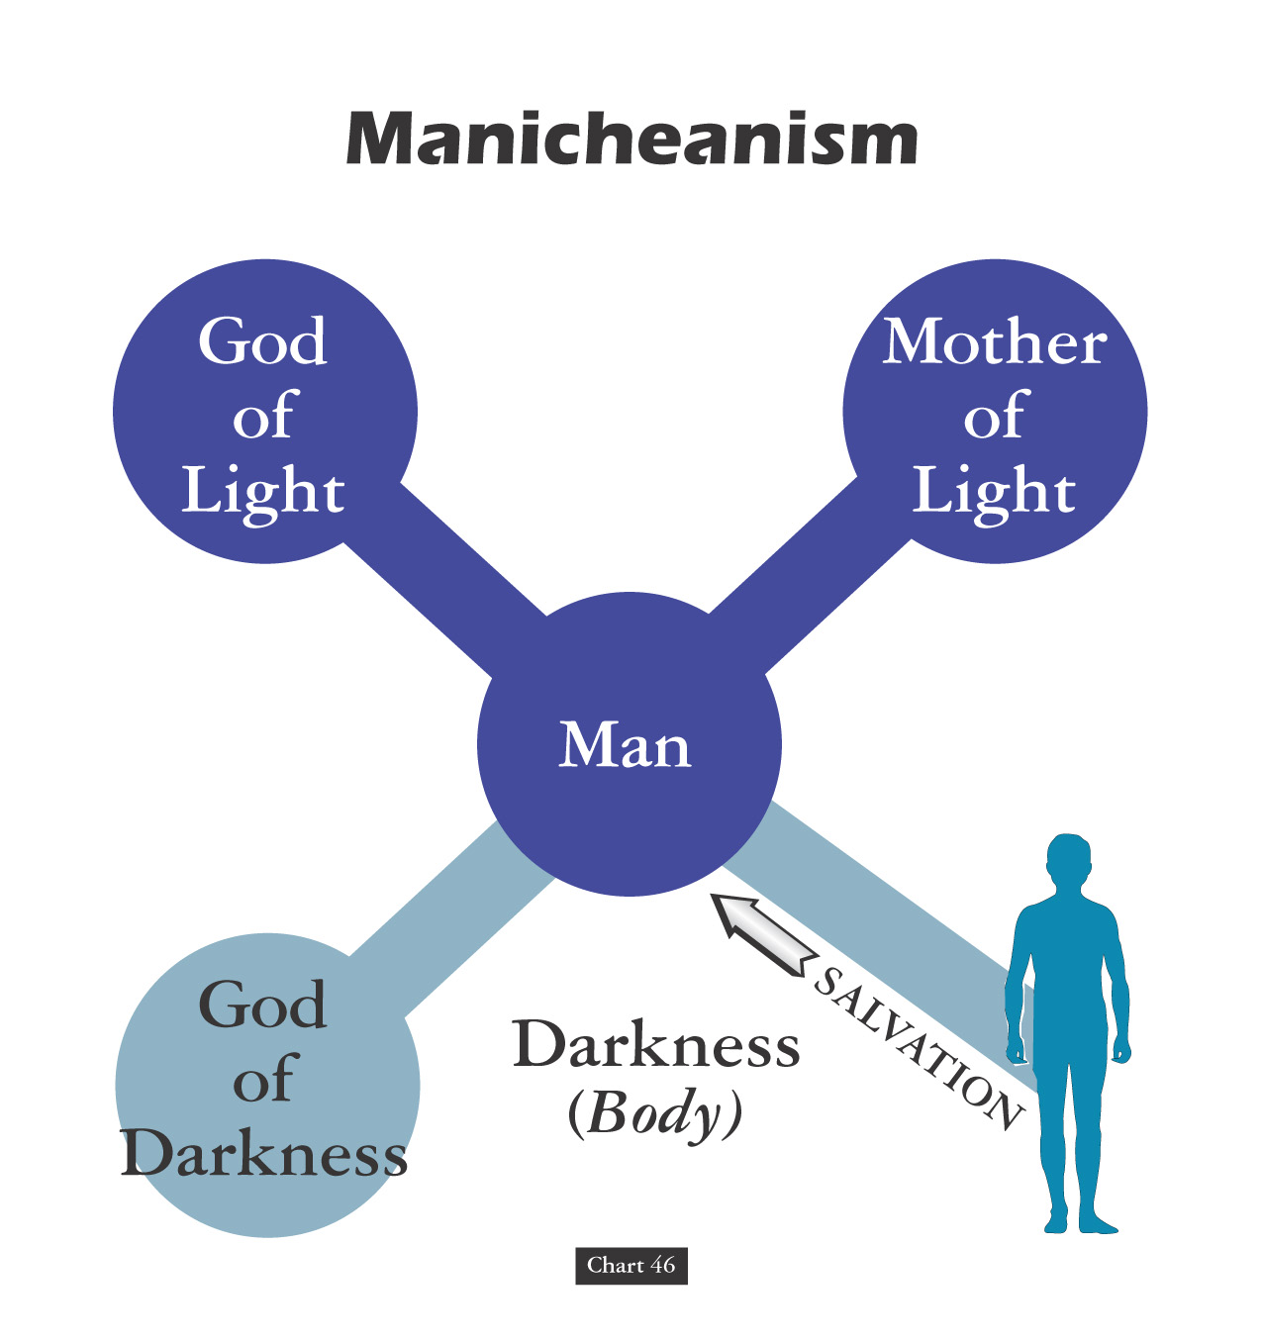
DITHEISM

Slide 47
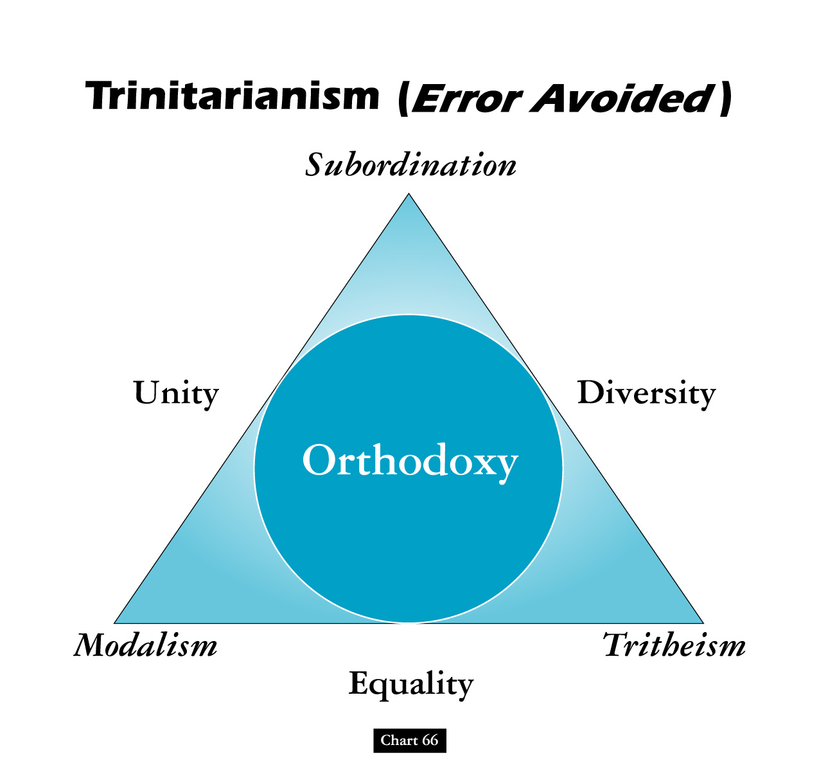

Slide 48
David Lee Burris:
The Doctrine Of Novatian – the “pure ones” – they refused to fellowship those who had committed heinous crimes after baptism regardless of their repentance. They withdrew themselves from other churches who practiced contrary to them and refused to fellowship those who came from other churches without rebaptizing them.
"My Echo, My Shadow, & Me" ?
Study Review:
MANICHAEAN
C A T H A R S
The Theoanthropic Debate Continued

Slide 49
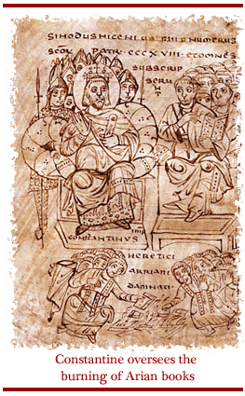
OVERVIEW: APOSTLE TO APOSTATE PATTERN Christology Debate: Theoanthropic Gnosticism
Marcionism
Docetism
Ditheism
Manicheaism
Catharism
ARIANISM
Apollinarianism
Nestorianism

Slide 50
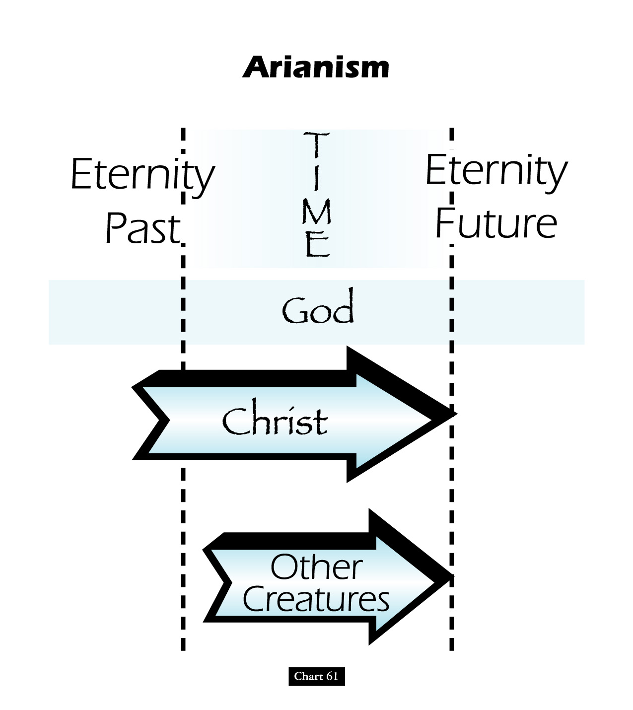

Slide 51
Battle Over An “i”: Homoousios or Homoiousios?
David Lee Burris:
Begins Innocent Enough But Ends Questioning Bible’s Inclusion Of Birth Narrative
Father God & God’s Son “Identical or Similar”? Gregory of Nyssa said of Constantinople in 378: “In this city if you ask anyone for change, he will discuss with you whether the Son is begotten …
AriansWatchword: “dissimilar” (anomoios)
Semi-Arians Watchword: “similar” (homoios)
Nicaeans Watchword: “of identical substance” (homoousios)
Cappadocians Watchword: “of like substance” (homoiousios)

Slide 52
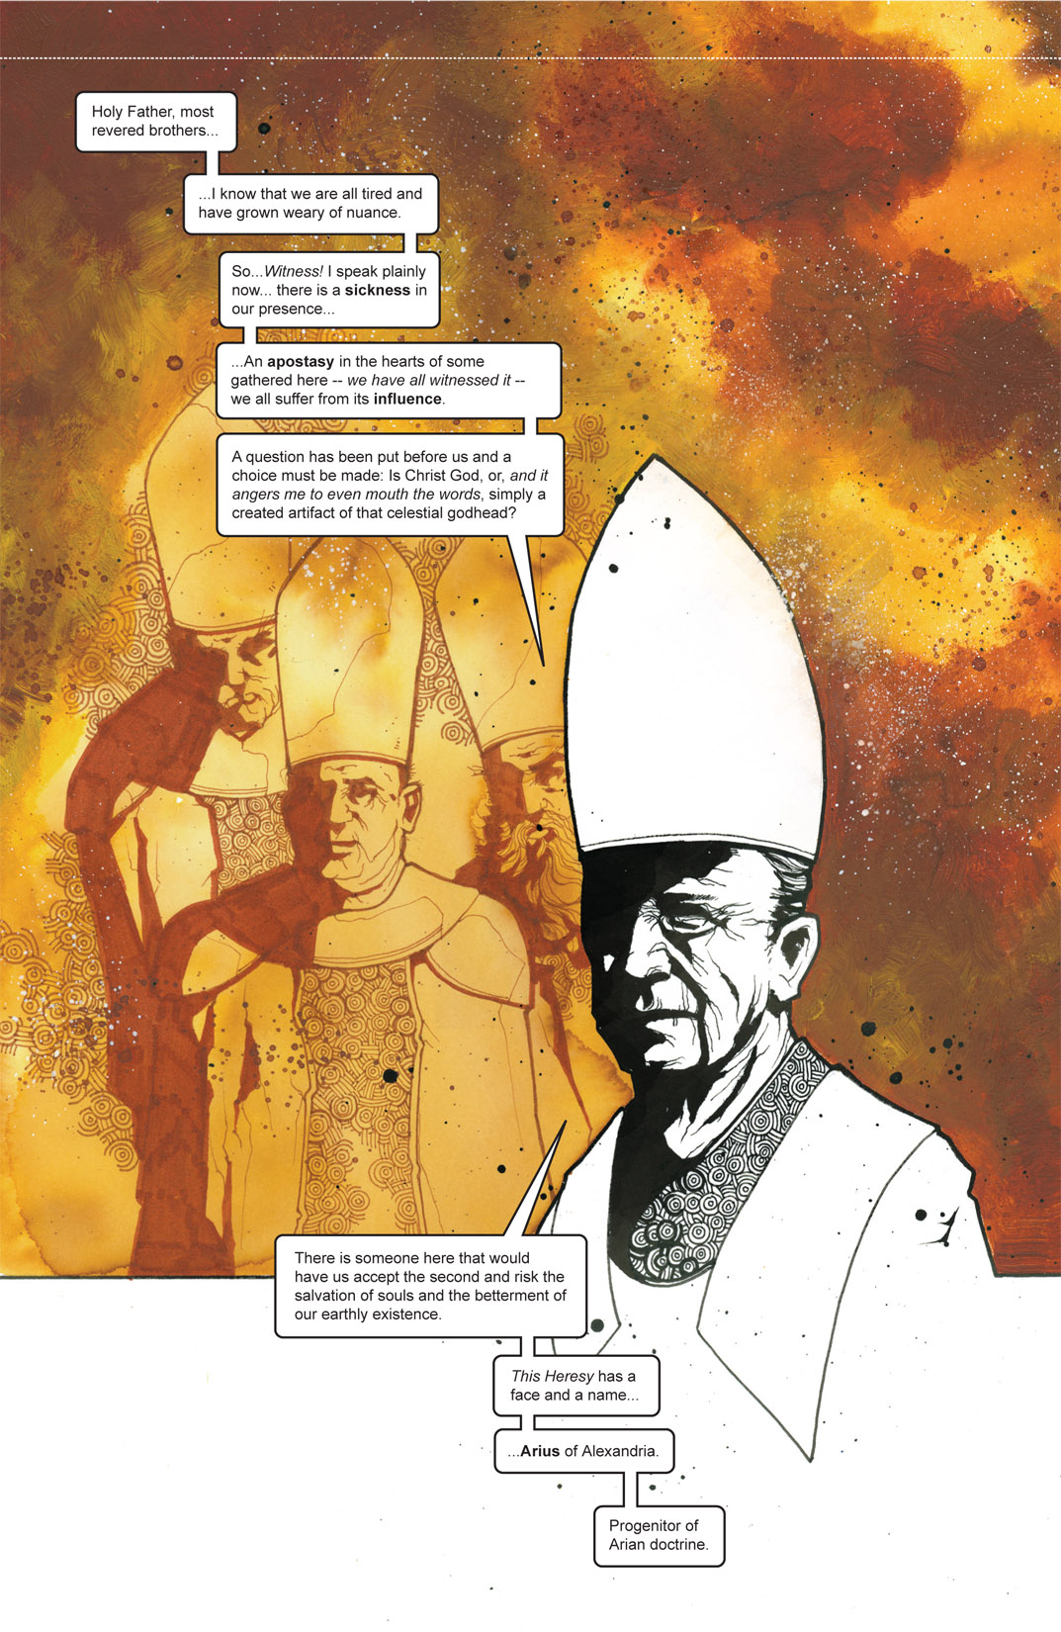

Slide 53
Arian Or Nicaean “Or Else”: The Debate “Unto Death”
David Lee Burris:
Shakespeare – “We Few, We Happy Few, We Band Of Brothers; For Whoever Has Shed His Blood With Me Shall Be My Brother” [Henry V]; It Is About Christ’s Blood Not Ours
Foxes Book Of Martyrs Notes From 363 a.d.:
“In Alexandria, innumerable were the martyrs who suffered by the sword, burning, crucifixion, and stoning. In Arethusa, several were ripped open & corn being put in their bellies, swine were brought to feed therein, which in devouring the grain, likewise devoured the entrails of the martyrs…”

Slide 54
SACRAMENTS & SOTERIOLOGY
Classic Apologetics to Theological Systematizing
Alexandrian School Versus Antiochene School
Changes in Worship: Lord’s Supper @Sacrament
Changes in Doctrine: Believer Baptism @Salvation
Historicity: Catholic Confessional-Treasury of Merit
The Godhead Three: Thee Trinitarian Controversy
Orthodoxy/Orthopraxy Brand Vs. Heretical Label

Slide 55
David Lee Burris:
Christian Emperor Theodosius invited Thessalonians to free games but sent his troops into the circus with orders to kill the 10,000 men, women, and children.
“The first recorded instance of Christians killing Pagans occurred shortly after {status change year 313}. In short order, the militant church extended its power by conquering lands & peoples throughout Europe, compelling them to become baptized Christians or die… As Charlemagne instructed his Christian troops in their conquest of the Saxons: ‘If there is anyone of the Saxon people lurking among them unbaptized, and if he scorns to come to baptism & stay a pagan - let him die’”.
Orthodox Versus HERETIC
Heresies are inaccurate choices in light of non-negotiable realities: “Heresy is an opinion or doctrine in philosophy, politics, science, art, etc., at variance with those generally accepted as authoritative” (Oxford English Dictionary) Heresies are incorrect choices, based on some generally accepted authority. From a Christian perspective, heresies are claims contradicting the clear objective truths described in the Bible. Irenaeus (the ancient apologist and disciple of Ignatius and Polycarp) made careful distinctions between heresies and apostolic truth. In “Against Heresies”, Irenaeus laid out the heretical claims of some of his errant contemporaries, and compared these claims to the truths he had been taught by Polycarp (the disciple of the Apostle John). Irenaeus referred to his own beliefs as “orthodox”. This word is derived from two Greek root words: Orthodox = Ortho (Right) + Dox (Belief) In essence, Irenaeus used the word to describe those beliefs supported by the apostolic, Biblical teaching. The idea of a “right belief” presumes there are objectively accurate Christian truths, and the Bible is the authority upon which we discover these “right beliefs”. Like all humans, Christians ground truths in an authoritative text. - COLD CASE CHRISTIANITY
- Gregory Boyd, Myth Of A Christian Nation

Slide 56
Doctrinal Developments: Thesis – Anti-Thesis-Synthesis Canon Creeds Councils

Slide 57
The Primary Versus Plenary Sense Of Scripture

Slide 58
How Did the Churches Respond?
Christians responded by:
1. Clarifying what sort of Christian writings should be authoritative or canonical.
2. Summarizing their faith in a confession known as the Rule of Faith.
3. Giving bishops (overseers) in certain cities the responsibility for maintaining doctrinal integrity in their churches.

Slide 59
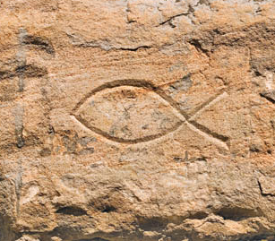
Confessions of Faith
The Greek word for fish (ichthus) represented a confession of faith among early Christians:
Iesous (Jesus)
Christos (Christ)
Theou (Divine)
Uios (Son)
Soter (Savior)
Notes:
Image: © Bill McKelvie

Slide 60
Confessions of Faith
In the 2nd century, a more comprehensive confession of faith emerged.
This confession of faith was repeated when a new believer was baptized to distinguish between faithful Christians and Gnostics.
It became known as the Rule of Faith, later as the Apostles’ Creed.

Slide 61
The Rule of Faith
Do you believe in God the Father, the Ruler of all things? Do you believe in Christ Jesus, God’s Son, who was born by the Holy Spirit through the virgin Mary; was crucified under Pontius Pilate; died, was buried, and rose again on the third day alive from the dead; ascended into heaven; sat at the Father’s right hand; and will come again to judge the living and the dead? Do you believe in the Holy Spirit, the holy church, and the resurrection of the flesh?

Slide 62
The Council of Nicaea—AD 325
In the early 4th century, Arius of Alexandria began to teach that Jesus was not eternal God.
The followers of Arius sang in the streets, “There was a time when the Son did not exist!”

Slide 63
The Council of Nicaea—AD 325
Those who rejected Arius responded with the Gloria Patri: “Glory be to the Father and to the Son and to the Holy Ghost; as it was in the beginning, is now and ever shall be, world without end.”
To maintain peace, Constantine convened a council in the village of Nicaea, in northern Asia Minor.
More than 300 bishops made their way to Nicaea; many elders and deacons—including Athanasius of Alexandria—were also present.

Slide 64
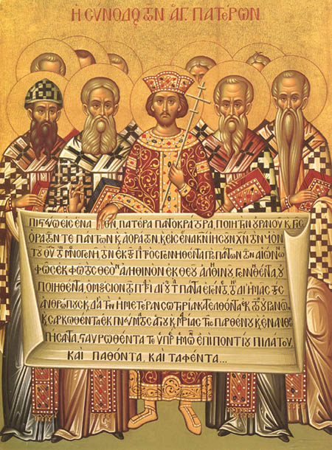
The Council of Nicaea—AD 325
On July 4, 325, Constantine called the council to order and declared himself a bishop and an apostle.
When Arius stated that Jesus had not existed eternally, all but two bishops agreed that this contradicted Scripture.
The Nicaea Council Creed responded to Arius’ heresy.
Emperor Constantine and the First Council of Nicaea

Slide 65
The Nature of Jesus
Was the recognition of Jesus as God really the result of a vote?
Notes:
Links on this slide will be activated in PowerPoint Show mode

Slide 66
The Nature of Jesus
Jesus as God
The Facts:
A council of more than 300 church leaders met in the city of Nicaea, nearly 300 years after Jesus’ death.
Their purpose was not to declare Jesus divine.
Notes:
Links on this slide will be activated in PowerPoint Show mode

Slide 67
The Creed of Nicaea
“We believe in one God, the Father, almighty creator of all things visible and invisible. We believe in one Lord, Jesus Christ, God’s Son, begotten from the Father, uniquely begotten from the Father’s essence; God from God, Light from Light, very God from very God; begotten not created, of one essence with the Father.
(Continued on Next Slide)
Notes:
Continued on next slide.

Slide 68
The Creed of Nicaea
Through him all things were made, in heaven and earth; for us humans and for our salvation, he came down and was made flesh—was made human—suffered, and rose again the third day;* he ascended into heaven and is coming to judge the living and the dead.
* Apostle’s Creed States Christ
Before Descended Into Hell;
Tenet of Error Compounded
(Continued on Next Slide)
Notes:
Continued on next slide.

Slide 69
The Creed of Nicaea
We believe in the Holy Spirit. The universal apostolic church curses all who say, ‘There was a time when he was not’ and ‘Before he was begotten, he was not’ and ‘He came out of nothing,’ or those who pretend God’s Son is of another substance or essence or created or variable or changeable.”
Notes:
This is the end of the Nicene creed. Click on the bottom right corner to return.

Slide 70
Determining Tradition

Slide 71
3 COUNCILS W/ 3 CREEDS
David Lee Burris:
Trials Of Belief; Synod = Court Of Jesus
@ NICAEA(325 a.d.) Arius Found Heretic
@ Constantinople (381 a.d.) East Evolve Triune Conventional
@ Chalcedon(451) Rome Second Class
Separate Christologies: Incarnate Terminology
Nicene Creed: Ancient Addition To Apostles; In 3 part for Godhead.
Formal Adoption Of Refined Creedal Of Athanasius Of Egypt.
Creed Further Formulated: Phrase “in two natures”; East word person=nature;
Start Point Church Split: Chalcedonian/Eutychian

Slide 72
Council of Chalcedon (451)
Why? Monophysites claimed that Jesus’ divine nature swallowed up his human nature.
What happened? Bishops affirmed that Jesus was one person with two natures: “Christ [is] ... recognized in two natures, without confusion, division, or separation ... but not as if Christ were parted into two persons.”

Slide 73
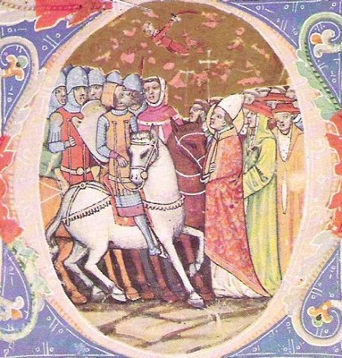
Council of Chalcedon (451)
Bishop Leo of Rome sent a “Tome” to Chalcedon that influenced the decisions there.
In 452, Leo also convinced Attila the Hun not to destroy Rome.
Attila Meeting Leo of Rome
Notes:
Image: Attila Meeting Pope Leo the Grea (c. 1360)

Slide 74
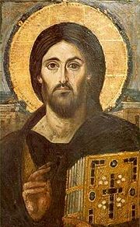
Council of Constantinople II (Again 553)
Why? Monophysite theology became popular again.
What happened? The council denounced both Nestorians and Monophysites.

Slide 76
Different Eastern Churches Accept Different Councils
THE GREEK ORTHODOX CHURCHES RECOGNIZE THE FIRST SEVEN
ARMENIAN ORTHODOX CHURCHES RECOGNIZE THE FIRST THREE
THE ETHIOPIAN COPTIC CHURCHES RECOGNIZE THE FIRST THREE
SCHISMATIC NESTORIAN CHURCHES RECOGNIZE THE FIRST TWO

Slide 77
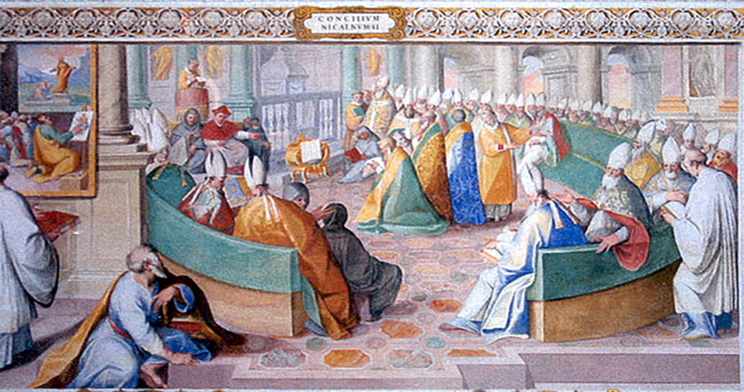
* 2nd Nicaea Last Ecumenical Of Eastern Church
* After 1123, Councils Are For Purposes Of The Pope

Slide 78
A creed, sometimes called a confession or rule of faith is an authoritative statement in a precise written form.
They declare religious beliefs established by other men of other times
Many people value the teachings and precepts of men as though they were the voice of God speaking through men.
When men regard the teachings of men as having authority in religion, they often follow them banking their salvation on it.

Slide 79
Explaining The Meaning of Scripture !
Many today look at their creeds as scripture
They use their creeds to explain their beliefs to their own followers as a means of understanding scriptures
Most of the Bible is too hard for a lay person to even grasp or understand and you need us to explain it to you.
Most denominations have a group that tell it’s members what they are to believe and follow.

Slide 80
Creeds Used To Establish Consensus !
Creeds are often written with the goal to establish a consensus or general agreement in what is believed by all the members of a certain group
Creeds are given to maintain unity and group solidarity as a congregation or denomination
This is our position as it relates to women preachers, homosexuality, marriage, divorce or diversity.

Slide 81
Why Do People Follow Creeds of Men !
They fail to study the Bible for themselves and depend on others for their knowledge – check with my pastor
They want quick answers to tough questions that bother them
They put more trust in men than God
Creeds, commentaries, magazines, internet sites, well known preachers are not a formidable replacement for the sacred scriptures inspired by almighty God.

Slide 82
The Obvious Weaknesses of Creeds !
They are not inspired – they are from men not God
They are grossly insufficient when it comes to the needs of the believer as it provides either too much or too little
They do not build genuine faith – remember without knowledge of scripture, people will lack saving faith.
They promote division- unity comes from all believing the same thing and being perfectly joined together in the same mind and judgment

Slide 83
Taking a look at “Creeds of Men”

Slide 84
Of the three great Ecumenical Creeds of Christianity (Apostles’ Creed, Nicene Creed, and the Athanasian Creed) the simplest, and at least in the Western Church, also the most widely accepted one is the Apostles’ Creed.
We can trace the Creeds' roots to Jesus himself. In their efforts to carry out the Savior's commission to “Baptize in the name of the Father and of the Son and of the Holy Spirit” (Matthew 28 :19,20), early Christians usually asked candidates for baptism to confess what they believed about the Holy Trinity.

Slide 85
History of the Nicene Creed
In 325A.D. Emperor Constantine the Great called together a Council at a city called Nicaea (present-day northwest Turkey ). The task assigned to this council was to address a controversy brought up by a man named Arius who said that Jesus Christ was only a man, not true God.
The words of the Nicene Creed, therefore, highlight the fact that Jesus Christ is true God. This Creed describes Jesus as “God from God, Light from light; true God from true God… of one being with the Father.” It focuses on who Jesus is: he is not a separate entity from God or an addition to God. He is the true God.
Since this Creed highlights who Jesus is, we speak the Creed on Communion Sundays when we partake of the true body and blood of Christ in, with, and under the bread and wine. Both in the Supper and in the Nicene Creed we confess that Jesus Christ is “God in flesh.”

Slide 86
NICENE CREED 325 A.D.
I believe in one God, the Father Almighty, Maker of heaven and earth, and of all things visible and invisible.
And in one Lord Jesus Christ, the only-begotten Son of God, begotten of the Father before all worlds; God of God, Light of Light, very God of very God; begotten, not made, being of one substance with the Father, by whom all things were made.
Who, for us men for our salvation, came down from heaven, and was incarnate by the Holy Spirit of the virgin Mary, and was made man; and was crucified also for us under Pontius Pilate; He suffered and was buried; and the third day He rose again, according to the Scriptures; and ascended into heaven, and sits on the right hand of the Father; and He shall come again, with glory, to judge the quick and the dead; whose kingdom shall have no end.
And I believe in the Holy Ghost, the Lord and Giver of Life; who proceeds from the Father and the Son; who with the Father and the Son together is worshipped and glorified; who spoke by the prophets. And I believe one holy catholic and apostolic Church. I acknowledge one baptism for the remission of sins; and I look for the resurrection of the dead, and the life of the world to come. Amen. (from Creeds of the Church)

Slide 87
The Bible Can Make Us Perfect
2 Peter 1:3 According as his divine power hath given unto us all things that pertain unto life and godliness, through the knowledge of him that hath called us to glory and virtue:
4 Whereby are given unto us exceeding great and precious promises: that by these ye might be partakers of the divine nature, having escaped the corruption that is in the world through lust.
Tim 2:4-5 Who will have all men to be saved, and to come unto the knowledge of the truth. 5 For there is one God, and one mediator between God and men, the man Christ Jesus;

Slide 88
The Athanasian Creed was the last of the three Ecumenical Creeds to be written. This Creed, like the Nicene Creed, was written in defense of the true teachings of Scripture and to reject doctrinal errors that were present at the time. This Creed is a strong statement that the faith of the Christian rests on the clear statements of Scripture alone even when we are not able to rationalize them. The following is a brief history of how the Athanasian Creed came to be and a short explanation of why it was written.

Slide 89
ATHANASIAN CREED
Named after Athanasian but not thought that he penned it
Written between 450 and 670 AD
Written in defense of the Triune of God
Written also to prove that Jesus was both divine and human
Written to give assurance of the redemption of man by Christ
Whoever wishes to be saved must, above all else, hold true to the Christian faith. Whoever does not keep this faith true in all points will certainly perish forever.

Slide 90
ATHANASIAN CREED
1 Whosoever will be saved, before all things it is necessary that he hold the catholic faith; 2. Which faith except every one do keep whole and undefiled, without doubt he shall perish everlastingly. 3. And the catholic faith is this: That we worship one God in Trinity, and Trinity in Unity; 4. Neither confounding the persons nor dividing the substance. 5. For there is one person of the Father, another of the Son, and another of the Holy Spirit. 6. But the Godhead of the Father, of the Son, and of the Holy Spirit is all one, the glory equal, the majesty coeternal. 7. Such as the Father is, such is the Son, and such is the Holy Spirit. 8. The Father uncreated, the Son uncreated, and the Holy Spirit uncreated. 9. The Father incomprehensible, the Son incomprehensible, and the Holy Spirit incomprehensible. 10. The Father eternal, the Son eternal, and the Holy Spirit eternal. 11. And yet they are not three eternals but one eternal. (from Creeds of the Church)
So if you want to be saved, you have to hold to the catholic faith which faith except every one do keep whole and undefiled, without doubt
he shall perish everlasting !
And they say, we think we are the only ones going to heaven ?

Slide 91
12. As also there are not three uncreated nor three incomprehensible, but one uncreated and one incomprehensible. 13. So likewise the Father is almighty, the Son almighty, and the Holy Spirit almighty. 14.And yet they are not three almighties, but one almighty. 15. So the Father is God, the Son is God, and the Holy Spirit is God; 16. And yet they are not three Gods, but one God. 17. So likewise the Father is Lord, the Son Lord, and the Holy Spirit Lord; 18. And yet they are not three Lords but one Lord. 19. For like as we are compelled by the Christian verity to acknowledge every Person by himself to be God and Lord; 20.So are we forbidden by the catholic religion to say; There are three Gods or three Lords.
(from Creeds of the Church)
So we are forbidden by the
Catholic Church …..

Slide 92
21. The Father is made of none, neither created nor begotten. 22. The Son is of the Father alone; not made nor created, but begotten. 23. The Holy Spirit is of the Father and of the Son; neither made, nor created, nor begotten, but proceeding. 24. So there is one Father, not three Fathers; one Son, not three Sons; one Holy Spirit, not three Holy Spirits. 25. And in this Trinity none is afore or after another; none is greater or less than another. 26. But the whole three persons are coeternal, and coequal. 27. So that in all things, as aforesaid, the Unity in Trinity and the Trinity in Unity is to be worshipped. 28. He therefore that will be saved must thus think of the Trinity. 29. Furthermore it is necessary to everlasting salvation that he also believe rightly the incarnation of our Lord Jesus Christ.
(from Creeds of the Church)
Clever words should not
influence the minds of
followers of our Lord.
People everywhere should
devote themselves to learning
the will of God for themselves

Slide 93
30. For the right faith is that we believe and confess that our Lord Jesus Christ, the Son of God, is God and man. 31. God of the substance of the Father, begotten before the worlds; and man of substance of His mother, born in the world. 32. Perfect God and perfect man, of a reasonable soul and human flesh subsisting. 33. Equal to the Father as touching His Godhead, and inferior to the Father as touching His manhood. 34. Who, although He is God and man, yet He is not two, but one Christ. 35. One, not by conversion of the Godhead into flesh, but by taking of that manhood into God. 36. One altogether, not by confusion of substance, but by unity of person. 37. For as the reasonable soul and flesh is one man, so God and man is one Christ;
(from Creeds of the Church)
If you believe the Bible, you already believe all these things.
Why Not Make It Simple and teach, “Just Believe The Bible” !

Slide 94
You should believe it because it is the “Catholic Faith” or because it is
“The Word Of GOD”!
38. Who suffered for our salvation, descended into hell, rose again the third day from the dead; 39. He ascended into heaven, He sits on the right hand of the Father, God, Almighty; 40. From thence He shall come to judge the quick and the dead.41. At whose coming all men shall rise again with their bodies; 42 and shall give account of their own works. 43. And they that have done good shall go into life everlasting and they that have done evil into everlasting fire. 44. This is the catholic faith, which except a man believe faithfully he cannot be saved.
(from Creeds of the Church)

Slide 95
SACRAMENTS & SOTERIOLOGY
Classic Apologetics to Theological Systematizing
Alexandrian School Versus Antiochene School
Changes in Worship: Lord’s Supper @Sacrament
Changes in Doctrine: Believer Baptism @Salvation
Historicity: Catholic Confessional-Treasury of Merit
The Godhead Three: Thee Trinitarian Controversy
Orthodoxy/Orthopraxy Brand Vs. Heretical Label
Magisterium: Canon Text–Law–Courts–Legal Curia

Slide 96
MAGISTERIUM
“The prerogative of the church to proclaim and teach the good news about Jesus. In many church bodies the term refers more specifically to the group of persons, generally vocational theologians and church officials, who together possess the authority to determine the content of and to pass on to others the official doctrine, teachings, & practices of the church.”
* Dictionary Of Theological Terms, Grenz & Guretzki

Slide 97
MAGISTERIUM
“Magisterium is used in a more limited sense to refer to the authoritative teaching body within the Roman Catholic Church, consisting of the bishops under the authority of the pope. The bishops fulfill ‘ordinary’ magisterium in an ongoing manner. The ‘extraordinary’ magisterium emerges when the bishops are assembled into a council or the pope proclaims new dogma(ex cathedra).”
* Dictionary Of Theological Terms, Grenz & Guretzki

Slide 98
From The Modern Scholar Course Guide: “One, Holy, Catholic, & Apostolic”
FROM CANON FORM TO CANON LAW!
“Collections were forged during the controversies of the eleventh century. In the 1140’s, a monk named Gratian produced the Concordance of the Discordant Canons, or the Decretum. This became the standard compilation. Canon law, based on principles of Roman Law, was more comprehensive and sophisticated than any secular laws. It was also the law that regulated more assets, leading to many practitioners.”

Slide 99
From The Modern Scholar Course Guide: “One, Holy, Catholic, & Apostolic”
David Lee Burris:
The Curia is divided into nine congregations, three tribunals , and eleven councils. Each congregation meets in congress monthly and is headed by a powerful prefect.
FROM CANON LAW TO COURTS & CURIA!
“Canon law was appended and amended by new papal decretals, which were usually in response to court cases. These were added to the corpus. The pope was the only one who could offer dispensations from canonical norms. This brought floods of requests. Ecclesiastical courts were extremely busy. Appeals could be made all the way to Rome, which caused the expansion of the curia.” {Curia Number In Rome Equals All Other Priests}
LUKE 11: 46 & 52

Slide 101
Dominant Augustinian Paradigm Doctrine Of Indulgences
Pope Urban & Recruitment For The First Crusade :
“The year 1095 provided an opportunity for replacing the penances of the early Church, whereby the wearing of sackcloth and ashes or some public sign of contrition became practically a way of life. In order to successfully launch the First Crusade, Pope Urban had a brainwave. He promised a remission of all punishment for those who set out to liberate the Holy Land. From that time onwards, such ‘indulgences’ came to be granted more and more freely. The pope delegated the power to grant them to the bishops and other lower clergy. Indulgences could be limited in time, as for so many days, or they could be ‘plenary’.”
- Gerald Noel, The Renaissance Popes

Slide 102
THERE IS NOTHING SO USELESS AS DOING EFFICIENTLY THAT WHICH SHOULD NOT BE DONE AT ALL!
Peter Drucker

Slide 103
THE CURIA CHURCH/STATE COURT SYSTEM BUILT UPON TWO FRAUDS:
Fraud #1: Apostle Peter Chief Apostle & First Pope
FRAUD TWO: CROWN DONATION OF CONSTANTINE * Forgery Wasn’t Written In Fourth Century Old Latin

Slide 104
The Donation of Constantine was a document of great importance in the Middle Ages. It was used by the Church to support its claim of supreme rule over even earthly powers. It supposedly was given by the Emperor Constantine to Pope Sylvester I in the 4th century, when Constantine relocated his capital in Constantinople, granting the pope (therefore the Roman Church) dominion over all Italy, as well as over Jerusalem, Constantinople, and Alexandria. It also claimed that Constantine had bestowed upon the papacy supreme control over all clergy, and, more significantly, a great deal of political power (though Sylvester had, apparently, humbly refused to accept from Constantine the Imperial Crown!).
For centuries the Donation was accepted by all, giving the popes great political clout. However, in the 15th century it was proven by Nicholas of Cusa, a German cardinal and scholar, to be a forgery.
Apparently it had been forged during the Frankish Empire in the 8th or 9th century. In that period the papacy was in a constant struggle for control with the powerful Carolingian rulers (such as the Holy Roman Emperor Charlemagne). The Church at Rome, seeing its power threatened, devised the idea, and produced the document that came to be known as The Donation.
The Waldensians (unaware that the document was a forgery) considered Sylvester’s supposed acceptance of worldly political power as a denial of the humility and poverty fundamental to obedient followers of Christ and the Apostles. They believed that from the 4th century on, the Church had compromised with the world, and therefore had denied Christ. And the power and luxury they saw in the Church seemed to support their claim.

Slide 105
FABRICATED CONSTANTINE DONATION

Slide 106
CITED PRECEDENT MELDING

Slide 107
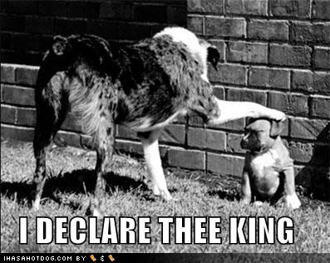
SPIRITUAL & TEMPORAL SWORDS

Slide 108
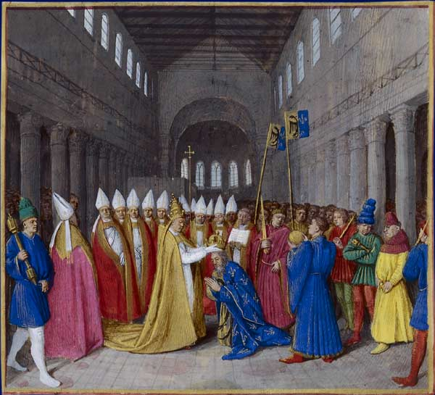
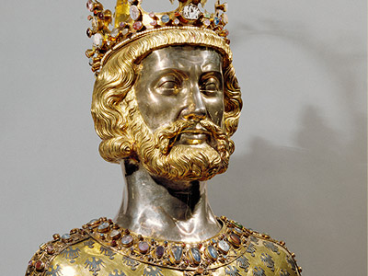
Once False Donation Precedent Established Pope Leo Crowns The Frankish King Charles Charlemagne: The First Holy Roman Emperor
David Lee Burris:
In 799, Leo III, while conducting a procession, was attacked by a band of armed men from a rival faction who believed they had blinded him. He recovered and fled to Charlemagne’s court. He was then restored to his position in Rome.”
INSTITUTIONAL CHURCH ORDAINS GOVERNMENTS
The Middle Ages saw a new Europe arise from the ruins of the old empire, a continent of nations with a strong sense of their own identities. United by the Catholic Church and the power of the papacy, this European Dark Age was also the embodiment of what has been called the “Christendom” concept. (Later protestant modification in social theory known as “Commonwealth.”)
Two Powers Of Interest Were Germany & France: In its nation building Germany was on the right course it was still greatly divided and thus more gradual in its development. France – on the other hand - was much more advanced & of continual influence beyond its borders. The French Nation had periodically & successfully exercised enough leverage in episodes as to evidence their power of regional hegemony and on occasion even of European dominance. France had protected the papacy at length against the pagan barbarian and much later from the Islamic infidel. Indeed, Charles had most recently rescued Rome itself and Vatican City from the invader.
On Christmas Day the Frankish King Charles was praying in the great cathedral of St. Peter’s in Rome. Suddenly Pope Leo entered. Striding to the king, he produced a crown and set it on his head. Kneeling before him – the only pope ever to make such obeisance to a mere king – he proclaimed Charles the new Roman emperor. The year was A.D. 800!

Slide 109
Genesis 1: 16 – Church Of Light Direct
David Lee Burris:
Understood Better During Age Of Alchemy – Sun Gold & Represented By Full Circle – Moon Silver & Represented By Half-Circle

Slide 110
Genesis 1: 16 – State Of Reflected Light

Slide 111
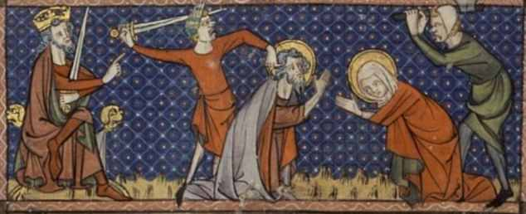
HOLY ROMAN EMPIRE
NEITHER - EMPIRE
NEITHER-ROMAN
And Not In The Least
H O L Y !

Slide 112
Two dynasties stand out as rulers of the empire. The Hohenstaufens led the empire during the Crusades. In fact, it was because of the Crusades that Frederick II dubbed his empire “Holy.” In the 13th century, however, the Hohenstaufens were replaced by the Hapsburgs, who were all over the thrones of Europe for the next 800 years. In the process, they won the history reward as the most thoroughly inbred royal family there ever was!
THE END OF AN EMPIRE

Slide 113
“To his friends, Frederick Hohenstaufen was the stupor mundi or ‘world wonder.’ To his enemies, he was the Antichrist. Of course, to the people of Sicily & the Holy Roman Empire, he was simply the king & skilled warlord. As a linguist, he wrote scientific tracts in a dozen languages. He was an early advocate of the experimental method and performed rather interesting (highly unethical) experiments – such as raising children in silence to see if they would speak a ‘natural language.’”
THE LAST HOHENSTAUFEN

Slide 114
“FRED [HOHENSTAUFEN] WAS BEST KNOWN FOR HIS DECADENT LIFESTYLE – ENAMORED OF ISLAMIC CULTURE & PHILOSOPHY, HE KEPT A HAREM OF NUBILE YOUNG LADIES AT HIS BECK AND CALL.”
THE LAST HOHENSTAUFEN
- Mental Floss, Forbidden Knowledge

Slide 115
Emperor Wenzel (1378-1419) had the margins of his German Bible translation decorated with pictures of himself being bathed and his hair washed by comely attendants wearing transparent white dresses.
Sacred illustration
- Kay Ashenburg, Unsanitized History

Slide 116
In theory the Holy Roman Empire was a continuation of the ancient Roman Empire. The fathers of the church had maintained that when the Roman Empire finally collapsed it would signal collapse of the great cycle of empires and begin the reign of the Antichrist.
WHITE ROBE BLACK ROBE
Politics Of Indulgences
by Charles Mee
See - PAGE 170 - The Time Was At Hand by ROB fINLEY

Slide 117
Civic Institution Church Of Inherited Religion
THE MAN OF SIN BELIEVED REVEALED
2nd Thessalonians Chapter 2: 3 – 12
DUAL APP: 2ND TIME ZONE REFERENCE
“The Antichrist, Muhammad, came in the Seventh Century. He was not ‘against Christ’ but rather took the place of Christ, as an ‘anti-climax’ replaces a climax. Muhammad’s cumulative influence over 13 centuries has been a 1000 times greater than all other antichrists put together: past, present, & future.”
“The first beast of Revelation 13 was the Roman Empire. It was ‘wounded unto death’ by barbarian invaders, then revived by the 2nd beast (the Papal Dynasty) in 800 A.D. as the Holy Roman Empire.”
– Robert Finley, The Time Was At Hand

Slide 118
Civic Institution Church Of Inherited Religion
THE MAN OF SIN BELIEVED REVEALED
2nd Thessalonians Chapter 2: 3 – 12
THE 2ND TIMELINE REFERENCE
“The emperors were forced to be obedient and subservient to the Popes that crowned them. When one of them knelt before him, the Pope placed the crown on the emperor’s head with his feet. Then before the new sovereign could arise, the Pope kicked the crown off his head. ‘Let that be a lesson to you,’ the Pope said, ‘Just as I have the power to crown you, so also I have the power to remove that crown from your head.’”
– Robert Finley, The Time Was At Hand

Slide 119
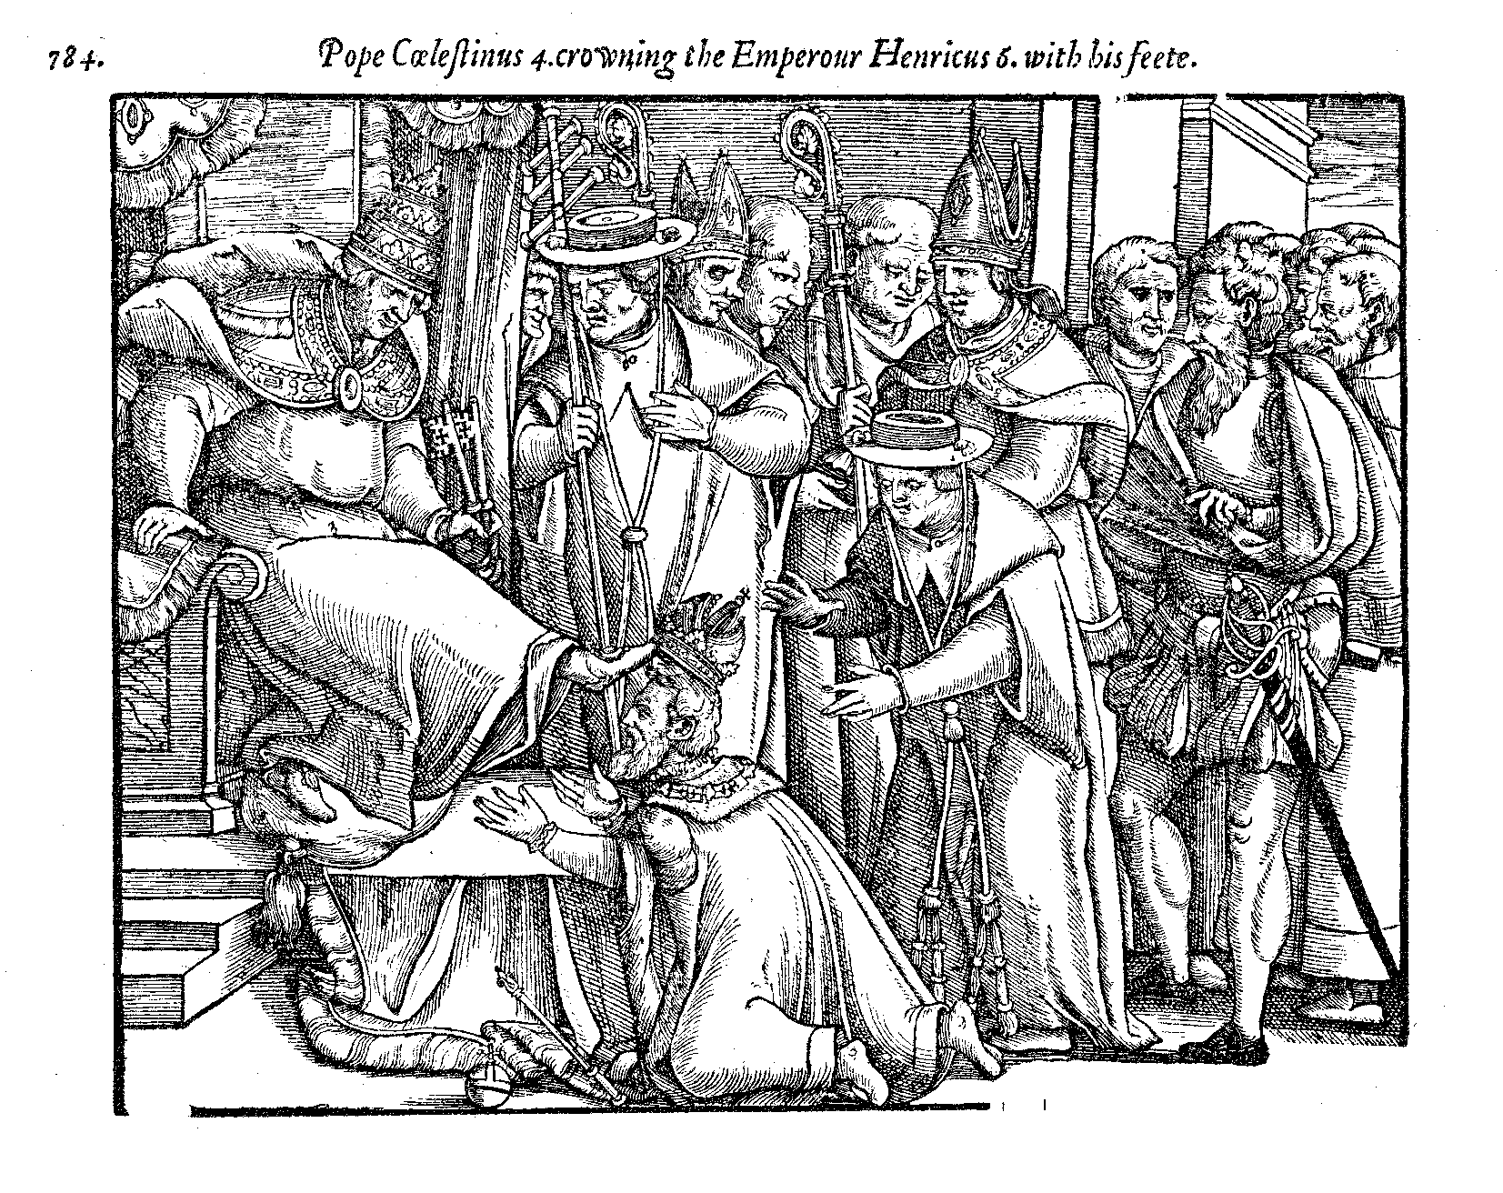

Slide 120
In truth, all that remained of the old empire was a bit of magic in the imperial name. The emperor labored in vain to keep his electors under the impression that they were his vassals. Where once the empire had seemed strong because all its enemies were weak, now the newly united nations of England, France and Spain defied the empire with impunity.
WHITE ROBE BLACK ROBE
Politics Of Indulgences
by Charles Mee

Slide 121
The Holy Roman Empire had no discernible boundaries & no center!
The emperor couldn’t collect taxes, keep standing army, or support a police force.
For that matter, it is a moot point just what laws police could have enforced. There was an imperial court of justice, but it had the scantiest of funds & few obeyed its mandates in any case.
The emperor was an infamous figure, scourge of innkeepers, because he could never afford to pay his bills. His empire was an omnium-gatherum that added up to a web of family ties and hopeless confusion.
WHITE ROBE BLACK ROBE
Politics Of Indulgences
by Charles Mee

Slide 122
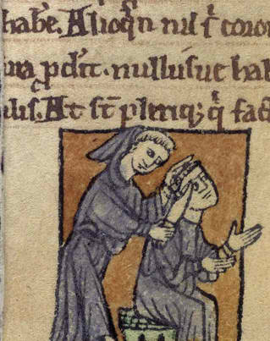
LATER CHURCH PRE-TEST Q-1
Which of these was an issue causing the Roman Catholic & Greek Orthodox churches to separate in 1054?
Should a monk wear a hair shirt?
Should a friar wear shoes?
Should a priest wear a beard?
Should a bishop wear head gear?
X

Slide 123
LATER CHURCH PRE-TEST Q-2
According to Catholic doctrine, the pope is infallible when speaking “ex-cathedra.” What, originally, was a cathedra?
The chair a bishop sat in to decide church cases
The scepter a bishop waved to call for silence
The room the emperor sealed law
Church Council Spokesperson
X

Slide 124
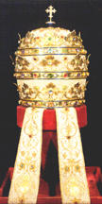
LATER CHURCH PRE-TEST Q-3
What religious item had forty-eight rubies, seventy-two sapphires, forty-five emeralds, and sixty-six pearls?
Crystal Cathedral Communion Set
Holy Roman Emperor’s Crown
Papal Crown of Pope Boniface VIII
Knights Templar Communion Set
X

Slide 125
LATER CHURCH PRE-TEST Q-4
When the pope (referring to the Vatican’s wealth) said to Dominic, “The church can no longer say,‘Silver & Gold Have I Not’” what was Dominic’s reply?
“Not to mention diamonds, and onyx, and rubies, and…”
“Neither can it now say, ‘Rise Up & Walk’ ”
“Peter gave us the keys to the treasury”
“Would His Holiness be interested in making a small loan?”
X

Slide 126
LATER CHURCH PRE-TEST Q-5
In the Renaissance many people believed it to be for the best that Adam & Eve sinned, because otherwise we’d never have known the extent of God’s mercy. What is this concept called?
The Excellent Expulsion
The Fortunate Fall
The Purifying Punishment
The Gateway Of Grace
X

Slide 127
“How The Story Might Have Ended” by Rabbi Harold Kushner
“So the woman saw that the tree was good to eat and a delight to the eye, and the serpent said to her, ‘Eat of it, for when you eat of it, you will be as wise as God.’ But the woman said, ‘No, God has commanded us not to eat of it, and I will not disobey God.’ And God called to the man and the woman and said to them, ‘Because you have hearkened to My word and not disobeyed My command, I shall reward you greatly.’ To the man, He said, ‘You will never have to work again. Spend all your days in idle contentment, with food growing all around you.’ To the woman, He said, ‘You will bear children without pain and you will raise them without pain. They will need nothing from you. Children will not cry when their parents die, and parents will not cry when their children die.’ To both of them, He said, ‘For the rest of your lives, you will have full bellies and contented smiles. You will not cry and you will never laugh. You will never long for something you don’t have, and you will never receive something you always wanted.’ And the man and the woman grew old together in the garden…”

Slide 128
LATER CHURCH PRE-TEST Q-6
In the early 1500’s, the Bishop of Constance absolved Swiss priests of fornication if they did what?
Left priesthood & married
Repeated ten “Hail Mary’s”
Paid a fine of four guilders
Drew the line @ wives & nuns
X
NOTE: He Raised ~ 8,000G Annually

Slide 129
LATER CHURCH PRE-TEST Q-7
The Council of 1512 ordered priests not to attend the weddings of whom?
People that were excommunicated
Practicing Protestants
Former priests
Their known illegitimate children
X

Slide 130
LATER CHURCH PRE-TEST Q-8
For several years in the fourteenth and fifteenth centuries there were two popes. When the Council of Pisa met in 1409 to resolve this situation, what happened?
They had one pope killed
They let God decide & one died
Deposed both & Council ruled 40 yrs
Selected Another – Then There Three
X

Slide 131
LATER CHURCH PRE-TEST Q-9
Why was an armed guard placed around the deathbed of Francis of Assisi?
To get more relics, some churches had started cutting off body parts before the saints expired
There was a prophecy that at death his body would be possessed by the anti-Christ
Toward the end, the extremely meek & mild mannered Assisi had become violently insane
To keep the wild animals he had domesticated away from his dying body
X
* “Don’t be too quick to canonize me. I am perfectly capable of fathering a child.”

Slide 132
LATER CHURCH PRE-TEST Q-10
Many Catholics accused Erasmus of starting the Reformation because of his coming out with the New Testament in Greek. How did Erasmus respond?
“Paul & John produced Greek before I did; blame them”
“I don’t understand this Reformation; it’s Greek to me”
“I laid a hen egg, but Luther hatched it into a rooster”
“I gave men a lamp for their feet; Luther pushed it into their eyes so that they can’t see”
X

Slide 133
LATER CHURCH PRE-TEST Q-11
When the pope claimed the power to release people from purgatory, what was Martin Luther’s comment?
“Then why doesn’t he empty the place”?
“He’s putting me through purgatory every day; why won’t he release me”?
“His death will release more people from purgatory than anything else he can do”
“I have the same power; Therefore, I declare purgatory nonexistent”
X

Slide 134
LATER CHURCH PRE-TEST Q-12
What recurrent physical problem did Martin Luther claim was caused by Satan during his period in the tower?
Migraines
Incontinence
Spinal Fusion
Constipation
X

Slide 135
LATER CHURCH PRE-TEST Q-13
When Philip of Hesse wanted to end his marriage and marry another woman, what was Martin Luther’s controversial advice?
As head of the wife he could take her life in order to end the marriage
Philip could get divorce without Catholic Church or Pope’s consent
Send his present wife into exile
Divorce wrong – commit bigamy!
X

Slide 136
LATER CHURCH PRE-TEST Q-14
Who, during the German Peasants’ War, encouraged rulers to “smite, slay, and stab” peasants like mad dogs?
Menno Simons
Philip Melancthon
Desiderius Erasmus
Martin Luther
X

Slide 137
LATER CHURCH PRE-TEST Q-15
In the early 1500’s, Anabaptist leader Felix Manz practiced adult baptism. How did Reformation leader Ulrich Zwingli have him punished?
A FINE
EXILE
HANGING
DROWNING
X

Slide 138
LATER CHURCH PRE-TEST Q-16
When a playing-card maker in Geneva criticized John Calvin, what did Calvin make him do?
Walk around town without pants
Become a Catholic
Eat an entire suit of cards
Apologize, Confess & Beg For Calvin’s Prayers In His Behalf
X

Slide 139
LATER CHURCH PRE-TEST Q-17
When a young man in John Calvin’s Geneva struck his parents, how did the city fathers respond?
They asked him to apologize
They required him to read the Old Testament books seven times
They had him flogged!
They had him beheaded!
X

Slide 140
LATER CHURCH PRE-TEST Q-18
What alleged relic, kept at Canterbury, England, did the medieval church claim was the oldest relic in the world?
The club with which Cain killed Abel
The apple core from which Adam & Eve took bites
Bone splinter of Adam’s rib
The clay that God had left over from making Adam
X
READ: Peter Manseau, Rag & Bone , Chapter 3 – One, Two, Three Foreskin

Slide 141
LATER CHURCH PRE-TEST Q-19
In fourteenth-century England, what was unusual about the way the “kiss of peace” was handled in churches?
For the first time, the kiss was replaced with the handshake
Enemies specially selected to kiss or both excommunicated
Instead of kissing each other, kissed a paddle & passed it on
Abandoned With The Plague
X

Slide 142
LATER CHURCH PRE-TEST Q-20
What was the only restriction that Henry VIII placed on oral Bible-reading in 1543?
It could only be done in church
It could only be done for the families of nobles
It had to be from the King James
It could only be New Testament
X

Slide 143
LATER CHURCH PRE-TEST Q-21
In a typical English city centuries ago, less than one percent of seats in Anglican churches were what?
Used on Sunday
Free
Wooden
Hygienic
X
Origin of the Official Usher

Slide 144
LATER CHURCH PRE-TEST Q-22
Why was an hourglass found on English pulpits during the reformation period?
To keep sermons from lasting more than hour
To keep sermons from lasting less than hour
To symbolize the sands of life running out
Cromwell government condemned clocks
X

Slide 145
LATER CHURCH PRE-TEST Q-23
What English women were told to leave their homes under Henry VIII, get married under Edward VI, leave their husbands under Mary I, and return to their husbands under Elizabeth I?
Members Of The Royal Court
Quakers
Female Preachers
Nuns
X

Slide 146
LATER CHURCH PRE-TEST Q-24
In medieval England, what was a “neck verse”?
If a person committed a crime he had to wear around his neck the Bible verse condemning
It was a nickname for the stocks
If a clergyman committed a hanging offense he was spared by reading an assigned verse
Heretical Branding For Jews
X

Slide 147
LATER CHURCH PRE-TEST Q-25
What is the unusual feature about the hymn “Faith of Our Fathers”?
It was originally “Faith of Our Mothers”
It was written as an anti-Protestant hymn, but has been sung more often by Protestants
The fifth verse about teaching children is not popular & left out
The author, Frederick Faber, was a pencil manufacturer who wrote no other hymns
X

Slide 148
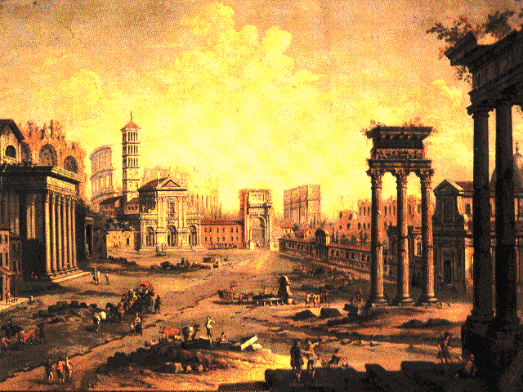
Later Church Struggles Were With:
David Lee Burris:
Tonsure: Origins In Persecuted Church; Roman Mockery To Shave Heads As Slave Property
CONTAMINATE
CONTAINMENT
CORRUPTION

Slide 149
SACRAMENTS & SOTERIOLOGY
Classic Apologetics to Theological Systematizing
Alexandrian School Versus Antiochene School
Changes in Worship: Lord’s Supper @Sacrament
Changes in Doctrine: Believer Baptism @Salvation
Historicity: Catholic Confessional-Treasury of Merit
The Godhead Three: Thee Trinitarian Controversy
Orthodoxy/Orthopraxy Brand Vs. Heretical Label
Magisterium: Canon Text–Law–Courts–Legal Curia
CONTAMINATE – CONTAINMENT - CORRUPTION

Slide 150
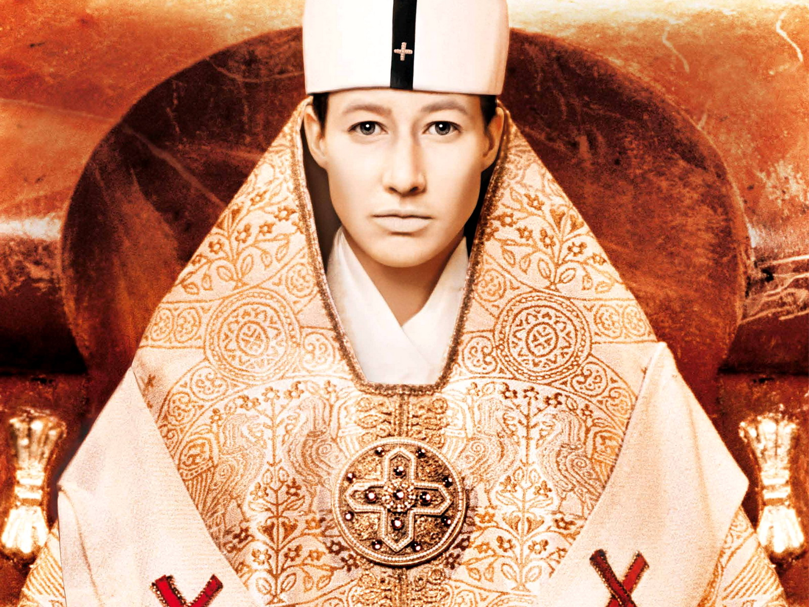
Optional Viewing:
ABC NEWS SPECIAL
“The Mystery of Pope Joan”

Slide 151
POPESS JOHN VIII HISTORICITY
The first time mention by Scottish Monk Marianus Scotus in his 1058 book Universal Chronicle: “Leo the pope died on the 1st of August. To him succeeded John, who, as it is asserted, was a woman, and sat for two years, five months, and four days.”
In 1276, after ordering a thorough search of the papal records, Pope John XX changed his own title to John XXI in official recognition of Joan’s reign as Pope John XIII.
In Tuscany, around 1400, her face was carved among the papal busts in the cathedral at Siena. It remained there, travelers said, until its replacement by the bust of a male pope two centuries later.
In 1601, under command of Pope Clement VIII, her statues and busts suddenly “metamorphosed” into those of Pope Zacharias.
Pope Joan first appeared on the Tarot Card Deck about the 13th Century. Moreover, Pope Joan was a card game once very popular in Scotland. Although it involved gambling, it was popular during the Victorian era as a social activity.
Joan’s Story was included in the official guidebook to Rome used for 300 years.
Frederick Spanheim, the learned German historian who conducted an extensive study of these events, cites no fewer than 500 ancient manuscripts containing accounts of Joan’s papacy, including those of such acclaimed authors as Petrarch.
J.N.D. Kelly writes in his Oxford Dictionary Of Popes: “The story of a pope named Joan was accepted without question in Catholic circles for centuries.”
Another striking piece of historical evidence is found in the well-documented 1413 trial of Jan Hus for heresy. Hus was condemned for preaching the heretical doctrine that the Pope is fallible. In his defense Hus cited many examples of Popes who had committed crimes against the Church. To each charge his ecclesiastical court judges and jury replied in detail denying. Only one Huss charge went unchallenged: “Many times have the Popes fallen into sin and error, for instance when Joan was elected Pope, who was a woman.”

Slide 152
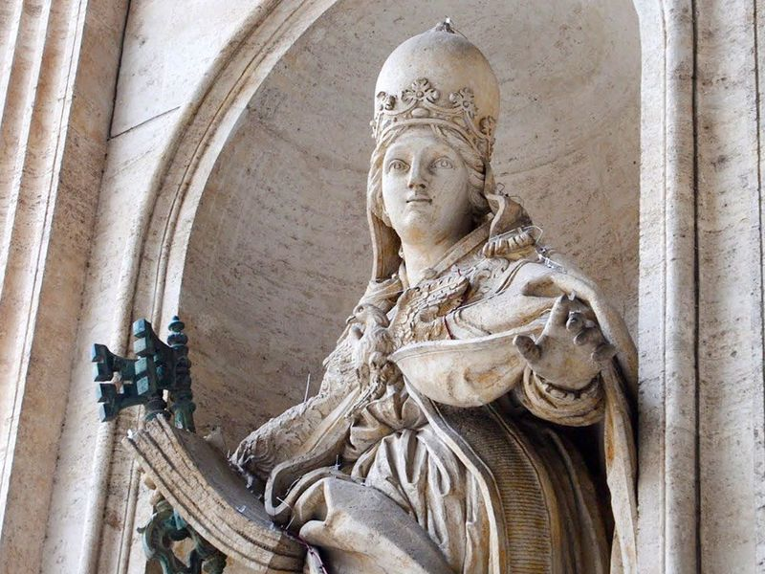

Slide 153
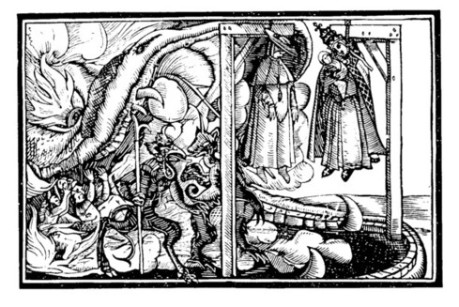
POPESS JOHN VIII HISTORICITY
The Sequence Of Events per Friar Martin of Troppau writing in 1265 A.D. -- The female pope reportedly was born in Germany of English missionary parents and grew up unusually bright in an era when learned women were considered unnatural if not dangerous. To break the glass ceiling, it was said she pretended to be male. At 12, she was taken in masculine attire to Athens by a monk described as her teacher. Disguised in the sexless garb of a cleric she made much progress in her studies eventually giving a scholarly lecture at the Trivium in Rome and ultimately staying to climb the church hierarchy to the high rank of cardinal. Here her knowledge of the scriptures so impressed her colleagues in the College Of Cardinals that they elected her Pope John Anglicus in 855 A.D..
Papal Momma. According to most versions, spectators watched in horror as the pope, trying to mount a horse, went into labor and gave birth to a son. Hierarchs who were profoundly devoted to the Holy See sought to save the day and change horror and disgust to amazement by crying out – “A miracle” – bellowing loudly for for the faithful to kneel and worship. They were quite unsuccessful. Moments later, reports said, the crowd tied her feet to the horse’s tail, then stoned her to death as she was dragged along the street. {Marginal notes in a 15th century document refer to a statue erected close by the Lateran called - “The Woman Pope With Her Child.”}
Groping Chair. There is circumstantial evidence difficult to explain if there never was a female Pope. The most important part of the medieval papal consecration ceremony for almost 600 years was the so-called chair exam. Each newly elected Pope after Joan sat on the sella stercoraria (literally, “dung seat”), pierced in the middle like the classic Roman public toilet, where his genitals were examined to give proof of his manhood. Afterward the examiner solemnly informed those gathered, “Mas nobis nominus est” – “Our nominee is a man.” Only then was the Pope handed the keys of St. Peter. The ceremony continued until the sixteenth century. In his excellent 1999 book, The Legend Of Pope Joan, British writer Peter Stanford reports in visiting the basements of Vatican inspecting an unusual chair that meets this description; He has convincing photo evidence included inside this publication.
After Pope Joan the 10th Century Marozia Pornocracy

Slide 154
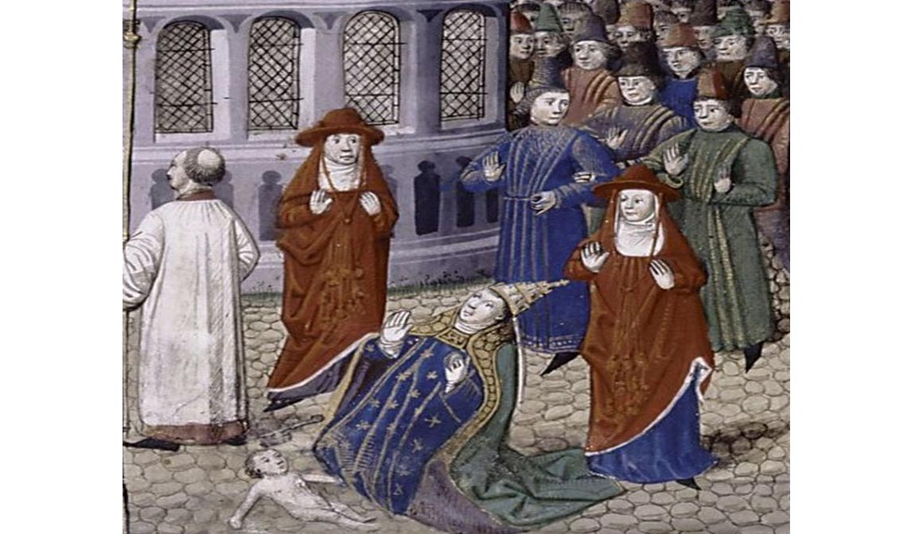

Slide 155
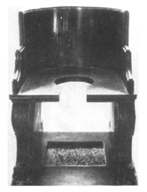
TESTICULAR VERIFICATION OF GENDER

Slide 156
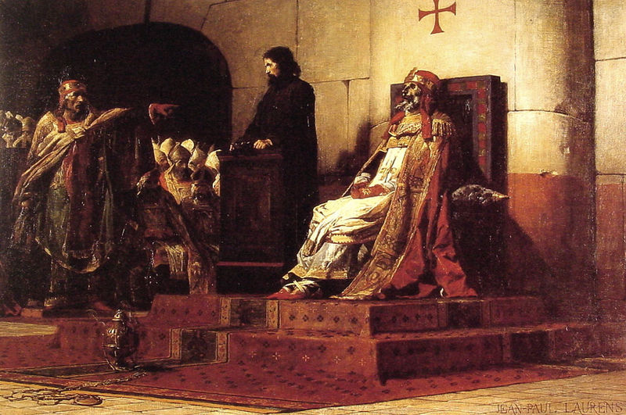
March 0f 896: The Synod Horrenda Quoting Pages 19 - 20, The Bad Popes by E. R. Chamberlin
Said Of Author & Book By The Catholic World Magazine:
“John XII, the dissolute, satyr-like Roman prince; Benedict IX, who subjected the Papacy to its greatest indignity; Boniface
VIII, ruthless in his insatiable hunger for absolute power; Urban VI, the wild man from Naples whose grotesque savageries
widened the Great Schism; Alexander VI, who brought Borgia intrigues and debauchery to the See of Peter; Leo X, ruler of
Rome at the height of its glory and corruption; Clement VII, the unskillful fox who brought ruin to the city and almost to his
Church. Seven different Popes, each of whom precipitated a crisis in the Church – they stole, plundered, gambled, killed,
fornicated. …E. R. Chamberlin’s in-depth approach adds much to the honesty of Church history and carries out Leo XIII’s
injunction at the opening of the Vatican archives to tell the truth.” Cover Page Endorsement Along With Washington Post
“In that month(March) the triumphant faction, whose leader now ruled briefly as Pope
Stephen VII, set in motion a solemn trial of the late Pope Formosus, quondam leader
of the rival faction. The act of judgment was no mere formality. The corpse itself was
dragged from the tomb where it had rested for eight months and, dressed again in its
sacerdotal robes, was brought into the council chamber. There it was propped up in
the throne that it had occupied in life while, in a parody of legal form, the ‘trial’ went
its blasphemous way. The corpse was provided with a council, who wisely kept silent
while Pope Stephen raved and screamed his insults at it.”
Notes:
Pope Joan & Synod Horrenda Discussed Fully & Examined Fairly In ABC Special Of 12/29/05 - “The Mystery Of Pope Joan”

Slide 157
David Lee Burris:
Like The Beatles Song?
To Make Sure The Pope's Death!
SILVER HAMMER OF SUCCESSION

Slide 158
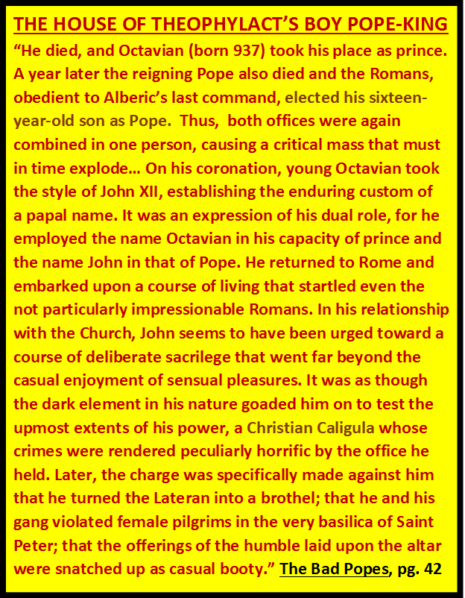

Slide 159
The Medieval Church Scandals chapter in book by charles franklin
David Lee Burris:
Starting With Alexander VI In 1492 - Borgias Regarded The Holy See As Tool To Improve Temporal Power Of Their Family – Their Relatives Including Women Lived At Vatican – Borgia Women Were Political Pawns & Public Mistresses Connected To Other Bad Popes .
GIROLAMO SAVONAROLA’S BONFIRE
JOHN XXIII ARRIVING AT CONSTANCE
LIFE AT THE PAPAL COURT
BAPTISM – SPRINKLED NUDE
ROVING HANDS
ORGY IN A MONASTERY
TAKING A BATH – MIXED BATHING
ALTAR CARVING
DISCIPLINARY MEASURES
GIFT FROM HUBBY – CHASTITY BELTS
MONEY–CHANGERS RESTORED TO POWER
TRAFFIC IN REDEMPTION
TETZEL: SUPER SALESMAN
HANDBILL ADVERTISING INDULGENCES
Chapter
Subheadings

Slide 160
Annual Feast Of Salome

Slide 161
The popes brought marriage under clerical control and forbade divorce for the common people, but they also declared marriage under five or six degrees of kindred to be invalid. The result was that divorce now took the form of “discovering,” when the parties wanted a divorce, that there had never been any marriage because they were related, say, through their great-great-great-grandparents.
DISCOVERY
DIVORCE
THROUGH

Slide 162
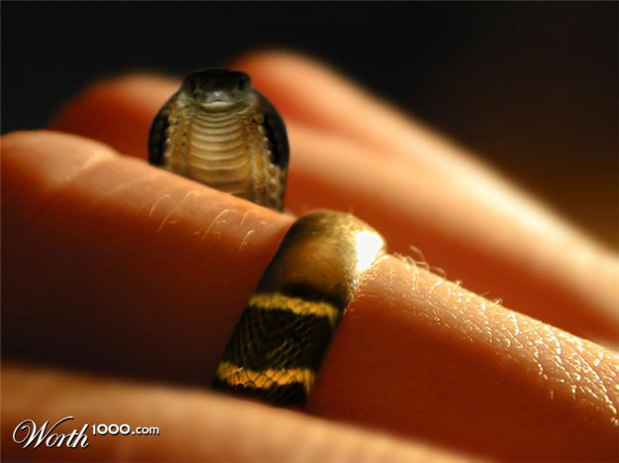
Queen Eleanor got a divorce from the very religious king of France on that precise ground. Procedurally, you paid your abbots or bishops to scan the genealogical tree. But because relationship was counted by sponsorship at baptism as well as by blood or marriage, you could almost always discover it. It made a mockery of marriage and set unlawful desires free!
The Rich Compounded Fortunes Marrying Within
DISCOVERY
DIVORCE
THROUGH
DISCOVERY WAS EASY & DIVORCE WAS EASY!

Slide 163
DEVIL MARRIES MONIED!

Slide 164
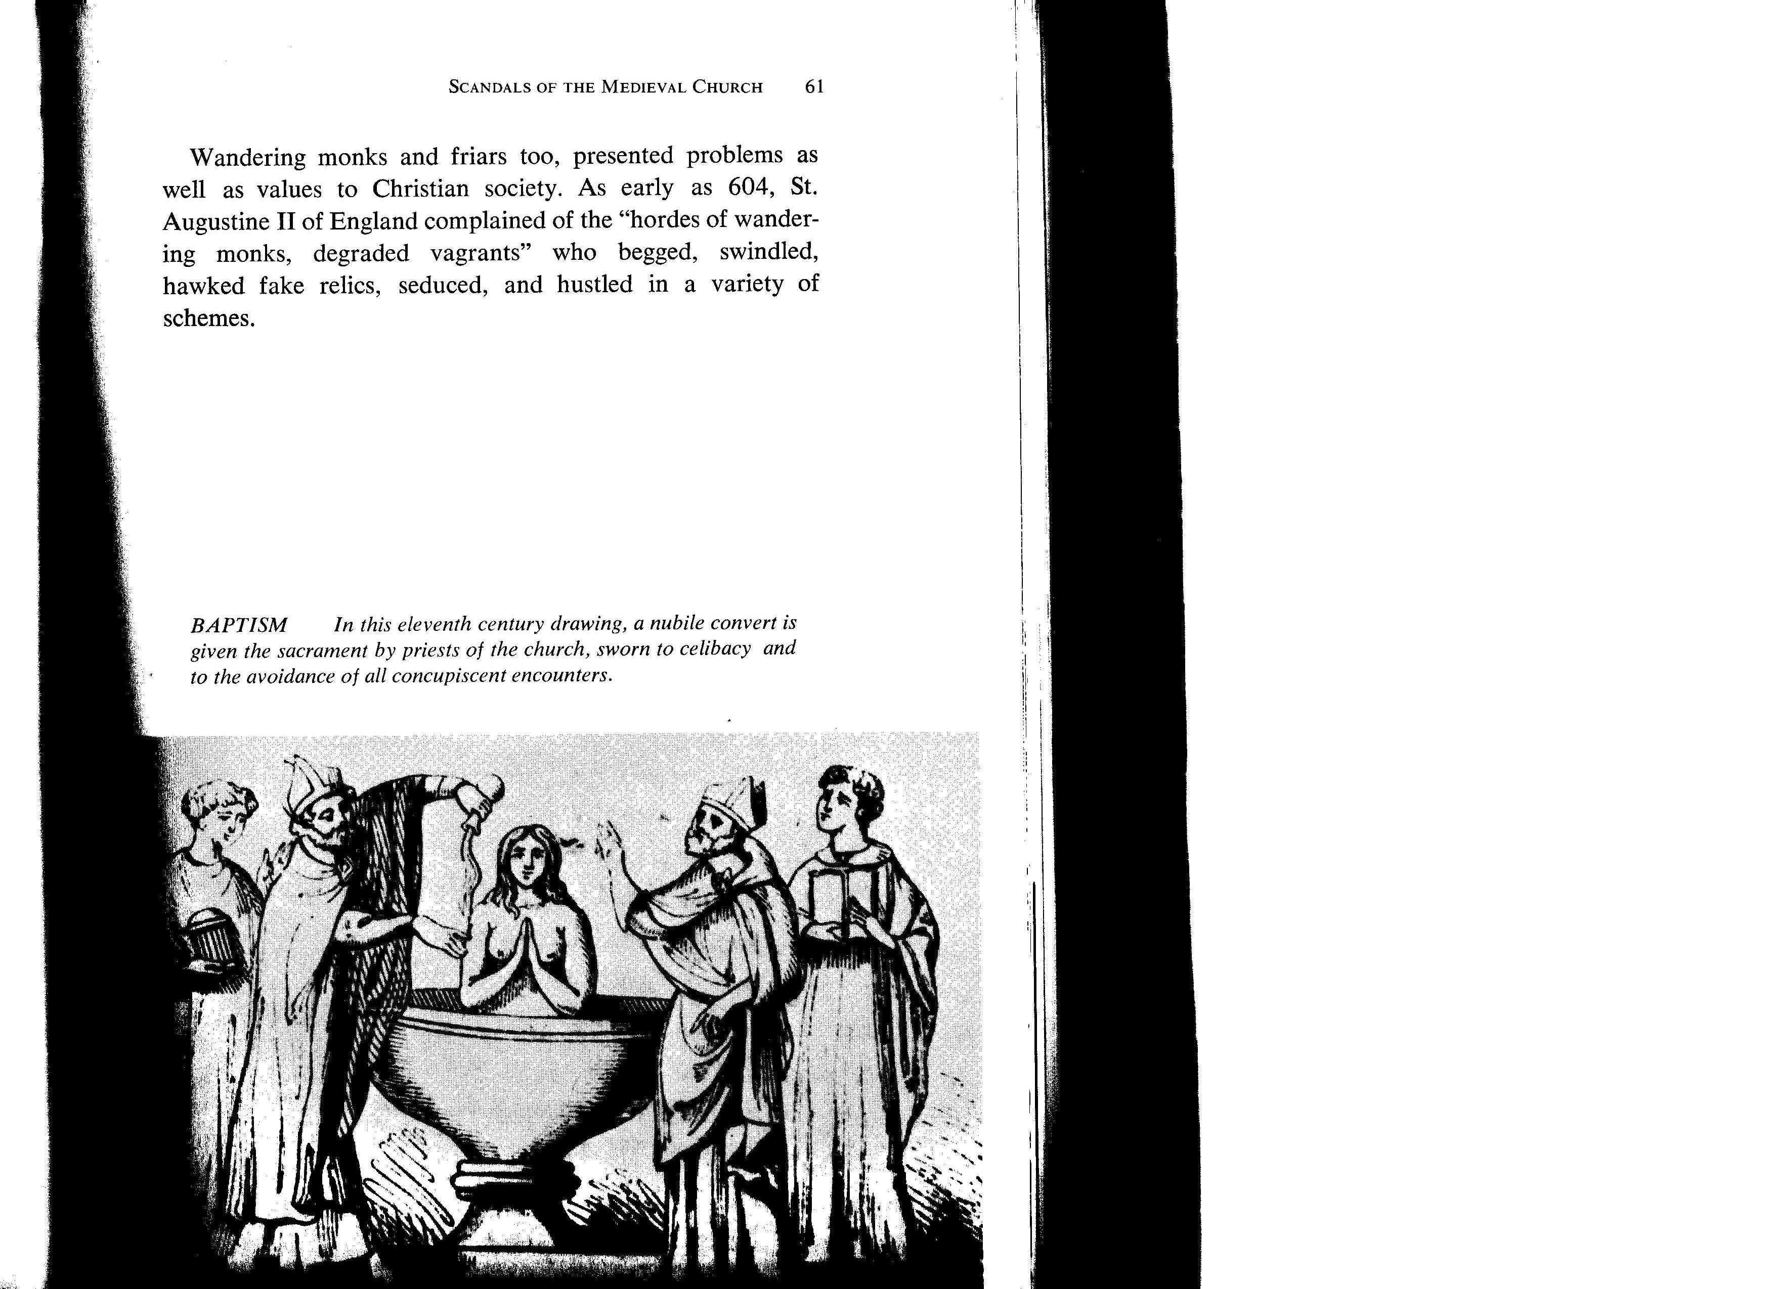
The Medieval Church Scandals chapter in book by charles franklin
David Lee Burris:
Starting With Alexander VI In 1492 - Borgias Regarded The Holy See As Tool To Improve Temporal Power Of Their Family – Their Relatives Including Women Lived At Vatican – Borgia Women Were Political Pawns & Public Mistresses Connected To Other Bad Popes .
GIROLAMO SAVONAROLA’S BONFIRE
JOHN XXIII ARRIVING AT CONSTANCE
LIFE AT THE PAPAL COURT
BAPTISM – SPRINKLED NUDE
ROVING HANDS
ORGY IN A MONASTERY
TAKING A BATH – MIXED BATHING
ALTAR CARVING
DISCIPLINARY MEASURES
GIFT FROM HUBBY – CHASTITY BELTS
MONEY–CHANGERS RESTORED TO POWER
TRAFFIC IN REDEMPTION
TETZEL: SUPER SALESMAN
HANDBILL ADVERTISING INDULGENCES
Chapter
Subheadings

Slide 165
The Medieval Church Scandals chapter in book by charles franklin
“Under Sir Ecgbert’s code of 729, a monk who fornicated with a woman was required to fast for three years. But if a child was born, the deprivation would extend to four years; and if they slew the child, retribution extended to seven years.”
“St. Ecgbert also ordained that a habitually homosexual bishop would have a similar penance for 14 years; and that a bishop who fornicated with cattle should be punished by a eight-year fast for a first offense, and by a ten-year fast for repeated malfeasance.”

Slide 166
The Medieval Church Scandals chapter in book by charles franklin
“Similar codes existed through the centuries. Nevertheless, offenders among the clergy often went unscathed – first because such men were part of the very establishment which administered the laws, and secondly because the Church could not afford to lose the services of every capable man who was guilty of sexual misdeeds. An offender, though sometimes deposed from his exalted station, was more often merely transferred to an equally lucrative benefice.”
“During Gregory VII’s reign, a number of priests who had married were caught up by the mob and castrated and then exposed in their mutilated state to the public. Gregory’s successor, Urban II, simply offered the wives of priests as slaves to any nobleman who would accept them.”

Slide 167
The Medieval Church Scandals chapter in book by charles franklin
“In 836, the Council of Aix-la-Chapelle openly declared that many abbesses were to blame for running their convents as bawdy-houses. The Council directed future architects to be sure that there would be no ‘dark corners’ in convents that could be used for immoral purposes. (Upon the dissolution of the convents in England under Henry VIII the bones of newborn babies were found ‘all over the place,’ in convents, for it was much more difficult for nuns than for priests to get their bastards accepted in the outside world.)”

Slide 168
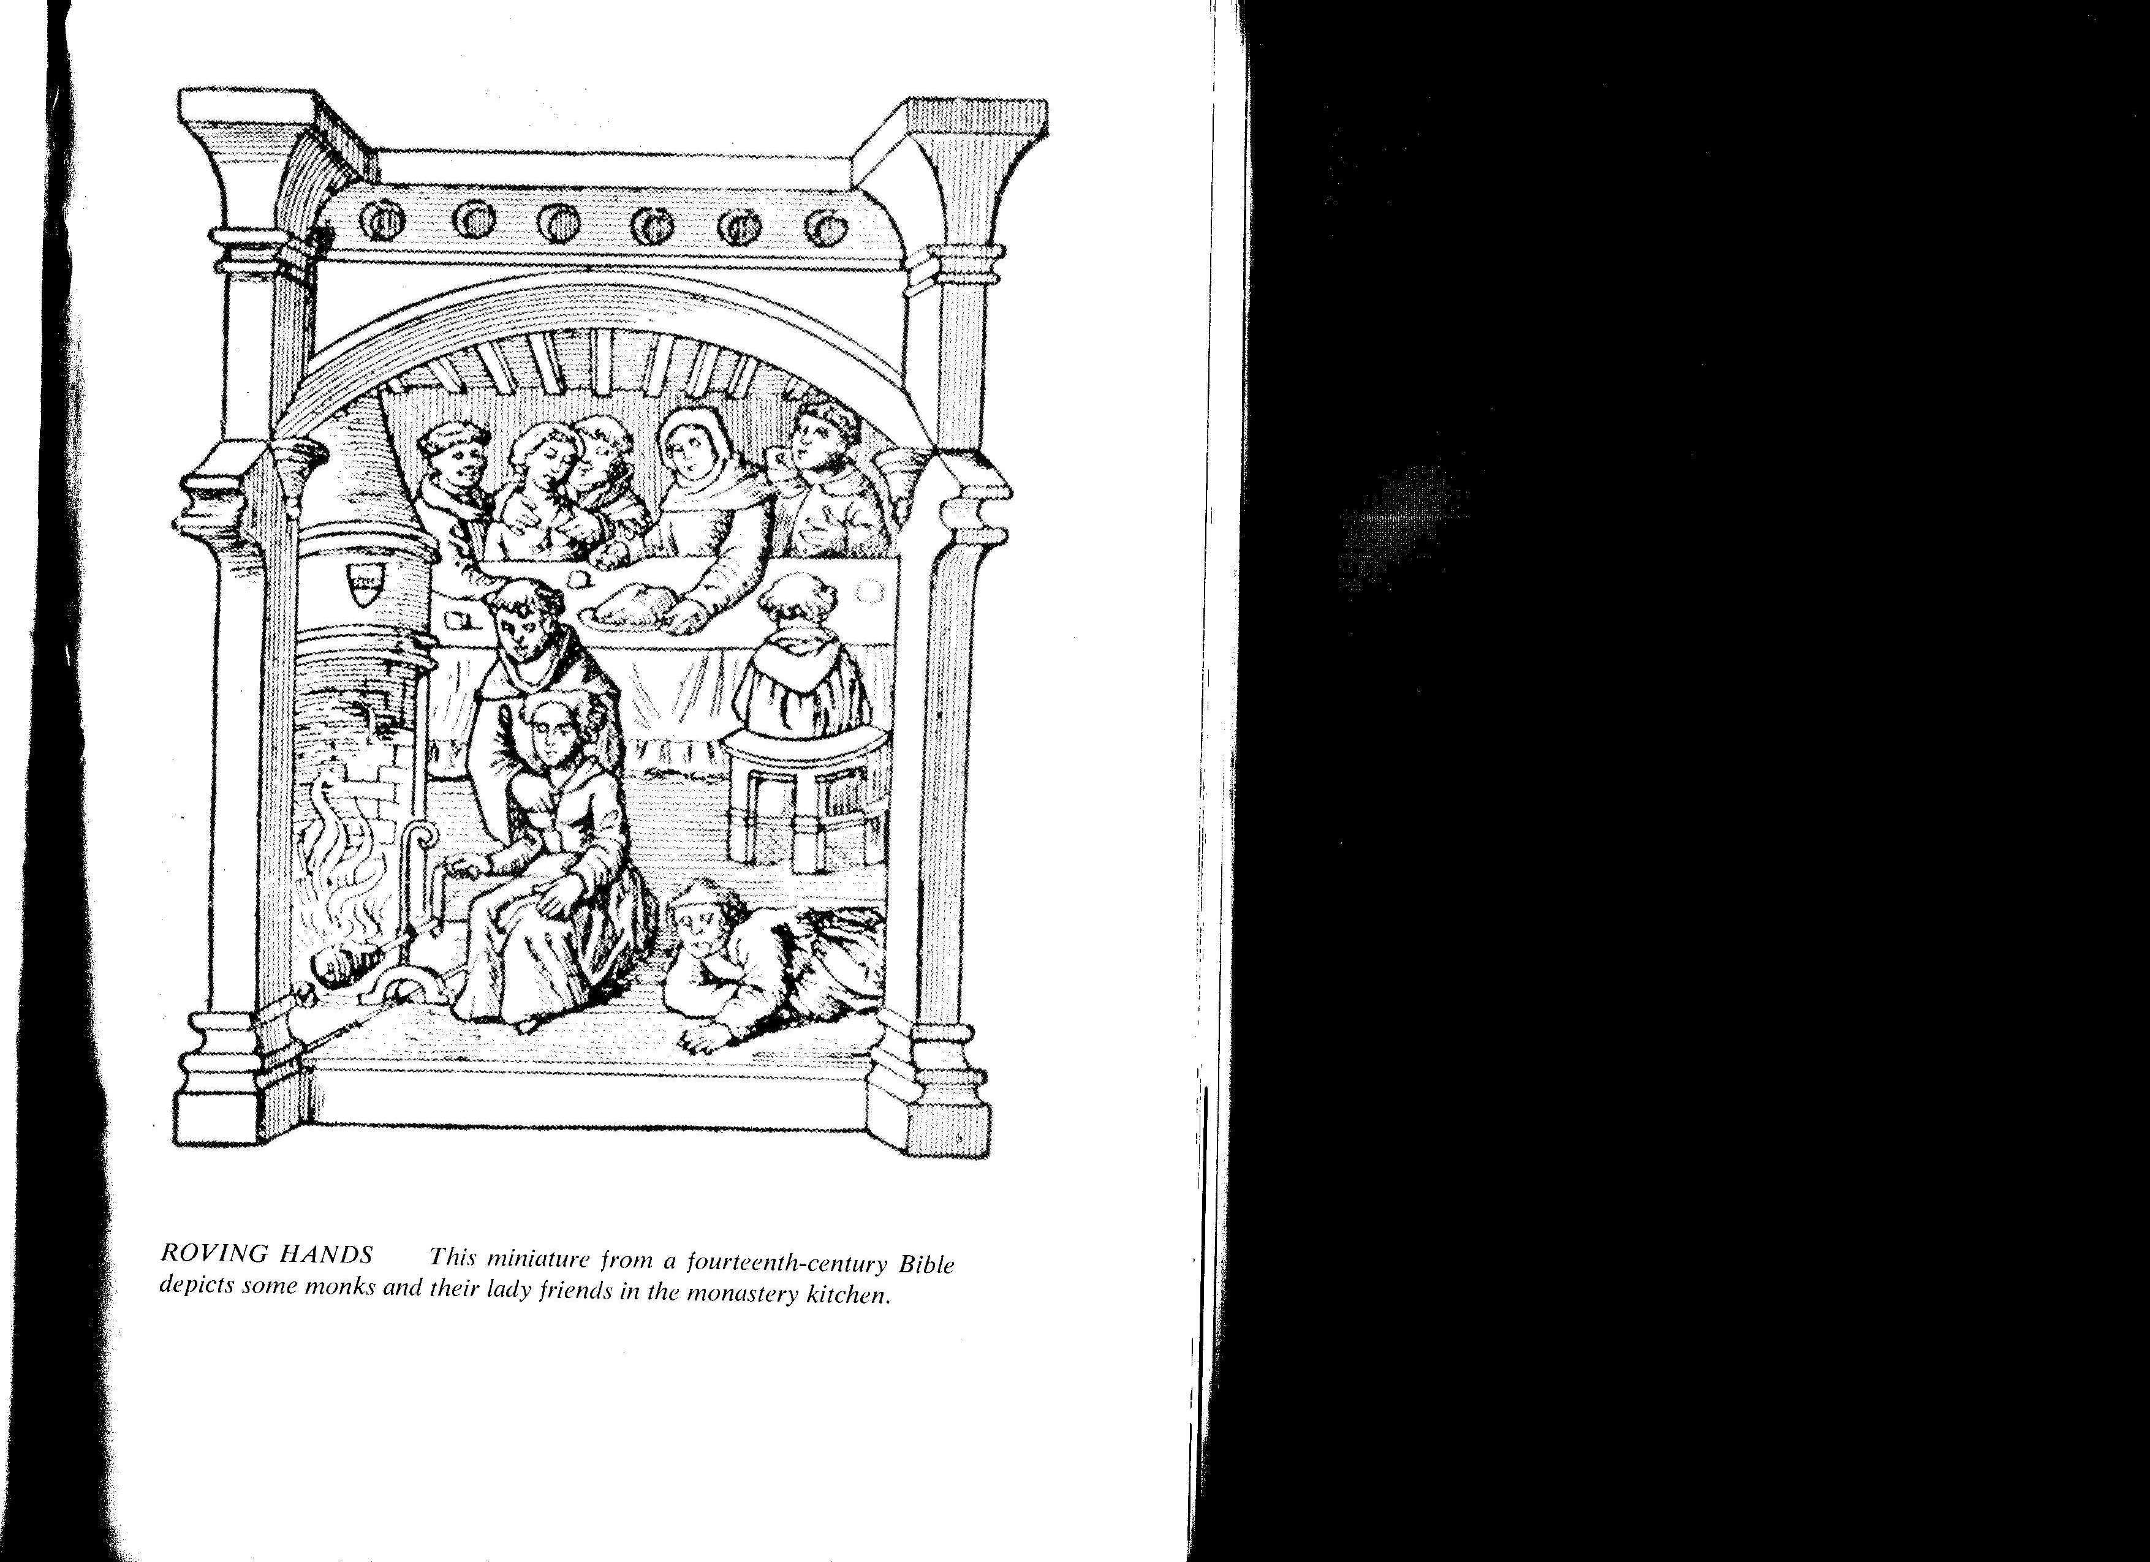
The Medieval Church Scandals chapter in book by charles franklin
“Looking back on this period, the scholar Erasmus wrote that chastity was more endangered in the cloister than out of it; and Thomas Fuller philosophically mused that ‘Virginity is least kept where it is most constrained.’ ”
“During the 10th century, loose federations of monks and nuns were established which led to the building of ‘double monasteries’ with only a wall between monks & nuns - this innovation notoriously unsuccessful, nearly all the nuns becoming pregnant.”

Slide 169
The Medieval Church Scandals chapter in book by charles franklin
“Pope John XII, who ruled from 955 to 964, kept a harem in the Lateran Palace. This man, who became Pope at the age of 18 through the influence of his family, was deposed on grounds of perjury, murder, sacrilege, and incest.”
“In 1126, Cardinal Giovanni of Cremona was sent by Pope Honorius II to restore discipline among the English clergy. He called a meeting of the London Synod and denounced concubinage among British priests. That very night, however, he was himself surprised in bed with a prostitute.”

Slide 170
The Medieval Church Scandals chapter in book by charles franklin
“Many archbishops and abbots installed, not only hawks and hounds, but women – either in abbeys or other residences. Illegitimate children were legion. In 1171, one Clarembald, abbot of St. Augustine’s foundation at Canterbury, boasted that he had fathered 17 bastards in one village alone. The Prince Bishop of Liege similarly admitted having achieved the paternity of 14 bastards in 22 months. In Germany, the word Pfaffenkind (literally, ‘priest’s child’) became the commonly used word for any child born out of wedlock.”

Slide 171
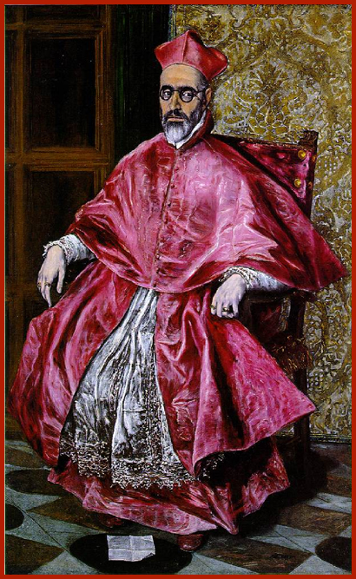
Cardinals, Princes of the Church One of the pope’s most important duties was to appoint the right men as cardinals. But the pontiff was often limited in his choices. France, Spain, and the Holy Roman Emperor would squawk to have their supporters made cardinals, and threaten to withhold church revenues, or even wage war, if the pope did not agree. A new pope was expected to create a cardinal from the family of the pope who had made him a cardinal, years earlier. Additionally, he had to give “the red hat” to someone in every family that had married into his own family. Sometimes these candidates were poorly suited to the religious life. Only after all these requirements had been fulfilled could the pope look around for truly intelligent, devout churchmen.
Cardinals drew income from owning benefices, or church lands. Though canon law decreed that each churchman could own only one benefice and must reside there to look after it, this decree was blithely ignored when it came to cardinals “to assist them to bear the burden of expense which their office imposed on them,” according to a 1507 bull. In 1503 the church declared that “having to perform higher duties so ought they to enjoy greater privileges than the other servants of Christ.”
Rustling in several layers of dark red satin, with just a touch of lace, the cardinal presented a majestic and powerful figure. Cardinals had not always worn special robes but had dressed as regular priests until the reign of Pope Innocent IV (1243-1254) who invented the impressive red cap as a mark of distinction.
By the reign of Boniface IX (1389-1404)), cardinals usually wore red robes as a sign of their willingness to be martyred for the church, though by the seventeenth century the color was mostly appreciated for its ability to conceal wine stains. On days of mourning – the forty days of Lent, All Saints’ Day, and the ten days immediately following the death of a pope – cardinals wore fuchsia. On two feast days a year – the third Sunday in Advent right before Christmas, and the fourth Sunday of Lent – they wore rose.
Etiquette regarding the princes of the church was extremely exacting down to the most minor detail. Cardinals had to be seated in identical chairs. It would have been a gross insult to the church for one cardinal to have a lower seat than his colleague, or for one to have the honor of arms on his chair and the other to be dishonored by a chair with no arms. And it would have been unthinkable for one cardinal to sit disconsolately on a cushion with mere silver tassels, while his counterpart exulted in a cushion tasseled in gold.

Slide 172
The Medieval Church Scandals chapter in book by charles franklin
“I cannot with a safe conscience commit the confessions of the laity to you. Ye lead women behind the altar under pretence of confession and there ye deal as the sons of Eli dealt at the door of the tabernacle, which is horrible to relate and more horrible to do.”
In 1261, at the Council of Ravenna, the presiding archbishop said:

Slide 173
In 1614 young women would have noticed a novelty in their Easter confession, a grill between them and the priest. Pope Paul V had issued an edict mandating that all confessionals be outfitted with grills because of the many complaints he had received from women who, when they confessed their sexual sins in graphic detail, suddenly found themselves pawed and groped by hormonally overwrought priests who could no longer contain themselves.

Slide 174
The Priest the Woman and the Confessional chapter in book by Father Charles Chiniquy
“There is not a single one of the Roman Catholic authors, who have written on that subject for the priests, who has not deplored their innumerable & degrading sins against purity, on account of the auricular confession; but those very men will be the first to try to prove the very contrary when they write books for the people.”

Slide 175
Morality Plays Attacking Holy Church?
The Gilbertine Libertines.
The Gilbertine Order was most famous for having both male and female canons in one double monastery, under one roof. Sniggering in some secular quarters was inevitable. In 1348 a group of players pull up their wagon in the streets of Exeter and set about performing their play about the “Order of Brothelyng- ham.” The authorities’ reaction is shock. The local bishop forwards immediately up the hierarchy to his archdeacon…

Slide 176
Morality Plays Attacking Holy Church?
The Gilbertine Libertines.
“We have heard, not without grave disquietude, that a certain abominable sect of evil-minded men, named the Brothelyngham Order, has lately arisen by inspiration of him who sows all evil deeds.
These men have chosen for their head a certain crazy lunatic, of temper most suitable to their evil purpose. This man they call their abbot; they dress him in monastic garb, set him upon a stage, and adore him as their idol. Then, at the sound of a horn, which they have chosen instead of a bell, they lead him through the streets and lanes of the city of Exeter with a great throng of horse and foot at their heels. In this procession they lay hold of any clergymen whom they find in their way and hold them with rash, headlong and sometimes sacrilegious spirit until they have extorted from them sums of money by way of sacrifice…” - The Time Traveler’s Guide

Slide 177
Holy Church A Whorehouse Landlord?
The Southwark Stews.
“Stews or bathhouses are a tourist attraction of an altogether different sort. Prostitutes are not tolerated in London except in one street, Cock Lane. Hence Londoners and visitors resort to the stews at Southwark, on the other side of the river. Here men may eat and drink; have a hot scented bath and spend time in female company. In 1374 there are eighteen establishments, all run by Flemish women.
Some clergymen rail against such immorality, of course, but few directly allude to Southwark.
Most of the bathhouses are rented from the Bishop of Winchester.” - Time Traveler’s Guide

Slide 178
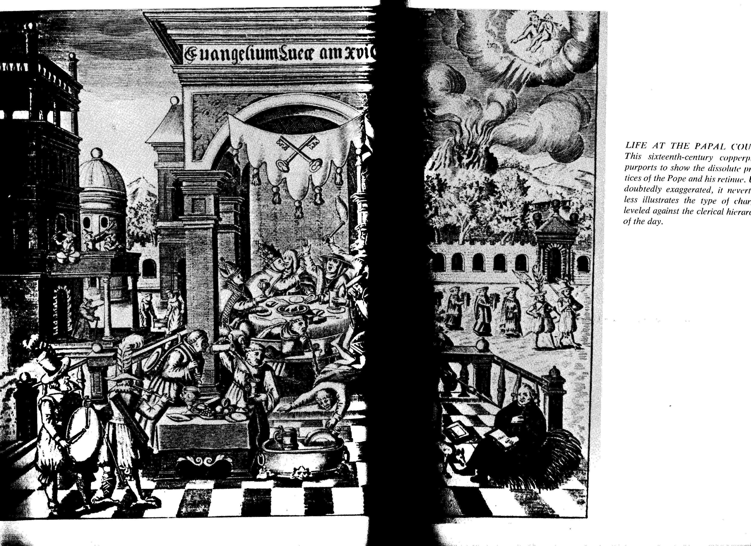
The Medieval Church Scandals chapter in book by charles franklin
“The Council of Constance (1414 – 1418), called to institute church reform, must have been quite a lively gathering. Lasting four years, it was attended, according to the contemporary chronicler G. Dacher, by 18,000 priests, 83 wine merchants, 346 ‘clowns, dancers, and jugglers,’ and 700 undisguised whores. These were the 700 prostitutes whose addresses G. Dacher was able to obtain. A list drawn up in Vienna lists 1,500 (meretrices vagabundae) or ‘common harlots’ present at the Council.”

Slide 179
The Medieval Church Scandals chapter in book by charles franklin
“Another custom of the medieval period was the so-called ‘right of the first night’ (jus primae noctis) whereby the lord of the manor under his ‘driot de seigneur’ could enjoy a bride on the first night of her marriage, before the husband had carnal knowledge of his wife. This right was often exercised by clerical higher-ups, and a few monasteries made this a steady practice. All brides-to-be, married under the auspices of such an institution, were required to make pilgrimage to the monastery, there to be deflowered. In some localities, it was customary for the bride to bring a gift to the cleric who was scheduled to take her virginity.”

Slide 180
MOVEMENTS TO REFORM & RESET
14TH CENTURY TENSIONS: POPE FRANCE & POPE ITALY
15TH CENTURY TENSIONS: ROMANS VERSUS GERMANS
A CORRUPT CHURCH & A CORRUPT SOCIETY
ILLUSTRATION: CLERGEY LITERATE FREED FROM JAIL
ILLUSTRATION: DIVORCED BY DISCOVERY
ILLUSTRATION: ADULT BAPTISM IS IN THE NUDE
ILLUSTRATION: PROACTIVE CHASTITY BELT
Crusader’s Caution Preventing “Pfaffenkind”
ILLUSTRATION: Cullagium Priest Mistress Tax
ILLUSTRATION: Bishopric “Jus Primae Noctis”
ILLUSTRATION: Ecgbert Deviance Code(729)
ILLUSTRATION: Chapple Council @Convents

Slide 181
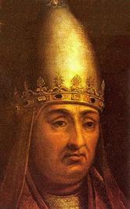
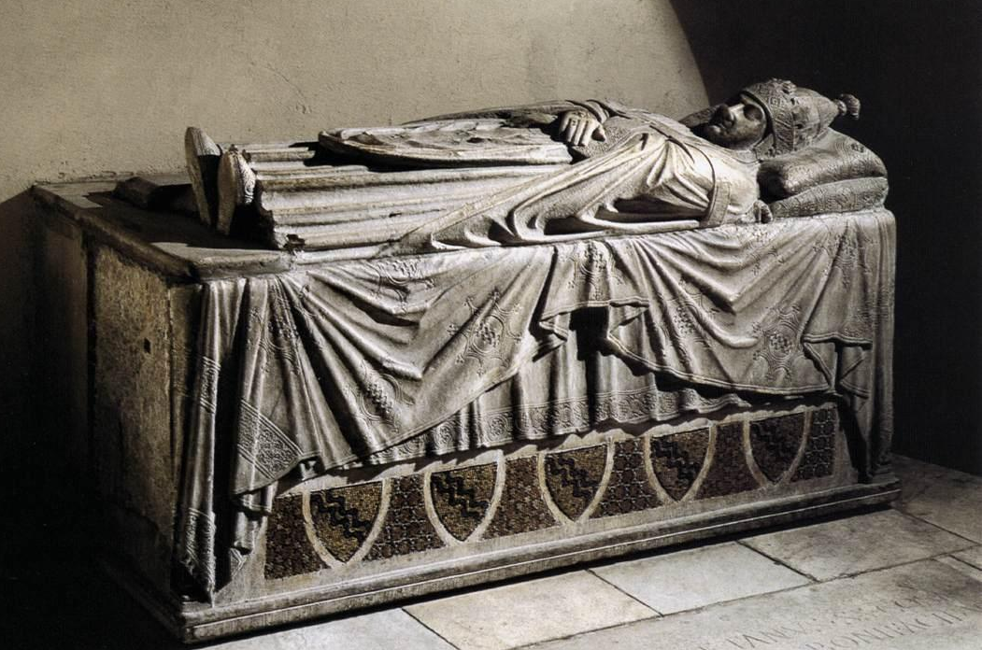
1302
Pope Boniface VIII claims that the pope has supremacy over every human being, in his bull Unam Sanctam (Latin for “the One Holy,” that is, the Church)
Pope Boniface VIII

Slide 182
A “bull” is a sealed declaration by a pope. The bull “Unam Sanctam” declared that:
There is only one true Church, outside of which there is no salvation; the church has one head, not two.
2. That head is Christ and His representative, the Roman pope.

Slide 183
The bull “Unam Sanctam” declared that:
3. There are two swords (forms of power), the spiritual and the temporal (earthly or civic).
Spiritual power is borne by the Church.
Temporal power is borne for the Church under the direction of the clergy.

Slide 184
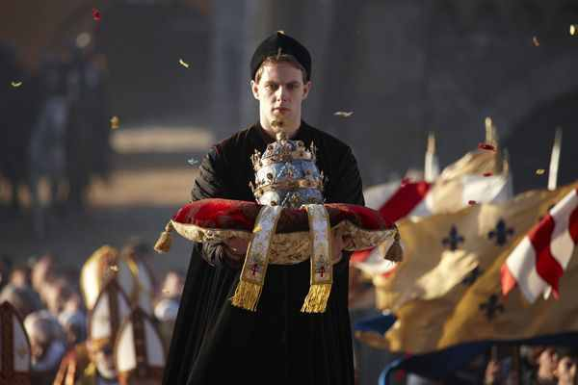
1334
1334-1342 Pope Benedict XII
“The Pope’s Three Crowns” became evident with Benedict. The first crown symbolizes (every) pope’s universal episcopate, second his supremacy or jurisdiction and the third his temporal influence – father of princes and kings, ruler of the world, Vicar of our Savior Jesus Christ”(New Catholic Dictionary)

Slide 186
Of Disputes Over Bibliology & Christology Develop
Divisions Over Soteriology & Ecclesiology

Slide 187
The Crazy Change History
The fit in the choir. Three of young Luther’s contemporaries report that sometime during his early or middle twenties, he suddenly fell to the ground in the choir of the monastery at Erfurt, “raved” like one possessed, and roared with the voice of a bull: “Ish bin’s nit! Non Sum!” or “I am not!” & “It isn’t me!”
Confessional Compulsion. In confessing transgressions in the order of the five senses, Luther was so meticulous in his attempt to be truthful that he spelled out every intention as well as every deed; he splintered acceptable purities into smaller and smaller impurities; he reported temptations in historical sequence, starting back in childhood; and having confessed for hours, he would ask for special appointments in order to correct previous statements. His obsession in this regard was both so very chronic and acute as to warrant his preceptor to threaten punishment for upsetting the monastic order through obstruction of confession.
psychoanalysis & History
YOUNG MAN LUTHER
By Erik H Erikson

Slide 188
FROM ‘YOUNG MAN LUTHER’ PAGE 216:
“Luther had recourse to massive totalisms from which he derived the foundation stones for a new wholeness. The whole person includes certain total states in his balances: we are, Luther proclaimed, totally sinners (totus homo peccator) and totally just (totus homo justus), always both damned and blessed, both alive and dead.
We thus cannot strive, by hook or by crook, to get from one absolute stage into another; we can only use our God-given organs of awareness in the here and now to encompass the paradoxes of the human condition. This means that at any given moment, and in any given act or thought, we are codetermined to a degree which can never become quite conscious by our drives and by our conscience.”

Slide 189
Tower Antics & Angst
The model professor, though his students may not have realized it, was battling with the Devil in his tower room every night. For Luther was plagued by fear and doubt and the Devil, by his own anger, his hostile feelings toward God, his rebelliousness – and by constipation. Somehow, getting rid of one problem was linked to getting rid of them all. In his tower study the Devil would throw black ink at Luther, and Luther would throw black ink back at the Devil as he contended with the righteousness of God. When he was more confident he would say, ‘I can drive away the Devil with a single fart!’
WHITE ROBE BLACK ROBE
Righteousness Of God
by Charles Mee

Slide 190
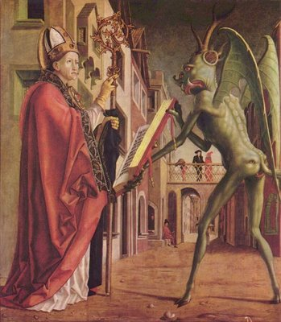
It is the supreme art of the devil that he can make the law out of the gospel. If I can hold on to the distinction between law & gospel, I can say to him any and every time that he should kiss my backside!
Martin Luther

Slide 191
The popes themselves had become rather decadent and worldly with luxury, non-celibacy, and the exercising of secular power.
Pope Alexander VI (1492 – 1503) has been described as the worse pope ever. While this man was serving as a cardinal his morality was such that his uncle, the Pope, Pius II, wrote:
“Beloved Son,
We have heard that, four days ago, several ladies of Siena – women entirely given over to worldly frivolities – were assembled in the gardens of Giovanni I Bichis and that you, quite forgetful of the high office with which you are invested, were with them from the seventeenth to the twenty-second hour. With you was one of your colleagues whose age alone, if not the dignity of his office, ought to have recalled him to his duty. We have heard that the most licentious dances were indulged in, none of the allurements of love were lacking and you conducted yourself in a wholly worldly manner. Shame forbids mention of all that took place – not only the acts themselves but their very names are unworthy of your position. In order that your lusts might be given free rein the husbands, fathers, brothers and kinsmen of the young women were not admitted. All Siena is talking about this orgy. Our displeasure is beyond words.”

Slide 192
The popes themselves had become rather decadent and worldly with luxury, non-celibacy, and the exercising of secular power.
Pope Alexander VI (1492 – 1503) has been described as the worse pope ever. Moreover, while serving as pope in his own right – he was not of double standard in his decision-making as applied to either fellow clergy or secular rulers.
An important historical precedent was established when Louis XII (King of France after Charles VIII) appealed to Alexander to dissolve his marriage to ‘an ailing and unattractive woman to marry a beautiful and attractive heiress.’ Pope Alexander readily agreed if he would do a favor for him and arrange a marriage of royalty with his son.

Slide 193
The popes themselves had become rather decadent and worldly with luxury, non-celibacy, and the exercising of secular power.
The papacy was also increasingly political as powerful families competed to put their relatives on the throne of St. Peter.
Pope Leo X (the pope from 1513 thru 1521), for example, was Lorenzo the Magnificent’s second son. He continued the Medici ways of luxury and patronage, but with Church money.
Upon being elected, he said, “Since God has given us the papacy, let us enjoy it.” And he did… he nearly bankrupted the Church which was no small feat.

Slide 194
Dominant Augustinian Paradigm 1,000 Year Fruit: Italy & Germany
14th Cent. Curia Def: Fool = “a good christian”
Bembo Quotes Gospel & Pope Leo X Remarks:
“How very profitable this fable of Christ has been to us through the ages.” Vatican Archives
Christendom Extremes: Cynical Italians & Anxious Germans
Roman Catholic Fear: Mortal Sin Before Sudden Death
Lutheran Pious Angst: Whether God Will Be Gracious
Swiss Reform Obsess: Whether They Have True Faith

Slide 195
Sentence Launching Reformation Public Papal Reply Sending Luther Over The Edge Luther Responds: “The Pope’s The Anti-Christ”
Following Written Faith Belief Profession In The Not Yet
Developed Or Formulated Papal Infallibility Doctrine We
Find These Words From S. Prierias - Rome’s Theologian:
“If the Pope were so scandalously bad that he led multitudes of souls to the Devil, still he could not be removed from office.”

